Slide 1

28 Regulation of Gene Expression
© 2021 Macmillan Learning

Slide 2

Principle 1 (1 of 6)
The cellular concentration of a protein
is determined by a delicate balance of at least seven processes, each having several potential points of regulation. These processes include synthesis of the primary RNA transcript (transcription); posttranscriptional modification of mRNA; degradation of mRNA; protein synthesis (translation); posttranslational modification of proteins; protein targeting and transport; and protein degradation.

Slide 3

Principle 2 (1 of 7)
Regulation is achieved by specialized proteins and RNAs. The proteins are usually ligand-binding proteins with no other function. They bind to specific sequences in DNA or RNA. They respond to molecular signals that can be any kind of biological molecule. The RNAs either interact with other RNAs or serve as protein cofactors.

Slide 4

Principle 3 (1 of 4)
Regulated gene expression may bring about increases or decreases in the amount of a gene product. Gene products that increase in concentration under particular molecular circumstances are referred to as inducible; the process of increasing their expression is induction. Conversely, gene products that decrease in concentration in response to a molecular signal are referred to as repressible, and the process is called repression.

Slide 5
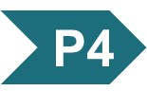
Principle 4 (1 of 6)
The default transcriptional state of a gene, on or off, is dictated in part by the size and complexity of the genome. In bacteria, where genomes are relatively small and DNA is readily accessible, the default state of genes is generally “on.” Transcription of each gene or gene cluster is usually limited by a specific protein repressor. In eukaryotes, where genomes are larger and genes are encapsulated in chromatin, the default state of most genes is “off.” Gene transcription requires chromatin modification followed by the action of transcription activators.

Slide 6
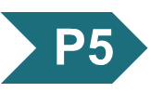
Principle 5 (1 of 2)
Regulation is expensive. For many genes, especially in eukaryotes, the regulatory processes can require a considerable investment of chemical energy. That expenditure is nevertheless small when compared to the cost of RNA and protein synthesis when the gene is expressed.

Slide 7
Principle 1 (2 of 6)
The cellular concentration of a protein
is determined by a delicate balance of at least seven processes, each having several potential points of regulation. These processes include synthesis of the primary RNA transcript (transcription); posttranscriptional modification of mRNA; degradation of mRNA; protein synthesis (translation); posttranslational modification of proteins; protein targeting and transport; and protein degradation.

Slide 8
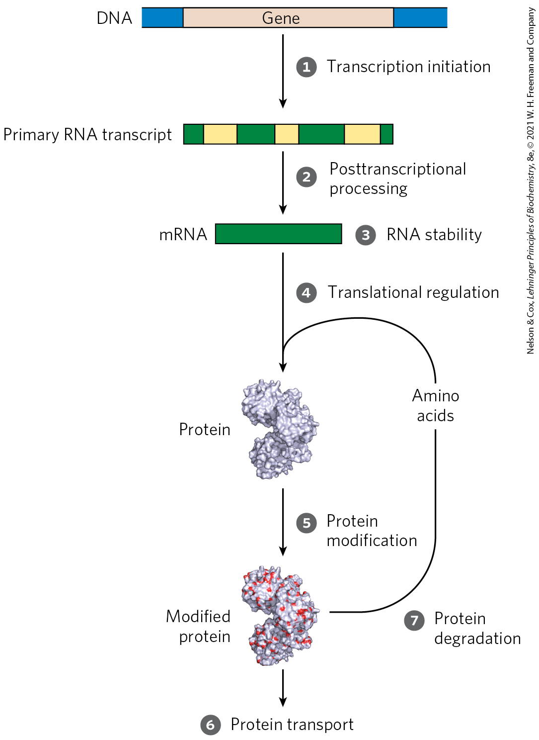
Processes that Affect the Steady-State Concentration of a Protein

Slide 9
28.1 The Proteins and RNAs of Gene Regulation

Slide 10
RNA Polymerase Binds to DNA at Promoters
promoters = sites on the DNA template that are generally found near points at which RNA synthesis begins
regulation of transcription initiation often changes how RNA polymerase interacts with a promoter
differences in promoter sequence affect RNA polymerase binding and the frequency of transcription initiation

Slide 11
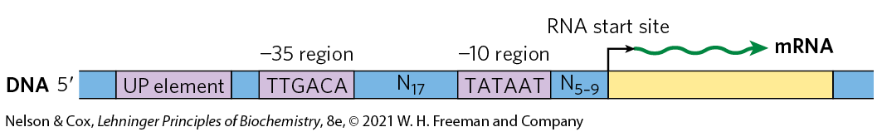
Consensus Sequence for Many E. coli Promoters
most E. coli promoters have a sequence close to a consensus
  mutations away from consensus sequence usually decrease promoter function
  mutations toward consensus usually enhance promoter function

Slide 12
Housekeeping Genes
housekeeping genes = genes for products that are required at all times and are expressed continuously
  examples: enzymes of central metabolic pathways
  cellular concentrations of the proteins encoded vary
constitutive gene expression = expression of a gene at approximately constant levels
the RNA polymerase–promoter interaction strongly influences the rate of transcription initiation

Slide 13
Principle 2 (2 of 7)
Regulation is achieved by specialized proteins and RNAs. The proteins are usually ligand-binding proteins with no other function. They bind to specific sequences in DNA or RNA. They respond to molecular signals that can be any kind of biological molecule. The RNAs either interact with other RNAs or serve as protein cofactors.

Slide 14
Transcription Initiation Is Regulated by Proteins and RNAs
regulatory proteins regulate transcription initiation by RNA polymerase:
  specificity factors = alter the specificity of RNA polymerase for a given promoter or set of promoters
  repressors = restrict access of RNA polymerase to the promoter
  activators = enhance the RNA polymerase–promoter interaction

Slide 15
ncRNAs and IncRNAs
noncoding RNAs (ncRNAs) = RNA molecules that are not translated
long noncoding RNAs (lncRNAs) = noncoding RNAs more than 200 nucleotides long that lack an open reading frame (ORF) that encodes a protein

Slide 16
Known Functions of IncRNAs
known functions of functions of lncRNAs include:
  regulation of nucleosome positioning and chromatin structure
  control of DNA methylation and posttranscriptional histone modifications
  transcriptional gene silencing
  multiple roles in transcriptional activation and repression

Slide 17
Bacterial Specificity Factors
specificity factor = amino acid sequence that mediates promoter recognition and binding
  example: the σ subunit of the E. coli RNA polymerase
most E. coli promoters are recognized by σ⁷⁰
σ⁷⁰ is replaced by σ³² under conditions of heat stress
  directs RNA polymerase to a specialized set of promoters with a different consensus sequence
  causes expression of genes involved in the heat shock response

Slide 18
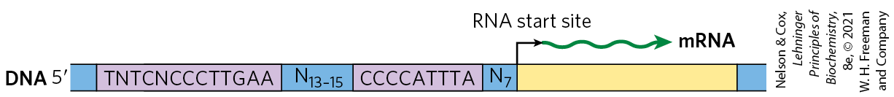
When Bacteria Are Subjected to Heat Stress, σ³² Replaces σ⁷⁰
σ⁷⁰ is replaced by σ³² under conditions of heat stress
  directs RNA polymerase to a specialized set of promoters with a different consensus sequence
  causes expression of genes involved in the heat shock response

Slide 19
Eukaryotic Specificity Factors
some of the general transcription factors may be considered specificity factors
  example: the TATA-binding protein (TBP)

Slide 20
Principle 3 (2 of 4)
Regulated gene expression may bring about increases or decreases in the amount of a gene product. Gene products that increase in concentration under particular molecular circumstances are referred to as inducible; the process of increasing their expression is induction. Conversely, gene products that decrease in concentration in response to a molecular signal are referred to as repressible, and the process is called repression.

Slide 21
Bacterial Repressors
repressors = proteins that block RNA polymerase binding or its movement along DNA
operators = binding sites on the DNA that bind repressors
  generally located near a promoter
effector = a small molecule or a protein that regulates repressor binding to DNA to alter transcription
  binds to the repressor and causes a conformational change

Slide 22
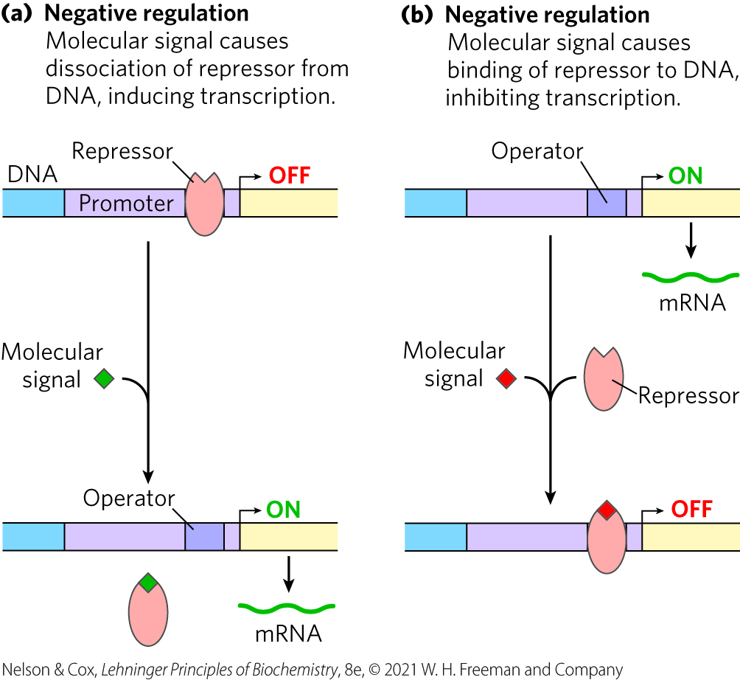
Negative Regulation
negative regulation = regulation by means of a repressor protein that blocks transcription

Slide 23
Principle 4 (2 of 6)
The default transcriptional state of a gene, on or off, is dictated in part by the size and complexity of the genome. In bacteria, where genomes are relatively small and DNA is readily accessible, the default state of genes is generally “on.” Transcription of each gene or gene cluster is usually limited by a specific protein repressor. In eukaryotes, where genomes are larger and genes are encapsulated in chromatin, the default state of most genes is “off.” Gene transcription requires chromatin modification followed by the action of transcription activators.

Slide 24
Eukaryotic Repressors
gene regulation by a repressor is less common in eukaryotic cells
  more common in lower eukaryotes such as yeast
the binding site for a repressor may be some distance from the promoter

Slide 25
Principle 3 (3 of 4)
Regulated gene expression may bring about increases or decreases in the amount of a gene product. Gene products that increase in concentration under particular molecular circumstances are referred to as inducible; the process of increasing their expression is induction. Conversely, gene products that decrease in concentration in response to a molecular signal are referred to as repressible, and the process is called repression.

Slide 26
Bacterial Activators
activators = proteins that enhance the RNA polymerase–promoter interaction
activator-binding sites are often adjacent to promoters that are bound weakly or not at all by RNA polymerase alone

Slide 27
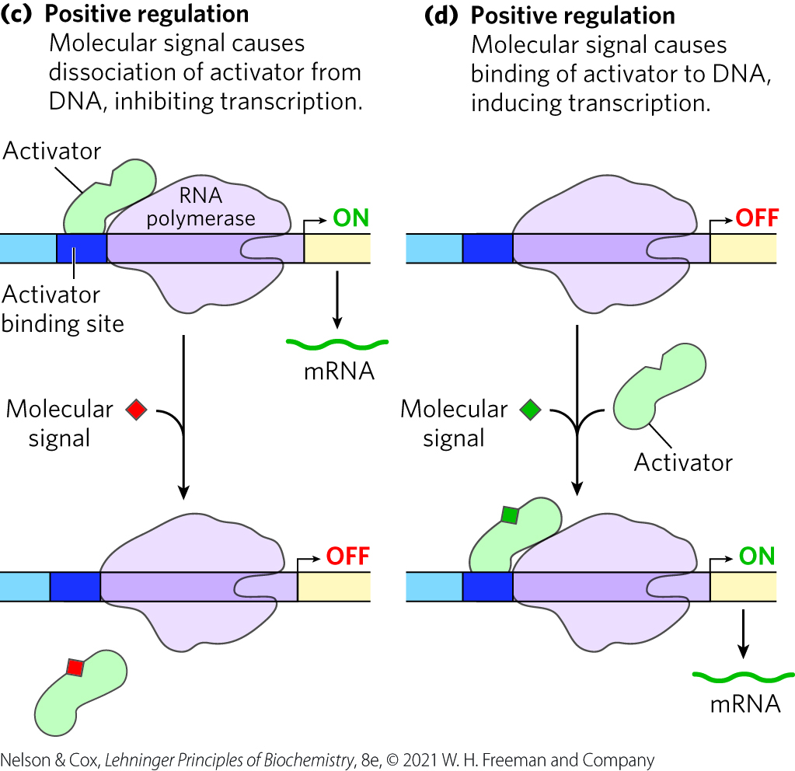
Positive Regulation
positive regulation = regulation by means of an activator protein that induces transcription

Slide 28
Principle 4 (3 of 6)
The default transcriptional state of a gene, on or off, is dictated in part by the size and complexity of the genome. In bacteria, where genomes are relatively small and DNA is readily accessible, the default state of genes is generally “on.” Transcription of each gene or gene cluster is usually limited by a specific protein repressor. In eukaryotes, where genomes are larger and genes are encapsulated in chromatin, the default state of most genes is “off.” Gene transcription requires chromatin modification followed by the action of transcription activators.

Slide 29
Eukaryotic Activators
positive regulation by activators is common in eukaryotes
enhancers = DNA sites that bind activators and are distant from the promoter
  activator binding can affect the rate of transcription at far away promoters

Slide 30
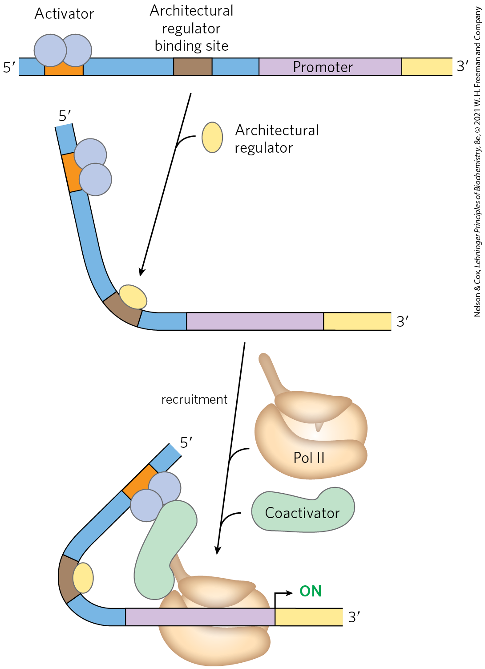
Architectural Regulators and Coactivators
architectural regulators = proteins that bind to sites between a promotor and the activator or repressor binding site and facilitate DNA looping
coactivators = proteins that mediate the interaction between activators and RNA polymerase
  protein repressors may bind in their place instead

Slide 31
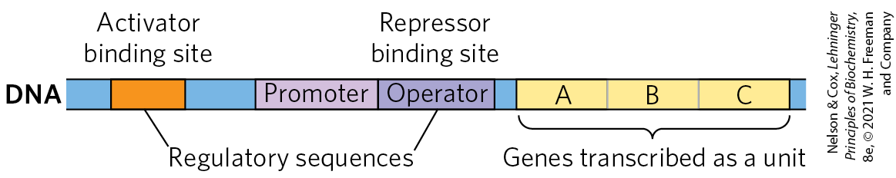
Many Bacterial Genes Are Clustered and Regulated in Operons
operon = a gene cluster and promoter, plus additional sequences that function together in regulation
many genes in the same operon encode subunits of a larger protein complex or are involved in related processes that require coordinated regulation

Slide 32
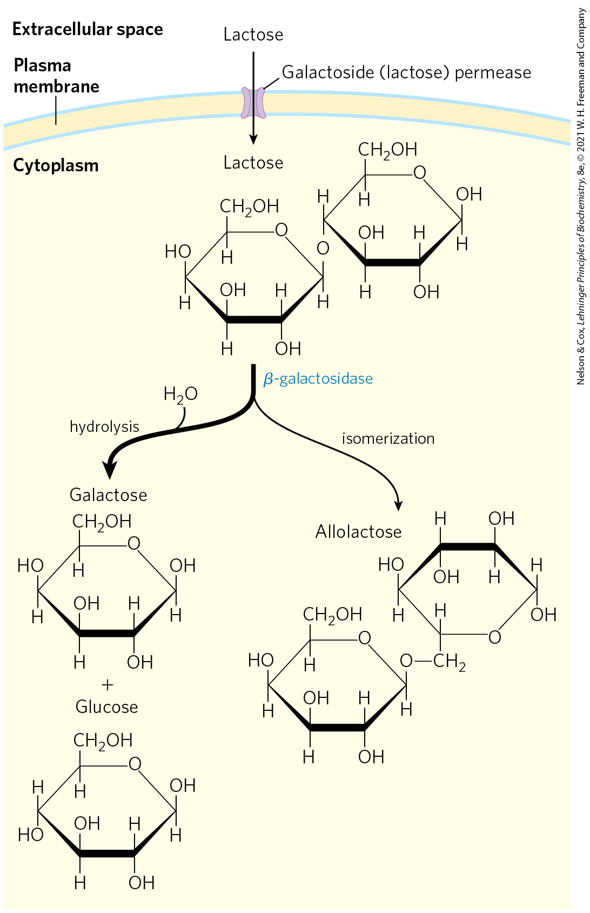
Lactose Metabolism in E. coli
β-galactosidase = cleaves lactose to galactose and glucose
galactoside permease = transports lactose into the cell

Slide 33
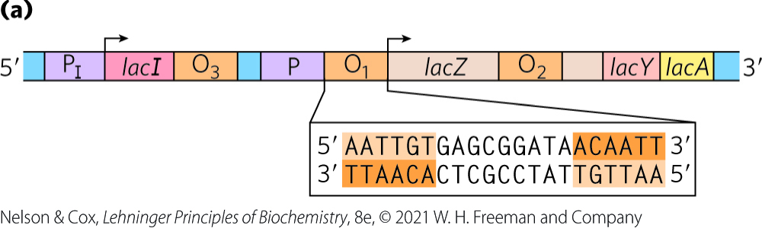
The lac Operon Is Subject to Negative Regulation
lactose (lac) operon includes the genes for:
  β-galactosidase (Z)
  galactoside permease (Y)
  thiogalactoside transacetylase (A) = modifies toxic galactosides to facilitate their removal
the lac operon is repressed in the absence of lactose
  repression is not absolute

Slide 34
lacI Encodes the Lac Repressor
lacI encodes the Lac repressor protein
  lacI has its own promoter (P_{I})
  mutations in lacI result in constitutive synthesis of the operon

Slide 35
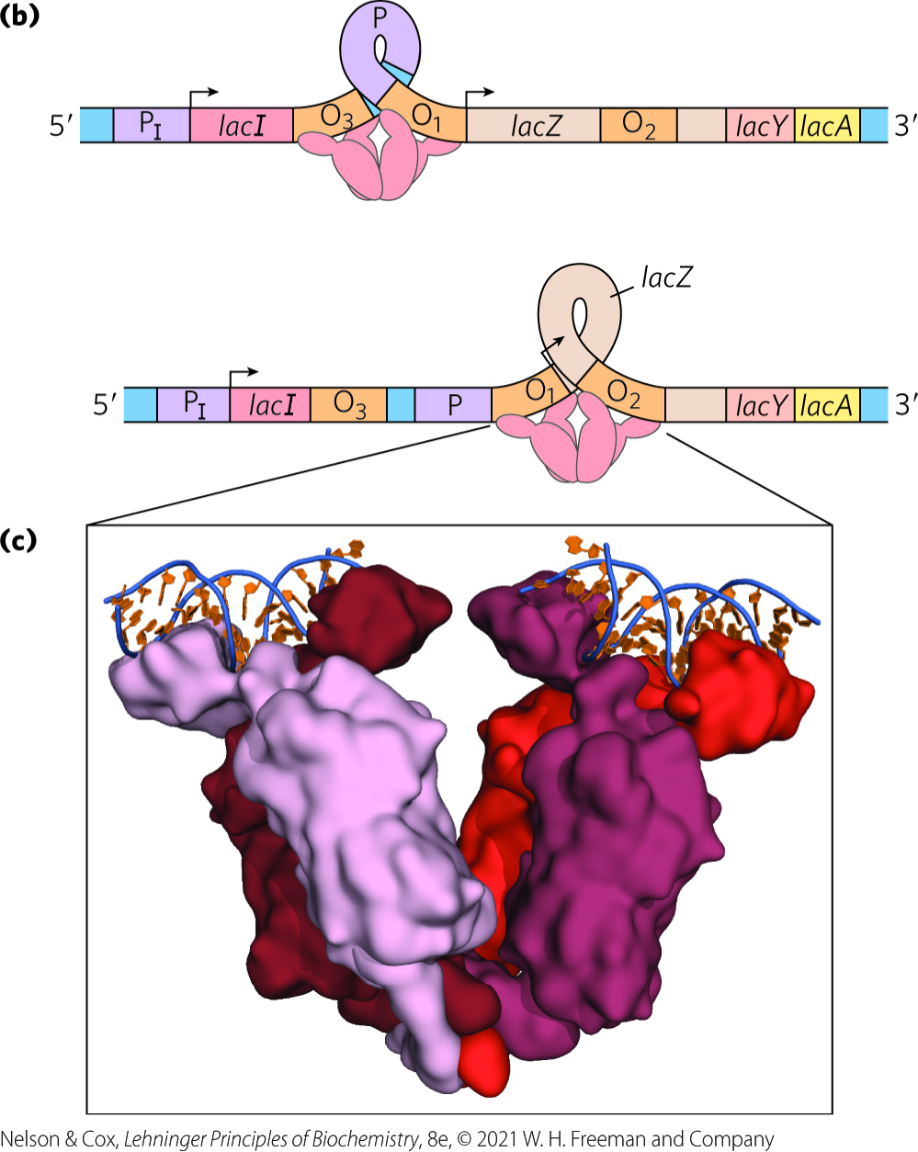
The Lac Repressor Binds to Operators
the Lac repressor binds to O₁ (the main operator for the lac operon) and either O₂ or O₃
Lac repressor binding loops the intervening DNA to block transcription initiation

Slide 36
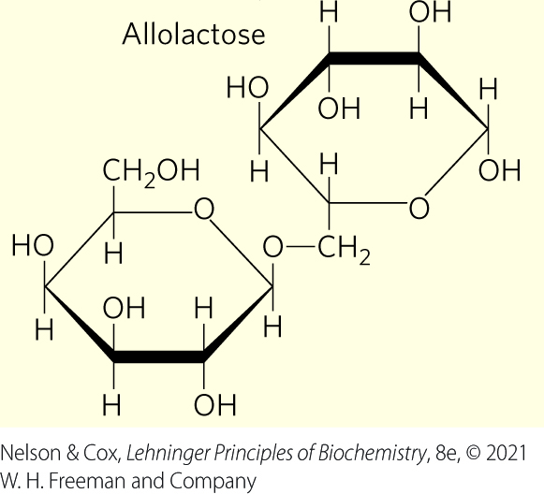
Allolactose Is The Inducer of the lac Operon System
allolactose, an isomer of lactose, is the inducer of the lac operon
binding of allolactose to the Lac repressor causes a conformational change and dissociation
  results in expression of lac operon genes

Slide 37
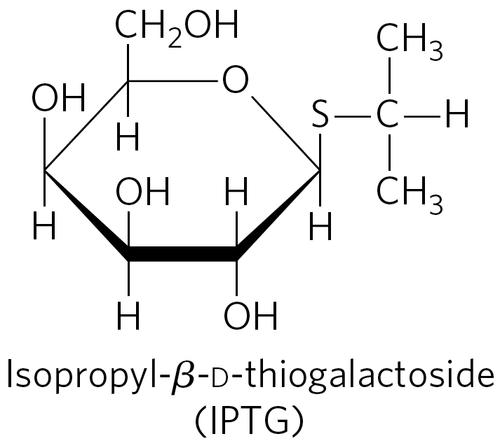
IPTG is an Inducer of the lac Operon
isopropylthiogalactoside (IPTG) is an inducer of the lac operon
  nonmetabolizable
  often used experimentally

Slide 38
Principle 2 (3 of 7)
Regulation is achieved by specialized proteins and RNAs. The proteins are usually ligand-binding proteins with no other function. They bind to specific sequences in DNA or RNA. They respond to molecular signals that can be any kind of biological molecule. The RNAs either interact with other RNAs or serve as protein cofactors.

Slide 39
Regulatory Proteins Have Discrete DNA-Binding Domains
regulatory proteins generally bind to specific DNA sequences.
  have discrete DNA-binding domains containing characteristic structural motifs that interact with the DNA

Slide 40
Regulatory Proteins Must Recognize DNA Surface Features
most of the chemical groups that differ among the four bases are hydrogen-bond donor and acceptor groups exposed in the major groove of DNA
  permits discrimination between base pairs
most of the protein-DNA contacts that impart specificity are hydrogen bonds

Slide 41
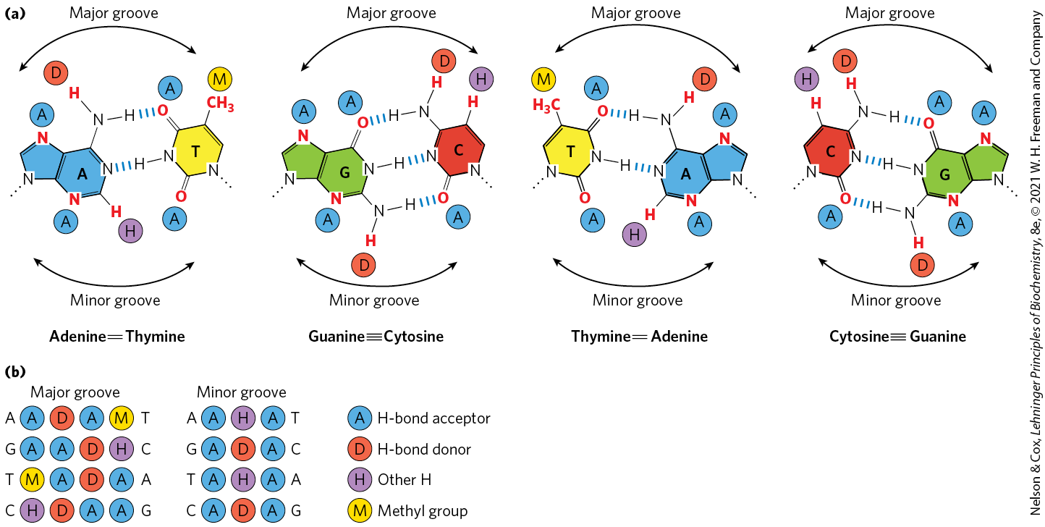
Groups in DNA Available for
Protein Binding

Slide 42
Interactions Between Amino Acid Residues and DNA Base Pairs
Asn, Gln, Glu, Lys, and Arg side chains most often hydrogen bond to the DNA bases
there is no simple amino acid–base code

Slide 43
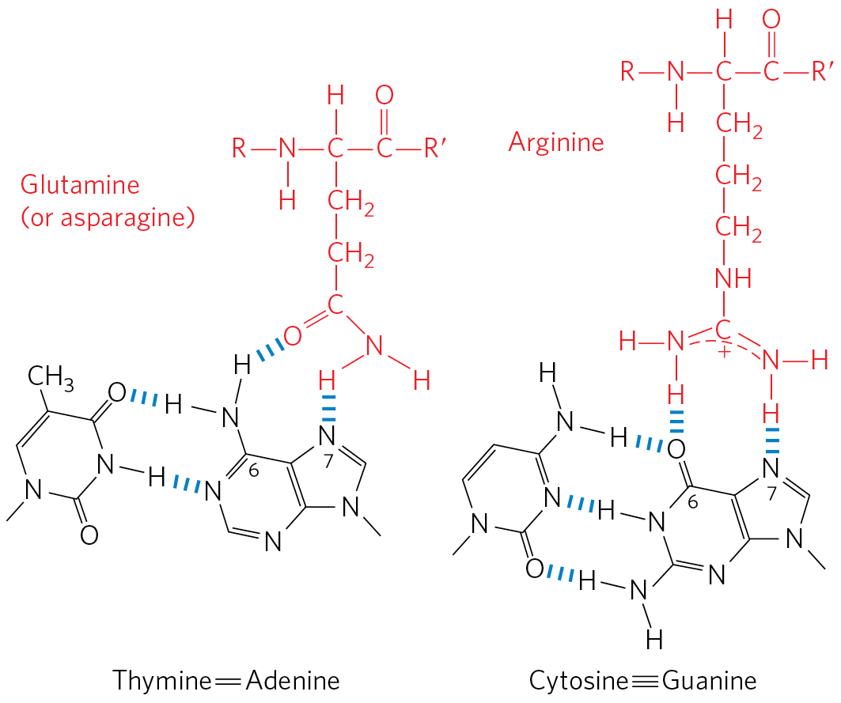
Specific Amino Acid Residue–Base
Pair Interactions
Gln or Asn can hydrogen bond with the N⁶ and N-7 positions of adenine
Arg can form two hydrogen bonds with N-7 and O⁶ of guanine

Slide 44
Principle 2 (4 of 7)
Regulation is achieved by specialized proteins and RNAs. The proteins are usually ligand-binding proteins with no other function. They bind to specific sequences in DNA or RNA. They respond to molecular signals that can be any kind of biological molecule. The RNAs either interact with other RNAs or serve as protein cofactors.

Slide 45
DNA-Binding Sites for
Regulatory Proteins
often inverted repeats of a short DNA sequence (a palindrome)
multiple (usually two) subunits of a regulatory protein bind cooperatively to the sequence
Lac repressor binding is unique
  each of the two tethered dimers of the Lac repressor separately binds to a palindromic operator sequence

Slide 46
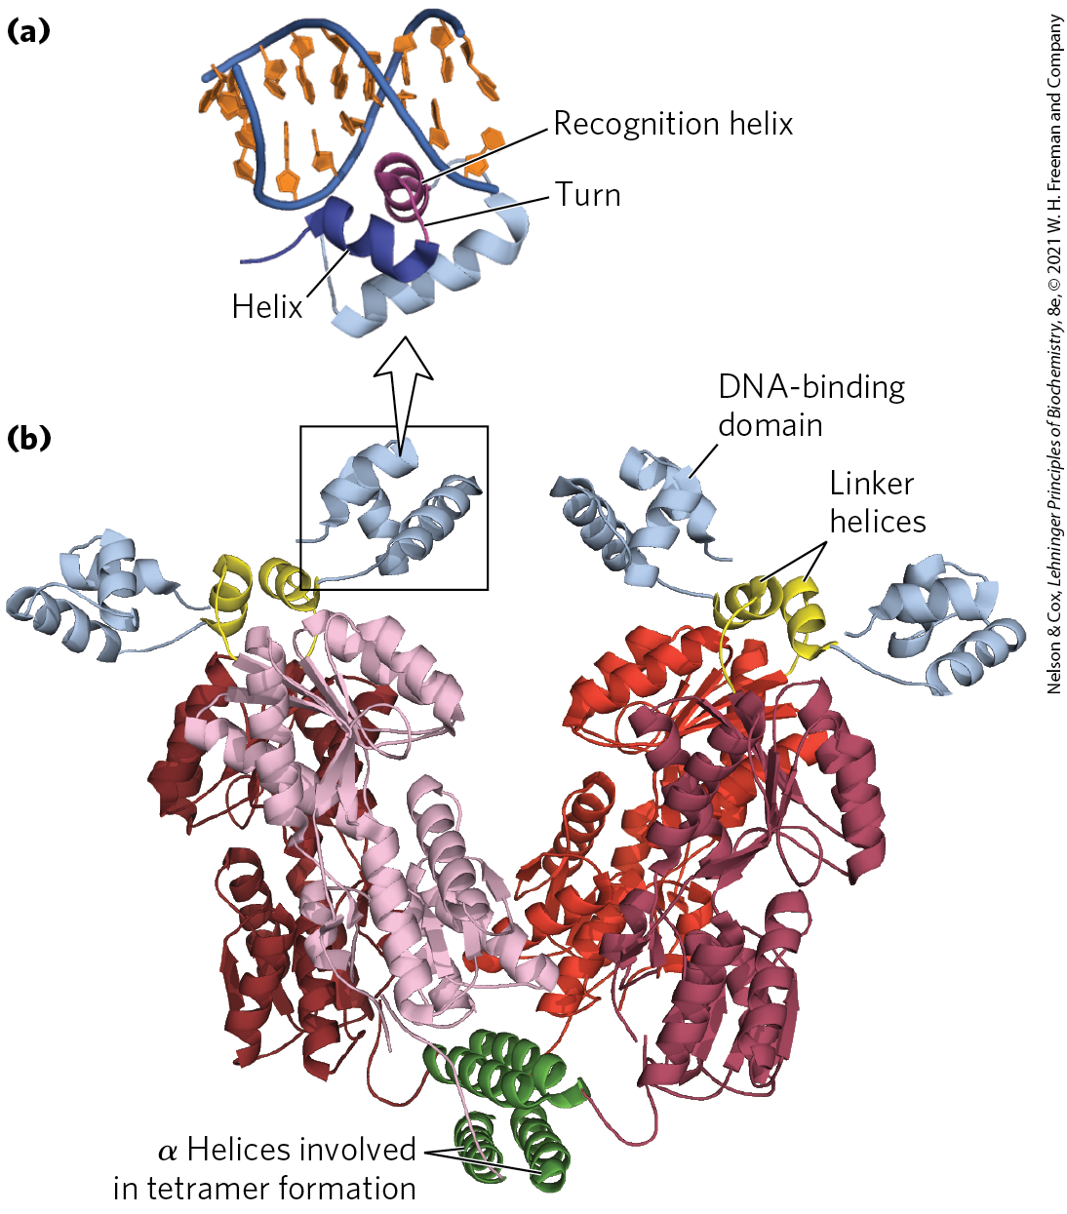
Helix-Turn-Helix
helix-turn-helix motif = ~20 amino acid residues in two short α-helical segments, each 7 to 9 residues long, separated by a β turn
  example: the Lac repressor
  not stable by itself

Slide 47
The Recognition Helix
recognition helix = the α-helical segment that contains many of the amino acids that interact with DNA in a sequence-specific way
  protrudes from the protein surface
  positioned in or nearly in the major groove when bound to DNA

Slide 48
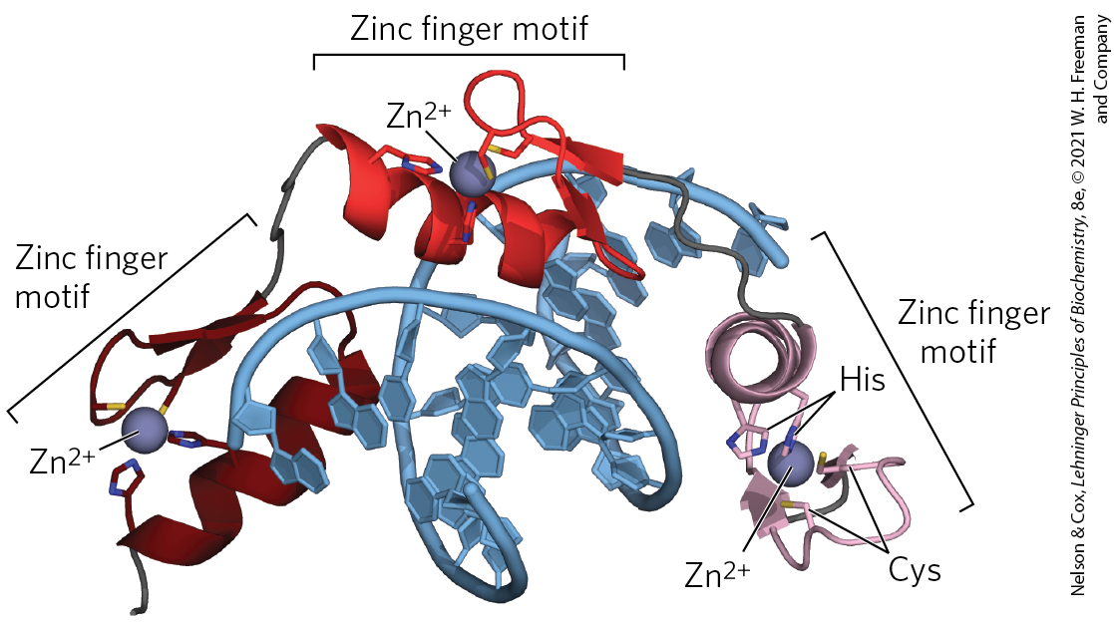
Zinc Finger
zinc finger = ~30 amino acid residues forming an elongated loop held together at the base by a single Zn²⁺ ion
  Zn²⁺ is coordinated to 4 residues (4 Cys or 2 Cys and 2 His)
many eukaryotic DNA-binding proteins contain zinc fingers

Slide 49
Zinc Finger Binding
the interaction of a single zinc finger with DNA is typically weak
  multiple zinc fingers substantially enhances binding
some zinc fingers have the residues for sequence discrimination, whereas others seem to bind DNA nonspecifically
zinc fingers can also function as RNA-binding motifs

Slide 50
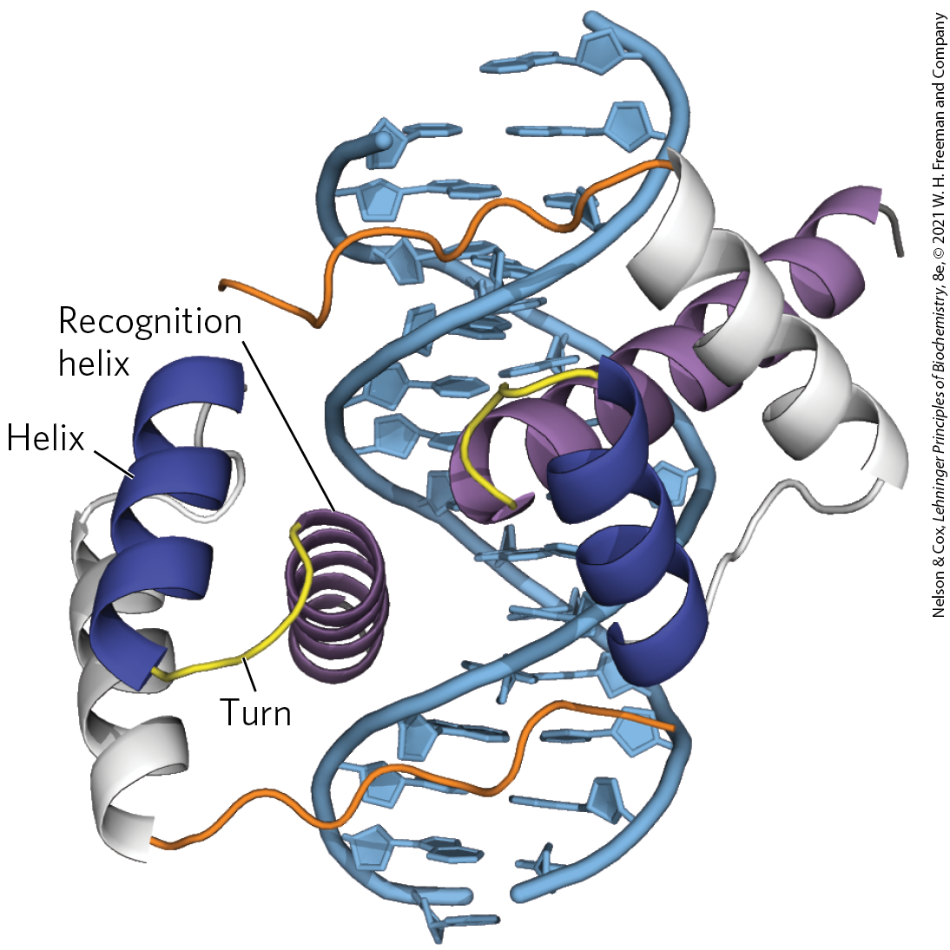
Homeodomain
homeodomain = 60 highly-conserved amino acid residues
  identified in proteins that function as transcriptional regulators, especially during eukaryotic development
homeobox = the DNA sequence that encodes this domain

Slide 51
RNA Recognition Motif
RNA recognition motifs (RRMs) = 90 to 100 amino acid residues arranged in a four-strand antiparallel β sheet sandwiched against two α helices (β₁-α₁-β₂-β₃-α₂-β₄)
  found in some eukaryotic gene activators, where they may bind DNA and RNA to induce transcription
  proteins with RRM motifs may bind to mRNA, rRNA, or other smaller, noncoding RNAs
  lncRNAs compete with DNA binding and decrease gene transcription

Slide 52
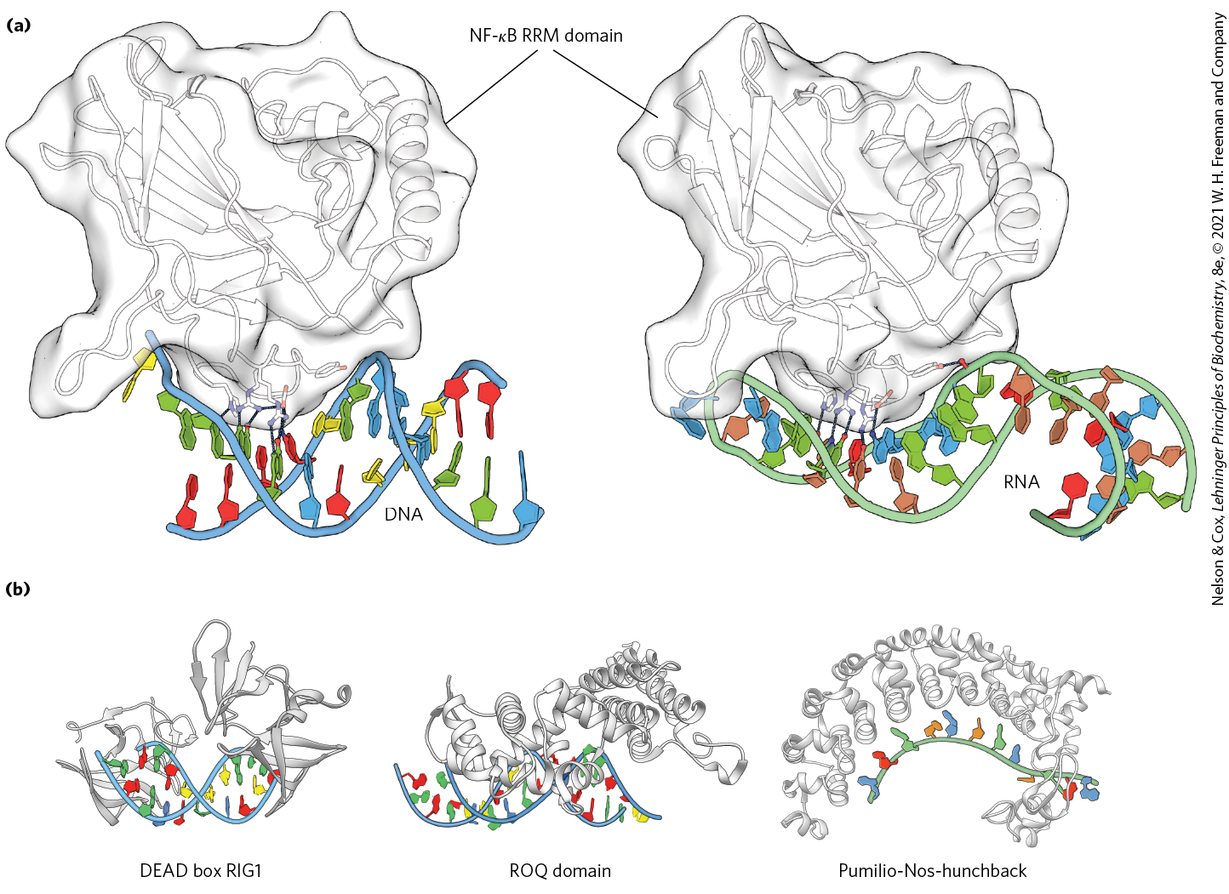
Examples of RNA Recognition
Motifs (RRMs)

Slide 53
Regulatory Proteins Also Have Protein-Protein Interaction Domains
regulatory proteins contain domains for protein-protein interactions
  example: domains for dimer formation of eukaryotic transcription factors

Slide 54
Leucine Zipper
leucine zipper = an amphipathic α helix with a series of hydrophobic amino acid residues on one side and a hydrophobic surface between two polypeptides of a dimer
  Leu occurs at every 7th position along the α helices
  helices form a coiled coil
  found in many eukaryotic proteins
  often found in proteins with a separate DNA-binding domain containing a high concentration of basic (Lys or Arg) residues that can interact with the DNA backbone

Slide 55
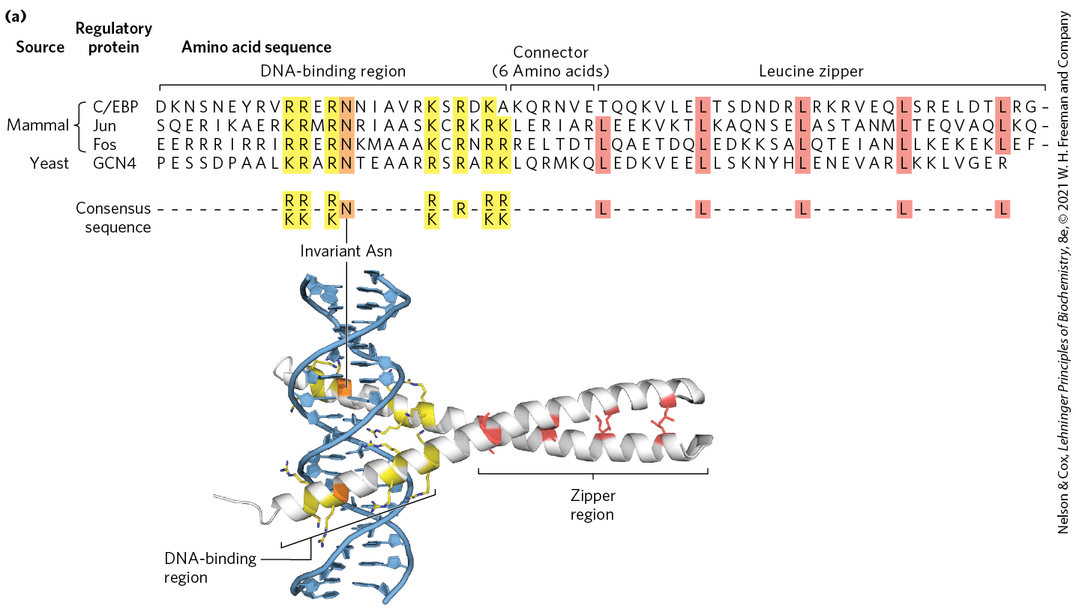
Leucine Zippers

Slide 56
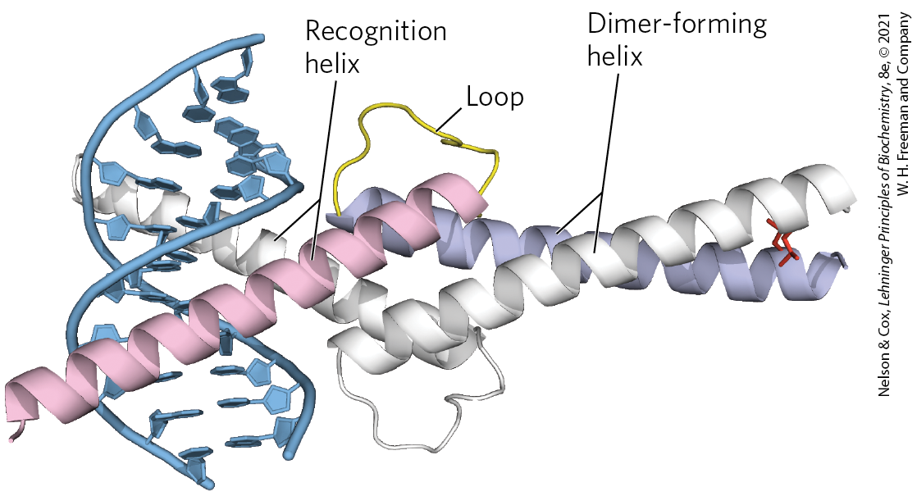
Basic Helix-Loop-Helix
basic helix-loop-helix = conserved 50 amino acid residues that can form two short, amphipathic α helices linked by a loop of variable length
  two helix-loop-helix motifs can interact to form dimers
  occurs in some eukaryotic regulatory proteins involved in gene expression during development

Slide 57
Principle 4 (4 of 6)
The default transcriptional state of a gene, on or off, is dictated in part by the size and complexity of the genome. In bacteria, where genomes are relatively small and DNA is readily accessible, the default state of genes is generally “on.” Transcription of each gene or gene cluster is usually limited by a specific protein repressor. In eukaryotes, where genomes are larger and genes are encapsulated in chromatin, the default state of most genes is “off.” Gene transcription requires chromatin modification followed by the action of transcription activators.

Slide 58
Protein-Protein Interactions in Eukaryotic Regulatory Proteins
eukaryotes have a larger number of genes than activators
  yeast have 300 transcription factors for 1000s of genes
most genes are subject to regulation by multiple transcription factors
combinatorial control = a mechanism involving mixing and matching of protein family variants in dimeric transcription factors
  provides for more efficient and responsive regulation

Slide 59
28.2 Regulation of Gene Expression in Bacteria

Slide 60
The lac Operon Undergoes
Positive Regulation
other factors besides lactose, such as the availability of glucose, affect the expression of the lac gene
glucose is the preferred energy source in E. coli
expressing the genes for proteins that metabolize other sugars is wasteful when glucose is abundant

Slide 61
Catabolite Repression
catabolite repression = a regulatory mechanism that restricts expression of the genes required for catabolism of other sugars in the presence of glucose
  mediated by cAMP as a coactivator and an activator protein, cAMP receptor protein (CRP)

Slide 62
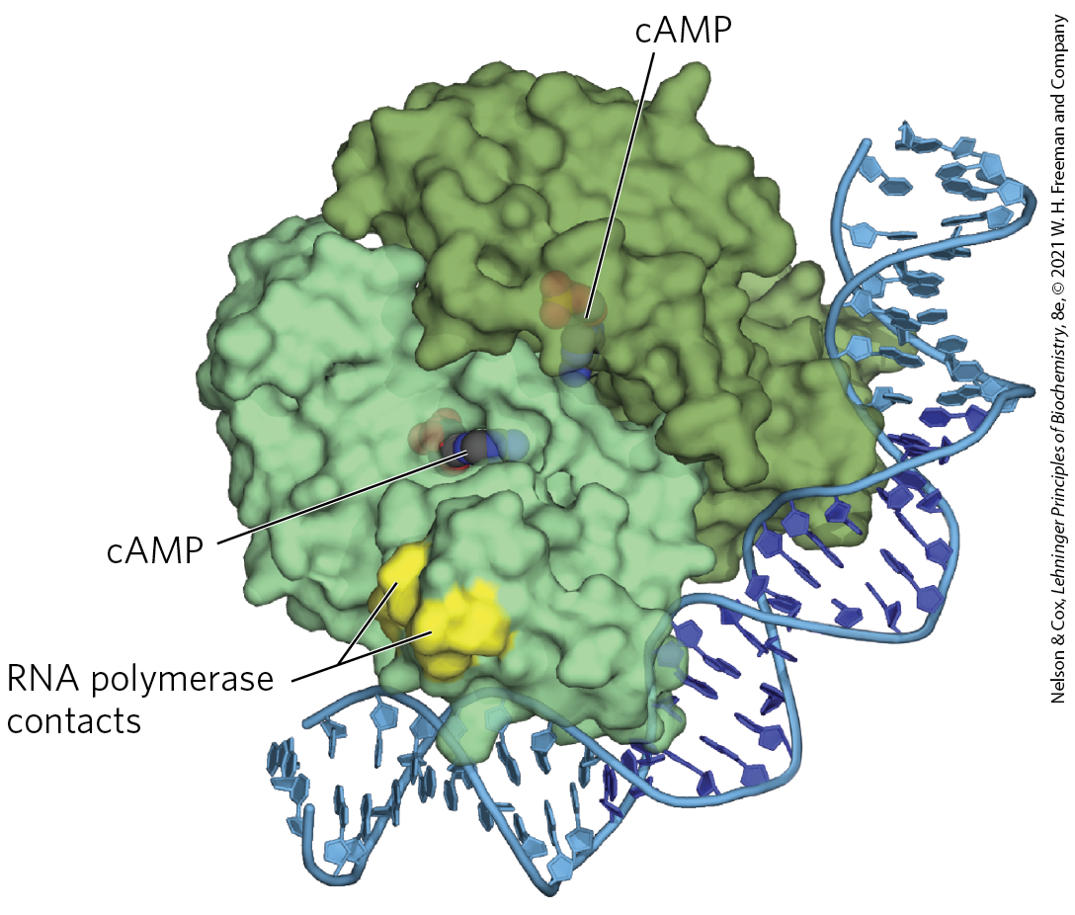
cAMP Receptor Protein (CRP)
cAMP receptor protein (CRP) = an activator protein that contains binding sites for DNA and cAMP
  binding is mediated by a helix-turn-helix motif in the DNA-binding domain

Slide 63
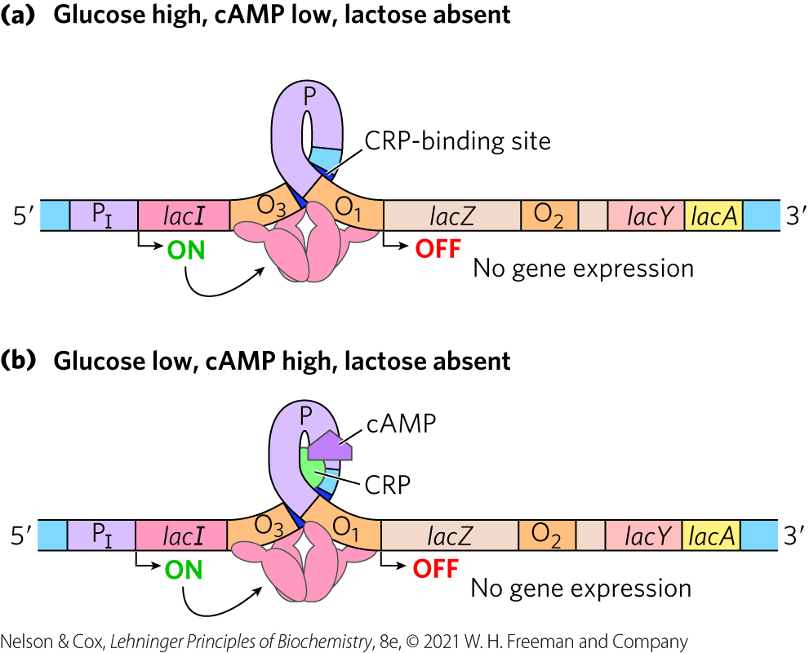
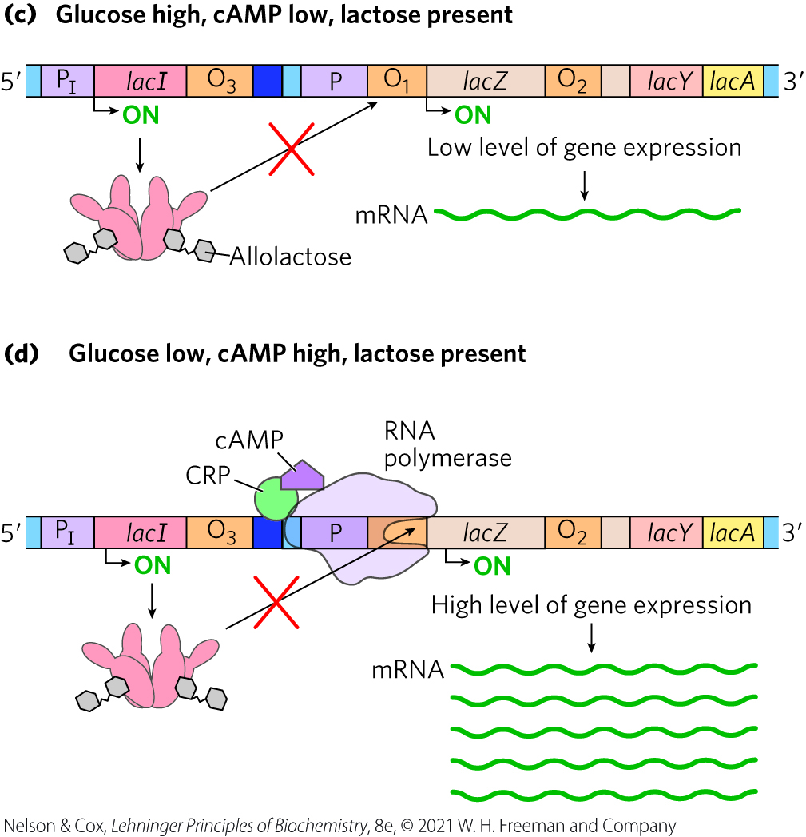
Positive Regulation of the lac Operon by CRP

Slide 64
Regulon
regulon = a network of operons with a common regulator
  allows coordinated shifts in cellular functions
examples include:
  operons encoding enzymes for secondary sugar metabolism (regulated by CRP and cAMP)
  the heat shock gene system that responds to temperature changes
  genes induced as part of the SOS response to DNA damage in E. coli

Slide 65
Many Genes for Amino Acid Biosynthetic Enzymes Are Regulated by Transcription Attenuation
E. coli can synthesize all 20 common amino acids
operons contain the genes encoding enzymes needed to synthesize a given amino acid
  the operon is repressed when the amino acid is abundant

Slide 66
The E. coli Tryptophan (trp) Operon
the E. coli tryptophan (trp) operon contains five genes for the enzymes required to convert chorismate to tryptophan
the Trp repressor binds to the trp operator when tryptophan is abundant
  inhibits expression of the trp operon by blocking RNA polymerase binding

Slide 67
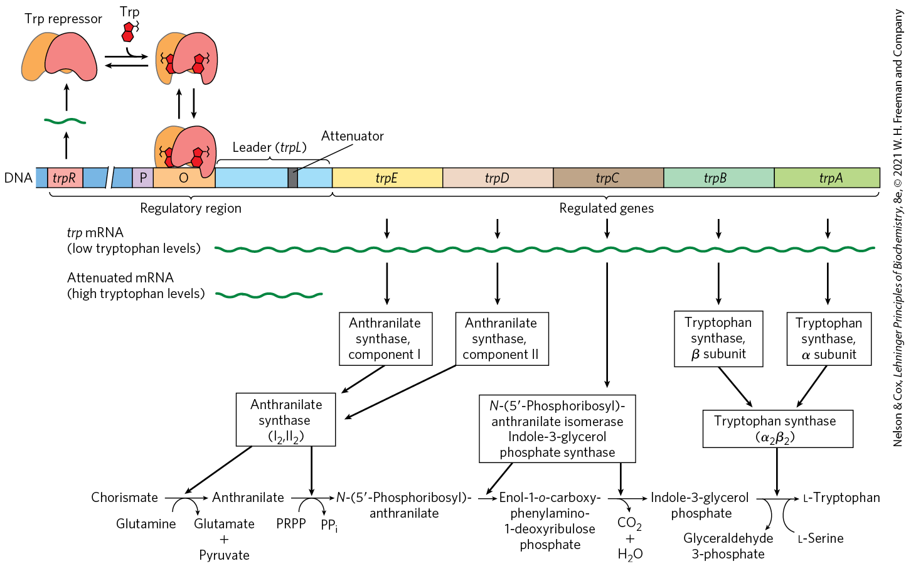
The trp Operon

Slide 68
Principle 1 (3 of 6)
The cellular concentration of a protein
is determined by a delicate balance of at least seven processes, each having several potential points of regulation. These processes include synthesis of the primary RNA transcript (transcription); posttranscriptional modification of mRNA; degradation of mRNA; protein synthesis (translation); posttranslational modification of proteins; protein targeting and transport; and protein degradation.

Slide 69
Transcription Attenuation
once repression is lifted, the rate of transcription is fine-tuned to cellular tryptophan requirements
transcription attenuation = a regulatory process in which transcription is initiated normally but is abruptly halted before the operon genes are transcribed

Slide 70
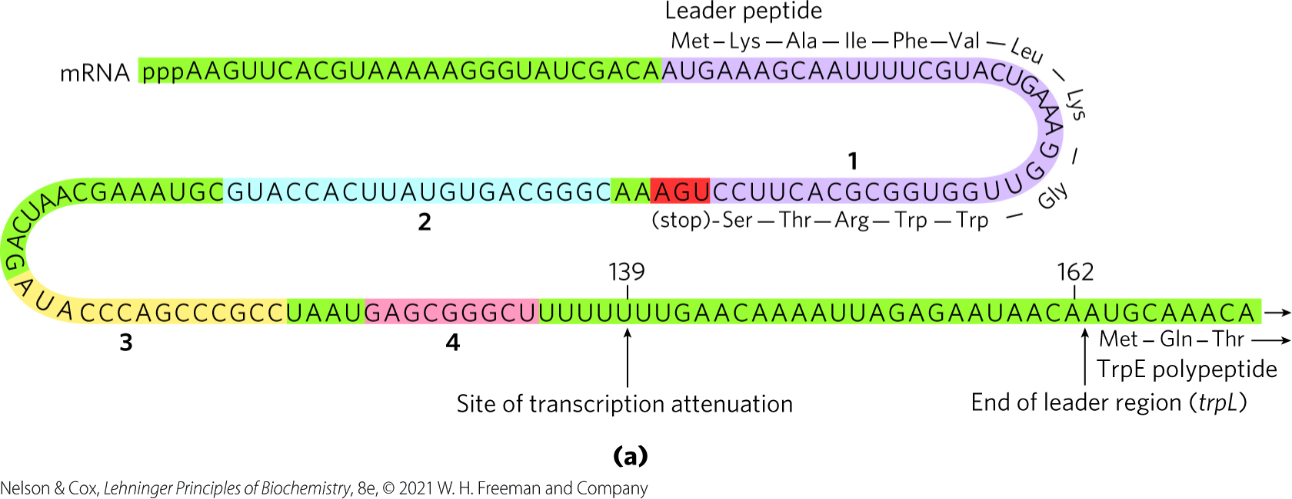
The Leader Region Contains the Attenuator
leader region = 162 nucleotide region at the 5′ end of the mRNA that contains four sequences
attenuator = a region of the leader made up of sequences 3 and 4

Slide 71
The Attenuator Structure
sequence 3 can base pair with sequence 4 or sequence 2
attenuator structure = a stem-and-loop structure that forms when sequences 3 and 4 base-pair
  acts as a transcription terminator
the attenuator structure cannot form when sequences 2 and 3 base-pair
  transcription continues into the trp biosynthetic genes

Slide 72
Regulatory Sequence 1
regulatory sequence 1 = encodes a leader peptide of 14 amino acids (including 2 Trp residues)
translation of regulatory sequence 1 determined whether the attenuator structure forms

Slide 73
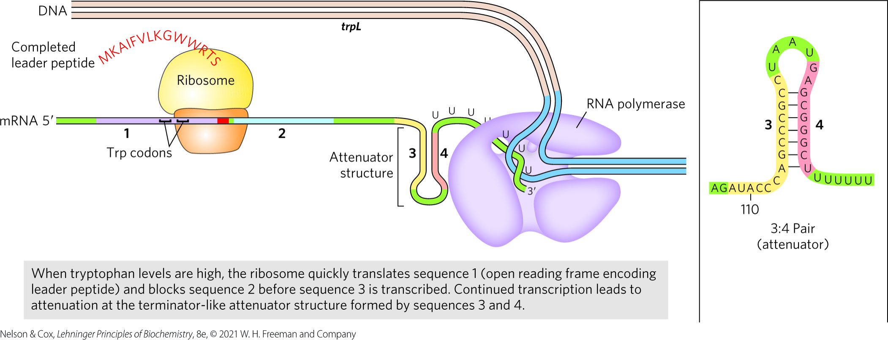
Formation of the Attenuator Structure (3:4 Pair)
when [tryptophan] is high, translation proceeds rapidly into sequence 2 before sequence 3 is synthesized
  sequence 2 is covered by the ribosome and unavailable for pairing to sequence 3
  the attenuator structure forms and transcription halts

Slide 74
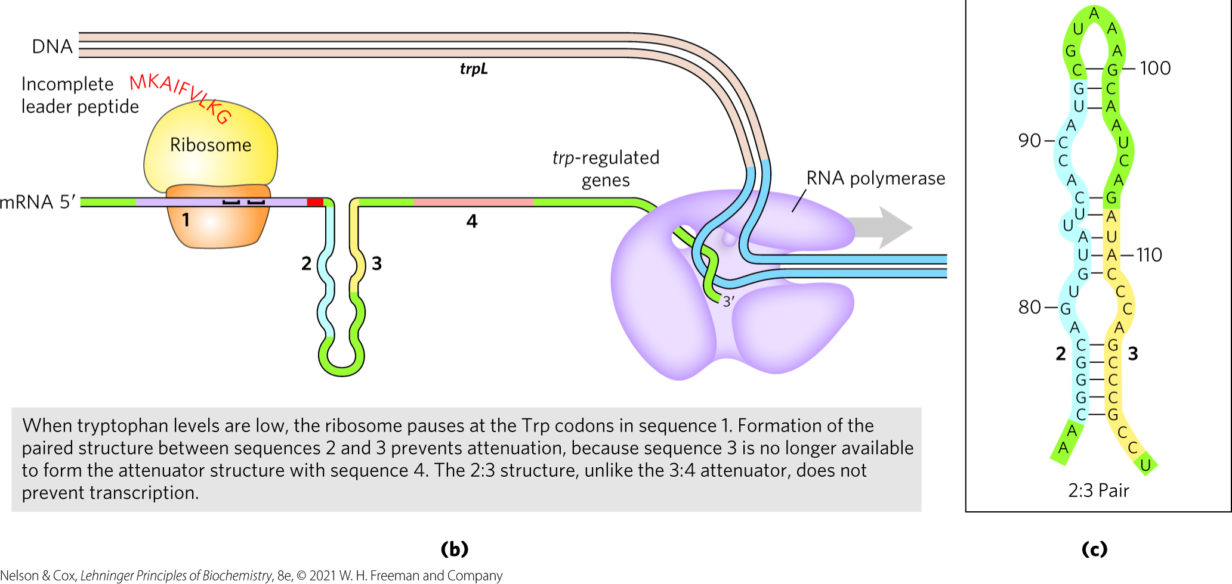
Formation of the 2:3 Pair
when [tryptophan] is low, the ribosome stalls at the Trp codons in sequence 1
  sequence 2 remains free while sequence 3 is synthesized
  the 2:3 pair forms and transcription proceeds

Slide 75
Other Amino Acid Biosynthetic Operons Use Similar Attenuation Strategies
the phe operon leader peptide contains 7 Phe residues
the leu operon leader peptide contains 4 Leu residues
the his operon leader peptide contains 7 His residues
  attenuation is sufficiently sensitive to be the only regulatory mechanism

Slide 76
Principle 3 (4 of 4)
Regulated gene expression may bring about increases or decreases in the amount of a gene product. Gene products that increase in concentration under particular molecular circumstances are referred to as inducible; the process of increasing their expression is induction. Conversely, gene products that decrease in concentration in response to a molecular signal are referred to as repressible, and the process is called repression.

Slide 77
Induction of the SOS Response Requires Destruction of Repressor Proteins
extensive DNA damage in the bacterial chromosome triggers the SOS response
  results in the induction of ~60 genes scattered about the chromosome (the SOS regulon)

Slide 78
The Key Regulatory Proteins of the SOS Response
LexA repressor inhibits transcription of all the SOS genes
induction of the SOS response requires inactivation of LexA when it catalyzes its own cleavage
  autocleavage reaction requires the RecA protein
RecA binds to ssDNA, leading to LexA cleavage and SOS induction

Slide 79
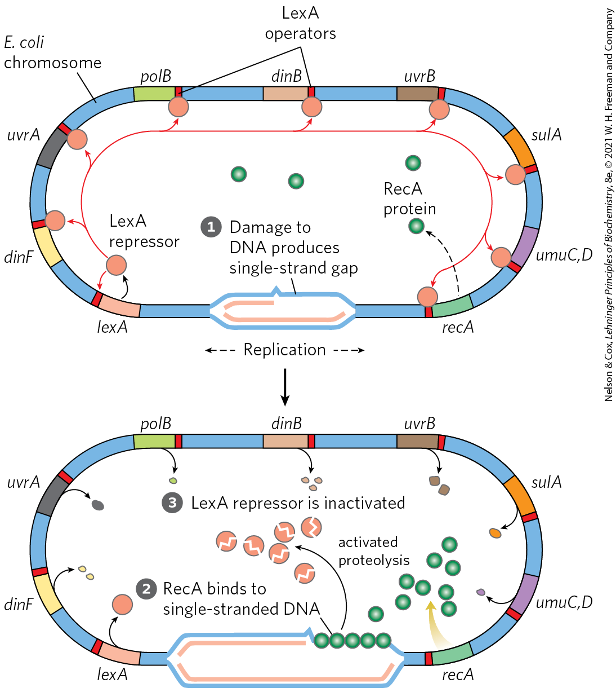
The SOS Response in E. coli
RecA protein binds to damaged ssDNA, activating its protein’s co-protease activity
RecA protein facilitates cleavage and inactivation of LexA
  induces the SOS genes

Slide 80
The Link Between the SOS Response and Virus Propagation
some repressors keep viruses in a dormant state within the bacterial host
RecA can promote autocatalytic cleavage of these repressors
  permits replication of the virus and lysis of the cell

Slide 81
Principle 5 (2 of 2)
Regulation is expensive. For many genes, especially in eukaryotes, the regulatory processes can require a considerable investment of chemical energy. That expenditure is nevertheless small when compared to the cost of RNA and protein synthesis when the gene is expressed.

Slide 82
The Energetic Cost of Regulation
LexA must be resynthesized to reestablish SOS regulon repression when the DNA damage is no longer present
protein synthesis requires a considerable amount of ATP and GTP

Slide 83
Principle 1 (4 of 6)
The cellular concentration of a protein
is determined by a delicate balance of at least seven processes, each having several potential points of regulation. These processes include synthesis of the primary RNA transcript (transcription); posttranscriptional modification of mRNA; degradation of mRNA; protein synthesis (translation); posttranslational modification of proteins; protein targeting and transport; and protein degradation.

Slide 84
Synthesis of Ribosomal Proteins Is
Coordinated with rRNA Synthesis
increased demand for protein synthesis leads to an increase in the number of ribosomes
cells coordinate the synthesis ribosomal proteins (r-proteins) and RNAs (rRNAs)
  occurs at the level of translation

Slide 85
Translational Repressors
r-protein operons are regulated primarily through a translational feedback mechanism
translational repressor = one protein in each r-protein operon binds to the mRNA transcribed from the operon and blocks translation of all genes encoded
translational repressors bind with higher affinity to the appropriate rRNA than to its mRNA
  balances r-protein synthesis with rRNA availability

Slide 86
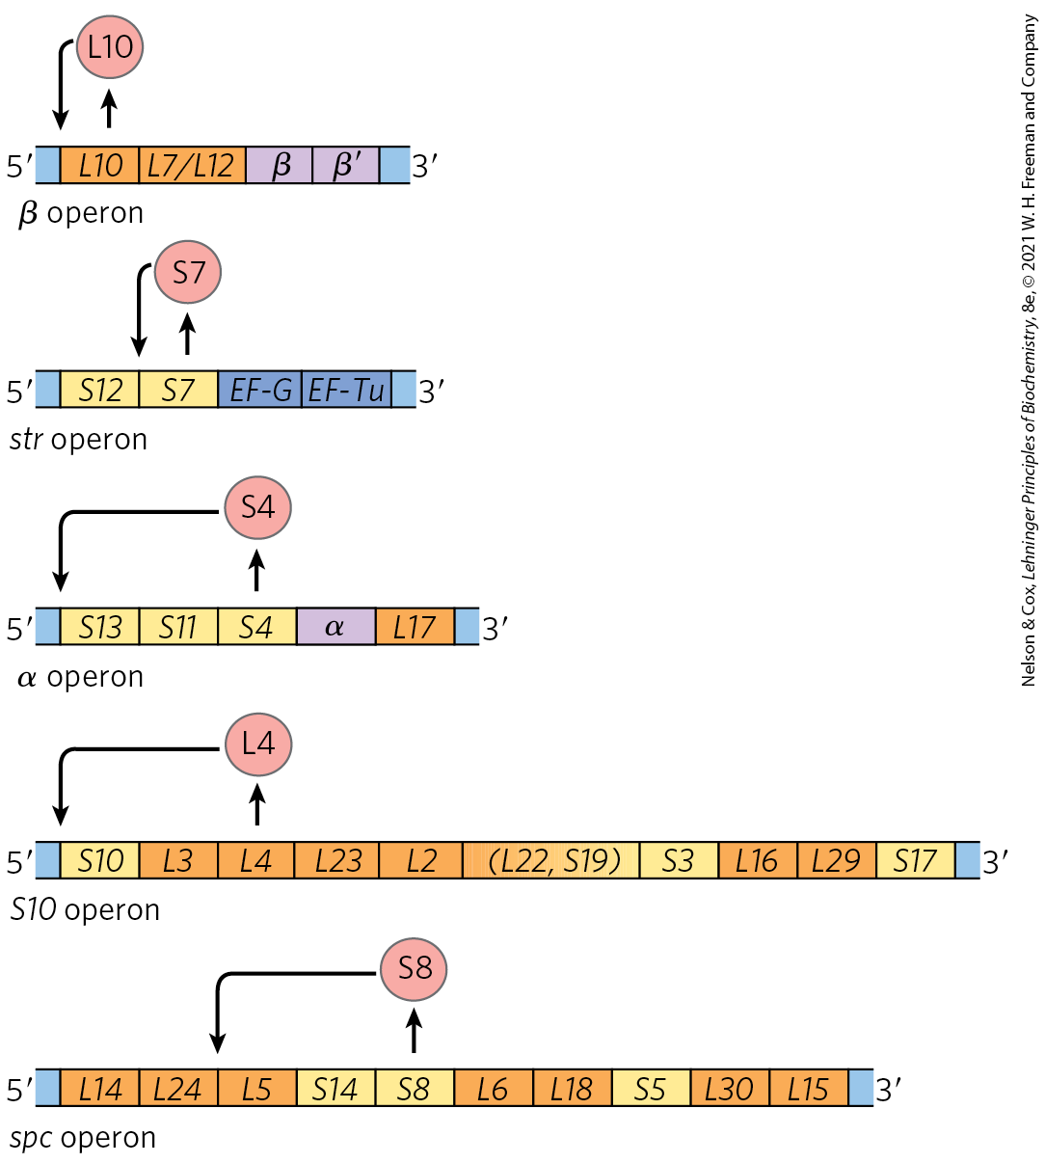
Translational Feedback in Some Ribosomal Protein Operons
the mRNA-binding site for the translational repressor is near the translational start site of one of the genes in the operon
translation of all genes is blocked by folding of the mRNA into a 3-D structure

Slide 87
The Stringent Response
stringent response = coordinates rRNA synthesis with amino acid concentrations
binding of uncharged tRNA to the ribosomal A site triggers the binding of the stringent factor to the ribosome

Slide 88
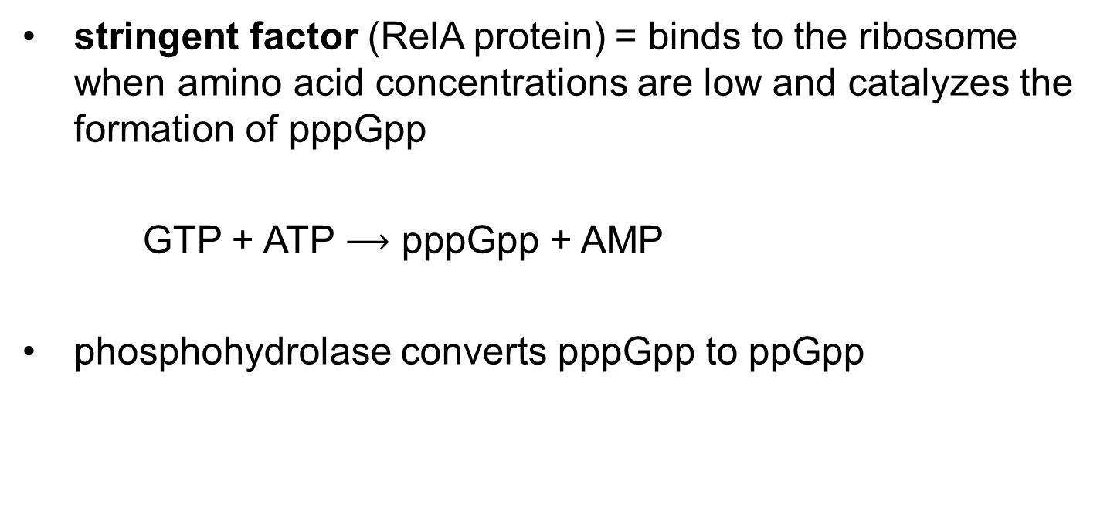
The Stringent Factor
stringent factor (RelA protein) = binds to the ribosome when amino acid concentrations are low and catalyzes the formation of pppGpp
GTP + ATP $⟶$ pppGpp + AMP
phosphohydrolase converts pppGpp to ppGpp

Slide 89
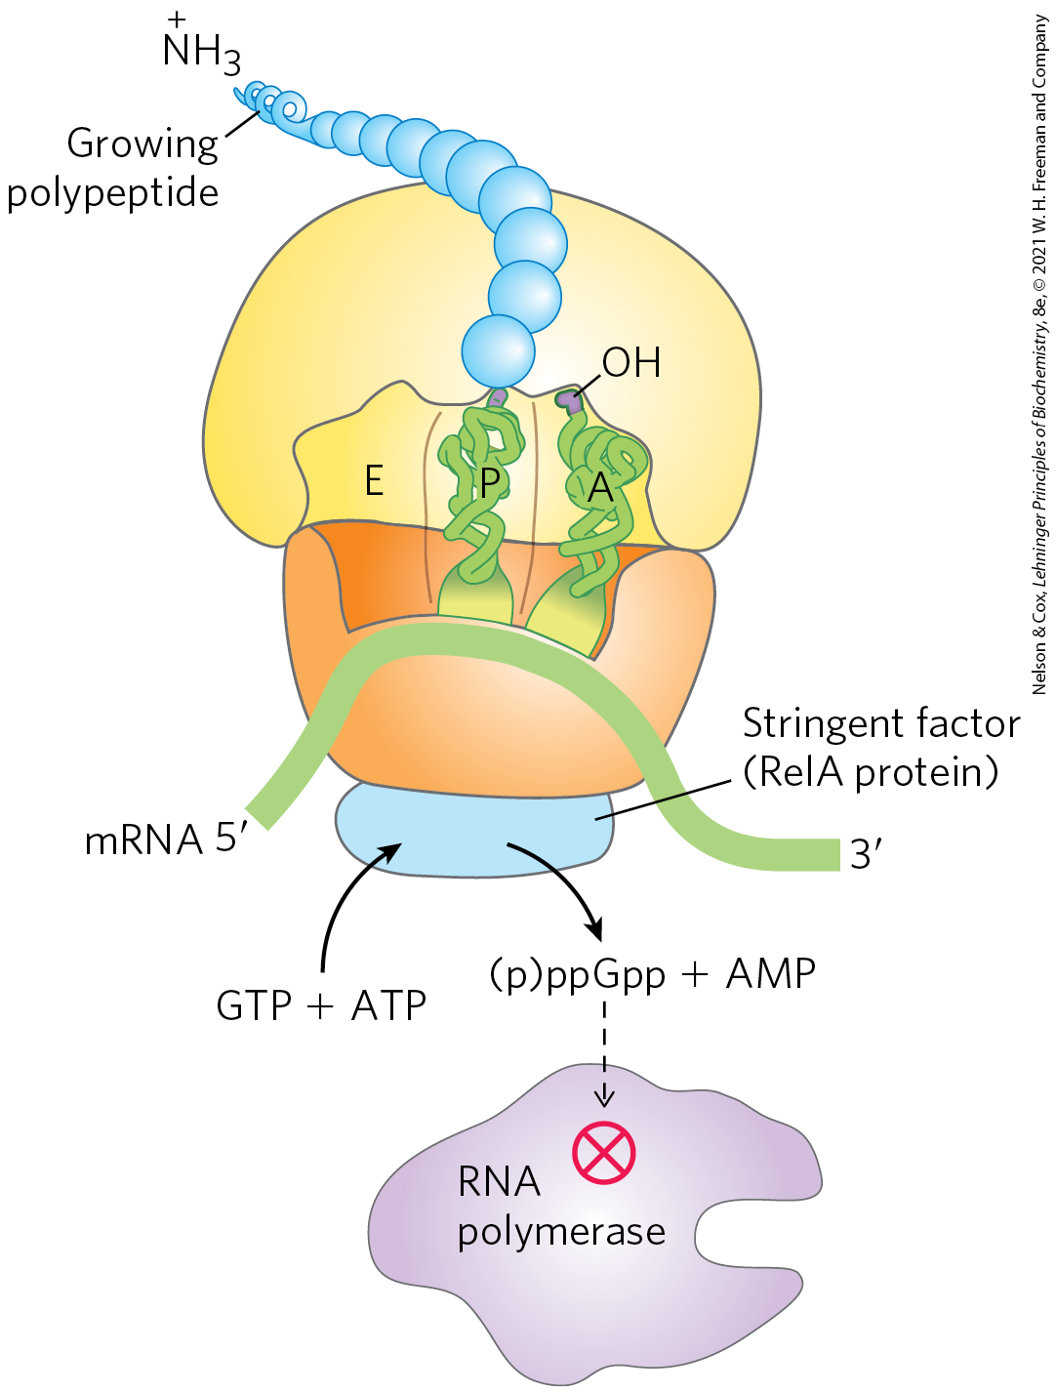
Stringent Response in E. coli
the rise in pppGpp and ppGpp levels results in a reduction in rRNA synthesis
  mediated in part by the binding of ppGpp to RNA polymerase

Slide 90
The Function of Some mRNAs Is Regulated by Small RNAs in Cis or in Trans
a separate RNA molecule may bind to the mRNA “in trans” and affect its activity
a portion of mRNA itself may act ”in cis” and regulate its own function

Slide 91
Principle 2 (5 of 7)
Regulation is achieved by specialized proteins and RNAs. The proteins are usually ligand-binding proteins with no other function. They bind to specific sequences in DNA or RNA. They respond to molecular signals that can be any kind of biological molecule. The RNAs either interact with other RNAs or serve as protein cofactors.

Slide 92
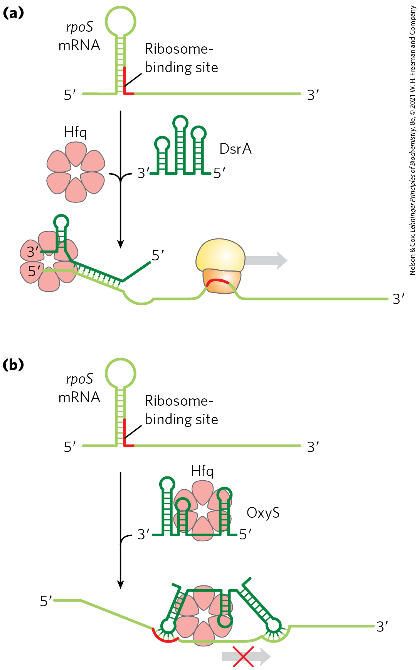
Regulation of mRNA in Trans
rpoS mRNA encodes σ^{S} (an E. coli sigma factor)
  translation is inhibited by a large hairpin structure
binding of ncRNAs (DsrA and RprA) disrupts the hairpin
  allows rpoS translation
the RNA OxyS pairs with the ribosome binding site
  blocks rpoS translation

Slide 93
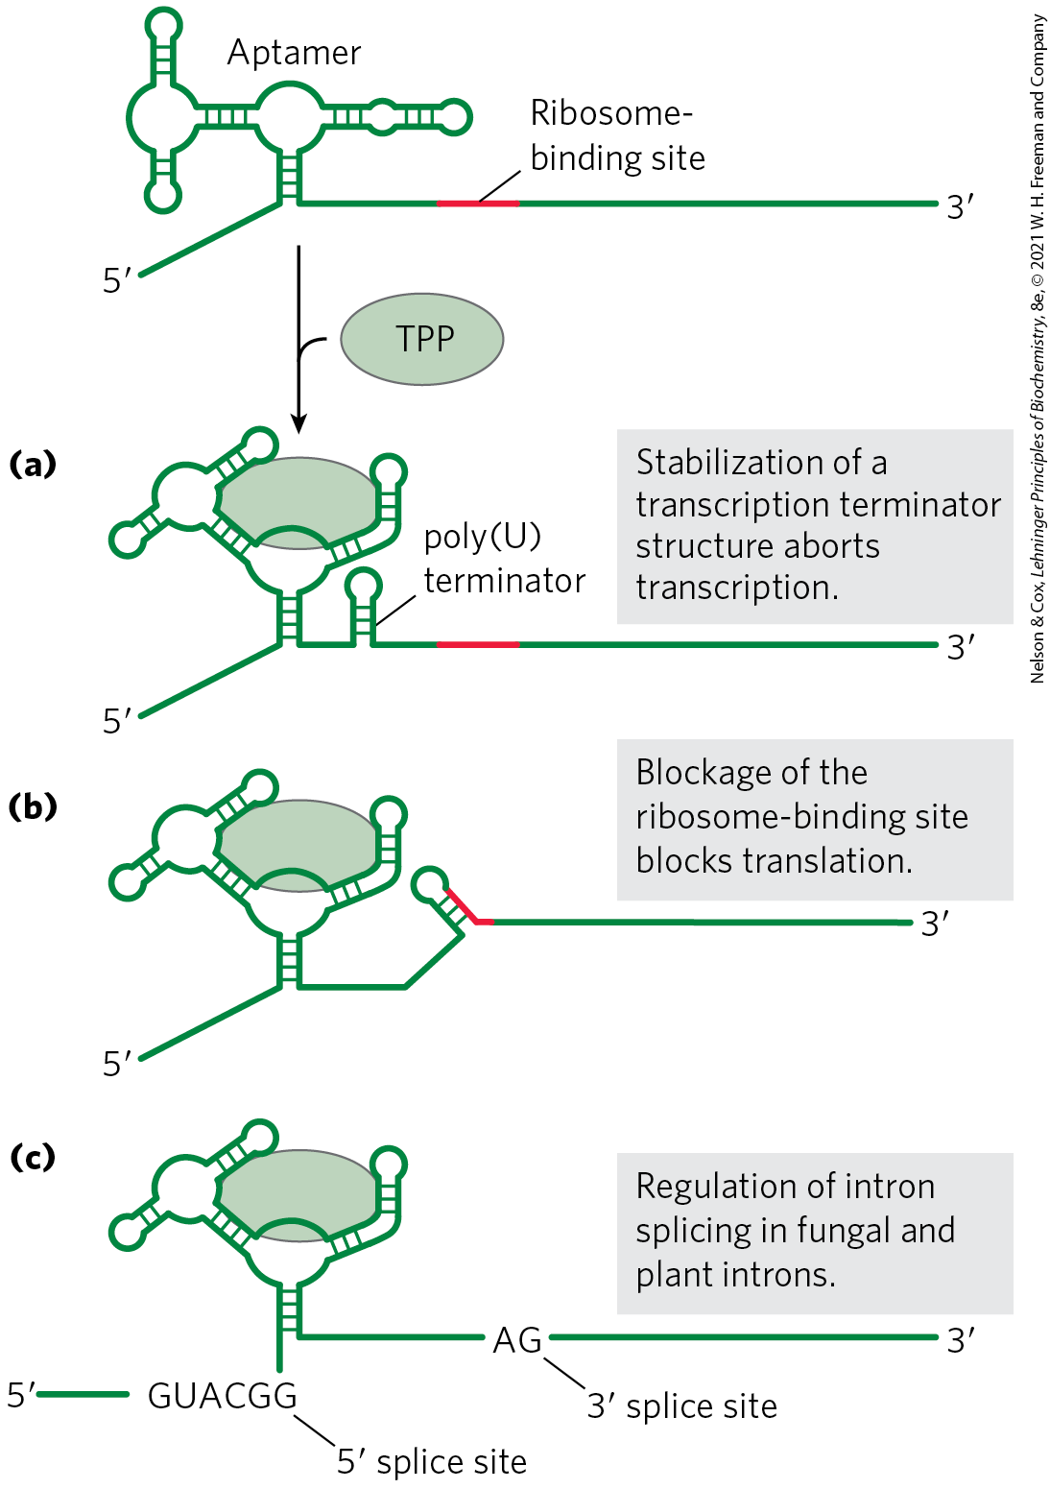
Regulation of mRNA in Cis
riboswitches = ligand-binding mRNA domain
  found in untranslated regions at the 5′ ends
ligand binding results in a conformational change in the mRNA
  inhibits transcription

Slide 94
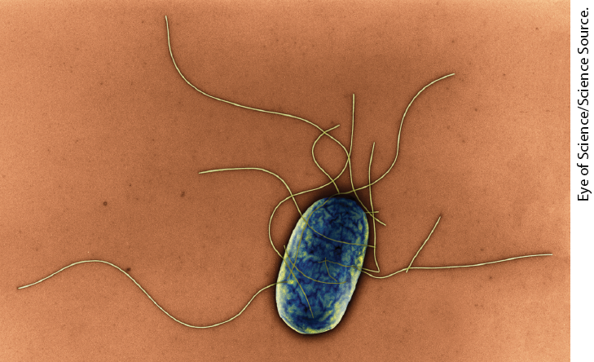
Some Genes Are Regulated by Genetic Recombination
Salmonella typhimurium moves by rotating the flagella on its cell surface
many copies of the protein flagellin make up the flagella
  are prominent targets of mammalian immune systems

Slide 95
Phase Variation
phase variation = a process that switches between two flagellin proteins to evade the mammalian immune response
  occurs roughly once every 1,000 generations
  accomplished by periodic inversion of the DNA segment containing the flagellin promoter

Slide 96
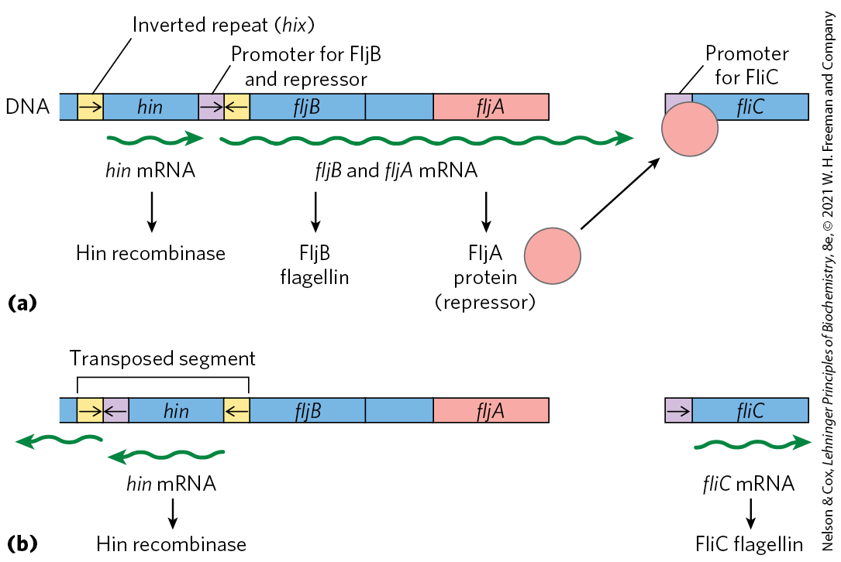
Regulation of Flagellin Genes in Salmonella
the inversion is a site-specific recombination reaction mediated by the Hin recombinase

Slide 97
Examples of Gene Regulation by Recombination
Table 28-1 Examples of Gene Regulation by Recombination
System | Recombinase/recombination site | Type of recombination | Function
Phase variation (Salmonella) | Hin/hix | Site-specific | Alternative expression of two flagellin genes allows evasion of host immune response.
Host range (bacteriophage μ) | Gin/gix | Site-specific | Alternative expression of two sets of tail fiber genes affects host range.
Mating-type switch (yeast) | HO endonuclease, RAD52 protein, other proteins/ MAT | Nonreciprocal gene conversionª | Alternative expression of two mating types of yeast, a and α, creates cells of different mating types that can mate and undergo meiosis.
Antigenic variation (trypanosomes)^{b} | Varies | Nonreciprocal gene conversionª | Successive expression of different genes encoding the variable surface glycoproteins (VSGs) allows evasion of host immune response.

Slide 98
28.3 Regulation of Gene Expression in Eukaryotes

Slide 99
Principle 4 (5 of 6)
The default transcriptional state of a gene, on or off, is dictated in part by the size and complexity of the genome. In bacteria, where genomes are relatively small and DNA is readily accessible, the default state of genes is generally “on.” Transcription of each gene or gene cluster is usually limited by a specific protein repressor. In eukaryotes, where genomes are larger and genes are encapsulated in chromatin, the default state of most genes is “off.” Gene transcription requires chromatin modification followed by the action of transcription activators.

Slide 100
Transcriptional Ground States
transcriptional ground state = the inherent activity of promoters and transcriptional machinery in vivo
  in bacteria, RNA polymerase can initiate transcription at some level of efficiency
  in eukaryotes, strong promoters are generally inactive in the absence of regulatory proteins

Slide 101
Features of Eukaryotic
Gene Regulation
access to eukaryotic promoters is restricted by the structure of chromatin
  transcription requires chromatin remodeling
positive regulation mechanisms are more prominent and are required for transcription
eukaryotic transcriptional regulation commonly involves lncRNAs

Slide 102
Features of Eukaryotic
Gene Regulation, Continued
eukaryotic cells have larger, more complex multimeric regulatory proteins
transcription (in the nucleus) and translation (in the cytoplasm) are separated in space and time

Slide 103
Transcriptionally Active Chromatin Is Structurally Distinct from Inactive Chromatin
heterochromatin = more-condensed form of chromatin that is transcriptionally inactive
  ~10% of chromatin in a typical eukaryotic cell
  generally associated with chromosome structures, such as centromeres
euchromatin = less-condensed form of chromatin

Slide 104
Chromatin Remodeling
chromatin remodeling = transcription-associated structural changes in chromatin
chromatin remodeling to yield transcriptionally active genes involves:
  repositioning nucleosomes
  the presence of histone variants
  covalent modification of nucleosomes

Slide 105
Some Enzyme Complexes That Catalyze Chromatin Remodeling
Table 28-2 Some Enzyme Complexes That Catalyze Chromatin Structural Changes Associated with Transcription
Enzyme complexª | Oligomeric structure (number of polypeptides) | Source | Activities
Histone movement, replacement, or editing, requiring ATP
SWI/SNF family | 8–17, M_{r} > 10⁶ | Eukaryotes | Nucleosome remodeling; transcriptional activation
ISWI family | 2–4 | Eukaryotes | Nucleosome remodeling; transcriptional repression; transcriptional activation in some cases
CHD family | 1–10 | Eukaryotes | Nucleosome remodeling; nucleosome ejection for transcriptional activation; some have repressive roles
INO80 family | >10 | Eukaryotes | Nucleosome remodeling; transcriptional activation; family member SWR1 engages in replacement of H2A-H2B with H2AZ-H2B
Histone modification
GCN5-ADA2-ADA3 | 3 | Yeast | GCN5 has type A HAT activity
SAGA/PCAF | >20 | Eukaryotes | Includes GCN5-ADA2-ADA3; acetylates residues in H3, H2B, H2AZ
NuA4 | ≥12 | Eukaryotes | EsaI component has HAT activity; acetylates H4, H2A, and H2AZ
Histone chaperones not requiring ATP
HIRA | 1 | Eukaryotes | Deposition of H3.3 during transcription

Slide 106
SWI/SNF and ISWI Complexes
SWI/SNF complexes = remodel chromatin so that nucleosomes are ejected near transcription start sites
  involved in a cycle that replaces nucleosomes with transcription factors
ISWI complexes = optimize nucleosome spacing to allow chromatin assembly and transcriptional silencing

Slide 107
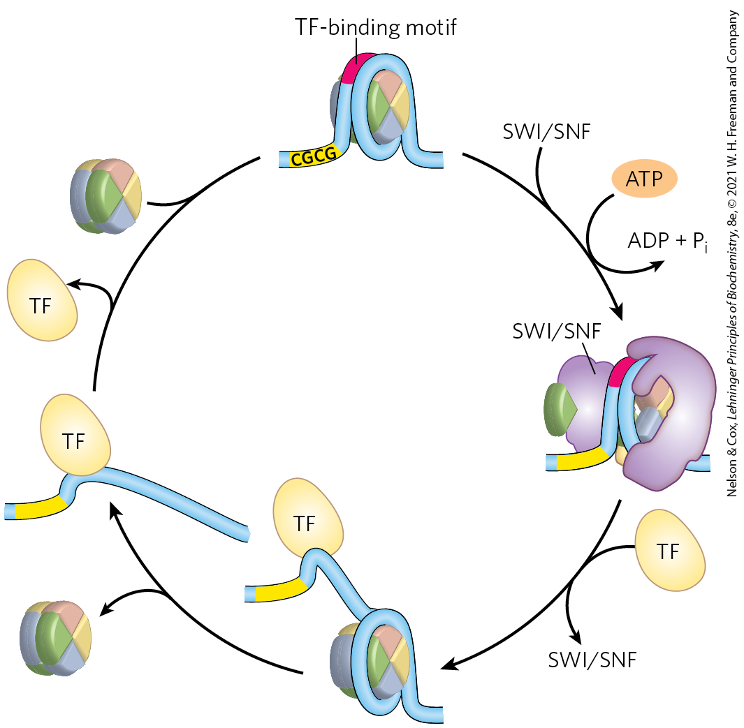
Nucleosome Ejection by a
SWI/SNF Remodeler
when transcription is needed, a transcription factor replaces the nucleosome
  requires ATP
when transcription is no longer needed, the nucleosome replaces the transcription factor

Slide 108
CHD and INO80 Complexes
CHD complexes = either eject nucleosomes to activate transcription or assemble chromatin to repress transcription
INO80 complexes = remodel chromatin for transcriptional activation and DNA repair
  SWR1 = promotes subunit exchange in nucleosomes to introduce histone variants

Slide 109
Covalent Modification of Histones
the core histones of nucleosome particles are modified by:
  methylation of Lys or Arg residues
  phosphorylation of Ser or Thr residues
  acetylation
  ubiquitination
  SUMOylation
covalent modifications occur at specific residues concentrated in this amino-terminal domain
  patterns of modification may indicate the existence of a histone code

Slide 110
Histone Acetyltransferases (HATs)
during transcription, histone methylases methylate histone H3 at Lys⁴ and Lys³⁶
histone acetyltransferases (HATs) = enzymes that acetylate particular Lys residues
  type B = acetylate newly synthesized histones
  type A = acetylate nucleosomal histones following H3 methylation
Lys acetylation decreases histone affinity for DNA
  results in transcriptional activation

Slide 111
Histone Deacetylases (HDACs)
histone deacetylases (HDACs) = enzymes that deacetylate specific Lys residues
  marks chromatin as transcriptionally inactive
  examples: SIRT1, SIRT2, SIRT6, and SIRT7

Slide 112
Principle 4 (6 of 6)
The default transcriptional state of a gene, on or off, is dictated in part by the size and complexity of the genome. In bacteria, where genomes are relatively small and DNA is readily accessible, the default state of genes is generally “on.” Transcription of each gene or gene cluster is usually limited by a specific protein repressor. In eukaryotes, where genomes are larger and genes are encapsulated in chromatin, the default state of most genes is “off.” Gene transcription requires chromatin modification followed by the action of transcription activators.

Slide 113
Most Eukaryotic Promoters Are Positively Regulated
initiation of transcription depends on multiple activator proteins, not RNA polymerase affinity
chromatin renders most promoters inaccessible
  repressors would be redundant
combinatorial control provides precise positive control
negative regulation in eukaryotes typically involves lncRNAs

Slide 114
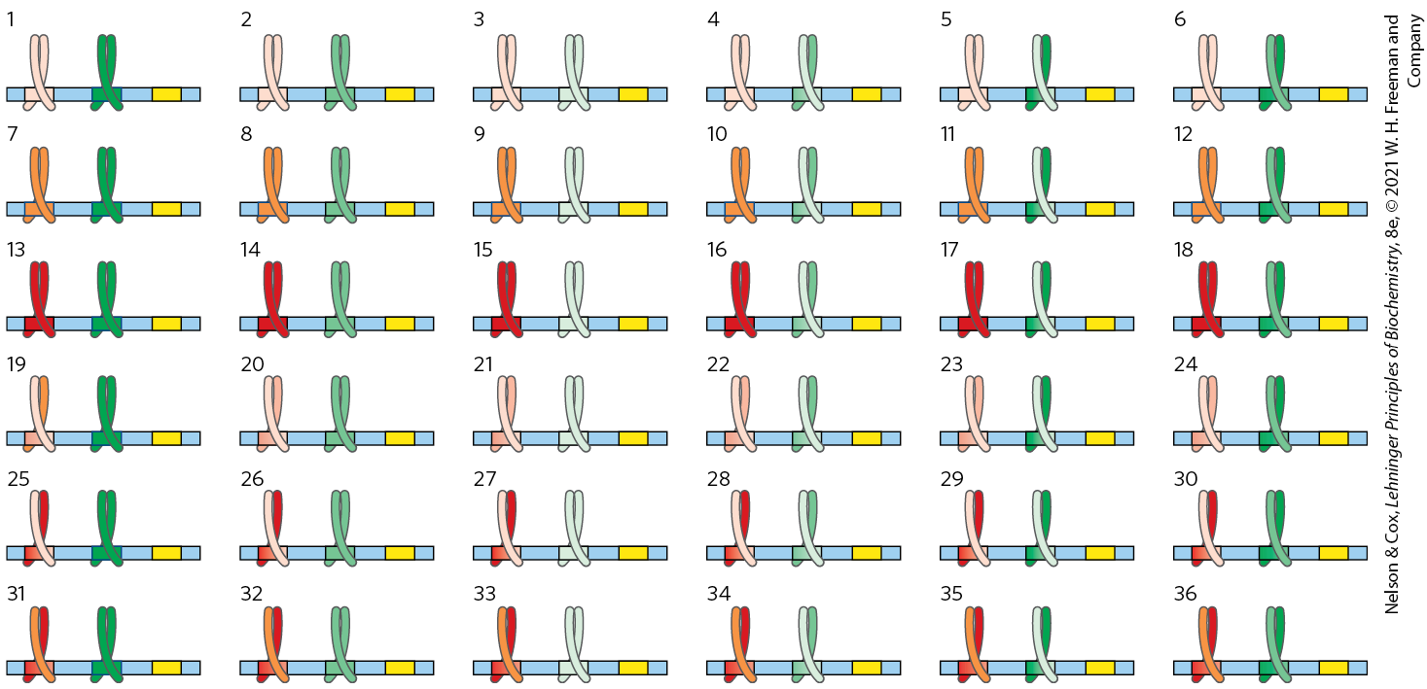
Advantages of
Combinatorial Control
with two regulatory gene families (each with three members that can form dimers), 36 different regulatory combinations are possible

Slide 115
DNA-Binding Activators and Coactivators Facilitate Assembly of the Basal Transcription Factors
many (but not all) Pol II promoters include the TATA box and Inr (initiator) sequences, with their standard spacing
additional regulatory sequences are bound by transcriptional activators to increase transcription
  enhancers in higher eukaryotes
    can be located anywhere
  upstream activator sequences (UASs) in yeast
    must be upstream and within a few hundred bp

Slide 116
Pol II Holoenzyme Binding Requires Five Types of Proteins
transcription activators = bind to enhancers or UASs and facilitate transcription
architectural regulators = facilitate DNA looping
chromatin modification and remodeling proteins

Slide 117
Pol II Holoenzyme Binding Requires Five Types of Proteins, Continued
coactivators = facilitate communication between activators and the complex of Pol II and basal transcription factors
  play a direct role in assembly of the preinitiation complex (PIC)
basal transcription factors (general transcription factors)

Slide 118
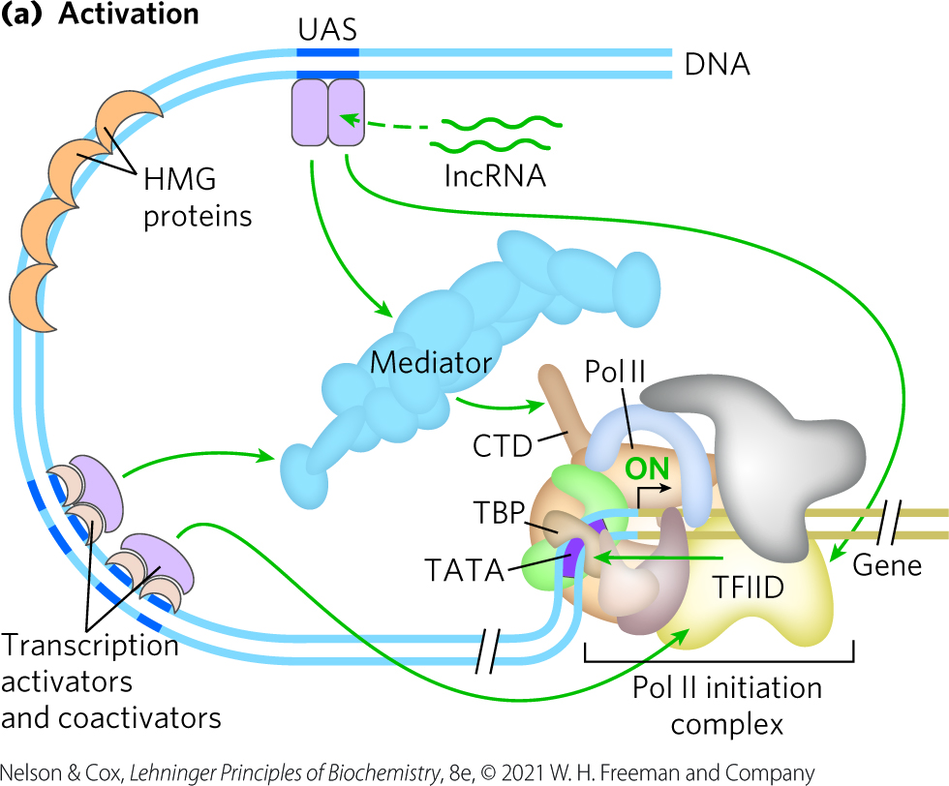
Activation of Transcription

Slide 119
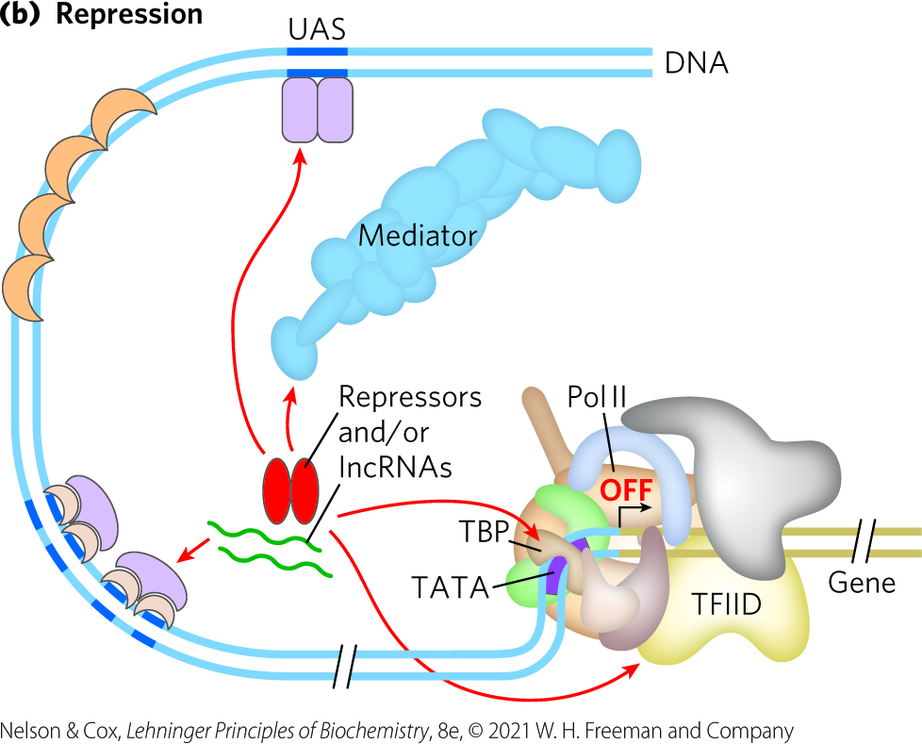
Repression of Transcription
repressor proteins interfere with communication between Pol II and the activators
  leads to repression of transcription

Slide 120
Transcription Activators
activator requirements vary greatly between promoters:
  may activate transcription at 100s of promoters or be specific for a few promoters
  may be sensitive to signal molecule binding
  may bind to enhancers that are distant from the TATA box
  may bind to both DNA and RNA
  function may be affected by lncRNAs

Slide 121
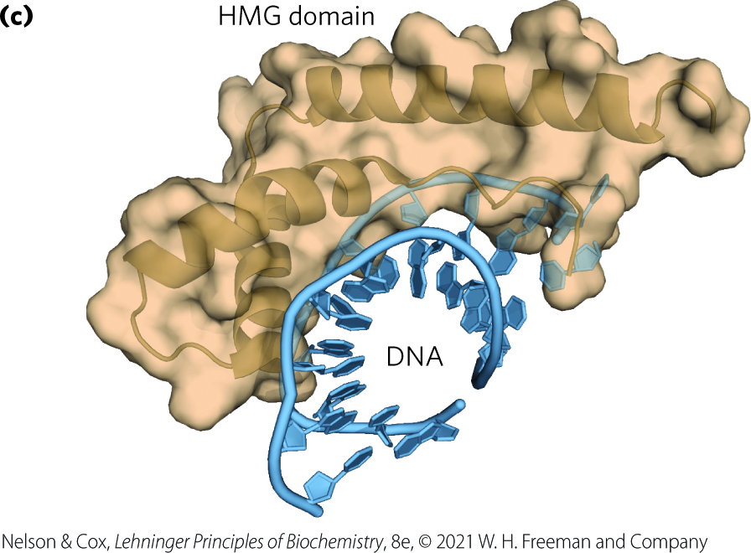
Architectural Regulators
architectural regulators = facilitate DNA looping to allow activators to function at a distance
  abundant in chromatin
  bind to DNA with limited specificity
high mobility group (HMG) proteins = play an important structural role in chromatin remodeling and transcriptional activation

Slide 122
Coactivator Protein Complexes
Mediator complex = a major eukaryotic coactivator
  consisting of 25 (yeast) to 30 (human) polypeptides, many of which are highly conserved
  binds to the CTD of the largest subunit of Pol
  required for basal and regulated transcription
  facilitates the effects of transcription activators on Pol II

Slide 123
TATA-Binding Protein and Basal Transcription Factors
TATA-binding protein (TBP) = the first component to bind in the assembly of a preinitiation complex (PIC) at the TATA box of a typical Pol II promoter
basal transcription factors (TFIIB, TFIIE, TFIIF, TFIIH) make up the minimal PIC
  often insufficient for initiation of transcription

Slide 124
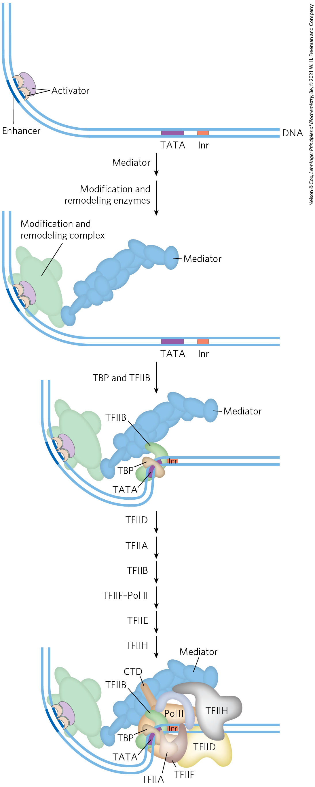
Choreography of
Transcriptional Activation
activators bind the DNA first
activators recruit remodeling complexes and a coactivator (Mediator)
Mediator facilitates the binding of additional required components
phosphorylation of the CTD of Pol II leads to transcription initiation

Slide 125
The Genes of Galactose Metabolism in Yeast Are Subject to Both Positive and
Negative Regulation
Gene | Protein function | Chromosomal location | Protein size (number of residues) | Relative protein expression in different carbon sources: Glucose | Relative protein expression in different carbon sources: Glycerol | Relative protein expression in different carbon sources: Galactose
Regulated genes
GAL1 | Galactokinase | II | 528 | – | – | + + +
GAL2 | Galactose permease | XII | 574 | – | – | + + +
PGM2 | Phosphoglucomutase | XIII | 569 | + | + | + +
GAL7 | Galactose 1-phosphate uridylyltransferase | II | 365 | – | – | + + +
GAL10 | UDP-glucose 4-epimerase | II | 699 | – | – | + + +
MEL1 | α-Galactosidase | II | 453 | – | + | + +
Regulatory genes
GAL3 | Inducer | IV | 520 | – | + | + +
GAL4 | Transcriptional activator | XVI | 881 | +/– | + | +
GAL80 | Transcriptional inhibitor | XIII | 435 | + | + | + +
Notes:
Table 28-3 Genes of Galactose Metabolism in Yeast

Slide 126
Promoters for GAL Genes
promoters for the GAL genes consist of:
  the TATA box
  Inr sequences
  an upstream activator sequence (UAS_{G}) recognized by the transcription activator Gal4 protein (Gal4p)

Slide 127
Regulation of Gene Expression
By Galactose
Gal80p forms a complex with Gal4p
  prevents Gal4p from functioning as an activator of the GAL promoters
when galactose is present, it binds Gal3p, which then interacts with the Gal80p-Gal4p complex
  allows Gal4p to function as an activator at the GAL promoters

Slide 128
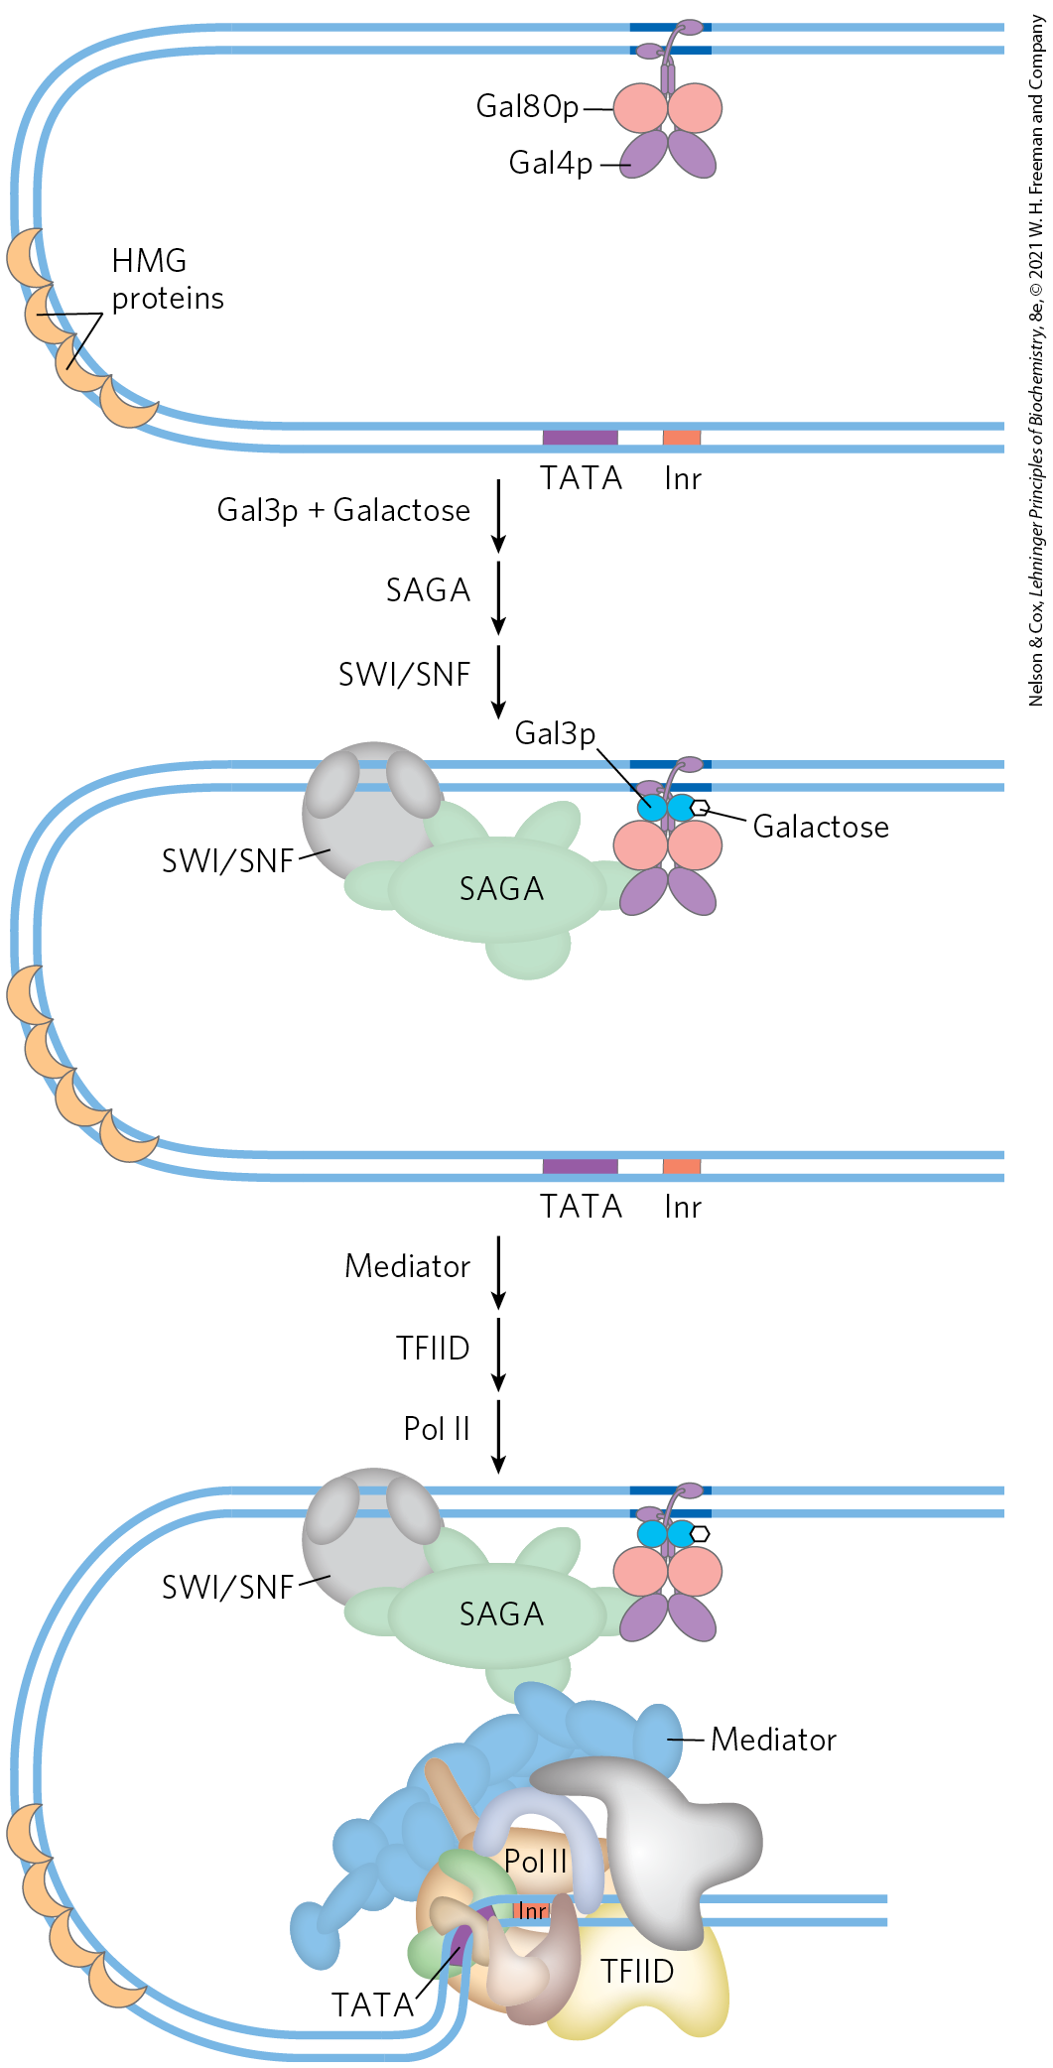
Regulation of Transcription of GAL Genes in Yeast
Gal4p recruits additional factors:
  SAGA complex = involved in histone acetylation and chromatin remodeling
  SWI/SNF complex = involved in chromatin remodeling
  Mediator

Slide 129
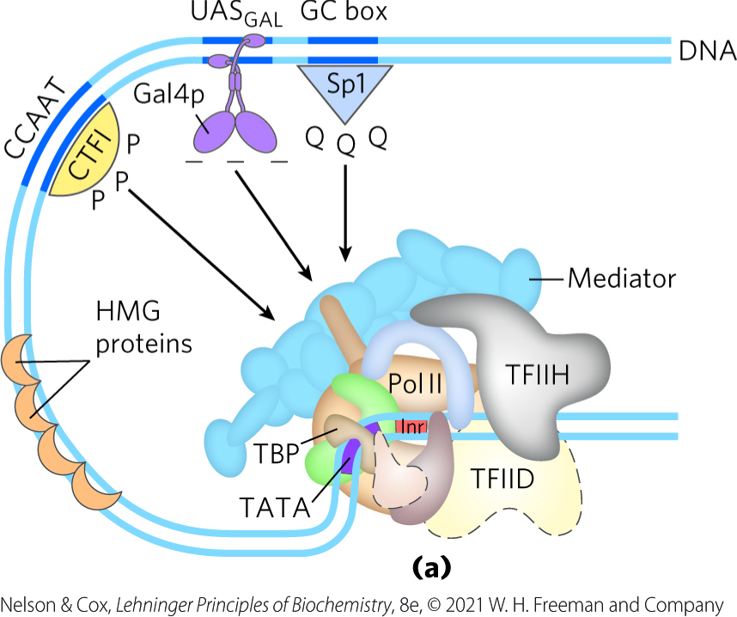
Transcription Activators Have a Modular Structure
typical activators have a DNA-binding domain and an activation domain

Slide 130
Gal4p
contains a zinc finger-like structure in its DNA-binding domain
functions as a homodimer
binds to UAS_{G} (a palindromic DNA sequence)
has an acidic activation domain
  the acidic nature is critical to its function

Slide 131
Sp1
Sp1 = a transcription activator for many genes in higher eukaryotes
  its DNA-binding site is usually near the TATA box.
  its DNA-binding domain is near its carboxyl terminus and contains three zinc fingers
  has two glutamine-rich domains that function in activation
a wide variety of other activator proteins also have these glutamine-rich domains
  25% of residues are Gln

Slide 132
CTF1
CTF1 (CCAAT-binding transcription factor 1) = a transcription activator that bind a sequence called the CCAAT site
  its DNA-binding domain contains many basic amino acid residues
  its binding region is probably an α helix.
  has a proline-rich activation domain, with Pro accounting for >20% of the residues

Slide 133
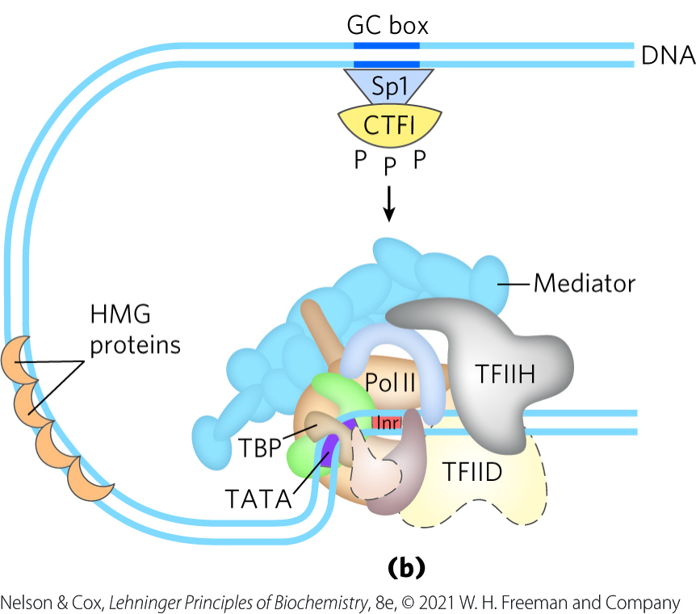
Domain-Swapping Experiments
activation and DNA-binding domains of regulatory proteins often act completely independently
genetic engineering techniques can join the activation domain of one protein with the DNA-binding domain of another

Slide 134
Eukaryotic Gene Expression Can
Be Regulated by Intercellular and Intracellular Signals
the hormone-receptor complex binds to DNA sequences called hormone response elements (HREs)
  receptors act as transcription activators, recruiting coactivators and Pol II (plus associated transcription factors)

Slide 135
Hormone Receptors
hormone receptors:
  have a consensus HRE sequence
  have a highly conserved DNA-binding domain with two zinc fingers
  have a specific ligand-binding region at the carboxyl terminus
Table 28-4 Hormone Response Elements (HREs) Bound by Steroid-Type Hormone Receptors
Receptor | HRE consensus sequence bound
Androgen | GG(A/T)ACAN₂TGTTCT
Glucocorticoid | GGTACAN₃TGTTCT
Retinoic acid (some) | AGGTCAN₅AGGTCA
Vitamin D | AGGTCAN₃AGGTCA
Thyroid hormone | AGGTCAN₃AGGTCA
RX^{b} | AGGTCANAGGTCANAG GTCANAGGTCA

Slide 136
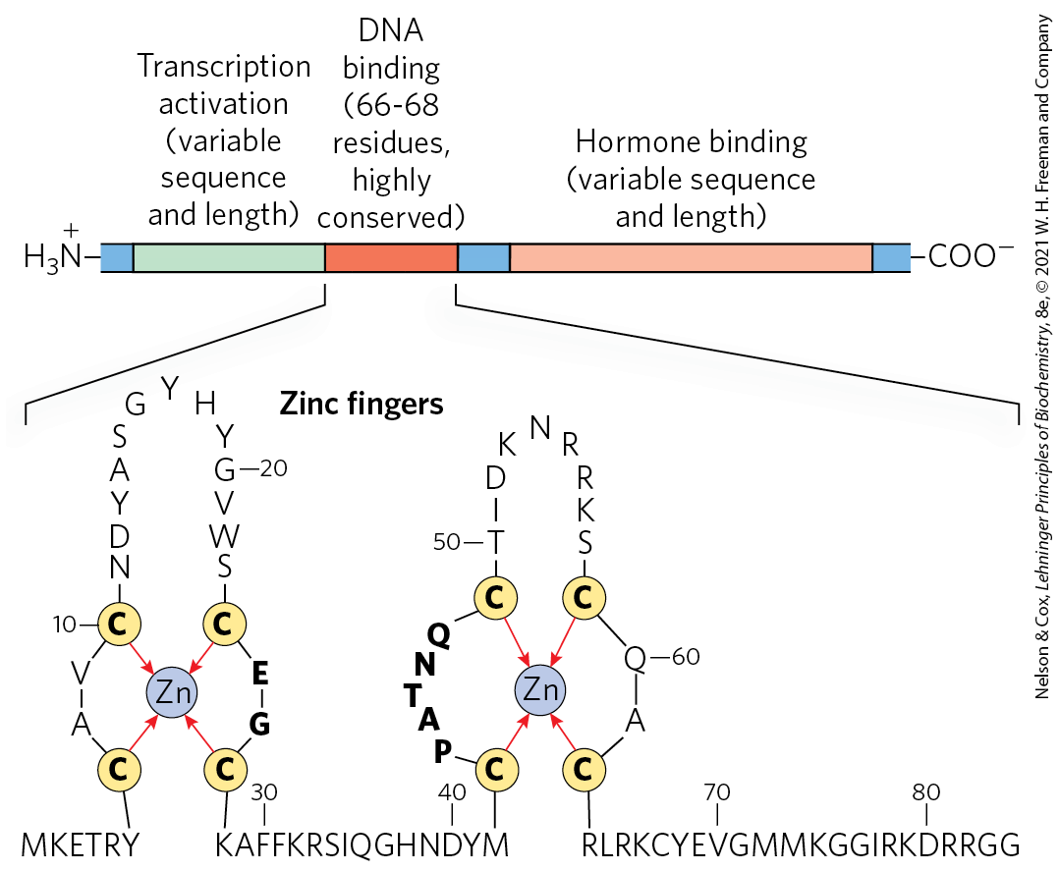
Typical Steroid Hormone Receptors

Slide 137
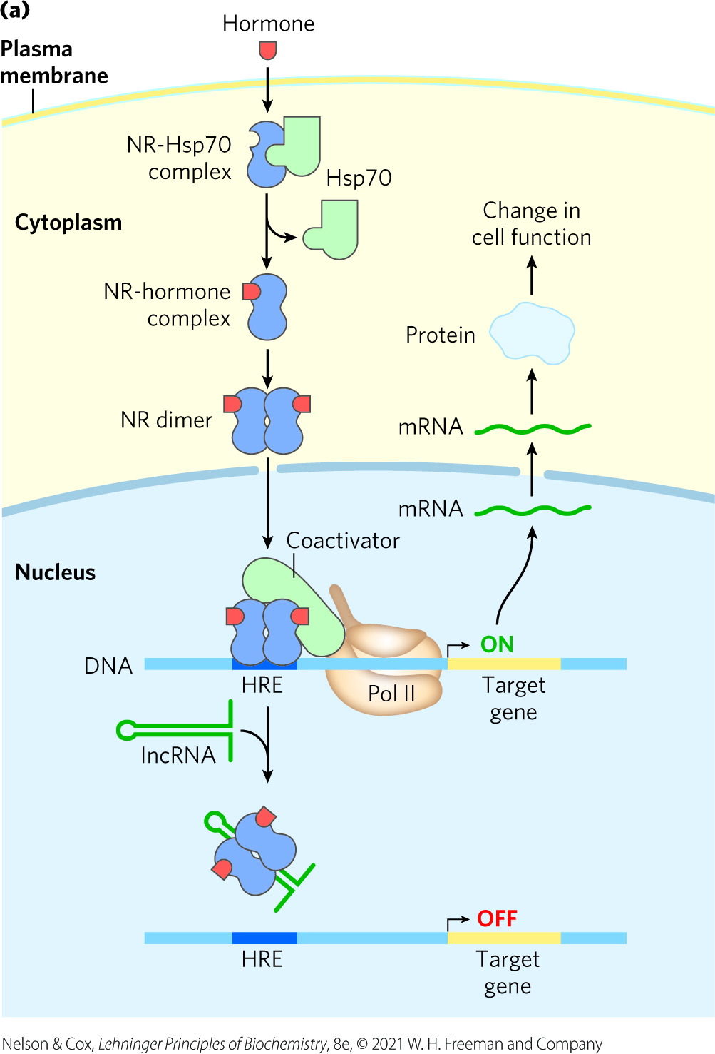
Monomeric Type I Receptors (NR)
examples: receptors for sex hormones and glucocorticoids
found in the cytoplasm, in complex with Hsp70
Hsp70 dissociates when the hormone binds and the receptor dimerizes, exposing a nuclear localization signal
  receptor enters the nucleus and acts as an activator

Slide 138
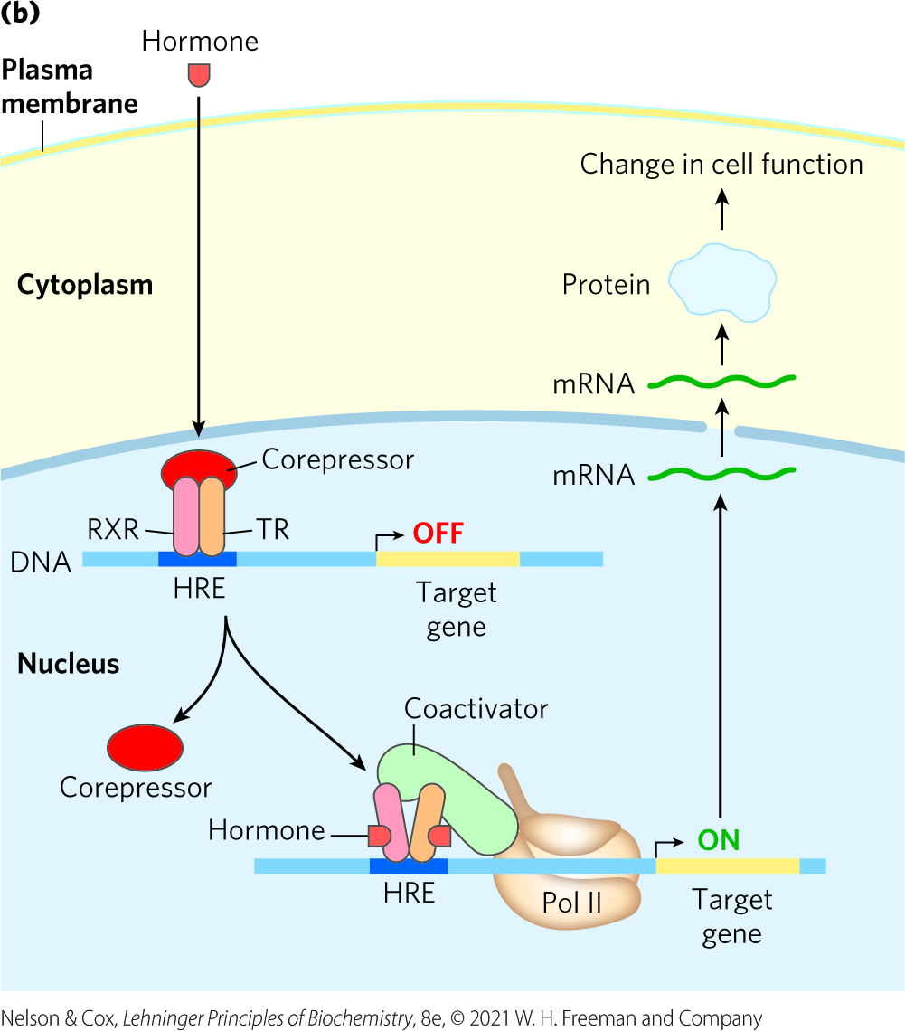
Type II Receptors
example: thyroid hormone receptor
found in the nucleus, bound to an HRE and a corepressor
the corepressor dissociates when the hormone binds
  receptor functions as an activator

Slide 139
Principle 2 (6 of 7)
Regulation is achieved by specialized proteins and RNAs. The proteins are usually ligand-binding proteins with no other function. They bind to specific sequences in DNA or RNA. They respond to molecular signals that can be any kind of biological molecule. The RNAs either interact with other RNAs or serve as protein cofactors.

Slide 140
IncRNAs Regulate
Hormone Receptors
GAS5 (growth arrest specific 5) = an IncRNA that inhibits transcriptional activation by the glucocorticoid receptor and related receptors
  directly competes with DNA for receptor binding
steroid receptor RNA activator (SRA) = an IncRNA that acts as a coactivator
  part of a ribonucleoprotein complex

Slide 141
Regulation Can Result from Phosphorylation of Nuclear Transcription Factors
nonsteroid hormones bind to cell surface receptors
  triggers a signaling pathway leading to phosphorylation of a regulatory protein to regulate its activity

Slide 142
The β-Adrenergic Pathway
the β-adrenergic pathway increases cytosolic [cAMP], which activates protein kinase A (PKA)
PKA enters the nucleus and phosphorylates the CRE-binding protein (CREB)
phosphorylated CREB binds cAMP response element (CRE) and acts as a transcription factor
  increases gene expression

Slide 143
Principle 1 (5 of 6)
The cellular concentration of a protein
is determined by a delicate balance of at least seven processes, each having several potential points of regulation. These processes include synthesis of the primary RNA transcript (transcription); posttranscriptional modification of mRNA; degradation of mRNA; protein synthesis (translation); posttranslational modification of proteins; protein targeting and transport; and protein degradation.

Slide 144
Many Eukaryotic mRNAs Are Subject to Translational Repression
activating a translationally repressed mRNA in the cytoplasm is quicker than de novo assembly of transcription complexes and mRNA synthesis
four main mechanisms of translational regulation:
  phosphorylation of translation initiation factors
  binding of translational repressors (often to the 3′ UTR)
  binding proteins disrupting eIF4E and eIF4G interactions
  RNA-mediated regulation (often translational repression)

Slide 145
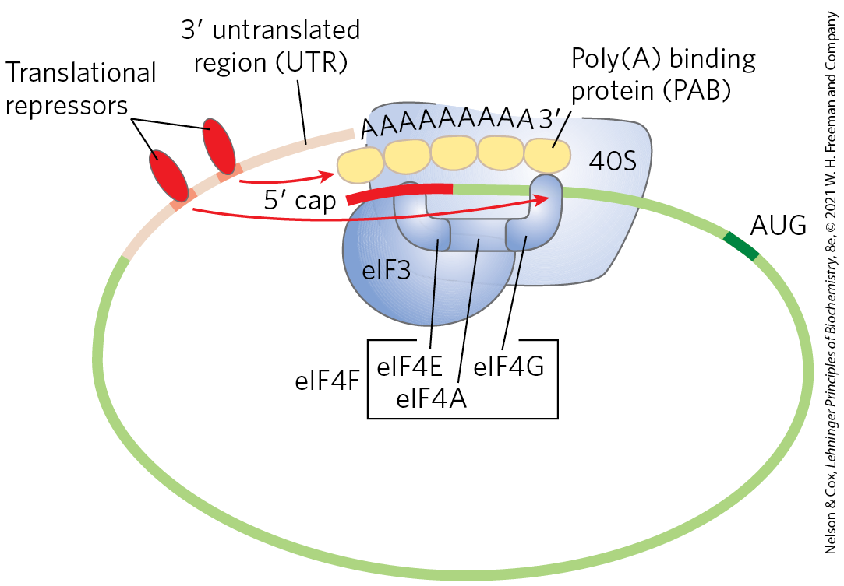
Translational Regulation of Eukaryotic mRNA
translational repressors bind to specific sites in the 3′ UTR of mRNA to block or slow translation
  interact with eukaryotic initiation factors or with the ribosome

Slide 146
Translational Regulation in Reticulocytes
reticulocyte maturation involves destruction of the nucleus
mRNA deposited in the cytoplasm before the loss of the nucleus allow for the replacement of hemoglobin
HCR (hemin-controlled repressor) = catalyzes the phosphorylation of eIF2 when reticulocytes are deficient in iron or heme
  sequesters eIF2, making it unavailable for translation
  coordinates synthesis of globin with heme availability

Slide 147
Posttranscriptional Gene Silencing
Is Mediated by RNA Interference
microRNAs (miRNAs) = bind to mRNAs to mediate gene silencing
  controls developmental timing in some organisms
  protects against invading RNA viruses
small temporal RNAs (stRNAs) = miRNAs that are present transiently during development

Slide 148

Gene Silencing by RNA Interference
RNA interference (RNAi) = gene silencing technology where Dicer cleaves a duplex RNA molecule into small interfering RNAs (siRNAs)
  siRNAs bind mRNA and silence it

Slide 149
Principle 2 (7 of 7)
Regulation is achieved by specialized proteins and RNAs. The proteins are usually ligand-binding proteins with no other function. They bind to specific sequences in DNA or RNA. They respond to molecular signals that can be any kind of biological molecule. The RNAs either interact with other RNAs or serve as protein cofactors.

Slide 150
RNA-Mediated Regulation of Gene Expression Takes Many Forms in Eukaryotes
ncRNAs = RNAs that do not encode proteins
  called lncRNAs when their length is >200 nucleotides
the lncRNA HSR1 stimulates heat shock factor 1 trimerization and DNA binding to activate transcription
the lncRNA 7SK binds to the Pol II transcription elongation factor pTEFb and represses transcript elongation
ncRNA B2 binds directly to Pol II during heat shock and represses transcription

Slide 151
Development Is Controlled by Cascades of Regulatory Proteins
embryonic development requires tightly coordinated changes in genome expression
more genes are expressed during early development than any other part of the life cycle
  sea urchin oocyte has ~18,500 different mRNAs vs. ~6,000 different mRNAs in a differentiated tissue

Slide 152

Life Cycle of the Fruit Fly
Drosophila melanogaster
Drosophila undergoes a complete metamorphosis from embryo to adult

Slide 153
Important Characteristics of the Embryo
polarity = the anterior and posterior parts of the animal are readily distinguished, as are its dorsal and ventral surfaces
metamerism = the embryo body is made up of serially repeating segments, each with characteristic features
  become organized into a head, thorax, and abdomen

Slide 154

Early Development in Drosophila
maternal mRNAs and proteins are deposited in the developing oocyte by nurse cells and follicle cells
after fertilization, the nuclei of the egg divide in synchrony within the common cytoplasm (syncytium)
nuclei migrate to the periphery and membrane invaginations create a monolayer of cells (cellular blastoderm stage)

Slide 155
Morphogens Are the Products of Pattern-Regulating Genes
morphogens = proteins that cause the surrounding tissue to take up a particular shape or structure
  function through changes in local concentration or activity
morphogens are the products of pattern-regulating genes:
  maternal genes
  segmentation genes
  homeotic genes

Slide 156
Maternal Genes
maternal genes = expressed in the unfertilized egg to yield maternal mRNAs
maternal mRNAs:
  remain dormant until fertilization
  provide most of the proteins needed in very early development, until the cellular blastoderm is formed

Slide 157
Segmentation Genes
segmentation genes = direct the formation of the proper number of body segments
  transcribed after fertilization
subclasses of segmentation genes act successively:
  gap genes = divide the developing embryo into several broad regions
  pair-rule genes and segment polarity genes = define 14 stripes that become the 14 segments of an embryo

Slide 158
Homeotic Genes
homeotic genes = specify which organs and appendages will develop in particular body segments
  expressed after segmentation genes

Slide 159

Distribution of Maternal Gene Product in a Drosophila Egg
different cells in the cellular blastoderm inherit different amounts of maternal mRNA protein products
  sets cells on different developmental paths

Slide 160
The Bicoid Protein
Bicoid protein = a major anterior morphogen
  contains a homeodomain encoded by a homeobox gene sequence motif
  acts as a transcription factor and translational repressor
bicoid mRNA is synthesized by nurse cells and deposited in the unfertilized egg near its anterior pole
Bicoid diffuses through the cell to create a concentration gradient radiating out from the anterior pole

Slide 161

Hox Gene Clusters
Hox genes = responsible for the development of structures in a defined part of the body
  Drosophila has one Hox gene cluster
  humans have four

Slide 162
Principle 1 (6 of 6)
The cellular concentration of a protein
is determined by a delicate balance of at least seven processes, each having several potential points of regulation. These processes include synthesis of the primary RNA transcript (transcription); posttranscriptional modification of mRNA; degradation of mRNA; protein synthesis (translation); posttranslational modification of proteins; protein targeting and transport; and protein degradation.

Slide 163
Translational Repression Regulates Developmental Pathways
many mRNAs are deposited in the egg long before translation is required
  translational repression helps regulate developmental pathways

Slide 164
Stem Cells Have Developmental Potential That Can Be Controlled
stem cells = cells that can differentiate into various tissues
totipotent cells = cells that can differentiate into any tissue or a complete organism
pluripotent cells = cells that can give rise to cells of all three germ layers and many tissue types
  cannot differentiate into a complete organism
unipotent cells = cells that can develop into only one type of cell and/or tissue

Slide 165

Development Potential of Stem Cells

Slide 166

Stem Cell Proliferation Versus Differentiation and Development
stem cells have two functions:
  replenishing themselves
  providing cells that can differentiate

Slide 167
Embryonic and Adult Stem Cells
embryonic stem cells = pluripotent cells of the blastocyst
  used in embryonic stem cell research
adult stem cells = have more limited potential than embryonic stem cells
  considered multipotent
  have a niche, a microenvironment that promotes stem cell maintenance while allowing differentiation of some daughter cells

Slide 168

Adult Stem Cells Have a Niche
niche = a microenvironment that promotes stem cell maintenance while allowing differentiation of some daughter cells
signaling from neighboring cells maintains the stem cell lineage

