Slide 1

26 RNA Metabolism
© 2021 Macmillan Learning

Slide 2
Ribozymes and
Ribonucleoproteins (RNPs)
ribozymes = catalytic RNAs that act as enzymes
ribonucleoproteins (RNPs) = complexes of RNAs with proteins

Slide 3
Transcription Produces RNA Molecules from DNA
transcription = process by which an enzyme system converts the genetic information in dsDNA into an RNA strand with a complementary base sequence

Slide 4
Major Types of RNA Molecules
messenger RNAs (mRNAs) = encode the amino acid sequences of polypeptides
transfer RNAs (tRNAs) = read the mRNA and transfer the appropriate amino acid to a growing polypeptide chain during protein synthesis
ribosomal RNAs (rRNAs) = constituents of ribosomes, the cellular machines that synthesize proteins
noncoding RNAs (ncRNAs) = have a variety of catalytic, structural, and regulatory functions

Slide 5
The Cellular Transcriptome
the entire chromosome is usually copied during replication
transcription is more selective
transcriptome = the sum of all the RNA molecules produced in a cell under a given set of conditions
  ~76% of the human genome is transcribed into RNA
  most products are ncRNAs

Slide 6

Principle 1 (1 of 5)
RNA is synthesized by RNA polymerases using DNA templates and ribonucleoside 5′-triphosphates. RNA is made in the 5′→3′ direction and complementary to the template DNA strand. Transcription is highly regulated and initiates by recruitment of the transcription machinery to gene promoters. Although bacterial and eukaryotic polymerases share many conserved features, the transcriptional machinery and its regulation are much more complex in eukaryotes.

Slide 7

Principle 2 (1 of 8)
Many RNAs must be modified and processed to become functional. RNAs can be modified by nucleases, by excision of certain RNA segments, and/or by chemical modification of the RNA nucleotides. In humans, nearly all mRNAs are 5′ capped, spliced, and polyadenylated before being exported from the nucleus for translation in the cytoplasm.

Slide 8

Principle 3 (1 of 4)
RNA can be used as a template for synthesis of DNA by reverse transcriptases. RNA carries genetic information that can be reverse transcribed into DNA. Retroviruses, such as HIV or those responsible for some cancers, must convert their RNA genomes into DNA by reverse transcription. Reverse transcription by telomerase is also responsible for producing the telomeres that protect the DNA found at the ends of eukaryotic chromosomes.

Slide 9

Principle 4 (1 of 5)
RNA can act as both a catalyst and carrier of genetic information. Ribozymes can catalyze chemical transformations using many of the same strategies as protein-based enzymes. The dual capacity of RNA as both a carrier of genetic information and a catalyst is support for the RNA world hypothesis for the evolution of life on Earth.

Slide 10
26.1 DNA-Dependent Synthesis of RNA

Slide 11
Principle 1 (2 of 5)
RNA is synthesized by RNA polymerases using DNA templates and ribonucleoside 5′-triphosphates. RNA is made in the 5′→3′ direction and complementary to the template DNA strand. Transcription is highly regulated and initiates by recruitment of the transcription machinery to gene promoters. Although bacterial and eukaryotic polymerases share many conserved features, the transcriptional machinery and its regulation are much more complex in eukaryotes.

Slide 12
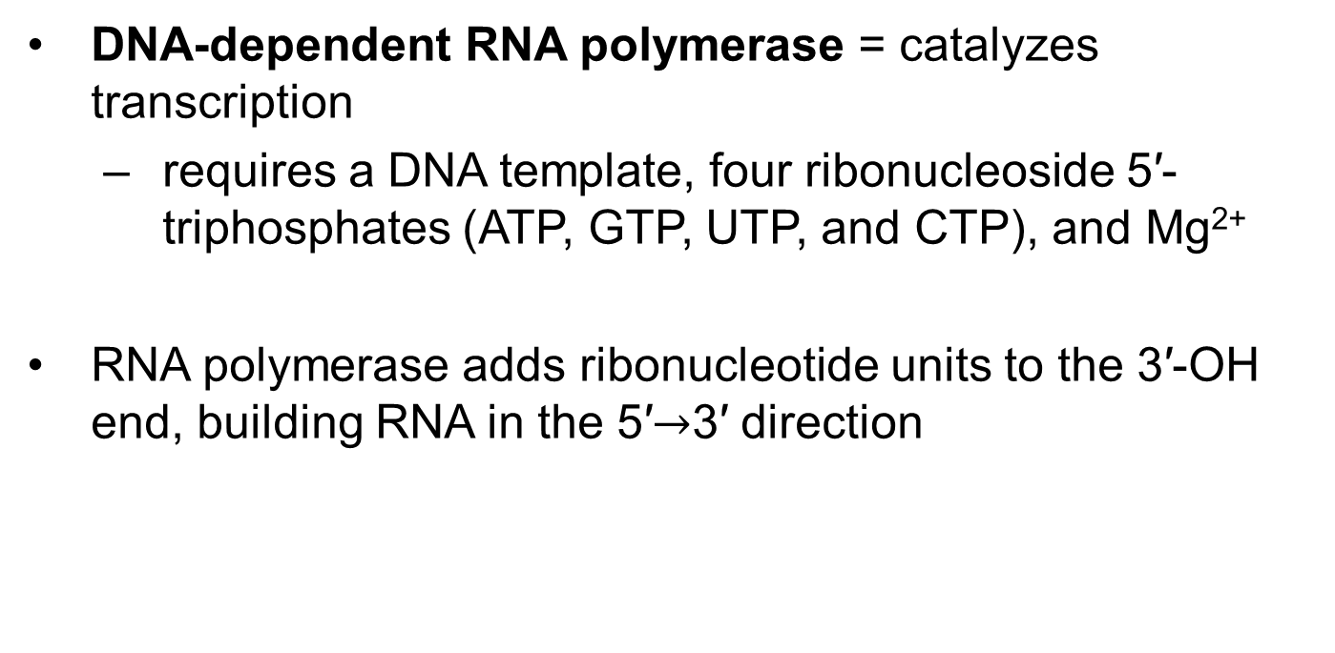
RNA Is Synthesized by RNA Polymerases
DNA-dependent RNA polymerase = catalyzes transcription
  requires a DNA template, four ribonucleoside 5′-triphosphates (ATP, GTP, UTP, and CTP), and Mg²⁺
RNA polymerase adds ribonucleotide units to the 3′-OH end, building RNA in the 5′$→$3′ direction

Slide 13
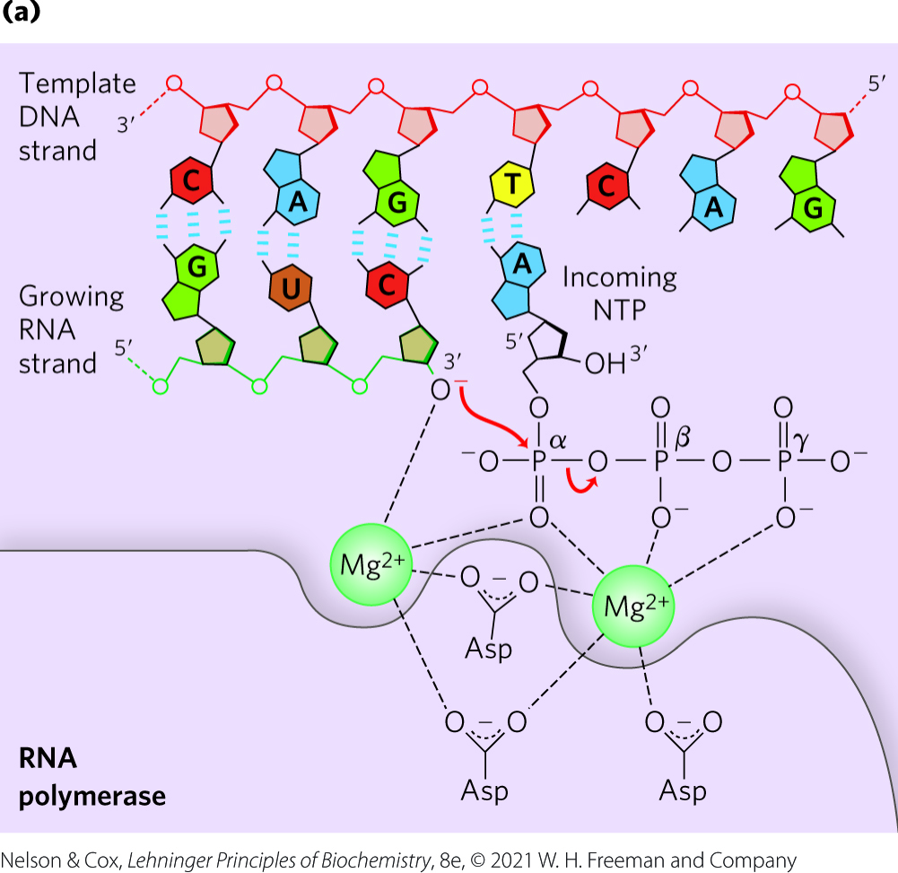
Transcription by RNA Polymerase in E. coli
the 3′-OH acts as a nucleophile, attacking the α phosphate of the incoming ribonucleoside triphosphate
each nucleotide in the RNA is selected by Watson-Crick base-pairing interaction

Slide 14
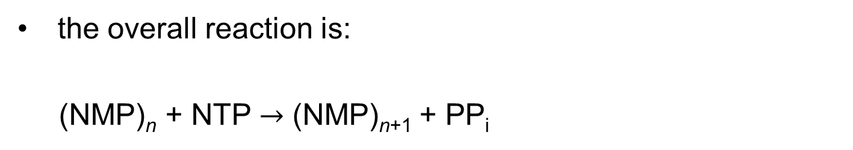
The Overall Reaction of Transcription
the overall reaction is:
(NMP)_{n} + NTP $→$ (NMP)_{n+1} + PP_{i}
RNA
lengthened
RNA

Slide 15
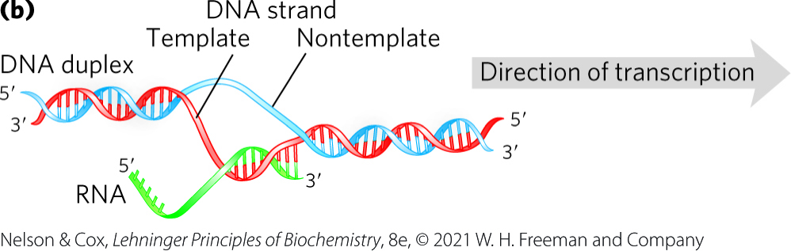
Initiation and Elongation of Transcription
initiation occurs when RNA polymerase binds at promoter sequences
  promoters are not required
during elongation, the growing RNA strand temporarily base-pairs with the DNA template to form a short hybrid RNA-DNA double helix

Slide 16
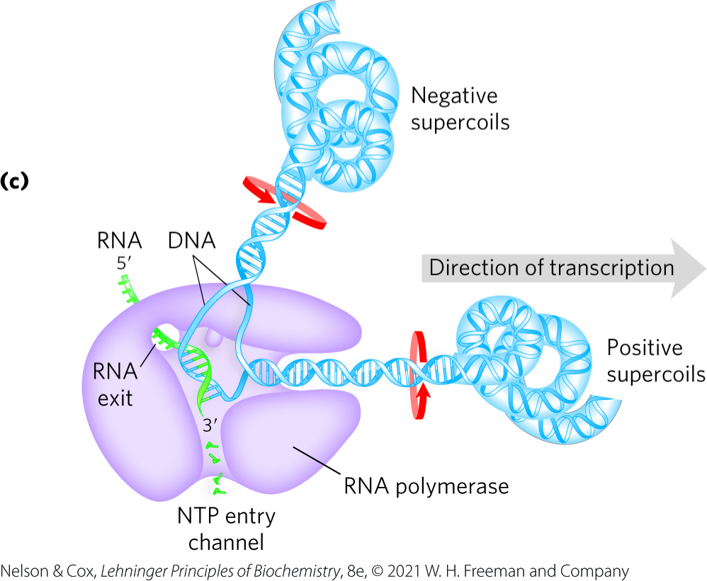
Movement of RNA Polymerase Creates Supercoils
a transcription “bubble” forms when the DNA duplex unwinds
RNA polymerase generates positive supercoils ahead of the “bubble” and negative supercoils behind
  due to restricted DNA strand rotation
  relieved through topoisomerases

Slide 17
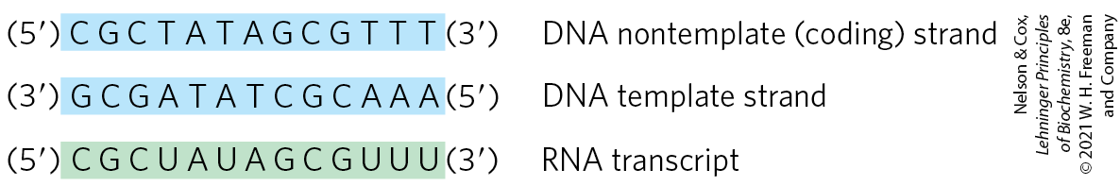
The Template and
Nontemplate Strand
template strand = DNA strand that serves as template for RNA synthesis
nontemplate strand (coding strand) = DNA strand that is identical in base sequence to the transcribed RNA, with U in RNA in place of T in DNA

Slide 18
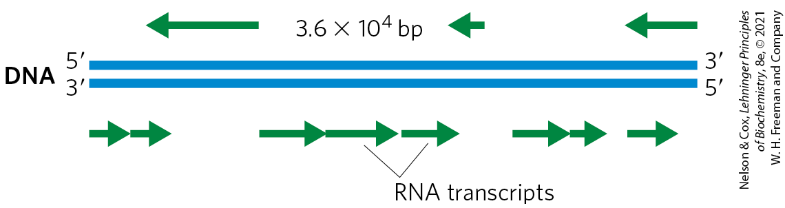
Organization of Coding Information in the Adenovirus Genome
the coding strand for a particular gene may be located in either strand of a given chromosome

Slide 19
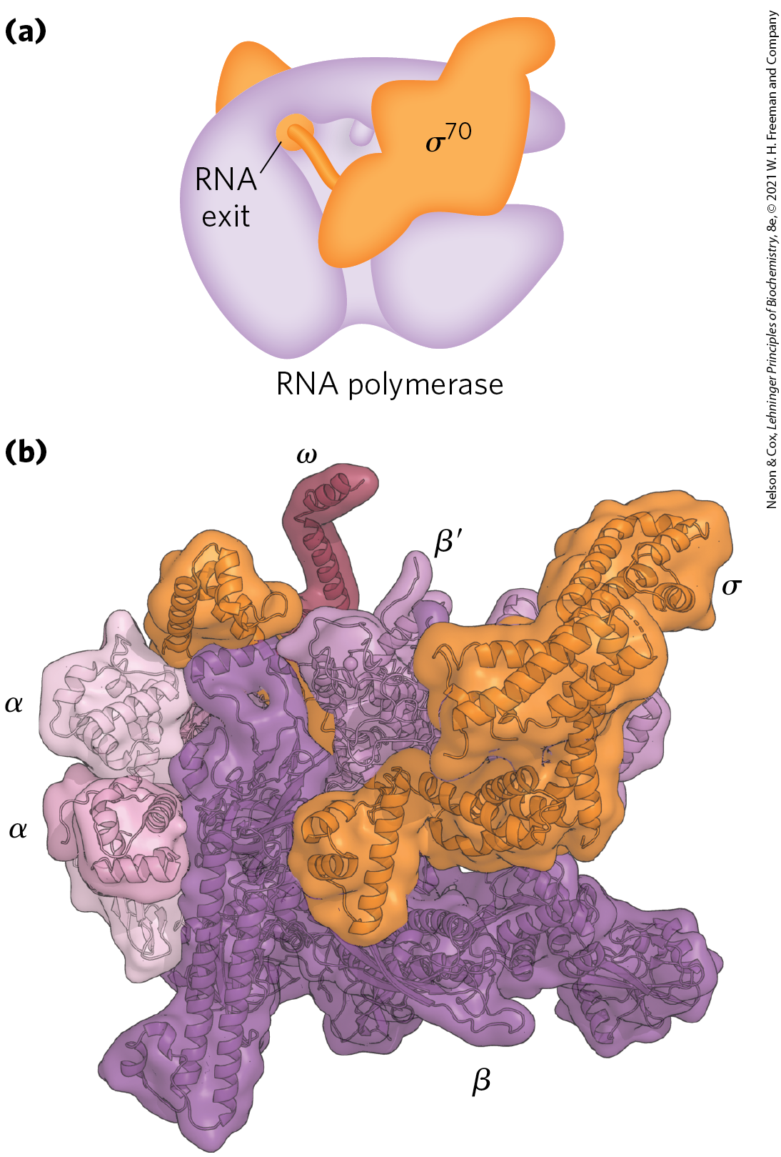
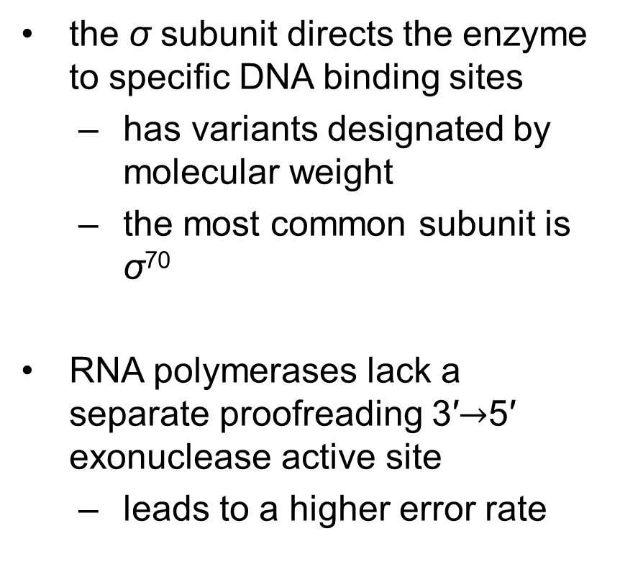
Six Subunits Constitute the RNA Polymerase Holoenzyme
the σ subunit directs the enzyme to specific DNA binding sites
  has variants designated by molecular weight
  the most common subunit is σ⁷⁰
RNA polymerases lack a separate proofreading 3′$→$5′ exonuclease active site
  leads to a higher error rate

Slide 20
Principle 1 (3 of 5)
RNA is synthesized by RNA polymerases using DNA templates and ribonucleoside 5′-triphosphates. RNA is made in the 5′→3′ direction and complementary to the template DNA strand. Transcription is highly regulated and initiates by recruitment of the transcription machinery to gene promoters. Although bacterial and eukaryotic polymerases share many conserved features, the transcriptional machinery and its regulation are much more complex in eukaryotes.

Slide 21
RNA Synthesis Begins at Promoters
promoters = specific sequences in DNA that RNA polymerase binds to
  direct that transcription of adjacent segments of DNA (genes)
  sequences are variable
promoter regions extend between positions -70 and +30

Slide 22
Consensus Sequences and the UP Element
consensus sequence = formed by certain nucleotides that are particularly common at a given position
  (5′)TATAAT(3′) at the -10 region
  (5′)TTGACA(3′) at the -35 region
UP (upstream promoter) element = a third AT-rich recognition element that occurs between positions -40 and -60 in the promoters of certain highly expressed genes
  bound by the α subunit of RNA polymerase

Slide 23
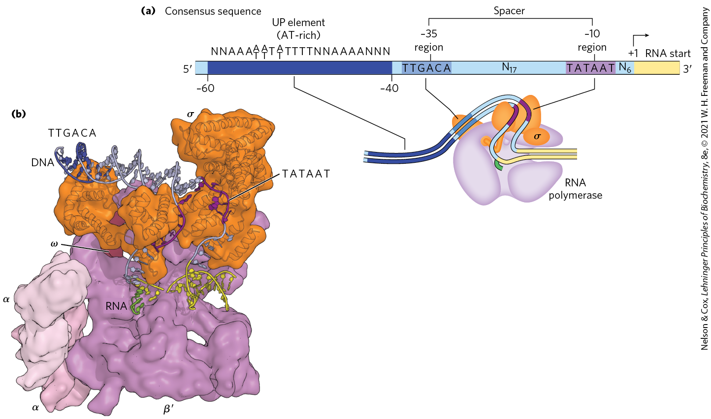
Promoter Recognition by σ⁷⁰ RNA Polymerase Holoenzyme

Slide 24
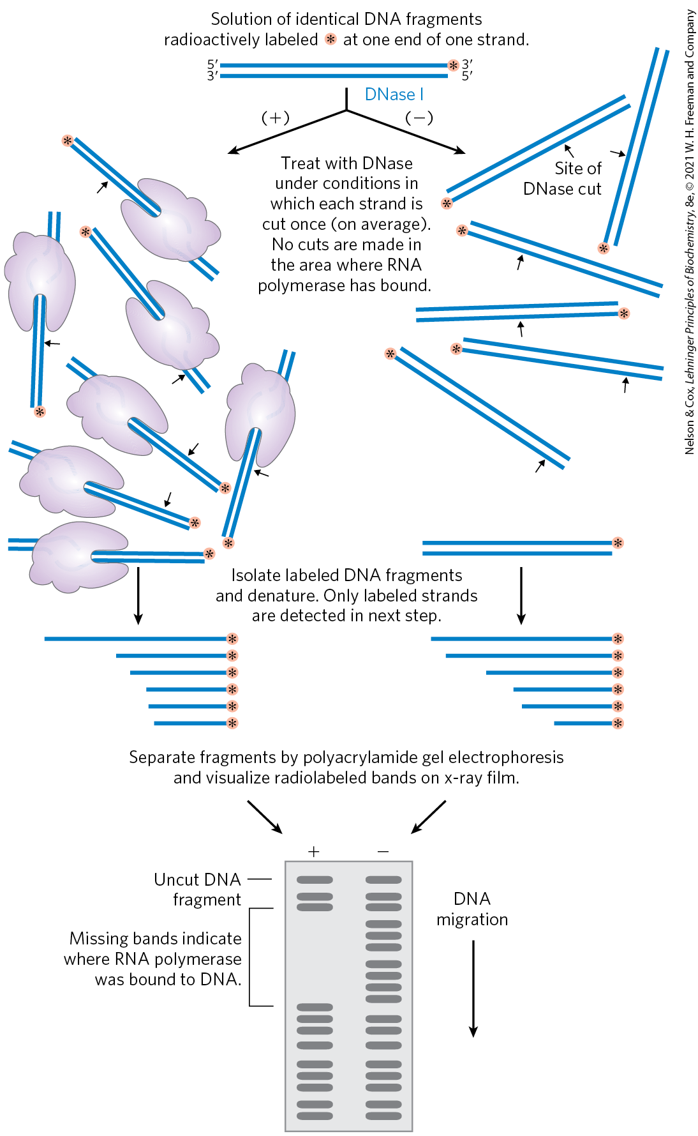
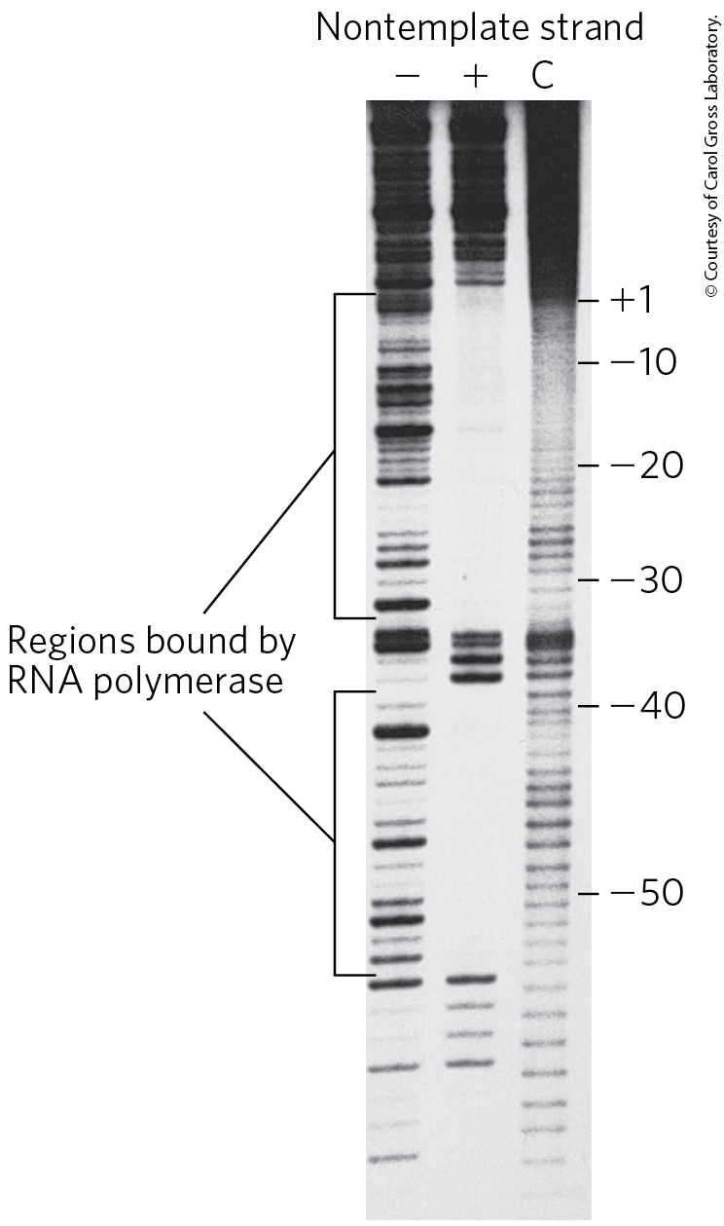
The Footprinting Technique is a Way to Find a DNA-Binding Site
footprinting = identifies the DNA sequences bound by a particular protein

Slide 25
Initiation by E. coli RNA Polymerase
the polymerase binds to the promoter
  directed by its bound σ factor
a closed complex (bound DNA remains double-stranded) forms, followed by an open complex (bound DNA is partially unwound near the −10 sequence)
initiation causes a conformational change that converts the complex to the elongation form and moves the complex away from the promoter (promoter clearance)

Slide 26
Elongation by E. coli
RNA Polymerase
the σ subunit dissociates at random as the polymerase enters elongation
the NusA protein competes with the σ subunit to bind the polymerase
after transcription:
  NusA dissociates from the enzyme
  RNA polymerase dissociates from the DNA

Slide 27
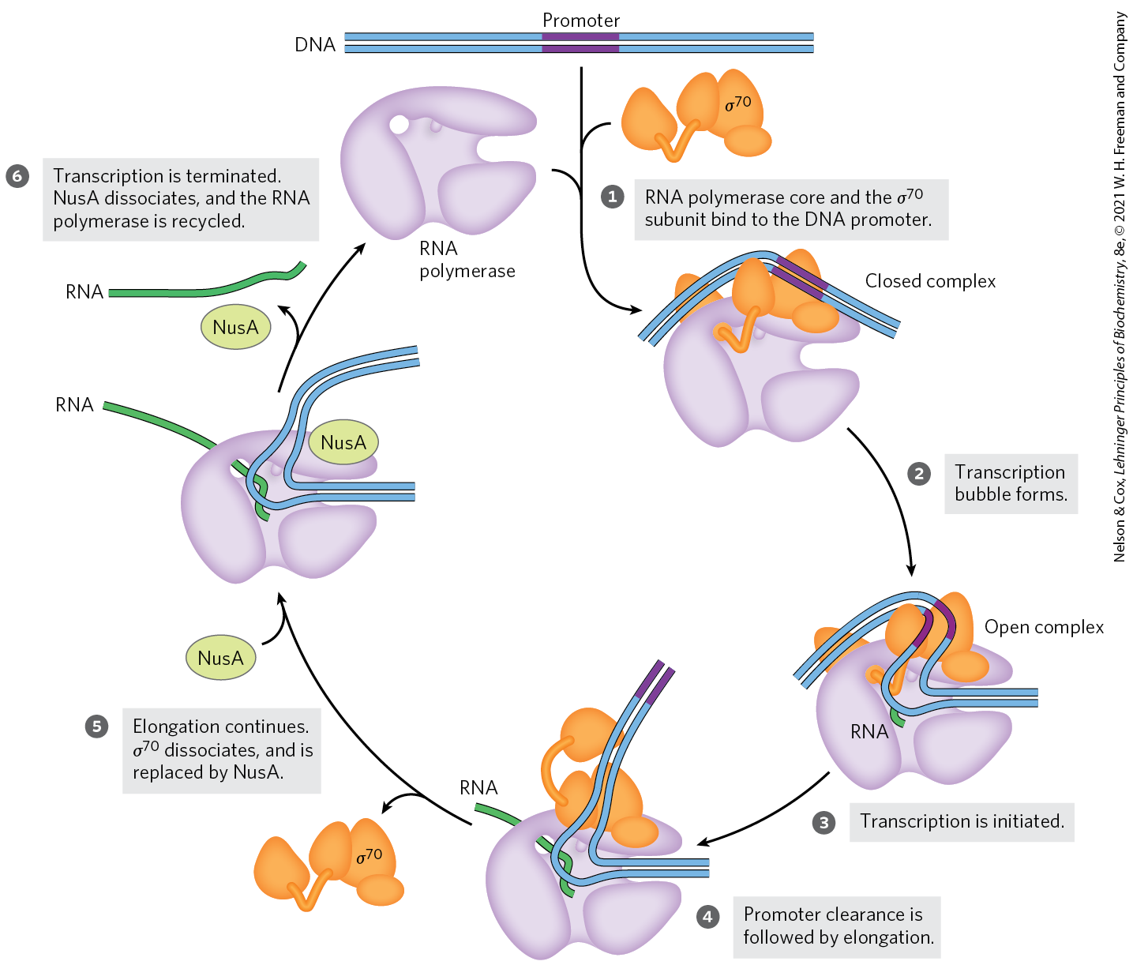
Initiation and Elongation by E. coli RNA Polymerase

Slide 28
The σ³² Subunit
the σ³² subunit = specific for the heat shock promoters
  RNA polymerase binds these promoters only when σ⁷⁰ is replaced with σ³²
the products of heat shock genes are made at higher levels when the cell is exposed to environmental stress
using different σ subunits allows the cell to coordinate the expression of sets of genes

Slide 29
Principle 1 (4 of 5)
RNA is synthesized by RNA polymerases using DNA templates and ribonucleoside 5′-triphosphates. RNA is made in the 5′→3′ direction and complementary to the template DNA strand. Transcription is highly regulated and initiates by recruitment of the transcription machinery to gene promoters. Although bacterial and eukaryotic polymerases share many conserved features, the transcriptional machinery and its regulation are much more complex in eukaryotes.

Slide 30
Transcription Is Regulated at
Several Levels
regulation can occur at any step of transcription
as the first committed steps in transcription, binding of RNA polymerase to the promoter and initiation of transcription are closely regulated
protein binding can activate or repress transcription
  cAMP receptor protein (CRP) activates transcription
  repressors block RNA synthesis at specific genes

Slide 31
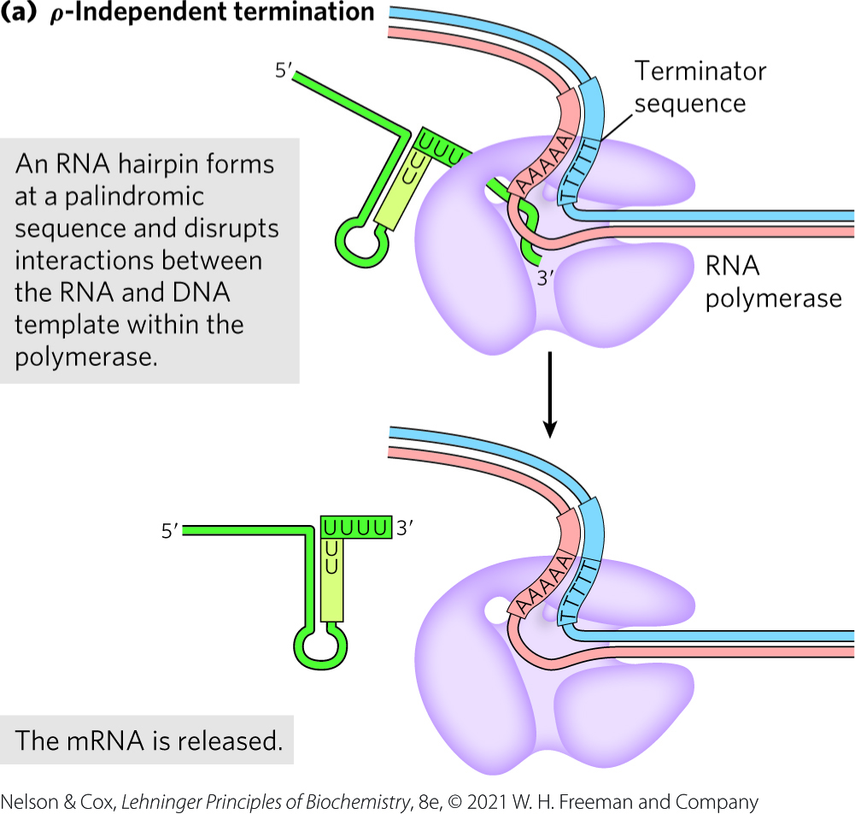
Specific Sequences Signal Termination of RNA Synthesis
ρ-independent terminators:
  have a self-complementary region that forms a hairpin
  have a conserved string of three A residues that are transcribed into U residues near the 3′ end of the hairpin

Slide 32
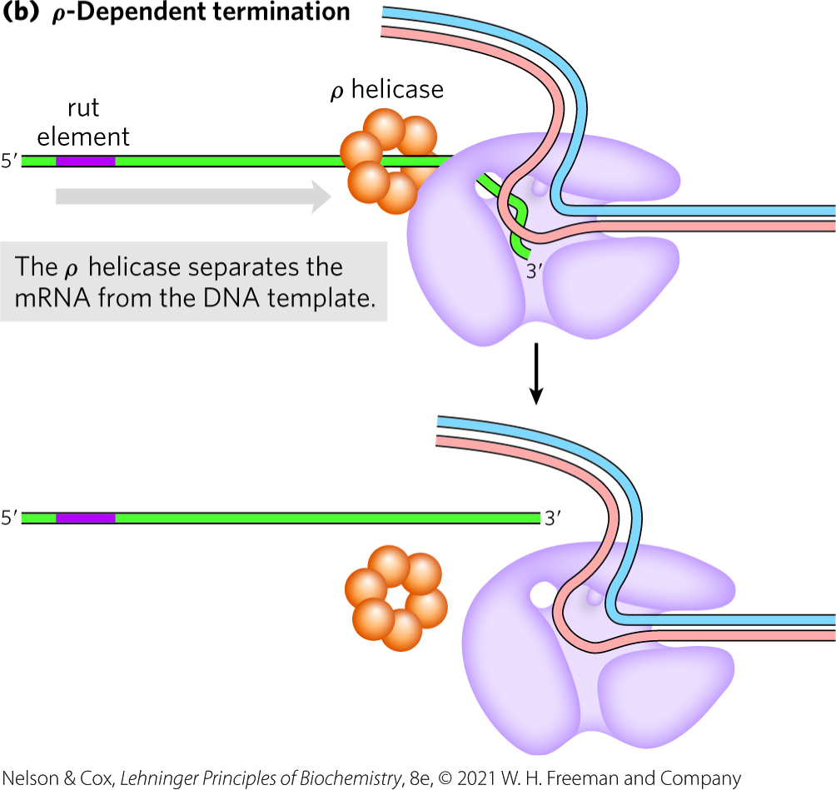
ρ-Dependent Terminators
ρ (rho) = protein factor that has an ATP-dependent RNA-DNA helicase activity
ρ-dependent terminators = class of terminators that rely on the protein factor ρ (rho)
  have a CA-rich sequence called a rut (rho utilization) element
  ρ promotes release of the RNA

Slide 33
Eukaryotic Cells Have Three Kinds of Nuclear RNA Polymerases
eukaryotes have three nuclear RNA polymerases: I, II, and III
  each has a specific function and is recruited to a specific promoter sequence
Table 26-1 Eukaryotic Nuclear RNA Polymerases
RNA polymerase | Types of RNA synthesized
I | Pre-ribosomal RNA
II | mRNA ncRNA
III | tRNA 5S rRNA ncRNA

Slide 34
Mitochondria and Chloroplast RNA Polymerases
eukaryotic mitochondria and chloroplasts have their own RNA polymerases
RNA polymerases in these organelles are similar to bacterial RNA polymerases

Slide 35
RNA Polymerase I (Pol I)
RNA polymerase I (Pol I) = responsible for the synthesis of a transcript called pre-ribosomal RNA (or pre-rRNA)
pre-rRNA contains the precursor for the 18S, 5.8S, and 28S rRNAs

Slide 36
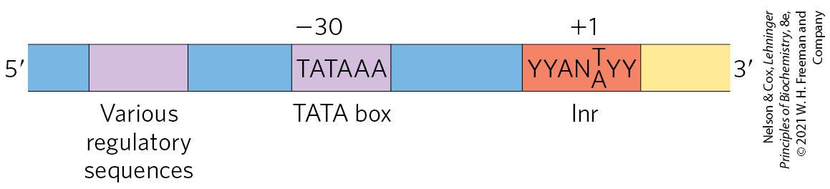
RNA Polymerase II (Pol II)
RNA polymerase II (Pol II) = responsible for the synthesis of mRNAs and many ncRNAs
  can recognize 1000s of promoters
some Pol II promoters have sequences in common:
  a TATA box consensus sequence (TATA(A/T)A(A/T)(A/G)) near -30
  an Inr sequence (initiator) at +1

Slide 37
RNA Polymerase III (Pol III)
RNA polymerase III (Pol III) = responsible for the synthesis of tRNAs, the 5S rRNA, and other ncRNAs
Pol III promoters are well characterized

Slide 38
Principle 1 (5 of 5)
RNA is synthesized by RNA polymerases using DNA templates and ribonucleoside 5′-triphosphates. RNA is made in the 5′→3′ direction and complementary to the template DNA strand. Transcription is highly regulated and initiates by recruitment of the transcription machinery to gene promoters. Although bacterial and eukaryotic polymerases share many conserved features, the transcriptional machinery and its regulation are much more complex in eukaryotes.

Slide 39
RNA Polymerase II Requires Many Other Protein Factors for Its Activity
Pol II is more complex than its bacterial counterpart, but structure, function, and mechanism are conserved
  RBP1 subunit exhibits a high degree of homology to the bacterial β′ subunit
  RBP2 subunit is structurally similar to the bacterial β subunit
  RBP3 and RBP11 subunits show some structural homology to the two bacterial α subunits

Slide 40
The Carboxyl-Terminal
Domain (CTD)
carboxyl-terminal domain (CTD) = a long carboxyl-terminal tail in RBP1 that consists of many repeats of a consensus heptad amino acid sequence, -YSPTSPS-
  yeast enzyme contains 26 repeats
  human and mouse enzymes contain 52 repeats
  separated from the main body of the enzyme by an intrinsically disordered linker sequence

Slide 41
Transcription Factors
transcription factors = an array of proteins that work with Pol II form the active transcription complex
general transcription factors = those required at every Pol II promoter

Slide 42
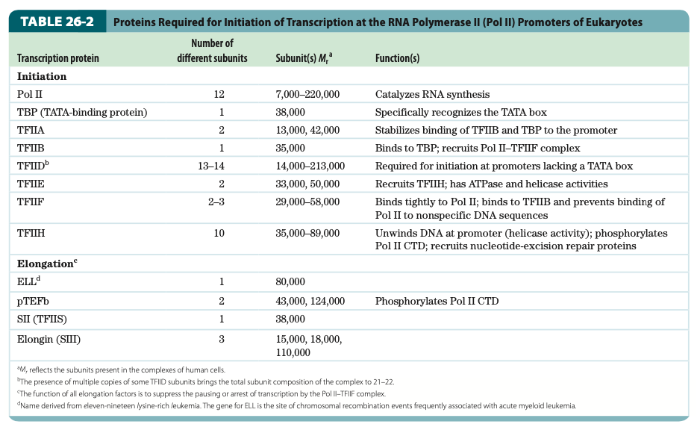
Proteins Required for Initiation of Transcription at Pol II Promoters of Eukaryotes

Slide 43
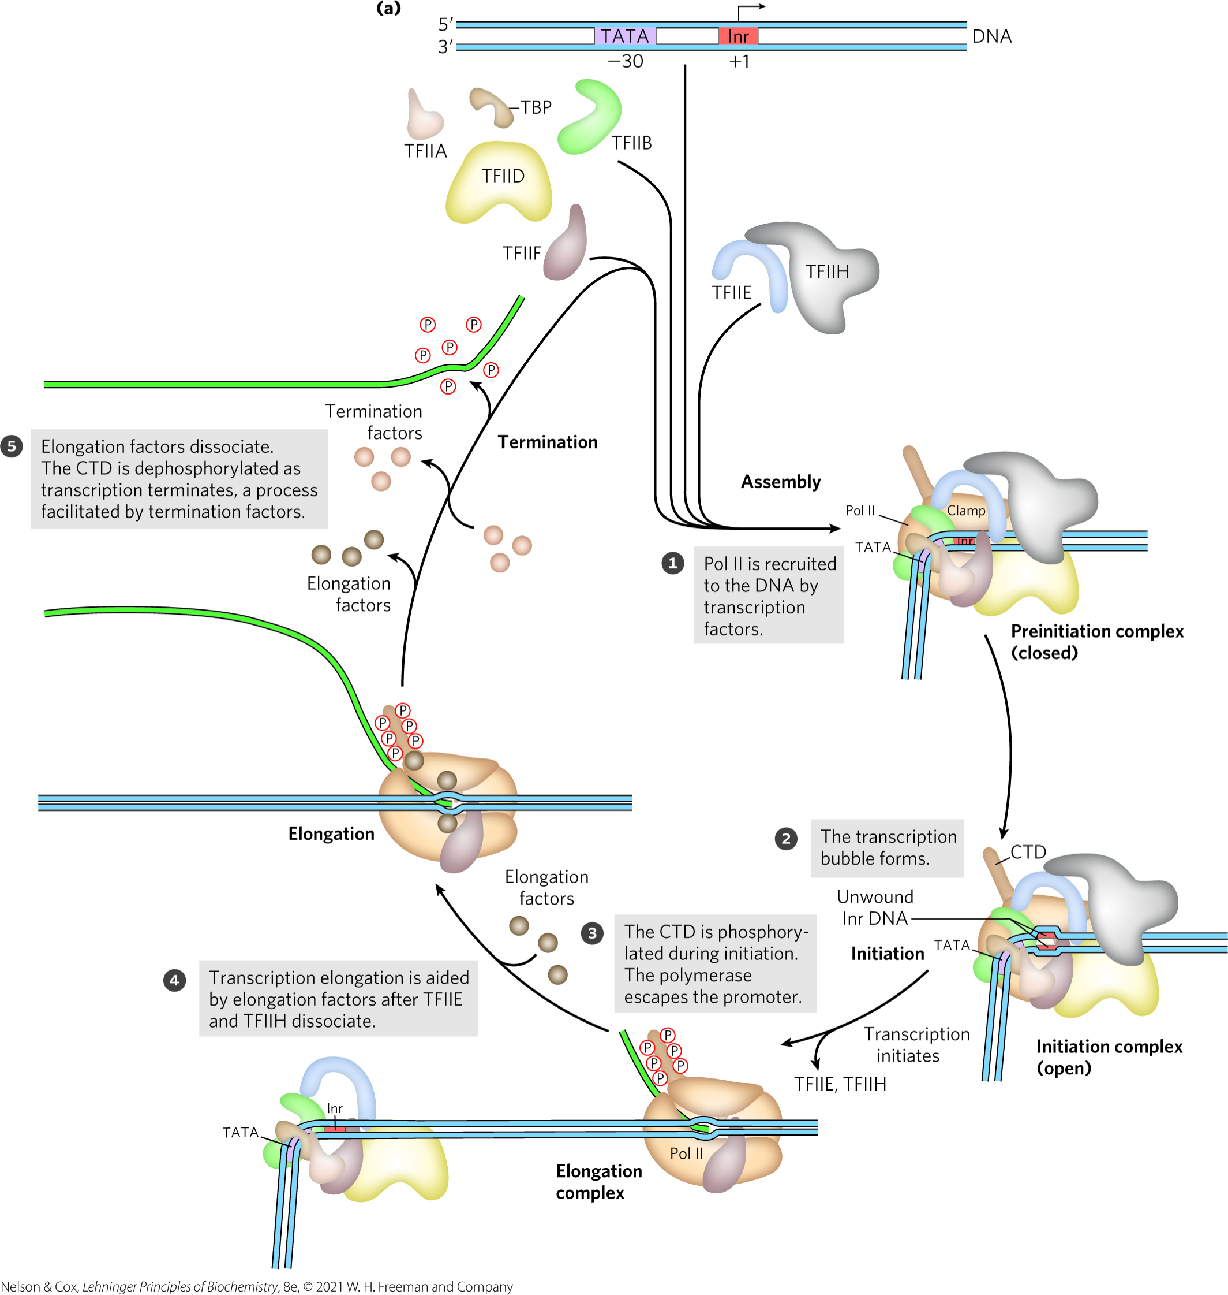
Transcription at RNA
Polymerase II Promoters

Slide 44
Assembly of RNA Polymerase and Transcription Factors at a Promoter
formation of a closed complex begins when TATA-binding protein (TBP) binds to the TATA box
preinitiation complex (PIC) = a closed complex
  contains TBP, TFIIA, TFIIB, TFIID, TFIIE, TFIIF, TFIIH, and Pol II

Slide 45
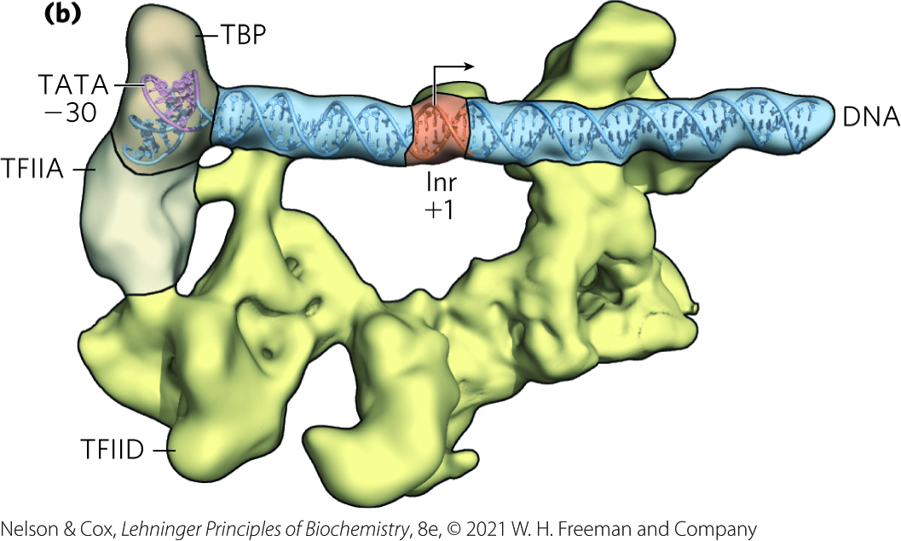
TFIID Positions TBP and Pol II on the Promoter
TFIID binds the promoter DNA in an elongated complex that is anchored by TBP-DNA interactions on one end
the Inr sequence is straddled on both ends by TFIID subunits

Slide 46
TFIIH Promotes Unwinding of the DNA Near the RNA Start Site
TFIIH has DNA helicase activity that promotes the unwinding of DNA to create an open complex
  requires ATP

Slide 47
RNA Strand Initiation and
Promoter Clearance
TFIIH has kinase activity that phosphorylates Pol II at many places in the CTD
  other kinases also phosphorylate the CTD
CTD phosphorylation causes a conformational change in the overall complex, initiating transcription
Pol II enters elongation after TFIIE and TFIIH are released
  occurs after synthesis of 60 to 70 nucleotides of RNA

Slide 48
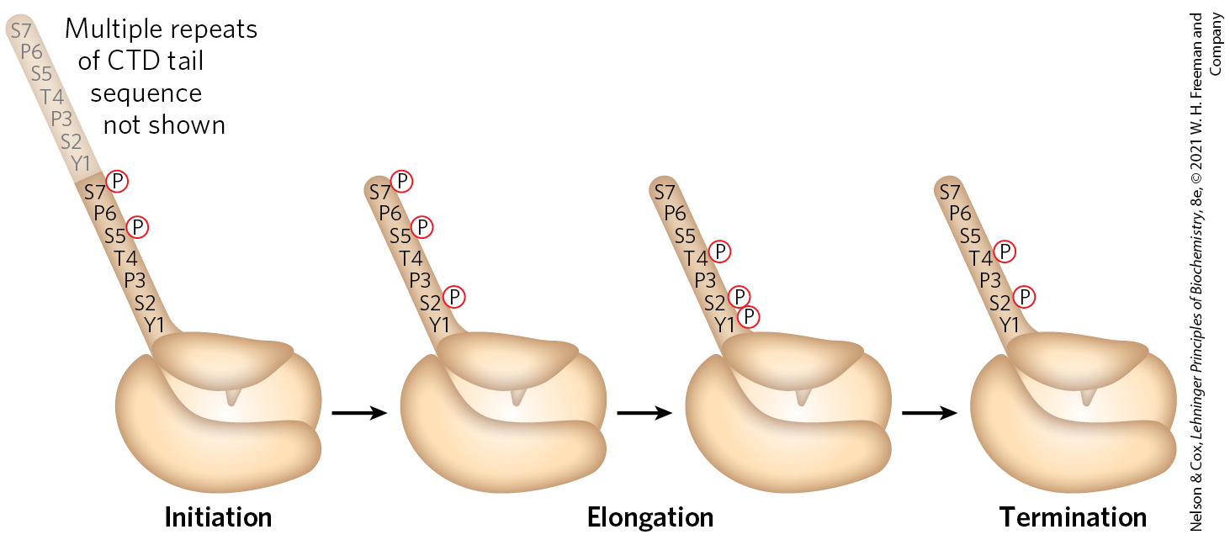
Phosphorylation of the CTD of RNA Polymerase II
the phosphorylation state of the CTD changes throughout transcription

Slide 49
Elongation, Termination, and Release
during elongation, elongation factors bound to RNA Pol II enhance processivity and coordinate posttranslational modifications
  some are bound to phosphorylated CTD
during termination, Pol II CTD is dephosphorylated and transcription machinery is recycled

Slide 50
RNA Polymerases Are Drug Targets
actinomycin D = an antibiotic that inhibits RNA elongation in bacteria and eukaryotes
  intercalates into the double-helical DNA to deform the DNA duplex and prevent polymerase movement

Slide 51
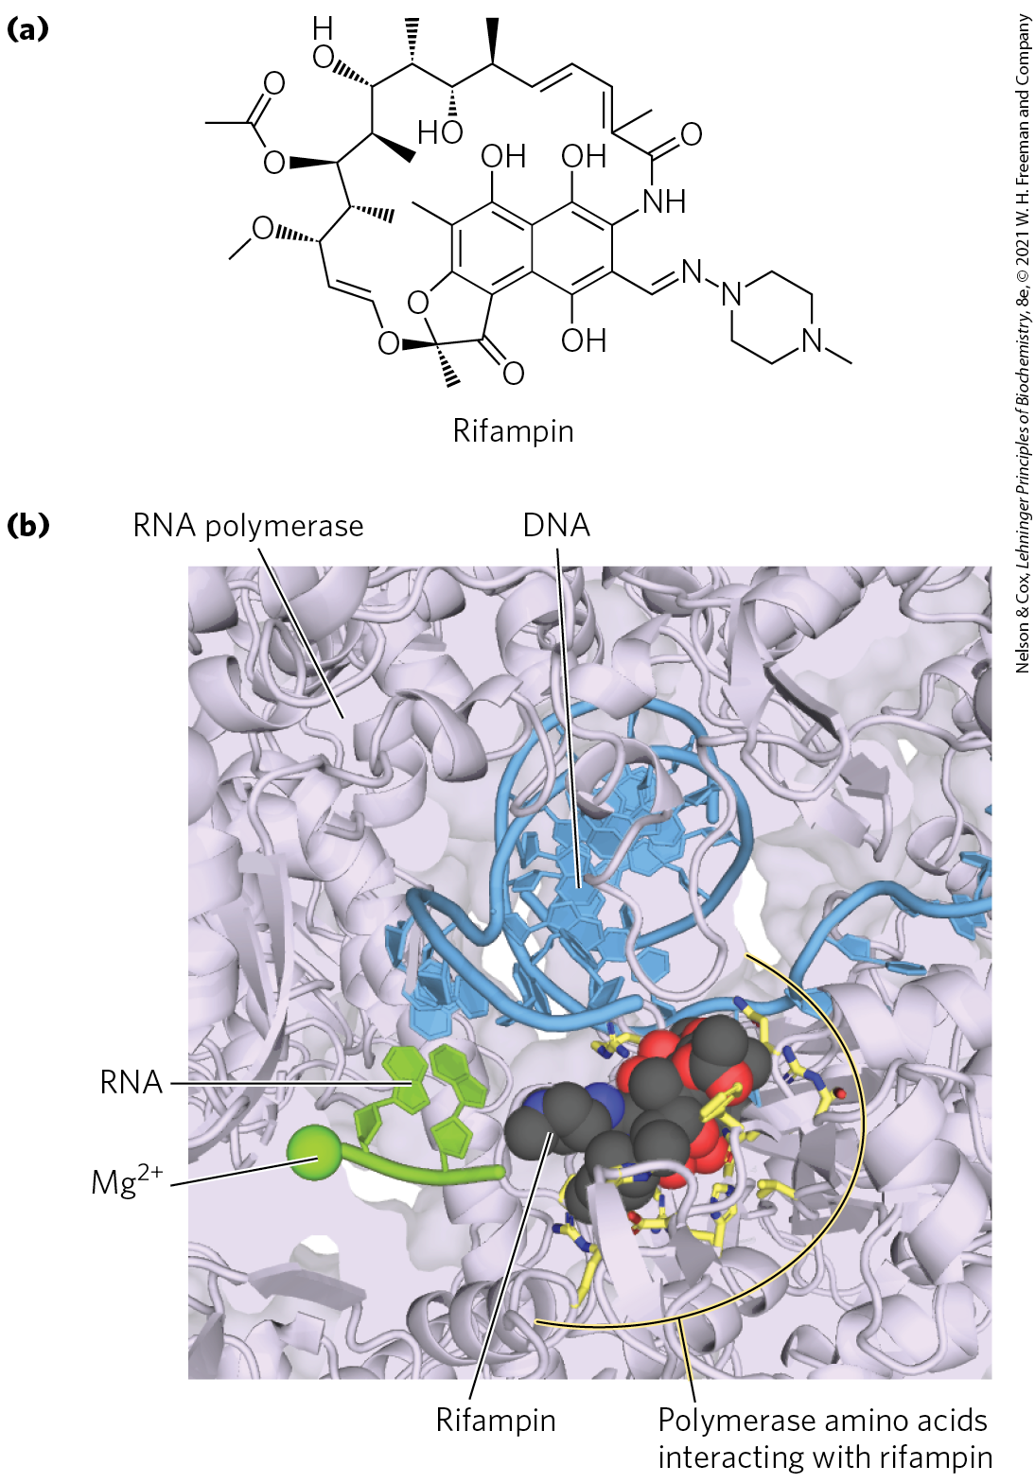
Rifampin
rifampin = antibiotic that inhibits bacterial RNA synthesis by preventing the promoter clearance step of transcription
  important for the treatment of tuberculosis (TB)
  binds near the active site of RNA polymerase and prevents extension of the RNA product

Slide 52
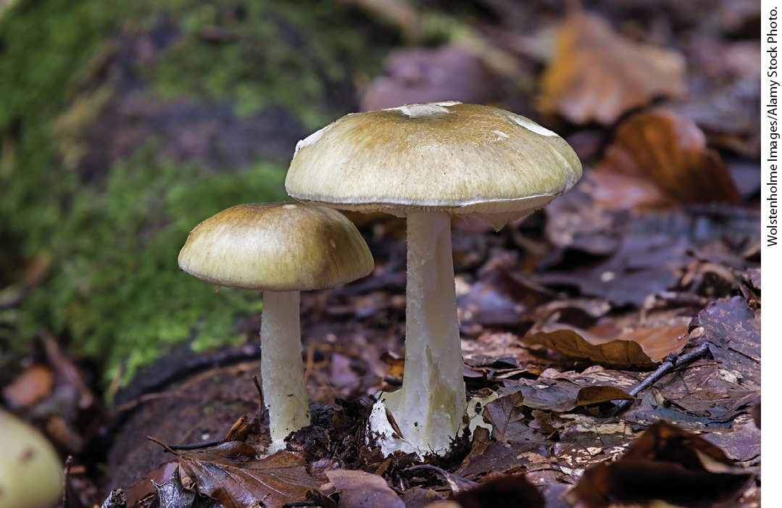
The Death Cap Mushroom Produces α-Amanitin
α-amanitin = compound produced by the death cap mushroom Amanita phalloides
  disrupts transcription in animal cells by blocking Pol II and, at higher concentrations, Pol III

Slide 53
26.2 RNA Processing

Slide 54
Principle 2 (2 of 8)
Many RNAs must be modified and processed to become functional. RNAs can be modified by nucleases, by excision of certain RNA segments, and/or by chemical modification of the RNA nucleotides. In humans, nearly all mRNAs are 5′ capped, spliced, and polyadenylated before being exported from the nucleus for translation in the cytoplasm.

Slide 55
RNA Processing
virtually all eukaryotic RNAs and many bacterial RNAs undergo processing
processing includes:
  addition and deletion of nucleotide sequences
  chemical modification of RNA nucleotides
  degradation
ribozymes = catalytic RNAs that catalyze posttranscriptional processing reactions

Slide 56
Principle 2 (3 of 8)
Many RNAs must be modified and processed to become functional. RNAs can be modified by nucleases, by excision of certain RNA segments, and/or by chemical modification of the RNA nucleotides. In humans, nearly all mRNAs are 5′ capped, spliced, and polyadenylated before being exported from the nucleus for translation in the cytoplasm.

Slide 57
RNA Splicing
primary or precursor transcript = a newly synthesized RNA molecule
introns = noncoding tracts that break up the coding region of the mRNA transcript
  human genes average eight introns per gene
exons = coding segments of the mRNA transcript
RNA splicing = the process by which introns are removed from pre-mRNA and exons are spliced together to form a continuous sequence that specifies a functional polypeptide

Slide 58
Eukaryotic mRNAs Are Modified At Each End
at the 5′ end, a 5′ cap (a modified nucleotide structure) is added
at the 3′ end, cleavage occurs and 80 to 250 A residues are added to create a poly(A) “tail”

Slide 59
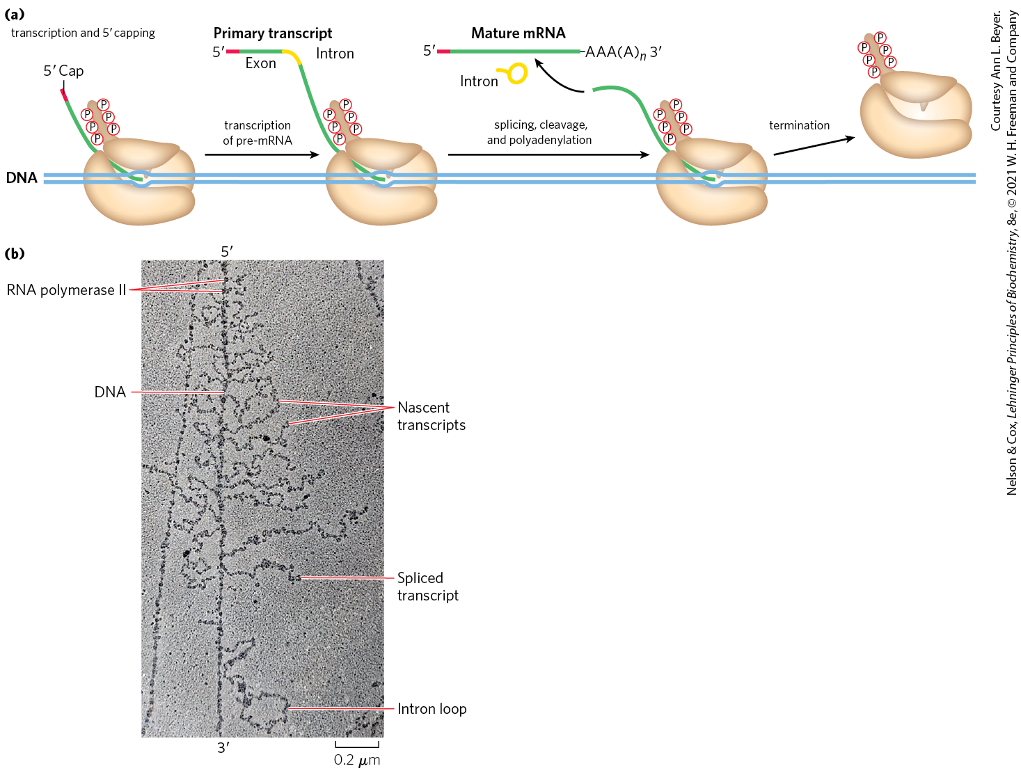
Processing of the Primary
Transcript during mRNA Maturation
the protein complexes that carry out mRNA-processing reactions are organized in association with each other and with the phosphorylated CTD of Pol II

Slide 60
The Messenger Ribonucleoprotein (mRNP) Complex
proteins involved in mRNA transport to the cytoplasm are also associated with the mRNA in the nucleus
processing of the transcript is coupled to its transport
messenger ribonucleoprotein (mRNP) complex = an elaborate and dynamic supramolecular complex of dozens of proteins that associates with the transcript
  its composition changes as the transcript is processed, transported to the cytoplasm, and delivered to the ribosome for translation

Slide 61
Principle 2 (4 of 8)
Many RNAs must be modified and processed to become functional. RNAs can be modified by nucleases, by excision of certain RNA segments, and/or by chemical modification of the RNA nucleotides. In humans, nearly all mRNAs are 5′ capped, spliced, and polyadenylated before being exported from the nucleus for translation in the cytoplasm.

Slide 62
Eukaryotic mRNAs Are Capped at the 5′ End
5′ cap = a residue of 7-methylguanosine linked to the 5′-terminal residue of the mRNA through an unusual 5′,5′-triphosphate linkage
functions:
  helps protect mRNA from ribonucleases
  binds to specific cap-binding complexes of proteins
  participates in binding of the mRNA to the ribosome

Slide 63
Formation of the 5′ Cap
formed by condensation of a molecule of GTP with the triphosphate at the 5′ end of the transcript
methylation occurs at the N-7 guanine and often the 2′-OH groups of the two nucleotides adjacent to the cap
  methyl groups are derived from S-adenosylmethionine

Slide 64
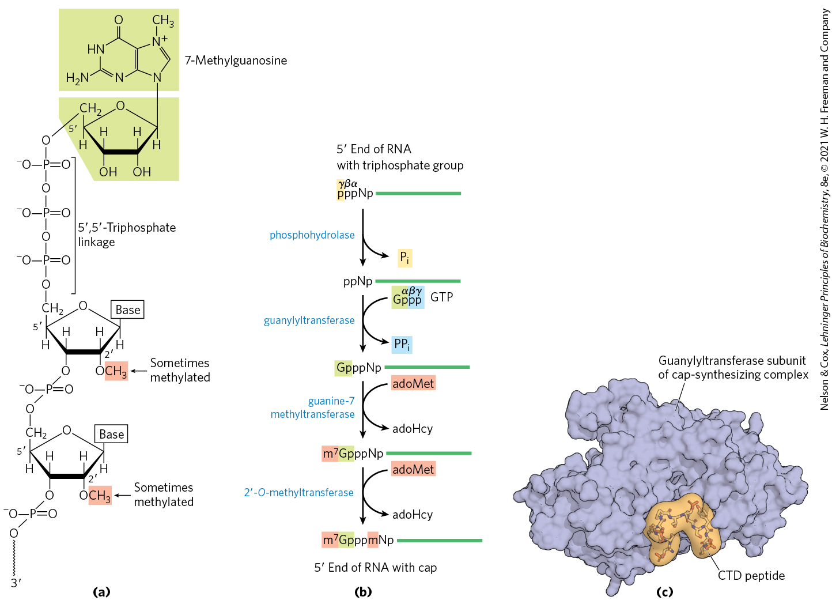
The 5′ Cap of mRNA

Slide 65
Principle 2 (5 of 8)
Many RNAs must be modified and processed to become functional. RNAs can be modified by nucleases, by excision of certain RNA segments, and/or by chemical modification of the RNA nucleotides. In humans, nearly all mRNAs are 5′ capped, spliced, and polyadenylated before being exported from the nucleus for translation in the cytoplasm.

Slide 66
Both Introns and Exons Are Transcribed from DNA into RNA
most genes in vertebrates contain introns
  exceptions include genes that encode histones
some yeast and a few bacterial and archaeal genes contain introns
in eukaryotic mRNAs:
  exons are <1,000 bp long
  introns are 50-700,000 bp long (median = 1,800)
the human genome has 200,000+ introns spread across ~20,000 genes

Slide 67
RNA Catalyzes the Splicing of Introns
four classes of introns:
  group I and II are self-splicing
  spliceosome introns are removed by a large RNP called the spliceosome
  protein-catalyzed introns are removed by enzymes
Table 26-3 Mechanisms of RNA Splicing
Mechanism | Components | Features | Cellular locations
Group I Intron | Catalytic RNA | Self-splicing using a guanine-derived cofactor | Found in nuclear, mitochondrial, and chloroplast genes that encode mRNAs, rRNAs, or tRNAs. Can be found in bacteria.
Group II Intron | Catalytic RNA; maturase and reverse transcriptase proteins | Self-splicing using a nucleophile within the intron to form a lariat | Primarily found in mitochondrial and chloroplast genes of fungi, algae, and plants. Can be found in bacteria.
Spliceosome | Catalytic snRNAs; dozens of protein splicing factors | Requires a large RNP for processing using a nucleophile within the intron to form a lariat | Found in nuclear genes of eukaryotes. Capable of alternative splicing to create multiple products from a given transcript.
Protein-catalyzed | Protein enzymes | Uses a splicing endonuclease and ligase | Found in tRNAs and a few mRNAs.

Slide 68
Group I and Group II Introns
group I introns are found in rRNAs, mRNAs, and tRNAs of nuclear, mitochondrial, and chloroplast genes
group II introns are found in the mRNAs of mitochondrial or chloroplast genes in fungi, algae, and plants
both are also found in bacteria

Slide 69
The Splicing Mechanisms of
Group I and II Introns
an –OH group makes a nucleophilic attack on a phosphorus, forming a new phosphodiester bond
  in group I splicing, the 3′-OH group of guanosine of a required guanine nucleoside or nucleotide cofactor
  in group II splicing, the 2′-OH group of an A residue within the intron
the 3′-OH of the displaced exon acts as a nucleophile in a similar reaction at the 3′ end of the intron

Slide 70
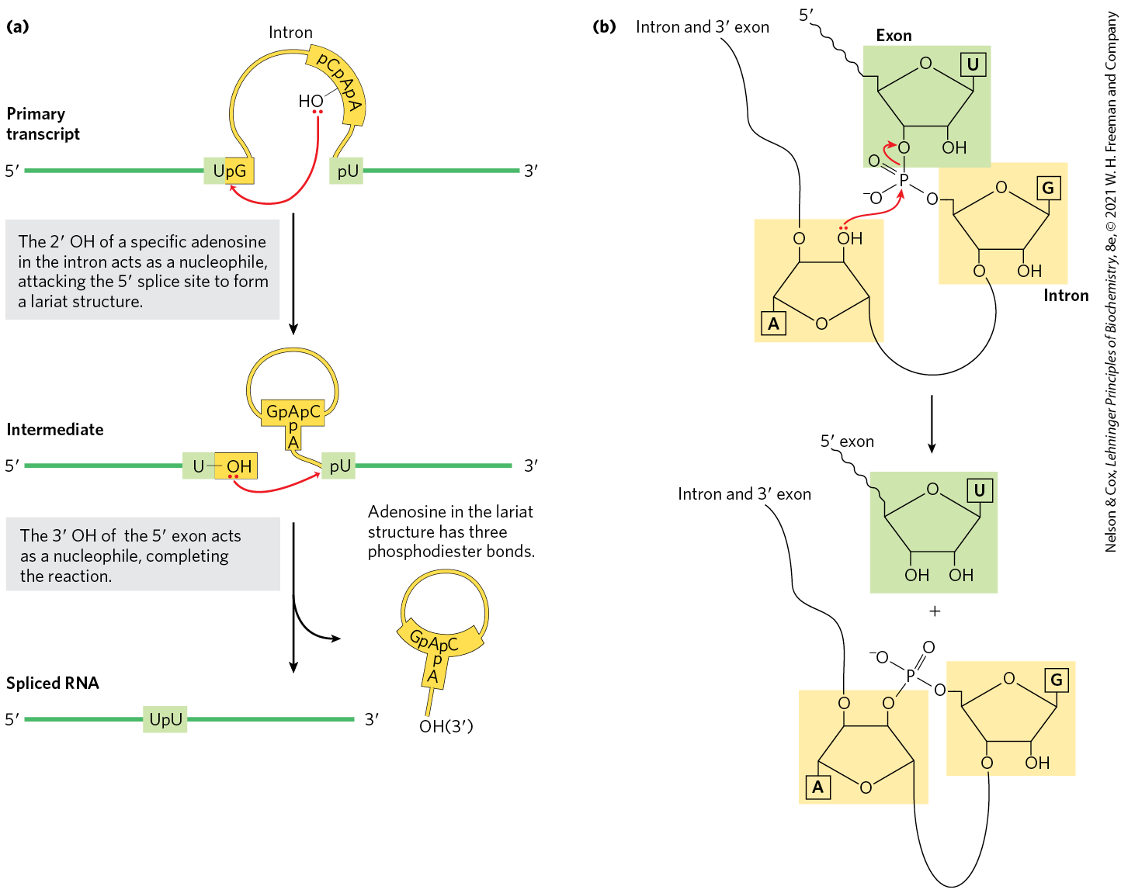
Splicing Mechanism of
Group II Introns
a branched lariat structure forms as an intermediate

Slide 71
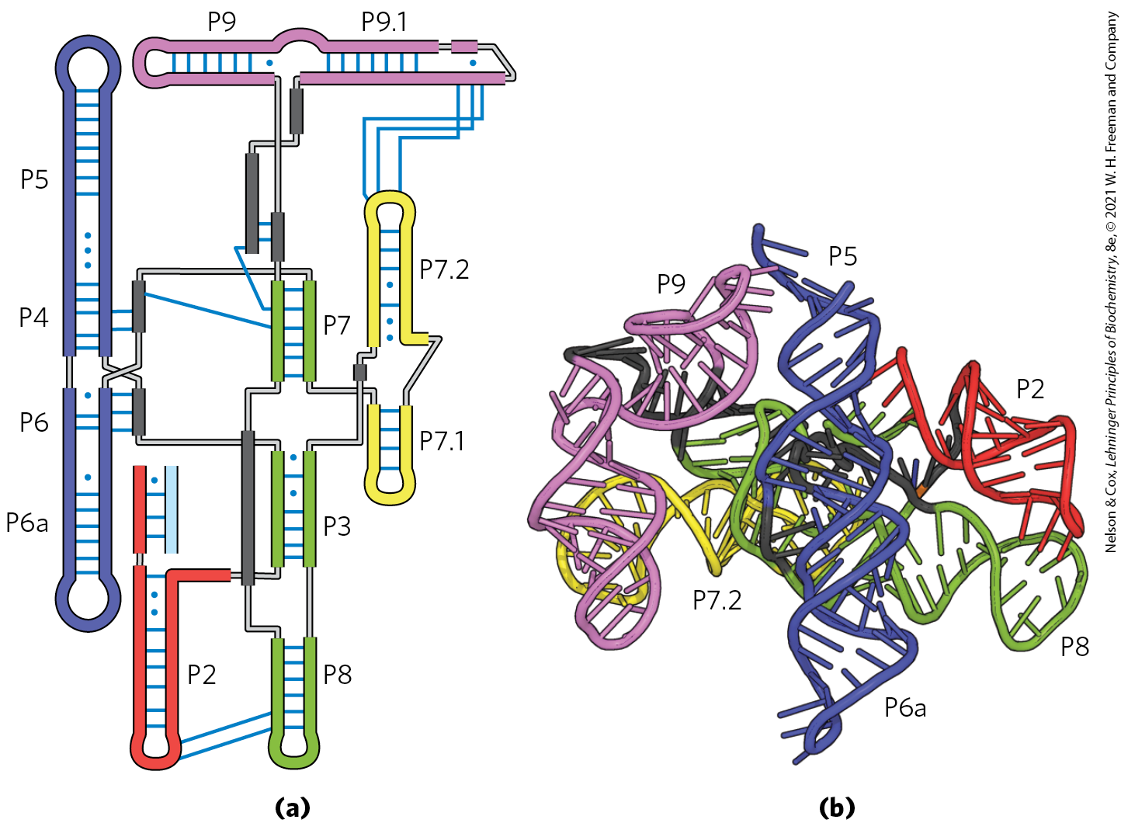
Structure of a Group I Intron

Slide 72
Principle 2 (6 of 8)
Many RNAs must be modified and processed to become functional. RNAs can be modified by nucleases, by excision of certain RNA segments, and/or by chemical modification of the RNA nucleotides. In humans, nearly all mRNAs are 5′ capped, spliced, and polyadenylated before being exported from the nucleus for translation in the cytoplasm.

Slide 73
In Eukaryotes, the Spliceosome Carries out Nuclear pre-mRNA Splicing
spliceosome introns are the most common intron in eukaryotes
  GU at the 5′ end and AG at the 3′ end mark the sites of splicing
some splicing apparatus components are tethered to the CTD of RNA polymerase II
  indicates splicing is tightly coordinated with transcription

Slide 74
The Spliceosome and snRNAs
spliceosome = a large complex made up of multiple specialized RNP complexes called small nuclear ribonucleoproteins (snRNPs) and dozens of other proteins
small nuclear RNAs (snRNAs) = 100-200 nucleotide RNAs that make up snRNPs
  U1, U2, U4, U5, and U6 are abundant in the nuclei

Slide 75
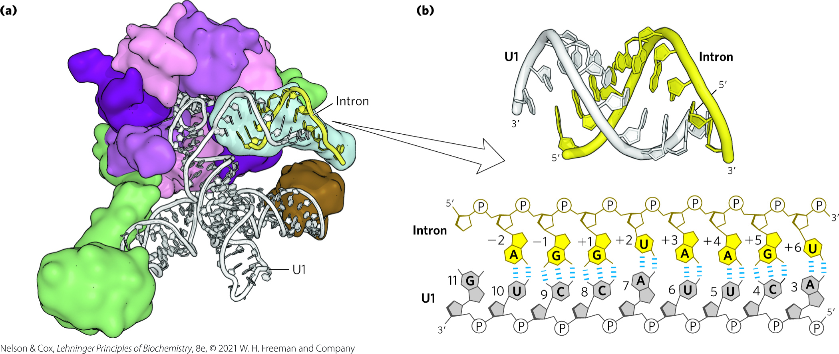
Binding of U1 and U2 snRNA
U1 snRNA base pairs with the 5′ splice site
U2 snRNP base pairs with the 3′ end and identifies the A residue that becomes the nucleophile

Slide 76
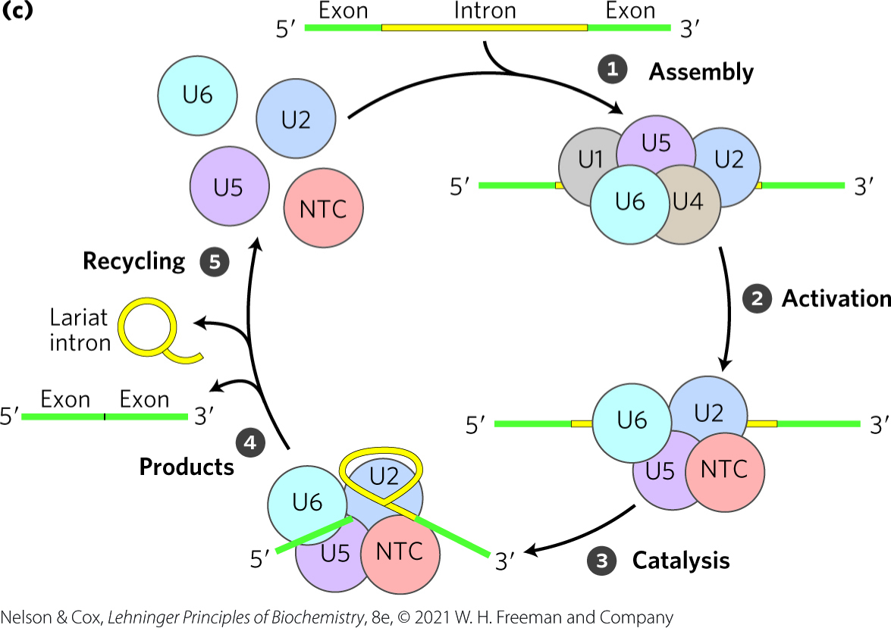
Spliceosome Assembly
addition the tri-snRNP (a complex of U4, U5, and U6 snRNPs) forms the spliceosome
ATP is required for assembly
spliceosomes are single turnover enzymes

Slide 77
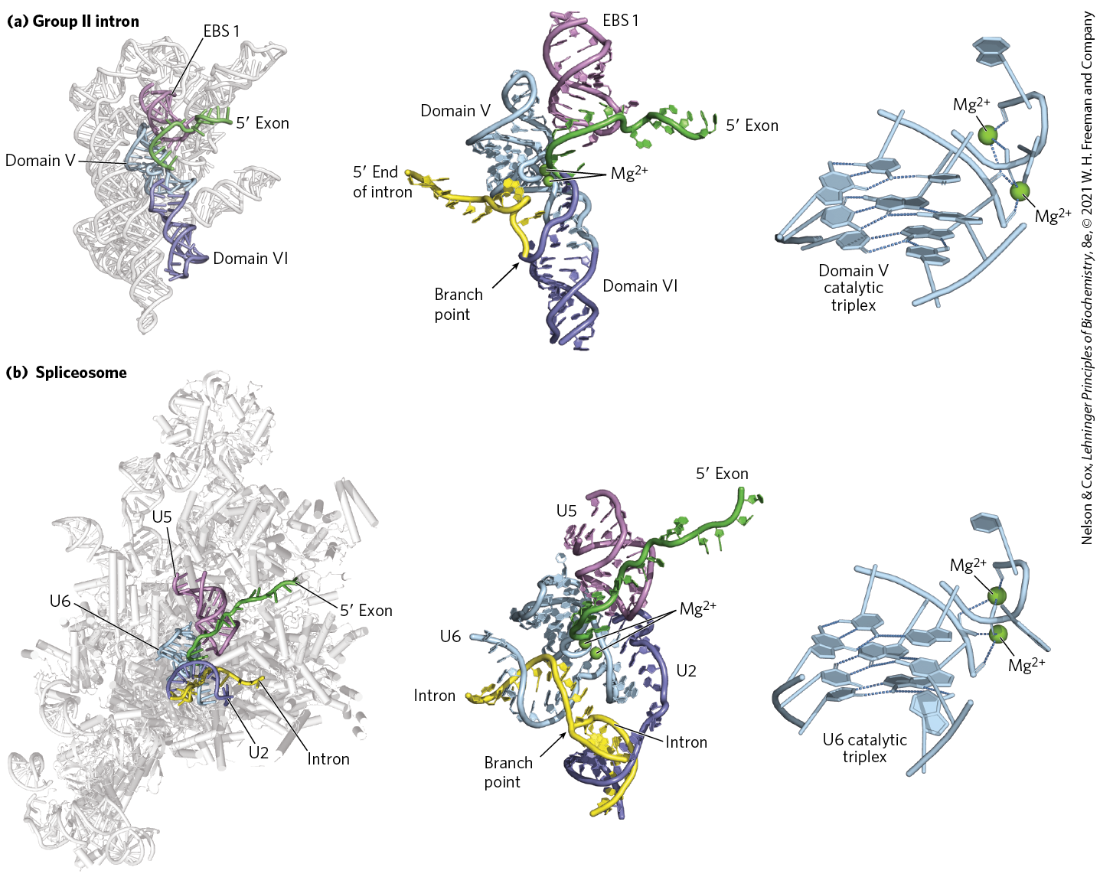
RNA Active Site Conservation
the chemical events of splicing are identical in mechanism to that of group II introns

Slide 78
Proteins Catalyze Splicing of tRNAs
found in certain tRNAs and a few mRNAs
endonucleases cleave the phosphodiester bonds at both ends of the intron
ligases join the two exons

Slide 79
Principle 2 (7 of 8)
Many RNAs must be modified and processed to become functional. RNAs can be modified by nucleases, by excision of certain RNA segments, and/or by chemical modification of the RNA nucleotides. In humans, nearly all mRNAs are 5′ capped, spliced, and polyadenylated before being exported from the nucleus for translation in the cytoplasm.

Slide 80
Eukaryotic mRNAs Have a Distinctive 3′ End Structure
poly(A) tail = a string of A residues added to the 3′ end of most eukaryotic mRNAs that undergo translation
  ~30 residues in yeast and 50-100 in animals
  serves as a binding site for specific proteins
  may help protect mRNA from enzymatic destruction

Slide 81
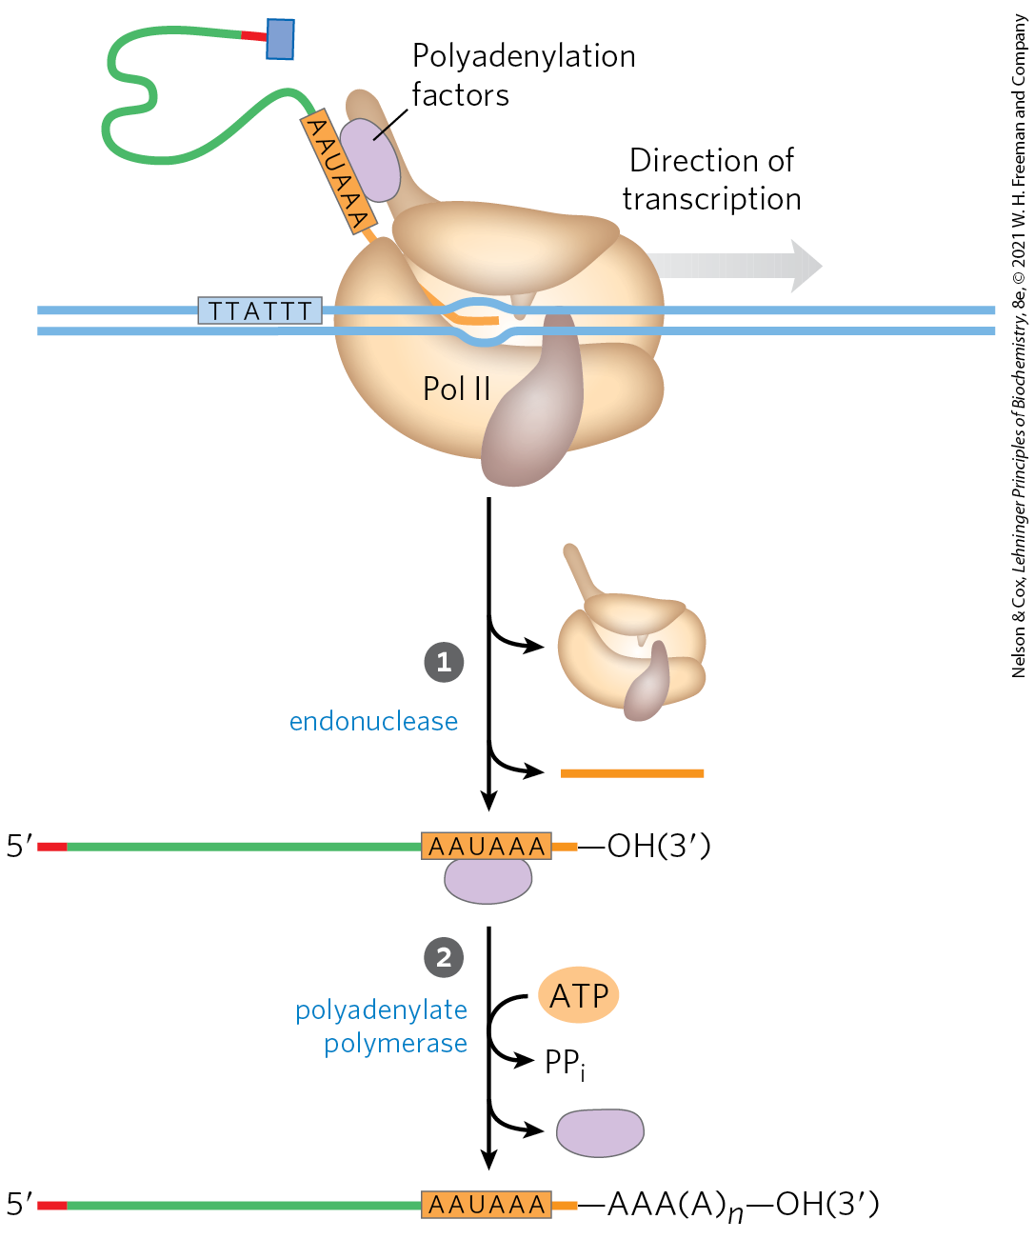
Addition of the Poly(A) Tail
endonuclease cleaves at the poly(A) addition site
the addition site is:
  10-30 nucleotides downstream from the highly conserved sequence (5′)AAUAAA(3′)
  20-40 nucleotides upstream from a sequence rich in G and U residues

Slide 82
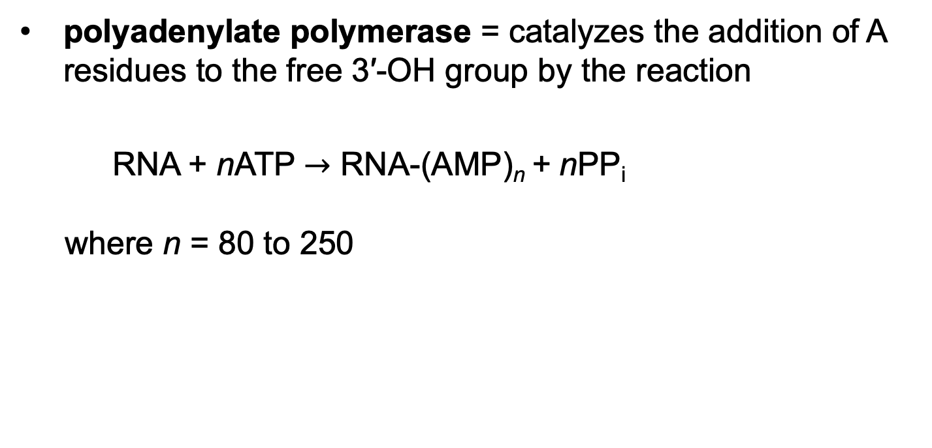
Polyadenylate Polymerase
polyadenylate polymerase = catalyzes the addition of A residues to the free 3′-OH group by the reaction
RNA + nATP $→$ RNA-(AMP)_{n} + nPP_{i}
where n = 80 to 250

Slide 83
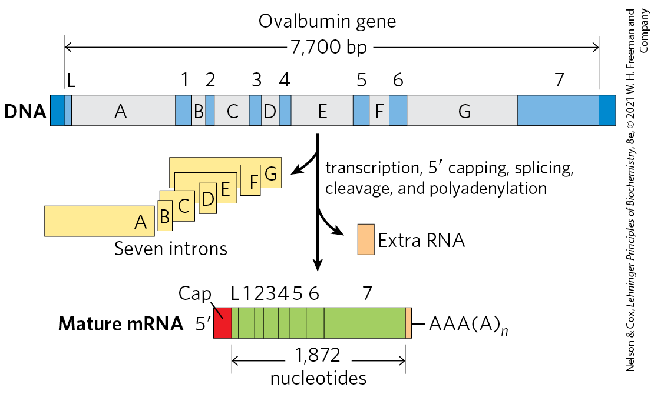
Overview of mRNA Processing

Slide 84
A Gene Can Give Rise to Multiple Products by Differential RNA Processing
some eukaryotic mRNA transcripts can be processed in more than one way to produce different mRNAs and thus different polypeptides
alternative splicing = process in which a particular exon may or may not be incorporated into the mature mRNA transcript
  occurs in >95% of human genes

Slide 85
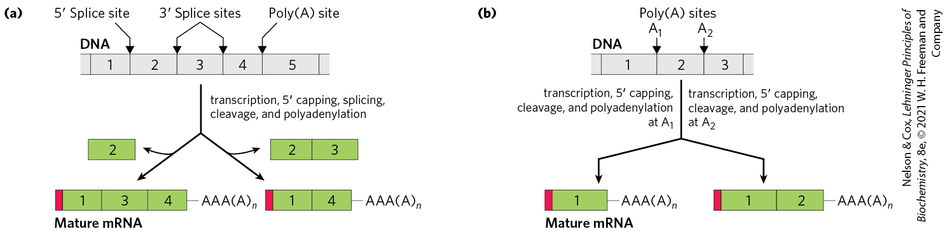
Alternative Transcript Production in Eukaryotes
pre-mRNA contains molecular signals for all the alternative processing pathways
  RNA-binding proteins promote one particular path
complex transcripts can have more than one site where poly(A) tails can form (poly(A) site)

Slide 86
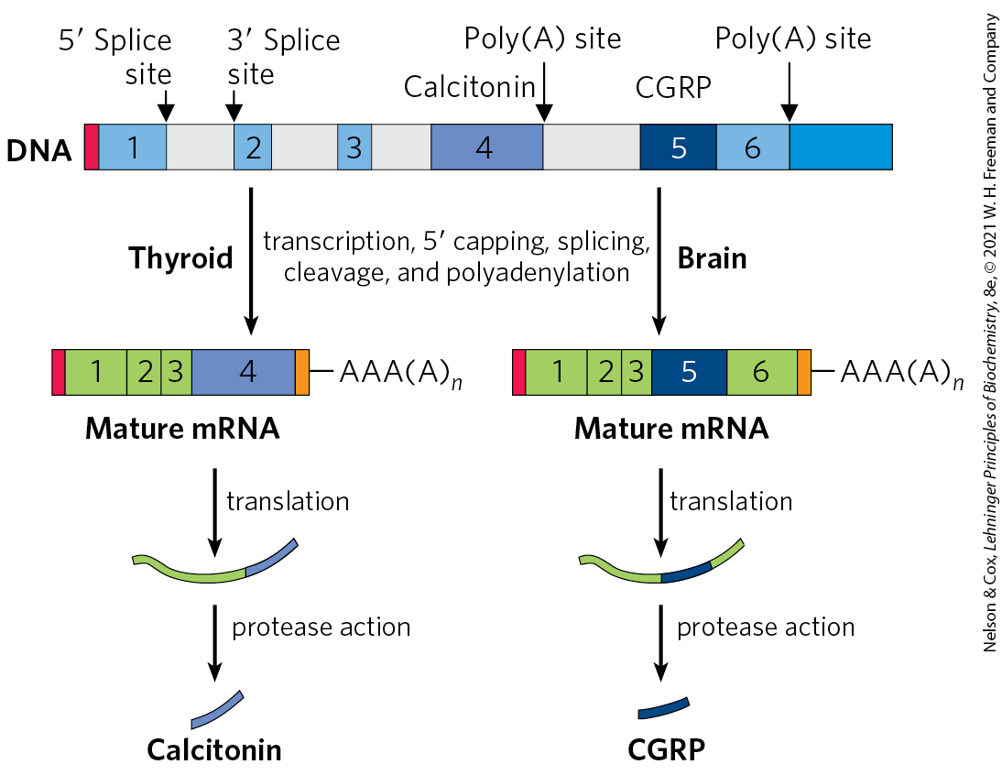
Alternative Processing of the Calcitonin Gene Transcript in Rats
alternative splicing and poly(A) site choice increase the variety of proteins generated from the genomes of higher eukaryotes

Slide 87
Ribosomal RNAs and tRNAs Also Undergo Processing
pre-ribosomal RNAs (pre-rRNAs) = longer precursors of ribosomal RNAs
transfer RNAs are also derived from longer precursors
these RNAs may contain modified nucleosides

Slide 88
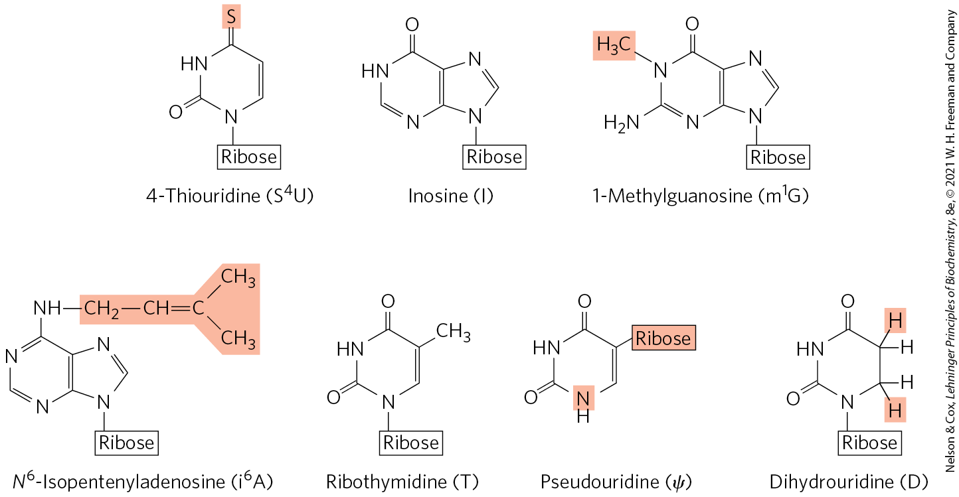
Some Modified Bases of RNA Produced in Posttranscriptional Reactions

Slide 89
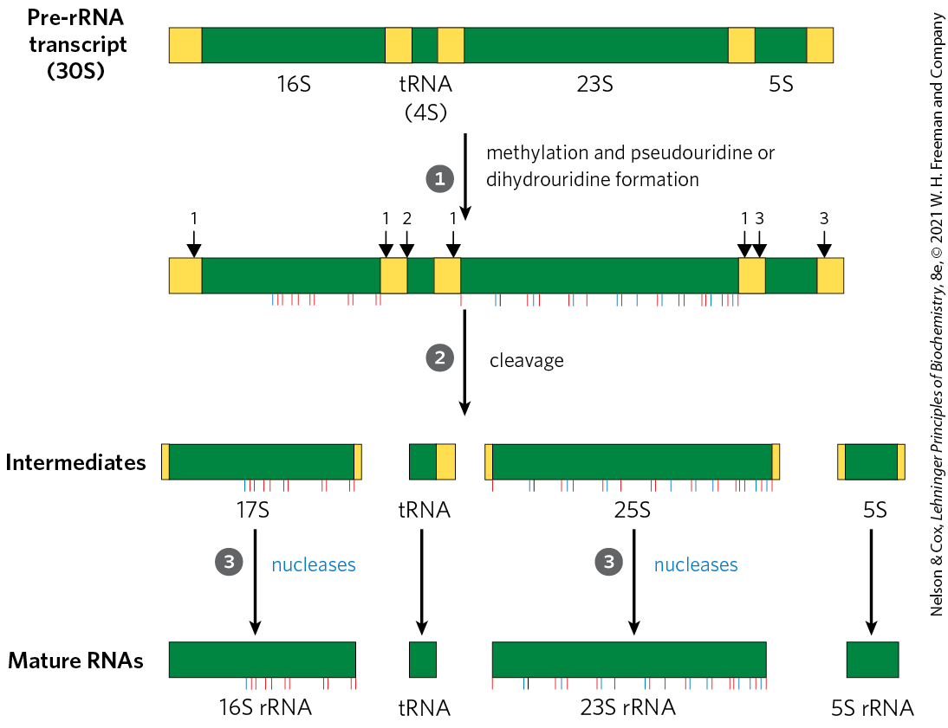
Ribosomal RNAs
in bacteria, a single 30S RNA precursor encodes 16S, 23S, 5S rRNAs, and some tRNAs
the 16S and 23S rRNAs contain modified nucleosides

Slide 90
Eukaryotic Ribosomal RNAs
processing is initiated in the nucleolus, in large complexes that assemble on the rRNA precursor as it is synthesized
  tight coupling occurs between rRNA transcription, rRNA maturation, and ribosome assembly in the nucleolus
each complex includes:
  ribonucleases that cleave the rRNA precursor
  enzymes that modify particular bases
  small nucleolar RNAs (snoRNAs) = ncRNAs that guide nucleoside modification and some cleavage reactions
  ribosomal proteins

Slide 91
Nucleoside Modifications in Eukaryotic rRNAs
common nucleoside modifications include:
  conversion of uridine to pseudouridine
  adoMet-dependent nucleoside methylation
snoRNAs = 60 to 300 nucleotide RNAs that bind to rRNA to identify the modification site
snoRNA-protein complexes (snoRNPs) = complexes of a snoRNA and proteins that carry out nucleoside modifications
  box H/ACA snoRNPs function in pseudouridylylation
  box C/D snoRNPs function in in 2′-O-methylations

Slide 92
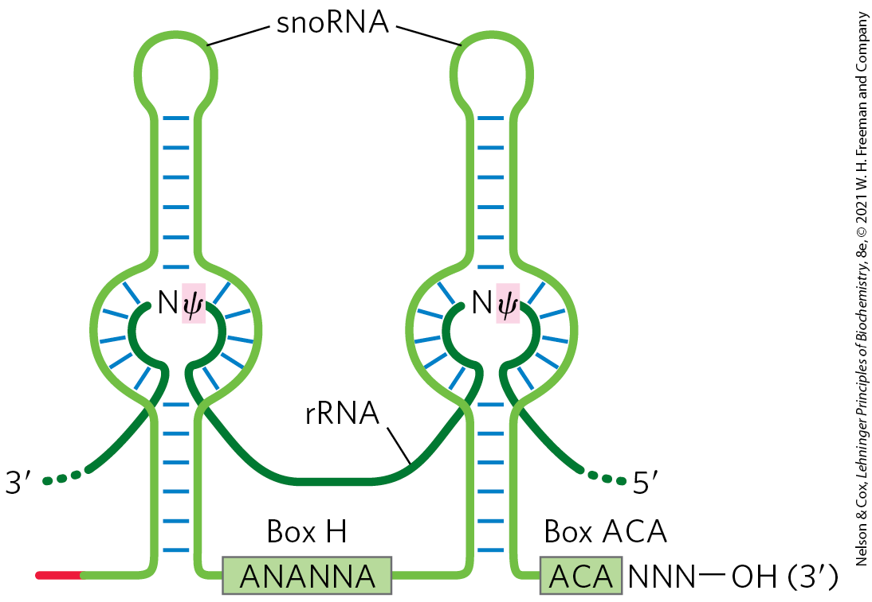
RNA Pairing with Box
H/ACA snoRNAs to Guide Pseudouridylations

Slide 93
Transfer RNAs
most cells have 40 to 50 distinct tRNAs
eukaryotic cells have multiple copies of many of the tRNA genes
transfer RNAs are derived from longer RNA precursors by enzymatic removal of nucleotides from the 5′ and 3′ ends
  the endonuclease RNase P removes RNA at the 5′ end
  1+ nucleases, including the exonuclease RNase D, remove RNA at the 3′ end

Slide 94
Further Post-Transcriptional Processing of tRNA Precursors
further post-transcriptional processing includes:
  addition of the 3′-terminal trinucleotide CCA(3′) by tRNA nucleotidyltransferase
  modification of some bases by methylation, deamination, or reduction

Slide 95
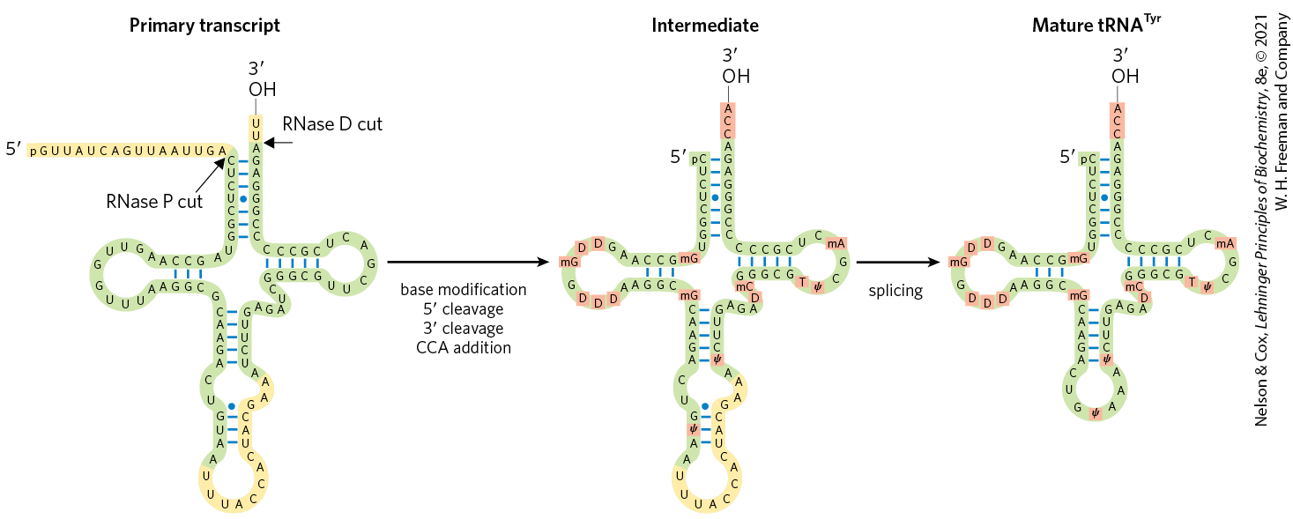
Processing of tRNAs in Bacteria and Eukaryotes

Slide 96
Special-Function RNAs Undergo
Several Types of Processing
snRNAs and snoRNAs are synthesized as larger precursors and then processed
microRNAs (miRNAs) = a special class of non-coding RNAs that promote mRNA degradation and suppress translation to fine-tune gene expression
  ~22 nucleotides long
  complementary in sequence to particular regions of mRNAs
  found in plants and in animals

Slide 97
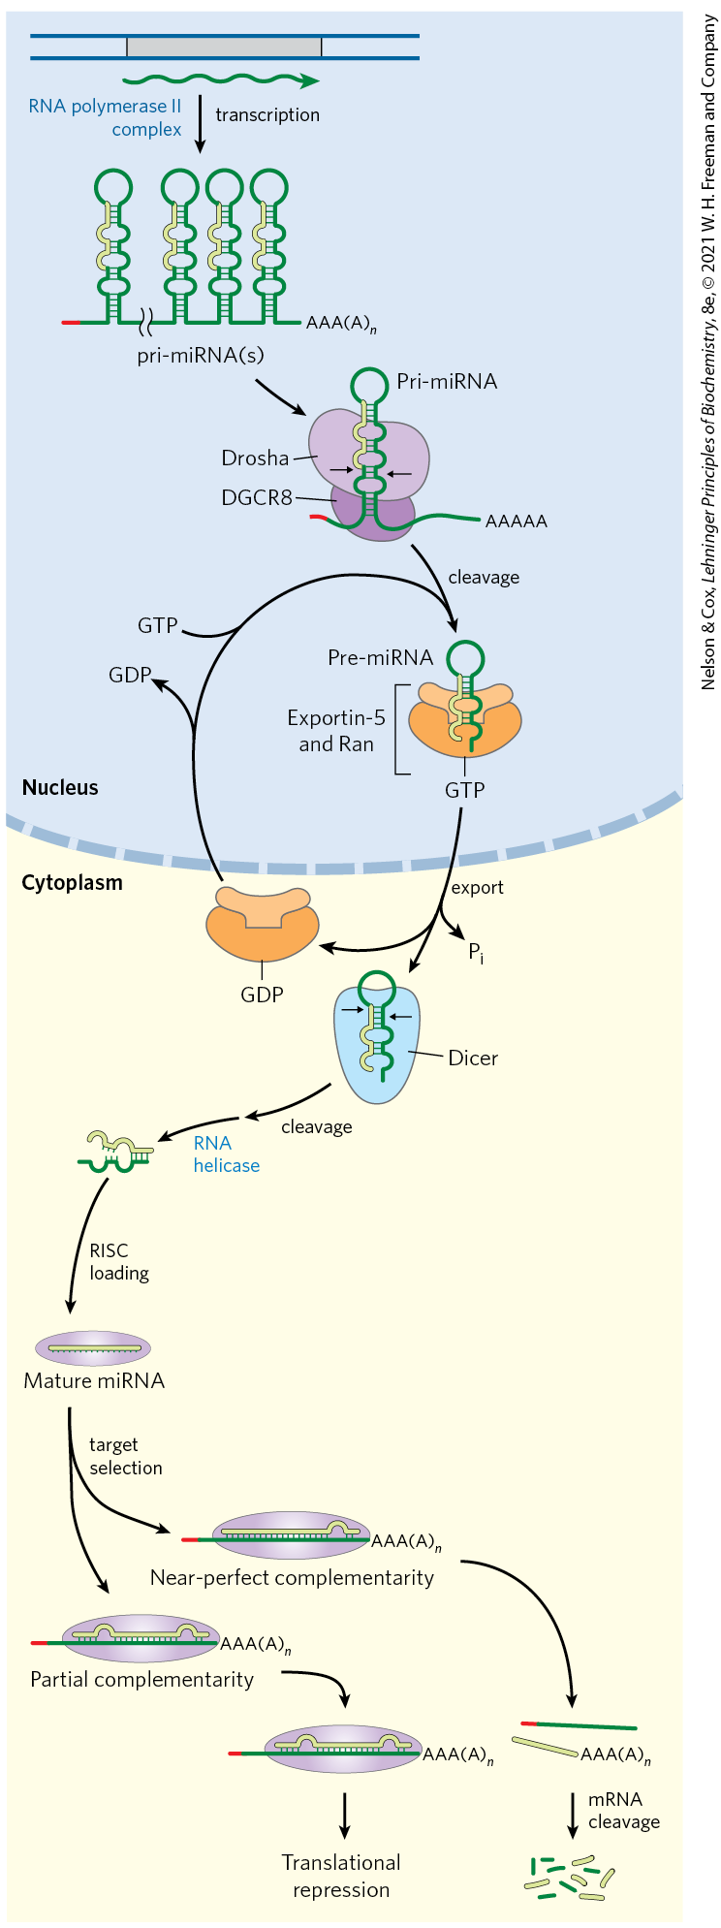
Synthesis and Processing of miRNAs
some primary transcripts for miRNAs (pri-miRNAs) are encoded in the introns of other genes
processing of pri-miRNA is mediated by the endoribonucleases Drosha and Dicer

Slide 98
Steps in miRNA Processing
in the nucleus, Drosha and DGCR8 reduce pri-miRNA to a 70−80 nucleotide precursor miRNA (pre-miRNA)
exportin-5 and Ran GTPase export pre-miRNA to the cytoplasm
Ran hydrolyzes the GTP and exportin-5 and the pre-miRNA are released
Dicer produces nearly mature miRNA paired with a short RNA complement

Slide 99
Steps in miRNA
Processing, Continued
an RNA helicase removes the complement
miRNA is loaded onto a protein complex such as RNA-induced silencing complex (RISC)
RISC binds to target mRNA

Slide 100
RISC-miRNA Binding to Target mRNA
if the complementarity between miRNA and its target is nearly perfect, the target mRNA is cleaved
if the complementarity is only partial, the complex blocks translation of the target mRNA

Slide 101
Principle 2 (8 of 8)
Many RNAs must be modified and processed to become functional. RNAs can be modified by nucleases, by excision of certain RNA segments, and/or by chemical modification of the RNA nucleotides. In humans, nearly all mRNAs are 5′ capped, spliced, and polyadenylated before being exported from the nucleus for translation in the cytoplasm.

Slide 102
Cellular mRNAs Are Degraded at Different Rates
the cellular concentration of mRNA helps govern the level of gene expression
degradative pathways ensure that mRNAs do not build up in the cell and direct the synthesis of unnecessary proteins
rates of degradation vary greatly for eukaryotic mRNAs
  average half-life is ~3 hours

Slide 103
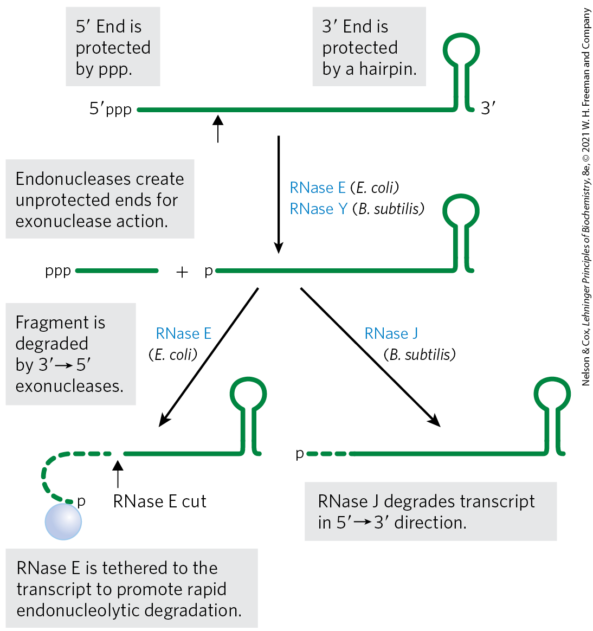
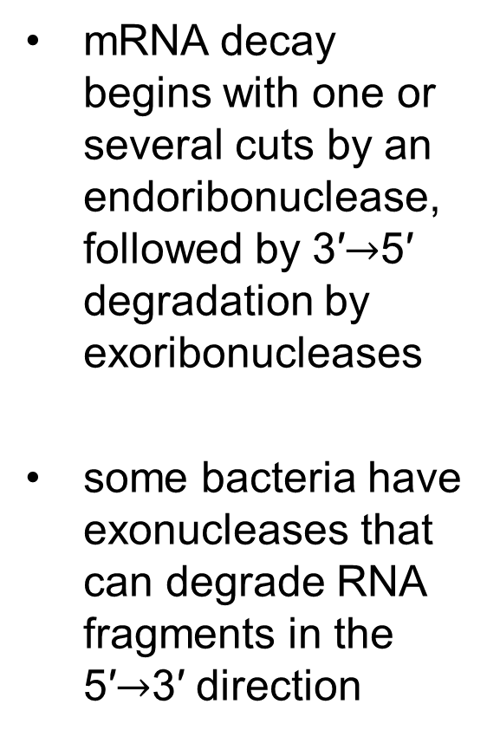
Degradation of RNA in Bacteria
mRNA decay begins with one or several cuts by an endoribonuclease, followed by 3′$→$5′ degradation by exoribonucleases
some bacteria have exonucleases that can degrade RNA fragments in the 5′$→$3′ direction

Slide 104

Polynucleotide
Phosphorylase (PNPase)
polynucleotide phosphorylase (PNPase) = a common 3′$→$5′ exoribonuclease responsible for the degradation of many mRNAs in bacteria, chloroplasts, and mitochondria
  catalyzes reversible phosphorolysis of mRNA using orthophosphate as the nucleophile

Slide 105
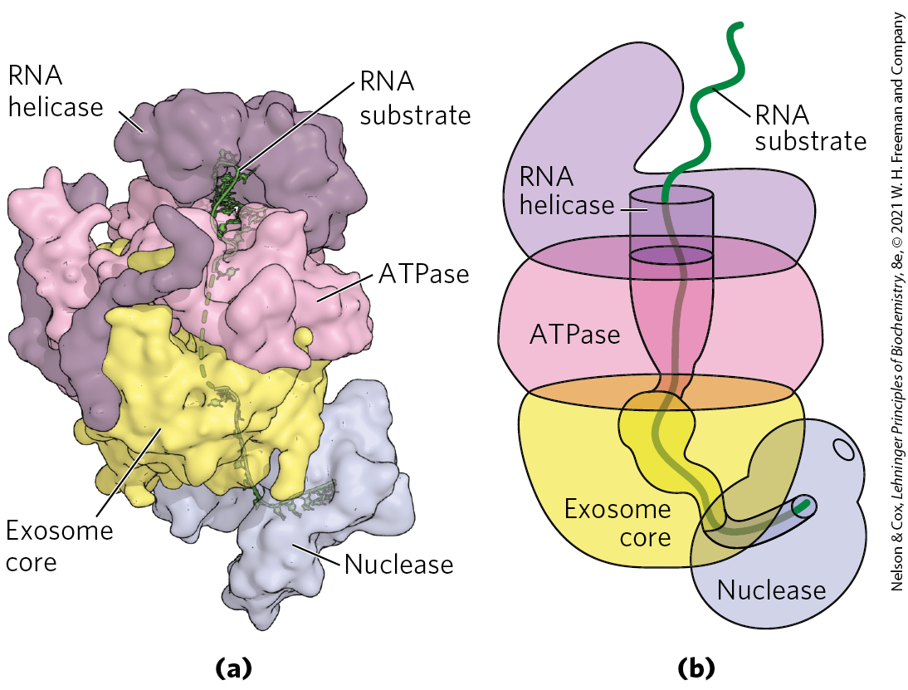
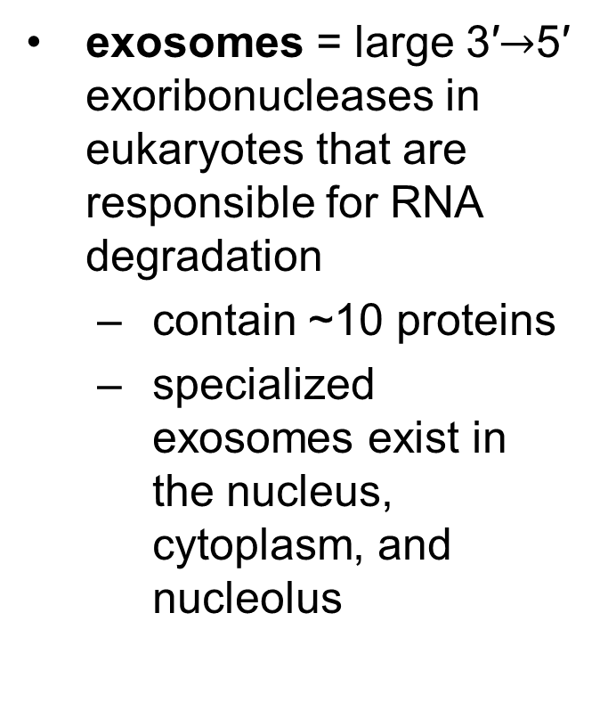
Exosomes
exosomes = large 3′$→$5′ exoribonucleases in eukaryotes that are responsible for RNA degradation
  contain ~10 proteins
  specialized exosomes exist in the nucleus, cytoplasm, and nucleolus

Slide 106
26.3 RNA-Dependent Synthesis of RNA and DNA

Slide 107
Principle 3 (2 of 4)
RNA can be used as a template for synthesis of DNA by reverse transcriptases. RNA carries genetic information that can be reverse transcribed into DNA. Retroviruses, such as HIV or those responsible for some cancers, must convert their RNA genomes into DNA by reverse transcription. Reverse transcription by telomerase is also responsible for producing the telomeres that protect the DNA found at the ends of eukaryotic chromosomes.

Slide 108
Reverse Transcriptase Produces DNA from Viral RNA
reverse transcriptase = an RNA-dependent DNA polymerase
  contained within certain RNA viruses called retroviruses
  discovery showed genetic information can flow “backward” from RNA to DNA
reverse transcriptase catalyzes conversion of viral RNA to dsDNA, which is often integrated into the host genome

Slide 109
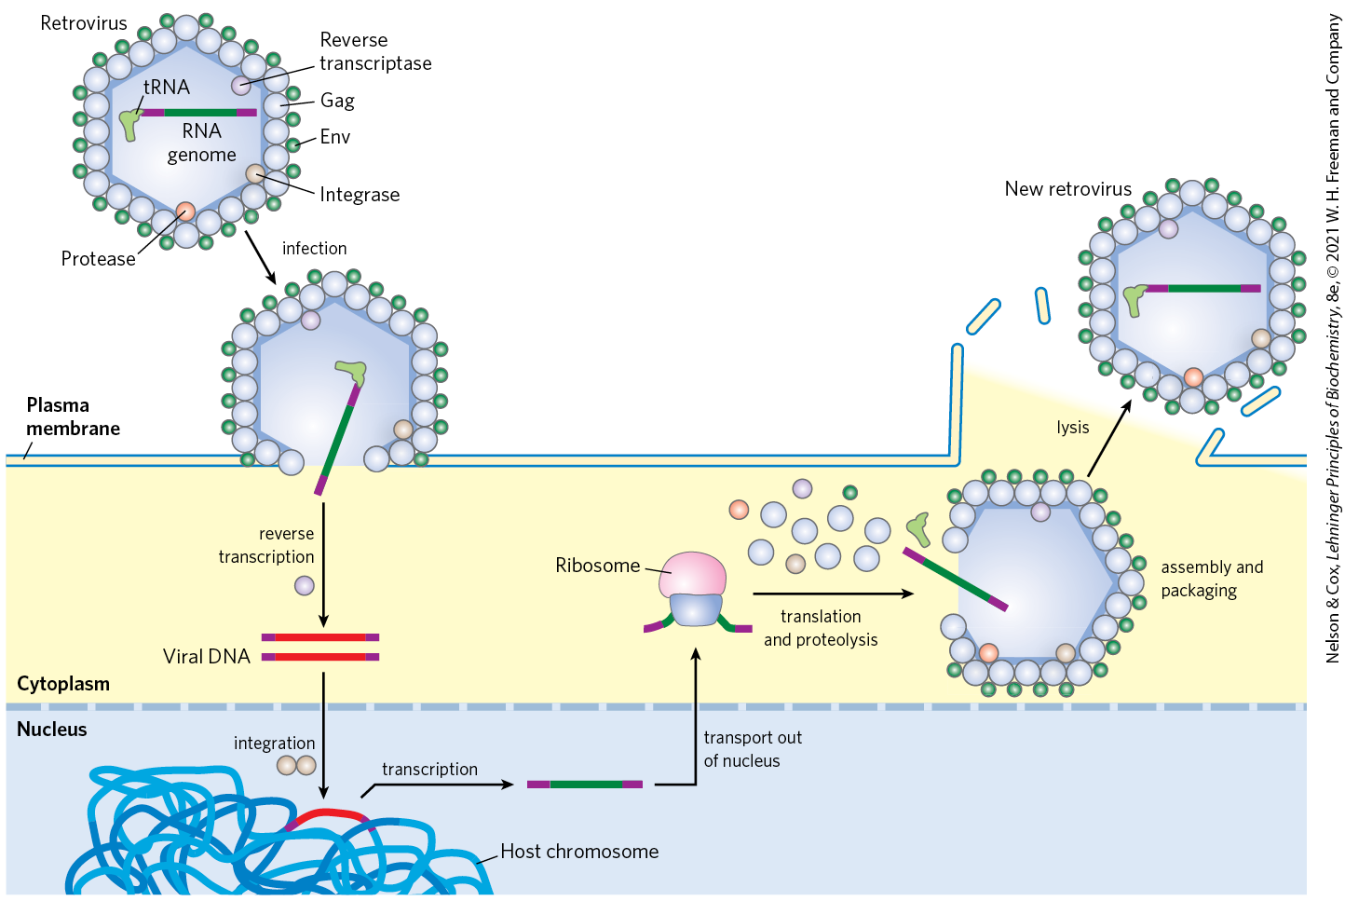
Retroviral Infection of a
Mammalian Cell

Slide 110
Retroviruses Have Three Genes and LTR Sequences
gag = encodes the proteins of the interior viral core
pol = encodes the protease that cleaves the long polypeptide, an integrase, and reverse transcriptase
env = encodes the proteins of the viral envelope
long terminal repeat (LTR) sequences facilitate integration into host DNA

Slide 111
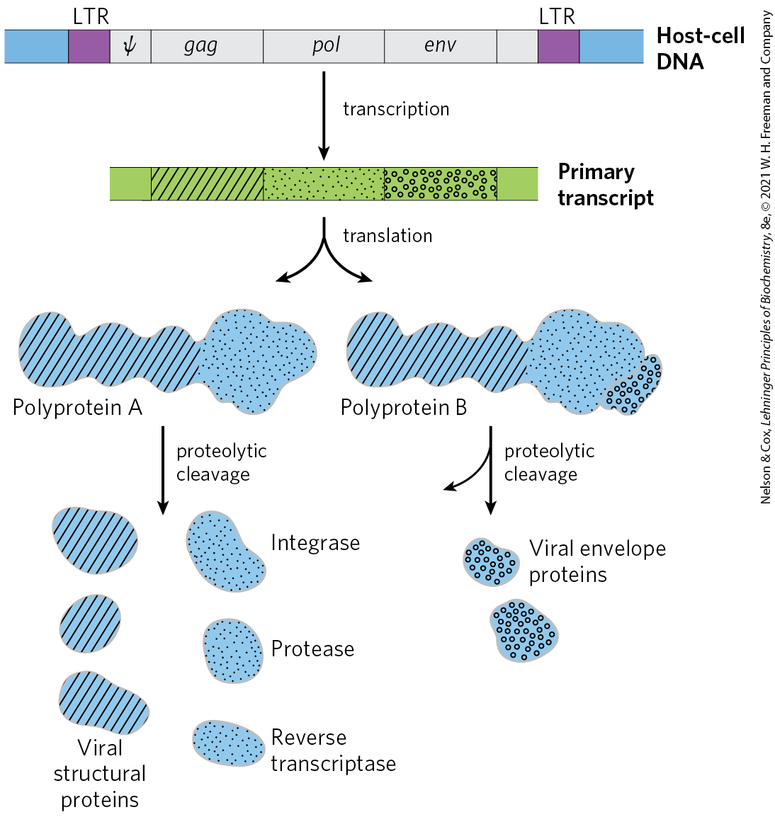
Structure and Gene Products of an Integrated Retroviral Genome

Slide 112
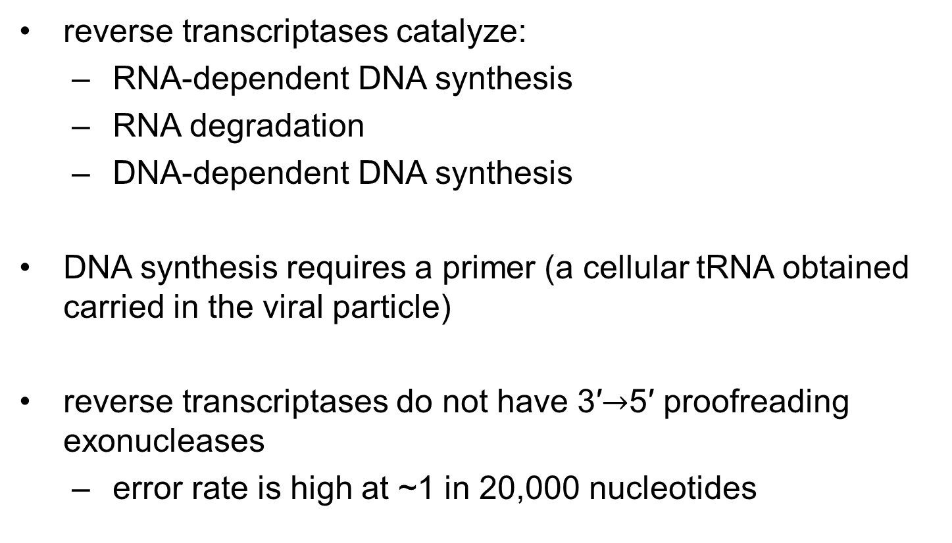
Reverse Transcriptases Catalyze Three Reactions
reverse transcriptases catalyze:
  RNA-dependent DNA synthesis
  RNA degradation
  DNA-dependent DNA synthesis
DNA synthesis requires a primer (a cellular tRNA obtained carried in the viral particle)
reverse transcriptases do not have 3′$→$5′ proofreading exonucleases
  error rate is high at ~1 in 20,000 nucleotides

Slide 113
Reverse Transcriptases Are Important Reagents
reverse transcriptases permit the synthesis of DNA complementary to an mRNA template
complementary DNA (cDNA) = synthetic DNA prepared by reverse transcriptases
  can be used to clone cellular genes

Slide 114
Principle 3 (3 of 4)
RNA can be used as a template for synthesis of DNA by reverse transcriptases. RNA carries genetic information that can be reverse transcribed into DNA. Retroviruses, such as HIV or those responsible for some cancers, must convert their RNA genomes into DNA by reverse transcription. Reverse transcription by telomerase is also responsible for producing the telomeres that protect the DNA found at the ends of eukaryotic chromosomes.

Slide 115
Some Retroviruses Cause Cancer and AIDS
some retroviruses contain an oncogene that can cause the cell to grow abnormally
  classified as RNA tumor viruses
  example: Rous sarcoma virus (also called avian sarcoma virus)

Slide 116
Principle 3 (4 of 4)
RNA can be used as a template for synthesis of DNA by reverse transcriptases. RNA carries genetic information that can be reverse transcribed into DNA. Retroviruses, such as HIV or those responsible for some cancers, must convert their RNA genomes into DNA by reverse transcription. Reverse transcription by telomerase is also responsible for producing the telomeres that protect the DNA found at the ends of eukaryotic chromosomes.

Slide 117
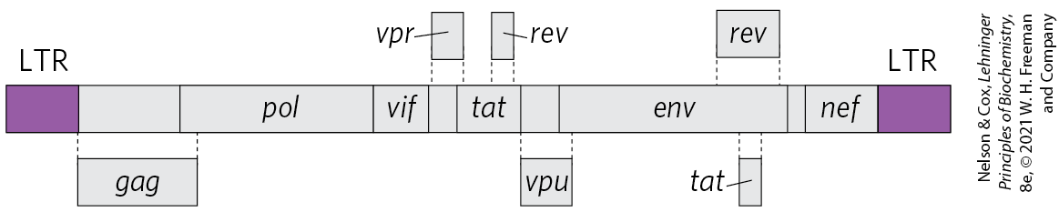
The Human Immunodeficiency
Virus (HIV)
the retrovirus human immunodeficiency virus (HIV) causes acquired immune deficiency syndrome (AIDS)
  kills many of the cells it infects (T lymphocytes)
  leads to suppression of the host immune system
the reverse transcriptase of HIV is very error-prone
  results in 1+ errors every time the genome is replicated

Slide 118
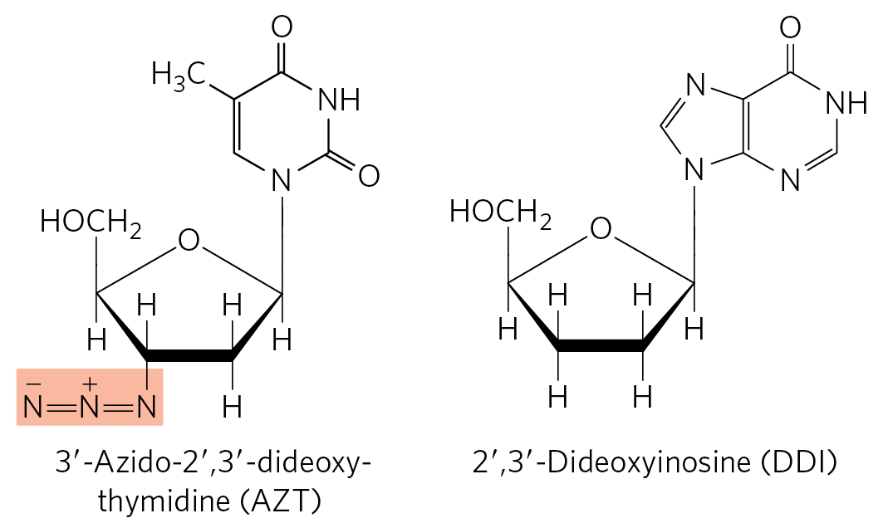
Fighting AIDS With Inhibitors of HIV Reverse Transcriptase
azidothymidine (AZT) is a deoxythymidine analog
  converted to AZT triphosphate inside T lymphocytes
binding of AZT triphosphate to HIV reverse transcriptase competitively inhibits dTTP binding
  terminates viral DNA synthesis
dideoxyinosine (DDI) has a similar mechanism of action

Slide 119
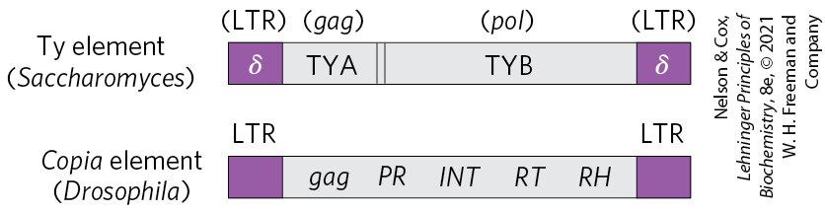
Many Transposons, Retroviruses, and Introns May Have a Common Evolutionary Origin
retrotransposons = eukaryotic DNA transposons with structures similar to retroviruses
  encode an enzyme homologous to the retroviral reverse transcriptase
  transpose by means of an RNA intermediate,
  lack an env gene and so cannot form viral particles

Slide 120
Homing
many group I and group II introns are also mobile genetic elements
  encode DNA endonucleases that promote their movement
homing = process by which DNA endonucleases promote insertion of the intron into an identical site in a homologous gene that does not contain the intron
  group I intron homing is DNA-based
  group II intron homing occurs through an RNA intermediate

Slide 121


Production of Homing Endonuclease and the Homing Process

Slide 122

Retrohoming
group II intron endonucleases have associated reverse transcriptase activity
retrohoming = process by which in an RNA intron is inserted into a DNA gene followed by production of a DNA copy by a reverse transcriptase

Slide 123
Telomerase is a Specialized
Reverse Transcriptase
telomeres = structures at the ends of linear eukaryotic chromosomes
  not easily replicated by cellular DNA polymerases because there is no template for an RNA primer

Slide 124

Telomere Synthesis and Structure
telomerase = a ribonucleoprotein that synthesizes the telomere ends of linear chromosomes
  acts as a specialized reverse transcriptase
  contains an internal RNA with C_{y}A_{x} repeat that serves as a template for synthesis of the T_{x}G_{y} strand of the telomere

Slide 125

T Loops in Telomeres
T loop = specialized structure that sequesters the single-stranded end of the telomere by base pairing
  protect the 3′ ends of chromosomes from nucleases and enzymes that repair double-strand breaks
TRF1 and TRF2 bind the looped DNA

Slide 126
Some RNAs Are Replicated by
RNA-Dependent RNA Polymerase
Other RNA viruses include E. coli bacteriophages, influenza virus, and coronaviruses (SARS, COVID-19)
RNA-dependent RNA polymerase (RNA replicase) = replicate RNA in the host cell
  template-specific for viral RNA
  lack a separate proofreading endonuclease activity
  found in viruses (except retroviruses), plants, protists, fungi, and some simpler animals

Slide 127

RNA-Dependent RNA Polymerases
Share a Common Structural Fold
polymerases involved in viral RNA replication, reverse transcription, retrohoming, and telomere synthesis share structural homology

Slide 128
26.4 Catalytic RNAs and the RNA World Hypothesis

Slide 129
Principle 4 (2 of 5)
RNA can act as both a catalyst and carrier of genetic information. Ribozymes can catalyze chemical transformations using many of the same strategies as protein-based enzymes. The dual capacity of RNA as both a carrier of genetic information and a catalyst is support for the RNA world hypothesis for the evolution of life on Earth.

Slide 130
Ribozymes
ribozymes = RNA enzymes
  examples: self-splicing group I introns, RNase P, hammerhead ribozyme
ribozyme activities are based on two fundamental reactions:
  transesterification
  phosphodiester bond hydrolysis (cleavage)

Slide 131
Ribozymes Share Features with Protein Enzymes
similarities between ribozymes and protein enzymes:
  vary greatly in size
  3-D structure important for function
  can be inactivated by heating, denaturing agents, or complementary oligonucleotides
  can be inactivated if essential nucleotides are changed

Slide 132

Secondary Structure of the Self-Splicing rRNA Intron of Tetrahymena
internal guide sequence = base-pairs with exon sequences near the 5′ splice site to promote the alignment of specific bonds to be cleaved and rejoined

Slide 133
Principle 4 (3 of 5)
RNA can act as both a catalyst and carrier of genetic information. Ribozymes can catalyze chemical transformations using many of the same strategies as protein-based enzymes. The dual capacity of RNA as both a carrier of genetic information and a catalyst is support for the RNA world hypothesis for the evolution of life on Earth.

Slide 134
Ribozymes Share Several Properties With Enzymes
shared properties include:
  acceleration of reaction rates
  saturable kinetics
  reaction specificity
  making use of substrate orientation, covalent catalysis, and metal-ion catalysis

Slide 135

In Vitro Catalytic Activity of L-19 IVS
L-19 IVS (intervening sequence) promotes nucleotidyl transfer reactions
  processes ~100 molecules per hour
  is not altered in the reaction

Slide 136
Ribozymes Participate in a Variety of Biological Processes
E. coli RNase P has an RNA component and a protein component
  the M1 RNA alone is capable of cleaving tRNA precursors at the correct position
  the protein component serves to stabilize the RNA or facilitate its function in vivo

Slide 137

Hammerhead Ribozyme
the hammerhead ribozyme catalyzes the hydrolysis of an internal phosphodiester bond
  cleave RNA of virusoids (small RNAs associated with plant RNA viruses)
  use general acid and base catalysis

Slide 138
Principle 4 (4 of 5)
RNA can act as both a catalyst and carrier of genetic information. Ribozymes can catalyze chemical transformations using many of the same strategies as protein-based enzymes. The dual capacity of RNA as both a carrier of genetic information and a catalyst is support for the RNA world hypothesis for the evolution of life on Earth.

Slide 139
Ribozymes Provide Clues to the Origin of Life in an RNA World
RNA world hypothesis = proposal that the evolution of life on Earth may have included an RNA world in which RNA was the central information carrier and catalyst before proteins and DNA emerged as key players

Slide 140

Prebiotic Chemistry Experiments
a concentrated solution of ammonium cyanide, refluxed for a few days, generates adenine in yields of up to 0.5%
most enzyme cofactors contain adenosine and it is the most abundant nucleotide constituent

Slide 141
Principle 4 (5 of 5)
RNA can act as both a catalyst and carrier of genetic information. Ribozymes can catalyze chemical transformations using many of the same strategies as protein-based enzymes. The dual capacity of RNA as both a carrier of genetic information and a catalyst is support for the RNA world hypothesis for the evolution of life on Earth.

Slide 142
The Existence of Catalytic RNAs
in an “RNA world,” RNAs, not proteins, act as catalysts
the discovery of ribozymes gave life to the RNA world hypothesis
the parent of all life on this planet might have been a self- replicating RNA, or a polymer with equivalent chemical characteristics

Slide 143
The Expanding Catalytic Repertoire of Ribozymes
RNA has the potential to catalyze the many reactions needed in a primitive system of metabolic pathways
SELEX = a method that rapidly searches pools of random RNA polymers and extracts those with particular activities
isolated ribozymes have been found that catalyze:
  ester and amide bond formation
  SN2 reactions
  metallation of (addition of metal ions to) porphyrins
  carbon-carbon bond formation

Slide 144
The Structure of the Ribosome
natural RNA molecules are components of ribosomes, which catalyze the formation of peptide bonds
the evolution of a capacity to synthesize proteins would have been a major event in the RNA world
the information-carrying role of RNA may have passed to DNA because DNA is chemically more stable

Slide 145
Extant Vestiges of an RNA World
many nonliving entities (RNA viruses, retoviruses, retrotransposons) exist and can parasitize living cells
transposons may have been an early innovation in an RNA world

Slide 146
Progress in the Search for an RNA Replicator
the RNA world hypothesis requires a nucleotide polymer to reproduce itself
researchers are currently searching for a ribozyme capable of directing its own synthesis

Slide 147

Self-Sustained Replication of an RNA Enzyme
two ribozymes can cross-catalyze each other’s formation

