Slide 1

25 DNA Metabolism
© 2021 Macmillan Learning

Slide 2

Principle 1 (1 of 6)
Along with catalysis, biological information is one of the two key prerequisites for life. The faithful maintenance and transmission of genetic information from one generation to another ensures continuity within each species.

Slide 3

Principle 2 (1 of 7)
Information is expensive. The chemistry of joining one nucleotide to the next in DNA replication is elegant and simple, almost deceptively so. However, the enzymatic and thermodynamic commitment to linking one nucleotide to another in DNA far exceeds what would normally be required to successfully form a phosphodiester bond. It is not enough to synthesize a phosphodiester bond; that bond must accurately link two particular nucleotides.

Slide 4

Principle 3 (1 of 7)
The fidelity of genome maintenance and transmission is not perfect. DNA damage happens, often by spontaneous processes. DNA replication and repair deal with the vast majority of DNA lesions, providing a high degree of genetic fidelity and stability. The few DNA damage events that slip through uncorrected provide fuel for evolution.

Slide 5
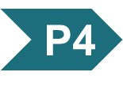
Principle 4 (1 of 5)
Although considered separately, the processes of replication, repair, and recombination of DNA are not distinct. These processes are highly integrated in cells, and they are required for proper genome maintenance.

Slide 6
Bacterial Gene Naming
typically named using three italicized lowercase letters reflecting a function
  examples: dna, uvr, and rec
capital letters added to abbreviation reflect order of discovery, not enzymatic order
  examples: dnaA, dnaB, and dnaQ

Slide 7
Bacterial Protein Naming
often named after their genes using nonitalicized, roman type with the first letter capitalized
  examples: DnaA (encoded by dnaA) and RecA (encoded by recA)

Slide 8
Eukaryotic Gene Naming
no single convention exists for all eukaryotic systems
in Saccharomyces cerevisiae, gene names are three italicized uppercase letters followed by an italicized number
  example: COX1

Slide 9
Eukaryotic Protein Naming
complex and variable
in yeast, some proteins have long common names
  example: cytochrome oxidase
other yeast proteins have the same name as the gene, with one uppercase and two lowercase letters in roman type, followed by a number and the letter “p”
  example: Rad51p (encoded by RAD51)

Slide 10
25.1 DNA Replication

Slide 11
Principle 1 (2 of 6)
Along with catalysis, biological information is one of the two key prerequisites for life. The faithful maintenance and transmission of genetic information from one generation to another ensures continuity within each species.

Slide 12
DNA as a Template
template = a structure that would allow molecules to be lined up in a specific order and joined to create a macromolecule with a unique sequence and function
the structure of DNA revealed one strand is the complement of the other.
  each strand provides the template for a new strand

Slide 13
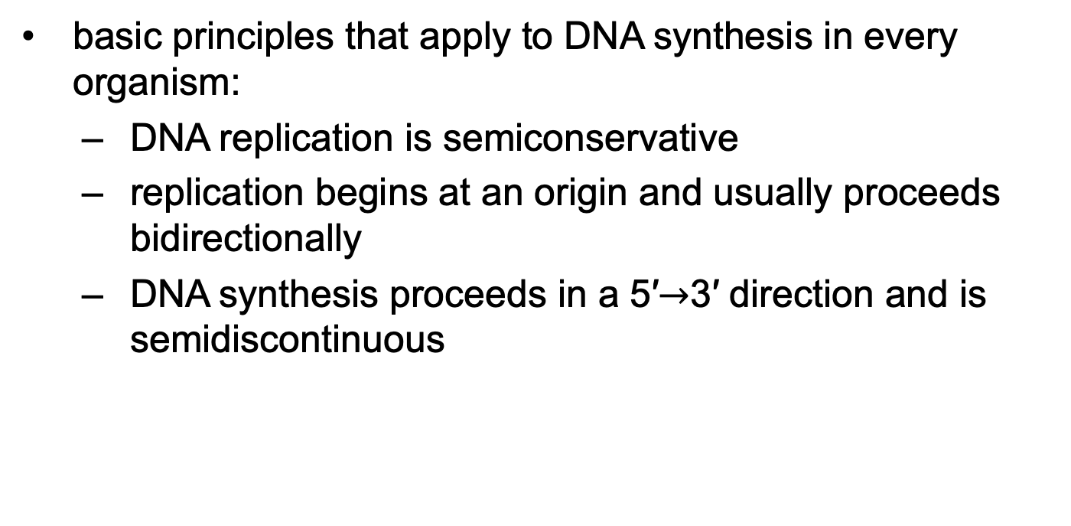
DNA Replication Follows a Set of Fundamental Rules
basic principles that apply to DNA synthesis in every organism:
  DNA replication is semiconservative
  replication begins at an origin and usually proceeds bidirectionally
  DNA synthesis proceeds in a 5′$→$3′ direction and is semidiscontinuous

Slide 14
Principle 1 (3 of 6)
Along with catalysis, biological information is one of the two key prerequisites for life. The faithful maintenance and transmission of genetic information from one generation to another ensures continuity within each species.

Slide 15
DNA Replication
Is Semiconservative
semiconservative replication = each DNA strand serves as a template for the synthesis of a new strand
  produces two new DNA molecules, each with one new strand and one old strand
  established by Meselson and Stahl in 1957

Slide 16
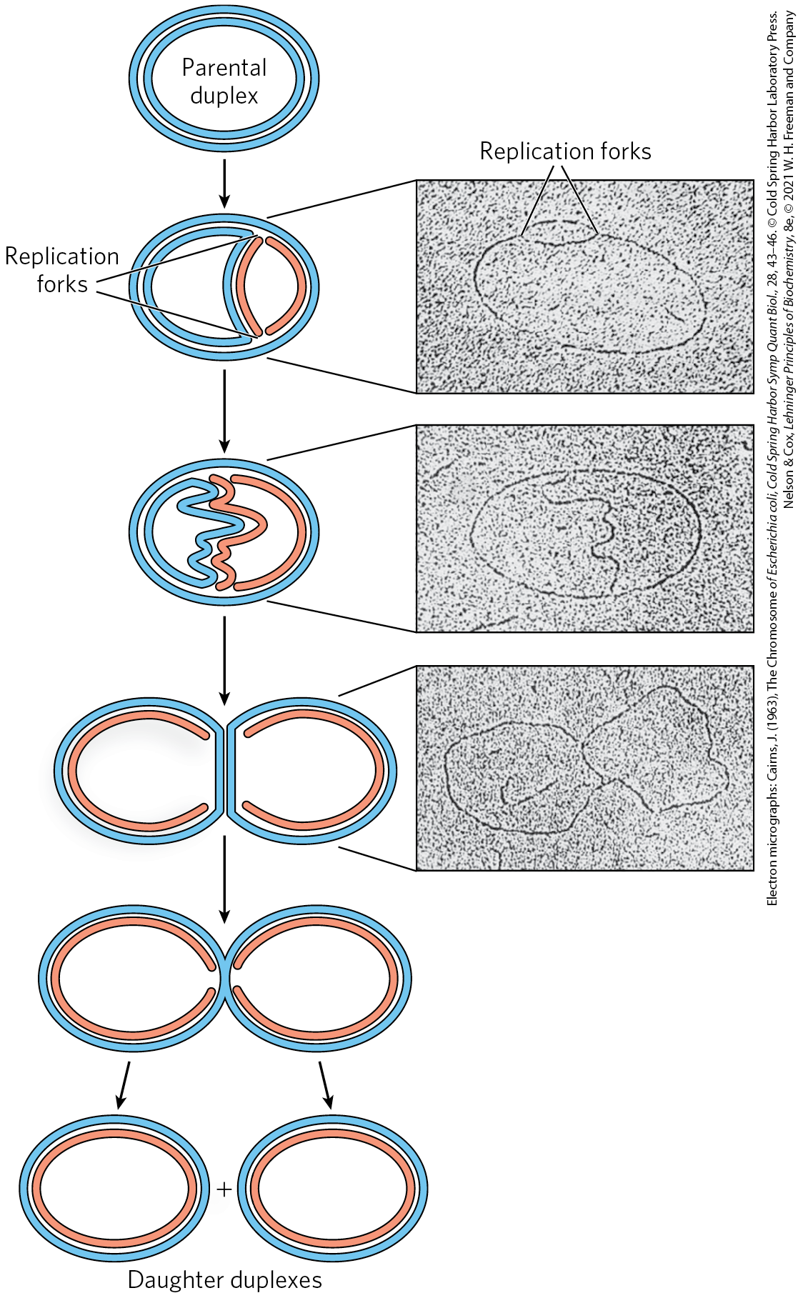
Replication Begins at an Origin and Usually Proceeds Bidirectionally
replication forks = dynamic points where parent DNA is being unwound and separated strands replicated
both DNA strands are replicated simultaneously
both ends of the bacterial chromosome have active replication forks (bidirectional replication)

Slide 17
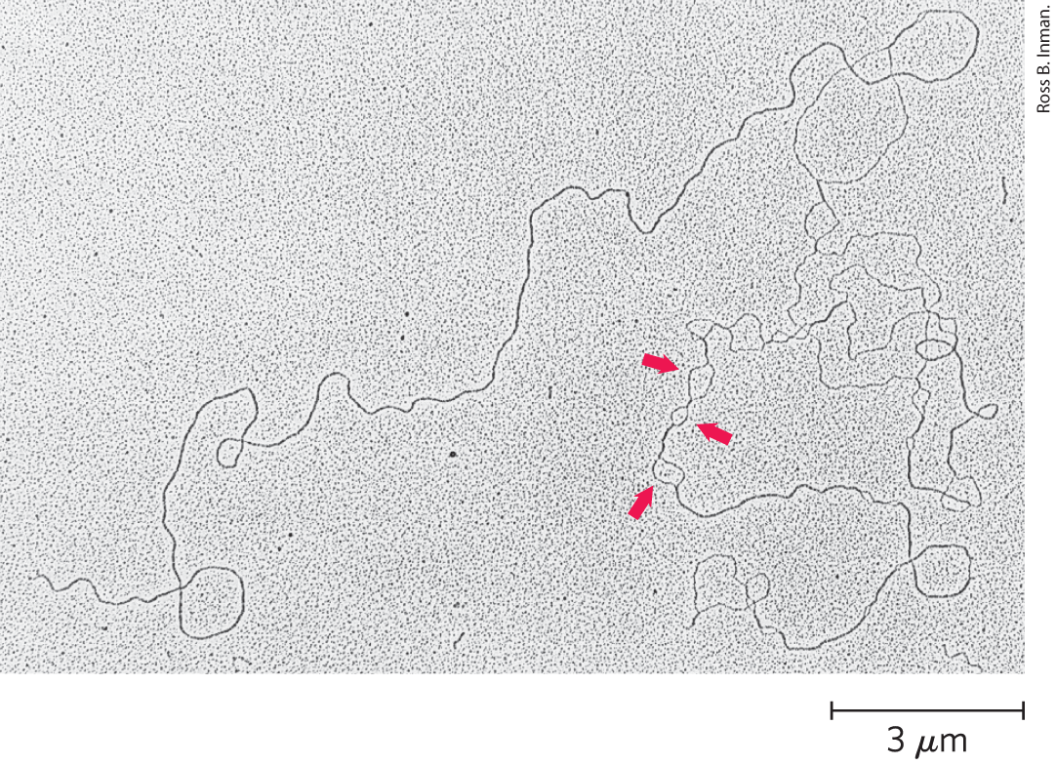
Replication Loops Always Initiate at an Origin
denaturation mapping = selective denaturing of sequences unusually rich in A=T base pairs to provide landmarks along the DNA molecule
  generates a reproducible pattern of single-strand bubbles
origin = location where replication loops are initiated

Slide 18
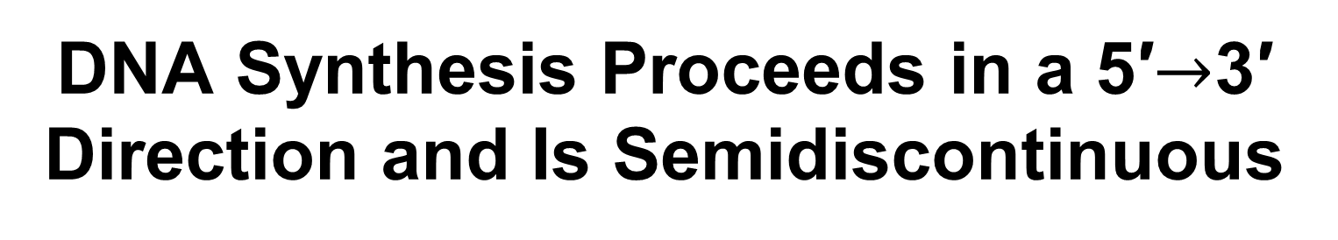
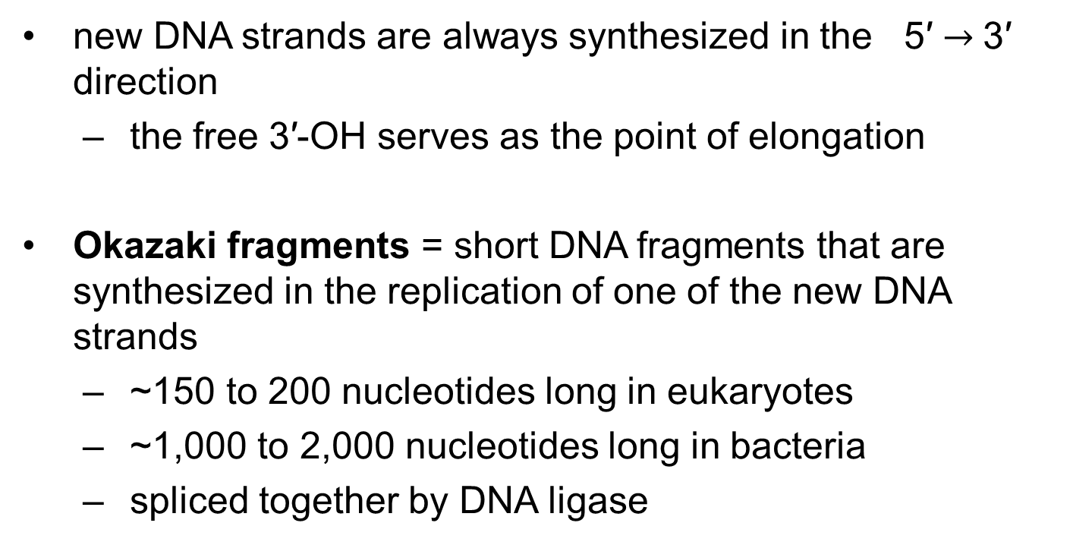
DNA Synthesis Proceeds in a 5′$→$3′ Direction and Is Semidiscontinuous
new DNA strands are always synthesized in the 5′ $→$3′ direction
  the free 3′-OH serves as the point of elongation
Okazaki fragments = short DNA fragments that are synthesized in the replication of one of the new DNA strands
  ~150 to 200 nucleotides long in eukaryotes
  ~1,000 to 2,000 nucleotides long in bacteria
  spliced together by DNA ligase

Slide 19
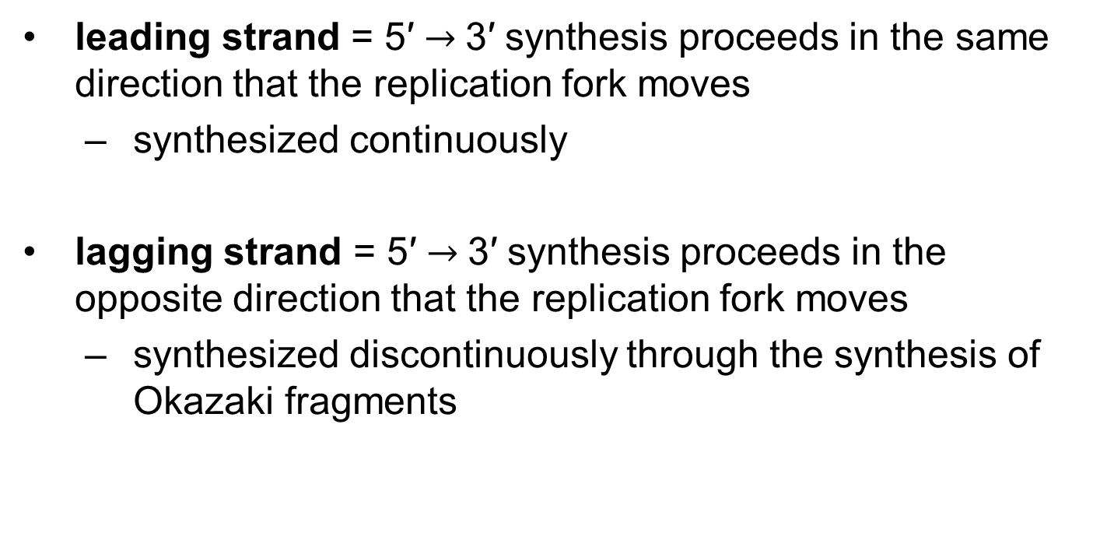
Leading and Lagging Strands
leading strand = 5′ $→$3′ synthesis proceeds in the same direction that the replication fork moves
  synthesized continuously
lagging strand = 5′ $→$3′ synthesis proceeds in the opposite direction that the replication fork moves
  synthesized discontinuously through the synthesis of Okazaki fragments

Slide 20
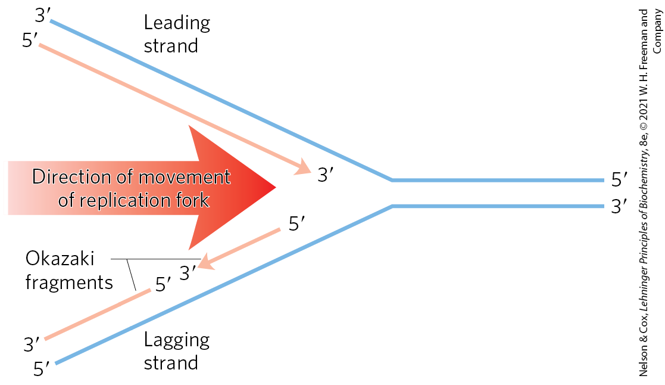
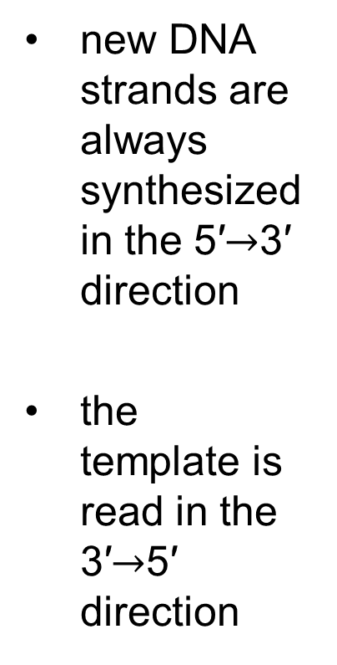
Defining DNA Strands at the Replication Fork
new DNA strands are always synthesized in the 5′$→$3′ direction
the template is read in the 3′$→$5′ direction

Slide 21
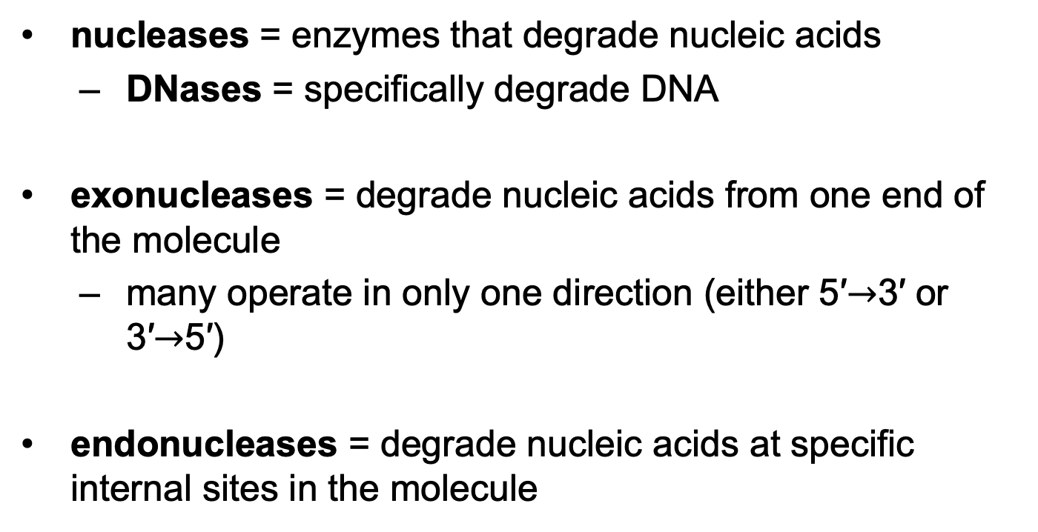
DNA Is Degraded by Nucleases
nucleases = enzymes that degrade nucleic acids
  DNases = specifically degrade DNA
exonucleases = degrade nucleic acids from one end of the molecule
  many operate in only one direction (either 5′$→$3′ or 3′$→$5′)
endonucleases = degrade nucleic acids at specific internal sites in the molecule

Slide 22
DNA Is Synthesized by
DNA Polymerases
DNA polymerase = complex enzymes that can synthesize DNA
  many have additional activities
  E. coli cells have at least 5 DNA polymerases, including DNA polymerase I

Slide 23
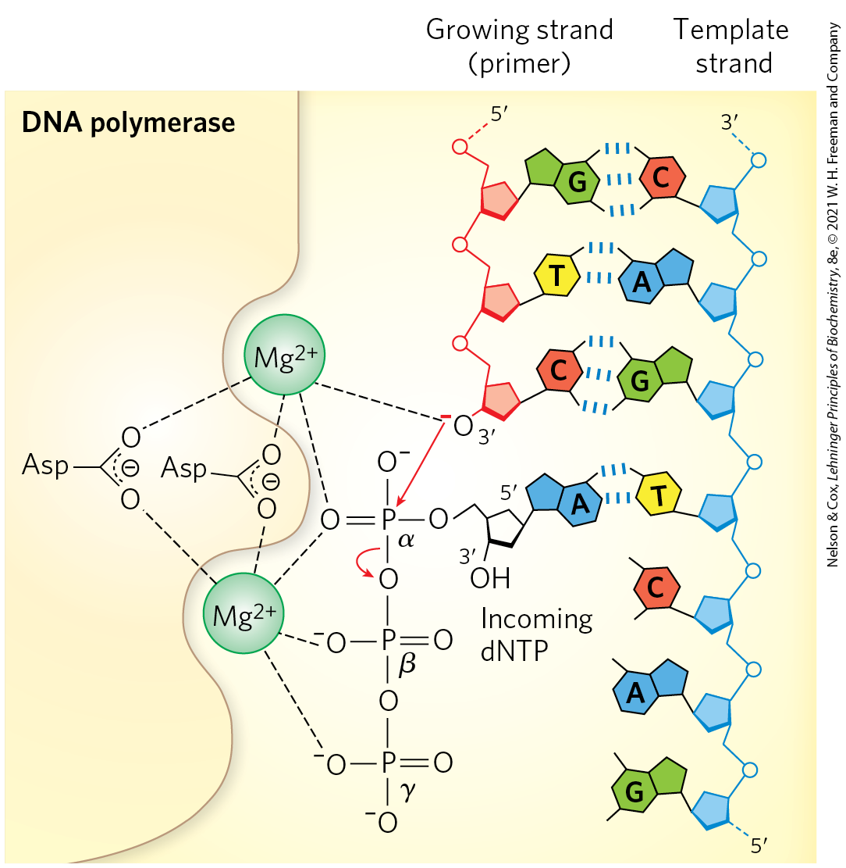
The DNA Polymerase Reaction
the reaction is a phosphoryl group transfer
the 3′-OH of the nucleotide at the 3′ end of the strand (the nucleophile) attacks the α phosphorus of the incoming dNTP

Slide 24
Catalysis by DNA Polymerases Involves Two Mg²⁺ Ions
one Mg²⁺ ion helps deprotonate the 3′-OH group
  makes it a more effective nucleophile
one Mg²⁺ ion binds the incoming dNTP and facilitates departure of PP_{i}

Slide 25
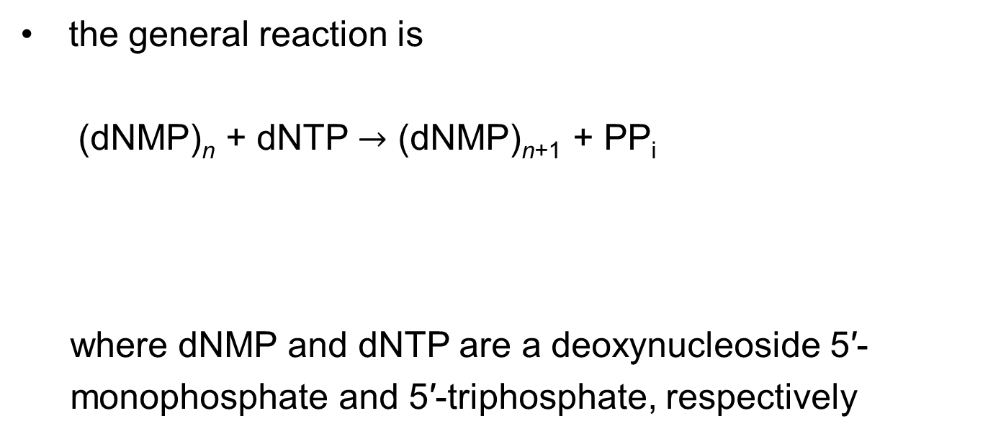
The General DNA Polymerase Reaction
the general reaction is
  (dNMP)_{n} + dNTP $→$ (dNMP)_{n+1} + PP_{i}
where dNMP and dNTP are a deoxynucleoside 5′-
monophosphate and 5′-triphosphate, respectively
(25-1)
lengthened DNA
DNA

Slide 26
Principle 2 (2 of 7)
Information is expensive. The chemistry of joining one nucleotide to the next in DNA replication is elegant and simple, almost deceptively so. However, the enzymatic and thermodynamic commitment to linking one nucleotide to another in DNA far exceeds what would normally be required to successfully form a phosphodiester bond. It is not enough to synthesize a phosphodiester bond; that bond must accurately link two particular nucleotides.

Slide 27
The DNA Polymerase Reaction Proceeds with a Minimal Change in Free Energy
one phosphodiester bond is formed at the expense of a somewhat less stable phosphate anhydride
noncovalent base-stacking and base-pairing interactions stabilize the lengthened DNA product
the formation of products is facilitated by the subsequent hydrolysis of the pyrophosphate

Slide 28
Principle 1 (4 of 6)
Along with catalysis, biological information is one of the two key prerequisites for life. The faithful maintenance and transmission of genetic information from one generation to another ensures continuity within each species.

Slide 29
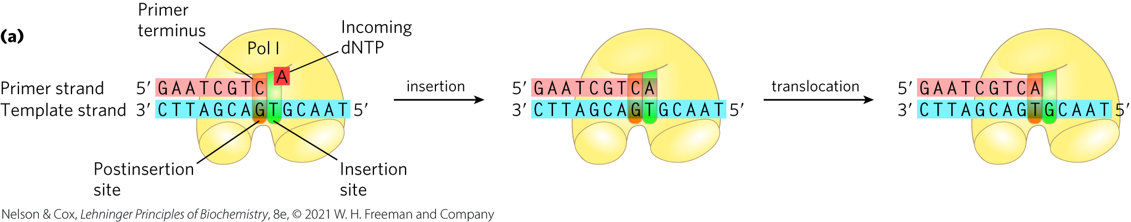
DNA Polymerases Require a Template
polymerization is guided by a template DNA strand according to Watson and Crick base-pairing rules

Slide 30
DNA Polymerases Require a Primer
primer = a strand segment with a free 3′-OH group to which a nucleotide can be added
  must be complementary to the template
  many are RNA oligonucleotides
primer terminus = the free 3′ end of the primer

Slide 31
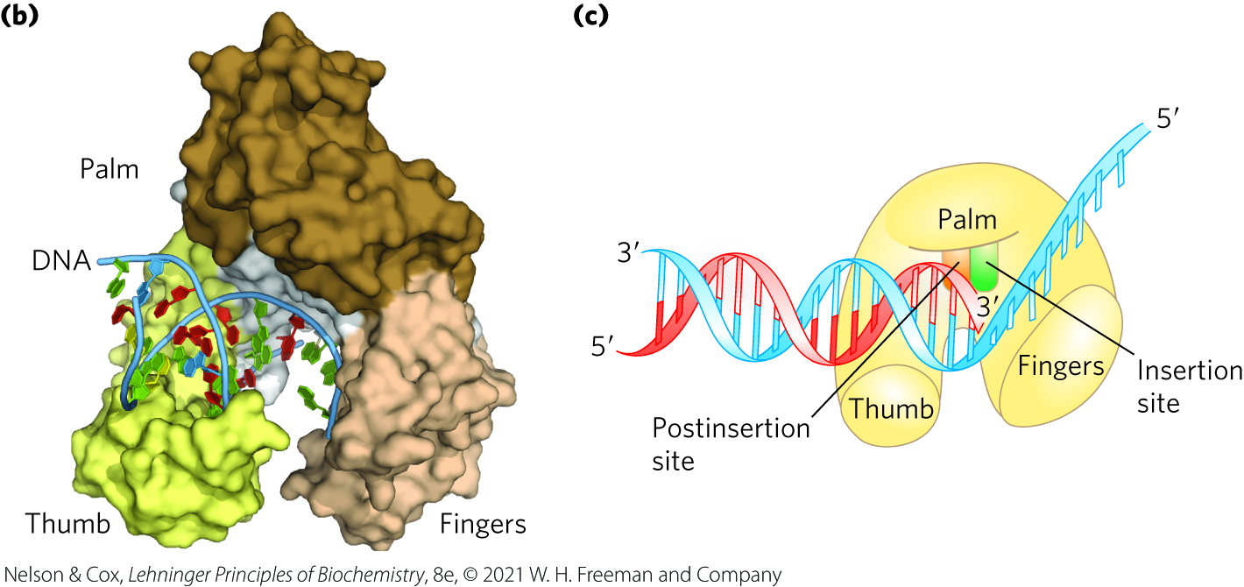
The DNA Polymerase Active Site Has Two Parts
insertion site = the portion of the active site where the incoming nucleotide binds
postinsertion site = the portion of the active site where the new base pair resides when the polymerase slides forward

Slide 32
The Processivity of
DNA Polymerases
processivity = the average number of nucleotides added before a polymerase dissociates
DNA polymerases vary greatly in processivity.
  ranges from a few nucleotides to many thousand

Slide 33
Replication is Very Accurate
errors in E. coli occur every 1 in 10⁹ to 1 in 10¹⁰ nucleotides added
  equates to an error only once per 1,000 to 10,000 replications
the active site of DNA polymerase excludes base pairs with the incorrect geometry
DNA polymerases insert one incorrect nucleotide for every 10⁴ to 10⁵ correct nucleotides
  may occur because a base is in a tautomeric form

Slide 34
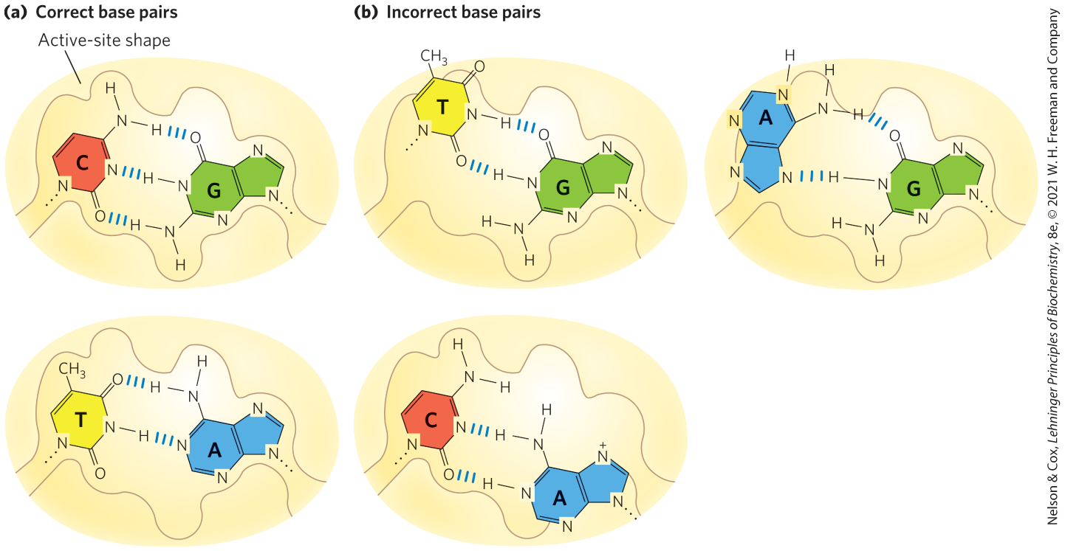
Contribution of Base-Pair Geometry to the Fidelity of DNA Replication

Slide 35
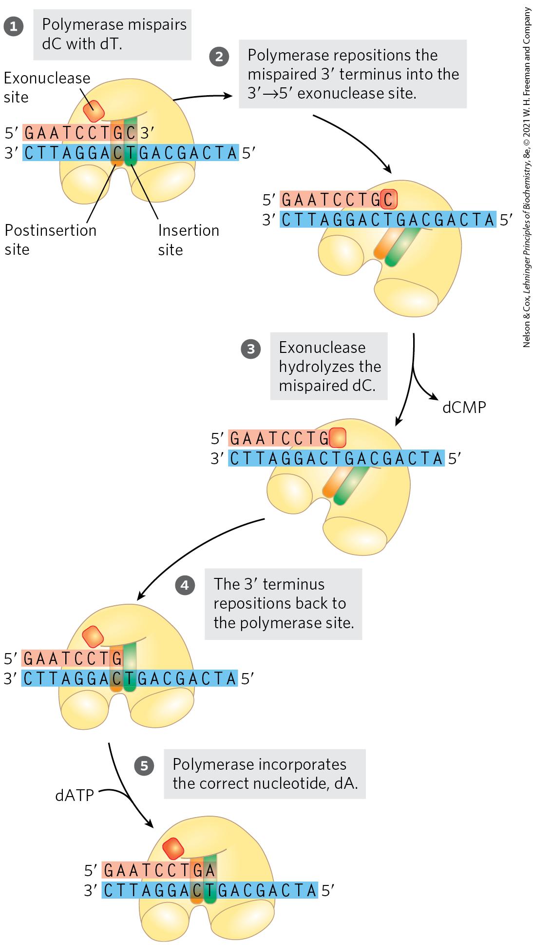
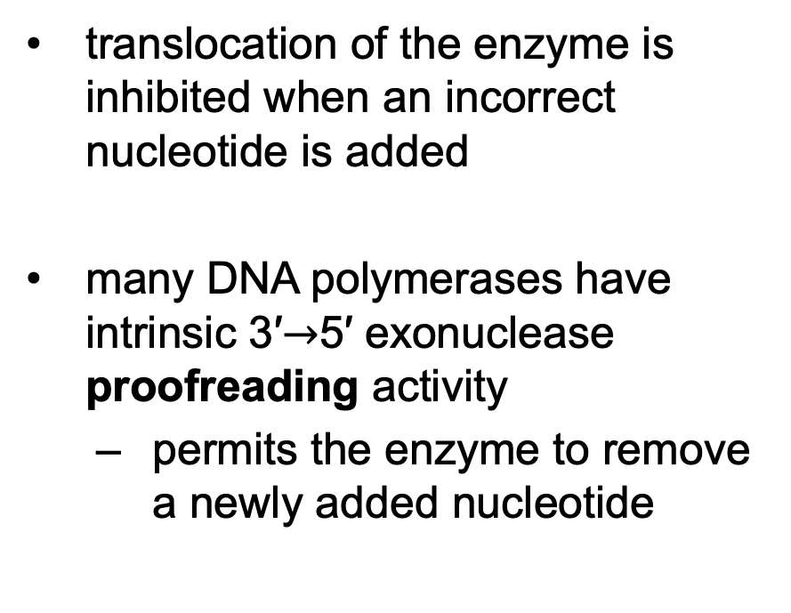
Error Correction by DNA
Polymerase I
translocation of the enzyme is inhibited when an incorrect nucleotide is added
many DNA polymerases have intrinsic 3′$→$5′ exonuclease proofreading activity
  permits the enzyme to remove a newly added nucleotide

Slide 36
Principle 2 (3 of 7)
Information is expensive. The chemistry of joining one nucleotide to the next in DNA replication is elegant and simple, almost deceptively so. However, the enzymatic and thermodynamic commitment to linking one nucleotide to another in DNA far exceeds what would normally be required to successfully form a phosphodiester bond. It is not enough to synthesize a phosphodiester bond; that bond must accurately link two particular nucleotides.

Slide 37
Proofreading is Energetically Expensive
proofreading = DNA polymerase activity that involves replacement of the incorrect nucleotide
  requires the expenditure of three high-energy bonds

Slide 38
Principle 3 (2 of 7)
The fidelity of genome maintenance and transmission is not perfect. DNA damage happens, often by spontaneous processes. DNA replication and repair deal with the vast majority of DNA lesions, providing a high degree of genetic fidelity and stability. The few DNA damage events that slip through uncorrected provide fuel for evolution.

Slide 39
Accuracy After Base Selection and Proofreading
proofreading improves the accuracy 10² - to 10³-fold
one error in every 10⁶ to 10⁸ bases remains after base selection and proofreading
  the higher measured accuracy of E. coli replication comes from mismatch repair

Slide 40
E. Coli Has at Least Five
DNA Polymerases
DNA polymerase I is abundant, but insufficient for replication of the E. coli chromosome
  rate (600 nucleotides/min) is slower than observed for replication fork movement
  low processivity
the primary function of DNA polymerase I is cleanup during replication, recombination, and repair

Slide 41
DNA Polymerase II, III, IV, and V
DNA polymerase II = involved in DNA repair
DNA polymerase III = the principal replication enzyme in E. coli
DNA polymerases IV and V = involved in an unusual form of DNA repair

Slide 42
Comparison of the Five DNA Polymerases of E. coli
Table 25-1 Comparison of the Five DNA Polymerases of E.coli
 | DNA polymerase I | DNA polymerase II | DNA polymerase III | DNA polymerase IV | DNA polymerase V
Structural gene^{b} | polA | polB | polC (dnaE) | dinB | umuC
Subunits (number of different types) | 1 | 7 | 9 | 1 | 3
M_{r} | 103,000 | 88,000^{c} | 1,065,400 | 39,100 | 110,000
3′→5′ exonuclease (proofreading) | Yes | Yes | Yes | No | No
5′→3′ exonuclease | Yes | No | No | No | No
Polymerization rate (nucleotides/s) | 10–20 | 40 | 250–1,000 | 2–3 | 1
Processivity (nucleotides added before polymerase dissociates) | 3–200 | 1,500 | ≥500,000 | 1 | 6–8

Slide 43
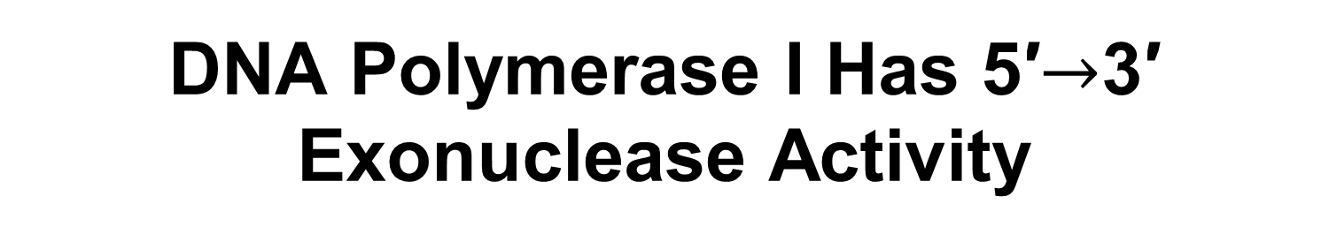
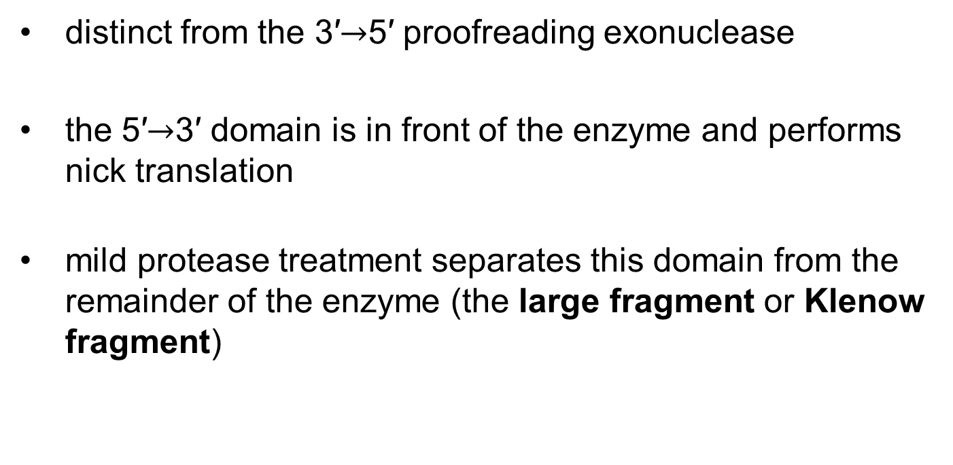
DNA Polymerase I Has 5′$→$3′ Exonuclease Activity
distinct from the 3′$→$5′ proofreading exonuclease
the 5′$→$3′ domain is in front of the enzyme and performs nick translation
mild protease treatment separates this domain from the remainder of the enzyme (the large fragment or Klenow fragment)

Slide 44
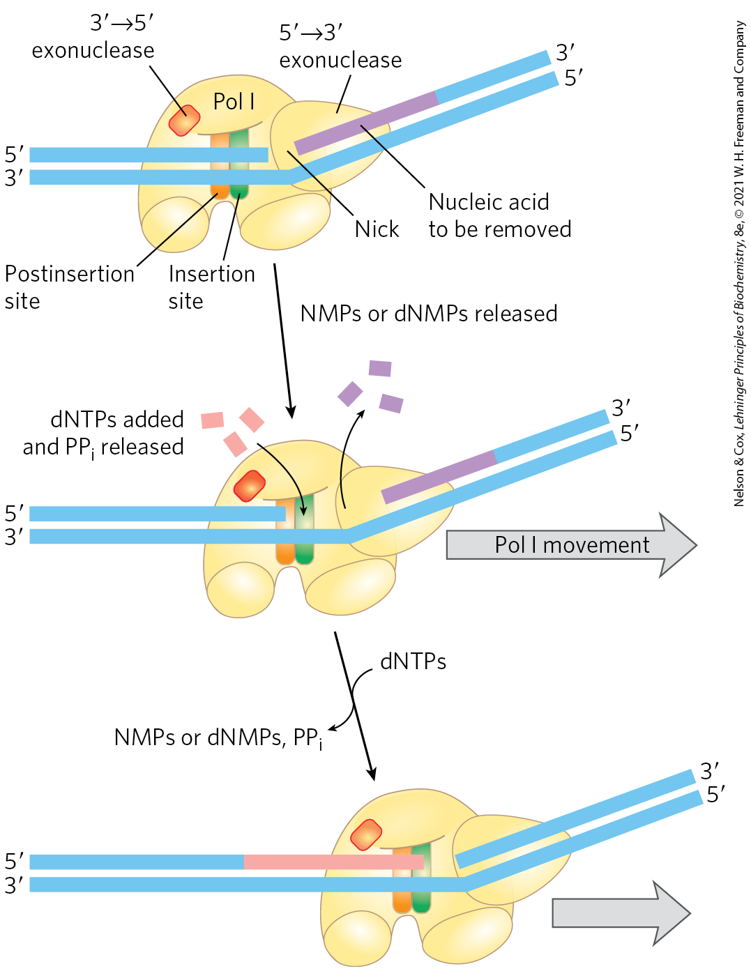
Nick Translation
nick translation = a break or nick in the DNA is moved along with the enzyme
important in:
  DNA repair
  the removal of RNA primers during replication

Slide 45
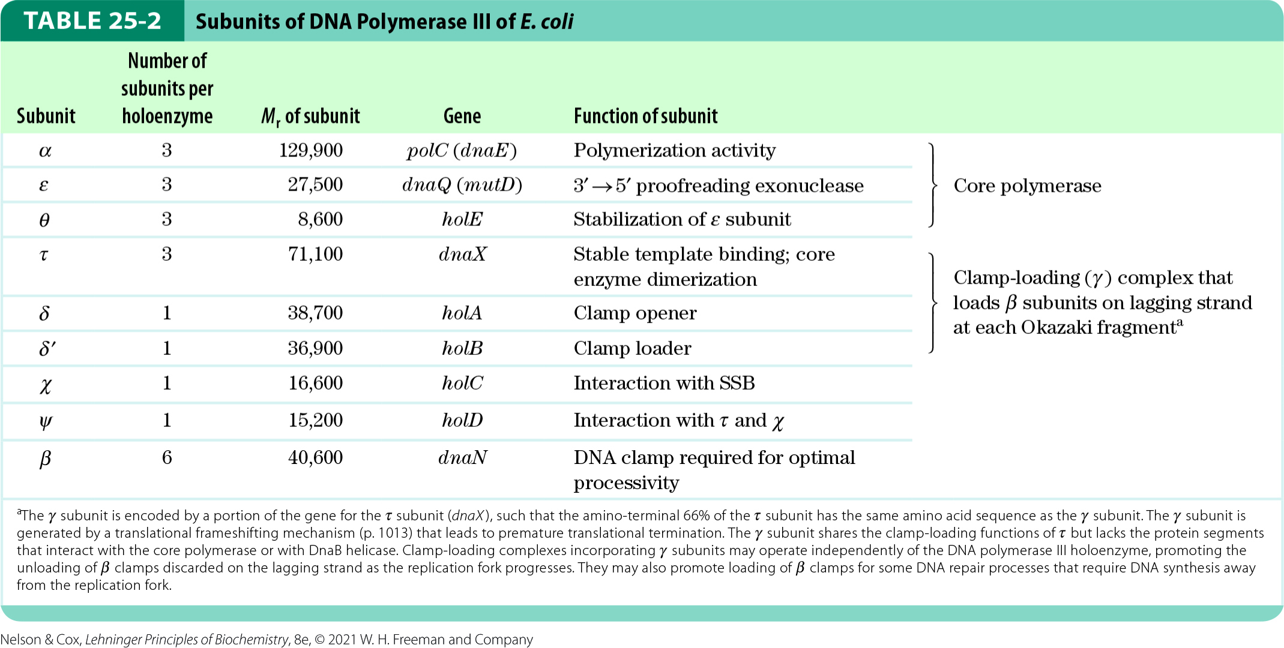
Subunits of DNA Polymerase III of
E. coli

Slide 46
Subunits of DNA Polymerase III* in E. coli
α subunit = contains polymerization activity
ε subunit = contains proofreading activity
θ subunit associates with α and ε subunits to form a core polymerase
  can polymerize DNA but with limited processivity
  up to three core polymerases are linked by a clamp-loading complex (τ₃δδ′)
χ and ψ bind to the clamp-loading complex

Slide 47
β Subunits Converts DNA Polymerase III* to DNA Polymerase III Holoenzyme
DNA polymerase III* = the entire assembly of 16 protein subunits (eight different types)
β subunits = provide an increase in processivity by preventing dissociation of DNA polymerase III from DNA
  one dimer of β subunits associates with each active core subassembly
  addition of β subunits converts DNA polymerase III* to DNA polymerase III holoenzyme

Slide 48
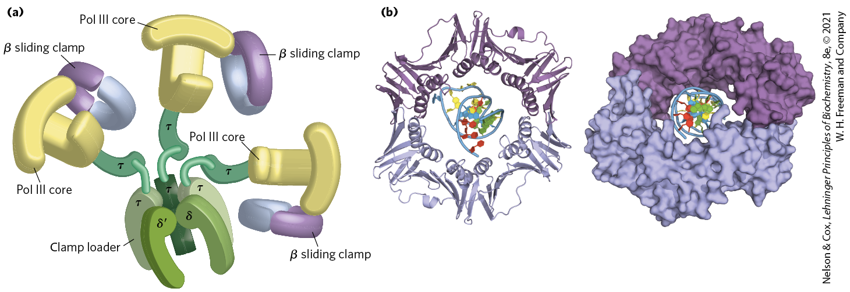
DNA Polymerase III

Slide 49
DNA Replication Requires Many
Enzymes and Protein Factors
DNA replicase system (replisome) = the entire complex of enzymes and proteins required for replication in E. coli
  consists of 20+ different enzymes and proteins

Slide 50
Principle 2 (4 of 7)
Information is expensive. The chemistry of joining one nucleotide to the next in DNA replication is elegant and simple, almost deceptively so. However, the enzymatic and thermodynamic commitment to linking one nucleotide to another in DNA far exceeds what would normally be required to successfully form a phosphodiester bond. It is not enough to synthesize a phosphodiester bond; that bond must accurately link two particular nucleotides.

Slide 51
Main Classes of
Replication Enzymes
helicases = enzymes that move along the DNA and separate the strands
  requires chemical energy from ATP
topoisomerases = relieve topological stress created by strand separation
DNA-binding proteins = stabilize separated strands
primases = synthesize short segments of RNA to serve as primers

Slide 52
Main Classes of Replication Enzymes, Continued
DNA polymerase I = removes and replaces RNA primers
RNase H1 = a specialized nuclease that degrades RNA in RNA-DNA hybrids
  can remove RNA primers
DNA ligases = seals nicks in the DNA backbone following removal and replacement of an RNA primer

Slide 53
Replication of the E. coli Chromosome Proceeds in Stages
DNA synthesis can be divided into three stages:
  initiation
  elongation
  termination

Slide 54
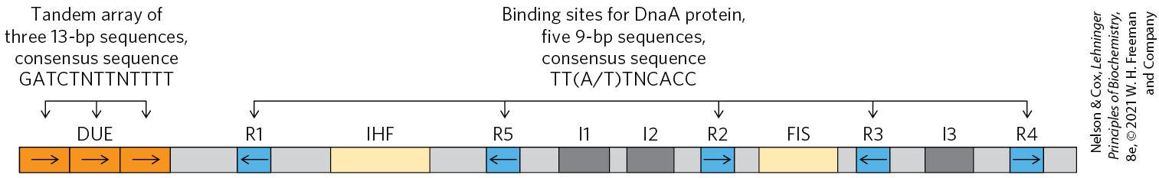
Initiation
the E. coli replication origin (oriC) consists of:
  five repeats of a 9 bp sequence (R sites) that serve as binding sites for the key initiator protein, DnaA
  the DNA unwinding element (DUE) = a region rich in A=T base pairs
  three additional DnaA-binding sites (I sites)
  binding sites for the proteins IHF (integration host factor) and FIS (factor for inversion stimulation)

Slide 55
Proteins Required to Initiation Replication at the E. coli Origin
Table 25-3 Proteins Required to Initiate Replication at the E.coli Origin
Protein | M_{r} | Number of subunits | Function
DnaA protein | 52,000 | 1 | Recognizes oriC sequence; opens duplex at specific sites in origin
DnaB protein (helicase) | 300,000 | 6 | Unwinds DNA
DnaC protein | 174,000 | 6 | Required for DnaB binding at origin
HU | 19,000 | 2 | Histonelike protein; DNA-binding protein; stimulates initiation
FIS | 22,500 | 2 | DNA-binding protein; stimulates initiation
IHF | 22,000 | 2 | DNA-binding protein; stimulates initiation
Primase (DnaG protein) | 60,000 | 1 | Synthesizes RNA primers
Single-stranded DNA–binding protein (SSB) | 75,600 | 4 | Binds single-stranded DNA
DNA gyrase (DNA topoisomerase II) | 400,000 | 4 | Relieves torsional strain generated by DNA unwinding
Dam methylase | 32,000 | 1 | Methylates (5′)GATC sequences at oriC

Slide 56
The AAA+ ATPase Protein Family
AAA+ ATPase protein family (ATPases associated with diverse cellular activities) = proteins that form oligomers and hydrolyze ATP relatively slowly
  ATP hydrolysis mediates interconversion of the protein between two states

Slide 57
The DnaA Protein
DnaA protein = a crucial component in the initiation process
  a member of the AAA+ ATPase family
  active when ATP is bound and inactive when ADP is bound

Slide 58
DnaA Proteins Bind at R and I Sites in oriC
eight ATP-bound DnaA molecules bind to the R and I sites in oriC
strand separation in the A=T-rich DUE occurs due to:
  strain due to positive supercoiling
  binding of DnaA to the DUE region

Slide 59
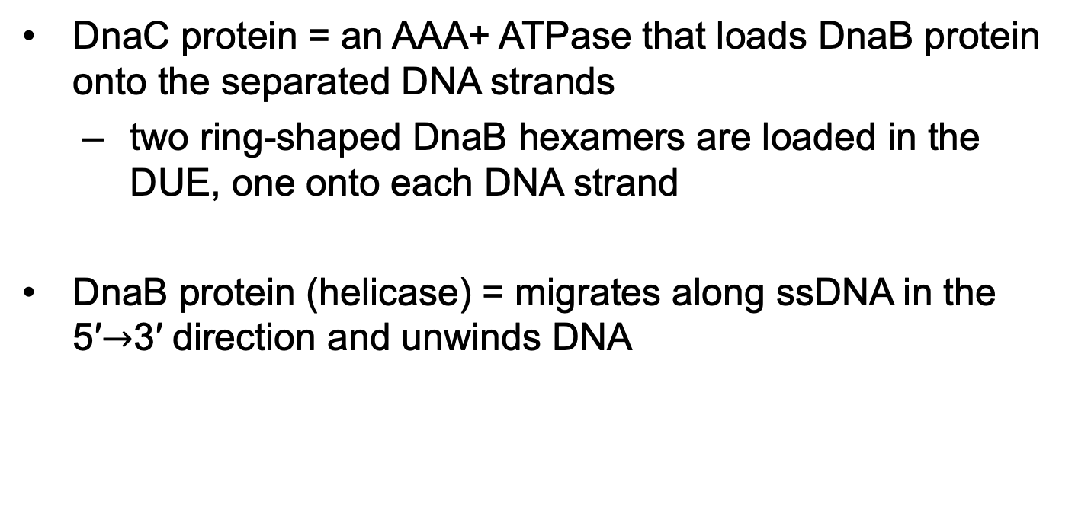
Loading of the DnaB Helicase
DnaC protein = an AAA+ ATPase that loads DnaB protein onto the separated DNA strands
  two ring-shaped DnaB hexamers are loaded in the DUE, one onto each DNA strand
DnaB protein (helicase) = migrates along ssDNA in the 5′$→$3′ direction and unwinds DNA

Slide 60
The Role of SSB and DNA Gyrase in Initiation
single-stranded DNA-binding protein (SSB) stabilizes separated strands
DNA gyrase relieves topological stress ahead of the replication forks

Slide 61
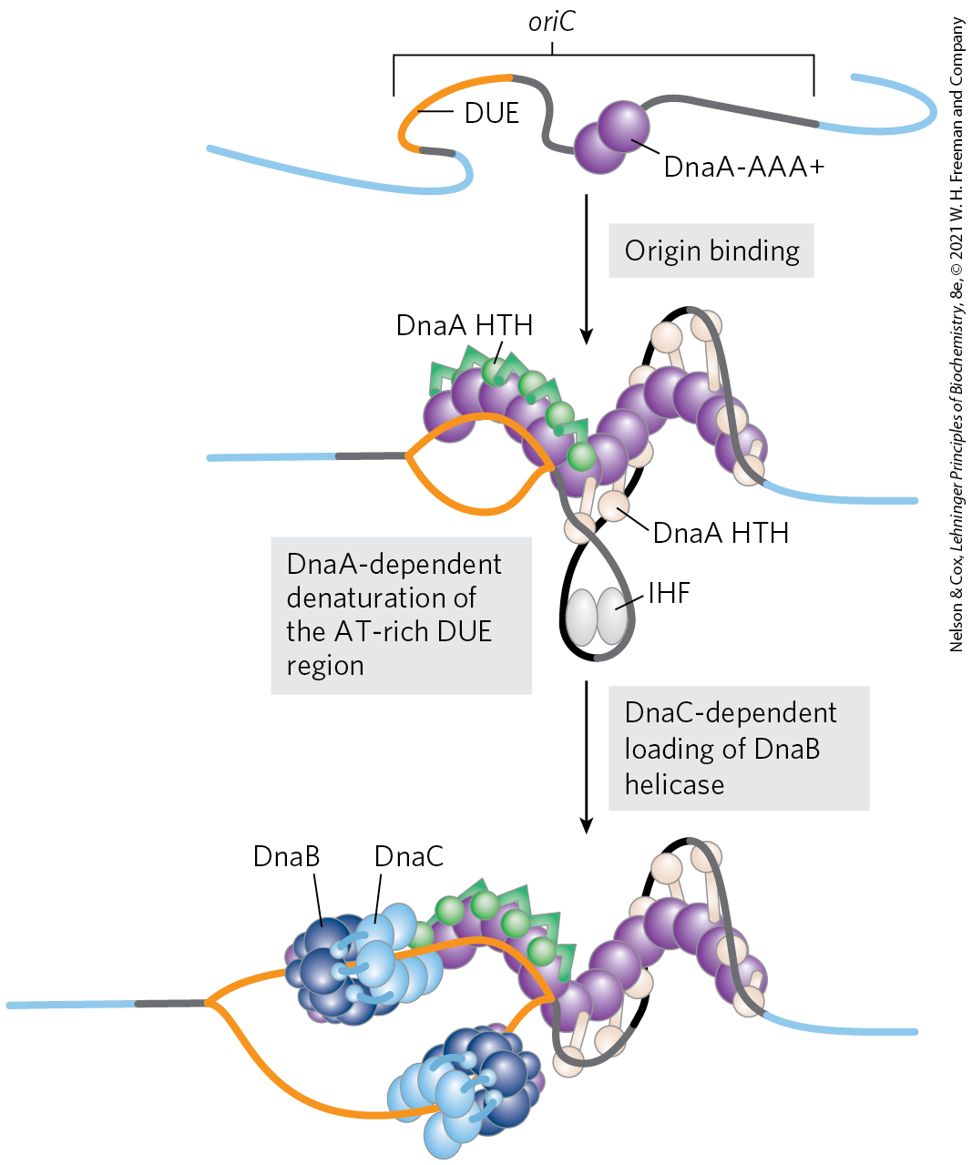
Model for Initiation of Replication

Slide 62
Initiation Occurs Only Once in Each Cell Cycle
Hda protein = an AAA+ ATPase that binds to the β subunits of DNA polymerase III and stimulates hydrolysis of the ATP bound to DnaA
  causes disassembly of the DnaA complex
  homologous to DnaA
release of ADP by DnaA and rebinding of ATP occurs on a time scale of 20 to 40 minutes

Slide 63
Regulation of Replication Initiation via Methylation
Dam (DNA adenine methylation) methylase = methylates the N⁶ position of adenine within the palindromic sequence (5′)GATC of oriC DNA
hemimethylated oriC sequences are sequestered by:
  interaction with the plasma membrane
  binding of the protein SeqA
after SeqA dissociation, oriC sequences are released from the membrane and Dam methylase fully methylates DNA to allow new DnaA to bind

Slide 64
Elongation
elongation includes:
  leading strand synthesis
  lagging strand synthesis

Slide 65
Elongation of the Leading Strand
the more straightforward of the two strands
primase (DnaG) synthesizes a short (10 to 60 nucleotide) RNA primer at the replication origin
  requires interaction with DnaB helicase
  primase and DnaB move in opposite directions
DNA polymerase III adds nucleotides to the 3′ of the primer
  linked to the DnaB tethered to the opposite DNA strand

Slide 66
Elongation of the Lagging Strand
accomplished in short Okazaki fragments
as in leading strand synthesis, primase synthesizes an RNA primer and DNA Pol III adds nucleotides to the 3′ end
DNA of the lagging strand loops around so one asymmetric DNA Pol III dimer complex can synthesize both strands

Slide 67
Leading and Lagging Strand Synthesis by DNA Polymerase III
DNA polymerase III uses one set of its core subunits to synthesize the leading strand continuously
the other two sets of core subunits cycle from one Okazaki fragment to the next on the looped lagging strand

Slide 68
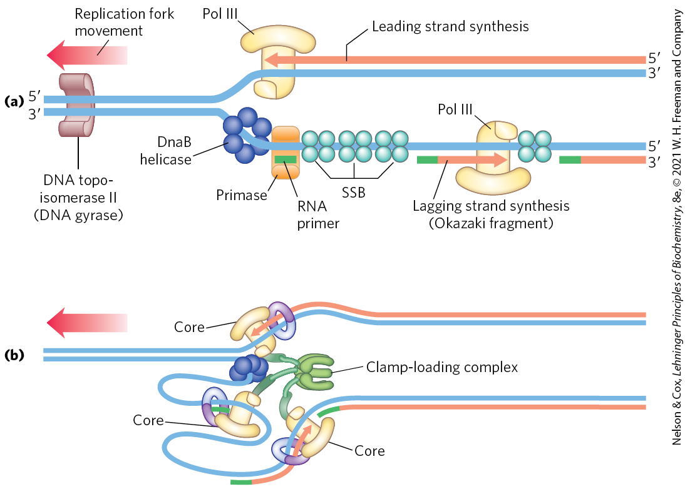
Synthesis of Okazaki Fragments

Slide 69
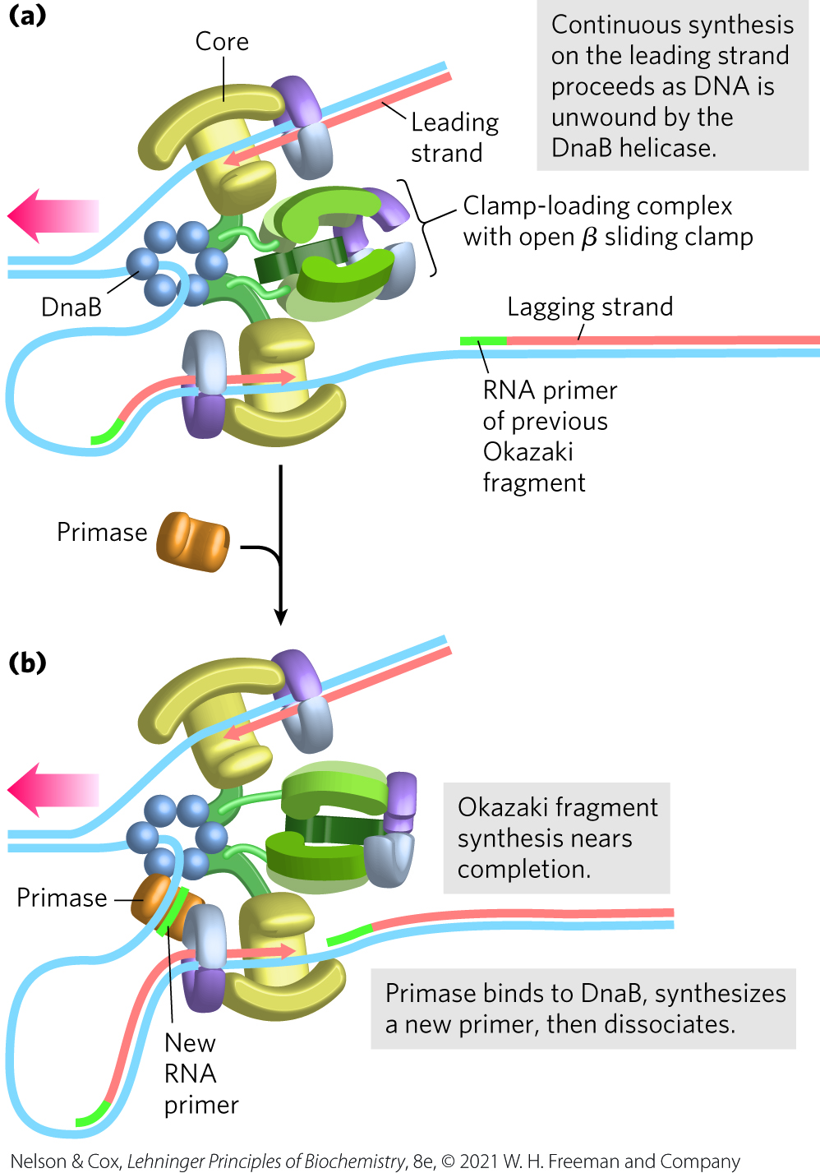
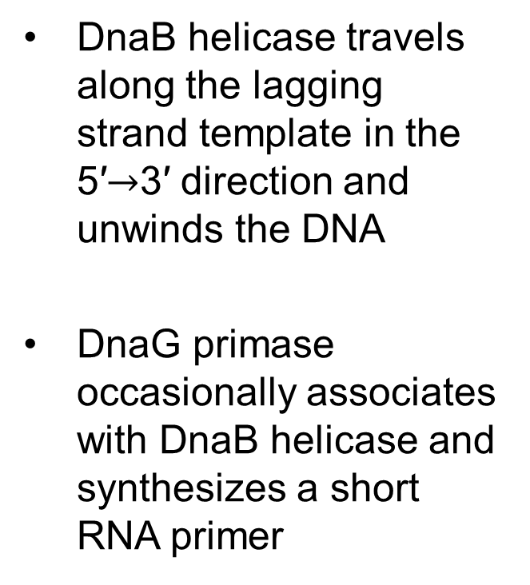
Leading and Lagging Strand Synthesis, Part 1
DnaB helicase travels along the lagging strand template in the 5′$→$3′ direction and unwinds the DNA
DnaG primase occasionally associates with DnaB helicase and synthesizes a short RNA primer

Slide 70
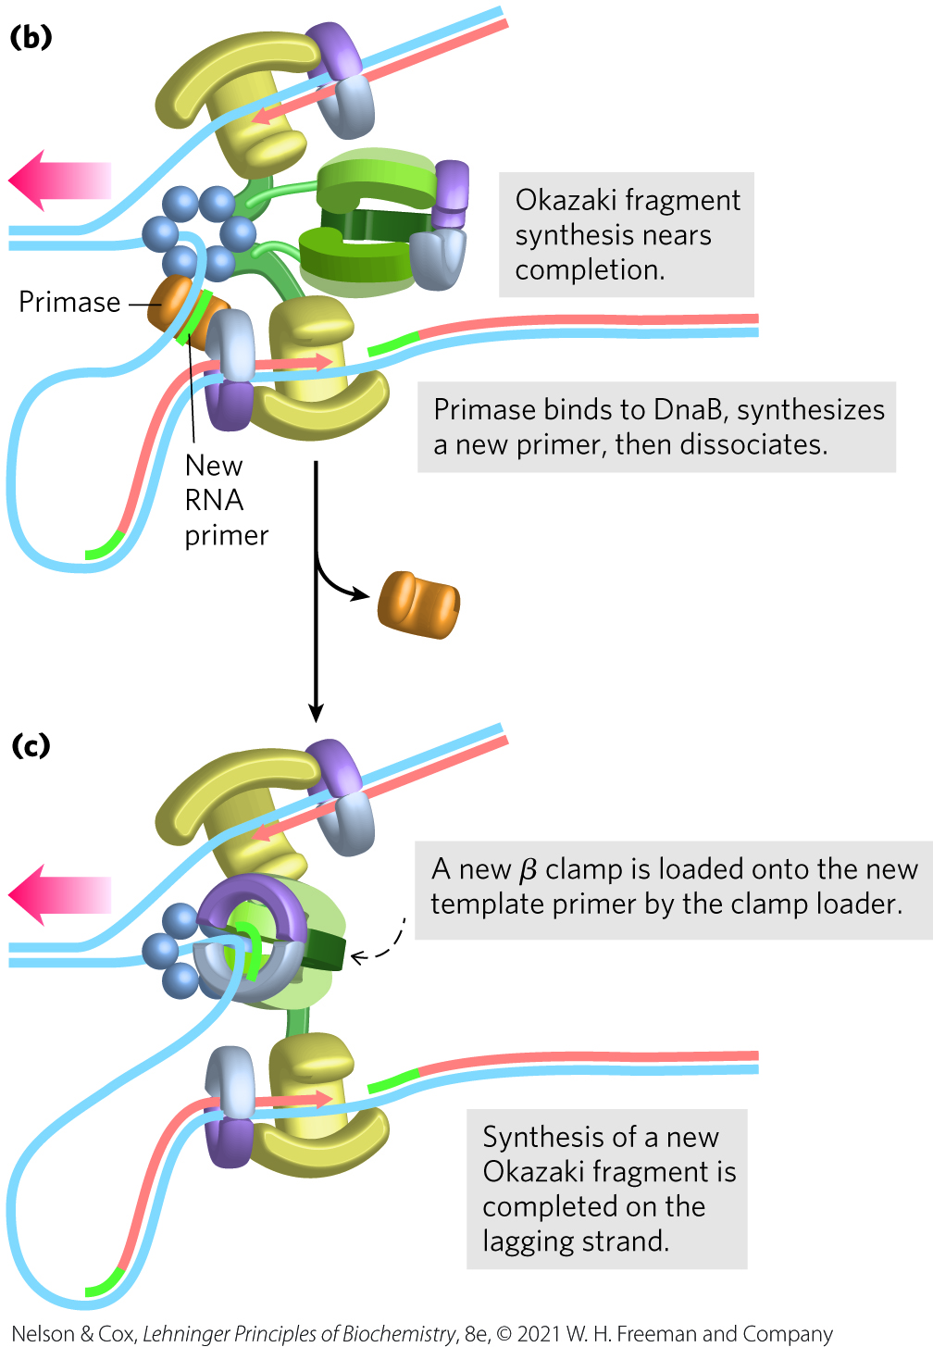
Leading and Lagging Strand Synthesis, Part 2
a new β sliding clamp is positioned at the primer by the clamp-loading complex of DNA polymerase III

Slide 71
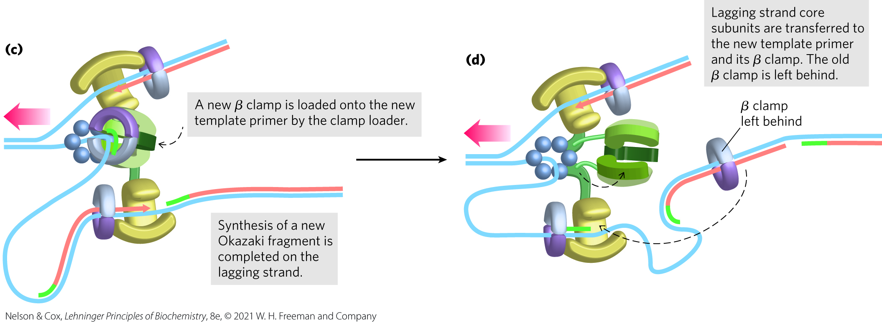
Leading and Lagging Strand Synthesis, Part 3
replication halts after synthesis of an Okazaki fragment is completed and DNA polymerase III core subunits dissociate from the β sliding clamp

Slide 72
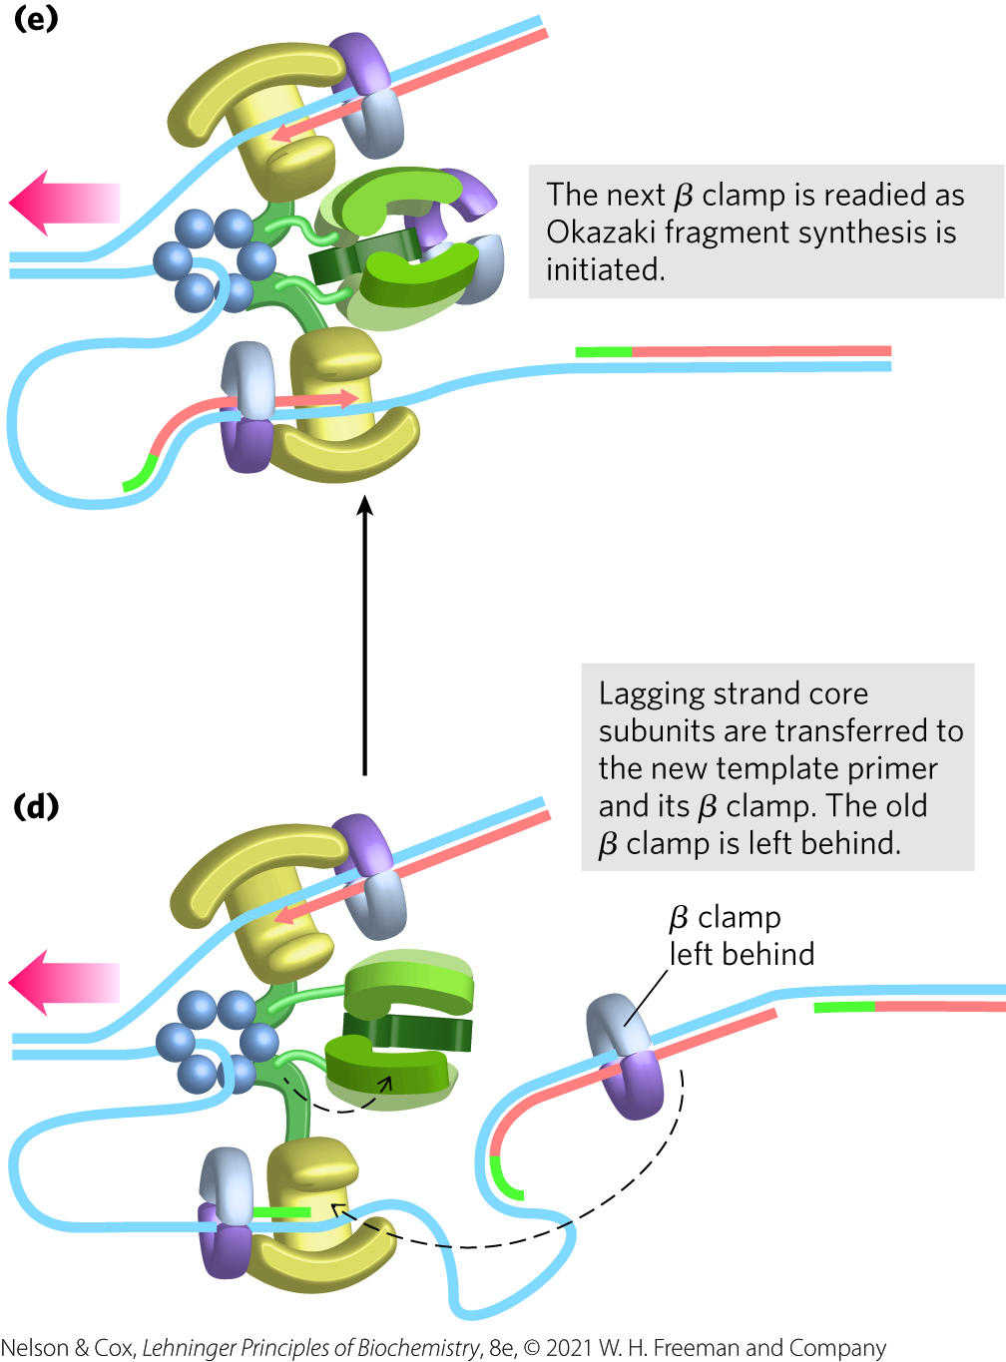
Leading and Lagging Strand Synthesis, Part 4
DNA polymerase III core subunits associate with a new β sliding clamp
  initiates synthesis of a new Okazaki fragment

Slide 73
Proteins Acting at the
Replication Fork
Table 25-4 Proteins of the E.coli Replisome
Protein | M_{r} | Number of subunits | Function
SSB | 75,600 | 4 | Binding to single-stranded DNA
Helicase (DnaB protein) | 300,000 | 6 | DNA unwinding
Primase (DnaG protein) | 60,000 | 1 | RNA primer synthesis
DNA polymerase III | 1,065,400 | 17 | New strand elongation
DNA polymerase I | 103,000 | 1 | Filling of gaps; excision of primers
DNA ligase | 74,000 | 1 | Ligation
DNA gyrase (DNA topoisomerase II) | 400,000 | 4 | Supercoiling

Slide 74
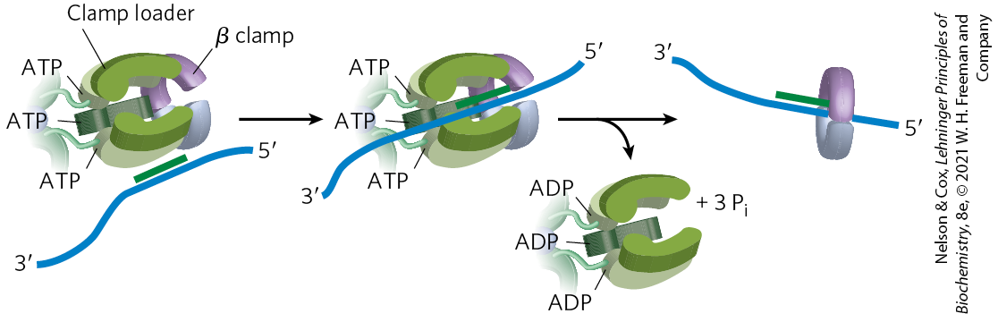
The DNA Polymerase III
Clamp Loader
clamp-loading complex = and AAA+ ATPase that binds ATP and the new β sliding clamp
  consists of parts of the three τ subunits along with the δ and δ′ subunits
  ATP binding opens the ring at one subunit interface
  ATP hydrolysis closes the clamp around the DNA

Slide 75
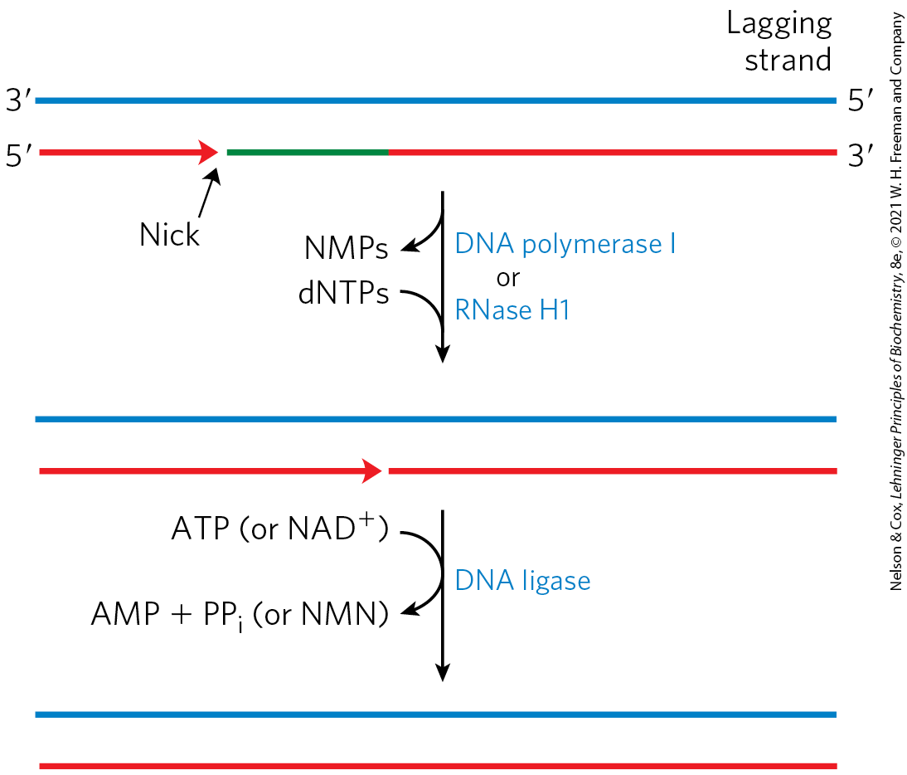
The Final Steps in Lagging Strand Synthesis
DNA polymerase I or RNase H1 = removes the RNA primer and replaces it with DNA
DNA ligase = seals the remaining nick

Slide 76
DNA Ligase
DNA ligase = catalyzes the formation of a phosphodiester bond between a 3′-OH at the end of one DNA strand and a 5′ phosphate at the end of another strand
  the phosphate must be activated by adenylylation using ATP (virus and eukaryotes) or NAD⁺ (bacteria)

Slide 77
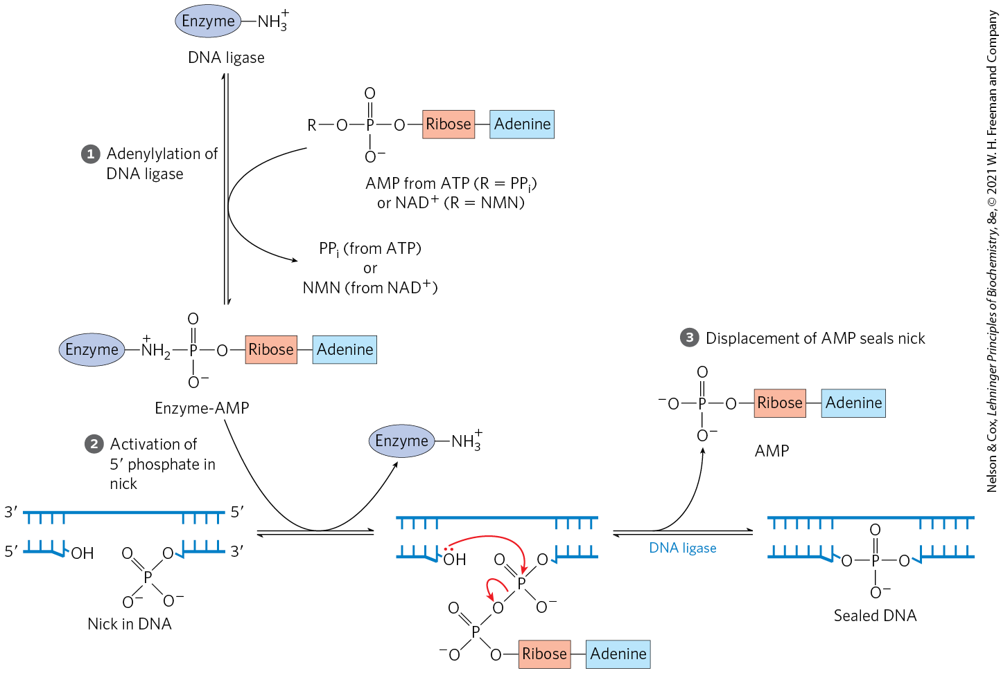
The DNA Ligase Mechanism

Slide 78
Termination
replication forks meet at a region with multiple copies of a 20-bp sequence called Ter
Ter sequences are found near each other, but in opposite directions
  creates a site that replication forks cannot leave
Ter is also a binding site for the protein Tus (terminus utilization sequence)
  causes a replication fork to stop

Slide 79
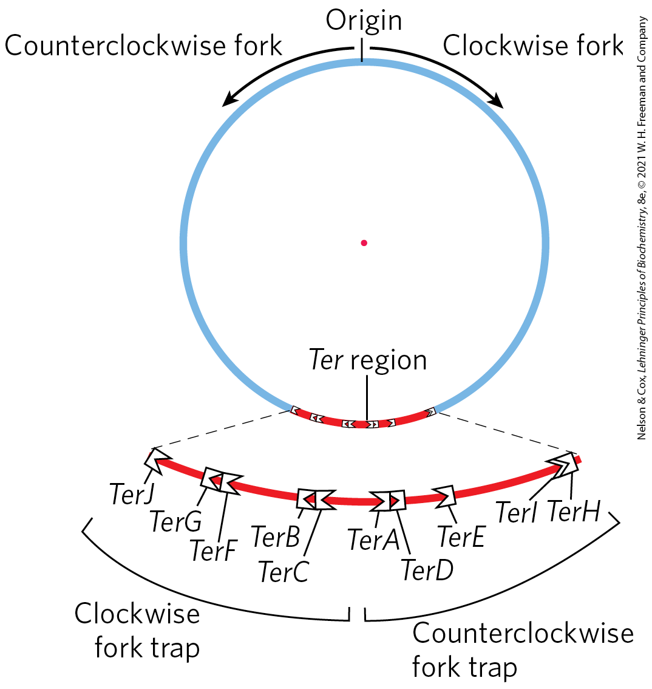
Termination of Chromosome Replication in E. coli
only one Tus-Ter complex functions per replication cycle

Slide 80
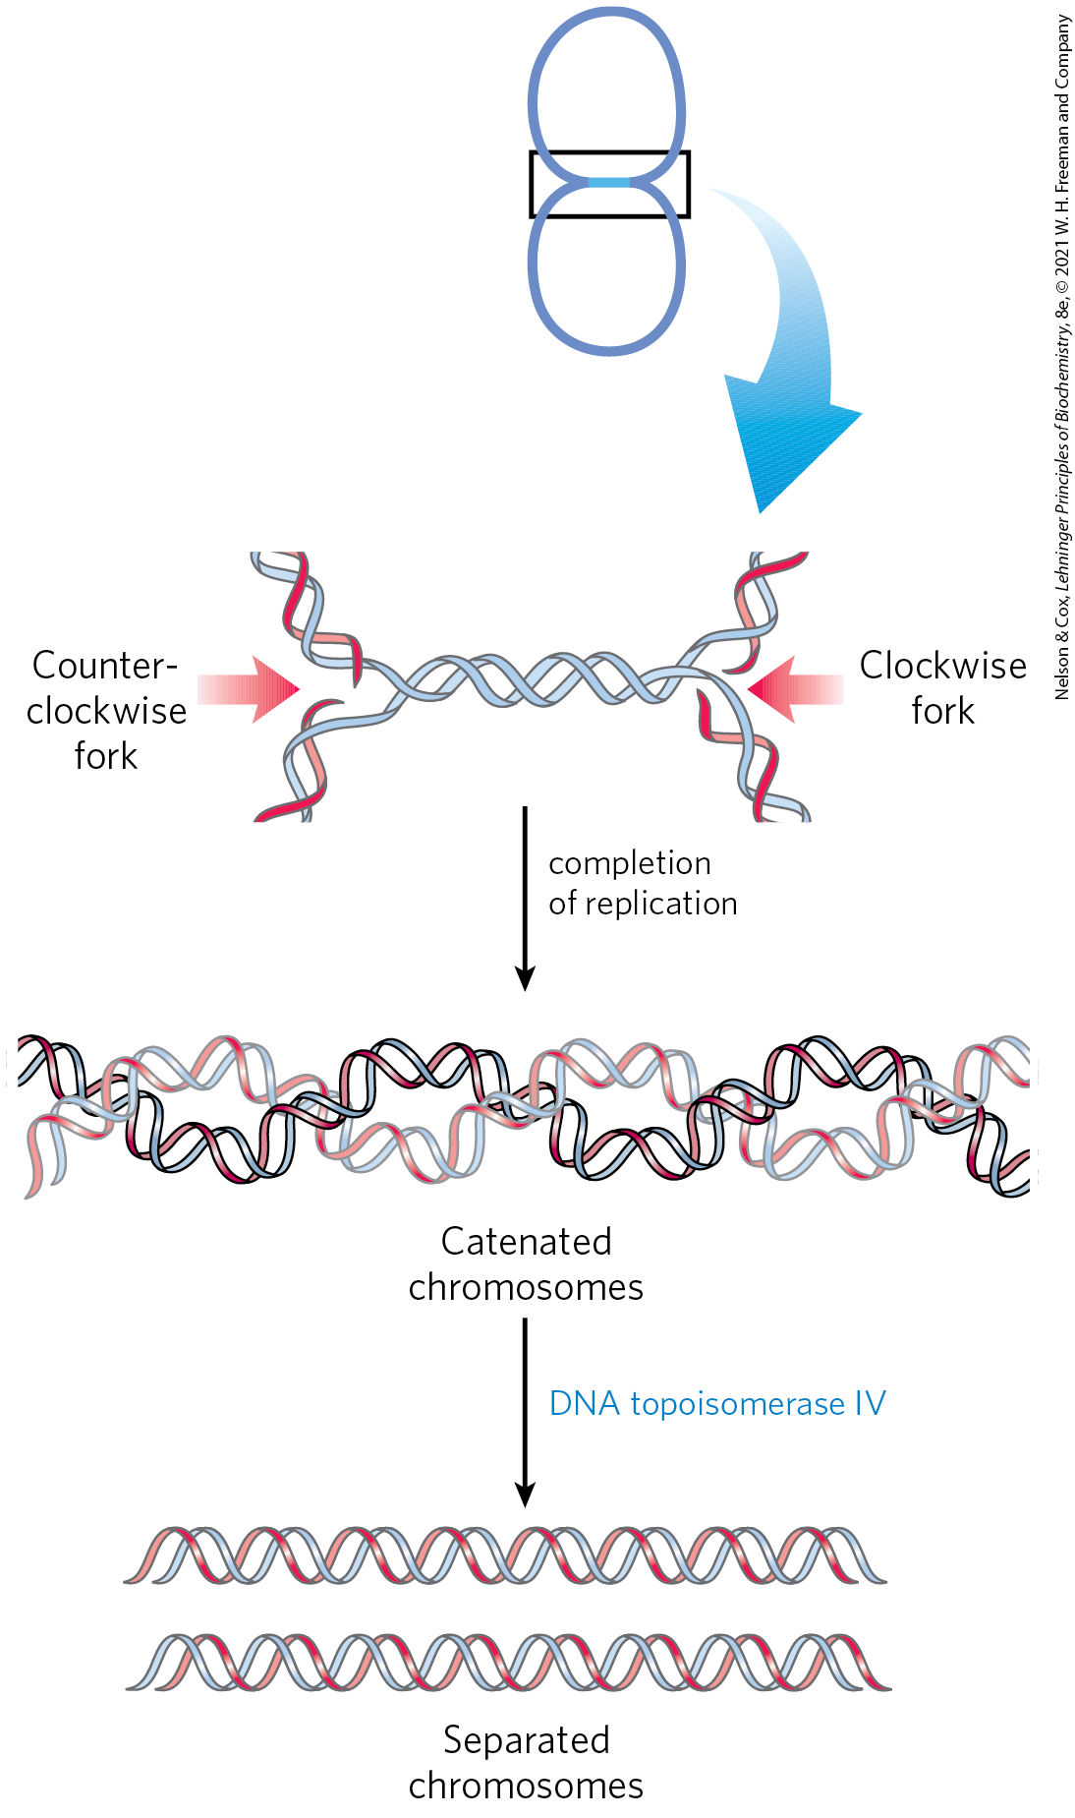
Separation of Catenanes by Topoisomerase IV
catenanes = two topologically interlinked circular chromosomes
separation of the catenated circles in E. coli requires topoisomerase IV (a type II topoisomerase)

Slide 81
Replication in Eukaryotic Cells Is Similar but More Complex
replicators = yeast (S. cerevisiae) replication origins
  also called autonomously replicating sequences (ARSs)
  yeast have ~400 replicators
  each spans ∼150 bp and contains several essential, conserved sequences
human chromosomes have ~30,000 to 50,000 replication origins

Slide 82
Regulation Ensures Cellular DNA Is Replicated Once Per Cell Cycle
regulation involves cyclins and the cyclin-dependent kinases (CDKs)
  cyclins undergo ubiquitin-dependent proteolysis at the end of the M phase (mitosis)
prereplicative complexes (pre-RCs) = established on replication initiation sites in the absence of cyclins
  their formation (sometimes called licensing) renders the cell competent for replication

Slide 83
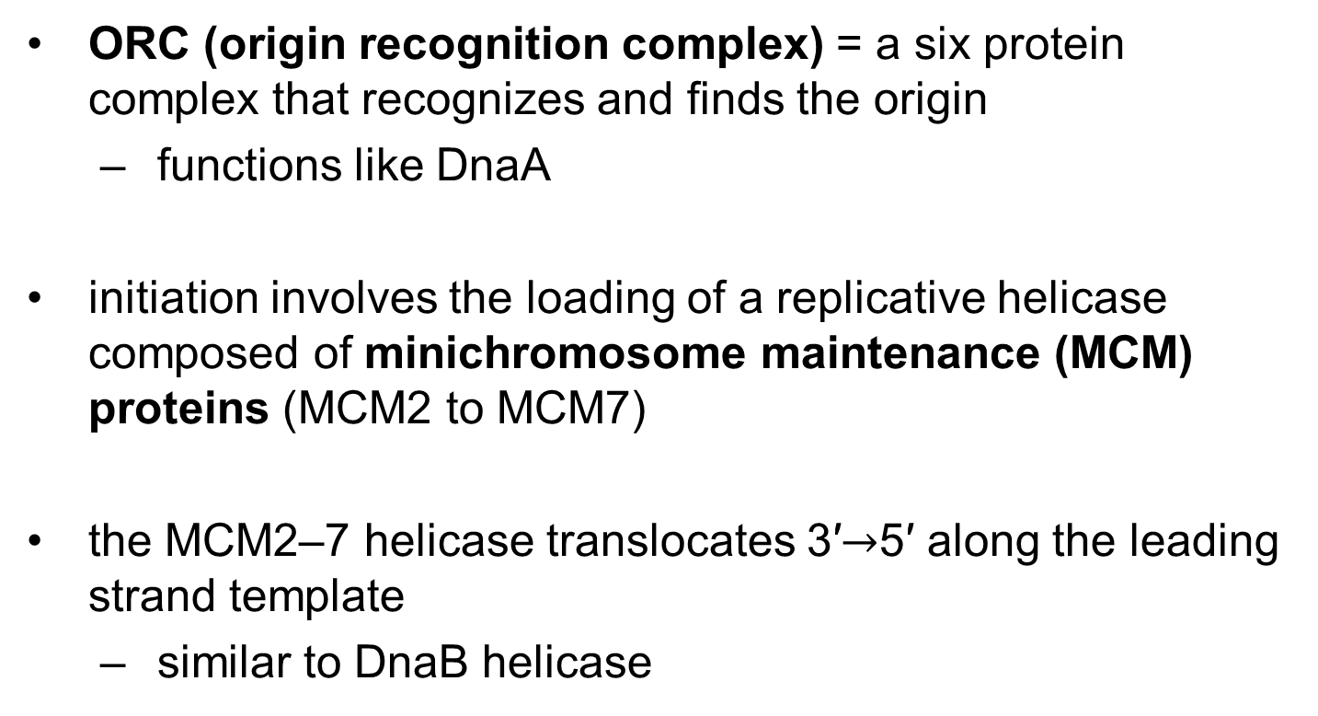
Initiation of Replication in Eukaryotes
ORC (origin recognition complex) = a six protein complex that recognizes and finds the origin
  functions like DnaA
initiation involves the loading of a replicative helicase composed of minichromosome maintenance (MCM) proteins (MCM2 to MCM7)
the MCM2–7 helicase translocates 3′$→$5′ along the leading strand template
  similar to DnaB helicase

Slide 84
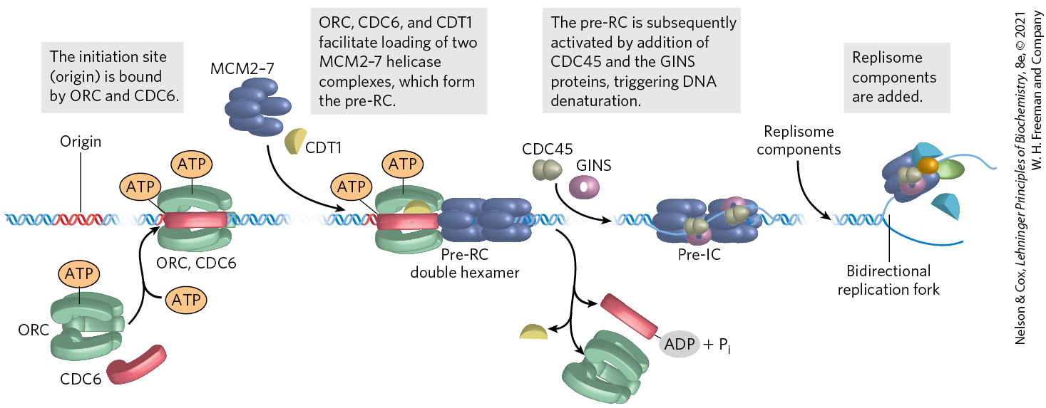
Assembly of a Prereplicative Complex at a Eukaryotic Replication Origin

Slide 85
Eukaryotic Rate of Replication
the replication fork moves ~50 nucleotides/second
  ~1/20th the rate seen in E. coli
eukaryotes compensate for the slower rate by having many origins

Slide 86
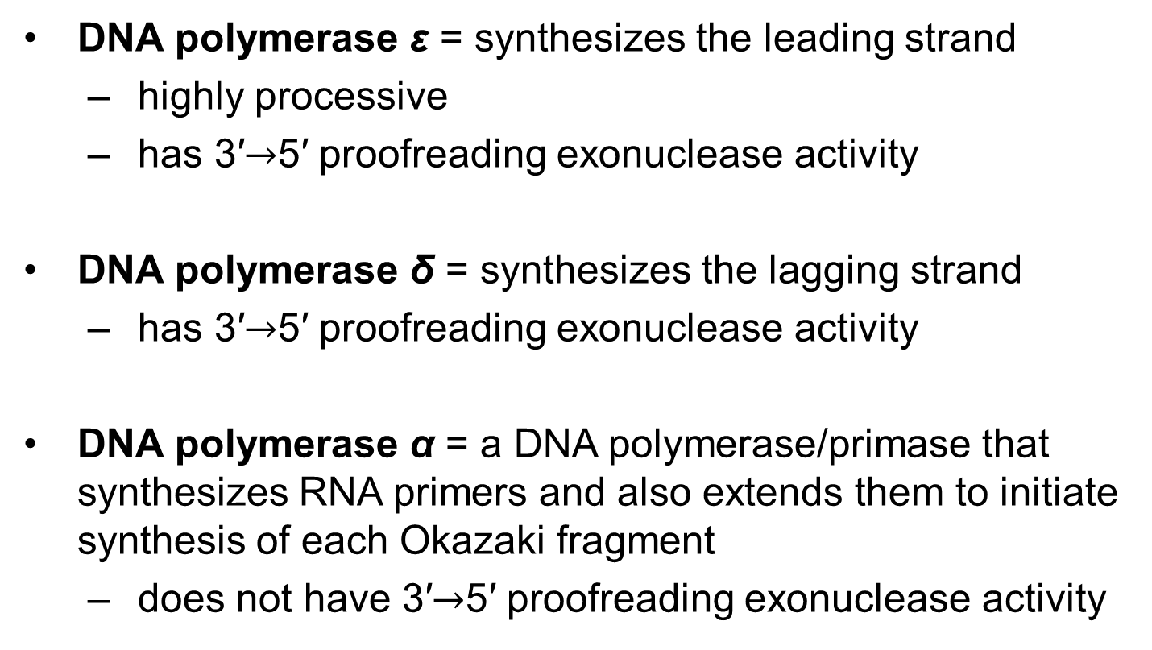
Eukaryotes Have Several Types of DNA Polymerases
DNA polymerase ε = synthesizes the leading strand
  highly processive
  has 3′$→$5′ proofreading exonuclease activity
DNA polymerase δ = synthesizes the lagging strand
  has 3′$→$5′ proofreading exonuclease activity
DNA polymerase α = a DNA polymerase/primase that synthesizes RNA primers and also extends them to initiate synthesis of each Okazaki fragment
  does not have 3′$→$5′ proofreading exonuclease activity

Slide 87
Function of PCNA
proliferating cell nuclear antigen (PCNA) = a protein that forms a circular clamp to enhance the processivity of two polymerases
  analogous function to the β subunit

Slide 88
Functions of RPA and RFC
RPA (replication protein A) = single-stranded DNA-binding protein
  equivalent in function to the E. coli SSB protein
RFC (replication factor C) = a clamp loader for PCNA that facilitates the assembly of active replication complexes
  significant sequence similarity to the subunits of the bacterial clamp-loading (γ) complex

Slide 89
Termination of
Eukaryotic Replication
termination occurs when replication forks operating from nearby origins converge

Slide 90
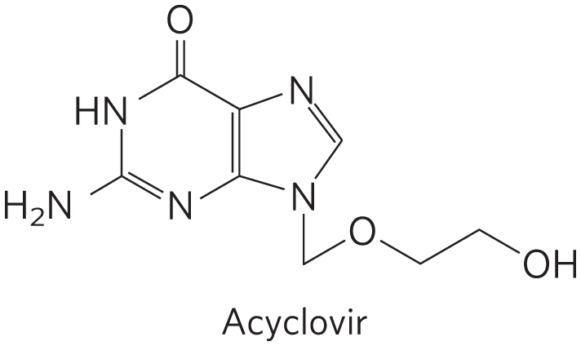
Viral DNA Polymerases Provide Targets for Antiviral Therapy
acyclovir = inhibits the DNA polymerase of the herpes simplex virus
  converted to acyclo-GTP
acyclo-GTP competitively inhibits viral DNA polymerases and terminates replication

Slide 91
25.2 DNA Repair

Slide 92
Principle 1 (5 of 6)
Along with catalysis, biological information is one of the two key prerequisites for life. The faithful maintenance and transmission of genetic information from one generation to another ensures continuity within each species.

Slide 93
DNA Molecules Are Irreplaceable
damaged proteins and RNA molecules can be replaced using information encoded in the DNA
DNA molecules themselves are irreplaceable

Slide 94
Principle 3 (3 of 7)
The fidelity of genome maintenance and transmission is not perfect. DNA damage happens, often by spontaneous processes. DNA replication and repair deal with the vast majority of DNA lesions, providing a high degree of genetic fidelity and stability. The few DNA damage events that slip through uncorrected provide fuel for evolution.

Slide 95
Mutations Are Linked to Cancer
mutation = a permanent change in the nucleotide sequence
  substitution mutation = replacement of one base pair with another
  insertion mutation = the addition of 1+ base pairs
  deletion mutation = the deletion of 1+ base pairs
silent mutation = a mutation that affects nonessential DNA or has a negligible effect on gene function

Slide 96
Principle 1 (6 of 6)
Along with catalysis, biological information is one of the two key prerequisites for life. The faithful maintenance and transmission of genetic information from one generation to another ensures continuity within each species.

Slide 97
Principle 3 (4 of 7)
The fidelity of genome maintenance and transmission is not perfect. DNA damage happens, often by spontaneous processes. DNA replication and repair deal with the vast majority of DNA lesions, providing a high degree of genetic fidelity and stability. The few DNA damage events that slip through uncorrected provide fuel for evolution.

Slide 98
Mutations Are
Rarely Advantageous
mutations rarely confer some biological advantage
most nonsilent mutations are neutral or deleterious

Slide 99
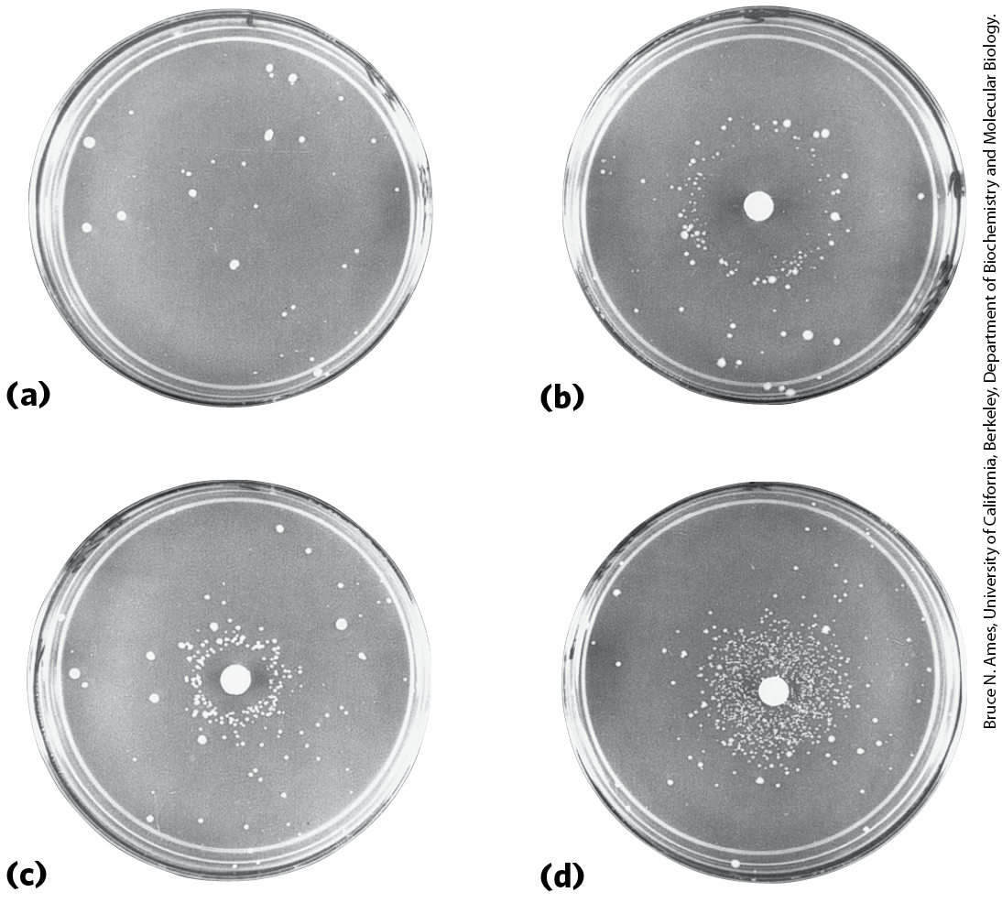
The Ames Test
the Ames test = measures the potential of a given chemical compound to promote certain easily detected mutations in a strain of S. typhimurium that cannot synthesize histidine
  strains that grow contain mutations that restore the ability to synthesize histidine

Slide 100
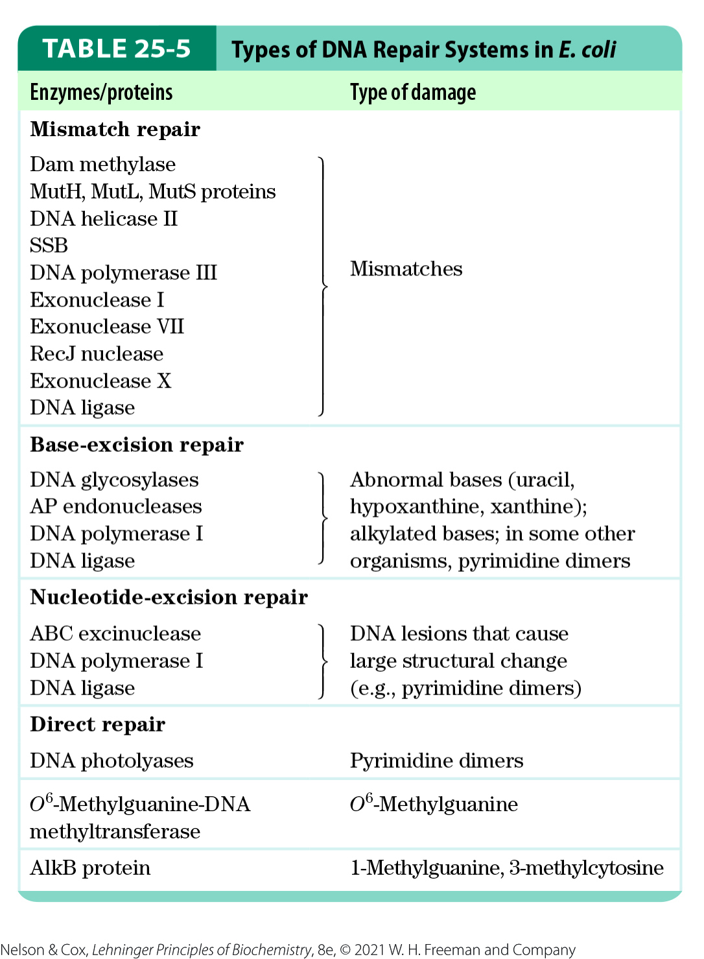
All Cells Have Multiple DNA
Repair Systems
nearly 200 genes in the human genome encode proteins dedicated to DNA repair

Slide 101
Principle 2 (5 of 7)
Information is expensive. The chemistry of joining one nucleotide to the next in DNA replication is elegant and simple, almost deceptively so. However, the enzymatic and thermodynamic commitment to linking one nucleotide to another in DNA far exceeds what would normally be required to successfully form a phosphodiester bond. It is not enough to synthesize a phosphodiester bond; that bond must accurately link two particular nucleotides.

Slide 102
DNA Repair Seems
Energetically Inefficient
many DNA repair processes seem to be extraordinarily inefficient energetically
  irrelevant because the integrity of the genetic information is more important

Slide 103
Mismatch Repair
mismatches are corrected to reflect template strand information
  distinguished from the newly synthesized strand by the presence of methyl group tags on the template DNA
in E. coli, Dam methylase methylates DNA at the N⁶ position of adenines within (5′)GATC sequences

Slide 104
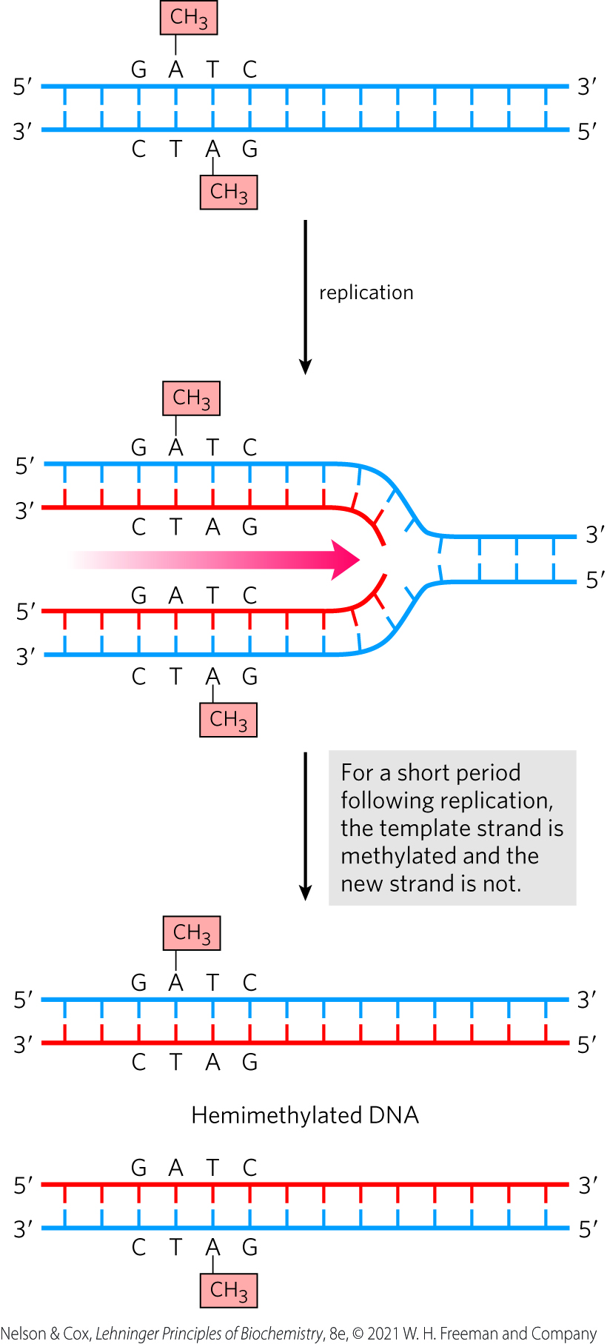
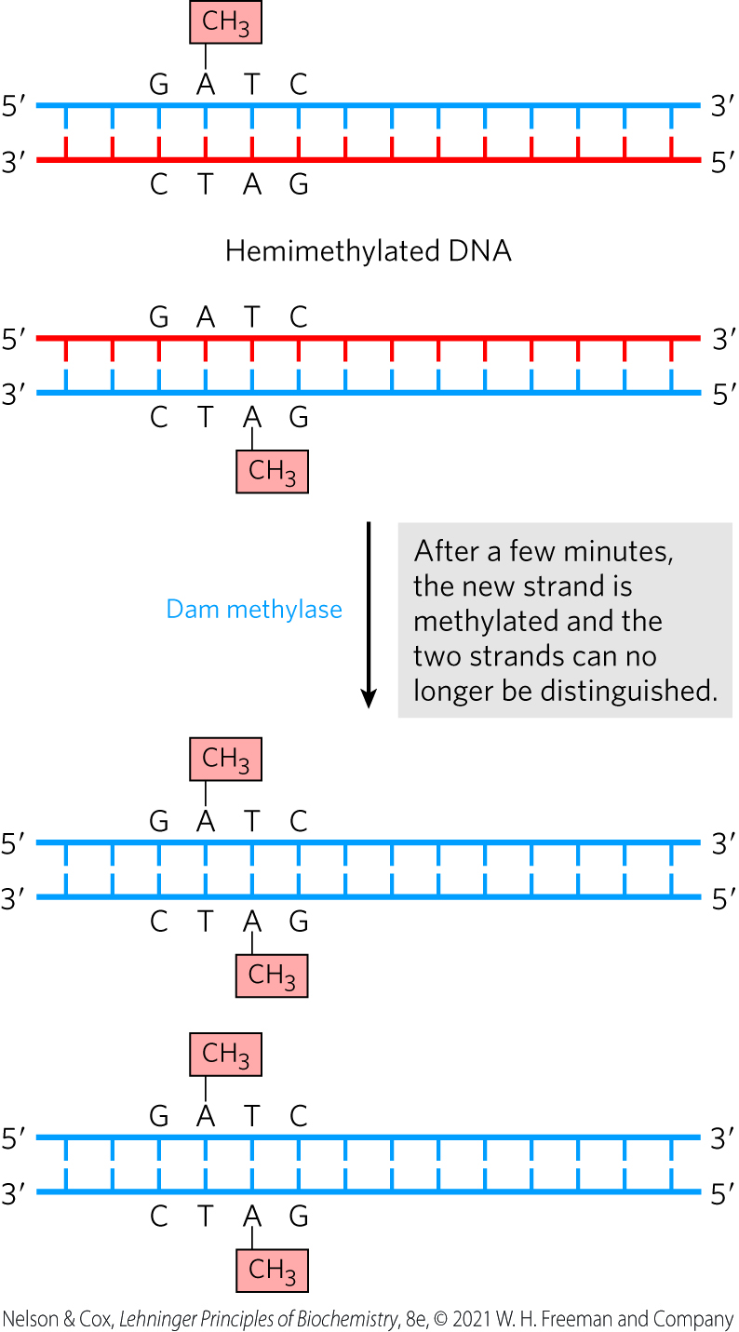
Methylation and Mismatch Repair

Slide 105
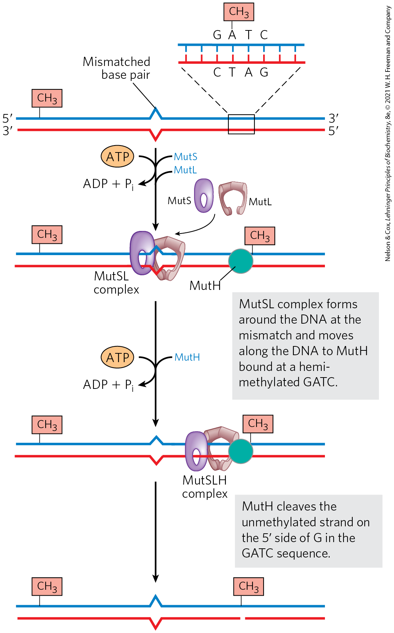
A Model for the Early Steps of Methyl-Directed Mismatch Repair
MutS recognizes the mismatch
MutH recognizes the sequence (5′)GATC and has site-specific endonuclease activity
MutL binds to both MutS and MutH

Slide 106
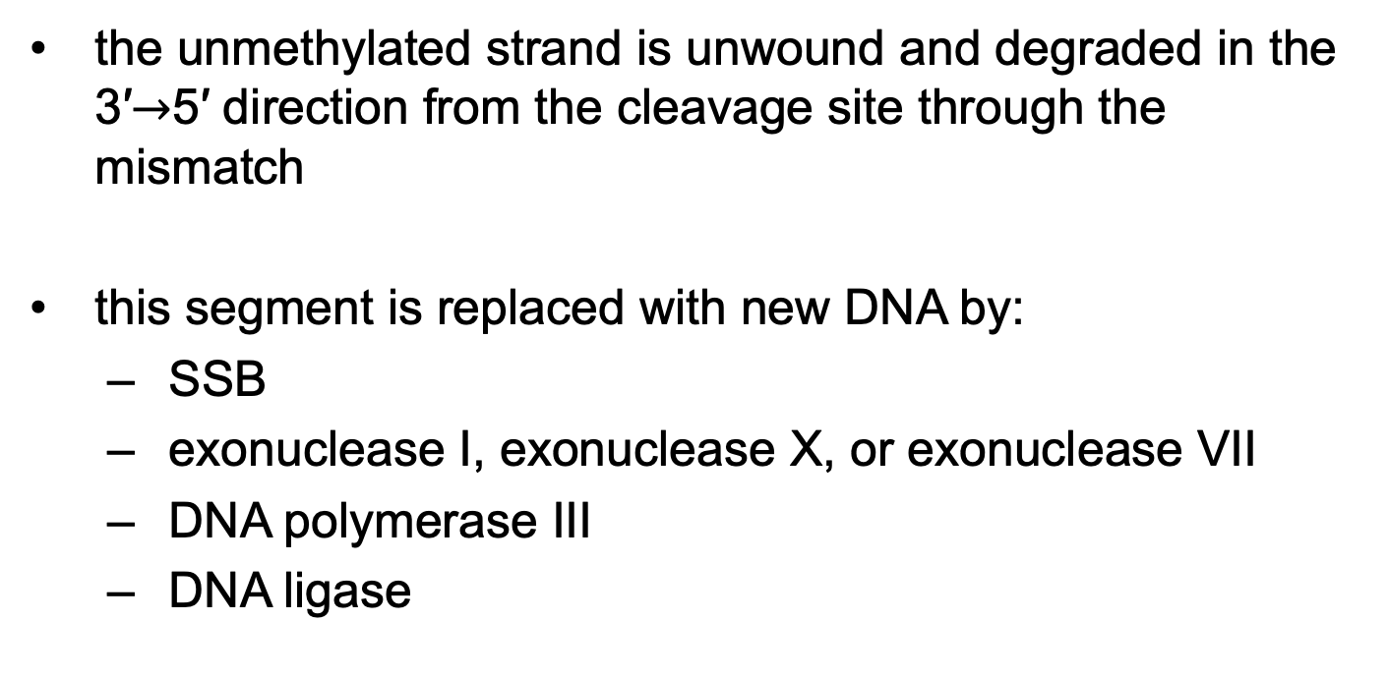
Mismatch Repair on the 5′ Side of the Cleavage Site
the unmethylated strand is unwound and degraded in the 3′$→$5′ direction from the cleavage site through the mismatch
this segment is replaced with new DNA by:
  SSB
  exonuclease I, exonuclease X, or exonuclease VII
  DNA polymerase III
  DNA ligase

Slide 107
Mismatch Repair on the 3′ Side of the Cleavage Site
repair is similar to mismatches on the 5′ side
the exonuclease is either exonuclease VII or RecJ nuclease

Slide 108
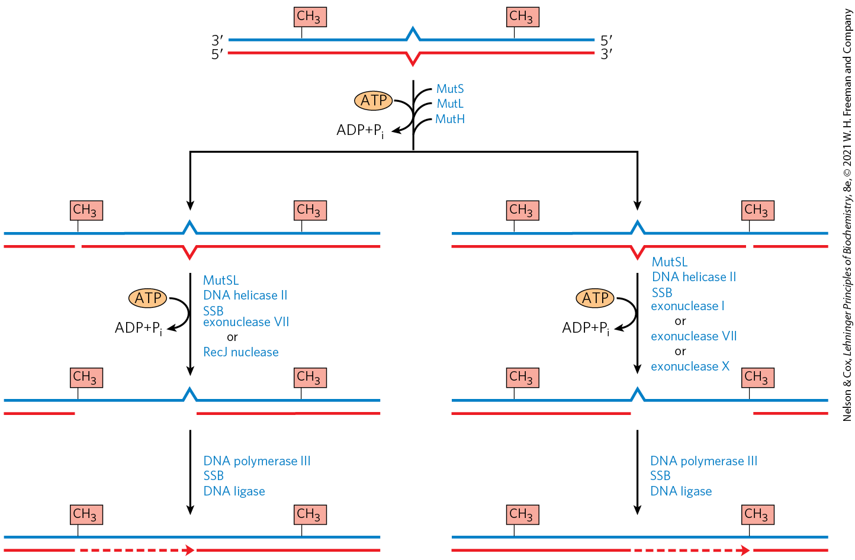
Completion of Methyl-Directed Mismatch Repair

Slide 109
Principle 2 (6 of 7)
Information is expensive. The chemistry of joining one nucleotide to the next in DNA replication is elegant and simple, almost deceptively so. However, the enzymatic and thermodynamic commitment to linking one nucleotide to another in DNA far exceeds what would normally be required to successfully form a phosphodiester bond. It is not enough to synthesize a phosphodiester bond; that bond must accurately link two particular nucleotides.

Slide 110
Energy Cost of Mismatch Repair
mismatch repair is particularly costly for E. coli
mismatches may occur 1,000+ base pairs from the GATC sequence
  repair requires degradation and replacement of a strand segment of this entire length

Slide 111
Eukaryotic Mismatch Repair Systems
several proteins are structurally and functionally analogous to the bacterial MutS and MutL proteins
many details of eukaryotic mismatch repair are unknown
identification of newly synthesized DNA strands does not involve GATC sequences

Slide 112
Base-Excision Repair
DNA glycosylases = recognize common DNA lesions and remove the affected base by cleaving the N-glycosyl bond in the process of base-excision repair
  generally specific for one lesion type
AP site or abasic site = an apurinic or apyrimidinic site in the DNA resulting from removal of a base by DNA glycosylase

Slide 113
Uracil DNA Glycosylases
uracil DNA glycosylases = specifically remove from DNA the uracil that results from spontaneous deamination of cytosine
  does not remove uracil residues from RNA or thymine residues from DNA
  deamination is 100-fold faster in ssDNA

Slide 114
Other DNA Glycosylases
other DNA glycosylases recognize:
  formamidopyrimidine (from purine oxidation)
  8-hydroxyguanine (from purine oxidation)
  hypoxanthine (from adenine deamination)
  alkylated bases
  pyrimidine dimers

Slide 115
Repair at AP Sites in Bacteria
the deoxyribose 5′-phosphate left behind is removed and replaced with a new nucleotide
AP endonucleases = cut the DNA strand containing the AP site
DNA polymerase I replaces the DNA
DNA ligase seals the remaining nick

Slide 116
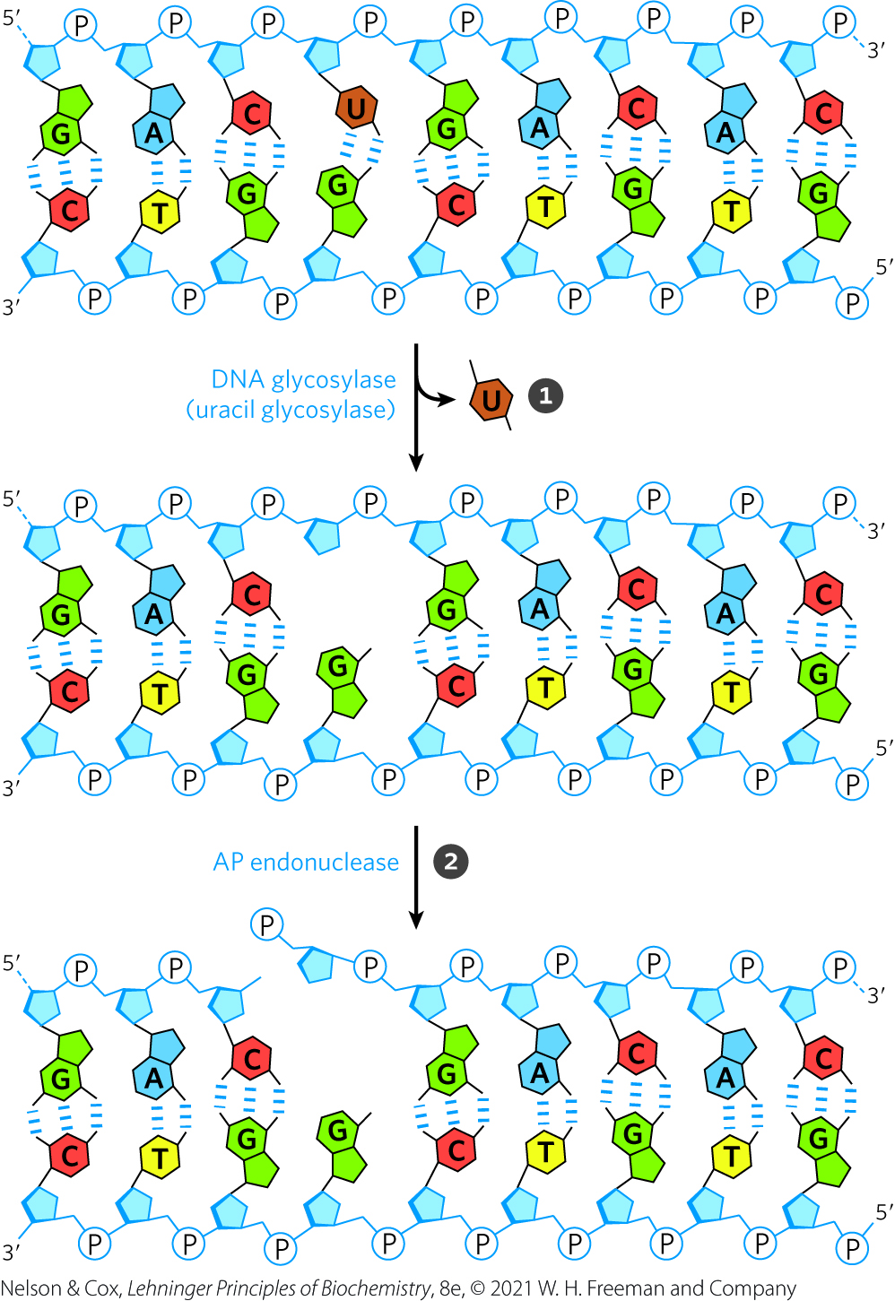
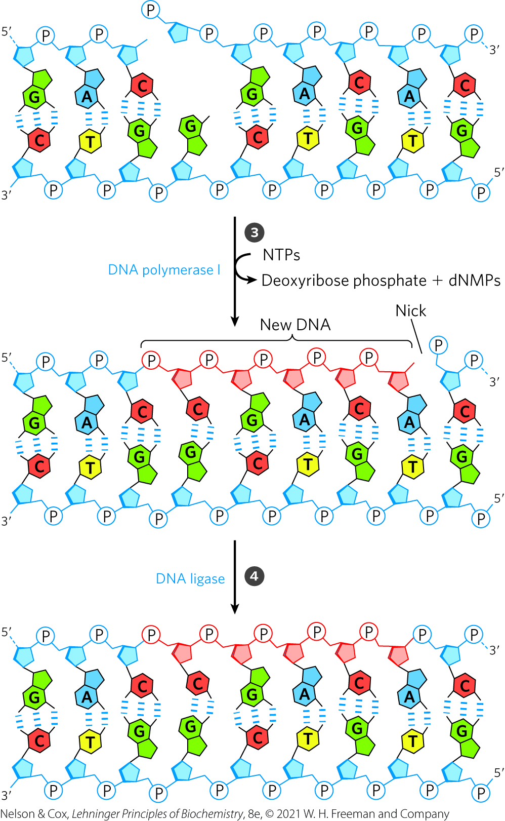
DNA Repair by the Base-Excision Repair Pathway

Slide 117
Nucleotide-Excision Repair
nucleotide-excision system = repairs DNA lesions that cause large distortions in the DNA helical structure
excinuclease = a multisubunit enzyme that hydrolyzes two phosphodiester bonds, one on either side of the distortion
DNA polymerase I (E. coli) or DNA polymerase ε (humans) fills the gap
DNA ligase seals the nick

Slide 118
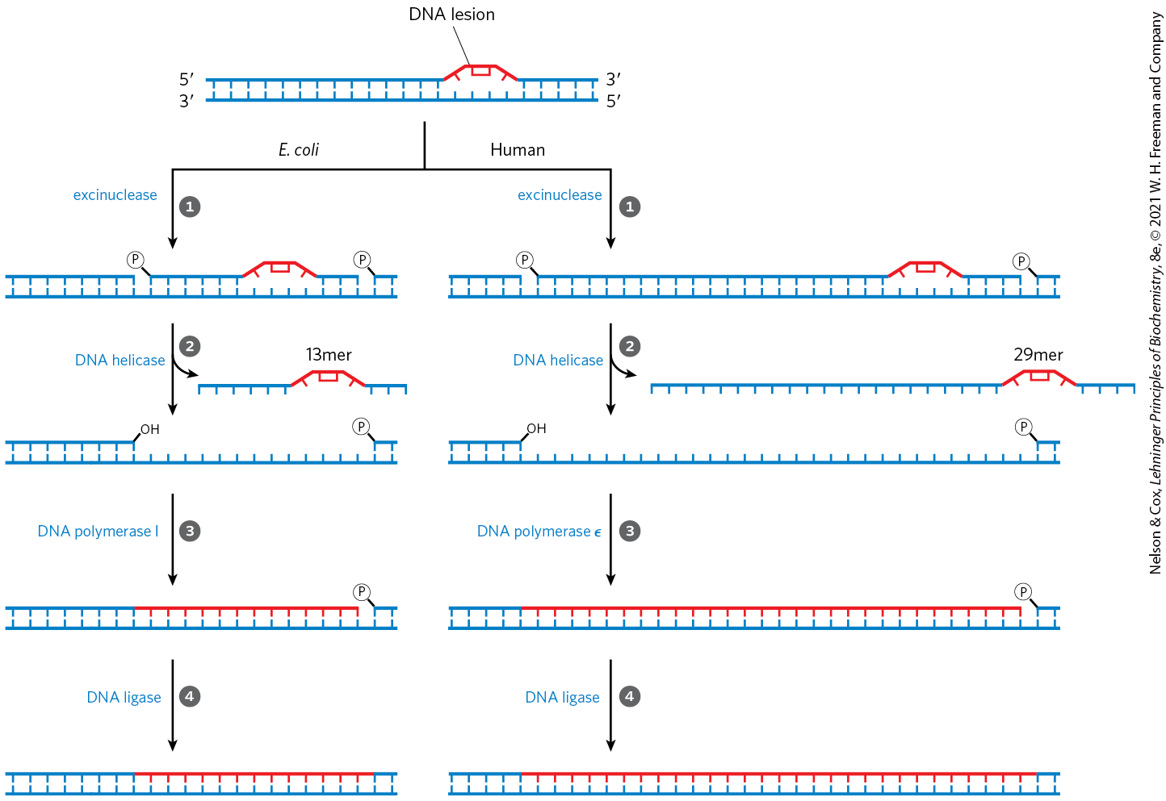
Nucleotide-Excision Repair in E. coli and Humans

Slide 119
The ABC Excinuclease
has three components:
  UvrA = a dimeric ATPase that scan DNA and binds to the lesion site
  UvrB = binds UvrA and makes an incision at the fifth phosphodiester bond on the 3′-side of the lesion after UvrA dissociates from the lesion
  UvrC = binds UvrB and makes an incision at the eighth phosphodiester bond on the 5′-side of the lesion after UvrB does
removes a fragment of 12 to 13 nucleotides

Slide 120
Eukaryotic Excinuclease
similar mechanism to that of the bacterial enzyme
requires 16+ polypeptides with no similarity to the E. coli excinuclease subunits
hydrolyzes the sixth phosphodiester bond on the 3′ side and the twenty-second phosphodiester bond on the 5′ side
  produces a fragment of 27 to 29 nucleotides

Slide 121
Direct Repair
pyrimidine dimers result from a UV-induced reaction
DNA photolyases = promote direct photoreactivation of cyclobutane pyrimidine dimers
  use energy from absorbed light
  generally contain two cofactors: FADH₂ and folate

Slide 122

Repair of Pyrimidine Dimers with Photolyase
DNA photolyases are not found in placental mammals (including humans)

Slide 123

Formation of Nucleotides with
Alkylation Damage
O⁶-methylguanine = a modified nucleotide that forms in the presence of alkylating agents
  common and highly mutagenic lesion
  tends to pair with thymine rather than cytosine

Slide 124

Repair of Nucleotides with
Alkylation Damage
O⁶-methylguanine-DNA methyltransferase = catalyzes transfer of the methyl group of O⁶-methylguanine to one of its own Cys residues
  a single methyl transfer event permanently methylates the protein, inactivating it

Slide 125
Principle 2 (7 of 7)
Information is expensive. The chemistry of joining one nucleotide to the next in DNA replication is elegant and simple, almost deceptively so. However, the enzymatic and thermodynamic commitment to linking one nucleotide to another in DNA far exceeds what would normally be required to successfully form a phosphodiester bond. It is not enough to synthesize a phosphodiester bond; that bond must accurately link two particular nucleotides.

Slide 126

Consumption of the Methyltransferase Illustrates the Importance of DNA Integrity
consumption of an entire protein to correct a single damaged base illustrates the priority given to maintaining the integrity of cellular DNA

Slide 127

Direct Repair of Alkylated Bases by AlkB

Slide 128
Principle 3 (5 of 7)
The fidelity of genome maintenance and transmission is not perfect. DNA damage happens, often by spontaneous processes. DNA replication and repair deal with the vast majority of DNA lesions, providing a high degree of genetic fidelity and stability. The few DNA damage events that slip through uncorrected provide fuel for evolution.

Slide 129
The Interaction of Replication Forks with DNA Damage Can Lead to Error-Prone Translesion DNA Synthesis
double-strand breaks and lesions in ssDNA arise from:
  a replication fork encountering an unrepaired DNA lesion
  ionizing radiation
  oxidative reactions

Slide 130

Stalling of a Replication Fork

Slide 131
Repair Avenues for a Stalled Bacterial Replication Fork
two avenues:
  homologous genetic recombination
  error-prone translesion DNA synthesis (TLS)

Slide 132
Error-Prone TLS in Bacteria
part of the SOS response (a cellular stress response to extensive DNA damage)
other SOS proteins include UvrA, UvrB + UmuC, and UmuD
  Umu = unmutable (because lack of umu genes eliminates error-prone repair)
cleaved UmuD′ and UmuC bind with RecA to create DNA Pol V (a specialized polymerase)
  the polymerase can process past the damaged area

Slide 133
Principle 3 (6 of 7)
The fidelity of genome maintenance and transmission is not perfect. DNA damage happens, often by spontaneous processes. DNA replication and repair deal with the vast majority of DNA lesions, providing a high degree of genetic fidelity and stability. The few DNA damage events that slip through uncorrected provide fuel for evolution.

Slide 134
Purpose of Error-Prone TLS
error-prone TLS serves as a desperation strategy
the resulting mutations kill some cells and create deleterious mutations in others
at least a few mutant daughter cells survive
the resultant mutations contribute to evolution

Slide 135
DNA Polymerase IV
induced during the SOS response
replication by DNA polymerase IV is highly error-prone
lack a proofreading exonuclease and have a more open active site than other DNA polymerases
  accommodates damaged template nucleotides

Slide 136
Principle 4 (2 of 5)
Although considered separately, the processes of replication, repair, and recombination of DNA are not distinct. These processes are highly integrated in cells, and they are required for proper genome maintenance.

Slide 137
TLS Polymerases in Mammals
mammals have many low-fidelity TLS polymerases
  most also have specialized functions in DNA repair
  typically limited to short lengths to minimize mutagenic potential
DNA polymerase η = promotes translesion synthesis primarily across cyclobutane T–T dimers
DNA polymerases β, ι, and λ have specialized roles in eukaryotic base-excision repair

Slide 138
25.3 DNA Recombination

Slide 139
Three Classes of Genetic Recombination Events
homologous genetic recombination = involves genetic exchanges between any two DNAs that share an extended region of nearly identical sequence
site-specific recombination = involves genetic exchanges only at a particular DNA sequence
DNA transposition = involves a short segment of DNA with the capacity to move from one location in a chromosome to another (“jumping genes”)

Slide 140
Nonhomologous End
Joining (NHEJ)
nonhomologous end joining (NHEJ) = an alternative process for double-strand break repair
  does not entail recombination

Slide 141
Principle 4 (3 of 5)
Although considered separately, the processes of replication, repair, and recombination of DNA are not distinct. These processes are highly integrated in cells, and they are required for proper genome maintenance.

Slide 142
Bacterial Homologous Recombination Is a DNA Repair Function
recombinational DNA repair = homologous genetic recombination as a DNA repair process
  typically directed at the reconstruction of stalled or collapsed replication forks

Slide 143
Principle 4 (4 of 5)
Although considered separately, the processes of replication, repair, and recombination of DNA are not distinct. These processes are highly integrated in cells, and they are required for proper genome maintenance.

Slide 144
Reconstruction of a Collapsed Replication Fork
the replication fork collapses when it encounters a damaged site in a template strand
the 5′-ending strand is degraded
the 3′ single-stranded extension is bound by a recombinase that pairs with a complementary sequence in the intact DNA duplex
  creates a branched DNA structure (a point where three DNAs come together)

Slide 145
Reconstruction of a Collapsed Replication Fork, Continued
branch migration = process that moves the DNA branch
  creates a Holliday intermediate (an X-like crossover structure)
a special class of nucleases cleaves The Holliday intermediate
ligation restores the replication fork

Slide 146

Recombinational DNA Repair

Slide 147

The RecBCD Helicase/Nuclease
RecBCD nuclease/helicase = promotes DNA end-processing in E. coli
  coupled to ATP hydrolysis
RecB (moves 3′$→$5′) and RecD (moves 5′$→$3′) are helicase motors
RecC binds tightly to the chi sequence ((5′)GCTGGTGG)
  decreases degradation of the 3′-terminal strand
  increases degradation of the 5′-terminal strand
  creates ssDNA with a 3′ end for use in recombination

Slide 148

The RecBCD Enzyme Structure

Slide 149


RecBCD Activity

Slide 150

RecA Protein Filaments
RecA = the bacterial recombinase
  active form is an ordered, helical filament of thousands of subunits that assemble cooperatively on ssDNA
  promotes central steps of homologous recombination
RecBCD acts directly as a RecA loader
filaments assemble and disassemble predominantly in a 5′$→$3′ direction

Slide 151

RecA Filament Formation

Slide 152

RecA Filament Bound to DNA

Slide 153

RecA Filament with Three Helical Turns of DNA

Slide 154

Resolution of a Holliday
Intermediate by RuvC
bacterial RuvC protein = specialized nuclease that cleaves the Holliday intermediate

Slide 155
Reassembly of the Replication Fork After Recombination
origin-independent restart of replication = the process of reassembling the replication fork after recombination
  tightly intertwined with replication
replication restart primosomes = complexes that include the proteins required for origin-independent restart of replication

Slide 156
Eukaryotic Homologous Recombination Is Required for Proper Chromosome Segregation During Meiosis
meiosis = the process by which diploid germ-line cells with two sets of chromosomes divide to produce haploid gametes
  involves a high frequency of recombination

Slide 157

Meiosis in Animal Germ-Line Cells
homologous chromosomes are segregated into separate daughter cells at the end of meiosis I
sister chromatids are separated during meiosis II

Slide 158

Recombination in Meiosis (1 of 2)

Slide 159

Recombination in Meiosis (2 of 2)

Slide 160

Recombination During Prophase I
also referred to as crossing over
  occurs at “hot spots” on chromosomes
chiasmata = points where two pairs of sister chromatids are linked due to crossing over
this process aligns sister chromosomes for proper segregation and increases genetic diversity

Slide 161
Model of Homologous Recombination in Meiosis
double-strand break repair model = 3′ ends are used to initiate the genetic exchange
key features of the model:
  homologous chromosomes align
  a double-strand break occurs in one chromosome and an exonuclease leaves a free 3′-OH
  3′ ends “invade” the intact duplex DNA of the homolog
  cleavage of the crossovers creates recombinant products

Slide 162

The Contribution of Independent Assortment to Genetic Diversity

Slide 163
Principle 3 (7 of 7)
The fidelity of genome maintenance and transmission is not perfect. DNA damage happens, often by spontaneous processes. DNA replication and repair deal with the vast majority of DNA lesions, providing a high degree of genetic fidelity and stability. The few DNA damage events that slip through uncorrected provide fuel for evolution.

Slide 164
The Functions of Homologous Recombination in Eukaryotes
homologous recombination:
  contributes to the repair of several types of DNA damage
  provides a transient physical link between chromatids that promotes the orderly segregation of chromosomes at the first meiotic cell division
  enhances genetic diversity in a population

Slide 165
Some Double-Strand Breaks Are Repaired by Nonhomologous End Joining
nonhomologous end joining (NHEJ) = process by which broken chromosome ends are processed and ligated back together
  occurs when recombinational DNA repair is not feasible because replication is not occurring and sister chromatids are not present
  mutagenic process
  does not randomly join ends

Slide 166
Nonhomologous End Joining
the Ku70-Ku80 complex binds the DNA ends, followed by a complex including DNA-PKcs (kinase) and Artemis (nuclease)
remaining steps:
  the broken DNA ends are synapsed
  Artemis (after phosphorylation by DNA-PKcs) removes single-strand extensions or hairpins
  DNA ends are separated by a helicase
  strands from the two different ends are annealed

Slide 167


The Process of NHEJ

Slide 168

Site-Specific Recombination Results in Precise DNA Rearrangements
site-specific recombination = involves genetic exchanges only at specific sequences
  uses recombinase enzymes with Tyr or Ser residues in the active site

Slide 169

Site-Specific Recombination with Tyr Recombinase Enzymes
the recombinase is covalently linked to the DNA at the cleavage site
cleaved DNAs are rejoined to form a Holliday intermediate
exchange is reciprocal and precise

Slide 170
Site-Specific Recombination with Ser Recombinase Enzymes
both strands of each recombination site are cut concurrently and rejoined to new partners
no Holliday intermediate is formed
exchange is reciprocal and precise

Slide 171
Potential Outcomes of Site-Specific Recombination
inversion occurs if two sites are on the same DNA molecule and the recombination sites have the opposite orientation
deletion occurs if two sites are on the same DNA molecule and the recombination sites have the same orientation
intermolecular recombination occurs if recombination sites are on different DNAs
insertion occurs if one or both DNAs are circular

Slide 172

Effects of Site-Specific Recombination
outcome depends on the location and orientation of the recombination sites in a dsDNA molecule

Slide 173
Principle 4 (5 of 5)
Although considered separately, the processes of replication, repair, and recombination of DNA are not distinct. These processes are highly integrated in cells, and they are required for proper genome maintenance.

Slide 174

The XerCD System
resolution of a Holliday intermediate can generate a contiguous dimeric chromosome
XerCD = a specialized site-specific recombinase in E. coli
  converts the dimer to monomers
  allows chromosome segregation and cell division to proceed

Slide 175
Transposable Genetic Elements Move from One Location to Another
transposons = transposable elements that “jump” from one place on a chromosome (the donor site) to another on the same or a different chromosome (the target site)
  found in virtually all cells
transposition = movement of transposons
  determined more or less randomly
  tightly regulated and infrequent

Slide 176
Bacterial Classes of Transposons
insertion sequences (simple transposons) = contain only the sequences required for transposition and the genes for the proteins (transposases) that promote the process
complex transposons = contain 1+ genes in addition to those needed for transposition
  example: antibiotic-resistance genes

Slide 177

Insertion of a Transposon
short repeated sequences at each end of the transposon serve as binding sites for the transposase
  become duplicated following transposon insertion

Slide 178
Direct Transposition
the transposon is excised via cuts on each side and moves to a new location
a staggered cut is made at the target site and the transposon is inserted into the break
DNA replication fills in the gaps to duplicate the target-site sequence

Slide 179
Replicative Transposition
the entire transposon is replicated, leaving a copy behind at the donor location
cointegrate = the donor region covalently linked to DNA at the target site
  serves as an intermediate in the process
  contains two complete copies of the transposon

Slide 180

General Pathways for Transposition
direct transposition = “cut and paste”
replicative transposition = “copy and paste”

Slide 181
Immunoglobulin Genes Assemble by Recombination
millions of antibodies (immunoglobulins) can be created from the separate gene segment sets
  this is despite the human genome containing only ~20,000 genes
recombination occurs as bone marrow stem cells mature into B lymphocytes
  each B lymphocyte produces one kind of antibody

Slide 182
Structure of Immunoglobulins
immunoglobulins consist of:
  two heavy polypeptide chains
  two light polypeptide chains (can be in the kappa or lambda family)
each chain has a variable region and a constant region

Slide 183

Recombination of
Immunoglobulin Genes
during formation of a mature B lymphocyte, one V segment and one J segment are brought together
40 x 5 = 200 possible V–J combinations
  additional variation at the V-J junction increases this to 500

Slide 184
Mechanism of Recombination
recombination signal sequences (RSS) = found between the V and J segments
RSS bind to proteins RAG1 and RAG2.
  RAG = products of the recombination activating gene
RAG proteins catalyze formation of a double-strand break between segments to be joined

Slide 185

Mechanism of Immunoglobulin
Gene Rearrangement

