Slide 1

19 Oxidative Phosphorylation
© 2021 Macmillan Learning

Slide 2

Principle 1 (1 of 5)
Mitochondria play a central role in eukaryotic aerobic metabolism. ATP production is not the only important mitochondrial function. Mitochondria play host to the citric acid cycle, the fatty acid β-oxidation pathway, and the pathways of amino acid oxidation. The mitochondria also act in thermogenesis, steroid synthesis, and apoptosis (programmed cell death). The discovery of these diverse and important roles of mitochondria has stimulated much current research on the biochemistry of this organelle.

Slide 3

Principle 2 (1 of 4)
Mitochondria trace their evolutionary origin to bacteria. Over 1.45 billion years ago, an endosymbiotic relationship arose between bacteria and a primitive eukaryote or eukaryotic progenitor. Mitochondria are ubiquitous in modern eukaryotes, and their bacterial origin is evident in almost every aspect of their structure and function.

Slide 4

Principle 3 (1 of 6)
Electrons flow from electron donors (oxidizable substrates) through a chain of membrane-bound carriers to a final electron acceptor with a large reduction potential. The final acceptor is molecular oxygen, O₂. The appearance of oxygen in the atmosphere some 2.3 billion years ago, and its harnessing in living systems via the evolution of oxidative phosphorylation, made more complex life forms possible.

Slide 5

Principle 4 (1 of 5)
The free energy made available by “downhill” (exergonic) electron flow is coupled to the “uphill” transport of protons across a proton-impermeable membrane. The free energy of fuel oxidation is thus conserved as a transmembrane electrochemical potential.

Slide 6

Principle 5 (1 of 7)
The transmembrane flow of protons back down their electrochemical gradient through specific protein channels provides the free energy for synthesis of ATP. This process is catalyzed by a membrane protein complex (ATP synthase) that couples proton flow to phosphorylation of ADP.

Slide 7
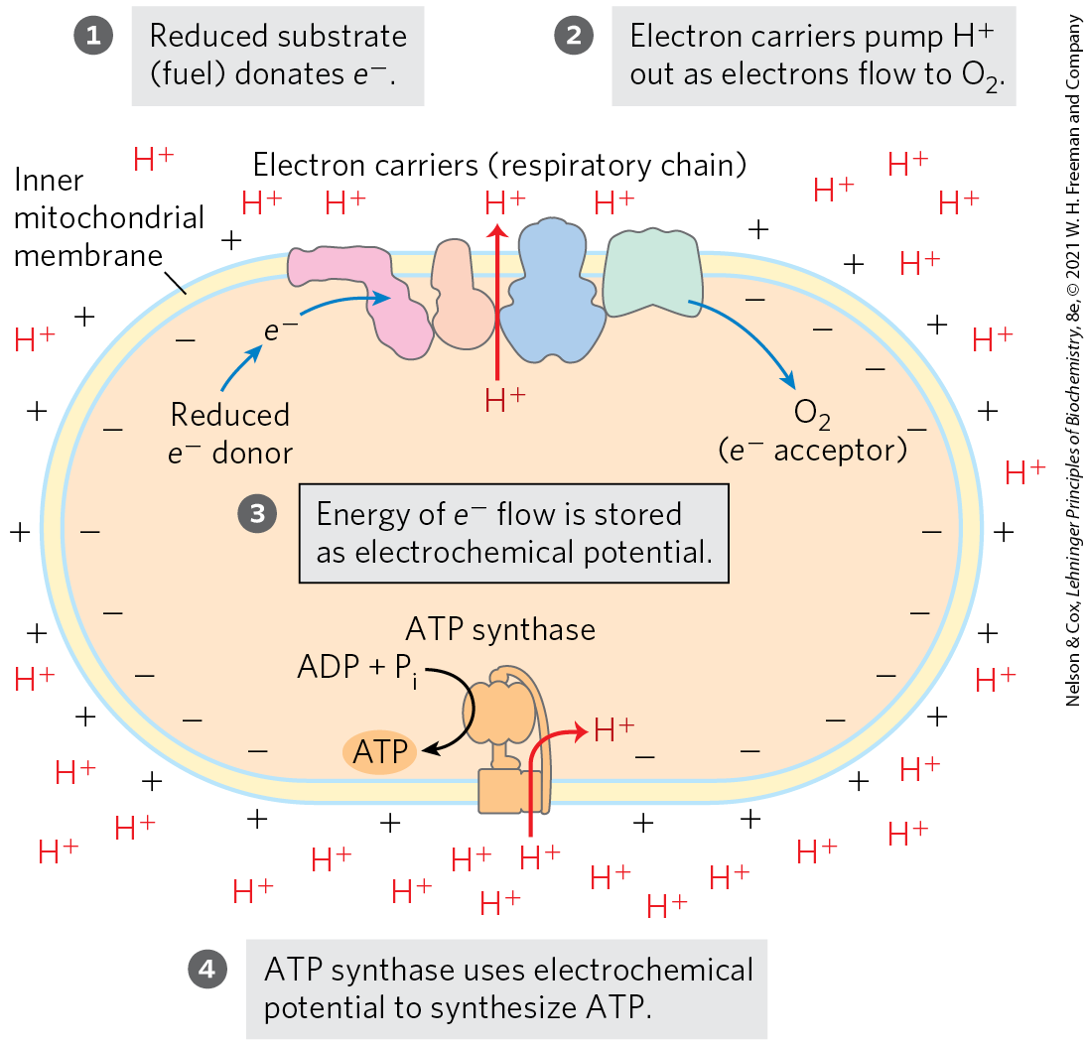
The Chemiosmotic Theory
chemiosmotic theory = transmembrane differences in proton concentration are the reservoir for the energy extracted from biological oxidation reactions

Slide 8
19.1 The Mitochondrial Respiratory Chain

Slide 9
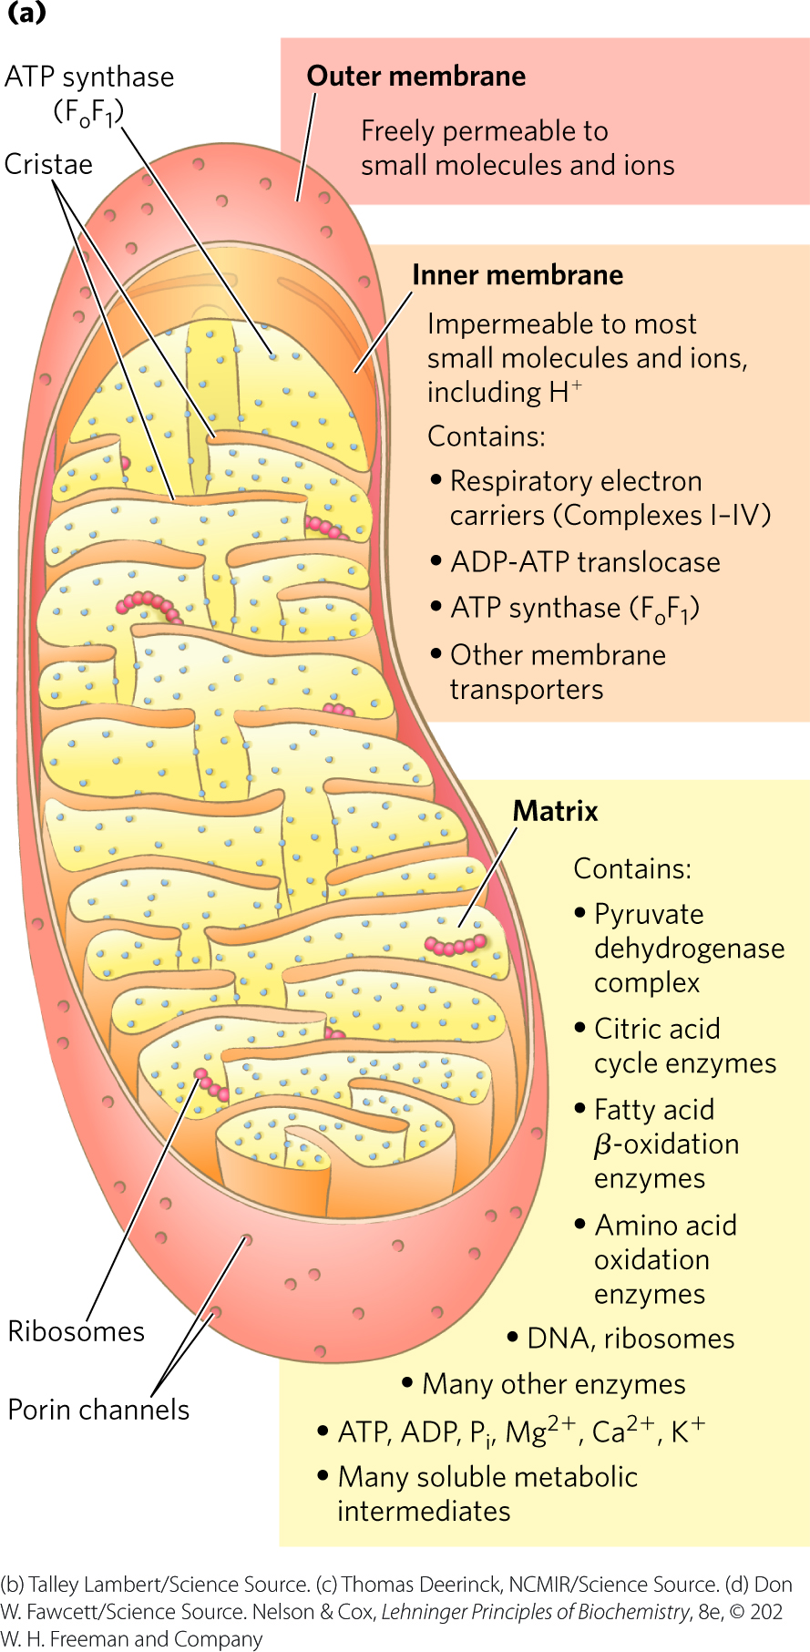
Mitochondria Have Two Membranes
outer membrane is readily permeable to small molecules and ions
  transport occurs through porins
inner membrane is impermeable to most small molecules and ions
  transport requires specific transporters

Slide 10
Principle 1 (2 of 5)
Mitochondria play a central role in eukaryotic aerobic metabolism. ATP production is not the only important mitochondrial function. Mitochondria play host to the citric acid cycle, the fatty acid β-oxidation pathway, and the pathways of amino acid oxidation. The mitochondria also act in thermogenesis, steroid synthesis, and apoptosis (programmed cell death). The discovery of these diverse and important roles of mitochondria has stimulated much current research on the biochemistry of this organelle.

Slide 11
The Mitochondrial Matrix
the mitochondrial matrix contains:
  the pyruvate dehydrogenase complex
  enzymes of the citric acid cycle
  enzymes of the fatty acid β-oxidation pathway
  enzymes of the pathways of amino acid oxidation
the inner mitochondrial membrane segregates the intermediates and enzymes of cytosolic and matrix metabolic pathways

Slide 12
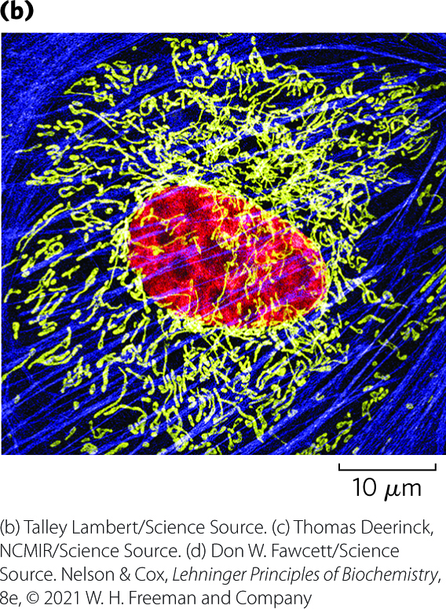
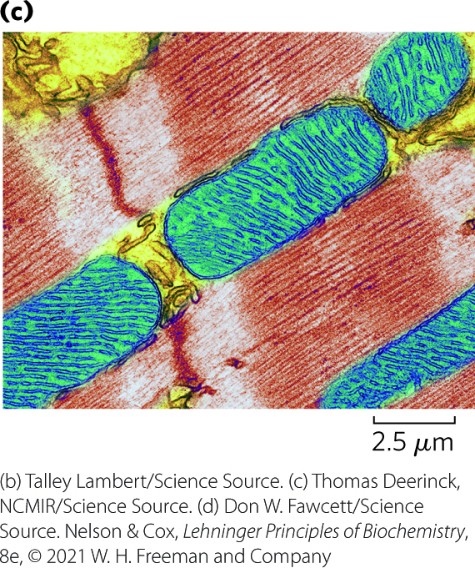
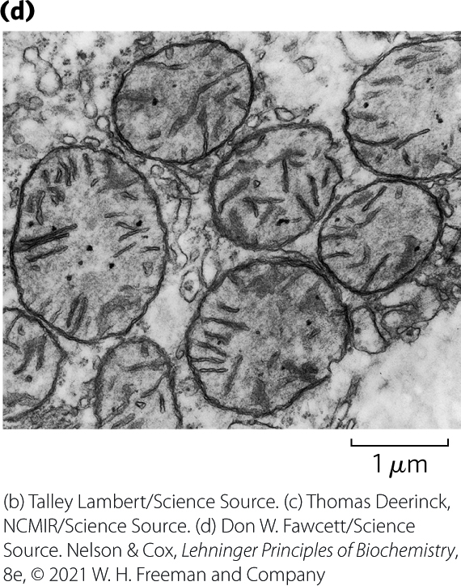
Mitochondrial Cristae
cristae = convolutions in the inner membrane of the mitochondrion
  mitochondria of cells with high metabolic activity have more cristae

Slide 13
Principle 2 (2 of 4)
Mitochondria trace their evolutionary origin to bacteria. Over 1.45 billion years ago, an endosymbiotic relationship arose between bacteria and a primitive eukaryote or eukaryotic progenitor. Mitochondria are ubiquitous in modern eukaryotes, and their bacterial origin is evident in almost every aspect of their structure and function.

Slide 14
The Effect of Stress on Mitochondria
during cell growth and division, mitochondria divide by fission
stressful conditions can trigger:
  mitochondrial fission
  mitophagy = the breakdown of mitochondria and recycling of the amino acids, nucleotides, and lipids
as stress is relieved, small mitochondria fuse to form long, thin, tubular organelles

Slide 15
Electrons Are Funneled to Universal Electron Acceptors
respiratory chain = series of electron carriers
dehydrogenases collect electrons from catabolic pathways and funnel them into universal electron acceptors:
  nicotinamide nucleotides (NAD⁺ or NADP⁺)
  flavin nucleotides (FMN or FAD)

Slide 16
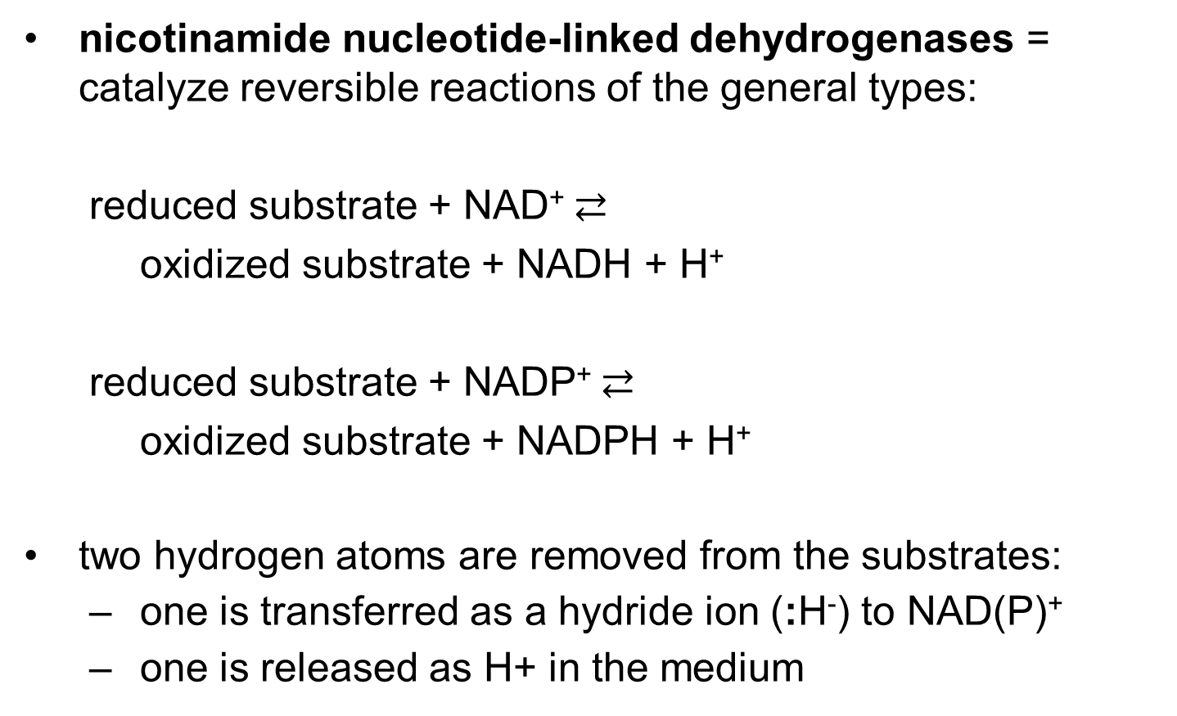
Nicotinamide Nucleotide-
Linked Dehydrogenases
nicotinamide nucleotide-linked dehydrogenases = catalyze reversible reactions of the general types:
  reduced substrate + NAD⁺ $⇄$
  oxidized substrate + NADH + H⁺
  reduced substrate + NADP⁺ $⇄$
  oxidized substrate + NADPH + H⁺
two hydrogen atoms are removed from the substrates:
  one is transferred as a hydride ion (:H⁻) to NAD(P)⁺
  one is released as H+ in the medium

Slide 17
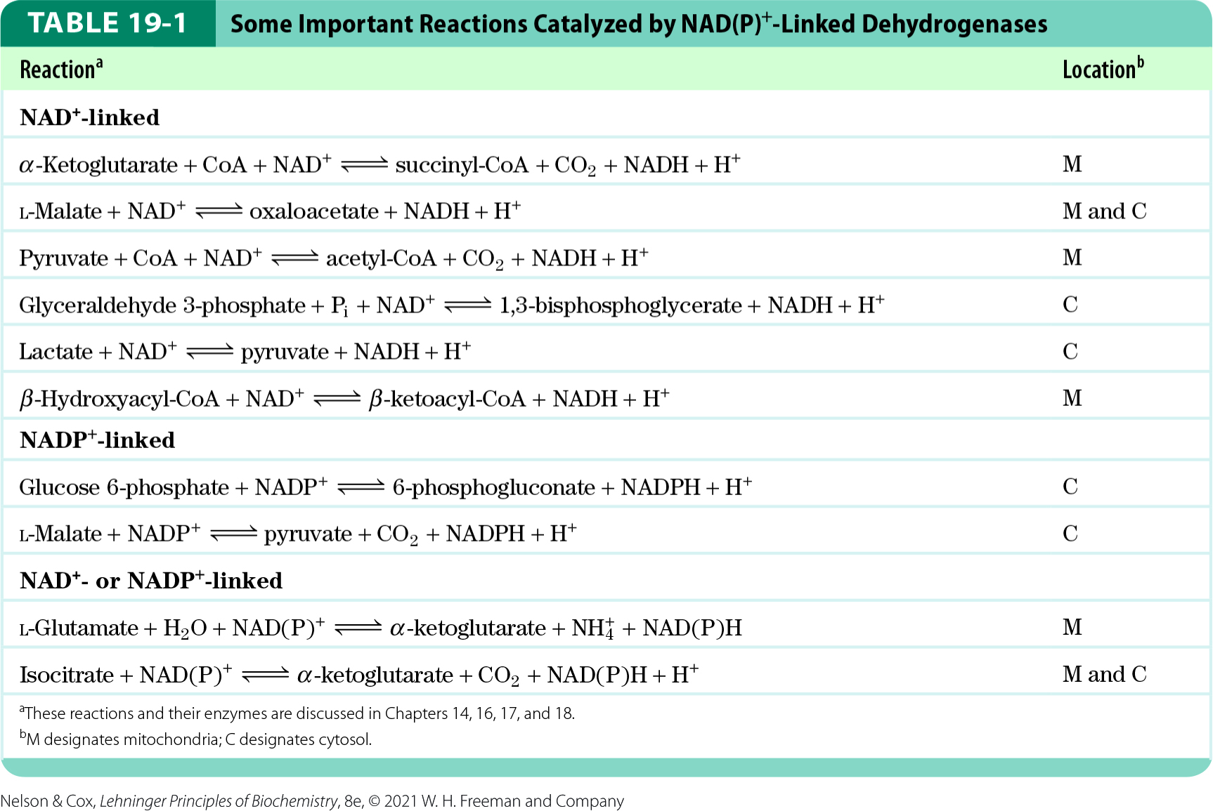
Important Reactions Catalyzed by NAD(P)⁺-Linked Dehydrogenases

Slide 18
Principle 3 (2 of 6)
Electrons flow from electron donors (oxidizable substrates) through a chain of membrane-bound carriers to a final electron acceptor with a large reduction potential. The final acceptor is molecular oxygen, O₂. The appearance of oxygen in the atmosphere some 2.3 billion years ago, and its harnessing in living systems via the evolution of oxidative phosphorylation, made more complex life forms possible.

Slide 19
Flavoproteins
flavoproteins = contain a very tightly, sometimes covalently, bound flavin nucleotide (FMN or FAD)
the oxidized flavin nucleotide can accept either:
  one electron (yielding the semiquinone form) or
  two electrons (yielding FADH₂ or FMNH₂)
electron transfer occurs because the flavoprotein has a higher E° than the compound oxidized
  E′° of a flavin nucleotide depends on the protein with which it is associated

Slide 20
Electrons Pass through a Series of Membrane-Bound Carriers
three types of electron transfers occur in oxidative phosphorylation:
  direct transfer of electrons
  transfer as a hydrogen atom (H⁺ + e⁻)
  transfer as a hydride ion (:H⁻)
reducing equivalent = a single electron equivalent transferred in an oxidation-reduction reaction

Slide 21
Principle 3 (3 of 6)
Electrons flow from electron donors (oxidizable substrates) through a chain of membrane-bound carriers to a final electron acceptor with a large reduction potential. The final acceptor is molecular oxygen, O₂. The appearance of oxygen in the atmosphere some 2.3 billion years ago, and its harnessing in living systems via the evolution of oxidative phosphorylation, made more complex life forms possible.

Slide 22
Electron-Carrying Molecules in the Respiratory Chain
five types of electron-carrying molecules:
  NAD
  flavoproteins
  ubiquinone (coenzyme Q or Q)
  cytochromes
  iron-sulfur proteins

Slide 23
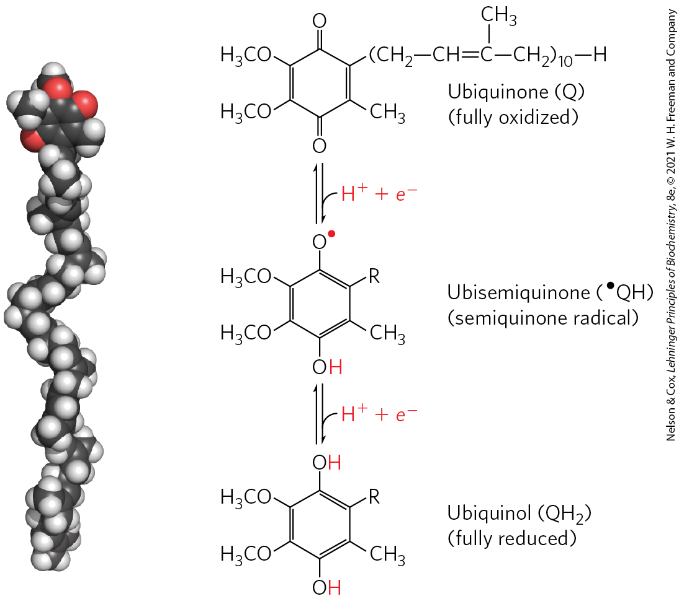
Ubiquinone
ubiquinone (coenzyme Q or Q) = a lipid-soluble benzoquinone with a long isoprenoid side chain
  can accept one or two electrons
  freely diffusible within the inner mitochondrial membrane
  plays a central role in coupling electron flow to proton movement

Slide 24
Cytochromes
cytochromes = proteins with characteristic strong absorption of visible light due to their iron-containing heme prosthetic groups
  one-electron carriers
  3 classes in mitochondria: a, b, and c
    hemes of a and b are not covalently bound to associated proteins
    c is covalently attached through Cys residues

Slide 25
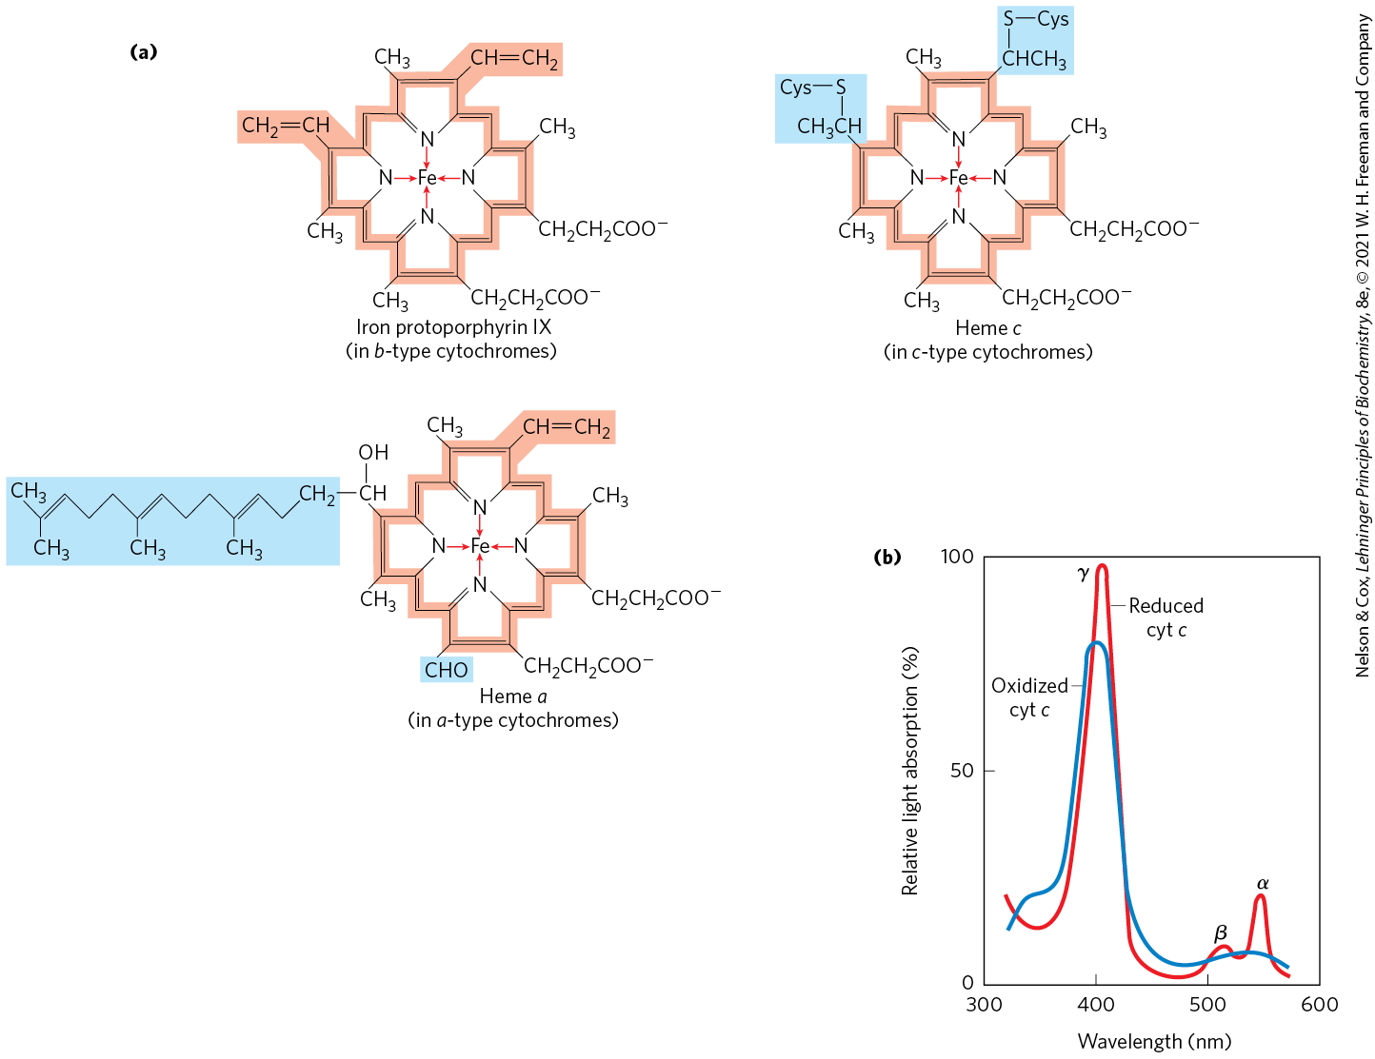
Prosthetic Groups of Cytochromes

Slide 26
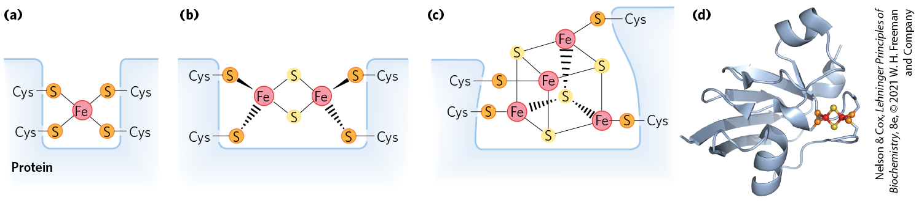
Iron-Sulfur Proteins
iron-sulfur proteins = proteins that contain iron in association with inorganic sulfur atoms and/or with the sulfur atoms of Cys residues in the protein
  participate in one-electron transfers
Rieske iron-sulfur proteins = proteins in which one Fe atom is coordinated to two His residues

Slide 27
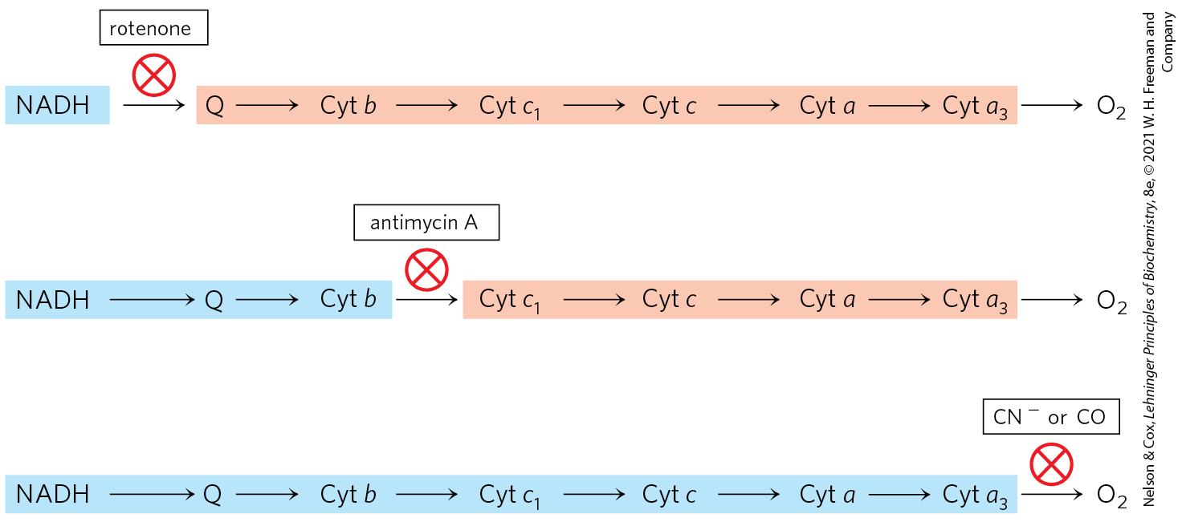
Methods for Determining The Sequence of Electron Carriers
determine the E′° of the individual electron carriers
reduce the entire chain of carriers by omitting O₂ and then measure the oxidation rate of each electron carrier when O₂ is reintroduced
measure the effects of inhibitors of electron transfer on the oxidation state of each carrier

Slide 28
Standard Reduction Potentials of Individual Electron Carriers
electrons tend to flow spontaneously from carriers of lower E′° to carriers of higher E′°
Table 19-2 Standard Reduction Potentials of Respiratory Chain and Related Electron Carriers
Redox reaction (half-reaction) | E′° (V)
2H⁺ + 2e⁻→H₂ | −0.414
NAD⁺ + H⁺ + 2e⁻→NADH | −0.320
NADP⁺ + H⁺ + 2e⁻→NADPH | −0.324
NADH dehydrogenase (FMN) + 2H⁺ + 2e⁻→NADH dehydrogenase (FMNH₂) | −0.30
Ubiquinone + 2H⁺ + 2e⁻→ubiquinol | 0.045
Cytochrome b (Fe³⁺) + e⁻→cytochrome b (Fe²⁺) | 0.077
Cytochrome c₁ (Fe³⁺) + e⁻→cytochrome c₁ (Fe²⁺) | 0.22
Cytochrome c (Fe³⁺) + e⁻→cytochrome c (Fe²⁺) | 0.254
Cytochrome a (Fe³⁺) + e⁻→cytochrome a (Fe²⁺) | 0.29
Cytochrome a₃ (Fe³⁺) + e⁻→cytochrome a₃ (Fe²⁺) | 0.35
½ O₂ + 2H⁺ + 2e⁻→H₂O | 0.817

Slide 29
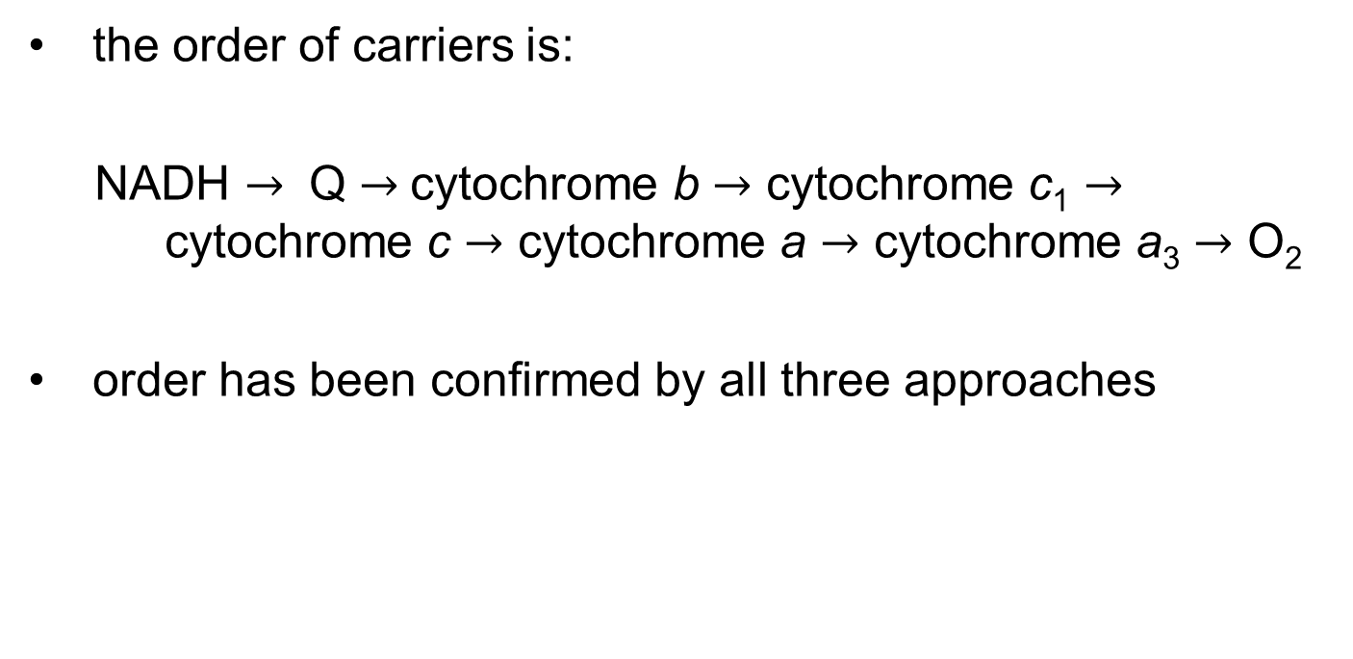
The Sequence of Electron Carriers
the order of carriers is:
NADH $→$ Q $→$cytochrome b $→$ cytochrome c₁ $→$ cytochrome c $→$ cytochrome a $→$ cytochrome a₃ $→$ O₂
order has been confirmed by all three approaches

Slide 30
Principle 3 (4 of 6)
Electrons flow from electron donors (oxidizable substrates) through a chain of membrane-bound carriers to a final electron acceptor with a large reduction potential. The final acceptor is molecular oxygen, O₂. The appearance of oxygen in the atmosphere some 2.3 billion years ago, and its harnessing in living systems via the evolution of oxidative phosphorylation, made more complex life forms possible.

Slide 31
Electron Carriers Function in Multienzyme Complexes
four unique electron-carrier complexes catalyze electron transfer through a portion of the chain:
  Complex I (from NADH to ubiquinone)
  Complex II (from succinate to ubiquinone)
  Complex III (from ubiquinone to cytochrome c)
  Complex IV (from cytochrome c to O₂)

Slide 32
Protein Components of the Mitochondrial Respiratory Chain
Table 19-3 The Protein Components of the Mitochondrial Respiratory Chain
Enzyme complex/protein | Mass (kDa) | Number of subunits | Prosthetic group(s)
I NADH dehydrogenase | 850 | 45 (14) | FMN, Fe-S
II Succinate dehydrogenase | 140 | 4 | FAD, Fe-S
III Ubiquinone: cytochrome c oxidoreductase | 250 | 11 | Hemes, Fe-S
Cytochrome c | 13 | 1 | Heme
IV Cytochrome oxidase | 204 | 13 (3–4) | Hemes; Cu_{A}, Cu_{B}

Slide 33
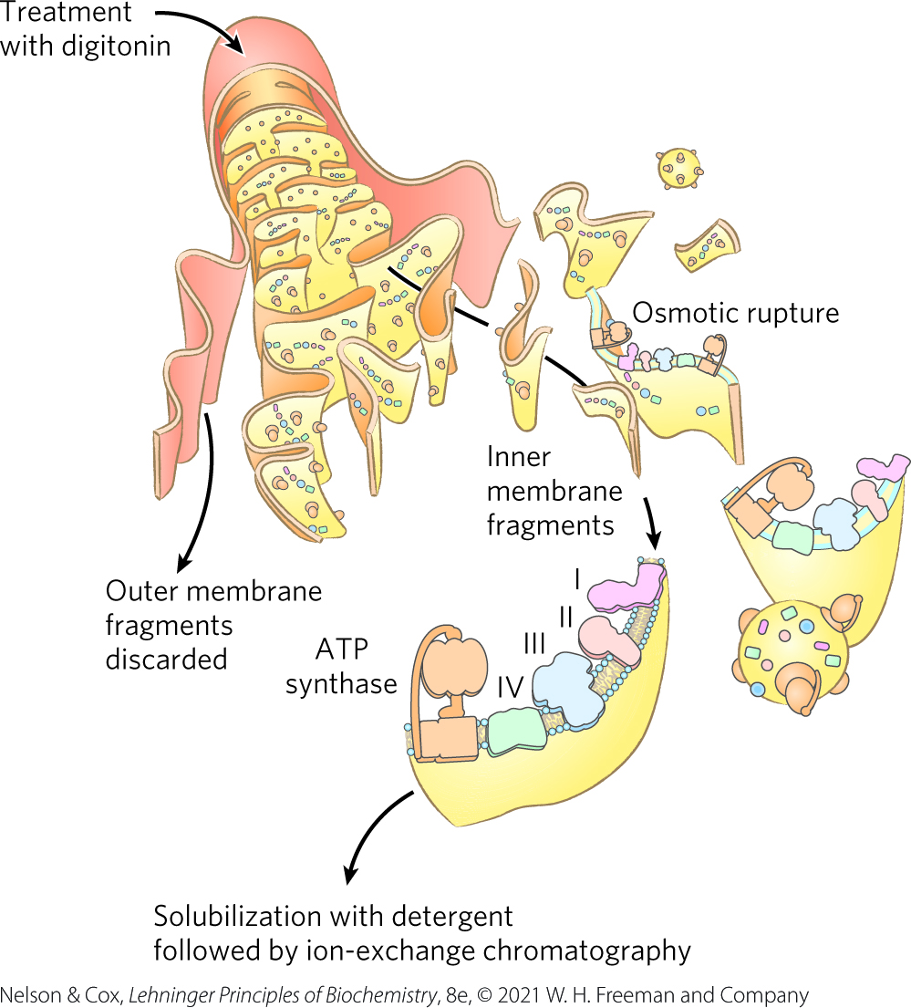
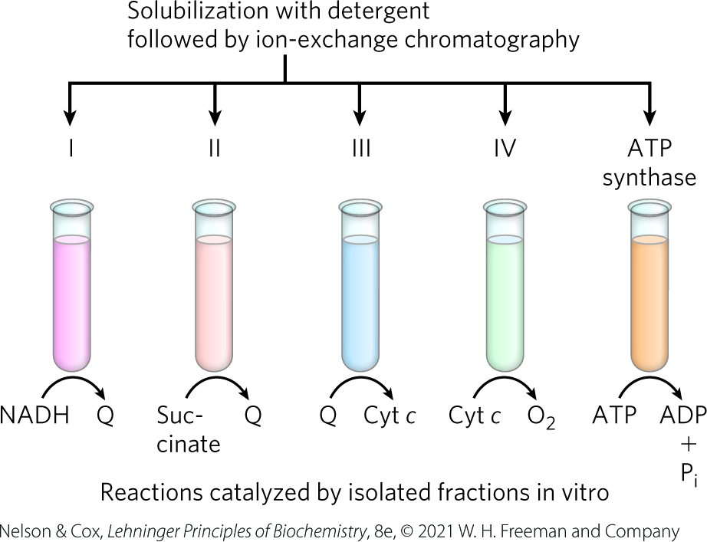
Separation of Functional Complexes of the Respiratory Chain

Slide 34
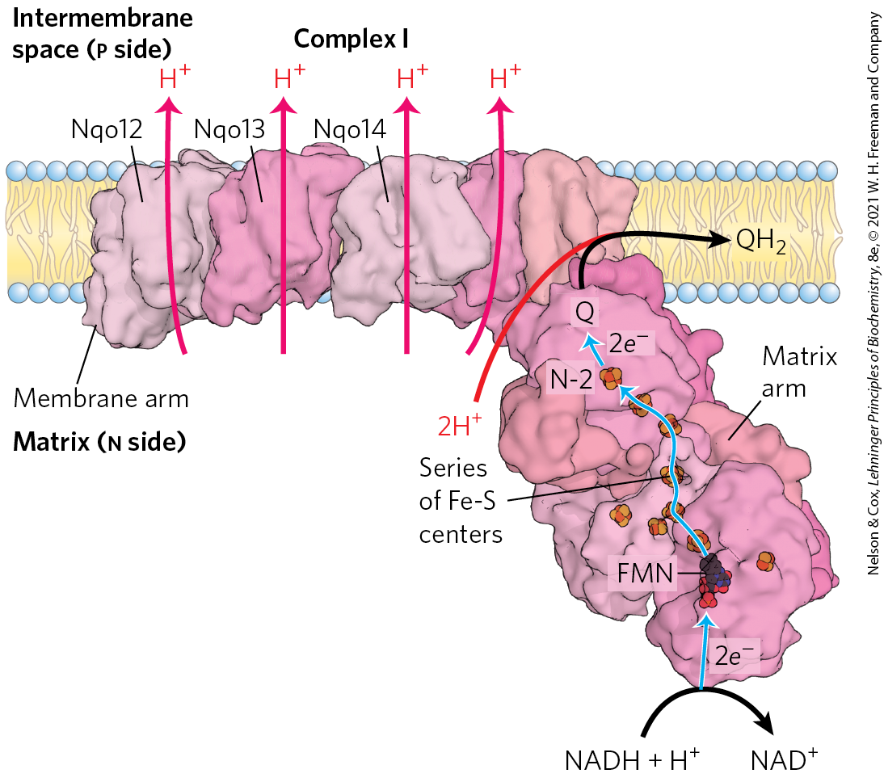
Complex I: NADH to Ubiquinone
Complex I (NADH:ubiquinone oxidoreductase, NADH dehydrogenase) = large L-shaped enzyme with >40 polypeptide chains
  FMN-containing flavoprotein accepts 2 electrons from NADH
  8+ Fe-S centers pass elections to ubiquinone

Slide 35
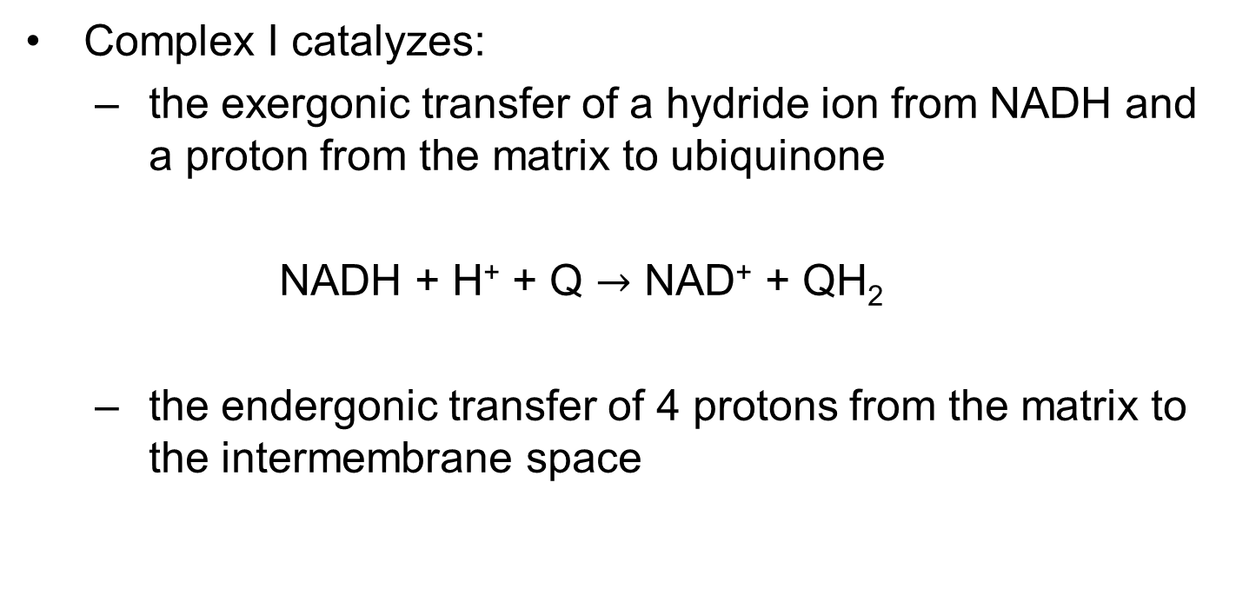
Complex I Catalyzes Two Simultaneous and Obligately Coupled Processes
Complex I catalyzes:
  the exergonic transfer of a hydride ion from NADH and a proton from the matrix to ubiquinone
  NADH + H⁺ + Q $→$ NAD⁺ + QH₂
  the endergonic transfer of 4 protons from the matrix to the intermembrane space
(19-1)

Slide 36
Principle 4 (2 of 5)
The free energy made available by “downhill” (exergonic) electron flow is coupled to the “uphill” transport of protons across a proton-impermeable membrane. The free energy of fuel oxidation is thus conserved as a transmembrane electrochemical potential.

Slide 37
Complex I Is a Proton Pump
Complex I is a proton pump driven by the energy of electron transfer
Complex I catalyzes a vectorial reaction (moves protons in a specific direction from one location to another)

Slide 38
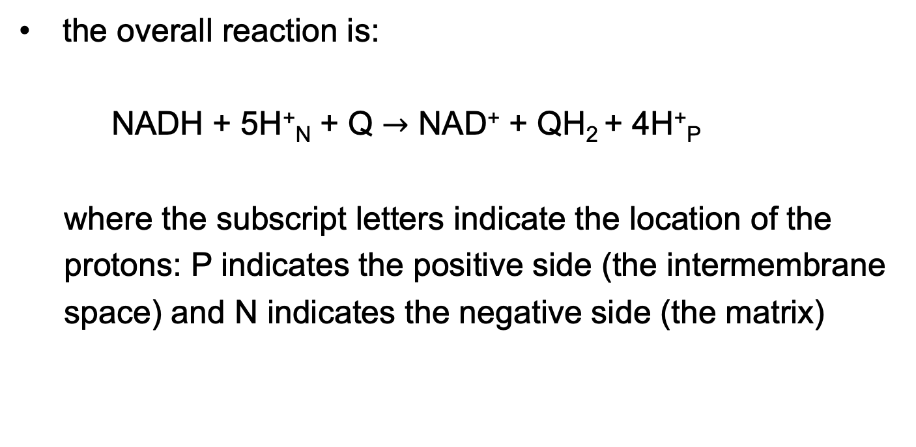
The Overall Reaction of Complex I
the overall reaction is:
NADH + 5H⁺_{N} + Q $→$ NAD⁺ + QH₂ + 4H⁺_{P}
where the subscript letters indicate the location of the
protons: P indicates the positive side (the intermembrane
space) and N indicates the negative side (the matrix)
(19-2)

Slide 39
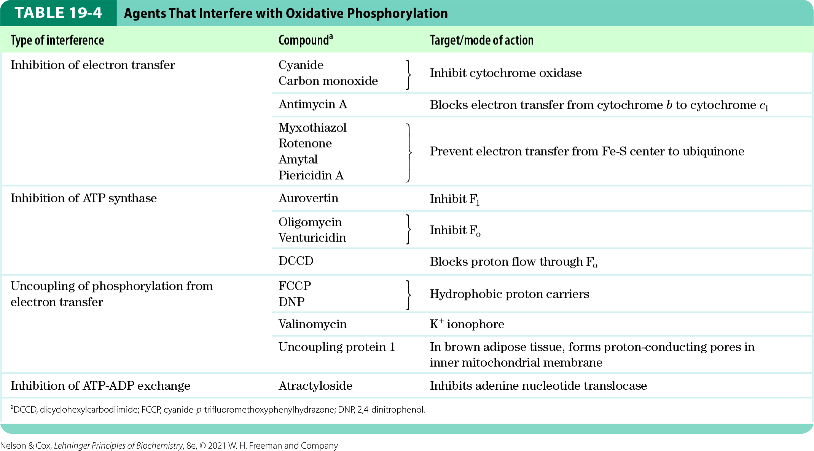
Agents that Inhibit
Oxidative Phosphorylation
inhibitors of Complex I:
  amytal (a barbiturate drug)
  rotenone (an insecticide)
  piericidin A (an antibiotic)

Slide 40
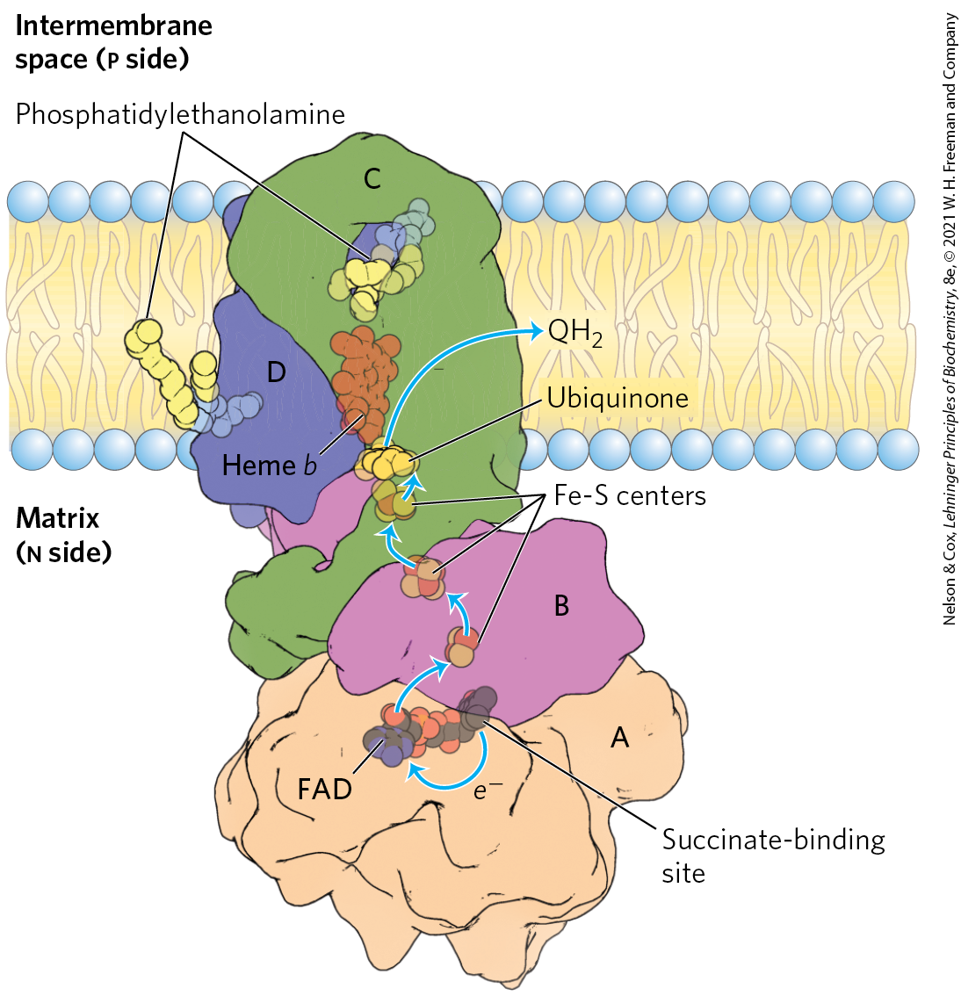
Complex II: Succinate to Ubiquinone
Complex II (succinate dehydrogenase) = couples the oxidation of succinate with the reduction of ubiquinone
  electrons pass from FAD to Fe-S centers to Q
  no proton pumping
  also functions to convert succinate to fumarate in the citric acid cycle

Slide 41
Heme b of Complex II
heme b reduces the frequency with which electrons “leak” out of the system, moving from succinate to molecular oxygen to produce the reactive oxygen species (ROS) H₂O₂ and the superoxide radical

Slide 42
Principle 3 (5 of 6)
Electrons flow from electron donors (oxidizable substrates) through a chain of membrane-bound carriers to a final electron acceptor with a large reduction potential. The final acceptor is molecular oxygen, O₂. The appearance of oxygen in the atmosphere some 2.3 billion years ago, and its harnessing in living systems via the evolution of oxidative phosphorylation, made more complex life forms possible.

Slide 43
Principle 4 (3 of 5)
The free energy made available by “downhill” (exergonic) electron flow is coupled to the “uphill” transport of protons across a proton-impermeable membrane. The free energy of fuel oxidation is thus conserved as a transmembrane electrochemical potential.

Slide 44
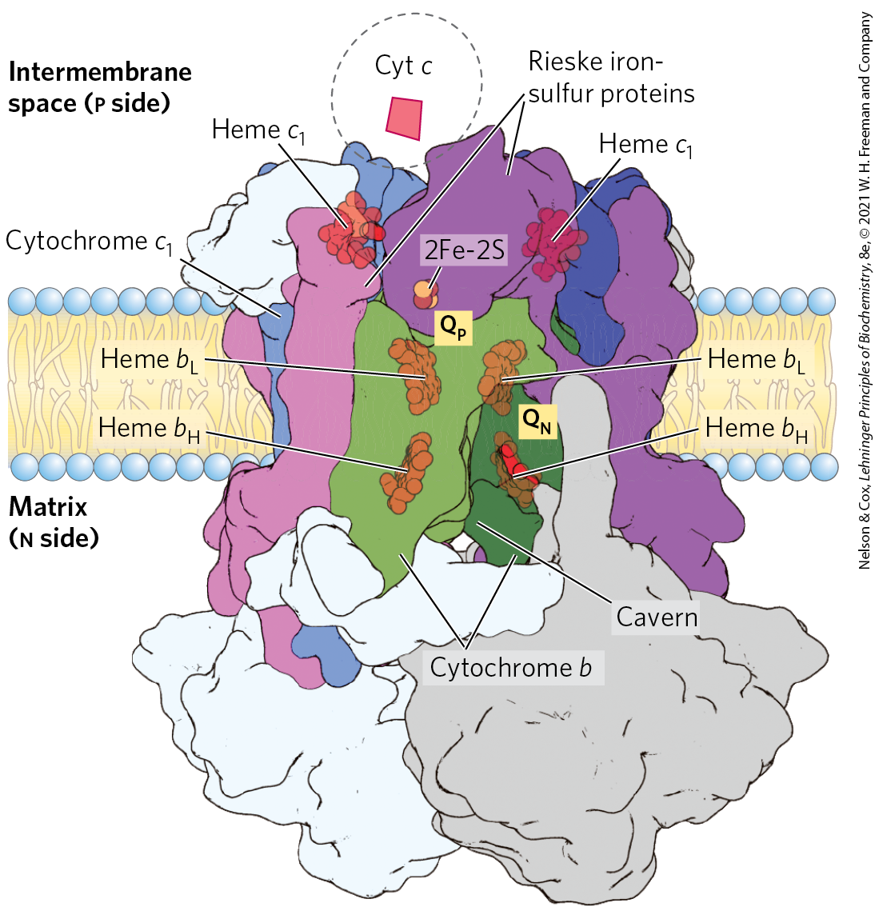
Complex III: Ubiquinone to Cytochrome c
Complex III (cytochrome bc₁ complex, ubiquinone: cytochrome c oxidoreductase) = couples the transfer of 2 electrons from ubiquinol to cytochrome c with the vectorial transport of four protons to the intermembrane space
  contains cytochrome b, cytochrome c1, and the Rieske iron-sulfur protein

Slide 45
The Path of Electrons through Complex III
ubiquinone diffuses through the inner mitochondrial membrane and transfers the electrons to cytochrome b
electrons pass to an Fe-S center which passes electrons, one at a time, through cytochrome c

Slide 46
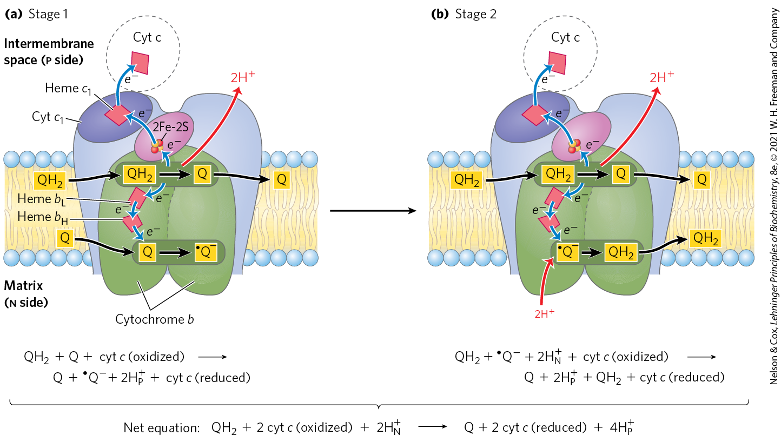
The Q Cycle

Slide 47

The Net Equation for the Redox Reactions of the Q Cycle
the net equation is:
QH₂ + 2 cyt c (oxidized) + 2H⁺_{N} $→$
Q + 2 cyt c (reduced) + 4H⁺_{P}
(19-3)

Slide 48
Principle 3 (6 of 6)
Electrons flow from electron donors (oxidizable substrates) through a chain of membrane-bound carriers to a final electron acceptor with a large reduction potential. The final acceptor is molecular oxygen, O₂. The appearance of oxygen in the atmosphere some 2.3 billion years ago, and its harnessing in living systems via the evolution of oxidative phosphorylation, made more complex life forms possible.

Slide 49
Principle 4 (4 of 5)
The free energy made available by “downhill” (exergonic) electron flow is coupled to the “uphill” transport of protons across a proton-impermeable membrane. The free energy of fuel oxidation is thus conserved as a transmembrane electrochemical potential.

Slide 50
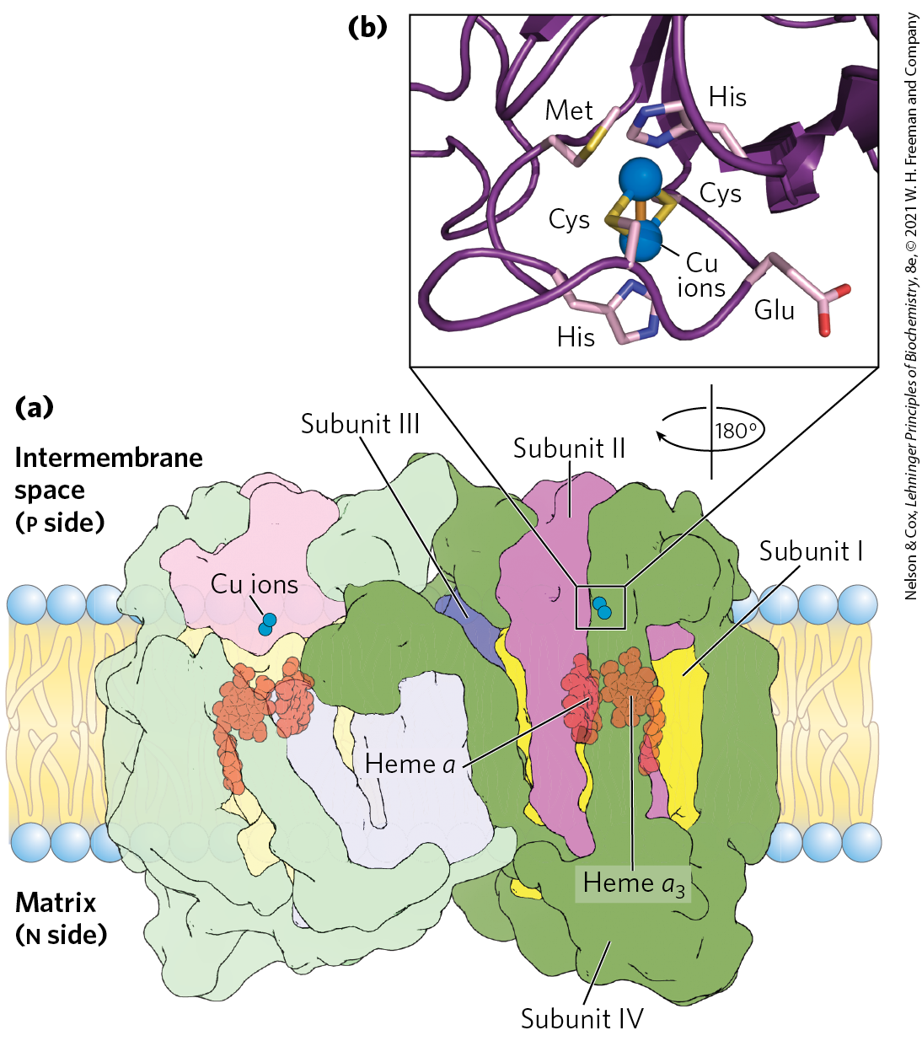
Complex IV: Cytochrome c to O₂
Complex IV (cytochrome oxidase) = carries electrons from cytochrome c to molecular oxygen, reducing it to H₂O
  large dimeric enzyme
  3 subunits have been conserved through evolution
  contains cytochromes a and a₃
  contains 2 Cu ions

Slide 51
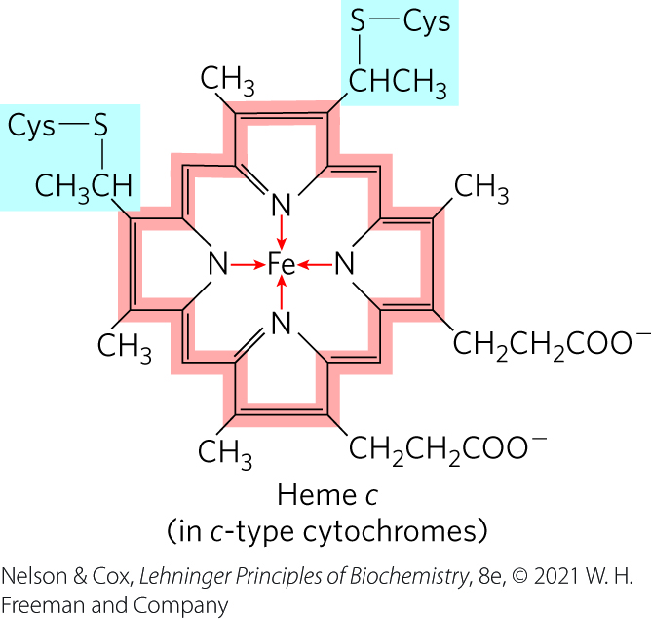
Cytochrome c
cytochrome c:
  moves through the intermembrane space
  carries a single electron from the cytochrome bc₁ complex to Complex IV
  absorbs visible light

Slide 52
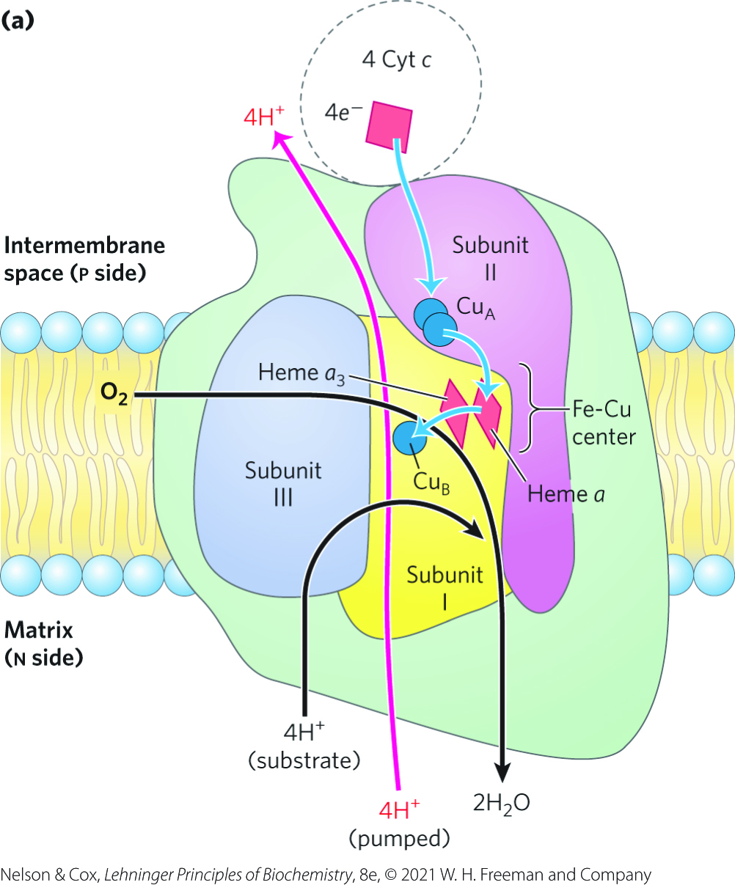
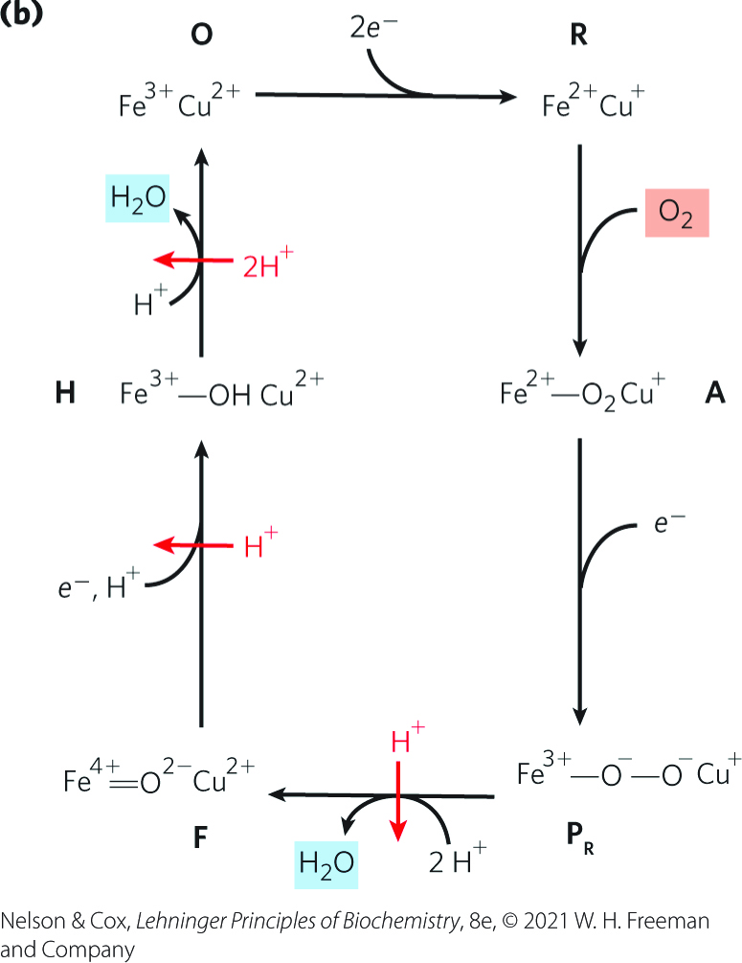
Path of Electrons Through
Complex IV

Slide 53
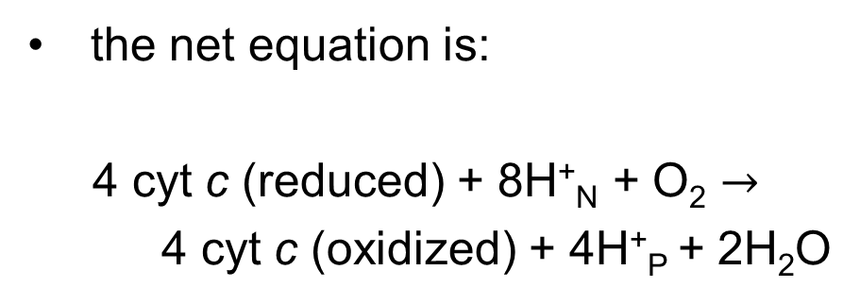
The Overall Reaction of Complex IV
the net equation is:
4 cyt c (reduced) + 8H⁺_{N} + O₂ $→$
4 cyt c (oxidized) + 4H⁺_{P} + 2H₂O
(19-4)

Slide 54
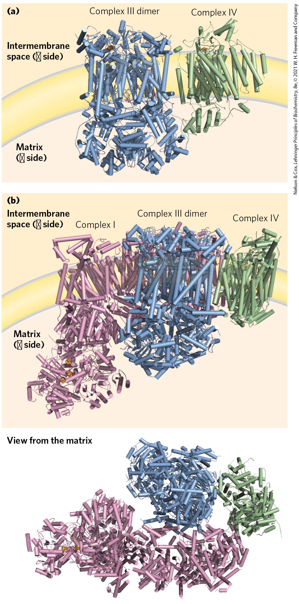
Mitochondrial Complexes Associate in Respirasomes
respirasome = supercomplex containing Complexes I, III, and IV
  may facilitate electron transfers or limit ROS production
cytochrome c and ubiquinone readily diffuse between supercomplexes

Slide 55
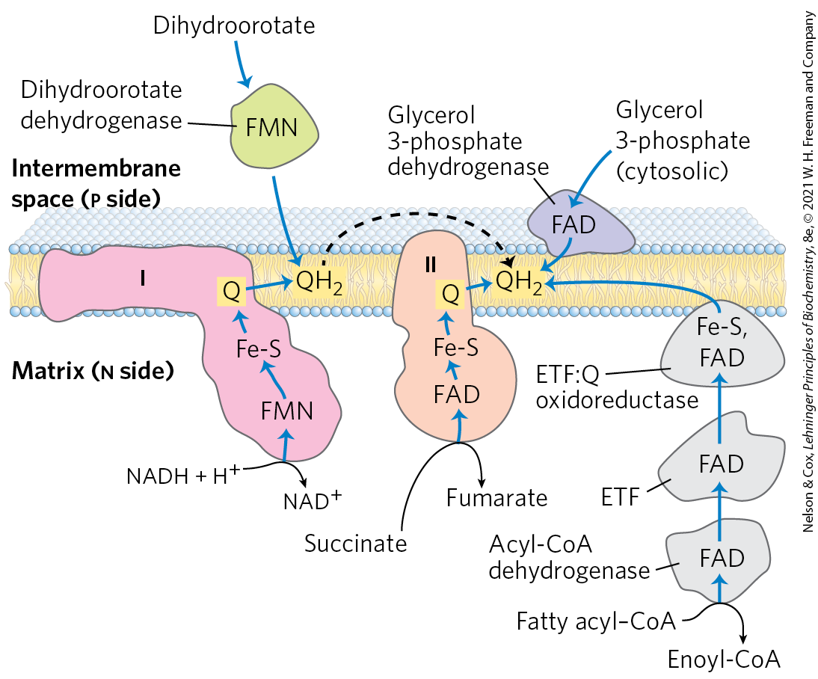
Other Pathways Donate Electrons to the Respiratory Chain via Ubiquinone

Slide 56
Electrons Derived from the Oxidation of Fatty Acids Pass to Ubiquinone
acyl-CoA dehydrogenase = flavoprotein that catalyzes the first step of the β oxidation of fatty acyl–CoA
  electrons pass from the substrate to the FAD of the dehydrogenase to electron-transferring flavoprotein (ETF)
ETF = passes its electrons to ETF:ubiquinone oxidoreductase
  reduces Q in the inner mitochondrial membrane to QH₂

Slide 57
The Oxidation of Glycerol Phosphate and Dihydroorotate
glycerol 3-phosphate dehydrogenase = flavoprotein located on the outer face of the inner mitochondrial membrane
  Q accepts electrons, and the QH₂ produced enters the pool of QH₂ in the membrane
dihydroorotate dehydrogenase = located on the outside of the inner mitochondrial membrane
  donates electrons to Q in the respiratory chain

Slide 58
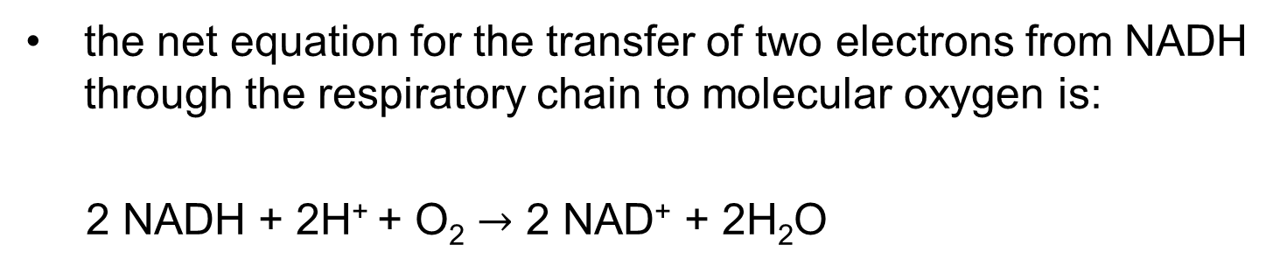
The Energy of Electron Transfer Is Efficiently Conserved in a Proton Gradient
the net equation for the transfer of two electrons from NADH through the respiratory chain to molecular oxygen is:
2 NADH + 2H⁺ + O₂ $→$ 2 NAD⁺ + 2H₂O
(19-5)

Slide 59
The Change in Standard Reduction Potential
the standard reduction potential change is:
∆E′° = E′° (electron acceptor)
− E′° (electron donor)
= 0.816 V − (−0.320 V)
= 1.14 V
E′° for NAD⁺/NADH is −0.320 V
E′° for O₂/H₂O is 0.816 V

Slide 60
The Net Reaction is Highly Exergonic
the standard free-energy change is:
  ∆G′° = −nF ∆E′°
  = −2(96.5 kJ/V • mol)(1.14 V)
  = −220 kJ/mol (of NADH)
(19-6)

Slide 61
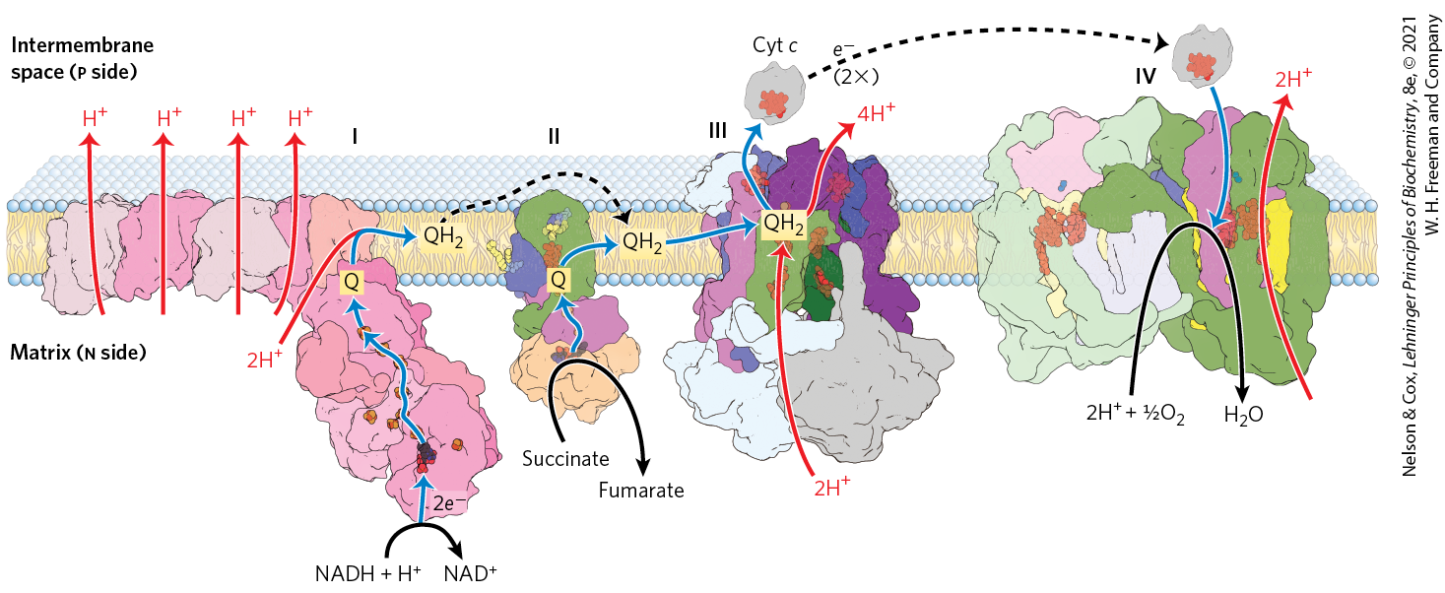
Summary of the Flow of Electrons and Protons through the Respiratory Chain
much of the free energy generated is recovered and stored in the form of an electrochemical proton gradient across the mitochondrial inner membrane

Slide 62
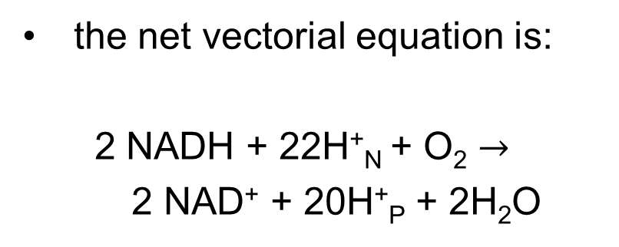
The Net Vectorial Equation
the net vectorial equation is:
  2 NADH + 22H⁺_{N} + O₂ $→$
  2 NAD⁺ + 20H⁺_{P} + 2H₂O
(19-7)

Slide 63
Principle 4 (5 of 5)
The free energy made available by “downhill” (exergonic) electron flow is coupled to the “uphill” transport of protons across a proton-impermeable membrane. The free energy of fuel oxidation is thus conserved as a transmembrane electrochemical potential.

Slide 64
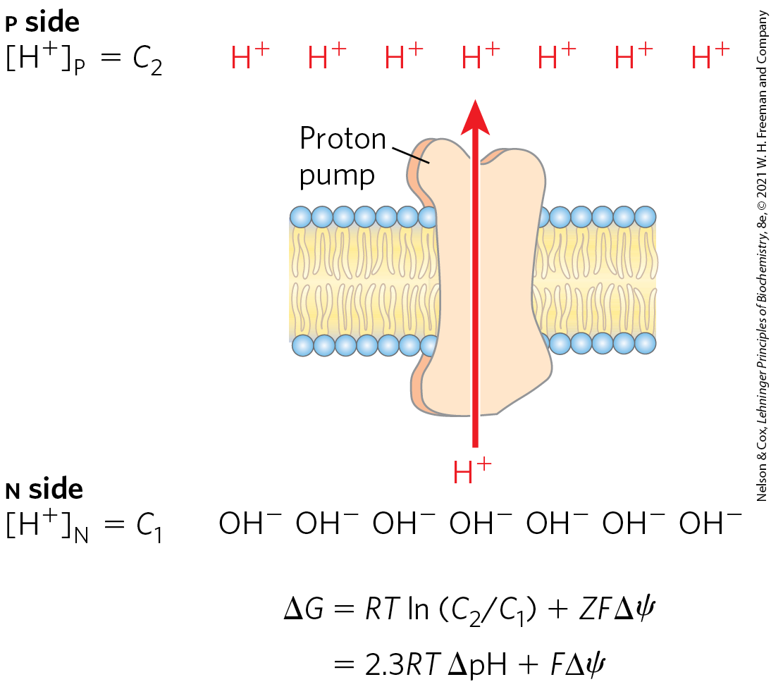
Proton-Motive Force
proton-motive force = the energy stored in an electrochemical proton gradient across the mitochondrial inner membrane
  composed of chemical and electrical potential energy

Slide 65
The Free-Energy Change for the Creation of an Electrochemical Gradient by an Ion Pump
the free-energy change is:
∆G = RT ln(C₂/C₁) + ZF ∆ψ
where C₂ and C₁ are the concentrations of an ion in two
regions, Z is the absolute value of its electrical charge,
and ∆ψ is the transmembrane difference in electrical
potential (in volts)
(19-8)

Slide 66
Calculating the Proton-Motive Force
the free-energy change is:
∆G = RT ln(C₂/C₁) + ZF ∆ψ
= RT (2.3(log[H⁺]_{P} − log[H⁺]_{N}) + ZF ∆ψ
= RT (2.3(pH_{N −} pH_{p}) + ZF ∆ψ
= RT (2.3 ∆pH) + ZF ∆ψ
= 2.3RT ∆pH + ZF ∆ψ
(19-9)

Slide 67
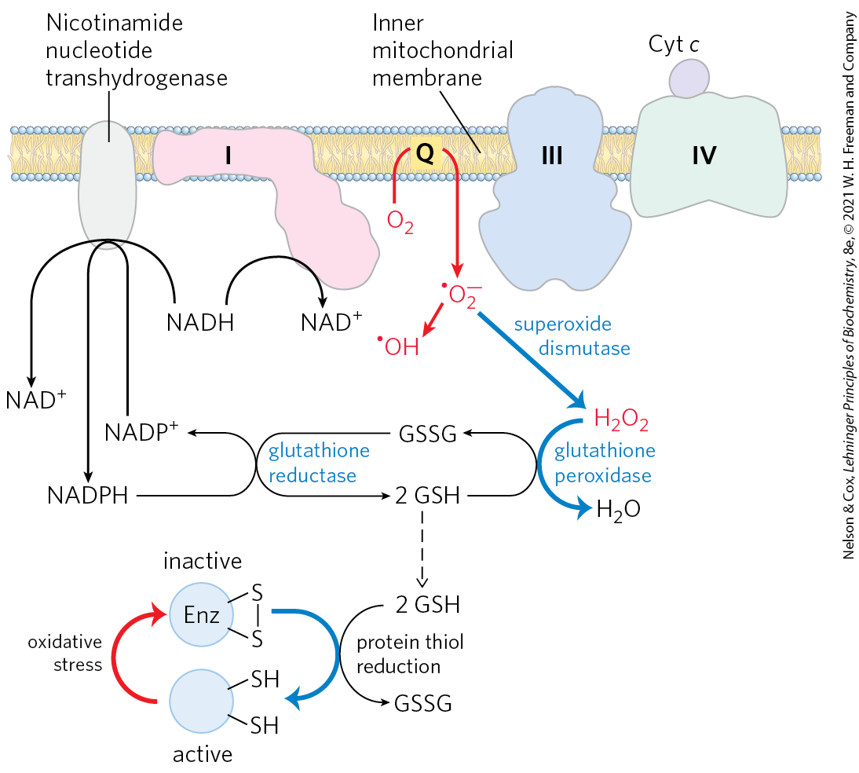
Reactive Oxygen Species Are Generated during Oxidative Phosphorylation
superoxide dismutase = catalyzes the conversion of superoxide and two protons to H₂O₂ and O₂
glutathione peroxidase = converts H₂O₂ to H₂O
low ROS levels serve as signals reflecting insufficient O₂

Slide 68
19.2 ATP Synthesis

Slide 69
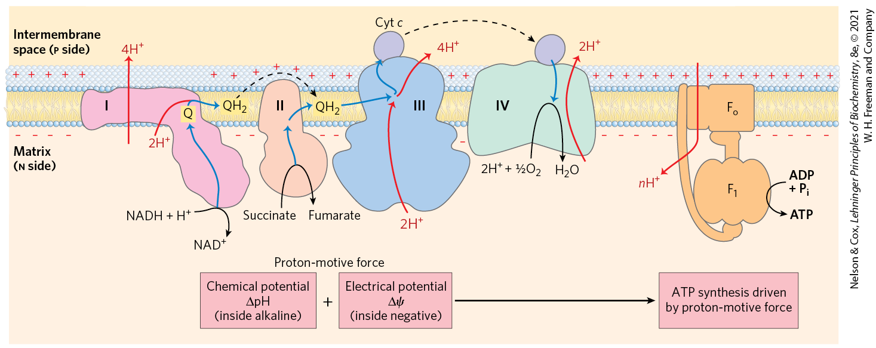
In the Chemiosmotic Model, Oxidation and Phosphorylation Are Obligately Coupled
chemiosmotic model = describes the coupling of ATP synthesis to an electrochemical proton gradient (the proton-motive force)

Slide 70
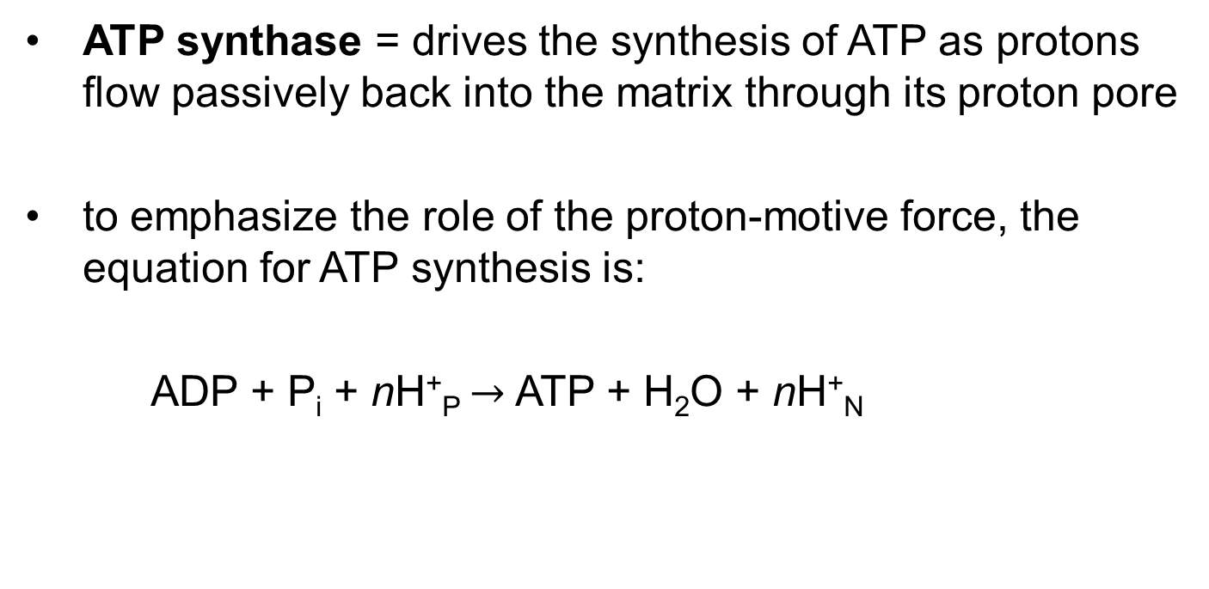
ATP Synthesis
ATP synthase = drives the synthesis of ATP as protons flow passively back into the matrix through its proton pore
to emphasize the role of the proton-motive force, the equation for ATP synthesis is:
  ADP + P_{i} + nH⁺_{P} $→$ ATP + H₂O + nH⁺_{N}
(19-10)

Slide 71
Principle 5 (2 of 7)
The transmembrane flow of protons back down their electrochemical gradient through specific protein channels provides the free energy for synthesis of ATP. This process is catalyzed by a membrane protein complex (ATP synthase) that couples proton flow to phosphorylation of ADP.

Slide 72
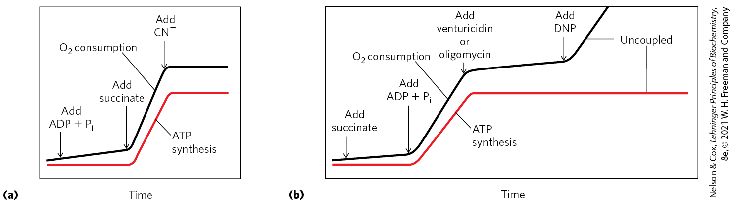
Coupling of Electron Transfer and ATP Synthesis in Mitochondria
inhibitors of electron transfer block ATP synthesis
inhibitors of ATP synthesis block electron transfer (unless oxidation and phosphorylation are uncoupled)

Slide 73
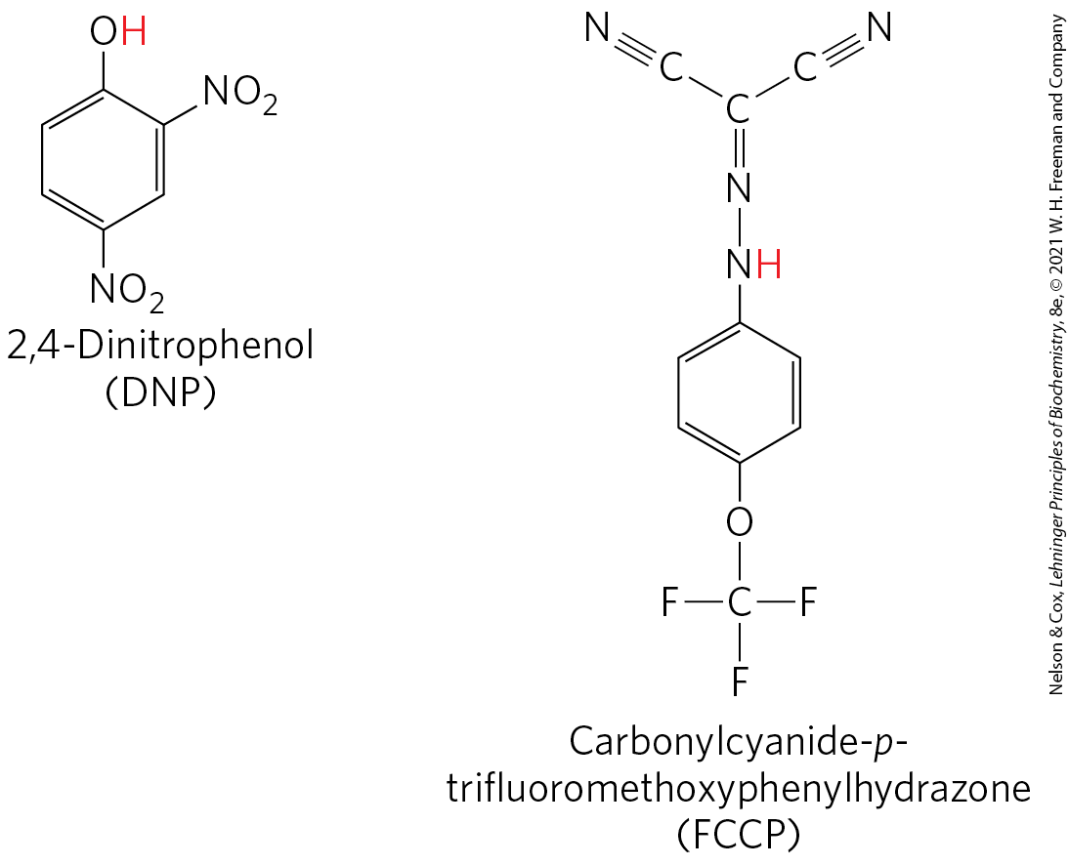
Chemical Uncouplers of
Oxidative Phosphorylation
physical shear or detergent uncouples electron transfer from ATP synthesis
DNP and FCCP = weak acids that carry protons across the inner mitochondrial membrane
  dissipates the proton gradient

Slide 74
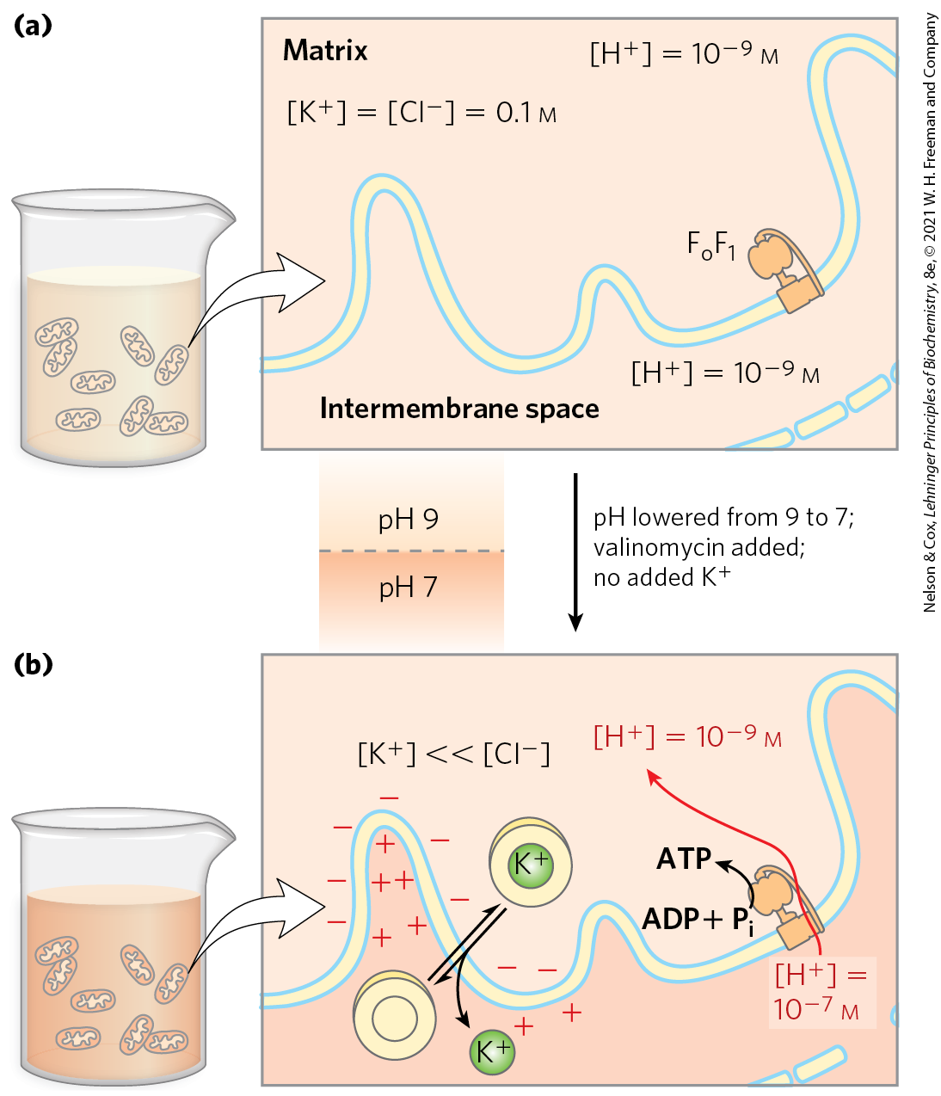
Proton-Motive Force Alone Drives ATP Synthesis
in the absence of an oxidizable substrate, the proton-motive force alone drives ATP synthesis

Slide 75
Principle 2 (3 of 4)
Mitochondria trace their evolutionary origin to bacteria. Over 1.45 billion years ago, an endosymbiotic relationship arose between bacteria and a primitive eukaryote or eukaryotic progenitor. Mitochondria are ubiquitous in modern eukaryotes, and their bacterial origin is evident in almost every aspect of their structure and function.

Slide 76
ATP Synthase Has Two Functional Domains, F_{o} and F₁
mitochondrial ATP synthase is an F-type ATPase
  similar in structure and mechanism to the ATP synthases of bacteria and chloroplasts

Slide 77
Principle 5 (3 of 7)
The transmembrane flow of protons back down their electrochemical gradient through specific protein channels provides the free energy for synthesis of ATP. This process is catalyzed by a membrane protein complex (ATP synthase) that couples proton flow to phosphorylation of ADP.

Slide 78
Mitochondrial ATP Synthase
contains two distinct components:
  F_{o} = an integral membrane protein with a proton pore
  F₁ (originally F₁ ATPase) = a peripheral membrane protein
    catalyzes hydrolysis of ATP when isolated

Slide 79
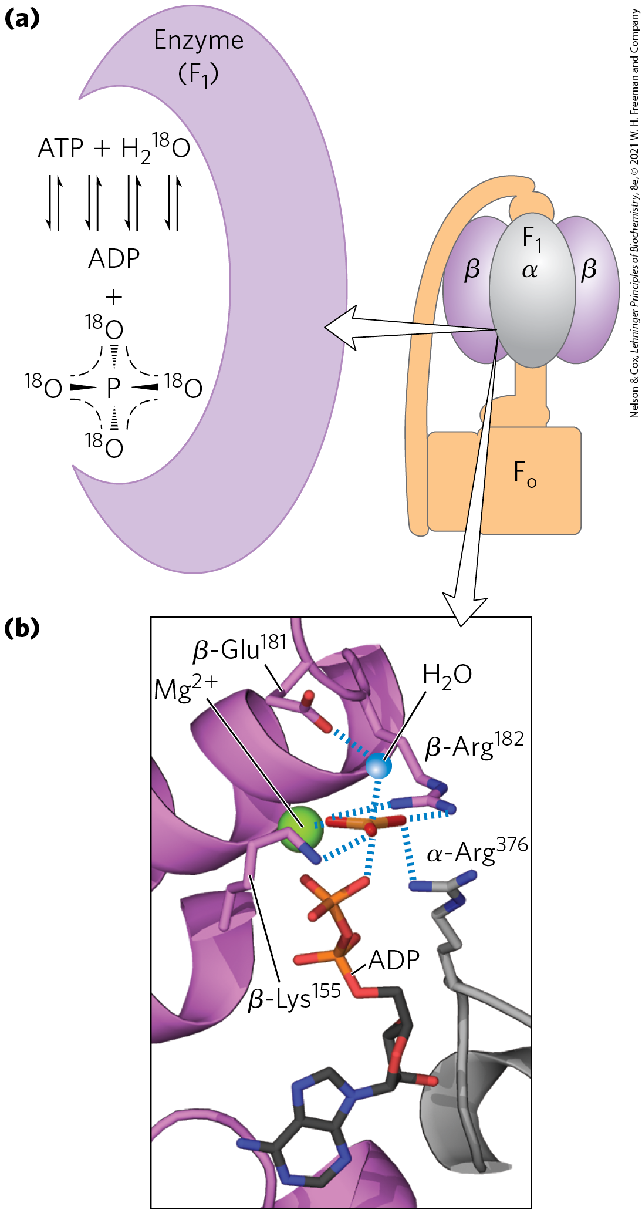
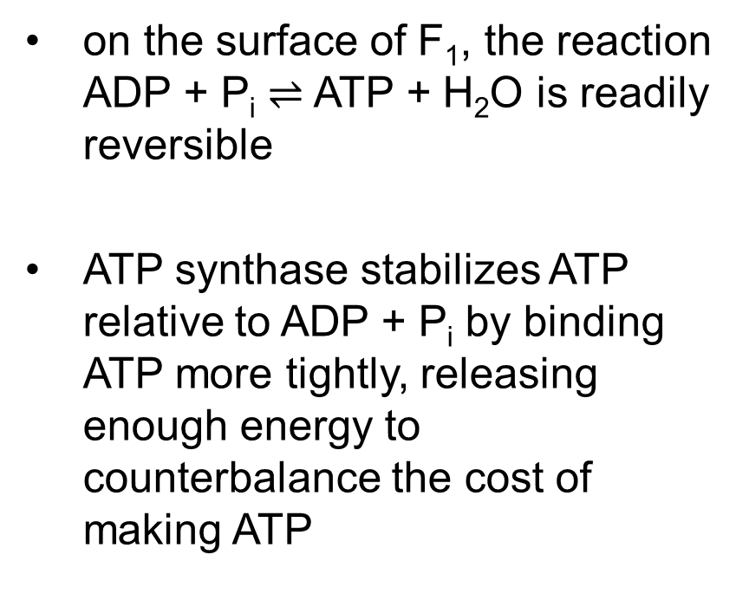
ATP Is Stabilized Relative to ADP on the Surface of F₁
on the surface of F₁, the reaction ADP + P_{i} $⇌$ ATP + H₂O is readily reversible
ATP synthase stabilizes ATP relative to ADP + P_{i} by binding ATP more tightly, releasing enough energy to counterbalance the cost of making ATP

Slide 80
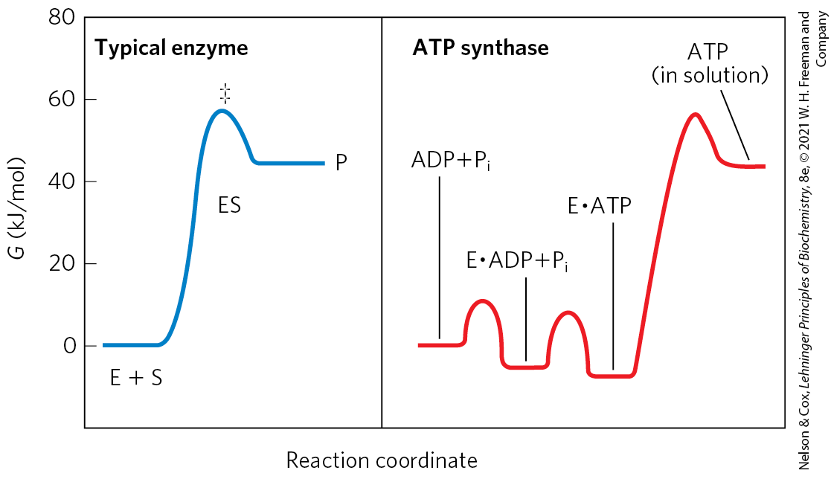
The Proton Gradient Drives the Release of ATP from the Enzyme Surface
the free energy required for the release of ATP is provided by the proton-motive force

Slide 81
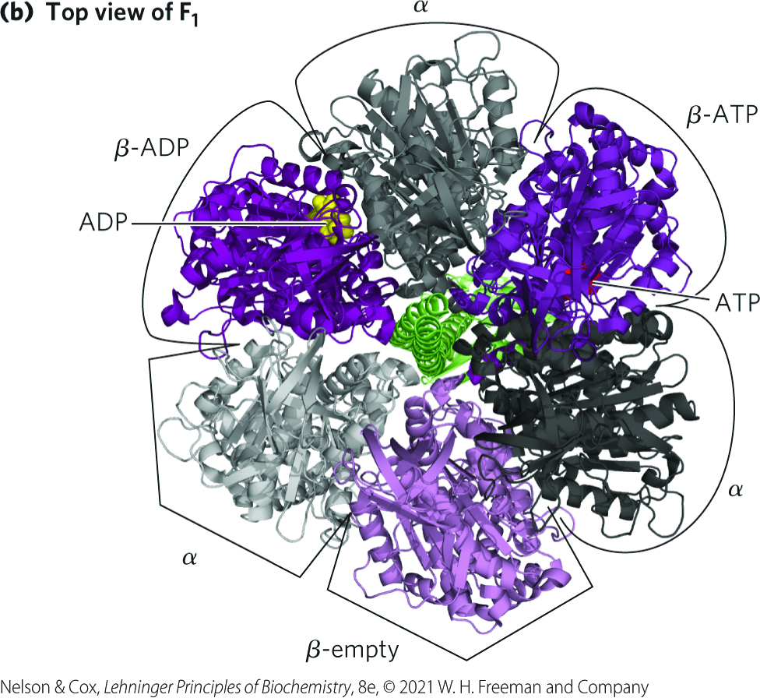
Each β Subunit of ATP Synthase Can Assume Three Different Conformations
mitochondrial F₁ has the composition α₃β₃γδε
  each of the three β subunits has one catalytic site for ATP synthesis
  each β subunit has a different conformation:
    β-ATP
    β-ADP
    β-empty

Slide 82
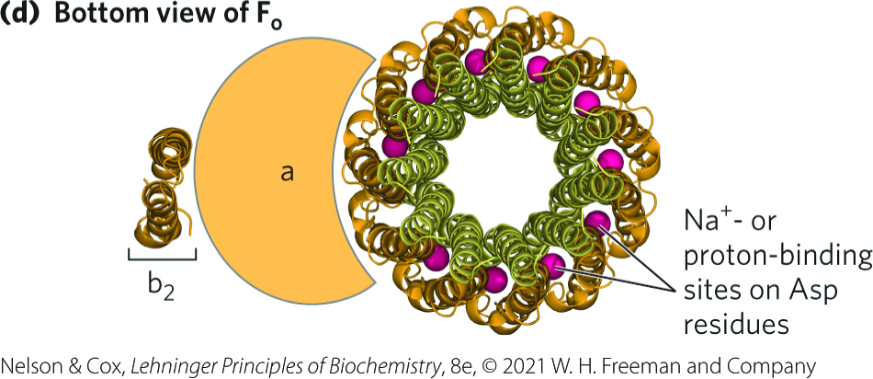
The Structure of the F_{o} Complex
mitochondrial F_{o} has the composition ab₂c_{n}
  n ranges from 8 to 17 depending on the species
c ring = arrangement of c subunits into two concentric circles
  the c subunits rotate together as a unit

Slide 83
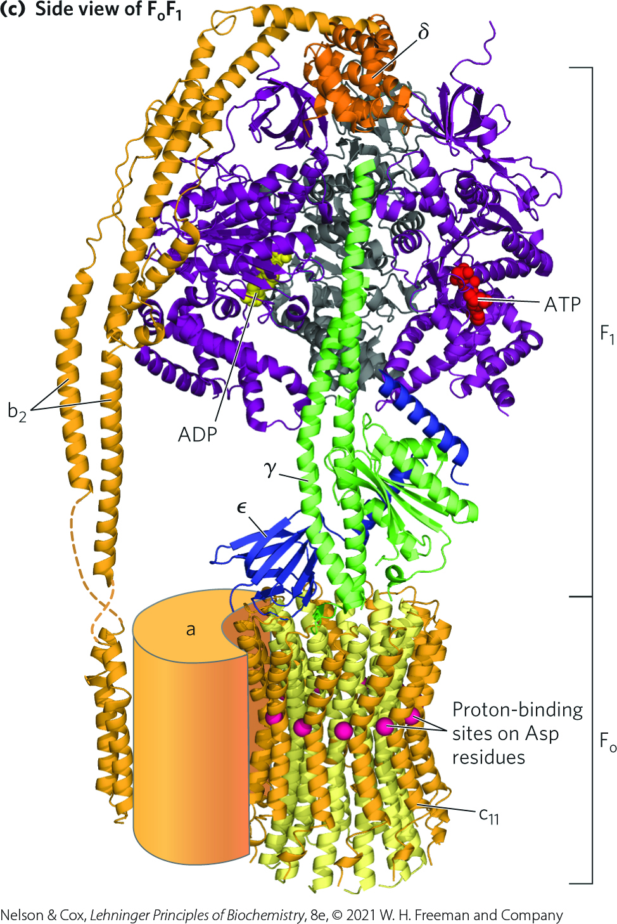
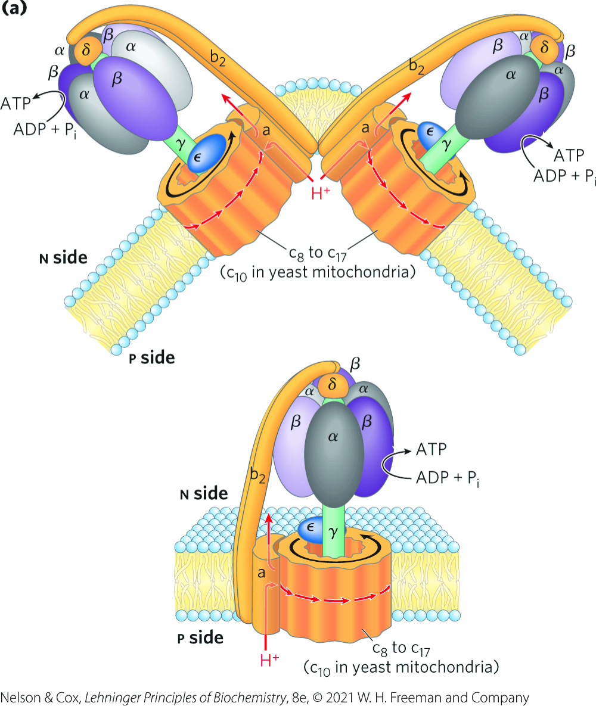
The Structure of the F_{o}F₁ Complex

Slide 84
Principle 5 (4 of 7)
The transmembrane flow of protons back down their electrochemical gradient through specific protein channels provides the free energy for synthesis of ATP. This process is catalyzed by a membrane protein complex (ATP synthase) that couples proton flow to phosphorylation of ADP.

Slide 85
Rotational Catalysis Is Key to the Binding-Change Mechanism for ATP Synthesis
rotational catalysis = mechanism by which the flow of protons through F_{o} causes the c ring to rotate and, in turn, trigger the subunit conformational changes in F₁

Slide 86
The Binding-Change Model
binding-change model = the active site of each β subunit cycles through the three conformations:
  β-ATP – tight binding
  β-ADP – loose binding
  β-empty – very loose binding

Slide 87
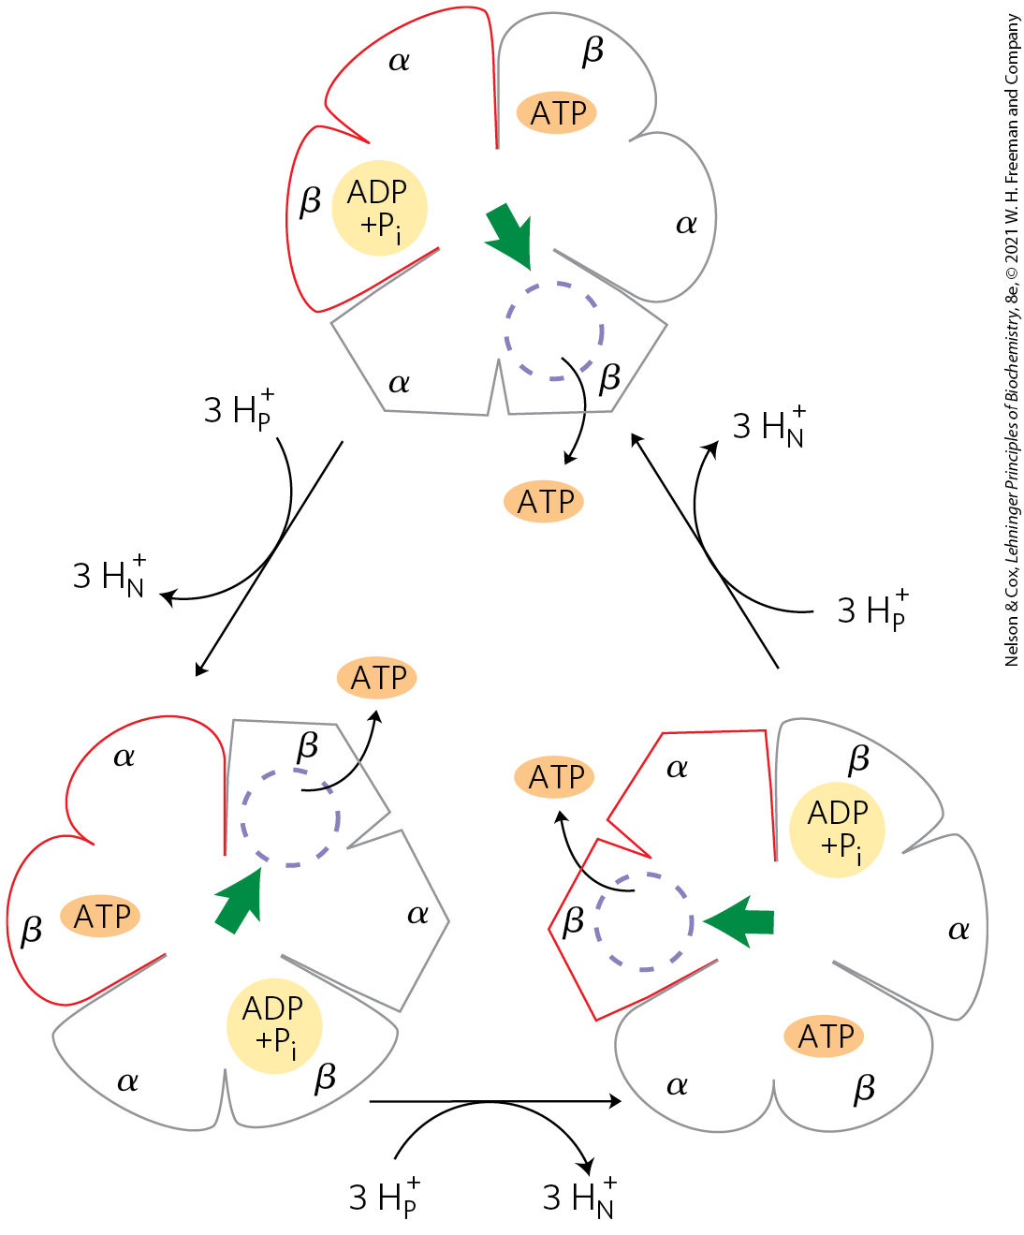
Binding-Change Model for ATP Synthase
the three active sites of F₁ take turns catalyzing ATP synthesis
translocation of three protons fuels synthesis of one ATP
each complete rotation synthesizes three ATP

Slide 88
Coupling Proton Translocation to ATP Synthesis
proton translocation causes a rotation of F₀ and γ
  causes a conformational change within all the three αβ pairs, one of which promotes condensation of ADP and P_{i} into ATP.

Slide 89
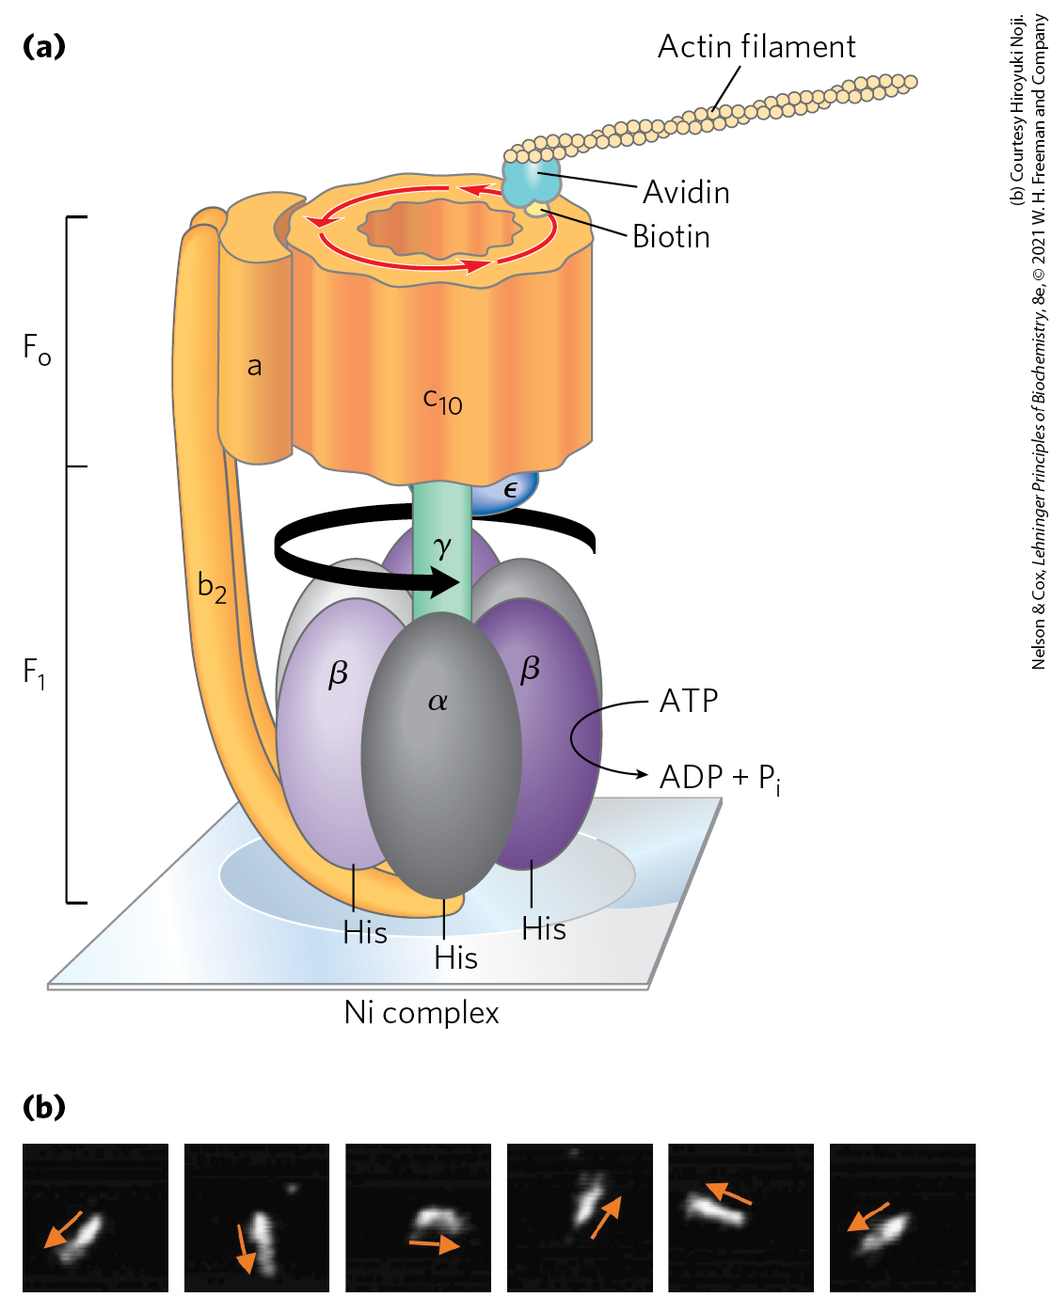
Experimental Demonstration of Rotation of F_{o} and γ
the γ subunit rotates in one direction when F_{o}F₁ is synthesizing ATP and in the opposite direction when hydrolyzing ATP

Slide 90
Principle 5 (5 of 7)
The transmembrane flow of protons back down their electrochemical gradient through specific protein channels provides the free energy for synthesis of ATP. This process is catalyzed by a membrane protein complex (ATP synthase) that couples proton flow to phosphorylation of ADP.

Slide 91
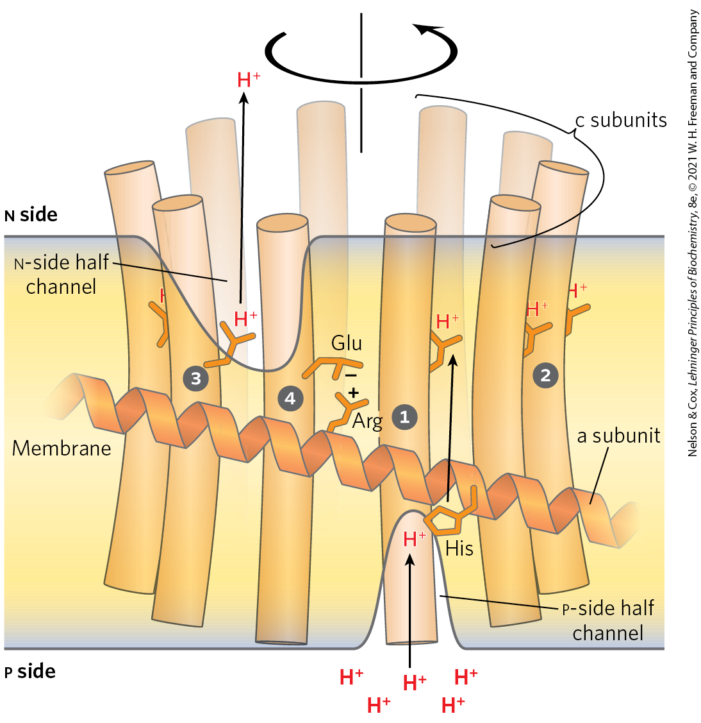
A Model for Proton-Driven Rotation of the c Ring
the a subunit is stationary and the c ring rotates
transient protonation of a key Glu residue in each c subunit elicits conformation changes that drive rotation and transmit protons

Slide 92
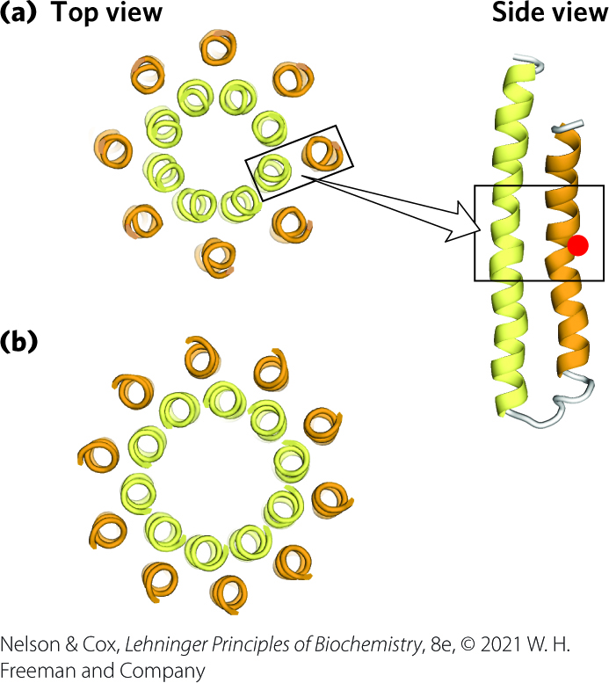

Species Differences in Number of c Subunits in the c Ring of the F_{o} Complex

Slide 93

Chemiosmotic Coupling Allows Nonintegral Stoichiometries of O₂ Consumption and ATP Synthesis
the overall reaction equation for ATP synthesis is:
x ADP + xP_{i} + ½ O₂ + H⁺ + NADH $→$
x ATP + H₂O + NAD⁺
P/O ratio (P/2e⁻ ratio) = the value of x
  there is no theoretical requirement for P/O to be integral
(19-11)

Slide 94
The P/O Ratio
the P/O ratio is:
  ~2.5 when electrons enter the respiratory chain at Complex I
  ~1.5 when electrons enter at ubiquinone
the ratio varies among species, depending on the number of c subunits in the F_{o} complex

Slide 95

The Proton-Motive Force Energizes Active Transport
adenine nucleotide translocase = antiporter that moves ADP into the matrix and ADP out
phosphate translocase = promotes symport of one H₂PO₄⁻ and one H⁺ into the matrix
ATP synthasome = a complex of ATP synthase and both translocases
translocation of a fourth proton per ATP is required to facilitate cotransport

Slide 96
Shuttle Systems Indirectly Convey Cytosolic NADH into Mitochondria for Oxidation
the inner mitochondrial membrane is impermeable to NADH and NAD
NADH equivalents are moved from the cytosol to the matrix by:
  the malate-asparate shuttle
  the glycerol 3-phosphate shuttle

Slide 97

The Malate-Aspartate Shuttle
NADH equivalents moved in by the malate-aspartate shuttle enter the respiratory chain at Complex I and yield a P/O ratio of 2.5

Slide 98

The Glycerol 3-Phosphate Shuttle
NADH equivalents moved in by the glycerol 3-phosphate shuttle enter the respiratory chain at Complex III and yield a P/O ratio of 1.5

Slide 99
19.3 Regulation of Oxidative Phosphorylation

Slide 100
ATP Yield from Complete Oxidation of Glucose
Table 19-5 ATP Yield from Complete Oxidation of Glucose
Process | Direct product | Final ATP
Glycolysis | 2 NADH (cytosolic) 2 ATP | 3 or 5 2
Pyruvate oxidation (two per glucose) | 2 NADH (mitochondrial matrix) | 5
Acetyl-CoA oxidation in citric acid cycle (two per glucose) | 6 NADH (mitochondrial matrix) 2 FADH₂ 2 ATP or 2 GTP | 15 3 2
Total yield per glucose |  | 30 or 32
glycolysis under anaerobic conditions (lactate fermentation) yields only 2 ATP per glucose

Slide 101
Oxidative Phosphorylation Is Regulated by Cellular Energy Needs
the acceptor control of respiration = ADP
  the rate of O₂ consumption depends on the availability of ADP, the P_{i} acceptor
the acceptor control ratio = the ratio of the maximal rate of ADP-induced O₂ consumption to the basal rate in the absence of ADP
  at least 10 in some animal tissues

Slide 102
The Mass-Action Ratio is a Measure of a Cell’s Energy Status
mass-action ratio = [ATP]/([ADP][P_{i}])
  usually this ratio is very high
  when lowered (and more ADP is available), the rate of respiration increases

Slide 103
Principle 5 (6 of 7)
The transmembrane flow of protons back down their electrochemical gradient through specific protein channels provides the free energy for synthesis of ATP. This process is catalyzed by a membrane protein complex (ATP synthase) that couples proton flow to phosphorylation of ADP.

Slide 104

An Inhibitory Protein Prevents
ATP Hydrolysis
IF₁ = protein inhibitor that simultaneously binds 2 ATP molecules to inhibit enzyme activity in both directions
  active in its dimeric form, which occurs when pH < 6.5
in hypoxic (oxygen-deprived) cells, IF₁ binds and prevents a drastic drop in [ATP].

Slide 105
Hypoxia Leads to ROS Production and Several Adaptive Responses
defenses against ROS:
  glutathione peroxidase system
  regulation of pyruvate dehydrogenase
    phosphorylated (inactive) under hypoxic conditions
  modification of a subunit of Complex IV (COX4-1 to COX4-2)
    acts more efficiently under hypoxic conditions

Slide 106

Regulation of Gene Expression by HIF-1
HIF-1 = the hypoxia-inducible factor
  accumulates in hypoxic cells
  acts as a transcription factor
  master regulator of O₂ homeostasis
  mediates changes in glucose transport and glycolytic enzymes that produce the Warburg effect

Slide 107
ATP-Producing Pathways Are Coordinately Regulated
ATP and ADP relative concentrations control the rates of:
  electron transfer
  oxidative phosphorylation
  the citric acid cycle
  pyruvate oxidation
  glycolysis

Slide 108


Regulation of ATP-Producing Pathways

Slide 109
19.4 Mitochondria in Thermogenesis, Steroid Synthesis, and Apoptosis

Slide 110
Principle 1 (3 of 5)
Mitochondria play a central role in eukaryotic aerobic metabolism. ATP production is not the only important mitochondrial function. Mitochondria play host to the citric acid cycle, the fatty acid β-oxidation pathway, and the pathways of amino acid oxidation. The mitochondria also act in thermogenesis, steroid synthesis, and apoptosis (programmed cell death). The discovery of these diverse and important roles of mitochondria has stimulated much current research on the biochemistry of this organelle.

Slide 111
Principle 5 (7 of 7)
The transmembrane flow of protons back down their electrochemical gradient through specific protein channels provides the free energy for synthesis of ATP. This process is catalyzed by a membrane protein complex (ATP synthase) that couples proton flow to phosphorylation of ADP.

Slide 112
Uncoupled Mitochondria in Brown Adipose Tissue Produce Heat
brown adipose tissue (BAT) = adipose tissue in newborn mammals that functions to generate heat through fuel oxidation
uncoupling protein 1 (UCP1) = a long-chain fatty acid/H⁺ symporter that provides a path for protons to return to the matrix without passing through the F_{o}F₁ complex
  results in energy of oxidation being dissipated as heat
hydrolysis of phosphocreatine also liberates heat

Slide 113

Two Mechanisms of Mitochondrial Thermogenesis

Slide 114
Hibernating Animals
hibernating animals depend on the activity of uncoupled BAT mitochondria to generate heat during their long dormancy

Slide 115
Principle 1 (4 of 5)
Mitochondria play a central role in eukaryotic aerobic metabolism. ATP production is not the only important mitochondrial function. Mitochondria play host to the citric acid cycle, the fatty acid β-oxidation pathway, and the pathways of amino acid oxidation. The mitochondria also act in thermogenesis, steroid synthesis, and apoptosis (programmed cell death). The discovery of these diverse and important roles of mitochondria has stimulated much current research on the biochemistry of this organelle.

Slide 116

Mitochondrial P-450 Monooxygenases Catalyze Steroid Hydroxylations
mitochondria are the site of biosynthetic reactions that produce steroid hormones
  occur in steroidogenic tissues (adrenal gland, gonads, liver, and kidney)

Slide 117

The Cytochrome P-450 Family
cytochrome P-450 family = monoxygenases that catalyze a series of hydroxylation reactions to synthesize steroid hormones from a sterol
  have a critical heme group
cytochrome P-450 enzymes catalyze the reaction
R–H + O₂ +NADPH + H⁺ $→$
R–OH + H₂O +NADP⁺

Slide 118

Path of Electron Flow in Mitochondrial Cytochrome P-450 Reactions
a flavoprotein and an iron-sulfur protein carry electrons from NADPH to the P-450 heme
all P-450 enzymes have a heme that interacts with O₂ and a substrate-binding site that confers specificity

Slide 119
P-450 Enzymes in the ER of Hepatocytes
catalyze similar reactions with hydrophobic compounds, including xenobiotics
xenobiotics = compounds not found in nature but synthesized industrially

Slide 120
Mitochondria Are Central to the Initiation of Apoptosis
apoptosis (programmed cell death) = process in which individual cells die for the good of the organism
can be triggered:
  during normal embryonic development
  in response to an external signal
  by internal events (DNA damage, viral infection, oxidative stress from the accumulation of ROS, heat shock)

Slide 121
Principle 1 (5 of 5)
Mitochondria play a central role in eukaryotic aerobic metabolism. ATP production is not the only important mitochondrial function. Mitochondria play host to the citric acid cycle, the fatty acid β-oxidation pathway, and the pathways of amino acid oxidation. The mitochondria also act in thermogenesis, steroid synthesis, and apoptosis (programmed cell death). The discovery of these diverse and important roles of mitochondria has stimulated much current research on the biochemistry of this organelle.

Slide 122

Role of Cytochrome c in Apoptosis
permeability transition pore complex (PTPC) = a multisubunit membrane protein that opens to increase permeability
Apaf-1 (apoptosis protease activating factor-1) = monomers that interact with cytochrome c molecules to form an apoptosome
caspases = proteases involved in apoptosis

Slide 123
19.5 Mitochondrial Genes: Their Origin and the Effects of Mutations

Slide 124

Mitochondrial Genes and Mutations
13 mitochondrial proteins are encoded by the mitochondrial genome and synthesized in mitochondria
~1,200 mitochondrial proteins are encoded by nuclear genes and imported into mitochondria

Slide 125

Respiratory Proteins Encoded by Mitochondrial Genes in Humans

Slide 126
Principle 2 (4 of 4)
Mitochondria trace their evolutionary origin to bacteria. Over 1.45 billion years ago, an endosymbiotic relationship arose between bacteria and a primitive eukaryote or eukaryotic progenitor. Mitochondria are ubiquitous in modern eukaryotes, and their bacterial origin is evident in almost every aspect of their structure and function.

Slide 127
Mitochondria Evolved from Endosymbiotic Bacteria
mitochondria arose from aerobic bacteria that entered into an endosymbiotic relationship with primitive eukaryotes
  endosymbiotic bacteria eventually became mitochondria
the chemiosmotic mechanism likely evolved before the emergence of eukaryotes

Slide 128

Respiration-Linked Extrusion of Protons Drives Other Processes
uptake of extracellular nutrients against a concentration gradient occurs in symport with protons
the rotary motion of bacterial flagella is driven by the transmembrane electrochemical potential

Slide 129
Mutations in Mitochondrial DNA Accumulate throughout the Life of the Organisms
defects in mtDNA occur over time because:
  of the greatest exposure to ROS
  the mtDNA replication system is less effective than the nuclear system at correcting mistakes and damage
animals inherit essentially all mitochondria from the female parent

Slide 130


Heteroplasmy and Homoplasmy
heteroplasmy = different types of mitochondrial genomes within a cell
  results in mutant phenotypes of varying degrees of severity
homoplasmy = the mitochondrial genome is the same within a cell

Slide 131
Some Mutations in Mitochondrial Genomes Cause Disease
mitochondrial encephalomyopathies = a group of genetic diseases that primarily affect the brain and skeletal muscle
  inherited from the mother
Leber hereditary optic neuropathy (LHON) = rare disease that affects the central nervous system
  single amino acid substitution in Complex I causes the mitochondria to be partially defective in electron transfer from NADH to ubiquinone

Slide 132

Myoclonic Epilepsy with Ragged-Red Fibers (MERRF) Syndrome
myoclonic epilepsy with ragged-red fibers (MERRF) syndrome = caused by a mutation in the gene that encodes a tRNA specific for lysine
skeletal muscle fibers of affected individuals have abnormally shaped mitochondria that sometimes contain paracrystalline structures

Slide 133
Mitochondrial Donation
mitochondrial donation = transplantation of a prospective mother’s nuclear genes into an enucleated ovum from a donor with healthy mitochondria
  creates an ovum free of a mutation that would have led to a mitochondrial disease
  raises ethical issues

Slide 134

A Rare Form of Diabetes Results from Defects in the Mitochondria of Pancreatic β Cells
mitochondrial defects in pancreatic β cells can limit ATP production when glucose levels are high
compromises insulin release and gives rise to a form of type 2 diabetes

