Slide 1

17 Fatty Acid Catabolism
© 2021 Macmillan Learning

Slide 2
The Oxidation of Long-Chain Fatty Acids to Acetyl-CoA
serves as a central energy-yielding pathway in many organisms and tissues
  provides as much as 80% of the energetic needs in mammalian heart and liver
  provides >40% of the daily energy requirement
electrons removed from fatty acids during oxidation pass through the respiratory chain, driving ATP synthesis
acetyl-CoA produced from the fatty acids may be completely oxidized to CO₂ in the citric acid cycle

Slide 3
β Oxidation
β oxidation = oxidation of the fatty acyl group at the C-3, or β, position—hence the name
  occurs after the carboxyl group at C-1 is activated by attachment to coenzyme A

Slide 4

Principle 1 (1 of 5)
Metabolites of diverse origin funnel into a few central pathways. Fatty acid catabolism and glycolysis convert quite different starting materials into the same product (acetyl-CoA). The electrons from the oxidative reactions of these pathways and of the citric acid cycle are carried by common cofactors (NAD and FAD) to the mitochondrial respiratory chain leading to oxygen, providing the energy for ATP synthesis by oxidative phosphorylation.

Slide 5

Principle 2 (1 of 5)
Evolution selects for chemical mechanisms that make useful reactions more energetically favorable, and those same mechanisms are used in different pathways. In the breakdown of fatty acids, we see the activation of a carboxylic acid by its conversion to a thioester, as we saw with acetyl-CoA in the citric acid cycle. To break the C–C bonds in the long chain of relatively inert –CH₂–CH₂– groups in fatty acids, a carbonyl group is created adjacent to the –CH₂– group, as we saw in the reactions of the citric acid cycle.

Slide 6

Principle 3 (1 of 4)
Allosteric mechanisms and posttranslational regulation (protein phosphorylation) coordinate metabolic processes within a cell. Hormones and growth factors coordinate metabolic activities among tissues and organs. Reciprocal regulation of catabolic and anabolic pathways prevents the inefficiency of futile cycling.

Slide 7
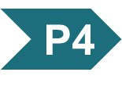
Principle 4 (1 of 6)
When a process lacks a critical component—an enzyme, a cofactor, or a regulatory agent—the resulting loss of homeostasis may cause disease across a spectrum of severity. Defects in fatty acid breakdown are no exception.

Slide 8
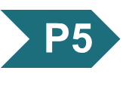
Principle 5 (1 of 4)
The liver plays a unique role in whole-body metabolism. When glucose is unavailable, the liver makes glucose by gluconeogenesis and releases it to the blood for distribution to other tissues, including the brain. During starvation, the liver processes fatty acids into ketone bodies, which, unlike fatty acids, can cross the blood brain barrier and fuel the brain.

Slide 9
17.1 Digestion, Mobilization, and Transport of Fats

Slide 10
Sources of Fatty Acid Fuels
cells can obtain fatty acid fuels from four sources:
  fats consumed in the diet
  fats stored in cells as lipid droplets
  fats synthesized in one organ for export to another
  fats obtained by autophagy

Slide 11
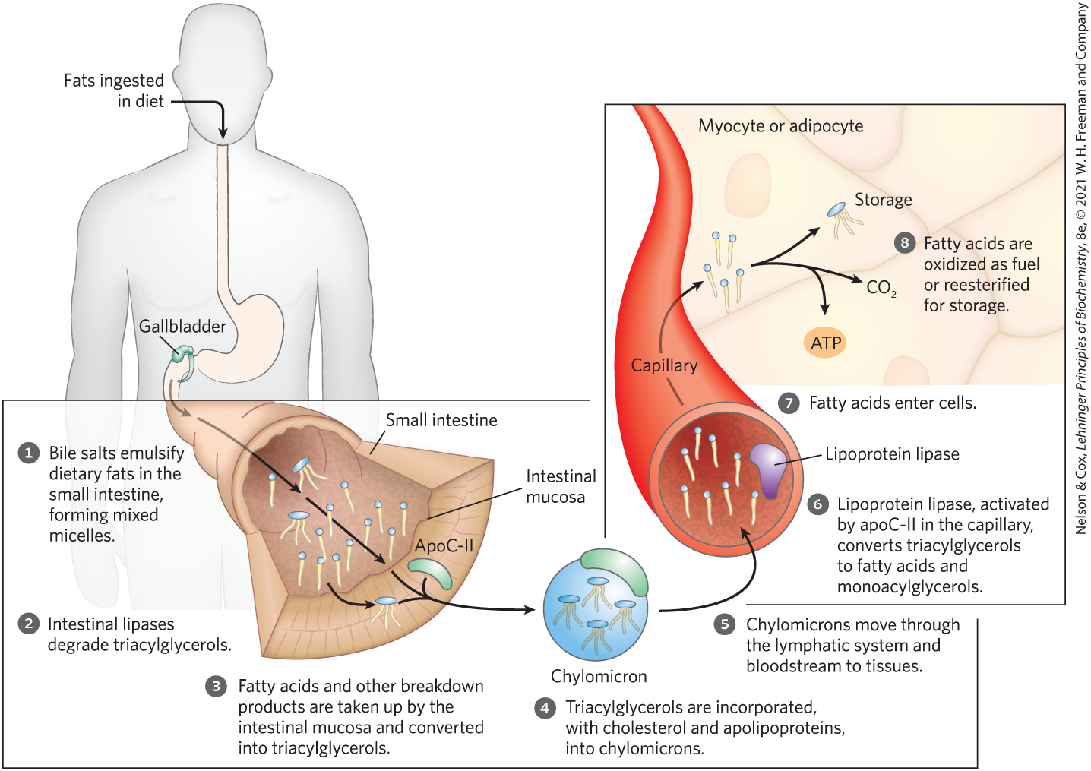
Dietary Fats Are Absorbed in the Small Intestine

Slide 12
Chylomicron Formation
apolipoproteins = proteins in their lipid-free form that bind lipids to form lipoproteins
  target triacylglycerols, phospholipids, cholesterol, and cholesteryl esters for transport between organs
chylomicrons = particles consisting of triacylglycerols, cholesterol, and apolipoproteins

Slide 13
Lipoprotein Particles
lipoprotein particles = spherical aggregates of apolipoproteins and lipids
  arranged with hydrophobic lipids at the core and hydrophilic protein side chains and lipid head groups at the surface
  various in densities depending on combinations of lipid and protein
    range from chylomicrons and very-low-density lipoproteins (VLDL) to very-high-density lipoproteins (VHDL)

Slide 14
Apolipoprotein B-48 (apoB-48) and Apolipoprotein C-II (apoC-II)
apolipoprotein B-48 (apoB-48) = primary protein component of chylomicrons
apolipoprotein C-II (apoC-II) = protein picked up in the blood by chylomicrons from high-density lipoprotein (HDL) particles

Slide 15
Lipoprotein Lipase
lipoprotein lipase = extracellular enzyme in the capillaries of muscle and adipose tissue that hydrolyzes triacylglycerols to free fatty acids and monoacylglycerols
  activated by apoC-II

Slide 16
Principle 3 (2 of 4)
Allosteric mechanisms and posttranslational regulation (protein phosphorylation) coordinate metabolic processes within a cell. Hormones and growth factors coordinate metabolic activities among tissues and organs. Reciprocal regulation of catabolic and anabolic pathways prevents the inefficiency of futile cycling.

Slide 17
Storage of Excess Fatty Acids
fatty acids are converted to triacylglycerols in the liver
triacylglycerols are packaged with specific apolipoproteins into VLDLs
VLDLs are secreted and transported in the blood to adipose tissue
triacylglycerols are removed and stored in lipid droplets within adipocytes in the adipose tissue

Slide 18
Hormones Trigger Mobilization of Stored Triacylglycerols
lipid droplets = organelles stored in adipocytes and steroid-synthesizing cells that contain neutral lipids
  contain a core of triacylglycerols and sterol esters surrounded by a monolayer of phospholipids
perilipins = family of proteins that coats the surface of lipid droplets to restrict access to lipid droplets
  prevent untimely lipid mobilization

Slide 19
Principle 1 (2 of 5)
Metabolites of diverse origin funnel into a few central pathways. Fatty acid catabolism and glycolysis convert quite different starting materials into the same product (acetyl-CoA). The electrons from the oxidative reactions of these pathways and of the citric acid cycle are carried by common cofactors (NAD and FAD) to the mitochondrial respiratory chain leading to oxygen, providing the energy for ATP synthesis by oxidative phosphorylation.

Slide 20
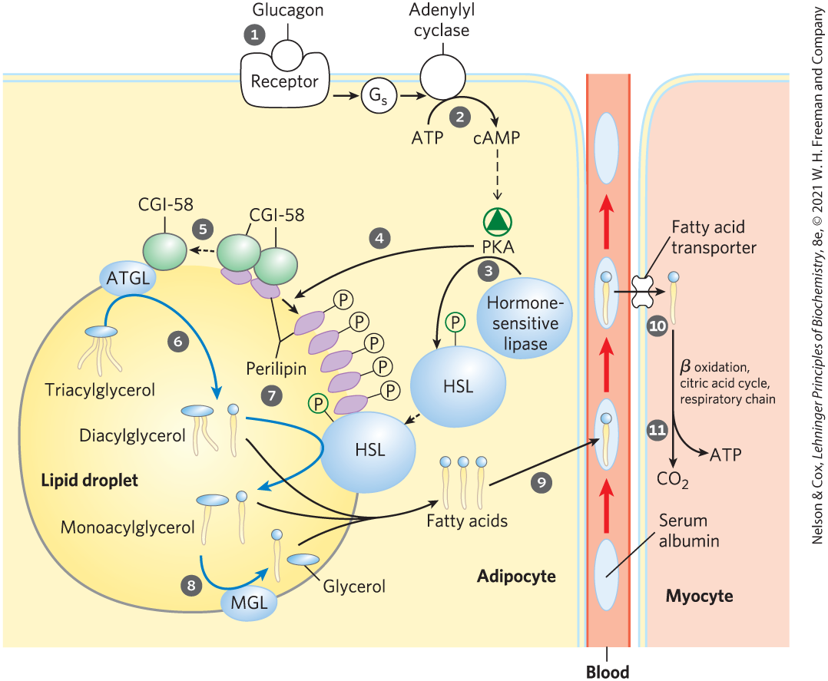
Mobilization of Triacylglycerols Stored in Adipose Tissue
mobilization occurs when hormones (glucagon and epinepherine) signal the need for metabolic energy
PKA triggers changes that open the lipid droplet to the action of three cytosolic lipases

Slide 21
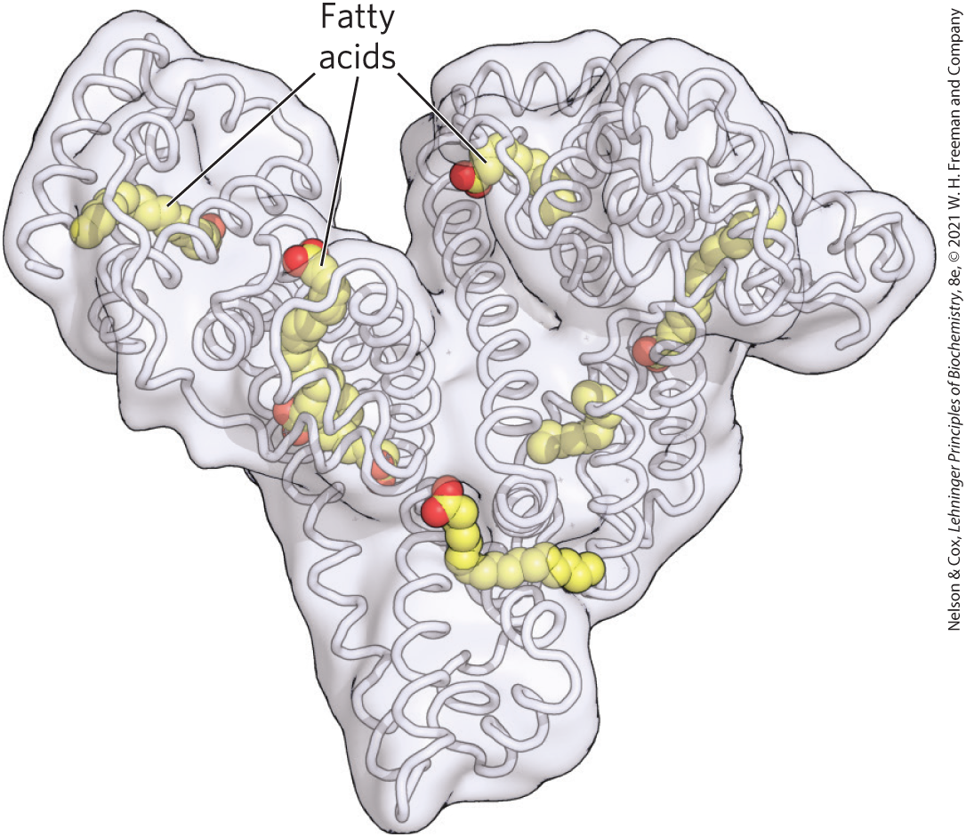
Human Serum Albumin
free fatty acids, FFAs = fatty acids released by lipases
serum albumin = blood protein that noncovalently binds and transports FFAs to target tissues
  makes up ~½ of the total serum protein

Slide 22
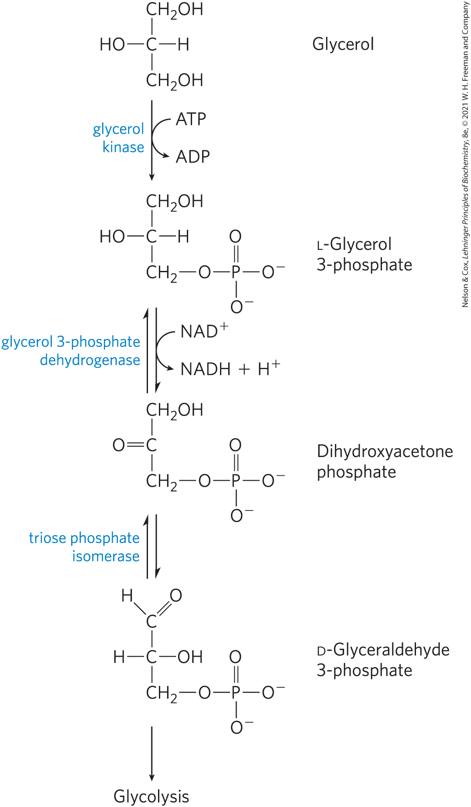
Entry of Glycerol into the
Glycolytic Pathway
most of the biologically available energy of triacylglycerols resides in their three long-chain fatty acids
glycerol kinase = phosphorylates glycerol to form glycerol 3-phosphate
glyceraldehyde 3-phosphate can enter glycolysis

Slide 23
Fatty Acids Are Activated and Transported into Mitochondria
small (< 12 carbons) fatty acids diffuse freely across mitochondrial membranes
carnitine shuttle = transports long-chain fatty acids (containing 14+ carbons) through the mitochondrial membrane
  requires activation to a fatty acyl-CoA and attachment to carnitine

Slide 24

Fatty Acyl-CoA Synthetase
fatty acyl-CoA synthetase = isozymes present in the outer mitochondrial membrane that activate the fatty acid by conversion to fatty acyl-CoA thioesters
fatty acid + CoA + ATP $⇄$
fatty acyl-CoA + AMP + PP_{i}

Slide 25
Principle 2 (2 of 5)
Evolution selects for chemical mechanisms that make useful reactions more energetically favorable, and those same mechanisms are used in different pathways. In the breakdown of fatty acids, we see the activation of a carboxylic acid by its conversion to a thioester, as we saw with acetyl-CoA in the citric acid cycle. To break the C–C bonds in the long chain of relatively inert –CH₂–CH₂– groups in fatty acids, a carbonyl group is created adjacent to the –CH₂– group, as we saw in the reactions of the citric acid cycle.

Slide 26
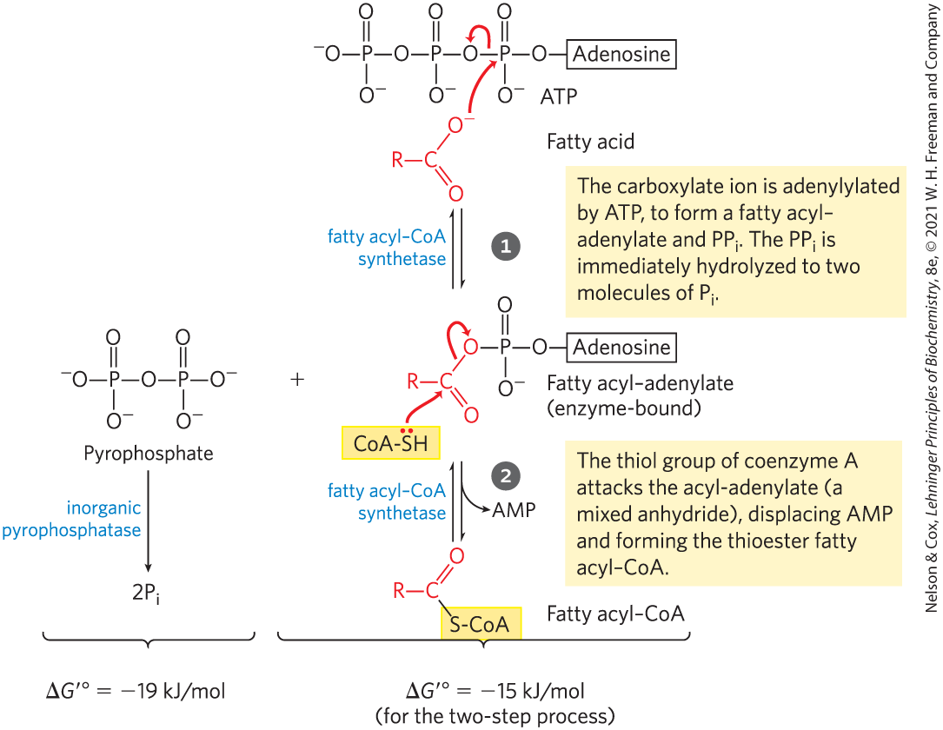
Formation of a Fatty Acyl-CoA
fatty acyl-CoA = contains a thioester linkage between the fatty acid carboxyl group and the thiol group of coenzyme A
  high energy compound
  formation is made more favorable by the hydrolysis of two ATP bonds

Slide 27
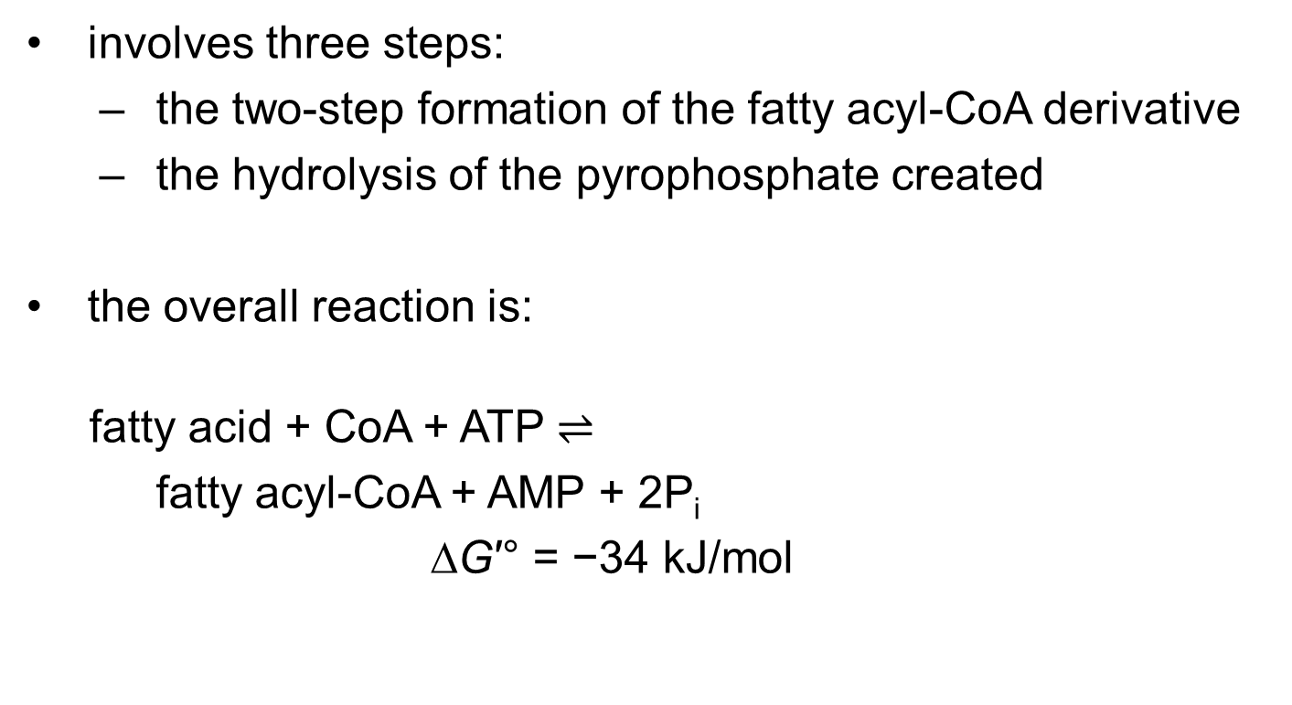
The Overall Reaction for Fatty Acyl-CoA Formation
involves three steps:
  the two-step formation of the fatty acyl-CoA derivative
  the hydrolysis of the pyrophosphate created
the overall reaction is:
fatty acid + CoA + ATP $⇌$
fatty acyl-CoA + AMP + 2P_{i}
∆G′° = −34 kJ/mol
(17-1)

Slide 28
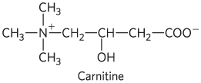
Carnitine
carnitine = compound that transports fatty acyl-CoAs destined for mitochondrial oxidation across the inner mitochondrial membrane

Slide 29
Attachment of Carnitine to the Fatty Acyl-CoA
carnitine acyl-transferase 1, CAT1 (carnitine palmitoyltransferase 1, CPT1) = catalyzes a transesterification reaction to transiently attach a fatty acyl-CoA to the hydroxyl group of carnitine to form fatty acyl-carnitine

Slide 30
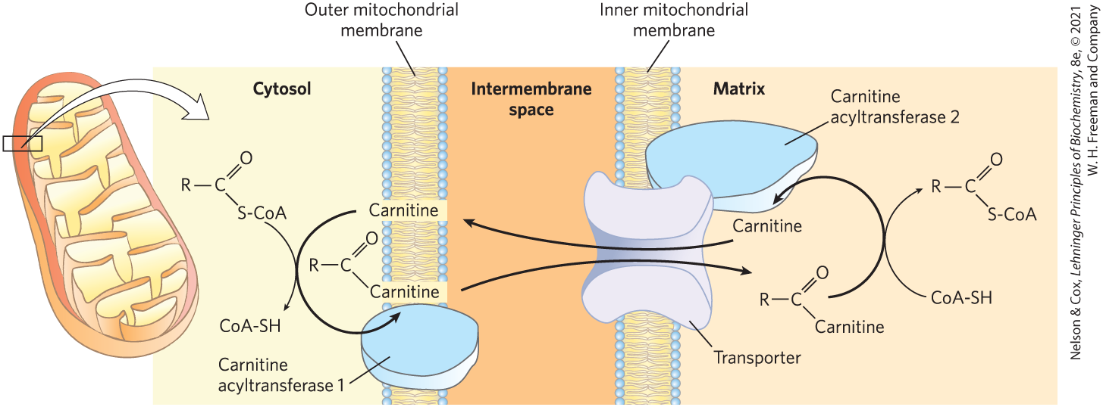
The Acyl-Carnitine/Carnitine Cotransporter
acyl-carnitine/carnitine cotransporter = allows the passive transport of the fatty acyl-carnitine ester
  moves one carnitine into the intermembrane space as one fatty acyl-carnitine moves into the matrix

Slide 31
Carnitine Acyltransferase 2 (CAT2)
carnitine acyltransferase 2 (CAT2, CPT2) = transfers the fatty acyl group from carnitine back to coenzyme A to regenerate fatty acyl-CoA and free carnitine
  located on the inner face of the inner mitochondrial membrane

Slide 32
The Two Pools of Coenzyme A
one pool is in the cytosol and the other is in mitochondria
coenzyme A in the mitochondrial matrix is largely used in oxidative degradation of pyruvate, fatty acids, and some amino acids
coenzyme A in the cytosol is used in the biosynthesis of fatty acids

Slide 33
The Two Pools of Fatty Acyl-CoA
one pool is in the cytosol and the other is in mitochondria
fatty acyl-CoA in the mitochondrial matrix can be used for oxidation and ATP production
  conversion to the carnitine ester commits it to oxidation
fatty acyl–CoA in the cytosolic pool can be used for membrane lipid synthesis

Slide 34
The Carnitine Shuttle Is a Major Control Point
carnitine-mediated entry is the rate-limiting step for oxidation of fatty acids in mitochondria
carnitine acyltransferase 1 is inhibited by malonyl-CoA, the first intermediate in fatty acid synthesis
  prevents the simultaneous synthesis and degradation of fatty acids

Slide 35
17.2 Oxidation of Fatty Acids

Slide 36
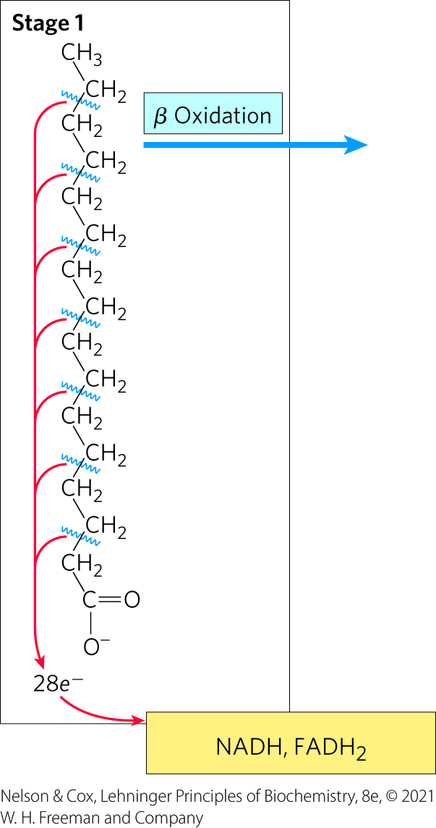
Stage 1 of Fatty Acid Oxidation
Stage 1: β oxidation
  fatty acids undergo oxidative removal of successive two-carbon units in the form of acetyl-CoA

Slide 37
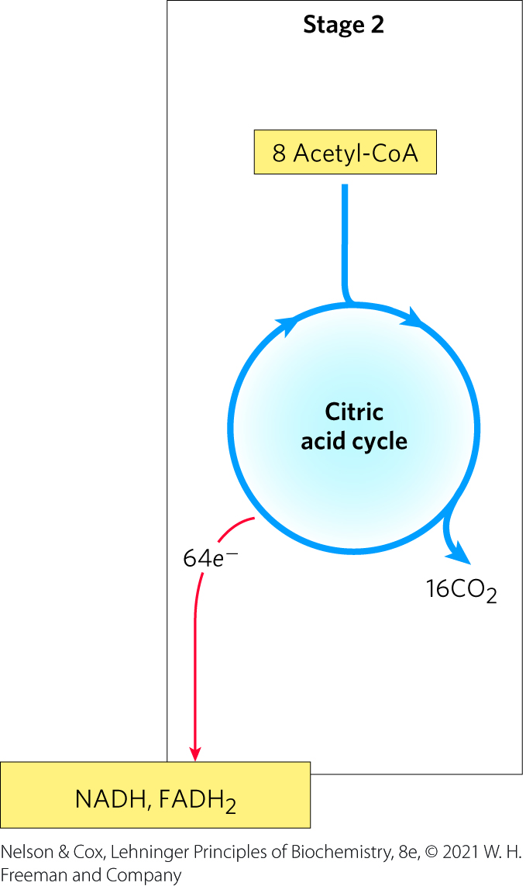
Stage 2 of Fatty Acid Oxidation
Stage 2: oxidation of acetyl-CoA groups to CO₂ in the citric acid cycle
  occurs in the mitochondrial matrix
  generates NADH, FADH₂, and one GTP

Slide 38
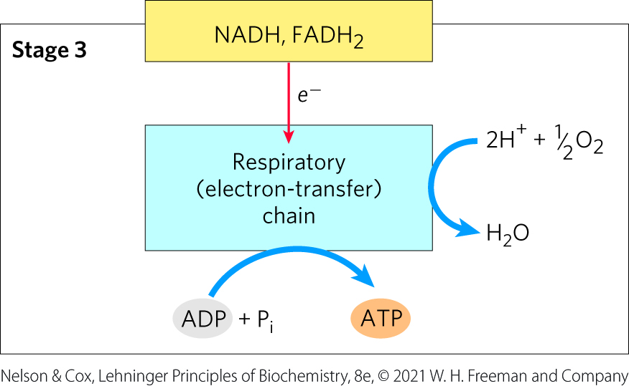
Stage 3 of Fatty Acid Oxidation
Stage 3: electron transfer chain and oxidative phosphorylation
  generates ATP from NADH and FADH₂

Slide 39
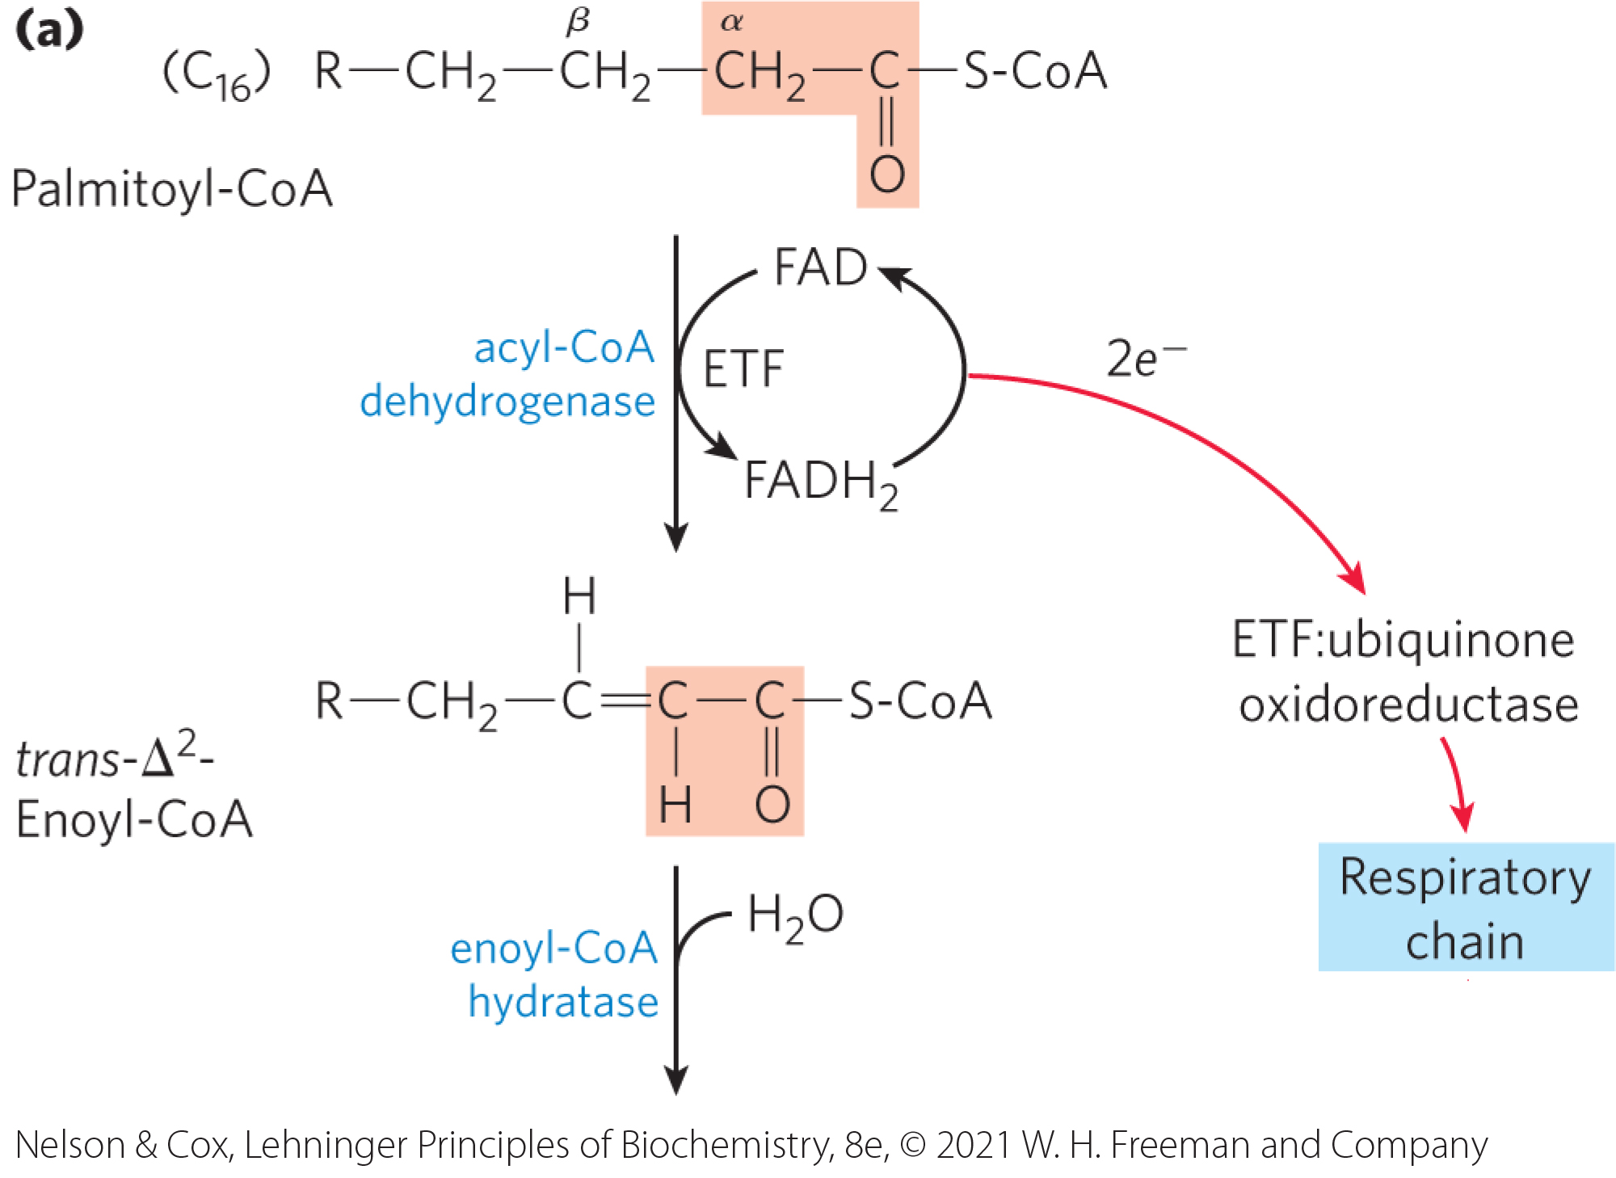
The β Oxidation of Saturated Fatty Acids Has Four Basic Steps
acyl-CoA dehydrogenase = flavoprotein with tightly bound FAD that catalyzes the dehydrogenation of fatty acyl-CoA to yield a trans-∆²-enoyl-CoA

Slide 40
Acyl-CoA Dehydrogenase Isozymes
isozymes are specific for fatty-acyl chain lengths:
    VLCAD (inner mitochondrial matrix): 12-18 carbons
    MCAD (matrix): 4-14 carbons
    SCAD (matrix): 4-8 carbons

Slide 41
Electrons from Fatty Acyl-CoA Enter the Mitochondrial Respiratory Chain
electron transfer flavoprotein (ETF) = electron carrier that accepts electrons from FADH₂
ETF:ubiquinone oxidoreductase = flavoprotein that accepts electrons from ETF
  passes electrons through ubiquinone into the mitochondrial respiratory chain

Slide 42
Principle 2 (3 of 5)
Evolution selects for chemical mechanisms that make useful reactions more energetically favorable, and those same mechanisms are used in different pathways. In the breakdown of fatty acids, we see the activation of a carboxylic acid by its conversion to a thioester, as we saw with acetyl-CoA in the citric acid cycle. To break the C–C bonds in the long chain of relatively inert –CH₂–CH₂– groups in fatty acids, a carbonyl group is created adjacent to the –CH₂– group, as we saw in the reactions of the citric acid cycle.

Slide 43
The Oxidation Catalyzed by Acyl‐CoA Dehydrogenase Is Analogous to Succinate Dehydrogenation
in both reactions:
  the enzyme is bound to the inner membrane
  a double bond is introduced into a carboxylic acid between the α and β carbons
  FAD is the electron acceptor
  electrons from the reaction ultimately enter the respiratory chain and pass to O₂

Slide 44
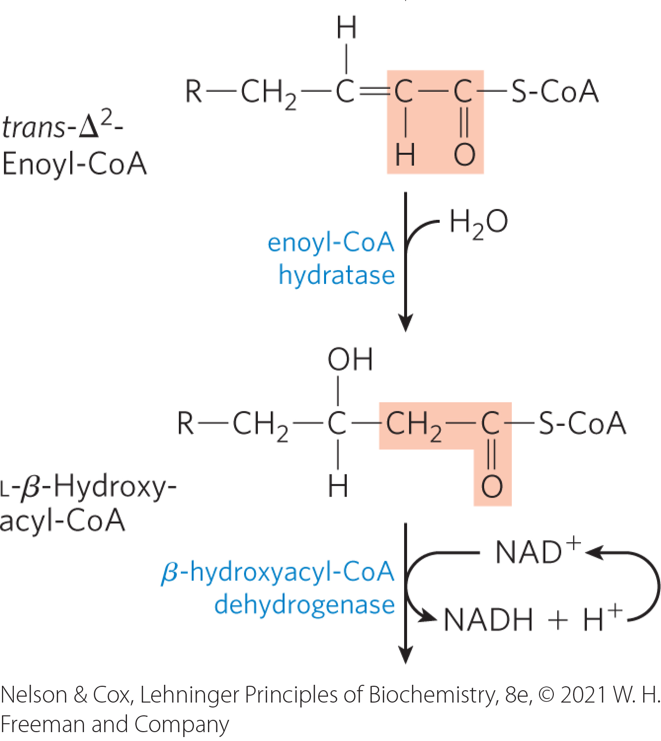
Hydration of the Trans-∆²-Enoyl-CoA
enoyl-CoA hydratase = catalyzes the addition of water to the double bond of the trans-∆²-enoyl-CoA to form L-β-hydroxyacyl-CoA (3-hydroxyacyl-CoA)
  formally analogous to the fumarase reaction in the citric acid cycle

Slide 45
Principle 2 (4 of 5)
Evolution selects for chemical mechanisms that make useful reactions more energetically favorable, and those same mechanisms are used in different pathways. In the breakdown of fatty acids, we see the activation of a carboxylic acid by its conversion to a thioester, as we saw with acetyl-CoA in the citric acid cycle. To break the C–C bonds in the long chain of relatively inert –CH₂–CH₂– groups in fatty acids, a carbonyl group is created adjacent to the –CH₂– group, as we saw in the reactions of the citric acid cycle.

Slide 46
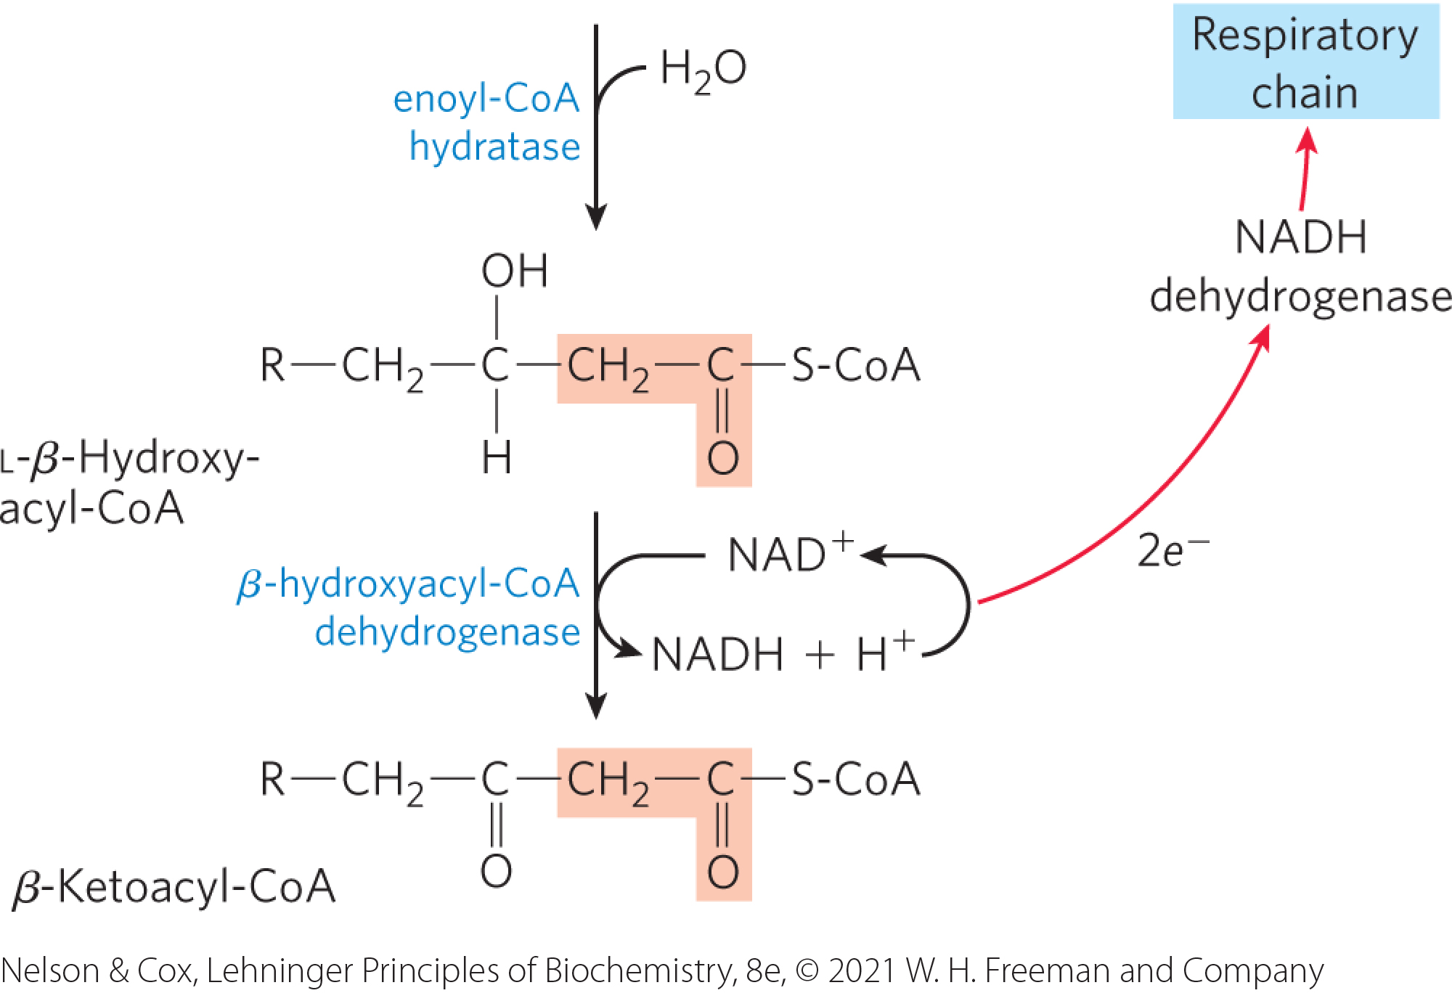
Dehydration of L-β-Hydroxyacyl-CoA
β-hydroxyacyl-CoA dehydrogenase = catalyzes the dehydrogenation of L-β-hydroxyacyl-CoA to form β-ketoacyl-CoA
  enzyme is specific for the L stereoisomer
  closely analogous to the malate dehydrogenase reaction of the citric acid cycle

Slide 47
Electrons from NADH Enter the Mitochondrial Respiratory Chain
NADH dehydrogenase (Complex I) = electron carrier of the respiratory chain
  accepts electrons from the NADH formed in the β-hydroxyacyl-CoA dehydrogenase reaction

Slide 48
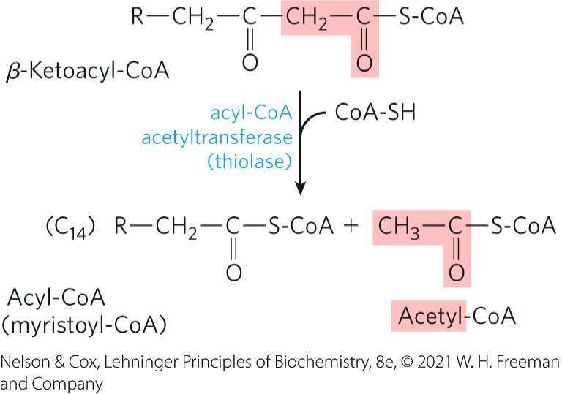
Cleavage of the β-Ketoacyl-CoA
acyl-CoA acetyl-transferase (thiolase) = catalyzes the reaction of β-ketoacyl-CoA with free coenzyme A to yield acetyl CoA and a fatty acyl-CoA shortened by two carbons
  reverse Claisen condensation

Slide 49
Trifunctional Protein (TFP)
trifunctional protein (TFP) = a multienzyme complex associated with the inner mitochondrial membrane that catalyzes steps 2-4 of the β-oxidation pathway for fatty acyl chains of 12+ carbons
  allows efficient substrate channeling
TFP is a heterooctamer of α₄β₄ subunits:
  α subunits contain enoyl-CoA hydratase and β-hydroxyacyl-CoA dehydrogenase activity
  β subunits contain thiolase activity

Slide 50
Principle 2 (5 of 5)
Evolution selects for chemical mechanisms that make useful reactions more energetically favorable, and those same mechanisms are used in different pathways. In the breakdown of fatty acids, we see the activation of a carboxylic acid by its conversion to a thioester, as we saw with acetyl-CoA in the citric acid cycle. To break the C–C bonds in the long chain of relatively inert –CH₂–CH₂– groups in fatty acids, a carbonyl group is created adjacent to the –CH₂– group, as we saw in the reactions of the citric acid cycle.

Slide 51
The Chemical Logic of the β-Oxidation Sequence
the first three reactions convert the stable single bond between methylene groups to a much less stable C–C bond
the ketone function on the β carbon (C-3) makes it a good target for nucleophilic attack
the terminal –CH₂–CO–S-CoA is a good leaving group, facilitating breakage of the α–β bond

Slide 52
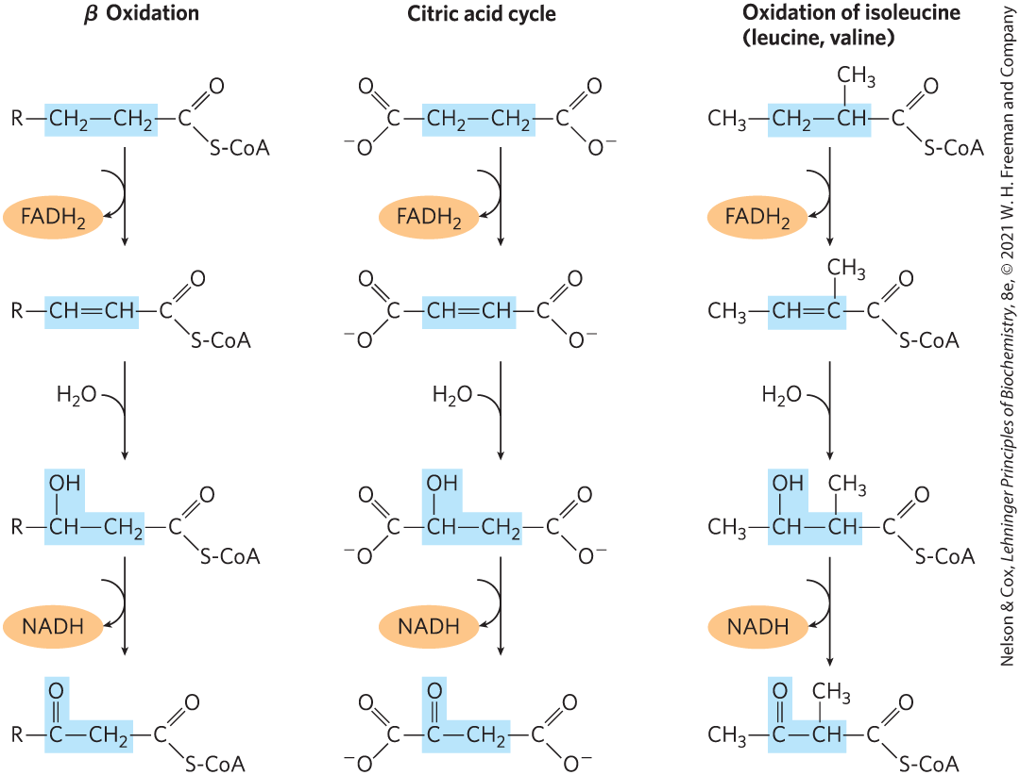
A Conserved Reaction Sequence

Slide 53
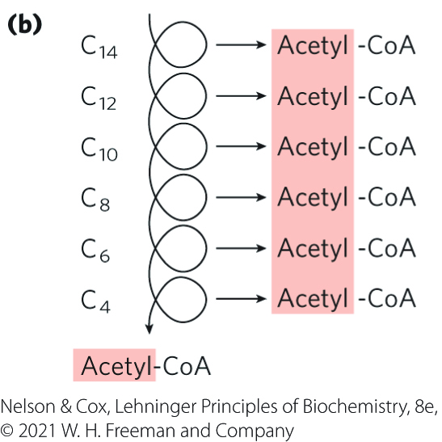
The Four β-Oxidation Steps Are Repeated to Yield Acetyl-CoA and ATP
the shortened fatty acyl–CoA reenters the β-oxidation sequence for removal of another, and then another, acetyl-CoA

Slide 54
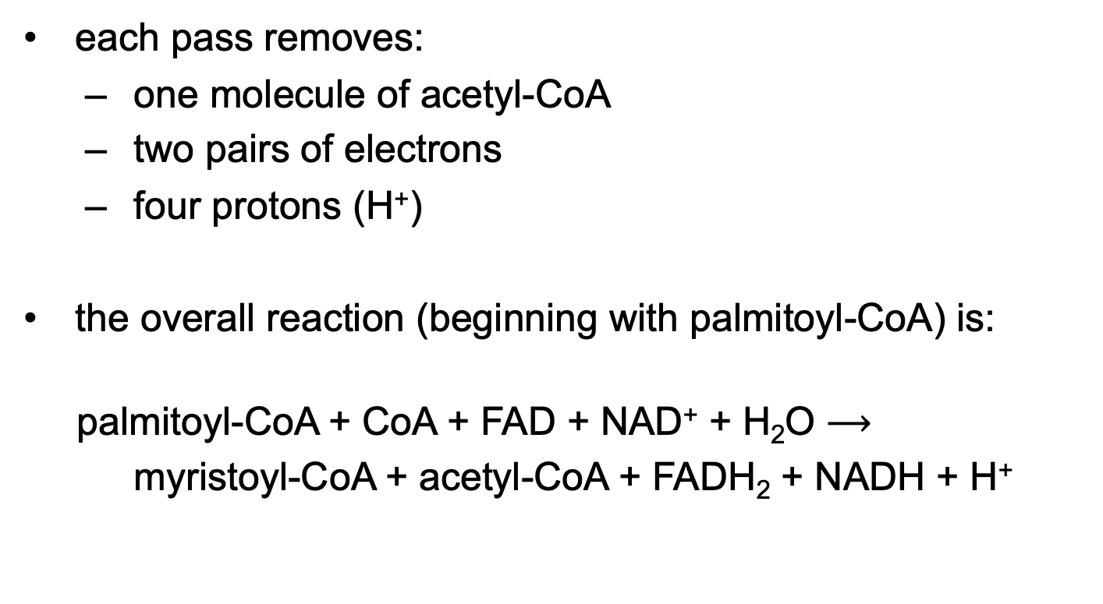
The Overall Reaction for One Pass Through Stage 1 of β Oxidation
each pass removes:
  one molecule of acetyl-CoA
  two pairs of electrons
  four protons (H⁺)
the overall reaction (beginning with palmitoyl-CoA) is:
palmitoyl-CoA + CoA + FAD + NAD⁺ + H₂O $⟶$
myristoyl-CoA + acetyl-CoA + FADH₂ + NADH + H⁺
(17-2)

Slide 55

The Overall Reaction for Stage 1 of β Oxidation
the overall reaction (beginning with palmitoyl-CoA) is:
palmitoyl-CoA + 7CoA + 7FAD + 7NAD⁺ + 7H₂O $⟶$
8 acetyl-CoA + 7FADH₂ + 7NADH + 7H⁺
(17-3)

Slide 56
Principle 1 (3 of 5)
Metabolites of diverse origin funnel into a few central pathways. Fatty acid catabolism and glycolysis convert quite different starting materials into the same product (acetyl-CoA). The electrons from the oxidative reactions of these pathways and of the citric acid cycle are carried by common cofactors (NAD and FAD) to the mitochondrial respiratory chain leading to oxygen, providing the energy for ATP synthesis by oxidative phosphorylation.

Slide 57
FADH₂ and NADH Donate Electrons to the Respiratory Chain
each FADH₂ donates a pair of electrons to ETF
  generates 1.5 molecules of ATP
each NADH donates a pair of electrons to the mitochondrial NADH dehydrogenase
  generates 2.5 molecules of ATP
in total, 4 ATP are formed for each pass through β oxidation

Slide 58
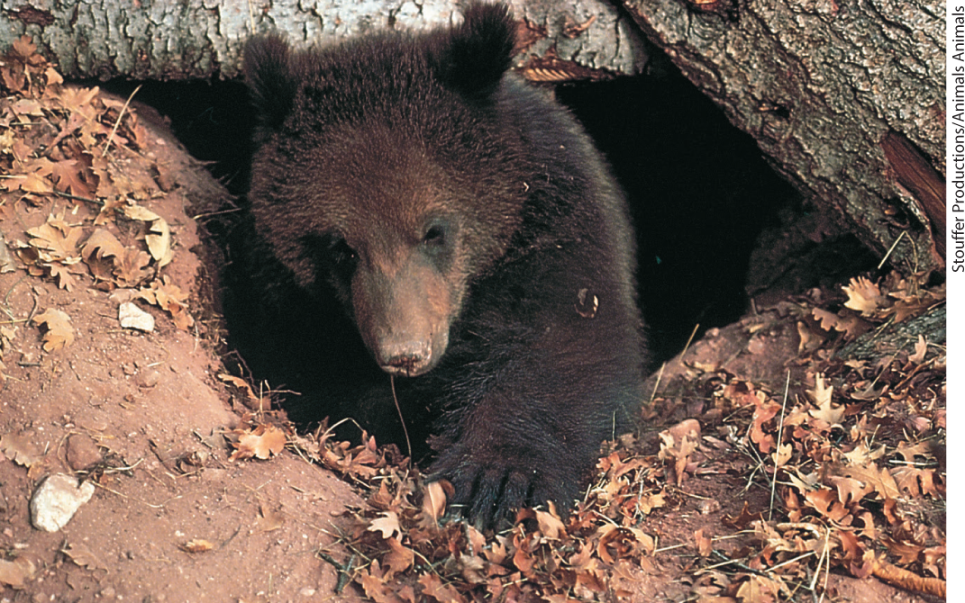
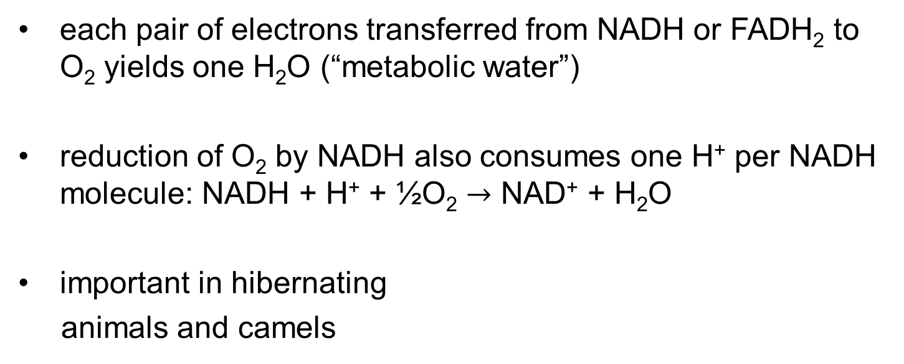
“Metabolic Water”
each pair of electrons transferred from NADH or FADH₂ to O₂ yields one H₂O (“metabolic water”)
reduction of O₂ by NADH also consumes one H⁺ per NADH molecule: NADH + H⁺ + ½O₂ $→$ NAD⁺ + H₂O
important in hibernating
animals and camels

Slide 59
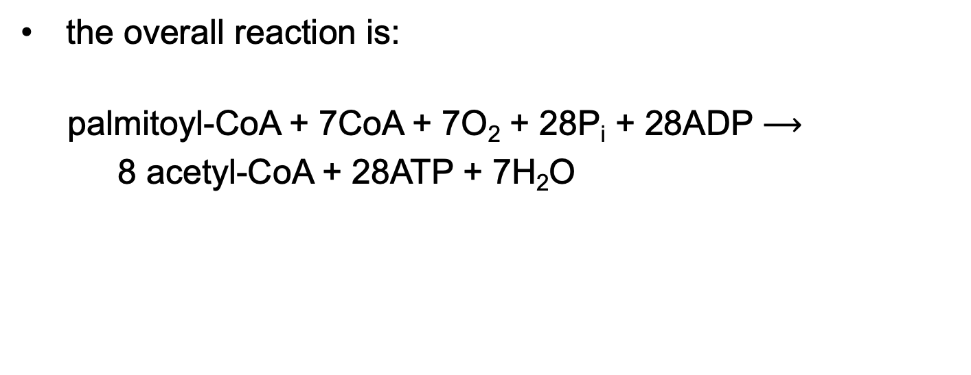
The Overall Reaction for Stage 1 of β Oxidation, Including Electron Transfers and Oxidative Phosphorylations
the overall reaction is:
palmitoyl-CoA + 7CoA + 7O₂ + 28P_{i} + 28ADP $⟶$
8 acetyl-CoA + 28ATP + 7H₂O
(17-4)

Slide 60
Principle 1 (4 of 5)
Metabolites of diverse origin funnel into a few central pathways. Fatty acid catabolism and glycolysis convert quite different starting materials into the same product (acetyl-CoA). The electrons from the oxidative reactions of these pathways and of the citric acid cycle are carried by common cofactors (NAD and FAD) to the mitochondrial respiratory chain leading to oxygen, providing the energy for ATP synthesis by oxidative phosphorylation.

Slide 61
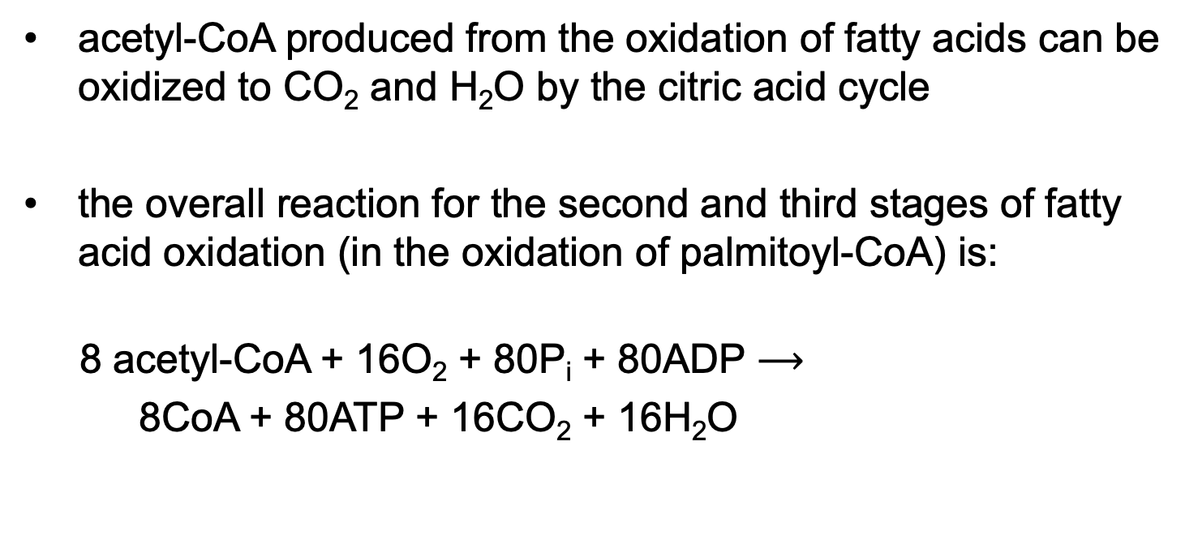
Acetyl-CoA Can Be Further Oxidized in the Citric Acid Cycle
acetyl-CoA produced from the oxidation of fatty acids can be oxidized to CO₂ and H₂O by the citric acid cycle
the overall reaction for the second and third stages of fatty acid oxidation (in the oxidation of palmitoyl-CoA) is:
8 acetyl-CoA + 16O₂ + 80P_{i} + 80ADP $⟶$
8CoA + 80ATP + 16CO₂ + 16H₂O
(17-5)

Slide 62

The Overall Reaction for the Complete Oxidation of Palmitoyl-CoA to CO₂ and H₂O
the overall reaction is:
palmitoyl-CoA + 23O₂ + 108P_{i} + 108ADP $⟶$
CoA + 108ATP + 16CO₂ + 23H₂O
(17-6)

Slide 63
ATP Yield During Complete Oxidation of Palmitoyl-CoA
Table 17-1 Yield of ATP during Oxidation of One Molecule of Palmitoyl-CoA to CO₂ and H₂O
Enzyme catalyzing the oxidation step | Number of NADH or FADH₂ formed | Number of ATP ultimately formed
β Oxidation
Acyl-CoA dehydrogenase | 7 FADH₂ | 10.5
β-Hydroxyacyl-CoA dehydrogenase | 7 NADH | 17.5
Citric acid cycle
Isocitrate dehydrogenase | 8 NADH | 20
α-Ketoglutarate dehydrogenase | 8 NADH | 20
Succinyl-CoA synthetase |  | 8
Succinate dehydrogenase | 8 FADH₂ | 12
Malate dehydrogenase | 8 NADH | 20
Total |  | 108

Slide 64
Principle 1 (5 of 5)
Metabolites of diverse origin funnel into a few central pathways. Fatty acid catabolism and glycolysis convert quite different starting materials into the same product (acetyl-CoA). The electrons from the oxidative reactions of these pathways and of the citric acid cycle are carried by common cofactors (NAD and FAD) to the mitochondrial respiratory chain leading to oxygen, providing the energy for ATP synthesis by oxidative phosphorylation.

Slide 65
Oxidation of Unsaturated Fatty Acids Requires Two Additional Reactions
enoyl-CoA hydratase cannot catalyze the addition of H₂O to a cis double bond
oxidation of unsaturated fatty acids requires two additional enzymes:
  enoyl-CoA isomerase (converts cis double bonds to trans)
  2,4-dienoyl-CoA reductase (reduces cis double bonds)

Slide 66
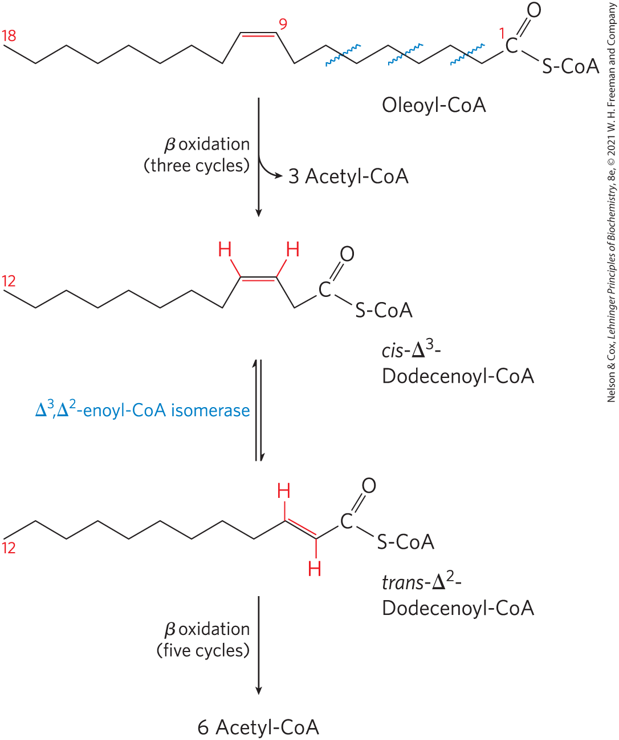
Oxidation of a Monounsaturated Fatty Acid
oxidation of a monounsaturated fatty acid requires an enoyl-CoA isomerase
∆³,∆²- enoyl-CoA isomerase = isomerizes the cis-∆³-enoyl-CoA to the trans-∆²-enoyl-CoA

Slide 67
Oxidation of a Polyunsaturated
Fatty Acid
requires both enoyl-CoA isomerase and 2,4-dienoyl-CoA reductase to transform the cis-∆³,cis-∆⁶ intermediate into one that can enter the β-oxidation pathway

Slide 68
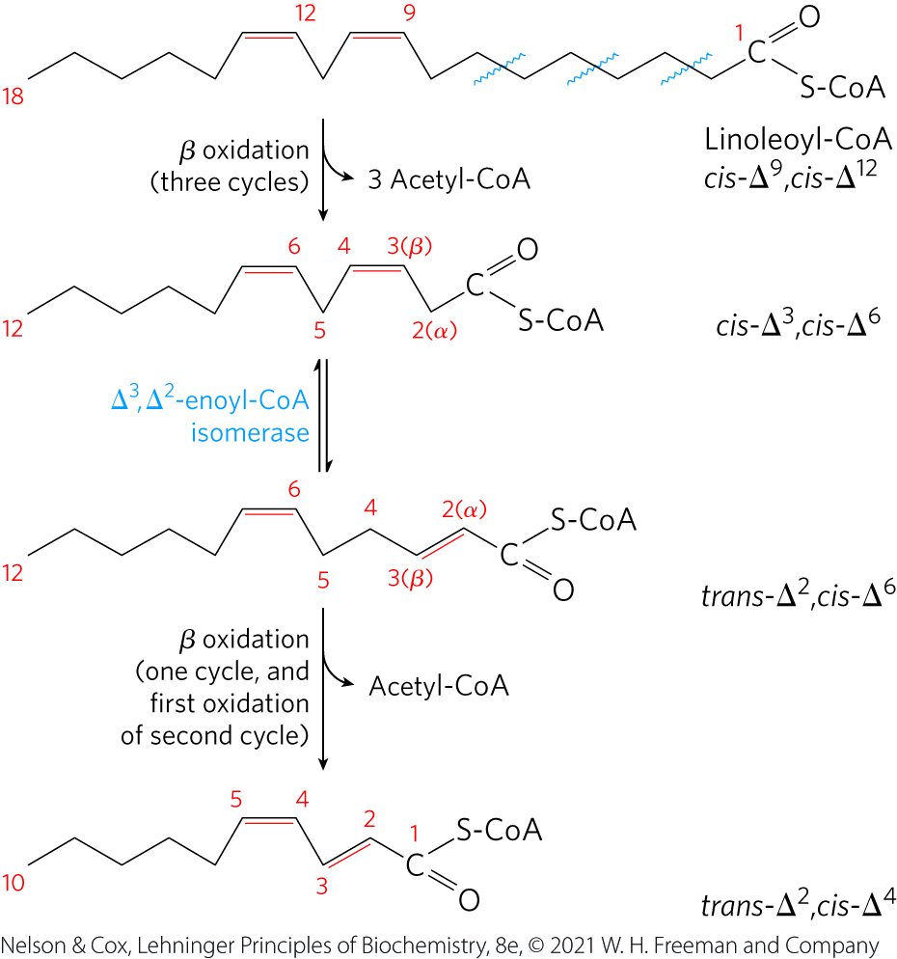
Oxidation of Linoleoyl-CoA (∆^{9,12})

Slide 69
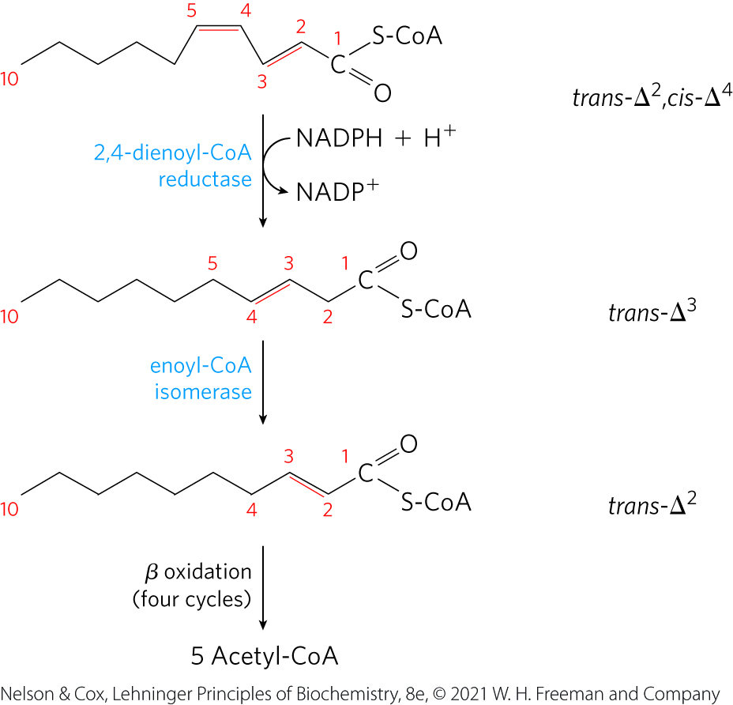
Oxidation of Linoleoyl-CoA (∆^{9,12}), Continued

Slide 70
Complete Oxidation of Odd-Number Fatty Acids Requires Three Extra Reactions
propionate (CH₃–CH₂–COO⁻) = three-carbon compounds formed by cattle and other ruminant animals during carbohydrate fermentation
odd-number fatty acids are oxidized by the β-oxidation pathway to yield acetyl-CoA and a molecule of propionyl-CoA

Slide 71
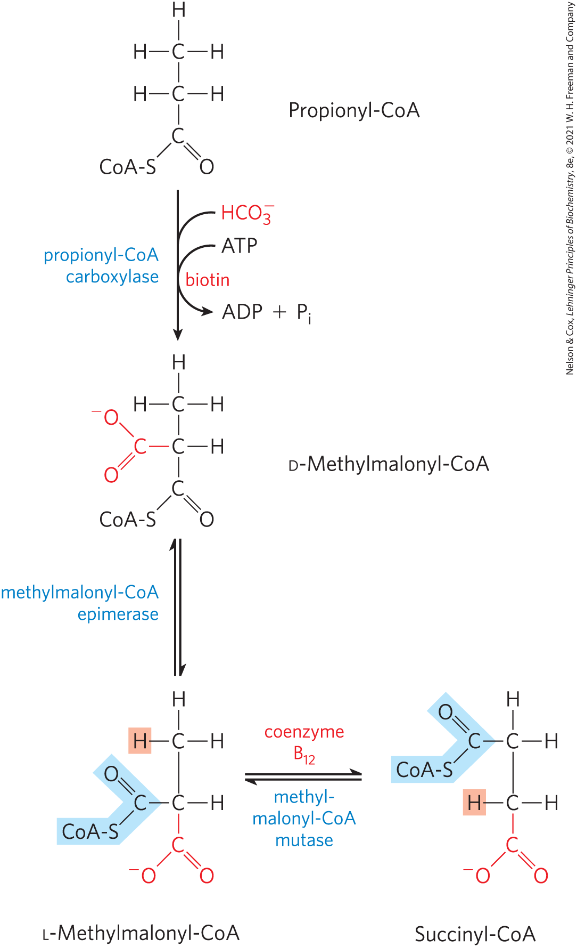
Oxidation of Propionyl-CoA – Step 1
propionyl-CoA carboxylase = catalyzes the carboxylation of propionyl-CoA to form D-methylmalonyl-CoA
  requires the cofactor biotin

Slide 72
Oxidation of Propionyl-CoA – Step 2
methylmalonyl-CoA epimerase = catalyzes the epimerization of D-methylmalonyl-CoA to its L stereoisomer

Slide 73
Oxidation of Propionyl-CoA – Step 3
methylmalonyl-CoA mutase = catalyzes the intramolecular rearrangement of L-methylmalonyl-CoA to form succinyl-CoA (which can enter the citric acid cycle)
  requires 5′-deoxyadenosylcobalamin, or coenzyme B₁₂, as its coenzyme

Slide 74
Principle 4 (2 of 6)
When a process lacks a critical component—an enzyme, a cofactor, or a regulatory agent—the resulting loss of homeostasis may cause disease across a spectrum of severity. Defects in fatty acid breakdown are no exception.

Slide 75
Deficiencies in
Propionyl-CoA Carboxylase
occurs in ~ 1 in 100,000 babies
propionic acidemia = severe acidification of the blood and urine resulting from accumulated propionyl-CoA in the mitochondria being released to the blood as propionate
  uses the carnitine shuttle

Slide 76
Principle 3 (3 of 4)
Allosteric mechanisms and posttranslational regulation (protein phosphorylation) coordinate metabolic processes within a cell. Hormones and growth factors coordinate metabolic activities among tissues and organs. Reciprocal regulation of catabolic and anabolic pathways prevents the inefficiency of futile cycling.

Slide 77
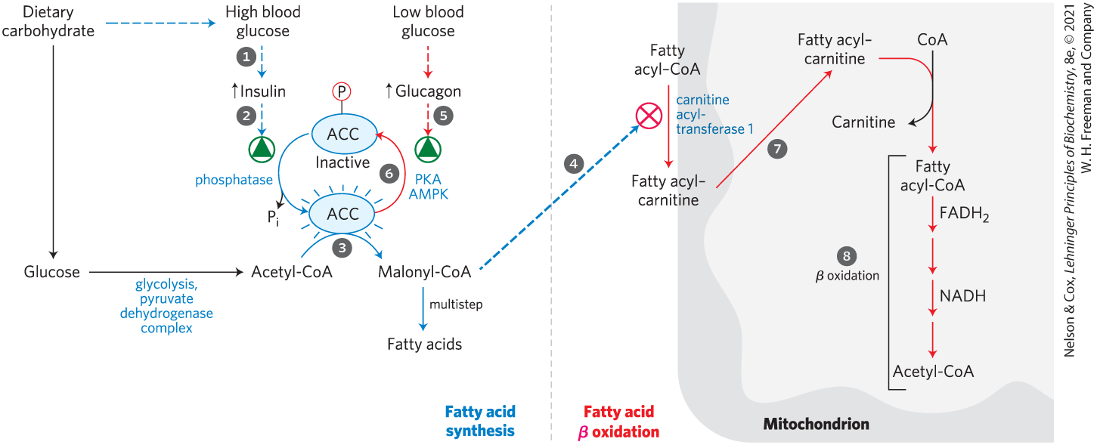
Fatty Acid Oxidation Is
Tightly Regulated
malonyl-CoA = the first intermediate of cytosolic fatty acid synthesis
  blocks entry of fatty acids into mitochondria to prevent futile cycling

Slide 78
Principle 3 (4 of 4)
Allosteric mechanisms and posttranslational regulation (protein phosphorylation) coordinate metabolic processes within a cell. Hormones and growth factors coordinate metabolic activities among tissues and organs. Reciprocal regulation of catabolic and anabolic pathways prevents the inefficiency of futile cycling.

Slide 79
Transcription Factors Turn on the Synthesis of Proteins for
Lipid Catabolism
PPAR family of nuclear receptors = transcription factors that affect many metabolic processes in response to a variety of fatty acid–like ligands
PPARα stimulates the synthesis of enzymes required in β oxidation when there is an increased demand for energy from fat catabolism

Slide 80
Principle 4 (3 of 6)
When a process lacks a critical component—an enzyme, a cofactor, or a regulatory agent—the resulting loss of homeostasis may cause disease across a spectrum of severity. Defects in fatty acid breakdown are no exception.

Slide 81
Genetic Defects in Fatty Acyl-CoA Dehydrogenases Cause Serious Disease
medium-chain acyl-CoA dehydrogenase (MCAD) = acyl-CoA dehydrogenase isozyme that acts on fatty acids of 4-14 carbons
individuals with two mutant MCAD alleles cannot oxidize fatty acids of 6-12 carbons
  symptoms include fatty liver, high blood levels of octanoic acid (8:0), coma, and death

Slide 82
Principle 4 (4 of 6)
When a process lacks a critical component—an enzyme, a cofactor, or a regulatory agent—the resulting loss of homeostasis may cause disease across a spectrum of severity. Defects in fatty acid breakdown are no exception.

Slide 83
Other Genetic Defects in Fatty Acid Transport or Oxidation
loss of the long-chain β-hydroxyacyl-CoA dehydrogenase activity of the trifunctional protein, TFP
defects in the α or β subunits that affect all three activities of TFP

Slide 84
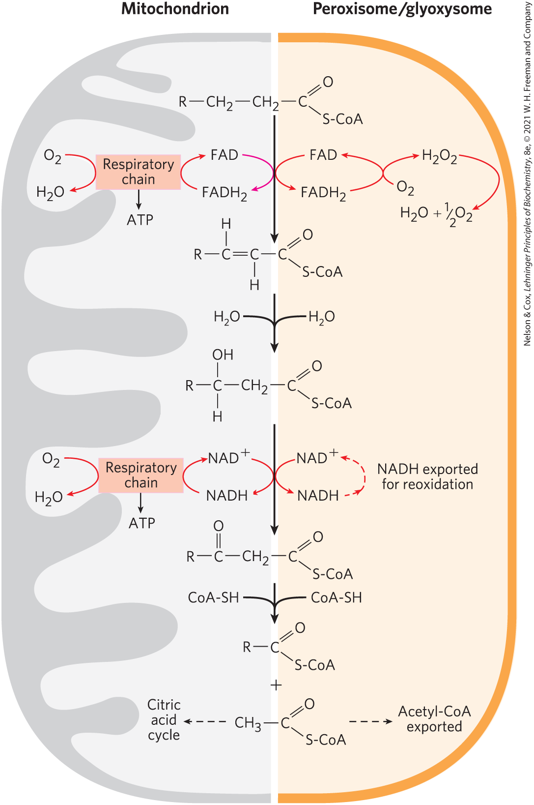
Peroxisomes Also Carry Out β Oxidation
peroxisomes = organelles found in plants and animals
β oxidation in peroxisomes has four steps:
  dehydrogenation
  addition of water to the resulting double bond
  oxidation of the β-hydroxyacyl-CoA to a ketone
  thiolytic cleavage by coenzyme A

Slide 85
Differences Between the Peroxisomal and Mitochondrial Pathways
in peroxisomes, the flavoprotein acyl-CoA oxidase that introduces the double bond passes electrons directly to O₂, producing H₂O₂
  the enzyme catalase cleaves H₂O₂ to H₂O and O₂
the peroxisomal system is much more active on very-long-chain fatty acids and branched-chain fatty acids

Slide 86
Principle 4 (5 of 6)
When a process lacks a critical component—an enzyme, a cofactor, or a regulatory agent—the resulting loss of homeostasis may cause disease across a spectrum of severity. Defects in fatty acid breakdown are no exception.

Slide 87
Genetic Defects in Peroxisomal Oxidation
Zellwger syndrome = characterized by an inability to make peroxisomes
  individuals lack all metabolism related to peroxisomes
X-linked adrenoleukodystrophy (XALD) = characterized by the inability of peroxisomes to oxidize very-long-chain fatty acids
  due to the lack of a functional transporter in the peroxisomal membrane

Slide 88
Phytanic Acid Undergoes α Oxidation in Peroxisomes
phytanic acid = a long-chain fatty acid with methyl branches that is derived from the phytol side chain of chlorophyll
  the methyl group on the β carbon makes β oxidation impossible

Slide 89
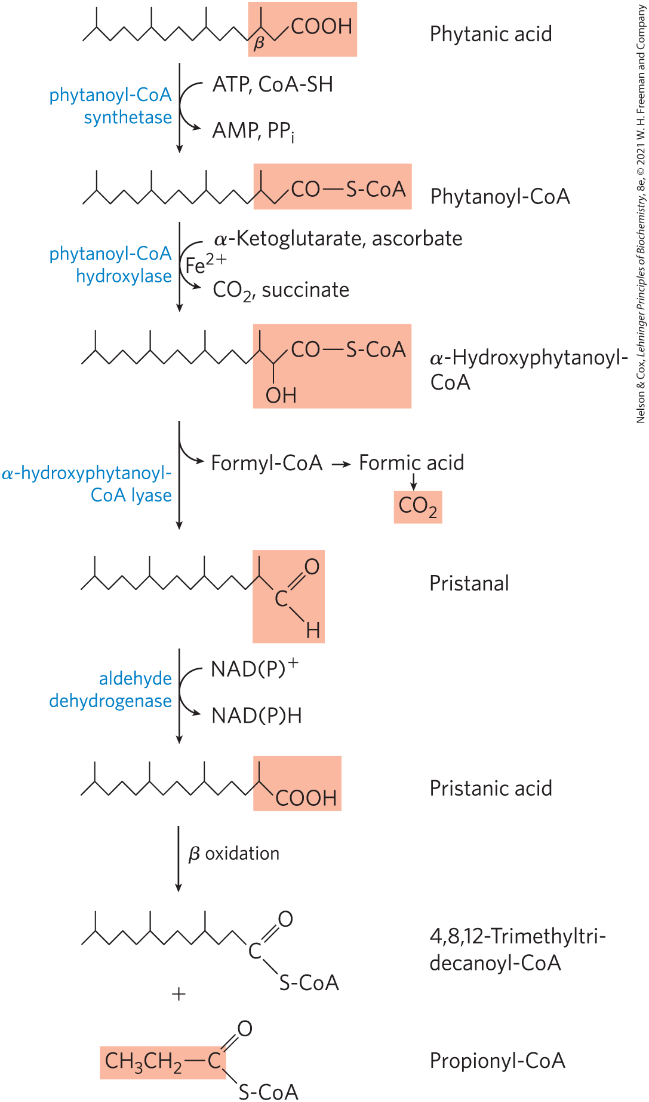
α Oxidation of Phytanic Acid
α oxidation = removes a single carbon from the carboxyl end of the fatty acid
  converts branched fatty acids to products that can undergo β oxidation to yield acetyl-CoA and propionyl-CoA
Refsum disease = results from a genetic defect in phytanoyl-CoA hydroxylase

Slide 90
17.3 Ketone Bodies

Slide 91
Principle 5 (2 of 4)
The liver plays a unique role in whole-body metabolism. When glucose is unavailable, the liver makes glucose by gluconeogenesis and releases it to the blood for distribution to other tissues, including the brain. During starvation, the liver processes fatty acids into ketone bodies, which, unlike fatty acids, can cross the blood brain barrier and fuel the brain.

Slide 92
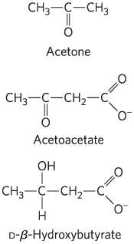
The “Ketone Bodies”
“ketone bodies” = acetone, acetoacetate, and D-β-hydroxybutyrate
  formed from acetyl-CoA in the liver
acetone is exhaled
acetoacetate and D-β-hydroxybutyrate are transported to extrahepatic tissues and converted to acetyl-CoA to be oxidized in the citric acid cycle

Slide 93
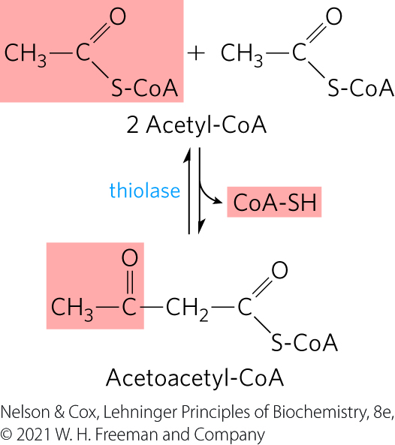
Ketone Bodies, Formed in the Liver, Are Exported to Other Organs as Fuel
thiolase = catalyzes the enzymatic condensation of two acetyl-CoA molecules to form acetoacetyl-CoA
  reversal of the last step of β oxidation

Slide 94
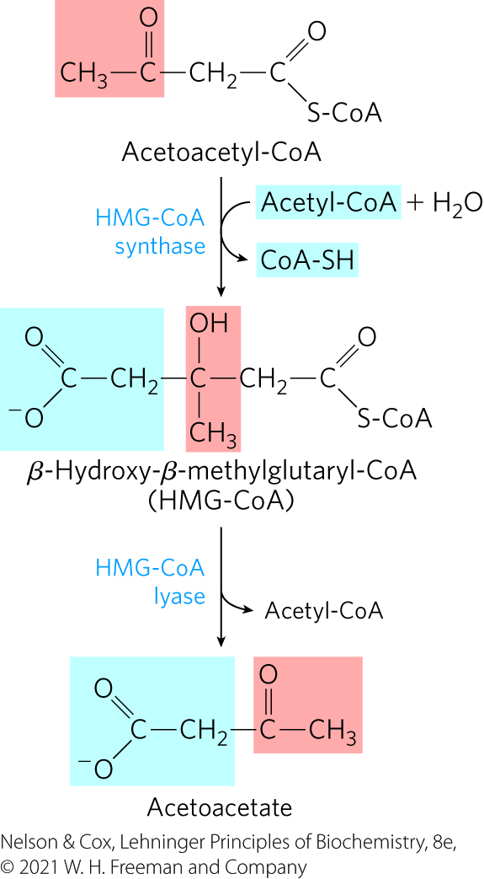
The HMG-CoA Synthase and HMG-CoA Lyase Reactions
HMG-CoA synthase = catalyzes the condensation of acetoacetyl-CoA with acetyl-CoA to form β-hydroxy-β-methylglutaryl-CoA (HMG-CoA)
HMG-CoA lyase = catalyzes the cleavage of HMG-CoA to free acetoacetate and acetyl-CoA

Slide 95
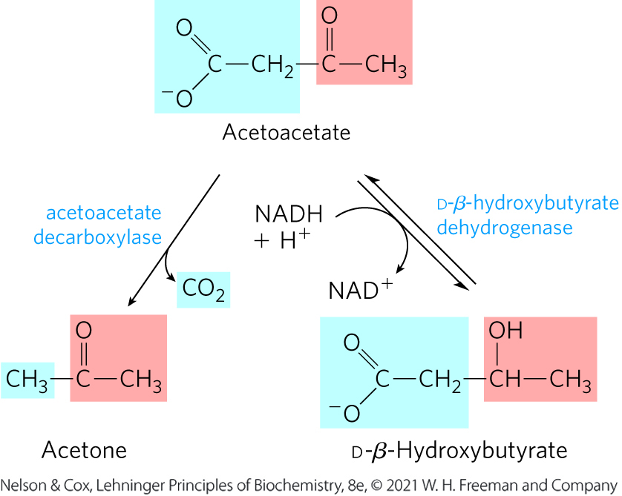
The Decarboxylation and Reduction of Acetoacetate
acetoacetate decarboxylase = catalyzes the decarboxylation of acetoacetate to acetone
D-β-hydroxybutyrate dehydrogenase = catalyzes the reversible reduction of acetoacetate to D-β-hydroxybutyrate

Slide 96
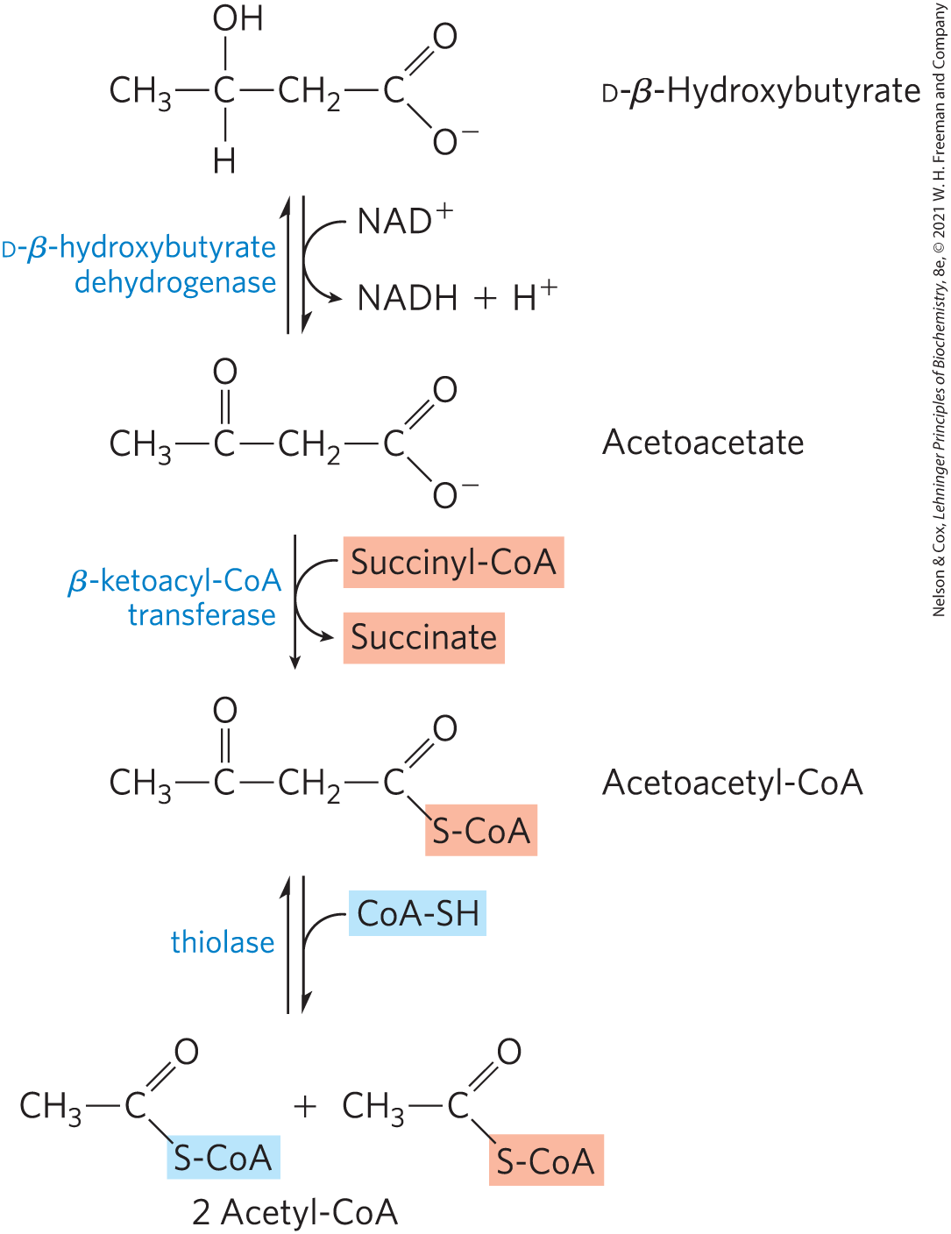
D-β-Hydroxybutyrate as Fuel
D-β-hydroxybutyrate dehydrogenase = catalyzes the oxidation of D-β-hydroxybutyrate to acetoacetate in extrahepatic tissue
β-ketoacyl-CoA transferase = catalyzes the activation of acetoacetate
acetyl-CoA enters the citric acid cycle

Slide 97
Principle 5 (3 of 4)
The liver plays a unique role in whole-body metabolism. When glucose is unavailable, the liver makes glucose by gluconeogenesis and releases it to the blood for distribution to other tissues, including the brain. During starvation, the liver processes fatty acids into ketone bodies, which, unlike fatty acids, can cross the blood brain barrier and fuel the brain.

Slide 98
Ketone Bodies Are Used as Fuels in all Tissues Except Liver
the liver lacks β-ketoacyl-CoA transferase
the liver is a producer of ketone bodies, not a consumer

Slide 99
Principle 4 (6 of 6)
When a process lacks a critical component—an enzyme, a cofactor, or a regulatory agent—the resulting loss of homeostasis may cause disease across a spectrum of severity. Defects in fatty acid breakdown are no exception.

Slide 100
Principle 5 (4 of 4)
The liver plays a unique role in whole-body metabolism. When glucose is unavailable, the liver makes glucose by gluconeogenesis and releases it to the blood for distribution to other tissues, including the brain. During starvation, the liver processes fatty acids into ketone bodies, which, unlike fatty acids, can cross the blood brain barrier and fuel the brain.

Slide 101
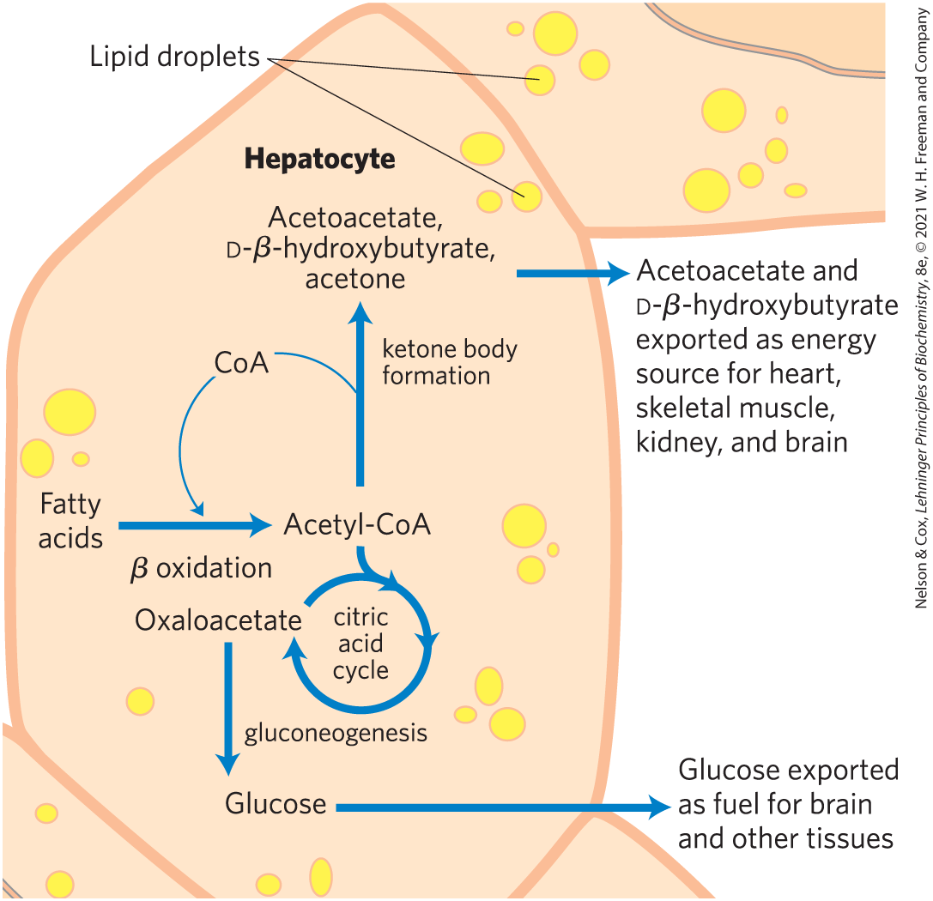
Ketone Bodies Are Overproduced in Diabetes and during Starvation
the accumulation of acetyl-CoA accelerates formation of ketone bodies
  extrahepatic tissues do not have the capacity to oxidize them all

Slide 102
Acidosis, Ketosis, and Ketoacidosis
acidosis = lowered blood pH
  can be caused by increased levels of acetoacetate, and D-β-hydroxybutyrate
ketosis = high levels of ketone bodies in the blood and urine
ketoacidosis = condition when ketosis and acidosis are combined

Slide 103
Individuals with Untreated Diabetes
Have High Acetone Levels
acetoacetate decarboxylase = catalyzes the decarboxylation of acetoacetate to acetone
individuals with untreated diabetes produce large quantities of acetoacetate
acetone formed from the decarboxylation of acetoacetate is volatile
  imparts a characteristic odor to the breath

