Slide 1

14 Glycolysis, Gluconeogenesis, and the Pentose Phosphate Pathway
© 2021 Macmillan Learning

Slide 2
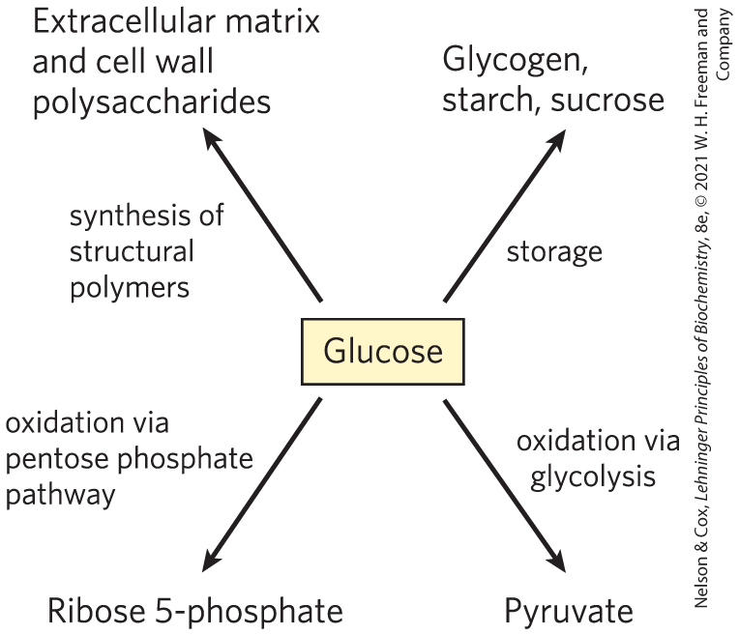
Major Pathways of
Glucose Utilization

Slide 3

Principle 1 (1 of 7)
Metabolites like glucose are often activated with a high-energy group before their catabolism. Glycolysis is a nearly universal 10-step metabolic pathway for producing ATP by the oxidation of glucose. In this process, two molecules of ATP are invested to activate glucose, but the products of the pathway include four ATP, as well as NADH (a form of reducing power) and the triose pyruvate, which can be metabolized further in other pathways.

Slide 4

Principle 2 (1 of 3)
Glucose and other hexoses and hexose phosphates obtained from stored polysaccharides or dietary carbohydrates feed into the glycolytic pathway. By using a common pathway for a number of starting materials, the cell economizes on the number of enzymes that must be synthesized and simplifies the regulation of the common pathway.

Slide 5

Principle 3 (1 of 7)
Pyruvate formed under anaerobic conditions is reduced to lactate with electrons from NADH, recycling NADH to NAD⁺ and allowing continued glycolysis in the processes of lactate or alcohol fermentation. Manipulation of the fermentable material and the microorganisms present allows the synthesis of a variety of industrial products and foods.

Slide 6
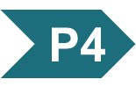
Principle 4 (1 of 5)
Gluconeogenesis is the synthesis of glucose from simpler precursors like pyruvate and lactate. Although it uses seven of the ten enzymes that also act in glycolysis, gluconeogenesis must bypass three of the most exergonic steps in glycolysis with energetically favorable reactions unique to gluconeogenesis.

Slide 7
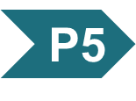
Principle 5 (1 of 6)
Glycolysis and gluconeogenesis are reciprocally regulated so that both processes don’t occur simultaneously in a futile cycle. Most regulatory mechanisms act on reactions that are unique to each pathway.

Slide 8
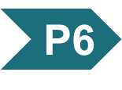
Principle 6 (1 of 5)
The pentose phosphate pathway is an alternative pathway for glucose oxidation. It yields pentoses for nucleotide synthesis and reduced cofactors for biosynthesis of fatty acids, sterols, and many other compounds.

Slide 9
14.1 Glycolysis

Slide 10
Principle 1 (2 of 7)
Metabolites like glucose are often activated with a high-energy group before their catabolism. Glycolysis is a nearly universal 10-step metabolic pathway for producing ATP by the oxidation of glucose. In this process, two molecules of ATP are invested to activate glucose, but the products of the pathway include four ATP, as well as NADH (a form of reducing power) and the triose pyruvate, which can be metabolized further in other pathways.

Slide 11
Glycolysis is an Almost Universal Central Pathway of Glucose Catabolism
glycolysis = process by which a molecule of glucose is degraded in a series of enzyme-catalyzed reactions to yield two molecules of the three-carbon compound pyruvate
  some free energy is conserved as ATP and NADH

Slide 12
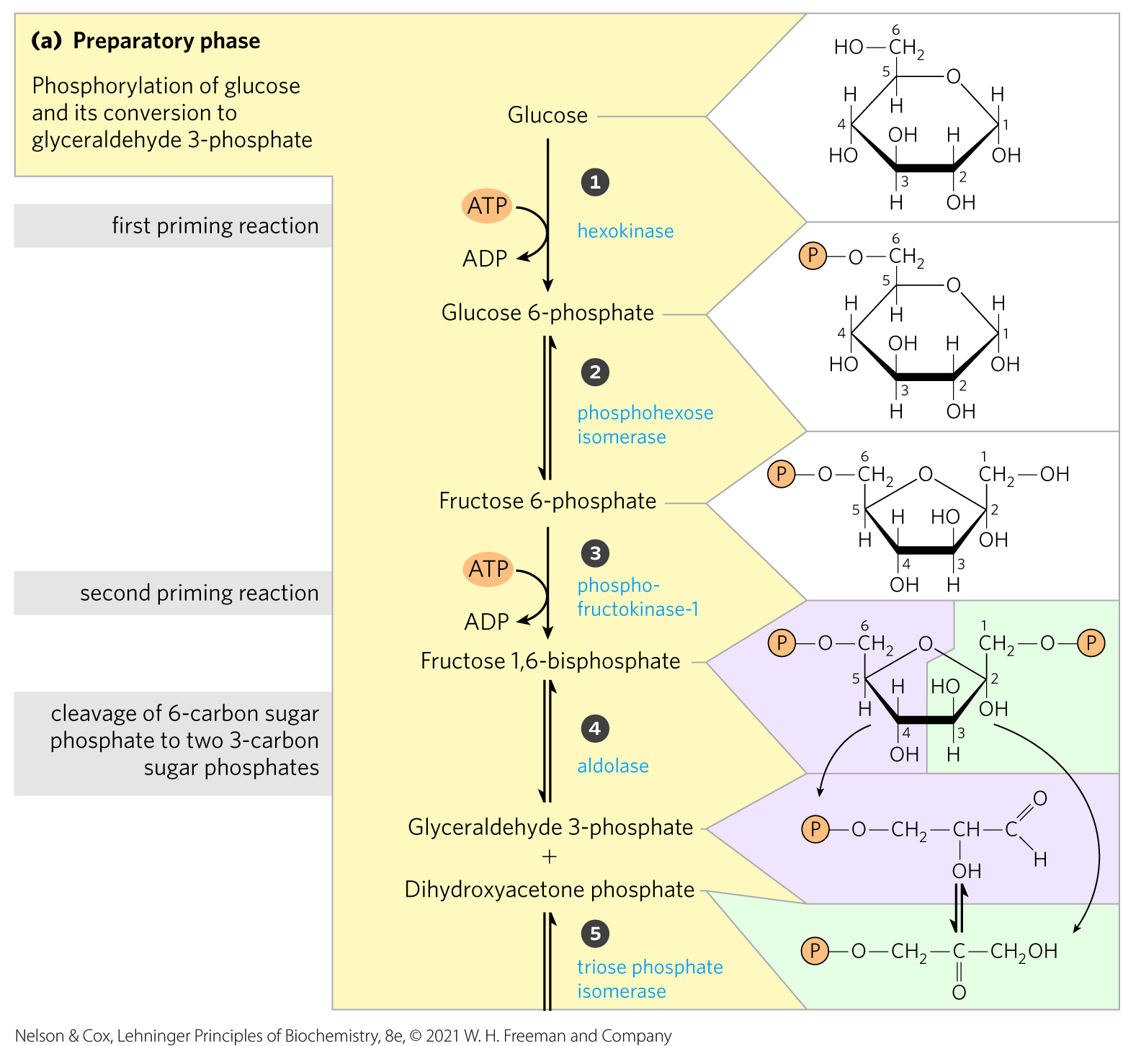
An Overview: Glycolysis Has
Two Phases
in the preparatory phase:
  ATP is consumed
  ∆G of the intermediates increases
  hexose carbon chains are converted to glyceraldehyde 3-phosphate

Slide 13
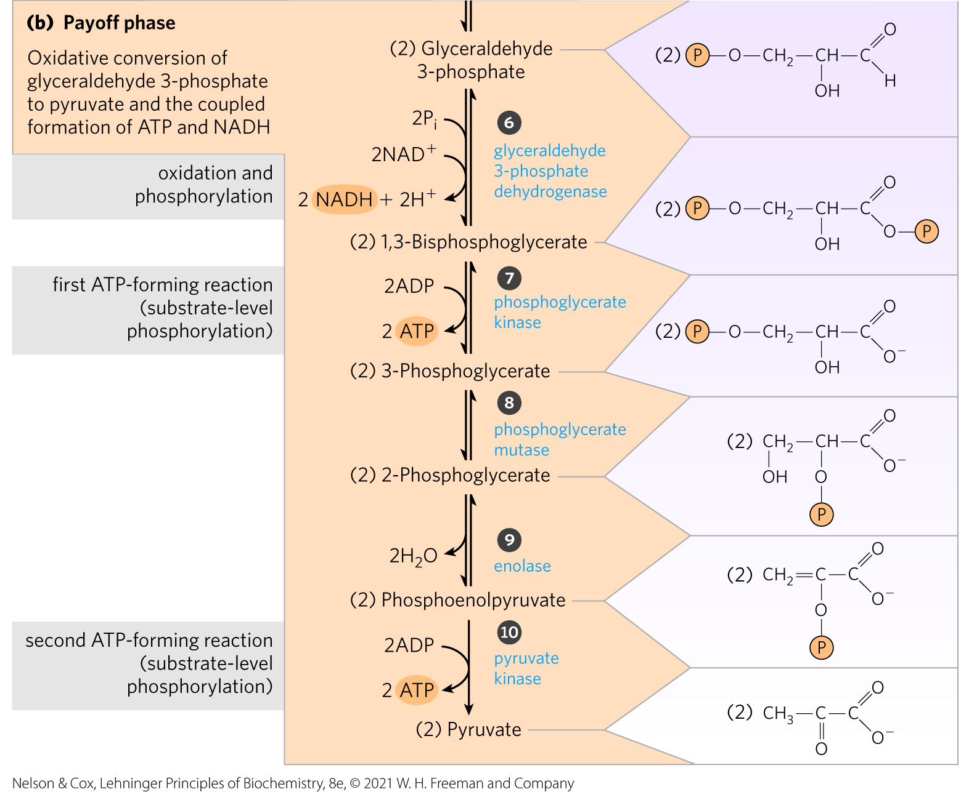
The Payoff Phase of Glycolysis
the payoff phase yields:
  energy conserved as 2 ATP and 2 NADH
  2 pyruvate

Slide 14
Principle 1 (3 of 7)
Metabolites like glucose are often activated with a high-energy group before their catabolism. Glycolysis is a nearly universal 10-step metabolic pathway for producing ATP by the oxidation of glucose. In this process, two molecules of ATP are invested to activate glucose, but the products of the pathway include four ATP, as well as NADH (a form of reducing power) and the triose pyruvate, which can be metabolized further in other pathways.

Slide 15
Noteworthy Chemical Transformations of Glycolysis
three noteworthy chemical transformations:
  degradation of the carbon skeleton of glucose to yield pyruvate
  phosphorylation of ADP to ATP by compounds with high phosphoryl group transfer potential, formed during glycolysis
  transfer of a hydride ion to NAD+, forming NADH

Slide 16
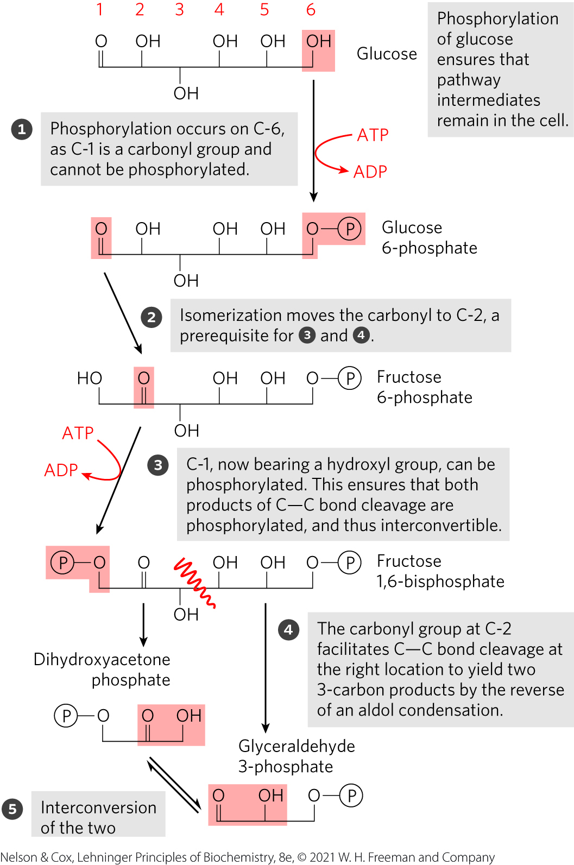
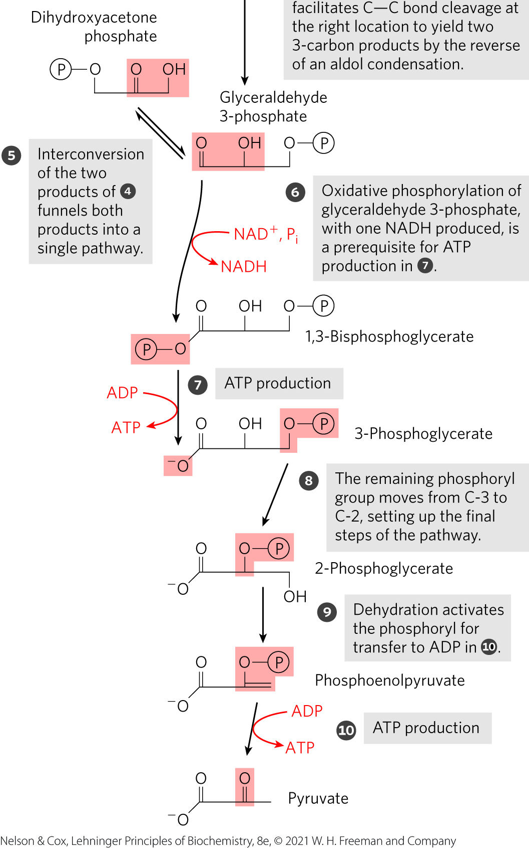
The Chemical Logic of the
Glycolytic Pathway

Slide 17
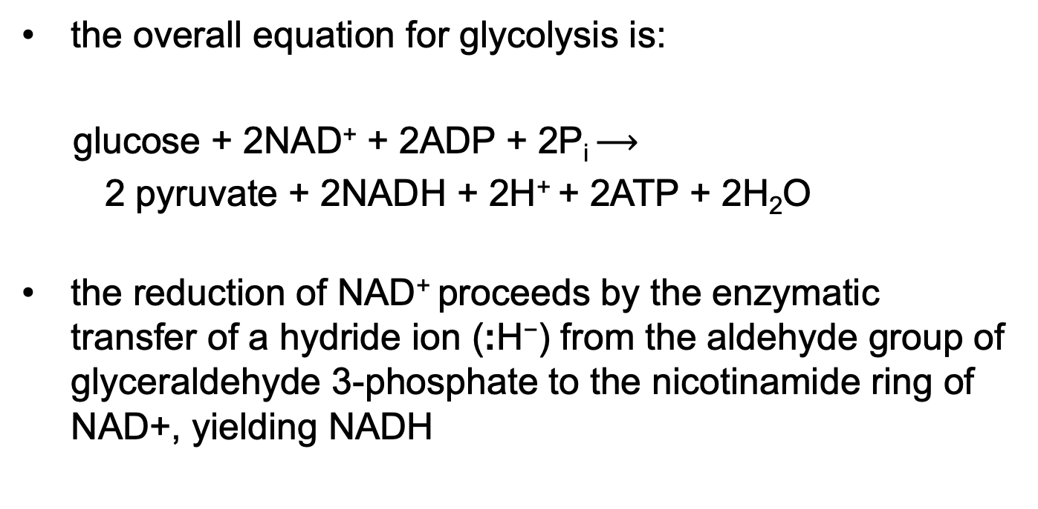
ATP and NADH Formation Coupled to Glycolysis
the overall equation for glycolysis is:
glucose + 2NAD⁺ + 2ADP + 2P_{i} $⟶$
2 pyruvate + 2NADH + 2H⁺ + 2ATP + 2H₂O
the reduction of NAD⁺ proceeds by the enzymatic transfer of a hydride ion (:H⁻) from the aldehyde group of glyceraldehyde 3-phosphate to the nicotinamide ring of NAD+, yielding NADH
(14-1)

Slide 18
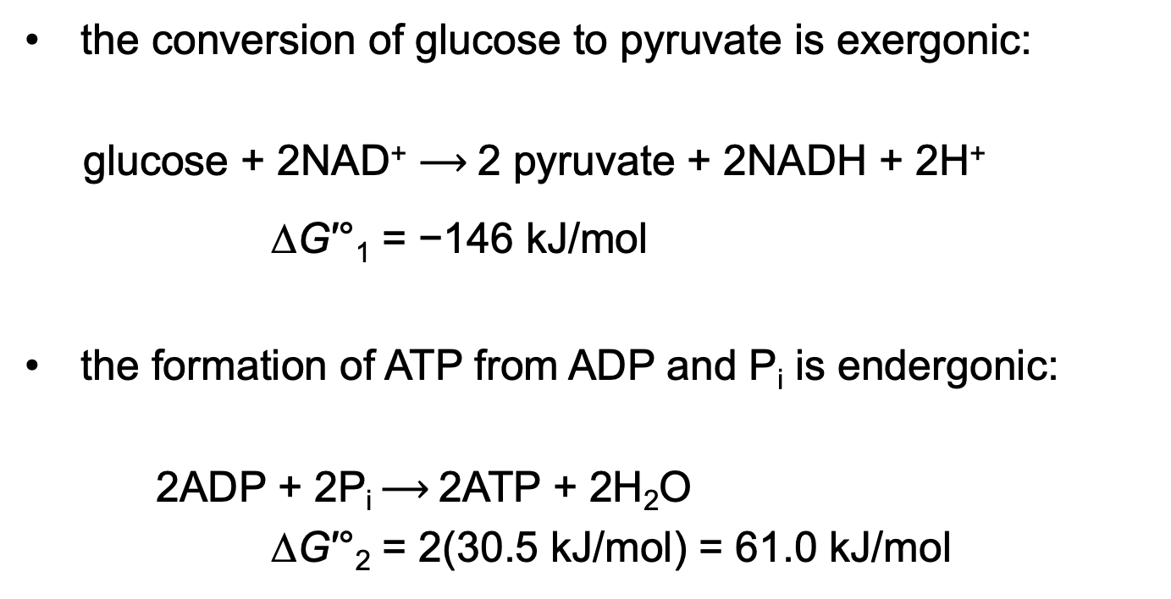
Resolving the Equation of Glycolysis into Two Processes
the conversion of glucose to pyruvate is exergonic:
glucose + 2NAD⁺ $⟶$2 pyruvate + 2NADH + 2H⁺
∆G′°₁ = −146 kJ/mol
the formation of ATP from ADP and P_{i} is endergonic:
2ADP + 2P_{i} $⟶$2ATP + 2H₂O
∆G′°₂ = 2(30.5 kJ/mol) = 61.0 kJ/mol
(14-2)
(14-3)

Slide 19
The Standard Free-Energy Change of Glycolysis, ∆G′°_{Sum}
the sum of the two processes gives the overall standard free-energy change of glycolysis, ∆G′°_{Sum}:
∆G′°_{Sum} = ∆G′°₁ + ∆G′°₂
= −146 kJ/mol + 61.0 kJ/mol
= −85 kJ/mol
under standard and cellular conditions, glycolysis is essentially irreversible

Slide 20
Energy Remaining in Pyruvate
energy stored in pyruvate can be extracted by:
  aerobic processes:
    oxidative reactions in the citric acid cycle
    oxidative phosphorylation
  anaerobic processes
    reduction to lactate
    reduction to ethanol
pyruvate can provide the carbon skeleton for alanine synthesis or fatty acid synthesis

Slide 21
Principle 1 (4 of 7)
Metabolites like glucose are often activated with a high-energy group before their catabolism. Glycolysis is a nearly universal 10-step metabolic pathway for producing ATP by the oxidation of glucose. In this process, two molecules of ATP are invested to activate glucose, but the products of the pathway include four ATP, as well as NADH (a form of reducing power) and the triose pyruvate, which can be metabolized further in other pathways.

Slide 22
Importance of Phosphorylated Intermediates
all nine intermediates are phosphorylated
functions of the phosphoryl groups:
  prevent glycolytic intermediates from leaving the cell
  serve as essential components in the enzymatic conservation of metabolic energy
  lower the activation energy and increase the specificity of the enzymatic reactions

Slide 23
The Preparatory Phase of Glycolysis Requires ATP
in the preparatory phase of glycolysis:
  two molecules of ATP are invested to activate glucose to fructose 1,6-bisphosphate
  the bond between C-3 and C-4 of fructose 1,6-bisphosphate is then broken to yield two molecules of triose phosphate

Slide 24
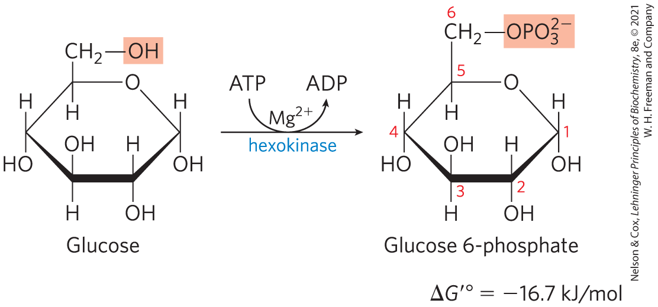
Phosphorylation of Glucose
hexokinase activates glucose by phosphorylating at C-6 to yield glucose 6-phosphate
  ATP serves as the phosphoryl donor
  hexokinase requires Mg²⁺ for its activity
  irreversible under intracellular conditions

Slide 25
Hexokinase is Present in Nearly All Organisms
humans encode 4 hexokinases (I to IV) that catalyze the same reaction
isozymes = two or more enzymes that catalyze the same reaction but are encoded by different genes

Slide 26
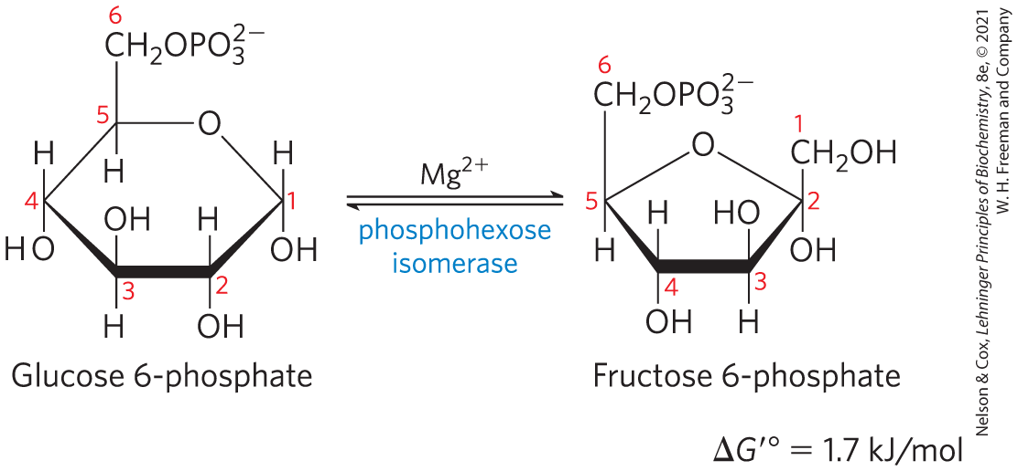
Conversion of Glucose 6-Phosphate to Fructose 6-Phosphate
phosphohexose isomerase (phosphoglucose isomerase) catalyzes the reversible isomerization of glucose 6-phosphate to fructose 6-phosphate
  mechanism involves an enediol intermediate
  reaction readily proceeds in either direction

Slide 27
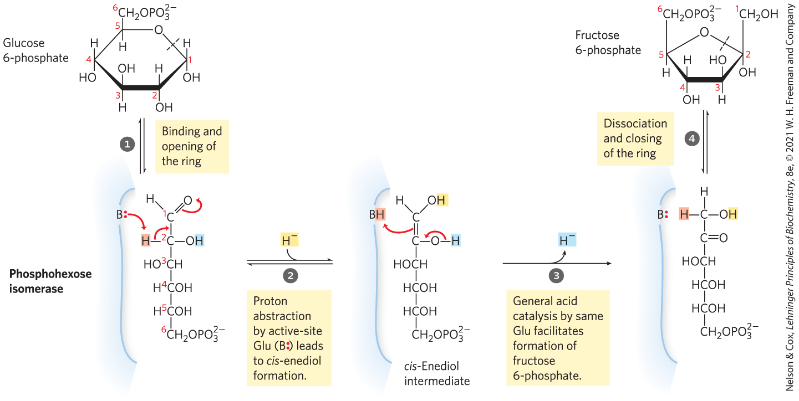
The Phosphohexose Isomerase Reaction

Slide 28
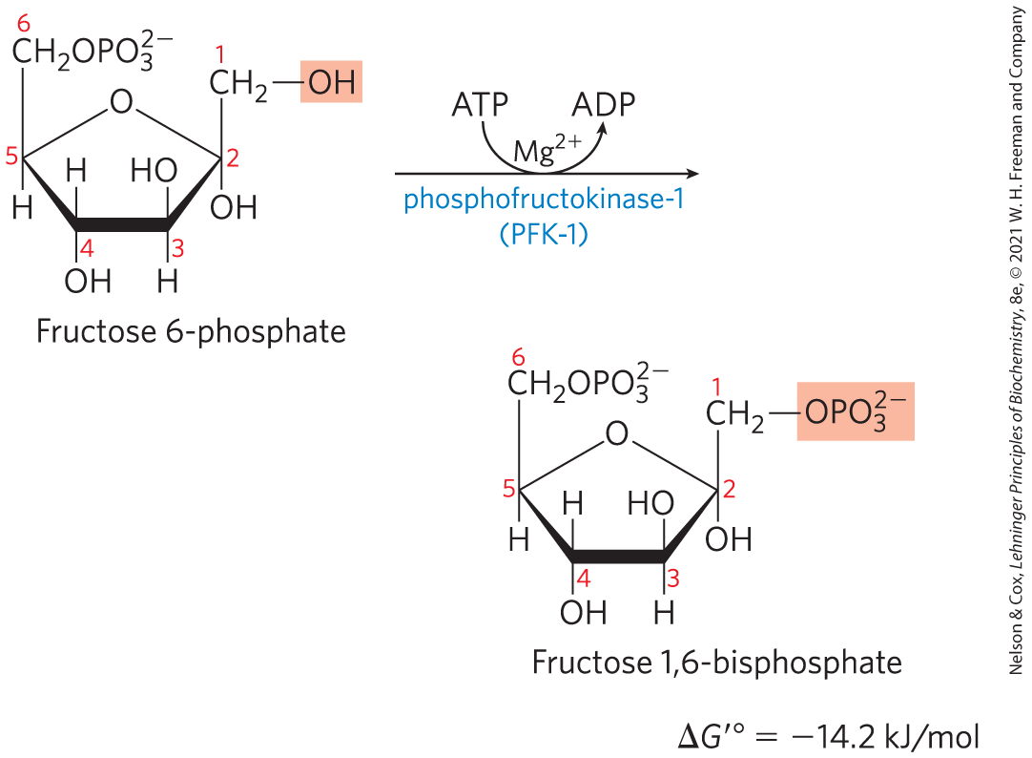
Phosphorylation of Fructose 6-Phosphate to Fructose 1,6-Bisphosphate
phosphofructokinase-1 (PFK-1) catalyzes the transfer of a phosphoryl group from ATP to fructose 6-phosphate to yield fructose 1,6-bisphosphate
  essentially irreversible under cellular conditions
  the first “committed” step in the glycolytic pathway

Slide 29
Allosteric Regulation of Phosphofructokinase-1
activity increases when:
  ATP supply is depleted
  ADP and AMP accumulate
fructose 2,6-bisphosphate is a potent allosteric activator
ribulose 5-phosphate indirectly activates

Slide 30
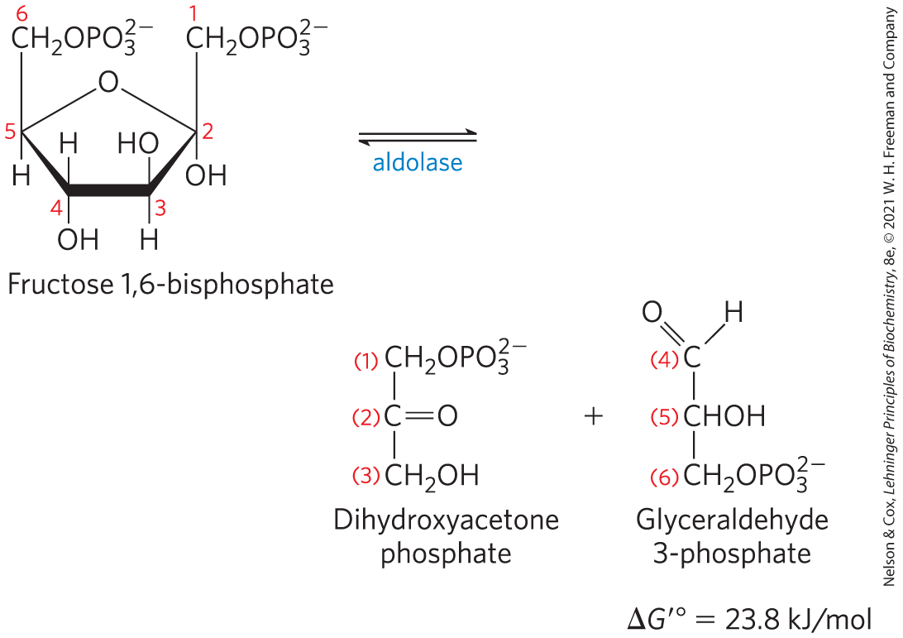
Cleavage of Fructose
1,6-Bisphosphate
fructose 1,6-bisphosphate aldolase (aldolase) catalyzes a reverse aldol condensation and cleaves fructose 1,6-bisphosphate to yield glyceraldehyde 3-phosphate and dihydroxyacetone phosphate
  reversible because reactant concentrations are low in the cell

Slide 31
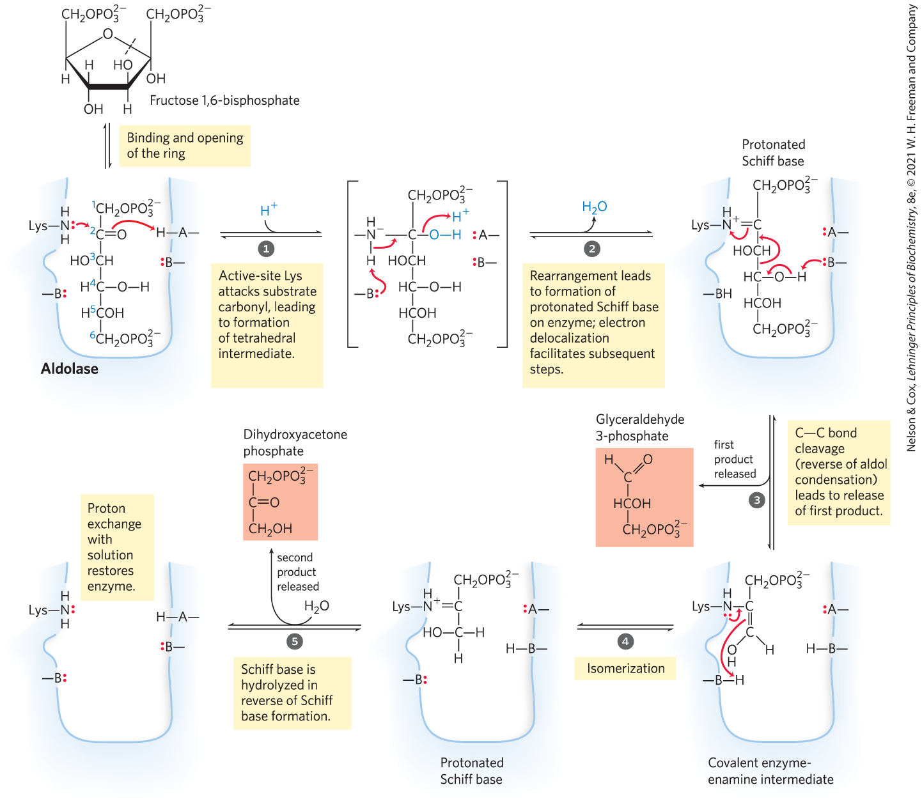
The Class I Aldolase Reaction
Class I = found in animals and plants
Class II = found in fungi and bacteria
  do not form the Schiff base intermediate

Slide 32
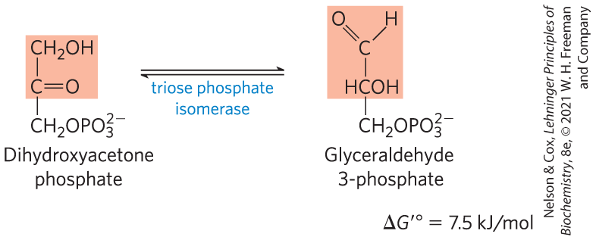
Interconversion of the Triose Phosphates
triose phosphate isomerase converts dihydroxyacetone phosphate to glyceraldehyde 3-phosphate
  reversible
  final step of the preparatory phase of glycolysis

Slide 33
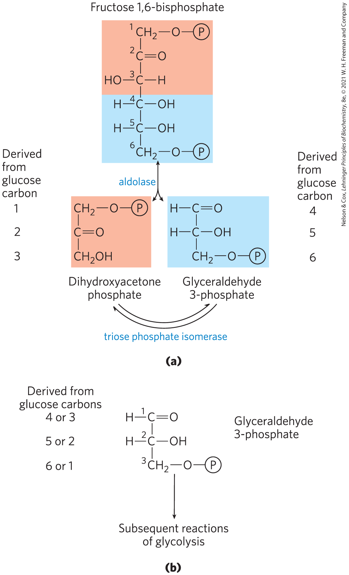
Fate of the Glucose Carbons in the Formation of Glyceraldehyde
3-Phosphate
after step 5 of glycolysis, the carbon atoms derived from C-1, C-2, and C-3 of the starting glucose are chemically indistinguishable from C-6, C-5, and C-4, respectively

Slide 34
The Payoff Phase of Glycolysis Yields ATP and NADH
in the payoff phase of glycolysis:
  each of the two molecules of glyceraldehyde 3-phosphate undergoes oxidation at C-1
  some energy from the oxidation reaction is conserved in the form of one NADH and two ATP per triose phosphate oxidized

Slide 35
Principle 1 (5 of 7)
Metabolites like glucose are often activated with a high-energy group before their catabolism. Glycolysis is a nearly universal 10-step metabolic pathway for producing ATP by the oxidation of glucose. In this process, two molecules of ATP are invested to activate glucose, but the products of the pathway include four ATP, as well as NADH (a form of reducing power) and the triose pyruvate, which can be metabolized further in other pathways.

Slide 36
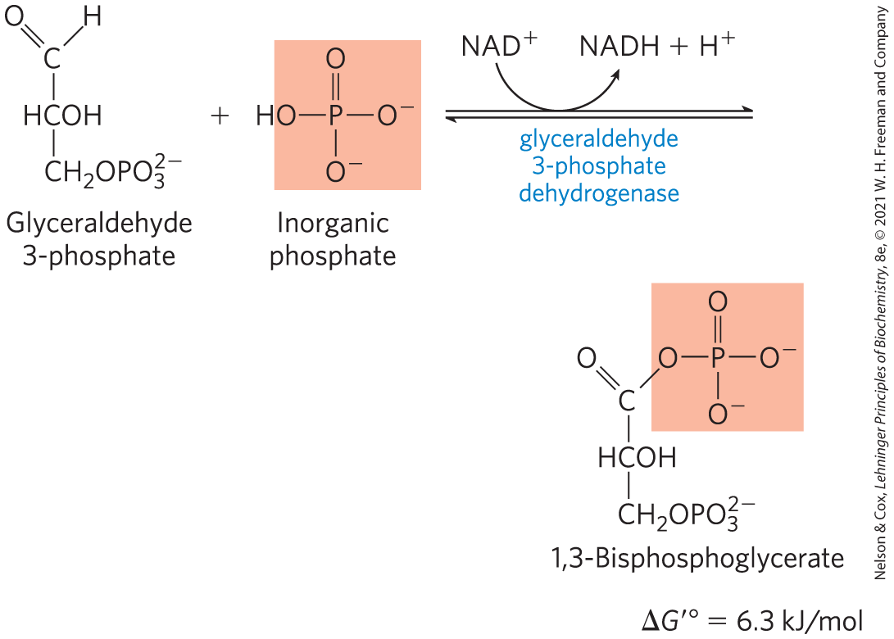
Oxidation of Glyceraldehyde
3-Phosphate to 1,3-Bisphosphoglycerate
glyceraldehyde 3-phosphate dehydrogenase catalyzes the oxidation glyceraldehyde 3-phosphate to 1,3-bisphosphoglycerate
  energy-conserving reaction

Slide 37
The First Step of the Payoff Phase is an Energy-Conserving Reaction
formation of the acyl phosphate group at C-1 of 1,3-bisphosphoglycerate conserves the free energy of oxidation
acyl phosphates have a very high standard free energy of hydrolysis (∆G′° = −49.3 kJ/mol)

Slide 38
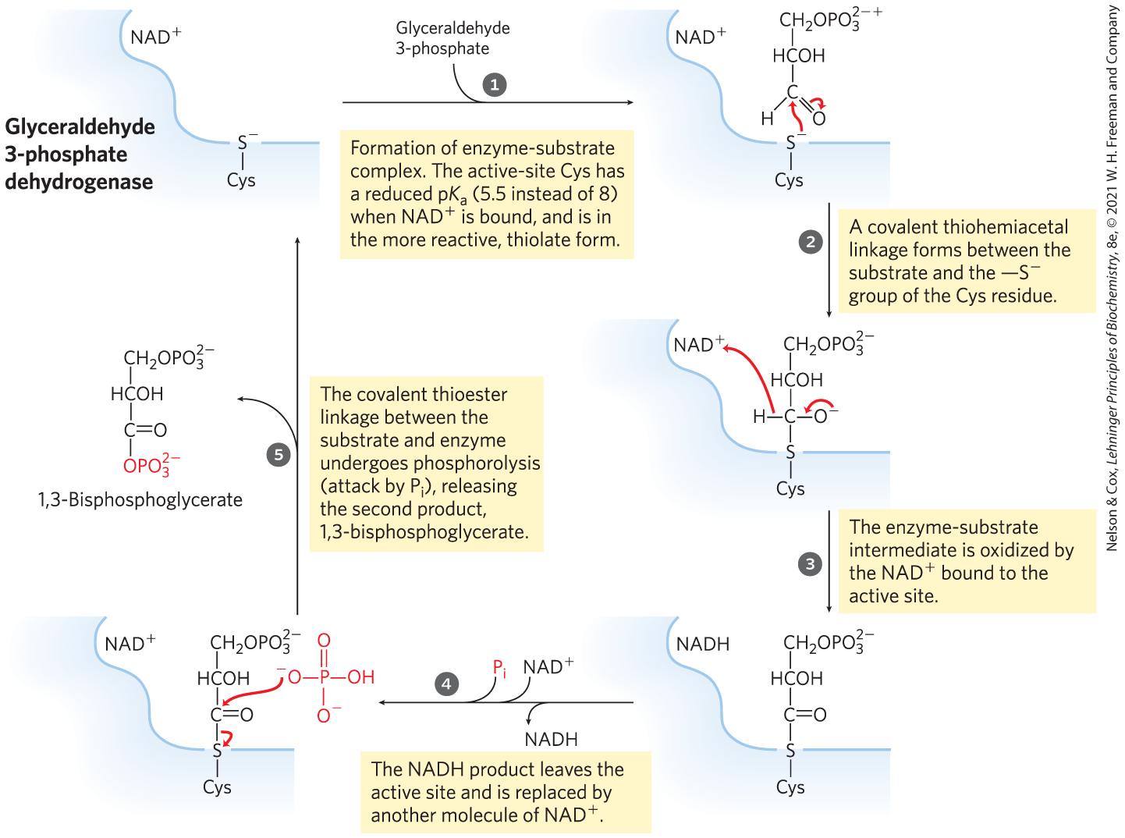
The Glyceraldehyde 3-Phosphate Dehydrogenase Reaction

Slide 39
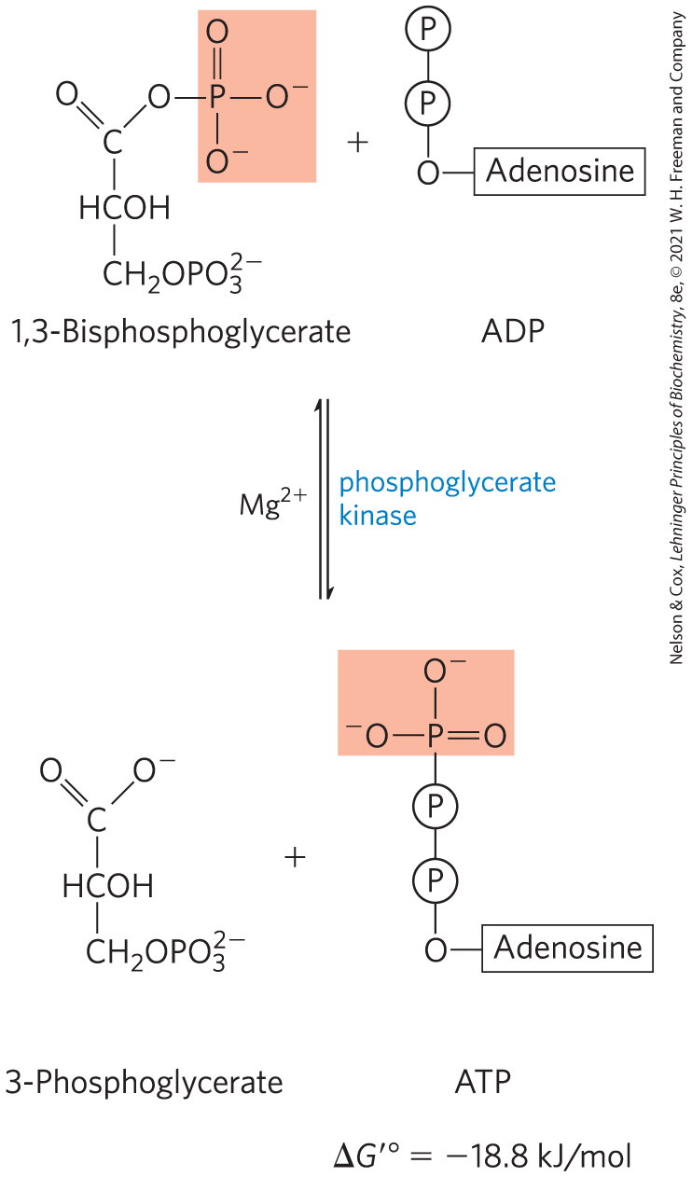
Phosphoryl Transfer from 1,3-Bisphosphoglycerate to ADP
phosphoglycerate kinase transfers the high-energy phosphoryl group from the carboxyl group of 1,3-bisphosphoglycerate to ADP, forming ATP and 3-phosphoglycerate

Slide 40
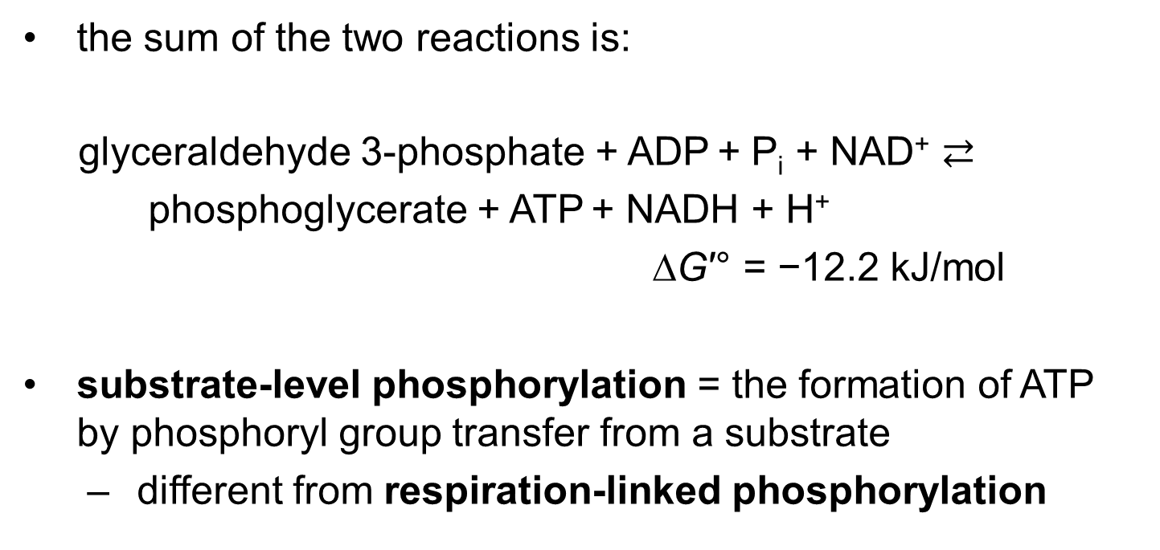
Steps 6 and 7 of Glycolysis Constitute an Energy-Coupling Process
the sum of the two reactions is:
glyceraldehyde 3-phosphate + ADP + P_{i} + NAD⁺ $⇄$
phosphoglycerate + ATP + NADH + H⁺
∆G′° = −12.2 kJ/mol
substrate-level phosphorylation = the formation of ATP by phosphoryl group transfer from a substrate
  different from respiration-linked phosphorylation

Slide 41
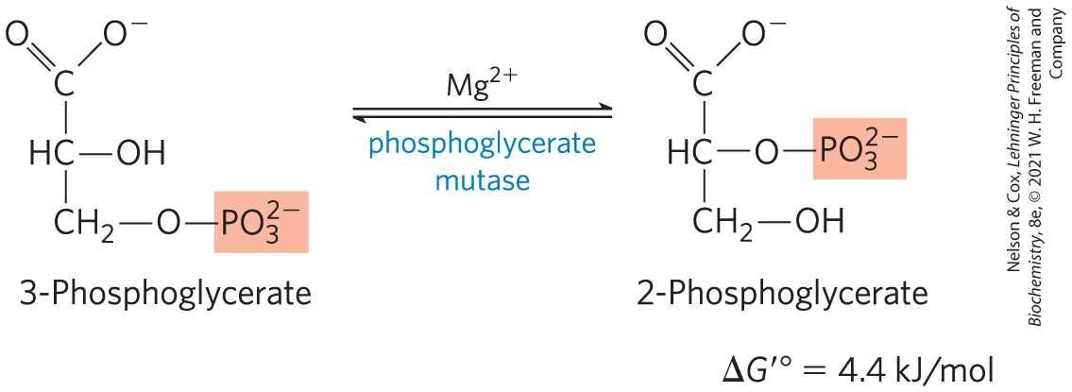
Conversion of 3-Phosphoglycerate to 2-Phosphoglycerate
phosphoglycerate mutase catalyzes a reversible shift of the phosphoryl group between C-2 and C-3 of glycerate
  requires Mg²⁺

Slide 42
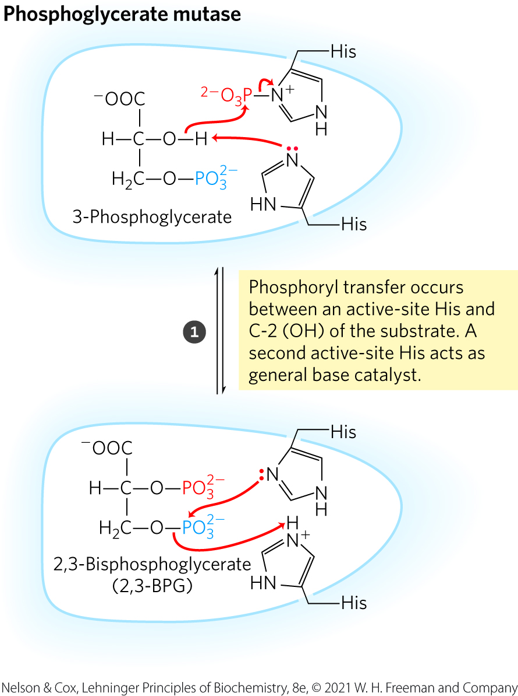
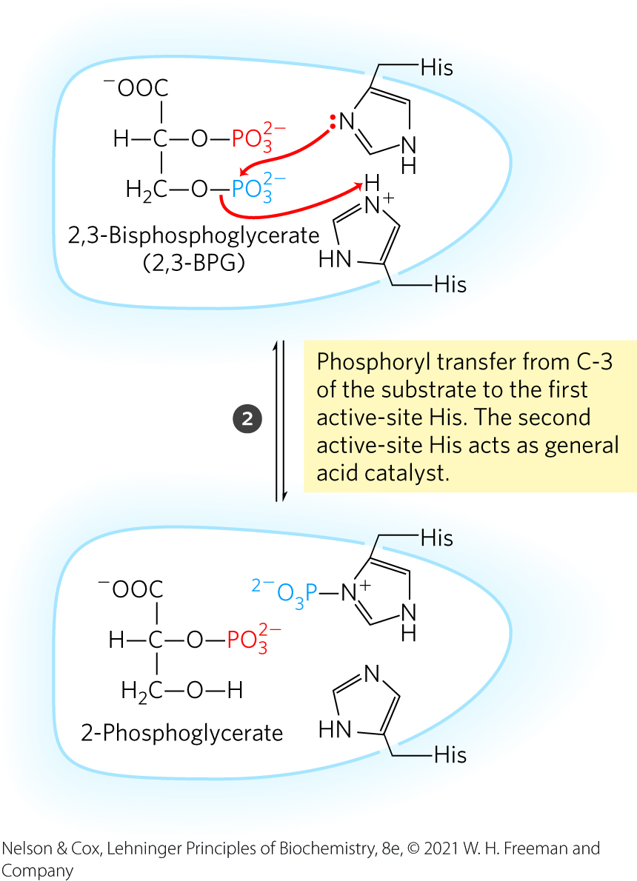
The Phosphoglycerate Mutase Reaction

Slide 43
Principle 1 (6 of 7)
Metabolites like glucose are often activated with a high-energy group before their catabolism. Glycolysis is a nearly universal 10-step metabolic pathway for producing ATP by the oxidation of glucose. In this process, two molecules of ATP are invested to activate glucose, but the products of the pathway include four ATP, as well as NADH (a form of reducing power) and the triose pyruvate, which can be metabolized further in other pathways.

Slide 44
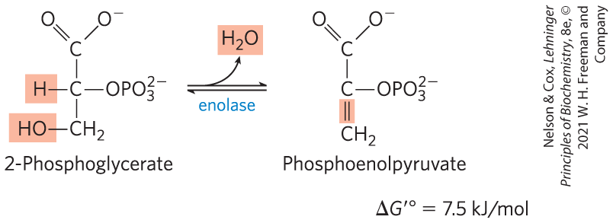
Dehydration of 2-Phosphoglycerate to Phosphoenolpyruvate
enolase promotes reversible removal of a molecule of water from 2-phosphoglycerate to yield phosphoenolpyruvate (PEP)
  energy-conserving reaction
  mechanism involves a Mg²⁺-stabilized enolic intermediate

Slide 45
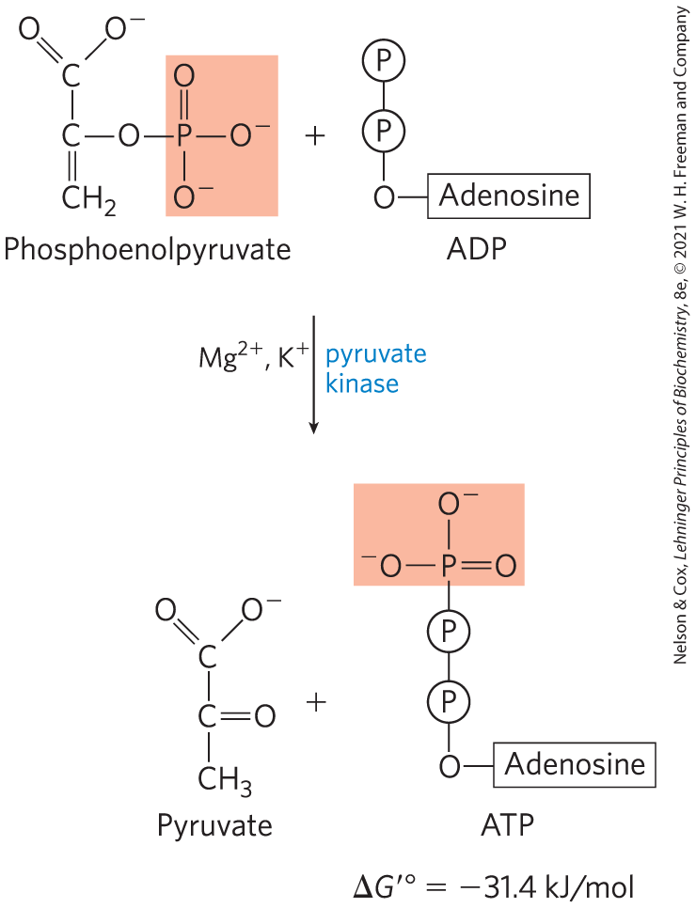
Transfer of the Phosphoryl Group from Phosphoenolpyruvate to ADP
pyruvate kinase catalyzes the transfer of the phosphoryl group from phosphoenolpyruvate to ADP, yielding pyruvate
  requires K⁺ and either Mg²⁺ or Mn²⁺

Slide 46
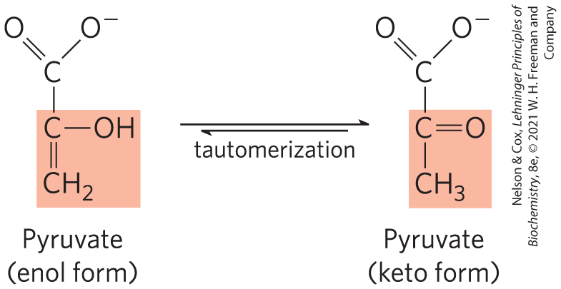
Pyruvate in its Enol Form Spontaneously Tautomerizes to its Keto Form
pyruvate kinase catalyzes the transfer of the phosphoryl group from phosphoenolpyruvate to ADP, yielding pyruvate
  requires K⁺ and either Mg²⁺ or Mn²⁺

Slide 47
Principle 1 (7 of 7)
Metabolites like glucose are often activated with a high-energy group before their catabolism. Glycolysis is a nearly universal 10-step metabolic pathway for producing ATP by the oxidation of glucose. In this process, two molecules of ATP are invested to activate glucose, but the products of the pathway include four ATP, as well as NADH (a form of reducing power) and the triose pyruvate, which can be metabolized further in other pathways.

Slide 48
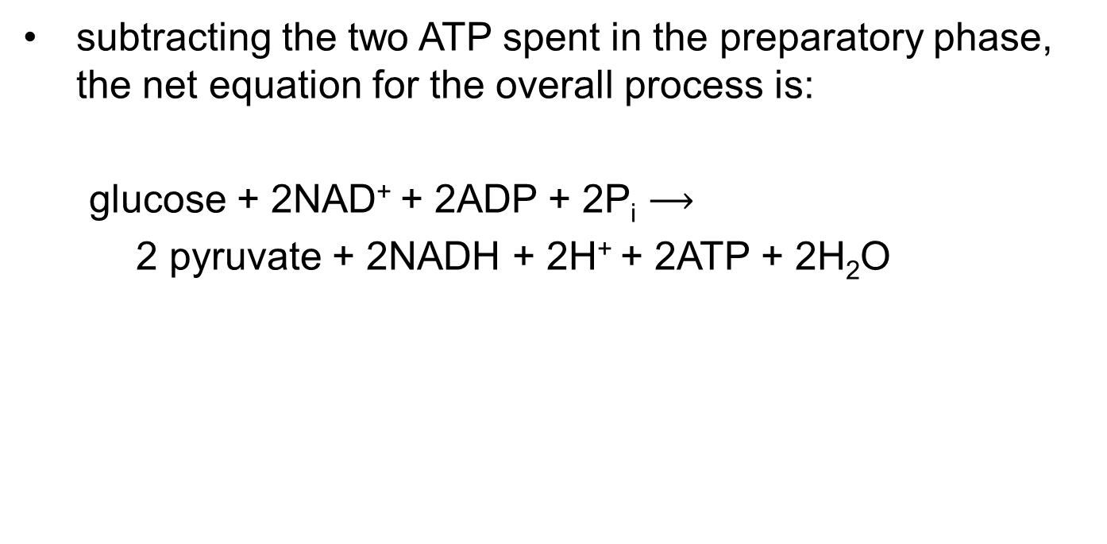
The Overall Balance Sheet Shows a Net Gain of Two ATP and Two NADH Per Glucose
subtracting the two ATP spent in the preparatory phase, the net equation for the overall process is:
glucose + 2NAD⁺ + 2ADP + 2P_{i} $⟶$
2 pyruvate + 2NADH + 2H⁺ + 2ATP + 2H₂O

Slide 49
14.2 Feeder Pathways for Glycolysis

Slide 50
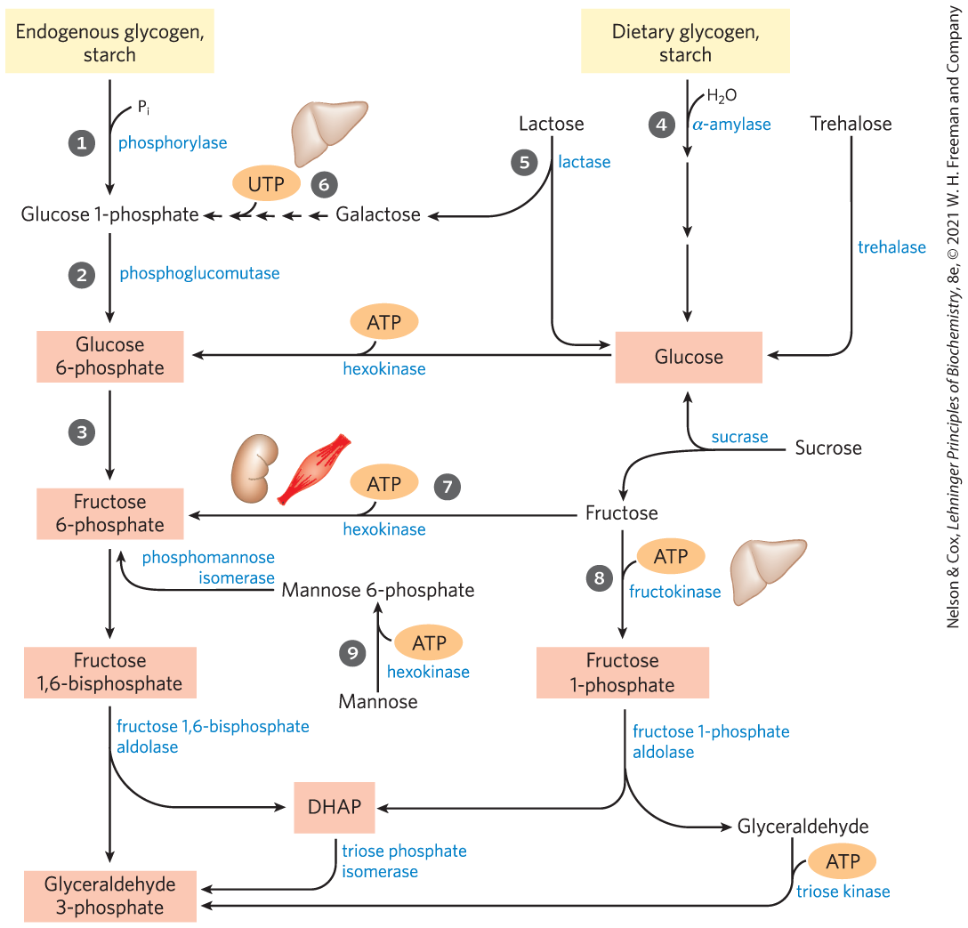
Entry of Dietary Glycogen, Starch, Disaccharides, and Hexoses into the Preparatory Stage of Glycolysis

Slide 51
Principle 2 (2 of 3)
Glucose and other hexoses and hexose phosphates obtained from stored polysaccharides or dietary carbohydrates feed into the glycolytic pathway. By using a common pathway for a number of starting materials, the cell economizes on the number of enzymes that must be synthesized and simplifies the regulation of the common pathway.

Slide 52
Endogenous Glycogen and Starch Are Degraded by Phosphorolysis
glycogen phosphorylase = mobilizes glycogen stored in animal tissues and microorganisms by a phosphorolytic reaction to yield glucose 1-phosphate
starch phosphorylase = mobilizes starch by a phosphorolytic reaction

Slide 53
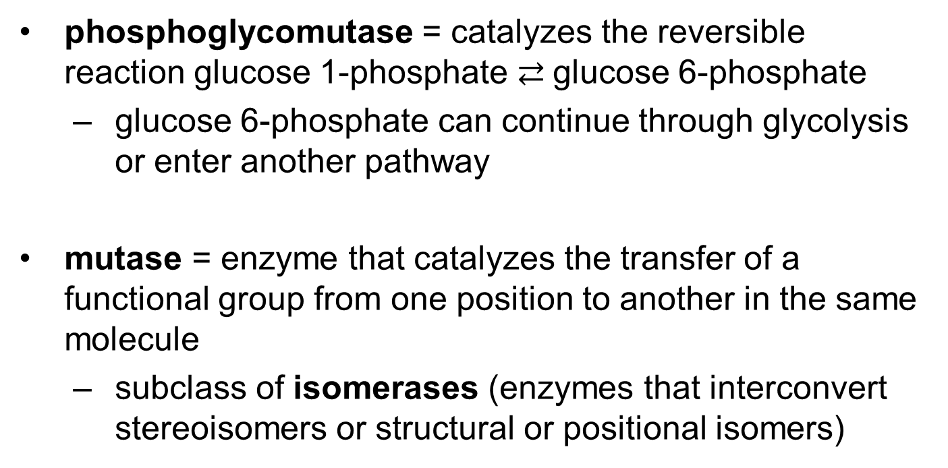
Phosphoglycomutase
phosphoglycomutase = catalyzes the reversible reaction glucose 1-phosphate $⇄$glucose 6-phosphate
  glucose 6-phosphate can continue through glycolysis or enter another pathway
mutase = enzyme that catalyzes the transfer of a functional group from one position to another in the same molecule
  subclass of isomerases (enzymes that interconvert stereoisomers or structural or positional isomers)

Slide 54
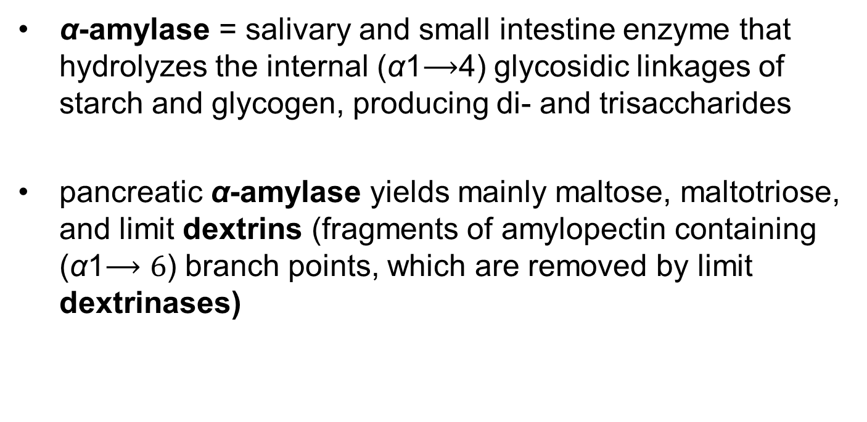
Dietary Polysaccharides and Disaccharides
α-amylase = salivary and small intestine enzyme that hydrolyzes the internal (α1$⟶$4) glycosidic linkages of starch and glycogen, producing di- and trisaccharides
pancreatic α-amylase yields mainly maltose, maltotriose, and limit dextrins (fragments of amylopectin containing (α1$⟶6$) branch points, which are removed by limit dextrinases)

Slide 55
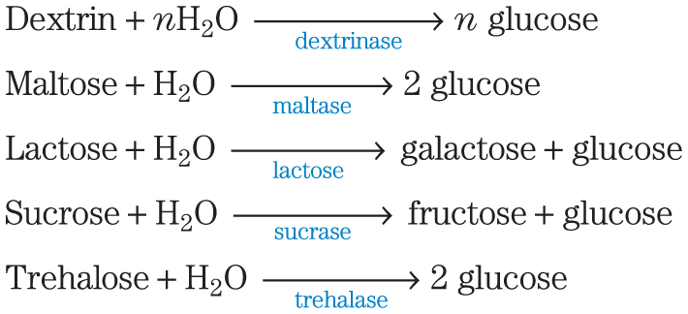
Hydrolysis of Disaccharides
membrane-bound hydrolases in the intestinal brush border hydrolyze disaccharides:
monosaccharides pass through intestinal cells to the bloodstream, which transports them to the liver or other tissues

Slide 56

Cellulase
cellulase = attacks the (β1$⟶$4) glycosidic bonds of cellulose
  absent in most animals
  microorganisms produce cellulase

Slide 57
Lactose Digestion and
Lactose Intolerance
lactase = converts lactose to glucose and galactose
  present in infants but often absent in adults, producing lactose intolerance
lactase persistence phenotype = production of lactase into adulthood
lactose intolerance = inability to digest lactose due to the disappearance of lactase in adulthood
  causes abdominal cramps and diarrhea

Slide 58
Galactose Metabolism and Disease
galactose = product of lactose hydrolysis
  important component in the infant diet
galactokinase = uses ATP to phosphorylate galactose at C-1

Slide 59
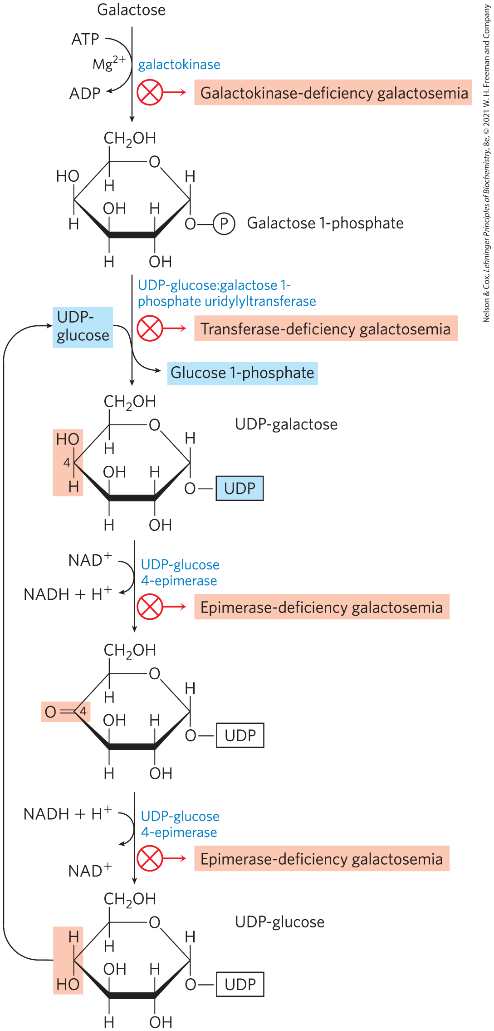
Conversion of Galactose to
Glucose 1-Phosphate
conversion proceeds through UDP-galactose and UDP-glucose intermediates
galactosemia diseases = caused by a genetic defect in enzymes of this pathway
  treatment involves carefully controlling dietary galactose

Slide 60
Principle 2 (3 of 3)
Glucose and other hexoses and hexose phosphates obtained from stored polysaccharides or dietary carbohydrates feed into the glycolytic pathway. By using a common pathway for a number of starting materials, the cell economizes on the number of enzymes that must be synthesized and simplifies the regulation of the common pathway.

Slide 61
Fructose and Mannose
fructose and mannose can be phosphorylated and funneled into glycolysis
hexokinase = phosphorylates fructose in the small intestine
fructose 1-phosphate aldolase = phosphorylates fructose in the liver

Slide 62
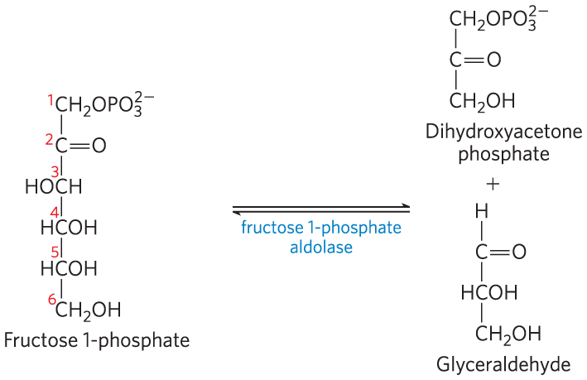
Fructose 1-Phosphate Aldolase
fructose 1-phosphate aldolase = cleaves fructose 1-phosphate to glyceraldehyde and dihydroxyacetone

Slide 63

Products of Fructose 1-Phosphate Hydrolysis Enter Glycolysis as Glyceraldehyde 3-Phosphate
triose phosphate isomerase = converts dihydroxyacetone phosphate to glyceraldehyde 3-phosphate
triose kinase = uses ATP to phosphorylate glyceraldehyde to glyceraldehyde 3-phosphate

Slide 64
Mannose Enters Glycolysis as Fructose 6-Phosphate
hexokinase = phosphorylates mannose at C-6
phosphohexose isomerase = converts mannose 6-phosphate to fructose 6-phosphate

Slide 65
14.3 Fates of Pyruvate

Slide 66
Principle 3 (2 of 7)
Pyruvate formed under anaerobic conditions is reduced to lactate with electrons from NADH, recycling NADH to NAD⁺ and allowing continued glycolysis in the processes of lactate or alcohol fermentation. Manipulation of the fermentable material and the microorganisms present allows the synthesis of a variety of industrial products and foods.

Slide 67
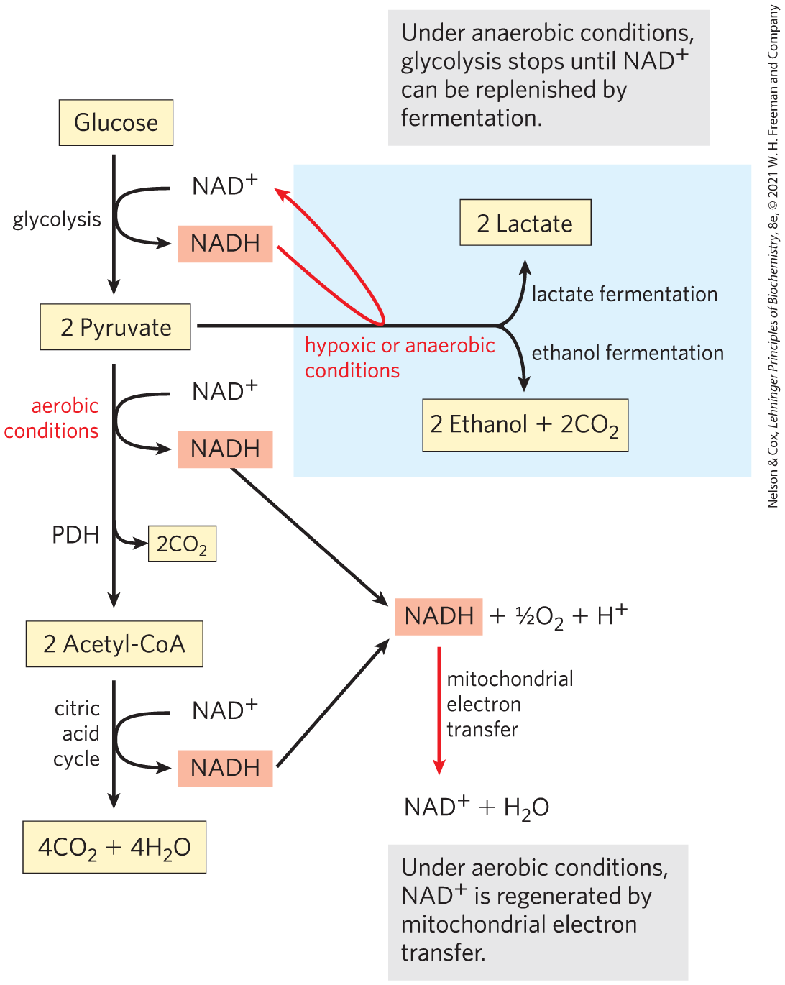
Three Catabolic Fates of Pyruvate
NADH must be recycled to regenerate NAD⁺
under aerobic conditions, pyruvate is oxidized to acetyl-CoA
under anaerobic conditions or low oxygen condition (hypoxia), pyruvate is reduced to lactate or ethanol

Slide 68
Fermentation
fermentation = general term for processes that extract energy (as ATP) but do not consume oxygen or change the concentrations of NAD⁺ or NADH
lactic acid fermentation = pyruvate accepts electrons from NADH and is reduced to lactate while regenerating the NAD⁺ necessary for glycolysis
ethanol (alcohol) fermentation = pyruvate is further catabolized to ethanol

Slide 69
The Pasteur and Warburg Effects Are Due to Dependence on Glycolysis Alone for ATP Production
“Pasteur effect” = effect by which the rate and total amount of glucose consumption under anaerobic conditions is many times greater than under aerobic conditions
  occurs because the ATP yield from glycolysis alone is much smaller (2 ATP per glucose) than complete oxidation to CO₂ (30 or 32 ATP per glucose)

Slide 70
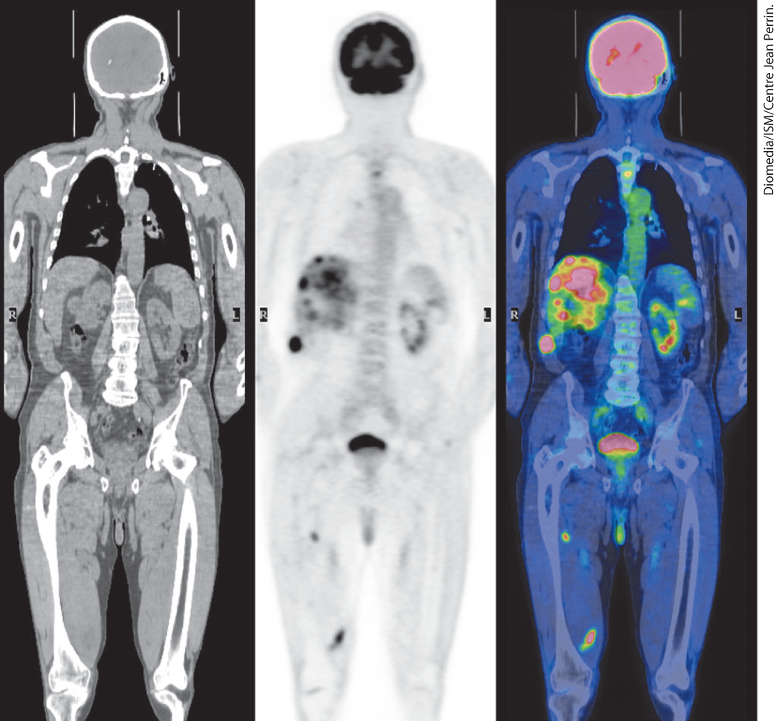
The Warburg Effect
“Warburg effect” = the observation that tumor cells have high rates of glycolysis, with fermentation of glucose to lactate, even in the presence of oxygen
  the basis of PET scanning used to diagnose tumors

Slide 71
Principle 3 (3 of 7)
Pyruvate formed under anaerobic conditions is reduced to lactate with electrons from NADH, recycling NADH to NAD⁺ and allowing continued glycolysis in the processes of lactate or alcohol fermentation. Manipulation of the fermentable material and the microorganisms present allows the synthesis of a variety of industrial products and foods.

Slide 72
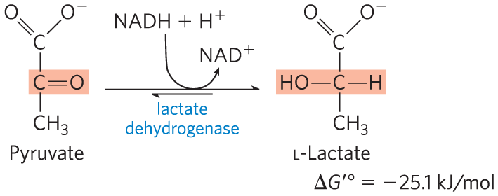
Pyruvate Is the Terminal Electron Acceptor in Lactic Acid Fermentation
organisms can regenerate NAD⁺ by transferring electrons from NADH to pyruvate, forming lactate
lactate dehydrogenase = catalyzes the reduction of pyruvate to lactate

Slide 73
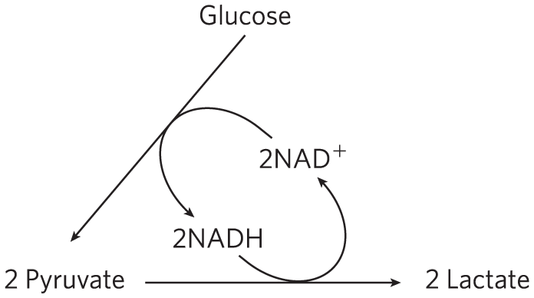
Reduction of Pyruvate to Lactate Regenerates NAD⁺
glycolysis converts 2NAD⁺ to 2NADH
reduction of pyruvate to lactate regenerates 2NAD⁺
there is no net change in NAD⁺ or NADH

Slide 74
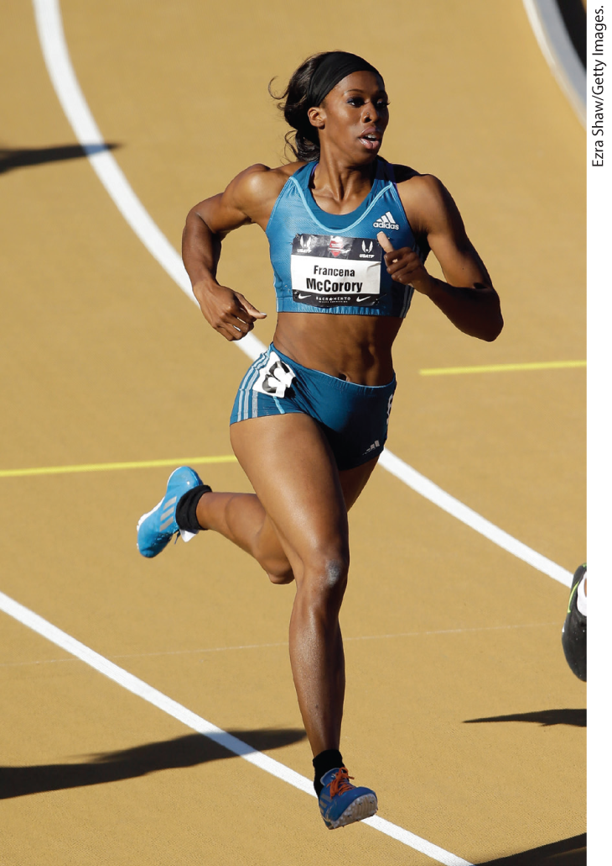
Lactate Can Be Recycled
lactate is carried in blood to the liver, where it is converted to glucose during recovery
acidification resulting from ionization of lactic acid in muscle and blood limits the period of vigorous activity, such as sprinting

Slide 75
Principle 3 (4 of 7)
Pyruvate formed under anaerobic conditions is reduced to lactate with electrons from NADH, recycling NADH to NAD⁺ and allowing continued glycolysis in the processes of lactate or alcohol fermentation. Manipulation of the fermentable material and the microorganisms present allows the synthesis of a variety of industrial products and foods.

Slide 76
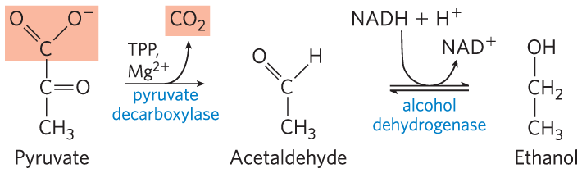
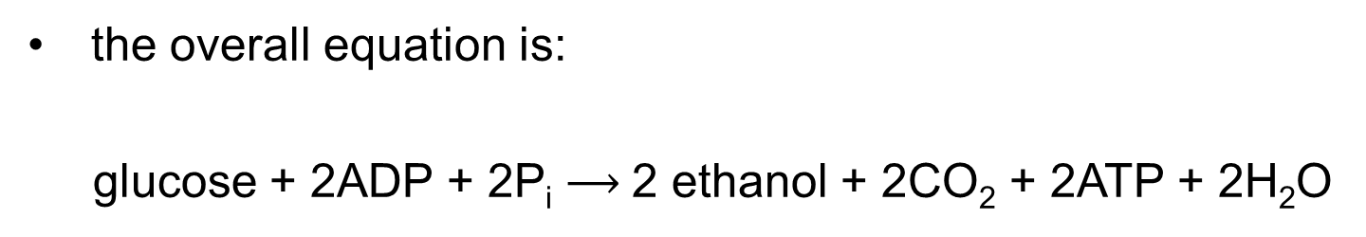
Ethanol Is the Reduced Product in Ethanol Fermentation
yeast and other microorganisms regenerate NAD⁺ by reducing pyruvate to ethanol and CO₂
the overall equation is:
glucose + 2ADP + 2P_{i} $⟶$2 ethanol + 2CO₂ + 2ATP + 2H₂O

Slide 77
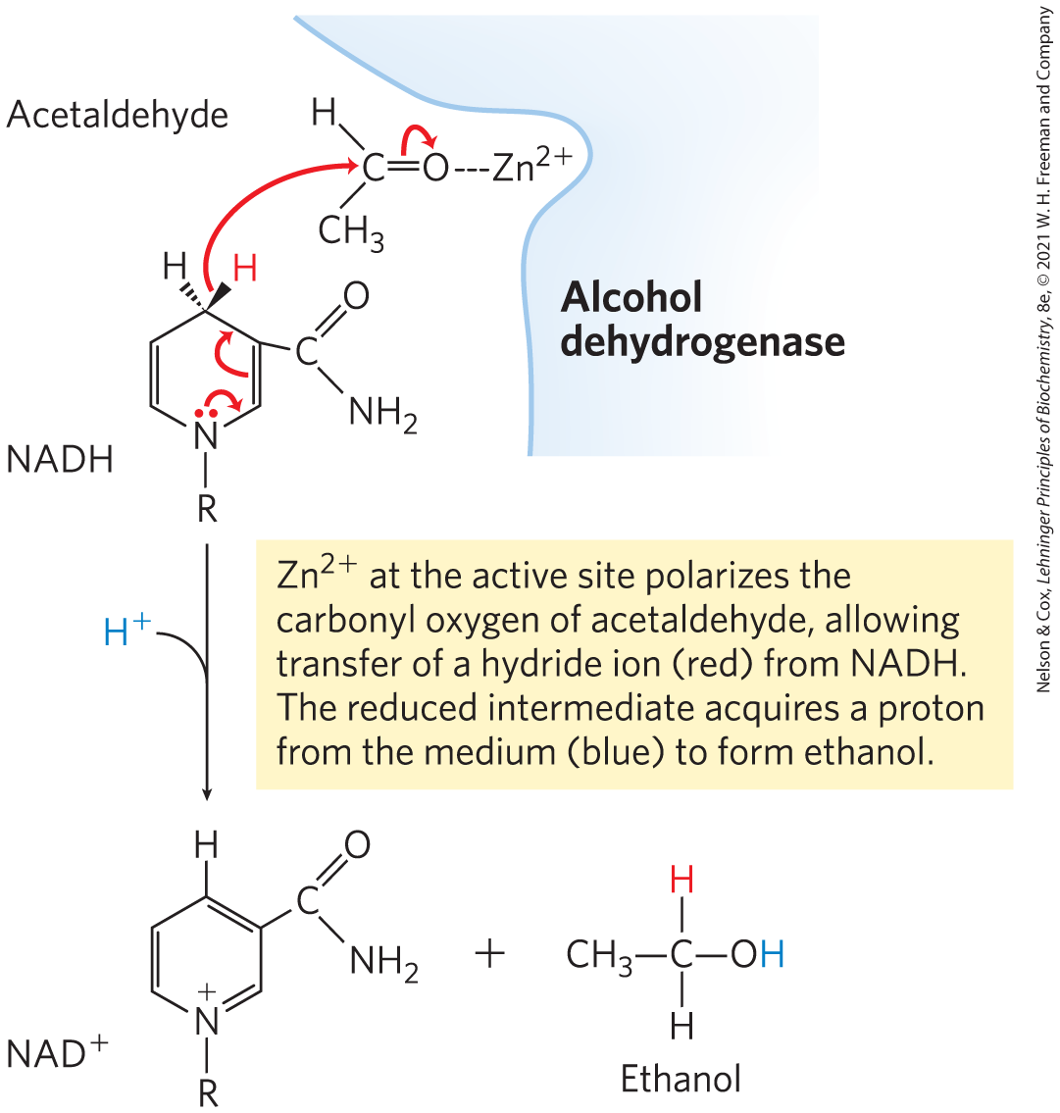
Pyruvate Decarboxylase and Alcohol Dehydrogenase Reactions
pyruvate decarboxylase = catalyzes the irreversible decarboxylation of pyruvate to acetaldehyde
  requires Mg²⁺ and the coenzyme thiamine pyrophosphate
alcohol dehydrogenase = catalyzes the reduction of acetaldehyde to ethanol

Slide 78
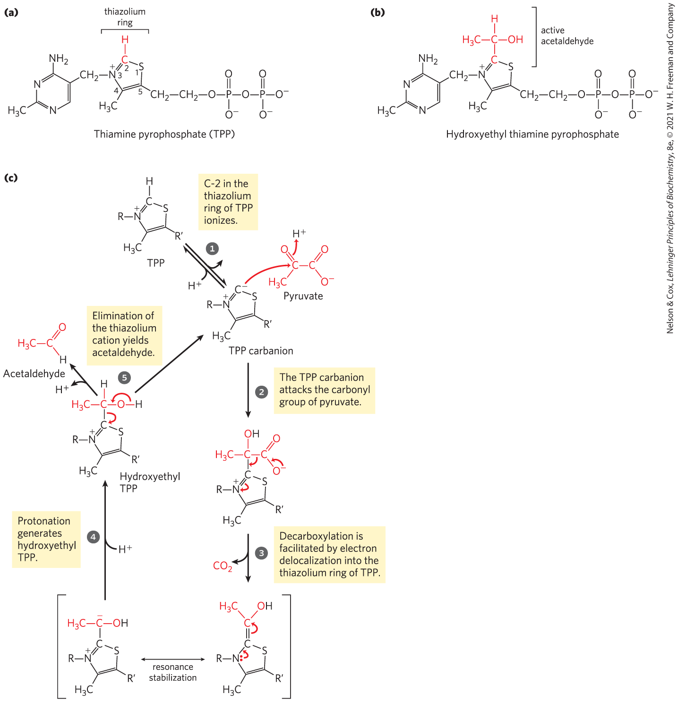
Thiamine Pyrophosphate (TPP)
thiamine pyrophosphate = coenzyme derived from vitamin B₁
  the thiazolium ring plays an important role in the cleavage of bonds adjacent to a carbonyl group

Slide 79
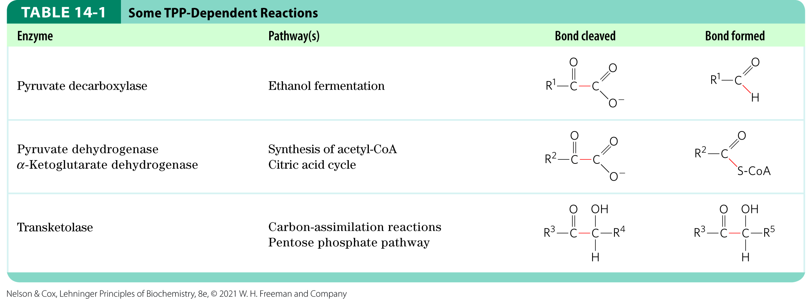
Some TPP-Dependent Reactions

Slide 80
Fermentations Produce Some Common Foods and Industrial Chemicals
certain microorganisms in food products ferment the carbohydrates and yield metabolic products that give the foods their characteristic forms, textures, and tastes
the drop in pH preserves food from spoilage

Slide 81
Fermented Foods
Lactobacillus bulgaricus ferments carbohydrates in milk to lactic acid to make yogurt
Propionibacterium freudenreichii ferments milk to produce propionic acid and CO₂ to make Swiss cheese
other examples: pickles, sauerkraut, sausage, soy sauce, kimchi, kefir, dahi, and kombucha

Slide 82
Principle 3 (6 of 7)
Pyruvate formed under anaerobic conditions is reduced to lactate with electrons from NADH, recycling NADH to NAD⁺ and allowing continued glycolysis in the processes of lactate or alcohol fermentation. Manipulation of the fermentable material and the microorganisms present allows the synthesis of a variety of industrial products and foods.

Slide 83
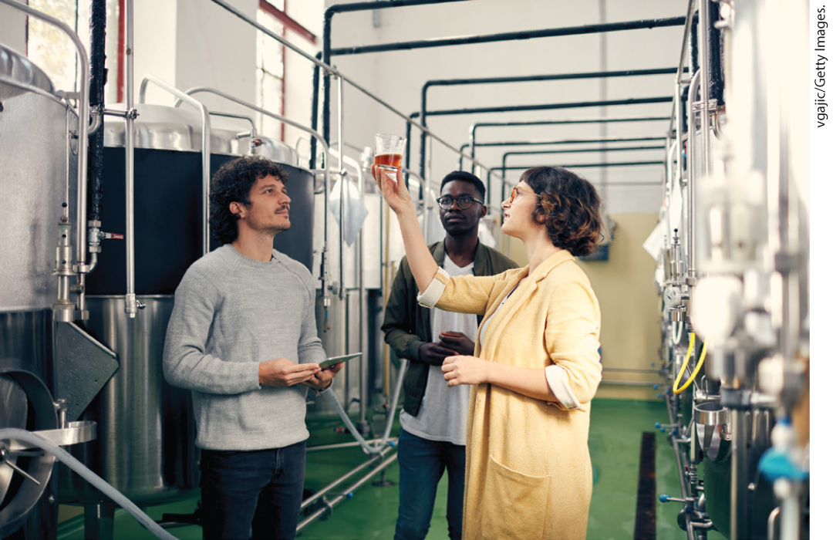
Fermented Beverages
ethanol fermentation of carbohydrates in cereal grains by yeast glycolytic enzymes produces beer

Slide 84
Principle 3 (7 of 7)
Pyruvate formed under anaerobic conditions is reduced to lactate with electrons from NADH, recycling NADH to NAD⁺ and allowing continued glycolysis in the processes of lactate or alcohol fermentation. Manipulation of the fermentable material and the microorganisms present allows the synthesis of a variety of industrial products and foods.

Slide 85
Chemical Production by Fermentation
Clostridium acetobutyricum ferments starch to butanol and acetone
  this discovery opened the field of industrial fermentations
other examples:
  formic, acetic, propionic, butyric, and succinic acids
  ethanol, glycerol, methanol, isopropanol, butanol, and butanediol
  penicillin, streptomycin, and chloramphenicol

Slide 86
Fuel Production by Fermentation
technology developed for large-scale production of alcoholic beverages can be applied to the production of ethanol as a renewable fuel
fuel can be produced from relatively inexpensive and renewable resources

Slide 87
14.4 Gluconeogenesis

Slide 88
Principle 4 (2 of 5)
Gluconeogenesis is the synthesis of glucose from simpler precursors like pyruvate and lactate. Although it uses seven of the ten enzymes that also act in glycolysis, gluconeogenesis must bypass three of the most exergonic steps in glycolysis with energetically favorable reactions unique to gluconeogenesis.

Slide 89
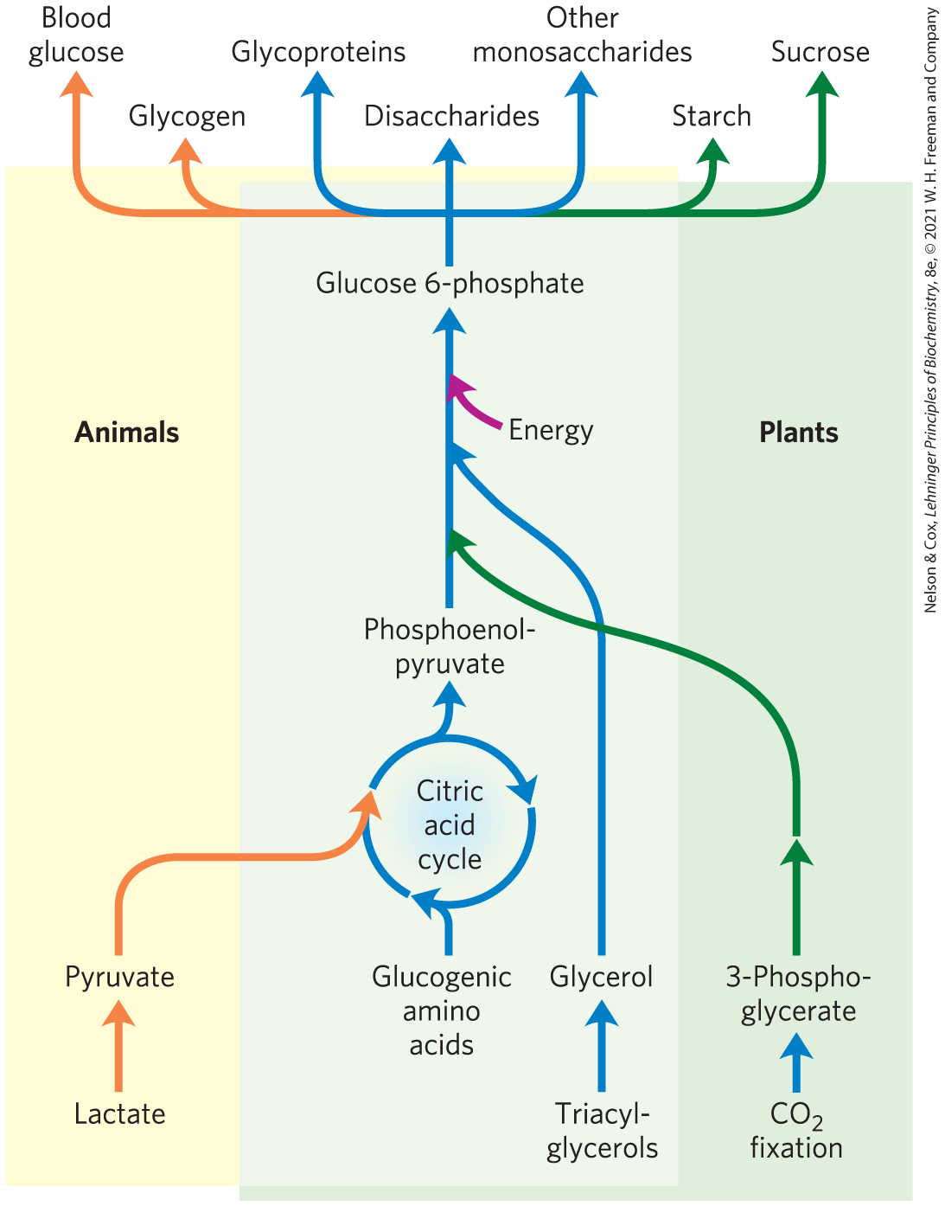
Gluconeogenesis
gluconeogenesis = pathway that converts pyruvate and related three- and four-carbon compounds to glucose
occurs in all animals, plants, fungi, and microorganisms
mainly occurs in the liver in mammals

Slide 90
Principle 4 (3 of 5)
Gluconeogenesis is the synthesis of glucose from simpler precursors like pyruvate and lactate. Although it uses seven of the ten enzymes that also act in glycolysis, gluconeogenesis must bypass three of the most exergonic steps in glycolysis with energetically favorable reactions unique to gluconeogenesis.

Slide 91
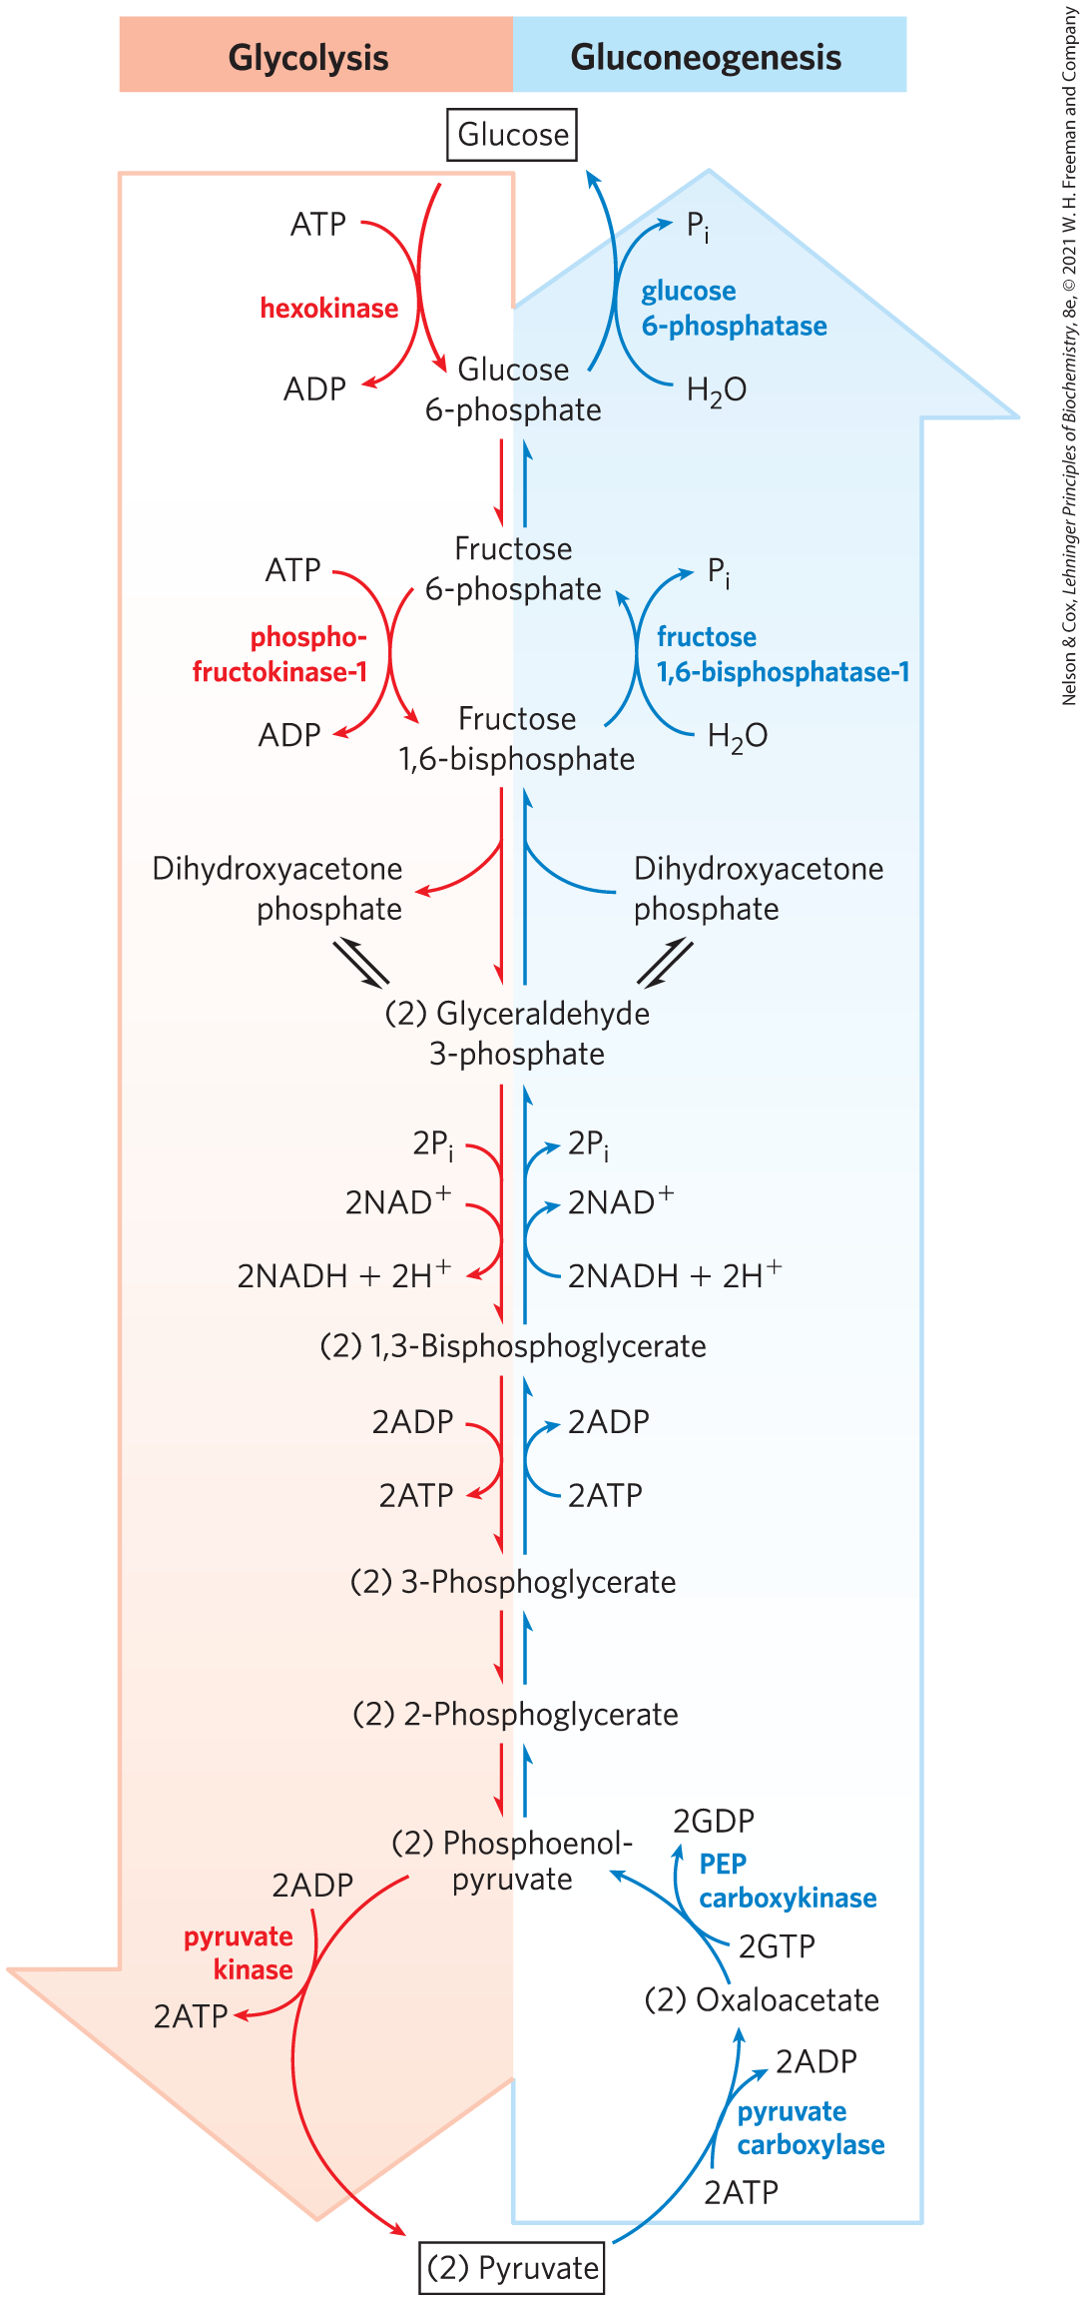
Gluconeogenesis and Glycolysis Share Several Steps
gluconeogenesis and glycolysis are not identical pathways running in opposite directions
3 glycolysis reactions are essentially irreversible in vivo and cannot be used in gluconeogenesis
  must be bypassed with exergonic reactions

Slide 92
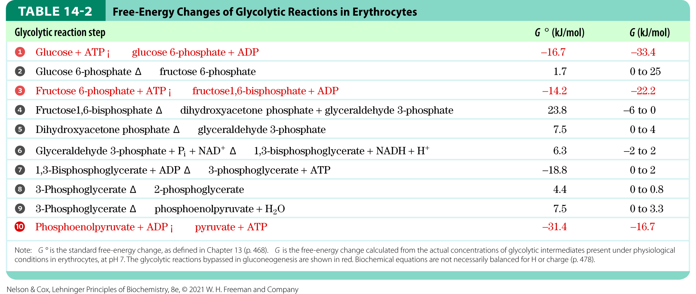
Free-Energy Changes of Glycolytic Reactions
the essentially irreversible glycolytic reactions are characterized by a large negative ∆G

Slide 93
Principle 4 (4 of 5)
Gluconeogenesis is the synthesis of glucose from simpler precursors like pyruvate and lactate. Although it uses seven of the ten enzymes that also act in glycolysis, gluconeogenesis must bypass three of the most exergonic steps in glycolysis with energetically favorable reactions unique to gluconeogenesis.

Slide 94

The First Bypass: Conversion of Pyruvate to Phosphoenolpyruvate Requires Two Exergonic Reactions
pyruvate is transported from the cytosol into mitochondria or generated from alanine within mitochondria by transamination
pyruvate carboxylase = mitochondrial enzyme that converts pyruvate to oxaloacetate
  requires the coenzyme biotin
pyruvate + HCO₃⁻ + ATP $⟶$
oxaloacetate + ADP + P_{i}
(14-4)

Slide 95

The Role of Biotin in the Pyruvate Carboxylase Reaction

Slide 96

Malate Dehydrogenase
the mitochondrial membrane does not have an oxaloacetate transporter
malate dehydrogenase = mitochondrial enzyme that uses NADH to reduce oxaloacetate to malate
  reaction is readily reversible under physiological conditions
oxaloacetate + NADH + H⁺ $⇄$
L-malate + NAD⁺
(14-5)

Slide 97

In the Cytosol, Malate is Reoxidized to Oxaloacetate
malate leaves the mitochondrion through a malate transporter in the inner mitochondrial membrane
reoxidation of malate to oxaloacetate forms NADH
malate + NAD⁺$⟶$
oxaloacetate + NADH + H⁺
(14-6)

Slide 98


Phosphoenolpyruvate Carboxykinase
phosphoenolpyruvate carboxykinase = converts oxaloacetate to PEP
  requires Mg²⁺ and GTP
  reversible under intracellular conditions
oxaloacetate + GTP $⇄$
PEP + CO₂ + GDP
(14-7)

Slide 99

The Overall Equation for the First Bypass Reaction
the overall equation for this set of bypass reactions is:
pyruvate + ATP + GTP + HCO₃⁻ $⟶$
PEP + ADP + GDP + P_{i} + CO₂
∆G′° = 0.9 kJ/mol
the actual free energy is strongly negative (−25 kJ/mol). making the reaction effectively irreversible
(14-8)

Slide 100
Principle 4 (5 of 5)
Gluconeogenesis is the synthesis of glucose from simpler precursors like pyruvate and lactate. Although it uses seven of the ten enzymes that also act in glycolysis, gluconeogenesis must bypass three of the most exergonic steps in glycolysis with energetically favorable reactions unique to gluconeogenesis.

Slide 101

Alternative Paths from Pyruvate to Phosphoenolpyruvate
when lactate is the glucogenic precursor, a second bypass predominates
oxaloacetate is directly converted to PEP in the mitochondrion by a mitochondrial isozyme of PEP carboxykinase

Slide 102

The Second and Third Bypasses Are Simple Dephosphorylations by Phosphatases
fructose 1,6-bisphosphatase (FBPase-1) = converts fructose 1,6-bisphosphate to fructose 6-phosphate by hydrolysis of the C-1 phosphate
  requires Mg²⁺
  essentially irreversible
fructose 1,6-bisphosphate + H₂O $⟶$
fructose 6-phosphate + P_{i}
∆G′° = −16.3 kJ/mol

Slide 103

The Third Bypass Reaction
glucose 6-phosphatase = catalyzes the simple hydrolysis of glucose 6-phosphate to glucose
  requires Mg²⁺
  only found in the lumen of the endoplasmic reticulum of hepatocytes, renal cells, and epithelial cells of the small intestine
glucose 6-phosphate + H₂O $⟶$ glucose + P_{i}
∆G′° = −13.8 kJ/mol

Slide 104

Gluconeogenesis Is Energetically Expensive, But Essential
the sum of the biosynthetic reactions leading from pyruvate to free blood glucose is:
2 pyruvate + 4ATP + 2GTP + 2NADH + 2H⁺ + 4H₂O $⟶$
glucose + 4ADP + 2GDP + 6P_{i} + 2NAD⁺
(14-9)

Slide 105

Sequential Reactions in Gluconeogenesis

Slide 106
Glucogenic Amino Acids
glucogenic amino acids = able to undergo net conversion to glucose
intermediates of the citric acid cycle can also undergo oxidation to oxaloacetate
Table 14-4 Glucogenic Amino Acids, Grouped by Site of Entry
Pyruvate | α-Ketoglutarate | Succinyl-CoA | Fumarate | Oxaloacetate
Alanine | Arginine | Isoleucine | Phenylalanine | Asparagine
Cysteine | Glutamate | Methionine | Tyrosine | Asparate
Glycine | Glutamine | Threonine
Serine | Histidine | Valine
Threonine | Proline
Tryptophan

Slide 107
Mammals Cannot Convert Fatty Acids to Glucose; Plants and Microorganisms Can
animals lack the enzymatic machinery to convert acetyl-CoA from fatty acids to pyruvate.
plants and microorganisms have the glyoxylate pathway, which allows them to make glucose from fatty acids

Slide 108
Glyceroneogenesis
glyceroneogenesis = conversion of pyruvate to dihydroxyacetone phosphate via the early reactions of gluconeogenesis, followed by reduction to glycerol 3-phosphate
  carried out in adipocytes

Slide 109
14.5 Coordinated Regulation of Glycolysis and Gluconeogenesis

Slide 110
Principle 5 (2 of 6)
Glycolysis and gluconeogenesis are reciprocally regulated so that both processes don’t occur simultaneously in a futile cycle. Most regulatory mechanisms act on reactions that are unique to each pathway.

Slide 111
Glycolysis and Gluconeogenesis Are Reciprocally Regulated
simultaneous operation of both pathways at each of the three bypass points would consume ATP without accomplishing chemical or biological work
regulation prevents wasteful operation of both pathways at the same time

Slide 112
Principle 5 (3 of 6)
Glycolysis and gluconeogenesis are reciprocally regulated so that both processes don’t occur simultaneously in a futile cycle. Most regulatory mechanisms act on reactions that are unique to each pathway.

Slide 113
Hexokinase Isozymes Are Affected Differently by Their Product, Glucose 6-Phosphate
hexokinase I, hexokinase II, and hexokinase III are all inhibited by their product, glucose 6-phosphate
hexokinase IV (glucokinase) in the liver is not inhibited by glucose 6-phosphate

Slide 114

Kinetic Properties of Hexokinase IV and Hexokinase I
hexokinase IV (glucokinase) in the liver has kinetic properties related to its role in maintaining glucose homeostasis
  K_{m} is higher than the usual glucose concentration

Slide 115

Regulation of Hexokinase IV by Sequestration in the Nucleus
the regulatory protein anchors hexokinase IV inside the nucleus, where it is segregated from the other glycolytic enzymes
  fructose 6-phosphate is an allosteric effector
  glucose causes dissociation of the regulatory protein

Slide 116


Phosphofructokinase-1 and Fructose 1,6-Bisphosphatase Are Reciprocally Regulated
ATP inhibits PFK-1 by binding to an allosteric site
ADP and AMP allosterically relieve this inhibition by ATP

Slide 117
Allosteric Regulation of PFK-1
By Citrate
citrate = key intermediate in the aerobic oxidation of pyruvate, fatty acids, and amino acids
citrate allosterically regulates PFK-1
  high concentrations increase the inhibitory effect of ATP
  serves as an intracellular signal that the cell is meeting its current needs for energy-yielding metabolism by the oxidation of fats and proteins

Slide 118

FBPase-1 Is Allosterically Inhibited by AMP
high [AMP], which corresponds to low ATP, inhibits FBPase
  slows glucose synthesis
high [ATP] slows glycolysis and speeds gluconeogenesis

Slide 119
Fructose 2,6-Bisphosphate Is a Potent Allosteric Regulator of PFK-1 and FBPase-1
glucagon = hormone that signals the liver to produce and release more glucose and to stop consuming it
  released when blood glucose level decreases
insulin = hormone that signals the liver to use glucose as a fuel and as a precursor for the storage of glycogen and triacylglycerol
  released when blood glucose level increases

Slide 120
Principle 5 (4 of 6)
Glycolysis and gluconeogenesis are reciprocally regulated so that both processes don’t occur simultaneously in a futile cycle. Most regulatory mechanisms act on reactions that are unique to each pathway.

Slide 121

Fructose 2,6-Bisphosphate
fructose 2,6-bisphosphate = mediates the rapid hormonal regulation of glycolysis and gluconeogenesis
  binds to PFK-1 and increases its affinity for fructose 6-phosphate
  binds to FBPase-1 and reduces its affinity for its substrate

Slide 122

Regulation of Glycolysis and Gluconeogenesis by Fructose
2,6-Bisphosphate

Slide 123

Regulation of Fructose 2,6-Bisphosphate Level
phosphofructokinase-2 (PFK-2) = catalyzes the formation of fructose 2,6-bisphosphate
fructose 2,6-bisphosphatase (FBPase-2) = catalyzes the breakdown of fructose 2,6-bisphosphate

Slide 124
Effects of Glucagon and Insulin on Fructose 2,6-Bisphosphate
glucagon (through phosphorylation by cAMP-dependent protein kinase) lowers [fructose 2,6-bisphosphate]
  inhibits glycolysis and stimulates gluconeogenesis
insulin (through removal of the phosphoryl group) increases [fructose 2,6-bisphosphate]
  stimulates glycolysis and inhibits gluconeogenesis

Slide 125
Xylulose 5-Phosphate Is a Key Regulator of Carbohydrate and Fat Metabolism
xylulose 5-phosphate = an intermediate of the pentose phosphate pathway that activates phosphoprotein phosphatase 2A
phosphoprotein phosphatase 2A = dephosphorylates the bifunctional PFK-2/FBPase-2 enzyme
  causes an increase in [fructose 2,6-bisphosphate]

Slide 126

The Glycolytic Enzyme Pyruvate Kinase Is Allosterically Inhibited by ATP

Slide 127
Principle 5 (5 of 6)
Glycolysis and gluconeogenesis are reciprocally regulated so that both processes don’t occur simultaneously in a futile cycle. Most regulatory mechanisms act on reactions that are unique to each pathway.

Slide 128

Conversion of Pyruvate to Phosphoenolpyruvate Is Stimulated When Fatty Acids Are Available
acetyl-CoA signals that further glucose oxidation is not needed
acetyl-CoA:
  allosterically stimulates pyruvate carboxylase
  allosterically inhibits pyruvate dehydrogenase

Slide 129
Transcriptional Regulation Changes the Number of Enzyme Molecules
Change in gene expression | Role in glucose metabolism
Increased expression Hexokinase II Hexokinase IV Phosphofructokinase-1 (PFK-1) PFK-2/FBPase-2 Pyruvate kinase | Essential for glycolysis, which consumes glucose for energy
Glucose 6-phosphate dehydrogenase 6-Phosphogluconate dehydrogenase Malic enzyme | Produce NADPH, which is essential for conversion of glucose to lipids
ATP-citrate lyase Pyruvate dehydrogenase | Produce acetyl-CoA, which is essential for conversion of glucose to lipids
Acetyl-CoA carboxylase Fatty acid synthase complex Stearoyl-CoA dehydrogenase Acyl-CoA-glycerol transferases | Essential for conversion of glucose to lipids
Decreased expression PEP carboxykinase Glucose 6-phosphatase (catalytic subunit) | Essential for glucose production by gluconeogenesis
insulin transcriptionally regulates more than 150 genes
Table 14-5 Some of the Many Genes Regulated by Insulin

Slide 130
Principle 5 (6 of 6)
Glycolysis and gluconeogenesis are reciprocally regulated so that both processes don’t occur simultaneously in a futile cycle. Most regulatory mechanisms act on reactions that are unique to each pathway.

Slide 131

ChREBP (Carbohydrate Response Element Binding Protein)
ChREBP (carbohydrate response element binding protein) = transcription factor expressed in liver, adipose tissue, and kidney
  acts in the nucleus to regulate gene expression for genes coding for enzymes needed for carbohydrate and fat synthesis

Slide 132
14.6 Pentose Phosphate Pathway of Glucose Oxidation

Slide 133
Principle 6 (2 of 5)
The pentose phosphate pathway is an alternative pathway for glucose oxidation. It yields pentoses for nucleotide synthesis and reduced cofactors for biosynthesis of fatty acids, sterols, and many other compounds.

Slide 134

The Pentose Phosphate Pathway
pentose phosphate pathway (phosphogluconate pathway, hexose monophosphate pathway) = pathway that oxidizes glucose 6-phosphate, producing pentose phosphates and NADPH

Slide 135
Cells and Tissues That Use the Pentose Phosphate Pathway
rapidly dividing cells use ribose 5-phosphate to make RNA, DNA, and coenzymes
tissues that carry out extensive fatty acid synthesis (liver, adipose, lactating mammary gland) require the NADPH provided by this pathway.
tissues that actively synthesize cholesterol and steroid hormones (liver, adrenal glands, gonads) require the NADPH provided by this pathway.

Slide 136
Principle 6 (3 of 5)
The pentose phosphate pathway is an alternative pathway for glucose oxidation. It yields pentoses for nucleotide synthesis and reduced cofactors for biosynthesis of fatty acids, sterols, and many other compounds.

Slide 137

The Oxidative Phase Produces NADPH and Pentose Phosphates
glucose 6-phosphate dehydrogenase (G6PD) = catalyzes the oxidation of glucose 6-phosphate to 6-phosphoglucono-δ-lactone using NADP⁺ as the electron acceptor

Slide 138

Lactonase Hydrolyzes Lactone to
6-Phosphogluconate
lactonase = catalyzes the hydrolysis of lactone to the free acid 6-phosphogluconate

Slide 139

6-Phosphogluconate Dehydrogenase Forms Ribulose 5-Phosphate
6-phosphogluconate dehydrogenase = catalyzes the oxidation and decarboxylation of 6-phosphogluconate to form ribulose 5-phosphate and NADPH

Slide 140

Phosphopentose Isomerase Generates Ribose 5-Phosphate
phosphopentose isomerase = converts ribulose 5-phosphate to its aldose isomer, ribose 5-phosphate

Slide 141

The Overall Equation for the Pentose Phosphate Pathway
the overall equation for this pathway is:
glucose 6-phosphate + 2NADP⁺ + H₂O $⟶$
ribulose 5-phosphate + CO₂ + 2NADPH + 2H⁺

Slide 142
Principle 6 (4 of 5)
The pentose phosphate pathway is an alternative pathway for glucose oxidation. It yields pentoses for nucleotide synthesis and reduced cofactors for biosynthesis of fatty acids, sterols, and many other compounds.

Slide 143

The Nonoxidative Phase Recycles Pentose Phosphates to Glucose 6-Phosphate
ribulose 5-phosphate epimerase = epimerizes ribulose 5-phosphate to xylulose 5-phosphate

Slide 144

Nonoxidative Reactions of the Pentose Phosphate Pathway
the conversion of pentose phosphates to glucose 6-phosphate begins the oxidative cycle again

Slide 145

The First Transketolase Reaction
transketolase = catalyzes the transfer of a two-carbon fragment from a ketose donor to an aldose acceptor
the first transketolase reaction yields sedoheptulose 7-phosphate

Slide 146

The Transaldolase Reaction
transaldolase = catalyzes the condensation of a three-carbon fragment from sedoheptulose 7-phosphate and glyceraldehyde 3-phosphate, forming fructose 6-phosphate and the tetrose erythrose 4-phosphate

Slide 147

The Second Transketolase Reaction
the second transketolase reaction forms fructose 6-phosphate and glyceraldehyde 3-phosphate from erythrose 4-phosphate and xylulose 5-phosphate

Slide 148

Stabilization of Carbanion Intermediates
thiamine pyrophosphate (TPP) = stabilizes a two-carbon carbanion in the transketolase reaction
protonated Schiff base = stabilizes the carbanion in the transaldolase reaction

Slide 149
The Oxidative and Nonoxidative Reactions of the Pentose Phosphate Pathway
the first and third steps of the oxidative pentose phosphate pathway are essentially irreversible in the cell
the nonoxidative reactions are readily reversible

Slide 150
The Reductive Pentose Phosphate Pathway
reductive pentose phosphate pathway = converts hexose phosphates to pentose phosphates
  central to the photosynthetic assimilation of CO₂ by plants
  essentially the reversal of the nonoxidative reactions of the pentose phosphate pathway

Slide 151
Principle 6 (5 of 5)
The pentose phosphate pathway is an alternative pathway for glucose oxidation. It yields pentoses for nucleotide synthesis and reduced cofactors for biosynthesis of fatty acids, sterols, and many other compounds.

Slide 152

Glucose 6-Phosphate Is Partitioned between Glycolysis and the Pentose Phosphate Pathway
the relative concentrations of NADP⁺ and NADPH determine whether glucose 6-phosphate enters glycolysis or the pentose phosphate pathway

Slide 153
Thiamine Deficiency Causes Beriberi and Wernicke-Korsakoff Syndrome
thiamine is the precursor to the cofactor thiamine pyrophosphate (TPP)
beriberi = characterized by swelling, pain, paralysis, and ultimately, without treatment, death
Wernicke-Korsakoff syndrome = characterized by problems with voluntary movements
  more common among heavy drinkers due to decreased intestinal absorption of thiamine

