Slide 1

13 Introduction to Metabolism
© 2021 Macmillan Learning

Slide 2
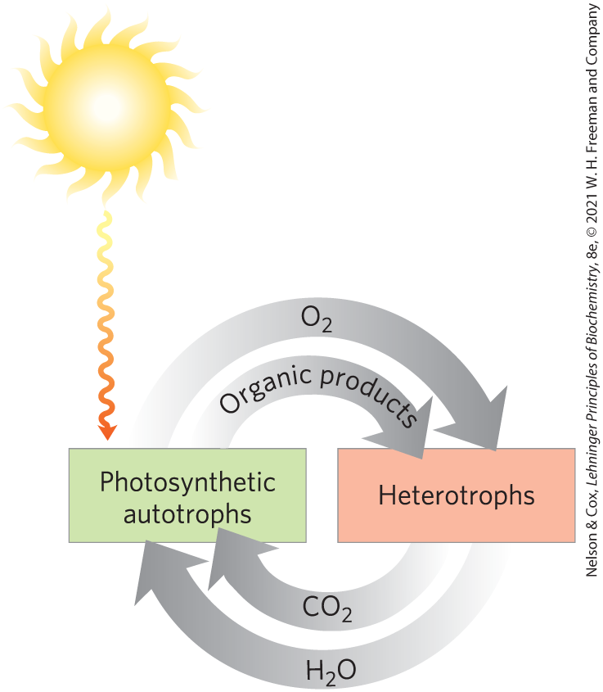
Autotrophs and Heterotrophs
autotrophs = use CO₂ from the atmosphere as their sole source of carbon
heterotrophs = cannot use atmospheric CO₂ and must obtain carbon from their environment

Slide 3
Metabolites and Intermediary Metabolism
metabolites = series of intermediates through which precursors are converted to products
intermediary metabolism = the combined activities of all the metabolic pathways that interconvert precursors, metabolites, and products of low molecular weight

Slide 4
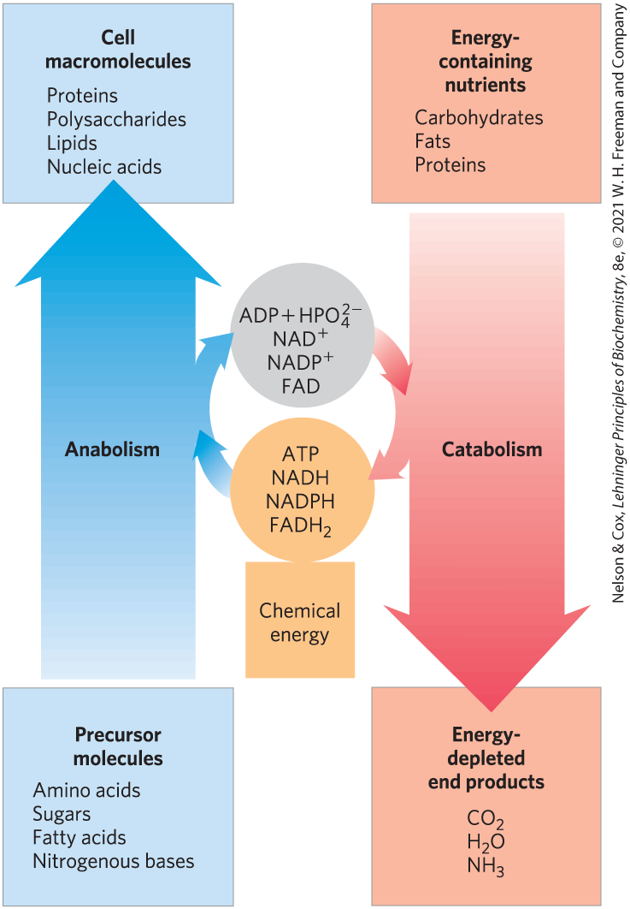
The Relationship Between Catabolic and Anabolic Pathways
catabolism = the degradative phase of metabolism
  releases energy
anabolism (biosynthesis) = the building phase of metabolism
  requires energy

Slide 5
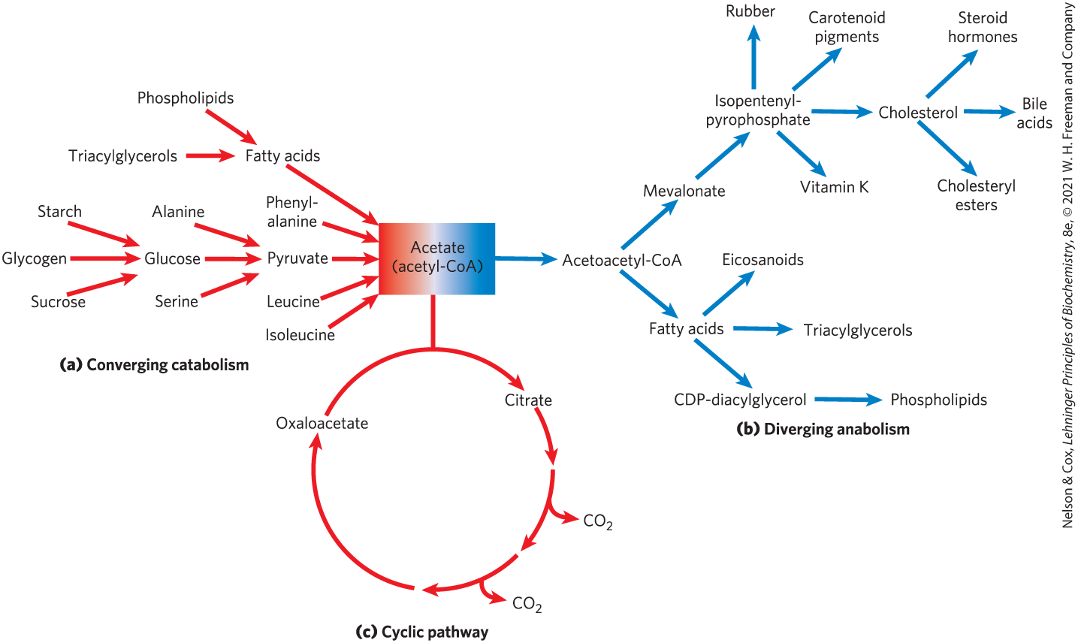
Catabolic Pathways Converge and Anabolic Pathways Diverge

Slide 6

Principle 1 (1 of 4)
The chemical changes and energy transductions in living organisms follow the laws of thermodynamics.

Slide 7

Principle 2 (1 of 3)
The free-energy change is the maximum energy made available to do work when a chemical reaction occurs. If two reactions can be combined to yield a third reaction, the overall free energy change is the sum of the two. Cells accomplish energy-requiring chemical work by coupling an energy-releasing (exergonic) reaction, such as the cleavage of ATP, to an endergonic reaction (which requires energy input).

Slide 8

Principle 3 (1 of 4)
Although thousands of different chemical reactions occur in the biosphere, most of them fall within a small set of reaction types.

Slide 9
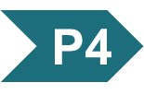
Principle 4 (1 of 5)
ATP is the universal energy currency in living organisms. Transfer of its phosphoryl group to a water molecule or metabolic intermediates provides the energetic push for muscle contraction, the pumping of solutes against concentration gradients, and the synthesis of complex molecules.

Slide 10

Principle 5 (1 of 5)
Oxidation-reduction reactions indirectly provide much of the energy needed to make ATP. Reduced substrates such as glucose are oxidized in several steps, with the energy of oxidation steps conserved in the form of a reduced cofactor, NADH. Energy stored in NADH is used to drive the synthesis of ATP.

Slide 11

Principle 6 (1 of 5)
To respond to changes in external circumstances, cells must regulate enzyme activities by changing either the number of enzyme molecules or the catalytic activity of preexisting enzyme molecules.

Slide 12
13.1 Bioenergetics and Thermodynamics

Slide 13
Bioenergetics Is the Quantitative Study of Energy Transductions
energy transductions = changes of one form of energy into another

Slide 14
Biological Energy Transformations Obey the Laws of Thermodynamics
the first law of thermodynamics is the principle of the conservation of energy
the second law of thermodynamics says that the universe always tends toward increasing disorder

Slide 15
Systems and Their Surroundings
reacting system = the collection of matter that is undergoing a particular chemical or physical process
  can be closed or open
universe = the reacting system and its surroundings together
living cells and organisms are open systems, exchanging material and energy with their surroundings

Slide 16
Free Energy, G
free energy, G = expresses the amount of energy capable of doing work during a reaction at constant temperature and pressure
  when ∆G is negative, free energy is released and the reaction is exergonic
  when ∆G is positive, free energy is gained and the reaction is endergonic

Slide 17
Enthalpy, H
enthalpy, H = the heat content of the reacting system
  reflects the number and kinds of chemical bonds (covalent and noncovalent) in the reactants and products
  when ∆H is negative, the reaction releases heat and the reaction is exothermic
  when ∆H is positive, the reaction takes up heat and the reaction is endothermic

Slide 18
Entropy, S
entropy, S = a quantitative expression for the randomness or disorder in a system
  when ∆S is negative, the reactants are less complex and more disordered than the products
  when ∆S is positive, the products are less complex and more disordered than the reactants

Slide 19
Physical Constants and Units Used in Thermodynamics
Table 13-1 Some Physical Constants and Units Used in Thermodynamics
Boltzmann constant, k = 1.381 × 10⁻²³ J/K Avogadro’s number, N = 6.022 × 10²³ mol⁻¹ Faraday constant, F = 96,480 J/V • mol Gas constant, R = 8.315 J/mol • K (= 1.987 cal/mol • K) Units of ΔG and ΔH are J/mol (or cal/mol) Units of ΔS are J/mol • K (or cal/mol • K) 1 cal = 4.184 J Units of absolute temperature, T, are Kelvin, K 25 °C = 298 K At 25 °C, RT = 2.478 kJ/mol (= 0.592 kcal/mol)

Slide 20
Free Energy Change, ∆G
free-energy change, ∆G = ∆H − T∆S
  ∆H is negative for a reaction that releases heat
  ∆S is positive for a reaction that increases the system’s randomness
spontaneous reactions occur when ∆G is negative
(13-1)

Slide 21
Living Cells and the Second Law of Thermodynamics
the order produced within cells as they grow and divide is compensated for by the disorder they create in their surroundings
  living organisms take free energy from, and return heat and entropy to, their surroundings

Slide 22
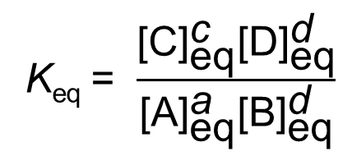
Standard Free-Energy Change Is Directly Related to the Equilibrium Constant
for the general reaction
aA + bB → cC + dD
the equilibrium constant, K_{eq}, is given by
(13-2)

Slide 23
Standard Transformed Constants
standard transformed constants = physical constants based on the biochemical standard state ([H⁺] is 10⁻⁷ M, [H₂O] is 55.5 M, [Mg²⁺] is 1 mM)
  standard free-energy change, ∆G′°
  standard equilibrium constant, K′_{eq}

Slide 24
Principle 1 (3 of 4)
The chemical changes and energy transductions in living organisms follow the laws of thermodynamics.

Slide 25
The Relationship Between
K′_{eq} and ∆G′°
the relationship between K′_{eq} and ∆G′° is:
∆G′° = -RT ln K′_{eq}
the standard free-energy change of a chemical reaction is simply an alternative mathematical way of expressing its equilibrium constant
(13-3)

Slide 26
Relationship between Equilibrium Constants and Standard Free-Energy Changes
if K′_{eq} is > 1.0, its ∆G′° is negative
if K′_{eq} is < 1.0, its ∆G′° is positive
the relationship is exponential
K′_{eq} | ΔG′˚ (kJ/mol) | ΔG′˚ (kcal/mol)
10³ | −17.1 | −4.1
10² | −11.4 | −2.7
10¹ | −5.7 | −1.4
1 | 0.0 | 0.0
10^{₋1} | 5,7 | 1.4
10^{₋2} | 11.4 | 2.7
10^{₋3} | 17.1 | 4.1
10^{₋4} | 22.8 | 5.5
10^{₋5} | 28.5 | 6.8
10^{₋6} | 34.2 | 8.2
Table 13-2 Relationship between Equilibrium Constants and Standard Free-Energy Changes of Chemical Reactions

Slide 27
Effects of K′_{eq} and ∆G′° on the Direction of Chemical Reactions
Table 13-3 Relationships among K′_{eq}, ΔG′˚, and the Direction of Chemical Reactions
When K′_{eq} is… | ΔG′˚ is… | Starting with all components at 1 M, the reaction…
>1.0 | negative | proceeds forward
1.0 | zero | is at equilibrium
<1.0 | positive | proceeds in reverse

Slide 28
Standard Free-Energy Changes of Some Chemical Reactions
Reaction type | ΔG′˚ (kJ/mol) | ΔG′˚ (kcal/mol)
Hydrolysis reactions
Acid anhydrides
Acetic anhydride + H₂O→2 acetate | −91.1 | −21.8
ATP + H₂O→ADP + P_{i} | −30.5 | −7.3
ATP + H₂O→AMP + PP_{i} | −45.6 | −10.9
PP_{i} + H₂O→2P_{i} | −19.2 | −4.6
UDP-glucose + H₂O→UMP + glucose 1-phosphate | −43.0 | −10.3
Esters
Ethyl acetate + H₂O→ethanol + acetate | −19.6 | −4.7
Glucose 6-phosphate + H₂O→glucose + P_{i} | −13.8 | −3.3
Amides and peptides
Glutamine + H₂O→glutamate + NH⁺₄ | −14.2 | −3.4
Glycylglycine + H₂O→2 glycine | −9.2 | −2.2
Glycosides
Maltose + H₂O→2 glucose | −15.5 | −3.7
Lactose + H₂O→glucose + galactose | −15.9 | −3.8
Rearrangements
Glucose 1-phosphate→glucose 6-phosphate | −7.3 | −1.7
Fructose 6-phosphate→glucose 6-phosphate | −1.7 | −0.4
Elimination of water
Malate →fumarate + H₂O | 3.1 | 0.8
Oxidations with molecular oxygen
Glucose + 6O₂→6CO₂+ 6H₂O | −2,840 | −686
Palmitate + 23O₂→16CO₂+ 16H₂O | −9,770 | −2,338
to describe the energy released under the conditions existing in cells, an expression for the actual free-energy change is needed
Table 13-4 Standard Free-Energy Changes of Some Chemical Reactions

Slide 29
Principle 1 (4 of 4)
The chemical changes and energy transductions in living organisms follow the laws of thermodynamics.

Slide 30

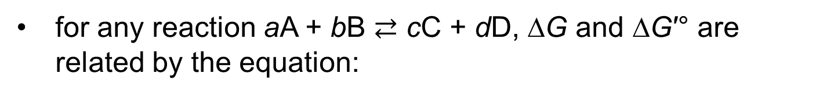
Actual Free-Energy Changes
Depend on Reactant and Product Concentrations
for any reaction aA + bB $⇄$ cC + dD, ∆G and ∆G′° are related by the equation:
(13-4)
mass-action ratio, Q
when ∆G = 0, the system is at equilibrium

Slide 31
Free-Energy Changes and Enzymes
the free-energy change for a reaction is independent of the pathway by which the reaction occurs
enzymes cannot change equilibrium constants
  can increase the rate at which a reaction proceeds

Slide 32
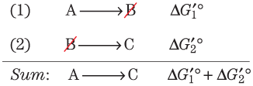
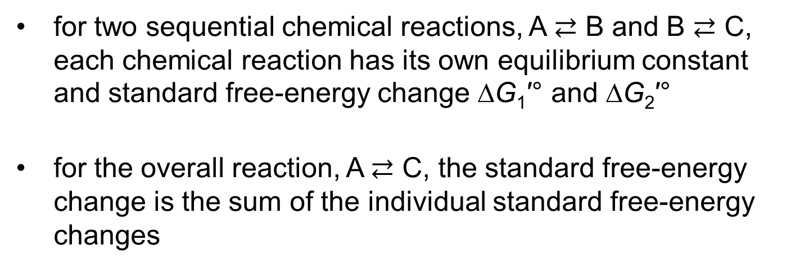
Standard Free-Energy Changes
Are Additive
for two sequential chemical reactions, A $⇄$ B and B $⇄$ C, each chemical reaction has its own equilibrium constant and standard free-energy change ∆G₁′° and ∆G₂′°
for the overall reaction, A $⇄$ C, the standard free-energy change is the sum of the individual standard free-energy changes

Slide 33
Principle 2 (2 of 3)
The free-energy change is the maximum energy made available to do work when a chemical reaction occurs. If two reactions can be combined to yield a third reaction, the overall free energy change is the sum of the two. Cells accomplish energy-requiring chemical work by coupling an energy-releasing (exergonic) reaction, such as the cleavage of ATP, to an endergonic reaction (which requires energy input).

Slide 34
Thermodynamically Unfavorable Reactions Can Be Coupled to Favorable Reactions
a thermodynamically unfavorable (endergonic) reaction can be driven in the forward direction by coupling it to a highly exergonic reaction
  often involves coupling to ATP hydrolysis (∆G′° = -30.5 kJ/mol)

Slide 35
Equilibrium Constants Are Multiplicative
the K′_{eq} for the overall reaction is the product of the individual K′_{eq} values for the two reactions

Slide 36
13.2 Chemical Logic and Common Biochemical Reactions

Slide 37
Principle 3 (2 of 4)
Although thousands of different chemical reactions occur in the biosphere, most of them fall within a small set of reaction types.

Slide 38
Biochemical Reactions Occur in Repeating Patterns
five general categories of reactions in living cells:
  reactions that make or break carbon–carbon bonds
  internal rearrangements, isomerizations, and eliminations
  free-radical reactions
  group transfers
  oxidation-reductions

Slide 39
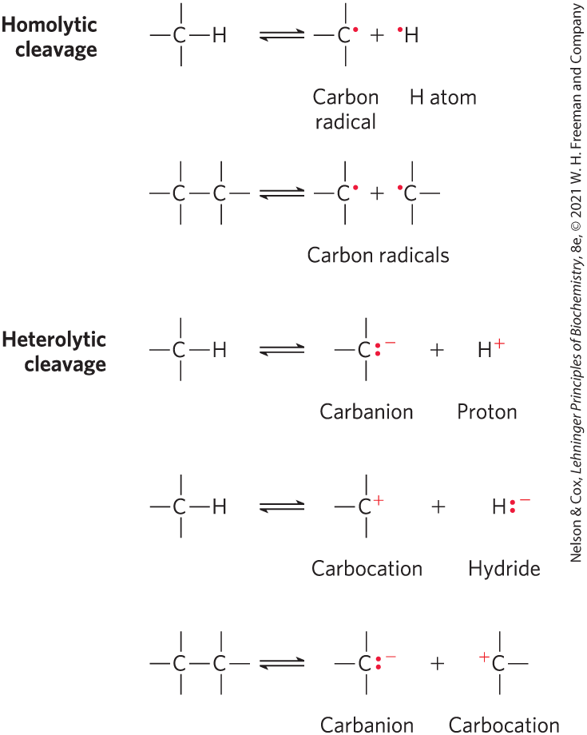
Homolytic and Heterolytic Cleavage
homolytic cleavage = cleavage of a covalent bond where each atom leaves the bond as a radical, carrying one unpaired electron
heterolytic cleavage = cleavage of a covalent bond where one atom retains both bonding electrons
  more common

Slide 40
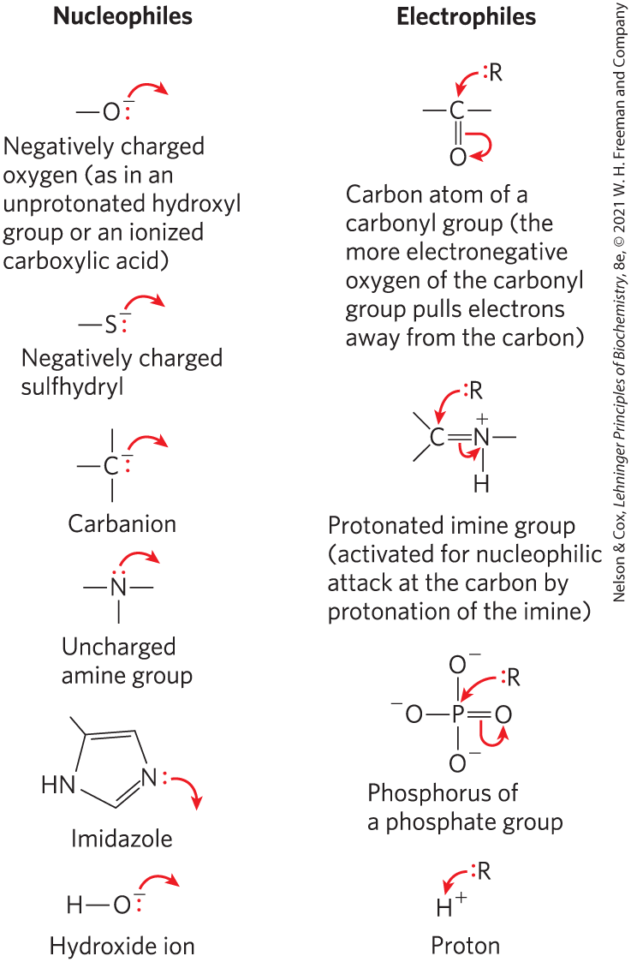
Nucleophiles and Electrophiles
nucleophiles = functional groups rich in and capable of donating electrons
  combine with and give up electrons to electrophiles
electrophiles = electron-deficient functional groups that seek electrons
carbon can act as either a nucleophile or electrophile

Slide 41
Reactions That Make or Break Carbon–Carbon Bonds
heterolytic cleavage of a C–C bond yields a carbanion and a carbocation
combination of a nucleophilic carbanion and an electrophilic carbocation forms a C–C bond
impossible reactions for the purposes of biochemistry because carbanions and carbocations are generally unstable

Slide 42
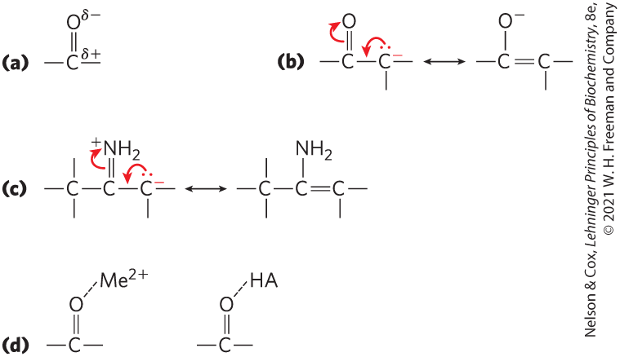
Chemical Properties of
Carbonyl Groups
the carbon of a carbonyl group is an electrophilic carbon
carbonyl and imine groups form carbanions on adjoining carbons by delocalizing electrons
  general acid catalysts or metal ions (Me²⁺) further enhance

Slide 43
Principle 3 (3 of 4)
Although thousands of different chemical reactions occur in the biosphere, most of them fall within a small set of reaction types.

Slide 44
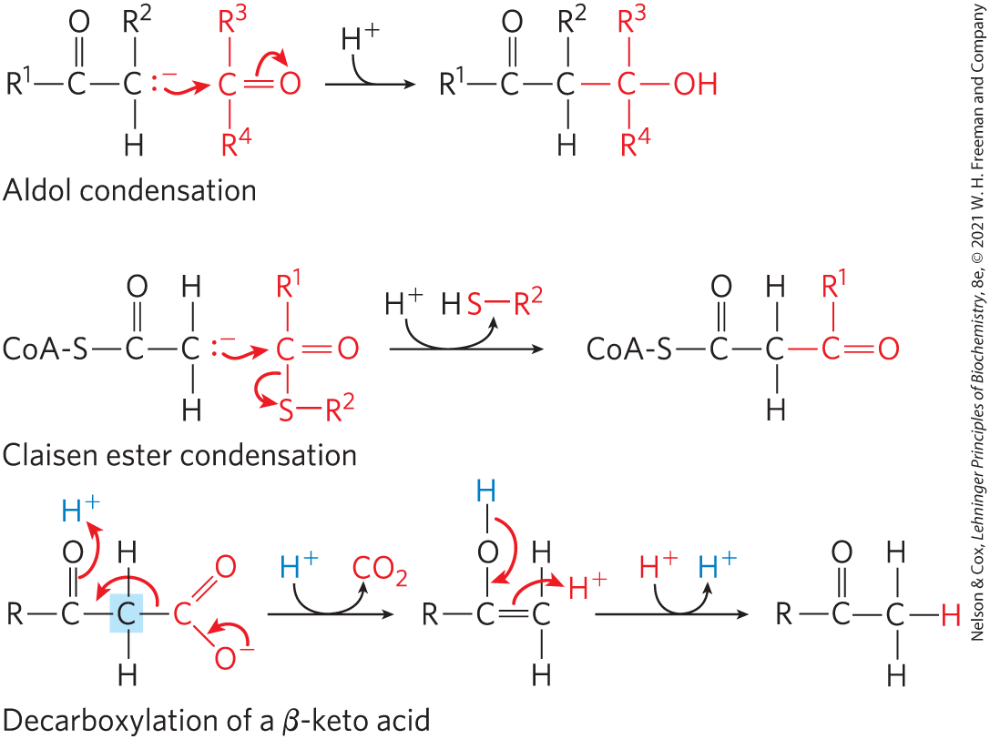
Common Reactions that Form and Break Carbon–Carbon Bonds
in aldol condensation, Claisen condensation, and decarboxylation reactions, a carbanion intermediate is stabilized by a carbonyl group

Slide 45
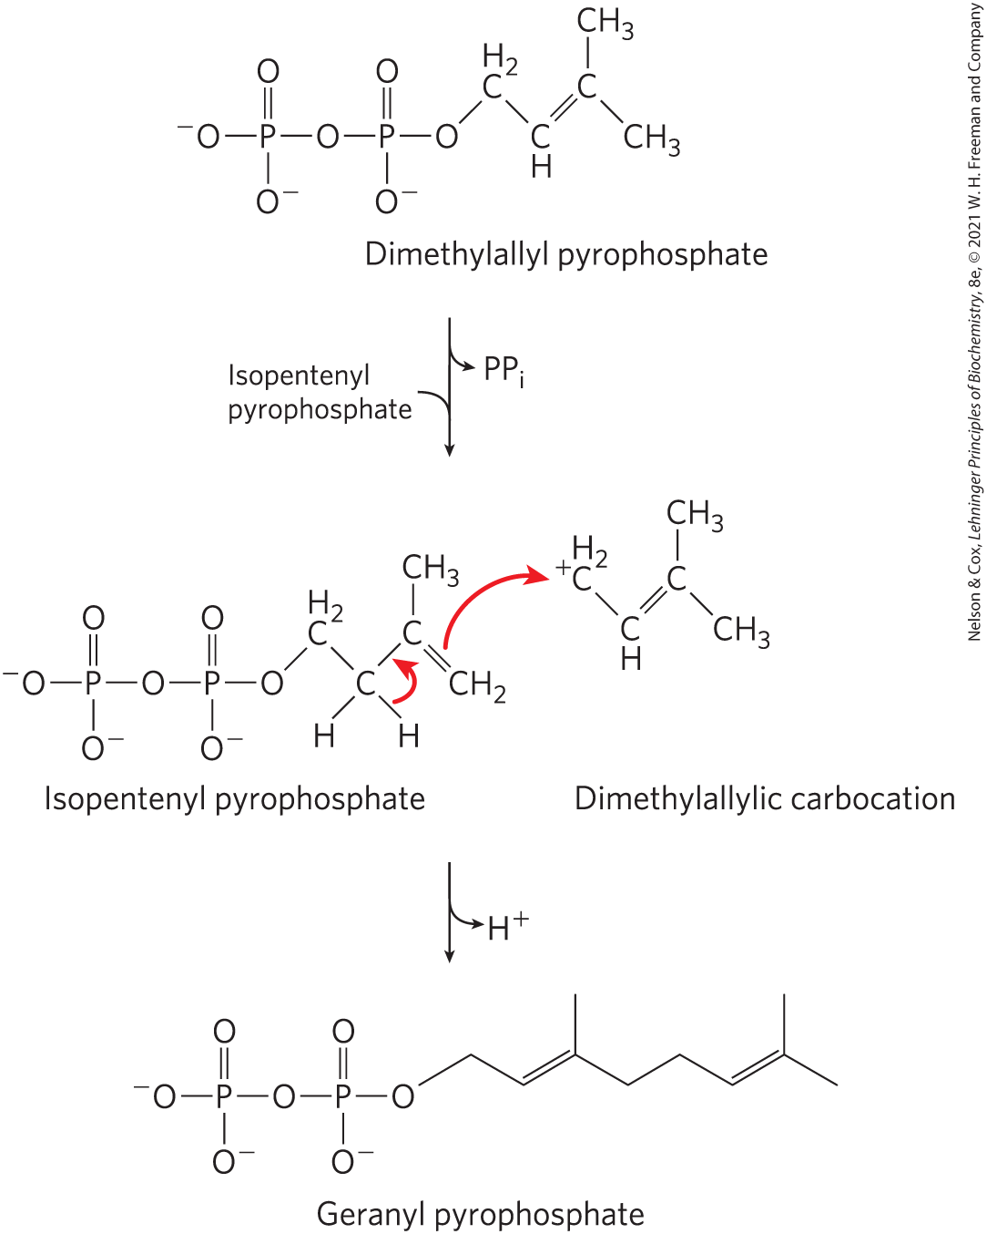
Carbocations in Carbon–Carbon Bond Formation
carbocation intermediates are generated by the elimination of an excellent leaving group, such as pyrophosphate

Slide 46
Internal Rearrangements, Isomerizations, and Eliminations
redistribution of electrons results in alterations without changes in the overall oxidation state of the molecule
reactions include:
  intramolecular oxidation-reduction
  change in cis-trans arrangement at a double bond
  transposition of double bonds

Slide 47
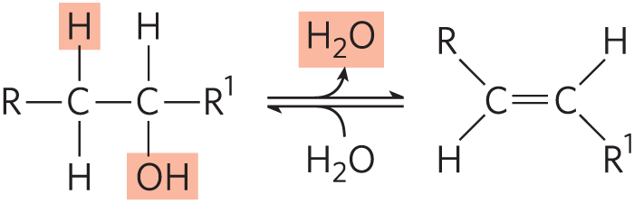
Elimination Reactions
loss of water from an alcohol introduces a C=C bond
similar reactions result from eliminations in amines

Slide 48
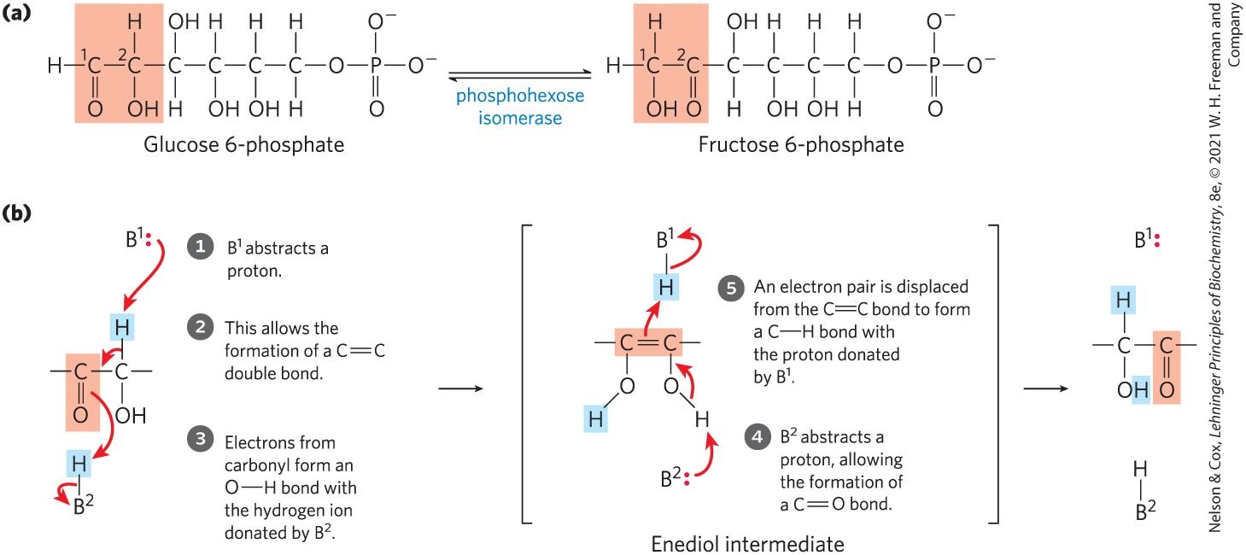
Isomerization and
Elimination Reactions

Slide 49
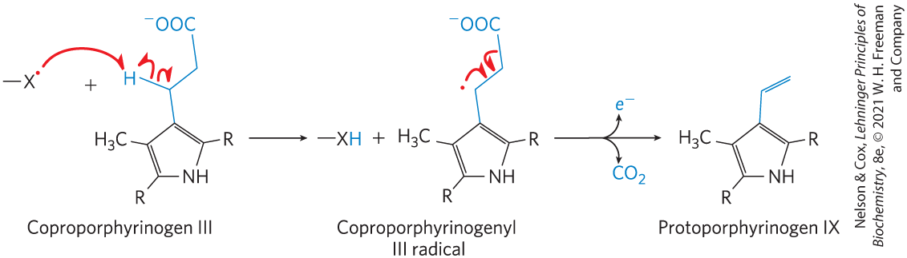
Free-Radical Reactions
homolytic cleavage of covalent bonds to generate free radicals occurs in some pathways

Slide 50
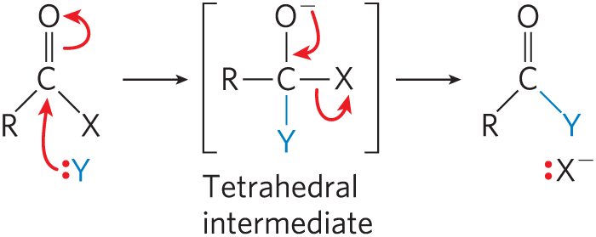
Group Transfer Reactions
the transfer of acyl, glycosyl, and phosphoryl groups from one nucleophile to another is common
acyl group transfer involves the addition of a nucleophile to the carbonyl carbon of an acyl group to form a tetrahedral intermediate

Slide 51
Glycosyl Group Transfers
glycosyl group transfers involve nucleophilic substitution at C-1 of a sugar ring
  substitution can proceed by an S_{N}1 or S_{N}2 pathway

Slide 52
Principle 3 (4 of 4)
Although thousands of different chemical reactions occur in the biosphere, most of them fall within a small set of reaction types.

Slide 53
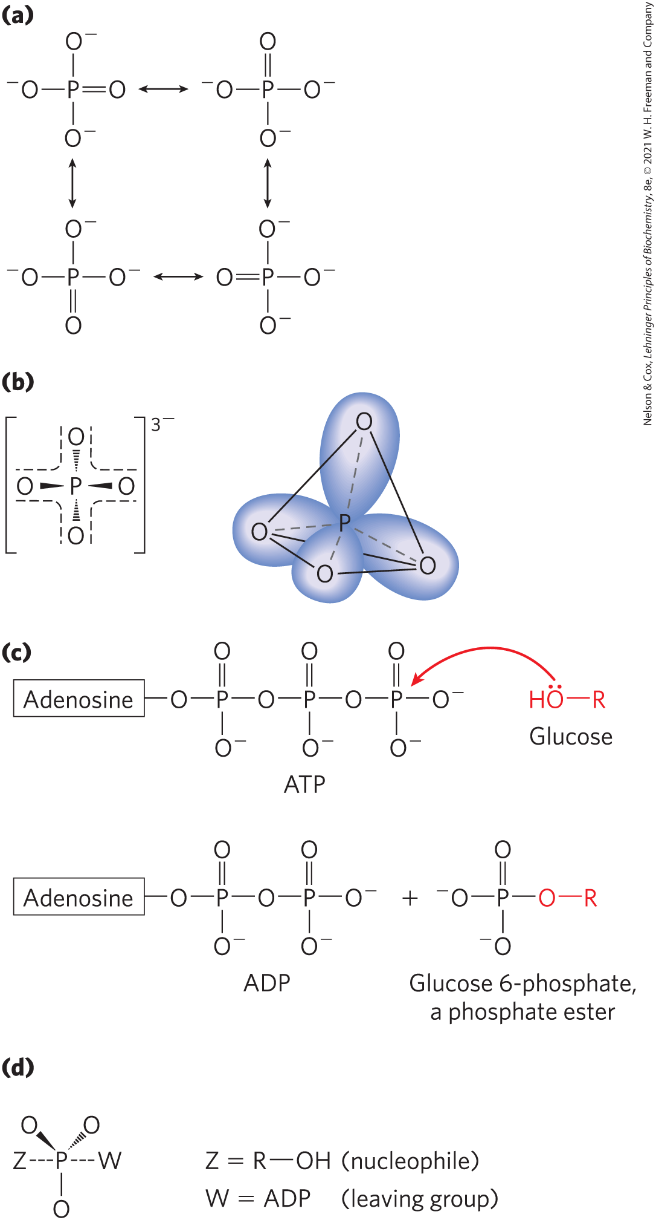
Phosphoryl Group Transfers
attachment of a good leaving group to a metabolic intermediate “activates” the intermediate for subsequent reaction
  phosphoryl groups (–PO₃²⁻) commonly serve as leaving groups
kinases = enzymes that catalyze phosphoryl group transfers with ATP as a donor

Slide 54
Kinases, Phosphorylases, and Phosphatases
kinases = transfer a phosphoryl group from ATP to an acceptor molecule
  catalyze a phosphorylation reaction
phosphorylases = catalyze a displacement reaction where phosphate attacks and becomes covalently attached at the point of bond breakage
  catalyze a phosphorolysis reaction
phosphatases = catalyze the removal of a phosphoryl group from a phosphate ester
  catalyze dephosphorylation reactions

Slide 55
Synthases, Synthetases,
Ligases, and Lyases
synthases = catalyze condensation reactions in which no nucleotide triphosphate is required
synthetases = catalyze condensation reactions that require a nucleotide triphosphate
ligases = catalyze condensation reactions in which two atoms are joined using ATP or another energy source
lyases = catalyze cleavages or additions in which electronic rearrangements occur

Slide 56
Oxidases and Oxygenases
oxidases = catalyze biological oxidation reactions where oxygen is the electron acceptor and oxygen does not appear in the oxidized product
  mixed function oxidases = oxidize two different substrates simultaneously
oxygenases = catalyze biological oxidation reactions where oxygen is the electron acceptor and oxygen does appear in the oxidized product
  monooxygenases = one oxygen atom is incorporated in the product
  dioxygenases = two oxygen atoms are incorporated in the product

Slide 57
Dehydrogenases
dehydrogenases = catalyze oxidation-reductase reactions in which NAD⁺ is the electron acceptor and molecular oxygen is not involved

Slide 58
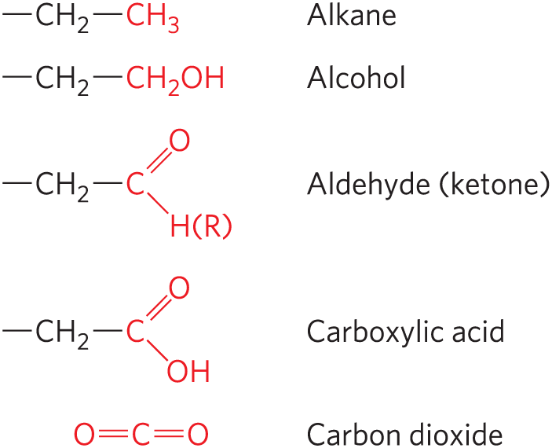
Oxidation-Reduction Reactions
least oxidized
carbon atoms exist in different oxidation states, depending on the elements with which they share electrons
most oxidized

Slide 59
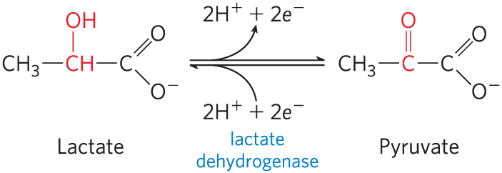
An Oxidation-Reduction Reaction
in many biological oxidations, a compound loses two electrons and two hydrogen ions
  catalyzed by dehydrogenases
in some biological oxidations, a carbon atom becomes bonded to an oxygen
  catalyzed by oxidases or oxygenases

Slide 60
Principle 5 (2 of 5)
Oxidation-reduction reactions indirectly provide much of the energy needed to make ATP. Reduced substrates such as glucose are oxidized in several steps, with the energy of oxidation steps conserved in the form of a reduced cofactor, NADH. Energy stored in NADH is used to drive the synthesis of ATP.

Slide 61
Oxidations Are Accompanied by Reductions
oxidation-reduction reactions involve the loss or gain of electrons
  one reactant gains electrons and is reduced
  the other loses electrons and is oxidized
oxidation reactions generally release energy
  living cells oxidize metabolic fuels (carbohydrates, fat)

Slide 62
Biochemical and Chemical Equations Are Not Identical
biochemical equations:
  do not balance for H⁺ or Mg²⁺
  do not attempt to describe the state of phosphate ionization
chemical equations account for all atoms and charges in a reaction

Slide 63
13.3 Phosphoryl Group Transfers and ATP

Slide 64
The Special Role of ATP
ATP is the chemical link between catabolism and anabolism
  energy obtained from catabolism of nutrient molecules is used to make ATP from ADP and P_{i}
  the exergonic conversion of ATP to ADP and P_{i} (or to AMP and PP_{i}) is coupled to many endergonic reactions and processes

Slide 65
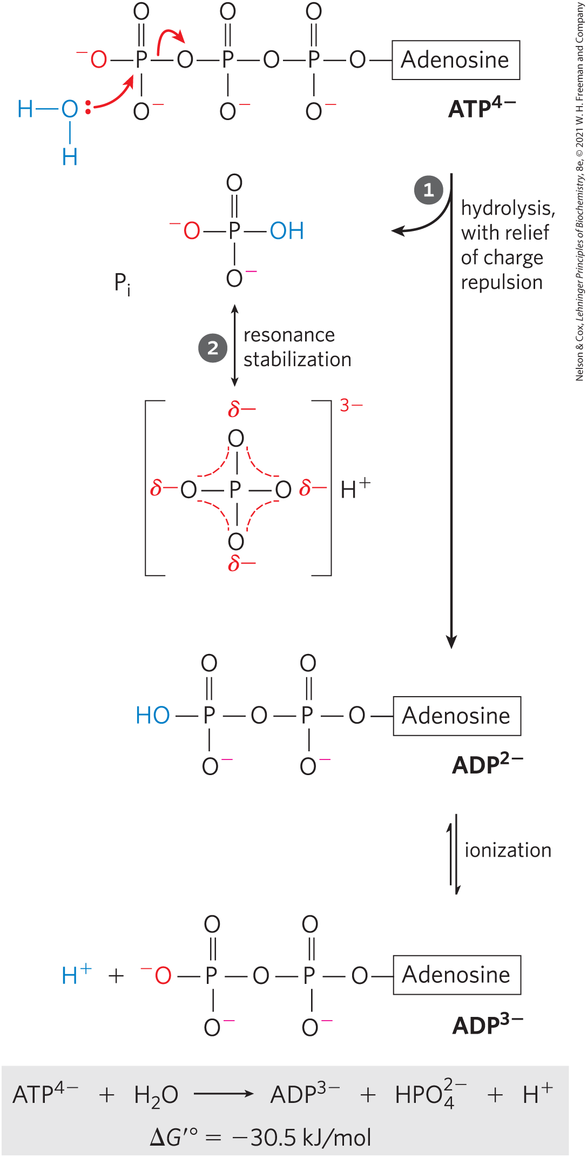
The Free-Energy Change for ATP Hydrolysis Is Large and Negative
the hydrolytic cleavage of the terminal phosphoanhydride bond in ATP relieves some of the internal electrostatic repulsion in ATP

Slide 66
Cellular Conditions of ATP,
ADP, and P_{i}
Table 13-5 Total Concentrations of Adenine Nucleotides, Inorganic Phosphate, and Phosphocreatine in Some Cells
Cell type | Concentration (mM): ATP | Concentration (mM): ADP | Concentration (mM): AMP | Concentration (mM): P_{i} | Concentration (mM): PCr
Rat hepatocyte | 3.38 | 1.32 | 0.29 | 4.8 | 0
Rat myocyte | 8.05 | 0.93 | 0.04 | 8.05 | 27
Rat neuron | 2.59 | 0.73 | 0.06 | 2.72 | 4.7
Human erythrocyte | 2.25 | 0.25 | 0.02 | 1.65 | 0
E. coli cell | 9.6 | 0.56 | 0.28 | ⸻ | ⸻

Slide 67
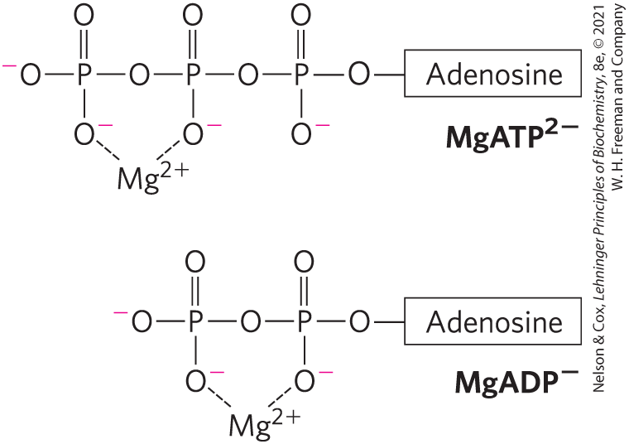
Mg²⁺ and ATP
Mg²⁺ in the cytosol binds to ATP and ADP
for most enzymatic reactions involving ATP, the true substrate is MgATP²⁻

Slide 68
The Free-Energy Change for
ATP Hydrolysis Under Cellular Conditions
phosphorylation potential, ∆G_{p} = the actual free energy of hydrolysis of ATP under intracellular conditions
  varies from cell to cell and over time
in vivo, the energy released by ATP hydrolysis is greater than the standard free-energy change, ∆G′°

Slide 69
Principle 4 (2 of 5)
ATP is the universal energy currency in living organisms. Transfer of its phosphoryl group to a water molecule or metabolic intermediates provides the energetic push for muscle contraction, the pumping of solutes against concentration gradients, and the synthesis of complex molecules.

Slide 70
Cellular ATP Levels
due to strong selective pressure over the course of evolution, regulatory mechanisms hold cellular [ATP] far above the equilibrium concentrations for the hydrolysis reaction
when the ATP level drops:
  the amount of fuel decreases
  the fuel itself loses its potency

Slide 71
Other Phosphorylated Compounds and Thioesters Also Have Large, Negative Free Energies of Hydrolysis
in these phosphate-releasing reactions, the several resonance forms available to P_{i} stabilize this product relative to the reactant
Table 13-6 Standard Free Energies of Hydrolysis of Some Phosphorylated Compounds and Acetyl-CoA (a Thioester)
Compounds and Acetyl-CoA | ΔG′°: (kJ/mol) | ΔG′°: (kcal/mol)
Phosphoenolpyruvate | −61.9 | −14.8
1,3-Bisphosphoglycerate (→3-phosphoglycerate + P_{i}) | −49.3 | −11.8
Phosphocreatine | −43.0 | −10.3
ADP (→AMP + P_{i}) | −32.8 | −7.8
ATP (→ADP + P_{i}) | −30.5 | −7.3
ATP (→AMP + PP_{i}) | −45.6 | −10.9
AMP (→adenosine + P_{i}) | −14.2 | −3.4
PP_{i}(→2P_{i}) | −19.2 | −4.0
Glucose 3-phosphate | −20.9 | −5.0
Fructose 6-phosphate | −15.9 | −3.8
Glucose 6-phosphate | −13.8 | −3.3
Glycerol 3-phosphate | −9.2 | −2.2
Acetyl-CoA | −31.4 | −7.5

Slide 72
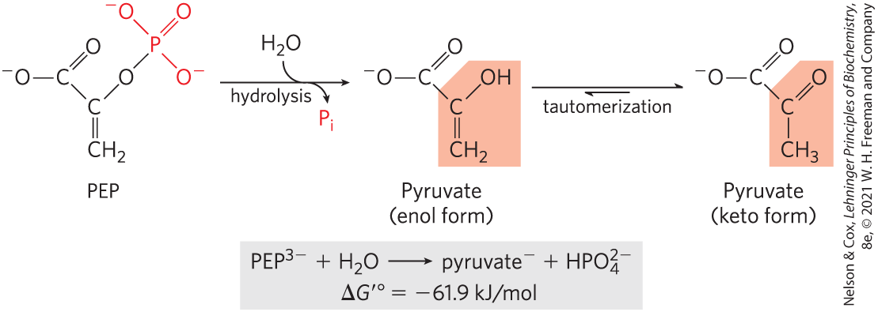
Hydrolysis of Phosphoenolpyruvate (PEP)
high standard free energy of hydrolysis because:
  the reaction occurs with a gain in entropy
  greater resonance stabilization in the P_{i} released by PEP cleavage

Slide 73
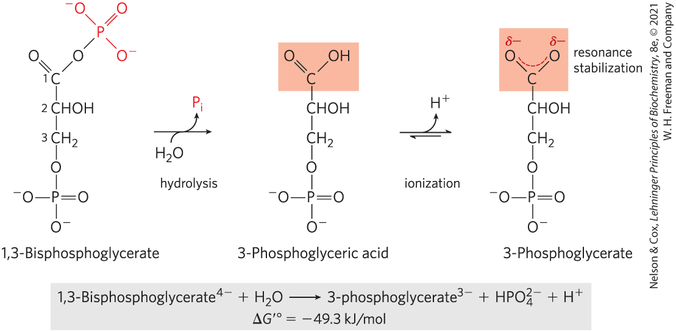
Hydrolysis of 1,3-Bisphosphoglycerate
large standard free energy of hydrolysis because:
  3-phosphoglycerate has two resonance forms
  removal of 3-phosphoglyceric acid by further metabolism and formation of the ion favor the forward reaction

Slide 74
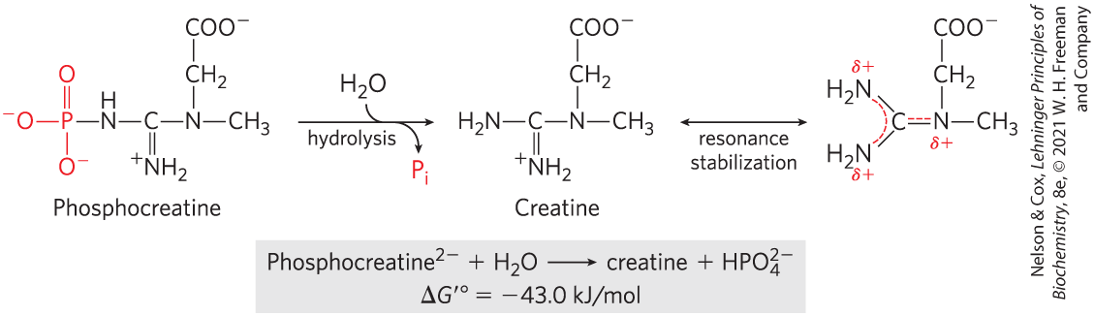
Hydrolysis of Phosphocreatine
large standard free energy of hydrolysis because the release of P_{i} and the resonance stabilization of creatine favor the forward reaction

Slide 75
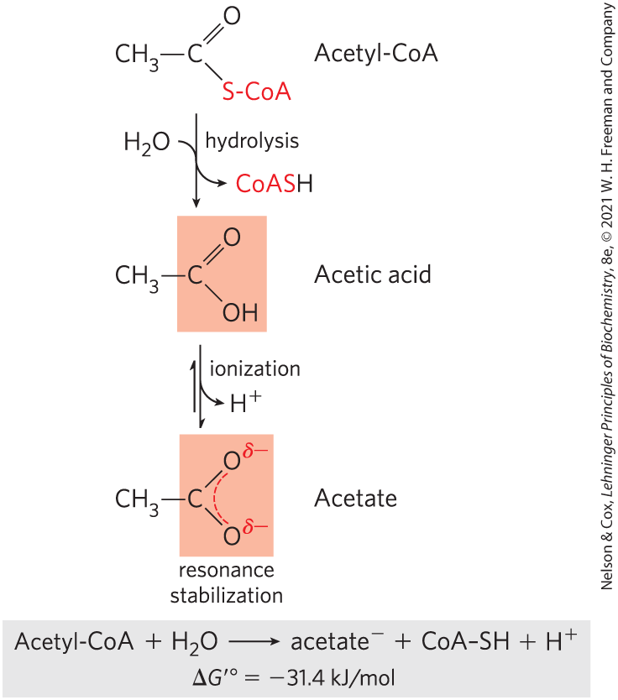
Hydrolysis of Acetyl-Coenzyme A
thioesters = have a sulfur atom that has replaced the oxygen in the ester bond

Slide 76
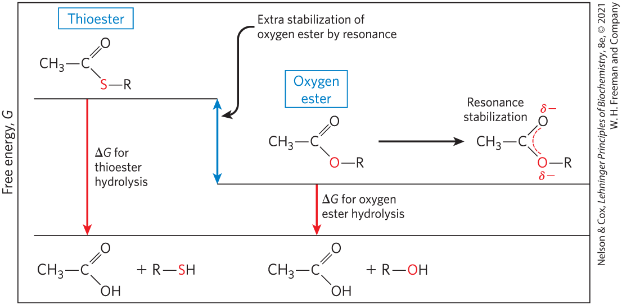
Free Energy of Hydrolysis for Thioesters and Oxygen Esters
thioesters undergo much less resonance stabilization than oxygen esters
  difference in free energy between reactant and products is greater for thioesters

Slide 77
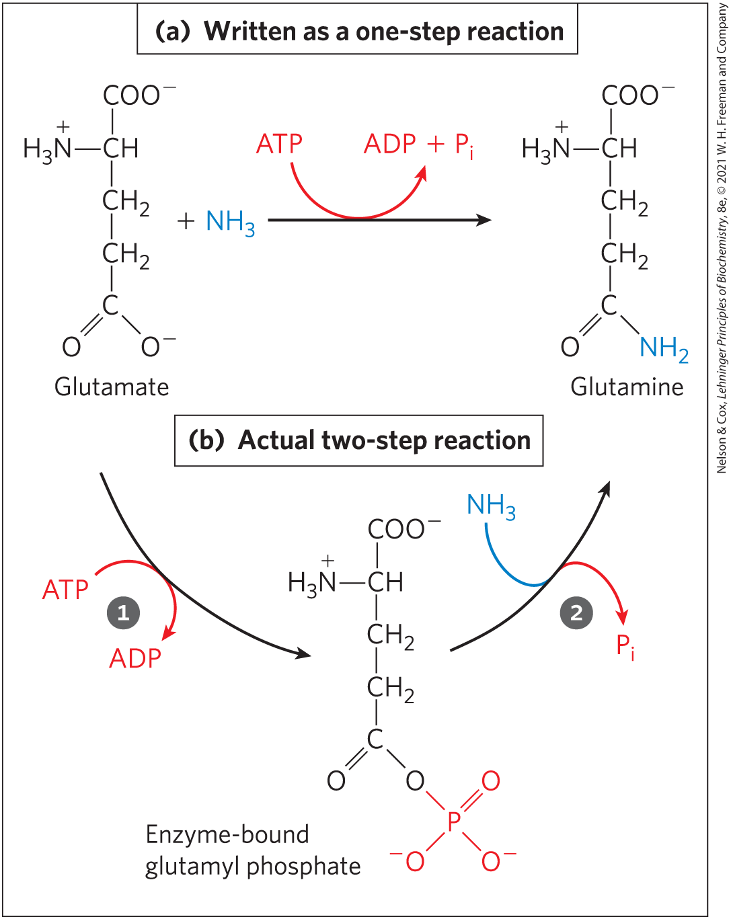
ATP Provides Energy by Group Transfers, Not by Simple Hydrolysis
first step = transfer of part of the ATP molecule to a substrate molecule or to an amino acid residue, activating it
second step = displacement of the phosphate-containing moiety, generating P_{i}, PP_{i}, or AMP as the leaving group

Slide 78
Principle 4 (3 of 5)
ATP is the universal energy currency in living organisms. Transfer of its phosphoryl group to a water molecule or metabolic intermediates provides the energetic push for muscle contraction, the pumping of solutes against concentration gradients, and the synthesis of complex molecules.

Slide 79
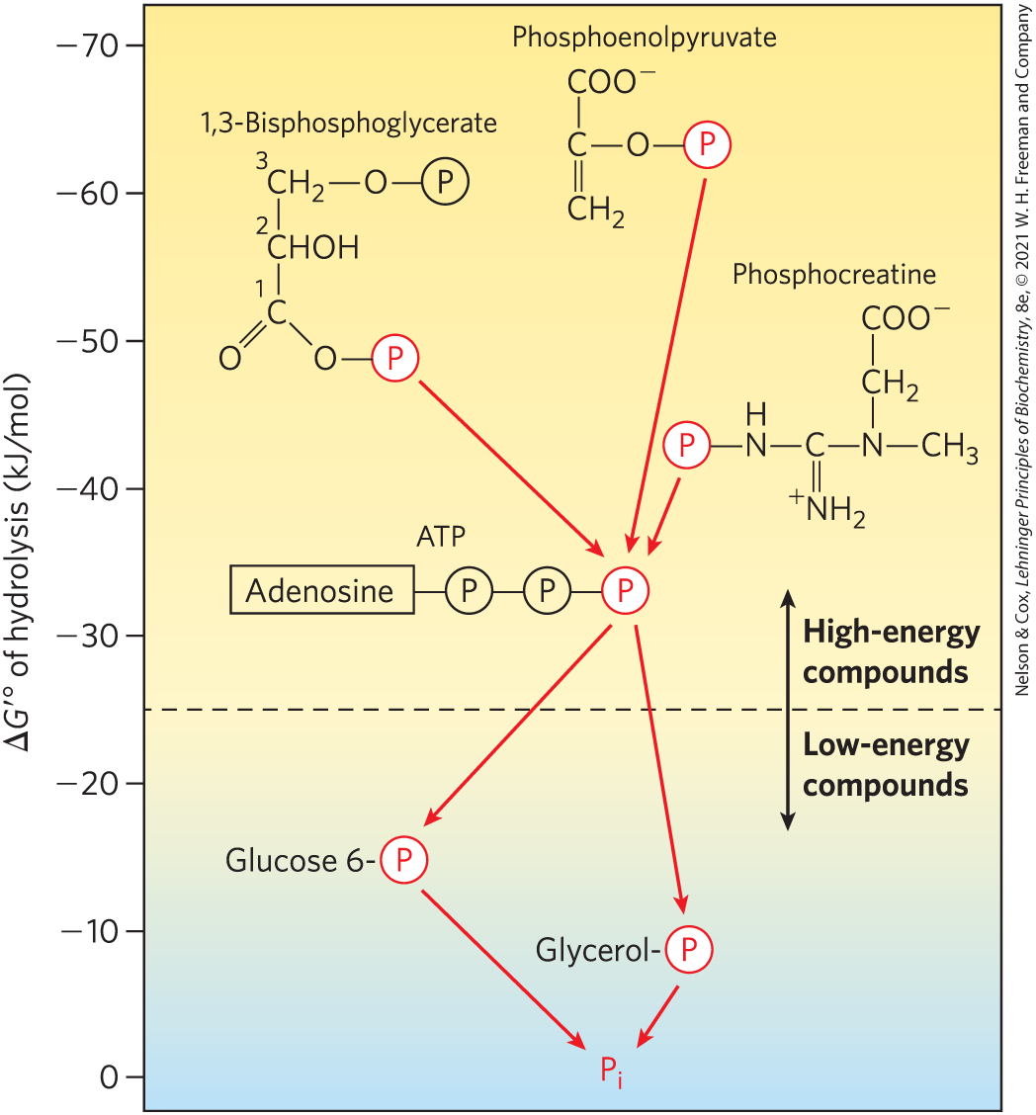
Ranking of Biological Phosphate Compounds by ∆G′°
“high-energy” compounds have a ∆G′° more negative than -25 kJ/mol
“low-energy” compounds have a less negative ∆G′°

Slide 80
Principle 2 (3 of 3)
The free-energy change is the maximum energy made available to do work when a chemical reaction occurs. If two reactions can be combined to yield a third reaction, the overall free energy change is the sum of the two. Cells accomplish energy-requiring chemical work by coupling an energy-releasing (exergonic) reaction, such as the cleavage of ATP, to an endergonic reaction (which requires energy input).

Slide 81
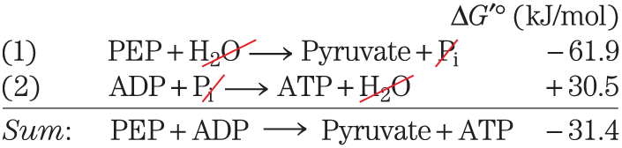
Phosphate Compounds with High ∆G′° of Hydrolysis Donate their Phosphoryl Group
any phosphorylated compound can be synthesized by coupling the synthesis to the breakdown of another phosphorylated compound with a more negative free energy of hydrolysis

Slide 82
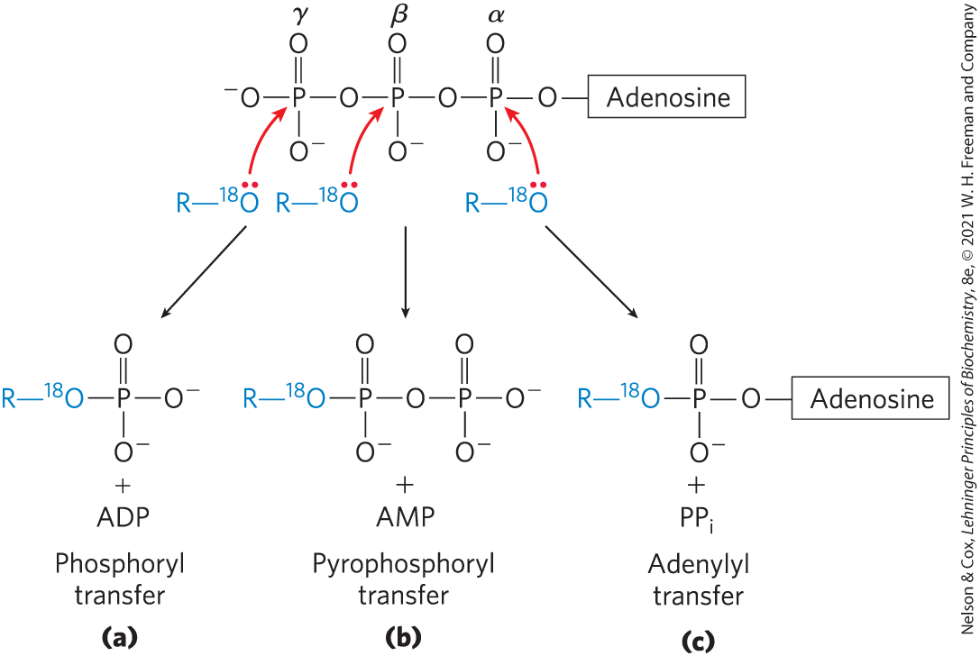
ATP Donates Phosphoryl, Pyrophosphoryl, and Adenylyl Groups
each of the three phosphates of ATP is susceptible to nucleophilic attack

Slide 83
Principle 4 (4 of 5)
ATP is the universal energy currency in living organisms. Transfer of its phosphoryl group to a water molecule or metabolic intermediates provides the energetic push for muscle contraction, the pumping of solutes against concentration gradients, and the synthesis of complex molecules.

Slide 84
Adenylylation Reactions
adenylylation = reaction that transfers adenylate (5′-AMP) as an adenyl group
  often the method of energy coupling
thermodynamically very favorable
  hydrolysis of the α–β phosphoanhydride bond releases more energy than hydrolysis of the β–γ bond
  PP_{i} formed as a byproduct is hydrolyzed to two P_{i} by inorganic pyro­phosphatase, releasing additional energy

Slide 85
Assembly of Informational Macromolecules Requires Energy
through group transfer reactions, ATP provides the energy for:
  the synthesis of informational macromolecules (DNA, RNA, protein)
  the transport of molecules and ions across membranes against gradients
through hydrolysis, ATP provides the energy for muscle contraction

Slide 86
Principle 4 (5 of 5)
ATP is the universal energy currency in living organisms. Transfer of its phosphoryl group to a water molecule or metabolic intermediates provides the energetic push for muscle contraction, the pumping of solutes against concentration gradients, and the synthesis of complex molecules.

Slide 87
Transphosphorylations between Nucleotides Occur in All Cell Types
the other nucleoside triphosphates (GTP, UTP, and CTP) and all deoxynucleoside triphosphates (dATP, dGTP, dTTP, and dCTP) are energetically equivalent to ATP
nucleoside diphosphate kinase = carries phosphoryl groups from ATP to other nucleotides
  high [ATP]/[ADP] ratio normally drives the reaction forward

Slide 88
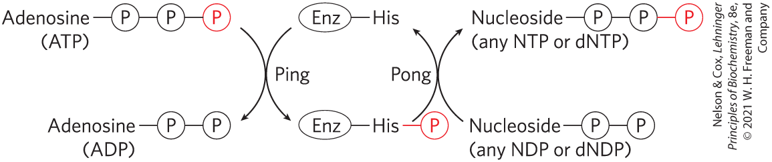
Ping-Pong Mechanism of Nucleoside Diphosphate Kinase
first step = phosphoryl group transfer from ATP to an active-site His residue produces a phosphoenzyme intermediate
second step = transfer of the phosphoryl group is from the His residue to an NDP acceptor

Slide 89
Adenylate Kinase and Creatine Kinase
adenylate kinase = lowers the ADP concentration and replenishes ATP during periods of intense demand for ATP
  guanylate kinase is a similar enzyme
creatine kinase = uses the phosphocreatine reservoir to replenish ATP at a rapid rate
  lower phyla organisms employ phosphagens (phosphocreatine-like molecules) as phosphoyl reservoirs

Slide 90
13.4 Biological Oxidation-Reduction Reactions

Slide 91
Principle 5 (3 of 5)
Oxidation-reduction reactions indirectly provide much of the energy needed to make ATP. Reduced substrates such as glucose are oxidized in several steps, with the energy of oxidation steps conserved in the form of a reduced cofactor, NADH. Energy stored in NADH is used to drive the synthesis of ATP.

Slide 92
The Flow of Electrons in Oxidation-Reduction Reactions
electron flow in oxidation-reduction reactions is responsible for all work done by living organisms
electrons move from metabolic intermediates to electron carriers to acceptors with higher electron affinities
  release energy

Slide 93
Principle 5 (4 of 5)
Oxidation-reduction reactions indirectly provide much of the energy needed to make ATP. Reduced substrates such as glucose are oxidized in several steps, with the energy of oxidation steps conserved in the form of a reduced cofactor, NADH. Energy stored in NADH is used to drive the synthesis of ATP.

Slide 94
The Flow of Electrons Can Do Biological Work
electromotive force (emf) = force proportional to the difference in electron affinity between chemical species
  drives electron flow spontaneously through a circuit
biological “circuit” = electrons from glucose flow through a series of electron-carrier intermediates to another chemical species, such as O₂

Slide 95
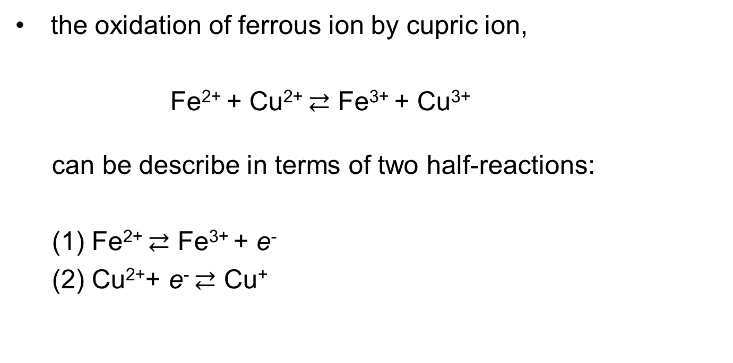
Oxidation-Reductions Can Be Described as Half-Reactions
the oxidation of ferrous ion by cupric ion,
Fe²⁺ + Cu²⁺ $⇄$ Fe³⁺ + Cu³⁺
can be describe in terms of two half-reactions:
(1) Fe²⁺ $⇄$ Fe³⁺ + e⁻
(2) Cu²⁺+ e⁻ $⇄$ Cu⁺

Slide 96
Conjugate Redox Pairs
reducing agent or reductant = electron-donating molecule
oxidizing agent or oxidant = electron-accepting molecule
conjugate redox pair = consists of an electron donor and an electron acceptor

Slide 97
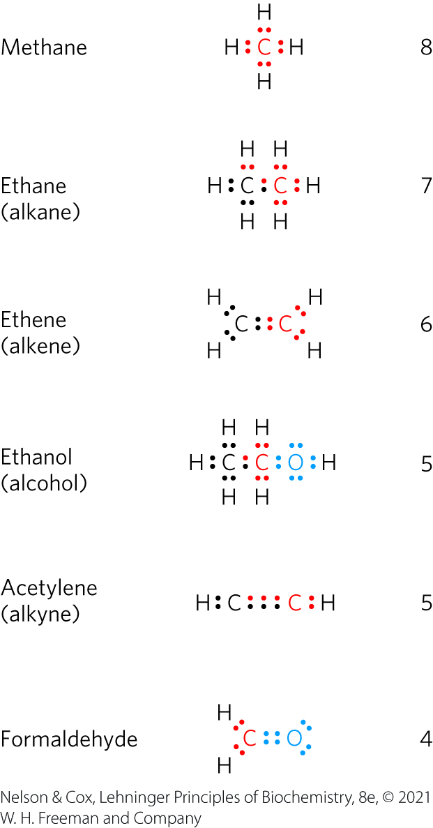
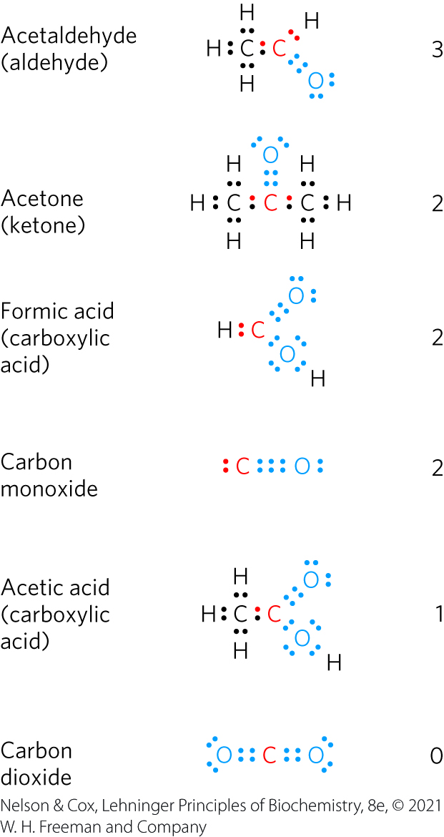
Biological Oxidations Often Involve Dehydrogenation
the more electro-negative atom “owns” the bonding electrons it shares with another atom

Slide 98
Oxidation Is Often Synonymous
With Dehydrogenation
dehydrogenation = reaction where a compound loses two electrons and two hydrogen ions
  catalyzed by dehydrogenases
electrons are transferred from the electron donor to the electron acceptor:
  directly as electrons
  as hydrogen atoms
  as a hydride ion (:H⁻)
  through direct combination with oxygen

Slide 99
Reducing Equivalent
reducing equivalent = designates a single electron equivalent participating in an oxidation-reduction reaction regardless of the transfer method

Slide 100
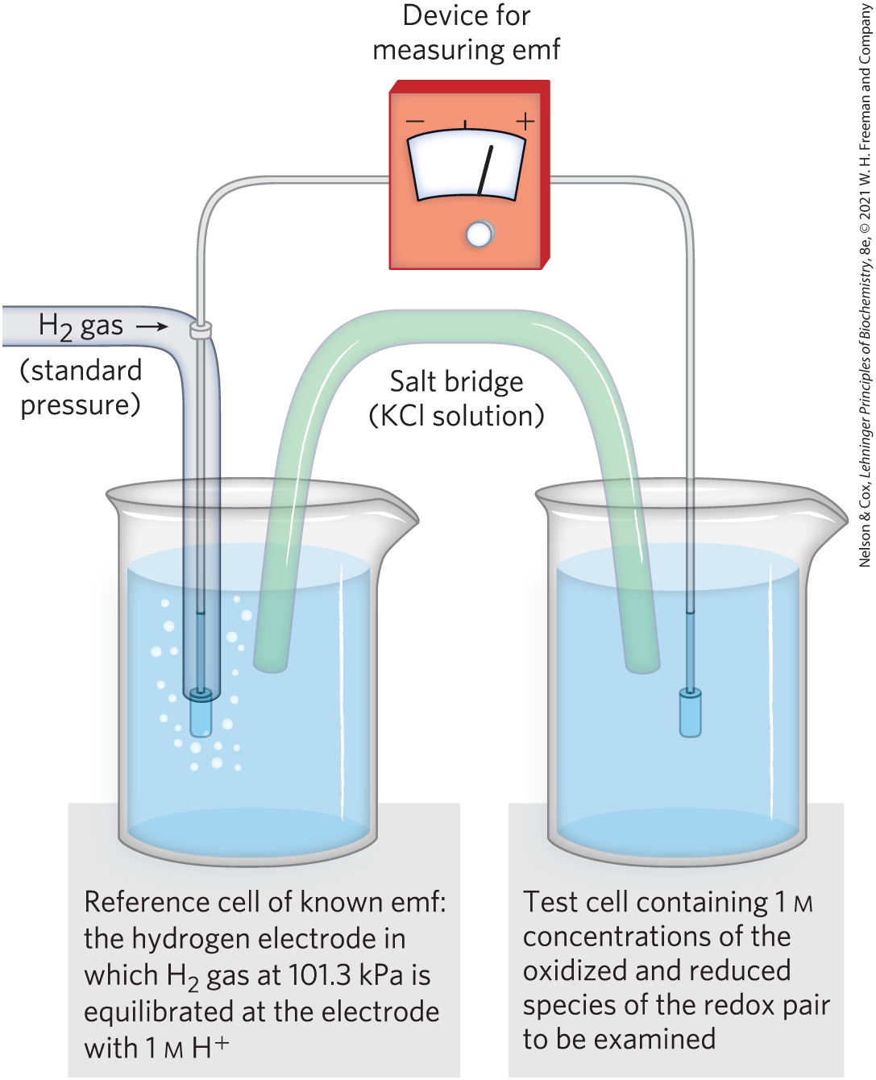
Reduction Potentials Measure Affinity for Electrons
standard reduction potential, E° = a measure (in volts) of the relative affinity of the electron acceptor of each redox pair for electrons
  positive value = takes electrons
  negative value = donates electrons

Slide 101
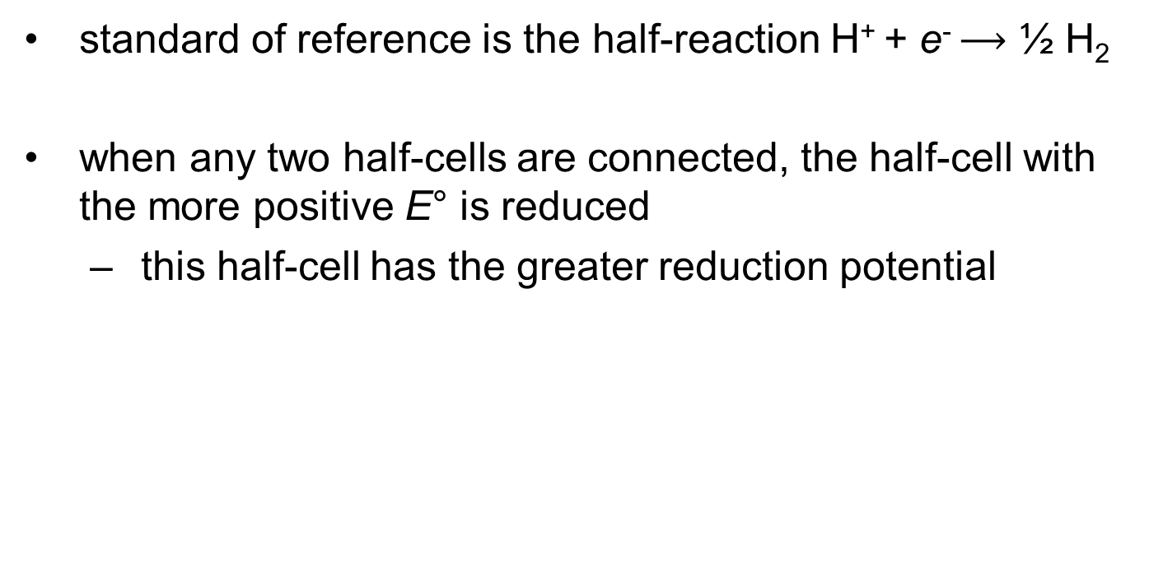
Electrons Tend to Flow From Low to High Reduction Potential
standard of reference is the half-reaction H⁺ + e⁻ $⟶$ ½ H₂
when any two half-cells are connected, the half-cell with the more positive E° is reduced
  this half-cell has the greater reduction potential

Slide 102
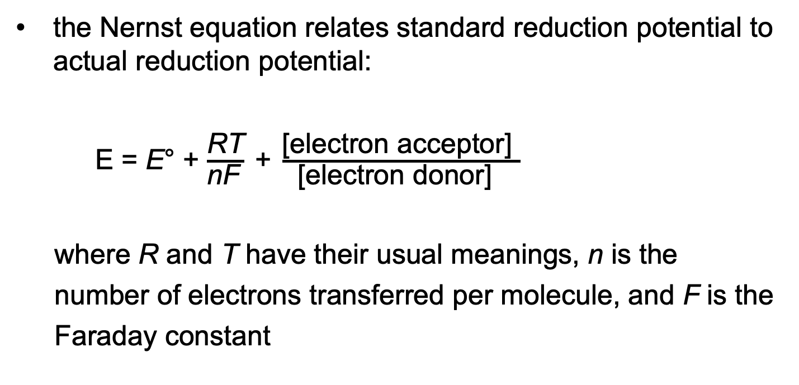
The Nernst Equation
the Nernst equation relates standard reduction potential to actual reduction potential:
E = E° + $\frac{\text{RT}}{\text{nF} } \text{+} \frac{\text{[}\text{electron} \text{acceptor}\text{] }}{\text{[}\text{electron} \text{donor}\text{] } }$
where R and T have their usual meanings, n is the
number of electrons transferred per molecule, and F is the
Faraday constant
(13-5)

Slide 103

The Simplified Nernst Equation
at 298 K (25 °C), the Nernst equation reduces to:
E = E° + $\frac{\text{0.026 }\text{V} }{\text{n} } \text{+} \frac{\text{[}\text{electron} \text{acceptor}\text{] }}{\text{[}\text{electron} \text{donor}\text{] }}$
(13-6)

Slide 104
Standard Reduction Potentials
Half-reaction | E′˚ (V)
½O₂ + 2H⁺ + 2e⁻→H₂O | 0.816
Fe³⁺ + e⁻→Fe²⁺ | 0.771
NO⁻₃ + 2H⁺ + 2e⁻→NO⁻₂ + H₂O | 0.421
Cytochrome f (Fe³⁺) + e⁻→cytochrome f (Fe²⁺) | 0.365
Fe(CN)³⁻₆ (ferricyanide) + e⁻→Fe(CN)⁴⁻₆ | 0.36
Cytochrome a₃ (Fe³⁺) + e⁻→cytochrome a₃ (Fe²⁺) | 0.35
O₂ + 2H⁺ + 2e⁻→H₂O₂ | 0.295
Cytochrome a (Fe³⁺) + e⁻→cytochrome a (Fe²⁺) | 0.29
Cytochrome c (Fe³⁺) + e⁻→cytochrome c (Fe²⁺) | 0.254
Cytochrome c₁ (Fe³⁺) + e⁻→cytochrome c₁ (Fe²⁺) | 0.22
Cytochrome b (Fe³⁺) + e⁻→cytochrome b (Fe²⁺) | 0.077
Ubiquinone + 2H⁺ + 2e⁻→ubiquinol | 0.045
Fumarate²⁻ + 2H⁺ + 2e⁻→succinate²⁻ | 0.031
2H⁺ + 2e⁻→H₂ (at standard conditions, pH 0) | 0.000
Crotonyl-CoA + 2H⁺ + 2e⁻→butyryl-CoA | −0.015
Oxaloacetate²⁻ + 2H⁺ + 2e⁻→lactate⁻ | −0.166
Pyruvate⁻ + 2H⁺ + 2e⁻→lactate⁻ | −0.185
Acetaldehyde + 2H⁺ + 2e⁻→ethanol | −0.197
FAD + 2H⁺ + 2e⁻→FADH₂ | −0.219
Glutathione + 2H⁺ + 2e⁻→2 reduced glutathione | −0.23
S + 2H⁺ + 2e⁻→H₂S | −0.243
Lipoic acid + 2H⁺ + 2e⁻→dihydrolipoic acid | −0.29
NAD⁺ + H⁺ + 2e⁻→NADH | −0.320
NADP⁺ + H⁺ + 2e⁻→NADPH | −0.324
Acetoacetate + 2H⁺ + 2e⁻→β-hydroxybutyrate | −0.346
α-Ketoglutarate + CO₂ + 2H⁺ + 2e⁻→isocitrate | −0.38
2H⁺ + 2e⁻→H₂ (at pH 7) | −0.414
Ferredoxin (Fe³⁺) + e⁻→ferredoxin (Fe²⁺) | −0.432
standard reduction potentials are valid only for systems at neutral pH
by convention, ∆E′° for any redox reaction is given as E′° of the electron acceptor minus E′° of the electron donor
Table 13-7 Standard Reduction Potentials of Some Biologically Important Half-Reactions

Slide 105
Principle 5 (5 of 5)
Oxidation-reduction reactions indirectly provide much of the energy needed to make ATP. Reduced substrates such as glucose are oxidized in several steps, with the energy of oxidation steps conserved in the form of a reduced cofactor, NADH. Energy stored in NADH is used to drive the synthesis of ATP.

Slide 106
Standard Reduction Potentials
Can Be Used to Calculate
Free-Energy Change
electrons tend to flow to the half-cell with the more positive E (higher reduction potential)
the strength of this tendency is:
  proportional to ∆E
  a function of the concentrations of oxidized and reduced species
∆G = −nF∆E or ∆G′° = −nF∆E′°
  where n is the number of electrons transferred
(13-7)

Slide 107
A Few Types of Coenzymes and Proteins Serve as Universal Electron Carriers
NAD, NADP, FMN, and FAD are water-soluble coenzymes that undergo reversible oxidation and reduction in many of the electron-transfer reactions
  NAD and NADP are freely diffusible
  FMN and FAD are usually enzyme-bound

Slide 108
The Pyridine Nucleotides
pyridine nucleotides = compounds with a nicotinamide ring that resembles pyridine
  nicotinamide adenine dinucleotide (NAD; NAD⁺ when oxidized)
  nicotinamide adenine dinucleotide phosphate (NADP; NADP⁺ when oxidized)

Slide 109
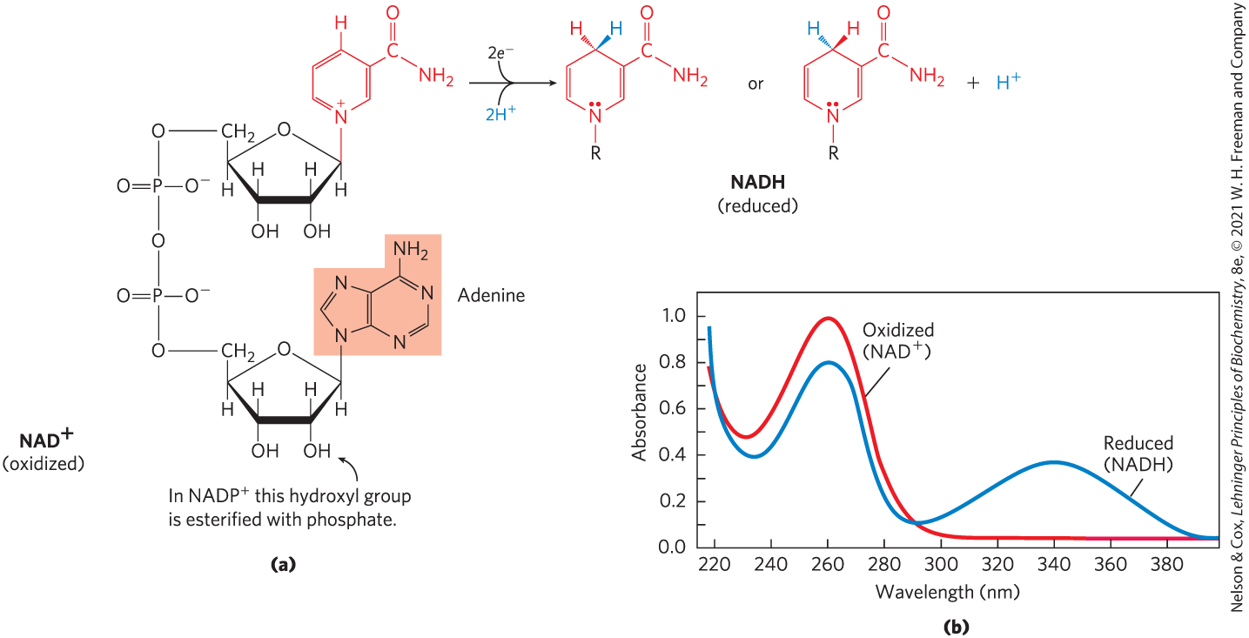
NAD and NADP Undergo Reversible Reduction of the Nicotinamide Ring

Slide 110

Half-Reactions for
Nucleotide Cofactors
both NAD+ and NADP+ accept two electrons and one proton
NAD⁺ + 2e⁻ + 2H⁺ $⟶$ NADH + H⁺
NADP⁺ + 2e⁻ + 2H⁺ $⟶$ NADPH + H⁺

Slide 111
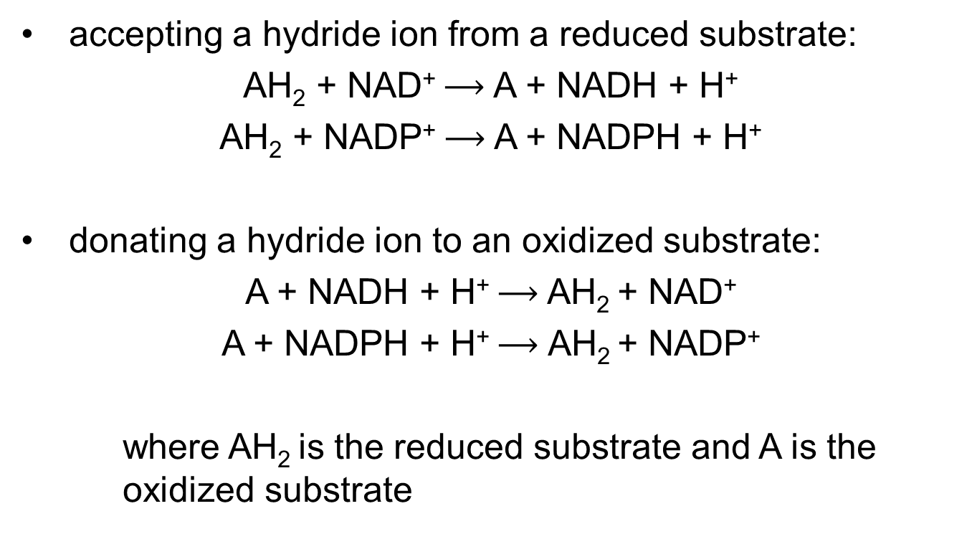
General Reactions for
Nucleotide Cofactors
accepting a hydride ion from a reduced substrate:
AH₂ + NAD⁺ $⟶$ A + NADH + H⁺
AH₂ + NADP⁺ $⟶$ A + NADPH + H⁺
donating a hydride ion to an oxidized substrate:
A + NADH + H⁺ $⟶$ AH₂ + NAD⁺
A + NADPH + H⁺ $⟶$ AH₂ + NADP⁺
where AH₂ is the reduced substrate and A is the oxidized substrate

Slide 112
Oxidoreductase (Dehydrogenases)
oxidoreductases = also called dehydrogenases = catalyze oxidation-reductase reactions using NAD⁺ (or NADP⁺) as coenzymes

Slide 113
NAD Has Important Functions in Addition to Electron Transfer
NAD⁺ is:
  the source of the activating AMP group in the bacterial DNA ligase reaction
  the source of ADP-ribose in the cholera toxin reaction
  hydrolyzed in the deacetylation of the ε-amino group of an acetylated Lys residue by sirtuin proteins
    regulates inflammation, apoptosis, aging, and DNA transcription (through histones)

Slide 114
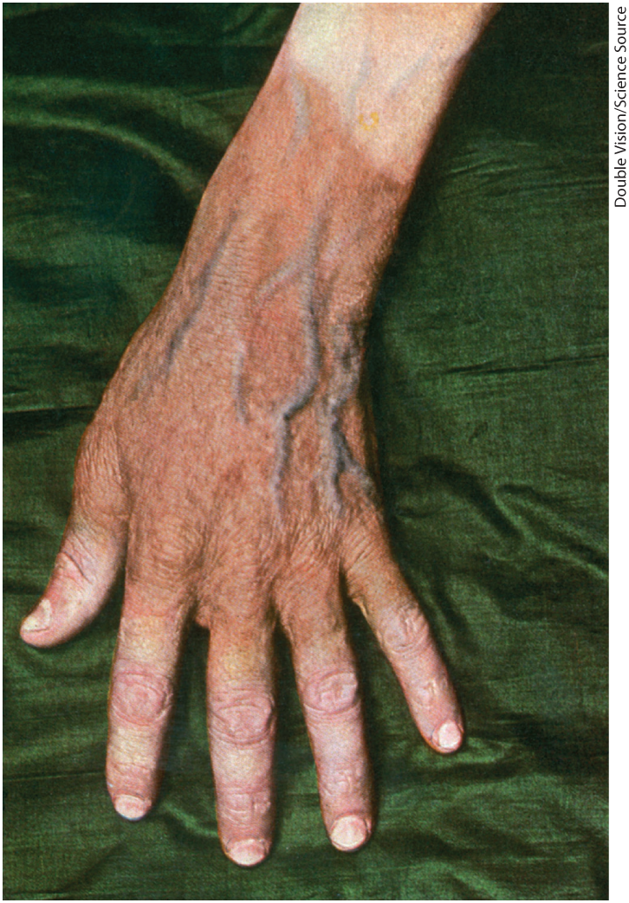
Insufficient Niacin in the Diet
Causes Pellagra
dietary deficiency of niacin (the vitamin form of NAD and NADP) prevents NAD synthesis and causes pellagra
  characterized by the “three Ds”: dermatitis, diarrhea, and dementia
black tongue = related disease in dogs

Slide 115
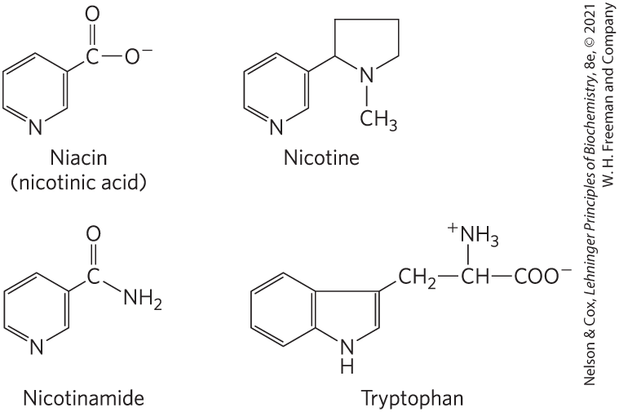
Niacin (Nicotinic Acid) and Its Derivative Nicotin-Amide
tryptophan = the biosynthetic precursor
nicotinic acid and nicotinamide cure pellagra
nicotine (from cigarettes) has no curative activity

Slide 116
Flavin Nucleotides Are Tightly Bound in Flavoproteins
flavoproteins = enzymes that catalyze oxidation- reduction reactions using either flavin mononucle- otide (FMN) or flavin adenine dinucleotide (FAD) as coenzyme
flavin nucleotides = enzymes derived from the vitamin riboflavin
  reduction potentials depend on the flavoprotein with which they are associated

Slide 117
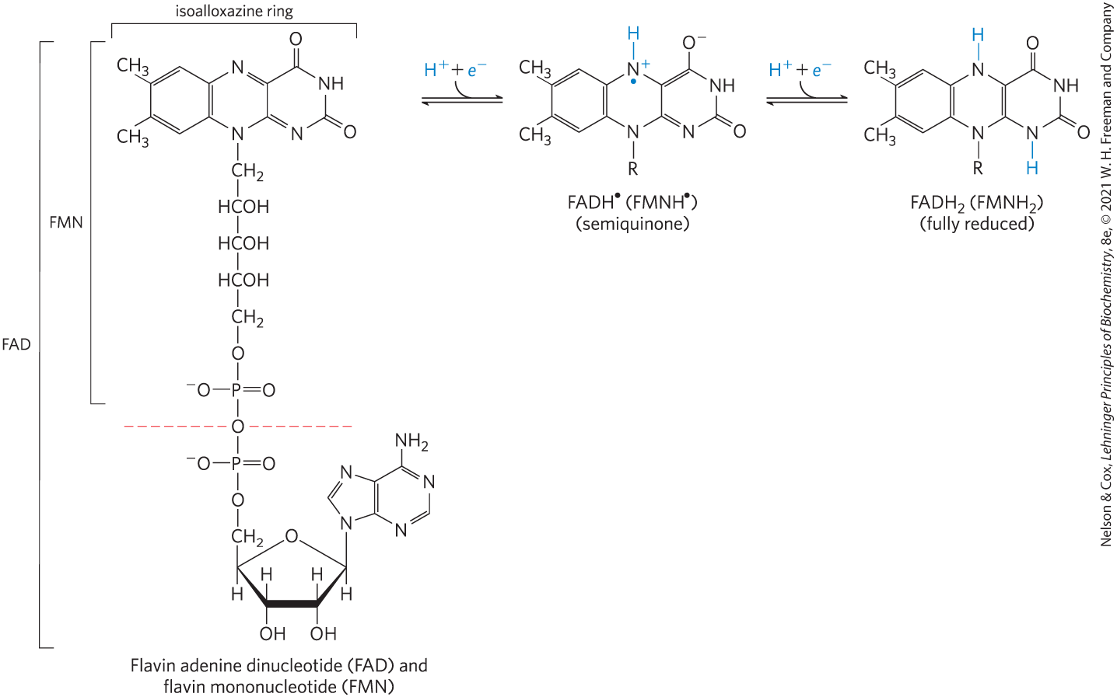
Oxidized and Reduced FAD and FMN
can accept either one or two electrons in the form of one or two hydrogen atoms from a reduced substrate

Slide 118
13.5 Regulation of Metabolic Pathways

Slide 119
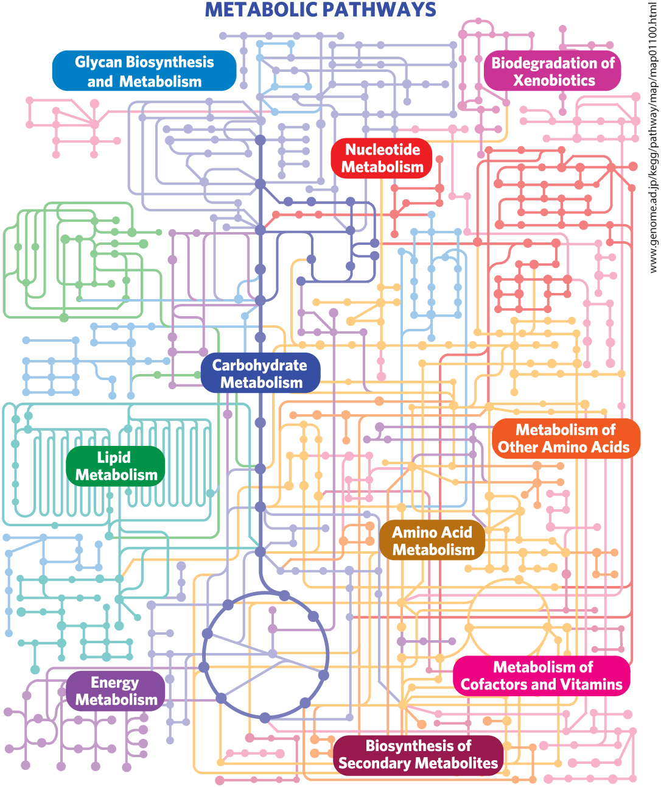
Metabolism as a Three-Dimensional Meshwork
pathways are inextricably intertwined with all the other cellular pathways in a multidimensional network of reactions

Slide 120
Principle 6 (2 of 5)
To respond to changes in external circumstances, cells must regulate enzyme activities by changing either the number of enzyme molecules or the catalytic activity of preexisting enzyme molecules.

Slide 121
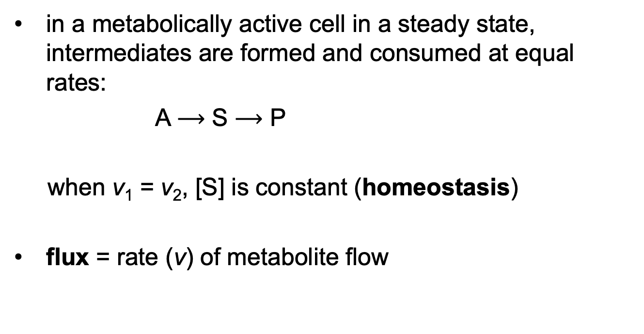
Cells and Organisms Maintain a Dynamic Steady State
in a metabolically active cell in a steady state, intermediates are formed and consumed at equal rates:
A $⟶$ S $⟶$ P
when v₁ = v₂, [S] is constant (homeostasis)
flux = rate (v) of metabolite flow
v₁
v₂

Slide 122
Both the Amount and the Catalytic Activity of an Enzyme Can
Be Regulated
to return a system to the steady state, flux can be modulated by changes in the:
  number of enzyme molecules
  catalytic activity of each present enzyme molecule
time scale = less than a millisecond to days

Slide 123
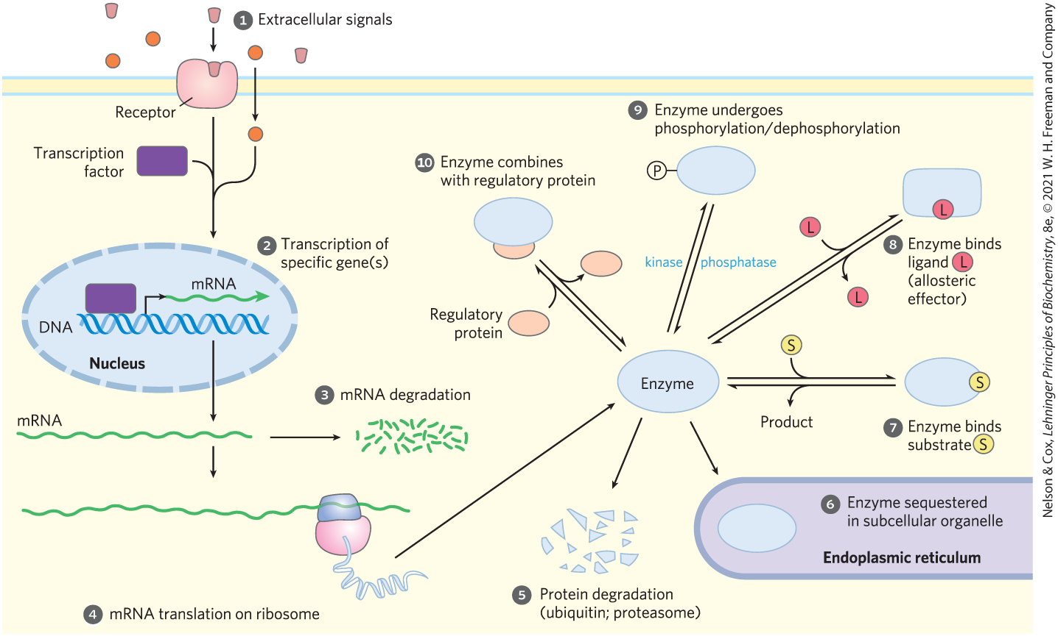
Factors Affecting Enzyme Activity

Slide 124
Extracellular Signals
extracellular signals may be:
  hormonal (insulin, epinephrine)
  neuronal (acetylcholine)
  growth factors
  cytokines

Slide 125
Transcription Factors
transcription factors = nuclear proteins that, when activated, bind specific DNA regions (response elements) near a gene’s promoter
  can activate or repress gene transcription

Slide 126
mRNA Degradation and Translation
stability of mRNA varies
  depends on their resistance to ribonuclease degradation
rate of mRNA translation is regulated

Slide 127
Principle 6 (3 of 5)
To respond to changes in external circumstances, cells must regulate enzyme activities by changing either the number of enzyme molecules or the catalytic activity of preexisting enzyme molecules.

Slide 128
Protein Degradation
turnover = synthesis followed by degradation
rapid turnover is energetically expensive, but proteins with a short half-life reach new steady-state levels faster than those with a long half-life
Table 13-8 Average Half-Life of Proteins in Mammalian Tissues
Tissue | Average half-life (days)
Liver | 0.9
Kidney | 1.7
Heart | 4.1
Brain | 4.6
Muscle | 10.7

Slide 129
Enzyme Sequestration
sequestering enzyme and its substrate in different compartments alters the effective activity of an enzyme

Slide 130
Changes in the Transcriptome Affect the Proteome and the Metabolome
changes in the transcriptome lead to changes in the proteome and, ultimately, in the metabolome of a cell or tissue
transcriptome = entire complement of mRNAs
proteome = entire complement of protein
metabolome = entire complement of low molecular weight metabolites

Slide 131
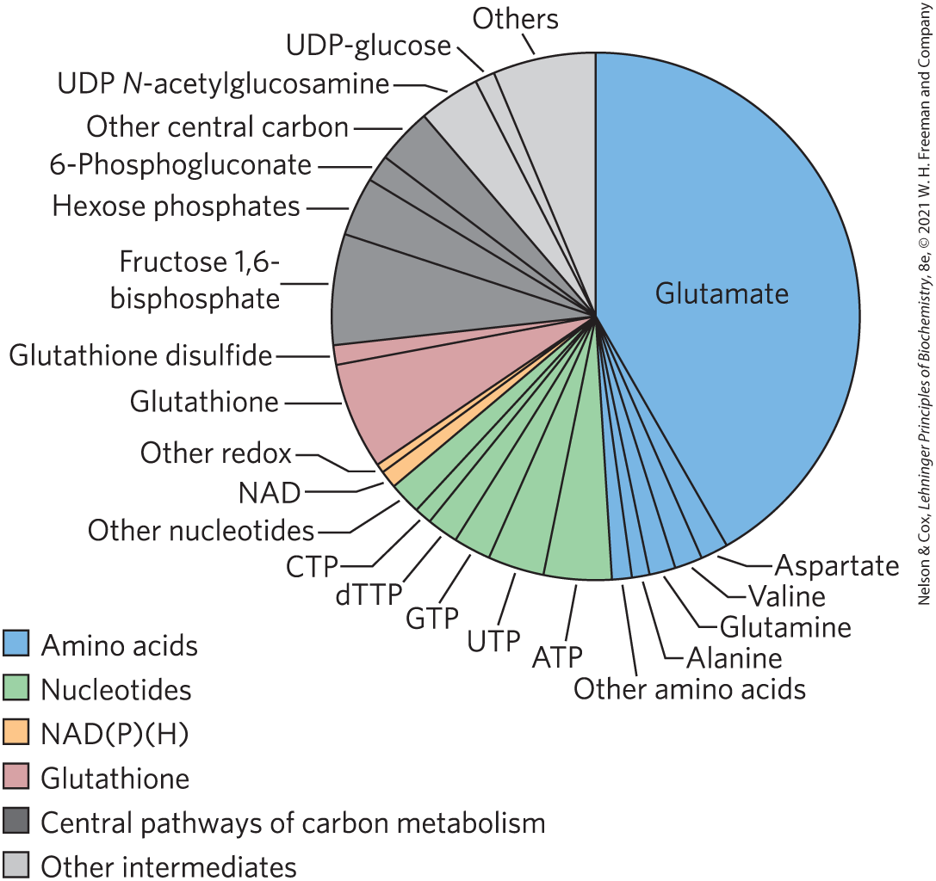
The Metabolome of E. coli Growing on Glucose

Slide 132
Regulating the Catalytic Activity of Individual Enzyme Molecules
can be regulated by:
  the concentration of substrate
  the presence of allosteric effectors
  covalent modifications
  binding of regulatory proteins

Slide 133
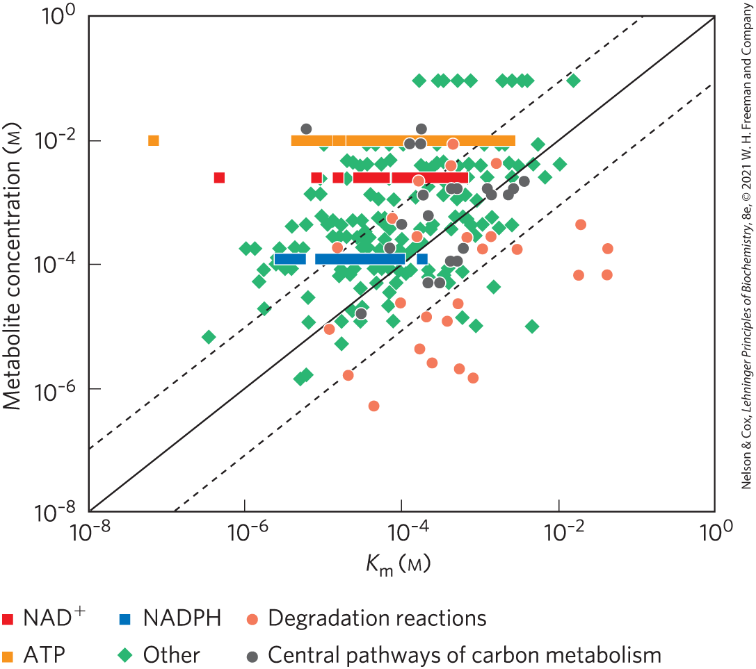
Enzymes Are Sensitive to
Substrate Concentration
for enzymes that follow Michaelis-Menten kinetics:
  the initial rate of the reaction is half-max when [S] = K_{m}
  activity drops off at lower [S]
  when [S] << K_{m}, the reaction rate is linearly dependent on [S]

Slide 134
Allosteric Effectors Can Increase or Decrease Enzyme Activity
typically convert hyperbolic kinetics to sigmoid kinetics
cooperativity of an allosteric protein can be expressed as a Hill coefficient, with higher coefficients meaning greater cooperativity
Hill coefficient (n_{H}) | Required change in [S] to increase V₀ from 10% to 90% V_{max}
0.5 | × 6,600
1.0 | × 81
2.0 | × 9
3.0 | × 4.3
4.0 | × 3
Table 13-9 Relationship between Hill Coefficient and the Effect of Substrate Concentration on Reaction Rate for Allosteric Enzymes

Slide 135

Covalent Modifications and Binding of Regulatory Proteins
covalent modifications:
  occur within seconds or minutes of a regulatory signal
  phosphorylation and dephosphorylation are most common
association with and dissociation from regulatory proteins regulates enzymes

Slide 136
Principle 6 (4 of 5)
To respond to changes in external circumstances, cells must regulate enzyme activities by changing either the number of enzyme molecules or the catalytic activity of preexisting enzyme molecules.

Slide 137
The Mechanisms for Altering Flux Are Not Mutually Exclusive
enzymes are commonly regulated at the level of transcription and by both allosteric and covalent mechanisms
allow for fast, smooth, effective regulation

Slide 138
Metabolic Regulation and
Metabolic Control
metabolic regulation = processes that serve to maintain homeostasis at the molecular level
metabolic control = processes that lead to a change in the output of a metabolic pathway over time

Slide 139

Reactions Far from Equilibrium in Cells Are Common Points of Regulation
far from equilibrium
near equilibrium

Slide 140

Mass-Action Ratio, Q
mass-action ratio, Q = [C][D]/[A][B] for the reaction A + B $⟶$ C + D
when Q and K′_{eq} are within 1 to 2 orders of magnitude of each other, the reaction is near equilibrium

Slide 141
Enzymes of Carbohydrate Metabolism
Table 13-10 Equilibrium Constants, Mass-Action Ratios, and Free-Energy Changes for Enzymes of Carbohydrate Metabolism
Enzyme | K′_{eq} | Mass-action ratio, Q: Liver | Mass-action ratio, Q: Heart | Reaction near equilibrium in vivo? | ΔG′˚ (kJ/mol) | ΔG′˚ (kJ/mol) in heart
Hexokinase | 1 ×10³ | 2 ×10⁻² | 8 ×10⁻² | No | −17 | −27
PFK-1 | 1.0 ×10³ | 9 ×10⁻² | 3 ×10⁻² | No | −14 | −23
Aldolase | 1.0 ×10⁻⁴ | 1.2 ×10⁻⁶ | 9 ×10⁻⁶ | Yes | +24 | −6.0
Triose phosphate isomerase | 4 ×10⁻² | ⸻ | 2.4 ×10⁻¹ | Yes | +7.5 | +3.8
Glyceraldehyde 3-phosphate dehydrogenase + phosphoglycerate kinase | 2 ×10³ | 6 ×10² | 9.0 | Yes | −13 | +3.5
Phosphoglycerate mutase | 1 ×10⁻¹ | 1 ×10⁻¹ | 1.2 ×10⁻¹ | Yes | +4.4 | +0.6
Enolase | 3 | 2.9 | 1.4 | Yes | −3.2 | −0.5
Pyruvate kinase | 2 ×10⁴ | 7 ×10⁻¹ | 40 | No | −31 | −17
Phosphohexose isomerase | 4 ×10⁻¹ | 3.1 ×10⁻¹ | 2.4 ×10⁻¹ | Yes | +2.2 | −1.4
Pyruvate carboxylase + PEP carboxykinase | 7 | 1 ×10⁻³ | ⸻ | No | −5.0 | −23
Glucose 6-phosphatase | 8.5 ×10² | 1.2 ×10² | ⸻ | Yes | −17 | −5.0

Slide 142

Adenine Nucleotides Play Special Roles in Metabolic Regulation
if [ATP] were to drop, enzymes would be less than fully saturated by their substrate (ATP), and the reaction rates would decrease

Slide 143
Principle 6 (5 of 5)
To respond to changes in external circumstances, cells must regulate enzyme activities by changing either the number of enzyme molecules or the catalytic activity of preexisting enzyme molecules.

Slide 144

Adenylate Kinase and AMP-Activated Protein Kinase (AMPK)
adenylate kinase = catalyzes the production of AMP in the reaction 2ADP $⟶$ AMP + ATP
AMP-activated protein kinase (AMPK) = responds to a decrease in the [ATP]/[AMP] ratio by phosphorylating key proteins and regulating their activities

