Slide 1

11 Biological Membranes and Transport
© 2021 Macmillan Learning

Slide 2

Principle 1 (1 of 3)
The biological membrane is a lipid bilayer with proteins of various functions (enzymes, transporters) embedded in or associated with the bilayer. The hydrophobic effect stabilizes structures (lipid bilayers and vesicles) in which lipids with some polar and some nonpolar regions can protect their nonpolar regions from interaction with the very polar solvent, water. Membrane proteins are associated with the lipid bilayer more or less tightly, and proteins and lipids are both allowed limited lateral motion in the plane of the bilayer.

Slide 3

Principle 2 (1 of 8)
All of the internal membranes of cells are part of an interconnected, functionally specialized, and dynamic endomembrane system. Proteins and lipids synthesized in the endoplasmic reticulum move through the Golgi apparatus, and they are targeted to the membranes of organelles or to the plasma membrane, where they provide the essential properties of these structures. During this membrane trafficking, some proteins are covalently altered, and some lipids are segregated into different organelles or are concentrated in one of the bilayer leaflets. Rafts are functionally specialized regions with unique lipid and protein compositions.

Slide 4

Principle 3 (1 of 11)
Although the lipid bilayer is impermeable to charged or polar solutes, cells of all kinds have many membrane transporters and
ion channels that catalyze transmembrane movement of specific solutes. Some transporters merely speed the movement of solutes in the direction that simple diffusion takes them, whereas others use an energy source to move solutes against a concentration gradient.

Slide 5
11.1 The Composition and Architecture of Membranes

Slide 6
The Lipid Bilayer Is Stable in Water
glycerophospholipids, sphingolipids, and sterols:
  virtually insoluble in water
  spontaneously form microscopic lipid aggregates when mixed with water
hydrophobic interactions = the clustering of hydrophobic molecule surfaces in an aqueous environment to find the lowest-energy environment by reducing the hydrophobic surface area exposed to water

Slide 7
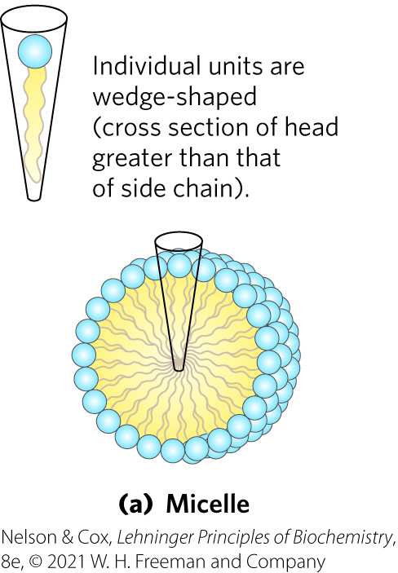
Micelle Formation
micelles = spherical structures containing amphipathic molecules arranged with hydrophobic regions in the interior and hydrophilic head groups on the exterior
  favored when the cross-sectional area of the head group is greater than that of the acyl side chain(s)

Slide 8
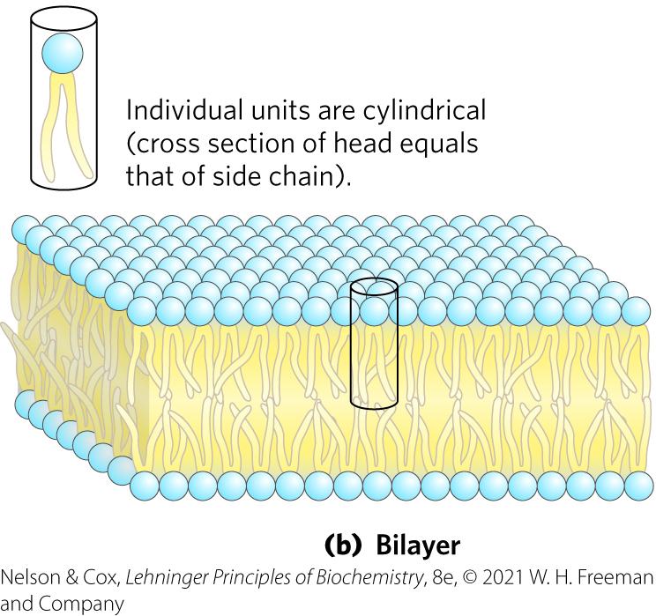
Bilayer Formation
bilayer = lipid aggregate in which two lipid monolayers (leaflets) form a two-dimensional sheet
  favored when the cross-sectional areas of the head group and acyl side chain(s) are similar

Slide 9
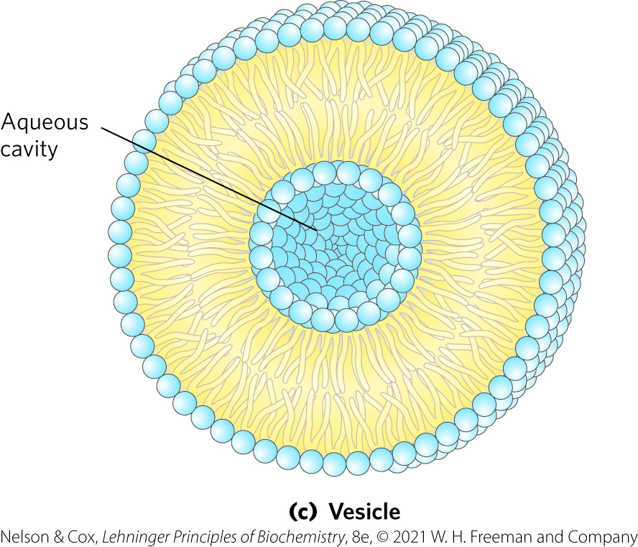
Vesicle Formation
vesicle (liposome) = forms spontaneously when a bilayer sheet folds back on itself to form a hollow sphere

Slide 10
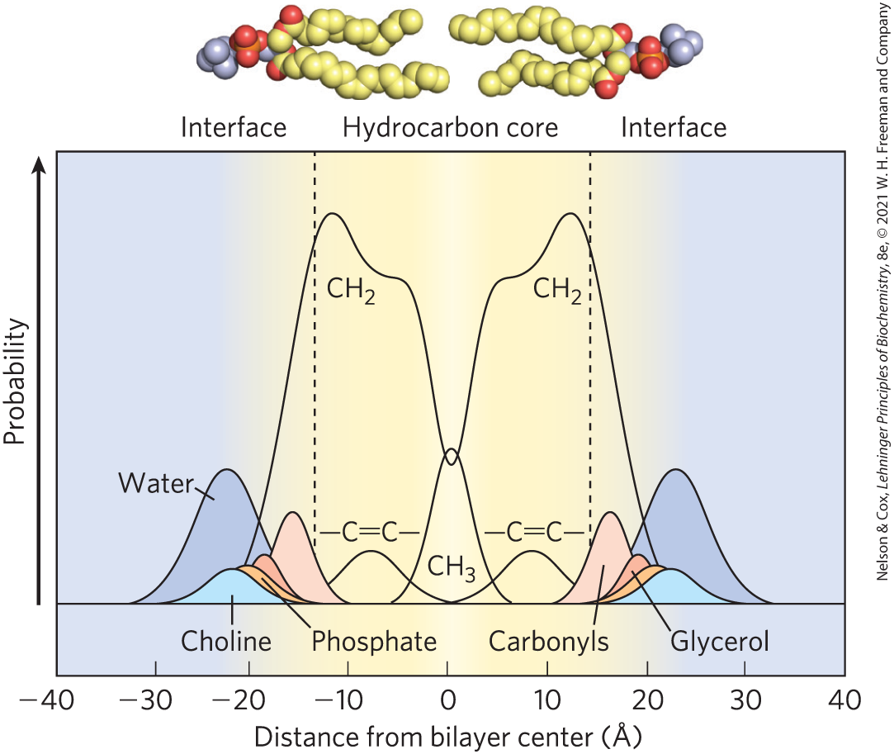
Distribution of Membrane Lipids in an Artificial Membrane
hydrocarbon core of the bilayer = ~30 Å
biological membranes (including protruding proteins) = ~50 – 80 Å

Slide 11
Principle 1 (2 of 3)
The biological membrane is a lipid bilayer with proteins of various functions (enzymes, transporters) embedded in or associated with the bilayer. The hydrophobic effect stabilizes structures (lipid bilayers and vesicles) in which lipids with some polar and some nonpolar regions can protect their nonpolar regions from interaction with the very polar solvent, water. Membrane proteins are associated with the lipid bilayer more or less tightly, and proteins and lipids are both allowed limited lateral motion in the plane of the bilayer.

Slide 12
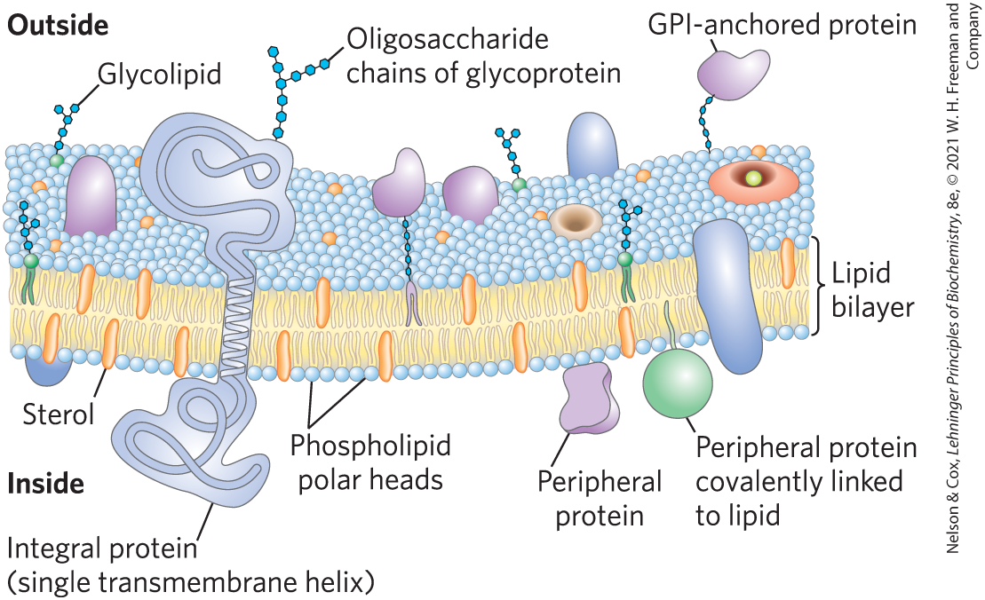
Bilayer Architecture Underlies the Structure and Function of Biological Membranes
fluid mosaic = pattern formed by individual lipid and protein units in a membrane
  pattern can change while maintaining the permeability membrane

Slide 13
Functions of Biological Membranes
permit shape changes that accompany cell growth and movement
permit exocytosis, endocytosis, and cell division
serve as molecular gatekeepers

Slide 14
Proteins and Enzymes In and On Membranes
transporters = move specific organic solutes and inorganic ions across the membrane
receptors = sense extracellular signals and trigger molecular changes in the cell
ion channels = mediate electrical signaling between cells
adhesion molecules = hold neighboring cells together

Slide 15
Principle 2 (2 of 8)
All of the internal membranes of cells are part of an interconnected, functionally specialized, and dynamic endomembrane system. Proteins and lipids synthesized in the endoplasmic reticulum move through the Golgi apparatus, and they are targeted to the membranes of organelles or to the plasma membrane, where they provide the essential properties of these structures. During this membrane trafficking, some proteins are covalently altered, and some lipids are segregated into different organelles or are concentrated in one of the bilayer leaflets. Rafts are functionally specialized regions with unique lipid and protein compositions.

Slide 16
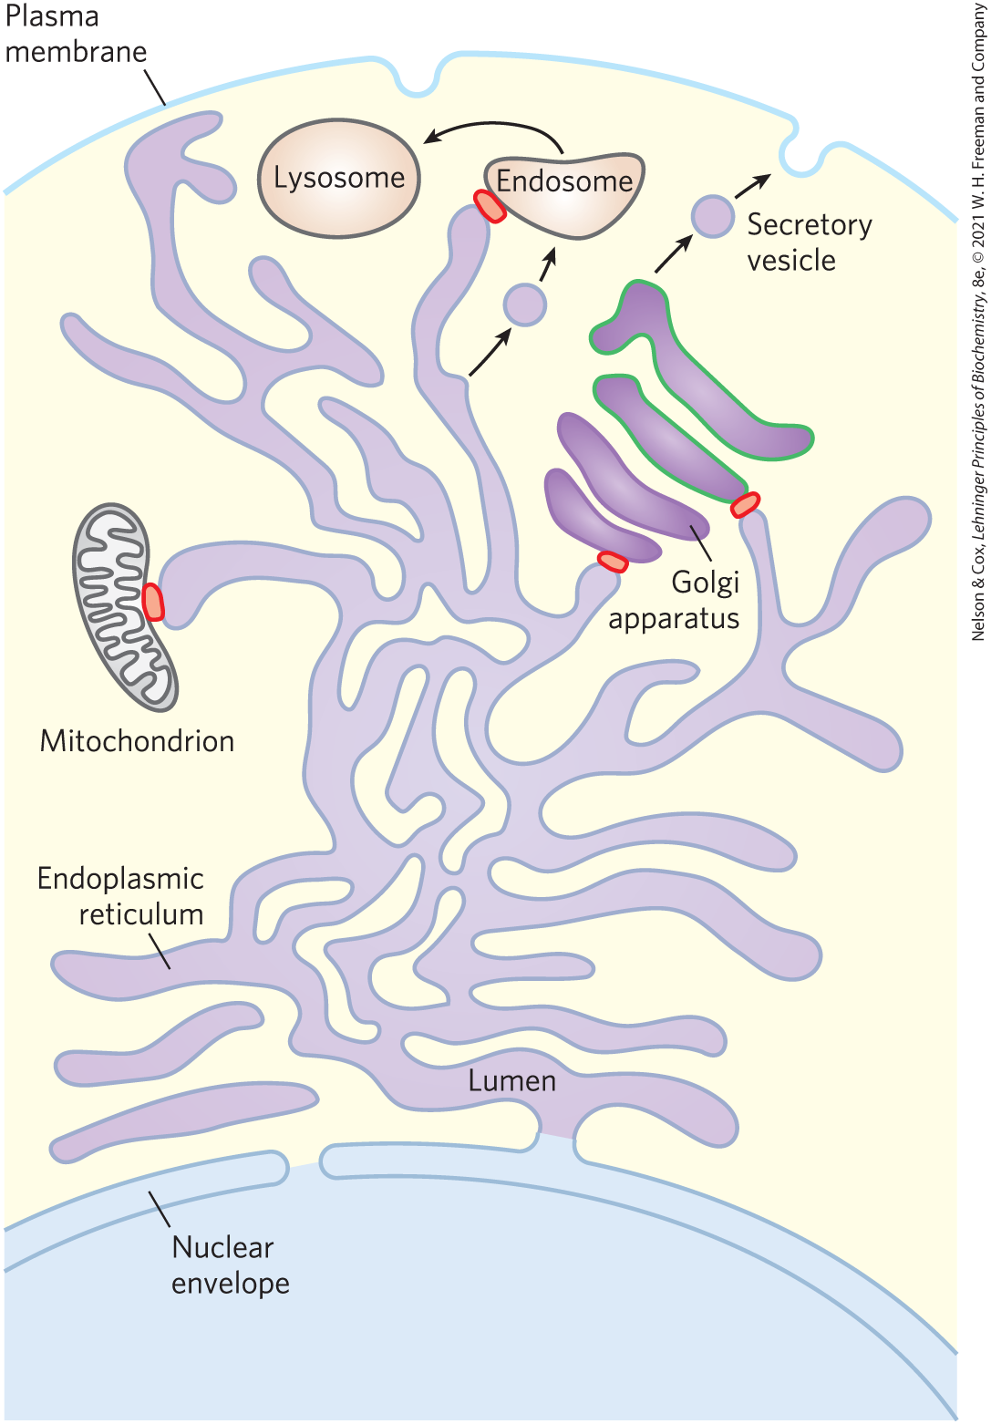
The Endomembrane System Is Dynamic and Functionally Differentiated
single membrane surrounds:
  endoplasmic reticulum (ER)
  Golgi apparatus
  lysosomes
  various small vesicles
double membrane surrounds:
  nucleus
  mitochondrion
  chloroplasts (in plants)

Slide 17
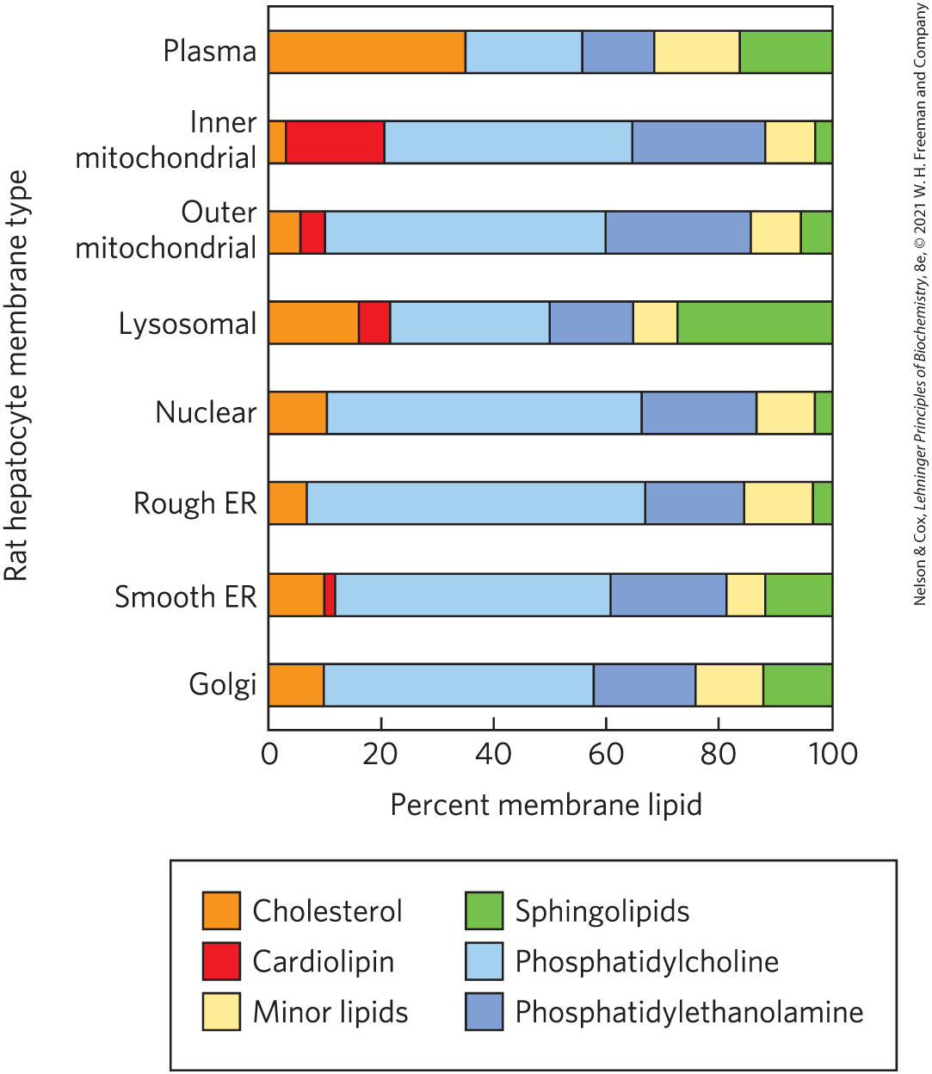
Lipid Composition of the Plasma and Organelle Membranes
the functional specialization of each membrane type is reflected in its unique lipid composition

Slide 18
Membrane Trafficking
membrane trafficking = process by which membrane lipids and proteins that are synthesized in the ER move to their destination organelles or to the plasma membrane
lipids and proteins undergo covalent modifications in the Golgi apparatus
  dictates the eventual location of the mature protein

Slide 19
Principle 2 (3 of 8)
All of the internal membranes of cells are part of an interconnected, functionally specialized, and dynamic endomembrane system. Proteins and lipids synthesized in the endoplasmic reticulum move through the Golgi apparatus, and they are targeted to the membranes of organelles or to the plasma membrane, where they provide the essential properties of these structures. During this membrane trafficking, some proteins are covalently altered, and some lipids are segregated into different organelles or are concentrated in one of the bilayer leaflets. Rafts are functionally specialized regions with unique lipid and protein compositions.

Slide 20
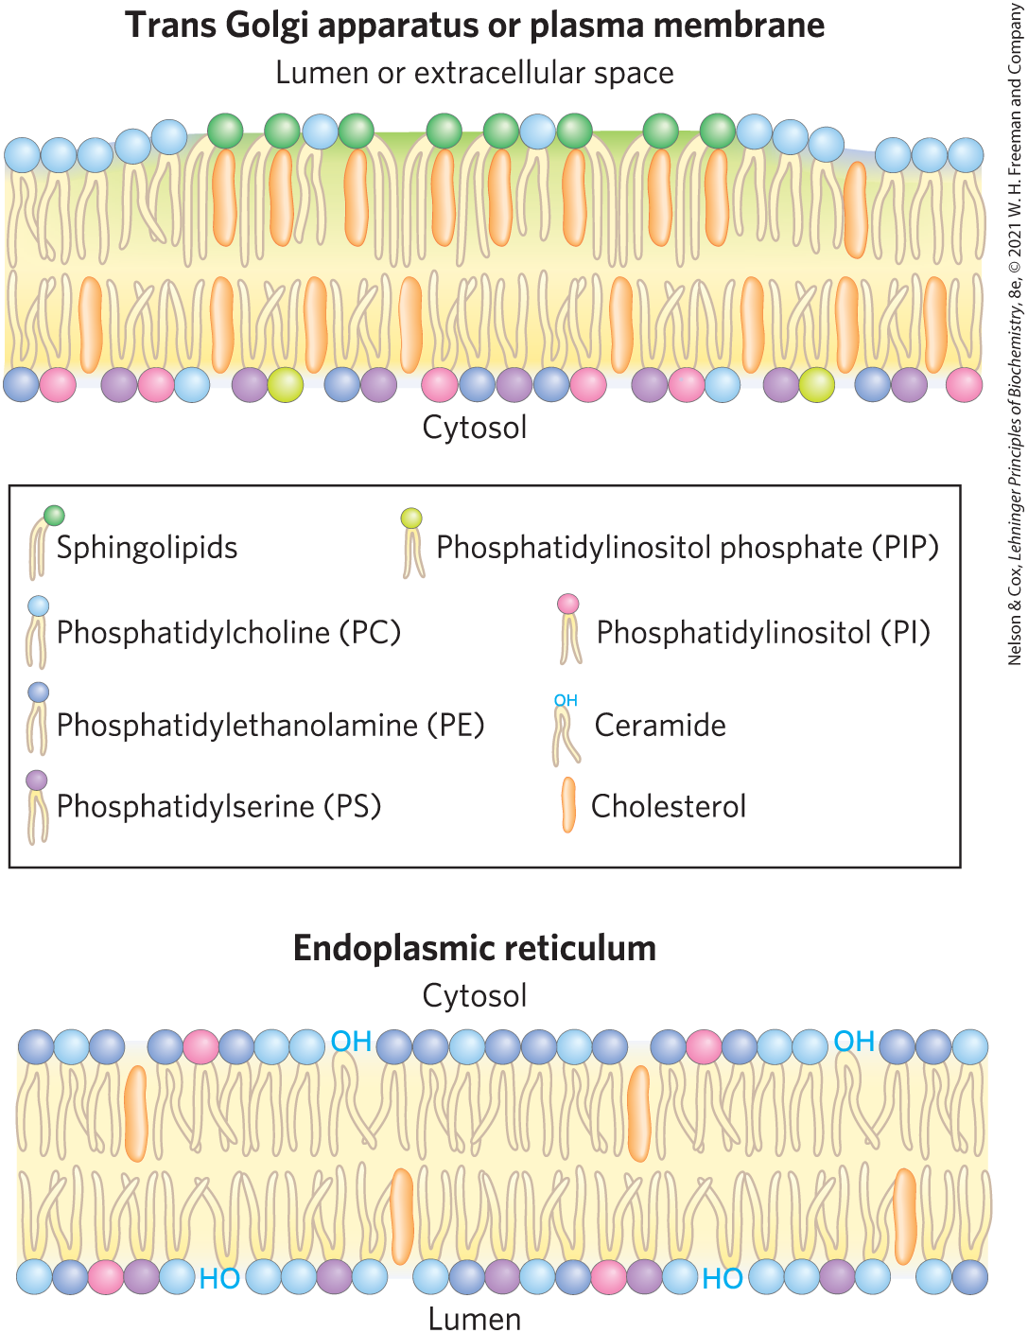
Changes in Lipid Composition During Membrane Trafficking
sphingolipids and cholesterol largely replace phosphatidylcholine
plasma membrane lipids are asymmetrically distributed between the two leaflets of the bilayer

Slide 21
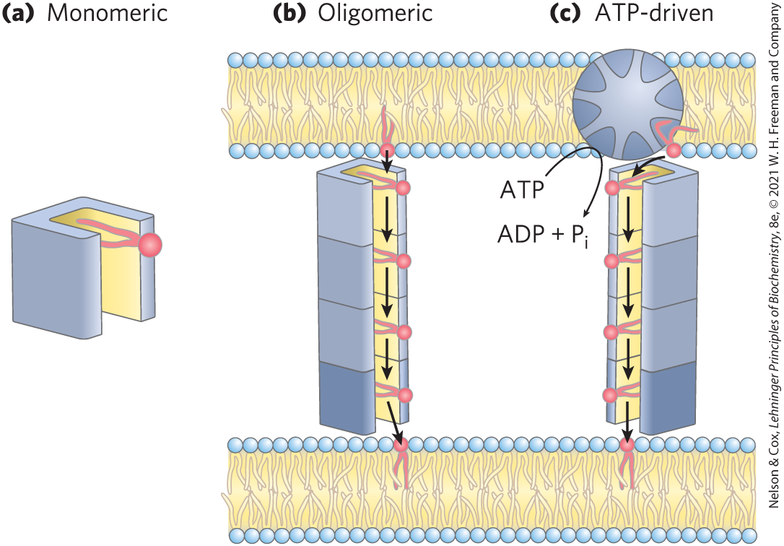
Lipid Transfer Proteins (LTPs)
lipid transfer proteins (LTPs) = soluble proteins that contain a hydrophobic lipid-binding pocket to carry a lipid from one membrane to another
  can be bispecific

Slide 22
Principle 2 (4 of 8)
All of the internal membranes of cells are part of an interconnected, functionally specialized, and dynamic endomembrane system. Proteins and lipids synthesized in the endoplasmic reticulum move through the Golgi apparatus, and they are targeted to the membranes of organelles or to the plasma membrane, where they provide the essential properties of these structures. During this membrane trafficking, some proteins are covalently altered, and some lipids are segregated into different organelles or are concentrated in one of the bilayer leaflets. Rafts are functionally specialized regions with unique lipid and protein compositions.

Slide 23
Membrane Proteins Are Receptors, Transporters, and Enzymes
groups of membrane proteins:
  receptors for extracellular signals
  transporters to carry specific polar or charged compounds across the plasma membrane or between organelles
  enzymes

Slide 24
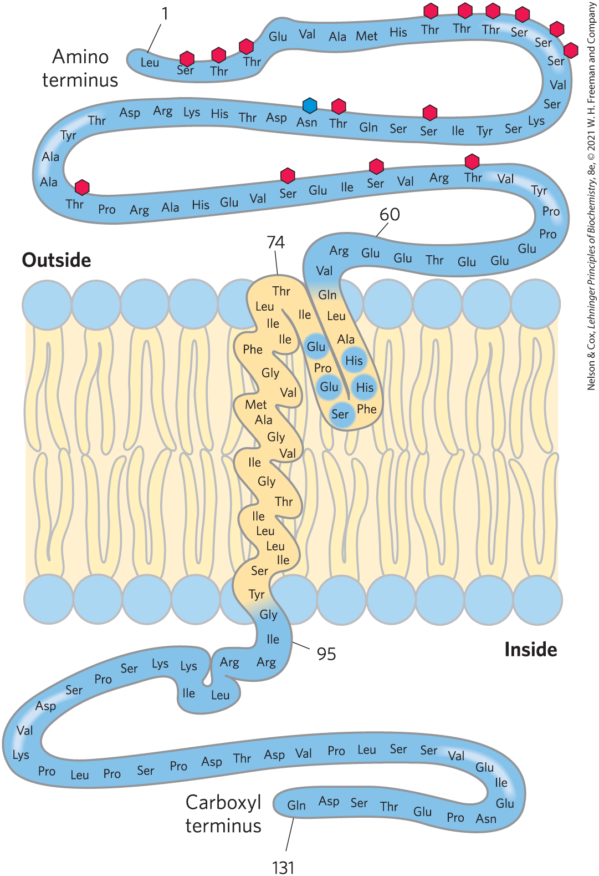
Posttranslational Modification of Membrane Proteins
glycosylation = attachment of oligosaccharides to proteins
  typically on the outer face of the plasma membrane
attachment of 1+ lipids = serve as hydrophobic anchors or targeting tags

Slide 25
Membrane Proteins Differ in the Nature of Their Association with the Membrane Bilayer
integral membrane proteins = firmly embedded within the lipid bilayer
peripheral membrane proteins = associate with the membrane through electrostatic interactions and hydrogen bonding
amphitropic proteins = associate reversibly with membranes
  found in both membranes and the cytosol

Slide 26
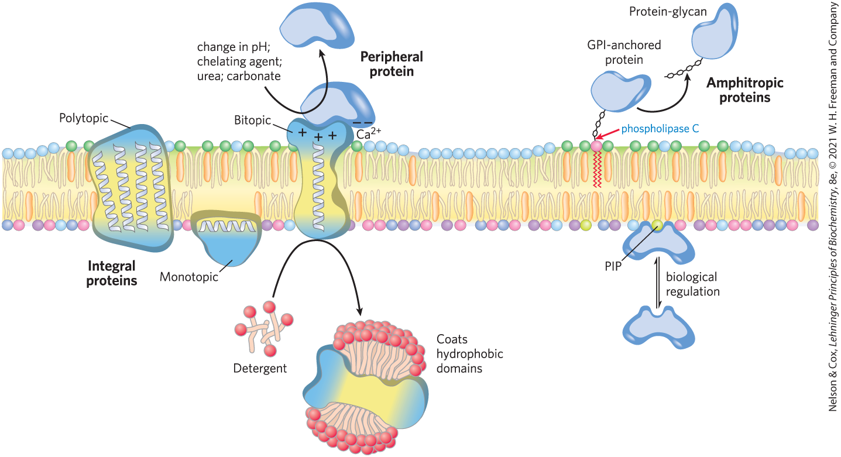
Integral, Peripheral, and Amphitropic Proteins

Slide 27
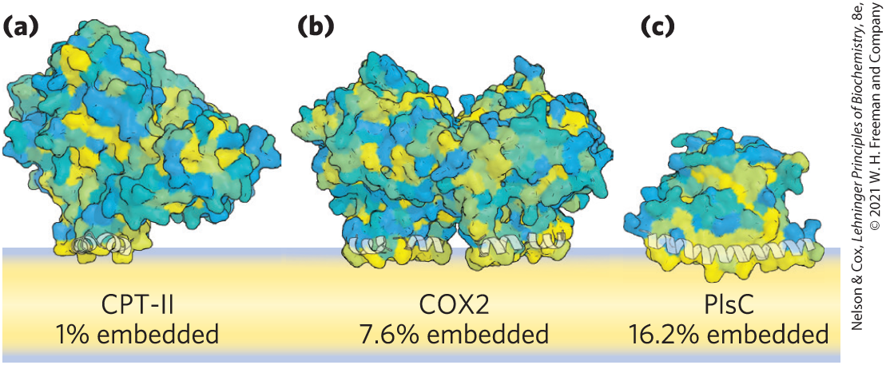
Monotopic Proteins
monotopic = have small hydrophobic domains that interact with only a single leaflet of the membrane

Slide 28
Bitopic Proteins
bitopic = span the bilayer once, extending on either surface
  have a single hydrophobic sequence somewhere in the molecule

Slide 29
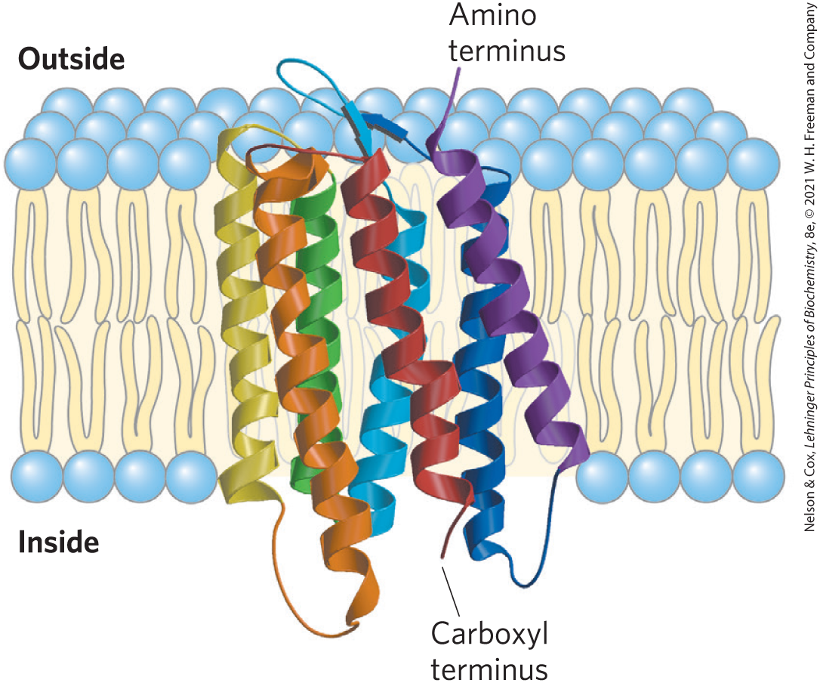
Polytopic Proteins
polytopic = cross the membrane several times
  have multiple hydrophobic sequences of ~20 residues that each cross the membrane when in the α-helical conformation
bacteriorhodopsin

Slide 30
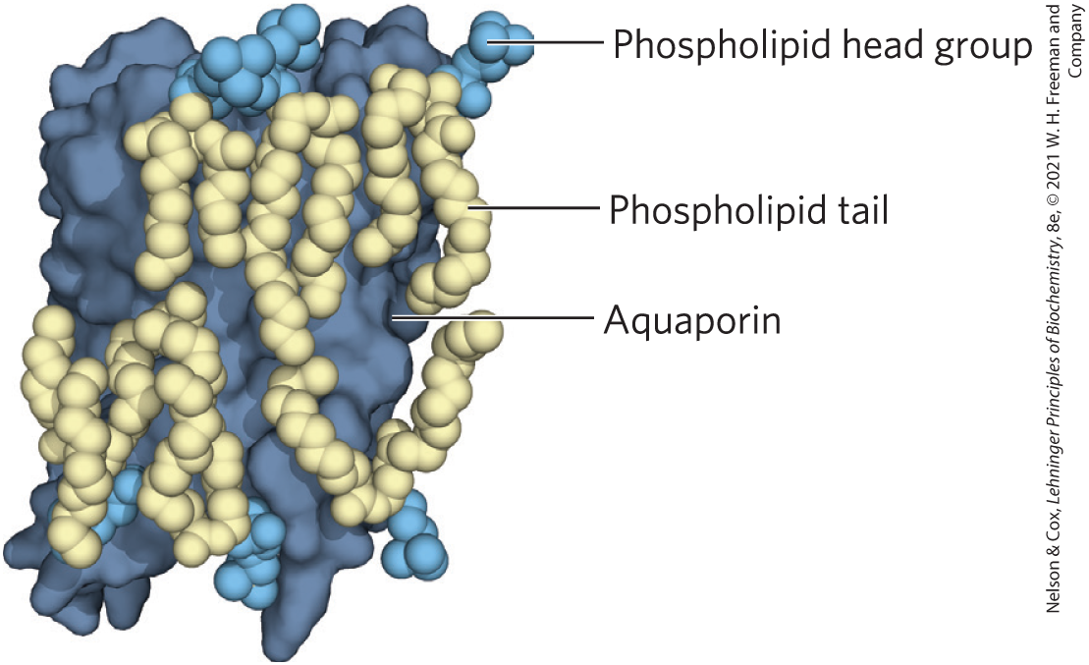
Many Membrane Proteins Co-Crystallize with Phospholipid Molecules
phospholipids lie:
  on the protein surface
  at interfaces between monomers of multisubunit proteins, forming a “grease seal”

Slide 31
The Topology of an Integral Membrane Protein Can Often Be Predicted from Its Sequence
an α-helical sequence of 20-25 residues (each 1.5 Å) is just long enough to span the thickness (30 Å) of the lipid bilayer
  stabilized by intrachain hydrogen bonding and the hydrophobic effect
in many organisms, 20-30% of proteins are integral proteins

Slide 32
Hydropathy Index
hydropathy index = expresses the free-energy change associated with the movement of an amino acid side chain from a hydrophobic environment to water
  ranges from highly exergonic to highly endergonic
overall hydropathy index = estimated by summing the free energies of transfer for the residues in the sequence

Slide 33
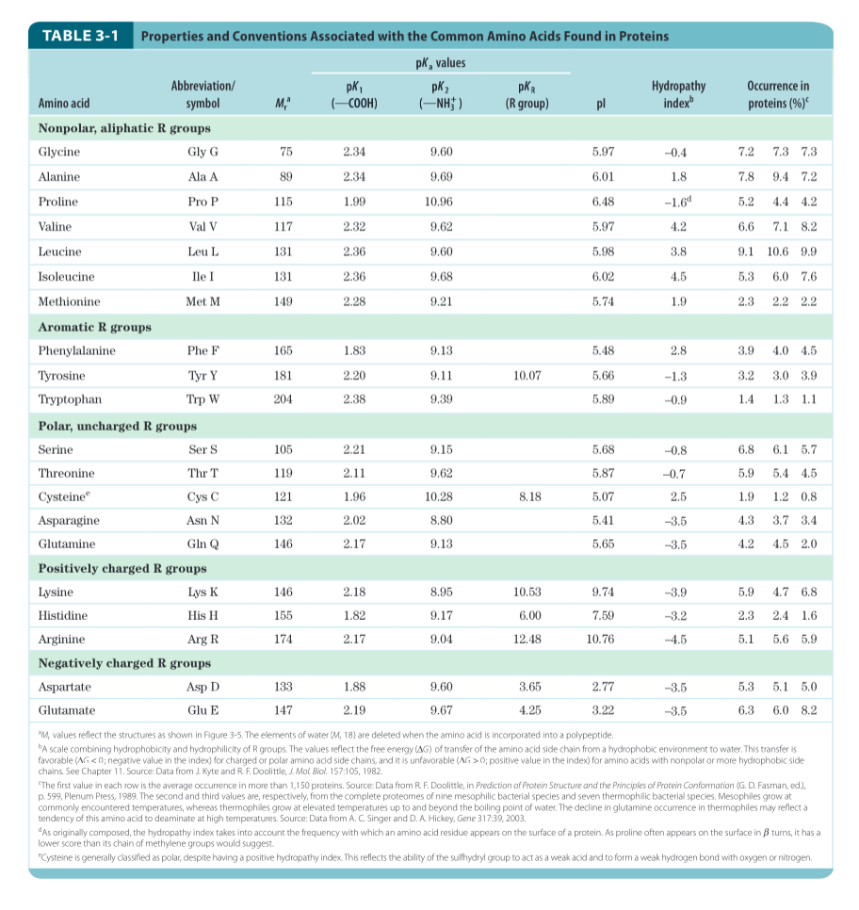
Hydropathy Index for the 20 Common Amino Acids

Slide 34
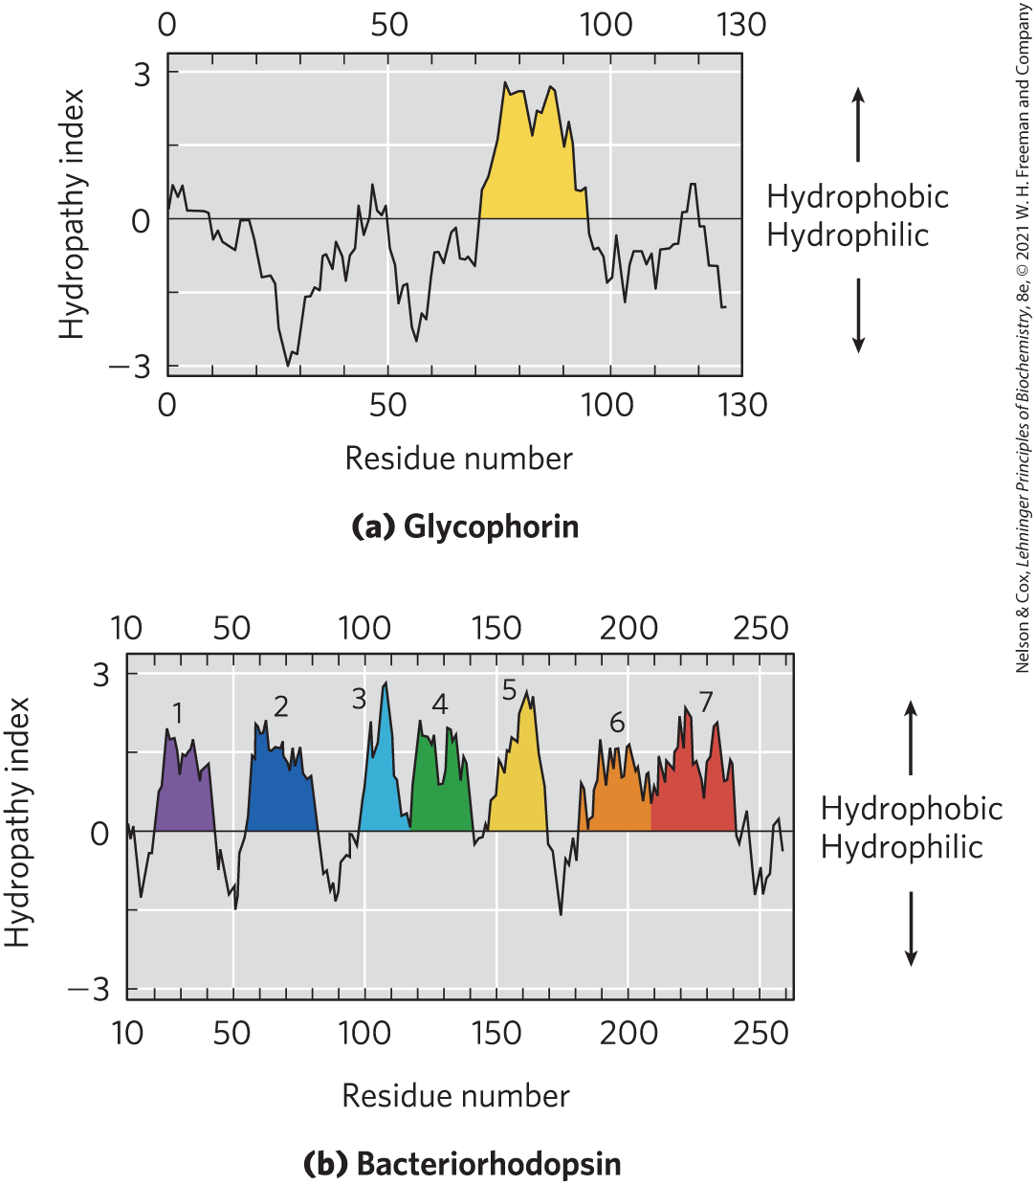
Hydropathy Plots
hydropathy plot = average hydropathy index plotted against residue number
  window = segment of given length
  hydropathy index (y-axis) = average hydropathy for a window
  residue number (x-axis) = the residue in the middle of the window

Slide 35
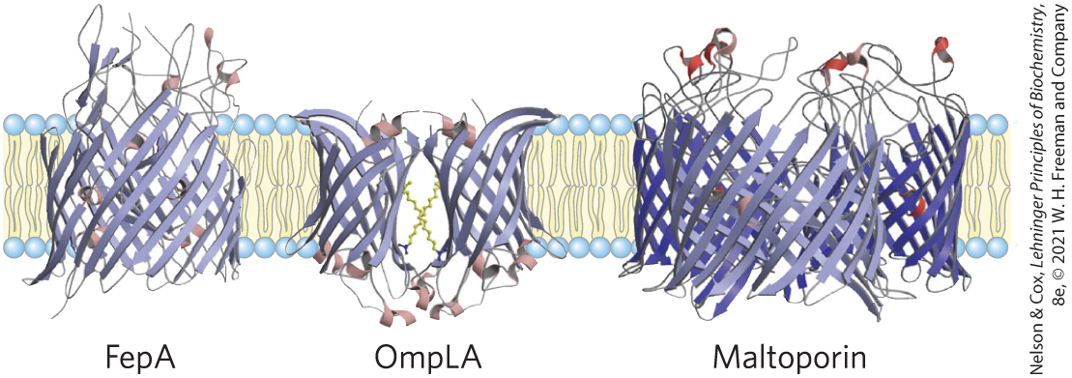
β Barrel
β barrel = structural motif in which 20+ transmembrane segments form β sheets that line a cylinder
  stabilized by intrachain hydrogen bonds
porins = proteins that allow certain polar solutes to cross the outer membrane of gram-negative bacteria
  have β barrels lining the transmembrane passage

Slide 36
β Strands of Membrane Proteins
in β conformation:
  seven to nine residues are needed to span a membrane
  alternating side chains project above and below the sheet
in β strands of membrane proteins:
  every second residue in the membrane-spanning segment is hydrophobic and interacts with the lipid bilayer
  aromatic side chains are commonly found at the lipid-protein interface

Slide 37
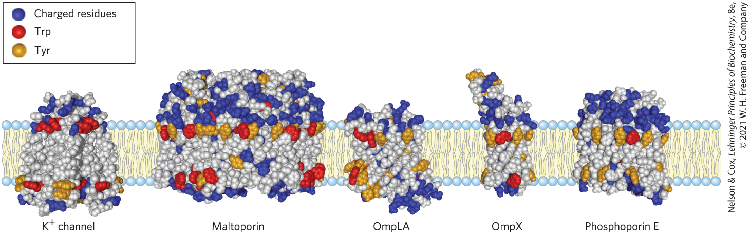
Amino Acid Locations Relative to the Bilayer
Tyr and Trp side chains serve as membrane interface anchors
positive-inside rule = positively charged Lys and Arg residues in the extramembrane loop of membrane proteins occur more commonly on the cytoplasmic face

Slide 38
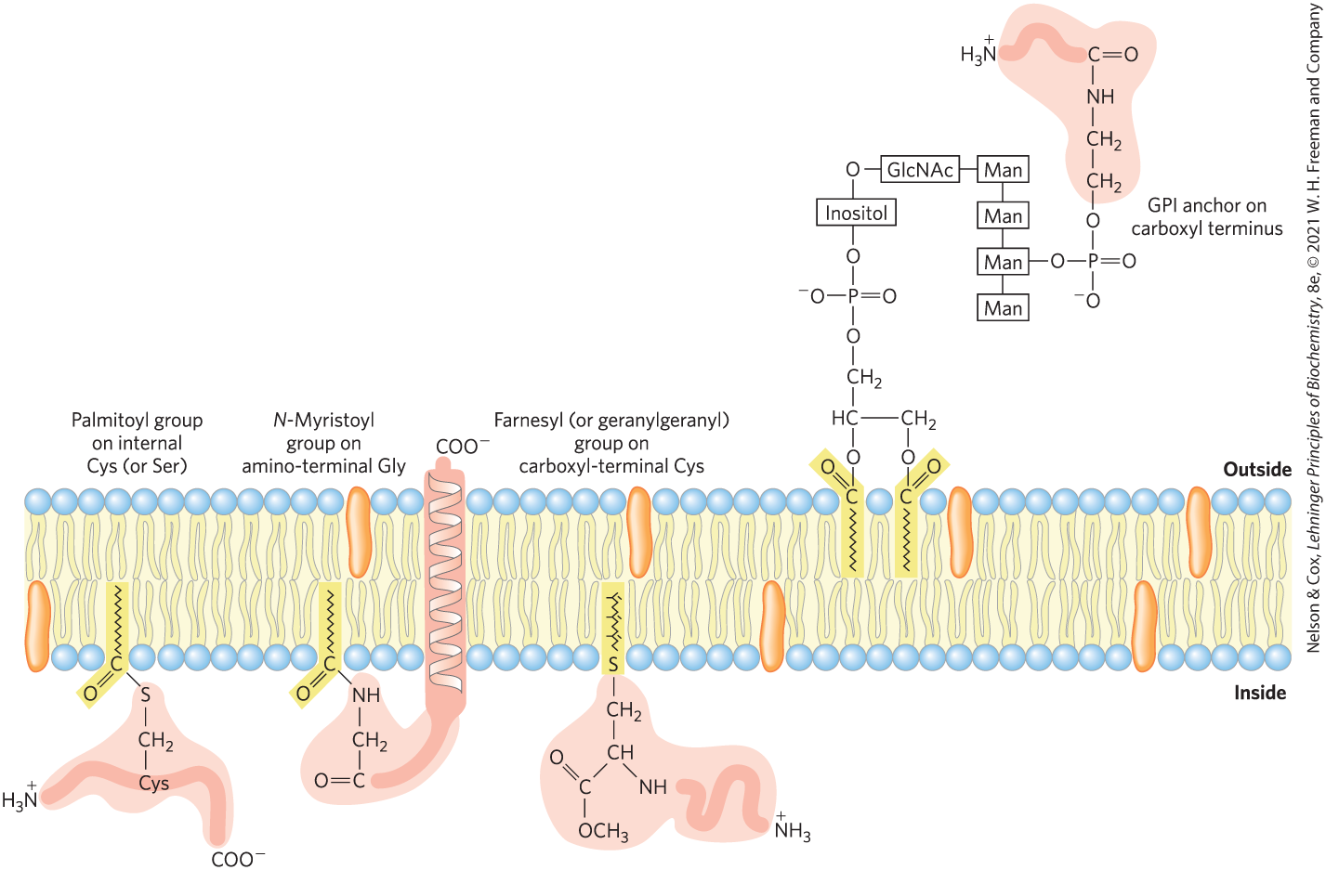
Covalently Attached Lipids Anchor or Direct Some Membrane Proteins
GPI-anchored protein = exclusively on the outer face and are clustered in certain regions

Slide 39
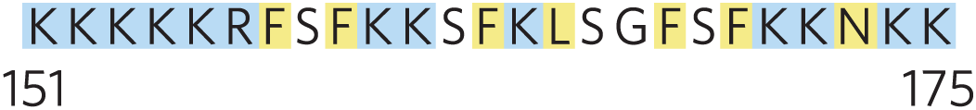
Ionic Attractions Can Add to the Anchoring Effect of a Covalently Bound Lipid
ionic attractions between positively charged residues in the protein and negatively charged lipid head groups add to the protein’s affinity for the membrane
  example: the plasma membrane protein MARCKS (myristoylated alanine-rich C-kinase substrate)

Slide 40
11.2 Membrane Dynamics

Slide 41
Principle 1 (3 of 3)
The biological membrane is a lipid bilayer with proteins of various functions (enzymes, transporters) embedded in or associated with the bilayer. The hydrophobic effect stabilizes structures (lipid bilayers and vesicles) in which lipids with some polar and some nonpolar regions can protect their nonpolar regions from interaction with the very polar solvent, water. Membrane proteins are associated with the lipid bilayer more or less tightly, and proteins and lipids are both allowed limited lateral motion in the plane of the bilayer.

Slide 42
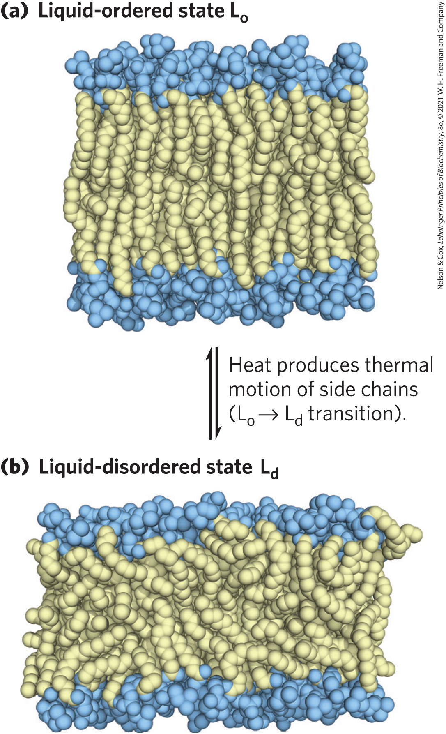
Acyl Groups in the Bilayer Interior Are Ordered to Varying Degrees
liquid-ordered (L_{o}) state = gel-like state in which all types of motion of individual molecules are strongly constrained
liquid-disordered (L_{d}) state = state in which individual hydrocarbon chains are in constant motion (lateral and rotational)

Slide 43
Fatty Acid Composition Affects Membrane Fluidity
at physiological temperatures:
  long-chain saturated fatty acids tend to pack into an L_{o} phase
  kinks in unsaturated fatty acids interfere with packing, favoring the L_{d} state
  shorter-chain fatty acyl groups favor the L_{d} state

Slide 44
Sterol Content Affects Membrane Fluidity
sterols have paradoxical effects on bilayer fluidity:
  they interact with phospholipids containing unsaturated fatty acyl chains, compacting them and constraining their motion
  they associate with sphingolipids and phospholipids having long, saturated fatty acyl chains, making the bilayer fluid

Slide 45
Principle 2 (5 of 8)
All of the internal membranes of cells are part of an interconnected, functionally specialized, and dynamic endomembrane system. Proteins and lipids synthesized in the endoplasmic reticulum move through the Golgi apparatus, and they are targeted to the membranes of organelles or to the plasma membrane, where they provide the essential properties of these structures. During this membrane trafficking, some proteins are covalently altered, and some lipids are segregated into different organelles or are concentrated in one of the bilayer leaflets. Rafts are functionally specialized regions with unique lipid and protein compositions.

Slide 46
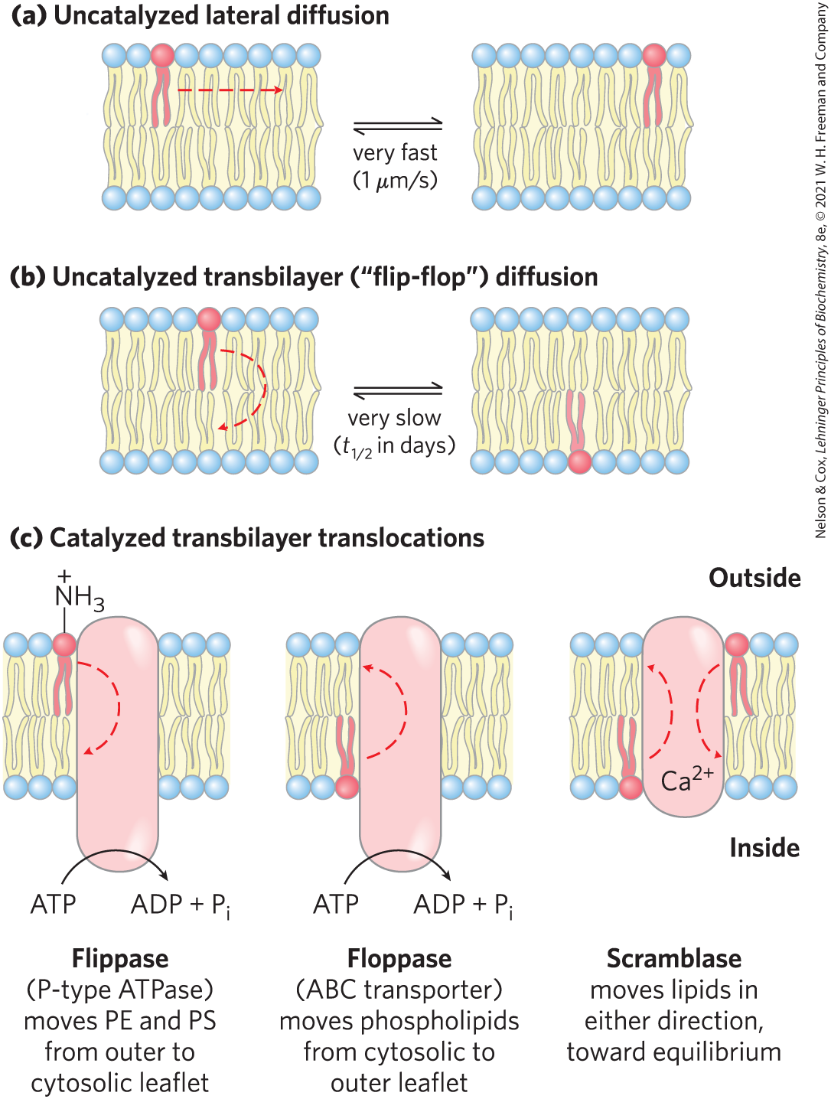
Transbilayer Movement of Lipids Requires Catalysis
transbilayer (“flip-flop”) movement has a large, positive free-energy change
membrane proteins facilitate the translocation of individual lipid molecules

Slide 47
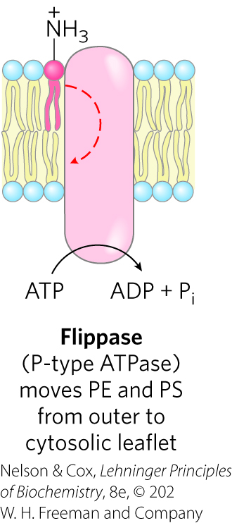
Flippases
flippases = catalyze translocation of the amino- phospholipids phosphatidylethanolamine (PE) and phosphatidylserine (PS) from the extracellular to the cytoplasmic leaflet of the plasma membrane
  consume ~1 ATP per molecule of phospholipid translocated
  related to the P-type ATPases (active transporters)

Slide 48
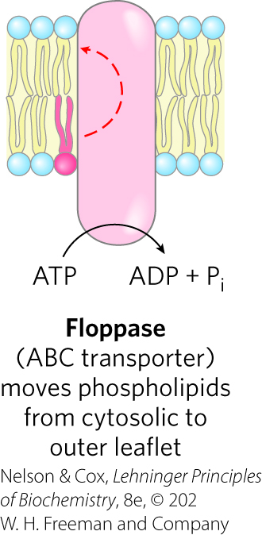
Floppases
floppases = move plasma membrane phospholipids and sterols from the cytoplasmic leaflet to the extracellular leaflet
  are ATP-dependent
  members of the ABC transporter family
  each specializes in movement of specific lipids

Slide 49
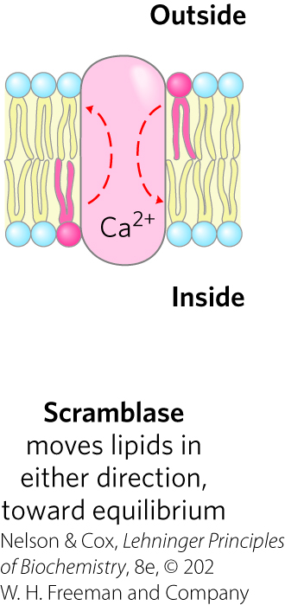
Scramblases
scramblases = move any membrane phospholipid across the bilayer down its concentration gradient
  not dependent on ATP; some require Ca²⁺
  lead to controlled randomization of the head-group composition on the two faces of the bilayer

Slide 50
Phosphatidylinositol Transfer Proteins
phosphatidylinositol transfer proteins = move phosphatidylinositol lipids across lipid bilayers
  believed to have roles in lipid signaling and membrane trafficking

Slide 51
Principle 2 (6 of 8)
All of the internal membranes of cells are part of an interconnected, functionally specialized, and dynamic endomembrane system. Proteins and lipids synthesized in the endoplasmic reticulum move through the Golgi apparatus, and they are targeted to the membranes of organelles or to the plasma membrane, where they provide the essential properties of these structures. During this membrane trafficking, some proteins are covalently altered, and some lipids are segregated into different organelles or are concentrated in one of the bilayer leaflets. Rafts are functionally specialized regions with unique lipid and protein compositions.

Slide 52
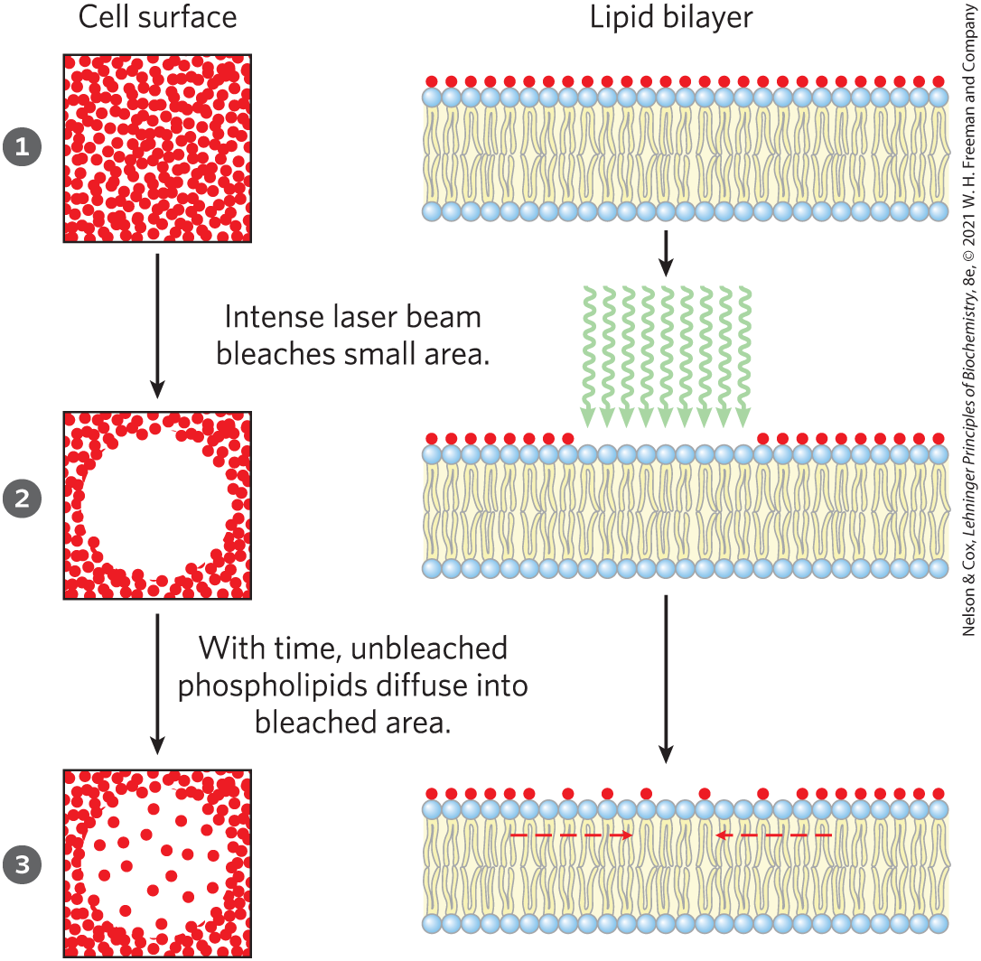
Lipids and Proteins Diffuse Laterally in the Bilayer
individual lipid molecules undergo Brownian movement
FRAP = fluorescence recovery after photobleaching
  rate is a measure of the rate of lateral diffusion of the lipids

Slide 53
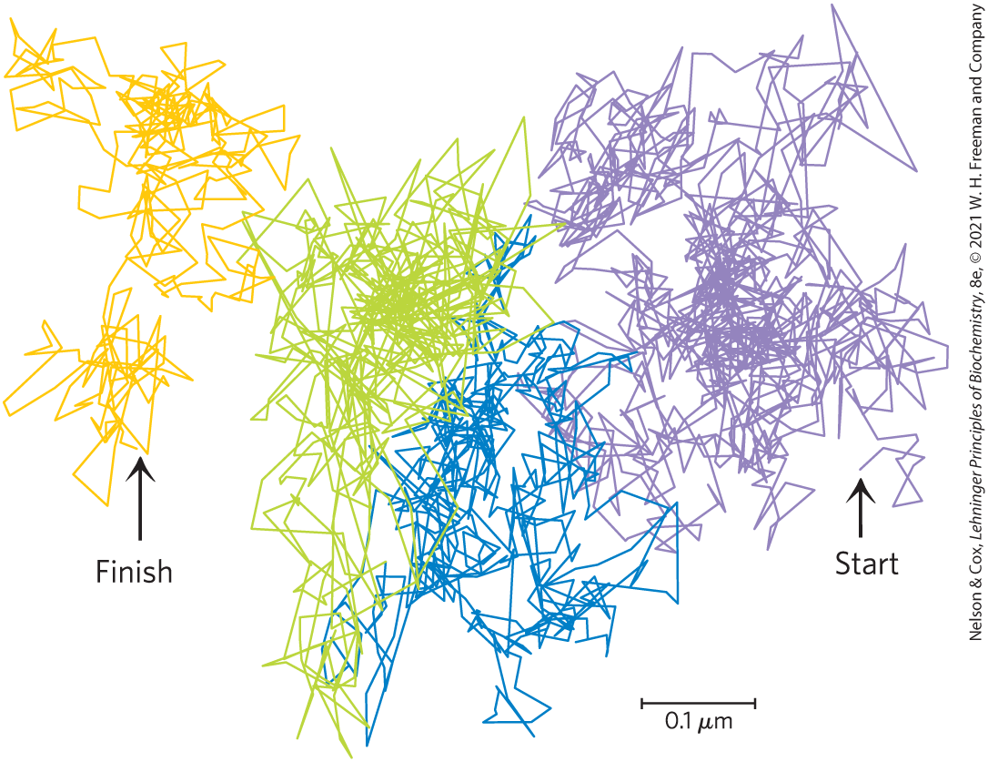
Hop Diffusion of Individual Lipid Molecules
single particle tracking confirms lipid molecules diffuse laterally within small regions
movement from one region to another (“hop diffusion”) is rarer

Slide 54
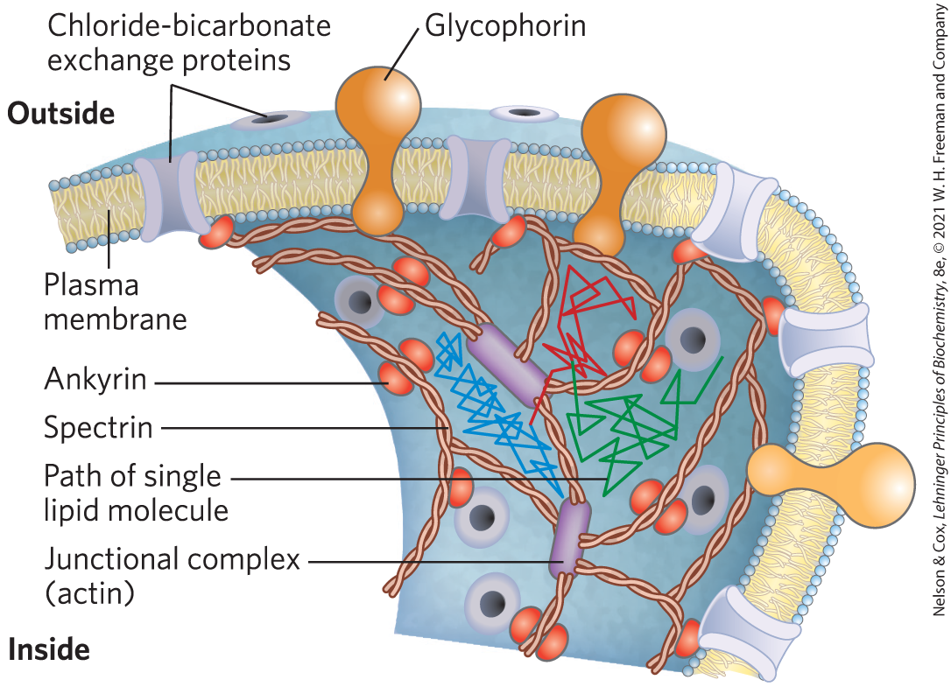
Some Membrane Proteins Are Free to Diffuse, Whereas Others Are Not
membrane proteins are limited in movement by:
  associating to form large aggregates (“patches”)
  anchoring to internal structures

Slide 55
Principle 2 (7 of 8)
All of the internal membranes of cells are part of an interconnected, functionally specialized, and dynamic endomembrane system. Proteins and lipids synthesized in the endoplasmic reticulum move through the Golgi apparatus, and they are targeted to the membranes of organelles or to the plasma membrane, where they provide the essential properties of these structures. During this membrane trafficking, some proteins are covalently altered, and some lipids are segregated into different organelles or are concentrated in one of the bilayer leaflets. Rafts are functionally specialized regions with unique lipid and protein compositions.

Slide 56
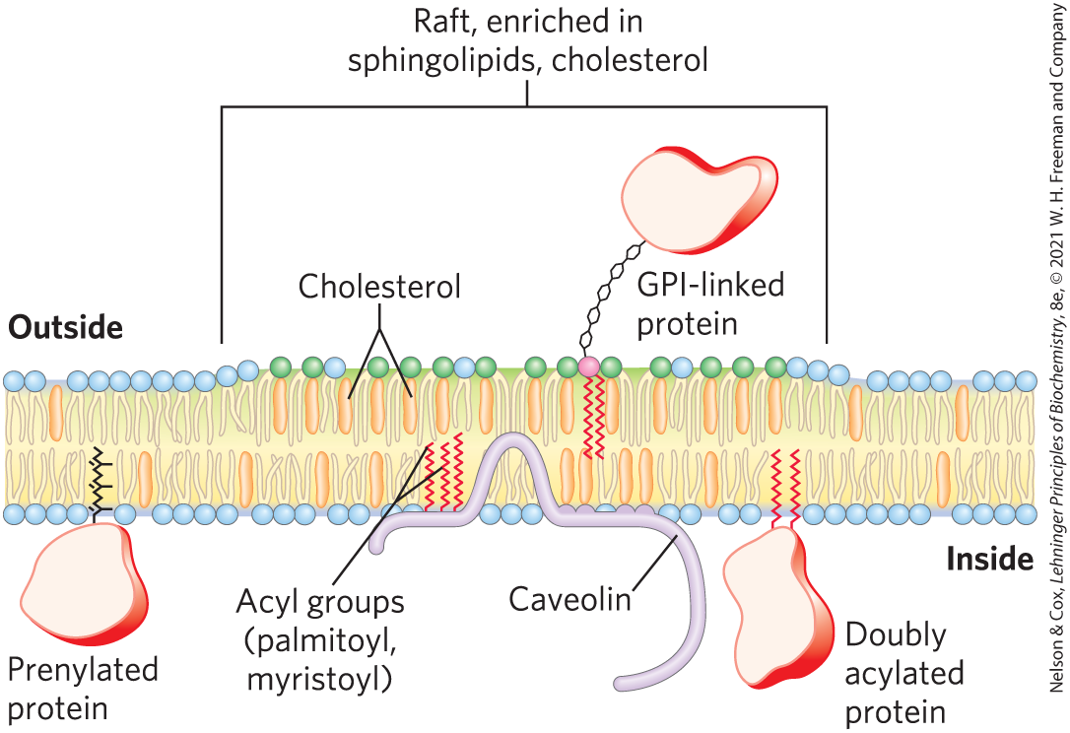
Sphingolipids and Cholesterol Cluster Together in Membrane Rafts
microdomains (rafts) = clusters of cholesterol and sphingolipids that make the bilayer slightly thicker and more ordered than neighboring, phospholipid-rich regions
  can be up to 50% of the cell surface

Slide 57
Proteins and Lipid Rafts
proteins must have hydrophobic helical sections long enough to segregate into the thicker bilayer regions of rafts
lipid rafts are enriched in:
  proteins that have two long-chain saturated fatty acids covalently attached through Cys residues
  GPI-anchored proteins

Slide 58
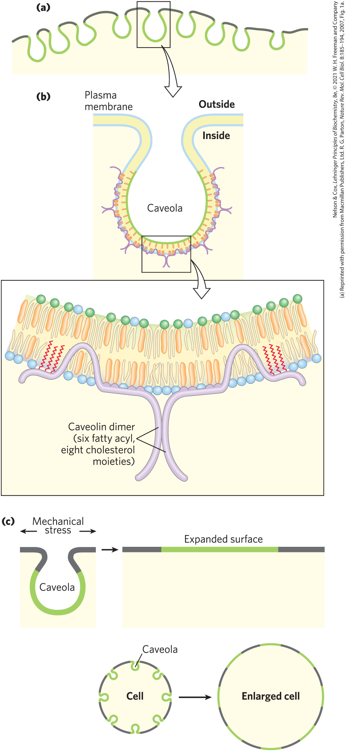
Caveolae and Caveolin
caveolae (“little caves”) = specialized rafts
caveolin = integral protein that binds to the cytoplasmic leaflet of the plasma membrane
  forms dimers
  associates with cholesterol-rich membrane regions
  forces the bilayer to curve inward to form caveolae

Slide 59
Principle 2 (8 of 8)
All of the internal membranes of cells are part of an interconnected, functionally specialized, and dynamic endomembrane system. Proteins and lipids synthesized in the endoplasmic reticulum move through the Golgi apparatus, and they are targeted to the membranes of organelles or to the plasma membrane, where they provide the essential properties of these structures. During this membrane trafficking, some proteins are covalently altered, and some lipids are segregated into different organelles or are concentrated in one of the bilayer leaflets. Rafts are functionally specialized regions with unique lipid and protein compositions.

Slide 60
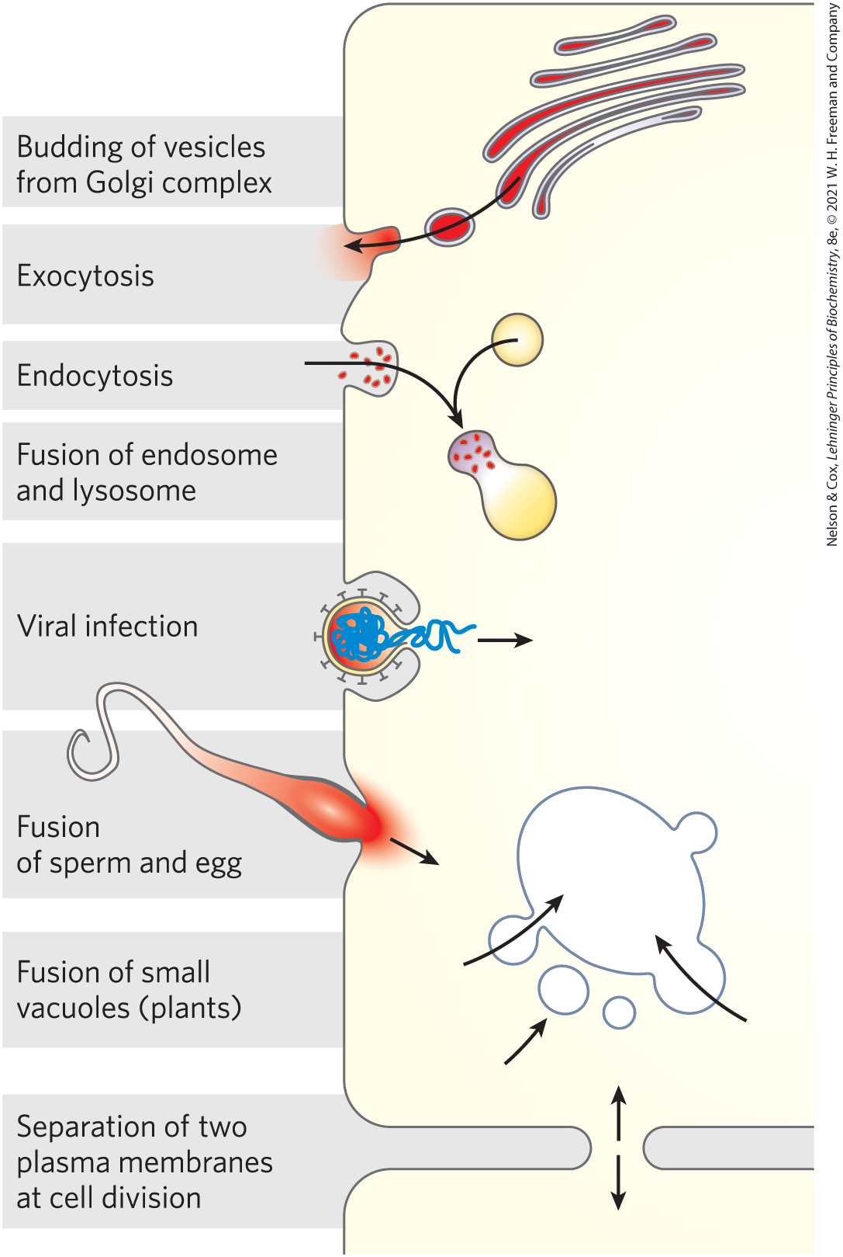
Membrane Curvature and Fusion
Are Central to Many Biological Processes
curvature changes are central to the ability of biological membranes to undergo fusion with other membranes without losing continuity

Slide 61
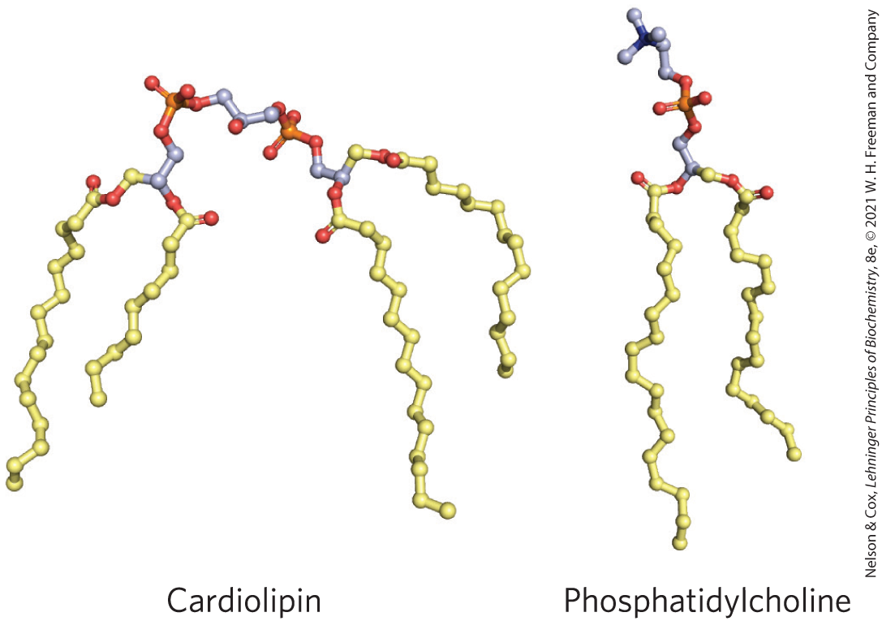
Cardiolipid
cardiolipin = can create or recognize membrane curvature
  located in mitochondrial and bacterial membranes

Slide 62
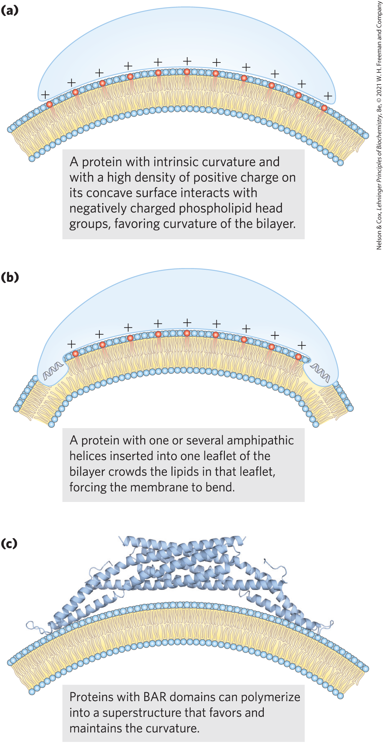
Protein-Induced Curvature of Membranes
BAR domains = domains consisting of coiled coils that form long, thin, curved dimers with a positively charged concave surface
BAR domain proteins assemble into crescent-shaped scaffolds and favor membrane curvature

Slide 63
Septins
septins = family of GTP-binding proteins that polymerize at curved regions of the plasma membrane
  participate in cell division, exocytosis, phagocytosis, and apoptosis
  have an amphipathic helix that is important in vesicle trafficking and neurotransmitter release

Slide 64
Fusion Proteins
fusion proteins = mediate specific fusion of two membranes by bringing about specific recognition and a transient local distortion of the bilayer structure

Slide 65
SNARE Proteins
SNAREs (snap receptors) = family of proteins
v-SNAREs = SNAREs in the cytoplasmic face of the intracellular vesicle
t-SNAREs = SNAREs in the target membrane with which the vesicle fuses

Slide 66
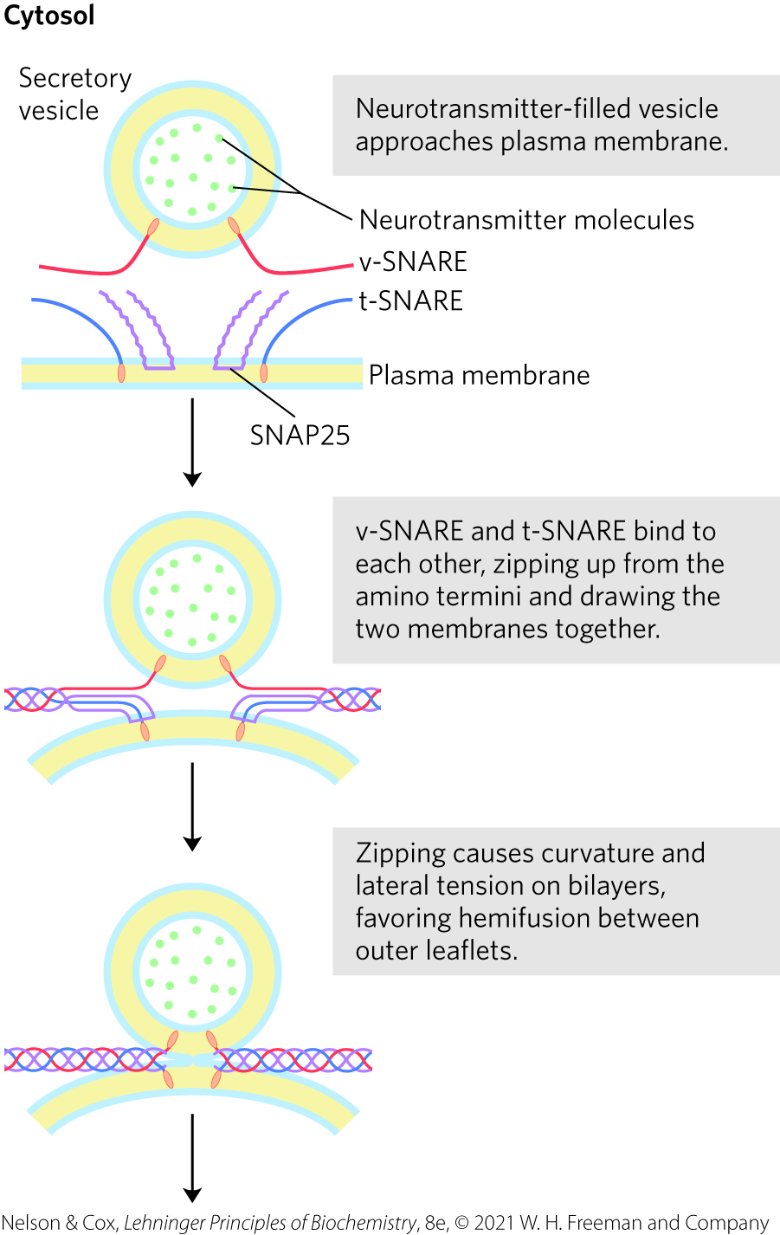
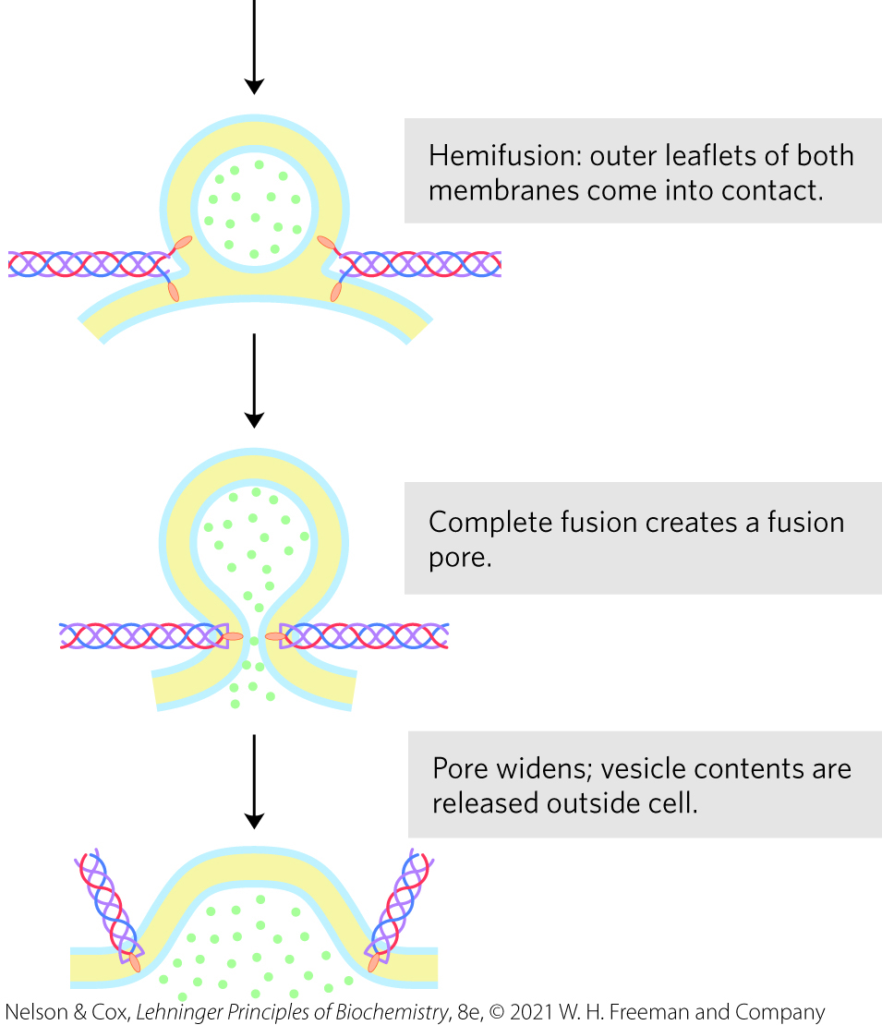
Membrane Fusion During Neurotransmitter Release

Slide 67
Integral Proteins of the Plasma Membrane Are Involved in Surface Adhesion, Signaling, and Other Cellular Processes
integrins = surface adhesion proteins that mediate a cell’s interaction with the extracellular matrix and with other cells
  carry signals in both directions across the plasma membrane
  heterodimeric proteins composed of two unlike subunits, α and β

Slide 68
Cadherins and Selectins
cadherins = involved in surface adhesion
  undergo homophilic interactions with identical cadherins in an adjacent cell
selectins = have extracellular domains that bind specific polysaccharides on the surface of an adjacent cell
  require Ca²⁺
  essential part of the blood-clotting process

Slide 69
11.3 Solute Transport across Membranes

Slide 70
Principle 3 (2 of 11)
Although the lipid bilayer is impermeable to charged or polar solutes, cells of all kinds have many membrane transporters and
ion channels that catalyze transmembrane movement of specific solutes. Some transporters merely speed the movement of solutes in the direction that simple diffusion takes them, whereas others use an energy source to move solutes against a concentration gradient.

Slide 71
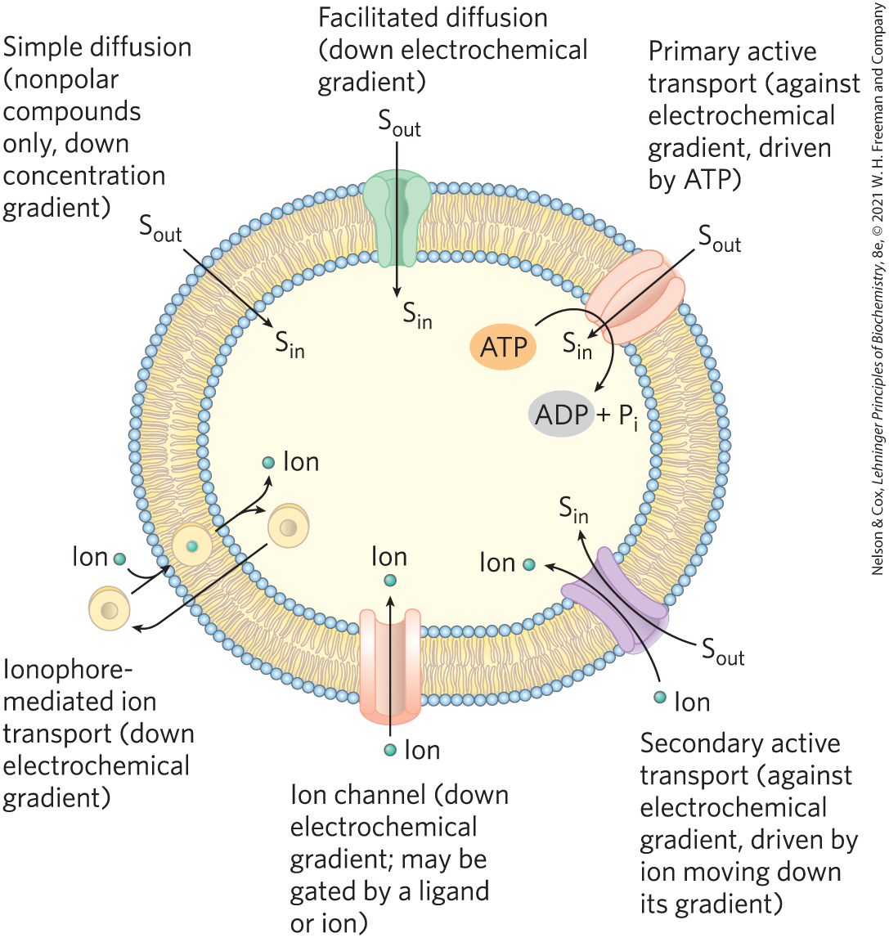
Summary of Transport Types
nonpolar compounds can dissolve in the lipid bilayer and cross a membrane unassisted
polar compounds and ions require a specific membrane protein carrier

Slide 72
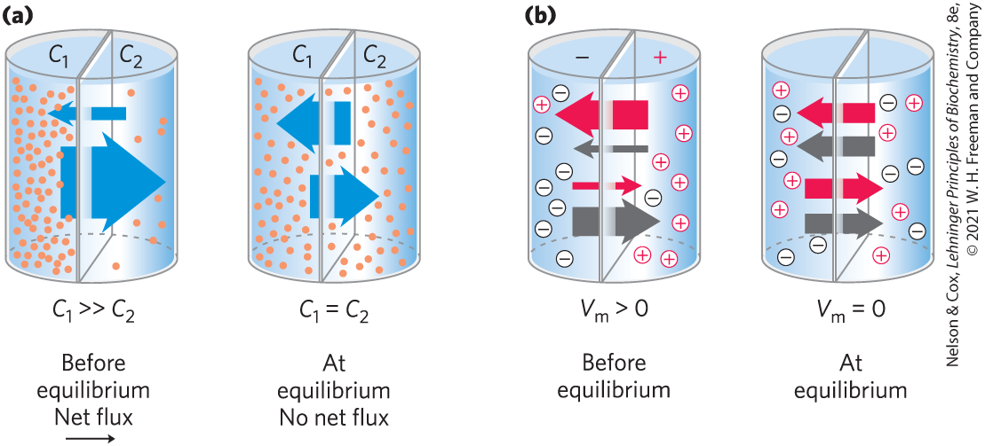
Transport May Be Passive or Active
simple diffusion = movement of a solute from the region of higher concentration to the region of lower concentration

Slide 73
Membrane Potential, V_{m}
membrane potential, V_{m} = a transmembrane electrical gradient that occurs when ions of opposite charge are separated by a permeable membrane
  produces a force that:
    opposes ion movements that increase V_{m}
    drives movements that reduce V_{m}

Slide 74
Principle 3 (3 of 11)
Although the lipid bilayer is impermeable to charged or polar solutes, cells of all kinds have many membrane transporters and
ion channels that catalyze transmembrane movement of specific solutes. Some transporters merely speed the movement of solutes in the direction that simple diffusion takes them, whereas others use an energy source to move solutes against a concentration gradient.

Slide 75
Electrochemical Gradient
electrochemical gradient (electrochemical potential) = determines the direction in which a charged solute moves across a membrane
  composed of:
    the chemical gradient
    the electrical gradient (V_{m})

Slide 76
Principle 3 (4 of 11)
Although the lipid bilayer is impermeable to charged or polar solutes, cells of all kinds have many membrane transporters and
ion channels that catalyze transmembrane movement of specific solutes. Some transporters merely speed the movement of solutes in the direction that simple diffusion takes them, whereas others use an energy source to move solutes against a concentration gradient.

Slide 77
Passive and Active Transporters
passive transporters = facilitate movement down a concentration gradient, increasing the transport rate
  process is called passive transport or facilitated diffusion
active transporters = move substrates across a membranes against a concentration gradient or an electrical potential
  process is called active transport

Slide 78
Types of Active Transporters
primary active transporters = use energy provided directly by a chemical reaction
secondary active transporters = couple uphill transport of one substrate with downhill transport of another

Slide 79
Principle 3 (5 of 11)
Although the lipid bilayer is impermeable to charged or polar solutes, cells of all kinds have many membrane transporters and
ion channels that catalyze transmembrane movement of specific solutes. Some transporters merely speed the movement of solutes in the direction that simple diffusion takes them, whereas others use an energy source to move solutes against a concentration gradient.

Slide 80
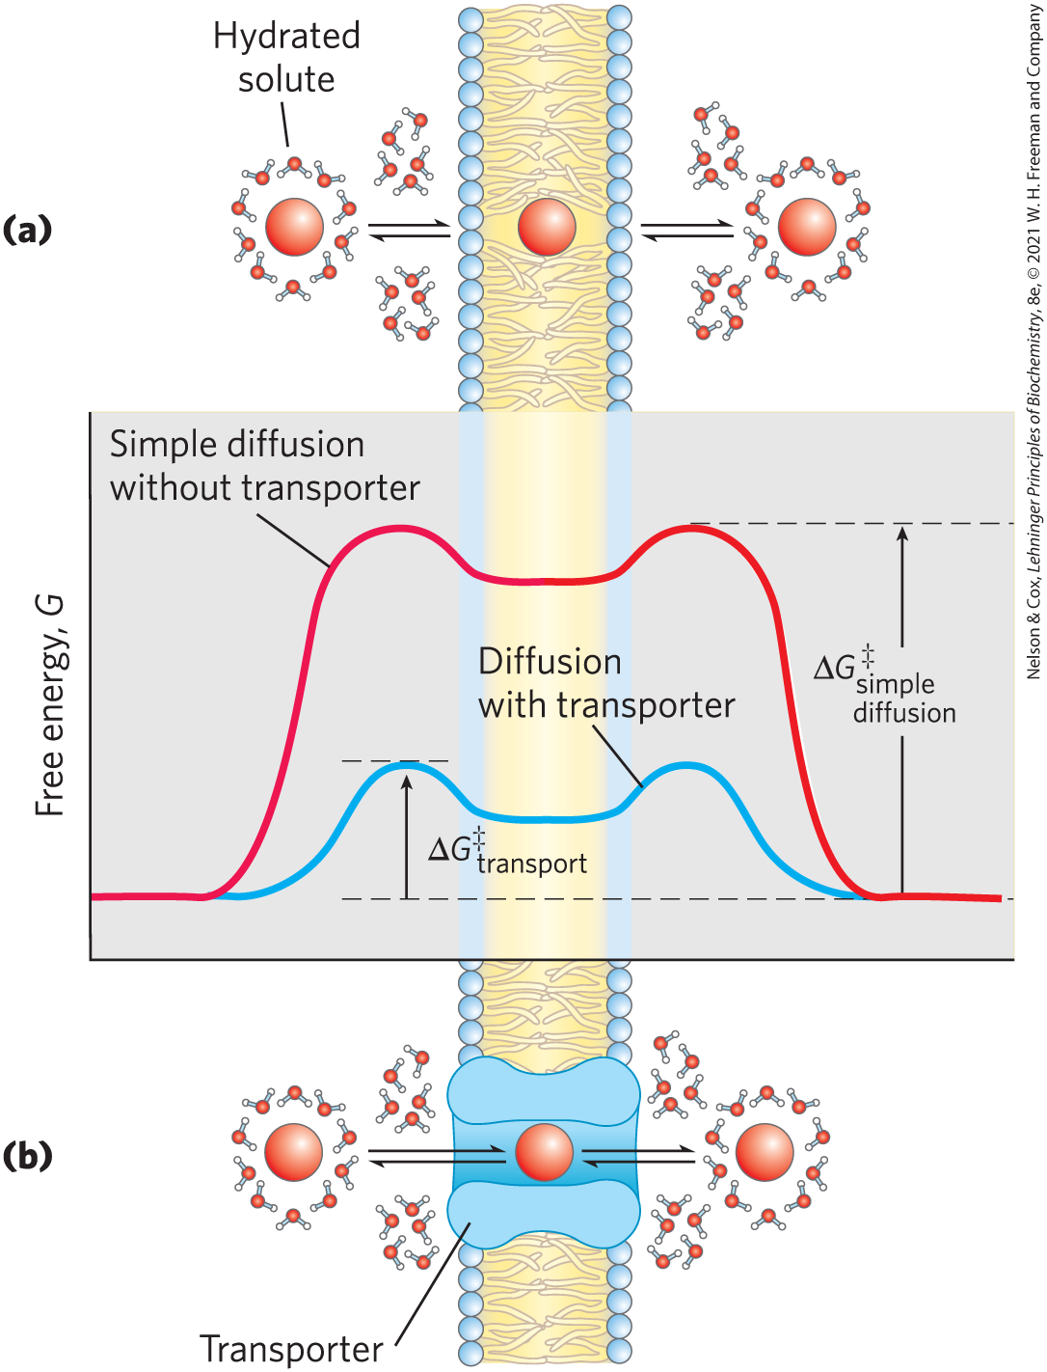
Transporters and Ion Channels Share Some Structural Properties but Have Different Mechanisms
transporter proteins reduce the energy of activation (∆G‡) for diffusion by:
  forming noncovalent interactions with the dehydrated solute
  providing a hydrophilic transmembrane pathway

Slide 81
Principle 3 (6 of 11)
Although the lipid bilayer is impermeable to charged or polar solutes, cells of all kinds have many membrane transporters and
ion channels that catalyze transmembrane movement of specific solutes. Some transporters merely speed the movement of solutes in the direction that simple diffusion takes them, whereas others use an energy source to move solutes against a concentration gradient.

Slide 82
Ion Channels
ion channels = provide an aqueous path across the membrane through which inorganic ions can diffuse at very high rates
  most have a “gate” regulated by a biological signal
  typically show some specificity for an ion
  are not saturable with their ion substrate
  flow stops either when the gate is closed or when there is no longer an electrochemical gradient

Slide 83
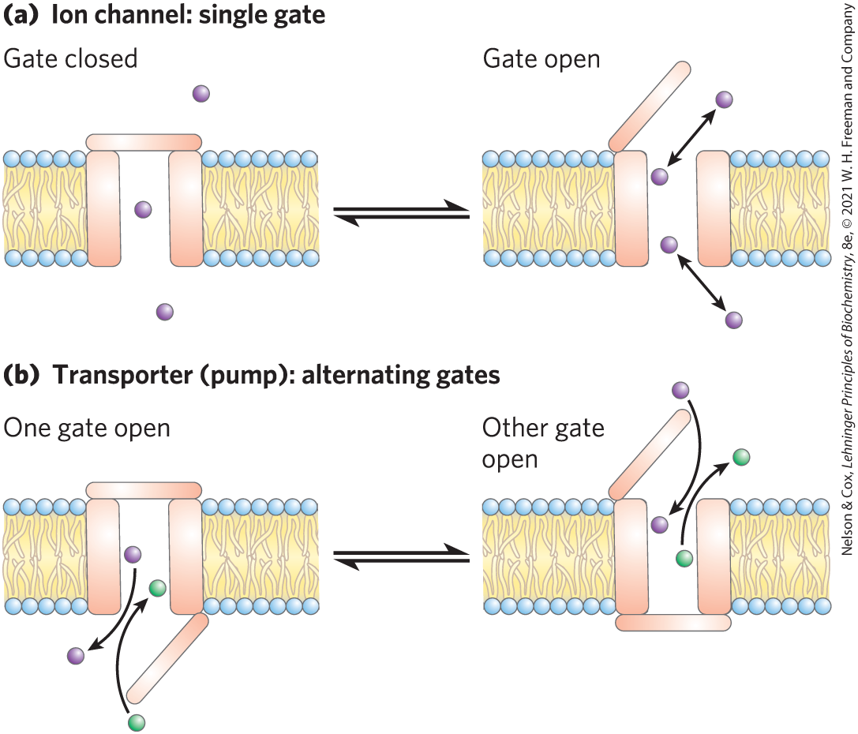
Differences Between Ion Channels and Transporters

Slide 84
Principle 3 (7 of 11)
Although the lipid bilayer is impermeable to charged or polar solutes, cells of all kinds have many membrane transporters and
ion channels that catalyze transmembrane movement of specific solutes. Some transporters merely speed the movement of solutes in the direction that simple diffusion takes them, whereas others use an energy source to move solutes against a concentration gradient.

Slide 85
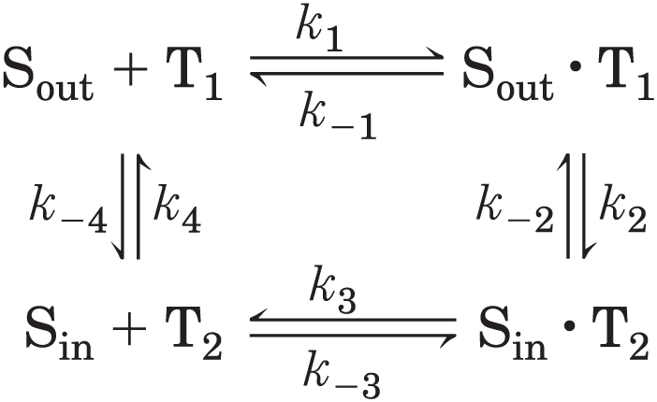
The Glucose Transporter of Erythrocytes Mediates Passive Transport
glucose enters the erythrocyte by passive transport via GLUT1
analogous with an enzymatic reaction where:
  glucose (“substrate”) outside is S_{out}
  glucose (“product”) inside is S_{in}
  transporter (“enzyme”) is T

Slide 86
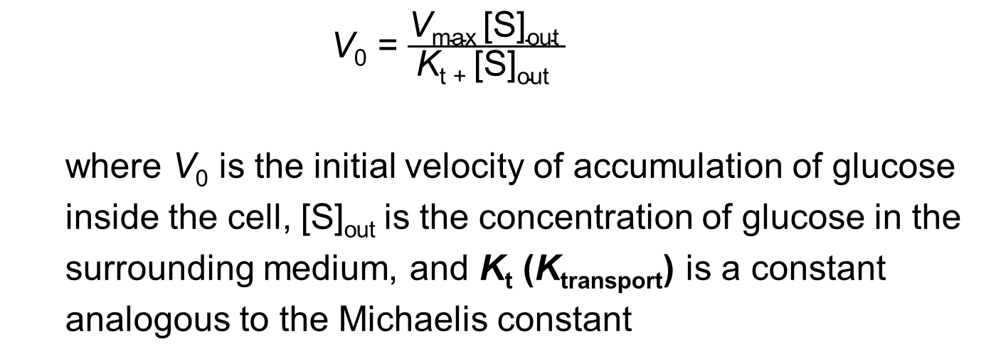
Rate Equations for Glucose Transport
analogous to the Michaelis-Menten equation:
V₀ = $\frac{\text{V}\text{max}\text{ [}\text{S}\text{]}\text{out} }{\text{K}\text{t}\text{ + [}\text{S}\text{]}\text{out} }$
where V₀ is the initial velocity of accumulation of glucose
inside the cell, [S]_{out} is the concentration of glucose in the
surrounding medium, and K_{t} (K_{transport}) is a constant
analogous to the Michaelis constant
(11-1)

Slide 87
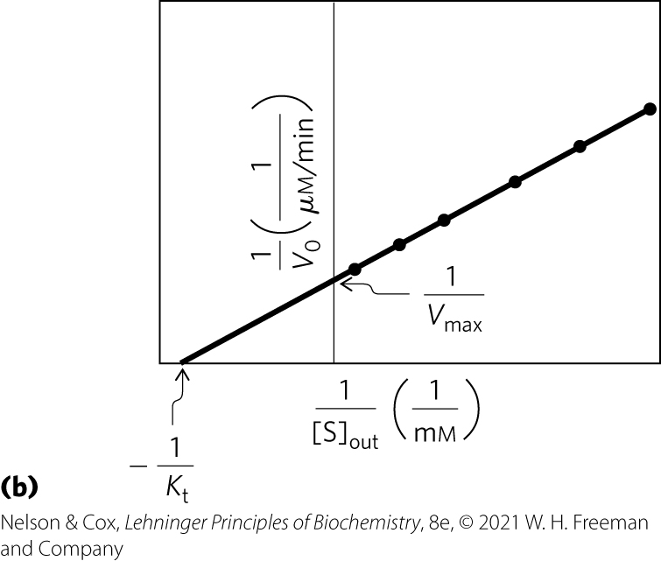
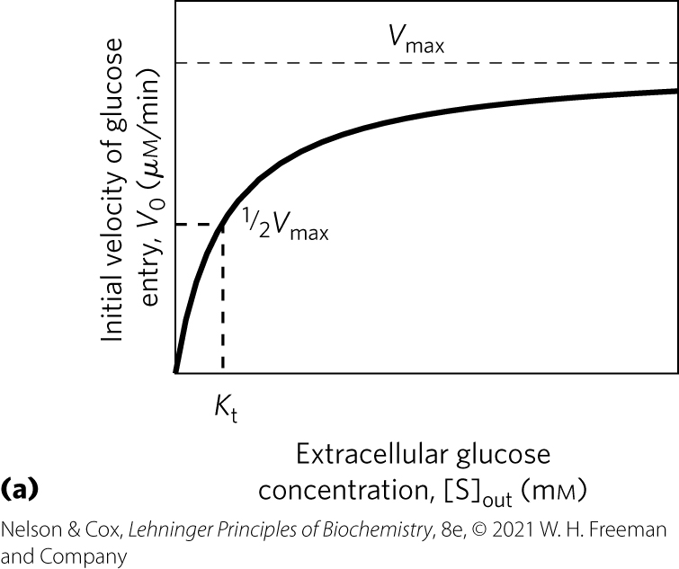
Kinetics of Glucose Transport into Erythrocytes

Slide 88
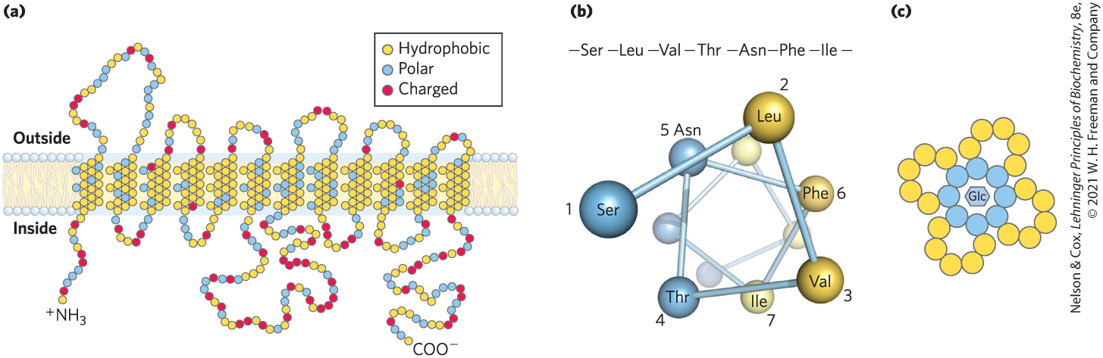
Membrane Topology of GLUT1
GLUT1 = integral membrane protein with 12 hydrophobic segments that form 12 membrane-spanning helices
  helices are amphipathic (resides are nonpolar on one side and polar on the other side)

Slide 89
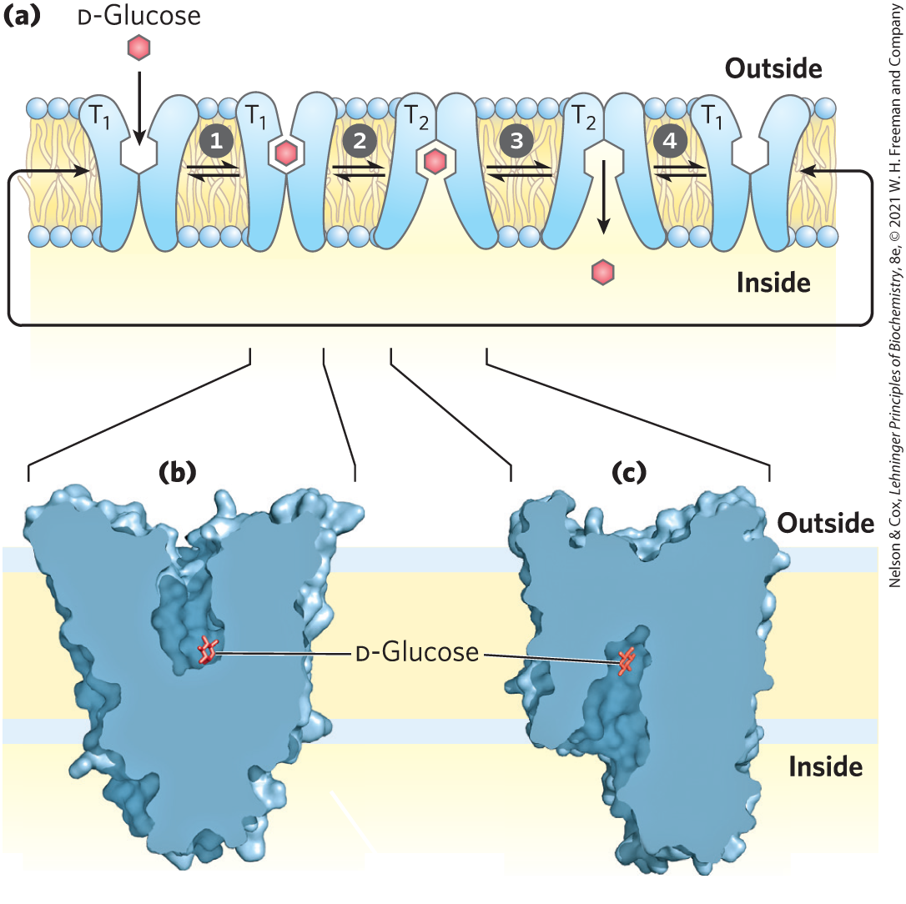
Model of Glucose Transport into Erythrocytes
cycles between two extreme conformations:
  T₁ form: glucose-binding site exposed on the outer membrane surface
  T₂ form: glucose-binding site exposed on the inner surface

Slide 90
Glucose Transporters in Humans
Table 11-1 Glucose Transporters in Humans
Transporter | Tissue(s) where expressed | K_{t} (mᴍ) | Role/characteristics
GLUT1 | Erythrocytes, blood-brain barrier, placenta, most tissues at a low level | 3 | Basal glucose uptake; defective in De Vivo disease
GLUT2 | Liver, pancreatic islets, intestine, kidney | 17 | In liver and kidney, removal of excess glucose from blood; in pancreas, regulation of insulin release
GLUT3 | Brain (neuron), tests (sperm) | 1.4 | Badal glucose uptake; high turnover number
GLUT4 | Muscle, fat, heart | 5 | Activity increased by insulin
GLUT5 | Intestine (primarily), testis, kidney | 6 | Primarily fructose transport
GLUT6 | Spleen, leukocytes, brain | >5 | Possibly no transporter function
GLUT7 | Small intestine, colon, testis, kidney | 0.3 | ⸻
GLUT8 | Testis, sperm acrosome | −2 | ⸻
GLUT9 | Liver, kidney, intestine, lung, placenta | 0.6 | Urate and glucose transporter in liver, kidney
GLUT10 | Heart, lung, brain, liver, muscle, pancreas, placenta, kidney | 0.3 | Glucose and galactose transporter
GLUT11 | Heart, skeletal muscle | 0.16 | Glucose and fructose transporter
GLUT12 | Skeletal muscle, heart, prostate, placenta | ⸻ | ⸻

Slide 91
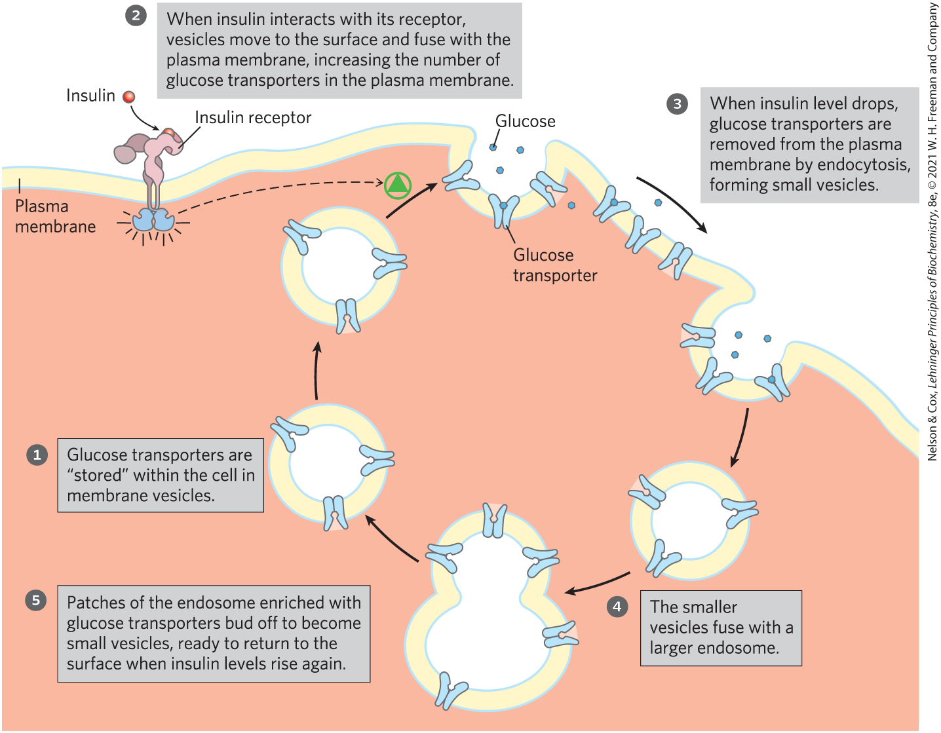
Transport of Glucose Into a Myocyte by GLUT4 Is Regulated by Insulin

Slide 92
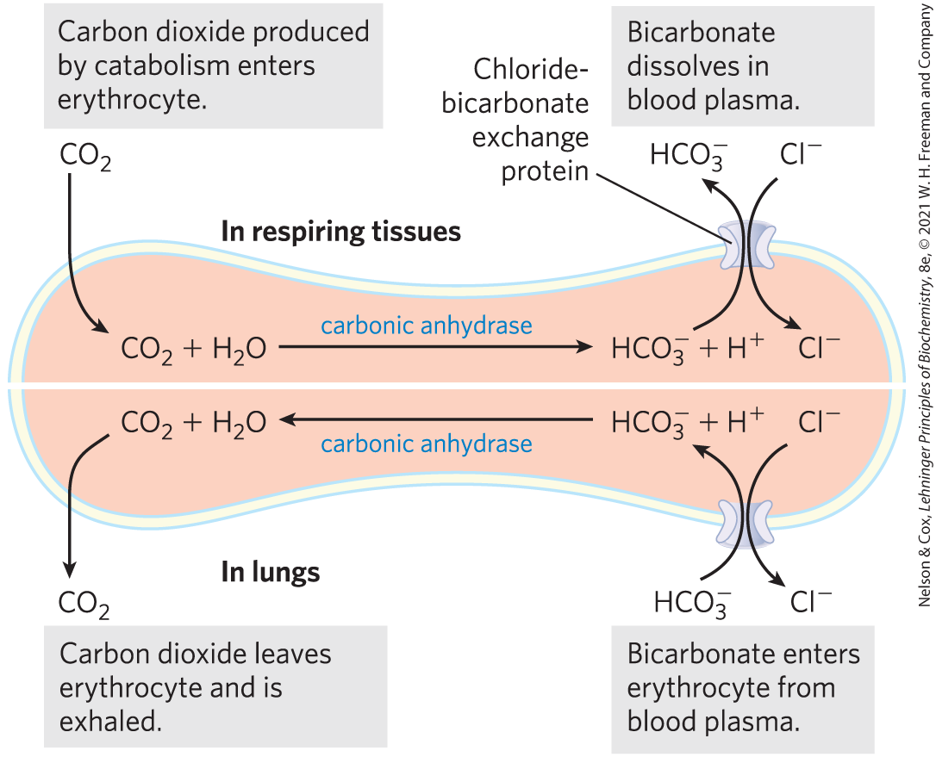
The Chloride-Bicarbonate Exchanger Catalyzes Electroneutral Cotransport of Anions across the Plasma Membrane
chloride-bicarbonate exchanger = anion exchanger essential in CO₂ transport to the lungs from tissues
  passive transport system
  electroneutral exchange = no net transfer of charge

Slide 93
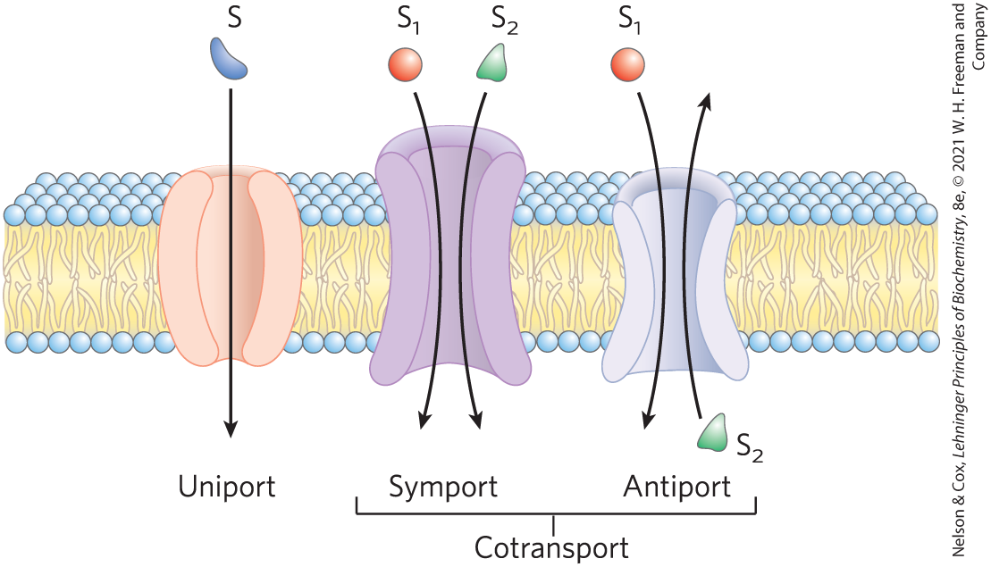
Three General Classes of Transport Systems
cotransport systems = simultaneously transport two solutes across a membrane
  antiport = moves in opposite directions
  symport = moves in the same direction
uniport systems = carry only one substrate

Slide 94
Principle 3 (8 of 11)
Although the lipid bilayer is impermeable to charged or polar solutes, cells of all kinds have many membrane transporters and
ion channels that catalyze transmembrane movement of specific solutes. Some transporters merely speed the movement of solutes in the direction that simple diffusion takes them, whereas others use an energy source to move solutes against a concentration gradient.

Slide 95
Active Transport Results in Solute Movement against a Concentration or Electrochemical Gradient
results in the accumulation of a solute above the equilibrium point
thermodynamically unfavorable (endergonic)
  must be directly or indirectly coupled to an exergonic process

Slide 96
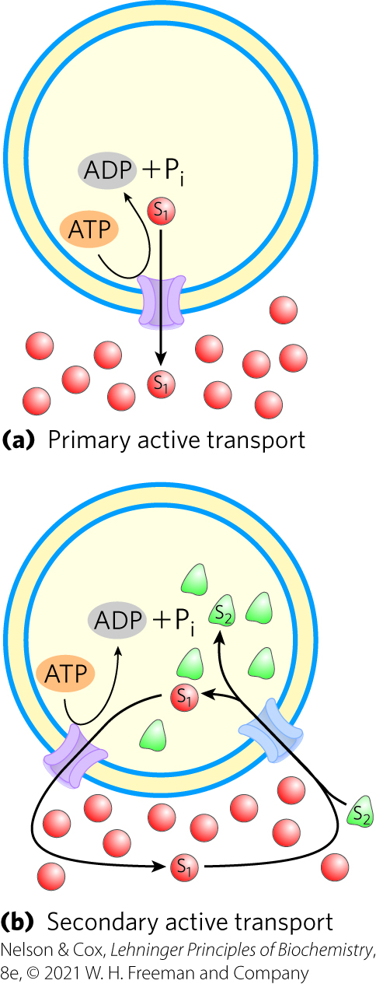
Two Types of Active Transport
primary active transport = solute accumulation is coupled directly to an exergonic chemical reaction
secondary active transport = endergonic transport of one solute is coupled to the exergonic flow of a different solute that was originally pumped uphill by primary active transport

Slide 97
Free-Energy Change for the Conversion of a Substrate to a Product
general equation for the free-energy change:
∆G = ∆G′° + RT ln ([P]/[S])
where ∆G′° is the standard free-energy change, R is the
gas constant, and T is the absolute temperature
(11-2)

Slide 98
Free-Energy Change for Transport of an Uncharged Solute
no bonds are broken and ∆G′° is zero
free-energy change for transport, ∆G_{t}, of a solute from a region where its concentration is C₁ to a region where its concentration is C₂ is:
∆G_{t} = RT ln(C₂/C₁)
(11-3)

Slide 99
Free-Energy Change for Transport of an Ion
without movement of an accompanying counterion, the process is electrogenic (produces an electrical potential)
free-energy change for transport, ∆G_{t}, of an ion is the sum of the chemical and electrical gradients:
∆G_{t} = RT ln(C₂/C₁) + ZF ∆ψ
where Z is the charge on the ion, F is the Faraday
constant, and ∆ψ is the transmembrane electrical potential
(in volts)
(11-4)

Slide 100
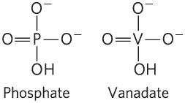
P-Type ATPases Undergo Phosphorylation during Their Catalytic Cycles
P-type ATPases = family of cation transporters that are reversibly phosphorylated by ATP as part of the transport cycle
  integral proteins with 8 or 10 predicted membrane-spanning regions
  sensitive to inhibition by the transition-state analog vanadate

Slide 101
Examples of P-Type ATPases
Na⁺ K⁺ ATPase = animal cell antiporter for Na⁺ and K⁺
H⁺ ATPase = plant and fungi transporter
sarcoplasmic/endoplasmic reticulum Ca²⁺ ATPase (SERCA) pump and the plasma membrane Ca²⁺ ATPase pump = uniporters for Ca²⁺ ions

Slide 102

General Structure of the P-Type ATPases
critical Asp residue in the P domain undergoes phosphorylation and dephosphorylation

Slide 103

Postulated Mechanism of the
SERCA Pump
each catalytic cycle moves two Ca²⁺ ions across the membrane and converts an ATP to ADP and P_{i}
two conformations of the transporter, E1 and E2, interconvert

Slide 104

Role of the Na⁺ K⁺ ATPase in Animal Cells
Na⁺ K⁺ ATPase = couples phosphorylation-dephosphorylation of the critical Asp residue to the movement of Na⁺ and K⁺ against their electrochemical gradients
  maintains low [Na⁺] and high [K⁺] in the cell
  essential to the conduction of action potentials in neurons

Slide 105

V-Type and F-Type ATPases Are ATP-Driven Proton Pumps
V-type ATPases = class of proton-transporting ATPases responsible for acidifying intracellular compartments
  V_{o} domain serves as a proton channel
  V₁ domain contains the ATP-binding site and the ATPase activity

Slide 106

F-Type ATPases
F-type ATPases = catalyze the uphill transmembrane passage of protons, driven by ATP hydrolysis
  F_{o} integral membrane protein complex provides a pathway for protons
  F₁ protein uses energy of ATP to drive proteins uphill

Slide 107
Principle 3 (9 of 11)
Although the lipid bilayer is impermeable to charged or polar solutes, cells of all kinds have many membrane transporters and
ion channels that catalyze transmembrane movement of specific solutes. Some transporters merely speed the movement of solutes in the direction that simple diffusion takes them, whereas others use an energy source to move solutes against a concentration gradient.

Slide 108
F-Type ATPases Catalyze Reactions in Both Directions
a large proton gradient can supply the energy to drive ATP synthesis
when functioning in this direction, F-type ATPases are named ATP synthases

Slide 109
ABC Transporters Use ATP to Drive the Active Transport of a Wide Variety of Substrates
ABC transporters = family of ATP-driven transporters that pump substrates across a membrane against a concentration gradient
  have two ATP-binding domains (“cassettes”) and two transmembrane domains
  example substrates: amino acids, peptides, proteins, metal ions, various lipids, bile salts, and hydrophobic compounds, including drugs

Slide 110

Mechanism of ABC Transporters
substrates move across the membrane when two forms of the transporter interconvert
  driven by ATP hydrolysis

Slide 111
Some ABC Transporters in Humans
Table 11-2 Some ABC Transporters in Humans
Gene(s) | Role/characteristics | Text reference
ABCA1 | Reverse cholesterol transport; defect causes Tangier disease | Fig. 21-47
ABCA4 | Only in visual receptors, recycling of all-trans-retinal | Fig. 12-19
ABCB1 | Multidrug resistance P-glycoprotein 1; transport across blood-brain barrier | ⸻
ABCB4 | Multidrug resistance; transport of phosphatidylcholine | ⸻
ABCB11 | Transports bile salts out of hepatocytes | Fig. 17-1
ABCC6 | Sulfonylurea receptor; targeted by the drug glipizide in type 2 diabetes | Fig. 23-27
ABCG2 | Breast cancer resistance protein (BCRP); major exporter of anticancer drugs | p. 396
ABCC7 | CFTR (Cl₋ channel); defect causes cystic fibrosis | Box 11-2
multidrug transporter (MDR1) = human ABC transporter with very broad substrate specificity
  encoded by the ABCB1 gene
  removes toxic compounds
  responsible for resistance of tumors to drugs

Slide 112

A Defective Ion Channel in Cystic Fibrosis

Slide 113

Cystic Fibrosis Therapies

Slide 114
Principle 3 (10 of 11)
Although the lipid bilayer is impermeable to charged or polar solutes, cells of all kinds have many membrane transporters and
ion channels that catalyze transmembrane movement of specific solutes. Some transporters merely speed the movement of solutes in the direction that simple diffusion takes them, whereas others use an energy source to move solutes against a concentration gradient.

Slide 115

Ion Gradients Provide the Energy for Secondary Active Transport
Na⁺-glucose symporter = takes up glucose from the intestine in a process driven by the downhill flow of Na⁺
strong thermodynamic tendency for Na⁺ to move into the cell provides the energy needed for the transport of glucose into the cell

Slide 116

The Peptide Ionophore Valinomycin Is An Antibiotic
acts as a shuttle, carrying K⁺ across the membrane down its concentration gradient and deflating that gradient
ionophores (“ion bearers”) = compounds that shuttle ions across membranes in this way

Slide 117
Principle 3 (11 of 11)
Although the lipid bilayer is impermeable to charged or polar solutes, cells of all kinds have many membrane transporters and
ion channels that catalyze transmembrane movement of specific solutes. Some transporters merely speed the movement of solutes in the direction that simple diffusion takes them, whereas others use an energy source to move solutes against a concentration gradient.

Slide 118
Aquaporins Form Hydrophilic Transmembrane Channels for the Passage of Water
aquaporins (AQPs) = provide channels for movement of water molecules across plasma membranes
  each protein has a specific location and role
  low activation energy suggests that water moves in a continuous stream
  do not allow passage of protons (hydronium ions, H₃O⁺)

Slide 119
The 11 Known Aquaporins in Mammals
Table 11-3 Permeability Characteristics and Predominant Distribution of Known Mammalian Aquaporins
Aquaporin | Permeant (permeability) | Tissue distribution | Primary subcellular distribution
AQP0 | Water (low) | Lens | Plasma membrane
AQP1 | Water (high) | Erythrocyte, kidney, lung, vascular endothelium, brain, eye | Plasma membrane
AQP2 | Water (high) | Kidney, vas deferens | Apical plasma membrane, intracellular vesicles
AQP3 | Water (high), glycerol (high), urea (moderate) | Kidney, skin, lung, eye, colon | Basolateral plasma membrane
AQP4 | Water (high) | Brain, muscle, kidney, lung, stomach, small intestine | Basolateral plasma membrane
AQP5 | Water (high) | Salivary gland, lacrimal gland, sweat gland, lung, cornea | Apical plasma membrane
AQP6 | Water (low), anions (NO⁻₃>Cl⁻) | Kidney | Intracellular vesicles
AQP7 | Water (high), glycerol (high), urea (high) | Adipose tissue, kidney, testis | Plasma membrane
AQP8 | Water (high) | Testis, kidney, liver, pancreas, small intestine, colon | Plasma membrane, intracellular vesicles
AQP9 | Water (low), glycerol (high), urea (high) | Liver, leukocyte, brain, testis | Plasma membrane
AQP10 | Water (low), glycerol (high), urea (high) | Small intestine | Intracellular vesicles

Slide 120
Ion-Selective Channels Allow Rapid Movement of Ions across Membranes
ion-selective channels = move inorganic ions across membranes
  the rate of flux can be orders of magnitude greater than the turnover number for a transporter
  not saturable
  gated in response to cellular event

Slide 121
Ligand-Gated Channels and Voltage-Gated Ion Channels
ligand-gated channels = binding of an extracellular or intracellular small molecule forces an allosteric transition in the protein, which opens or closes the channel
  generally oligomeric
voltage-gated ion channels = a change in transmembrane electrical potential (V_{m}) causes a charged protein domain to move relative to the membrane, opening or closing the channel

Slide 122

Electrical Measurements of Ion-Channel Function
patch-clamping = currents are measured through a region of the membrane surface containing only one or a few ion-channel molecules

Slide 123

The Structure of a K⁺ Channel Reveals the Basis for Its Specificity
channel is just wide enough to accommodate an unhydrated metal ion such as potassium
K⁺ (radius 1.33 Å) passes 10⁴ times more readily than Na⁺ (radius 0.95 Å)

Slide 124

The Mechanism of the K⁺ Channel
the polar transmembrane passage precisely fits the K⁺ ion

