Slide 1

10 Lipids
© 2021 Macmillan Learning

Slide 2

Principle 1 (1 of 4)
Fatty acids are water-insoluble hydrocarbons used for cellular energy storage. Fatty acids are highly reduced and thus provide a rich source of stored chemical energy for cells. Storage of hydrophobic fats as triacylglycerols is also highly efficient because water is not needed to hydrate the stored fats.

Slide 3

Principle 2 (1 of 6)
Membrane lipids are composed of hydrophobic tails attached to polar head groups. Cellular membranes are composed of a variety of lipids, including glycerophospholipids and sterols. These lipids are used for structuring membranes as well as for displaying molecules on the membrane surfaces for signaling and molecular recognition.

Slide 4

Principle 3 (1 of 7)
Lipids have uses in the cell beyond energy storage and membranes construction. Many lipids are present in the cell at smaller amounts than those making up membranes or being stored as fat. These lipids can function as cellular messengers, hormones, electron carriers, or pigments.

Slide 5

Principle 4 (1 of 6)
The chemical properties of lipids are
related to their structure and composition. As in studies of other biomolecules, methods such as enzymatic, chromatographic, and mass spectrometry can all be used to identify lipids and determine their atomic structure.

Slide 6
10.1 Storage Lipids

Slide 7
Principle 1 (2 of 4)
Fatty acids are water-insoluble hydrocarbons used for cellular energy storage. Fatty acids are highly reduced and thus provide a rich source of stored chemical energy for cells. Storage of hydrophobic fats as triacylglycerols is also highly efficient because water is not needed to hydrate the stored fats.

Slide 8
Fats and Oils Used as Stored Energy Are Derivatives of Fatty Acids
fatty acids = hydrocarbon derivatives
oxidation of fatty acids (to CO₂ and H₂O) is highly exergonic

Slide 9
Fatty Acids Are Hydrocarbon Derivatives
fatty acids = carboxylic acids with hydrocarbon tails ranging from 4 to 36 carbons long (C₄ to C₃₆)
  can be saturated or unsaturated
  can be branched or unbranched

Slide 10
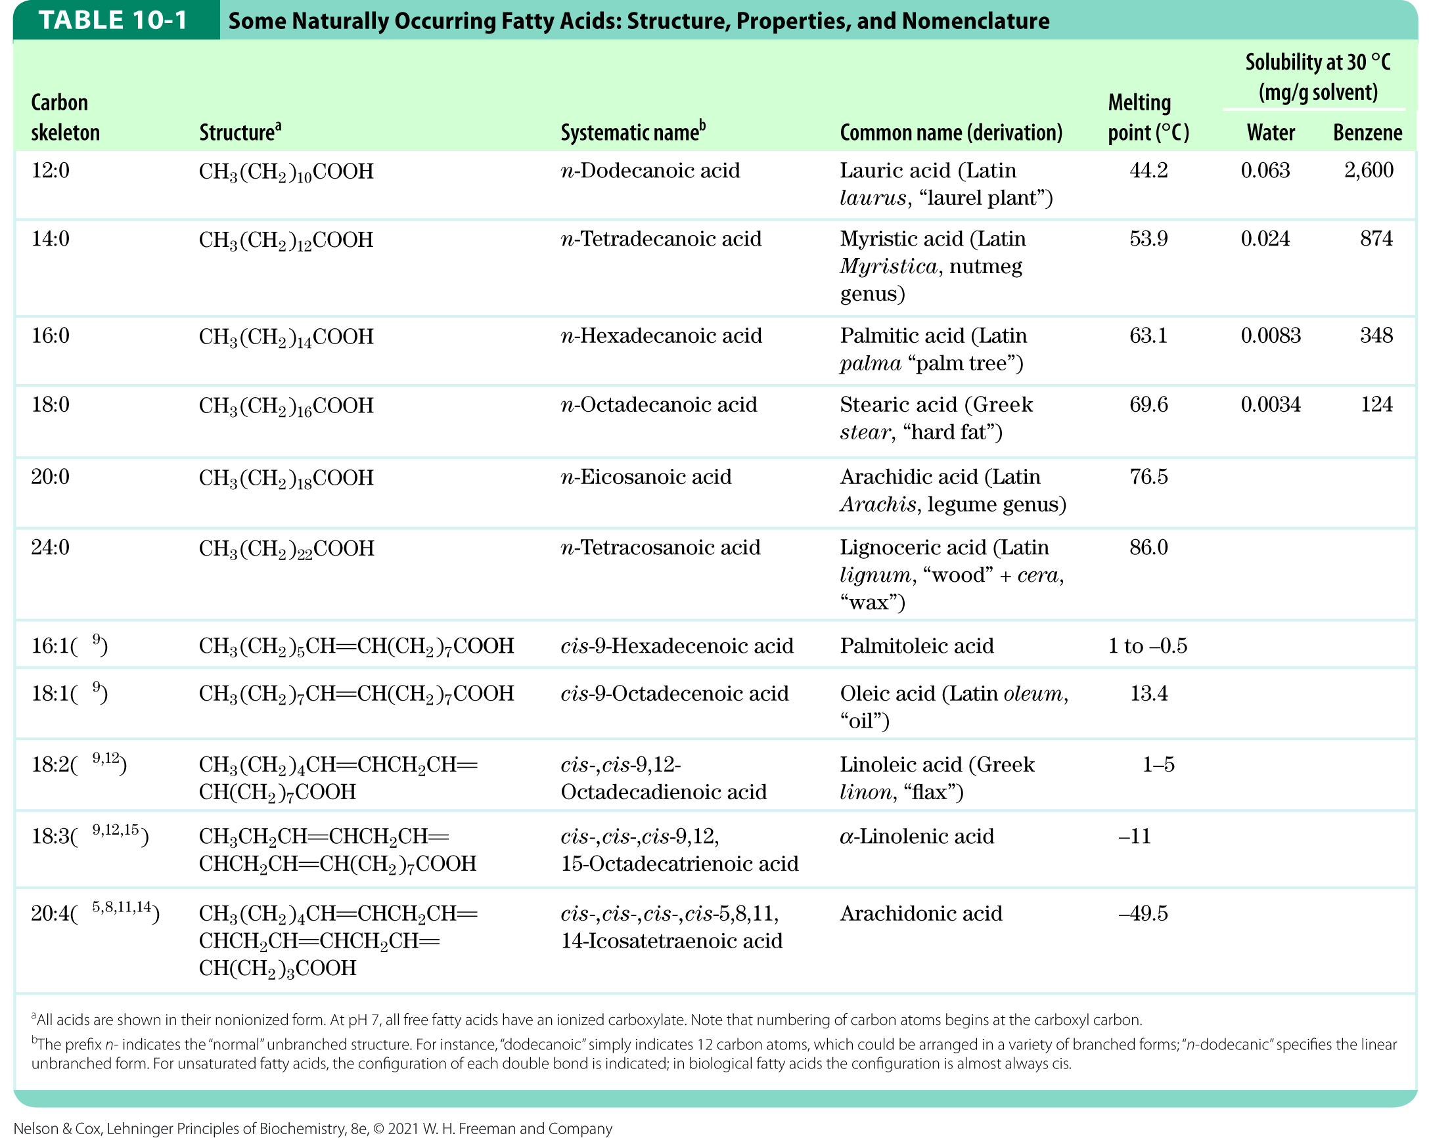
Naturally Occurring Fatty Acids

Slide 11
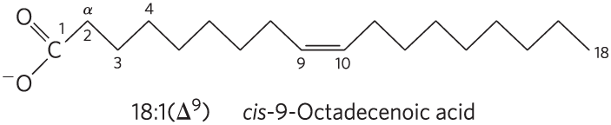
Nomenclature for Unbranched Fatty Acids
the chain length and number of bonds, separated by a colon
numbering begins at the carboxyl carbon
positions of double bonds are indicated by ∆ and a superscript number

Slide 12
Common Patterns in Fatty Acids
most common fatty acids have even numbers of carbon atoms in an unbranched chain of 12 to 24 carbons
in monounsaturated fatty acids, the double bond is usually between C-9 and C-10 (∆⁹)
in polyunsaturated fatty acids:
  the double bonds are usually ∆¹² and ∆¹⁵
  double bonds are usually separated by a methylene group
double bonds are usually in the cis configuration

Slide 13
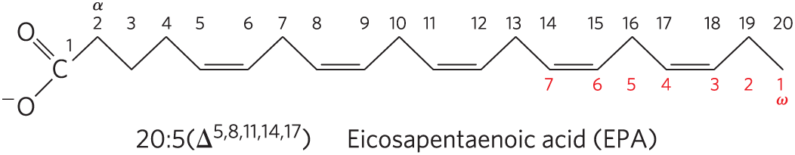
Polyunsaturated Fatty Acids (PUFAs)
polyunsaturated fatty acids (PUFAs) = contain more than one double bond in their backbone
  omega-3 (ω-3) fatty acids = double bond between C-3 and C-4 relative to the most distant carbon (ω)
  omega-6 (ω-6) fatty acids = double bond between C-6 and C-7 relative to ω
omega-3 (ω-3) fatty acid

Slide 14
PUFAs and Human Nutrition
humans must obtain the omega-3 PUFA α-linolenic acid (ALA; 18:3(∆^{9,12,15})) from their diet
humans use ALA to synthesize:
  eicosapentaenoic acid (EPA; 20:5(∆^{5,8,11,14,17}))
  docosahexaenoic acid (DHA; 22:6(∆^{4,7,10,13,16,19}))
the optimal dietary ratio of omega-6 to omega-3 PUFAs is between 1:1 and 4:1

Slide 15
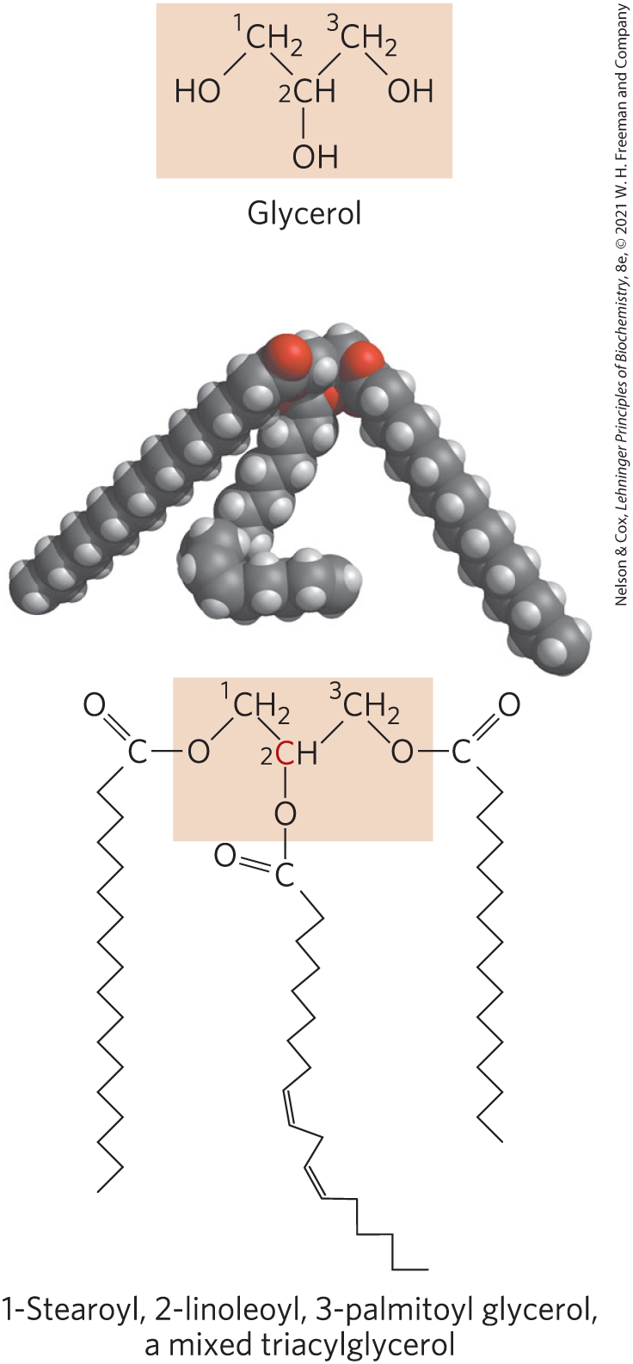
Triacylglycerols Are Fatty Acid Esters of Glycerol
triacylglycerols = simplest lipids constructed from fatty acids
  composed of three fatty acids, each in ester linkage with a single glycerol
  can be simple (one kind of fatty acid) or mixed (two or three different fatty acids)
  non-polar, hydrophobic

Slide 16
Principle 1 (3 of 4)
Fatty acids are water-insoluble hydrocarbons used for cellular energy storage. Fatty acids are highly reduced and thus provide a rich source of stored chemical energy for cells. Storage of hydrophobic fats as triacylglycerols is also highly efficient because water is not needed to hydrate the stored fats.

Slide 17
Solubility of Fatty Acids
poor solubility in water due to the nonpolar hydrocarbon chain
  increased chain length decreases solubility
  decreased double bond number decreases solubility
carboxylic acid group is polar and ionized at neutral pH

Slide 18
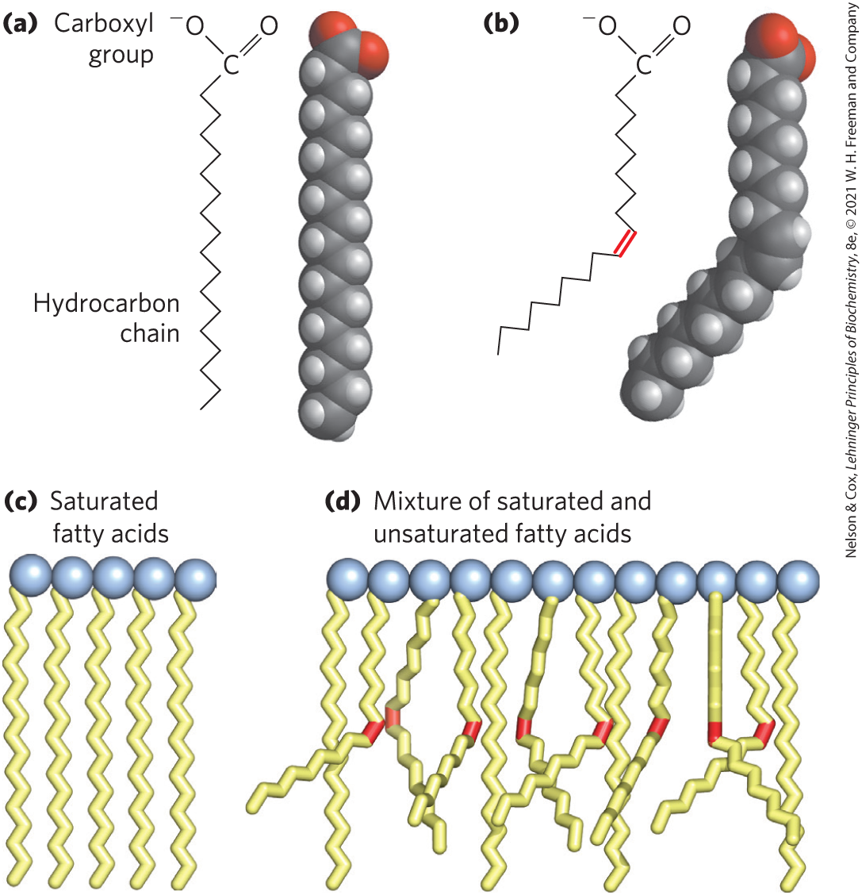
Melting Points of Fatty Acids
at room temperature:
  saturated fatty acids have a waxy consistency
  unsaturated fatty acids are oily liquids
extent of packing depends on degree of saturation

Slide 19
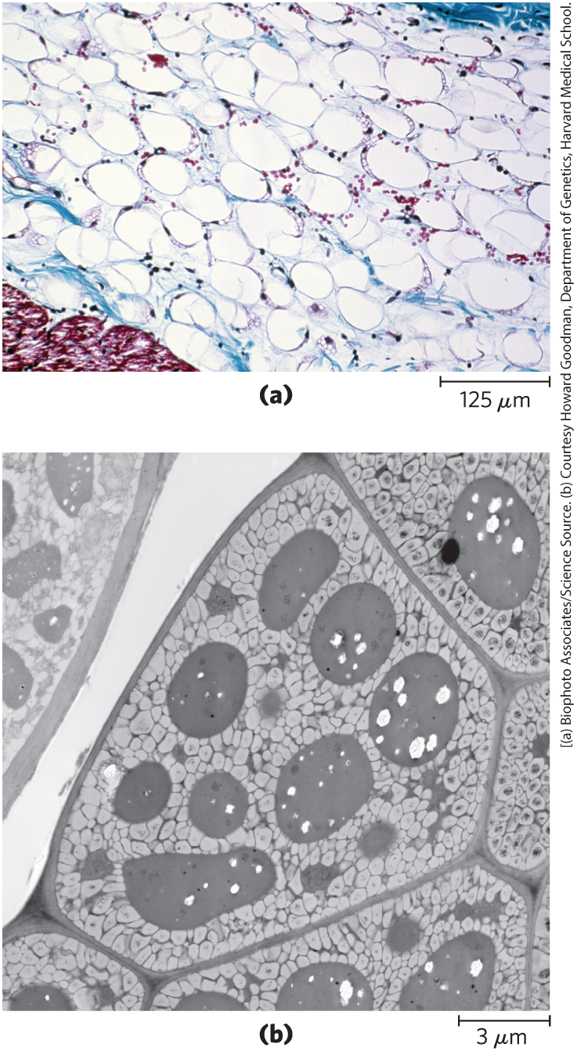
Triacylglycerols Provide Stored Energy and Insulation
vertebrates store triacylglycerols as lipid droplets in adipocytes (fat cells)
plants store triacylglycerols in the seeds

Slide 20
Lipases
lipases = enzymes that catalyze the hydrolysis of stored triacylglycerols, releasing fatty acids for export to sites where they are required as fuel
  adipocytes and germinating seeds contain lipases

Slide 21
Principle 1 (4 of 4)
Fatty acids are water-insoluble hydrocarbons used for cellular energy storage. Fatty acids are highly reduced and thus provide a rich source of stored chemical energy for cells. Storage of hydrophobic fats as triacylglycerols is also highly efficient because water is not needed to hydrate the stored fats.

Slide 22
Advantages to Using Triacylglycerols as Stored Fuels
two significant advantages:
  because carbon atoms of fatty acids are more reduced than those of sugars, oxidation of fatty acids yields more energy
  because triacylglycerols are hydrophobic and unhydrated, the organism does not have to carry the extra weight of water hydration that is associated with stored polysaccharides

Slide 23
Triacylglycerols Provide Insulation
seals, walruses, penguins, and other warm-blooded polar animals are amply padded with triacylglycerols
  provides insulation against low temperatures
hibernating animals (e.g. bears) accumulate huge fat reserves before hibernation
  provides insulation and energy storage

Slide 24
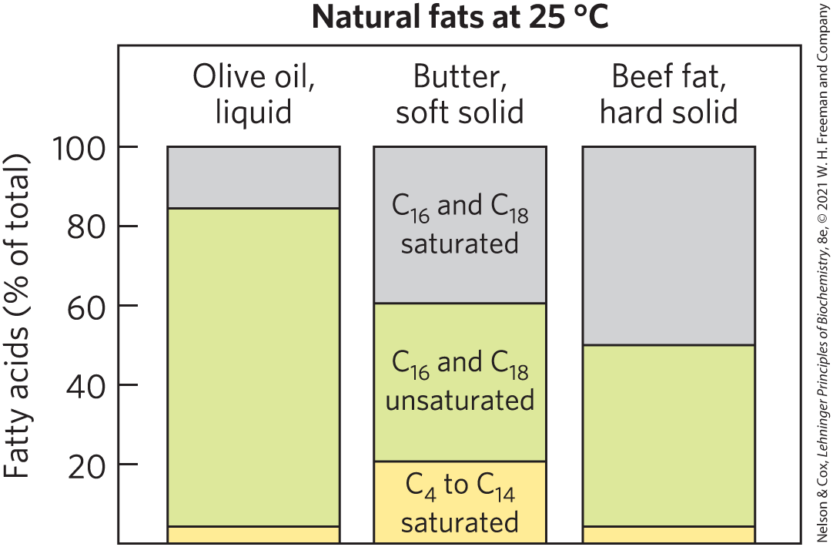
Partial Hydrogenation of Cooking Oils Improves Their Stability but Creates Fatty Acids with Harmful Health Effects
natural fats are complex mixtures of simple and mixed triacylglycerols

Slide 25
Partial Hydrogenation
oxidative cleavage of double bonds in unsaturated fatty acids to aldehydes and carboxylic acids causes lipid-rich food to become rancid
partial hydrogenation = process that converts many of the cis double bonds in the fatty acids to single bonds
  improves shelf life and increases stability
  increases the melting temperature
  converts some cis double bonds to trans double bonds

Slide 26
Trans Fatty Acids (“Trans Fats”)
dietary intake of trans fatty acids is linked to a higher incidence of cardiovascular disease
trans fatty acids:
  raise the level of triacylglycerols in the blood
  raise the level of LDL (“bad”) cholesterol in the blood
  lower the level of HDL (“good”) cholesterol
  increase the body’s inflammatory response

Slide 27
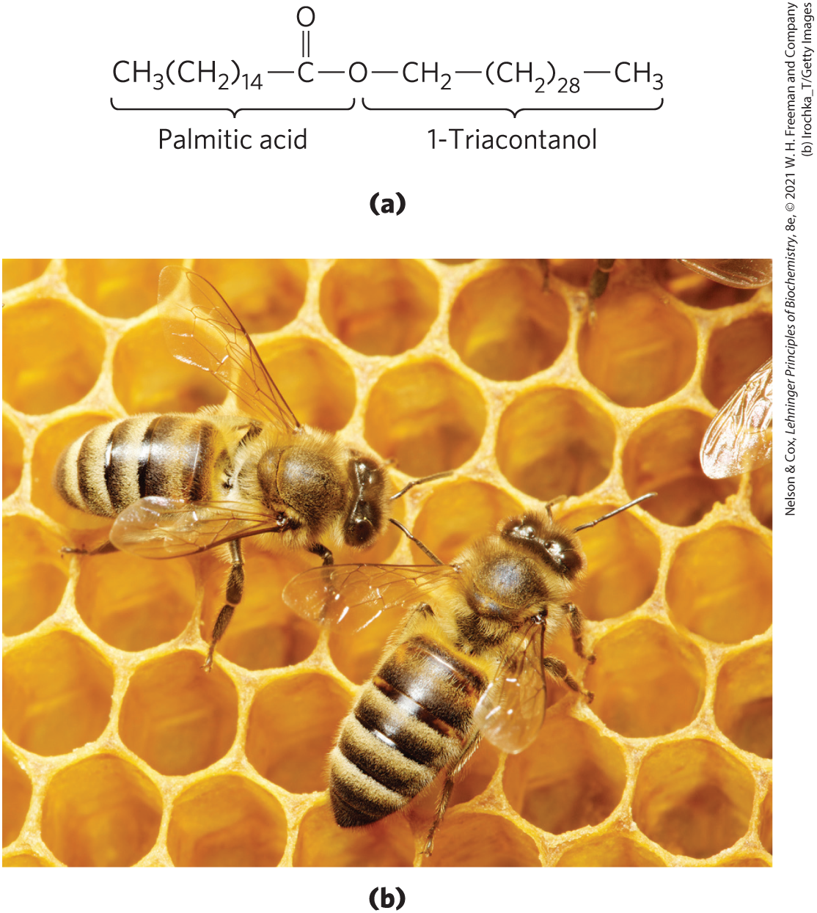
Waxes Serve as Energy Stores and Water Repellents
biological waxes = esters of long-chain (C₁₄ to C₃₆) saturated and unsaturated fatty acids with long-chain (C₁₆ to C₃₀) alcohols
  higher melting point than triacylglycerols
  water-repellant properties
  firm consistency

Slide 28
10.2 Structural Lipids in Membranes

Slide 29
Principle 2 (2 of 6)
Membrane lipids are composed of hydrophobic tails attached to polar head groups. Cellular membranes are composed of a variety of lipids, including glycerophospholipids and sterols. These lipids are used for structuring membranes as well as for displaying molecules on the membrane surfaces for signaling and molecular recognition.

Slide 30
Biological Membranes
biological membranes = double layer of lipids that acts as a barrier to polar molecules and ions
membrane lipids:
  amphipathic = one end of the molecule is hydrophobic, the other hydrophilic
  hydrophobic regions associate with each other
  hydrophilic regions associate with water

Slide 31
Four General Types of Membrane Lipids
phospholipids = have hydrophobic regions composed of two fatty acids joined to glycerol or sphingosine
glycolipids = contain a simple sugar or a complex oligosaccharide at the polar ends
archaeal tetraether lipids = have two very long alkyl chains ether-linked to glycerol at both ends
sterols = compounds characterized by a rigid system of four fused hydrocarbon rings

Slide 32
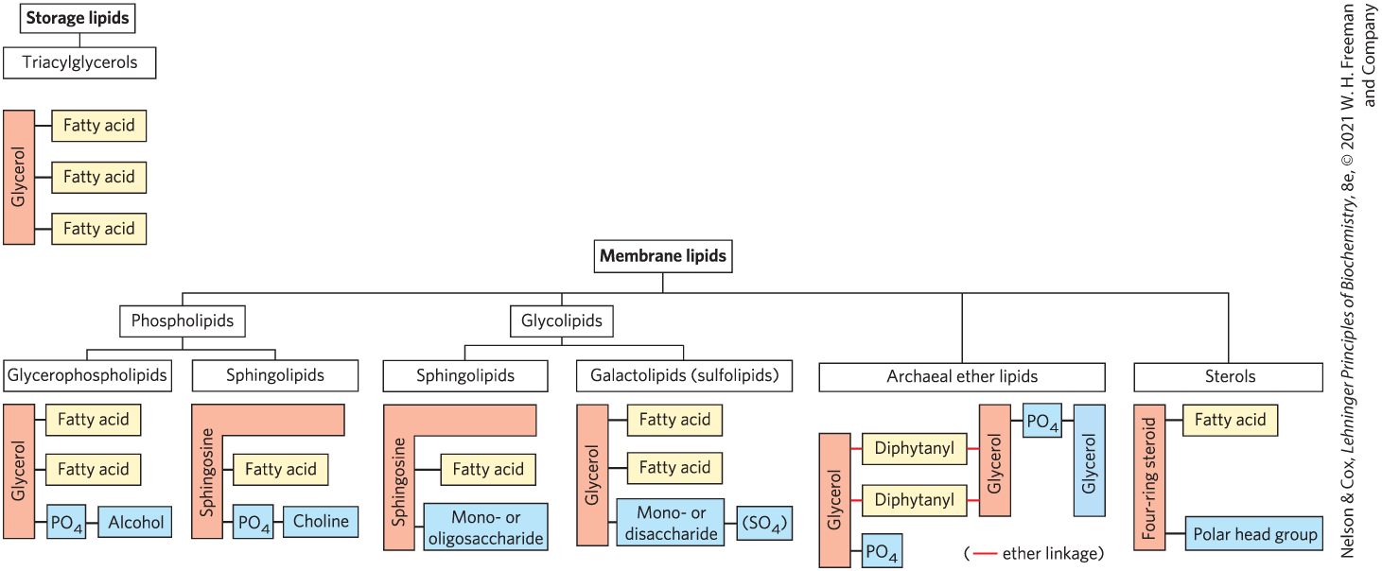
Some Common Types of Storage and Membrane Lipids

Slide 33
Principle 2 (3 of 6)
Membrane lipids are composed of hydrophobic tails attached to polar head groups. Cellular membranes are composed of a variety of lipids, including glycerophospholipids and sterols. These lipids are used for structuring membranes as well as for displaying molecules on the membrane surfaces for signaling and molecular recognition.

Slide 34
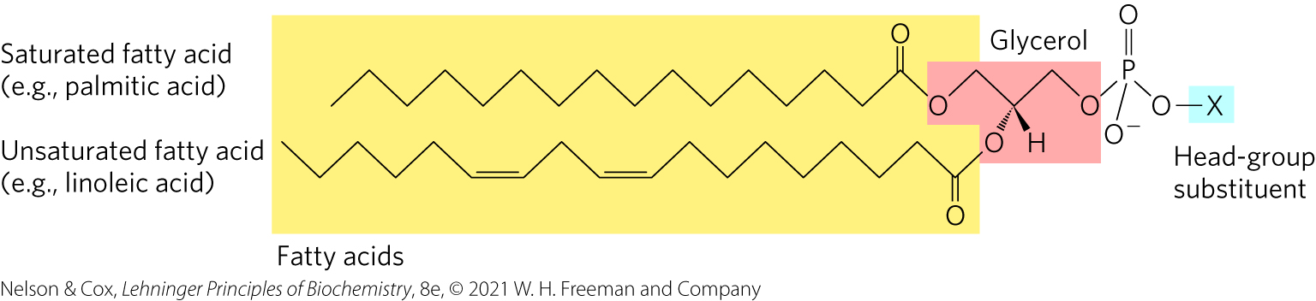
Glycerophospholipids Are Derivatives of Phosphatidic Acid
glycerophospholipids (phosphoglycerides) = membrane lipids in which two fatty acids are attached in ester linkage to the first and second carbons of glycerol, and a highly polar or charged group is attached through a phosphodiester linkage to the third carbon

Slide 35
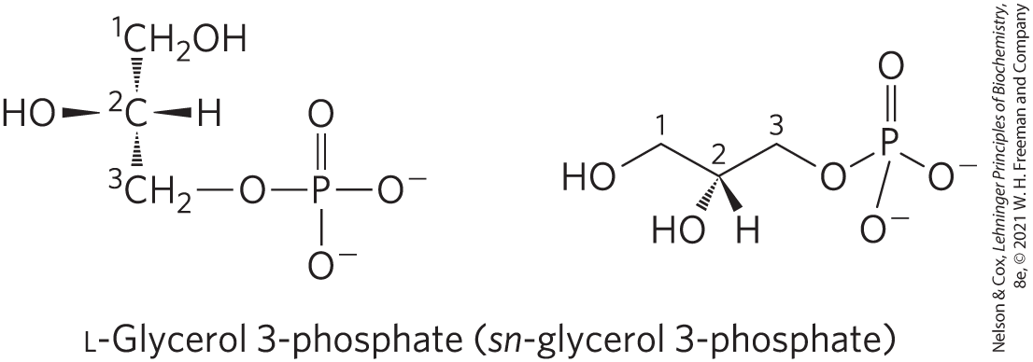
Glycerol is Prochiral
attachment of phosphate at one end of glycerol converts it to a chiral compound
  named using the D, L system

Slide 36
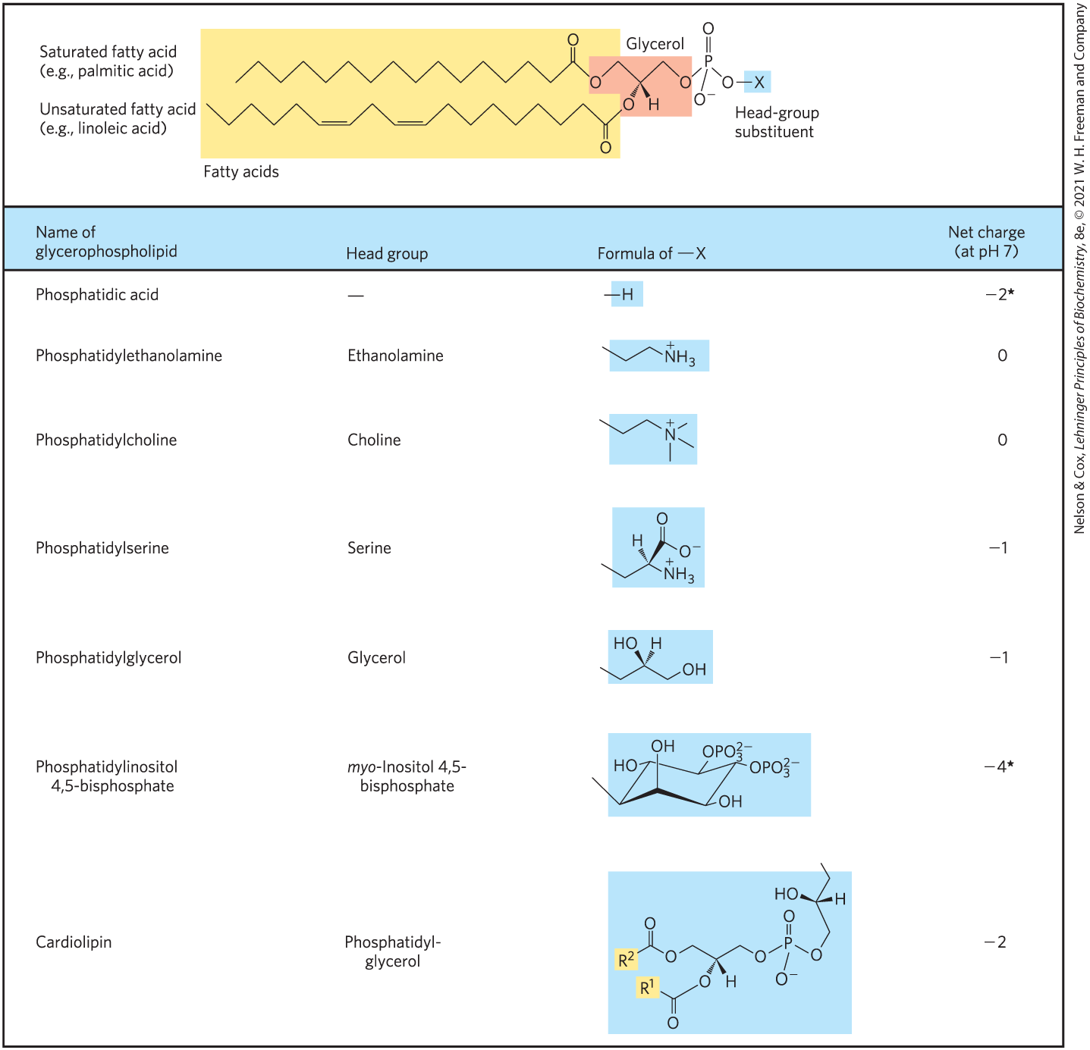
Glycerophospholipids Are Named as Derivatives of Phosphatidic Acid
a phosphodiester bond joins the head group to glycerol
the phosphate group can bear a negative, neutral, or positive charge

Slide 37
The Fatty Acids in Glycerophospholipids
can be any of a wide variety
in general, glycerophospholipids contain:
  a C₁₆ or C₁₈ saturated fatty acid at C-1
  a C₁₈ or C₂₀ unsaturated fatty acid at C-2

Slide 38
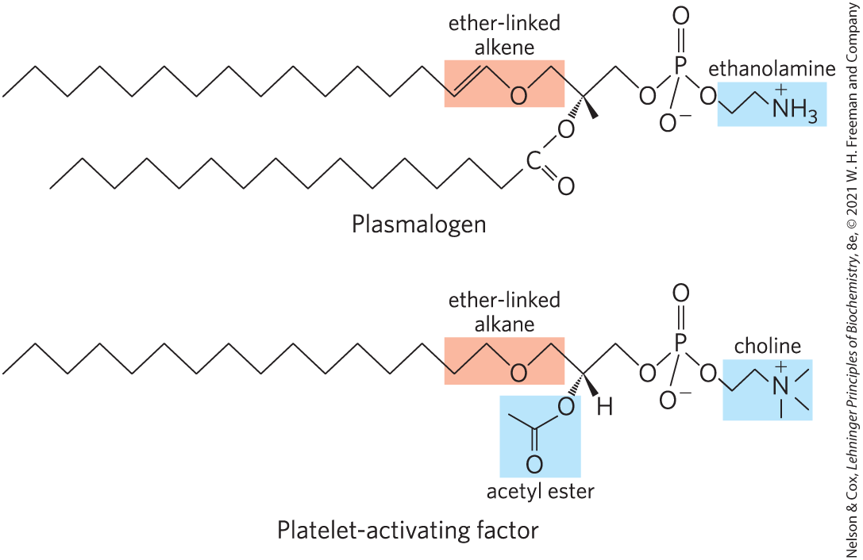
Some Glycerophospholipids Have Ether-Linked Fatty Acids
ether lipids = one of the two acyl chains is attached to glycerol in ether, rather than ester, linkage
  chain may be saturated
  chain may contain a double bond between C-1 and C-2 as in plasmalogens

Slide 39
Platelet-Activating Factor
platelet-activating factor = an ether lipid that serves as a potent molecular signal
  releases from leukocytes called basophils
  stimulates platelet aggregation and serotonin release
  plays a role in inflammation and the allergic response

Slide 40
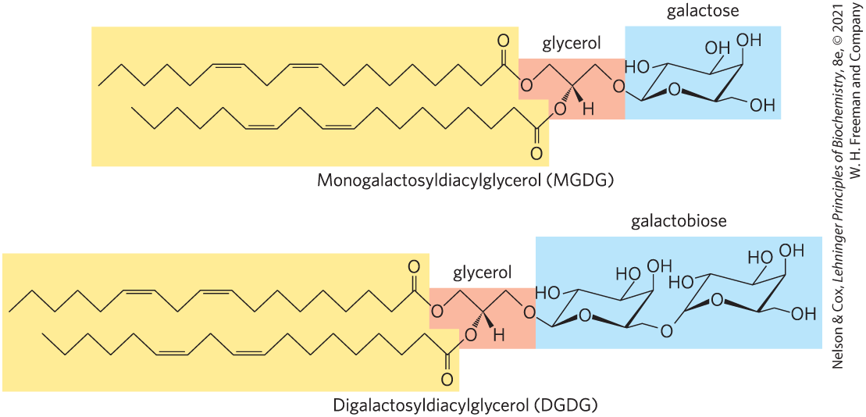
Galactolipids of Plants and Ether-Linked Lipids of Archaea Are Environmental Adaptations
galactolipids = member of the glycolipids group that predominate in plant cells
  one or two galactose residues are connected by a glycosidic linkage to C-3 of a 1,2-diacylglycerol

Slide 41
Principle 2 (4 of 6)
Membrane lipids are composed of hydrophobic tails attached to polar head groups. Cellular membranes are composed of a variety of lipids, including glycerophospholipids and sterols. These lipids are used for structuring membranes as well as for displaying molecules on the membrane surfaces for signaling and molecular recognition.

Slide 42
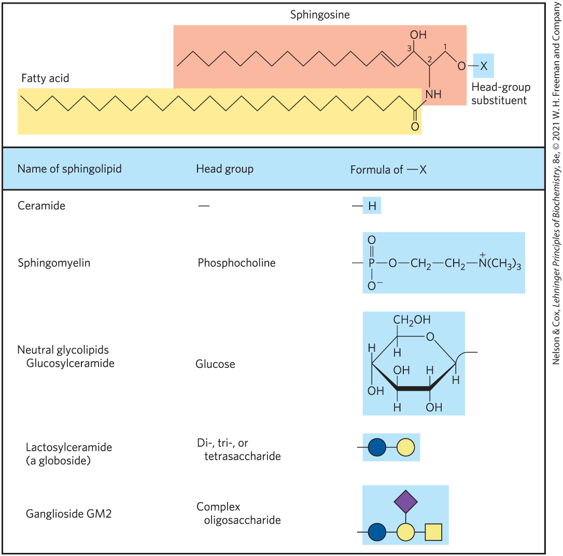
Sphingolipids Are Derivatives of Sphingosine
sphingolipids = large class of membrane phospholipids and glycolipids
  have a polar head group and two nonpolar tails
  contain no glycerol
  contain one molecule of the long-chain amino alcohol sphingosine or one of its derivatives

Slide 43
Ceramides Are The Structural Parent of All Sphingolipids
C-1, C-2, and C-3 of sphingosine are structurally analogous of the three carbons of glycerol in glycerophospholipids
ceramide = compound resulting when a fatty acid is attached in amide linkage to the –NH₂ on C-2
  structurally similar to a diacylglycerol

Slide 44
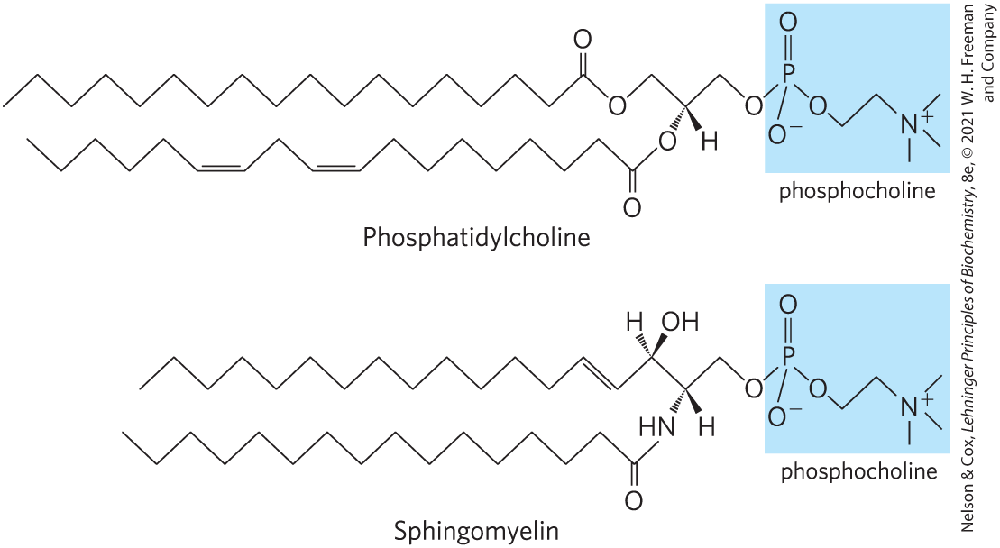
Sphingomyelins
sphingomyelins = subclass of sphingolipids that contains phosphocholine or phosphoethanolamine as their polar head group

Slide 45
Glycosphingolipids
glycosphingolipids = have head groups with 1+ sugars connected directly to the –OH at C-1 of the ceramide moiety
  do not contain phosphate
  occur largely in the outer face of plasma membranes

Slide 46
Cerebrosides and Globosides
cerebrosides = have a single sugar linked to ceramide
  those with galactose are found in the plasma membranes of cells in neural tissue
  those with glucose are found in the plasma membranes of cells in nonneural tissues
globosides = glycosphingolipids with 2+ sugars, usually D-glucose, D-galactose, or N-acetyl-D-galactosamine
sometimes called neutral glycolipids, as they have no charge at pH 7

Slide 47
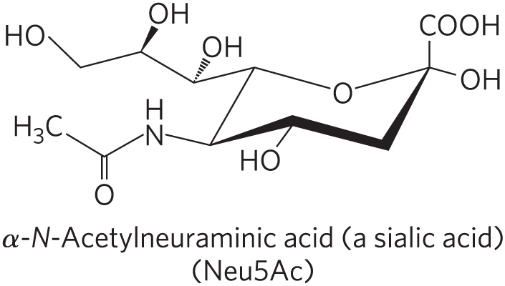
Gangliosides
gangliosides = have oligosaccharides as their polar head groups and 1+ residues of N-acetylneuraminic acid (Neu5Ac), a sialic acid, at the termini
  1 sialic acid residue = GM (M for mono-) series
  2 sialic acid residues = GD (D for di-) series
  3 sialic acid residues = GT (T for tri-) series (and so on)

Slide 48
Principle 2 (5 of 6)
Membrane lipids are composed of hydrophobic tails attached to polar head groups. Cellular membranes are composed of a variety of lipids, including glycerophospholipids and sterols. These lipids are used for structuring membranes as well as for displaying molecules on the membrane surfaces for signaling and molecular recognition.

Slide 49
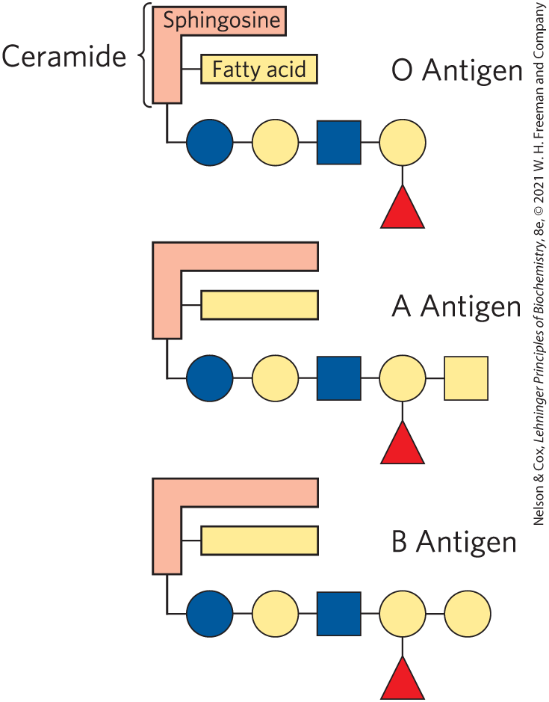
Sphingolipids at Cell Surfaces Are Sites of Biological Recognition
prominent in the plasma membranes of neurons
human blood groups (O, A, B) are determined in part by the oligosaccharide head groups of these glycosphingolipids

Slide 50
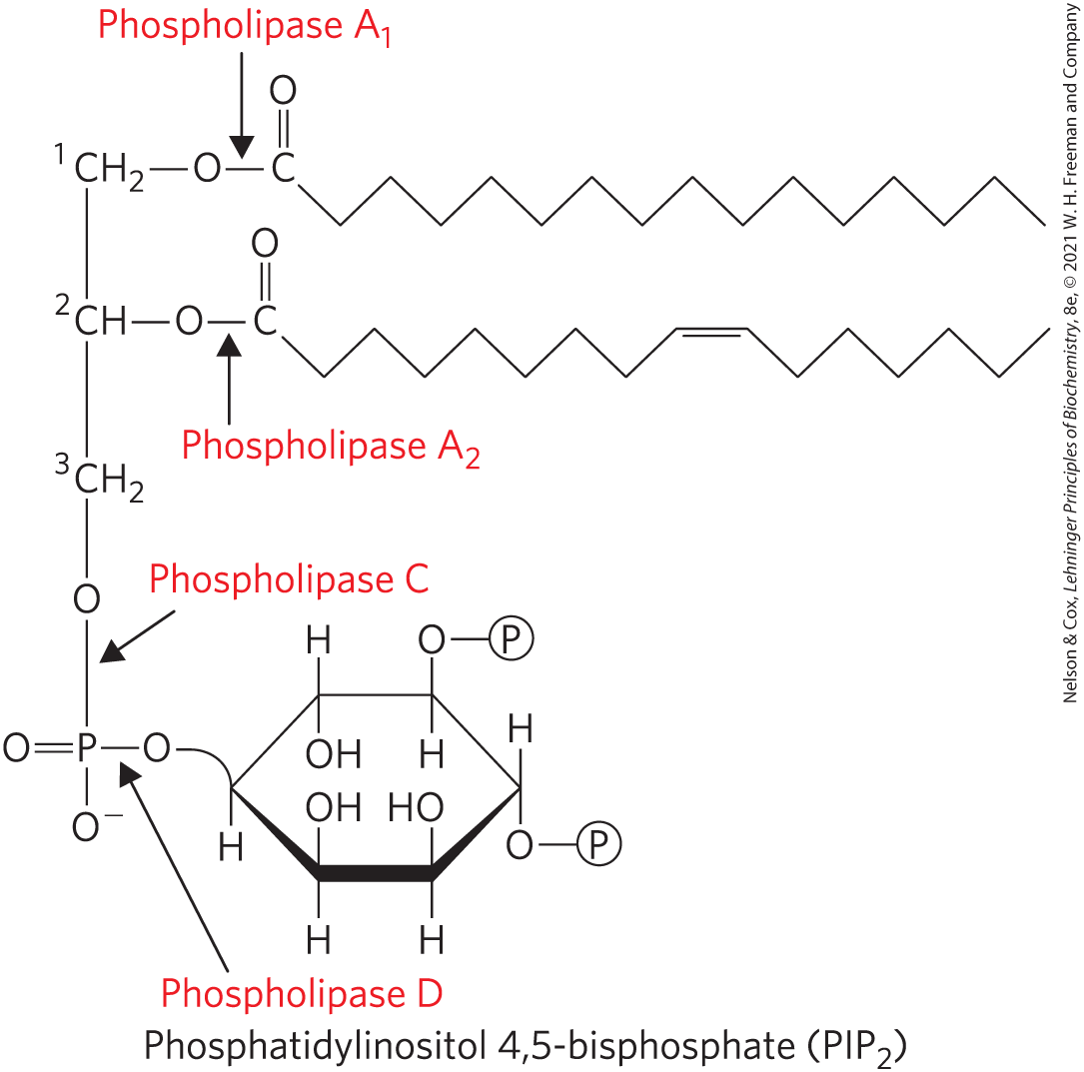
Phospholipids and Sphingolipids Are Degraded in Lysosomes
phospholipases of the A type remove one of the two fatty acids
lysophospholipases remove the remaining fatty acid
lysosomal enzymes catalyze the stepwise removal of sugar units of gangliosides

Slide 51
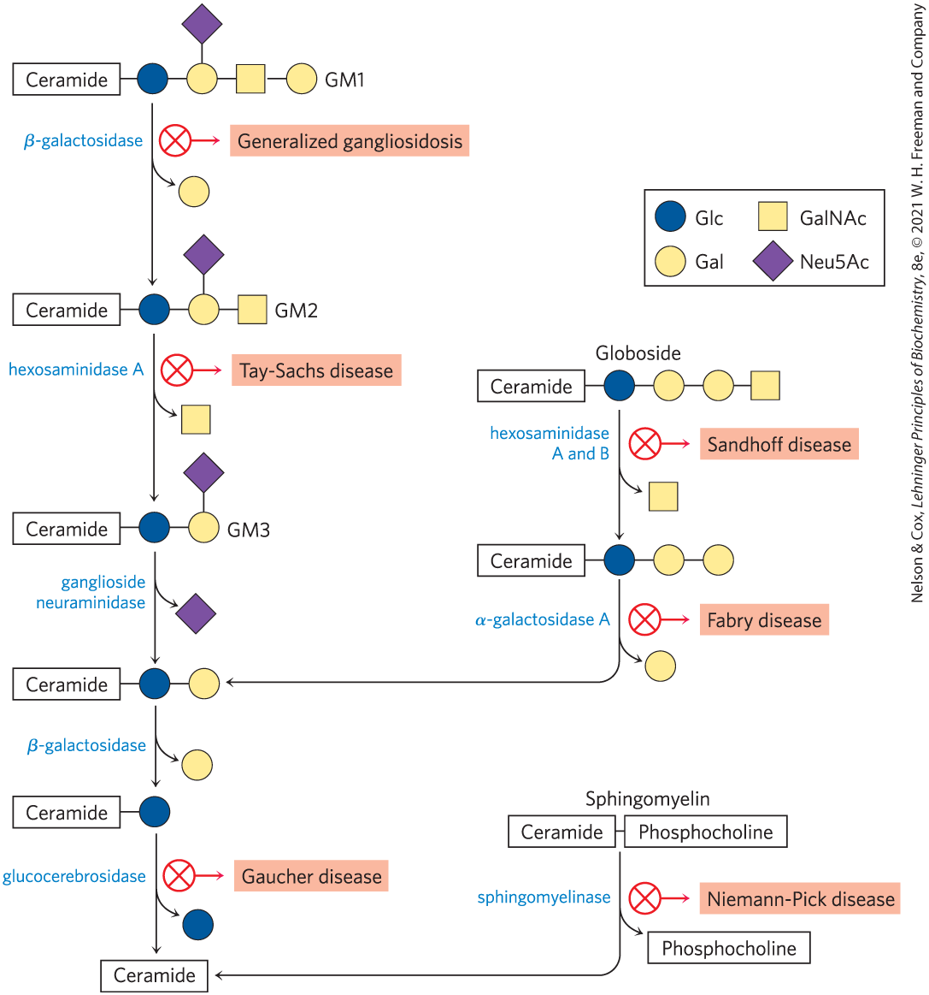
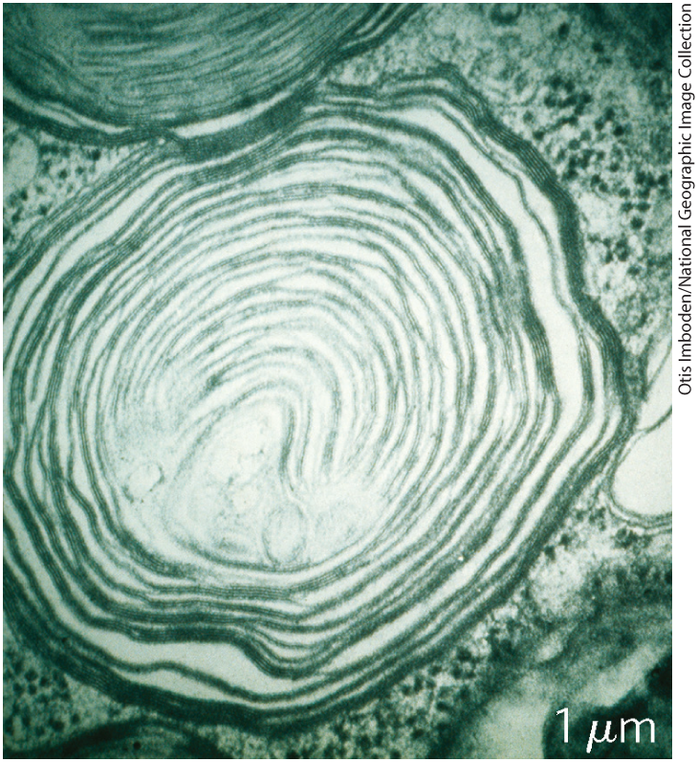
Abnormal Accumulations of Membrane Lipids
genetic defects in any of these hydrolytic enzymes leads to the accumulation of gangliosides in the cell

Slide 52
Principle 2 (6 of 6)
Membrane lipids are composed of hydrophobic tails attached to polar head groups. Cellular membranes are composed of a variety of lipids, including glycerophospholipids and sterols. These lipids are used for structuring membranes as well as for displaying molecules on the membrane surfaces for signaling and molecular recognition.

Slide 53
Sterols Have Four Fused Carbon Rings
sterols = structural lipids present in the membranes of most eukaryotic cells
steroid nucleus:
  consists of four fused rings
  almost planar
  relatively rigid

Slide 54
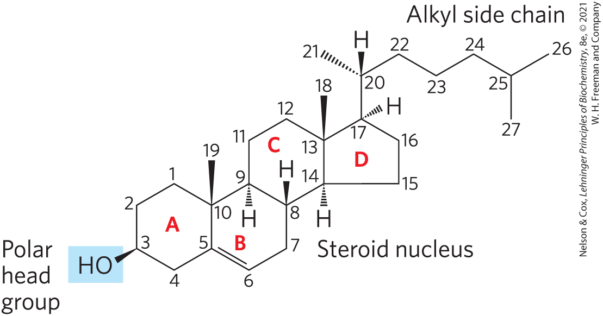
Cholesterol
cholesterol = major sterol in animal tissues
  amphipathic
  polar head group
  nonpolar hydrocarbon body
  membrane constituents
  similar to stigmasterol in plants and ergosterol in fungi

Slide 55
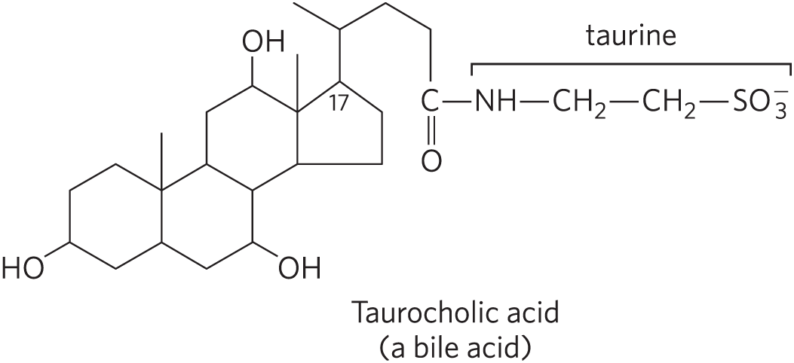
Sterols Serve as Precursors for Products with Specific Biological Activities
steroid hormones regulate gene expression
bile acids = polar derivatives of cholesterol that emulsify dietary fats in the intestine to make them more readily accessible to digestive lipases

Slide 56
10.3 Lipids as Signals, Cofactors, and Pigments

Slide 57
Principle 3 (2 of 7)
Lipids have uses in the cell beyond energy storage and membranes construction. Many lipids are present in the cell at smaller amounts than those making up membranes or being stored as fat. These lipids can function as cellular messengers, hormones, electron carriers, or pigments.

Slide 58
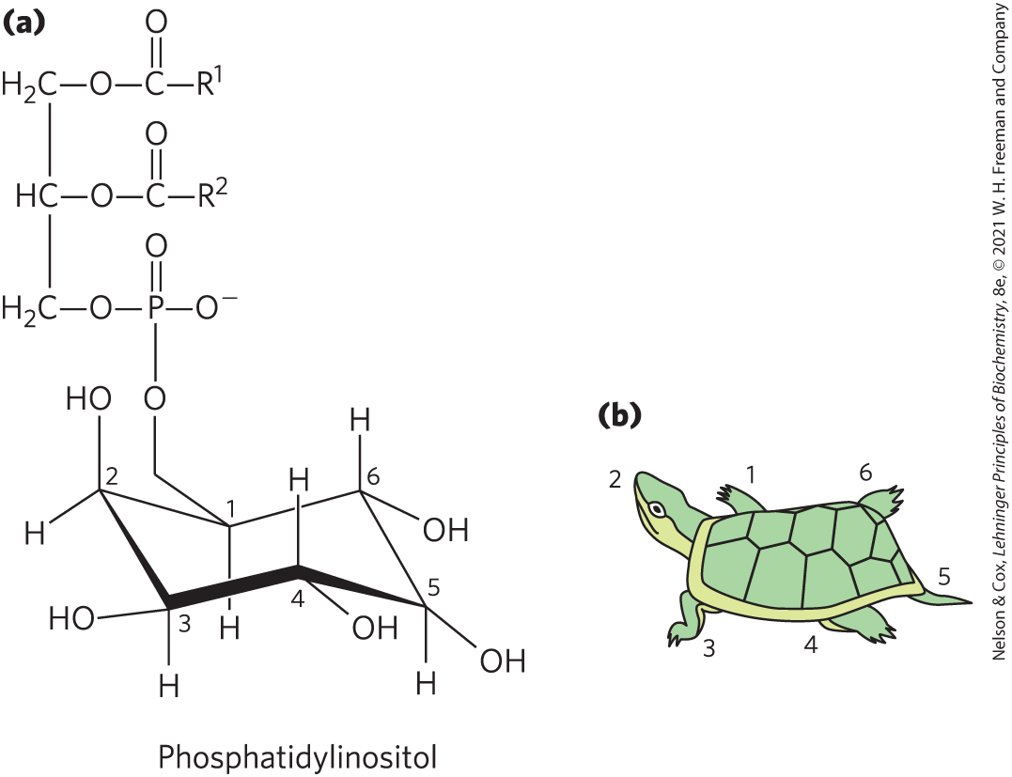
Phosphatidylinositols and Sphingosine Derivatives Act as Intracellular Signals
phosphatidylinositol (PI) and its phosphorylated derivatives regulate cell structure and metabolism

Slide 59
Phosphatidylinositol 4,5-Bisphosphate (PIP₂)
in the cytoplasmic face of plasma membranes
serves as a reservoir of messenger molecules that are released in response to extracellular signals
  phospholipase C hydrolyzes PIP₂ to IP₃ and diacylglycerol (intracellular messengers)

Slide 60
Principle 3 (3 of 7)
Lipids have uses in the cell beyond energy storage and membranes construction. Many lipids are present in the cell at smaller amounts than those making up membranes or being stored as fat. These lipids can function as cellular messengers, hormones, electron carriers, or pigments.

Slide 61
Inositol Phospholipids Serve As Points of Nucleation
signaling proteins bind specifically to phosphatidylinositol 3,4,5-trisphosphate (PIP₃) in the plasma membrane
  initiates formation of multienzyme complexes at the membrane’s cytosolic surface

Slide 62
Membrane Sphingolipids Serve As Sources of Intracellular Messengers
ceramide and sphingomyelin are potent regulators of protein kinases
ceramide or its derivatives are involved in the regulation of:
  cell division
  differentiation
  migration
  programmed cell death

Slide 63
Principle 3 (4 of 7)
Lipids have uses in the cell beyond energy storage and membranes construction. Many lipids are present in the cell at smaller amounts than those making up membranes or being stored as fat. These lipids can function as cellular messengers, hormones, electron carriers, or pigments.

Slide 64
Eicosanoids Carry Messages to Nearby Cells
eicosanoids = paracrine hormones, substances that act only on cells near the point of hormone synthesis instead of being transported in the blood
involved in:
  reproductive function
  inflammation, fever, and pain associated with injury or disease
  formation of blood clots
  regulation of blood pressure
  gastric acid secretion

Slide 65
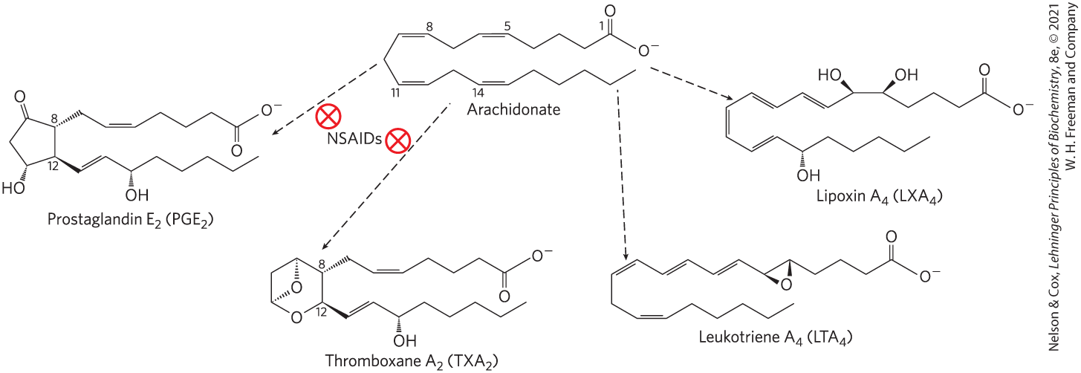
Eicosanoids Are Derived From Arachidonic Acid
four major classes of eicosanoids = prostaglandins, thromboxanes, leukotrienes, and lipoxins

Slide 66
Prostaglandins (PG)
prostaglandins (PG) = class of eicosanoids that contain a five-carbon ring
array of functions:
  stimulate contraction of the smooth muscle of the uterus
  affect blood flow to specific organs, the wake-sleep cycle, and the responsiveness of certain tissues to hormones
  elevate body temperature and cause inflammation and pain

Slide 67
Thromboxanes (TX)
thromboxanes (TX) = class of eicosanoids that have a six-membered ring containing an ether
produced by platelets (also called thrombocytes)
act in the formation of blood clots and reduction of blood flow to the site of a clot

Slide 68
Leukotrienes (LT)
leukotrienes (LT) = class of eicosanoids that contain three conjugated double bonds
powerful biological signals
  leukotriene D₄ induces contraction of the smooth muscle lining the airways to the lung

Slide 69
Lipoxins (LX)
lipoxins (LX) = class of eicosanoids that are linear and contain several hydroxyl groups along the chain
potent anti-inflammatory agents

Slide 70
Principle 3 (5 of 7)
Lipids have uses in the cell beyond energy storage and membranes construction. Many lipids are present in the cell at smaller amounts than those making up membranes or being stored as fat. These lipids can function as cellular messengers, hormones, electron carriers, or pigments.

Slide 71
Steroid Hormones Carry Messages between Tissues
steroids = oxidized derivates of sterols
  lack the alkyl chain attached to ring D of cholesterol
  more polar than cholesterol
steroid hormones move through the bloodstream (on protein carriers) to target tissues
binding to highly specific receptor proteins in the nucleus triggers changes in gene expression

Slide 72
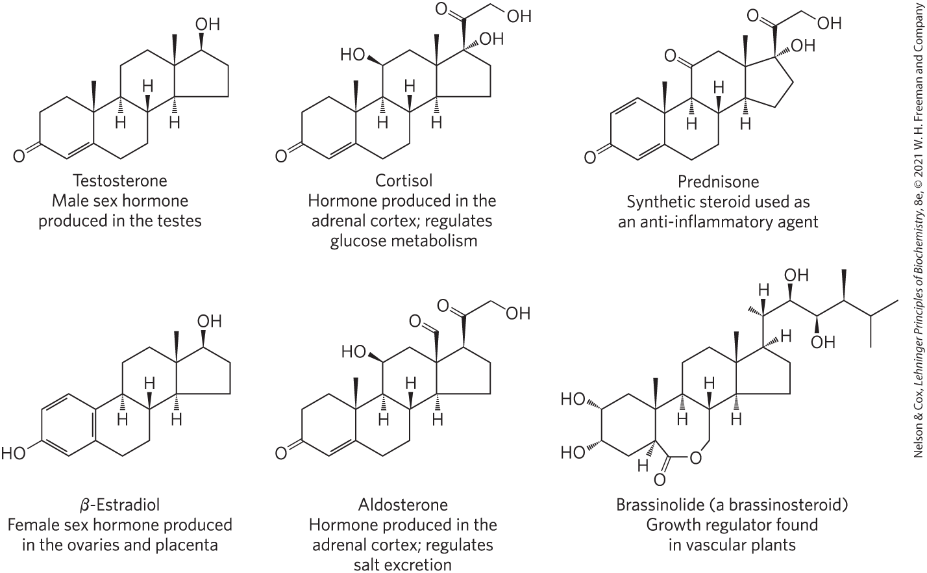
Steroids Derived From Cholesterol

Slide 73
Principle 3 (6 of 7)
Lipids have uses in the cell beyond energy storage and membranes construction. Many lipids are present in the cell at smaller amounts than those making up membranes or being stored as fat. These lipids can function as cellular messengers, hormones, electron carriers, or pigments.

Slide 74
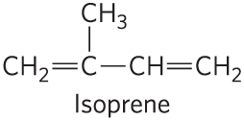
Vascular Plants Produce Thousands of Volatile Signals
functions of volatile, lipophilic compounds:
  attract pollinators
  repel herbivores
  attract organisms that defend the plant against herbivores
  communicate with other plants
many are derived from fatty acids or from compounds made by the condensation of isoprene units

Slide 75
Principle 3 (7 of 7)
Lipids have uses in the cell beyond energy storage and membranes construction. Many lipids are present in the cell at smaller amounts than those making up membranes or being stored as fat. These lipids can function as cellular messengers, hormones, electron carriers, or pigments.

Slide 76
Vitamins A and D Are Hormone Precursors
vitamins = compounds that are essential to the health of humans and other vertebrates but cannot be synthesized
fat-soluble vitamins include the groups A, D, E, and K

Slide 77
Vitamin D₃ and Calcitrol
vitamin D₃ (cholecalciferol) = formed in the skin from 7-dehydrocholesterol in a photochemical reaction driven by the UV component of sunlight
  not biologically active
  converted by enzymes in the liver and kidney to calcitriol

Slide 78
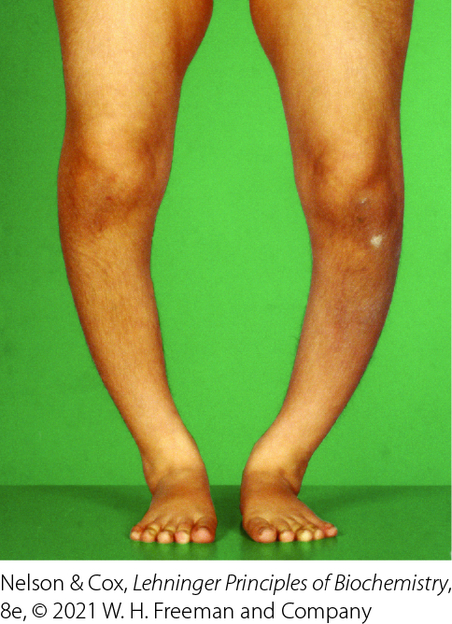
Vitamin D Deficiencies
deficiency leads to defective bone formation and the disease rickets

Slide 79
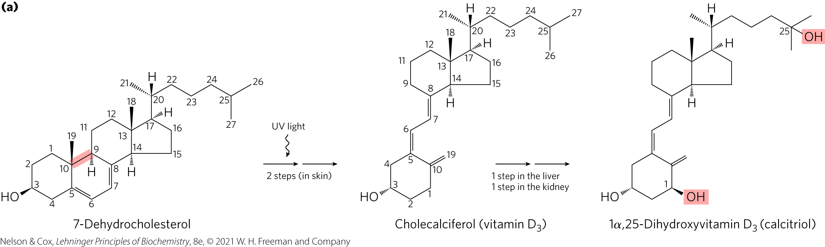
Vitamin D₃ Production and Metabolism
calcitrol = hormone that regulates calcium uptake in the intestine and calcium levels in the kidney and bone

Slide 80
Vitamin A₁
vitamin A₁ (all-trans-retinol) = acts in processes of development, cell growth and differentiation, and vision
  can be stored for some time in the body

Slide 81
All-Trans-Retinoic Acid
vitamin A₁ (all-trans-retinol) = acts in processes of development, cell growth and differentiation, and vision
vitamin A₁ or β-carotene can be converted enzymatically to all-trans-retinoic acid
all-trans-retinoic acid = retinoid hormone that acts through a family of nuclear receptor proteins to regulate gene expression

Slide 82
Carotenoids
carotenoids = natural products with a characteristic extensive system of conjugated double bonds, which makes possible their strong absorption of visible light (450–470 nm)
  β-carotene pigment is a source of vitamin A

Slide 83
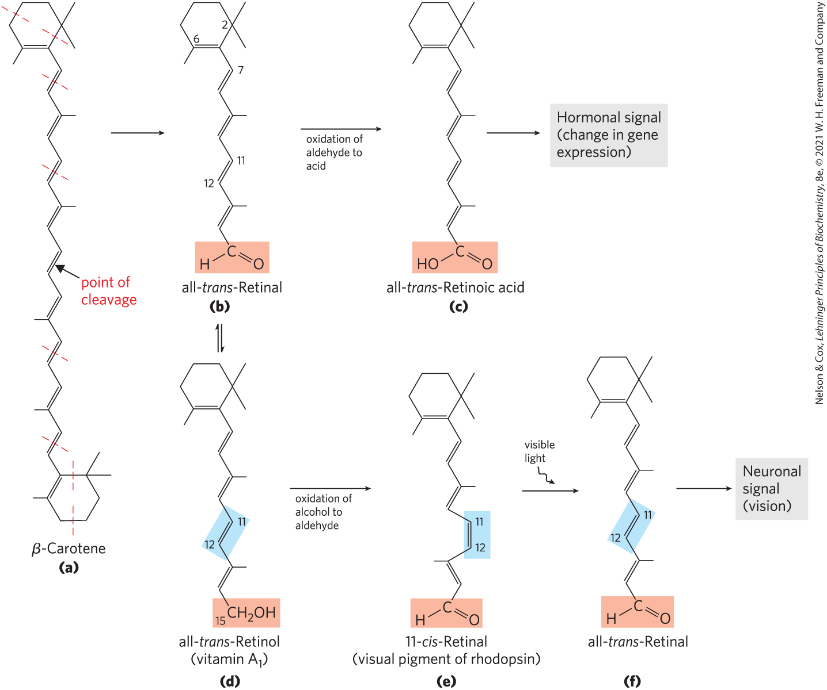
Dietary β-Carotene and Vitamin A₁ as Precursors of the Retinoids

Slide 84
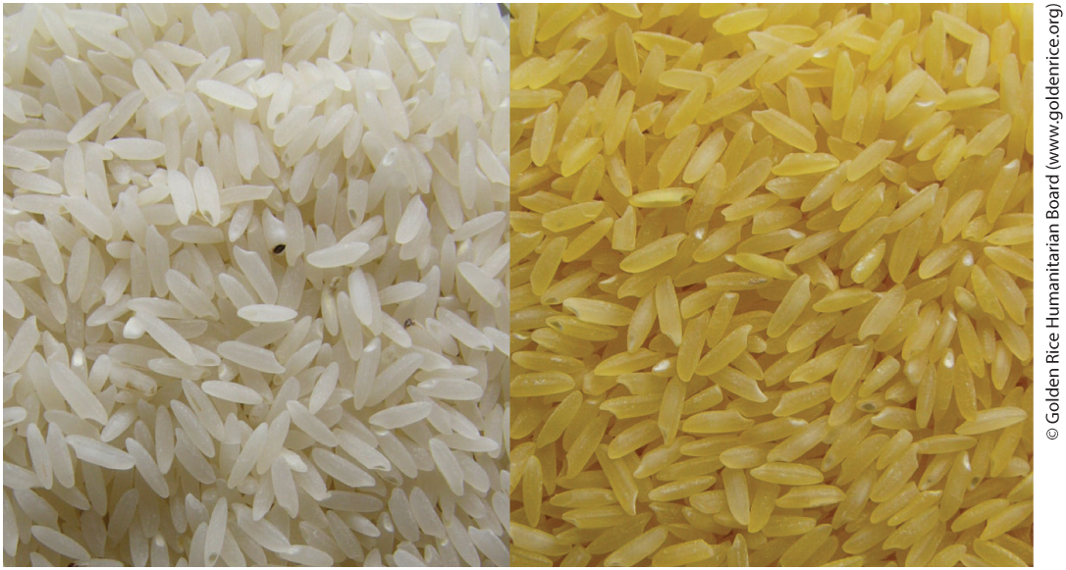
Vitamin A Deficiencies
in pregnant women, leads to congenital malformations and growth retardation in the infant
in adults, leads to dryness of skin, eyes, and mucous membranes, and night blindness
“golden rice” = genetically engineered rice enriched in β-carotene

Slide 85
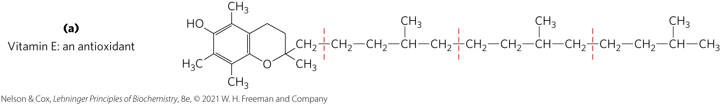
Vitamins E and K and the Lipid Quinones Are Oxidation-Reduction Cofactors
vitamin E = collective name for a group of lipids called tocopherols
tocopherols = hydrophobic compounds that contain a substituted aromatic ring and a long isoprenoid side chain
  associate with cell membranes, lipid deposits, and lipoproteins
  biological antioxidants

Slide 86
Vitamin E Deficiencies
cause scaly skin, muscular weakness and wasting, and sterility
very rare in humans
principal symptom is fragile erythrocytes

Slide 87
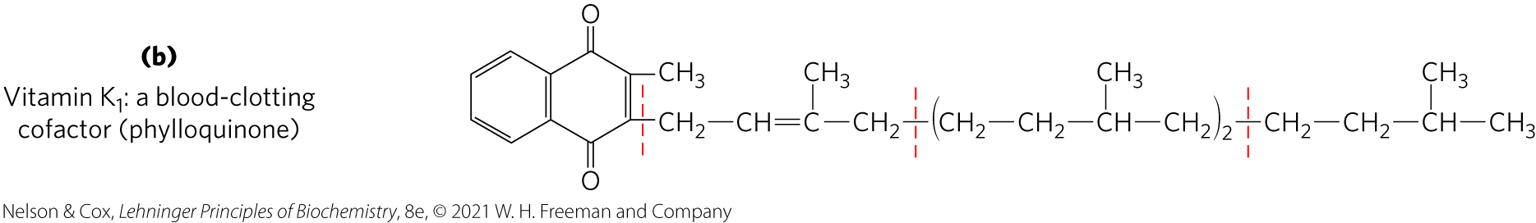
Vitamin K
vitamin K = contains an aromatic ring that undergoes a cycle of oxidation and reduction during the formation of active prothrombin, a blood plasma protein essential in blood clotting

Slide 88
Vitamin K Deficiencies
slow blood clotting
extremely uncommon in humans

Slide 89
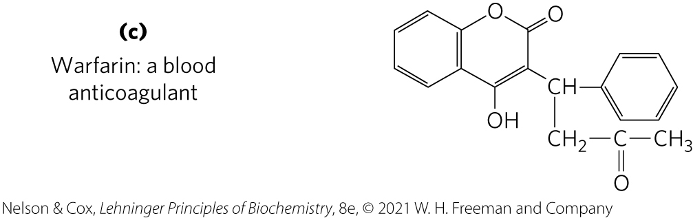
Warfarin
warfarin = a synthetic compound that inhibits the formation of active prothrombin
  potent rodenticide
  invaluable anticoagulant drug for treating humans at risk for excessive blood clotting

Slide 90
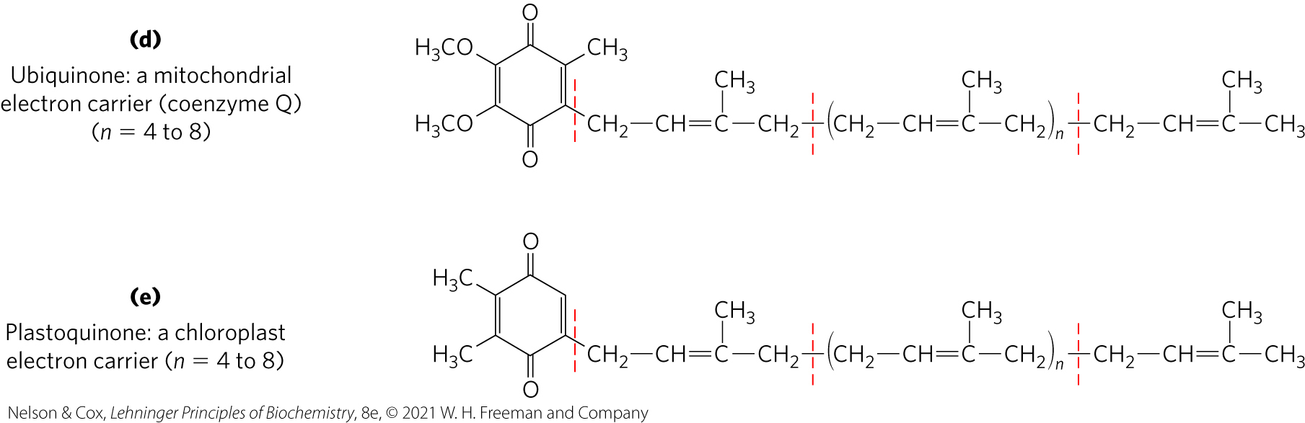
Ubiquinone and Plastoquinone
ubiquinone (coenzyme Q) and plastoquinone = isoprenoids that function as lipophilic electron carriers in the oxidation-reduction reactions that drive ATP synthesis in mitochondria and chloroplasts, respectively

Slide 91
Dolichols Activate Sugar Precursors for Biosynthesis
dolichols = isopenoid alcohols that activate and anchor sugars to cellular membranes
  sugar groups are then used in the synthesis of complex carbohydrates, glycolipids, and glycoproteins
  allow attached sugars to participate in sugar-transfer reactions

Slide 92
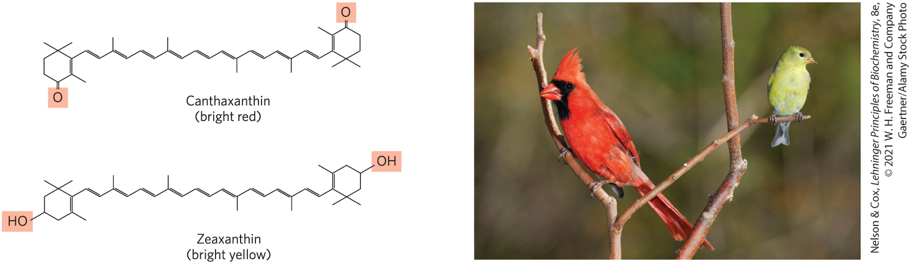
Many Natural Pigments Are Lipidic Conjugated Dienes
conjugated dienes = have carbon chains with alternating single and double bonds
  allow the delocalization of electrons
  compounds can be excited by visible light

Slide 93
Polyketides Are Natural Products with Potent Biological Activities
polyketides = diverse group of lipids with biosynthetic pathways (Claisen condensations) similar to those for fatty acids
  secondary metabolites = compounds that are not central to an organism’s metabolism but serve some subsidiary function that gives the organism an advantage
  used as antibiotics, antifungals, or inhibitors of cholesterol synthesis

Slide 94
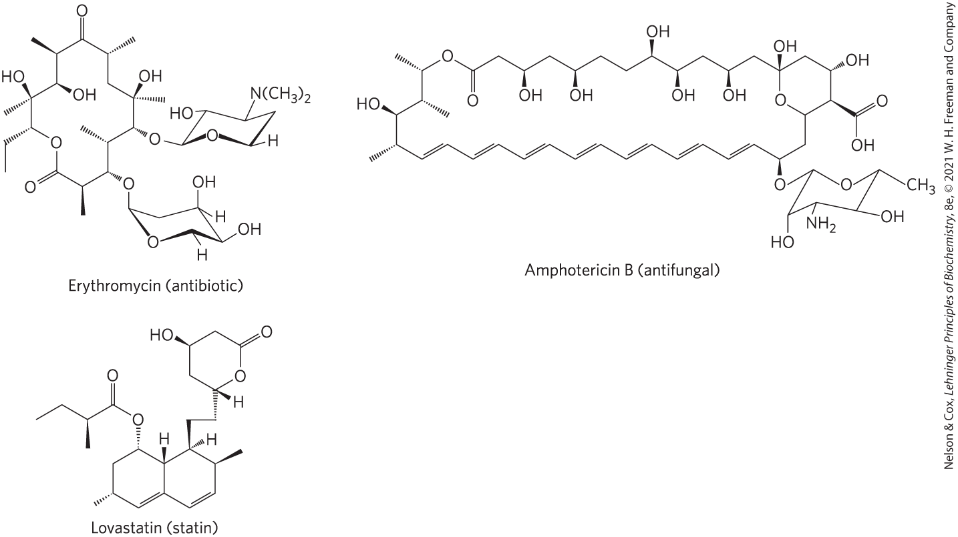
Polyketide Natural Products Used in Human Medicine

Slide 95
10.4 Working with Lipids

Slide 96
Principle 4 (2 of 6)
The chemical properties of lipids are
related to their structure and composition. As in studies of other biomolecules, methods such as enzymatic, chromatographic, and mass spectrometry can all be used to identify lipids and determine their atomic structure.

Slide 97
Separation of Lipids
lipids are insoluble in water
in general, complex mixtures of lipids are separated by differences in polarity or solubility in nonpolar solvents

Slide 98
Lipid Extraction Requires Organic Solvents
neutral lipids are extracted with ethyl ether, chloroform, or benzene
  does not permit lipid clustering driven by the hydrophobic effect
membrane lipids are extracted by ethanol or methanol
  reduces the hydrophobic interactions among lipid molecules
  weakens the hydrogen bonds and electrostatic interactions that bind membrane lipids to membrane proteins

Slide 99
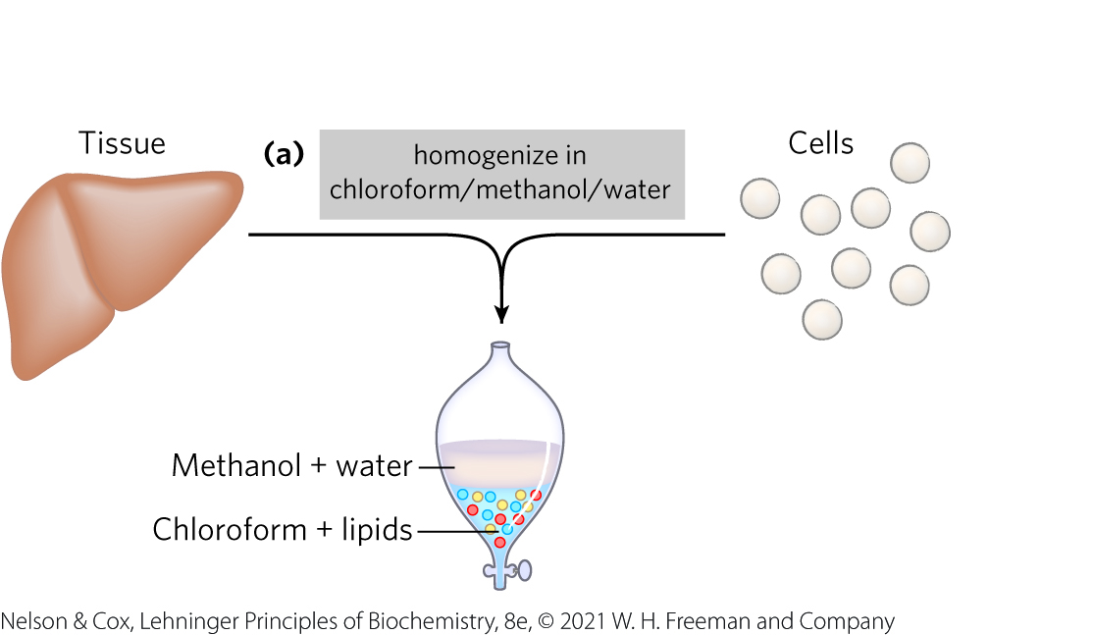
A Commonly Used Extractant is a Mixture of Chloroform, Methanol, and Water
mixture separates into two phases: methanol/water (top phase) and chloroform (bottom phase)
  lipids remain in the chloroform layer
  more polar molecules (proteins and sugars) partition into the methanol/water layer

Slide 100
Principle 4 (3 of 6)
The chemical properties of lipids are
related to their structure and composition. As in studies of other biomolecules, methods such as enzymatic, chromatographic, and mass spectrometry can all be used to identify lipids and determine their atomic structure.

Slide 101
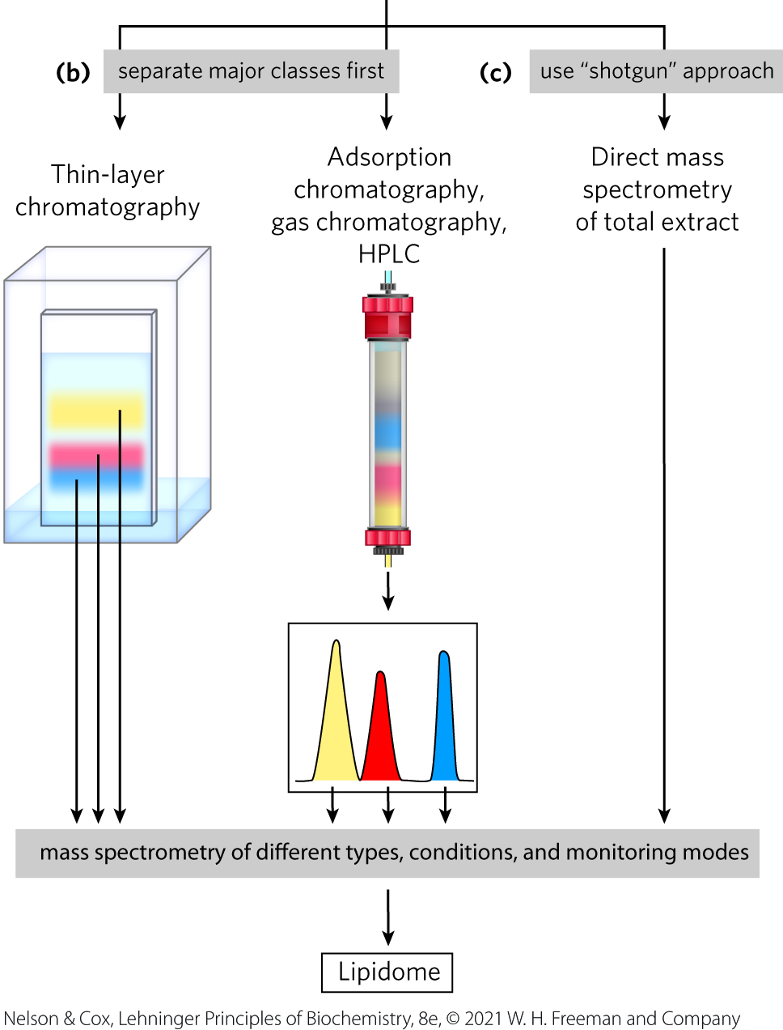
Adsorption Chromatography Separates Lipids of Different Polarity
lipids in mixtures can be separated based on their polarity and interactions with polar materials such as silica, using adsorption chromatography methods such as HPLC or TLC

Slide 102
Principle 4 (4 of 6)
The chemical properties of lipids are
related to their structure and composition. As in studies of other biomolecules, methods such as enzymatic, chromatographic, and mass spectrometry can all be used to identify lipids and determine their atomic structure.

Slide 103
Gas Chromatography Resolves Mixtures of Volatile Lipid Derivatives
GC volatilizes lipids so that they can be carried by a stream of inert gas and resolved based on their ability to partition into a soluble column material

Slide 104
Principle 4 (5 of 6)
The chemical properties of lipids are
related to their structure and composition. As in studies of other biomolecules, methods such as enzymatic, chromatographic, and mass spectrometry can all be used to identify lipids and determine their atomic structure.

Slide 105
Specific Hydrolysis Aids in Determination of Lipid Structure
all ester-linked fatty acids are released by mild acid or alkaline treatment
harsher hydrolysis conditions release amide-bound fatty acids from sphingolipids
phospholipases specific for one of the bonds in a phospholipid generate simpler compounds

Slide 106
Principle 4 (6 of 6)
The chemical properties of lipids are
related to their structure and composition. As in studies of other biomolecules, methods such as enzymatic, chromatographic, and mass spectrometry can all be used to identify lipids and determine their atomic structure.

Slide 107
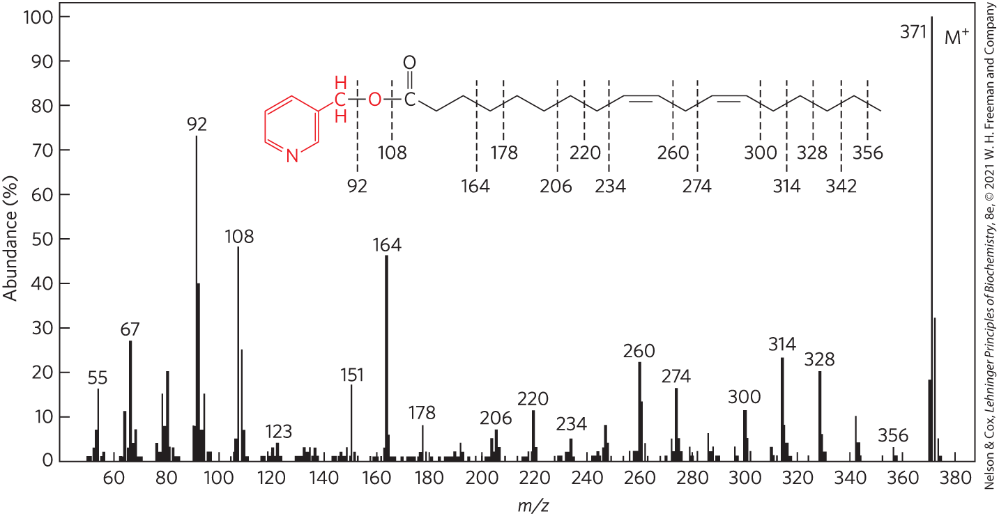
Mass Spectrometry Reveals Complete Lipid Structure
allows the analysis of crude mixtures of lipids without prefractionation
can determine the length of a hydrocarbon chain or positions of double bonds

Slide 108
Lipidomics Seeks to Catalog All Lipids and Their Functions
LIPID MAPS Lipidomics Gateway = database analogous to the Protein Data Bank
  has its own classification system of eight chemical categories
Table 10-2 Eight Major Categories of Biological Lipids
Category | Category code | Examples
Fatty acids | FA | Oleate, stearoyl-CoA, palmitoylcarnitine
Glycerolipids | GL | Di- and triaclyglycerols
Glycerophospholipids | GP | Phosphatidylcholine, phosphatidylserine, phosphatidyethanoloamine
Sphingolipids | SP | Sphingomyelin, ganglioside, GM2
Sterol lipids | ST | Cholesterol, progesterone, bile acids
Prenol lipids | PR | Farnesol, geraniol, retinol, ubiquinone
Saccharolipids | SL | Lipopolysaccharide
Polyketides | PK | Tetracycline, erythromycin, aflatoxin B₁

Slide 109
The Lipidome
lipidome = the full complement of lipids present in a specific cell type under particular conditions

