Slide 1

7 Carbohydrates and Glycobiology
© 2021 Macmillan Learning

Slide 2
Carbohydrates
carbohydrates = aldehydes or ketones with at least two hydroxyl groups, or substances that yield such compounds on hydrolysis
many carbohydrates have the empirical formula (CH₂O)_{n}

Slide 3
Classes of Carbohydrates
monosaccharides = simple sugars, consist of a single polyhydroxy aldehyde or ketone unit
  example: D-glucose
oligosaccharides = short chains of monosaccharide units, or residues, joined by glycosidic bonds

Slide 4
Classes of Carbohydrates, Continued
disaccharides = oligosaccharides with two monosaccharide units
  example: sucrose (D-glucose and D-fructose)
polysaccharides = sugar polymers with 10+ monosaccharide units
  examples: cellulose (linear), glycogen (branched)

Slide 5

Principle 1 (1 of 4)
Carbohydrates can have multiple chiral carbons; the configuration of groups around each carbon atom determines how the compound interacts with other biomolecules. As we saw for L-amino acids in proteins, with rare exceptions, biological evolution selected one stereochemical series (D-series) for sugars.

Slide 6

Principle 2 (1 of 3)
Monomeric subunits, monosaccharides, serve as the building blocks of large carbohydrate polymers. The specific sugar, the way the units are linked, and whether the polymer is branched determine its properties and thus its function.

Slide 7

Principle 3 (1 of 2)
Storage of low molecular weight metabolites in polymeric form avoids the very high osmolarity that would result from storing them as individual monomers. If the glucose in liver glycogen were monomeric, the glucose concentration in liver would be so high that cells would swell and lyse from the entry of water by osmosis.

Slide 8

Principle 4 (1 of 2)
The sequences of complex polysaccharides
are determined by the intrinsic properties
of the biosynthetic enzymes that add each monomeric unit to the growing polymer. This is in contrast with DNA, RNA, and proteins, which are synthesized on templates that direct their sequence.

Slide 9

Principle 5 (1 of 6)
Polysaccharides assume three-dimensional structures with the lowest-energy conformations, determined by covalent bonds, hydrogen bonds, charge interactions, and steric factors. Starch folds into a helical structure stabilized by internal hydrogen bonds; cellulose assumes an extended structure in which intermolecular hydrogen bonds are more important.

Slide 10
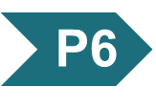
Principle 6 (1 of 4)
Molecular complementarity is central to function. The recognition of oligosaccharides by sugar-binding proteins (lectins) results from a perfect fit between lectin and ligand.

Slide 11
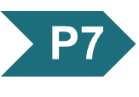
Principle 7 (1 of 3)
An almost infinite variety of discrete structures can be built from a small number of monomeric subunits. Even short polymers, when arranged in different sequences, joined through different linkages, and branched to specific degrees, present unique faces recognized by their molecular partners.

Slide 12
7.1 Monosaccharides and Disaccharides

Slide 13
Stereoisomerism in Sugars
sugar stereoisomers arise because many of the carbon atoms to which the hydroxyl groups are attached are chiral centers
enzymes that act on sugars are stereospecific

Slide 14
Principle 1 (2 of 4)
Carbohydrates can have multiple chiral carbons; the configuration of groups around each carbon atom determines how the compound interacts with other biomolecules. As we saw for L-amino acids in proteins, with rare exceptions, biological evolution selected one stereochemical series (D-series) for sugars.

Slide 15
The Two Families of Monosaccharides Are Aldoses and Ketoses
backbones of monosaccharides:
  unbranched carbon chains with single bonds linking all carbon atoms
  one of the carbon atoms is double-bonded to an oxygen atom to form a carbonyl group
  other carbon atoms are bonded to a hydroxyl group

Slide 16
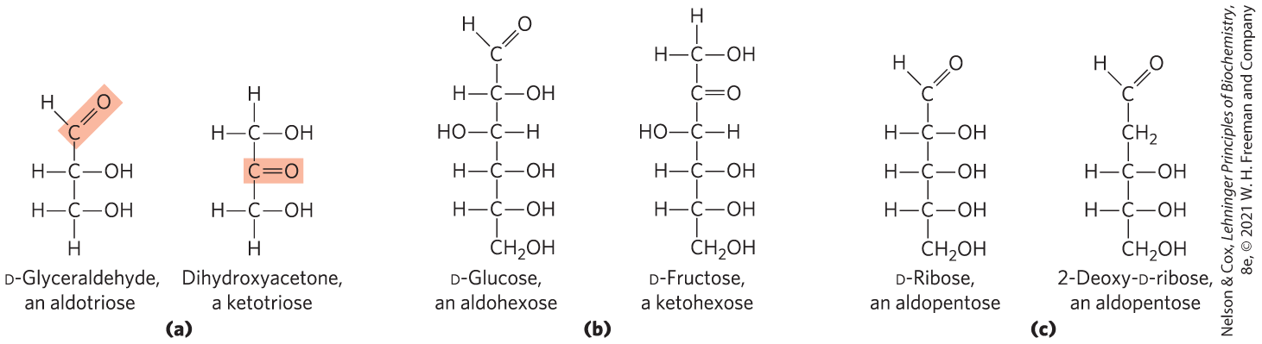
Aldoses and Ketoses
aldose = carbonyl group is at an end of the carbon chain (in an aldehyde group)
ketose = carbonyl group is at any other position (in a ketone group)

Slide 17
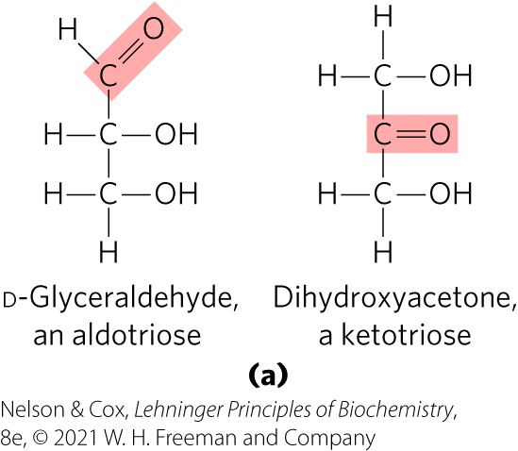
Trioses
trioses = simplest monosaccharides, three carbon backbone

Slide 18
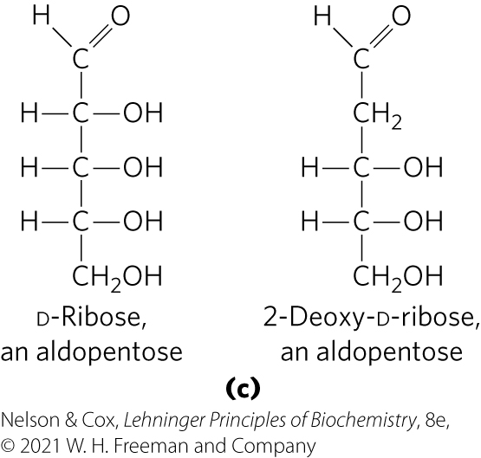
Tetroses and Pentoses
tetroses = four carbon backbone
pentoses = five carbon backbone
  component of RNA
  component of DNA

Slide 19
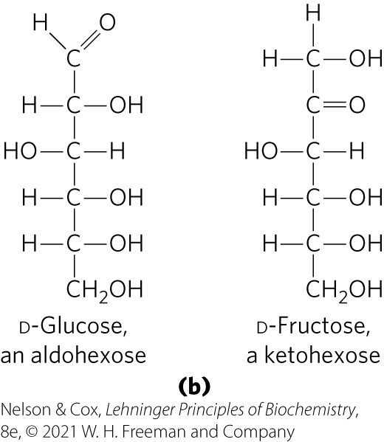
Hexoses and Heptoses
hexoses = six carbon backbone
heptoses = seven carbon backbone

Slide 20
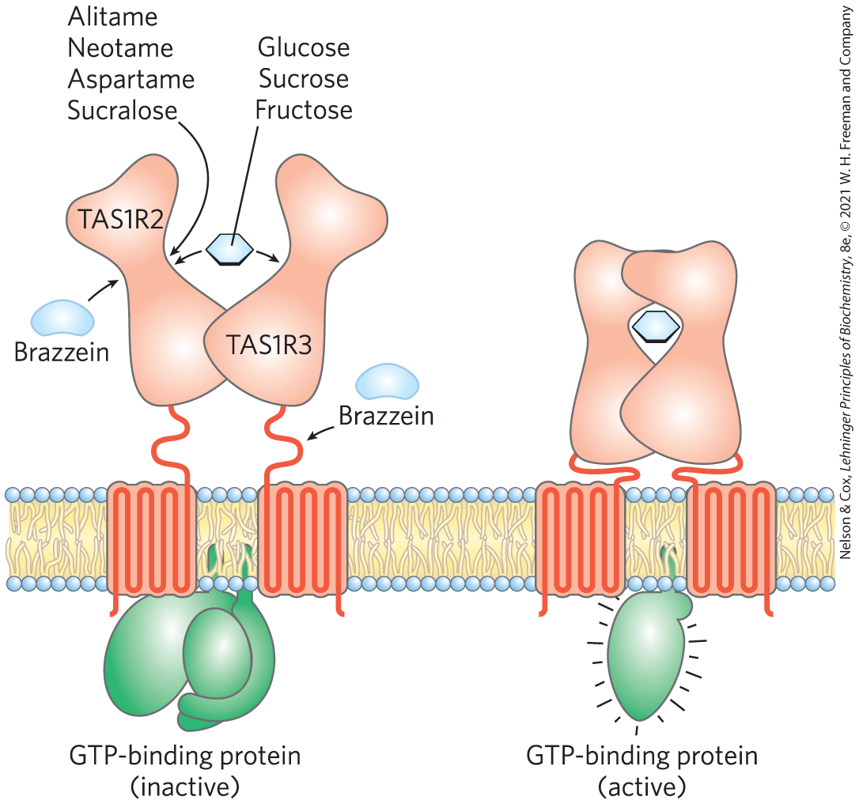
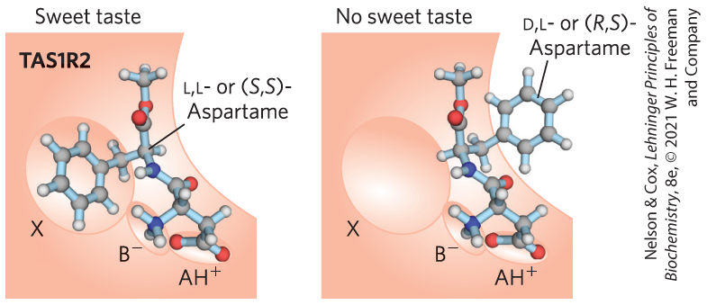
What Makes Sugar Sweet?
TAS1R2 and TAS1R3 encode sweet-taste receptors
binding of a compatible molecule generates a “sweet” electrical signal in the brain
  requires a steric match

Slide 21
Principle 1 (3 of 4)
Carbohydrates can have multiple chiral carbons; the configuration of groups around each carbon atom determines how the compound interacts with other biomolecules. As we saw for L-amino acids in proteins, with rare exceptions, biological evolution selected one stereochemical series (D-series) for sugars.

Slide 22
Monosaccharides Have Asymmetric Centers
all monosaccharides (except dihydroxyacetone) contain 1+ chiral carbon atom
  occur in optically active isomeric forms
enantiomers = two different optical isomers that are mirror images
in general, a molecule with n chiral centers can have 2^{n} stereoisomers

Slide 23
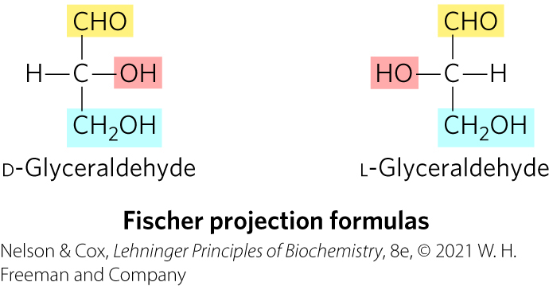
Fischer Projection Formulas
used to represent three-dimensional sugar structures on paper
bonds drawn horizontally indicate bonds that project out of the plane of the paper
bonds drawn vertically project behind the plane of the paper

Slide 24
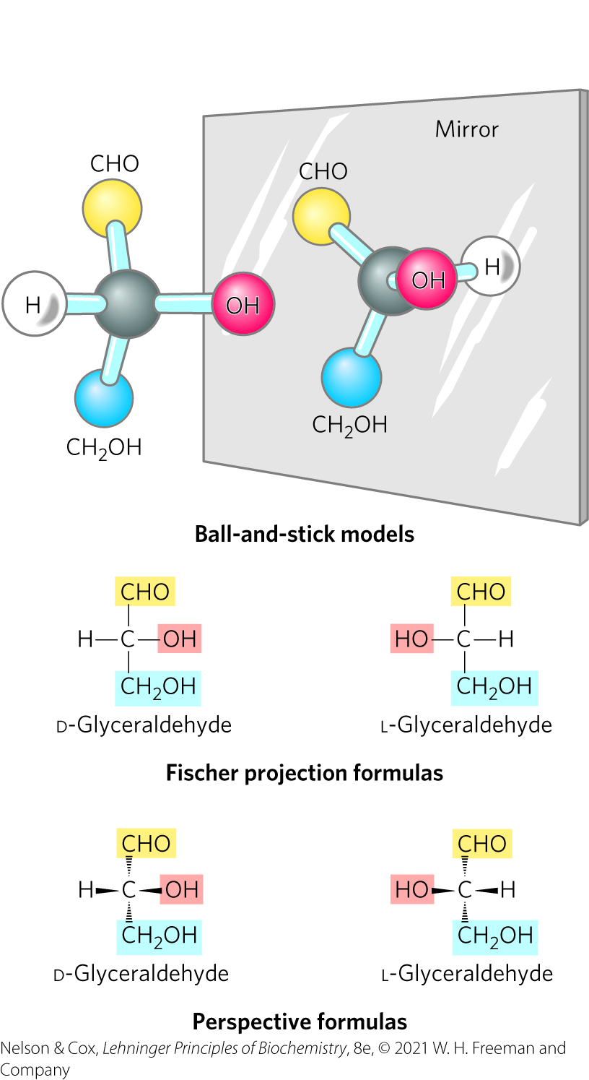
Enantiomers of Glyceraldehyde

Slide 25
Principle 1 (4 of 4)
Carbohydrates can have multiple chiral carbons; the configuration of groups around each carbon atom determines how the compound interacts with other biomolecules. As we saw for L-amino acids in proteins, with rare exceptions, biological evolution selected one stereochemical series (D-series) for sugars.

Slide 26
D Isomers and L Isomers
reference carbon = chiral center most distant from the carbonyl carbon
two groups of stereoisomers:
  D isomers = configuration at reference carbon is the same as D-glyceraldehyde
    on the right (dextro) in a projection formula
    most hexoses of living organisms
  L isomers = configuration at reference carbon is the same as L-glyceraldehyde
    on the left (levo) in a projection formula

Slide 27
Numbering Carbons of a Sugar
carbons are numbered beginning at the end of the chain near the carbonyl group

Slide 28
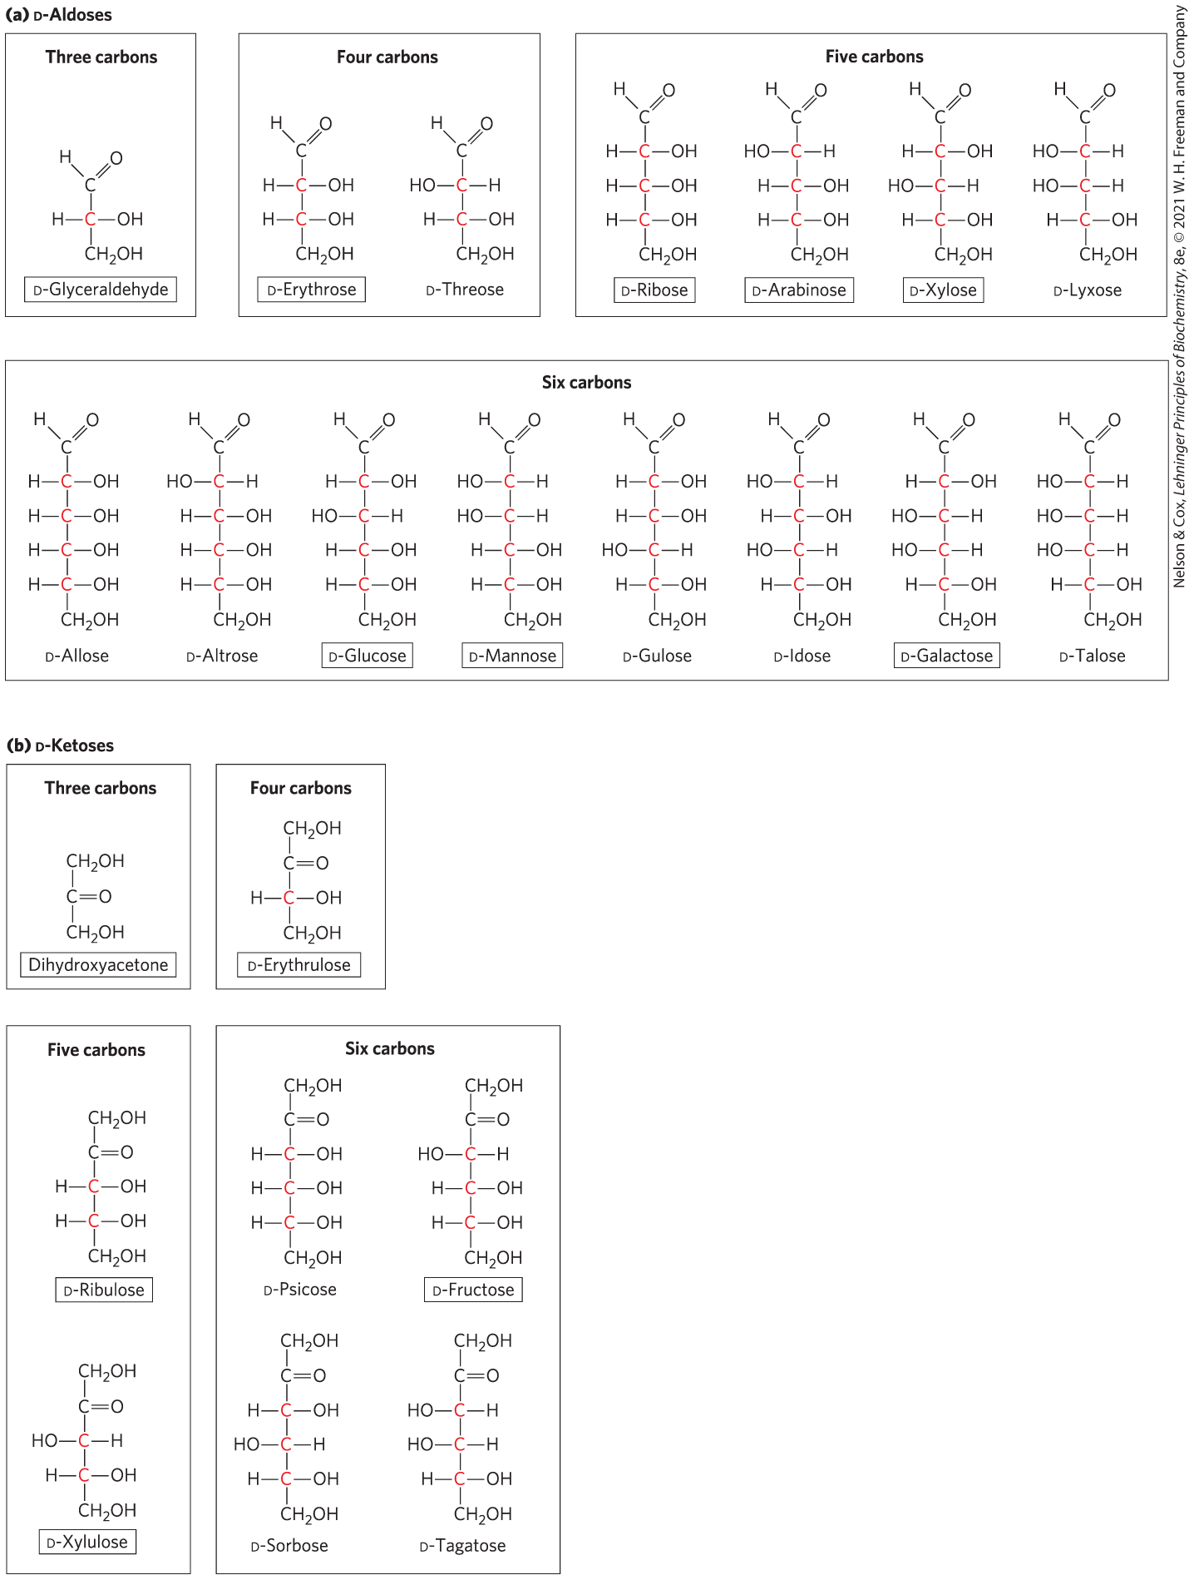
D-Aldoses

Slide 29
D-Ketoses

Slide 30
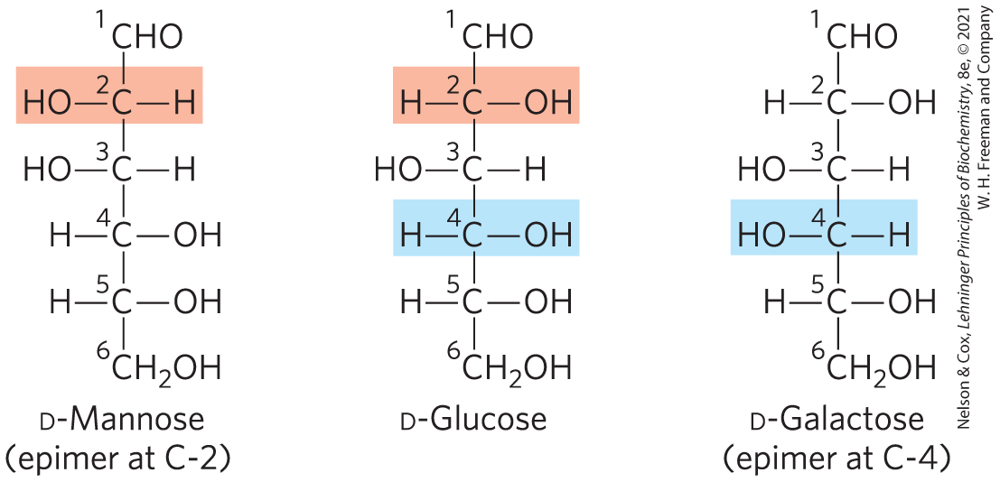
Epimers
epimers = two sugars that differ only in the configuration around one carbon atom

Slide 31
The Common Monosaccharides Have Cyclic Structures
in aqueous solution, aldotetroses and all monosaccharides with 5+ backbone carbon atoms occur as cyclic structures
  covalent bond between the carbonyl group and the oxygen of a hydroxyl group

Slide 32
Hemiacetals and Hemiketals
hemiacetals or hemiketals = derivatives formed by a general reaction between alcohols and aldehydes or ketones
  product of the first alcohol molecule addition
  a five- or six-membered ring forms if the —OH and carbonyl groups are on the same molecule
acetal or ketal = product of the second alcohol molecule addition
  forms a glycosidic bond

Slide 33
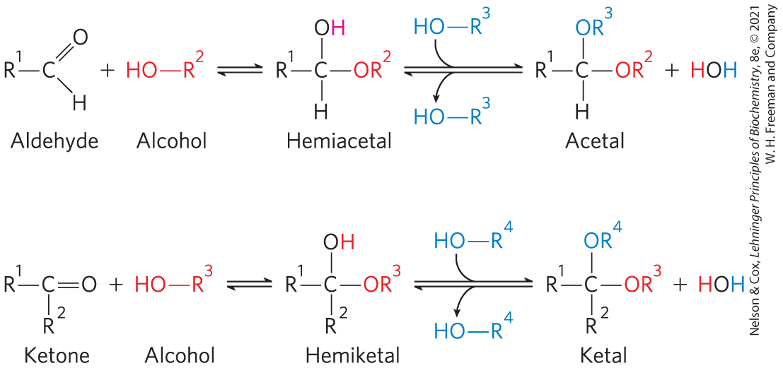
Formation of Hemiacetals and Hemiketals

Slide 34
α and β Stereoisomeric Configurations
reaction with the first alcohol molecule creates an additional chiral center (the carbonyl carbon)
produces either of two stereoisomeric configurations: α and β
anomers = isomeric forms of monosaccharides that differ only in their configuration about the hemiacetal or hemiketal carbon atom
anomeric carbon = the carbonyl carbon atom

Slide 35
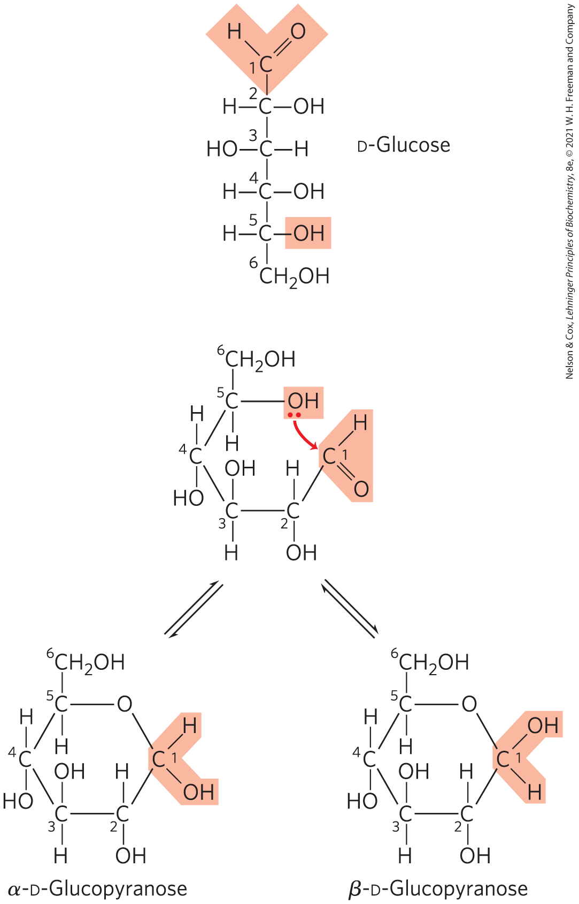
Formation of the Two Cyclic Forms of D-Glucose
reaction between the aldehyde group at C-1 and the hydroxyl group at C-5 forms a hemiacetal linkage
mutarotation = the interconversion of α and β anomers

Slide 36
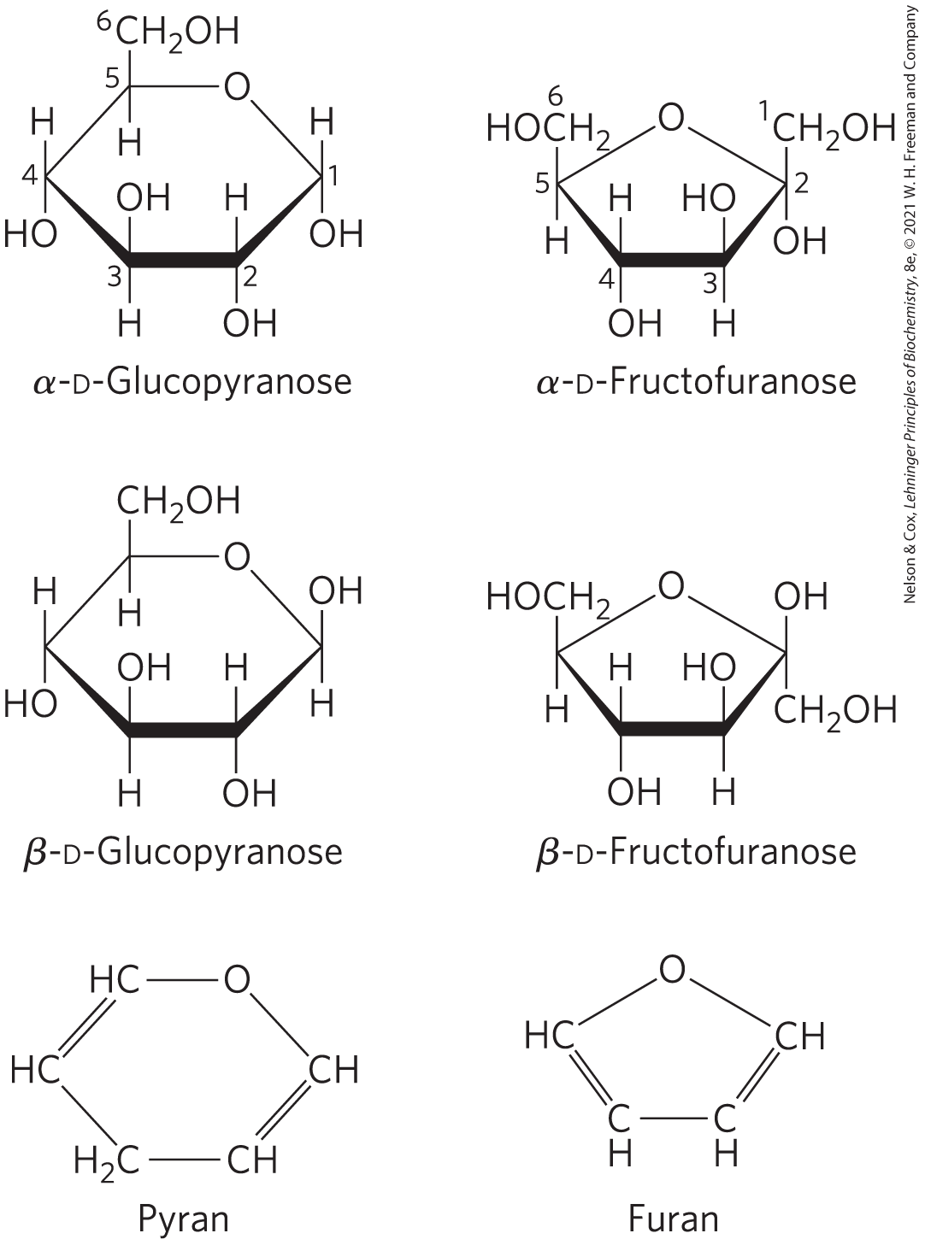
Pyranoses and Furanoses
pyranoses = six-membered ring compounds
  form when the hydroxyl group at C-6 reacts with the keto group at C-2
furanoses = five-membered ring compounds
  form when the hydroxyl group at C-5 reacts with the keto group at C-2

Slide 37
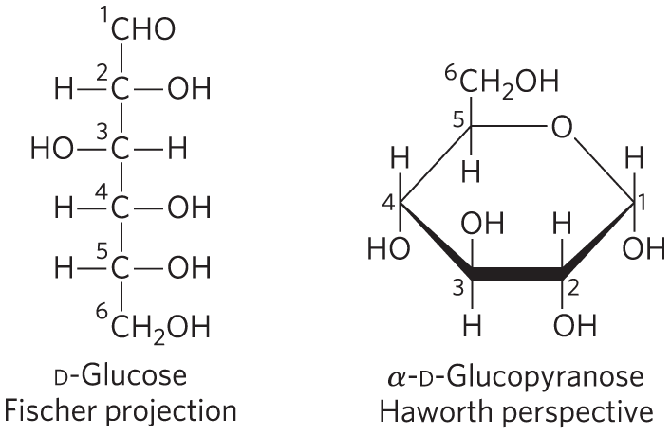
Haworth Perspective Formulas
Haworth perspective formulas = more accurate representation of cyclic sugar structure than Fischer projections
  six-membered ring is tilted to make its plane almost perpendicular to that of the paper
  bonds closest to the reader are drawn thicker than those farther away

Slide 38
Converting D-Hexose Fischer Projections to Haworth Perspective Formulas
step 1: draw the six­-membered ring (five carbons, and one oxygen at the upper right)
step 2: number the carbons in a clockwise direction beginning with the anomeric carbon
step 3: place the hydroxyl groups
  hydroxyl groups on the right in a Fischer projection are placed pointing down and those on the left are placed pointing up

Slide 39
Converting D-Hexose Fischer Projections to Haworth Perspective Formulas, Continued
step 4: place the terminal —CH₂OH group
  projects upward for the D enantiomer, downward for the L enantiomer
step 5: place the anomeric hydroxyl group
  for a β structure, the hydroxyl group is placed on the same side of the ring as C-­6
  for an α structure, it is placed on the opposite side

Slide 40

Principle 5 (2 of 6)
Polysaccharides assume three-dimensional structures with the lowest-energy conformations, determined by covalent bonds, hydrogen bonds, charge interactions, and steric factors. Starch folds into a helical structure stabilized by internal hydrogen bonds; cellulose assumes an extended structure in which intermolecular hydrogen bonds are more important.

Slide 41
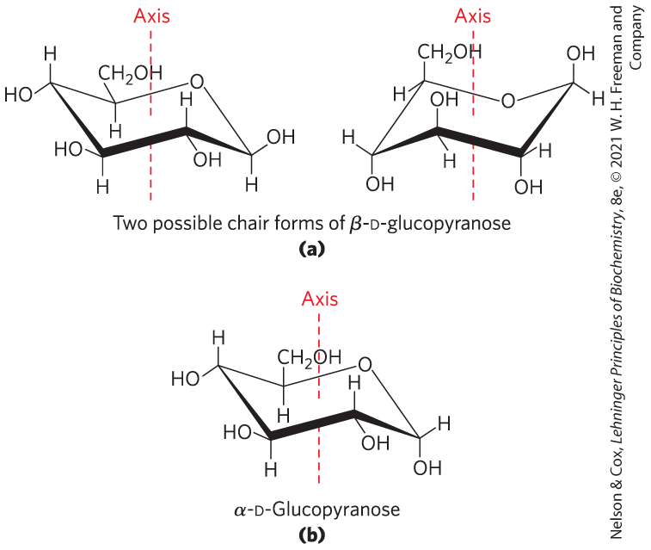
Conformational Formulas of Pyranoses
pyranose rings tend to assume either of two “chair” conformations
  interconvertible without breaking covalent bonds
  requires energy input

Slide 42
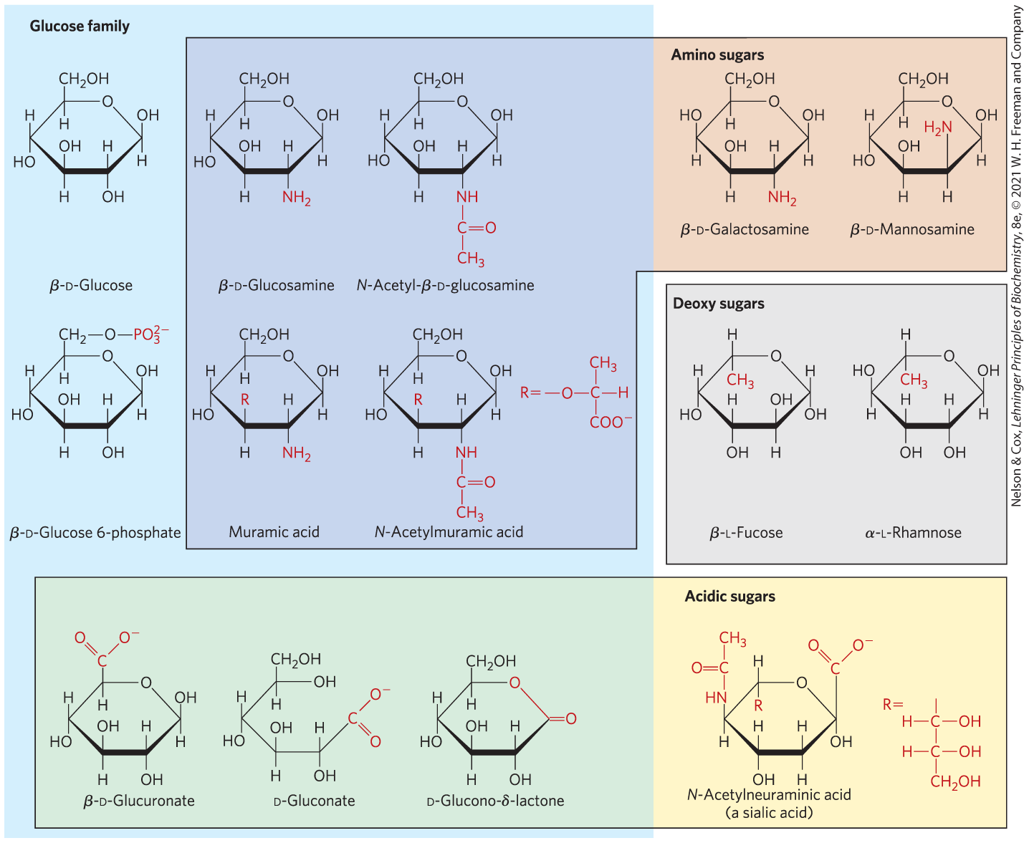
Organisms Contain a Variety of Hexose Derivatives

Slide 43
Aldonic and Uronic Acids
aldonic acids = form following oxidation of the carbonyl carbon of aldoses
uronic acids = form following oxidation at C-6
both form stable intramolecular esters called lactones

Slide 44
Phosphorylated Derivatives
some sugar intermediates are phosphate esters
  example: glucose 6-phosphate
stable at neutral pH and bear a negative charge
functions to trap sugar inside the cell because most cells do not have membrane transporters for phosphorylated sugars

Slide 45
Sugars That Are, or Can Form, Aldehydes Are Reducing Sugars
reducing sugars = undergo a characteristic redox reaction where free aldehyde groups react with Cu²⁺ under alkaline condition
  reduction of Cu²⁺ to Cu⁺ forms a brick-red precipitate
ketoses that can tautomerize to form aldehydes are also reducing sugars

Slide 46
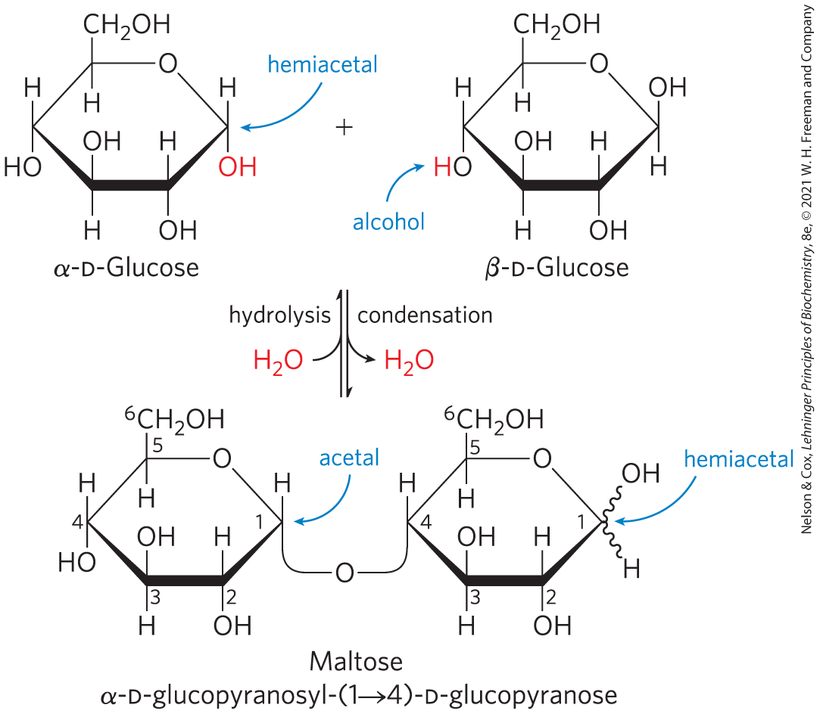
O-Glycosidic Bonds
O-glycosidic bond = covalent linkage joining two monosaccharides
  formed when a hydroxyl group of one sugar molecule reacts with the anomeric carbon of the other
  readily hydrolyzed by acid

Slide 47
The Reducing End
formation of a glycosidic bond renders a sugar nonreducing
reducing end = the end of a disaccharide or polysaccharide chain with a free anomeric carbon
Free anomeric carbon

Slide 48
Naming Reducing Oligosaccharides
step 1: with the nonreducing end on the left, give the configuration (α or β) at the anomeric carbon joining the first unit to the second
step 2: name the nonreducing residue using “furano” or “pyrano”
step 3: indicate in parentheses the two carbon atoms joined by the glycosidic bond, with an arrow connecting the two numbers
step 4: name the second residue and repeat for additional residues

Slide 49
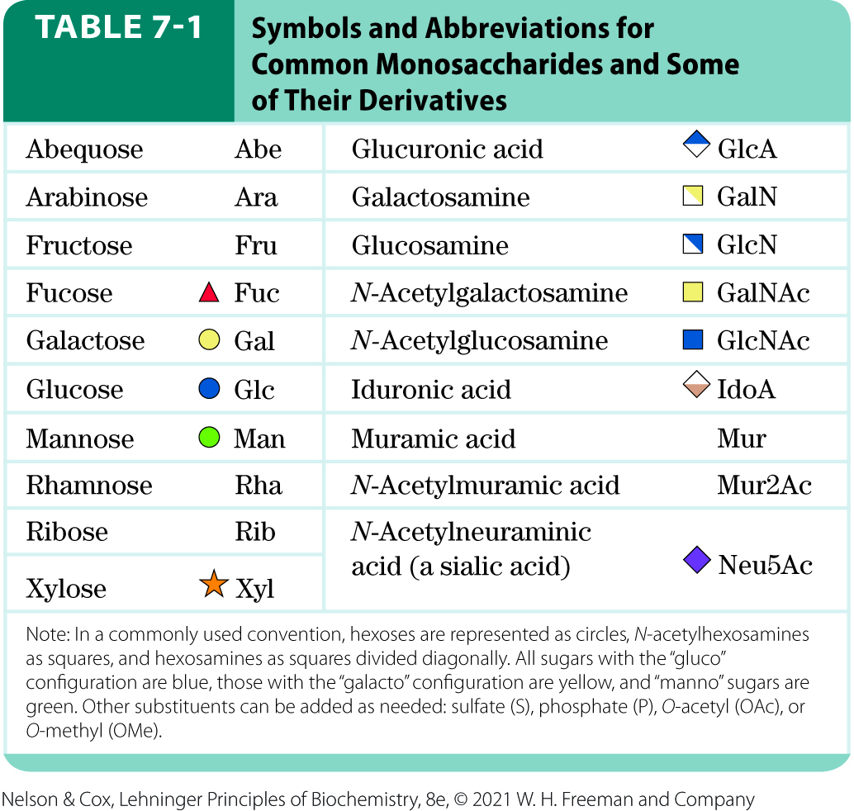
Symbols and Abbreviations for Monosaccharides and Derivatives

Slide 50
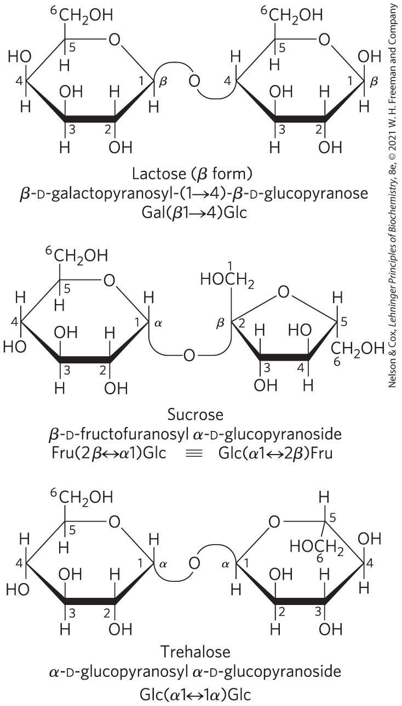
Three Common Disaccharides
lactose is a reducing disaccharide
sucrose and trehalose are nonreducing sugars

Slide 51
7.2 Polysaccharides

Slide 52
Principle 2 (2 of 3)
Monomeric subunits, monosaccharides, serve as the building blocks of large carbohydrate polymers. The specific sugar, the way the units are linked, and whether the polymer is branched determine its properties and thus its function.

Slide 53
Polysaccharides
most carbohydrates in nature occur as polysaccharides (M_{r} > 20,000)
also called glycans

Slide 54
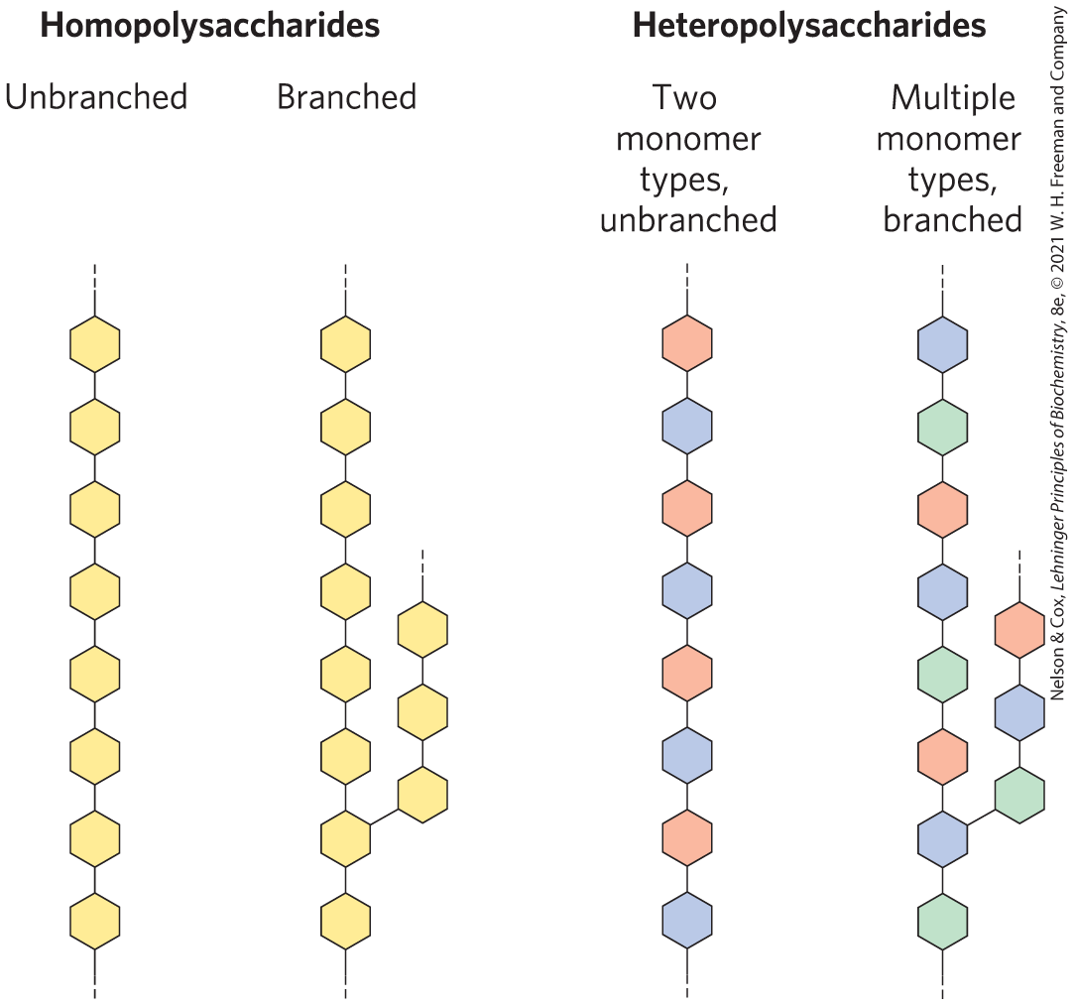
Homopolysaccharides and Heteropolysaccharides
homopolysaccharides = contain only a single monomeric sugar species
  serve as storage forms and structural elements
heteropolysaccharides = contain 2+ kinds of monomers
  provide extracellular support

Slide 55
Principle 4 (2 of 2)
The sequences of complex polysaccharides
are determined by the intrinsic properties
of the biosynthetic enzymes that add each monomeric unit to the growing polymer. This is in contrast with DNA, RNA, and proteins, which are synthesized on templates that direct their sequence.

Slide 56
Polysaccharides Generally Do Not Have Defined Lengths or Molecular Weights
this distinction between proteins and polysaccharides is a consequence of the mechanisms of assembly
there is no template for polysaccharide synthesis
the program for polysaccharide synthesis is intrinsic to the enzymes that catalyze the polymerization of monomer units

Slide 57
Some Homopolysaccharides Are Storage Forms of Fuel
storage polysaccharides = starch in plant cells and glycogen in animal cells
starch and glycogen molecules are heavily hydrated because they have many exposed hydroxyl groups available to hydrogen bond

Slide 58
Starch and Glycogen
starch = contains two types of glucose polymer, amylose and amylopectin
  amylose = long, unbranched chains of D-glucose residues connected by (α1→4) linkages
  amylopectin = larger than amylose with (α1→4) linkages between glucose residues and highly branched due to (α1→6) linkages
glycogen = polymer of (α1→4)-linked glucose subunits, with (α1→6)-linked branches
  more extensively branched
  more compact than starch

Slide 59
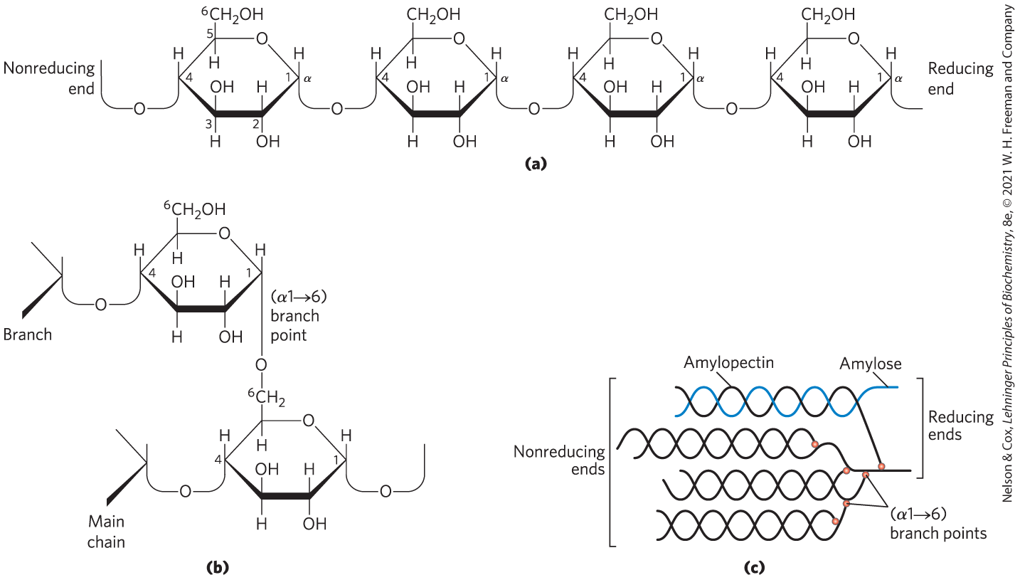
Structure of Starch and Glycogen

Slide 60
Principle 3 (2 of 2)
Storage of low molecular weight metabolites in polymeric form avoids the very high osmolarity that would result from storing them as individual monomers. If the glucose in liver glycogen were monomeric, the glucose concentration in liver would be so high that cells would swell and lyse from the entry of water by osmosis.

Slide 61
Storage of Glucose as Polymers Avoids High Osmolarity
hepatocytes in the fed state store glycogen equivalent to a glucose concentration of 0.4 M
0.4 M glucose in the cytosol would elevate the osmolarity
  the resulting osmotic entry of water might rupture the cell

Slide 62
Principle 5 (3 of 6)
Polysaccharides assume three-dimensional structures with the lowest-energy conformations, determined by covalent bonds, hydrogen bonds, charge interactions, and steric factors. Starch folds into a helical structure stabilized by internal hydrogen bonds; cellulose assumes an extended structure in which intermolecular hydrogen bonds are more important.

Slide 63
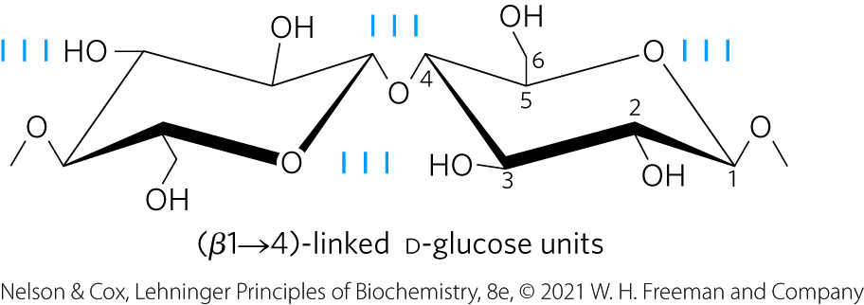
Some Homopolysaccharides Serve Structural Roles
cellulose = tough, fibrous, water-insoluble substance
  linear, unbranched homopolysaccharide, consisting of 10,000 to 15,000 D-glucose units
  glucose residues have the β configuration
  linked by (β1→4) glycosidic bonds
  animals do not have the enzyme to hydrolyze (β1→4) glycosidic bonds

Slide 64
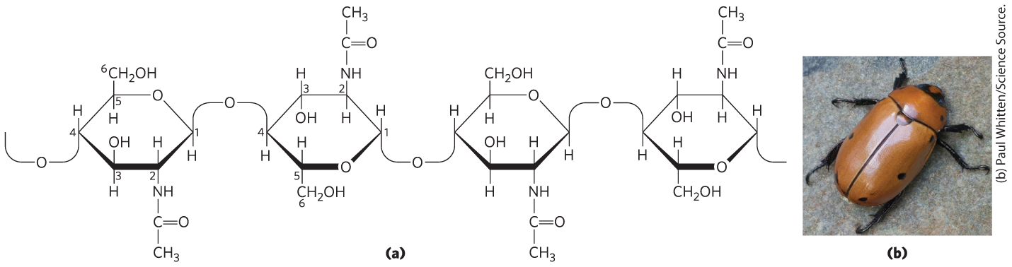
Chitin
chitin = linear homopolysaccharide composed of N-acetylglucosamine residues in (β1→4) linkage
  acetylated amino group makes chitin more hydrophobic and water-resistant than cellulose

Slide 65

Principle 5 (4 of 6)
Polysaccharides assume three-dimensional structures with the lowest-energy conformations, determined by covalent bonds, hydrogen bonds, charge interactions, and steric factors. Starch folds into a helical structure stabilized by internal hydrogen bonds; cellulose assumes an extended structure in which intermolecular hydrogen bonds are more important.

Slide 66
Steric Factors and Hydrogen Bonding Influence Homopolysaccharide Folding
three-dimensional structures stabilized by weak interactions within or between molecules
  hydrogen bonding is especially important due to the high number of hydroxyl groups in polysaccharides
free rotation about both C—O bonds linking the residues is limited by steric hindrance by substituents

Slide 67
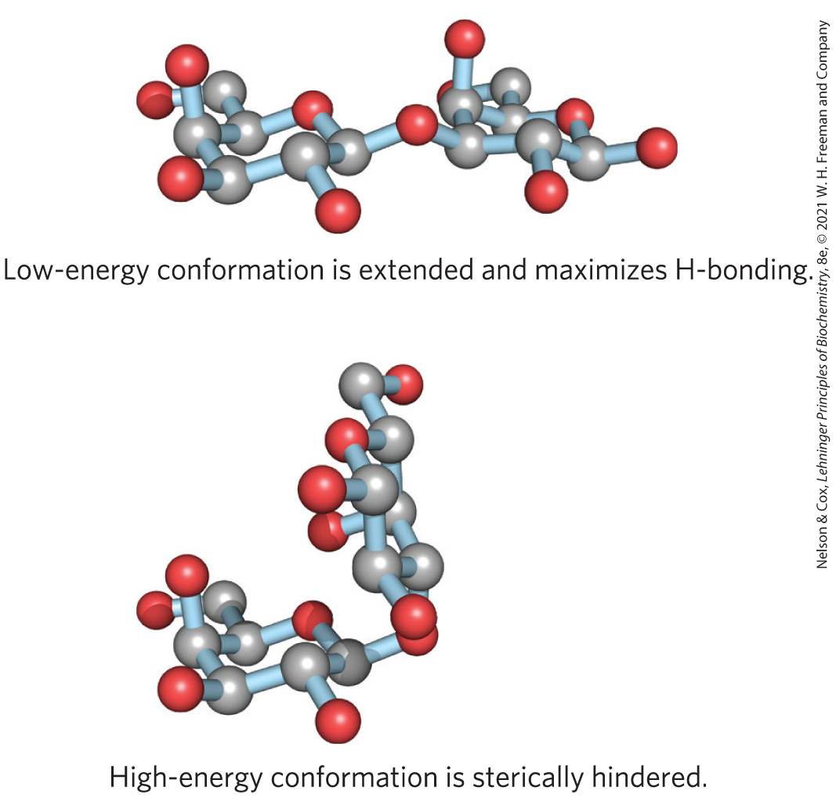
Different Energetic Conformation of a Disaccharide
bulkiness and electronic effects at the anomeric carbon place constraints on φ and ψ

Slide 68
Principle 5 (5 of 6)
Polysaccharides assume three-dimensional structures with the lowest-energy conformations, determined by covalent bonds, hydrogen bonds, charge interactions, and steric factors. Starch folds into a helical structure stabilized by internal hydrogen bonds; cellulose assumes an extended structure in which intermolecular hydrogen bonds are more important.

Slide 69
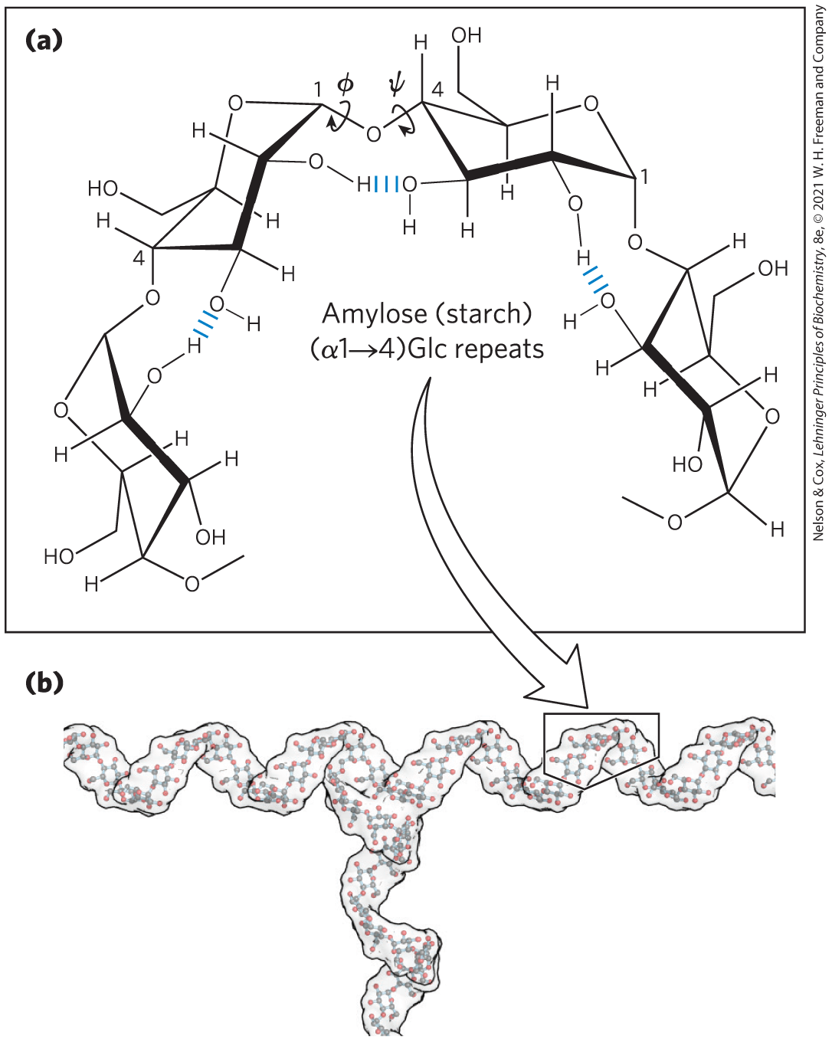
Helical Structure of Starch and Glycogen
most stable three-dimensional structure for the (α1→4)-linked chains of starch and glycogen
  six residues/turn

Slide 70

Principle 5 (6 of 6)
Polysaccharides assume three-dimensional structures with the lowest-energy conformations, determined by covalent bonds, hydrogen bonds, charge interactions, and steric factors. Starch folds into a helical structure stabilized by internal hydrogen bonds; cellulose assumes an extended structure in which intermolecular hydrogen bonds are more important.

Slide 71
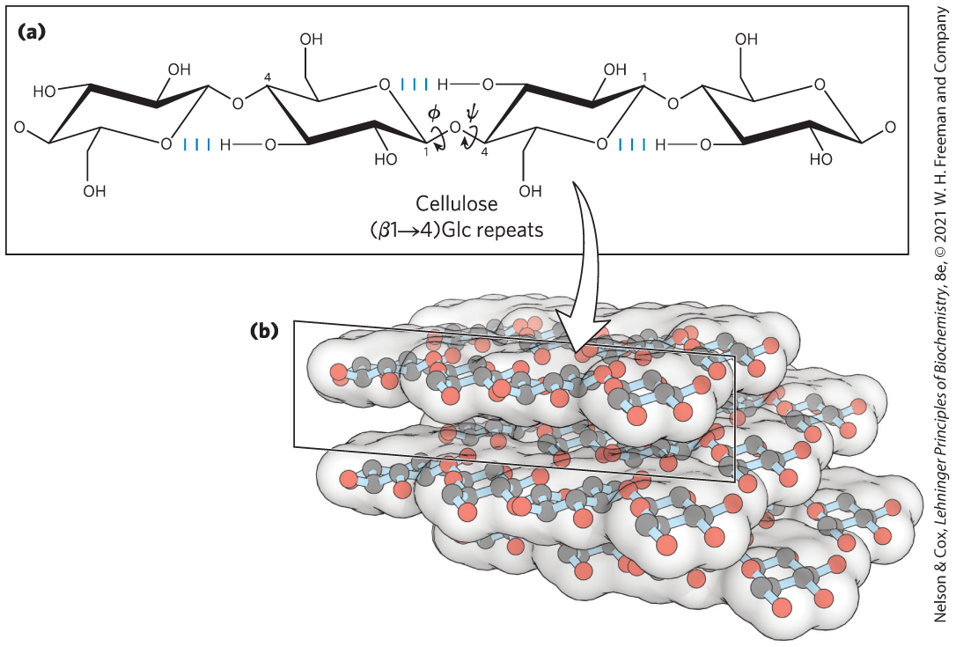
Linear Structure of Cellulose
most stable conformation is a straight, extended chain
  each chair is turned 180° relative to its neighbors

Slide 72
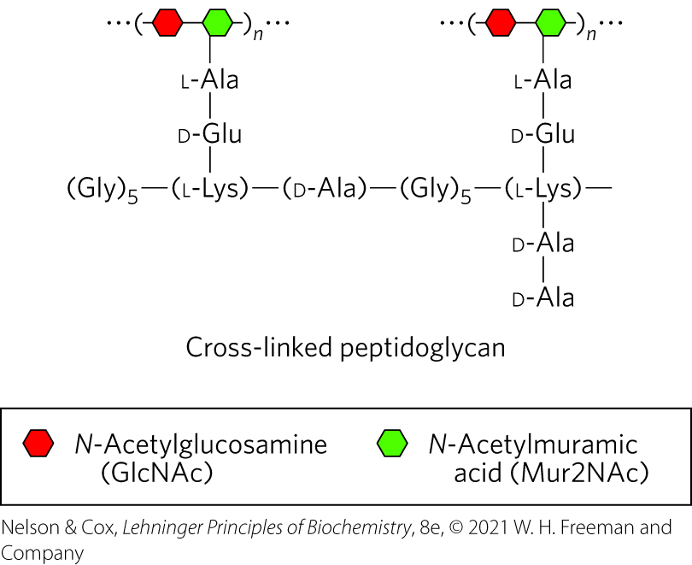
Peptidoglycan Reinforces the Bacterial Cell Wall
peptidoglycan = rigid component of bacterial cell walls
  heteropolymer of alternating (β1→4)-linked N-acetylglucosamine and N-acetylmuramic acid residues
  cross-linked by short peptides

Slide 73
Glycosaminoglycans Are Heteropolysaccharides of the Extracellular Matrix
extracellular matrix (ECM) = gel-like material in the extracellular space of tissues that holds cells together and provides a porous pathway for nutrient and O₂ diffusion
  composed of an interlocking meshwork of heteropolysaccharides (ground substance) and fibrous proteins
basement membrane (specialized ECM) also contains heteropolysaccharides

Slide 74
Principle 2 (3 of 3)
Monomeric subunits, monosaccharides, serve as the building blocks of large carbohydrate polymers. The specific sugar, the way the units are linked, and whether the polymer is branched determine its properties and thus its function.

Slide 75
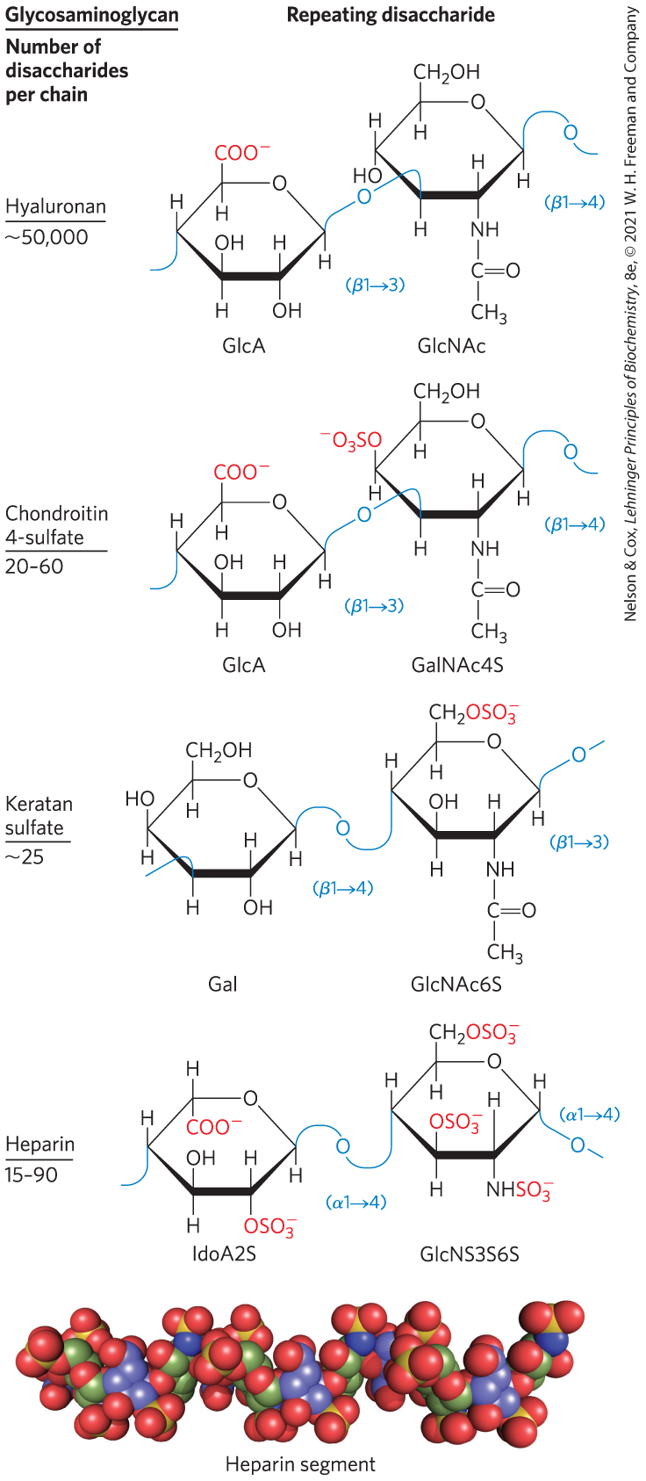
Repeating Units of Glycosaminoglycans of ECM
glycosaminoglycans = heteropolysaccharides in ECM
  linear polymers composed of repeating disaccharide units
  one monosaccharide is always either N-acetylglucosamine or N-acetylgalactosamine and the other is usually a uronic acid
  unique to animals and bacteria
  some contain esterified sulfate groups

Slide 76
Types of Glycosaminoglycans
hyaluronan (hyaluronic acid) = alternating residues of D-glucuronic acid and N-acetylglucosamine
chondroitin sulfate, dermatan sulfate, keratan sulfate, and heparan sulfate differ from hyaluronan in three respects:
  generally much shorter polymers
  covalently linked to specific proteins (proteoglycans)
  one or both monomer units differ from hyaluronan
provide viscosity, adhesiveness, and tensile strength to the extracellular matrix

Slide 77
Heparan Sulfate
contains variable, nonrandom arrangements of sulfated and nonsulfated sugars
sulfated residues gives the molecule the ability to interact specifically with proteins

Slide 78
Heparan
highly sulfated, intracellular form of heparan sulfate produced primarily by mast cells
used as a therapeutic agent to inhibit coagulation of blood through its capacity to bind the protease inhibitor antithrombin

Slide 79
Structure and Roles of Some Polysaccharides
Table 7-2 Structures and Roles of Some Polysaccharides
Polymer | Type | Repeating unit | Size (number of monosaccharide units) | Roles/significance
Starch: Amylose | Homo- | (𝛼1→4)Glc, linear | 50-5,000 | Energy storage: in plants
Starch: Amylopectin | Homo- | (𝛼1→4)Glc, with (𝛼1→6)Glc branches every 24-30 residues | Up to 10⁶ | Energy storage: in plants
Glycogen | Homo- | (𝛼1→4)Glc, with (𝛼1→6)Glc branches every 8-12 residues | Up to 50,000 | Energy storage: in bacteria and animal cells
Cellulose | Homo- | (𝛽1→4)Glc | Up to 15,000 | Structural: in plants, gives rigidity and strength to cell walls
Chitin | Homo- | (𝛽1→4)GlcNAc | Very large | Structural: in insects, spiders, crustaceans, gives rigidity and strength to exoskeletons
Dextran | Homo- | (𝛼1→6)Glc, with (𝛼1→3) branches | Wide range | Structural: in bacteria, extracellular adhesive
Peptidoglycan | Hetero-; peptides attached | 4)Mur2Ac(𝛽1→4) GlcNAc (𝛽1 | Very large | Structural: in bacteria, gives rigidity and strength to cell envelope
Hyaluronan (a glycosaminoglycan) | Hetero-; acidic | 4)GlcA(𝛽1→3) GlcNAc (𝛽1 | Up to 100,000 | Structural: in vertebrates, extracellular matrix of skin and connective tissue; viscosity and lubrication in joints

Slide 80
7.3 Glycoconjugates: Proteoglycans, Glycoproteins, and Glycolipids

Slide 81
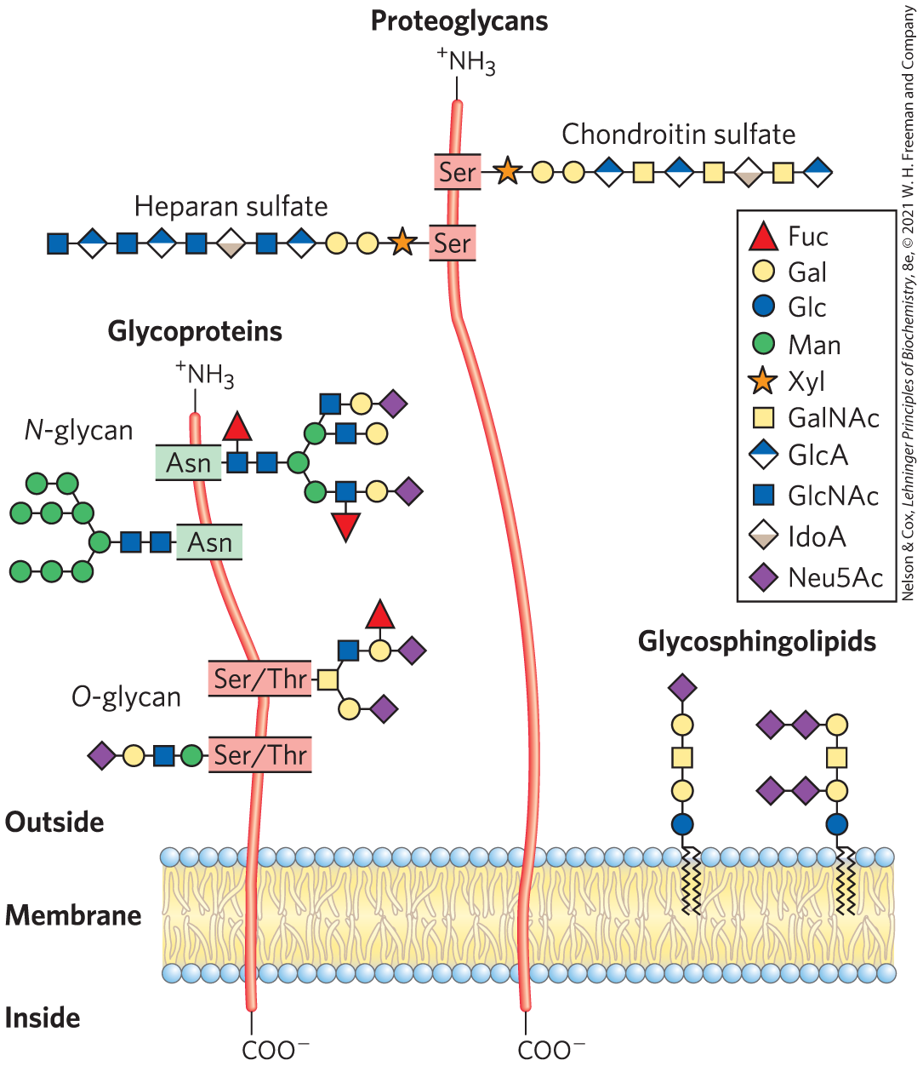
Glycoconjugate
glycoconjugate = biologically active molecule consisting of an informational carbohydrate joined to a protein or lipid

Slide 82
Proteoglycans
proteoglycans = macromolecules of the cell surface or ECM consisting of 1+ sulfated glycosaminoglycan chain(s) joined covalently to a membrane protein or secreted protein
  major component of all extracellular matrices

Slide 83
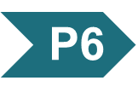
Principle 6 (2 of 4)
Molecular complementarity is central to function. The recognition of oligosaccharides by sugar-binding proteins (lectins) results from a perfect fit between lectin and ligand.

Slide 84
Glycoproteins
glycoproteins = have one or several oligosaccharides joined covalently to a protein
  found on the outer face of the plasma membrane, in ECM, in blood, and in organelles (Golgi complexes, secretory granules, and lysosomes)
  oligosaccharide portions are heterogenous and rich in information

Slide 85
Glycolipids and Glycosphingolipids
glycolipids = plasma membrane components in which the hydrophilic head groups are oligosaccharides
glycosphingolipids = class of glycolipids with specific backbone structure
  neurons are rich in glycosphingolipids
  play a role in signal transduction

Slide 86
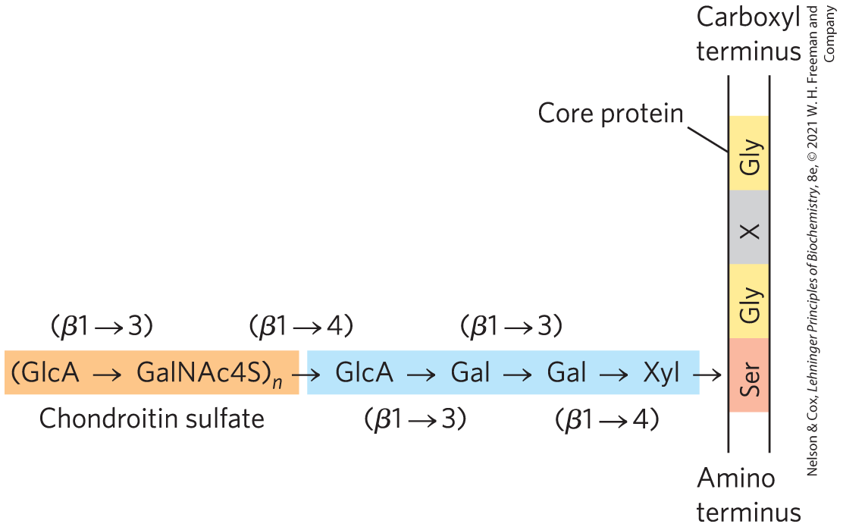
Proteoglycans Are Glycosaminoglycan-Containing Macromolecules of the Cell Surface and Extracellular Matrix
proteoglycan unit = “core protein” with covalently attached glycosaminoglycan(s)
tetrasaccharide linker connects to glycosaminoglycan to a Ser residue of the protein

Slide 87
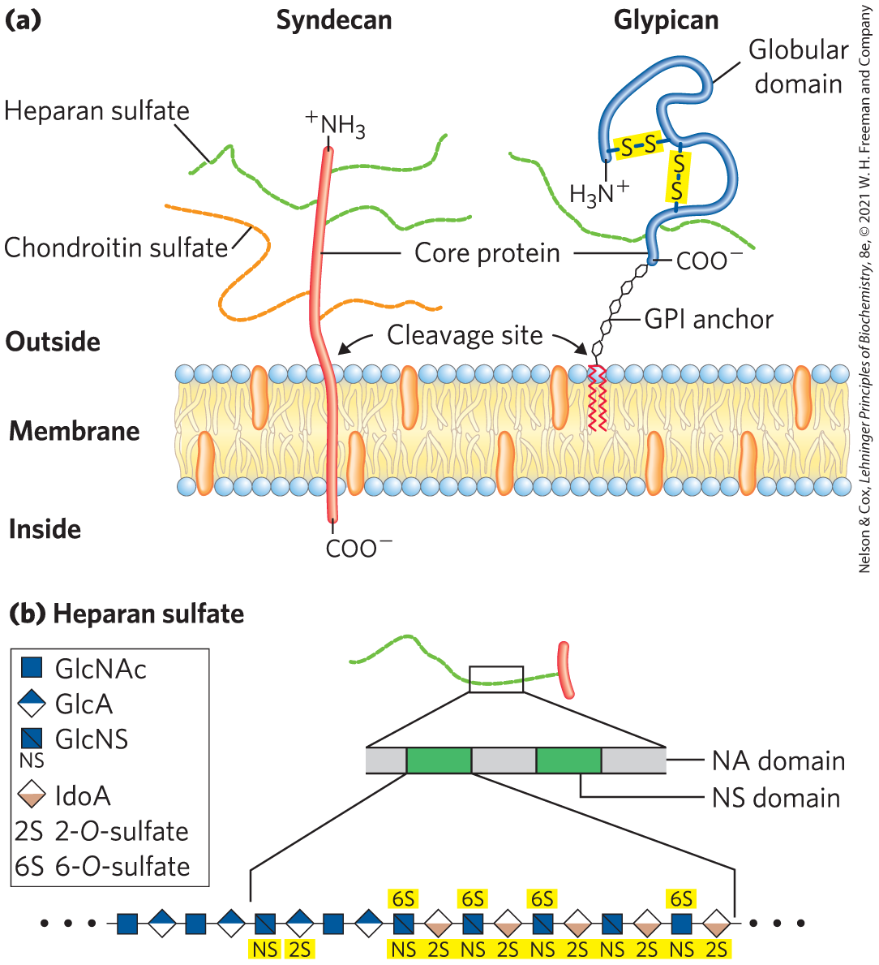
Two Families of Membrane Heparan Sulfate Proteoglycans
syndecans = single transmembrane domain and an extracellular domain bearing 3–5 chains of heparan sulfate and chondroitin sulfate
glypicans = attached to the membrane by a GPI anchor (a glycosylated derivative of the membrane lipid phosphatidylinositol)

Slide 88
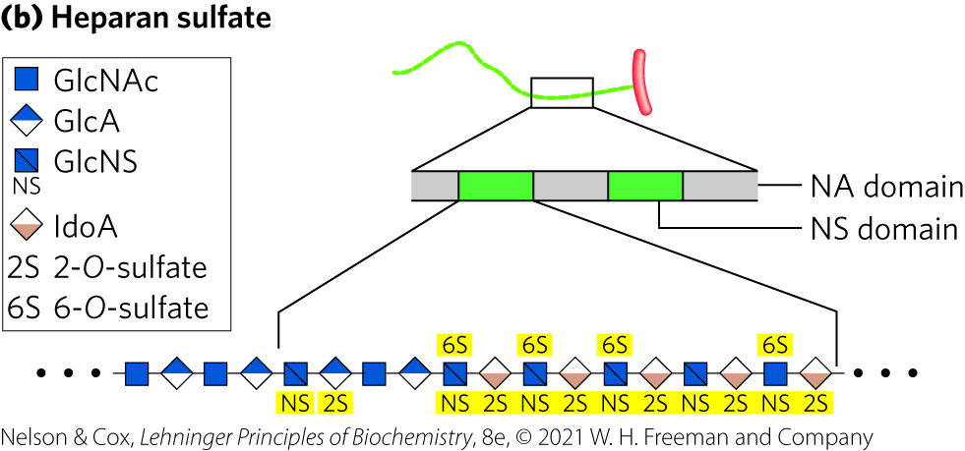
NS Domains
NS domains = highly sulfated domains that alternate with domains having unmodified GlcNAc and GlcA residues

Slide 89
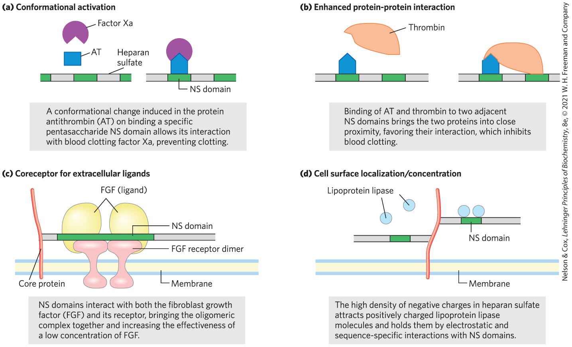
Four Types of Protein Interactions with NS Domains of Heparan Sulfate

Slide 90
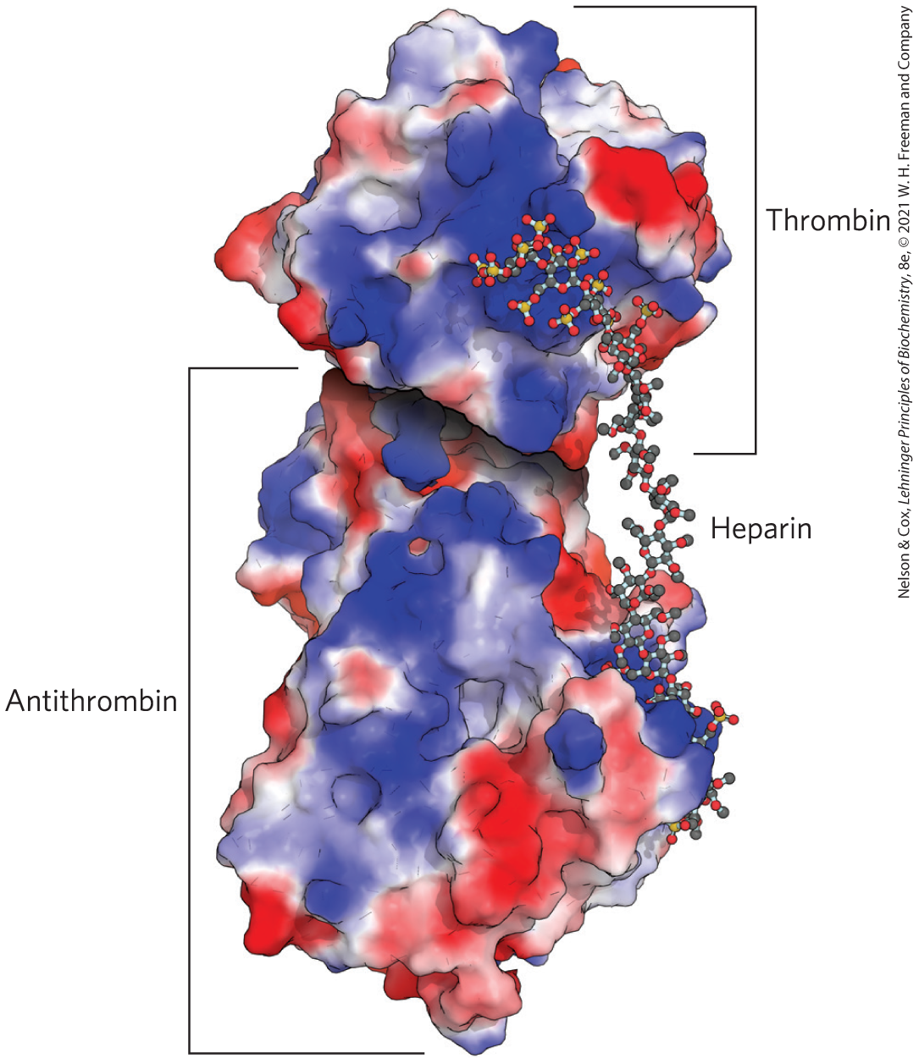
Heparan Sulfate Enhancement of the Binding of Thrombin to Antithrombin
antithrombin binds to and inhibits the protease thrombin only in the presence of heparan sulfate
both proteins are rich in Arg and Lys residues
  interact electrostatically with the sulfates of the glycosaminoglycans
Positively charged regions

Slide 91
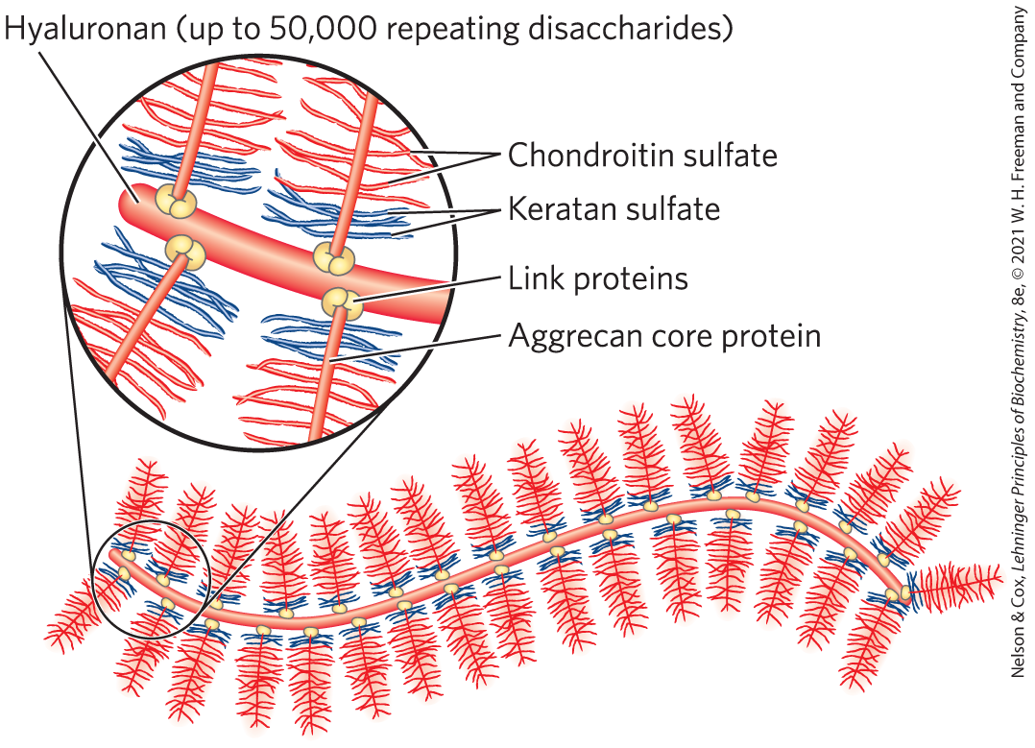
Proteoglycan Aggregates
proteoglycan aggregates = supramolecular assemblies of many core proteins all bound to a single molecule of hyaluronan
aggrecan interacts strongly with collagen in the ECM of cartilage

Slide 92
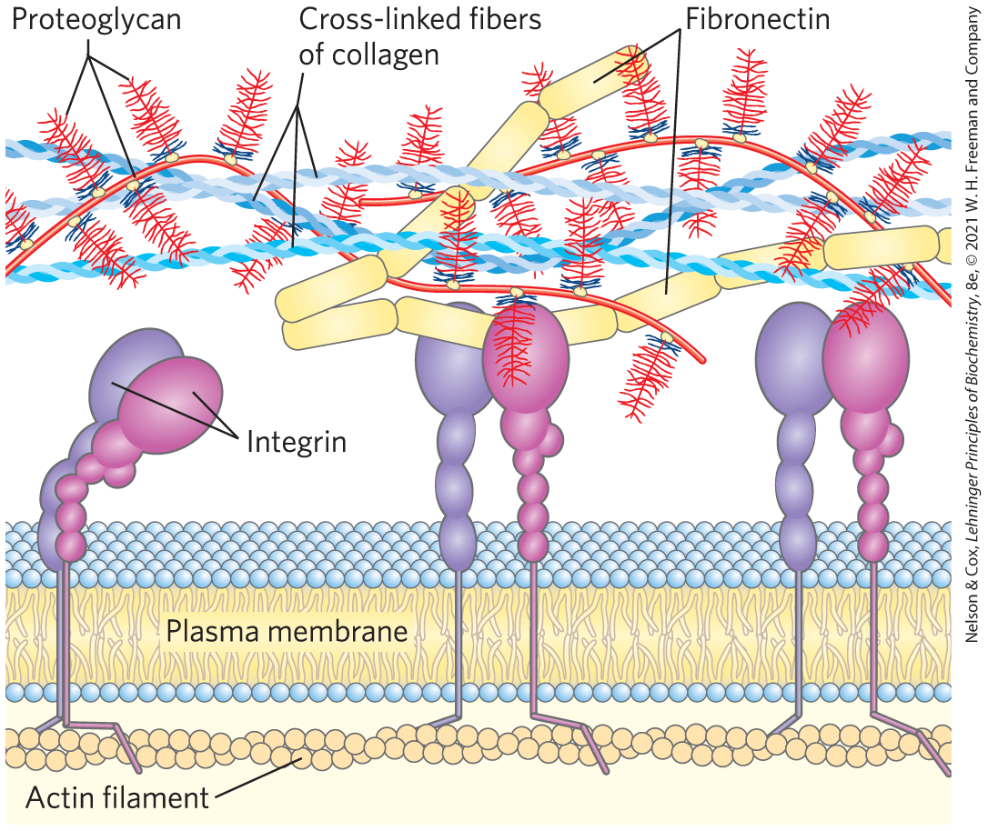
Fibronectin and Integrins
fibronectin = has separate domains to bind fibrin, heparan sulfate, and collagen
  contain the conserved RGD sequence (Arg–Gly–Asp) to bind integrins
integrins = mediate signaling between cell interior and ECM molecules

Slide 93
Principle 7 (2 of 3)
An almost infinite variety of discrete structures can be built from a small number of monomeric subunits. Even short polymers, when arranged in different sequences, joined through different linkages, and branched to specific degrees, present unique faces recognized by their molecular partners.

Slide 94
Purpose of Interactions between Cells and the ECM
interactions between cells and the ECM:
  anchor cells to the ECM, providing the strength and elasticity of skin and joints
  provide paths that direct the migration of cells in developing tissue
  convey information in both directions across the plasma membrane

Slide 95
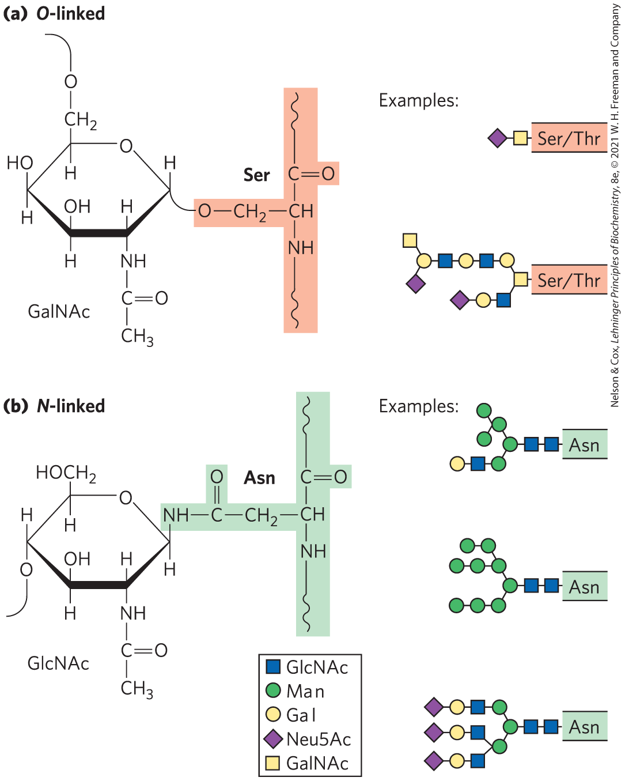
Glycoproteins Have Covalently Attached Oligosaccharides
two types of attachments:
  O-linked = a glycoside bond joins the anomeric carbon of a carbohydrate to the —OH of a Ser or Thr residue
  N-linked = an N-glycosyl bond joins the anomeric carbon of a sugar to the amide nitrogen of an Asn residue

Slide 96
Examples of Glycoproteins
mucins = secreted or membrane glycoproteins
  can contain large numbers of O-linked oligosaccharide chains
  present in most secretions
proteins of the blood
  examples: immunoglobulins (antibodies), follicle-stimulating hormone, luteinizing hormone, and thyroid-stimulating hormone
milk proteins
  example: major whey protein α-lactalbumin

Slide 97
Glycomics
glycomics = the systematic characterization of all carbohydrate components of a given cell or tissue, including those attached to proteins and to lipids

Slide 98
Principle 7 (3 of 3)
An almost infinite variety of discrete structures can be built from a small number of monomeric subunits. Even short polymers, when arranged in different sequences, joined through different linkages, and branched to specific degrees, present unique faces recognized by their molecular partners.

Slide 99
The Biological Advantages of Adding Oligosaccharides to Proteins
covalently attached oligosaccharides:
  influence the folding and stability of the proteins
  provide critical information about the targeting of newly synthesized proteins
  allow specific recognition by other proteins

Slide 100
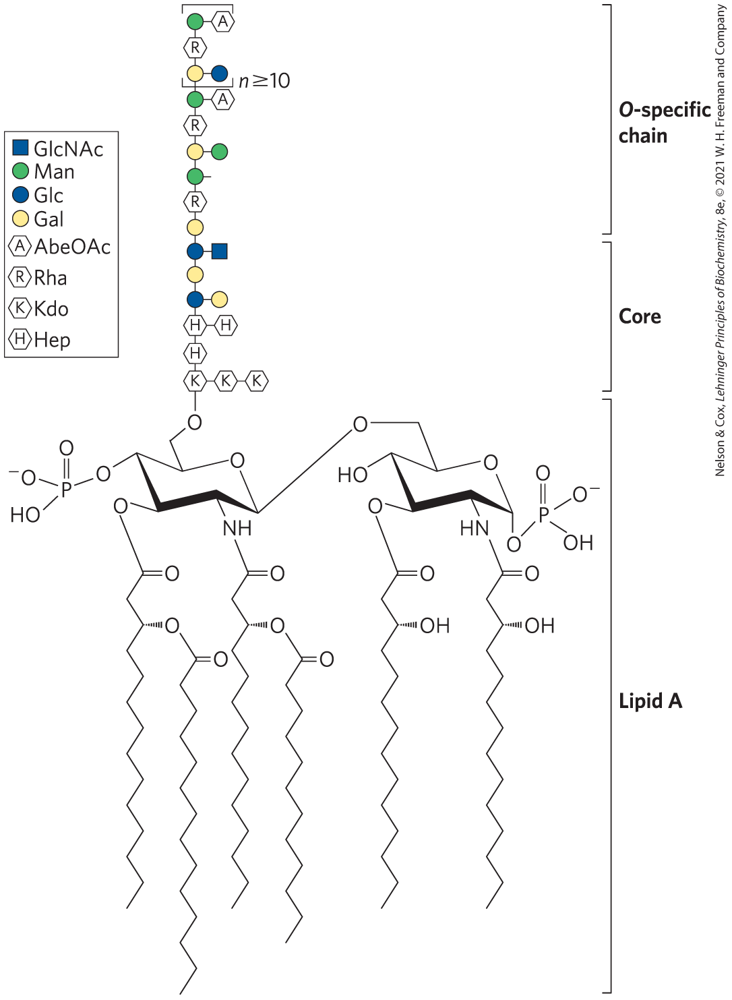
Glycolipids and Lipopolysaccharides Are Membrane Components
gangliosides = membrane lipids of eukaryotic cells in which the polar head group is a complex oligosaccharide containing a sialic acid and other monosaccharide residues
lipopolysaccharides = dominant surface feature of the outer membrane of gram-negative bacteria

Slide 101
7.4 Carbohydrates as Informational Molecules: The Sugar Code

Slide 102
Principle 6 (3 of 4)
Molecular complementarity is central to function. The recognition of oligosaccharides by sugar-binding proteins (lectins) results from a perfect fit between lectin and ligand.

Slide 103
The Challenge of Glycobiology
glycobiology = the study of the structure and function of glycoconjugates
the challenge is to understand how cells use specific oligosaccharides to encode information about:
  intracellular targeting of proteins
  cell-cell interactions
  cell differentiation and tissue development
  extracellular signals

Slide 104
Oligosaccharide Structures Are Information-Dense
branched structures, not found in nucleic acids or proteins, are common in oligosaccharides
almost limitless variety of oligosaccharides due to differences in:
  stereochemistry and position of glycosidic bonds
  type and orientation of substituent groups
  the number and type of branches

Slide 105
Principle 6 (4 of 4)
Molecular complementarity is central to function. The recognition of oligosaccharides by sugar-binding proteins (lectins) results from a perfect fit between lectin and ligand.

Slide 106
Lectins Are Proteins That Read the Sugar Code and Mediate Many Biological Processes
lectins = bind carbohydrates with high specificity and with moderate to high affinity
functions:
  cell-cell recognition
  signaling
  adhesion
  intracellular targeting of newly synthesized proteins

Slide 107
Selectins
selectins = family of plasma membrane lectins that mediate cell-cell recognition and adhesion in a wide range of cellular processes
  move immune cells through the capillary wall
  mediate inflammatory responses
  mediate the rejection of transplanted organs

Slide 108
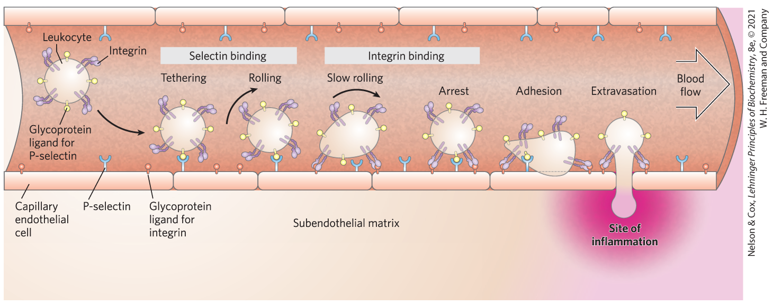
Role of Lectin-Ligand Interactions in Leukocyte Movement

Slide 109
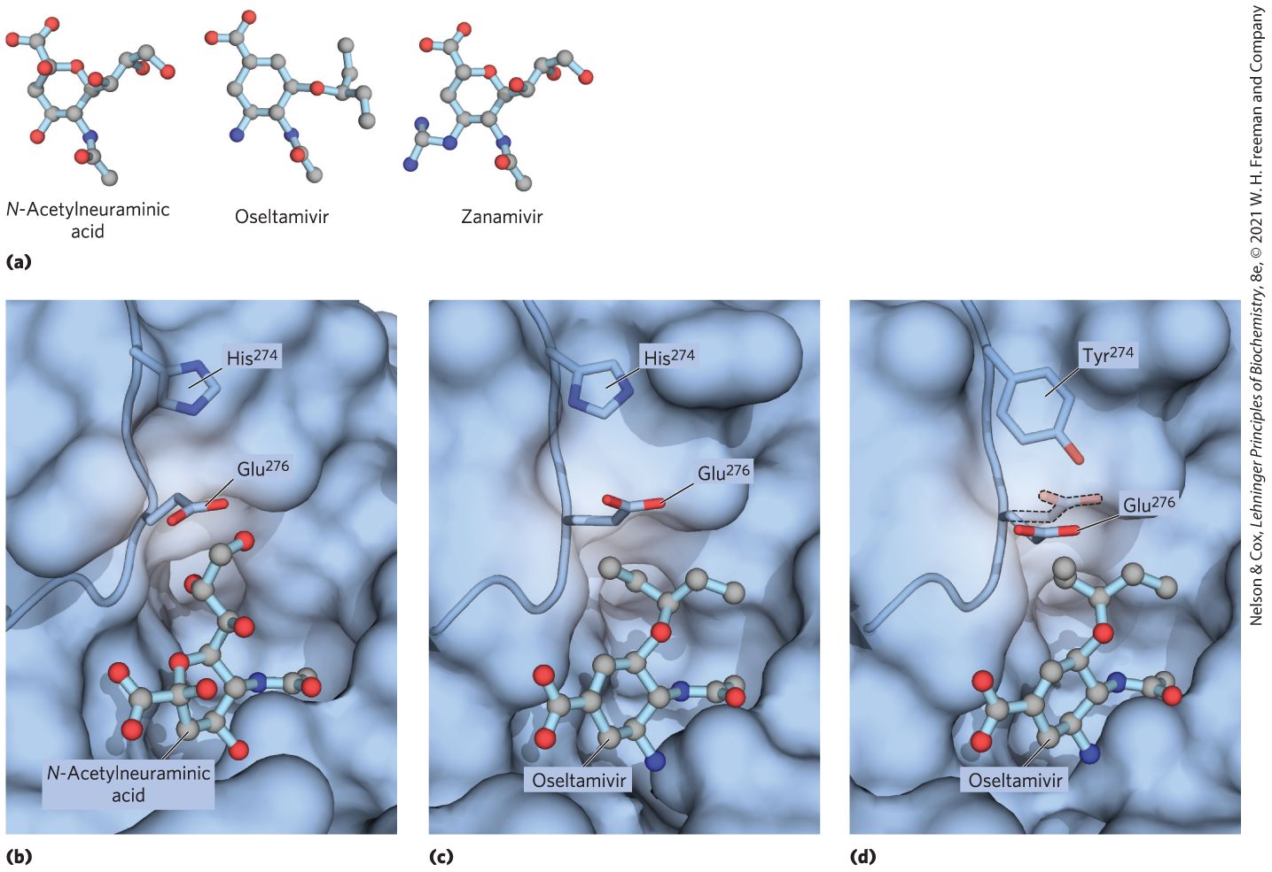
Binding Site on Influenza Neuraminidase

Slide 110
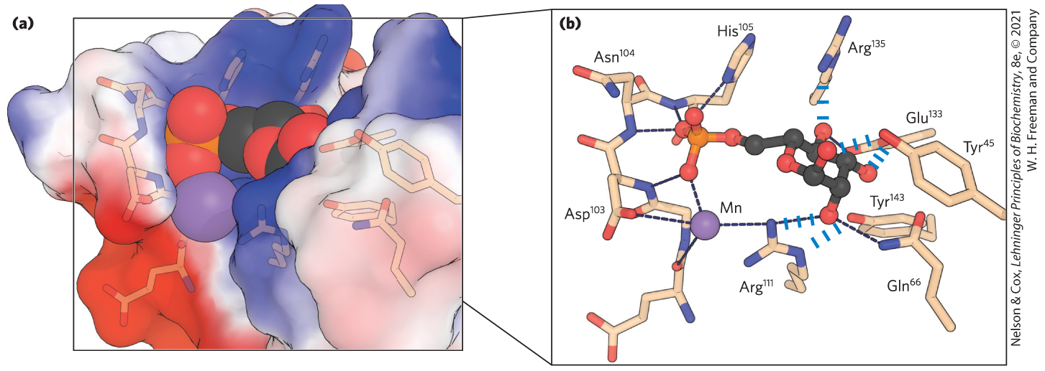
Lectin-Carbohydrate Interactions Are Highly Specific and Often Multivalent
subtle molecular complementarity allows interaction only with the lectin’s correct carbohydrate binding partners

Slide 111
Lectin Multivalency
lectin multivalency = single lectin molecule has multiple carbohydrate binding domains
  increases effective affinity

Slide 112
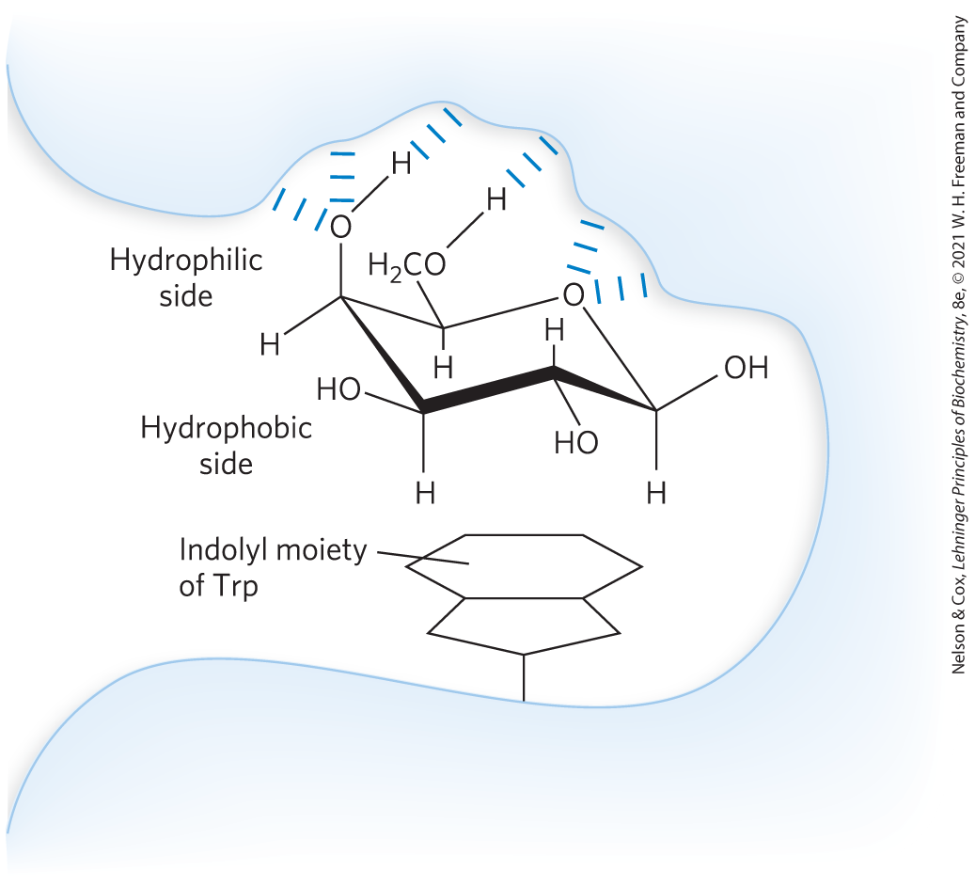
Interactions of Sugar Residues Due to the Hydrophobic Effect
many sugars have a more polar side and a less polar side

Slide 113
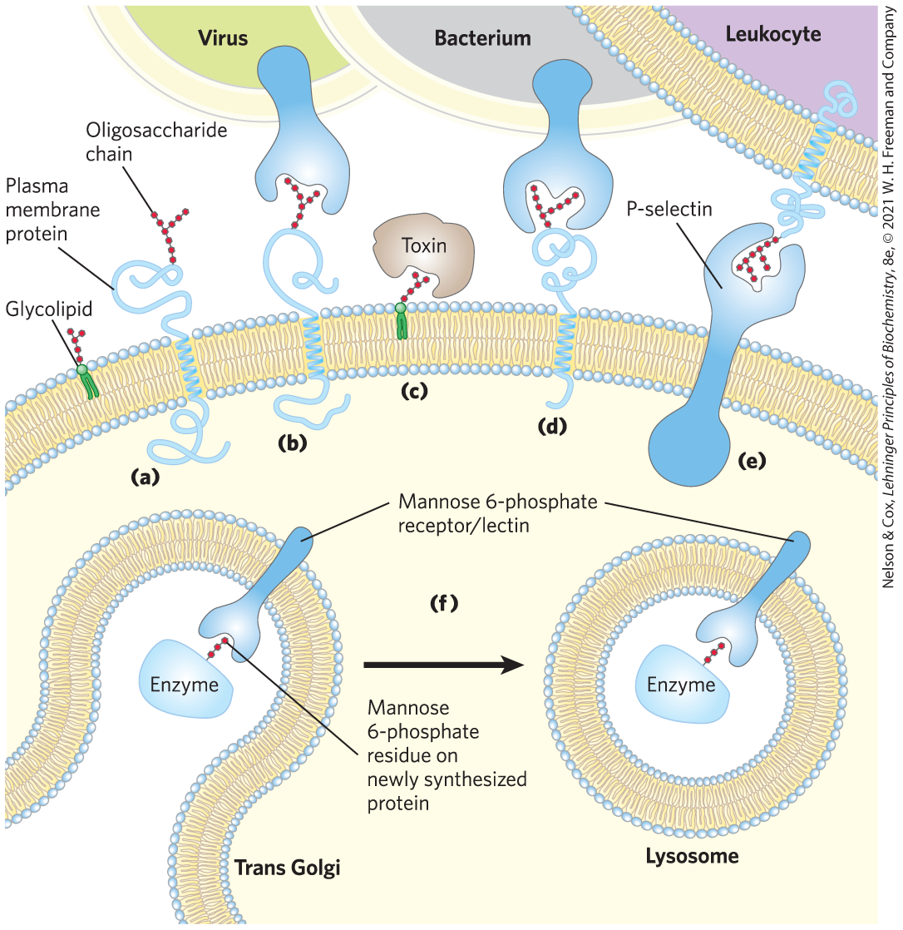
Biological Interactions Mediated by the Sugar Code

Slide 114
7.5 Working with Carbohydrates

Slide 115
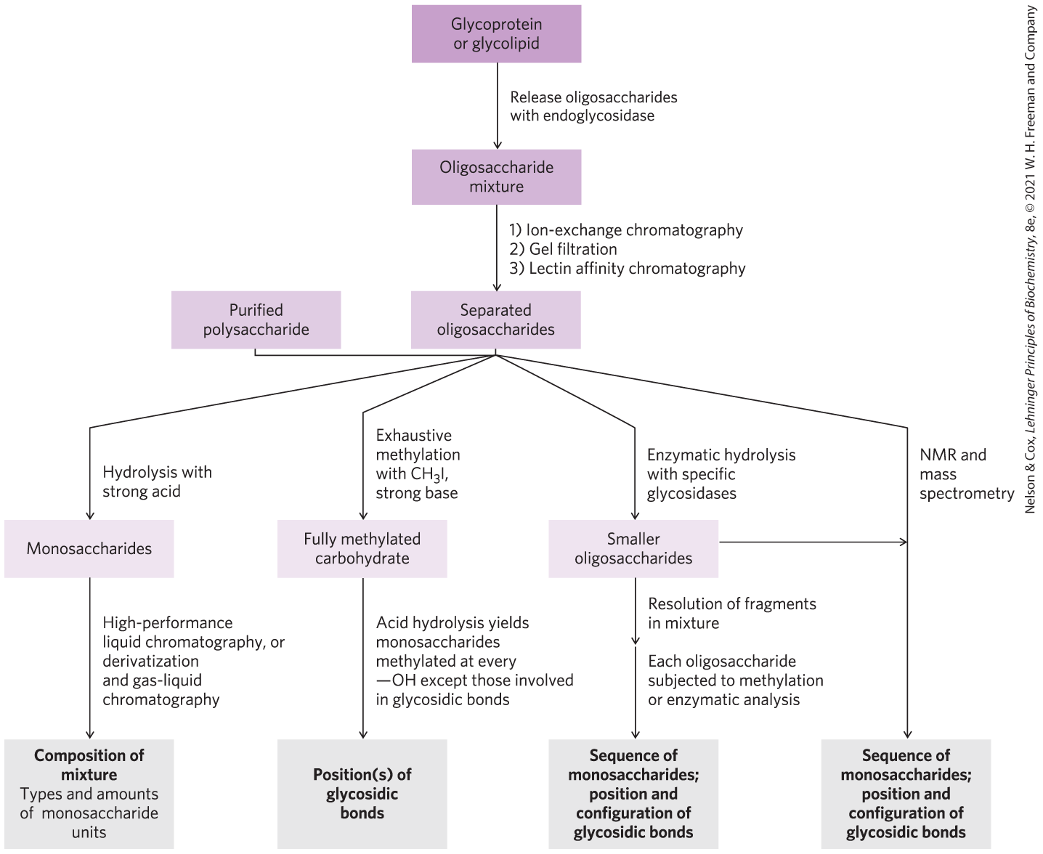
Methods of Carbohydrate Analysis

Slide 116
Determining Oligosaccharide and Polysaccharide Structures
more complex than protein and nucleic acid analysis
can employ a variety of methods to determine sequence, configuration at anomeric and other carbons, and positions of glycosidic bonds:
  traditional chemical and enzymatic approaches
  mass spectrometry
  high-resolution NMR spectroscopy

Slide 117
Solid-Phase Synthetic Methods
carbohydrate chemists can synthesize short segments of almost any glycosaminoglycan
solid-phase oligosaccharide synthesis:
  based on the same principles as peptide synthesis
  yields defined oligosaccharides
  useful in exploring lectin-oligosaccharide interactions

