Slide 1

6 Enzymes
© 2021 Macmillan Learning

Slide 2

Principle 1 (1 of 4)
Enzymes are powerful biological catalysts. Rate accelerations by enzymes are often far greater than those by synthetic or inorganic catalysts. Like all catalysts, enzymes increase reaction rates, lowering reaction activation barriers. Enzymes do not affect the equilibria of reactions.

Slide 3

Principle 2 (1 of 3)
Enzymes exhibit a very high degree of specificity. Each enzyme catalyzes only one chemical reaction, or sometimes a few closely related reactions. Reaction activation barriers are thus lowered selectively.

Slide 4

Principle 3 (1 of 3)
Enzymatic reactions occur in specialized pockets called active sites. These pockets are similar to ligand binding sites, except that a reaction occurs there—the conversion of a substrate, a molecule that is acted on by an enzyme, to a product.

Slide 5

Principle 4 (1 of 8)
Two concepts explain the catalytic power of enzymes. First, enzymes bind most tightly to the transition state of the catalyzed reaction, using binding energy to lower the activation barrier. Second, enzyme active sites are organized by evolution to facilitate multiple mechanisms of chemical catalysis simultaneously.

Slide 6
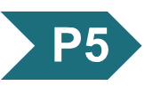
Principle 5 (1 of 3)
Many enzymes are regulated. Regulatory mechanisms include reversible covalent modification, binding of allosteric modulators, proteolytic activation, noncovalent binding to regulatory proteins, and elaborate regulatory cascades. Enzymes are often subject to multiple methods of regulation, which allows for exquisite control of every chemical process that occurs in a cell.

Slide 7
6.1 An Introduction to Enzymes

Slide 8
Enzymes
in 1897, Eduard Buchner:
  demonstrated cell-free yeast extracts could ferment sugar to alcohol
  showed fermentation was promoted by molecules that continued to function when removed from cells
the name enzymes were given to the molecules detected by Buchner

Slide 9
Principle 1 (2 of 4)
Enzymes are powerful biological catalysts. Rate accelerations by enzymes are often far greater than those by synthetic or inorganic catalysts. Like all catalysts, enzymes increase reaction rates, lowering reaction activation barriers. Enzymes do not affect the equilibria of reactions.

Slide 10
Most Enzymes Are Proteins
catalytic activity depends on the integrity of the native protein conformation
molecular weight = ranges from 12,000 to >1 million
some enzyme require additional chemical components:
  cofactor = 1+ inorganic ions, such as Fe²⁺, Mg²⁺, Mn²⁺, or Zn²⁺
  coenzyme = complex organic or metalloorganic molecule that act as transient carriers of specific functional groups

Slide 11
Inorganic Ions as Cofactors
Table 6-1 Some Inorganic Ions That Serve as Cofactors for Enzymes
Ions | Enzymes
Cu²⁺ | Cytochrome oxidase
Fe²⁺ or Fe³⁺ | Cytochrome oxidase, catalase, peroxidase
K⁺ | Pyruvate kinase
Mg²⁺ | Hexokinase, glucose 6-phosphatase, pyruvate kinase
Mn²⁺ | Arginase, ribonucleotide reductase
Mo | Dinitrogenase
Ni²⁺ | Urease
Zn²⁺ | Carbonic anhydrase, alcohol dehydrogenase, carboxypeptidases A and B

Slide 12
Coenzymes as Transient Carriers of Atoms or Functional Groups
Table 6-2 Some Coenzymes That Serve as Transient Carriers of Specific Atoms or Functional Groups
Coenzyme | Examples of chemical groups transferred | Dietary precursor in mammals
Biocytin | CO₂ | Biotin (vitamin B₇)
Coenzyme A | Acyl groups | Pantothenic acid (vitamin B5) and other compounds
5′-Deoxyadenosylcobalamin (coenzyme B₁₂) | H atoms and alkyl groups | Vitamin B₁₂
Flavin adenine dinucleotide | Electrons | Riboflavin (vitamin B₂)
Lipoate | Electrons and acyl groups | Not required in diet
Nicotinamide adenine dinucleotide | Hydride ion (:H–) | Nicotinic acid (niacin, vitamin B₃)
Pyridoxal phosphate | Amino groups | Pyridoxine (vitamin B₆)
Tetrahydrofolate | One-carbon groups | Folate (vitamin B₉)
Thiamine pyrophosphate | Aldehydes | Thiamine (vitamin B₁)
Notes:
Note on Table 6-2: The structures and modes of action of these coenzymes are described in Part II.

Slide 13
Describing Enzymes and Their Additional Chemical Components
prosthetic group = coenzyme or metal ion that is very tightly or covalently bound to the enzyme protein
holoenzyme = complete catalytically active enzyme together with its bound coenzyme and/or metal ions
apoenzyme or apoprotein = the protein part of a holoenzyme

Slide 14
Enzymes Are Classified by the Reactions They Catalyze
enzymes are divided into seven classes, each with subclasses, based on the type of reaction catalyzed
each enzyme has a four-part Enzyme Commission number (E.C. number) and a systematic name
most enzymes have trivial names
Table 6-3 International Classification of Enzymes
Class number | Class name | Type of reaction catalyzed
1 | Oxidoreductases | Transfer of electrons (hydride ions or H atoms)
2 | Transferases | Group transfer
3 | Hydrolases | Hydrolysis (transfer of functional groups to water)
4 | Lyases | Cleavage of C—C, C—O, C—N, or other bonds by elimination, leaving double bonds or rings, or addition of groups to double bonds
5 | Isomerases | Transfer of groups within molecules to yield isomeric forms
6 | Ligases | Formation of C—C, C—S, C—O, and C—N bonds by condensation reactions coupled to cleavage of ATP or similar cofactor
7 | Translocases | Movement of molecules or ions across membranes or their separation within membranes

Slide 15
6.2 How Enzymes Work

Slide 16
Principle 3 (2 of 3)
Enzymatic reactions occur in specialized pockets called active sites. These pockets are similar to ligand binding sites, except that a reaction occurs there—the conversion of a substrate, a molecule that is acted on by an enzyme, to a product.

Slide 17
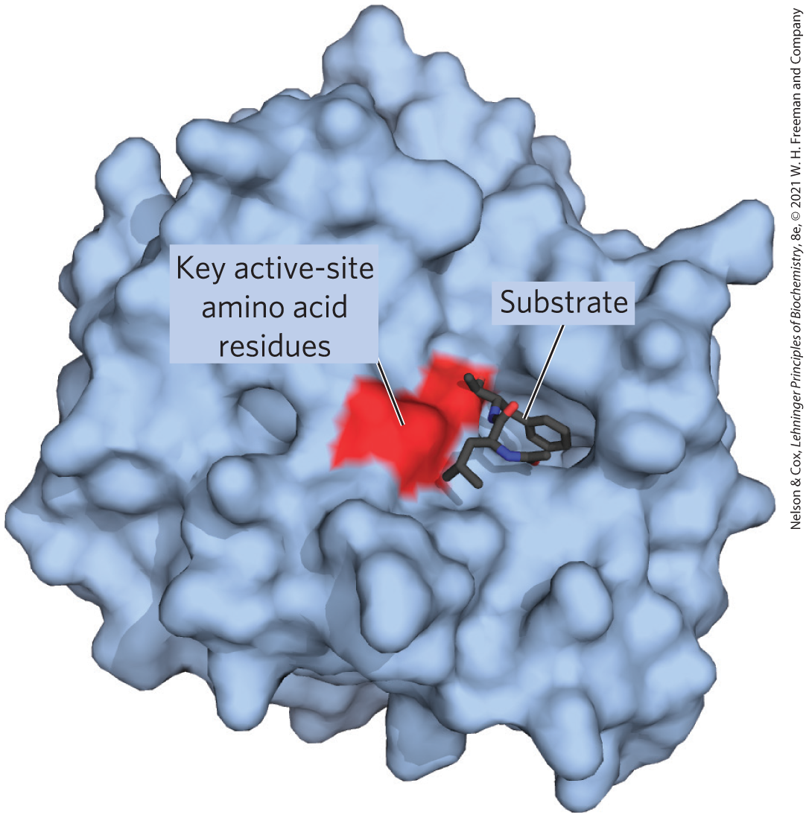
Enzyme-Catalyzed Reactions Take Place within the Active Site
active site = provides a specific environment in which a given reaction can occur more rapidly
substrate = the molecule that is bound to the active site and acted upon by the enzyme

Slide 18
Enzymes Affect Reaction Rates,
Not Equilibria
simple enzymatic reactions can be written as
E + S ⇌ ES ⇌ EP ⇌ E + P
(6-1)
where E, S, and P represent the enzyme, substrate, and product and ES and EP are transient complexes of the enzyme

Slide 19
Principle 1 (3 of 4)
Enzymes are powerful biological catalysts. Rate accelerations by enzymes are often far greater than those by synthetic or inorganic catalysts. Like all catalysts, enzymes increase reaction rates, lowering reaction activation barriers. Enzymes do not affect the equilibria of reactions.

Slide 20
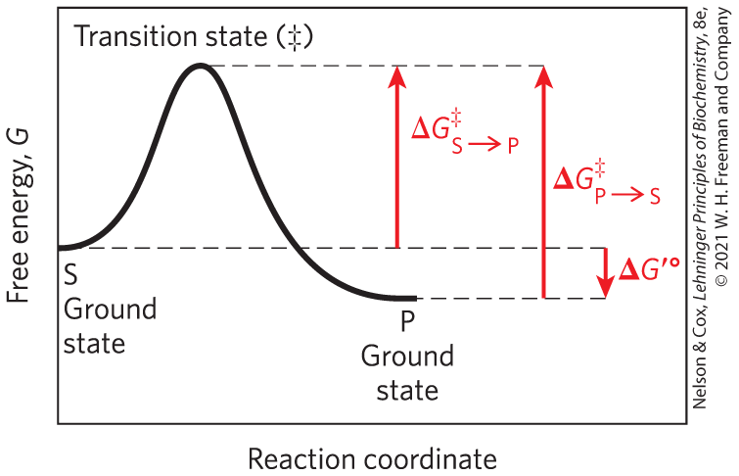
Ground State and Transition State
ground state = starting point for either the forward or reverse reaction
transition state (‡) = the point at which decay to substrate or product are equally likely

Slide 21
Energy Changes in a Reaction Coordinate Diagram
biochemical standard free-energy change = ∆G′° = the standard free-energy change at pH 7.0
activation energy (∆G‡) = difference between the ground state energy level and the transition state energy level

Slide 22
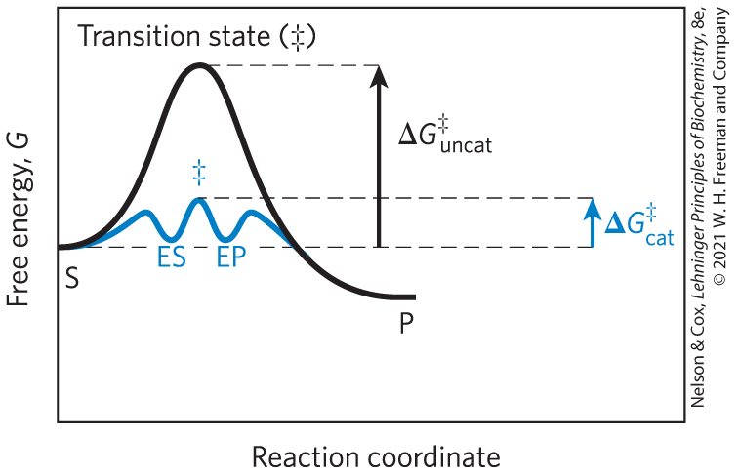
Catalysts Lower the Activation Energy and Increase the Reaction Rate

Slide 23
Catalysts Do Not Affect Reaction Equilibria
any enzyme that catalyzes the reaction S → P also catalyzes the reaction P → S
enzymes accelerate the interconversion of S and P
enzymes are not used up in the process
the equilibrium point is unaffected

Slide 24
Reaction Intermediates
reaction intermediate = any species on the reaction pathway that has a finite chemical lifetime
  example: ES and EP complexes

Slide 25
Rate-Limiting Steps
rate-limiting step = the step in a reaction with the highest activation energy that determines the overall rate of the reaction
activation energies are barriers to chemical reactions

Slide 26
Principle 2 (2 of 3)
Enzymes exhibit a very high degree of specificity. Each enzyme catalyzes only one chemical reaction, or sometimes a few closely related reactions. Reaction activation barriers are thus lowered selectively.

Slide 27
Enzymes Lower Activation Energies Selectively
enzymes have developed to lower activation energies selectively to increase rates for reactions needed for cell survival

Slide 28
Principle 1 (4 of 4)
Enzymes are powerful biological catalysts. Rate accelerations by enzymes are often far greater than those by synthetic or inorganic catalysts. Like all catalysts, enzymes increase reaction rates, lowering reaction activation barriers. Enzymes do not affect the equilibria of reactions.

Slide 29
Reaction Rates and Equilibria Have Precise Thermodynamic Definitions
reaction equilibria are linked to the standard free-energy change for the reaction, ∆G′°
reaction rates are linked to the activation energy, ∆G‡

Slide 30
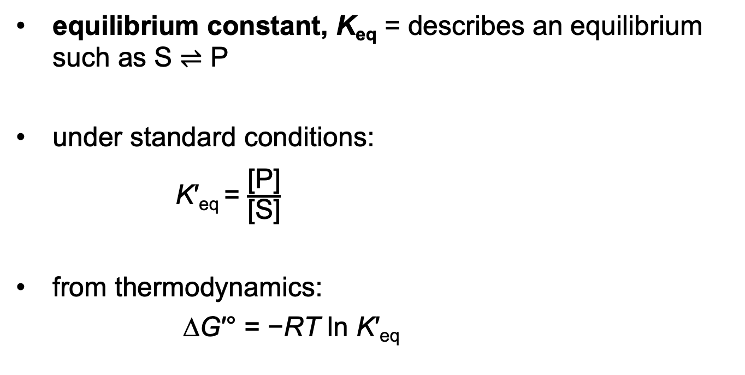
Thermodynamics Relates
K′_{eq} and ∆G′ °
equilibrium constant, K_{eq} = describes an equilibrium such as S ⇌ P
under standard conditions:
K′_{eq} = $\frac{\text{[}\text{P}\text{]}}{\text{[}\text{S}\text{]}}$
from thermodynamics:
∆G′° = −RT ln K′_{eq}
(6-2)
(6-3)

Slide 31
The Relationship between
K′ _{eq} and ∆G′ °
Table 6-4 Relationship between K′_{eq} and ∆G′°
K′_{eq} | ∆G′° (kJ/mol)
10^{–6} | 34.2
10^{–5} | 28.5
10^{–4} | 22.8
10^{–3} | 17.1
10^{–2} | 11.4
10^{–1} | 5.7
1 | 0.0
10¹ | –5.7
10² | –11.4
10³ | –17.1
Notes:
Note on Table 6-4: The relationship is calculated from ∆G′° = –RT in K′_{eq} (6-3)

Slide 32
Rate Constants and Rate Equations
the rate of any reaction is determined by the concentration of reactant(s) and the rate constant, k
for the unimolar reaction S → P, a rate equation expresses the rate of the reaction
V = k[S]
(6-4)
where V is the velocity or rate of the reaction and [S] is
the concentration of the substrate

Slide 33
First-Order Reactions
first-order reaction = rate depends only on the concentration of S
k has units of reciprocal time, such as s^{–1}

Slide 34
Second-Order Reactions
second-order reaction = rate depends on the concentration of two different compounds or the reaction is between two molecules of the same compound
k has units of M^{–1}s^{–1}
the rate equation becomes
V = k[S₁][S₂]
(6-5)

Slide 35
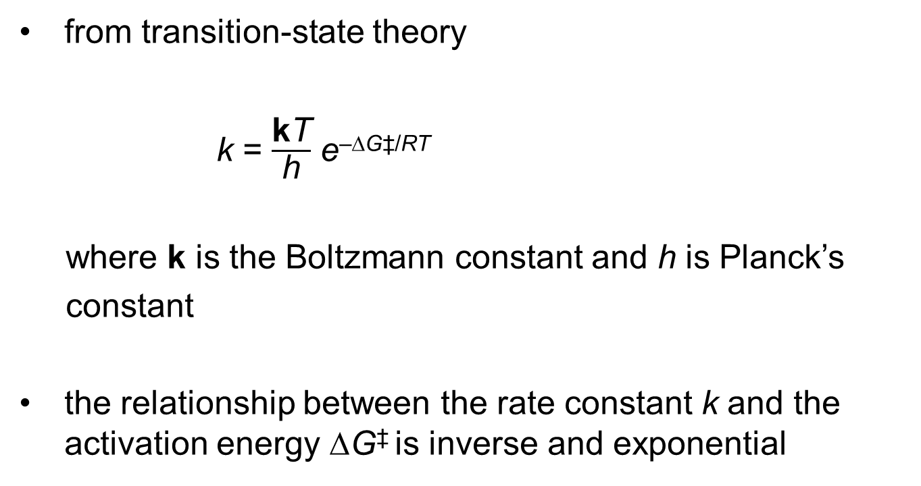
The Relationship between Rate Constants and Activation Energy
from transition-state theory
k = $\frac{\text{k}\text{T}}{\text{h}}$ e^{–∆G‡/RT}
where k is the Boltzmann constant and h is Planck’s
constant
the relationship between the rate constant k and the activation energy ∆G‡ is inverse and exponential
(6-6)

Slide 36
A Few Principles Explain the Catalytic Power and Specificity of Enzymes
enzymes enhance rates in the range of 5 to 17 orders of magnitude
Table 6-5 Some Rate Enhancements Produced by Enzymes
Cyclophilin | 10⁵
Carbonic anhydrase | 10⁷
Triose phosphate isomerase | 10⁹
Carboxypeptidase A | 10¹¹
Phosphoglucomutase | 10¹²
Succinyl-CoA transferase | 10¹³
Urease | 10¹⁴
Orotidine monophosphate decarboxylase | 10¹⁷

Slide 37
Principle 4 (2 of 8)
Two concepts explain the catalytic power of enzymes. First, enzymes bind most tightly to the transition state of the catalyzed reaction, using binding energy to lower the activation barrier. Second, enzyme active sites are organized by evolution to facilitate multiple mechanisms of chemical catalysis simultaneously.

Slide 38
Interactions between Enzymes and Substrates
binding energy, ∆G_{B} = energy derived from noncovalent enzyme-substrate interaction
  mediated by hydrogen bonds, ionic interactions, and the hydrophobic effect
  major source of free energy used by enzymes to lower the activation energy
covalent interactions between enzyme and substrate lower the activation energy

Slide 39
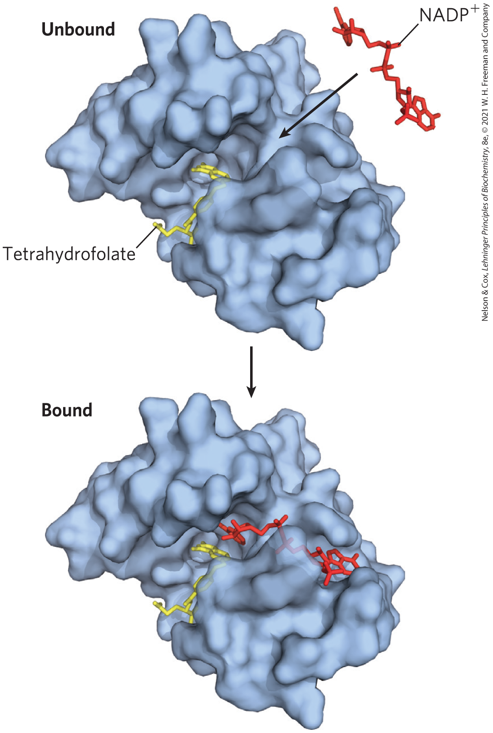
Noncovalent Interactions between Enzyme and Substrate Are Optimized in the Transition State
“lock and key” hypothesis = enzymes are structurally complementary to their substrates
  would make for a poor enzyme

Slide 40
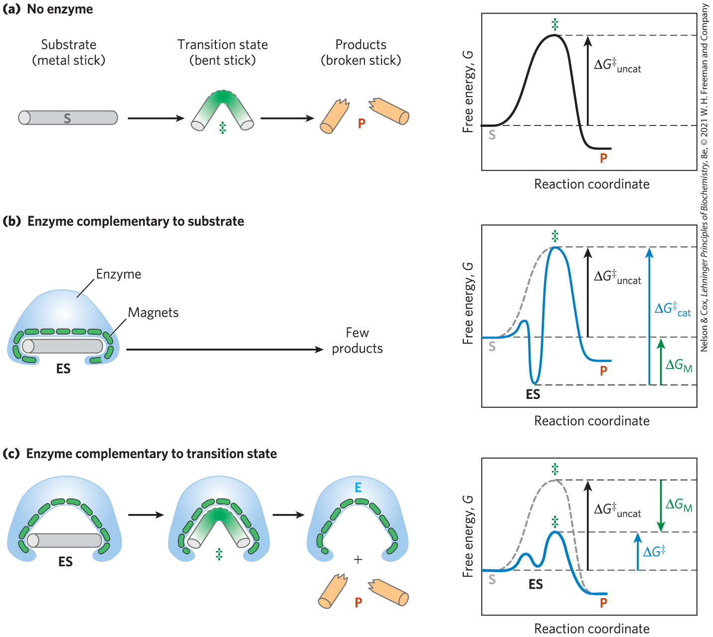
Enzymes Must Be Complementary to the Reaction Transition State
the full complement of interactions between substrate and enzyme is formed only when the substrate reaches the transition state

Slide 41
Principle 4 (3 of 8)
Two concepts explain the catalytic power of enzymes. First, enzymes bind most tightly to the transition state of the catalyzed reaction, using binding energy to lower the activation barrier. Second, enzyme active sites are organized by evolution to facilitate multiple mechanisms of chemical catalysis simultaneously.

Slide 42
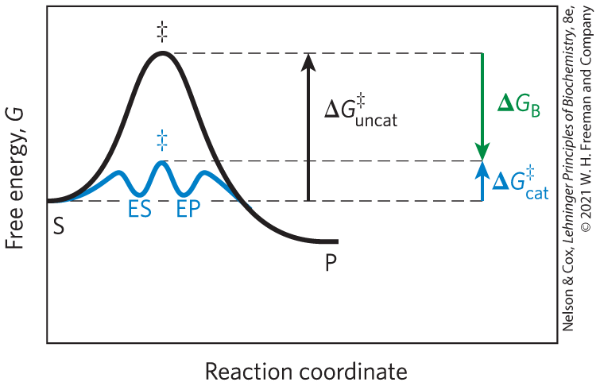
The Role of Binding Energy in Catalysis
the sum of the unfavorable activation energy ∆G‡ and the favorable binding energy ∆G_{B} results in a lower net activation energy
weak binding interactions between the enzyme and the substrate drive enzymatic catalysis

Slide 43
Principle 3 (3 of 3)
Enzymatic reactions occur in specialized pockets called active sites. These pockets are similar to ligand binding sites, except that a reaction occurs there—the conversion of a substrate, a molecule that is acted on by an enzyme, to a product.

Slide 44
The Active Site of an Enzyme
optimized binding energy in the transition state is accomplished by positioning a substrate in a cavity (the active site), removed from H₂O

Slide 45
Principle 2 (3 of 3)
Enzymes exhibit a very high degree of specificity. Each enzyme catalyzes only one chemical reaction, or sometimes a few closely related reactions. Reaction activation barriers are thus lowered selectively.

Slide 46
Enzyme Specificity
specificity = ability to discriminate between a substrate and a competing molecule
  given by binding energy

Slide 47
Binding Energy Overcomes the Barrier to Reaction
barrier to reaction, ∆G‡ includes:
  the entropy of molecules in solution
  the solvation shell of hydrogen-bonded water that surrounds and stabilizes most biomolecules in aqueous solution
  the distortion of substrates that must occur in many reactions
  the need for proper alignment of catalytic functional groups on the enzyme

Slide 48
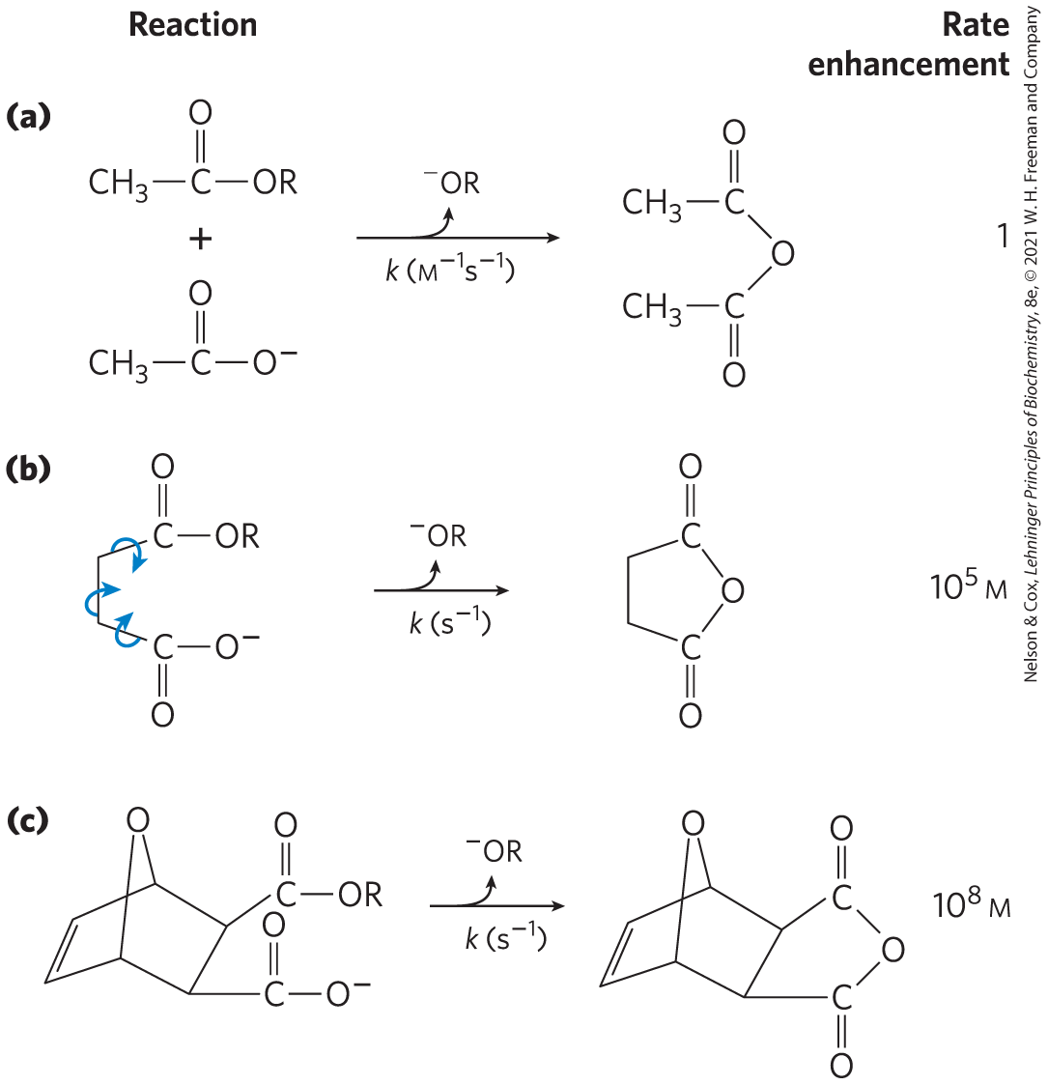
Rate Enhancement by Entropy Reduction
entropy reduction = large restriction in the relative motions of two substrates that are to react
binding energy constrains substrates in the proper orientation to reaction

Slide 49
Desolvation of the Substrate
desolvation = replacement of the solvation shell of structured water around the substrate with weak bonds between substrate and enzyme
  replaces most or all hydrogen bonds between the substrate and H₂O

Slide 50
Distortion of the Substrate
substrate must undergo distortion (electron redistribution) to react
  causes an unfavorable free-energy change
binding energy compensates thermodynamically for this

Slide 51
The Induced Fix Mechanism
induced fit = mechanism by which the enzyme itself undergoes a conformational change when the substrate binds, induced by multiple weak interactions with the substrate
  enhances catalytic properties

Slide 52
Principle 4 (4 of 8)
Two concepts explain the catalytic power of enzymes. First, enzymes bind most tightly to the transition state of the catalyzed reaction, using binding energy to lower the activation barrier. Second, enzyme active sites are organized by evolution to facilitate multiple mechanisms of chemical catalysis simultaneously.

Slide 53
Covalent Interactions and Metal Ions Contribute to Catalysis
catalytic functional groups aid in the cleavage and formation of bonds by a variety of mechanisms:
  general acid-base catalysis
  covalent catalysis
  metal ion catalysis

Slide 54
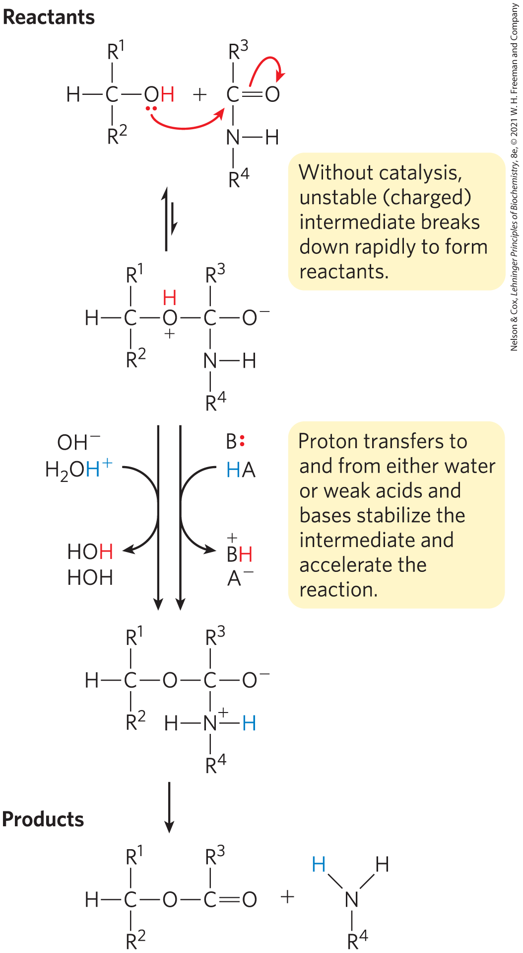
General Acid-Base Catalysis
protons are transferred between an enzyme and a substrate or intermediate
specific acid-base catalysis = uses only the H⁺ (H₃O⁺) or OH– ions present in water
general acid-base catalysis = mediated by weak acids or bases other than water

Slide 55
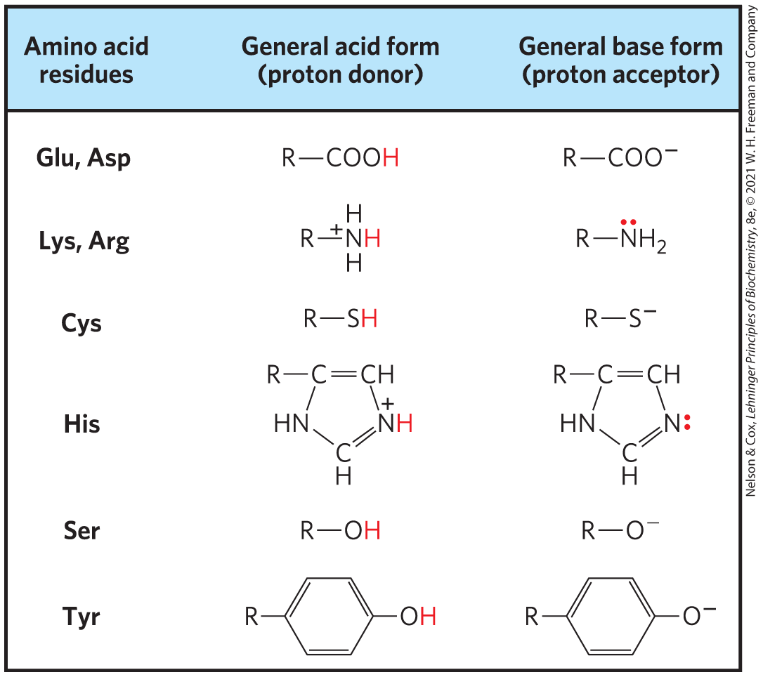
Amino Acids in General Acid-Base Catalysis
occurs in the vast majority of enzymes

Slide 56
Covalent Catalysis
covalent catalysis = transient covalent bond forms between the enzyme and the substrate
  catalysis only results when the new pathway has a lower activation energy than the uncatalyzed pathway
  all new steps must be faster than the uncatalyzed reaction
hydrolysis of a bond:
hydrolysis of a bond between A and B in the presence of a covalent catalyst:

Slide 57
Metal Ion Catalysis
metals:
  help orient the substrate for reaction
  stabilize charged reaction transition states
  mediate oxidation-reduction reactions by reversible changes in the metal ion’s oxidation state
nearly 1/3 of all known enzymes require 1+ metal ions for catalytic activity

Slide 58
6.3 Enzyme Kinetics as an Approach to Understanding Mechanism

Slide 59
Enzyme Kinetics
enzyme kinetics = the discipline focused on determining the rate of a reaction and how it changes in response to changes in experimental parameters

Slide 60
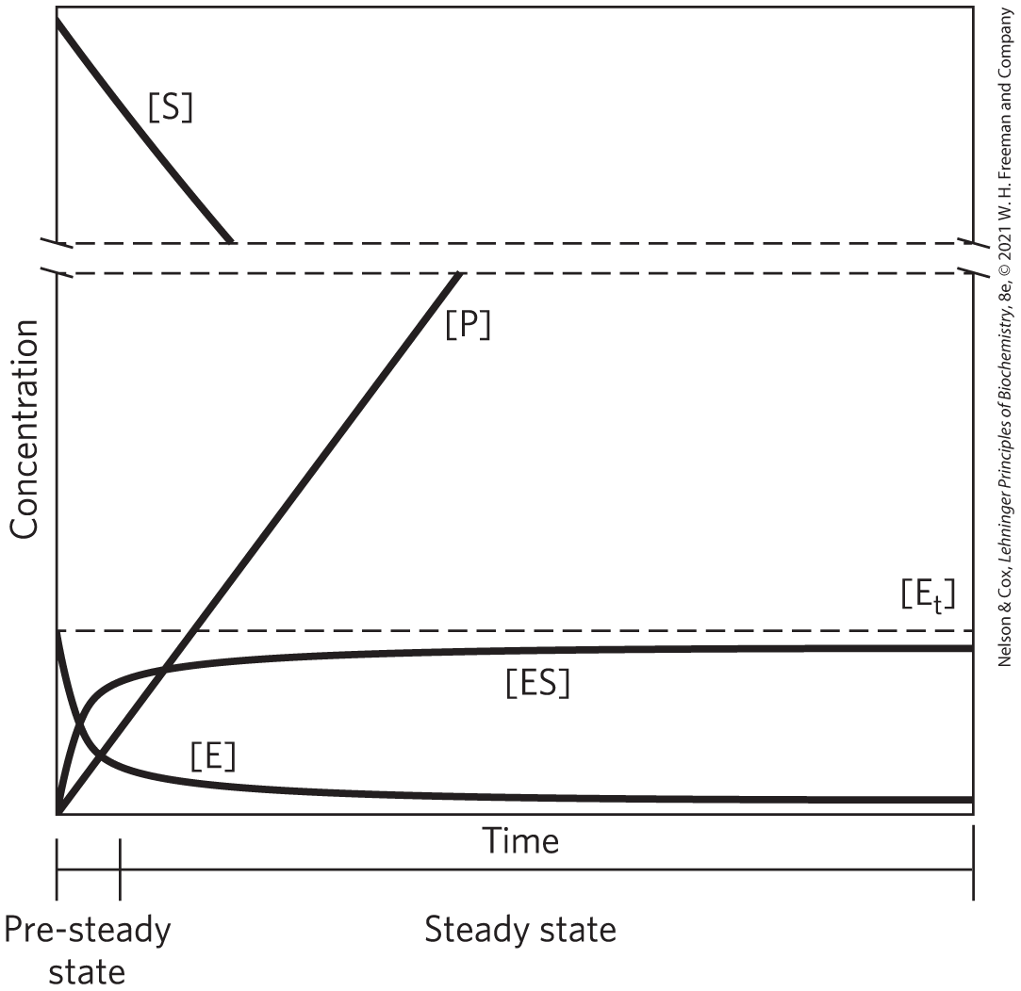
Substrate Concentration Affects the Rate of Enzyme-Catalyzed Reactions
pre–steady state = initial transient period during which ES builds up
steady state = period during which [ES] and other intermediates remain constant
steady-state kinetics = the traditional analysis of reaction rates

Slide 61
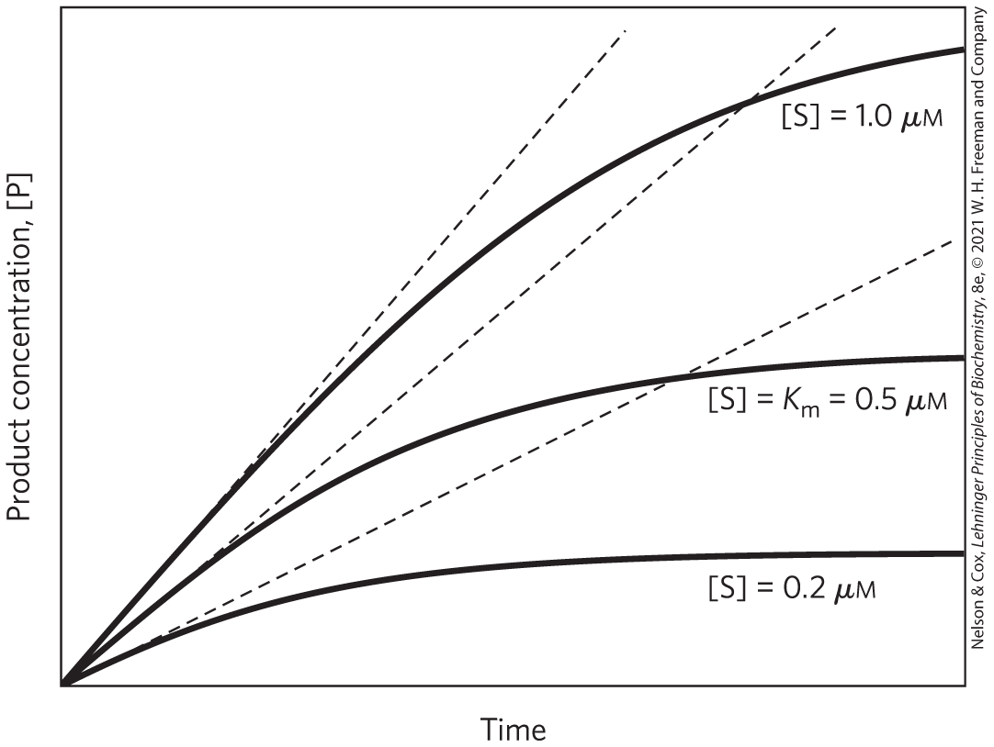
Initial Velocities of Enzyme-Catalyzed Reactions
initial rate (initial velocity), V₀ = tangent to each curve taken at time = 0
  reflects a steady state
at the beginning of the reaction, [S] is regarded as constant

Slide 62
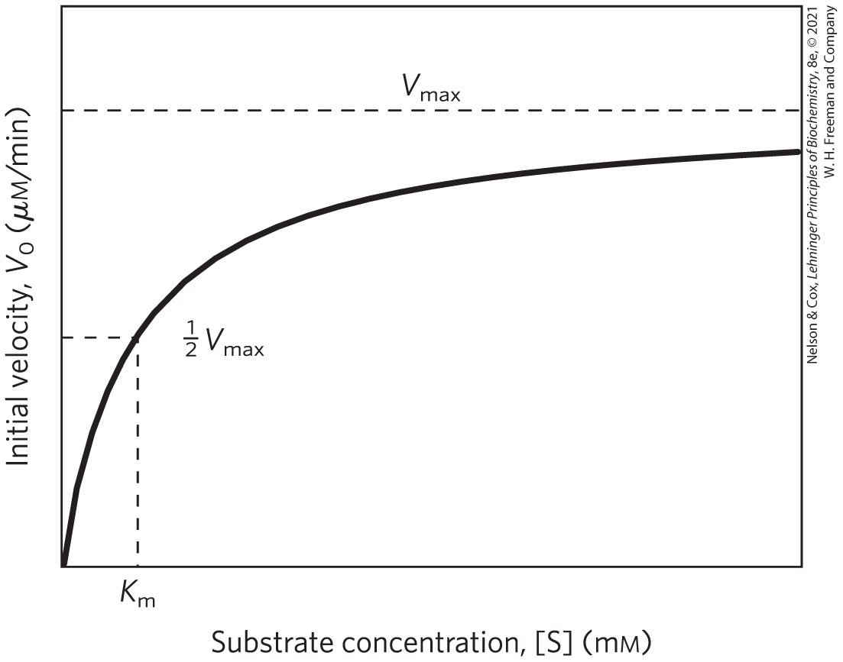
Effect of [S] on the V₀ of an
Enzyme-Catalyzed Reaction
the plateau-like V₀ region is close to the maximum velocity, V_{max}

Slide 63
General Theory of Enzyme Action Proposed by Michaelis and Menten
step 1 – enzyme and substrate combine to form a complex in a reversible, relatively fast step:
(6-7)
step 2 – the complex breaks down to yield the free enzyme and the reaction product in a slower step:
(6-8)
because the second step limits the overall reaction rate, the overall rate is proportional to [ES]

Slide 64
The Saturation Effect
V_{max} is observed when virtually all the enzyme is present as the ES complex
  further increases in [S] have no effect on rate
  responsible for the plateau observed

Slide 65
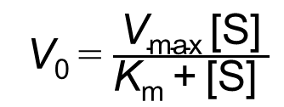
The Relationship between Substrate Concentration and Reaction Rate Can Be Expressed with the Michaelis-Menten Equation
the curve expressing the relationship between [S] and V₀ can be expressed by the Michaelis-Menten equation:
V₀ = $\frac{\text{V}\text{max} \text{[}\text{S}\text{]}}{\text{K}\text{m} \text{+} \text{[}\text{S}\text{] }}$
(6-9)
where V₀ is the initial velocity, V_{max} is the maximum velocity, [S] is the initial substrate concentration, and K_{m} is a constant called the Michaelis constant

Slide 66
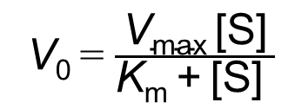
The Michaelis-Menten Equation
the Michaelis-Menten equation is the rate equation for a one-substrate enzyme-catalyzed reaction:
V₀ = $\frac{\text{V}\text{max}\text{ [}\text{S}\text{]}}{\text{K}\text{m}\text{ + [}\text{S}\text{] }}$
(6-9)
V₀, V_{max}, [S], and K_{m} are readily measured experimentally

Slide 67
Deriving the Michaelis-Menten Equation
the overall reaction for the formation and breakdown of ES simplifies to
(6-10)
V₀ is determined by the breakdown of ES to form product, which is determined by [ES]:
V₀ = k₂[ES]
(6-11)

Slide 68
Deriving the Michaelis-Menten Equation, [E_{t}]
[ES] is not easily measured experimentally
[E_{t}] = the total enzyme concentration (the sum of free and substrate-bound enzyme)
free or unbound enzyme [E] = [E_{t}] – [ES]
because [S] >> [E_{t}], the amount of substrate bound by the enzyme at any given time is negligible compared with the total [S]

Slide 69
Deriving the Michaelis-Menten Equation, Step 1
rate of ES formation = k₁([E_{t}] – [ES])[S]
rate of ES breakdown = k_{–1}[ES] + k₂[ES]
(6-12)
(6-13)

Slide 70
Deriving the Michaelis-Menten Equation, Step 2
steady-state assumption = the rate of formation of ES is equal to the rate of its breakdown
when equated for the steady state:
k₁([E_{t}] – [ES])[S] = k_{–1} [ES] + k₂[ES]
(6-14)

Slide 71
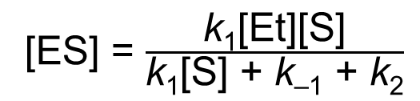
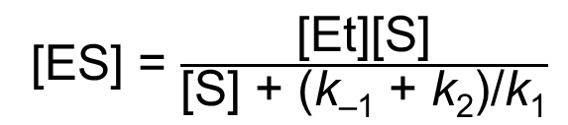
Deriving the Michaelis-Menten Equation, Step 3
solving for [ES]:
k₁[E_{t}][S] – k₁[ES][S] = (k_{–1} + k₂)[ES]
(6-15)
k₁[E_{t}][S] = (k₁[S] + k_{–1} + k₂)[ES]
(6-16)
[ES] = $\frac{\text{k}\text{1}\text{[}\text{Et}\text{][}\text{S}\text{]}}{\text{k}\text{1}\text{[}\text{S}\text{] + }\text{k}\text{–1} \text{+} \text{k}\text{2}}$
(6-17)
[ES] = $\frac{\text{[}\text{Et}\text{][}\text{S}\text{]}}{\text{[}\text{S}\text{] + (}\text{k}\text{–1} \text{+} \text{k}\text{2}\text{)/}\text{k}\text{1}}$
(6-18)

Slide 72
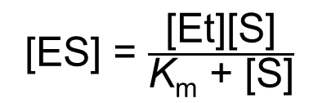
Deriving the Michaelis-Menten Equation, K_{m}
the Michaelis constant, K_{m} = (k_{–1} + k₂)/ k₁
substituting K_{m} into the equation:
[ES] = $\frac{\text{[}\text{Et}\text{][}\text{S}\text{]}}{\text{K}\text{m}\text{ + [}\text{S}\text{]}}$
(6-19)

Slide 73
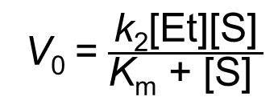
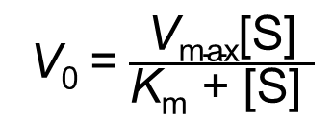
Deriving the Michaelis-Menten Equation, Step 4
expressing V₀ in terms of [ES]:
V₀ = k₂[ES]
(6-11)
V₀ = $\frac{\text{k}\text{2}\text{[}\text{Et}\text{][}\text{S}\text{]}}{\text{K}\text{m}\text{ + [}\text{S}\text{]} }$
(6-20)
given V_{max} occurs when the enzyme is saturated (when [ES] = [E_{t}]), V_{max} = k₂[E_{t}]:
V₀ = $\frac{\text{V}\text{max}\text{[}\text{S}\text{]}}{\text{K}\text{m}\text{ + [}\text{S}\text{]} }$
(6-9)

Slide 74
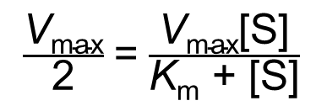
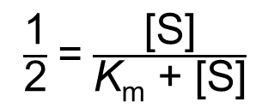
K_{m} = [S], When V₀ = ½V_{max}
when V₀ = ½V_{max}:
$\frac{\text{V}\text{max}}{\text{2}}$ = $\frac{\text{V}\text{max}\text{[}\text{S}\text{]}}{\text{K}\text{m}\text{ + [}\text{S}\text{]}}$
(6-21)
$\frac{\text{1}}{\text{2}}$ = $\frac{\text{[}\text{S}\text{]}}{\text{K}\text{m}\text{ + [}\text{S}\text{]}}$
(6-22)
solving for K_{m}:
K_{m} = [S] when V₀ = ½V_{max}
(6-23)

Slide 75
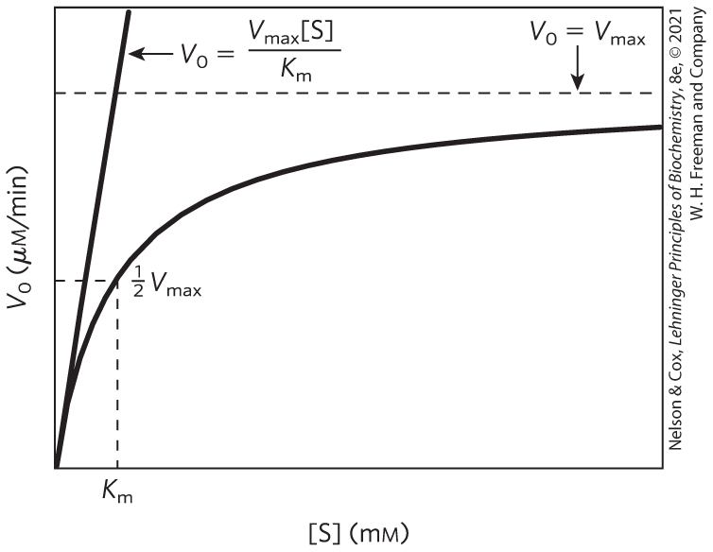
Dependence of V₀ on [S]

Slide 76
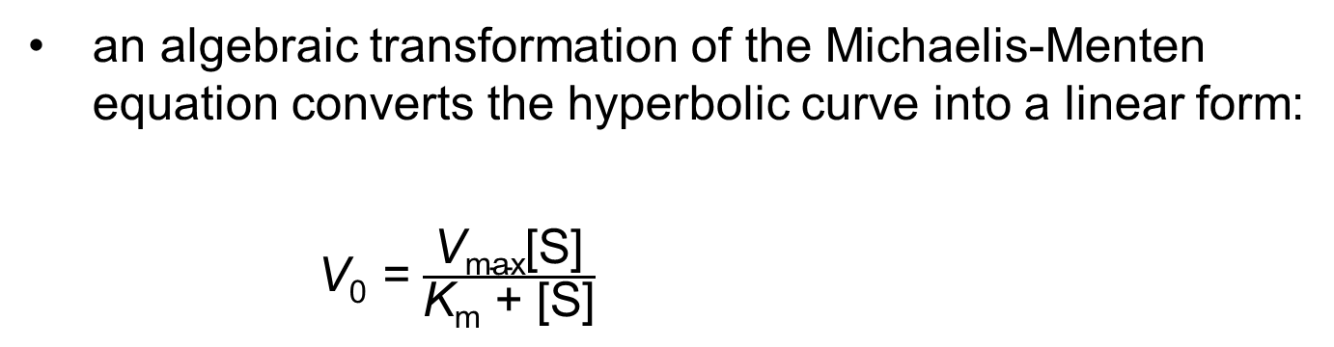
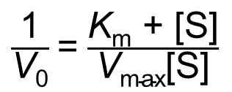
Michaelis-Menten Kinetics Can Be Analyzed Quantitatively
an algebraic transformation of the Michaelis-Menten equation converts the hyperbolic curve into a linear form:
V₀ = $\frac{\text{V}\text{max}\text{[}\text{S}\text{]}}{\text{K}\text{m}\text{ + [}\text{S}\text{]}}$
$\frac{\text{1}}{\text{V}\text{0}}$ = $\frac{\text{K}\text{m}\text{ + [}\text{S}\text{]}}{\text{V}\text{max}\text{[}\text{S}\text{]}}$
(6-24)

Slide 77
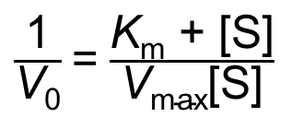
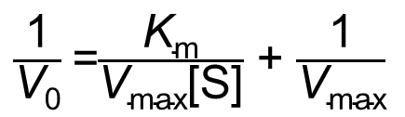
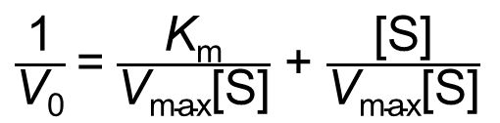
Deriving the Lineweaver-Burk Equation
simplifying this equation gives the Lineweaver-Burk equation:
$\frac{\text{1}}{\text{V}\text{0}}$ = $\frac{\text{K}\text{m}\text{ + [}\text{S}\text{]}}{\text{V}\text{max}\text{[}\text{S}\text{]}}$
(6-24)
$\frac{\text{1}}{\text{V}\text{0}}$ = $\frac{\text{K}\text{m}}{\text{V}\text{max}\text{[}\text{S}\text{]}}$ + $\frac{\text{[}\text{S}\text{]}}{\text{V}\text{max}\text{[}\text{S}\text{]}}$
(6-25)
$\frac{\text{1}}{\text{V}\text{0}}$ =$\frac{\text{K}\text{m}}{\text{V}\text{max}\text{[}\text{S}\text{]}}$ + $\frac{\text{1}}{\text{V}\text{max}}$
(6-26)

Slide 78
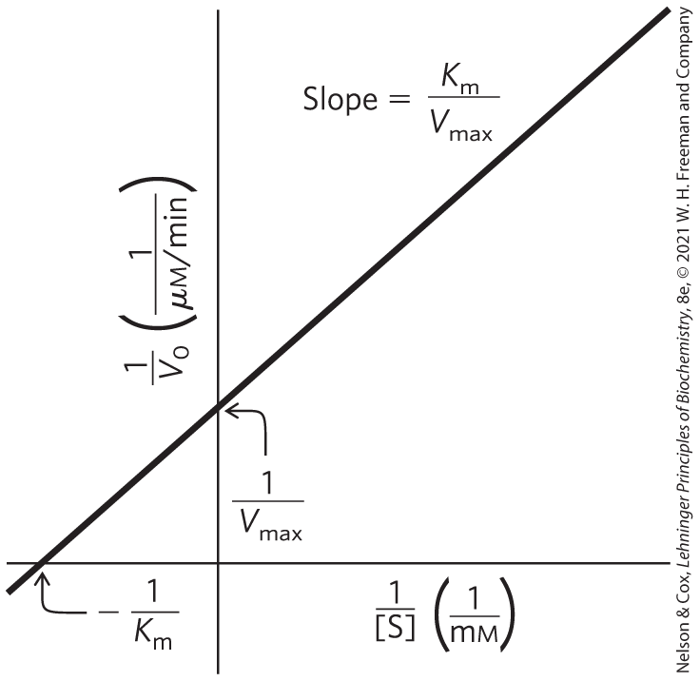
A Double-Reciprocal, or Lineweaver-Burk, Plot
for enzymes obeying the Michaelis-Menten relationship, a plot of 1/V₀ versus 1/[S] yields a straight line

Slide 79
Kinetic Parameters Are Used to Compare Enzyme Activities
all enzymes that exhibit a hyperbolic dependence of V₀ on [S] follow Michaelis-Menten kinetics where:
K_{m} = [S] when V₀ = ½V_{max}
(6-23)

Slide 80
Interpreting K_{m} and V_{max}
K_{m} can vary for different substrates of the same enzyme
Table 6-6 K_{m} for Some Enzymes and Substrates
Enzyme | Substrate | K_{m} (mM)
Hexokinase (brain) | ATP D-Glucose D-Fructose | 0.4 0.05 1.5
Carbonic anhydrase | HCO₃– | 26
Chymotrypsin | Glycyltyrosinylglycine N-Benzoyltyrosinamide | 108 2.5
β-Galactosidase | D-Lactose | 4.0
Threonine dehydratase | L-Threonine | 5.0

Slide 81
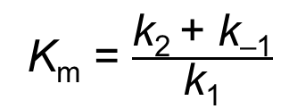
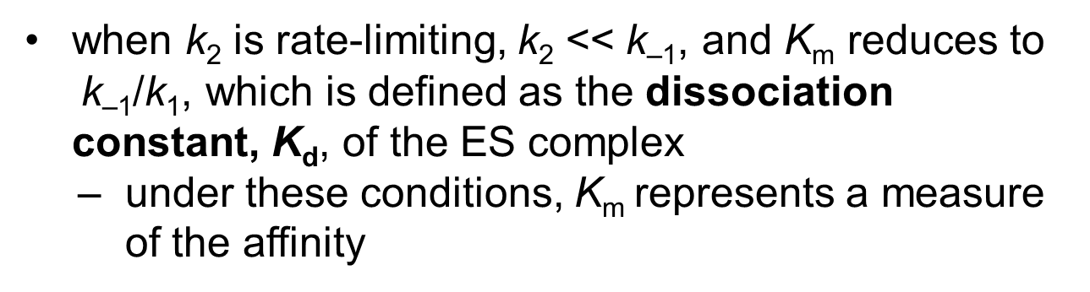
The Dissociation Constant, K_{d}
for reactions with two steps:
K_{m} = $\frac{\text{k}\text{2 }\text{+} \text{k}\text{–1}}{\text{k}\text{1}}$
(6-27)
when $\text{k}\text{2}$is rate-limiting, k₂ << $\text{k}\text{–1}\text{, }\text{and}$K_{m} reduces to $\text{k}\text{–1}\text{/}\text{k}\text{1}\text{,}$ which is defined as the dissociation constant, K_{d}, of the ES complex
under these conditions, K_{m} represents a measure of the affinity

Slide 82
Interpreting V_{max}
the number of reactions steps and the identity of the rate-limiting step(s) varies from enzyme to enzyme
for a two-step Michaelis-Menten mechanism,
V_{max} = k₂[E_{t}]
when product release, EP → E + P, is rate-limiting:
(6-28)

Slide 83
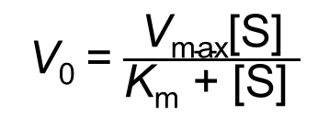
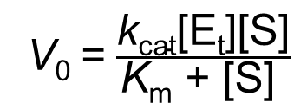
The General Rate Constant, k_{cat}
general rate constant, k_{cat} = describes the limiting rate of any enzyme-catalyzed reaction at saturation
  if one step in a multistep reaction is clearly limiting, k_{cat} equals the rate constant for the step
  more complex when several steps are rate-limiting
in the Michaelis-Menten equation, k_{cat} = V_{max}/[E_{t}]:
V₀ = $\frac{\text{V}\text{max}\text{[}\text{S}\text{]}}{\text{K}\text{m}\text{ + [}\text{S}\text{]} }$
(6-9)
V₀ = $\frac{\text{k}\text{cat}\text{[}\text{Et}\text{][}\text{S}\text{]}}{\text{K}\text{m}\text{ + [}\text{S}\text{]} }$
(6-29)

Slide 84
The Constant k_{cat} Is a First-Order Rate Constant
k_{cat} = turnover number = the number of substrate molecules converted to product in a given unit of time on a single enzyme molecule when the enzyme is saturated
Table 6-7 Turnover Number, k_{cat}, of Some Enzymes
Enzyme | Substrate | k_{cat} (s^{–1})
Catalase | H₂O₂ | 40,000,000
Carbonic anhydrase | HCO₃– | 400,000
Acetylcholinesterase | Acetylcholine | 14,000
β-Lactamase | Benzylpenicillin | 2,000
Fumarase | Fumarate | 800
RecA protein (an ATPase) | ATP | 0.5

Slide 85
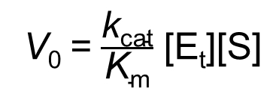
Comparing Catalytic Mechanisms and Efficiencies
comparing the ratio k_{cat}/k_{m} for two reactions is the best way to compare catalytic efficiencies or turnover
specificity constant = the rate constant for the conversion of E + S to E + P
when [S] << k_{m}:
V₀ = $\frac{\text{k}\text{cat}}{\text{K}\text{m}}$ $\text{[}\text{Et}\text{][}\text{S}\text{]}$
(6-30)

Slide 86
The Constant k_{cat}/K_{m} Is a Second-Order Rate Constant
k_{cat}/K_{m} has units of M^{–1}s^{–1} with an upper limit of 10⁸ to 10⁹ M^{–1}s^{–1}
Table 6-8 Enzymes for Which k_{cat}/K_{m} Is Close to the Diffusion-Controlled Limit (10⁸ to 10⁹ M^{–1}s^{–1})
Enzyme | Substrate | k_{cat} (s^{–1}) | K_{m} (M) | k_{cat}/K_{m} (M^{–1}s^{–1})
Acetylcholinesterase | Acetylcholine | 1.4×10⁴ | 9×10^{–5} | 1.6×10⁸
Carbonic anhydrase | CO₂ HCO₃– | 1×10⁶ 4×10⁵ | 1.2×10^{–2} 2.6×10^{–2} | 8.3×10⁷ 1.5×10⁷
Catalase | H₂O₂ | 4×10⁷ | 1.1×10⁰ | 4×10⁷
Crotonase | Crotonyl-CoA | 5.7×10³ | 2×10^{–5} | 2.8×10⁸
Fumarase | Fumarate Malate | 8×10² 9×10² | 5×10^{–6} 2.5×10^{–5} | 1.6×10⁸ 3.6×10⁷
β-Lactamase | Benzylpenicillin | 2.0×10³ | 2×10^{–5} | 1×10⁸
Notes:
Note on Table 6-8: Information from A. Fersht, Structure and Mechanism in Protein Science, p. 166, W. H. Freeman and Company, 1999.

Slide 87
Many Enzymes Catalyze Reactions with Two or More Substrates
nearly 2/3 of all enzymatic reactions have 2 substrates and 2 products
example types of reactions:
  a group is transferred from one substrate to the other
  one substrate is oxidized while the other is reduced

Slide 88
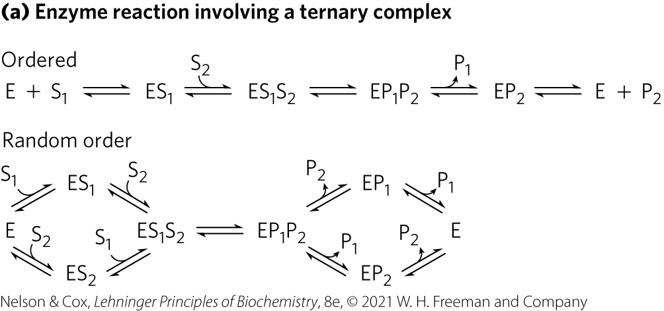
Some Enzyme Reactions Involve a Ternary Complex
substrates can bind in a random sequence or in a specific order

Slide 89
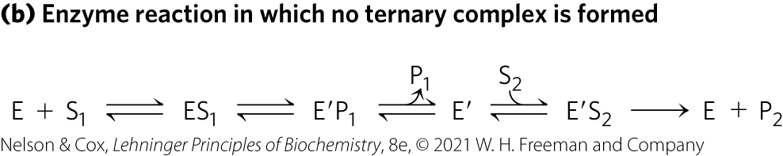
Some Enzyme Reactions Do Not Form a Ternary Complex
the first substrate is converted to product and dissociates before the second substrate binds
  example: Ping-Pong, or double-displacement, mechanism

Slide 90
Cleland Nomenclature
Cleland nomenclature = shorthand notation for describing reactions with multiple substrates and products
  substrates = A, B, C, and D, in the order in which they bind to the enzyme
  products = P, Q, S, and T, in the order in which they dissociate
  one, two, three, or four substrates = uni, bi, ter, and quad, respectively
  the enzyme = E, but if modified during the reaction, successive forms = F, G, and so on

Slide 91
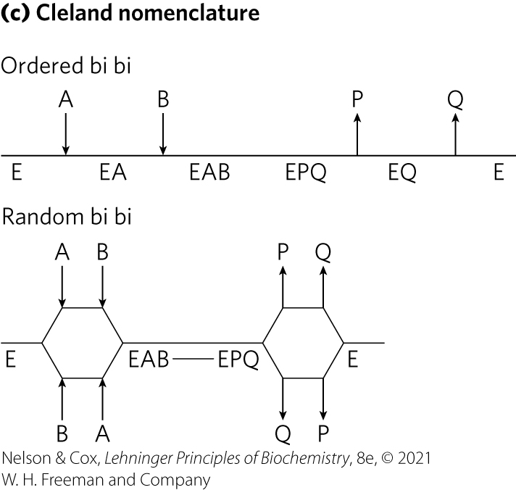
Cleland Nomenclature for a Bi Bi Reaction

Slide 92
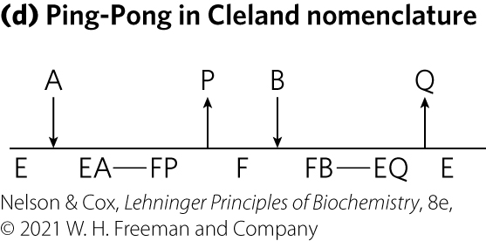
Cleland Nomenclature for a Ping-Pong Reaction

Slide 93
Steady-State Kinetic Analysis of Bisubstrate Reactions
Michaelis-Menten steady-state kinetics can distinguish between pathways that have a ternary intermediate and pathways that do not

Slide 94
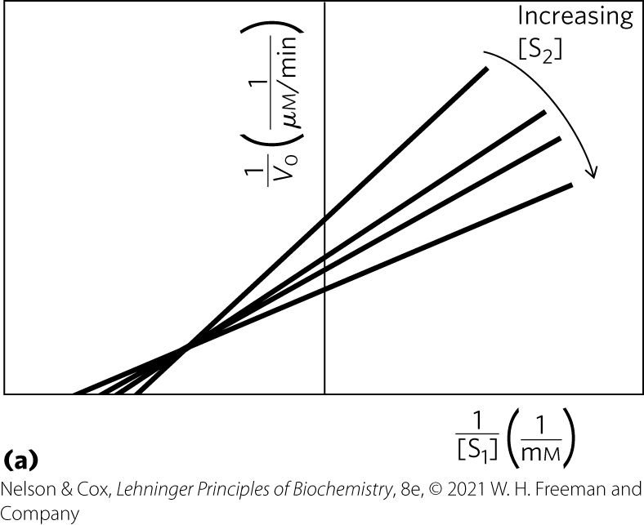
Intersecting Lines Indicate the Formation of a Ternary Complex

Slide 95
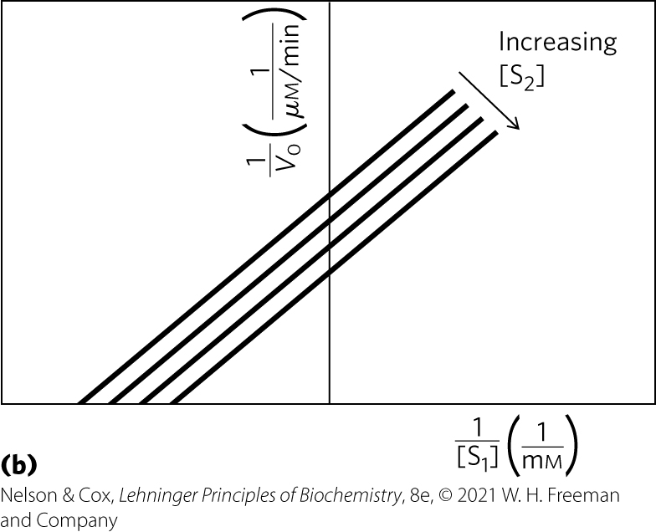
Parallel Lines Indicate a Ping-Pong (Double-Displacement) Pathway

Slide 96
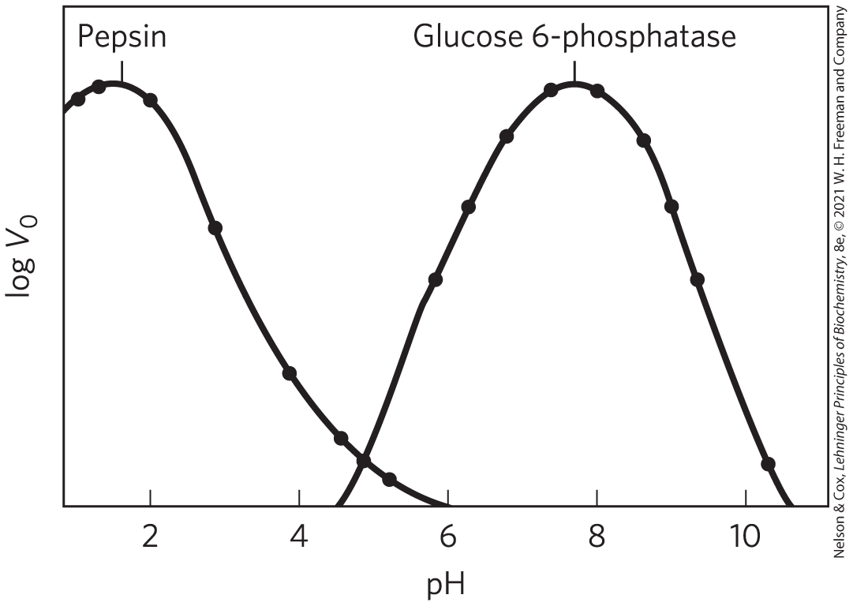
Enzyme Activity Depends on pH
the pH range over which an enzyme undergoes changes in activity can provide a clue to the type of amino acid residue involved

Slide 97
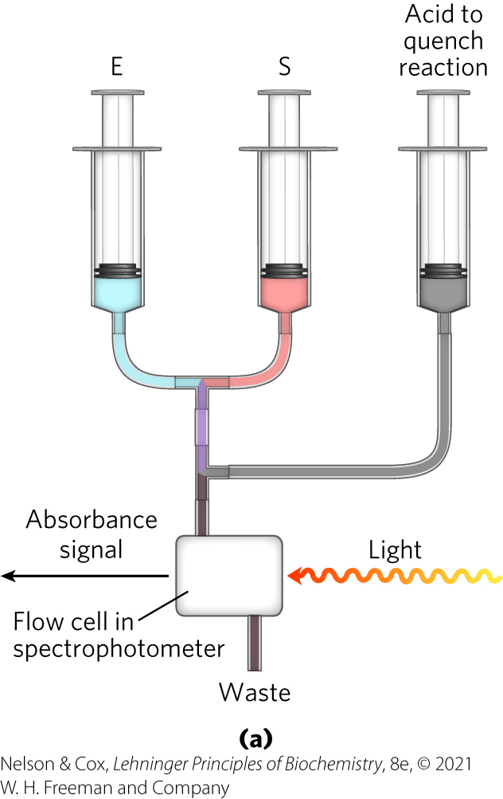
Pre–Steady State Kinetics Can Provide Evidence for Specific Reaction Steps
used to measure rate constants of individual steps
stopped-flow device allows mixing and sampling on a second or millisecond time scale

Slide 98


Dissociation of the Product is Rate-Limiting for Many Enzymes
for an enzyme where product release, EP → E + P, is rate-limiting (k₃ is rate-limiting):
E + S ⇌ ES ⇌ EP ⇌ E + P
k₁
k₂
k₃
(6-28)
k$\text{–}$₁
k$\text{–}$₂

Slide 99
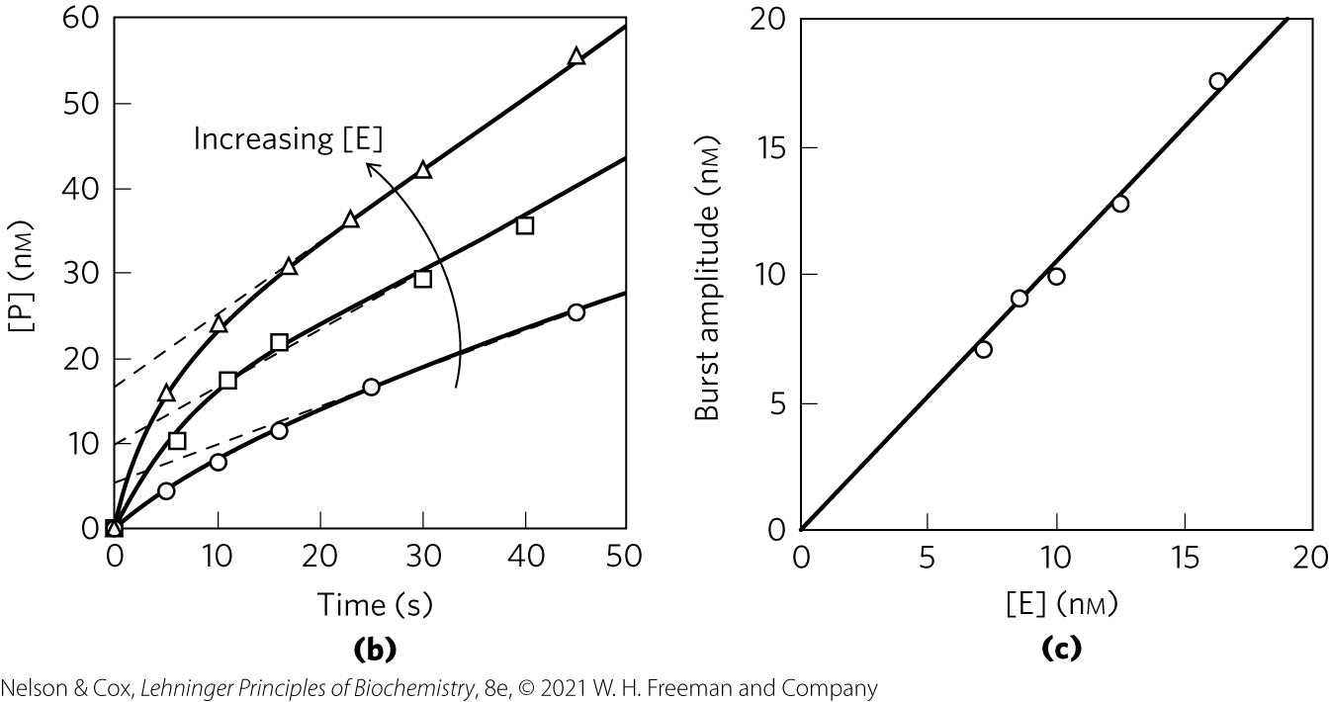
Using Pre–Steady State Kinetics to Determine the Rate-Limiting Step
the observation of a burst indicates that a rate-limiting step (product release, enzyme conformational change, etc.) occurs after formation of the product being monitored

Slide 100
Enzymes Are Subject to Reversible or Irreversible Inhibition
enzyme inhibitors = molecules that interfere with catalysis, slowing or halting enzymatic reactions
2 classes of enzyme inhibitors:
  reversible
  irreversible

Slide 101
Reversible Inhibition
types of reversible inhibition:
  competitive inhibition
  uncompetitive inhibition
  mixed inhibition
  noncompetitive inhibition

Slide 102
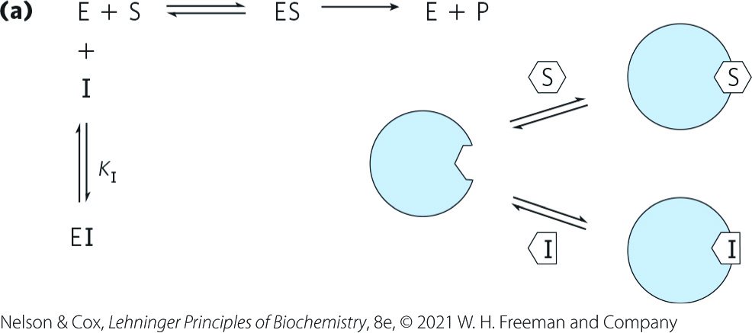
Competitive Inhibition
competitive inhibitor:
  competes with the substrate for the active site of an enzyme
  type of reversible inhibition
  by definition, the value of α′ for a competitive inhibitor is 1

Slide 103
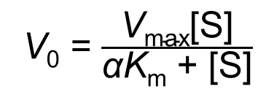
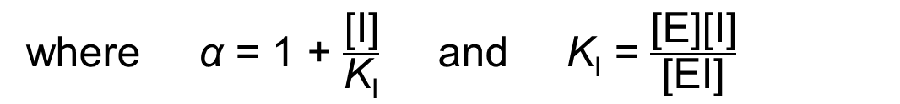
Competitive Inhibitors Alter the Michaelis-Menten Equation
competitive inhibition can be measured by steady-state kinetics
the Michaelis-Menten equation becomes
V₀ = $\frac{\text{V}\text{max}\text{[}\text{S}\text{]}}{\text{α}\text{K}\text{m}\text{ + [}\text{S}\text{]}}$
(6-31)
where $\text{α}$ = 1 + $\frac{\text{[}\text{I}\text{]}}{\text{K}\text{I}}$ and K_{I} = $\frac{\text{[}\text{E}\text{][}\text{I}\text{]}}{\text{[}\text{EI}\text{]}}$

Slide 104
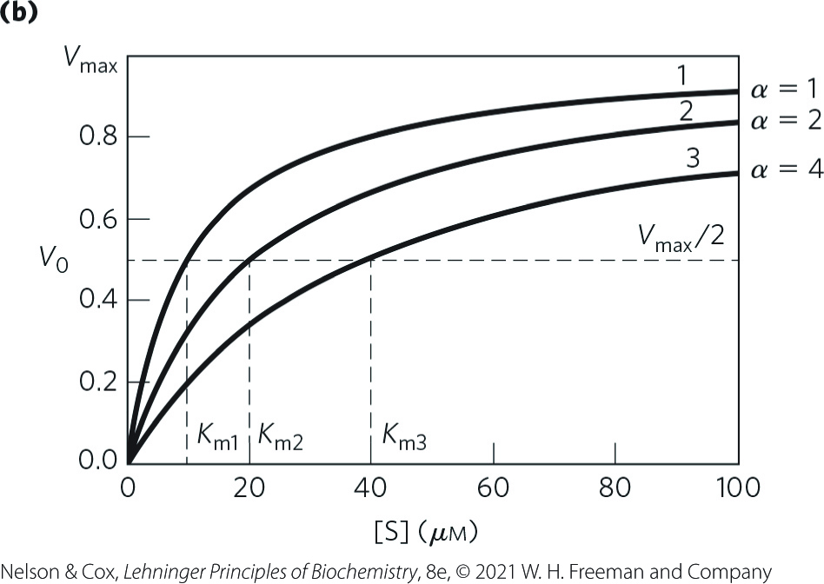
Competitive Inhibitors Affect the Apparent K_{m}, but Not the V_{max}
“apparent” K_{m} = the experimentally determined variable αK_{m}
when [S] >> [I], the reaction exhibits normal V_{max}
in the presence of inhibitor, the [S] at which V₀ = ½V_{max}, the apparent K_{m}, increases by the factor α

Slide 105
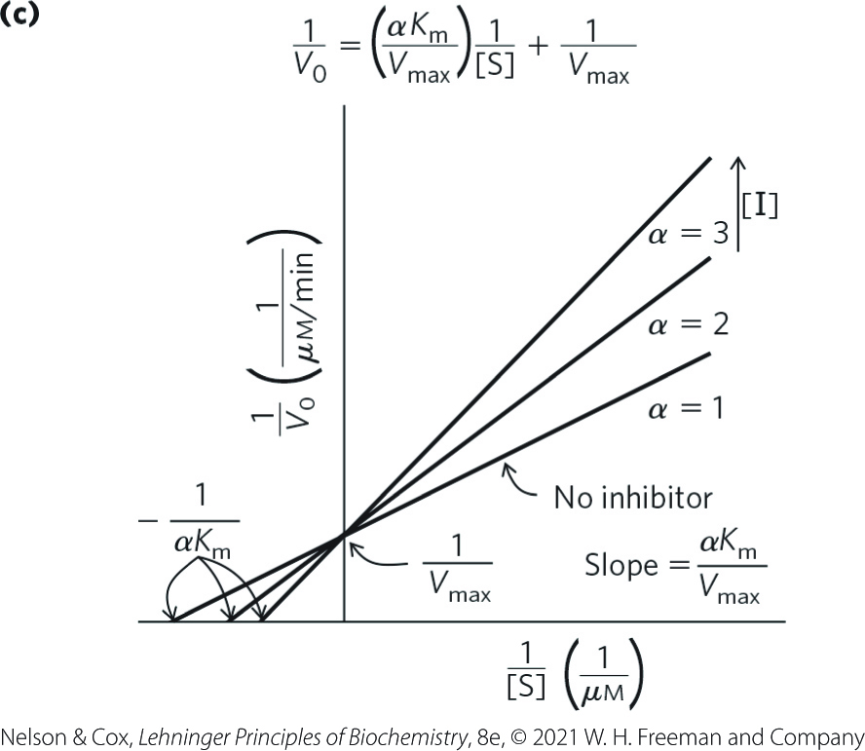
A Lineweaver-Burk Plot Reveals Competitive Inhibition
lines intersect at the y axis

Slide 106

Uncompetitive Inhibition
uncompetitive inhibitor:
  binds at a site distinct from the substrate active site
  unlike a competitive inhibitor, binds only to the ES complex
  type of reversible inhibition

Slide 107


Uncompetitive Inhibitors Alter the Michaelis-Menten Equation
the Michaelis-Menten equation becomes
V₀ = $\frac{\text{V}\text{max}\text{[}\text{S}\text{]}}{\text{K}\text{m}\text{ + }\text{α}\text{′[}\text{S}\text{]} }$
(6-32)
where $\text{α}$′ = 1 + $\frac{\text{[}\text{I}\text{]}}{\text{K}\text{′}\text{I}}$ and K′_{I} = $\frac{\text{[}\text{ES}\text{][}\text{I}\text{]}}{\text{[}\text{ESI}\text{]}}$

Slide 108

Uncompetitive Inhibitors Affect Both the Apparent K_{m} and the V_{max}
the measured V_{max} decreases because at high [S], V₀ approaches V_{max}/α′
apparent K_{m} decreases because the [S] required to reach ½V_{max} decreases by the factor α′

Slide 109

A Lineweaver-Burk Plot Reveals Uncompetitive Inhibition
lines are parallel

Slide 110

Mixed Inhibition
mixed inhibitor:
  binds at a site distinct from the substrate active site
  binds to either E or the ES complex
  type of reversible inhibition

Slide 111

Mixed Inhibitors Alter the Michaelis-Menten Equation
the Michaelis-Menten equation becomes
V₀ = $\frac{\text{V}\text{max}\text{[}\text{S}\text{]}}{\text{α}\text{K}\text{m}\text{ + }\text{α}\text{′[}\text{S}\text{]}}$
(6-33)

Slide 112

Mixed Inhibitors Usually Affect Both the Apparent K_{m} and the V_{max}
V_{max} is affected because the effective [E] on which V_{max} depends decreases
apparent K_{m} may increase or decrease depending on which enzyme form the inhibitor binds most strongly

Slide 113

A Lineweaver-Burk Plot Reveals Mixed Inhibition
lines intersect to the left of the y axis

Slide 114
Noncompetitive Inhibition
noncompetitive inhibitor:
  special case of α = α′
  affects the V_{max} but not the K_{m}

Slide 115
Effects of Reversible Inhibitors on Apparent V_{max} and Apparent K_{m}
Table 6-9 Effects of Reversible Inhibitors on Apparent V_{max} and Apparent K_{m}
Inhibitor type | Apparent V_{max} | Apparent K_{m}
None | V_{max} | K_{m}
Competitive | V_{max} | K_{m}
Uncompetitive | V_{max}/α′ | K_{m}/α′
Mixed | V_{max}/α′ | αK_{m}/α′

Slide 116

Irreversible Inhibition
irreversible inhibitor = bind covalently with or destroy a functional group on an enzyme that is essential for the enzyme’s activity, or form a highly stable noncovalent association

Slide 117
Suicide Inactivators
suicide inactivator = mechanism-based inactivators = undergo the first few steps until it is converted into a compound that combines irreversibly with the enzyme
  class of irreversible inhibitors

Slide 118
Principle 4 (5 of 8)
Two concepts explain the catalytic power of enzymes. First, enzymes bind most tightly to the transition state of the catalyzed reaction, using binding energy to lower the activation barrier. Second, enzyme active sites are organized by evolution to facilitate multiple mechanisms of chemical catalysis simultaneously.

Slide 119

Transition-State Analogs
transition-state analogs = stable molecules designed to resemble transition states
  type of irreversible inhibitors
  bind to an enzyme more tightly than does the substrate in the ES complex

Slide 120
6.4 Examples of Enzymatic Reactions

Slide 121

The Chymotrypsin Mechanism Involves Acylation and Deacylation of a Ser Residue
protease = an enzyme that catalyzes the hydrolytic cleavage of peptide bonds
  example = bovine pancreatic chymotrypsin

Slide 122
The Chymotrypsin Mechanism Involves Two Phases
acylation phase = the peptide bond is cleaved and an ester linkage is formed between the peptide carbonyl carbon and the enzyme
deacylation phase = the ester linkage is hydrolyzed and the nonacylated enzyme is regenerated

Slide 123

Pre–Steady State Kinetic Evidence for an Acyl-Enzyme Intermediate
presence of a burst suggested that turnover of the enzyme was limited by a subsequent, slower deacylation step

Slide 124

The pH Dependence of Chymotrypsin-Catalyzed Reactions
optimal activity at pH 8
  His⁵⁷ is unprotonated and Ile¹⁶ is protonated
the transition just above pH 7 is due to changes in k_{cat}
  results from protonation of His⁵⁷
the transition above pH 8.5 is due to changes in 1/K_{m}
  results from the ionization of the α-amino group of Ile¹⁶

Slide 125
The Chymotrypsin Reaction
serine proteases = proteases with a Ser residue that acts as the nucleophile
  acylation phase nucleophile is the oxygen of Ser¹⁹⁵
catalytic triad = hydrogen bonding network
  in chymotrypsin, Ser¹⁹⁵ is linked to His⁵⁷ and Asp¹⁰²

Slide 126
Principle 4 (6 of 8)
Two concepts explain the catalytic power of enzymes. First, enzymes bind most tightly to the transition state of the catalyzed reaction, using binding energy to lower the activation barrier. Second, enzyme active sites are organized by evolution to facilitate multiple mechanisms of chemical catalysis simultaneously.

Slide 127

Chymotrypsin Mechanism, Step 1

Slide 128

Chymotrypsin Mechanism, Step 2

Slide 129

Chymotrypsin Mechanism, Step 3

Slide 130

Chymotrypsin Mechanism, Step 4

Slide 131

Chymotrypsin Mechanism, Step 5

Slide 132

Chymotrypsin Mechanism, Step 6

Slide 133

Chymotrypsin Mechanism, Step 7

Slide 134

Mechanism of Action of an HIV Protease

Slide 135
Principle 4 (7 of 8)
Two concepts explain the catalytic power of enzymes. First, enzymes bind most tightly to the transition state of the catalyzed reaction, using binding energy to lower the activation barrier. Second, enzyme active sites are organized by evolution to facilitate multiple mechanisms of chemical catalysis simultaneously.

Slide 136

HIV Protease Inhibitors
HIV protease inhibitors form noncovalent complexes with the enzyme
  designed as transition-state analogs
  can be considered irreversible inhibitors

Slide 137

Hexokinase Undergoes Induced Fit on Substrate Binding
yeast hexokinase = bisubstrate enzyme that catalyzes the reversible reaction:

Slide 138

Induced Fit in Hexokinase
when glucose (but not water) and Mg⋅ATP bind, the binding energy derived induces a conformational change in hexokinase to the catalytically active form

Slide 139

Addition of Xylose Increases the Rate of ATP Hydrolysis
xylose cannot be phosphorylated
binding of xylose induces a change in hexokinase to its active conformation

Slide 140
Principle 4 (8 of 8)
Two concepts explain the catalytic power of enzymes. First, enzymes bind most tightly to the transition state of the catalyzed reaction, using binding energy to lower the activation barrier. Second, enzyme active sites are organized by evolution to facilitate multiple mechanisms of chemical catalysis simultaneously.

Slide 141
The Catalytic Mechanism of Hexokinase
active-site amino acid residues participate in general acid-base catalysis and transition-state stabilization

Slide 142

The Enolase Reaction Mechanism Requires Metal Ions
enolase = catalyzes the reversible dehydration of 2-phosphoglycerate to phosphoenolpyruvate:

Slide 143

The Enolase Reaction Illustrates Metal Ion Catalysis

Slide 144

An Understanding of Enzyme Mechanism Produces Useful Antibiotics
peptidoglycan = major component of the bacterial cell wall
  consists of polysaccharides and peptides cross-linked in several steps that include a transpeptidase reaction

Slide 145

Transpeptidase Inhibition by β-Lactam Antibiotics
β-lactam antibiotics bind to the active site of transpeptidase
the covalent complex irreversibly inactivates the enzyme, blocking synthesis of the cell wall

Slide 146

β-Lactamases
β-lactamases = enzymes that cleave β-lactam antibiotics
bacteria that express β-lactamases become resistant to β-lactam antibiotics
compounds that mimic the structure of a β-lactam antibiotic can inactivate β-lactamases

Slide 147
6.5 Regulatory Enzymes

Slide 148
Principle 5 (2 of 3)
Many enzymes are regulated. Regulatory mechanisms include reversible covalent modification, binding of allosteric modulators, proteolytic activation, noncovalent binding to regulatory proteins, and elaborate regulatory cascades. Enzymes are often subject to multiple methods of regulation, which allows for exquisite control of every chemical process that occurs in a cell.

Slide 149
Regulatory Enzymes
regulatory enzymes = catalytic activity increases or decreases in response to certain signals
  allows the cell to meet changing needs for energy and biomolecules

Slide 150
Modulation of Regulatory Enzymes
activities of regulatory enzymes are modulated in a variety of ways:
  allosteric enzymes = function through reversible, noncovalent binding of regulatory compounds called allosteric modulators or allosteric effectors (small metabolites or cofactors)
  reversible covalent modification
  binding of separate regulatory proteins
  removal of peptide segments by proteolytic cleavage

Slide 151

Allosteric Enzymes Undergo Conformational Changes in Response to Modulator Binding
homotrophic = regulation in which the substrate and modulator are identical
heterotropic = regulation in which the modulator is a molecule other than the substrate

Slide 152

The Regulatory Enzyme Aspartate Transcarbamoylase
aspartate transcarbamoylase (ATCase) = catalyzes the formation of carbamoyl aspartate, an early step in pyrimidine biosynthesis:

Slide 153

The Quaternary Structure of Aspartate Transcarbamoylase
ATP = Positive regulator
CTP = Negative regulator

Slide 154
The Kinetic Properties of Allosteric Enzymes Diverge from Michaelis-Menten Behavior
plots of V₀ versus [S] usually produce a sigmoid saturation curve, rather than a hyperbolic curve
[S]_{0.5} or K_{0.5} represents the [S] giving half-maximal velocity of the reaction

Slide 155

The Sigmoid Curve of a Homotropic Enzyme
a relatively small increase in [S] in the steep part of the curve causes a comparatively large increase in V₀

Slide 156

Modulation in Which K_{0.5}, but Not V_{max}, Is Altered
for heterotropic allosteric enzymes:
  activators may cause the curve to become more hyperbolic
  inhibitor may cause the curve to become more sigmoidal

Slide 157

Modulation in Which V_{max}, but Not K_{0.5}, Is Altered
less common type of modulation for heterotropic allosteric enzymes

Slide 158


Some Enzymes Are Regulated by Reversible Covalent Modification

Slide 159
Phosphoryl Groups Affect the Structure and Catalytic Activity of Enzymes
protein kinases = catalyze the attachment of phosphoryl groups to specific amino acid residues (Ser, Thr, Tyr, His)
phosphoprotein phosphatases = protein phosphatases = remove phosphoryl groups from the same target proteins

Slide 160


Regulation of Muscle Glycogen Phosphorylase Activity by Phosphorylation

Slide 161

Phosphorylation in Glycogen Phosphorylase Causes a Conformational Change

Slide 162
Multiple Phosphorylations Allow Exquisite Regulatory Control
residues that are typically phosphorylated in regulated proteins occur within common structural motifs (consensus sequences)

Slide 163
Common Recognition Sequences for Protein Kinases
Table 6-10 Consensus Recognition Sequences for a Few Protein Kinases
Protein kinase | Consensus sequence and phosphorylated residue
Protein kinase A | -x-R-[RK]-x-[ST]-B-
Protein kinase G | -x-R-[RK]-x-[ST]-X-
Protein kinase C | -[RK](2)-x-[ST]-B-[RK](2)-
Protein kinase B | R-x-x-R-x-[ST]-x-ψ-
Ca²⁺/calmodulin kinase I | -B-x-R-x(2)-[ST]-x(3)-B-
Ca²⁺/calmodulin kinase II | -B-x-[RK]-x(2)-[ST]-x(2)-
Myosin light chain kinase (smooth muscle) | -K(2)-R-x(2)-S-x-B(2)-
Phosphorylase b kinase | -K-R-K-Q-I-S-V-R-
Extracellular signal-regulated kinase (ERK) | -P-x-[ST]-P(2)
Cyclin-dependent protein kinase (cdc2) | -x-[ST]-P-x-[KR]-
Casein kinase I | -[SpTp]-x(2)-[ST]-B
Casein kinase II | -x-[ST]-x(2)-[ED]-x-
β-Adrenergic receptor kinase | -[DE](n)-[ST]-x(3)
Rhodopsin kinase | -x(2)-[ST]-E(n)-vABL-[YLV]-Y-X₁₋₃-[PF]-
Epidermal growth factor (EGF) receptor kinase | -E(4)-Y-F-E-L-V-
Notes:
See Table 6-10 in text for footnotes.

Slide 164

Multiple Regulatory Phosphorylations
provide the potential for extremely subtle modulation of enzyme activity
sequential phosphorylation processes can be hierarchical

Slide 165

Some Enzymes and Other Proteins Are Regulated by Proteolytic Cleavage of an Enzyme Precursor
zymogen = inactive precursor that is cleaved to form an active protease enzyme
proprotein or proenzyme = precursors that are cleaved to form other proteins

Slide 166
A Cascade of Proteolytically Activated Zymogens Leads to Blood Coagulation
regulatory cascade = a mechanism that allows a very sensitive response to—and amplification of—a molecular signal
  example = formation of a blood clot

Slide 167

Blood Clots
blood clot = aggregate of specialized cell fragments that lack nuclei (platelets) cross-linked and stabilized by proteinaceous fibers consisting mainly of the protein fibrin (derived from the soluble zymogen fibrinogen)

Slide 168
Platelet Activation
caused by collagen exposure to blood
causes the release of signaling molecules such as thromboxanes to stimulate the activation of additional platelets

Slide 169
The Cleavage of Fibrinogen to Fibrin
fibrinogen is converted to fibrin by the proteolytic removal of amino acid residues
thrombin = serine protease that catalyzes peptide removal
factor XIIIa = transglutaminase enzyme that catalyzes the formation of covalent cross-links between fibrins

Slide 170

Two Regulatory Cascades Lead to Fibrinogen Activation
intrinsic pathway = involves all components found in the blood plasma
extrinsic pathway = tissue factor pathway = involves the protein tissue factor (TF) which is not present in blood

Slide 171

The Inheritance of Hemophilia B

Slide 172
Principle 5 (3 of 3)
Many enzymes are regulated. Regulatory mechanisms include reversible covalent modification, binding of allosteric modulators, proteolytic activation, noncovalent binding to regulatory proteins, and elaborate regulatory cascades. Enzymes are often subject to multiple methods of regulation, which allows for exquisite control of every chemical process that occurs in a cell.

Slide 173
Some Regulatory Enzymes Use Several Regulatory Mechanisms
when chemical resources are plentiful, cells synthesize and store glucose and other metabolites
when chemical resources are scarce, cells use these stores to fuel cellular metabolism
the availability of specific catalysts allows for the regulation of these reactions

