Slide 1

5 Protein Function
© 2021 Macmillan Learning

Slide 2
Proteins Function by Interacting Dynamically with Other Molecules
two types of interactions:
  protein acting as a reaction catalyst, or enzyme, alters the chemical configuration or composition of a bound molecule
  neither the chemical configuration nor the composition of the bound molecule is changed

Slide 3

Principle 1 (1 of 4)
The functions of many proteins involve the reversible binding of other molecules. A molecule bound reversibly by a protein is called a ligand. A ligand may be any kind of molecule, including another protein. The transient nature of protein-ligand interactions is critical to life, allowing an organism to respond rapidly and reversibly to changing environmental and metabolic circumstances.

Slide 4

Principle 2 (1 of 4)
A ligand binds a protein at a binding site that is complementary to the ligand in size, shape, charge, and hydrophobic or hydrophilic character. The interaction is specific: the protein can discriminate among the thousands of different molecules in its environment and selectively bind only one or a few types. A given protein may have separate binding sites for several different ligands. These specific molecular interactions are crucial in maintaining the high degree of order in a living system.

Slide 5

Principle 3 (1 of 2)
Proteins are flexible. Changes in conformation may be subtle, reflecting molecular vibrations and small movements of amino acid residues throughout the protein. Changes in conformation may also be more dramatic, with major segments of the protein structure moving as much as several nanometers. Specific conformational changes are frequently essential to a protein’s function.

Slide 6

Principle 4 (1 of 2)
The binding of a protein and a ligand is often coupled to a conformational change in the protein that makes the binding site more complementary to the ligand, permitting tighter binding. The structural adaptation that occurs between protein and ligand is called induced fit.

Slide 7

Principle 5 (1 of 4)
In a multisubunit protein, a conformational change in one subunit often affects the conformation of other subunits.

Slide 8

Principle 6 (1 of 3)
Interactions between ligands and proteins may be regulated.

Slide 9
5.1 Reversible Binding of a Protein to a Ligand: Oxygen-Binding Proteins

Slide 10
Principle 1 (2 of 4)
The functions of many proteins involve the reversible binding of other molecules. A molecule bound reversibly by a protein is called a ligand. A ligand may be any kind of molecule, including another protein. The transient nature of protein-ligand interactions is critical to life, allowing an organism to respond rapidly and reversibly to changing environmental and metabolic circumstances.

Slide 11
Oxygen Can Bind to a Heme Prosthetic Group
oxygen:
  poorly soluble in aqueous solutions
  diffusion through tissues is ineffective over large distances
  transition metals have strong tendency to bind (iron, copper)

Slide 12
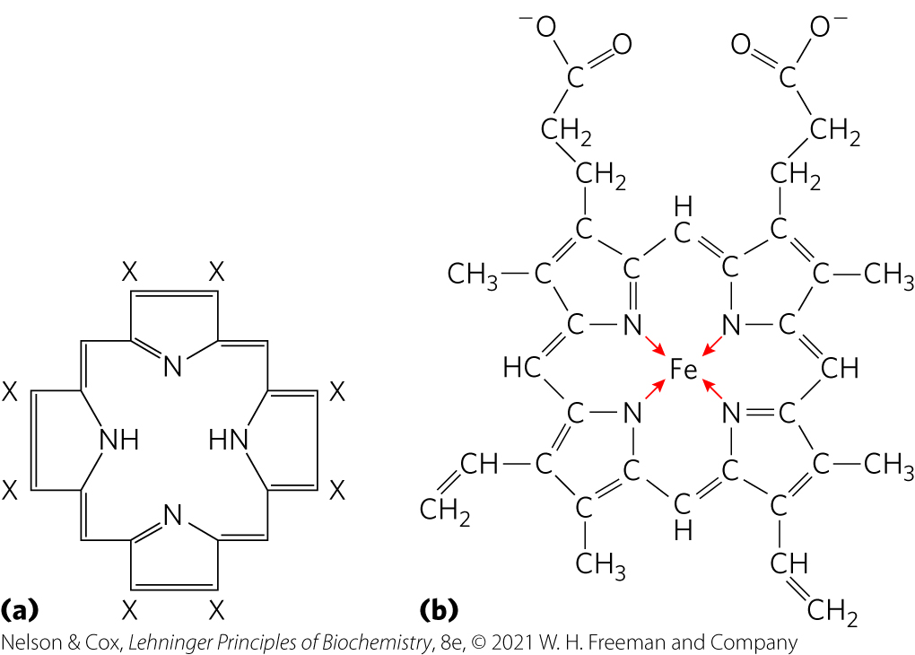
Heme Prosthetic Group
heme = protein-bound prosthetic group
  present in myoglobin and hemoglobin
  consists of a complex organic ring structure, protoporphyrin, with a bound Fe²⁺ atom

Slide 13
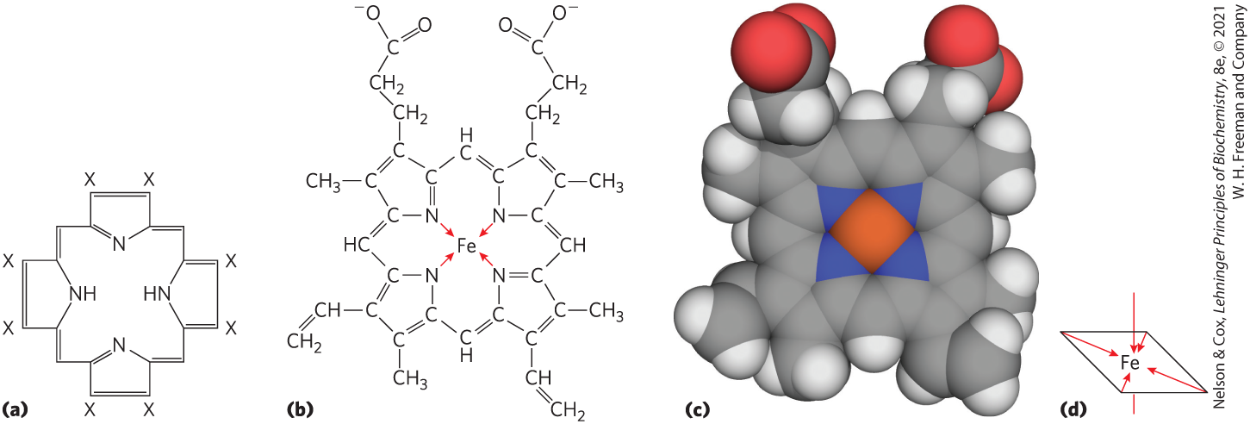
Coordination Bonds of Iron
six coordination bonds:
  four to nitrogen atoms in the flat porphyrin ring
  two perpendicular to the porphyrin

Slide 14
Principle 2 (2 of 4)
A ligand binds a protein at a binding site that is complementary to the ligand in size, shape, charge, and hydrophobic or hydrophilic character. The interaction is specific: the protein can discriminate among the thousands of different molecules in its environment and selectively bind only one or a few types. A given protein may have separate binding sites for several different ligands. These specific molecular interactions are crucial in maintaining the high degree of order in a living system.

Slide 15
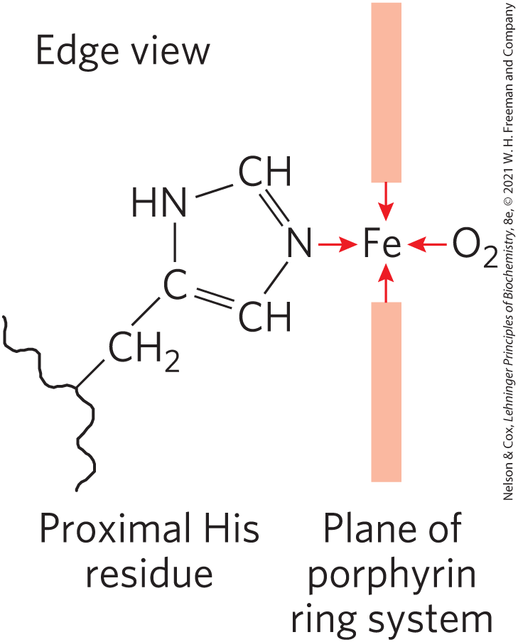
Perpendicular Coordination Bonds
two perpendicular coordination bonds:
  one is occupied by a side-chain nitrogen of a highly conserved proximal His residue
  one is the binding site for molecular oxygen (O₂)
    Fe²⁺ binds O₂ reversibly
    Fe³⁺ does not bind O₂

Slide 16
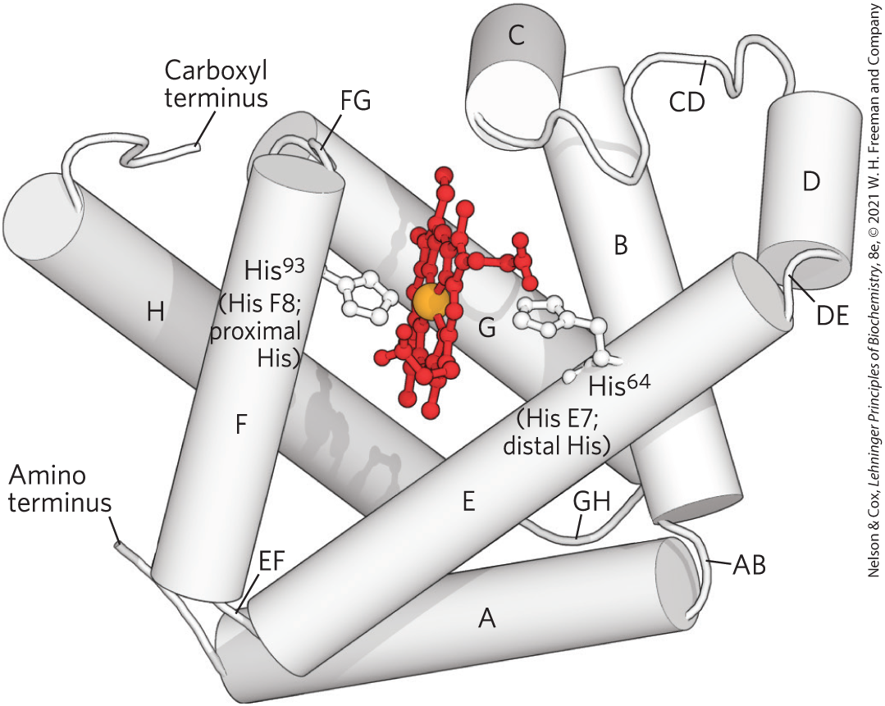
Globins Are a Family of Oxygen-Binding Proteins
globins = widespread protein family
  highly conserved tertiary structure: eight α-helical segments connected by bends (globin fold)
  most function in O₂ transport or storage

Slide 17
Types of Globins
four types in humans and other mammals:
  myoglobin = monomeric, facilitates O₂ diffusion in muscle tissue
  hemoglobin = tetrameric, responsible for O₂ transport in the bloodstream
  neuroglobin = monomeric, expressed largely in neurons to protect the brain from low O₂ or restricted blood supply
  cytoglobin = monomeric, regulates levels of nitric oxide, a localized signal for muscle relaxation

Slide 18
Myoglobin Has a Single Binding Site for Oxygen
myoglobin:
  153 residues + one molecule of heme
  bends named after the α-helical segments they connect
His⁹³ = ninety-third reside from the amino terminal end
His F8 = eighth residue in α helix F

Slide 19
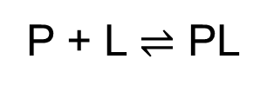
Protein-Ligand Interactions Can Be Described Quantitively
a simple equilibrium expression describes the reversible binding of a protein (P) to a ligand (L):
(5-1)

Slide 20
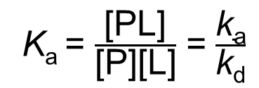
Association Constant
association constant (K_{a}) = provides a measure of the affinity of the ligand L for the protein
  higher K_{a} = higher affinity
  equivalent to the ratio of the rates of the forward (association) and the reverse (dissociation) reactions that form the PL complex
K_{a} = $\frac{\text{[}\text{PL}\text{]}}{\text{[}\text{P}\text{][}\text{L}\text{]}}$ = $\frac{\text{k}\text{a}}{\text{k}\text{d}}$
(5-2)

Slide 21
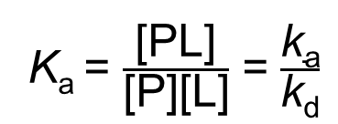
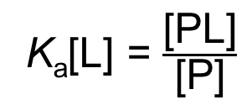
[L] Remains Constant
K_{a} = $\frac{\text{[}\text{PL}\text{]}}{\text{[}\text{P}\text{][}\text{L}\text{]}}$ = $\frac{\text{k}\text{a}}{\text{k}\text{d}}$
(5-2)
when [L] >>> [ligand-binding sites], the binding of the ligand by the protein does not appreciably change [L]
K_{a}[L] = $\frac{\text{[}\text{PL}\text{]}}{\text{[}\text{P}\text{]}}$
(5-3)

Slide 22
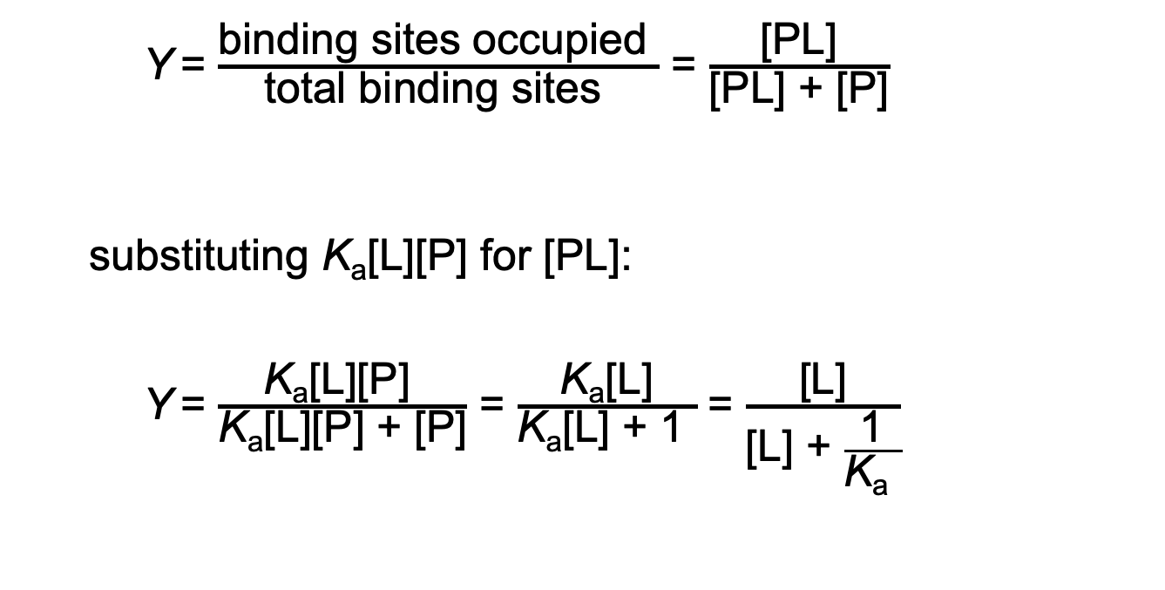
Binding Equilibrium
Y = $\frac{\text{binding} \text{sites} \text{occupied} }{\text{total} \text{binding} \text{sites} }$ = $\frac{\text{[}\text{PL}\text{]}}{\text{[}\text{PL}\text{] + [}\text{P}\text{]}}$
  substituting K_{a}[L][P] for [PL]:
  Y = $\frac{\text{K}\text{a}\text{[}\text{L}\text{][}\text{P}\text{]} }{\text{K}\text{a}\text{[}\text{L}\text{][}\text{P}\text{]} \text{+ [}\text{P}\text{]}}$ = $\frac{\text{K}\text{a}\text{[}\text{L}\text{]}}{\text{K}\text{a}\text{[}\text{L}\text{]} \text{+} \text{1} }$ = $\frac{\text{[}\text{L}\text{]}}{\text{[}\text{L}\text{] + }\frac{\text{1}}{\text{K}\text{a} }}$
(5-4)
(5-5)
x = y/(y + z) describes a hyperbola

Slide 23
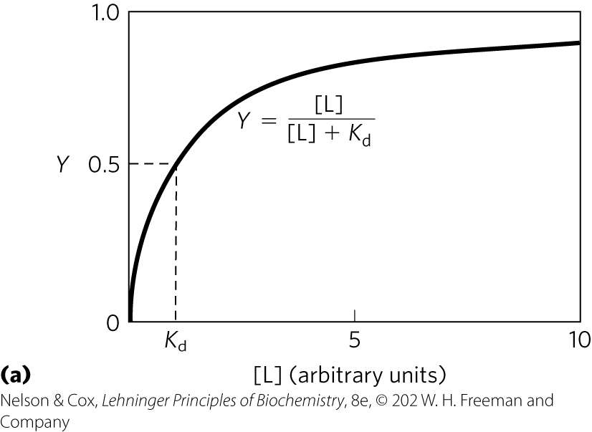
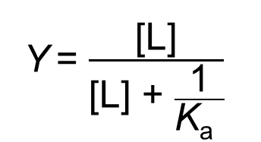
Graphical Representations of
Ligand Binding
Y = $\frac{\text{[}\text{L}\text{]}}{\text{[}\text{L}\text{] + }\frac{\text{1}}{\text{K}\text{a} }}$
(5-5)
[L] at which ½ of the available ligand-binding sites are occupied (Y = 0.5) corresponds to 1/K_{a}

Slide 24
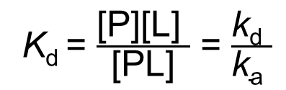
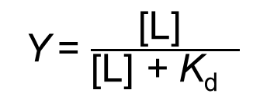
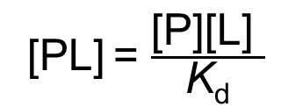
Dissociation Constant
dissociation constant (K_{d}) = reciprocal of K_{a}
  equilibrium constant for the release of ligand
  lower K_{d} = higher affinity
K_{d} = $\frac{\text{[}\text{P}\text{][}\text{L}\text{] }}{\text{[}\text{PL}\text{]}}$ = $\frac{\text{k}\text{d} }{\text{k}\text{a} }$
when [L] = K_{d}, ½ of the ligand-binding sites are occupied
(5-6)
[PL] = $\frac{\text{[}\text{P}\text{][}\text{L}\text{] }}{\text{K}\text{d}}$
(5-7)
Y = $\frac{\text{[}\text{L}\text{] }}{\text{[}\text{L}\text{]}\text{ + }\text{K}\text{d} }$
(5-8)

Slide 25
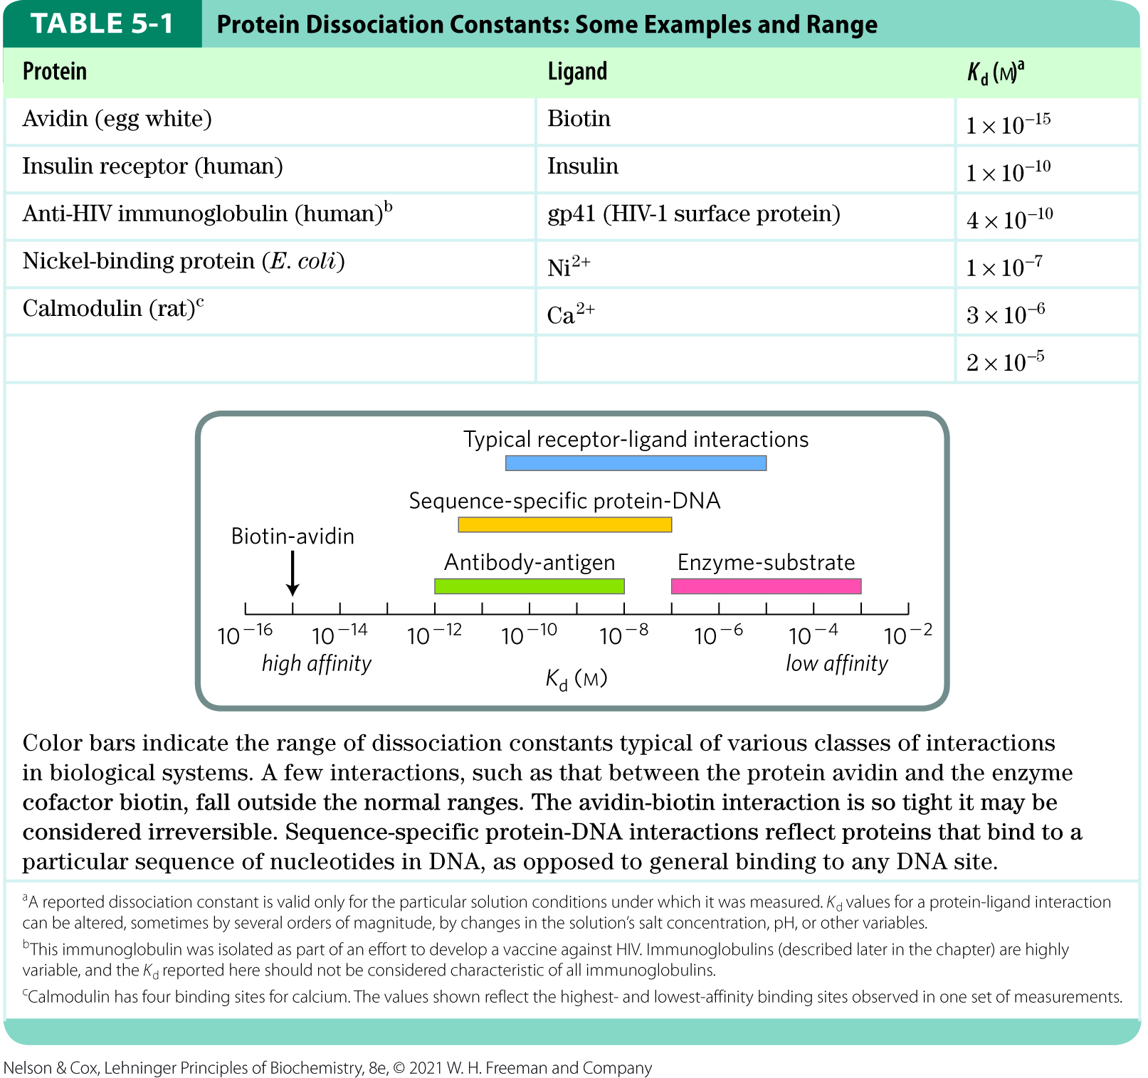
Representative K_{d} Values

Slide 26
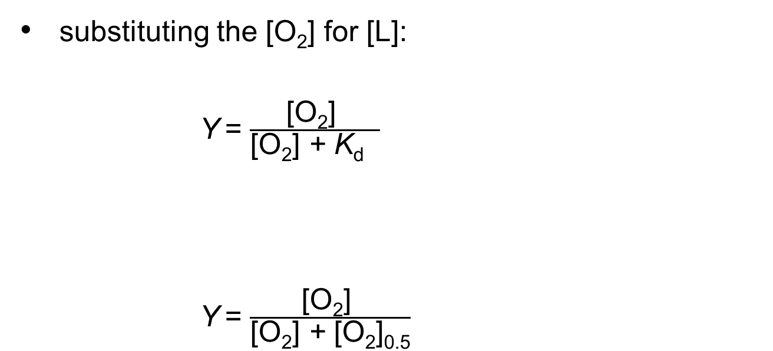
Binding of O₂ to Myoglobin
substituting the [O₂] for [L]:
Y = $\frac{\text{[}\text{O}\text{2}\text{] }}{\text{[}\text{O}\text{2}\text{] }\text{+ }\text{K}\text{d} }$
Y = $\frac{\text{[}\text{O}\text{2}\text{] }}{\text{[}\text{O}\text{2}\text{] }\text{+} \text{[}\text{O}\text{2}\text{]}\text{0.5}}$
(5-9)
K_{d} equals the [O₂] at which ½ of the available ligand-binding sites are occupied, or [O₂]_{0.5}:
(5-10)

Slide 27
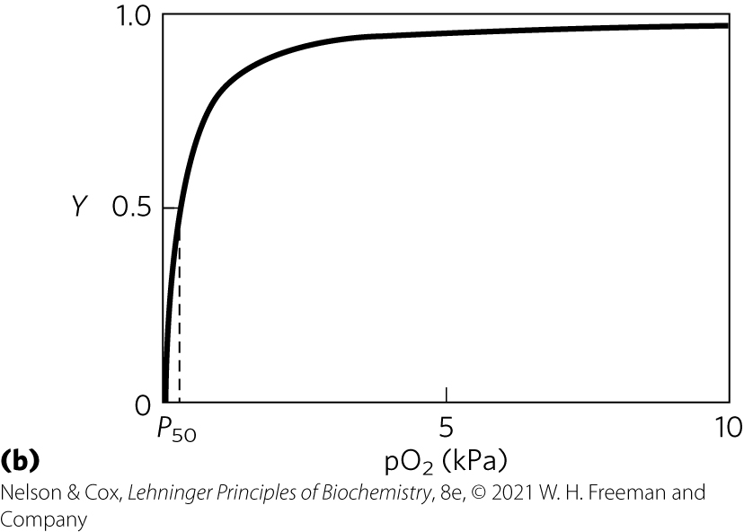
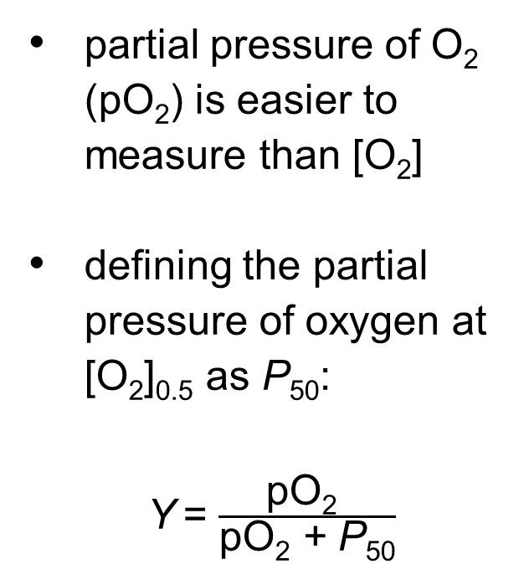
Partial Pressure of O₂
partial pressure of O₂ (pO₂) is easier to measure than [O₂]
defining the partial pressure of oxygen at [O₂]_{0.5} as P₅₀:
Y = $\frac{\text{p}\text{O}\text{2} }{\text{p}\text{O}\text{2} \text{+} \text{P}\text{50}}$
(5-11)

Slide 28
Principle 3 (2 of 2)
Proteins are flexible. Changes in conformation may be subtle, reflecting molecular vibrations and small movements of amino acid residues throughout the protein. Changes in conformation may also be more dramatic, with major segments of the protein structure moving as much as several nanometers. Specific conformational changes are frequently essential to a protein’s function.

Slide 29
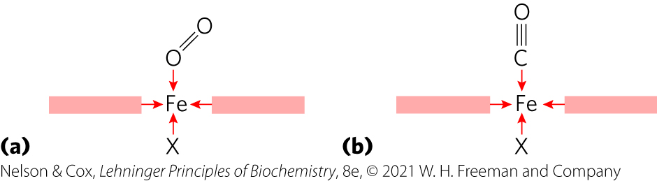
Protein Structure Affects How Ligands Bind
carbon monoxide (CO) binds free heme more than 20,000 times better than does O₂
  differences in the orbital structures affect binding geometries

Slide 30
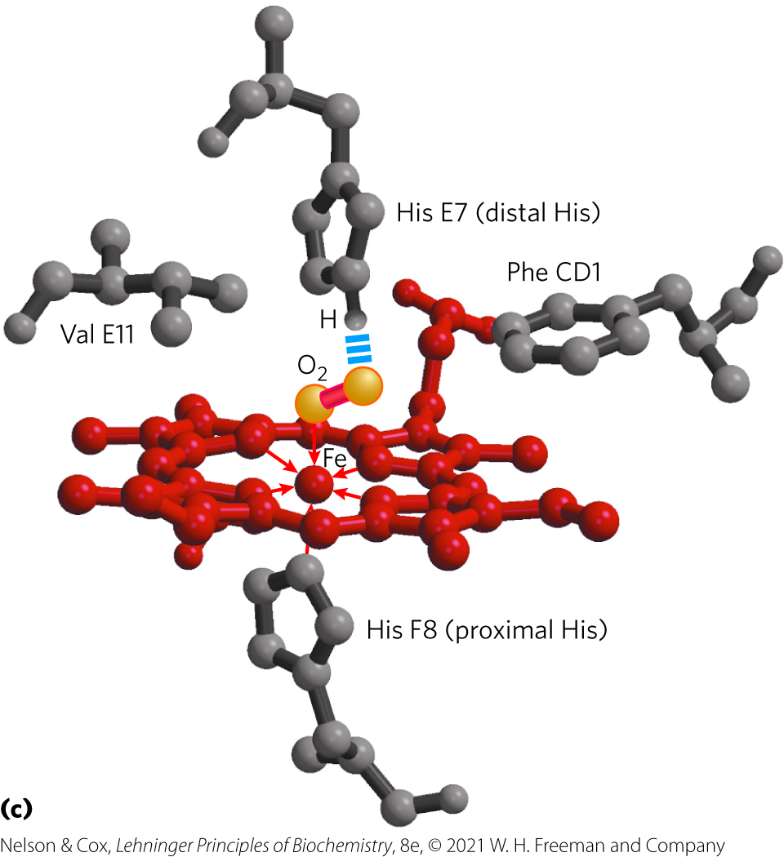
Myoglobin’s Distal His Increases Heme’s Affinity for O₂
hydrogen bond between the imidazole side chain of His E7 and bound O₂ electrostatically stabilizes the Fe-O₂ polar complex
20,000-fold stronger binding affinity of free heme for CO compared with O₂ declines to ~40-fold
Rotates to open and close the pocket

Slide 31
Hemoglobin Transports Oxygen in Blood
erythrocytes (red blood cells) transport O₂
  formed from hemocytoblasts (precursor stem cells)
  main function is to carry hemoglobin
arterial blood = ~96% saturated with O₂
peripheral blood = ~64% saturated with O₂

Slide 32
Principle 5 (2 of 4)
In a multisubunit protein, a conformational change in one subunit often affects the conformation of other subunits.

Slide 33
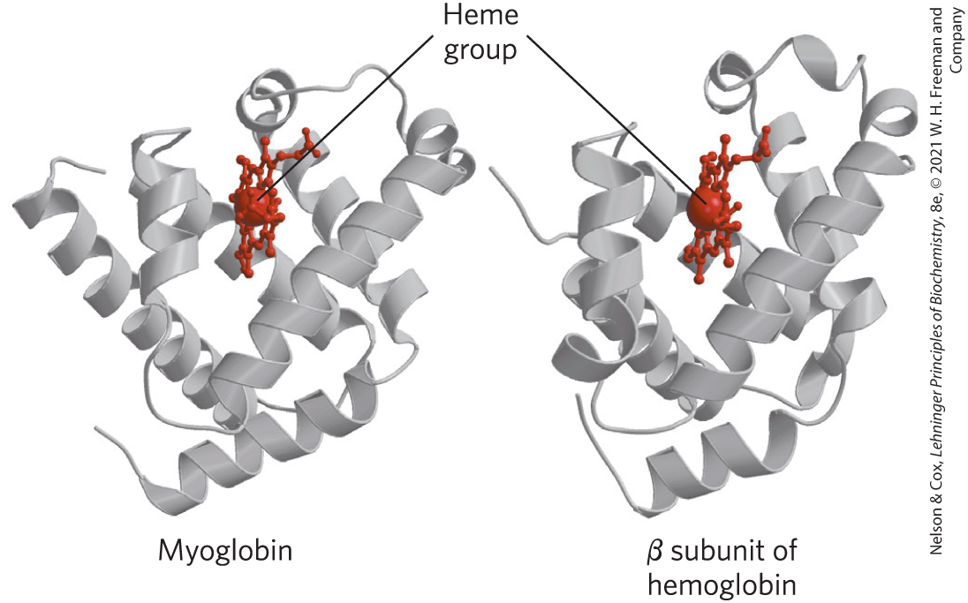
Hemoglobin Subunits Are Structurally Similar to Myoglobin
hemoglobin:
  tetrameric protein with 4 heme groups
  adult hemoglobin has two globin types: two α chains (141 residues each) and two β chains (146 residues each)

Slide 34
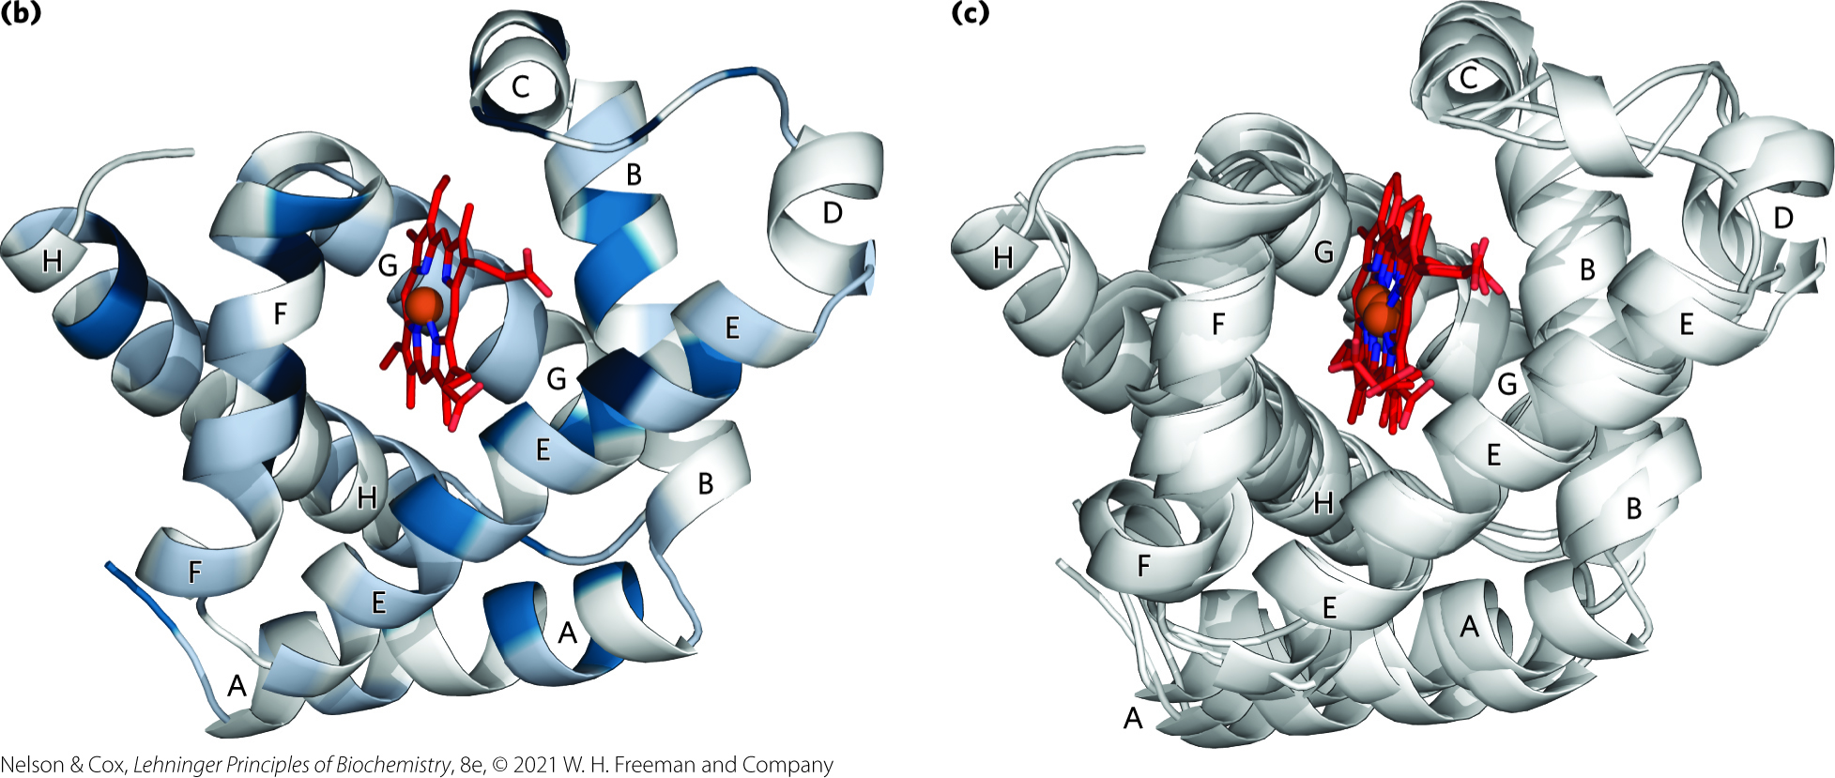
Structural Conservation of Globins
Low sequence similarity
High structural similarity

Slide 35
The Quaternary Structure of Hemoglobin
strong interactions between unlike subunits
  hydrophobic effect
  hydrogen bonds
  ion pairs (salt bridges)
α₁β₁ (and α₂β₂) interface involves >30 residues
α₁β₂ (and α₂β₁) interface involves 19 residues

Slide 36
Principle 4 (2 of 2)
The binding of a protein and a ligand is often coupled to a conformational change in the protein that makes the binding site more complementary to the ligand, permitting tighter binding. The structural adaptation that occurs between protein and ligand is called induced fit.

Slide 37
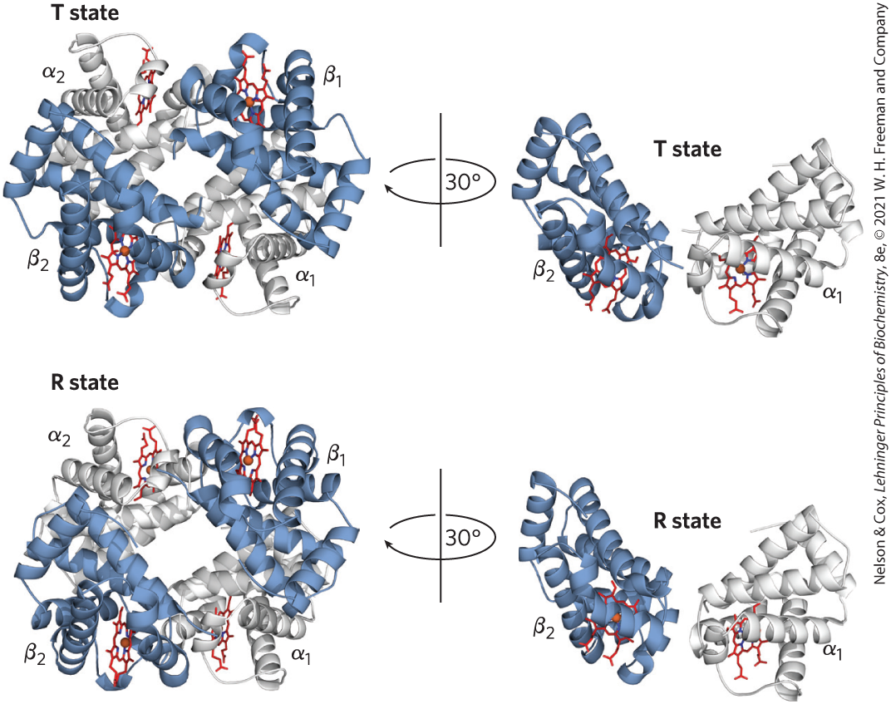
Hemoglobin Undergoes a Structural Change on Binding Oxygen
two conformations of hemoglobin:
  R state = O₂ has a higher affinity for hemoglobin
  T state = more stable when O₂ is absent, predominant conformation of deoxyhemoglobin
Greater number of ion pairs

Slide 38
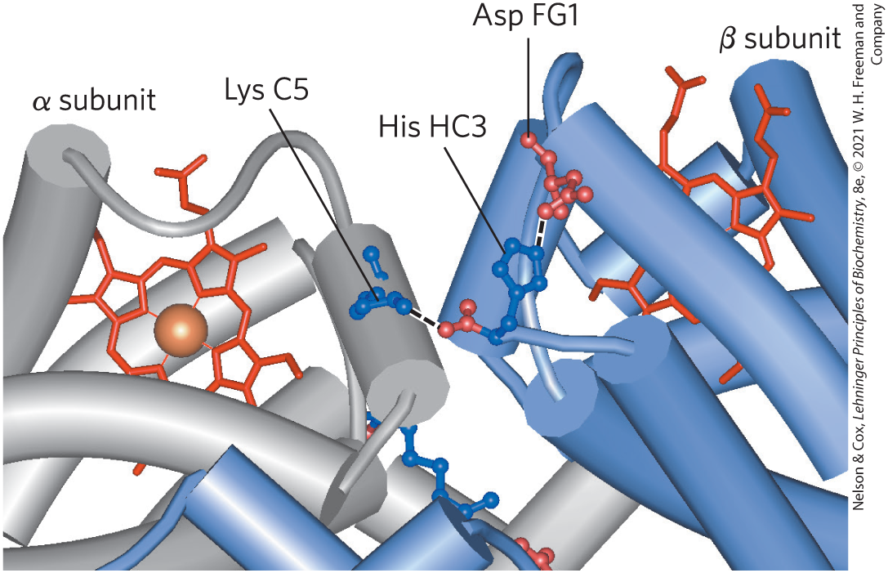
Ion Pairs Stabilize the T State
T state is stabilized by a greater number of ion pairs, many of which lie at the α₁β₂ (and α₂β₁) interface

Slide 39
Conformational Change in Hemoglobin
O₂ binding to hemoglobin in the T state triggers a conformational change to the R state
  αβ subunit pairs slide past each other and rotate
  the pocket between the β subunits narrow
  some ion pairs that stabilize the T state break and some new ones form

Slide 40
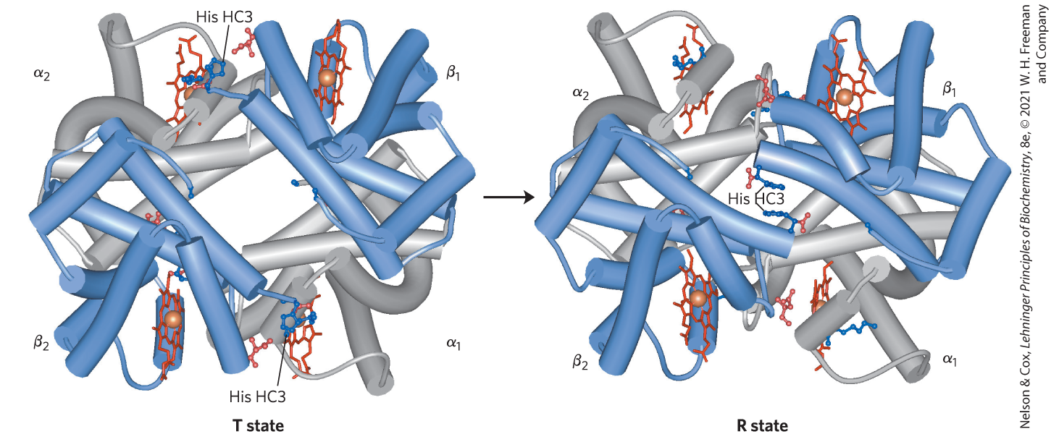
The T → R Transition

Slide 41
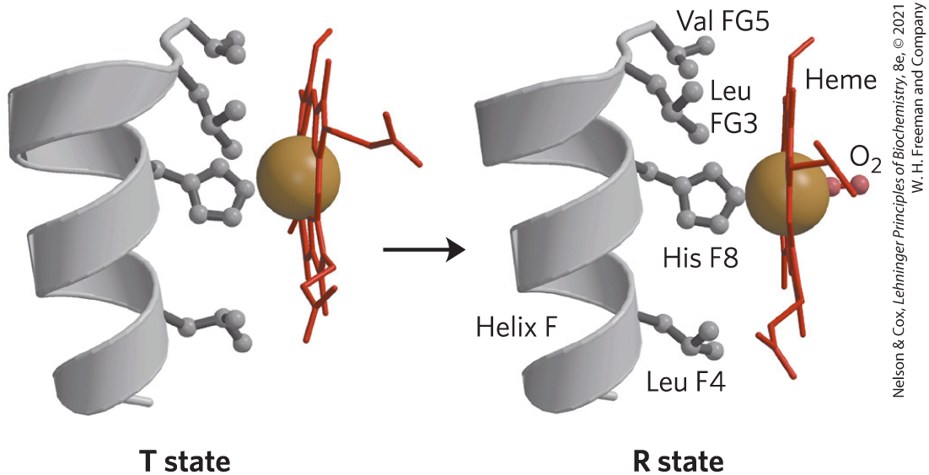
Changes in Conformation Near Heme

Slide 42

Principle 5 (3 of 4)
In a multisubunit protein, a conformational change in one subunit often affects the conformation of other subunits.

Slide 43
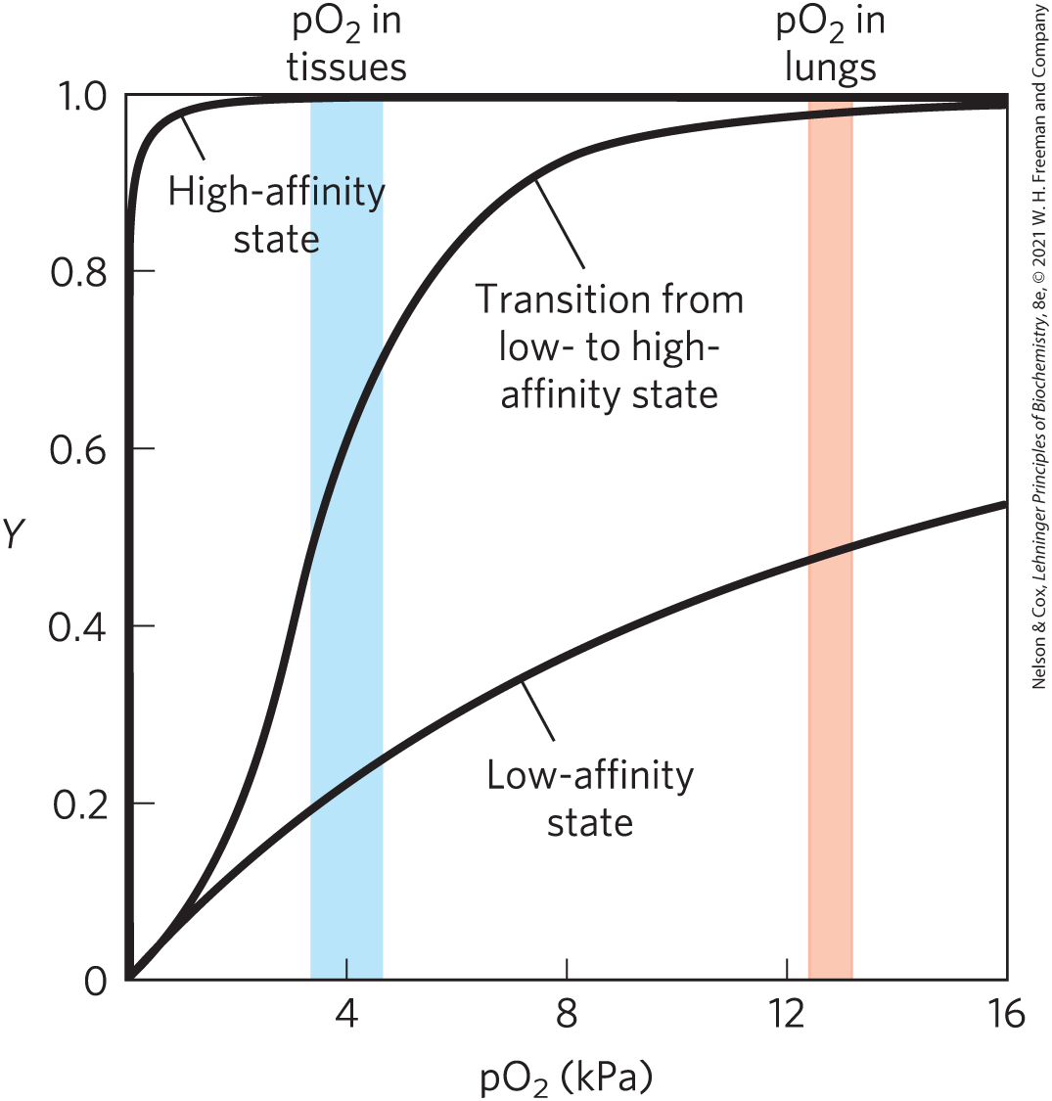
Hemoglobin Binds Oxygen Cooperatively
hemoglobin has a hybrid sigmoid binding curve for oxygen

Slide 44
Principle 6 (2 of 3)
Interactions between ligands and proteins may be regulated.

Slide 45
Allosteric Proteins
allosteric protein (e.g., hemoglobin) = binding of a ligand to one site affects the binding properties of another site on the same protein
  modulators = ligands that bind to an allosteric protein to induce a conformational change
  homotropic = normal ligand and modulator are identical
  heterotropic = modulator is a molecule other than the normal ligand

Slide 46
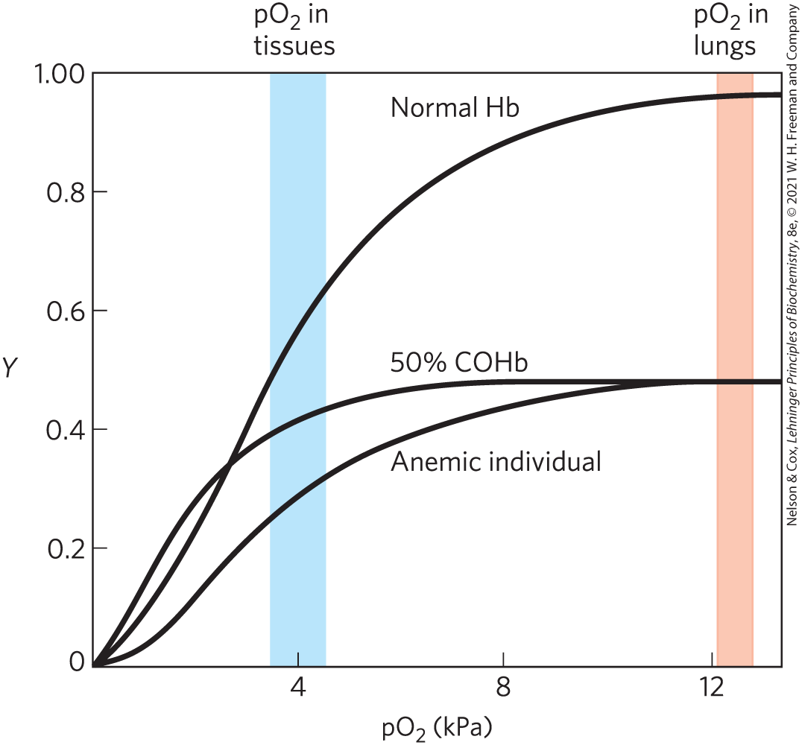
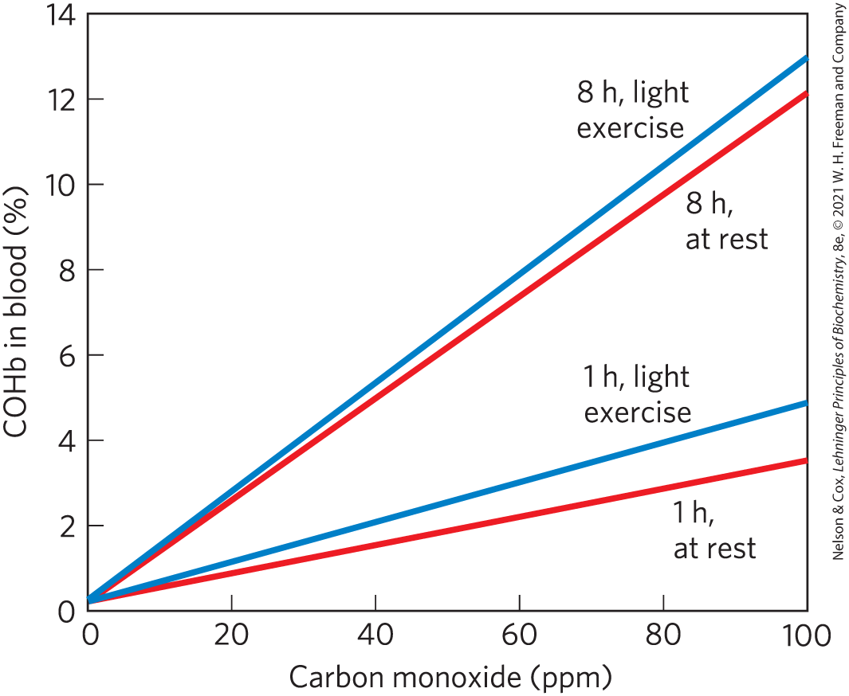
Carbon Monoxide Can Bind to Hemoglobin
CO has ~250-fold greater affinity for hemoglobin than does O₂

Slide 47
Cooperative Ligand Binding Can Be Described Quantitatively
for a protein with n binding sites, the equilibrium becomes:
P + nL ⇌ PL_{n}
(5-12)

Slide 48
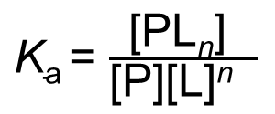
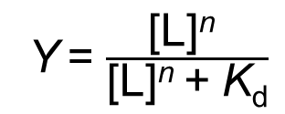
The K_{a} and Y for Cooperative
Ligand Binding
the expression for the association constant becomes:
$\text{K}\text{a}$ = $\frac{\text{[}\text{PL}\text{n}\text{] }}{\text{[}\text{P}\text{][}\text{L}\text{]}\text{n} }$
(5-13)
the expression for Y is:
Y = $\frac{\text{[}\text{L}\text{]}\text{n} }{\text{[}\text{L}\text{]}\text{n}\text{ + }\text{K}\text{d}}$
(5-14)

Slide 49
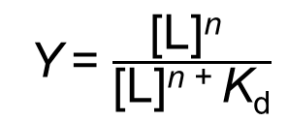
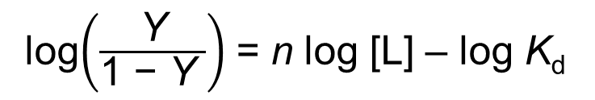
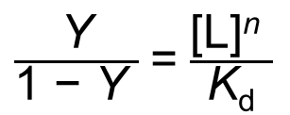
The Hill Equation
Y = $\frac{\text{[}\text{L}\text{]}\text{n} }{\text{[}\text{L}\text{]}\text{n}\text{ + }\text{K}\text{d}}$
(5-14)
rearranging, then taking the log of both sides, yields:
$\frac{\text{Y}}{\text{1 − }\text{Y} }$ = $\frac{\text{[}\text{L}\text{]}\text{n} }{\text{K}\text{d}}$
(5-15)
the Hill equation:
log$\left(\frac{\text{Y}}{\text{1 − }\text{Y} }\right)$ = n log [L] – log $\text{K}\text{d}$
(5-16)

Slide 50
Hill Plots and Hill Coefficients
Hill plot = plot of log [Y/(1 − Y)] versus log [L]
Hill coefficient = n_{H} = slope of a Hill plot
  If n_{H} = 1, ligand binding is not cooperative
  n_{H} > 1 indicates positive cooperativity
  n_{H} < 1 indicates negative cooperativity

Slide 51
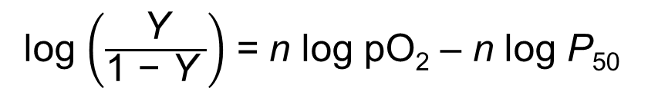
Adapting the Hill Equation to the Binding of O₂ to Hemoglobin
substituting pO₂ for [L] and ${\text{P}}_{\text{50} }^{ \text{n}}$for K_{d}:
log $\left(\frac{\text{Y}}{\text{1 − }\text{Y} }\right)$ = n log pO₂ – n log P₅₀
(5-17)
Hill coefficient = n_{H} = slope of a Hill plot
  If n_{H} = 1, ligand binding is not cooperative
  n_{H} > 1 indicates positive cooperativity
  n_{H} < 1 indicates negative cooperativity

Slide 52
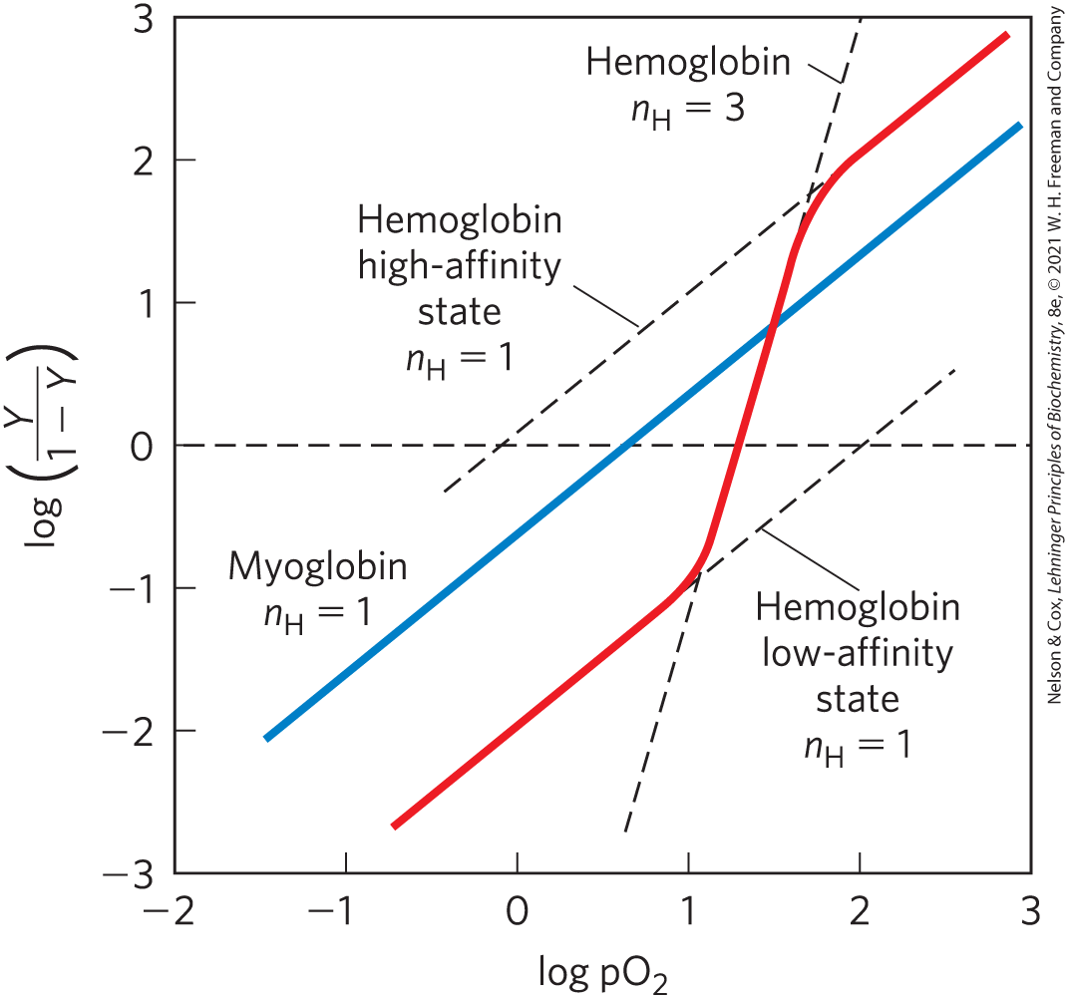
Hill Plots for Myoglobin and Hemoglobin

Slide 53

Principle 5 (4 of 4)
In a multisubunit protein, a conformational change in one subunit often affects the conformation of other subunits.

Slide 54
Two Models Suggest Mechanisms for Cooperative Binding
MWC model = concerted model
  all subunits in the same conformation
  ligand binds more tightly to the R state
sequential model
  each subunit can be in either conformation
  equilibrium is altered as additional ligands are bound, progressively favoring the R state

Slide 55
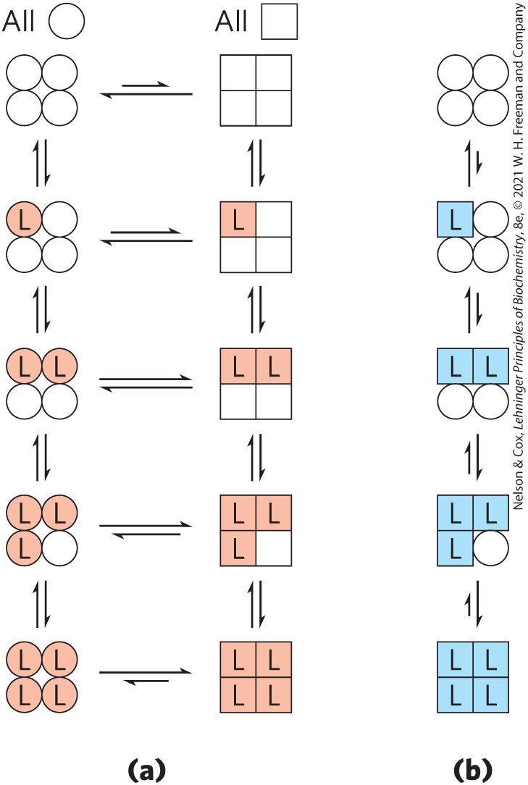
Concerted and Sequential Models
Low affinity or inactive
High affinity or active
MWC model (concerted model)
Sequential model

Slide 56
Hemoglobin Also Transports H⁺ and CO₂
hemoglobin carries two end products of cellular respiration: H⁺ and CO₂
carbonic anhydrase catalyzes the hydration of CO₂ to bicarbonate:
  CO₂ + H₂O ⇌ H⁺ + HCO₃–

Slide 57

Principle 6 (3 of 3)
Interactions between ligands and proteins may be regulated.

Slide 58
The Bohr Effect
the structural effects of H⁺ and CO₂ binding to hemoglobin favor the T state
  the binding of H⁺ and CO₂ is inversely related to the binding of O₂
Bohr effect = describes the effect of pH and [CO₂] on the binding and release of O₂ by hemoglobin
  HHB⁺ + O₂ ⇌ HbO₂ + H⁺

Slide 59
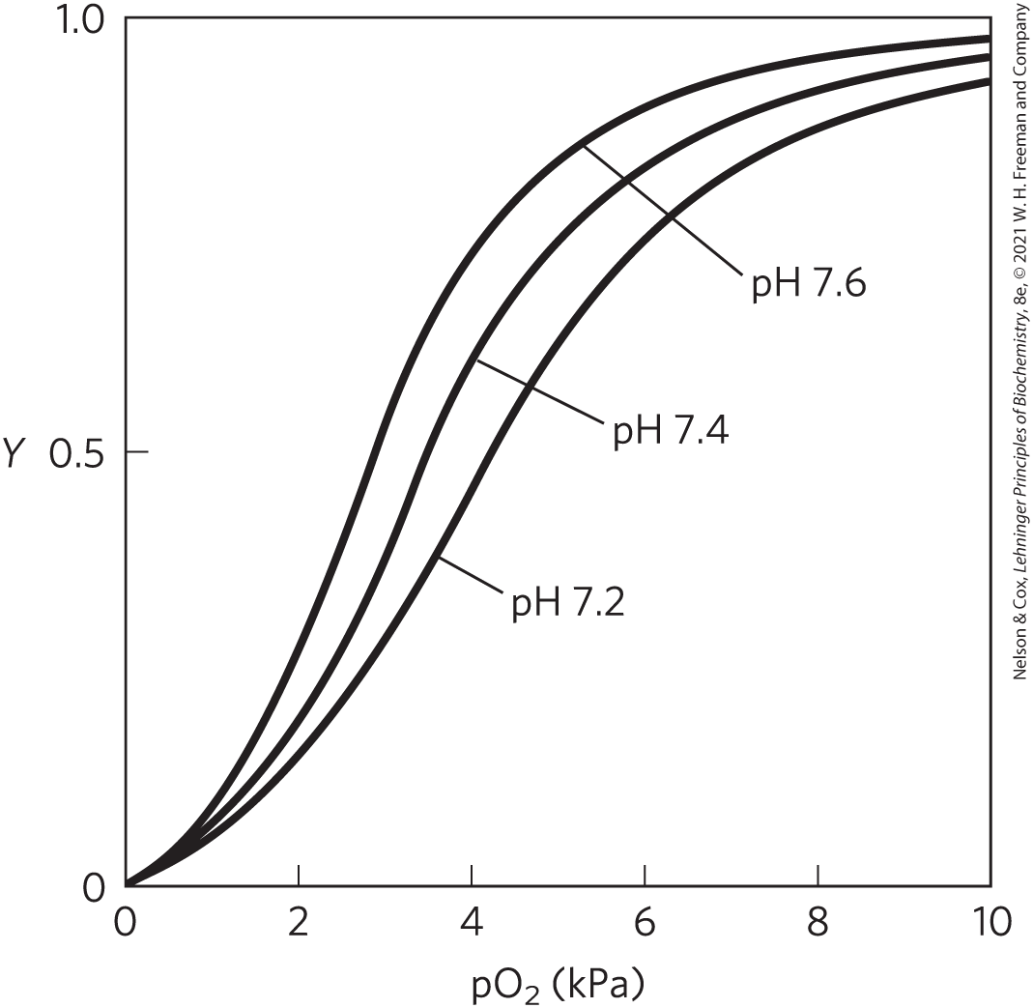
The Effect of pH on O₂ Binding to Hemoglobin
when [O₂] is high, hemoglobin binds O₂ and releases H⁺
when [O₂] is low, hemoglobin releases O₂ and binds H⁺

Slide 60
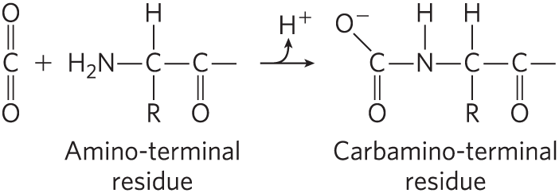
Hemoglobin Binds CO₂
CO₂ binding to hemoglobin is inversely related to binding of O₂
  contributes to the Bohr effect by producing H⁺

Slide 61
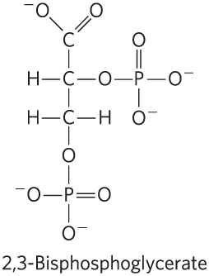
Oxygen Binding to Hemoglobin Is Regulated by 2,3-Bisphosphoglycerate (1 of 2)
2,3-bisphosphoglycerate (BPG):
  example of heterotropic allosteric modulation
  binds to a site distant from O₂-binding site
  greatly reduces the affinity of hemoglobin for oxygen

Slide 62
Oxygen Binding to Hemoglobin Is Regulated by 2,3-Bisphosphoglycerate (2 of 2)
2,3-bisphosphoglycerate (BPG):
  example of heterotropic allosteric modulation
  binds to a site distant from O₂-binding site
  greatly reduces the affinity of hemoglobin for oxygen
  HbBPG + O₂ ⇌ HbO₂ + BPG

Slide 63
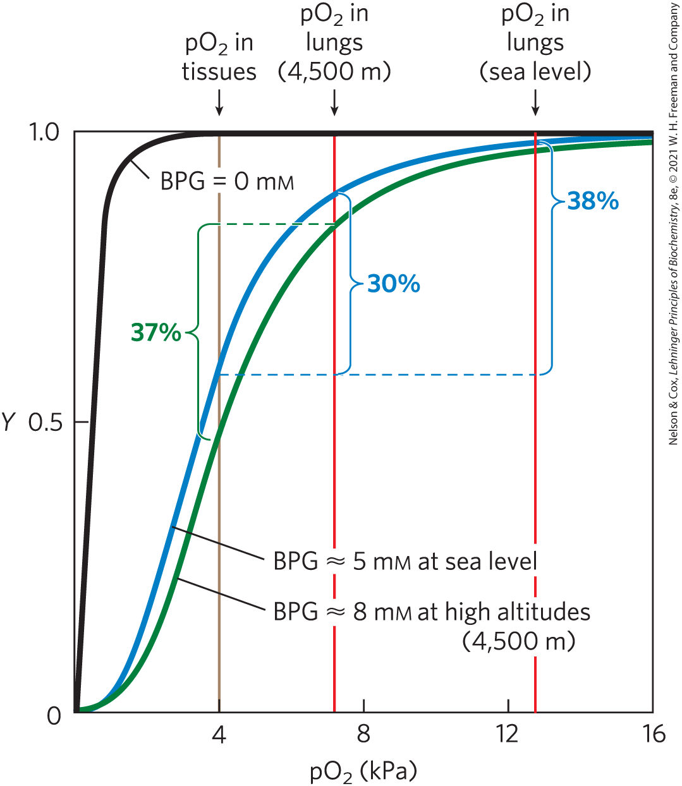
Effect of BPG on O₂ Binding to Hemoglobin
BPG increases at high altitudes
hypoxia = lowered oxygenation of peripheral tissues
  causes BPG increases

Slide 64
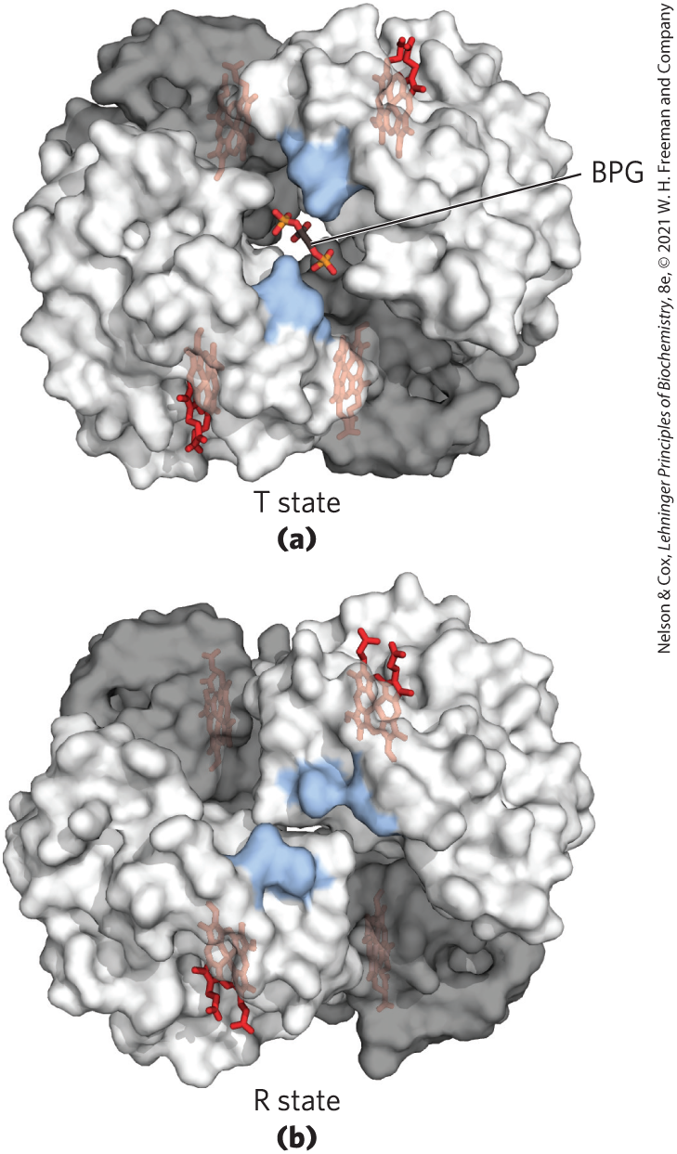
Binding of BPG to Deoxyhemoglobin
BPG binds to the cavity between the β subunits in the T state
  cavity is lined with positively charged residues
  BPG stabilizes the T state

Slide 65
Fetal Hemoglobin
fetus synthesizes α₂γ₂ hemoglobin
  lower affinity for BPG than normal adult hemoglobin
  higher affinity for O₂ than normal adult hemoglobin

Slide 66
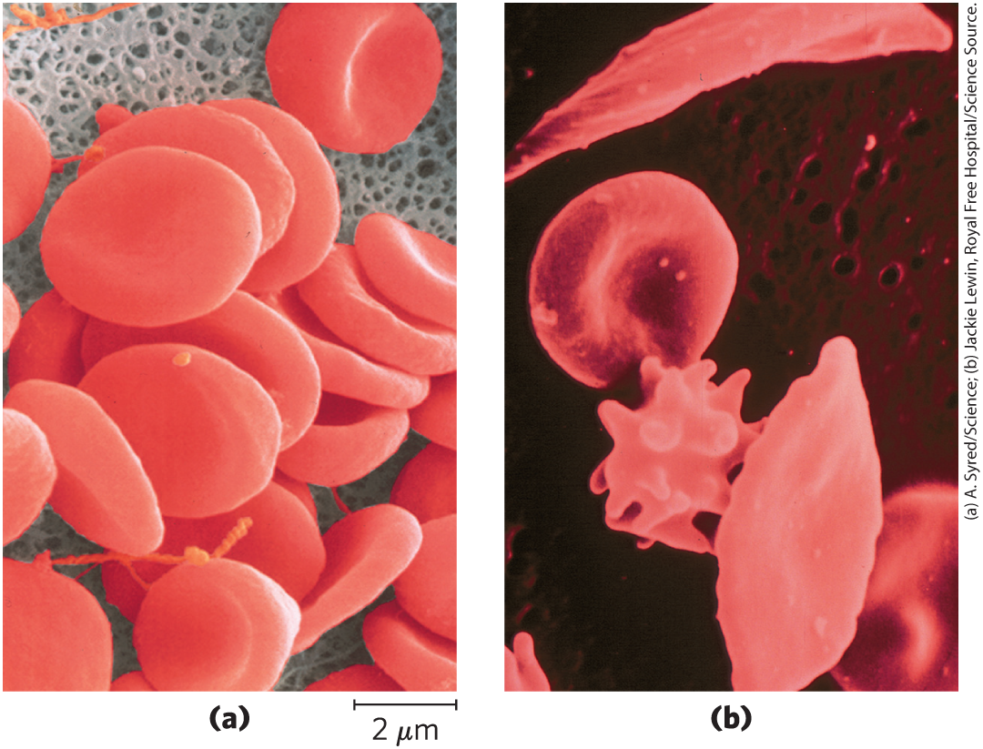
Sickle Cell Anemia Is a Molecular Disease of Hemoglobin
sickle cell anemia:
  homozygous condition
  single amino acid substitution (Glu⁶ to Val⁶) β chains produces a hydrophobic patch

Slide 67
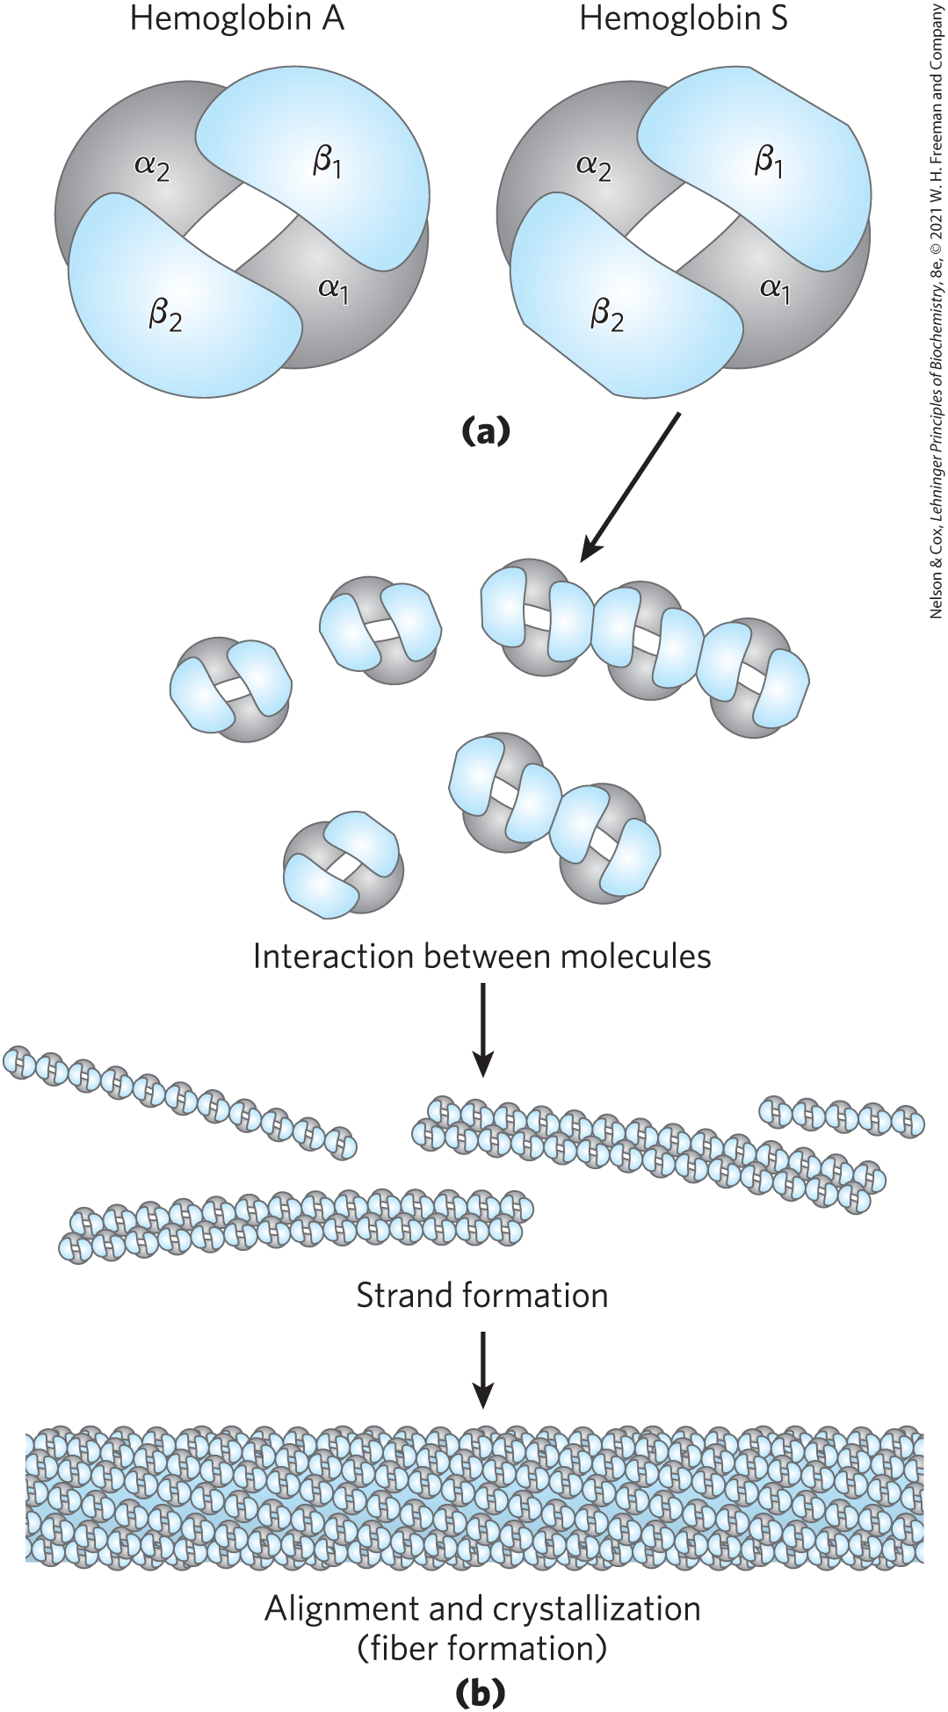
Normal and Sickle Cell Hemoglobin
deoxygenated hemoglobin becomes insoluble and forms polymers that aggregate
normal hemoglobin remains soluble upon deoxygenation

Slide 68
5.2 Complementary Interactions between Proteins and Ligands: The Immune System and Immunoglobulins

Slide 69
Principle 2 (3 of 4)
A ligand binds a protein at a binding site that is complementary to the ligand in size, shape, charge, and hydrophobic or hydrophilic character. The interaction is specific: the protein can discriminate among the thousands of different molecules in its environment and selectively bind only one or a few types. A given protein may have separate binding sites for several different ligands. These specific molecular interactions are crucial in maintaining the high degree of order in a living system.

Slide 70
Immune Responses
immune response = coordinated set of interactions among many classes of proteins, molecules, and cell types
  distinguishes molecular “self” from “nonself” and destroys “nonself”
  eliminates viruses, bacteria, and other pathogens and molecules

Slide 71
The Immune Response Includes a Specialized Array of Cells and Proteins
leukocytes = white blood cells, including macrophages and lymphocytes
The immune response consists of two complementary systems:
  humoral immune system = directed at bacterial infections and extracellular viruses
  cellular immune system = destroys infected host cells, parasites, and foreign tissues

Slide 72
The Humoral Immune Response
antibodies = immunoglobulins (Ig) = bind bacteria, viruses, or large molecules identified as foreign and target them for destruction
  produced by B lymphocytes or B cells

Slide 73
The Cellular Immune Response
T lymphocytes = cytotoxic T cells (T_{C} cells)
  recognition of infected cells or parasites involves T-cell receptors on the surface of T_{C} cells
helper T cells (T_{H} cells) = produce soluble signaling proteins called cytokines
  interact with macrophages
  stimulate the selective proliferation of T_{C} and B cells that can bind to a particular antigen (clonal selection)
memory cells = permit a rapid response to pathogens previously encountered

Slide 74
Vaccines
often consists of weakened or killed virus or isolated proteins from a viral or bacterial protein coat
“teaches” the immune system what the viral particles look like, stimulating the production of memory cells

Slide 75
Principle 1 (3 of 4)
The functions of many proteins involve the reversible binding of other molecules. A molecule bound reversibly by a protein is called a ligand. A ligand may be any kind of molecule, including another protein. The transient nature of protein-ligand interactions is critical to life, allowing an organism to respond rapidly and reversibly to changing environmental and metabolic circumstances.

Slide 76
Antigens and Haptens
antigen = molecule or pathogen capable of eliciting an immune response
  can be a virus, a bacterial cell wall, or an individual protein or other macromolecule
  antibodies or T-cell receptors bind to an antigenic determinant or epitope within the antigen
haptens = small molecules that can elicit an immune response when covalently attached to large proteins

Slide 77
Antibodies Have Two Identical Antigen-Binding Sites
immunoglobulin G (IgG) = major class of antibodies
  one of the most abundant blood serum proteins
  4 polypeptide chains: 2 heavy chains and 2 light chains
  cleavage with protease papain releases the basal fragment Fc and two Fab branches (each with a single antigen-binding site)
  constant domains contain the immunoglobulin fold structural motif

Slide 78
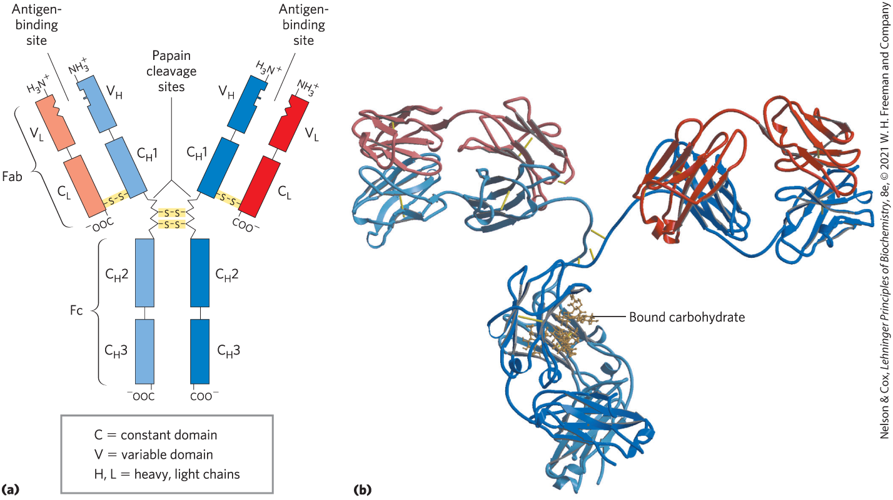
The Structure of Immunoglobulin G

Slide 79
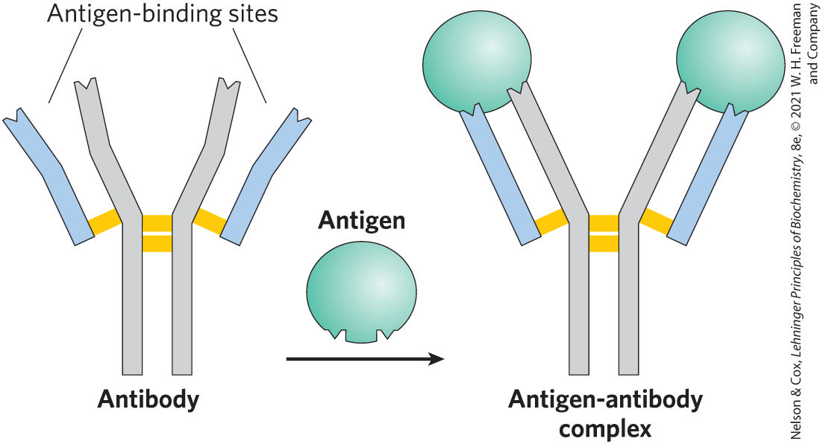
The Variable Domain of Immunoglobulin G
heavy and light chains each have a variable domain
  variable domains associate to create the antigen-binding site
  allows formation of an antigen-antibody complex

Slide 80
Classes of Immunoglobulins
5 classes in vertebrates:
  characterized by heavy chain:
    α for IgA
    δ for IgD
    ε for IgE
    γ for IgG
    μ for IgM

Slide 81
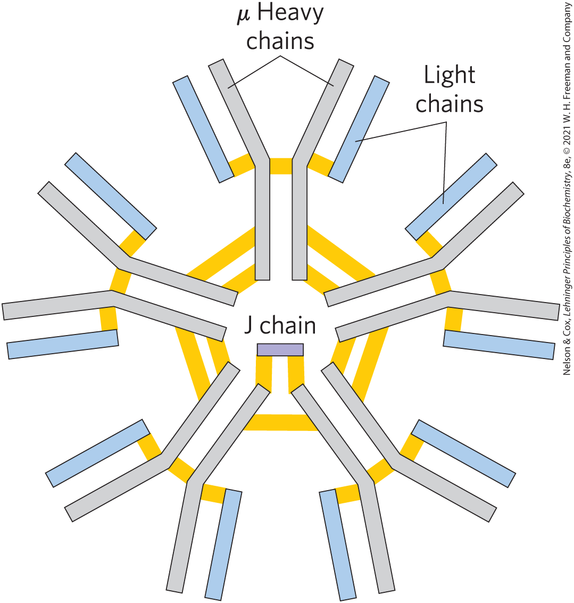
Structure of Immunoglobulins
IgD and IgE = similar in structure to IgG
IgM = monomeric, membrane-bound form or in a secreted form that is a cross-linked pentamer of this basic structure
IgA = monomer, dimer, or trimer
IgM pentamer

Slide 82
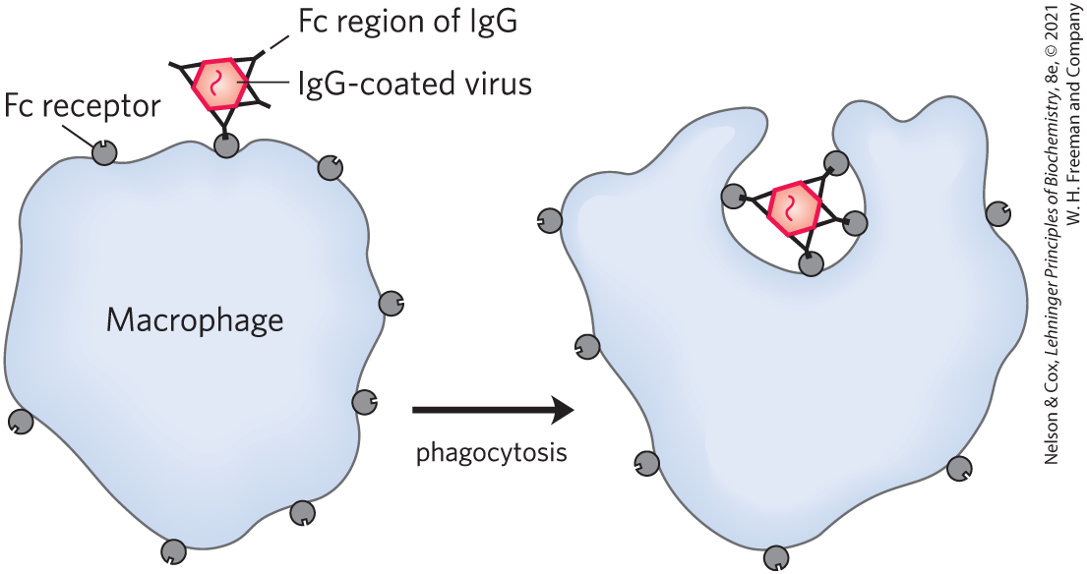
Phagocytosis of Antibody-Bound Viruses by Macrophages
When Fc receptors bind an antibody pathogen complex, macrophages engulf the complex

Slide 83
Principle 2 (4 of 4)
A ligand binds a protein at a binding site that is complementary to the ligand in size, shape, charge, and hydrophobic or hydrophilic character. The interaction is specific: the protein can discriminate among the thousands of different molecules in its environment and selectively bind only one or a few types. A given protein may have separate binding sites for several different ligands. These specific molecular interactions are crucial in maintaining the high degree of order in a living system.

Slide 84
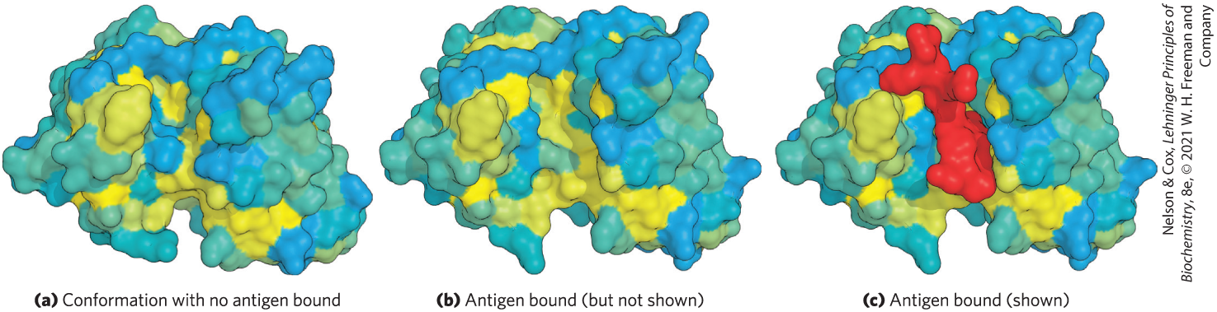
Antibodies Bind Tightly and Specifically to Antigen
induced fit = conformational changes in the antibody and/or antigen allow the complementary groups to interact fully
K_{d} values as low as 10^{–10} M

Slide 85
The Antibody-Antigen Interaction Is the Basis for a Variety of Important Analytical Procedures
two types of antibody preparations are used:
  polyclonal antibodies
    produced by injecting a protein into an animal
    contain a mixture of antibodies that recognize different parts of the protein
  monoclonal antibodies
    Synthesized by a population of identical B cells (a clone)
    homogeneous, all recognizing the same epitope.

Slide 86
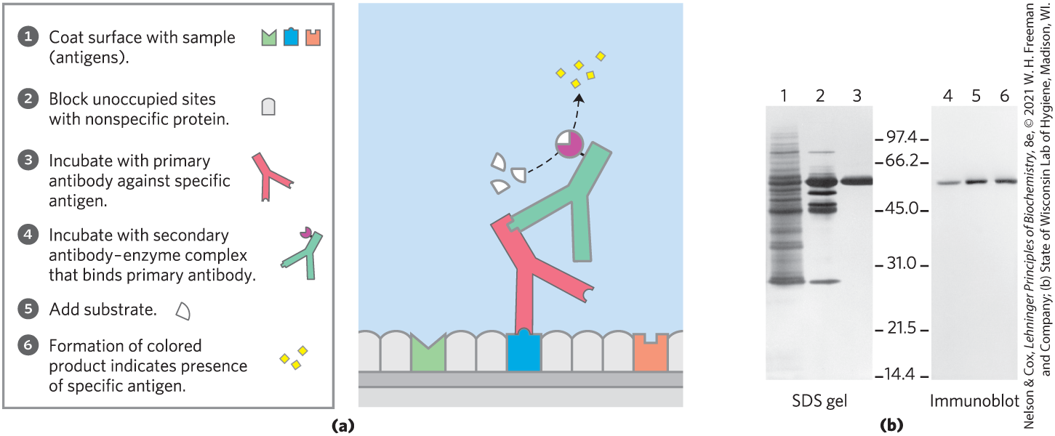
Western Blots
immunoblot = Western blot assay = uses antibodies to detect a protein

Slide 87
5.3 Protein Interactions Modulated by Chemical Energy: Actin, Myosin, and Molecular Motors

Slide 88
The Major Proteins of Muscle Are Myosin and Actin
arranged in filaments that undergo transient interactions and slide past each other to bring about contraction

Slide 89

Myosin
myosin (M_{r} 520,000)
  2 heavy chains and 4 light chains
  forms a fibrous, left-handed coiled coil domain (tail) and a large globular domain (head)

Slide 90

Actin
actin:
  monomeric G-actin (M_{r} 42,000) associates to form a long polymer called F-actin

Slide 91

Thick Filaments
thick filaments = rodlike structures of aggregated myosin

Slide 92
Thin Filaments
thin filaments = F-actin along with the proteins troponin and tropomyosin
  assemble as successive monomeric actin molecules add to one end
  each monomer binds and hydrolyzes ATP

Slide 93

Components of Muscle
each actin monomer in the thin filament binds to one myosin head group

Slide 94

Additional Proteins Organize the Thin and Thick Filaments into Ordered Structures
muscle fiber = large, single, elongated, multinuclear cell
each muscle fiber contains ~1,000 myofibrils, each consisting of thick and thin filaments and surrounded by sarcoplasmic reticulum

Slide 95

The Structure of a Sarcomere
sarcomere = entire contractile unit
  A band = stretches the length of the thick filament
  I band = contains only thin filaments
  Z disk = attachment site for thin filaments
  M line = bisects the A band

Slide 96
Principle 1 (4 of 4)
The functions of many proteins involve the reversible binding of other molecules. A molecule bound reversibly by a protein is called a ligand. A ligand may be any kind of molecule, including another protein. The transient nature of protein-ligand interactions is critical to life, allowing an organism to respond rapidly and reversibly to changing environmental and metabolic circumstances.

Slide 97

Myosin Thick Filaments Slide along Actin Thin Filaments
myosin binds actin tightly when ATP is not bound to myosin
series of conformational changes due to binding, hydrolysis, and release of ATP and ADP causes muscle contraction

Slide 98

Tropomyosin
tropomyosin = binds to the thin filament and blocks the myosin-binding sites

Slide 99
Troponin
troponin = binds Ca²⁺ released from the sarcoplasmic reticulum, causes a conformational change, and exposes myosin-binding sites
  subunit C binds Ca²⁺
  subunit I prevents binding of the myosin head to actin
  subunit T links the troponin complex to tropomyosin

