Slide 1

3 Amino Acids, Peptides, and Proteins
© 2021 Macmillan Learning

Slide 2

Principle 1 (1 of 2)
In every living organism, proteins are constructed from a common set of 20 amino acids. Each amino acid has a side chain with distinctive chemical properties. Amino acids may be regarded as the alphabet in which the language of protein structure is written.

Slide 3

Principle 2 (1 of 3)
In proteins, amino acids are joined in characteristic linear sequences through a common amide linkage, the peptide bond. The amino acid sequence of a protein constitutes its primary structure, a first level we will introduce within the broader complexities of protein structure.

Slide 4

Principle 3 (1 of 2)
For study, individual proteins can be separated from the thousands of other proteins present in a cell, based on differences in their chemical and functional properties arising from their distinct amino acid sequences. As proteins are central to biochemistry, the purification of individual proteins for study is a quintessential biochemical endeavor.

Slide 5

Principle 4 (1 of 2)
Shaped by evolution, amino acid sequences are a key resource for understanding the function of individual proteins and for tracing broader functional and evolutionary relationships.

Slide 6
3.1 Amino Acids

Slide 7
Principle 1 (2 of 2)
In every living organism, proteins are constructed from a common set of 20 amino acids. Each amino acid has a side chain with distinctive chemical properties. Amino acids may be regarded as the alphabet in which the language of protein structure is written.

Slide 8
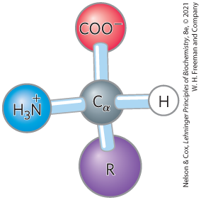
Amino Acids Share
Common Structural Features
α carbon and four substituents
α carbon is the chiral center
tetrahedral

Slide 9
Amino Acid Substituents
four substituents:
  a carboxyl group
  an amino group
  a hydrogen atom
  an R group (a side chain unique to each amino acid)
    glycine has a second hydrogen atom instead of an R group

Slide 10
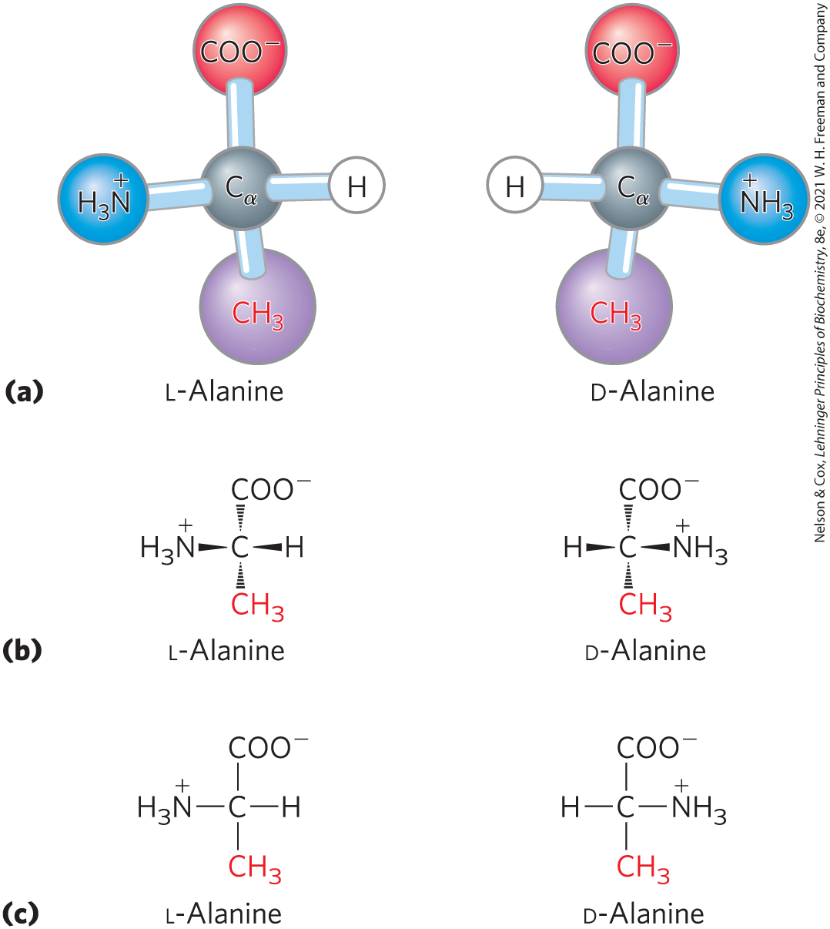
The Amino Acid Residues in
Proteins are L Stereoisomers
two possible stereoisomers = enantiomers
optically active
D, L system specifies absolute configuration

Slide 11
Amino Acids Can Be Classified by
R Group
five main classes:
  nonpolar, aliphatic (7)
  aromatic (3)
  polar, uncharged (5)
  positively charged (3)
  negatively charged (2)

Slide 12
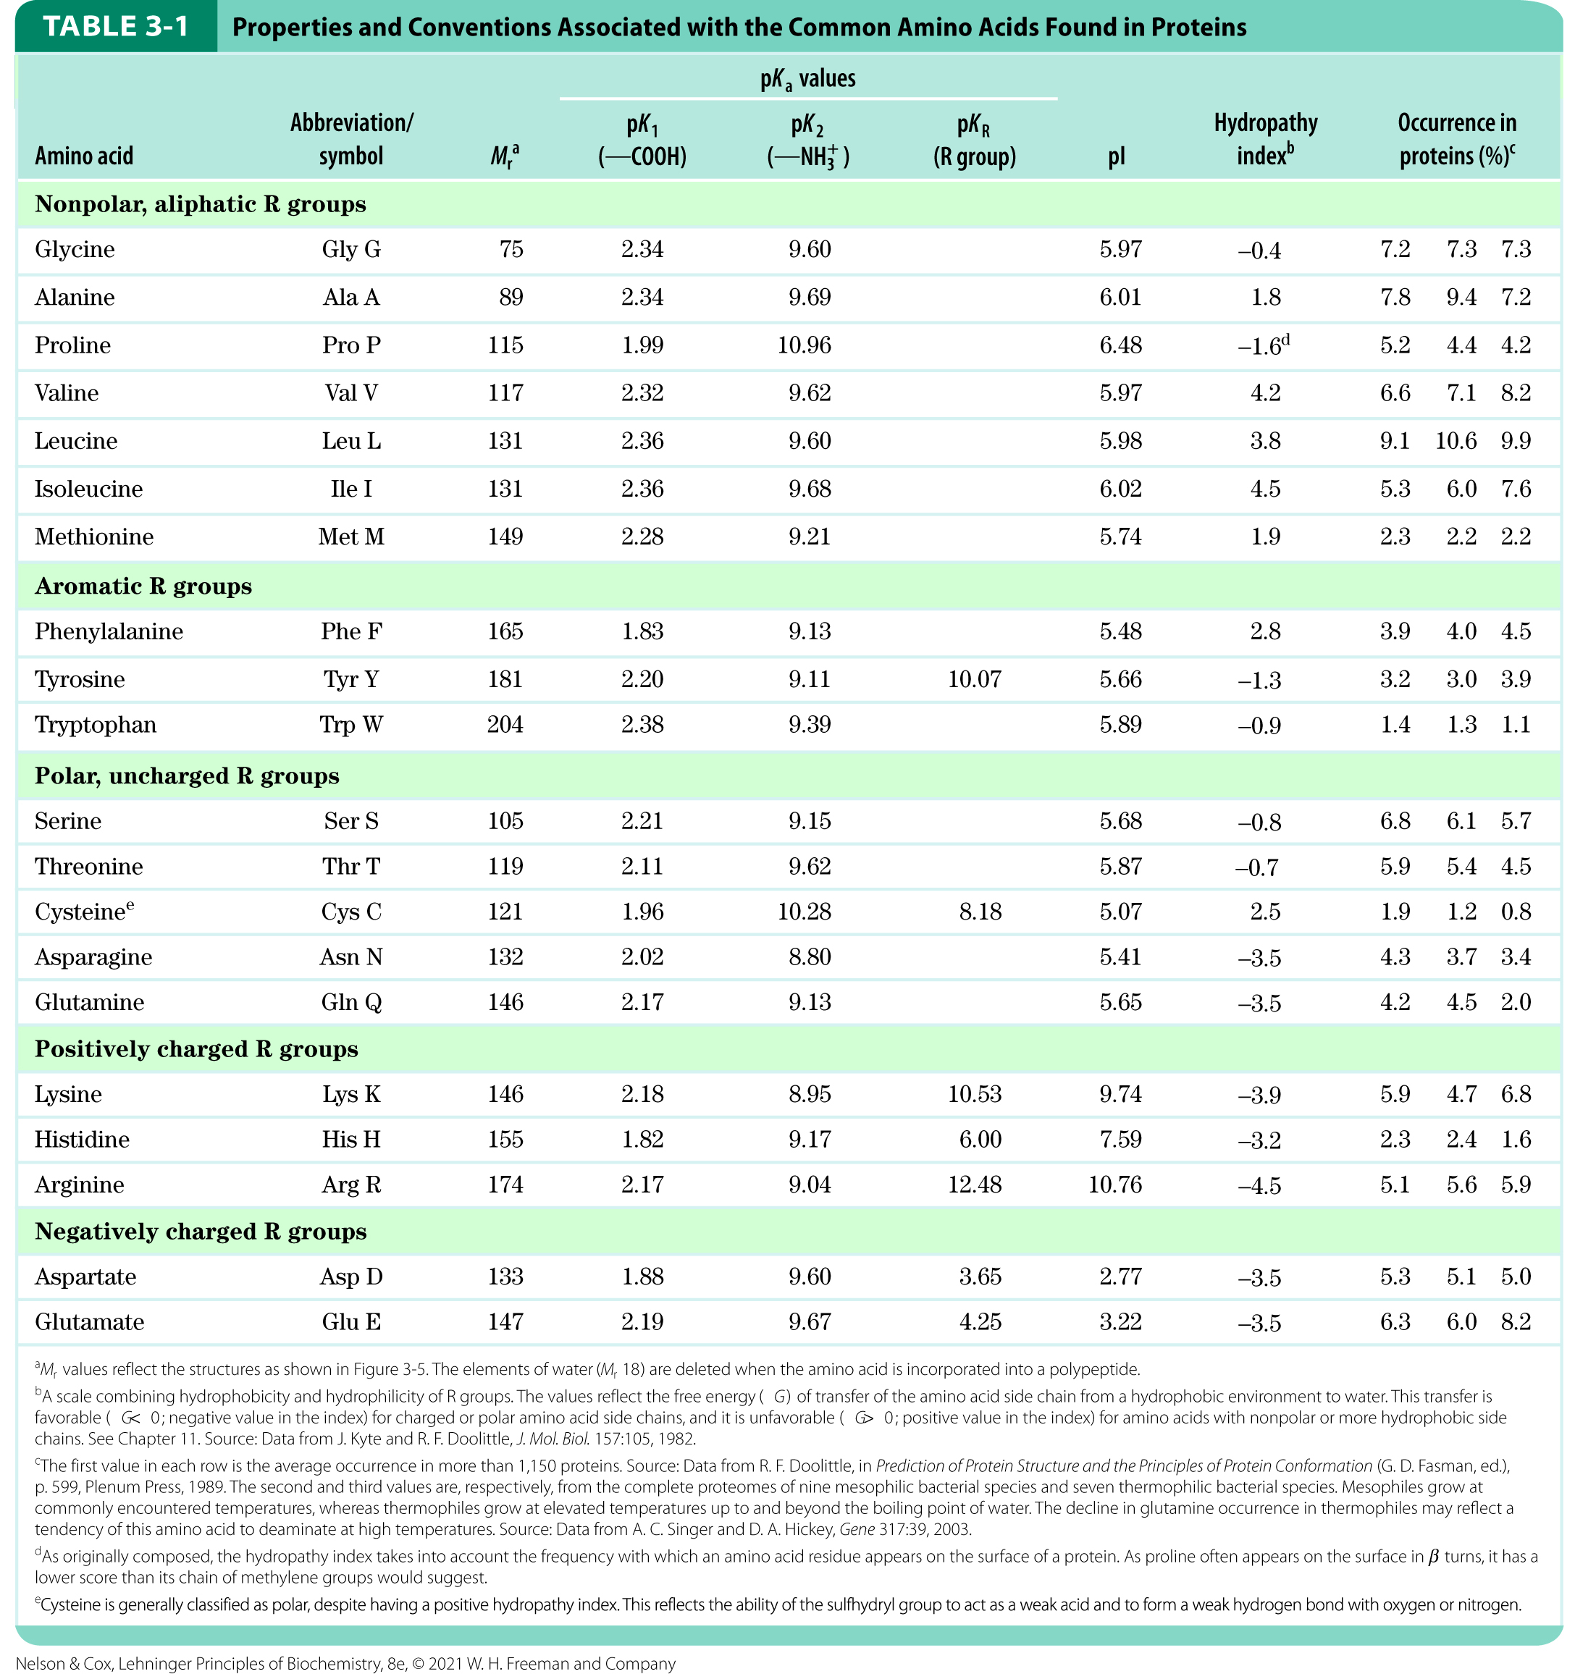
Table 3-1

Slide 13
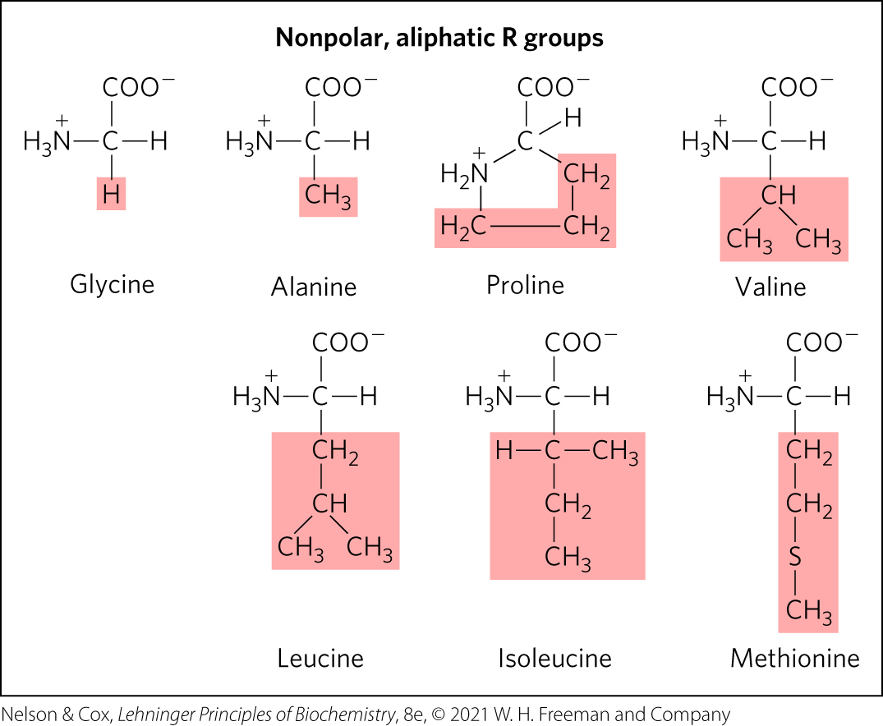
Nonpolar, aliphatic R groups
the hydrophobic effect stabilizes protein structure

Slide 14
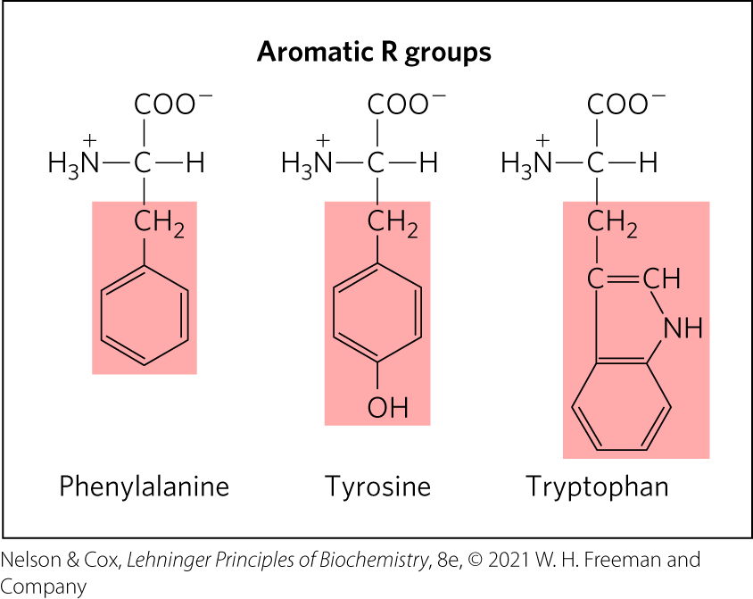
Aromatic R Groups
R groups absorb UV light at 270–280 nm
can contribute to the hydrophobic effect

Slide 15
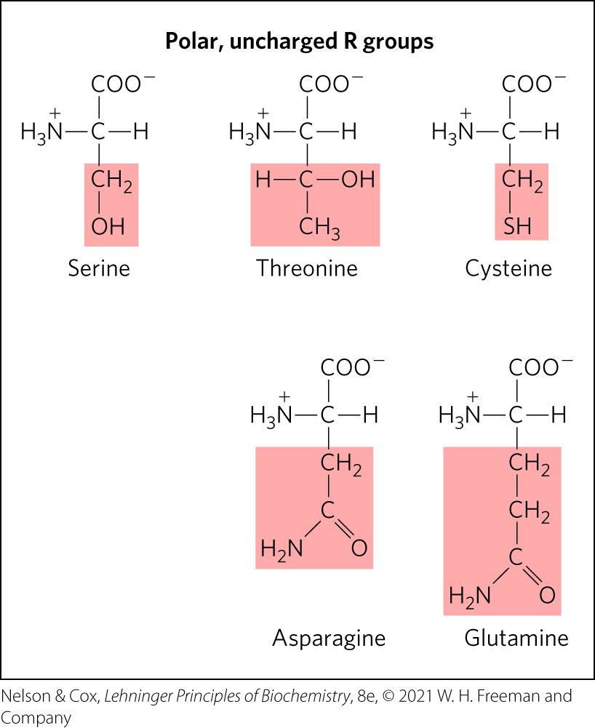
Polar, Uncharged R Groups
R groups can form hydrogen bonds
cysteine can form disulfide bonds

Slide 16
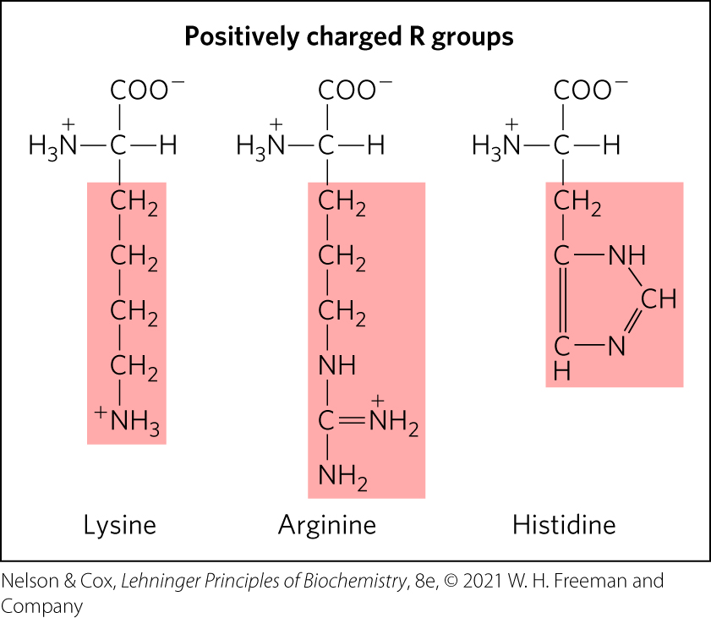
Positively Charged R Groups
have significant positive charge at pH 7.0

Slide 17
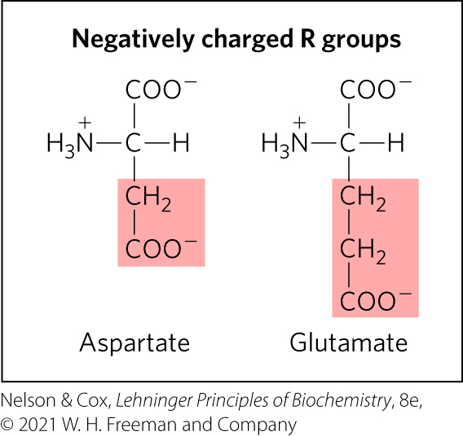
Negatively Charged R Groups
have a net negative charge at pH 7.0

Slide 18
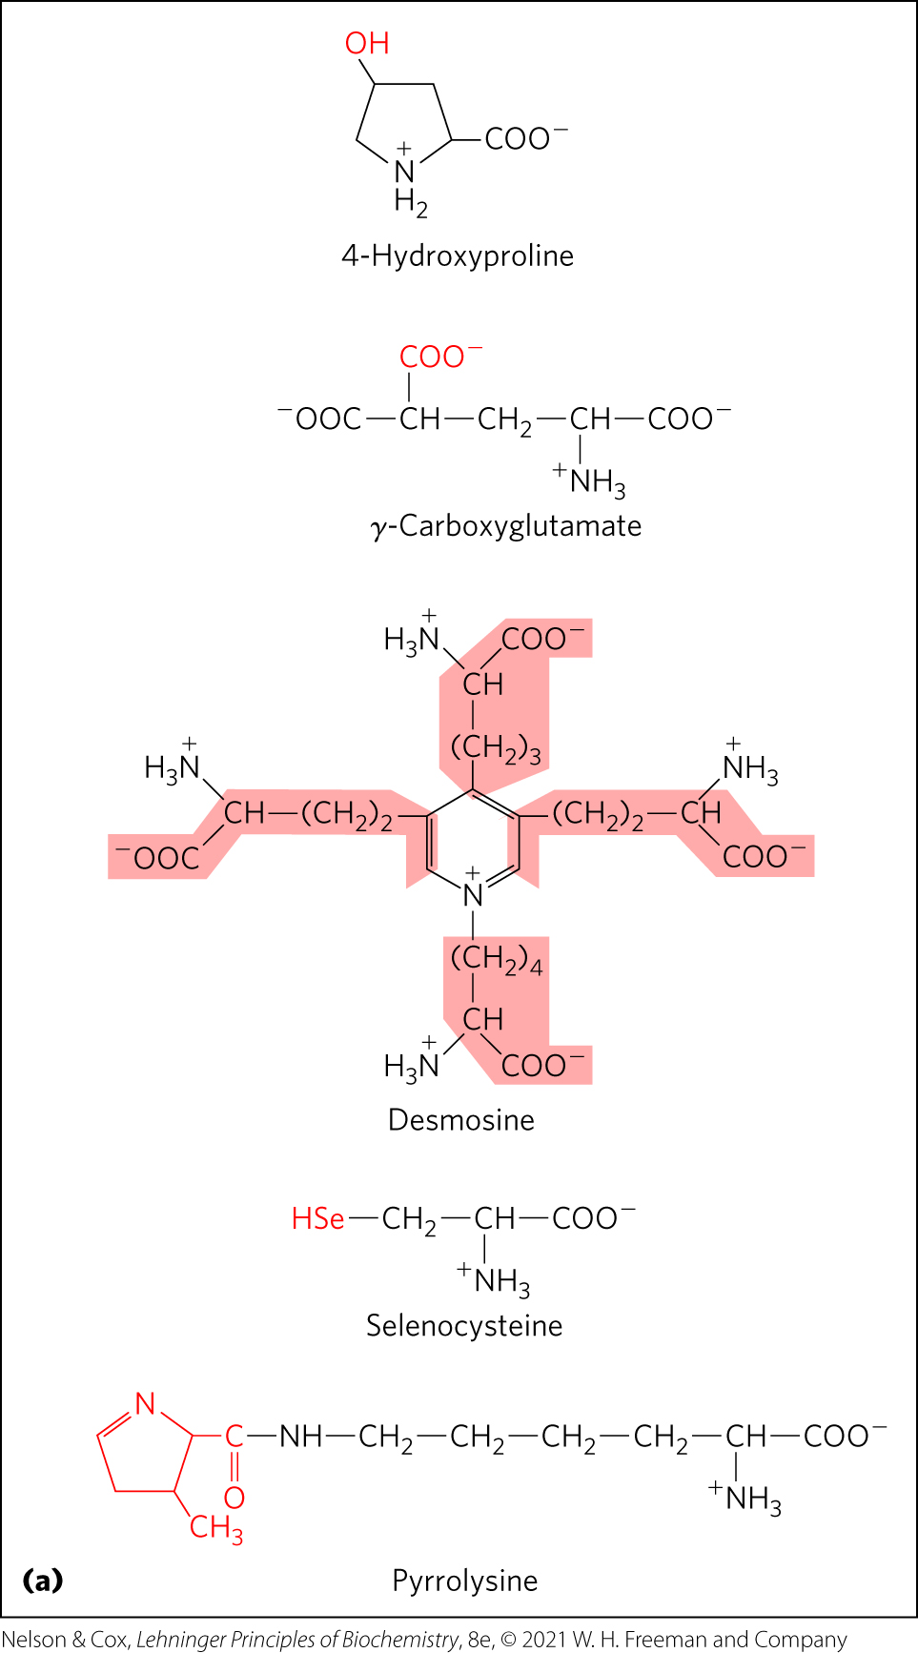
Uncommon Amino Acids Also Have Important Functions
modifications of common amino acids:
  modified after protein synthesis (e.g., 4-hydroxyproline, found in collagen)
  modified during protein synthesis (e.g., pyrrolysine, contributes to methane biosynthesis)
  modified transiently to change protein’s function (e.g., phosphorylation)
free metabolites (e.g., ornithine, intermediate in arginine biosynthesis)

Slide 19
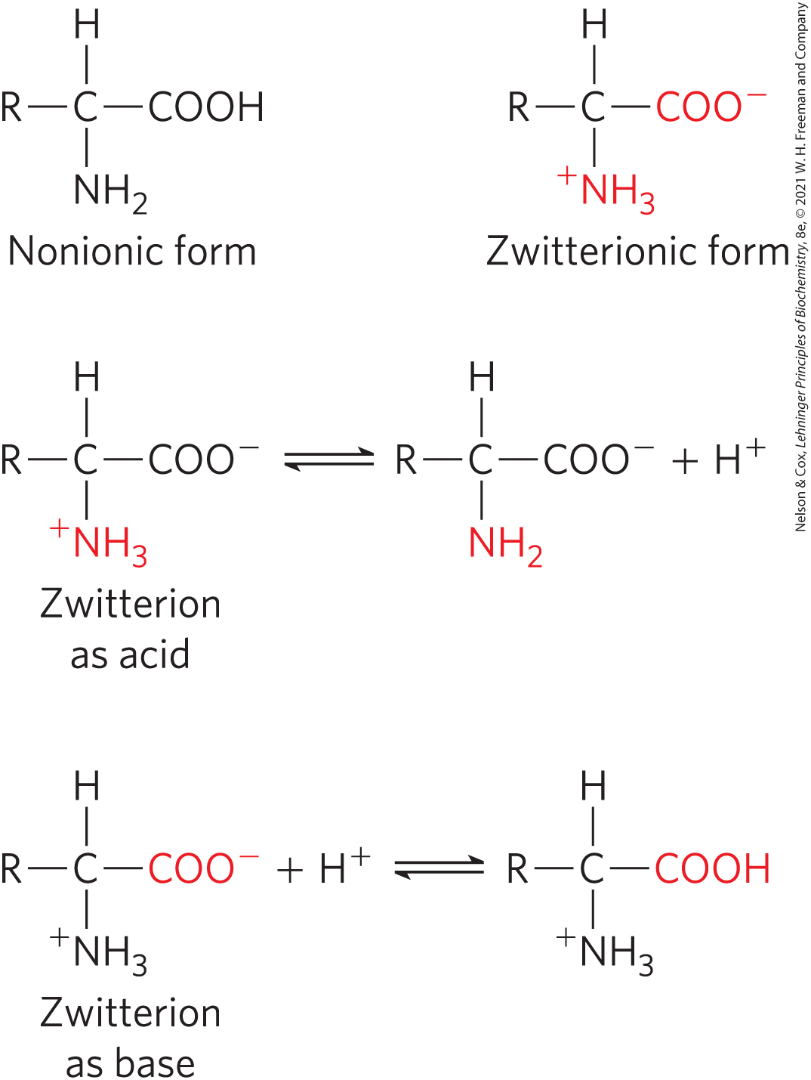
Amino Acids Can Act as Acids or Bases
amino groups, carboxyl groups, and ionizable R groups = weak acids and bases
zwitterion occurs at neutral pH

Slide 20
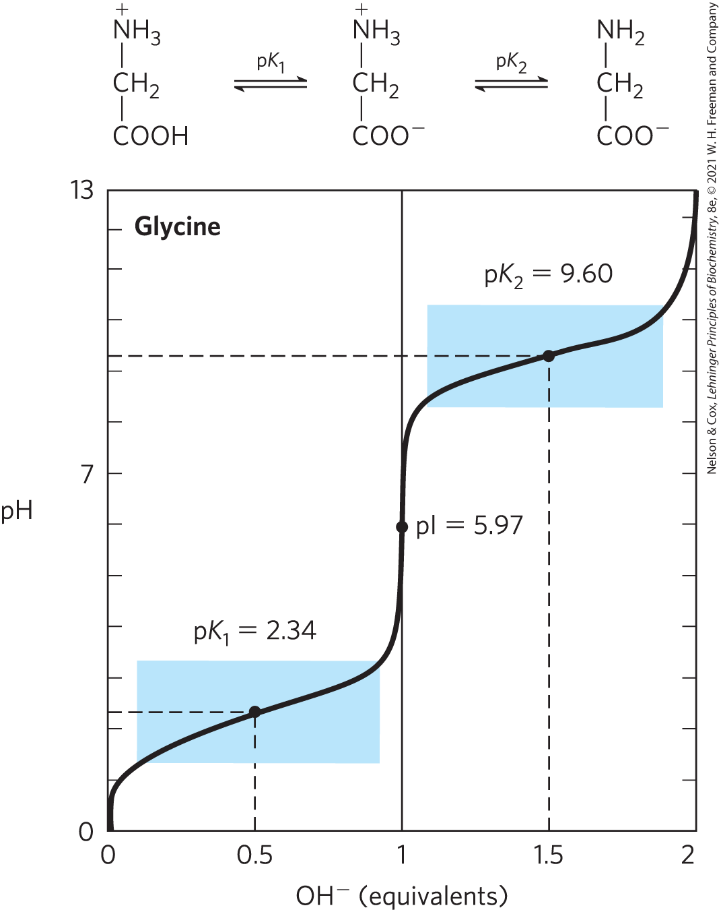
Titration of Amino Acids
cation ⇌ zwitterion ⇌ anion
—COOH has an acidic pK_{a} (pK₁)
—NH₃⁺ has a basic pK_{a} (pK₂)
the pH at which the net electric charge is zero is the isoelectric point (pI)

Slide 21
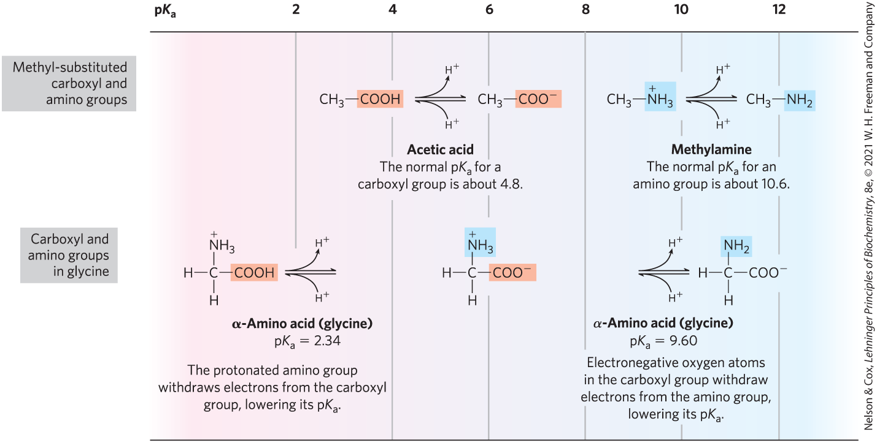
Effect of the Chemical Environment on pK_{a}
α-carboxyl group is more acidic than in carboxylic acids
α-amino group is less basic than in amines

Slide 22
Information from a Titration Curve
quantitative measure of the pK_{a} of each ionizing group
regions of buffering power
relationship between its net charge and the pH of the solution
  isoelectric point, pI

Slide 23
Amino Acids as Buffers
buffers prevent changes in pH close to the pK_{a}
glycine has two buffer regions:
  centered around the pK_{a} of the α-carboxyl group (pK₁ = 2.34)
  centered around the pK_{a} of the α-amino group (pK₂ = 9.6)
buffer
regions

Slide 24
Isoelectric Point, pI
for amino acids without ionizable side chains, the isoelectric point (pI) is:
pH = pI = net charge is zero (amino acid least soluble in water, does not migrate in electric field)
pH > pI = net negative change
pH < pI = net positive charge

Slide 25
Amino Acids Differ in Their Acid-Base Properties
ionizable side chains:
  have a pK_{a} value
  act as buffers
  influence the pI of the amino acid
  can be titrated (titration curve has 3 ionization steps)

Slide 26
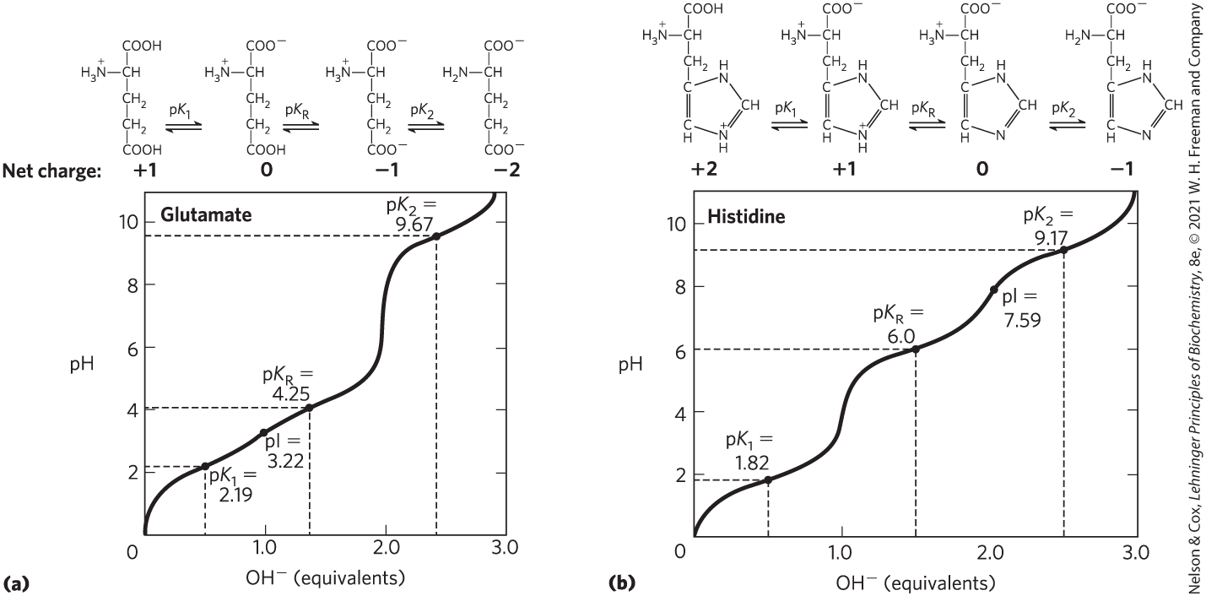
Titration of Amino Acids with an Ionizable R Group

Slide 27
3.2 Peptides and Proteins

Slide 28
Principle 2 (2 of 3)
In proteins, amino acids are joined in characteristic linear sequences through a common amide linkage, the peptide bond. The amino acid sequence of a protein constitutes its primary structure, a first level we will introduce within the broader complexities of protein structure.

Slide 29
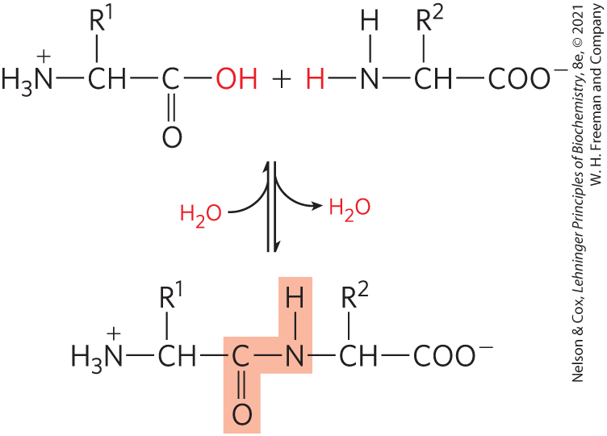
Peptides Are Chains of
Amino Acids
peptide bond:
  covalent
  formed through condensation
  broken through hydrolysis

Slide 30
Peptide Types by the Number
dipeptide = 2 amino acids, 1 peptide bond
tripeptide = 3 amino acids, 2 peptide bonds
oligopeptide = a few amino acids
polypeptide = many amino acids, molecular weight < 10 kDa
protein = thousands of amino acids, molecular weight > 10 kDa

Slide 31
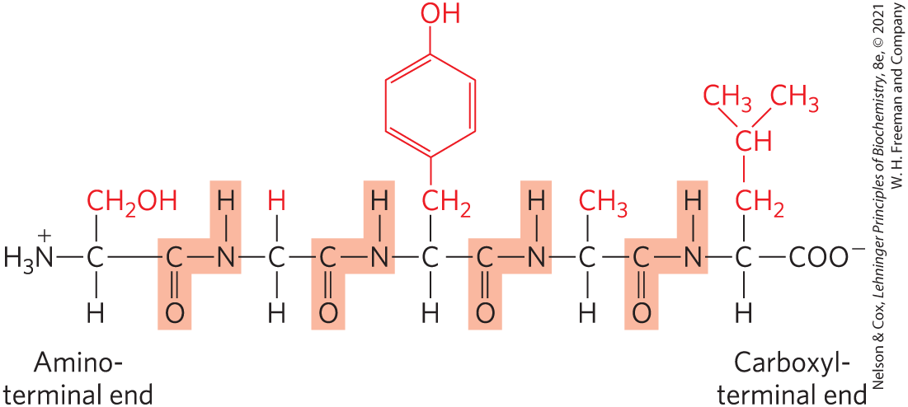
Peptide Terminals
numbering (and naming) starts from the
amino-terminal residue (N-terminal)
N-terminal
C-terminal

Slide 32
Naming Peptides
full amino acid names:
serylglycyltyrosylalanylleucine
three-letter code abbreviations:
Ser–Gly–Tyr–Ala–Leu
one-letter code abbreviation:
SGYAL

Slide 33
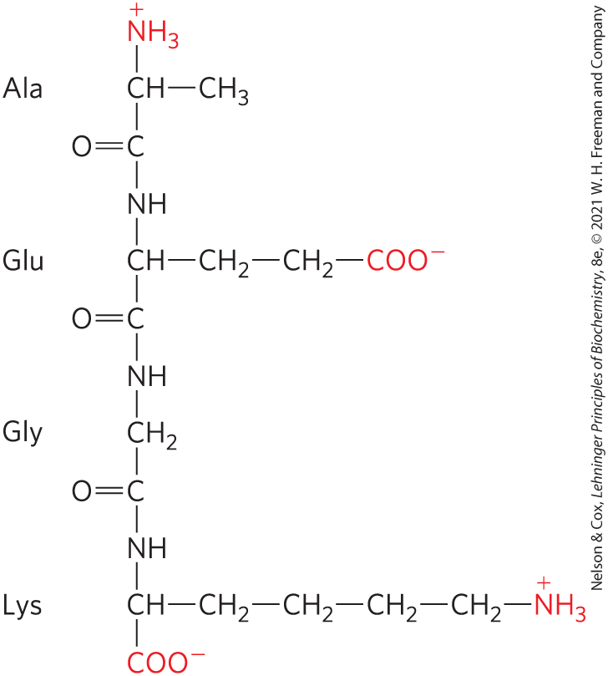
Peptides Can Be Distinguished by Their Ionization Behavior
ionizable groups in peptides:
  one free α-amino group
  one free α-carboxyl group
  some R groups

Slide 34
Biologically Active Peptides and Polypeptides Occur in a Vast Range of Sizes and Compositions
length of naturally occurring peptides = 2 to many thousands of amino acid residues
Table 3-2 Molecular Data on Some Proteins
Protein | Molecular weight | Number of residues | Number of polypeptide chains
Cytochrome c (human) | 12,400 | 104 | 1
Myoglobin (equine heart) | 16,700 | 153 | 1
Chymotrypsin (bovine pancreas) | 25,200 | 241 | 3
Hemoglobin (human) | 64,500 | 574 | 4
Hexokinase (yeast) | 107,900 | 972 | 2
RNS polymerase (E. coli) | 450,00 | 4,158 | 5
Glutamine synthetase (E. coli) | 619,000 | 5,628 | 12
Titin (human) | 2,993,000 | 26,926 | 1

Slide 35
Peptide Subunits
multisubunit protein = 2+ polypeptides associated noncovalently
oligomeric protein = at least 2 identical subunits
  identical units = protomers

Slide 36
Amino Acid Composition of Proteins
Table 3-3 Amino Acid Composition of Two Proteins
amino acid composition is highly variable
Amino Acid | Bovine cytochrome c: Number of residues per molecule | Bovine cytochrome c: percentage of total | Bovine chymotrypsinogen: Number of residues per molecule | Bovine chymotrypsinogen: Percentage of total
Ala | 6 | 6 | 22 | 9
Arg | 2 | 2 | 4 | 1.6
Asn | 5 | 5 | 14 | 5.7
Asp | 3 | 3 | 9 | 3.7
Cys | 2 | 2 | 10 | 4
Gln | 3 | 3 | 10 | 4
Glu | 9 | 9 | 5 | 2
Gly | 14 | 13 | 23 | 9.4
His | 3 | 3 | 2 | 0.8
Ile | 6 | 6 | 10 | 4
Leu | 6 | 6 | 19 | 7.8
Lys | 18 | 17 | 14 | 5.7
Met | 2 | 2 | 2 | 0.8
Phe | 4 | 4 | 6 | 2.4
Pro | 4 | 4 | 9 | 3.7
Ser | 1 | 1 | 28 | 11.4
Thr | 8 | 8 | 23 | 9.4
Trp | 1 | 1 | 8 | 3.3
Tyr | 4 | 4 | 4 | 1.6
Val | 3 | 3 | 23 | 9.4
Total | 104 | 102 | 245 | 99.7
Notes:
See Table 3-3 in the text for footnotes

Slide 37
Estimating the Number of
Amino Acid Residues
number of residues = molecular weight/110
average molecular weight of amino acid = ~128
molecule of water removed to form peptide bond = 18
128 – 18 = 110

Slide 38
Some Proteins Contain Chemical Groups Other Than Amino Acids
conjugated proteins = contain permanently associated chemical components
  non–amino acid part = prosthetic group
lipoproteins contain lipids
glycoproteins contain sugars
metalloproteins contain specific metals
Table 3-4 Conjugated Proteins
Class | Prosthetic group | Example
Lipoproteins | Lipids | β₁-Lipoprotein of blood (Fig. 17-2)
Glycoproteins | Carbohydrates | Immunoglobulin G (Fig. 5-20)
Phosphoproteins | Phosphate groups | Glycogen phosphorylase (Fig. 6-39)
Hemoproteins | Heme (iron porphyrin) | Hemoglobin (Figs 5-8 to 5-11)
Flavoproteins | Flavin nucleotides | Succinate dehydrogenase (Fig. 19-9)
Metallproteins | Iron Zinc Calcium Molybdenum Copper | Ferritin (Box 16-1) Alcohol dehrogenase (Fig. 14-12) Calmodulin (Fig. 12-17) Dinitrogenase (Fig. 22-3) Complex IV (Fig. 19-12)

Slide 39
3.3 Working with Proteins

Slide 40
Principle 3 (2 of 2)
For study, individual proteins can be separated from the thousands of other proteins present in a cell, based on differences in their chemical and functional properties arising from their distinct amino acid sequences. As proteins are central to biochemistry, the purification of individual proteins for study is a quintessential biochemical endeavor.

Slide 41
Proteins Can Be Separated and Purified
separated based on:
  size
  charge
  binding properties
  protein solubility

Slide 42
Methods for Purifying Proteins
first step = break open tissue or microbial cells
  crude extract = releases proteins in solution
second step = fractionation = separate proteins into fractions based on size or charge
  “salting out” = lower solubility of proteins in salt to selectively precipitate proteins
third step = dialysis = use semipermeable membrane to separate proteins from small solutes

Slide 43
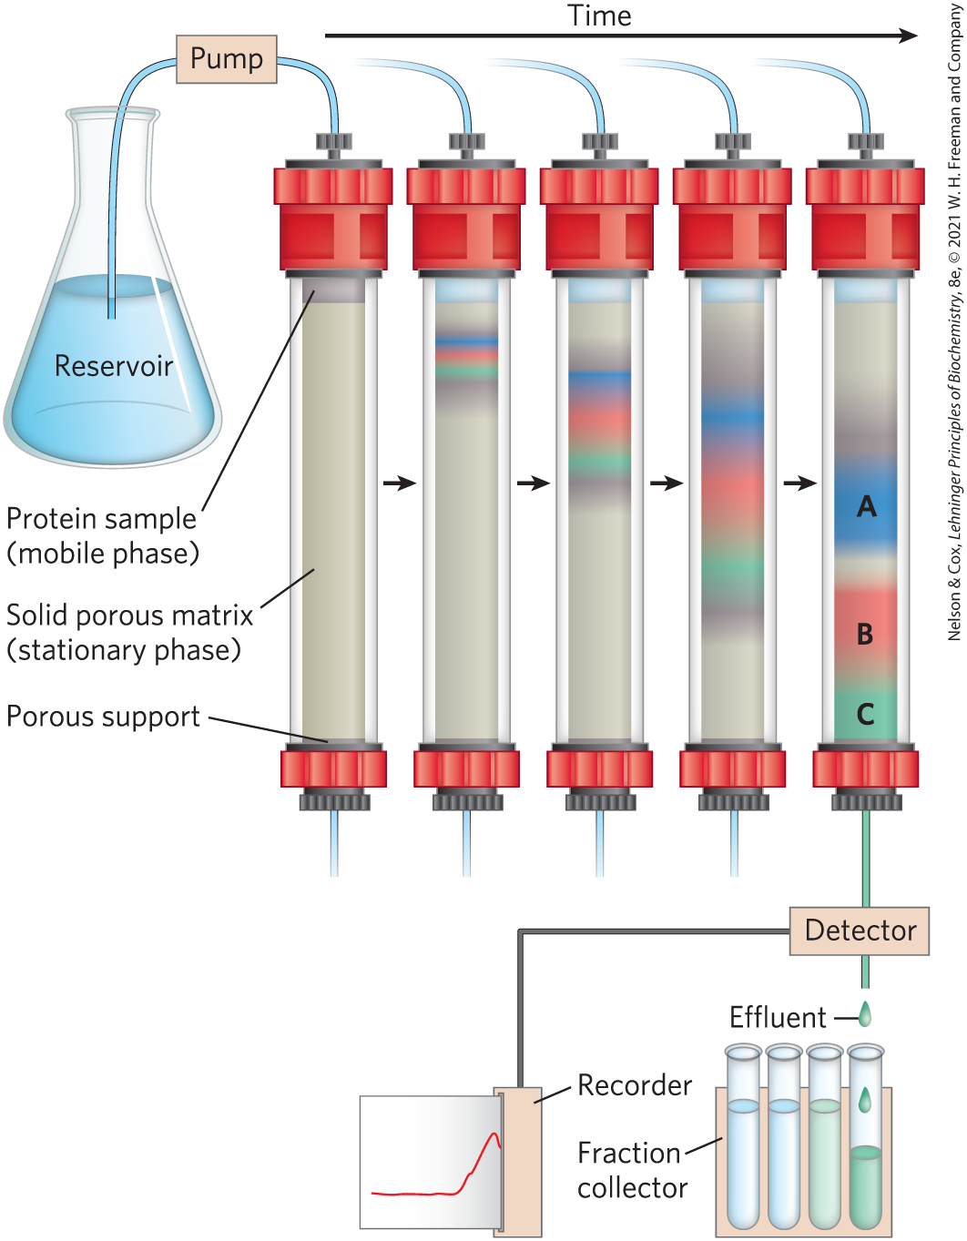
Column Chromatography
first step = buffered solution (mobile phase) migrates through porous solid material (solid phase)
second step = buffered solution containing protein migrates through solid phase
protein properties affect migration rates

Slide 44
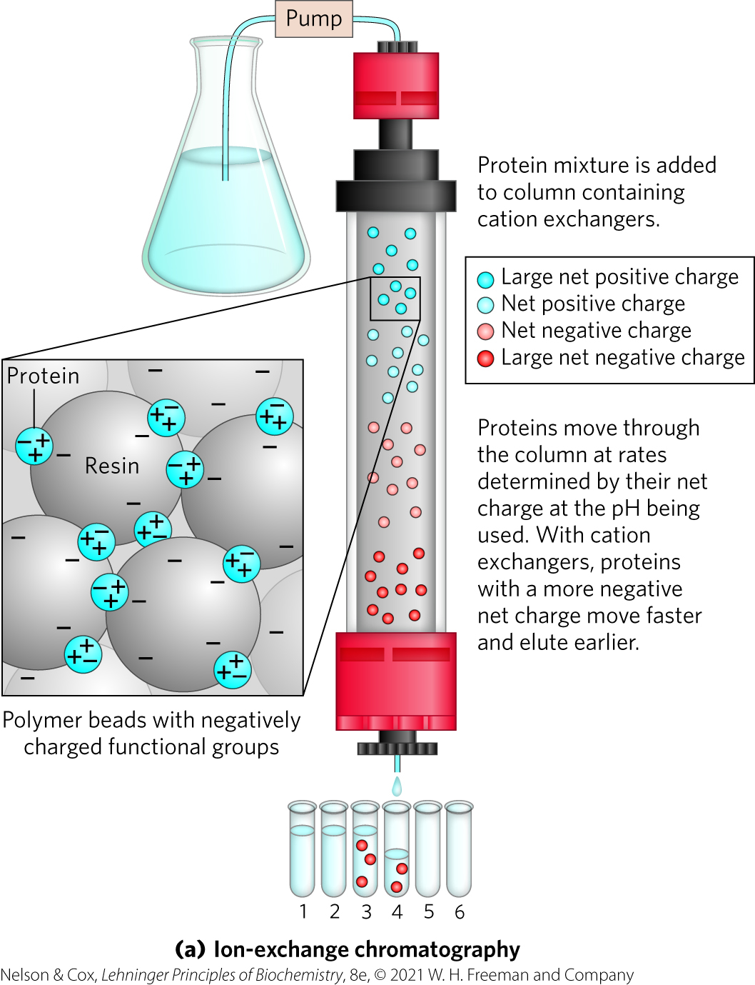
Ion-Exchange Chromatography
separates based on sign and magnitude of the net electric charge
pH and concentration of free salt ions affect protein affinity
uses bound charged groups:
  cation exchangers
  anion exchangers

Slide 45
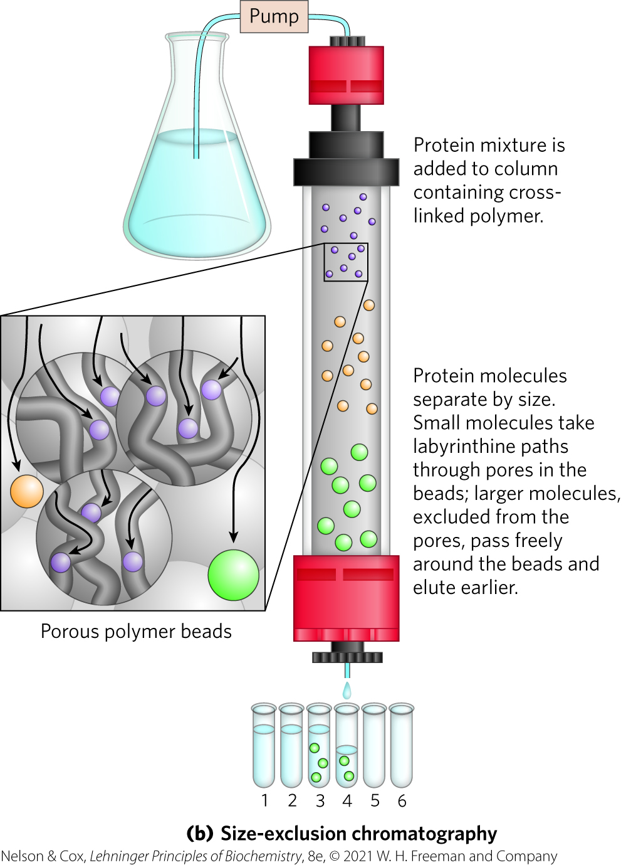
Size-Exclusion Chromatography
also called gel filtration chromatography
separates based on size
large proteins emerge from the column before small proteins do

Slide 46
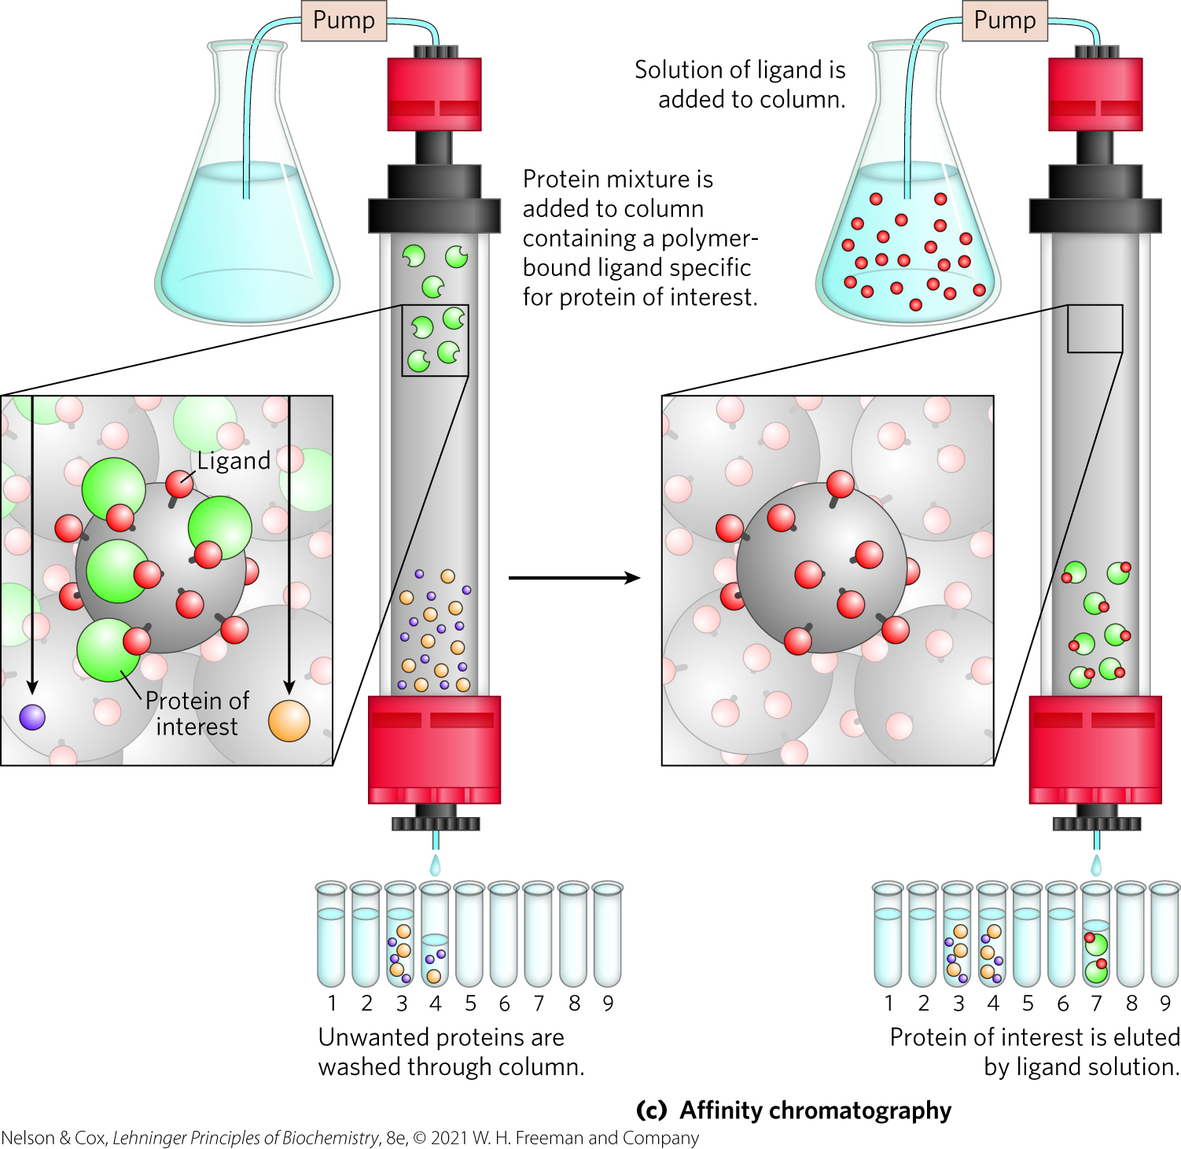
Affinity Chromatography
separates based on binding affinity
eluted by high concentration of salt or ligand

Slide 47
High-Performance Liquid Chromatography
uses high-pressure pumps to move proteins down the column
greatly improves resolution

Slide 48
Sequential Purification Steps Decrease Sample Size
Table 3-5 A Hypothetical Purification Table for an Enzyme
Procedure or step | Fraction volume (mL) | Total protein (mg) | Activity (units) | Specific activity (units/mg)
1. Crude cellular extract | 1,400 | 10,000 | 100,000 | 10
2. Precipitation with ammonium sulfate | 280 | 3,000 | 96,000 | 32
3. Ion-exchange chromatography | 90 | 400 | 80,000 | 200
4. Size-exclusion chromatography80 | 80 | 100 | 60,000 | 600
5. Affinity chromatography | 6 | 3 | 45,000 | 15,000
Note: All data represent the status of the sample after the designated procedure has been carried out. “Activity” and “specific activity” are defined on page 90.
final specific activity: starting specific activity ratio = purification factor
percentage of the final activity/percentage starting activity = percent yield

Slide 49
Proteins Can Be Separated and Characterized by Electrophoresis
electrophoresis = visualize and characterize purified proteins
can be used to estimate:
  number of different proteins in a mixture
  degree of purity
  isoelectric point
  approximate molecular weight

Slide 50
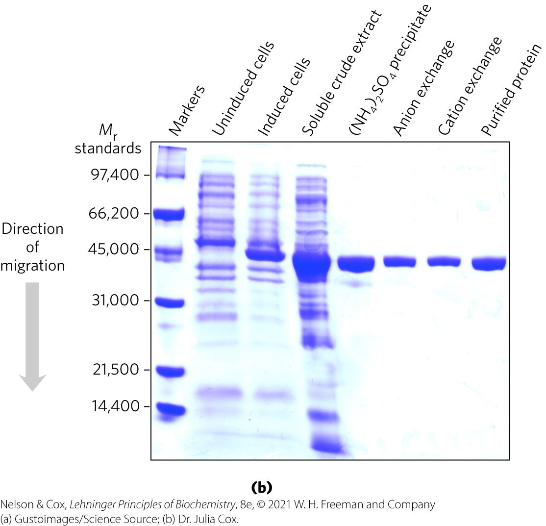
Electrophoresis for Protein Analysis
uses cross-linked polymer polyacrylamide gels
proteins migrate based on charge-to-mass ratio
visualization = Coomassie blue dye binds to proteins

Slide 51
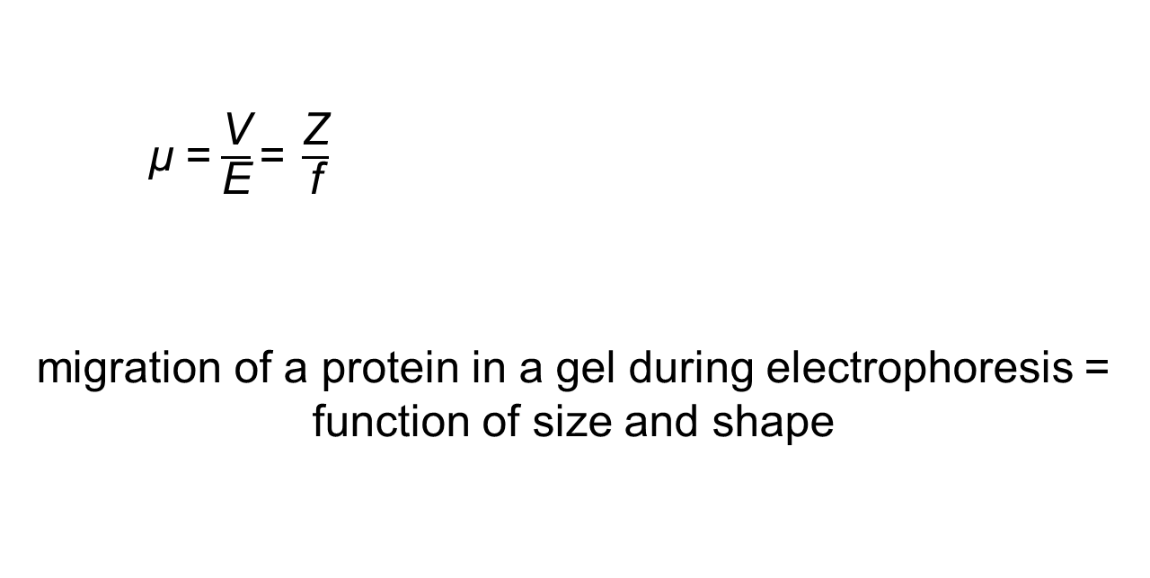
Migration of Proteins during Electrophoresis
  μ =$\frac{\text{V}}{\text{E}}\text{=} \frac{\text{Z}}{\text{f}}$
  migration of a protein in a gel during electrophoresis = function of size and shape
  μ = electrophoretic mobility
  V = velocity
  E = electrical potential
  Z = net charge
  f = frictional coefficient

Slide 52
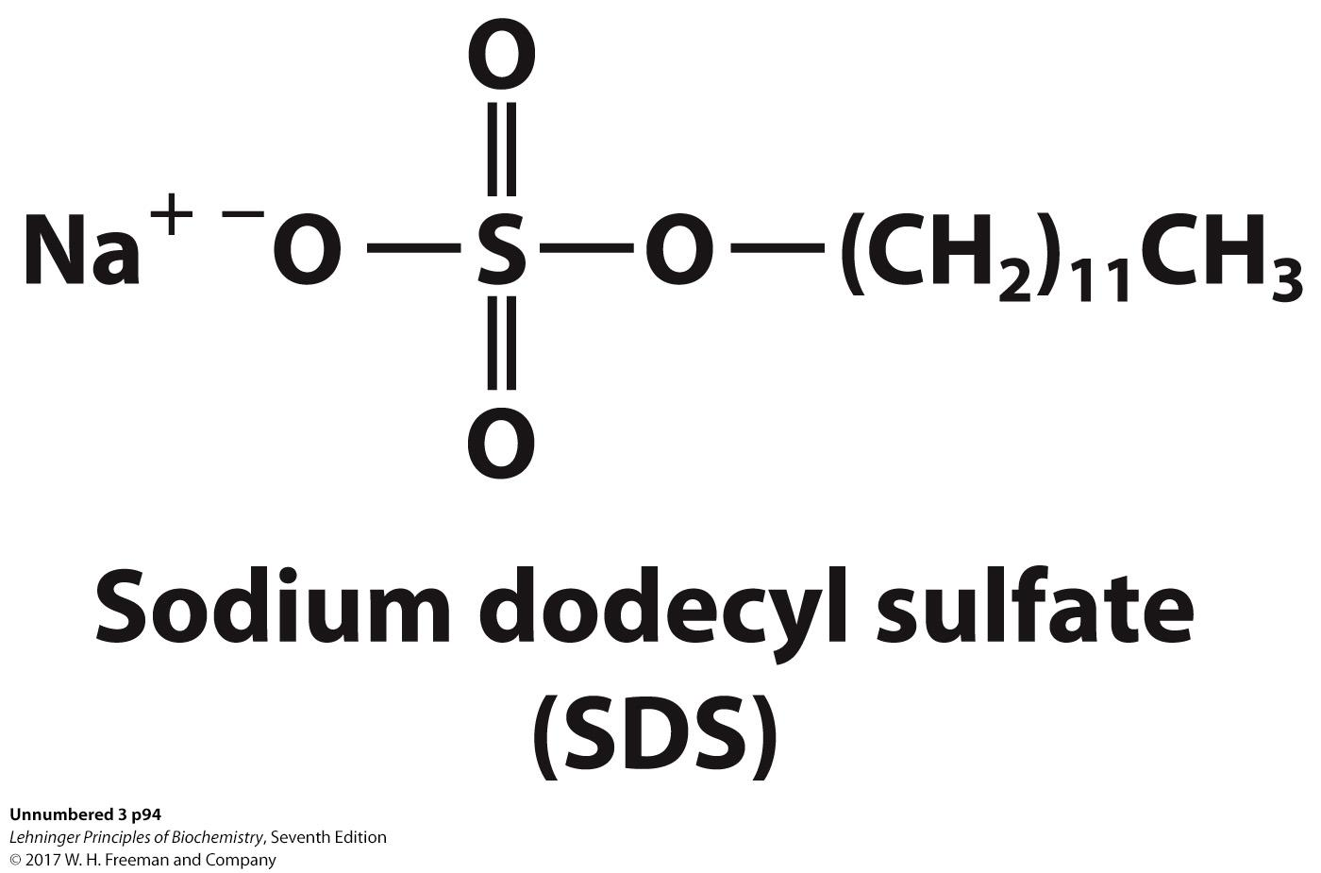
Sodium Dodecyl Sulfate (SDS)
sodium dodecyl sulfate (SDS) = a detergent
  binds and partially unfolds proteins
  gives all proteins a similar charge-to-mass ratio
  electrophoresis in the presence of SDS separates proteins by molecular weight
    smaller proteins migrate more rapidly

Slide 53
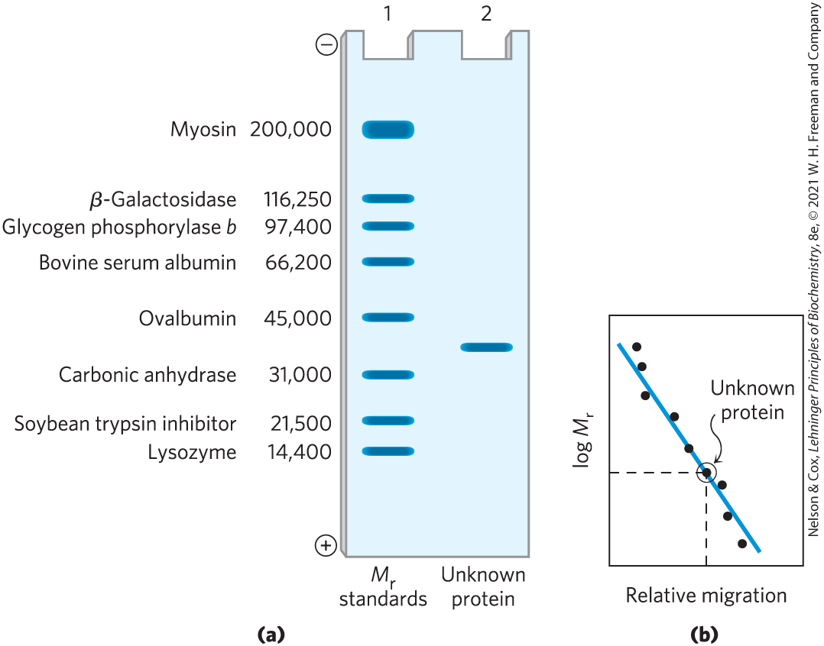
Estimating the Molecular Weight of a Protein
plot of log M_{r} of marker proteins vs. relative migration during electrophoresis = linear

Slide 54
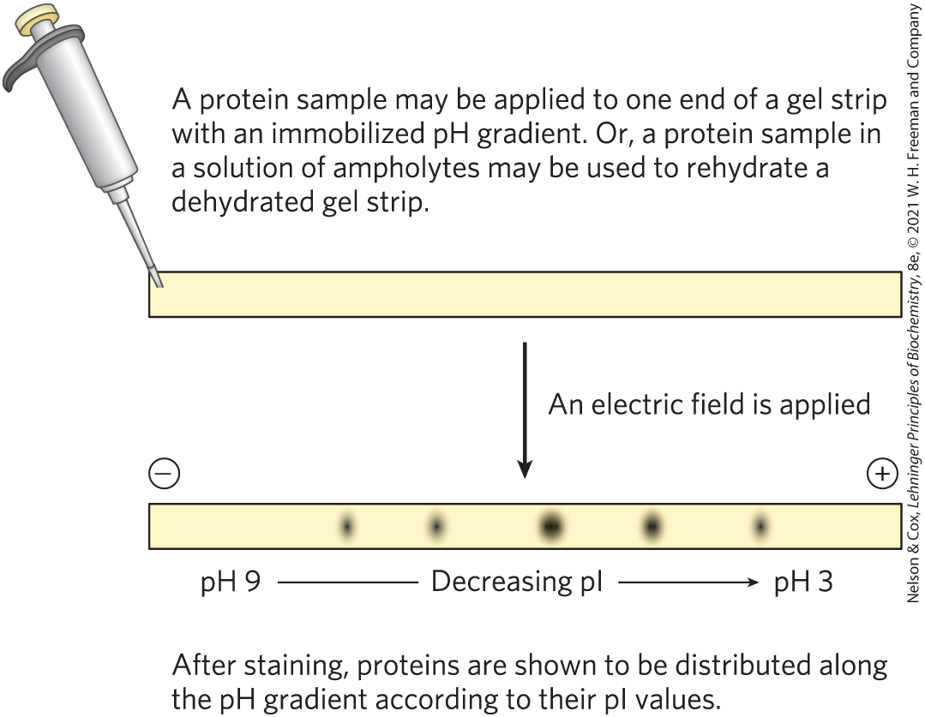
Using Isoelectric Focusing to Determine the pI of a Protein

Slide 55
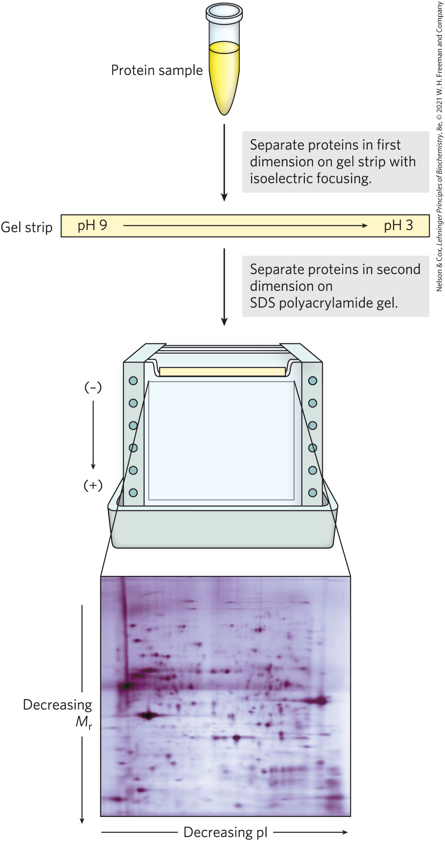
Two-Dimensional Electrophoresis
permits resolution of complex protein mixtures of proteins
more sensitive than individual methods

Slide 56
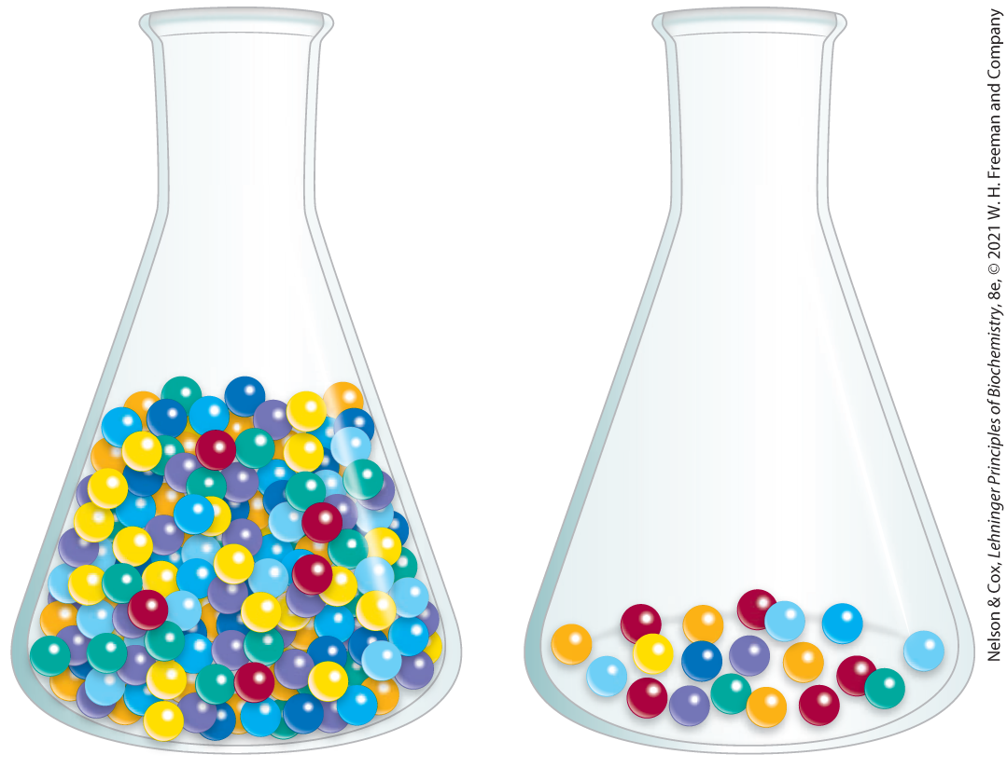
Unseparated Proteins Are Detected and Quantified Based on Their Functions
can monitor enzyme purification by assaying specific activity:
  activity = total enzyme units in a solution
  specific activity = number of enzyme units per mg of total protein

Slide 57
3.4 The Structure of Proteins: Primary Structure

Slide 58
Principle 2 (3 of 3)
In proteins, amino acids are joined in characteristic linear sequences through a common amide linkage, the peptide bond. The amino acid sequence of a protein constitutes its primary structure, a first level we will introduce within the broader complexities of protein structure.

Slide 59
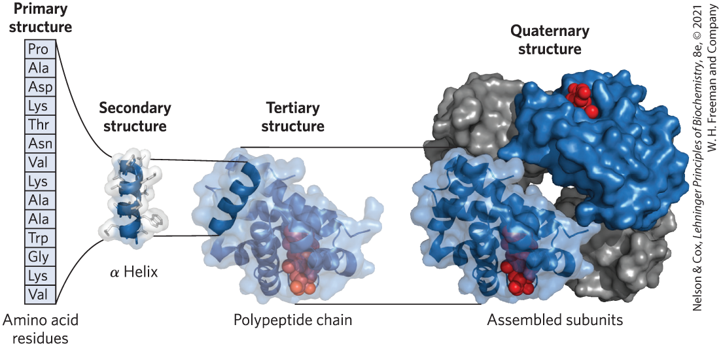
Levels of Structure in Proteins
four levels:
  primary structure = covalent bonds linking amino acid residues in a polypeptide chain
  secondary structure = recurring structural patterns
  tertiary structure = 3D folding of polypeptide
  quaternary structure = 2+ polypeptide subunits

Slide 60
Principle 4 (2 of 2)
Shaped by evolution, amino acid sequences are a key resource for understanding the function of individual proteins and for tracing broader functional and evolutionary relationships.

Slide 61
The Function of a Protein Depends on Its Amino Acid Sequence
amino acid sequence confers 3D structure
3D structure confers function
most human proteins = polymorphic = have amino acid sequence variants
Edman degradation = classic method of sequencing amino acids

Slide 62
Protein Structure Is Studied Using Methods That Exploit Protein Chemistry
traditional protein sequencing techniques:
  labeling proteins
  breaking proteins into parts

Slide 63
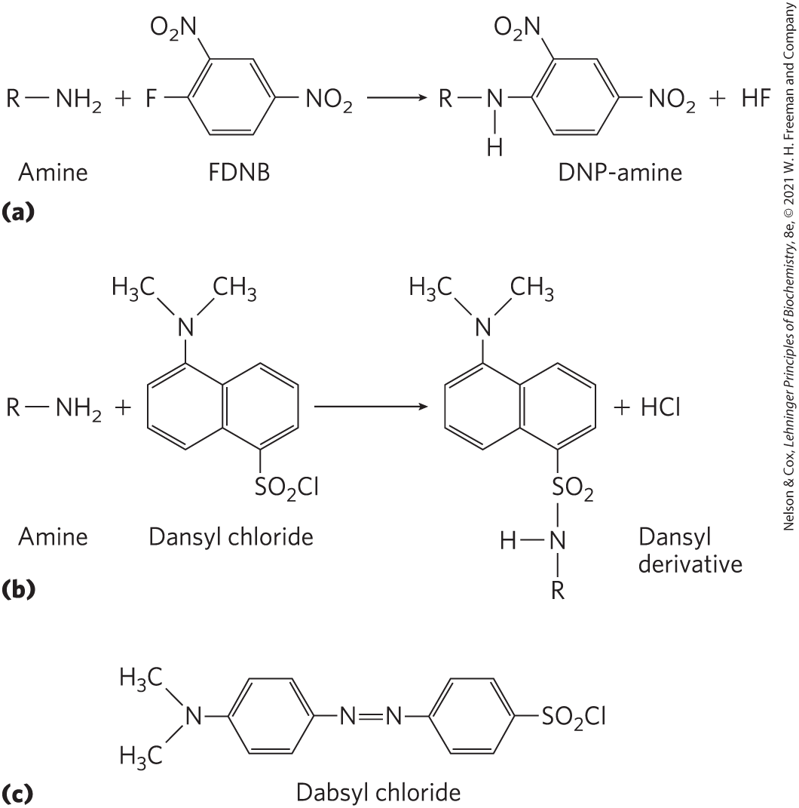
Studying Protein Structure through Labeling
FDNB, dansyl chloride, dabsyl chloride = label amino-terminal α-amino group and ε-amino group of lysine residues

Slide 64
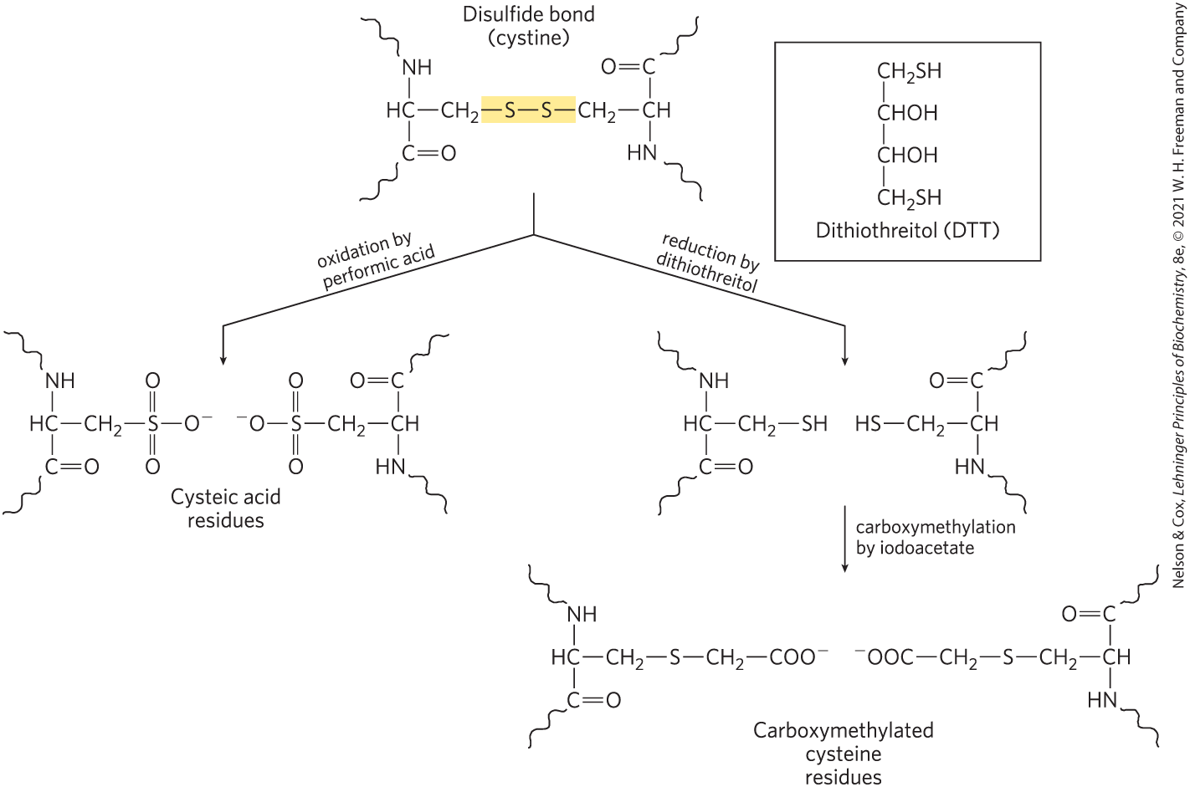
Studying Protein Structure through Breaking Bonds
oxidation with performic acid or reduction by dithiothreitol = breaks disulfide bonds, denatures proteins

Slide 65
Studying Protein Structure Using Proteases
proteases = catalyze hydrolytic cleavage of peptide bonds
Table 3-6 The Specificity of Some Common Methods for Fragmenting Polypeptide Chains
Reagent (biological source) | Cleavage points
Trypsin (bovine pancreas) | Lys, Arg (C)
Chymotrypsin (bovine pancreas) | Phe, Trp, Tyr (C)
Staphylococcus aureus V8 protease (bacterium S. aureus) | Asp, Glu (C)
Asp-N-protease (bacterium Pseudomonas fragi) | Asp, Glu (N)
Pepsin (porcine stomach) | Leu, Phe, Trp, Tyr (N)
Endoproteinase Lys C (bacterium lysobacter enzymogenes) | Lys (C)
Cyanogen bromide | Met (C)
Notes:
See Table 3-6 in text for footnotes.

Slide 66
Mass Spectrometry Provides Information on Molecular Mass, Amino Acid Sequence, and Entire Proteomes
mass spectrometry = measure molecular mass with high accuracy
  can sequence short amino acid sequences (20 to 30 amino acid residues)
  can document the entire cellular proteome

Slide 67
General Steps Involved in Mass Spectrometry
first step: ionize analytes in a vacuum
second step: introduce charged molecules to electric and/or magnetic field
third step: charged molecules move through field as a function of the mass-to-charge ratio, m/z
fourth step: deduce mass (m) of analyte

Slide 68
Matrix-Assisted Laser Desorption/Ionization Mass Spectrometry (MALDI MS)
proteins placed in light-absorbing matrix
pulse of laser light ionizes and desorbs proteins from matrix

Slide 69
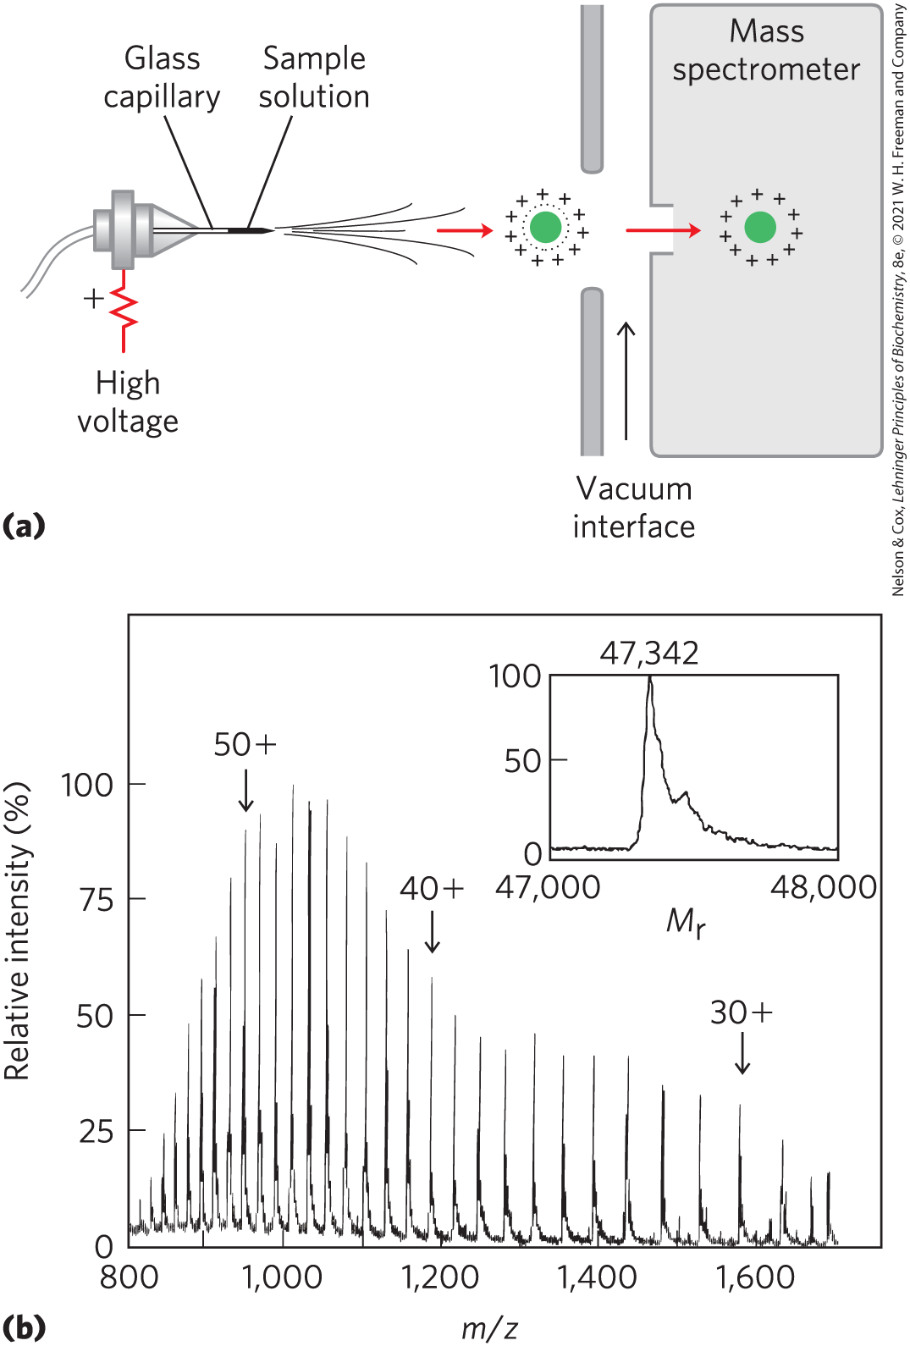
Electrospray Ionization Mass Spectrometry (ESI MS)
macromolecules forced directly from the liquid to gas phase

Slide 70
Methods for Analyzing the Mass-to-Charge Ratio, m/z
time of flight (TOF) = ion acceleration in an electric field depends on m/z
Orbitrap = traps ions in orbit, electron trajectory converted to m/z

Slide 71
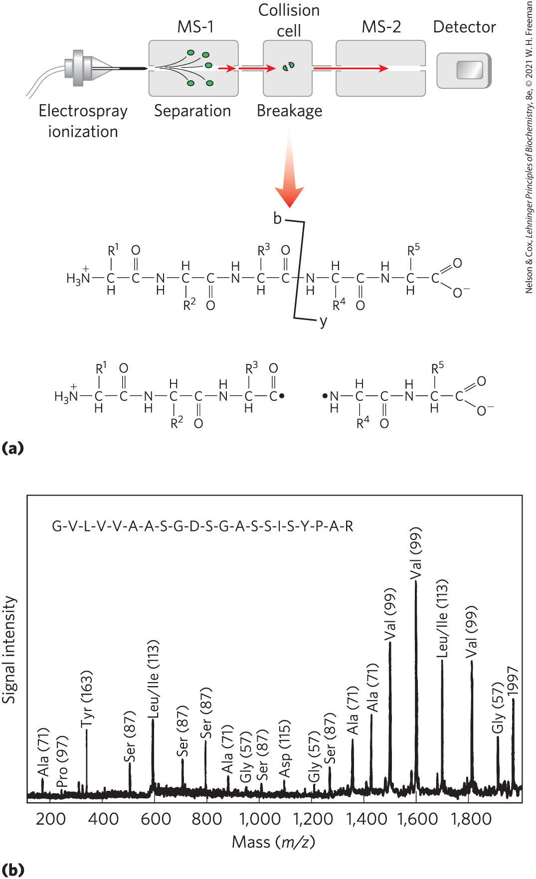
Extracting Amino Acid Sequence Information Using Tandem MS
tandem MS (MS/MS) = two mass filters in tandem
  first = sorts peptides produced by cleavage
  second = measures m/z ratios of charged fragments

Slide 72
Analyzing Complex Protein Mixtures Using Liquid Chromatography (LC)
LC-MS/MS = liquid chromatography-tandem MS
  chromatography on complex mixture of peptides
  resolved peptides introduced to MS successively
  identifies proteins and protein abundance

Slide 73
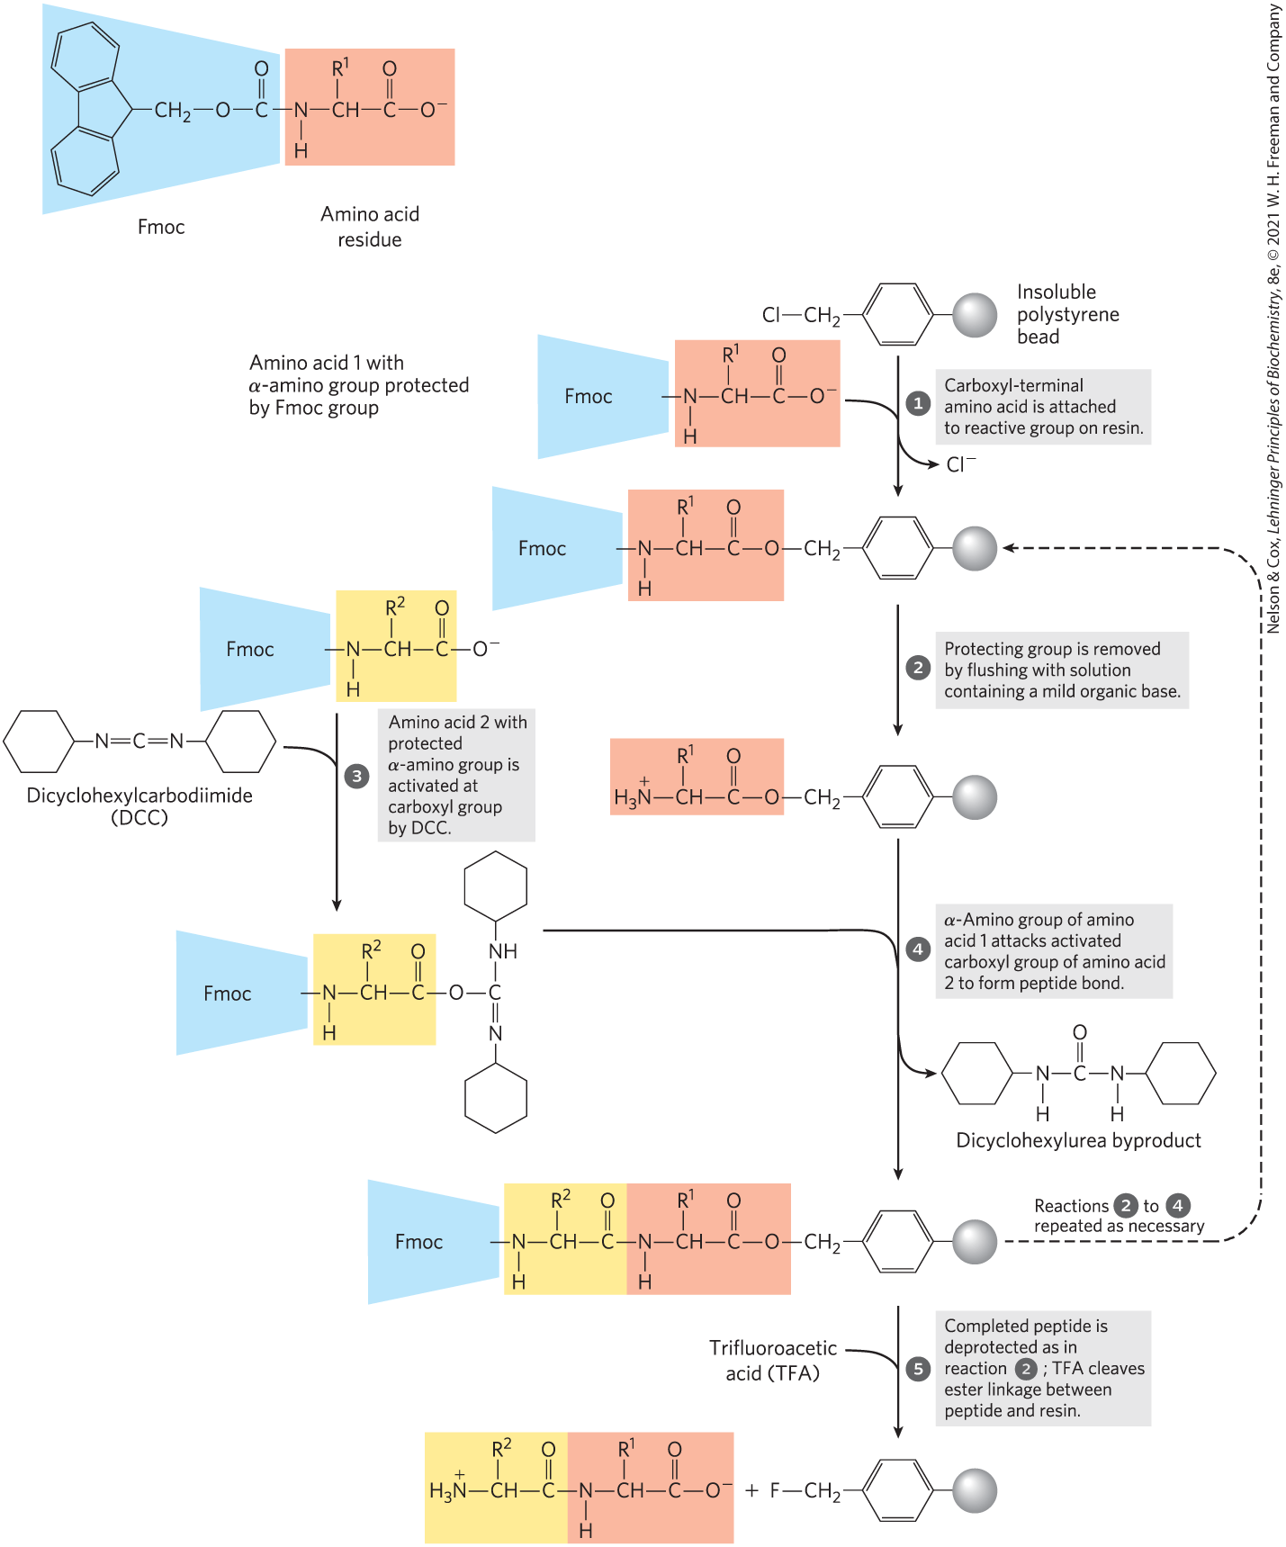
Small Peptides and Proteins Can Be Chemically Synthesized
the Merrifield method
one end of peptide = attached to resin in column
protective chemical groups block unwanted reactions

Slide 74
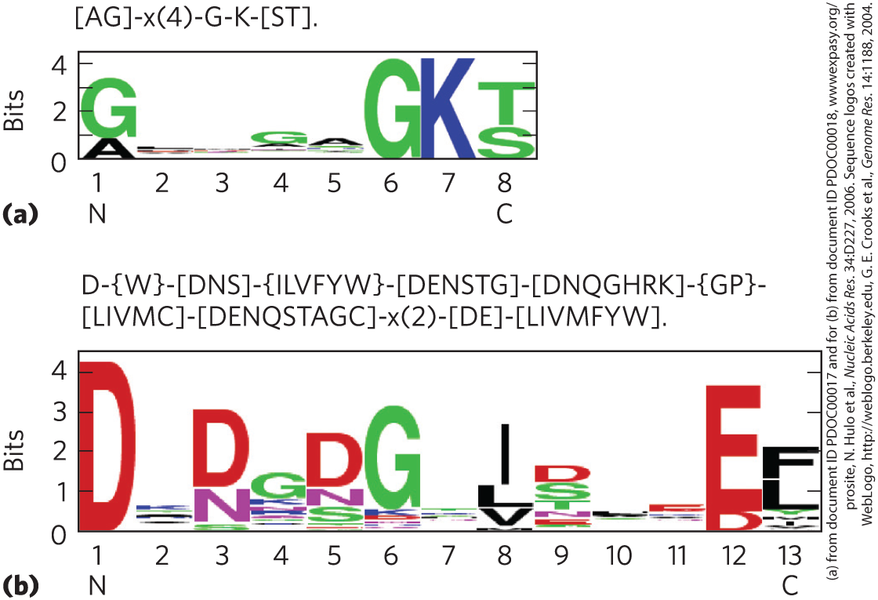
Amino Acid Sequences Provide Important Biochemical Information
amino acid sequence can inform:
  3D structure
  function
  cellular location
  evolution
consensus sequence = reflects most common amino acid at each position

Slide 75
Protein Sequences Help Elucidate the History of Life on Earth
bioinformatics:
  identifies functional segments in new proteins
  establishes sequence and structural relationships to known proteins
essential amino acid residues = conserved over evolutionary time
less important amino acid residues = vary over evolutionary time

Slide 76
Transfer of Genes from Organism to Organism
horizontal gene transfer = transfer of a gene or group of genes from one organism to another
  proteins derived from transferred genes are not good candidates for bacterial evolution studies
  for example, rapid spread of antibiotic-resistance genes in bacterial populations

Slide 77
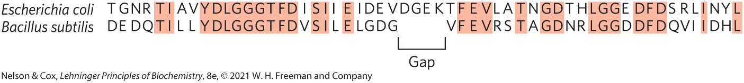
Defining Members of Protein Families
homologs = homologous proteins = members of protein families
  paralogs = homologs in same species
  orthologs = homologs in different species
  identified by comparing protein sequences to a database of protein sequences

Slide 78
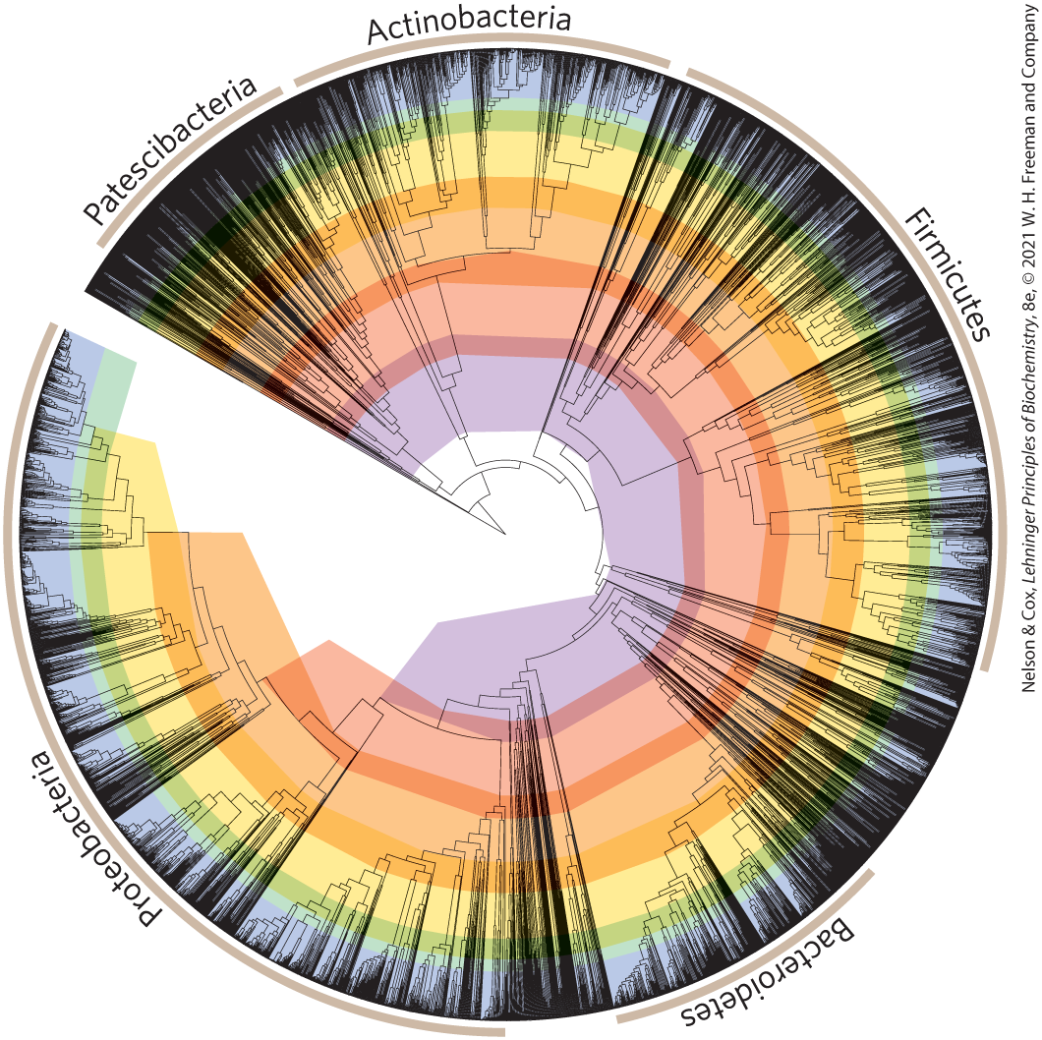
Constructing Evolutionary Trees
segregate organisms into classes based on sequence divergence in protein families
signature sequences = certain protein segments specific to a taxonomic group

