Slide 1

1 The Foundations of Biochemistry
© 2021 Macmillan Learning

Slide 2
Life Arose on Earth around 4 Billion Years Ago
simple microorganisms:
  extracted energy from chemical compounds and sunlight
  used energy to make biomolecules from the simple elements and compounds on the Earth’s surface

Slide 3

Principle 1 (1 of 2)
Cells are the fundamental unit of life. Although they vary in complexity and can be highly specialized for their environment or function within a multicellular organism, they share remarkable similarities.

Slide 4

Principle 2 (1 of 6)
Cells use a relatively small set of carbon- based metabolites to create polymeric machines, supramolecular structures, and information repositories. The chemical structure of these components defines their cellular function. The collection of molecules carries out a program, the end result of which is reproduction of the program and self-perpetuation of that collection of molecules—in short, life.

Slide 5

Principle 3 (1 of 5)
Living organisms exist in a dynamic
steady state, never at equilibrium with
their surroundings. Following the laws of thermodynamics, living organisms extract energy from their surroundings and employ it to maintain homeostasis and do useful work. Essentially all of the energy obtained by a cell comes from the flow of electrons, driven by sunlight or by metabolic redox reactions.

Slide 6

Principle 4 (1 of 5)
Cells have the capacity for precise self-replication and self-assembly using chemical information stored in the genome. A single bacterial cell placed in a sterile nutrient medium can give rise to a billion identical “daughter” cells in 24 hours. Each cell is a faithful copy of the original, its construction directed entirely by information contained in the genetic material of the original cell. On a larger scale, the progeny of vertebrate animals share a striking resemblance to their parents, also the result of their inheritance of parental genes.

Slide 7

Principle 5 (1 of 3)
Living organisms change over time by gradual evolution. The result of eons of evolution is an enormous diversity of life forms, fundamentally related through their shared ancestry, which can be seen at the molecular level in the similarity of gene sequences and protein structures.

Slide 8
What Is Biochemistry?
biochemistry = describes the structures, mechanisms, and chemical processes shared by all organisms

Slide 9
1.1 Cellular Foundations

Slide 10
Principle 1 (2 of 2)
Cells are the fundamental unit of life. Although they vary in complexity and can be highly specialized for their environment or function within a multicellular organism, they share remarkable similarities.

Slide 11
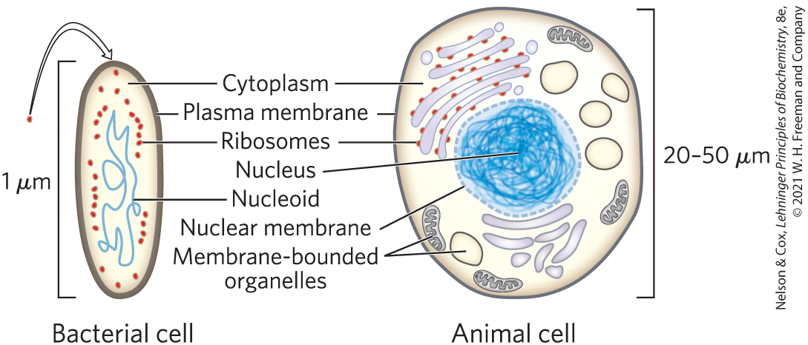
Cells Are the Structural and Functional Units of All Living Organisms

Slide 12
The Plasma Membrane
plasma membrane = defines the periphery of the cell
  composed of lipid and protein molecules
  thin, flexible, hydrophobic barrier around the cell
  contains embedded transport proteins, receptor proteins, and membrane enzymes

Slide 13
Cytoplasm Contains Cytosol and Suspended Particles
cytoplasm = internal volume enclosed by the plasma membrane
  composed of the cytosol (an aqueous solution) and a variety of suspended particles (such as mitochondria, chloroplasts, ribosomes, and proteasomes)
cytosol = highly concentrated solution
  contains enzymes, RNA, amino acids, nucleotides, metabolites, coenzymes, and inorganic ions

Slide 14
The Nucleoid or Nucleus of a Cell Stores the Genome
genome = complete set of genes, composed of DNA
  bacteria and archaea (formally grouped as prokaryotes) store their genome in a nucleoid
  eukaryotes store their genome in a membrane-enclosed nucleus

Slide 15
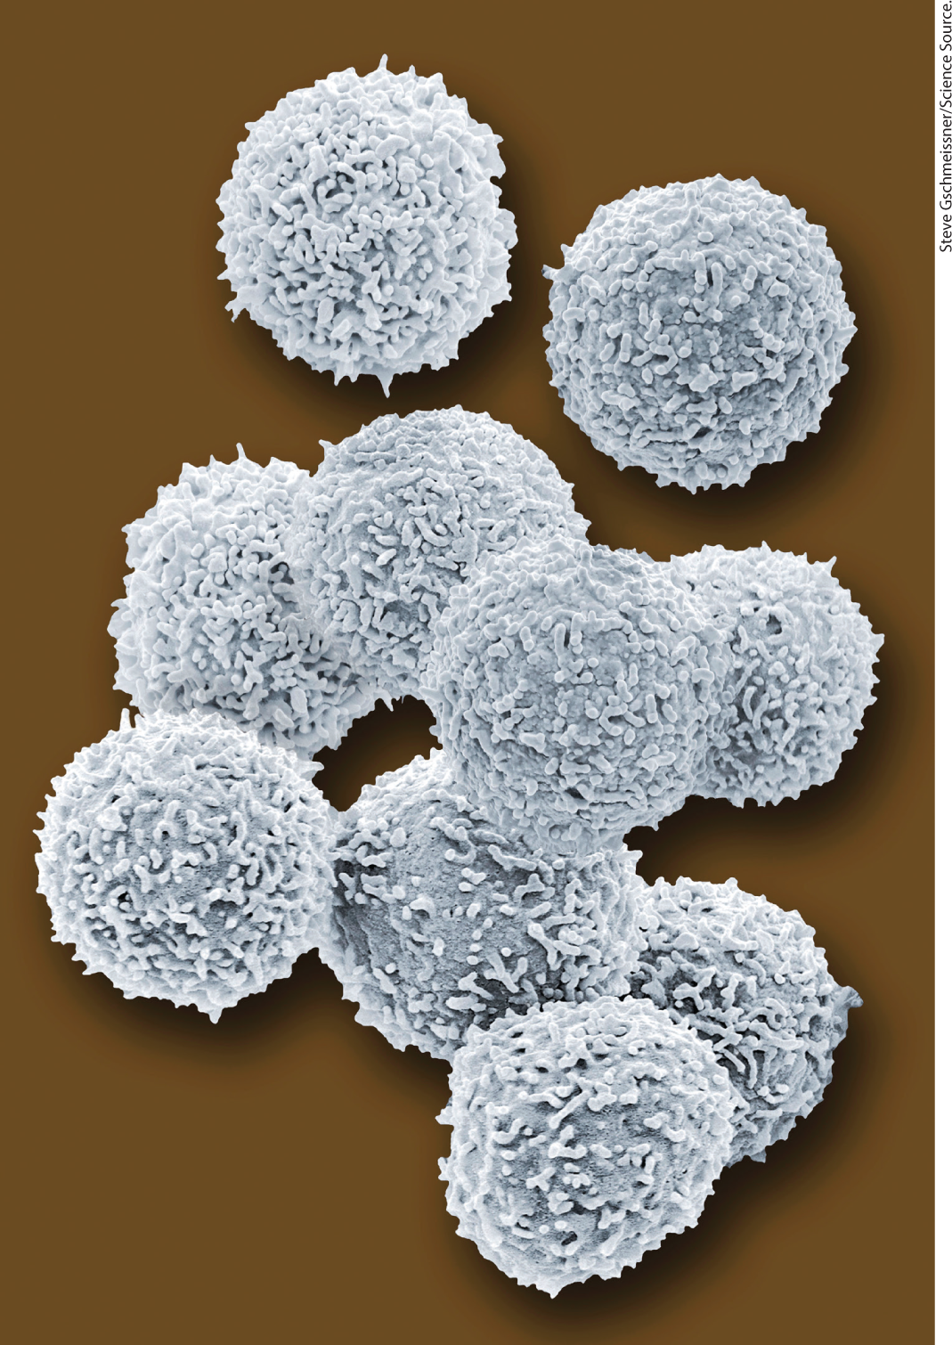
Cellular Dimensions Are Limited by Diffusion
cells are microscopic:
  animal and plant cells:
  5 to 100 μm in diameter
  unicellular microorganisms: 1 to 2 μm long
upper limit of cell size is likely set by the rate of transport and the need to deliver O₂ to all parts of the cell
  as size increases, surface-to-volume ratio decreases
human lymphocytes

Slide 16
Organisms Belong to Three Distinct Domains of Life
Bacteria = inhabit soils, surface waters, and the tissues of other living or decaying organisms
Archaea = inhabit extreme environments
Eukarya = all eukaryotic organisms
  more closely related to archaea than bacteria

Slide 17
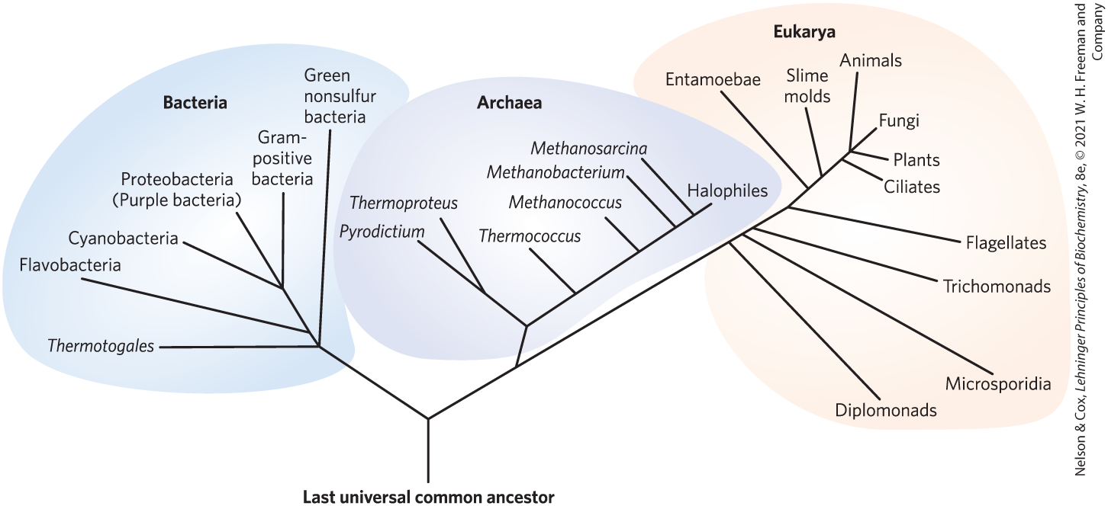
Phylogeny of the Three Domains of Life

Slide 18
Archaea and Bacteria Subgroups Are Distinguished by Their Habitats
aerobic = plentiful supply of O₂; organisms transfer electrons from fuel to O₂ for energy
anaerobic = devoid of O₂; organisms transfer electrons to nitrate, sulfate or CO₂ for energy
  obligate anaerobes = die when exposed to O₂
  facultative anaerobes = can live with or without O₂

Slide 19
Principle 3 (2 of 5)
Living organisms exist in a dynamic
steady state, never at equilibrium with
their surroundings. Following the laws of thermodynamics, living organisms extract energy from their surroundings and employ it to maintain homeostasis and do useful work. Essentially all of the energy obtained by a cell comes from the flow of electrons, driven by sunlight or by metabolic redox reactions.

Slide 20
Organisms Differ Widely in Their Sources of Energy and Biosynthetic Precursors
phototrophs = trap and use sunlight
chemotrophs = derive energy from oxidation of a chemical fuel
autotrophs = can synthesize all their biomolecules directly from CO₂
heterotrophs = require some preformed organic nutrients made by other organisms

Slide 21
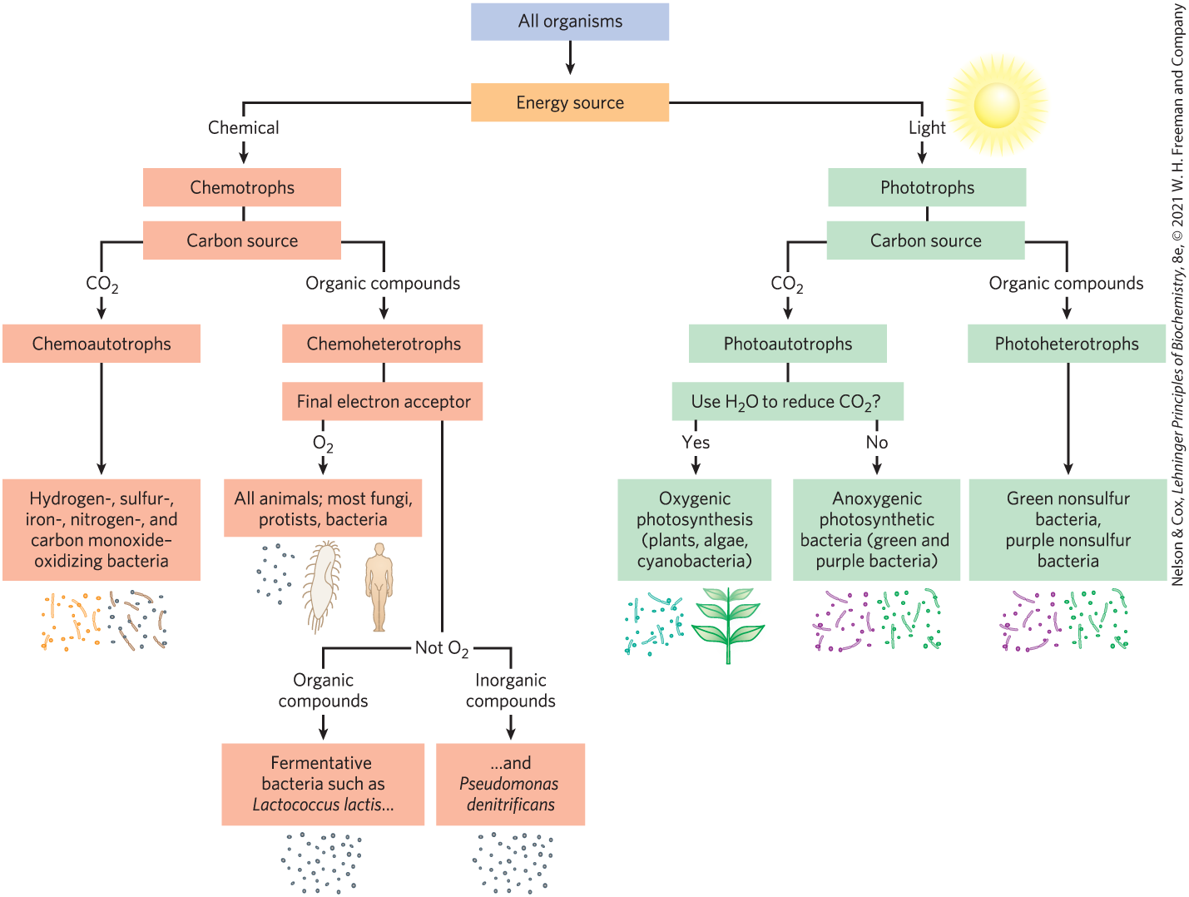
Classifying Organisms According to Their Source of Energy

Slide 22
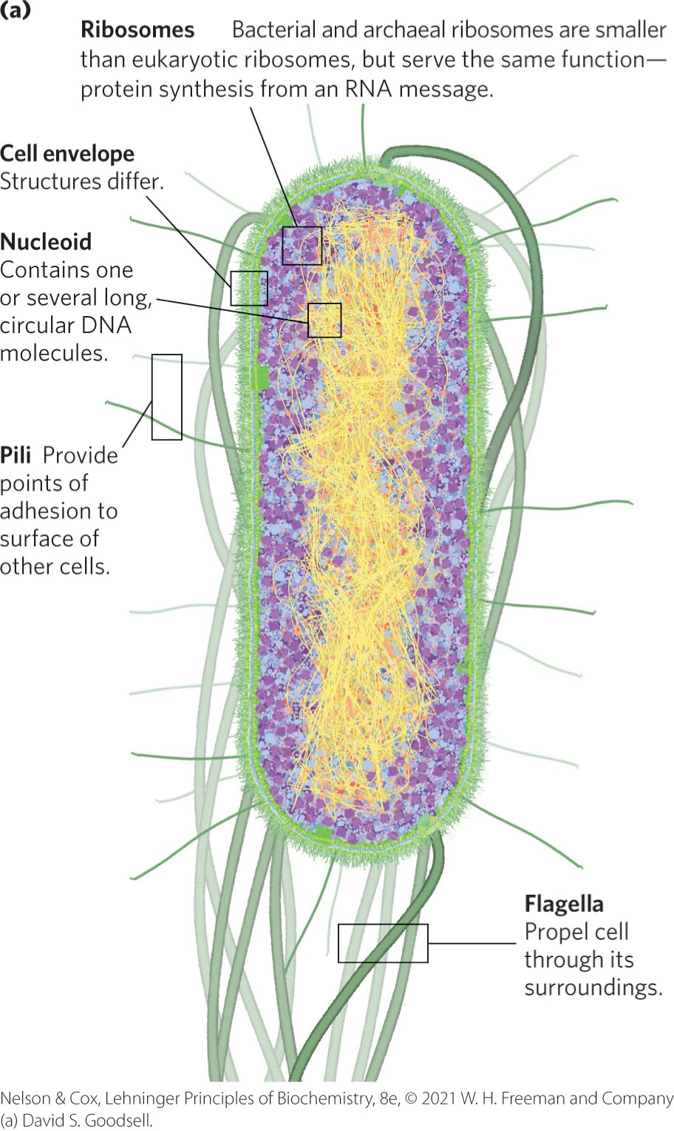
Bacteria and Archaeal Cells Share Common Features but Differ in Important Ways
cell envelope = composed of plasma membrane, outer membrane, and peptidoglycan (high molecular weight polymer)

Slide 23
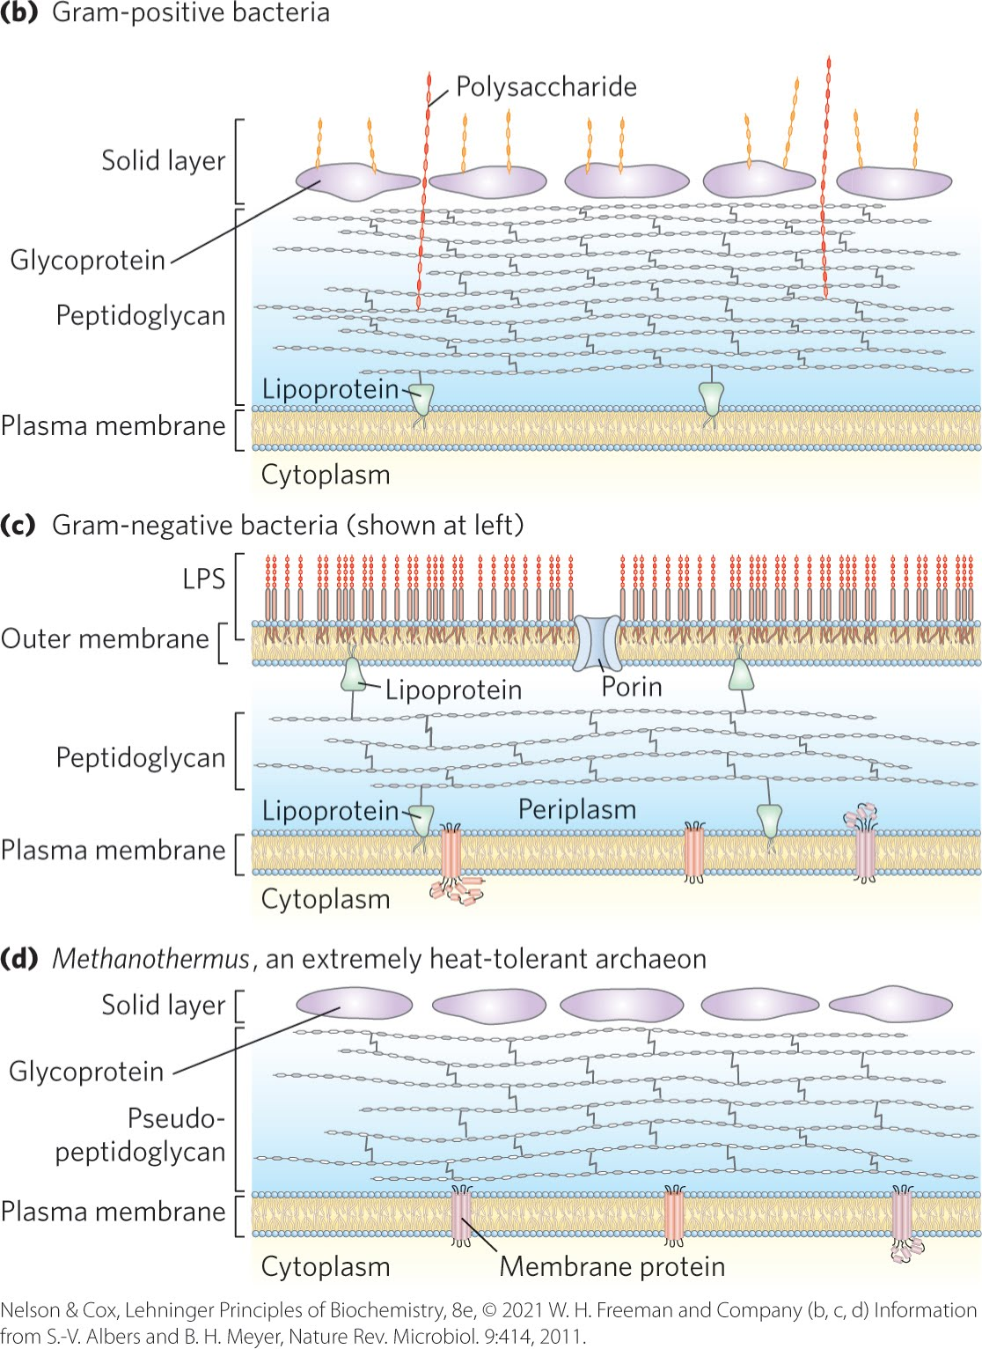
Bacterial and Archaeal Cell Envelopes
gram-positive bacteria:
  colored by Gram’s stain
  thick peptidoglycan layer outside plasma membrane
  lack an outer membrane
gram-negative bacteria:
  outer membrane composed of a lipid bilayer
archaea:
  layer of peptidoglycan or protein confers rigidity on their cell envelopes

Slide 24
Principle 2 (2 of 6)
Cells use a relatively small set of carbon- based metabolites to create polymeric machines, supramolecular structures, and information repositories. The chemical structure of these components defines their cellular function. The collection of molecules carries out a program, the end result of which is reproduction of the program and self-perpetuation of that collection of molecules—in short, life.

Slide 25
The E. coli Cytoplasm
contains ribosomes, enzymes, metabolites, cofactors, and inorganic ions.
the nucleoid contains a single, circular molecule of DNA
plasmids = smaller, circular segments of DNA that confer resistance to toxins and antibiotics in the environment

Slide 26
Eukaryotic Cells Have a Variety of Membranous Organelles, Which Can Be Isolated for Study
mitochondria = the site of most of the energy-extracting reactions of the cell
endoplasmic reticulum and Golgi complexes = play central roles in the synthesis and processing of lipids and membrane proteins
peroxisomes = site of the oxidation of very-long-chain fatty acids and detoxification of reactive oxygen species
lysosomes = filled with digestive enzymes
granules or droplets containing stored nutrients, such as starch and fat

Slide 27
Plant Cell Organelles
vacuoles = store large quantities of organic acids
chloroplasts = where sunlight drives the synthesis of ATP (adenosine triphosphate) in the process of photosynthesis

Slide 28
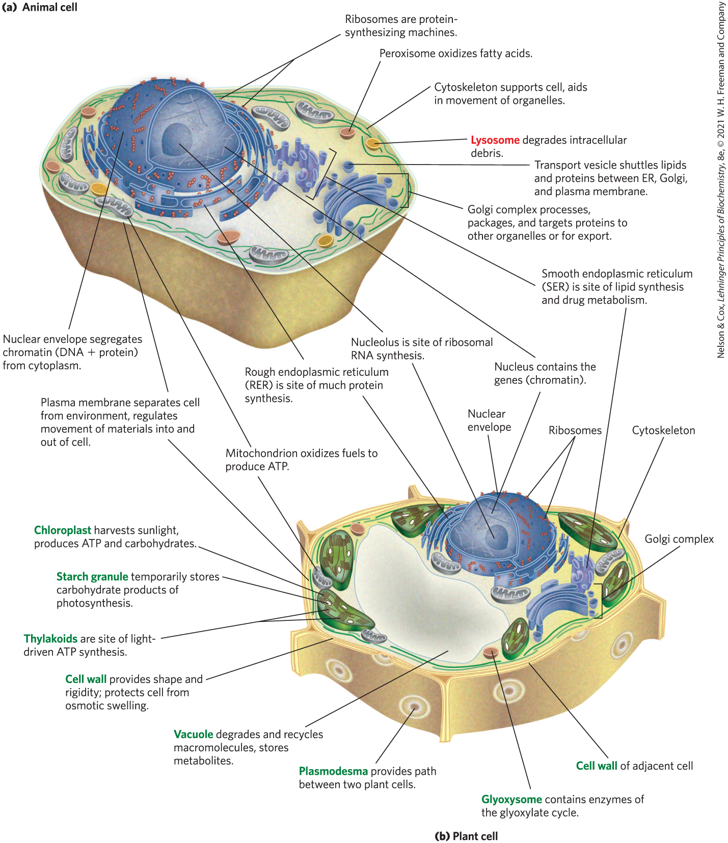
Eukaryotic Cell Structure

Slide 29
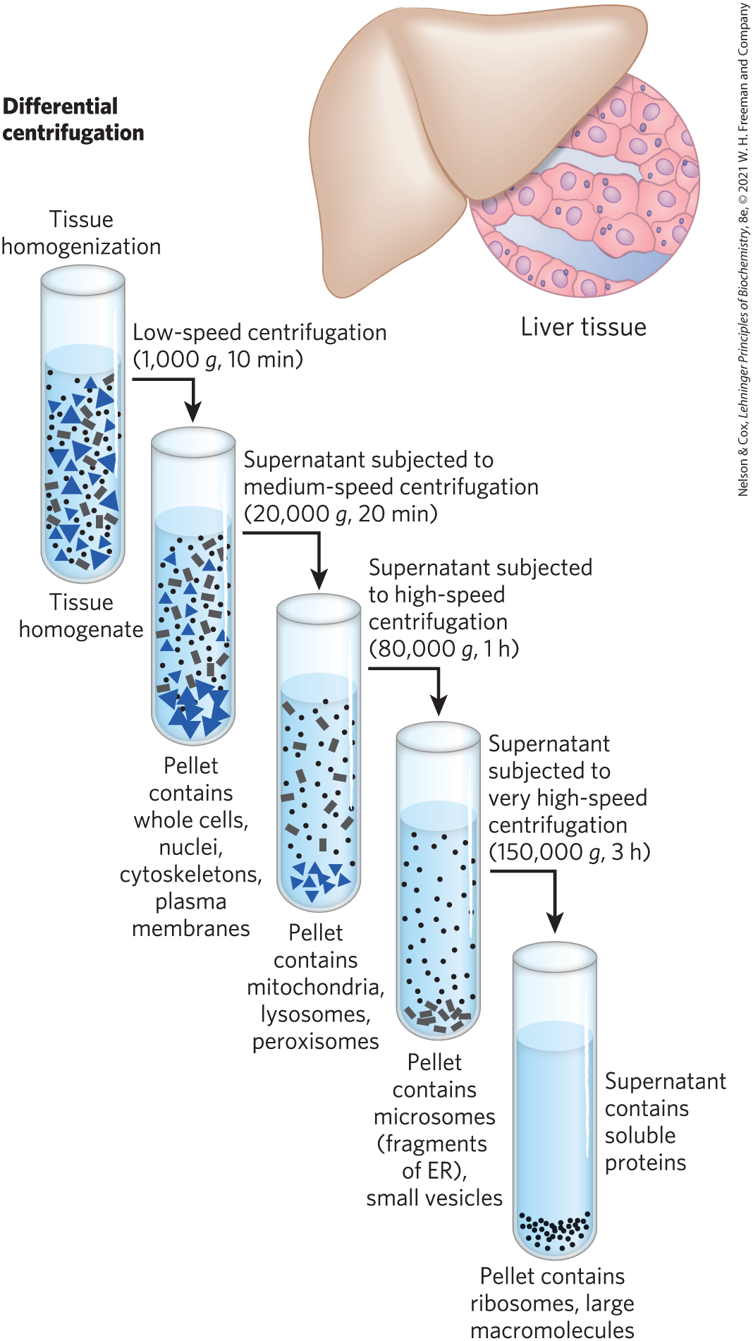
Subcellular Fractionation of Tissue
first step = gently disrupt cells or tissues by physical shear to rupture the plasma membrane
second step = centrifuge the homogenate
organelles differ in size and sediment at different rates

Slide 30
The Cytoplasm Is Organized by the Cytoskeleton and Is Highly Dynamic
cytoskeleton = three-dimensional network of protein filaments in eukaryotic cells
  actin filaments
  microtubules
  intermediate filaments
filaments undergo constant disassembly into their protein subunits and reassembly into filaments

Slide 31
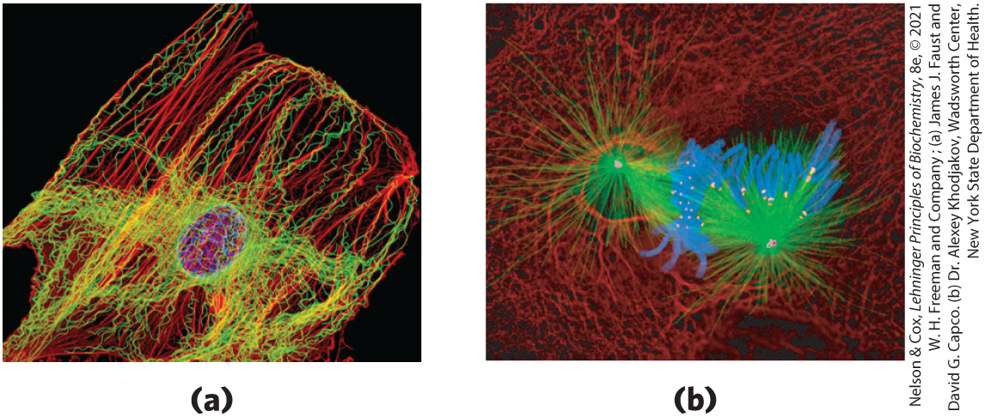
Cytoskeletal Filaments
actin filaments microtubules
chromosomes
microtubules
kinetochores
chromosomes centrosomes
intermediate filaments

Slide 32
The Structural Organization of the Cytoplasm
endomembrane system = segregates specific metabolic processes and provides surfaces on which certain enzyme-catalyzed reactions occur
exocytosis and endocytosis = mechanisms of transport (out of and into cells, respectively)
  involve membrane fusion and fission
  provide paths between the cytoplasm and the surrounding medium

Slide 33
Principle 2 (3 of 6)
Cells use a relatively small set of carbon- based metabolites to create polymeric machines, supramolecular structures, and information repositories. The chemical structure of these components defines their cellular function. The collection of molecules carries out a program, the end result of which is reproduction of the program and self-perpetuation of that collection of molecules—in short, life.

Slide 34
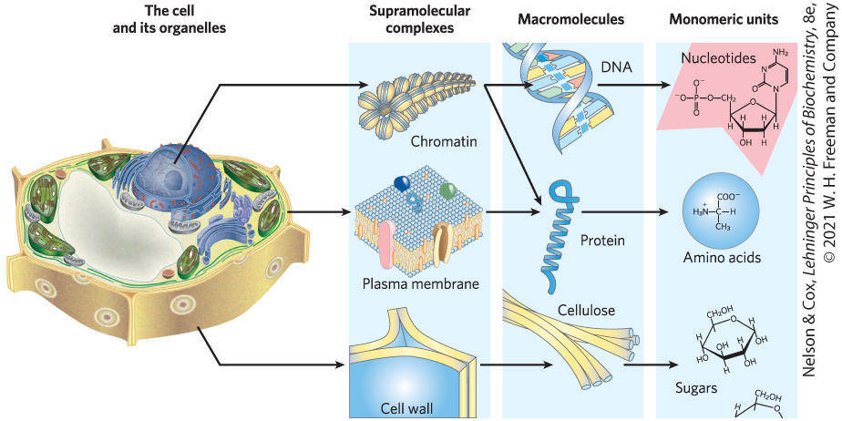
Cells Build Supramolecular Structures
held together by noncovalent interactions (hydrogen bonds, ionic interactions, van der Waals interactions, and the hydrophobic effect)

Slide 35
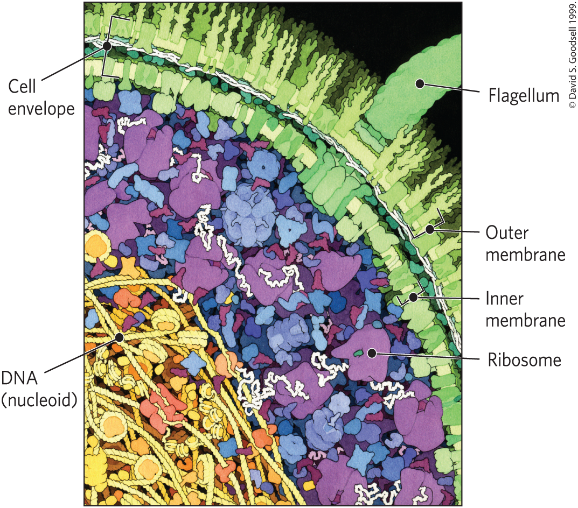
In Vitro Studies May Overlook Important Interactions among Molecules
in vitro = “in glass”
in vivo = “in the living”
molecules may behave differently in vivo and in vitro

Slide 36
1.2 Chemical Foundations

Slide 37
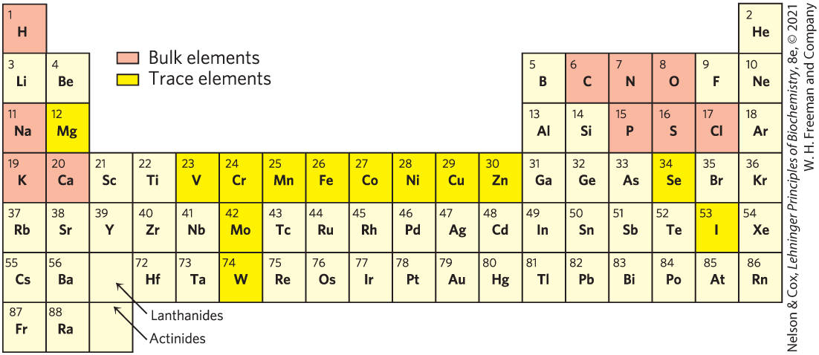
Elements Essential to Animal Life and Health

Slide 38
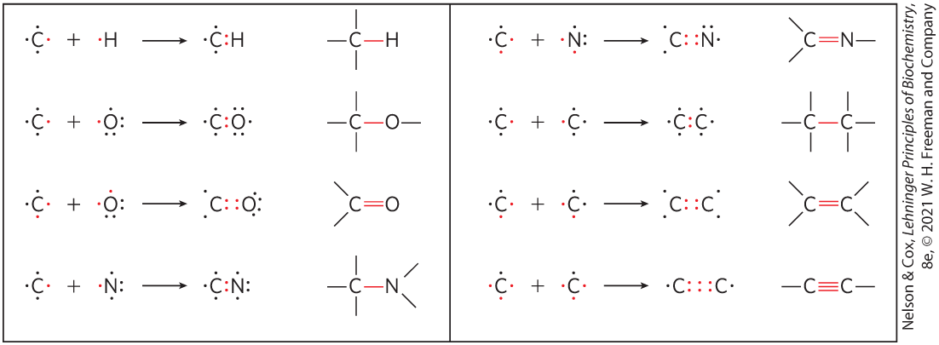
Biomolecules Are Compounds of Carbon with a Variety of Functional Groups
carbon can form covalent single, double, and triple bonds

Slide 39
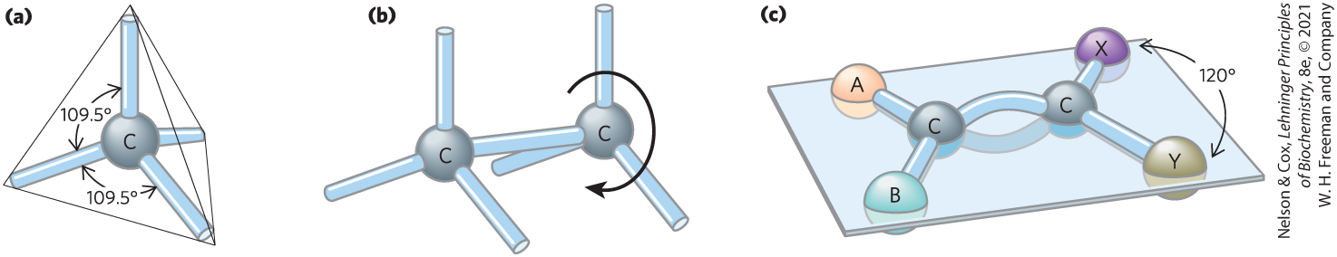
Geometry of Carbon Bonding
carbon atoms have a characteristic tetrahedral arrangement of their four single bonds
free rotation around each single bond
limited rotation about the axis of a double bond

Slide 40
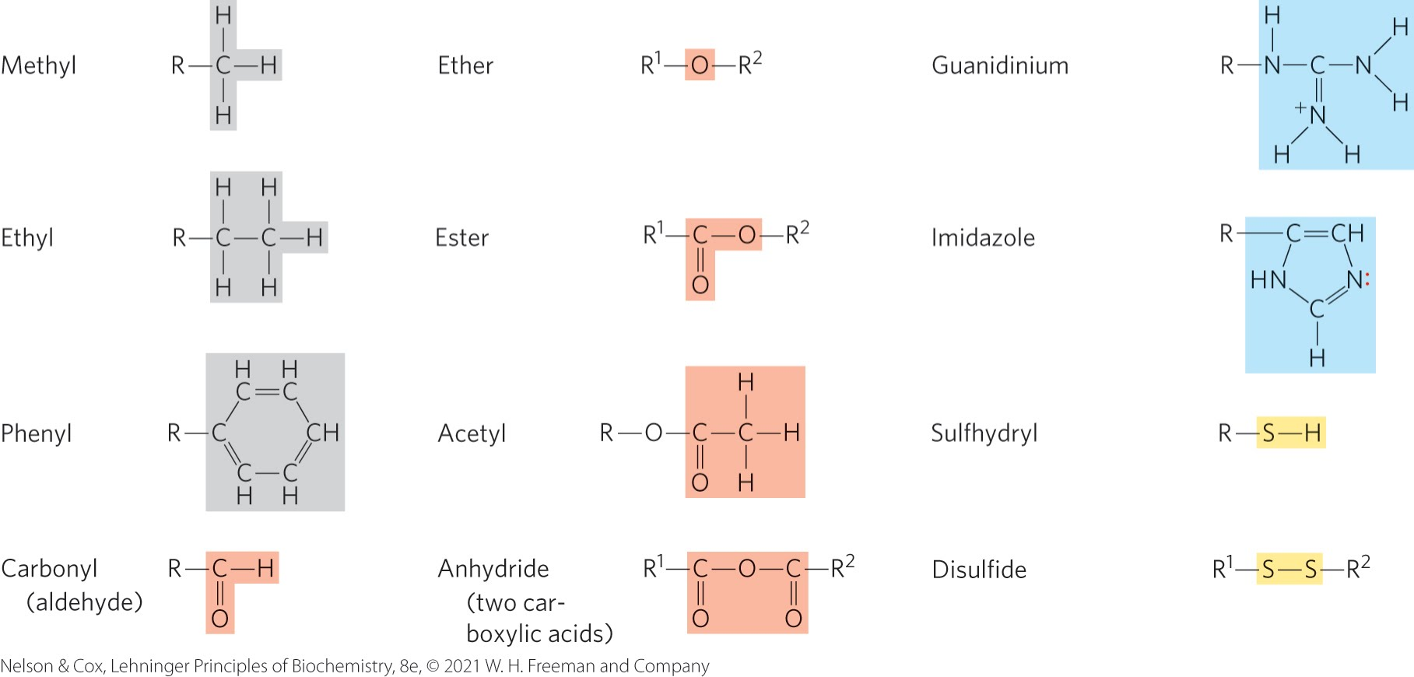
Common Functional Groups of Biomolecules

Slide 41
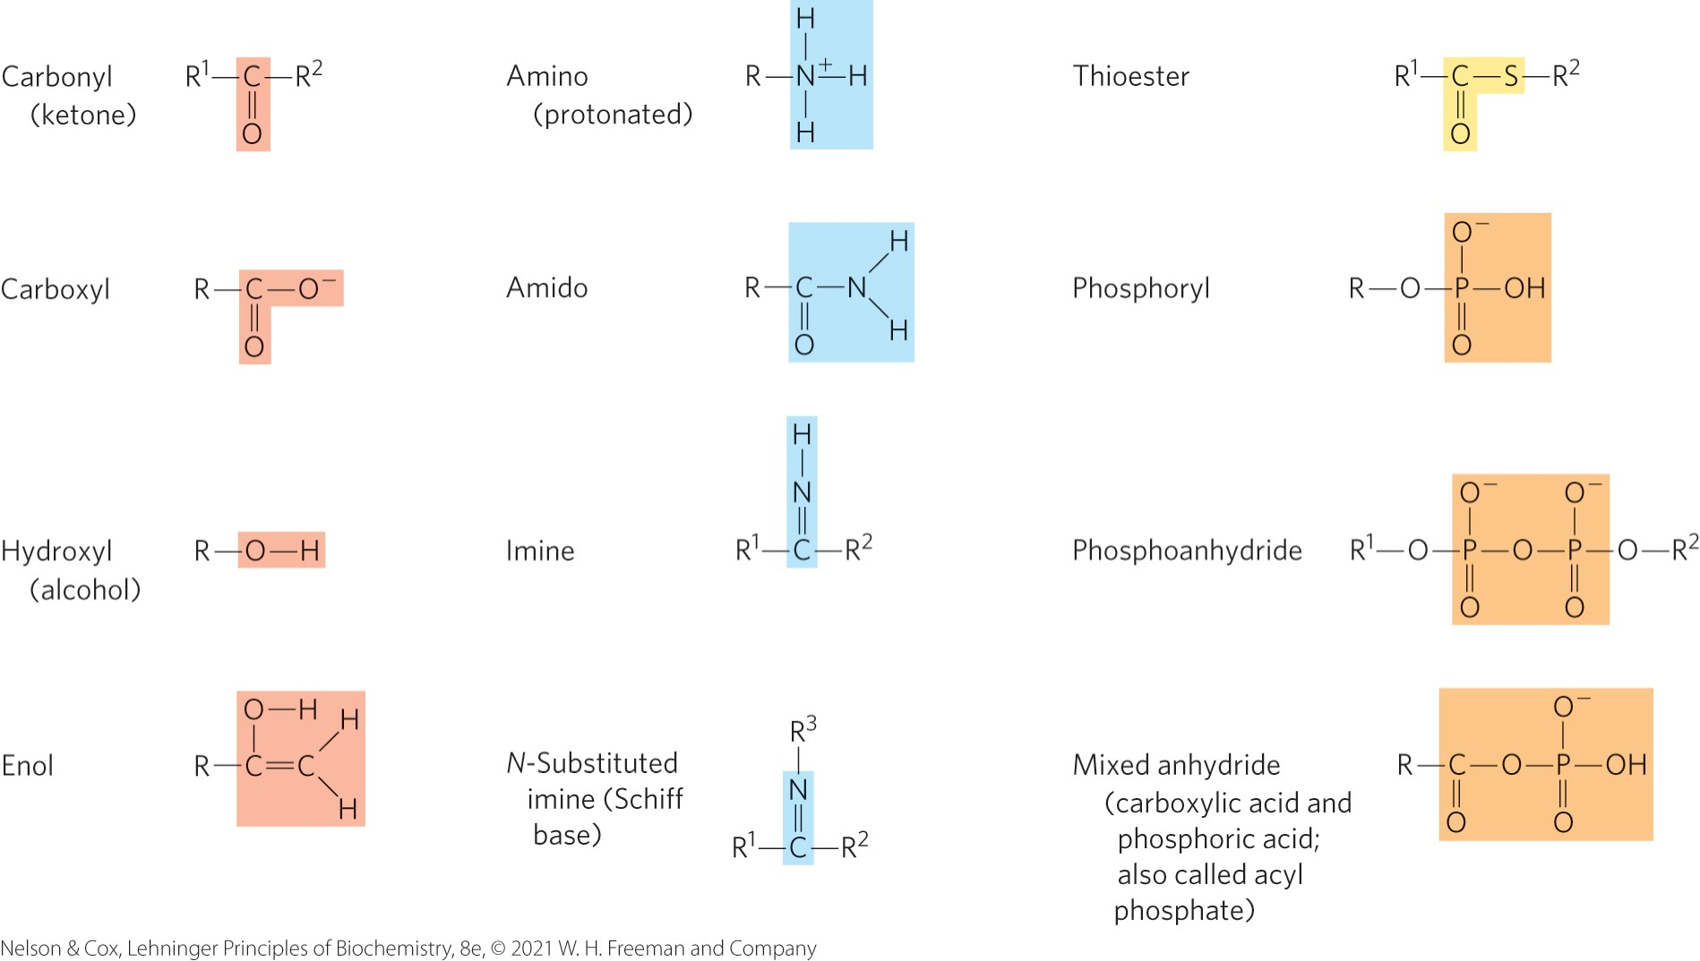
Additional Functional Groups of Biomolecules

Slide 42
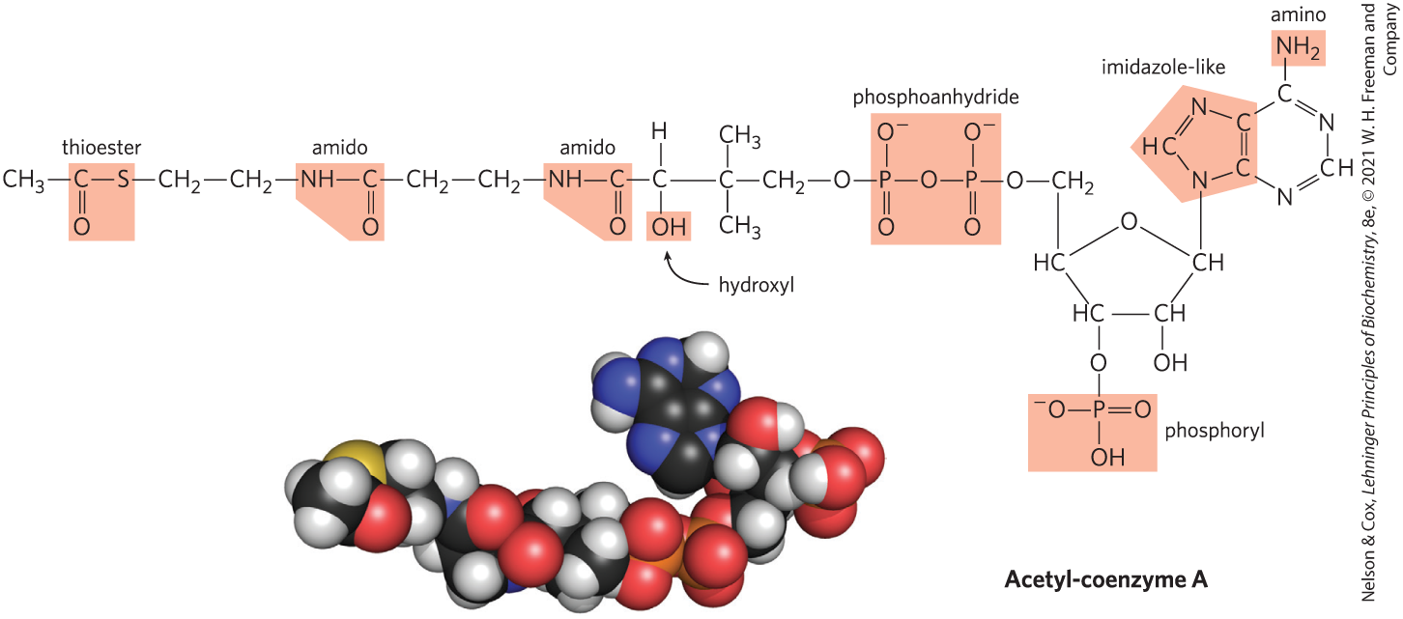
Many Biomolecules Are Polyfunctional

Slide 43
Cells Contain a Universal Set of Small Molecules
central metabolites:
  common amino acids
  nucleotides
  sugars and their phosphorylated derivatives
  mono-, di-, and tricarboxylic acids
secondary metabolites = specific to the organism
metabolome = entire collection of small molecules in a given cell under a specific set of conditions
  metabolomics = the systematic characterization of the metabolome under very specific conditions

Slide 44
Macromolecules Are the Major Constituents of Cells
macromolecules = polymers with molecular weights above ~5,000 that are assembled from relatively simple precursors
  proteins
  nucleic acids
  polysaccharides
oligomers = shorter polymers
informational macromolecules = name for proteins, nucleic acids, and some oligosaccharides, given their information-rich subunit sequences

Slide 45
Protein Macromolecules
proteins = long polymers of amino acids
  can function as enzymes, structural elements, signal receptors, transporters
proteome = sum of all the proteins functioning in a cell
proteomics = the systematic characterization of this protein complement under a specific set of conditions

Slide 46
Nucleic Acid Macromolecules
nucleic acids = DNA and RNA = polymers of nucleotides
  store and transmit genetic information
  some RNA molecules have structural and catalytic roles in supramolecular complexes
genome = entire sequence of a cell’s DNA or RNA
genomics = the characterization of the structure, function, evolution, and mapping of genomes

Slide 47
Polysaccharide Macromolecules
polysaccharides = polymers of simple sugars
  energy-rich fuel stores
  rigid structural components of cell walls (in plants and bacteria)
  extracellular recognition elements that bind to proteins on other cells
glycome = entire complement of carbohydrate-containing molecules

Slide 48
Lipid Molecules
lipids = water-insoluble hydrocarbon derivatives
  structural components of membranes
  energy-rich fuel stores
  pigments
  intracellular signals
lipidome = the lipid containing molecules in a cell

Slide 49
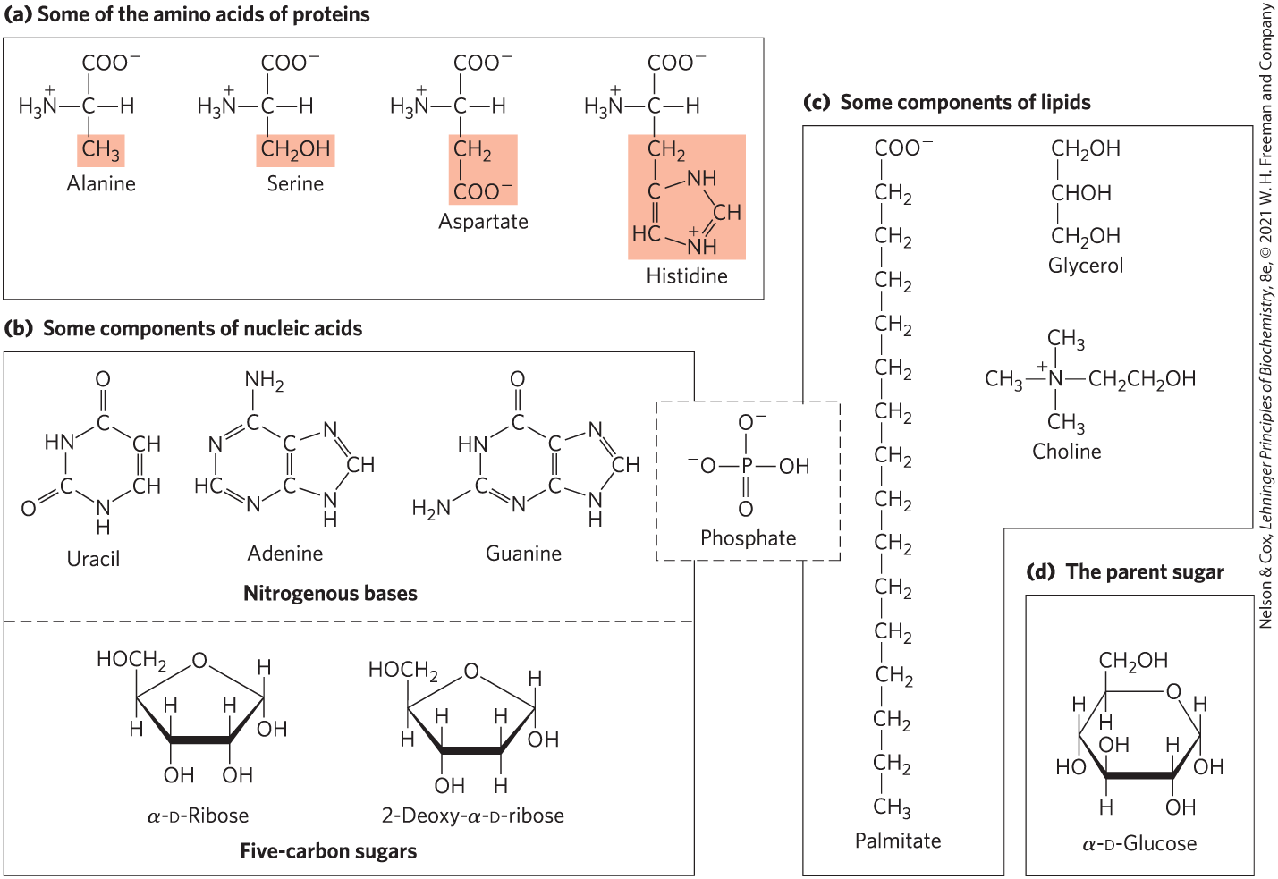
Building Blocks of Biochemistry

Slide 50
Major Classes of Biomolecules in E. coli Cells
Table 1-1 Molecular Components of an E. coli Cell
 | Percentage of total weight of cell | Approximate number of different molecular species
Water | 70 | 1
Proteins | 15 | 3,000
Nucleic acids: DNA | 1 | 1–4
Nucleic acids: RNA | 6 | >3,000
Polysaccharides | 3 | 20
Lipids | 2 | 50ª
Monomeric subunits and intermediates | 2 | 2,600
Inorganic ions | 1 | 20
Source: A. C. Guo et al., Nucleic Acids Res. 41:D625, 2013.
ªIf all permutations and combinations of fatty acid substitutions are considered, this number is much larger.

Slide 51
Three-Dimensional Structure Is Described by Configuration and Conformation
configuration = the fixed spatial arrangement of atoms
stereoisomers = molecules with the same chemical bonds and same chemical formula
stereospecific = requiring specific conformations in the interacting molecules
  describes typical interactions between biomolecules

Slide 52
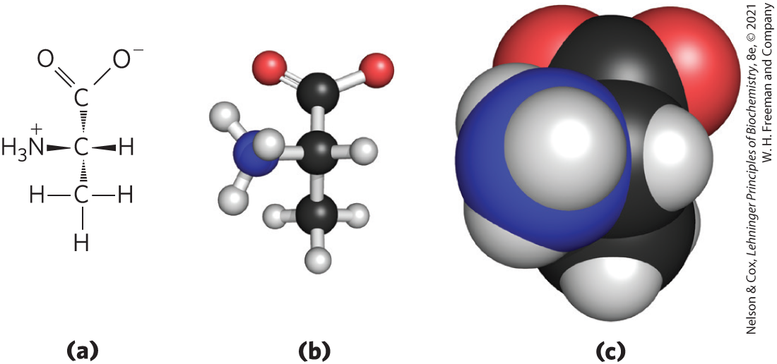
Illustrating Stereochemistry

Slide 53
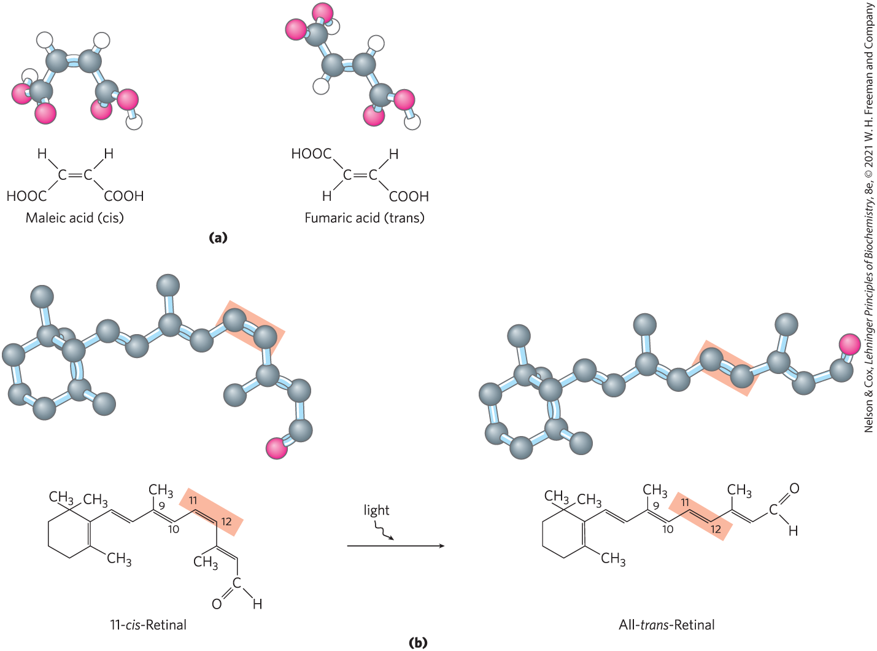
Configurations of Geometric Isomers
geometric isomers, or cis-trans isomers = differ in the arrangement of substituent groups with respect to the double bond

Slide 54
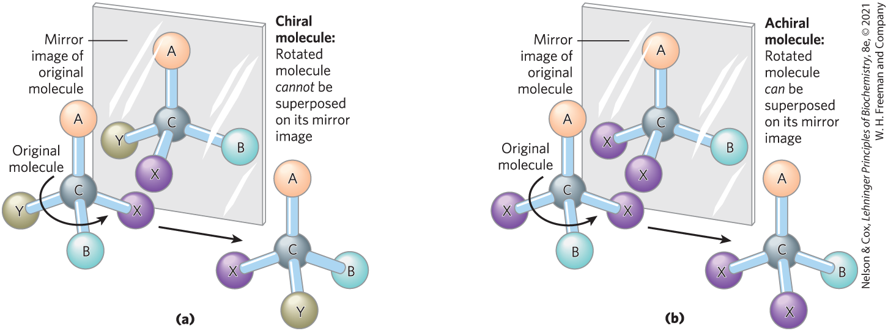
Chiral and Achiral Molecules
chiral centers = asymmetric carbons
a molecule can have 2^{n} stereoisomers, where n is the number of chiral carbons

Slide 55
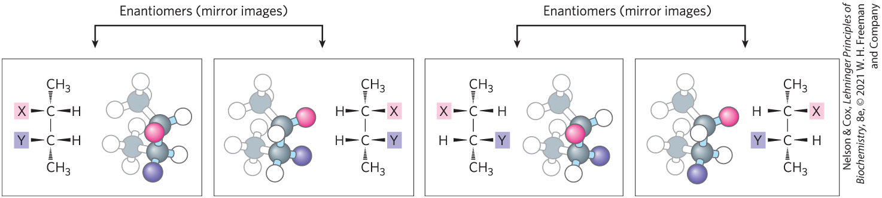
Enantiomers and Diastereomers
enantiomers = stereoisomers that are mirror images of each other
diastereomers = stereoisomers that are not mirror images of each other

Slide 56
Optical Activity of Enantiomers
enantiomers have nearly identical chemical reactivities, but differ in optical activity
a racemic mixture (equimolar solution of two enantiomers) shows no optical rotation

Slide 57
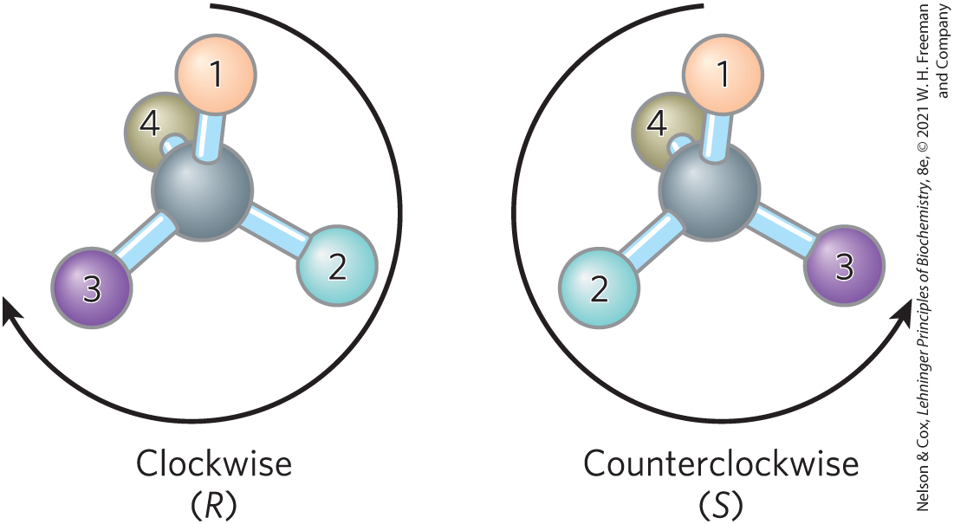
Naming Stereoisomers Using the RS System
each group attached to a chiral carbon is assigned a priority, where:
—OCH₃ > —OH > —NH₂ > —COOH > —CHO >
—CH₂OH > —CH₃ > —H

Slide 58
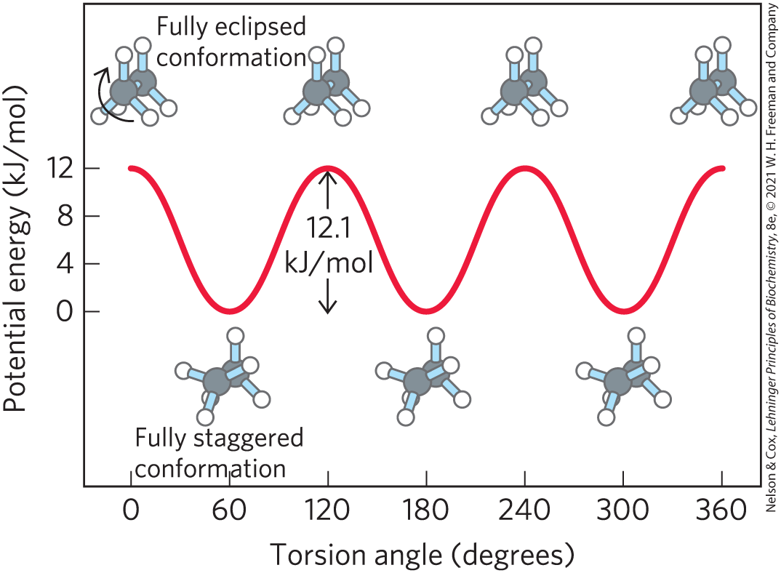
Molecular Conformation
conformation = the spatial arrangement of substituent groups that are free to assume different positions in space

Slide 59
Principle 2 (4 of 6)
Cells use a relatively small set of carbon- based metabolites to create polymeric machines, supramolecular structures, and information repositories. The chemical structure of these components defines their cellular function. The collection of molecules carries out a program, the end result of which is reproduction of the program and self-perpetuation of that collection of molecules—in short, life.

Slide 60
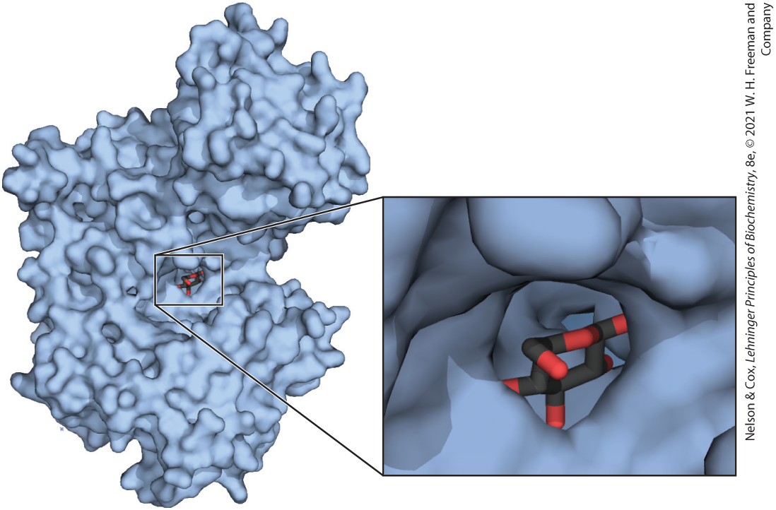
Interactions between Biomolecules Are Stereospecific

Slide 61
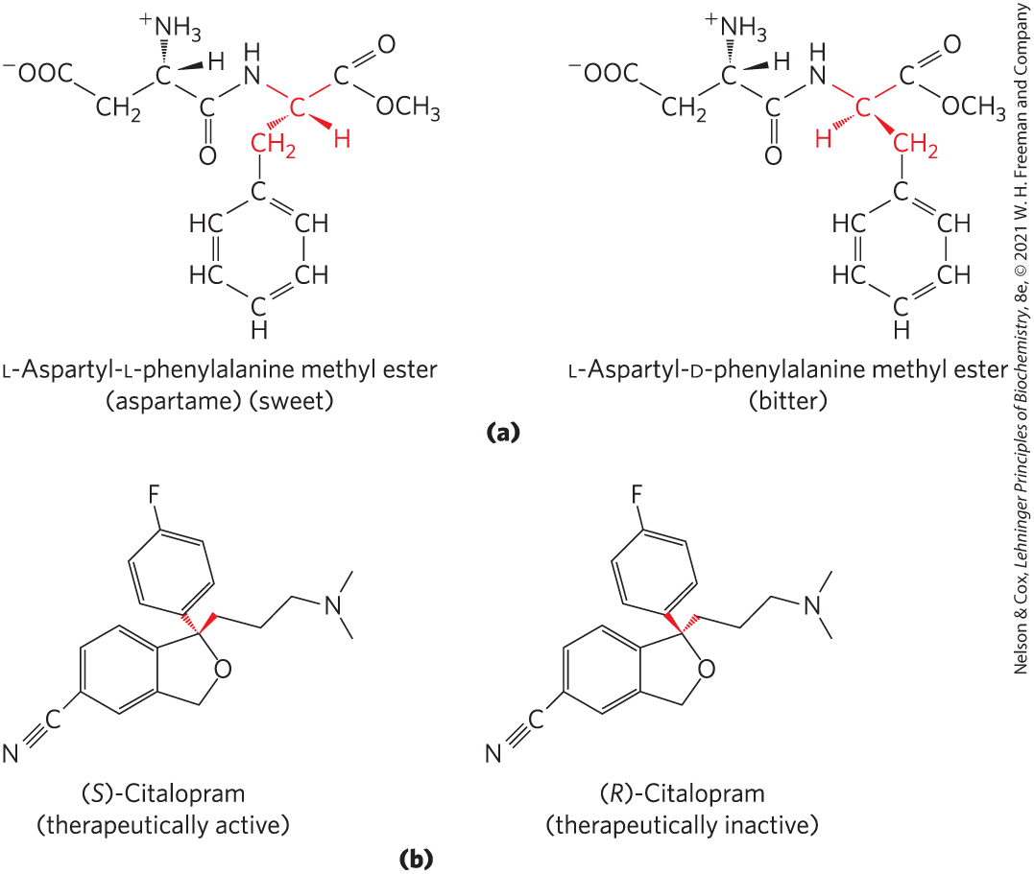
Biological Systems Can Distinguish Stereoisomers
stereospecificity = the ability to distinguish between stereoisomers

Slide 62
1.3 Physical Foundations

Slide 63
Living Organisms Exist in a Dynamic Steady State, Never at Equilibrium with Their Surroundings
small molecules, macromolecules, and supramolecular complexes are continuously synthesized and broken down
living cells maintain themselves in a dynamic steady state distant from equilibrium
maintaining steady state requires the constant investment of energy

Slide 64
Organisms Transform Energy and Matter from Their Surroundings
system = all the constituent reactants and products, the solvent that contains them, and the immediate atmosphere
universe = system and its surroundings
types of systems:
  isolated = system exchanges neither matter nor energy with its surroundings
  closed system = system exchanges energy but not matter with its surroundings
  open system = system exchanges both energy and matter with its surroundings

Slide 65
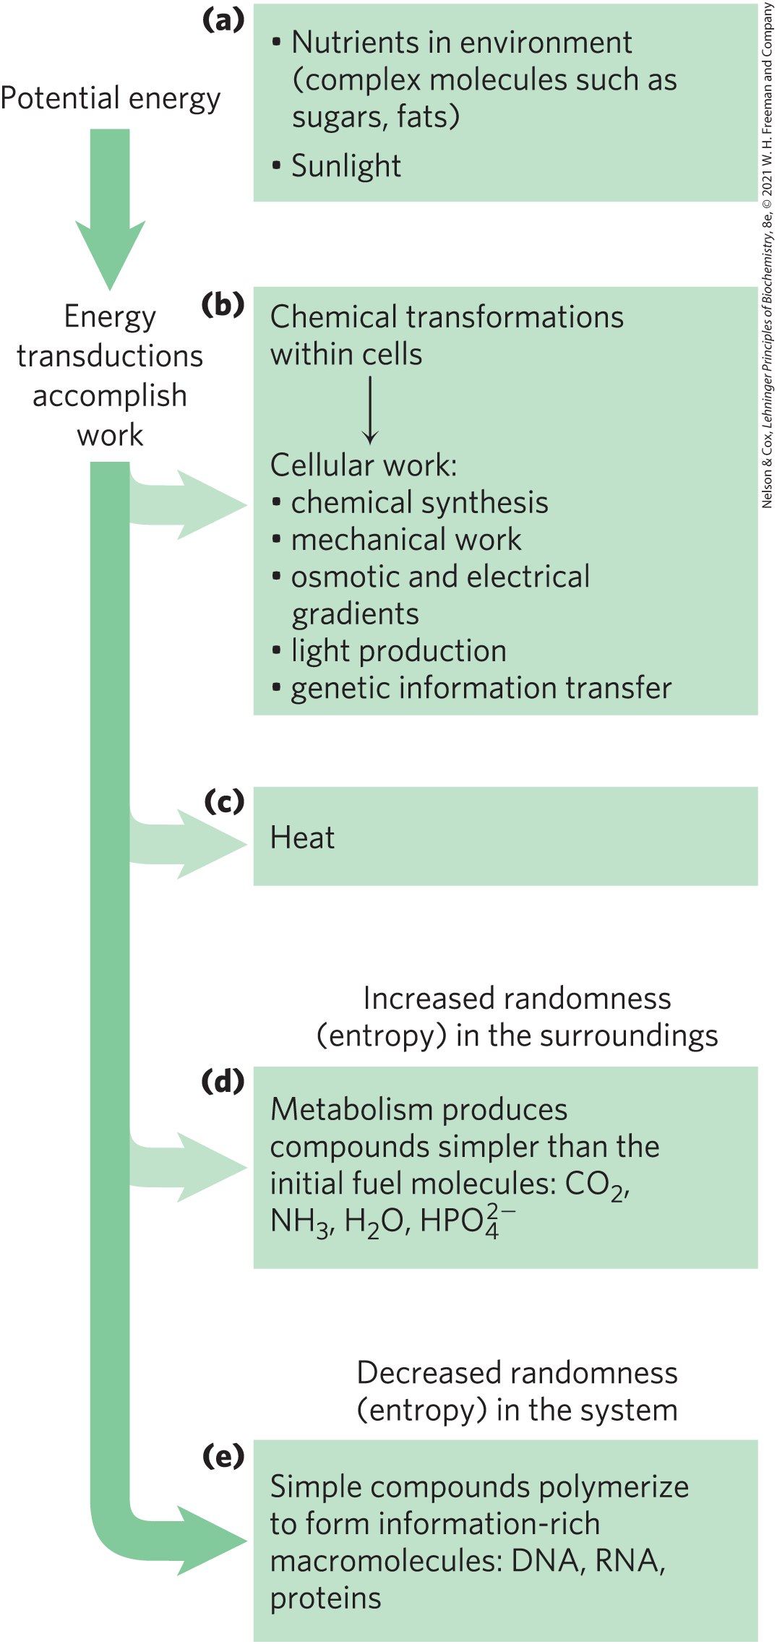
Energy Transformation in Living Organisms
first law of thermodynamics: in any physical or chemical change, the total amount of energy in the universe remains constant, although the form of the energy may change

Slide 66
Principle 3 (3 of 5)
Living organisms exist in a dynamic
steady state, never at equilibrium with
their surroundings. Following the laws of thermodynamics, living organisms extract energy from their surroundings and employ it to maintain homeostasis and do useful work. Essentially all of the energy obtained by a cell comes from the flow of electrons, driven by sunlight or by metabolic redox reactions.

Slide 67
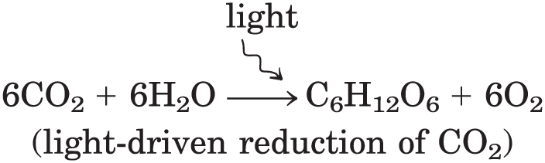
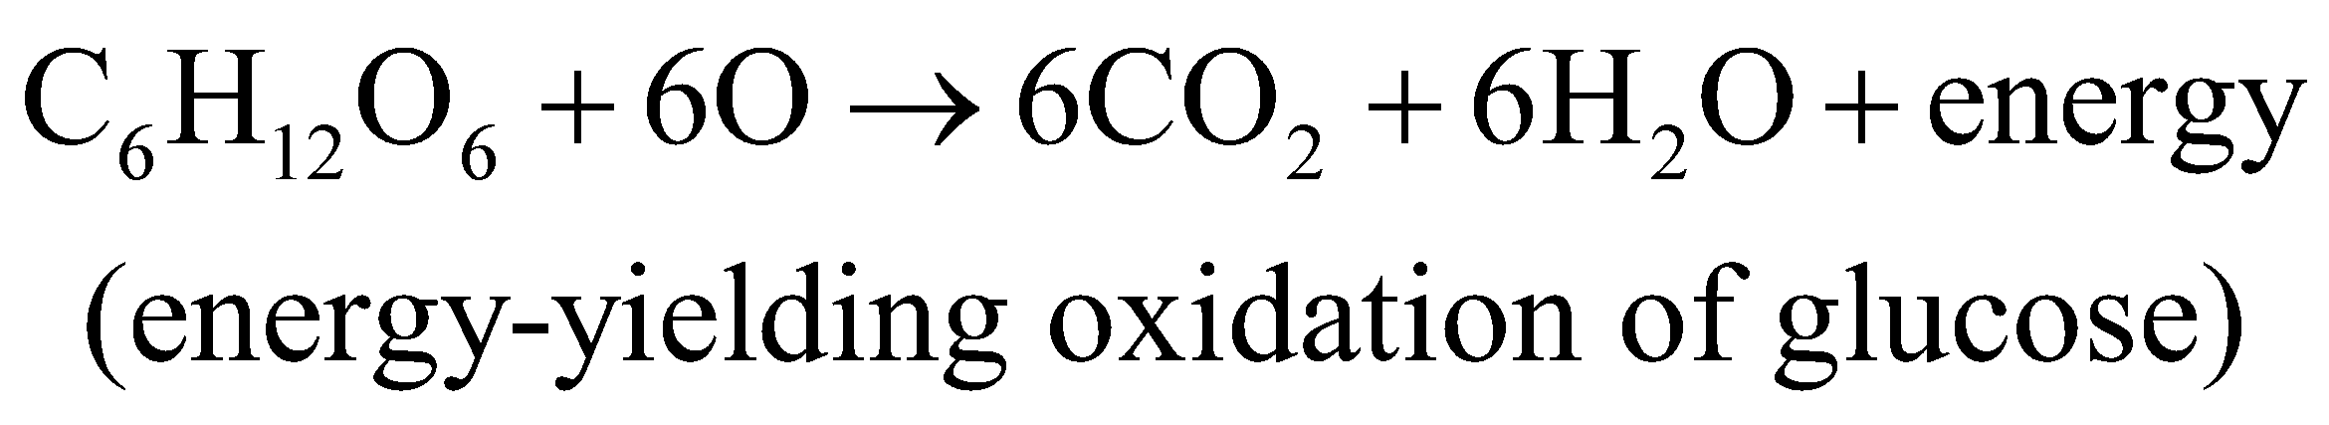
Extracting Energy from the Surroundings
photoautotrophs:
chemotrophs:

Slide 68
Oxidation-Reduction Reactions
autotrophs and heterotrophs participate in global cycles of O₂ and CO₂, driven by sunlight, making these two groups interdependent
oxidation-reduction reactions = one reactant is oxidized (loses electrons) as another is reduced (gains electrons)
  describes reactions involved in electron flow

Slide 69
Creating and Maintaining Order Requires Work and Energy
second law of thermodynamics: randomness in the universe is constantly increasing
entropy, S = represents the randomness or disorder of the components of a chemical system

Slide 70
Free Energy, G
enthalpy, H = heat content, roughly reflecting the number and kinds of bonds
free energy, G, of a closed system = H – TS,
where H represents enthalpy, T represents absolute temperature, and S represents entropy

Slide 71
Free-Energy Change, ∆G
free-energy change, ∆G = ∆H − T∆S
  where ∆H is negative for a reaction that releases heat, and ∆S is positive for a reaction that increases the system’s randomness
spontaneous reactions occur when ∆G is negative

Slide 72
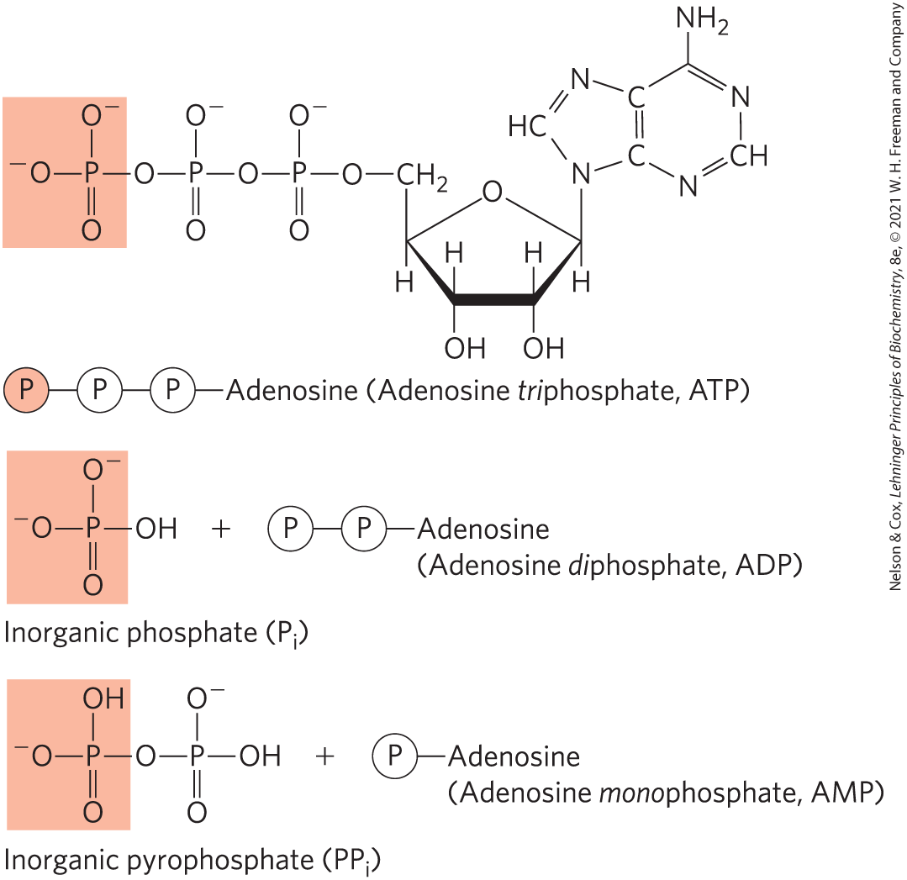
Coupling Reactions
energy-requiring (endergonic) reactions are often coupled to reactions that release free energy (exergonic)
the breakage of phosphoanhydride bonds in ATP is highly exergonic

Slide 73
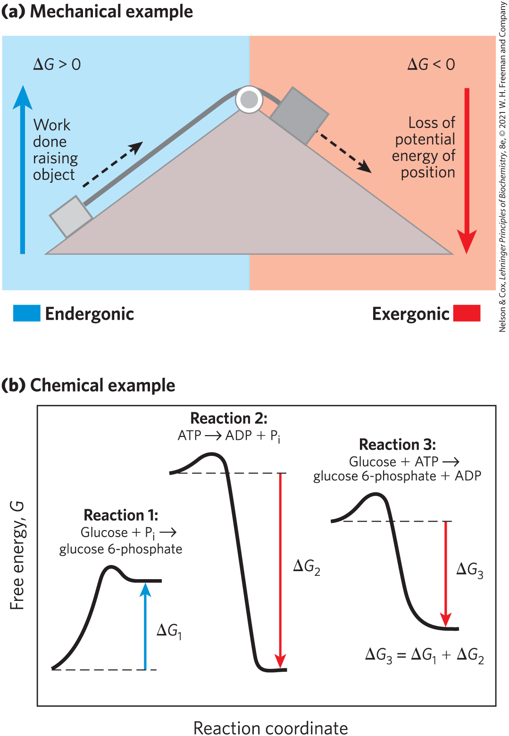
Energy Coupling Links Reactions in Biology
free-energy change, ∆G = amount of energy available to do work
  always less than the theoretical amount of energy released
in closed systems, chemical reactions proceed spontaneously until equilibrium is reached

Slide 74
K_{eq} and ∆G° Are Measures of a Reaction’s Tendency to Proceed Spontaneously
For the reaction,
The equilibrium constant, K_{eq}, is given by
Where [A]_{eq} is the concentration of A, [B]_{eq} the concentration of B, and so on, when the system has reached equilibrium.

Slide 75
Mass-Action Ratio, Q
mass-action ratio, Q = ratio of product concentrations to reactant concentrations at a given time
  can be calculated to determine how far the reaction is from equilibrium

Slide 76
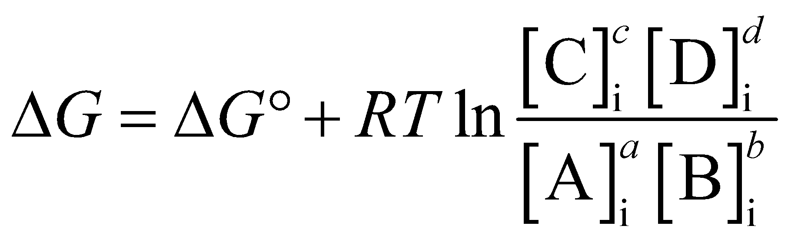
Standard Free-Energy Change, ∆G°
∆G (the actual free-energy change) for any chemical reaction is a function of the standard free-energy change, ∆G°
(Eqn 1-1)
where [A]_{i} is the initial concentration of A, and so forth; R is the gas constant; and T is the absolute temperature

Slide 77
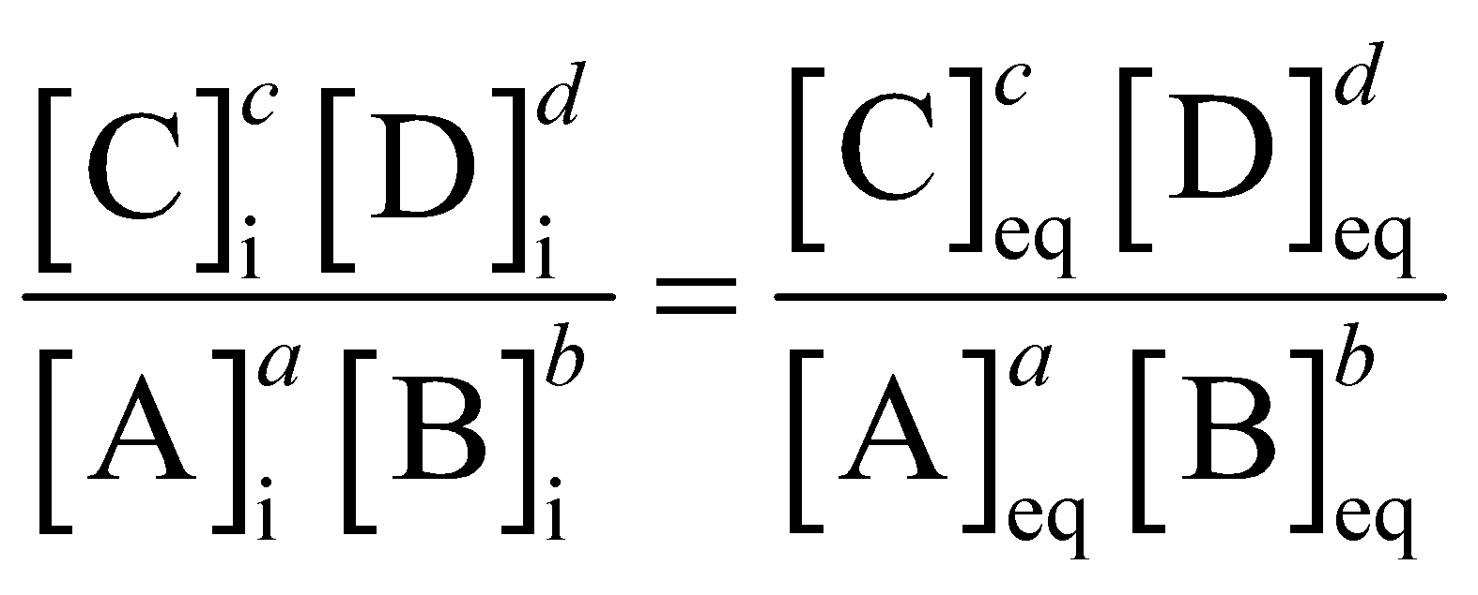
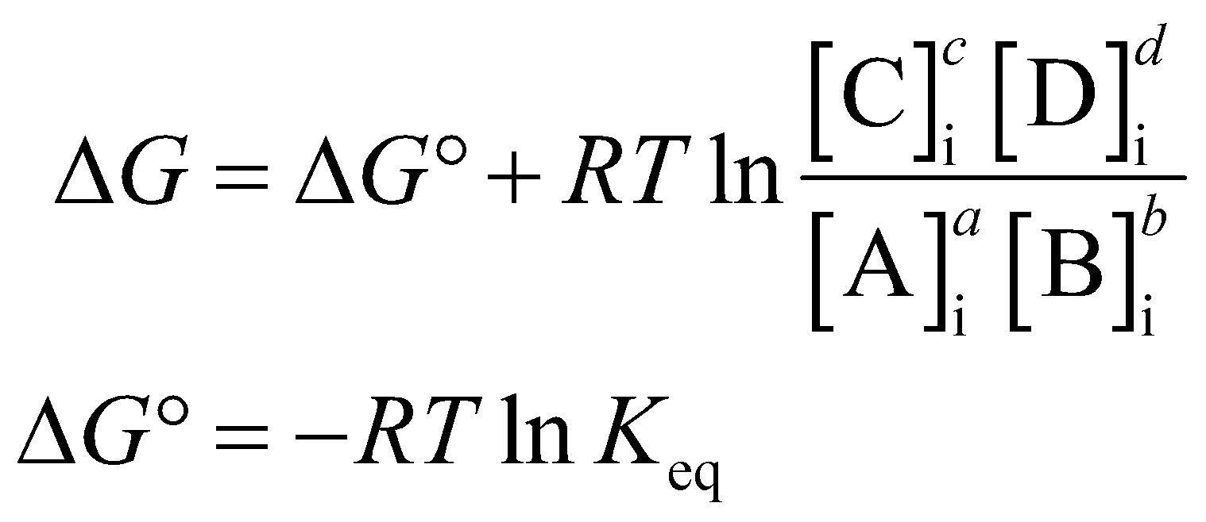
Reactions Can Do No Work at Equilibrium
at equilibrium, ∆G = 0 and
thus,

Slide 78
Principle 3 (4 of 5)
Living organisms exist in a dynamic
steady state, never at equilibrium with
their surroundings. Following the laws of thermodynamics, living organisms extract energy from their surroundings and employ it to maintain homeostasis and do useful work. Essentially all of the energy obtained by a cell comes from the flow of electrons, driven by sunlight or by metabolic redox reactions.

Slide 79
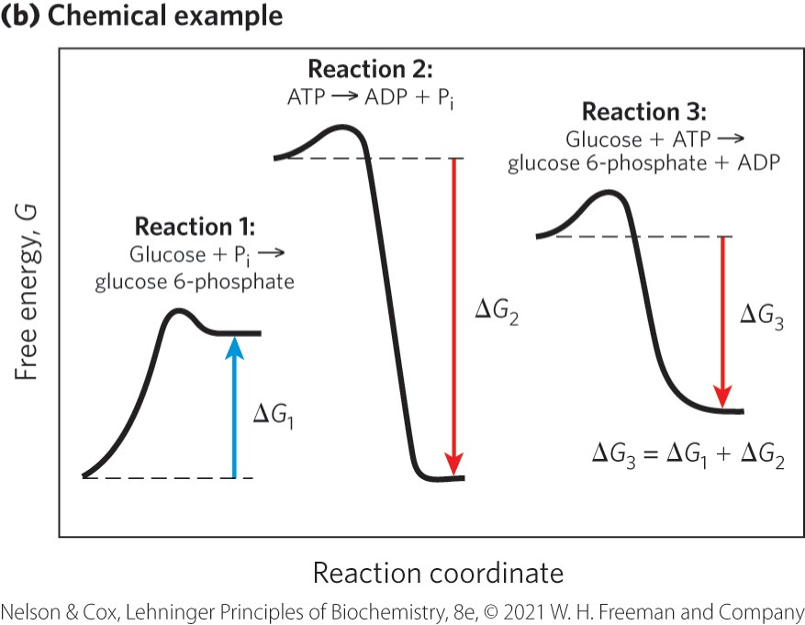
Reaction Coordinate Diagrams
reaction coordinate diagrams = illustrates how exergonic reactions can be coupled to endergonic reactions
reaction 1: endergonic; ∆G₁ is positive
reaction 2: exergonic; ∆G₂ is negative
reaction 3: ∆G₃ is negative

Slide 80
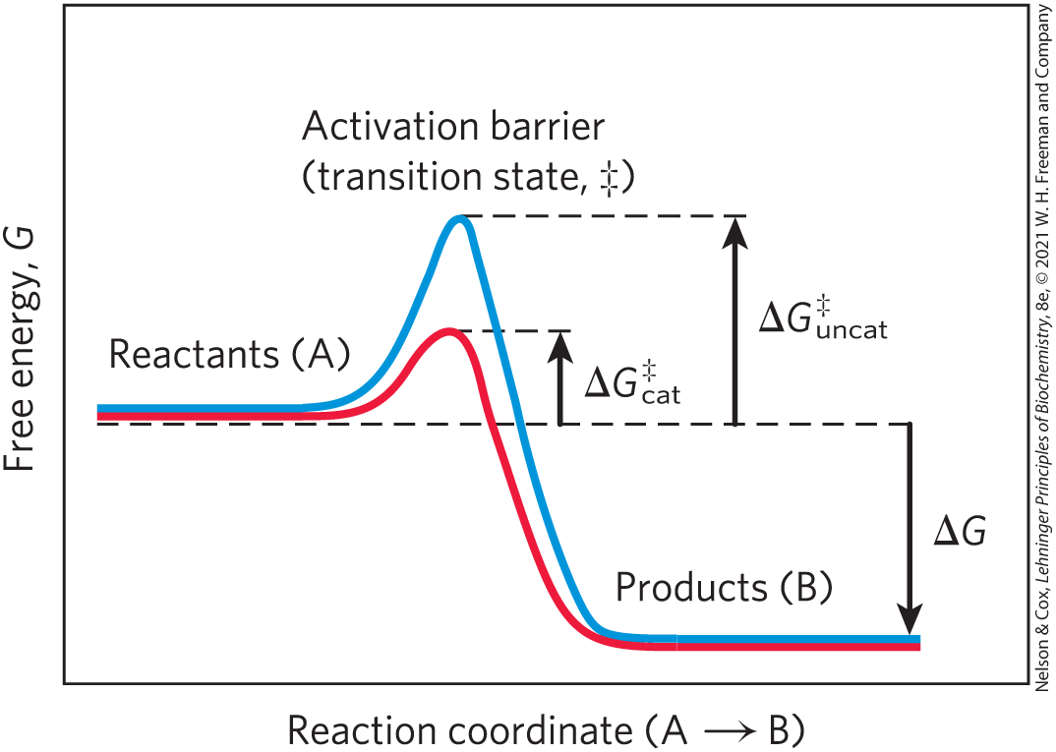
Enzymes Promote Sequences of Chemical Reactions
enzymes = greatly enhance reaction rates of specific chemical reactions without being consumed in the process
transition state = higher free energy than reactant or product
activation energy, ∆G‡ = difference in energy between the reactant in its ground state and its transition state

Slide 81
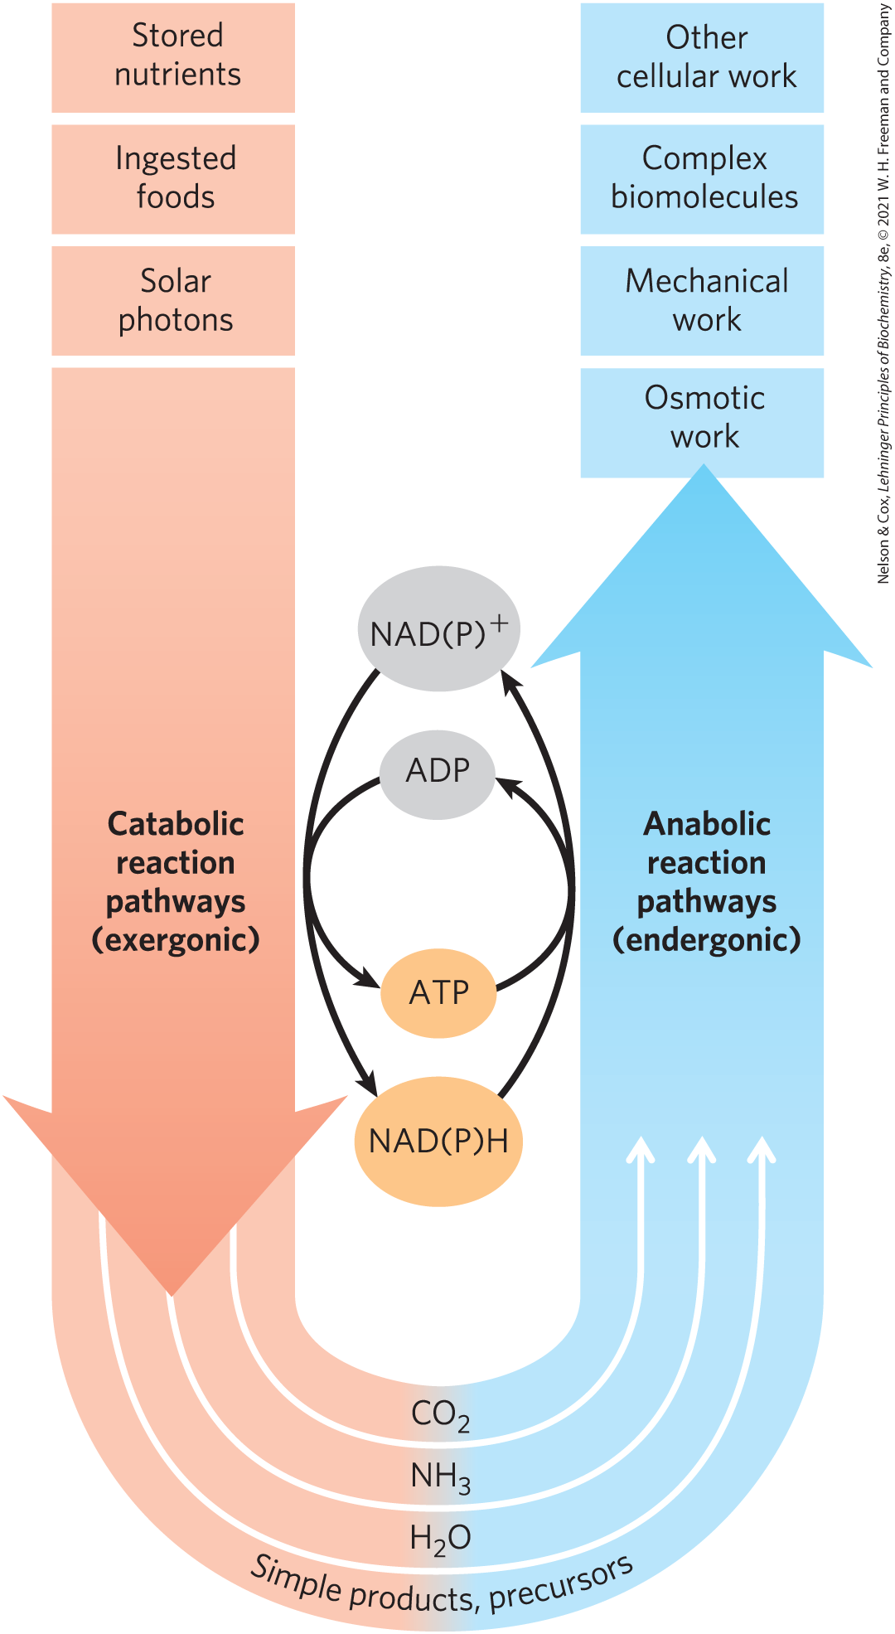
Catabolism and Anabolism
pathways = sequences of consecutive reactions in which the product of one reaction becomes the reactant in the next
catabolism = degradative, free-energy-yielding reactions
  drives ATP synthesis
  produces the reduced electron carriers NAD(P)H
anabolism = synthetic pathways that require the input of energy

Slide 82
Principle 2 (5 of 6)
Cells use a relatively small set of carbon- based metabolites to create polymeric machines, supramolecular structures, and information repositories. The chemical structure of these components defines their cellular function. The collection of molecules carries out a program, the end result of which is reproduction of the program and self-perpetuation of that collection of molecules—in short, life.

Slide 83
Metabolism
metabolism = overall network of enzyme-catalyzed pathways, both catabolic and anabolic
unity of life = pathways of enzyme-catalyzed reactions that act on the main constituents of cells—proteins, fats, sugars, and nucleic acids—are nearly identical in all living organisms

Slide 84
Principle 3 (5 of 5)
Living organisms exist in a dynamic
steady state, never at equilibrium with
their surroundings. Following the laws of thermodynamics, living organisms extract energy from their surroundings and employ it to maintain homeostasis and do useful work. Essentially all of the energy obtained by a cell comes from the flow of electrons, driven by sunlight or by metabolic redox reactions.

Slide 85
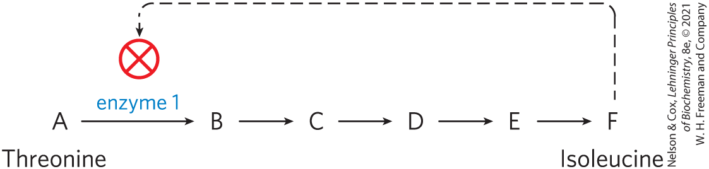
Metabolism Is Regulated to Achieve Balance and Economy
feedback inhibition = keeps the production and utilization of each metabolic intermediate in balance
systems biology = tasked with understanding complex interactions among intermediates and pathways in quantitative terms

Slide 86
1.4 Genetic Foundations

Slide 87
Principle 4 (2 of 5)
Cells have the capacity for precise self-replication and self-assembly using chemical information stored in the genome. A single bacterial cell placed in a sterile nutrient medium can give rise to a billion identical “daughter” cells in 24 hours. Each cell is a faithful copy of the original, its construction directed entirely by information contained in the genetic material of the original cell. On a larger scale, the progeny of vertebrate animals share a striking resemblance to their parents, also the result of their inheritance of parental genes.

Slide 88
Principle 2 (6 of 6)
Cells use a relatively small set of carbon- based metabolites to create polymeric machines, supramolecular structures, and information repositories. The chemical structure of these components defines their cellular function. The collection of molecules carries out a program, the end result of which is reproduction of the program and self-perpetuation of that collection of molecules—in short, life.

Slide 89
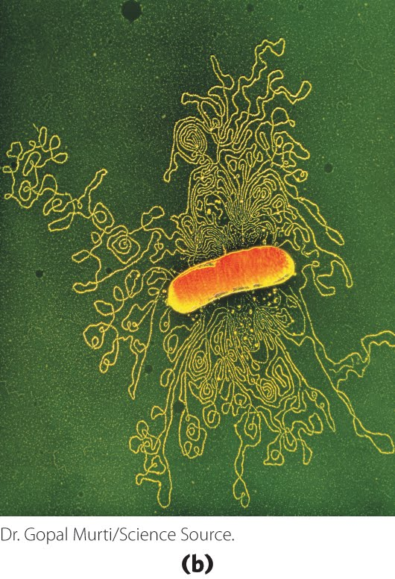
Genetic Information Is Encoded in DNA
deoxyribonucleic acid, DNA = sequence of the monomeric subunits (deoxyribonucleotides)
  encode the instructions for forming all other cellular components
  provide a template to produce identical DNA molecules

Slide 90
Principle 4 (3 of 5)
Cells have the capacity for precise self-replication and self-assembly using chemical information stored in the genome. A single bacterial cell placed in a sterile nutrient medium can give rise to a billion identical “daughter” cells in 24 hours. Each cell is a faithful copy of the original, its construction directed entirely by information contained in the genetic material of the original cell. On a larger scale, the progeny of vertebrate animals share a striking resemblance to their parents, also the result of their inheritance of parental genes.

Slide 91
Genetic Continuity Is Vested in Single DNA Molecules
DNA of an E. coli cell is a single molecule containing 4.64 million nucleotide pairs
  must be replicated perfectly to give rise to identical progeny by cell division

Slide 92
Principle 4 (4 of 5)
Cells have the capacity for precise self-replication and self-assembly using chemical information stored in the genome. A single bacterial cell placed in a sterile nutrient medium can give rise to a billion identical “daughter” cells in 24 hours. Each cell is a faithful copy of the original, its construction directed entirely by information contained in the genetic material of the original cell. On a larger scale, the progeny of vertebrate animals share a striking resemblance to their parents, also the result of their inheritance of parental genes.

Slide 93
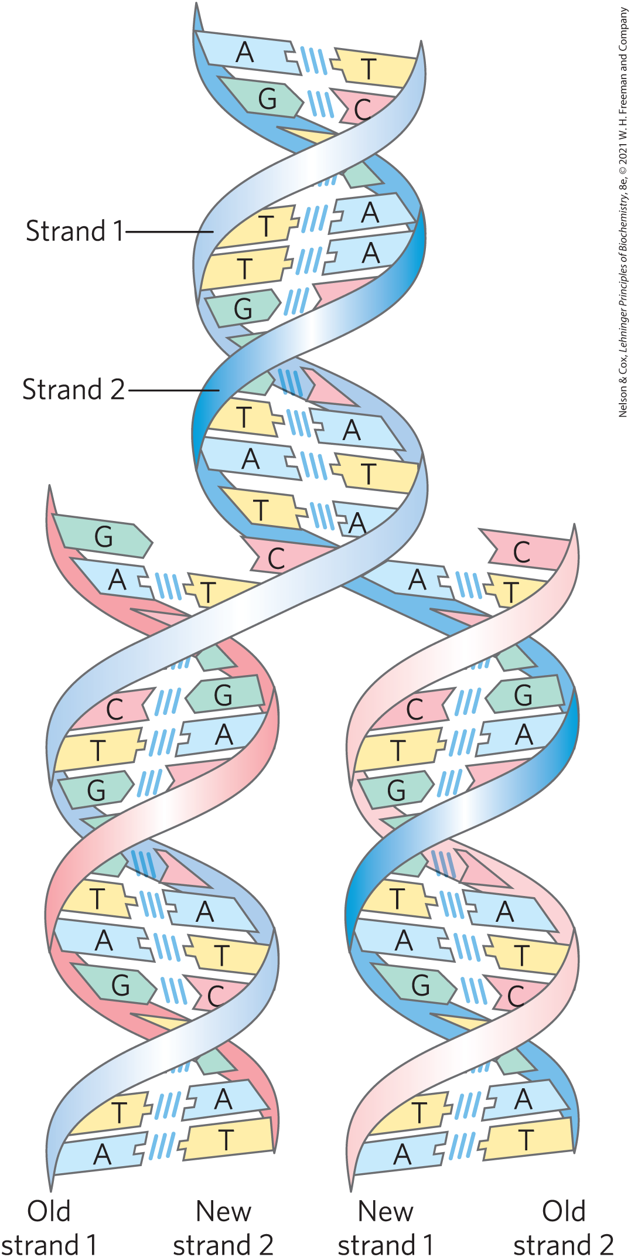
The Structure of DNA Allows Its Replication and Repair with Near-Perfect Fidelity
deoxyribonucleotides = monomeric subunit that make up the DNA polymer
  each deoxyribonucleotide in one strand pairs specifically with a complementary deoxyribonucleotide in the opposite strand
  strands are held together by hydrogen bonds

Slide 94
Principle 4 (5 of 5)
Cells have the capacity for precise self-replication and self-assembly using chemical information stored in the genome. A single bacterial cell placed in a sterile nutrient medium can give rise to a billion identical “daughter” cells in 24 hours. Each cell is a faithful copy of the original, its construction directed entirely by information contained in the genetic material of the original cell. On a larger scale, the progeny of vertebrate animals share a striking resemblance to their parents, also the result of their inheritance of parental genes.

Slide 95
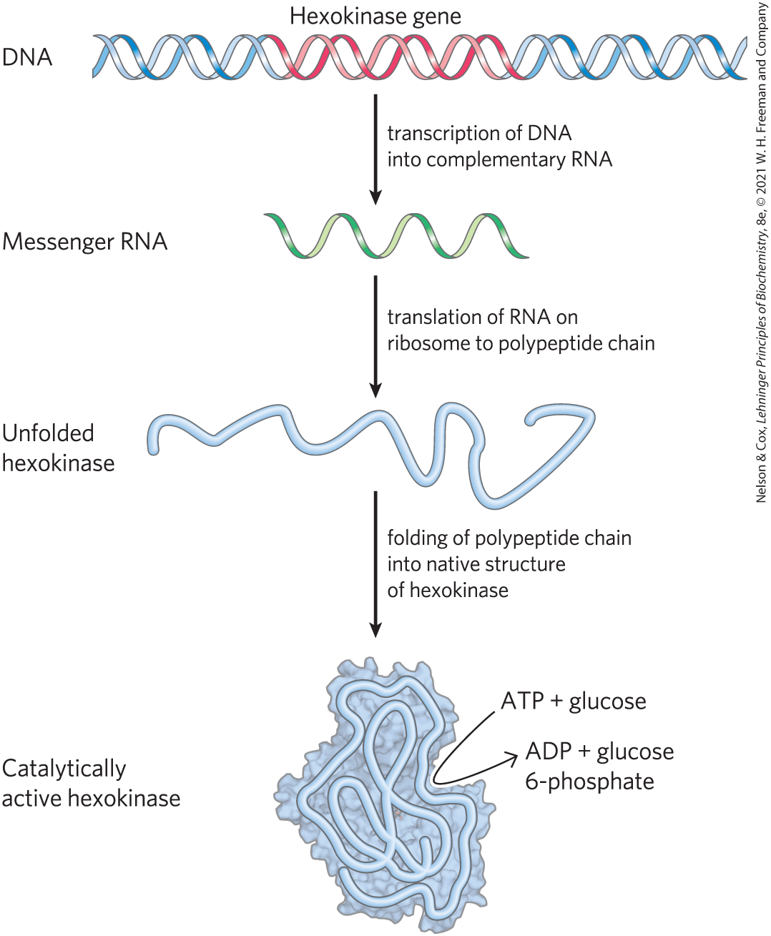
The Linear Sequence in DNA Encodes Proteins with Three-Dimensional Structures
native conformation = precise three-dimensional structure of a protein
  crucial to protein function

Slide 96
1.5 Evolutionary Foundations

Slide 97

Principle 5 (2 of 3)
Living organisms change over time by gradual evolution. The result of eons of evolution is an enormous diversity of life forms, fundamentally related through their shared ancestry, which can be seen at the molecular level in the similarity of gene sequences and protein structures.

Slide 98
Changes in the Hereditary Instructions Allow Evolution
mutation = changes in the nucleotide sequence of DNA
  changes the instructions for a cellular component
  can be beneficial
wild type = unmutated cells

Slide 99
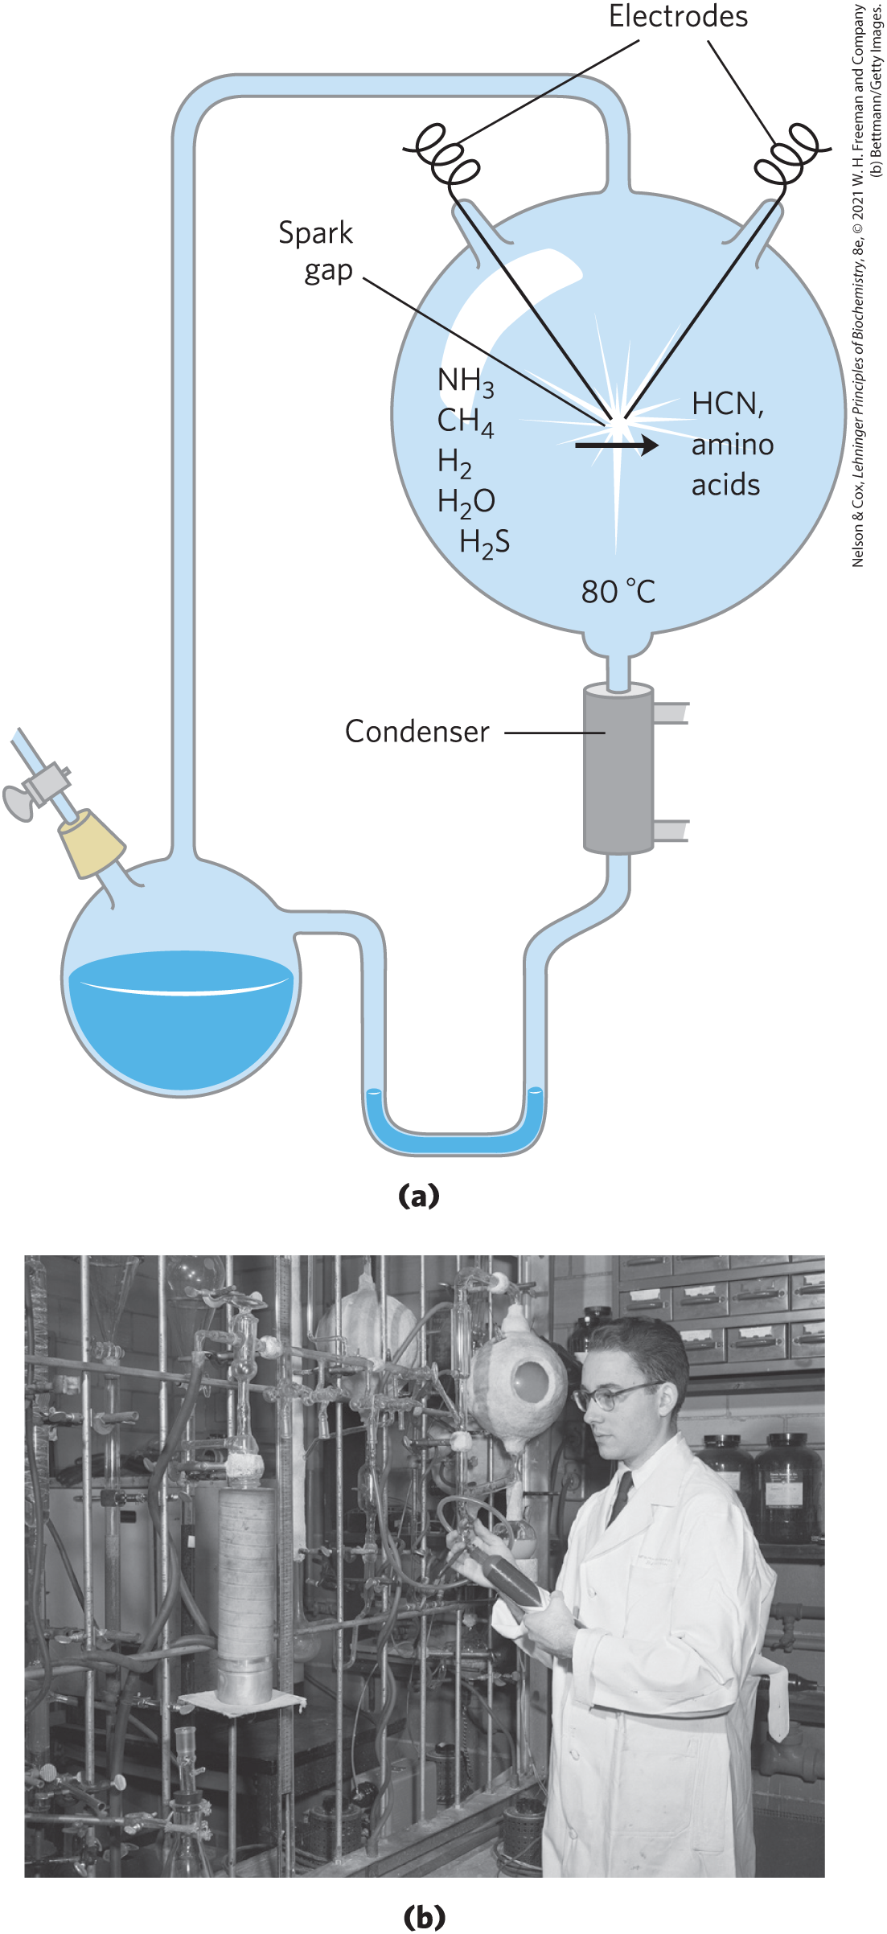
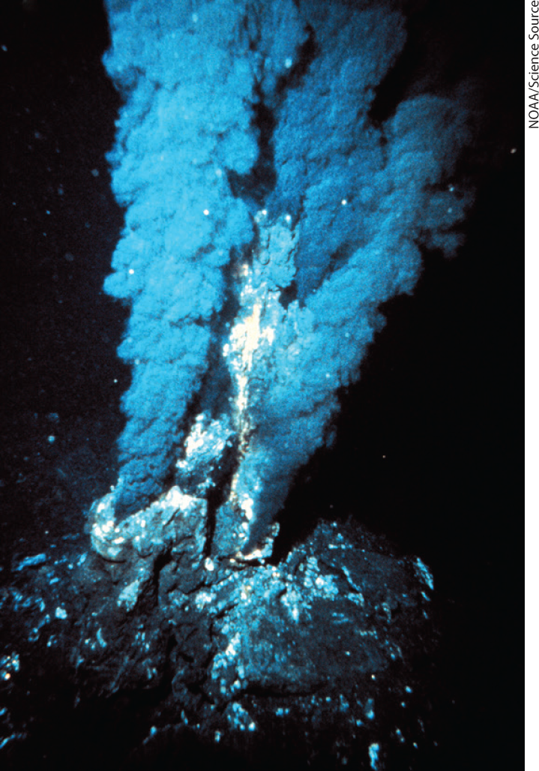
Biomolecules First Arose by Chemical Evolution
Miller and Urey experiments found that biomolecules may have been produced near hydrothermal vents at the bottom of the sea or by the action of lightning and high temperature on gaseous mixtures

Slide 100
The Role of RNA in Prebiotic Evolution
RNA (ribonucleic acid) = can act as catalysts in biologically significant reactions
likely played a crucial role in prebiotic evolution, both as catalyst and as information repository

Slide 101
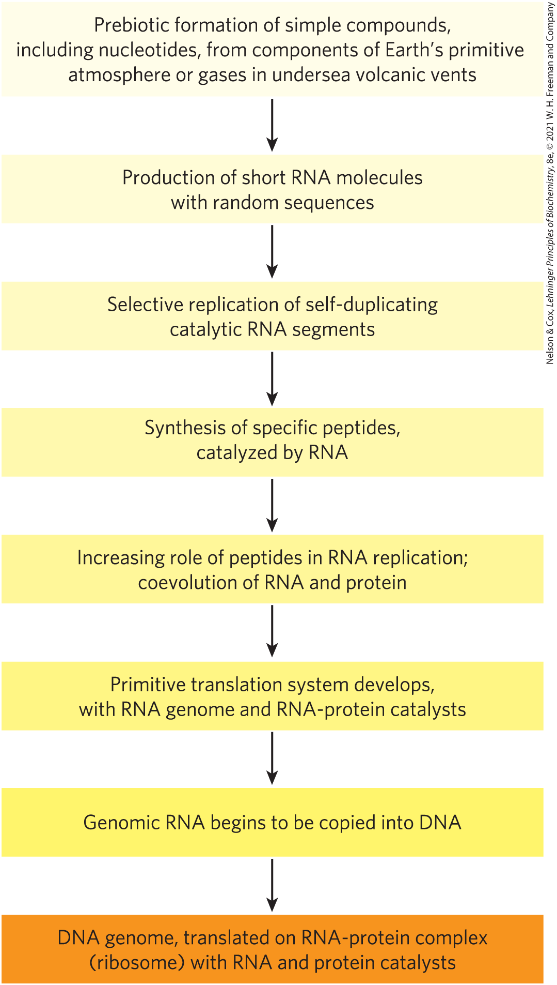
RNA or Related Precursors May Have Been the First Genes and Catalysts
RNA or similar molecule may have been the first gene and the first catalyst
alternatively, simple metabolic pathways may have evolved first, perhaps at the hot vents in the ocean floor

Slide 102
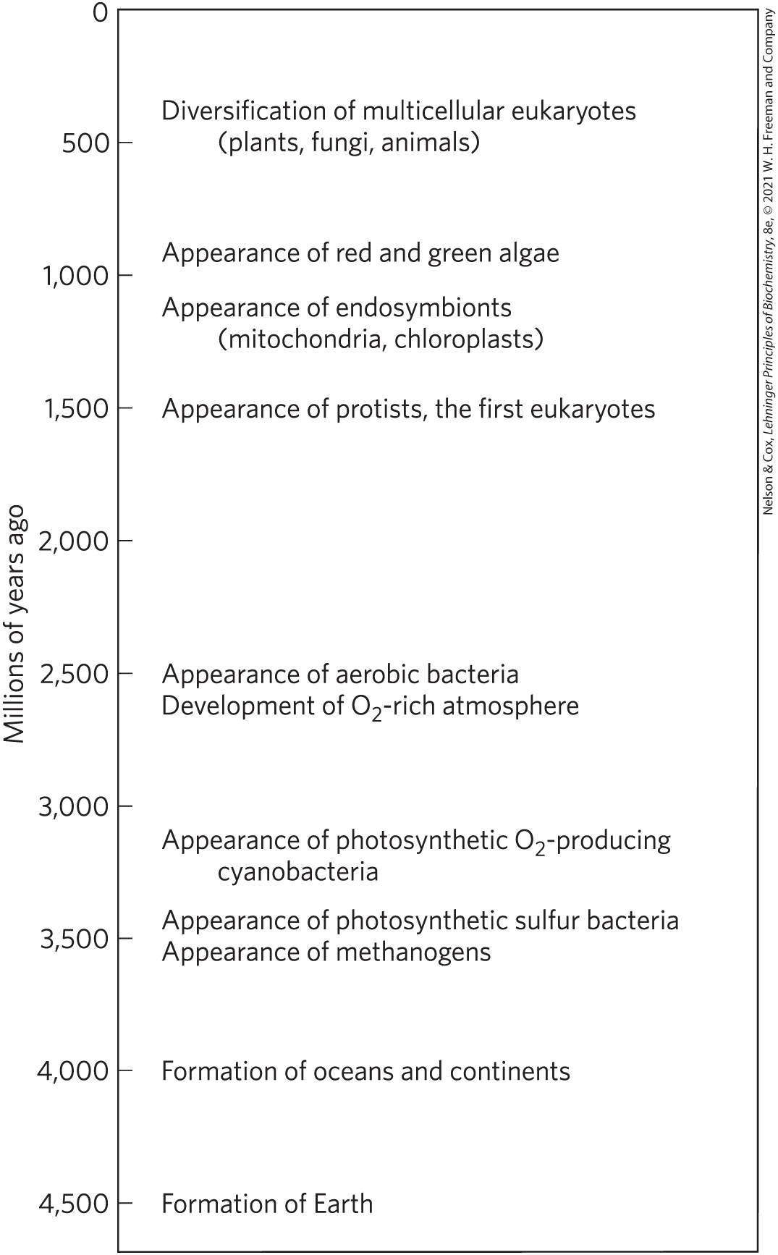
Biological Evolution Began More Than Three and a Half Billion Years Ago
lipid vesicles containing organic compounds and self-replicating RNA gave rise to protocells
protocells with the greatest capacity for self-replication became more numerous

Slide 103
The First Cell Probably Used Inorganic Fuels
earliest cells probably obtained energy from inorganic fuels, such as ferrous sulfide and ferrous carbonate
photosynthetic processes:
  arose from evolution
  pigments capture energy of light from the sun and reduce CO₂ to organic compounds
atmosphere became richer in O₂ with the rise of O₂-producing photosynthetic bacteria

Slide 104
Eukaryotic Cells Evolved from Simpler Precursors in Several Stages
three major changes led to the evolution of eukaryotes:
  evolution of the chromosome
  evolution of the nucleus
  formation of endosymbiotic associations between early eukaryotic cells and aerobic or photosynthetic bacteria
in multicellular organisms, differentiated cell types specialize in functions essential to the organism’s survival

Slide 105
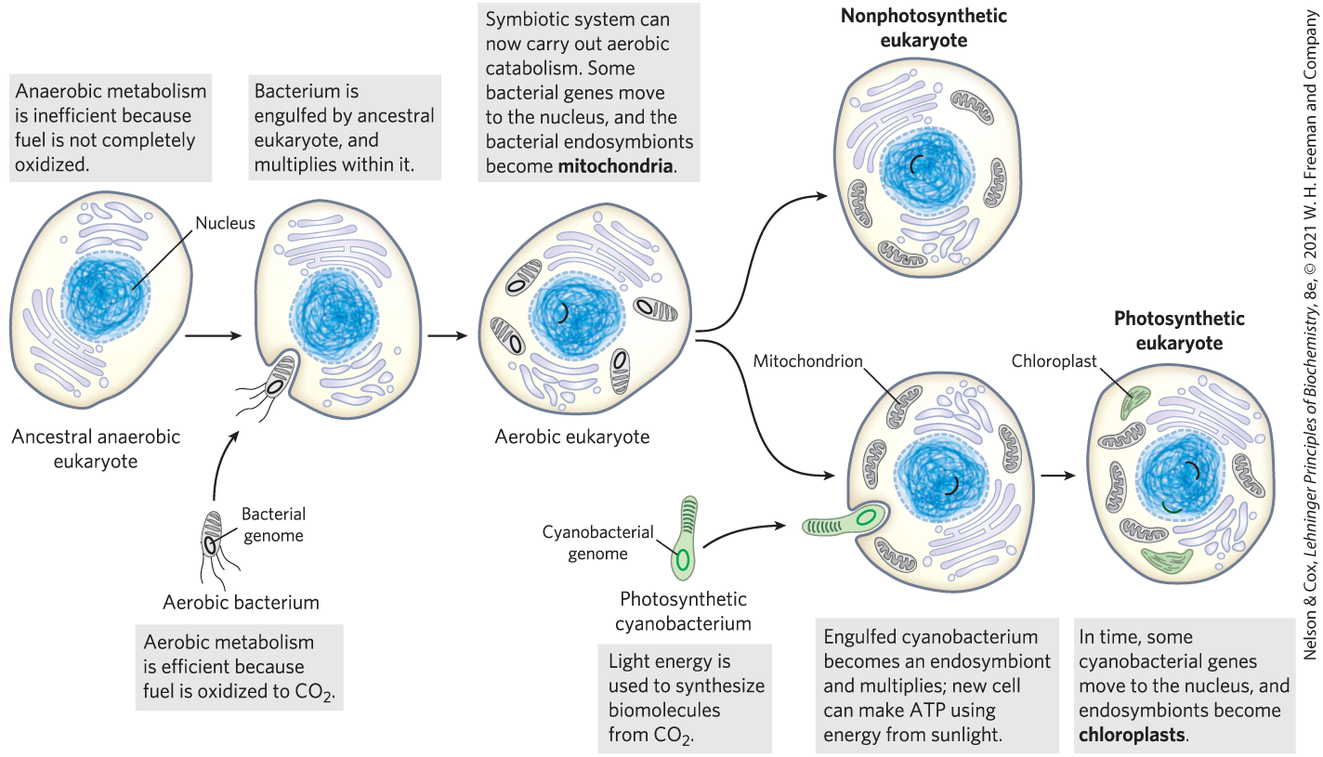
Evolution of Eukaryotes through Endosymbiosis

Slide 106
Principle 5 (3 of 3)
Living organisms change over time by gradual evolution. The result of eons of evolution is an enormous diversity of life forms, fundamentally related through their shared ancestry, which can be seen at the molecular level in the similarity of gene sequences and protein structures.

Slide 107
Molecular Anatomy Reveals Evolutionary Relationships
homologs = proteins encoded by genes that share ready detectable sequence similarities
gene or protein sequence similarities between organisms can determine phylogenetic relationships

Slide 108
Functional Genomics Shows the Allocations of Genes to Specific Cellular Processes
genes can be grouped according to the specific process in which they function
  can approximate the proportion of the genome dedicated to a specific process
  genes involved in regulation of cellular processes tend to increase with organism complexity
housekeeping genes = expressed under all conditions, not subject to much regulation

Slide 109
Genomic Comparisons Have Increasing Importance in Medicine
large-scale sequencing studies have identified many genes in which mutations correlate with a medical condition
the proteins these genes encode might become the target for drugs to treat a given condition

