Slide 1

28 Regulation of Gene Expression
© 2021 Macmillan Learning

Slide 2

Principle 1 (1 of 6)
The cellular concentration of a protein
is determined by a delicate balance of at least seven processes, each having several potential points of regulation. These processes include synthesis of the primary RNA transcript (transcription); posttranscriptional modification of mRNA; degradation of mRNA; protein synthesis (translation); posttranslational modification of proteins; protein targeting and transport; and protein degradation.

Slide 3

Principle 2 (1 of 7)
Regulation is achieved by specialized proteins and RNAs. The proteins are usually ligand-binding proteins with no other function. They bind to specific sequences in DNA or RNA. They respond to molecular signals that can be any kind of biological molecule. The RNAs either interact with other RNAs or serve as protein cofactors.

Slide 4

Principle 3 (1 of 4)
Regulated gene expression may bring about increases or decreases in the amount of a gene product. Gene products that increase in concentration under particular molecular circumstances are referred to as inducible; the process of increasing their expression is induction. Conversely, gene products that decrease in concentration in response to a molecular signal are referred to as repressible, and the process is called repression.

Slide 5
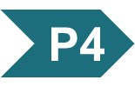
Principle 4 (1 of 6)
The default transcriptional state of a gene, on or off, is dictated in part by the size and complexity of the genome. In bacteria, where genomes are relatively small and DNA is readily accessible, the default state of genes is generally “on.” Transcription of each gene or gene cluster is usually limited by a specific protein repressor. In eukaryotes, where genomes are larger and genes are encapsulated in chromatin, the default state of most genes is “off.” Gene transcription requires chromatin modification followed by the action of transcription activators.

Slide 6

Principle 5 (1 of 2)
Regulation is expensive. For many genes, especially in eukaryotes, the regulatory processes can require a considerable investment of chemical energy. That expenditure is nevertheless small when compared to the cost of RNA and protein synthesis when the gene is expressed.

Slide 7
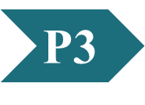
Clicker Question 1
What term refers to gene products that increase in concentration as a result of changes in cellular environment?
expressable
repressible
constitutive
inducible
housekeeping
Notes:
Answer: D
Principle: 28.3
Learning Objective(s):
Bloom’s: 1:1

Slide 8
Clicker Question 1, Response
What term refers to gene products that increase in concentration as a result of changes in cellular environment?
inducible
The rapid activation of gene transcription in response to external stimuli and the resulting production of new proteins is known as inducible gene expression.

Slide 9
Principle 1 (2 of 6)
The cellular concentration of a protein
is determined by a delicate balance of at least seven processes, each having several potential points of regulation. These processes include synthesis of the primary RNA transcript (transcription); posttranscriptional modification of mRNA; degradation of mRNA; protein synthesis (translation); posttranslational modification of proteins; protein targeting and transport; and protein degradation.

Slide 10
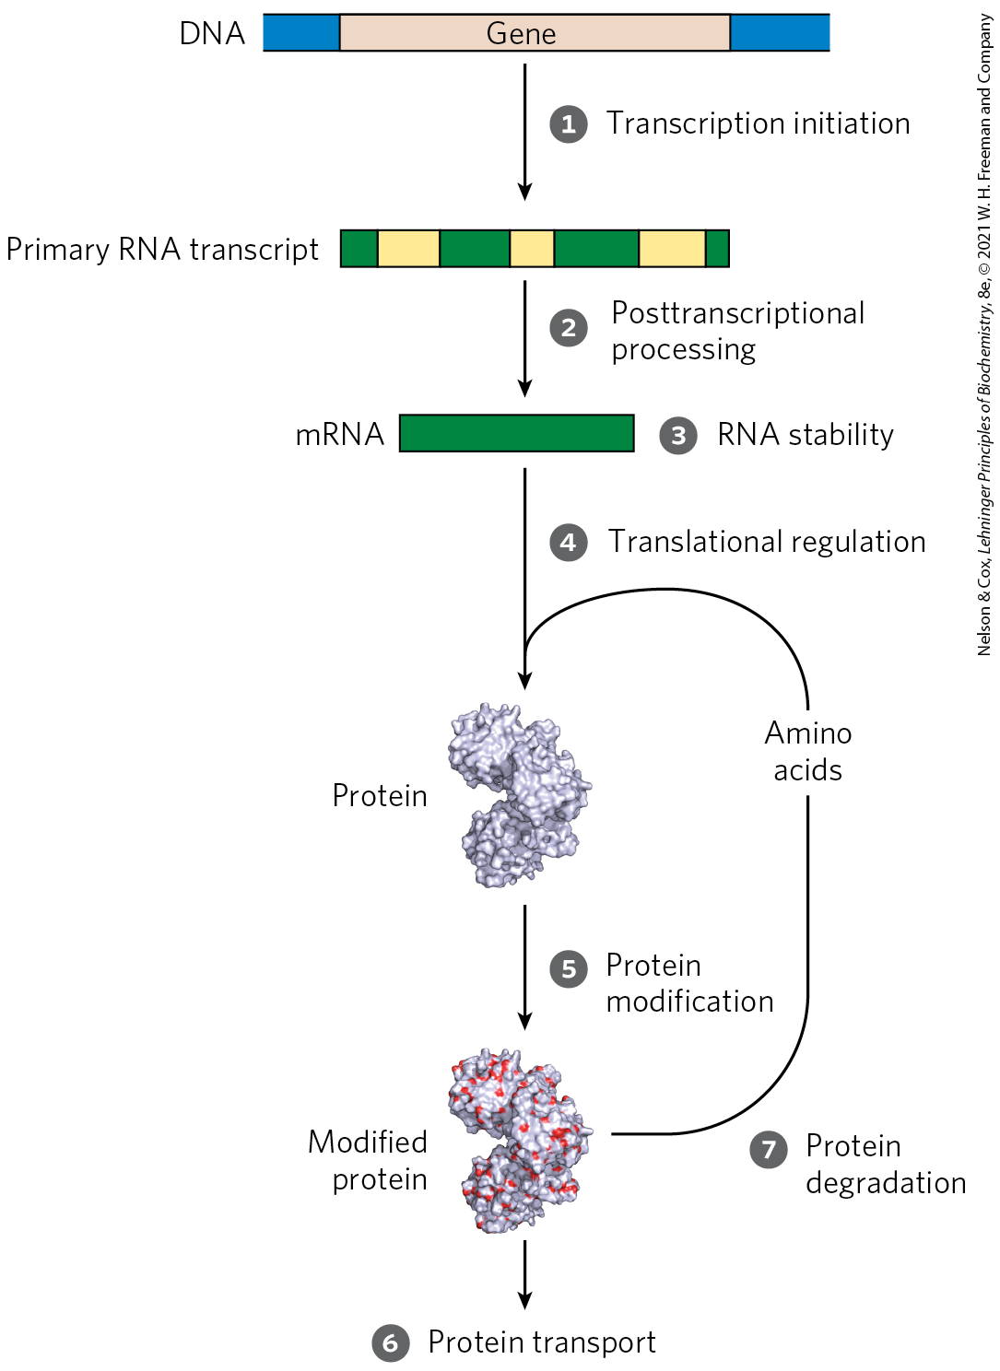
Processes that Affect the Steady-State Concentration of a Protein

Slide 11
28.1 The Proteins and RNAs of Gene Regulation

Slide 12
RNA Polymerase Binds to DNA at Promoters
promoters = sites on the DNA template that are generally found near points at which RNA synthesis begins
regulation of transcription initiation often changes how RNA polymerase interacts with a promoter
differences in promoter sequence affect RNA polymerase binding and the frequency of transcription initiation

Slide 13
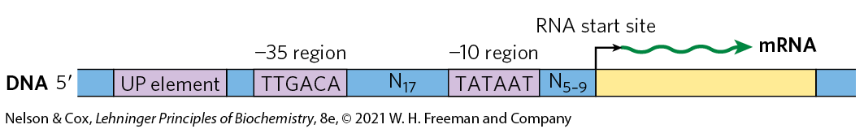
Consensus Sequence for Many E. coli Promoters
most E. coli promoters have a sequence close to a consensus
  mutations away from consensus sequence usually decrease promoter function
  mutations toward consensus usually enhance promoter function

Slide 14
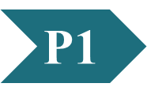
Clicker Question 2
A plasmid construct contains a version of the lac operon. One of the genes codes for an enzyme that metabolizes maltose for energy. The promoter was engineered so that a 22 bp fragment was removed. What would be the effect on cells transformed with this plasmid?
growth on maltose, even with a repressor
no growth on maltose because the gene cluster cannot be transcribed
no growth on maltose because the inducer cannot bind to the mutated promoter
no phenotypic difference because the promoter is not required for operon function
transcription of all the genes in the operon because there would be no regulation
Notes:
Answer: B
Principle: 28.1
Learning Objective(s): Explain how promoter sequences impact transcription initiation.
Bloom’s: 3:2

Slide 15
Clicker Question 2, Response
A plasmid construct contains a version of the lac operon. One of the genes codes for an enzyme that metabolizes maltose for energy. The promoter was engineered so that a 22 bp fragment was removed. What would be the effect on cells transformed with this plasmid?
no growth on maltose because the gene cluster cannot be transcribed
Deleting part of the promoter sequence will likely reduce the binding affinity of RNA polymerases and thus the frequency of transcription initiation.

Slide 16
Housekeeping Genes
housekeeping genes = genes for products that are required at all times and are expressed continuously
  examples: enzymes of central metabolic pathways
  cellular concentrations of the proteins encoded vary
constitutive gene expression = expression of a gene at approximately constant levels
the RNA polymerase–promoter interaction strongly influences the rate of transcription initiation

Slide 17
Principle 2 (2 of 7)
Regulation is achieved by specialized proteins and RNAs. The proteins are usually ligand-binding proteins with no other function. They bind to specific sequences in DNA or RNA. They respond to molecular signals that can be any kind of biological molecule. The RNAs either interact with other RNAs or serve as protein cofactors.

Slide 18
Transcription Initiation Is Regulated by Proteins and RNAs
regulatory proteins regulate transcription initiation by RNA polymerase:
  specificity factors = alter the specificity of RNA polymerase for a given promoter or set of promoters
  repressors = restrict access of RNA polymerase to the promoter
  activators = enhance the RNA polymerase–promoter interaction

Slide 19
ncRNAs and IncRNAs
noncoding RNAs (ncRNAs) = RNA molecules that are not translated
long noncoding RNAs (lncRNAs) = noncoding RNAs more than 200 nucleotides long that lack an open reading frame (ORF) that encodes a protein

Slide 20
Known Functions of IncRNAs
known functions of functions of lncRNAs include:
  regulation of nucleosome positioning and chromatin structure
  control of DNA methylation and posttranscriptional histone modifications
  transcriptional gene silencing
  multiple roles in transcriptional activation and repression

Slide 21
Bacterial Specificity Factors
specificity factor = amino acid sequence that mediates promoter recognition and binding
  example: the σ subunit of the E. coli RNA polymerase
most E. coli promoters are recognized by σ⁷⁰
σ⁷⁰ is replaced by σ³² under conditions of heat stress
  directs RNA polymerase to a specialized set of promoters with a different consensus sequence
  causes expression of genes involved in the heat shock response

Slide 22
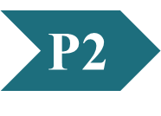
Clicker Question 3
Which DNA transcriptional component is NOT a specificity factor?
IncRNAs
TATA-binding protein
σ⁷⁰
σ³²
Notes:
Answer: A.
Principle: 28.2
Learning Objective(s): Identify the functions of IncRNAs
Bloom’s: 2:1

Slide 23
Clicker Question 3, Response
Which DNA transcriptional component is NOT a specificity factor?
IncRNAs
Specificity factors are proteins that alter the specificity of RNA polymerase for a given promoter or set of promoters. Although lncRNAs have roles in transcriptional gene silencing, transcriptional activation, and transcriptional repression, they are not considered specificity factors.

Slide 24
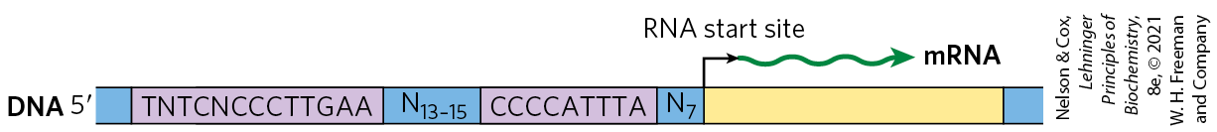
When Bacteria Are Subjected to Heat Stress, σ³² Replaces σ⁷⁰
σ⁷⁰ is replaced by σ³² under conditions of heat stress
  directs RNA polymerase to a specialized set of promoters with a different consensus sequence
  causes expression of genes involved in the heat shock response

Slide 25
Eukaryotic Specificity Factors
some of the general transcription factors may be considered specificity factors
  example: the TATA-binding protein (TBP)

Slide 26
Principle 3 (2 of 4)
Regulated gene expression may bring about increases or decreases in the amount of a gene product. Gene products that increase in concentration under particular molecular circumstances are referred to as inducible; the process of increasing their expression is induction. Conversely, gene products that decrease in concentration in response to a molecular signal are referred to as repressible, and the process is called repression.

Slide 27
Bacterial Repressors
repressors = proteins that block RNA polymerase binding or its movement along DNA
operators = binding sites on the DNA that bind repressors
  generally located near a promoter
effector = a small molecule or a protein that regulates repressor binding to DNA to alter transcription
  binds to the repressor and causes a conformational change

Slide 28
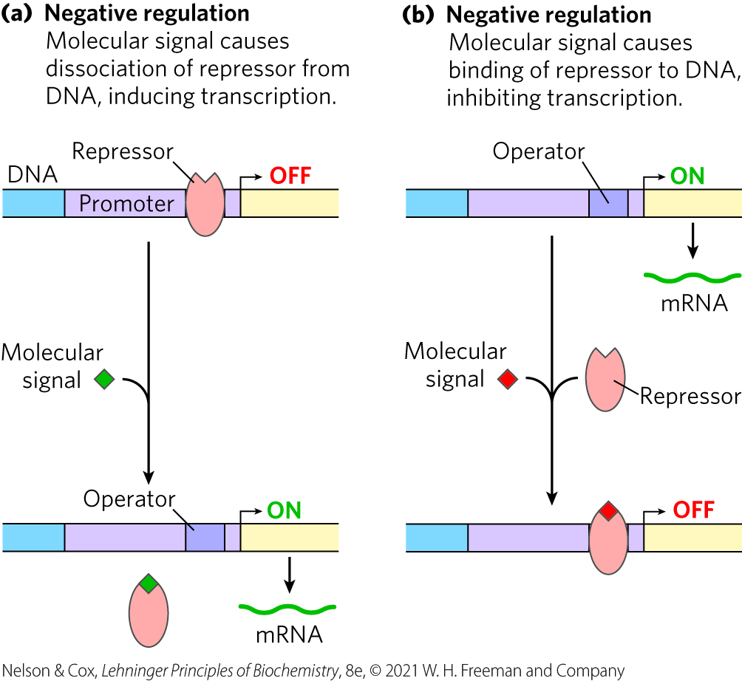
Negative Regulation
negative regulation = regulation by means of a repressor protein that blocks transcription

Slide 29
Principle 4 (2 of 6)
The default transcriptional state of a gene, on or off, is dictated in part by the size and complexity of the genome. In bacteria, where genomes are relatively small and DNA is readily accessible, the default state of genes is generally “on.” Transcription of each gene or gene cluster is usually limited by a specific protein repressor. In eukaryotes, where genomes are larger and genes are encapsulated in chromatin, the default state of most genes is “off.” Gene transcription requires chromatin modification followed by the action of transcription activators.

Slide 30
Eukaryotic Repressors
gene regulation by a repressor is less common in eukaryotic cells
  more common in lower eukaryotes such as yeast
the binding site for a repressor may be some distance from the promoter

Slide 31
Clicker Question 4
Which situation is NOT one where you would typically find an example of negative regulation?
bacterial cells where the operator is near the promoter
yeast cells where the operator is separated from the promoter
eukaryotic cells where the operator is near the promoter
eukaryotic cells where the operator is separated from the promoter
Notes:
Answer: C
Principle: 28.2
Learning Objective(s): Explain the type of regulation that involves operator sequences in E.coli
Bloom’s: 2:2

Slide 32
Clicker Question 4, Response
Which situation is NOT one where you would typically find an example of negative regulation?
eukaryotic cells where the operator is near the promoter
In eukaryotic cells, gene regulation by a repressor is less common. Where it does occur (more often in lower eukaryotes such as yeast), the binding site for a repressor may be some distance from the promoter.

Slide 33
Principle 3 (3 of 4)
Regulated gene expression may bring about increases or decreases in the amount of a gene product. Gene products that increase in concentration under particular molecular circumstances are referred to as inducible; the process of increasing their expression is induction. Conversely, gene products that decrease in concentration in response to a molecular signal are referred to as repressible, and the process is called repression.

Slide 34
Bacterial Activators
activators = proteins that enhance the RNA polymerase–promoter interaction
activator-binding sites are often adjacent to promoters that are bound weakly or not at all by RNA polymerase alone

Slide 35
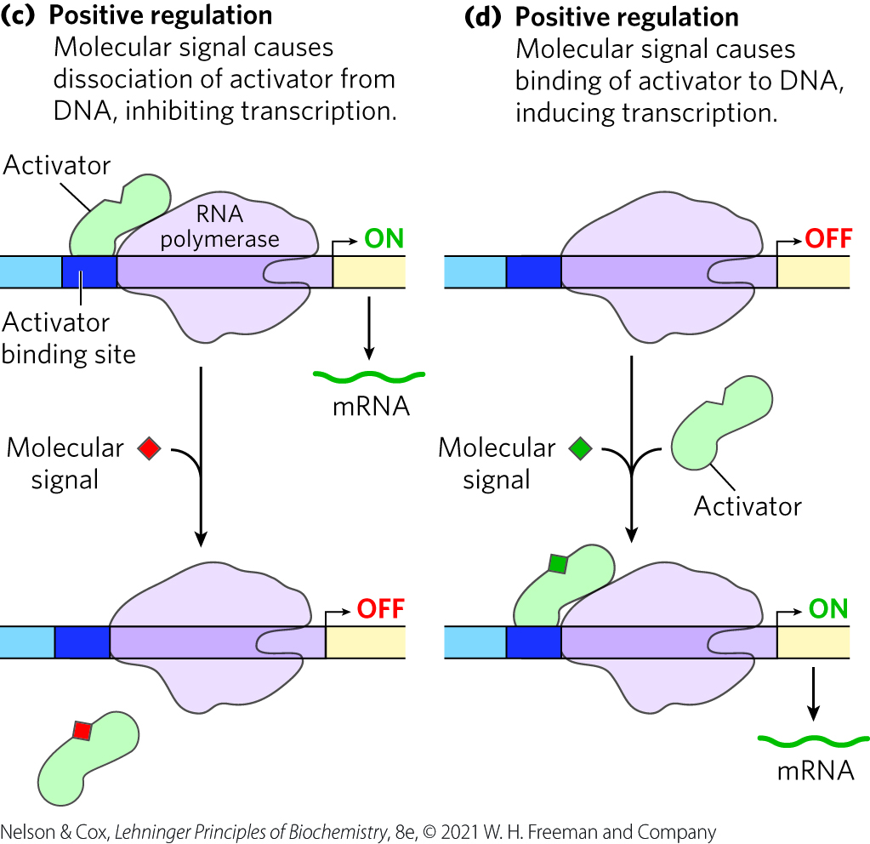
Positive Regulation
positive regulation = regulation by means of an activator protein that induces transcription

Slide 36
Clicker Question 5
Which function is positive regulation of gene expression?
molecular signal causes dissociation of repressor from DNA, inducing transcription
molecular signal causes dissociation of activator from DNA, inhibiting transcription
molecular signal causes binding of repressor to DNA, inhibiting transcription
All of the answers are correct.
None of the answers is correct.
Notes:
Answer: B. Fig 28-4.
Principle: 28.3
Learning Objective(s): Explain the effect of activators on transcription.
Bloom’s: 2:2

Slide 37
Clicker Question 5, Response
Which function is positive regulation of gene expression?
molecular signal causes dissociation of activator from DNA, inhibiting transcription
Activators provide a molecular counterpoint to repressors; they bind to DNA and enhance the activity of RNA polymerase at a promoter; this is positive regulation.

Slide 38
Principle 4 (3 of 6)
The default transcriptional state of a gene, on or off, is dictated in part by the size and complexity of the genome. In bacteria, where genomes are relatively small and DNA is readily accessible, the default state of genes is generally “on.” Transcription of each gene or gene cluster is usually limited by a specific protein repressor. In eukaryotes, where genomes are larger and genes are encapsulated in chromatin, the default state of most genes is “off.” Gene transcription requires chromatin modification followed by the action of transcription activators.

Slide 39
Eukaryotic Activators
positive regulation by activators is common in eukaryotes
enhancers = DNA sites that bind activators and are distant from the promoter
  activator binding can affect the rate of transcription at far away promoters

Slide 40
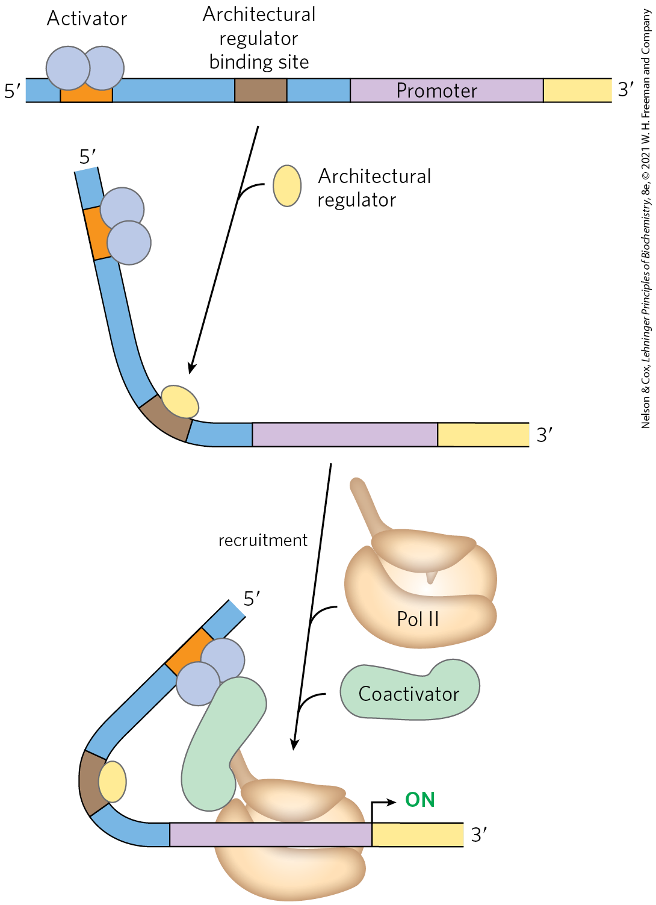
Architectural Regulators and Coactivators
architectural regulators = proteins that bind to sites between a promotor and the activator or repressor binding site and facilitate DNA looping
coactivators = proteins that mediate the interaction between activators and RNA polymerase
  protein repressors may bind in their place instead

Slide 41
Clicker Question 6
Which statement regarding regulation of gene expression is false?
Regulation by repressors is more common in prokaryotes than in eukaryotes.
Eukaryotic architectural regulators bind to DNA, causing it to loop so that sequences thousands of base pairs apart are brought in close proximity.
Constitutive gene expression is when the levels of expression of a gene are varied.
Activators and repressors often bind thousands of base pairs away from the promoter they are affecting.
Notes:
Answer: C
Principle: 28.3
Learning Objective(s): Define constitutive gene expression.
Bloom’s: 2:2

Slide 42
Clicker Question 6, Response
Which statement regarding regulation of gene expression is false?
Constitutive gene expression is when the levels of expression of a gene are varied.
Constitutive gene expression is the expression of a gene at approximately constant levels.

Slide 43
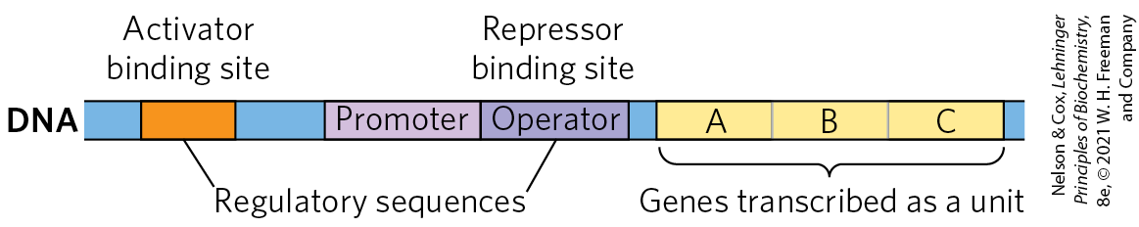
Many Bacterial Genes Are Clustered and Regulated in Operons
operon = a gene cluster and promoter, plus additional sequences that function together in regulation
many genes in the same operon encode subunits of a larger protein complex or are involved in related processes that require coordinated regulation

Slide 44
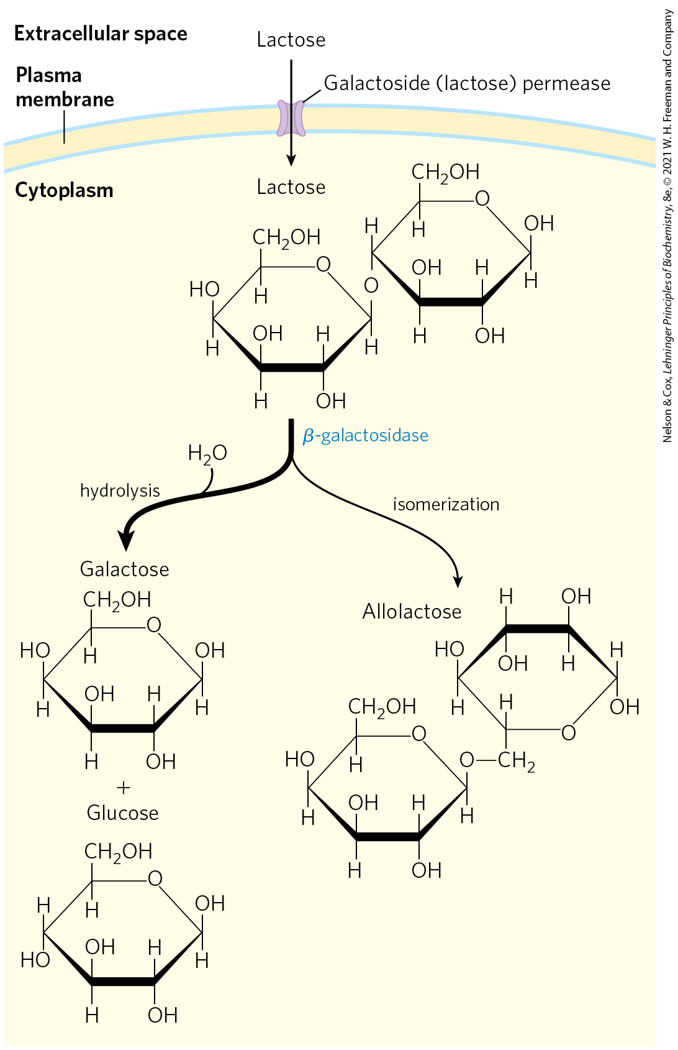
Lactose Metabolism in E. coli
β-galactosidase = cleaves lactose to galactose and glucose
galactoside permease = transports lactose into the cell

Slide 45
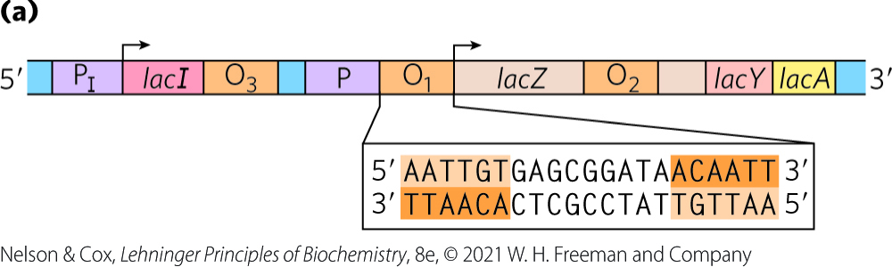
The lac Operon Is Subject to Negative Regulation
lactose (lac) operon includes the genes for:
  β-galactosidase (Z)
  galactoside permease (Y)
  thiogalactoside transacetylase (A) = modifies toxic galactosides to facilitate their removal
the lac operon is repressed in the absence of lactose
  repression is not absolute

Slide 46
Clicker Question 7
The term operon refers to:
a contiguous mRNA with more than two genes that can be translated into proteins.
a region of DNA that interacts with a repressor protein to control the expression of a gene or group of genes.
a gene cluster, its promoter, and additional regulatory sequences that function together.
a complex of an mRNA molecule and two or more ribosomes.
Notes:
Answer: C
Principle: 28.3
Learning Objective(s): Define an operon.
Bloom’s: 2:2

Slide 47
Clicker Question 7, Response
The term operon refers to:
a gene cluster, its promoter, and additional regulatory sequences that function together.
Many bacterial mRNAs are polycistronic and the single promoter that initiates transcription of the cluster is the site of regulation for expression of all the genes in the cluster. The gene cluster and promoter, plus additional sequences that function together in regulation, are called an operon.

Slide 48
lacI Encodes the Lac Repressor
lacI encodes the Lac repressor protein
  lacI has its own promoter (P_{I})
  mutations in lacI result in constitutive synthesis of the operon

Slide 49
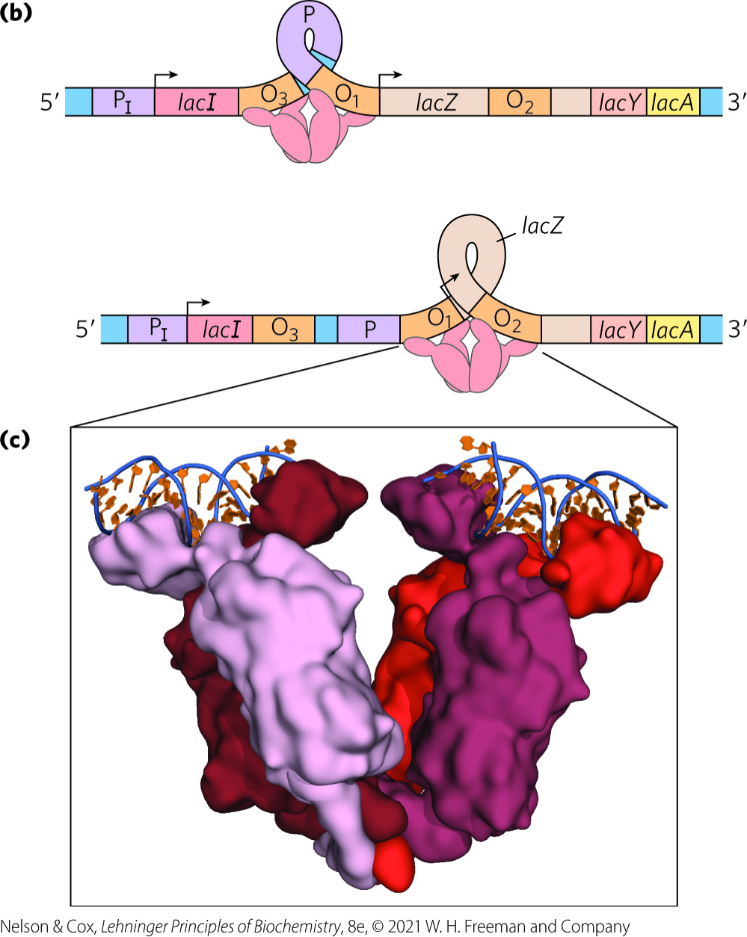
The lac Repressor Binds to Operators
the Lac repressor binds to O₁ (the main operator for the lac operon) and either O₂ or O₃
Lac repressor binding loops the intervening DNA to block transcription initiation

Slide 50
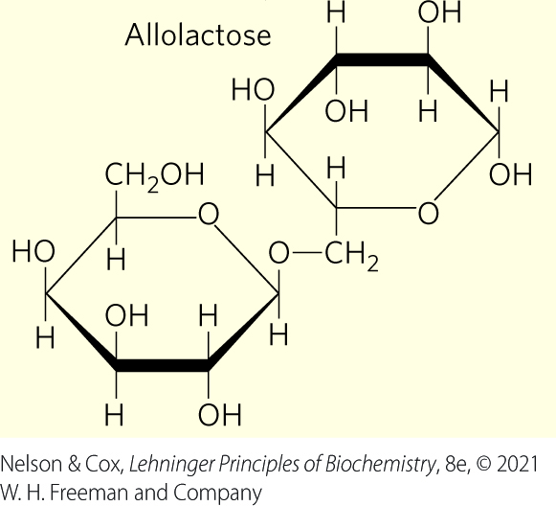
Allolactose Is The Inducer of the lac Operon System
allolactose, an isomer of lactose, is the inducer of the lac operon
binding of allolactose to the Lac repressor causes a conformational change and dissociation
  results in expression of lac operon genes

Slide 51
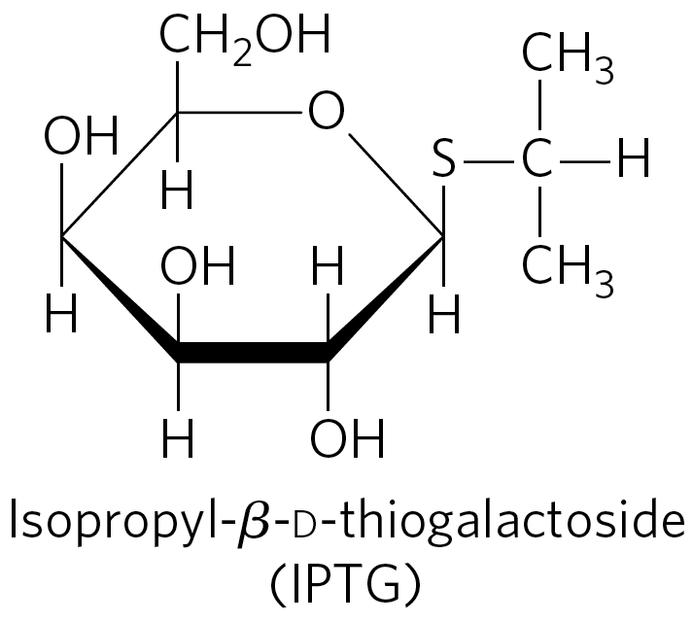
IPTG is an Inducer of the lac Operon
isopropylthiogalactoside (IPTG) is an inducer of the lac operon
  nonmetabolizable
  often used experimentally

Slide 52
Clicker Question 8
The lac operon:
consists of the genes lacI, lacZ, lacY, lacA, and lacD.
is not 100% inactivated by the Lac repressor.
allows E. coli to synthesize lactose.
binding of lactose to Lac repressor causes it to dissociate from its operator.
Notes:
Answer: B
Principle: 28.3
Learning Objective(s): Explain the effect of the presence of lactose on the lac operon.
Bloom’s: 1:1

Slide 53
Clicker Question 8, Response
The lac operon:
is not 100% inactivated by the Lac repressor.
Even in the repressed state, each cell has a few molecules of β-galactosidase and galactoside permease, presumably synthesized on the rare occasions when the repressor transiently dissociates from the operators. This basal level of transcription is essential to operon regulation.

Slide 54
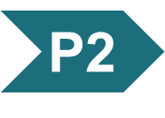
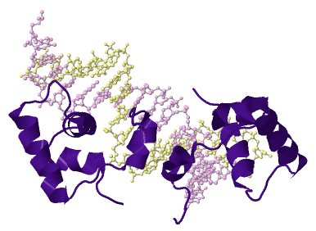
Activity: Transcriptional
Regulation
Observe the structure of the Lac repressor in
Mol3D viewer in your Achieve course.
Notes:
Instructor: This Mol3D structure is located in the Achieve course. It can be found in the Chapter 28 content, in the folder titled “Ch28 In-Class Activities and Resources.”

Slide 55
Activity Instructions (1 of 4)
On your own, think of answers to the question:
  To what region of DNA is the Lac repressor bound? Select the region and upload a screenshot to your course.
  How does the Lac repressor downregulate lac operon gene expression?
  What happens to Lac repressor in the presence of lactose? (2 minutes)
Pair up to discuss your ideas. (2 minutes)
Share your ideas with the class in group discussion. (3 minutes)
Notes:
Instructor: This Mol3D structure is located in the Achieve course. It can be found in the Chapter 28 content, in the folder titled “Ch28 In-Class Activities and Resources.”

Slide 56
Activity Solution (1 of 5)
  To what region of DNA is the Lac repressor bound? Select the region and upload a screenshot to your course. The operator, which is adjacent to the transcriptional start site of the lac operon. In the Mol3D, the operator is represented as the strand of DNA to which the Lac repressor protein is bound.
Notes:
Instructor: This Mol3D structure is located in the Achieve course. It can be found in the Chapter 28 content, in the folder titled “Ch28 In-Class Activities and Resources.”

Slide 57
Activity Solution (2 of 5)
  How does the Lac repressor downregulate lac operon gene expression? Binding of Lac repressor to the operator region blocks transcriptional initiation either by looping out the promoter DNA or the lacZ DNA.
  What happens to Lac repressor in the presence of lactose? In the presence of lactose, an inducer molecule binds to the repressor, changing its shape and resulting in its dissociation from the operator.
Notes:
Instructor: This Mol3D structure is located in the Achieve course. It can be found in the Chapter 28 content, in the folder titled “Ch28 In-Class Activities and Resources.”

Slide 58
Principle 2 (3 of 7)
Regulation is achieved by specialized proteins and RNAs. The proteins are usually ligand-binding proteins with no other function. They bind to specific sequences in DNA or RNA. They respond to molecular signals that can be any kind of biological molecule. The RNAs either interact with other RNAs or serve as protein cofactors.

Slide 59
Regulatory Proteins Have Discrete DNA-Binding Domains
regulatory proteins generally bind to specific DNA sequences.
  have discrete DNA-binding domains containing characteristic structural motifs that interact with the DNA

Slide 60
Regulatory Proteins Must Recognize DNA Surface Features
most of the chemical groups that differ among the four bases are hydrogen-bond donor and acceptor groups exposed in the major groove of DNA
  permits discrimination between base pairs
most of the protein-DNA contacts that impart specificity are hydrogen bonds

Slide 61
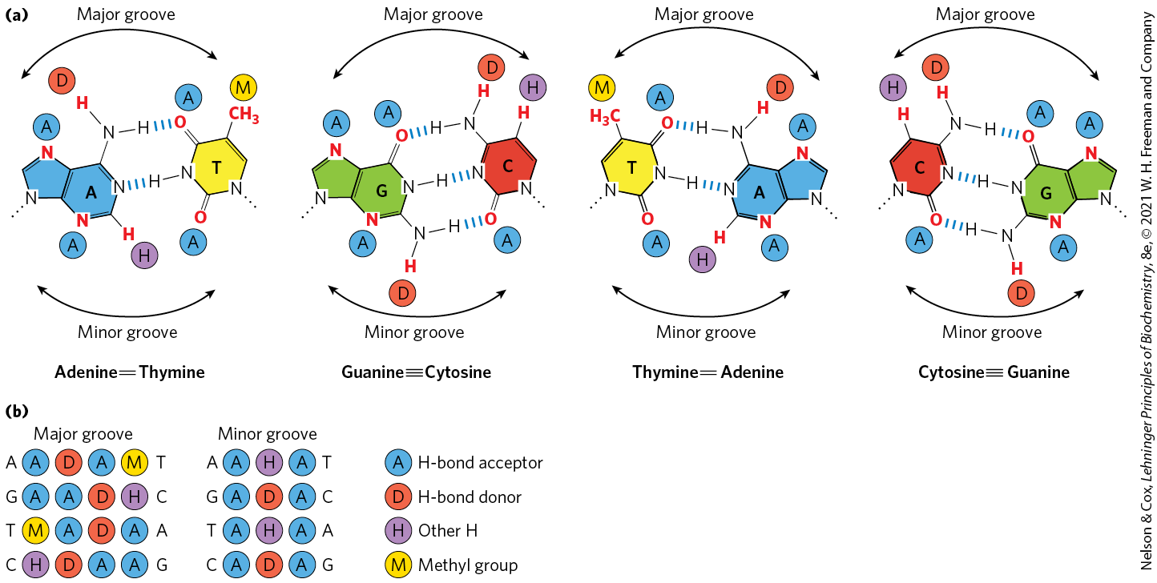
Groups in DNA Available for
Protein Binding

Slide 62
Clicker Question 9
Regulation of gene expression due to protein binding is a result of:
changes in the shape of the major and minor grooves, leading to single-stranded areas.
changes in the hydrogen bonding between bases in specific regulatory sequences of DNA.
proteins bound in the major groove of DNA through hydrogen bonds.
alterations in Lk of the DNA in specific regions that changes it from B form to either Z form or single strands.
triplex DNA regions that permit regulatory protein binding.
Notes:
Answer: C
Principle: 28.2
Learning Objective(s): Identify the structural element of cellular DNA where most protein-DNA contacts occur
Bloom’s: 2:2

Slide 63
Clicker Question 9, Response
Regulation of gene expression due to protein binding is a result of:
proteins bound in the major groove of DNA through hydrogen bonds.
Most of the chemical groups that differ among the four bases and thus permit discrimination between base pairs are hydrogen-bond donor and acceptor groups exposed in the major groove of DNA, and most of the protein-DNA contacts that impart specificity are hydrogen bonds.

Slide 64
Interactions Between Amino Acid Residues and DNA Base Pairs
Asn, Gln, Glu, Lys, and Arg side chains most often hydrogen bond to the DNA bases
there is no simple amino acid–base code

Slide 65
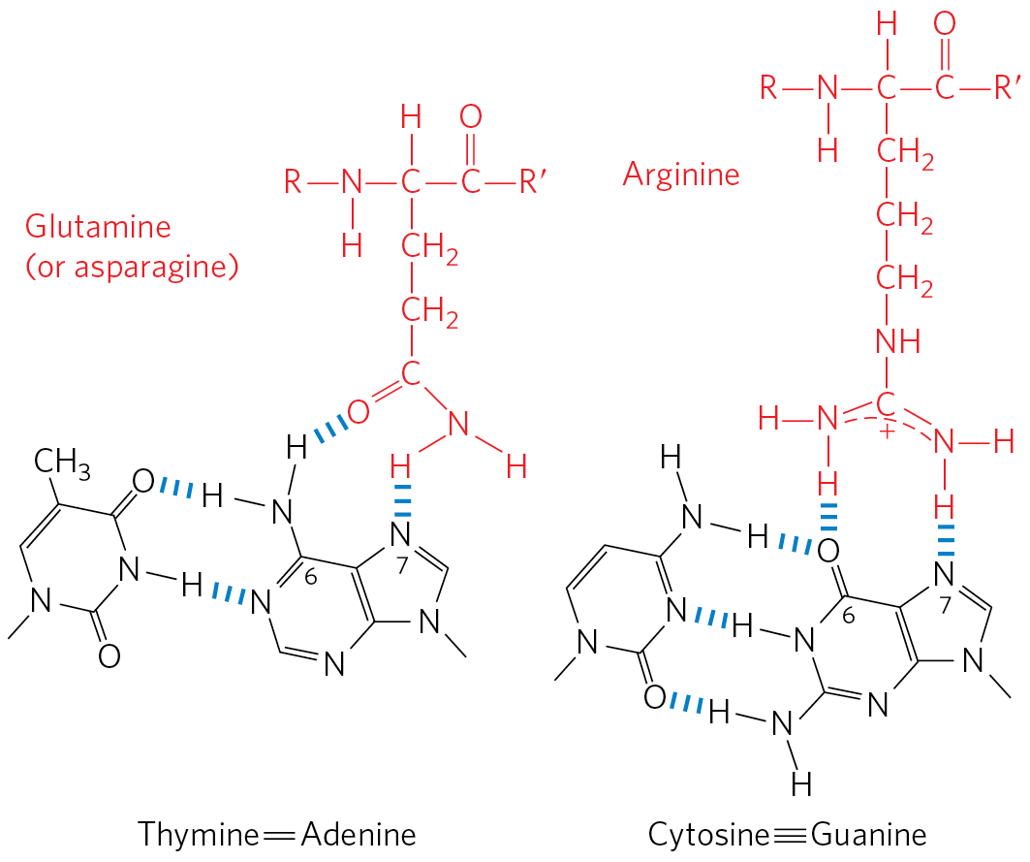
Specific Amino Acid Residue–Base
Pair Interactions
Gln or Asn can hydrogen bond with the N⁶ and N-7 positions of adenine
Arg can form two hydrogen bonds with N-7 and O⁶ of guanine

Slide 66
Clicker Question 10
Regulatory proteins that interact with DNA usually do NOT do this through the amino acid residue:
Asn
Asp
Gln
Glu
Arg
Notes:
Answer: B
Principle: 28.2
Learning Objective(s): Describe the structural components of the basic helix-loop-helix motif.
Bloom’s: 1:1

Slide 67
Clicker Question 10, Response
Regulatory proteins that interact with DNA usually do NOT do this through the amino acid residue:
Asp
Within regulatory proteins, the amino acid side chains most often hydrogen-bonding to bases in the DNA are those of Asn, Gln, Glu, Lys, and Arg residues.

Slide 68
Principle 2 (4 of 7)
Regulation is achieved by specialized proteins and RNAs. The proteins are usually ligand-binding proteins with no other function. They bind to specific sequences in DNA or RNA. They respond to molecular signals that can be any kind of biological molecule. The RNAs either interact with other RNAs or serve as protein cofactors.

Slide 69
DNA-Binding Sites for
Regulatory Proteins
often inverted repeats of a short DNA sequence (a palindrome)
multiple (usually two) subunits of a regulatory protein bind cooperatively to the sequence
Lac repressor binding is unique
  each of the two tethered dimers of the Lac repressor separately binds to a palindromic operator sequence

Slide 70
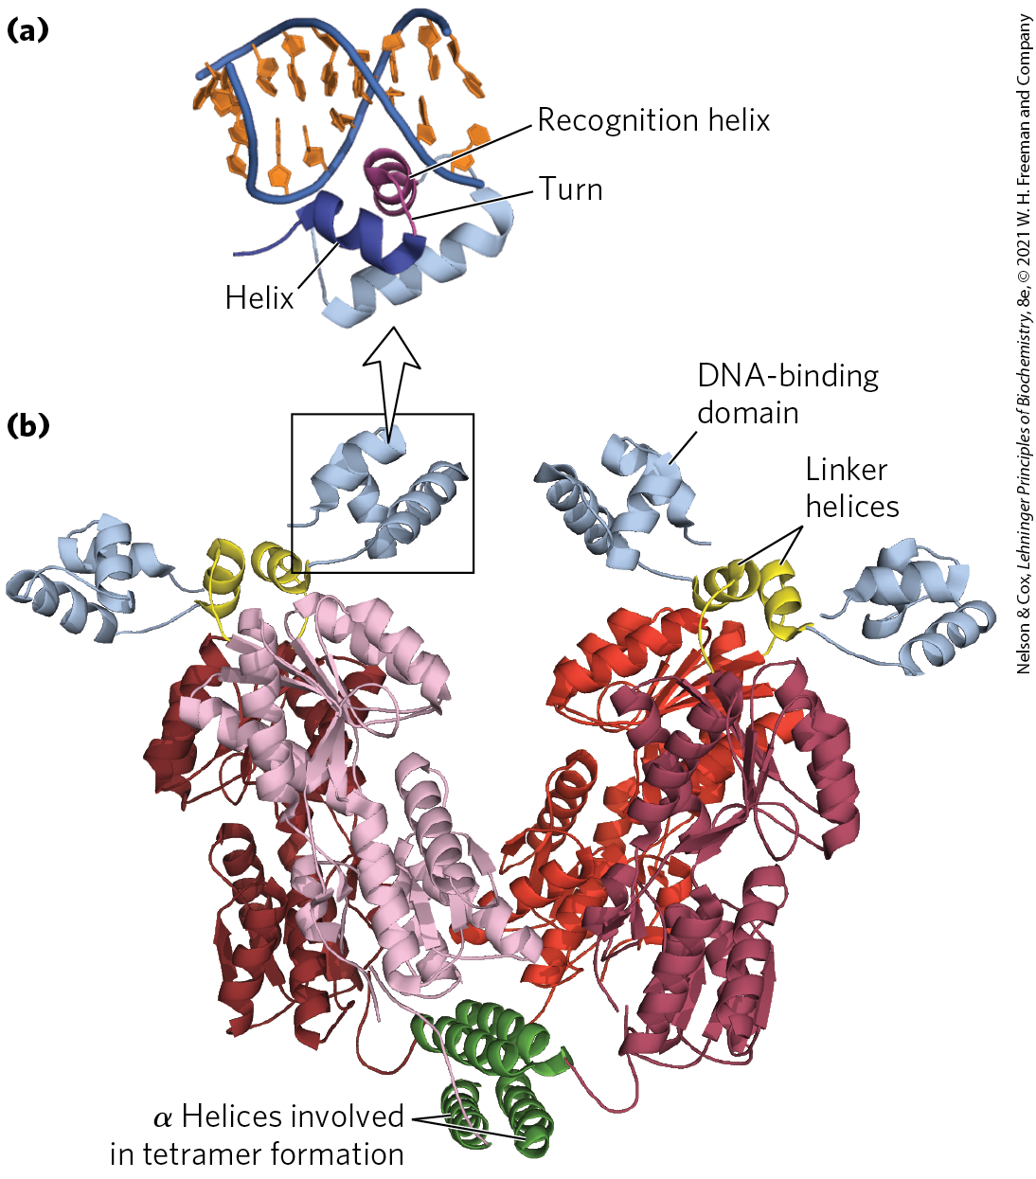
Helix-Turn-Helix
helix-turn-helix motif = ~20 amino acid residues in two short α-helical segments, each 7 to 9 residues long, separated by a β turn
  example: the Lac repressor
  not stable by itself

Slide 71
The Recognition Helix
recognition helix = the α-helical segment that contains many of the amino acids that interact with DNA in a sequence-specific way
  protrudes from the protein surface
  positioned in or nearly in the major groove when bound to DNA

Slide 72
Clicker Question 11
A set of four proteins was identified in the proteome of a cell line. All had two α helices, with one β turn at the amino side of a helix and one β turn between the helices. What would lead you to conclude that these proteins are transcription regulators?
ability to bind DNA in the major groove with a relatively low K_{d}
ability to bind mRNA near or at its 5′ end
two-dimensional gel electrophoresis results showing these proteins are small and acidic, similar to all known regulatory proteins
ability to hydrolyze GTP (or ATP)
ability to partially denature DNA and bind in the minor groove
Notes:
Answer: A. This is a motif similar to helix-turn-helix, but with an extra turn on the amino end.
Principle: 28.2
Learning Objective(s): Describe the structural components of the basic helix-loop-helix motif.
Bloom’s: 4:2

Slide 73
Clicker Question 11, Response
A set of four proteins was identified in the proteome of a cell line. All had two α helices, with one β turn at the amino side of a helix and one β turn between the helices. What would lead you to conclude that these proteins are transcription regulators?
ability to bind DNA in the major groove with a relatively low K_{d}
This is a motif similar to helix-turn-helix, a crucial motif in many regulatory proteins. When bound to DNA, the recognition helix is positioned in or nearly in the major groove. A low K_{d} indicates high-affinity binding.

Slide 74
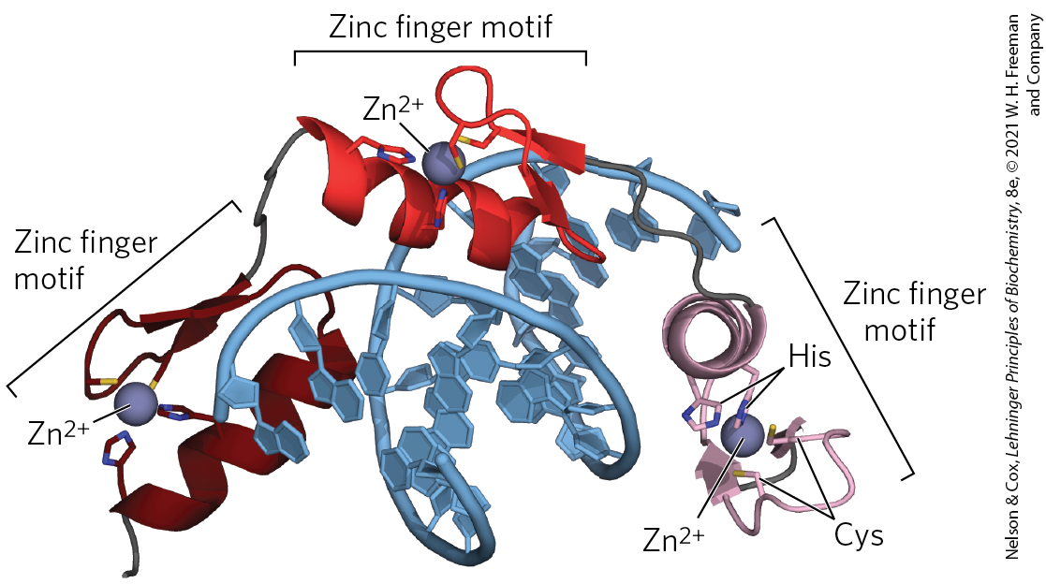
Zinc Finger
zinc finger = ~30 amino acid residues forming an elongated loop held together at the base by a single Zn²⁺ ion
  Zn²⁺ is coordinated to 4 residues (4 Cys or 2 Cys and 2 His)
many eukaryotic DNA-binding proteins contain zinc fingers

Slide 75
Zinc Finger Binding
the interaction of a single zinc finger with DNA is typically weak
  multiple zinc fingers substantially enhances binding
some zinc fingers have the residues for sequence discrimination, whereas others seem to bind DNA nonspecifically
zinc fingers can also function as RNA-binding motifs

Slide 76
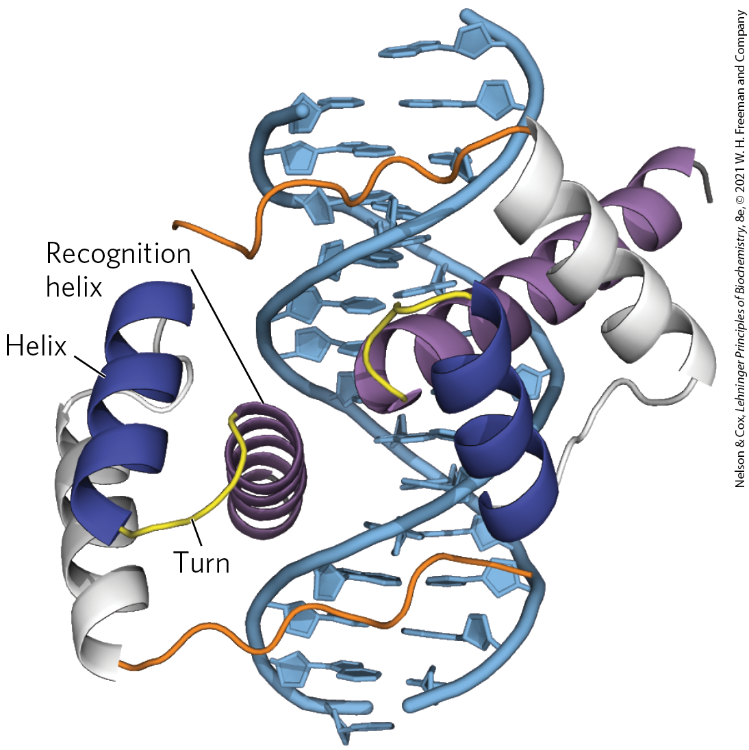
Homeodomain
homeodomain = 60 highly-conserved amino acid residues
  identified in proteins that function as transcriptional regulators, especially during eukaryotic development
homeobox = the DNA sequence that encodes this domain

Slide 77
RNA Recognition Motif
RNA recognition motifs (RRMs) = 90 to 100 amino acid residues arranged in a four-strand antiparallel β sheet sandwiched against two α helices (β₁-α₁-β₂-β₃-α₂-β₄)
  found in some eukaryotic gene activators, where they may bind DNA and RNA to induce transcription
  proteins with RRM motifs may bind to mRNA, rRNA, or other smaller, noncoding RNAs
  lncRNAs compete with DNA binding and decrease gene transcription

Slide 78
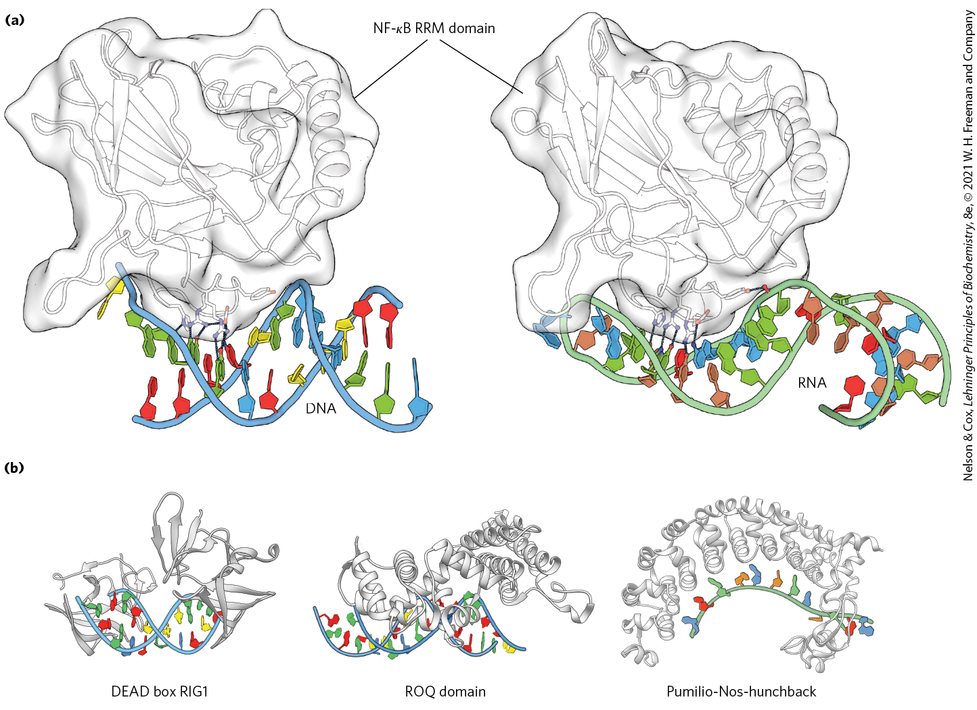
Examples of RNA Recognition
Motifs (RRMs)

Slide 79
Clicker Question 12
Which protein motif does NOT bind DNA?
helix bundle
zinc finger
helix-turn-helix
homeodomain
All of these bind DNA.
Notes:
Answer: A. Helix bundles are common to bind lipid membranes.
Principle: 28.2
Learning Objective(s): Define the DNA-binding motif by regulatory proteins known as a homeodomain.
Bloom’s: 1:1

Slide 80
Clicker Question 12, Response
Which protein motif does NOT bind DNA?
helix bundle
The helix-turn-helix and zinc finger motifs both play prominent roles in the binding of DNA by regulatory proteins. The DNA-binding segment of the homeodomain is related to the helix-turn-helix motif. Helix bundles are common to bind lipid membranes.

Slide 81
Clicker Question 13
Which factor is NOT a DNA-binding domain found in regulatory proteins?
helix-turn-helix
homeodomain
RNA recognition motif
DNA recognition motif
Notes:
Answer: D
Principle: 28.2
Learning Objective(s): Define the DNA-binding motif by regulatory proteins known as RNA recognition motifs (RRMs).
Bloom’s: 1:1

Slide 82
Clicker Question 13, Response
Which factor is NOT a DNA-binding domain found in regulatory proteins?
DNA recognition motif
The helix-turn-helix motif is crucial to the interaction of many regulatory proteins with DNA. The DNA-binding segment of the homeodomain is related to the helix-turn-helix motif. RNA recognition motifs (RRMs) are found in some eukaryotic gene activators.

Slide 83
Regulatory Proteins Also Have Protein-Protein Interaction Domains
regulatory proteins contain domains for protein-protein interactions
  example: domains for dimer formation of eukaryotic transcription factors

Slide 84
Leucine Zipper
leucine zipper = an amphipathic α helix with a series of hydrophobic amino acid residues on one side and a hydrophobic surface between two polypeptides of a dimer
  Leu occurs at every 7th position along the α helices
  helices form a coiled coil
  found in many eukaryotic proteins
  often found in proteins with a separate DNA-binding domain containing a high concentration of basic (Lys or Arg) residues that can interact with the DNA backbone

Slide 85
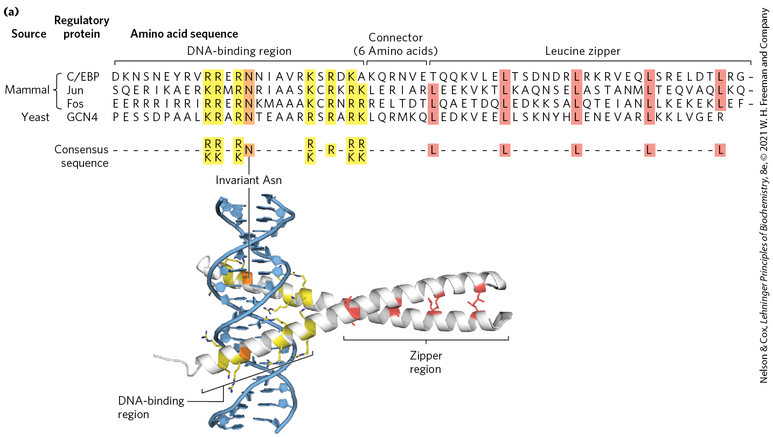
Leucine Zippers

Slide 86
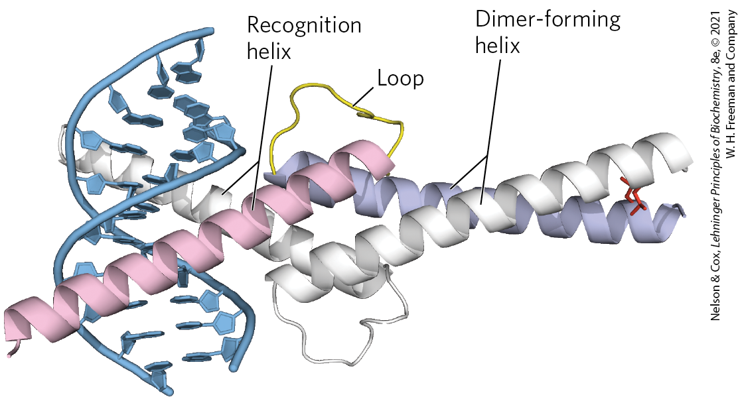
Basic Helix-Loop-Helix
basic helix-loop-helix = conserved 50 amino acid residues that can form two short, amphipathic α helices linked by a loop of variable length
  two helix-loop-helix motifs can interact to form dimers
  occurs in some eukaryotic regulatory proteins involved in gene expression during development

Slide 87
Principle 4 (4 of 6)
The default transcriptional state of a gene, on or off, is dictated in part by the size and complexity of the genome. In bacteria, where genomes are relatively small and DNA is readily accessible, the default state of genes is generally “on.” Transcription of each gene or gene cluster is usually limited by a specific protein repressor. In eukaryotes, where genomes are larger and genes are encapsulated in chromatin, the default state of most genes is “off.” Gene transcription requires chromatin modification followed by the action of transcription activators.

Slide 88
Protein-Protein Interactions in Eukaryotic Regulatory Proteins
eukaryotes have a larger number of genes than activators
  yeast have 300 transcription factors for 1000s of genes
most genes are subject to regulation by multiple transcription factors
combinatorial control = a mechanism involving mixing and matching of protein family variants in dimeric transcription factors
  provides for more efficient and responsive regulation

Slide 89
Clicker Question 14
Which protein-binding motif consists of two short, amphipathic α helices that enable protein dimerization?
leucine zipper
basic helix-loop-helix
helix-turn-helix
zinc finger
Notes:
Answer: B
Principle: 28.2
Learning Objective(s): Describe the structural components of the basic helix-loop-helix motif
Bloom’s: 2:1

Slide 90
Clicker Question 14, Response
Which protein-binding motif consists of two short, amphipathic α helices that enable protein dimerization?
basic helix-loop-helix
The basic helix-loop-helix occurs in some eukaryotic regulatory proteins. These proteins share a conserved region of about 50 amino acid residues important in both DNA binding and protein dimerization. This region can form two short, amphipathic α helices linked by a loop of variable length, the helix-loop-helix. The helix-loop-helix motifs of two polypeptides interact to form dimers.

Slide 91
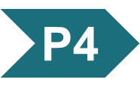
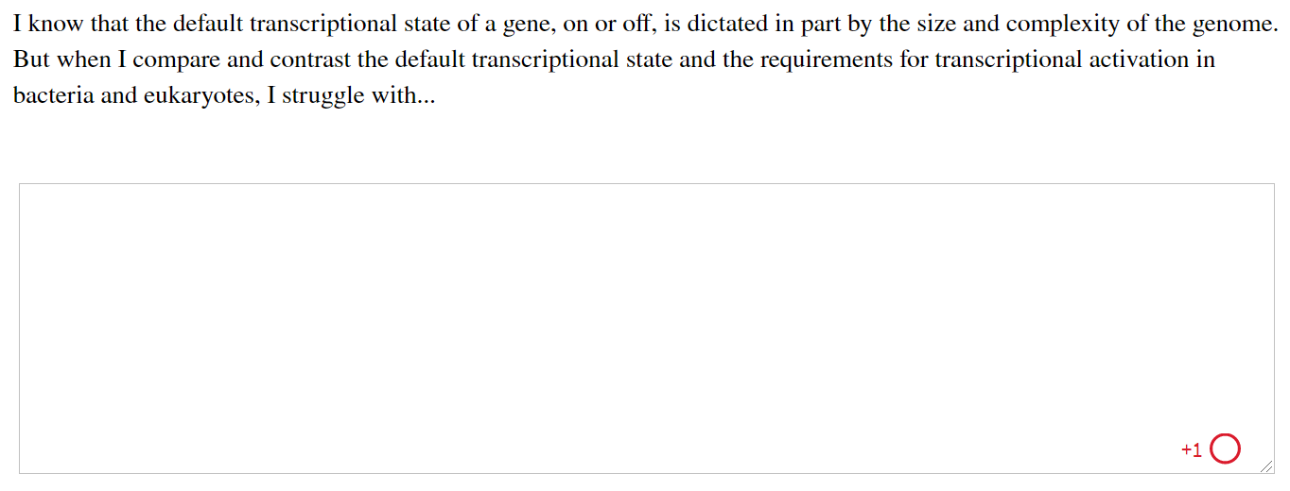
Activity: Default
Transcriptional State Muddiest Point
Complete the Ch28 Student Activity, Day 1: Default Transcriptional State (Muddiest Point) Achieve assessment.
Notes:
Instructor: This muddiest point activity can be found in Achieve in the Chapter 28 folder titled “Ch28 In-Class Activities and Resources.” See the Instructor Activity Guide in the same folder for more information.

Slide 92
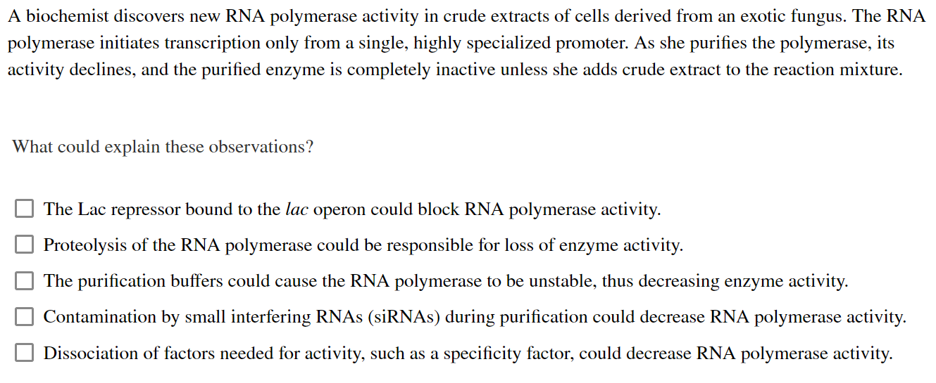
Activity: Default
Transcriptional State Muddiest Point
Complete the Ch28 Student Activity, Day 2: Default Transcriptional State (Muddiest Point) Achieve assessment.
Notes:
Instructor: This muddiest point activity can be found in Achieve in the Chapter 28 folder titled “Ch28 In-Class Activities and Resources.” See the Instructor Activity Guide in the same folder for more information.

Slide 93
28.2 Regulation of Gene Expression in Bacteria

Slide 94
The lac Operon Undergoes
Positive Regulation
other factors besides lactose, such as the availability of glucose, affect the expression of the lac gene
glucose is the preferred energy source in E. coli
expressing the genes for proteins that metabolize other sugars is wasteful when glucose is abundant

Slide 95
Catabolite Repression
catabolite repression = a regulatory mechanism that restricts expression of the genes required for catabolism of other sugars in the presence of glucose
  mediated by cAMP as a coactivator and an activator protein, cAMP receptor protein (CRP)

Slide 96
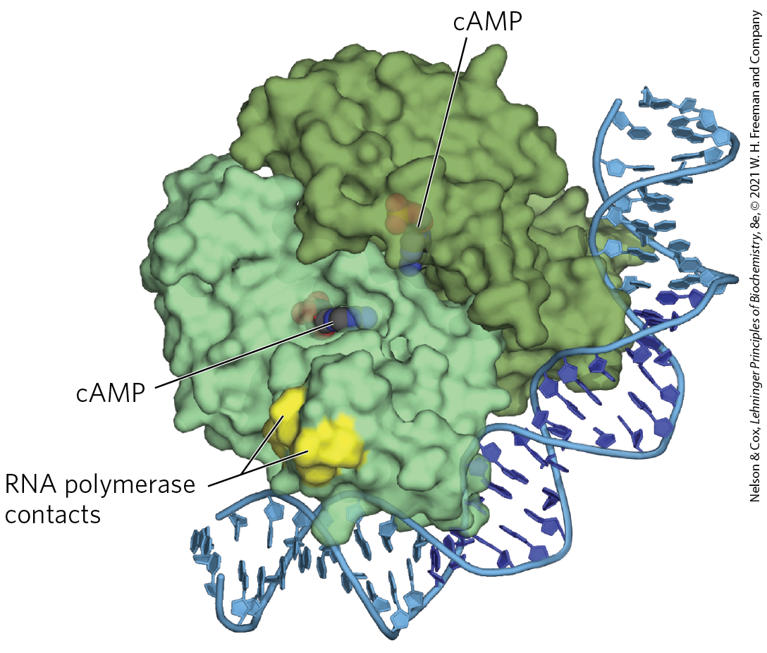
cAMP Receptor Protein (CRP)
cAMP receptor protein (CRP) = an activator protein that contains binding sites for DNA and cAMP
  binding is mediated by a helix-turn-helix motif in the DNA-binding domain

Slide 97
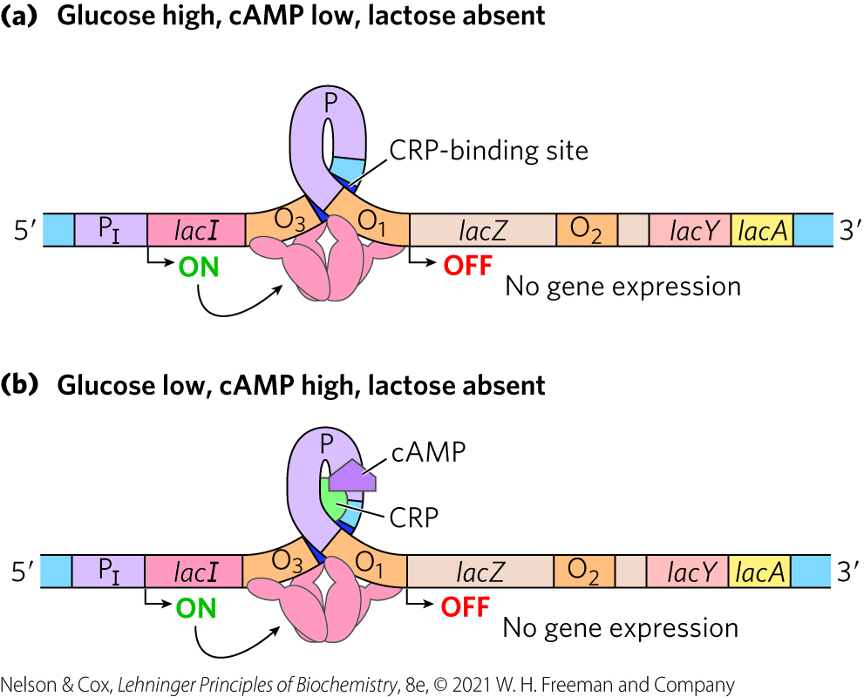
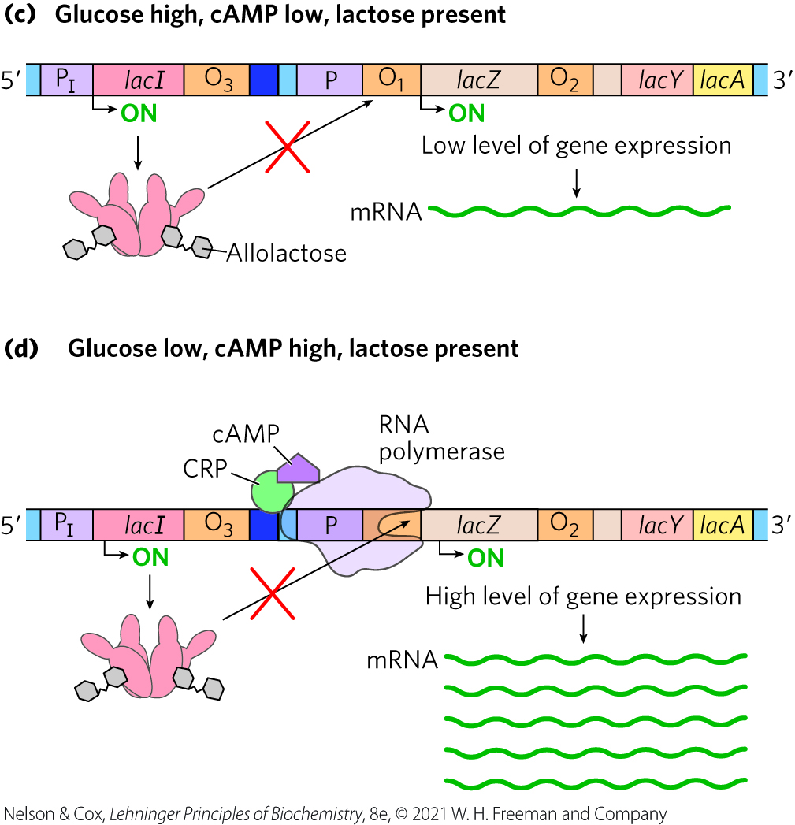
Positive Regulation of the lac Operon by CRP

Slide 98
Regulon
regulon = a network of operons with a common regulator
  allows coordinated shifts in cellular functions
examples include:
  operons encoding enzymes for secondary sugar metabolism (regulated by CRP and cAMP)
  the heat shock gene system that responds to temperature changes
  genes induced as part of the SOS response to DNA damage in E. coli

Slide 99

Clicker Question 15
Yeast cells were engineered to have the his, lac, and trp operons in their genomic DNA. What term could be applied to these operons plus an engineered molecule that functioned to inhibit all three operons using the same mechanism?
transcriptome
gene cluster
morphogen
regulon
homeodomain
Notes:
Answer: D
Principle: 28.4
Learning Objective(s): Explain the advantage of regulons.
Bloom’s: 1:1

Slide 100
Clicker Question 15, Response
Yeast cells were engineered to have the his, lac, and trp operons in their genomic DNA. What term could be applied to these operons plus an engineered molecule that functioned to inhibit all three operons using the same mechanism?
regulon
A network of operons with a common regulator is called a regulon.

Slide 101
Many Genes for Amino Acid Biosynthetic Enzymes Are Regulated by Transcription Attenuation
E. coli can synthesize all 20 common amino acids
operons contain the genes encoding enzymes needed to synthesize a given amino acid
  the operon is repressed when the amino acid is abundant

Slide 102
The E. coli Tryptophan (trp) Operon
the E. coli tryptophan (trp) operon contains five genes for the enzymes required to convert chorismate to tryptophan
the Trp repressor binds to the trp operator when tryptophan is abundant
  inhibits expression of the trp operon by blocking RNA polymerase binding

Slide 103
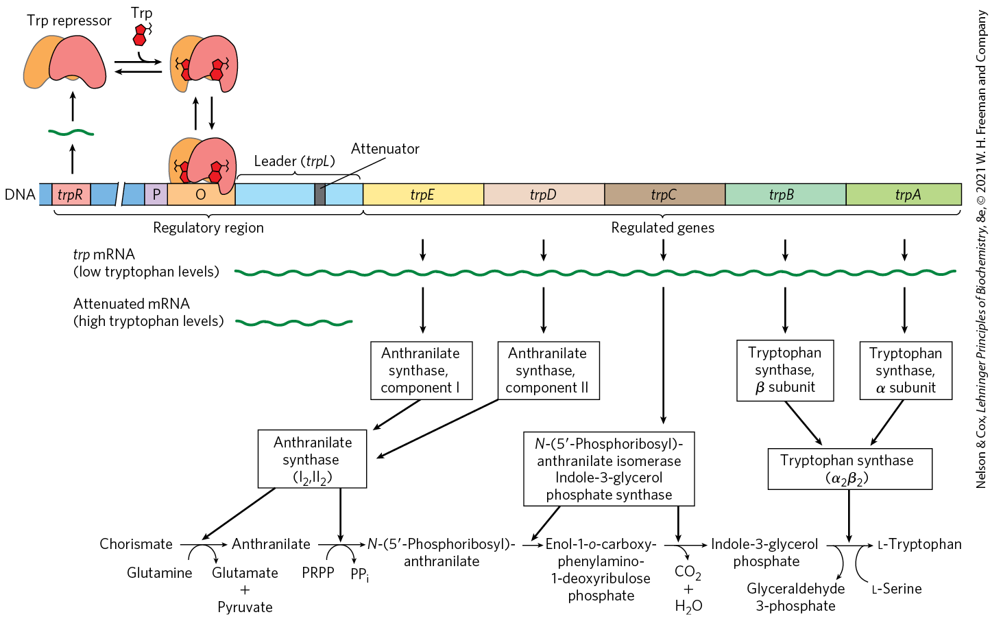
The trp Operon

Slide 104
Clicker Question 16
Which molecule is NOT one of the amino acids synthesized by the reactions catalyzed by the enzymes encoded by the trp operon?
glutamate
L-tryptophan
L-serine
arginine
Notes:
Answer: D
Principle: 28.4
Learning Objective(s): Describe the function associated with the genes present in the tryptophan operon.
Bloom’s: 2:2

Slide 105
Clicker Question 16, Response
Which molecule is NOT one of the amino acids synthesized by the reactions catalyzed by the enzymes encoded by the trp operon?
arginine
The five-step reaction to form tryptophan generates glutamate, L-tryptophan, and L-serine.

Slide 106
Principle 1 (3 of 6)
The cellular concentration of a protein
is determined by a delicate balance of at least seven processes, each having several potential points of regulation. These processes include synthesis of the primary RNA transcript (transcription); posttranscriptional modification of mRNA; degradation of mRNA; protein synthesis (translation); posttranslational modification of proteins; protein targeting and transport; and protein degradation.

Slide 107
Transcription Attenuation
once repression is lifted, the rate of transcription is fine-tuned to cellular tryptophan requirements
transcription attenuation = a regulatory process in which transcription is initiated normally but is abruptly halted before the operon genes are transcribed

Slide 108
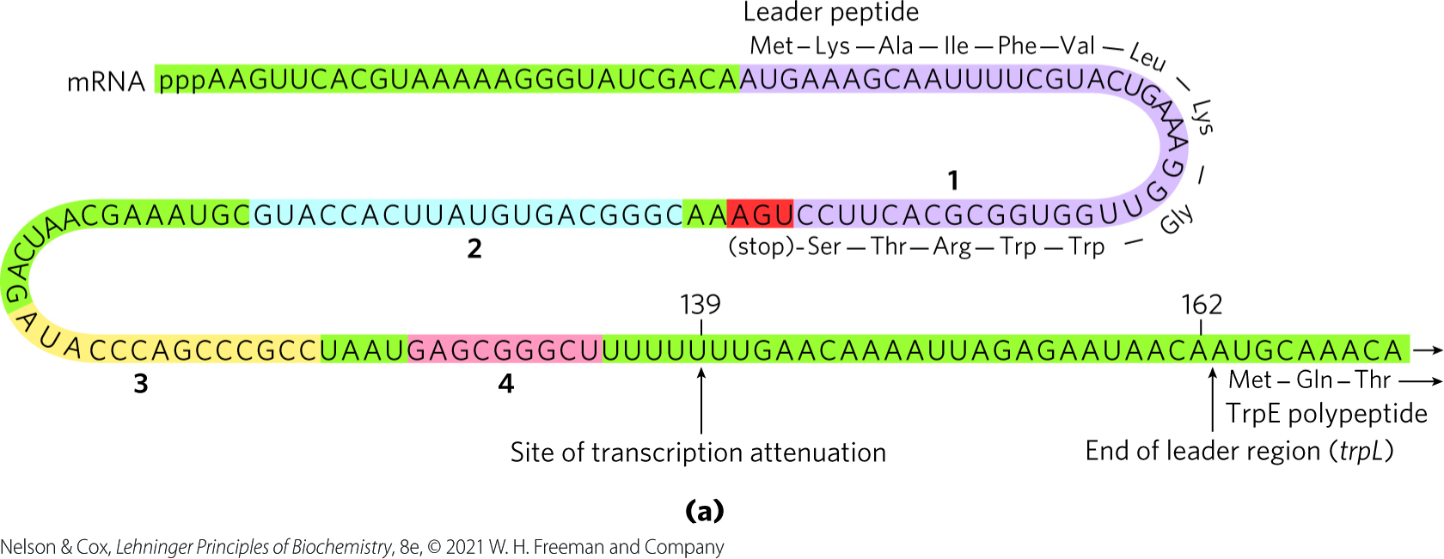
The Leader Region Contains the Attenuator
leader region = 162 nucleotide region at the 5′ end of the mRNA that contains four sequences
attenuator = a region of the leader made up of sequences 3 and 4

Slide 109
The Attenuator Structure
sequence 3 can base pair with sequence 4 or sequence 2
attenuator structure = a stem-and-loop structure that forms when sequences 3 and 4 base-pair
  acts as a transcription terminator
the attenuator structure cannot form when sequences 2 and 3 base-pair
  transcription continues into the trp biosynthetic genes

Slide 110
Clicker Question 17
Attenuation occurs in the trp operon when which sequences pair together?
1 and 2
2 and 3
3 and 4
2 and 4
Notes:
Answer: C
Principle: 28.1
Learning Objective(s): Describe the structure and function of the attenuator.
Bloom’s: 2:1

Slide 111
Clicker Question 17, Response
Attenuation occurs in the trp operon when which sequences pair together?
3 and 4
The leader contains a region known as the attenuator, made up of sequences 3 and 4. These sequences base-pair to form a stem-and-loop structure closely followed by a series of U residues. The attenuator structure acts as a transcription terminator.

Slide 112
Regulatory Sequence 1
regulatory sequence 1 = encodes a leader peptide of 14 amino acids (including 2 Trp residues)
translation of regulatory sequence 1 determined whether the attenuator structure forms

Slide 113
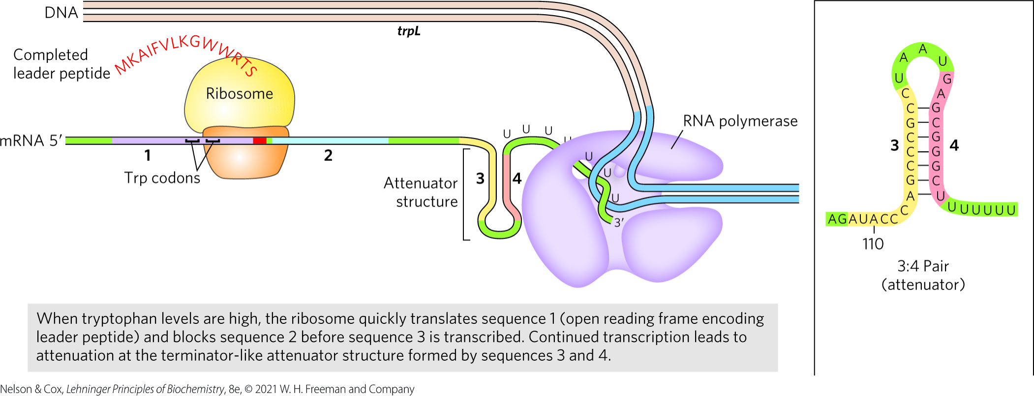
Formation of the Attenuator Structure (3:4 Pair)
when [tryptophan] is high, translation proceeds rapidly into sequence 2 before sequence 3 is synthesized
  sequence 2 is covered by the ribosome and unavailable for pairing to sequence 3
  the attenuator structure forms and transcription halts

Slide 114
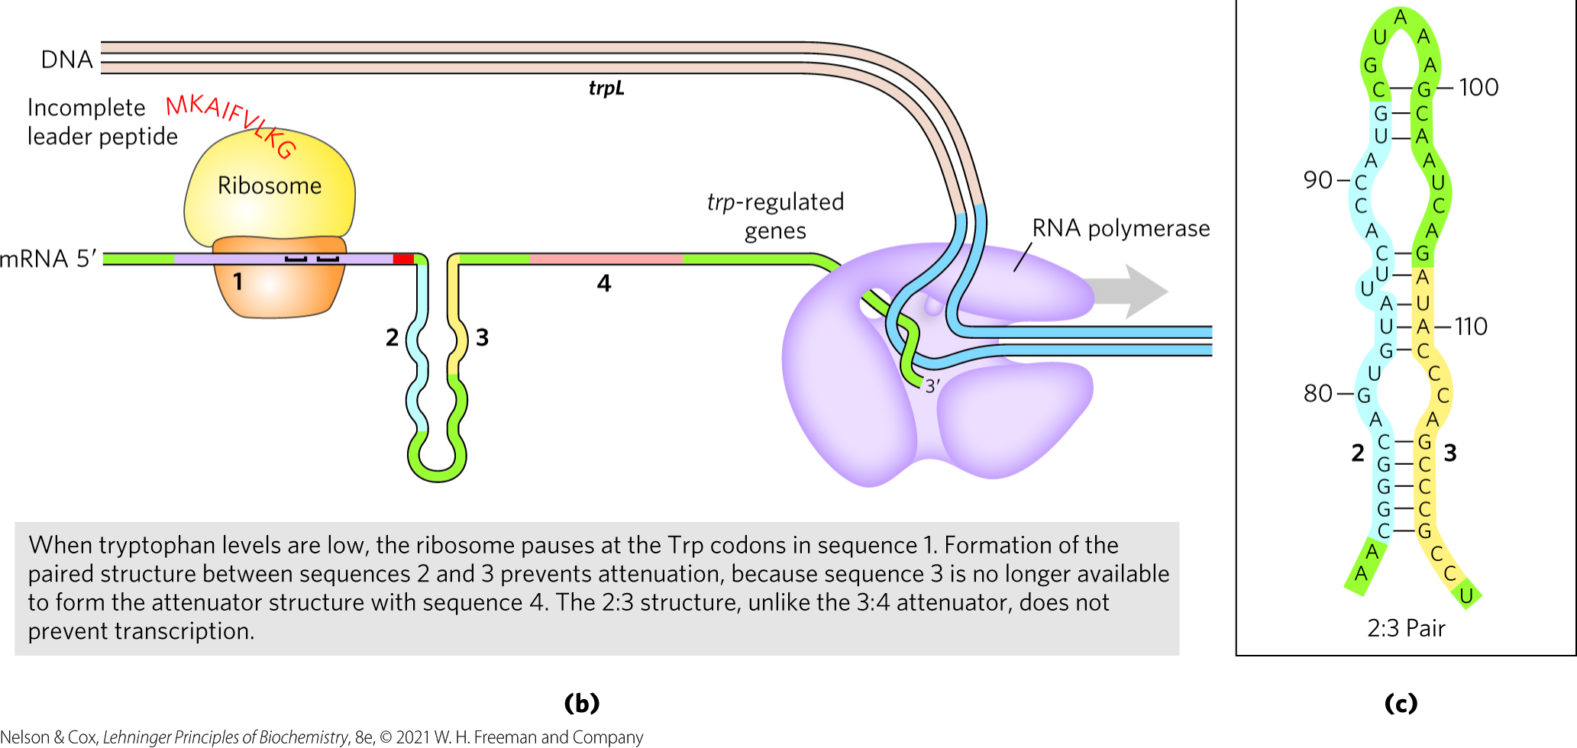
Formation of the 2:3 Pair
when [tryptophan] is low, the ribosome stalls at the Trp codons in sequence 1
  sequence 2 remains free while sequence 3 is synthesized
  the 2:3 pair forms and transcription proceeds

Slide 115
Clicker Question 18
Transcriptional attenuation of the trp operon:
is based on the rate at which the ribosome can translate past tryptophan codons, which is dependent on the abundance of Trp-tRNA^{Trp}.
results from binding of the Trp repressor to its operator.
is the transcription of all but the last gene of the operon.
is due to the formation of a hairpin structure in the DNA sequence of the operon.
Notes:
Answer: A
Principle: 28.1
Learning Objective(s): Explain how transcription attenuation fine tunes transcription.
Bloom’s: 2:2

Slide 116
Clicker Question 18, Response
Transcriptional attenuation of the trp operon:
is based on the rate at which the ribosome can translate past tryptophan codons, which is dependent on the abundance of Trp-tRNA^{Trp}.
When tryptophan concentrations are low, the ribosome stalls at the two Trp codons in sequence 1, because charged tRNA^{Trp} is less available.

Slide 117
Other Amino Acid Biosynthetic Operons Use Similar Attenuation Strategies
the phe operon leader peptide contains 7 Phe residues
the leu operon leader peptide contains 4 Leu residues
the his operon leader peptide contains 7 His residues
  attenuation is sufficiently sensitive to be the only regulatory mechanism

Slide 118
Principle 3 (4 of 4)
Regulated gene expression may bring about increases or decreases in the amount of a gene product. Gene products that increase in concentration under particular molecular circumstances are referred to as inducible; the process of increasing their expression is induction. Conversely, gene products that decrease in concentration in response to a molecular signal are referred to as repressible, and the process is called repression.

Slide 119
Induction of the SOS Response Requires Destruction of Repressor Proteins
extensive DNA damage in the bacterial chromosome triggers the SOS response
  results in the induction of ~60 genes scattered about the chromosome (the SOS regulon)

Slide 120
The Key Regulatory Proteins of the SOS Response
LexA repressor inhibits transcription of all the SOS genes
induction of the SOS response requires inactivation of LexA when it catalyzes its own cleavage
  autocleavage reaction requires the RecA protein
RecA binds to ssDNA, leading to LexA cleavage and SOS induction

Slide 121
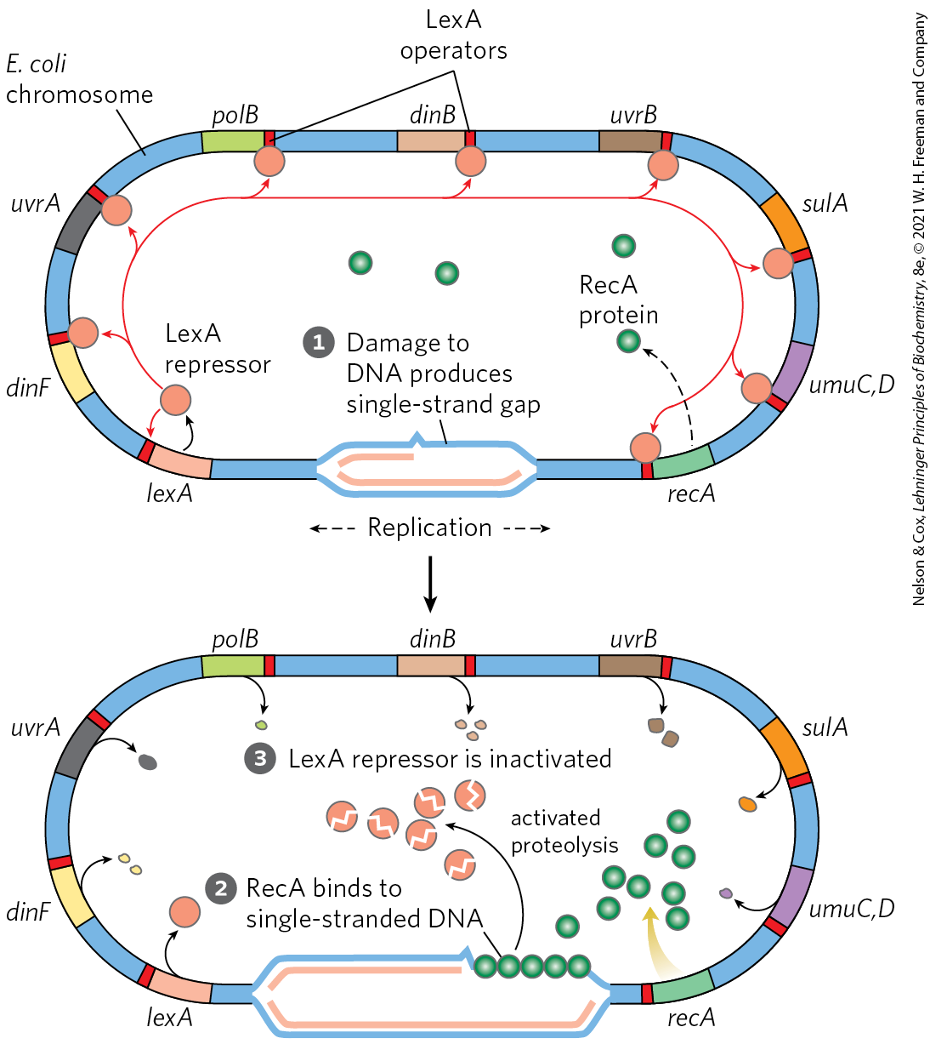
The SOS Response in E. coli
RecA protein binds to damaged ssDNA, activating its protein’s co-protease activity
RecA protein facilitates cleavage and inactivation of LexA
  induces the SOS genes

Slide 122
Clicker Question 19
What is NOT one of the functions of RecA?
It inhibits transcription of all the SOS genes.
It is a co-protease for LexA cleavage.
It binds to single-strand gaps in the DNA.
It inactivates repressors that allow viral propagation within the bacterial host.
Notes:
Answer: A
Principle: 28.3
Learning Objective(s): Describe how RecA is involved in the induction of the SOS genes
Bloom’s: 2:2

Slide 123
Clicker Question 19, Response
What is NOT one of the functions of RecA?
It inhibits transcription of all the SOS genes.
The LexA repressor inhibits transcription of all the SOS genes. The RecA protein provides the functional link between the biological signal (DNA damage) and induction of the SOS genes.

Slide 124
The Link Between the SOS Response and Virus Propagation
some repressors keep viruses in a dormant state within the bacterial host
RecA can promote autocatalytic cleavage of these repressors
  permits replication of the virus and lysis of the cell

Slide 125
Principle 5 (2 of 2)
Regulation is expensive. For many genes, especially in eukaryotes, the regulatory processes can require a considerable investment of chemical energy. That expenditure is nevertheless small when compared to the cost of RNA and protein synthesis when the gene is expressed.

Slide 126
The Energetic Cost of Regulation
LexA must be resynthesized to reestablish SOS regulon repression when the DNA damage is no longer present
protein synthesis requires a considerable amount of ATP and GTP

Slide 127
Clicker Question 20
Which statement regarding the SOS response is false?
Expression of the SOS genes is inhibited by the LexA repressor.
Cleavage of the LexA repressor stimulated by RecA allows transcription of the SOS genes.
Activated RecA causes viruses in the cell to enter a dormant state until the DNA damage is repaired.
Binding of RecA to single-stranded DNA activates its co-protease activity.
Notes:
Answer: D
Principle: 28.3
Learning Objective(s): Explain how viruses take advantage of the SOS response.
Bloom’s: 2:2

Slide 128
Clicker Question 20, Response
Which statement regarding the SOS response is false?
Activated RecA causes viruses in the cell to enter a dormant state until the DNA damage is repaired.
During induction of the SOS response in a severely damaged cell, RecA promotes the autocatalytic cleavage of, and thus inactivates, the repressors that otherwise allow propagation of certain viruses in a dormant lysogenic state within the bacterial host.

Slide 129
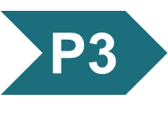
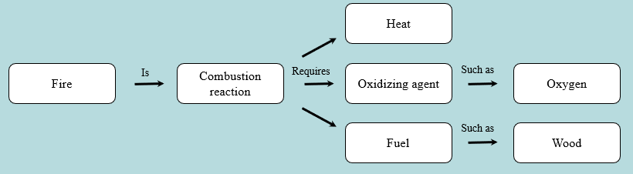
Activity: Relating
Terms within the Chapter
A concept map displays the relationships between different concepts. Observe the following example of a concept map.
Notes:
Instructor: For additional information, see the Instructor Activity Guide located in Achieve. It can be found within Chapter 28, in the folder titled “Ch28 In-Class Activities, Videos, and Resources.”

Slide 130
Activity Instructions (2 of 4)
Think about how the following terms and phrases relate to each other and then use scratch paper to draw a concept map using these terms and phrases. (3 minutes)
regulated gene expression
increase gene products
decrease gene products
induction
repression
inducible genes
repressible genes
Notes:
Instructor: For additional information, see the Instructor Activity Guide located in Achieve. It can be found within Chapter 28, in the folder titled “Ch28 In-Class Activities, Videos, and Resources.”

Slide 131
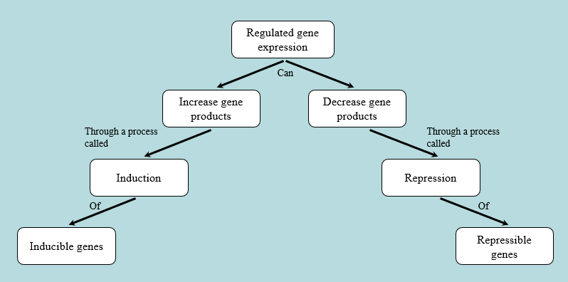
Activity Solution (3 of 5)
Pair up and share how this possible concept map might differ from yours. (2 minutes)
Notes:
Instructor: For additional information, see the Instructor Activity Guide located in Achieve. It can be found within Chapter 28, in the folder titled “Ch28 In-Class Activities, Videos, and Resources.”

Slide 132
Principle 1 (4 of 6)
The cellular concentration of a protein
is determined by a delicate balance of at least seven processes, each having several potential points of regulation. These processes include synthesis of the primary RNA transcript (transcription); posttranscriptional modification of mRNA; degradation of mRNA; protein synthesis (translation); posttranslational modification of proteins; protein targeting and transport; and protein degradation.

Slide 133
Synthesis of Ribosomal Proteins Is
Coordinated with rRNA Synthesis
increased demand for protein synthesis leads to an increase in the number of ribosomes
cells coordinate the synthesis ribosomal proteins (r-proteins) and RNAs (rRNAs)
  occurs at the level of translation

Slide 134
Translational Repressors
r-protein operons are regulated primarily through a translational feedback mechanism
translational repressor = one protein in each r-protein operon binds to the mRNA transcribed from the operon and blocks translation of all genes encoded
translational repressors bind with higher affinity to the appropriate rRNA than to its mRNA
  balances r-protein synthesis with rRNA availability

Slide 135
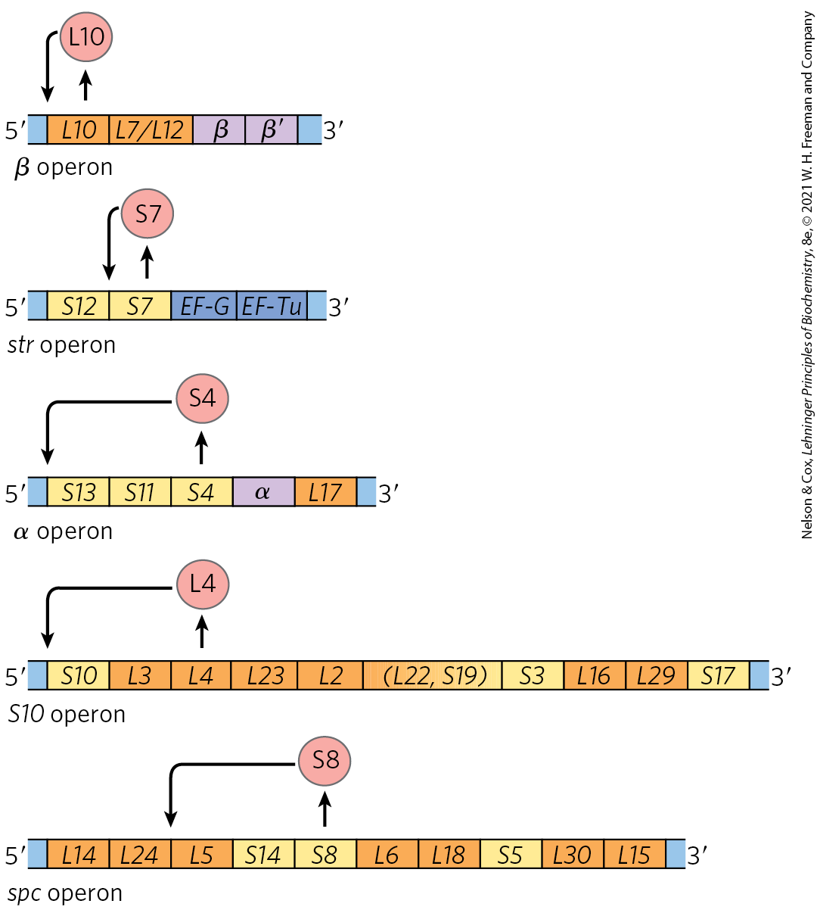
Translational Feedback in Some Ribosomal Protein Operons
the mRNA-binding site for the translational repressor is near the translational start site of one of the genes in the operon
translation of all genes is blocked by folding of the mRNA into a 3-D structure

Slide 136
Clicker Question 21
How do proteins of the r-protein operon regulate synthesis of ribosomal proteins?
One of them inhibits the initiation steps of transcription.
One of them inhibits the elongation steps of transcription.
One of them inhibits the termination steps of transcription.
One of them inhibits translation.
Notes:
Answer: D
Principle: 28.1
Learning Objective(s): Explain how a translational repressor blocks ribosomal protein synthesis.
Bloom’s: 2:2

Slide 137
Clicker Question 21, Response
How do proteins of the r-protein operon regulate synthesis of ribosomal proteins?
One of them inhibits translation.
One r-protein encoded by each operon also functions as a translational repressor, which binds to the mRNA transcribed from that operon and blocks translation of all the genes the messenger encodes.

Slide 138
The Stringent Response
stringent response = coordinates rRNA synthesis with amino acid concentrations
binding of uncharged tRNA to the ribosomal A site triggers the binding of the stringent factor to the ribosome

Slide 139
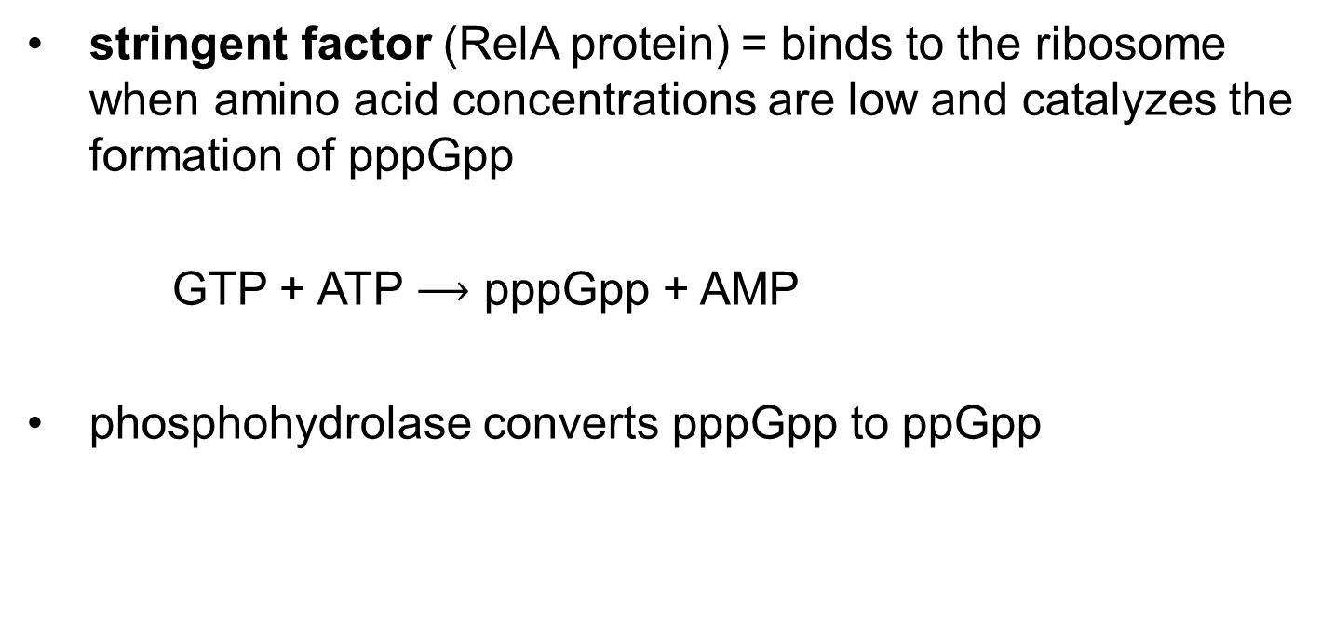
The Stringent Factor
stringent factor (RelA protein) = binds to the ribosome when amino acid concentrations are low and catalyzes the formation of pppGpp
GTP + ATP $⟶$ pppGpp + AMP
phosphohydrolase converts pppGpp to ppGpp

Slide 140
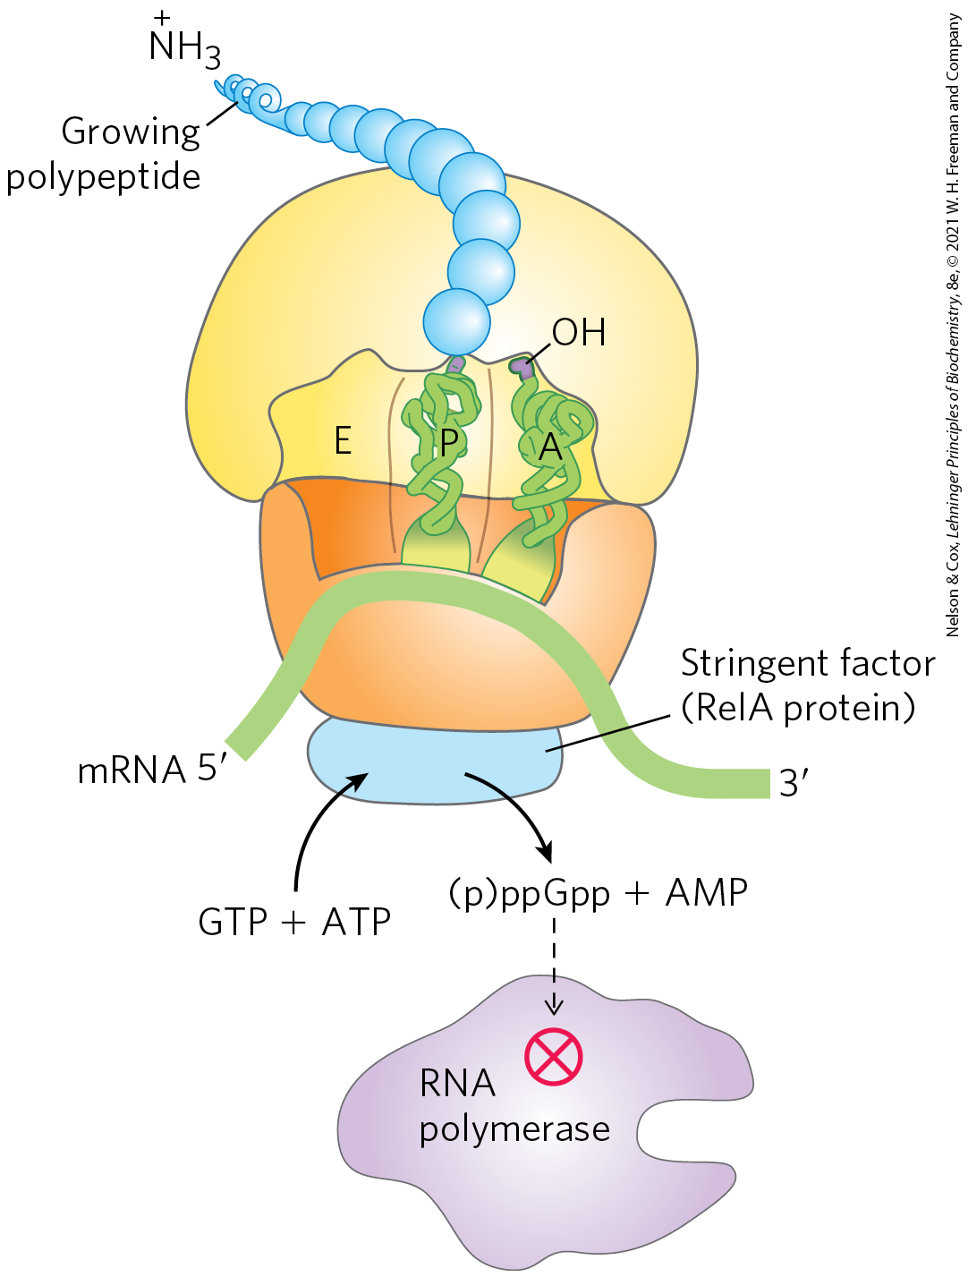
Stringent Response in E. coli
the rise in pppGpp and ppGpp levels results in a reduction in rRNA synthesis
  mediated in part by the binding of ppGpp to RNA polymerase

Slide 141
Clicker Question 22
Which statement is false regarding the stringent response?
The RelA protein is an enzyme that binds to the ribosome and catalyzes the formation of guanosine tetraphosphate.
The abrupt rise in pppGpp causes the ribosome to shutdown protein production and release the unfinished polypeptide strand.
The stringent response is energetically expensive as the formation of pppGpp requires one GTP and one ATP.
The nucleotides pppGpp and ppGpp are second messengers that change the transcription rates of hundreds of genes responsible for cellular metabolism.
Notes:
Answer: B
Principle: 28.1
Learning Objective(s): Describe how amino acid concentration regulates rRNA synthesis.
Bloom’s: 2:2

Slide 142
Clicker Question 22, Response
Which statement is false regarding the stringent response?
The abrupt rise in pppGpp causes the ribosome to shutdown protein production and release the unfinished polypeptide strand.
The stringent response to amino acid starvation is triggered by binding of an uncharged tRNA in the ribosomal A site. The stringent factor then binds to the ribosome and catalyzes the synthesis of pppGpp, which is converted by a phosphohydrolase to ppGpp. The signal ppGpp reduces transcription of some genes and increases transcription of others.

Slide 143
The Function of Some mRNAs Is Regulated by Small RNAs in Cis or in Trans
a separate RNA molecule may bind to the mRNA “in trans” and affect its activity
a portion of mRNA itself may act ”in cis” and regulate its own function

Slide 144
Principle 2 (5 of 7)
Regulation is achieved by specialized proteins and RNAs. The proteins are usually ligand-binding proteins with no other function. They bind to specific sequences in DNA or RNA. They respond to molecular signals that can be any kind of biological molecule. The RNAs either interact with other RNAs or serve as protein cofactors.

Slide 145
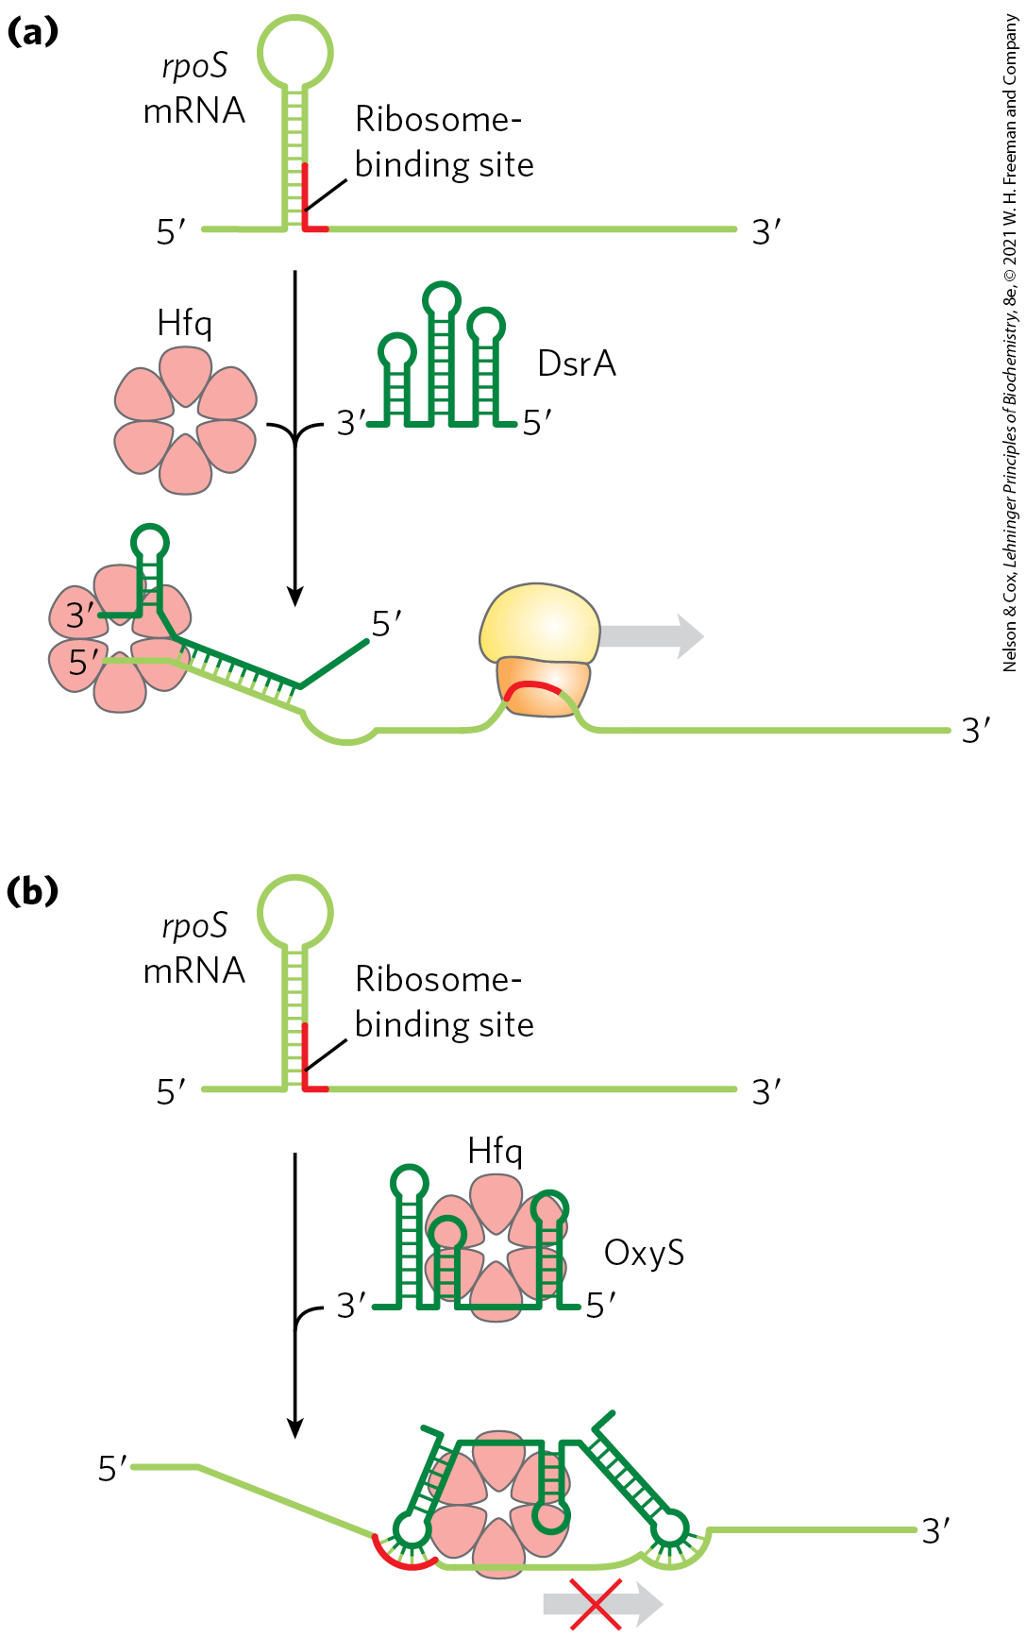
Regulation of mRNA in Trans
rpoS mRNA encodes σ^{S} (an E. coli sigma factor)
  translation is inhibited by a large hairpin structure
binding of ncRNAs (DsrA and RprA) disrupts the hairpin
  allows rpoS translation
the RNA OxyS pairs with the ribosome binding site
  blocks rpoS translation

Slide 146
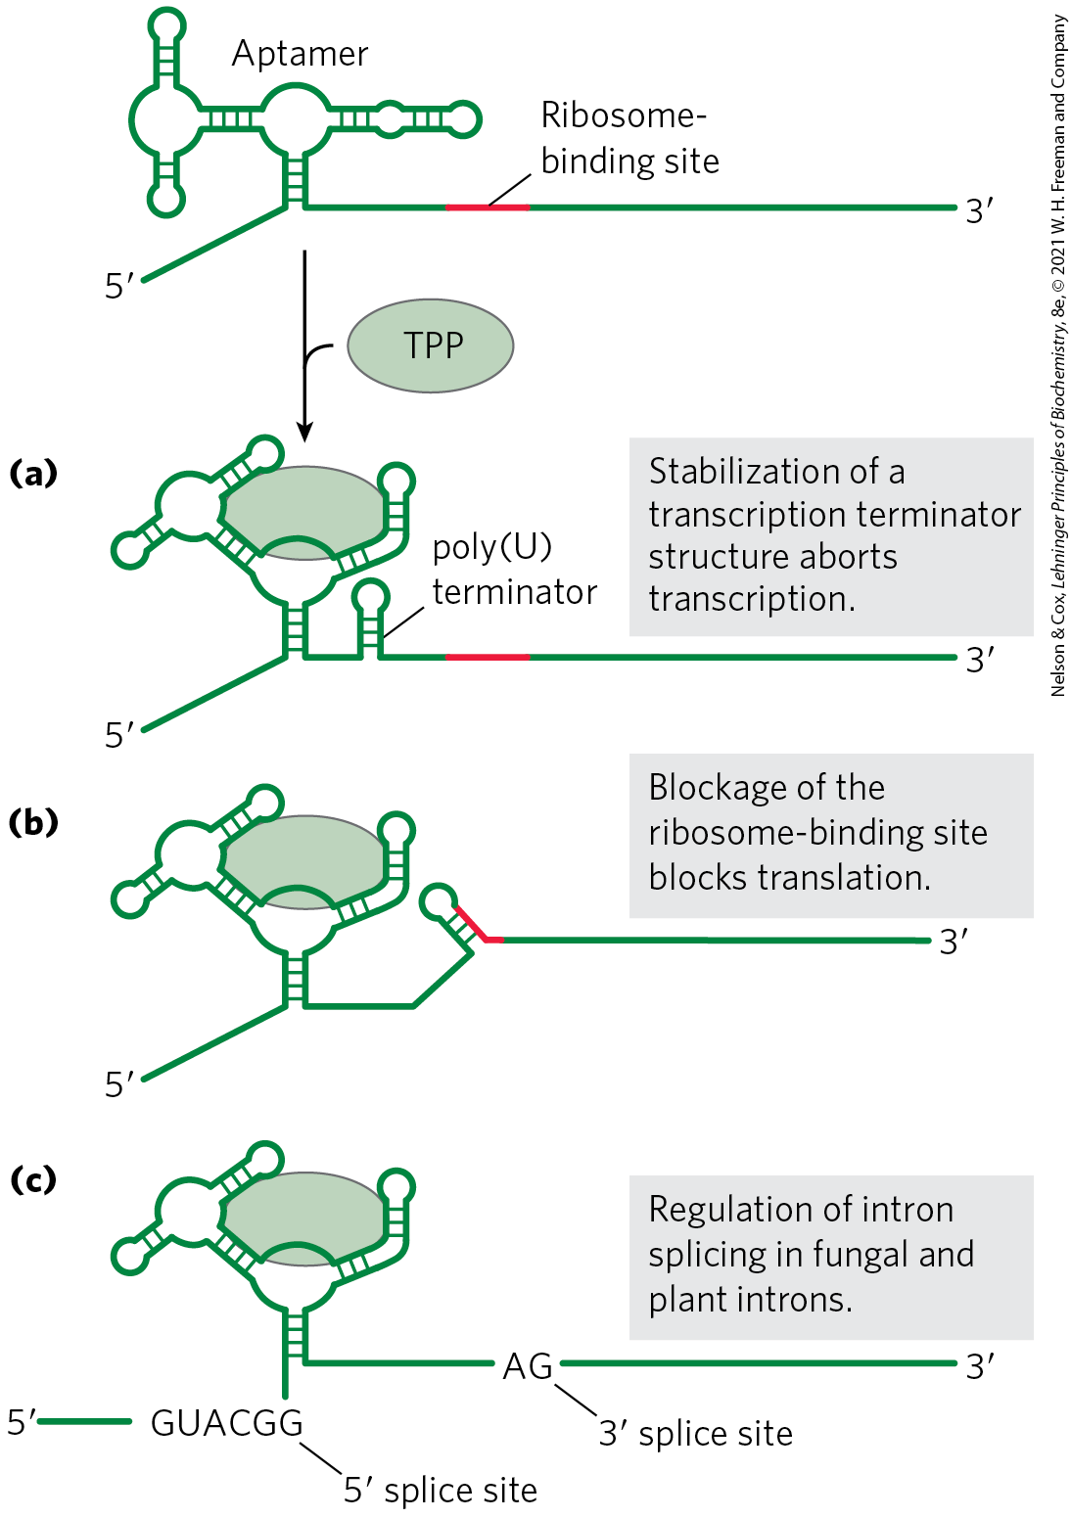
Regulation of mRNA in Cis
riboswitches = ligand-binding mRNA domain
  found in untranslated regions at the 5′ ends
ligand binding results in a conformational change in the mRNA
  inhibits transcription

Slide 147
Clicker Question 23
What is a riboswitch?
a protein that functions as a translational repressor and binds to the mRNA, blocking translation of all the genes the messenger encodes
a response to amino acid starvation triggered by the binding of an uncharged tRNA in the ribosomal A site
the mRNA-binding site for a repressor near the translational start site of one of the genes in an operon
a structured segment of mRNA that binds to a specific ligand and affects the translation or processing of the mRNA
Notes:
Answer: D
Principle: 28.2
Learning Objective(s): Explain the function of a riboswitch and its relationship to the binding ligand
Bloom’s: 2:2

Slide 148
Clicker Question 23, Response
What is a riboswitch?
a structured segment of mRNA that binds to a specific ligand and affects the translation or processing of the mRNA
Aptamers are RNA molecules, generated in vitro, that are capable of specific binding to a particular ligand. Riboswitches are natural aptamers: ligand-binding, structured domains found in untranslated regions at the 5′ ends of certain bacterial mRNAs.

Slide 149
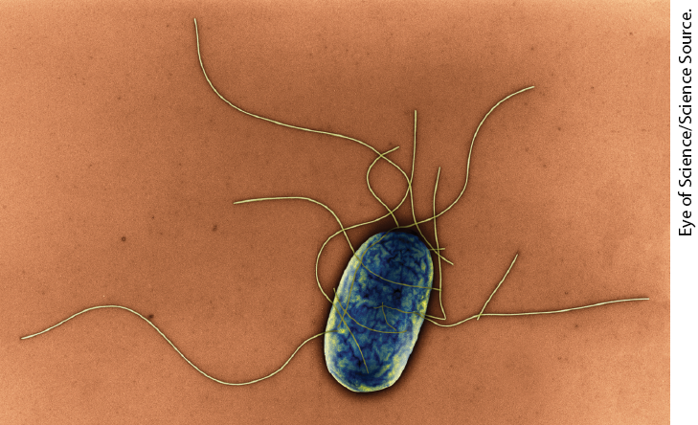
Some Genes Are Regulated by Genetic Recombination
Salmonella typhimurium moves by rotating the flagella on its cell surface
many copies of the protein flagellin make up the flagella
  are prominent targets of mammalian immune systems

Slide 150
Phase Variation
phase variation = a process that switches between two flagellin proteins to evade the mammalian immune response
  occurs roughly once every 1,000 generations
  accomplished by periodic inversion of the DNA segment containing the flagellin promoter

Slide 151
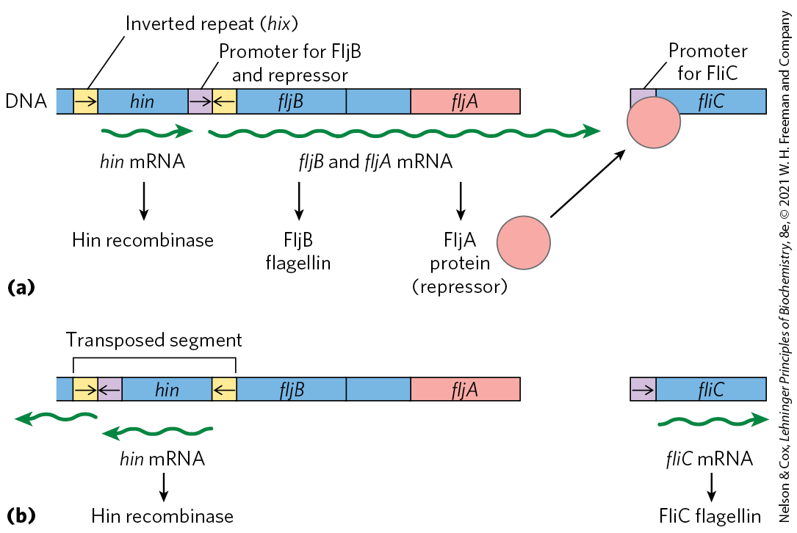
Regulation of Flagellin Genes in Salmonella
the inversion is a site-specific recombination reaction mediated by the Hin recombinase

Slide 152
Examples of Gene Regulation by Recombination
Table 28-1 Examples of Gene Regulation by Recombination
System | Recombinase/recombination site | Type of recombination | Function
Phase variation (Salmonella) | Hin/hix | Site-specific | Alternative expression of two flagellin genes allows evasion of host immune response.
Host range (bacteriophage μ) | Gin/gix | Site-specific | Alternative expression of two sets of tail fiber genes affects host range.
Mating-type switch (yeast) | HO endonuclease, RAD52 protein, other proteins/ MAT | Nonreciprocal gene conversionª | Alternative expression of two mating types of yeast, a and α, creates cells of different mating types that can mate and undergo meiosis.
Antigenic variation (trypanosomes)^{b} | Varies | Nonreciprocal gene conversionª | Successive expression of different genes encoding the variable surface glycoproteins (VSGs) allows evasion of host immune response.

Slide 153
Clicker Question 24
Phase variation:
is a regulatory mechanism based on the growth phase of bacteria.
is regulation by moving of a promoter through recombination.
occurs in Salmonella cells once every ten generations.
does not constitute an absolute on/off switch of genes.
Notes:
Answer: B
Principle: 28.1
Learning Objective(s): Describe the benefit of phase variation in the flagellin proteins of Salmonella typhimurium.
Bloom’s: 1:1

Slide 154
Clicker Question 24, Response
Phase variation:
is regulation by moving of a promoter through recombination.
Salmonella cells evade the immune response by switching between two distinct flagellin proteins (FljB and FliC) roughly once every 1,000 generations, using a process called phase variation. The switch is accomplished by periodic inversion of a segment of DNA containing the promoter for a flagellin gene.

Slide 155
28.3 Regulation of Gene Expression in Eukaryotes

Slide 156
Principle 4 (5 of 6)
The default transcriptional state of a gene, on or off, is dictated in part by the size and complexity of the genome. In bacteria, where genomes are relatively small and DNA is readily accessible, the default state of genes is generally “on.” Transcription of each gene or gene cluster is usually limited by a specific protein repressor. In eukaryotes, where genomes are larger and genes are encapsulated in chromatin, the default state of most genes is “off.” Gene transcription requires chromatin modification followed by the action of transcription activators.

Slide 157
Transcriptional Ground States
transcriptional ground state = the inherent activity of promoters and transcriptional machinery in vivo
  in bacteria, RNA polymerase can initiate transcription at some level of efficiency
  in eukaryotes, strong promoters are generally inactive in the absence of regulatory proteins

Slide 158
Features of Eukaryotic
Gene Regulation
access to eukaryotic promoters is restricted by the structure of chromatin
  transcription requires chromatin remodeling
positive regulation mechanisms are more prominent and are required for transcription
eukaryotic transcriptional regulation commonly involves lncRNAs

Slide 159
Features of Eukaryotic
Gene Regulation, Continued
eukaryotic cells have larger, more complex multimeric regulatory proteins
transcription (in the nucleus) and translation (in the cytoplasm) are separated in space and time

Slide 160
Clicker Question 25
Which statement does NOT describe a feature distinguishing regulation of gene expression in eukaryotes from that in prokaryotes?
Eukaryotes have simpler but more numerous regulatory proteins than do prokaryotes.
The structure of chromatin affects access to promoters.
Transcription in eukaryotes in separated in space and time from translation.
Positive regulatory mechanisms are more prominent than negative ones in eukaryotes.
Notes:
Answer: A
Principle: 28.4
Learning Objective(s): Describe the relationship between chromatin structure and transcriptional activity.
Bloom’s: 1:1

Slide 161
Clicker Question 25, Response
Which statement does NOT describe a feature distinguishing regulation of gene expression in eukaryotes from that in prokaryotes?
Eukaryotes have simpler but more numerous regulatory proteins than do prokaryotes.
Eukaryotic cells have larger, more complex multimeric regulatory proteins than do bacteria.

Slide 162
Transcriptionally Active Chromatin Is Structurally Distinct from Inactive Chromatin
heterochromatin = more-condensed form of chromatin that is transcriptionally inactive
  ~10% of chromatin in a typical eukaryotic cell
  generally associated with chromosome structures, such as centromeres
euchromatin = less-condensed form of chromatin

Slide 163
Chromatin Remodeling
chromatin remodeling = transcription-associated structural changes in chromatin
chromatin remodeling to yield transcriptionally active genes involves:
  repositioning nucleosomes
  the presence of histone variants
  covalent modification of nucleosomes

Slide 164
Some Enzyme Complexes That Catalyze Chromatin Remodeling
Table 28-2 Some Enzyme Complexes That Catalyze Chromatin Structural Changes Associated with Transcription
Enzyme complexª | Oligomeric structure (number of polypeptides) | Source | Activities
Histone movement, replacement, or editing, requiring ATP
SWI/SNF family | 8–17, M_{r} > 10⁶ | Eukaryotes | Nucleosome remodeling; transcriptional activation
ISWI family | 2–4 | Eukaryotes | Nucleosome remodeling; transcriptional repression; transcriptional activation in some cases
CHD family | 1–10 | Eukaryotes | Nucleosome remodeling; nucleosome ejection for transcriptional activation; some have repressive roles
INO80 family | >10 | Eukaryotes | Nucleosome remodeling; transcriptional activation; family member SWR1 engages in replacement of H2A-H2B with H2AZ-H2B
Histone modification
GCN5-ADA2-ADA3 | 3 | Yeast | GCN5 has type A HAT activity
SAGA/PCAF | >20 | Eukaryotes | Includes GCN5-ADA2-ADA3; acetylates residues in H3, H2B, H2AZ
NuA4 | ≥12 | Eukaryotes | EsaI component has HAT activity; acetylates H4, H2A, and H2AZ
Histone chaperones not requiring ATP
HIRA | 1 | Eukaryotes | Deposition of H3.3 during transcription

Slide 165
SWI/SNF and ISWI Complexes
SWI/SNF complexes = remodel chromatin so that nucleosomes are ejected near transcription start sites
  involved in a cycle that replaces nucleosomes with transcription factors
ISWI complexes = optimize nucleosome spacing to allow chromatin assembly and transcriptional silencing

Slide 166
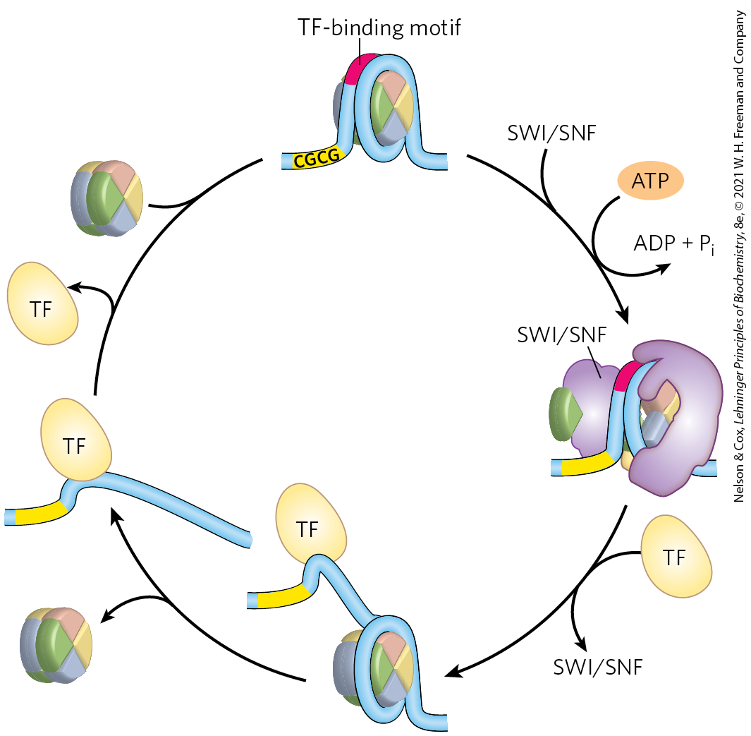
Nucleosome Ejection by a
SWI/SNF Remodeler
when transcription is needed, a transcription factor replaces the nucleosome
  requires ATP
when transcription is no longer needed, the nucleosome replaces the transcription factor

Slide 167
CHD and INO80 Complexes
CHD complexes = either eject nucleosomes to activate transcription or assemble chromatin to repress transcription
INO80 complexes = remodel chromatin for transcriptional activation and DNA repair
  SWR1 = promotes subunit exchange in nucleosomes to introduce histone variants

Slide 168
Clicker Question 26
Which chromatin remodeling complex family is CORRECTLY associated with its function?
The SWI/SNF family has a variety of roles in remodeling chromatin for transcriptional activation and DNA repair.
The ISWI family remodels chromatin so that nucleosomes are ejected from the DNA near transcription start sites.
The CHD family consists of three subfamilies responsible for ejecting nucleosomes to activate transcription or assembling chromatin to repress transcription.
The INO80 family optimizes nucleosome spacing to allow chromatin assembly and transcriptional silencing.
Notes:
Answer: C
Principle: 28.4
Learning Objective(s): Explain how nucleosome composition can be altered in transcribed regions.
Bloom’s: 2:2

Slide 169
Clicker Question 26, Response
Which chromatin remodeling complex family is CORRECTLY associated with its function?
The CHD family consists of three subfamilies responsible for ejecting nucleosomes to activate transcription or assembling chromatin to repress transcription.
There are generally 9 or 10 different CHD family complexes in eukaryotic cells, separated into three subfamilies. The family members have specialized roles, either ejecting nucleosomes to activate transcription or assembling chromatin to repress transcription.

Slide 170
Covalent Modification of Histones
the core histones of nucleosome particles are modified by:
  methylation of Lys or Arg residues
  phosphorylation of Ser or Thr residues
  acetylation
  ubiquitination
  SUMOylation
covalent modifications occur at specific residues concentrated in this amino-terminal domain
  patterns of modification may indicate the existence of a histone code

Slide 171
Histone Acetyltransferases (HATs)
during transcription, histone methylases methylate histone H3 at Lys⁴ and Lys³⁶
histone acetyltransferases (HATs) = enzymes that acetylate particular Lys residues
  type B = acetylate newly synthesized histones
  type A = acetylate nucleosomal histones following H3 methylation
Lys acetylation decreases histone affinity for DNA
  results in transcriptional activation

Slide 172
Histone Deacetylases (HDACs)
histone deacetylases (HDACs) = enzymes that deacetylate specific Lys residues
  marks chromatin as transcriptionally inactive
  examples: SIRT1, SIRT2, SIRT6, and SIRT7

Slide 173
Clicker Question 27
What regulatory function is served by acetylation of histone proteins?
increased rate of DNA condensation
unwinding DNA in preparation for replication
increased gene transcription
formation of 30-nm filaments through acetylation
degradation (i.e., proteolysis) of the histone proteins
Notes:
Answer: C
Principle: 28.4
Learning Objective(s): Explain how covalent modification of histones impacts transcription.
Bloom’s: 2:2

Slide 174
Clicker Question 27, Response
What regulatory function is served by acetylation of histone proteins?
increased gene transcription
Histone acetyltransferases (HATs) acetylate newly synthesized histones before the histones are imported into the nucleus. Where chromatin is being activated for transcription, the nucleosomal histones are further acetylated by nuclear (type A) HATs.

Slide 175
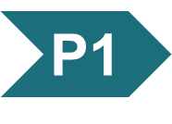
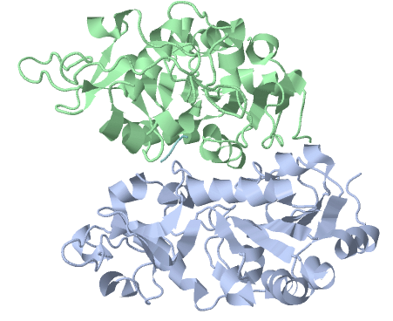
Activity: Regulating
Gene Expression
Observe the structure of the human sirtuin Sirt5, a histone deacetylase, in Mol3D viewer in your Achieve course.
Notes:
Instructor: This Mol3D structure is located in the Achieve course. It can be found in the Chapter 28 content, in the folder titled “Ch28 In-Class Activities and Resources.”

Slide 176
Activity Instructions (3 of 4)
On your own, think of answers to the questions:
  In general, what effect does deacetylation of histones have on rates of transcription?
  What residues are most commonly acetylated on histone proteins?
(2 minutes)
Pair up to discuss your ideas. (2 minutes)
Share your ideas with the class in group discussion. (3 minutes)
Notes:
Instructor: This Mol3D structure is located in the Achieve course. It can be found in the Chapter 28 content, in the folder titled “Ch28 In-Class Activities and Resources.”

Slide 177
Activity Solution (4 of 5)
  In general, what effect does deacetylation of histones have on rates of transcription? Acetylation reduces the affinity of the histone proteins for their associated DNA. Because the DNA is less tightly wound around the histone proteins in this state, RNA polymerase can more easily bind to and transcribe the DNA.
  What residues are most commonly acetylated on histone proteins? Lysine residues
Notes:
Instructor: This Mol3D structure is located in the Achieve course. It can be found in the Chapter 28 content, in the folder titled “Ch28 In-Class Activities and Resources.”

Slide 178
Principle 4 (6 of 6)
The default transcriptional state of a gene, on or off, is dictated in part by the size and complexity of the genome. In bacteria, where genomes are relatively small and DNA is readily accessible, the default state of genes is generally “on.” Transcription of each gene or gene cluster is usually limited by a specific protein repressor. In eukaryotes, where genomes are larger and genes are encapsulated in chromatin, the default state of most genes is “off.” Gene transcription requires chromatin modification followed by the action of transcription activators.

Slide 179
Most Eukaryotic Promoters Are Positively Regulated
initiation of transcription depends on multiple activator proteins, not RNA polymerase affinity
chromatin renders most promoters inaccessible
  repressors would be redundant
combinatorial control provides precise positive control
negative regulation in eukaryotes typically involves lncRNAs

Slide 180

Advantages of
Combinatorial Control
with two regulatory gene families (each with three members that can form dimers), 36 different regulatory combinations are possible

Slide 181
Clicker Question 28
Combinatorial control:
involves a combination of activation and repression.
results from mixing and matching regulatory monomers to form a series of active regulatory dimers.
is the combined regulation of multiple genes by a single regulatory system.
occurs when the regulatory DNA sequences for one gene are also used to control expression of another gene.
Notes:
Answer: B
Principle: 28.4
Learning Objective(s): Define combinatorial control.
Bloom’s: 2:2

Slide 182
Clicker Question 28, Response
Combinatorial control:
results from mixing and matching regulatory monomers to form a series of active regulatory dimers.
Appropriate regulation of different genes is accomplished by different combinations of a limited repertoire of transcription factors at each gene, a mechanism referred to as combinatorial control.

Slide 183
DNA-Binding Activators and Coactivators Facilitate Assembly of the Basal Transcription Factors
many (but not all) Pol II promoters include the TATA box and Inr (initiator) sequences, with their standard spacing
additional regulatory sequences are bound by transcriptional activators to increase transcription
  enhancers in higher eukaryotes
    can be located anywhere
  upstream activator sequences (UASs) in yeast
    must be upstream and within a few hundred bp

Slide 184
Pol II Holoenzyme Binding Requires Five Types of Proteins
transcription activators = bind to enhancers or UASs and facilitate transcription
architectural regulators = facilitate DNA looping
chromatin modification and remodeling proteins

Slide 185
Pol II Holoenzyme Binding Requires Five Types of Proteins, Continued
coactivators = facilitate communication between activators and the complex of Pol II and basal transcription factors
  play a direct role in assembly of the preinitiation complex (PIC)
basal transcription factors (general transcription factors)

Slide 186
Clicker Question 29
Where can enhancer sequences be located with respect to the genes they regulate?
upstream only
downstream only
within only
upstream, downstream, and within
Notes:
Answer: D
Principle: 28.4
Learning Objective(s): Identify additional regulatory sequences that are needed for eukaryotic transcription.
Bloom’s: 2:2

Slide 187
Clicker Question 29, Response
Where can enhancer sequences be located with respect to the genes they regulate?
upstream, downstream, and within
A typical enhancer may be found hundreds or even thousands of base pairs upstream from the transcription start site, or may even be downstream, within the gene itself. When bound by the appropriate regulatory proteins, an enhancer increases transcription at nearby promoters regardless of its orientation in the DNA.

Slide 188

Activation of Transcription

Slide 189

Repression of Transcription
repressor proteins interfere with communication between Pol II and the activators
  leads to repression of transcription

Slide 190
Transcription Activators
activator requirements vary greatly between promoters:
  may activate transcription at 100s of promoters or be specific for a few promoters
  may be sensitive to signal molecule binding
  may bind to enhancers that are distant from the TATA box
  may bind to both DNA and RNA
  function may be affected by lncRNAs

Slide 191

Architectural Regulators
architectural regulators = facilitate DNA looping to allow activators to function at a distance
  abundant in chromatin
  bind to DNA with limited specificity
high mobility group (HMG) proteins = play an important structural role in chromatin remodeling and transcriptional activation

Slide 192
Clicker Question 30
HMG proteins:
bind to specific DNA sequences.
determine how many genes are being expressed in a cell at any given time.
bind to the CTD of RNA Pol II.
are chromatin architectural regulators.
Notes:
Answer: D
Principle: 28.4
Learning Objective(s): Explain how architectural regulators promote transcription.
Bloom’s: 1:1

Slide 193
Clicker Question 30, Response
HMG proteins:
are chromatin architectural regulators.
The high mobility group (HMG) proteins play an important structural role in chromatin remodeling and transcriptional activation. “High mobility” refers to their electrophoretic mobility in polyacrylamide gels.

Slide 194
Coactivator Protein Complexes
Mediator complex = a major eukaryotic coactivator
  consisting of 25 (yeast) to 30 (human) polypeptides, many of which are highly conserved
  binds to the CTD of the largest subunit of Pol
  required for basal and regulated transcription
  facilitates the effects of transcription activators on Pol II

Slide 195
TATA-Binding Protein and Basal Transcription Factors
TATA-binding protein (TBP) = the first component to bind in the assembly of a preinitiation complex (PIC) at the TATA box of a typical Pol II promoter
basal transcription factors (TFIIB, TFIIE, TFIIF, TFIIH) make up the minimal PIC
  often insufficient for initiation of transcription

Slide 196

Choreography of
Transcriptional Activation
activators bind the DNA first
activators recruit remodeling complexes and a coactivator (Mediator)
Mediator facilitates the binding of additional required components
phosphorylation of the CTD of Pol II leads to transcription initiation

Slide 197
Clicker Question 31
Which sequence is the CORRECT series of events in the activation of transcription?
binding of TBP to TATA box, then binding of a chromatin remodeling complex, then binding of the activator, then binding of the RNA Pol II complex
binding of a chromatin remodeling complex, then binding of the activator, then binding of TBP to the TATA box, then binding of the RNA Pol II complex
binding of the activator, then binding of a chromatin remodeling complex, then binding of TBP to the TATA box, then binding of the RNA Pol II complex
binding of TBP to TATA box, then binding of the RNA Pol II complex, then binding of a chromatin remodeling complex, then binding of the activator
Notes:
Answer: C
Principle: 28.4
Learning Objective(s): Describe how the preinitiation complex is formed.
Bloom’s: 1:1

Slide 198
Clicker Question 31, Response
Which sequence is the CORRECT series of events in the activation of transcription?
binding of the activator, then binding of a chromatin remodeling complex, then binding of TBP to the TATA box, then binding of the RNA Pol II complex
Activators bind the DNA first. The activators recruit the histone modification/nucleosome remodeling complexes and a coactivator such as Mediator. Mediator facilitates the binding of TATA-binding protein (TBP), the first component to bind in the assembly of a preinitiation complex (PIC) at the TATA box of a typical Pol II promoter.

Slide 199
The Genes of Galactose Metabolism in Yeast Are Subject to Both Positive and
Negative Regulation
Gene | Protein function | Chromosomal location | Protein size (number of residues) | Relative protein expression in different carbon sources: Glucose | Relative protein expression in different carbon sources: Glycerol | Relative protein expression in different carbon sources: Galactose
Regulated genes
GAL1 | Galactokinase | II | 528 | – | – | + + +
GAL2 | Galactose permease | XII | 574 | – | – | + + +
PGM2 | Phosphoglucomutase | XIII | 569 | + | + | + +
GAL7 | Galactose 1-phosphate uridylyltransferase | II | 365 | – | – | + + +
GAL10 | UDP-glucose 4-epimerase | II | 699 | – | – | + + +
MEL1 | α-Galactosidase | II | 453 | – | + | + +
Regulatory genes
GAL3 | Inducer | IV | 520 | – | + | + +
GAL4 | Transcriptional activator | XVI | 881 | +/– | + | +
GAL80 | Transcriptional inhibitor | XIII | 435 | + | + | + +
Notes:
Table 28-3 Genes of Galactose Metabolism in Yeast

Slide 200
Promoters for GAL Genes
promoters for the GAL genes consist of:
  the TATA box
  Inr sequences
  an upstream activator sequence (UAS_{G}) recognized by the transcription activator Gal4 protein (Gal4p)

Slide 201
Regulation of Gene Expression
By Galactose
Gal80p forms a complex with Gal4p
  prevents Gal4p from functioning as an activator of the GAL promoters
when galactose is present, it binds Gal3p, which then interacts with the Gal80p-Gal4p complex
  allows Gal4p to function as an activator at the GAL promoters

Slide 202

Regulation of Transcription of GAL Genes in Yeast
Gal4p recruits additional factors:
  SAGA complex = involved in histone acetylation and chromatin remodeling
  SWI/SNF complex = involved in chromatin remodeling
  Mediator

Slide 203
Clicker Question 32
The GAL genes in yeast are:
transcribed as one polycistronic mRNA.
induced by binding of galactose to Gal3p.
repressed by Gal4p.
repressed by Gal1p.
Notes:
Answer: B
Principle: 28.4
Learning Objective(s): Explain the controls of galactose metabolism in yeast.
Bloom’s: 2:2

Slide 204
Clicker Question 32, Response
The GAL genes in yeast are:
induced by binding of galactose to Gal3p.
When galactose is present, it binds Gal3p, which then interacts with the Gal80p-Gal4p complex and allows Gal4p to function as an activator at the GAL promoters.

Slide 205

Transcription Activators Have a Modular Structure
typical activators have a DNA-binding domain and an activation domain

Slide 206
Gal4p
contains a zinc finger-like structure in its DNA-binding domain
functions as a homodimer
binds to UAS_{G} (a palindromic DNA sequence)
has an acidic activation domain
  the acidic nature is critical to its function

Slide 207
Sp1
Sp1 = a transcription activator for many genes in higher eukaryotes
  its DNA-binding site is usually near the TATA box.
  its DNA-binding domain is near its carboxyl terminus and contains three zinc fingers
  has two glutamine-rich domains that function in activation
a wide variety of other activator proteins also have these glutamine-rich domains
  25% of residues are Gln

Slide 208
CTF1
CTF1 (CCAAT-binding transcription factor 1) = a transcription activator that bind a sequence called the CCAAT site
  its DNA-binding domain contains many basic amino acid residues
  its binding region is probably an α helix.
  has a proline-rich activation domain, with Pro accounting for >20% of the residues

Slide 209

Domain-Swapping Experiments
activation and DNA-binding domains of regulatory proteins often act completely independently
genetic engineering techniques can join the activation domain of one protein with the DNA-binding domain of another

Slide 210
Clicker Question 33
Which eukaryotic transcription activator has an acidic activation domain that is critical to its function?
Gal4p
Sp1
CTF1
LexA repressor
Notes:
Answer: A
Principle: 28.4
Learning Objective(s): Identify structural domains of transcriptional activators
Bloom’s: 2:1

Slide 211
Clicker Question 33, Response
Which eukaryotic transcription activator has an acidic activation domain that is critical to its function?
Gal4p
Gal4p has a separate activation domain with many acidic amino acid residues. Experiments that substitute a variety of different peptide sequences for the acidic activation domain of Gal4p suggest that the acidic nature of this domain is critical to its function, although its precise amino acid sequence can vary considerably.

Slide 212
Eukaryotic Gene Expression Can
Be Regulated by Intercellular and Intracellular Signals
the hormone-receptor complex binds to DNA sequences called hormone response elements (HREs)
  receptors act as transcription activators, recruiting coactivators and Pol II (plus associated transcription factors)

Slide 213
Hormone Receptors
hormone receptors:
  have a consensus HRE sequence
  have a highly conserved DNA-binding domain with two zinc fingers
  have a specific ligand-binding region at the carboxyl terminus
Table 28-4 Hormone Response Elements (HREs) Bound by Steroid-Type Hormone Receptors
Receptor | HRE consensus sequence bound
Androgen | GG(A/T)ACAN₂TGTTCT
Glucocorticoid | GGTACAN₃TGTTCT
Retinoic acid (some) | AGGTCAN₅AGGTCA
Vitamin D | AGGTCAN₃AGGTCA
Thyroid hormone | AGGTCAN₃AGGTCA
RX^{b} | AGGTCANAGGTCANAG GTCANAGGTCA

Slide 214

Typical Steroid Hormone Receptors

Slide 215
Clicker Question 34
Hormone response elements are:
bound by the hormones alone.
physical regions in the testis that control testosterone production.
composed of two consensus sequences of six nucleotides, contiguous or separated, in tandem or palindromic.
composed of GC rich regions in the 3′ region of the gene.
bound by monomers of the hormone receptor complex.
Notes:
Answer: C
Principle: 28.4
Learning Objective(s): Identify characteristics of HREs (hormone response elements).
Bloom’s: 1:1

Slide 216
Clicker Question 34, Response
Hormone response elements are:
composed of two consensus sequences of six nucleotides, contiguous or separated, in tandem or palindromic.
Each receptor has a consensus HRE sequence to which the hormone-receptor complex binds well, with each consensus consisting of two six-nucleotide sequences, either contiguous or separated by three nucleotides, in tandem or in a palindromic arrangement.

Slide 217

Monomeric Type I Receptors (NR)
examples: receptors for sex hormones and glucocorticoids
found in the cytoplasm, in complex with Hsp70
Hsp70 dissociates when the hormone binds and the receptor dimerizes, exposing a nuclear localization signal
  receptor enters the nucleus and acts as an activator

Slide 218

Type II Receptors
example: thyroid hormone receptor
found in the nucleus, bound to an HRE and a corepressor
the corepressor dissociates when the hormone binds
  receptor functions as an activator

Slide 219
Clicker Question 35
In the mechanism of steroid hormone receptor function:
type II receptors are bound to Hsp70 until the hormone binds, then the activated receptor translocates to the nucleus.
type I receptors are bound to HREs, with a corepressor blocking activity until the hormone binds.
type I receptor dimers are bound to a corepressor in the cytosol, and hormone binding causing release of the corepressor and translocation of the activated receptor to the nucleus.
type II receptors are dimers bound to HREs, with a corepressor blocking activity until the hormone binds.
Notes:
Answer: D
Principle: 28.4
Learning Objective(s): Identify characteristics of hormone receptors.
Bloom’s: 2:2

Slide 220
Clicker Question 35, Response
In the mechanism of steroid hormone receptor function:
type II receptors are dimers bound to HREs, with a corepressor blocking activity until the hormone binds.
Monomeric type I receptors (NR) are found in the cytoplasm. Type II receptors, by contrast, are always in the nucleus, bound to an HRE in the DNA and to a corepressor that renders the receptor inactive.

Slide 221
Principle 2 (6 of 7)
Regulation is achieved by specialized proteins and RNAs. The proteins are usually ligand-binding proteins with no other function. They bind to specific sequences in DNA or RNA. They respond to molecular signals that can be any kind of biological molecule. The RNAs either interact with other RNAs or serve as protein cofactors.

Slide 222
IncRNAs Regulate
Hormone Receptors
GAS5 (growth arrest specific 5) = an IncRNA that inhibits transcriptional activation by the glucocorticoid receptor and related receptors
  directly competes with DNA for receptor binding
steroid receptor RNA activator (SRA) = an IncRNA that acts as a coactivator
  part of a ribonucleoprotein complex

Slide 223
Regulation Can Result from Phosphorylation of Nuclear Transcription Factors
nonsteroid hormones bind to cell surface receptors
  triggers a signaling pathway leading to phosphorylation of a regulatory protein to regulate its activity

Slide 224
The β-Adrenergic Pathway
the β-adrenergic pathway increases cytosolic [cAMP], which activates protein kinase A (PKA)
PKA enters the nucleus and phosphorylates the CRE-binding protein (CREB)
phosphorylated CREB binds cAMP response element (CRE) and acts as a transcription factor
  increases gene expression

Slide 225
Clicker Question 36
Biochemical signaling pathways interact by sharing molecules, resulting in an integrated, coordinated response on several levels. What second messenger molecule propagates β adrenergic receptor signaling and also regulates nuclear CRE-binding proteins by phosphorylation?
1,2-diacylglycerol
cyclic AMP
calcium
inositol 1,4,5-trisphosphate
NO
Notes:
Answer: B, through Protein Kinase A in both the cytosol and in the nucleus.
Principle: 28.2
Learning Objective(s): Explain how cAMP levels affects transcription of certain genes.
Bloom’s: 1:1

Slide 226
Clicker Question 36, Response
Biochemical signaling pathways interact by sharing molecules, resulting in an integrated, coordinated response on several levels. What second messenger molecule propagates β adrenergic receptor signaling and also regulates nuclear CRE-binding proteins by phosphorylation?
cyclic AMP
The catalytic subunit of protein kinase A, released when cAMP levels rise, enters the nucleus and phosphorylates CREB.

Slide 227
Clicker Question 37
How does cAMP regulate transcription?
cAMP activates PKA, which phosphorylates TBP.
cAMP binds CREB.
cAMP activates PKC, which phosphorylates CREB.
cAMP activates PKA, which phosphorylates CREB.
cAMP binds TBP.
Notes:
Answer: D
Principle: 28.4
Learning Objective(s): Explain how cAMP levels affects transcription of certain genes
Bloom’s: 2:2

Slide 228
Clicker Question 37, Response
How does cAMP regulate transcription?
cAMP activates PKA, which phosphorylates CREB.
The catalytic subunit of protein kinase A, released when cAMP levels rise, enters the nucleus and phosphorylates CREB.

Slide 229
Principle 1 (5 of 6)
The cellular concentration of a protein
is determined by a delicate balance of at least seven processes, each having several potential points of regulation. These processes include synthesis of the primary RNA transcript (transcription); posttranscriptional modification of mRNA; degradation of mRNA; protein synthesis (translation); posttranslational modification of proteins; protein targeting and transport; and protein degradation.

Slide 230
Many Eukaryotic mRNAs Are Subject to Translational Repression
activating a translationally repressed mRNA in the cytoplasm is quicker than de novo assembly of transcription complexes and mRNA synthesis
four main mechanisms of translational regulation:
  phosphorylation of translation initiation factors
  binding of translational repressors (often to the 3′ UTR)
  binding proteins disrupting eIF4E and eIF4G interactions
  RNA-mediated regulation (often translational repression)

Slide 231
Clicker Question 38
One advantage of translational repression is that:
the cell saves energy by not having ribosomes translocating on mRNAs.
an mRNA can be inactive and held ready in the cytosol for translation without delay when needed.
ribosomes can partially translate a protein and then halt, after which a signal can cause very rapid production of the full-length protein.
the signal for repression is a sequence in the very mRNA to be regulated.
Notes:
Answer: B
Principle: 28.1
Learning Objective(s): Identify the need for translational regulation in eukaryotes.
Bloom’s: 2:2

Slide 232
Clicker Question 38, Response
One advantage of translational repression is that:
an mRNA can be inactive and held ready in the cytosol for translation without delay when needed.
The transcripts generated in a eukaryotic nucleus must be processed and transported to the cytoplasm before translation, which can impose a significant delay on the appearance of a protein. When a rapid increase in protein production is needed, a translationally repressed mRNA already in the cytoplasm can be activated for translation without delay.

Slide 233

Translational Regulation of Eukaryotic mRNA
translational repressors bind to specific sites in the 3′ UTR of mRNA to block or slow translation
  interact with eukaryotic initiation factors or with the ribosome

Slide 234
Translational Regulation in Reticulocytes
reticulocyte maturation involves destruction of the nucleus
mRNA deposited in the cytoplasm before the loss of the nucleus allow for the replacement of hemoglobin
HCR (hemin-controlled repressor) = catalyzes the phosphorylation of eIF2 when reticulocytes are deficient in iron or heme
  sequesters eIF2, making it unavailable for translation
  coordinates synthesis of globin with heme availability

Slide 235
Clicker Question 39
Regulation of eukaryotic cell translation is primarily through which mechanism?
increased or decreased rates of mRNA degradation
binding regulatory proteins at or near the 3′ untranslated end of mRNA
conformational changes in the A-site of the ribosome
binding repressor proteins specifically to the 5′ cap
regulation of the rates of amino acid synthesis and degradation
Notes:
Answer: B
Principle: 28.4
Learning Objective(s): Explain how a translational repressor blocks ribosomal protein synthesis.
Bloom’s: 2:2

Slide 236
Clicker Question 39, Response
Regulation of eukaryotic cell translation is primarily through which mechanism?
binding regulatory proteins at or near the 3′ untranslated end of mRNA
One of the most important mechanisms for translational regulation in eukaryotes is the binding of translational repressors (RNA-binding proteins) to specific sites in the 3′ untranslated region (3′UTR) of the mRNA. These proteins interact with other translation initiation factors bound to the mRNA, or with the 40S ribosomal subunit, to prevent translation initiation.

Slide 237
Posttranscriptional Gene Silencing
Is Mediated by RNA Interference
microRNAs (miRNAs) = bind to mRNAs to mediate gene silencing
  controls developmental timing in some organisms
  protects against invading RNA viruses
small temporal RNAs (stRNAs) = miRNAs that are present transiently during development

Slide 238

Gene Silencing by RNA Interference
RNA interference (RNAi) = gene silencing technology where Dicer cleaves a duplex RNA molecule into small interfering RNAs (siRNAs)
  siRNAs bind mRNA and silence it

Slide 239
Clicker Question 40
In what location do you expect to find single-stranded siRNA?
attached to the major groove of DNA by hydrogen bonds
bound to an operon repressor site
bound to RNA polymerase
bound to the small ribosomal subunit
bound to mRNA
Notes:
Answer: E
Principle: 28.2
Learning Objective(s): Explain RNA interference.
Bloom’s: E

Slide 240
Clicker Question 40, Response
In what location do you expect to find single-stranded siRNA?
bound to mRNA
Small interfering RNAs (siRNAs) bind to the mRNA and silence it.

Slide 241
Clicker Question 41
Which statement regarding miRNAs/stRNAs is false?
Each one is specific for a single mRNA target.
They are transcribed as precursor RNAs about 70 nucleotides in length.
The precursor RNA forms a hairpin that is then processed by the Dicer endonuclease.
They bind to mRNAs and either prevent their translation or promote their degradation.
Notes:
Answer: A
Principle: 28.2
Learning Objective(s): Describe the consequences of miRNA binding to mRNA.
Bloom’s: 2:2

Slide 242
Clicker Question 41, Response
Which statement regarding miRNAs/stRNAs is false?
Each one is specific for a single mRNA target.
Some miRNAs bind to and affect a single mRNA and thus affect expression of only one gene. Others interact with multiple mRNAs and form the mechanistic core of regulons that coordinate the expression of multiple genes.

Slide 243
Principle 2 (7 of 7)
Regulation is achieved by specialized proteins and RNAs. The proteins are usually ligand-binding proteins with no other function. They bind to specific sequences in DNA or RNA. They respond to molecular signals that can be any kind of biological molecule. The RNAs either interact with other RNAs or serve as protein cofactors.

Slide 244
RNA-Mediated Regulation of Gene Expression Takes Many Forms in Eukaryotes
ncRNAs = RNAs that do not encode proteins
  called lncRNAs when their length is >200 nucleotides
the lncRNA HSR1 stimulates heat shock factor 1 trimerization and DNA binding to activate transcription
the lncRNA 7SK binds to the Pol II transcription elongation factor pTEFb and represses transcript elongation
ncRNA B2 binds directly to Pol II during heat shock and represses transcription

Slide 245
Clicker Question 42
Which statement is false regarding noncoding RNA?
Heat shock RNA 1 stimulates the trimerization and DNA binding of HSF1.
The mammalian lncRNA, 7SK, binds to the Pol II transcription elongation factor pTEFb to repress transcript elongation.
The ncRNA B2 binds directly to Pol II during heat shock and represses transcription.
Noncoding RNA includes miRNAs, snRNAs, snoRNAs and lncRNAs, but not tRNAs or rRNAs.
Notes:
Answer: D
Principle: 28.2
Learning Objective(s): Explain how genes in higher eukaryotes are regulated by ncRNAs.
Bloom’s: 2:2

Slide 246
Clicker Question 42, Response
Which statement is false regarding noncoding RNA?
Noncoding RNA includes miRNAs, snRNAs, snoRNAs and lncRNAs, but not tRNAs or rRNAs.
All RNAs (regardless of their length) that do not encode proteins, including rRNAs and tRNAs, come under the general designation of ncRNAs.

Slide 247
Development Is Controlled by Cascades of Regulatory Proteins
embryonic development requires tightly coordinated changes in genome expression
more genes are expressed during early development than any other part of the life cycle
  sea urchin oocyte has ~18,500 different mRNAs vs. ~6,000 different mRNAs in a differentiated tissue

Slide 248

Life Cycle of the Fruit Fly
Drosophila melanogaster
Drosophila undergoes a complete metamorphosis from embryo to adult

Slide 249
Important Characteristics of the Embryo
polarity = the anterior and posterior parts of the animal are readily distinguished, as are its dorsal and ventral surfaces
metamerism = the embryo body is made up of serially repeating segments, each with characteristic features
  become organized into a head, thorax, and abdomen

Slide 250

Early Development in Drosophila
maternal mRNAs and proteins are deposited in the developing oocyte by nurse cells and follicle cells
after fertilization, the nuclei of the egg divide in synchrony within the common cytoplasm (syncytium)
nuclei migrate to the periphery and membrane invaginations create a monolayer of cells (cellular blastoderm stage)

Slide 251
Clicker Question 43
Where do the mRNA and proteins that guide fruit fly development originate?
only from the fruit fly egg
only from the nurse cells
only from the follicle cells
from the nurse and follicle cells alone
Notes:
Answer: D
Principle: 28.1
Learning Objective(s): Describe the events that occur during the development of the Drosophila egg
Bloom’s: 2:2

Slide 252
Clicker Question 43, Response
Where do the mRNA and proteins that guide fruit fly development originate?
from the nurse and follicle cells alone
As the egg cell forms (before fertilization), mRNAs and proteins originating in the nurse and follicle cells are deposited in the egg cell, where some play a critical role in development.

Slide 253
Morphogens Are the Products of Pattern-Regulating Genes
morphogens = proteins that cause the surrounding tissue to take up a particular shape or structure
  function through changes in local concentration or activity
morphogens are the products of pattern-regulating genes:
  maternal genes
  segmentation genes
  homeotic genes

Slide 254
Maternal Genes
maternal genes = expressed in the unfertilized egg to yield maternal mRNAs
maternal mRNAs:
  remain dormant until fertilization
  provide most of the proteins needed in very early development, until the cellular blastoderm is formed

Slide 255
Segmentation Genes
segmentation genes = direct the formation of the proper number of body segments
  transcribed after fertilization
subclasses of segmentation genes act successively:
  gap genes = divide the developing embryo into several broad regions
  pair-rule genes and segment polarity genes = define 14 stripes that become the 14 segments of an embryo

Slide 256
Homeotic Genes
homeotic genes = specify which organs and appendages will develop in particular body segments
  expressed after segmentation genes

Slide 257
Clicker Question 44
Which statement is false regarding morphogens in the fruit fly?
Pair-rule genes divide the developing embryo into several broad regions.
Maternal genes in the unfertilized egg provide most of the proteins needed in very early development for spatial organization and polarity.
Segmentation genes, transcribed after fertilization, direct the formation of the proper number of body segments.
Homeotic genes specify which organs and appendages will develop in particular body segments.
Notes:
Answer: A
Principle: 28.4
Learning Objective(s): Define the result of segmentation gene expression.
Bloom’s: 2:2

Slide 258
Clicker Question 44, Response
Which statement is false regarding morphogens in the fruit fly?
Pair-rule genes divide the developing embryo into several broad regions.
Segmentation genes, transcribed after fertilization, direct the formation of the proper number of body segments. Gap genes divide the developing embryo into several broad regions. Pair-rule genes, together with segment polarity genes, define 14 stripes that become the 14 segments of a normal embryo.

Slide 259

Distribution of Maternal Gene Product in a Drosophila Egg
different cells in the cellular blastoderm inherit different amounts of maternal mRNA protein products
  sets cells on different developmental paths

Slide 260
The Bicoid Protein
Bicoid protein = a major anterior morphogen
  contains a homeodomain encoded by a homeobox gene sequence motif
  acts as a transcription factor and translational repressor
bicoid mRNA is synthesized by nurse cells and deposited in the unfertilized egg near its anterior pole
Bicoid diffuses through the cell to create a concentration gradient radiating out from the anterior pole

Slide 261

Hox Gene Clusters
Hox genes = responsible for the development of structures in a defined part of the body
  Drosophila has one Hox gene cluster
  humans have four

Slide 262
Principle 1 (6 of 6)
The cellular concentration of a protein
is determined by a delicate balance of at least seven processes, each having several potential points of regulation. These processes include synthesis of the primary RNA transcript (transcription); posttranscriptional modification of mRNA; degradation of mRNA; protein synthesis (translation); posttranslational modification of proteins; protein targeting and transport; and protein degradation.

Slide 263
Translational Repression Regulates Developmental Pathways
many mRNAs are deposited in the egg long before translation is required
  translational repression helps regulate developmental pathways

Slide 264
Clicker Question 45
Which statement is true regarding Bicoid?
The bicoid gene product is a major posterior morphogen.
If the bcd gene is not expressed by the mother (bcd⁻/bcd⁻ mutant) and thus no bicoid mRNA is deposited in the egg, the resulting larva has two anteriors.
The mRNA from the bicoid gene is synthesized by nurse cells and deposited in the unfertilized egg near its anterior pole.
The Bicoid protein diffuses through the cell to create, by the seventh nuclear division, a concentration gradient radiating out from the posterior pole
Notes:
Answer: C
Principle: 28.4
Learning Objective(s): Identify the role of the bicoid gene product.
Bloom’s: 2:2

Slide 265
Clicker Question 45, Response
Which statement is true regarding Bicoid?
The mRNA from the bicoid gene is synthesized by nurse cells and deposited in the unfertilized egg near its anterior pole.
The bicoid gene product is a major anterior morphogen. The mRNA from the bicoid gene is synthesized by nurse cells and deposited in the unfertilized egg near its anterior pole. Translated soon after fertilization, the Bicoid protein diffuses through the cell to create a concentration gradient radiating out from the anterior pole.

Slide 266
Stem Cells Have Developmental Potential That Can Be Controlled
stem cells = cells that can differentiate into various tissues
totipotent cells = cells that can differentiate into any tissue or a complete organism
pluripotent cells = cells that can give rise to cells of all three germ layers and many tissue types
  cannot differentiate into a complete organism
unipotent cells = cells that can develop into only one type of cell and/or tissue

Slide 267

Development Potential of Stem Cells

Slide 268

Stem Cell Proliferation Versus Differentiation and Development
stem cells have two functions:
  replenishing themselves
  providing cells that can differentiate

Slide 269
Embryonic and Adult Stem Cells
embryonic stem cells = pluripotent cells of the blastocyst
  used in embryonic stem cell research
adult stem cells = have more limited potential than embryonic stem cells
  considered multipotent
  have a niche, a microenvironment that promotes stem cell maintenance while allowing differentiation of some daughter cells

Slide 270

Adult Stem Cells Have a Niche
niche = a microenvironment that promotes stem cell maintenance while allowing differentiation of some daughter cells
signaling from neighboring cells maintains the stem cell lineage

Slide 271
Clicker Question 46
How are adult stem cells BEST classified?
totipotent
pluripotent
unipotent
multipotent
Notes:
Answer: D
Principle: 28.4
Learning Objective(s): Explain the differences between adult stem cells and embryonic stem cells as tools for medical research.
Bloom’s: 2:1

Slide 272
Clicker Question 46, Response
How are adult stem cells BEST classified?
D. multipotent
Adult stem cells have a more limited potential for further development than do embryonic stem cells. They are referred to as multipotent.

Slide 273


Activity: Protein
Expression
Watch the Animated Technique video titled “Western Blotting.”
Notes:
Instructor: This Animated Technique video is found within Chapter 5 of Achieve. It is in the folder titled “Ch5 In-Class Activities, Videos, and Resources.”

Slide 274
Activity Instructions (4 of 4)
On your own, think of answers to the question:
  What method of regulating eukaryotic protein translation requires chemical energy in the form of ATP or GTP hydrolysis?
  (2 minutes)
Pair up to discuss your ideas. (2 minutes)
Share your ideas with the class in group discussion. (3 minutes)
Notes:
Instructor: This Animated Technique video is found within Chapter 5 of Achieve. It is in the folder titled “Ch5 In-Class Activities, Videos, and Resources.”

Slide 275
Activity Solution (5 of 5)
  What method of regulating eukaryotic protein translation requires chemical energy in the form of ATP or GTP hydrolysis? Eukaryotic translation initiation factors (eIFs) are subject to phosphorylation by protein kinases, which consume ATP or GTP. The phosphorylated form of the eIFs are often less active and cause a general depression of translation in the cell.
Notes:
Instructor: This Animated Technique video is found within Chapter 5 of Achieve. It is in the folder titled “Ch5 In-Class Activities, Videos, and Resources.”

