Slide 1

27 Protein Metabolism
© 2021 Macmillan Learning

Slide 2

Principle 1 (1 of 8)
Information is expensive. This principle, noted in earlier chapters, is particularly well illustrated by protein synthesis. Protein synthesis consumes more cellular resources than any other process in most cells. The 15,000 ribosomes, 100,000 molecules of protein synthesis–related protein factors and enzymes, and 200,000 tRNA molecules in a typical bacterial cell can account for more than 35% of the cell’s dry weight. Overall, almost 300 different macromolecules cooperate to synthesize polypeptides. Protein synthesis can account for up to 90% of the chemical energy used by a cell for all biosynthetic reactions. Why? The enzymatic synthesis of an amide bond should require little energetic input. However, the sequence of amino acids in a protein is a form of biological information. Synthesis of each amide (peptide) bond between two particular amino acids is ensured by the investment of more than four nucleoside triphosphates (NTPs).

Slide 3

Principle 2 (1 of 3)
The genetic code is nearly universal and arose early in evolution. This is one of the many characteristics of living systems that ties all of them to a common ancestor. Even the rare exceptions to code universality reinforce this rule.

Slide 4

Principle 3 (1 of 6)
The genetic code functions via linker molecules. The tRNAs are the crucial adaptor, matching amino acids with DNA codons.

Slide 5

Principle 4 (1 of 3)
Proteins are synthesized by RNAs. The study of protein synthesis offers another important reward: a look at a world of RNA catalysts that may have existed in an RNA world before the dawn of life “as we know it.” Proteins are synthesized by a gigantic RNA enzyme.

Slide 6

Principle 5
Protein metabolism is regulated at many levels. The resource investment in protein synthesis ensures that many layers of regulation work together to determine which proteins are synthesized at any given moment. However, proteins often function only in particular cellular locations and at particular times. Mechanisms for spatial and temporal regulation — protein targeting, activation, and eventual degradation — exhibit complexities that can approach those of the biosynthetic processes.

Slide 7
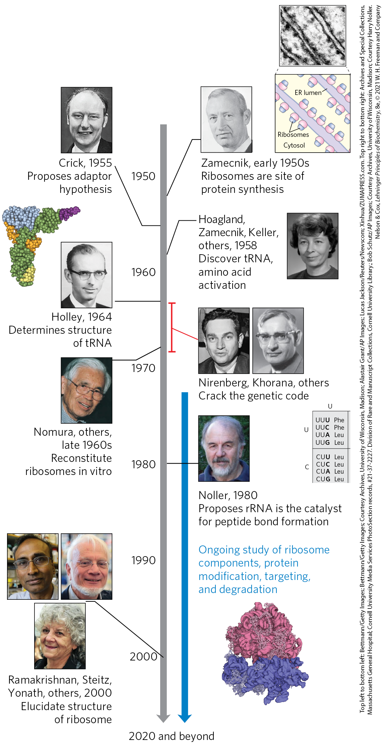
Timeline for Elucidating Protein Biosynthetic Pathways

Slide 8
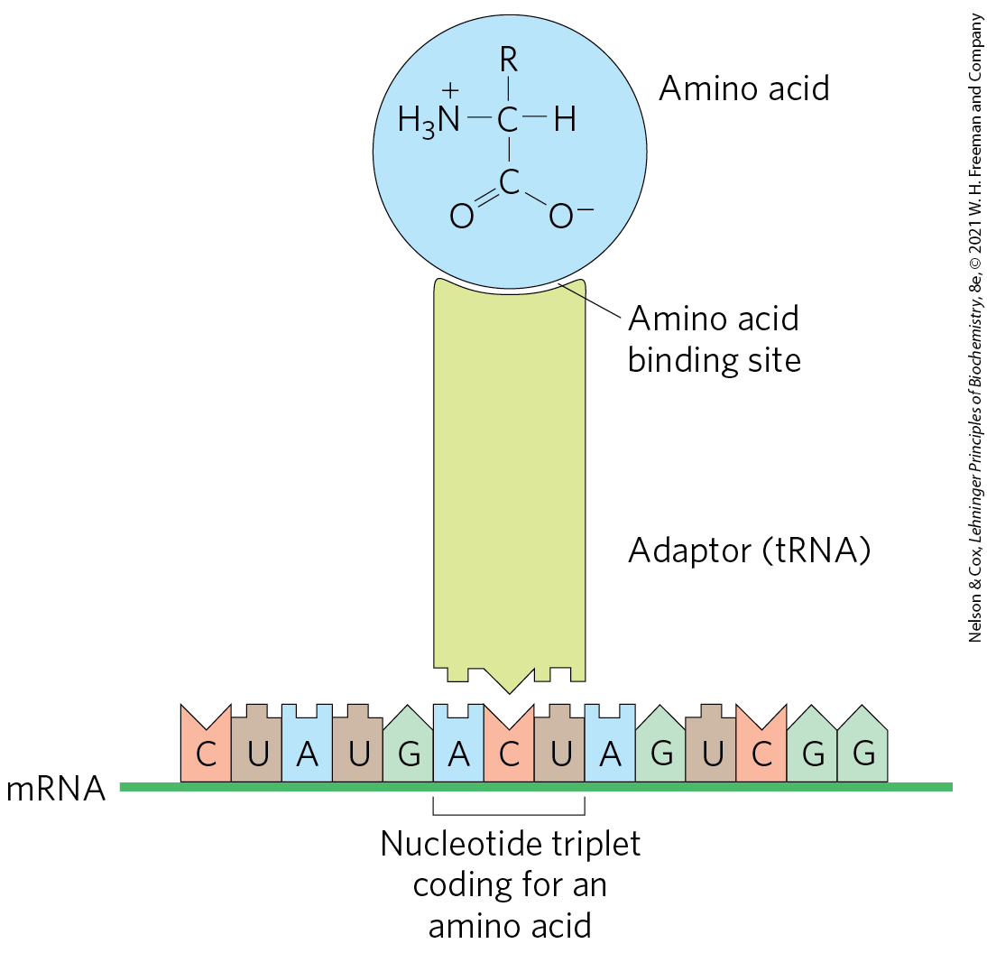
Crick’s Adaptor Hypothesis
adaptor hypothesis = postulation that a small nucleic acid could act as an adaptor, binding to both a specific amino acid and the mRNA sequence encoding that amino acid
  verified with the discovery of tRNA

Slide 9
The Process of Translation
translation = the overall process of mRNA-guided protein synthesis
the tRNA adaptor “translates” the nucleotide sequence of an mRNA into the amino acid sequence of a polypeptide

Slide 10
Aminoacyl-tRNAs
amino acids are “activated” for protein synthesis.
aminoacyl-tRNAs = tRNA attached to an amino acid
aminoacyl-tRNA synthetases = catalyze the formation of aminoacyl-tRNAs

Slide 11

Clicker Question 1
Crick’s adaptor hypothesis was verified with the discovery of:
DNA.
mRNA.
rRNA.
tRNA.
Notes:
Answer: D
Principle: 27.3
Learning Objective(s): Identify the adaptor molecule necessary for translation.
Bloom’s: 1:1

Slide 12
Clicker Question 1, Response
Crick’s adaptor hypothesis was verified with the discovery of:
tRNA.
Translation requires adaptor molecules, the tRNAs, that recognize codons and insert amino acids into their appropriate sequential positions in the polypeptide.

Slide 13
27.1 The Genetic Code

Slide 14
Three Nucleotides are Necessary to Encode Each Amino Acid
the four code letters of DNA (A, T, G, and C) in groups of two yields only 4² = 16 different combinations
  insufficient to encode 20 amino acids.
groups of three yield 4³ = 64 different combinations

Slide 15
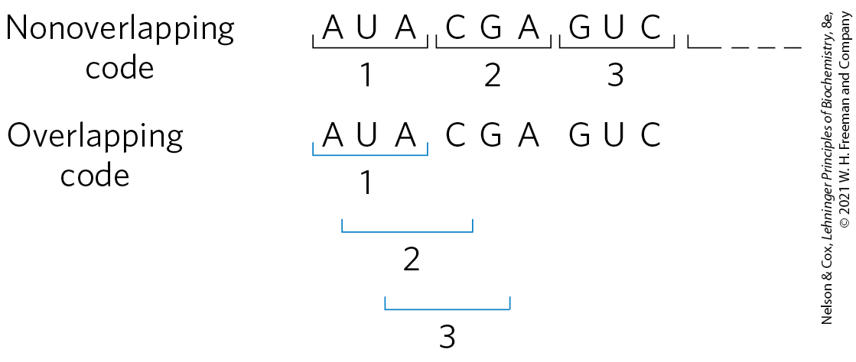
The Genetic Code Was Cracked Using Artificial mRNA Templates
codon = a triplet of nucleotides that codes for a specific amino acid
in all living systems, translation occurs in such a way that codons are read in a successive, nonoverlapping fashion

Slide 16
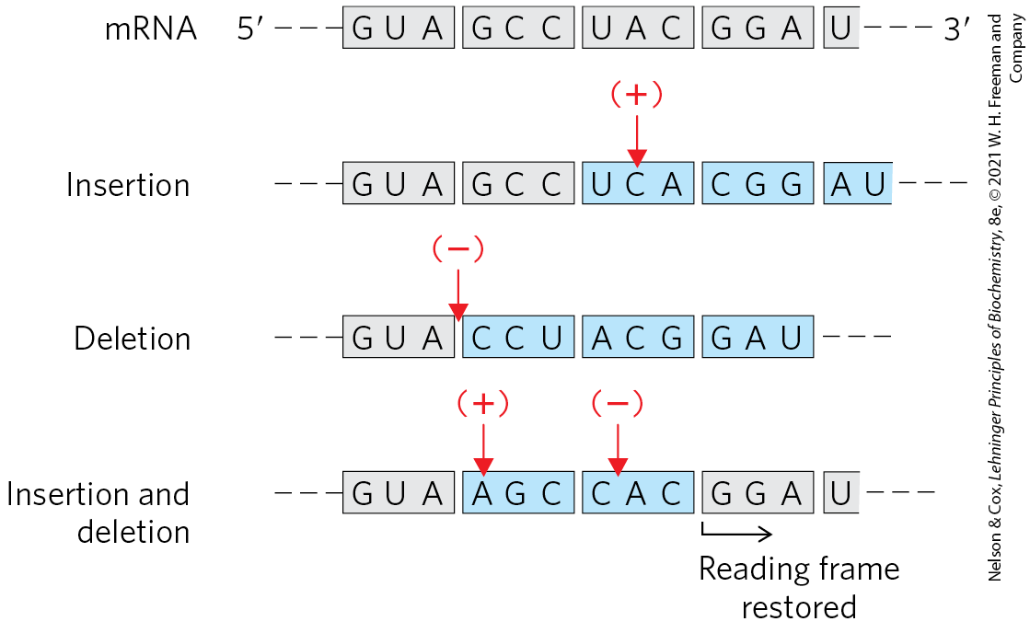
The Triplet, Nonoverlapping Code
inserting or deleting one base pair alters the amino acid sequence coded by the mRNA
inserting or deleting three nucleotides leaves the remaining triplets intact
  provides evidence that a codon has only three nucleotides

Slide 17
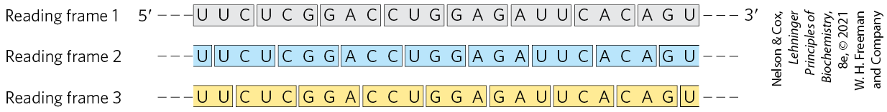
Reading Frames in the Genetic Code
reading frame = method of dividing nucleotides such that a new codon begins every three nucleotide residues
  established by the first codon
  no punctuation between codons
  in principle, any given ssDNA or mRNA sequence has three possible reading frames

Slide 18

Clicker Question 2
In principle, how many reading frames does any given single-stranded DNA or mRNA sequence possess?
1
2
3
4
Notes:
Answer: C
Principle: 27.1
Learning Objective(s): Define codon and reading frame.
Bloom’s: 2:2

Slide 19
Clicker Question 2, Response
In principle, how many reading frames does any given single-stranded DNA or mRNA sequence possess?
3
In principle, any given single-stranded DNA or mRNA sequence has three possible reading frames. Each reading frame gives a different sequence of codons, but only one is likely to encode a given protein.

Slide 20
The First Breakthrough
Nirenberg and Matthaei fed poly(U) and 20 radiolabeled amino acids to E.coli
  found that radioactive polypeptide only formed in the tube containing *Phe
  thus UUU codes for Phe
the same approach revealed:
  CCC codes for proline
  AAA codes for lysine
  GGG did not generate any polypeptide, because it forms tetraplexes that cannot be bound by ribosomes

Slide 21
Polynucleotide Phosphorylase
polynucleotide phosphorylase = catalyzes the formation of RNA polymers with a base composition that reflects the relative concentrations of precursors in the medium
  discovered by Ochoa
Nirenberg and Ochoa groups used artificial mRNAs made by polynucleotide phosphorylase to identify the base compositions of coding triplets

Slide 22
Incorporation of Amino Acids into Polypeptides
Table 27-1 Incorporation of Amino Acids into Polypeptides in Response to Random Polymers of RNA
Amino acid | Observed frequency of incorporation (Lys = 100) | Tentative assignment for nucleotide composition of corresponding codon | Expected frequency of incorporation based on assignment (Lys = 100)
Asparagine | 24 | A₂C | 20
Glutamine | 24 | A₂C | 20
Histidine | 6 | AC₂ | 4
Lysine | 100 | AAA | 100
Proline | 7 | AC₂, CCC | 4.8
Threonine | 26 | A₂C, AC₂ | 24

Slide 23
Trinucleotides That Induce Specific Binding of Aminoacyl-tRNAs to Ribosomes
isolated E. coli ribosomes bind a specific aminoacyl-tRNA in the presence of the corresponding synthetic polynucleotide messenger
Table 27-2 Trinucleotides That Induce Specific Binding of Aminoacyl-tRNAs to Ribosomes
Trinucleotide | Relative increase in ¹⁴C-labeled aminoacyl-tRNA bound to ribosome: Phe-tRNA^{Phe} | Relative increase in ¹⁴C-labeled aminoacyl-tRNA bound to ribosome: Lys-tRNA^{Lys} | Relative increase in ¹⁴C-labeled aminoacyl-tRNA bound to ribosome: Pro-tRNA^{Pro}
UUU | 4.6 | 0 | 0
AAA | 0 | 7.7 | 0
CCC | 0 | 0 | 3.1

Slide 24
Clicker Question 3
Nirenberg and Matthaei incubated either synthetic poly(A), poly(C), poly(G), and poly(U) and a mixture of the 20 amino acids in 20 different tubes, each tube containing a different radioactively labeled amino acid. However, this approach did NOT reveal that:
AAA codes for lysine.
CCC codes for proline.
GGG codes for glycine.
UUU codes for phenylalanine.
Notes:
Answer: C
Principle: 27.1
Learning Objective(s): Explain how the genetic code was deciphered.
Bloom’s: 1:1

Slide 25
Clicker Question 3, Response
Nirenberg and Matthaei incubated either synthetic poly(A), poly(C), poly(G), and poly(U) and a mixture of the 20 amino acids in 20 different tubes, each tube containing a different radioactively labeled amino acid. However, this approach did NOT reveal that:
GGG codes for glycine.
Poly(G) did not generate any polypeptide because it forms tetraplexes that cannot be bound by ribosomes.

Slide 26
A Complementary Approach
Khorana used defined mRNAs in planned patterns to produce polypeptides with repeating patterns
  (AC)_{n} (alternating ACA and CAC codons) produced a polypeptide with equal amounts of His and Thr

Slide 27
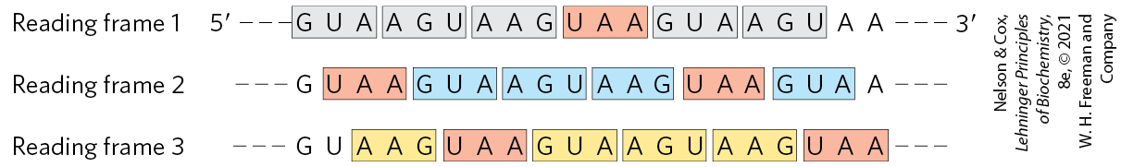
Effect of a Termination Codon
three codons disrupted amino acid coding patterns when they occurred in a synthetic RNA polymer
  synthesized dipeptides or tripeptides
these codons were identified as termination codons
termination codons

Slide 28
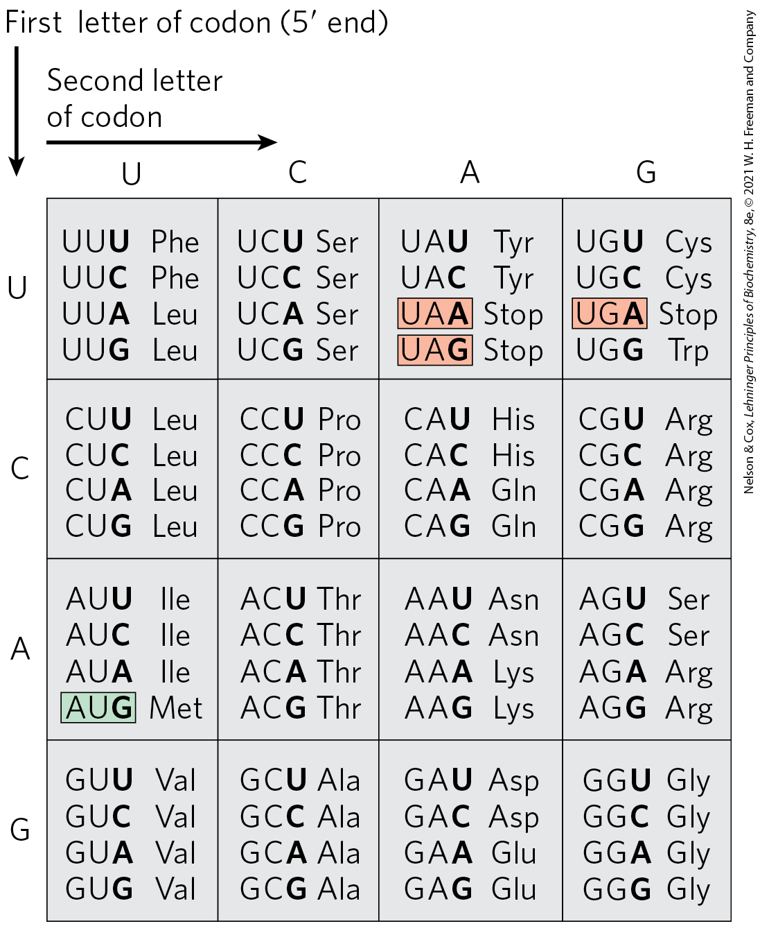
“Dictionary” of Amino Acid Code Words in mRNAs
61 codons code for amino acids
3 codons (UAA, UGA, UAG) are termination codons
1 codon (AUG) is the start codon (as well as the Met codon)

Slide 29
Clicker Question 4
How many codon combinations actually encode amino acids?
20
32
61
64
Notes:
Answer: C
Principle: 27.1
Learning Objective(s): Define codon and reading frame.
Bloom’s: 1:1

Slide 30
Clicker Question 4, Response
How many codon combinations actually encode amino acids?
61
Consolidation of the results from many experiments permitted assignment of 61 of the 64 possible codons. The other three were identified as termination codons.

Slide 31
Principle 2 (2 of 3)
The genetic code is nearly universal and arose early in evolution. This is one of the many characteristics of living systems that ties all of them to a common ancestor. Even the rare exceptions to code universality reinforce this rule.

Slide 32
Setting and Maintaining the
Reading Frame
the reading frame is set when translation of an mRNA molecule begins
the reading frame is maintained as triplets are read sequentially
a “missense” protein with a garbled amino acid sequence forms if:
  the initial reading frame is off by one or two bases
  translation skips a nucleotide in the mRNA

Slide 33
Several Codons Serve
Special Functions
initiation codon (AUG) = signal the beginning of a polypeptide in all cells
  also codes for Met in internal positions of polypeptides
termination codons (UAA, UAG, and UGA) = normally signal the end of polypeptide synthesis
  also called stop codons or nonsense codons
  do not code for any known amino acids

Slide 34
Principle 1 (2 of 8)
Information is expensive. This principle, noted in earlier chapters, is particularly well illustrated by protein synthesis. Protein synthesis consumes more cellular resources than any other process in most cells. The 15,000 ribosomes, 100,000 molecules of protein synthesis–related protein factors and enzymes, and 200,000 tRNA molecules in a typical bacterial cell can account for more than 35% of the cell’s dry weight. Overall, almost 300 different macromolecules cooperate to synthesize polypeptides. Protein synthesis can account for up to 90% of the chemical energy used by a cell for all biosynthetic reactions. Why? The enzymatic synthesis of an amide bond should require little energetic input. However, the sequence of amino acids in a protein is a form of biological information. Synthesis of each amide (peptide) bond between two particular amino acids is ensured by the investment of more than four nucleoside triphosphates (NTPs).

Slide 35
Initiation of Protein Synthesis is an Elaborate Process
initiation of protein synthesis in the cell relies on initiation codons and other signals in the mRNA
in retrospect, the experiments to identify codon function should not have worked without initiation codons
  experimental conditions caused the initiation requirements for protein synthesis to be relaxed

Slide 36
Open Reading Frame (ORF)
open reading frame (ORF) = a reading frame without a termination codon among 50+ consecutive codons
long ORFs usually correspond to genes that encode proteins
  a typical protein requires an ORF with 500+ codons

Slide 37
The Genetic Code is Degenerate
degenerate = an amino acid may be specified by more than one codon
  degeneracy of the code is not uniform
each codon specifies only one amino acid
Table 27-3 Degeneracy of the Genetic Code
Amino acid | Number of codons | Amino acid | Number of codons
Met | 1 | Tyr | 2
Trp | 1 | Ile | 3
Asn | 2 | Ala | 4
Asp | 2 | Gly | 4
Cys | 2 | Pro | 4
Gln | 2 | Thr | 4
Glu | 2 | Val | 4
His | 2 | Arg | 6
Lys | 2 | Leu | 6
Phe | 2 | Ser | 6

Slide 38
Clicker Question 5
Why is the genetic code said to be “degenerate”?
The first base in a codon is the most important for coding, followed by the second base, and the third base is least important.
Each amino acid can be specified by more than one codon.
Fewer amino acids are coded by the four bases than was expected.
The less complexity in an organism, the fewer codons are specified.
The genetic code deteriorates with each replication (generation), unless proofreading functions correct for errors.
Notes:
Answer: B. Answer B is actually the opposite of expectations. Protein was initially thought to carry genetic information because more combinations of the 20 common amino acids are possible than combinations of the four bases, thus protein can carry more unique sequences. Answer E would be true, but it is not the definition of Degenerate.
Principle: 27.1
Learning Objective(s): Explain the idea that the genetic code is degenerate.
Bloom’s: 2:2

Slide 39
Clicker Question 5, Response
Why is the genetic code said to be “degenerate”?
Each amino acid can be specified by more than one codon.
A striking feature of the genetic code is that an amino acid may be specified by more than one codon, so the code is described as degenerate.

Slide 40
The Genetic Code is
Nearly Universal
amino acid codons are identical in nearly all species examined so far
  exceptions include minor variations in mitochondria, some bacteria, and some single-celled eukaryotes
suggests that all life-forms have a common evolutionary ancestor

Slide 41

Clicker Question 6
Which statement does NOT describe a feature of the genetic code?
It consists of nonoverlapping triplet codons, with three possible reading frames.
Bacteria have a slightly different code than do eukaryotes.
It is degenerate.
Base-pairing of the 3′ base of the mRNA codon to the 5′ base of the tRNA anticodon is often not “normal” Watson-Crick base-pairing.
Notes:
Answer: B
Principle: 27.2
Learning Objective(s): Explain the significance of the preservation of the genetic code across diverse biological entities.
Bloom’s: 2:2

Slide 42
Clicker Question 6, Response
Which statement does NOT describe a feature of the genetic code?
Bacteria have a slightly different code than do eukaryotes.
The genetic code is nearly universal. With the intriguing exception of a few minor variations in mitochondria, some bacteria, and some single-celled eukaryotes, amino acid codons are identical in all species examined so far.

Slide 43
Wobble Allows Some tRNAs to Recognize More than One Codon
when several different codons specify one amino acid, the difference usually lies at the third base position
  for example, alanine is encoded by GCU, GCC, GCA, and GCG
the third position in each codon is much less specific and is said to “wobble”
  this allows certain tRNAs to recognize more than one codon

Slide 44
Principle 3 (2 of 6)
The genetic code functions via linker molecules. The tRNAs are the crucial adaptor, matching amino acids with DNA codons.

Slide 45
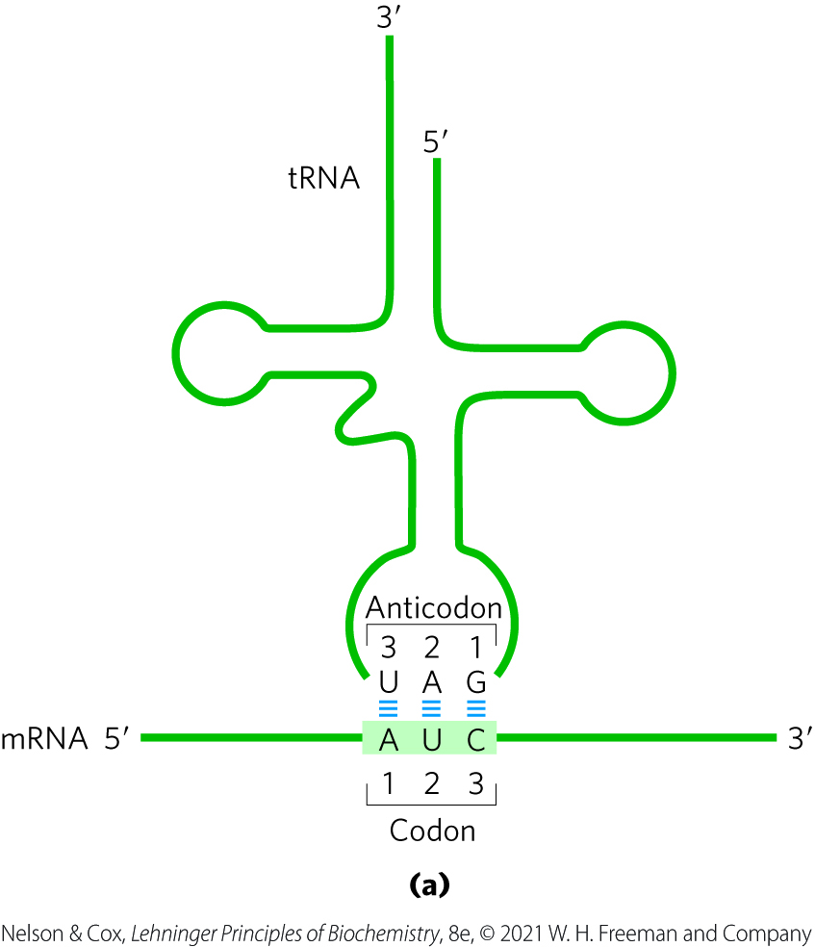
Pairing Relationship of Codon and Anticodon
anticodon = a three-base sequence on the tRNA that base pairs with mRNA codons
base pairing occurs via hydrogen bonding
the alignment of the two RNA segments is antiparallel

Slide 46
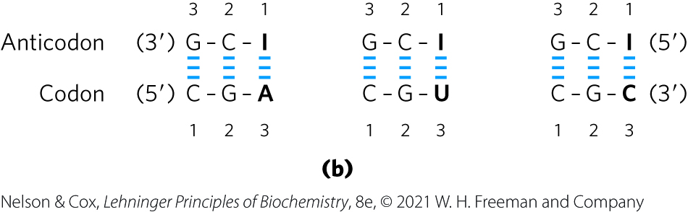
Inosinate in Anticodons
the anticodons in some tRNAs include the nucleotide inosinate (designated I)
inosinate can form weak hydrogen bonds with A, U, and C

Slide 47
Clicker Question 7
What mediates the interaction between the nucleotide triplets present on tRNA molecules and triplet codons?
ionic bonds
hydrogen bonds
covalent bonds
peptide bonds
Notes:
Answer: B
Principle: 27.3
Learning Objective(s): Describe what is necessary for translation to occur.
Bloom’s: 1:1

Slide 48
Clicker Question 7, Response
What mediates the interaction between the nucleotide triplets present on tRNA molecules and triplet codons?
hydrogen bonds
Transfer RNAs base-pair with mRNA codons at a three-base sequence on the tRNA called the anticodon. As in DNA, base pairing occurs via hydrogen bonding.

Slide 49
The Wobble Hypothesis
the wobble hypothesis = proposes the third base of most codons pairs loosely with the corresponding anticodon base
  permits rapid dissociation of the tRNA from its codon during protein synthesis

Slide 50
Clicker Question 8
The wobble hypothesis of Francis Crick concerns what association?
specific pairing of purines with pyrimidines
binding of large and small ribosomal subunits
binding of codon with anticodon
binding of tRNA with the A-site on ribosomes
specific binding of mRNA to ribosomes
Notes:
Answer: C
Principle: 27.3
Learning Objective(s): Explain the wobble hypothesis.
Bloom’s: 1:1

Slide 51
Clicker Question 8, Response
The wobble hypothesis of Francis Crick concerns what association?
binding of codon with anticodon
Examination of codon-anticodon pairings led Crick to conclude that the third base of most codons pairs rather loosely with the corresponding base of its anticodon.

Slide 52
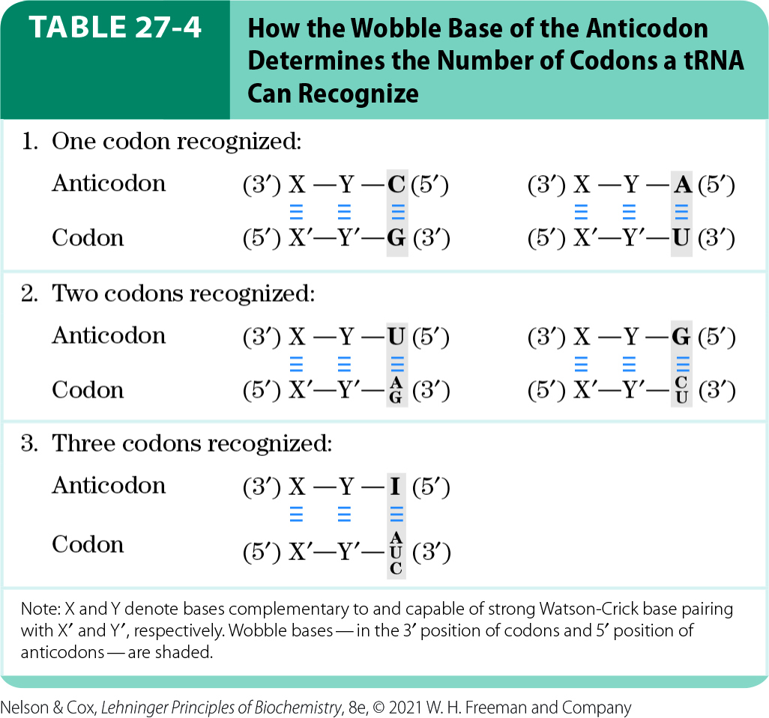
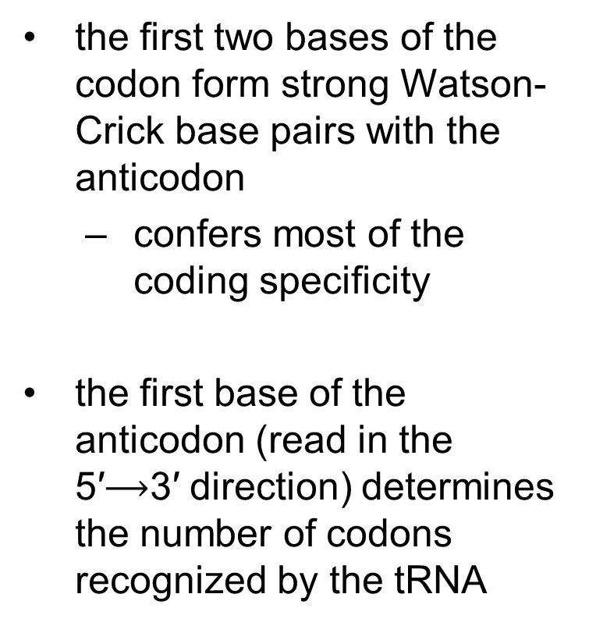
The Relationships of the Wobble Hypothesis (1 of 2)
the first two bases of the codon form strong Watson-Crick base pairs with the anticodon
  confers most of the coding specificity
the first base of the anticodon (read in the 5′$⟶$3′ direction) determines the number of codons recognized by the tRNA

Slide 53
The Relationships of the Wobble Hypothesis (2 of 2)
when an amino acid is specified by several different codons, the codons that differ in either of the first two bases require different tRNAs
at least 32 tRNAs are required to translate all 61 codons (31 to encode the amino acids, 1 for initiation)

Slide 54
Clicker Question 9
Mutation of the codon GAU to which codon would MOST likely result in a protein with unaltered or minimally altered function?
GAG
GUG
GCG
GGG
Notes:
Answer: A
Principle: 27.3
Learning Objective(s): Define a missense mutation, a transition mutation, and a silent mutation.
Bloom’s: 4:2

Slide 55
Clicker Question 9, Response
Mutation of the codon GAU to which codon would MOST likely result in a protein with unaltered or minimally altered function?
GAG
In the third, or wobble, position of the codon, single base substitutions produce a change in the encoded amino acid only about 25% of the time. Most such changes are thus silent mutations, in which the nucleotide is different but the encoded amino acid remains the same.

Slide 56
Principle 3 (3 of 6)
The genetic code functions via linker molecules. The tRNAs are the crucial adaptor, matching amino acids with DNA codons.

Slide 57
Number of tRNAs in E. coli Cells
most cells have more tRNAs than the 32 tRNAs required to translate all codons
there are 86 total tRNA genes in the E. coli genome

Slide 58
The Genetic Code Is
Mutation-Resistant
missense mutations = mutations in which a single new base pair replaces another
  most common type of mutation
  in the third position of the codon, single base substitutions change the amino acid ~25% of the time
silent mutations = mutations in which the nucleotide is different but the encoded amino acid stays the same

Slide 59
Transition Mutations
transition mutation = a missense mutation in which a a purine is replaced by a purine, or a pyrimidine by a pyrimidine
  all three codon positions have some resistance to these mutations
mutation in the first base of a codon usually produces a conservative substitution
  for example, changing GUU (Val) to AUU (Ile) substitutes one hydrophobic amino acid for another

Slide 60
Clicker Question 10
Which mutation is an example of a transition mutation?
G→A
G→T
A→C
A→T
Notes:
Answer: A
Principle: 27.3
Learning Objective(s): Define a missense mutation, a transition mutation, and a silent mutation.
Bloom’s: 2:2

Slide 61
Clicker Question 10, Response
Which mutation is an example of a transition mutation?
G→A
A transition mutation is when a purine is replaced by another purine or a pyrimidine is replaced by another pyrimidine.

Slide 62
Principle 2 (3 of 3)
The genetic code is nearly universal and arose early in evolution. This is one of the many characteristics of living systems that ties all of them to a common ancestor. Even the rare exceptions to code universality reinforce this rule.

Slide 63
Alternative Genetic Codes Are Less Resistant to Mutation
alternative genetic codes, delineated at random, are almost always less resistant to mutation than the existing genetic code

Slide 64

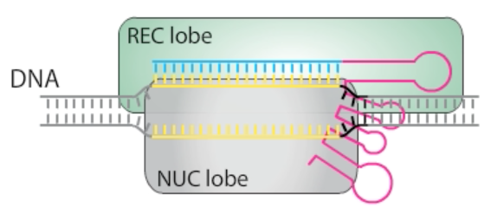
Activity: The
Genetic Code
Watch the Animated Technique video titled “CRISPR.”
Notes:
Instructor: This Animated Technique video is found within Chapter 9 of Achieve. It is in the folder titled “Ch9 In-Class Activities, Videos, and Resources.”

Slide 65
Activity Instructions (1 of 4)
On your own, think of answers to the question:
  Consider the innate function of the CRISPR-Cas system in bacteria. Why did bacteria evolve the CRISPR-Cas system and why is it effective?
  (2 minutes)
Pair up to discuss your ideas. (2 minutes)
Share your ideas with the class in group discussion. (3 minutes)
Notes:
Instructor: This Animated Technique video is found within Chapter 9 of Achieve. It is in the folder titled “Ch9 In-Class Activities, Videos, and Resources.”

Slide 66
Activity Solution (1 of 5)
  Why did bacteria evolve the CRISPR-Cas system and why is it effective? In bacteria, the CRISPR-Cas system evolved as an adaptive immune system in response to bacteriophages (viruses) in the environment, where the system allows bacteria to cleave the invading viral genome. This system is effective because viruses contain genetic material composed of nucleic acids just like bacteria and all other life forms on Earth.
Notes:
Instructor: This Animated Technique video is found within Chapter 9 of Achieve. It is in the folder titled “Ch9 In-Class Activities, Videos, and Resources.”

Slide 67
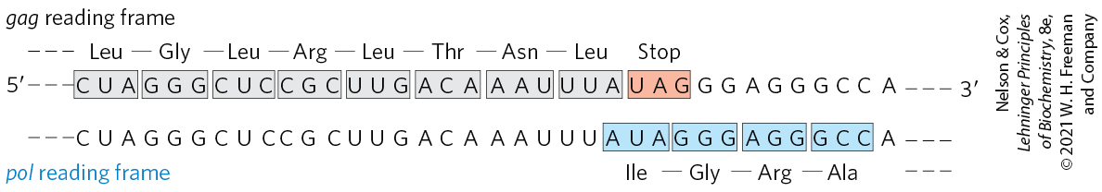
Translational Frameshifting Affects How the Code Is Read
translational frameshifting = “hiccupping” of ribosomes at a certain point in the translation to change the reading frame
  allows 2+ related but distinct proteins to be produced from a single transcript
  occurs during translation for the overlapping gag and pol genes of the retrovirus Rous sarcoma virus

Slide 68
Clicker Question 11
Which term describes the production of two or more related but distinct proteins from a single transcript?
transition mutation
third base wobble
translational frameshifting
RNA editing
Notes:
Answer: C
Principle: 27.3
Learning Objective(s): Explain the advantage of translational frameshifting.
Bloom’s: 1:1

Slide 69
Clicker Question 11, Response
Which term describes the production of two or more related but distinct proteins from a single transcript?
translational frameshifting
A few genes are structured so that ribosomes “hiccup” at a certain point in the translation of their mRNAs, changing the reading frame from that point on. This process, called translational frameshifting, allows two or more related but distinct proteins to be produced from a single transcript.

Slide 70
Some mRNAs Are Edited before Translation
RNA editing = the addition, deletion, or alteration of RNA nucleotides in a manner that affects the meaning of the transcript during translation
addition or deletion of nucleotides is common in RNAs from mitochondrial and chloroplast genomes

Slide 71
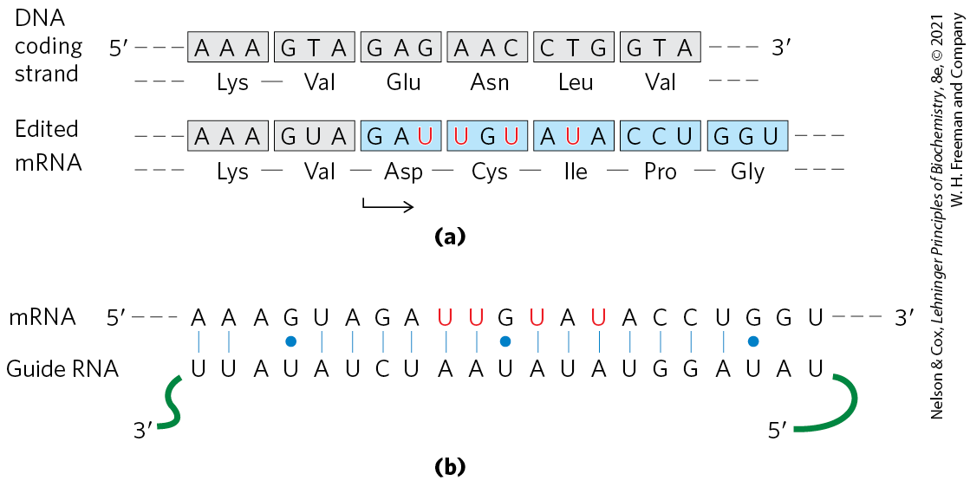
RNA Editing of the Transcripts Encoding Cytochrome Oxidase Subunit II
posttranscriptional editing inserts four U residues
  revises the reading frame
guide RNAs (gRNAs) = act as templates for the editing process

Slide 72
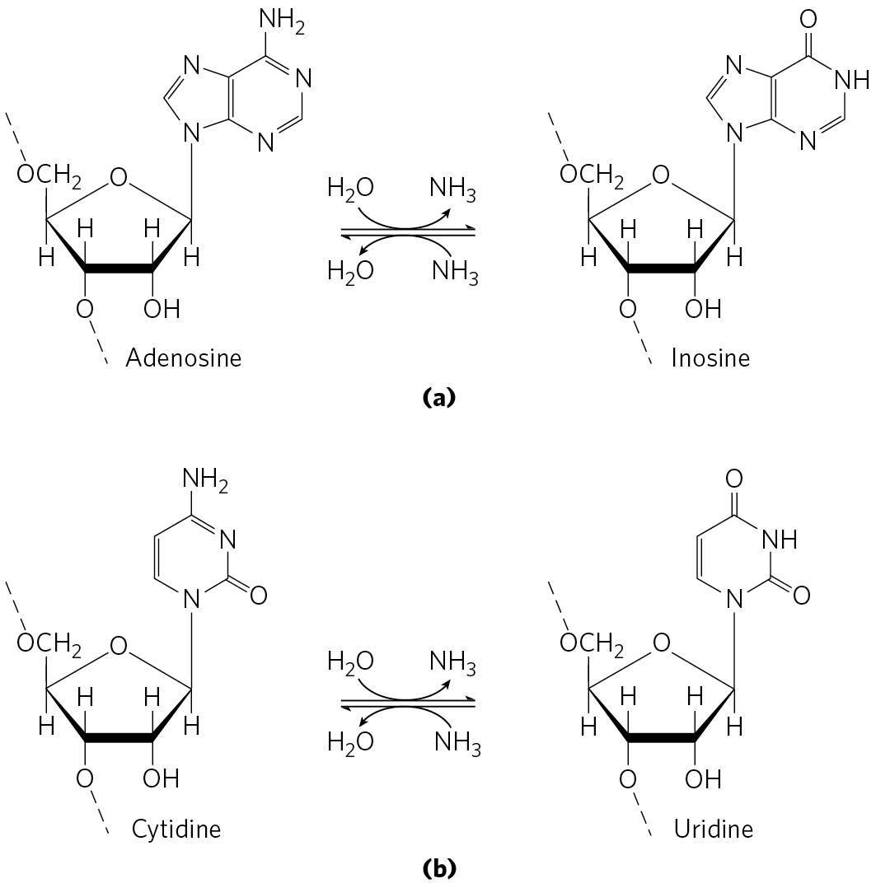
RNA Editing by Alteration of Nucleotides
commonly involves enzymatic deamination of adenosine or cytidine to form inosine or uridine, respectively

Slide 73
Clicker Question 12
RNA editing:
occurs in a complex known as the editosome.
does not occur in vertebrates.
results in translational frameshifting.
usually occurs by deamination of A or C.
Notes:
Answer: D
Principle: 27.1
Learning Objective(s): Explain RNA editing.
Bloom’s: 2:2

Slide 74
Clicker Question 12, Response
RNA editing:
usually occurs by deamination of A or C.
RNA editing by alteration of nucleotides most commonly involves the enzymatic deamination of adenosine or cytidine residues, forming inosine or uridine, respectively.

Slide 75
ADARs and APOBEC Enzymes
ADARs (adenosine deaminases that act on RNA) = carry out adenosine deamination reactions
APOBEC (apoB mRNA editing catalytic peptide) family of enzymes = carry out cytidine deaminations
  includes AID (activation-induced deaminase) enzymes

Slide 76
Clicker Question 13
APOBEC1:
deaminates cytosine to uracil.
introduces a premature stop codon in the apoB mRNA.
is beneficial because it suppresses pathogenic retroviruses.
is harmful because it causes mutations in proteins.
All of the answers are correct.
Notes:
Answer: E
Principle: 27.1
Learning Objective(s): Define the function of APOBEC enzymes.
Bloom’s: 2:2

Slide 77
Clicker Question 13, Response
APOBEC1:
All of the answers are correct.
The cytidine deaminase APOBEC1 converts C to U, creating the stop codon UAA in the mRNA produced from the gene for apoB-100. This permits tissue-specific synthesis of two different proteins from one gene. APOBEC enzymes also provide a mechanism for introducing multiple mutations into a targeted segment of a chromosome. Many of these enzymes also suppress retroviruses and retrotransposons by targeting DNA.

Slide 78
Principle 1 (3 of 8)
Information is expensive. This principle, noted in earlier chapters, is particularly well illustrated by protein synthesis. Protein synthesis consumes more cellular resources than any other process in most cells. The 15,000 ribosomes, 100,000 molecules of protein synthesis–related protein factors and enzymes, and 200,000 tRNA molecules in a typical bacterial cell can account for more than 35% of the cell’s dry weight. Overall, almost 300 different macromolecules cooperate to synthesize polypeptides. Protein synthesis can account for up to 90% of the chemical energy used by a cell for all biosynthetic reactions. Why? The enzymatic synthesis of an amide bond should require little energetic input. However, the sequence of amino acids in a protein is a form of biological information. Synthesis of each amide (peptide) bond between two particular amino acids is ensured by the investment of more than four nucleoside triphosphates (NTPs).

Slide 79
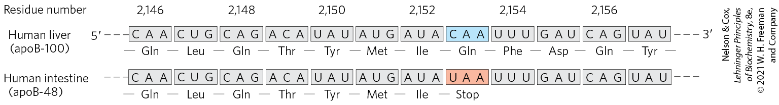
RNA Editing of the Gene Transcript for the apoB-100 Component of LDL
an APOBEC cytidine deaminase found only in the intestine binds to the apoB-100 mRNA and changes a Gln codon to a stop codon
  produces a truncated protein
  reaction permits tissue-specific synthesis of two different proteins from one gene

Slide 80
27.2 Protein Synthesis

Slide 81
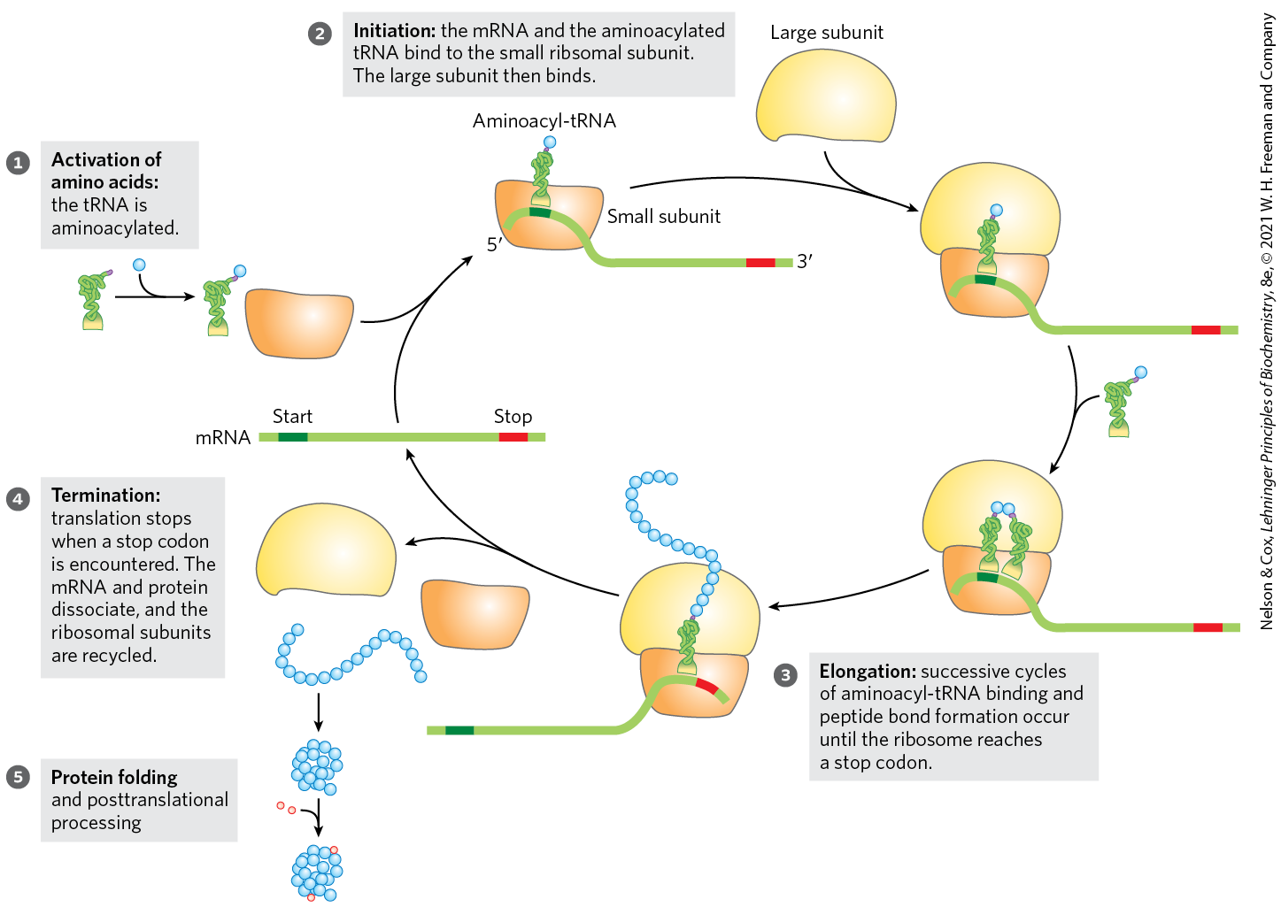
An Overview of the Five Stages of Protein Synthesis

Slide 82
Principle 1 (4 of 8)
Information is expensive. This principle, noted in earlier chapters, is particularly well illustrated by protein synthesis. Protein synthesis consumes more cellular resources than any other process in most cells. The 15,000 ribosomes, 100,000 molecules of protein synthesis–related protein factors and enzymes, and 200,000 tRNA molecules in a typical bacterial cell can account for more than 35% of the cell’s dry weight. Overall, almost 300 different macromolecules cooperate to synthesize polypeptides. Protein synthesis can account for up to 90% of the chemical energy used by a cell for all biosynthetic reactions. Why? The enzymatic synthesis of an amide bond should require little energetic input. However, the sequence of amino acids in a protein is a form of biological information. Synthesis of each amide (peptide) bond between two particular amino acids is ensured by the investment of more than four nucleoside triphosphates (NTPs).

Slide 83
Components Required for Protein Synthesis in E. coli
Table 27-5 Components Required for the Five Major Stages of Protein Synthesis in E.coli
Stage | Essential components | Essential components
1. Activation of amino acids | 20 amino acids 20 aminoacyl-tRNA synthases 32 or more tRNAs | ATP Mg²⁺
2. Initiation | mRNA N-Formylmethionyl-tRNA^{fMet} Initiation codon in mRNA (AUG) 30S ribosomal subunit | 50S ribosomal subunit Initiation factors (IF1, IF2, IF3) GTP Mg²⁺
3. Elongation | Functional 70S ribosomes (initiation complex) Aminoacyl-tRNAs specified by codons | Elongation factors (EF-Tu, EF-Ts, EF-G) GTP Mg²⁺
4. Termination and ribosome recycling | Termination codon in mRNA Release factors (RF1, RF2, RF3, RRF) | EF-G IF3
5. Folding and posttranslational processing | Chaperones and folding enzymes (PPI, PDI); specific enzymes, cofactors, and other components for removal of initiating residues and signal sequences, additional proteolytic processing, modification of terminal residues, and attachment of acetyl, phosphoryl, methyl, carboxyl, carbohydrate, or prosthetic groups

Slide 84
Principle 4 (2 of 3)
Proteins are synthesized by RNAs. The study of protein synthesis offers another important reward: a look at a world of RNA catalysts that may have existed in an RNA world before the dawn of life “as we know it.” Proteins are synthesized by a gigantic RNA enzyme.

Slide 85
The Ribosome Is a Complex Supramolecular Machine
each E. coli cell contains 15,000+ ribosomes
  ~25% of the dry weight of bacteria
bacterial ribosomes:
  contain ~65% rRNA (forms the core and catalyzes peptide bond formation) and ~35% protein
  have two unequal subunits (30S and 50S)
Table 27-6 RNA and Protein Components of the E.coli Ribosome
Subunit | Number of different proteins | Total number of proteins | Protein designations | Number and type of rRNAs
30S | 21 | 21 | S1–S21 | 1 (16S rRNA)
50S | 33 | 36 | L1–L36ª | 2 (5S and 23S rRNAs)

Slide 86
Ribosomal Subunits are Identified by Their S Values
S (Svedberg unit) values = sedimentation coefficients that refer to their rate of sedimentation in a centrifuge
bacterial ribosomes have 30S and 50S subunits
  the combined sedimentation coefficient is 70S

Slide 87

Clicker Question 14
What type of rRNA is present in the 30S subunit of the E. coli ribosome?
5S
23S
16S
The 30S subunit does not contain rRNA.
Notes:
Answer: C
Principle: 27.4
Learning Objective(s): Identify the major components of ribosomes.
Bloom’s: 1:1

Slide 88
Clicker Question 14, Response
What type of rRNA is present in the 30S subunit of the E. coli ribosome?
16S
Each 30S ribosomal subunit contains one 16S rRNA. Each 50S subunit contains two 5S and two 23S rRNAs.

Slide 89
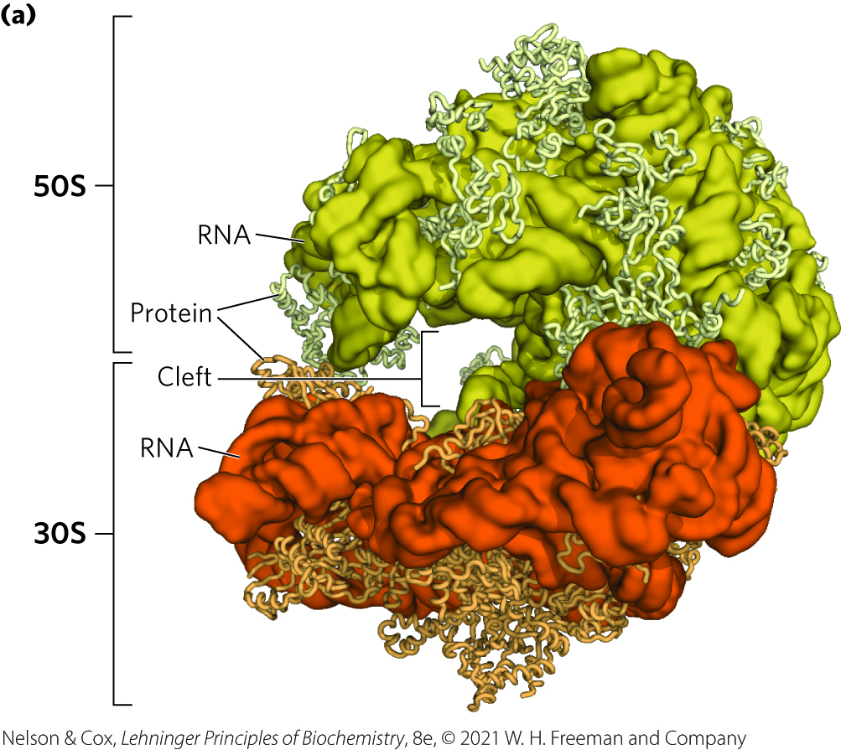
Bacterial Ribosomal Structure
50S and 30S subunits come together to form a cleft through which mRNA passes
there is no protein within 18 Å of the active site for peptide bond formation
high-resolution structure confirms that the ribosome is a ribozyme

Slide 90
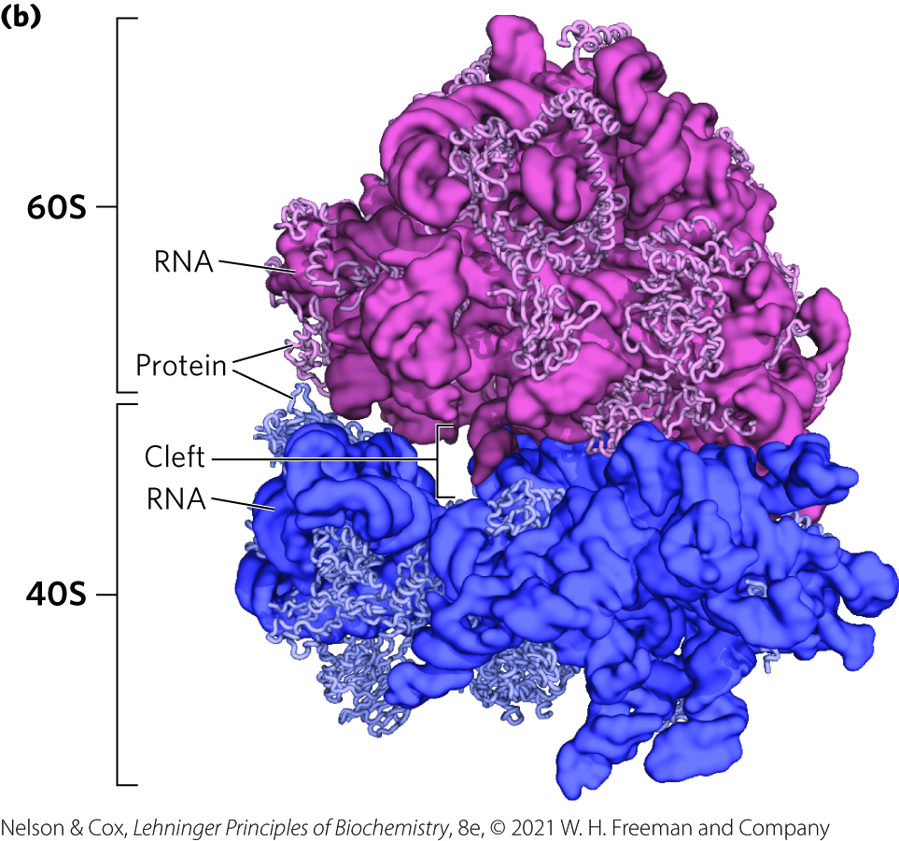
Eukaryotic Ribosomal Structure
eukaryotic ribosomes have a similar structure to bacterial ribosomes with somewhat increased complexity

Slide 91
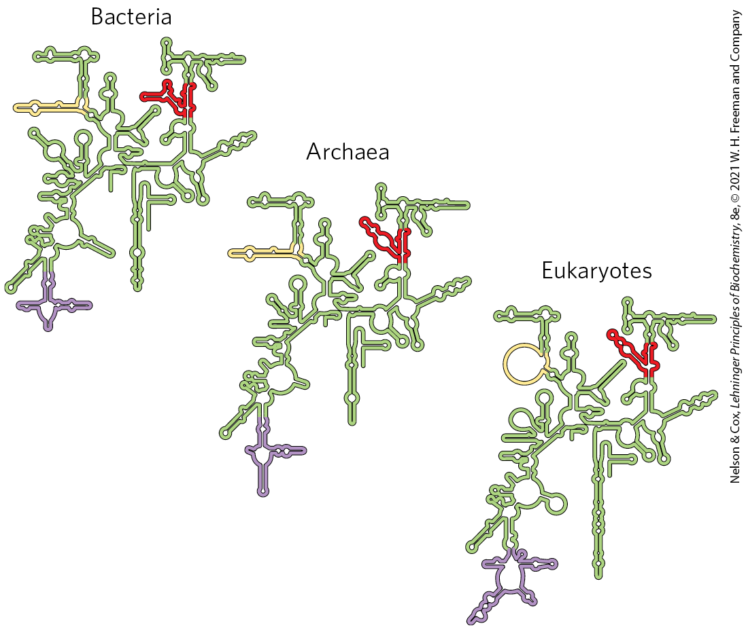
Conservation of Secondary Structure in Small Subunit rRNAs
folding patterns of rRNAs are highly conserved in all organisms

Slide 92
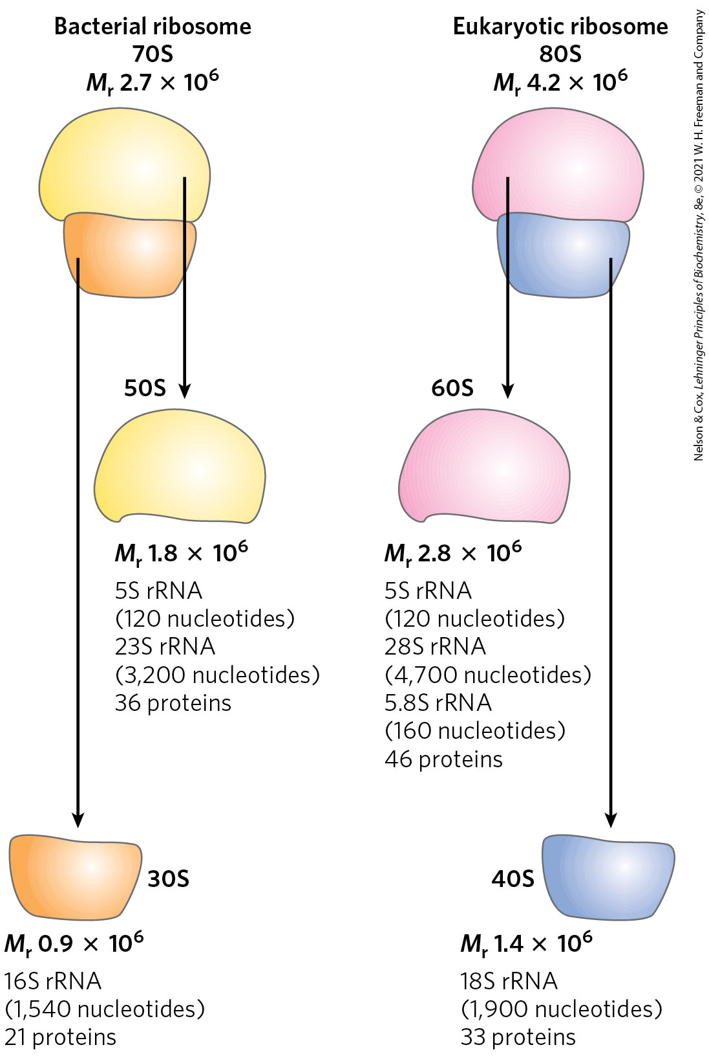
Summary of Eukaryotic Ribosomes
overall very similar to bacterial ribosomes
eukaryotic ribosomes:
  are larger (~80S) and more complex than bacterial ribosomes
  have two subunits (60S and 40S on average)
chloroplasts and mitochondria have simpler ribosomes than bacteria

Slide 93
Clicker Question 15
Which statement regarding rRNAs is false?
rRNAs have conserved secondary and tertiary structures.
rRNA catalyzes peptide bond formation.
Both bacterial and eukaryotic ribosomes contain only three rRNAs.
Ribosomal proteins are incorporated into nascent ribosomes as the rRNA is being synthesized and processed.
Notes:
Answer: C
Principle: 27.4
Learning Objective(s): Identify the major components of ribosomes.
Bloom’s: 1:1

Slide 94
Clicker Question 15, Response
Which statement regarding rRNAs is false?
Both bacterial and eukaryotic ribosomes contain only three rRNAs.
Bacterial ribosomes have three rRNAs (5S, 23S, and 16S), whereas eukaryotic ribosomes have four rRNAs (5S, 28S, 5.8S, and 18S).

Slide 95

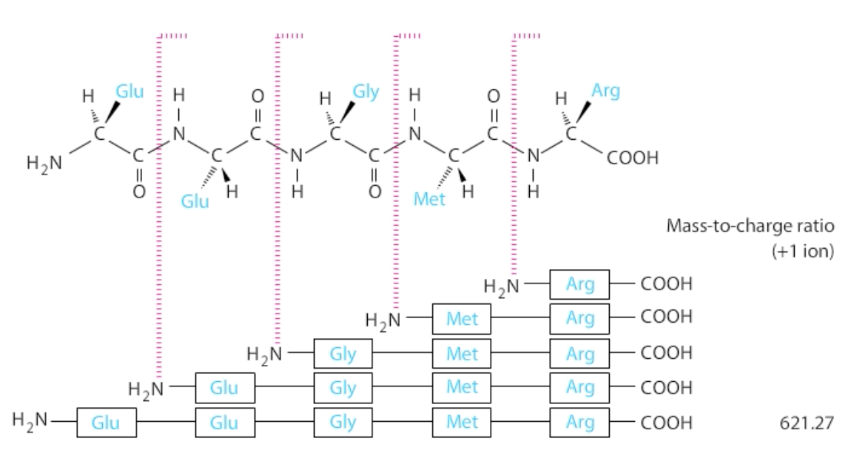
Activity: Protein
Composition
Watch the Animated Technique video titled “Tandem Mass Spectroscopy.”
Notes:
Instructor: This Animated Technique video is found within Chapter 3 of Achieve. It is in the folder titled “Ch3 In-Class Activities, Videos, and Resources.”

Slide 96
Activity Instructions (2 of 4)
On your own, think of answers to the question:
  What molecular machines mediate protein synthesis and what structural component of these machines catalyzes peptide bond formation?
  (2 minutes)
Pair up to discuss your ideas. (2 minutes)
Share your ideas with the class in group discussion. (3 minutes)
Notes:
Instructor: This Animated Technique video is found within Chapter 3 of Achieve. It is in the folder titled “Ch3 In-Class Activities, Videos, and Resources.”

Slide 97
Activity Solution (2 of 5)
  What molecular machines mediate protein synthesis and what structural component of these machines catalyzes peptide bond formation? Ribosomes are the molecular machines responsible for carrying out protein synthesis. Ribosomes primarily consist of RNAs (rRNAs), along with some protein components. Unlike most other reactions within cells, peptide bond formation is catalyzed by rRNA (23S rRNA) within the ribosome, not by an enzyme (protein). Accordingly, ribosomes are sometimes referred to as “ribozymes”, or catalytic RNAs.
Notes:
Instructor: This Animated Technique video is found within Chapter 3 of Achieve. It is in the folder titled “Ch3 In-Class Activities, Videos, and Resources.”

Slide 98
Principle 1 (5 of 8)
Information is expensive. This principle, noted in earlier chapters, is particularly well illustrated by protein synthesis. Protein synthesis consumes more cellular resources than any other process in most cells. The 15,000 ribosomes, 100,000 molecules of protein synthesis–related protein factors and enzymes, and 200,000 tRNA molecules in a typical bacterial cell can account for more than 35% of the cell’s dry weight. Overall, almost 300 different macromolecules cooperate to synthesize polypeptides. Protein synthesis can account for up to 90% of the chemical energy used by a cell for all biosynthetic reactions. Why? The enzymatic synthesis of an amide bond should require little energetic input. However, the sequence of amino acids in a protein is a form of biological information. Synthesis of each amide (peptide) bond between two particular amino acids is ensured by the investment of more than four nucleoside triphosphates (NTPs).

Slide 99
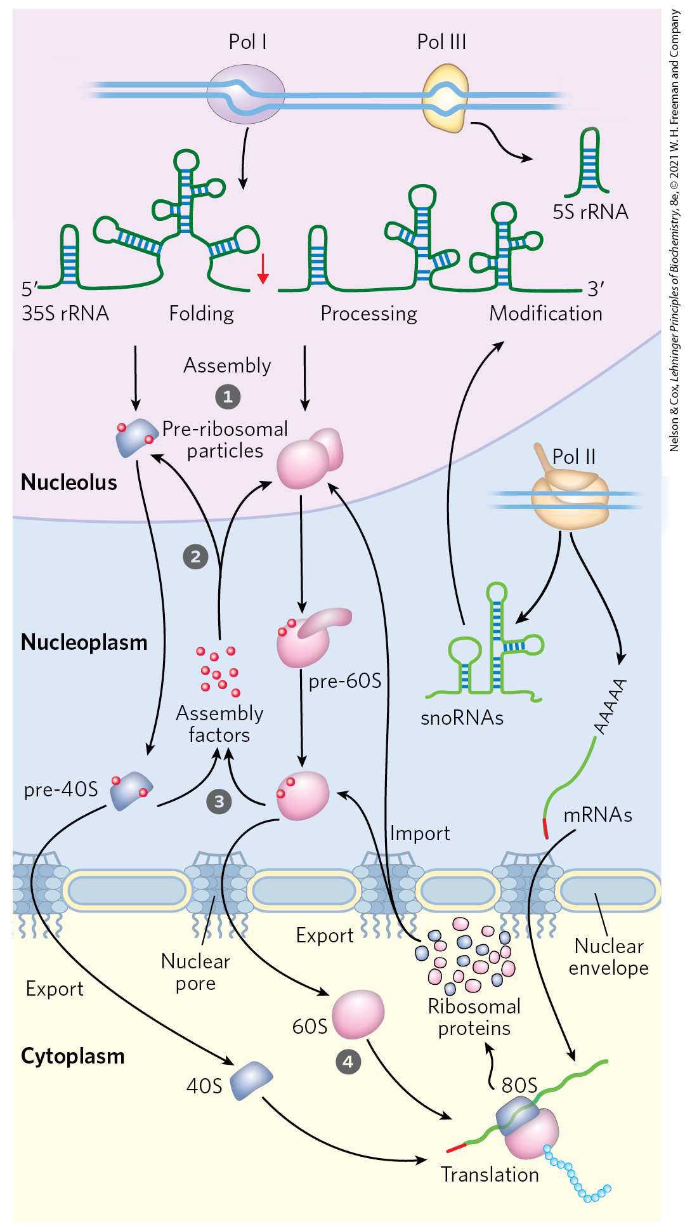
Assembly of Ribosomes in Eukaryotes
ribosomes are assembled through a hierarchical incorporation of r-proteins as the rRNAs are synthesized
processing of pre-rRNAs occurs within large ribonucleoprotein complexes
dozens of proteins and snoRNAs are involved in final maturation of the ribosome

Slide 100
Transfer RNAs Have Characteristic Structural Features
in both bacteria and eukaryotes, tRNAs are small and consist of 73-93 nucleotide ssRNA
  mitochondria and chloroplasts contain smaller tRNAs
common structural elements:
  8+ residues have modified bases and sugars (many are methylated derivatives)
  have a guanylate (pG) residue at the 5′ end
  have the trinucleotide sequence CCA(3′) at the 3′ end
  have a cloverleaf shape in 2-D and a twisted L shape in 3-D

Slide 101
Principle 3 (4 of 6)
The genetic code functions via linker molecules. The tRNAs are the crucial adaptor, matching amino acids with DNA codons.

Slide 102
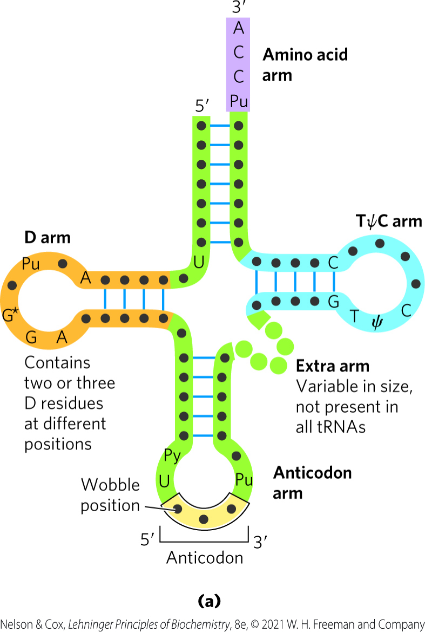
The Amino Acid Arm and Anticodon Arm of tRNA
amino acid arm = carries a specific amino acid esterified by its carboxyl group to the 2′-OH or 3′-OH group of the A residue at the 3′ end of the tRNA
anticodon arm = contains the anticodon

Slide 103
The D Arm and TψC Arm of tRNA
D arm = contains the unusual nucleotide dihydrouridine (D)
  contributes to overall folding of tRNAs
TψC arm = contains ribothymidine and pseudouridine (ψ)
  ψ has an unusual carbon-carbon bond between the base and ribose
  contributes to overall folding of tRNAs
  interacts with the large-subunit rRNA

Slide 104
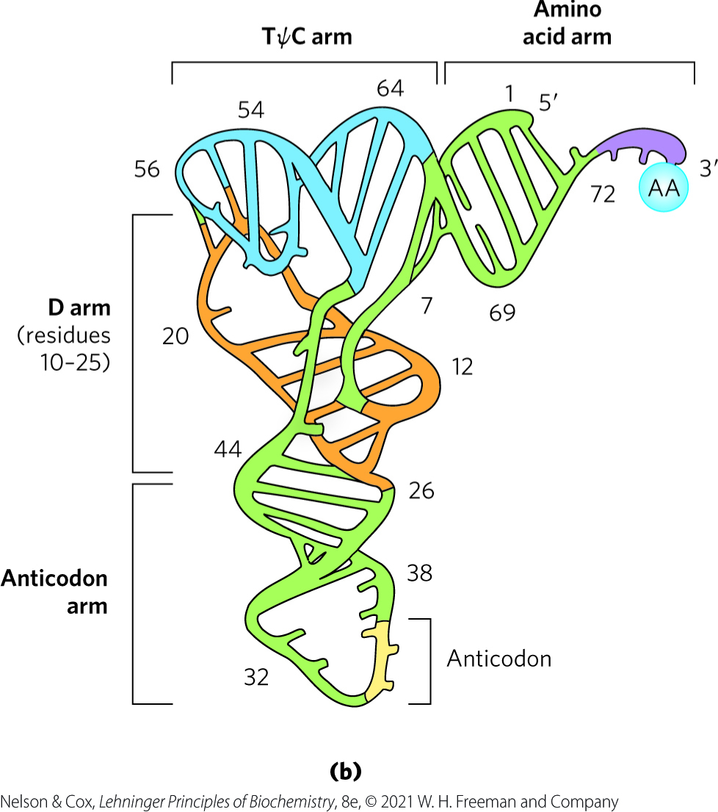
3-D Structure of tRNAs

Slide 105
Clicker Question 16
Mature tRNAs:
vary in size from 50 to 100 nucleotides.
have an anticodon arm, a D arm, an amino acid arm, and a ribosomal arm.
have little secondary structure.
All have very similar three-dimensional structures.
Notes:
Answer: D
Principle: 27.3
Learning Objective(s): Define common structural features of tRNA that exist across species lines.
Bloom’s: 1:1

Slide 106
Clicker Question 16, Response
Mature tRNAs:
All have very similar three-dimensional structures.
Transfer RNAs are relatively small (73 and 93 nucleotide residues) and consist of a single strand of RNA folded into a precise three-dimensional structure.

Slide 107
Principle 3 (5 of 6)
The genetic code functions via linker molecules. The tRNAs are the crucial adaptor, matching amino acids with DNA codons.

Slide 108
Stage 1: Aminoacyl-tRNA Synthetases Attach the Correct Amino Acids to Their tRNAs
stage 1:
  occurs in the cytosol
  activates the carboxyl group of each amino acid
  establishes a link between each new amino acid and the information encoding it in the mRNA
tRNAs are “charged” when attached to their amino acid (aminoacylated)

Slide 109
Aminoacyl-tRNA Synthetases
aminoacyl-tRNA synthetases = esterify the 20 amino acids to their corresponding tRNAs
  specific for one amino acid and 1+ corresponding tRNAs
  most organisms have one enzyme for each amino acid

Slide 110
Aminoacyl-tRNA Synthetases Fall into Two Different Classes
aminoacyl-tRNA synthetases fall into Class I or Class II
no evidence of a common ancestor
based on differences in:
  primary and tertiary structure
  reaction mechanism
Table 27-7 The Two Classes of Aminoacyl-tRNA Synthesis
Class I | Class I | Class II | Class II
Arg | Leu | Ala | Lys
Cys | Met | Asn | Phe
Gln | Trp | Asp | Pro
Glu | Tyr | Gly | Ser
Ile | Val | His | Thr

Slide 111
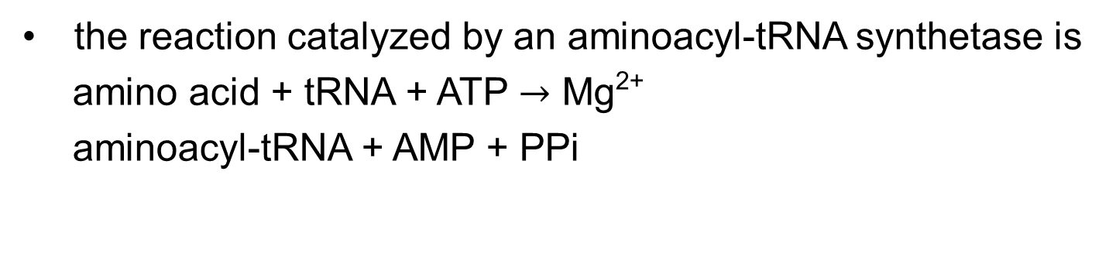
The Reaction Catalyzed by Aminoacyl-tRNA Synthetases
the reaction catalyzed by an aminoacyl-tRNA synthetase is
amino acid + tRNA + ATP $→$ Mg²⁺
aminoacyl-tRNA + AMP + PPi

Slide 112
Clicker Question 17
What high-energy reaction mechanisms permit the “activation” of an amino acid with tRNA?
adenylylation and hydrolysis
hydrolysis and phosphorylation
dehydrogenation and hydrolysis
oxygenase and dehydrogenation
reduction and phosphorylation
Notes:
Answer: A. Adenylylation forms a reactive adenylate intermediate and a pyrophosphate, which is later hydrolyzed. Two high-energy bonds are hydrolyzed to provide enough energy to combine an amino acid with its corresponding tRNA.
Principle: 27.1
Learning Objective(s): Define the function of aminoacyl-tRNA synthetases.
Bloom’s: 2:2

Slide 113
Clicker Question 17, Response
What high-energy reaction mechanisms permit the “activation” of an amino acid with tRNA?
adenylylation and hydrolysis
Adenylylation forms a reactive adenylate intermediate and a pyrophosphate, which is later hydrolyzed to phosphate by inorganic pyrophosphatase. Thus two high-energy bonds are hydrolyzed to provide enough energy to combine an amino acid with its corresponding tRNA.

Slide 114
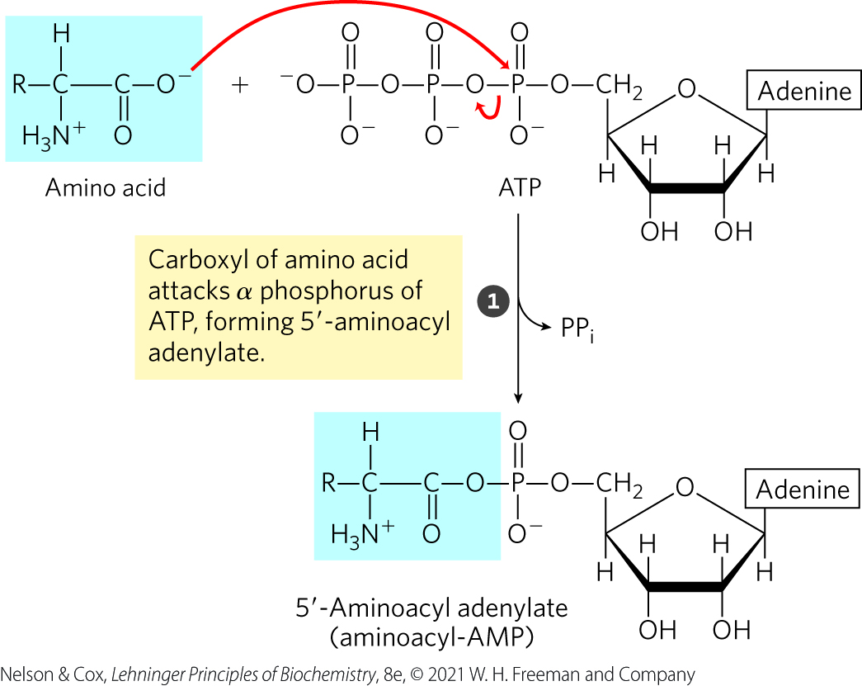
Step 1 of The Aminoacyl-tRNA Synthetase Reaction
step 1 forms the enzyme-bound intermediate, aminoacyl adenylate (aminoacyl-AMP)

Slide 115
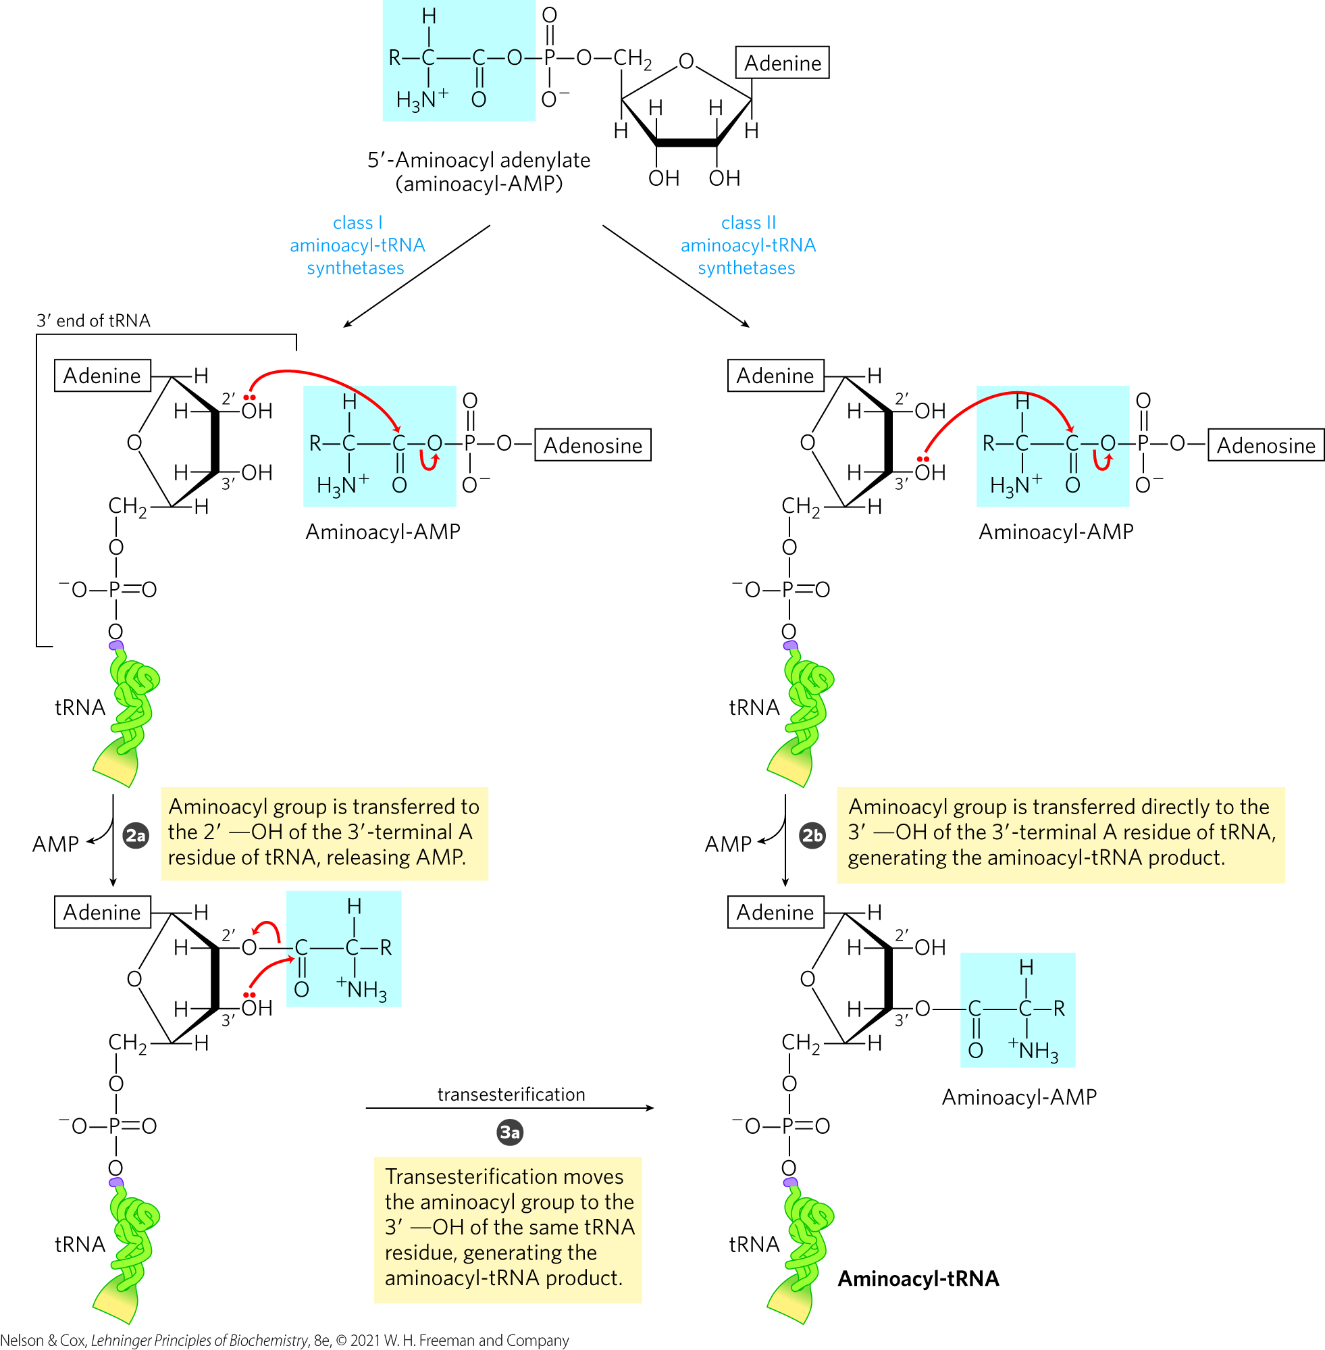
Step 2 of The Aminoacyl-tRNA Synthetase Reaction
step 2 transfers the aminoacyl group from enzyme-bound aminoacyl-AMP to its corresponding specific tRNA
  mechanism depends on the enzyme class

Slide 116
Clicker Question 18
Which statement regarding aminoacyl-tRNA synthetases is NOT true?
After attaching the amino acid to the tRNA, they proofread the result.
One class initially attaches the amino acid to the 3′—OH of the 3′-terminal A residue; the other class initially attaches the amino acid to the 2′—OH.
These enzymes hydrolyze ATP to ADP and P_{i}.
Correct attachment of an amino acid to its tRNA constitutes what is known as the second genetic code.
Notes:
Answer: C
Principle: 27.3
Learning Objective(s): Define the function of aminoacyl-tRNA synthetases
Bloom’s: 2:2

Slide 117
Clicker Question 18, Response
Which statement regarding aminoacyl-tRNA synthetases is NOT true?
These enzymes hydrolyze ATP to ADP and P_{i}.
Aminoacyl-tRNA synthetases hydrolyze ATP to AMP and 2P_{i}. Adenylylation forms a reactive adenylate intermediate (aminoacyl-AMP) and a pyrophosphate, which is later hydrolyzed to phosphate by inorganic pyrophosphatase.

Slide 118
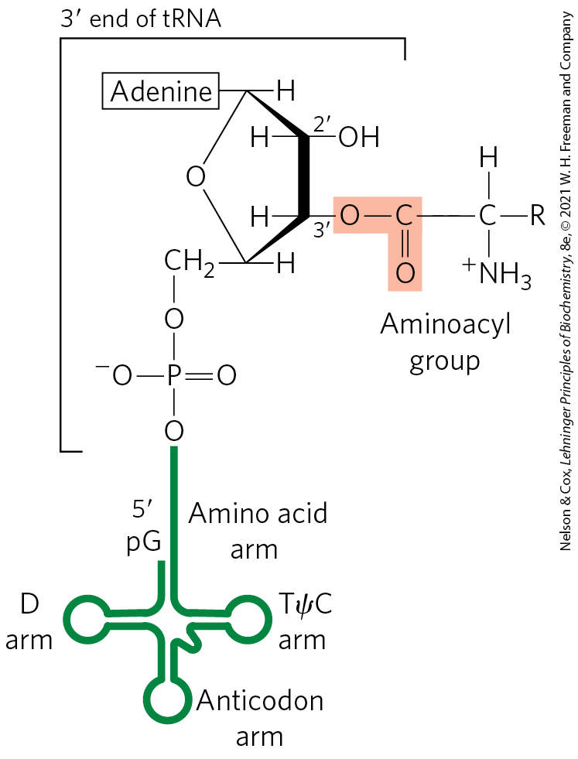
General Structure of
Aminoacyl-tRNAs
the aminoacyl group is esterified to the 3′ position of the terminal A residue
the ester linkage activates the amino acid and joins it to the tRNA

Slide 119
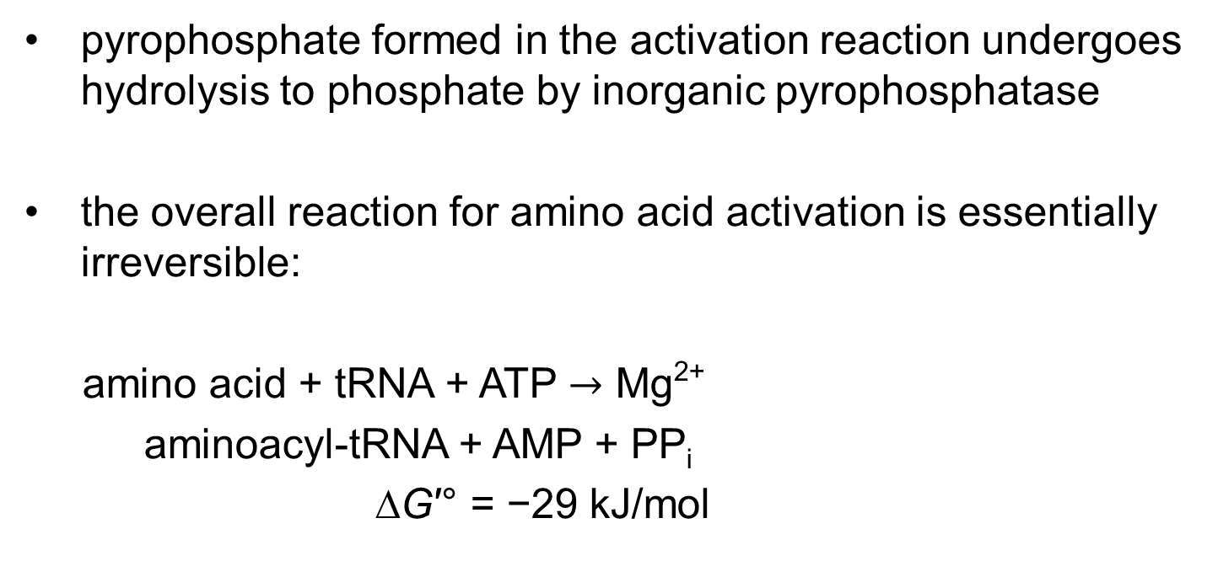
The Ester Linkage Has a Highly Negative ∆G′°
pyrophosphate formed in the activation reaction undergoes hydrolysis to phosphate by inorganic pyrophosphatase
the overall reaction for amino acid activation is essentially irreversible:
amino acid + tRNA + ATP $→$ Mg²⁺
aminoacyl-tRNA + AMP + PP_{i}
∆G′° = −29 kJ/mol

Slide 120
Principle 1 (6 of 8)
Information is expensive. This principle, noted in earlier chapters, is particularly well illustrated by protein synthesis. Protein synthesis consumes more cellular resources than any other process in most cells. The 15,000 ribosomes, 100,000 molecules of protein synthesis–related protein factors and enzymes, and 200,000 tRNA molecules in a typical bacterial cell can account for more than 35% of the cell’s dry weight. Overall, almost 300 different macromolecules cooperate to synthesize polypeptides. Protein synthesis can account for up to 90% of the chemical energy used by a cell for all biosynthetic reactions. Why? The enzymatic synthesis of an amide bond should require little energetic input. However, the sequence of amino acids in a protein is a form of biological information. Synthesis of each amide (peptide) bond between two particular amino acids is ensured by the investment of more than four nucleoside triphosphates (NTPs).

Slide 121
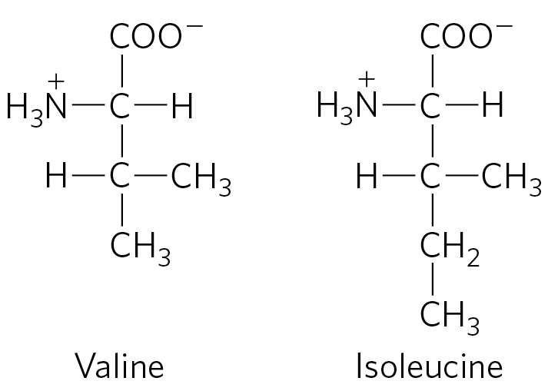
Proofreading by
Aminoacyl-tRNA Synthetases
Ile-tRNA synthetase has a proofreading function to distinguish between Val and Ile
Val-AMP fits into the hydrolytic (proofreading) site of Ile-tRNA synthetase
  Val-AMP is hydrolyzed
  tRNA does not become aminoacylated to the wrong amino acid

Slide 122
Additional Methods for Enhancing Fidelity of Protein Synthesis
most aminoacyl-tRNA synthetases can hydrolyze the ester linkage in the aminoacyl-tRNAs
some aminoacylation active sites can sufficiently discriminate between the proper substrate and incorrect amino acids

Slide 123
The Error Rate of Protein Synthesis
the overall error rate of protein synthesis is ∼1 mistake per 10⁴ amino acids incorporated
  higher than that of DNA replication
flaws in a protein have less biological significance
  eliminated when the protein is degraded
  not passed on to future generations

Slide 124
Clicker Question 19
Which statement about the fidelity of protein synthesis is false?
The overall error rate of protein synthesis is higher than that of DNA replication.
Errors in protein synthesis can be passed on to future generations.
Ile-tRNA synthetase can prevent tRNA bound to the enzyme from becoming aminoacylated to Val.
Hydrolysis of the ester linkage between amino acids and tRNAs in the aminoacyl-tRNAs is greatly accelerated for incorrectly charged tRNAs.
Notes:
Answer: B
Principle: 27.3
Learning Objective(s): Explain the proofreading ability of aminoacyl-tRNA synthetases.
Bloom’s: 2:2

Slide 125
Clicker Question 19, Response
Which statement about the fidelity of protein synthesis is false?
Errors in protein synthesis can be passed on to future generations.
Unlike with DNA, flaws in a protein are eliminated when the protein is degraded; thus, errors in protein synthesis cannot be passed on to future generations.

Slide 126
Principle 3 (6 of 6)
The genetic code functions via linker molecules. The tRNAs are the crucial adaptor, matching amino acids with DNA codons.

Slide 127
A “Second Genetic Code”
individual aminoacyl-tRNA synthetases must be specific for a single amino acid and for certain tRNAs
“second genetic code” refers to the interaction between aminoacyl-tRNA synthetases and tRNAs
nucleotides in tRNA that confer binding specificity are concentrated in:
  the amino acid arm
  the anticodon arm
  the nucleotides of the anticodon itself

Slide 128
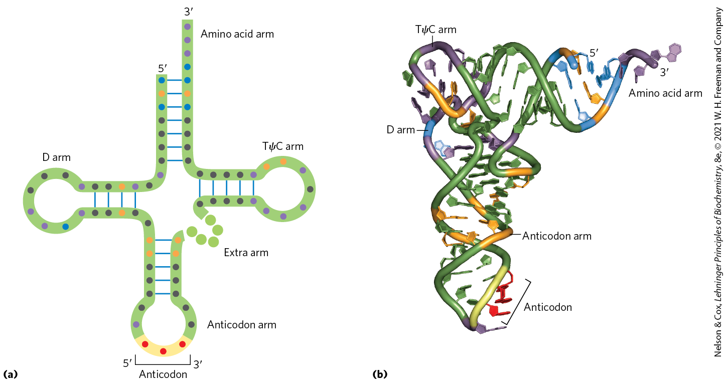
Nucleotide Positions in a tRNA That are Recognized by Aminoacyl-tRNA Synthetases

Slide 129
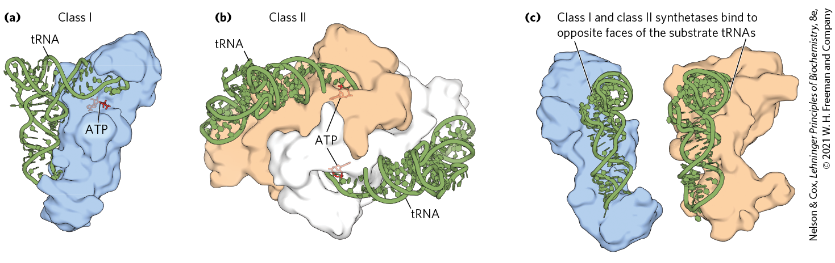
Crystal Structures of Aminoacyl-tRNA Synthetases

Slide 130
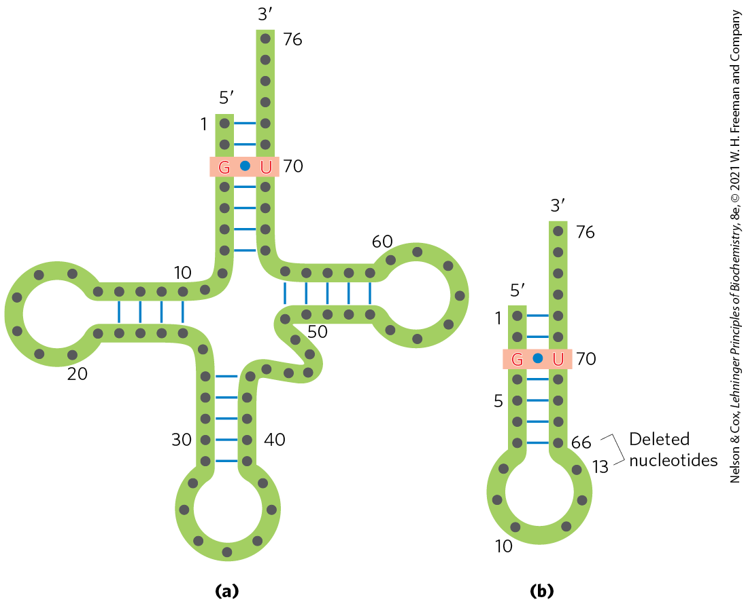
tRNA Recognition by
Ala-tRNA Synthetases
a single G=U base pair in the amino acid arm of tRNA^{Ala} determines tRNA recognition by Ala-tRNA synthetases
  true across a range of organisms, from bacteria to humans

Slide 131

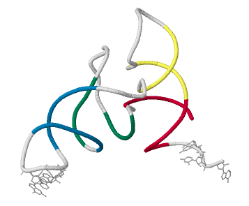
Activity: Identifying tRNAs
Observe the structure of a tRNA in Mol3D viewer in your Achieve course.
Notes:
Instructor: This Mol3D structure is located in the Achieve course. It can be found in the Chapter 27 content, in the folder titled “Ch27 In-Class Activities and Resources.”

Slide 132
Activity Instructions (3 of 4)
On your own, think of answers to the questions:
  To which codon would the anticodon present on this tRNA bind?
  Which amino acid corresponds to this codon?
  Where on the tRNA would the corresponding aminoacyl-tRNA synthetase attach the amino acid? Select the region and upload a screenshot to your course. (2 minutes)
Pair up to discuss your ideas. (2 minutes)
Share your ideas with the class in group discussion.
(3 minutes)
Notes:
Instructor: This Mol3D structure is located in the Achieve course. It can be found in the Chapter 27 content, in the folder titled “Ch27 In-Class Activities and Resources.”

Slide 133
Activity Solution (3 of 5)
  To which codon would the anticodon present on this tRNA bind? Because the anticodon in this case is AAA, it would bind to the codon UUU in an mRNA undergoing transcription.
  Which amino acid corresponds to this codon? UUU corresponds to phenylalanine.
Notes:
Instructor: This Mol3D structure is located in the Achieve course. It can be found in the Chapter 27 content, in the folder titled “Ch27 In-Class Activities and Resources.”

Slide 134
Activity Solution (4 of 5)
  Where on the tRNA would the corresponding aminoacyl-tRNA synthetase attach the amino acid? Select the region and upload a screenshot to your course. The phenylalanyl-tRNA synthetase would attach Phe to the CCA sequence at the 3′ end of tRNA^{Phe}. All tRNAs possess the amino acid docking sequence CCA.
Notes:
Instructor: This Mol3D structure is located in the Achieve course. It can be found in the Chapter 27 content, in the folder titled “Ch27 In-Class Activities and Resources.”

Slide 135
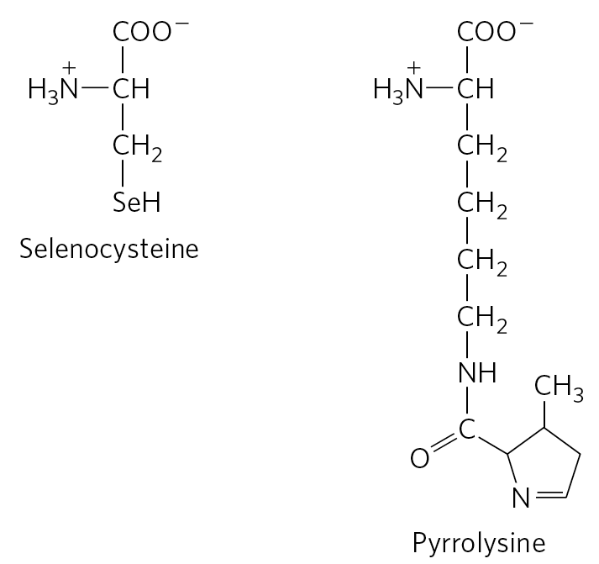
Unusual Amino Acids in Peptides
selenocysteine = formed after charging a UGA-recognizing tRNA with serine in both bacteria and eukaryotes
pyrrolysine = directly attached to its tRNA that recognizes UAG(stop) codon in some archaea

Slide 136
Stage 2: A Specific Amino Acid Initiates Protein Synthesis
the AUG initiation codon specifies an amino-terminal methionine residue.
all organisms have two tRNAs for methionine:
  one for when (5′)AUG is the initiation codon
  one when a Met residue in an internal position in a polypeptide

Slide 137
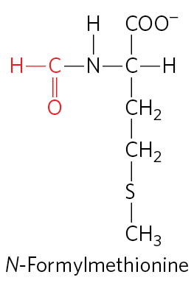
The Two tRNAs Specific for Methionine in Bacteria
fMet-tRNA^{fMet} inserts N-formyl-methionine (fMet) at the amino-terminal end
  added in response to the (5′)AUG initiation codon
Met-tRNA^{Met} inserts methionine in interior positions
  added in response to the interior (5′)AUG codons

Slide 138
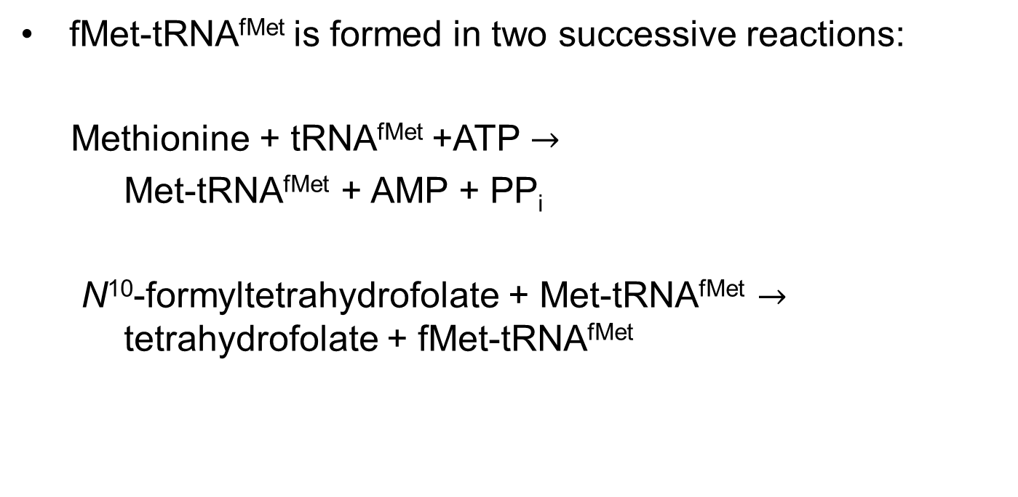
The Formation of fMet-tRNA^{fMet}
fMet-tRNA^{fMet} is formed in two successive reactions:
Methionine + tRNA^{fMet} +ATP $→$
Met-tRNA^{fMet} + AMP + PP_{i}
N¹⁰-formyltetrahydrofolate + Met-tRNA^{fMet} $→$ tetrahydrofolate + fMet-tRNA^{fMet}

Slide 139
tRNAs Specific for Methionine in Eukaryotic Cells
in eukaryotic cells:
  a specialized initiating tRNA inserts methionine at the amino-terminal end
  Met-tRNA^{Met} inserts methionine in interior positions
polypeptides synthesized by mitochondrial and chloroplast ribosomes begin with N-formylmethionine

Slide 140
Clicker Question 20
Why do a great many eukaryotic proteins start with a Met residue on the amino terminus?
At the start of synthesis, only the Met tRNA can bind to the regulatory site on the small ribosomal subunit.
Most proteins are soluble and the signal sequence always starts with a Met.
The sulfur of Met forms a thioester linkage to the small ribosomal subunit during synthesis.
The initiation codon also codes for Met.
There is currently no accepted hypothesis for this observation.
Notes:
Answer: D
Principle: 27.3
Learning Objective(s): Define an initiation codon.
Bloom’s: 2:2

Slide 141
Clicker Question 20, Response
Why do a great many eukaryotic proteins start with a Met residue on the amino terminus?
The initiation codon also codes for Met.
The initiation codon AUG is the most common signal for the beginning of a polypeptide in all cells, in addition to coding for Met residues in internal positions of polypeptides.

Slide 142
The Three Steps of Initiation
initiation in bacteria requires:
  the 30S ribosomal subunit
  mRNA
  the initiating fMet-tRNA^{fMet}
  three initiation factors (IF1, IF2, and IF3)
  GTP
  the 50S ribosomal subunit
  Mg²⁺

Slide 143
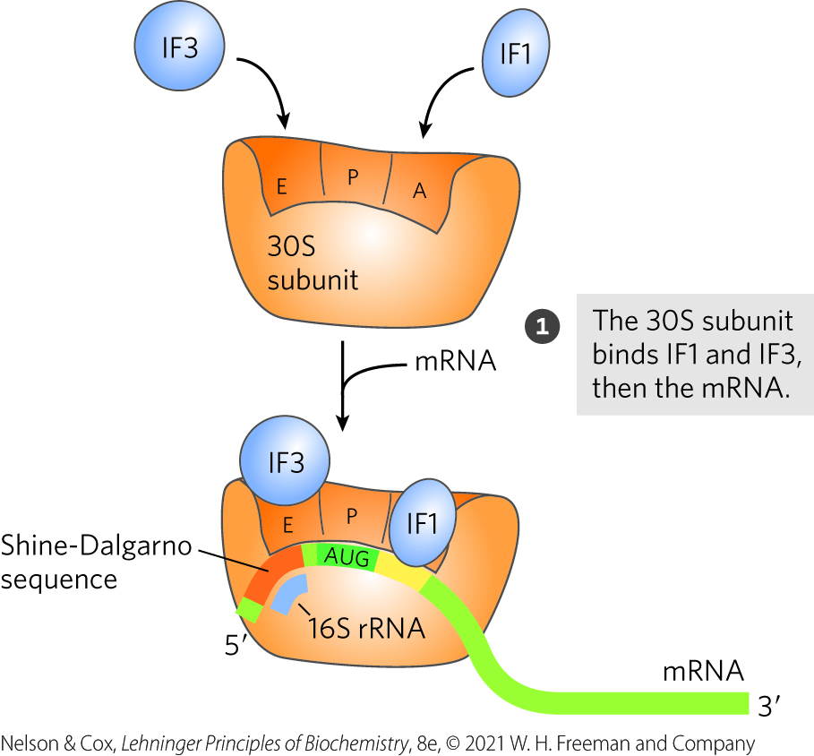
Formation of the Initiation Complex in Bacteria, Step 1
IF3 prevents the 30S and 50S subunits from combining prematurely
Shine-Dalgarno sequence = region of mRNA that guides the initiating (5′)AUG to its correct position
  the mRNA is complementary to a sequence in the rRNA

Slide 144
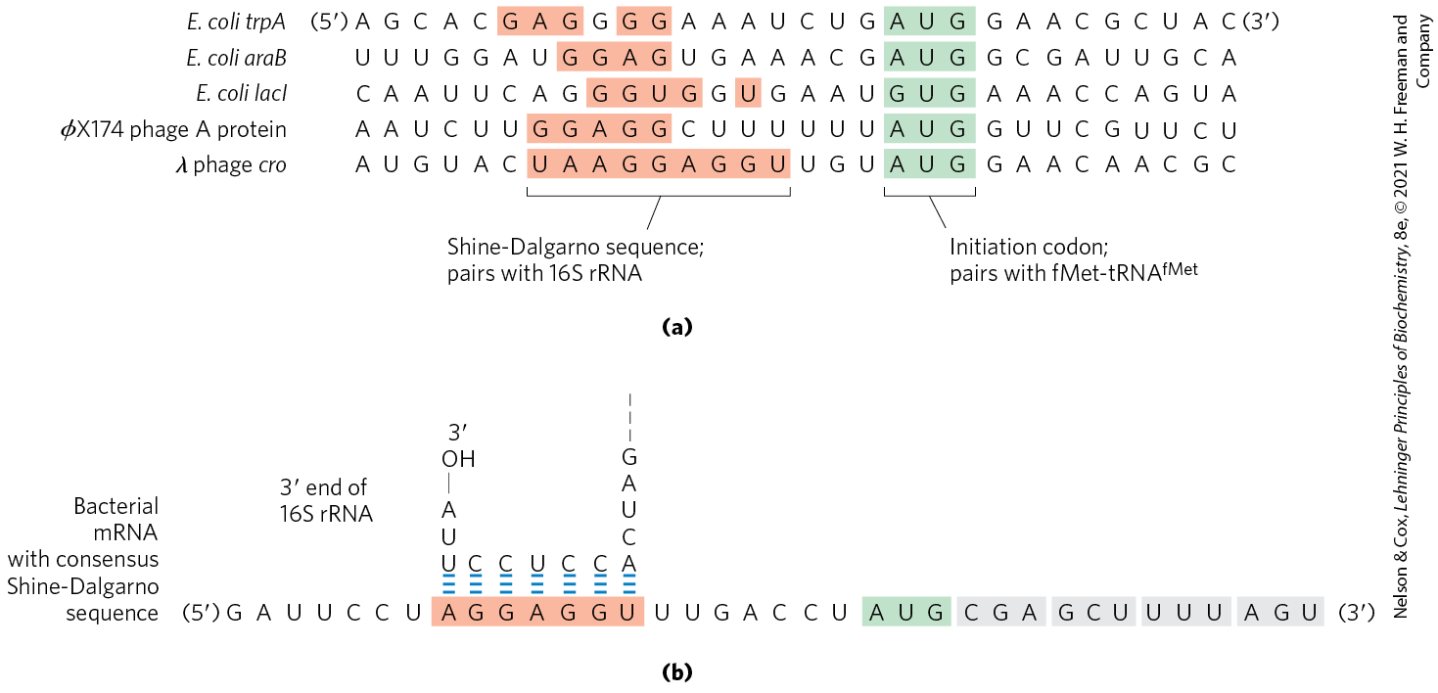
mRNA Sequences that Serve as Signals for Initiation of Protein Synthesis in Bacteria

Slide 145
Bacterial Ribosomes Have Three Sites that Bind tRNAs
the aminoacyl (A) site = site where incoming aminoacyl-tRNAs (other than fMet-tRNA^{fMet}) bind
  IF1 binds and prevents tRNA binding at the A site during initiation
the peptidyl (P) site = site where amino acids are added to the growing chain
  only site where fMet-tRNA^{fMet} can bind
the exit (E) site = binds uncharged tRNAs

Slide 146
Clicker Question 21
Which of these sites is largely confined to the 50S subunit of bacterial ribosomes?
the site where incoming aminoacyl-tRNAs bind
the site where amino acids are added to the growing chain
the site that binds only uncharged tRNAs that have completed their task on the ribosome
the site where fMet-tRNA^{fMet} can bind
Notes:
Answer: C
Principle: 27.3
Learning Objective(s): Define activity associated with the A, P and E sites of the ribosomes.
Bloom’s: 2:2

Slide 147
Clicker Question 21, Response
Which of these sites is largely confined to the 50S subunit of bacterial ribosomes?
the site that binds only uncharged tRNAs that have completed their task on the ribosome
Both the 30S and the 50S subunits contribute to the characteristics of the aminoacyl (A) and peptidyl (P) sites, whereas the exit (E) site is largely confined to the 50S subunit.

Slide 148
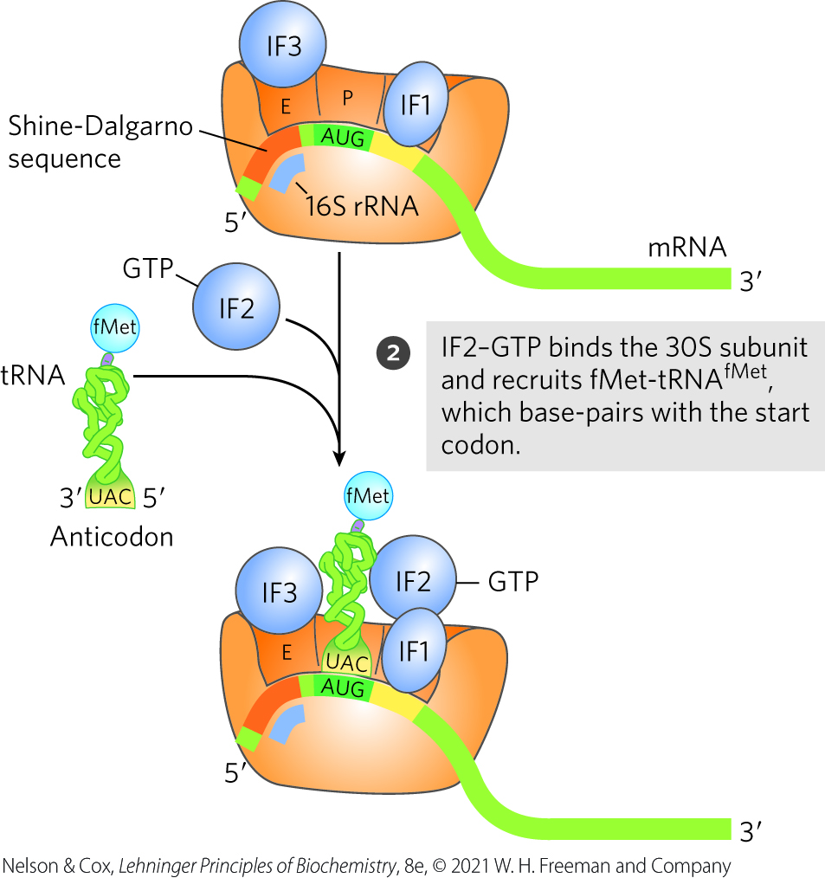
Formation of the Initiation Complex in Bacteria, Step 2
the anticodon of fMet-tRNA^{fMet} is correctly paired with the mRNA’s initiation codon at the P site

Slide 149
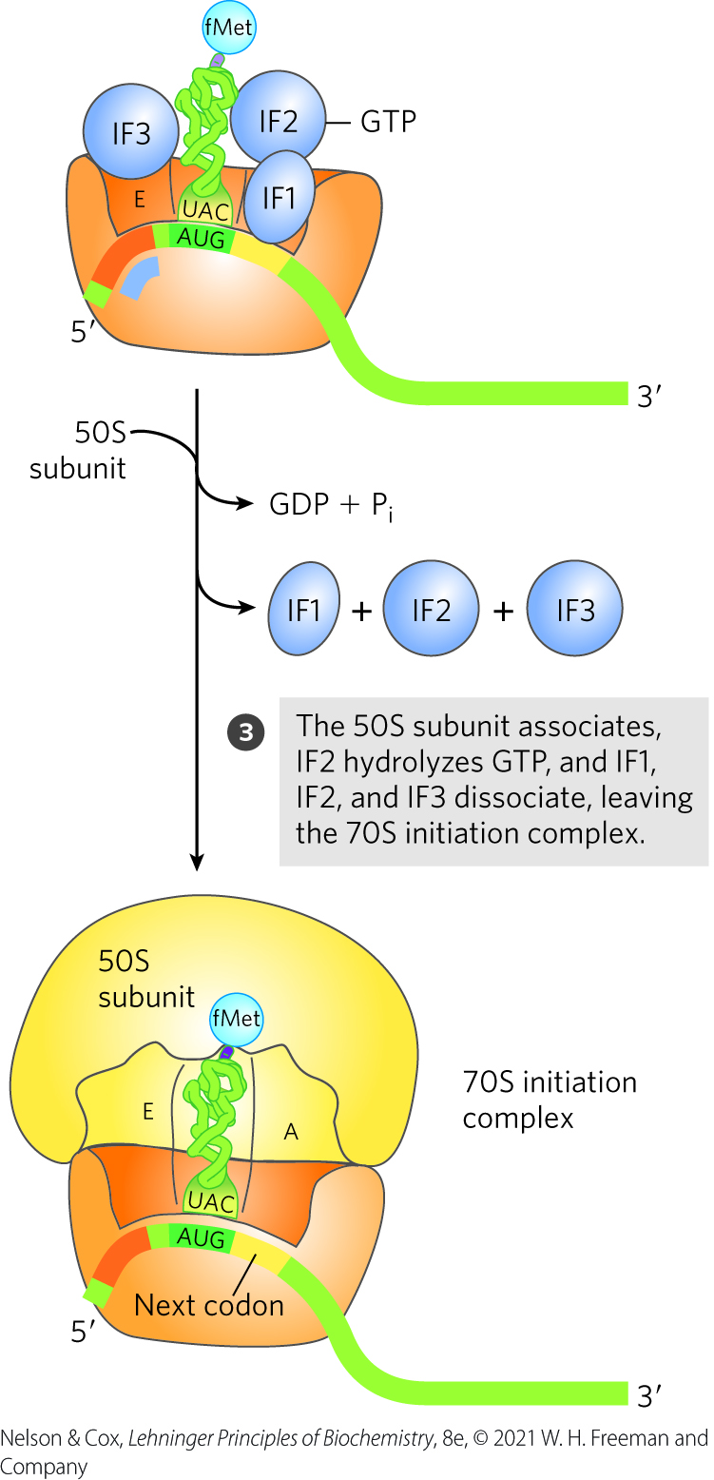
Formation of the Initiation Complex in Bacteria, Step 3
the initiation complex = a functional 70S ribosome containing mRNA and the initiating fMet-tRNA^{fMet}

Slide 150
Clicker Question 22
The first aminoacyl-tRNA that binds to the ribosome:
is a special fMet-tRNA^{fMet} in bacteria.
is a special fMet-tRNA^{fMet} in eukaryotes.
is a normal Met-tRNA^{Met} in bacteria and eukaryotes.
will vary, depending upon the identity of the N-terminal amino acid residue of the protein.
Notes:
Answer: A
Principle: 27.3
Learning Objective(s): Explain the differences in use of the methionine and f-methionine.
Bloom’s: 2:2

Slide 151
Clicker Question 22, Response
The first aminoacyl-tRNA that binds to the ribosome:
is a special fMet-tRNA^{fMet} in bacteria.
In bacteria, the amino acid incorporated in response to the (5′)AUG initiation codon is N-formylmethionine (fMet). It arrives at the ribosome as N-formylmethionyl-tRNA^{fMet} (fMet-tRNA^{fMet}).

Slide 152
Initiation in Eukaryotic Cells
eukaryotic mRNAs are bound to the ribosome as a complex with specific binding proteins
eukaryotic cells have at least 12 initiation factors
  eIF1A is a functional homolog of IF1
  eIF3 is a functional homolog of IF3

Slide 153
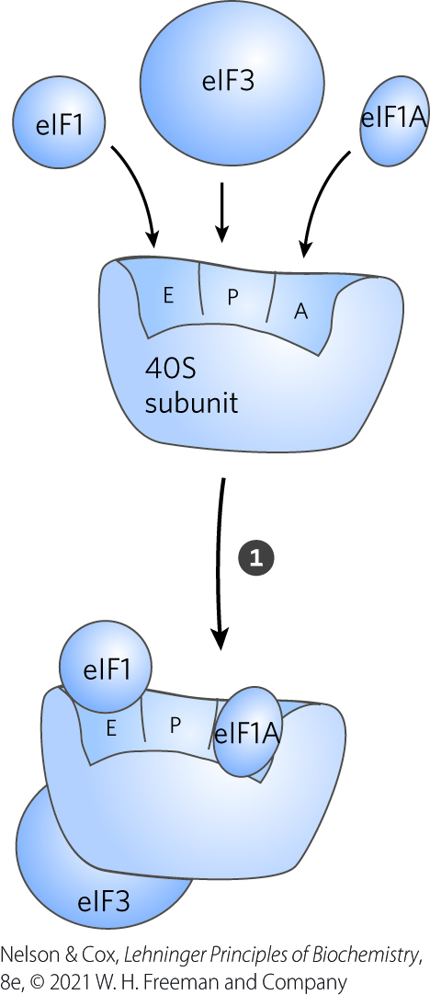
Initiation of Protein Synthesis in Eukaryotic Cells, Step 1
eIF1A blocks tRNA binding to the A site
eIF3 prevents premature joining of the ribosomal subunits
eIF1 binds to the E site

Slide 154
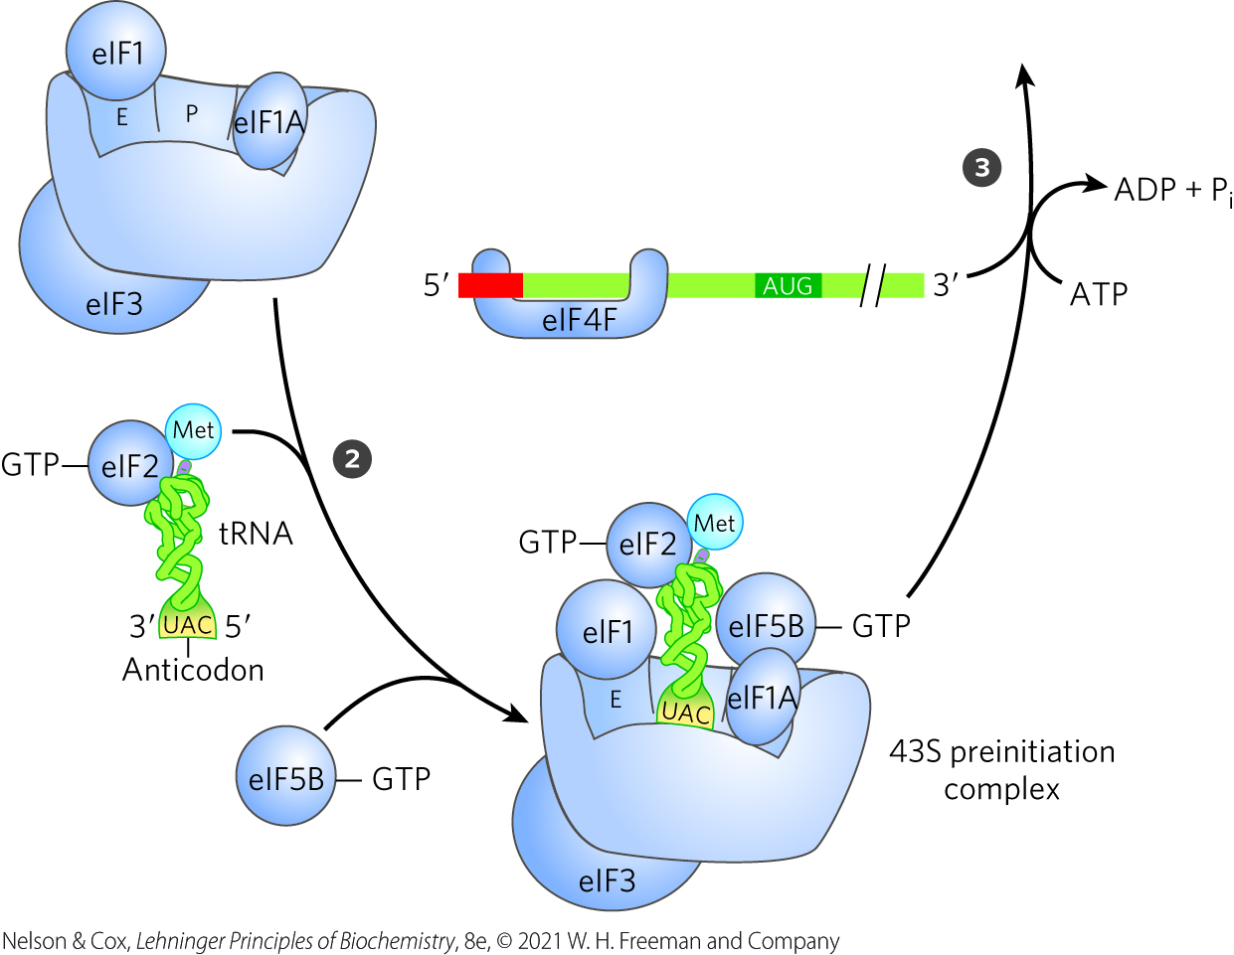
Initiation of Protein Synthesis in Eukaryotic Cells, Step 2
a complex containing charged tRNA^{Met}, eIF2, and GTP binds to the 40S subunit, along with eIF5 and eIF5B
  creates a 43S preinitiation complex

Slide 155
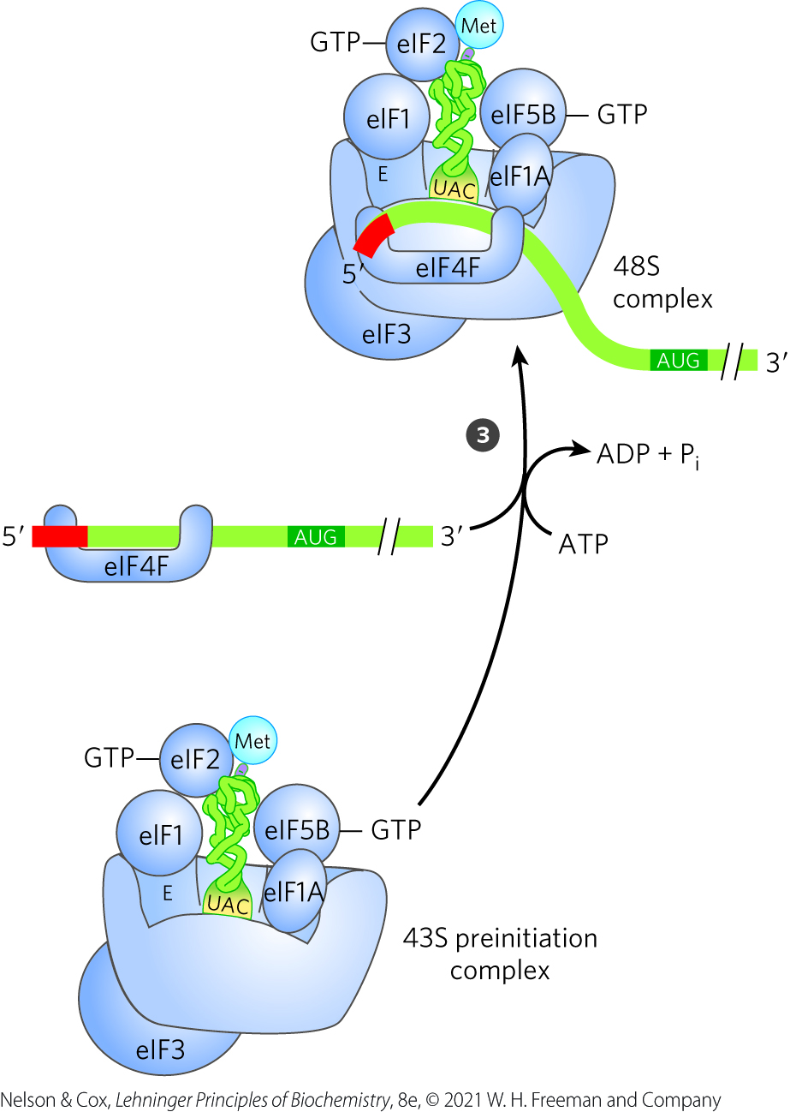
Initiation of Protein Synthesis in Eukaryotic Cells, Step 3
the eIF4F complex contains:
  eIF4E (binds 5′ cap)
  eIF4A (an ATPase and RNA helicase)
  eIF4G (a linker protein)
mRNA binds to eIF4F
  mediates its association with the 43S preinitiation complex

Slide 156
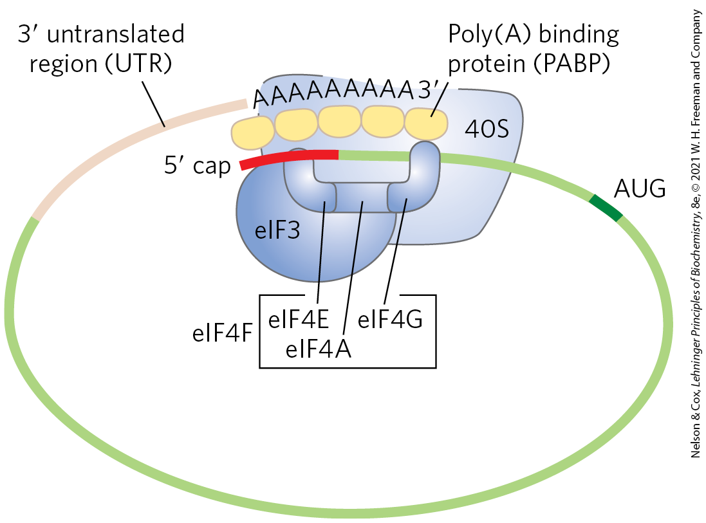
Circularization of mRNA in the Eukaryotic Initiation Complex
eIF4G binds to the poly(A) binding pro- tein (PABP) at the 3′ end of the mRNA, circularizing the mRNA
  facilitating the translational regulation of gene expression

Slide 157
Clicker Question 23
What is the function of the mRNA 5′ cap in protein synthesis?
It binds to the terminal adenosine residue of the poly(A) tail, temporarily forming a circular nucleic acid.
It prevents misfolding of the mRNA in preparation for protein synthesis.
It stabilizes the mRNA by binding an initiation factor.
It is removed before protein synthesis.
It serves no function in protein synthesis.
Notes:
Answer: C
Principle: 27.1
Learning Objective(s): Identify the components necessary for the initiation of protein synthesis.
Bloom’s: 2:2

Slide 158
Clicker Question 23, Response
What is the function of the mRNA 5′ cap in protein synthesis?
It stabilizes the mRNA by binding an initiation factor.
In eukaryotes, the eIF4E subunit of the eIF4F complex binds to the 5′ cap.

Slide 159
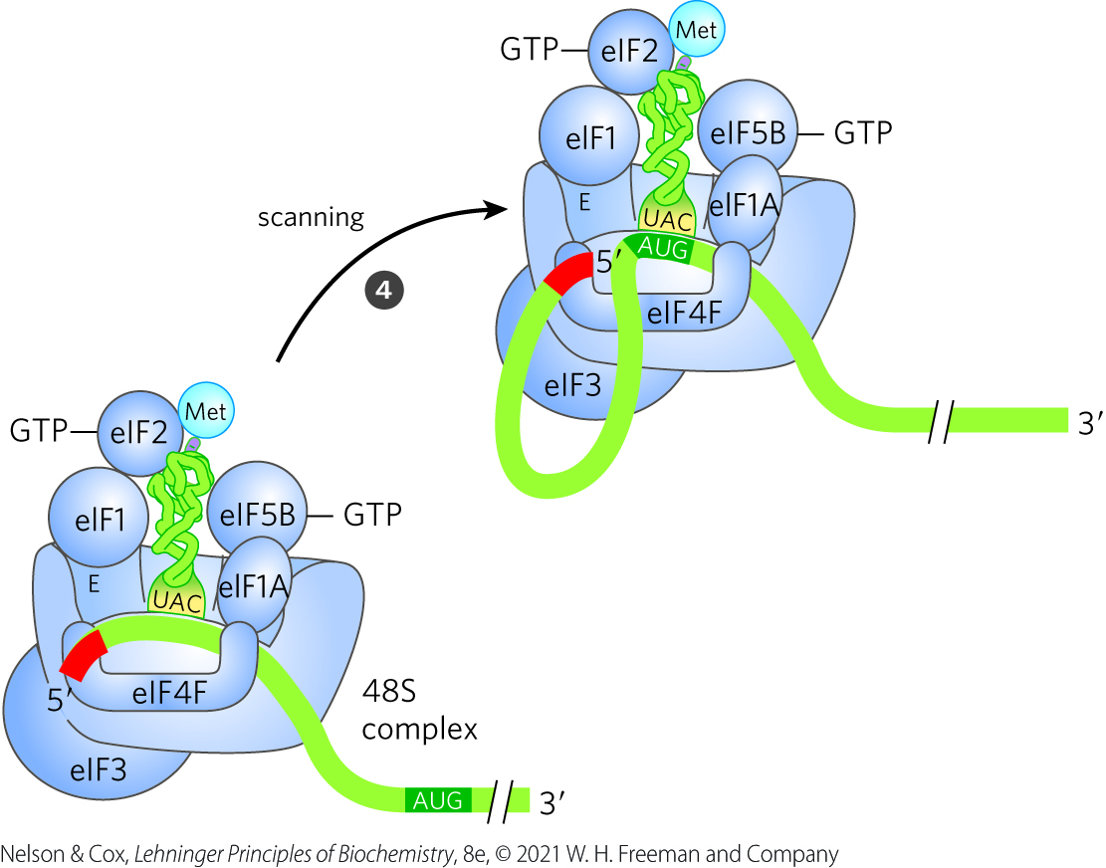
Initiation of Protein Synthesis in Eukaryotic Cells, Step 4
addition of the mRNA and associated factors creates a 48S complex
the 48S complex scans the mRNA until AUG is encountered
  may be facilitated by the RNA helicase of eIF4A

Slide 160
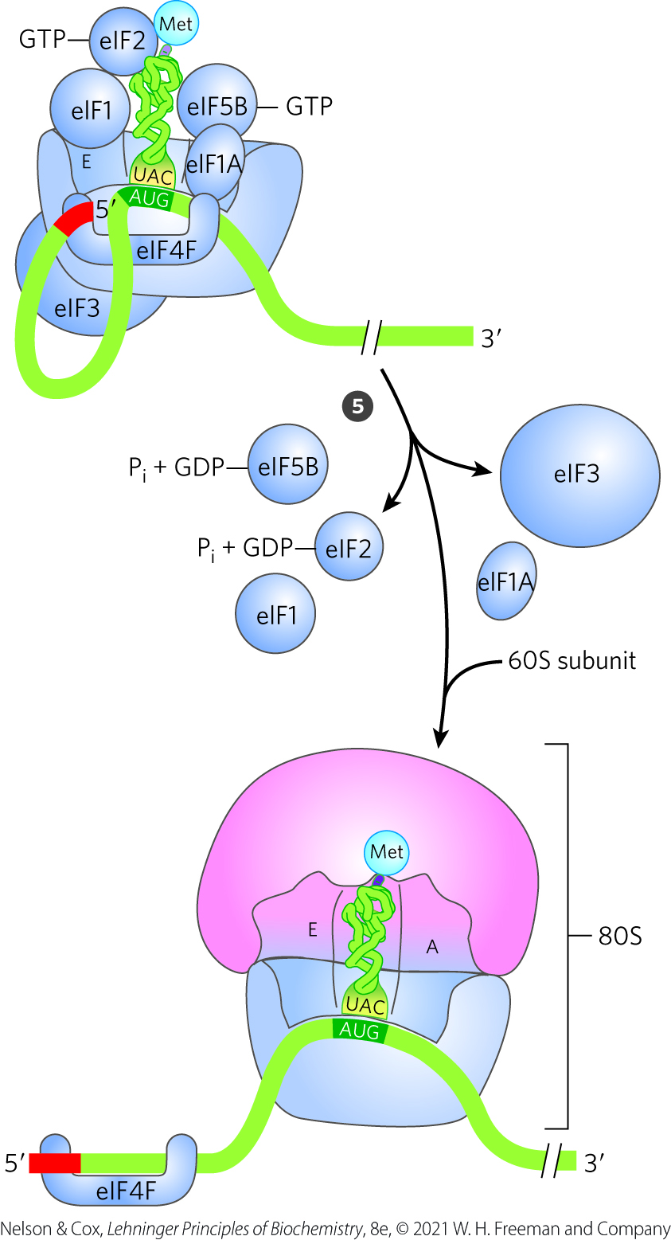
Initiation of Protein Synthesis in Eukaryotic Cells, Step 5
the 60S subunit associates with the complex
eIF5 promotes eIF2 GTPase activity
  eIF2-GDP complex has reduced affinity for the initiator tRNA
eIF5B hydrolyzes GTP and triggers dissociation of eIF2-GDP and other factors
  homologous to IF2

Slide 161
Protein Factors Required for Initiation of Translation
Table 27-8 Protein Factors Required for Initiation of Translation in Bacterial and Eukaryotic Cells
Factor | Function
Bacterial
IF1 | Prevents premature binding of tRNAs to A site
IF2 | Facilitates binding of fMet-tRNA^{fMet} to 30S ribosomal subunit
IF3 | Binds to 30S subunit; prevents premature association of 50S subunit; enhances specificity of P site for fMet-rRNA^{fMet}
Eukaryotic
eIF1 | Binds to the E site of the 40S subunit; facilitates interaction between elF2-tRNA-GTP ternary complex and the 40S subunit
elF1A | Homolog of bacterial IF1; prevents premature binding of tRNAs to A site
eIF2 | GTPase; facilitates binding of initiating Met-tRNA^{Met} to 40S ribosomal subunit
eIF2Bª, eIF3 | First factors to bind 40S subunit; facilitate subsequent steps
eIF4F | Complex consisting of eIF4E, eIF4A, and eIF4G
eIF4A | RNA helicase activity; removes secondary structure in the mRNA to permit binding to 40S subunit; part of the eIF4F complex
eIF4B | Binds to mRNA; facilitates scanning of mRNA to locate the first AUG
eIF4E | Binds to the 5′ cap of mRNA; part of the eIF4F complex
eIF4G | Binds to eIF4E and to poly(A) binding protein (PABP); part of the eIF4F complex
eIF5ª | Promotes dissociation of several other initiation factors from 40S subunit as a prelude to association of 60S subunit to form 80S initiation complex
eIF5b | GTPase homologous to bacterial IF2; promotes dissociation of initiation factors before final ribosome assembly

Slide 162
Clicker Question 24
A significant difference between bacteria and eukaryotes in initiation of translation is that:
GTP hydrolysis is required for bacterial initiation but not eukaryotic initiation.
many more initiation factors are required for bacteria than for eukaryotes.
in bacteria, the large subunit of the ribosome binds after the mRNA; in eukaryotes, the large subunit binds before the mRNA.
in bacteria, base-pairing between the mRNA and a rRNA determines which start codon to use; in eukaryotes, the small subunit begins scanning the mRNA at the 5′ cap until it reaches the first start codon.
Notes:
Answer: D
Principle: 27.1
Learning Objective(s): Define the differences between eukaryotic and bacterial protein synthesis initiation.
Bloom’s: 1:1

Slide 163
Clicker Question 24, Response
A significant difference between bacteria and eukaryotes in initiation of translation is that:
in bacteria, base-pairing between the mRNA and a rRNA determines which start codon to use; in eukaryotes, the small subunit begins scanning the mRNA at the 5′ cap until it reaches the first start codon.
In bacteria, the Shine-Dalgarno sequence in the mRNA base-pairs with a complementary sequence near the 3′ end of the 16S rRNA of the 30S ribosomal subunit. In eukaryotes, a 48S complex scans the bound mRNA, starting at the 5′ cap, until an AUG codon is encountered.

Slide 164
Stage 3: Peptide Bonds Are Formed in the Elongation Stage
elongation requires:
  the initiation complex
  aminoacyl-tRNAs
  elongation factors (EF-Tu, EF-Ts, and EF-G in bacteria)
  GTP

Slide 165
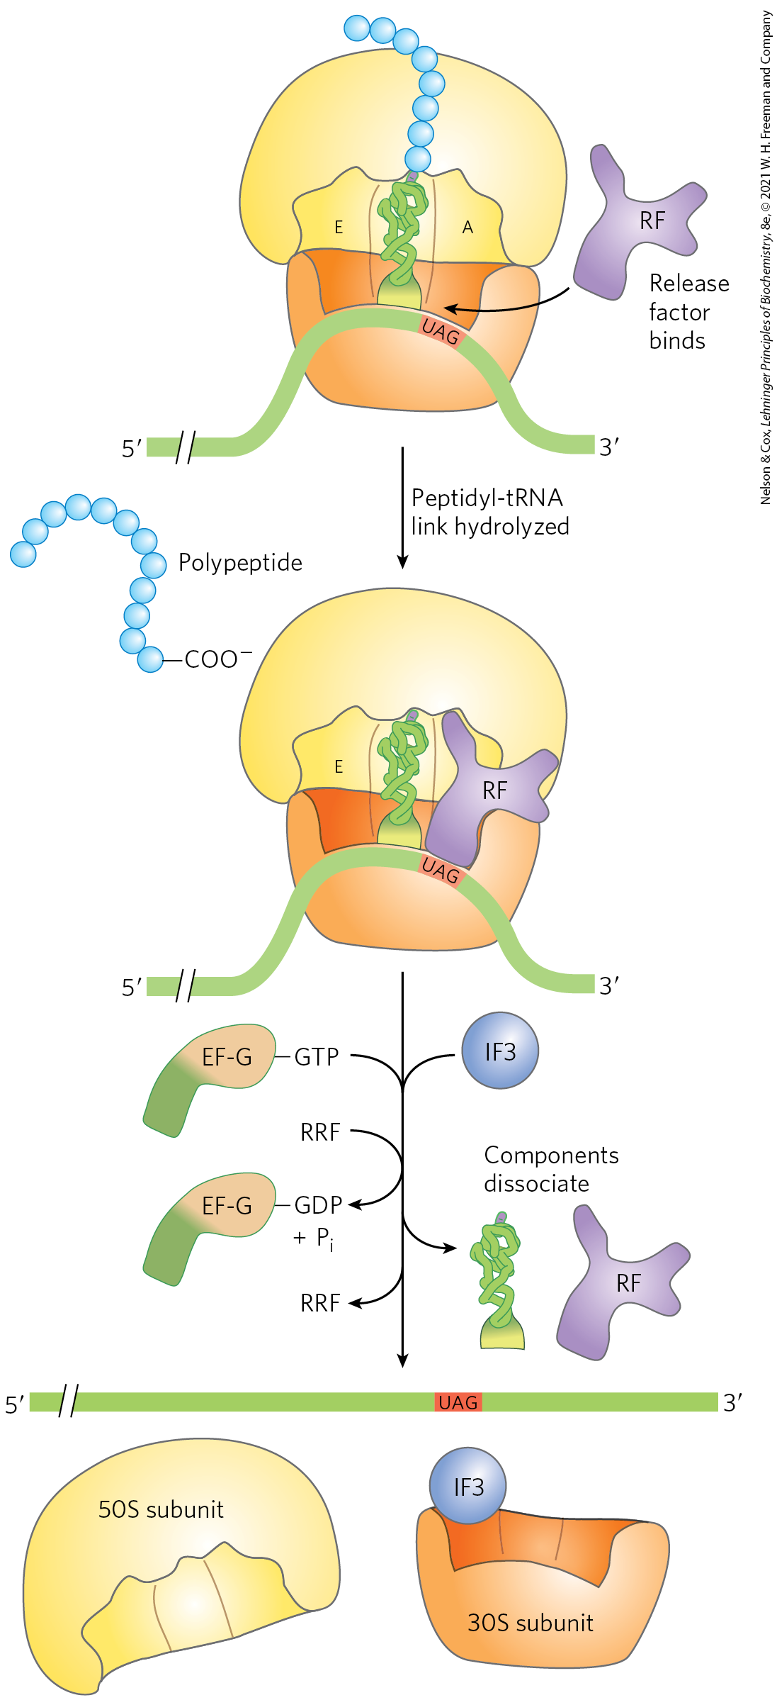
Elongation Step 1: Binding of an Incoming Aminoacyl-tRNA
an incoming aminoacyl-tRNA binds an GTP-bound EF-Tu complex
the aminoacyl-tRNA–EF-Tu–GTP complex binds to the A site of the 70S initiation complex
after GTP hydrolysis, EF-Tu–GDP complex leaves the ribosome

Slide 166
Elongation Step 2: Peptide Bond Formation
the N-formylmethionyl group is transferred to the amino group of the aminoacyl-tRNA in the A site to form a dipeptidyl-tRNA
  α-amino group of the amino acid in the A site acts as the nucleophile
tRNA shift to a hybrid binding state
  the 3′ and 5′ ends of tRNA^{fMet} are in the E site
  the 3′ and 5′ ends of the peptidyl-tRNA are in the P site

Slide 167
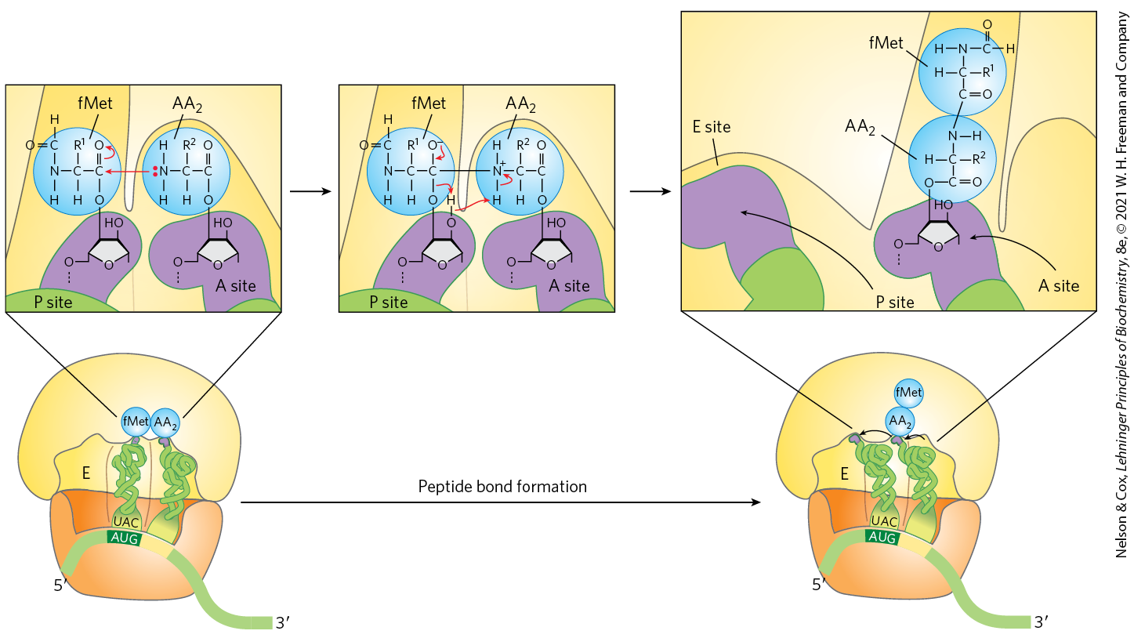
Formation of the First Peptide Bond in Bacteria

Slide 168

Ribosome Pausing, Arrest, and Rescue
ribosomes may stall if mRNA is damaged or incomplete
tmRNA rescues stalled bacterial ribosomes in a multistep pathway
  permits release and degradation of the damaged mRNA
  tags the truncated polypeptide for degradation

Slide 169
Clicker Question 25
What happens if the mRNA terminates before a stop codon appears?
Nothing; the polypeptide will just end.
The ribosome complex will be stuck until the trans-translation rescue mechanism engages.
A random tRNA with wobble properties will bind to terminate the polypeptide.
A tRNA specific for the stop codon will bind and terminate the polypeptide.
The ribosome will be stuck forever.
Notes:
Answer: B
Principle: 27.3
Learning Objective(s): Explain the steps that termination factors take part in.
Bloom’s: 2:2

Slide 170
Clicker Question 25, Response
What happens if the mRNA terminates before a stop codon appears?
The ribosome complex will be stuck until the trans-translation rescue mechanism engages.
When the ribosome encounters the end of an mRNA before encountering a stop codon, the translocation step leads to formation of a stable non-stop complex in which the A site has no mRNA that can interact with a new charged tRNA. The non-stop complex cannot be recycled by the normal termination factors. Instead, the ribosome is rescued by trans-translation.

Slide 171
Principle 4 (3 of 3)
Proteins are synthesized by RNAs. The study of protein synthesis offers another important reward: a look at a world of RNA catalysts that may have existed in an RNA world before the dawn of life “as we know it.” Proteins are synthesized by a gigantic RNA enzyme.

Slide 172
Peptidyl Transferase Activity
the 23S rRNA has peptidyl transferase activity that catalyzes peptide bond formation
  catalyzes the reaction by binding and aligning the tRNAs in the A and P sites in the proper orientations
a highly conserved active site A residue in 23S rRNA may facilitate the reaction by general base catalysis and transition state stabilization

Slide 173
Clicker Question 26
What catalyzes formation of the peptide bond?
ribozyme
peptidyltransferase
23S rRNA
All of the answers are correct.
None of the answers is correct.
Notes:
Answer: D. Trick question. The 23S rRNA is a ribozyme that catalyzes formation of the peptide bond. Peptidyl transferase is the name given to the enzyme activity.
Principle: 27.5
Learning Objective(s): Identify the enzyme needed to form a peptide bond.
Bloom’s: 1:1

Slide 174
Clicker Question 26, Response
What catalyzes formation of the peptide bond?
All of the answers are correct.
The 23S rRNA is a ribozyme that catalyzes formation of the peptide bond. Peptidyl transferase is the name given to the enzyme activity.

Slide 175
Elongation Step 3: Translocation
in translocation, the ribosome moves one codon toward the 3′ end of the mRNA
  shifts the anticodon of the dipeptidyl-tRNA from the A site to the P site
  shifts the deacylated tRNA from the P site to the E site
  leaves the A site open for a new aminocyl-tRNA
ribosome translocation requires EF-G and energy provided GTP hydrolysis

Slide 176


Translocation in Bacteria

Slide 177

The Structure of EF-G Mimics the Structure of the EF-Tu–tRNA Complex
EF-G binds the A site and displaces the peptidyl-tRNA

Slide 178
Clicker Question 27
In bacteria, translocation of the ribosome to the next codon:
is caused by peptide bond formation.
is possible because of the similarity in structure between the EF-Tu-tRNA complex and the EF-G elongation factor.
occurs in three steps, one for each nucleotide in the next codon.
is powered by ribosomal catalysis of ATP hydrolysis.
Notes:
Answer: B
Principle: 27.1
Learning Objective(s): Explain movement of the ribosome along the mRNA (translocation).
Bloom’s: 2:2

Slide 179
Clicker Question 27, Response
In bacteria, translocation of the ribosome to the next codon:
is possible because of the similarity in structure between the EF-Tu-tRNA complex and the EF-G elongation factor.
Because the structure of EF-G mimics the structure of the EF-Tu–tRNA complex, EF-G can bind the A site and, presumably, displace the peptidyl-tRNA.

Slide 180
The Elongation Cycle Repeats
the attachment of a third amino acid residue occurs in the same way as addition of the second residue
two GTPs are hydrolyzed for each amino acid residue added to the growing polypeptide

Slide 181
Clicker Question 28
Given the initiation and elongation phases of protein synthesis, how many nucleoside triphosphates (or their equivalents) are hydrolyzed to nucleoside diphosphates in order to make one peptide bond?
one
two
more than 4
more than 8
There is no hydrolysis. All the reactions are phosphoryl transfers.
Notes:
Answer: C. Adenylylation and hydrolysis (form one ATP) to form an aminoacyl-tRNA, one GTP hydrolysis during elongation, and one GTP hydrolysis during translocation.
Principle: 27.1
Learning Objective(s): Explain peptide bond formation and elongation. (stage 3)
Bloom’s: 2:2

Slide 182
Clicker Question 28, Response
Given the initiation and elongation phases of protein synthesis, how many nucleoside triphosphates (or their equivalents) are hydrolyzed to nucleoside diphosphates in order to make one peptide bond?
more than 4
Formation of each aminoacyl-tRNA uses two high-energy phosphate groups. An additional ATP is consumed each time an incorrectly activated amino acid is hydrolyzed by the deacylation activity of an aminoacyl-tRNA synthetase as part of its proofreading activity. A GTP is cleaved to GDP and P_{i} during the first elongation step, and another during the translocation step.

Slide 183
The Eukaryotic Elongation Cycle
elongation cycle steps are similar to those in bacteria
eukaryotic elongation factors have analogous functions to the bacterial elongation factors
  eEF1α is analogous to EF-Tu
  eEF1βγ is analogous to EF-Ts
  eEF2 is analogous to EF-G
when a new aminoacyl-tRNA binds to the A site, an allosteric interaction leads to ejection of the uncharged tRNA from the E site

Slide 184
Proofreading on the Ribosome
the GTPase activity of EF-Tu contributes to the rate and fidelity of protein synthesis
EF-Tu–GTP and EF-Tu–GDP complexes exist for a few milliseconds before dissociation
  incorrect aminoacyl-tRNAs dissociate from the A site during one of these periods

Slide 185

GTPγS Improves Fidelity of
Protein Synthesis
the GTP analog guanosine 5′-O-(3-thiotriphosphate) (GTPγ S):
  slows hydrolysis
  improves fidelity (by increasing the proofreading intervals)
  reduces the rate of protein synthesis

Slide 186
Clicker Question 29
What reaction mechanism provides a role in bacterial cell proofreading during elongation, ensuring the correct aminoacyl-tRNA is added to the A-site?
phosphorylation from ATP
peptide bond formation
formation of a temporary disulfide bond
adenylylation
GTP hydrolysis
Notes:
Answer: E. The GTPase function of EF-Tu during elongation.
Principle: 27.1
Learning Objective(s): Define activity associated with the A, P and E sites of the ribosomes.
Bloom’s: 2:2

Slide 187
Clicker Question 29, Response
What reaction mechanism provides a role in bacterial cell proofreading during elongation, ensuring the correct aminoacyl-tRNA is added to the A-site?
GTP hydrolysis
The GTPase activity of EF-Tu during the first step of elongation in bacterial cells makes an important contribution to the rate and fidelity of the overall biosynthetic process.

Slide 188
Clicker Question 30
Use of GTPγS during the elongation cycle of translation:
increases fidelity.
slows GTP hydrolysis.
reduces the rate of protein synthesis.
All of the answers are correct.
None of the answers is correct.
Notes:
Answer: D. There is a offsetting compromise between fidelity and speed; faster you go the less fidelity, higher fidelity, slower protein production rate.
Principle: 27.1
Learning Objective(s): Explain peptide bond formation and elongation. (stage 3)
Bloom’s: 2:2

Slide 189
Clicker Question 30, Response
Use of GTPγS during the elongation cycle of translation:
All of the answers are correct.
If the GTP analog guanosine 5-O-(3-thiotriphosphate) (GTPγS) is used in place of GTP, hydrolysis is slowed, improving the fidelity (by increasing the proofreading intervals) but reducing the rate of protein synthesis.

Slide 190
Stage 4: Termination of Polypeptide
Synthesis Requires a Special Signal
termination is signaled by a termination codon in the mRNA (UAA, UAG, UGA) occupying the A site
termination factors (release factors) = the proteins RF1, RF2, and RF3 which function to:
  hydrolyze the terminal peptidyl-tRNA bond
  release the polypeptide and the last uncharged tRNA
  cause dissociation of the 70S ribosome into its subunits
eukaryotes have a single release factor, eRF

Slide 191
Termination of Protein Synthesis in Bacteria
ribosome recycling factor (RRF) and energy from GTP hydrolysis aid in ribosome dissociation
IF3 promotes dissociation of the tRNA
the complex of IF3 and the 30S subunit is then ready to initiate another round

Slide 192
Clicker Question 31
Termination of polypeptide synthesis:
results from the release of a single release factor, eRF, in eukaryotes.
requires the binding of a complex of RF1 and RF2 to the A site in bacteria.
requires ATP hydrolysis.
requires binding of RF3 to the E site in bacteria.
Notes:
Answer: A
Principle: 27.1
Learning Objective(s): Identify differences between bacterial and eukaryotic termination.
Bloom’s: 2:2

Slide 193
Clicker Question 31, Response
Termination of polypeptide synthesis:
results from the release of a single release factor, eRF, in eukaryotes.
In eukaryotes, the termination factor, or release factor, eRF recognizes all three termination codons. In bacteria, once a termination codon occupies the ribosomal A site, three release factors — the proteins RF1, RF2, and RF3 — contribute to termination of polypeptide synthesis.

Slide 194
Principle 1 (7 of 8)
Information is expensive. This principle, noted in earlier chapters, is particularly well illustrated by protein synthesis. Protein synthesis consumes more cellular resources than any other process in most cells. The 15,000 ribosomes, 100,000 molecules of protein synthesis–related protein factors and enzymes, and 200,000 tRNA molecules in a typical bacterial cell can account for more than 35% of the cell’s dry weight. Overall, almost 300 different macromolecules cooperate to synthesize polypeptides. Protein synthesis can account for up to 90% of the chemical energy used by a cell for all biosynthetic reactions. Why? The enzymatic synthesis of an amide bond should require little energetic input. However, the sequence of amino acids in a protein is a form of biological information. Synthesis of each amide (peptide) bond between two particular amino acids is ensured by the investment of more than four nucleoside triphosphates (NTPs).

Slide 195
Energy Cost of Fidelity in
Protein Synthesis
at least four high-energy phosphate equivalents are required to generate each peptide bond
  aminoacyl-tRNA formation uses two high-energy phosphate groups
  a GTP is cleaved during the first elongation step
  a GTP is cleaved during translocation
  ATP is consumed each time an incorrectly activated amino acid is hydrolyzed during proofreading
the energy investment is required to guarantee fidelity

Slide 196


Activity: Energy Cost of Protein Biosynthesis Muddiest Point (1 of 2)
Complete the Ch27 Student Activity, Day 1: Energy Cost of Protein Biosynthesis (Muddiest Point) Achieve assessment.
Notes:
Instructor: This muddiest point activity can be found in Achieve in the Chapter 27 folder titled “Ch27 In-Class Activities and Resources.” See the Instructor Activity Guide in the same folder for more information.

Slide 197

Activity: Energy Cost of Protein Biosynthesis Muddiest Point (2 of 2)
Complete the Ch27 Student Activity, Day 2: Energy Cost of Protein Biosynthesis (Muddiest Point) Achieve assessment.
Notes:
Instructor: This muddiest point activity can be found in Achieve in the Chapter 27 folder titled “Ch27 In-Class Activities and Resources.” See the Instructor Activity Guide in the same folder for more information.

Slide 198

Rapid Translation of a Single Message by Polysomes
polysome = cluster of ribosomes
in bacteria, transcription and translation are tightly coupled
expressome = a complex of ribosomes and RNA polymerase that begins translation during transcription

Slide 199
Clicker Question 32
What is the biochemical (i.e. kinetic) advantage when a cell uses polysomes?
many fewer translation errors
far less energy expended per protein synthesized
fewer molecules of ribosomal RNA needed
much faster protein synthesis
containment of all of the newly synthesized proteins in an organelle
Notes:
Answer: D. Answer E was given because some students think polysome sounds like an organelle name.
Principle: 27.1
Learning Objective(s): Explain the advantage to having multiple ribosomes loaded in succession a bacterial mRNA.
Bloom’s: 2:2

Slide 200
Clicker Question 32, Response
What is the biochemical (i.e. kinetic) advantage when a cell uses polysomes?
much faster protein synthesis
A polysome, which consists of many ribosomes simultaneously translating the same mRNA, allows for faster protein synthesis.

Slide 201
Stage 5: Newly Synthesized Polypeptide Chains Undergo Folding and Processing
during or after synthesis, a polypeptide progressively assumes its native conformation
chaperones and chaperonins assist by restricting formation of unproductive aggregates and limiting the conformational space
  examples: GroEL/GroES in bacteria and Hsp60 in eukaryotes
  requires ATP

Slide 202

Chaperonins in Protein Folding

Slide 203
Posttranslational Modifications
many proteins require further processing by posttranslational modifications to attain their final active conformation

Slide 204
Amino-Terminal and Carboxyl-Terminal Modifications
forming the final functional protein may include enzymatic removal of residues, including:
  the formyl group
  the amino-terminal Met residue
  additional amino-terminal residues
  carboxyl-terminal residues
the amino group of the amino-terminal residue is N-acetylated in up to 50% of eukaryotic proteins
carboxyl-terminal residues may also be modified

Slide 205
Loss of Signal Sequences
signal sequences = the 15 to 30 residues at the amino-terminal end of some proteins
  play a role in directing the protein to its ultimate destination in the cell
  are eventually removed by specific peptidases

Slide 206
Clicker Question 33
Which statement about posttranslational modifications of newly synthesized proteins is false?
The amino-terminal fMet or Met residue may be enzymatically removed.
The amino-terminal Met residue in eukaryotes may be N-acetylated.
Carboxyl-terminal residues are never modified or removed.
Sequences that help direct the protein to its ultimate destination in the cell may be removed by specific peptidases.
Notes:
Answer: C
Principle: 27.1
Learning Objective(s): Identify the modifications of individual amino acids that occur post-translationally.
Bloom’s: 2:2

Slide 207
Clicker Question 33, Response
Which statement about posttranslational modifications of newly synthesized proteins is false?
Carboxyl-terminal residues are never modified or removed.
In some cases, carboxyl-terminal residues may be removed enzymatically or modified in formation of the final functional protein.

Slide 208

Modification of Individual Amino Acid Residues
the -OH groups of certain Ser, Thr, and Tyr residues may be enzymatically phosphorylated by ATP
  adds negative charges to these polypeptides
  functional significance varies

Slide 209

The Addition of Extra Carboxyl Groups to Glu Residues
extra carboxyl groups may be added to Glu residues of some proteins
γ-carboxyglutamate residues in the amino-terminal region of prothrombin bind Ca²⁺ to initiate the clotting mechanism

Slide 210

Methylated Amino Acids
monomethyl- and dimethyllysine residues occur in some muscle proteins and in cytochrome c
calmodulin contains trimethyllysine
carboxyl groups of Glu residues may undergo methylation to remove their negative charge

Slide 211
Attachment of Carbohydrate
Side Chains
carbohydrate side chains of glycoproteins are attached covalently during or after polypeptide synthesis
can be attached enzymatically to:
  Asn residues (N-linked oligosaccharides)
  Ser or Thr residues (O-linked oligosaccharides)

Slide 212
Additional of Isoprenyl Groups
isoprenyl groups are added to some eukaryotic proteins
  via a thioester bond between the isoprenyl group and a Cys resiude
  helps anchor proteins in a membrane
proteins modified this way include Ras proteins and lamins

Slide 213
Clicker Question 34
Specific modification of amino acid residues in proteins does NOT include:
phosphorylation.
carboxylation.
methylation.
uridation.
heranylgeranylation.
Notes:
Answer: D
Principle: 27.1
Learning Objective(s): Identify the modifications of individual amino acids that occur post-translationally.
Bloom’s: 1:1

Slide 214
Clicker Question 34, Response
Specific modification of amino acid residues in proteins does NOT include:
uridation.
Uridation is fictitious; the rest are actual modifications.

Slide 215

Farnesylation of a Cys Residue

Slide 216
Additional of Prosthetic Groups
many proteins require covalently bound prosthetic groups for their activity
examples:
  the biotin molecule of acetyl-CoA carboxylase
  the heme group of hemoglobin or cytochrome c

Slide 217
Proteolytic Processing
many proteins are synthesized as large, inactive precursor polypeptides
  proteolytic cleavage yields their active forms
examples:
  proinsulin
  some viral proteins
  proteases (chymotrypsinogen, trypsinogen, etc.)

Slide 218
Formation of Disulfide Cross-Links
some proteins form intrachain or interchain disulfide bridges between Cys residues
  common in exported eukaryotic proteins
  helps protect the native conformation of the protein from the extracellular environment

Slide 219
Clicker Question 35
Which function is NOT a part of posttranslational processing?
formation of disulfide linkages
addition of carbohydrates (i.e. glycosylation)
addition of hydrophobic groups
addition of prosthetic groups
insertion of proteins into membranes
Notes:
Answer: E. This actually happens during translation. Answer C: addition of isoprenes, farnesyl or geranyl groups to form Type V membrane proteins.
Principle: 27.1
Learning Objective(s): Identify the modifications of individual amino acids that occur post-translationally.
Bloom’s: 2:2

Slide 220
Clicker Question 35, Response
Which function is NOT a part of posttranslational processing?
insertion of proteins into membranes
Insertion of proteins into membranes actually happens during translation. Posttranslational modifications include the removal of signal sequences at the amino-terminal end, covalent attachment of carbohydrate side chains, addition of isoprenyl groups, and formation of disulfide bridges between Cys residues.

Slide 221

Protein Synthesis Is Inhibited by Many Antibiotics and Toxins
puromycin = an inhibitory antibiotic that binds to the A site and terminates polypeptide synthesis
  made by the mold Streptomyces alboniger
  structure similar to the 3′ end of an aminoacyl-tRNA

Slide 222

Tetracycline and Chloramphenicol
tetracyclines = inhibit bacterial protein by blocking the A site
  prevent aminoacyl-tRNA binding
chloramphenicol = inhibits bacterial, mitochondrial, and chloroplast protein synthesis blocking peptidyl transfer
  does not affect eukaryotic protein synthesis

Slide 223
Cycloheximide and Streptomycin
cycloheximide = blocks the peptidyl transferase of 80S eukaryotic ribosomes
  does not affect 70S bacterial, mitochondrial, and chloroplast ribosomes
streptomycin = causes misreading of the genetic code in bacteria at low concentrations and inhibits initiation at higher concentrations

Slide 224
Clicker Question 36
Which antibiotic or toxin mechanism is INCORRECT?
Tetracyclines block the A site of the ribosome.
Cycloheximide blocks the peptidyl transferase activity of eukaryotic ribosomes.
Chloramphenicol blocks peptidyl transfer in bacteria.
Puromycin blocks the P site of bacterial ribosomes.
Notes:
Answer: D
Principle: 27.1
Learning Objective(s): Define the specific action of different antibiotics on bacteria.
Bloom’s: 1:1

Slide 225
Clicker Question 36, Response
Which antibiotic or toxin mechanism is INCORRECT?
Puromycin blocks the P site of bacterial ribosomes.
Puromycin resembles the aminoacyl end of a charged tRNA, and it can bind to the ribosomal A site and participate in peptide bond formation. The product of this reaction, peptidyl puromycin, is not translocated to the P site. Instead, it dissociates from the ribosome, causing premature chain termination.

Slide 226
The Diphtheria Toxin and Ricin
diphtheria toxin = catalyzes the ADP-ribosylation of a diphthamide (a modified histidine) residue of eEF2 to inactivate it
  released by the bacterium Corynebacterium diphtheriae
ricin = a toxic protein of the castor bean that inactivates the 60S subunit of eukaryotic ribosomes by depurinating a specific A residue in 28S rRNA

Slide 227
27.3 Protein Targeting and Degradation

Slide 228
Principle 1 (8 of 8)
Information is expensive. This principle, noted in earlier chapters, is particularly well illustrated by protein synthesis. Protein synthesis consumes more cellular resources than any other process in most cells. The 15,000 ribosomes, 100,000 molecules of protein synthesis–related protein factors and enzymes, and 200,000 tRNA molecules in a typical bacterial cell can account for more than 35% of the cell’s dry weight. Overall, almost 300 different macromolecules cooperate to synthesize polypeptides. Protein synthesis can account for up to 90% of the chemical energy used by a cell for all biosynthetic reactions. Why? The enzymatic synthesis of an amide bond should require little energetic input. However, the sequence of amino acids in a protein is a form of biological information. Synthesis of each amide (peptide) bond between two particular amino acids is ensured by the investment of more than four nucleoside triphosphates (NTPs).

Slide 229
The Thermodynamic Cost of Transport
the thermodynamic cost of protein synthesis is magnified by cellular processes to transport proteins to their correct locations
occurs in eukaryotic cells

Slide 230
Signal Sequences
signal sequence = a short sequence of amino acids that directs a protein to its appropriate location in the cell
  typically removed during transport or after reaching the final destination
  at the amino terminus for proteins slated for transport into mitochondria, chloroplasts, or the ER

Slide 231

Posttranslational Modification of Many Eukaryotic Proteins Begins in the Endoplasmic Reticulum
signal sequences mark most lysosomal, membrane, or secreted proteins for translocation into the ER lumen

Slide 232
Features of Signal Sequences
signal sequences:
  vary in length from 13 to 36 amino acid residues
  have ~10 to 15 hydrophobic amino acid residues
  have 1+ positively charged residues, usually near the amino terminus
  have a short, polar sequence at the carboxyl terminus

Slide 233

Clicker Question 37
What is the actual function of the signal sequence in translation?
to designate a protein for transport to Golgi, rather than stay within endoplasmic reticulum
to indicate that a specific protein will be soluble within the endoplasmic reticulum
to indicate proteins that should be glycosylated
to indicate proteins that must bind molecular chaperones in order to fold properly
to assist a protein with folding and retention in a membrane
Notes:
Answer: B
Principle: 27.5
Learning Objective(s): Define the role of a signal sequence in transport.
Bloom’s: 1:1

Slide 234
Clicker Question 37, Response
What is the actual function of the signal sequence in translation?
to indicate that a specific protein will be soluble within the endoplasmic reticulum
Most lysosomal, membrane, or secreted proteins have an amino-terminal signal sequence that marks them for translocation into the lumen of the endoplasmic reticulum.

Slide 235
The ER Targeting Pathway
the signal sequence is synthesized first
signal recognition particle (SRP) = a large complex that binds the signal sequence and the ribosome
  binds GTP and halts elongation at ~70 amino acids
GTP-bound SRP directs the ribosome, the mRNA, and the incomplete polypeptide to GTP-bound SRP receptors in the cytosolic face of the ER
peptide translocation complex = interacts directly with the ribosome and accepts the nascent polypeptide

Slide 236
The ER Targeting
Pathway, Continued
SRP dissociates from the ribosome
  accompanied by GTP hydrolysis
elongation of the polypeptide resumes
  the growing polypeptide is fed into the ER lumen
the signal sequence is removed by a signal peptidase within the ER lumen
the ribosome dissociates and is recycled

Slide 237

Directing Eukaryotic Proteins With the Appropriate Signals to the ER

Slide 238
Glycosylation Plays a Key Role in Protein Targeting
N-glycosylation occurs in the in the ER lumen
  involves a 14-residue core oligosaccharide that is built up stepwise
most O-glycosylation occurs in the Golgi complex or in the cytosol

Slide 239
Clicker Question 38
N-glycosylation of proteins:
begins in the Golgi complex and continues as the proteins are trafficked to the ER.
occurs initially by transfer of a core oligosaccharide structure from dolichol phosphate to an asparagine side chain of the protein.
only occurs on proteins destined for secretion from the cell.
occurs primarily in the cytosol.
Notes:
Answer: B
Principle: 27.5
Learning Objective(s): Identify the pathway for synthesis of N-linked oligosaccharides.
Bloom’s: 2:2

Slide 240
Clicker Question 38, Response
N-glycosylation of proteins:
occurs initially by transfer of a core oligosaccharide structure from dolichol phosphate to an asparagine side chain of the protein.
A 14 residue core oligosaccharide is built up stepwise, first on the cytosolic face of the ER membrane and then on the lumenal face. Once completed, it is transferred from a dolichol phosphate donor molecule to certain Asn residues in the protein.

Slide 241

Synthesis of the Core Oligosaccharide of Glycoproteins

Slide 242

Tunicamycin
tunicamycin = blocks the first step in the synthesis of the core oligosaccharide
  mimics the structure of UDP-N-acetylglucosamine

Slide 243

Proteins Destined for Lysosomes, the Plasma Membrane, or Secretion
proteins travel from the ER to the cis side of the Golgi complex in transport vesicles
sorting occurs in the trans side of the Golgi complex

Slide 244

Phosphorylation of Mannose Residues on Lysosome-Targeted Enzymes
N-acetylglucosamine phosphotransferase recognizes an unknown structural feature of hydrolases destined for lysosomes

Slide 245
Clicker Question 39
What is the structural signal that targets proteins to lysosomes?
ubiquitin
mannose 6-phosphate residues in N-linked oligosaccharides
a signal sequence of 10–15 hydrophobic amino acids
one or more positively charged residues, usually near the amino terminus, preceding the hydrophobic sequence
Notes:
Answer: B
Principle: 27.5
Learning Objective(s): Identify the structure present in proteins destined for the lysosomes.
Bloom’s: 1:1

Slide 246
Clicker Question 39, Response
What is the structural signal that targets proteins to lysosomes?
mannose 6-phosphate residues in N-linked oligosaccharides
In the Golgi complex, a phosphotransferase phosphorylates a terminal mannose residue in the oligosaccharide of a glycoproteins such as a hydrolase. The presence of one or more mannose 6-phosphate residues in its N-linked oligosaccharide is the structural signal that targets a protein to lysosomes.

Slide 247
Signal Sequences for Nuclear Transport Are Not Cleaved
nuclear localization sequence (NLS) = a signal sequence that targets a protein to the nucleus
  not cleaved to allow for repeated nuclear importation following nuclear envelope breakdown
nuclear importation is mediated by:
  importin α and β
  a GTPase called Ran

Slide 248

Targeting of Nuclear Proteins

Slide 249

Bacteria Also Use Signal Sequences for Protein Targeting
bacteria use amino terminus signal sequences to target proteins to:
  their inner or outer membranes
  the periplasmic space between these membranes
  the extracellular medium

Slide 250

Model for Protein Export in Bacteria
SecB = chaperone protein
SecA = a receptor and a translocating ATPase
translocation complex = made up of SecY, E, and G

Slide 251
Clicker Question 40
What is the function of SecA in bacterial protein export?
It delivers a newly translated polypeptide to the interior side of the membrane.
It pushes exported proteins through a membrane pore.
It forms a membrane pore in the plasma membrane.
It targets proteins for export via glycosylation.
Notes:
Answer: B
Principle: 27.5
Learning Objective(s): Explain protein transport in bacteria.
Bloom’s: 2:2

Slide 252
Clicker Question 40, Response
What is the function of SecA in bacterial protein export?
It pushes exported proteins through a membrane pore.
The soluble chaperone protein SecB delivers the bound protein to SecA on the inner surface of the plasma membrane. SecA acts as both a receptor and a translocating ATPase, pushing the exported protein through a membrane pore formed by the SecYEG complex.

Slide 253

Cells Import Proteins by Receptor-Mediated Endocytosis

Slide 254

Clathrin-Dependent Endocytosis
coated pits = invaginations of the membrane which concentrate endocytic receptors
  coated on their cytosolic side with the protein clathrin
dynamin = a GTPase that pinches off the endocytic vesicle

Slide 255
Clicker Question 41
Targeting of proteins to specific locations does NOT involve:
a signal peptide, causing the nascent polypeptide chain to be imported into the ER.
nuclear localization sequences, amino acid sequences usually four to eight amino acid residues in length.
phosphorylation of α and β importins, causing them to translocate nuclear-targeted proteins through nuclear pore complexes.
clathrin-coated pits, which import proteins into the cell.
Notes:
Answer: C
Principle: 27.5
Learning Objective(s): Identify feature of the nuclear localization sequence in nuclear proteins.
Bloom’s: 1:1

Slide 256
Clicker Question 41, Response
Targeting of proteins to specific locations does NOT involve:
phosphorylation of α and β importins, causing them to translocate nuclear-targeted proteins through nuclear pore complexes.
The heterodimer of importin α and β functions as a soluble receptor for proteins targeted to the nucleus. Phosphorylation of α and β importins would likely inhibit this process.

Slide 257
Protein Degradation Is Mediated by
Specialized Systems in All Cells
protein degradation is critical to cellular proteostasis
half-lives of eukaryotic proteins vary from 30 seconds to many days
  defective proteins are short-lived
  enzymes at key regulatory points in metabolic pathways are short-lived
  hemoglobin is long-lived

Slide 258
Protein Degradation in E. coli
proteins are degraded by proteolytic systems that contain AAA+ ATPases, including:
  Lon
  ClpXP
  ClpAP
  ClpCP
  ClpYQ
  FtsH
ATP hydrolysis maneuvers a target protein through a pore into a proteolytic chamber where they are cleaved

Slide 259
Protein Degradation in Eukaryotes
ubiquitin = protein that is covalently linked to proteins slated for destruction via an ATP-dependent pathway
  highly conserved protein
the ATP-dependent pathway includes three enzyme types:
  E1 activating enzymes
  E2 conjugating enzymes
  E3 ligases

Slide 260


Attachment of Ubiquitin to
Target Proteins

Slide 261

The 26S Proteasome
26S proteasome = a large complex that degrades ubiquitinated proteins
  highly conserved

Slide 262
Clicker Question 42
In the 26S proteasomal degradation pathway, which enzyme provides the specificity for a target protein?
E1
E2
E3
19S regulatory particle
AAA + ATPases
Notes:
Answer: C
Principle: 27.5
Learning Objective(s): Identify the 26S proteasome components.
Bloom’s: 1:1

Slide 263
Clicker Question 42, Response
In the 26S proteasomal degradation pathway, which enzyme provides the specificity for a target protein?
E3
An E3 ligase catalyzes transfer of the ubiquitin from E2 to the target protein.

Slide 264

A Simple Signal for Ubiquitination
the identity of the first residue has a profound influence on half-life

Slide 265
Clicker Question 43
Which factor is NOT associated with protein degradation?
the identity of the N-terminal amino acid residue of some proteins
covalent attachment of ubiquitin to some proteins
the 26S proteasome
the proportion of tryptophan residues in the protein
Notes:
Answer: D
Principle: 27.5
Learning Objective(s): Explain the relationship between protein half-life and the amino terminal amino acid residue.
Bloom’s: 1:1

Slide 266
Clicker Question 43, Response
Which factor is NOT associated with protein degradation?
the proportion of tryptophan residues in the protein
For many proteins, the identity of the first residue that remains after removal of the amino-terminal Met residue, and any other posttranslational proteolytic processing of the amino-terminal end, has a profound influence on half-life. Ubiquitinated proteins are degraded by a large complex known as the 26S proteasome. The proportion of tryptophan residues in the protein is not a factor in protein degradation.

Slide 267


Activity: Relating
Terms within the Chapter
A concept map displays the relationships between different concepts. Observe the following example of a concept map.
Notes:
Instructor: For additional information, see the Instructor Activity Guide located in Achieve. It can be found within Chapter 27, in the folder titled “Ch27 In-Class Activities, Videos, and Resources.”

Slide 268
Activity Instructions (4 of 4)
Think about how the following terms and phrases relate to each other and then use scratch paper to draw a concept map using these terms and phrases. (3 minutes)
protein metabolism
regulated at many levels
resource investment in protein synthesis
spatial and temporal regulation
protein targeting
protein activation
protein degradation
Notes:
Instructor: For additional information, see the Instructor Activity Guide located in Achieve. It can be found within Chapter 27, in the folder titled “Ch27 In-Class Activities, Videos, and Resources.”

Slide 269

Activity Solution (5 of 5)
Pair up and share how this possible concept map might differ from yours. (2 minutes)
Notes:
Instructor: For additional information, see the Instructor Activity Guide located in Achieve. It can be found within Chapter 27, in the folder titled “Ch27 In-Class Activities, Videos, and Resources.”

