Slide 1

26 RNA Metabolism
© 2021 Macmillan Learning

Slide 2
Ribozymes and
Ribonucleoproteins (RNPs)
ribozymes = catalytic RNAs that act as enzymes
ribonucleoproteins (RNPs) = complexes of RNAs with proteins

Slide 3
Transcription Produces RNA Molecules from DNA
transcription = process by which an enzyme system converts the genetic information in dsDNA into an RNA strand with a complementary base sequence

Slide 4
Major Types of RNA Molecules
messenger RNAs (mRNAs) = encode the amino acid sequences of polypeptides
transfer RNAs (tRNAs) = read the mRNA and transfer the appropriate amino acid to a growing polypeptide chain during protein synthesis
ribosomal RNAs (rRNAs) = constituents of ribosomes, the cellular machines that synthesize proteins
noncoding RNAs (ncRNAs) = have a variety of catalytic, structural, and regulatory functions

Slide 5
The Cellular Transcriptome
the entire chromosome is usually copied during replication
transcription is more selective
transcriptome = the sum of all the RNA molecules produced in a cell under a given set of conditions
  ~76% of the human genome is transcribed into RNA
  most products are ncRNAs

Slide 6

Clicker Question 1
Which statement about transcription is false?
Transcription uses a DNA strand as the template.
Transcription is more selective than replication.
Most RNA molecules in the transcriptome code for proteins.
The majority of the human genome is transcribed into RNA.
Notes:
Answer: C
Principle: 26.1
Learning Objective(s): Describe how RNA synthesis is dependent on DNA.
Bloom’s: 1:1

Slide 7
Clicker Question 1, Response
Which statement about transcription is false?
Most RNA molecules in the transcriptome code for proteins.
Most products of transcription are noncoding RNAs (ncRNAs).

Slide 8

Principle 1 (1 of 5)
RNA is synthesized by RNA polymerases using DNA templates and ribonucleoside 5′-triphosphates. RNA is made in the 5′→3′ direction and complementary to the template DNA strand. Transcription is highly regulated and initiates by recruitment of the transcription machinery to gene promoters. Although bacterial and eukaryotic polymerases share many conserved features, the transcriptional machinery and its regulation are much more complex in eukaryotes.

Slide 9

Principle 2 (1 of 8)
Many RNAs must be modified and processed to become functional. RNAs can be modified by nucleases, by excision of certain RNA segments, and/or by chemical modification of the RNA nucleotides. In humans, nearly all mRNAs are 5′ capped, spliced, and polyadenylated before being exported from the nucleus for translation in the cytoplasm.

Slide 10

Principle 3 (1 of 4)
RNA can be used as a template for synthesis of DNA by reverse transcriptases. RNA carries genetic information that can be reverse transcribed into DNA. Retroviruses, such as HIV or those responsible for some cancers, must convert their RNA genomes into DNA by reverse transcription. Reverse transcription by telomerase is also responsible for producing the telomeres that protect the DNA found at the ends of eukaryotic chromosomes.

Slide 11

Principle 4 (1 of 5)
RNA can act as both a catalyst and carrier of genetic information. Ribozymes can catalyze chemical transformations using many of the same strategies as protein-based enzymes. The dual capacity of RNA as both a carrier of genetic information and a catalyst is support for the RNA world hypothesis for the evolution of life on Earth.

Slide 12
26.1 DNA-Dependent Synthesis of RNA

Slide 13
Principle 1 (2 of 5)
RNA is synthesized by RNA polymerases using DNA templates and ribonucleoside 5′-triphosphates. RNA is made in the 5′→3′ direction and complementary to the template DNA strand. Transcription is highly regulated and initiates by recruitment of the transcription machinery to gene promoters. Although bacterial and eukaryotic polymerases share many conserved features, the transcriptional machinery and its regulation are much more complex in eukaryotes.

Slide 14
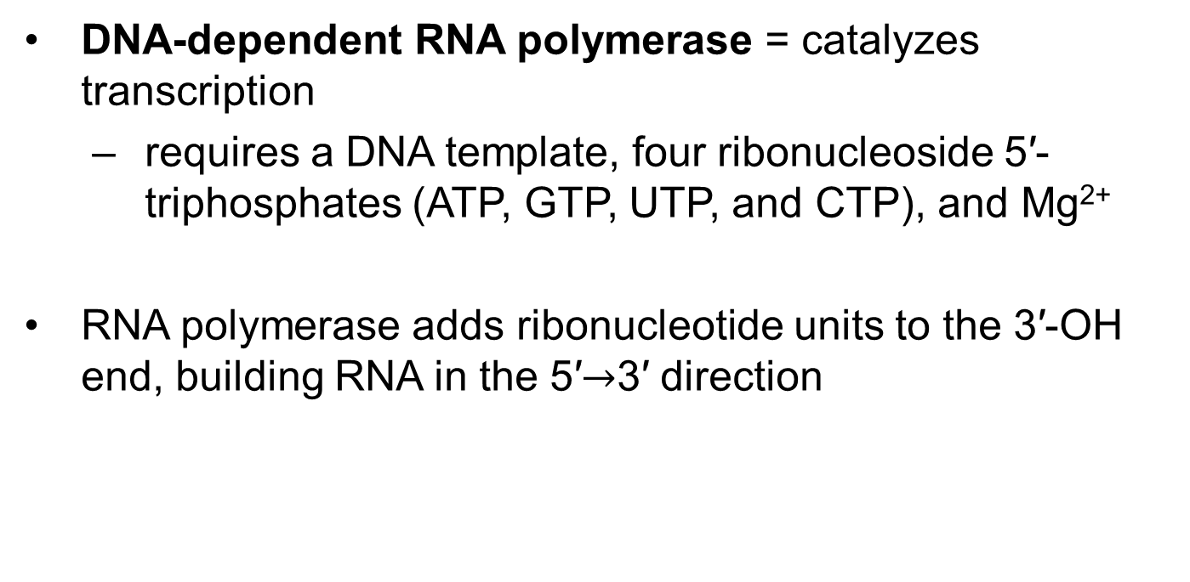
RNA Is Synthesized by RNA Polymerases
DNA-dependent RNA polymerase = catalyzes transcription
  requires a DNA template, four ribonucleoside 5′-triphosphates (ATP, GTP, UTP, and CTP), and Mg²⁺
RNA polymerase adds ribonucleotide units to the 3′-OH end, building RNA in the 5′$→$3′ direction

Slide 15
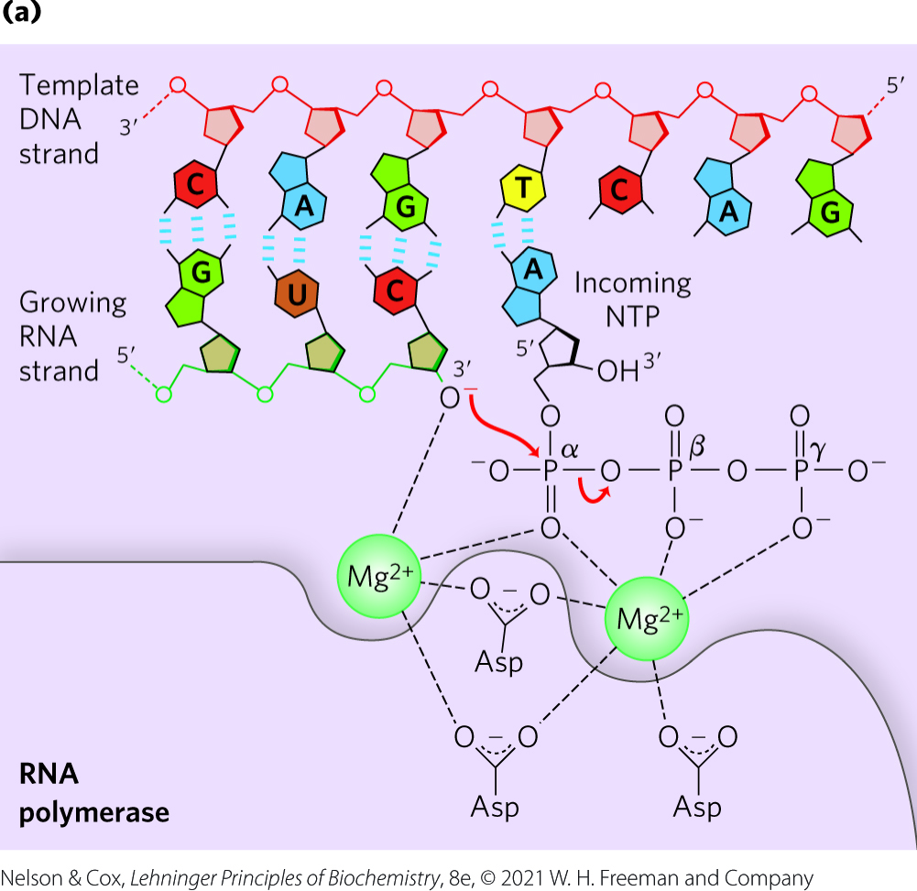
Transcription by RNA Polymerase in E. coli
the 3′-OH acts as a nucleophile, attacking the α phosphate of the incoming ribonucleoside triphosphate
each nucleotide in the RNA is selected by Watson-Crick base-pairing interaction

Slide 16
Clicker Question 2
What metal plays an important role in transcription, a role similar to phosphoryl group transfer?
manganese
iron
copper
magnesium
cobalt
Notes:
Answer: D. It stabilizes deprotonated oxygen atoms of phosphoryl groups and of carboxyl groups on Asp. See Figure 26-1, for example.
Principle: 26.1
Learning Objective(s): Explain the chemical reaction performed by DNA dependent RNA polymerase.
Bloom’s: 1:1

Slide 17
Clicker Question 2, Response
What metal plays an important role in transcription, a role similar to phosphoryl group transfer?
magnesium
Mg²⁺ stabilizes deprotonated oxygen atoms of phosphoryl groups and of carboxyl groups on Asp residues within the active site.

Slide 18
Clicker Question 3
E. coli RNA polymerase does NOT require:
a template DNA strand.
ATP, GTP, UTP, and CTP.
two Mg²⁺.
a Mg²⁺ and Mn²⁺.
Notes:
Answer: D
Principle: 26.1
Learning Objective(s): Define the reactants necessary for DNA dependent RNA polymerase to accomplish transcription.
Bloom’s: 1:1

Slide 19
Clicker Question 3, Response
E. coli RNA polymerase does NOT require:
a Mg²⁺ and Mn²⁺.
DNA-dependent RNA polymerase requires a DNA template, all four ribonucleoside 5-triphosphates (ATP, GTP, UTP, and CTP) as precursors of the nucleotide units of RNA, and two Mg²⁺ ions.

Slide 20
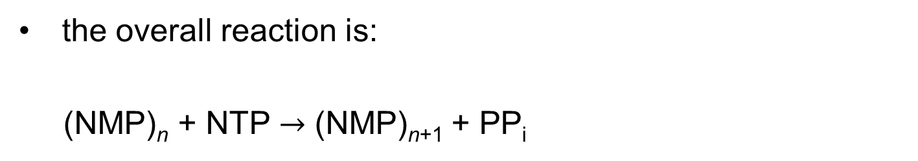
The Overall Reaction of Transcription
the overall reaction is:
(NMP)_{n} + NTP $→$ (NMP)_{n+1} + PP_{i}
RNA
lengthened
RNA

Slide 21
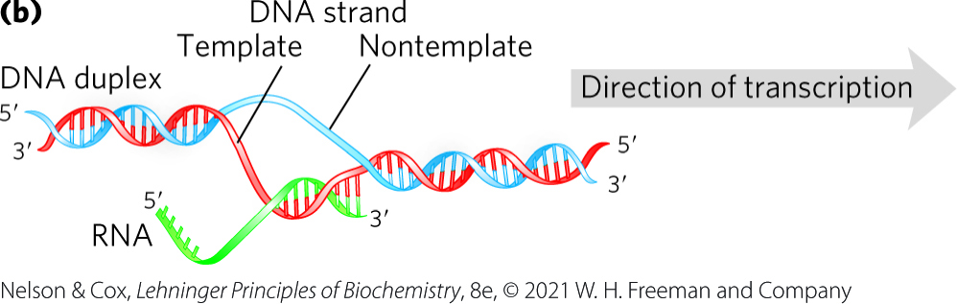
Initiation and Elongation of Transcription
initiation occurs when RNA polymerase binds at promoter sequences
  promoters are not required
during elongation, the growing RNA strand temporarily base-pairs with the DNA template to form a short hybrid RNA-DNA double helix

Slide 22
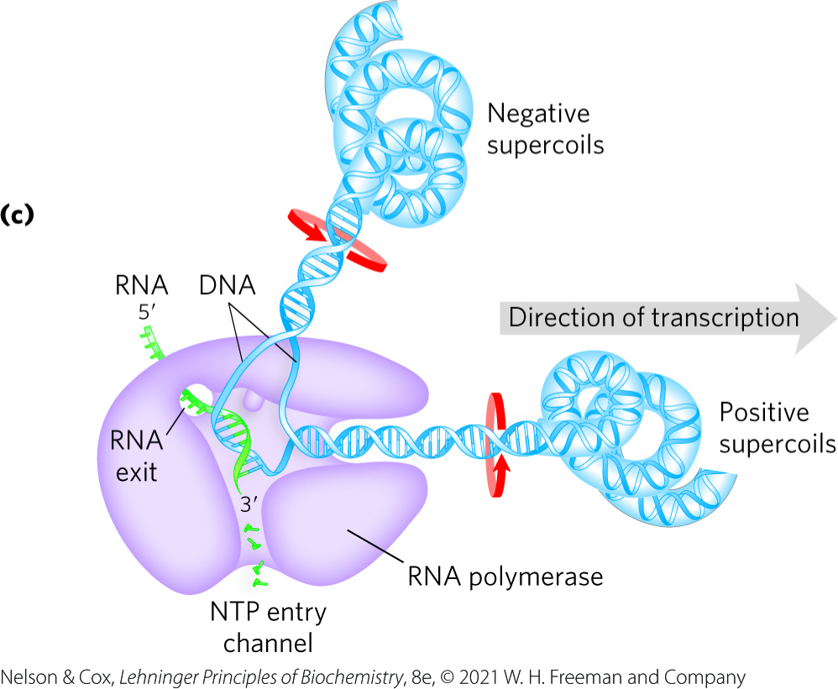
Movement of RNA Polymerase Creates Supercoils
a transcription “bubble” forms when the DNA duplex unwinds
RNA polymerase generates positive supercoils ahead of the “bubble” and negative supercoils behind
  due to restricted DNA strand rotation
  relieved through topoisomerases

Slide 23
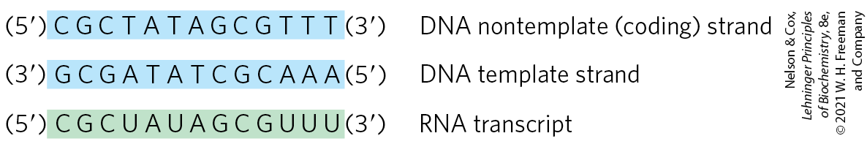
The Template and
Nontemplate Strand
template strand = DNA strand that serves as template for RNA synthesis
nontemplate strand (coding strand) = DNA strand that is identical in base sequence to the transcribed RNA, with U in RNA in place of T in DNA

Slide 24
Clicker Question 4
Other than having U in the RNA in place of T in the DNA, the base sequence of transcribed RNA:
is identical to the template DNA strand sequence.
is identical to the nontemplate DNA strand sequence.
is the reverse of the template DNA strand sequence.
is the reverse of the nontemplate DNA strand sequence.
Notes:
Answer: B
Principle: 26.1
Learning Objective(s): Define template strand and nontemplate (or coding) strand of DNA.
Bloom’s: 1:1

Slide 25
Clicker Question 4, Response
Other than having U in the RNA in place of T in the DNA, the base sequence of transcribed RNA:
is identical to the nontemplate DNA strand sequence.
The strand that serves as template for RNA synthesis is called the template strand. The DNA strand complementary to the template, the nontemplate strand, or coding strand, is identical in base sequence to the RNA transcribed from the gene, with U in the RNA in place of T in the DNA.

Slide 26
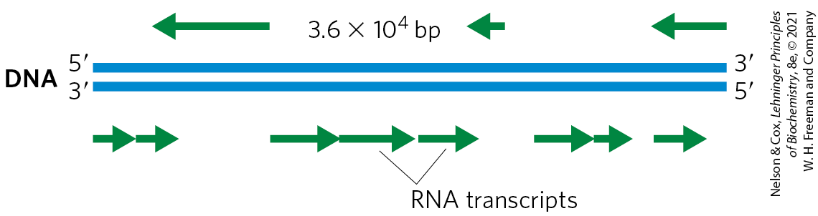
Organization of Coding Information in the Adenovirus Genome
the coding strand for a particular gene may be located in either strand of a given chromosome

Slide 27
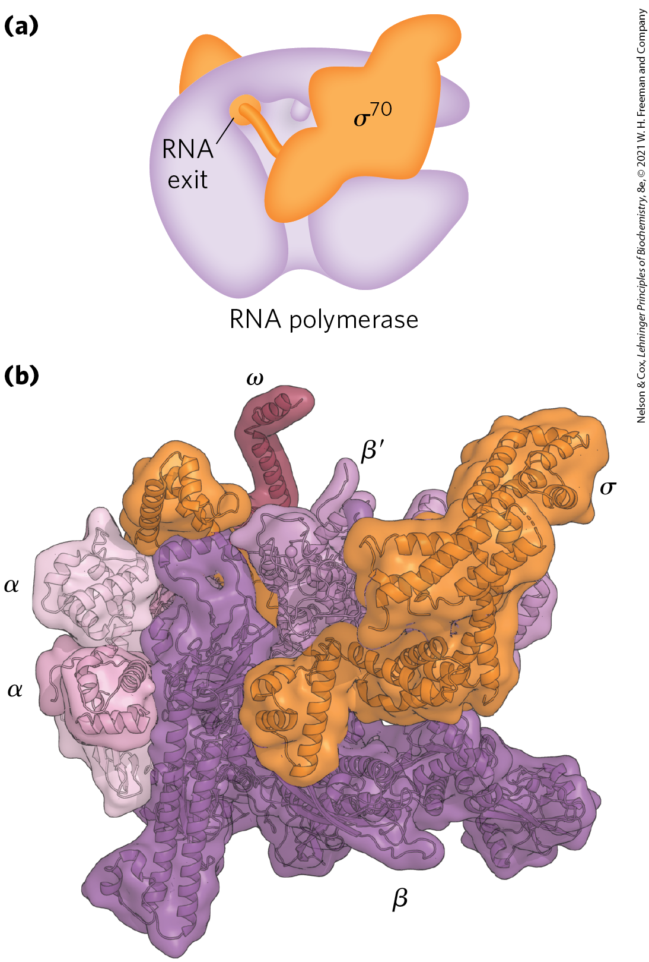
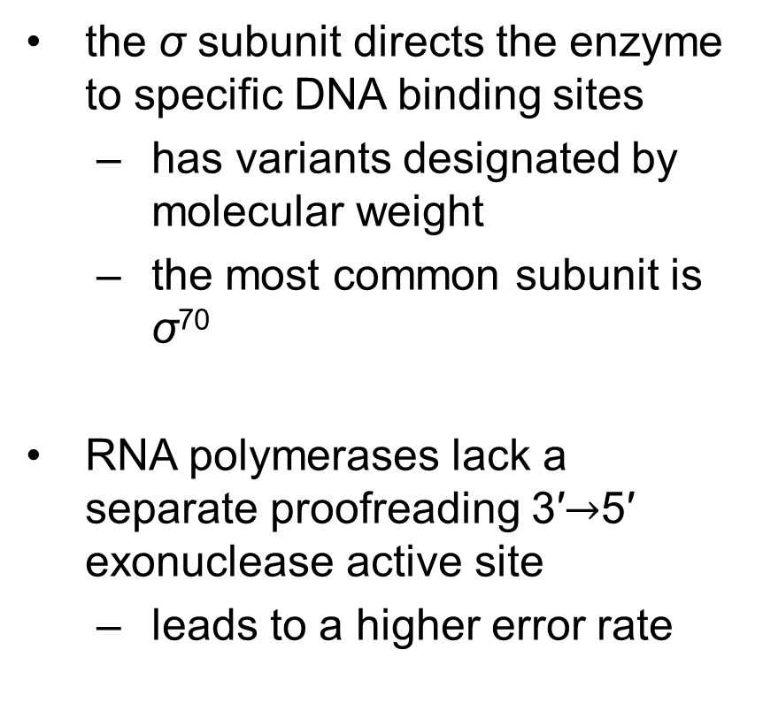
Six Subunits Constitute the RNA Polymerase Holoenzyme
the σ subunit directs the enzyme to specific DNA binding sites
  has variants designated by molecular weight
  the most common subunit is σ⁷⁰
RNA polymerases lack a separate proofreading 3′$→$5′ exonuclease active site
  leads to a higher error rate

Slide 28
Clicker Question 5
Which subunit is NOT part of the E. coli DNA-dependent RNA polymerase holoenzyme?
α subunit
β subunit
γ subunit
σ subunit
ω subunit
Notes:
Answer: C
Principle: 26.1
Learning Objective(s): Explain the difference between RNA polymerase of E.coli and RNA polymerase holoenzyme.
Bloom’s: 1:1

Slide 29
Clicker Question 5, Response
Which subunit is NOT part of the E. coli DNA-dependent RNA polymerase holoenzyme?
γ subunit
The DNA-dependent RNA polymerase of E. coli is a large, complex enzyme with five core subunits (α₂ββ′ω) and a sixth subunit, one of a group designated σ. These six subunits constitute the RNA polymerase holoenzyme.

Slide 30
Principle 1 (3 of 5)
RNA is synthesized by RNA polymerases using DNA templates and ribonucleoside 5′-triphosphates. RNA is made in the 5′→3′ direction and complementary to the template DNA strand. Transcription is highly regulated and initiates by recruitment of the transcription machinery to gene promoters. Although bacterial and eukaryotic polymerases share many conserved features, the transcriptional machinery and its regulation are much more complex in eukaryotes.

Slide 31
RNA Synthesis Begins at Promoters
promoters = specific sequences in DNA that RNA polymerase binds to
  direct that transcription of adjacent segments of DNA (genes)
  sequences are variable
promoter regions extend between positions -70 and +30

Slide 32
Consensus Sequences and the UP Element
consensus sequence = formed by certain nucleotides that are particularly common at a given position
  (5′)TATAAT(3′) at the -10 region
  (5′)TTGACA(3′) at the -35 region
UP (upstream promoter) element = a third AT-rich recognition element that occurs between positions -40 and -60 in the promoters of certain highly expressed genes
  bound by the α subunit of RNA polymerase

Slide 33
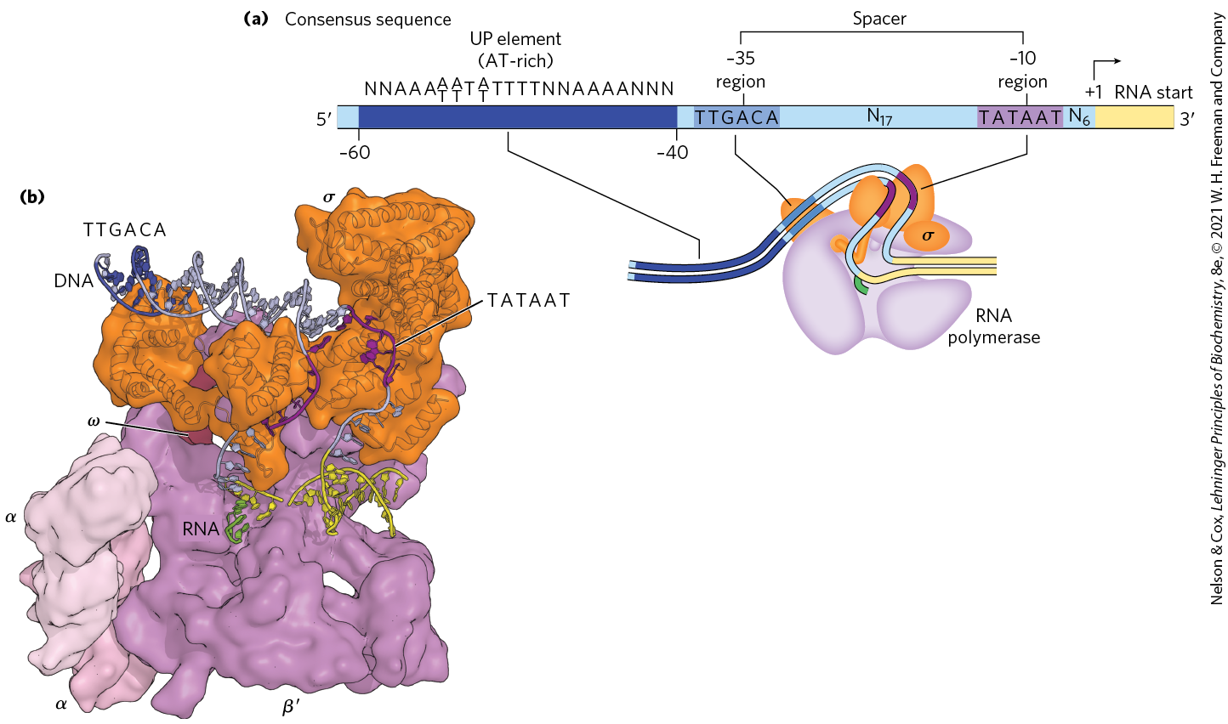
Promoter Recognition by σ⁷⁰ RNA Polymerase Holoenzyme

Slide 34
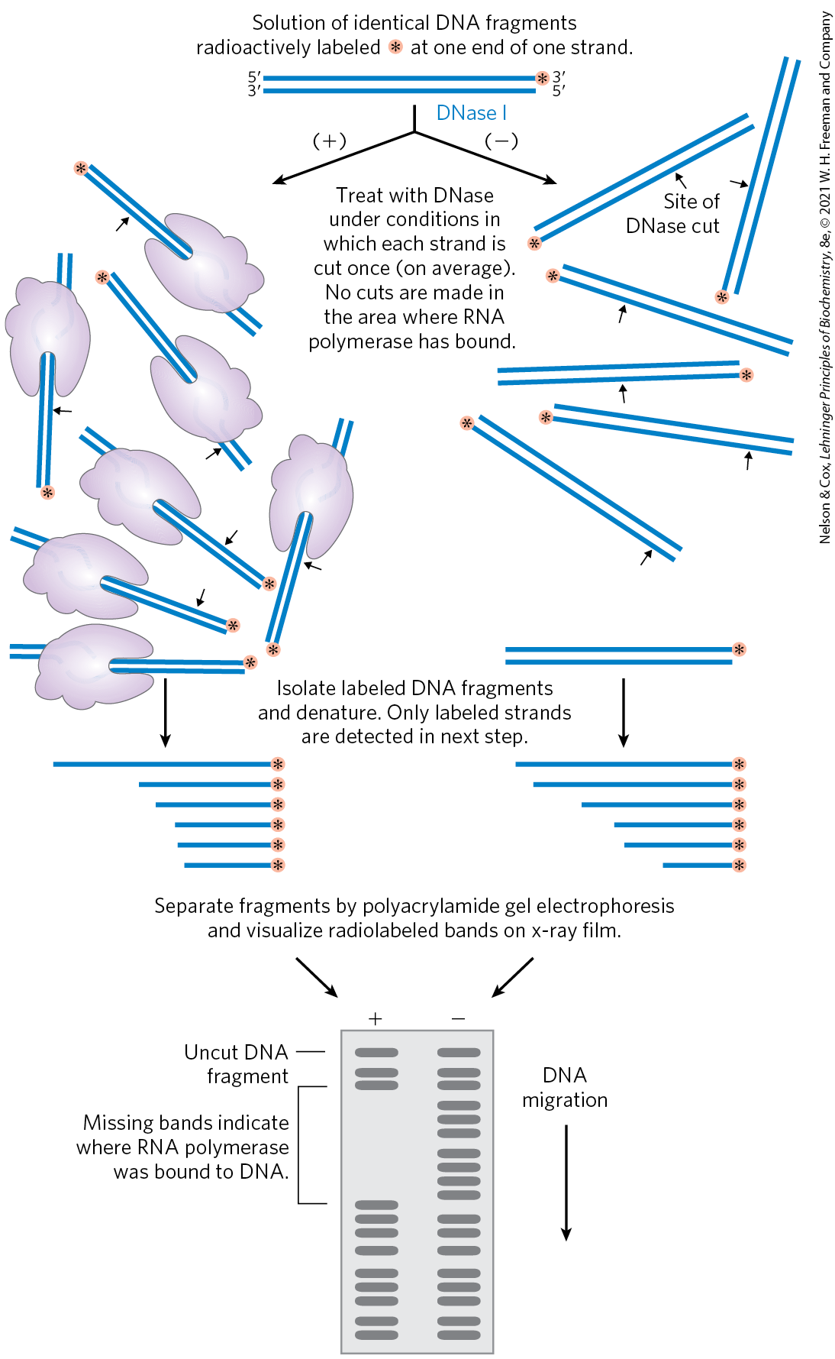
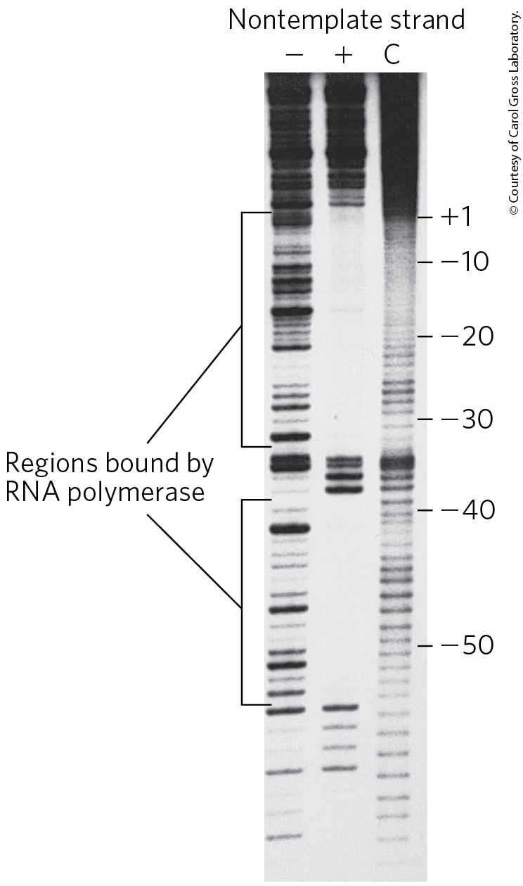
The Footprinting Technique is a Way to Find a DNA-Binding Site
footprinting = identifies the DNA sequences bound by a particular protein

Slide 35
Clicker Question 6
What valuable piece of information is obtained by DNA footprinting?
the location of a promoter region of DNA
the specific sequence of bases to which a particular protein binds
the location of the 5′ end of a coding sequence
all the DNA sequences in a genome to which a known DNA sequence binds
the location(s) in genomic DNA to which a known sequence of RNA binds
Notes:
Answer: B
Principle: 26.1
Learning Objective(s): Explain how footprinting can be used to identify RNA polymerase promoter sequences.
Bloom’s: 2:2

Slide 36
Clicker Question 6, Response
What valuable piece of information is obtained by DNA footprinting?
the specific sequence of bases to which a particular protein binds
Footprinting, a technique derived from principles used in DNA sequencing, identifies the DNA sequences bound by a particular protein.

Slide 37
Initiation by E. coli RNA Polymerase
the polymerase binds to the promoter
  directed by its bound σ factor
a closed complex (bound DNA remains double-stranded) forms, followed by an open complex (bound DNA is partially unwound near the −10 sequence)
initiation causes a conformational change that converts the complex to the elongation form and moves the complex away from the promoter (promoter clearance)

Slide 38
Elongation by E. coli
RNA Polymerase
the σ subunit dissociates at random as the polymerase enters elongation
the NusA protein competes with the σ subunit to bind the polymerase
after transcription:
  NusA dissociates from the enzyme
  RNA polymerase dissociates from the DNA

Slide 39
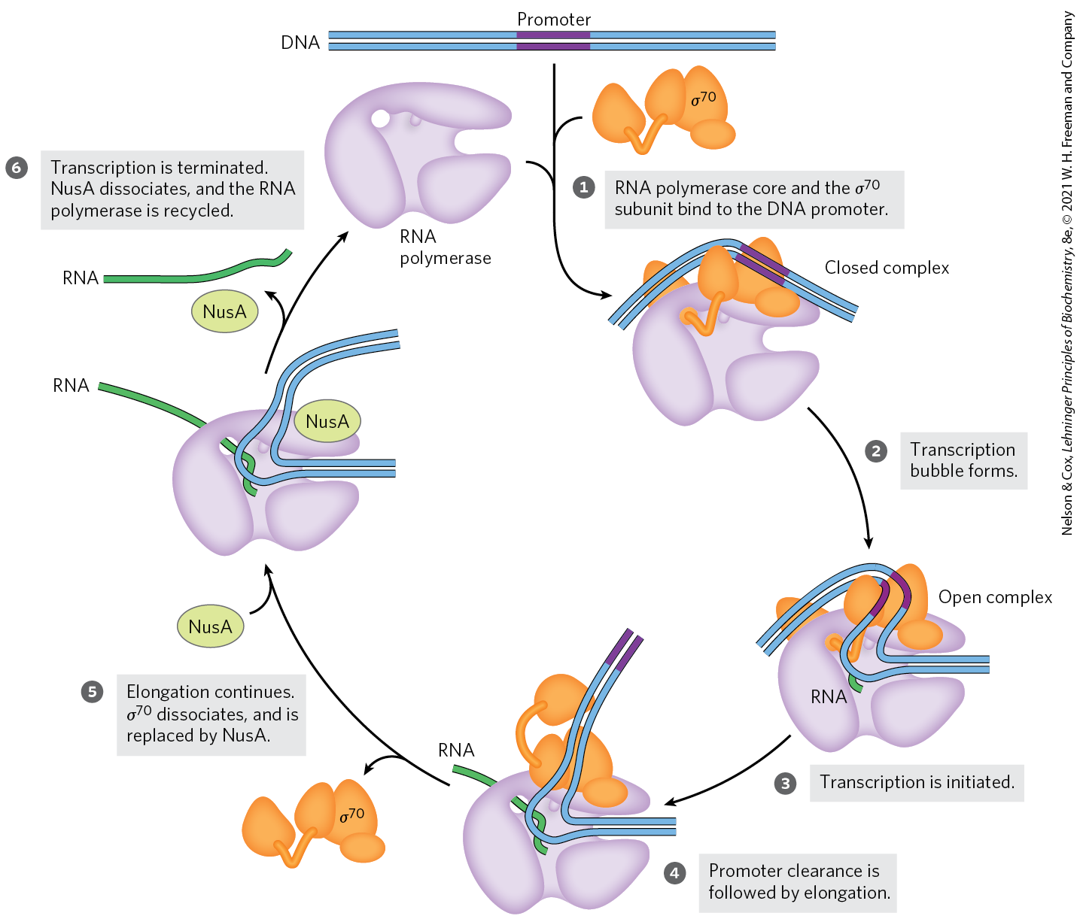
Initiation and Elongation by E. coli RNA Polymerase

Slide 40
The σ³² Subunit
the σ³² subunit = specific for the heat shock promoters
  RNA polymerase binds these promoters only when σ⁷⁰ is replaced with σ³²
the products of heat shock genes are made at higher levels when the cell is exposed to environmental stress
using different σ subunits allows the cell to coordinate the expression of sets of genes

Slide 41
Clicker Question 7
When does the σ subunit dissociate from the RNA polymerase core subunits?
randomly as the polymerase enters the elongation phase of transcription
when NusA displaces it
when the promoter region has passed through
exactly when the second NTP has been added to the chain
Notes:
Answer: A
Principle: 26.1
Learning Objective(s): Define the changes that occur in the RNA polymerase as elongation occurs.
Bloom’s: 2:2

Slide 42
Clicker Question 7, Response
When does the σ subunit dissociate from the RNA polymerase core subunits?
randomly as the polymerase enters the elongation phase of transcription
The σ subunit dissociates at random as the polymerase enters the elongation phase of transcription. The protein NusA binds to the elongating RNA polymerase, competitively with the σ subunit.

Slide 43
Principle 1 (4 of 5)
RNA is synthesized by RNA polymerases using DNA templates and ribonucleoside 5′-triphosphates. RNA is made in the 5′→3′ direction and complementary to the template DNA strand. Transcription is highly regulated and initiates by recruitment of the transcription machinery to gene promoters. Although bacterial and eukaryotic polymerases share many conserved features, the transcriptional machinery and its regulation are much more complex in eukaryotes.

Slide 44
Transcription Is Regulated at
Several Levels
regulation can occur at any step of transcription
as the first committed steps in transcription, binding of RNA polymerase to the promoter and initiation of transcription are closely regulated
protein binding can activate or repress transcription
  cAMP receptor protein (CRP) activates transcription
  repressors block RNA synthesis at specific genes

Slide 45
Clicker Question 8
Signal transduction systems incorporate molecules that have other cellular functions. What second messenger ion or molecule plays a role in activating bacterial gene transcription?
cGMP
inositol 1,4,5-trisphosphate
1,2-diacylglycerol
Ca²⁺
cAMP
Notes:
Answer: E. Through the cAMP receptor protein (CRP).
Principle: 26.1
Learning Objective(s): Explain how specific proteins can activate or repress transcription.
Bloom’s: 1:1

Slide 46
Clicker Question 8, Response
Signal transduction systems incorporate molecules that have other cellular functions. What second messenger ion or molecule plays a role in activating bacterial gene transcription?
cAMP
In E. coli, the cAMP receptor protein (CRP) increases the transcription of genes coding for enzymes that metabolize sugars other than glucose when cells are grown in the absence of glucose.

Slide 47
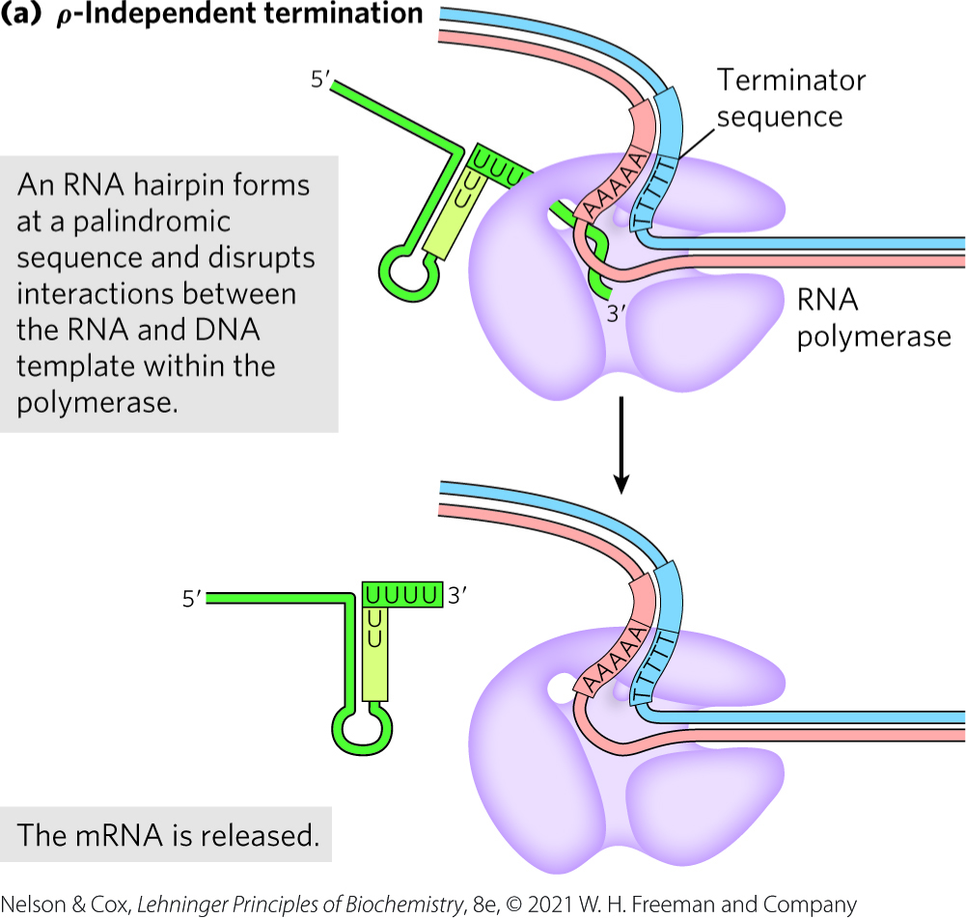
Specific Sequences Signal Termination of RNA Synthesis
ρ-independent terminators:
  have a self-complementary region that forms a hairpin
  have a conserved string of three A residues that are transcribed into U residues near the 3′ end of the hairpin

Slide 48
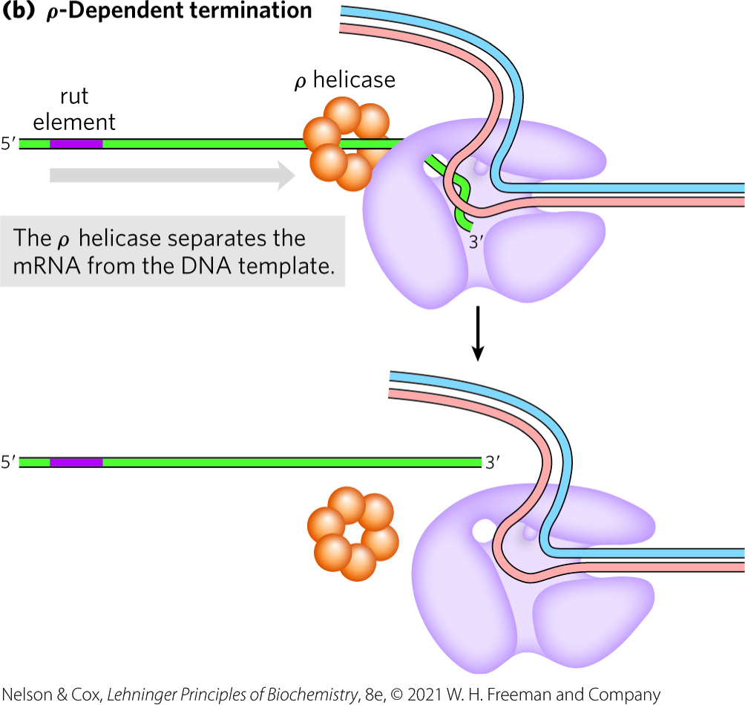
ρ-Dependent Terminators
ρ (rho) = protein factor that has an ATP-dependent RNA-DNA helicase activity
ρ-dependent terminators = class of terminators that rely on the protein factor ρ (rho)
  have a CA-rich sequence called a rut (rho utilization) element
  ρ promotes release of the RNA

Slide 49
Clicker Question 9
Which factor is NOT associated with the process of transcriptional termination?
sequence-dependent binding of Term protein in eukaryotes
dephosphorylation of the CTD of Pol II in eukaryotes
the action of ρ helicase in E. coli
hairpin formation in the RNA product of E. coli RNA polymerase
Notes:
Answer: A
Principle: 26.1
Learning Objective(s): Describe the impact of phosphorylation and dephosphorylation of Pol II.
Bloom’s: 1:1

Slide 50
Clicker Question 9, Response
Which factor is NOT associated with the process of transcriptional termination?
sequence-dependent binding of Term protein in eukaryotes
In eukaryotes, termination begins when elongation factors dissociate. The Pol II carboxyl-terminal domain (CTD) is dephosphorylated, a process facilitated by termination factors. The transcription machinery is then recycled, ready to initiate another transcript.

Slide 51
Eukaryotic Cells Have Three Kinds of Nuclear RNA Polymerases
eukaryotes have three nuclear RNA polymerases: I, II, and III
  each has a specific function and is recruited to a specific promoter sequence
Table 26-1 Eukaryotic Nuclear RNA Polymerases
RNA polymerase | Types of RNA synthesized
I | Pre-ribosomal RNA
II | mRNA ncRNA
III | tRNA 5S rRNA ncRNA

Slide 52
Mitochondria and Chloroplast RNA Polymerases
eukaryotic mitochondria and chloroplasts have their own RNA polymerases
RNA polymerases in these organelles are similar to bacterial RNA polymerases

Slide 53
RNA Polymerase I (Pol I)
RNA polymerase I (Pol I) = responsible for the synthesis of a transcript called pre-ribosomal RNA (or pre-rRNA)
pre-rRNA contains the precursor for the 18S, 5.8S, and 28S rRNAs

Slide 54
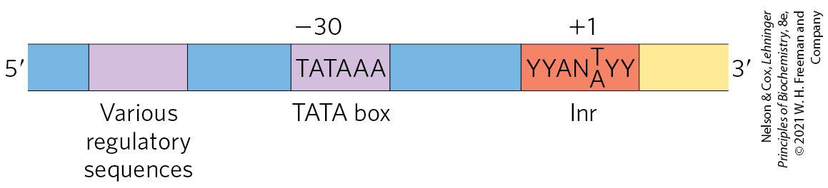
RNA Polymerase II (Pol II)
RNA polymerase II (Pol II) = responsible for the synthesis of mRNAs and many ncRNAs
  can recognize 1000s of promoters
some Pol II promoters have sequences in common:
  a TATA box consensus sequence (TATA(A/T)A(A/T)(A/G)) near -30
  an Inr sequence (initiator) at +1

Slide 55
RNA Polymerase III (Pol III)
RNA polymerase III (Pol III) = responsible for the synthesis of tRNAs, the 5S rRNA, and other ncRNAs
Pol III promoters are well characterized

Slide 56
Clicker Question 10
Which eukaryotic RNA polymerase is responsible for transcribing MOST rRNAs?
Pol I
Pol II
Pol III
Pol I and Pol II
Notes:
Answer: A
Principle: 26.1
Learning Objective(s): Define the function of each eukaryotic RNA polymerase.
Bloom’s: 1:1

Slide 57
Clicker Question 10, Response
Which eukaryotic RNA polymerase is responsible for transcribing MOST rRNAs?
Pol I
RNA polymerase I (Pol I) is responsible for the synthesis of only one type of RNA, a transcript called pre-ribosomal RNA (or pre-rRNA), which contains the precursor for the 18S, 5.8S, and 28S rRNAs.

Slide 58
Principle 1 (5 of 5)
RNA is synthesized by RNA polymerases using DNA templates and ribonucleoside 5′-triphosphates. RNA is made in the 5′→3′ direction and complementary to the template DNA strand. Transcription is highly regulated and initiates by recruitment of the transcription machinery to gene promoters. Although bacterial and eukaryotic polymerases share many conserved features, the transcriptional machinery and its regulation are much more complex in eukaryotes.

Slide 59
RNA Polymerase II Requires Many Other Protein Factors for Its Activity
Pol II is more complex than its bacterial counterpart, but structure, function, and mechanism are conserved
  RBP1 subunit exhibits a high degree of homology to the bacterial β′ subunit
  RBP2 subunit is structurally similar to the bacterial β subunit
  RBP3 and RBP11 subunits show some structural homology to the two bacterial α subunits

Slide 60
The Carboxyl-Terminal
Domain (CTD)
carboxyl-terminal domain (CTD) = a long carboxyl-terminal tail in RBP1 that consists of many repeats of a consensus heptad amino acid sequence, -YSPTSPS-
  yeast enzyme contains 26 repeats
  human and mouse enzymes contain 52 repeats
  separated from the main body of the enzyme by an intrinsically disordered linker sequence

Slide 61
Transcription Factors
transcription factors = an array of proteins that work with Pol II form the active transcription complex
general transcription factors = those required at every Pol II promoter

Slide 62
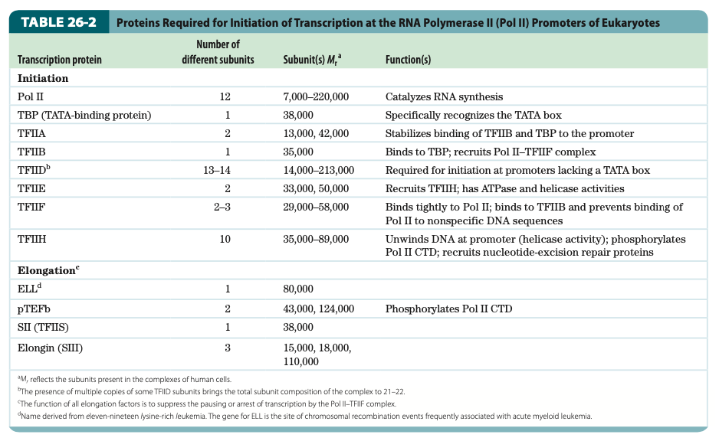
Proteins Required for Initiation of Transcription at Pol II Promoters of Eukaryotes

Slide 63
Clicker Question 11
Which statement about general transcription factors is false?
They are required at every Pol II promoter.
They are usually designated TFII with an additional identifier.
They are highly conserved in all eukaryotes.
They are proteins that block the synthesis of RNA at specific genes.
Notes:
Answer: D
Principle: 26.1
Learning Objective(s): Explain the role of transcription factors in initiation of transcription.
Bloom’s: 1:1

Slide 64
Clicker Question 11, Response
Which statement about general transcription factors is false?
They are proteins that block the synthesis of RNA at specific genes.
The general transcription factors required at every Pol II promoter (factors usually designated TFII with an additional identifier) are highly conserved in all eukaryotes. Repressors are proteins that block the synthesis of RNA at specific genes.

Slide 65
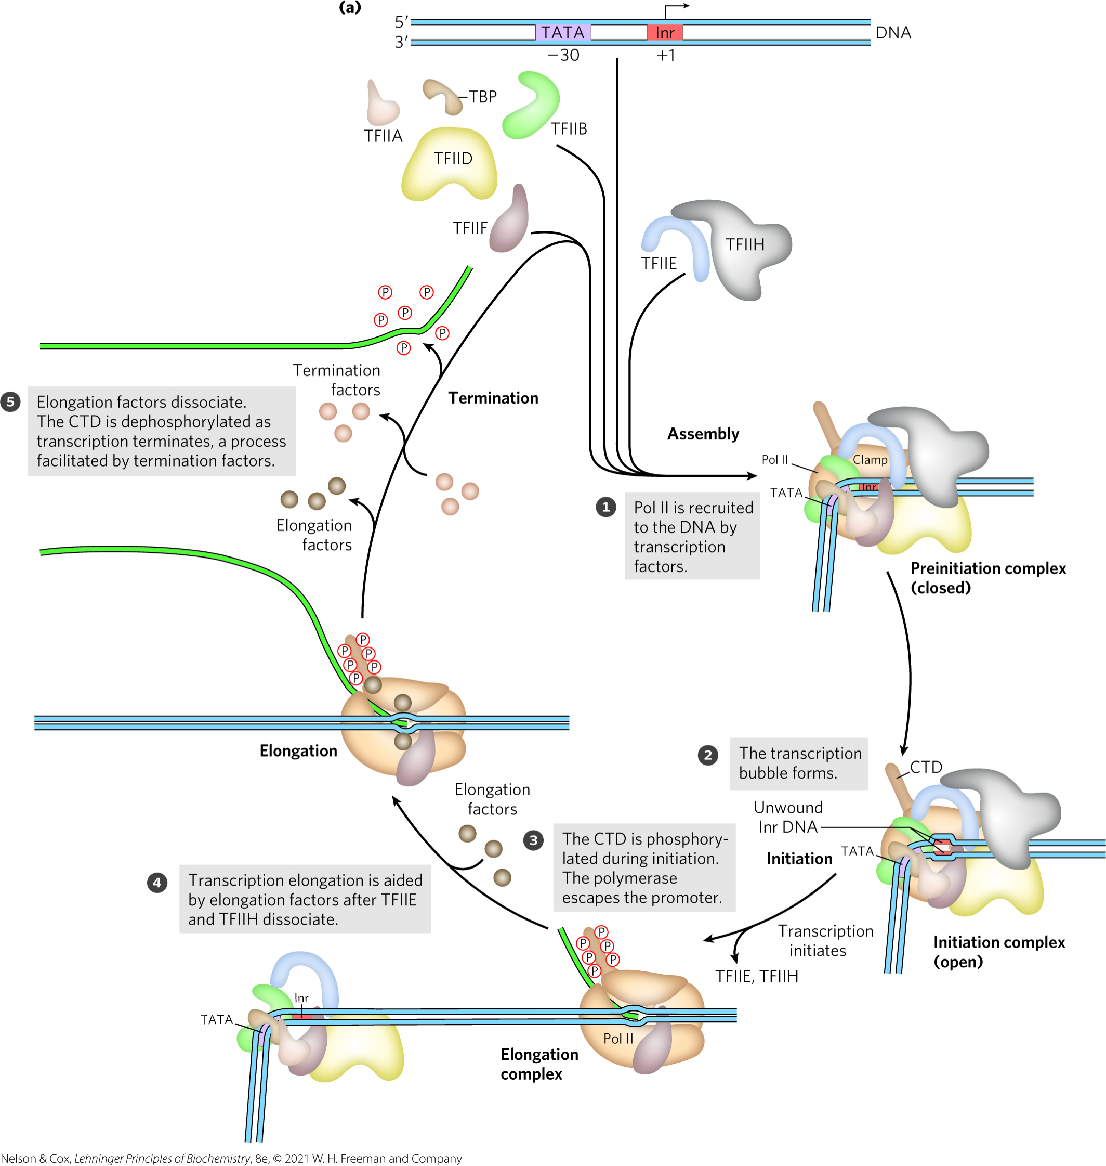
Transcription at RNA
Polymerase II Promoters

Slide 66
Assembly of RNA Polymerase and Transcription Factors at a Promoter
formation of a closed complex begins when TATA-binding protein (TBP) binds to the TATA box
preinitiation complex (PIC) = a closed complex
  contains TBP, TFIIA, TFIIB, TFIID, TFIIE, TFIIF, TFIIH, and Pol II

Slide 67
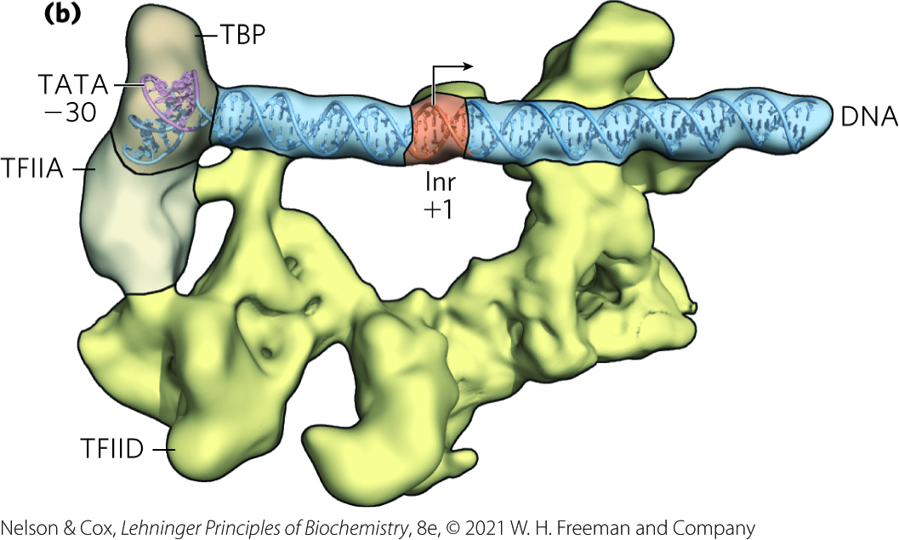
TFIID Positions TBP and Pol II on the Promoter
TFIID binds the promoter DNA in an elongated complex that is anchored by TBP-DNA interactions on one end
the Inr sequence is straddled on both ends by TFIID subunits

Slide 68
Clicker Question 12
Which factor is NOT associated with the function of promoters?
different σ factors in E. coli specific for specific promoters
requirement of several transcription factors to properly position Pol II at the promoter in eukaryotes
binding of the E. coli core RNA polymerase, directed by its σ factor, to a promoter
Pol II in eukaryotes having strict specificity for the TATA box and Inr sequence
Notes:
Answer: D
Principle: 26.1
Learning Objective(s): Define the function of the promoter sequences found in DNA.
Bloom’s: 2:2

Slide 69
Clicker Question 12, Response
Which factor is NOT associated with the function of promoters?
Pol II in eukaryotes having strict specificity for the TATA box and Inr sequence
TATA-binding protein (TBP), not Pol II, binds to the TATA box. TBP is bound, in turn, by the transcription factor TFIIB. The TFIIB-TBP complex is next bound by another complex consisting of TFIIF and Pol II. The Inr sequence is straddled on both ends by TFIID subunits, which act as a scaffold to direct binding of Pol II.

Slide 70
TFIIH Promotes Unwinding of the DNA Near the RNA Start Site
TFIIH has DNA helicase activity that promotes the unwinding of DNA to create an open complex
  requires ATP

Slide 71
RNA Strand Initiation and
Promoter Clearance
TFIIH has kinase activity that phosphorylates Pol II at many places in the CTD
  other kinases also phosphorylate the CTD
CTD phosphorylation causes a conformational change in the overall complex, initiating transcription
Pol II enters elongation after TFIIE and TFIIH are released
  occurs after synthesis of 60 to 70 nucleotides of RNA

Slide 72
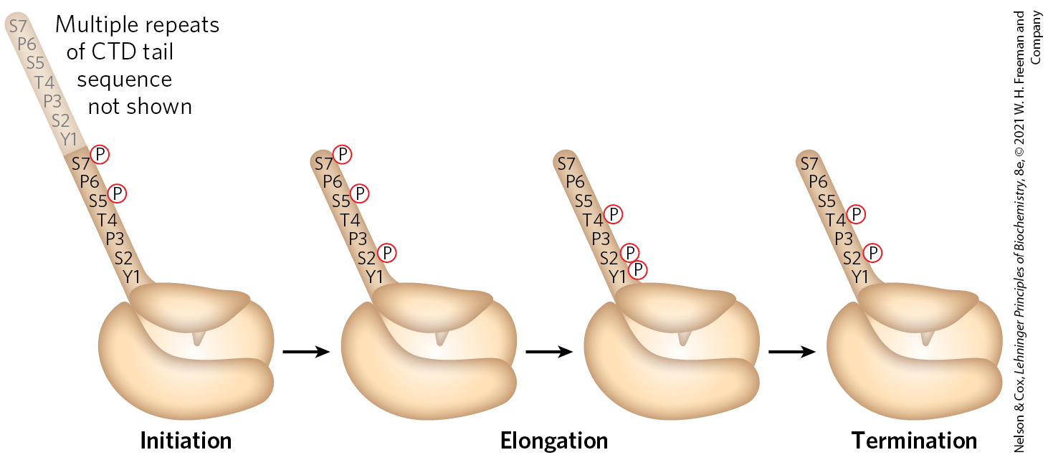
Phosphorylation of the CTD of RNA Polymerase II
the phosphorylation state of the CTD changes throughout transcription

Slide 73
Elongation, Termination, and Release
during elongation, elongation factors bound to RNA Pol II enhance processivity and coordinate posttranslational modifications
  some are bound to phosphorylated CTD
during termination, Pol II CTD is dephosphorylated and transcription machinery is recycled

Slide 74
Clicker Question 13
Which is NOT a phase of eukaryotic transcription?
elongation
assembly
preparation
termination
initiation
Notes:
Answer: C
Principle: 26.1
Learning Objective(s): Identify the phases of eukaryotic transcription.
Bloom’s: 1:1

Slide 75
Clicker Question 13, Response
Which is NOT a phase of eukaryotic transcription?
preparation
The process of transcription by Pol II can be described in terms of several phases — assembly, initiation, elongation, and termination — each associated with characteristic proteins.

Slide 76
RNA Polymerases Are Drug Targets
actinomycin D = an antibiotic that inhibits RNA elongation in bacteria and eukaryotes
  intercalates into the double-helical DNA to deform the DNA duplex and prevent polymerase movement

Slide 77
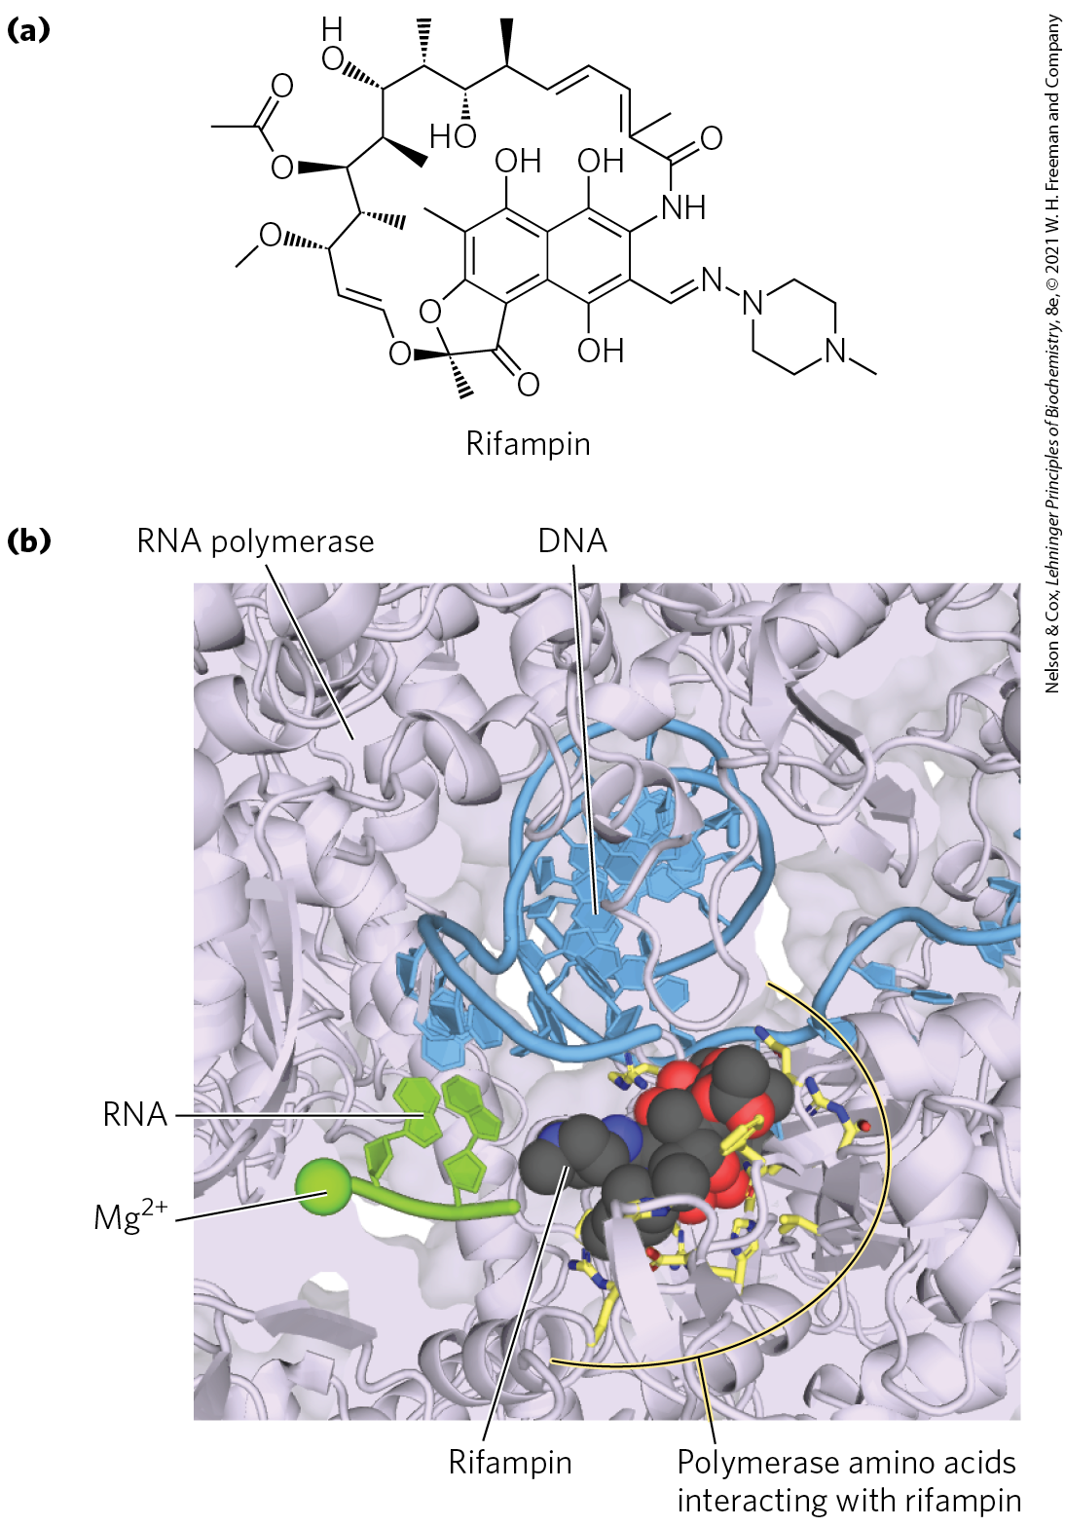
Rifampin
rifampin = antibiotic that inhibits bacterial RNA synthesis by preventing the promoter clearance step of transcription
  important for the treatment of tuberculosis (TB)
  binds near the active site of RNA polymerase and prevents extension of the RNA product

Slide 78
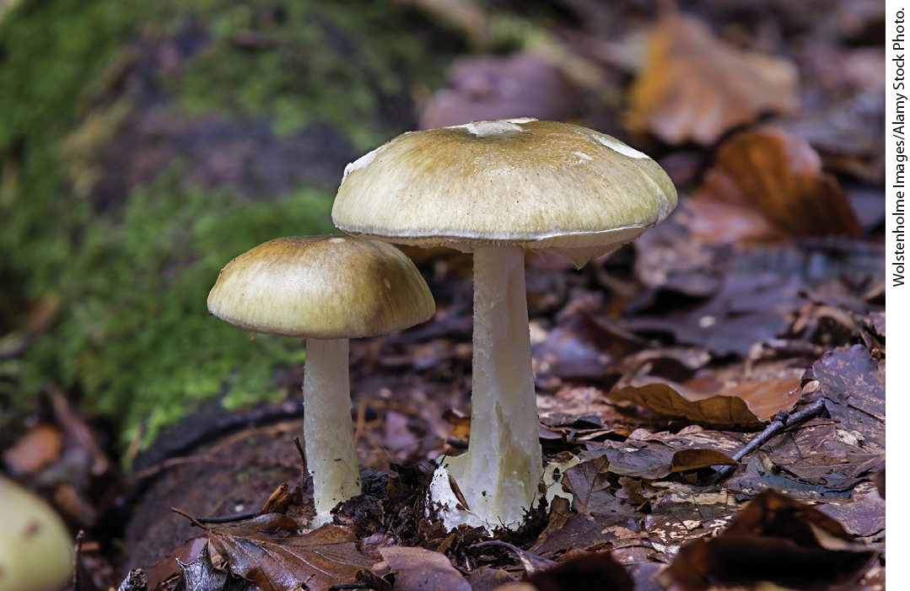
The Death Cap Mushroom Produces α-Amanitin
α-amanitin = compound produced by the death cap mushroom Amanita phalloides
  disrupts transcription in animal cells by blocking Pol II and, at higher concentrations, Pol III

Slide 79
Clicker Question 14
Which compound CANNOT be used to inhibit bacterial RNA polymerase?
rifampin
actinomycin D
α-amanitin
All of these compounds can be used to inhibit bacterial RNA polymerase.
Notes:
Answer: C
Principle: 26.1
Learning Objective(s): Explain how RNA polymerases can be used as drug targets.
Bloom’s: 1:1

Slide 80
Clicker Question 14, Response
Which compound CANNOT be used to inhibit bacterial RNA polymerase?
α-amanitin
α-Amanitin, produced by the death cap mushroom Amanita phalloides, disrupts transcription in animal cells by blocking Pol II and, at higher concentrations, Pol III. However, neither Pol I nor bacterial RNA polymerase is sensitive to α-amanitin, nor is the RNA polymerase II of A. phalloides itself.

Slide 81

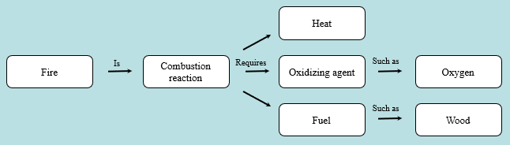
Activity: Relating
Terms within the Chapter
A concept map displays the relationships between different concepts. Observe the following example of a concept map.
Notes:
Instructor: For additional information, see the Instructor Activity Guide located in Achieve. It can be found within Chapter 26, in the folder titled “Ch26 In-Class Activities, Videos, and Resources.”

Slide 82
Activity Instructions (1 of 3)
Think about how the following terms and phrases relate to each other and then use scratch paper to draw a concept map using these terms and phrases. (3 minutes)
RNA
transcription
complementary
DNA template strand
RNA polymerase
ribonucleoside 5′-triphosphates
5′→3′ direction
highly regulated
eukaryotes
recruitment of transcription machinery to gene promoters
Notes:
Instructor: For additional information, see the Instructor Activity Guide located in Achieve. It can be found within Chapter 26, in the folder titled “Ch26 In-Class Activities, Videos, and Resources.”

Slide 83
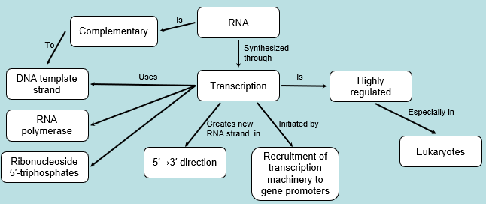
Activity Solution (1 of 3)
Pair up and share how this possible concept map might differ from yours. (2 minutes)
Notes:
Instructor: For additional information, see the Instructor Activity Guide located in Achieve. It can be found within Chapter 26, in the folder titled “Ch26 In-Class Activities, Videos, and Resources.”

Slide 84
26.2 RNA Processing

Slide 85
Principle 2 (2 of 8)
Many RNAs must be modified and processed to become functional. RNAs can be modified by nucleases, by excision of certain RNA segments, and/or by chemical modification of the RNA nucleotides. In humans, nearly all mRNAs are 5′ capped, spliced, and polyadenylated before being exported from the nucleus for translation in the cytoplasm.

Slide 86
RNA Processing
virtually all eukaryotic RNAs and many bacterial RNAs undergo processing
processing includes:
  addition and deletion of nucleotide sequences
  chemical modification of RNA nucleotides
  degradation
ribozymes = catalytic RNAs that catalyze posttranscriptional processing reactions

Slide 87
Principle 2 (3 of 8)
Many RNAs must be modified and processed to become functional. RNAs can be modified by nucleases, by excision of certain RNA segments, and/or by chemical modification of the RNA nucleotides. In humans, nearly all mRNAs are 5′ capped, spliced, and polyadenylated before being exported from the nucleus for translation in the cytoplasm.

Slide 88
RNA Splicing
primary or precursor transcript = a newly synthesized RNA molecule
introns = noncoding tracts that break up the coding region of the mRNA transcript
  human genes average eight introns per gene
exons = coding segments of the mRNA transcript
RNA splicing = the process by which introns are removed from pre-mRNA and exons are spliced together to form a continuous sequence that specifies a functional polypeptide

Slide 89

Clicker Question 15
What is removed from the RNA primary transcript in order to produce mRNA?
TATA boxes
recombination signal sequences
introns
promoter sites
polyadenylation
Notes:
Answer: C
Principle: 26.2
Learning Objective(s): Describe what the process of RNA splicing will accomplish.
Bloom’s: 1:1

Slide 90
Clicker Question 15, Response
What is removed from the RNA primary transcript in order to produce mRNA?
introns
In a process called RNA splicing, the introns are removed from the pre-mRNA, and the exons are spliced together to form a continuous sequence that specifies a functional polypeptide.

Slide 91
Eukaryotic mRNAs Are Modified At Each End
at the 5′ end, a 5′ cap (a modified nucleotide structure) is added
at the 3′ end, cleavage occurs and 80 to 250 A residues are added to create a poly(A) “tail”

Slide 92
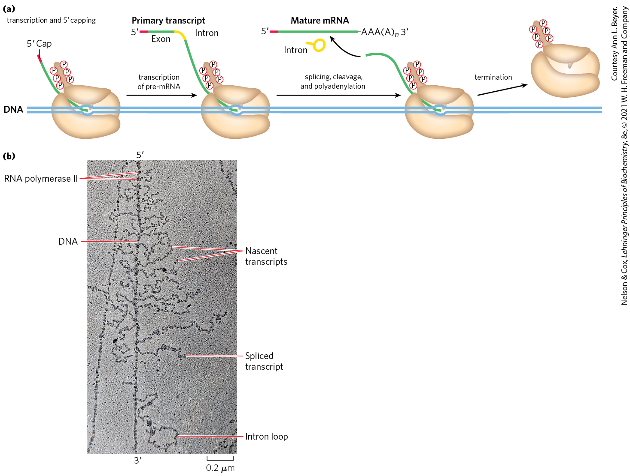
Processing of the Primary
Transcript during mRNA Maturation
the protein complexes that carry out mRNA-processing reactions are organized in association with each other and with the phosphorylated CTD of Pol II

Slide 93
Clicker Question 16
Which factor is NOT a typical modification found in a eukaryotic mRNA?
polyadenylation of the 3′ end
addition of a 5′ cap
exon addition
intron removal
Notes:
Answer: C
Principle: 26.2
Learning Objective(s): Explain RNA processing.
Bloom’s: 2:1

Slide 94
Clicker Question 16, Response
Which factor is NOT a typical modification found in a eukaryotic mRNA?
exon addition
Following the removal of introns, the exons that remain are joined together to form a mature, functional RNA.

Slide 95
The Messenger Ribonucleoprotein (mRNP) Complex
proteins involved in mRNA transport to the cytoplasm are also associated with the mRNA in the nucleus
processing of the transcript is coupled to its transport
messenger ribonucleoprotein (mRNP) complex = an elaborate and dynamic supramolecular complex of dozens of proteins that associates with the transcript
  its composition changes as the transcript is processed, transported to the cytoplasm, and delivered to the ribosome for translation

Slide 96
Principle 2 (4 of 8)
Many RNAs must be modified and processed to become functional. RNAs can be modified by nucleases, by excision of certain RNA segments, and/or by chemical modification of the RNA nucleotides. In humans, nearly all mRNAs are 5′ capped, spliced, and polyadenylated before being exported from the nucleus for translation in the cytoplasm.

Slide 97
Eukaryotic mRNAs Are Capped at the 5′ End
5′ cap = a residue of 7-methylguanosine linked to the 5′-terminal residue of the mRNA through an unusual 5′,5′-triphosphate linkage
functions:
  helps protect mRNA from ribonucleases
  binds to specific cap-binding complexes of proteins
  participates in binding of the mRNA to the ribosome

Slide 98
Formation of the 5′ Cap
formed by condensation of a molecule of GTP with the triphosphate at the 5′ end of the transcript
methylation occurs at the N-7 guanine and often the 2′-OH groups of the two nucleotides adjacent to the cap
  methyl groups are derived from S-adenosylmethionine

Slide 99
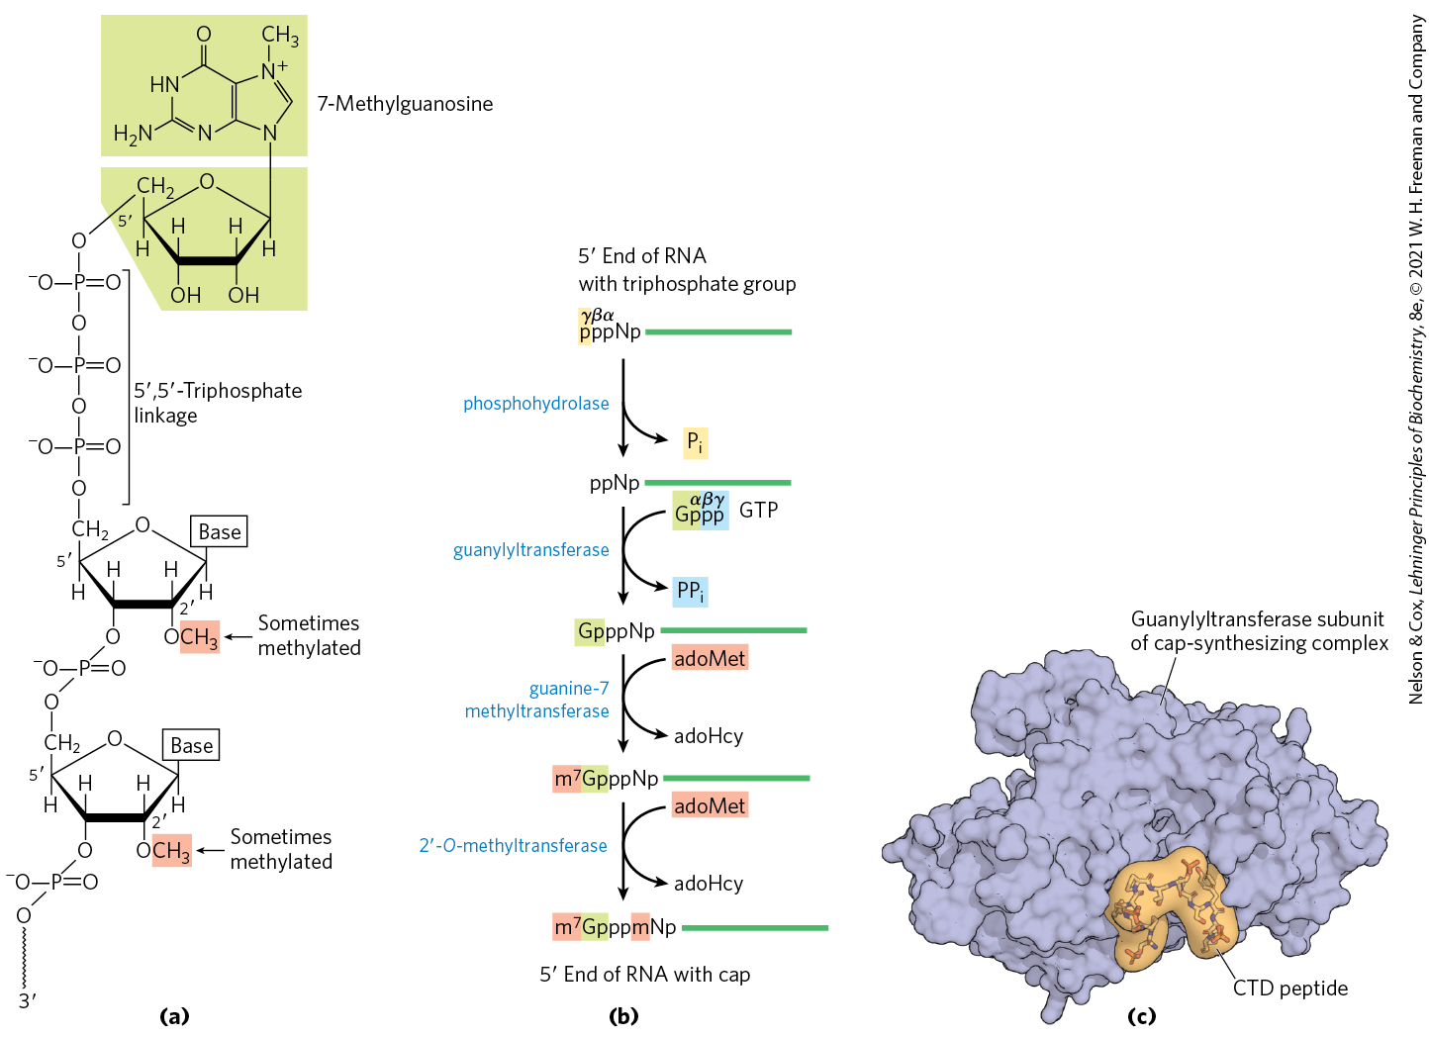
The 5′ Cap of mRNA

Slide 100
Clicker Question 17
What is a 5′ cap, structurally?
7-methylguanosine on the 5′ end of RNA
a sequence of adenosine residues added to the 5′ end of the RNA
3-methyluracil added to the 5′ end of the RNA
5-methylguanosine on the 3′ end of the RNA
methylation of the 5′ base of RNA, preventing further addition of bases
Notes:
Answer: A
Principle: 26.2
Learning Objective(s): Describe the function and structure of the 5′ cap on eukaryotic mRNA.
Bloom’s: 1:1

Slide 101
Clicker Question 17, Response
What is a 5′ cap, structurally?
7-methylguanosine on the 5′ end of RNA
Most eukaryotic mRNAs have a 5′ cap, a residue of 7-methylguanosine linked to the 5′-terminal residue of the mRNA through an unusual 5′,5′-triphosphate linkage.

Slide 102
Clicker Question 18
The 5′ cap:
is composed of 4-methylguanosine.
is attached via a 5′,3′-triphosphate linkage.
protects the rRNA from degradation.
participates in binding of the mRNA to the ribosome to initiate translation.
All of the answers are correct.
Notes:
Answer: D. Trick question. Should be 7-methylguanosine (A); 5′,5′-triphosphate linkage (B); protects the mRNA from degradation (C)
Principle: 26.2
Learning Objective(s): Describe the function and structure of the 5′ cap on eukaryotic mRNA.
Bloom’s: 2:2

Slide 103
Clicker Question 18, Response
The 5′ cap:
participates in binding of the mRNA to the ribosome to initiate translation.
The 5′ cap is a residue of 7-methylguanosine linked to the 5′-terminal residue of the mRNA through an unusual 5,5-triphosphate linkage. The cap helps protect mRNA from ribonucleases and participates in binding of the mRNA to the ribosome to initiate translation.

Slide 104
Principle 2 (5 of 8)
Many RNAs must be modified and processed to become functional. RNAs can be modified by nucleases, by excision of certain RNA segments, and/or by chemical modification of the RNA nucleotides. In humans, nearly all mRNAs are 5′ capped, spliced, and polyadenylated before being exported from the nucleus for translation in the cytoplasm.

Slide 105
Both Introns and Exons Are Transcribed from DNA into RNA
most genes in vertebrates contain introns
  exceptions include genes that encode histones
some yeast and a few bacterial and archaeal genes contain introns
in eukaryotic mRNAs:
  exons are <1,000 bp long
  introns are 50-700,000 bp long (median = 1,800)
the human genome has 200,000+ introns spread across ~20,000 genes

Slide 106
RNA Catalyzes the Splicing of Introns
four classes of introns:
  group I and II are self-splicing
  spliceosome introns are removed by a large RNP called the spliceosome
  protein-catalyzed introns are removed by enzymes
Table 26-3 Mechanisms of RNA Splicing
Mechanism | Components | Features | Cellular locations
Group I Intron | Catalytic RNA | Self-splicing using a guanine-derived cofactor | Found in nuclear, mitochondrial, and chloroplast genes that encode mRNAs, rRNAs, or tRNAs. Can be found in bacteria.
Group II Intron | Catalytic RNA; maturase and reverse transcriptase proteins | Self-splicing using a nucleophile within the intron to form a lariat | Primarily found in mitochondrial and chloroplast genes of fungi, algae, and plants. Can be found in bacteria.
Spliceosome | Catalytic snRNAs; dozens of protein splicing factors | Requires a large RNP for processing using a nucleophile within the intron to form a lariat | Found in nuclear genes of eukaryotes. Capable of alternative splicing to create multiple products from a given transcript.
Protein-catalyzed | Protein enzymes | Uses a splicing endonuclease and ligase | Found in tRNAs and a few mRNAs.

Slide 107
Group I and Group II Introns
group I introns are found in rRNAs, mRNAs, and tRNAs of nuclear, mitochondrial, and chloroplast genes
group II introns are found in the mRNAs of mitochondrial or chloroplast genes in fungi, algae, and plants
both are also found in bacteria

Slide 108
Clicker Question 19
Which statement comparing group I and group II introns is true?
Group I introns are only found in bacteria, whereas group II introns are only found in eukaryotes.
Group II introns are primarily found in the mRNAs of nuclear genes in fungi, algae, and plants.
Group I and group II introns both contain catalytic RNA.
Group I introns are self-splicing, whereas group II introns require protein enzymes.
Notes:
Answer: C
Principle: 26.2
Learning Objective(s): Identify the classes of introns.
Bloom’s: 1:1

Slide 109
Clicker Question 19, Response
Which statement comparing group I and group II introns is true?
Group I and group II introns both contain catalytic RNA.
Although they use different mechanisms, group I and group II introns are both self-splicing, meaning that the splicing is catalyzed by catalytic RNA, not proteins.

Slide 110
The Splicing Mechanisms of
Group I and II Introns
an –OH group makes a nucleophilic attack on a phosphorus, forming a new phosphodiester bond
  in group I splicing, the 3′-OH group of guanosine of a required guanine nucleoside or nucleotide cofactor
  in group II splicing, the 2′-OH group of an A residue within the intron
the 3′-OH of the displaced exon acts as a nucleophile in a similar reaction at the 3′ end of the intron

Slide 111
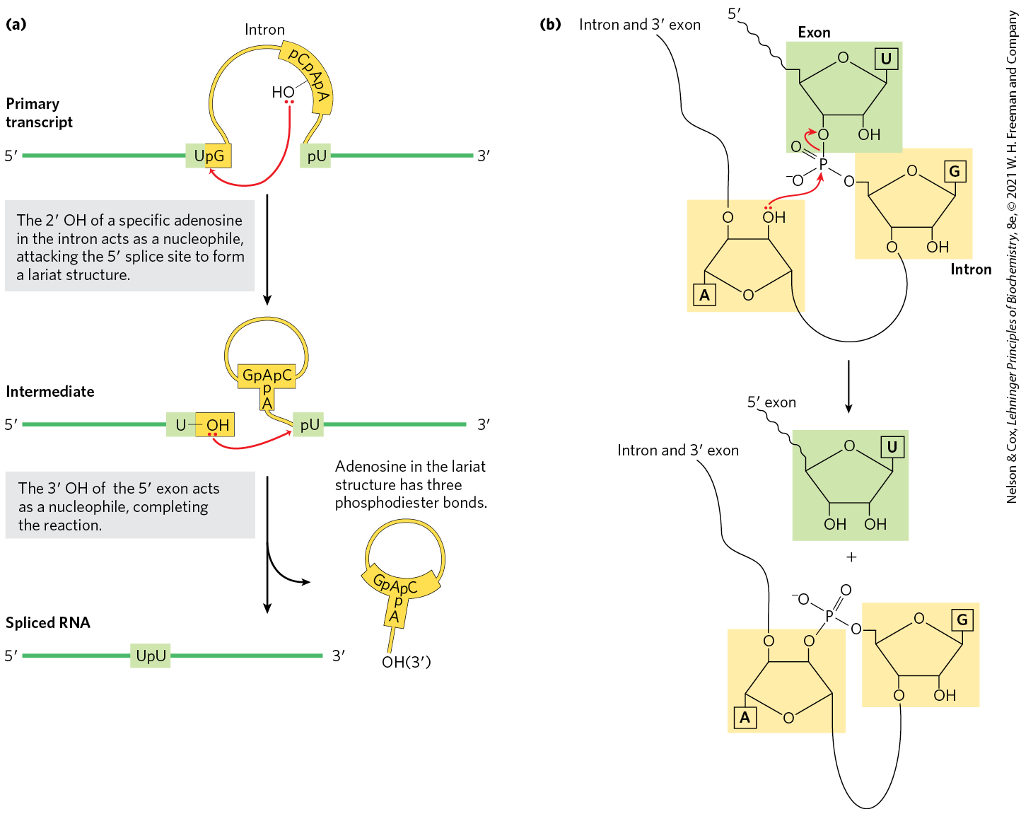
Splicing Mechanism of
Group II Introns
a branched lariat structure forms as an intermediate

Slide 112
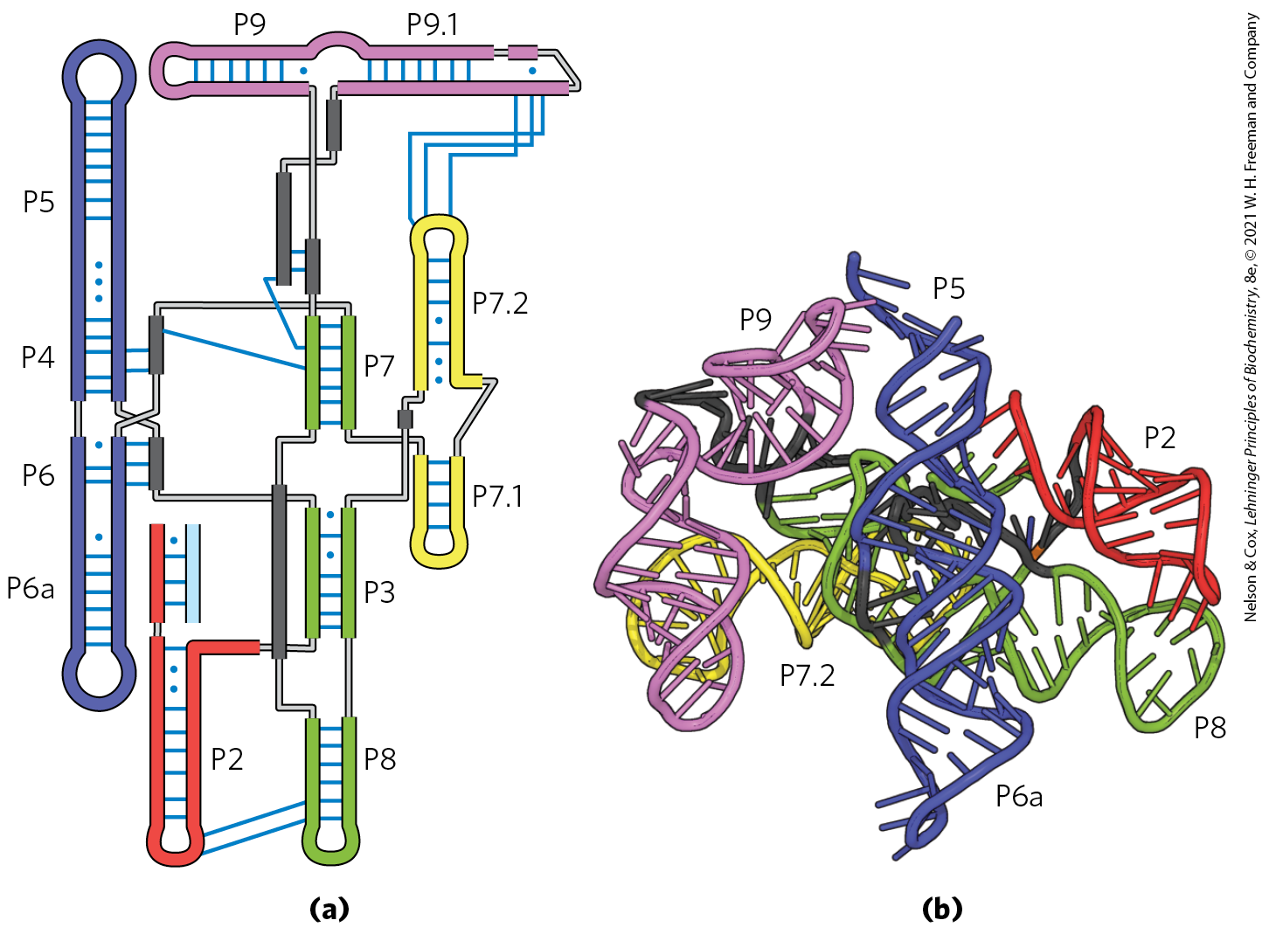
Structure of a Group I Intron

Slide 113
Clicker Question 20
Self-splicing of:
group I introns requires GTP.
group II introns results in a product that has an adenosine with three phosphodiester bonds.
group I introns produces a lariat structure.
group II introns uses the 2′-OH of a guanosine in the intron as a nucleophile.
Notes:
Answer: B
Principle: 26.2
Learning Objective(s): Explain self-splicing.
Bloom’s: 2:2

Slide 114
Clicker Question 20, Response
Self-splicing of:
group II introns results in a product that has an adenosine with three phosphodiester bonds.
The 2′-OH of a specific adenosine in the group II intron acts as a nucleophile, attacking the 5′ splice site to form a lariat structure. Adenosine in the lariat structure has three phosphodiester bonds.

Slide 115
Principle 2 (6 of 8)
Many RNAs must be modified and processed to become functional. RNAs can be modified by nucleases, by excision of certain RNA segments, and/or by chemical modification of the RNA nucleotides. In humans, nearly all mRNAs are 5′ capped, spliced, and polyadenylated before being exported from the nucleus for translation in the cytoplasm.

Slide 116
In Eukaryotes, the Spliceosome Carries out Nuclear pre-mRNA Splicing
spliceosome introns are the most common intron in eukaryotes
  GU at the 5′ end and AG at the 3′ end mark the sites of splicing
some splicing apparatus components are tethered to the CTD of RNA polymerase II
  indicates splicing is tightly coordinated with transcription

Slide 117
The Spliceosome and snRNAs
spliceosome = a large complex made up of multiple specialized RNP complexes called small nuclear ribonucleoproteins (snRNPs) and dozens of other proteins
small nuclear RNAs (snRNAs) = 100-200 nucleotide RNAs that make up snRNPs
  U1, U2, U4, U5, and U6 are abundant in the nuclei

Slide 118
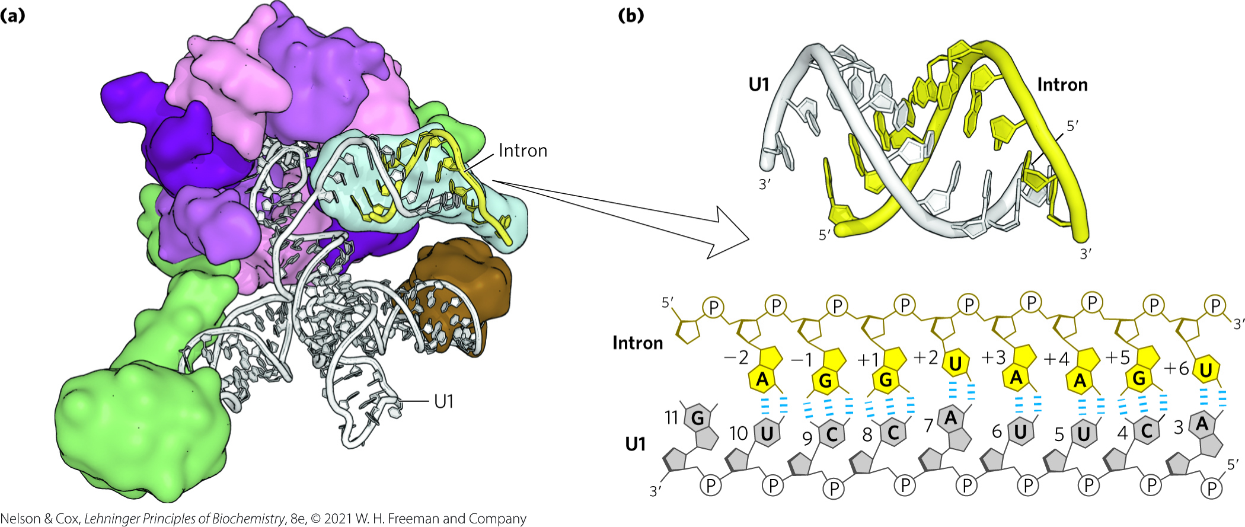
Binding of U1 and U2 snRNA
U1 snRNA base pairs with the 5′ splice site
U2 snRNP base pairs with the 3′ end and identifies the A residue that becomes the nucleophile

Slide 119
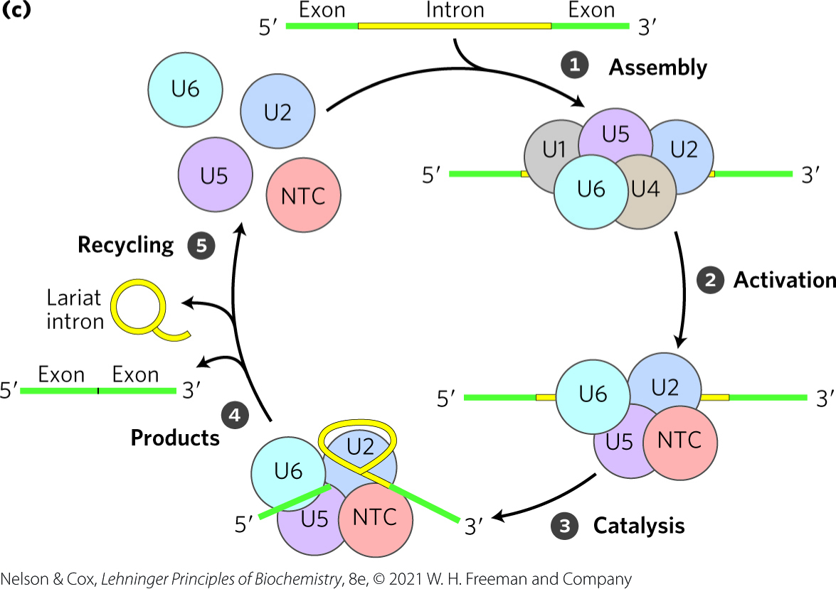
Spliceosome Assembly
addition the tri-snRNP (a complex of U4, U5, and U6 snRNPs) forms the spliceosome
ATP is required for assembly
spliceosomes are single turnover enzymes

Slide 120
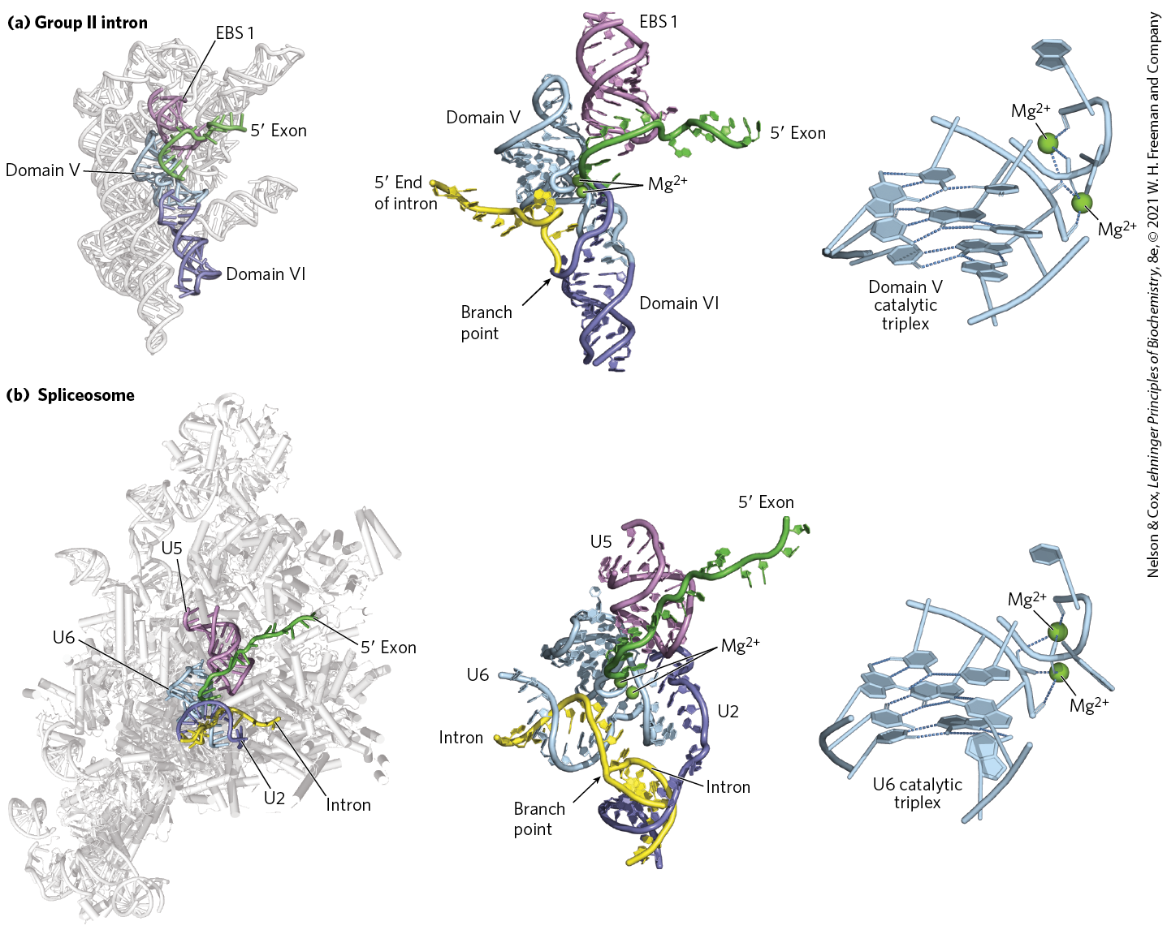
RNA Active Site Conservation
the chemical events of splicing are identical in mechanism to that of group II introns

Slide 121
Clicker Question 21
Which statement regarding eukaryotic mRNA splicing is false?
It involves a transesterification reaction.
The splicing is catalyzed by the RNA components of the spliceosome.
The spliceosome is associated with the C-terminal domain of RNA Pol II.
All mRNA introns require some sort of spliceosome for removal.
Notes:
Answer: D
Principle: 26.2
Learning Objective(s): Explain the action of the spliceosome.
Bloom’s: 2:2

Slide 122
Clicker Question 21, Response
Which statement regarding eukaryotic mRNA splicing is false?
All mRNA introns require some sort of spliceosome for removal.
There are four classes of introns. The first two, the group I and group II introns, differ in the details of their splicing mechanisms but share one surprising characteristic: they are self-splicing — no proteins are needed to carry out catalysis.

Slide 123
Proteins Catalyze Splicing of tRNAs
found in certain tRNAs and a few mRNAs
endonucleases cleave the phosphodiester bonds at both ends of the intron
ligases join the two exons

Slide 124
Principle 2 (7 of 8)
Many RNAs must be modified and processed to become functional. RNAs can be modified by nucleases, by excision of certain RNA segments, and/or by chemical modification of the RNA nucleotides. In humans, nearly all mRNAs are 5′ capped, spliced, and polyadenylated before being exported from the nucleus for translation in the cytoplasm.

Slide 125
Eukaryotic mRNAs Have a Distinctive 3′ End Structure
poly(A) tail = a string of A residues added to the 3′ end of most eukaryotic mRNAs that undergo translation
  ~30 residues in yeast and 50-100 in animals
  serves as a binding site for specific proteins
  may help protect mRNA from enzymatic destruction

Slide 126
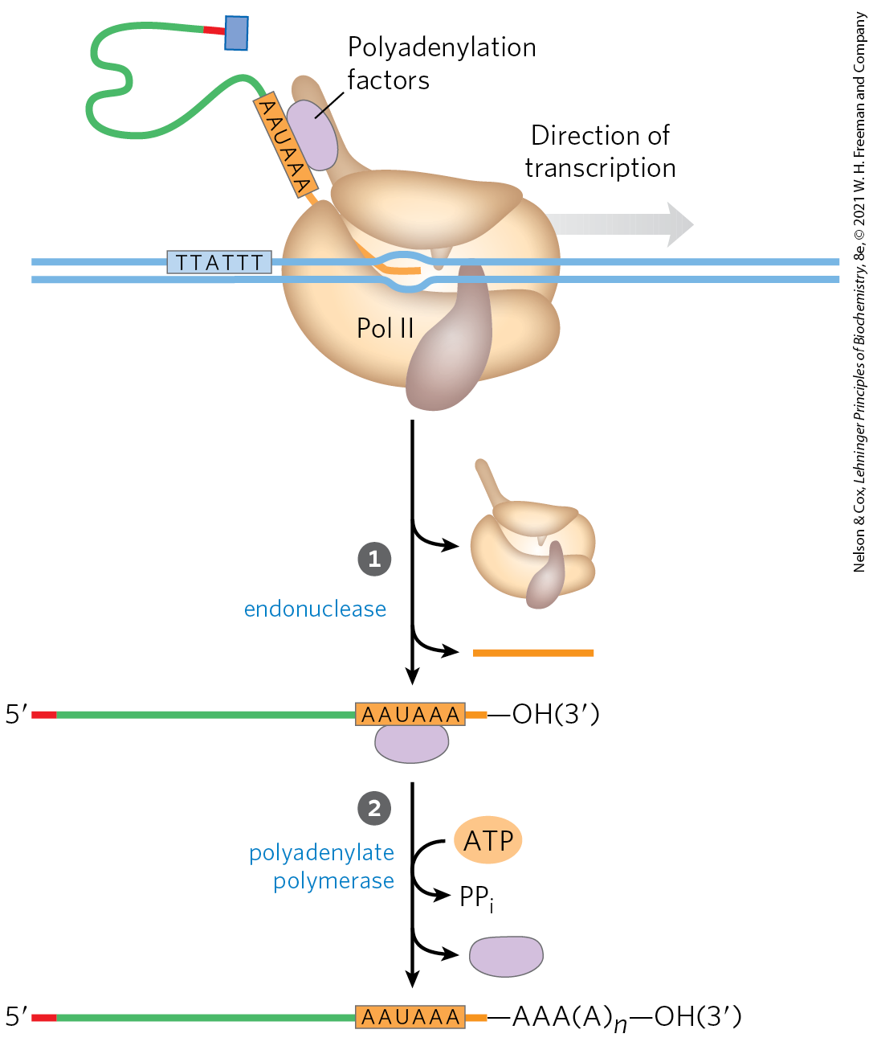
Addition of the Poly(A) Tail
endonuclease cleaves at the poly(A) addition site
the addition site is:
  10-30 nucleotides downstream from the highly conserved sequence (5′)AAUAAA(3′)
  20-40 nucleotides upstream from a sequence rich in G and U residues

Slide 127
Clicker Question 22
Which statement is false regarding the mRNA poly(A) tail?
The cleavage site is marked by a region rich in guanine and uracil residues on the 5′ side.
The mRNA 3′ end is cleaved prior to the addition of the poly(A) tail.
Polyadenylate polymerase adds the poly(A) tail to the free 3′-OH.
ATP provides the energy required for the poly(A) tail addition.
Longer poly(A) tails added in the nucleus are significantly shortened after mRNA transport to the cytoplasm.
Notes:
Answer: A
Principle: 26.2
Learning Objective(s): Explain the end processing of a transcript, including the addition of a poly(A) tail, that occurs in the nucleus.
Bloom’s: 2:2

Slide 128
Clicker Question 22, Response
Which statement is false regarding the mRNA poly(A) tail?
The cleavage site is marked by a region rich in guanine and uracil residues on the 5′ side.
The mRNA site where cleavage occurs is marked by two sequence elements: the highly conserved sequence (5′)AAUAAA(3′), 10 to 30 nucleotides on the 5′ side (upstream) of the cleavage site, and a less well-defined sequence rich in G and U residues, 20 to 40 nucleotides downstream of the cleavage site.

Slide 129
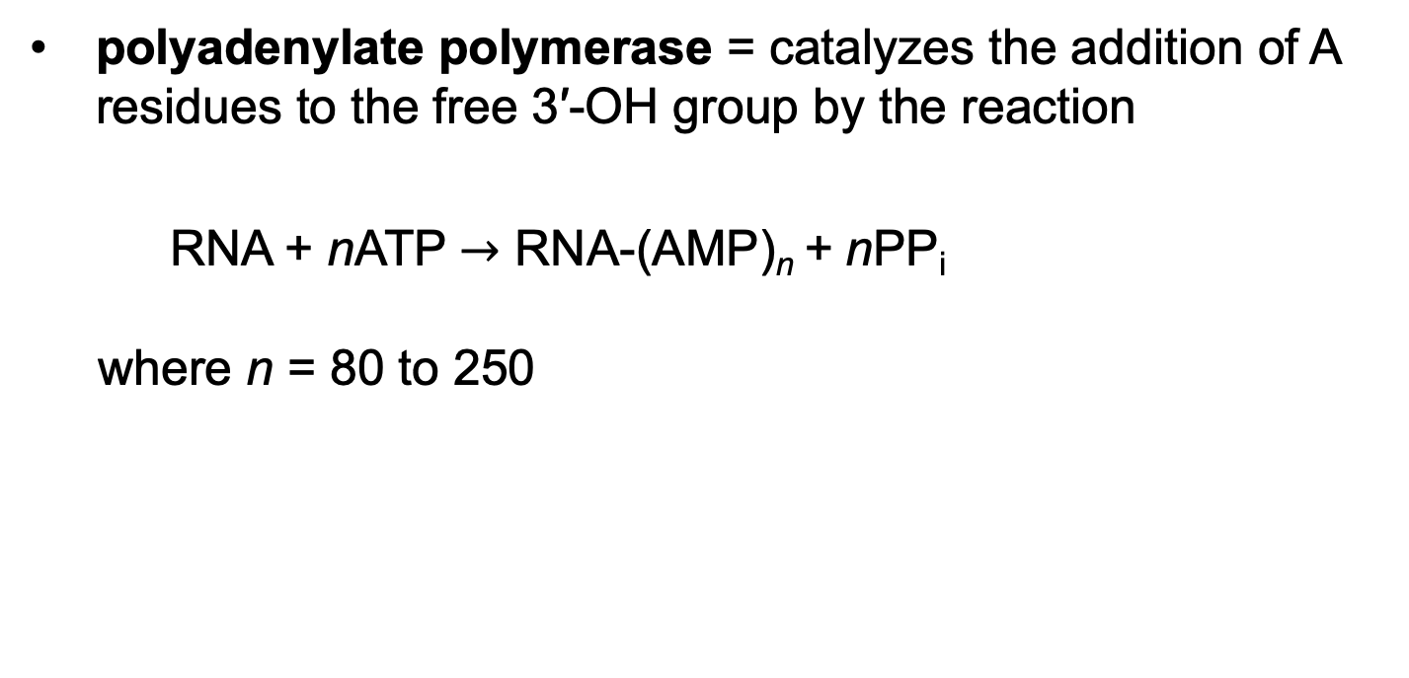
Polyadenylate Polymerase
polyadenylate polymerase = catalyzes the addition of A residues to the free 3′-OH group by the reaction
RNA + nATP $→$ RNA-(AMP)_{n} + nPP_{i}
where n = 80 to 250

Slide 130
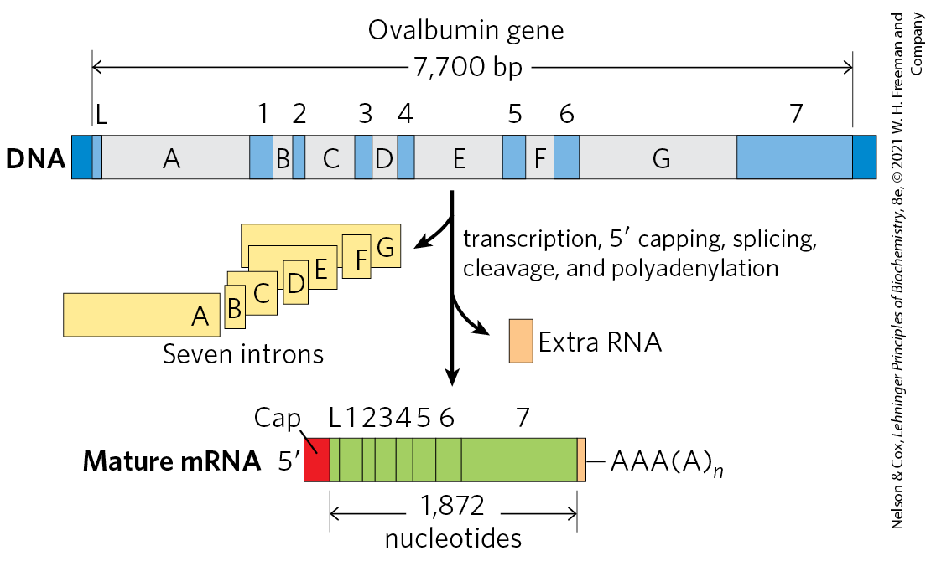
Overview of mRNA Processing

Slide 131
A Gene Can Give Rise to Multiple Products by Differential RNA Processing
some eukaryotic mRNA transcripts can be processed in more than one way to produce different mRNAs and thus different polypeptides
alternative splicing = process in which a particular exon may or may not be incorporated into the mature mRNA transcript
  occurs in >95% of human genes

Slide 132
Clicker Question 23
Alternative splicing:
allows one gene to code for more than one protein.
is the use of either a spliceosome or not for a self-splicing intron.
occurs in prokaryotes, but only rarely in eukaryotes.
describes how the same gene from different organisms can be spliced differently.
Notes:
Answer: A
Principle: 26.2
Learning Objective(s): Explain how alternative splicing gives rise to different polypeptides.
Bloom’s: 2:2

Slide 133
Clicker Question 23, Response
Alternative splicing:
allows one gene to code for more than one protein.
Some eukaryotic mRNA transcripts can be processed in more than one way to produce different mRNAs and thus different polypeptides. Much of the variability in processing is the result of alternative splicing, in which a particular exon may or may not be incorporated into the mature mRNA transcript.

Slide 134
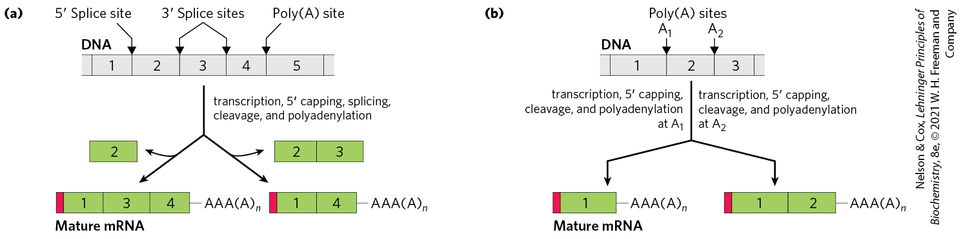
Alternative Transcript Production in Eukaryotes
pre-mRNA contains molecular signals for all the alternative processing pathways
  RNA-binding proteins promote one particular path
complex transcripts can have more than one site where poly(A) tails can form (poly(A) site)

Slide 135
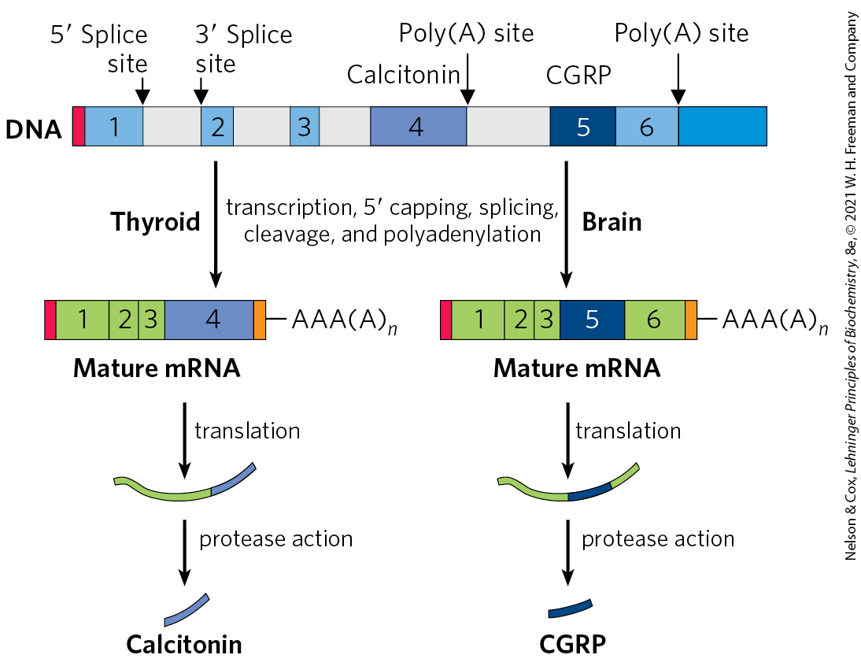
Alternative Processing of the Calcitonin Gene Transcript in Rats
alternative splicing and poly(A) site choice increase the variety of proteins generated from the genomes of higher eukaryotes

Slide 136
Clicker Question 24
A single primary transcript can be used for the production of different mRNA molecules that code for different proteins, such as different classes of immunoglobulins. How is that accomplished in eukaryotes?
by using different isozymes of polyadenylate polymerase
by alternative polyadenylation sites on the RNA
through expression of different regulatory proteins
by addition of the 5′ cap to different bases
by transposition of exons
Notes:
Answer: B
Principle: 26.2
Learning Objective(s): Explain how poly(A) site choice gives rise to diversity.
Bloom’s: 2:2

Slide 137
Clicker Question 24, Response
A single primary transcript can be used for the production of different mRNA molecules that code for different proteins, such as different classes of immunoglobulins. How is that accomplished in eukaryotes?
by alternative polyadenylation sites on the RNA
If there are two or more sites where poly(A) tails can form, use of the one closest to the 5′ end will remove more of the primary transcript sequence. This mechanism, called poly(A) site choice, generates diversity in the variable domains of immunoglobulin heavy chains.

Slide 138
Ribosomal RNAs and tRNAs Also Undergo Processing
pre-ribosomal RNAs (pre-rRNAs) = longer precursors of ribosomal RNAs
transfer RNAs are also derived from longer precursors
these RNAs may contain modified nucleosides

Slide 139
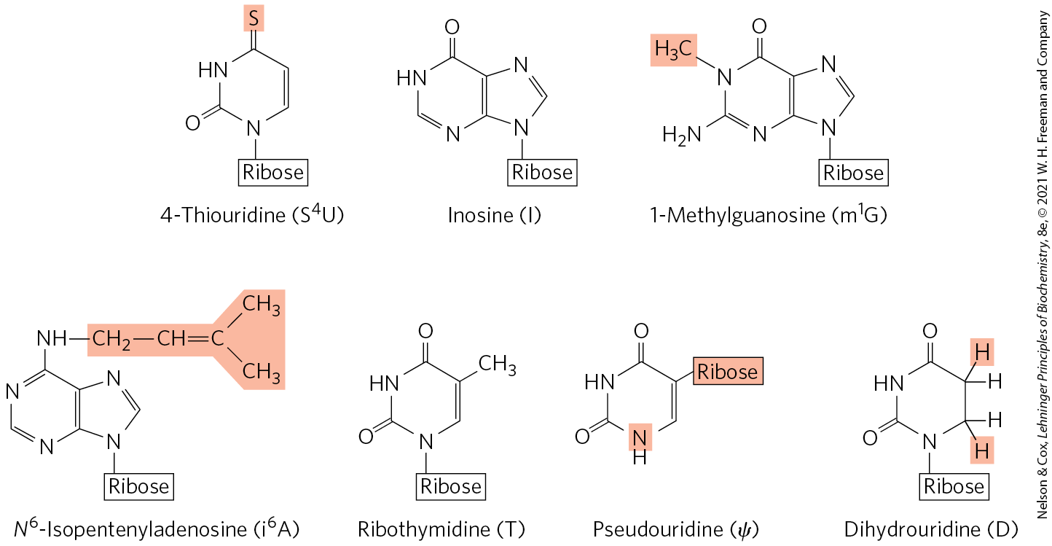
Some Modified Bases of RNA Produced in Posttranscriptional Reactions

Slide 140
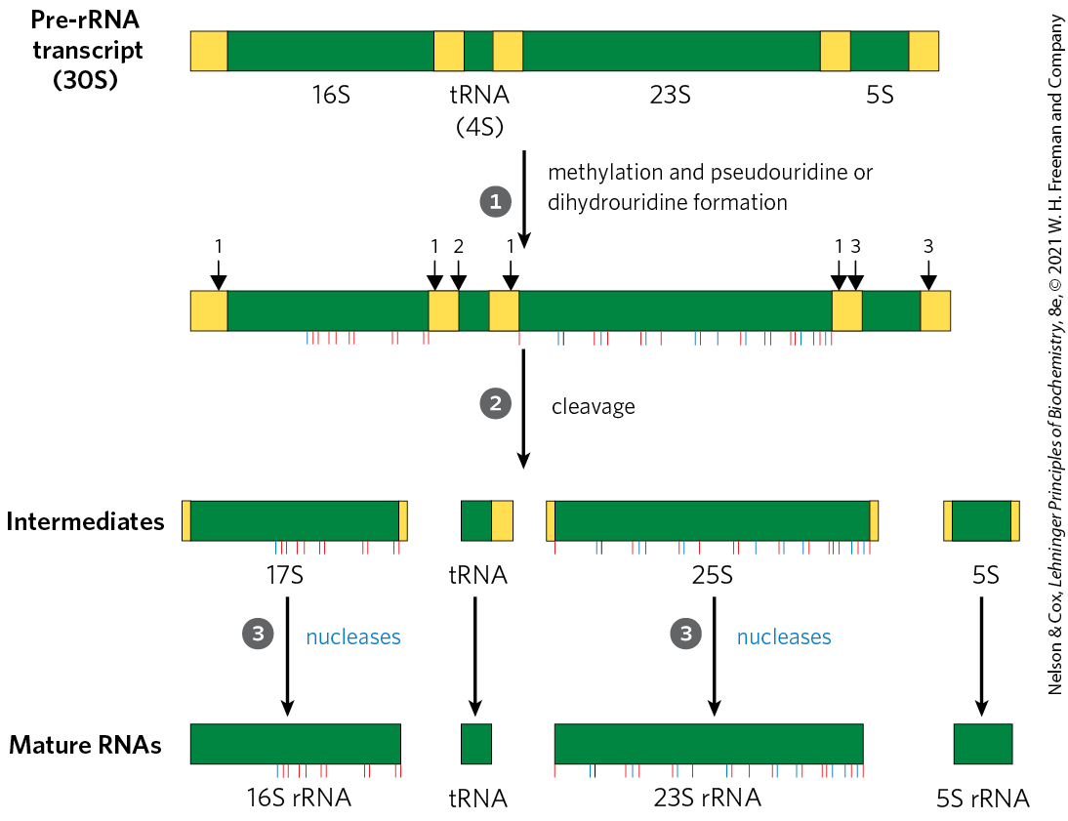
Ribosomal RNAs
in bacteria, a single 30S RNA precursor encodes 16S, 23S, 5S rRNAs, and some tRNAs
the 16S and 23S rRNAs contain modified nucleosides

Slide 141
Eukaryotic Ribosomal RNAs
processing is initiated in the nucleolus, in large complexes that assemble on the rRNA precursor as it is synthesized
  tight coupling occurs between rRNA transcription, rRNA maturation, and ribosome assembly in the nucleolus
each complex includes:
  ribonucleases that cleave the rRNA precursor
  enzymes that modify particular bases
  small nucleolar RNAs (snoRNAs) = ncRNAs that guide nucleoside modification and some cleavage reactions
  ribosomal proteins

Slide 142
Nucleoside Modifications in Eukaryotic rRNAs
common nucleoside modifications include:
  conversion of uridine to pseudouridine
  adoMet-dependent nucleoside methylation
snoRNAs = 60 to 300 nucleotide RNAs that bind to rRNA to identify the modification site
snoRNA-protein complexes (snoRNPs) = complexes of a snoRNA and proteins that carry out nucleoside modifications
  box H/ACA snoRNPs function in pseudouridylylation
  box C/D snoRNPs function in in 2′-O-methylations

Slide 143
Clicker Question 25
Which statement is false regarding eukaryotic ribosomal RNA?
The seven pre-rRNA molecules have identical rRNA-coding regions, but different segments in between.
Small nucleolar RNA-protein complexes generate uridine to pseudouridine conversion.
Small nucleolar RNAs guide nucleoside modification and some cleavage reactions.
rRNA processing takes place in the nucleolus.
Small nucleolar RNA-protein complexes cause adoMet-dependent nucleoside methylation.
Notes:
Answer: A
Principle: 26.2
Learning Objective(s): Explain the processing that occurs to rRNAs.
Bloom’s: 2:2

Slide 144
Clicker Question 25, Response
Which statement is false regarding eukaryotic ribosomal RNA?
The seven pre-rRNA molecules have identical rRNA-coding regions, but different segments in between.
The genome of E. coli, not eukaryotes, encodes seven pre-rRNA molecules with essentially identical rRNA-coding regions.

Slide 145
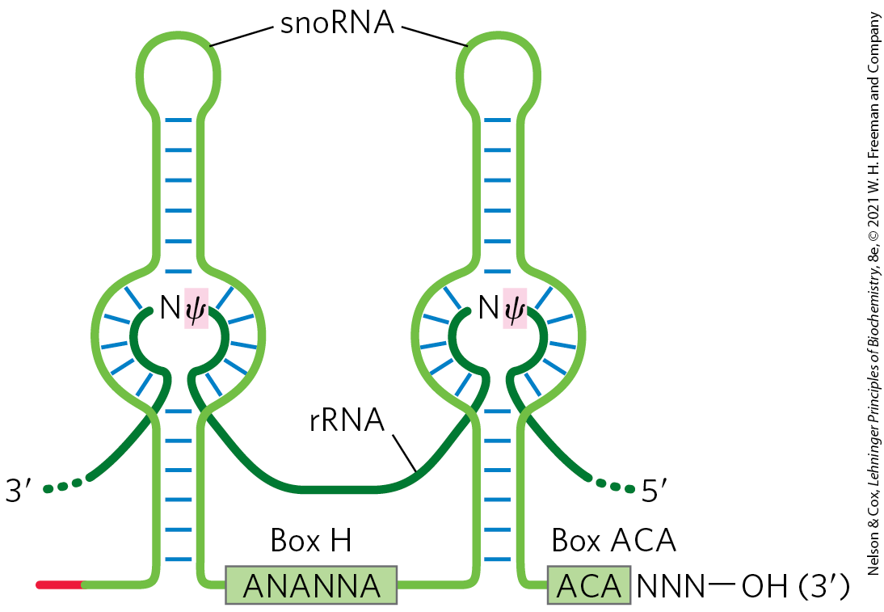
RNA Pairing with Box
H/ACA snoRNAs to Guide Pseudouridylations

Slide 146
Transfer RNAs
most cells have 40 to 50 distinct tRNAs
eukaryotic cells have multiple copies of many of the tRNA genes
transfer RNAs are derived from longer RNA precursors by enzymatic removal of nucleotides from the 5′ and 3′ ends
  the endonuclease RNase P removes RNA at the 5′ end
  1+ nucleases, including the exonuclease RNase D, remove RNA at the 3′ end

Slide 147
Further Post-Transcriptional Processing of tRNA Precursors
further post-transcriptional processing includes:
  addition of the 3′-terminal trinucleotide CCA(3′) by tRNA nucleotidyltransferase
  modification of some bases by methylation, deamination, or reduction

Slide 148
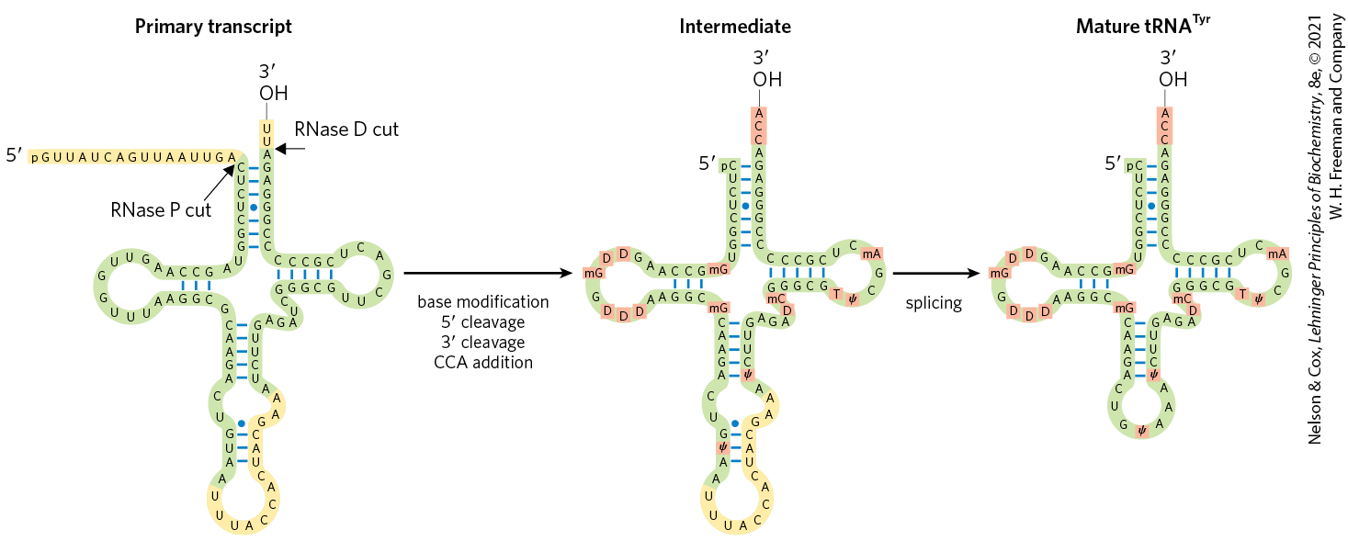
Processing of tRNAs in Bacteria and Eukaryotes

Slide 149
Special-Function RNAs Undergo
Several Types of Processing
snRNAs and snoRNAs are synthesized as larger precursors and then processed
microRNAs (miRNAs) = a special class of non-coding RNAs that promote mRNA degradation and suppress translation to fine-tune gene expression
  ~22 nucleotides long
  complementary in sequence to particular regions of mRNAs
  found in plants and in animals

Slide 150
Clicker Question 26
Posttranscriptional modifications are NOT made to bases in:
ribosomal RNA.
messenger RNA.
transfer RNA.
silencing RNA.
All of these can have posttranscriptional modifications.
Notes:
Answer: E. See Figure 26-23, for example.
Principle: 26.2
Learning Objective(s): Explain the processing that occurs to tRNAs.
Bloom’s: 2:2

Slide 151
Clicker Question 26, Response
Posttranscriptional modifications are NOT made to bases in:
All of these can have posttranscriptional modifications.
Posttranscriptional processing is not limited to mRNA. For example, both ribosomal and transfer RNAs are derived from longer precursors. These RNAs may also contain a variety of modified nucleosides.

Slide 152
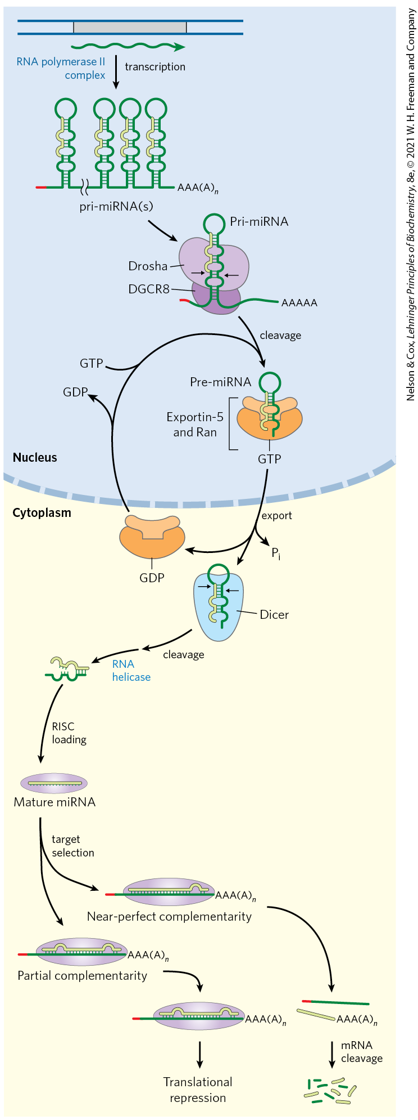
Synthesis and Processing of miRNAs
some primary transcripts for miRNAs (pri-miRNAs) are encoded in the introns of other genes
processing of pri-miRNA is mediated by the endoribonucleases Drosha and Dicer

Slide 153
Steps in miRNA Processing
in the nucleus, Drosha and DGCR8 reduce pri-miRNA to a 70−80 nucleotide precursor miRNA (pre-miRNA)
exportin-5 and Ran GTPase export pre-miRNA to the cytoplasm
Ran hydrolyzes the GTP and exportin-5 and the pre-miRNA are released
Dicer produces nearly mature miRNA paired with a short RNA complement

Slide 154
Steps in miRNA
Processing, Continued
an RNA helicase removes the complement
miRNA is loaded onto a protein complex such as RNA-induced silencing complex (RISC)
RISC binds to target mRNA

Slide 155
RISC-miRNA Binding to Target mRNA
if the complementarity between miRNA and its target is nearly perfect, the target mRNA is cleaved
if the complementarity is only partial, the complex blocks translation of the target mRNA

Slide 156
Clicker Question 27
Which statement is false regarding the RNA-induced silencing complex (RISC)?
It functions in the cytoplasm of the cell.
It incorporates mature miRNA to form a protein complex.
If there is a perfect match between the miRNA and the target, RISC cleaves the target.
If there is a partial match between the miRNA and the target, RISC blocks transcription.
Notes:
Answer: D
Principle: 26.2
Learning Objective(s): Explain the processing of microRNAs.
Bloom’s: 2:2

Slide 157
Clicker Question 27, Response
Which statement is false regarding the RNA-induced silencing complex (RISC)?
If there is a partial match between the miRNA and the target, RISC blocks transcription.
If the complementarity is only partial, the complex blocks translation, not transcription, of the target mRNA. If the complementarity between miRNA and its target is nearly perfect, the target mRNA is cleaved.

Slide 158
Principle 2 (8 of 8)
Many RNAs must be modified and processed to become functional. RNAs can be modified by nucleases, by excision of certain RNA segments, and/or by chemical modification of the RNA nucleotides. In humans, nearly all mRNAs are 5′ capped, spliced, and polyadenylated before being exported from the nucleus for translation in the cytoplasm.

Slide 159
Cellular mRNAs Are Degraded at Different Rates
the cellular concentration of mRNA helps govern the level of gene expression
degradative pathways ensure that mRNAs do not build up in the cell and direct the synthesis of unnecessary proteins
rates of degradation vary greatly for eukaryotic mRNAs
  average half-life is ~3 hours

Slide 160
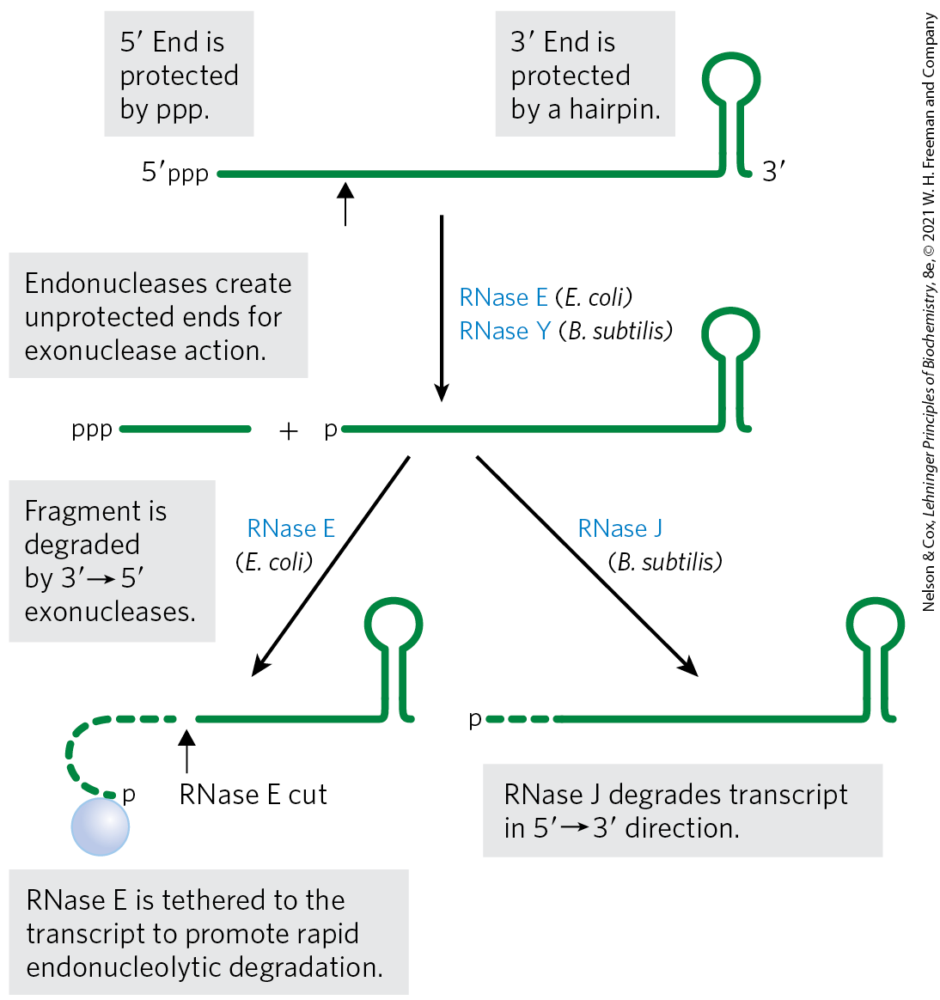
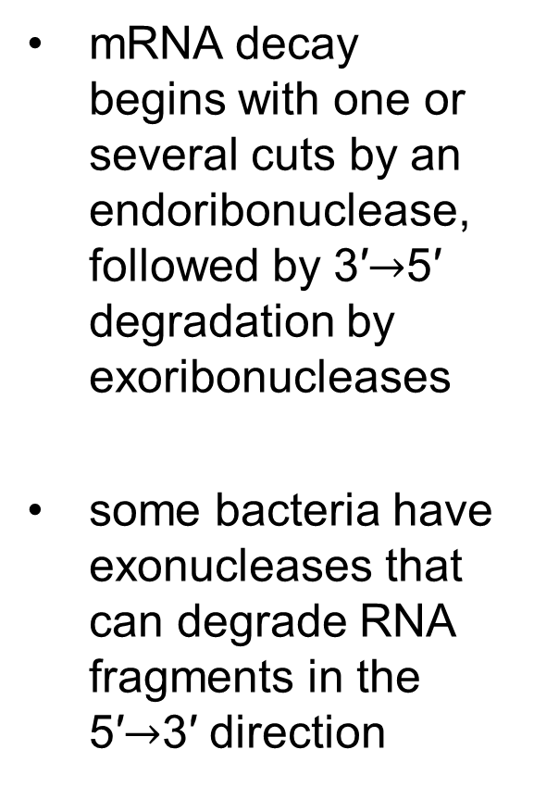
Degradation of RNA in Bacteria
mRNA decay begins with one or several cuts by an endoribonuclease, followed by 3′$→$5′ degradation by exoribonucleases
some bacteria have exonucleases that can degrade RNA fragments in the 5′$→$3′ direction

Slide 161

Polynucleotide
Phosphorylase (PNPase)
polynucleotide phosphorylase (PNPase) = a common 3′$→$5′ exoribonuclease responsible for the degradation of many mRNAs in bacteria, chloroplasts, and mitochondria
  catalyzes reversible phosphorolysis of mRNA using orthophosphate as the nucleophile

Slide 162
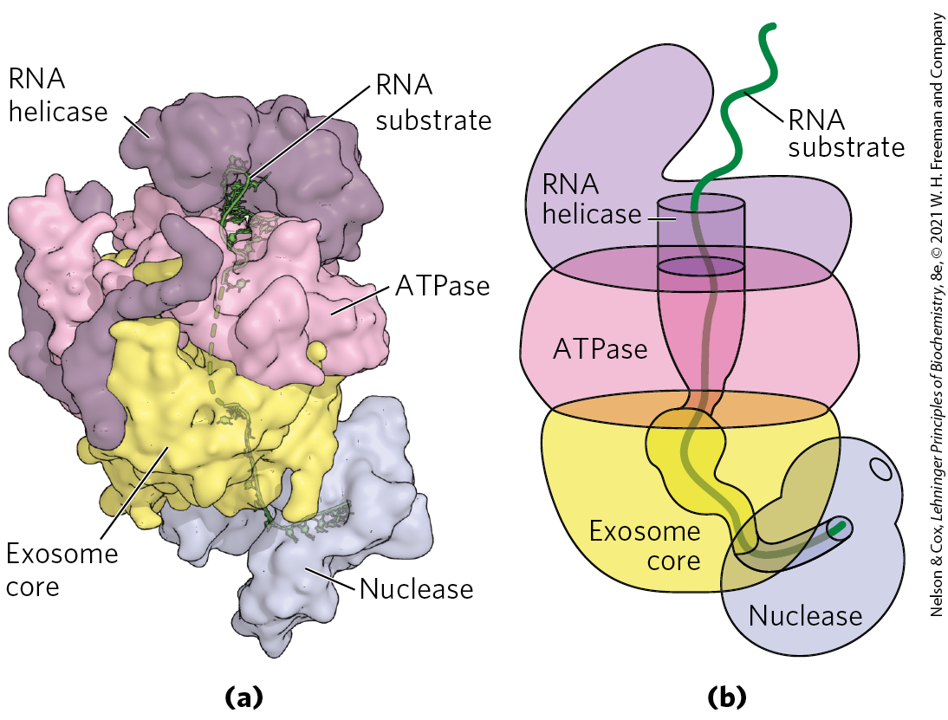
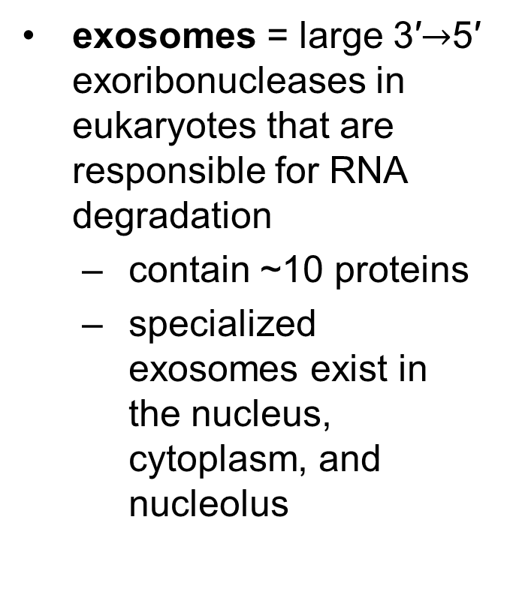
Exosomes
exosomes = large 3′$→$5′ exoribonucleases in eukaryotes that are responsible for RNA degradation
  contain ~10 proteins
  specialized exosomes exist in the nucleus, cytoplasm, and nucleolus

Slide 163
Clicker Question 28
Degradation of cellular mRNA is NOT associated with:
import into the lysosomes in eukaryotes.
greatly variable rates in eukaryotes.
resistance to degradation in bacterial mRNAs due to the hairpin structure in ρ-independent termination of transcription.
3′→5′ degradation in higher eukaryotes by the exosome.
Notes:
Answer: A
Principle: 26.2
Learning Objective(s): Explain the role of exosomes in eukaryotic RNA degradation.
Bloom’s: 1:1

Slide 164
Clicker Question 28, Response
Degradation of cellular mRNA is NOT associated with:
import into the lysosomes in eukaryotes.
Cytosolic endonucleases degrade mRNA in bacteria, and large 3′→5′ exoribonucleases called exosomes degrade nearly all types of RNA in eukaryotes.

Slide 165

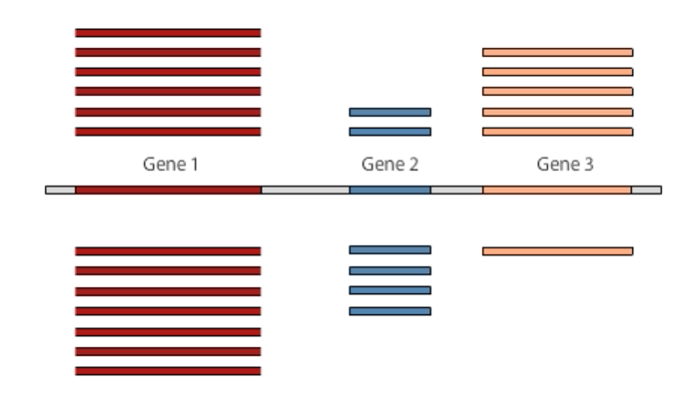
Activity: Sequencing mRNA
Watch the Animated Technique video titled “RNA Sequencing” in your Achieve course.
Notes:
Instructor: This Animated Technique video is found within Chapter 9 of Achieve. It is in the folder titled “Ch9 In-Class Activities, Videos, and Resources.”

Slide 166
Activity Instructions (2 of 3)
On your own, think of answers to the question:
  Consider how RNAseq is used to identify and quantify the levels of mRNA transcripts in different cell types in humans. What structural features do almost all mRNAs have in common? (2 minutes)
Pair up to discuss your ideas. (2 minutes)
Share your ideas with the class in group discussion. (3 minutes)
Notes:
Instructor: This Animated Technique video is found within Chapter 9 of Achieve. It is in the folder titled “Ch9 In-Class Activities, Videos, and Resources.”

Slide 167
Activity Solution (2 of 3)
  What structural features do almost all mRNAs have in common? In humans, nearly all mRNAs are 5ʹ capped, spliced, and polyadenylated before being exported from the nucleus for translation in the cytosol.
Notes:
Instructor: This Animated Technique video is found within Chapter 9 of Achieve. It is in the folder titled “Ch9 In-Class Activities, Videos, and Resources.”

Slide 168
26.3 RNA-Dependent Synthesis of RNA and DNA

Slide 169
Principle 3 (2 of 4)
RNA can be used as a template for synthesis of DNA by reverse transcriptases. RNA carries genetic information that can be reverse transcribed into DNA. Retroviruses, such as HIV or those responsible for some cancers, must convert their RNA genomes into DNA by reverse transcription. Reverse transcription by telomerase is also responsible for producing the telomeres that protect the DNA found at the ends of eukaryotic chromosomes.

Slide 170
Reverse Transcriptase Produces DNA from Viral RNA
reverse transcriptase = an RNA-dependent DNA polymerase
  contained within certain RNA viruses called retroviruses
  discovery showed genetic information can flow “backward” from RNA to DNA
reverse transcriptase catalyzes conversion of viral RNA to dsDNA, which is often integrated into the host genome

Slide 171
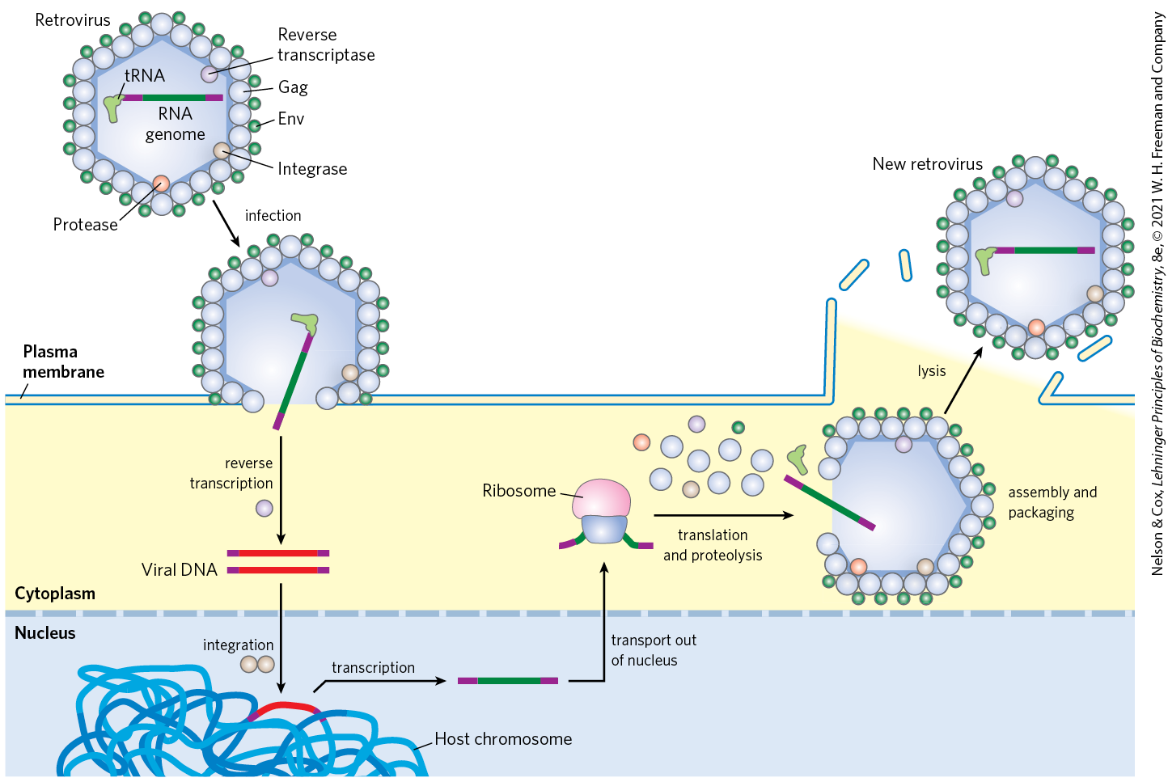
Retroviral Infection of a
Mammalian Cell

Slide 172
Retroviruses Have Three Genes and LTR Sequences
gag = encodes the proteins of the interior viral core
pol = encodes the protease that cleaves the long polypeptide, an integrase, and reverse transcriptase
env = encodes the proteins of the viral envelope
long terminal repeat (LTR) sequences facilitate integration into host DNA

Slide 173
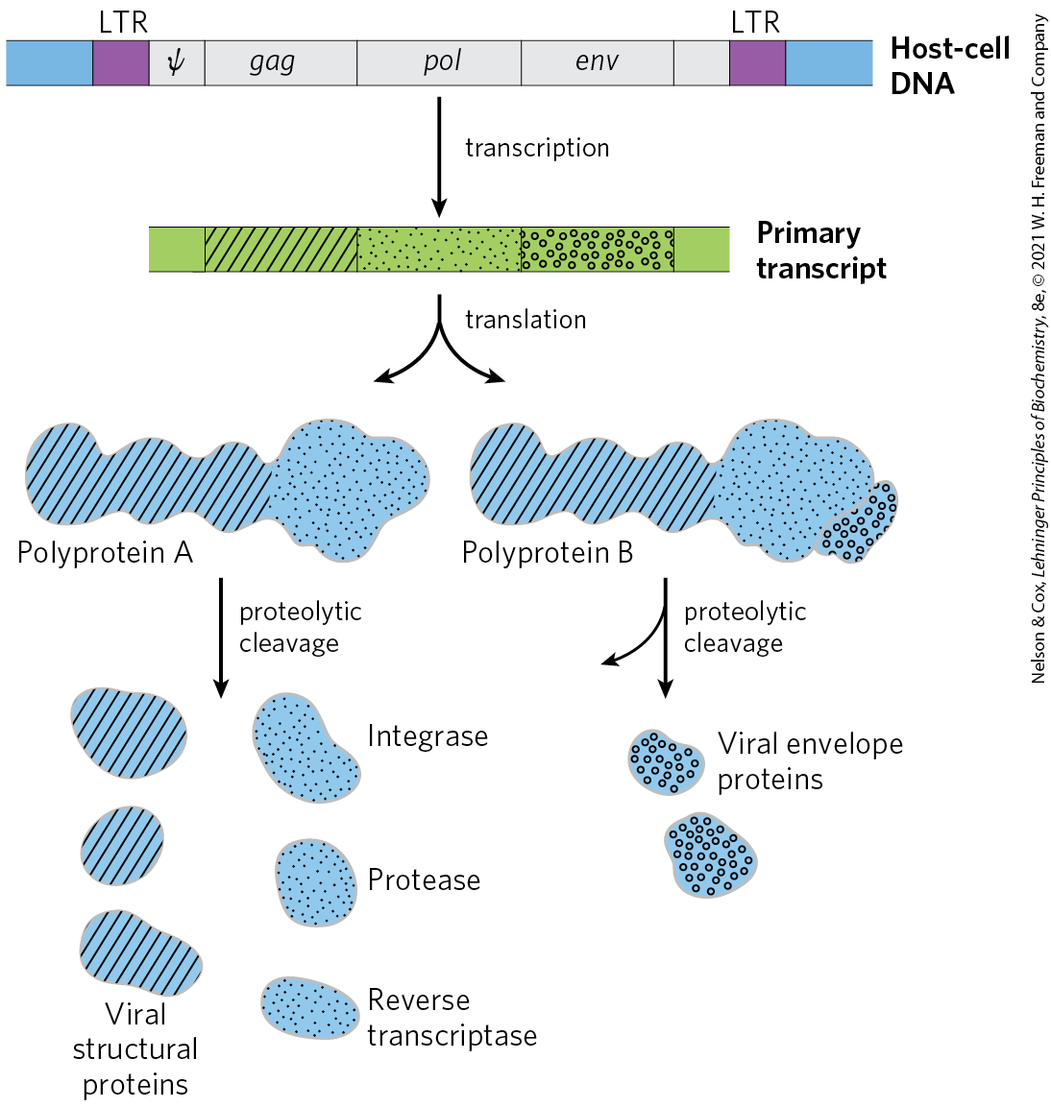
Structure and Gene Products of an Integrated Retroviral Genome

Slide 174
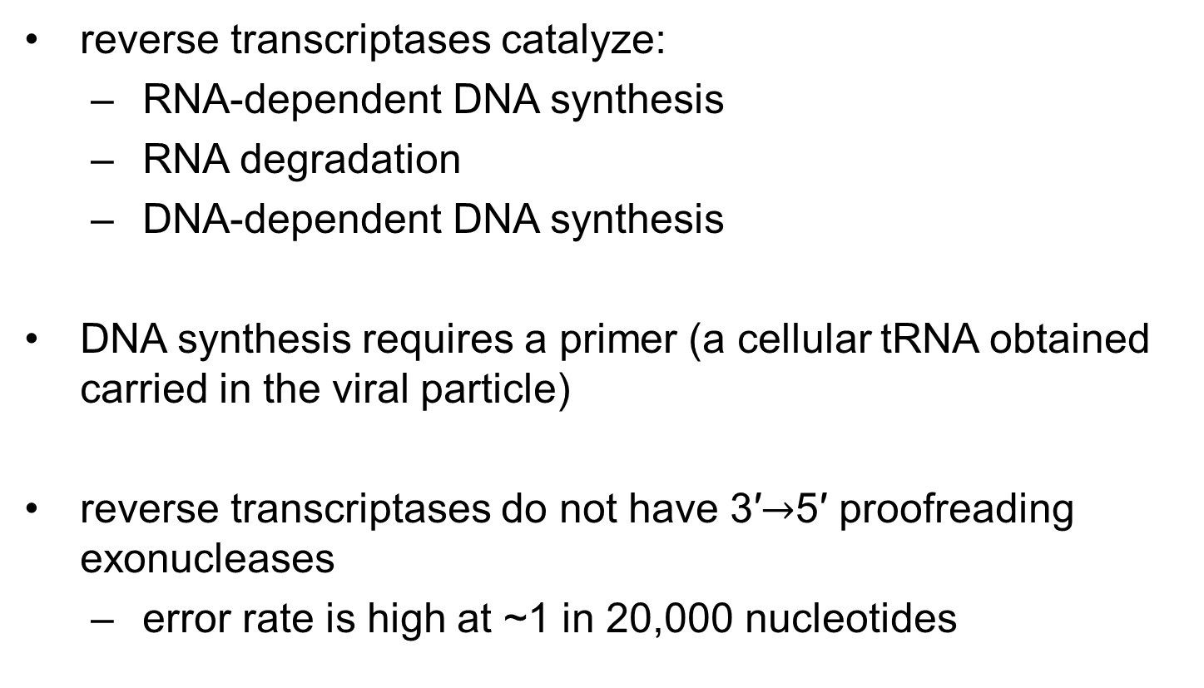
Reverse Transcriptases Catalyze Three Reactions
reverse transcriptases catalyze:
  RNA-dependent DNA synthesis
  RNA degradation
  DNA-dependent DNA synthesis
DNA synthesis requires a primer (a cellular tRNA obtained carried in the viral particle)
reverse transcriptases do not have 3′$→$5′ proofreading exonucleases
  error rate is high at ~1 in 20,000 nucleotides

Slide 175

Clicker Question 29
What biochemical event is necessary for retroviruses to propagate and to cause their characteristic illnesses?
producing mRNA from protein, and then a DNA complementary copy from the RNA
copying genomic RNA directly from the RNA
producing a DNA complementary copy of their genomic RNA
producing a template strand of DNA from their RNA
producing copies of their genomic RNA from existing host cell RNA
Notes:
Answer: C
Principle: 26.3
Learning Objective(s): Define the activity associated with viral reverse transcriptase in retroviruses.
Bloom’s: 2:2

Slide 176
Clicker Question 29, Response
What biochemical event is necessary for retroviruses to propagate and to cause their characteristic illnesses?
producing a DNA complementary copy of their genomic RNA
Retroviruses are RNA viruses that carry an RNA-dependent DNA polymerase called reverse transcriptase within the viral particle. The reverse transcriptase first catalyzes the synthesis of a DNA strand complementary to the viral RNA, then degrades the RNA strand of the viral RNA-DNA hybrid and replaces it with DNA.

Slide 177
Reverse Transcriptases Are Important Reagents
reverse transcriptases permit the synthesis of DNA complementary to an mRNA template
complementary DNA (cDNA) = synthetic DNA prepared by reverse transcriptases
  can be used to clone cellular genes

Slide 178
Principle 3 (3 of 4)
RNA can be used as a template for synthesis of DNA by reverse transcriptases. RNA carries genetic information that can be reverse transcribed into DNA. Retroviruses, such as HIV or those responsible for some cancers, must convert their RNA genomes into DNA by reverse transcription. Reverse transcription by telomerase is also responsible for producing the telomeres that protect the DNA found at the ends of eukaryotic chromosomes.

Slide 179
Some Retroviruses Cause Cancer and AIDS
some retroviruses contain an oncogene that can cause the cell to grow abnormally
  classified as RNA tumor viruses
  example: Rous sarcoma virus (also called avian sarcoma virus)

Slide 180
Clicker Question 30
Reverse transcriptase:
synthesizes RNA from a protein template.
is found in retroviruses.
polymerizes nucleotides in the 3′→5′ direction.
uses a DNA template to guide exonuclease digestion of RNA.
Notes:
Answer: B
Principle: 26.3
Learning Objective(s): Define the activity associated with viral reverse transcriptase in retroviruses.
Bloom’s: 1:1

Slide 181
Clicker Question 30, Response
Reverse transcriptase:
is found in retroviruses.
RNA-dependent DNA polymerases, also called reverse transcriptases, were first discovered in retroviruses, which must convert their RNA genomes into double-stranded DNA as part of their life cycle.

Slide 182
Principle 3 (4 of 4)
RNA can be used as a template for synthesis of DNA by reverse transcriptases. RNA carries genetic information that can be reverse transcribed into DNA. Retroviruses, such as HIV or those responsible for some cancers, must convert their RNA genomes into DNA by reverse transcription. Reverse transcription by telomerase is also responsible for producing the telomeres that protect the DNA found at the ends of eukaryotic chromosomes.

Slide 183

The Human Immunodeficiency
Virus (HIV)
the retrovirus human immunodeficiency virus (HIV) causes acquired immune deficiency syndrome (AIDS)
  kills many of the cells it infects (T lymphocytes)
  leads to suppression of the host immune system
the reverse transcriptase of HIV is very error-prone
  results in 1+ errors every time the genome is replicated

Slide 184

Fighting AIDS With Inhibitors of HIV Reverse Transcriptase
azidothymidine (AZT) is a deoxythymidine analog
  converted to AZT triphosphate inside T lymphocytes
binding of AZT triphosphate to HIV reverse transcriptase competitively inhibits dTTP binding
  terminates viral DNA synthesis
dideoxyinosine (DDI) has a similar mechanism of action

Slide 185
Clicker Question 31
What is the MOST effective treatment for AIDS currently?
monotherapy with a protease inhibitor
monotherapy with a reverse transcriptase inhibitor
monotherapy with an antibiotic
combination therapy with two or more antibiotics
combination therapy with reverse transcriptase inhibitors and a protease inhibitor
Notes:
Answer: E
Principle: 26.3
Learning Objective(s): Explain why AZT is effective on HIV replication.
Bloom’s: 3:2

Slide 186
Clicker Question 31, Response
What is the MOST effective treatment for AIDS currently?
combination therapy with a protease inhibitor and a reverse transcriptase inhibitor
Inhibition of viral enzymes offers the most effective therapy currently available. HIV’s very rapid mutation rate gives it the ability to quickly develop resistance to single-drug treatments.

Slide 187

Many Transposons, Retroviruses, and Introns May Have a Common Evolutionary Origin
retrotransposons = eukaryotic DNA transposons with structures similar to retroviruses
  encode an enzyme homologous to the retroviral reverse transcriptase
  transpose by means of an RNA intermediate,
  lack an env gene and so cannot form viral particles

Slide 188
Homing
many group I and group II introns are also mobile genetic elements
  encode DNA endonucleases that promote their movement
homing = process by which DNA endonucleases promote insertion of the intron into an identical site in a homologous gene that does not contain the intron
  group I intron homing is DNA-based
  group II intron homing occurs through an RNA intermediate

Slide 189


Production of Homing Endonuclease and the Homing Process

Slide 190

Retrohoming
group II intron endonucleases have associated reverse transcriptase activity
retrohoming = process by which in an RNA intron is inserted into a DNA gene followed by production of a DNA copy by a reverse transcriptase

Slide 191
Clicker Question 32
What is common to retroviruses, eukaryotic transposons, and group II retrohoming introns?
They are all infectious agents.
They all have env genes.
They all have long terminal repeats.
They all use RNA to produce a DNA sequence in the genome.
Notes:
Answer: D
Principle: 26.3
Learning Objective(s): Explain how eukaryotic transposons resemble retroviruses.
Bloom’s: 1:1

Slide 192
Clicker Question 32, Response
What is common to retroviruses, eukaryotic transposons, and group II retrohoming introns?
They all use RNA to produce a DNA sequence in the genome.
Many eukaryotic transposons are related to retroviruses, and their mechanism of transposition includes an RNA intermediate. An RNA intermediate is also present in group II intron retrohoming, in which the RNA intron is inserted into a DNA gene followed by production of a DNA copy by a reverse transcriptase.

Slide 193
Telomerase is a Specialized
Reverse Transcriptase
telomeres = structures at the ends of linear eukaryotic chromosomes
  not easily replicated by cellular DNA polymerases because there is no template for an RNA primer

Slide 194


Activity: The Components of Telomerase
Observe the structure of telomerase, a telomere lengthening enzyme with both protein and RNA components, in Mol3D viewer in your Achieve course.
Notes:
Instructor: This Mol3D structure is located in the Achieve course. It can be found in the Chapter 26 content, in the folder titled “Ch26 In-Class Activities and Resources.”

Slide 195
Activity Instructions (3 of 3)
On your own, think of answers to the questions:
  Where is the protein region of telomerase? Select a protein region and upload a screenshot to your course.
  Where is the RNA region of telomerase? Select an RNA region and upload a screenshot to your course.
  (2 minutes)
Pair up to discuss your ideas. (2 minutes)
Share your ideas with the class in group discussion.
(3 minutes)
Notes:
Instructor: This Mol3D structure is located in the Achieve course. It can be found in the Chapter 26 content, in the folder titled “Ch26 In-Class Activities and Resources.”

Slide 196
Activity Solution (3 of 3)
  Where is the protein region of telomerase? Select a protein region and upload a screenshot to your course. In Mol3D, the protein regions are shown as ribbon structures (depicted in light green and light blue), primarily consisting of alpha helices.
  Where is the RNA region of telomerase? Select an RNA region and upload a screenshot to your course. In Mol3D, the RNA regions are the helical structures shown in ball-and-stick form.
Notes:
Instructor: This Mol3D structure is located in the Achieve course. It can be found in the Chapter 26 content, in the folder titled “Ch26 In-Class Activities and Resources.”

Slide 197

Telomere Synthesis and Structure
telomerase = a ribonucleoprotein that synthesizes the telomere ends of linear chromosomes
  acts as a specialized reverse transcriptase
  contains an internal RNA with C_{y}A_{x} repeat that serves as a template for synthesis of the T_{x}G_{y} strand of the telomere

Slide 198

T Loops in Telomeres
T loop = specialized structure that sequesters the single-stranded end of the telomere by base pairing
  protect the 3′ ends of chromosomes from nucleases and enzymes that repair double-strand breaks
TRF1 and TRF2 bind the looped DNA

Slide 199
Clicker Question 33
Telomerase:
contains both protein and RNA components.
is a cellular reverse transcriptase.
is essential to maintain the length of chromosomal DNA.
uses its RNA component as a template for 5′→3′ polymerase activity.
All of the answers are correct.
Notes:
Answer: E
Principle: 26.3
Learning Objective(s): Explain the function of telomerase.
Bloom’s: 2:2

Slide 200
Clicker Question 33, Response
Telomerase:
All of the answers are correct.
Telomerase is a specialized reverse transcriptase that adds telomeres to the ends of chromosomes using a small segment of RNA that it carries within itself as a template. Telomere synthesis proceeds in the usual 5′→3′ direction.

Slide 201
Clicker Question 34
Which statement regarding telomerase is false?
It is a reverse transcriptase that carries its own template.
It is a ribonucleoprotein with a catalytic RNA.
In its absence, chromosomes shorten.
It synthesizes numerous copies of a relatively small sequence at the ends of chromosomes.
Notes:
Answer: B
Principle: 26.3
Learning Objective(s): Explain the function of telomerase.
Bloom’s: 2:2

Slide 202
Clicker Question 34, Response
Which statement regarding telomerase is false?
It is a ribonucleoprotein with a catalytic RNA.
Although telomerase is a ribonucleoprotein, the RNA component functions as a template, not a catalyst.

Slide 203
Some RNAs Are Replicated by
RNA-Dependent RNA Polymerase
Other RNA viruses include E. coli bacteriophages, influenza virus, and coronaviruses (SARS, COVID-19)
RNA-dependent RNA polymerase (RNA replicase) = replicate RNA in the host cell
  template-specific for viral RNA
  lack a separate proofreading endonuclease activity
  found in viruses (except retroviruses), plants, protists, fungi, and some simpler animals

Slide 204

RNA-Dependent RNA Polymerases
Share a Common Structural Fold
polymerases involved in viral RNA replication, reverse transcription, retrohoming, and telomere synthesis share structural homology

Slide 205
26.4 Catalytic RNAs and the RNA World Hypothesis

Slide 206
Principle 4 (2 of 5)
RNA can act as both a catalyst and carrier of genetic information. Ribozymes can catalyze chemical transformations using many of the same strategies as protein-based enzymes. The dual capacity of RNA as both a carrier of genetic information and a catalyst is support for the RNA world hypothesis for the evolution of life on Earth.

Slide 207
Ribozymes
ribozymes = RNA enzymes
  examples: self-splicing group I introns, RNase P, hammerhead ribozyme
ribozyme activities are based on two fundamental reactions:
  transesterification
  phosphodiester bond hydrolysis (cleavage)

Slide 208

Clicker Question 35
Ribozymes do NOT include:
the L-19 IVS of the Tetrahymena group I rRNA intron.
hammerhead ribozymes.
splicing endonuclease.
group II introns.
RNase P.
Notes:
Answer: C
Principle: 26.4
Learning Objective(s): Identify types of ribozymes.
Bloom’s: 2:2

Slide 209
Clicker Question 35, Response
Ribozymes do NOT include:
splicing endonuclease.
Splicing endonuclease, which cleaves the phosphodiester bonds at both ends of introns, does not contain a catalytic RNA.

Slide 210
Ribozymes Share Features with Protein Enzymes
similarities between ribozymes and protein enzymes:
  vary greatly in size
  3-D structure important for function
  can be inactivated by heating, denaturing agents, or complementary oligonucleotides
  can be inactivated if essential nucleotides are changed

Slide 211

Secondary Structure of the Self-Splicing rRNA Intron of Tetrahymena
internal guide sequence = base-pairs with exon sequences near the 5′ splice site to promote the alignment of specific bonds to be cleaved and rejoined

Slide 212
Principle 4 (3 of 5)
RNA can act as both a catalyst and carrier of genetic information. Ribozymes can catalyze chemical transformations using many of the same strategies as protein-based enzymes. The dual capacity of RNA as both a carrier of genetic information and a catalyst is support for the RNA world hypothesis for the evolution of life on Earth.

Slide 213
Ribozymes Share Several Properties With Enzymes
shared properties include:
  acceleration of reaction rates
  saturable kinetics
  reaction specificity
  making use of substrate orientation, covalent catalysis, and metal-ion catalysis

Slide 214

In Vitro Catalytic Activity of L-19 IVS
L-19 IVS (intervening sequence) promotes nucleotidyl transfer reactions
  processes ~100 molecules per hour
  is not altered in the reaction

Slide 215
Ribozymes Participate in a Variety of Biological Processes
E. coli RNase P has an RNA component and a protein component
  the M1 RNA alone is capable of cleaving tRNA precursors at the correct position
  the protein component serves to stabilize the RNA or facilitate its function in vivo

Slide 216
Clicker Question 36
What would NOT be expected of a ribozyme?
following Michaelis-Menten kinetics
allosteric regulation
a low K_{d} for a substrate
an optimal pH requirement for activity
function in translation
Notes:
Answer: E
Principle: 26.4
Learning Objective(s): Compare ribozymes to protein enzymes.
Bloom’s: 2:2

Slide 217
Clicker Question 36, Response
What would NOT be expected of a ribozyme?
function in translation
All of the properties of protein enzymes can apply to ribozymes, at least theoretically. However, by their nature, these RNA molecules would not be expected to function as mRNA, rRNA, or tRNA.

Slide 218

Hammerhead Ribozyme
the hammerhead ribozyme catalyzes the hydrolysis of an internal phosphodiester bond
  cleave RNA of virusoids (small RNAs associated with plant RNA viruses)
  use general acid and base catalysis

Slide 219
Principle 4 (4 of 5)
RNA can act as both a catalyst and carrier of genetic information. Ribozymes can catalyze chemical transformations using many of the same strategies as protein-based enzymes. The dual capacity of RNA as both a carrier of genetic information and a catalyst is support for the RNA world hypothesis for the evolution of life on Earth.

Slide 220
Ribozymes Provide Clues to the Origin of Life in an RNA World
RNA world hypothesis = proposal that the evolution of life on Earth may have included an RNA world in which RNA was the central information carrier and catalyst before proteins and DNA emerged as key players

Slide 221

Prebiotic Chemistry Experiments
a concentrated solution of ammonium cyanide, refluxed for a few days, generates adenine in yields of up to 0.5%
most enzyme cofactors contain adenosine and it is the most abundant nucleotide constituent

Slide 222
Principle 4 (5 of 5)
RNA can act as both a catalyst and carrier of genetic information. Ribozymes can catalyze chemical transformations using many of the same strategies as protein-based enzymes. The dual capacity of RNA as both a carrier of genetic information and a catalyst is support for the RNA world hypothesis for the evolution of life on Earth.

Slide 223
The Existence of Catalytic RNAs
in an “RNA world,” RNAs, not proteins, act as catalysts
the discovery of ribozymes gave life to the RNA world hypothesis
the parent of all life on this planet might have been a self- replicating RNA, or a polymer with equivalent chemical characteristics

Slide 224
The Expanding Catalytic Repertoire of Ribozymes
RNA has the potential to catalyze the many reactions needed in a primitive system of metabolic pathways
SELEX = a method that rapidly searches pools of random RNA polymers and extracts those with particular activities
isolated ribozymes have been found that catalyze:
  ester and amide bond formation
  SN2 reactions
  metallation of (addition of metal ions to) porphyrins
  carbon-carbon bond formation

Slide 225
Clicker Question 37
Ribonucleotides called aptamers can be generated using random base additions. How can they then be separated based on binding specificity?
affinity chromatography
polyacrylamide gel electrophoresis
thin-layer chromatography
ion-exchange chromatography
radio-immune assay
Notes:
Answer: A. See Box 26-4, for example. This method is being used to search for ribozymes with specific catalytic properties.
Principle: 26.4
Learning Objective(s): Explain how SELEX can aid in the search for RNAs with new catalytic functions.
Bloom’s: 4:2

Slide 226
Clicker Question 37, Response
Ribonucleotides called aptamers can be generated using random base additions. How can they then be separated based on binding specificity?
affinity chromatography
In the SELEX process, a random mixture of RNA polymers is subjected to “unnatural selection” by passing it through a resin to which ATP is attached. RNA polymers that pass through the column are discarded; those that bind to ATP are washed from the column with salt solution and collected.

Slide 227


Activity: The RNA World
Hypothesis Muddiest Point (1 of 2)
Complete the Ch26 Student Activity, Day 1: The RNA World Hypothesis (Muddiest Point) Achieve assessment.
Notes:
Instructor: This muddiest point activity can be found in Achieve in the Chapter 26 folder titled “Ch26 In-Class Activities and Resources.” See the Instructor Activity Guide in the same folder for more information.

Slide 228

Activity: The RNA World
Hypothesis Muddiest Point (2 of 2)
Complete the Ch26 Student Activity, Day 2: The RNA World Hypothesis (Muddiest Point) Achieve assessment.
Notes:
Instructor: This muddiest point activity can be found in Achieve in the Chapter 26 folder titled “Ch26 In-Class Activities and Resources.” See the Instructor Activity Guide in the same folder for more information.

Slide 229
The Structure of the Ribosome
natural RNA molecules are components of ribosomes, which catalyze the formation of peptide bonds
the evolution of a capacity to synthesize proteins would have been a major event in the RNA world
the information-carrying role of RNA may have passed to DNA because DNA is chemically more stable

Slide 230
Extant Vestiges of an RNA World
many nonliving entities (RNA viruses, retoviruses, retrotransposons) exist and can parasitize living cells
transposons may have been an early innovation in an RNA world

Slide 231
Progress in the Search for an RNA Replicator
the RNA world hypothesis requires a nucleotide polymer to reproduce itself
researchers are currently searching for a ribozyme capable of directing its own synthesis

Slide 232

Self-Sustained Replication of an RNA Enzyme
two ribozymes can cross-catalyze each other’s formation

Slide 233
Clicker Question 38
Which factor is NOT a line of evidence supporting the RNA world hypothesis?
catalytic RNAs
the structure of the ribosome
the discovery of self-replicating RNA systems
the lack of introns in bacterial genes
Notes:
Answer: D
Principle: 26.4
Learning Objective(s): Explain how the existence of catalytic RNAs supports the idea of an RNA world.
Bloom’s: 2:2

Slide 234
Clicker Question 38, Response
Which factor is NOT a line of evidence supporting the RNA world hypothesis?
the lack of introns in bacterial genes
Six lines of evidence support the RNA world hypothesis, including the existence of catalytic RNAs and the RNA components of ribosomes. Researchers are also getting close to finding a nucleotide polymer that can self-replicate, a requirement for an RNA world. The lack of introns in bacterial genes does not support or undermine this hypothesis.

