Slide 1

25 DNA Metabolism
© 2021 Macmillan Learning

Slide 2

Principle 1 (1 of 6)
Along with catalysis, biological information is one of the two key prerequisites for life. The faithful maintenance and transmission of genetic information from one generation to another ensures continuity within each species.

Slide 3

Principle 2 (1 of 7)
Information is expensive. The chemistry of joining one nucleotide to the next in DNA replication is elegant and simple, almost deceptively so. However, the enzymatic and thermodynamic commitment to linking one nucleotide to another in DNA far exceeds what would normally be required to successfully form a phosphodiester bond. It is not enough to synthesize a phosphodiester bond; that bond must accurately link two particular nucleotides.

Slide 4

Principle 3 (1 of 7)
The fidelity of genome maintenance and transmission is not perfect. DNA damage happens, often by spontaneous processes. DNA replication and repair deal with the vast majority of DNA lesions, providing a high degree of genetic fidelity and stability. The few DNA damage events that slip through uncorrected provide fuel for evolution.

Slide 5
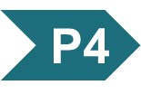
Principle 4 (1 of 5)
Although considered separately, the processes of replication, repair, and recombination of DNA are not distinct. These processes are highly integrated in cells, and they are required for proper genome maintenance.

Slide 6
Bacterial Gene Naming
typically named using three italicized lowercase letters reflecting a function
  examples: dna, uvr, and rec
capital letters added to abbreviation reflect order of discovery, not enzymatic order
  examples: dnaA, dnaB, and dnaQ

Slide 7
Bacterial Protein Naming
often named after their genes using nonitalicized, roman type with the first letter capitalized
  examples: DnaA (encoded by dnaA) and RecA (encoded by recA)

Slide 8
Eukaryotic Gene Naming
no single convention exists for all eukaryotic systems
in Saccharomyces cerevisiae, gene names are three italicized uppercase letters followed by an italicized number
  example: COX1

Slide 9
Eukaryotic Protein Naming
complex and variable
in yeast, some proteins have long common names
  example: cytochrome oxidase
other yeast proteins have the same name as the gene, with one uppercase and two lowercase letters in roman type, followed by a number and the letter “p”
  example: Rad51p (encoded by RAD51)

Slide 10

Clicker Question 1
Which answer choice shows a correctly named bacterial gene?
dnaA
dnaA
DnaA
DnaA
Notes:
Answer: B
Principle: 25.1
Learning Objective(s):
Bloom’s: 1:1

Slide 11
Clicker Question 1, Response
Which answer choice shows a correctly named bacterial gene?
dnaA
Bacterial genes are typically named using three italicized lowercase letters reflecting a function with capital letters added to reflect order of discovery. In this case, the dnaA gene encodes the DnaA protein.

Slide 12
25.1 DNA Replication

Slide 13
Principle 1 (2 of 6)
Along with catalysis, biological information is one of the two key prerequisites for life. The faithful maintenance and transmission of genetic information from one generation to another ensures continuity within each species.

Slide 14
DNA as a Template
template = a structure that would allow molecules to be lined up in a specific order and joined to create a macromolecule with a unique sequence and function
the structure of DNA revealed one strand is the complement of the other.
  each strand provides the template for a new strand

Slide 15
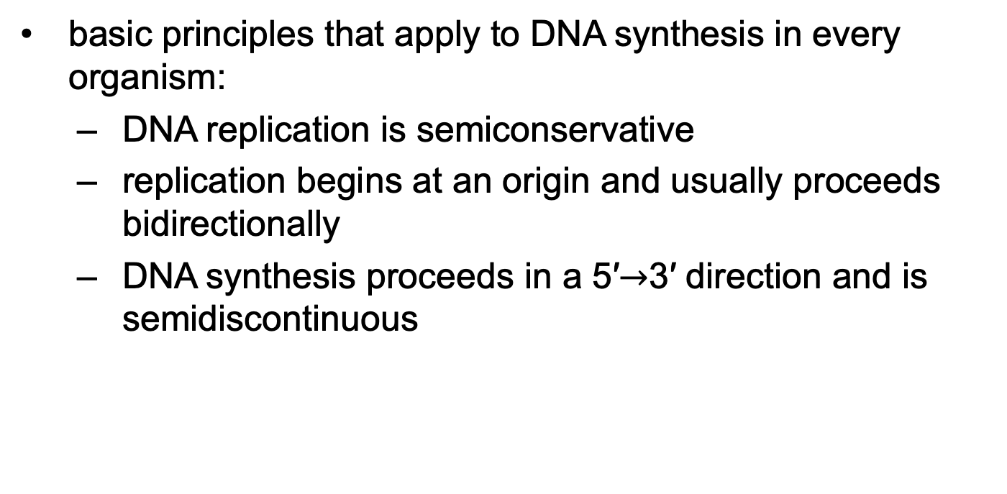
DNA Replication Follows a Set of Fundamental Rules
basic principles that apply to DNA synthesis in every organism:
  DNA replication is semiconservative
  replication begins at an origin and usually proceeds bidirectionally
  DNA synthesis proceeds in a 5′$→$3′ direction and is semidiscontinuous

Slide 16
Principle 1 (3 of 6)
Along with catalysis, biological information is one of the two key prerequisites for life. The faithful maintenance and transmission of genetic information from one generation to another ensures continuity within each species.

Slide 17
DNA Replication
Is Semiconservative
semiconservative replication = each DNA strand serves as a template for the synthesis of a new strand
  produces two new DNA molecules, each with one new strand and one old strand
  established by Meselson and Stahl in 1957

Slide 18

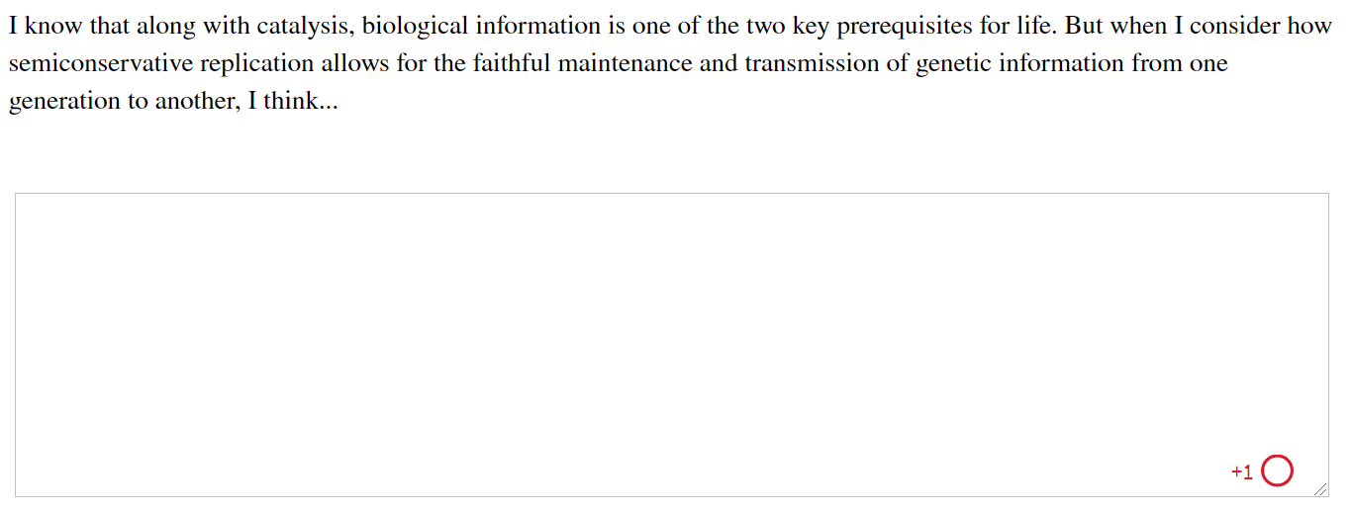
Activity: Semiconservative
Replication Muddiest Point (1 of 2)
Complete the Ch25 Student Activity, Day 1: Semiconservative Replication (Muddiest Point) Achieve assessment.
Notes:
Instructor: This muddiest point activity can be found in Achieve in the Chapter 25 folder titled “Ch25 In-Class Activities and Resources.” See the Instructor Activity Guide in the same folder for more information.

Slide 19
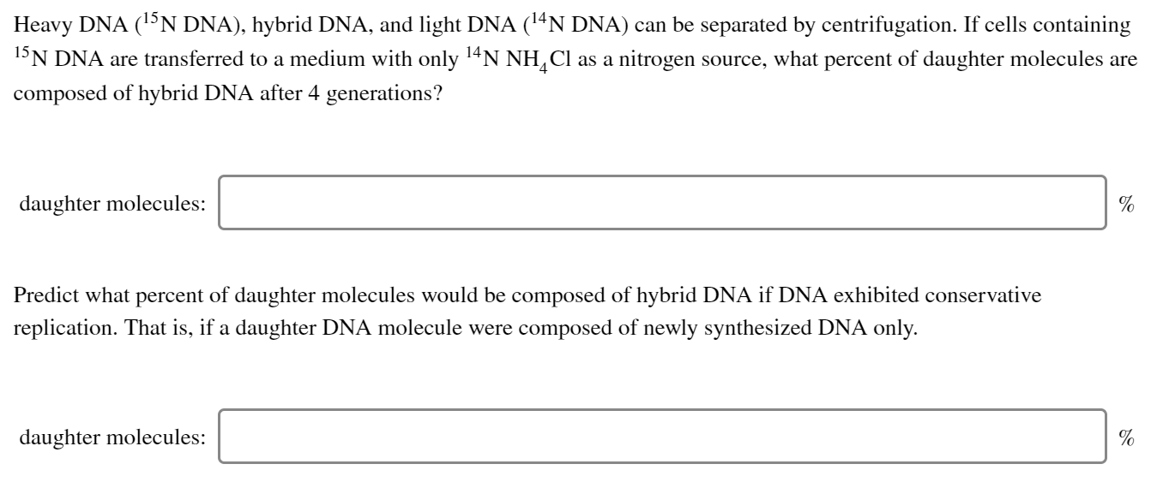
Activity: Semiconservative
Replication Muddiest Point (2 of 2)
Complete the Ch25 Student Activity, Day 2: Semiconservative Replication (Muddiest Point) Achieve assessment.
Notes:
Instructor: This muddiest point activity can be found in Achieve in the Chapter 25 folder titled “Ch25 In-Class Activities and Resources.” See the Instructor Activity Guide in the same folder for more information.

Slide 20
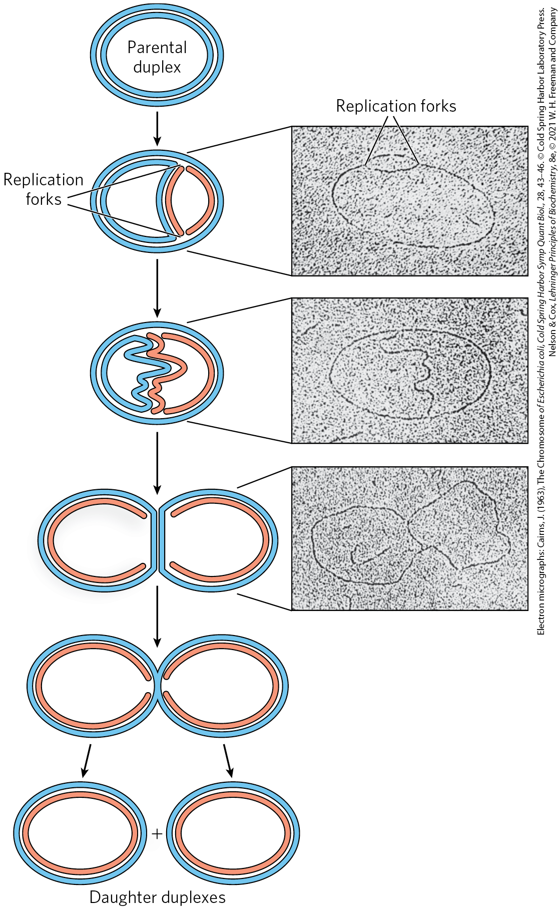
Replication Begins at an Origin and Usually Proceeds Bidirectionally
replication forks = dynamic points where parent DNA is being unwound and separated strands replicated
both DNA strands are replicated simultaneously
both ends of the bacterial chromosome have active replication forks (bidirectional replication)

Slide 21
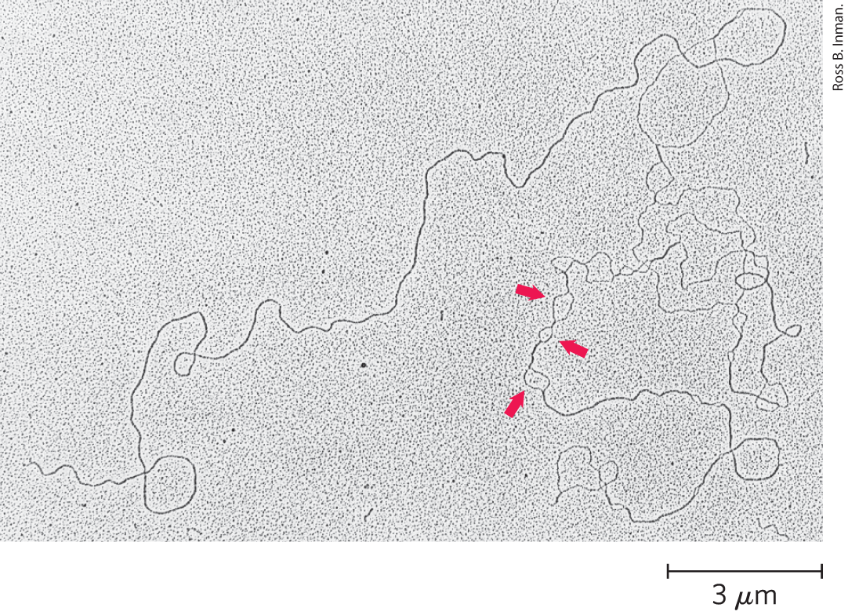
Replication Loops Always Initiate at an Origin
denaturation mapping = selective denaturing of sequences unusually rich in A=T base pairs to provide landmarks along the DNA molecule
  generates a reproducible pattern of single-strand bubbles
origin = location where replication loops are initiated

Slide 22
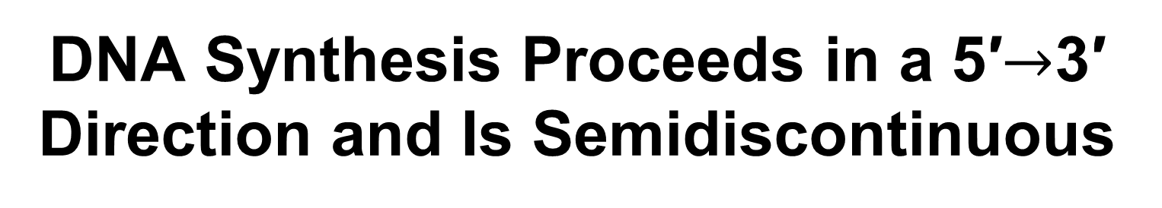
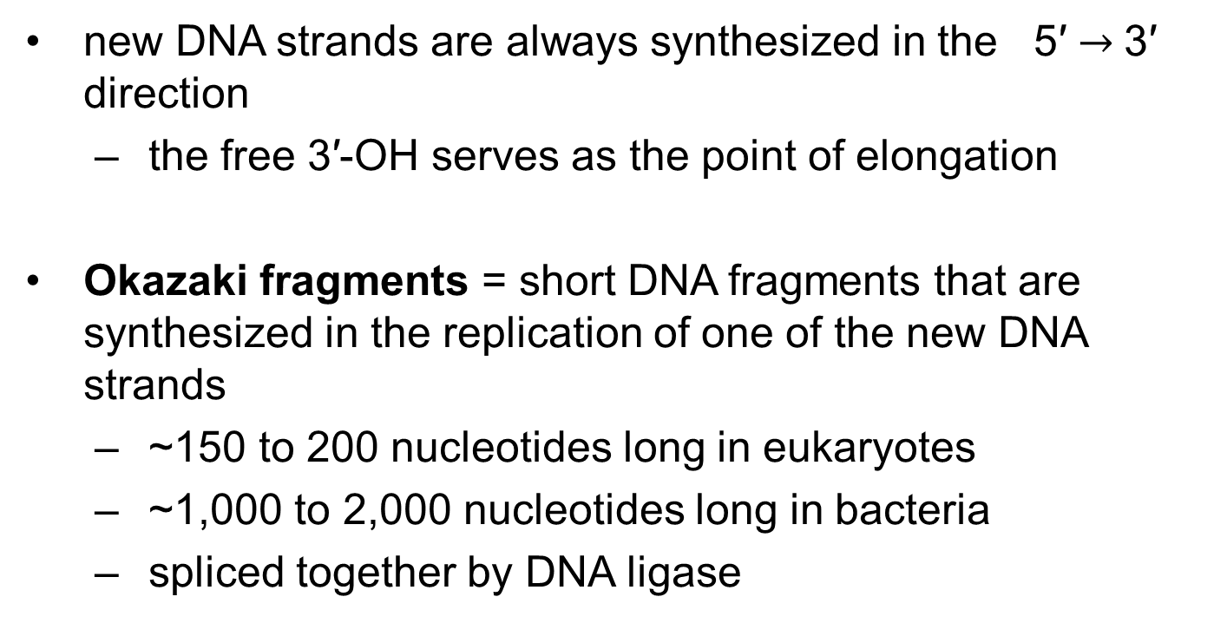
DNA Synthesis Proceeds in a 5′$→$3′ Direction and Is Semidiscontinuous
new DNA strands are always synthesized in the 5′ $→$3′ direction
  the free 3′-OH serves as the point of elongation
Okazaki fragments = short DNA fragments that are synthesized in the replication of one of the new DNA strands
  ~150 to 200 nucleotides long in eukaryotes
  ~1,000 to 2,000 nucleotides long in bacteria
  spliced together by DNA ligase

Slide 23
Clicker Question 2
What type of bond must be made between Okazaki fragments in order to make a complete DNA strand?
hydrogen
disulfide
ester
phosphodiester
ionic
Notes:
Answer: D
Principle: 25.1
Learning Objective(s): Compare DNA synthesis on the leading strand and the lagging strand.
Bloom’s: 1:1

Slide 24
Clicker Question 2, Response
What type of bond must be made between Okazaki fragments in order to make a complete DNA strand?
phosphodiester
DNA ligase catalyzes the formation of a phosphodiester bond between a 3′ hydroxyl at the end of one DNA strand and a 5′ phosphate at the end of another strand.

Slide 25
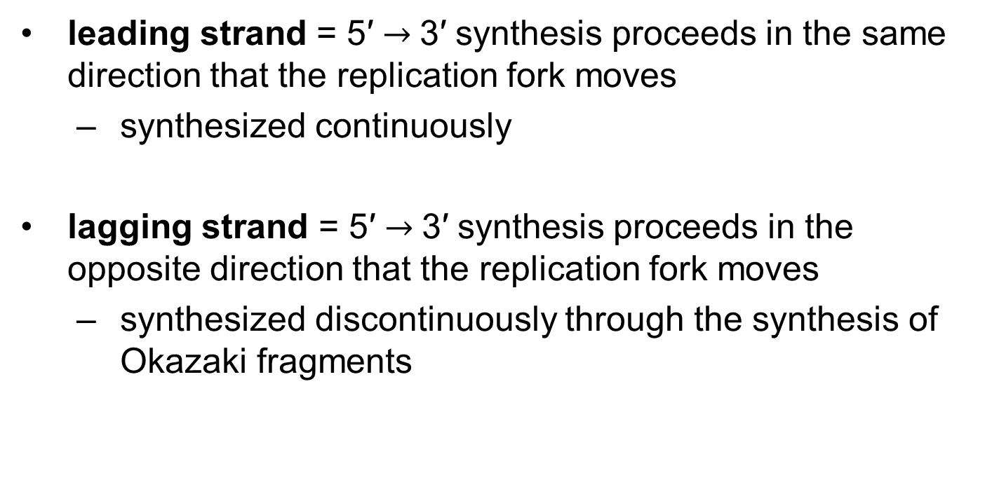
Leading and Lagging Strands
leading strand = 5′ $→$3′ synthesis proceeds in the same direction that the replication fork moves
  synthesized continuously
lagging strand = 5′ $→$3′ synthesis proceeds in the opposite direction that the replication fork moves
  synthesized discontinuously through the synthesis of Okazaki fragments

Slide 26
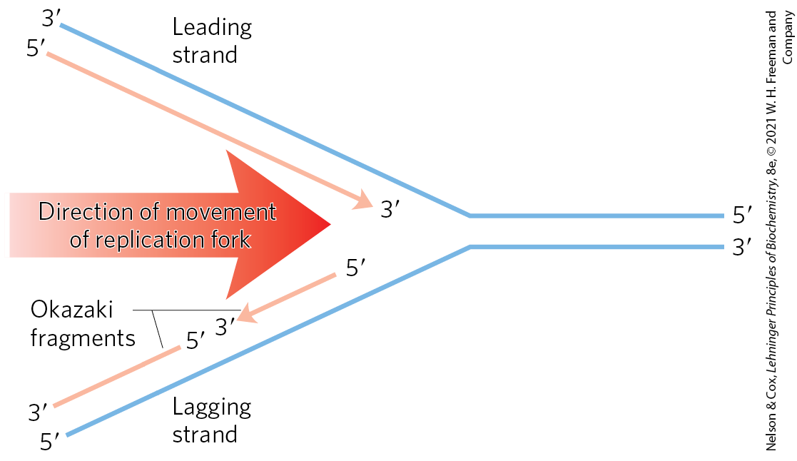
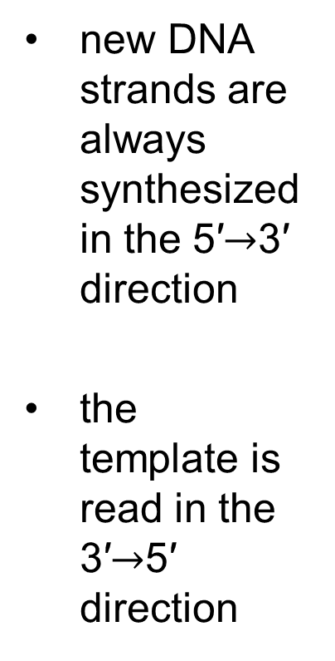
Defining DNA Strands at the Replication Fork
new DNA strands are always synthesized in the 5′$→$3′ direction
the template is read in the 3′$→$5′ direction

Slide 27
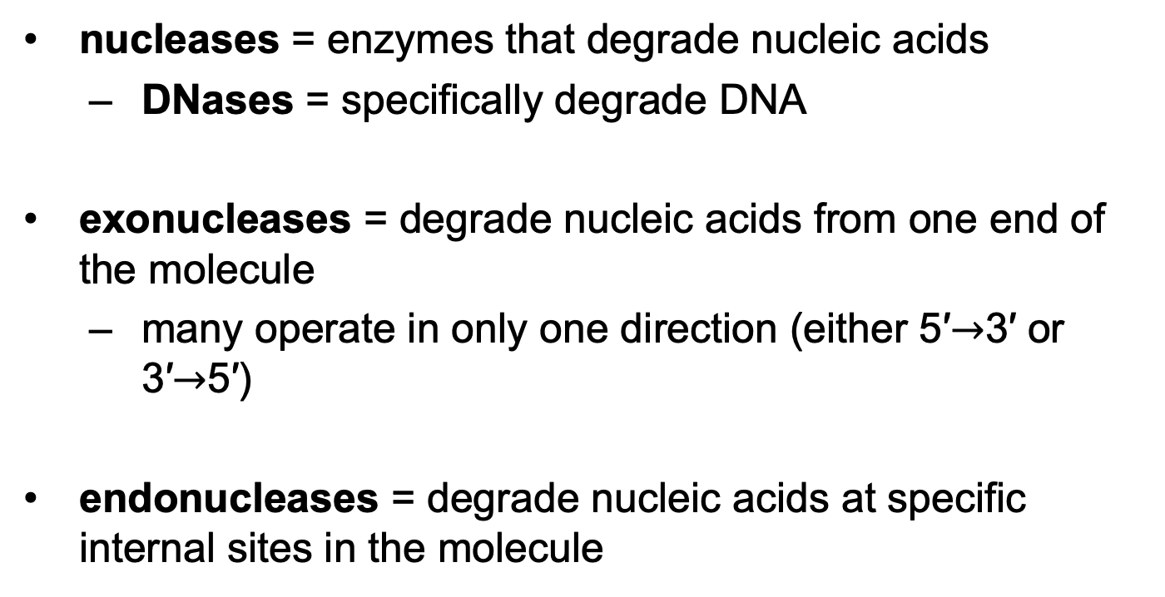
DNA Is Degraded by Nucleases
nucleases = enzymes that degrade nucleic acids
  DNases = specifically degrade DNA
exonucleases = degrade nucleic acids from one end of the molecule
  many operate in only one direction (either 5′$→$3′ or 3′$→$5′)
endonucleases = degrade nucleic acids at specific internal sites in the molecule

Slide 28
DNA Is Synthesized by
DNA Polymerases
DNA polymerase = complex enzymes that can synthesize DNA
  many have additional activities
  E. coli cells have at least 5 DNA polymerases, including DNA polymerase I

Slide 29
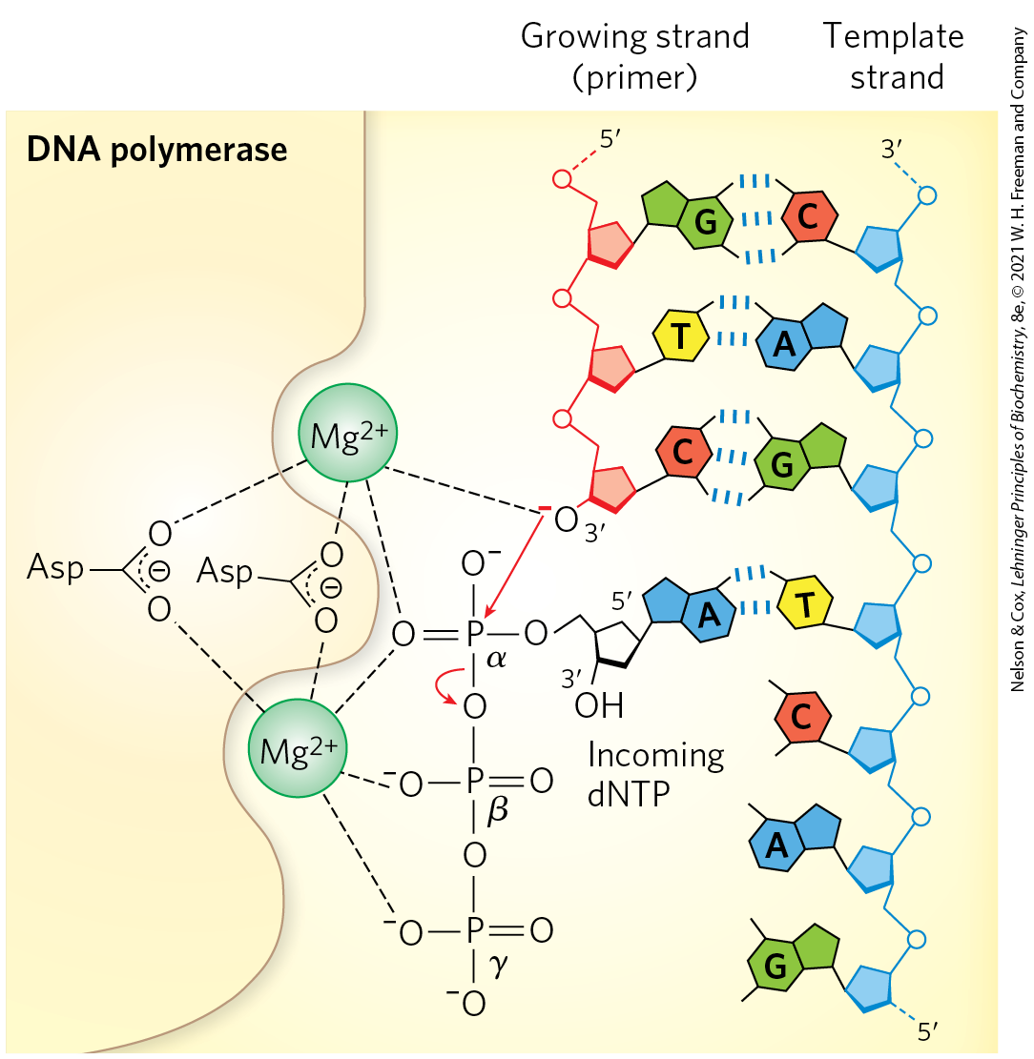
The DNA Polymerase Reaction
the reaction is a phosphoryl group transfer
the 3′-OH of the nucleotide at the 3′ end of the strand (the nucleophile) attacks the α phosphorus of the incoming dNTP

Slide 30
Clicker Question 3
Which statement correctly describes the reaction catalyzed by DNA polymerase I?
The nucleophile is the α phosphate of the incoming deoxynucleoside 5′-triphosphate.
The nucleophile is the 3′-OH group of the nucleotide at the 3′ end of the growing strand.
The nucleophile is the 3′-OH group of the nucleotide at the 5′ end of the growing strand.
The nucleophile is the γ phosphate of the incoming deoxynucleoside 5′-triphosphate.
Notes:
Answer: B
Principle: 25.1
Learning Objective(s): Define the DNA polymerase reaction.
Bloom’s: 1:1

Slide 31
Clicker Question 3, Response
Which statement correctly describes the reaction catalyzed by DNA polymerase I?
The nucleophile is the 3′-OH group of the nucleotide at the 3′ end of the growing strand.
The 3′-OH of the nucleotide at the 3′ end of the strand (the nucleophile) attacks the α phosphorus of the incoming dNTP.

Slide 32
Catalysis by DNA Polymerases Involves Two Mg²⁺ Ions
one Mg²⁺ ion helps deprotonate the 3′-OH group
  makes it a more effective nucleophile
one Mg²⁺ ion binds the incoming dNTP and facilitates departure of PP_{i}

Slide 33
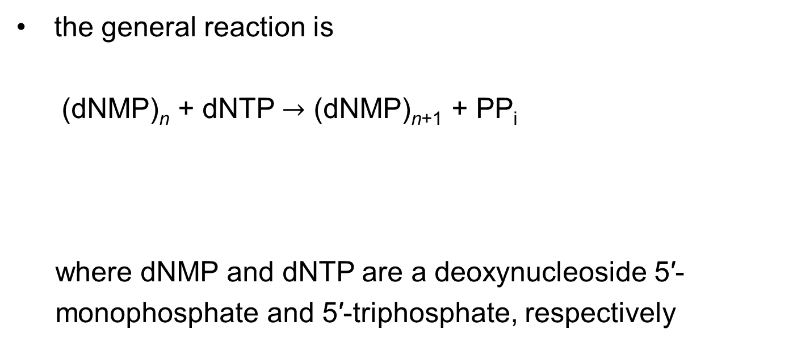
The General DNA Polymerase Reaction
the general reaction is
  (dNMP)_{n} + dNTP $→$ (dNMP)_{n+1} + PP_{i}
where dNMP and dNTP are a deoxynucleoside 5′-
monophosphate and 5′-triphosphate, respectively
(25-1)
lengthened DNA
DNA

Slide 34
Principle 2 (2 of 7)
Information is expensive. The chemistry of joining one nucleotide to the next in DNA replication is elegant and simple, almost deceptively so. However, the enzymatic and thermodynamic commitment to linking one nucleotide to another in DNA far exceeds what would normally be required to successfully form a phosphodiester bond. It is not enough to synthesize a phosphodiester bond; that bond must accurately link two particular nucleotides.

Slide 35
The DNA Polymerase Reaction Proceeds with a Minimal Change in Free Energy
one phosphodiester bond is formed at the expense of a somewhat less stable phosphate anhydride
noncovalent base-stacking and base-pairing interactions stabilize the lengthened DNA product
the formation of products is facilitated by the subsequent hydrolysis of the pyrophosphate

Slide 36
Principle 1 (4 of 6)
Along with catalysis, biological information is one of the two key prerequisites for life. The faithful maintenance and transmission of genetic information from one generation to another ensures continuity within each species.

Slide 37
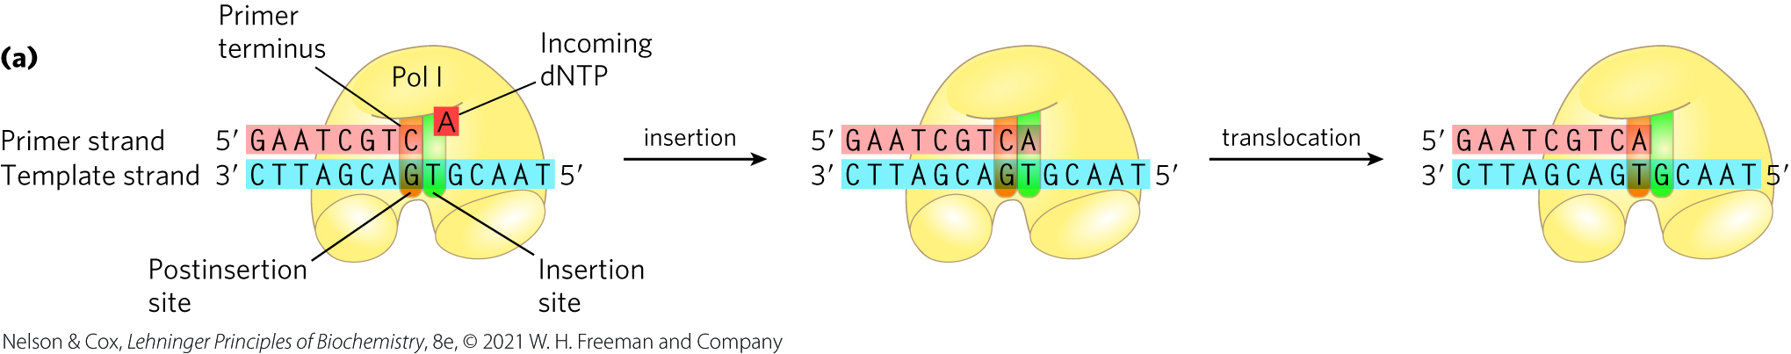
DNA Polymerases Require a Template
polymerization is guided by a template DNA strand according to Watson and Crick base-pairing rules

Slide 38
DNA Polymerases Require a Primer
primer = a strand segment with a free 3′-OH group to which a nucleotide can be added
  must be complementary to the template
  many are RNA oligonucleotides
primer terminus = the free 3′ end of the primer

Slide 39
Clicker Question 4
Which statement does NOT describe a fundamental feature of DNA replication?
It requires a template.
It is semiconservative.
It begins at a DNA location known as an origin.
It involves polymerizing deoxyribonucleotides only.
Notes:
Answer: D
Principle: 25.1
Learning Objective(s): Compare DNA synthesis on the leading strand and the lagging strand.
Bloom’s: 1:1

Slide 40
Clicker Question 4, Response
Which statement does NOT describe a fundamental feature of DNA replication?
It involves polymerizing deoxyribonucleotides only.
Lagging strand synthesis requires the synthesis of ribonucleotide (RNA) primers.

Slide 41
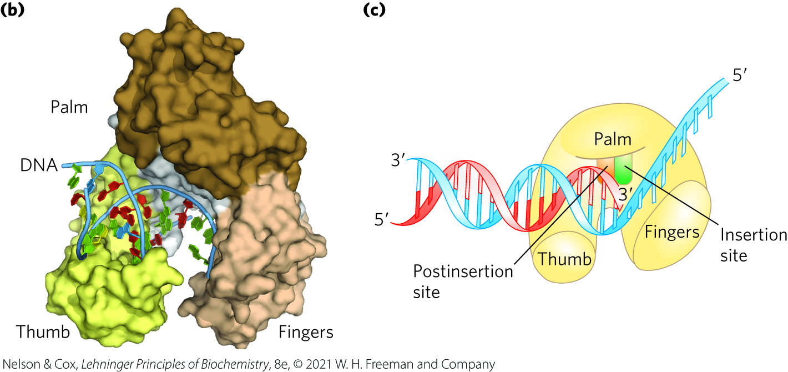
The DNA Polymerase Active Site Has Two Parts
insertion site = the portion of the active site where the incoming nucleotide binds
postinsertion site = the portion of the active site where the new base pair resides when the polymerase slides forward

Slide 42
The Processivity of
DNA Polymerases
processivity = the average number of nucleotides added before a polymerase dissociates
DNA polymerases vary greatly in processivity.
  ranges from a few nucleotides to many thousand

Slide 43
Clicker Question 5
Processivity is defined as:
how many errors are incorporated into the DNA per 1,000 bases.
the average number of nucleotides added before a polymerase dissociates.
the rate at which nucleotides are added to the DNA.
the number of DNA polymerases bound to one DNA molecule.
which DNA polymerase is performing the elongation.
Notes:
Answer: B
Principle: 25.1
Learning Objective(s): Compare the five DNA polymerases of E.coli.
Bloom’s: 1:1

Slide 44
Clicker Question 5, Response
Processivity is defined as:
the average number of nucleotides added before a polymerase dissociates.
DNA polymerases vary greatly in processivity; some add just a few nucleotides before dissociating, whereas others add many thousands.

Slide 45
Clicker Question 6
DNA polymerases:
all have a 5′→3′ exonuclease activity for proofreading.
only polymerize in a 5′→3′ direction.
are all highly processive.
are only found at replication forks.
Notes:
Answer: B
Principle: 25.1
Learning Objective(s): Compare the five DNA polymerases of E.coli.
Bloom’s: 2:2

Slide 46
Clicker Question 6, Response
DNA polymerases:
only polymerize in a 5′→3′ direction.
DNA polymerases only add nucleotides to the 3′ end of the growing strand. Therefore, DNA is always synthesized in the 5′→3′ direction.

Slide 47
Replication is Very Accurate
errors in E. coli occur every 1 in 10⁹ to 1 in 10¹⁰ nucleotides added
  equates to an error only once per 1,000 to 10,000 replications
the active site of DNA polymerase excludes base pairs with the incorrect geometry
DNA polymerases insert one incorrect nucleotide for every 10⁴ to 10⁵ correct nucleotides
  may occur because a base is in a tautomeric form

Slide 48
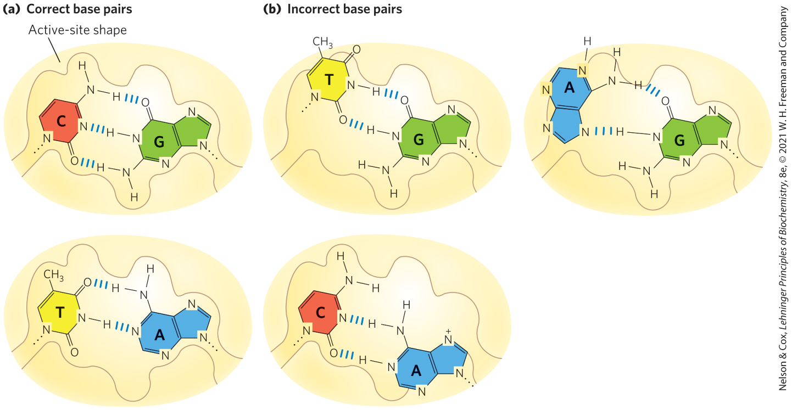
Contribution of Base-Pair Geometry to the Fidelity of DNA Replication

Slide 49
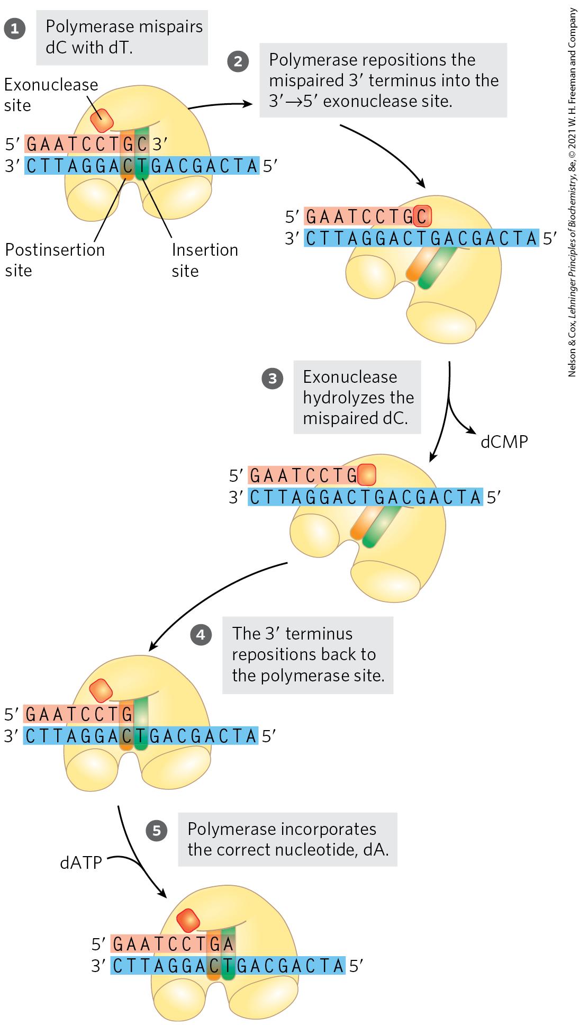
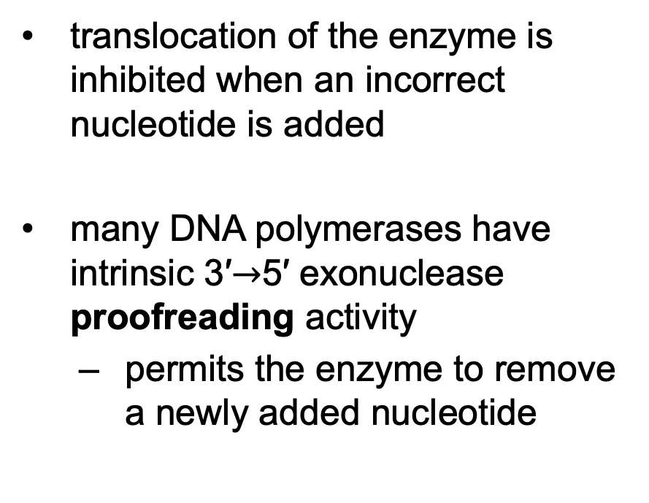
Error Correction by DNA
Polymerase I
translocation of the enzyme is inhibited when an incorrect nucleotide is added
many DNA polymerases have intrinsic 3′$→$5′ exonuclease proofreading activity
  permits the enzyme to remove a newly added nucleotide

Slide 50
Principle 2 (3 of 7)
Information is expensive. The chemistry of joining one nucleotide to the next in DNA replication is elegant and simple, almost deceptively so. However, the enzymatic and thermodynamic commitment to linking one nucleotide to another in DNA far exceeds what would normally be required to successfully form a phosphodiester bond. It is not enough to synthesize a phosphodiester bond; that bond must accurately link two particular nucleotides.

Slide 51
Proofreading is Energetically Expensive
proofreading = DNA polymerase activity that involves replacement of the incorrect nucleotide
  requires the expenditure of three high-energy bonds

Slide 52

Clicker Question 7
What pathway(s) must be operating at a high rate just before and during bacterial DNA replication?
only oxidative phosphorylation
only citric acid cycle and oxidative phosphorylation
only glycolysis, citric acid cycle, and oxidative phosphorylation
glycolysis, citric acid cycle, oxidative phosphorylation, and the pentose phosphate pathway
Notes:
Answer: C
Principle: 25.2
Learning Objective(s):
Bloom’s: 2:2

Slide 53
Clicker Question 7, Response
What pathway(s) must be operating at a high rate just before and during bacterial DNA replication?
only glycolysis, citric acid cycle, and oxidative phosphorylation
Since DNA replication requires a great deal of ATP, the rates of all the ATP-producing pathways must increase. The pentose phosphate pathway does not produce energy in the form of ATP.

Slide 54
Principle 3 (2 of 7)
The fidelity of genome maintenance and transmission is not perfect. DNA damage happens, often by spontaneous processes. DNA replication and repair deal with the vast majority of DNA lesions, providing a high degree of genetic fidelity and stability. The few DNA damage events that slip through uncorrected provide fuel for evolution.

Slide 55
Accuracy After Base Selection and Proofreading
proofreading improves the accuracy 10² - to 10³-fold
one error in every 10⁶ to 10⁸ bases remains after base selection and proofreading
  the higher measured accuracy of E. coli replication comes from mismatch repair

Slide 56
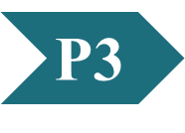
Clicker Question 8
Which statement regarding the fidelity of DNA replication by E. coli is false?
It is due in part to 3′→5′ exonuclease activities.
It is due in part to the chromosome being circular.
It is due in part to DNA repair systems.
It is due in part to correct base pairing.
Notes:
Answer: B
Principle: 25.3
Learning Objective(s): Classify the types of mistakes that can happen in DNA replication.
Bloom’s: 2:2

Slide 57
Clicker Question 8, Response
Which statement regarding the fidelity of DNA replication by E. coli is false?
It is due in part to the chromosome being circular.
Accuracy of DNA replication is maintained by (1) base selection by the polymerase, (2) a 3′→5′ proofreading exonuclease activity that is part of many DNA polymerases, and (3) specific repair systems for mismatches left behind after replication.

Slide 58
E. Coli Has at Least Five
DNA Polymerases
DNA polymerase I is abundant, but insufficient for replication of the E. coli chromosome
  rate (600 nucleotides/min) is slower than observed for replication fork movement
  low processivity
the primary function of DNA polymerase I is cleanup during replication, recombination, and repair

Slide 59
DNA Polymerase II, III, IV, and V
DNA polymerase II = involved in DNA repair
DNA polymerase III = the principal replication enzyme in E. coli
DNA polymerases IV and V = involved in an unusual form of DNA repair

Slide 60
Comparison of the Five DNA Polymerases of E. coli
Table 25-1 Comparison of the Five DNA Polymerases of E.coli
 | DNA polymerase I | DNA polymerase II | DNA polymerase III | DNA polymerase IV | DNA polymerase V
Structural gene^{b} | polA | polB | polC (dnaE) | dinB | umuC
Subunits (number of different types) | 1 | 7 | 9 | 1 | 3
M_{r} | 103,000 | 88,000^{c} | 1,065,400 | 39,100 | 110,000
3′→5′ exonuclease (proofreading) | Yes | Yes | Yes | No | No
5′→3′ exonuclease | Yes | No | No | No | No
Polymerization rate (nucleotides/s) | 10–20 | 40 | 250–1,000 | 2–3 | 1
Processivity (nucleotides added before polymerase dissociates) | 3–200 | 1,500 | ≥500,000 | 1 | 6–8

Slide 61
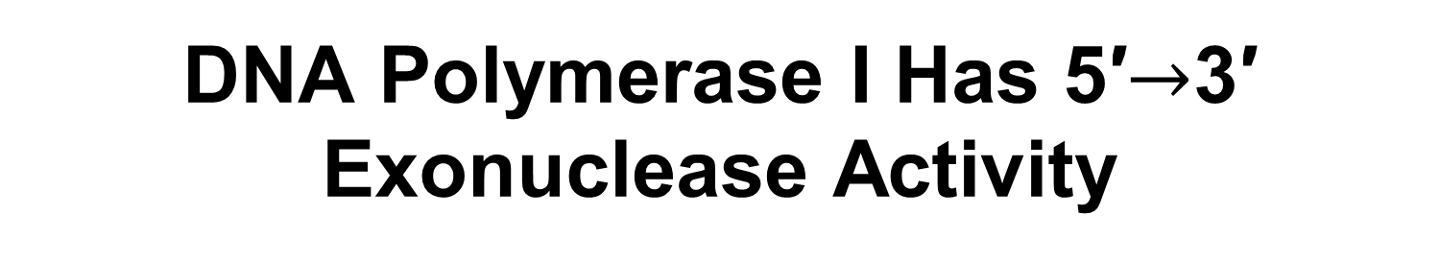
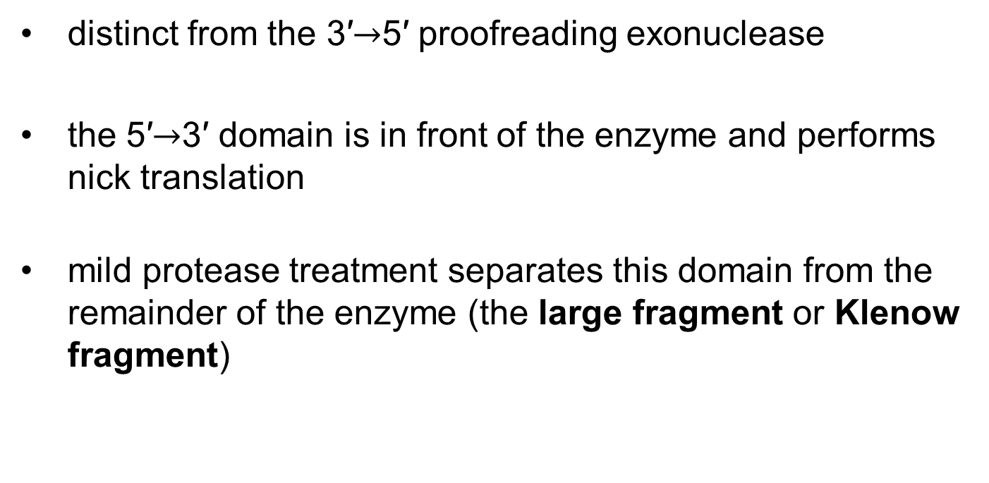
DNA Polymerase I Has 5′$→$3′ Exonuclease Activity
distinct from the 3′$→$5′ proofreading exonuclease
the 5′$→$3′ domain is in front of the enzyme and performs nick translation
mild protease treatment separates this domain from the remainder of the enzyme (the large fragment or Klenow fragment)

Slide 62
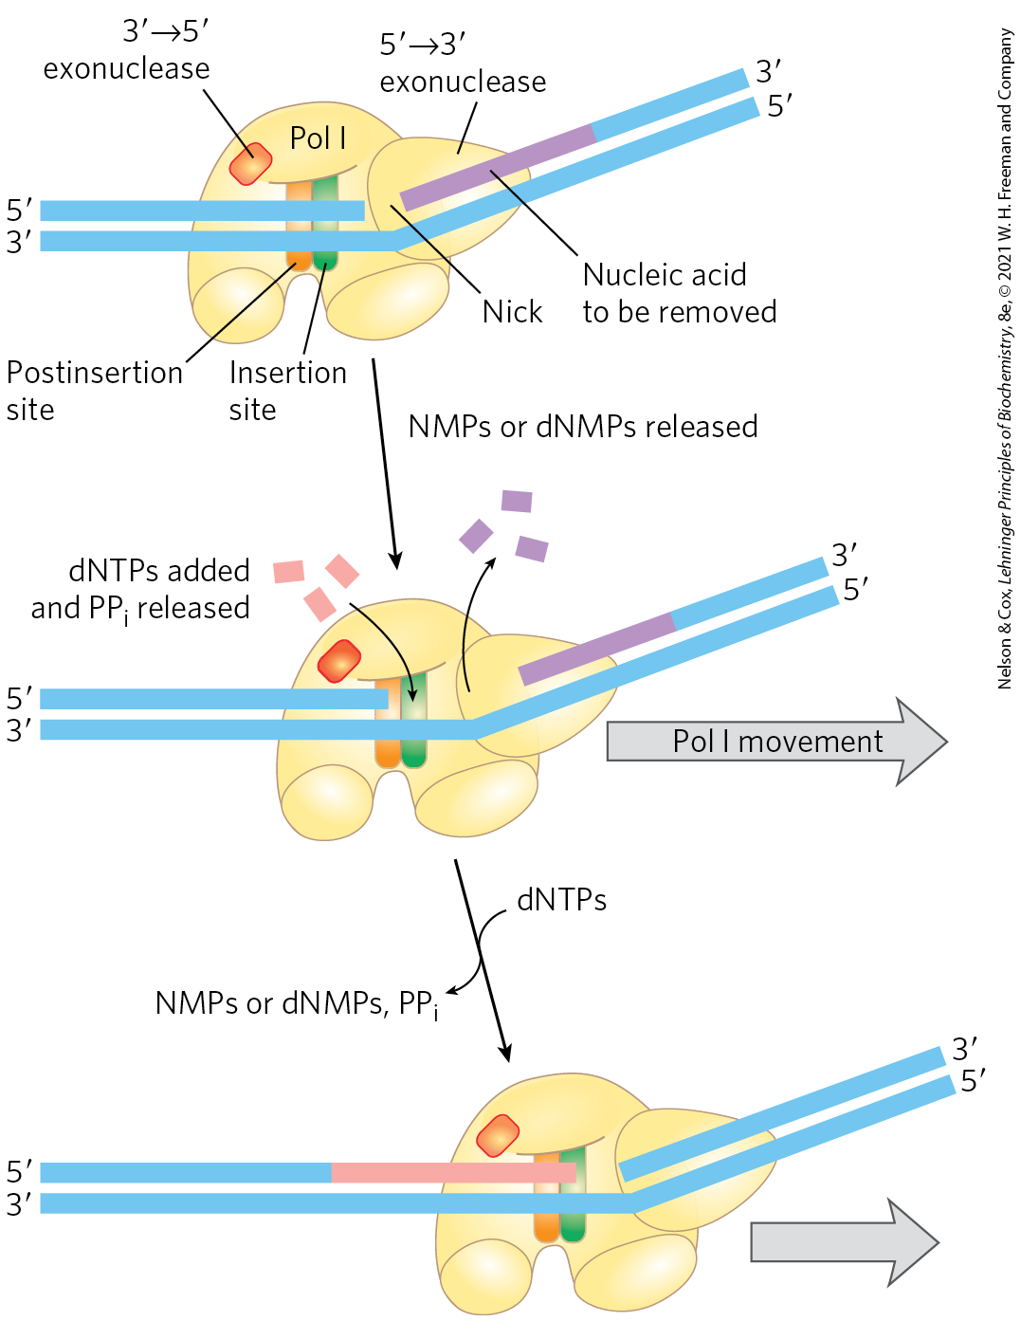
Nick Translation
nick translation = a break or nick in the DNA is moved along with the enzyme
important in:
  DNA repair
  the removal of RNA primers during replication

Slide 63
Clicker Question 9
Which statement about DNA polymerase I is false?
It is the principle replication enzyme in E. coli.
It has both 3′→5′ exonuclease activity and 5′→3′ exonuclease activity.
It is active as a single subunit.
It accounts for more than 90% of the DNA polymerase activity observed in E. coli extracts.
All of the statements are true.
Notes:
Answer: A
Principle: 25.3
Learning Objective(s): Compare the five DNA polymerases of E.coli.
Bloom’s: 1:1

Slide 64
Clicker Question 9, Response
Which statement about DNA polymerase I is false?
It is the principle replication enzyme in E. coli.
DNA polymerase I is not the primary enzyme of replication; instead, it performs a host of cleanup functions during replication, recombination, and repair.

Slide 65
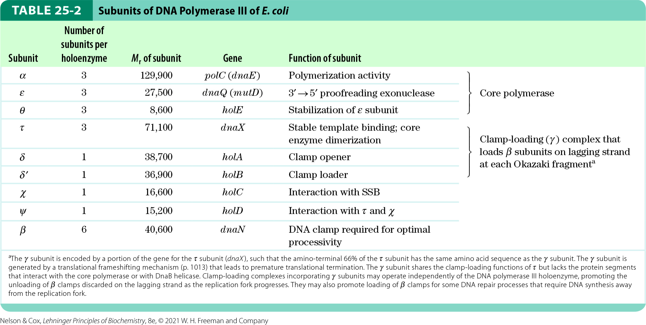
Subunits of DNA Polymerase III of
E. coli

Slide 66
Subunits of DNA Polymerase III* in E. coli
α subunit = contains polymerization activity
ε subunit = contains proofreading activity
θ subunit associates with α and ε subunits to form a core polymerase
  can polymerize DNA but with limited processivity
  up to three core polymerases are linked by a clamp-loading complex (τ₃δδ′)
χ and ψ bind to the clamp-loading complex

Slide 67
β Subunits Converts DNA Polymerase III* to DNA Polymerase III Holoenzyme
DNA polymerase III* = the entire assembly of 16 protein subunits (eight different types)
β subunits = provide an increase in processivity by preventing dissociation of DNA polymerase III from DNA
  one dimer of β subunits associates with each active core subassembly
  addition of β subunits converts DNA polymerase III* to DNA polymerase III holoenzyme

Slide 68
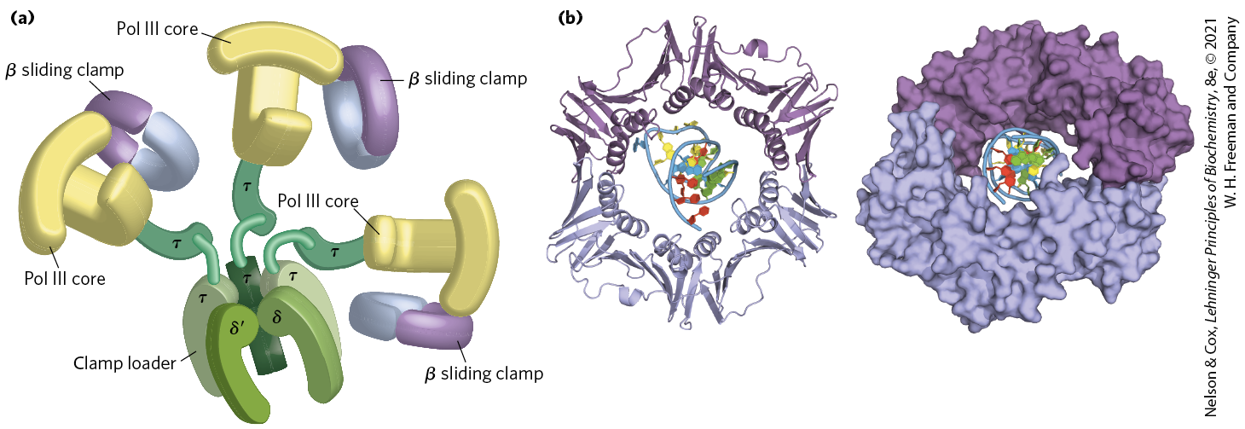
DNA Polymerase III

Slide 69
DNA Replication Requires Many
Enzymes and Protein Factors
DNA replicase system (replisome) = the entire complex of enzymes and proteins required for replication in E. coli
  consists of 20+ different enzymes and proteins

Slide 70
Clicker Question 10
Which statement about DNA polymerase III is false?
It is the principle replication enzyme in E. coli.
It is much more complex than DNA polymerase I.
Its core polymerases each consist of an α, ε, and θ subunit.
Its processivity dramatically increases after the addition of the β subunits.
All of the statements are true.
Notes:
Answer: E
Principle: 25.3
Learning Objective(s): Compare the five DNA polymerases of E.coli.
Bloom’s: 1:1

Slide 71
Clicker Question 10, Response
Which statement about DNA polymerase III is false?
All of the statements are true.
DNA polymerase III, the principle replication enzyme in E. coli, consists of nine different subunits. It has up to three core polymerases, each made up of an an α, ε, and θ subunit. The addition of a β sliding clamp to each core polymerase prevents the dissociation of the enzyme from DNA, dramatically increasing processivity.

Slide 72
Principle 2 (4 of 7)
Information is expensive. The chemistry of joining one nucleotide to the next in DNA replication is elegant and simple, almost deceptively so. However, the enzymatic and thermodynamic commitment to linking one nucleotide to another in DNA far exceeds what would normally be required to successfully form a phosphodiester bond. It is not enough to synthesize a phosphodiester bond; that bond must accurately link two particular nucleotides.

Slide 73
Main Classes of
Replication Enzymes
helicases = enzymes that move along the DNA and separate the strands
  requires chemical energy from ATP
topoisomerases = relieve topological stress created by strand separation
DNA-binding proteins = stabilize separated strands
primases = synthesize short segments of RNA to serve as primers

Slide 74
Main Classes of Replication Enzymes, Continued
DNA polymerase I = removes and replaces RNA primers
RNase H1 = a specialized nuclease that degrades RNA in RNA-DNA hybrids
  can remove RNA primers
DNA ligases = seals nicks in the DNA backbone following removal and replacement of an RNA primer

Slide 75
Replication of the E. coli Chromosome Proceeds in Stages
DNA synthesis can be divided into three stages:
  initiation
  elongation
  termination

Slide 76
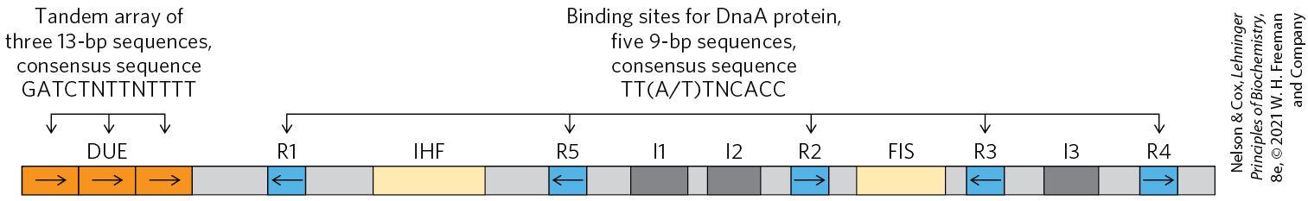
Initiation
the E. coli replication origin (oriC) consists of:
  five repeats of a 9 bp sequence (R sites) that serve as binding sites for the key initiator protein, DnaA
  the DNA unwinding element (DUE) = a region rich in A=T base pairs
  three additional DnaA-binding sites (I sites)
  binding sites for the proteins IHF (integration host factor) and FIS (factor for inversion stimulation)

Slide 77
Proteins Required to Initiation Replication at the E. coli Origin
Table 25-3 Proteins Required to Initiate Replication at the E.coli Origin
Protein | M_{r} | Number of subunits | Function
DnaA protein | 52,000 | 1 | Recognizes oriC sequence; opens duplex at specific sites in origin
DnaB protein (helicase) | 300,000 | 6 | Unwinds DNA
DnaC protein | 174,000 | 6 | Required for DnaB binding at origin
HU | 19,000 | 2 | Histonelike protein; DNA-binding protein; stimulates initiation
FIS | 22,500 | 2 | DNA-binding protein; stimulates initiation
IHF | 22,000 | 2 | DNA-binding protein; stimulates initiation
Primase (DnaG protein) | 60,000 | 1 | Synthesizes RNA primers
Single-stranded DNA–binding protein (SSB) | 75,600 | 4 | Binds single-stranded DNA
DNA gyrase (DNA topoisomerase II) | 400,000 | 4 | Relieves torsional strain generated by DNA unwinding
Dam methylase | 32,000 | 1 | Methylates (5′)GATC sequences at oriC

Slide 78
Clicker Question 11
Which protein is NOT necessary to initiate DNA replication in E. coli?
helicases
primases
topoisomerases
DNA-binding proteins
All of them are necessary.
Notes:
Answer: E
Principle: 25.2
Learning Objective(s): Explain how other proteins are needed for DNA replication to occur.
Bloom’s: 1:1

Slide 79
Clicker Question 11, Response
Which protein is NOT necessary to initiate DNA replication in E. coli?
All of them are necessary.
At least 10 different enzymes or proteins (summarized in Table 25-3) participate in the initiation phase of replication.

Slide 80
The AAA+ ATPase Protein Family
AAA+ ATPase protein family (ATPases associated with diverse cellular activities) = proteins that form oligomers and hydrolyze ATP relatively slowly
  ATP hydrolysis mediates interconversion of the protein between two states

Slide 81
The DnaA Protein
DnaA protein = a crucial component in the initiation process
  a member of the AAA+ ATPase family
  active when ATP is bound and inactive when ADP is bound

Slide 82
DnaA Proteins Bind at R and I Sites in oriC
eight ATP-bound DnaA molecules bind to the R and I sites in oriC
strand separation in the A=T-rich DUE occurs due to:
  strain due to positive supercoiling
  binding of DnaA to the DUE region

Slide 83
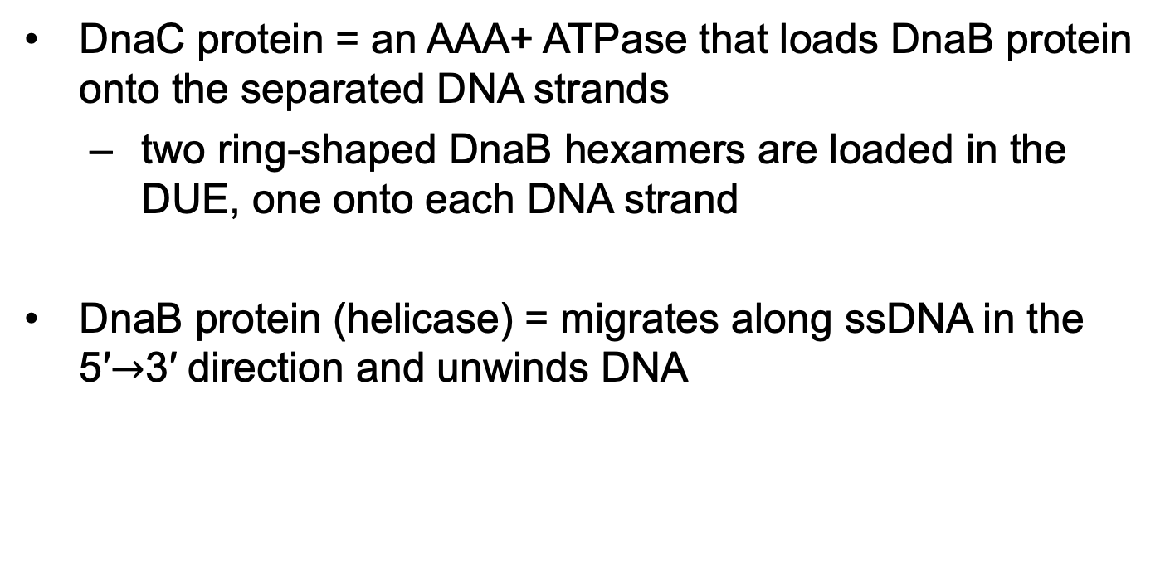
Loading of the DnaB Helicase
DnaC protein = an AAA+ ATPase that loads DnaB protein onto the separated DNA strands
  two ring-shaped DnaB hexamers are loaded in the DUE, one onto each DNA strand
DnaB protein (helicase) = migrates along ssDNA in the 5′$→$3′ direction and unwinds DNA

Slide 84
The Role of SSB and DNA Gyrase in Initiation
single-stranded DNA-binding protein (SSB) stabilizes separated strands
DNA gyrase relieves topological stress ahead of the replication forks

Slide 85
Clicker Question 12
During replication initiation at the E. coli origin, which protein recognizes the oriC sequence?
DnaA
helicase
DnaC
primase
DNA gyrase
Notes:
Answer: A
Principle: 25.2
Learning Objective(s): Explain how other proteins are needed for DNA replication to occur.
Bloom’s: 1:1

Slide 86
Clicker Question 12, Response
During replication initiation at the E. coli origin, which protein recognizes the oriC sequence?
DnaA
Eight ATP-bound DnaA molecules bind to the R and I sites in oriC.

Slide 87
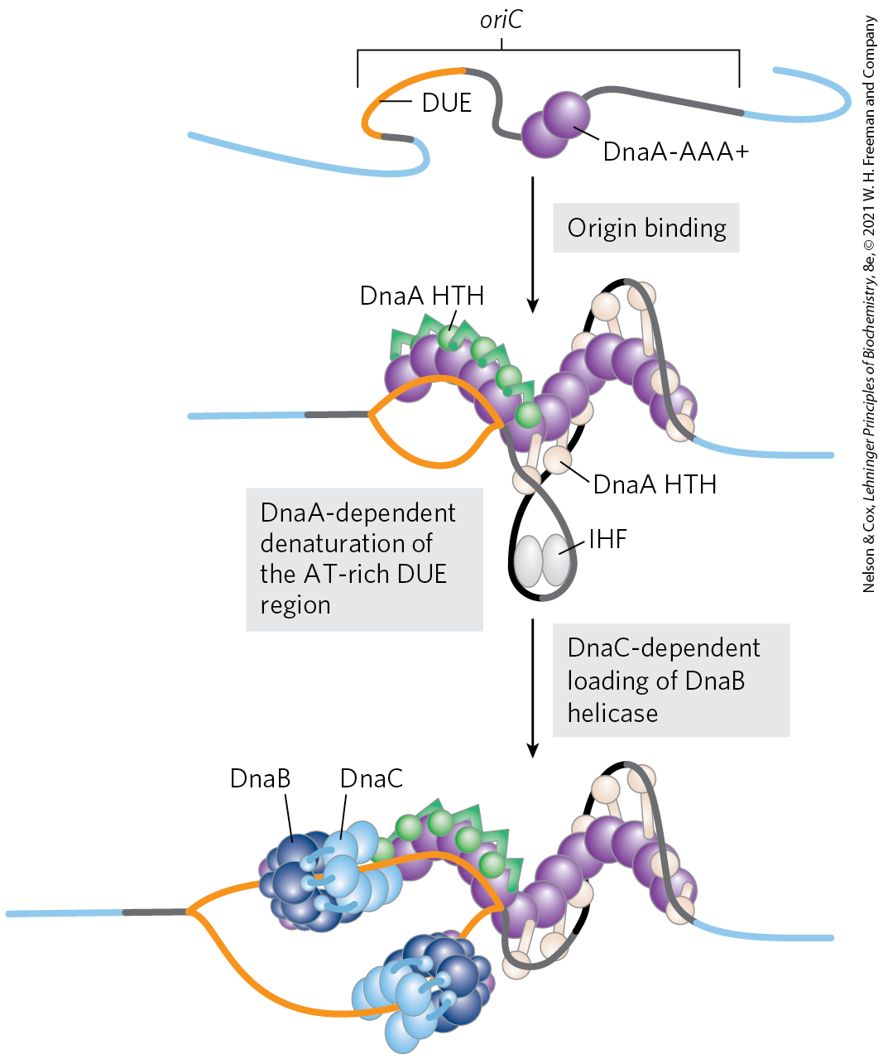
Model for Initiation of Replication

Slide 88
Initiation Occurs Only Once in Each Cell Cycle
Hda protein = an AAA+ ATPase that binds to the β subunits of DNA polymerase III and stimulates hydrolysis of the ATP bound to DnaA
  causes disassembly of the DnaA complex
  homologous to DnaA
release of ADP by DnaA and rebinding of ATP occurs on a time scale of 20 to 40 minutes

Slide 89
Regulation of Replication Initiation via Methylation
Dam (DNA adenine methylation) methylase = methylates the N⁶ position of adenine within the palindromic sequence (5′)GATC of oriC DNA
hemimethylated oriC sequences are sequestered by:
  interaction with the plasma membrane
  binding of the protein SeqA
after SeqA dissociation, oriC sequences are released from the membrane and Dam methylase fully methylates DNA to allow new DnaA to bind

Slide 90
Clicker Question 13
Which of these proteins is NOT a member of the AAA+ ATPase family?
DnaA
DnaB
DnaC
Hda
Notes:
Answer: B
Principle: 25.2
Learning Objective(s): Explain how other proteins are needed for DNA replication to occur.
Bloom’s: 1:1

Slide 91
Clicker Question 13, Response
Which of these proteins is NOT a member of the AAA+ ATPase family?
DnaB
The AAA+ ATPase (ATPases associated with diverse cellular activities) family includes DnaA, DnaC, and the Hda protein. DnaB is a replicative helicase.

Slide 92
Elongation
elongation includes:
  leading strand synthesis
  lagging strand synthesis

Slide 93
Elongation of the Leading Strand
the more straightforward of the two strands
primase (DnaG) synthesizes a short (10 to 60 nucleotide) RNA primer at the replication origin
  requires interaction with DnaB helicase
  primase and DnaB move in opposite directions
DNA polymerase III adds nucleotides to the 3′ of the primer
  linked to the DnaB tethered to the opposite DNA strand

Slide 94
Elongation of the Lagging Strand
accomplished in short Okazaki fragments
as in leading strand synthesis, primase synthesizes an RNA primer and DNA Pol III adds nucleotides to the 3′ end
DNA of the lagging strand loops around so one asymmetric DNA Pol III dimer complex can synthesize both strands

Slide 95
Leading and Lagging Strand Synthesis by DNA Polymerase III
DNA polymerase III uses one set of its core subunits to synthesize the leading strand continuously
the other two sets of core subunits cycle from one Okazaki fragment to the next on the looped lagging strand

Slide 96
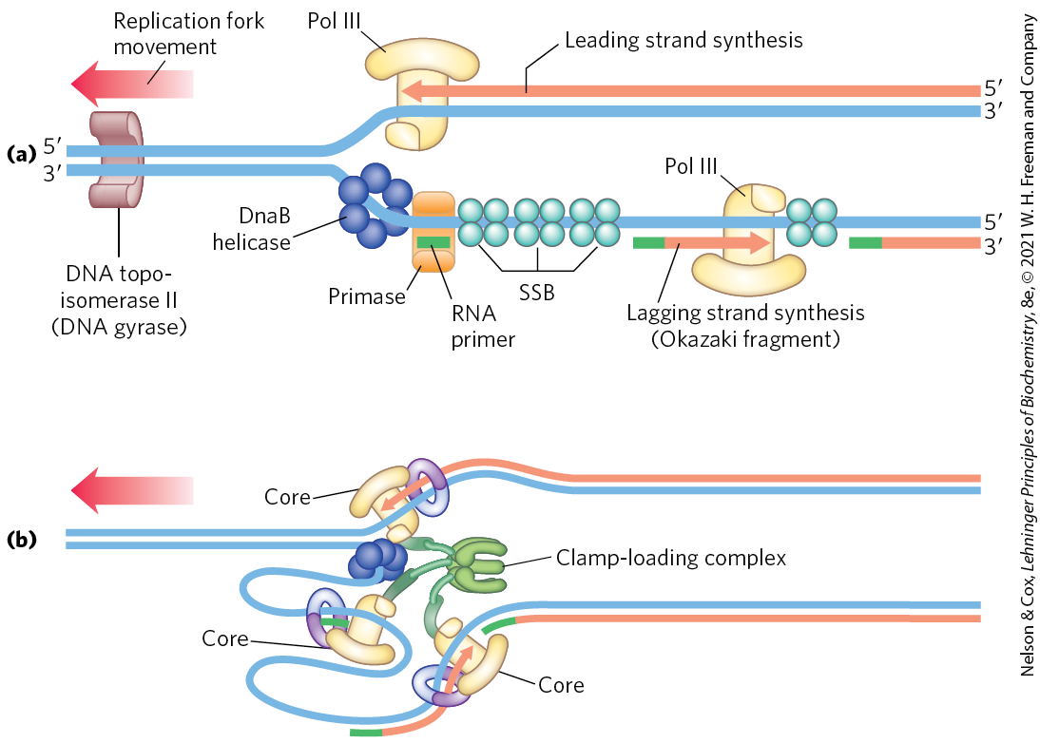
Synthesis of Okazaki Fragments

Slide 97
Clicker Question 14
The lagging strand in DNA replication:
requires its own replisome.
is synthesized after the leading strand.
is an inescapable consequence of replicating both strands of template DNA at a single replication fork.
causes the formation of Okazaki fragments in the leading strand.
Notes:
Answer: C
Principle: 25.2
Learning Objective(s): Compare DNA synthesis on the leading strand and the lagging strand.
Bloom’s: 2:2

Slide 98
Clicker Question 14, Response
The lagging strand in DNA replication:
is an inescapable consequence of replicating both strands of template DNA at a single replication fork.
In the leading strand, 5′→3′ synthesis proceeds in the same direction that the replication fork moves. In the lagging strand, 5′→3′ synthesis proceeds in the direction opposite to the direction of fork movement.

Slide 99
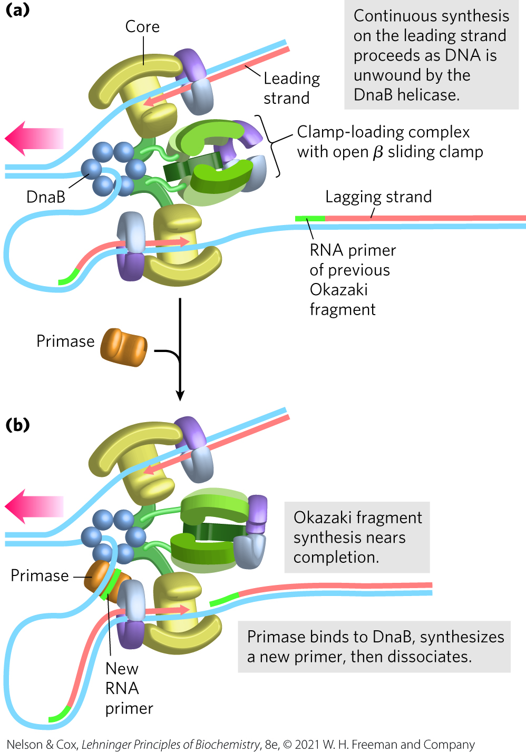
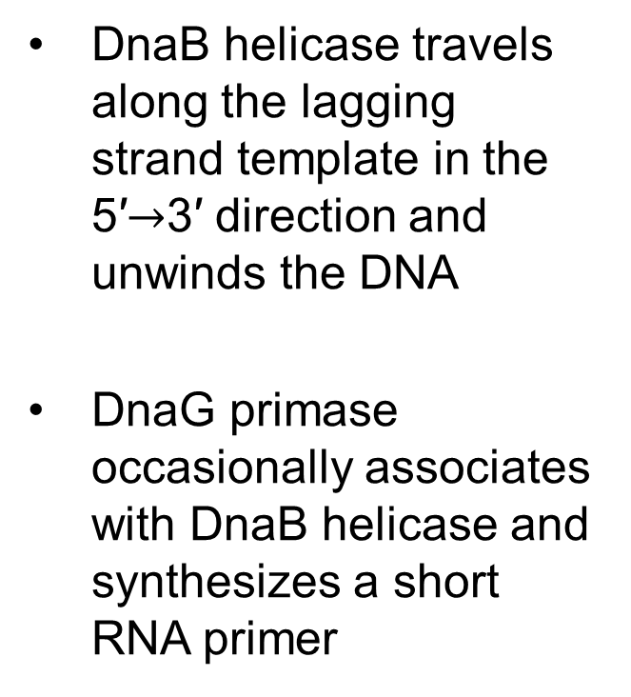
Leading and Lagging Strand Synthesis, Part 1
DnaB helicase travels along the lagging strand template in the 5′$→$3′ direction and unwinds the DNA
DnaG primase occasionally associates with DnaB helicase and synthesizes a short RNA primer

Slide 100
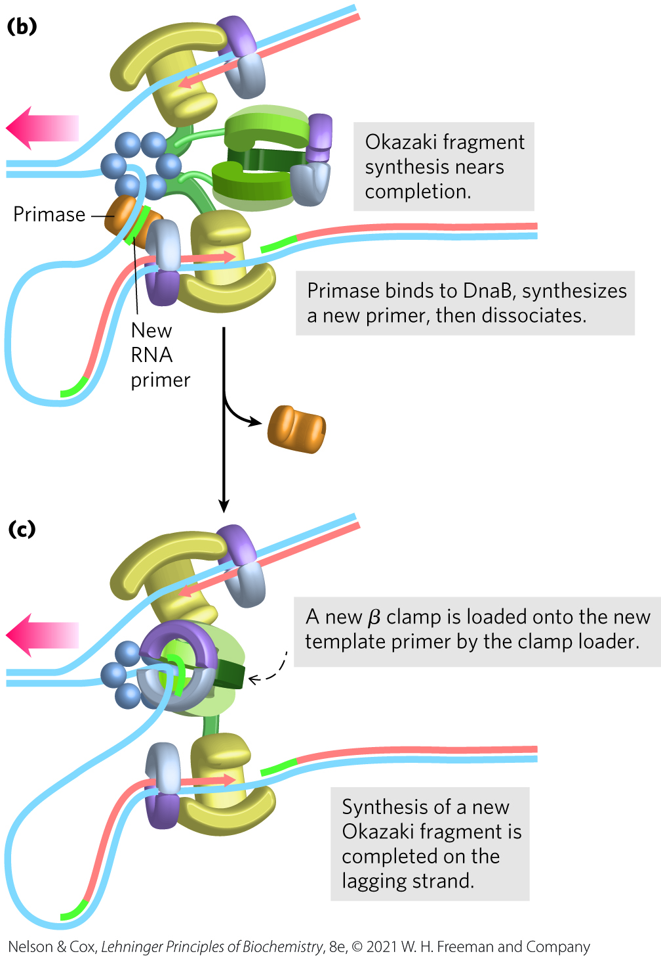
Leading and Lagging Strand Synthesis, Part 2
a new β sliding clamp is positioned at the primer by the clamp-loading complex of DNA polymerase III

Slide 101
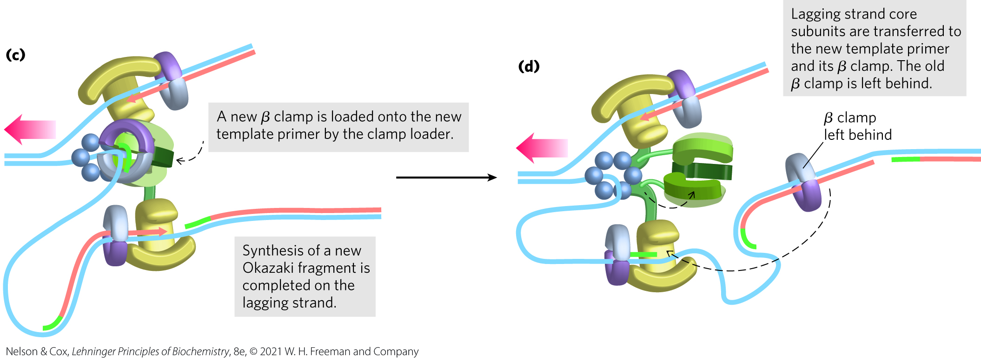
Leading and Lagging Strand Synthesis, Part 3
replication halts after synthesis of an Okazaki fragment is completed and DNA polymerase III core subunits dissociate from the β sliding clamp

Slide 102
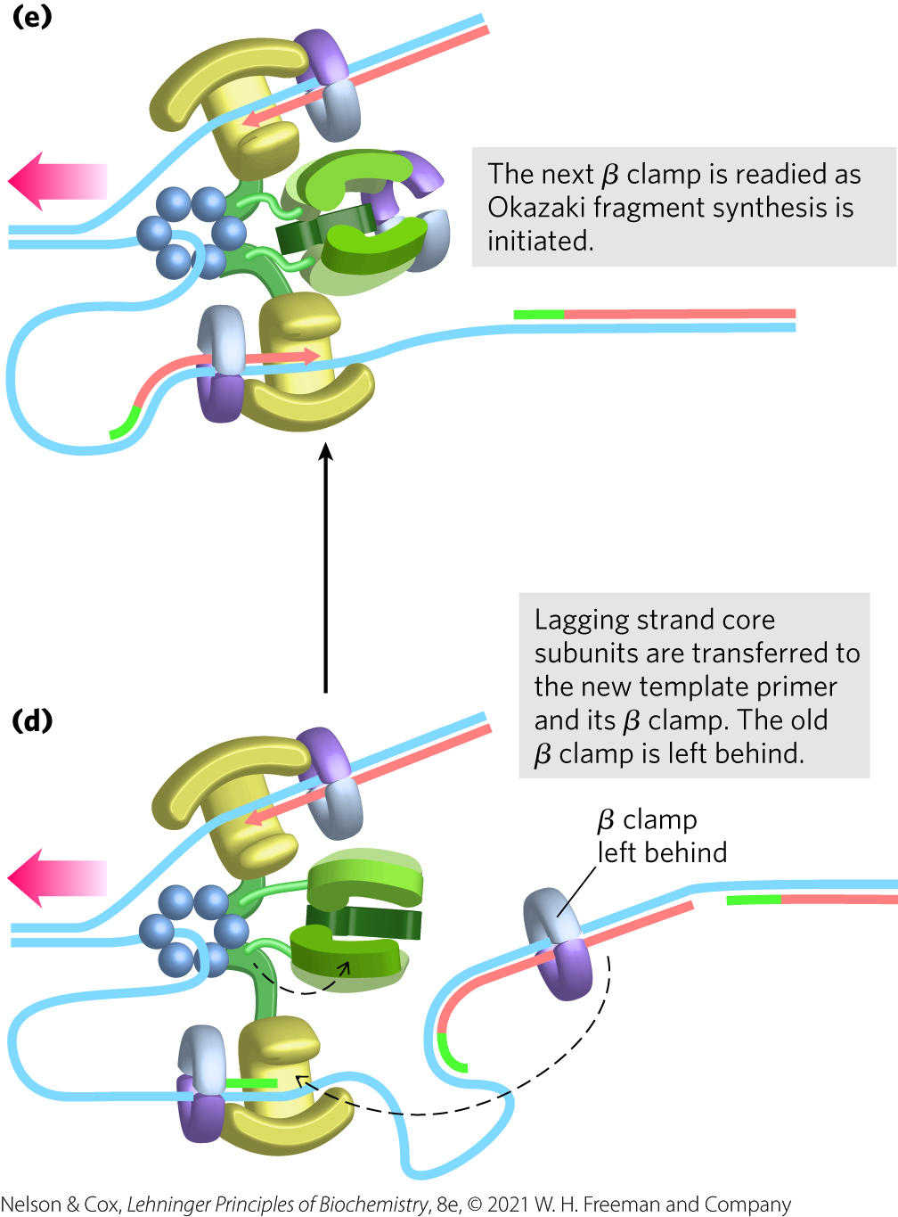
Leading and Lagging Strand Synthesis, Part 4
DNA polymerase III core subunits associate with a new β sliding clamp
  initiates synthesis of a new Okazaki fragment

Slide 103
Proteins Acting at the
Replication Fork
Table 25-4 Proteins of the E.coli Replisome
Protein | M_{r} | Number of subunits | Function
SSB | 75,600 | 4 | Binding to single-stranded DNA
Helicase (DnaB protein) | 300,000 | 6 | DNA unwinding
Primase (DnaG protein) | 60,000 | 1 | RNA primer synthesis
DNA polymerase III | 1,065,400 | 17 | New strand elongation
DNA polymerase I | 103,000 | 1 | Filling of gaps; excision of primers
DNA ligase | 74,000 | 1 | Ligation
DNA gyrase (DNA topoisomerase II) | 400,000 | 4 | Supercoiling

Slide 104
Clicker Question 15
Which compound is NOT a component of the E. coli replisome?
DNA polymerase III (more than one copy)
DnaB
gyrase
Tus protein
Notes:
Answer: D
Principle: 25.2
Learning Objective(s): Explain how other proteins are needed for DNA replication to occur.
Bloom’s: 1:1

Slide 105
Clicker Question 15, Response
Which compound is NOT a component of the E. coli replisome?
Tus protein
The replisome, which is responsible for elongation, is a supramolecular complex of nucleic acids and many proteins, including polymerases, DnaB, and gyrase. A replication fork halts when it meets a complex of the Tus (terminus utilization substance) protein and Ter sequence to which it binds.

Slide 106
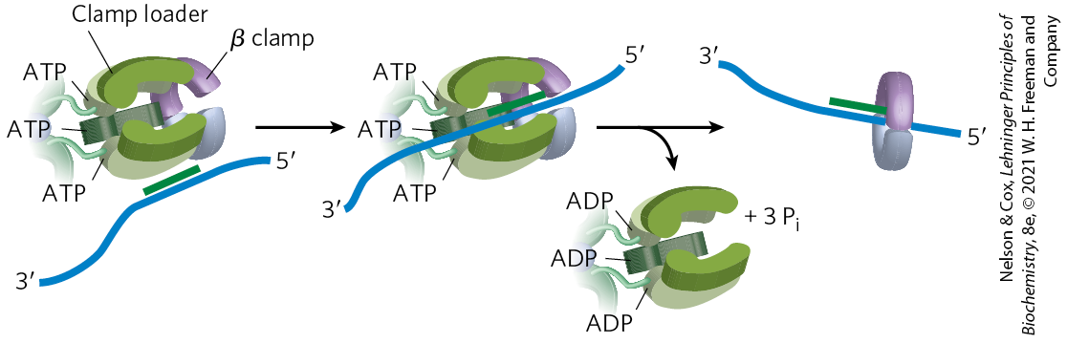
The DNA Polymerase III
Clamp Loader
clamp-loading complex = and AAA+ ATPase that binds ATP and the new β sliding clamp
  consists of parts of the three τ subunits along with the δ and δ′ subunits
  ATP binding opens the ring at one subunit interface
  ATP hydrolysis closes the clamp around the DNA

Slide 107
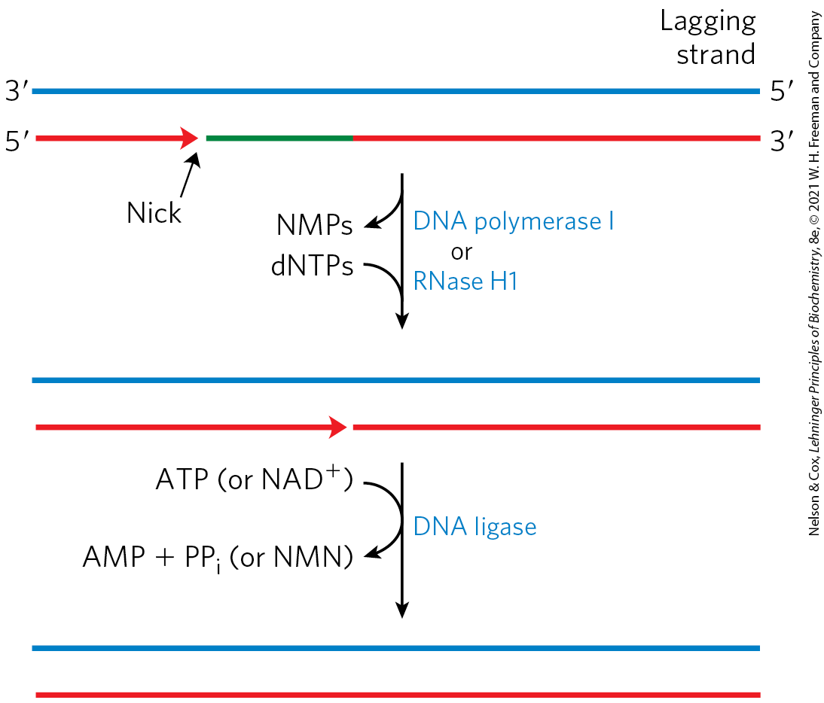
The Final Steps in Lagging Strand Synthesis
DNA polymerase I or RNase H1 = removes the RNA primer and replaces it with DNA
DNA ligase = seals the remaining nick

Slide 108
Clicker Question 16
A research project using E. coli has come to a halt because DNA replication is blocked. It seems that the DNA strands are not separating. What enzyme is likely faulty?
helicase (DnaB protein)
topoisomerase I
DNA ligase
one of the DNA primases
DNA polymerase I
Notes:
Answer: A
Principle: 25.2
Learning Objective(s): Explain how other proteins are needed for DNA replication to occur.
Bloom’s: 2:2

Slide 109
Clicker Question 16, Response
A research project using E. coli has come to a halt because DNA replication is blocked. It seems that the DNA strands are not separating. What enzyme is likely faulty?
helicase (DnaB protein)
Loading of the DnaB helicase is the key step in replication initiation. As a replicative helicase, DnaB migrates along the single-stranded DNA in the 5′→3′ direction, unwinding the DNA as it travels.

Slide 110
DNA Ligase
DNA ligase = catalyzes the formation of a phosphodiester bond between a 3′-OH at the end of one DNA strand and a 5′ phosphate at the end of another strand
  the phosphate must be activated by adenylylation using ATP (virus and eukaryotes) or NAD⁺ (bacteria)

Slide 111
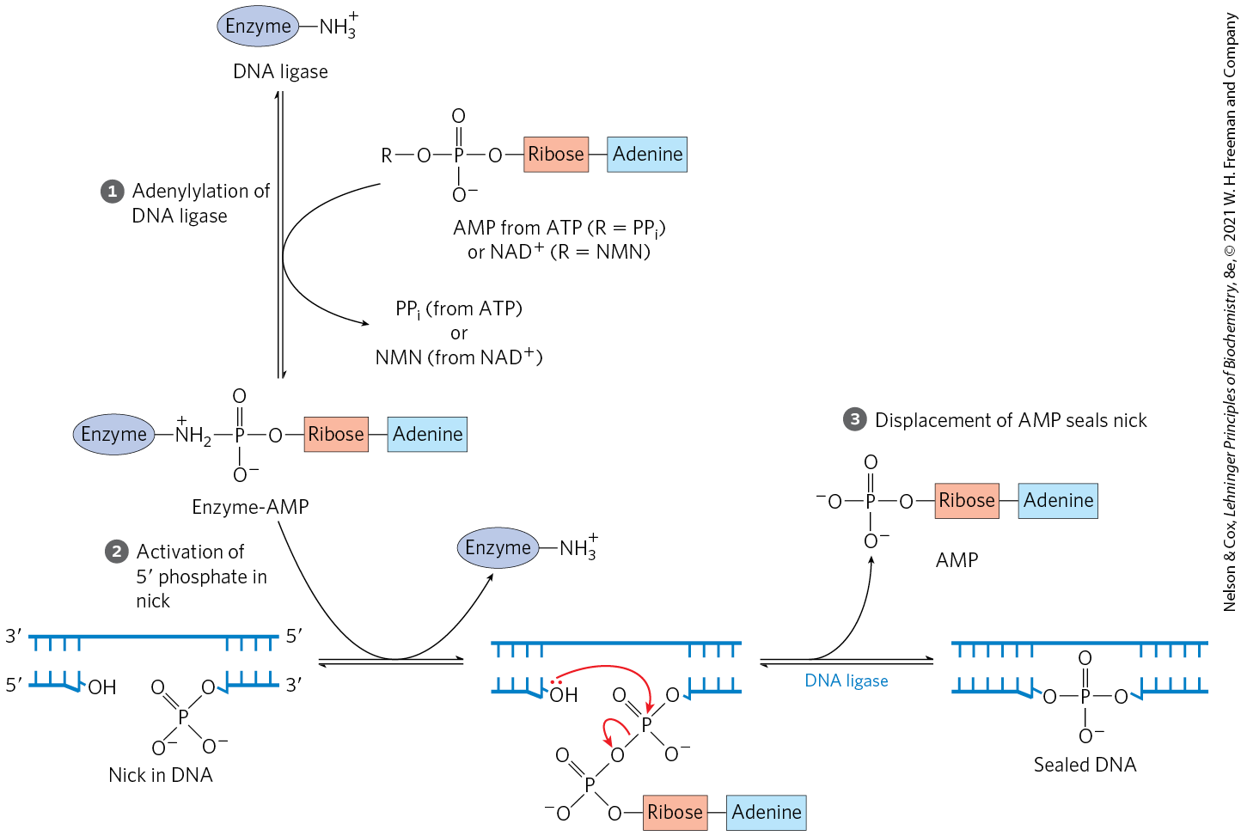
The DNA Ligase Mechanism

Slide 112
Clicker Question 17
What do MOST bacterial DNA ligases use for phosphodiester bond formation?
GTP
ATP
TTP
CTP
NAD⁺
Notes:
Answer: E
Principle: 25.2
Learning Objective(s): Compare DNA synthesis on the leading strand and the lagging strand.
Bloom’s: 1:1

Slide 113
Clicker Question 17, Response
What do MOST bacterial DNA ligases use for phosphodiester bond formation?
NAD⁺
DNA ligases from bacteria are unusual in that many use NAD⁺ — a cofactor that usually functions in hydride transfer reactions — as the source of the AMP activating group.

Slide 114
Termination
replication forks meet at a region with multiple copies of a 20-bp sequence called Ter
Ter sequences are found near each other, but in opposite directions
  creates a site that replication forks cannot leave
Ter is also a binding site for the protein Tus (terminus utilization sequence)
  causes a replication fork to stop

Slide 115
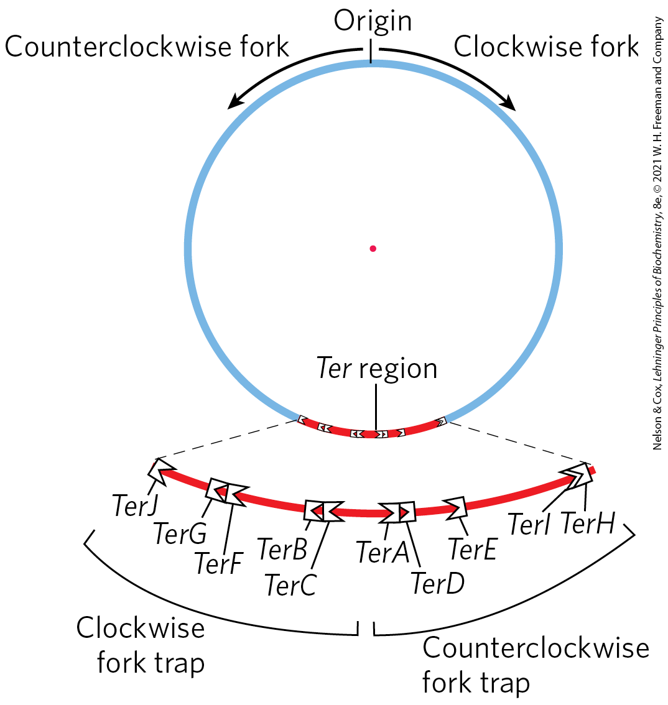
Termination of Chromosome Replication in E. coli
only one Tus-Ter complex functions per replication cycle

Slide 116
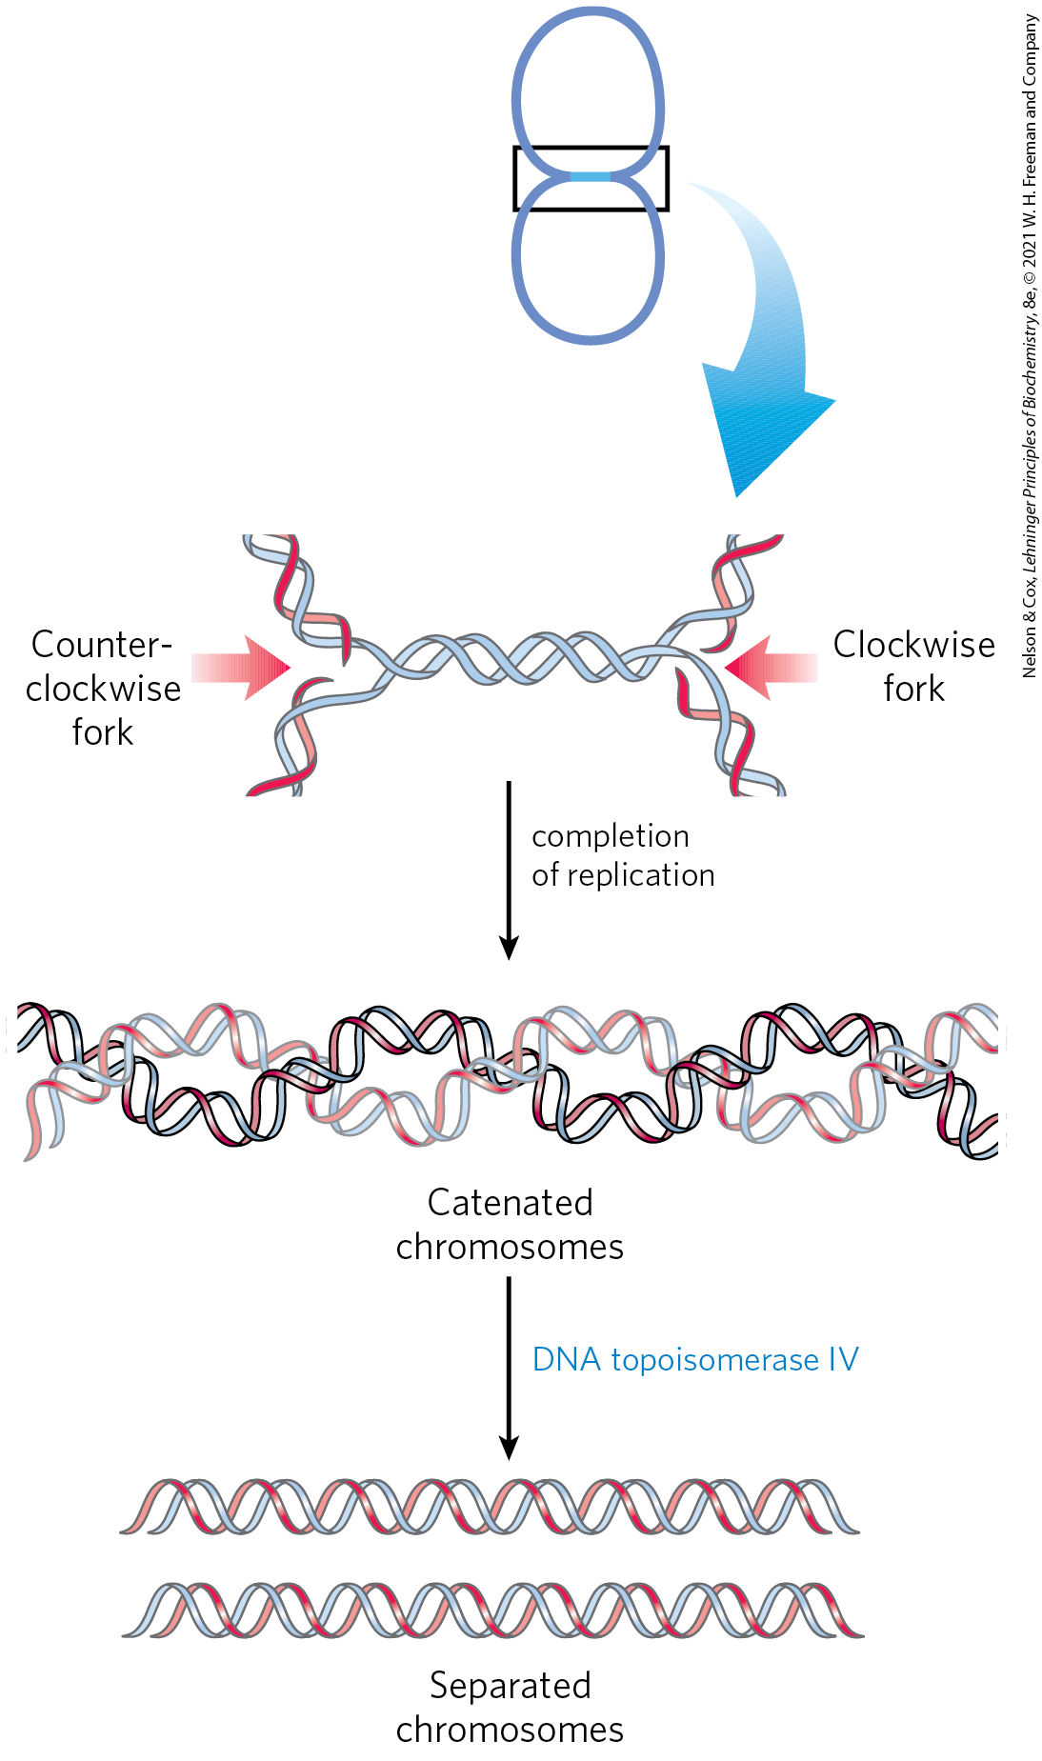
Separation of Catenanes by Topoisomerase IV
catenanes = two topologically interlinked circular chromosomes
separation of the catenated circles in E. coli requires topoisomerase IV (a type II topoisomerase)

Slide 117
Clicker Question 18
Plasmids and other circular DNA strands replicate and finish as two rings linked together, as in a chain. How are they separated?
using one of the functions of helicase
using the exonuclease function of DNA polymerase
using one of the functions of DNA primase
using DNA gyrase (topoisomerase II)
using topoisomerase IV
Notes:
Answer: E
Principle: 25.2
Learning Objective(s): Explain how other proteins are needed for DNA replication to occur.
Bloom’s: 1:1

Slide 118
Clicker Question 18, Response
Plasmids and other circular DNA strands replicate and finish as two rings linked together, as in a chain. How are they separated?
using topoisomerase IV
DNA circles linked in this way are known as catenanes. Separation of the catenated circles in E. coli requires topoisomerase IV (a type II topoisomerase).

Slide 119
Replication in Eukaryotic Cells Is Similar but More Complex
replicators = yeast (S. cerevisiae) replication origins
  also called autonomously replicating sequences (ARSs)
  yeast have ~400 replicators
  each spans ∼150 bp and contains several essential, conserved sequences
human chromosomes have ~30,000 to 50,000 replication origins

Slide 120
Regulation Ensures Cellular DNA Is Replicated Once Per Cell Cycle
regulation involves cyclins and the cyclin-dependent kinases (CDKs)
  cyclins undergo ubiquitin-dependent proteolysis at the end of the M phase (mitosis)
prereplicative complexes (pre-RCs) = established on replication initiation sites in the absence of cyclins
  their formation (sometimes called licensing) renders the cell competent for replication

Slide 121
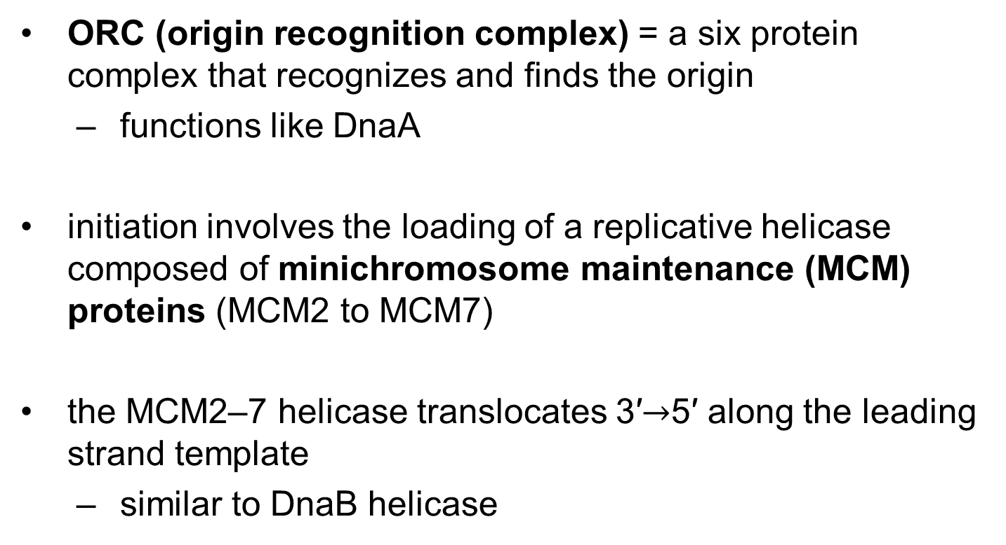
Initiation of Replication in Eukaryotes
ORC (origin recognition complex) = a six protein complex that recognizes and finds the origin
  functions like DnaA
initiation involves the loading of a replicative helicase composed of minichromosome maintenance (MCM) proteins (MCM2 to MCM7)
the MCM2–7 helicase translocates 3′$→$5′ along the leading strand template
  similar to DnaB helicase

Slide 122
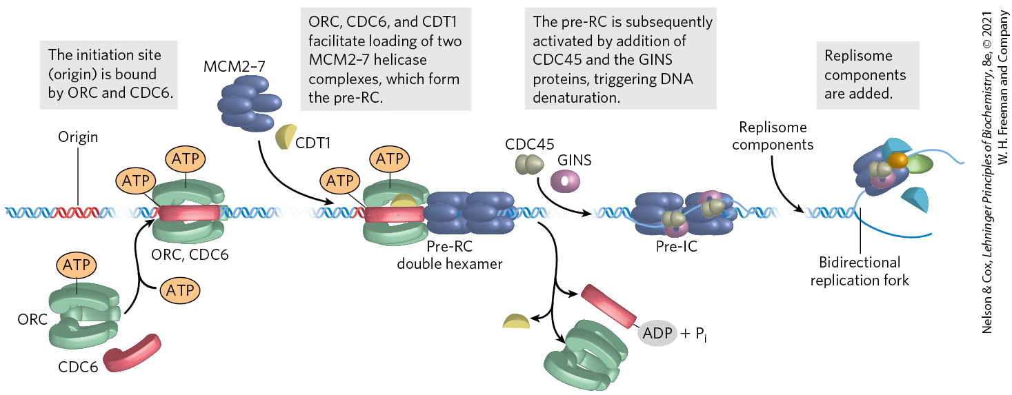
Assembly of a Prereplicative Complex at a Eukaryotic Replication Origin

Slide 123
Eukaryotic Rate of Replication
the replication fork moves ~50 nucleotides/second
  ~1/20th the rate seen in E. coli
eukaryotes compensate for the slower rate by having many origins

Slide 124
Clicker Question 19
Which statement about the initiation of DNA replication in eukaryotes is false?
The origin replication complex (ORC) functions like DnaA in bacteria.
The minichromosome maintenance (MCM) protein is similar to DnaB in bacteria.
Cyclins undergo ubiquitin-dependent proteolysis at the end of the S phase.
The absence of cyclins allows the establishment of prereplicative complexes (pre-RCs) on replication initiation sites.
Notes:
Answer: C
Principle: 25.2
Learning Objective(s): Compare the origin of replication in E.coli and eukaryotes.
Bloom’s: 2:2

Slide 125
Clicker Question 19, Response
Which statement about the initiation of DNA replication in eukaryotes is false?
Cyclins undergo ubiquitin-dependent proteolysis at the end of the S phase.
The cyclins are rapidly destroyed by ubiquitin-dependent proteolysis at the end of the M phase (mitosis). The absence of cyclins allows the establishment of prereplicative complexes (pre-RCs) on replication initiation sites.

Slide 126
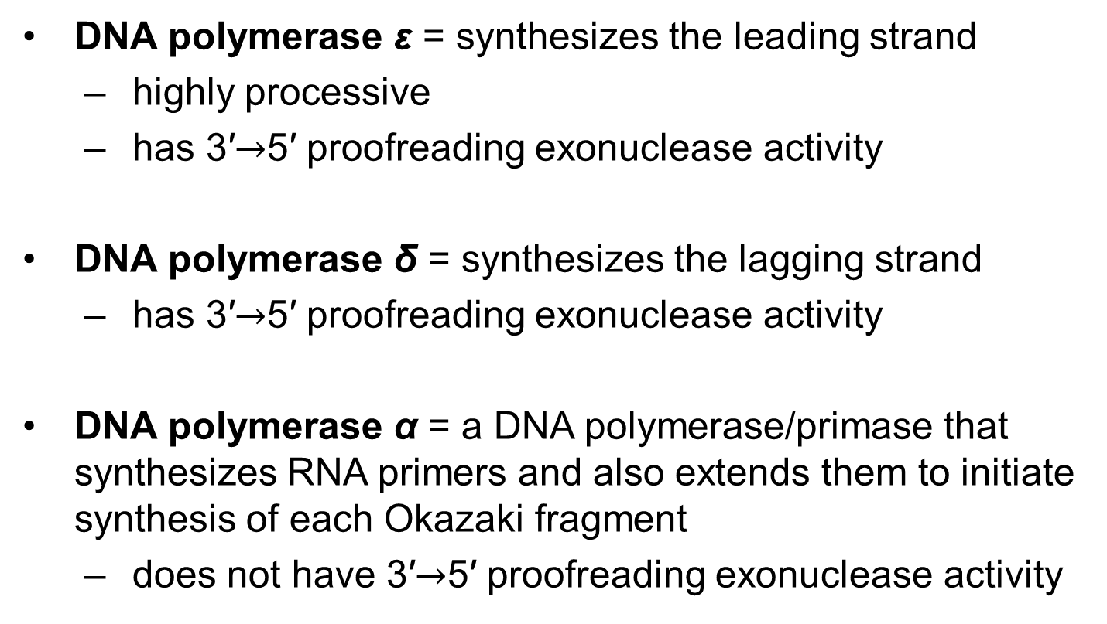
Eukaryotes Have Several Types of DNA Polymerases
DNA polymerase ε = synthesizes the leading strand
  highly processive
  has 3′$→$5′ proofreading exonuclease activity
DNA polymerase δ = synthesizes the lagging strand
  has 3′$→$5′ proofreading exonuclease activity
DNA polymerase α = a DNA polymerase/primase that synthesizes RNA primers and also extends them to initiate synthesis of each Okazaki fragment
  does not have 3′$→$5′ proofreading exonuclease activity

Slide 127
Function of PCNA
proliferating cell nuclear antigen (PCNA) = a protein that forms a circular clamp to enhance the processivity of two polymerases
  analogous function to the β subunit

Slide 128
Functions of RPA and RFC
RPA (replication protein A) = single-stranded DNA-binding protein
  equivalent in function to the E. coli SSB protein
RFC (replication factor C) = a clamp loader for PCNA that facilitates the assembly of active replication complexes
  significant sequence similarity to the subunits of the bacterial clamp-loading (γ) complex

Slide 129
Termination of
Eukaryotic Replication
termination occurs when replication forks operating from nearby origins converge

Slide 130
Clicker Question 20
Which factor is NOT associated with a stage of replication in eukaryotes?
G1 phase
formation of pre-replicative complexes
elongation
synthesis of telomeres
Notes:
Answer: A
Principle: 25.2
Learning Objective(s): Compare initiation, elongation, and termination of DNA replication.
Bloom’s: 1:1

Slide 131
Clicker Question 20, Response
Which factor is NOT associated with a stage of replication in eukaryotes?
G1 phase
DNA replication occurs in the S (synthesis) phase, not the G1 phase.

Slide 132
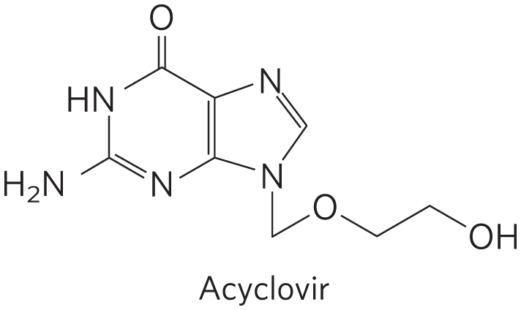
Viral DNA Polymerases Provide Targets for Antiviral Therapy
acyclovir = inhibits the DNA polymerase of the herpes simplex virus
  converted to acyclo-GTP
acyclo-GTP competitively inhibits viral DNA polymerases and terminates replication

Slide 133
25.2 DNA Repair

Slide 134
Principle 1 (5 of 6)
Along with catalysis, biological information is one of the two key prerequisites for life. The faithful maintenance and transmission of genetic information from one generation to another ensures continuity within each species.

Slide 135
DNA Molecules Are Irreplaceable
damaged proteins and RNA molecules can be replaced using information encoded in the DNA
DNA molecules themselves are irreplaceable

Slide 136
Principle 3 (3 of 7)
The fidelity of genome maintenance and transmission is not perfect. DNA damage happens, often by spontaneous processes. DNA replication and repair deal with the vast majority of DNA lesions, providing a high degree of genetic fidelity and stability. The few DNA damage events that slip through uncorrected provide fuel for evolution.

Slide 137
Mutations Are Linked to Cancer
mutation = a permanent change in the nucleotide sequence
  substitution mutation = replacement of one base pair with another
  insertion mutation = the addition of 1+ base pairs
  deletion mutation = the deletion of 1+ base pairs
silent mutation = a mutation that affects nonessential DNA or has a negligible effect on gene function

Slide 138
Principle 1 (6 of 6)
Along with catalysis, biological information is one of the two key prerequisites for life. The faithful maintenance and transmission of genetic information from one generation to another ensures continuity within each species.

Slide 139
Principle 3 (4 of 7)
The fidelity of genome maintenance and transmission is not perfect. DNA damage happens, often by spontaneous processes. DNA replication and repair deal with the vast majority of DNA lesions, providing a high degree of genetic fidelity and stability. The few DNA damage events that slip through uncorrected provide fuel for evolution.

Slide 140
Mutations Are
Rarely Advantageous
mutations rarely confer some biological advantage
most nonsilent mutations are neutral or deleterious

Slide 141
Clicker Question 21
DNA repair is necessary because:
any mutation in DNA will affect the function of the product of the gene in which it occurs.
while some mutation is necessary for evolution, most mutations do not confer a biological advantage and therefore represent more danger than they do opportunity.
DNA replication results in approximately one mistake made per 10⁶ nucleotides polymerized.
DNA is chemically unstable.
Notes:
Answer: B
Principle: 25.3
Learning Objective(s): Classify the types of mistakes that can happen in DNA replication.
Bloom’s: 4:2

Slide 142
Clicker Question 21, Response
DNA repair is necessary because:
while some mutation is necessary for evolution, most mutations do not confer a biological advantage and therefore represent more danger than they do opportunity.
Most nonsilent mutations are neutral or deleterious.

Slide 143
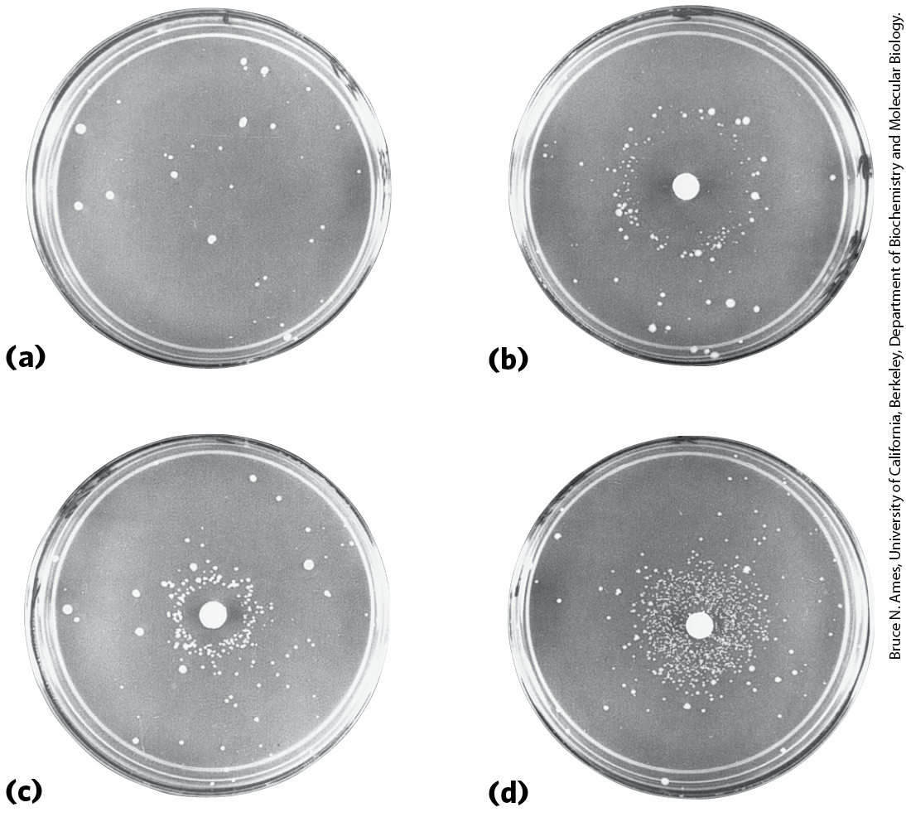
The Ames Test
the Ames test = measures the potential of a given chemical compound to promote certain easily detected mutations in a strain of S. typhimurium that cannot synthesize histidine
  strains that grow contain mutations that restore the ability to synthesize histidine

Slide 144
Clicker Question 22
Which statement is true about the Ames test?
It can be used to screen for potential human carcinogens.
It requires a histidine-rich growth medium.
It requires a strain of antibiotic-resistant bacteria.
It involves sacrificing lab animals and evaluating them for tumors.
Notes:
Answer: A
Principle: 25.3
Learning Objective(s): Explain the Ames test and its value.
Bloom’s: 2:2

Slide 145
Clicker Question 22, Response
Which statement is true about the Ames test?
It can be used to screen for potential human carcinogens.
More than 90% of the compounds known to be carcinogenic from extensive animal trials are also found to be mutagenic in the Ames test. Because of this strong correlation between mutagenesis and carcinogenesis, the Ames test for bacterial mutagens is still widely used as a rapid and inexpensive screen for potential human carcinogens.

Slide 146
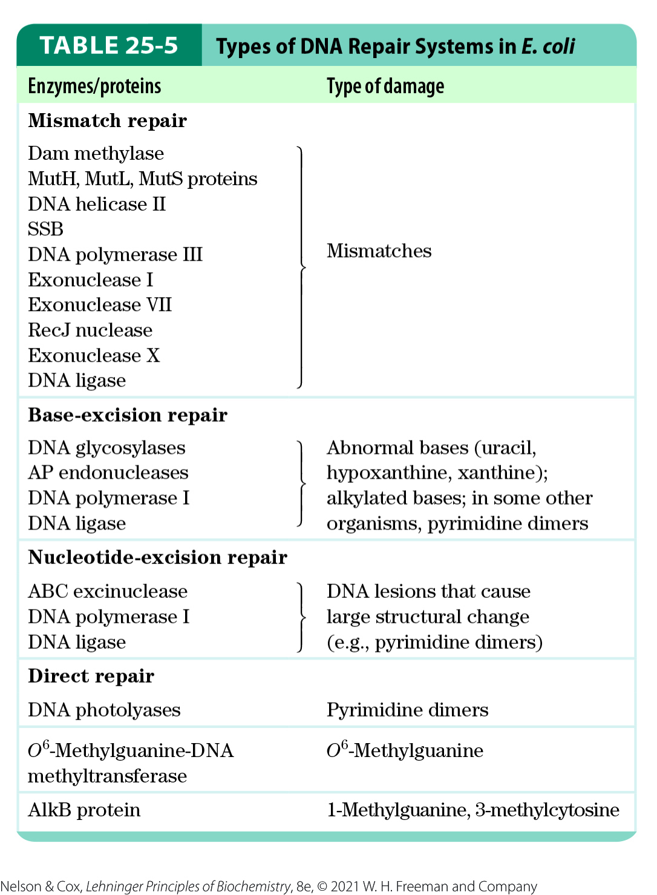
All Cells Have Multiple DNA
Repair Systems
nearly 200 genes in the human genome encode proteins dedicated to DNA repair

Slide 147
Principle 2 (5 of 7)
Information is expensive. The chemistry of joining one nucleotide to the next in DNA replication is elegant and simple, almost deceptively so. However, the enzymatic and thermodynamic commitment to linking one nucleotide to another in DNA far exceeds what would normally be required to successfully form a phosphodiester bond. It is not enough to synthesize a phosphodiester bond; that bond must accurately link two particular nucleotides.

Slide 148
DNA Repair Seems
Energetically Inefficient
many DNA repair processes seem to be extraordinarily inefficient energetically
  irrelevant because the integrity of the genetic information is more important

Slide 149
Mismatch Repair
mismatches are corrected to reflect template strand information
  distinguished from the newly synthesized strand by the presence of methyl group tags on the template DNA
in E. coli, Dam methylase methylates DNA at the N⁶ position of adenines within (5′)GATC sequences

Slide 150
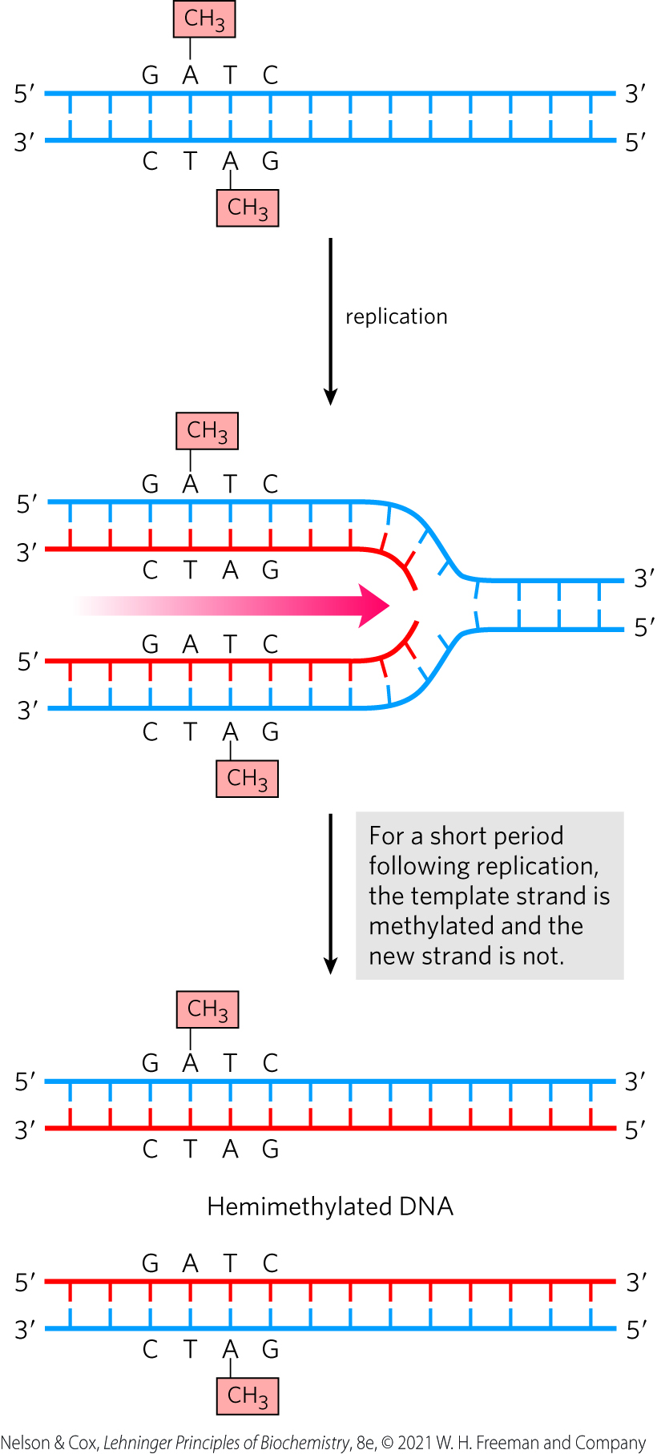
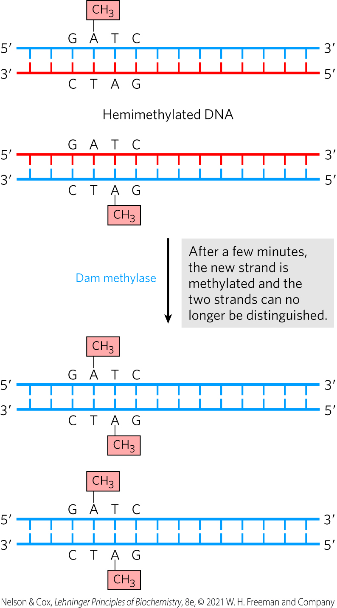
Methylation and Mismatch Repair

Slide 151
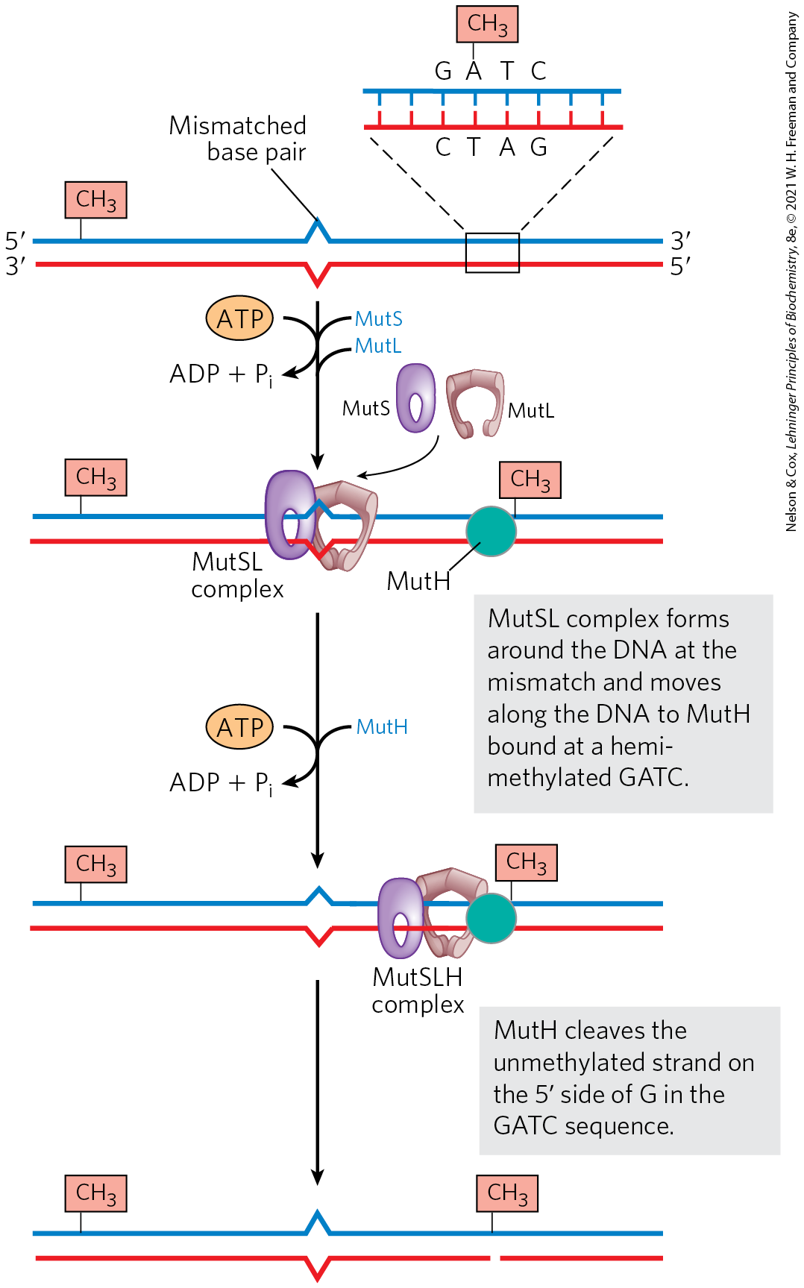
A Model for the Early Steps of Methyl-Directed Mismatch Repair
MutS recognizes the mismatch
MutH recognizes the sequence (5′)GATC and has site-specific endonuclease activity
MutL binds to both MutS and MutH

Slide 152
Clicker Question 23
Which statement about a model for the early steps of methyl-directed mismatch repair is false?
MutS protein scans the DNA and forms a clamplike complex upon encountering a lesion.
MutH protein binds a hemimethylated (5′)GATC sequence.
MutL protein forms a complex with MutS protein.
Exonuclease I cleaves the unmethylated strand on the 5′ side of the G in GATC.
Notes:
Answer: D
Principle: 25.2
Learning Objective(s): Describe mismatch repair.
Bloom’s: 2:2

Slide 153
Clicker Question 23, Response
Which statement about a model for the early steps of methyl-directed mismatch repair is false?
Exonuclease I cleaves the unmethylated strand on the 5′ side of the G in GATC.
MutH has a site-specific endonuclease activity that is inactive until the complex encounters a hemimethylated GATC sequence. At this site, MutH catalyzes cleavage of the unmethylated strand on the 5′ side of the G in GATC, which marks the strand for repair.

Slide 154
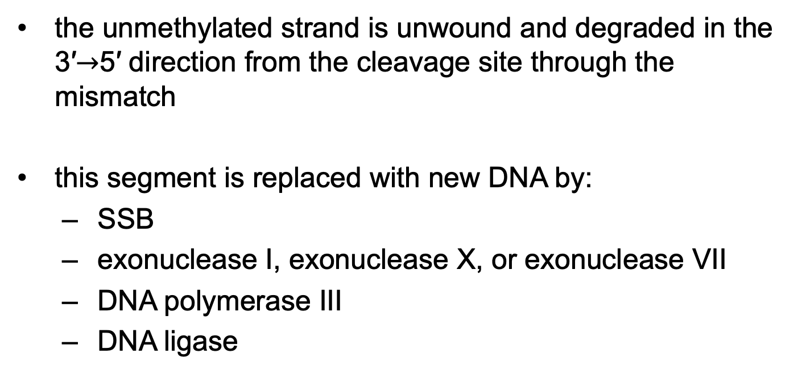
Mismatch Repair on the 5′ Side of the Cleavage Site
the unmethylated strand is unwound and degraded in the 3′$→$5′ direction from the cleavage site through the mismatch
this segment is replaced with new DNA by:
  SSB
  exonuclease I, exonuclease X, or exonuclease VII
  DNA polymerase III
  DNA ligase

Slide 155
Mismatch Repair on the 3′ Side of the Cleavage Site
repair is similar to mismatches on the 5′ side
the exonuclease is either exonuclease VII or RecJ nuclease

Slide 156
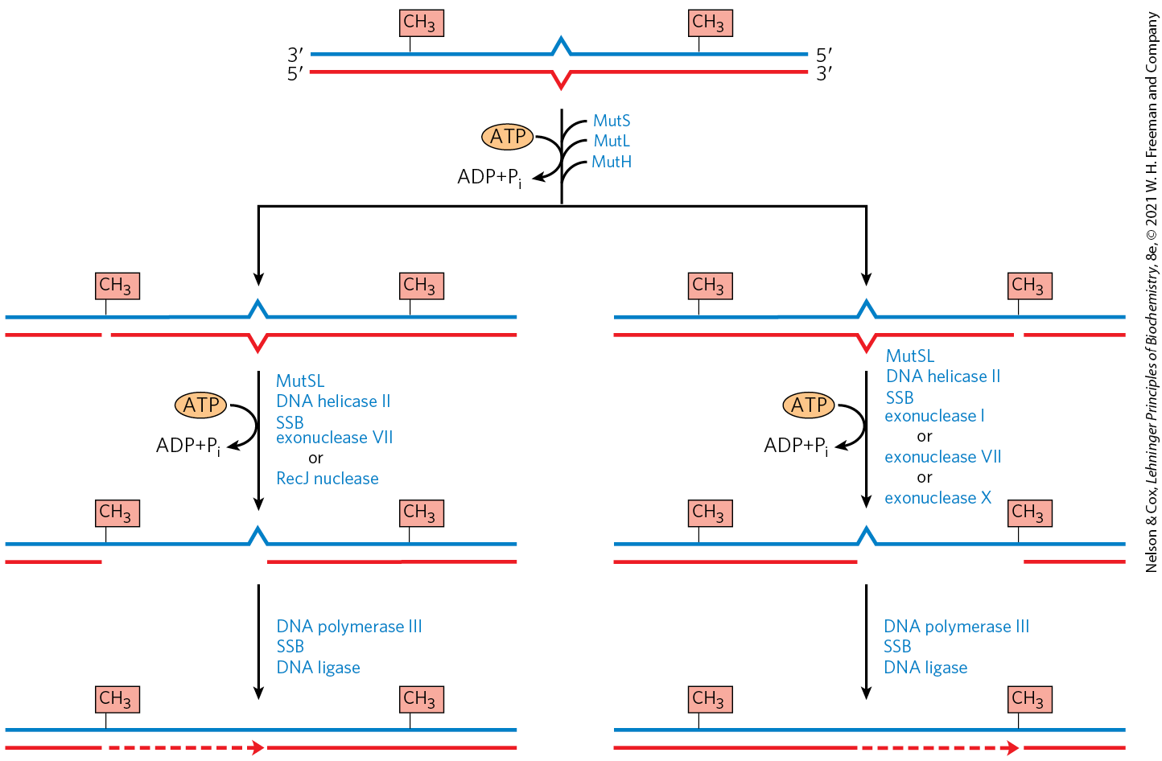
Completion of Methyl-Directed Mismatch Repair

Slide 157
Principle 2 (6 of 7)
Information is expensive. The chemistry of joining one nucleotide to the next in DNA replication is elegant and simple, almost deceptively so. However, the enzymatic and thermodynamic commitment to linking one nucleotide to another in DNA far exceeds what would normally be required to successfully form a phosphodiester bond. It is not enough to synthesize a phosphodiester bond; that bond must accurately link two particular nucleotides.

Slide 158
Energy Cost of Mismatch Repair
mismatch repair is particularly costly for E. coli
mismatches may occur 1,000+ base pairs from the GATC sequence
  repair requires degradation and replacement of a strand segment of this entire length

Slide 159
Clicker Question 24
Which statement regarding DNA mismatch repair in E. coli is false?
If both strands appear to be parental (“correct”), the mismatch repair system can still repair the strand with the mistake (through a process still poorly understood).
The parental (“correct”) strand can be distinguished by its methylation.
A single mismatch may require replacing hundreds of nucleotides on the unmethylated strand.
It involves exonucleases.
Notes:
Answer: B
Principle: 25.2
Learning Objective(s): Describe mismatch repair.
Bloom’s: 2:2

Slide 160
Clicker Question 24, Response
Which statement regarding DNA mismatch repair in E. coli is false?
The parental (“correct”) strand can be distinguished by its methylation.
The mismatches are nearly always corrected to reflect the information in the old (template) strand, which the repair system can distinguish from the newly synthesized strand by the presence of methyl group tags on the template DNA.

Slide 161
Eukaryotic Mismatch Repair Systems
several proteins are structurally and functionally analogous to the bacterial MutS and MutL proteins
many details of eukaryotic mismatch repair are unknown
identification of newly synthesized DNA strands does not involve GATC sequences

Slide 162
Base-Excision Repair
DNA glycosylases = recognize common DNA lesions and remove the affected base by cleaving the N-glycosyl bond in the process of base-excision repair
  generally specific for one lesion type
AP site or abasic site = an apurinic or apyrimidinic site in the DNA resulting from removal of a base by DNA glycosylase

Slide 163
Uracil DNA Glycosylases
uracil DNA glycosylases = specifically remove from DNA the uracil that results from spontaneous deamination of cytosine
  does not remove uracil residues from RNA or thymine residues from DNA
  deamination is 100-fold faster in ssDNA

Slide 164
Other DNA Glycosylases
other DNA glycosylases recognize:
  formamidopyrimidine (from purine oxidation)
  8-hydroxyguanine (from purine oxidation)
  hypoxanthine (from adenine deamination)
  alkylated bases
  pyrimidine dimers

Slide 165


Activity: Mechanisms of
DNA Repair
Observe the structure of cytosine in Mol3D viewer in your Achieve course.
Notes:
Instructor: This Mol3D structure is located in the Achieve course. It can be found in the Chapter 25 content, in the folder titled “Ch25 In-Class Activities and Resources.”

Slide 166
Activity Instructions (1 of 2)
On your own, think of answers to the questions:
  What is the product of spontaneous deamination of cytosine?
  What DNA repair enzyme removes the product of spontaneous deamination of cytosine?
  Where does this enzyme cleave?
  (2 minutes)
Pair up to discuss your ideas. (2 minutes)
Share your ideas with the class in group discussion.
(3 minutes)
Notes:
Instructor: This Mol3D structure is located in the Achieve course. It can be found in the Chapter 25 content, in the folder titled “Ch25 In-Class Activities and Resources.”

Slide 167
Activity Solution (1 of 2)
  What is the product of spontaneous deamination of cytosine? thymine
  What DNA repair enzyme removes the product of spontaneous deamination of cytosine? uracil DNA glycosylase
  Where does this enzyme cleave? the N-glycosyl bond
Notes:
Instructor: This Mol3D structure is located in the Achieve course. It can be found in the Chapter 25 content, in the folder titled “Ch25 In-Class Activities and Resources.”

Slide 168
Repair at AP Sites in Bacteria
the deoxyribose 5′-phosphate left behind is removed and replaced with a new nucleotide
AP endonucleases = cut the DNA strand containing the AP site
DNA polymerase I replaces the DNA
DNA ligase seals the remaining nick

Slide 169


DNA Repair by the Base-Excision Repair Pathway

Slide 170
Clicker Question 25
In the base-excision repair pathway, a DNA glycosylase creates:
an AP site.
an alkylated base.
a pyrimidine dimer.
a gap of 12 to 13 nucleotides.
Notes:
Answer: A
Principle: 25.2
Learning Objective(s): Describe nucleotide-excision repair.
Bloom’s: 1:1

Slide 171
Clicker Question 25, Response
In the base-excision repair pathway, a DNA glycosylase creates:
an AP site.
DNA glycosylases recognize particularly common DNA lesions and remove the affected base by cleaving the N-glycosyl bond. This cleavage creates an apurinic or apyrimidinic site in the DNA, commonly referred to as an AP site or abasic site.

Slide 172
Nucleotide-Excision Repair
nucleotide-excision system = repairs DNA lesions that cause large distortions in the DNA helical structure
excinuclease = a multisubunit enzyme that hydrolyzes two phosphodiester bonds, one on either side of the distortion
DNA polymerase I (E. coli) or DNA polymerase ε (humans) fills the gap
DNA ligase seals the nick

Slide 173

Nucleotide-Excision Repair in E. coli and Humans

Slide 174
The ABC Excinuclease
has three components:
  UvrA = a dimeric ATPase that scan DNA and binds to the lesion site
  UvrB = binds UvrA and makes an incision at the fifth phosphodiester bond on the 3′-side of the lesion after UvrA dissociates from the lesion
  UvrC = binds UvrB and makes an incision at the eighth phosphodiester bond on the 5′-side of the lesion after UvrB does
removes a fragment of 12 to 13 nucleotides

Slide 175
Eukaryotic Excinuclease
similar mechanism to that of the bacterial enzyme
requires 16+ polypeptides with no similarity to the E. coli excinuclease subunits
hydrolyzes the sixth phosphodiester bond on the 3′ side and the twenty-second phosphodiester bond on the 5′ side
  produces a fragment of 27 to 29 nucleotides

Slide 176
Clicker Question 26
Nucleotide-excision repair:
is required when the DNA lesion to be repaired does not cause a detectable distortion in the DNA structure.
in both bacteria and eukaryotes requires removal of 60–70 nucleotides.
involves DNA polymerase II in E. coli.
occurs in all free-living organisms.
Notes:
Answer: D
Principle: 25.2
Learning Objective(s): Describe nucleotide-excision repair.
Bloom’s: 1:1

Slide 177
Clicker Question 26, Response
Nucleotide-excision repair:
occurs in all free-living organisms.
Major repair systems present in all organisms include mismatch repair, base-excision repair, nucleotide-excision repair, and direct repair.

Slide 178
Direct Repair
pyrimidine dimers result from a UV-induced reaction
DNA photolyases = promote direct photoreactivation of cyclobutane pyrimidine dimers
  use energy from absorbed light
  generally contain two cofactors: FADH₂ and folate

Slide 179

Repair of Pyrimidine Dimers with Photolyase
DNA photolyases are not found in placental mammals (including humans)

Slide 180

Formation of Nucleotides with
Alkylation Damage
O⁶-methylguanine = a modified nucleotide that forms in the presence of alkylating agents
  common and highly mutagenic lesion
  tends to pair with thymine rather than cytosine

Slide 181

Repair of Nucleotides with
Alkylation Damage
O⁶-methylguanine-DNA methyltransferase = catalyzes transfer of the methyl group of O⁶-methylguanine to one of its own Cys residues
  a single methyl transfer event permanently methylates the protein, inactivating it

Slide 182
Clicker Question 27
DNA may be repaired by removing a mutation and replacing it - so-called excision repair. Which mutation can actually be repaired directly by a mechanism requiring light?
pyrimidine dimers
mismatched bases
methylation of bases, such as 1-methylguanine or 3-methylcytosine
uracil incorporated into DNA
depurination
Notes:
Answer: A. This is an example of direct DNA repair. See Figure 25-25, 8e.
Principle: 25.2
Learning Objective(s): Describe direct repair.
Bloom’s: 2:2

Slide 183
Clicker Question 27, Response
DNA may be repaired by removing a mutation and replacing it - so-called excision repair. Which mutation can actually be repaired directly by a mechanism requiring light?
pyrimidine dimers
Photolyases use energy derived from absorbed light to reverse the damage. This is an example of direct DNA repair.

Slide 184
Principle 2 (7 of 7)
Information is expensive. The chemistry of joining one nucleotide to the next in DNA replication is elegant and simple, almost deceptively so. However, the enzymatic and thermodynamic commitment to linking one nucleotide to another in DNA far exceeds what would normally be required to successfully form a phosphodiester bond. It is not enough to synthesize a phosphodiester bond; that bond must accurately link two particular nucleotides.

Slide 185

Consumption of the Methyltransferase Illustrates the Importance of DNA Integrity
consumption of an entire protein to correct a single damaged base illustrates the priority given to maintaining the integrity of cellular DNA

Slide 186

Direct Repair of Alkylated Bases by AlkB

Slide 187
Clicker Question 28
DNA must be replicated with extremely high fidelity, and maintained free of structural defects in order to propagate a species. Which structural change in DNA, considered damage, CANNOT be repaired?
pyrimidine dimers
mismatched bases
methylation of bases, such as 1-methylguanine or 3-methycytosine
uracil incorporated into DNA
All of these can be repaired.
Notes:
Answer: E
Principle: 25.3
Learning Objective(s): Describe direct repair.
Bloom’s: 2:2

Slide 188
Clicker Question 28, Response
DNA must be replicated with extremely high fidelity, and maintained free of structural defects in order to propagate a species. Which structural change in DNA, considered damage, CANNOT be repaired?
All of these can be repaired.
DNA replication and repair deal with the vast majority of DNA lesions, providing a high degree of genetic fidelity and stability.

Slide 189
Principle 3 (5 of 7)
The fidelity of genome maintenance and transmission is not perfect. DNA damage happens, often by spontaneous processes. DNA replication and repair deal with the vast majority of DNA lesions, providing a high degree of genetic fidelity and stability. The few DNA damage events that slip through uncorrected provide fuel for evolution.

Slide 190
The Interaction of Replication Forks with DNA Damage Can Lead to Error-Prone Translesion DNA Synthesis
double-strand breaks and lesions in ssDNA arise from:
  a replication fork encountering an unrepaired DNA lesion
  ionizing radiation
  oxidative reactions

Slide 191

Stalling of a Replication Fork

Slide 192

Clicker Question 29
Homologous recombination in bacteria:
occurs during meiosis.
permits DNA replication to resume when a replication fork has stalled due to a DNA strand break.
is unique in that it does not generate a Holliday intermediate.
involves a recombinase-generated 5′ single stranded DNA extension.
Notes:
Answer: B
Principle: 25.4
Learning Objective(s): Define the process of homologous genetic recombination as recombinational DNA repair.
Bloom’s: 2:2

Slide 193
Clicker Question 29, Response
Homologous recombination in bacteria:
permits DNA replication to resume when a replication fork has stalled due to a DNA strand break.
Recombinational DNA repair is usually directed at the reconstruction of replication forks that have stalled or collapsed at the site of DNA damage.

Slide 194
Repair Avenues for a Stalled Bacterial Replication Fork
two avenues:
  homologous genetic recombination
  error-prone translesion DNA synthesis (TLS)

Slide 195
Error-Prone TLS in Bacteria
part of the SOS response (a cellular stress response to extensive DNA damage)
other SOS proteins include UvrA, UvrB + UmuC, and UmuD
  Umu = unmutable (because lack of umu genes eliminates error-prone repair)
cleaved UmuD′ and UmuC bind with RecA to create DNA Pol V (a specialized polymerase)
  the polymerase can process past the damaged area

Slide 196
Clicker Question 30
Translesion DNA synthesis in E. coli:
is a replisome-mediated form of DNA repair.
primarily uses DNA polymerase III.
is error prone.
occurs only when levels of DNA damage are low.
Notes:
Answer: C
Principle: 25.3
Learning Objective(s): Explain the value of error-prone translesion DNA synthesis (TLS).
Bloom’s: 2:2

Slide 197
Clicker Question 30, Response
Translesion DNA synthesis in E. coli:
is error prone.
When this pathway is active, DNA repair is significantly less accurate, and a high mutation rate can result.

Slide 198
Principle 3 (6 of 7)
The fidelity of genome maintenance and transmission is not perfect. DNA damage happens, often by spontaneous processes. DNA replication and repair deal with the vast majority of DNA lesions, providing a high degree of genetic fidelity and stability. The few DNA damage events that slip through uncorrected provide fuel for evolution.

Slide 199
Purpose of Error-Prone TLS
error-prone TLS serves as a desperation strategy
the resulting mutations kill some cells and create deleterious mutations in others
at least a few mutant daughter cells survive
the resultant mutations contribute to evolution

Slide 200
DNA Polymerase IV
induced during the SOS response
replication by DNA polymerase IV is highly error-prone
lack a proofreading exonuclease and have a more open active site than other DNA polymerases
  accommodates damaged template nucleotides

Slide 201


Activity: Fidelity of DNA
Replication Muddiest Point (1 of 2)
Complete the Ch25 Student Activity, Day 1: Fidelity of DNA Replication (Muddiest Point) Achieve assessment.
Notes:
Instructor: This muddiest point activity can be found in Achieve in the Chapter 25 folder titled “Ch25 In-Class Activities and Resources.” See the Instructor Activity Guide in the same folder for more information.

Slide 202

Activity: Fidelity of DNA
Replication Muddiest Point (2 of 2)
Complete the Ch25 Student Activity, Day 2: Fidelity of DNA Replication (Muddiest Point) Achieve assessment.
Notes:
Instructor: This muddiest point activity can be found in Achieve in the Chapter 25 folder titled “Ch25 In-Class Activities and Resources.” See the Instructor Activity Guide in the same folder for more information.

Slide 203
Principle 4 (2 of 5)
Although considered separately, the processes of replication, repair, and recombination of DNA are not distinct. These processes are highly integrated in cells, and they are required for proper genome maintenance.

Slide 204
TLS Polymerases in Mammals
mammals have many low-fidelity TLS polymerases
  most also have specialized functions in DNA repair
  typically limited to short lengths to minimize mutagenic potential
DNA polymerase η = promotes translesion synthesis primarily across cyclobutane T–T dimers
DNA polymerases β, ι, and λ have specialized roles in eukaryotic base-excision repair

Slide 205
25.3 DNA Recombination

Slide 206
Three Classes of Genetic Recombination Events
homologous genetic recombination = involves genetic exchanges between any two DNAs that share an extended region of nearly identical sequence
site-specific recombination = involves genetic exchanges only at a particular DNA sequence
DNA transposition = involves a short segment of DNA with the capacity to move from one location in a chromosome to another (“jumping genes”)

Slide 207
Nonhomologous End
Joining (NHEJ)
nonhomologous end joining (NHEJ) = an alternative process for double-strand break repair
  does not entail recombination

Slide 208
Principle 4 (3 of 5)
Although considered separately, the processes of replication, repair, and recombination of DNA are not distinct. These processes are highly integrated in cells, and they are required for proper genome maintenance.

Slide 209
Bacterial Homologous Recombination Is a DNA Repair Function
recombinational DNA repair = homologous genetic recombination as a DNA repair process
  typically directed at the reconstruction of stalled or collapsed replication forks

Slide 210


Activity: Relating
Terms within the Chapter
A concept map displays the relationships between different concepts. Observe the following example of a concept map.
Notes:
Instructor: For additional information, see the Instructor Activity Guide located in Achieve. It can be found within Chapter 25, in the folder titled “Ch25 In-Class Activities and Resources.”

Slide 211
Activity Instructions (2 of 2)
Think about how the following terms and phrases relate to each other and then use scratch paper to draw a concept map using these terms and phrases. (3 minutes)
DNA replication
DNA repair
DNA recombination
separate but not distinct
required for proper genome maintenance
highly integrated
Notes:
Instructor: For additional information, see the Instructor Activity Guide located in Achieve. It can be found within Chapter 25, in the folder titled “Ch25 In-Class Activities and Resources.”

Slide 212

Activity Solution (2 of 2)
Pair up and share how this possible concept map might differ from yours. (2 minutes)
Notes:
Instructor: For additional information, see the Instructor Activity Guide located in Achieve. It can be found within Chapter 25, in the folder titled “Ch25 In-Class Activities and Resources.”

Slide 213
Principle 4 (4 of 5)
Although considered separately, the processes of replication, repair, and recombination of DNA are not distinct. These processes are highly integrated in cells, and they are required for proper genome maintenance.

Slide 214
Reconstruction of a Collapsed Replication Fork
the replication fork collapses when it encounters a damaged site in a template strand
the 5′-ending strand is degraded
the 3′ single-stranded extension is bound by a recombinase that pairs with a complementary sequence in the intact DNA duplex
  creates a branched DNA structure (a point where three DNAs come together)

Slide 215
Reconstruction of a Collapsed Replication Fork, Continued
branch migration = process that moves the DNA branch
  creates a Holliday intermediate (an X-like crossover structure)
a special class of nucleases cleaves The Holliday intermediate
ligation restores the replication fork

Slide 216
Clicker Question 31
The intermediate of homologous recombination is called the:
Holliday intermediate.
replication fork.
double-strand break repair model.
junction cleavage model.
DNA substrate model.
Notes:
Answer: A
Principle: 25.4
Learning Objective(s): Describe the process of how branch migration can create a Holliday intermediate.
Bloom’s: 1:1

Slide 217
Clicker Question 31, Response
The intermediate of homologous recombination is called the:
Holliday intermediate.
The DNA branch can be moved in a process called branch migration to create an X-like crossover structure known as a Holliday intermediate, named after researcher Robin Holliday, who first postulated its existence.

Slide 218

Recombinational DNA Repair

Slide 219

The RecBCD Helicase/Nuclease
RecBCD nuclease/helicase = promotes DNA end-processing in E. coli
  coupled to ATP hydrolysis
RecB (moves 3′$→$5′) and RecD (moves 5′$→$3′) are helicase motors
RecC binds tightly to the chi sequence ((5′)GCTGGTGG)
  decreases degradation of the 3′-terminal strand
  increases degradation of the 5′-terminal strand
  creates ssDNA with a 3′ end for use in recombination

Slide 220

The RecBCD Enzyme Structure

Slide 221


RecBCD Activity

Slide 222
Clicker Question 32
A genomic DNA segment may be spontaneously removed and inserted into another location of the same chromosome. What is the name of this process, discovered by Barbara McClintock?
conjugation
transposition
branch migration
SOS response
cointegration
Notes:
Answer: B. Answer E: In this case, the original sequence remains in its location, but a copy is transposed to another location.
Principle: 25.4
Learning Objective(s): Identify other situations where homologous genetic recombination can occur.
Bloom’s: 1:1

Slide 223
Clicker Question 32, Response
A genomic DNA segment may be spontaneously removed and inserted into another location of the same chromosome. What is the name of this process, discovered by Barbara McClintock?
transposition
DNA transposition usually involves a short segment of DNA with the remarkable capacity to move from one location in a chromosome to another. These “jumping genes” were first observed in maize in the 1940s by Barbara McClintock.

Slide 224

RecA Protein Filaments
RecA = the bacterial recombinase
  active form is an ordered, helical filament of thousands of subunits that assemble cooperatively on ssDNA
  promotes central steps of homologous recombination
RecBCD acts directly as a RecA loader
filaments assemble and disassemble predominantly in a 5′$→$3′ direction

Slide 225

RecA Filament Formation

Slide 226

RecA Filament Bound to DNA

Slide 227

RecA Filament with Three Helical Turns of DNA

Slide 228

Resolution of a Holliday
Intermediate by RuvC
bacterial RuvC protein = specialized nuclease that cleaves the Holliday intermediate

Slide 229
Clicker Question 33
A DNA segment was isolated and analyzed. It actually contained three DNA strands held together by a protein polymer. The polymer appeared to be filamentous but was later found to assist with location of homologous DNA sequences. What is the MOST likely protein serving these roles?
DnaG protein
helicase
RecA
chi
gyrase
Notes:
Answer: C
Principle: 25.4
Learning Objective(s): Define the process of homologous genetic recombination as recombinational DNA repair.
Bloom’s: 2:2

Slide 230
Clicker Question 33, Response
A DNA segment was isolated and analyzed. It actually contained three DNA strands held together by a protein polymer. The polymer appeared to be filamentous but was later found to assist with location of homologous DNA sequences. What is the MOST likely protein serving these roles?
RecA
The active form of RecA (bacterial recombinase) is an ordered, helical filament of up to several thousand subunits that assemble cooperatively on DNA. It promotes the central steps of homologous recombination, as well as other strand exchange reactions occurring in vitro.

Slide 231
Reassembly of the Replication Fork After Recombination
origin-independent restart of replication = the process of reassembling the replication fork after recombination
  tightly intertwined with replication
replication restart primosomes = complexes that include the proteins required for origin-independent restart of replication

Slide 232
Eukaryotic Homologous Recombination Is Required for Proper Chromosome Segregation During Meiosis
meiosis = the process by which diploid germ-line cells with two sets of chromosomes divide to produce haploid gametes
  involves a high frequency of recombination

Slide 233

Meiosis in Animal Germ-Line Cells
homologous chromosomes are segregated into separate daughter cells at the end of meiosis I
sister chromatids are separated during meiosis II

Slide 234
Clicker Question 34
What is the final product of meiosis?
diploid gametes
diploid germ-line cells
tetrads
haploid gametes
haploid germ-line cells
Notes:
Answer: D
Principle: 25.4
Learning Objective(s): Identify the genetic material present after meiosis.
Bloom’s: 2:2

Slide 235
Clicker Question 34, Response
What is the final product of meiosis?
haploid gametes
Meiosis is the process by which diploid germ-line cells with two sets of chromosomes divide to produce haploid gametes (sperm cells or ova) in animals (haploid spores in plants) — each gamete having only one member of each chromosome pair.

Slide 236

Recombination in Meiosis (1 of 2)

Slide 237

Recombination in Meiosis (2 of 2)

Slide 238

Recombination During Prophase I
also referred to as crossing over
  occurs at “hot spots” on chromosomes
chiasmata = points where two pairs of sister chromatids are linked due to crossing over
this process aligns sister chromosomes for proper segregation and increases genetic diversity

Slide 239
Clicker Question 35
P4
Which statement regarding meiotic recombination is false?
It allows for tetrad formation prior to the first meiotic division by crossing over between homologous pairs of sister chromatids.
It allows for greater genetic diversity by resulting in haploid gametes with different combinations of alleles throughout the genome in each gamete.
It begins with the generation of double-strand DNA breaks, which invade homologous chromosomes and form Holliday structures.
After crossing over, the resulting Holliday intermediate must propagate to the end of the chromosome to permit the separation of the homologous chromosomes.
Notes:
Answer: D
Principle: 25.4
Learning Objective(s): Explain the key features to homologous recombination during meiosis.
Bloom’s: 2:2

Slide 240
Clicker Question 35, Response
Which statement regarding meiotic recombination is false?
After crossing over, the resulting Holliday intermediate must propagate to the end of the chromosome to permit the separation of the homologous chromosomes.
Cleavage of the two crossovers creates either of two pairs of complete recombinant products. This is very similar to the bacterial recombinational repair processes.

Slide 241
Model of Homologous Recombination in Meiosis
double-strand break repair model = 3′ ends are used to initiate the genetic exchange
key features of the model:
  homologous chromosomes align
  a double-strand break occurs in one chromosome and an exonuclease leaves a free 3′-OH
  3′ ends “invade” the intact duplex DNA of the homolog
  cleavage of the crossovers creates recombinant products

Slide 242

The Contribution of Independent Assortment to Genetic Diversity

Slide 243
Clicker Question 36
Failure of homologous chromosomes to form covalent crossovers during meiosis:
results in a skipping of the second meiotic division.
can result in aneuploid gametes.
occurs in human females after puberty.
will simply result in less genetic diversity.
Notes:
Answer: B
Principle: 25.4
Learning Objective(s): Describe how errors in meiosis can lead to aneuploidy.
Bloom’s: 2:2

Slide 244
Clicker Question 36, Response
Failure of homologous chromosomes to form covalent crossovers during meiosis:
can result in aneuploid gametes.
When chromosomal alignment and recombination are not correct and complete in meiosis I, segregation of chromosomes can go awry. One result may be aneuploidy, a condition in which a cell has the wrong number of chromosomes.

Slide 245
Principle 3 (7 of 7)
The fidelity of genome maintenance and transmission is not perfect. DNA damage happens, often by spontaneous processes. DNA replication and repair deal with the vast majority of DNA lesions, providing a high degree of genetic fidelity and stability. The few DNA damage events that slip through uncorrected provide fuel for evolution.

Slide 246
The Functions of Homologous Recombination in Eukaryotes
homologous recombination:
  contributes to the repair of several types of DNA damage
  provides a transient physical link between chromatids that promotes the orderly segregation of chromosomes at the first meiotic cell division
  enhances genetic diversity in a population

Slide 247
Some Double-Strand Breaks Are Repaired by Nonhomologous End Joining
nonhomologous end joining (NHEJ) = process by which broken chromosome ends are processed and ligated back together
  occurs when recombinational DNA repair is not feasible because replication is not occurring and sister chromatids are not present
  mutagenic process
  does not randomly join ends

Slide 248
Nonhomologous End Joining
the Ku70-Ku80 complex binds the DNA ends, followed by a complex including DNA-PKcs (kinase) and Artemis (nuclease)
remaining steps:
  the broken DNA ends are synapsed
  Artemis (after phosphorylation by DNA-PKcs) removes single-strand extensions or hairpins
  DNA ends are separated by a helicase
  strands from the two different ends are annealed

Slide 249


The Process of NHEJ

Slide 250
Clicker Question 37
Nonhomologous end joining (NHEJ):
occurs at the telomeres during meiosis.
conserves the original DNA sequence.
is the result of the resolution of a Holliday structure.
results in ligation of double-strand breaks without the benefit of using a sister chromatid as a guide for the repair.
Notes:
Answer: D
Principle: 25.4
Learning Objective(s): Explain the role of nonhomologous end joining (NHEJ) in DNA repair.
Bloom’s: 2:2

Slide 251
Clicker Question 37, Response
Nonhomologous end joining (NHEJ):
results in ligation of double-strand breaks without the benefit of using a sister chromatid as a guide for the repair.
When recombinational DNA repair is not feasible, NHEJ simply processes and ligates broken chromosome ends together. Although NHEJ avoids the cell death that would result from a broken chromosome, it is a mutagenic process.

Slide 252

Site-Specific Recombination Results in Precise DNA Rearrangements
site-specific recombination = involves genetic exchanges only at specific sequences
  uses recombinase enzymes with Tyr or Ser residues in the active site

Slide 253

Site-Specific Recombination with Tyr Recombinase Enzymes
the recombinase is covalently linked to the DNA at the cleavage site
cleaved DNAs are rejoined to form a Holliday intermediate
exchange is reciprocal and precise

Slide 254
Site-Specific Recombination with Ser Recombinase Enzymes
both strands of each recombination site are cut concurrently and rejoined to new partners
no Holliday intermediate is formed
exchange is reciprocal and precise

Slide 255
Potential Outcomes of Site-Specific Recombination
inversion occurs if two sites are on the same DNA molecule and the recombination sites have the opposite orientation
deletion occurs if two sites are on the same DNA molecule and the recombination sites have the same orientation
intermolecular recombination occurs if recombination sites are on different DNAs
insertion occurs if one or both DNAs are circular

Slide 256

Effects of Site-Specific Recombination
outcome depends on the location and orientation of the recombination sites in a dsDNA molecule

Slide 257
Clicker Question 38
Which statement about site-specific recombination is false?
It involves genetic exchanges only at specific sequences.
If one or both DNAs are circular, the result is an insertion.
It always involves formation of a Holliday intermediate.
The outcome depends on the location and orientation of the recombination sites.
The exchange is reciprocal and precise.
Notes:
Answer: C
Principle: 25.4
Learning Objective(s): Define the requirements for each site-specific recombination system.
Bloom’s: 2:2

Slide 258
Clicker Question 38, Response
Which statement about site-specific recombination is false?
It always involves formation of a Holliday intermediate
Tyr recombinase enzymes form Holliday intermediates, whereas Ser recombinase enzymes do not.

Slide 259
Principle 4 (5 of 5)
Although considered separately, the processes of replication, repair, and recombination of DNA are not distinct. These processes are highly integrated in cells, and they are required for proper genome maintenance.

Slide 260

The XerCD System
resolution of a Holliday intermediate can generate a contiguous dimeric chromosome
XerCD = a specialized site-specific recombinase in E. coli
  converts the dimer to monomers
  allows chromosome segregation and cell division to proceed

Slide 261
Transposable Genetic Elements Move from One Location to Another
transposons = transposable elements that “jump” from one place on a chromosome (the donor site) to another on the same or a different chromosome (the target site)
  found in virtually all cells
transposition = movement of transposons
  determined more or less randomly
  tightly regulated and infrequent

Slide 262
Bacterial Classes of Transposons
insertion sequences (simple transposons) = contain only the sequences required for transposition and the genes for the proteins (transposases) that promote the process
complex transposons = contain 1+ genes in addition to those needed for transposition
  example: antibiotic-resistance genes

Slide 263

Insertion of a Transposon
short repeated sequences at each end of the transposon serve as binding sites for the transposase
  become duplicated following transposon insertion

Slide 264
Clicker Question 39
What unique structural feature of DNA is found at the ends of bacterial transposons, a feature than permits transposon insertion at the new site?
a random number of adenine residues
a guanosine tetraplex
a series of restriction endonuclease sites
a specific recognition sequence common to all transposons
a short repeated DNA sequence
Notes:
Answer: E
Principle: 25.4
Learning Objective(s): Identify other situations where homologous genetic recombination can occur.
Bloom’s: 2:2

Slide 265
Clicker Question 39, Response
What unique structural feature of DNA is found at the ends of bacterial transposons, a feature than permits transposon insertion at the new site?
a short repeated DNA sequence
Bacterial transposons vary in structure, but most have short repeated sequences at each end that serve as binding sites for the transposase.

Slide 266
Direct Transposition
the transposon is excised via cuts on each side and moves to a new location
a staggered cut is made at the target site and the transposon is inserted into the break
DNA replication fills in the gaps to duplicate the target-site sequence

Slide 267
Replicative Transposition
the entire transposon is replicated, leaving a copy behind at the donor location
cointegrate = the donor region covalently linked to DNA at the target site
  serves as an intermediate in the process
  contains two complete copies of the transposon

Slide 268

General Pathways for Transposition
direct transposition = “cut and paste”
replicative transposition = “copy and paste”

Slide 269
Clicker Question 40
What kind of DNA transposition is MOST analogous to blunt-end cutting by type II restriction endonucleases?
replicative transposition
site-directed transposition
complex transposition
direct transposition
branch migration
Notes:
Answer: D. This question requires students to recall information presented earlier in the course. See Table 9-2 (8e), for example.
Principle: 25.4
Learning Objective(s): Identify other situations where homologous genetic recombination can occur.
Bloom’s: 2:2

Slide 270
Clicker Question 40, Response
What kind of DNA transposition is MOST analogous to blunt-end cutting by type II restriction endonucleases?
direct transposition
In direct (simple) transposition, the DNA is first cleaved on each side of the transposon.

Slide 271
Immunoglobulin Genes Assemble by Recombination
millions of antibodies (immunoglobulins) can be created from the separate gene segment sets
  this is despite the human genome containing only ~20,000 genes
recombination occurs as bone marrow stem cells mature into B lymphocytes
  each B lymphocyte produces one kind of antibody

Slide 272
Structure of Immunoglobulins
immunoglobulins consist of:
  two heavy polypeptide chains
  two light polypeptide chains (can be in the kappa or lambda family)
each chain has a variable region and a constant region

Slide 273

Recombination of
Immunoglobulin Genes
during formation of a mature B lymphocyte, one V segment and one J segment are brought together
40 x 5 = 200 possible V–J combinations
  additional variation at the V-J junction increases this to 500

Slide 274
Mechanism of Recombination
recombination signal sequences (RSS) = found between the V and J segments
RSS bind to proteins RAG1 and RAG2.
  RAG = products of the recombination activating gene
RAG proteins catalyze formation of a double-strand break between segments to be joined

Slide 275

Mechanism of Immunoglobulin
Gene Rearrangement

Slide 276
Clicker Question 41
Recombination in generation of immunoglobulin diversity:
occurs by recombination of the V segments of the heavy chains.
results in the joining of a J segment of a heavy chain to a V segment of a light chain.
results in the joining of one J segment and one V segment.
occurs by recombination of the J segments of the light chains.
Notes:
Answer: C
Principle: 25.4
Learning Objective(s): Classify the DNA recombination that occurs during generation of immunoglobulin genes.
Bloom’s: 1:1

Slide 277
Clicker Question 41, Response
Recombination in generation of immunoglobulin diversity:
results in the joining of one J segment and one V segment.
As a stem cell in the bone marrow differentiates to form a mature B lymphocyte, one V segment and one J segment are brought together by a specialized recombination system.

