Slide 1

24 Genes and Chromosomes
© 2021 Macmillan Learning

Slide 2
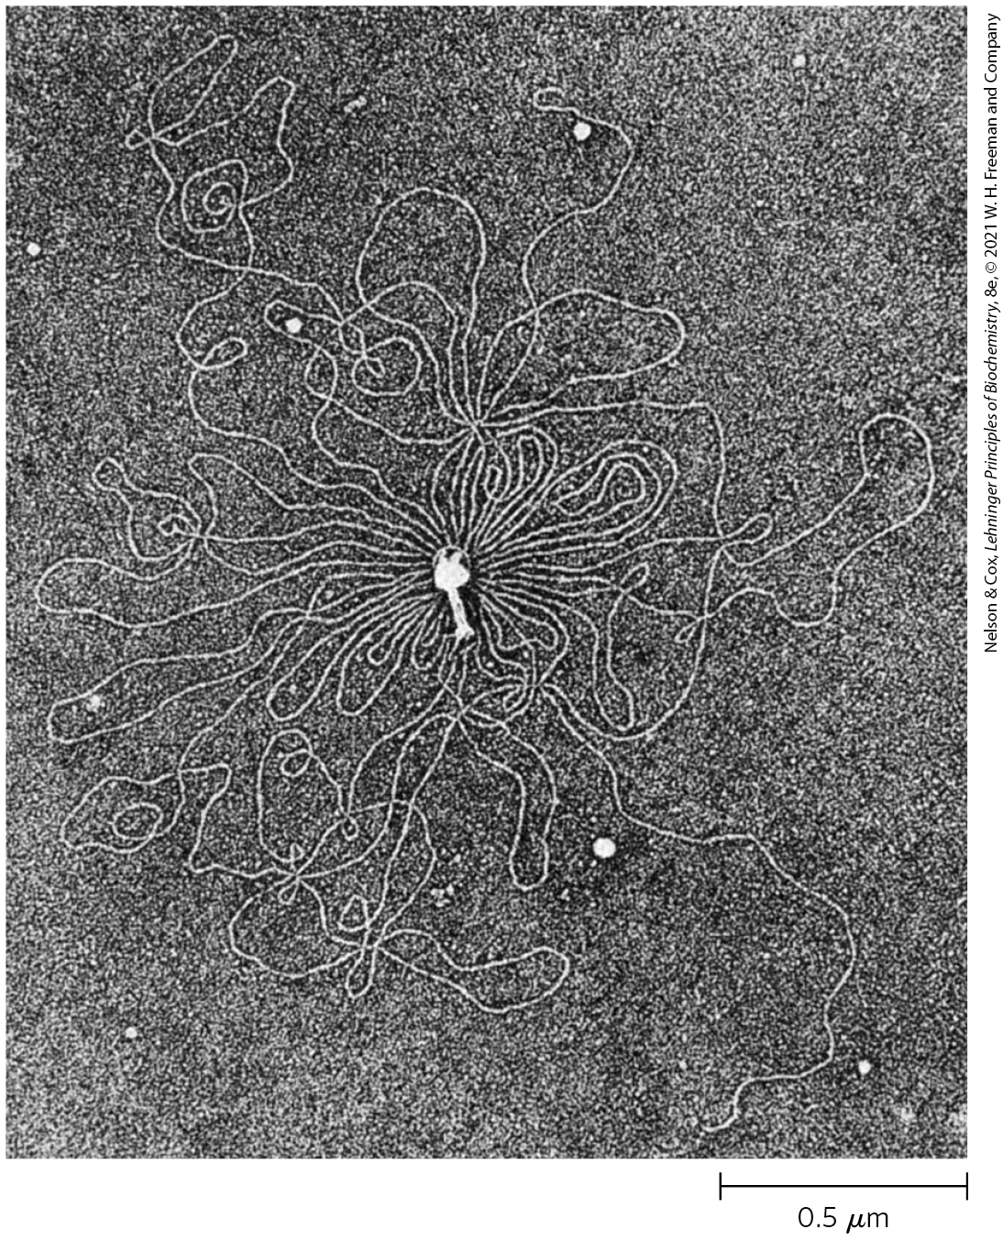
Chromosomes
chromosomes = tertiary packaging of DNA
  serve as repositories of genetic information

Slide 3

Principle 1 (1 of 4)
Chromosomes include dedicated sequences that ensure their replication, transcription, packaging, and transmission from one generation to the next. They are more than a long stretch of protein-encoding genes.

Slide 4

Principle 2 (1 of 6)
Chromosomes are large. To constrain them in a small space can require multiple layers and multiple modes of tertiary structure.

Slide 5

Principle 3 (1 of 7)
Chromosomes in all cells are maintained in a state of torsional stress. DNA is underwound relative to the stable B-form structure, facilitating both the packaging of DNA and access to the genetic information contained within it.

Slide 6

Principle 4 (1 of 7)
Specialized proteins and RNAs maintain chromosome structure. Topoisomerases control DNA underwinding. Histones, condensins, cohesins, and other DNA-binding proteins provide scaffolds to organize chromosome structure. Certain long, noncoding RNAs also play important roles in chromosome structure and function.

Slide 7
24.1 Chromosomal Elements

Slide 8
Genes Are Segments of DNA That Code for Polypeptide Chains and RNAs
phenotype = visible property
classically, a gene was defined as a portion of a chromosome that determines or affects a single phenotype

Slide 9
Molecular Definitions of a Gene
mutations = alterations in DNA sequence
experiments by Beadle and Tatum found that mutant fungal strains lacked one or another specific enzyme
the one gene-one enzyme hypothesis = a gene is a segment of genetic material that determines, or codes for, one enzyme
  later broadened to one gene-one polypeptide hypothesis

Slide 10
The Modern Biochemical Definition of a Gene
gene = all the DNA that encodes the primary sequence of some final gene product (polypeptide or RNA with a structural or catalytic function)

Slide 11

Clicker Question 1
A gene:
encodes an enzyme.
that is 1500 bp of genomic DNA will produce a protein 500 amino acids in length.
is all the DNA that encodes the sequence of some protein or RNA product.
can never be a cause of phenotype.
Notes:
Answer: C
Principle: 24.1
Learning Objective(s): Contrast the classic and modern definitions of a gene.
Bloom’s: 2:1

Slide 12
Clicker Question 1, Response
A gene:
is all the DNA that encodes the sequence of some protein or RNA product.
A gene is all the DNA that encodes the primary sequence of some final gene product, which can be either a polypeptide or an RNA with a structural or catalytic function.

Slide 13
Regulatory Sequences
regulatory sequences = segments of sequences of DNA that have a purely regulatory function
functions of regulatory sequences:
  denote the beginning or the end of genes
  influence the transcription of genes
  initiation points for replication or recombination

Slide 14
Clicker Question 2
Regulatory sequences do NOT include:
a signal for the start of a gene.
sequences that affect rates of transcription.
a signal for the end of a gene.
a signal for termination of DNA repair.
Notes:
Answer: C
Principle: 24.1
Learning Objective(s): Describe the functions of sequences that do not encode proteins.
Bloom’s: 2:1

Slide 15
Clicker Question 2, Response
Regulatory sequences do NOT include:
a signal for termination of DNA repair.
Regulatory sequences provide signals that may denote the beginning or the end of genes, influence the transcription of genes, or function as initiation points for replication or recombination.

Slide 16
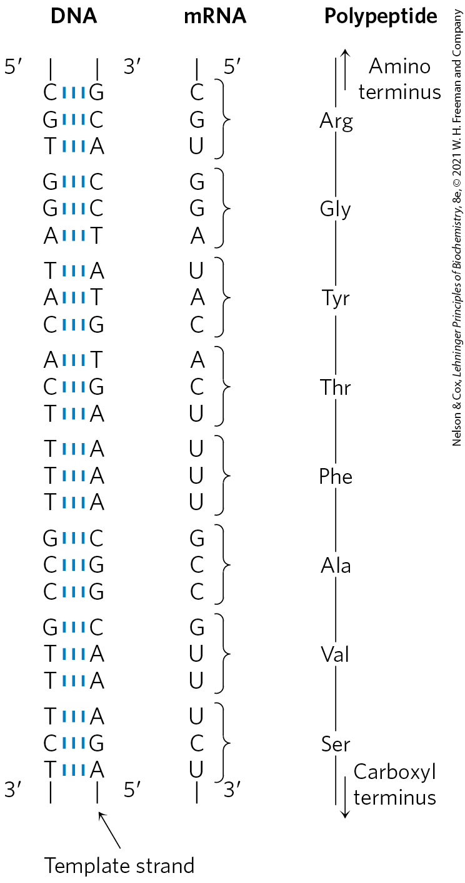
Colinearity of DNA, mRNA, and Protein
each amino acid of a polypeptide chain is coded for by three consecutive nucleotides in a single strand of DNA (“codon”)
a polypeptide chain of 350 amino acid residues (an average-size chain) corresponds to 1,050 base pairs (bp) of coding DNA

Slide 17

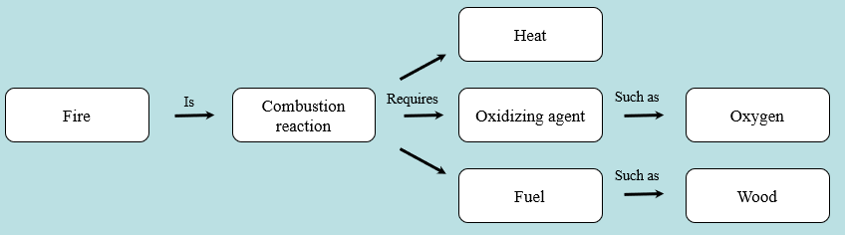
Activity: Relating
Terms within the Chapter
A concept map displays the relationships between different concepts. Observe the following example of a concept map.
Notes:
Instructor: For additional information, see the Instructor Activity Guide located in Achieve. It can be found within Chapter 24, in the folder titled “Ch24 In-Class Activities, Videos, and Resources.”

Slide 18
Activity Instructions (1 of 3)
Think about how the following terms and phrases relate to each other and then use scratch paper to draw a concept map using these terms and phrases. (3 minutes)
chromosomes
dedicated sequences
replication
transcription
packaging
transmission
Notes:
Instructor: For additional information, see the Instructor Activity Guide located in Achieve. It can be found within Chapter 24, in the folder titled “Ch24 In-Class Activities, Videos, and Resources.”

Slide 19
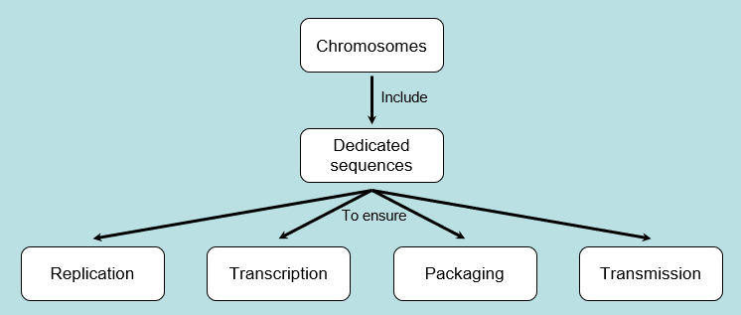
Activity Solution (1 of 3)
Pair up and share how this possible concept map might differ from yours. (2 minutes)
Notes:
Instructor: For additional information, see the Instructor Activity Guide located in Achieve. It can be found within Chapter 24, in the folder titled “Ch24 In-Class Activities, Videos, and Resources.”

Slide 20
Number of Genes in a Single Chromosome
the Escherichia coli chromosome is a circular DNA molecule with 4,641,652 bp
  encodes ~4,300 genes for proteins and >200 genes for structural or catalytic RNAs
the human genome is ~3.1 billion bp
  encodes approximately 20,000 genes across 24 different chromosomes

Slide 21
DNA Molecules Are Much Longer than the Cellular or Viral Packages That Contain Them
chromosomal DNAs are many orders of magnitude longer than the cells or viruses in which they are located
Table 24-1 The Sizes of DNA and Viral Particles for Some Bacteria Viruses (Bacteriophages)
Virus | Size of viral DNA (bp) | Length of viral DNA (nm) | Long dimension of viral particles (nm)
φX174 | 5,386 | 1,939 | 25
T7 | 39,936 | 14,377 | 78
λ (lambda) | 48,502 | 17,460 | 190
T4 | 168,889 | 60,800 | 210

Slide 22

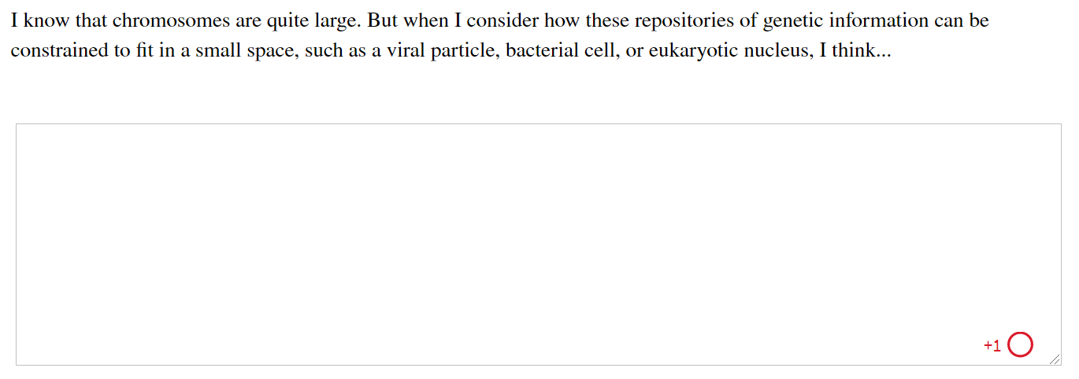
Activity: DNA Packaging (1 of 2)
Complete the Ch24 Student Activity, Day 1: DNA Packaging (Muddiest Point) Achieve assessment.
Notes:
Instructor: This muddiest point activity can be found in Achieve in the Chapter 24 folder titled “Ch24 In-Class Activities and Resources.” See the Instructor Activity Guide in the same folder for more information.

Slide 23
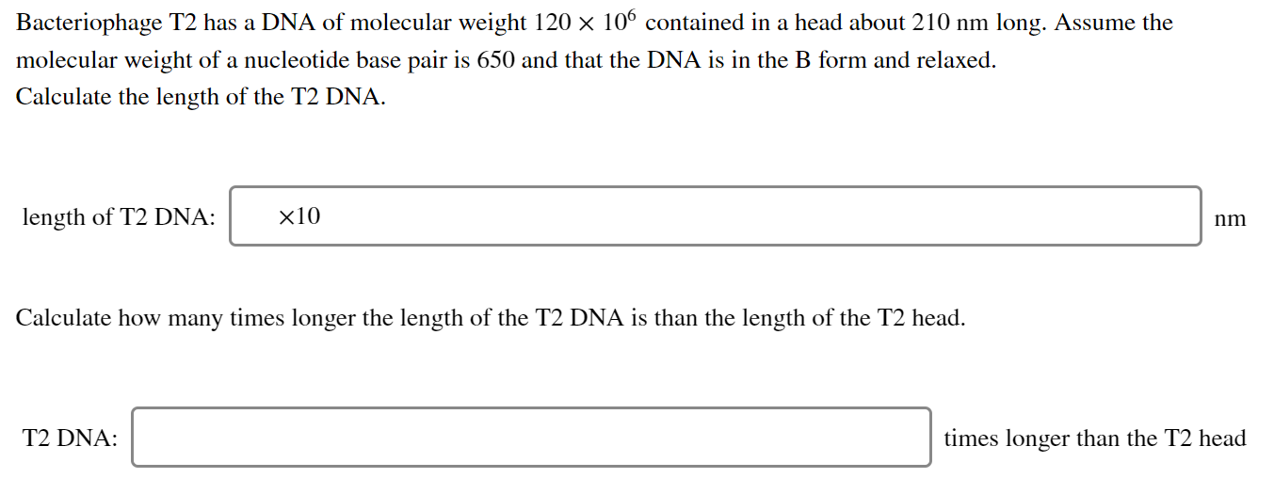
Activity: DNA Packaging (2 of 2)
Complete the Ch24 Student Activity, Day 2: DNA Packaging (Muddiest Point) Achieve assessment.
Notes:
Instructor: This muddiest point activity can be found in Achieve in the Chapter 24 folder titled “Ch24 In-Class Activities and Resources.” See the Instructor Activity Guide in the same folder for more information.

Slide 24
Viruses
viruses = infectious parasites that use resources of a host cell to carry out processes required to propagate
  many consist of just a single RNA or DNA molecule and a protein coat

Slide 25

Clicker Question 3
The major problem associated with intracellular packaging of DNA is:
that the DNA has no organization to its arrangement in the cell.
the fact that the total length of DNA in a cell is many times longer than the dimensions of the cell.
avoided by having some of the DNA in the form of plasmids.
the rigid nature of DNA structure.
Notes:
Answer: B
Principle: 24.2
Learning Objective(s):
Bloom’s: 2:2

Slide 26
Clicker Question 3, Response
The major problem associated with intracellular packaging of DNA is:
the fact that the total length of DNA in a cell is many times longer than the dimensions of the cell.
Chromosomal DNAs are often many orders of magnitude longer than the cells or viruses in which they are located. This is true of every class of organism or viral parasite.

Slide 27
Principle 2 (2 of 6)
Chromosomes are large. To constrain them in a small space can require multiple layers and multiple modes of tertiary structure.

Slide 28
RNA and DNA Viruses
almost all plant viruses and some bacterial and animal viruses have RNA genomes
  tend to be particularly small
DNA viral genomes vary greatly in size and tend to be circular for at least part of their life
the contour lengths of their DNA are typically hundreds of times longer than the long dimensions of the viral particles that contain them

Slide 29
Replicative Forms Appear During Viral Replication
replicative forms = specific types of viral DNA that appear during viral replication within a host cell
examples of replicative forms:
  many linear DNAs become circular
  all single-stranded DNAs become double-stranded

Slide 30
Clicker Question 4
What is the replicative form of bacteriophage λ in host cells?
single-stranded circular DNA
single-stranded linear DNA
double-stranded circular DNA
double-stranded linear DNA
Notes:
Answer: C
Principle: 24.2
Learning Objective(s): Describe viral genomes.
Bloom’s: 1:1

Slide 31
Clicker Question 4, Response
What is the replicative form of bacteriophage λ in host cells?
double-stranded circular DNA
In its replicative form inside E. coli cells, λ DNA is a circular double helix.

Slide 32
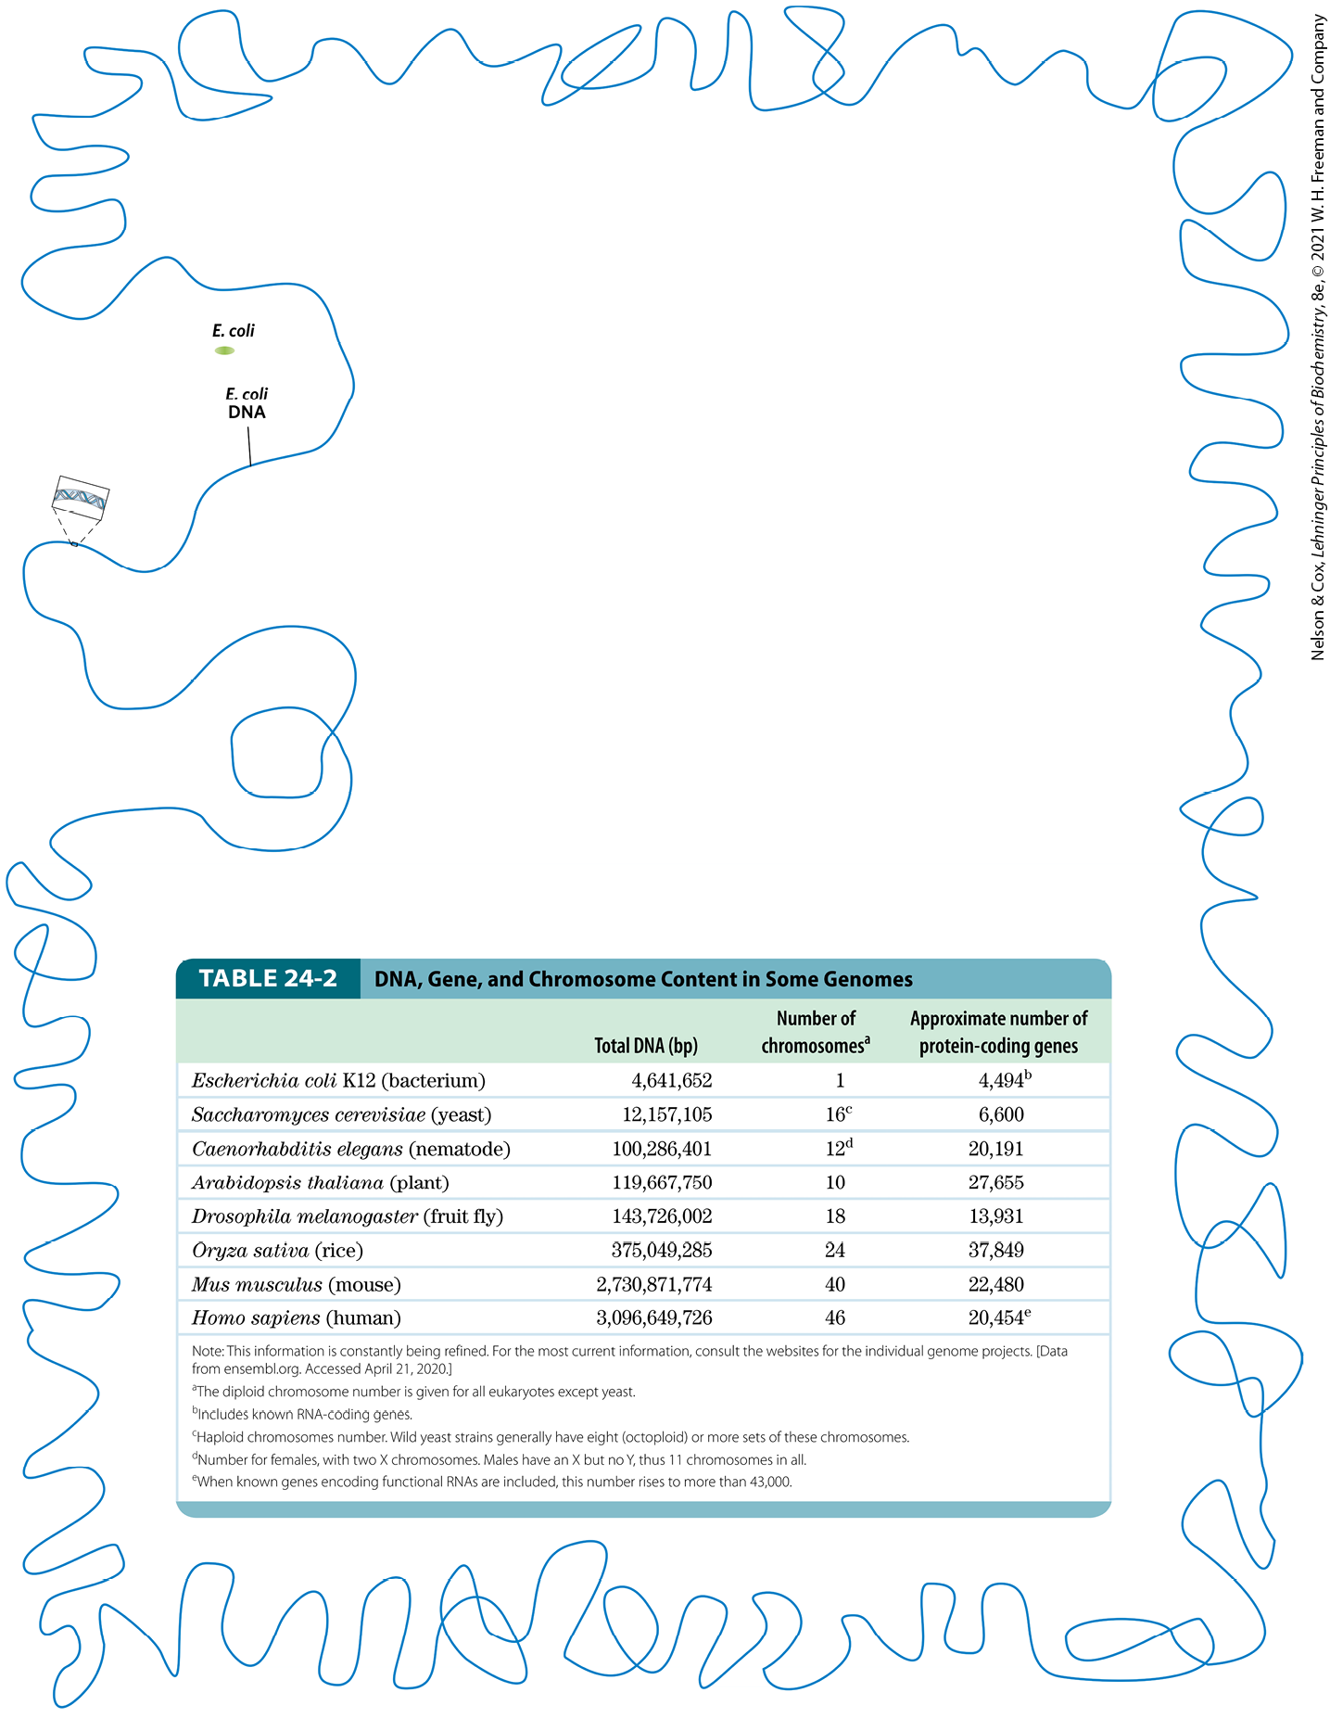
Bacteria
an E. coli cell contains ~100x as much DNA as a bacteriophage λ particle
the E. coli chromosome is a single, double-stranded circular DNA molecule of 4,641,652 bp
  the genome is ~850 times the length of the cell

Slide 33
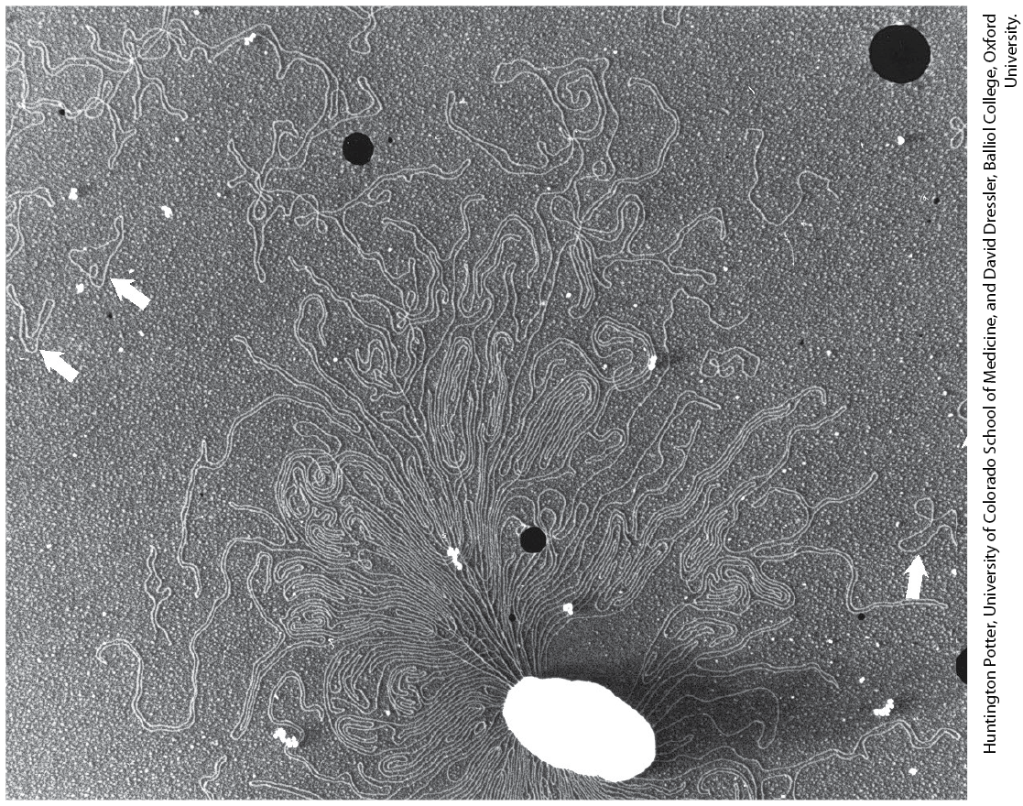
Bacterial Plasmids
plasmids = small, circular DNA molecules that are in the cytosol of many bacteria
  undergo replication
  some carry useful genes, such as antibiotic resistance genes

Slide 34
Eukaryotes
a yeast cell contains 2.6x as much DNA as an E. coli cell.
a Drosophila (fruit fly) cell contains >35x as much DNA as an E. coli cell
a human cell contains ~700x as much DNA as an E. coli cell
  cells of many plants and amphibians contain even more

Slide 35
DNA, Gene, and Chromosome Content in Some Genomes
Table 24-2 DNA, Gene, and Chromosome Content in Some Genomes
 | Total DNA (bp) | Number of chromosomes | Approximate number of protein-coding genes
Escherichia coli K12 (bacterium) | 4,641,652 | 1 | 4,494^{b}
Saccharomyces cerevisiae (yeast) | 12,157,105 | 16^{c} | 6,600
Caenorhabditis elegans (nematode) | 100,286,401 | 12^{d} | 20,191
Arabidopsis thaliana (plant) | 119,667,750 | 10 | 27,655
Drosophila melanogaster (fruit fly) | 143,726,002 | 18 | 13,931
Oryza sativa (rice) | 375,049,285 | 24 | 37,849
Mus musculus (mouse) | 2,730,871,774 | 40 | 22,480
Homo sapiens (human) | 3,096,649,726 | 46 | 20,454e

Slide 36
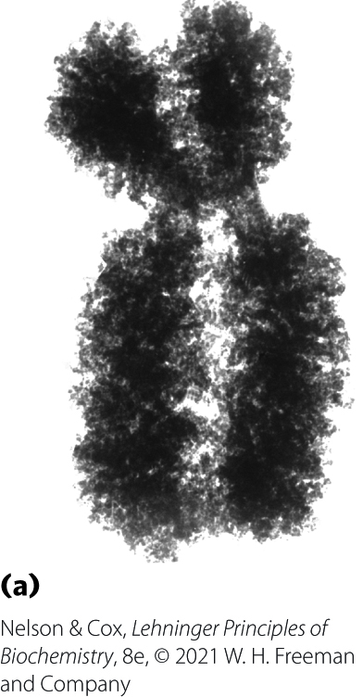
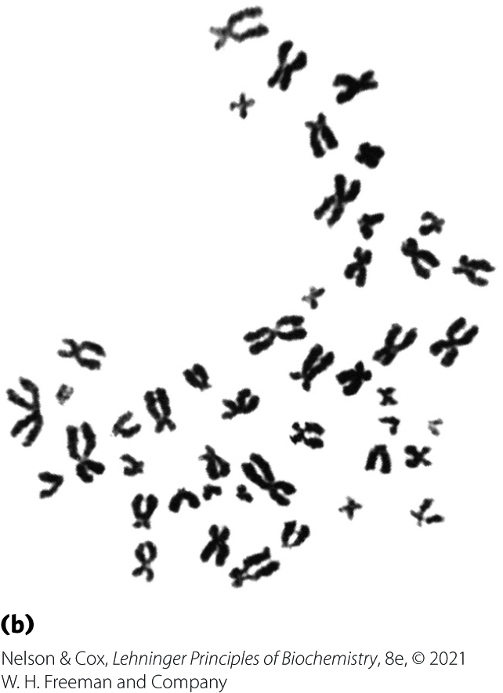
Eukaryotic Chromosomes
genetic material of eukaryotic cells is distributed into chromosomes
  the diploid (2n) number depends on the species
  each chromosome contains a single, very large, duplex DNA molecule that carries a characteristic set of genes
human somatic cells have 46 chromosomes

Slide 37
Clicker Question 5
Which statement about the human genome is false?
A human somatic cell has 46 chromosomes in all.
The human genome contains more than 20,000 protein-coding genes.
Human cells contain more DNA than the cells of any other organism.
Each human chromosome contains a single, very large, duplex DNA molecule.
Notes:
Answer: C
Principle: 24.2
Learning Objective(s): Describe the organization of genes within eukaryotic genomes.
Bloom’s: 1:1

Slide 38
Clicker Question 5, Response
Which statement about the human genome is false?
Human cells contain more DNA than the cells of any other organisms.
The cells of many plants and amphibians contain even more DNA than human cells.

Slide 39
Principle 2 (3 of 6)
Chromosomes are large. To constrain them in a small space can require multiple layers and multiple modes of tertiary structure.

Slide 40
The Length of Human
DNA Molecules
placed end to end, DNA molecules of one human genome would extend for about a meter
  human cells are diploid, so each cell has 2 m of DNA
the adult human body contains ~10¹⁴ cells and a total DNA length of 2×10¹¹ km
  greater than the the circumference of the earth (4 x 10⁴ km)
  greater than the distance between the earth and the sun (1.5 x 10⁸ km)

Slide 41
Mitochondria Contain DNA
mitochondrial DNA (mtDNA) molecules are much smaller than nuclear chromosomes
  codes for mitochondrial tRNAs and rRNAs and for a few mitochondrial proteins
animal mtDNA contains <20,000 bp in a circular duplex
  each mitochondrion has 2-10 copies
  number of copies rises in some cells in an embryo during cell differentiation
plant mtDNA ranges from 200,000 to 2,500,000 bp

Slide 42
Chloroplasts Contain DNA
chloroplast DNA (cpDNA) exists as circular duplexes from 120,000 to 160,000 bp

Slide 43
Clicker Question 6
Which statement about mitochondrial DNA (mtDNA) is false?
mtDNA has an evolutionary origin in the chromosomes of ancient bacteria that gained access to the cytoplasm of host cells.
mtDNA codes for tRNAs, rRNAs, and a few proteins.
Each mitochondrion contains a single copy of the mtDNA.
mtDNA is much smaller than nuclear chromosomes.
Notes:
Answer: C
Principle: 24.2
Learning Objective(s): Compare bacterial and eukaryotic genome organization.
Bloom’s: 1:1

Slide 44
Clicker Question 6, Response
Which statement about mitochondrial DNA (mtDNA) is false?
Each mitochondrion contains a single copy of the mtDNA.
Each mitochondrion typically has 2 to 10 copies of this mtDNA molecule, and the number can rise to hundreds in certain cells of an embryo that is undergoing cell differentiation.

Slide 45
Principle 1 (2 of 4)
Chromosomes include dedicated sequences that ensure their replication, transcription, packaging, and transmission from one generation to the next. They are more than a long stretch of protein-encoding genes.

Slide 46
Eukaryotic Genes and Chromosomes Are Very Complex
introns = nontranslated, intervening DNA segments that do not code for the amino acid sequence of the polypeptide product
exons = coding DNA segments
  makes up only ~1.5% of human DNA
the colinearity of the eukaryotic DNA and amino acid sequence is broken by introns
  few bacterial genes contain introns

Slide 47
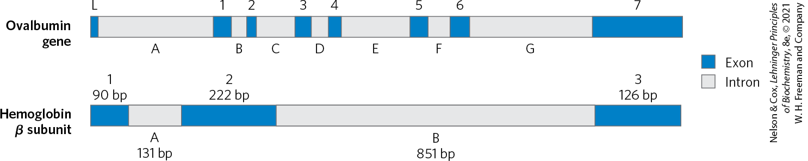
Introns in Eukaryotic Genes
in higher eukaryotes, the typical gene has more intron sequences than exon sequences
together, introns and exons make up as much as 30% of the human genome

Slide 48
Highly Repetitive Sequences
highly repetitive sequences (simple-sequence DNA or simple sequence repeats (SSR)) = short sequences, generally less than 10 bp long, that are sometimes repeated millions of times per cell
  make up ~3% of the human genome
  do not encode proteins or RNAs
  associated with centromeres and telomeres
satellite DNA = another name for simple-sequence DNA
  named as such because it migrates as “satellite” bands in a cesium chloride density gradient

Slide 49
Clicker Question 7
Which chromosomal element occupies the SMALLEST relative proportion of DNA in the human genome?
highly repetitive sequences
satellite DNA
exons
genes
introns
Notes:
Answer: C
Principle: 24.1
Learning Objective(s): Differentiate between an exon and an intron.
Bloom’s: 1:1

Slide 50
Clicker Question 7, Response
Which chromosomal element occupies the SMALLEST relative proportion of DNA in the human genome?
exons
In total, only about 1.5% of human DNA is “coding” or exon DNA, carrying sequence information for protein products.

Slide 51
Principle 1 (3 of 4)
Chromosomes include dedicated sequences that ensure their replication, transcription, packaging, and transmission from one generation to the next. They are more than a long stretch of protein-encoding genes.

Slide 52
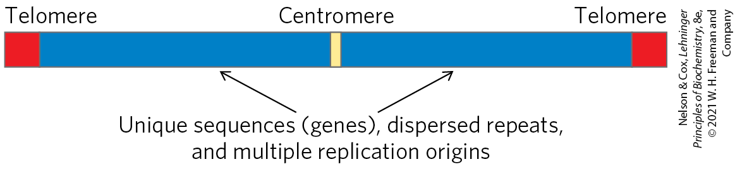
Centromeres
centromere = a DNA sequence that functions during cell division as an attachment point for proteins that link the chromosome to the mitotic spindle
  essential sequences in yeast are ~130 bp long and are very rich in A=T pairs
  sequences of higher eukaryotes are longer and generally consist of thousands of tandem copies of one or several sequences of 5 to 10 bp

Slide 53
Principle 1 (4 of 4)
Chromosomes include dedicated sequences that ensure their replication, transcription, packaging, and transmission from one generation to the next. They are more than a long stretch of protein-encoding genes.

Slide 54
Telomeres
telomeres = sequences at the ends of eukaryotic chromosomes that help stabilize the chromosome
  shortened after each round of replication
  end with multiple repeated sequences of the form
(5′)(T_{x}G_{y})_{n}
(3′)(A_{x}C_{y})_{n}
where x and y are generally between 1 and 4 and n is in the range of 20 to 100 for single-celled eukaryotes and >1,500 in mammals

Slide 55
Telomere Sequences
Table 24-3 Telomere Sequences
Organism | Telomere repeat sequence
Homo sapiens (human) | (TTAGGG)_{n}
Tetrahymena thermophile (ciliated protozoan) | (TTGGGG)_{n}
Saccharomyces cerevisiae (yeast) | (T(G)_{1–3}(TG)_{2–3})_{n}
Arabidopsis thaliana (plant) | (TTTAGGG)_{n}

Slide 56
Clicker Question 8
What is the functional consequence of underfunctioning telomerases?
nothing, as telomeres contain no functional information
more poly(A)-tail regions at the telomeres
severe shortening of chromosomes and eventual truncation/loss of functional genes
loss of trans-acting elements
protection against cancer
Notes:
Answer: C
Principle: 24.1
Learning Objective(s): Describe the structure of a eukaryotic chromosome.
Bloom’s: 2:2

Slide 57
Clicker Question 8, Response
What is the functional consequence of underfunctioning telomerases?
severe shortening of chromosomes and eventual truncation/loss of functional genes
Because the ends of a linear DNA molecule cannot be routinely replicated by the cellular replication machinery, repeated telomeric sequences must be added to eukaryotic chromosome ends primarily by telomerase enzymes. Without functioning telomerases, each replication will shorten the chromosomes.

Slide 58
Clicker Question 9
Which statement regarding chromosomes is false?
They are all of natural origin.
They are circular in bacteria.
They contain centromeres in eukaryotes.
They contain telomeres in eukaryotes.
Notes:
Answer: A
Principle: 24.1
Learning Objective(s): Describe the structure of a eukaryotic chromosome.
Bloom’s: 1:1

Slide 59
Clicker Question 9, Response
Which statement regarding chromosomes is false?
They are all of natural origin.
Artificial chromosomes (Chapter 9) have been constructed as a means of better understanding the functional significance of many structural features of eukaryotic chromosomes.

Slide 60
24.2 DNA Supercoiling

Slide 61
The Structural Organization of DNA
keys to DNA compaction:
  neutralizing the negative charges of the phosphoryl groups in the DNA backbone with cations and polyamines
  a DNA structural alteration known as supercoiling

Slide 62
Principle 3 (2 of 7)
Chromosomes in all cells are maintained in a state of torsional stress. DNA is underwound relative to the stable B-form structure, facilitating both the packaging of DNA and access to the genetic information contained within it.

Slide 63
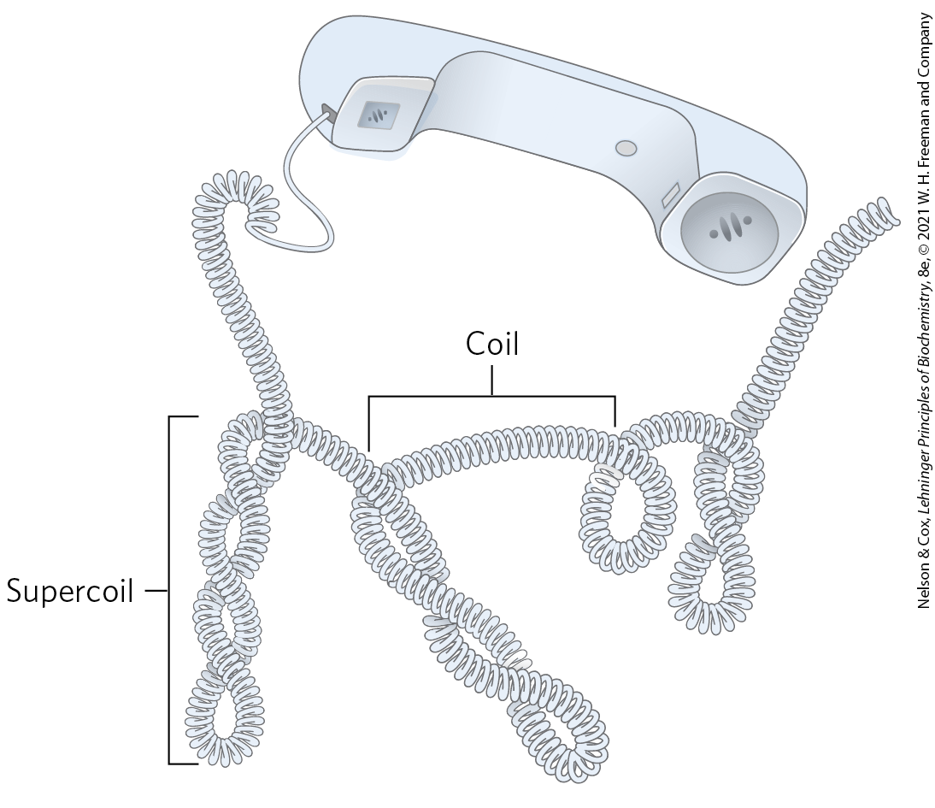
DNA Supercoiling (1 of 2)
“supercoiling” means the coiling of a coil

Slide 64
Principle 3 (3 of 7)
Chromosomes in all cells are maintained in a state of torsional stress. DNA is underwound relative to the stable B-form structure, facilitating both the packaging of DNA and access to the genetic information contained within it.

Slide 65
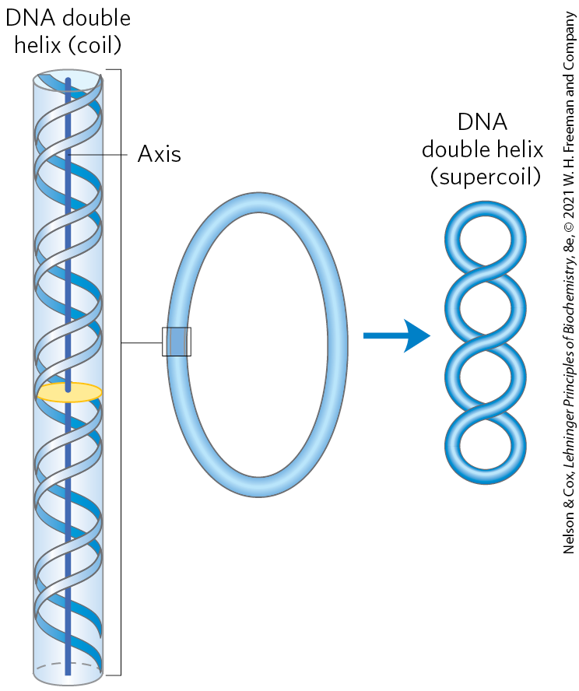
DNA Supercoiling (2 of 2)
underwound DNA = state where DNA has fewer right-handed helical turns per given length of DNA than B-form DNA
  places structural strain on the DNA, causing it to twist upon itself (supercoiling)
most cellular DNAs are supercoiled
  this is an intrinsic property of DNA tertiary structure

Slide 66
The Relaxed State of DNA
relaxed DNA = state where there is no net bending of the DNA axis upon itself

Slide 67

Clicker Question 10
Supercoiling:
is the coiling of antiparallel single strands of DNA around each other in the Watson-Crick model of DNA structure.
can be thought of as the coiling of the central axis of a DNA double helix upon itself.
is the overwinding of DNA, and relaxation is the underwinding of DNA.
makes it more difficult to separate the two strands of a DNA double helix.
Notes:
Answer: B
Principle: 24.3
Learning Objective(s): Compare underwound, B form, and overwound DNA.
Bloom’s: 2:2

Slide 68
Clicker Question 10, Response
Supercoiling:
can be thought of as the coiling of the central axis of a DNA double helix upon itself.
“Supercoiling” means the coiling of a coil. DNA is coiled in the form of a double helix, with both strands of the DNA coiling around an axis. The further coiling of that axis upon itself produces DNA supercoiling.

Slide 69
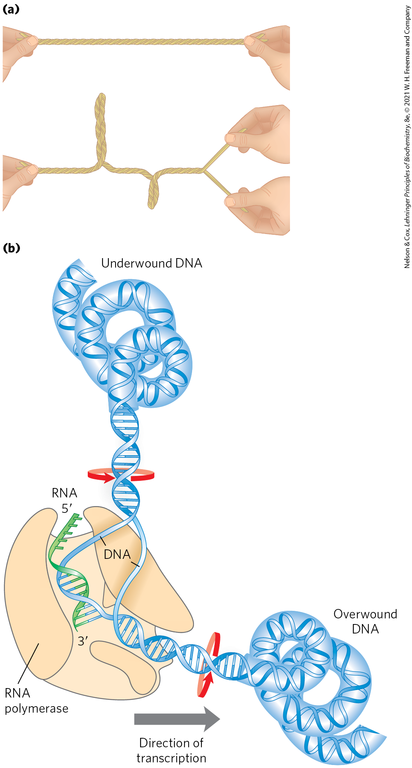
The Effects of Replication and Transcription on DNA Supercoiling
supercoiling reflects underwinding of the DNA
it facilitates the separation of strands required for replication and transcription

Slide 70
The Study of Supercoiling Relies on Topology
topology = the study of the properties of an object that do not change under continuous deformations
  a branch of mathematics
continuous deformations for DNA include conformational changes due to thermal motion or molecular interactions
discontinuous deformations for DNA include strand breakage
  topological properties are changed only by breakage and rejoining of the DNA backbone

Slide 71
Clicker Question 11
Which factor would hamper research on DNA linking number (Lk)?
DNA supercoiling in the opposite direction than expected
a single-stranded break in the DNA
a change in DNA from supercoiled to relaxed
changes in writhe or twist of the DNA
topoisomerase activity
Notes:
Answer: : B. Answer D: These are components of Lk, of course. Answer E: Topoisomerases are commonly used in Lk studies.
Principle: 24.3
Learning Objective(s): Explain how the linking number of a DNA molecule can change.
Bloom’s: 2:2

Slide 72
Clicker Question 11, Response
Which factor would hamper research on DNA linking number (Lk)?
a single-stranded break in the DNA
If there is a break in either strand, the two strands can, in principle, be unraveled and separated completely. In this case, no topological bond exists and Lk is undefined.

Slide 73
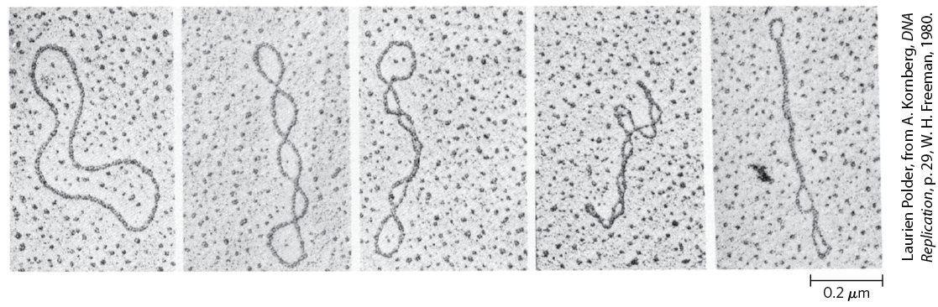
Most Cellular DNA Is Underwound
closed-circular DNAs = small-circular DNAs that have no breaks in either strand
DNA is most stable in the B-form structure (one turn of the double helix per 10.5 bp)
  DNA closely conforming to this is relaxed
increasing supercoiling

Slide 74
Principle 3 (4 of 7)
Chromosomes in all cells are maintained in a state of torsional stress. DNA is underwound relative to the stable B-form structure, facilitating both the packaging of DNA and access to the genetic information contained within it.

Slide 75
Purified Closed-Circular DNA is Rarely Relaxed
DNAs derived from a given cellular source have a characteristic degree of supercoiling
DNA structure is strained in a manner that is regulated by the cell to induce the supercoiling
  typically due to underwinding

Slide 76
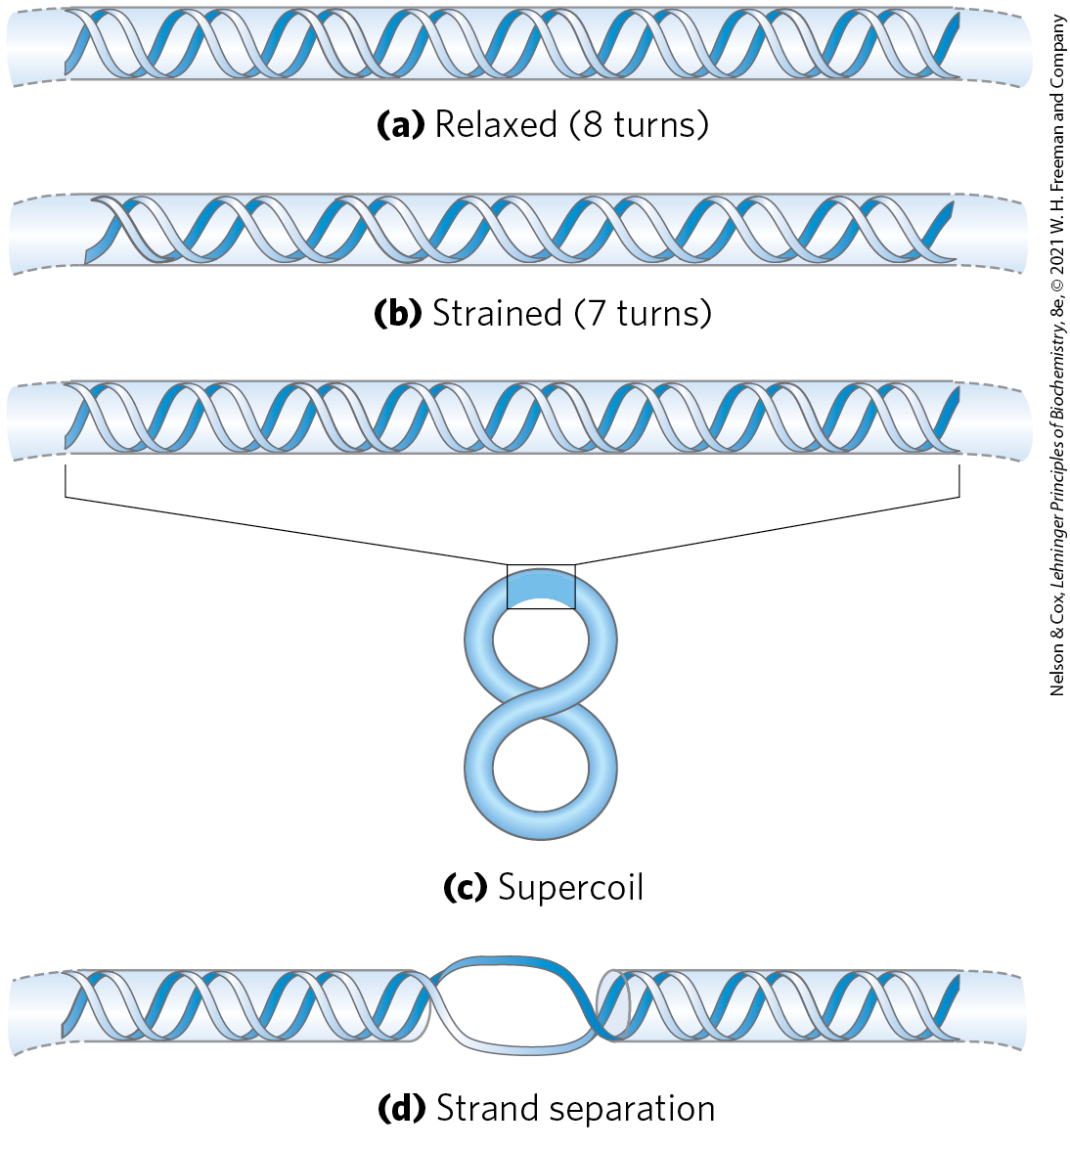
Effects of DNA Underwinding
DNA becomes thermodynamically strained when turns are removed
this strain can be accommodated by forming a supercoil or separating the two DNA strands over a short distance

Slide 77
Maintaining the Underwound State
to maintain an underwound state, DNA must be either:
  a closed circle
  bound and stabilized by protein

Slide 78
Clicker Question 12
The finding that DNA is commonly underwound was a surprise. Predictions based on the B form of closed, circular DNA suggest that underwinding serves what purpose?
It facilitates supercoiling.
It prevents strain on the helix and strand breaks.
It promotes more rapid rates of endonuclease activity.
It prevents supercoiling and promotes spontaneous strand separation.
It tends to prevent common structural mutations such as thymine dimers.
Notes:
Answer: A. No evidence for Answer C.
Principle: 24.3
Learning Objective(s): Compare underwound, B form, and overwound DNA.
Bloom’s: 2:2

Slide 79
Clicker Question 12, Response
The finding that DNA is commonly underwound was a surprise. Predictions based on the B form of closed, circular DNA suggest that underwinding serves what purpose?
It facilitates supercoiling.
All cells maintain their DNA in a state that is underwound — having fewer right-handed helical turns per given length of DNA — than B-form DNA. The underwinding places structural strain on the DNA, causing it to twist upon itself.

Slide 80
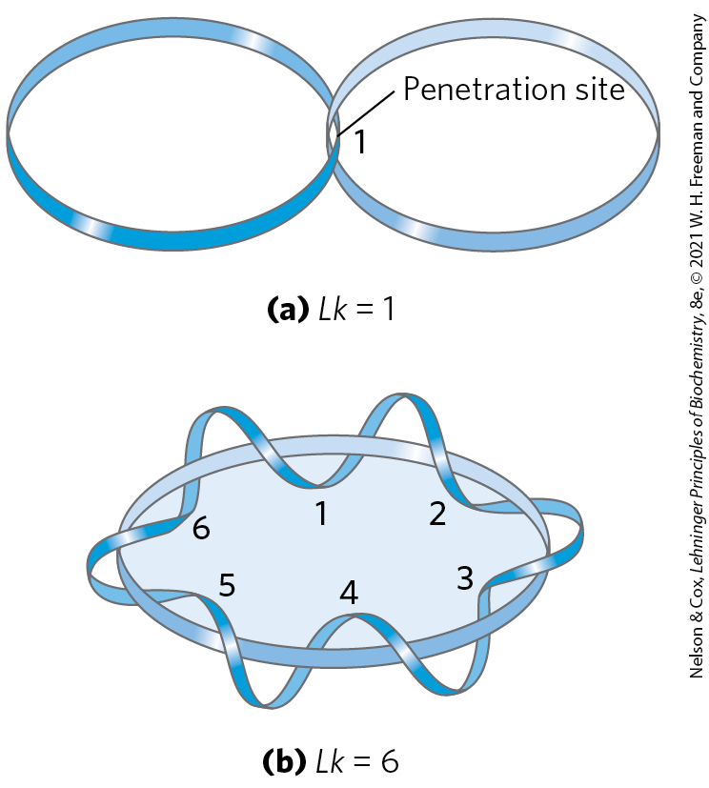
DNA Underwinding Is Defined by Topological Linking Number
linking number (Lk) = the number of times the twisting strand penetrates a surface
  topological property of double-stranded DNA
topoisomerases = catalyze changes in the linking number

Slide 81
Linking Number (Lk)
the linking number for a closed-circular DNA is always an integer
the linking number is positive for strands interwound in a right-handed helix
the linking number is negative for strands interwound in a left-handed helix.
  not encountered in DNA

Slide 82
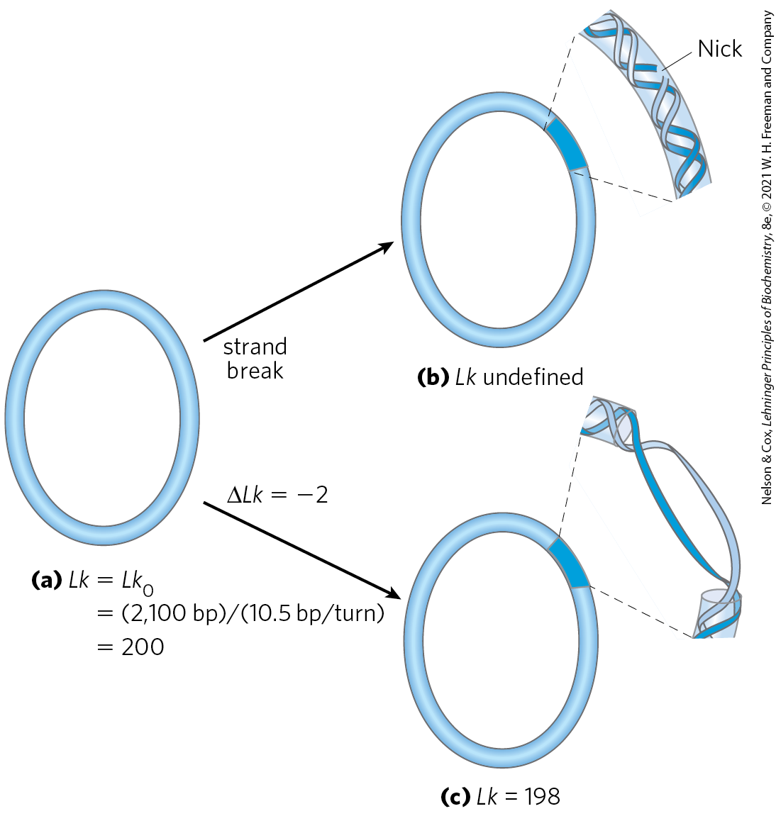
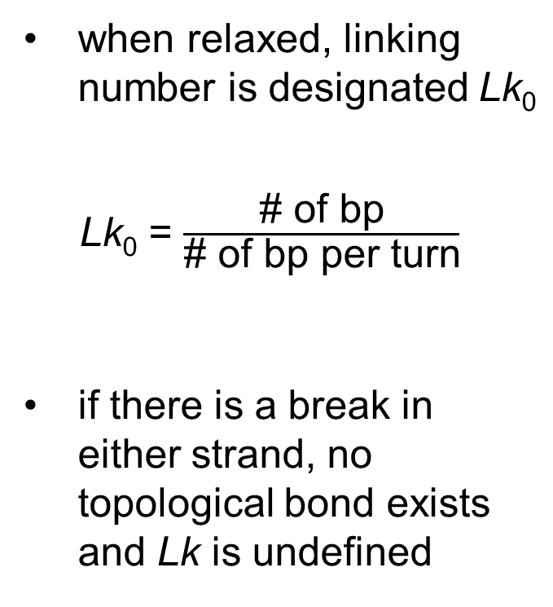
Linking Number (Lk) Applied to Closed-Circular DNA
when relaxed, linking number is designated Lk₀
Lk₀ = $\frac{\text{\# }\text{of} \text{bp}}{\text{\# }\text{of} \text{bp} \text{per} \text{turn}}$
if there is a break in either strand, no topological bond exists and Lk is undefined

Slide 83
DNA Underwinding Can Be Described By Changes in the Lk
the change in linking number can be described by the equation:
∆Lk = Lk − Lk₀
(24-1)

Slide 84
Clicker Question 13
If a negatively supercoiled (ΔLk = –32) closed circular DNA of 2520 bp is relaxed by one catalytic cycle by a type II topoisomerase, what is the resulting Lk?
240
242
270
210
Notes:
Answer: D
Principle: 24.3
Learning Objective(s): Determine the change in DNA linking number.
Bloom’s: 3:2

Slide 85
Clicker Question 13, Response
If a negatively supercoiled (ΔLk = –32) closed circular DNA of 2520 bp is relaxed by one catalytic cycle by a type II topoisomerase, what is the resulting Lk?
210
Eukaryotic type II topoisomerase relaxes DNA by introducing 2 positive supercoils, increasing Lk by 2. Therefore, ΔLk = –32 + 2 = −30.
Lk₀ = 2520 bp/(10.5 bp/turn) = 240
ΔLk = Lk – Lk₀
−30 = Lk − 240
Lk = 210

Slide 86
Specific Linking Difference
specific linking difference or superhelical density (σ) = a measure of the number of turns removed relative to the number present in relaxed DNA
  expresses ∆Lk independently of the length of the DNA molecule
(24-2)
underwinding in cellular DNAs generally falls in the range of 5% to 7% (σ = –0.05 to –0.07)

Slide 87
Principle 2 (4 of 6)
Chromosomes are large. To constrain them in a small space can require multiple layers and multiple modes of tertiary structure.

Slide 88
Principle 3 (5 of 7)
Chromosomes in all cells are maintained in a state of torsional stress. DNA is underwound relative to the stable B-form structure, facilitating both the packaging of DNA and access to the genetic information contained within it.

Slide 89
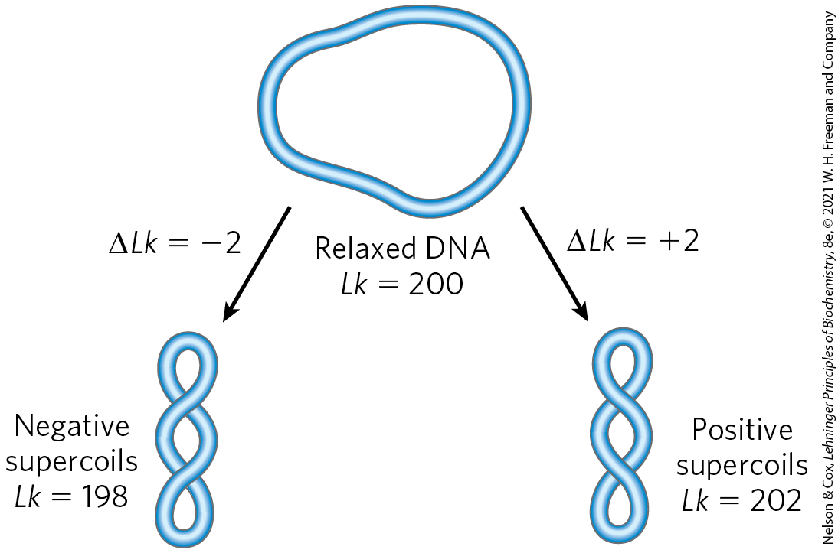
Negative and Positive Supercoils
underwinding results in negative supercoiling
overwinding results in positive supercoiling
an increase in σ brings about an increase in DNA compaction

Slide 90
Topoisomers
topoisomers = two forms of a circular DNA that differ only in a topological property, such as linking number

Slide 91
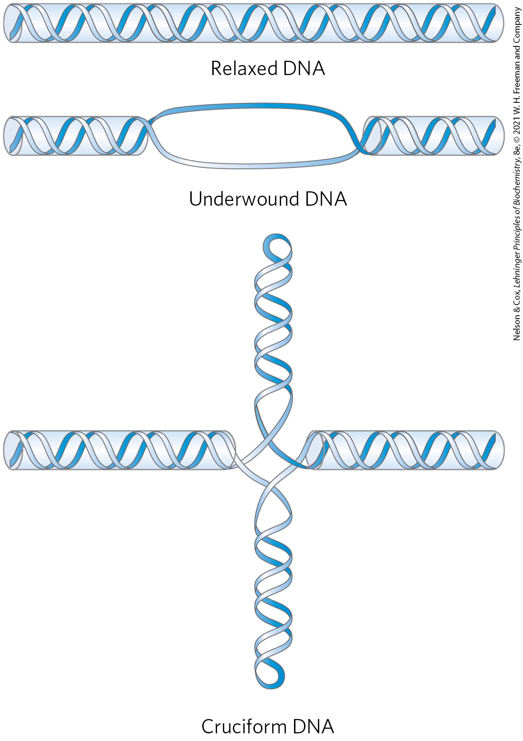
Promotion of Cruciform Structures by DNA Underwinding
a cruciform generally contains a few unpaired bases
DNA underwinding helps to maintain the required strand separation

Slide 92
Clicker Question 14
A change in what structural feature of DNA would promote the formation of cruciform structures?
restriction endonuclease activity
an increase in Lk
binding of regulatory proteins in the major groove
a large change in twist and a small change in writhe
underwinding
Notes:
Answer: E
Principle: 24.3
Learning Objective(s): Compare underwound, B form, and overwound DNA.
Bloom’s: 2:2

Slide 93
Clicker Question 14, Response
A change in what structural feature of DNA would promote the formation of cruciform structures?
underwinding
A cruciform generally contains a few unpaired bases, and DNA underwinding helps to maintain the required strand separation.

Slide 94
Topoisomerases Catalyze Changes in the Linking Number of DNA
topoisomerases = enzymes that increase or decrease the extent of DNA underwinding
  change the linking number
  play an important role in replication and DNA packaging
type I topoisomerases = act by transiently breaking one of the two DNA strands, passing the unbroken strand through the break, and rejoining the broken ends
  change Lk in increments of 1
type II topoisomerases = break both DNA strands
  change Lk in increments of 2

Slide 95

Clicker Question 15
What is the fundamental biochemical difference in the function of type I versus type II topoisomerases?
whether they change linking number or retain the original linking number
whether they break one DNA strand or both
whether they relax DNA or supercoil DNA as a part of the enzyme mechanism
whether they change the writhe or the twist of the DNA
whether they have only phosphodiesterase activity or both phosphodiesterase and ligase activities
Notes:
Answer: B
Principle: 24.4
Learning Objective(s): Describe topoisomerases.
Bloom’s: 1:1

Slide 96
Clicker Question 15, Response
What is the fundamental biochemical difference in the function of type I versus type II topoisomerases?
whether they break one DNA strand or both
Type I topoisomerases act by transiently breaking one of the two DNA strands, whereas type II topoisomerases break both DNA strands.

Slide 97
Principle 2 (5 of 6)
Chromosomes are large. To constrain them in a small space can require multiple layers and multiple modes of tertiary structure.

Slide 98
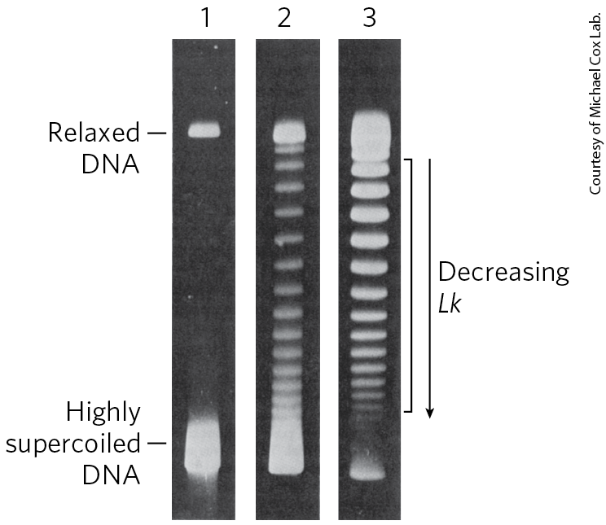
Visualization of Topoisomers
supercoiled circular DNA is more compact than relaxed DNA
  will migrate faster in a gel matrix

Slide 99

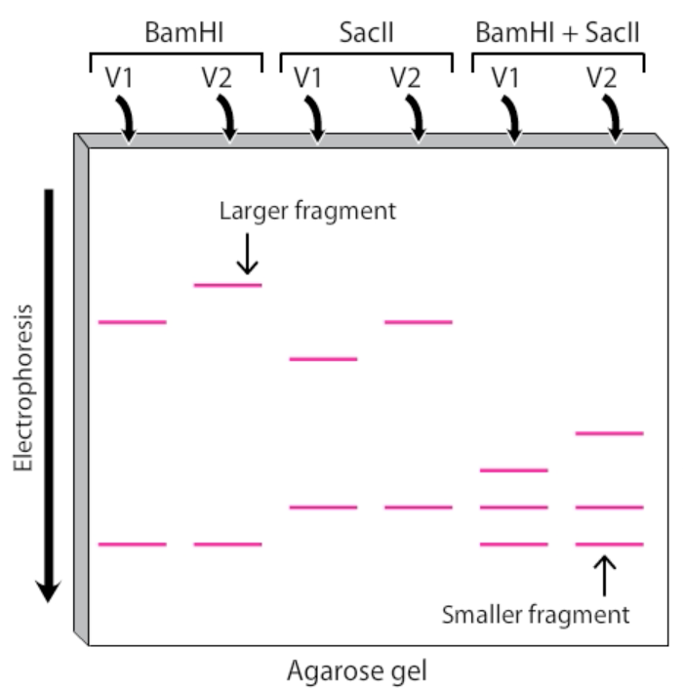
Activity: Gel
Electrophoresis
Watch the Animated Technique video titled “Gel Electrophoresis/Restriction Digest.”
Notes:
Instructor: This Animated Technique video is found within Chapter 9 of Achieve. It is in the folder titled “Ch9 In-Class Activities, Videos, and Resources.”

Slide 100
Activity Instructions (2 of 3)
On your own, think of answers to the question:
  Consider how DNA moves through an agarose gel during gel electrophoresis. If two identical fragments of DNA are run on a gel but one is relaxed and one is supercoiled, which fragment would travel farther and why?
  (2 minutes)
Pair up to discuss your ideas. (2 minutes)
Share your ideas with the class in group discussion. (3 minutes)
Notes:
Instructor: This Animated Technique video is found within Chapter 9 of Achieve. It is in the folder titled “Ch9 In-Class Activities, Videos, and Resources.”

Slide 101
Activity Solution (2 of 3)
  If two identical fragments of DNA are run on a gel but one is relaxed and one is supercoiled, which fragment would travel farther and why? The supercoiled DNA would travel farther down the gel than the relaxed DNA. Supercoiled DNA exhibits a high degree of torsional stress caused by its twisted structure. Accordingly, supercoiled DNA is very compact. Conversely, relaxed DNA does not exhibit torsional stress and, as a result, has a less compact structure relative to supercoiled DNA. Thus, because the supercoiled fragment is smaller in size, it is able to travel more freely through the gel matrix than the relaxed fragment.
Notes:
Instructor: This Animated Technique video is found within Chapter 9 of Achieve. It is in the folder titled “Ch9 In-Class Activities, Videos, and Resources.”

Slide 102
Bacterial Topoisomerases
E. coli has at least four individual topoisomerases (I-IV)
  I and II maintain the overall degree of supercoiling of bacterial DNA
  III and IV have more specialized roles in DNA metabolism
type I (topoisomerases I and III) isomerases relax DNA by removing negative supercoils (increasing Lk)
type II isomerases (called either topoisomerase II or DNA gyrase) introduce negative supercoils (decrease Lk).

Slide 103
Clicker Question 16
Topoisomerases:
can only relax supercoiled DNA.
interconvert topological isomers of DNA.
are of three general classes: type I, type II, and type III.
are similar to DNA gyrase.
Notes:
Answer: B
Principle: 24.4
Learning Objective(s): Describe topoisomerases.
Bloom’s: 2:2

Slide 104
Clicker Question 16, Response
Topoisomerases:
interconvert topological isomers of DNA.
DNAs that differ only in linking number (Lk) are called topoisomers. Topoisomerases interconvert topological isomers by increasing or decreasing the extent of DNA underwinding. The two classes of topoisomerases, type I and type II, change Lk in increments of 1 or 2, respectively, per catalytic event. DNA gyrase is a type 2 topoisomerase.

Slide 105
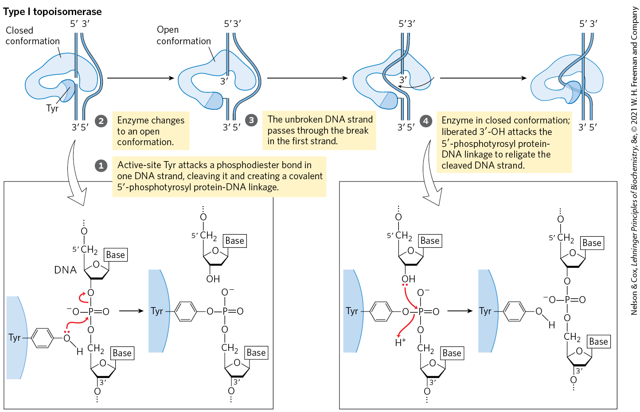
The Type I Topoisomerase Reaction

Slide 106
Eukaryotic Topoisomerases
eukaryotes also have type I and type II topoisomerases
the type I enzymes are topoisomerases I and III.
the type II enzyme has two isoforms in vertebrates (IIα and IIβ)
  cannot underwind DNA (introduce negative supercoils)
  can relax both positive and negative supercoils

Slide 107
Type IIα Topoisomerases Can Untangle Catenanes
catenanes = DNA circles that are topologically linked
type II topoisomerases can pass one duplex DNA segment through a double-strand break in another duplex
  allows these enzymes to untangle catenanes

Slide 108
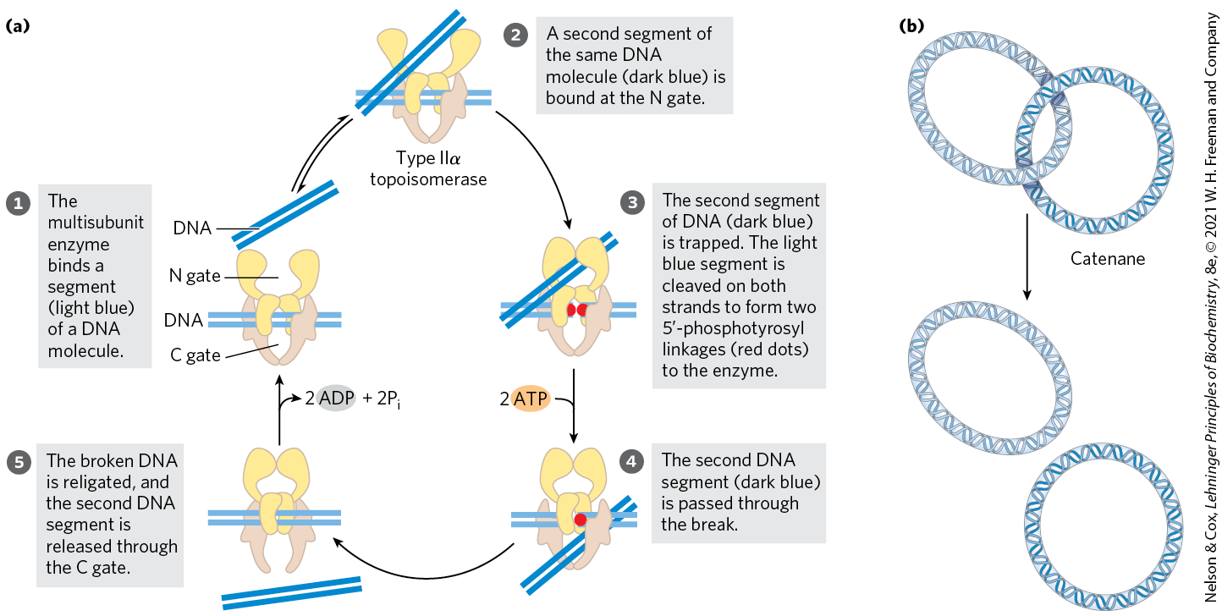
Alteration of Lk by a Eukaryotic Type IIα Topoisomerase

Slide 109
Diversity in DNA Topoisomerases
Table 24-4 Diversity in DNA Topoisomerases
Type | Mechanism | Family (defined by structural class) | Domain(s) | Notes
IA | Strand passageª | Topoisomerase I | Bacteria, Eukarya | Relaxes (−)
 |  | Topoisomerase III | Bacteria, Eukarya | Relaxes (−)
 |  | Reverse gyrase | Archaea, Bacteria | Uses ATP to introduce positive supercoils; thermophilic bacteria and archaea only
IB | Swivelase^{b} | Topoisomerase IB | Bacteria, Eukarya | A few bacteria; all eukaryotes
IC | Swivelase | Topoisomerase V | Archaea | Methanopyrus only
IIA | Strand passage^{c} | Topoisomerase II (DNA gyrase) | Archaea, Bacteria | Introduces negative supercoils (ATPase)
 |  | Topoisomerase IIα | Eukarya | Relaxes (+ or −)
 |  | Topoisomerase IIβ | Eukarya | Relaxes (+ or −)
 |  | Topoisomerase IV | Bacteria | Decatenase^{d}
IIB | Strand passage | Topoisomerase VI | Archaea, Bacteria, Eukarya | Among eukaryotes, plants, algae, and protists only

Slide 110
Clicker Question 17
Type I topoisomerases:
are only found in bacteria.
require ATP hydrolysis.
pass one strand of a DNA double helix through a transient break in its complementary strand.
do not change the linking number of a supercoiled DNA.
Notes:
Answer: C
Principle: 24.4
Learning Objective(s): Describe topoisomerases.
Bloom’s: 2:2

Slide 111
Clicker Question 17, Response
Type I topoisomerases:
pass one strand of a DNA double helix through a transient break in its complementary strand.
Type I topoisomerases, which are found in both bacteria and eukaryotes, generally relax DNA by removing negative supercoils (increasing Lk). They do so by passing the unbroken strand through the break, then resealing the break. Although type II topoisomerases use the energy of ATP hydrolysis, type I topoisomerases do not.

Slide 112
Clicker Question 18
Type II topoisomerases:
can decatenate catenated circular DNA molecules.
are the dimeric form of type I topoisomerases.
relax supercoiled DNA in an ATP-independent reaction.
pass one strand of a DNA double helix through a transient break in one strand of another DNA double helix.
Notes:
Answer: A
Principle: 24.4
Learning Objective(s): Describe topoisomerases.
Bloom’s: 2:2

Slide 113
Clicker Question 18, Response
Type II topoisomerases:
can decatenate catenated circular DNA molecules.
Type II topoisomerases use the energy of ATP to introduce negative supercoils (decrease Lk). The capacity of type II topoisomerases to pass one duplex DNA segment through a double-strand break in another duplex allows these enzymes to untangle catenanes, DNA circles that are topologically linked.

Slide 114
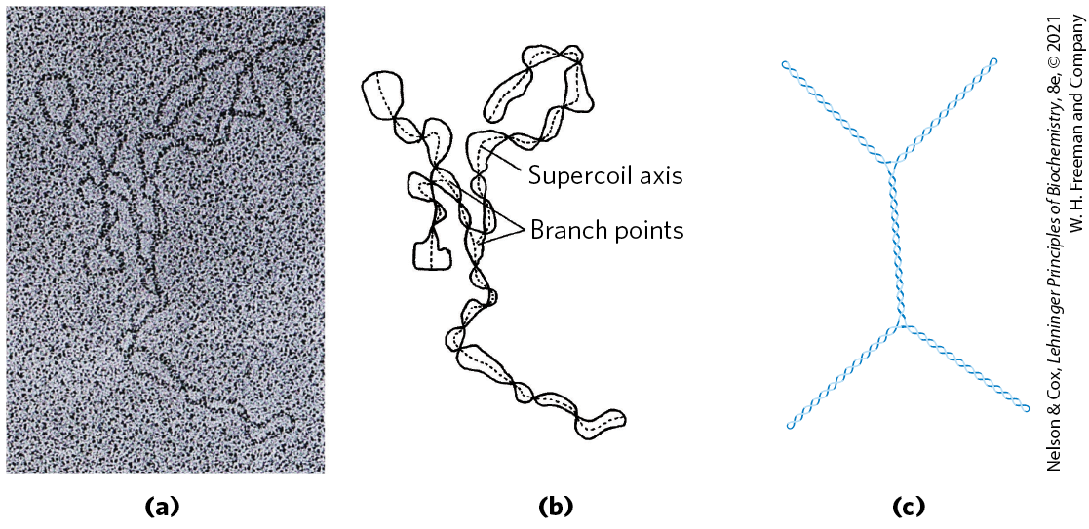
DNA Compaction Requires a Special Form of Supercoiling
plectonemic = extended righthanded supercoils where the length of the supercoil axis (including branches) is ~40% of the DNA length
  the general structure of supercoiled DNA in solution
  does not produce sufficient compaction to package DNA in the cell

Slide 115
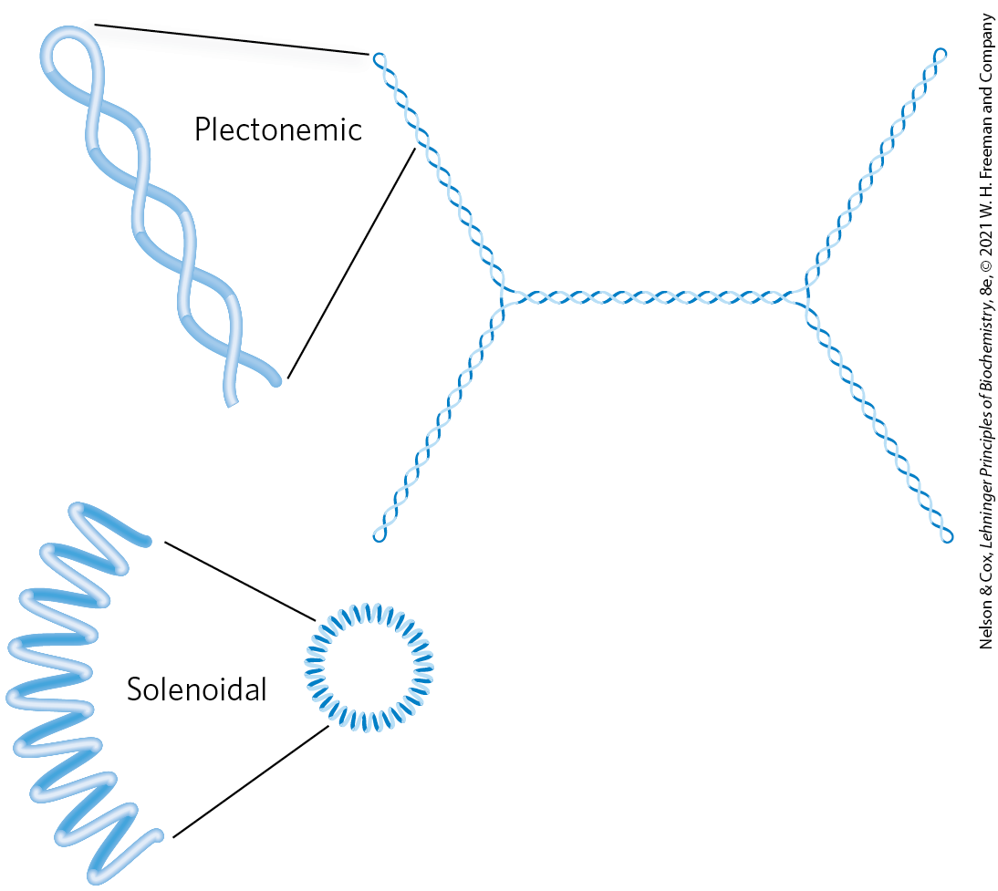
Solenoidal Supercoiling
solenoidal = supercoiling involving tight left-handed turns
  primary mechanism by which underwinding contributes to DNA compaction in cells
  stabilized by protein binding
both plectonemic and solenoidal are negative forms of supercoiling
  readily interconvertible

Slide 116
Clicker Question 19
What is plectonemic?
possessing mitochondrial DNA
alternate alignment of DNA, like in cruciform DNA
DNA that has been acted upon by topoisomerases
intertwined in a regular way, like with supercoils
epigenetically modified
Notes:
Answer: D
Principle: 24.3
Learning Objective(s): Differentiate plectonemic and solenoidal coiling?
Bloom’s: 1:1

Slide 117
Clicker Question 19, Response
What is plectonemic?
intertwined in a regular way, like with supercoils
Plectonemic is from the Greek plektos, “twisted,” and nema, “thread.” The term can be applied to any structure with strands intertwined in some simple and regular way, and it is a good description of the general structure of supercoiled DNA in solution.

Slide 118
24.3 The Structure of Chromosomes

Slide 119
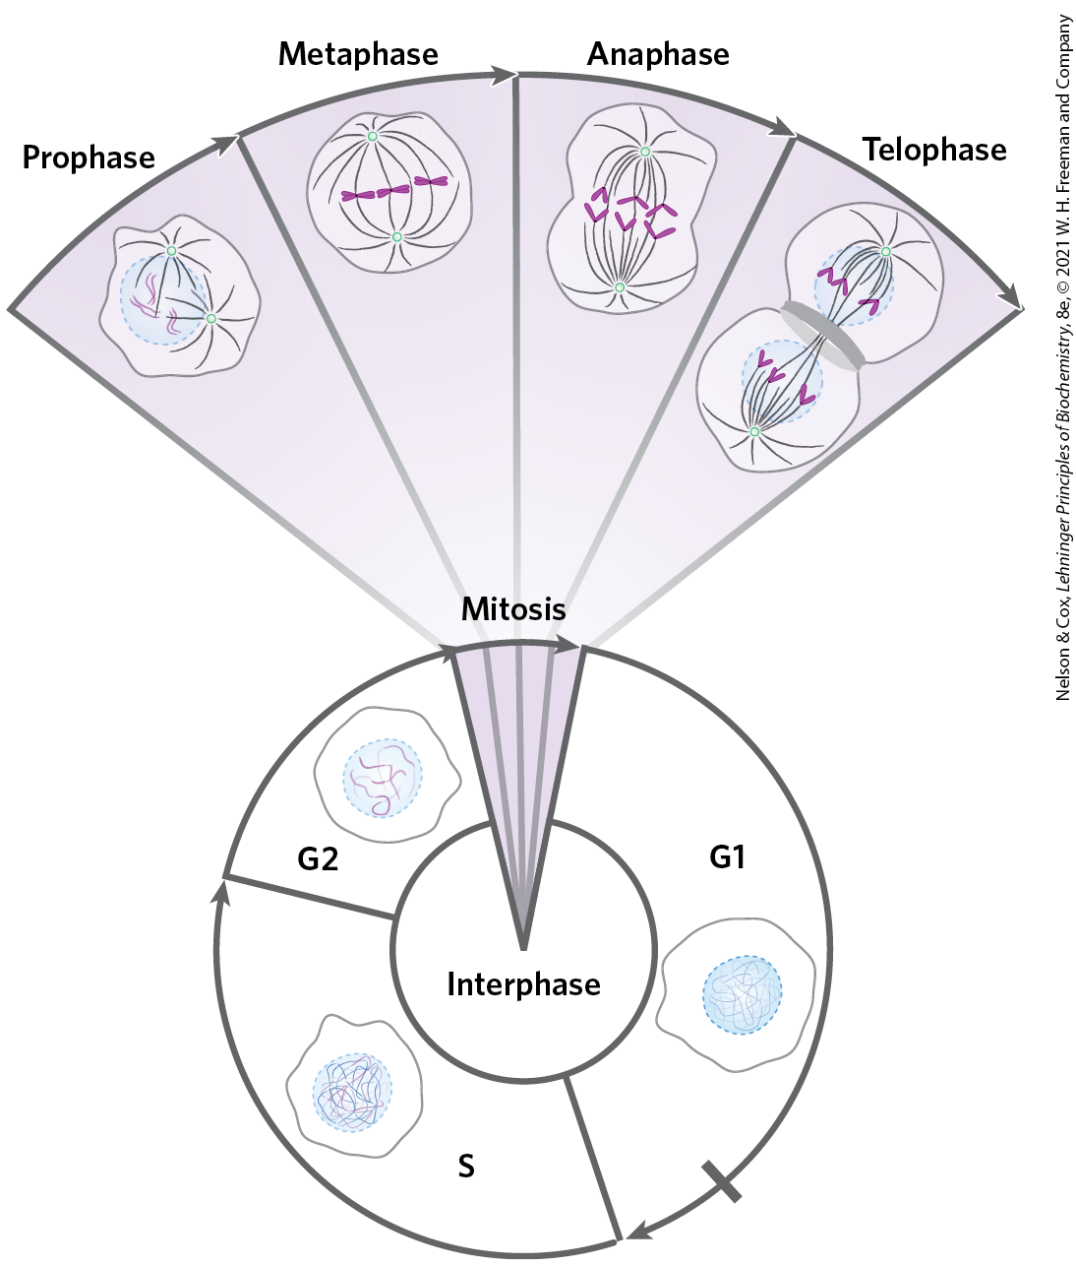
Chromatin Consists of DNA, Proteins, and RNA
chromatin = eukaryotic chromosomal material composed of DNA, RNA, and proteins
  amorphous in G0 and interphase (G1, S, and G2) phases
in the S phase of interphase, the amorphous DNA replicates to produce sister chromatids

Slide 120
Clicker Question 20
DNA in the nuclei of interphase cells:
is positively supercoiled.
does not express its genes.
is in a form known as chromatin.
must condense into chromosomes in order to be replicated.
Notes:
Answer: C
Principle: 24.4
Learning Objective(s): Relate the appearance of a chromosome to the phase of the cell cycle.
Bloom’s: 1:1

Slide 121
Clicker Question 20, Response
DNA in the nuclei of interphase cells:
is in a form known as chromatin.
In nondividing eukaryotic cells (in the G₀ phase) and those in interphase (G₁, S, and G₂), the chromosomal material, chromatin, is amorphous. In the S phase of interphase, the DNA in this amorphous state replicates, producing sister chromatids.

Slide 122
Principle 4 (2 of 7)
Specialized proteins and RNAs maintain chromosome structure. Topoisomerases control DNA underwinding. Histones, condensins, cohesins, and other DNA-binding proteins provide scaffolds to organize chromosome structure. Certain long, noncoding RNAs also play important roles in chromosome structure and function.

Slide 123
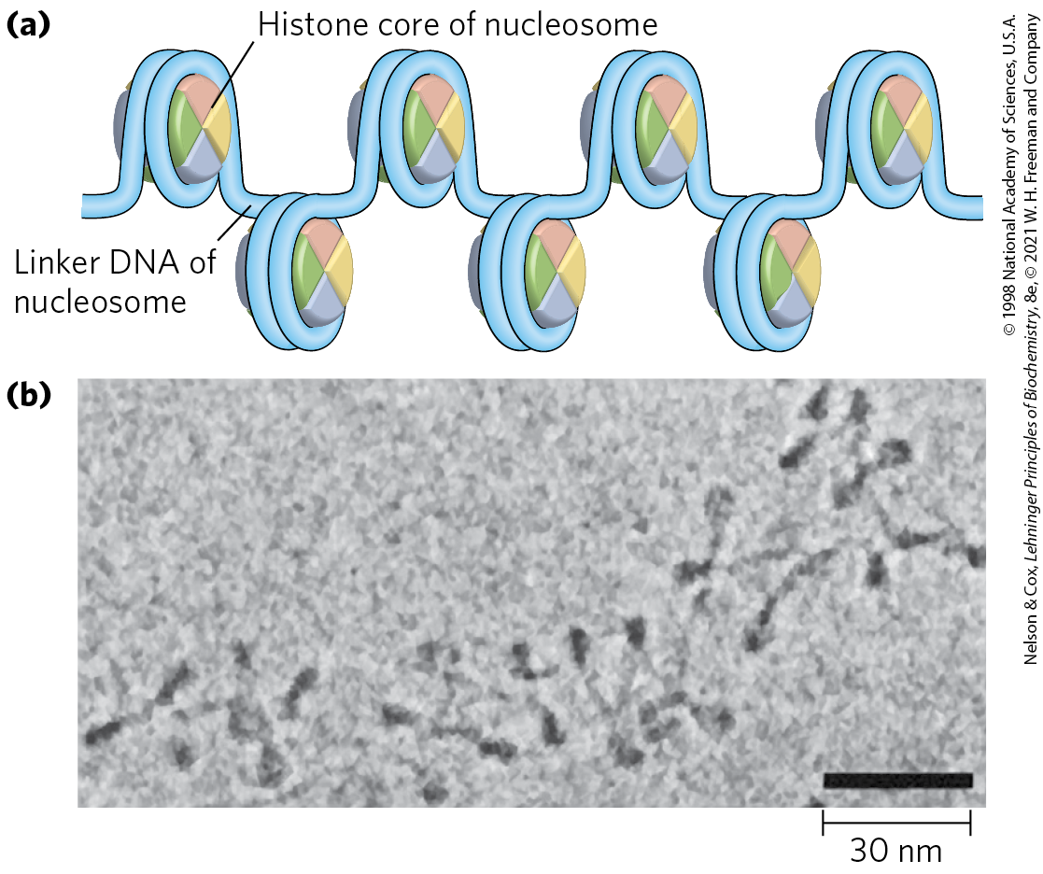
Histones Package and Order DNA into Nucleosomes
histones = proteins that are tightly associated with chromatin and function to package and order the DNA
nucleosomes = the fundamental structural unit of chromatin
  composed of core histone proteins bound to DNA

Slide 124
Clicker Question 21
Nucleosomes consist of:
chromosomes in a nucleus.
only DNA.
DNA and histones.
organelles found in the nucleus.
Notes:
Answer: C
Principle: 24.4
Learning Objective(s): Describe the structure of nucleosomes.
Bloom’s: 1:1

Slide 125
Clicker Question 21, Response
Nucleosomes consist of:
DNA and histones.
Nucleosomes consist of DNA wrapped tightly around a core of eight histone molecules.

Slide 126
Histones Are Small, Basic Proteins
all eukaryotic cells have five major classes of histones
  H3 and H4 are nearly identical in all eukaryotes
  H1, H2A, and H2B show less sequence similarity across eukaryotic species
Table 24-5 Types and Properties of the Common Histones
Histones | Molecular weight | Number of amino acid residues | Content of basic amino acids (% of total): Lys | Content of basic amino acids (% of total): Arg
H1ª | 21,130 | 223 | 29.5 | 11.3
H2Aª | 13,960 | 129 | 10.9 | 19.3
H2Bª | 13,774 | 125 | 16.0 | 16.4
H3 | 15,273 | 135 | 19.6 | 13.3
H4 | 11,236 | 102 | 10.8 | 13.7

Slide 127
Clicker Question 22
Why are histones basically charged?
because of the pH of the nucleus
because of the presence of glutamate and aspartate amino acid residues
to bind negatively charged DNA
because of extensive acetylation
None of the answers is correct.
Notes:
Answer: C
Principle: 24.4
Learning Objective(s): Describe the structure of nucleosomes.
Bloom’s: 2:2

Slide 128
Clicker Question 22, Response
Why are histones basically charged?
to bind negatively charged DNA
Histones are very rich in the basic amino acids arginine and lysine, which have positively charged side chains. These positive charges allow the histones to closely associate with the negatively charged DNA through electrostatic interactions.

Slide 129
Clicker Question 23
A novel succulent plant was discovered in a rainforest in the Amazon delta, and it may represent a new family of organisms. A number of histone-like proteins were discovered in the nucleus of leaf cells. What function would be expected from a protein with 67% homology to histone H1?
form part of the histone core
form the central element of nucleosomes
bind to DNA regions between nucleosomes
promote supercoiling by crosslinking nucleosomes
reverse or inhibit condensation of DNA during transcription
Notes:
Answer: C
Principle: 24.4
Learning Objective(s): Describe the major classes of histone proteins.
Bloom’s: 2:2

Slide 130
Clicker Question 23, Response
A novel succulent plant was discovered in a rainforest in the Amazon delta, and it may represent a new family of organisms. A number of histone-like proteins were discovered in the nucleus of leaf cells. What function would be expected from a protein with 67% homology to histone H1?
bind to DNA regions between nucleosomes
Histone H1 binds to the linker DNA between nucleosome beads.

Slide 131
Principle 4 (3 of 7)
Specialized proteins and RNAs maintain chromosome structure. Topoisomerases control DNA underwinding. Histones, condensins, cohesins, and other DNA-binding proteins provide scaffolds to organize chromosome structure. Certain long, noncoding RNAs also play important roles in chromosome structure and function.

Slide 132
Nucleosomes Are the Fundamental Organizational Units of Chromatin
chromosomes are arranged as “beads-on-a-string”
the beads are complexes of histones and DNA
  nucleosome contains eight histone molecules: two copies each of H2A, H2B, H3, and H4
  contains ~200 bp of DNA, of which 146 bp are bound tightly around the histone core in a left-handed solenoidal supercoil
the nucleosome is the bead plus the connecting DNA that leads to the next bead

Slide 133
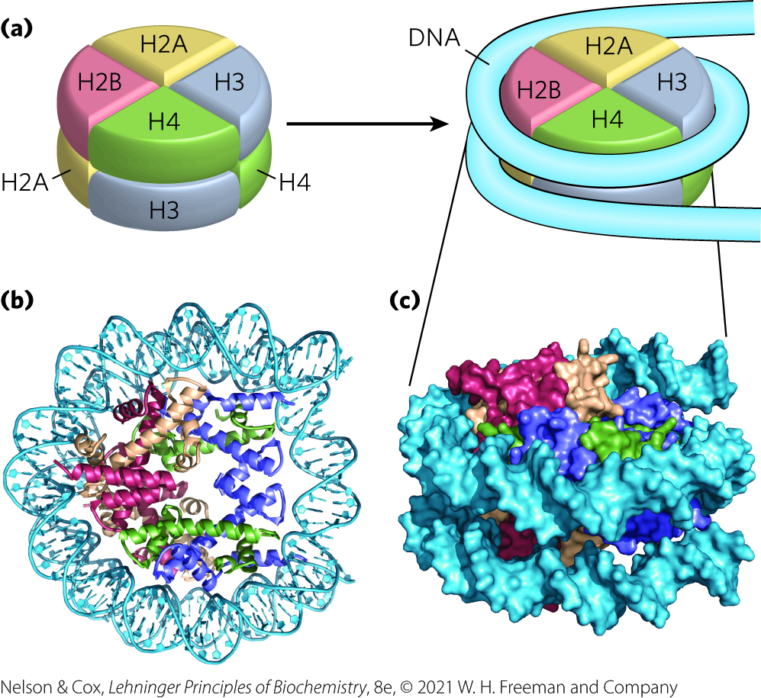
DNA Wrapped Around a
Histone Core

Slide 134
Clicker Question 24
Your science courses have used the visual model of “beads on a string” when describing condensed DNA. Which factor is MOST responsible for the structural change from “beads on a string” to 30-nm fiber?
the core histones
histone H1
condensin
topoisomerase II
scaffold proteins
Notes:
Answer: A. Answer B: Cohesins link sister chromatids. Answer C: Both are involved in later stages of condensation and DNA binding.
Principle: 24.4
Learning Objective(s): Describe nucleosome assembly.
Bloom’s: 2:2

Slide 135
Clicker Question 24, Response
Your science courses have used the visual model of “beads on a string” when describing condensed DNA. Which factor is MOST responsible for the structural change from “beads on a string” to 30-nm fiber?
the core histones
The beads in the “beads-on-a-string” arrangement are complexes of histones and DNA. The bead of each nucleosome contains eight core histone molecules: two copies each of H2A, H2B, H3, and H4.

Slide 136
Clicker Question 25
Higher orders of DNA organization:
are not alone sufficient to allow packing of DNA into the nucleus.
prevent the actions of topoisomerases.
are essentially random.
are at least partly a result of interactions between nucleosomes.
Notes:
Answer: D
Principle: 24.4
Learning Objective(s): Describe nucleosome assembly.
Bloom’s: 2:2

Slide 137
Clicker Question 25, Response
Higher orders of DNA organization:
are at least partly a result of interactions between nucleosomes.
The nucleosome is the fundamental unit of organization on which the higher-order packing of chromatin is built. Although the condensation does not follow a rigid organization, it is not random and occurs so as to avoid the formation of knots.

Slide 138
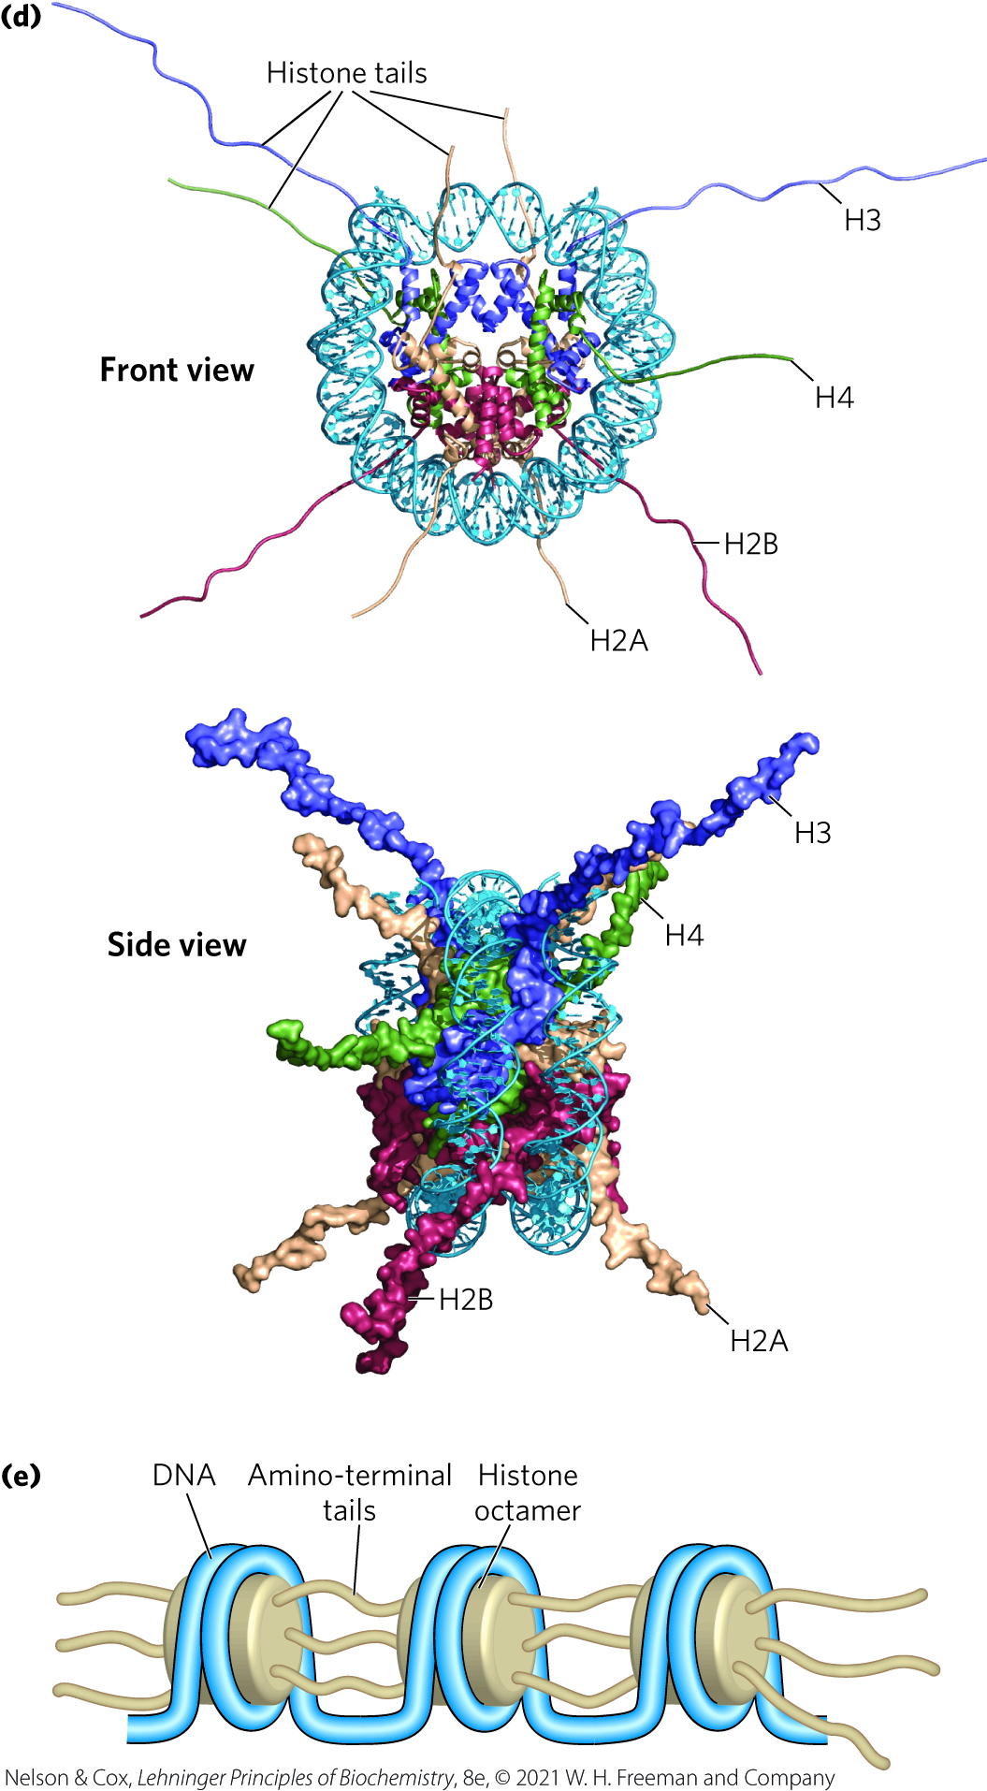
Front and Side Views of Histone Amino-Terminal Tails
the amino-terminal tails of the histones:
  are intrinsically disordered
  are where most of the histone modifications occur
  play a key role in forming contacts between nucleosomes in the chromatin

Slide 139

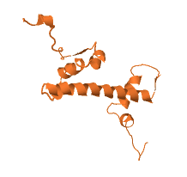
Activity: Histone Proteins
Observe the structure of the histone protein H2A
in Mol3D viewer in your Achieve course.
Notes:
Instructor: This Mol3D structure is located in the Achieve course. It can be found in the Chapter 24 content, in the folder titled “Ch24 In-Class Activities and Resources.”

Slide 140
Activity Instructions (3 of 3)
On your own, think of answers to the questions:
  What is the function of the tail regions of histones?
  The tail regions of histones are notoriously difficult to crystallize. Why might this be the case?
  (2 minutes)
Pair up to discuss your ideas. (2 minutes)
Share your ideas with the class in group discussion.
(3 minutes)
Notes:
Instructor: This Mol3D structure is located in the Achieve course. It can be found in the Chapter 24 content, in the folder titled “Ch24 In-Class Activities and Resources.”

Slide 141
Activity Solution (3 of 3)
  What is the function of the tail regions of histones? The tails are the primary site of histone modification and play a key role in forming contacts between nucleosomes in the chromatin.
  The tail regions of histones are notoriously difficult to crystallize. Why might this be the case?
  The tail regions of histones are intrinsically disordered, making it difficult to lock them into a conformation during the crystallization process.
Notes:
Instructor: This Mol3D structure is located in the Achieve course. It can be found in the Chapter 24 content, in the folder titled “Ch24 In-Class Activities and Resources.”

Slide 142
Clicker Question 26
How are histones regulated?
by acetylation
by phosphorylation
by sumoylation
by ubiquitination
All of the answers are correct.
Notes:
Answer: E
Principle: 24.4
Learning Objective(s): Describe the factors that affect DNA binding to histone proteins.
Bloom’s: 2:2

Slide 143
Clicker Question 26, Response
How are histones regulated?
All of the answers are correct.
Each type of histone is subject to enzymatic modification by methylation, acetylation, ADP-ribosylation, phosphorylation, glycosylation, SUMOylation, or ubiquitination. Such modifications affect the net electric charge, shape, and other properties of histones, as well as the structural and functional properties of the chromatin.

Slide 144
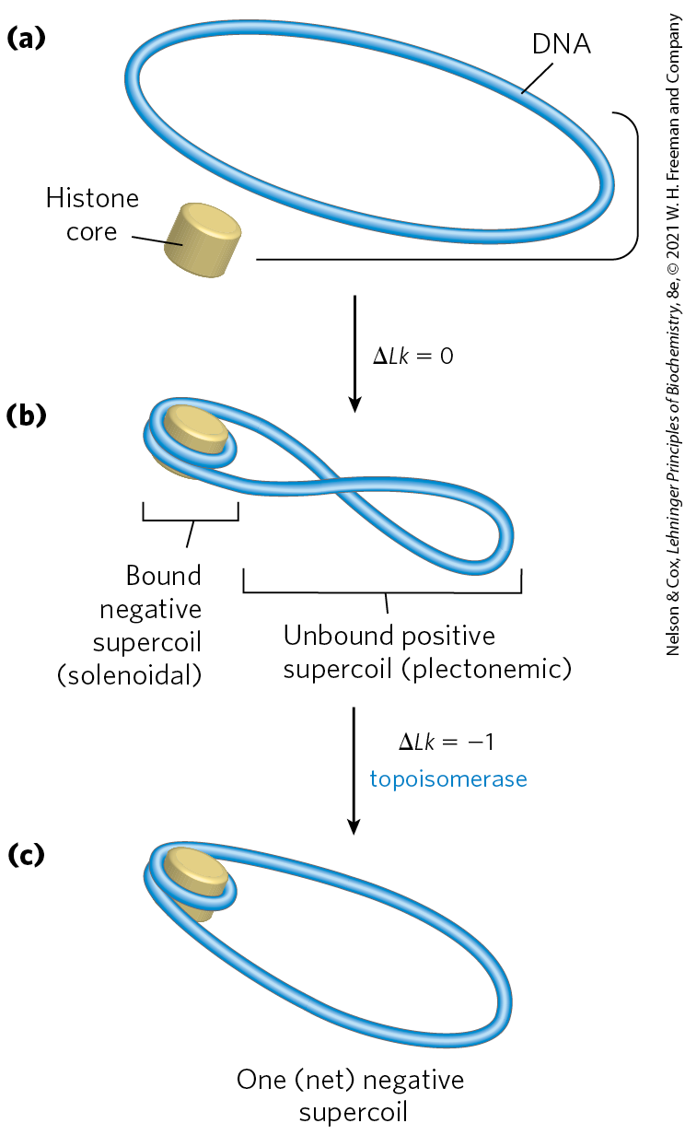
Chromatin Assembly
DNA wrapping around the histone core requires removal of ~1 helical turn in the DNA
binding of the histone core to a relaxed closed-circular DNA introduces a negative supercoil
  accompanied by a positive supercoil in the unbound region
when eukaryotic topoisomerases relax positive supercoils, Lk decreases

Slide 145
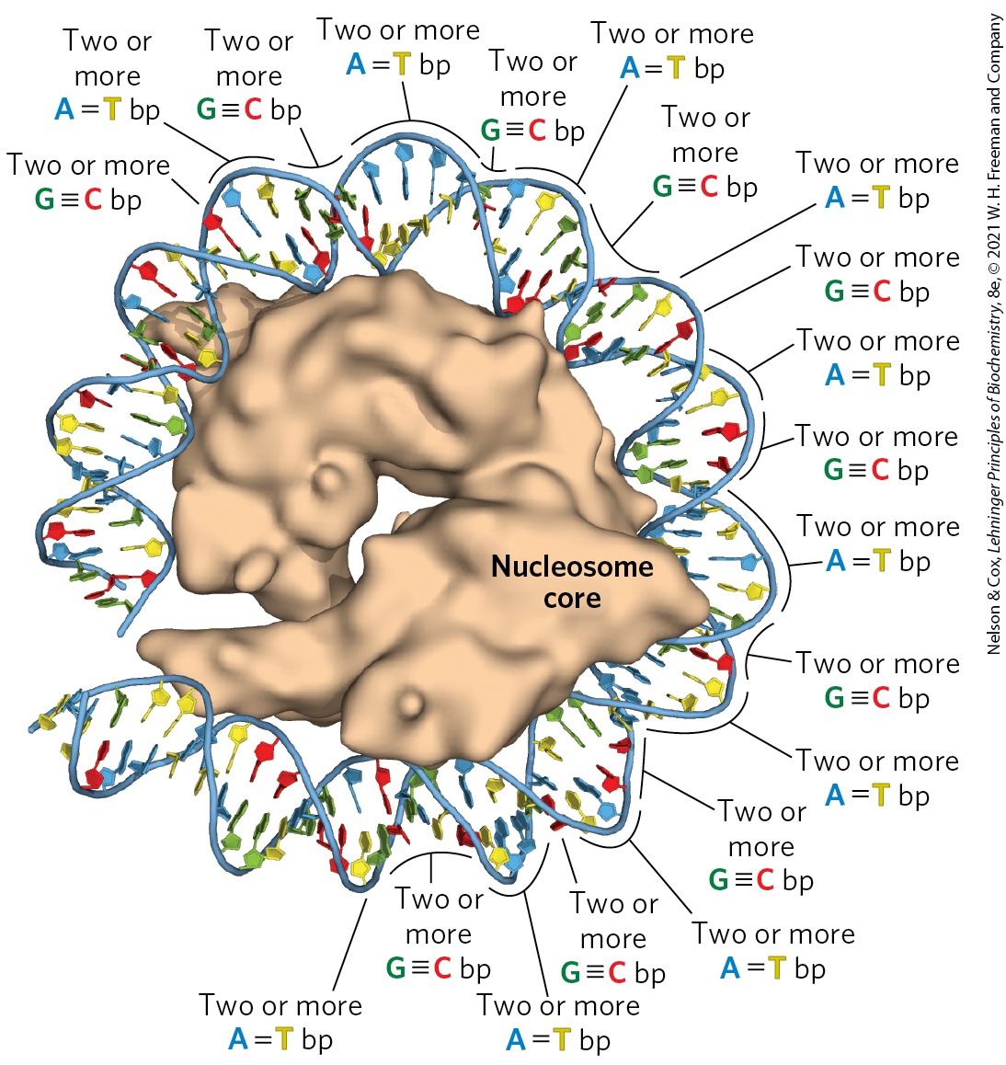
The Effect of DNA Sequence on Nucleosome Binding
histone binding is not random
binding of the histone core seems to depend on a local abundance of A=T base pairs.
staggering AA, AT, or TT dinucleotides at 10 bp intervals facilitates DNA binding around the histone core

Slide 146
Depositing Nucleosome Cores on DNA
deposited stepwise: a tetramer of two H3 and two H4 histones binds first, followed by two H2A–H2B dimers
histone chaperones = mediate the incorporation of nucleosomes into chromosomes after chromosomal replication
  conserved in all eukaryotes
histone exchange factors = permit the substitution of histone variants for core histones in contexts other than postreplication

Slide 147
Clicker Question 27
What would molecular biologists study if they were interested in learning about information that is passed through generations but not encoded in DNA or RNA?
euchromatin
plasmids in mitochondria
SMS proteins
nucleoids
epigenetic information
Notes:
Answer: E
Principle: 24.4
Learning Objective(s): Describe the roles of histone variants.
Bloom’s: 1:1

Slide 148
Clicker Question 27, Response
What would molecular biologists study if they were interested in learning about information that is passed through generations but not encoded in DNA or RNA?
epigenetic information
Information that is passed from one generation to the next — to daughter cells at cell division or from parent to offspring — but is not encoded in DNA sequences is referred to as epigenetic information. Much of it is in the form of covalent modification of histones and/or the placement of histone variants in chromosomes.

Slide 149
Principle 4 (4 of 7)
Specialized proteins and RNAs maintain chromosome structure. Topoisomerases control DNA underwinding. Histones, condensins, cohesins, and other DNA-binding proteins provide scaffolds to organize chromosome structure. Certain long, noncoding RNAs also play important roles in chromosome structure and function.

Slide 150
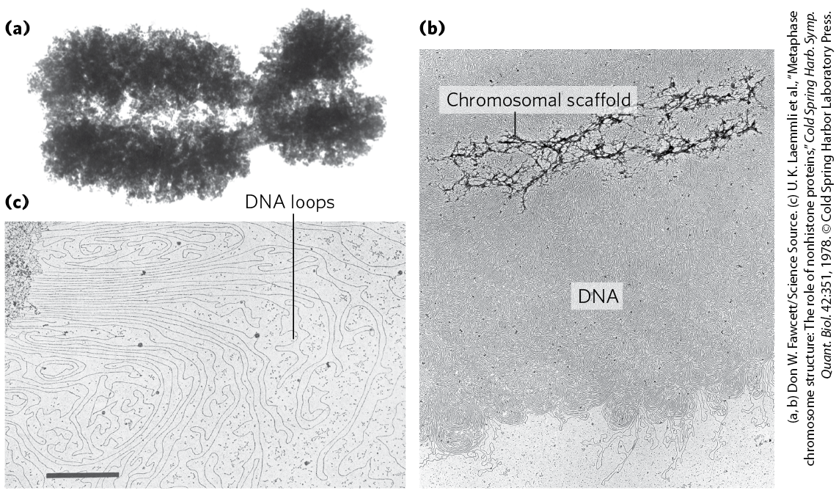
Nucleosomes Are Packed into Highly Condensed Chromosome Structures
certain regions of DNA seem to associate with a chromosomal scaffold

Slide 151
Clicker Question 28
Nuclear DNA:
is in the form of chromatin during mitosis and heterochromatin during interphase.
appears to be organized as loops of DNA in some way attached to a proteinaceous scaffold.
is replicated during mitosis.
is not found in the nucleolus.
Notes:
Answer: B
Principle: 24.4
Learning Objective(s): Describe the organization of eukaryotic chromosomes within the nucleus.
Bloom’s: 2:2

Slide 152
Clicker Question 28, Response
Nuclear DNA:
appears to be organized as loops of DNA in some way attached to a proteinaceous scaffold.
The higher levels of folding are not yet fully understood, but certain regions of DNA seem to associate with a chromosomal scaffold that contains many proteins.

Slide 153
Principle 3 (6 of 7)
Chromosomes in all cells are maintained in a state of torsional stress. DNA is underwound relative to the stable B-form structure, facilitating both the packaging of DNA and access to the genetic information contained within it.

Slide 154
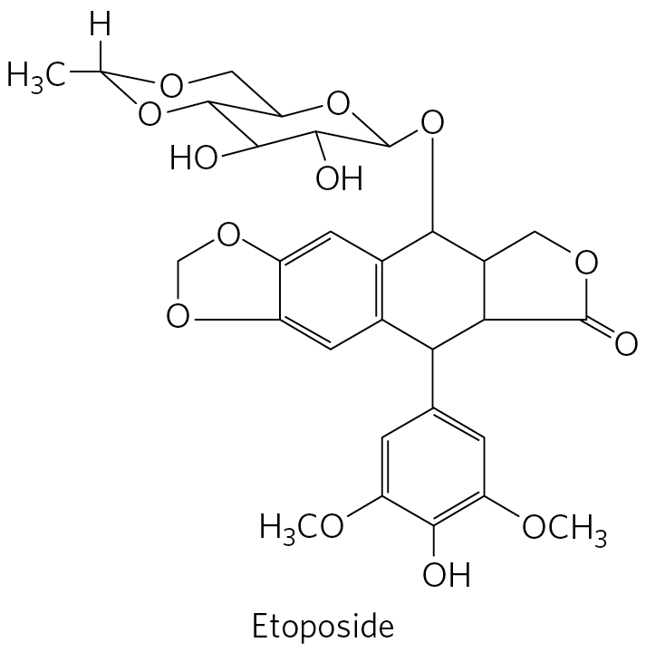
Topoisomerase II Is One of the Most Abundant Proteins in the Chromosome
topoisomerase II is important to the maintenance of chromatin structure
inhibitors of topoisomerase II can kill rapidly dividing cells
  several chemotherapy drugs are topoisomerase II inhibitors

Slide 155
Clicker Question 29
Which pair of molecules is MOST important for the formation and stable maintenance of DNA rosettes during condensation?
topoisomerase II and scaffold proteins
cohesins and topoisomerase I
condensins and cohesins
scaffold proteins and ATP
histones H2A and H2B
Notes:
Answer: A. Answer B: Cohesins link sister chromatids. Answer C: Both are involved in later stages of condensation and DNA binding.
Principle: 24.4
Learning Objective(s): Relate the appearance of a chromosome to the phase of the cell cycle.
Bloom’s: 2:2

Slide 156
Clicker Question 29, Response
Which pair of molecules is MOST important for the formation and stable maintenance of DNA rosettes during condensation?
topoisomerase II and scaffold proteins
Given the need to fold and compact the chromosome without creating knots, topoisomerase II is one of the most abundant proteins in the chromosome. Higher-order folding of chromosomes involves attachment to a chromosomal scaffold.

Slide 157
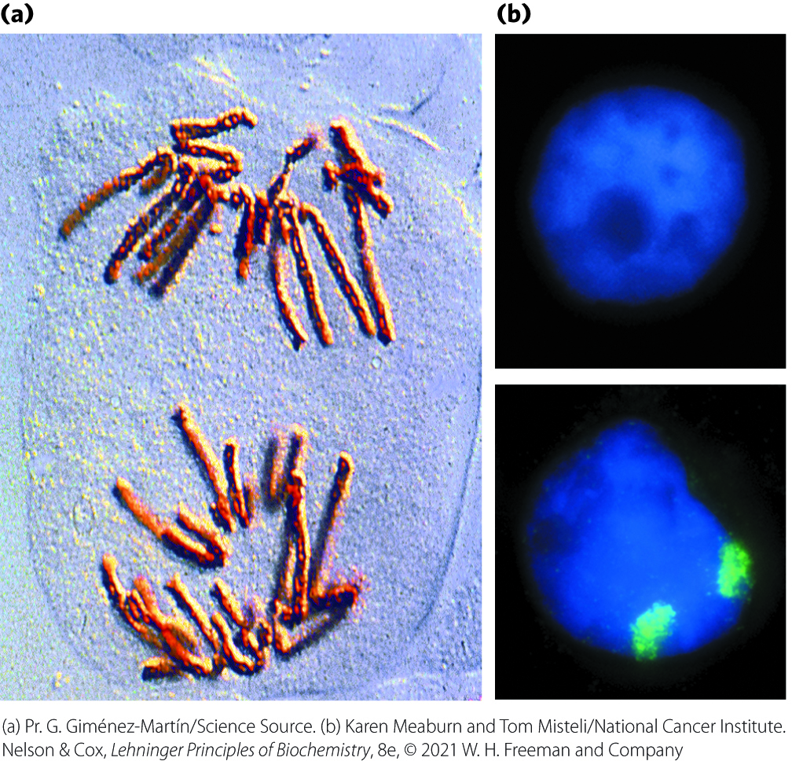
Chromosomal Organization in Eukaryotic Nucleus
chromosomes are highly condensed and organized just before cell division
chromosomes appear dispersed during interphase
  each chromosome is still organized, with two sets of compartments

Slide 158
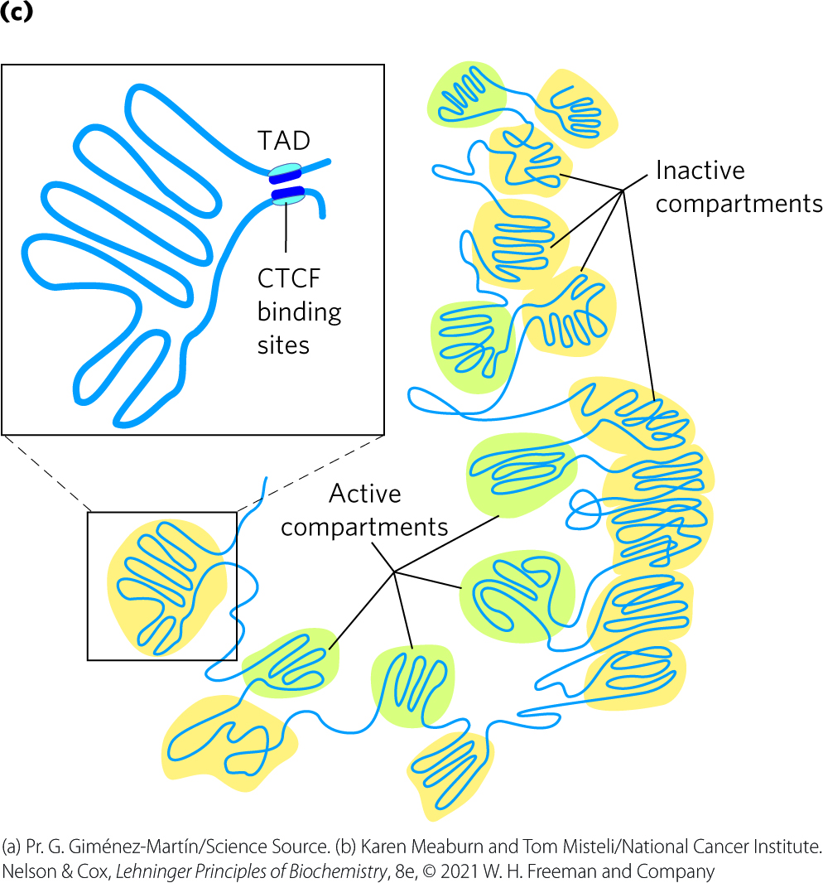
Active and Inactive Compartments
active compartments have reduced chromatin condensation
inactive compartments (heterochromatin) are highly condensed
topologically associating domains (TADs) = large segments of DNA are organized in loops
  binding of CTCF to bordering sites brings DNA together

Slide 159
Clicker Question 30
What is heterochromatin?
random structural regions of DNA
transcriptionally inactive regions of DNA
regions of DNA containing genes
places where histones bind
regions where epigenetic modification occurs
Notes:
Answer: B
Principle: 24.4
Learning Objective(s): Differentiate between euchromatin and heterochromatin.
Bloom’s: 1:1

Slide 160
Clicker Question 30, Response
What is heterochromatin?
transcriptionally inactive regions of DNA
The highly condensed DNA in transcriptionally inactive regions or in regions lacking genes is called heterochromatin.

Slide 161
Principle 4 (5 of 7)
Specialized proteins and RNAs maintain chromosome structure. Topoisomerases control DNA underwinding. Histones, condensins, cohesins, and other DNA-binding proteins provide scaffolds to organize chromosome structure. Certain long, noncoding RNAs also play important roles in chromosome structure and function.

Slide 162
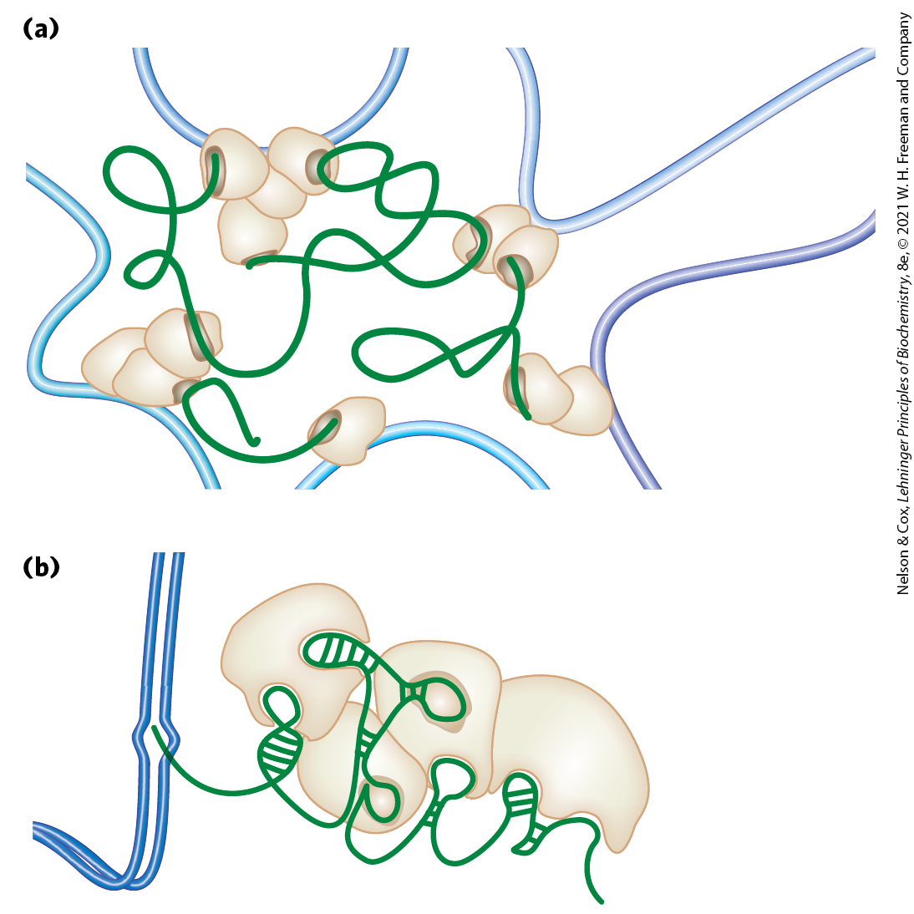
Long Noncoding RNAs (lncRNAs)
long noncoding RNAs (lncRNAs) = play a functional role in defining the chromosome structure
  many provide a scaffold for proteins

Slide 163
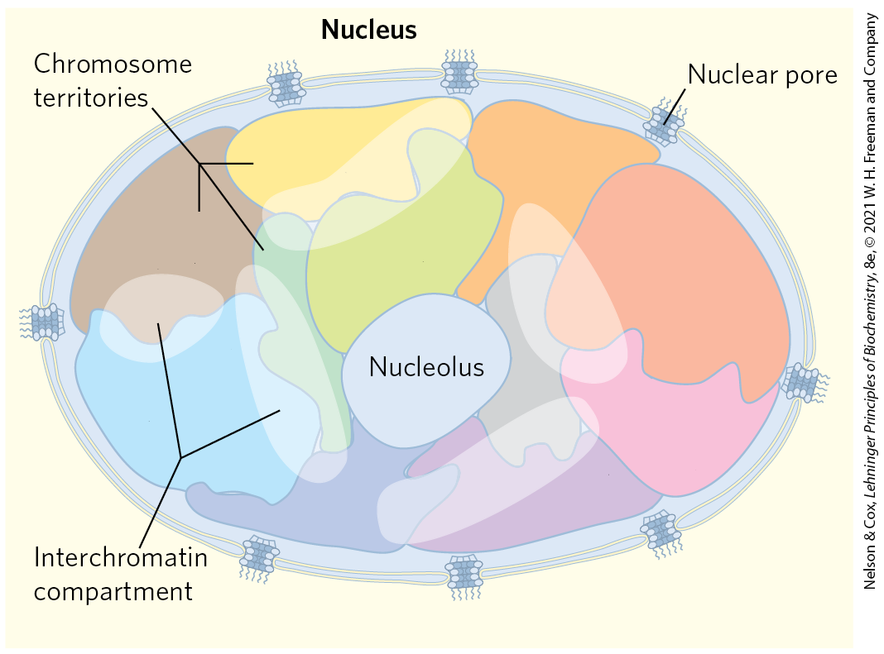
Chromosome Territory
chromosome territory = subnuclear domain that constrains the entire structure of each chromosome
  little or no intermingling of DNA in different territories

Slide 164
Clicker Question 31
Xist is a(n) _____ that contributes to the condensation of an X chromosome into an inactive form called a _____.
lncRNA; Barr body
histone chaperone; Barr body
lncRNA; chromosome territory
histone chaperone; chromosome territory
Notes:
Answer: A
Principle: 24.4
Learning Objective(s): Describe the organization of eukaryotic chromosomes within the nucleus.
Bloom’s: 2:2

Slide 165
Clicker Question 31, Response
Xist is a(n) _____ that contributes to the condensation of an X chromosome into an inactive form called a _____.
lncRNA; Barr body
In organisms with two X chromosomes, dosage compensation is accomplished by X chromosome inactivation. An lncRNA called Xist migrates in the region immediately proximal to the gene from which it is transcribed, gradually encompassing more and more DNA as that X chromosome undergoes a major condensation, giving rise to the inactive form called a Barr body.

Slide 166
Principle 4 (6 of 7)
Specialized proteins and RNAs maintain chromosome structure. Topoisomerases control DNA underwinding. Histones, condensins, cohesins, and other DNA-binding proteins provide scaffolds to organize chromosome structure. Certain long, noncoding RNAs also play important roles in chromosome structure and function.

Slide 167
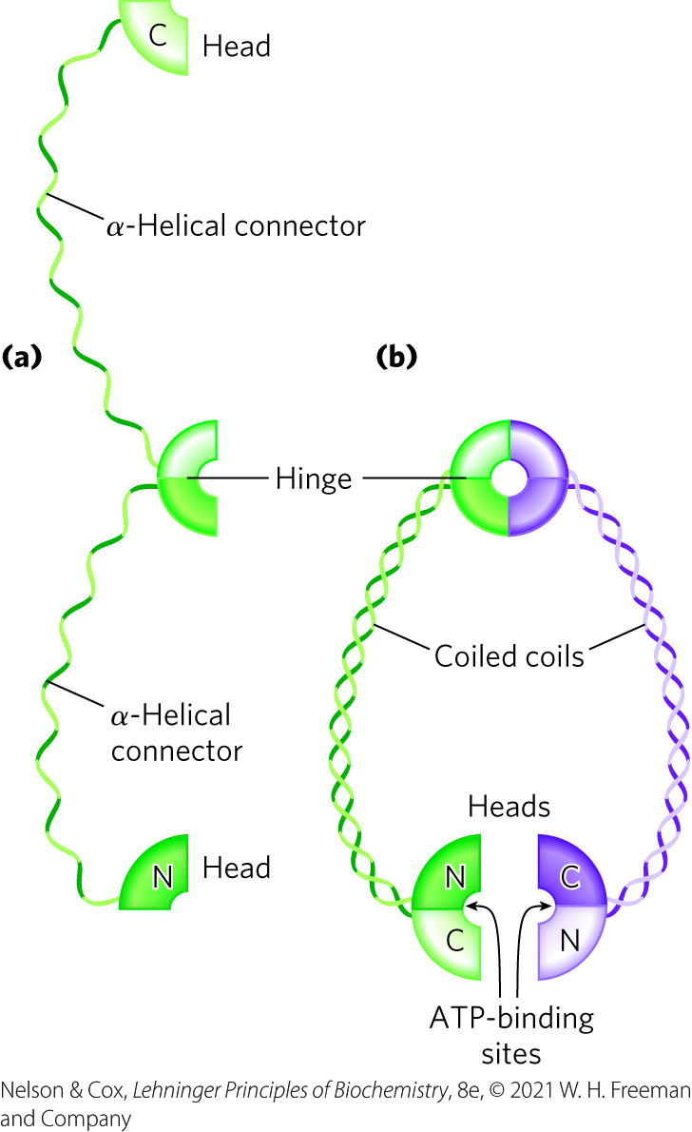
Condensed Chromosome Structures Are Maintained by SMC Proteins
SMC proteins (structural maintenance of chromosomes) = responsible for maintaining the structure and integrity of chromosomes following replication
  consist of 5 distinct domains

Slide 168
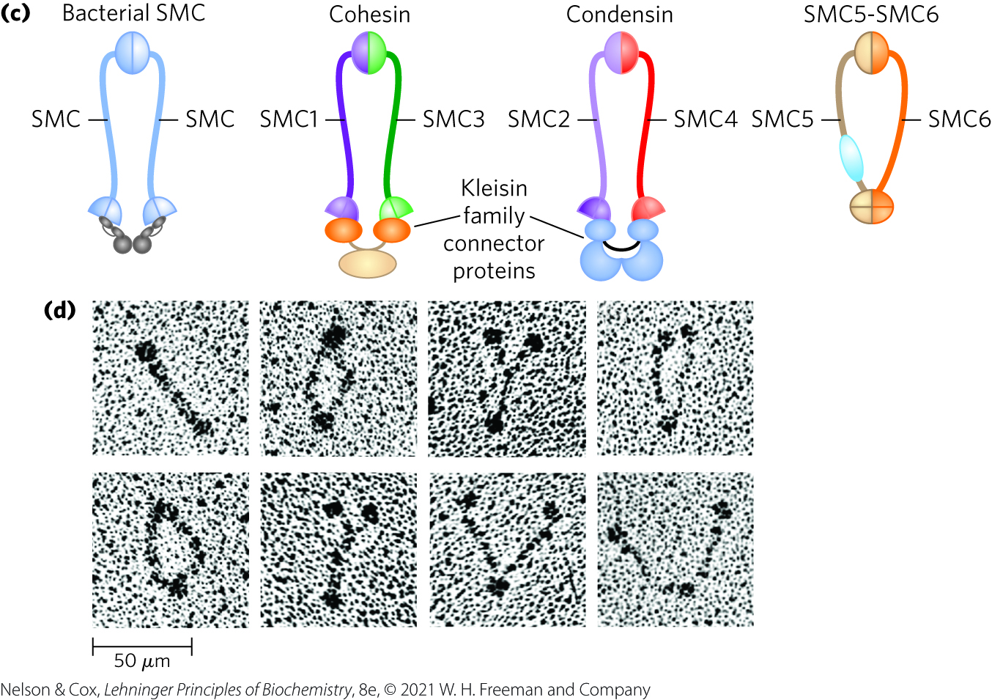
Eukaryotes Have Two Major Types of SMC Proteins
cohesins = link sister chromatids together after replication and keep them together as the chromosomes condense to metaphase
condensins = essential to chromosomal condensation as cells enter mitosis
  create positive supercoils

Slide 169
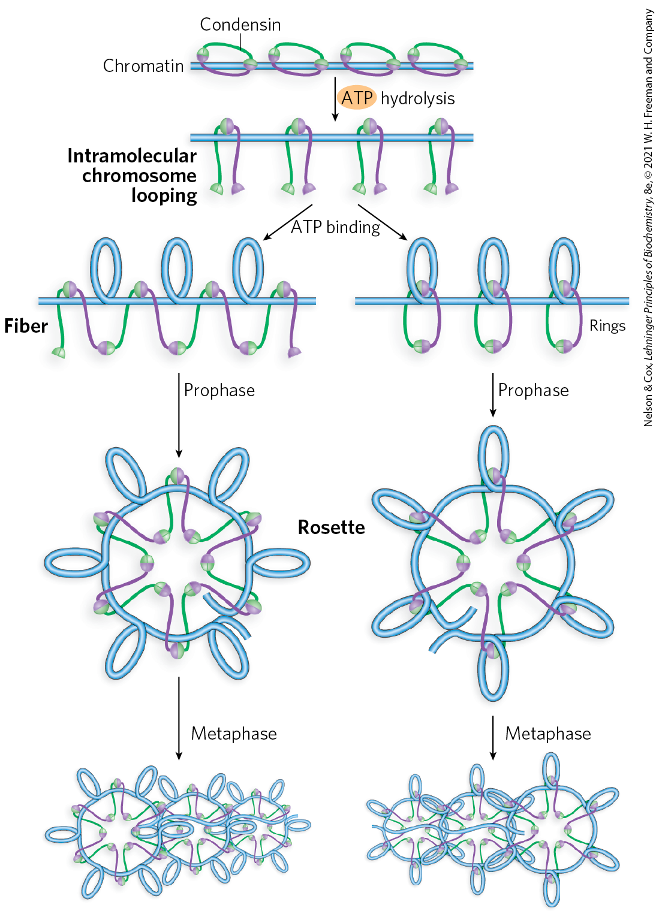
Models of the Role of Condensins in Chromatin Condensation
as DNA is compacted to form tighter and tighter loops, condensins stabilize the loops by binding at the base of each one

Slide 170
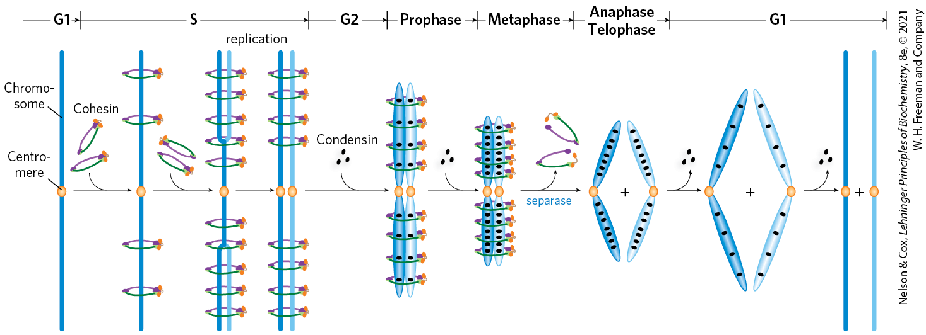
The Role of Cohesins and Condensins in the Cell Cycle

Slide 171
Clicker Question 32
The SMC (“structural maintenance of chromosomes”) proteins include:
topoisomerases and cohesins.
histones and condensins.
histones, topoisomerases, condensins, and cohesins.
condensins and cohesins.
Notes:
Answer: D
Principle: 24.4
Learning Objective(s): Describe the functions of structural maintenance of chromosome (SMC) proteins.
Bloom’s: 1:1

Slide 172
Clicker Question 32, Response
The SMC (“structural maintenance of chromosomes”) proteins include:
condensins and cohesins.
The two major types of eukaryotes SMC proteins are cohesins and condensins. Cohesins play a substantial role in linking together sister chromatids immediately after replication and keeping them together as the chromosomes condense to metaphase. Condensins are essential to the condensation of chromosomes as cells enter mitosis.

Slide 173
Principle 2 (6 of 6)
Chromosomes are large. To constrain them in a small space can require multiple layers and multiple modes of tertiary structure.

Slide 174
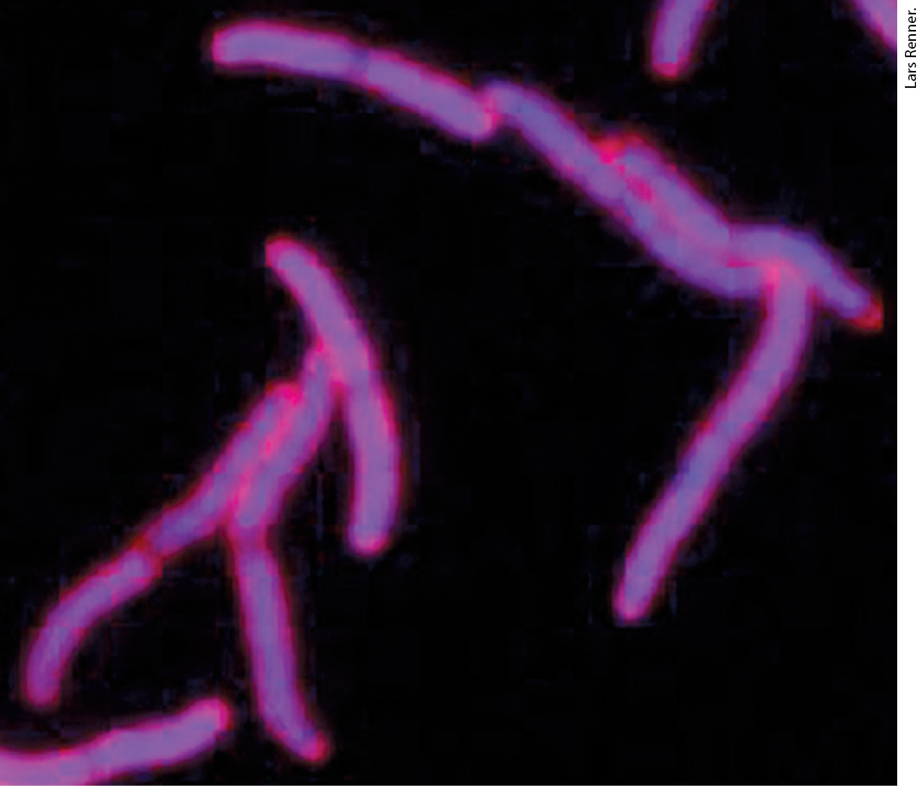
Bacterial DNA Is Also
Highly Organized
bacterial DNA is compacted in a structure called the nucleoid
  can occupy a significant fraction of the cell volume
  appears attached at 1+ points in the inner surface of the plasma membrane

Slide 175
Principle 3 (7 of 7)
Chromosomes in all cells are maintained in a state of torsional stress. DNA is underwound relative to the stable B-form structure, facilitating both the packaging of DNA and access to the genetic information contained within it.

Slide 176
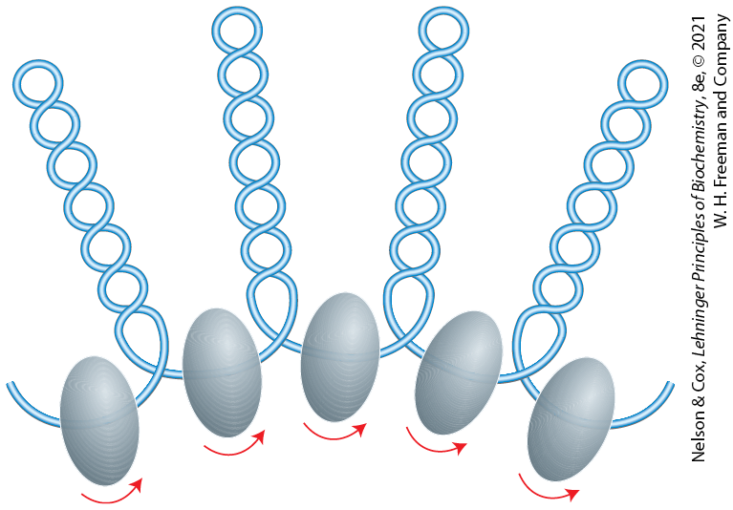
Looped Domains of the
E. coli Chromosome
a scaffoldlike structure seems to organize the circular chromosome into a series of ~500 looped domains
  domains are topologically constrained
  domains do not have fixed end points

Slide 177
Principle 4 (7 of 7)
Specialized proteins and RNAs maintain chromosome structure. Topoisomerases control DNA underwinding. Histones, condensins, cohesins, and other DNA-binding proteins provide scaffolds to organize chromosome structure. Certain long, noncoding RNAs also play important roles in chromosome structure and function.

Slide 178
Histonelike Proteins Are Abundant in E. coli
bacterial DNA does not seem to have comparable structure to eukaryotic nucleosomes
histonelike proteins = proteins that bind and dissociate within minutes
  no regular, stable DNA-histone structure has been found
the dynamic and irregular structure of the bacterial chromosome reflects:
  the shorter cell cycle
  very active metabolism

Slide 179
Clicker Question 33
Which statement regarding bacterial DNA is false?
It is attached to the plasma membrane.
It is organized into nucleosomes.
It is found in a structure known as the nucleoid.
It has topologically constrained domains.
Notes:
Answer: B
Principle: 24.3
Learning Objective(s): Describe DNA compaction in bacteria.
Bloom’s: 2:2

Slide 180
Clicker Question 33, Response
Which statement regarding bacterial DNA is false?
It is organized into nucleosomes.
Bacterial DNA does not seem to have any structure comparable to the local organization provided by nucleosomes in eukaryotes.

