Slide 1

19 Oxidative Phosphorylation
© 2021 Macmillan Learning

Slide 2

Principle 1 (1 of 5)
Mitochondria play a central role in eukaryotic aerobic metabolism. ATP production is not the only important mitochondrial function. Mitochondria play host to the citric acid cycle, the fatty acid β-oxidation pathway, and the pathways of amino acid oxidation. The mitochondria also act in thermogenesis, steroid synthesis, and apoptosis (programmed cell death). The discovery of these diverse and important roles of mitochondria has stimulated much current research on the biochemistry of this organelle.

Slide 3

Principle 2 (1 of 4)
Mitochondria trace their evolutionary origin to bacteria. Over 1.45 billion years ago, an endosymbiotic relationship arose between bacteria and a primitive eukaryote or eukaryotic progenitor. Mitochondria are ubiquitous in modern eukaryotes, and their bacterial origin is evident in almost every aspect of their structure and function.

Slide 4

Principle 3 (1 of 6)
Electrons flow from electron donors (oxidizable substrates) through a chain of membrane-bound carriers to a final electron acceptor with a large reduction potential. The final acceptor is molecular oxygen, O₂. The appearance of oxygen in the atmosphere some 2.3 billion years ago, and its harnessing in living systems via the evolution of oxidative phosphorylation, made more complex life forms possible.

Slide 5

Principle 4 (1 of 5)
The free energy made available by “downhill” (exergonic) electron flow is coupled to the “uphill” transport of protons across a proton-impermeable membrane. The free energy of fuel oxidation is thus conserved as a transmembrane electrochemical potential.

Slide 6

Principle 5 (1 of 7)
The transmembrane flow of protons back down their electrochemical gradient through specific protein channels provides the free energy for synthesis of ATP. This process is catalyzed by a membrane protein complex (ATP synthase) that couples proton flow to phosphorylation of ADP.

Slide 7
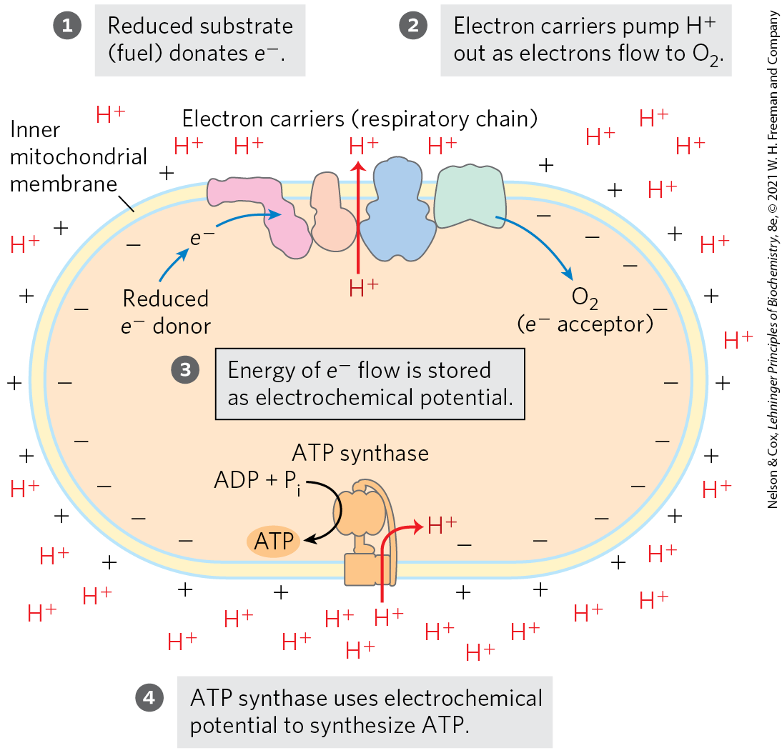
The Chemiosmotic Theory
chemiosmotic theory = transmembrane differences in proton concentration are the reservoir for the energy extracted from biological oxidation reactions

Slide 8
19.1 The Mitochondrial Respiratory Chain

Slide 9
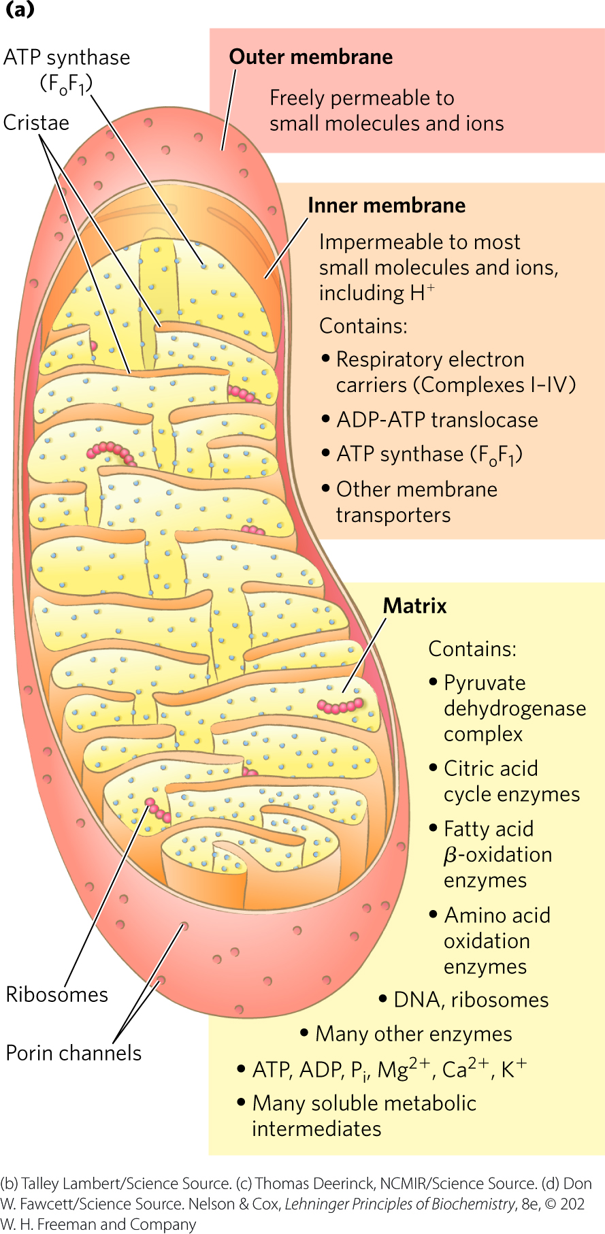
Mitochondria Have Two Membranes
outer membrane is readily permeable to small molecules and ions
  transport occurs through porins
inner membrane is impermeable to most small molecules and ions
  transport requires specific transporters

Slide 10
Principle 1 (2 of 5)
Mitochondria play a central role in eukaryotic aerobic metabolism. ATP production is not the only important mitochondrial function. Mitochondria play host to the citric acid cycle, the fatty acid β-oxidation pathway, and the pathways of amino acid oxidation. The mitochondria also act in thermogenesis, steroid synthesis, and apoptosis (programmed cell death). The discovery of these diverse and important roles of mitochondria has stimulated much current research on the biochemistry of this organelle.

Slide 11
The Mitochondrial Matrix
the mitochondrial matrix contains:
  the pyruvate dehydrogenase complex
  enzymes of the citric acid cycle
  enzymes of the fatty acid β-oxidation pathway
  enzymes of the pathways of amino acid oxidation
the inner mitochondrial membrane segregates the intermediates and enzymes of cytosolic and matrix metabolic pathways

Slide 12

Clicker Question 1
Which of these dehydrogenase enzymes is NOT found in the mitochondrial matrix?
malate dehydrogenase
glutamate dehydrogenase
acyl-CoA dehydrogenase
lactate dehydrogenase
Notes:
Answer: D
Principle: 19.1
Learning Objective(s): Describe the role of mitochondria in eukaryotic aerobic metabolism.
Bloom’s: 1:1

Slide 13
Clicker Question 1, Response
Which of these dehydrogenase enzymes is NOT found in the mitochondrial matrix?
lactate dehydrogenase
The mitochondrial matrix contains enzymes of the citric acid cycle (malate dehydrogenase), the β-oxidation pathway (acyl-CoA dehydrogenase), and amino acid oxidation (glutamate dehydrogenase). The enzymes of glycolysis and fermentation (lactate dehydrogenase) are located in the cytosol.

Slide 14
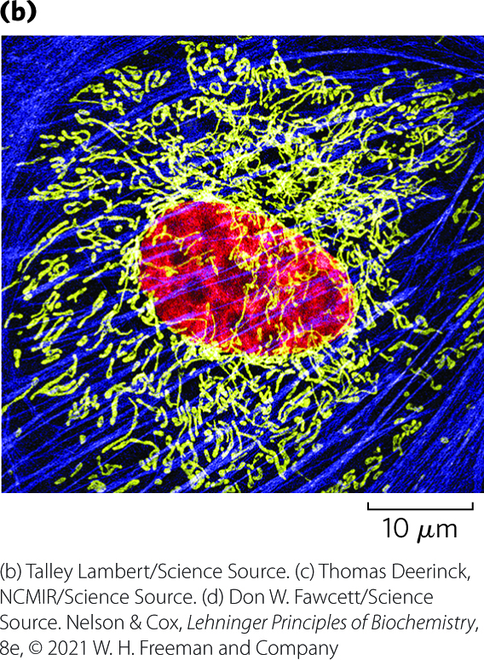
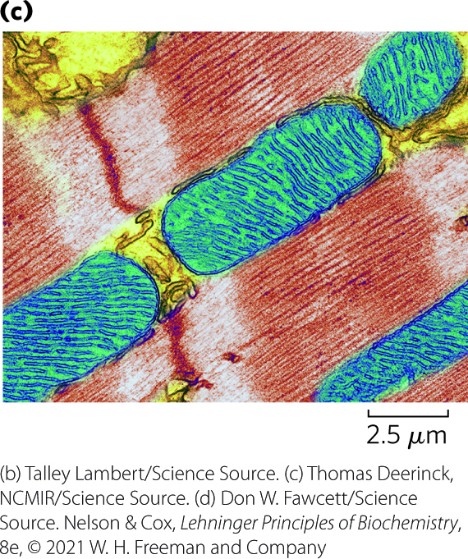
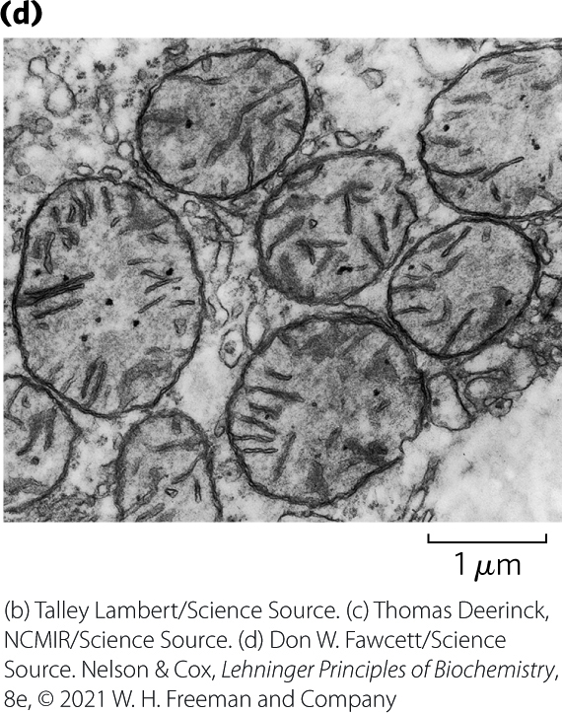
Mitochondrial Cristae
cristae = convolutions in the inner membrane of the mitochondrion
  mitochondria of cells with high metabolic activity have more cristae

Slide 15
Principle 2 (2 of 4)
Mitochondria trace their evolutionary origin to bacteria. Over 1.45 billion years ago, an endosymbiotic relationship arose between bacteria and a primitive eukaryote or eukaryotic progenitor. Mitochondria are ubiquitous in modern eukaryotes, and their bacterial origin is evident in almost every aspect of their structure and function.

Slide 16
The Effect of Stress on Mitochondria
during cell growth and division, mitochondria divide by fission
stressful conditions can trigger:
  mitochondrial fission
  mitophagy = the breakdown of mitochondria and recycling of the amino acids, nucleotides, and lipids
as stress is relieved, small mitochondria fuse to form long, thin, tubular organelles

Slide 17

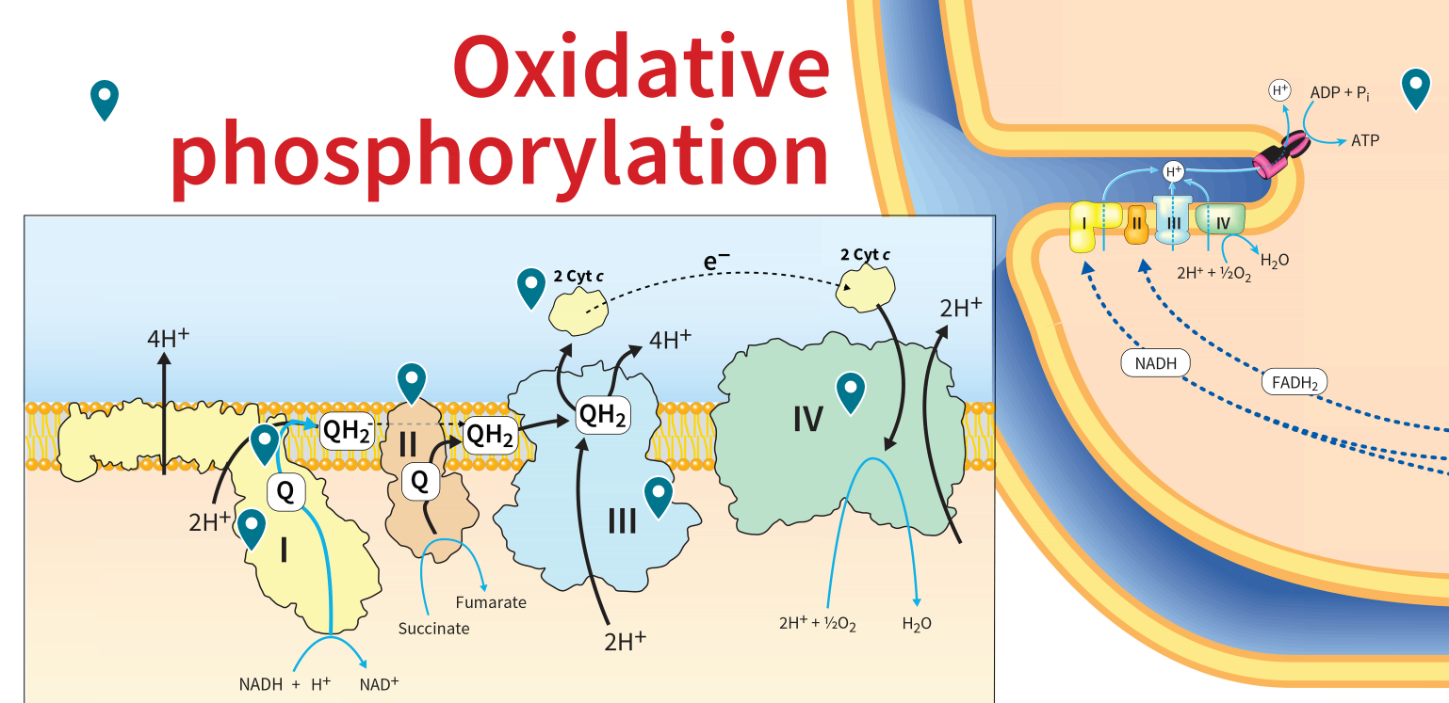
Activity: Oxidative
Phosphorylation
Observe the Oxidative Phosphorylation pathway in the Metabolic Map in your Achieve course.
Notes:
Instructor: The Metabolic Map is located in the Achieve course. It can be found immediately before the Chapter 13 folder in the list of content. For more information on this activity, please see the In-Class Activity Guide in your Achieve course in Chapter 19.

Slide 18
Activity Instructions (1 of 4)
On your own, think of answers to the questions:
  What are the initial electron donors of oxidative phosphorylation?
  What other electron-carrying molecules feature in the respiratory chain?
  What is the final electron acceptor? (2 minutes)
Pair up to discuss your ideas. (2 minutes)
Share your ideas with the class in group discussion.
(3 minutes)
Notes:
Instructor: The Metabolic Map is located in the Achieve course. It can be found immediately before the Chapter 13 folder in the list of content. For more information on this activity, please see the In-Class Activity Guide in your Achieve course in Chapter 19.

Slide 19
Activity Solution, Part 1
  What are the initial electron donors of oxidative phosphorylation? NADH and FADH₂
  Where do they come from?
Notes:
Instructor: The Metabolic Map is located in the Achieve course. It can be found immediately before the Chapter 13 folder in the list of content. For more information on this activity, please see the In-Class Activity Guide in your Achieve course in Chapter 19.
Where do they come from? The citric acid cycle and beta-oxidation.

Slide 20
Activity Solution, Part 2
  What other electron-carrying molecules feature in the respiratory chain? ubiquinone, cytochromes a, b, and c, and iron-sulfur proteins
Notes:
Instructor: The Metabolic Map is located in the Achieve course. It can be found immediately before the Chapter 13 folder in the list of content. For more information on this activity, please see the In-Class Activity Guide in your Achieve course in Chapter 19.
Where do they come from? The citric acid cycle and beta-oxidation.

Slide 21
Activity Solution, Part 3
  What is the final electron acceptor of Oxidative Phosphorylation?
    O₂
  What is the fate of this O₂ molecule?
Notes:
Instructor: The Metabolic Map is located in the Achieve course. It can be found immediately before the Chapter 13 folder in the list of content. For more information on this activity, please see the In-Class Activity Guide in your Achieve course in Chapter 19.
What is the fate of this O2 molecule? Reduction to H₂O

Slide 22
Electrons Are Funneled to Universal Electron Acceptors
respiratory chain = series of electron carriers
dehydrogenases collect electrons from catabolic pathways and funnel them into universal electron acceptors:
  nicotinamide nucleotides (NAD⁺ or NADP⁺)
  flavin nucleotides (FMN or FAD)

Slide 23
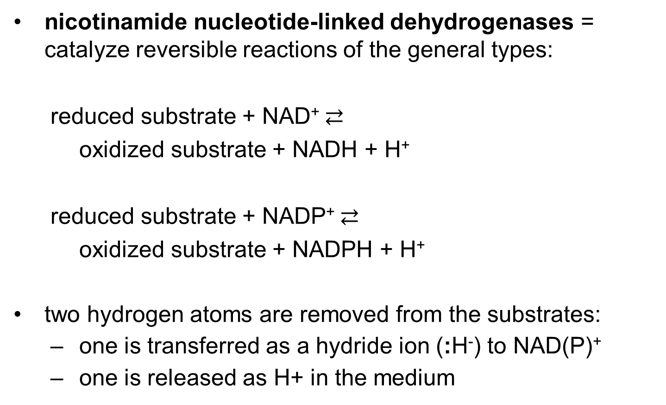
Nicotinamide Nucleotide-
Linked Dehydrogenases
nicotinamide nucleotide-linked dehydrogenases = catalyze reversible reactions of the general types:
  reduced substrate + NAD⁺ $⇄$
  oxidized substrate + NADH + H⁺
  reduced substrate + NADP⁺ $⇄$
  oxidized substrate + NADPH + H⁺
two hydrogen atoms are removed from the substrates:
  one is transferred as a hydride ion (:H⁻) to NAD(P)⁺
  one is released as H+ in the medium

Slide 24
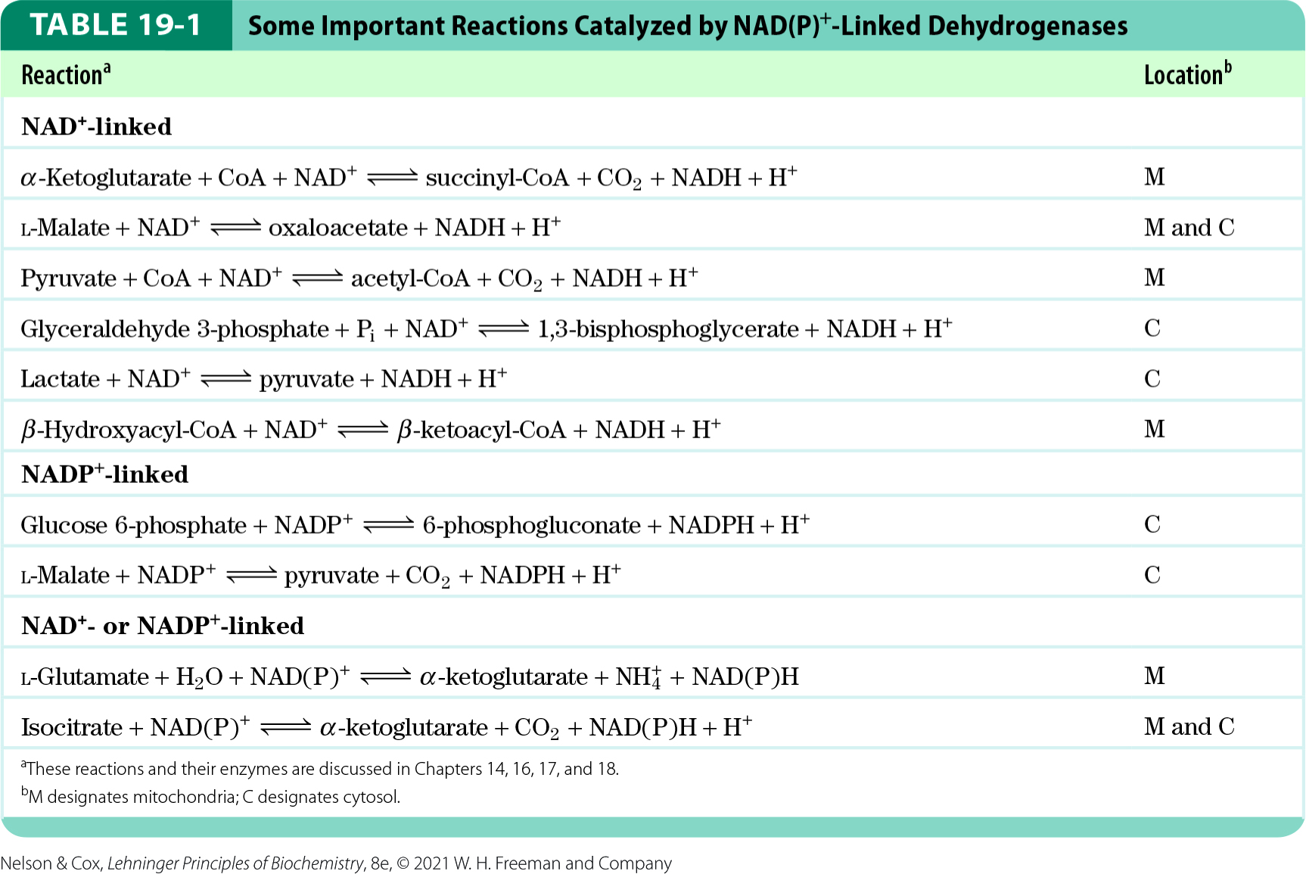
Important Reactions Catalyzed by NAD(P)⁺-Linked Dehydrogenases

Slide 25

Clicker Question 2
Which enzyme would NOT be expected to contribute electron carriers to oxidative phosphorylation?
alcohol dehydrogenase
malate dehydrogenase
succinate dehydrogenase
glucose 6-phosphate dehydrogenase
glyceraldehyde 3-phosphate dehydrogenase
Notes:
Answer: D
Principle: 19.3
Learning Objective(s): Provide examples of reactions catalyzed by NAD(P)+-linked dehydrogenases.
Bloom’s: 2:2

Slide 26
Clicker Question 2, Response
Which enzyme would NOT be expected to contribute electron carriers to oxidative phosphorylation?
glucose 6-phosphate dehydrogenase
Glucose 6-phosphate dehydrogenase produces NADPH, which does not contribute electrons to the respiratory chain.

Slide 27
Principle 3 (2 of 6)
Electrons flow from electron donors (oxidizable substrates) through a chain of membrane-bound carriers to a final electron acceptor with a large reduction potential. The final acceptor is molecular oxygen, O₂. The appearance of oxygen in the atmosphere some 2.3 billion years ago, and its harnessing in living systems via the evolution of oxidative phosphorylation, made more complex life forms possible.

Slide 28
Flavoproteins
flavoproteins = contain a very tightly, sometimes covalently, bound flavin nucleotide (FMN or FAD)
the oxidized flavin nucleotide can accept either:
  one electron (yielding the semiquinone form) or
  two electrons (yielding FADH₂ or FMNH₂)
electron transfer occurs because the flavoprotein has a higher E° than the compound oxidized
  E′° of a flavin nucleotide depends on the protein with which it is associated

Slide 29
Electrons Pass through a Series of Membrane-Bound Carriers
three types of electron transfers occur in oxidative phosphorylation:
  direct transfer of electrons
  transfer as a hydrogen atom (H⁺ + e⁻)
  transfer as a hydride ion (:H⁻)
reducing equivalent = a single electron equivalent transferred in an oxidation-reduction reaction

Slide 30
Clicker Question 3
Which ion, atom, or molecule constitutes one reducing equivalent?
proton (H⁺)
hydrogen atom (H⁺ + e⁻)
hydride ion (:H⁻)
NADH
Notes:
Answer: B
Principle: 19.3
Learning Objective(s): Define reducing equivalent.
Bloom’s: 2:1

Slide 31
Clicker Question 3, Response
Which ion, atom, or molecule constitutes one reducing equivalent?
hydrogen atom (H⁺ + e⁻)
The term reducing equivalent is used to designate a single electron equivalent transferred in an oxidation-reduction reaction. A proton cannot act as a reducing equivalent because it has no electrons. A hydrogen atom acts as one reducing equivalent. A hydride ion or NADH molecule acts as two reducing equivalents.

Slide 32
Principle 3 (3 of 6)
Electrons flow from electron donors (oxidizable substrates) through a chain of membrane-bound carriers to a final electron acceptor with a large reduction potential. The final acceptor is molecular oxygen, O₂. The appearance of oxygen in the atmosphere some 2.3 billion years ago, and its harnessing in living systems via the evolution of oxidative phosphorylation, made more complex life forms possible.

Slide 33
Electron-Carrying Molecules in the Respiratory Chain
five types of electron-carrying molecules:
  NAD
  flavoproteins
  ubiquinone (coenzyme Q or Q)
  cytochromes
  iron-sulfur proteins

Slide 34
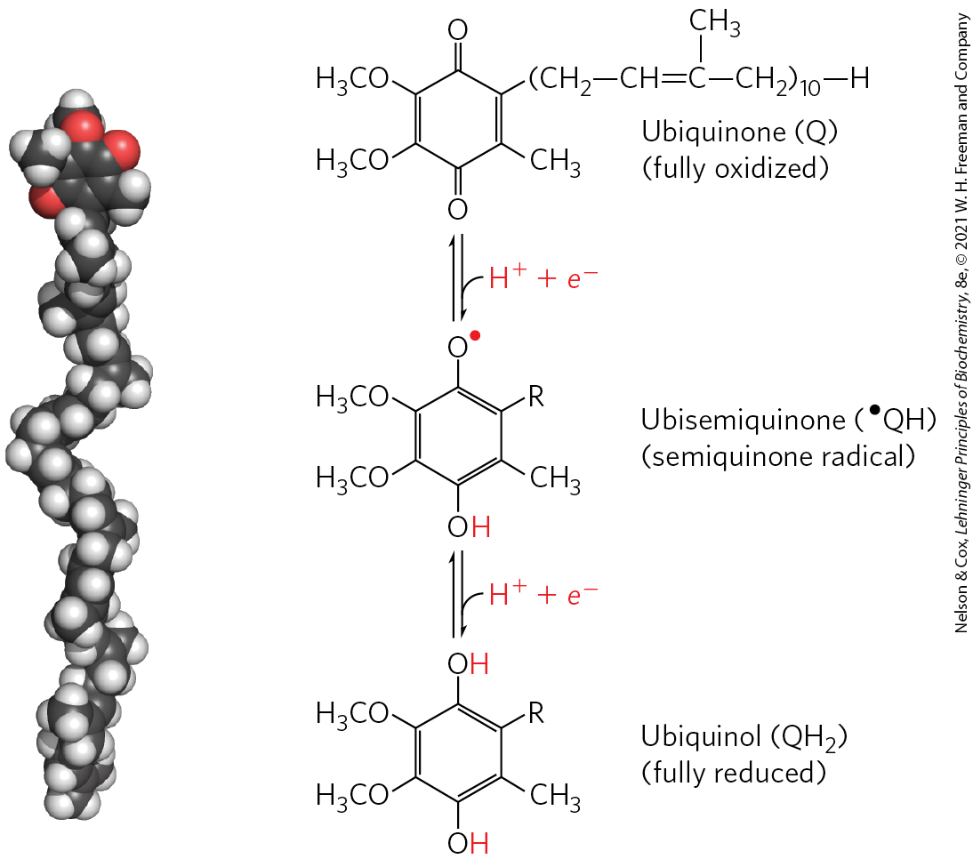
Ubiquinone
ubiquinone (coenzyme Q or Q) = a lipid-soluble benzoquinone with a long isoprenoid side chain
  can accept one or two electrons
  freely diffusible within the inner mitochondrial membrane
  plays a central role in coupling electron flow to proton movement

Slide 35
Cytochromes
cytochromes = proteins with characteristic strong absorption of visible light due to their iron-containing heme prosthetic groups
  one-electron carriers
  3 classes in mitochondria: a, b, and c
    hemes of a and b are not covalently bound to associated proteins
    c is covalently attached through Cys residues

Slide 36
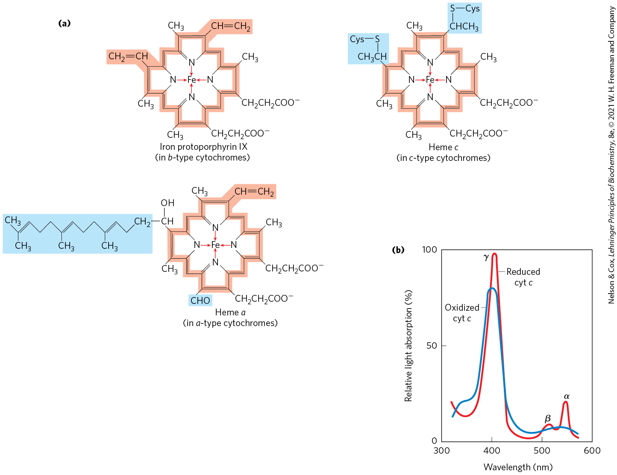
Prosthetic Groups of Cytochromes

Slide 37
Clicker Question 4
Which statement is false about the cytochrome electron carriers?
Cytochromes a, b, and c are distinguished by differences in their light-absorption spectra.
Soluble cytochrome c associates with the outer surface of the inner membrane through electrostatic interactions.
The heme of cytochrome c is tightly, but not covalently, bound to its associated protein.
Cytochromes a and b are integral proteins of the inner mitochondrial membrane.
Notes:
Answer: C
Principle: 19.3
Learning Objective(s): Describe cytochromes.
Bloom’s: 1:1

Slide 38
Clicker Question 4, Response
Which statement is false about the cytochrome electron carriers?
The heme of cytochrome c is tightly, but not covalently, bound to its associated protein.
The hemes of a and b cytochromes are tightly, but not covalently, bound to their associated proteins; the hemes of c-type cytochromes are covalently attached through Cys residues.

Slide 39
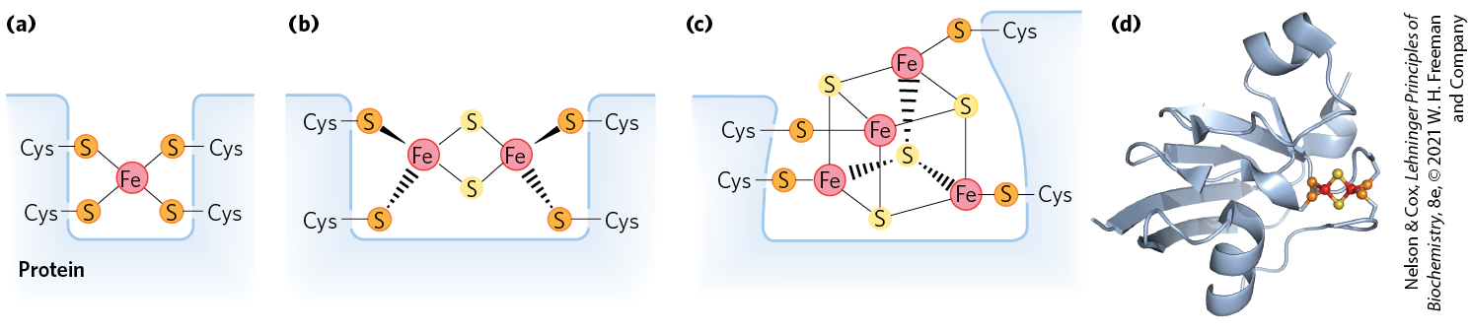
Iron-Sulfur Proteins
iron-sulfur proteins = proteins that contain iron in association with inorganic sulfur atoms and/or with the sulfur atoms of Cys residues in the protein
  participate in one-electron transfers
Rieske iron-sulfur proteins = proteins in which one Fe atom is coordinated to two His residues

Slide 40
Clicker Question 5
Which compound is NOT an electron carrier involved in the respiratory chain?
NADH
iron-sulfur proteins
cytochromes
coenzyme A
Notes:
Answer: D
Principle: 19.3
Learning Objective(s): List five different types of electron-carrying molecules which function in the respiratory chain.
Bloom’s: 1:1

Slide 41
Clicker Question 5, Response
Which compound is NOT an electron carrier involved in the respiratory chain?
coenzyme A
Coenzyme A serves multiple metabolic functions in both anabolic and catabolic pathways; however, it does not act as an electron carrier in the respiratory chain.

Slide 42
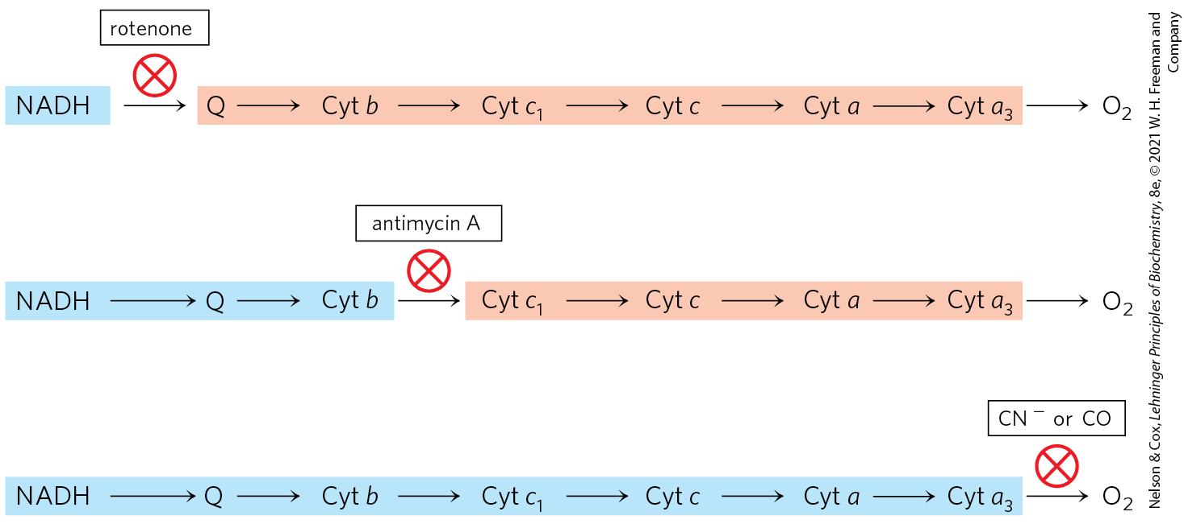
Methods for Determining The Sequence of Electron Carriers
determine the E′° of the individual electron carriers
reduce the entire chain of carriers by omitting O₂ and then measure the oxidation rate of each electron carrier when O₂ is reintroduced
measure the effects of inhibitors of electron transfer on the oxidation state of each carrier

Slide 43
Standard Reduction Potentials of Individual Electron Carriers
electrons tend to flow spontaneously from carriers of lower E′° to carriers of higher E′°
Table 19-2 Standard Reduction Potentials of Respiratory Chain and Related Electron Carriers
Redox reaction (half-reaction) | E′° (V)
2H⁺ + 2e⁻→H₂ | −0.414
NAD⁺ + H⁺ + 2e⁻→NADH | −0.320
NADP⁺ + H⁺ + 2e⁻→NADPH | −0.324
NADH dehydrogenase (FMN) + 2H⁺ + 2e⁻→NADH dehydrogenase (FMNH₂) | −0.30
Ubiquinone + 2H⁺ + 2e⁻→ubiquinol | 0.045
Cytochrome b (Fe³⁺) + e⁻→cytochrome b (Fe²⁺) | 0.077
Cytochrome c₁ (Fe³⁺) + e⁻→cytochrome c₁ (Fe²⁺) | 0.22
Cytochrome c (Fe³⁺) + e⁻→cytochrome c (Fe²⁺) | 0.254
Cytochrome a (Fe³⁺) + e⁻→cytochrome a (Fe²⁺) | 0.29
Cytochrome a₃ (Fe³⁺) + e⁻→cytochrome a₃ (Fe²⁺) | 0.35
½ O₂ + 2H⁺ + 2e⁻→H₂O | 0.817

Slide 44
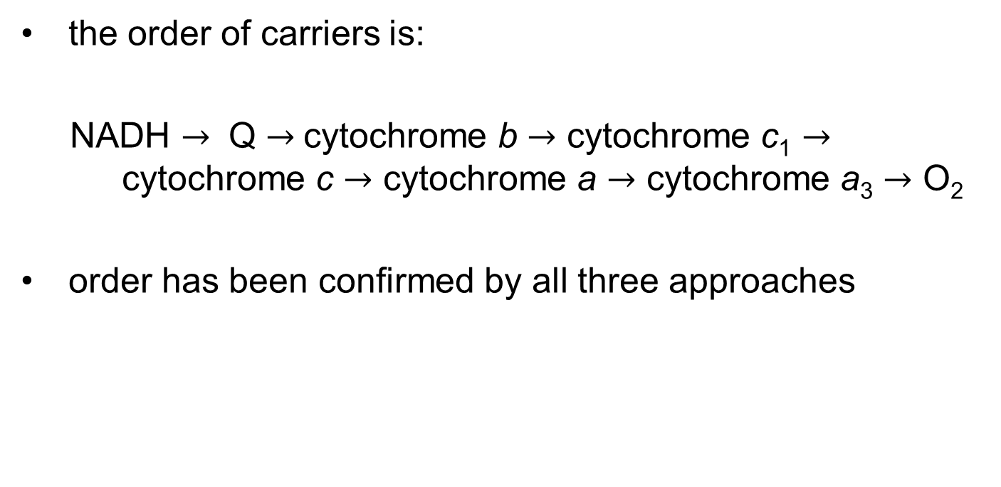
The Sequence of Electron Carriers
the order of carriers is:
NADH $→$ Q $→$cytochrome b $→$ cytochrome c₁ $→$ cytochrome c $→$ cytochrome a $→$ cytochrome a₃ $→$ O₂
order has been confirmed by all three approaches

Slide 45
Principle 3 (4 of 6)
Electrons flow from electron donors (oxidizable substrates) through a chain of membrane-bound carriers to a final electron acceptor with a large reduction potential. The final acceptor is molecular oxygen, O₂. The appearance of oxygen in the atmosphere some 2.3 billion years ago, and its harnessing in living systems via the evolution of oxidative phosphorylation, made more complex life forms possible.

Slide 46
Electron Carriers Function in Multienzyme Complexes
four unique electron-carrier complexes catalyze electron transfer through a portion of the chain:
  Complex I (from NADH to ubiquinone)
  Complex II (from succinate to ubiquinone)
  Complex III (from ubiquinone to cytochrome c)
  Complex IV (from cytochrome c to O₂)

Slide 47
Clicker Question 6
Which electron-carrier complex in the respiratory chain oxidizes ubiquinone?
Complex I
Complex II
Complex III
Complex IV
Notes:
Answer: C
Principle: 19.3
Learning Objective(s): Describe the structure and function of Complex III (cytochrome bc1 complex, or ubiquinone:cytochrome c oxidoreductase).
Bloom’s: 1:1

Slide 48
Clicker Question 6, Response
Which electron-carrier complex in the respiratory chain oxidizes ubiquinone?
Complex III
Complex III carries electrons from reduced ubiquinone to cytochrome c.

Slide 49
Protein Components of the Mitochondrial Respiratory Chain
Table 19-3 The Protein Components of the Mitochondrial Respiratory Chain
Enzyme complex/protein | Mass (kDa) | Number of subunits | Prosthetic group(s)
I NADH dehydrogenase | 850 | 45 (14) | FMN, Fe-S
II Succinate dehydrogenase | 140 | 4 | FAD, Fe-S
III Ubiquinone: cytochrome c oxidoreductase | 250 | 11 | Hemes, Fe-S
Cytochrome c | 13 | 1 | Heme
IV Cytochrome oxidase | 204 | 13 (3–4) | Hemes; Cu_{A}, Cu_{B}

Slide 50
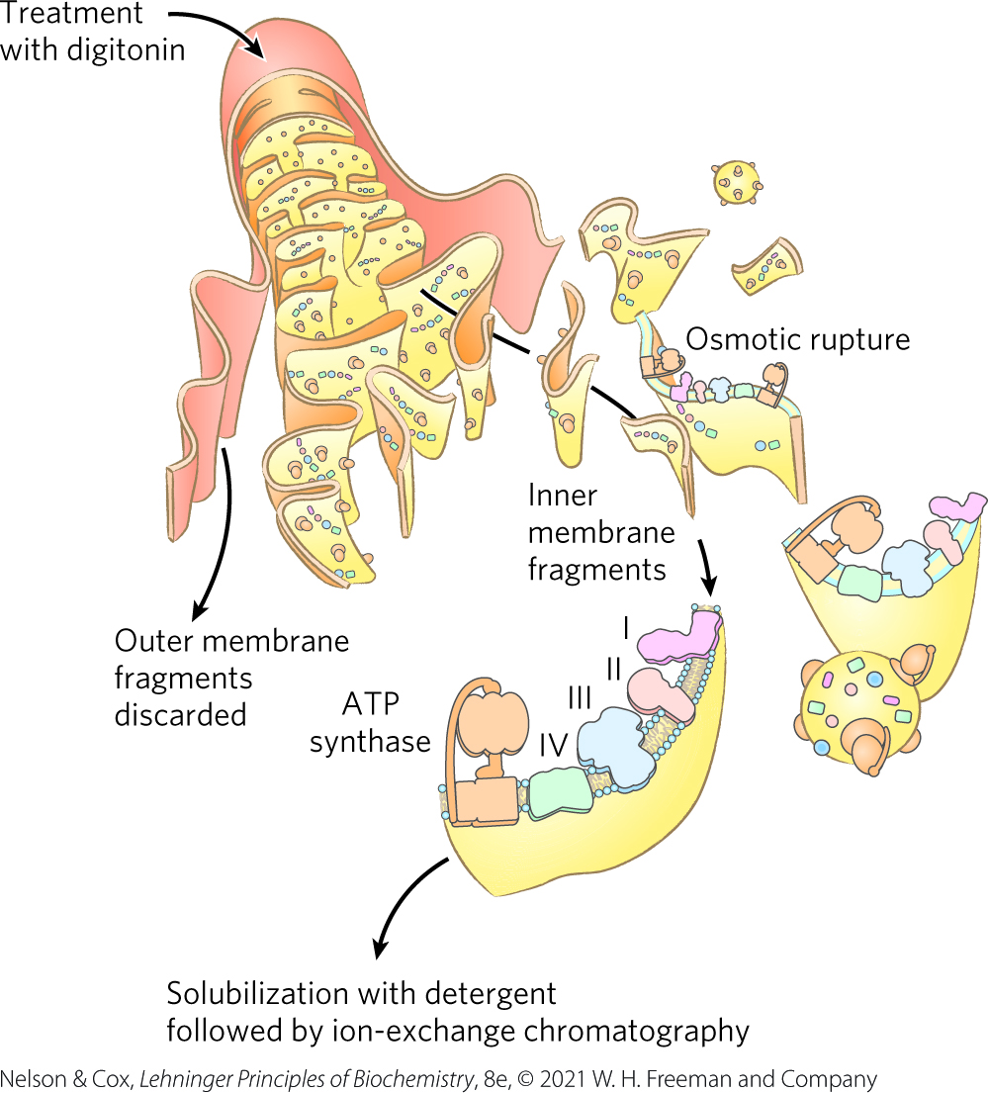
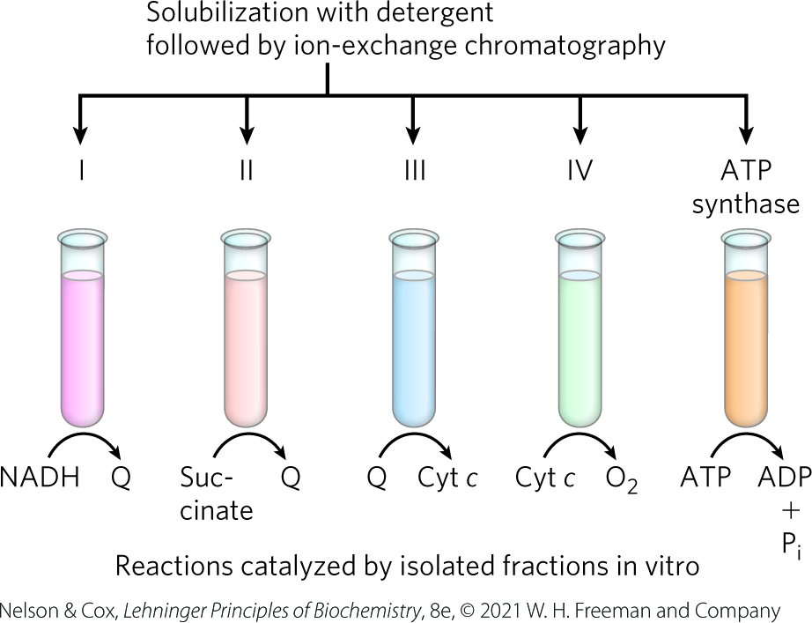
Separation of Functional Complexes of the Respiratory Chain

Slide 51
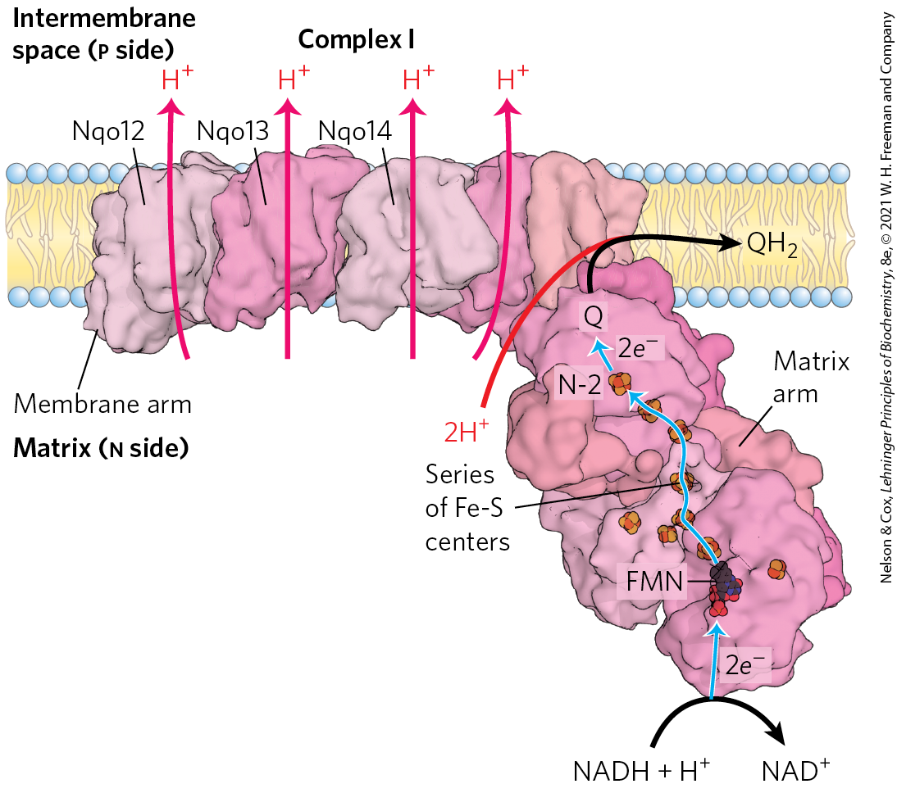
Complex I: NADH to Ubiquinone
Complex I (NADH:ubiquinone oxidoreductase, NADH dehydrogenase) = large L-shaped enzyme with >40 polypeptide chains
  FMN-containing flavoprotein accepts 2 electrons from NADH
  8+ Fe-S centers pass elections to ubiquinone

Slide 52
Clicker Question 7
How many electrons would enter Complex I from complete oxidation of myristic acid, 14:0?
18
40
42
52
54
Notes:
Answer: E
Principle: 19.3
Learning Objective(s): For a reaction catalyzed by Complex I, identify the electron donor, the electron acceptor, the conjugate redox pair, the reducing agent, and the oxidizing agent.
Bloom’s: 3:2

Slide 53
Clicker Question 7, Response
How many electrons would enter Complex I from complete oxidation of myristic acid, 14:0?
54
Myristic acid undergoes 6 rounds of β oxidation, producing 7 acetyl-CoA and 6 NADH (1 NADH per round). Each acetyl-CoA yields 3 NADH in the citric acid cycle.
6 NADH + (7 acetyl-CoA×3 NADH/acetyl-CoA) = 27 NADH
Each NADH molecule donates 2 electrons to Complex I.
27 NADH×2e⁻/NADH = 54e⁻

Slide 54
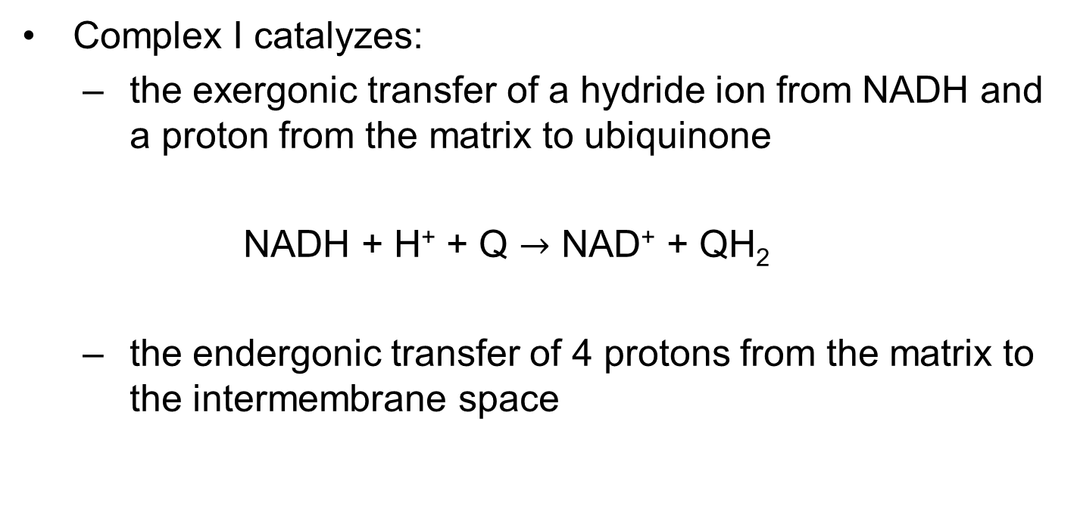
Complex I Catalyzes Two Simultaneous and Obligately Coupled Processes
Complex I catalyzes:
  the exergonic transfer of a hydride ion from NADH and a proton from the matrix to ubiquinone
  NADH + H⁺ + Q $→$ NAD⁺ + QH₂
  the endergonic transfer of 4 protons from the matrix to the intermembrane space
(19-1)

Slide 55
Principle 4 (2 of 5)
The free energy made available by “downhill” (exergonic) electron flow is coupled to the “uphill” transport of protons across a proton-impermeable membrane. The free energy of fuel oxidation is thus conserved as a transmembrane electrochemical potential.

Slide 56
Complex I Is a Proton Pump
Complex I is a proton pump driven by the energy of electron transfer
Complex I catalyzes a vectorial reaction (moves protons in a specific direction from one location to another)

Slide 57
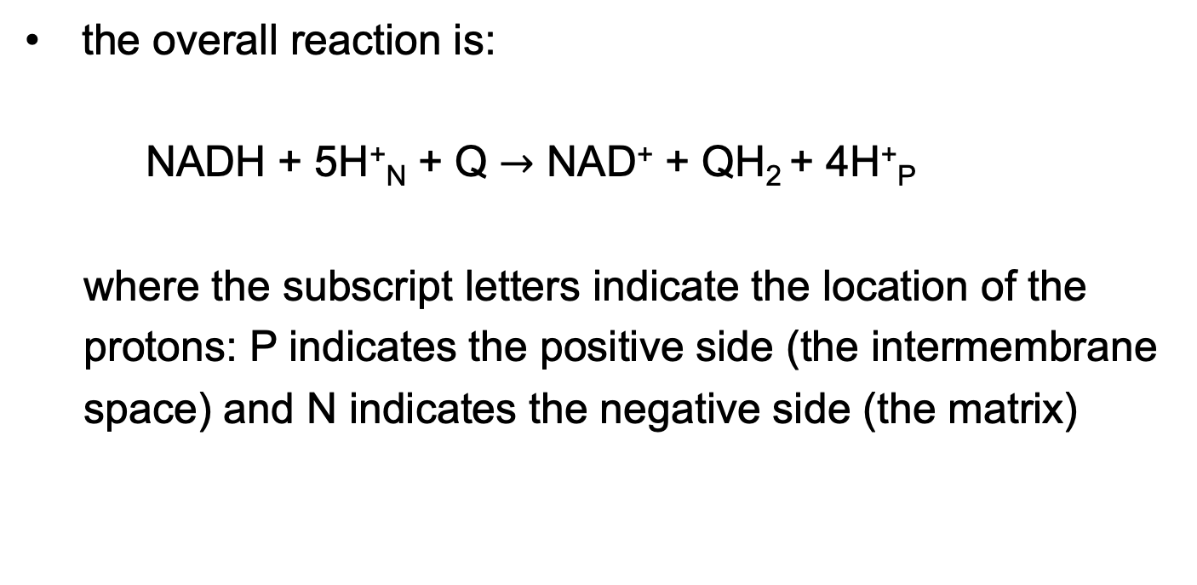
The Overall Reaction of Complex I
the overall reaction is:
NADH + 5H⁺_{N} + Q $→$ NAD⁺ + QH₂ + 4H⁺_{P}
where the subscript letters indicate the location of the
protons: P indicates the positive side (the intermembrane
space) and N indicates the negative side (the matrix)
(19-2)

Slide 58
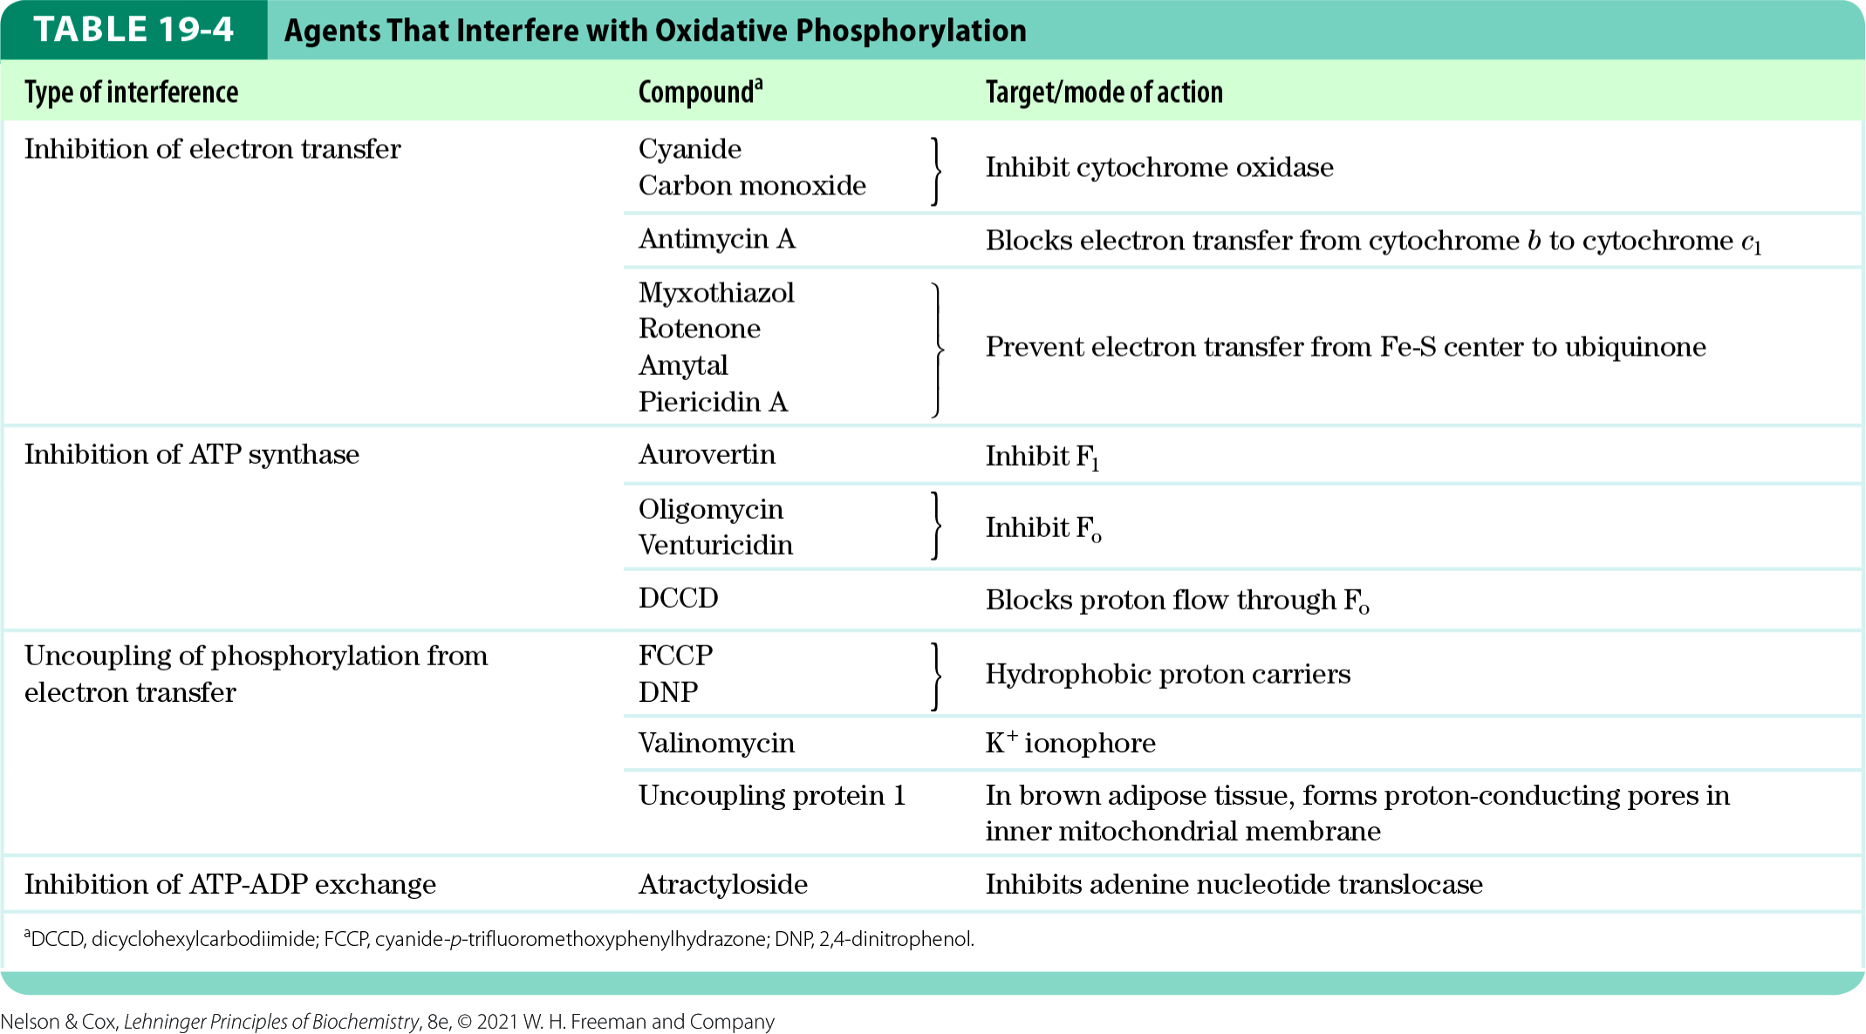
Agents that Inhibit
Oxidative Phosphorylation
inhibitors of Complex I:
  amytal (a barbiturate drug)
  rotenone (an insecticide)
  piericidin A (an antibiotic)

Slide 59
Clicker Question 8
Which statement is false about Complex I?
It consists of more than 40 different polypeptide chains.
It has an FMN-containing flavoprotein.
It catalyzes the transfer of a hydride from NADH and a proton from the matrix to ubiquinone (Q).
Its activity makes the matrix more positively charged.
Notes:
Answer: D
Principle: 19.3
Learning Objective(s): Describe the structure and function of Complex I (NADH:ubiquinone oxidoreductase).
Bloom’s: 2:1

Slide 60
Clicker Question 8, Response
Which statement is false about Complex I?
Its activity makes the matrix more positively charged.
Complex I transfers four protons from the matrix to the intermembrane space. The loss of positively charged protons makes the matrix more negative.

Slide 61
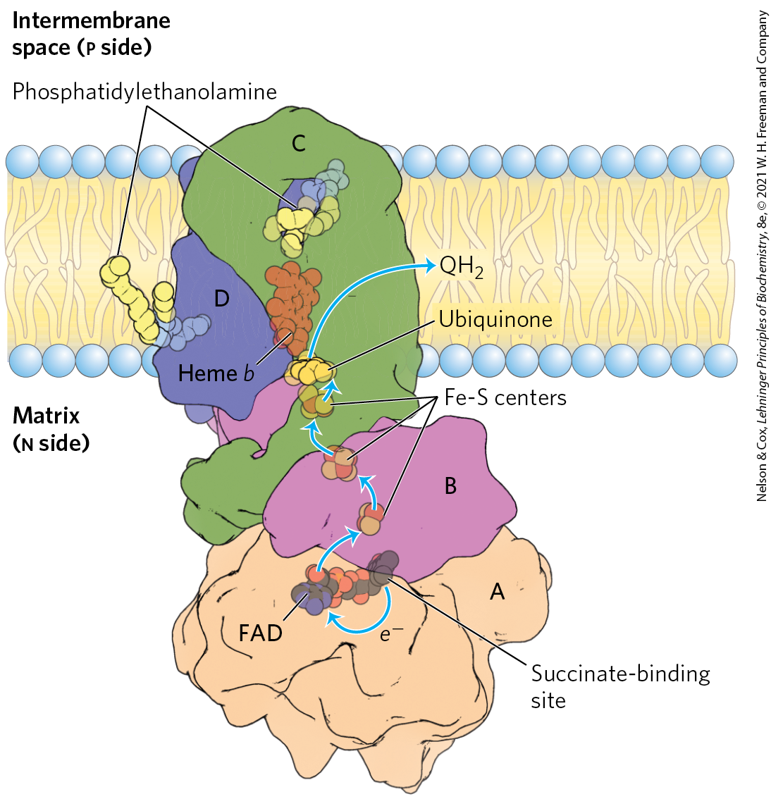
Complex II: Succinate to Ubiquinone
Complex II (succinate dehydrogenase) = couples the oxidation of succinate with the reduction of ubiquinone
  electrons pass from FAD to Fe-S centers to Q
  no proton pumping
  also functions to convert succinate to fumarate in the citric acid cycle

Slide 62
Heme b of Complex II
heme b reduces the frequency with which electrons “leak” out of the system, moving from succinate to molecular oxygen to produce the reactive oxygen species (ROS) H₂O₂ and the superoxide radical

Slide 63
Clicker Question 9
Which electron carrier or prosthetic group would NOT function after site-directed mutagenesis substituted Pro for Cys in succinate dehydrogenase?
cytochrome c
iron-sulfur center
flavin adenine dinucleotide
ubiquinone
FMN
Notes:
Answer: B
Principle: 19.3
Learning Objective(s): Describe the structure and function of Complex II (succinate dehydrogenase).
Bloom’s: 2:2

Slide 64
Clicker Question 9, Response
Which electron carrier or prosthetic group would NOT function after site-directed mutagenesis substituted Pro for Cys in succinate dehydrogenase?
iron-sulfur center
Subunits A and B contain three iron-sulfur (2Fe-2S) centers, in which the iron is present in association with the sulfur atoms of Cys residues in the protein.

Slide 65
Principle 3 (5 of 6)
Electrons flow from electron donors (oxidizable substrates) through a chain of membrane-bound carriers to a final electron acceptor with a large reduction potential. The final acceptor is molecular oxygen, O₂. The appearance of oxygen in the atmosphere some 2.3 billion years ago, and its harnessing in living systems via the evolution of oxidative phosphorylation, made more complex life forms possible.

Slide 66
Principle 4 (3 of 5)
The free energy made available by “downhill” (exergonic) electron flow is coupled to the “uphill” transport of protons across a proton-impermeable membrane. The free energy of fuel oxidation is thus conserved as a transmembrane electrochemical potential.

Slide 67
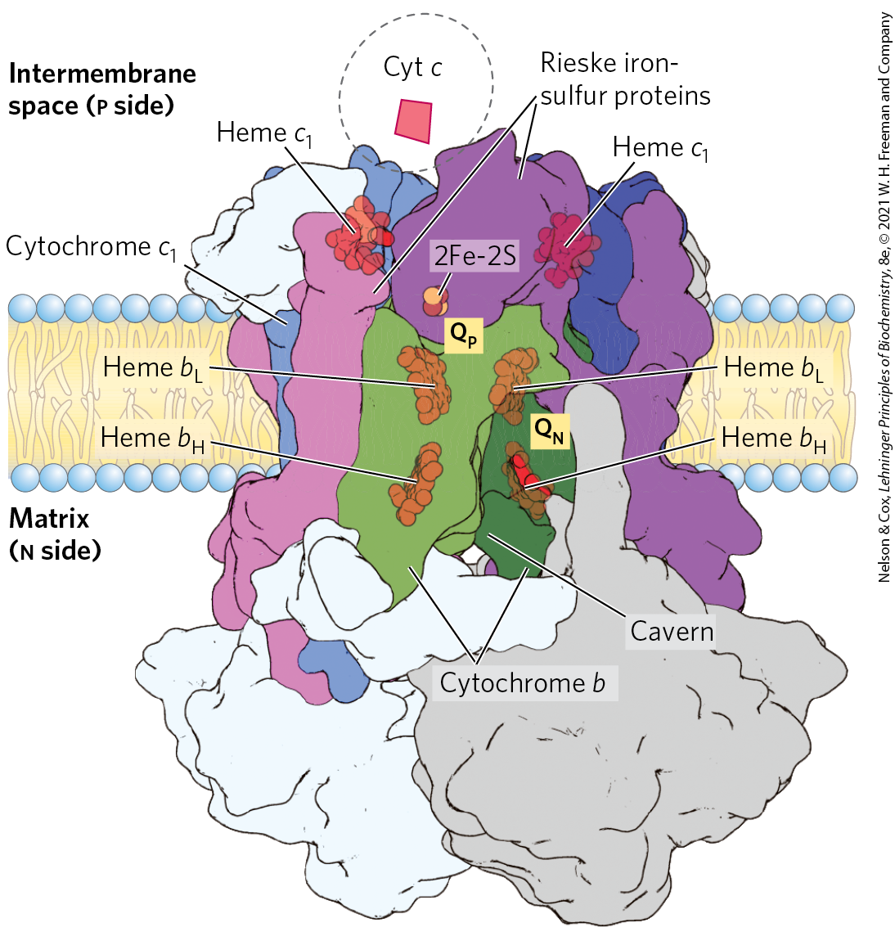
Complex III: Ubiquinone to Cytochrome c
Complex III (cytochrome bc₁ complex, ubiquinone: cytochrome c oxidoreductase) = couples the transfer of 2 electrons from ubiquinol to cytochrome c with the vectorial transport of four protons to the intermembrane space
  contains cytochrome b, cytochrome c1, and the Rieske iron-sulfur protein

Slide 68
The Path of Electrons through Complex III
ubiquinone diffuses through the inner mitochondrial membrane and transfers the electrons to cytochrome b
electrons pass to an Fe-S center which passes electrons, one at a time, through cytochrome c

Slide 69
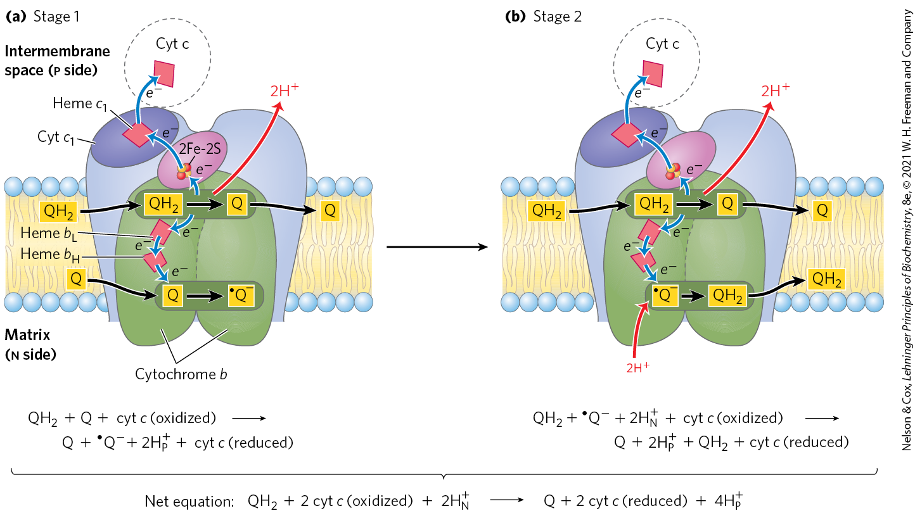
The Q Cycle

Slide 70

The Net Equation for the Redox Reactions of the Q Cycle
the net equation is:
QH₂ + 2 cyt c (oxidized) + 2H⁺_{N} $→$
Q + 2 cyt c (reduced) + 4H⁺_{P}
(19-3)

Slide 71

Clicker Question 10
Which statement is false about Complex III?
It holds ubiquinone on the matrix side of the inner mitochondrial membrane throughout the redox process.
Its functional unit consists of two dimers made up of cytochrome b, cytochrome c₁, and the Rieske iron-sulfur protein.
It couples the oxidation of two molecules of reduced ubiquinone (QH₂) with the reduction of two molecules of cytochrome c.
It catalyzes the net movement of two protons from the N side to the P side of the inner mitochondrial membrane.
Notes:
Answer: A
Principle: 19.4
Learning Objective(s): Describe the structure and function of Complex III (cytochrome bc1 complex, or ubiquinone:cytochrome c oxidoreductase).
Bloom’s: 1:1

Slide 72
Clicker Question 10, Response
Which statement is false about Complex III?
It holds ubiquinone on the matrix side of the inner mitochondrial membrane throughout the redox process.
The two cytochrome b monomers surround a cavern in the middle of the membrane in which ubiquinone is free to move from the matrix side of the membrane (site Q_{N} on one monomer) to the intermembrane space (site Q_{P} on the other monomer) as it shuttles electrons and protons across the inner mitochondrial membrane.

Slide 73
Principle 3 (6 of 6)
Electrons flow from electron donors (oxidizable substrates) through a chain of membrane-bound carriers to a final electron acceptor with a large reduction potential. The final acceptor is molecular oxygen, O₂. The appearance of oxygen in the atmosphere some 2.3 billion years ago, and its harnessing in living systems via the evolution of oxidative phosphorylation, made more complex life forms possible.

Slide 74
Principle 4 (4 of 5)
The free energy made available by “downhill” (exergonic) electron flow is coupled to the “uphill” transport of protons across a proton-impermeable membrane. The free energy of fuel oxidation is thus conserved as a transmembrane electrochemical potential.

Slide 75
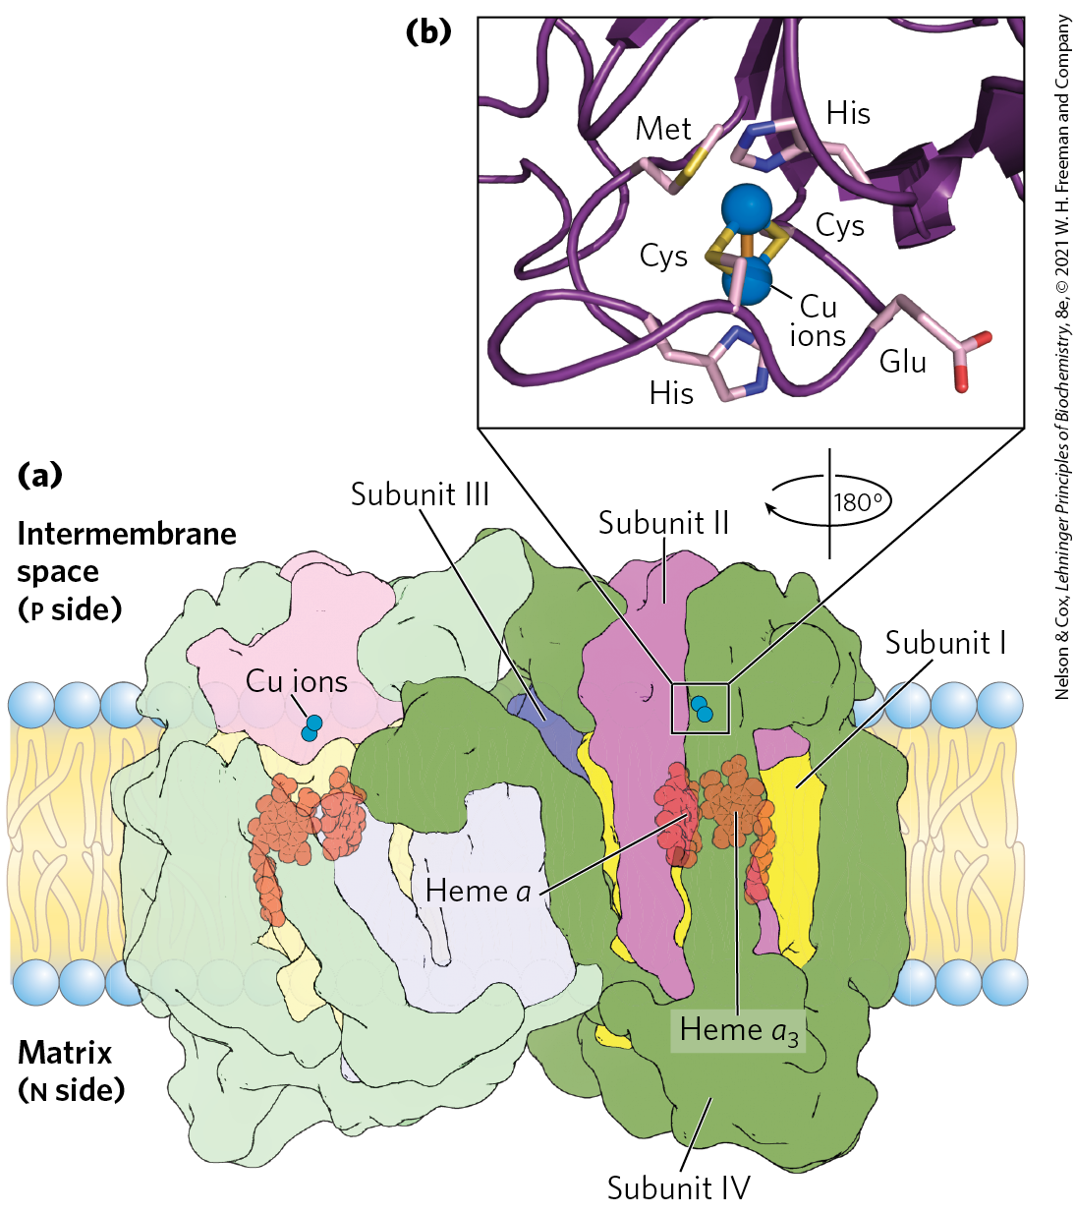
Complex IV: Cytochrome c to O₂
Complex IV (cytochrome oxidase) = carries electrons from cytochrome c to molecular oxygen, reducing it to H₂O
  large dimeric enzyme
  3 subunits have been conserved through evolution
  contains cytochromes a and a₃
  contains 2 Cu ions

Slide 76
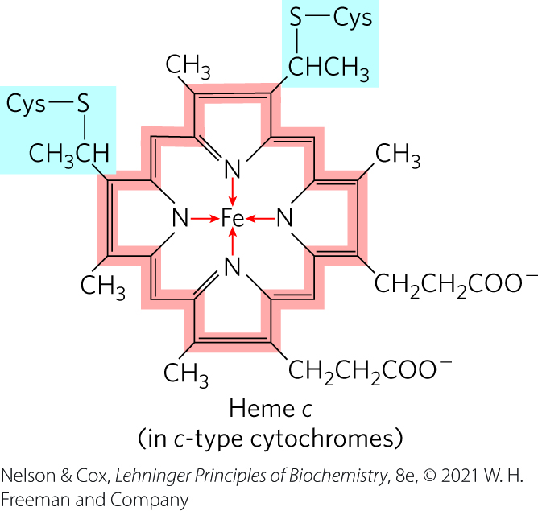
Cytochrome c
cytochrome c:
  moves through the intermembrane space
  carries a single electron from the cytochrome bc₁ complex to Complex IV
  absorbs visible light

Slide 77
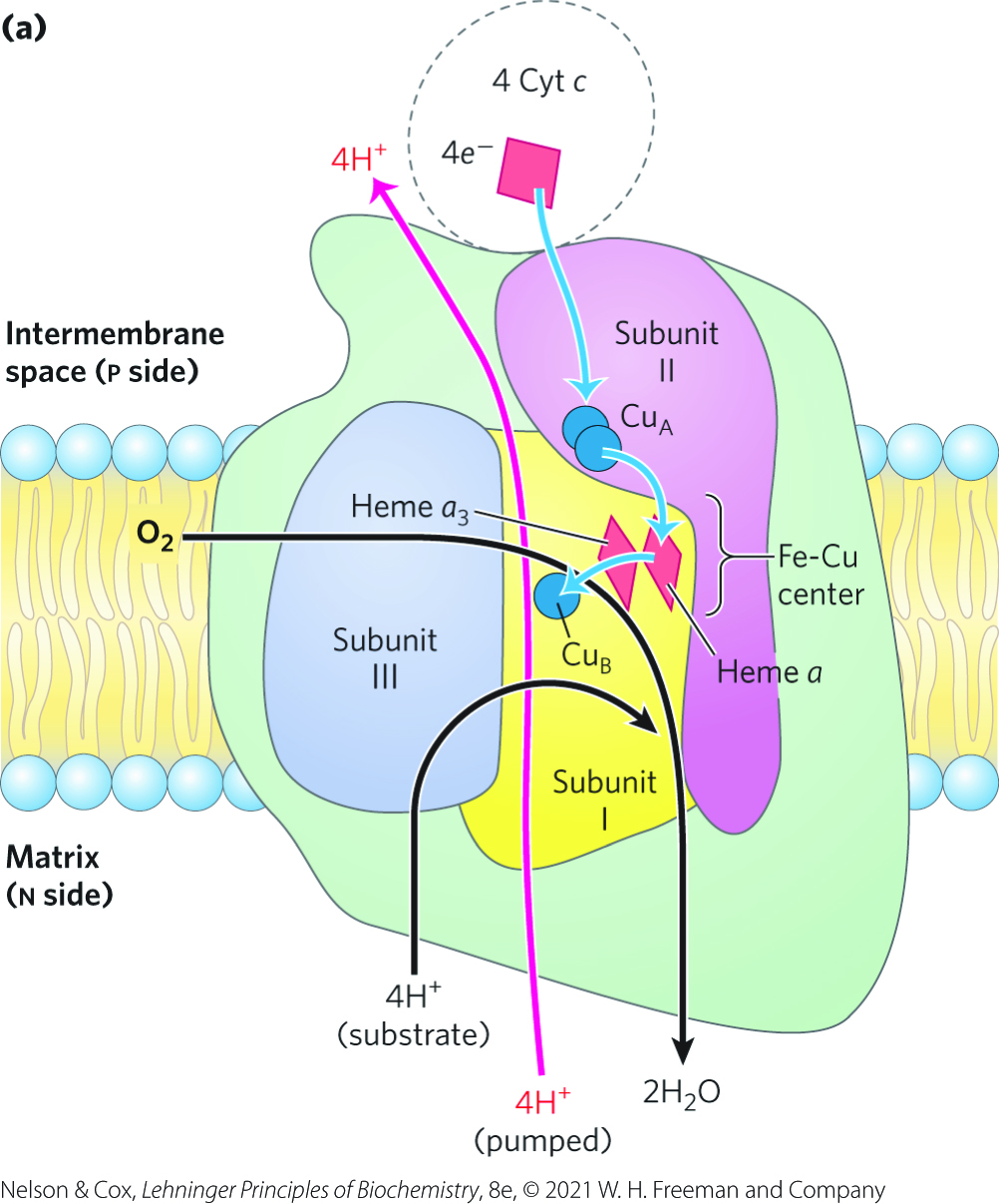
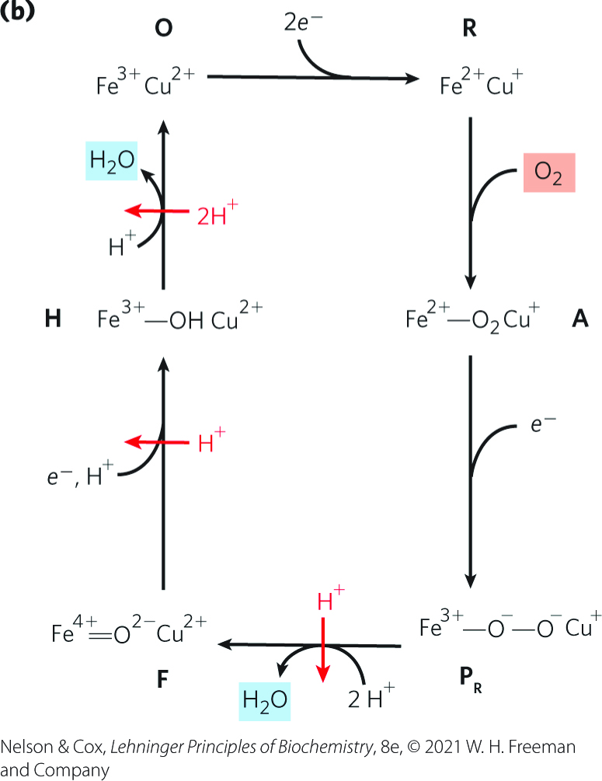
Path of Electrons Through
Complex IV

Slide 78
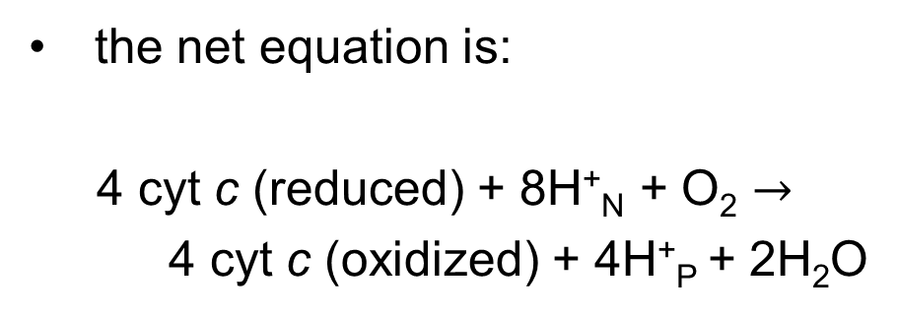
The Overall Reaction of Complex IV
the net equation is:
4 cyt c (reduced) + 8H⁺_{N} + O₂ $→$
4 cyt c (oxidized) + 4H⁺_{P} + 2H₂O
(19-4)

Slide 79
Clicker Question 11
Which complex does NOT transport H⁺ from the mitochondrial matrix to the intermembrane space?
Complex I
Complex II
Complex III
Complex IV
Notes:
Answer: B
Principle: 19.4
Learning Objective(s): Describe the structure and function of Complex II (succinate dehydrogenase).
Bloom’s: 1:1

Slide 80
Clicker Question 11, Response
Which complex does NOT transport H⁺ from the mitochondrial matrix to the intermembrane space?
Complex II
Electron transfer through Complex II is not accompanied by proton pumping across the inner membrane, although the QH₂ produced by succinate oxidation will be used by Complex III to drive proton transfer.

Slide 81
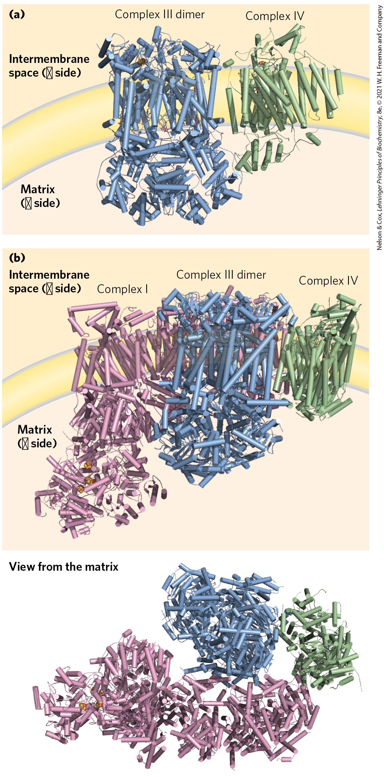
Mitochondrial Complexes Associate in Respirasomes
respirasome = supercomplex containing Complexes I, III, and IV
  may facilitate electron transfers or limit ROS production
cytochrome c and ubiquinone readily diffuse between supercomplexes

Slide 82
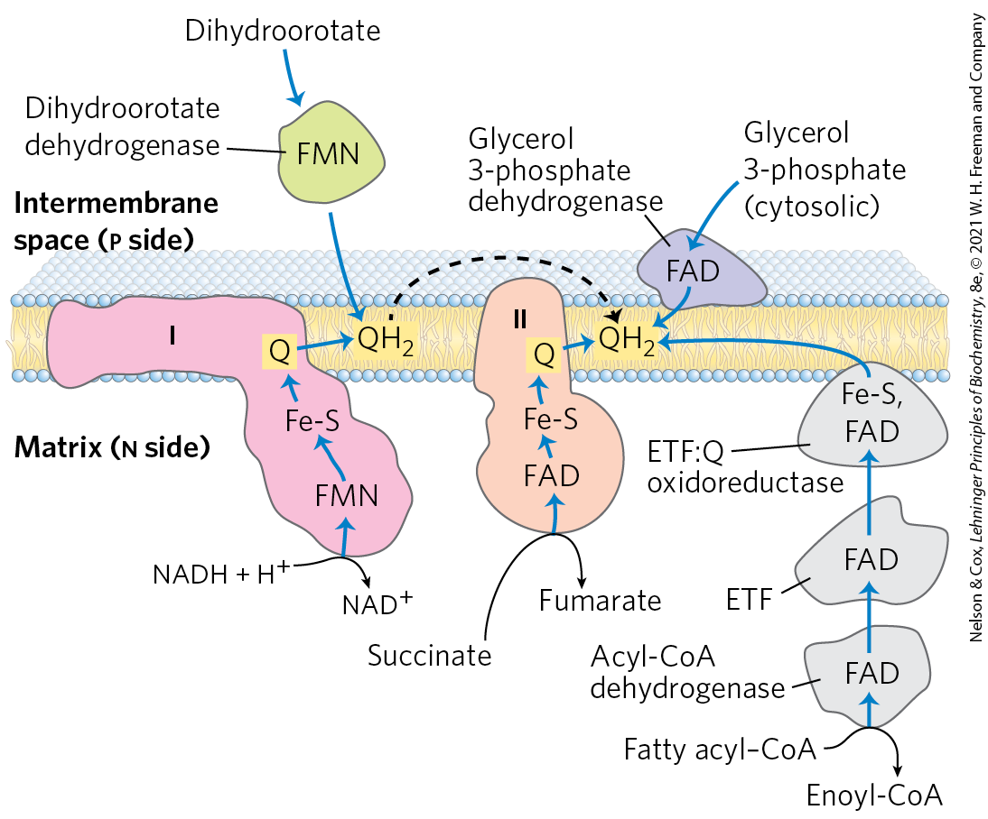
Other Pathways Donate Electrons to the Respiratory Chain via Ubiquinone

Slide 83
Electrons Derived from the Oxidation of Fatty Acids Pass to Ubiquinone
acyl-CoA dehydrogenase = flavoprotein that catalyzes the first step of the β oxidation of fatty acyl–CoA
  electrons pass from the substrate to the FAD of the dehydrogenase to electron-transferring flavoprotein (ETF)
ETF = passes its electrons to ETF:ubiquinone oxidoreductase
  reduces Q in the inner mitochondrial membrane to QH₂

Slide 84
The Oxidation of Glycerol Phosphate and Dihydroorotate
glycerol 3-phosphate dehydrogenase = flavoprotein located on the outer face of the inner mitochondrial membrane
  Q accepts electrons, and the QH₂ produced enters the pool of QH₂ in the membrane
dihydroorotate dehydrogenase = located on the outside of the inner mitochondrial membrane
  donates electrons to Q in the respiratory chain

Slide 85
Clicker Question 12
Which compound is NOT a direct source of electrons for the respiratory chain?
cytosolic NADH
dihydroorotate dehydrogenase
glycerol 3-phosphate dehydrogenase
FADH₂
Notes:
Answer: A
Principle: 19.3
Learning Objective(s): Describe two shuttle systems which take part in providing NADH into the mitochondria for oxidation.
Bloom’s: 2:1

Slide 86
Clicker Question 12, Response
Which compound is NOT a direct source of electrons for the respiratory chain?
cytosolic NADH
The inner mitochondrial membrane is not permeable to NADH. Thus special shuttle systems carry reducing equivalents from cytosolic NADH into mitochondria by an indirect route.

Slide 87
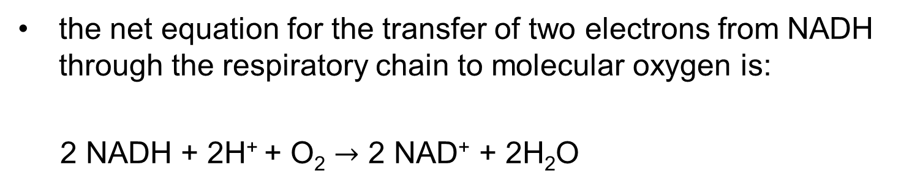
The Energy of Electron Transfer Is Efficiently Conserved in a Proton Gradient
the net equation for the transfer of two electrons from NADH through the respiratory chain to molecular oxygen is:
2 NADH + 2H⁺ + O₂ $→$ 2 NAD⁺ + 2H₂O
(19-5)

Slide 88
The Change in Standard Reduction Potential
the standard reduction potential change is:
∆E′° = E′° (electron acceptor)
− E′° (electron donor)
= 0.816 V − (−0.320 V)
= 1.14 V
E′° for NAD⁺/NADH is −0.320 V
E′° for O₂/H₂O is 0.816 V

Slide 89
The Net Reaction is Highly Exergonic
the standard free-energy change is:
  ∆G′° = −nF ∆E′°
  = −2(96.5 kJ/V • mol)(1.14 V)
  = −220 kJ/mol (of NADH)
(19-6)

Slide 90
Clicker Question 13
Calculate the standard free-energy change for the transfer of two electrons from FADH₂ through the respiratory chain to molecular oxygen (E′° for FAD/FADH₂ is 0.050 V in succinate dehydrogenase and E′° for O₂/H₂O is 0.816 V).
−220 kJ/mol
−150 kJ/mol
150 kJ/mol
220 kJ/mol
Notes:
Answer: B
Principle: 19.3
Learning Objective(s): Summarize the energetics of transferring a pair of electrons to O2.
Bloom’s: 3:2

Slide 91
Clicker Question 13, Response
Calculate the standard free-energy change for the transfer of two electrons from FADH₂ through the respiratory chain to molecular oxygen (E′° for FAD/FADH₂ is 0.050 V in succinate dehydrogenase and E′° for O₂/H₂O is 0.816 V).
−150 kJ/mol
∆E′° = E′° (electron acceptor) − E′° (electron donor)
= 0.816 V − 0.050 V = 0.766 V
∆G′° = −nF ∆E′°
  = −2(96.5 kJ/V • mol)(0.766 V) = −150 kJ/mol

Slide 92
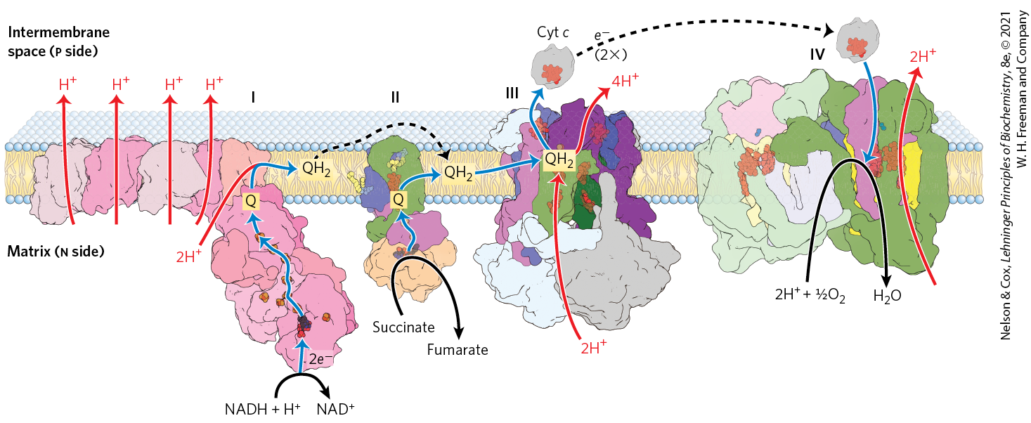
Summary of the Flow of Electrons and Protons through the Respiratory Chain
much of the free energy generated is recovered and stored in the form of an electrochemical proton gradient across the mitochondrial inner membrane

Slide 93
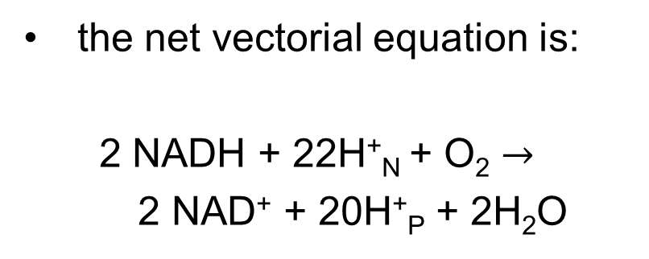
The Net Vectorial Equation
the net vectorial equation is:
  2 NADH + 22H⁺_{N} + O₂ $→$
  2 NAD⁺ + 20H⁺_{P} + 2H₂O
(19-7)

Slide 94
Principle 4 (5 of 5)
The free energy made available by “downhill” (exergonic) electron flow is coupled to the “uphill” transport of protons across a proton-impermeable membrane. The free energy of fuel oxidation is thus conserved as a transmembrane electrochemical potential.

Slide 95
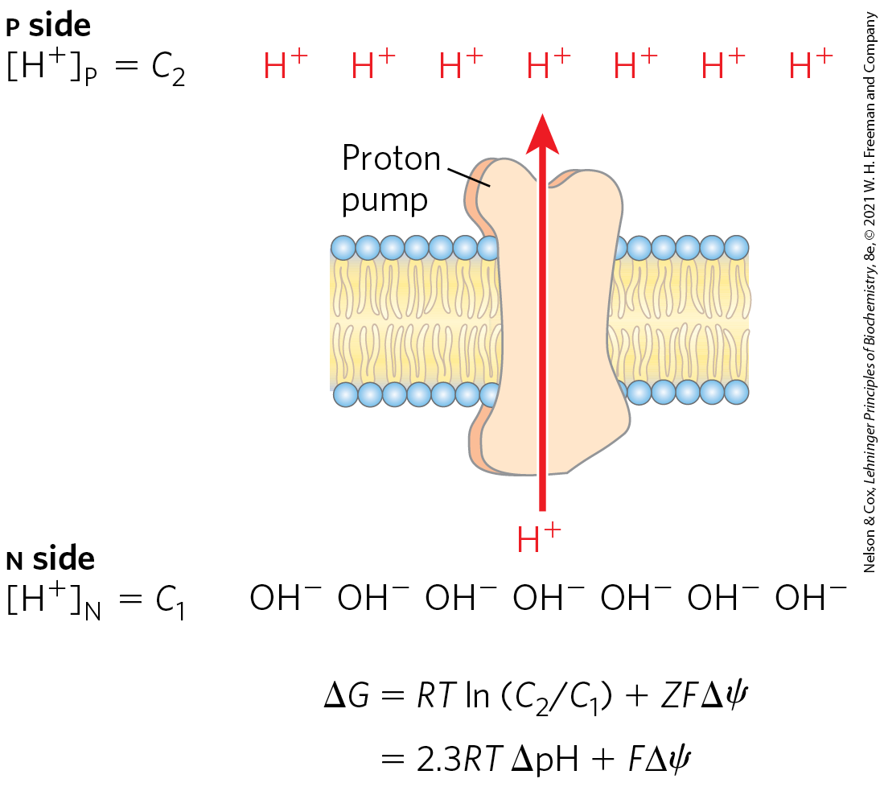
Proton-Motive Force
proton-motive force = the energy stored in an electrochemical proton gradient across the mitochondrial inner membrane
  composed of chemical and electrical potential energy

Slide 96
Clicker Question 14
The electron-transfer chain generates ATP by:
creating a proton-motive force.
substrate-level phosphorylation.
activating uncoupling protein 1 (UCP1).
pumping phosphate ions into the intermembrane space.
adding electrons to ADP to form ATP.
Notes:
Answer: A
Principle: 19.4
Learning Objective(s): Describe the role of proton-motive force on the synthesis of ATP.
Bloom’s: 2:1

Slide 97
Clicker Question 14, Response
The electron-transfer chain generates ATP by:
creating a proton-motive force.
The flow of electrons through Complexes I, III, and IV results in the pumping of protons across the inner mitochondrial membrane, making the matrix alkaline relative to the intermembrane space. This proton gradient provides the energy, in the form of the proton-motive force, for ATP synthesis from ADP and P_{i}.

Slide 98
Clicker Question 15
Which statement regarding the proton-motive force is false?
It is a result of electron flow through the respiratory chain.
It is used by ATP synthase to synthesize ATP.
It results from an [H⁺] gradient across the outer mitochondrial membrane.
It is both chemical and electrical potential energy.
Notes:
Answer: C
Principle: 19.4
Learning Objective(s): Describe the role of proton-motive force on the synthesis of ATP.
Bloom’s: 1:1

Slide 99
Clicker Question 15, Response
Which statement regarding the proton-motive force is false?
It results from an [H⁺] gradient across the outer mitochondrial membrane.
The proton-motive force results from an [H⁺] gradient across the inner, not the outer, mitochondrial membrane.

Slide 100
The Free-Energy Change for the Creation of an Electrochemical Gradient by an Ion Pump
the free-energy change is:
∆G = RT ln(C₂/C₁) + ZF ∆ψ
where C₂ and C₁ are the concentrations of an ion in two
regions, Z is the absolute value of its electrical charge,
and ∆ψ is the transmembrane difference in electrical
potential (in volts)
(19-8)

Slide 101
Calculating the Proton-Motive Force
the free-energy change is:
∆G = RT ln(C₂/C₁) + ZF ∆ψ
= RT (2.3(log[H⁺]_{P} − log[H⁺]_{N}) + ZF ∆ψ
= RT (2.3(pH_{N −} pH_{p}) + ZF ∆ψ
= RT (2.3 ∆pH) + ZF ∆ψ
= 2.3RT ∆pH + ZF ∆ψ
(19-9)

Slide 102
Clicker Question 16
Calculate the free-energy change for the creation of an electrochemical gradient by a proton pump if the pH of the matrix is 0.75 units more alkaline than that of the intermembrane space, the transmembrane difference in electrical potential is 0.20 V, and the temperature is 37 °C.
−24 kJ/mol
−15 kJ/mol
15 kJ/mol
24 kJ/mol
Notes:
Answer: D
Principle: 19.4
Learning Objective(s): Calculate the amount of energy conserved in the proton gradient across the inner mitochondrial membrane per pair of electrons transferred through the respiratory chain from NADH to oxygen.
Bloom’s: 3:2

Slide 103
Clicker Question 16, Response
Calculate the free-energy change for the creation of an electrochemical gradient by a proton pump if the pH of the matrix is 0.75 units more alkaline than that of the intermembrane space, the transmembrane difference in electrical potential is 0.20 V, and the temperature is 37 °C.
24 kJ/mol
∆G = 2.3RT ∆pH + ZF ∆ψ
= 2.3(0.008315 kJ/mol • K)(310 K)(0.75) + (+1)(96.5 kJ/V • mol)(0.20 V)
= 19.3 kJ/mol + 4.45 kJ/mol
= 24 kJ/mol

Slide 104
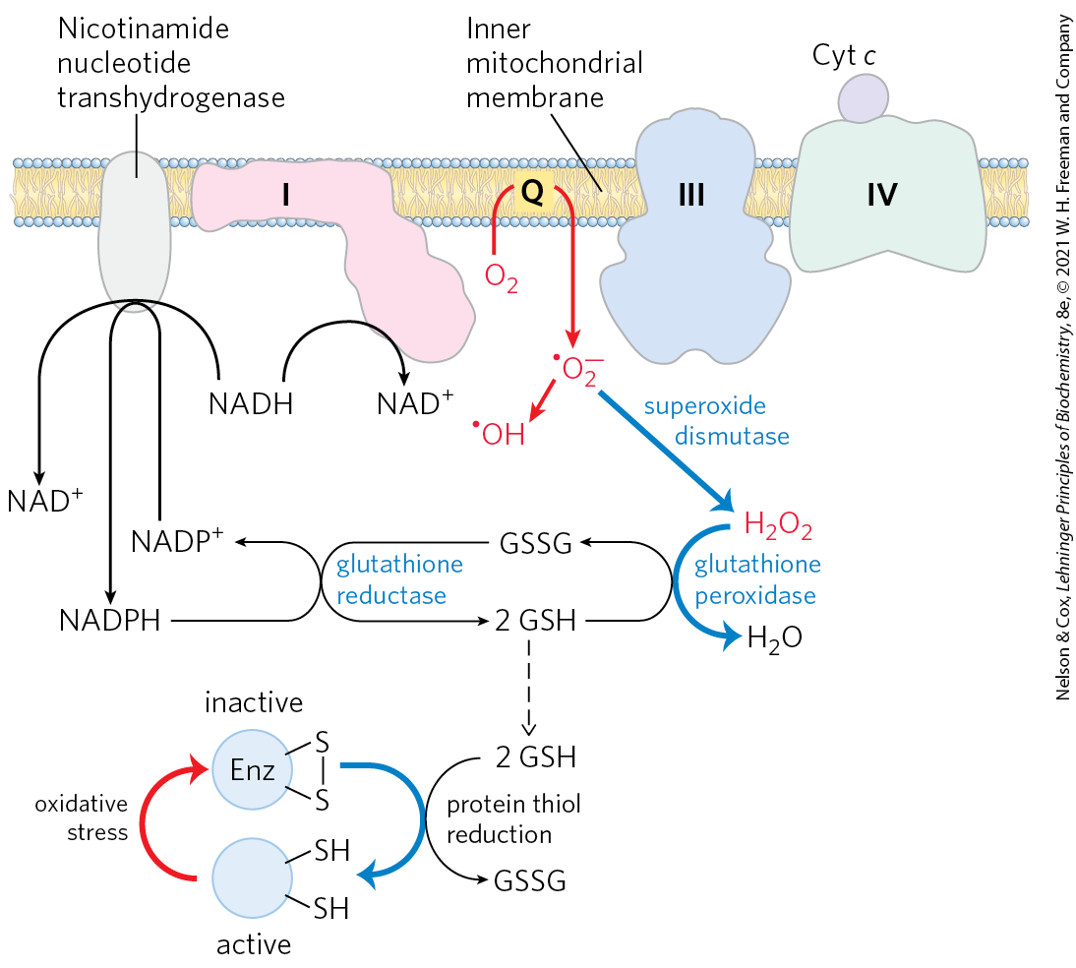
Reactive Oxygen Species Are Generated during Oxidative Phosphorylation
superoxide dismutase = catalyzes the conversion of superoxide and two protons to H₂O₂ and O₂
glutathione peroxidase = converts H₂O₂ to H₂O
low ROS levels serve as signals reflecting insufficient O₂

Slide 105
Clicker Question 17
Why are reactive oxygen species (ROS) generated?
Molecular oxygen recombines with hydrogen to produce dihydrogen oxide.
Stray electrons bind to oxygen, creating a free radical oxygen species.
There are high ADP levels.
There is a high NAD⁺/NADH ratio.
Transfer of a H⁺ across the inner mitochondrial membrane is uncoupled from ATP synthase.
Notes:
Answer: B
Principle: 19.3
Learning Objective(s): Describe how reactive oxygen is created during oxidative phosphorylation.
Bloom’s: 2:2

Slide 106
Clicker Question 17, Response
Why are reactive oxygen species (ROS) generated?
Stray electrons bind to oxygen, creating a free radical oxygen species.
Some intermediates in the electron-transfer system, such as the partially reduced ubisemiquinone (•QH), can react directly with oxygen to form the superoxide radical (•O₂⁻) as an intermediate.The superoxide radical forms when a single electron is passed to O₂ in the reaction:
O₂ + e⁻ → •O₂⁻

Slide 107
Clicker Question 18
How is production of reactive oxygen species (ROS) controlled?
through increased ADP content in the matrix
through an increase in the NAD⁺/NADH ratio
with expression of superoxide dismutase
with expression of glutathione peroxidase
All of the answers are correct.
Notes:
Answer: E
Principle: 19.3
Learning Objective(s): Describe how cells prevent oxidative damage by reactive oxygen.
Bloom’s: 2:2

Slide 108
Clicker Question 18, Response
How is production of reactive oxygen species (ROS) controlled?
All of the answers are correct.
The formation of ROS is favored when mitochondria are not making ATP (for lack of ADP or O₂) and when there is a high NADH/NAD⁺ ratio in the matrix. ROS produced in mitochondria are inactivated by a set of protective enzymes, including superoxide dismutase and glutathione peroxidase.

Slide 109

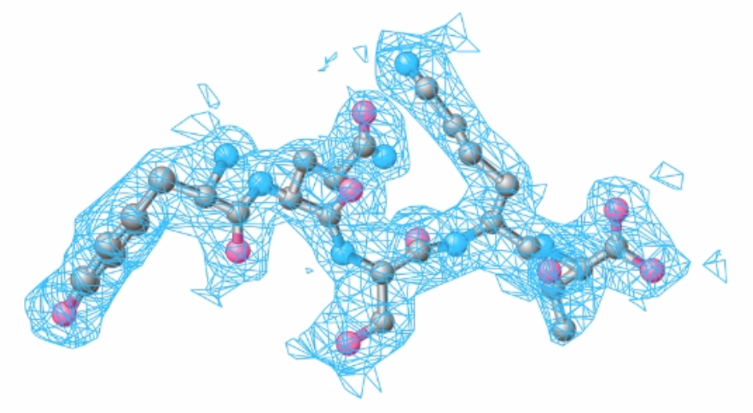
Activity: X-Ray Crystallography and Protein Characterization
Watch the Animated Technique video titled “X-ray Crystallography.”
Notes:
Instructor: This Animated Technique video is found within Chapter 4 of Achieve. It is in the folder titled “Ch4 In-Class Activities, Videos, and Resources.”

Slide 110
Activity Instructions (2 of 4)
On your own, think about how x-ray crystallography could be used to study the structures of the proteins involved in the respiratory chain. What proteins shuttle electrons from reduced electron donors to O₂ in the mitochondria? Which of these proteins does not contribute to the establishment of a proton gradient across the inner membrane?
Pair up to discuss your ideas. (2 minutes)
Share your ideas with the class in group discussion. (3 minutes)
Notes:
Instructor: This Animated Technique video is found within Chapter 4 of Achieve. It is in the folder titled “Ch4 In-Class Activities, Videos, and Resources.”

Slide 111
Activity Solution (1 of 4)
What proteins shuttle electrons from reduced electron donors to O₂ in the mitochondria? Which of these proteins does not directly contribute to the establishment of the proton gradient across the inner membrane?
Complex I, complex II, complex III, and complex IV are the proteins responsible for shuttling electrons from the reduced electron donors NADH and FADH₂ to O₂ in the mitochondria. Complex II is the only one that does not pump protons from the matrix to the intermembrane space. Accordingly, complex II does not directly contribute to the establishment of the proton gradient needed to power ATP synthase.
Notes:
Instructor: This Animated Technique video is found within Chapter 4 of Achieve. It is in the folder titled “Ch4 In-Class Activities, Videos, and Resources.”

Slide 112
19.2 ATP Synthesis

Slide 113
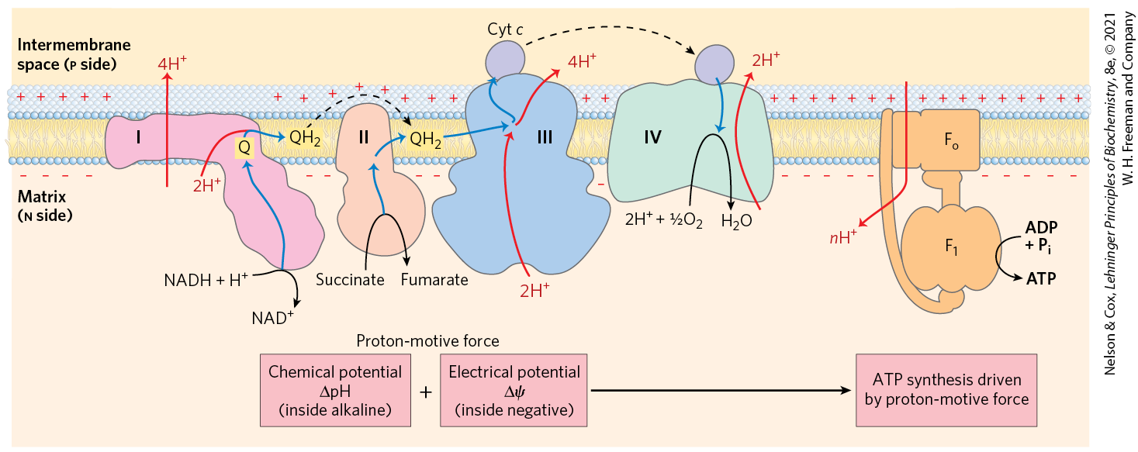
In the Chemiosmotic Model, Oxidation and Phosphorylation Are Obligately Coupled
chemiosmotic model = describes the coupling of ATP synthesis to an electrochemical proton gradient (the proton-motive force)

Slide 114
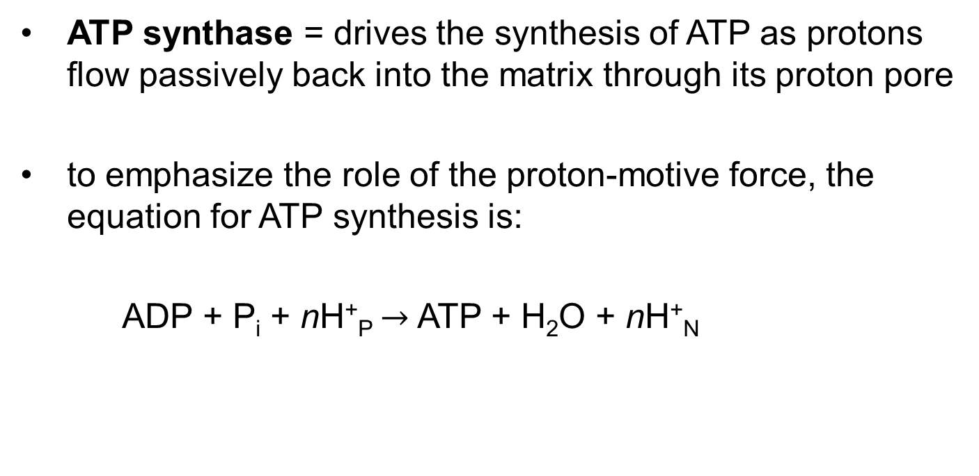
ATP Synthesis
ATP synthase = drives the synthesis of ATP as protons flow passively back into the matrix through its proton pore
to emphasize the role of the proton-motive force, the equation for ATP synthesis is:
  ADP + P_{i} + nH⁺_{P} $→$ ATP + H₂O + nH⁺_{N}
(19-10)

Slide 115

Clicker Question 19
The chemiosmotic model:
is supported by the observation that, when isolated mitochondria have an artificial electrochemical gradient (higher pH in the matrix) imposed on them, electrons spontaneously flow through the respiratory chain.
requires an intact outer mitochondrial membrane.
requires that mitochondrial ATP synthesis and electron flow through the respiratory chain be obligately coupled.
is supported by the observation that isolated mitochondria that are actively respiring cause the pH of the solution they are in to increase.
Notes:
Answer: C
Principle: 19.5
Learning Objective(s): Describe the chemiosmotic theory.
Bloom’s: 1:1

Slide 116
Clicker Question 19, Response
The chemiosmotic model:
requires that mitochondrial ATP synthesis and electron flow through the respiratory chain be obligately coupled.
The chemiosmotic model, proposed by Peter Mitchell, is the paradigm for energy coupling. Here, “coupling” refers to the obligate connection between mitochondrial ATP synthesis and electron flow through the respiratory chain.

Slide 117
Principle 5 (2 of 7)
The transmembrane flow of protons back down their electrochemical gradient through specific protein channels provides the free energy for synthesis of ATP. This process is catalyzed by a membrane protein complex (ATP synthase) that couples proton flow to phosphorylation of ADP.

Slide 118
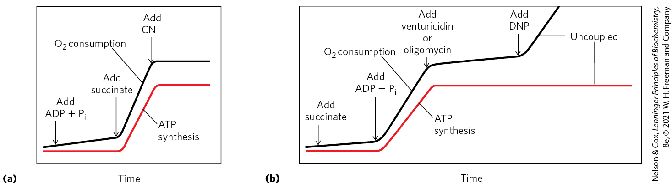
Coupling of Electron Transfer and ATP Synthesis in Mitochondria
inhibitors of electron transfer block ATP synthesis
inhibitors of ATP synthesis block electron transfer (unless oxidation and phosphorylation are uncoupled)

Slide 119
Clicker Question 20
The addition of oligomycin, an inhibitor of ATP synthase, to mitochondria suspended in a buffered medium blocks both ATP synthesis and respiration. What would happen if 2,4-dinitrophenol (DNP) were also added to this suspension?
Respiration and ATP synthesis would both resume.
Respiration would resume without ATP synthesis.
ATP synthesis would resume without respiration.
Neither respiration nor ATP synthesis would resume.
Notes:
Answer: B
Principle: 19.5
Learning Objective(s): Summarize the chemiosmotic theory.
Bloom’s: 2:2

Slide 120
Clicker Question 20, Response
The addition of oligomycin, an inhibitor of ATP synthase, to mitochondria suspended in a buffered medium blocks both ATP synthesis and respiration. What would happen if 2,4-dinitrophenol (DNP) were also added to this suspension
Respiration would resume without ATP synthesis.
Dinitrophenol (DNP) uncouples respiration from ATP synthesis by entering the matrix in the protonated form and releasing a proton, thus dissipating the proton gradient. This allows respiration to continue without ATP synthesis.

Slide 121
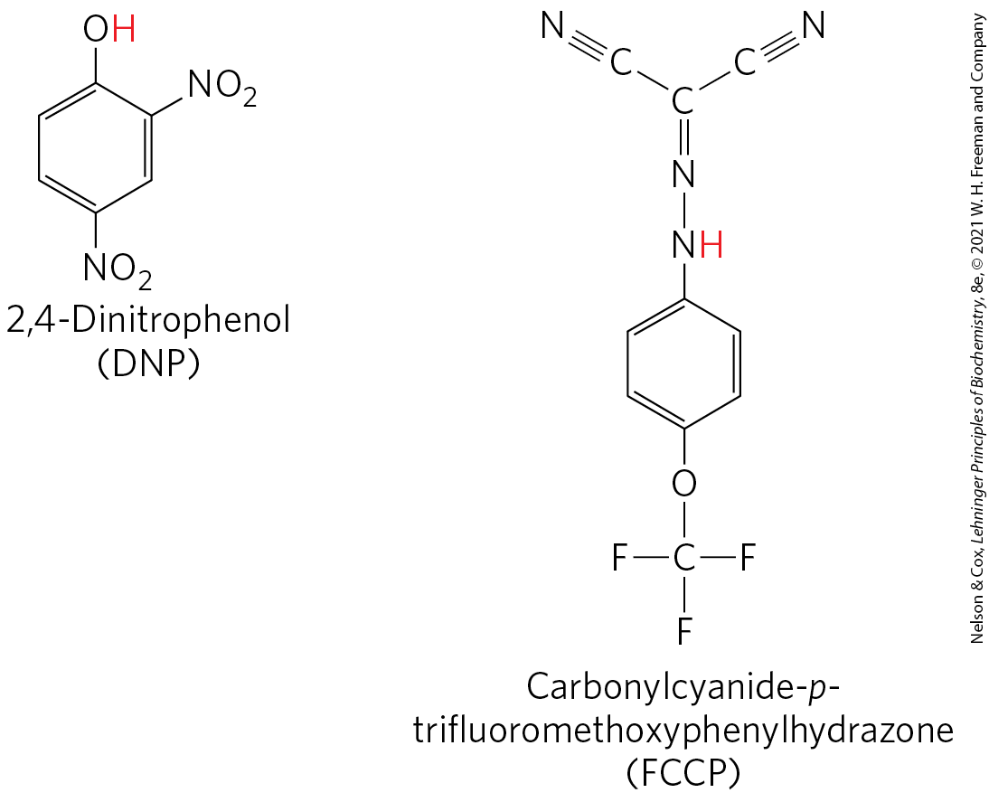
Chemical Uncouplers of
Oxidative Phosphorylation
physical shear or detergent uncouples electron transfer from ATP synthesis
DNP and FCCP = weak acids that carry protons across the inner mitochondrial membrane
  dissipates the proton gradient

Slide 122
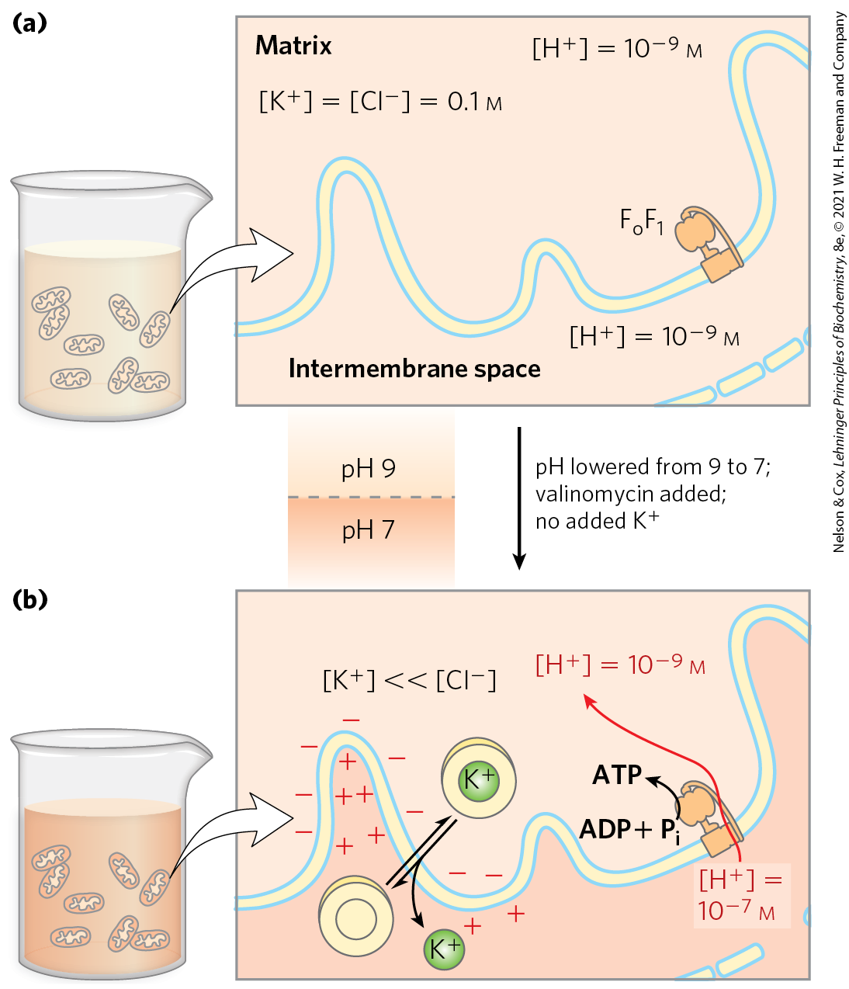
Proton-Motive Force Alone Drives ATP Synthesis
in the absence of an oxidizable substrate, the proton-motive force alone drives ATP synthesis

Slide 123
Principle 2 (3 of 4)
Mitochondria trace their evolutionary origin to bacteria. Over 1.45 billion years ago, an endosymbiotic relationship arose between bacteria and a primitive eukaryote or eukaryotic progenitor. Mitochondria are ubiquitous in modern eukaryotes, and their bacterial origin is evident in almost every aspect of their structure and function.

Slide 124
ATP Synthase Has Two Functional Domains, F_{o} and F₁
mitochondrial ATP synthase is an F-type ATPase
  similar in structure and mechanism to the ATP synthases of bacteria and chloroplasts

Slide 125

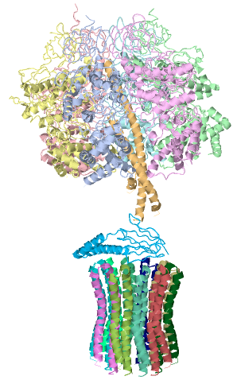
Activity: Visualizing
ATP Synthase
ATP synthase has two functional domains: F_{o} and F₁. F_{o} is an integral membrane protein, whereas F₁ is a peripheral membrane protein. Observe the structure of ATP synthase in Mol3D viewer in your Achieve course.
Notes:
Instructor: This Mol3D structure is located in the Achieve course. It can be found in the Chapter 19 content, in the folder titled “Ch19 In-Class Activities and Resources.”

Slide 126
Activity Instructions (3 of 4)
On your own, think of answers to the questions:
  Which domain is F_{o} and which domain is F₁? Select each domain and upload a screenshot to your course.
  Which domain binds to ATP?
  Is the direction of proton flow from F_{o} to F₁ or from F₁ to F_{o}? (2 minutes)
Pair up to discuss your ideas. (2 minutes)
Share your ideas with the class in group discussion.
(3 minutes)
Notes:
Instructor: This Mol3D structure is located in the Achieve course. It can be found in the Chapter 19 content, in the folder titled “Ch19 In-Class Activities and Resources.”

Slide 127
Activity Solution (2 of 4)
  Which domain is F_{o} and which domain is F₁? Select each domain and upload a screenshot to your course. The F_{o} domain is the domain composed of alpha helices arranged in a cylindrical form. The F₁ domain is the spherically shaped domain composed of alpha helices and random coils.
  Which domain binds to ATP? the F₁ domain
Notes:
Instructor: This Mol3D structure is located in the Achieve course. It can be found in the Chapter 19 content, in the folder titled “Ch19 In-Class Activities and Resources.”

Slide 128
Activity Solution (3 of 4)
  Is the direction of proton flow from F_{o} to F₁ or from F₁ to F_{o}?
  F_{o} is embedded in the mitochondrial membrane, and protons flow from the intermembrane space (the P side) into the matrix (the N side) in a process facilitated by F_{o}. Thus protons flow from F_{o} to F₁.
Notes:
Instructor: This Mol3D structure is located in the Achieve course. It can be found in the Chapter 19 content, in the folder titled “Ch19 In-Class Activities and Resources.”

Slide 129
Principle 5 (3 of 7)
The transmembrane flow of protons back down their electrochemical gradient through specific protein channels provides the free energy for synthesis of ATP. This process is catalyzed by a membrane protein complex (ATP synthase) that couples proton flow to phosphorylation of ADP.

Slide 130
Mitochondrial ATP Synthase
contains two distinct components:
  F_{o} = an integral membrane protein with a proton pore
  F₁ (originally F₁ ATPase) = a peripheral membrane protein
    catalyzes hydrolysis of ATP when isolated

Slide 131
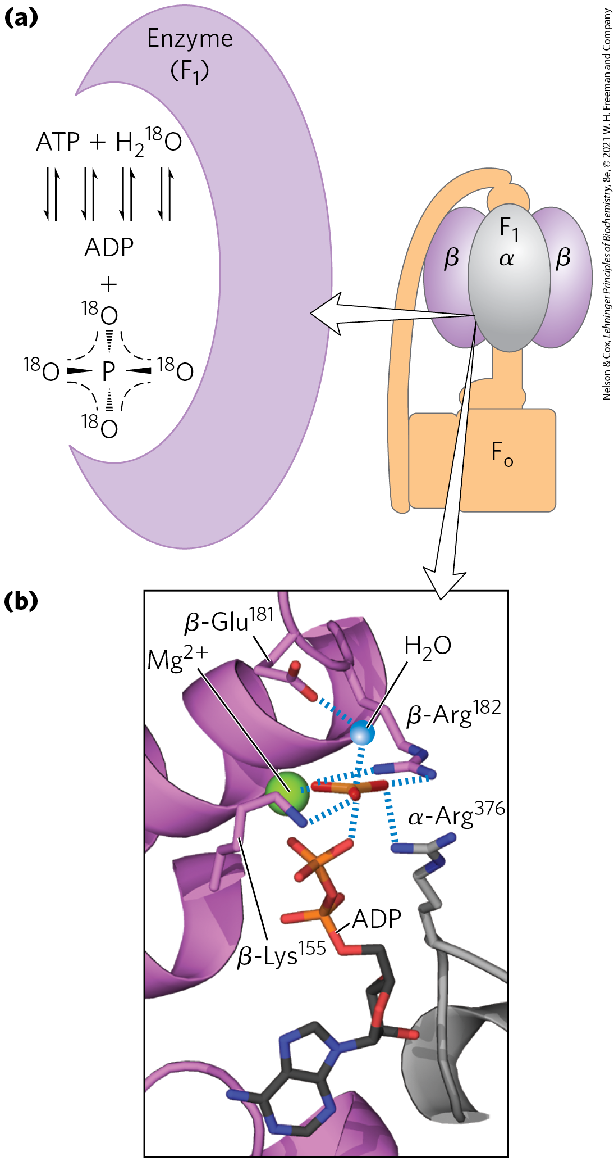
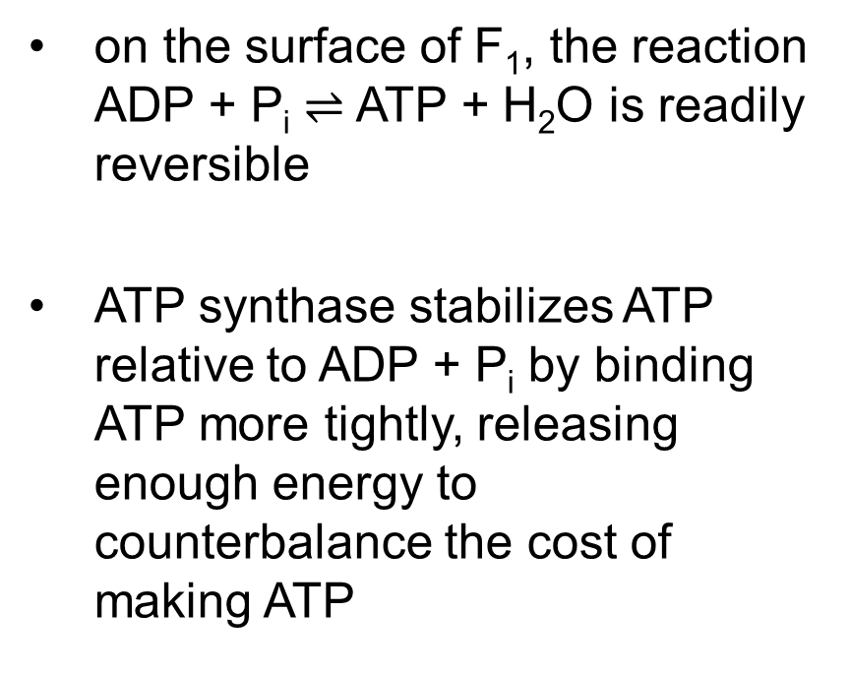
ATP Is Stabilized Relative to ADP on the Surface of F₁
on the surface of F₁, the reaction ADP + P_{i} $⇌$ ATP + H₂O is readily reversible
ATP synthase stabilizes ATP relative to ADP + P_{i} by binding ATP more tightly, releasing enough energy to counterbalance the cost of making ATP

Slide 132
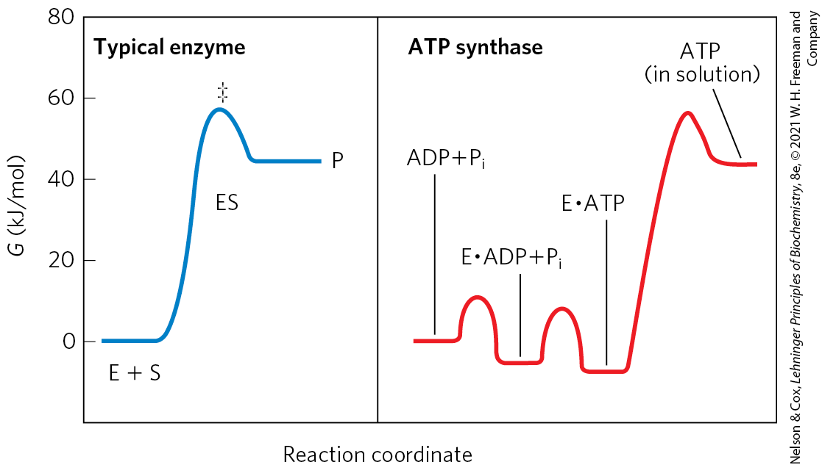
The Proton Gradient Drives the Release of ATP from the Enzyme Surface
the free energy required for the release of ATP is provided by the proton-motive force

Slide 133
Clicker Question 21
What is the major energy barrier for ATP synthase?
binding of ADP to the enzyme
binding of P_{i} to the enzyme
formation of ATP
release of ATP from the enzyme
Notes:
Answer: D
Principle: 19.5
Learning Objective(s): Summarize the kinetic relationship of ATP and ADP on the surface of F1.
Bloom’s: 2:1

Slide 134
Clicker Question 21, Response
What is the major energy barrier for ATP synthase?
release of ATP from the enzyme
In a typical enzyme-catalyzed reaction, reaching the transition state between substrate and product is the major energy barrier to overcome. In the reaction catalyzed by ATP synthase, release of ATP from the enzyme, not formation of ATP, is the major energy barrier.

Slide 135
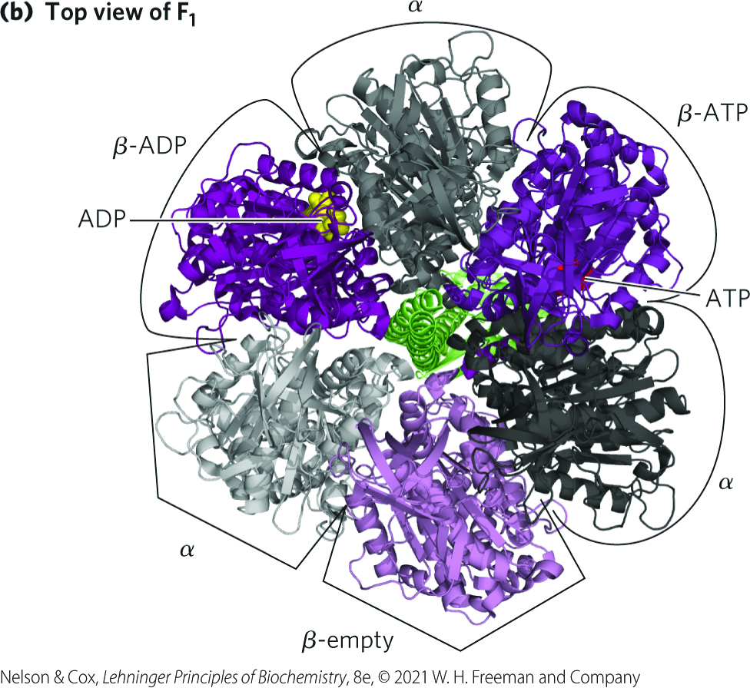
Each β Subunit of ATP Synthase Can Assume Three Different Conformations
mitochondrial F₁ has the composition α₃β₃γδε
  each of the three β subunits has one catalytic site for ATP synthesis
  each β subunit has a different conformation:
    β-ATP
    β-ADP
    β-empty

Slide 136
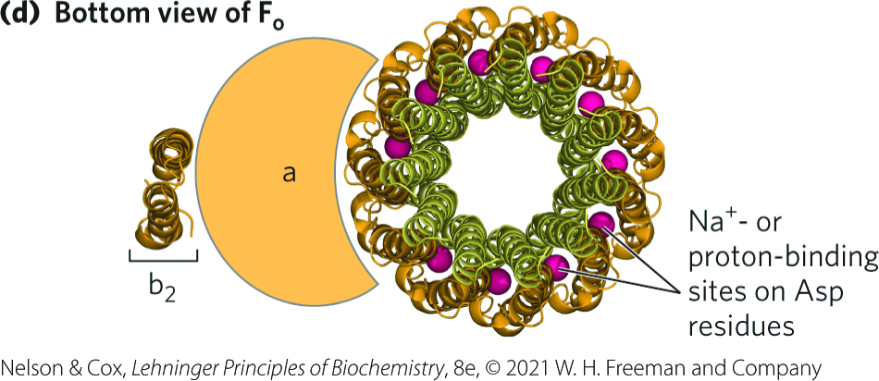
The Structure of the F_{o} Complex
mitochondrial F_{o} has the composition ab₂c_{n}
  n ranges from 8 to 17 depending on the species
c ring = arrangement of c subunits into two concentric circles
  the c subunits rotate together as a unit

Slide 137
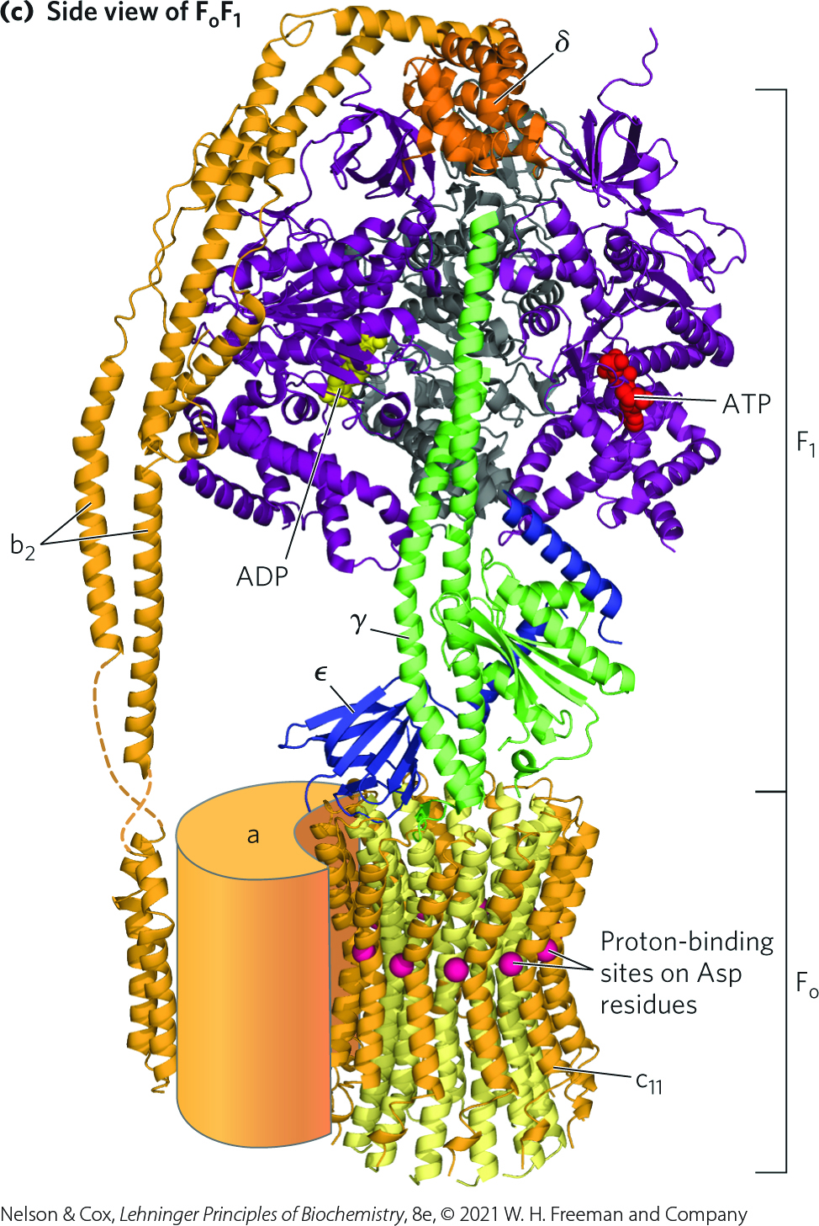
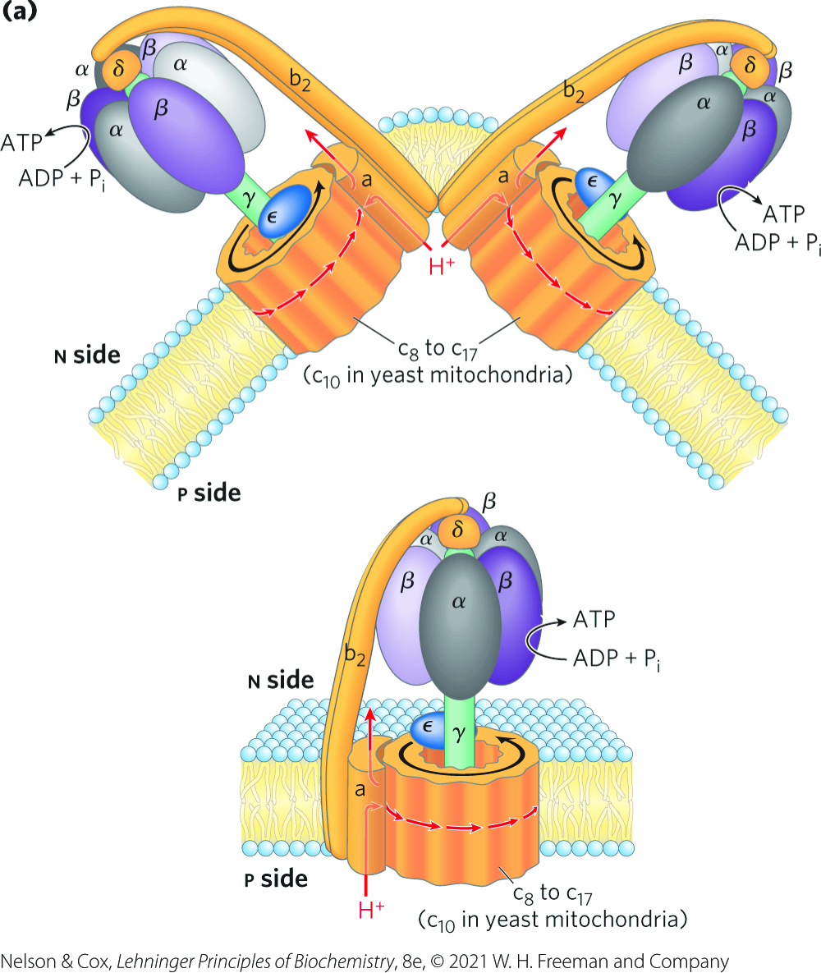
The Structure of the F_{o}F₁ Complex

Slide 138
Principle 5 (4 of 7)
The transmembrane flow of protons back down their electrochemical gradient through specific protein channels provides the free energy for synthesis of ATP. This process is catalyzed by a membrane protein complex (ATP synthase) that couples proton flow to phosphorylation of ADP.

Slide 139
Clicker Question 22
The β subunits of ATP synthase:
have three distinct isozymes.
are each associated with a δ subunit.
have three distinct conformations.
will act as an ATPase if protons flow through the F_{o} domain into the mitochondrion.
Notes:
Answer: C
Principle: 19.5
Learning Objective(s): Describe the three conformations of the beta subunits of ATP synthase F1.
Bloom’s: 2:1

Slide 140
Clicker Question 22, Response
The β subunits of ATP synthase:
have three distinct conformations.
The F₁ complex has three nonequivalent adenine nucleotide–binding sites, one for each pair of α and β subunits. At any given moment, one of these sites is in the β-ATP conformation (which binds ATP tightly), a second is in the β-ADP (loose-binding) conformation, and a third is in the β-empty (very loose-binding) conformation.

Slide 141
Rotational Catalysis Is Key to the Binding-Change Mechanism for ATP Synthesis
rotational catalysis = mechanism by which the flow of protons through F_{o} causes the c ring to rotate and, in turn, trigger the subunit conformational changes in F₁

Slide 142
The Binding-Change Model
binding-change model = the active site of each β subunit cycles through the three conformations:
  β-ATP – tight binding
  β-ADP – loose binding
  β-empty – very loose binding

Slide 143
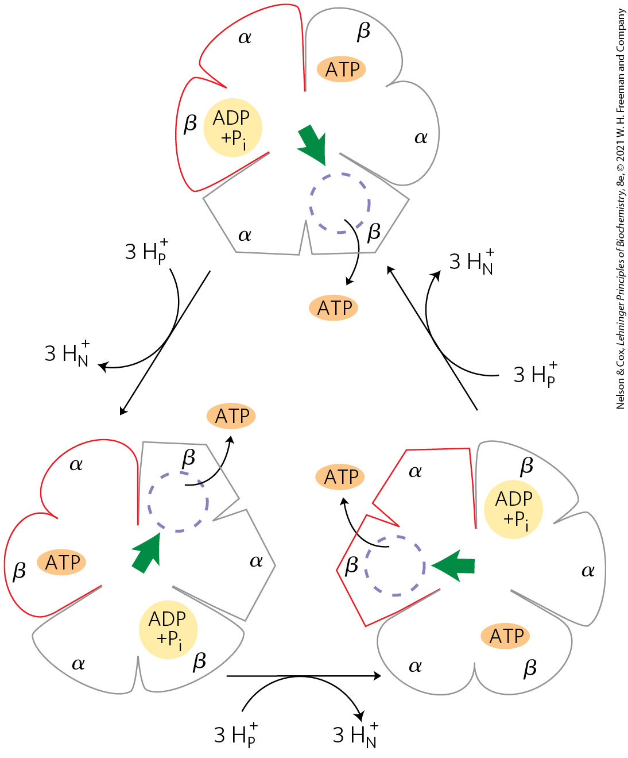
Binding-Change Model for ATP Synthase
the three active sites of F₁ take turns catalyzing ATP synthesis
translocation of three protons fuels synthesis of one ATP
each complete rotation synthesizes three ATP

Slide 144
Clicker Question 23
With each rotation of 120°, the γ subunit of F_{o}F₁ comes into contact with a different β subunit, forcing that β subunit:
into the β-empty conformation.
into the β-ADP conformation.
into the β-ATP conformation.
to catalyze the synthesis of ATP.
Notes:
Answer: A
Principle: 19.5
Learning Objective(s): Describe the rotational catalysis mechanism for catalyzing ATP synthesis.
Bloom’s: 2:1

Slide 145
Clicker Question 23, Response
With each rotation of 120°, the γ subunit of F_{o}F₁ comes into contact with a different β subunit, forcing that β subunit:
into the β-empty conformation.
The β subunit changes to the β-empty conformation when it comes into contact with the γ subunit. Because this conformation has very low affinity for ATP, the newly synthesized ATP leaves the enzyme surface.

Slide 146
Coupling Proton Translocation to ATP Synthesis
proton translocation causes a rotation of F₀ and γ
  causes a conformational change within all the three αβ pairs, one of which promotes condensation of ADP and P_{i} into ATP.

Slide 147

Experimental Demonstration of Rotation of F_{o} and γ
the γ subunit rotates in one direction when F_{o}F₁ is synthesizing ATP and in the opposite direction when hydrolyzing ATP

Slide 148
Clicker Question 24
Which statement regarding ATP synthase is false?
The γ subunit is stationary as the αβ dimers rotate around it.
Protons flow through the a and c subunits.
When the F₁ domain is isolated, it functions as an ATPase.
It is considered to have an F_{o} domain and an F₁ domain.
Notes:
Answer: A
Principle: 19.5
Learning Objective(s): Describe the rotational catalysis mechanism for catalyzing ATP synthesis.
Bloom’s: 2:1

Slide 149
Clicker Question 24, Response
Which statement regarding ATP synthase is false?
The γ subunit is stationary as the αβ dimers rotate around it.
The streaming of protons through the F_{o} pore causes the c ring and the attached γ subunit to rotate about the long axis of γ, which is perpendicular to the plane of the membrane. The γ subunit passes through the center of the α₃β₃ spheroid, which is held stationary relative to the membrane surface.

Slide 150
Principle 5 (5 of 7)
The transmembrane flow of protons back down their electrochemical gradient through specific protein channels provides the free energy for synthesis of ATP. This process is catalyzed by a membrane protein complex (ATP synthase) that couples proton flow to phosphorylation of ADP.

Slide 151

A Model for Proton-Driven Rotation of the c Ring
the a subunit is stationary and the c ring rotates
transient protonation of a key Glu residue in each c subunit elicits conformation changes that drive rotation and transmit protons

Slide 152


Species Differences in Number of c Subunits in the c Ring of the F_{o} Complex

Slide 153

Chemiosmotic Coupling Allows Nonintegral Stoichiometries of O₂ Consumption and ATP Synthesis
the overall reaction equation for ATP synthesis is:
x ADP + xP_{i} + ½ O₂ + H⁺ + NADH $→$
x ATP + H₂O + NAD⁺
P/O ratio (P/2e⁻ ratio) = the value of x
  there is no theoretical requirement for P/O to be integral
(19-11)

Slide 154
The P/O Ratio
the P/O ratio is:
  ~2.5 when electrons enter the respiratory chain at Complex I
  ~1.5 when electrons enter at ubiquinone
the ratio varies among species, depending on the number of c subunits in the F_{o} complex

Slide 155
Clicker Question 25
Succinate dehydrogenase is dysfunctional in a species of garden slug. While its metabolism is compromised on a number of levels, it can still undergo oxidative phosphorylation. What is the maximal P/O ratio for these organisms if NADH is used as an electron source?
1
1.5
2
2.5
4
Notes:
Answer: D
Principle: 19.5
Learning Objective(s): Predict the ratio of ATP formed per NADH oxidized based on the number of c subunits per c ring.
Bloom’s: 2:2

Slide 156
Clicker Question 25, Response
Succinate dehydrogenase is dysfunctional in a species of garden slug. While its metabolism is compromised on a number of levels, it can still undergo oxidative phosphorylation. What is the maximal P/O ratio for these organisms if NADH is used as an electron source?
2.5
If 10 protons are pumped out per NADH and 4 must flow in to produce 1 ATP, the proton-based P/O ratio is 2.5 for NADH as the electron donor.

Slide 157

The Proton-Motive Force Energizes Active Transport
adenine nucleotide translocase = antiporter that moves ADP into the matrix and ADP out
phosphate translocase = promotes symport of one H₂PO₄⁻ and one H⁺ into the matrix
ATP synthasome = a complex of ATP synthase and both translocases
translocation of a fourth proton per ATP is required to facilitate cotransport

Slide 158
Shuttle Systems Indirectly Convey Cytosolic NADH into Mitochondria for Oxidation
the inner mitochondrial membrane is impermeable to NADH and NAD
NADH equivalents are moved from the cytosol to the matrix by:
  the malate-asparate shuttle
  the glycerol 3-phosphate shuttle

Slide 159

The Malate-Aspartate Shuttle
NADH equivalents moved in by the malate-aspartate shuttle enter the respiratory chain at Complex I and yield a P/O ratio of 2.5

Slide 160

The Glycerol 3-Phosphate Shuttle
NADH equivalents moved in by the glycerol 3-phosphate shuttle enter the respiratory chain at Complex III and yield a P/O ratio of 1.5

Slide 161
Clicker Question 26
Why is the malate-aspartate shuttle necessary for oxidative phosphorylation in the liver?
to bring malate into the mitochondrial matrix
to bring aspartate out of the mitochondrial matrix
to bring the reducing equivalents of NADH into the mitochondrial matrix
to convert oxaloacetate into malate
to convert glutamate into α-ketoglutarate
Notes:
Answer: C
Principle: 19.3
Learning Objective(s): Describe two shuttle systems which take part in providing NADH into the mitochondria for oxidation.
Bloom’s: 2:2

Slide 162
Clicker Question 26, Response
Why is the malate-aspartate shuttle necessary for oxidative phosphorylation in the liver?
to bring the reducing equivalents of NADH into the mitochondrial matrix
NADH dehydrogenase (Complex I) of the inner mitochondrial membrane can accept electrons only from NADH in the matrix; however, the inner membrane is not permeable to NADH. Thus special shuttle systems carry reducing equivalents from cytosolic NADH into mitochondria by an indirect route.

Slide 163
Clicker Question 27
Why is the glycerol 3-phosphate shuttle necessary for oxidative phosphorylation in the brain?
to bring malate into the mitochondrial matrix
to bring aspartate out of the mitochondrial matrix
to bring the reducing equivalents of NADH into the mitochondrial matrix
to convert oxaloacetate into malate
to convert glutamate into α-ketoglutarate
Notes:
Answer: C
Principle: 19.3
Learning Objective(s): Describe two shuttle systems which take part in providing NADH into the mitochondria for oxidation.
Bloom’s: 2:2

Slide 164
Clicker Question 27, Response
Why is the glycerol 3-phosphate shuttle necessary for oxidative phosphorylation in the brain?
to bring the reducing equivalents of NADH into the mitochondrial matrix
NADH dehydrogenase (Complex I) of the inner mitochondrial membrane can accept electrons only from NADH in the matrix; however, the inner membrane is not permeable to NADH. Thus special shuttle systems carry reducing equivalents from cytosolic NADH into mitochondria by an indirect route.

Slide 165
Clicker Question 28
Shuttles are used to transport reducing equivalents and molecules, which themselves have no specific transporter, through the inner mitochondrial membrane. Which molecule CANNOT move through the membrane directly?
pyruvate
malate
glutamate
α-ketoglutarate
oxaloacetate
Notes:
Answer: C
Principle: 19.3
Learning Objective(s): Describe two shuttle systems which take part in providing NADH into the mitochondria for oxidation.
Bloom’s: 2:2

Slide 166
Clicker Question 28, Response
Shuttles are used to transport reducing equivalents and molecules, which themselves have no specific transporter, through the inner mitochondrial membrane. Which molecule CANNOT move through the membrane directly?
oxaloacetate
In the matrix, malate passes two reducing equivalents to NAD⁺, and the resulting NADH is oxidized by the respiratory chain. The oxaloacetate formed from malate cannot pass directly into the cytosol and must first be transaminated to aspartate, which can leave via the glutamate-aspartate shuttle.

Slide 167
19.3 Regulation of Oxidative Phosphorylation

Slide 168
ATP Yield from Complete Oxidation of Glucose
Table 19-5 ATP Yield from Complete Oxidation of Glucose
Process | Direct product | Final ATP
Glycolysis | 2 NADH (cytosolic) 2 ATP | 3 or 5 2
Pyruvate oxidation (two per glucose) | 2 NADH (mitochondrial matrix) | 5
Acetyl-CoA oxidation in citric acid cycle (two per glucose) | 6 NADH (mitochondrial matrix) 2 FADH₂ 2 ATP or 2 GTP | 15 3 2
Total yield per glucose |  | 30 or 32
glycolysis under anaerobic conditions (lactate fermentation) yields only 2 ATP per glucose

Slide 169
Oxidative Phosphorylation Is Regulated by Cellular Energy Needs
the acceptor control of respiration = ADP
  the rate of O₂ consumption depends on the availability of ADP, the P_{i} acceptor
the acceptor control ratio = the ratio of the maximal rate of ADP-induced O₂ consumption to the basal rate in the absence of ADP
  at least 10 in some animal tissues

Slide 170
The Mass-Action Ratio is a Measure of a Cell’s Energy Status
mass-action ratio = [ATP]/([ADP][P_{i}])
  usually this ratio is very high
  when lowered (and more ADP is available), the rate of respiration increases

Slide 171
Clicker Question 29
Which molecule is part of an important mass-action ratio in most cells and is a modulator of the three major ATP-producing pathways?
ADP
NAD⁺
AMP
acetate
NADH
Notes:
Answer: A
Principle: 19.5
Learning Objective(s): Describe how the concentration of ADP regulates oxidative phosphorylation.
Bloom’s: 2:2

Slide 172
Clicker Question 29, Response
Which molecule is part of an important mass-action ratio in most cells and is a modulator of the three major ATP-producing pathways?
ADP
The mass-action ratio of the ATP-ADP system is [ATP]/([ADP][P_{i} ]). With more ADP available for oxidative phosphorylation, the rate of respiration increases, causing regeneration of ATP. This continues until the mass-action ratio returns to its normal high level, at which point respiration slows again.

Slide 173
Principle 5 (6 of 7)
The transmembrane flow of protons back down their electrochemical gradient through specific protein channels provides the free energy for synthesis of ATP. This process is catalyzed by a membrane protein complex (ATP synthase) that couples proton flow to phosphorylation of ADP.

Slide 174

An Inhibitory Protein Prevents
ATP Hydrolysis
IF₁ = protein inhibitor that simultaneously binds 2 ATP molecules to inhibit enzyme activity in both directions
  active in its dimeric form, which occurs when pH < 6.5
in hypoxic (oxygen-deprived) cells, IF₁ binds and prevents a drastic drop in [ATP].

Slide 175
Hypoxia Leads to ROS Production and Several Adaptive Responses
defenses against ROS:
  glutathione peroxidase system
  regulation of pyruvate dehydrogenase
    phosphorylated (inactive) under hypoxic conditions
  modification of a subunit of Complex IV (COX4-1 to COX4-2)
    acts more efficiently under hypoxic conditions

Slide 176

Regulation of Gene Expression by HIF-1
HIF-1 = the hypoxia-inducible factor
  accumulates in hypoxic cells
  acts as a transcription factor
  master regulator of O₂ homeostasis
  mediates changes in glucose transport and glycolytic enzymes that produce the Warburg effect

Slide 177
Clicker Question 30
In hypoxic cells:
a subunit of Complex IV is replaced with another subunit optimized for activity under hypoxic conditions.
PDH activity increases.
flux through glycolysis decreases.
levels of reactive oxygen species decline.
Notes:
Answer: A
Principle: 19.3
Learning Objective(s): Describe how cells prevent oxidative damage by reactive oxygen.
Bloom’s: 2:2

Slide 178
Clicker Question 30, Response
In hypoxic cells:
a subunit of Complex IV is replaced with another subunit optimized for activity under hypoxic conditions.
One means of preventing reactive oxygen species formation is the replacement of one subunit of Complex IV, known as COX4-1, with another subunit, COX4-2, that is better suited to hypoxic conditions.

Slide 179
ATP-Producing Pathways Are Coordinately Regulated
ATP and ADP relative concentrations control the rates of:
  electron transfer
  oxidative phosphorylation
  the citric acid cycle
  pyruvate oxidation
  glycolysis

Slide 180


Regulation of ATP-Producing Pathways

Slide 181
Clicker Question 31
How is oxidative phosphorylation inhibited during anaerobic conditions?
A lack of terminal electron acceptor blocks the electron-transfer chain.
ADP levels decrease.
A buildup of glycolytic products (pyruvic acid, lactic acid) lowers pH.
Inhibitory protein IF₁ becomes functionally dimeric under acidic conditions and binds the ATP synthase inhibiting it.
All of the answers are correct.
Notes:
Answer: E
Principle: 19.5
Learning Objective(s): Summarize how the inhibitory protein IF1 regulates ATP synthase.
Bloom’s: 2:2

Slide 182
Clicker Question 31, Response
How is oxidative phosphorylation inhibited during anaerobic conditions?
All of the answers are correct.
Under anaerobic conditions, the main source of ATP becomes glycolysis, and the pyruvic or lactic acid thus formed lowers the pH in the cytosol and the mitochondrial matrix. This favors IF₁ dimerization, leading to inhibition of ATP synthase. The rate of oxidative phosphorylation also decreases when less ADP (the substrate) and O₂ (the terminal electron acceptor) are available.

Slide 183
19.4 Mitochondria in Thermogenesis, Steroid Synthesis, and Apoptosis

Slide 184
Principle 1 (3 of 5)
Mitochondria play a central role in eukaryotic aerobic metabolism. ATP production is not the only important mitochondrial function. Mitochondria play host to the citric acid cycle, the fatty acid β-oxidation pathway, and the pathways of amino acid oxidation. The mitochondria also act in thermogenesis, steroid synthesis, and apoptosis (programmed cell death). The discovery of these diverse and important roles of mitochondria has stimulated much current research on the biochemistry of this organelle.

Slide 185
Principle 5 (7 of 7)
The transmembrane flow of protons back down their electrochemical gradient through specific protein channels provides the free energy for synthesis of ATP. This process is catalyzed by a membrane protein complex (ATP synthase) that couples proton flow to phosphorylation of ADP.

Slide 186
Uncoupled Mitochondria in Brown Adipose Tissue Produce Heat
brown adipose tissue (BAT) = adipose tissue in newborn mammals that functions to generate heat through fuel oxidation
uncoupling protein 1 (UCP1) = a long-chain fatty acid/H⁺ symporter that provides a path for protons to return to the matrix without passing through the F_{o}F₁ complex
  results in energy of oxidation being dissipated as heat
hydrolysis of phosphocreatine also liberates heat

Slide 187

Two Mechanisms of Mitochondrial Thermogenesis

Slide 188
Hibernating Animals
hibernating animals depend on the activity of uncoupled BAT mitochondria to generate heat during their long dormancy

Slide 189
Clicker Question 32
Which statement regarding uncoupling protein 1 (UCP1) is false?
It is found in brown adipose tissue.
It forms proton-conducting pores in the inner mitochondrial membrane.
It provides a path for protons to return to the matrix without passing through the F_{o}F₁ complex.
It allows for ATP generation in addition to heat formation.
Notes:
Answer: D
Principle: 19.5
Learning Objective(s): Summarize the process of generating heat from brown adipose tissue.
Bloom’s: 2:1

Slide 190
Clicker Question 32, Response
Which statement regarding uncoupling protein 1 (UCP1) is false?
It allows for ATP generation in addition to heat formation.
UCP1, an uncoupling protein in the mitochondria of brown adipose tissue, causes the energy conserved by proton pumping to be dissipated as heat by providing an alternative route for protons to reenter the mitochondrial matrix. Because the protons passing through UCP1 bypass the F_{o}F₁ complex, ATP is not generated.

Slide 191
Principle 1 (4 of 5)
Mitochondria play a central role in eukaryotic aerobic metabolism. ATP production is not the only important mitochondrial function. Mitochondria play host to the citric acid cycle, the fatty acid β-oxidation pathway, and the pathways of amino acid oxidation. The mitochondria also act in thermogenesis, steroid synthesis, and apoptosis (programmed cell death). The discovery of these diverse and important roles of mitochondria has stimulated much current research on the biochemistry of this organelle.

Slide 192

Mitochondrial P-450 Monooxygenases Catalyze Steroid Hydroxylations
mitochondria are the site of biosynthetic reactions that produce steroid hormones
  occur in steroidogenic tissues (adrenal gland, gonads, liver, and kidney)

Slide 193

The Cytochrome P-450 Family
cytochrome P-450 family = monoxygenases that catalyze a series of hydroxylation reactions to synthesize steroid hormones from a sterol
  have a critical heme group
cytochrome P-450 enzymes catalyze the reaction
R–H + O₂ +NADPH + H⁺ $→$
R–OH + H₂O +NADP⁺

Slide 194

Path of Electron Flow in Mitochondrial Cytochrome P-450 Reactions
a flavoprotein and an iron-sulfur protein carry electrons from NADPH to the P-450 heme
all P-450 enzymes have a heme that interacts with O₂ and a substrate-binding site that confers specificity

Slide 195
P-450 Enzymes in the ER of Hepatocytes
catalyze similar reactions with hydrophobic compounds, including xenobiotics
xenobiotics = compounds not found in nature but synthesized industrially

Slide 196
Mitochondria Are Central to the Initiation of Apoptosis
apoptosis (programmed cell death) = process in which individual cells die for the good of the organism
can be triggered:
  during normal embryonic development
  in response to an external signal
  by internal events (DNA damage, viral infection, oxidative stress from the accumulation of ROS, heat shock)

Slide 197
Principle 1 (5 of 5)
Mitochondria play a central role in eukaryotic aerobic metabolism. ATP production is not the only important mitochondrial function. Mitochondria play host to the citric acid cycle, the fatty acid β-oxidation pathway, and the pathways of amino acid oxidation. The mitochondria also act in thermogenesis, steroid synthesis, and apoptosis (programmed cell death). The discovery of these diverse and important roles of mitochondria has stimulated much current research on the biochemistry of this organelle.

Slide 198
Clicker Question 33
Which statement does NOT describe a function associated with mitochondria?
In brown adipocytes, electron transport is uncoupled from ATP synthesis.
They make xenobiotic compounds more soluble for excretion.
They release cytochrome c in the process of apoptosis.
They are responsible for the production of steroid hormones by cytochrome P-450 enzymes.
Notes:
Answer: B
Principle: 19.1
Learning Objective(s): Describe the relationship between the mitochondria and the cytochrome P-450 family of enzymes.
Bloom’s: 1:1

Slide 199
Clicker Question 33, Response
Which statement does NOT describe a function associated with mitochondria?
They make xenobiotic compounds more soluble for excretion.
The P-450 enzymes that make hydrophobic compounds, including xenobiotics, more soluble are found in the endoplasmic reticulum of hepatocytes. These enzymes catalyze reactions similar to the mitochondrial P-450 reactions.

Slide 200

Role of Cytochrome c in Apoptosis
permeability transition pore complex (PTPC) = a multisubunit membrane protein that opens to increase permeability
Apaf-1 (apoptosis protease activating factor-1) = monomers that interact with cytochrome c molecules to form an apoptosome
caspases = proteases involved in apoptosis

Slide 201


Activity: Relating
Terms within the Chapter
A concept map displays the relationships between different concepts. Observe the following example of a concept map.
Notes:
Instructor: For additional information, see the Instructor Activity Guide located in Achieve. It can be found within Chapter 19, in the folder titled “Ch19 In-Class Activities and Resources.”

Slide 202
Activity Instructions (4 of 4)
Think about how the following terms and phrases relate to each other and then use scratch paper to draw a concept map using these terms and phrases. (3 minutes)
mitochondria
apoptosis
steroid synthesis
thermogenesis
central role in eukaryotic aerobic metabolism
citric acid cycle
ATP production
amino acid oxidation pathways
fatty acid β-oxidation pathway
Notes:
Instructor: For additional information, see the Instructor Activity Guide located in Achieve. It can be found within Chapter 19, in the folder titled “Ch19 In-Class Activities and Resources.”

Slide 203

Activity Solution (4 of 4)
Pair up and share how this possible concept map might differ from yours. (2 minutes)
Notes:
Instructor: For additional information, see the Instructor Activity Guide located in Achieve. It can be found within Chapter 19, in the folder titled “Ch19 In-Class Activities and Resources.”

Slide 204
19.5 Mitochondrial Genes: Their Origin and the Effects of Mutations

Slide 205

Mitochondrial Genes and Mutations
13 mitochondrial proteins are encoded by the mitochondrial genome and synthesized in mitochondria
~1,200 mitochondrial proteins are encoded by nuclear genes and imported into mitochondria

Slide 206

Respiratory Proteins Encoded by Mitochondrial Genes in Humans

Slide 207

Clicker Question 34
The human mitochondrial genome:
is less susceptible to DNA damage than is nuclear DNA.
is a linear chromosome of 16,569 base pairs.
encodes 37 genes, 13 of which code for polypeptide chains.
is inherited in two copies per mitochondrion, one of paternal lineage and the other of maternal lineage.
Notes:
Answer: C
Principle: 19.2
Learning Objective(s): Describe the structure and contents of the mitochondrial genome.
Bloom’s: 1:1

Slide 208
Clicker Question 34, Response
The human mitochondrial genome:
encodes 37 genes, 13 of which code for polypeptide chains.
A small proportion of human mitochondrial proteins, 13 in all, are encoded by the mitochondrial genome and synthesized in mitochondria. The mitochondrial genome is circular and less efficient at repairing DNA damage than the nuclear genome. Moreover, the mitochondrial genome is derived almost exclusively from the maternal lineage.

Slide 209
Principle 2 (4 of 4)
Mitochondria trace their evolutionary origin to bacteria. Over 1.45 billion years ago, an endosymbiotic relationship arose between bacteria and a primitive eukaryote or eukaryotic progenitor. Mitochondria are ubiquitous in modern eukaryotes, and their bacterial origin is evident in almost every aspect of their structure and function.

Slide 210
Mitochondria Evolved from Endosymbiotic Bacteria
mitochondria arose from aerobic bacteria that entered into an endosymbiotic relationship with primitive eukaryotes
  endosymbiotic bacteria eventually became mitochondria
the chemiosmotic mechanism likely evolved before the emergence of eukaryotes

Slide 211


Activity: Origin of
Mitochondria Muddiest Point (1 of 2)
Complete the Ch19 Student Activity, Day 1: Origin of Mitochondria (Muddiest Point) Achieve assessment.
Notes:
Instructor: This muddiest point activity can be found in Achieve in the Chapter 19 folder titled “Ch19 In-Class Activities and Resources.” See the Instructor Activity Guide in the same folder for more information.

Slide 212

Activity: Origin of
Mitochondria Muddiest Point (2 of 2)
Complete the Ch19 Student Activity, Day 2: Origin of Mitochondria (Muddiest Point) Achieve assessment.
Notes:
Instructor: This muddiest point activity can be found in Achieve in the Chapter 19 folder titled “Ch19 In-Class Activities and Resources.” See the Instructor Activity Guide in the same folder for more information.

Slide 213

Respiration-Linked Extrusion of Protons Drives Other Processes
uptake of extracellular nutrients against a concentration gradient occurs in symport with protons
the rotary motion of bacterial flagella is driven by the transmembrane electrochemical potential

Slide 214
Mutations in Mitochondrial DNA Accumulate throughout the Life of the Organisms
defects in mtDNA occur over time because:
  of the greatest exposure to ROS
  the mtDNA replication system is less effective than the nuclear system at correcting mistakes and damage
animals inherit essentially all mitochondria from the female parent

Slide 215


Heteroplasmy and Homoplasmy
heteroplasmy = different types of mitochondrial genomes within a cell
  results in mutant phenotypes of varying degrees of severity
homoplasmy = the mitochondrial genome is the same within a cell

Slide 216
Clicker Question 35
Which statement is true about heteroplasmic cells (and tissues) in which some of the mitochondria have a gene mutation?
All of the cells (and tissues) will have the mutant phenotype.
All of the cells (and tissues) will have the wild-type phenotype.
Cells (and tissues) containing mostly wild-type mitochondria will have the wild-type phenotype.
Cells (and tissues) containing mostly wild-type mitochondria will have the mutant phenotype.
Notes:
Answer: C
Principle: 19.2
Learning Objective(s): Provide examples of diseases caused by mutations in mitochondrial genomes.
Bloom’s: 2:2

Slide 217
Clicker Question 35, Response
Which statement is true about heteroplasmic cells (and tissues) in which some of the mitochondria have a gene mutation?
Cells (and tissues) containing mostly wild-type mitochondria will have the wild-type phenotype.
Cells (and tissues) containing mostly wild-type mitochondria are essentially normal. Other heteroplasmic cells have intermediate phenotypes, some almost normal, others (with a high proportion of mutant mitochondria) abnormal.

Slide 218
Some Mutations in Mitochondrial Genomes Cause Disease
mitochondrial encephalomyopathies = a group of genetic diseases that primarily affect the brain and skeletal muscle
  inherited from the mother
Leber hereditary optic neuropathy (LHON) = rare disease that affects the central nervous system
  single amino acid substitution in Complex I causes the mitochondria to be partially defective in electron transfer from NADH to ubiquinone

Slide 219

Myoclonic Epilepsy with Ragged-Red Fibers (MERRF) Syndrome
myoclonic epilepsy with ragged-red fibers (MERRF) syndrome = caused by a mutation in the gene that encodes a tRNA specific for lysine
skeletal muscle fibers of affected individuals have abnormally shaped mitochondria that sometimes contain paracrystalline structures

Slide 220
Mitochondrial Donation
mitochondrial donation = transplantation of a prospective mother’s nuclear genes into an enucleated ovum from a donor with healthy mitochondria
  creates an ovum free of a mutation that would have led to a mitochondrial disease
  raises ethical issues

Slide 221

A Rare Form of Diabetes Results from Defects in the Mitochondria of Pancreatic β Cells
mitochondrial defects in pancreatic β cells can limit ATP production when glucose levels are high
compromises insulin release and gives rise to a form of type 2 diabetes

Slide 222
Clicker Question 36
Which statement regarding mutations in mitochondrial DNA is false?
Type 1 diabetes is due to dysfunctional β-cell mitochondria resulting from mutations in the mitochondrial tRNA genes.
Impaired ATP production due to mutations in mitochondrial genes can result in human diseases.
Mutations in mitochondrial genes accumulate through the life of an organism.
An individual cell may have mitochondria that are not genetically identical to each other.
Notes:
Answer: A
Principle: 19.1
Learning Objective(s): Provide examples of diseases caused by mutations in mitochondrial genomes.
Bloom’s: 1:1

Slide 223
Clicker Question 36, Response
Which statement regarding mutations in mitochondrial DNA is false?
Type 1 diabetes is due to dysfunctional β-cell mitochondria resulting from mutations in the mitochondrial tRNA genes.
Type 2, not type 1, diabetes mellitus is common in individuals with mutations in the mitochondrial tRNA^{Lys} or tRNA^{Leu} genes (although such cases make up a very small fraction of all cases of diabetes).

