Slide 1

18 Amino Acid Oxidation and the Production of Urea
© 2021 Macmillan Learning

Slide 2

Principle 1 (1 of 7)
The many paths for amino acid catabolism have two broad parts, one involving the amino groups and the other involving the carbon skeletons. All of the pathways for amino acid degradation include a key step, always involving a pyridoxal phosphate cofactor, in which the α-amino group is separated from the carbon skeleton and shunted into the pathways of amino group metabolism. The carbon skeletons are broken down to citric acid cycle intermediates.

Slide 3

Principle 2 (1 of 4)
Four amino acids—alanine, glutamate, glutamine, and aspartate—play key roles in the transport and distribution of amino groups. All are present in relatively high concentrations in one or many mammalian tissues. All are readily converted to key citric acid cycle intermediates.

Slide 4

Principle 3 (1 of 5)
Metabolic pathways are not distinct. The various pathways for amino acid catabolism are elaborately intertwined with other catabolic and anabolic pathways.

Slide 5
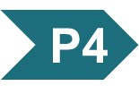
Principle 4 (1 of 3)
Free ammonia is toxic. Excess amino groups must be safely excreted. In mammals, the urea cycle serves this purpose.

Slide 6
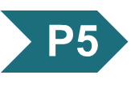
Principle 5 (1 of 6)
Each amino acid has a different catabolic fate. The varied carbon skeletons of amino acids are broken down via equally varied pathways. All can be oxidized to generate ATP. All but leucine and lysine can contribute to gluconeogenesis when needed.

Slide 7
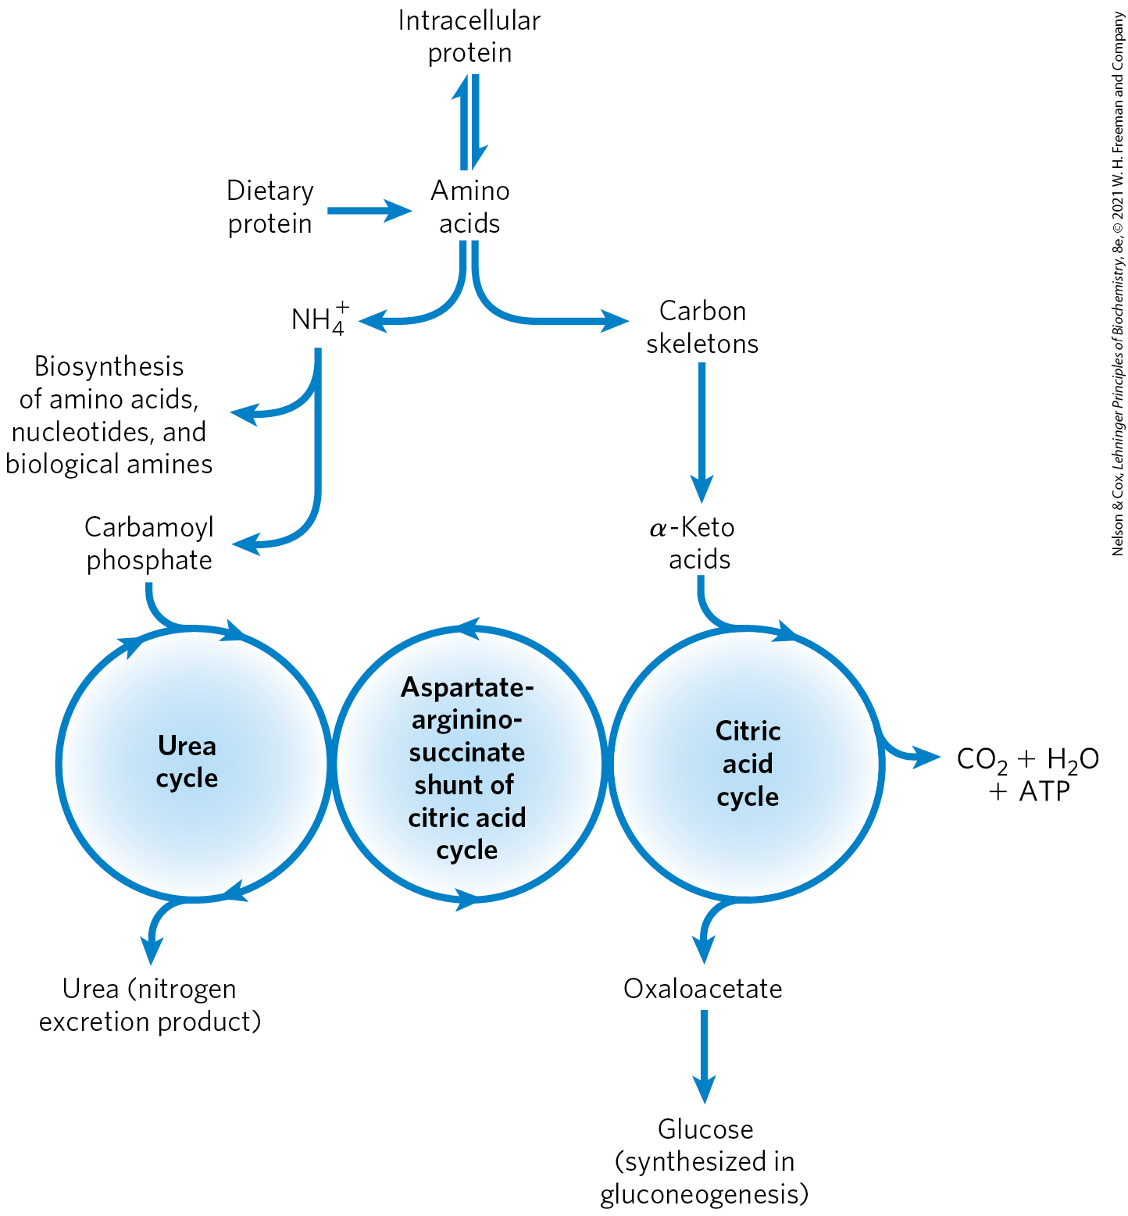
Overview of Amino Acid Catabolism in Mammals

Slide 8
Metabolic Circumstances of Amino Acid Oxidation
amino acids undergo oxidative degradation when:
  amino acids released during protein turnover are not needed for new protein synthesis
  ingested amino acids exceed the body’s needs for protein synthesis
  cellular proteins are used as fuel because carbohydrates are either unavailable or not properly utilized

Slide 9
18.1 Metabolic Fates of Amino Groups

Slide 10
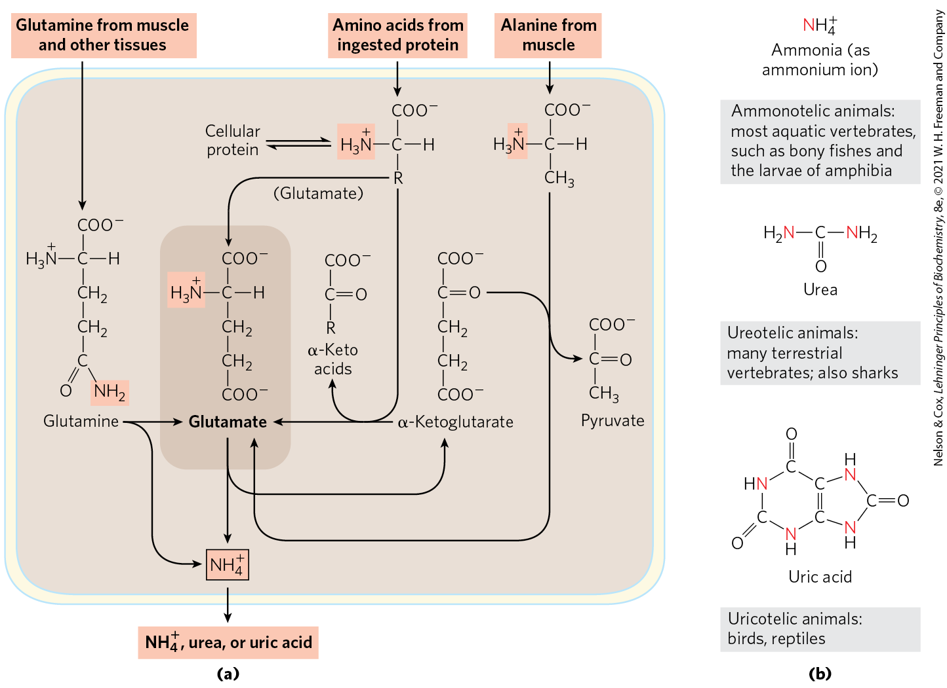
Amino Group Catabolism
unless reused, amino groups are channeled into a single excretory end product

Slide 11
Ammonotelic, Ureotelic, and Uricotelic Animals
ammonotelic animals = excrete amino nitrogen as ammonia
  most aquatic species
ureotelic animals = excrete amino nitrogen as urea
  most terrestrial animals
uricotelic animals = excrete amino nitrogen as uric acid
  birds and reptiles

Slide 12
Amino Acids Involved in Nitrogen Metabolism
glutamate, glutamine, alanine, and aspartate are most easily converted into citric acid cycle intermediates:
  glutamate to α-ketoglutarate
  glutamine to α-ketoglutarate
  alanine to pyruvate
  aspartate to oxaloacetate

Slide 13
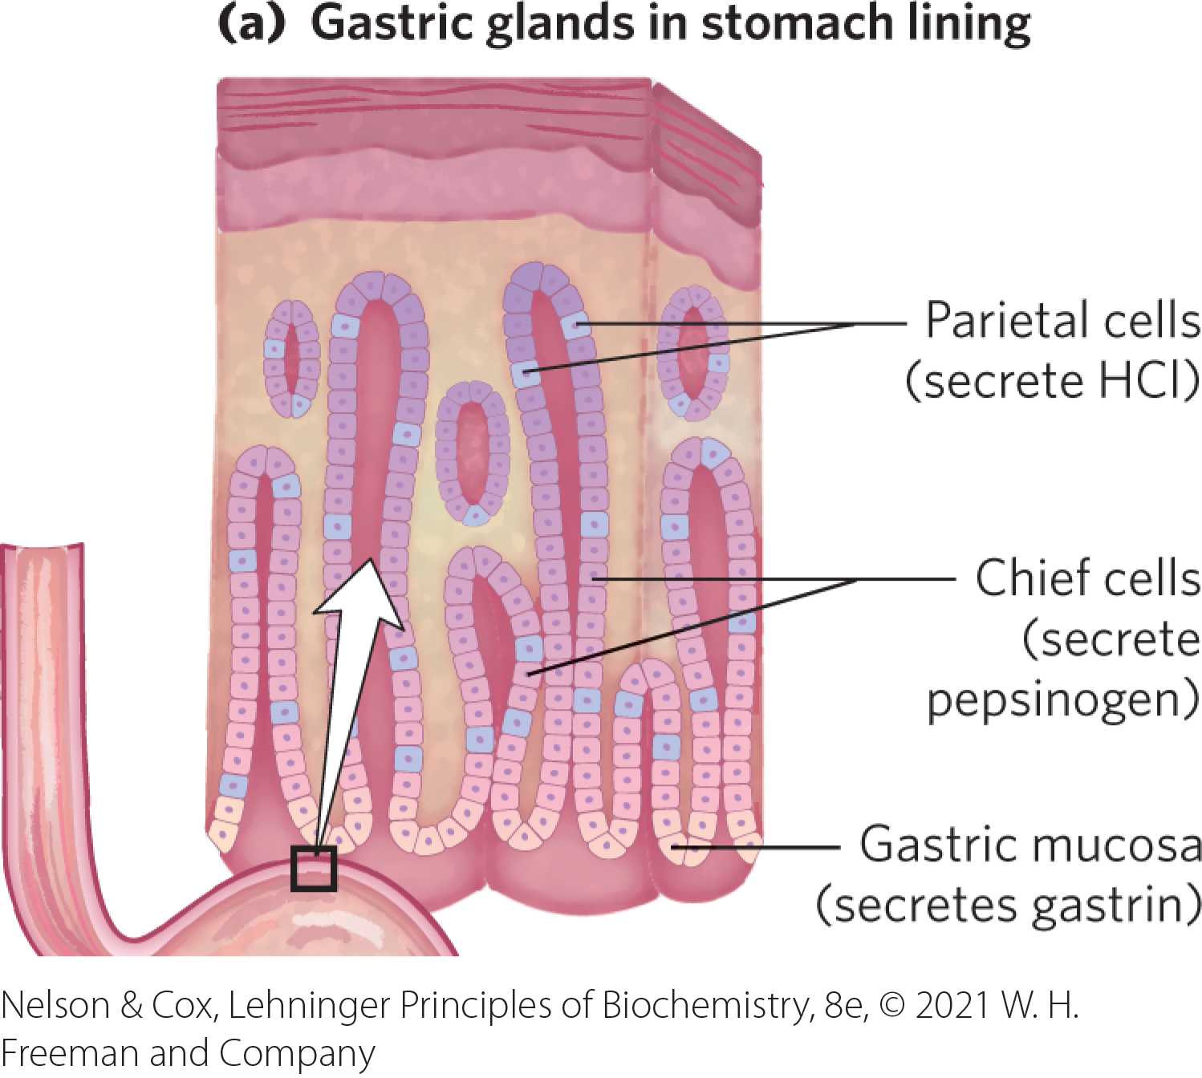
Dietary Protein Is Enzymatically Degraded to Amino Acids
degradation occurs in the gastrointestinal tract
gastrin = hormone secreted when dietary protein enters the stomach
  stimulates the secretion of HCl and pepsinogen
pepsinogen = zymogen that is converted to active pepsin by autocatalytic cleavage at low pH

Slide 14
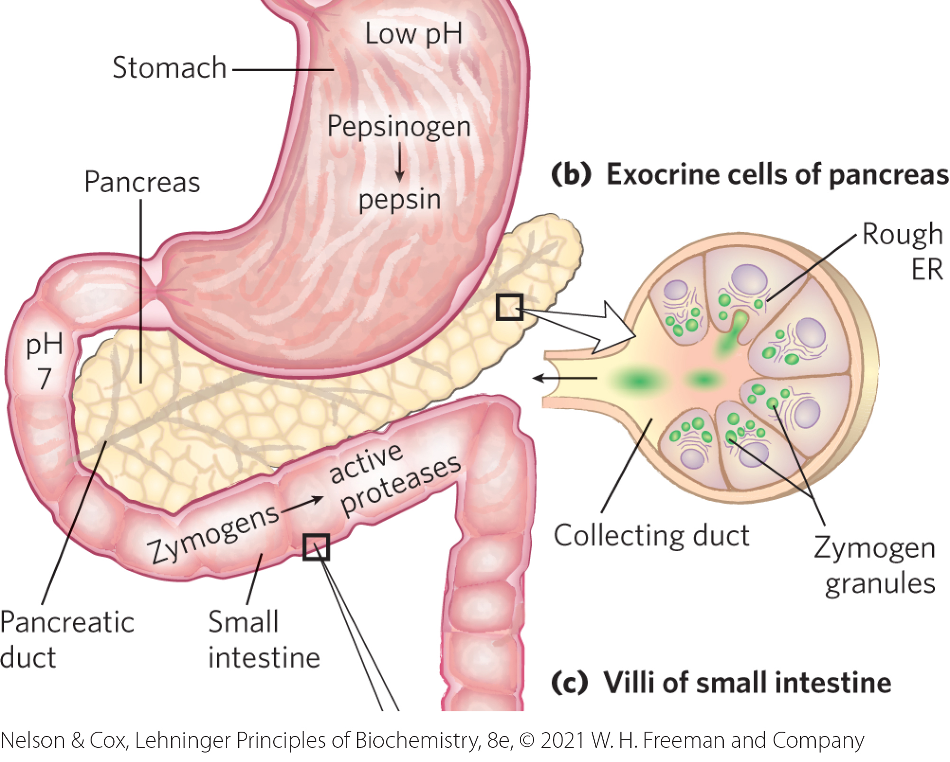
Pepsin and Secretin
pepsin = cleaves long polypeptide chains into a mixture of smaller peptides
secretin = hormone secreted into the blood in response to low pH in the small intestine
  stimulates the pancreas to secrete bicarbonate into the small intestine

Slide 15
Zymogens Are Secreted by the Exocrine Cells of the Pancreas
cholecystokinin = hormone secreted into the blood in response to the arrival of peptides in the duodenum
  stimulates secretion of several pancreatic proteases:
    trypsinogen is the zymogen of trypsin
    chymotrypsinogen is the zymogen of chymotrypsin
    procarboxypeptidases A and B are the zymogens of carboxypeptidases A and B

Slide 16
Trypsin and Pancreatic
Trypsin Inhibitor
enteropeptidase = a proteolytic enzyme that converts trypsinogen to trypsin
trypsin = activates additional trypsinogen, chymotrypsinogen, the procarboxypeptidases, and proelastase
pancreatic trypsin inhibitor = protein inhibitor that further protects the pancreas against self-digestion

Slide 17
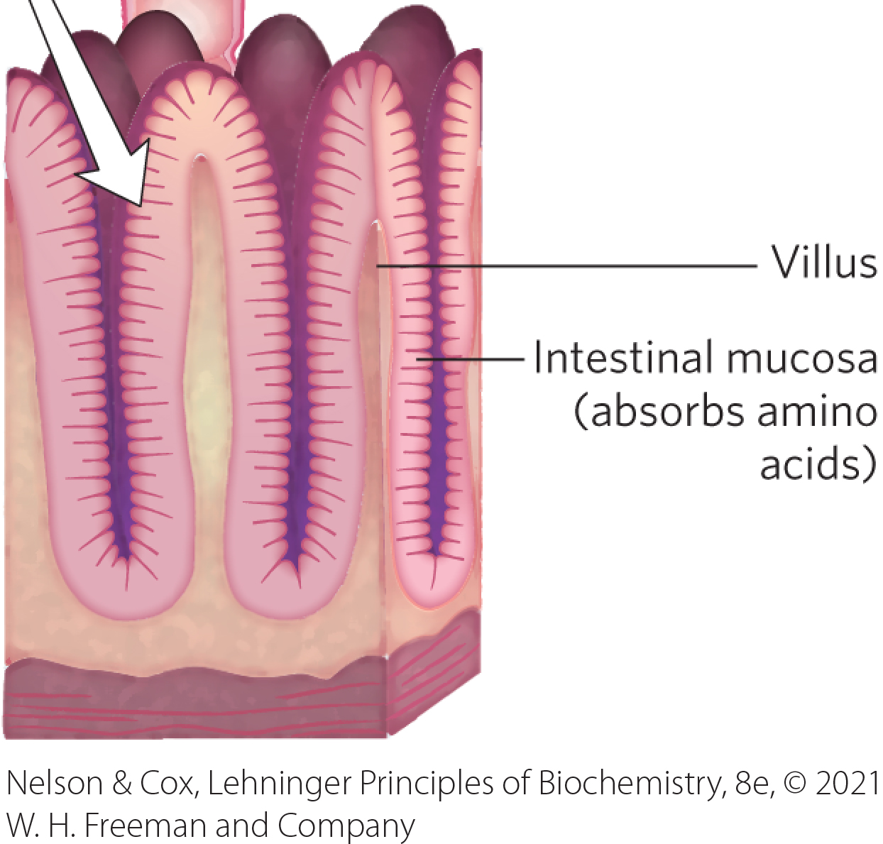
The Intestinal Mucosa Absorbs Amino Acids
free amino acids are transported into the epithelial cells lining the small intestine, enter the blood capillaries in the villi, and travel to the liver

Slide 18
Acute Pancreatitis
acute pancreatitis = caused by obstruction of the pathway by which pancreatic secretions enter the intestine
  zymogens are prematurely converted to their active forms inside the pancreatic cells and attack the pancreatic tissue

Slide 19
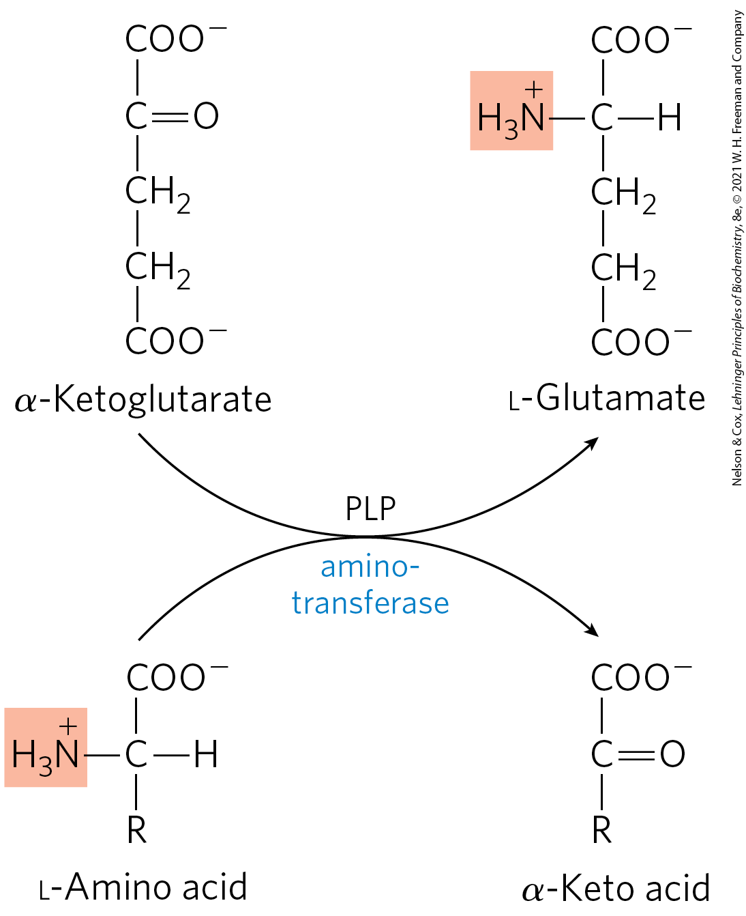
Pyridoxal Phosphate Participates in the Transfer of α-Amino Groups to α-Ketoglutarate
aminotransferases (transaminases) = catalyze the removal of the α-amino groups
  cells contain different types that differ in their specificity for the L-amino acid
  many are specific for α-ketoglutarate as the amino group acceptor

Slide 20
Transamination Reactions
transamination reactions = transfer the α-amino group to the α-carbon atom of α-ketoglutarate, yielding an α-keto acid analog of the amino acid
  reactions are freely reversible (∆G′ ≈ 0 kJ/mol)
  effectively collect the amino groups from many amino acids in the form of L-glutamate

Slide 21
Pyridoxal Phosphate (PLP)
pyridoxal phosphate (PLP) = the coenzyme form of pyridoxine or vitamin B₆
  used as a prosthetic group by all aminotransferases
  carries amino groups at the active site

Slide 22
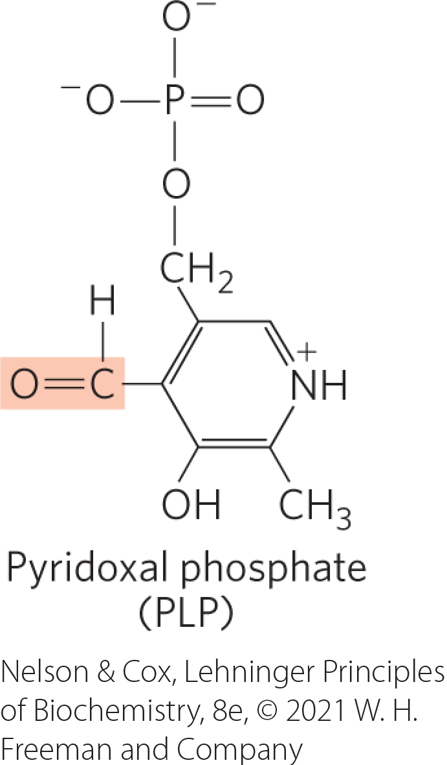
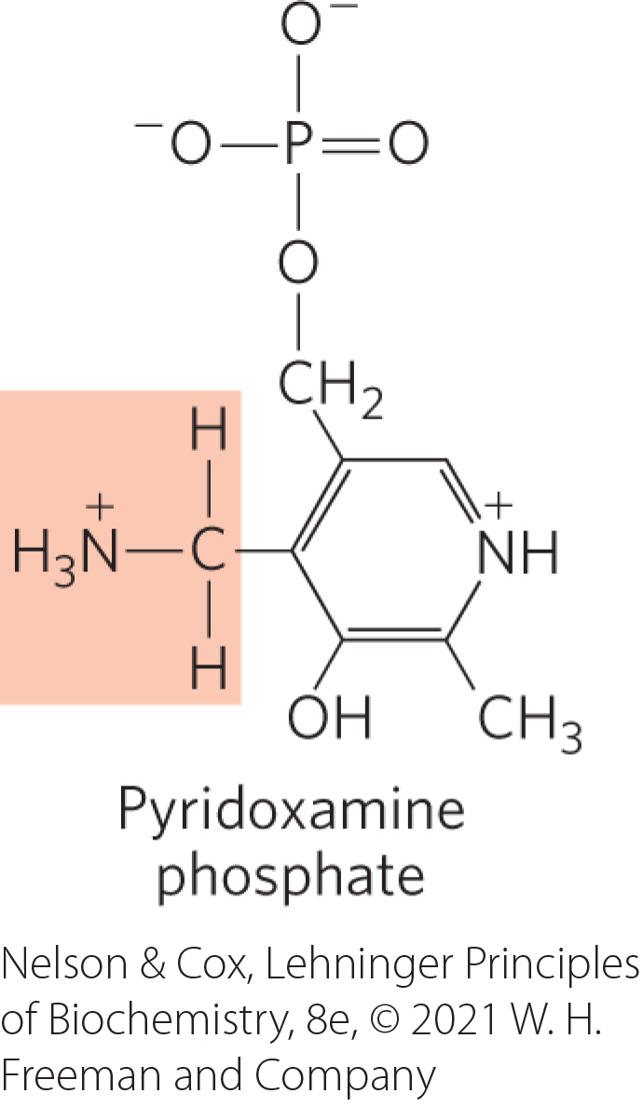
The Structure of Pyridoxal Phosphate and Pyridoxamine Phosphate
PLP (aldehyde form) = accepts an amino group
pyridoxamine phosphate (aminated form) = donates its amino group to an α-keto acid

Slide 23
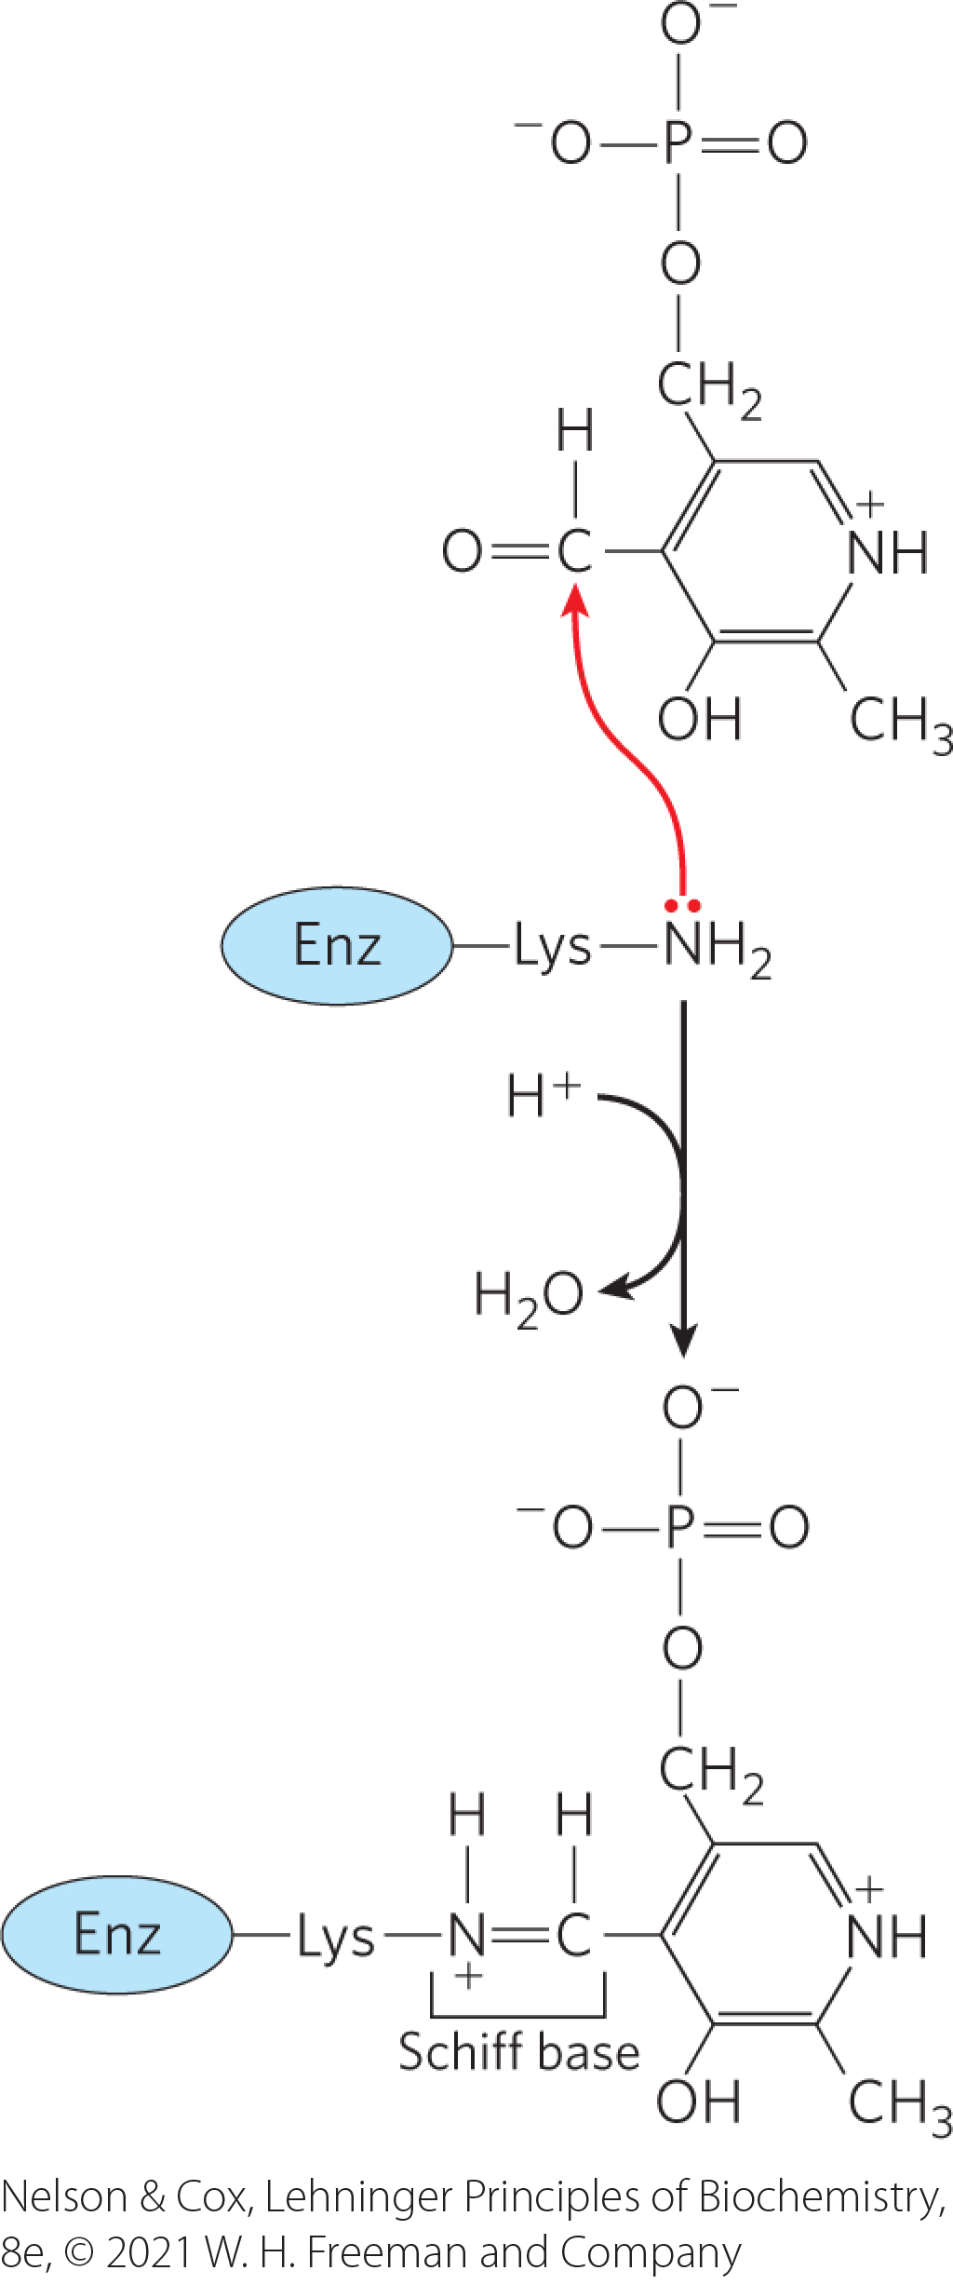
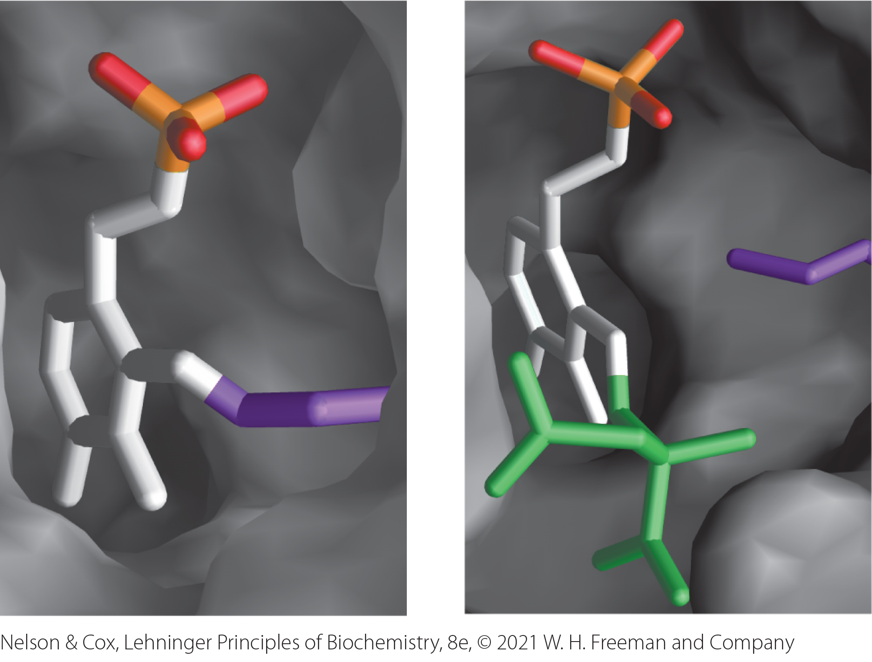
Pyridoxal Phosphate Is Covalently Linked to the Enzyme
covalently linked through an aldimine (Schiff base) linkage to the ε-amino group of a Lys residue

Slide 24
The Aldimine Linkage Is Replaced by the Amino Group
the aldimine linkage is replaced by the amino group of the amino acid as the first step in most PLP-catalyzed reactions

Slide 25
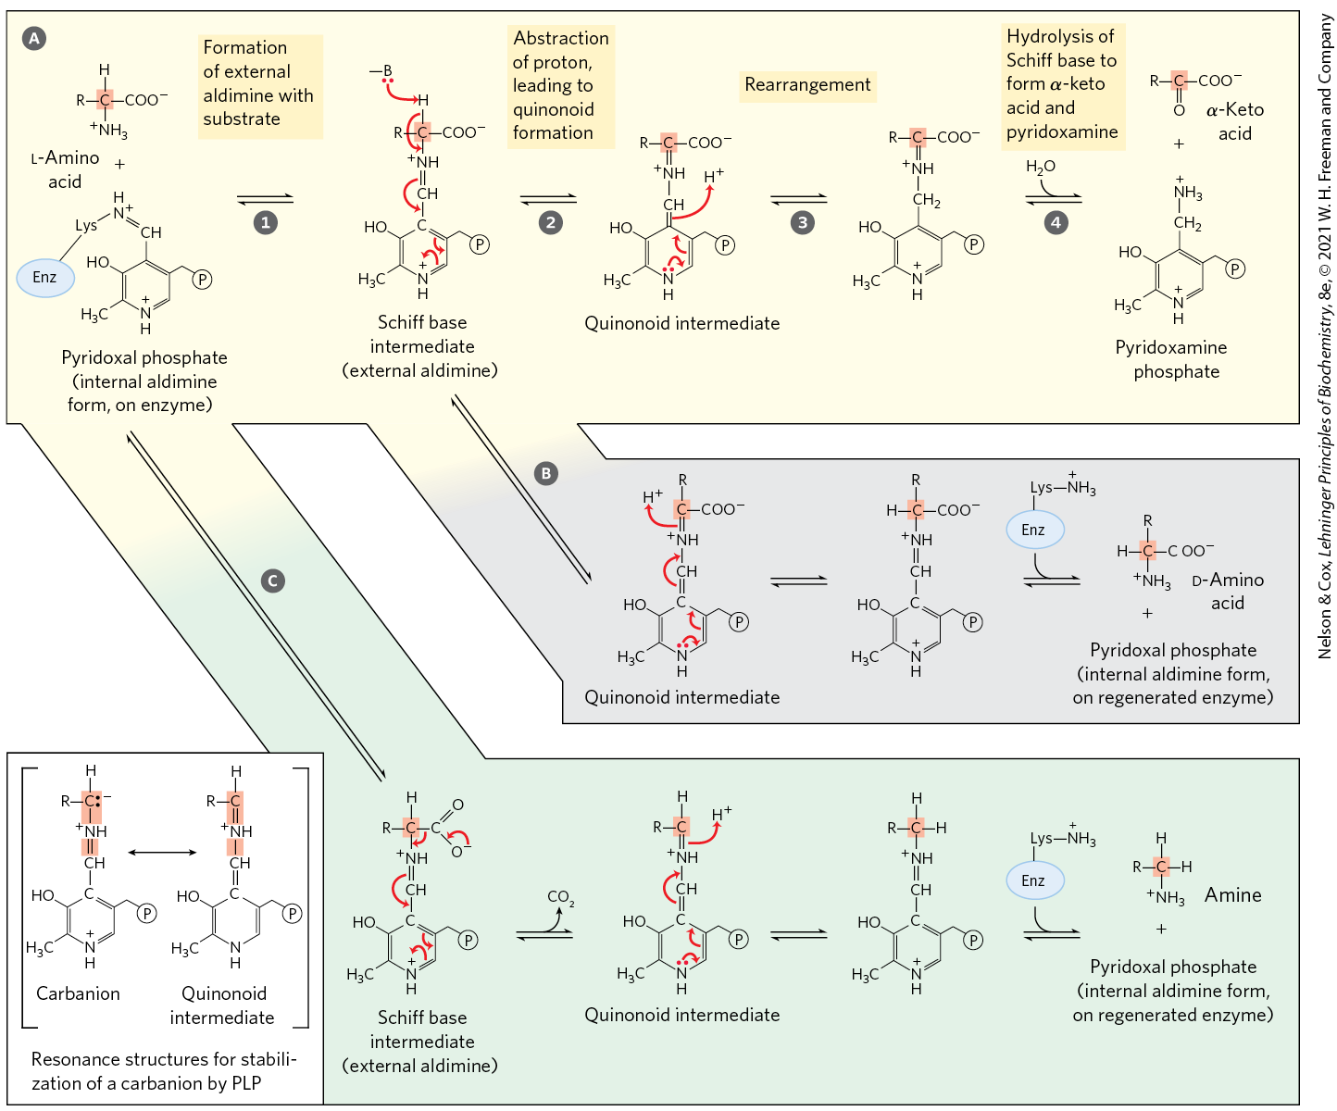
Some Reactions Facilitated by PLP
transamination
racemization
decarboxylation

Slide 26
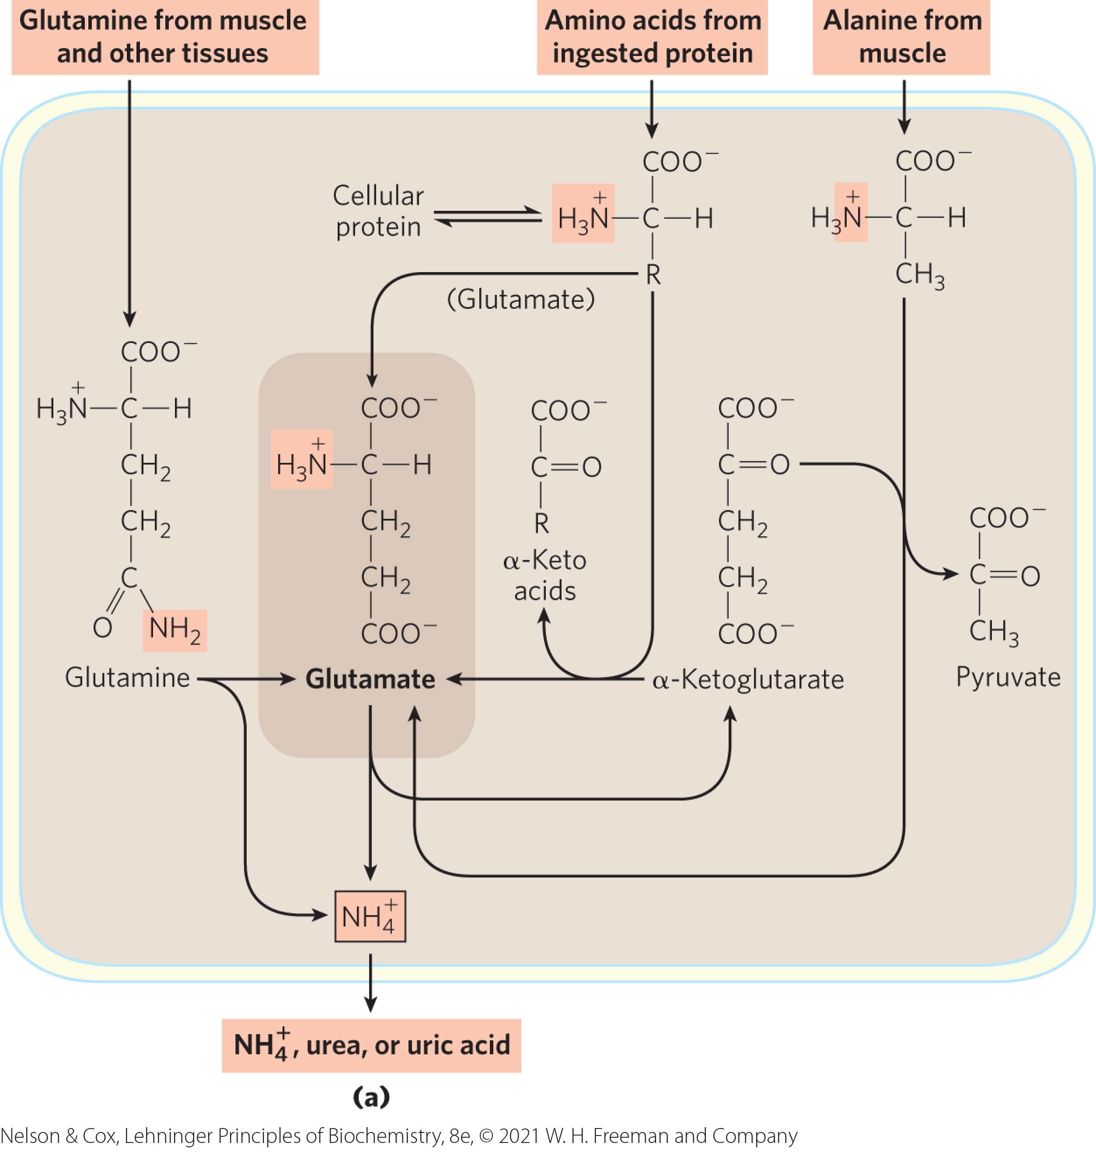
Glutamate Releases Its Amino Group as Ammonia in the Liver
NH₄⁺ in the mitochondria comes from many different α-amino acids in the form of:
  the amino group of L-glutamate
  the amide nitrogen of glutamine

Slide 27
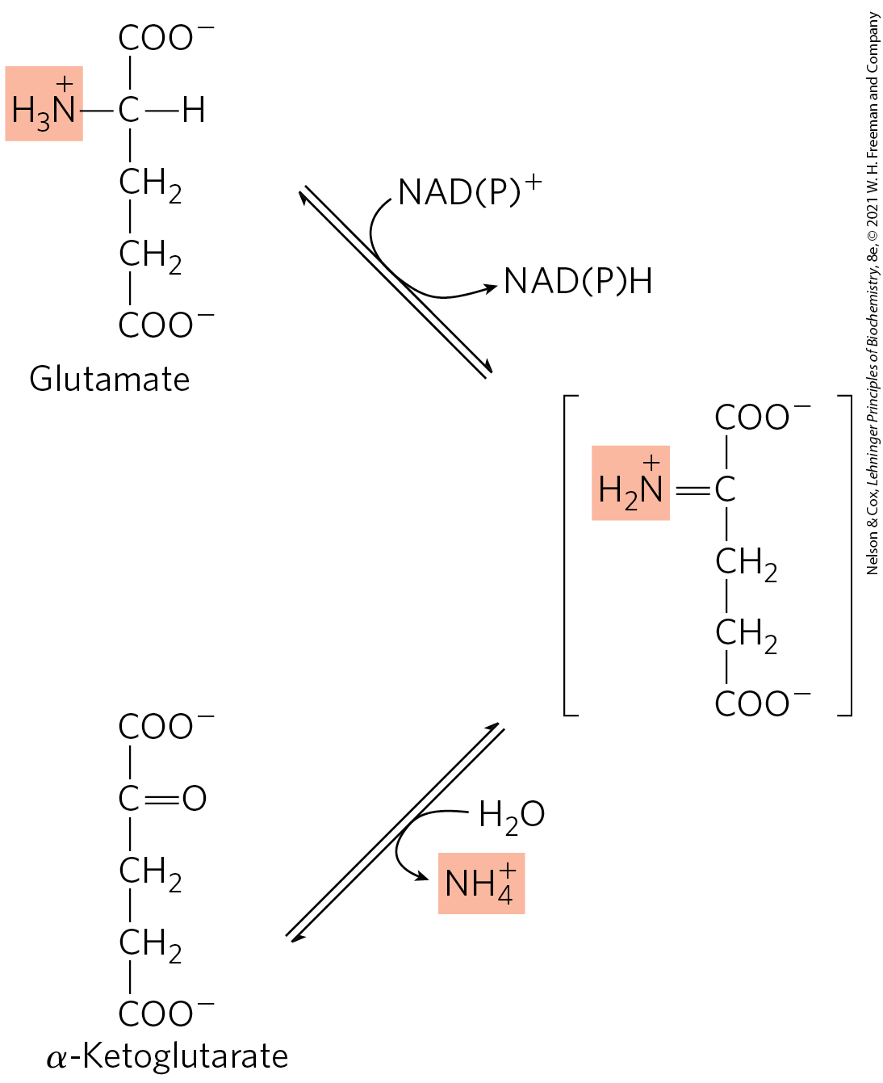
L-Glutamate Dehydrogenase
L-glutamate dehydrogenase = catalyzes the oxidative deamination of glutamate to produce NH₄⁺ and α-ketoglutarate
  present in the mitochondrial matrix
  can use either NAD⁺ or NADP⁺
α-ketoglutarate can enter the citric acid cycle or be used for glucose synthesis

Slide 28
Transdeamination Reactions
transdeamination reactions = result from the combined action of an aminotransferase and glutamate dehydrogenase

Slide 29
Glutamate Dehydrogenase Operates at an Important Intersection in Carbon and Nitrogen Metabolism
α-ketoglutarate product can be oxidized as fuel or serve as a glucose precursor in gluconeogenesis
glutamate dehydrogenase is:
  positively modulated by ADP (signals low glucose levels)
  negatively modulated by GTP (signals high levels of α-ketoglutarate)

Slide 30
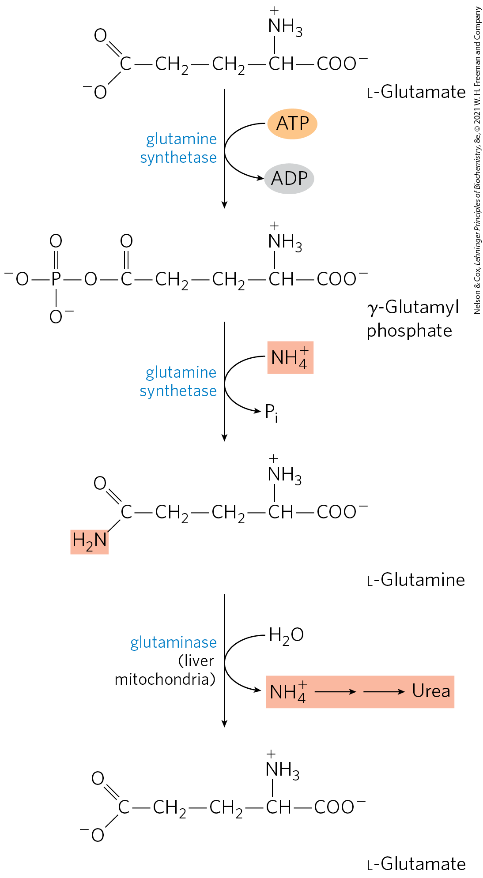
Glutamine Transports Ammonia in the Bloodstream
glutamine synthetase = catalyzes the combination of free ammonia with glutamate to yield glutamine
  requires ATP
  critical to transport toxic ammonia to the liver
glutaminase = catalyzes the conversion of glutamine to glutamate and NH₄⁺

Slide 31
Alanine Transports Ammonia from Skeletal Muscles to the Liver
skeletal muscles produce pyruvate, lactate, and ammonia
alanine aminotransferase = interconverts pyruvate and alanine via transamination with glutamate

Slide 32
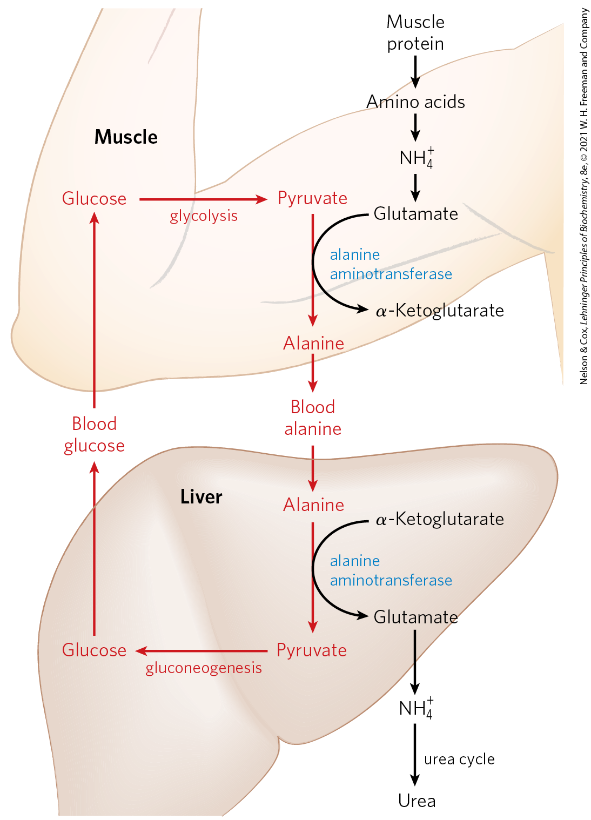
The Glucose-Alanine Cycle
glucose-alanine cycle = pathway by which alanine carries ammonia and the carbon skeleton from pyruvate to the liver
  ammonia is excreted
  pyruvate is used to produce glucose, which is returned to the muscle

Slide 33
Ammonia Is Toxic to Animals
free ammonia is toxic, especially to the brain
NH₄⁺ competes with K⁺ for transport into astrocyte cells through Na⁺K⁺ ATPase
  results in elevated extracellular [K⁺]
Na⁺-K⁺-2Cl⁻ cotransporter 1 (NKCC1) = symporter that transports Na⁺, K⁺, and Cl⁻
  excess Cl⁻ from the excess K⁺ alters neuronal response to the neurotransmitter GABA

Slide 34
18.2 Nitrogen Excretion and the Urea Cycle

Slide 35
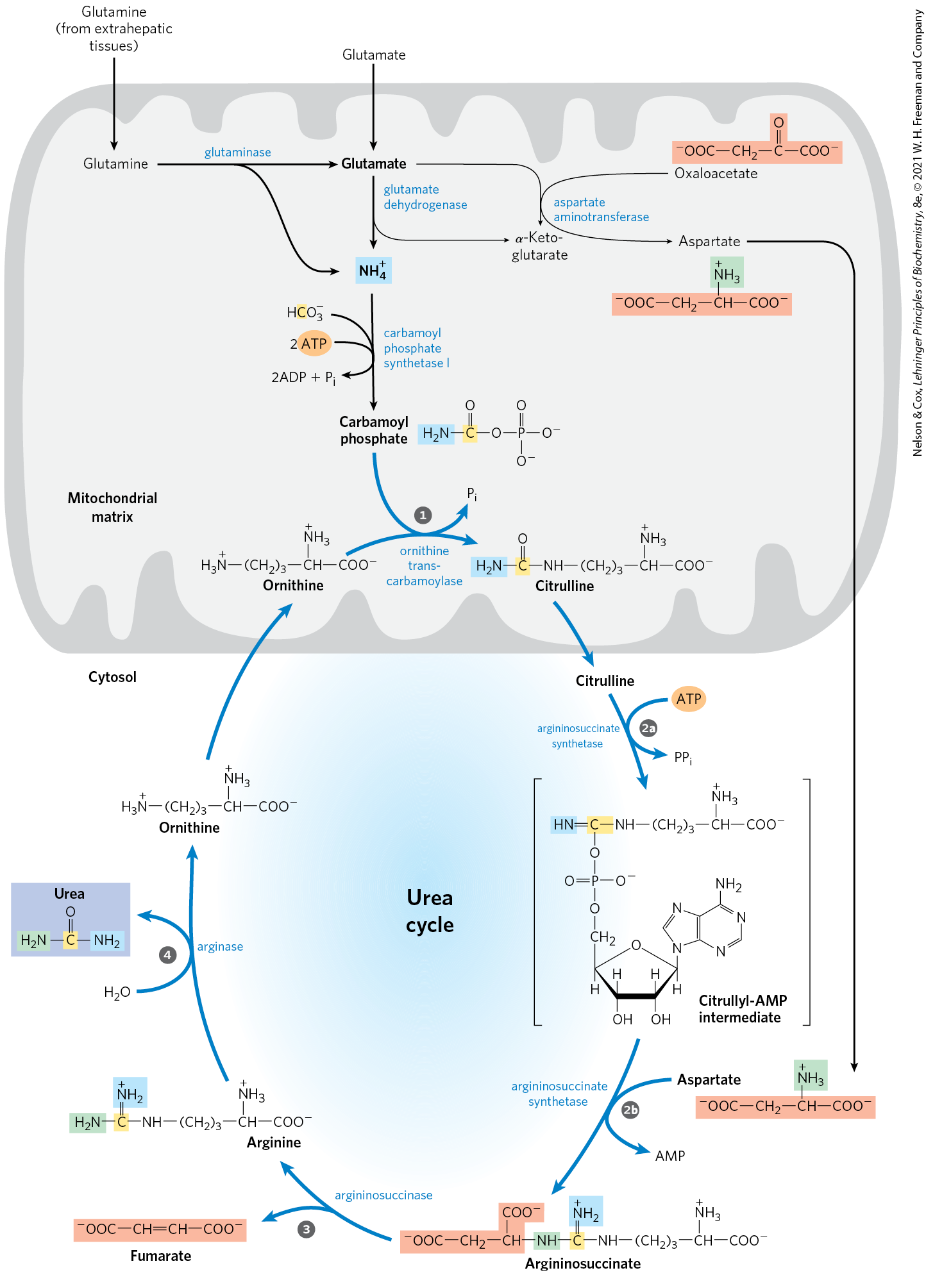
The Urea Cycle
urea cycle = pathway by which the ammonia deposited in the mitochondria of hepatocytes is converted to urea
  urea enters the bloodstream and is excreted into the urine
  enzymes are clustered in metabolons

Slide 36
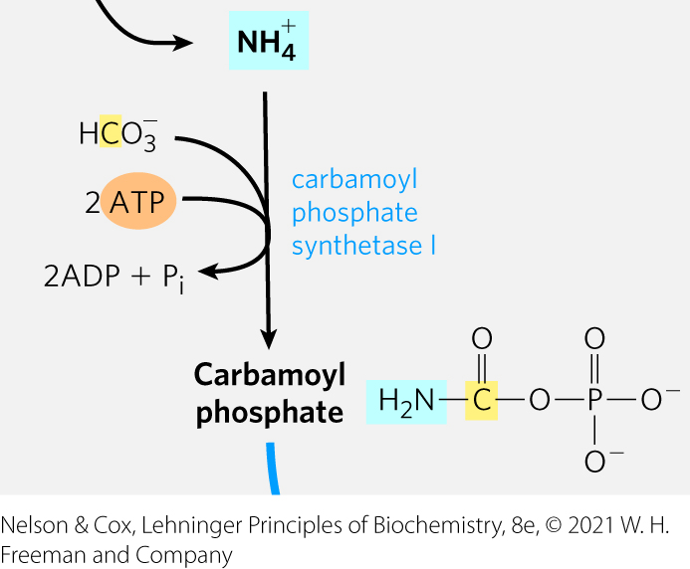
Urea Is Produced from Ammonia in Five Enzymatic Steps
carbamoyl phosphate synthetase I = catalyzes the formation of carbamoyl phosphate from NH₄⁺ and CO₂ (as HCO₃⁻)
  requires 2 ATP
  occurs in the mitochondrial matrix

Slide 37
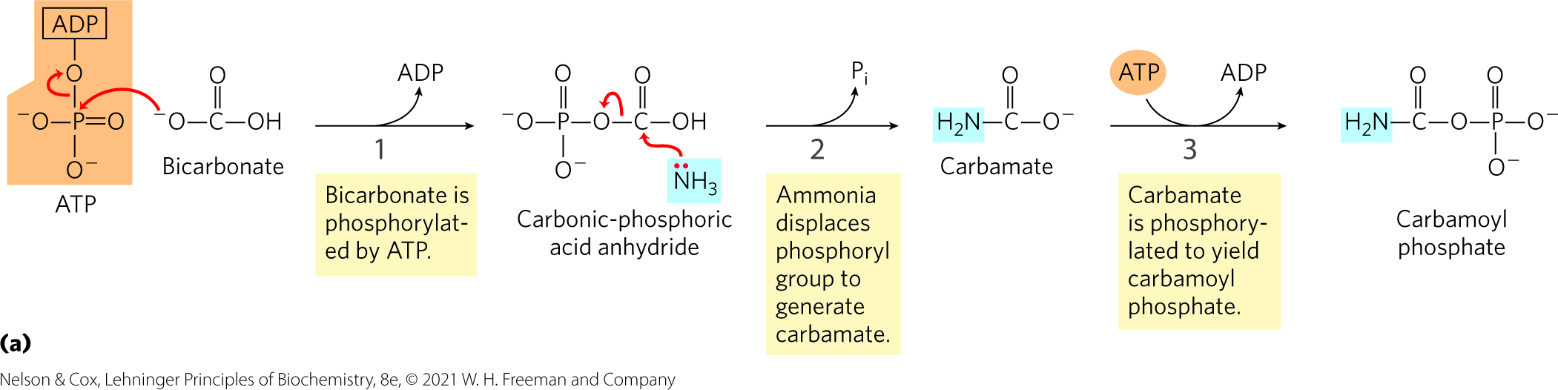
The Carbamoyl Phosphate Synthetase I Reaction
the first nitrogen enters from ammonia in the reaction catalyzed by carbamoyl phosphate synthetase I
the reaction has two activation steps that require ATP

Slide 38
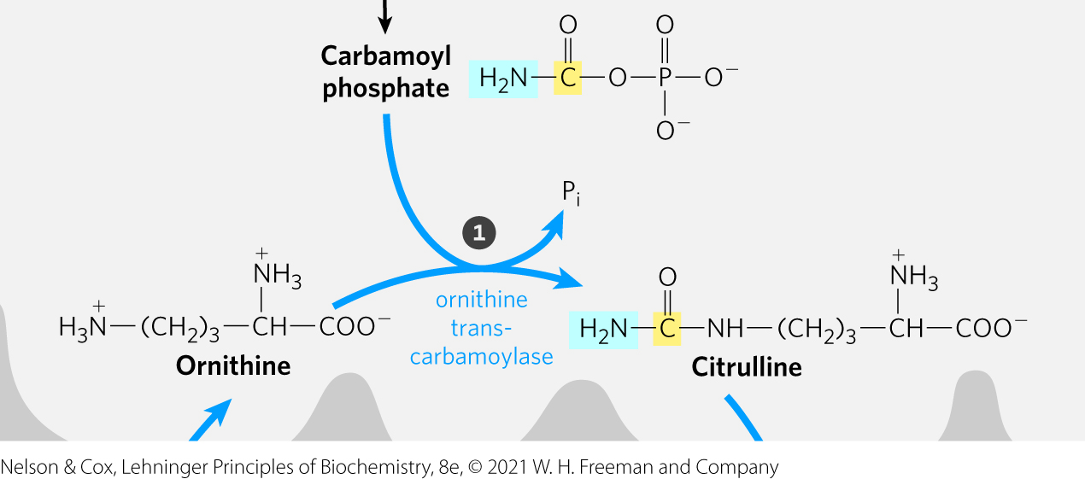
The Formation of Citrulline
ornithine transcarbamoylase = catalyzes the formation of citrulline and P_{i} from ornithine and carbamoyl phosphate

Slide 39
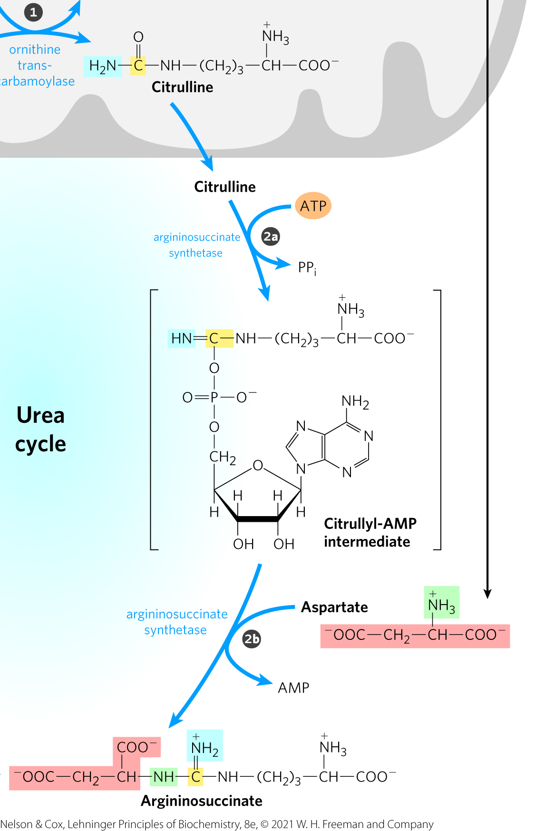
The Formation of Argininosuccinate
citrulline passes from the mitochondrion to the cytosol
argininosuccinate synthetase = catalyzes the condensation of the amino group of aspartate and the ureido group of citrulline to form argininosuccinate
  requires ATP
  uses a citrullyl-AMP intermediate

Slide 40
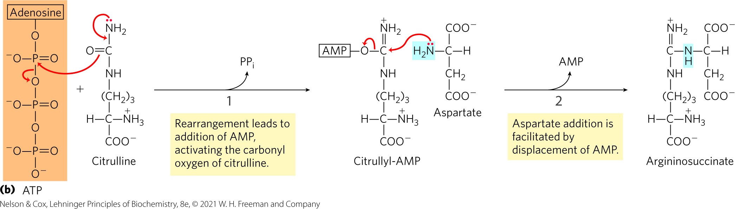
The Argininosuccinate
Synthetase Reaction
the second nitrogen enters from ammonia in the reaction catalyzed by argininosuccinate synthetase
the reaction has two activation steps

Slide 41
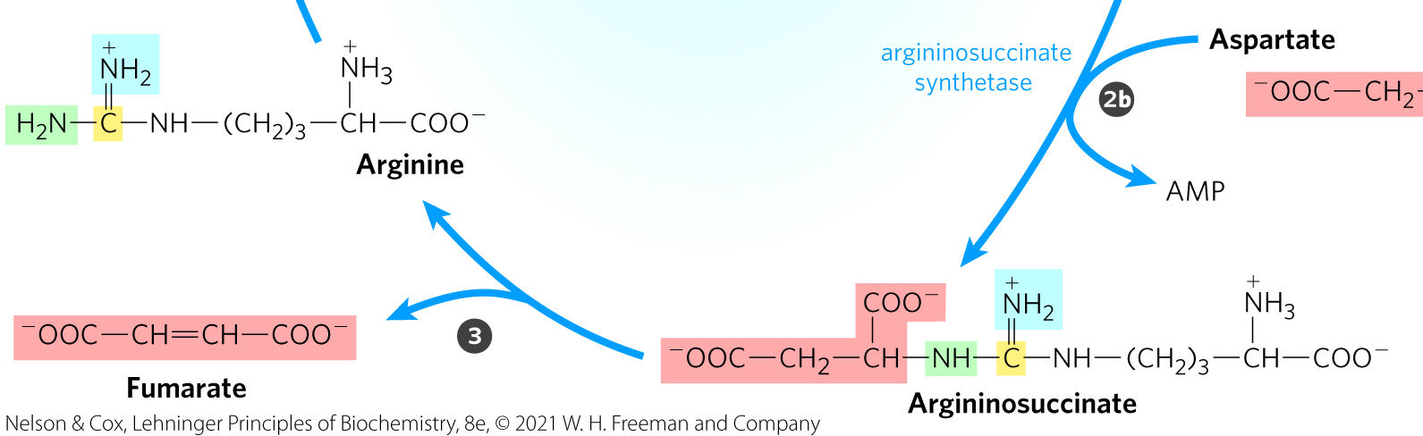
The Formation of Arginine
argininosuccinase = catalyzes the reversible cleavage of argininosuccinate to form arginine and fumarate
  fumarate is converted to malate and joins the pool of citric acid cycle intermediates

Slide 42
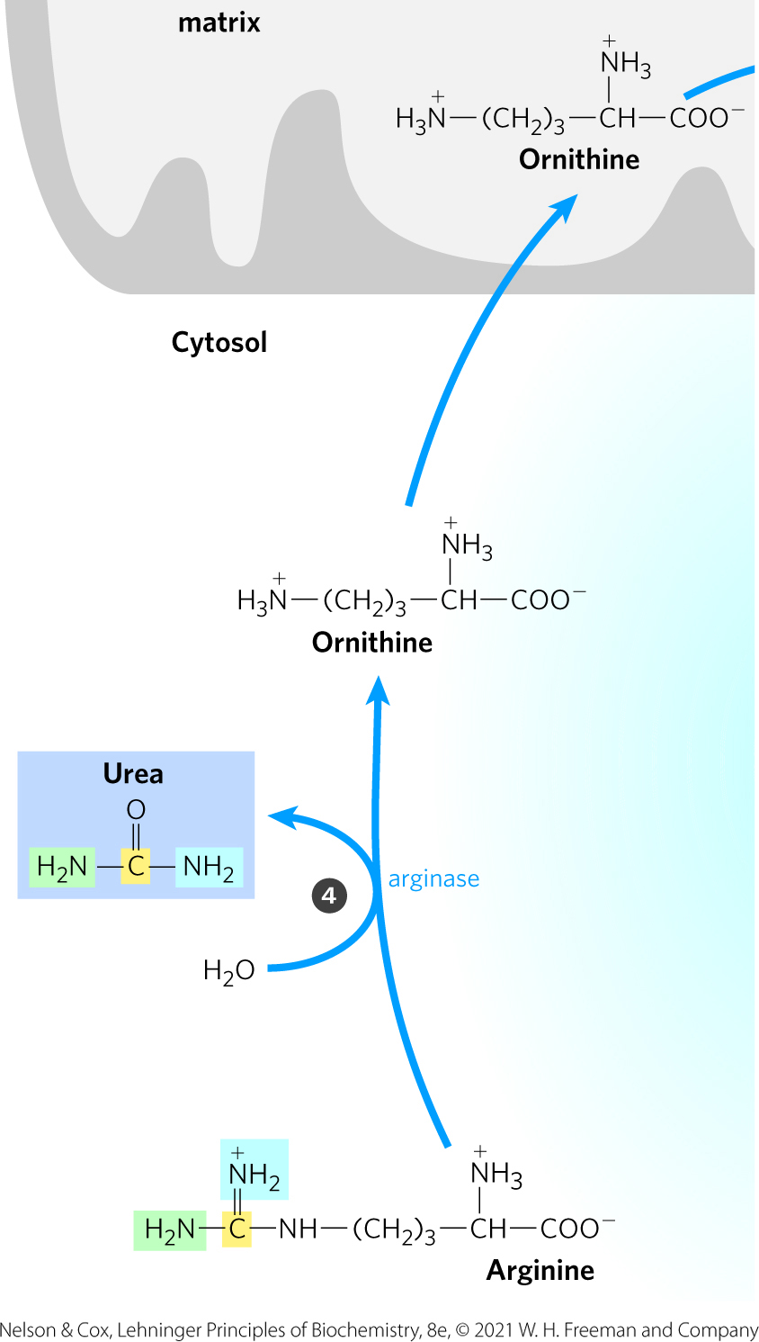
The Formation of Urea
arginase = catalyzes the cleavage of arginine to form urea and ornithine
  ornithine is transported into the mitochondrion to initiate another round

Slide 43
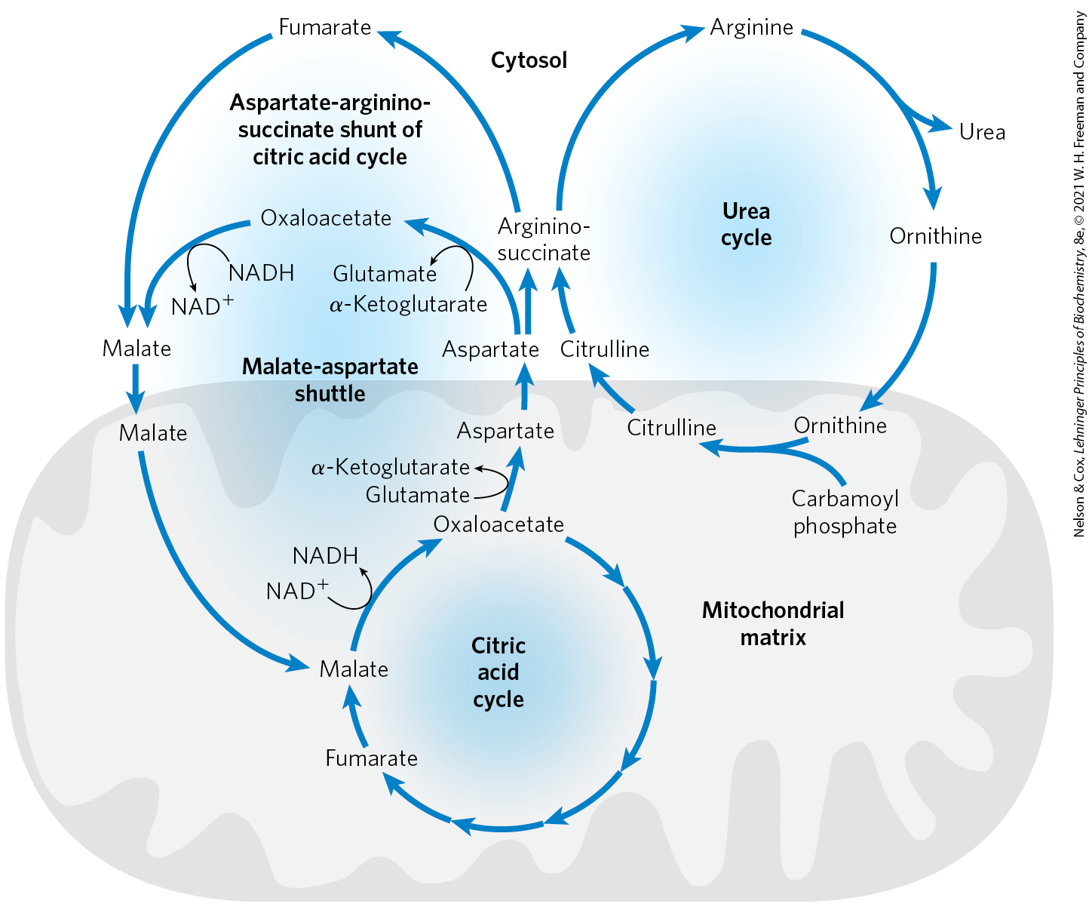
The Citric Acid and Urea Cycles Can Be Linked

Slide 44
Communication Between the Citric Acid and Urea Cycles
communication depends on the transport of key intermediates between the mitochondrion and cytosol:
  malate–α-ketoglutarate transporter
  glutamate-aspartate transporter
  glutamate-OH⁻ transporter

Slide 45
The Aspartate-Argininosuccinate Shunt
aspartate-argininosuccinate shunt = pathways linking the citric acid and urea cycles
  link the fates of the amino groups and the carbon skeletons of amino groups

Slide 46
Aspartate as a Nitrogen Donor
this pathway for nitrogen incorporation is one of the two common ways to introduce amino groups into biomolecules
the urea and citric acid cycles are closely tied to an additional process that brings NADH, in the form of reducing equivalents, into the mitochondrion

Slide 47
The Activity of the Urea Cycle Is Regulated at Two Levels
the urea cycle is regulated:
  at the level of enzyme synthesis for:
    the four urea cycle enzymes
    carbamoyl phosphate synthetase I
  by allosteric regulation of carbamoyl phosphate synthetase I

Slide 48
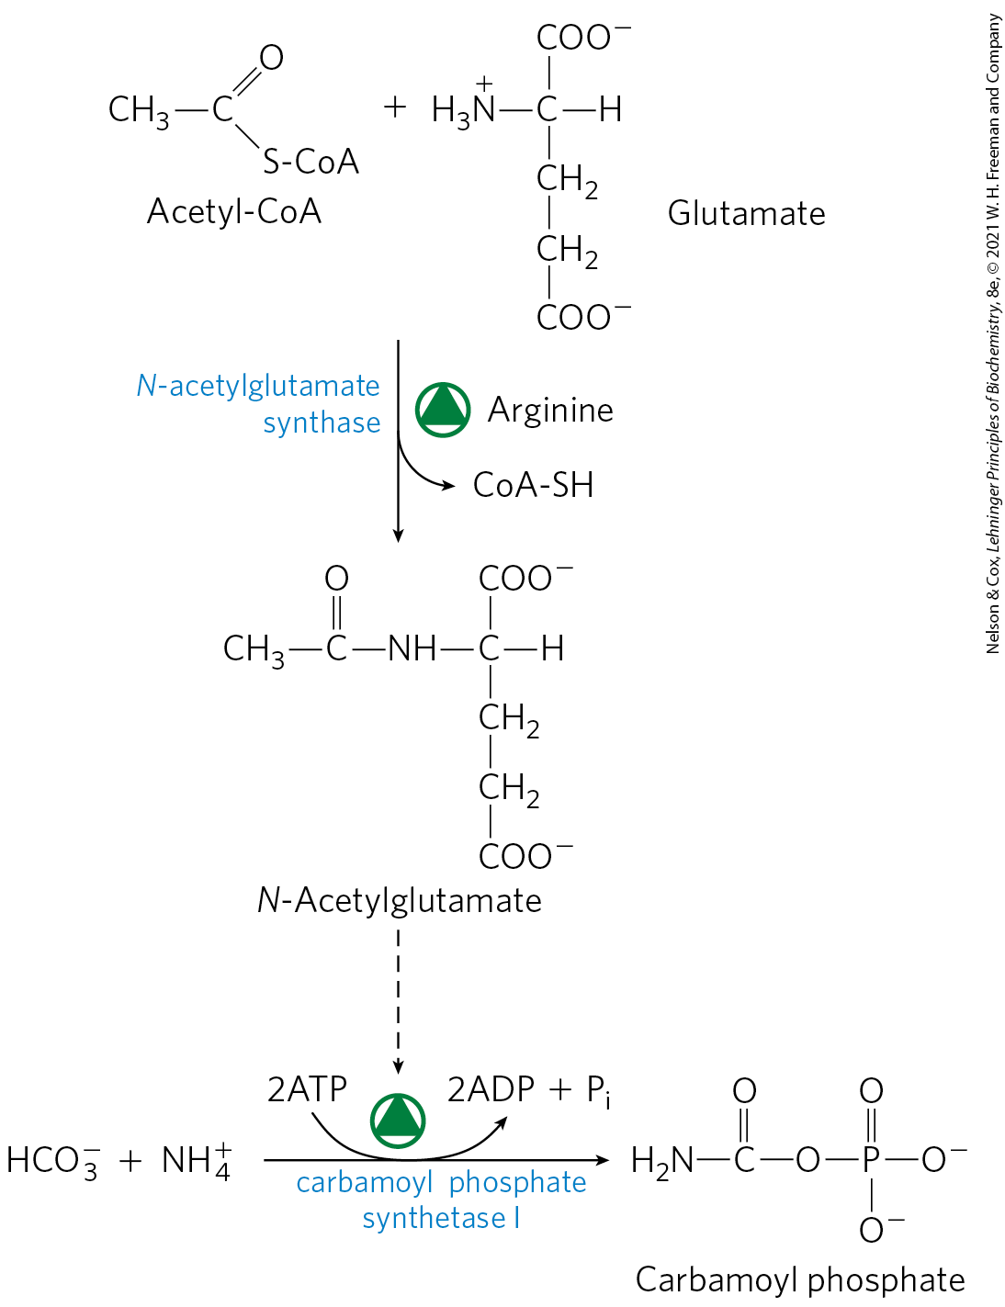
Synthesis of N-Acetylglutamate and Its Activation of Carbamoyl Phosphate Synthetase I
N-acetylglutamate synthase = catalyzes the formation of N-acetylglutamate from acetyl-CoA and glutamate
N-acetylglutamate = allosterically activates carbamoyl phosphate synthetase I

Slide 49
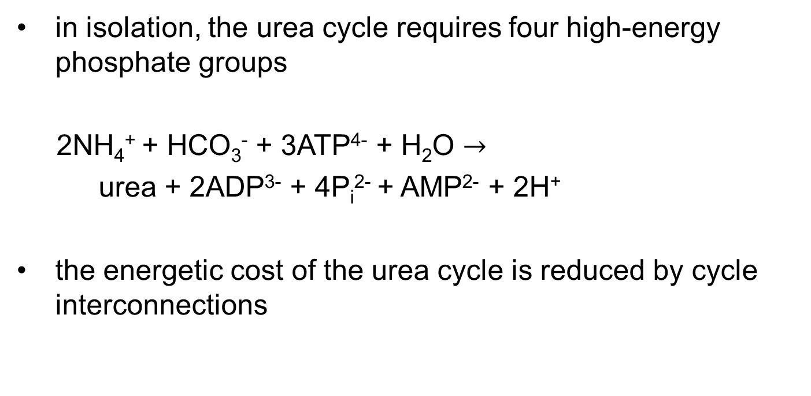
Pathway Interconnections Reduce the Energetic Cost of Urea Synthesis
in isolation, the urea cycle requires four high-energy phosphate groups
2NH₄⁺ + HCO₃⁻ + 3ATP⁴⁻ + H₂O $→$
urea + 2ADP³⁻ + 4P_{i}²⁻ + AMP²⁻ + 2H⁺
the energetic cost of the urea cycle is reduced by cycle interconnections

Slide 50
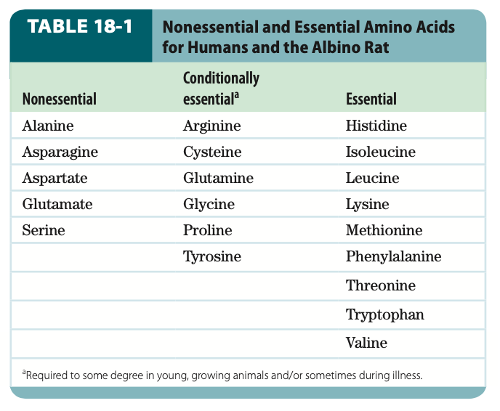
Genetic Defects in the Urea Cycle Can Be Life-Threatening
protein-free diets are not a treatment option for individuals with defects in urea cycle enzyme
essential amino acids = amino acids that cannot be synthesized by humans and must be obtained in the diet

Slide 51
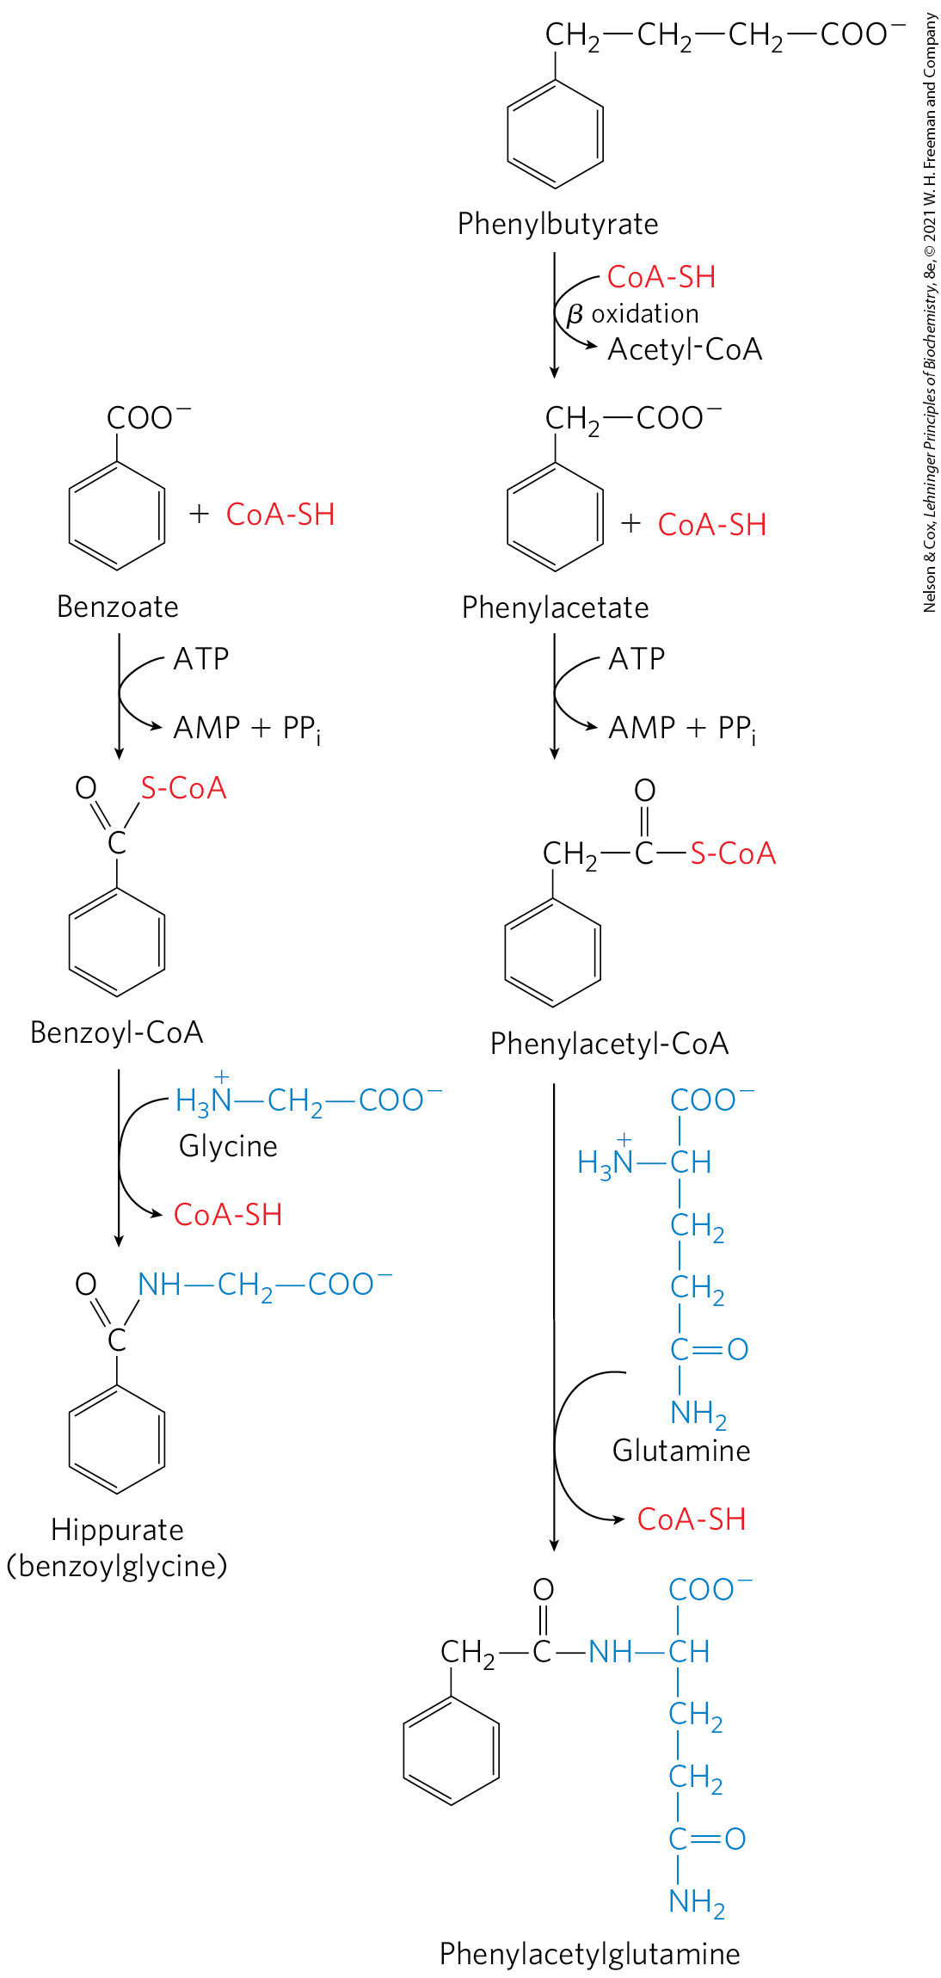
Treatments for Urea Cycle
Enzyme Deficiencies
the aromatic acid benzoate is metabolized and combines with glycine
the aromatic acid phenylbutyrate is metabolized and combines with glutamine

Slide 52
18.3 Pathways of Amino Acid Degradation

Slide 53
Amino Acid Catabolism
accounts for 10-15% of human energy production
the 20 catabolic pathways converge to form six major products (all of which enter the citric acid cycle):
  pyruvate
  acetyl-CoA
  α-ketoglutarate
  succinyl-CoA
  fumarate
  oxaloacetate

Slide 54
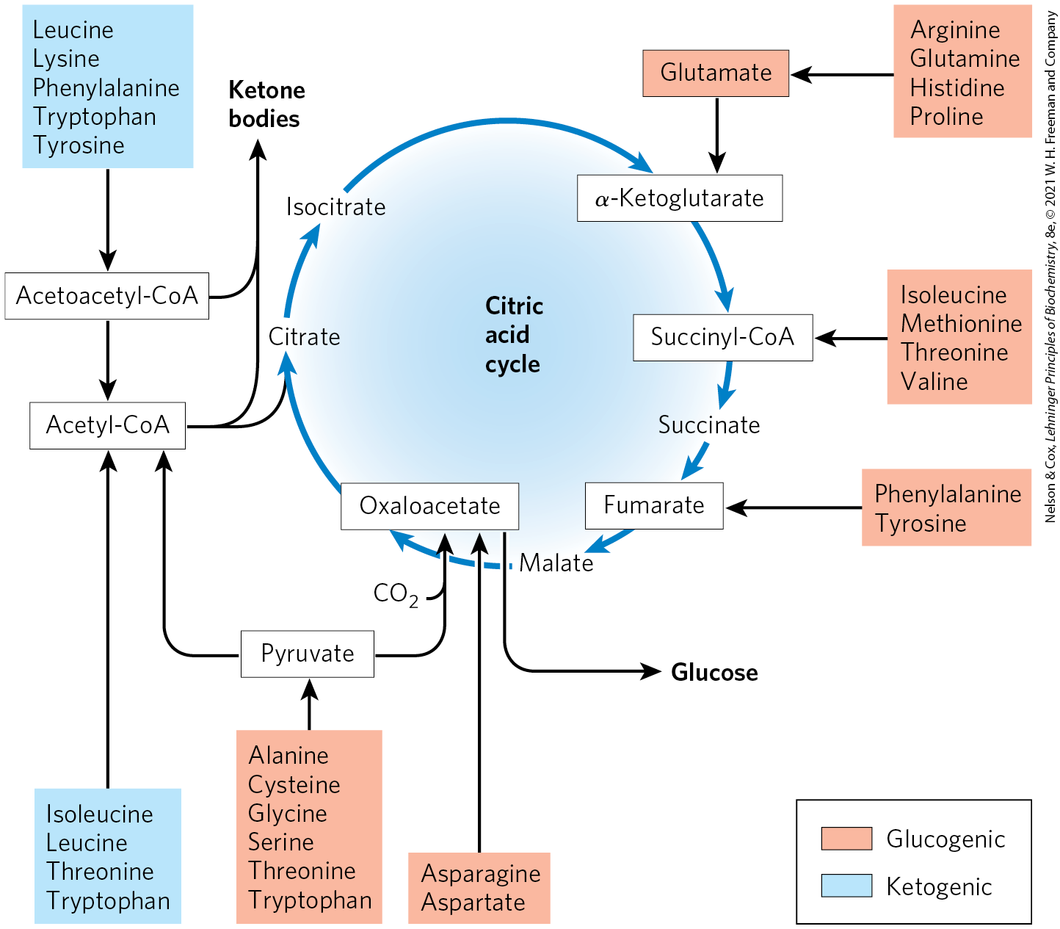
Summary of Amino Acid Catabolism

Slide 55
Some Amino Acids Can Contribute to Gluconeogenesis, Others to Ketone Body Formation
ketogenic amino acids = can yield ketone bodies in the liver
  phenylalanine, tyrosine, isoleucine, leucine, tryptophan, threonine, and lysine
glucogenic amino acids = can be converted to glucose and glycogen
  all amino acids except lysine and leucine

Slide 56
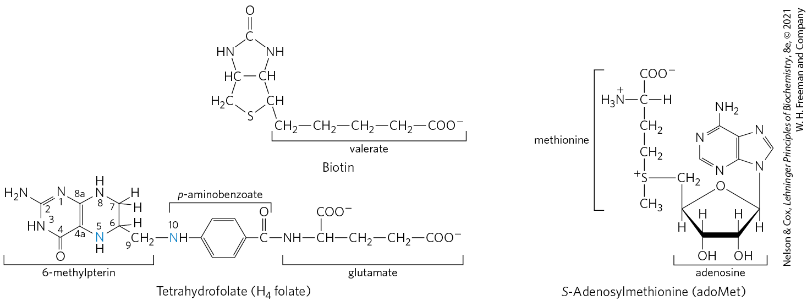
Several Enzyme Cofactors Play Important Roles in Amino Acid Catabolism
one-carbon transfers usually involve one of three cofactors:
  biotin (transfers CO₂)
  tetrahydrofolate (transfers intermediate oxidation states)
  S-adenosylmethionine (transfers methyl groups)

Slide 57
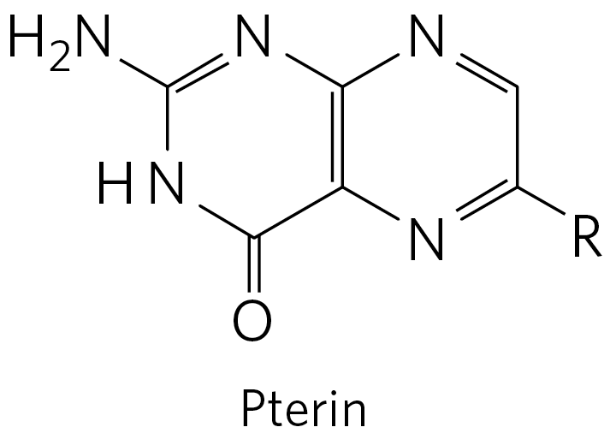
Tetrahydrofolate (H₄ Folate)
tetrahydrofolate (H₄ folate) = consists of substituted pterin (6-methylpterin), p-aminobenzoate, and glutamate moieties
  synthesized in bacteria
folate = the oxidized form of tetrahydrofolate
  converted to tetrahydrofolate in two steps by dihydrofolate reductase

Slide 58
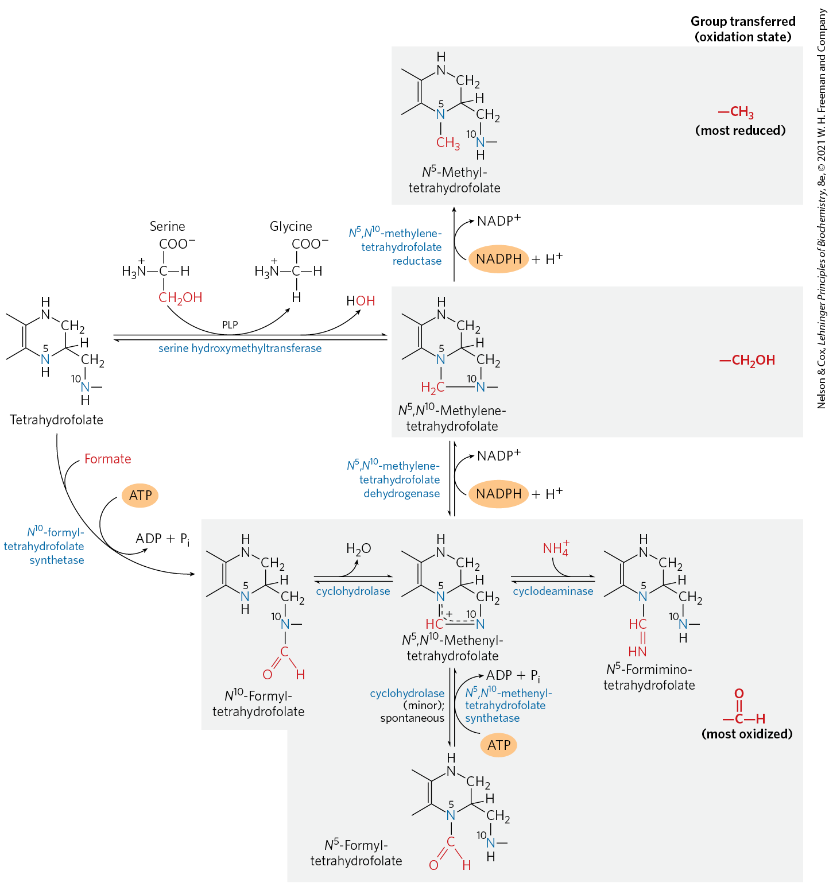
Conversions of One-Carbon Units on Tetrahydrofolate
the one-carbon group is bonded to N-5, N-10, or both

Slide 59
S-Adenosylmethionine (adoMet)
S-adenosylmethionine (adoMet) = preferred cofactor for biological methyl group transfers
  Its methyl group is ~ 1000x more reactive than the methyl group of N⁵-methyltetrahydrofolate
methionine adenosyl transferase = catalyzes the synthesis of S-adenosylmethionine from ATP and methionine
S-adenosylhomocysteine = formed when the methyl group from S-adenosylmethionine is transferred to an acceptor

Slide 60
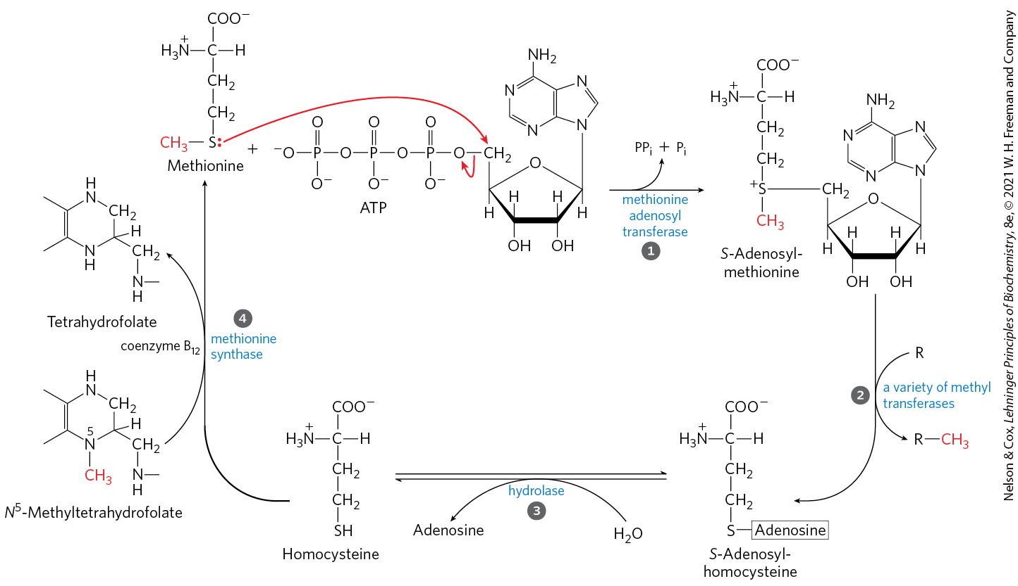
Synthesis of Methionine and
S-Adenosylmethionine

Slide 61
Pernicious Anemia
pernicious anemia = observed in B₁₂ deficiency disease
  traced to the methionine synthase reaction

Slide 62
Megaloblatic Anemia
megaloblastic anemia = observed in vitamin B₁₂ deficiency
  decline in the production of mature erythrocytes
  appearance of immature precursor cells, or megaloblasts, in the bone marrow
  replacement of erythrocytes with a smaller number of abnormally large erythrocytes (macrocytes)
erythocyte defects are due to the depletion of the N⁵,N¹⁰-methylenetetrahydrofolate

Slide 63
Tetrahydrobiopterin
tetrahydrobiopterin = cofactor of amino acid catabolism
  similar to the pterin moiety of tetrahydrofolate
  participates in oxidation reactions

Slide 64
Six Amino Acids Are Degraded to Pyruvate
alanine, tryptophan, cysteine, serine, glycine, and threonine are converted in whole or in part to pyruvate
pyruvate is either converted to:
  acetyl-CoA for oxidation via the citric acid cycle
  oxaloacetate to enter gluconeogenesis

Slide 65
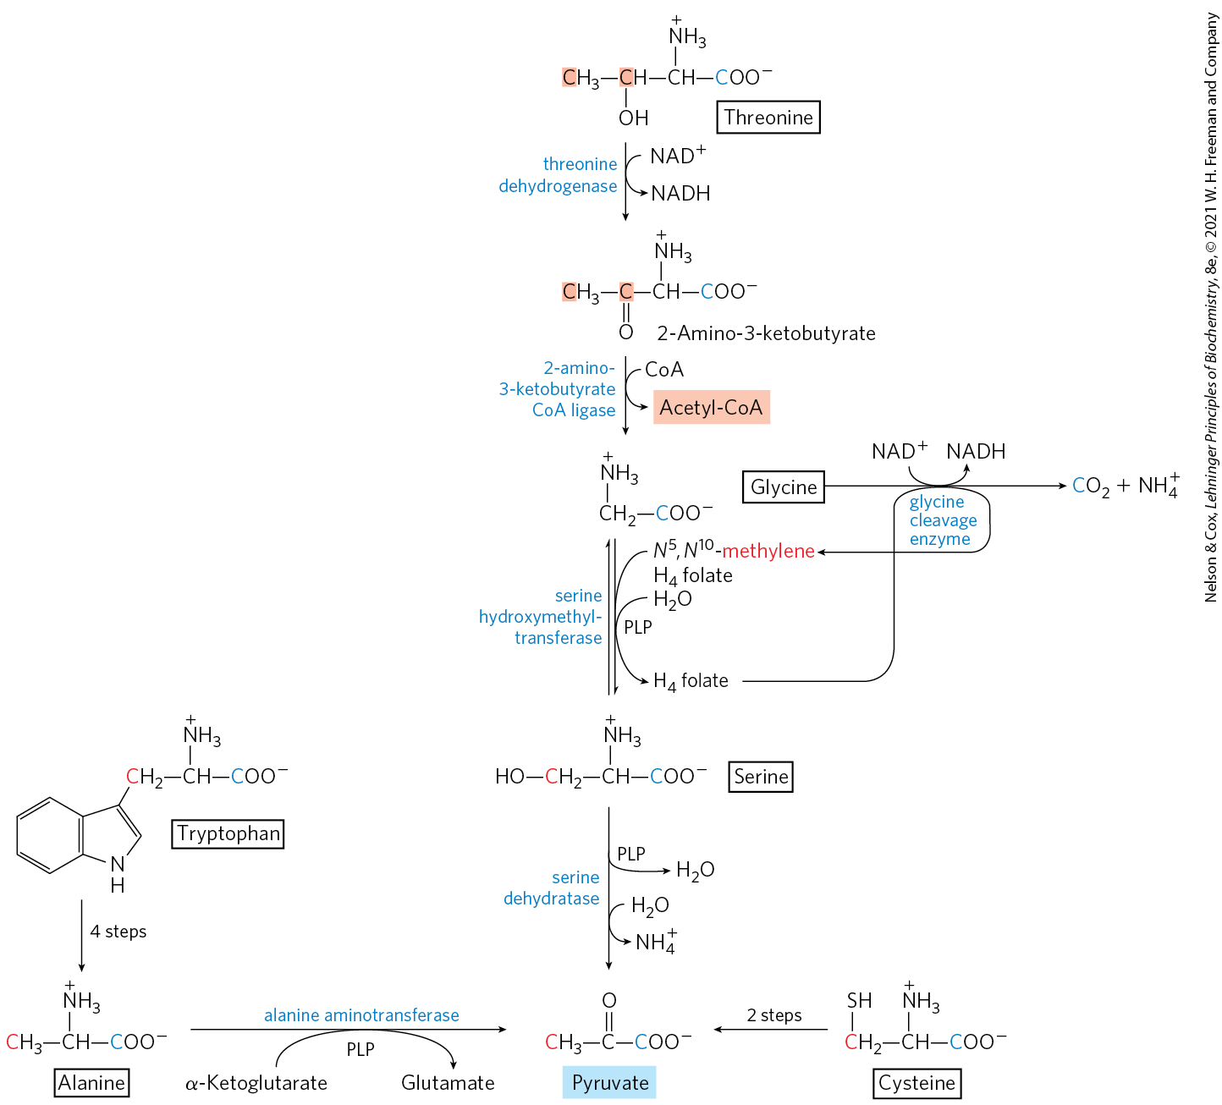
Amino Acid Degradation to Pyruvate

Slide 66
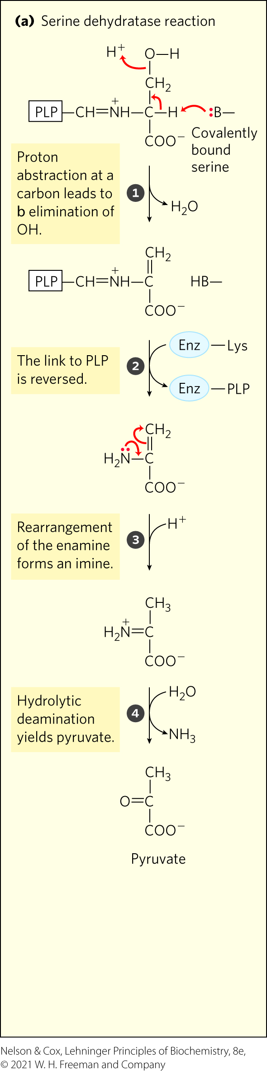
Serine Dehydratase
serine dehydratase = catalyzes the conversion of serine to pyruvate
  removes both the β-hydroxyl and the α-amino groups of serine
  pyridoxal phosphate–dependent reaction

Slide 67
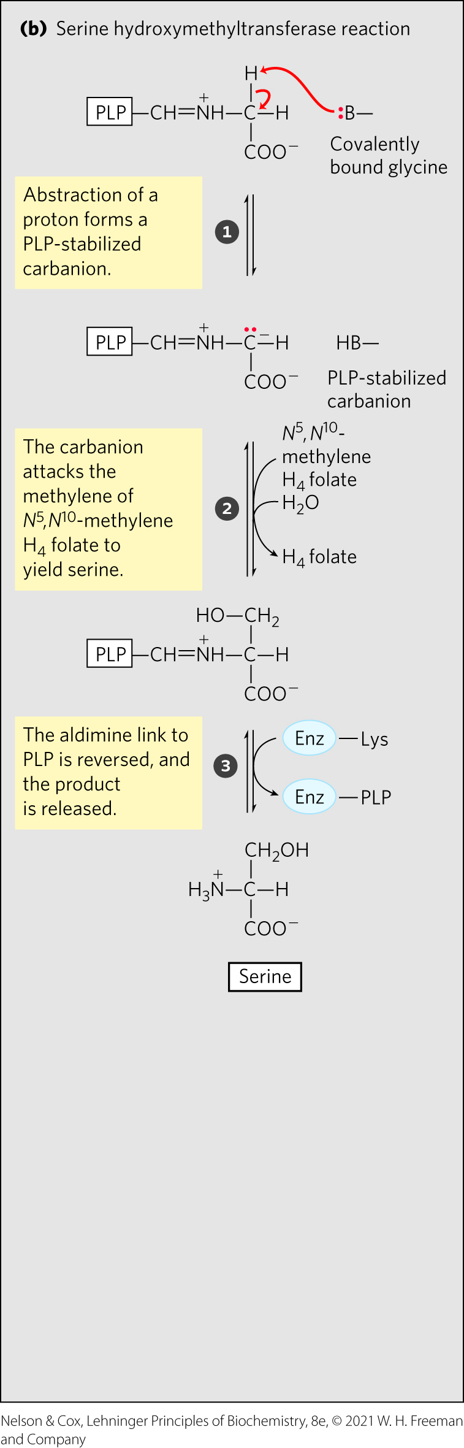
Glycine Degradation by Serine Hydroxymethyltransferase
serine hydroxymethyltransferase = catalyzes the enzymatic addition of a hydroxymethyl group to glycine to yield serine
  requires tetrahydrofolate and pyridoxal phosphate

Slide 68
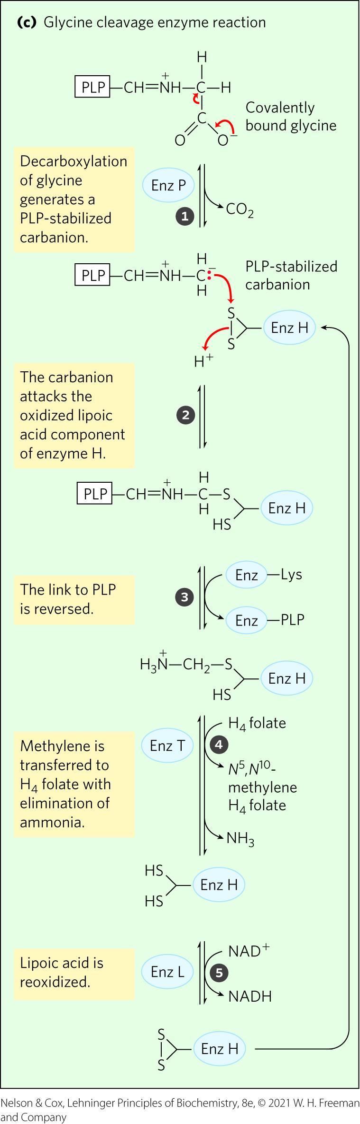
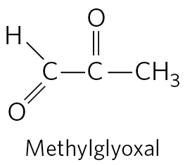
Glycine Degradation by Glycine Cleavage Enzyme
glycine cleavage enzyme = catalyzes the reversible oxidative cleavage of glycine to CO₂, NH₄⁺, and a methylene group
  requires tetrahydrofolate
  enzymatic defects causes the formation of methylglyoxal, which modifies proteins and DNA

Slide 69
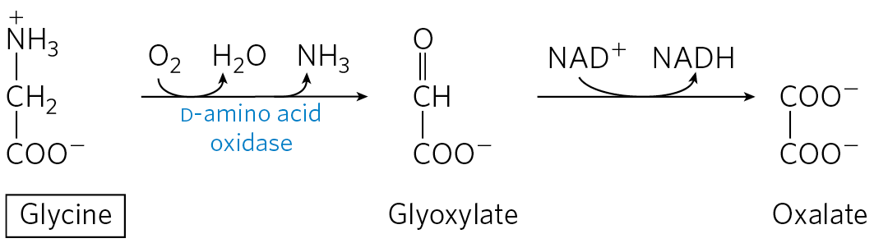
Glycine Degradation by D-Amino Acid Oxidase
D-amino acid oxidase = catalyzes the conversion of glycine to glyoxylate, which is oxidized to oxalate
calcium oxalate crystals account for up to 75% of all kidney stones

Slide 70
Genetic Defects of Amino Acid Metabolism
Table 18-2 Some Human Genetic Disorders Affecting Amino Acid Catabolism
Medical condition | Approximate incidence (per 100,000 births) | Defective process | Defective enzyme | Symptoms and effect
Albinism | < 3 | Melanin synthesis from tyrosine | Tyrosine 3-monooxygenase (tyrosinase) | Lack of pigmentation; white hair, pink skin
Alkaptonuria | < 0.4 | Tyrosine degradation | Homogentisate 1,2-dioxygenase | Dark pigment in urine; late-developing arthritis
Argininemia | < 0.5 | Urea synthesis | Arginase | Intellectual disability
Argininosuccinic acidemia | < 1.5 | Urea synthesis | Argininosuccinase | Vomiting; convulsions
Carbamoyl phosphate synthetase I deficiency | < 0.5 | Urea synthesis | Carbamoyl phosphate synthetase I | Lethargy; convulsions; early death
Homocystinuria | < 0.5 | Methionine degradation | Cystathionine β-synthase | Faulty bone development; intellectual disability
Maple syrup urine disease (branched-chain ketoaciduria) | < 0.4 | Isoleucine, leucine, and valine degradation | Branched-chain α-keto acid dehydrogenase complex | Vomiting; convulsions; intellectual disability; early death
Methylmalonic acidemia | < 0.5 | Conversion of propionyl-CoA to succinyl-CoA | Methylmalonyl-CoA mutase | Vomiting; convulsions; intellectual disability; early death
Phenylketonuria | < 8 | Conversion of phenylalanine to tyrosine | Phenylalanine hydroxylase | Neonatal vomiting; intellectual disability

Slide 71
Seven Amino Acids Are Degraded to Acetyl-CoA
leucine, lysine, phenylalanine, tyrosine, and tryptophan yield acetyl-CoA via acetoacetyl-CoA
isoleucine, leucine, threonine, and tryptophan form acetyl-CoA directly

Slide 72
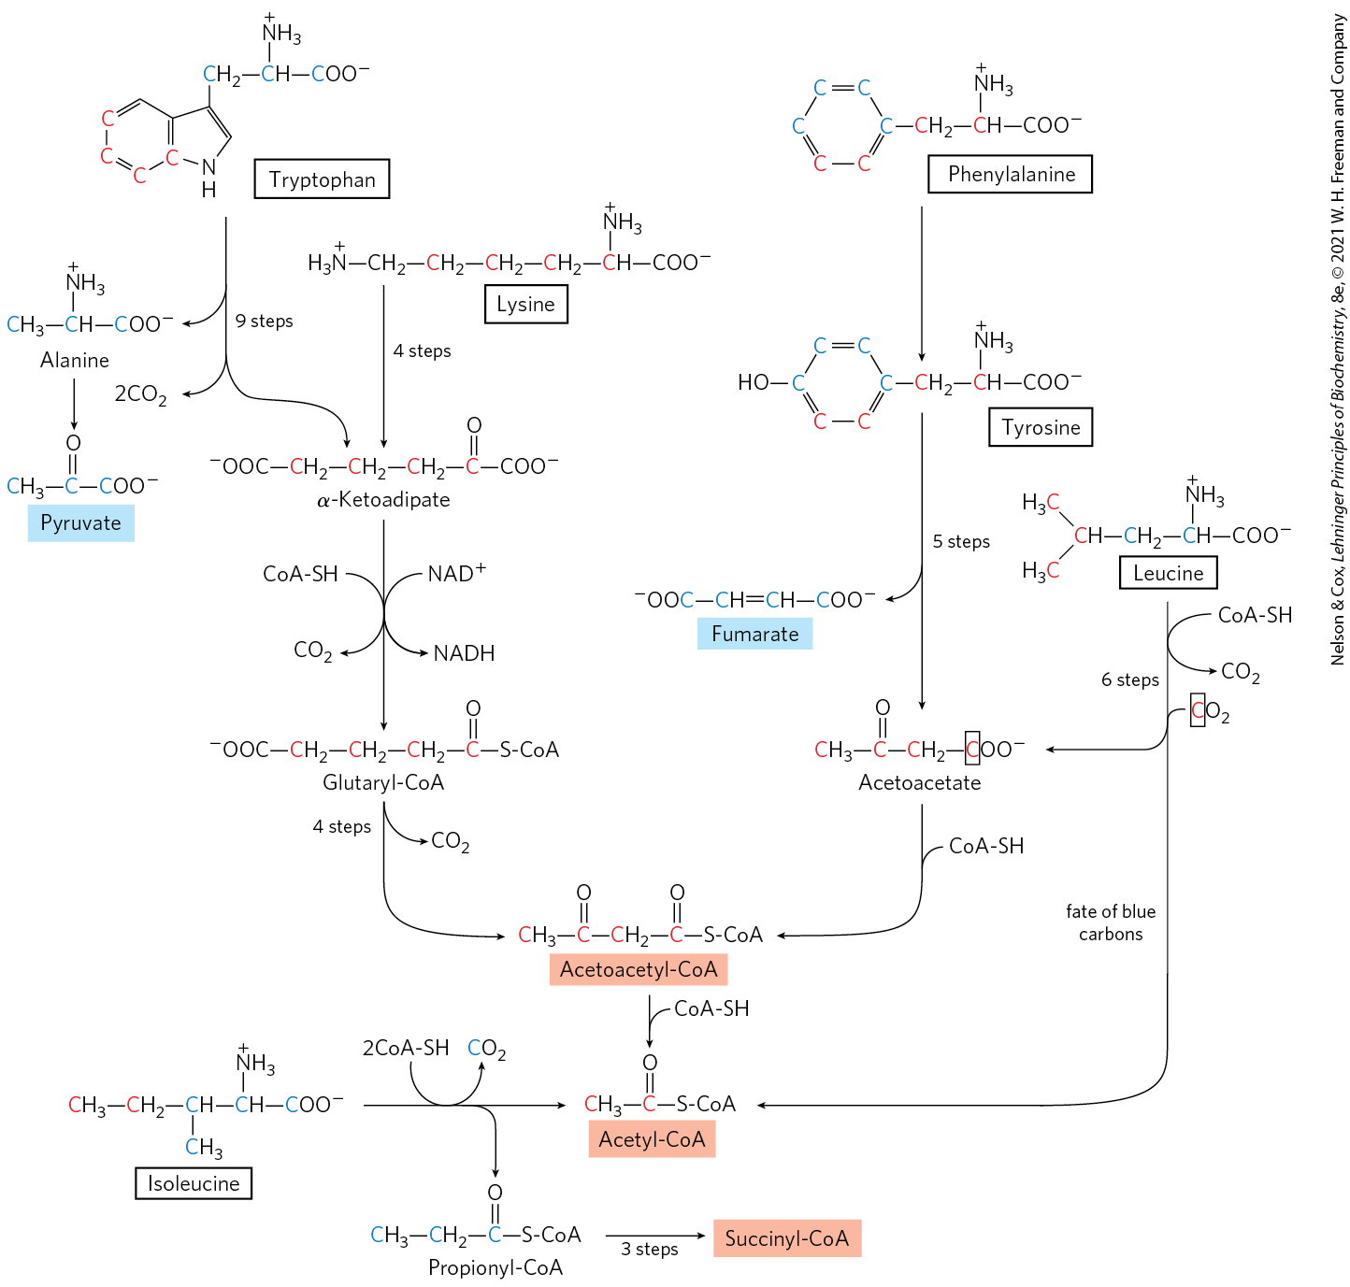
Amino Acid Degradation to
Acetyl-CoA

Slide 73
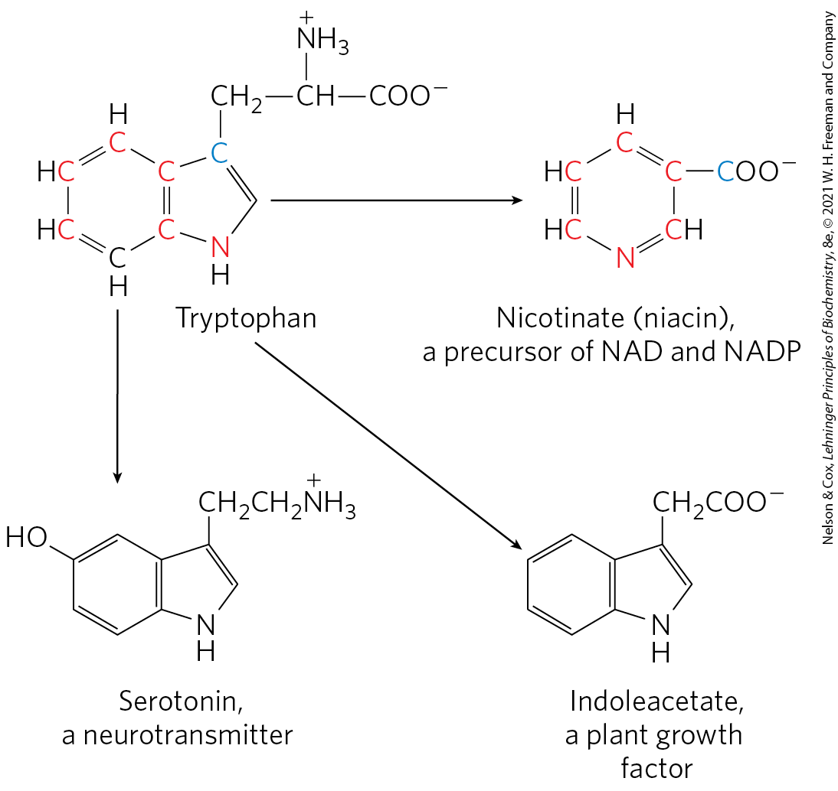
Tryptophan Breakdown
most complex of all the pathways of amino acid catabolism
some catabolic intermediates are precursors for the synthesis of other biomolecules

Slide 74
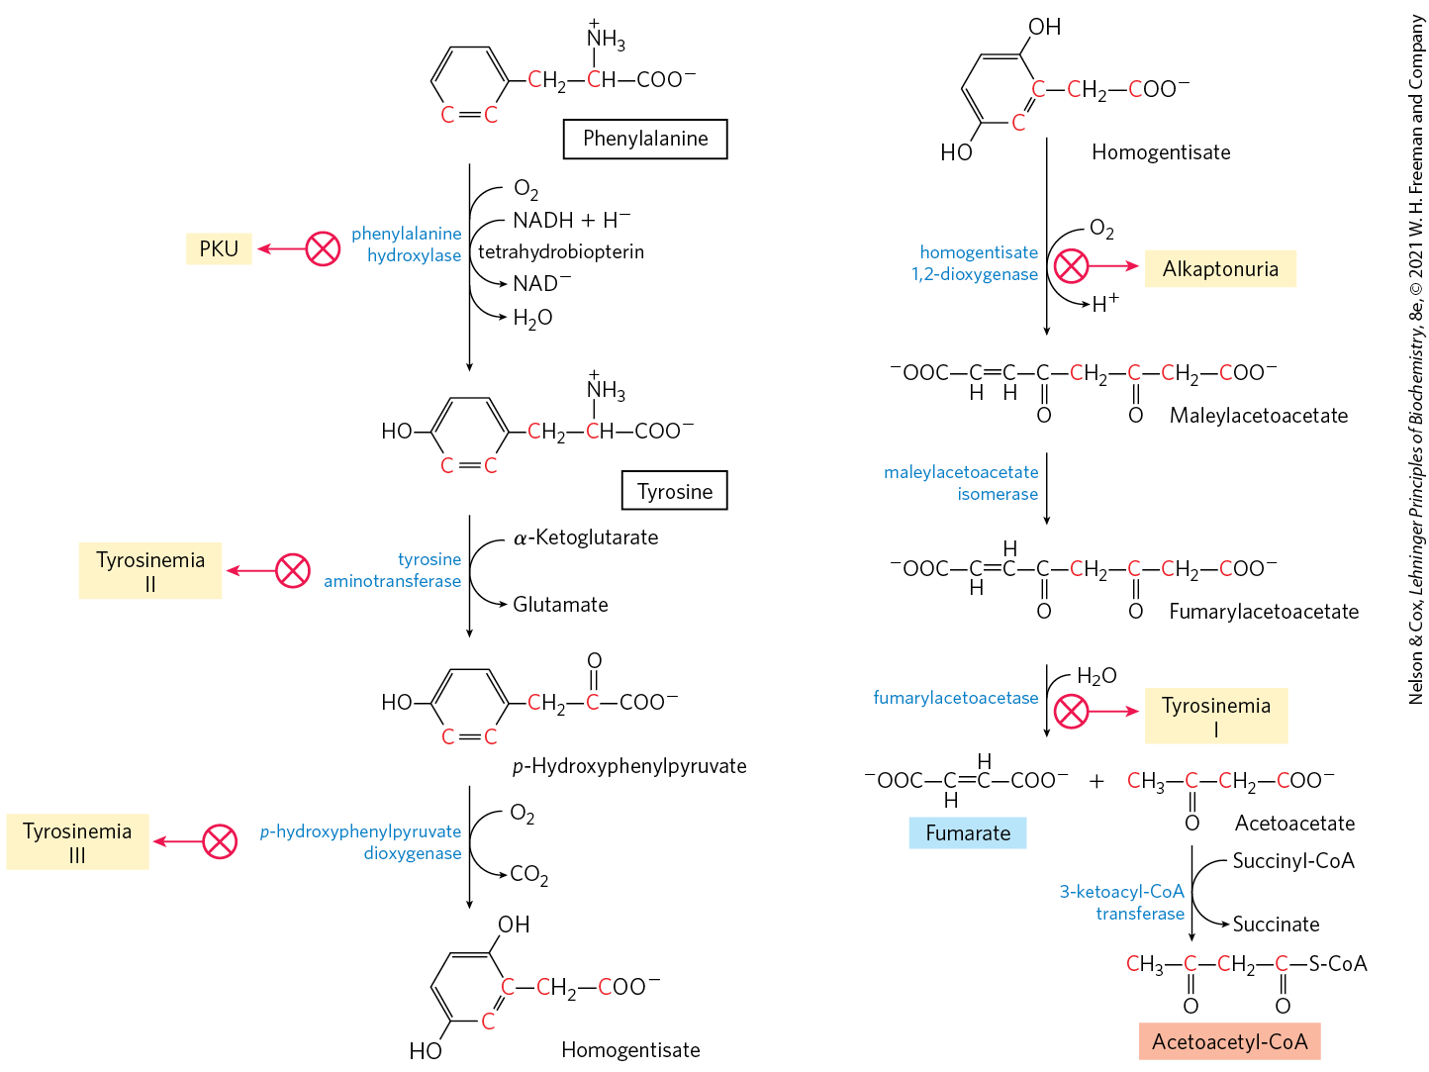
Catabolic Pathways for Phenylalanine and Tyrosine
phenylalanine and tyrosine are degraded into acetoacetyl-CoA (and thus acetyl-CoA) and fumarate
genetic defects in pathway enzymes lead to inheritable diseases

Slide 75
Phenylalanine Catabolism Is Genetically Defective in Some People
many amino acids are either neurotransmitters or precursors or antagonists of neurotransmitters
genetic defects of amino acid metabolism can cause defective neural development and intellectual deficits

Slide 76
Phenylketonuria (PKU)
phenylketonuria (PKU) = disease caused by a genetic defect in phenylalanine hydroxylase
  most common cause of elevated levels of phenylalanine in the blood
  treated with dietary intervention

Slide 77
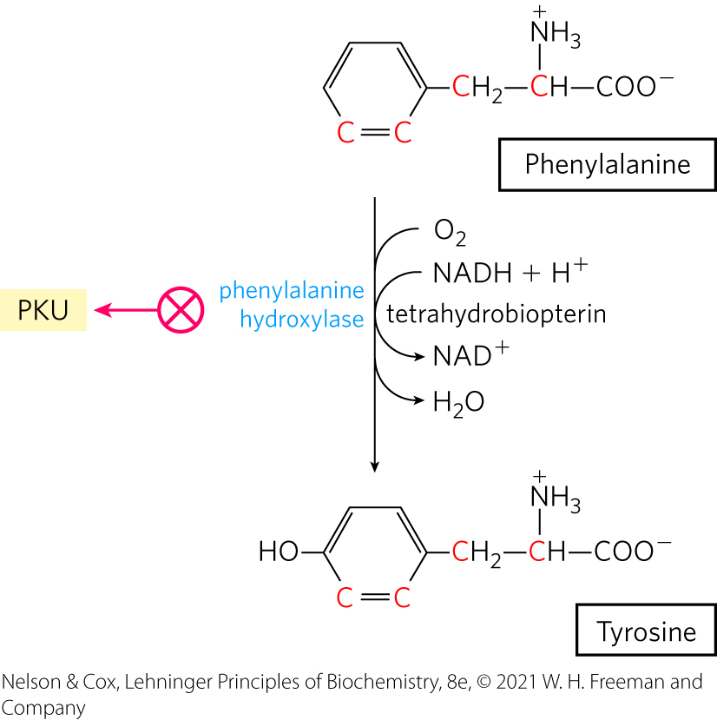
Phenylalanine Hydroxylase
phenylalanine hydroxylase = the first enzyme in the catabolic pathway for phenylalanine
  requires the cofactor tetrahydrobiopterin
  part of the mixed-function oxygenase enzyme class (catalyzes hydroxylation of a substrate by an oxygen atom of O₂ and reduction of the other oxygen atom to H₂O)

Slide 78
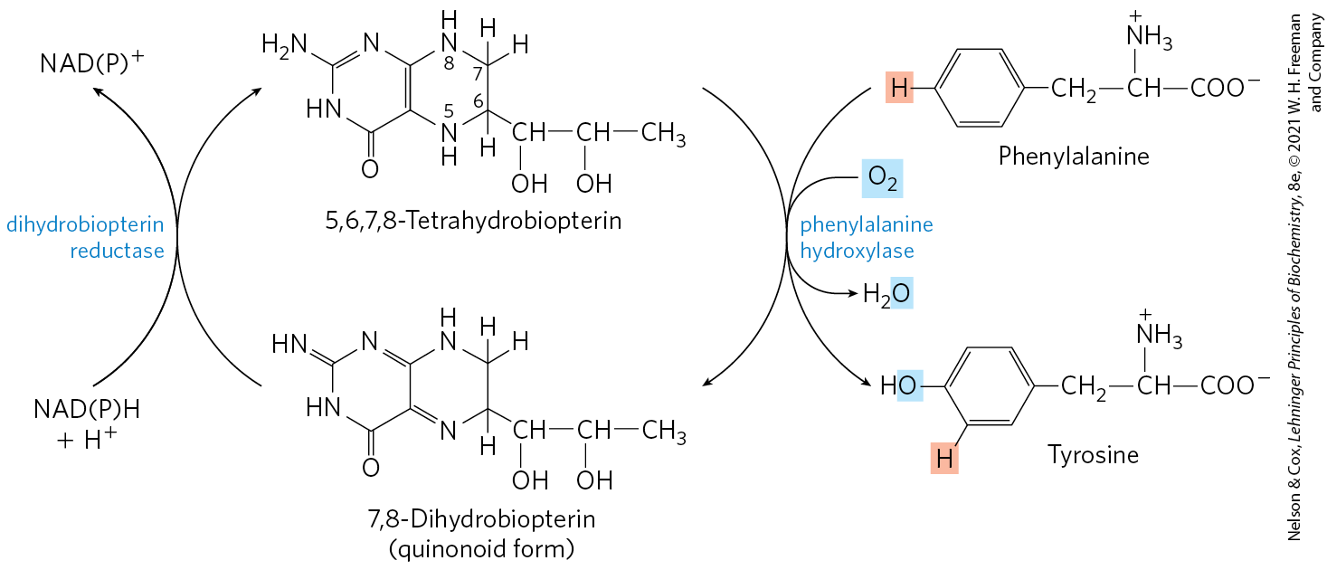
Role of Tetrahydrobiopterin in the Phenylalanine Hydroxylase Reaction
tetrahydrobiopterin carries electrons from NADPH to O₂ and becomes oxidized to dihydrobiopterin
dihydrobiopterin reductase = catalyzes the reduction of dihydrobiopterin to tetrahydrobiopterin

Slide 79
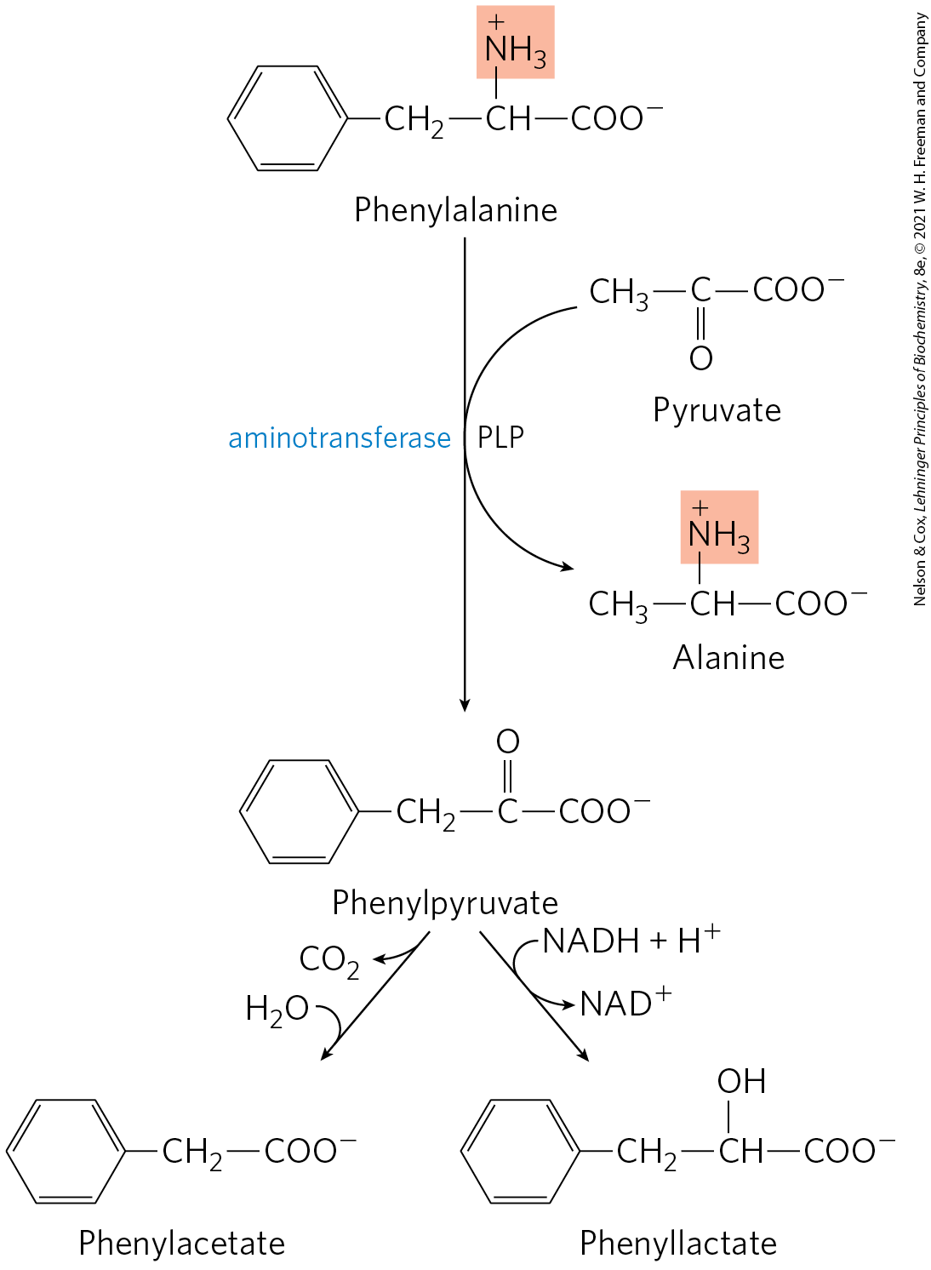
Alternative Pathways for Catabolism of Phenylalanine in PKU
aminotransferase = catalyzes the transamination of phenylalanine with pyruvate to form phenylpyruvate
phenylpyruvate is decarboxylated or reduced

Slide 80
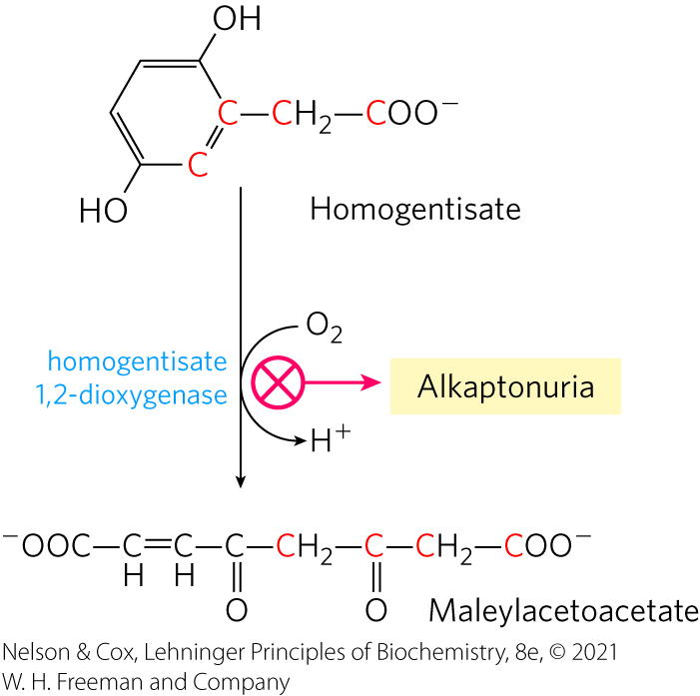
Alkaptonuria
alkaptonuria = disease caused by a genetic defect in homogentisate dioxygenase
large amounts of homogentisate are excreted, and its oxidation turns urine black

Slide 81
Five Amino Acids Are Converted to α-Ketoglutarate
arginine, glutamate, glutamine, histidine, and proline are degraded to α-ketoglutarate
proline, arginine, histidine, and glutamine are all converted to glutamate
glutamate is deaminated to α-ketoglutarate

Slide 82
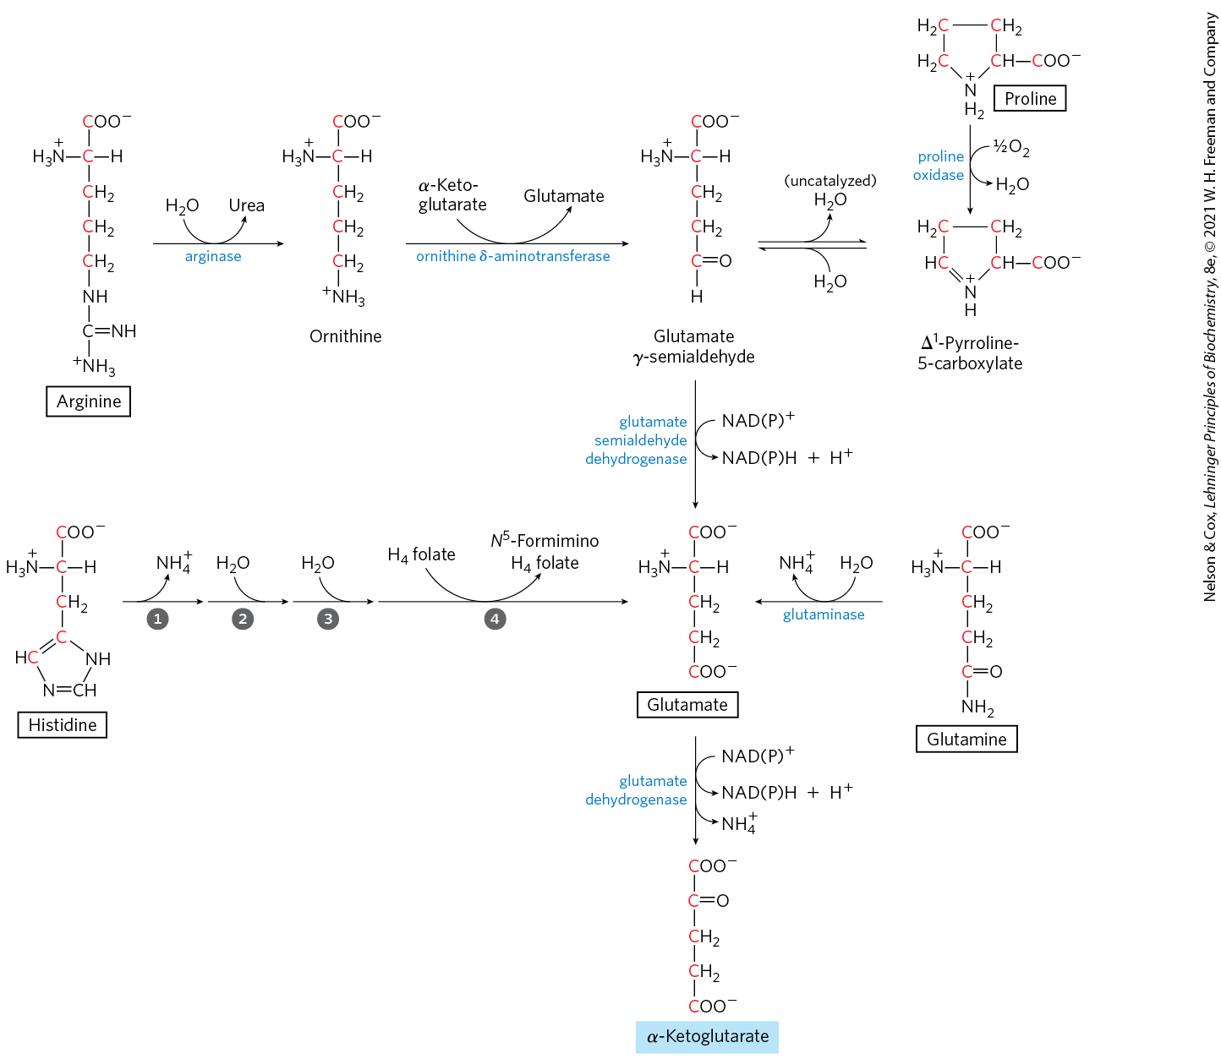
Amino Acid Degradation to α-Ketoglutarate
arginine degradation is part of the urea cycle

Slide 83
Four Amino Acids Are Converted to Succinyl-CoA
isoleucine, methionine, threonine, and valine are degraded to succinyl-CoA
succinyl-CoA is an important intermediate of the citric acid cycle

Slide 84
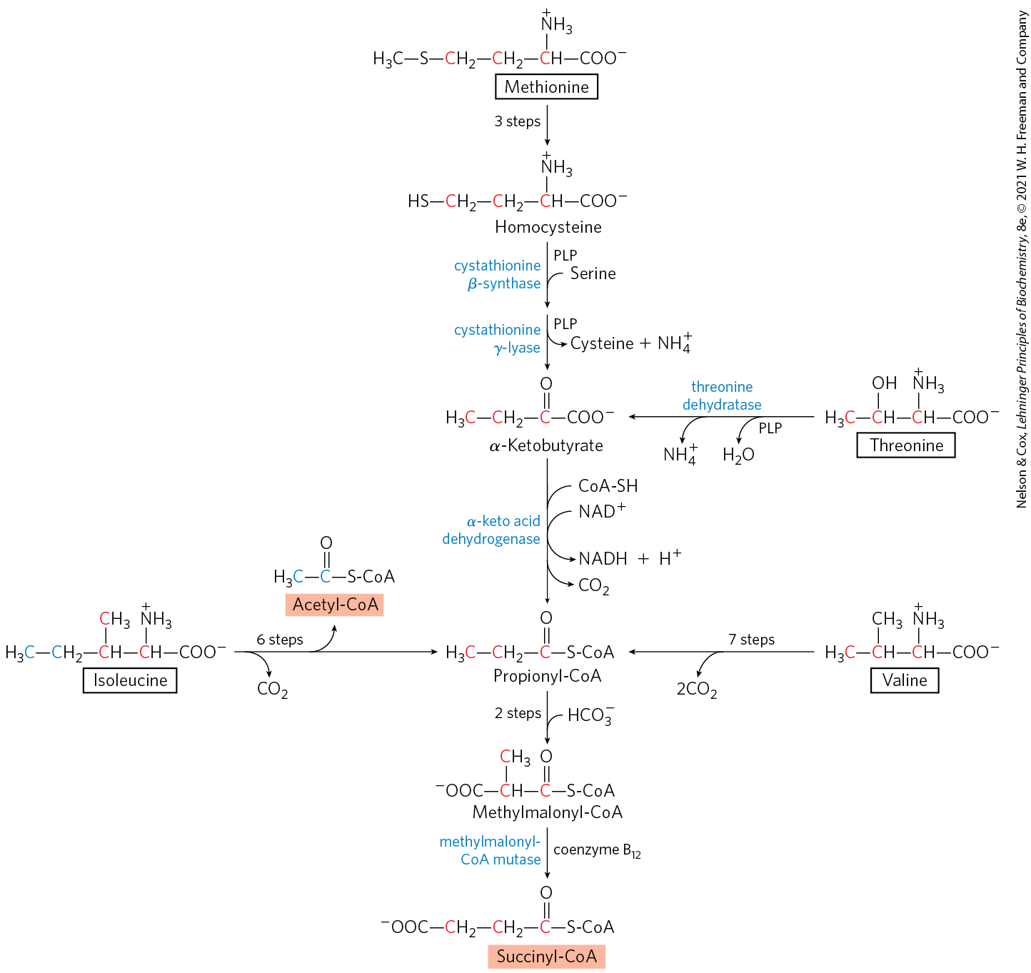
Amino Acid Degradation to
Succinyl-CoA

Slide 85

Branched-Chain Amino Acids Are Not Degraded in the Liver
unlike other amino acids, the branched-chain amino acids (isoleucine, leucine, and valine) are degraded only in extrahepatic tissues (muscle, adipose, kidney, brain)
  the aminotransferase is absent in liver

Slide 86
Branched-Chain α-Keto Acid Dehydrogenase Complex
branched-chain α-keto acid dehydrogenase complex = catalyzes oxidative decarboxylation of all three α-keto acids, releasing CO₂ and producing the acyl-CoA derivative
  regulated by covalent modification in response to the content of branched-chain amino acids in the diet
  inactive when phosphorylated

Slide 87

Maple Syrup Urine Disease
maple syrup urine disease = condition in which the three branched-chain α-keto acids and their precursor amino acids accumulate in the blood and “spill over” into the urine
  treated by rigid control of the diet

Slide 88

Asparagine and Aspartate Are Degraded to Oxaloacetate
asparagine and aspartate are degraded to oxaloacetate
asparaginase = catalyzes the hydrolysis of asparagine to aspartate
aspartate aminotransferase = catalyzes the transamination of aspartate with α-ketoglutarate to yield glutamate and oxaloacetate

