Slide 1

17 Fatty Acid Catabolism
© 2021 Macmillan Learning

Slide 2
The Oxidation of Long-Chain Fatty Acids to Acetyl-CoA
serves as a central energy-yielding pathway in many organisms and tissues
  provides as much as 80% of the energetic needs in mammalian heart and liver
  provides >40% of the daily energy requirement
electrons removed from fatty acids during oxidation pass through the respiratory chain, driving ATP synthesis
acetyl-CoA produced from the fatty acids may be completely oxidized to CO₂ in the citric acid cycle

Slide 3
β Oxidation
β oxidation = oxidation of the fatty acyl group at the C-3, or β, position—hence the name
  occurs after the carboxyl group at C-1 is activated by attachment to coenzyme A

Slide 4

Principle 1 (1 of 5)
Metabolites of diverse origin funnel into a few central pathways. Fatty acid catabolism and glycolysis convert quite different starting materials into the same product (acetyl-CoA). The electrons from the oxidative reactions of these pathways and of the citric acid cycle are carried by common cofactors (NAD and FAD) to the mitochondrial respiratory chain leading to oxygen, providing the energy for ATP synthesis by oxidative phosphorylation.

Slide 5

Principle 2 (1 of 5)
Evolution selects for chemical mechanisms that make useful reactions more energetically favorable, and those same mechanisms are used in different pathways. In the breakdown of fatty acids, we see the activation of a carboxylic acid by its conversion to a thioester, as we saw with acetyl-CoA in the citric acid cycle. To break the C–C bonds in the long chain of relatively inert –CH₂–CH₂– groups in fatty acids, a carbonyl group is created adjacent to the –CH₂– group, as we saw in the reactions of the citric acid cycle.

Slide 6

Principle 3 (1 of 4)
Allosteric mechanisms and posttranslational regulation (protein phosphorylation) coordinate metabolic processes within a cell. Hormones and growth factors coordinate metabolic activities among tissues and organs. Reciprocal regulation of catabolic and anabolic pathways prevents the inefficiency of futile cycling.

Slide 7
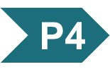
Principle 4 (1 of 6)
When a process lacks a critical component—an enzyme, a cofactor, or a regulatory agent—the resulting loss of homeostasis may cause disease across a spectrum of severity. Defects in fatty acid breakdown are no exception.

Slide 8

Principle 5 (1 of 4)
The liver plays a unique role in whole-body metabolism. When glucose is unavailable, the liver makes glucose by gluconeogenesis and releases it to the blood for distribution to other tissues, including the brain. During starvation, the liver processes fatty acids into ketone bodies, which, unlike fatty acids, can cross the blood brain barrier and fuel the brain.

Slide 9
17.1 Digestion, Mobilization, and Transport of Fats

Slide 10
Sources of Fatty Acid Fuels
cells can obtain fatty acid fuels from four sources:
  fats consumed in the diet
  fats stored in cells as lipid droplets
  fats synthesized in one organ for export to another
  fats obtained by autophagy

Slide 11
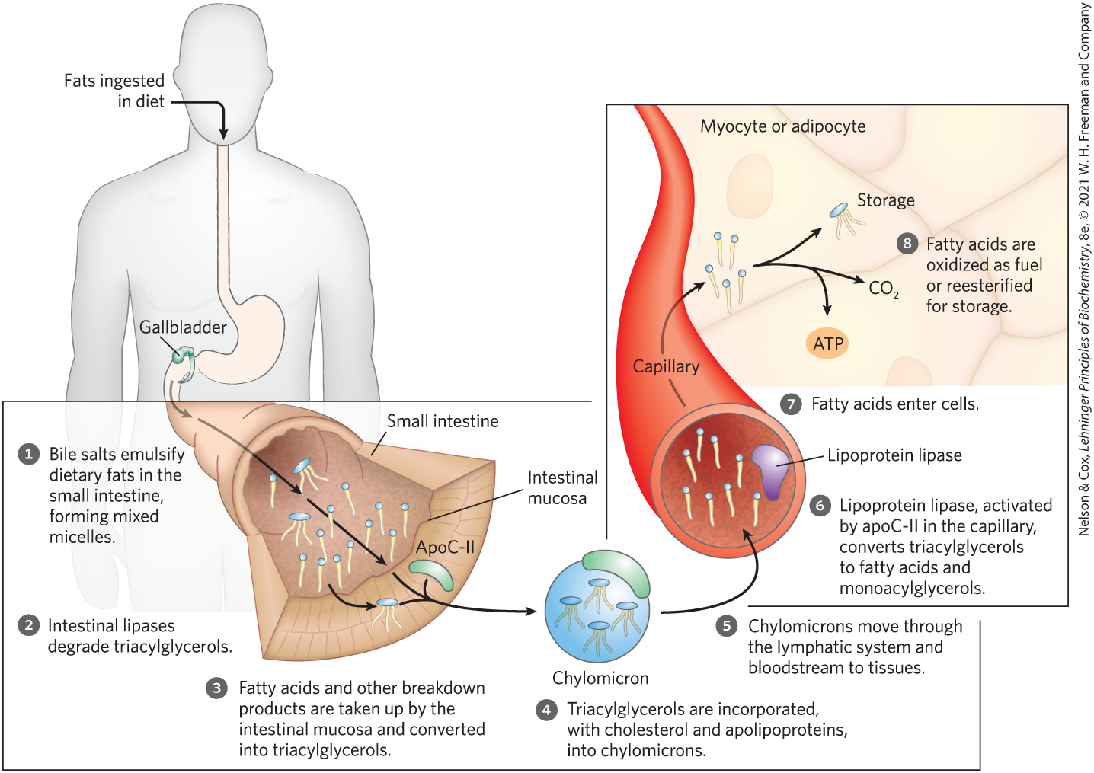
Dietary Fats Are Absorbed in the Small Intestine

Slide 12
Lipoprotein Particles
lipoprotein particles = spherical aggregates of apolipoproteins and lipids
  arranged with hydrophobic lipids at the core and hydrophilic protein side chains and lipid head groups at the surface
  various in densities depending on combinations of lipid and protein
    range from chylomicrons and very-low-density lipoproteins (VLDL) to very-high-density lipoproteins (VHDL)

Slide 13
Lipoprotein Lipase
lipoprotein lipase = extracellular enzyme in the capillaries of muscle and adipose tissue that hydrolyzes triacylglycerols to free fatty acids and monoacylglycerols
  activated by apoC-II

Slide 14
Storage of Excess Fatty Acids
fatty acids are converted to triacylglycerols in the liver
triacylglycerols are packaged with specific apolipoproteins into VLDLs
VLDLs are secreted and transported in the blood to adipose tissue
triacylglycerols are removed and stored in lipid droplets within adipocytes in the adipose tissue

Slide 15
Hormones Trigger Mobilization of Stored Triacylglycerols
lipid droplets = organelles stored in adipocytes and steroid-synthesizing cells that contain neutral lipids
  contain a core of triacylglycerols and sterol esters surrounded by a monolayer of phospholipids
perilipins = family of proteins that coats the surface of lipid droplets to restrict access to lipid droplets
  prevent untimely lipid mobilization

Slide 16
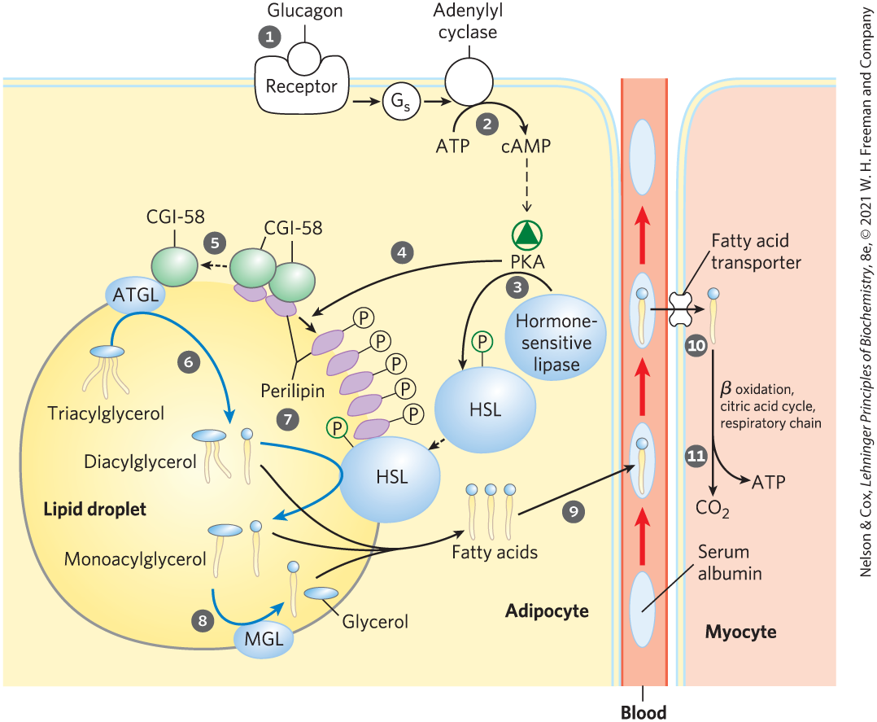
Mobilization of Triacylglycerols Stored in Adipose Tissue
mobilization occurs when hormones (glucagon and epinepherine) signal the need for metabolic energy
PKA triggers changes that open the lipid droplet to the action of three cytosolic lipases

Slide 17
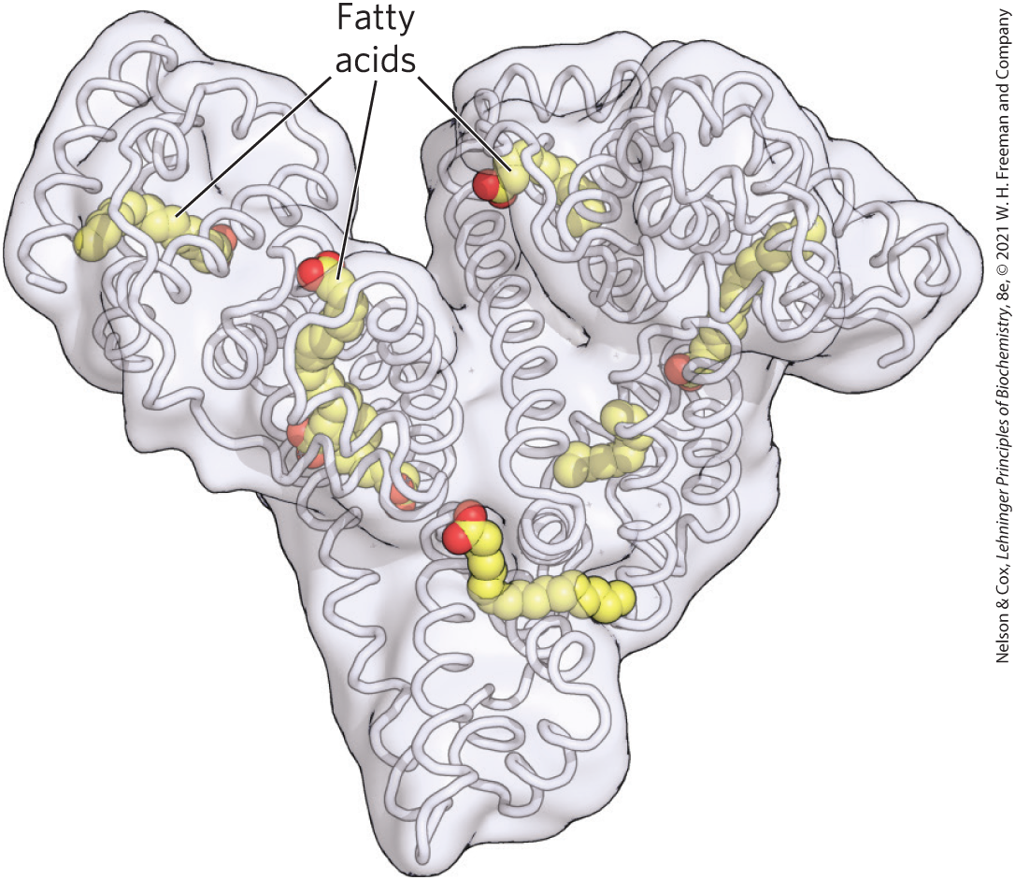
Human Serum Albumin
free fatty acids, FFAs = fatty acids released by lipases
serum albumin = blood protein that noncovalently binds and transports FFAs to target tissues
  makes up ~½ of the total serum protein

Slide 18
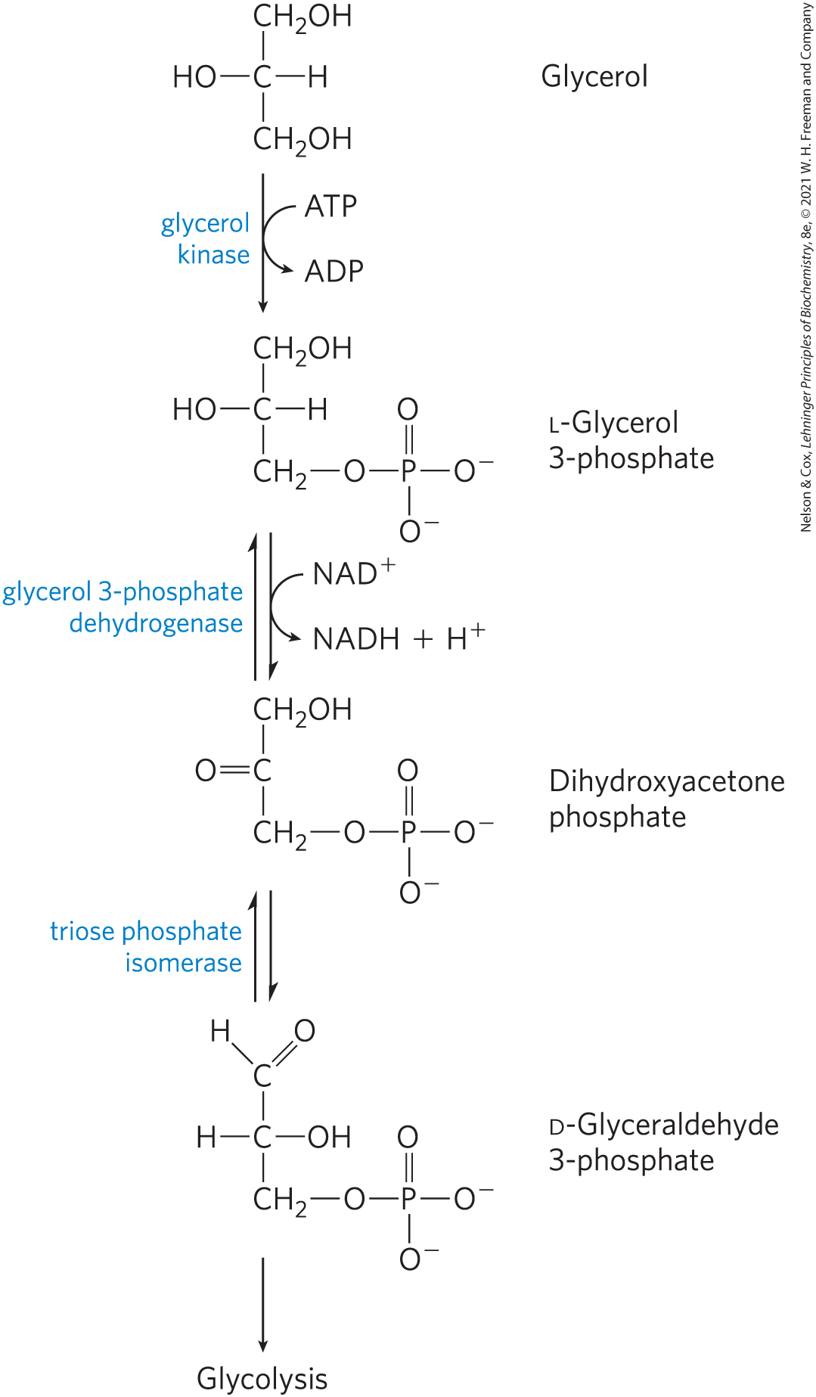
Entry of Glycerol into the
Glycolytic Pathway
most of the biologically available energy of triacylglycerols resides in their three long-chain fatty acids
glycerol kinase = phosphorylates glycerol to form glycerol 3-phosphate
glyceraldehyde 3-phosphate can enter glycolysis

Slide 19
Fatty Acids Are Activated and Transported into Mitochondria
small (< 12 carbons) fatty acids diffuse freely across mitochondrial membranes
carnitine shuttle = transports long-chain fatty acids (containing 14+ carbons) through the mitochondrial membrane
  requires activation to a fatty acyl-CoA and attachment to carnitine

Slide 20

Fatty Acyl-CoA Synthetase
fatty acyl-CoA synthetase = isozymes present in the outer mitochondrial membrane that activate the fatty acid by conversion to fatty acyl-CoA thioesters
fatty acid + CoA + ATP $⇄$
fatty acyl-CoA + AMP + PP_{i}

Slide 21
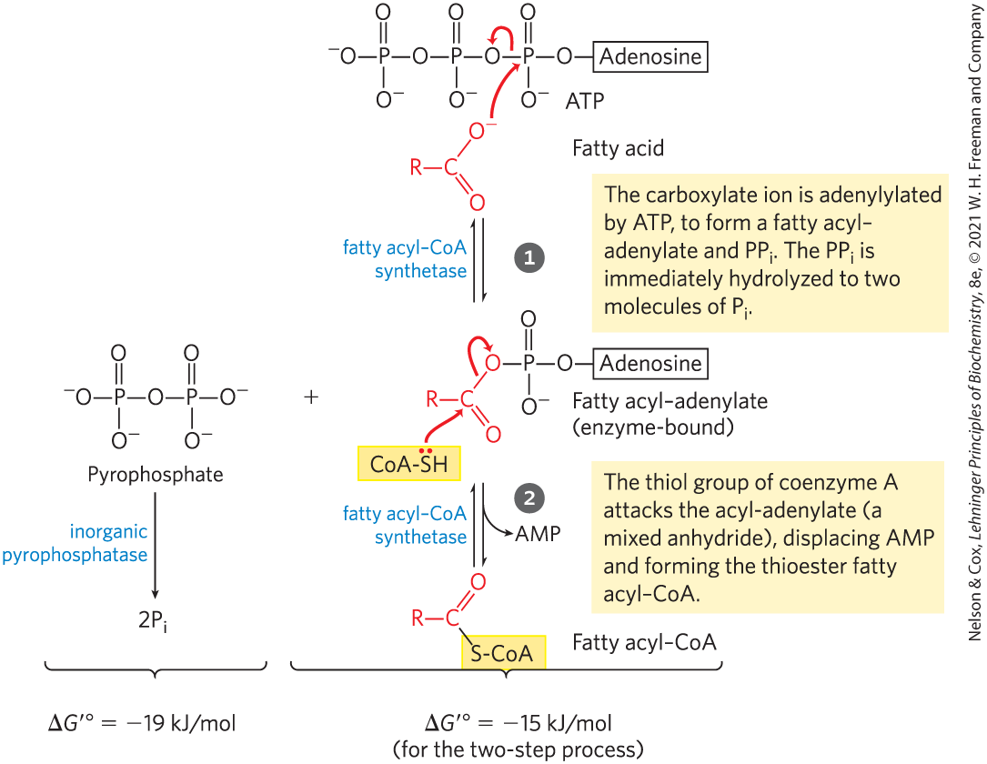
Formation of a Fatty Acyl-CoA
fatty acyl-CoA = contains a thioester linkage between the fatty acid carboxyl group and the thiol group of coenzyme A
  high energy compound
  formation is made more favorable by the hydrolysis of two ATP bonds

Slide 22
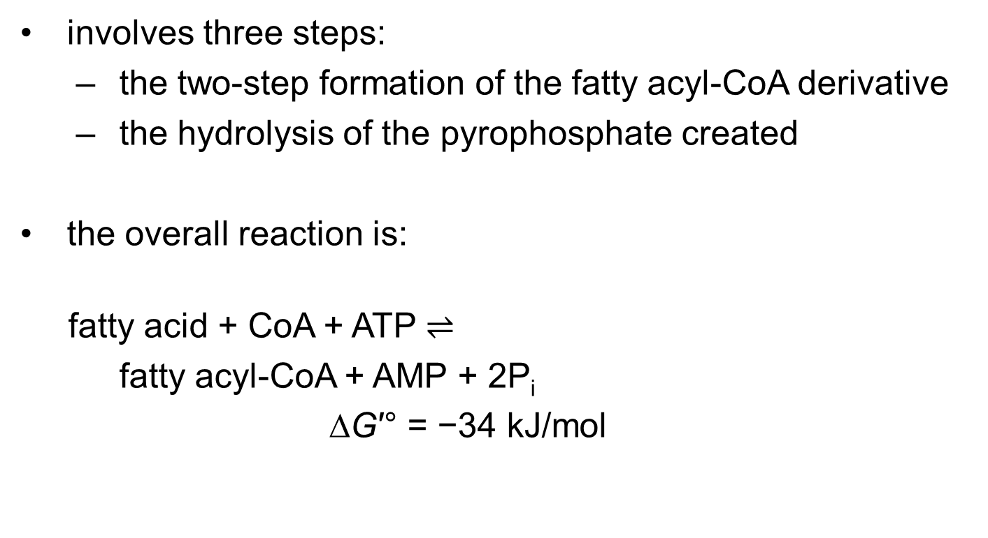
The Overall Reaction for Fatty Acyl-CoA Formation
involves three steps:
  the two-step formation of the fatty acyl-CoA derivative
  the hydrolysis of the pyrophosphate created
the overall reaction is:
fatty acid + CoA + ATP $⇌$
fatty acyl-CoA + AMP + 2P_{i}
∆G′° = −34 kJ/mol
(17-1)

Slide 23
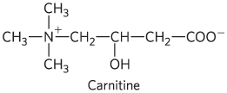
Carnitine
carnitine = compound that transports fatty acyl-CoAs destined for mitochondrial oxidation across the inner mitochondrial membrane

Slide 24
Attachment of Carnitine to the Fatty Acyl-CoA
carnitine acyl-transferase 1, CAT1 (carnitine palmitoyltransferase 1, CPT1) = catalyzes a transesterification reaction to transiently attach a fatty acyl-CoA to the hydroxyl group of carnitine to form fatty acyl-carnitine

Slide 25
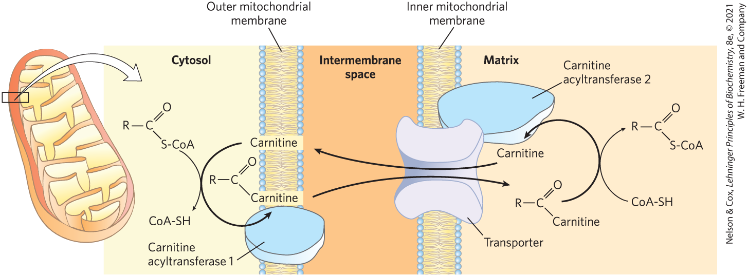
The Acyl-Carnitine/Carnitine Cotransporter
acyl-carnitine/carnitine cotransporter = allows the passive transport of the fatty acyl-carnitine ester
  moves one carnitine into the intermembrane space as one fatty acyl-carnitine moves into the matrix

Slide 26
Carnitine Acyltransferase 2 (CAT2)
carnitine acyltransferase 2 (CAT2, CPT2) = transfers the fatty acyl group from carnitine back to coenzyme A to regenerate fatty acyl-CoA and free carnitine
  located on the inner face of the inner mitochondrial membrane

Slide 27
The Two Pools of Coenzyme A
one pool is in the cytosol and the other is in mitochondria
coenzyme A in the mitochondrial matrix is largely used in oxidative degradation of pyruvate, fatty acids, and some amino acids
coenzyme A in the cytosol is used in the biosynthesis of fatty acids

Slide 28
The Two Pools of Fatty Acyl-CoA
one pool is in the cytosol and the other is in mitochondria
fatty acyl-CoA in the mitochondrial matrix can be used for oxidation and ATP production
  conversion to the carnitine ester commits it to oxidation
fatty acyl–CoA in the cytosolic pool can be used for membrane lipid synthesis

Slide 29
The Carnitine Shuttle Is a Major Control Point
carnitine-mediated entry is the rate-limiting step for oxidation of fatty acids in mitochondria
carnitine acyltransferase 1 is inhibited by malonyl-CoA, the first intermediate in fatty acid synthesis
  prevents the simultaneous synthesis and degradation of fatty acids

Slide 30
17.2 Oxidation of Fatty Acids

Slide 31
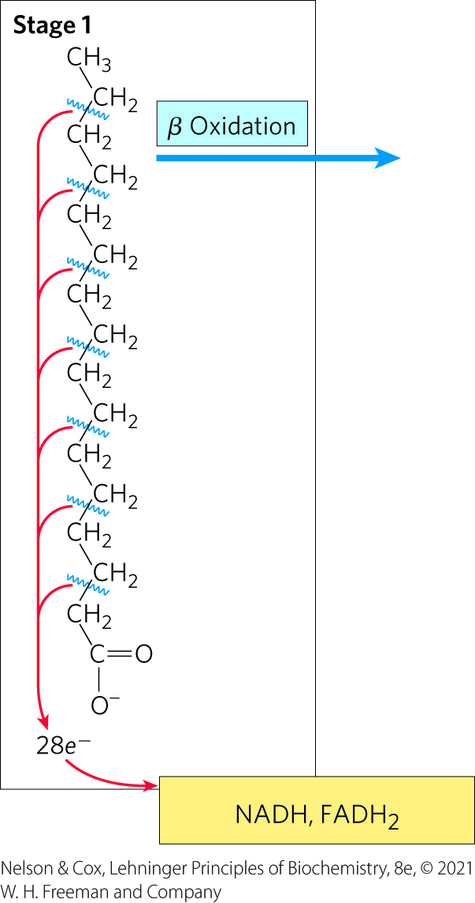
Stage 1 of Fatty Acid Oxidation
Stage 1: β oxidation
  fatty acids undergo oxidative removal of successive two-carbon units in the form of acetyl-CoA

Slide 32
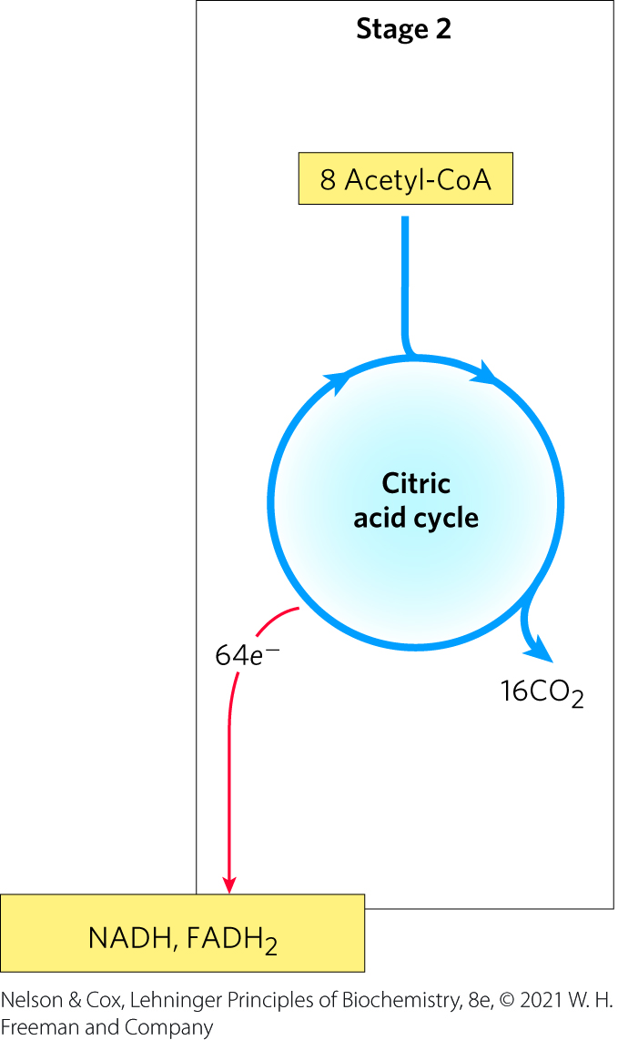
Stage 2 of Fatty Acid Oxidation
Stage 2: oxidation of acetyl-CoA groups to CO₂ in the citric acid cycle
  occurs in the mitochondrial matrix
  generates NADH, FADH₂, and one GTP

Slide 33
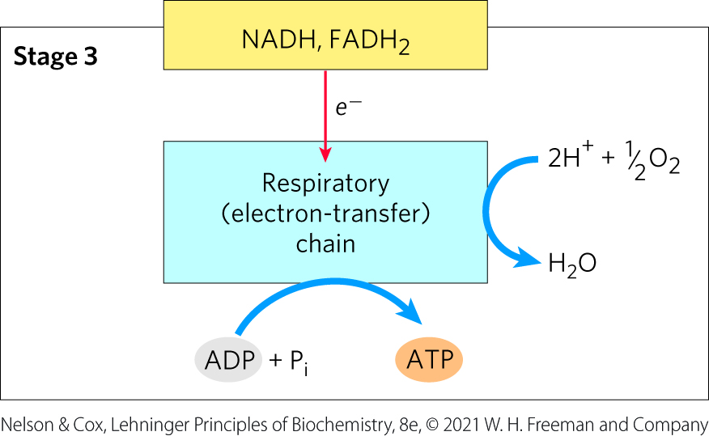
Stage 3 of Fatty Acid Oxidation
Stage 3: electron transfer chain and oxidative phosphorylation
  generates ATP from NADH and FADH₂

Slide 34
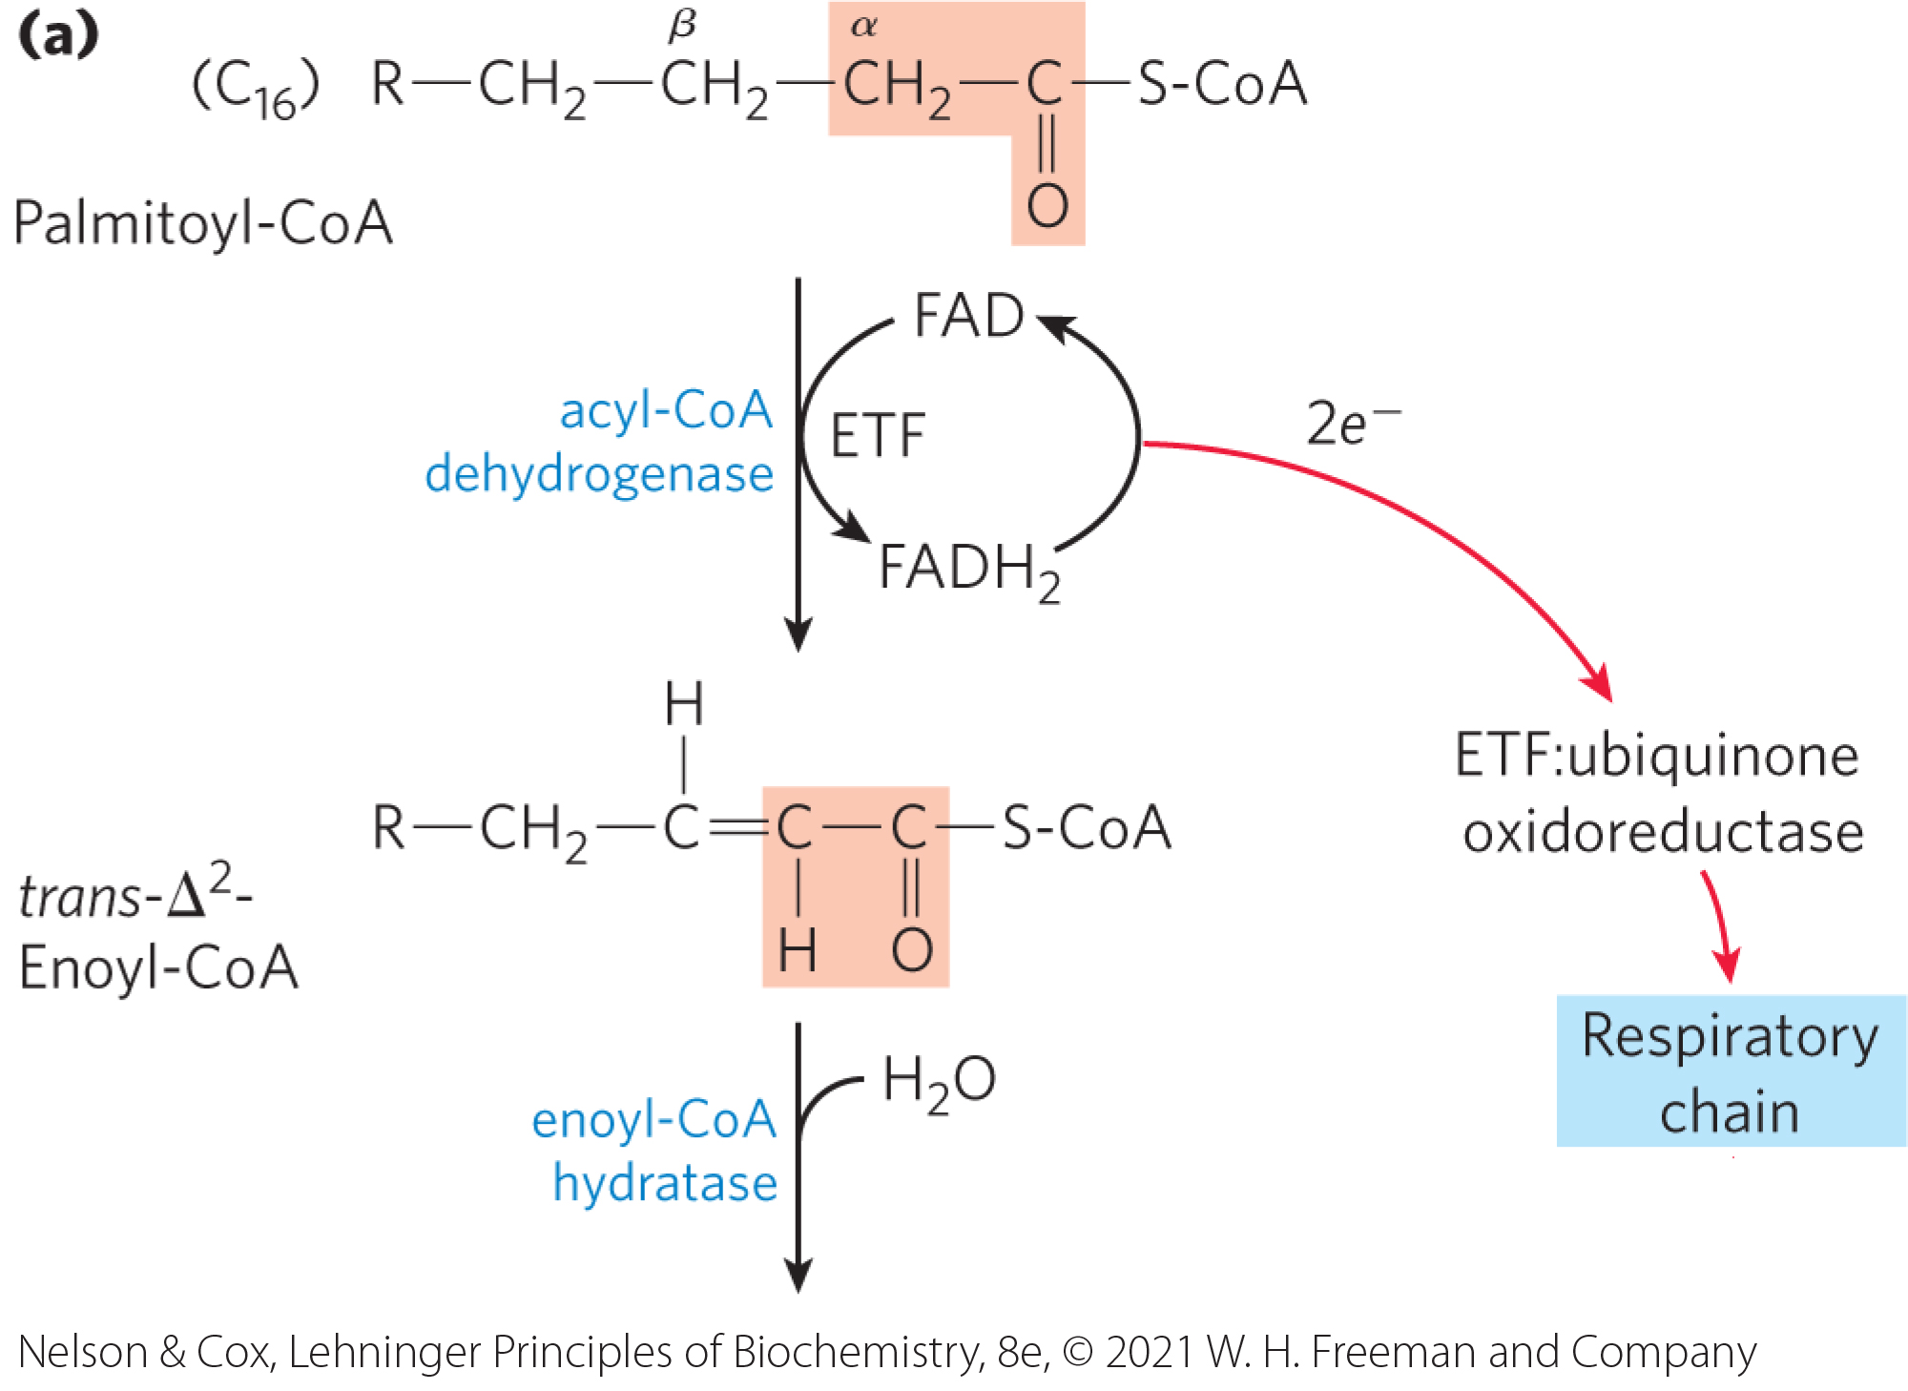
The β Oxidation of Saturated Fatty Acids Has Four Basic Steps
acyl-CoA dehydrogenase = flavoprotein with tightly bound FAD that catalyzes the dehydrogenation of fatty acyl-CoA to yield a trans-∆²-enoyl-CoA

Slide 35
Electrons from NADH Enter the Mitochondrial Respiratory Chain
NADH dehydrogenase (Complex I) = electron carrier of the respiratory chain
  accepts electrons from the NADH formed in the β-hydroxyacyl-CoA dehydrogenase reaction

Slide 36
The Chemical Logic of the β-Oxidation Sequence
the first three reactions convert the stable single bond between methylene groups to a much less stable C–C bond
the ketone function on the β carbon (C-3) makes it a good target for nucleophilic attack
the terminal –CH₂–CO–S-CoA is a good leaving group, facilitating breakage of the α–β bond

Slide 37
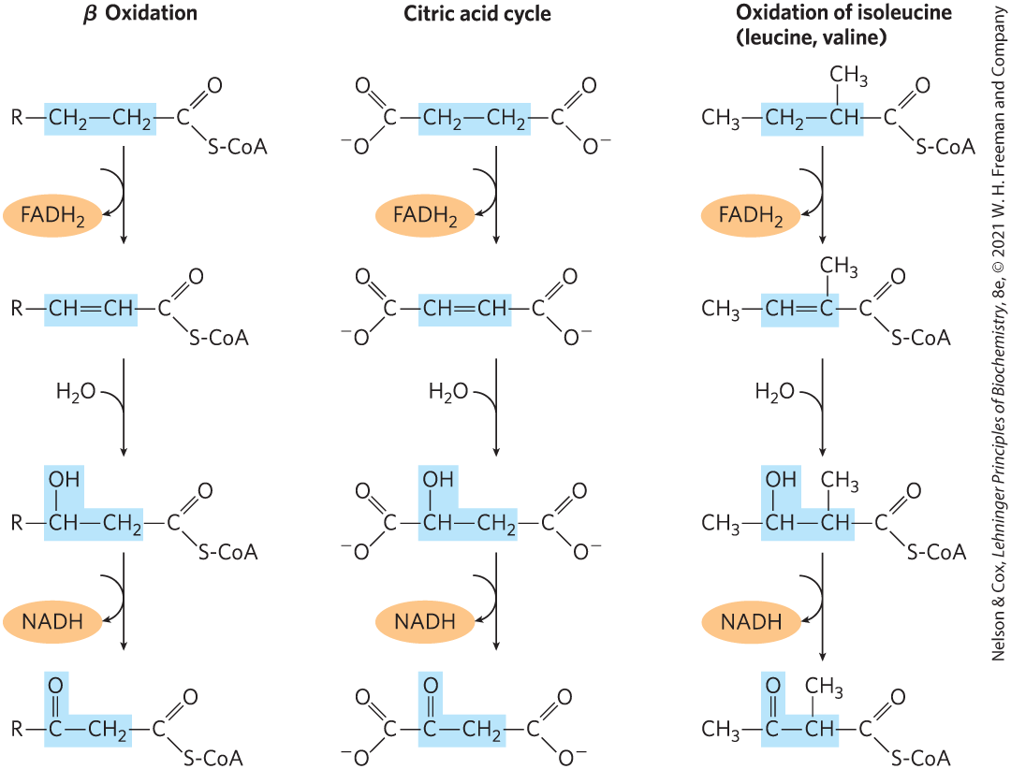
A Conserved Reaction Sequence

Slide 38
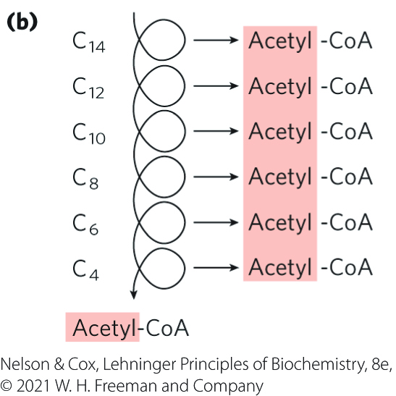
The Four β-Oxidation Steps Are Repeated to Yield Acetyl-CoA and ATP
the shortened fatty acyl–CoA reenters the β-oxidation sequence for removal of another, and then another, acetyl-CoA

Slide 39
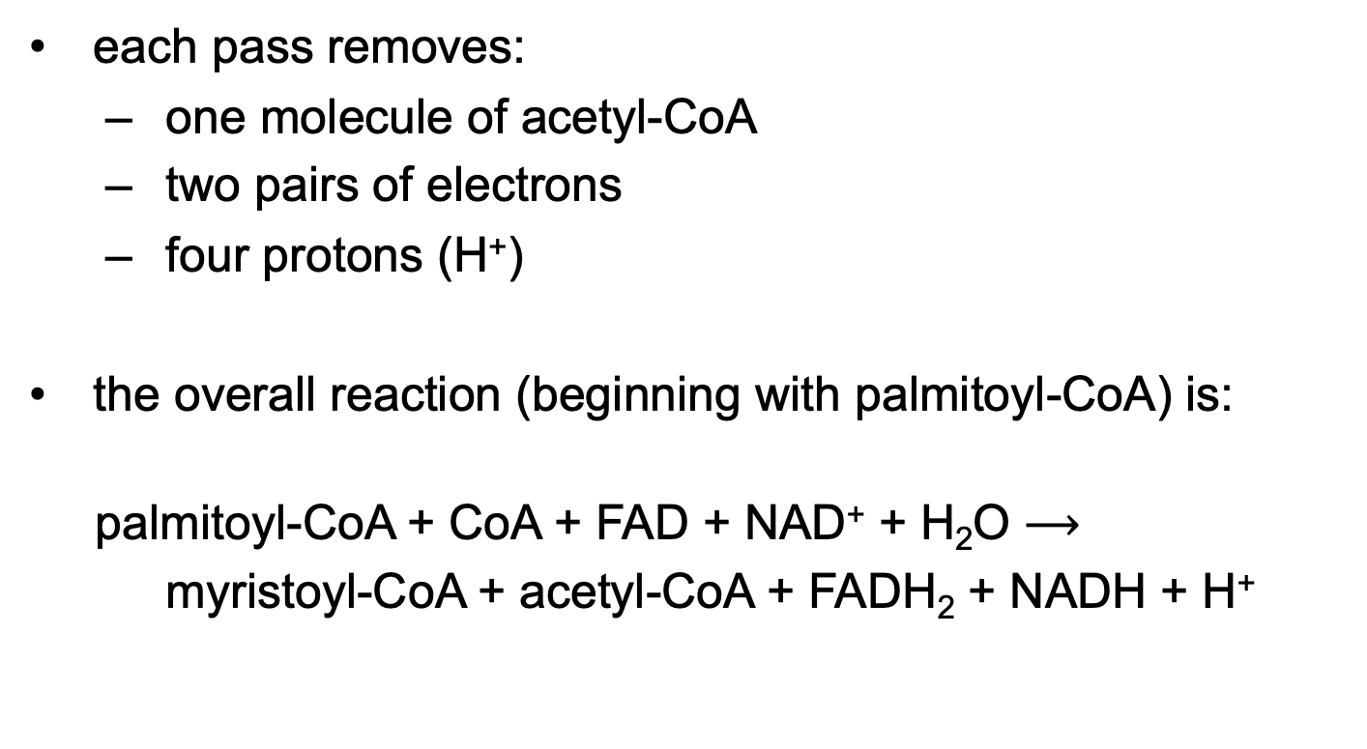
The Overall Reaction for One Pass Through Stage 1 of β Oxidation
each pass removes:
  one molecule of acetyl-CoA
  two pairs of electrons
  four protons (H⁺)
the overall reaction (beginning with palmitoyl-CoA) is:
palmitoyl-CoA + CoA + FAD + NAD⁺ + H₂O $⟶$
myristoyl-CoA + acetyl-CoA + FADH₂ + NADH + H⁺
(17-2)

Slide 40

The Overall Reaction for Stage 1 of β Oxidation
the overall reaction (beginning with palmitoyl-CoA) is:
palmitoyl-CoA + 7CoA + 7FAD + 7NAD⁺ + 7H₂O $⟶$
8 acetyl-CoA + 7FADH₂ + 7NADH + 7H⁺
(17-3)

Slide 41
FADH₂ and NADH Donate Electrons to the Respiratory Chain
each FADH₂ donates a pair of electrons to ETF
  generates 1.5 molecules of ATP
each NADH donates a pair of electrons to the mitochondrial NADH dehydrogenase
  generates 2.5 molecules of ATP
in total, 4 ATP are formed for each pass through β oxidation

Slide 42
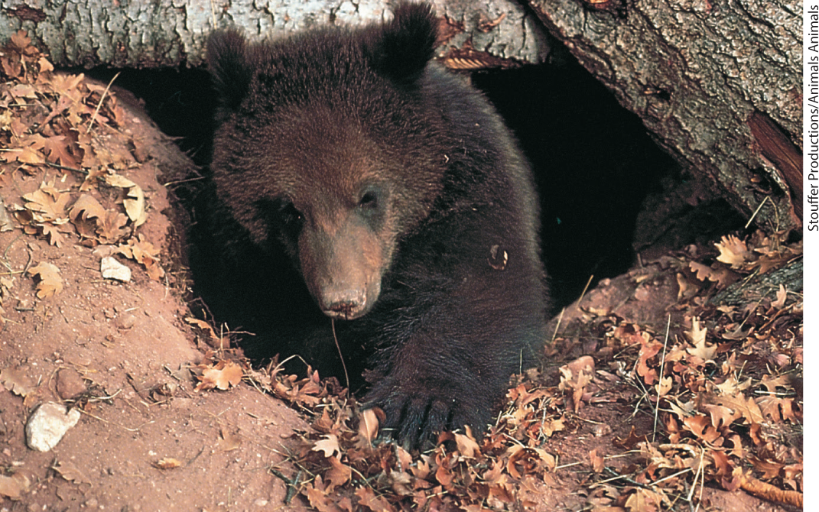
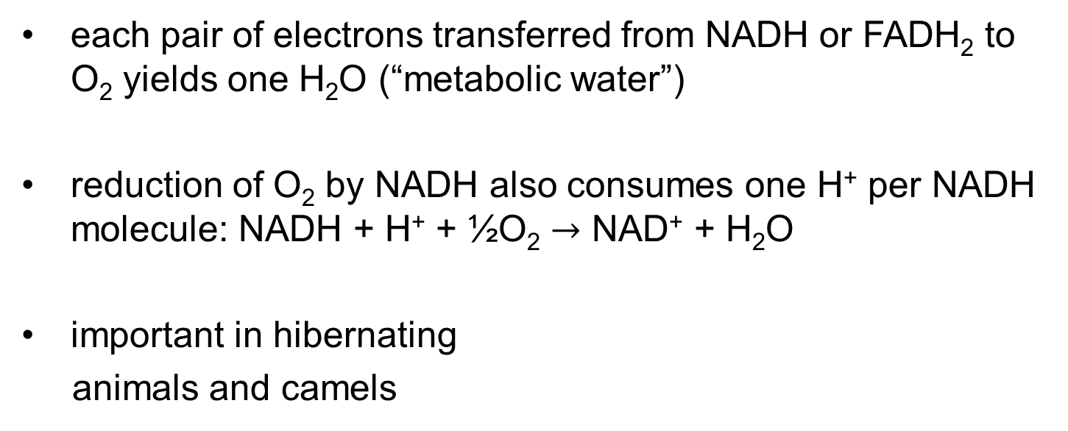
“Metabolic Water”
each pair of electrons transferred from NADH or FADH₂ to O₂ yields one H₂O (“metabolic water”)
reduction of O₂ by NADH also consumes one H⁺ per NADH molecule: NADH + H⁺ + ½O₂ $→$ NAD⁺ + H₂O
important in hibernating
animals and camels

Slide 43
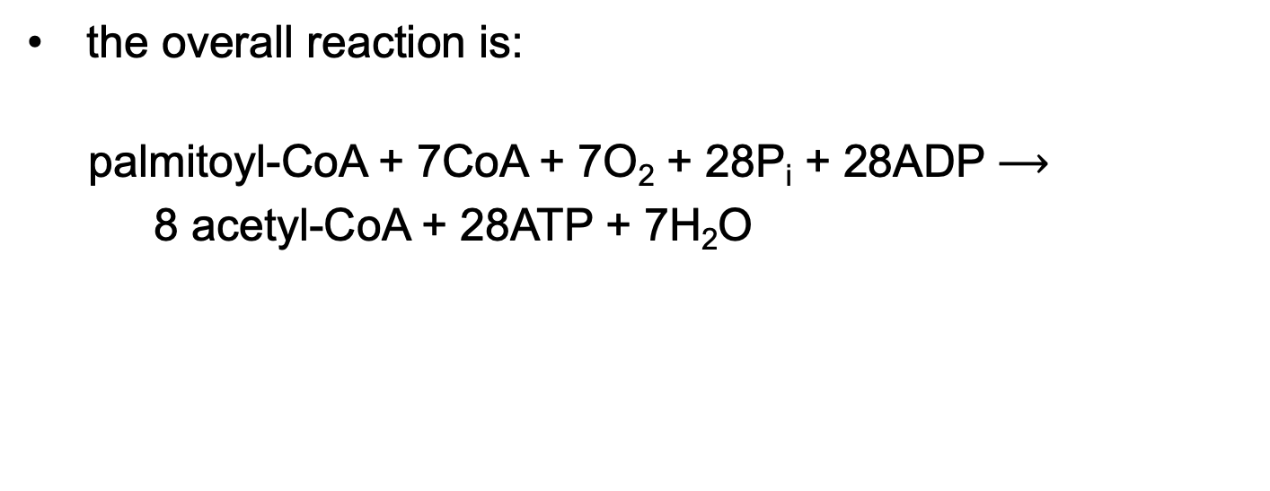
The Overall Reaction for Stage 1 of β Oxidation, Including Electron Transfers and Oxidative Phosphorylations
the overall reaction is:
palmitoyl-CoA + 7CoA + 7O₂ + 28P_{i} + 28ADP $⟶$
8 acetyl-CoA + 28ATP + 7H₂O
(17-4)

Slide 44
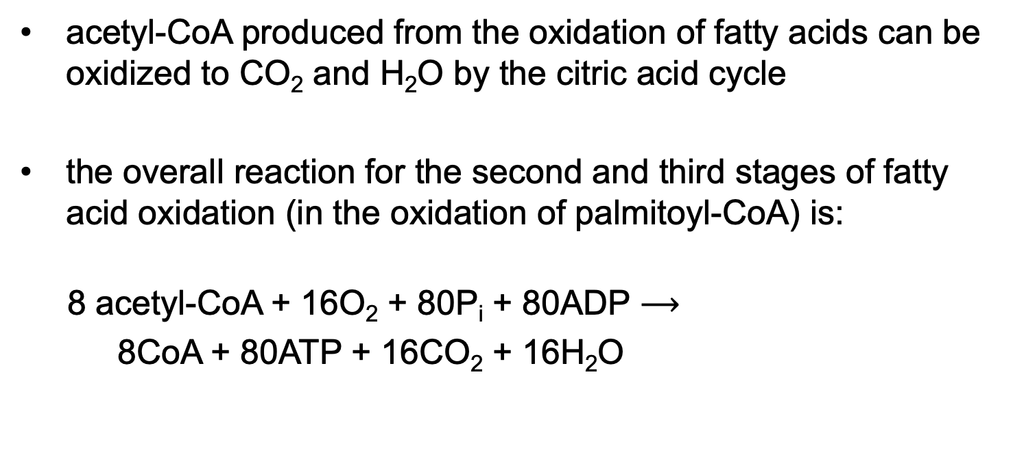
Acetyl-CoA Can Be Further Oxidized in the Citric Acid Cycle
acetyl-CoA produced from the oxidation of fatty acids can be oxidized to CO₂ and H₂O by the citric acid cycle
the overall reaction for the second and third stages of fatty acid oxidation (in the oxidation of palmitoyl-CoA) is:
8 acetyl-CoA + 16O₂ + 80P_{i} + 80ADP $⟶$
8CoA + 80ATP + 16CO₂ + 16H₂O
(17-5)

Slide 45

The Overall Reaction for the Complete Oxidation of Palmitoyl-CoA to CO₂ and H₂O
the overall reaction is:
palmitoyl-CoA + 23O₂ + 108P_{i} + 108ADP $⟶$
CoA + 108ATP + 16CO₂ + 23H₂O
(17-6)

Slide 46
ATP Yield During Complete Oxidation of Palmitoyl-CoA
Table 17-1 Yield of ATP during Oxidation of One Molecule of Palmitoyl-CoA to CO₂ and H₂O
Enzyme catalyzing the oxidation step | Number of NADH or FADH₂ formed | Number of ATP ultimately formed
β Oxidation
Acyl-CoA dehydrogenase | 7 FADH₂ | 10.5
β-Hydroxyacyl-CoA dehydrogenase | 7 NADH | 17.5
Citric acid cycle
Isocitrate dehydrogenase | 8 NADH | 20
α-Ketoglutarate dehydrogenase | 8 NADH | 20
Succinyl-CoA synthetase |  | 8
Succinate dehydrogenase | 8 FADH₂ | 12
Malate dehydrogenase | 8 NADH | 20
Total |  | 108

Slide 47
Oxidation of Unsaturated Fatty Acids Requires Two Additional Reactions
enoyl-CoA hydratase cannot catalyze the addition of H₂O to a cis double bond
oxidation of unsaturated fatty acids requires two additional enzymes:
  enoyl-CoA isomerase (converts cis double bonds to trans)
  2,4-dienoyl-CoA reductase (reduces cis double bonds)

Slide 48
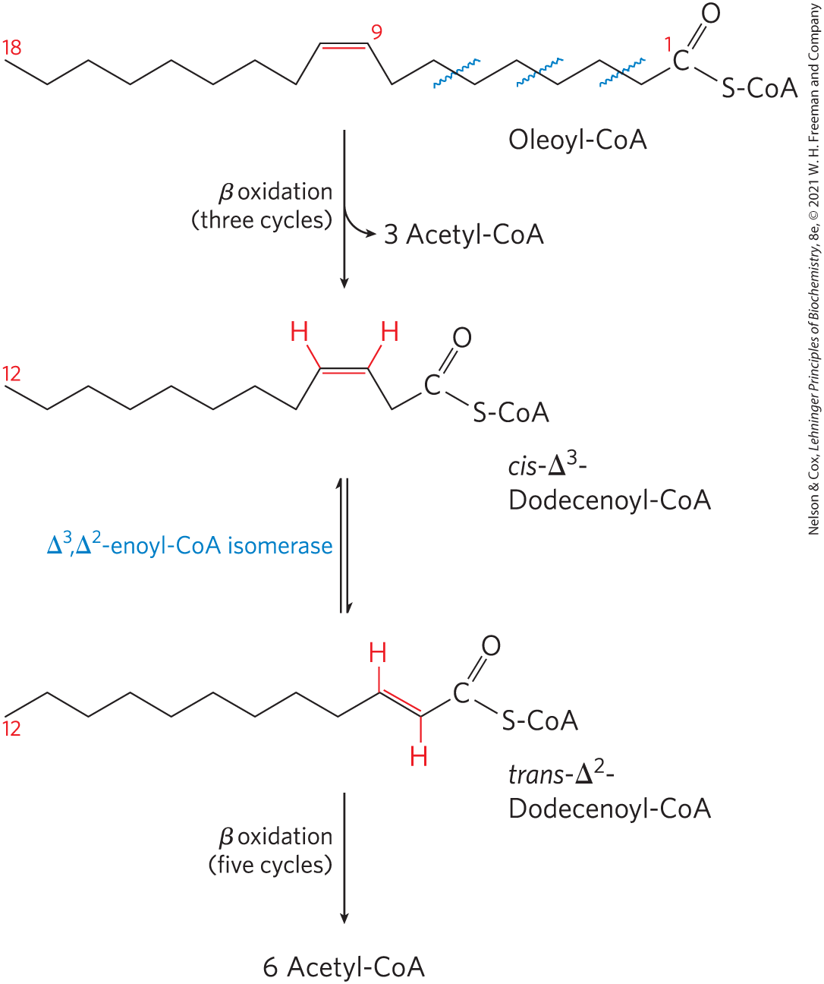
Oxidation of a Monounsaturated Fatty Acid
oxidation of a monounsaturated fatty acid requires an enoyl-CoA isomerase
∆³,∆²- enoyl-CoA isomerase = isomerizes the cis-∆³-enoyl-CoA to the trans-∆²-enoyl-CoA

Slide 49
Oxidation of a Polyunsaturated
Fatty Acid
requires both enoyl-CoA isomerase and 2,4-dienoyl-CoA reductase to transform the cis-∆³,cis-∆⁶ intermediate into one that can enter the β-oxidation pathway

Slide 50
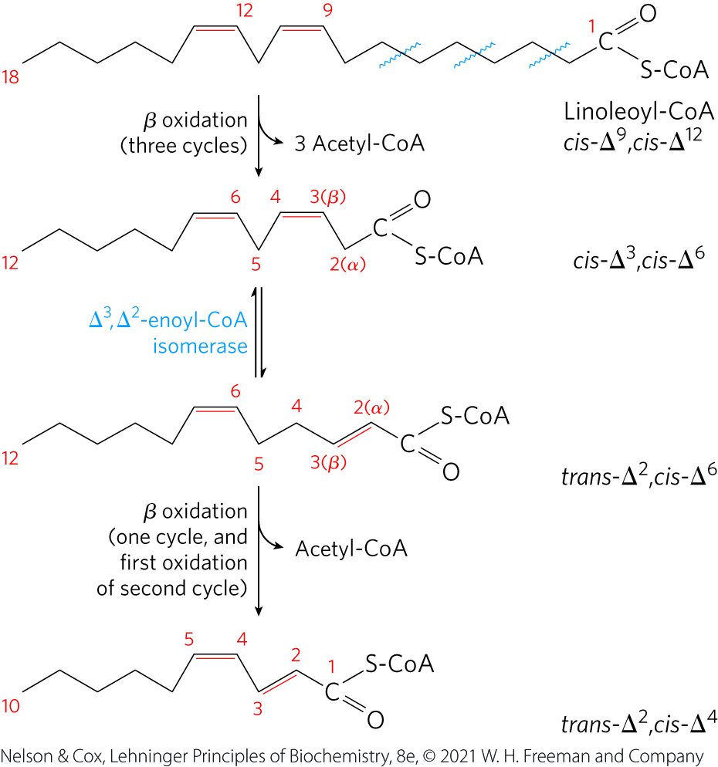
Oxidation of Linoleoyl-CoA (∆^{9,12})

Slide 51
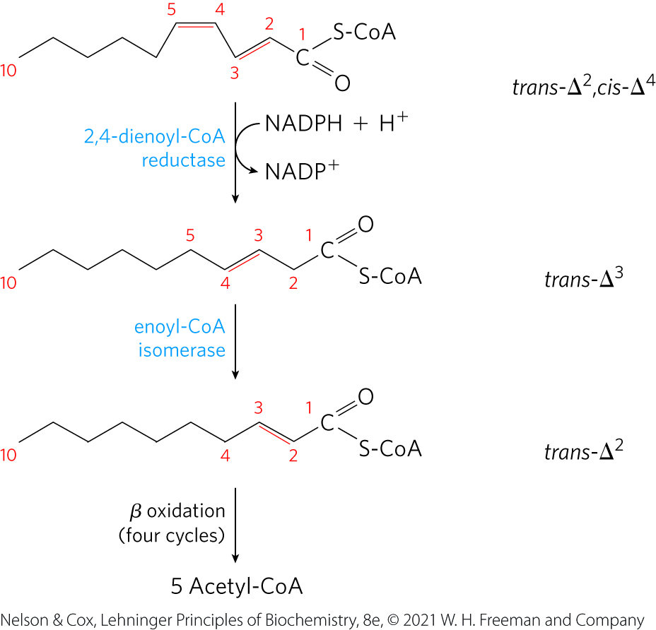
Oxidation of Linoleoyl-CoA (∆^{9,12}), Continued

Slide 52
Complete Oxidation of Odd-Number Fatty Acids Requires Three Extra Reactions
propionate (CH₃–CH₂–COO⁻) = three-carbon compounds formed by cattle and other ruminant animals during carbohydrate fermentation
odd-number fatty acids are oxidized by the β-oxidation pathway to yield acetyl-CoA and a molecule of propionyl-CoA

Slide 53
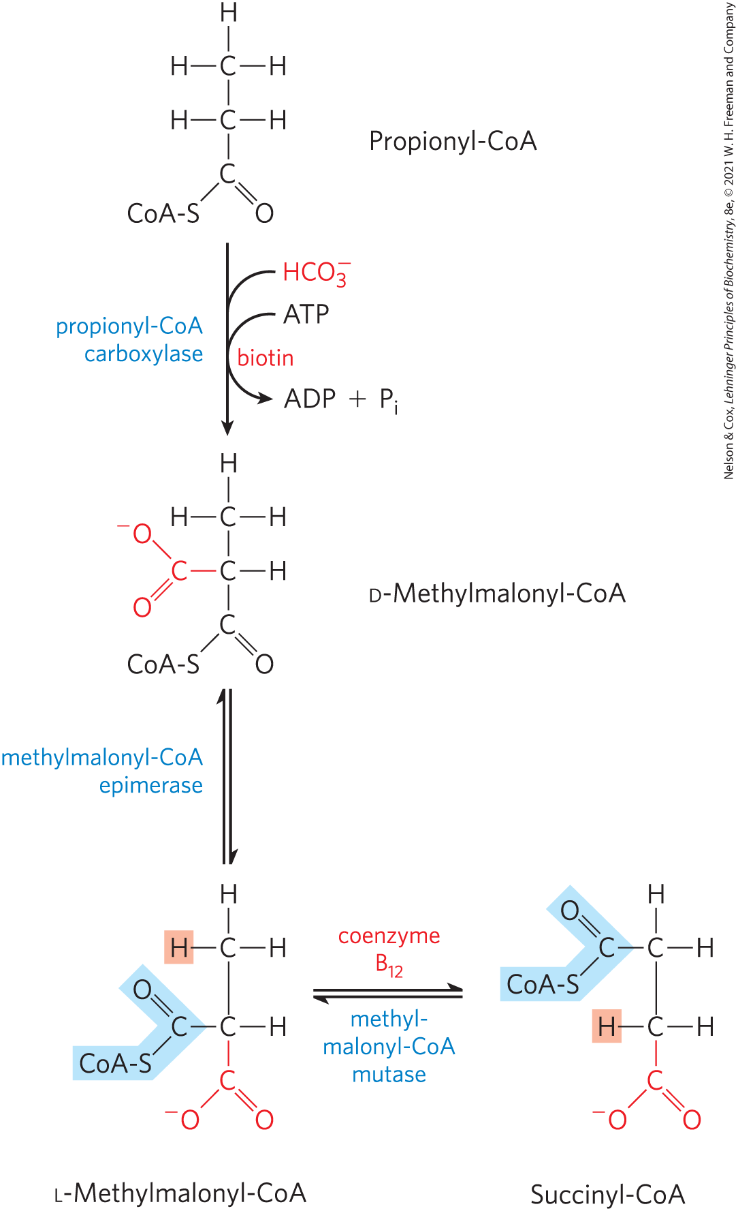
Oxidation of Propionyl-CoA – Step 1
propionyl-CoA carboxylase = catalyzes the carboxylation of propionyl-CoA to form D-methylmalonyl-CoA
  requires the cofactor biotin

Slide 54
Oxidation of Propionyl-CoA – Step 2
methylmalonyl-CoA epimerase = catalyzes the epimerization of D-methylmalonyl-CoA to its L stereoisomer

Slide 55
Oxidation of Propionyl-CoA – Step 3
methylmalonyl-CoA mutase = catalyzes the intramolecular rearrangement of L-methylmalonyl-CoA to form succinyl-CoA (which can enter the citric acid cycle)
  requires 5′-deoxyadenosylcobalamin, or coenzyme B₁₂, as its coenzyme

Slide 56
Deficiencies in
Propionyl-CoA Carboxylase
occurs in ~ 1 in 100,000 babies
propionic acidemia = severe acidification of the blood and urine resulting from accumulated propionyl-CoA in the mitochondria being released to the blood as propionate
  uses the carnitine shuttle

Slide 57
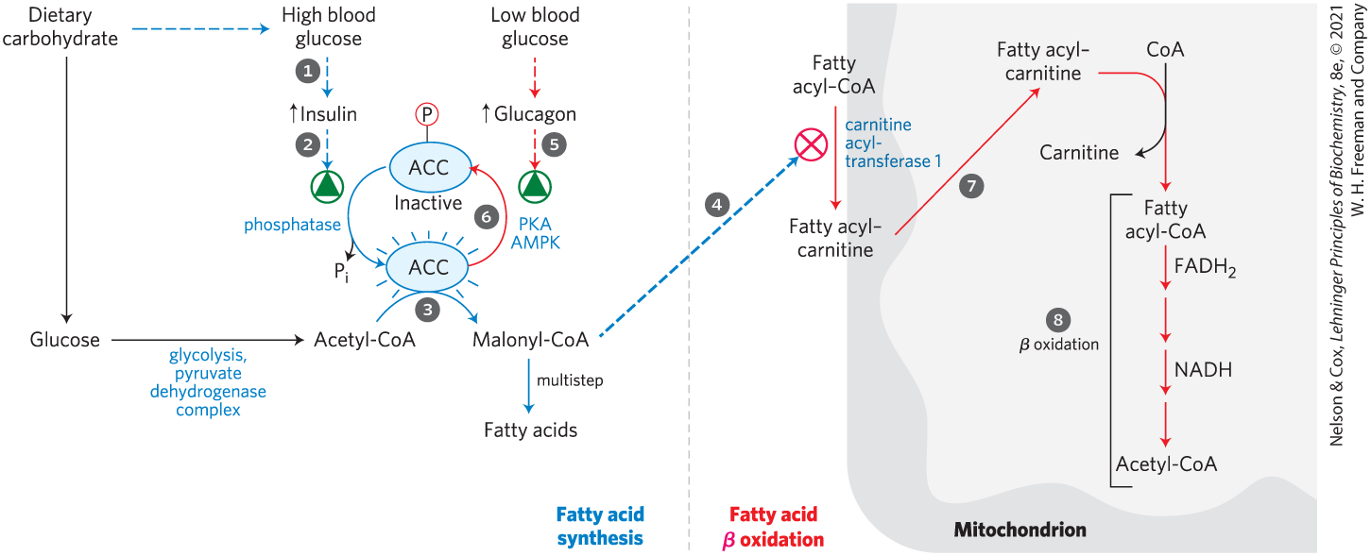
Fatty Acid Oxidation Is
Tightly Regulated
malonyl-CoA = the first intermediate of cytosolic fatty acid synthesis
  blocks entry of fatty acids into mitochondria to prevent futile cycling

Slide 58
Transcription Factors Turn on the Synthesis of Proteins for
Lipid Catabolism
PPAR family of nuclear receptors = transcription factors that affect many metabolic processes in response to a variety of fatty acid–like ligands
PPARα stimulates the synthesis of enzymes required in β oxidation when there is an increased demand for energy from fat catabolism

Slide 59
Genetic Defects in Fatty Acyl-CoA Dehydrogenases Cause Serious Disease
medium-chain acyl-CoA dehydrogenase (MCAD) = acyl-CoA dehydrogenase isozyme that acts on fatty acids of 4-14 carbons
individuals with two mutant MCAD alleles cannot oxidize fatty acids of 6-12 carbons
  symptoms include fatty liver, high blood levels of octanoic acid (8:0), coma, and death

Slide 60
Other Genetic Defects in Fatty Acid Transport or Oxidation
loss of the long-chain β-hydroxyacyl-CoA dehydrogenase activity of the trifunctional protein, TFP
defects in the α or β subunits that affect all three activities of TFP

Slide 61
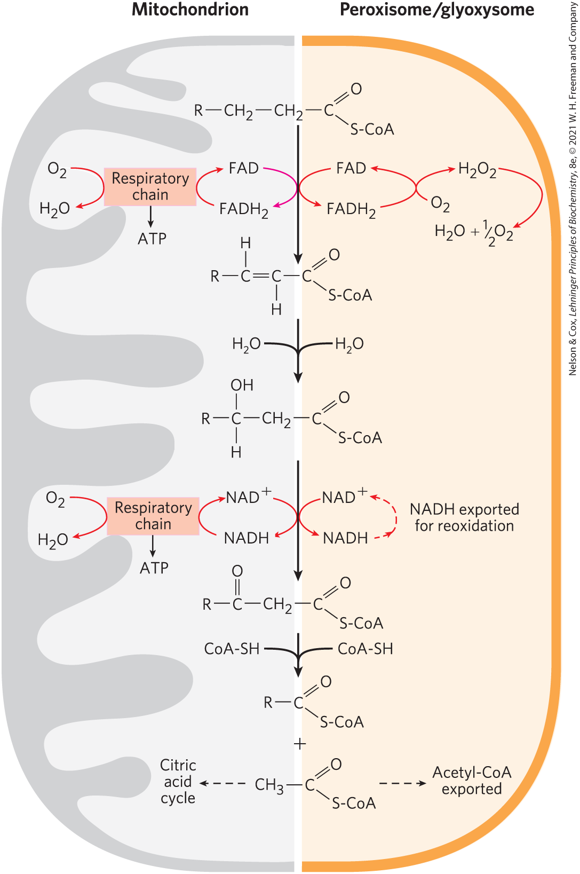
Peroxisomes Also Carry Out β Oxidation
peroxisomes = organelles found in plants and animals
β oxidation in peroxisomes has four steps:
  dehydrogenation
  addition of water to the resulting double bond
  oxidation of the β-hydroxyacyl-CoA to a ketone
  thiolytic cleavage by coenzyme A

Slide 62
Differences Between the Peroxisomal and Mitochondrial Pathways
in peroxisomes, the flavoprotein acyl-CoA oxidase that introduces the double bond passes electrons directly to O₂, producing H₂O₂
  the enzyme catalase cleaves H₂O₂ to H₂O and O₂
the peroxisomal system is much more active on very-long-chain fatty acids and branched-chain fatty acids

Slide 63
17.3 Ketone Bodies

Slide 64
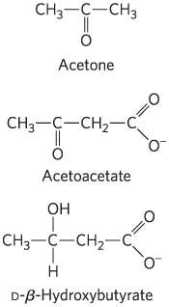
The “Ketone Bodies”
“ketone bodies” = acetone, acetoacetate, and D-β-hydroxybutyrate
  formed from acetyl-CoA in the liver
acetone is exhaled
acetoacetate and D-β-hydroxybutyrate are transported to extrahepatic tissues and converted to acetyl-CoA to be oxidized in the citric acid cycle

Slide 65
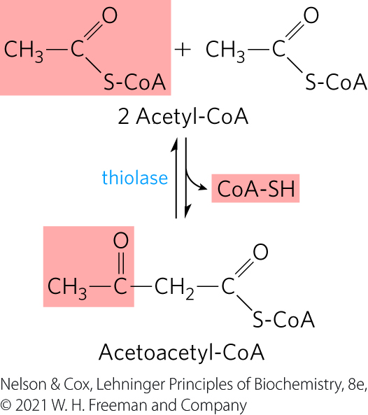
Ketone Bodies, Formed in the Liver, Are Exported to Other Organs as Fuel
thiolase = catalyzes the enzymatic condensation of two acetyl-CoA molecules to form acetoacetyl-CoA
  reversal of the last step of β oxidation

Slide 66
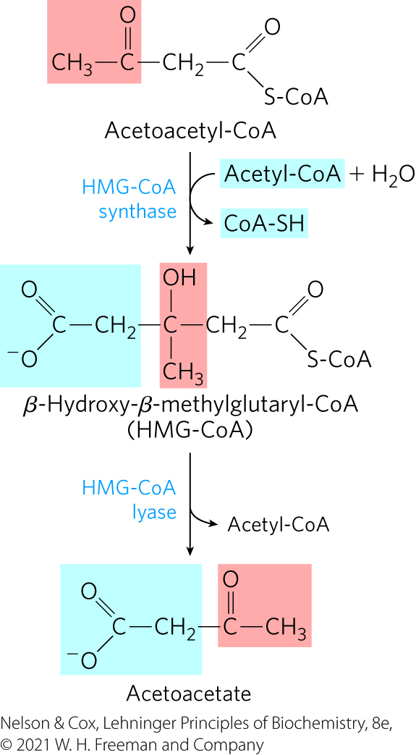
The HMG-CoA Synthase and HMG-CoA Lyase Reactions
HMG-CoA synthase = catalyzes the condensation of acetoacetyl-CoA with acetyl-CoA to form β-hydroxy-β-methylglutaryl-CoA (HMG-CoA)
HMG-CoA lyase = catalyzes the cleavage of HMG-CoA to free acetoacetate and acetyl-CoA

Slide 67
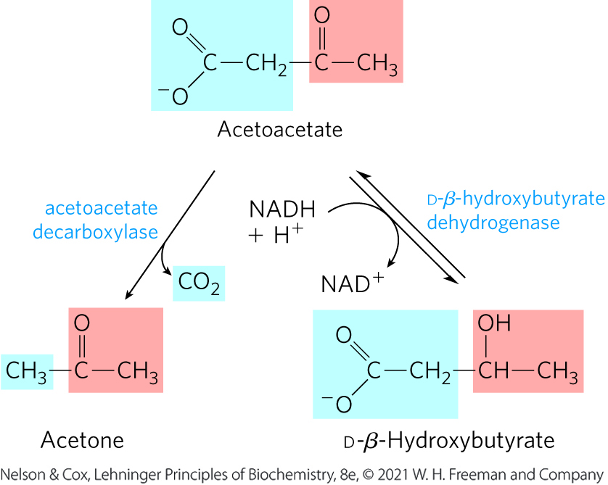
The Decarboxylation and Reduction of Acetoacetate
acetoacetate decarboxylase = catalyzes the decarboxylation of acetoacetate to acetone
D-β-hydroxybutyrate dehydrogenase = catalyzes the reversible reduction of acetoacetate to D-β-hydroxybutyrate

Slide 68
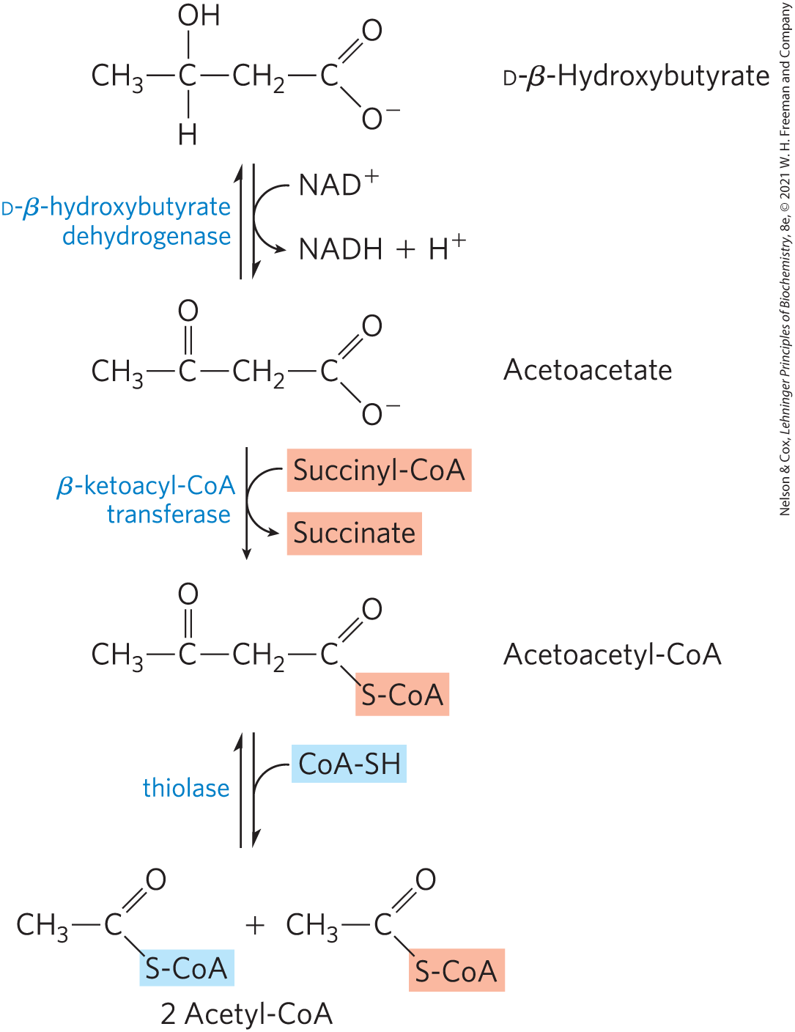
D-β-Hydroxybutyrate as Fuel
D-β-hydroxybutyrate dehydrogenase = catalyzes the oxidation of D-β-hydroxybutyrate to acetoacetate in extrahepatic tissue
β-ketoacyl-CoA transferase = catalyzes the activation of acetoacetate
acetyl-CoA enters the citric acid cycle

Slide 69
Ketone Bodies Are Used as Fuels in all Tissues Except Liver
the liver lacks β-ketoacyl-CoA transferase
the liver is a producer of ketone bodies, not a consumer

Slide 70
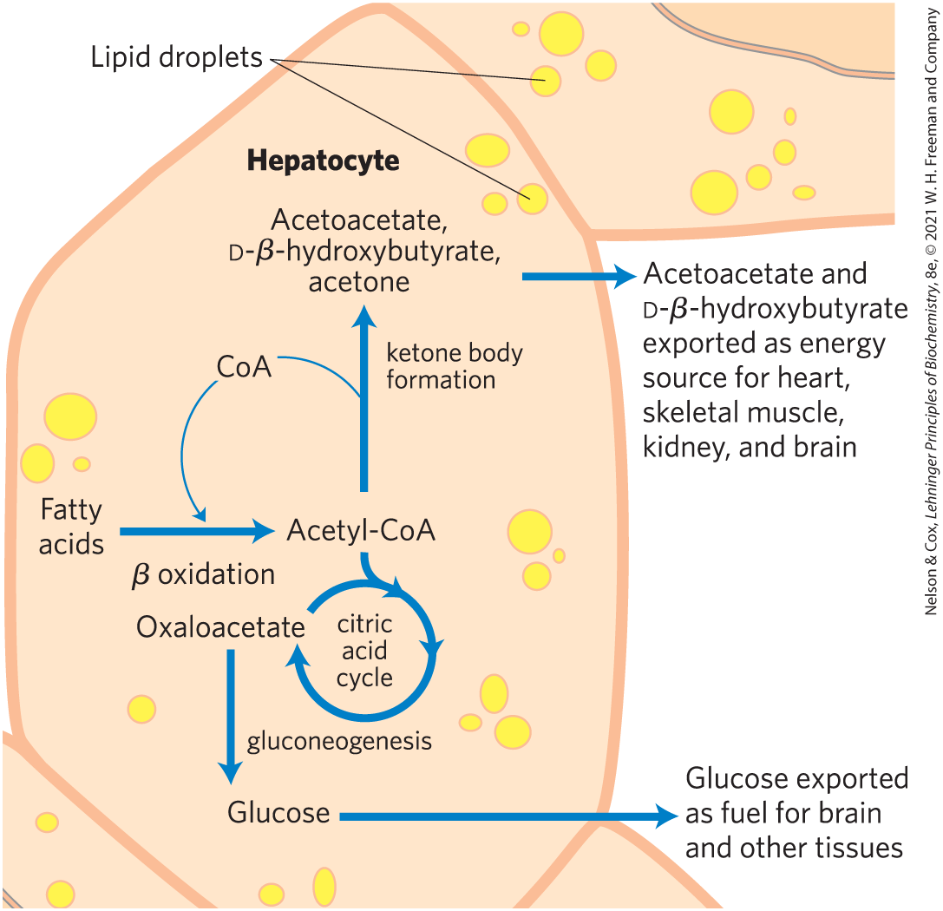
Ketone Bodies Are Overproduced in Diabetes and during Starvation
the accumulation of acetyl-CoA accelerates formation of ketone bodies
  extrahepatic tissues do not have the capacity to oxidize them all

Slide 71
Acidosis, Ketosis, and Ketoacidosis
acidosis = lowered blood pH
  can be caused by increased levels of acetoacetate, and D-β-hydroxybutyrate
ketosis = high levels of ketone bodies in the blood and urine
ketoacidosis = condition when ketosis and acidosis are combined

Slide 72
Individuals with Untreated Diabetes
Have High Acetone Levels
acetoacetate decarboxylase = catalyzes the decarboxylation of acetoacetate to acetone
individuals with untreated diabetes produce large quantities of acetoacetate
acetone formed from the decarboxylation of acetoacetate is volatile
  imparts a characteristic odor to the breath

