Slide 1

15 The Metabolism of Glycogen in Animals
© 2021 Macmillan Learning

Slide 2

Principle 1 (1 of 2)
Glycogen provides vertebrate animals with a ready source of glucose to supply the brain and skeletal muscles with energy. Although animals store about 100 times more energy as fat than as glycogen, they cannot metabolize fat into glucose. The highly branched polymeric structure of glycogen granules allows cells in the liver and muscle to make large numbers of glucose and glucose phosphate monomers available quickly without raising the osmolarity of the cytosol by storing them in monomeric form.

Slide 3

Principle 2 (1 of 3)
Monomers are released from glycogen granules by a phosphorolysis reaction that creates phosphorylated glucose molecules that can enter glycolysis to supply energy to the cell. Skeletal muscle cells especially require stores of glycogen to supply energy for bursts of activity. In the liver, the phosphate can be removed, allowing free glucose to be transported out of the cell to the blood for use in the brain and other tissues when dietary glucose is not sufficient.

Slide 4

Principle 3 (1 of 4)
Glycogen synthesis requires a protein primer and an activated glucose precursor. Individual glucose molecules activated as sugar nucleotides are added to the nonreducing end of the growing linear chains in the outer tiers of the glycogen β-granules, and a branching enzyme adds branches periodically.

Slide 5
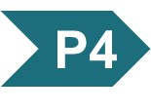
Principle 4 (1 of 7)
Regulation of the balance between
the formation of glycogen from excess glucose and the release of glucose from glycogen polymers when it is needed in metabolism is a critical function of cellular and organismal homeostasis. This balance, ultimately controlled by the hormones epinephrine, glucagon, and insulin, is achieved through allosteric regulation and phosphorylation of the synthetic and degradative enzymes. These enzymes and the regulatory proteins that act on them are integral parts of the glycogen granule.

Slide 6
15.1 The Structure and Function of Glycogen

Slide 7
Principle 1 (2 of 2)
Glycogen provides vertebrate animals with a ready source of glucose to supply the brain and skeletal muscles with energy. Although animals store about 100 times more energy as fat than as glycogen, they cannot metabolize fat into glucose. The highly branched polymeric structure of glycogen granules allows cells in the liver and muscle to make large numbers of glucose and glucose phosphate monomers available quickly without raising the osmolarity of the cytosol by storing them in monomeric form.

Slide 8
Vertebrate Animals Require a Ready Fuel Source for Brain and Muscle
glycogen = a polymeric storage form of glucose in animals that is found primarily in muscle and liver
glycogen breakdown in muscle delivers glucose needed for muscle contraction within seconds
glycogen stored in the liver provides a reservoir that maintains homeostasis of blood glucose

Slide 9
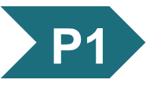
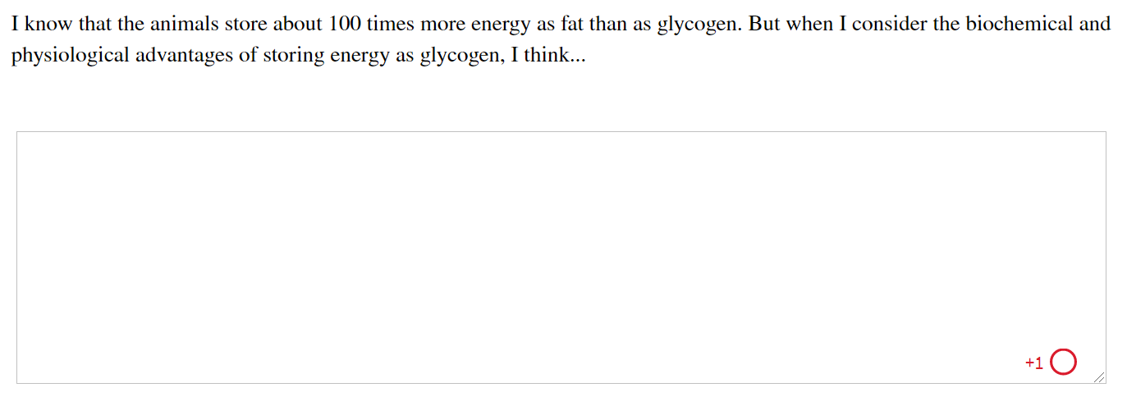
Activity: Glycogen as
Energy Storage Muddiest Point (1 of 2)
Complete the Ch15 Student Activity, Day 1: Glycogen as Energy Storage (Muddiest Point) Achieve assessment.
Notes:
Instructor: This muddiest point activity can be found in Achieve in the Chapter 15 folder titled “Ch15 In-Class Activities, Videos, and Resources.” See the Instructor Activity Guide in the same folder for more information.

Slide 10
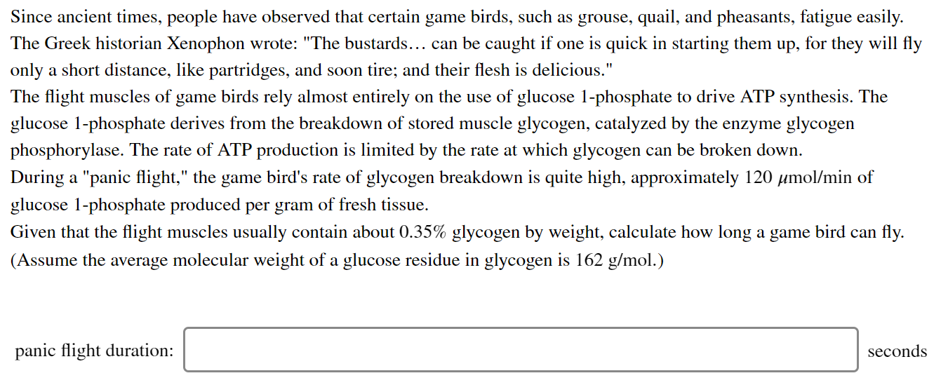
Activity: Glycogen as
Energy Storage Muddiest Point (2 of 2)
Complete the Ch15 Student Activity, Day 2: Glycogen as Energy Storage (Muddiest Point) Achieve assessment.
Notes:
Instructor: This muddiest point activity can be found in Achieve in the Chapter 15 folder titled “Ch15 In-Class Activities, Videos, and Resources.” See the Instructor Activity Guide in the same folder for more information.

Slide 11
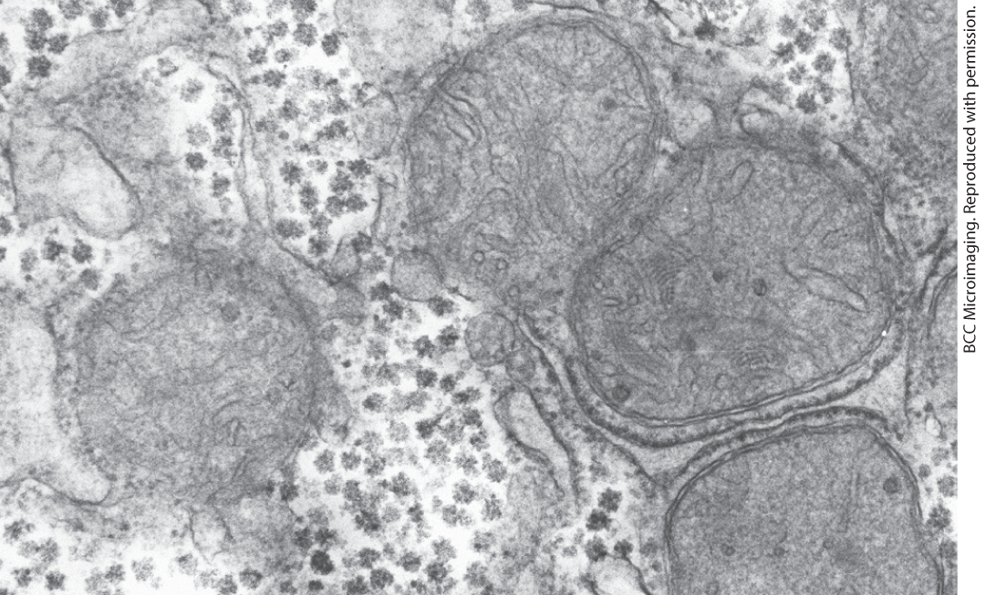
Glycogen Granules Have Many Tiers of Branched Chains of D-Glucose
glycogen β-granules = cytosolic granules that vary in size, structure, and subcellular location
  appear as electron-dense particles

Slide 12
β-Granules Cluster to Form α-Granules in the Liver
α-granules = protein-rich granules composed of 20-40 clustered β-granules
  release glucose slower than β-granules
  visible in well-fed animals, but absent after a 24-hour fast
  often associate with tubules of the smooth ER

Slide 13
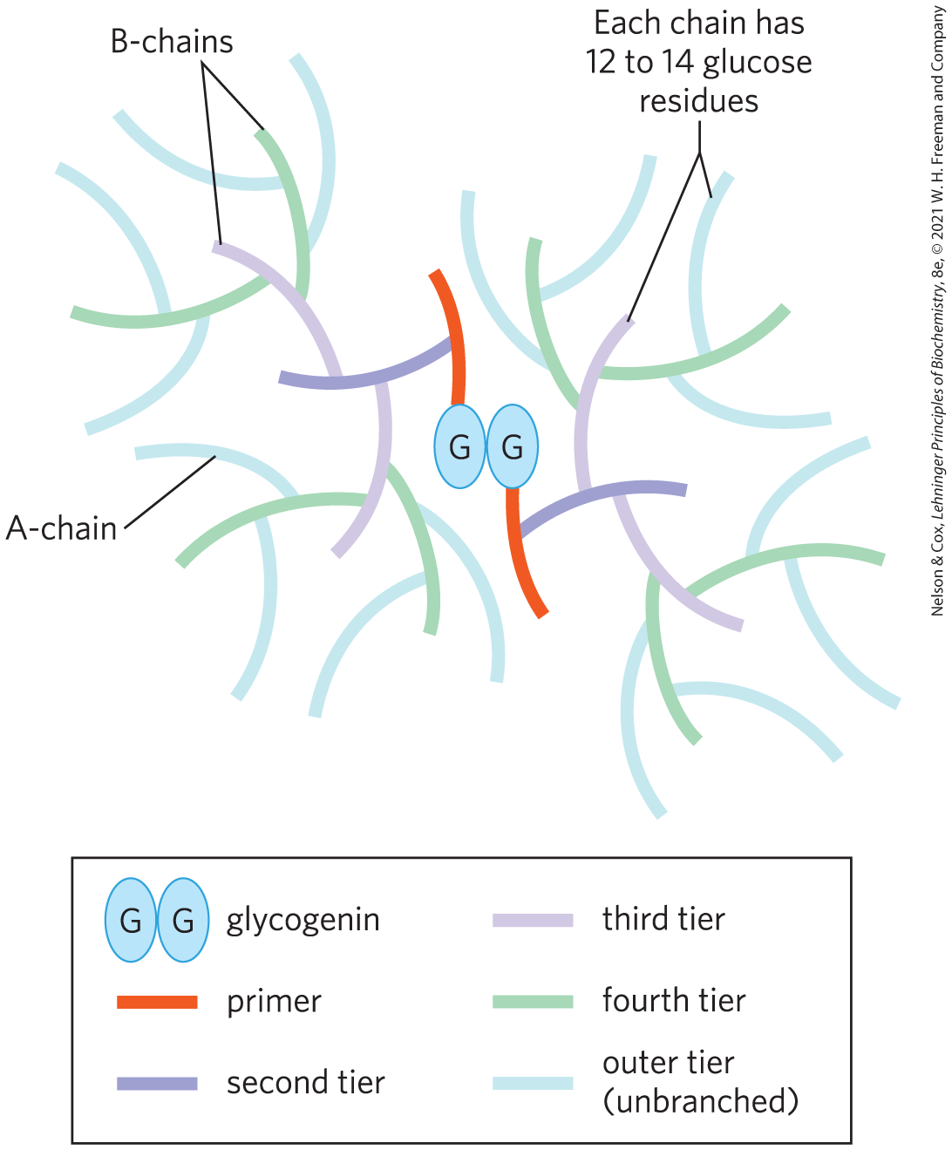
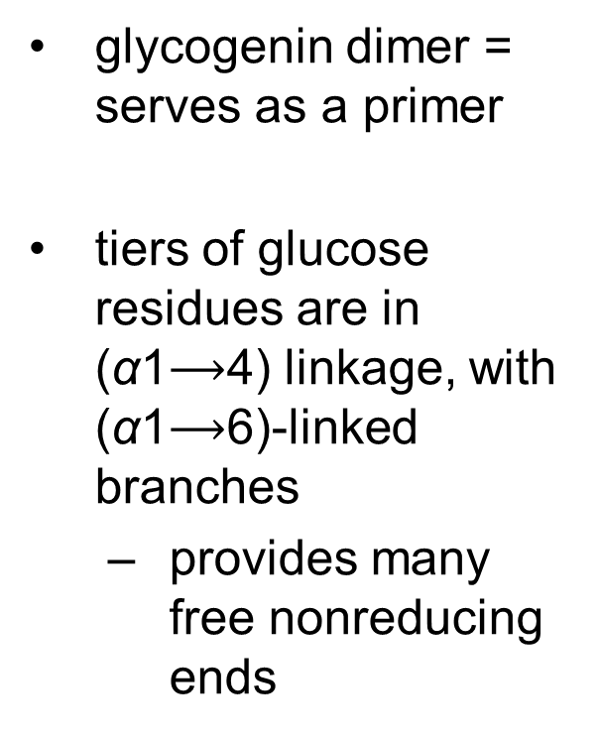
Structure of a Glycogen β-Granule
glycogenin dimer = serves as a primer
tiers of glucose residues are in (α1$⟶$4) linkage, with (α1$⟶$6)-linked branches
  provides many free nonreducing ends

Slide 14
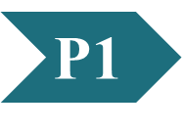
Clicker Question 1
Consider the way that glycogen is stored within a cell. Which answer choice correctly ranks the glycogen storage particles from smallest to largest?
glucose, α-granule, β-granule
α-granule, β-granule, glucose
glucose, β-granule, α-granule
β-granule, α-granule, glucose
Notes:
Answer: C
Principle: 15.1
Learning Objective(s): Define β-granule.
Bloom’s: 2:1

Slide 15
Clicker Question 1, Response
Consider the way that glycogen is stored within a cell. Which answer choice correctly ranks the glycogen storage particles from smallest to largest?
glucose, β-granule, α-granule
In muscle, β-granules are 20–30 nm in diameter and have an M_{r} of 10^{–10}. They consist of up to 55,000 glucose residues with about 2,000 nonreducing ends available for degradative enzymes to work on. In the liver, 20 to 40 β‑granules cluster together to form protein-rich α-granules as large as 300 nm in diameter and of M_{r} greater than 108.

Slide 16
15.2 Breakdown and Synthesis of Glycogen

Slide 17
Glycogenolysis and Glycogenesis
glycogenolysis = the breakdown of cellular glycogen to glucose 1-phosphate
glycogenesis = the synthesis of glycogen

Slide 18
Principle 2 (2 of 3)
Monomers are released from glycogen granules by a phosphorolysis reaction that creates phosphorylated glucose molecules that can enter glycolysis to supply energy to the cell. Skeletal muscle cells especially require stores of glycogen to supply energy for bursts of activity. In the liver, the phosphate can be removed, allowing free glucose to be transported out of the cell to the blood for use in the brain and other tissues when dietary glucose is not sufficient.

Slide 19
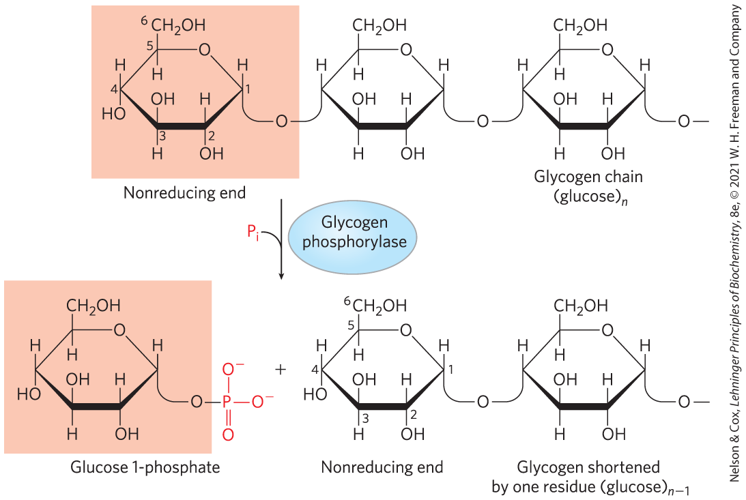
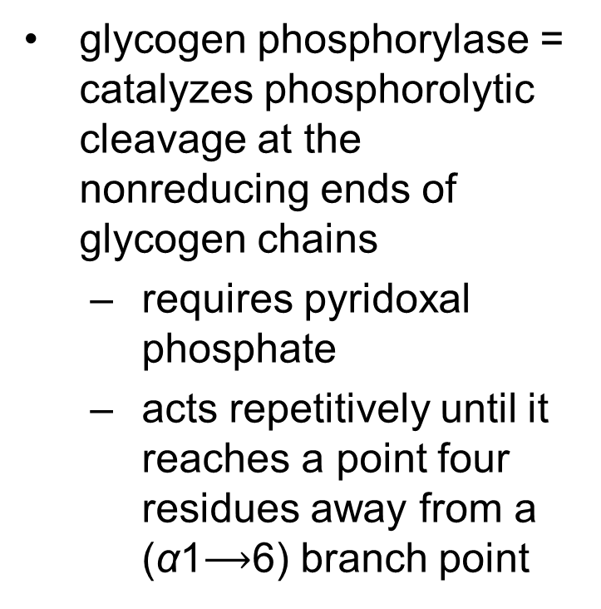
Glycogen Breakdown Is Catalyzed by Glycogen Phosphorylase
glycogen phosphorylase = catalyzes phosphorolytic cleavage at the nonreducing ends of glycogen chains
  requires pyridoxal phosphate
  acts repetitively until it reaches a point four residues away from a (α1$⟶$6) branch point

Slide 20
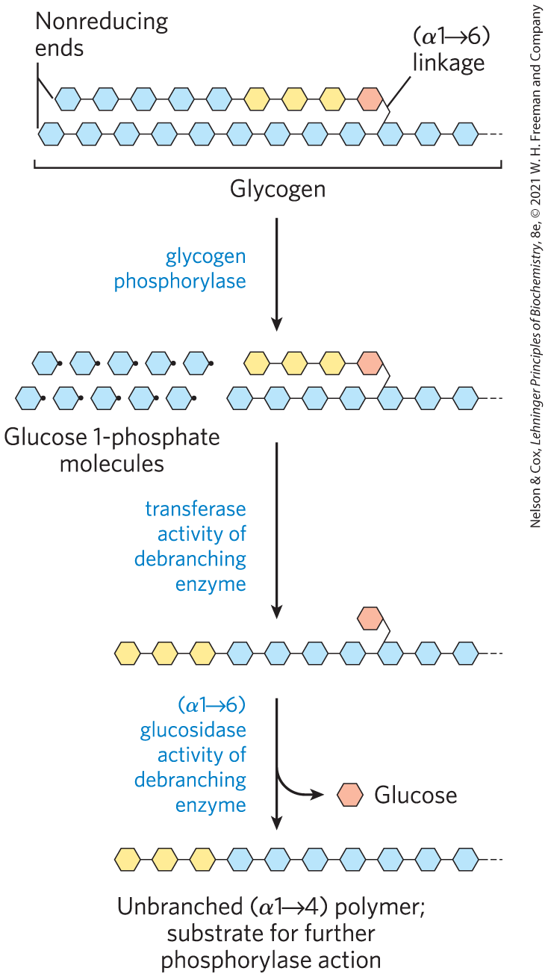

Debranching Enzyme
debranching enzyme = transfers branches onto main chains and releases the residue at the (α1$⟶$6) branch as free glucose

Slide 21
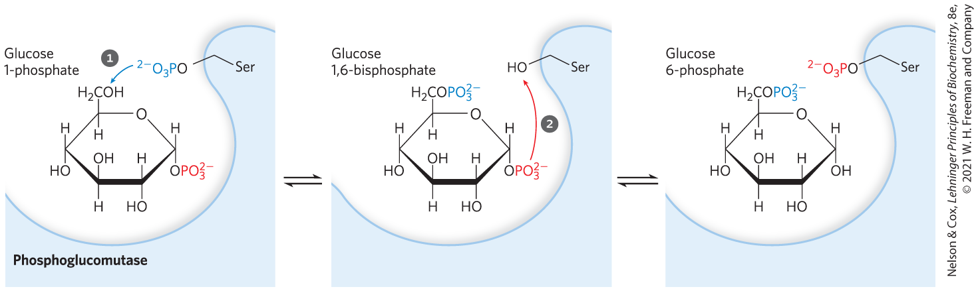
Glucose 1-Phosphate Can Enter Glycolysis or, in Liver, Replenish Blood Glucose
phosphoglucomutase = catalyzes the reversible conversion of glucose 1-phosphate to glucose 6-phosphate

Slide 22
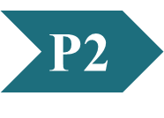
Clicker Question 2
Glycogenolysis releases a form of glucose that cannot enter glycolysis. What enzyme can transform it into a glycolytic intermediate?
glycogen phosphorylase
phosphoglucomutase
NDP-sugar pyrophosphorylase
transglycolase
glycogenin
Notes:
Answer: B
Principle: 15.2
Learning Objective(s): Describe the role of phosphoglucomutase after glycogen degradation.
Bloom’s: 2:1

Slide 23
Clicker Question 2, Response
Glycogenolysis releases a form of glucose that cannot enter glycolysis. What enzyme can transform it into a glycolytic intermediate?
phosphoglucomutase
Phosphoglucomutase transforms glucose 1-phosphate into glucose 6-phosphate.

Slide 24
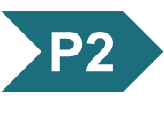
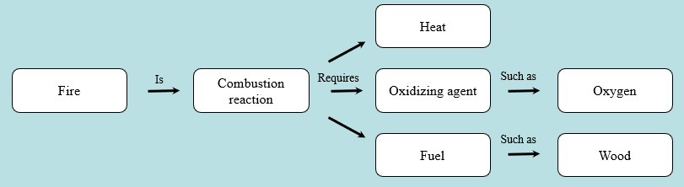
Activity: Relating
Terms within the Chapter
A concept map displays the relationships between different concepts. Observe the following example of a concept map.
Notes:
Instructor: For additional information, see the Instructor Activity Guide located in Achieve. It can be found within Chapter 15, in the folder titled “Ch15 In-Class Activities, Videos, and Resources.”

Slide 25
Activity Instructions (1 of 2)
Think about how the following terms and phrases relate to each other and then use scratch paper to draw a concept map using these terms and phrases. (3 minutes)
glycogen
phosphorylated glucose monomers
glycolysis
dephosphorylation in the liver
supplies energy to the cell
free glucose
used as needed in brain and other tissues
skeletal muscle
supplies energy for bursts of activity
Notes:
Instructor: For additional information, see the Instructor Activity Guide located in Achieve. It can be found within Chapter 15, in the folder titled “Ch15 In-Class Activities, Videos, and Resources.”

Slide 26
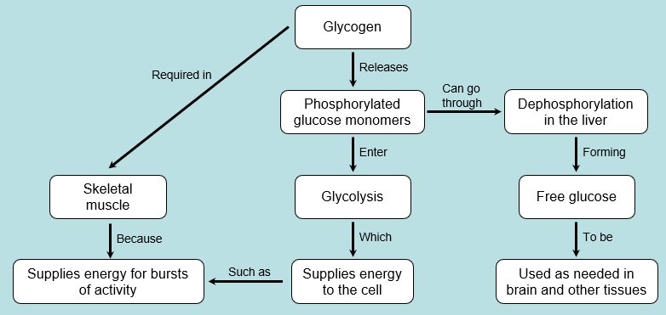
Activity Solution (1 of 2)
Pair up and share how this possible concept map might differ from yours. (2 minutes)
Notes:
Instructor: For additional information, see the Instructor Activity Guide located in Achieve. It can be found within Chapter 15, in the folder titled “Ch15 In-Class Activities, Videos, and Resources.”

Slide 27
Principle 2 (3 of 3)
Monomers are released from glycogen granules by a phosphorolysis reaction that creates phosphorylated glucose molecules that can enter glycolysis to supply energy to the cell. Skeletal muscle cells especially require stores of glycogen to supply energy for bursts of activity. In the liver, the phosphate can be removed, allowing free glucose to be transported out of the cell to the blood for use in the brain and other tissues when dietary glucose is not sufficient.

Slide 28
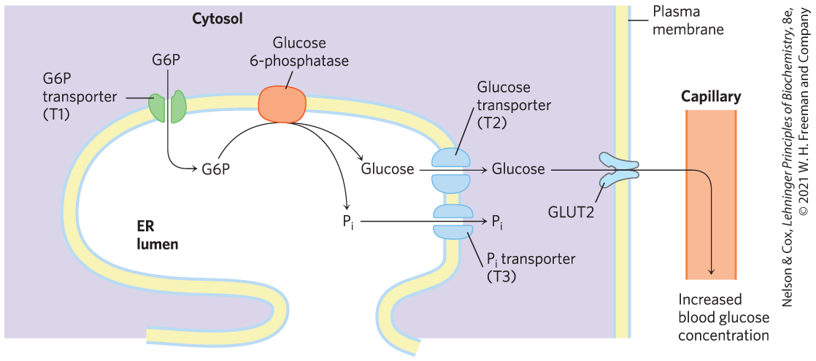
Fates of Glucose 6-Phosphate
in skeletal muscle, glucose 6-phosphate enters glycolysis
in liver, glucose 6-phosphatase converts glucose 6-phosphate to glucose in the ER for export to replenish blood glucose

Slide 29
Clicker Question 3
In glycogenolysis, why is the glucose 6-phosphatase activity in the ER lumen?
Glycogenolysis occurs in the ER lumen.
It prevents a futile cycle with enzymes of the glycolytic pathway.
The first steps of glycolysis are in the ER lumen.
It allows glucose to be easily exported from the liver by GLUT2.
It allows lipogenesis to occur rapidly.
Notes:
Answer: B
Principle: 15.2
Learning Objective(s): Describe the role of glucose 6-phosphatase after glycogen degradation.
Bloom’s: 2:2

Slide 30
Clicker Question 3, Response
In glycogenolysis, why is the glucose 6-phosphatase activity in the ER lumen?
It prevents a futile cycle with enzymes of the glycolytic pathway.
By having the active site of glucose 6-phosphatase in the ER lumen, the cell separates this reaction from the process of glycolysis, which takes place in the cytosol and would be aborted by the action of glucose 6-phosphatase.

Slide 31
Glycogen Storage Diseases
genetic defects in either glucose 6-phosphatase or the glucose 6-phosphate transporter T1 cause type Ia glycogen storage disease
Type (name) | Enzyme affected | Primary organ/ cells affected | Symptoms
Type 0 | Glycogen synthase | Liver | Low blood glucose, high ketone, bodies, early death
Type Ia (von Gierke) | Glucose 6-phosphatase | Liver | Enlarged liver, kidney failure
Type Ib | Microsomal glucose 6-phosphate translocase | Liver | As in type Ia; also high susceptibility to bacterial infections
Type Ic | Microsomal P, transporter | Liver | As in type Ia
Type II (Pompe) | Lysosomal glucosidase | Skeletal and cardiac muscle | Infantile form: death by age 2; juvenile form: muscle defects (myopathy); adult form: as in muscular dystrophy
Type IIIa (Cori or Forbes) | Debranching enzyme | Liver, skeletal, and cardiac muscle | Enlarged liver in infants; myopathy
Type IIIb | Liver debranching enzyme (muscle enzyme normal) | Liver | Enlarged liver in infants
Type IV (Andersen) | Branching enzyme | Liver, skeletal muscle | Enlarged liver and spleen, myoglobin in urine
Type V (McArdle) | Muscle phosphorylase | Skeletal muscle | Exercise-induced cramps and pain; myoglobin in urine
Type VI (Hers) | Liver phosphorylase | Liver | Enlarged liver
Type VII (Tarui) | Muscle PFK-1 | Muscle, erythrocytes | As in type V; also hemolytic anemia
Type VIb, VIII, or IX | Phosphorylase kinase | Liver, leukocytes, muscle | Enlarged liver
Type XI (Fanconi-Bickel) | Glucose transporter (GLUT2) | Liver | Failure to thrive, enlarged liver, rickets, kidney dysfunction
Table 1 Glycogen Storage Diseases of Humans

Slide 32
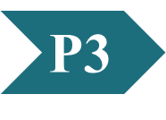
Clicker Question 4
A patient was seen by a gastrointestinal specialist and diagnosed with a glycogen storage disease. A liver biopsy showed that the patient was producing very little glycogen, the molecules were relatively small, and they only had α (14) glycosidic linkages. Blood and liver glucose concentrations were within normal ranges. What enzyme is LIKELY affected in this disease?
glycogen synthase
hexokinase
glycosyl (46) transferase
glycogenin
UDP-glucose pyrophosphorylase
Notes:
Answer: C
Principle: 15.3
Learning Objective(s): List the steps and enzymes involved in glycogen synthesis.
Bloom’s: 3:2

Slide 33
Clicker Question 4, Response
A patient was seen by a gastrointestinal specialist and diagnosed with a glycogen storage disease. A liver biopsy showed that the patient was producing very little glycogen, the molecules were relatively small, and they only had α (14) glycosidic linkages. Blood and liver glucose concentrations were within normal ranges. What enzyme is LIKELY affected in this disease?
glycosyl (46) transferase
The glycogen-branching enzyme, also called amylo (14) to (16) transglycosylase or glycosyl (46) transferase, makes the (16) bonds found at the branch points of glycogen.

Slide 34
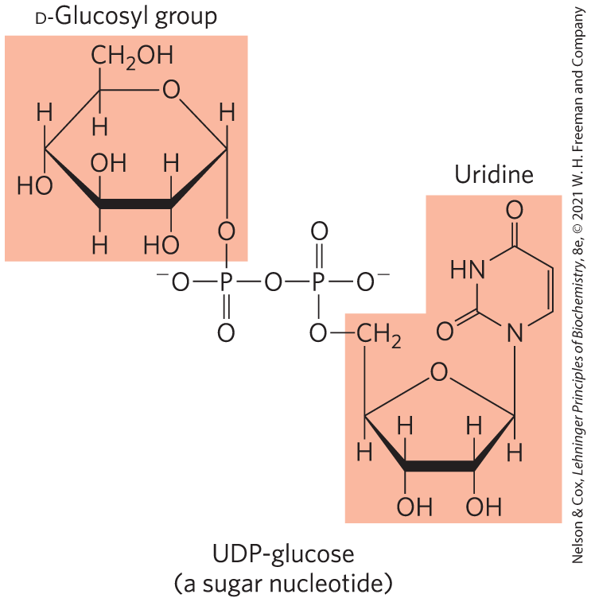
The Sugar Nucleotide UDP-Glucose Donates Glucose for Glycogen Synthesis
sugar nucleotides = compounds in which the anomeric carbon of a sugar is activated by attachment to a nucleotide through a phosphate ester linkage
  involved in reactions where hexoses are transformed or polymerized

Slide 35
Principle 3 (2 of 4)
Glycogen synthesis requires a protein primer and an activated glucose precursor. Individual glucose molecules activated as sugar nucleotides are added to the nonreducing end of the growing linear chains in the outer tiers of the glycogen β-granules, and a branching enzyme adds branches periodically.

Slide 36
Properties of Sugar Nucleotides
sugar nucleotides are suitable for biosynthetic reactions because:
  their formation is metabolically irreversible
  the nucleotide moiety has many groups that can undergo noncovalent interactions with enzymes
  the nucleotidyl group (UDP, ADP) is an excellent leaving group, facilitating nucleophilic attack
  “tagging” with nucleotidyl groups distinguishes the hexoses from hexoses destined for other purposes

Slide 37
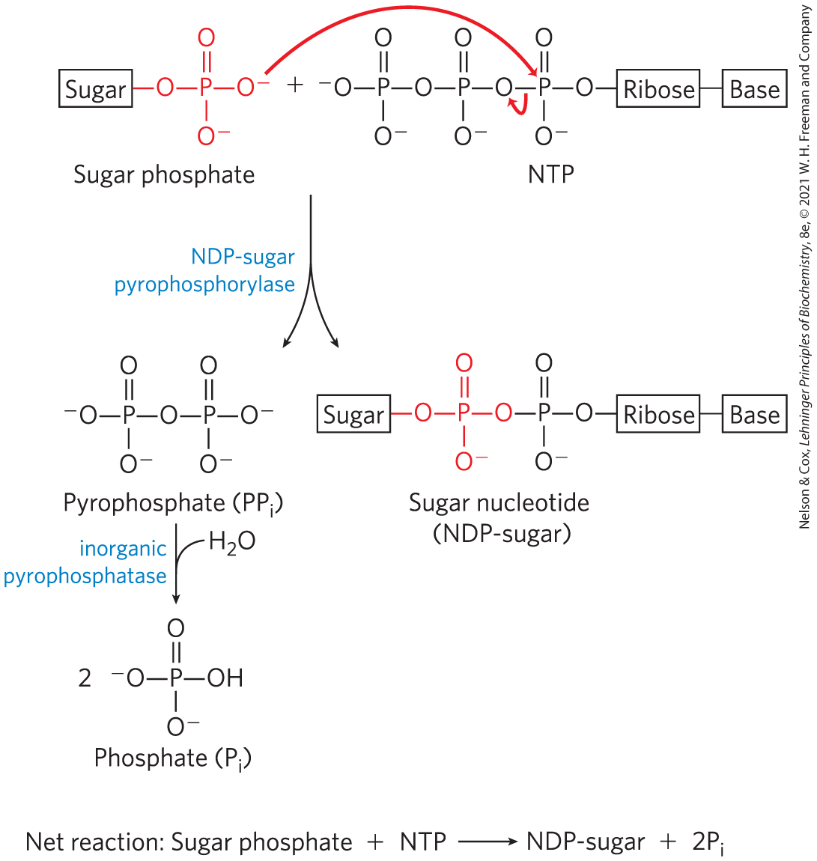
Formation of a Sugar Nucleotide
rapid removal of the product, driven by the large, negative free-energy change of PP_{i} (∆G′° = −19.2 kJ/mol) hydrolysis, pulls the synthetic reaction forward

Slide 38
Glycogen Synthesis Begins With Glucose 6-Phosphate
sources of glucose 6-phosphate:
  hexokinase isozymes derive glucose 6-phosphate from glucose
  lactate taken up by the liver is converted to glucose 6-phosphate by gluconeogenesis
phosphoglucomutase = converts glucose 6-phosphate to glucose 1-phosphate

Slide 39

UDP-Glucose Pyrophosphorylase Catalyzes A Key Step of Glycogen Biosynthesis
UDP-glucose pyrophosphorylase = converts glucose 1-phosphate to UDP-glucose
  glucose 1-phosphate + UTP $⟶$ UDP-glucose + PP_{i}

Slide 40
Clicker Question 5
Which nucleotide is required for glycogen synthesis?
ATP
UTP
CTP
GTP
cAMP
Notes:
Answer: B
Principle: 15.3
Learning Objective(s): Describe the process of glycogen synthesis.
Bloom’s: 2:1

Slide 41
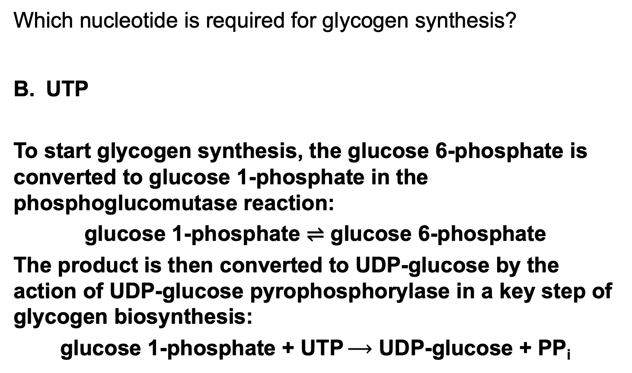
Clicker Question 5, Response
Which nucleotide is required for glycogen synthesis?
UTP
To start glycogen synthesis, the glucose 6-phosphate is converted to glucose 1-phosphate in the phosphoglucomutase reaction:
glucose 1-phosphate ⇌ glucose 6-phosphate
The product is then converted to UDP-glucose by the action of UDP-glucose pyrophosphorylase in a key step of glycogen biosynthesis:
glucose 1-phosphate + UTP $⟶$ UDP-glucose + PP_{i}

Slide 42
Principle 3 (3 of 4)
Glycogen synthesis requires a protein primer and an activated glucose precursor. Individual glucose molecules activated as sugar nucleotides are added to the nonreducing end of the growing linear chains in the outer tiers of the glycogen β-granules, and a branching enzyme adds branches periodically.

Slide 43
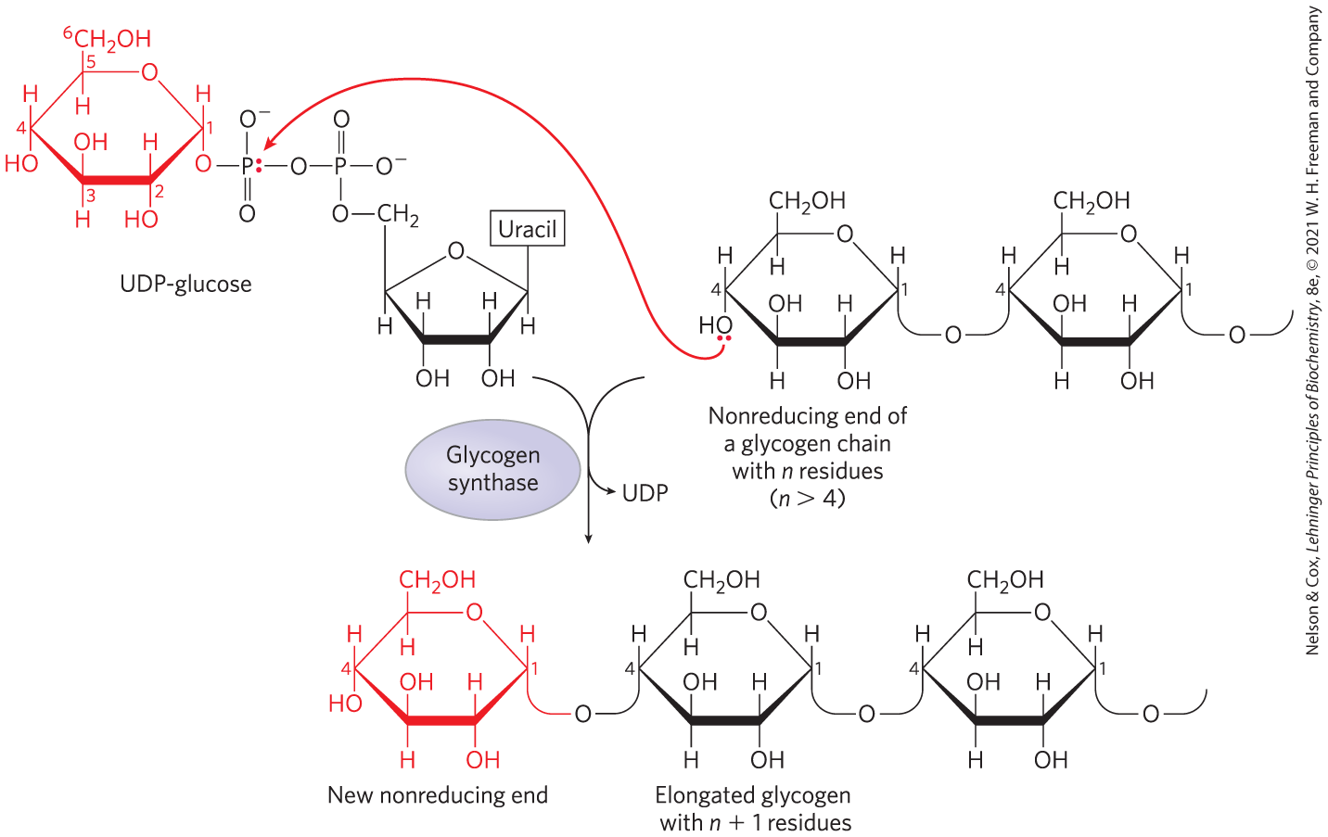
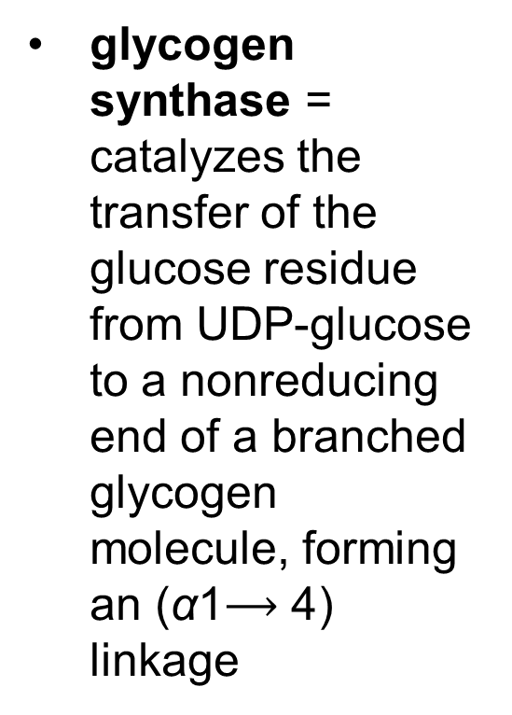
UDP-Glucose Donates Glucose to a Nonreducing End of Glycogen
glycogen synthase = catalyzes the transfer of the glucose residue from UDP-glucose to a nonreducing end of a branched glycogen molecule, forming an (α1$⟶\text{4}$) linkage

Slide 44
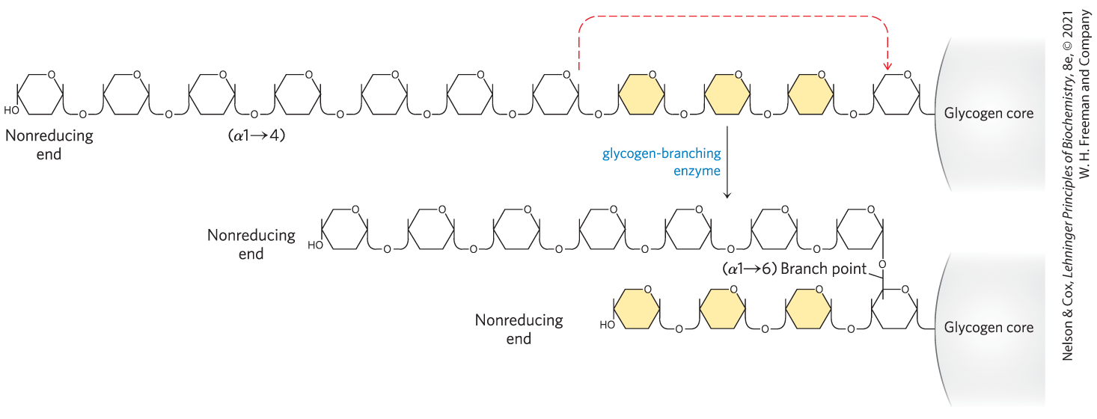
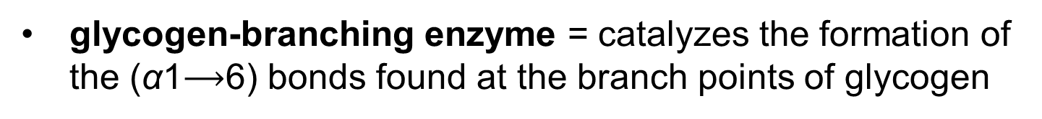
Glycogen-Branching Enzyme
glycogen-branching enzyme = catalyzes the formation of the (α1$⟶$6) bonds found at the branch points of glycogen

Slide 45
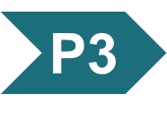
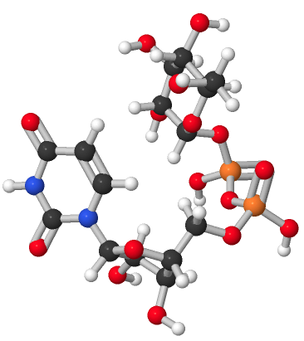
Activity: Understanding
Glycogen Synthesis
Observe the structure of UDP-glucose in Mol3D viewer in your Achieve course.
Notes:
Instructor: This Mol3D structure is located in the Achieve course. It can be found in the Chapter 15 content, in the folder titled “Ch15 In-Class Activities, Videos, and Resources.”

Slide 46
Activity Instructions (2 of 2)
On your own, think of answers to the questions:
  Which atom of glucose is bonded to UDP to form the activated UDP-glucose molecule? Select the atom and upload a screenshot to your course.
  Is the glucose molecule within UDP-glucose added to the reducing end or the nonreducing end of a molecule of glycogen?
  What type of linkage results from the addition of a new glucose monomer to a molecule of glycogen?
(2 minutes)
Pair up to discuss your ideas. (2 minutes)
Share your ideas with the class in group discussion.
(3 minutes)
Notes:
Instructor: This Mol3D structure is located in the Achieve course. It can be found in the Chapter 15 content, in the folder titled “Ch15 In-Class Activities, Videos, and Resources.”

Slide 47
Activity Solution (2 of 2)
  Which atom of glucose is bonded to UDP to form the activated UDP-glucose molecule? Select the atom and upload a screenshot to your course.
C-1 forms a phosphoester bond with UDP.
  Is the glucose moiety of UDP-glucose added to the reducing end or the nonreducing end of a molecule of glycogen? nonreducing end
  What type of linkage results from the addition of a new glucose monomer to a molecule of glycogen? (α1→4) linkage
Notes:
Instructor: This Mol3D structure is located in the Achieve course. It can be found in the Chapter 15 content, in the folder titled “Ch15 In-Class Activities, Videos, and Resources.”

Slide 48
Principle 3 (4 of 4)
Glycogen synthesis requires a protein primer and an activated glucose precursor. Individual glucose molecules activated as sugar nucleotides are added to the nonreducing end of the growing linear chains in the outer tiers of the glycogen β-granules, and a branching enzyme adds branches periodically.

Slide 49
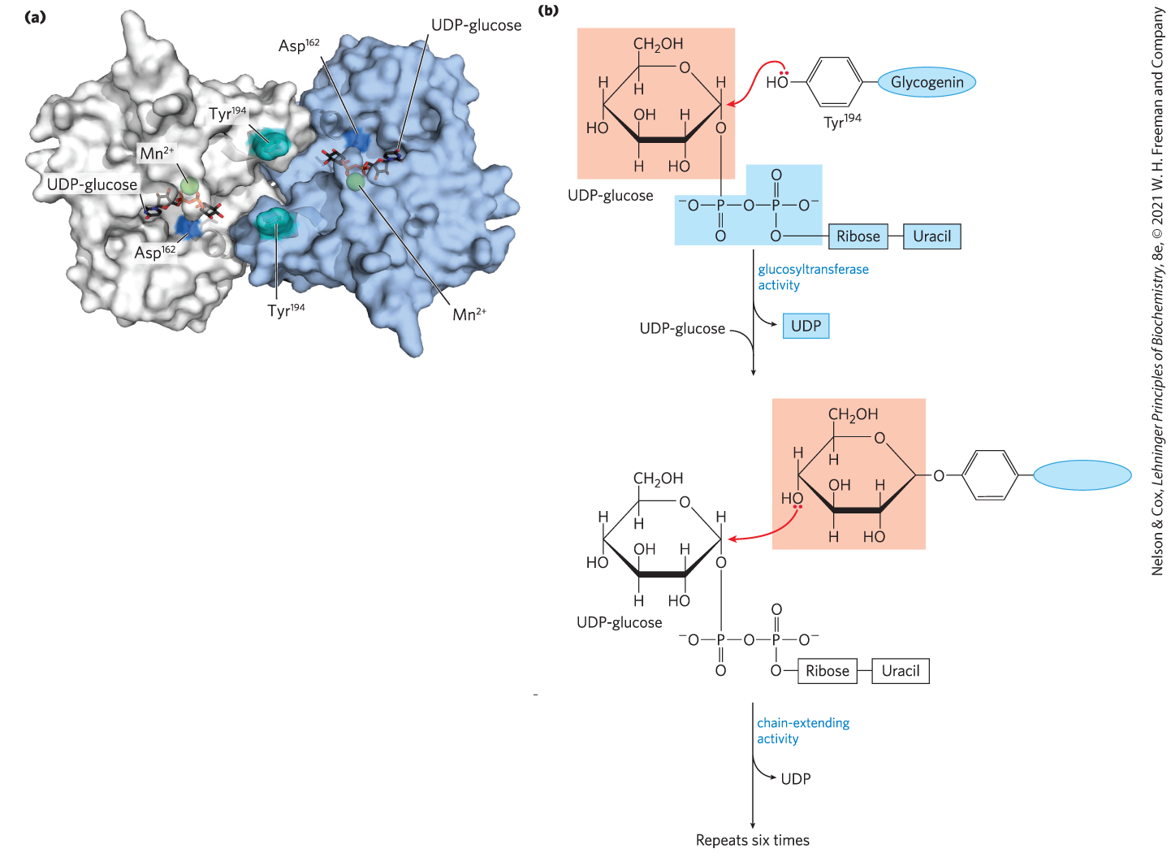
Glycogenin Primes the Initial Sugar Residues in Glycogen
glycogen synthase requires a primer
glycogenin = the primer on which new chains are assembled and the enzyme that catalyzes their assembly

Slide 50
The Glycogenin Mechanism
1st reaction = autocatalytic formation of a glycosidic bond between the glucose of UDP-glucose and Tyr¹⁹⁴ of glycogenin
2nd reaction = addition of seven more glucose residues, each from UDP-glucose, to form a primer that can be acted on by glycogen synthase

Slide 51
Clicker Question 6
Glycogenesis:
begins the production of a new glycogen molecule with the reactions of glycogenin.
involves the action of glycogen debranching enzyme.
involves transfer of glucose from CDP-glucose to a nonreducing end of a glycogen chain.
only occurs in the liver and muscle.
Notes:
Answer: A
Principle: 15.3
Learning Objective(s): Describe the process of glycogen synthesis.
Bloom’s: 2:1

Slide 52
Clicker Question 6, Response
Glycogenesis:
begins the production of a new glycogen molecule with the reactions of glycogenin,
The intriguing protein glycogenin is both the primer on which new chains are assembled and the enzyme that catalyzes their assembly.

Slide 53
15.3 Coordinated Regulation of Glycogen Breakdown and Synthesis

Slide 54
Principle 4 (2 of 7)
Regulation of the balance between
the formation of glycogen from excess glucose and the release of glucose from glycogen polymers when it is needed in metabolism is a critical function of cellular and organismal homeostasis. This balance, ultimately controlled by the hormones epinephrine, glucagon, and insulin, is achieved through allosteric regulation and phosphorylation of the synthetic and degradative enzymes. These enzymes and the regulatory proteins that act on them are integral parts of the glycogen granule.

Slide 55
Glycogen Phosphorylase Is Regulated by Hormone-Stimulated Phosphorylation and by Allosteric Effectors
skeletal glycogen phosphorylase has two forms:
  glycogen phosphorylase a = catalytically active
  glycogen phosphorylase b = much less active

Slide 56
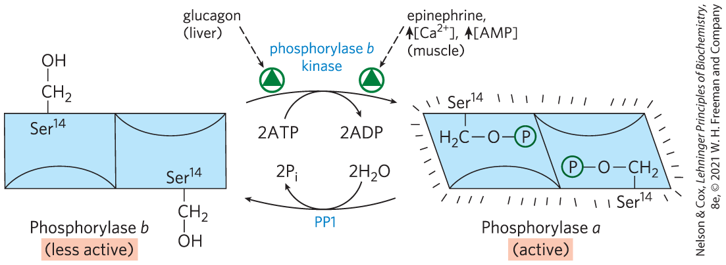
Regulation of Muscle Glycogen Phosphorylase by Covalent Modification
epinephrine (from vigorous muscle activity) and glucagon (in the liver) trigger phosphorylation of phosphorylase b, converting it to phosphorylase a

Slide 57
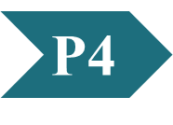
Clicker Question 7
In muscle, what are two allosteric activators of glycogen phosphorylase?
Mg²⁺ and ATP
Ca²⁺ and AMP
fructose-2,6-bisphosphate and citrate
AMP and glucose
cAMP and acetylCoA
Notes:
Answer: B
Principle: 15.4
Learning Objective(s): Characterise the glycogen regulation mechanisms specific to liver and muscle tissues.
Bloom’s: 2:1

Slide 58
Clicker Question 7, Response
In muscle, what are two allosteric activators of glycogen phosphorylase?
Ca²⁺ and AMP
In muscle, Ca²⁺, the signal for muscle contraction, binds to the δ subunit of phosphorylase kinase, which activates glycogen phosphorylase. AMP, which accumulates in vigorously contracting muscle as a result of ATP breakdown, binds to and activates phosphorylase, speeding the release of glucose 1-phosphate from glycogen.

Slide 59
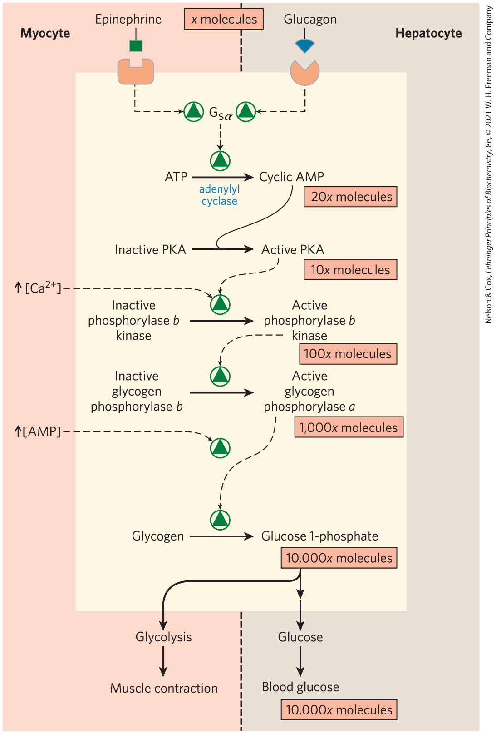
Elevated [cAMP] Initiates an
Enzyme Cascade
enzyme cascade = sequence of enzymatic reactions in which a catalyst activates a catalyst, which activates a catalyst
rise in [cAMP] activates PKA, which phosphorylates phosphorylase b kinase
phosphorylase b kinase = catalyzes the phosphorylation of glycogen phosphorylase b

Slide 60
Clicker Question 8
A G-protein coupled receptor binds its ligand, activating a heterotrimeric G-protein that stimulates a two-fold increase in cAMP. What important result on carbohydrate metabolism do the phosphorylases covalently activated by protein kinase A have?
They increase glycogen synthesis.
They increase gluconeogenesis and decrease glycolysis.
They inhibit hexokinase, especially in liver and muscle.
They activate anaerobic metabolic pathways.
They increase blood glucose concentration.
Notes:
Answer: E
Principle: 15.4
Learning Objective(s): Describe the hormonal regulation of glycogen phosphorylase.
Bloom’s: 2:2

Slide 61
Clicker Question 8, Response
A G-protein coupled receptor binds its ligand, activating a heterotrimeric G-protein that stimulates a two-fold increase in cAMP. What important result on carbohydrate metabolism do the phosphorylases covalently activated by protein kinase A have?
They increase blood glucose concentration.
The rise in [cAMP] activates cAMP-dependent protein kinase, also called protein kinase A (PKA). PKA then phosphorylates and activates phosphorylase b kinase, which catalyzes the phosphorylation of glycogen phosphorylase b, activating it and thus stimulating glycogen breakdown.

Slide 62
Principle 4 (3 of 7)
Regulation of the balance between
the formation of glycogen from excess glucose and the release of glucose from glycogen polymers when it is needed in metabolism is a critical function of cellular and organismal homeostasis. This balance, ultimately controlled by the hormones epinephrine, glucagon, and insulin, is achieved through allosteric regulation and phosphorylation of the synthetic and degradative enzymes. These enzymes and the regulatory proteins that act on them are integral parts of the glycogen granule.

Slide 63
Allosteric Control Mechanisms
Ca²⁺ is a signal for muscle contraction
  binds to and activates phosphorylase b kinase
AMP accumulates in vigorously contracting muscle
  binds to and activates phosphorylase to speed up glucose 1-phosphate release from glycogen
ATP blocks the allosteric site, inactivating phosphorylase

Slide 64
Phosphoprotein Phosphatase 1 (PP1)
phosphoprotein phosphatase 1 (PP1) = removes phosphoryl groups from phosphorylase a, converting it to the less active form, phosphorylase b

Slide 65
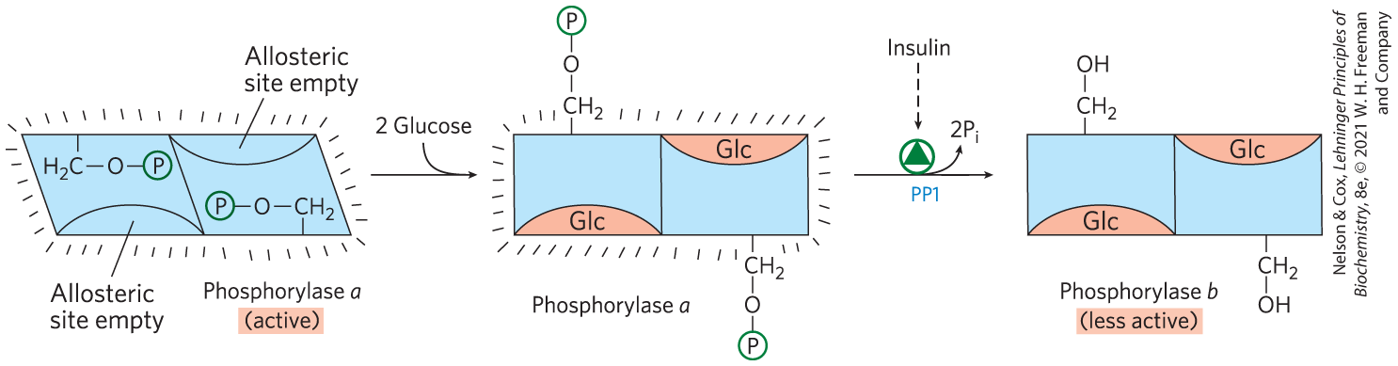
Liver Glycogen Phosphorylase a is a Glucose Sensor
glucose binds to an allosteric site on phosphorylase a, making it more susceptible to dephosphorylation by PP1

Slide 66
Clicker Question 9
Regulation of phosphorylase a is by phosphorylation. However, this covalent modification increases or decreases activity without completely inhibiting it. The velocity plot is sigmoidal. What statement can be made about this enzyme?
It likely follows a Michaelis-Menten kinetic.
Its reaction mechanism is likely exergonic.
Its reaction mechanism includes covalent catalysis.
The active site probably contains an SH2 domain.
It is probably an allosteric enzyme.
Notes:
Answer: E
Principle: 15.4
Learning Objective(s): Describe the differences between glycogen phosphorylase a and glycogen phosphorylase b.
Bloom’s: 2:2

Slide 67
Clicker Question 9, Response
Regulation of phosphorylase a is by phosphorylation. However, this covalent modification increases or decreases activity without completely inhibiting it. The velocity plot is sigmoidal. What statement can be made about this enzyme?
It is probably an allosteric enzyme.
Phosphoprotein phosphatase 1 (PP1) removes phosphoryl groups from phosphorylase a, converting it to the less active form, phosphorylase b. Glucose binds to an allosteric site on phosphorylase a, making it more susceptible to dephosphorylation by PP1.

Slide 68
Principle 4 (4 of 7)
Regulation of the balance between
the formation of glycogen from excess glucose and the release of glucose from glycogen polymers when it is needed in metabolism is a critical function of cellular and organismal homeostasis. This balance, ultimately controlled by the hormones epinephrine, glucagon, and insulin, is achieved through allosteric regulation and phosphorylation of the synthetic and degradative enzymes. These enzymes and the regulatory proteins that act on them are integral parts of the glycogen granule.

Slide 69
Glycogen Synthase Also Is Subject to Multiple Levels of Regulation
glycogen synthase has two forms:
  glycogen synthase a = unphosphorylated and catalytically active
  glycogen synthase b = phosphorylated and inactive unless glucose 6-phosphate is present
glycogen synthase kinase 3 (GSK3) = catalyzes the phosphorylation of glycogen synthase a

Slide 70
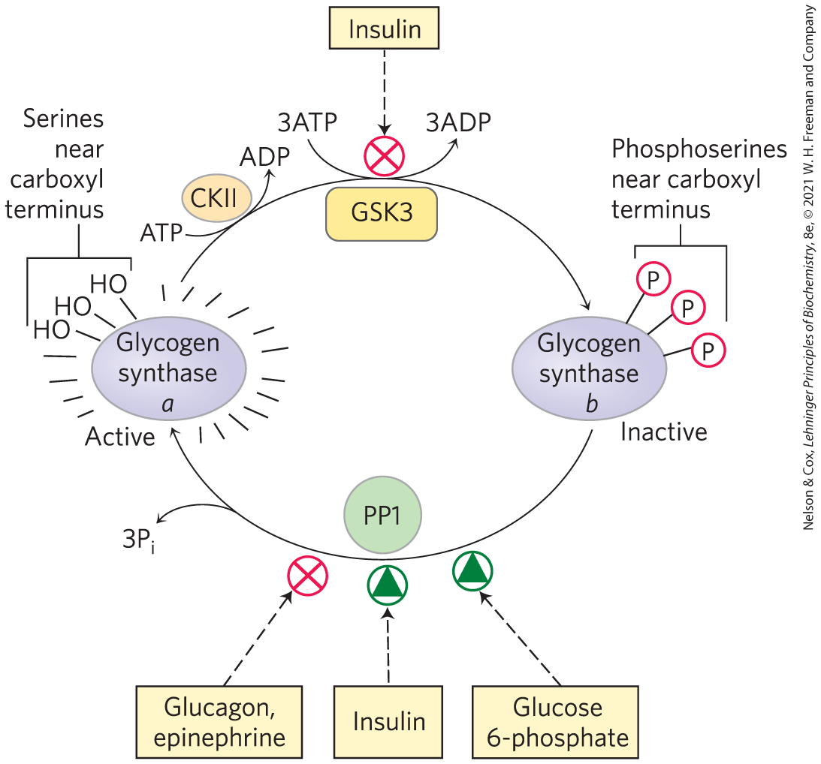
Effects of GSK3 on Glycogen Synthase Activity
insulin inactivates GSK3 and activates PP1
glucose 6-phosphate acts allosterically to make glycogen synthase b a better substrate for PP1

Slide 71
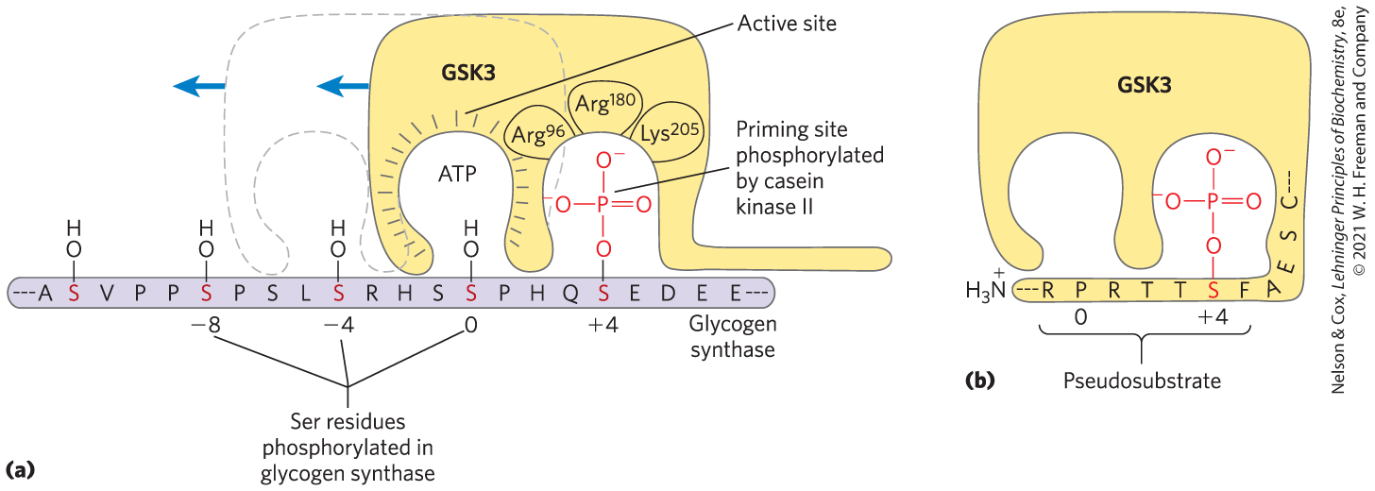
The Action of GSK3 is Hierarchical
GSK3 cannot phosphorylate glycogen synthase until casein kinase II (CKII) has phosphorylated the glycogen synthase on a nearby residue (a priming event)

Slide 72
Clicker Question 10
Glycogen synthase kinase 3 (GSK3):
functions only in regulation of glycogen synthase.
phosphorylates glycogen synthase only after glycogen synthase has been phosphorylated by another kinase.
is directly stimulated by insulin.
phosphorylates casein kinase II.
Notes:
Answer: B
Principle: 15.4
Learning Objective(s): Describe the factors responsible for the regulation of glycogen synthase.
Bloom’s: 2:2

Slide 73
Clicker Question 10, Response
Glycogen synthase kinase 3 (GSK3):
phosphorylates glycogen synthase only after glycogen synthase has been phosphorylated by another kinase.
The action of GSK3 is hierarchical, meaning it cannot phosphorylate glycogen synthase until another protein kinase, casein kinase II (CKII), has first phosphorylated the glycogen synthase on a nearby residue, an event called priming.

Slide 74
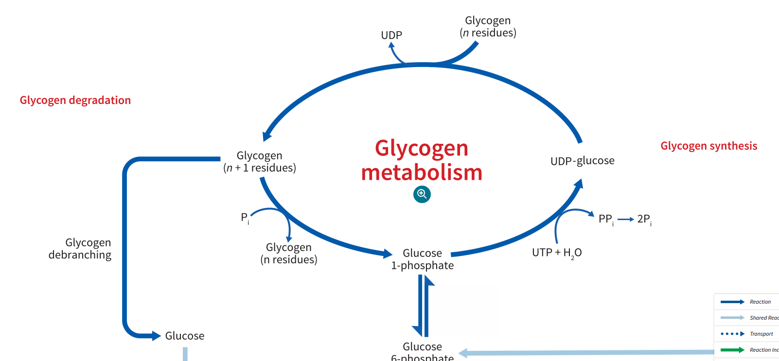
Activity: Glycogen
Breakdown and Synthesis
Review the glycogen pathway in the Metabolic Map within your Achieve course.
Notes:
Instructor: The Metabolic Map is located in the Achieve course. It can be found immediately before the Chapter 13 folder in the list of content. For more information on this activity, please see the In-Class Activity Guide in your Achieve course in Chapter 15.

Slide 75
Activity Instructions, Part 1
On your own, think of answers to the questions:
  Which enzyme is activated to initiate glycogen synthesis? Which hormone activates it?
  Which enzyme is activated to initiate glycogen degradation? Which hormone activates it?
(2 minutes)
Pair up to discuss your ideas. (2 minutes)
Share your ideas with the class in group discussion.
(3 minutes)
Notes:
Instructor: The Metabolic Map is located in the Achieve course. It can be found immediately before the Chapter 13 folder in the list of content. For more information on this activity, please see the In-Class Activity Guide in your Achieve course in Chapter 15.

Slide 76
Activity Solution, Part 2 (1 of 2)
  Which enzyme is activated to initiate glycogen synthesis? Which hormone activates it?
  Glycogen synthase is activated by insulin.
Notes:
Instructor: The Metabolic Map is located in the Achieve course. It can be found immediately before the Chapter 13 folder in the list of content. For more information on this activity, please see the In-Class Activity Guide in your Achieve course in Chapter 15.
Expanded answer: Insulin activates glycogen synthase through a signal cascade. When blood glucose is low, glycogen synthase kinase phosphorylates glycogen synthase, inhibiting it. In the fed state, insulin activates kinases that phosphorylate and inhibit the kinase. Protein phosphatase 1 (PP1) can then dephosphorylate glycogen synthase, activating it. As a result, glycogen synthesis is stimulated when blood sugar levels are high. (viewable in the Physiological State: Fed)

Slide 77
Activity Solution, Part 2 (2 of 2)
  Which enzyme is activated to initiate glycogen degradation? Which hormone activates it?
  Phosphorylase b is activated by glucagon, converting to phosphorylase a.
Notes:
Instructor: The Metabolic Map is located in the Achieve course. It can be found immediately before the Chapter 13 folder in the list of content. For more information on this activity, please see the In-Class Activity Guide in your Achieve course in Chapter 15.
Expanded answer: In the liver, glucagon activates glycogenolysis via the activation of phosphorylase b kinase by PKA. Active phosphorylase b kinase phosphorylates and activates phosphorylase b, converting it to the a form. Active glycogen phosphorylase a cleaves the glycogen polymer to release glucose 1-phosphate. Glucose 1-phosphate enters glycolysis after conversation to glucose 6-phosphate by phosphoglucomutase. (Viewable in Physiological State: Fasting)

Slide 78
Bonus Discussion
  What happens during the ‘fight-or-flight’ response, or during vigorous activity, in regard to metabolism and glycogen production?
Hint: Would you require increased or decreased glucose?
Notes:
Instructor: The Metabolic Map is located in the Achieve course. It can be found immediately before the Chapter 13 folder in the list of content. For more information on this activity, please see the In-Class Activity Guide in your Achieve course in Chapter 15.

Slide 79
Bonus Discussion, Solution
  What happens during the ‘fight-or-flight’ response, or during vigorous activity, in regard to metabolism and glycogen production? Phosphorylase b is converted to its more active form, phosphorylase a, resulting in increased glycogen degradation.
  Bonus Question: How is this activation different in muscle tissues when compared to standard glycogen degradation during fasting in the liver?
Notes:
Instructor: The Metabolic Map is located in the Achieve course. It can be found immediately before the Chapter 13 folder in the list of content. For more information on this activity, please see the In-Class Activity Guide in your Achieve course in Chapter 15.
The answer to this question is not stated or inferred from the content of the Metabolic Map, however it is included in the text as a key regulator of the glycogen pathway.

Slide 80
Bonus Discussion, Solution, Continued
Bonus Question: How is this activation different in muscle tissues when compared to standard glycogen degradation during fasting in the liver? During vigorous activity, or a ‘fight-or-flight’ response, epinephrine triggers the second messenger cAMP in muscle tissue (or glucagon in liver), which initiates an enzyme cascade. The rise in [cAMP] activates cAMP-dependent protein kinase (PKA), which phosphorylates and activates phosphorylase b, activating it and resulting in phosphorylase a stimulating glycogen breakdown.
Notes:
Instructor: The Metabolic Map is located in the Achieve course. It can be found immediately before the Chapter 13 folder in the list of content. For more information on this activity, please see the In-Class Activity Guide in your Achieve course in Chapter 15.
The answer to this question is not stated or inferred from the content of the Metabolic Map, however it is included in the text as a key regulator of the glycogen pathway.

Slide 81
Principle 4 (5 of 7)
Regulation of the balance between
the formation of glycogen from excess glucose and the release of glucose from glycogen polymers when it is needed in metabolism is a critical function of cellular and organismal homeostasis. This balance, ultimately controlled by the hormones epinephrine, glucagon, and insulin, is achieved through allosteric regulation and phosphorylation of the synthetic and degradative enzymes. These enzymes and the regulatory proteins that act on them are integral parts of the glycogen granule.

Slide 82
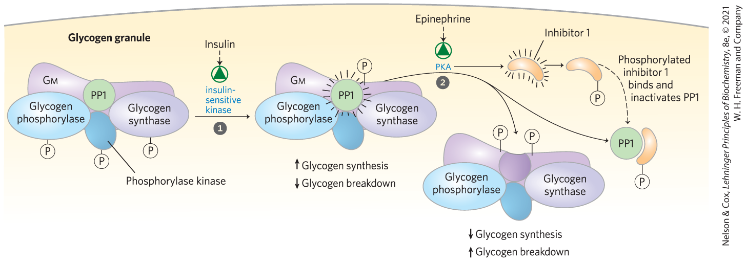
Glycogen-Targeting Proteins
glycogen-targeting protein = regulatory subunit of PP1 that serves as a scaffold, binding glycogen, phosphorylase kinase, glycogen phosphorylase, and glycogen synthase

Slide 83
Allosteric and Hormonal Signals Coordinate Carbohydrate Metabolism Globally
in the liver:
  insulin activates glycogen synthase by inactivating GSK3 and activating PP1
  glucagon stimulates glycogen breakdown and gluconeogenesis while blocking glycolysis
in muscle, epinephrine provides ATP by stimulating glycogen breakdown and glycolysis

Slide 84
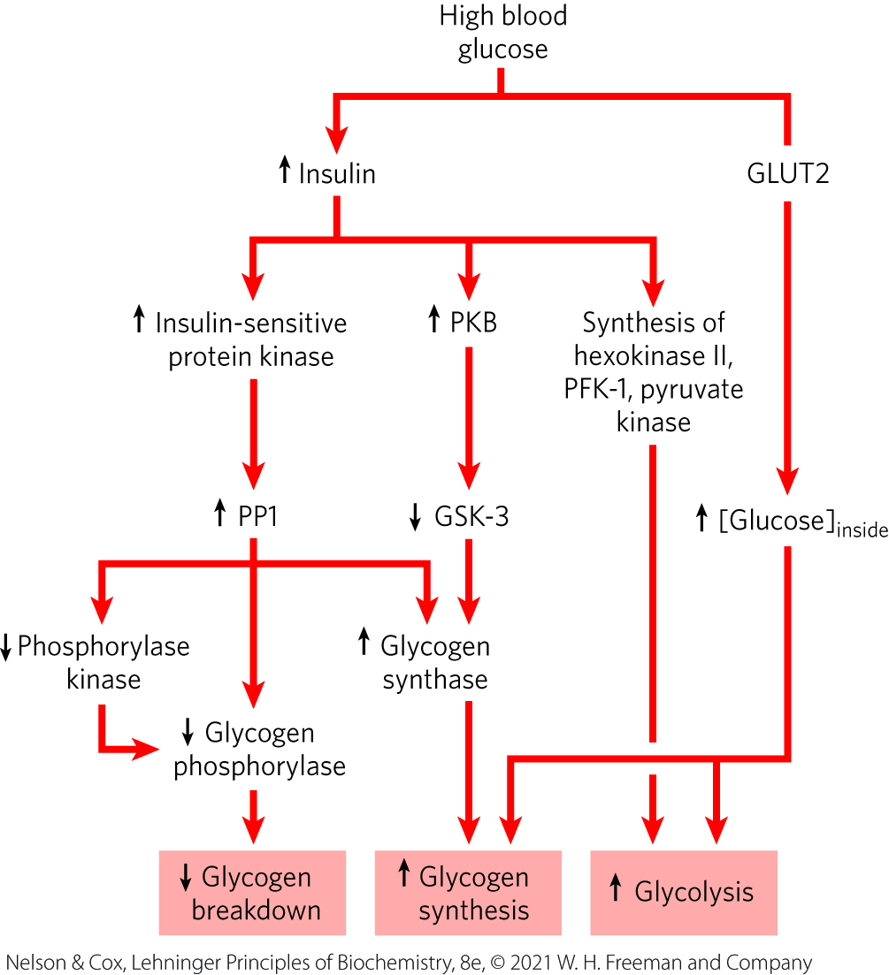
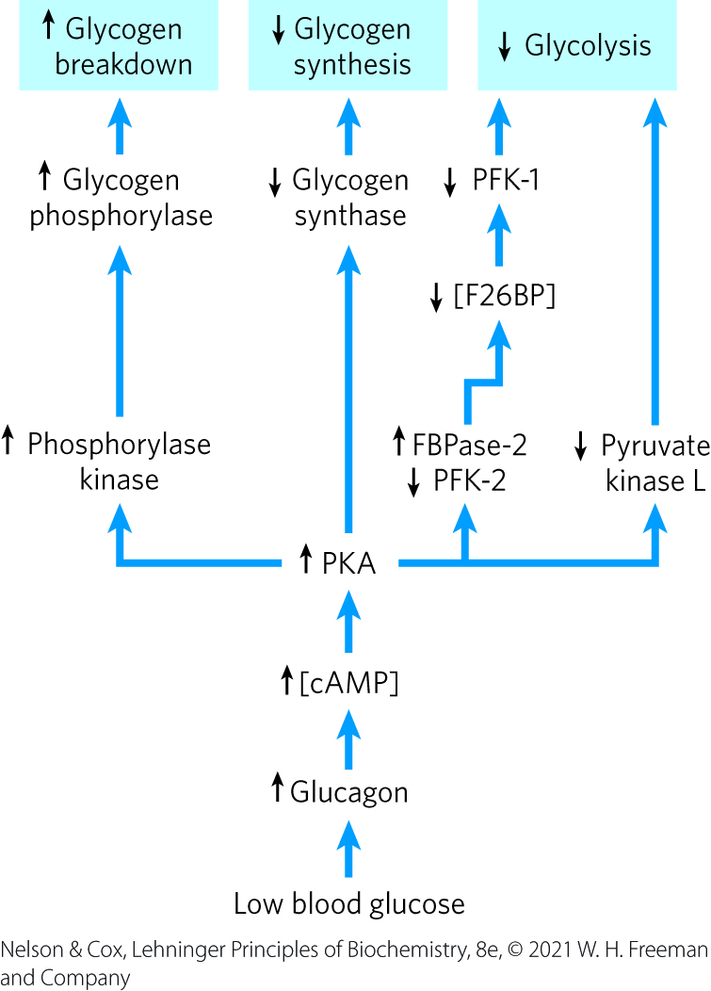
Regulation of Carbohydrate Metabolism in the Liver

Slide 85
Clicker Question 11
Which enzyme involved in glycogenesis and glycogenolysis is allosterically regulated?
glycogen phosphorylase
glycogen synthase
phosphoprotein phosphatase 1 (PP1)
All of the answers are correct.
Notes:
Answer: D
Principle: 15.4
Learning Objective(s): Describe the factors responsible for the regulation of glycogen synthase.
Bloom’s: 2:1

Slide 86
Clicker Question 11, Response
Which enzyme involved in glycogenesis and glycogenolysis is allosterically regulated?
All of the answers are correct.
In the liver, glucose acts allosterically to make phosphorylase a more susceptible to dephosphorylation/ inactivation by phosphoprotein PP1. Glucose 6-phosphate allosterically activates PP1. Glycogen synthase is inactive unless its allosteric activator, glucose 6-phosphate, is present.

Slide 87
Principle 4 (6 of 7)
Regulation of the balance between
the formation of glycogen from excess glucose and the release of glucose from glycogen polymers when it is needed in metabolism is a critical function of cellular and organismal homeostasis. This balance, ultimately controlled by the hormones epinephrine, glucagon, and insulin, is achieved through allosteric regulation and phosphorylation of the synthetic and degradative enzymes. These enzymes and the regulatory proteins that act on them are integral parts of the glycogen granule.

Slide 88
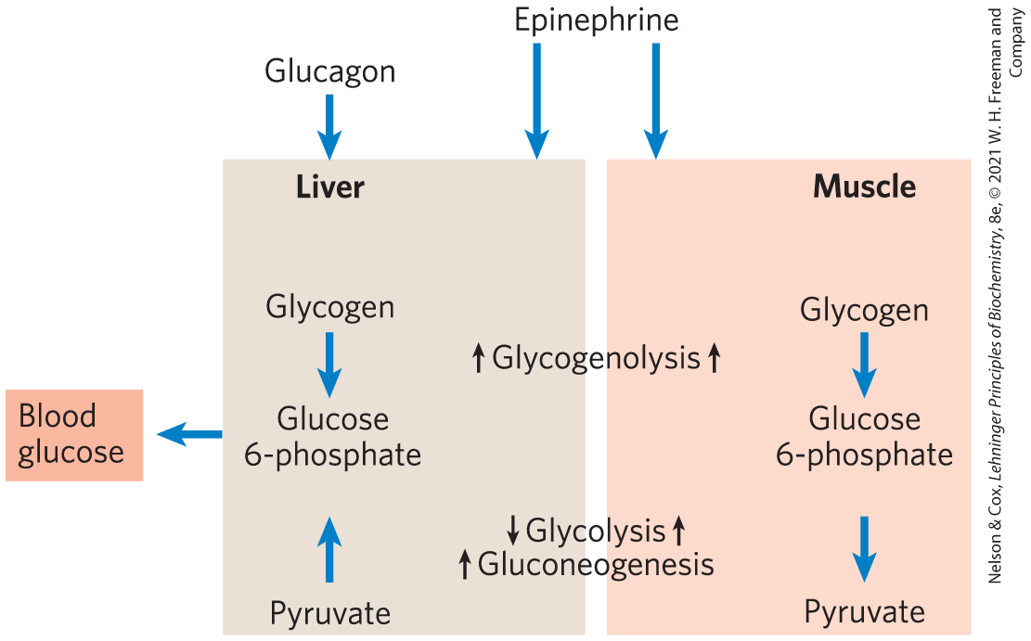
Difference in the Regulation of Carbohydrate Metabolism in Muscle
skeletal muscle:
  uses its stored glycogen only for its own needs
  undergoes very large changes in its demand for ATP
  lacks the enzymatic machinery for gluconeogenesis

Slide 89
Clicker Question 12
Which point is NOT a major difference between muscle and liver in terms of glucose regulation?
Muscle uses stored glycogen only for its own needs.
During exercise, muscle undergoes very large changes in need of ATP.
Muscle lacks the enzyme machinery for gluconeogenesis.
Muscle cells lack a receptor for glucagon.
None of the answers is correct.
Notes:
Answer: E
Principle: 15.4
Learning Objective(s): Characterise the glycogen regulation mechanisms specific to liver and muscle tissues.
Bloom’s: 2:2

Slide 90
Clicker Question 12, Response
Which point is NOT a major difference between muscle and liver in terms of glucose regulation?
None of the answers is correct.
The physiology of skeletal muscle differs from that of the liver in three important ways: muscle uses its stored glycogen only for its own needs; as it goes from rest to vigorous contraction, muscle undergoes very large changes in its demand for ATP, which is provided by glycolysis; and muscle lacks the enzymatic machinery for gluconeogenesis. Myocytes also lack receptors for glucagon, which are present on hepatocytes.

Slide 91
Clicker Question 13
Why are muscle and liver glycogen phosphorylase regulated differently?
Muscle only consumes glucose, and liver both consumes and secretes glucose.
They are isozymes and are encoded by different genes.
Muscle and liver have different glucose transporters.
Muscle has no glycogen phosphorylase a isoform.
Liver has no glycogen phosphorylase kinase.
Notes:
Answer: E
Principle: 15.4
Learning Objective(s): Characterise the glycogen regulation mechanisms specific to liver and muscle tissues.
Bloom’s: 2:2

Slide 92
Clicker Question 13, Response
Why are muscle and liver glycogen phosphorylase regulated differently?
Muscle only consumes glucose, and liver both consumes and secretes glucose.
Regulation serves different ends in muscle and liver. In extrahepatic tissues, typified by skeletal muscle (myocytes), phosphorylase supplies glucose for the tissue’s own needs. Conversely, liver phosphorylase supplies glucose to the blood for use by other tissues.

Slide 93
Principle 4 (7 of 7)
Regulation of the balance between
the formation of glycogen from excess glucose and the release of glucose from glycogen polymers when it is needed in metabolism is a critical function of cellular and organismal homeostasis. This balance, ultimately controlled by the hormones epinephrine, glucagon, and insulin, is achieved through allosteric regulation and phosphorylation of the synthetic and degradative enzymes. These enzymes and the regulatory proteins that act on them are integral parts of the glycogen granule.

Slide 94
Carbohydrate and Lipid Metabolism Are Integrated by Hormonal and Allosteric Mechanisms
the metabolism of fats and fatty acids is very closely tied to that of carbohydrates
regulatory controls adjust metabolite flow through various metabolic pathways without causing major changes in the concentrations of intermediates shared with other pathways

Slide 95
Clicker Question 14
Strenuous physical activity in vertebrates can cause an increase in AMP levels. What is the biochemical response in carbohydrate metabolism?
an increase in glycogen synthesis
inhibition of glycolysis and stimulation of gluconeogenesis
an increase in protein kinase A activity, mobilizing glucose
an increase in fatty acid and carbohydrate catabolic pathways
inhibition of transphosphorylation enzymes
Notes:
Answer: D
Principle: 15.4
Learning Objective(s): Describe the regulatory factors which act upon glycogen metabolism.
Bloom’s: 2:2

Slide 96
Clicker Question 14, Response
Strenuous physical activity in vertebrates can cause an increase in AMP levels. What is the biochemical response in carbohydrate metabolism?
an increase in fatty acid and carbohydrate catabolic pathways
AMP, which accumulates as a result of ATP breakdown, signals metabolic stress. Thus high [AMP] stimulates the catabolism of fatty acids and carbohydrates while inhibiting anabolic pathways such as gluconeogenesis and glycogen synthesis.

