Slide 1

14 Glycolysis, Gluconeogenesis, and the Pentose Phosphate Pathway
© 2021 Macmillan Learning

Slide 2
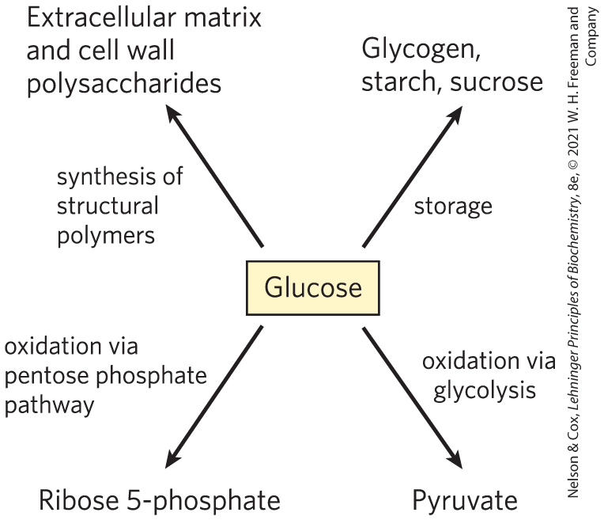
Major Pathways of
Glucose Utilization

Slide 3

Principle 1 (1 of 7)
Metabolites like glucose are often activated with a high-energy group before their catabolism. Glycolysis is a nearly universal 10-step metabolic pathway for producing ATP by the oxidation of glucose. In this process, two molecules of ATP are invested to activate glucose, but the products of the pathway include four ATP, as well as NADH (a form of reducing power) and the triose pyruvate, which can be metabolized further in other pathways.

Slide 4

Principle 2 (1 of 3)
Glucose and other hexoses and hexose phosphates obtained from stored polysaccharides or dietary carbohydrates feed into the glycolytic pathway. By using a common pathway for a number of starting materials, the cell economizes on the number of enzymes that must be synthesized and simplifies the regulation of the common pathway.

Slide 5

Principle 3 (1 of 7)
Pyruvate formed under anaerobic conditions is reduced to lactate with electrons from NADH, recycling NADH to NAD⁺ and allowing continued glycolysis in the processes of lactate or alcohol fermentation. Manipulation of the fermentable material and the microorganisms present allows the synthesis of a variety of industrial products and foods.

Slide 6
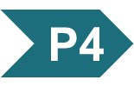
Principle 4 (1 of 5)
Gluconeogenesis is the synthesis of glucose from simpler precursors like pyruvate and lactate. Although it uses seven of the ten enzymes that also act in glycolysis, gluconeogenesis must bypass three of the most exergonic steps in glycolysis with energetically favorable reactions unique to gluconeogenesis.

Slide 7
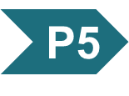
Principle 5 (1 of 6)
Glycolysis and gluconeogenesis are reciprocally regulated so that both processes don’t occur simultaneously in a futile cycle. Most regulatory mechanisms act on reactions that are unique to each pathway.

Slide 8
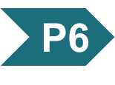
Principle 6 (1 of 5)
The pentose phosphate pathway is an alternative pathway for glucose oxidation. It yields pentoses for nucleotide synthesis and reduced cofactors for biosynthesis of fatty acids, sterols, and many other compounds.

Slide 9
14.1 Glycolysis

Slide 10
Principle 1 (2 of 7)
Metabolites like glucose are often activated with a high-energy group before their catabolism. Glycolysis is a nearly universal 10-step metabolic pathway for producing ATP by the oxidation of glucose. In this process, two molecules of ATP are invested to activate glucose, but the products of the pathway include four ATP, as well as NADH (a form of reducing power) and the triose pyruvate, which can be metabolized further in other pathways.

Slide 11
Glycolysis is an Almost Universal Central Pathway of Glucose Catabolism
glycolysis = process by which a molecule of glucose is degraded in a series of enzyme-catalyzed reactions to yield two molecules of the three-carbon compound pyruvate
  some free energy is conserved as ATP and NADH

Slide 12
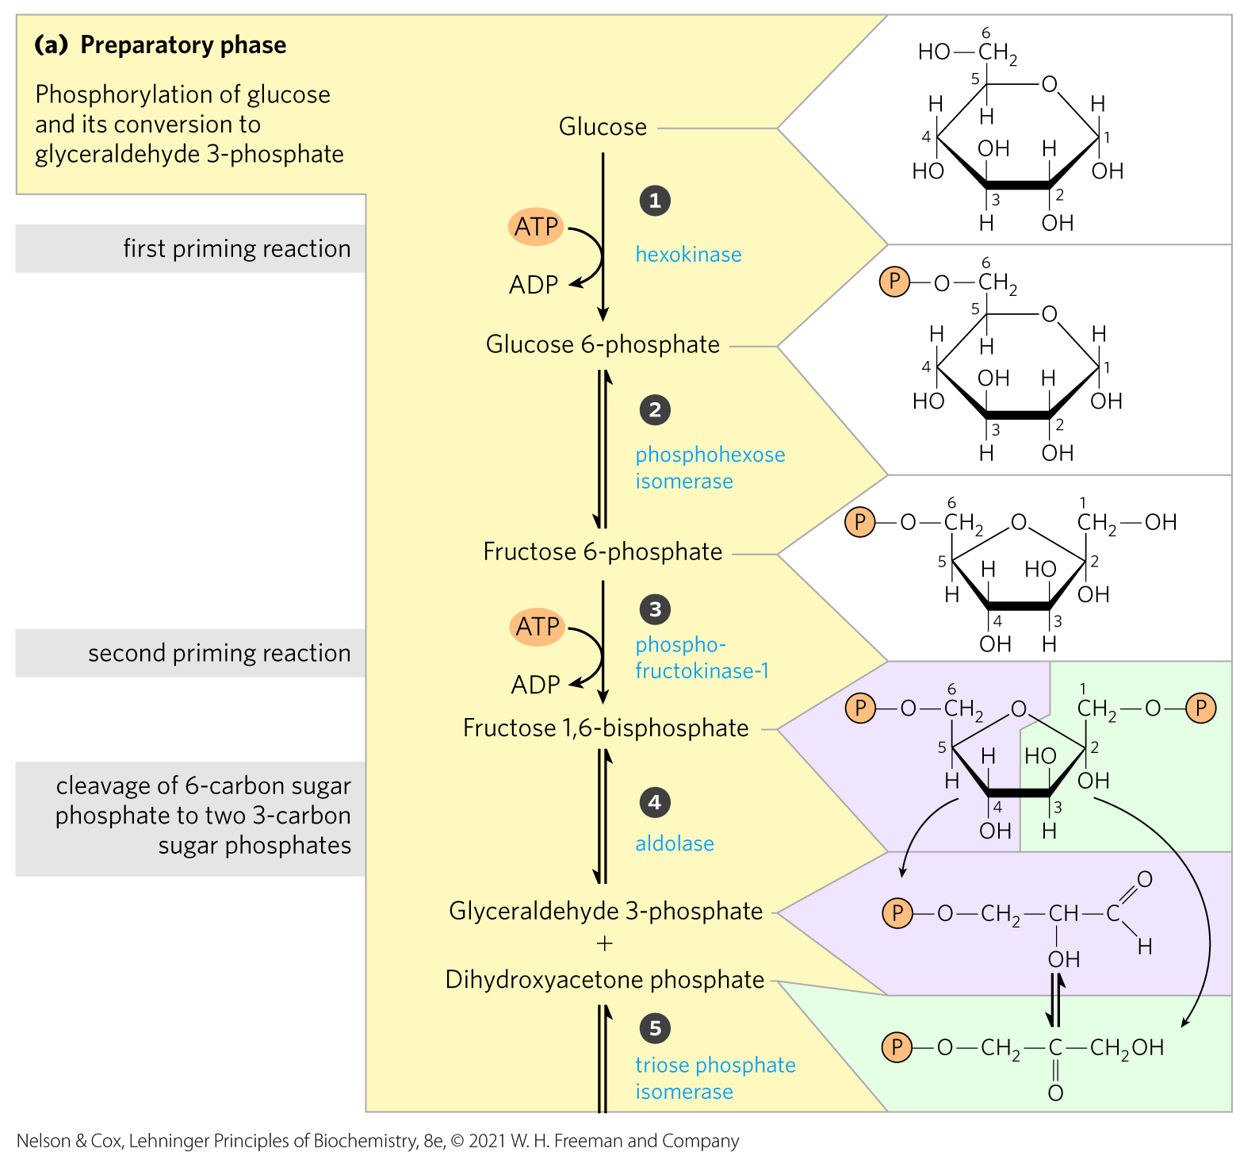
An Overview: Glycolysis Has
Two Phases
in the preparatory phase:
  ATP is consumed
  ∆G of the intermediates increases
  hexose carbon chains are converted to glyceraldehyde 3-phosphate

Slide 13
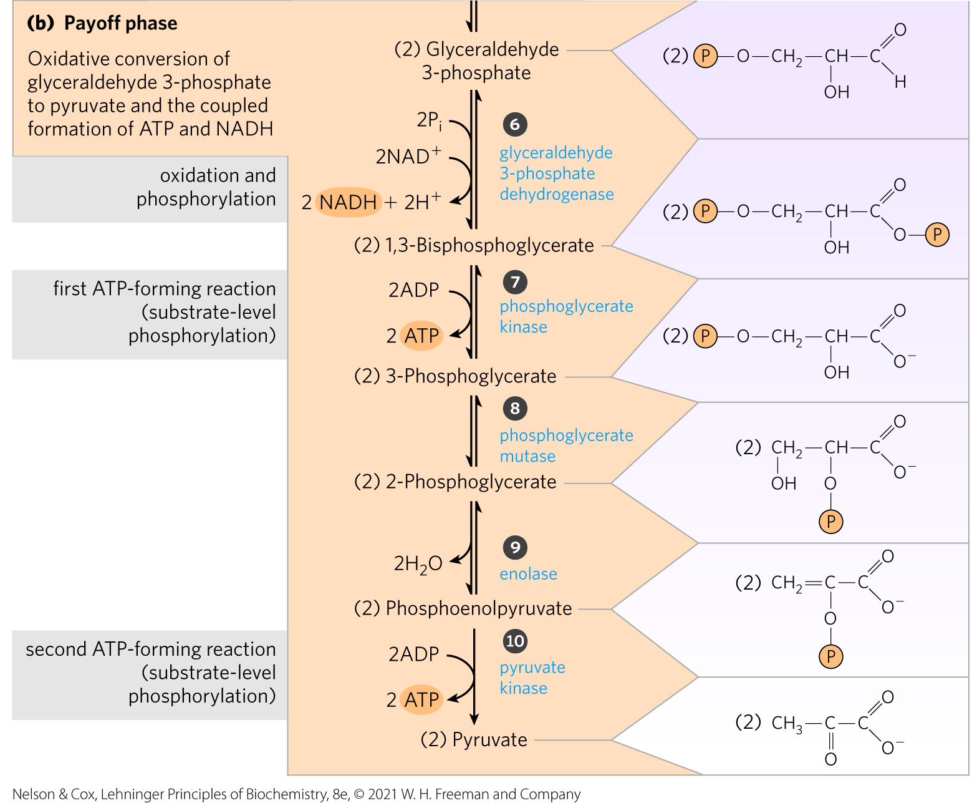
The Payoff Phase of Glycolysis
the payoff phase yields:
  energy conserved as 2 ATP and 2 NADH
  2 pyruvate

Slide 14
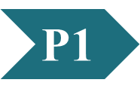
Clicker Question 1
What product of the preparatory phase of glycolysis is required, but at twice the concentration, as a reactant in the payoff phase?
dihydroxyacetone phosphate
pyruvate
NAD⁺
ADP
phosphate
Notes:
Answer: D
Principle: 14.1
Learning Objective(s): Summarize the payoff phase of glycolysis in regard to the investment of ATP.
Bloom’s: 2:1

Slide 15
Clicker Question 1, Response
What product of the preparatory phase of glycolysis is required, but at twice the concentration, as a reactant in the payoff phase?
ADP
The preparatory phase converts 2 ATP to 2 ADP, and the payoff phase converts 4 ADP to 4 ATP. Thus the net ATP yield from glycolysis is 2 ATP per molecule of glucose.

Slide 16
Principle 1 (3 of 7)
Metabolites like glucose are often activated with a high-energy group before their catabolism. Glycolysis is a nearly universal 10-step metabolic pathway for producing ATP by the oxidation of glucose. In this process, two molecules of ATP are invested to activate glucose, but the products of the pathway include four ATP, as well as NADH (a form of reducing power) and the triose pyruvate, which can be metabolized further in other pathways.

Slide 17
Noteworthy Chemical Transformations of Glycolysis
three noteworthy chemical transformations:
  degradation of the carbon skeleton of glucose to yield pyruvate
  phosphorylation of ADP to ATP by compounds with high phosphoryl group transfer potential, formed during glycolysis
  transfer of a hydride ion to NAD+, forming NADH

Slide 18
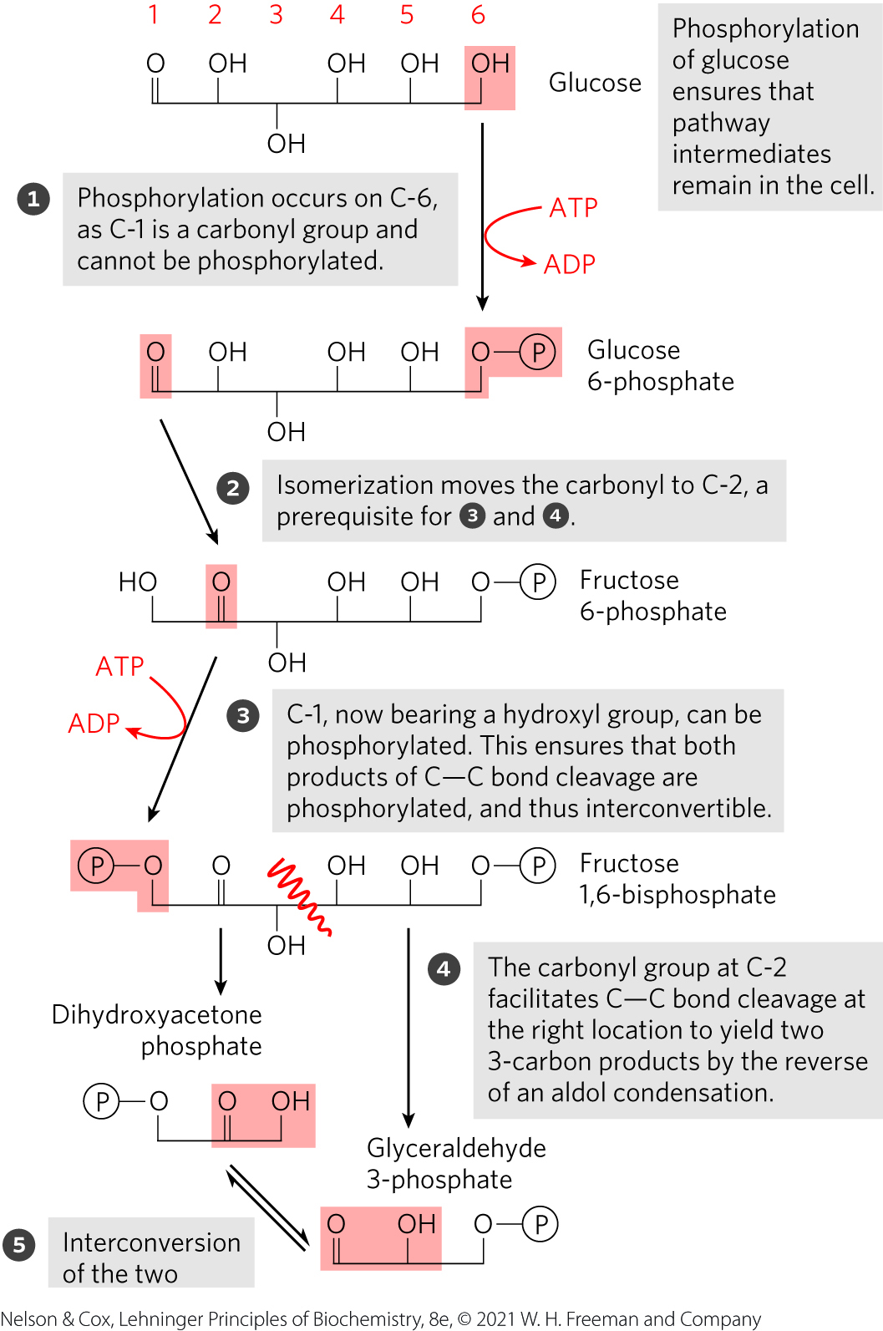
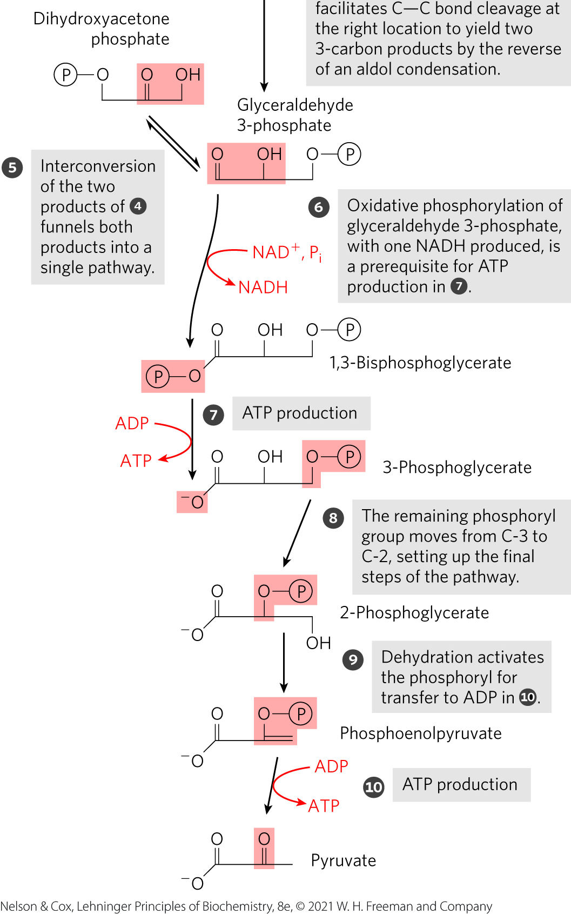
The Chemical Logic of the
Glycolytic Pathway

Slide 19
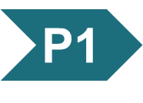
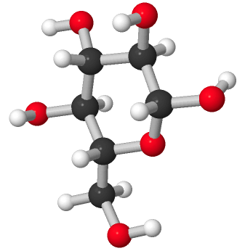
Activity: Properties of Glucose
Observe the structure of D-glucose in Mol3D viewer in your Achieve course.
Notes:
Instructor: This Mol3D structure is located in the Achieve course. It can be found in the Chapter 14 content, in the folder titled “Ch14 In-Class Activities, Videos, and Resources.”

Slide 20
Activity Instructions (1 of 3)
On your own, think of answers to the questions:
  What is the activated form of glucose?
  Which carbon atom participates in the new bond resulting from activation of glucose? Select the atom and upload a screenshot to your course.
  (2 minutes)
Pair up to discuss your ideas. (2 minutes)
Share your ideas with the class in group discussion.
(3 minutes)
Notes:
Instructor: This Mol3D structure is located in the Achieve course. It can be found in the Chapter 14 content, in the folder titled “Ch14 In-Class Activities, Videos, and Resources.”

Slide 21
Activity Solution (1 of 3)
  What is the activated form of glucose?
  glucose 6-phosphate
  Which carbon atom participates in the new bond resulting from activation of glucose?
C-6 of glucose (the carbon outside of the ring structure in the CH₂OH group)
Notes:
Instructor: This Mol3D structure is located in the Achieve course. It can be found in the Chapter 14 content, in the folder titled “Ch14 In-Class Activities, Videos, and Resources.”

Slide 22
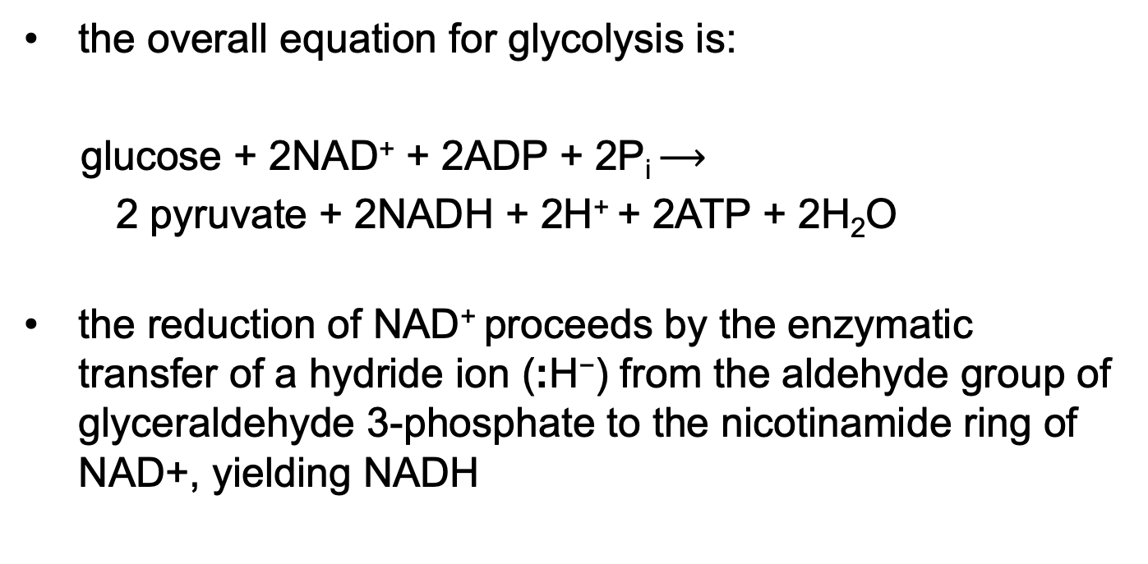
ATP and NADH Formation Coupled to Glycolysis
the overall equation for glycolysis is:
glucose + 2NAD⁺ + 2ADP + 2P_{i} $⟶$
2 pyruvate + 2NADH + 2H⁺ + 2ATP + 2H₂O
the reduction of NAD⁺ proceeds by the enzymatic transfer of a hydride ion (:H⁻) from the aldehyde group of glyceraldehyde 3-phosphate to the nicotinamide ring of NAD+, yielding NADH
(14-1)

Slide 23
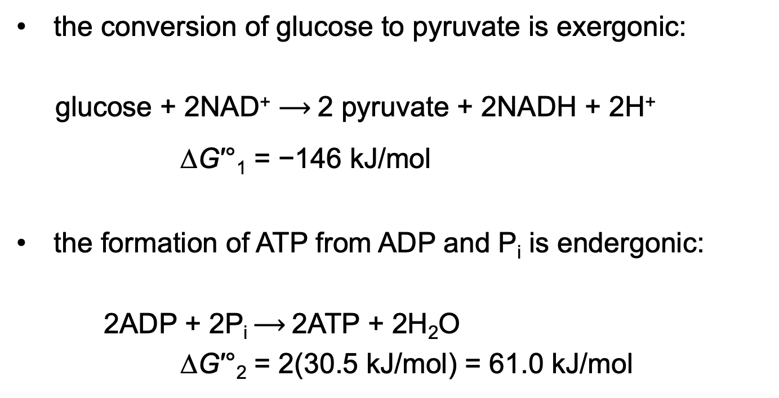
Resolving the Equation of Glycolysis into Two Processes
the conversion of glucose to pyruvate is exergonic:
glucose + 2NAD⁺ $⟶$2 pyruvate + 2NADH + 2H⁺
∆G′°₁ = −146 kJ/mol
the formation of ATP from ADP and P_{i} is endergonic:
2ADP + 2P_{i} $⟶$2ATP + 2H₂O
∆G′°₂ = 2(30.5 kJ/mol) = 61.0 kJ/mol
(14-2)
(14-3)

Slide 24
The Standard Free-Energy Change of Glycolysis, ∆G′°_{Sum}
the sum of the two processes gives the overall standard free-energy change of glycolysis, ∆G′°_{Sum}:
∆G′°_{Sum} = ∆G′°₁ + ∆G′°₂
= −146 kJ/mol + 61.0 kJ/mol
= −85 kJ/mol
under standard and cellular conditions, glycolysis is essentially irreversible

Slide 25
Clicker Question 2
Which enzyme catalyzes the MOST exergonic reaction of glycolysis?
hexokinase
triose phosphate isomerase
aldolase
phosphofructokinase-1
pyruvate kinase
Notes:
Answer: D
Principle: 14.1
Learning Objective(s): Write the overall net equation for the preparatory phase of glycolysis with the net standard free-energy change.
Bloom’s: 2:1

Slide 26
Clicker Question 2, Response
Which enzyme catalyzes the MOST exergonic reaction of glycolysis?
phosphofructokinase-1
Phosphofructokinase-1 catalyzes the transfer of a phosphoryl group from ATP to fructose 6-phosphate to yield fructose 1,6-bisphosphate. The standard free-energy change (∆G′°) for this reaction is −14.2 kJ/mol.

Slide 27
Energy Remaining in Pyruvate
energy stored in pyruvate can be extracted by:
  aerobic processes:
    oxidative reactions in the citric acid cycle
    oxidative phosphorylation
  anaerobic processes
    reduction to lactate
    reduction to ethanol
pyruvate can provide the carbon skeleton for alanine synthesis or fatty acid synthesis

Slide 28
Principle 1 (4 of 7)
Metabolites like glucose are often activated with a high-energy group before their catabolism. Glycolysis is a nearly universal 10-step metabolic pathway for producing ATP by the oxidation of glucose. In this process, two molecules of ATP are invested to activate glucose, but the products of the pathway include four ATP, as well as NADH (a form of reducing power) and the triose pyruvate, which can be metabolized further in other pathways.

Slide 29
Importance of Phosphorylated Intermediates
all nine intermediates are phosphorylated
functions of the phosphoryl groups:
  prevent glycolytic intermediates from leaving the cell
  serve as essential components in the enzymatic conservation of metabolic energy
  lower the activation energy and increase the specificity of the enzymatic reactions

Slide 30
The Preparatory Phase of Glycolysis Requires ATP
in the preparatory phase of glycolysis:
  two molecules of ATP are invested to activate glucose to fructose 1,6-bisphosphate
  the bond between C-3 and C-4 of fructose 1,6-bisphosphate is then broken to yield two molecules of triose phosphate

Slide 31
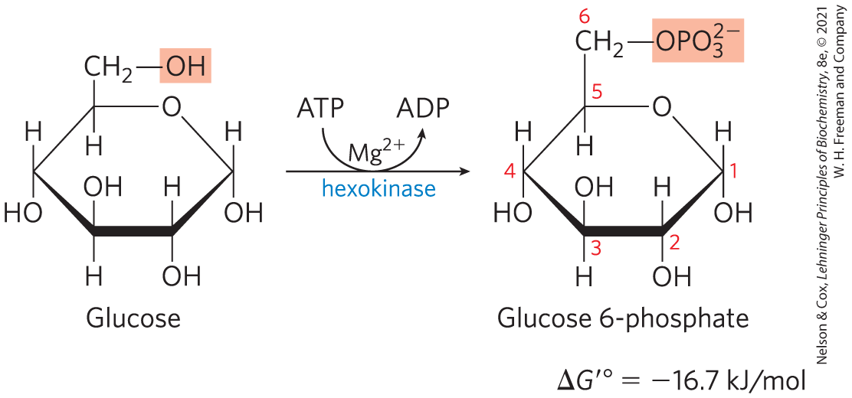
Phosphorylation of Glucose
hexokinase activates glucose by phosphorylating at C-6 to yield glucose 6-phosphate
  ATP serves as the phosphoryl donor
  hexokinase requires Mg²⁺ for its activity
  irreversible under intracellular conditions

Slide 32
Hexokinase is Present in Nearly All Organisms
humans encode 4 hexokinases (I to IV) that catalyze the same reaction
isozymes = two or more enzymes that catalyze the same reaction but are encoded by different genes

Slide 33
Clicker Question 3
How is glucose kept inside the cell, against a concentration gradient?
Glucose is kept inside the cell by active transport pumps.
Glucose is kept inside the cell by conversion to glucose 6-phosphate.
Glucose is kept inside the cell through rapid conversion to pyruvate.
There are no glucose transporters to pump glucose out of the cell.
Glucose is converted to fructose and there are no fructose transporters.
Notes:
Answer: B
Principle: 14.1
Learning Objective(s): Describe the role of phosphorylation in glucose catabolism.
Bloom’s: 2:2

Slide 34
Clicker Question 3, Response
How is glucose kept inside the cell, against a concentration gradient?
Glucose is kept inside the cell by conversion to glucose 6-phosphate.
Phosphorylation traps glucose inside the cell because the phosphate group has a negative charge at physiological pH.

Slide 35
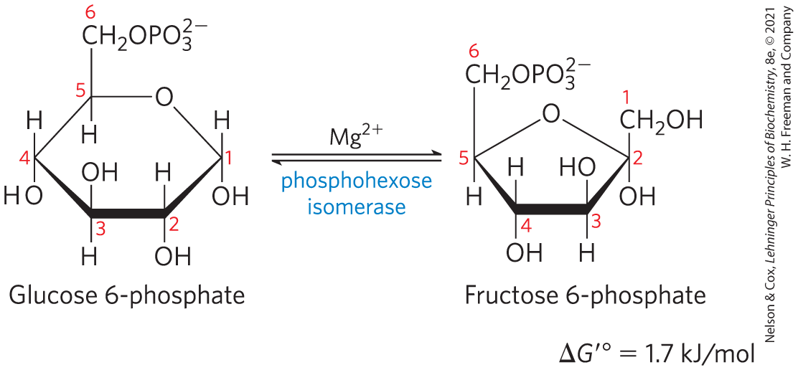
Conversion of Glucose 6-Phosphate to Fructose 6-Phosphate
phosphohexose isomerase (phosphoglucose isomerase) catalyzes the reversible isomerization of glucose 6-phosphate to fructose 6-phosphate
  mechanism involves an enediol intermediate
  reaction readily proceeds in either direction

Slide 36
Clicker Question 4
How is glucose 6-phosphate prevented from leaving the cell?
It is prevented from leaving by active transport pump.
There are no phospho-glucose specific transporters.
Glucose 6-phosphate is rapidly converted to fructose 6-phosphate.
The transporter is inhibited.
Glucose 6-phosphate is rapidly converted to pyruvate.
Notes:
Answer: B
Principle: 14.1
Learning Objective(s): Describe the role of phosphorylation in glucose catabolism.
Bloom’s: 2:2

Slide 37
Clicker Question 4, Response
How is glucose 6-phosphate prevented from leaving the cell?
There are no phospho-glucose specific transporters.
Because the plasma membrane lacks transporters for phosphorylated sugars, the phosphorylated glycolytic intermediates cannot leave the cell. After the initial phosphorylation, no further energy is necessary to retain phosphorylated intermediates in the cell, despite the large difference in their intracellular and extracellular concentrations.

Slide 38
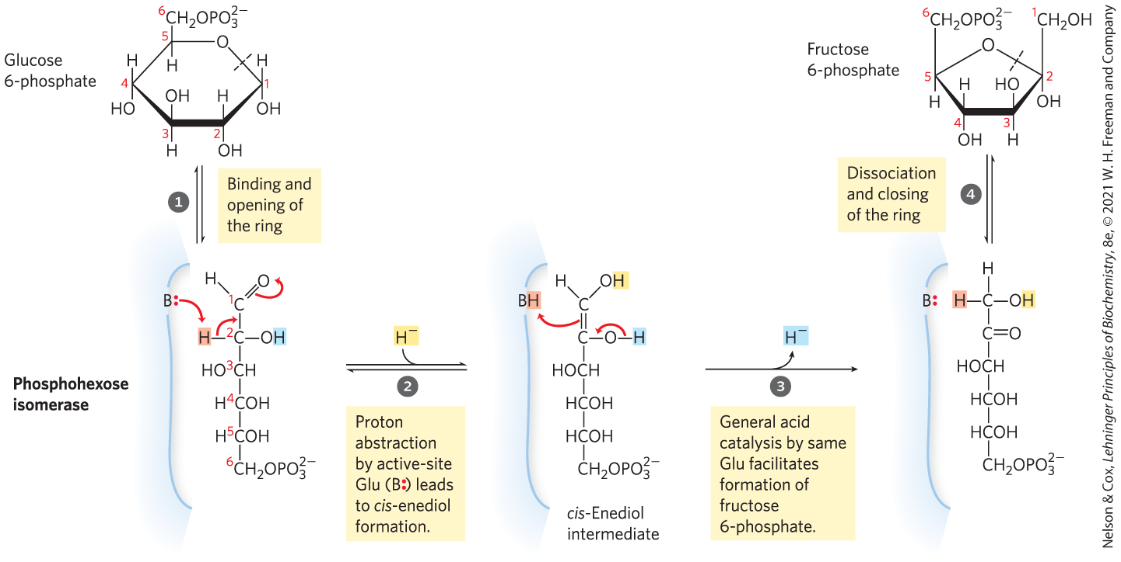
The Phosphohexose Isomerase Reaction

Slide 39
Clicker Question 5
What is the thermodynamic advantage for regulating glycolysis at hexokinase, rather than at phosphohexose isomerase?
salvaging glucose phosphates that can be used for other fates
salvaging one ATP
salvaging one NADH
salvaging two ATP
increasing the concentration of glucose 6-phosphate and its byproducts in cells
Notes:
Answer: B
Principle: 14.1
Learning Objective(s): Summarize the preparatory phase of glycolysis in regard to the investment of ATP.
Bloom’s: 2:2

Slide 40
Clicker Question 5, Response
What is the thermodynamic advantage for regulating glycolysis at hexokinase, rather than at phosphohexose isomerase?
salvaging one ATP
In the preparatory phase of glycolysis, two molecules of ATP are invested to activate glucose to fructose 1,6-bisphosphate. The reaction catalyzed by hexokinase, which consumes the first ATP molecule, precedes the reaction catalyzed by phosphohexose isomerase.

Slide 41
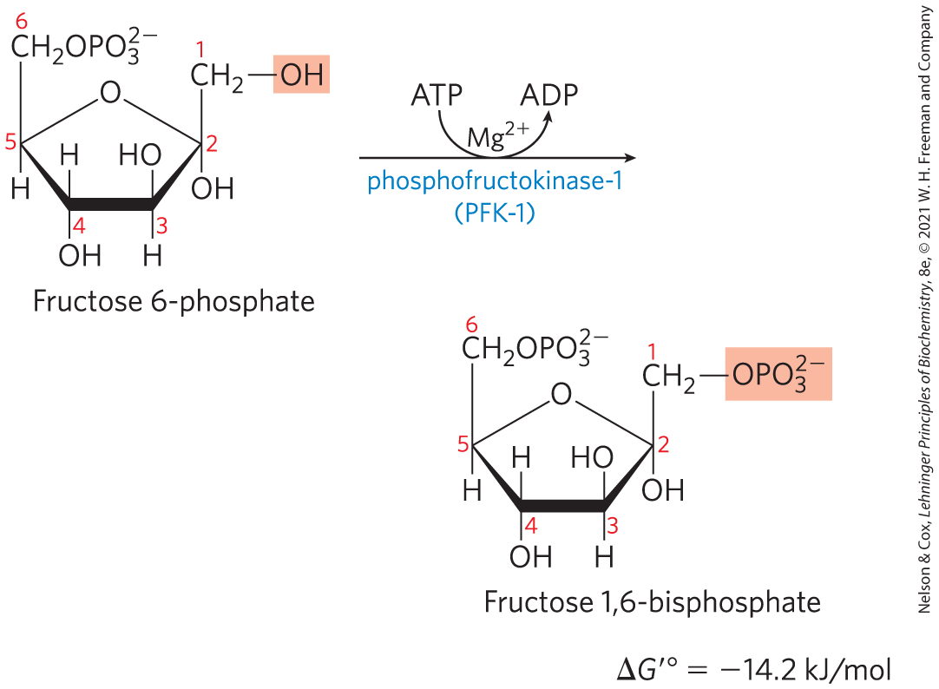
Phosphorylation of Fructose 6-Phosphate to Fructose 1,6-Bisphosphate
phosphofructokinase-1 (PFK-1) catalyzes the transfer of a phosphoryl group from ATP to fructose 6-phosphate to yield fructose 1,6-bisphosphate
  essentially irreversible under cellular conditions
  the first “committed” step in the glycolytic pathway

Slide 42
Allosteric Regulation of Phosphofructokinase-1
activity increases when:
  ATP supply is depleted
  ADP and AMP accumulate
fructose 2,6-bisphosphate is a potent allosteric activator
ribulose 5-phosphate indirectly activates

Slide 43
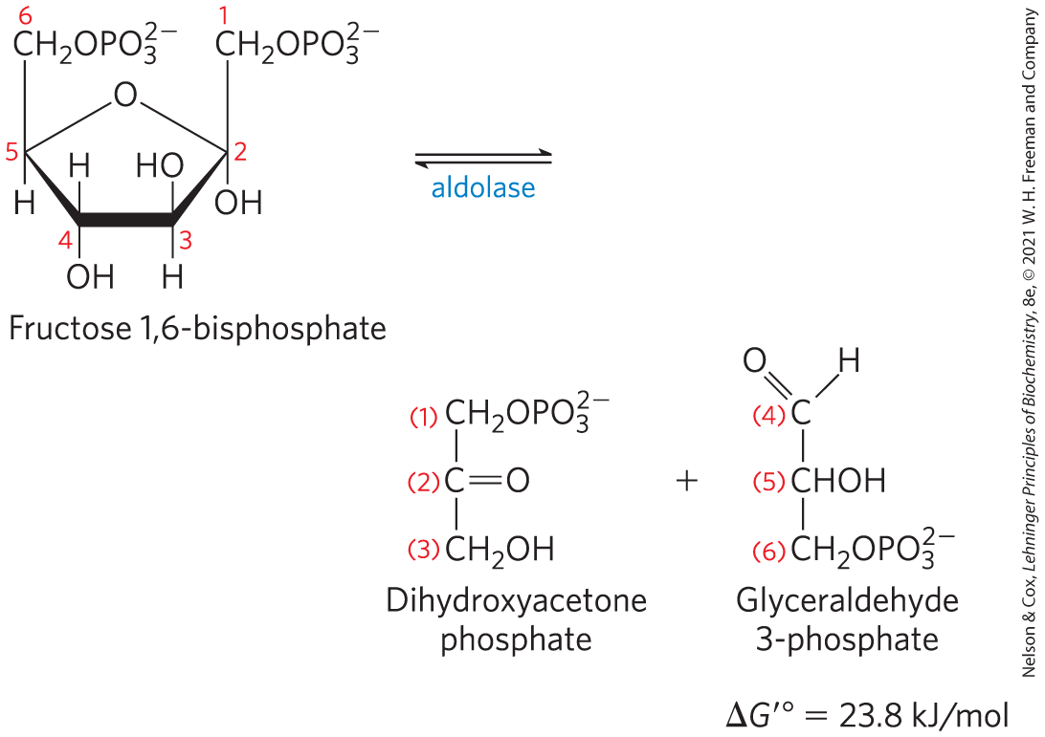
Cleavage of Fructose
1,6-Bisphosphate
fructose 1,6-bisphosphate aldolase (aldolase) catalyzes a reverse aldol condensation and cleaves fructose 1,6-bisphosphate to yield glyceraldehyde 3-phosphate and dihydroxyacetone phosphate
  reversible because reactant concentrations are low in the cell

Slide 44
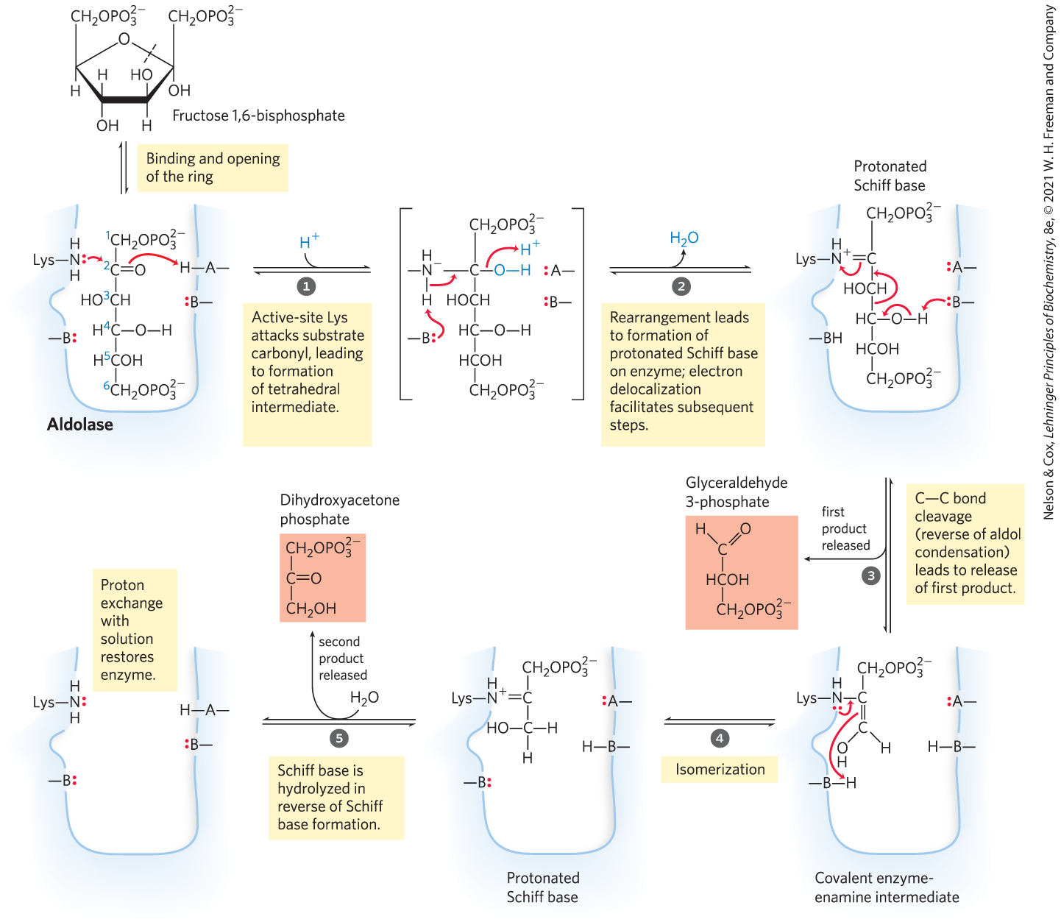
The Class I Aldolase Reaction
Class I = found in animals and plants
Class II = found in fungi and bacteria
  do not form the Schiff base intermediate

Slide 45
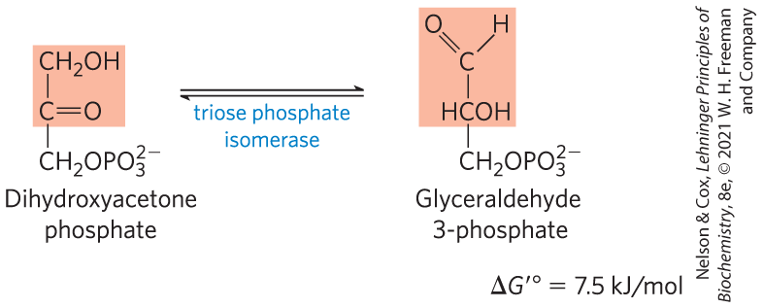
Interconversion of the Triose Phosphates
triose phosphate isomerase converts dihydroxyacetone phosphate to glyceraldehyde 3-phosphate
  reversible
  final step of the preparatory phase of glycolysis

Slide 46
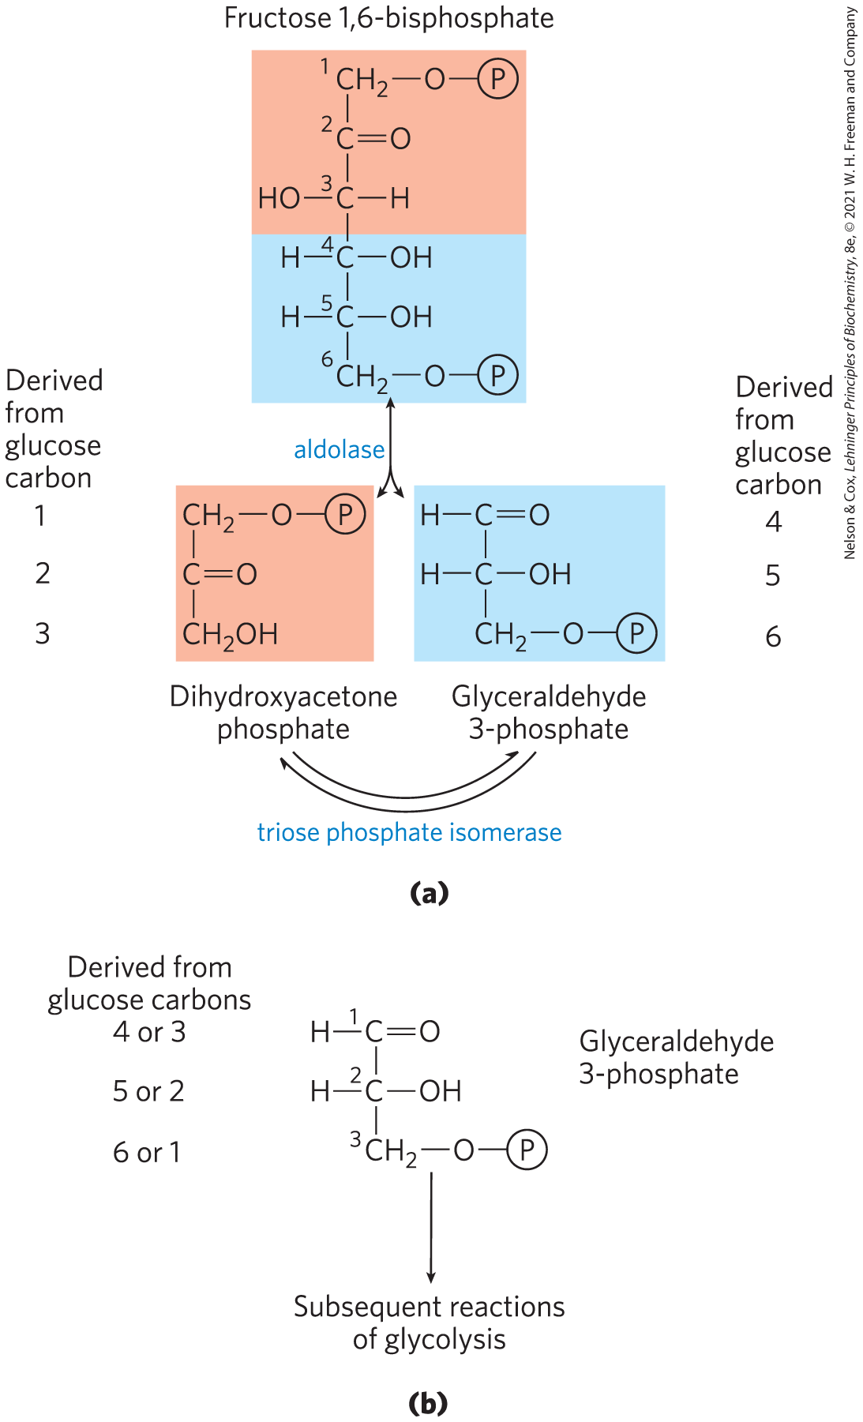
Fate of the Glucose Carbons in the Formation of Glyceraldehyde
3-Phosphate
after step 5 of glycolysis, the carbon atoms derived from C-1, C-2, and C-3 of the starting glucose are chemically indistinguishable from C-6, C-5, and C-4, respectively

Slide 47
Clicker Question 6
Which carbons of the original glucose are phosphorylated in the two molecules of glyceraldehyde 3-phosphate?
C-1 and C-2
C-3 and C-4
C-5 and C-6
C-1 and C-6
C-1 and C-4
Notes:
Answer: D
Principle: 14.1
Learning Objective(s): Illustrate the arrangement of carbon atoms as they move through glycolysis.
Bloom’s: 2:2

Slide 48
Clicker Question 6, Response
Which carbons of the original glucose are phosphorylated in the two molecules of glyceraldehyde 3-phosphate?
C-1 and C-6
The first three glycolytic reactions convert glucose to fructose 1,6-bisphosphate. After cleavage by aldolase, C-1 becomes the phosphorylated carbon of dihydroxyacetone phosphate and C-6 becomes the phosphorylated carbon of glyceraldehyde 3-phosphate. Triose phosphate isomerase converts the dihydroxyacetone phosphate to the second glyceraldehyde 3-phosphate molecule.

Slide 49
The Payoff Phase of Glycolysis Yields ATP and NADH
in the payoff phase of glycolysis:
  each of the two molecules of glyceraldehyde 3-phosphate undergoes oxidation at C-1
  some energy from the oxidation reaction is conserved in the form of one NADH and two ATP per triose phosphate oxidized

Slide 50
Principle 1 (5 of 7)
Metabolites like glucose are often activated with a high-energy group before their catabolism. Glycolysis is a nearly universal 10-step metabolic pathway for producing ATP by the oxidation of glucose. In this process, two molecules of ATP are invested to activate glucose, but the products of the pathway include four ATP, as well as NADH (a form of reducing power) and the triose pyruvate, which can be metabolized further in other pathways.

Slide 51
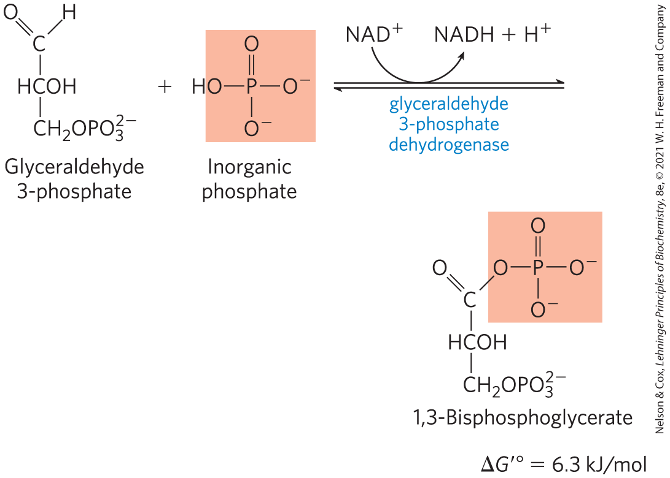
Oxidation of Glyceraldehyde
3-Phosphate to 1,3-Bisphosphoglycerate
glyceraldehyde 3-phosphate dehydrogenase catalyzes the oxidation glyceraldehyde 3-phosphate to 1,3-bisphosphoglycerate
  energy-conserving reaction

Slide 52
The First Step of the Payoff Phase is an Energy-Conserving Reaction
formation of the acyl phosphate group at C-1 of 1,3-bisphosphoglycerate conserves the free energy of oxidation
acyl phosphates have a very high standard free energy of hydrolysis (∆G′° = −49.3 kJ/mol)

Slide 53
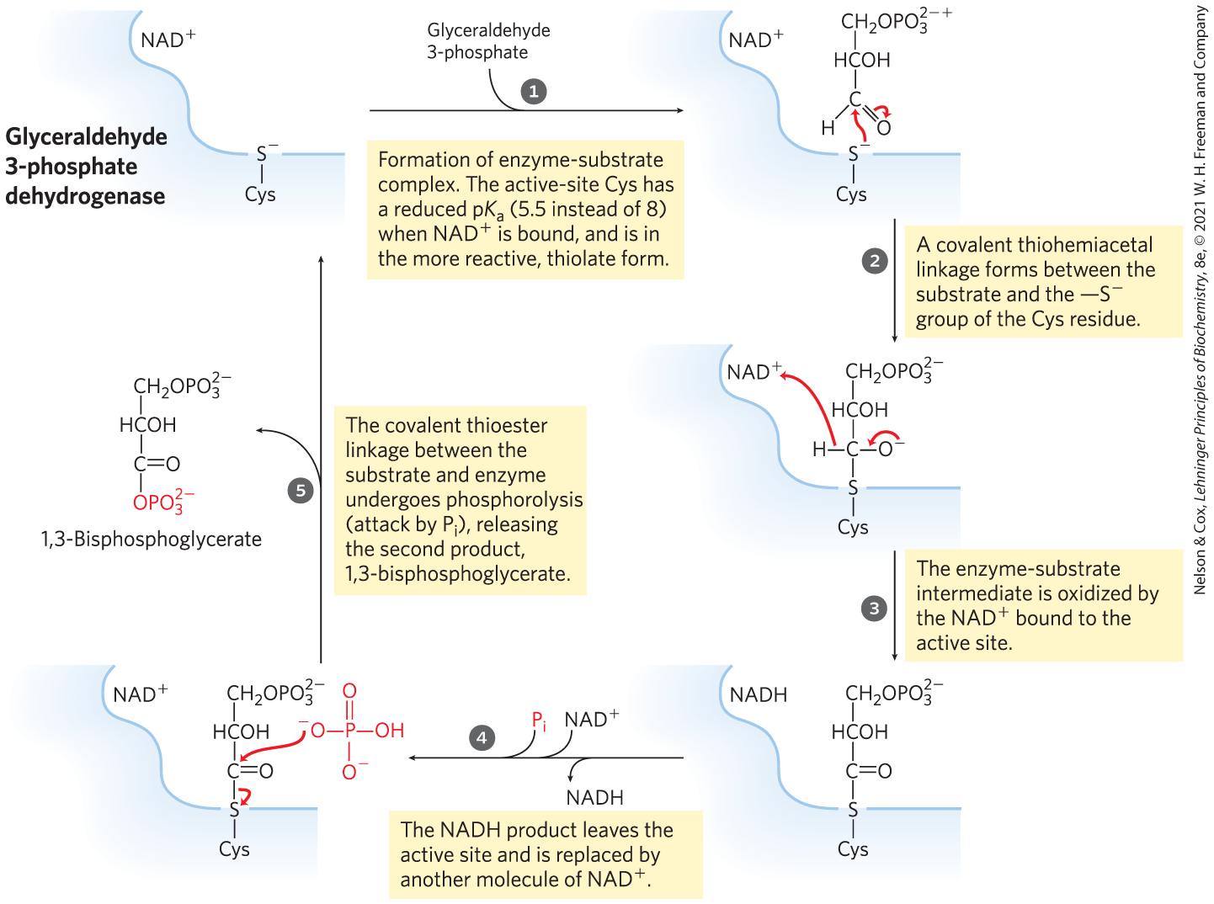
The Glyceraldehyde 3-Phosphate Dehydrogenase Reaction

Slide 54
Clicker Question 7
The reaction catalyzed by glyceraldehyde 3-phosphate dehydrogenase oxidizes an aldehyde group. How does this reaction conserve much of the free energy of oxidation?
through the formation of a carboxylic acid
through the formation of an acyl phosphate
through the formation of a carbon–carbon bond
through the formation of ATP
Notes:
Answer: B
Principle: 14.1
Learning Objective(s): Summarize the payoff phase of glycolysis in regard to the investment of ATP.
Bloom’s: 2:2

Slide 55
Clicker Question 7, Response
The reaction catalyzed by glyceraldehyde 3-phosphate dehydrogenase oxidizes an aldehyde group. How does this reaction conserve much of the free energy of oxidation?
through the formation of an acyl phosphate
The aldehyde group of glyceraldehyde 3-phosphate is oxidized to a carboxylic acid anhydride with phosphoric acid. This type of anhydride, called an acyl phosphate, has a very high standard free energy of hydrolysis (∆G′° = −49.3 kJ/mol).

Slide 56
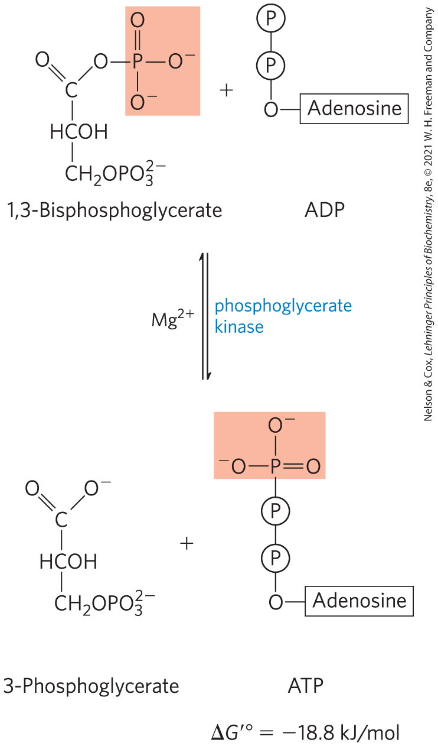
Phosphoryl Transfer from 1,3-Bisphosphoglycerate to ADP
phosphoglycerate kinase transfers the high-energy phosphoryl group from the carboxyl group of 1,3-bisphosphoglycerate to ADP, forming ATP and 3-phosphoglycerate

Slide 57
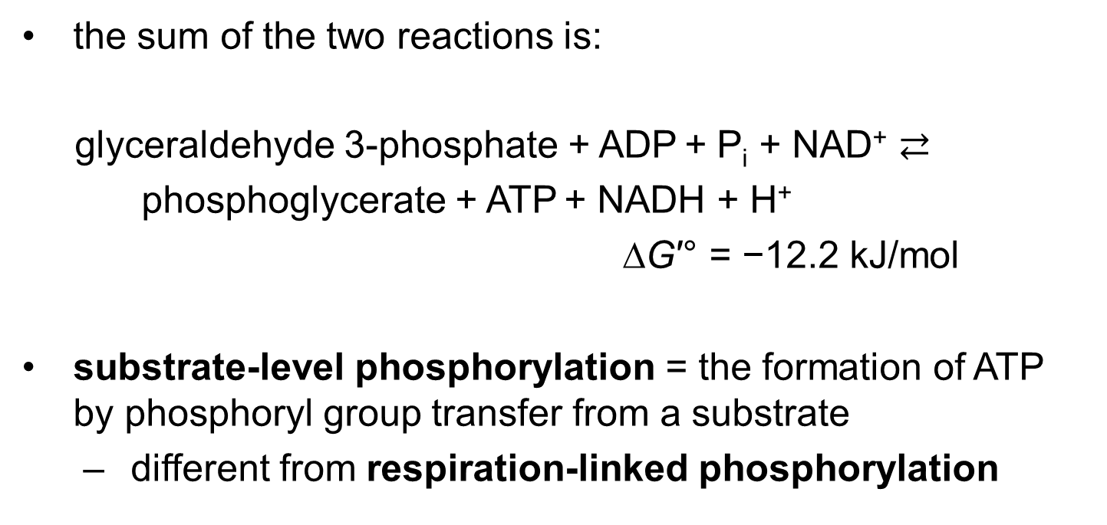
Steps 6 and 7 of Glycolysis Constitute an Energy-Coupling Process
the sum of the two reactions is:
glyceraldehyde 3-phosphate + ADP + P_{i} + NAD⁺ $⇄$
phosphoglycerate + ATP + NADH + H⁺
∆G′° = −12.2 kJ/mol
substrate-level phosphorylation = the formation of ATP by phosphoryl group transfer from a substrate
  different from respiration-linked phosphorylation

Slide 58
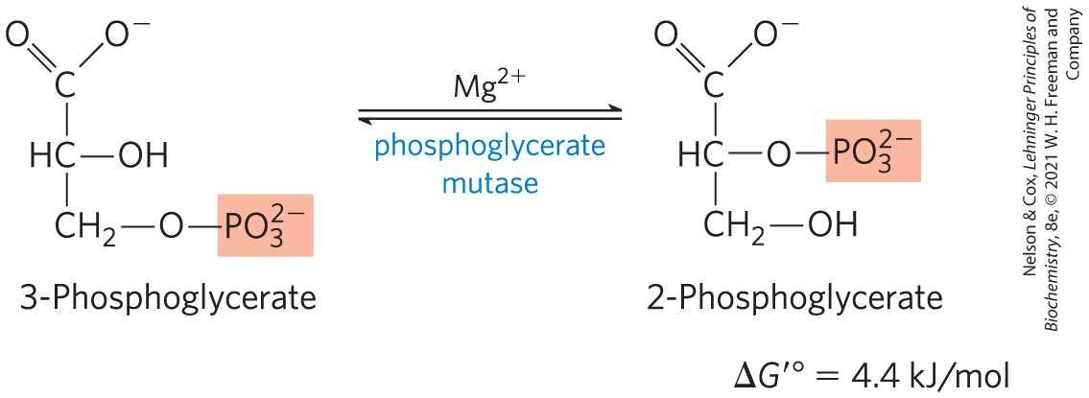
Conversion of 3-Phosphoglycerate to 2-Phosphoglycerate
phosphoglycerate mutase catalyzes a reversible shift of the phosphoryl group between C-2 and C-3 of glycerate
  requires Mg²⁺

Slide 59
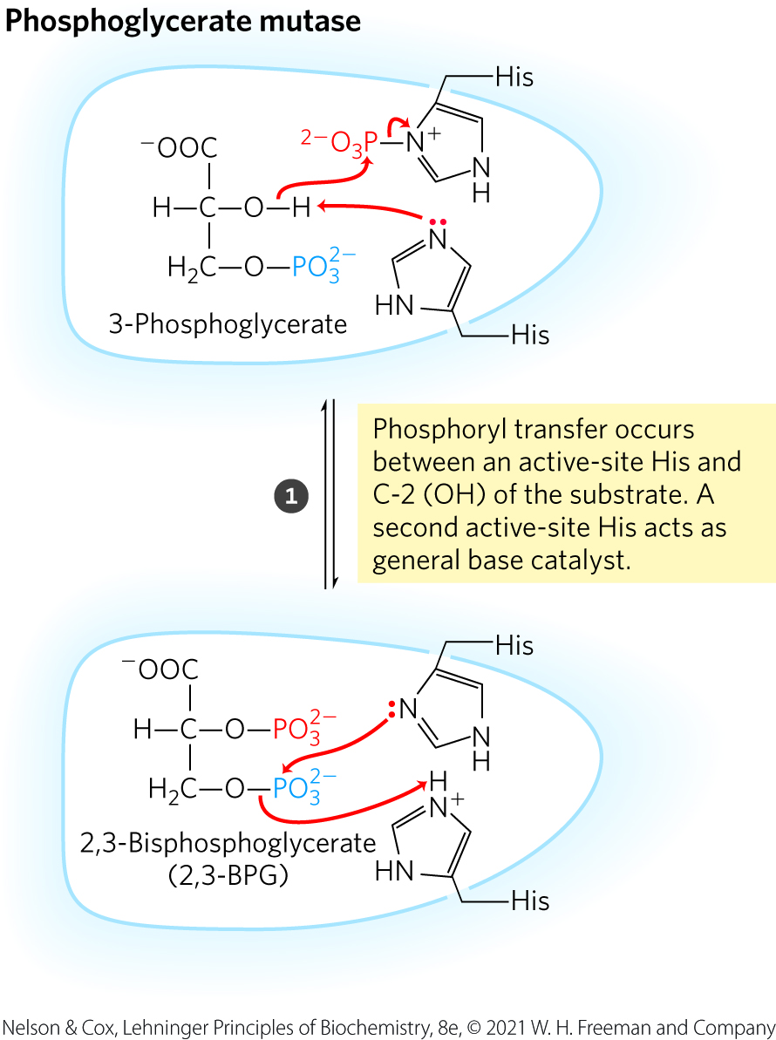
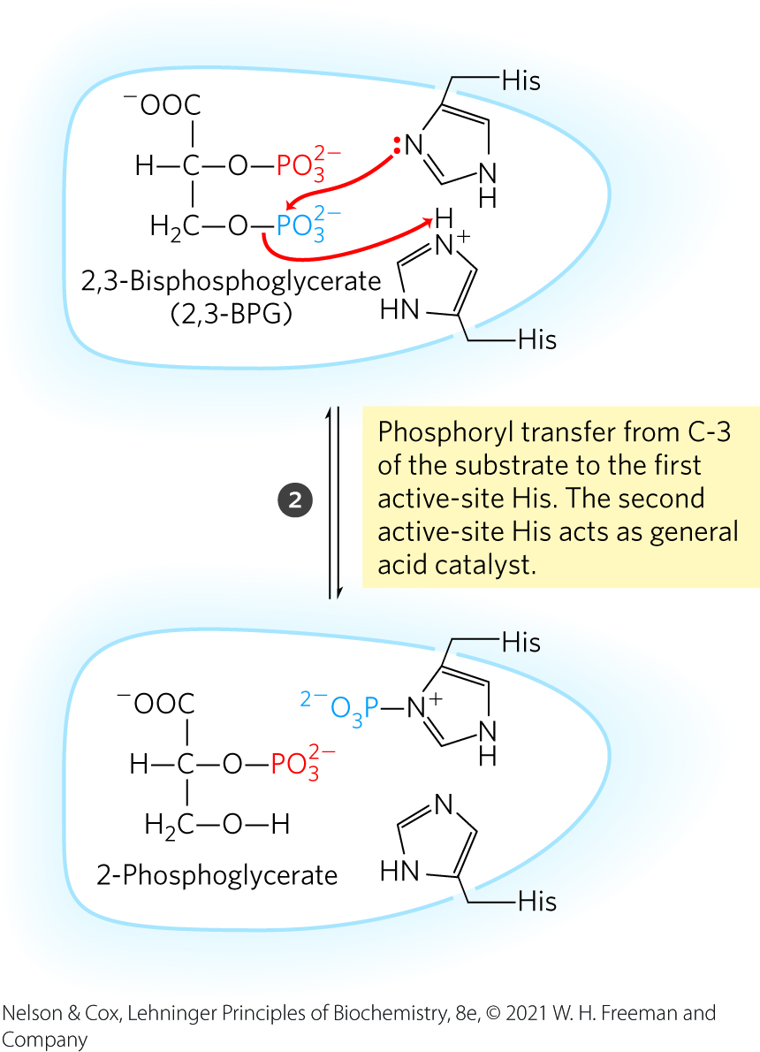
The Phosphoglycerate Mutase Reaction

Slide 60
Clicker Question 8
Which reaction of glycolysis includes substrate-level phosphorylation, a very different mechanism than oxidative phosphorylation?
hexokinase
phosphoglycerate kinase
phosphofructokinase-1
pyruvate kinase
PEP carboxykinase
Notes:
Answer: B
Principle: 14.1
Learning Objective(s): Explain the difference between substrate-level phosphorylation and respiration-linked phosphorylation.
Bloom’s: 2:1

Slide 61
Clicker Question 8, Response
Which reaction of glycolysis includes substrate-level phosphorylation, a very different mechanism than oxidative phosphorylation?
phosphoglycerate kinase
The formation of ATP by phosphoryl group transfer from a substrate such as 1,3-bisphosphoglycerate is referred to as a substrate-level phosphorylation. Substrate-level phosphorylations involve soluble enzymes and chemical intermediates (1,3-bisphosphoglycerate in this case).

Slide 62
Principle 1 (6 of 7)
Metabolites like glucose are often activated with a high-energy group before their catabolism. Glycolysis is a nearly universal 10-step metabolic pathway for producing ATP by the oxidation of glucose. In this process, two molecules of ATP are invested to activate glucose, but the products of the pathway include four ATP, as well as NADH (a form of reducing power) and the triose pyruvate, which can be metabolized further in other pathways.

Slide 63
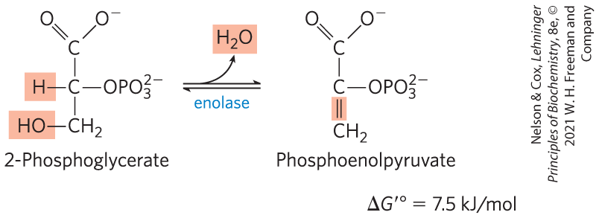
Dehydration of 2-Phosphoglycerate to Phosphoenolpyruvate
enolase promotes reversible removal of a molecule of water from 2-phosphoglycerate to yield phosphoenolpyruvate (PEP)
  energy-conserving reaction
  mechanism involves a Mg²⁺-stabilized enolic intermediate

Slide 64
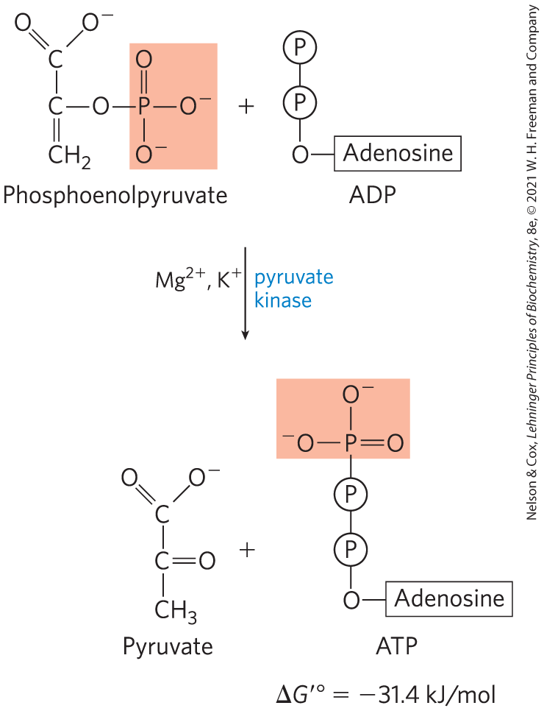
Transfer of the Phosphoryl Group from Phosphoenolpyruvate to ADP
pyruvate kinase catalyzes the transfer of the phosphoryl group from phosphoenolpyruvate to ADP, yielding pyruvate
  requires K⁺ and either Mg²⁺ or Mn²⁺

Slide 65
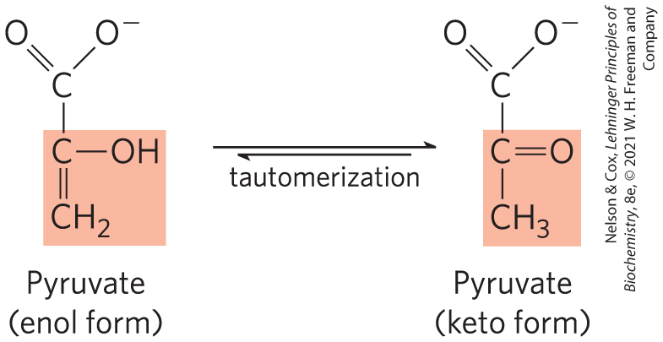
Pyruvate in its Enol Form Spontaneously Tautomerizes to its Keto Form
pyruvate kinase catalyzes the transfer of the phosphoryl group from phosphoenolpyruvate to ADP, yielding pyruvate
  requires K⁺ and either Mg²⁺ or Mn²⁺

Slide 66
Clicker Question 9
Which of these enzymes catalyzes a reversible reaction in glycolysis under typical cellular conditions?
phosphofructokinase-1
pyruvate kinase
hexokinase
phosphoglycerate kinase
Notes:
Answer: D
Principle: 14.1
Learning Objective(s): Explain why, from a thermodynamic standpoint, glycolysis is irreversible.
Bloom’s: 2:1

Slide 67
Clicker Question 9, Response
Which of these enzymes catalyzes a reversible reaction in glycolysis under typical cellular conditions?
phosphoglycerate kinase
During gluconeogenesis and photosynthetic CO₂ assimilation, phosphoglycerate kinase enzyme acts in the direction suggested by its name, phosphorylating 3-phosphoglycerate to 1,3-bisphosphoglycerate. In glycolysis, phosphoglycerate kinase catalyzes the reverse reaction.

Slide 68
Principle 1 (7 of 7)
Metabolites like glucose are often activated with a high-energy group before their catabolism. Glycolysis is a nearly universal 10-step metabolic pathway for producing ATP by the oxidation of glucose. In this process, two molecules of ATP are invested to activate glucose, but the products of the pathway include four ATP, as well as NADH (a form of reducing power) and the triose pyruvate, which can be metabolized further in other pathways.

Slide 69
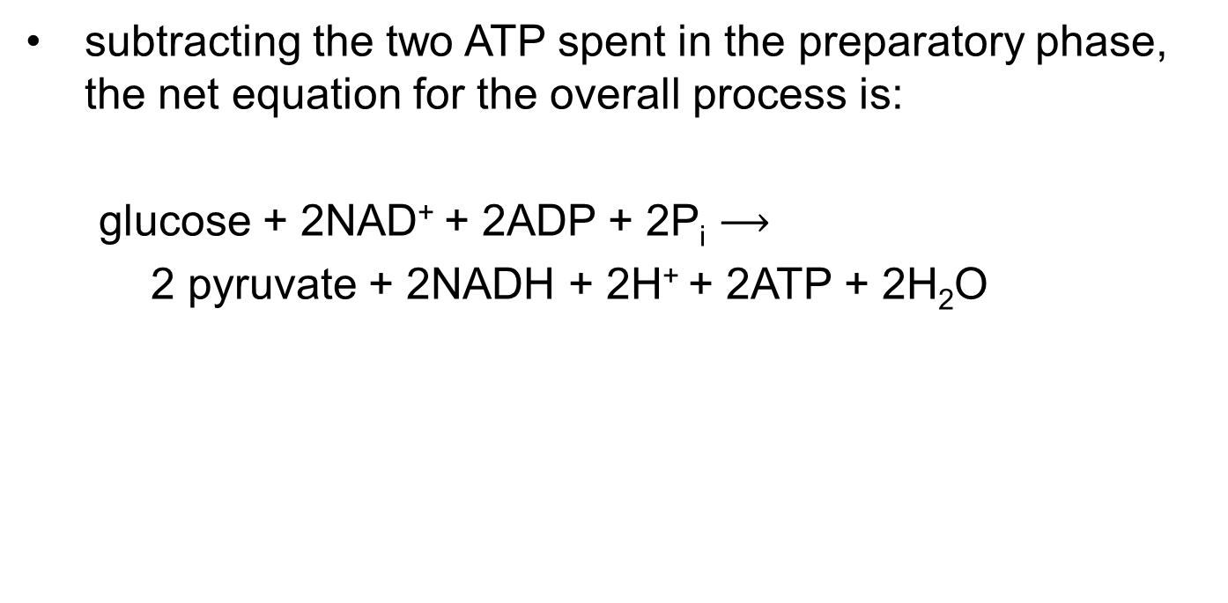
The Overall Balance Sheet Shows a Net Gain of Two ATP and Two NADH Per Glucose
subtracting the two ATP spent in the preparatory phase, the net equation for the overall process is:
glucose + 2NAD⁺ + 2ADP + 2P_{i} $⟶$
2 pyruvate + 2NADH + 2H⁺ + 2ATP + 2H₂O

Slide 70
Clicker Question 10
Which compound does NOT appear in the overall reaction for glycolysis?
2 pyruvate
fructose 6-phosphate
2 ATP
2 NADH
Notes:
Answer: B
Principle: 14.1
Learning Objective(s): Identify the energetic products of glycolysis.
Bloom’s: 2:1

Slide 71
Clicker Question 10, Response
Which compound does NOT appear in the overall reaction for glycolysis?
fructose 6-phosphate
Fructose 6-phosphate is a glycolytic intermediate, which gets converted to fructose 1,6-bisphosphate in the third step of the pathway. Intermediates do not appear in the overall reaction.

Slide 72
14.2 Feeder Pathways for Glycolysis

Slide 73
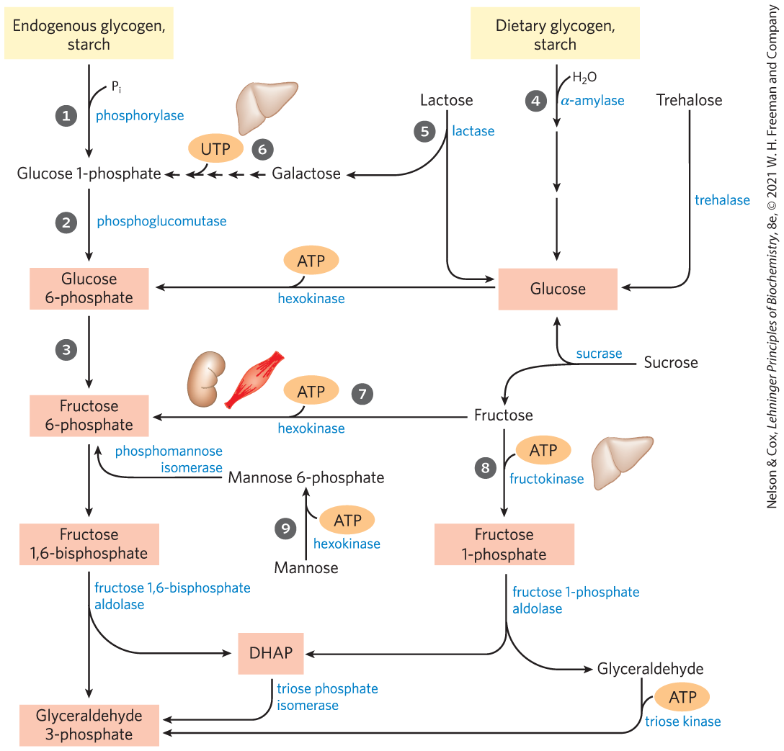
Entry of Dietary Glycogen, Starch, Disaccharides, and Hexoses into the Preparatory Stage of Glycolysis

Slide 74
Principle 2 (2 of 3)
Glucose and other hexoses and hexose phosphates obtained from stored polysaccharides or dietary carbohydrates feed into the glycolytic pathway. By using a common pathway for a number of starting materials, the cell economizes on the number of enzymes that must be synthesized and simplifies the regulation of the common pathway.

Slide 75
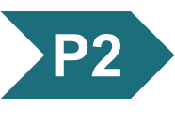
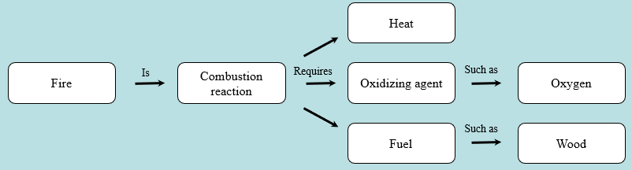
Activity: Relating
Terms within the Chapter
A concept map displays the relationships between different concepts. Observe the following example of a concept map.
Notes:
Instructor: For additional information, see the Instructor Activity Guide located in Achieve. It can be found within Chapter 14, in the folder titled “Ch14 In-Class Activities, Videos, and Resources.”

Slide 76
Activity Instructions (2 of 3)
Think about how the following terms and phrases relate to each other and then use scratch paper to draw a concept map using these terms and phrases. (3 minutes)
starting materials in cell
common pathway
simplify regulation
economize enzyme synthesis
glucose and other hexoses and hexose phosphates
glycolytic pathway
stored polysaccharides or dietary carbohydrates
Notes:
Instructor: For additional information, see the Instructor Activity Guide located in Achieve. It can be found within Chapter 14, in the folder titled “Ch14 In-Class Activities, Videos, and Resources.”

Slide 77
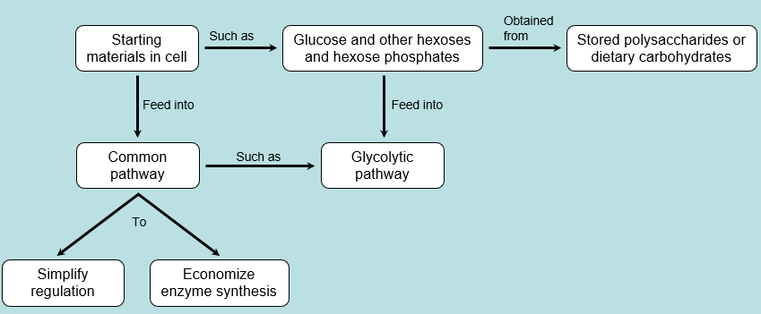
Activity Solution (2 of 3)
Pair up and share how this possible concept map might differ from yours. (2 minutes)
Notes:
Instructor: For additional information, see the Instructor Activity Guide located in Achieve. It can be found within Chapter 14, in the folder titled “Ch14 In-Class Activities, Videos, and Resources.”

Slide 78
Endogenous Glycogen and Starch Are Degraded by Phosphorolysis
glycogen phosphorylase = mobilizes glycogen stored in animal tissues and microorganisms by a phosphorolytic reaction to yield glucose 1-phosphate
starch phosphorylase = mobilizes starch by a phosphorolytic reaction

Slide 79
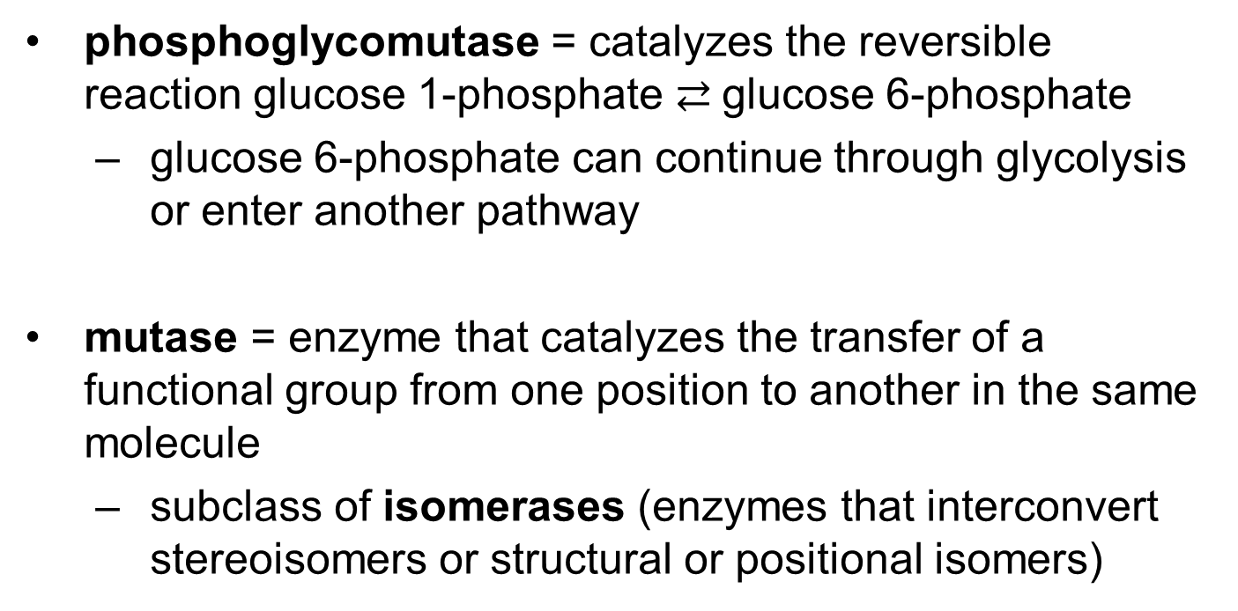
Phosphoglycomutase
phosphoglycomutase = catalyzes the reversible reaction glucose 1-phosphate $⇄$glucose 6-phosphate
  glucose 6-phosphate can continue through glycolysis or enter another pathway
mutase = enzyme that catalyzes the transfer of a functional group from one position to another in the same molecule
  subclass of isomerases (enzymes that interconvert stereoisomers or structural or positional isomers)

Slide 80
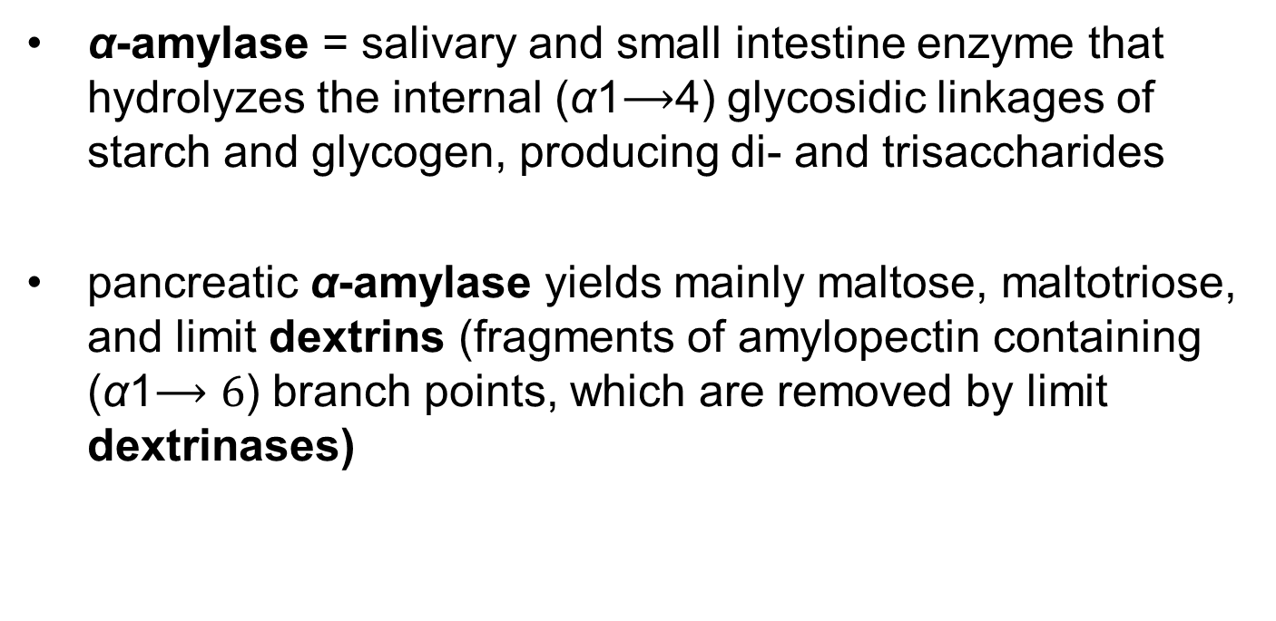
Dietary Polysaccharides and Disaccharides
α-amylase = salivary and small intestine enzyme that hydrolyzes the internal (α1$⟶$4) glycosidic linkages of starch and glycogen, producing di- and trisaccharides
pancreatic α-amylase yields mainly maltose, maltotriose, and limit dextrins (fragments of amylopectin containing (α1$⟶6$) branch points, which are removed by limit dextrinases)

Slide 81
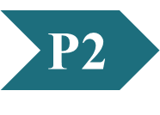
Clicker Question 11
Dietary glycogen:
effectively produces an extra ATP when its glucose goes through glycolysis.
is broken down to glucose by a different group of enzymes than is dietary starch.
is broken down to glucose 6-phosphate, which is then absorbed by intestinal cells.
is broken down in the intestine to limit dextrins, which are then degraded to glucose.
Notes:
Answer: D
Principle: 14.2
Learning Objective(s): Describe the process by which glycogen or starch might be utilized by glycolysis.
Bloom’s: 2:1

Slide 82
Clicker Question 11, Response
Dietary glycogen:
is broken down in the intestine to limit dextrins, which are then degraded to glucose.
Release of pancreatic α-amylase into the small intestine yields mainly maltose and maltotriose (the di- and trisaccharides of glucose) and oligosaccharides called limit dextrins, fragments of amylopectin containing (α1→6) branch points, which are removed by limit dextrinases.

Slide 83
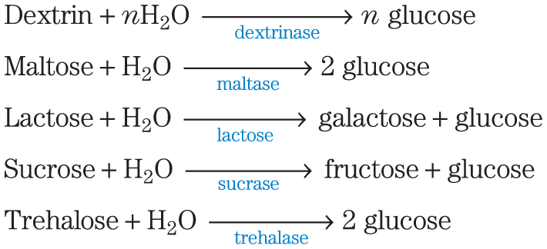
Hydrolysis of Disaccharides
membrane-bound hydrolases in the intestinal brush border hydrolyze disaccharides:
monosaccharides pass through intestinal cells to the bloodstream, which transports them to the liver or other tissues

Slide 84

Cellulase
cellulase = attacks the (β1$⟶$4) glycosidic bonds of cellulose
  absent in most animals
  microorganisms produce cellulase

Slide 85
Lactose Digestion and
Lactose Intolerance
lactase = converts lactose to glucose and galactose
  present in infants but often absent in adults, producing lactose intolerance
lactase persistence phenotype = production of lactase into adulthood
lactose intolerance = inability to digest lactose due to the disappearance of lactase in adulthood
  causes abdominal cramps and diarrhea

Slide 86
Galactose Metabolism and Disease
galactose = product of lactose hydrolysis
  important component in the infant diet
galactokinase = uses ATP to phosphorylate galactose at C-1

Slide 87
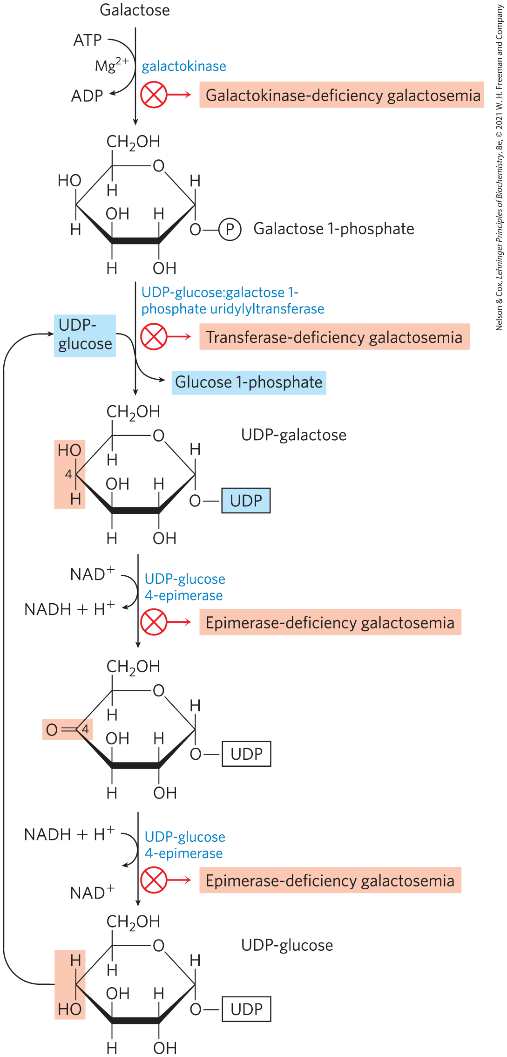
Conversion of Galactose to
Glucose 1-Phosphate
conversion proceeds through UDP-galactose and UDP-glucose intermediates
galactosemia diseases = caused by a genetic defect in enzymes of this pathway
  treatment involves carefully controlling dietary galactose

Slide 88
Clicker Question 12
Which statement about carbohydrate metabolism is false?
The overall strategy for metabolizing the common monosaccharides is to convert them into glycolytic intermediates.
Galactose metabolism requires a nucleotide.
Mannose is phosphorylated by hexokinase.
Galactosemia results from defective or absent lactase in the intestine.
Notes:
Answer: D
Principle: 14.2
Learning Objective(s): Describe the process by which monosaccharides such as fructose, mannose, and galactose might be utilized by glycolysis.
Bloom’s: 2:1

Slide 89
Clicker Question 12, Response
Which statement about carbohydrate metabolism is false?
Galactosemia results from defective or absent lactase in the intestine.
Galactosemia results from a defect in any of the enzymes in the pathway responsible for converting galactose to glucose 1-phosphate. Defective or absent intestinal lactase causes lactose intolerance.

Slide 90
Principle 2 (3 of 3)
Glucose and other hexoses and hexose phosphates obtained from stored polysaccharides or dietary carbohydrates feed into the glycolytic pathway. By using a common pathway for a number of starting materials, the cell economizes on the number of enzymes that must be synthesized and simplifies the regulation of the common pathway.

Slide 91
Fructose and Mannose
fructose and mannose can be phosphorylated and funneled into glycolysis
hexokinase = phosphorylates fructose in the small intestine
fructose 1-phosphate aldolase = phosphorylates fructose in the liver

Slide 92
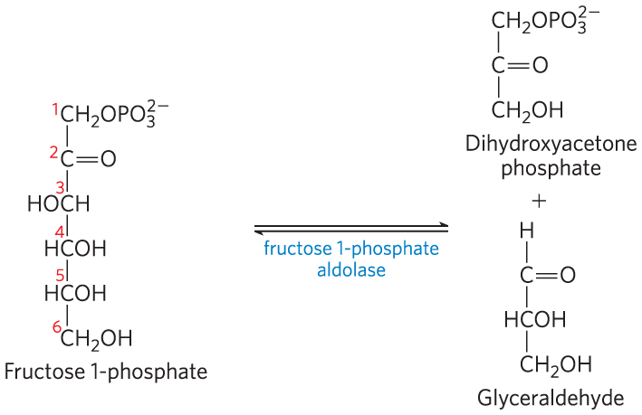
Fructose 1-Phosphate Aldolase
fructose 1-phosphate aldolase = cleaves fructose 1-phosphate to glyceraldehyde and dihydroxyacetone

Slide 93

Products of Fructose 1-Phosphate Hydrolysis Enter Glycolysis as Glyceraldehyde 3-Phosphate
triose phosphate isomerase = converts dihydroxyacetone phosphate to glyceraldehyde 3-phosphate
triose kinase = uses ATP to phosphorylate glyceraldehyde to glyceraldehyde 3-phosphate

Slide 94
Mannose Enters Glycolysis as Fructose 6-Phosphate
hexokinase = phosphorylates mannose at C-6
phosphohexose isomerase = converts mannose 6-phosphate to fructose 6-phosphate

Slide 95
Clicker Question 13
Which sugar could be transformed into fructose 6-phosphate if glucose and glucose phosphates were no longer available?
galactose
trehalose
lactose
amylose
mannose
Notes:
Answer: E
Principle: 14.2
Learning Objective(s): Describe the process by which monosaccharides such as fructose, mannose, and galactose might be utilized by glycolysis.
Bloom’s: 2:1

Slide 96
Clicker Question 13, Response
How are glycolysis, ethanol fermentation, and lactate fermentation all related?
mannose
Hexokinase uses ATP to phosphorylate mannose to mannose 6-phosphate. Phosphomannose isomerase then converts mannose 6-phosphate to fructose 6-phosphate.

Slide 97
Clicker Question 14
Which sugar CANNOT be fed into the glycolytic pathway?
sucrose
mannose
glycogen
cellulose
galactose
Notes:
Answer: D
Principle: 14.2
Learning Objective(s): Describe the process by which monosaccharides such as fructose, mannose, and galactose might be utilized by glycolysis.
Bloom’s: 2:1

Slide 98
Clicker Question 14, Response
Which sugar CANNOT be fed into the glycolytic pathway?
cellulose
Monosaccharides, such as fructose, mannose, and galactose, can be utilized by glycolysis, as can the glucose 1-phosphate released from glycogen breakdown. However, most animals cannot digest cellulose for lack of the enzyme cellulase, which attacks the (β1→4) glycosidic bonds of cellulose.

Slide 99
14.3 Fates of Pyruvate

Slide 100
Principle 3 (2 of 7)
Pyruvate formed under anaerobic conditions is reduced to lactate with electrons from NADH, recycling NADH to NAD⁺ and allowing continued glycolysis in the processes of lactate or alcohol fermentation. Manipulation of the fermentable material and the microorganisms present allows the synthesis of a variety of industrial products and foods.

Slide 101
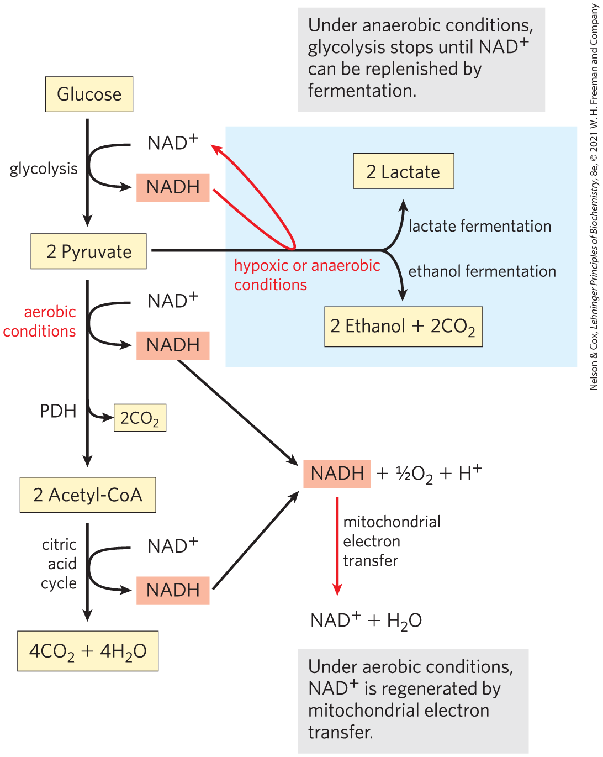
Three Catabolic Fates of Pyruvate
NADH must be recycled to regenerate NAD⁺
under aerobic conditions, pyruvate is oxidized to acetyl-CoA
under anaerobic conditions or low oxygen condition (hypoxia), pyruvate is reduced to lactate or ethanol

Slide 102
Fermentation
fermentation = general term for processes that extract energy (as ATP) but do not consume oxygen or change the concentrations of NAD⁺ or NADH
lactic acid fermentation = pyruvate accepts electrons from NADH and is reduced to lactate while regenerating the NAD⁺ necessary for glycolysis
ethanol (alcohol) fermentation = pyruvate is further catabolized to ethanol

Slide 103
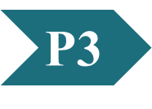
Clicker Question 15
How are glycolysis, ethanol fermentation, and lactate fermentation all related?
All are regulated by the ATP/ADP mass-action ratio.
All three produce carbon dioxide.
All can proceed in the absence of oxygen.
All require pyruvate.
All three produce NADH.
Notes:
Answer: C
Principle: 14.3
Learning Objective(s): Differentiate lactic acid and ethanol fermentation of pyruvate.
Bloom’s: 2:2

Slide 104
Clicker Question 15, Response
How are glycolysis, ethanol fermentation, and lactate fermentation all related?
All can proceed in the absence of oxygen.
Under anaerobic conditions, the pyruvate produced by glycolysis can be reduced to lactate or ethanol by fermentation. The recycling of NADH to NAD⁺ in the processes of lactate or alcohol fermentation allow continued glycolysis in the absence of oxygen.

Slide 105
The Pasteur and Warburg Effects Are Due to Dependence on Glycolysis Alone for ATP Production
“Pasteur effect” = effect by which the rate and total amount of glucose consumption under anaerobic conditions is many times greater than under aerobic conditions
  occurs because the ATP yield from glycolysis alone is much smaller (2 ATP per glucose) than complete oxidation to CO₂ (30 or 32 ATP per glucose)

Slide 106
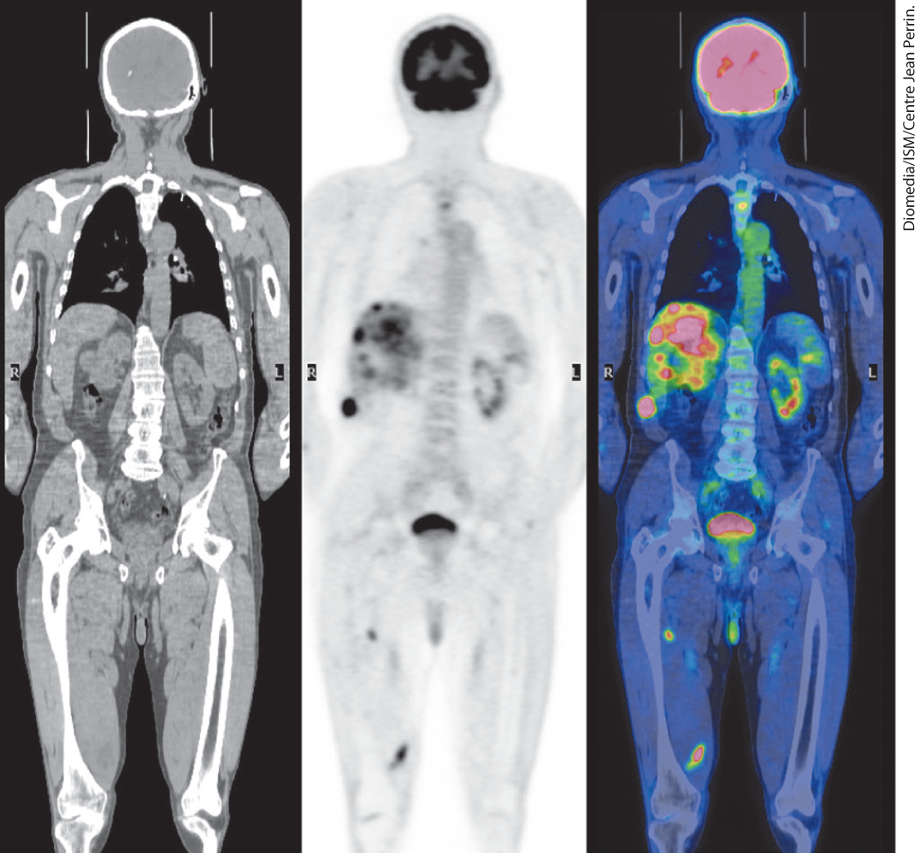
The Warburg Effect
“Warburg effect” = the observation that tumor cells have high rates of glycolysis, with fermentation of glucose to lactate, even in the presence of oxygen
  the basis of PET scanning used to diagnose tumors

Slide 107
Clicker Question 16
Which statement regarding glycolysis is false?
It consists of ten enzyme-catalyzed reactions.
It is cytosolic.
It tends to run more slowly in tumor cells.
It is nearly identical in all organisms.
Notes:
Answer: C
Principle: 14.3
Learning Objective(s): Understand differences in energy production under anaerobic and aerobic conditions.
Bloom’s: 2:2

Slide 108
Clicker Question 16, Response
Which statement regarding glycolysis is false?
It tends to run more slowly in tumor cells.
The German biochemist Otto Warburg first observed in 1928 that tumors of nearly all types carry out glycolysis at a much higher rate than normal tissue, even when oxygen is available. This “Warburg effect” is the basis for several methods of detecting and treating cancer.

Slide 109
Principle 3 (3 of 7)
Pyruvate formed under anaerobic conditions is reduced to lactate with electrons from NADH, recycling NADH to NAD⁺ and allowing continued glycolysis in the processes of lactate or alcohol fermentation. Manipulation of the fermentable material and the microorganisms present allows the synthesis of a variety of industrial products and foods.

Slide 110
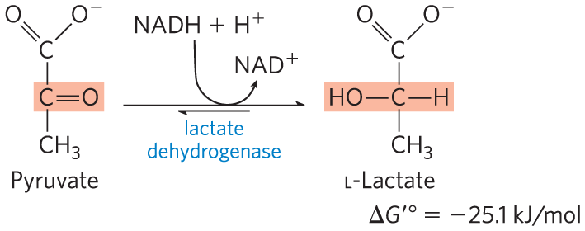
Pyruvate Is the Terminal Electron Acceptor in Lactic Acid Fermentation
organisms can regenerate NAD⁺ by transferring electrons from NADH to pyruvate, forming lactate
lactate dehydrogenase = catalyzes the reduction of pyruvate to lactate

Slide 111
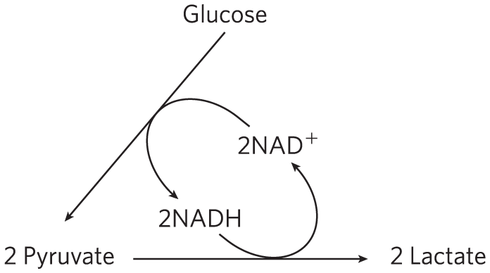
Reduction of Pyruvate to Lactate Regenerates NAD⁺
glycolysis converts 2NAD⁺ to 2NADH
reduction of pyruvate to lactate regenerates 2NAD⁺
there is no net change in NAD⁺ or NADH

Slide 112
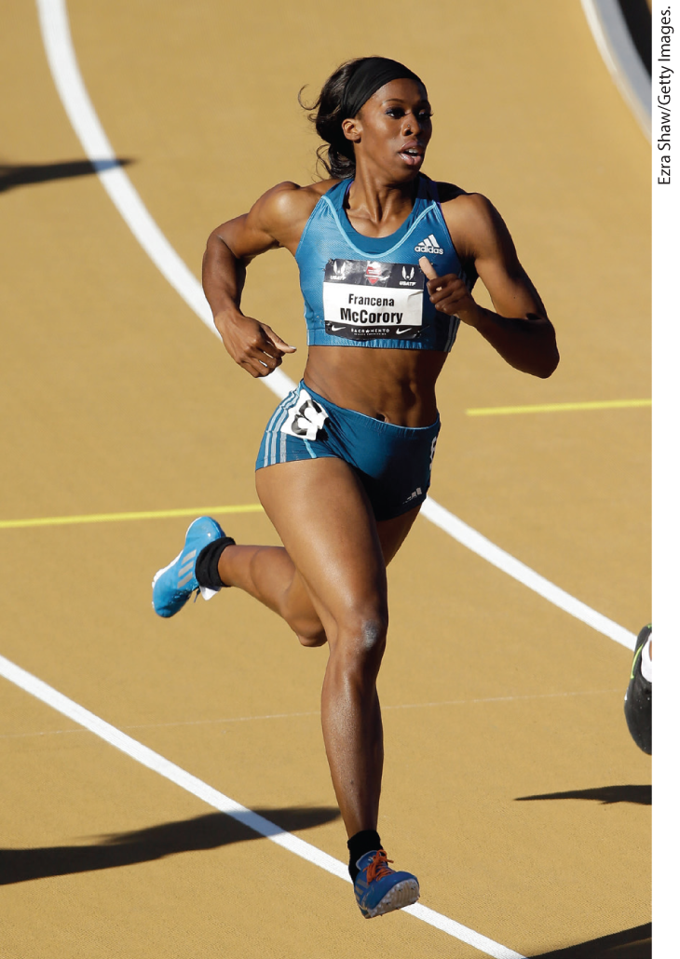
Lactate Can Be Recycled
lactate is carried in blood to the liver, where it is converted to glucose during recovery
acidification resulting from ionization of lactic acid in muscle and blood limits the period of vigorous activity, such as sprinting

Slide 113
Principle 3 (4 of 7)
Pyruvate formed under anaerobic conditions is reduced to lactate with electrons from NADH, recycling NADH to NAD⁺ and allowing continued glycolysis in the processes of lactate or alcohol fermentation. Manipulation of the fermentable material and the microorganisms present allows the synthesis of a variety of industrial products and foods.

Slide 114
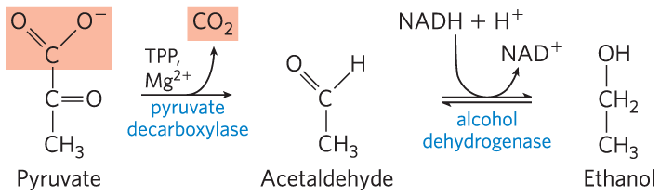

Ethanol Is the Reduced Product in Ethanol Fermentation
yeast and other microorganisms regenerate NAD⁺ by reducing pyruvate to ethanol and CO₂
the overall equation is:
glucose + 2ADP + 2P_{i} $⟶$2 ethanol + 2CO₂ + 2ATP + 2H₂O

Slide 115
Clicker Question 17
Fermentation is needed for anaerobic glycolysis:
only in organisms that produce ethanol.
to convert lactate to pyruvate.
only in anaerobic organisms.
to convert NADH back to NAD⁺.
Notes:
Answer: D
Principle: 14.3
Learning Objective(s): Predict the regeneration method of NAD+ in aerobic or anaerobic conditions.
Bloom’s: 2:2

Slide 116
Clicker Question 17, Response
Fermentation is needed for anaerobic glycolysis:
to convert NADH back to NAD⁺.
Under aerobic conditions, NADH produced by glycolysis is reoxidized to NAD⁺ through mitochondrial electron transfer. Under anaerobic conditions, pyruvate fermentation to lactate or to ethanol is required to produce the NAD⁺ needed for glycolysis to continue.

Slide 117

Pyruvate Decarboxylase and Alcohol Dehydrogenase Reactions
pyruvate decarboxylase = catalyzes the irreversible decarboxylation of pyruvate to acetaldehyde
  requires Mg²⁺ and the coenzyme thiamine pyrophosphate
alcohol dehydrogenase = catalyzes the reduction of acetaldehyde to ethanol

Slide 118

Thiamine Pyrophosphate (TPP)
thiamine pyrophosphate = coenzyme derived from vitamin B₁
  the thiazolium ring plays an important role in the cleavage of bonds adjacent to a carbonyl group

Slide 119

Some TPP-Dependent Reactions

Slide 120
Clicker Question 18
Which statement regarding fermentation is false?
At least one form of fermentation requires an enzyme with a thiamine pyrophosphate coenzyme.
It requires one enzyme to convert pyruvate to ethanol but two enzymes to convert pyruvate to lactate.
Anaerobic glycolysis coupled to fermentation results in ATP production without any net oxidation or reduction of the glucose carbons.
Fermentation produces lactate in heavily exercising muscle.
Notes:
Answer: B
Principle: 14.3
Learning Objective(s): Differentiate lactic acid and ethanol fermentation of pyruvate.
Bloom’s: 2:2

Slide 121
Clicker Question 18, Response
Which statement regarding fermentation is false?
It requires one enzyme to convert pyruvate to ethanol but two enzymes to convert pyruvate to lactate.
Lactate fermentation only requires lactate dehydrogenase, whereas ethanol fermentation requires pyruvate decarboxylase and alcohol dehydrogenase.

Slide 122
Principle 3 (5 of 7)
Pyruvate formed under anaerobic conditions is reduced to lactate with electrons from NADH, recycling NADH to NAD⁺ and allowing continued glycolysis in the processes of lactate or alcohol fermentation. Manipulation of the fermentable material and the microorganisms present allows the synthesis of a variety of industrial products and foods.

Slide 123
Fermentations Produce Some Common Foods and Industrial Chemicals
certain microorganisms in food products ferment the carbohydrates and yield metabolic products that give the foods their characteristic forms, textures, and tastes
the drop in pH preserves food from spoilage

Slide 124
Fermented Foods
Lactobacillus bulgaricus ferments carbohydrates in milk to lactic acid to make yogurt
Propionibacterium freudenreichii ferments milk to produce propionic acid and CO₂ to make Swiss cheese
other examples: pickles, sauerkraut, sausage, soy sauce, kimchi, kefir, dahi, and kombucha

Slide 125
Principle 3 (6 of 7)
Pyruvate formed under anaerobic conditions is reduced to lactate with electrons from NADH, recycling NADH to NAD⁺ and allowing continued glycolysis in the processes of lactate or alcohol fermentation. Manipulation of the fermentable material and the microorganisms present allows the synthesis of a variety of industrial products and foods.

Slide 126

Fermented Beverages
ethanol fermentation of carbohydrates in cereal grains by yeast glycolytic enzymes produces beer

Slide 127
Clicker Question 19
In brewing beer, why is it necessary to use an enclosed container so O₂ can be excluded?
Oxygen will react with the ethanol and convert it into ethane.
Under aerobic conditions, yeast oxidizes the product of glycolysis to CO₂ and H₂O.
Lactic acid can build up under aerobic conditions.
The yeast can only grow anaerobically.
Notes:
Answer: B
Principle: 14.3
Learning Objective(s): List foods that are the product of fermentation.
Bloom’s: 2:2

Slide 128
Clicker Question 19, Response
In brewing beer, why is it necessary to use an enclosed container so O₂ can be excluded?
Under aerobic conditions, yeast oxidizes the product of glycolysis to CO₂ and H₂O.
When supplied with oxygen, yeast oxidizes the pyruvate formed by glycolysis to CO₂ and H₂O via the citric acid cycle. When all the dissolved oxygen in the vat has been consumed, the yeast cells switch to anaerobic metabolism and ferment the sugars into ethanol and CO₂.

Slide 129
Principle 3 (7 of 7)
Pyruvate formed under anaerobic conditions is reduced to lactate with electrons from NADH, recycling NADH to NAD⁺ and allowing continued glycolysis in the processes of lactate or alcohol fermentation. Manipulation of the fermentable material and the microorganisms present allows the synthesis of a variety of industrial products and foods.

Slide 130
Chemical Production by Fermentation
Clostridium acetobutyricum ferments starch to butanol and acetone
  this discovery opened the field of industrial fermentations
other examples:
  formic, acetic, propionic, butyric, and succinic acids
  ethanol, glycerol, methanol, isopropanol, butanol, and butanediol
  penicillin, streptomycin, and chloramphenicol

Slide 131
Fuel Production by Fermentation
technology developed for large-scale production of alcoholic beverages can be applied to the production of ethanol as a renewable fuel
fuel can be produced from relatively inexpensive and renewable resources

Slide 132


Activity: Fermentation
For Food Preservation
Watch the Animated Mechanism video titled “Alcohol Dehydrogenase Reduces Acetaldehyde to Ethanol.”
Notes:
Instructor: This Animated Mechanism is found within Chapter 14 of Achieve. It is in the folder titled “Ch14 In-Class Activities, Videos, and Resources.”
Ch 14 3. Pyruvate formed under anaerobic conditions is reduced to lactate with electrons from NADH, recycling NADH to NAD and allowing continued glycolysis in the process of lactate fermentation. Manipulation of the fermentable material and the microorganisms present allows the synthesis of a variety of industrial products and foods.

Slide 133
Activity Instructions (3 of 3)
On your own, think of answers to the question:
  Why can the process of fermentation preserve food from spoilage?
  (2 minutes)
Pair up to discuss your ideas. (2 minutes)
Share your ideas with the class in group discussion. (3 minutes)
Notes:
Instructor: This Animated Mechanism is found within Chapter 14 of Achieve. It is in the folder titled “Ch14 In-Class Activities, Videos, and Resources.”

Slide 134
Activity Solution (3 of 3)
  Why can the process of fermentation preserve food from spoilage? Fermentation processes can produce acid, such as lactic acid and propionic acid, which lowers the pH. Most of the microorganisms that cause food spoilage cannot grow at low pH.
Notes:
Instructor: This Animated Mechanism is found within Chapter 14 of Achieve. It is in the folder titled “Ch14 In-Class Activities, Videos, and Resources.”

Slide 135
14.4 Gluconeogenesis

Slide 136
Principle 4 (2 of 5)
Gluconeogenesis is the synthesis of glucose from simpler precursors like pyruvate and lactate. Although it uses seven of the ten enzymes that also act in glycolysis, gluconeogenesis must bypass three of the most exergonic steps in glycolysis with energetically favorable reactions unique to gluconeogenesis.

Slide 137

Gluconeogenesis
gluconeogenesis = pathway that converts pyruvate and related three- and four-carbon compounds to glucose
occurs in all animals, plants, fungi, and microorganisms
mainly occurs in the liver in mammals

Slide 138
Principle 4 (3 of 5)
Gluconeogenesis is the synthesis of glucose from simpler precursors like pyruvate and lactate. Although it uses seven of the ten enzymes that also act in glycolysis, gluconeogenesis must bypass three of the most exergonic steps in glycolysis with energetically favorable reactions unique to gluconeogenesis.

Slide 139

Gluconeogenesis and Glycolysis Share Several Steps
gluconeogenesis and glycolysis are not identical pathways running in opposite directions
3 glycolysis reactions are essentially irreversible in vivo and cannot be used in gluconeogenesis
  must be bypassed with exergonic reactions

Slide 140

Clicker Question 20
Which enzyme is specific to the gluconeogenic pathway?
glucose 6-phosphatase
pyruvate carboxylase
PEP carboxykinase
fructose 1,6-bisphosphatase
All of the answers are correct.
Notes:
Answer: E
Principle: 14.4
Learning Objective(s): Identify the enzymes and intermediates that differ between gluconeogenesis and glycolysis.
Bloom’s: 2:1

Slide 141
Clicker Question 20, Response
Which enzyme is specific to the gluconeogenic pathway?
All of the answers are correct.
Although it uses seven of the ten enzymes that also act in glycolysis, gluconeogenesis must bypass three of the most exergonic steps in glycolysis with energetically favorable reactions unique to gluconeogenesis.

Slide 142

Free-Energy Changes of Glycolytic Reactions
the essentially irreversible glycolytic reactions are characterized by a large negative ∆G

Slide 143
Principle 4 (4 of 5)
Gluconeogenesis is the synthesis of glucose from simpler precursors like pyruvate and lactate. Although it uses seven of the ten enzymes that also act in glycolysis, gluconeogenesis must bypass three of the most exergonic steps in glycolysis with energetically favorable reactions unique to gluconeogenesis.

Slide 144

The First Bypass: Conversion of Pyruvate to Phosphoenolpyruvate Requires Two Exergonic Reactions
pyruvate is transported from the cytosol into mitochondria or generated from alanine within mitochondria by transamination
pyruvate carboxylase = mitochondrial enzyme that converts pyruvate to oxaloacetate
  requires the coenzyme biotin
pyruvate + HCO₃⁻ + ATP $⟶$
oxaloacetate + ADP + P_{i}
(14-4)

Slide 145

The Role of Biotin in the Pyruvate Carboxylase Reaction

Slide 146
Clicker Question 21
Which enzyme of gluconeogenesis requires biotin as a coenzyme?
PEP carboxykinase
glucose 6-phosphatase
aldolase
pyruvate carboxylase
pyruvate kinase
Notes:
Answer: D
Principle: 14.4
Learning Objective(s): Describe each bypass reaction of gluconeogenesis.
Bloom’s: 2:1

Slide 147
Clicker Question 21, Response
Which enzyme of gluconeogenesis requires biotin as a coenzyme?
pyruvate carboxylase
Biotin serves as a carrier of activated bicarbonate in the carboxylation of pyruvate to oxaloacetate by pyruvate carboxylase.

Slide 148

Malate Dehydrogenase
the mitochondrial membrane does not have an oxaloacetate transporter
malate dehydrogenase = mitochondrial enzyme that uses NADH to reduce oxaloacetate to malate
  reaction is readily reversible under physiological conditions
oxaloacetate + NADH + H⁺ $⇄$
L-malate + NAD⁺
(14-5)

Slide 149

In the Cytosol, Malate is Reoxidized to Oxaloacetate
malate leaves the mitochondrion through a malate transporter in the inner mitochondrial membrane
reoxidation of malate to oxaloacetate forms NADH
malate + NAD⁺$⟶$
oxaloacetate + NADH + H⁺
(14-6)

Slide 150


Phosphoenolpyruvate Carboxykinase
phosphoenolpyruvate carboxykinase = converts oxaloacetate to PEP
  requires Mg²⁺ and GTP
  reversible under intracellular conditions
oxaloacetate + GTP $⇄$
PEP + CO₂ + GDP
(14-7)

Slide 151

The Overall Equation for the First Bypass Reaction
the overall equation for this set of bypass reactions is:
pyruvate + ATP + GTP + HCO₃⁻ $⟶$
PEP + ADP + GDP + P_{i} + CO₂
∆G′° = 0.9 kJ/mol
the actual free energy is strongly negative (−25 kJ/mol). making the reaction effectively irreversible
(14-8)

Slide 152
Principle 4 (5 of 5)
Gluconeogenesis is the synthesis of glucose from simpler precursors like pyruvate and lactate. Although it uses seven of the ten enzymes that also act in glycolysis, gluconeogenesis must bypass three of the most exergonic steps in glycolysis with energetically favorable reactions unique to gluconeogenesis.

Slide 153

Alternative Paths from Pyruvate to Phosphoenolpyruvate
when lactate is the glucogenic precursor, a second bypass predominates
oxaloacetate is directly converted to PEP in the mitochondrion by a mitochondrial isozyme of PEP carboxykinase

Slide 154
Clicker Question 22
When lactate is the glucogenic precursor, mitochondria do not need to export malate. Why?
The hepatocytes that metabolize lactate lack mitochondrial malate dehydrogenase.
The conversion of lactate to pyruvate in the cytosol of hepatocytes produces NADH.
The pathway from lactate to PEP skips the production of oxaloacetate.
The pathway from lactate to PEP only requires the expenditure of one high-energy phosphate equivalent.
Notes:
Answer: B
Principle: 14.4
Learning Objective(s): Describe each bypass reaction of gluconeogenesis.
Bloom’s: 2:2

Slide 155
Clicker Question 22, Response
When lactate is the glucogenic precursor, mitochondria do not need to export malate. Why?
The conversion of lactate to pyruvate in the cytosol of hepatocytes produces NADH.
A second pyruvate → PEP bypass predominates when lactate is the glucogenic precursor. The conversion of lactate to pyruvate in the cytosol of hepatocytes yields NADH; therefore, the export of reducing equivalents (as malate) from mitochondria is unnecessary.

Slide 156

The Second and Third Bypasses Are Simple Dephosphorylations by Phosphatases
fructose 1,6-bisphosphatase (FBPase-1) = converts fructose 1,6-bisphosphate to fructose 6-phosphate by hydrolysis of the C-1 phosphate
  requires Mg²⁺
  essentially irreversible
fructose 1,6-bisphosphate + H₂O $⟶$
fructose 6-phosphate + P_{i}
∆G′° = −16.3 kJ/mol

Slide 157

The Third Bypass Reaction
glucose 6-phosphatase = catalyzes the simple hydrolysis of glucose 6-phosphate to glucose
  requires Mg²⁺
  only found in the lumen of the endoplasmic reticulum of hepatocytes, renal cells, and epithelial cells of the small intestine
glucose 6-phosphate + H₂O $⟶$ glucose + P_{i}
∆G′° = −13.8 kJ/mol

Slide 158
Clicker Question 23
Which enzyme is NOT part of gluconeogenesis?
glucose 6-phosphatase
PEP carboxykinase
pyruvate decarboxylase
fructose 1,6-bisphosphatase
Notes:
Answer: C
Principle: 14.4
Learning Objective(s): Describe each bypass reaction of gluconeogenesis.
Bloom’s: 2:1

Slide 159
Clicker Question 23, Response
Which enzyme is NOT part of gluconeogenesis?
pyruvate decarboxylase
Pyruvate decarboxylase catalyzes the first reaction of ethanol fermentation. Pyruvate carboxylase, which has a similar name, converts pyruvate to oxaloacetate in the first bypass reaction in gluconeogenesis.

Slide 160

Gluconeogenesis Is Energetically Expensive, But Essential
the sum of the biosynthetic reactions leading from pyruvate to free blood glucose is:
2 pyruvate + 4ATP + 2GTP + 2NADH + 2H⁺ + 4H₂O $⟶$
glucose + 4ADP + 2GDP + 6P_{i} + 2NAD⁺
(14-9)

Slide 161

Sequential Reactions in Gluconeogenesis

Slide 162
Clicker Question 24
How many enzymatic reactions (i.e. steps) comprise gluconeogenesis?
12
11
10
9
8
Notes:
Answer: B
Principle: 14.4
Learning Objective(s): Identify the enzymes and intermediates that differ between gluconeogenesis and glycolysis.
Bloom’s: 2:1

Slide 163
Clicker Question 24, Response
How many enzymatic reactions (i.e. steps) comprise gluconeogenesis?
11
The first bypass reaction has two steps.

Slide 164


Activity: Gluconeogenesis:
It Takes Energy to Make Energy
Review the gluconeogenesis pathway in the Metabolic Map in your Achieve course.
Notes:
Instructor: The Metabolic Map is located in the Achieve course. It can be found immediately before the Chapter 13 folder in the list of content. For more information on this activity, please see the In-Class Activity Guide in your Achieve course in Chapter 14.

Slide 165
Activity Instructions, Part 1 (1 of 2)
On your own, think of answers to the questions:
  Which reactions of glycolysis have the largest change in free energy?
  Which reactions are unique to gluconeogenesis?
  Why is gluconeogenesis not simply the reverse of glycolysis? (2 minutes)
Pair up to discuss your ideas. (2 minutes)
Share your ideas with the class in group discussion.
(3 minutes)
Notes:
Instructor: The Metabolic Map is located in the Achieve course. It can be found immediately before the Chapter 13 folder in the list of content. For more information on this activity, please see the In-Class Activity Guide in your Achieve course in Chapter 14.

Slide 166
Activity Solution, Part 2 (1 of 7)
  Which reactions of glycolysis have the largest change in free energy?
  Step 1: Glucose + ATP → glucose 6-phosphate + ADP (hexokinase)
  Step 3: Fructose 6-phosphate + ATP → fructose1,6-bisphosphate + ADP (phosphofructokinase-1)
  Step 10: Phosphoenolpyruvate + ADP → pyruvate + ATP (pyruvate kinase)
Notes:
Instructor: The Metabolic Map is located in the Achieve course. It can be found immediately before the Chapter 13 folder in the list of content. For more information on this activity, please see the In-Class Activity Guide in your Achieve course in Chapter 14.
For question 1: Which reactions of glycolysis require the most energy? Students may answer Step 7: 1,3-Bisphosphoglycerate + ADP ⇌ 3-phosphoglycerate + ATP. While the ∆G′º is rather high (−18.8) This is the standard free-energy change as defined in Chapter 13. The ∆G (free energy change calculated from the actual concentrations of glycolytic intermediates present under physiological conditions in erythrocytes, at pH 7) for this reaction is actually 0 to 2.

Slide 167
Activity Solution, Part 2 (2 of 7)
  Quick Review: What does a negative ΔG mean?
Notes:
Instructor: The Metabolic Map is located in the Achieve course. It can be found immediately before the Chapter 13 folder in the list of content. For more information on this activity, please see the In-Class Activity Guide in your Achieve course in Chapter 14.
While students wouldn’t be expected to have this chart memorized - they may infer from the Metabolic Map based on the irreversible reactions.
For question 1: Which reactions of glycolysis require the most energy? Students may answer Step 7: 1,3-Bisphosphoglycerate + ADP ⇌ 3-phosphoglycerate + ATP. While the ∆G′º is rather high (−18.8) This is the standard free-energy change as defined in Chapter 13. The ∆G (free energy change calculated from the actual concentrations of glycolytic intermediates present under physiological conditions in erythrocytes, at pH 7) for this reaction is actually 0 to 2.
Quick Review answer: Reactions with a negative ∆G release energy, which means that they can proceed without an energy input (are spontaneous), a large negative ∆G results in irreversible (or nearly irreversible) reactions.

Slide 168
Activity Solution, Part 2 (3 of 7)
  Which reactions are unique to gluconeogenesis?
  Pyruvate + HCO₃⁻ + ATP → oxaloacetate + ADP + P_{i} (pyruvate carboxylase)
  Oxaloacetate + GTP ⇌ phosphoenolpyruate + CO₂ + GDP (PEP carboxykinase)
  Fructose 1,6-bisphosphate → fructose 6-phosphate + P_{i} (fructose 1,6‐bisphosphatase-1)
  Glucose 6-phosphate + H₂O → glucose + P_{i} (glucose 6-phosphatase)
Notes:
Instructor: The Metabolic Map is located in the Achieve course. It can be found immediately before the Chapter 13 folder in the list of content. For more information on this activity, please see the In-Class Activity Guide in your Achieve course in Chapter 14.
Students should, by this point, have put together that the reactions unique to gluconeogenesis are specifically to replace the highest energy/irreversible reactions of glycolysis.

Slide 169
Activity Solution, Part 2 (4 of 7)
  Why is gluconeogenesis not simply the reverse of glycolysis?
  The reactions unique to gluconeogenesis are specifically to replace the highest energy/irreversible reactions of glycolysis with reactions that are energetically favorable.
Notes:
Instructor: The Metabolic Map is located in the Achieve course. It can be found immediately before the Chapter 13 folder in the list of content. For more information on this activity, please see the In-Class Activity Guide in your Achieve course in Chapter 14.
For question 1: Which reactions of glycolysis require the most energy? Students may answer Step 7: 1,3-Bisphosphoglycerate + ADP ←→3-phosphoglycerate + ATP. While the ∆G′º is rather high (-18.8) This is the standard free-energy change as defined in Chapter 13. The ∆G (free energy change calculated from the actual concentrations of glycolytic intermediates present under physiological conditions in erythrocytes, at pH 7) for this reaction is actually 0 to 2.

Slide 170
Glucogenic Amino Acids
glucogenic amino acids = able to undergo net conversion to glucose
intermediates of the citric acid cycle can also undergo oxidation to oxaloacetate
Table 14-4 Glucogenic Amino Acids, Grouped by Site of Entry
Pyruvate | α-Ketoglutarate | Succinyl-CoA | Fumarate | Oxaloacetate
Alanine | Arginine | Isoleucine | Phenylalanine | Asparagine
Cysteine | Glutamate | Methionine | Tyrosine | Asparate
Glycine | Glutamine | Threonine
Serine | Histidine | Valine
Threonine | Proline
Tryptophan

Slide 171
Mammals Cannot Convert Fatty Acids to Glucose; Plants and Microorganisms Can
animals lack the enzymatic machinery to convert acetyl-CoA from fatty acids to pyruvate.
plants and microorganisms have the glyoxylate pathway, which allows them to make glucose from fatty acids

Slide 172
Clicker Question 25
Which compound is NOT glucogenic?
alanine
oxaloacetate
glutamate
acetyl-CoA
All of these compounds are glucogenic.
Notes:
Answer: D
Principle: 14.4
Learning Objective(s): Describe the general process by which mammals get energy from fatty acids, while fatty acids cannot directly produce glucose.
Bloom’s: 2:1

Slide 173
Clicker Question 25, Response
Which enzyme of gluconeogenesis requires biotin as a coenzyme?
acetyl-CoA
Mammals cannot use acetyl-CoA as a precursor of glucose, because the pyruvate dehydrogenase reaction is irreversible and cells have no other pathway to convert acetyl-CoA to pyruvate.

Slide 174
Glyceroneogenesis
glyceroneogenesis = conversion of pyruvate to dihydroxyacetone phosphate via the early reactions of gluconeogenesis, followed by reduction to glycerol 3-phosphate
  carried out in adipocytes

Slide 175
14.5 Coordinated Regulation of Glycolysis and Gluconeogenesis

Slide 176
Principle 5 (2 of 6)
Glycolysis and gluconeogenesis are reciprocally regulated so that both processes don’t occur simultaneously in a futile cycle. Most regulatory mechanisms act on reactions that are unique to each pathway.

Slide 177
Glycolysis and Gluconeogenesis Are Reciprocally Regulated
simultaneous operation of both pathways at each of the three bypass points would consume ATP without accomplishing chemical or biological work
regulation prevents wasteful operation of both pathways at the same time

Slide 178

Clicker Question 26
Which of these pairings is an example of a futile cycle?
oxidative and nonoxidative pentose phosphate pathway
phosphorylation and pyrophosphorylation
oxidation and reduction
glycolysis and gluconeogenesis
glycolysis and glycogenolysis
Notes:
Answer: D
Principle: 14.5
Learning Objective(s): Describe why it would be unfavorable for glycolysis and gluconeogenesis to be active at the same time.
Bloom’s: 2:2

Slide 179
Clicker Question 26, Response
Which of these pairings is an example of a futile cycle?
glycolysis and gluconeogenesis
No biological work is done when both glycolysis and gluconeogenesis are active simultaneously. In general, if a molecule is oxidized in a reaction, another molecule in the same reaction is reduced.

Slide 180
Principle 5 (3 of 6)
Glycolysis and gluconeogenesis are reciprocally regulated so that both processes don’t occur simultaneously in a futile cycle. Most regulatory mechanisms act on reactions that are unique to each pathway.

Slide 181
Hexokinase Isozymes Are Affected Differently by Their Product, Glucose 6-Phosphate
hexokinase I, hexokinase II, and hexokinase III are all inhibited by their product, glucose 6-phosphate
hexokinase IV (glucokinase) in the liver is not inhibited by glucose 6-phosphate

Slide 182

Kinetic Properties of Hexokinase IV and Hexokinase I
hexokinase IV (glucokinase) in the liver has kinetic properties related to its role in maintaining glucose homeostasis
  K_{m} is higher than the usual glucose concentration

Slide 183

Regulation of Hexokinase IV by Sequestration in the Nucleus
the regulatory protein anchors hexokinase IV inside the nucleus, where it is segregated from the other glycolytic enzymes
  fructose 6-phosphate is an allosteric effector
  glucose causes dissociation of the regulatory protein

Slide 184
Clicker Question 27
Hexokinase IV (glucokinase):
is found in muscle and is important for partitioning glucose between glycolysis and gluconeogenesis.
is inhibited by glucose 6-phosphate.
is more active when blood glucose concentrations are high.
has a lower K_{m} for glucose than do the other kinases.
Notes:
Answer: C
Principle: 14.5
Learning Objective(s): Describe the differences between the hexokinase isozymes of liver and muscle tissues.
Bloom’s: 2:1

Slide 185
Clicker Question 27, Response
Hexokinase IV (glucokinase):
is more active when blood glucose concentrations are high.
Hexokinase IV has kinetic properties related to its special role in the liver: releasing glucose to the blood when blood [glucose] is low.

Slide 186
Clicker Question 28
Which statement comparing hexokinase IV of the liver with hexokinases I, II, and III of muscle is false?
Hexokinase IV has a higher K_{m} for glucose.
Hexokinase IV is not inhibited by glucose 6-phosphate.
Hexokinase IV is subject to inhibition by the reversible binding of a regulatory protein specific to the liver.
Hexokinase is activated by fructose 6-phosphate.
Notes:
Answer: D
Principle: 14.5
Learning Objective(s): Describe the differences between the hexokinase isozymes of liver and muscle tissues.
Bloom’s: 2:1

Slide 187
Clicker Question 28, Response
Which statement comparing hexokinase IV of the liver with hexokinases I, II, and III of muscle is false?
Hexokinase is activated by fructose 6-phosphate.
Hexokinase IV (glucokinase) is subject to inhibition by the reversible binding of a regulatory protein specific to liver. The binding is much tighter in the presence of the allosteric effector fructose 6-phosphate. Glucose competes with fructose 6-phosphate for binding and causes dissociation of the regulatory protein from the hexokinase, relieving the inhibition.

Slide 188


Phosphofructokinase-1 and Fructose 1,6-Bisphosphatase Are Reciprocally Regulated
ATP inhibits PFK-1 by binding to an allosteric site
ADP and AMP allosterically relieve this inhibition by ATP

Slide 189
Allosteric Regulation of PFK-1
By Citrate
citrate = key intermediate in the aerobic oxidation of pyruvate, fatty acids, and amino acids
citrate allosterically regulates PFK-1
  high concentrations increase the inhibitory effect of ATP
  serves as an intracellular signal that the cell is meeting its current needs for energy-yielding metabolism by the oxidation of fats and proteins

Slide 190

Activity: Coordinated
Regulation of Glycolysis and Gluconeogenesis Muddiest Point (1 of 2)
Complete the Ch14 Student Activity, Day 1: Coordinated Regulation of Glycolysis and Gluconeogenesis (Muddiest Point) Achieve assessment.
Notes:
Instructor: This muddiest point activity can be found in Achieve in the Chapter 14 folder titled “Ch14 In-Class Activities, Videos, and Resources.” See the Instructor Activity Guide in the same folder for more information.

Slide 191

Activity: Coordinated
Regulation of Glycolysis and Gluconeogenesis Muddiest Point (2 of 2)
Complete the Ch14 Student Activity, Day 2: Coordinated Regulation of Glycolysis and Gluconeogenesis (Muddiest Point) Achieve assessment.
Notes:
Instructor: This muddiest point activity can be found in Achieve in the Chapter 14 folder titled “Ch14 In-Class Activities, Videos, and Resources.” See the Instructor Activity Guide in the same folder for more information.

Slide 192

FBPase-1 Is Allosterically Inhibited by AMP
high [AMP], which corresponds to low ATP, inhibits FBPase
  slows glucose synthesis
high [ATP] slows glycolysis and speeds gluconeogenesis

Slide 193
Fructose 2,6-Bisphosphate Is a Potent Allosteric Regulator of PFK-1 and FBPase-1
glucagon = hormone that signals the liver to produce and release more glucose and to stop consuming it
  released when blood glucose level decreases
insulin = hormone that signals the liver to use glucose as a fuel and as a precursor for the storage of glycogen and triacylglycerol
  released when blood glucose level increases

Slide 194
Clicker Question 29
Phosphofructokinase-1 (PFK-1):
converts fructose 6-phosphate to fructose 2,6-bisphosphate.
is allosterically inhibited by citrate.
is part of the same polypeptide chain as FBPase-1.
is indirectly stimulated by glucagon in the liver.
Notes:
Answer: B
Principle: 14.5
Learning Objective(s): Explain the reciprocal regulation of Phosphofructokinase-1 and Fructose 1,6-bisphosphatase.
Bloom’s: 2:2

Slide 195
Clicker Question 29, Response
Phosphofructokinase-1 (PFK-1):
is allosterically inhibited by citrate.
High citrate concentration increases the inhibitory effect of ATP, further reducing the flow of glucose through glycolysis.

Slide 196
Principle 5 (4 of 6)
Glycolysis and gluconeogenesis are reciprocally regulated so that both processes don’t occur simultaneously in a futile cycle. Most regulatory mechanisms act on reactions that are unique to each pathway.

Slide 197

Fructose 2,6-Bisphosphate
fructose 2,6-bisphosphate = mediates the rapid hormonal regulation of glycolysis and gluconeogenesis
  binds to PFK-1 and increases its affinity for fructose 6-phosphate
  binds to FBPase-1 and reduces its affinity for its substrate

Slide 198

Regulation of Glycolysis and Gluconeogenesis by Fructose
2,6-Bisphosphate

Slide 199

Regulation of Fructose 2,6-Bisphosphate Level
phosphofructokinase-2 (PFK-2) = catalyzes the formation of fructose 2,6-bisphosphate
fructose 2,6-bisphosphatase (FBPase-2) = catalyzes the breakdown of fructose 2,6-bisphosphate

Slide 200
Clicker Question 30
It is uncommon for one molecule to act as both an activator and inhibitor in metabolism. Which molecule both activates glycolysis and inhibits gluconeogenesis?
NAD+
ADP
pyruvate
fructose 2,6-bisphosphate
glucose 6-phosphate
Notes:
Answer: D
Principle: 14.5
Learning Objective(s): Explain the role of fructose 2,6-bisphosphate in the regulation of phosphofructokinase-1 and fructose 1,6-bisphosphatase.
Bloom’s: 2:2

Slide 201
Clicker Question 30, Response
It is uncommon for one molecule to act as both an activator and inhibitor in metabolism. Which molecule both activates glycolysis and inhibits gluconeogenesis?
fructose 2,6-bisphosphate
Fructose 2,6-bisphosphate (F26BP) activates PFK-1, stimulating glycolysis. At the same time, F26BP inactivates FBPase-1, inhibiting gluconeogenesis.

Slide 202
Effects of Glucagon and Insulin on Fructose 2,6-Bisphosphate
glucagon (through phosphorylation by cAMP-dependent protein kinase) lowers [fructose 2,6-bisphosphate]
  inhibits glycolysis and stimulates gluconeogenesis
insulin (through removal of the phosphoryl group) increases [fructose 2,6-bisphosphate]
  stimulates glycolysis and inhibits gluconeogenesis

Slide 203
Xylulose 5-Phosphate Is a Key Regulator of Carbohydrate and Fat Metabolism
xylulose 5-phosphate = an intermediate of the pentose phosphate pathway that activates phosphoprotein phosphatase 2A
phosphoprotein phosphatase 2A = dephosphorylates the bifunctional PFK-2/FBPase-2 enzyme
  causes an increase in [fructose 2,6-bisphosphate]

Slide 204
Clicker Question 31
Which statement correctly describes the regulatory role of xylulose 5-phosphate in glucose metabolism?
It stimulates glycolysis and inhibits gluconeogenesis.
It inhibits both glycolysis and gluconeogenesis.
It stimulates gluconeogenesis and inhibits glycolysis.
It stimulates both glycolysis and gluconeogenesis.
Notes:
Answer: A
Principle: 14.5
Learning Objective(s): Explain the role of fructose 2,6-bisphosphate in the regulation of phosphofructokinase-1 and fructose 1,6-bisphosphatase.
Bloom’s: 2:2

Slide 205
Clicker Question 31, Response
Which statement correctly describes the regulatory role of xylulose 5-phosphate in glucose metabolism?
It stimulates glycolysis and inhibits gluconeogenesis.
Xylulose 5-phosphate activates phosphoprotein phosphatase 2A (PP2A), which dephosphorylates PFK-2/FBPase-2, thereby increasing production of fructose 2,6-bisphosphate (F26BP). Because F26BP activates PFK-1 and inhibits FBPase-1, a rise in [F26BP] stimulates glycolysis and inhibits gluconeogenesis.

Slide 206

The Glycolytic Enzyme Pyruvate Kinase Is Allosterically Inhibited by ATP

Slide 207
Principle 5 (5 of 6)
Glycolysis and gluconeogenesis are reciprocally regulated so that both processes don’t occur simultaneously in a futile cycle. Most regulatory mechanisms act on reactions that are unique to each pathway.

Slide 208

Conversion of Pyruvate to Phosphoenolpyruvate Is Stimulated When Fatty Acids Are Available
acetyl-CoA signals that further glucose oxidation is not needed
acetyl-CoA:
  allosterically stimulates pyruvate carboxylase
  allosterically inhibits pyruvate dehydrogenase

Slide 209
Transcriptional Regulation Changes the Number of Enzyme Molecules
Change in gene expression | Role in glucose metabolism
Increased expression Hexokinase II Hexokinase IV Phosphofructokinase-1 (PFK-1) PFK-2/FBPase-2 Pyruvate kinase | Essential for glycolysis, which consumes glucose for energy
Glucose 6-phosphate dehydrogenase 6-Phosphogluconate dehydrogenase Malic enzyme | Produce NADPH, which is essential for conversion of glucose to lipids
ATP-citrate lyase Pyruvate dehydrogenase | Produce acetyl-CoA, which is essential for conversion of glucose to lipids
Acetyl-CoA carboxylase Fatty acid synthase complex Stearoyl-CoA dehydrogenase Acyl-CoA-glycerol transferases | Essential for conversion of glucose to lipids
Decreased expression PEP carboxykinase Glucose 6-phosphatase (catalytic subunit) | Essential for glucose production by gluconeogenesis
insulin transcriptionally regulates more than 150 genes
Table 14-5 Some of the Many Genes Regulated by Insulin

Slide 210
Clicker Question 32
Which statement regarding the transcriptional regulation of PEP carboxykinase is false?
Transcription and degradation are the primary means of regulating PEP carboxykinase in mammals.
A sterol regulatory binding element decreases expression of the PEP carboxykinase gene.
The promoter region of the PEP carboxykinase gene has binding sites for more than a dozen transcription factors.
Insulin decreases expression of the PEP carboxykinase gene.
Notes:
Answer: D
Principle: 14.5
Learning Objective(s): Describe the role of transcription upon glucose metabolism regulation.
Bloom’s: 2:1

Slide 211
Clicker Question 32, Response
Which statement regarding the transcriptional regulation of PEP carboxykinase is false?
Insulin decreases expression of the PEP carboxykinase gene.
Insulin transcriptionally regulates more than 150 genes. It decreases the expression of PEP carboxykinase and the catalytic subunit of glucose 6-phosphatase, both of which are essential for glucose production by gluconeogenesis.

Slide 212
Principle 5 (6 of 6)
Glycolysis and gluconeogenesis are reciprocally regulated so that both processes don’t occur simultaneously in a futile cycle. Most regulatory mechanisms act on reactions that are unique to each pathway.

Slide 213

ChREBP (Carbohydrate Response Element Binding Protein)
ChREBP (carbohydrate response element binding protein) = transcription factor expressed in liver, adipose tissue, and kidney
  acts in the nucleus to regulate gene expression for genes coding for enzymes needed for carbohydrate and fat synthesis

Slide 214
Clicker Question 33
Which statement about the carbohydrate response element binding protein (ChREBP) is false?
It is primarily expressed in the liver, kidney, and adipose tissue.
Removal of a phosphoryl group by cytosolic protein phosphatase PP2A allows it to enter the nucleus.
Binding to a promoter inhibits the transcription of pyruvate kinase and fatty acid synthase.
Removal of a phosphoryl group by nuclear protein phosphatase PP2A allows it to join with the Mlx protein.
Notes:
Answer: C
Principle: 14.5
Learning Objective(s): Describe the role of transcription upon glucose metabolism regulation.
Bloom’s: 2:1

Slide 215
Clicker Question 33, Response
Which statement about the carbohydrate response element binding protein (ChREBP) is false?
Binding to a promoter inhibits the transcription of pyruvate kinase and fatty acid synthase.
When the cytosolic phosphoprotein phosphatase PP2A removes a phosphoryl group from ChREBP, the transcription factor can enter the nucleus. After nuclear PP2A removes another phosphoryl group, ChREBP joins with a partner protein, Mlx, and turns on the synthesis of pyruvate kinase, fatty acid synthase, and other enzymes.

Slide 216
Clicker Question 34
Which strategy is NOT actually applied in the coordinated regulation of carbohydrate metabolism?
a change in the expression of metabolic enzymes
an allosteric change in the activity of metabolic enzymes
a change in the cellular location of existing metabolic enzymes
phosphorylation or dephosphorylation of an enzyme in a metabolic pathway
All of these strategies function in cells to regulate carbohydrate metabolism.
Notes:
Answer: E
Principle: 15.4
Learning Objective(s): Describe the factors responsible for the regulation of glycogen synthase.
Bloom’s: 2:2

Slide 217
Clicker Question 34, Response
Which strategy is NOT actually applied in the coordinated regulation of carbohydrate metabolism?
All of these strategies function in cells to regulate carbohydrate metabolism.
Carbohydrate metabolism is controlled by hormones and is achieved through allosteric regulation, phosphorylation, changes in expression, and changes in the cellular location of the synthetic and degradative enzymes.

Slide 218
14.6 Pentose Phosphate Pathway of Glucose Oxidation

Slide 219
Principle 6 (2 of 5)
The pentose phosphate pathway is an alternative pathway for glucose oxidation. It yields pentoses for nucleotide synthesis and reduced cofactors for biosynthesis of fatty acids, sterols, and many other compounds.

Slide 220

The Pentose Phosphate Pathway
pentose phosphate pathway (phosphogluconate pathway, hexose monophosphate pathway) = pathway that oxidizes glucose 6-phosphate, producing pentose phosphates and NADPH

Slide 221
Cells and Tissues That Use the Pentose Phosphate Pathway
rapidly dividing cells use ribose 5-phosphate to make RNA, DNA, and coenzymes
tissues that carry out extensive fatty acid synthesis (liver, adipose, lactating mammary gland) require the NADPH provided by this pathway.
tissues that actively synthesize cholesterol and steroid hormones (liver, adrenal glands, gonads) require the NADPH provided by this pathway.

Slide 222

Clicker Question 35
Which pathway would be MOST important to produce sugars required in high concentration in advance of mitosis?
pentose phosphate, oxidative phase
gluconeogenesis
lactate fermentation
pentose phosphate, nonoxidative phase
None would contribute the specific sugars required in advance of mitosis.
Notes:
Answer: A
Principle: 14.6
Learning Objective(s): Explain why it would be beneficial for glucose to go through the pentose phosphate pathway as opposed to glycolytic breakdown.
Bloom’s: 2:1

Slide 223
Clicker Question 35, Response
Which pathway would be MOST important to produce sugars required in high concentration in advance of mitosis?
pentose phosphate, oxidative phase
The oxidative phase of the pentose phosphate pathway produces the ribose phosphates needed for doubling genomic DNA.

Slide 224
Principle 6 (3 of 5)
The pentose phosphate pathway is an alternative pathway for glucose oxidation. It yields pentoses for nucleotide synthesis and reduced cofactors for biosynthesis of fatty acids, sterols, and many other compounds.

Slide 225

The Oxidative Phase Produces NADPH and Pentose Phosphates
glucose 6-phosphate dehydrogenase (G6PD) = catalyzes the oxidation of glucose 6-phosphate to 6-phosphoglucono-δ-lactone using NADP⁺ as the electron acceptor

Slide 226

Lactonase Hydrolyzes Lactone to
6-Phosphogluconate
lactonase = catalyzes the hydrolysis of lactone to the free acid 6-phosphogluconate

Slide 227

6-Phosphogluconate Dehydrogenase Forms Ribulose 5-Phosphate
6-phosphogluconate dehydrogenase = catalyzes the oxidation and decarboxylation of 6-phosphogluconate to form ribulose 5-phosphate and NADPH

Slide 228

Phosphopentose Isomerase Generates Ribose 5-Phosphate
phosphopentose isomerase = converts ribulose 5-phosphate to its aldose isomer, ribose 5-phosphate

Slide 229
Clicker Question 36
Which pathway leads to a loss of carbon, which is undesirable in organisms that cannot fix carbon?
glycolysis
gluconeogenesis
pentose phosphate, oxidative phase
pentose phosphate, nonoxidative phase
None of the answers is correct.
Notes:
Answer: C
Principle: 14.6
Learning Objective(s): Describe the oxidative phase of the pentose phosphate pathway.
Bloom’s: 2:1

Slide 230
Clicker Question 36, Response
Which pathway leads to a loss of carbon, which is undesirable in organisms that cannot fix carbon?
pentose phosphate, oxidative phase
The 6-phosphogluconate dehydrogenase reaction oxidatively decarboxylates 6-phosphogluconate to form the ketopentose ribulose 5-phosphate.

Slide 231

The Overall Equation for the Pentose Phosphate Pathway
the overall equation for this pathway is:
glucose 6-phosphate + 2NADP⁺ + H₂O $⟶$
ribulose 5-phosphate + CO₂ + 2NADPH + 2H⁺

Slide 232
Principle 6 (4 of 5)
The pentose phosphate pathway is an alternative pathway for glucose oxidation. It yields pentoses for nucleotide synthesis and reduced cofactors for biosynthesis of fatty acids, sterols, and many other compounds.

Slide 233

The Nonoxidative Phase Recycles Pentose Phosphates to Glucose 6-Phosphate
ribulose 5-phosphate epimerase = epimerizes ribulose 5-phosphate to xylulose 5-phosphate

Slide 234

Nonoxidative Reactions of the Pentose Phosphate Pathway
the conversion of pentose phosphates to glucose 6-phosphate begins the oxidative cycle again

Slide 235

The First Transketolase Reaction
transketolase = catalyzes the transfer of a two-carbon fragment from a ketose donor to an aldose acceptor
the first transketolase reaction yields sedoheptulose 7-phosphate

Slide 236

The Transaldolase Reaction
transaldolase = catalyzes the condensation of a three-carbon fragment from sedoheptulose 7-phosphate and glyceraldehyde 3-phosphate, forming fructose 6-phosphate and the tetrose erythrose 4-phosphate

Slide 237
Clicker Question 37
Transketolase and transaldolase:
play key roles during the oxidative phase of the pentose phosphate pathway.
convert glucose 6-phosphate to ribulose 5-phosphate and reduce NADP⁺ to NADPH.
catalyze the interconversion of 3-, 4-, 5-, 6-, and 7-carbon sugars.
are located in the mitochondria.
Notes:
Answer: C
Principle: 14.6
Learning Objective(s): Identify the enzymes of the pentose phosphate pathway.
Bloom’s: 2:1

Slide 238
Clicker Question 37, Response
Transketolase and transaldolase:
catalyze the interconversion of 3-, 4-, 5-, 6-, and 7-carbon sugars.
The first transketolase reaction converts the five-carbon ribose 5-phosphate and xylulose 5-phosphate to the seven-carbon sedoheptulose 7-phosphate and the three-carbon glyceraldehyde 3-phosphate. Transaldolase then converts sedoheptulose 7-phosphate and glyceraldehyde 3-phosphate to the six-carbon fructose 6-phosphate and the four-carbon erythrose 4-phosphate.

Slide 239

The Second Transketolase Reaction
the second transketolase reaction forms fructose 6-phosphate and glyceraldehyde 3-phosphate from erythrose 4-phosphate and xylulose 5-phosphate

Slide 240

Stabilization of Carbanion Intermediates
thiamine pyrophosphate (TPP) = stabilizes a two-carbon carbanion in the transketolase reaction
protonated Schiff base = stabilizes the carbanion in the transaldolase reaction

Slide 241
The Oxidative and Nonoxidative Reactions of the Pentose Phosphate Pathway
the first and third steps of the oxidative pentose phosphate pathway are essentially irreversible in the cell
the nonoxidative reactions are readily reversible

Slide 242


Activity: Pentose
Phosphate Pathway
Review the pentose phosphate pathway in
the Metabolic Map in your Achieve course.
Notes:
Instructor: The Metabolic Map is located in the Achieve course. It can be found immediately before the Chapter 13 folder in the list of content. For more information on this activity, please see the In-Class Activity Guide in your Achieve course in Chapter 14.

Slide 243
Activity Instructions, Part 1 (2 of 2)
On your own, think of answers to the questions:
  Which intermediate from the glycolytic pathway feeds into the oxidative phase of the pentose phosphate pathway?
  What are the main products of the oxidative phase of the pentose phosphate pathway?
  What are the unique enzymes of the non-oxidative phase of the pentose phosphate pathway?
(2 minutes)
Pair up to discuss your ideas. (2 minutes)
Share your ideas with the class in group discussion.
(3 minutes)
Notes:
Instructor: The Metabolic Map is located in the Achieve course. It can be found immediately before the Chapter 13 folder in the list of content. For more information on this activity, please see the In-Class Activity Guide in your Achieve course in Chapter 14.

Slide 244
Activity Solution, Part 2 (5 of 7)
  Which intermediate from the glycolytic pathway feeds into the oxidative phase of the pentose phosphate pathway?
  glucose 6-phosphate
Notes:
Instructor: The Metabolic Map is located in the Achieve course. It can be found immediately before the Chapter 13 folder in the list of content. For more information on this activity, please see the In-Class Activity Guide in your Achieve course in Chapter 14.
The pentose phosphate pathway is an alternative pathway for glucose oxidation.

Slide 245
Activity Solution, Part 2 (6 of 7)
  What are the main products of the oxidative phase of the pentose phosphate pathway?
  ribose 5-phosphate and NADPH
  What is the fate of these intermediates?
Notes:
Instructor: The Metabolic Map is located in the Achieve course. It can be found immediately before the Chapter 13 folder in the list of content. For more information on this activity, please see the In-Class Activity Guide in your Achieve course in Chapter 14.
Students may state Ribulose 5-phosphate based on the Metabolic Map, which is also acceptable. The key is that they understand that a pentose is being formed as a precursor for nucleotide synthesis.
Students may not see the NADPH if they are not utilizing the Pentose Phosphate Pathway Tour or direct node information.
Answer to secondary question:
Pentose phosphates: Nucleotide Synthesis
NADPH: A reductant cofactor for biosynthesis of fatty acids, sterols, and other compounds.

Slide 246
Activity Solution, Part 2 (7 of 7)
  What are the unique enzymes of the non-oxidative phase of the pentose phosphate pathway?
  transketolase and transaldolase
  What are these enzymes responsible for in the non-oxidative phase of the pentose phosphate pathway?
Notes:
Instructor: The Metabolic Map is located in the Achieve course. It can be found immediately before the Chapter 13 folder in the list of content. For more information on this activity, please see the In-Class Activity Guide in your Achieve course in Chapter 14.
Answer to secondary question: They act in the interconversion of sugars, as pentose phosphates from the oxidative phase are converted to hexose sugar phosphates, allowing the continued oxidation of glucose 6-phosphate and production of NADPH.

Slide 247
The Reductive Pentose Phosphate Pathway
reductive pentose phosphate pathway = converts hexose phosphates to pentose phosphates
  central to the photosynthetic assimilation of CO₂ by plants
  essentially the reversal of the nonoxidative reactions of the pentose phosphate pathway

Slide 248
Principle 6 (5 of 5)
The pentose phosphate pathway is an alternative pathway for glucose oxidation. It yields pentoses for nucleotide synthesis and reduced cofactors for biosynthesis of fatty acids, sterols, and many other compounds.

Slide 249

Glucose 6-Phosphate Is Partitioned between Glycolysis and the Pentose Phosphate Pathway
the relative concentrations of NADP⁺ and NADPH determine whether glucose 6-phosphate enters glycolysis or the pentose phosphate pathway

Slide 250
Clicker Question 38
Which outcome would be an inappropriate biochemical response to low blood sugar?
increase in gluconeogenesis
increase in pentose phosphate, nonoxidative phase
increase in formation of glycogen
inhibition of glycolysis
increase in pentose phosphate, oxidative phase
Notes:
Answer: E
Principle: 14.6
Learning Objective(s): Describe the oxidative phase of the pentose phosphate pathway.
Bloom’s: 3:2

Slide 251
Clicker Question 38, Response
Which outcome would be an inappropriate biochemical response to low blood sugar?
increase in pentose phosphate, oxidative phase
The oxidative phase of the pentose phosphate pathway converts glucose 6-phosphate to ribulose 5-phosphate. Therefore, increasing metabolite flow through this pathway would decrease total glucose stores.

Slide 252
Thiamine Deficiency Causes Beriberi and Wernicke-Korsakoff Syndrome
thiamine is the precursor to the cofactor thiamine pyrophosphate (TPP)
beriberi = characterized by swelling, pain, paralysis, and ultimately, without treatment, death
Wernicke-Korsakoff syndrome = characterized by problems with voluntary movements
  more common among heavy drinkers due to decreased intestinal absorption of thiamine

Slide 253
Clicker Question 39
What should individuals avoid if they have a transketolase mutation that results in an enzyme with a lowered affinity for thiamine pyrophosphate (TPP)?
heavy alcohol consumption
foods rich in vitamin B₁
fava beans
antimalarial drugs
Notes:
Answer: A
Principle: 14.6
Learning Objective(s): Identify the enzymes of the pentose phosphate pathway.
Bloom’s: 2:2

Slide 254
Clicker Question 39, Response
What should individuals avoid if they have a transketolase mutation that results in an enzyme with a lowered affinity for thiamine pyrophosphate (TPP)?
heavy alcohol consumption
This mutation makes individuals much more sensitive to a thiamine deficiency, and heavy alcohol consumption interferes with the intestinal absorption of thiamine.

