Slide 1

13 Introduction to Metabolism
© 2021 Macmillan Learning

Slide 2
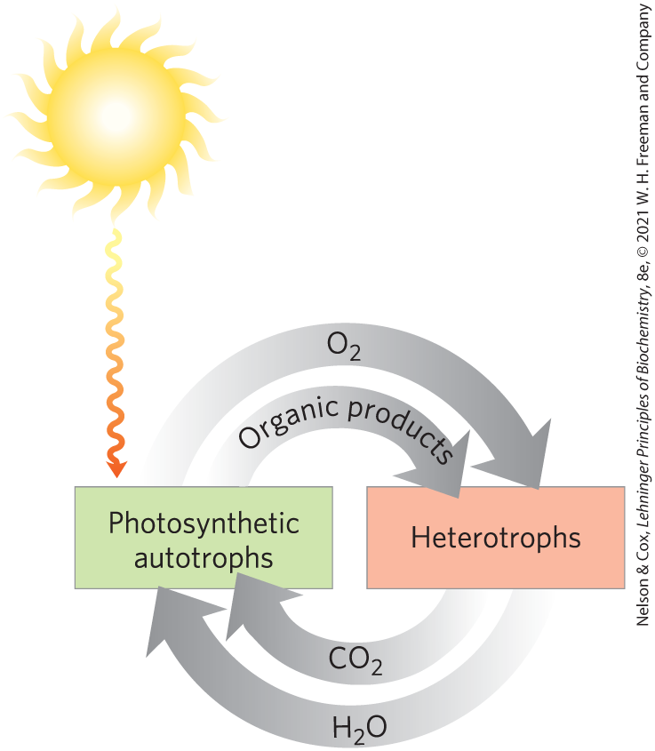
Autotrophs and Heterotrophs
autotrophs = use CO₂ from the atmosphere as their sole source of carbon
heterotrophs = cannot use atmospheric CO₂ and must obtain carbon from their environment

Slide 3
Metabolites and Intermediary Metabolism
metabolites = series of intermediates through which precursors are converted to products
intermediary metabolism = the combined activities of all the metabolic pathways that interconvert precursors, metabolites, and products of low molecular weight

Slide 4
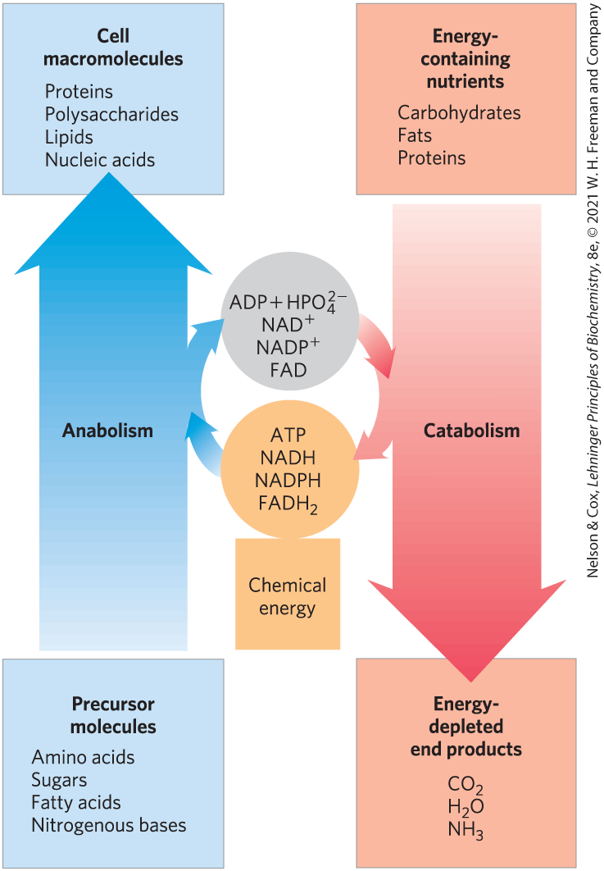
The Relationship Between Catabolic and Anabolic Pathways
catabolism = the degradative phase of metabolism
  releases energy
anabolism (biosynthesis) = the building phase of metabolism
  requires energy

Slide 5
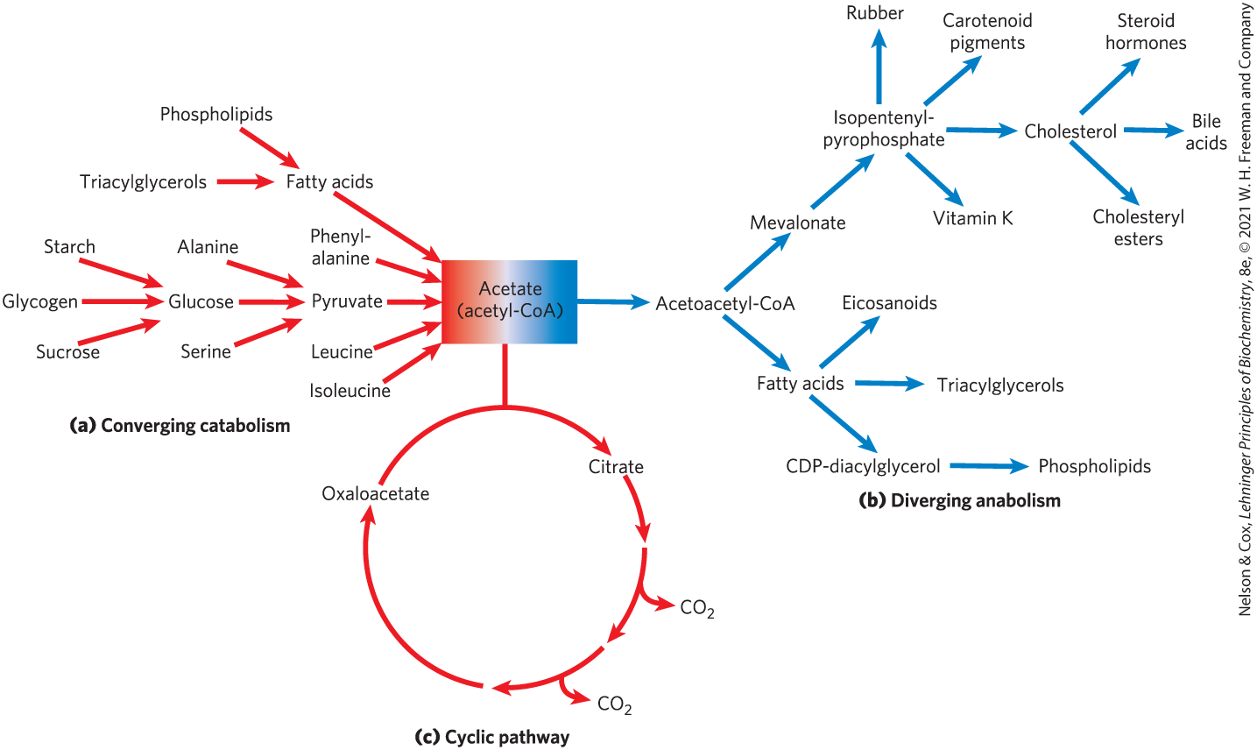
Catabolic Pathways Converge and Anabolic Pathways Diverge

Slide 6

Principle 1 (1 of 4)
The chemical changes and energy transductions in living organisms follow the laws of thermodynamics.

Slide 7

Principle 2 (1 of 3)
The free-energy change is the maximum energy made available to do work when a chemical reaction occurs. If two reactions can be combined to yield a third reaction, the overall free energy change is the sum of the two. Cells accomplish energy-requiring chemical work by coupling an energy-releasing (exergonic) reaction, such as the cleavage of ATP, to an endergonic reaction (which requires energy input).

Slide 8

Principle 3 (1 of 4)
Although thousands of different chemical reactions occur in the biosphere, most of them fall within a small set of reaction types.

Slide 9
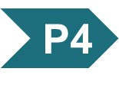
Principle 4 (1 of 5)
ATP is the universal energy currency in living organisms. Transfer of its phosphoryl group to a water molecule or metabolic intermediates provides the energetic push for muscle contraction, the pumping of solutes against concentration gradients, and the synthesis of complex molecules.

Slide 10

Principle 5 (1 of 5)
Oxidation-reduction reactions indirectly provide much of the energy needed to make ATP. Reduced substrates such as glucose are oxidized in several steps, with the energy of oxidation steps conserved in the form of a reduced cofactor, NADH. Energy stored in NADH is used to drive the synthesis of ATP.

Slide 11
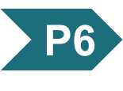
Principle 6 (1 of 5)
To respond to changes in external circumstances, cells must regulate enzyme activities by changing either the number of enzyme molecules or the catalytic activity of preexisting enzyme molecules.

Slide 12
13.1 Bioenergetics and Thermodynamics

Slide 13
Bioenergetics Is the Quantitative Study of Energy Transductions
energy transductions = changes of one form of energy into another

Slide 14
Biological Energy Transformations Obey the Laws of Thermodynamics
the first law of thermodynamics is the principle of the conservation of energy
the second law of thermodynamics says that the universe always tends toward increasing disorder

Slide 15
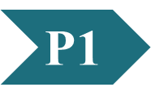
Clicker Question 1
Which statement describes the second law of thermodynamics?
In all natural processes, the entropy of the universe increases.
The entropy of a system at absolute zero is a well-defined constant.
For any physical or chemical change, the total amount of energy in the universe remains constant.
Energy may be created or destroyed, but it cannot change form or be transported from one region to another.
Notes:
Answer: A
Principle: 13.1
Learning Objective(s):
Bloom’s: 1:1

Slide 16
Clicker Question 1, Response
Which thermodynamic quantity relates MOST to breaking the α(14) O-glycosidic linkages between the two glucose molecules in maltose?
In all natural processes, the entropy of the universe increases.
The second law of thermodynamics says that the universe always tends toward increasing disorder, or entropy.

Slide 17
Systems and Their Surroundings
reacting system = the collection of matter that is undergoing a particular chemical or physical process
  can be closed or open
universe = the reacting system and its surroundings together
living cells and organisms are open systems, exchanging material and energy with their surroundings

Slide 18
Free Energy, G
free energy, G = expresses the amount of energy capable of doing work during a reaction at constant temperature and pressure
  when ∆G is negative, free energy is released and the reaction is exergonic
  when ∆G is positive, free energy is gained and the reaction is endergonic

Slide 19
Enthalpy, H
enthalpy, H = the heat content of the reacting system
  reflects the number and kinds of chemical bonds (covalent and noncovalent) in the reactants and products
  when ∆H is negative, the reaction releases heat and the reaction is exothermic
  when ∆H is positive, the reaction takes up heat and the reaction is endothermic

Slide 20
Entropy, S
entropy, S = a quantitative expression for the randomness or disorder in a system
  when ∆S is negative, the reactants are less complex and more disordered than the products
  when ∆S is positive, the products are less complex and more disordered than the reactants

Slide 21
Clicker Question 2
Which thermodynamic quantity relates MOST to breaking the α(14) O-glycosidic linkages between the two glucose molecules in maltose?
enthalpy
entropy
Gibbs free energy
equilibrium
Notes:
Answer: B
Principle: 13.1
Learning Objective(s):
Bloom’s: 2:1

Slide 22
Clicker Question 2, Response
Which thermodynamic quantity relates MOST to breaking the α(14) O-glycosidic linkages between the two glucose molecules in maltose?
B. entropy
Given only the information in the question, the system became more random.

Slide 23
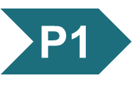
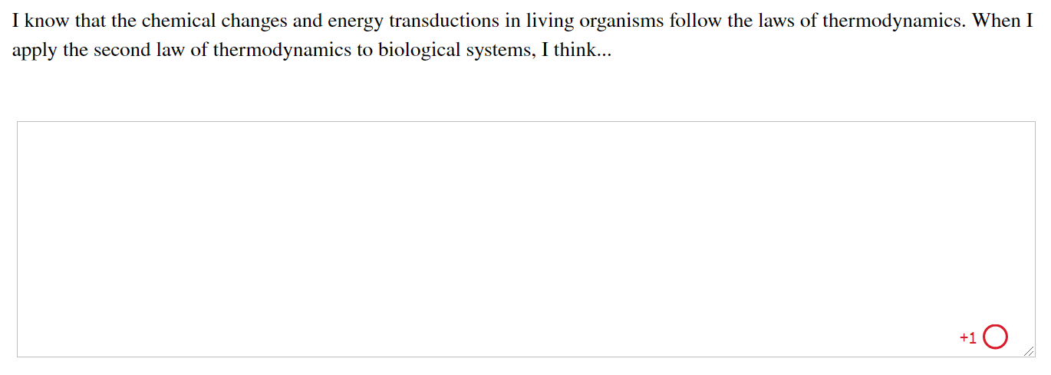
Activity: Thermodynamics
Muddiest Point (1 of 2)
Complete the Ch13 Student Activity, Day 1: Thermodynamics (Muddiest Point) Achieve assessment.
Notes:
Instructor: This muddiest point activity can be found in Achieve in the Chapter 13 folder titled “Ch13 In-Class Activities, Videos, and Resources.” See the Instructor Activity Guide in the same folder for more information.

Slide 24
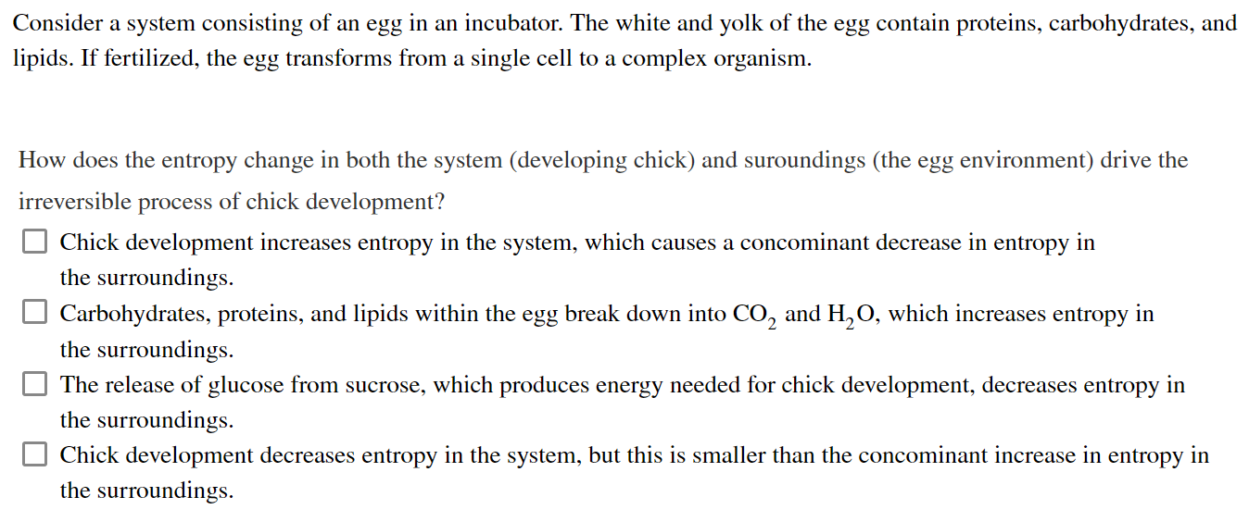
Activity: Thermodynamics
Muddiest Point (2 of 2)
Complete the Ch13 Student Activity, Day 2: Thermodynamics (Muddiest Point) Achieve assessment.
Notes:
Instructor: This muddiest point activity can be found in Achieve in the Chapter 13 folder titled “Ch13 In-Class Activities, Videos, and Resources.” See the Instructor Activity Guide in the same folder for more information.

Slide 25
Physical Constants and Units Used in Thermodynamics
Table 13-1 Some Physical Constants and Units Used in Thermodynamics
Boltzmann constant, k = 1.381 × 10⁻²³ J/K Avogadro’s number, N = 6.022 × 10²³ mol⁻¹ Faraday constant, F = 96,480 J/V • mol Gas constant, R = 8.315 J/mol • K (= 1.987 cal/mol • K) Units of ΔG and ΔH are J/mol (or cal/mol) Units of ΔS are J/mol • K (or cal/mol • K) 1 cal = 4.184 J Units of absolute temperature, T, are Kelvin, K 25 °C = 298 K At 25 °C, RT = 2.478 kJ/mol (= 0.592 kcal/mol)

Slide 26
Free Energy Change, ∆G
free-energy change, ∆G = ∆H − T∆S
  ∆H is negative for a reaction that releases heat
  ∆S is positive for a reaction that increases the system’s randomness
spontaneous reactions occur when ∆G is negative
(13-1)

Slide 27
Clicker Question 3
A reaction with ∆H < 0 and ∆S > 0 is:
always exergonic.
at equilibrium.
physically impossible.
always endothermic.
Notes:
Answer: A
Principle: 13.1
Learning Objective(s): Calculate the free energy change of a reaction using changes in enthalpy and entropy.
Bloom’s: 2:2

Slide 28
Clicker Question 3, Response
A reaction with ∆H < 0 and ∆S > 0 is:
always exergonic.
The change in free energy can be calculated by the equation ∆G = ∆H − T∆S. When ∆G is negative, free energy is released and the reaction is exergonic. If ∆H < 0 and ∆S > 0, ∆G will always be negative, thus the reaction will always be exergonic.

Slide 29
Principle 1 (2 of 4)
The chemical changes and energy transductions in living organisms follow the laws of thermodynamics.

Slide 30
Living Cells and the Second Law of Thermodynamics
the order produced within cells as they grow and divide is compensated for by the disorder they create in their surroundings
  living organisms take free energy from, and return heat and entropy to, their surroundings

Slide 31
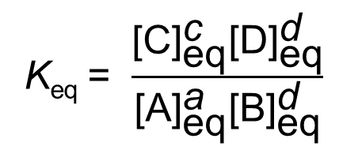
Standard Free-Energy Change Is Directly Related to the Equilibrium Constant
for the general reaction
aA + bB → cC + dD
the equilibrium constant, K_{eq}, is given by
(13-2)

Slide 32
Standard Transformed Constants
standard transformed constants = physical constants based on the biochemical standard state ([H⁺] is 10⁻⁷ M, [H₂O] is 55.5 M, [Mg²⁺] is 1 mM)
  standard free-energy change, ∆G′°
  standard equilibrium constant, K′_{eq}

Slide 33
Principle 1 (3 of 4)
The chemical changes and energy transductions in living organisms follow the laws of thermodynamics.

Slide 34
The Relationship Between
K′_{eq} and ∆G′°
the relationship between K′_{eq} and ∆G′° is:
∆G′° = -RT ln K′_{eq}
the standard free-energy change of a chemical reaction is simply an alternative mathematical way of expressing its equilibrium constant
(13-3)

Slide 35
Clicker Question 4
How much transformed free energy would be required to provide cells with 7.8 mM ATP at 37 °C if both ADP and inorganic phosphate are at 0.3 mM?
+11.5 kJ/mol
-10.1 kJ/mol
-8.4 kJ/mol
-11.5 kJ/mol
Notes:
Answer: D
Principle: 13.1
Learning Objective(s): Calculate the standard transformed free energy change of a system using the equilibrium constant.
Bloom’s: 3:2

Slide 36
Clicker Question 4, Response
How much transformed free energy would be required to provide cells with 7.8 mM ATP at 37 °C if both ADP and inorganic phosphate are at 0.3 mM?
D. -11.5 kJ/mol
∆G′° = -RT ln K′_{eq}
= -(8.315 J/mol·K)(310 K) ln(7.8/[(0.3)(0.3)])
= -(2.58 kJ/mol) ln(7.8/0.09)
= -11.5 kJ/mol

Slide 37
Relationship between Equilibrium Constants and Standard Free-Energy Changes
if K′_{eq} is > 1.0, its ∆G′° is negative
if K′_{eq} is < 1.0, its ∆G′° is positive
the relationship is exponential
K′_{eq} | ΔG′˚ (kJ/mol) | ΔG′˚ (kcal/mol)
10³ | −17.1 | −4.1
10² | −11.4 | −2.7
10¹ | −5.7 | −1.4
1 | 0.0 | 0.0
10^{₋1} | 5,7 | 1.4
10^{₋2} | 11.4 | 2.7
10^{₋3} | 17.1 | 4.1
10^{₋4} | 22.8 | 5.5
10^{₋5} | 28.5 | 6.8
10^{₋6} | 34.2 | 8.2
Table 13-2 Relationship between Equilibrium Constants and Standard Free-Energy Changes of Chemical Reactions

Slide 38
Effects of K′_{eq} and ∆G′° on the Direction of Chemical Reactions
Table 13-3 Relationships among K′_{eq}, ΔG′˚, and the Direction of Chemical Reactions
When K′_{eq} is… | ΔG′˚ is… | Starting with all components at 1 M, the reaction…
>1.0 | negative | proceeds forward
1.0 | zero | is at equilibrium
<1.0 | positive | proceeds in reverse

Slide 39
Standard Free-Energy Changes of Some Chemical Reactions
Reaction type | ΔG′˚ (kJ/mol) | ΔG′˚ (kcal/mol)
Hydrolysis reactions
Acid anhydrides
Acetic anhydride + H₂O→2 acetate | −91.1 | −21.8
ATP + H₂O→ADP + P_{i} | −30.5 | −7.3
ATP + H₂O→AMP + PP_{i} | −45.6 | −10.9
PP_{i} + H₂O→2P_{i} | −19.2 | −4.6
UDP-glucose + H₂O→UMP + glucose 1-phosphate | −43.0 | −10.3
Esters
Ethyl acetate + H₂O→ethanol + acetate | −19.6 | −4.7
Glucose 6-phosphate + H₂O→glucose + P_{i} | −13.8 | −3.3
Amides and peptides
Glutamine + H₂O→glutamate + NH⁺₄ | −14.2 | −3.4
Glycylglycine + H₂O→2 glycine | −9.2 | −2.2
Glycosides
Maltose + H₂O→2 glucose | −15.5 | −3.7
Lactose + H₂O→glucose + galactose | −15.9 | −3.8
Rearrangements
Glucose 1-phosphate→glucose 6-phosphate | −7.3 | −1.7
Fructose 6-phosphate→glucose 6-phosphate | −1.7 | −0.4
Elimination of water
Malate →fumarate + H₂O | 3.1 | 0.8
Oxidations with molecular oxygen
Glucose + 6O₂→6CO₂+ 6H₂O | −2,840 | −686
Palmitate + 23O₂→16CO₂+ 16H₂O | −9,770 | −2,338
to describe the energy released under the conditions existing in cells, an expression for the actual free-energy change is needed
Table 13-4 Standard Free-Energy Changes of Some Chemical Reactions

Slide 40
Clicker Question 5
∆G′° is:
defined as ∆G when T = 25 °C and P = 1 atm.
an expression of the minimum amount of free energy that a reaction can deliver.
always 0 kJ/mol when a reaction is at equilibrium.
is a constant, with an unchanging value for each given reaction.
Notes:
Answer: D
Principle: 13.1
Learning Objective(s): Compare standard transformed free energy change to actual free energy change of a reaction.
Bloom’s: 2:2

Slide 41
Clicker Question 5, Response
∆G′° is:
is a constant, with an unchanging value for each given reaction.
The standard transformed free-energy change, ∆G′°, is a physical constant that is characteristic for a given reaction and can be calculated from the equilibrium constant.

Slide 42
Principle 1 (4 of 4)
The chemical changes and energy transductions in living organisms follow the laws of thermodynamics.

Slide 43

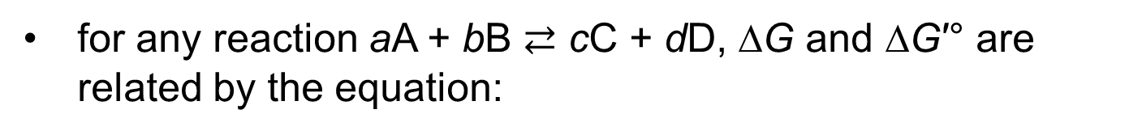
Actual Free-Energy Changes
Depend on Reactant and Product Concentrations
for any reaction aA + bB $⇄$ cC + dD, ∆G and ∆G′° are related by the equation:
(13-4)
mass-action ratio, Q
when ∆G = 0, the system is at equilibrium

Slide 44
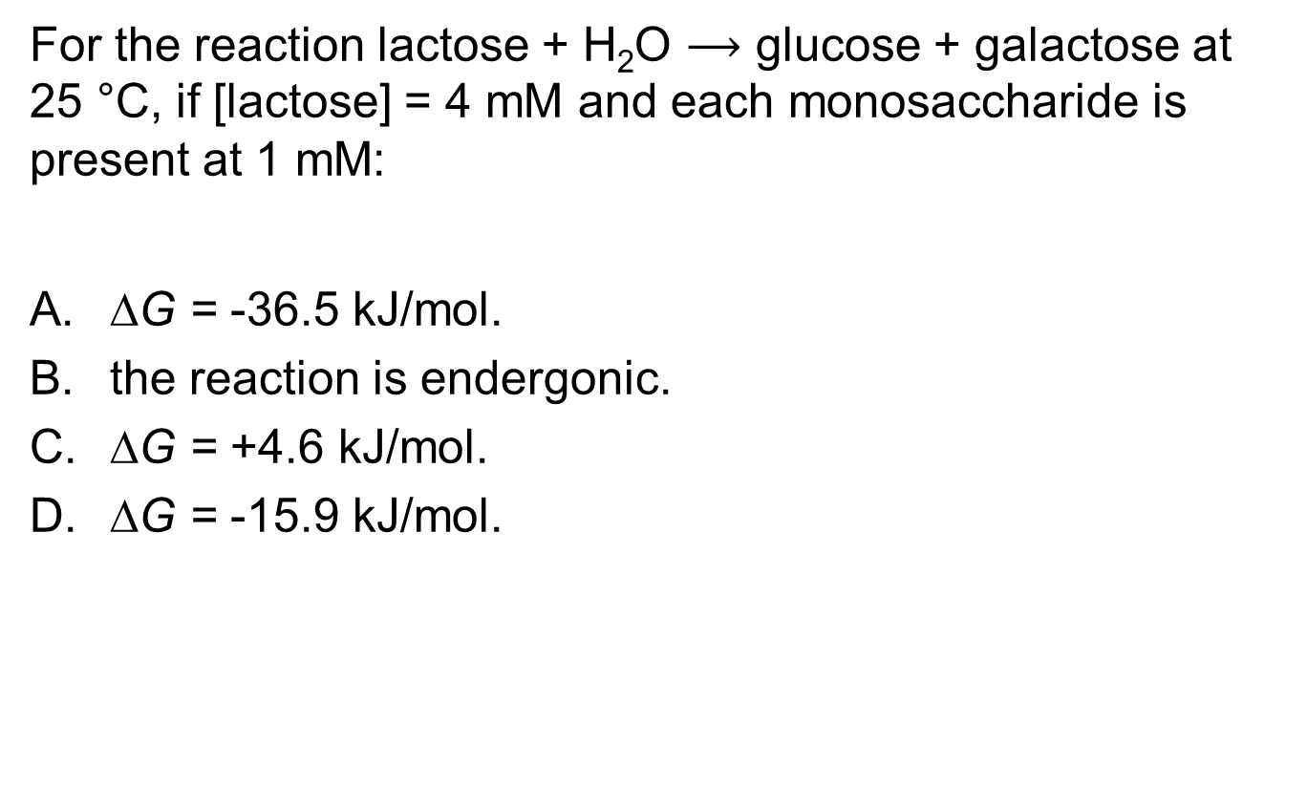
Clicker Question 6
For the reaction lactose + H₂O $⟶$ glucose + galactose at 25 °C, if [lactose] = 4 mM and each monosaccharide is present at 1 mM:
∆G = -36.5 kJ/mol.
the reaction is endergonic.
∆G = +4.6 kJ/mol.
∆G = -15.9 kJ/mol.
Notes:
Answer: A
Principle: 13.1
Learning Objective(s): Calculate the free energy change of a reaction under non-standard conditions.
Bloom’s: 3:2

Slide 45
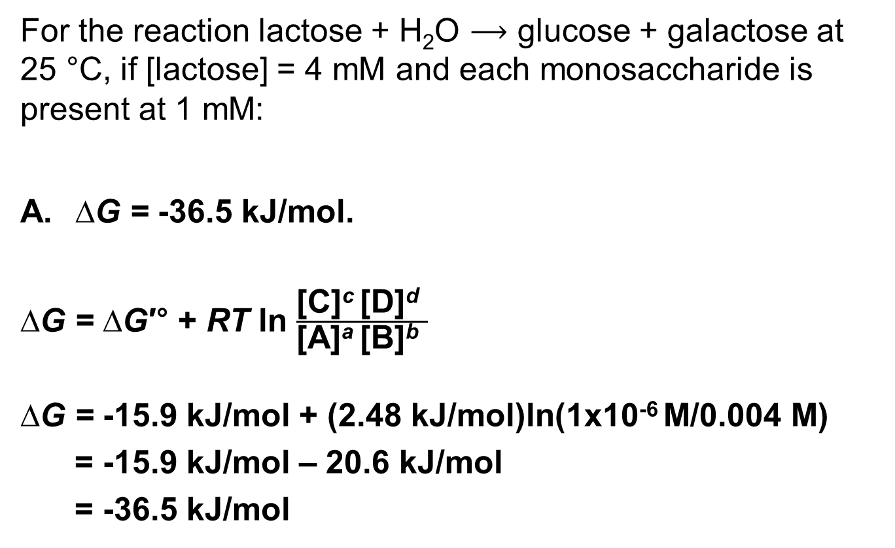
Clicker Question 6, Response
For the reaction lactose + H₂O $⟶$ glucose + galactose at 25 °C, if [lactose] = 4 mM and each monosaccharide is present at 1 mM:
∆G = -36.5 kJ/mol.
∆G = ∆G′° + RT ln $\frac{\text{[}\text{C}\text{]}\text{c} \text{[}\text{D}\text{]}\text{d} }{\text{[}\text{A}\text{]}\text{a} \text{[}\text{B}\text{]}\text{b} }$
∆G = -15.9 kJ/mol + (2.48 kJ/mol)ln(1x10⁻⁶ M/0.004 M)
= -15.9 kJ/mol – 20.6 kJ/mol
= -36.5 kJ/mol

Slide 46
Free-Energy Changes and Enzymes
the free-energy change for a reaction is independent of the pathway by which the reaction occurs
enzymes cannot change equilibrium constants
  can increase the rate at which a reaction proceeds

Slide 47
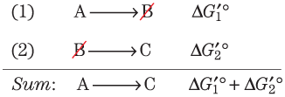
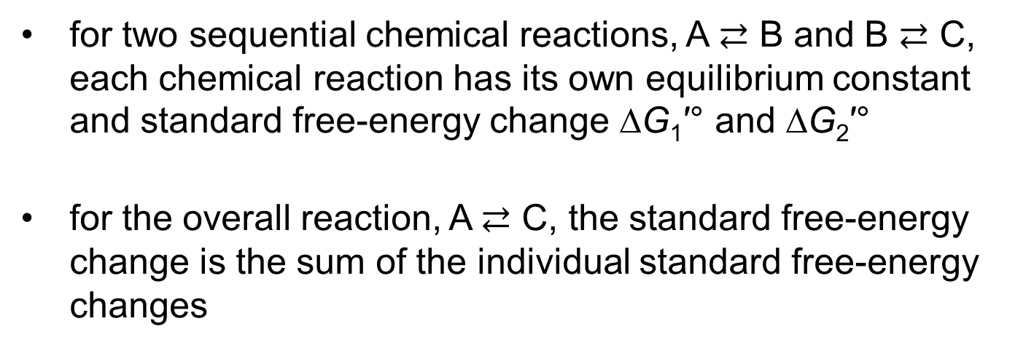
Standard Free-Energy Changes
Are Additive
for two sequential chemical reactions, A $⇄$ B and B $⇄$ C, each chemical reaction has its own equilibrium constant and standard free-energy change ∆G₁′° and ∆G₂′°
for the overall reaction, A $⇄$ C, the standard free-energy change is the sum of the individual standard free-energy changes

Slide 48
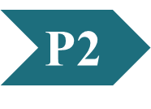
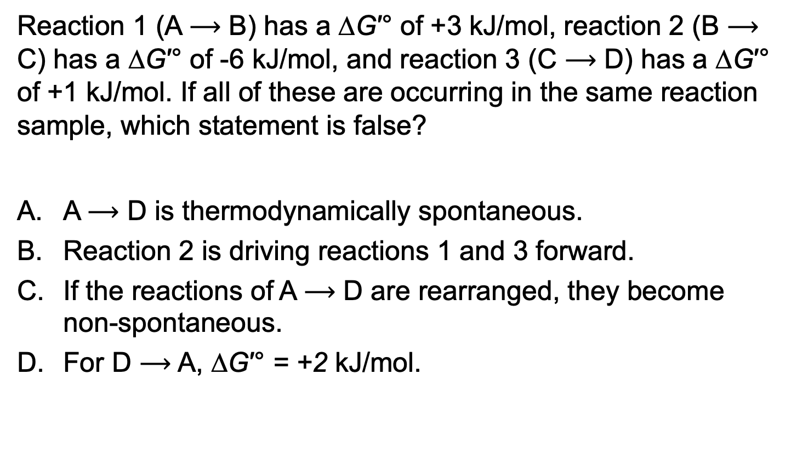
Clicker Question 7
Reaction 1 (A $⟶$ B) has a ∆G′° of +3 kJ/mol, reaction 2 (B $⟶$ C) has a ∆G′° of -6 kJ/mol, and reaction 3 (C $⟶$ D) has a ∆G′° of +1 kJ/mol. If all of these are occurring in the same reaction sample, which statement is false?
A $⟶$ D is thermodynamically spontaneous.
Reaction 2 is driving reactions 1 and 3 forward.
If the reactions of A $⟶$ D are rearranged, they become non-spontaneous.
For D $⟶$ A, ∆G′° = +2 kJ/mol.
Notes:
Answer: C
Principle: 13.2
Learning Objective(s): Propose how a reaction with a positive standard transformed free energy change can be spontaneous within an organism.
Bloom’s: 2:2

Slide 49
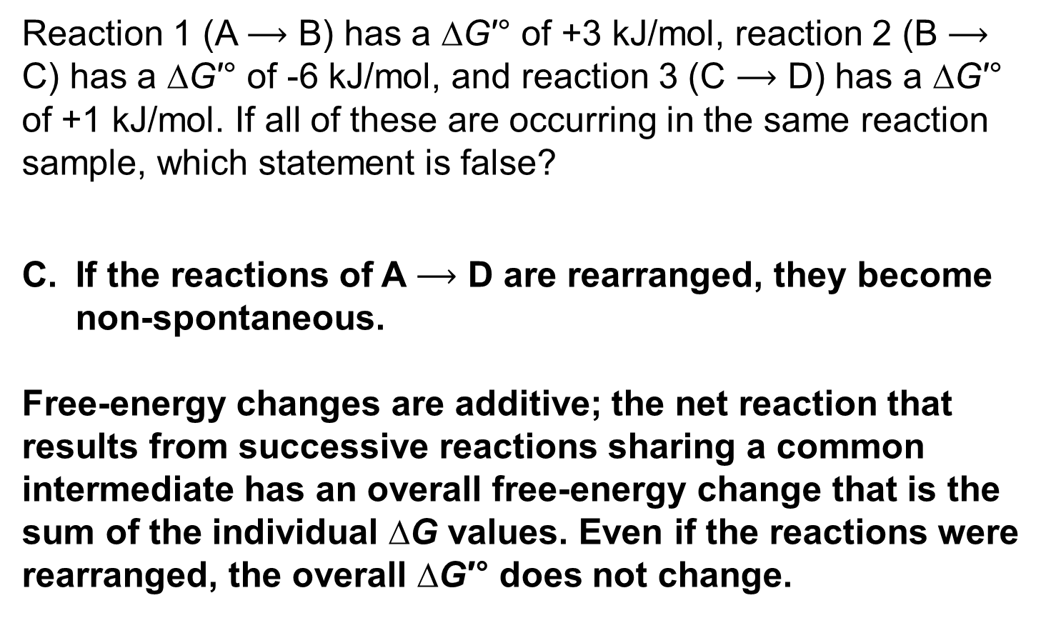
Clicker Question 7, Response
Reaction 1 (A $⟶$ B) has a ∆G′° of +3 kJ/mol, reaction 2 (B $⟶$ C) has a ∆G′° of -6 kJ/mol, and reaction 3 (C $⟶$ D) has a ∆G′° of +1 kJ/mol. If all of these are occurring in the same reaction sample, which statement is false?
If the reactions of A $⟶$ D are rearranged, they become non-spontaneous.
Free-energy changes are additive; the net reaction that results from successive reactions sharing a common intermediate has an overall free-energy change that is the sum of the individual ∆G values. Even if the reactions were rearranged, the overall ∆G′° does not change.

Slide 50
Principle 2 (2 of 3)
The free-energy change is the maximum energy made available to do work when a chemical reaction occurs. If two reactions can be combined to yield a third reaction, the overall free energy change is the sum of the two. Cells accomplish energy-requiring chemical work by coupling an energy-releasing (exergonic) reaction, such as the cleavage of ATP, to an endergonic reaction (which requires energy input).

Slide 51
Thermodynamically Unfavorable Reactions Can Be Coupled to Favorable Reactions
a thermodynamically unfavorable (endergonic) reaction can be driven in the forward direction by coupling it to a highly exergonic reaction
  often involves coupling to ATP hydrolysis (∆G′° = -30.5 kJ/mol)

Slide 52
Equilibrium Constants Are Multiplicative
the K′_{eq} for the overall reaction is the product of the individual K′_{eq} values for the two reactions

Slide 53
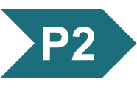
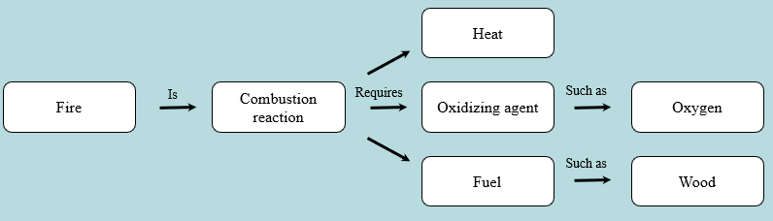
Activity: Relating
Terms within the Chapter
A concept map displays the relationships between different concepts. Observe the following example of a concept map.
Notes:
Instructor: For additional information, see the Instructor Activity Guide located in Achieve. It can be found within Chapter 13, in the folder titled “Ch13 In-Class Activities, Videos, and Resources.”

Slide 54
Activity Instructions (1 of 4)
Think about how the following terms and phrases relate to each other and then use scratch paper to draw a concept map using these terms and phrases. (3 minutes)
chemical reactions
free-energy change values
maximum energy made available to do work during chemical reaction
additive
coupled reactions
pairing an exergonic with an endergonic reaction
energy-requiring work in the cell
summing the free-energy change values from two sequential, individual reactions
Notes:
Instructor: For additional information, see the Instructor Activity Guide located in Achieve. It can be found within Chapter 13, in the folder titled “Ch13 In-Class Activities, Videos, and Resources.”

Slide 55
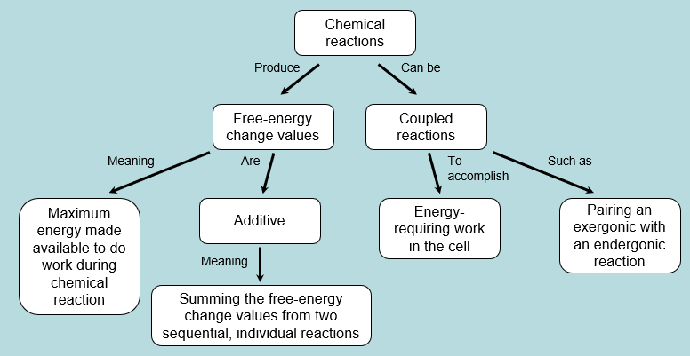
Activity Solution (1 of 4)
Pair up and share how this possible concept map might differ from yours. (2 minutes)
Notes:
Instructor: For additional information, see the Instructor Activity Guide located in Achieve. It can be found within Chapter 13, in the folder titled “Ch13 In-Class Activities, Videos, and Resources.”

Slide 56
13.2 Chemical Logic and Common Biochemical Reactions

Slide 57
Principle 3 (2 of 4)
Although thousands of different chemical reactions occur in the biosphere, most of them fall within a small set of reaction types.

Slide 58
Biochemical Reactions Occur in Repeating Patterns
five general categories of reactions in living cells:
  reactions that make or break carbon–carbon bonds
  internal rearrangements, isomerizations, and eliminations
  free-radical reactions
  group transfers
  oxidation-reductions

Slide 59
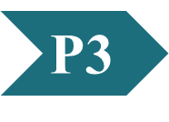
Clicker Question 8
Which process is NOT one of the five general reaction types typically found in biochemistry?
group transfers
isomerizations
combustions
oxidation-reduction reactions
Notes:
Answer: C
Principle: 13.3
Learning Objective(s): List the general categories of reactions commonly present in a living cell.
Bloom’s: 2:1

Slide 60
Clicker Question 8, Response
Which process is NOT one of the five general reaction types typically found in biochemistry?
C. combustions
Most of the reactions in living cells fall into one of five general categories: (1) reactions that make or break carbon–carbon bonds; (2) internal rearrangements, isomerizations, and eliminations; (3) free-radical reactions; (4) group transfers; and (5) oxidation-reductions.

Slide 61
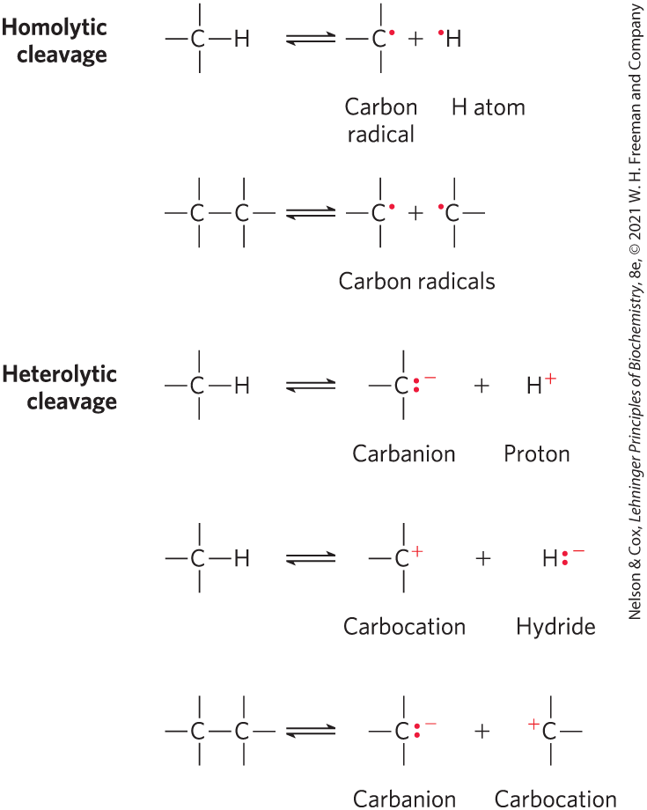
Homolytic and Heterolytic Cleavage
homolytic cleavage = cleavage of a covalent bond where each atom leaves the bond as a radical, carrying one unpaired electron
heterolytic cleavage = cleavage of a covalent bond where one atom retains both bonding electrons
  more common

Slide 62
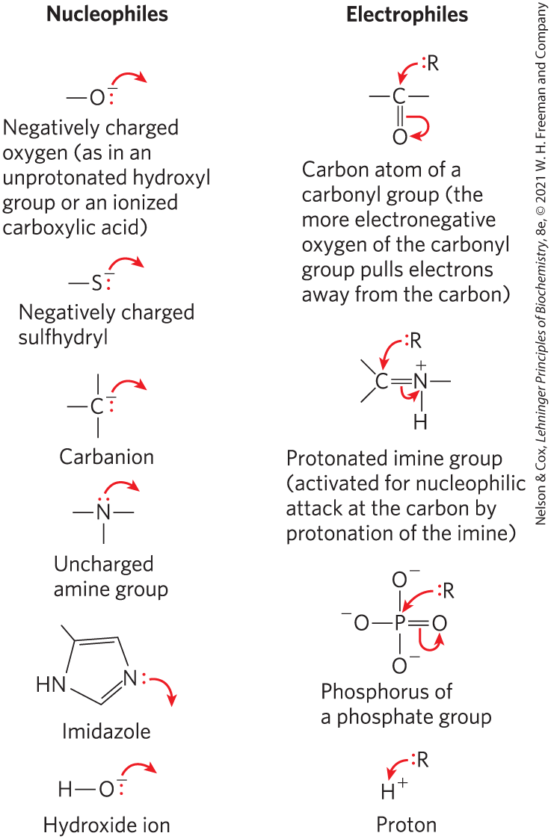
Nucleophiles and Electrophiles
nucleophiles = functional groups rich in and capable of donating electrons
  combine with and give up electrons to electrophiles
electrophiles = electron-deficient functional groups that seek electrons
carbon can act as either a nucleophile or electrophile

Slide 63
Clicker Question 9
Which statement is false?
A carbanion is stabilized by an adjacent carbonyl group.
A carbanion is an electrophile.
In homolytic bond cleavage, each atom that was sharing the electron pair leaves with one of the electrons.
Carbon atoms can exist in five oxidation states.
Notes:
Answer: B
Principle: 13.3
Learning Objective(s): Identify a nucleophile and an electrophile in a chemical reaction.
Bloom’s: 2:2

Slide 64
Clicker Question 9, Response
Which statement is false?
B. A carbanion is an electrophile.
A carbanion is an anion in which the carbon atom has two unpaired electrons that give the atom a negative charge. Carbanions are common nucleophiles, functional groups rich in and capable of donating electrons that combine with and give up electrons to electrophiles, electron-deficient functional groups that seek electrons.

Slide 65
Reactions That Make or Break Carbon–Carbon Bonds
heterolytic cleavage of a C–C bond yields a carbanion and a carbocation
combination of a nucleophilic carbanion and an electrophilic carbocation forms a C–C bond
impossible reactions for the purposes of biochemistry because carbanions and carbocations are generally unstable

Slide 66
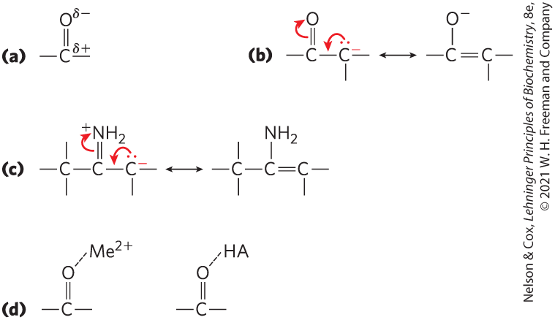
Chemical Properties of
Carbonyl Groups
the carbon of a carbonyl group is an electrophilic carbon
carbonyl and imine groups form carbanions on adjoining carbons by delocalizing electrons
  general acid catalysts or metal ions (Me²⁺) further enhance

Slide 67
Principle 3 (3 of 4)
Although thousands of different chemical reactions occur in the biosphere, most of them fall within a small set of reaction types.

Slide 68
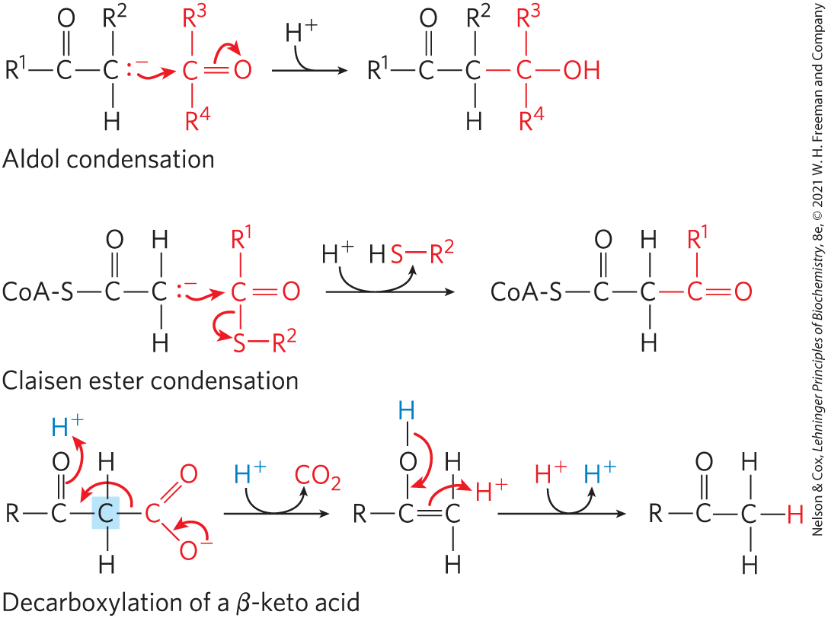
Common Reactions that Form and Break Carbon–Carbon Bonds
in aldol condensation, Claisen condensation, and decarboxylation reactions, a carbanion intermediate is stabilized by a carbonyl group

Slide 69
Clicker Question 10
Which statement is FALSE concerning carbonyl groups?
Carbonyl groups can function as electron sinks.
The carbonyl carbon is electrophilic.
The carbonyl oxygen has a partial positive charge.
Carbonyl groups can stabilize adjacent carbanions.
Notes:
Answer: C
Principle: 13.3
Learning Objective(s): Describe the importance carbonyls and imines in metabolic reactions such as aldol condensations, Claisen ester condensations, and decarboxylation reactions.
Bloom’s: 2:1

Slide 70
Clicker Question 10, Response
Which statement is FALSE concerning carbonyl groups?
C. The carbonyl oxygen has a partial positive charge.
The carbon of a carbonyl group has a partial positive charge due to the electron-withdrawing property of the carbonyl oxygen, and so is an electrophilic carbon. A carbonyl group can thus facilitate the formation of a carbanion on an adjoining carbon by delocalizing the carbanion’s negative charge.

Slide 71
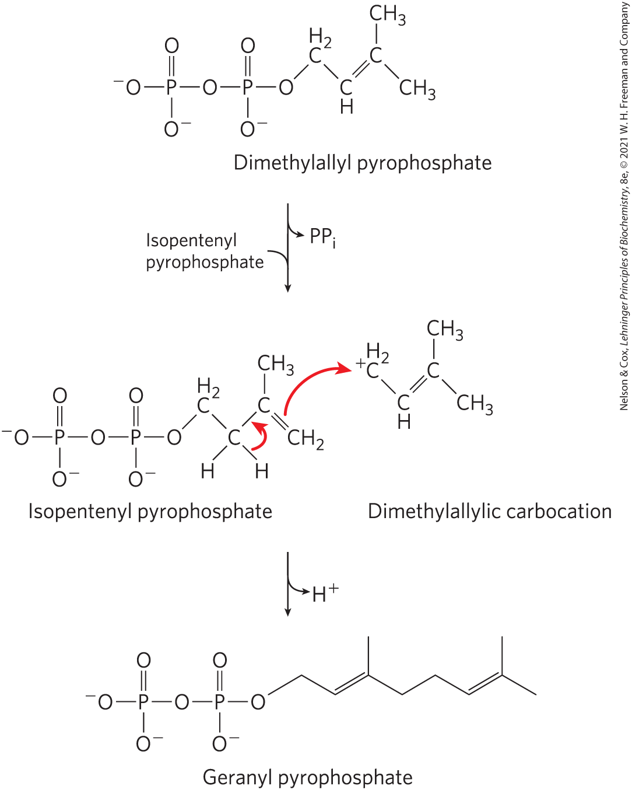
Carbocations in Carbon–Carbon Bond Formation
carbocation intermediates are generated by the elimination of an excellent leaving group, such as pyrophosphate

Slide 72
Internal Rearrangements, Isomerizations, and Eliminations
redistribution of electrons results in alterations without changes in the overall oxidation state of the molecule
reactions include:
  intramolecular oxidation-reduction
  change in cis-trans arrangement at a double bond
  transposition of double bonds

Slide 73
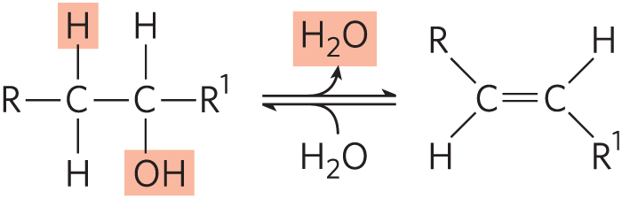
Elimination Reactions
loss of water from an alcohol introduces a C=C bond
similar reactions result from eliminations in amines

Slide 74
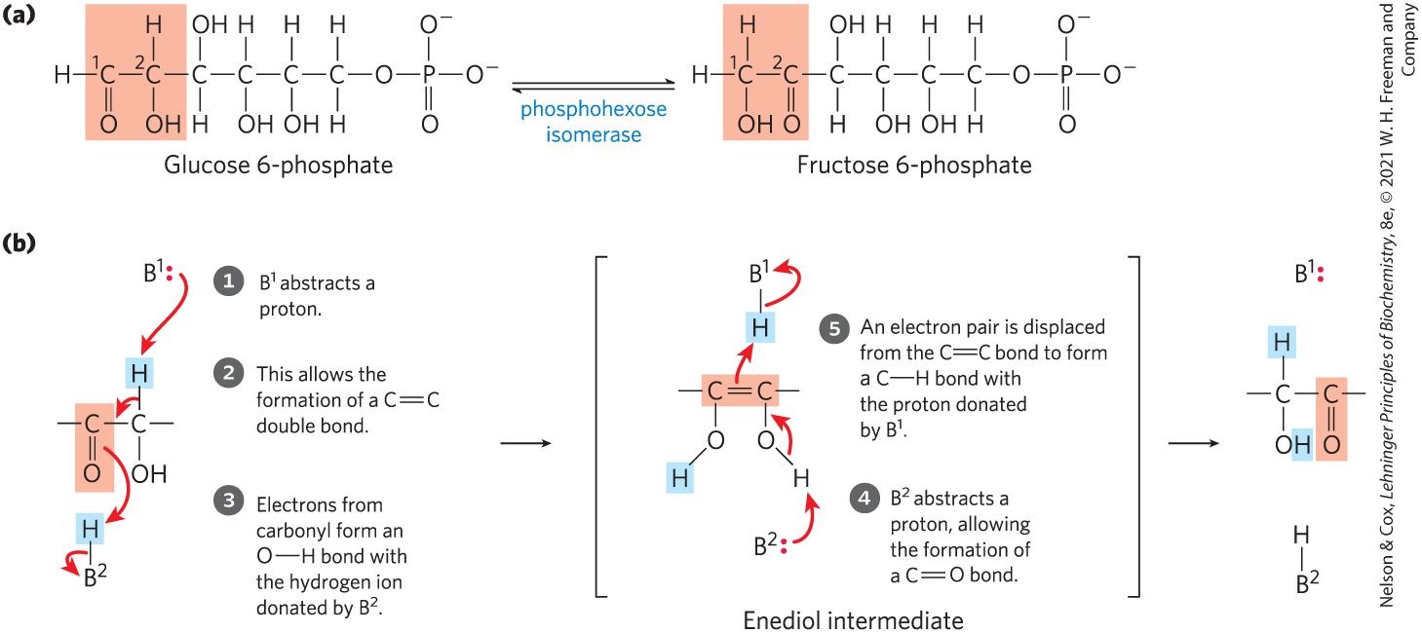
Isomerization and
Elimination Reactions

Slide 75
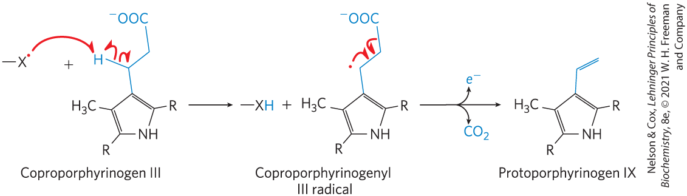
Free-Radical Reactions
homolytic cleavage of covalent bonds to generate free radicals occurs in some pathways

Slide 76
Clicker Question 11
Which of these enzymes does NOT catalyze a free-radical reaction?
methylmalonyl-CoA mutase
ribonucleotide reductase
DNA photolyase
aldolase
Notes:
Answer: D
Principle: 13.3
Learning Objective(s): Contrast homolytic and heterolytic cleavage.
Bloom’s: 2:1

Slide 77
Clicker Question 11, Response
Which of these enzymes does NOT catalyze a free-radical reaction?
D. aldolase
Reactions that generate free radicals by homolytic cleavage of covalent bonds include isomerizations, such as that catalyzed by methylmalonyl-CoA mutase, some reductase reactions, such as that catalyzed by ribonucleotide reductase, and some rearrangement reactions, such as that catalyzed by DNA photolyase. Aldolase catalyzes a heterolytic cleavage reaction.

Slide 78
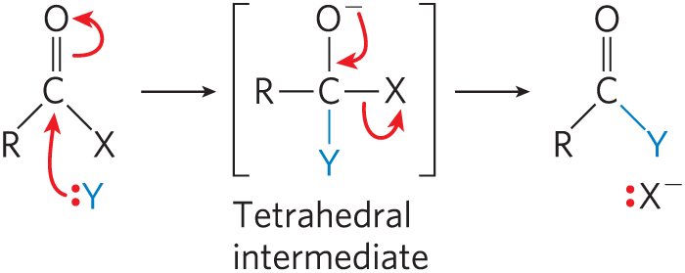
Group Transfer Reactions
the transfer of acyl, glycosyl, and phosphoryl groups from one nucleophile to another is common
acyl group transfer involves the addition of a nucleophile to the carbonyl carbon of an acyl group to form a tetrahedral intermediate

Slide 79
Glycosyl Group Transfers
glycosyl group transfers involve nucleophilic substitution at C-1 of a sugar ring
  substitution can proceed by an S_{N}1 or S_{N}2 pathway

Slide 80
Principle 3 (4 of 4)
Although thousands of different chemical reactions occur in the biosphere, most of them fall within a small set of reaction types.

Slide 81
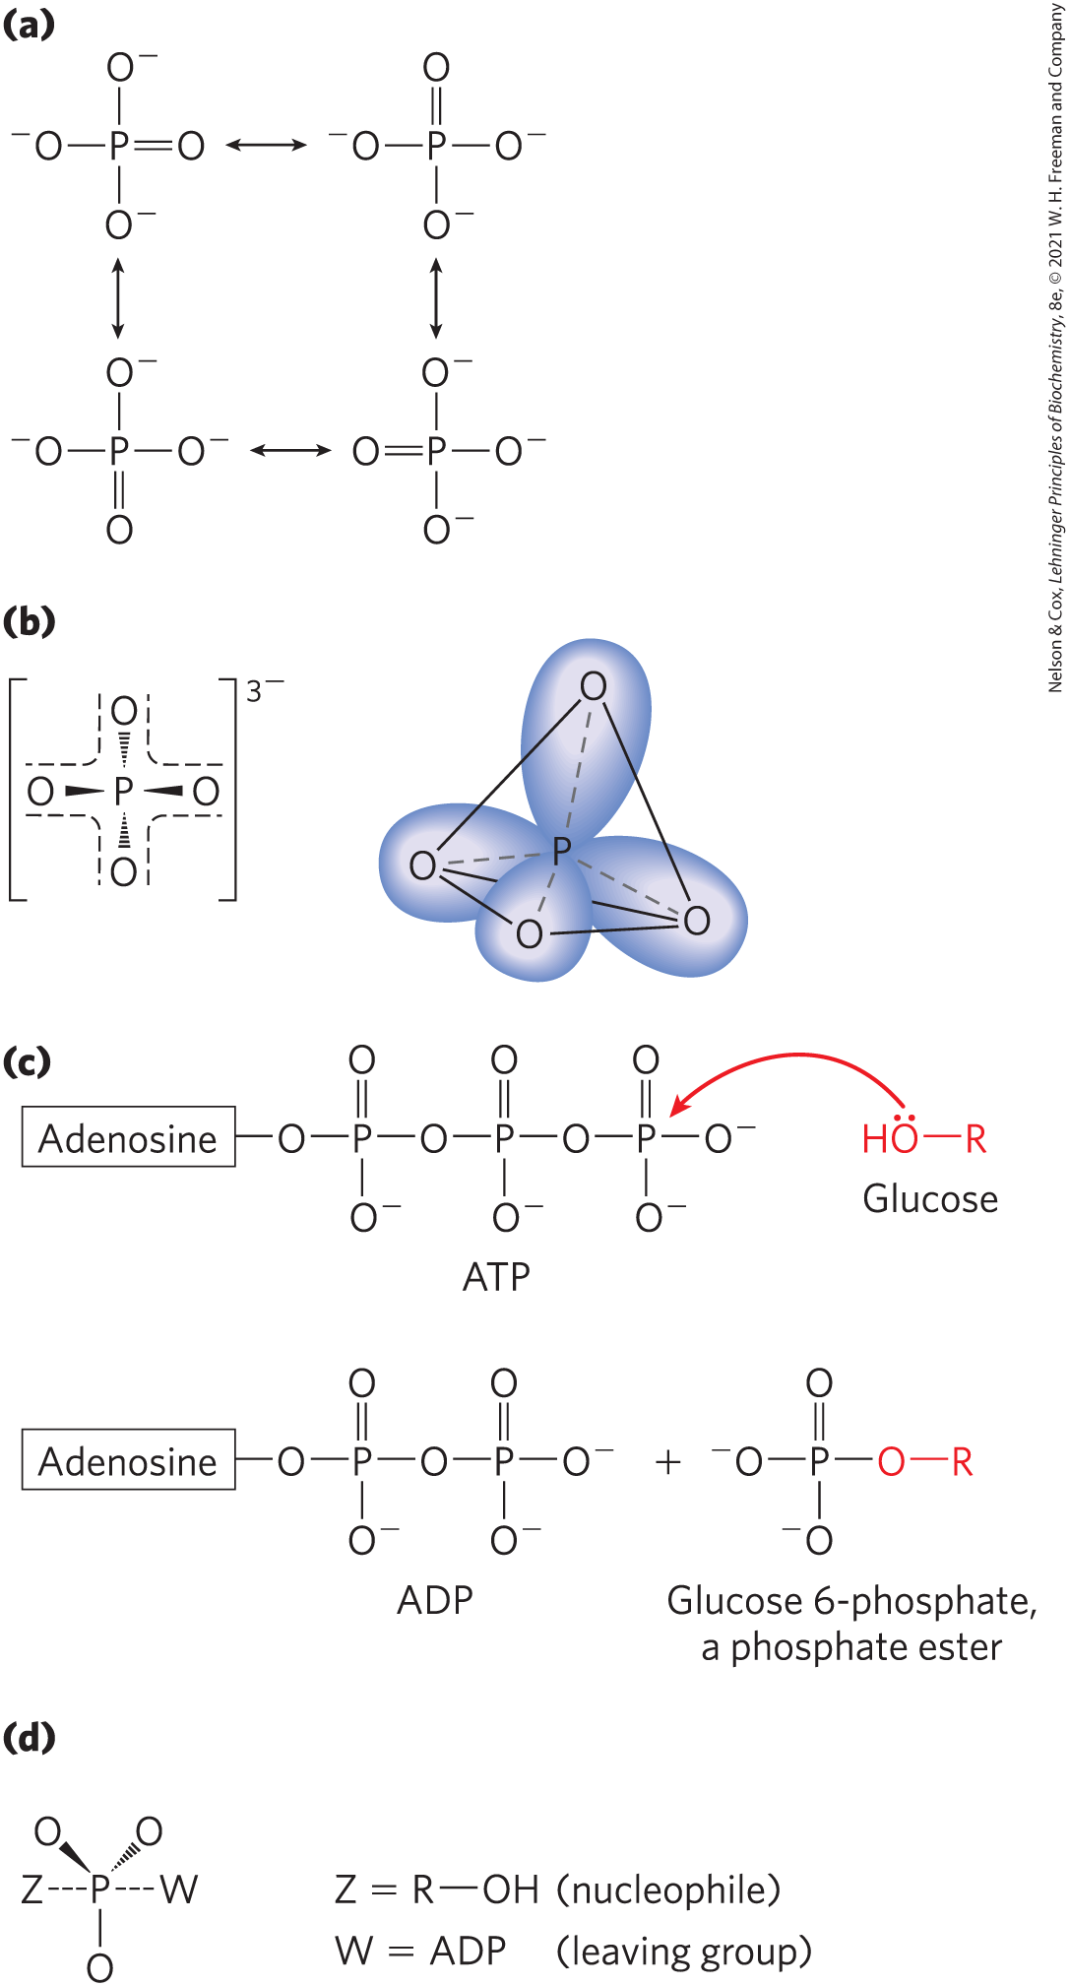
Phosphoryl Group Transfers
attachment of a good leaving group to a metabolic intermediate “activates” the intermediate for subsequent reaction
  phosphoryl groups (–PO₃²⁻) commonly serve as leaving groups
kinases = enzymes that catalyze phosphoryl group transfers with ATP as a donor

Slide 82
Kinases, Phosphorylases, and Phosphatases
kinases = transfer a phosphoryl group from ATP to an acceptor molecule
  catalyze a phosphorylation reaction
phosphorylases = catalyze a displacement reaction where phosphate attacks and becomes covalently attached at the point of bond breakage
  catalyze a phosphorolysis reaction
phosphatases = catalyze the removal of a phosphoryl group from a phosphate ester
  catalyze dephosphorylation reactions

Slide 83
Synthases, Synthetases,
Ligases, and Lyases
synthases = catalyze condensation reactions in which no nucleotide triphosphate is required
synthetases = catalyze condensation reactions that require a nucleotide triphosphate
ligases = catalyze condensation reactions in which two atoms are joined using ATP or another energy source
lyases = catalyze cleavages or additions in which electronic rearrangements occur

Slide 84
Clicker Question 12
The citric acid cycle includes the enzymes citrate synthase and succinyl-CoA synthetase. Which of these enzymes requires a nucleotide triphosphate for the synthetic reaction?
only citrate synthase
only succinyl-CoA synthetase
both citrate synthase and succinyl-CoA synthetase
neither citrate synthase nor succinyl-CoA synthetase
Notes:
Answer: B
Principle: 13.3
Learning Objective(s): List the general categories of reactions commonly present in a living cell.
Bloom’s: 2:1

Slide 85
Clicker Question 12, Response
The citric acid cycle includes the enzymes citrate synthase and succinyl-CoA synthetase. Which of these enzymes requires a nucleotide triphosphate for the synthetic reaction?
B. only succinyl-CoA synthetase
Synthetases catalyze condensations that use ATP or another nucleoside triphosphate as a source of energy for the synthetic reaction. Conversely, synthases catalyze condensation reactions in which no nucleoside triphosphate (ATP, GTP, and so forth) is required.

Slide 86
Oxidases and Oxygenases
oxidases = catalyze biological oxidation reactions where oxygen is the electron acceptor and oxygen does not appear in the oxidized product
  mixed function oxidases = oxidize two different substrates simultaneously
oxygenases = catalyze biological oxidation reactions where oxygen is the electron acceptor and oxygen does appear in the oxidized product
  monooxygenases = one oxygen atom is incorporated in the product
  dioxygenases = two oxygen atoms are incorporated in the product

Slide 87
Dehydrogenases
dehydrogenases = catalyze oxidation-reductase reactions in which NAD⁺ is the electron acceptor and molecular oxygen is not involved

Slide 88
Clicker Question 13
A recently reported mutase may generate an intermediate having a free radical. If you studied this reaction, what evidence would you look for in the mechanism that would be characteristic of other mutase reactions?
nucleophilic attack on the carbonyl carbon
a ring in a prosthetic group that could undergo resonance stabilization
a requirement for O₂
homolytic cleavage of a covalent bond
Notes:
Answer: D
Principle: 13.3
Learning Objective(s): Contrast homolytic and heterolytic cleavage; Characterize metabolic reactions using reaction mechansims and reaction conditions.
Bloom’s: 2:2

Slide 89
Clicker Question 13, Response
A recently reported mutase may generate an intermediate having a free radical. If you studied this reaction, what evidence would you look for in the mechanism that would be characteristic of other mutase reactions?
D. homolytic cleavage of a covalent bond
In homolytic cleavage of a covalent bond, each atom leaves the bond as a radical, carrying one unpaired electron.

Slide 90
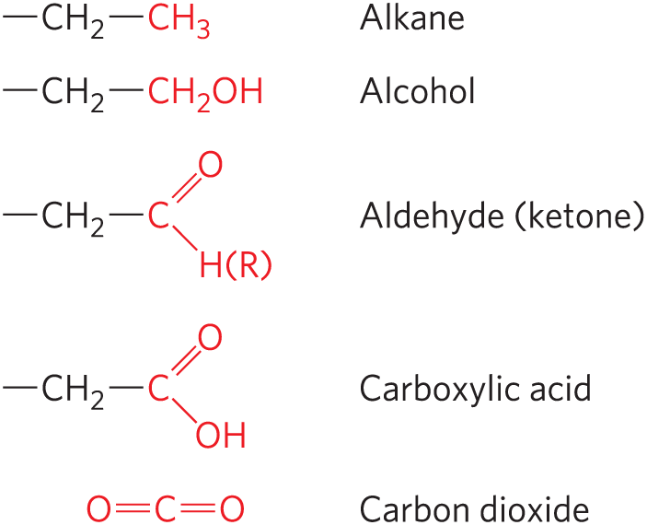
Oxidation-Reduction Reactions
least oxidized
carbon atoms exist in different oxidation states, depending on the elements with which they share electrons
most oxidized

Slide 91
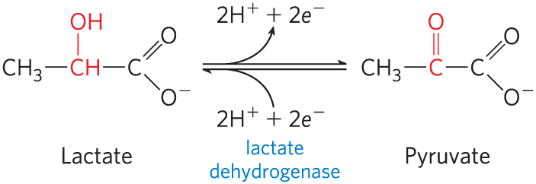
An Oxidation-Reduction Reaction
in many biological oxidations, a compound loses two electrons and two hydrogen ions
  catalyzed by dehydrogenases
in some biological oxidations, a carbon atom becomes bonded to an oxygen
  catalyzed by oxidases or oxygenases

Slide 92
Principle 5 (2 of 5)
Oxidation-reduction reactions indirectly provide much of the energy needed to make ATP. Reduced substrates such as glucose are oxidized in several steps, with the energy of oxidation steps conserved in the form of a reduced cofactor, NADH. Energy stored in NADH is used to drive the synthesis of ATP.

Slide 93
Oxidations Are Accompanied by Reductions
oxidation-reduction reactions involve the loss or gain of electrons
  one reactant gains electrons and is reduced
  the other loses electrons and is oxidized
oxidation reactions generally release energy
  living cells oxidize metabolic fuels (carbohydrates, fat)

Slide 94
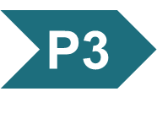
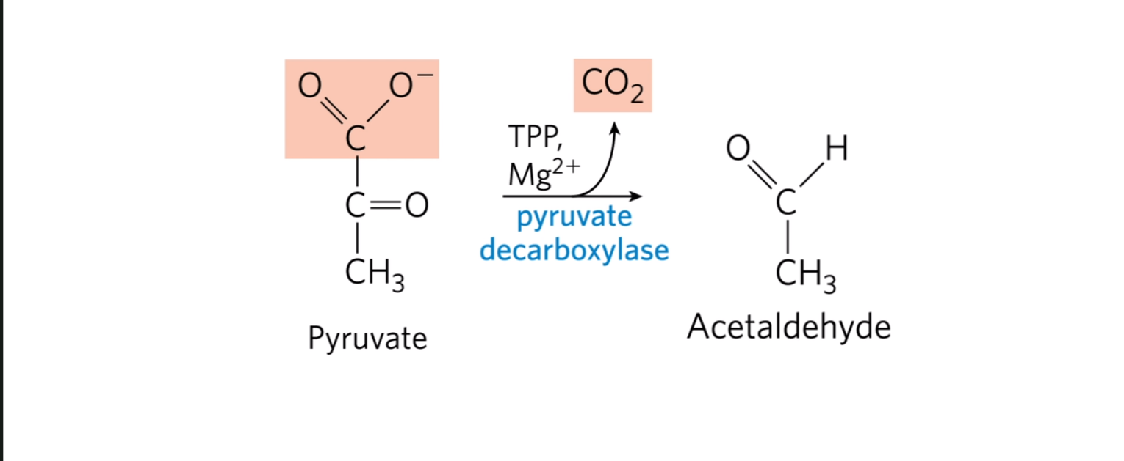
Activity: General
Reaction Types
Watch the Animated Mechanism video titled “Pyruvate Decarboxylase” as an example of a reaction that breaks a carbon–carbon bond.
Notes:
Instructor: This Animated Mechanism is found within Chapter 14 of Achieve. It is in the folder titled “Ch14 In-Class Activities, Videos, and Resources.”
Ch 13. Although thousands of different chemical reactions occur in the biosphere, a relatively small set of familiar reaction types are widely used.

Slide 95
Activity Instructions (2 of 4)
On your own, think of answers to the question:
  How do living systems make use of a large number of chemical reactions? These reactions can be classified into five general types. List these five categories.
  (2 minutes)
Pair up to discuss your ideas. (2 minutes)
Share your ideas with the class in group discussion. (3 minutes)
Notes:
Instructor: This Animated Mechanism is found within Chapter 14 of Achieve. It is in the folder titled “Ch14 In-Class Activities, Videos, and Resources.”

Slide 96
Activity Solution (2 of 4)
  How do living systems make use of a large number of chemical reactions? These reactions can be classified into five general types. List these five categories.
  1. Reactions that make or break carbon–carbon bonds
  2. Internal rearrangements, isomerizations, and eliminations
  3. Free-radical reactions
  4. Group transfers
  5. Oxidation-reductions
*Note that the five reaction types are not mutually exclusive.
Notes:
Instructor: This Animated Mechanism is found within Chapter 14 of Achieve. It is in the folder titled “Ch14 In-Class Activities, Videos, and Resources.”

Slide 97
Biochemical and Chemical Equations Are Not Identical
biochemical equations:
  do not balance for H⁺ or Mg²⁺
  do not attempt to describe the state of phosphate ionization
chemical equations account for all atoms and charges in a reaction

Slide 98
13.3 Phosphoryl Group Transfers and ATP

Slide 99
The Special Role of ATP
ATP is the chemical link between catabolism and anabolism
  energy obtained from catabolism of nutrient molecules is used to make ATP from ADP and P_{i}
  the exergonic conversion of ATP to ADP and P_{i} (or to AMP and PP_{i}) is coupled to many endergonic reactions and processes

Slide 100
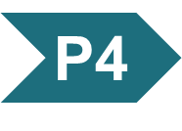
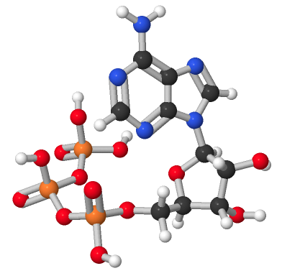
Activity: ATP Hydrolysis and Free Energy
Observe the structure of adenosine triphosphate (ATP)
in Mol3D viewer in your Achieve course.
Notes:
Instructor: This Mol3D structure is located in the Achieve course. It can be found in the Chapter 13 content, in the folder titled “Ch13 In-Class Activities, Videos, and Resources.”

Slide 101
Activity Instructions (3 of 4)
On your own, think of answers to the questions:
  Which bonds are the high energy bonds in this structure? Select the bonds and upload a screenshot to your course.
  Which phosphate group is lost when ATP undergoes hydrolysis to form ADP and inorganic phosphate? (2 minutes)
Pair up to discuss your ideas. (2 minutes)
Share your ideas with the class in group discussion.
(3 minutes)
Notes:
Instructor: This Mol3D structure is located in the Achieve course. It can be found in the Chapter 13 content, in the folder titled “Ch13 In-Class Activities, Videos, and Resources.”

Slide 102
Activity Solution (3 of 4)
  Which bonds are the high energy bonds in this structure? Select the atom and upload a screenshot to your course. the phosphoanhydride bond between the γ‐phosphate and the β-phosphate, and the phosphoanhydride bond between the β‐phosphate and the α-phosphate
  Which phosphate group is lost when ATP undergoes hydrolysis to form ADP and inorganic phosphate? the γ phosphate
Notes:
Instructor: This Mol3D structure is located in the Achieve course. It can be found in the Chapter 13 content, in the folder titled “Ch13 In-Class Activities, Videos, and Resources.”

Slide 103
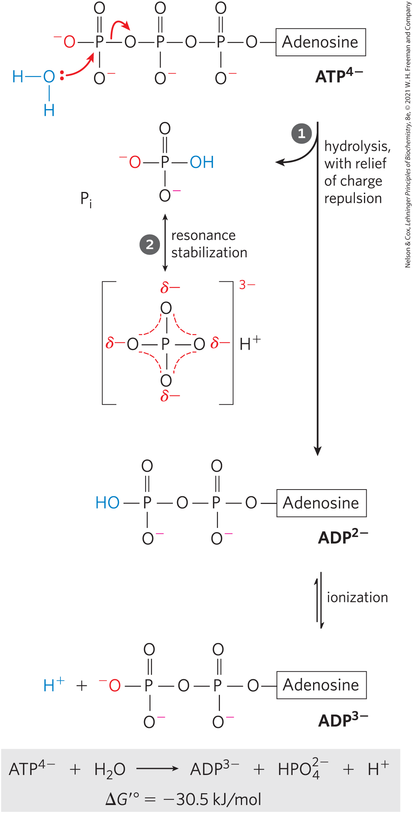
The Free-Energy Change for ATP Hydrolysis Is Large and Negative
the hydrolytic cleavage of the terminal phosphoanhydride bond in ATP relieves some of the internal electrostatic repulsion in ATP

Slide 104
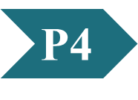
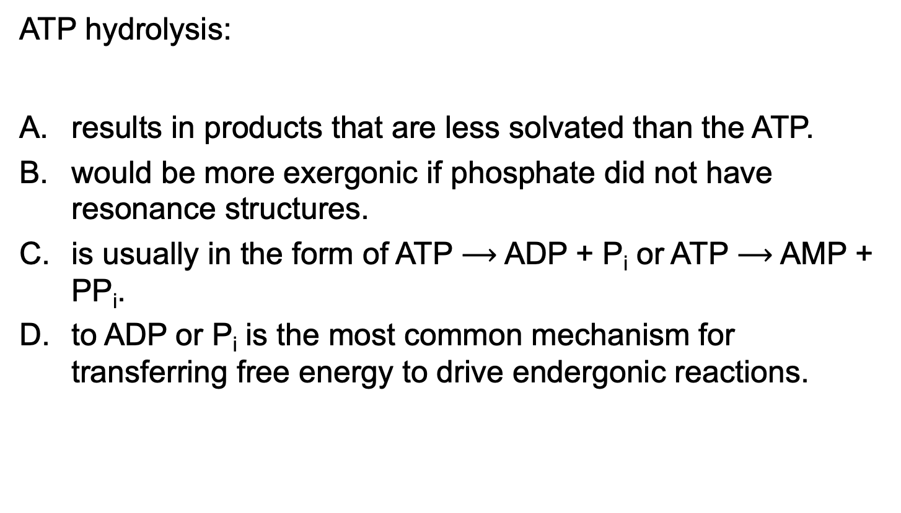
Clicker Question 14
ATP hydrolysis:
results in products that are less solvated than the ATP.
would be more exergonic if phosphate did not have resonance structures.
is usually in the form of ATP $⟶$ ADP + P_{i} or ATP $⟶$ AMP + PP_{i}.
to ADP or P_{i} is the most common mechanism for transferring free energy to drive endergonic reactions.
Notes:
Answer: C
Principle: 13.4
Learning Objective(s): Differentiate between the different mechanisms ATP provides energy into a biological system.
Bloom’s: 2:2

Slide 105
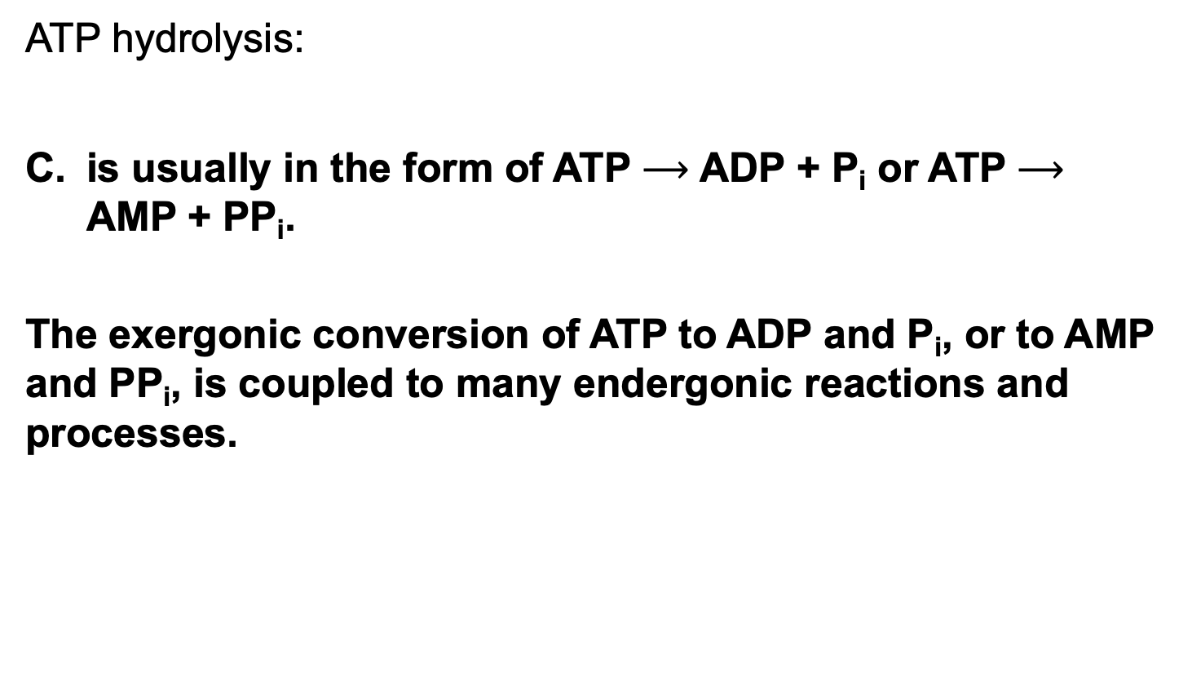
Clicker Question 14, Response
ATP hydrolysis:
is usually in the form of ATP $⟶$ ADP + P_{i} or ATP $⟶$ AMP + PP_{i}.
The exergonic conversion of ATP to ADP and P_{i}, or to AMP and PP_{i}, is coupled to many endergonic reactions and processes.

Slide 106
Cellular Conditions of ATP,
ADP, and P_{i}
Table 13-5 Total Concentrations of Adenine Nucleotides, Inorganic Phosphate, and Phosphocreatine in Some Cells
Cell type | Concentration (mM): ATP | Concentration (mM): ADP | Concentration (mM): AMP | Concentration (mM): P_{i} | Concentration (mM): PCr
Rat hepatocyte | 3.38 | 1.32 | 0.29 | 4.8 | 0
Rat myocyte | 8.05 | 0.93 | 0.04 | 8.05 | 27
Rat neuron | 2.59 | 0.73 | 0.06 | 2.72 | 4.7
Human erythrocyte | 2.25 | 0.25 | 0.02 | 1.65 | 0
E. coli cell | 9.6 | 0.56 | 0.28 | ⸻ | ⸻

Slide 107
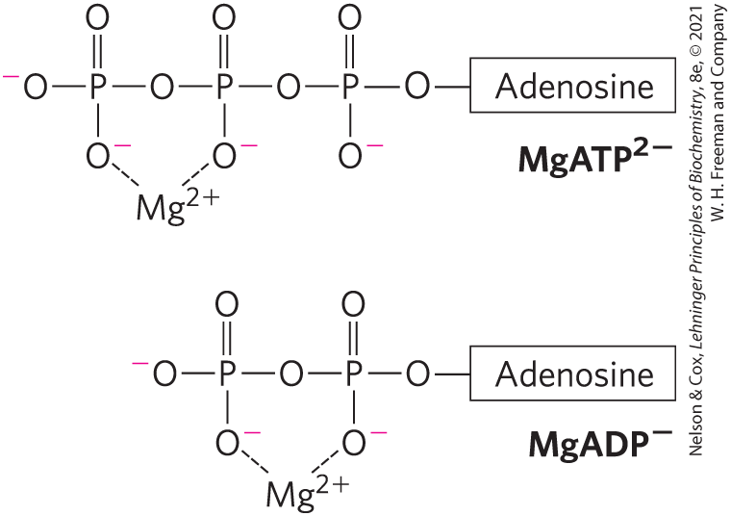
Mg²⁺ and ATP
Mg²⁺ in the cytosol binds to ATP and ADP
for most enzymatic reactions involving ATP, the true substrate is MgATP²⁻

Slide 108
The Free-Energy Change for
ATP Hydrolysis Under Cellular Conditions
phosphorylation potential, ∆G_{p} = the actual free energy of hydrolysis of ATP under intracellular conditions
  varies from cell to cell and over time
in vivo, the energy released by ATP hydrolysis is greater than the standard free-energy change, ∆G′°

Slide 109
Principle 4 (2 of 5)
ATP is the universal energy currency in living organisms. Transfer of its phosphoryl group to a water molecule or metabolic intermediates provides the energetic push for muscle contraction, the pumping of solutes against concentration gradients, and the synthesis of complex molecules.

Slide 110
Cellular ATP Levels
due to strong selective pressure over the course of evolution, regulatory mechanisms hold cellular [ATP] far above the equilibrium concentrations for the hydrolysis reaction
when the ATP level drops:
  the amount of fuel decreases
  the fuel itself loses its potency

Slide 111
Clicker Question 15
Which statement regarding phosphoryl group transfers is true?
The enzymes that catalyze these reactions using ATP are known as kinases.
Phosphoryl groups are poor leaving groups.
Phosphate has two resonance structures.
Phosphorous can only form four covalent bonds.
Notes:
Answer: A
Principle: 13.4
Learning Objective(s): Describe how alcohols and carboxylic acids react with phosphorus to transfer a phosphoryl group in a kinase.
Bloom’s: 2:2

Slide 112
Clicker Question 15, Response
Which statement regarding phosphoryl group transfers is true?
The enzymes that catalyze these reactions using ATP are known as kinases.
The large family of enzymes that catalyze phosphoryl group transfers with ATP as donor are called kinases. The reaction catalyzed by a kinase is a phosphorylation.

Slide 113
Other Phosphorylated Compounds and Thioesters Also Have Large, Negative Free Energies of Hydrolysis
in these phosphate-releasing reactions, the several resonance forms available to P_{i} stabilize this product relative to the reactant
Table 13-6 Standard Free Energies of Hydrolysis of Some Phosphorylated Compounds and Acetyl-CoA (a Thioester)
Compounds and Acetyl-CoA | ΔG′°: (kJ/mol) | ΔG′°: (kcal/mol)
Phosphoenolpyruvate | −61.9 | −14.8
1,3-Bisphosphoglycerate (→3-phosphoglycerate + P_{i}) | −49.3 | −11.8
Phosphocreatine | −43.0 | −10.3
ADP (→AMP + P_{i}) | −32.8 | −7.8
ATP (→ADP + P_{i}) | −30.5 | −7.3
ATP (→AMP + PP_{i}) | −45.6 | −10.9
AMP (→adenosine + P_{i}) | −14.2 | −3.4
PP_{i}(→2P_{i}) | −19.2 | −4.0
Glucose 3-phosphate | −20.9 | −5.0
Fructose 6-phosphate | −15.9 | −3.8
Glucose 6-phosphate | −13.8 | −3.3
Glycerol 3-phosphate | −9.2 | −2.2
Acetyl-CoA | −31.4 | −7.5

Slide 114
Clicker Question 16
Phosphoryl group transfer:
is not associated with a change in free energy.
is catalyzed by a group of enzymes known as phosphagens.
does not appreciably occur between nucleotides.
can use inorganic polyphosphate as a phosphoryl group donor.
Notes:
Answer: D
Principle: 13.3
Learning Objective(s): Characterize metabolic reactions using reaction mechansims and reaction conditions.
Bloom’s: 2:2

Slide 115
Clicker Question 16, Response
Phosphoryl group transfer:
can use inorganic polyphosphate as a phosphoryl group donor.
Phosphate compounds with high free energies of hydrolysis can donate their phosphoryl group to form another phosphate compound with a smaller free energy of hydrolysis. Polyphosphate has a standard free energy of hydrolysis of -20 kJ/mol for each P_{i} released. Thus, phosphoryl group transfer can use inorganic polyphosphate as a group donor.

Slide 116
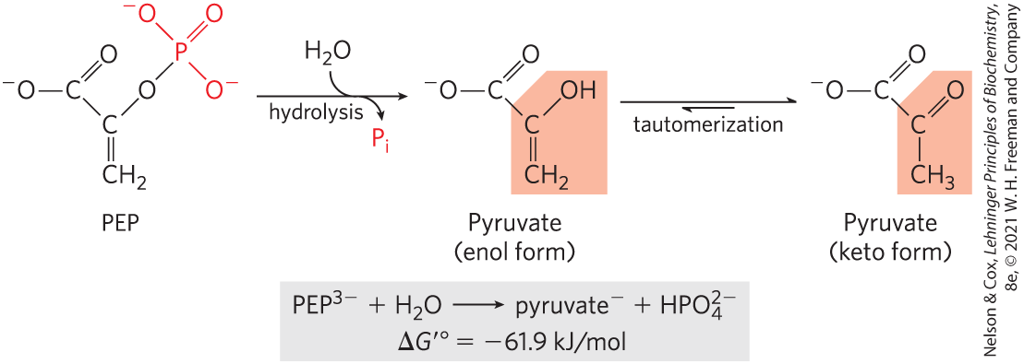
Hydrolysis of Phosphoenolpyruvate (PEP)
high standard free energy of hydrolysis because:
  the reaction occurs with a gain in entropy
  greater resonance stabilization in the P_{i} released by PEP cleavage

Slide 117
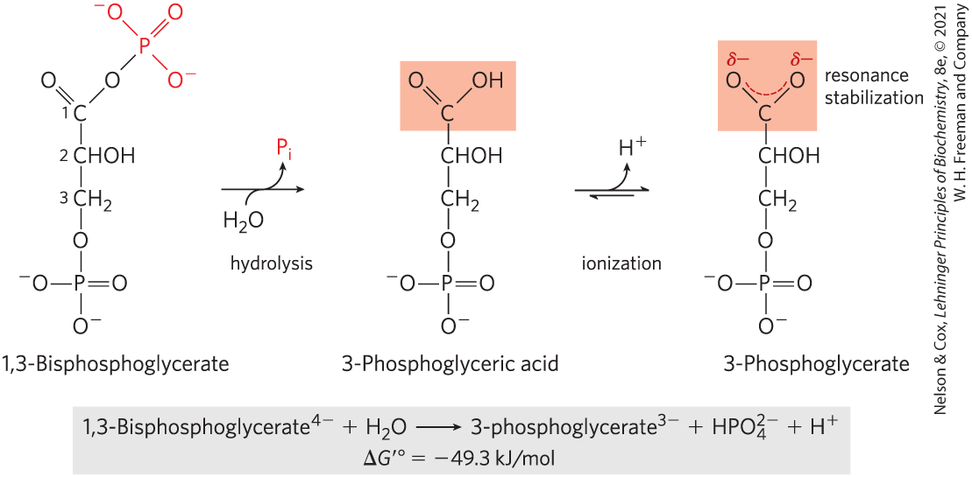
Hydrolysis of 1,3-Bisphosphoglycerate
large standard free energy of hydrolysis because:
  3-phosphoglycerate has two resonance forms
  removal of 3-phosphoglyceric acid by further metabolism and formation of the ion favor the forward reaction

Slide 118
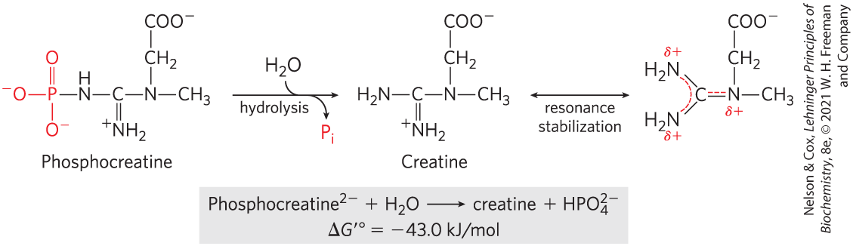
Hydrolysis of Phosphocreatine
large standard free energy of hydrolysis because the release of P_{i} and the resonance stabilization of creatine favor the forward reaction

Slide 119
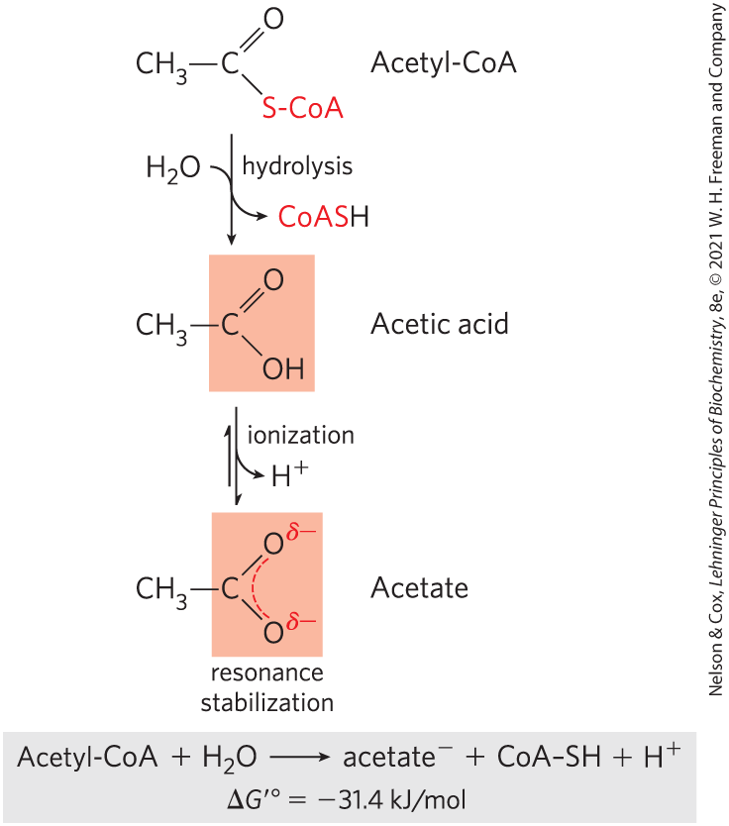
Hydrolysis of Acetyl-Coenzyme A
thioesters = have a sulfur atom that has replaced the oxygen in the ester bond

Slide 120
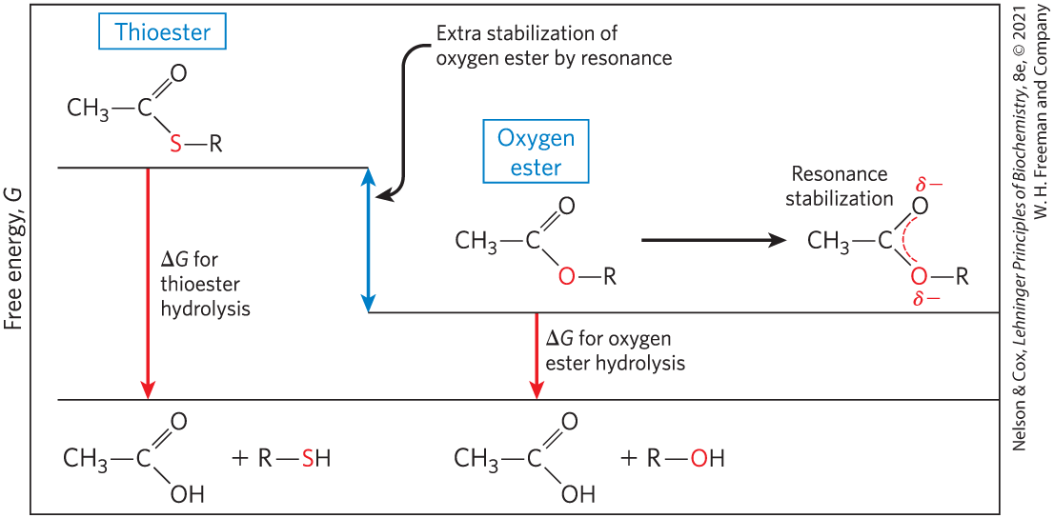
Free Energy of Hydrolysis for Thioesters and Oxygen Esters
thioesters undergo much less resonance stabilization than oxygen esters
  difference in free energy between reactant and products is greater for thioesters

Slide 121
Clicker Question 17
Thioesters:
have resonance stabilization but much less than oxygen esters.
are not found in acetyl-CoA.
have positive standard free energies of hydrolysis.
are formed between sulfhydryl groups and aldehyde groups.
Notes:
Answer: A
Principle: 13.4
Learning Objective(s): Explain why the energy released after the hydrolysis of a thioester is more energetically favorable than an oxygen ester.
Bloom’s: 2:2

Slide 122
Clicker Question 17, Response
Thioesters:
have resonance stabilization but much less than oxygen esters.
Thioesters undergo much less resonance stabilization than do oxygen esters; consequently, the difference in free energy between the reactant and its hydrolysis products, which are resonance-stabilized, is greater for thioesters than for comparable oxygen esters.

Slide 123
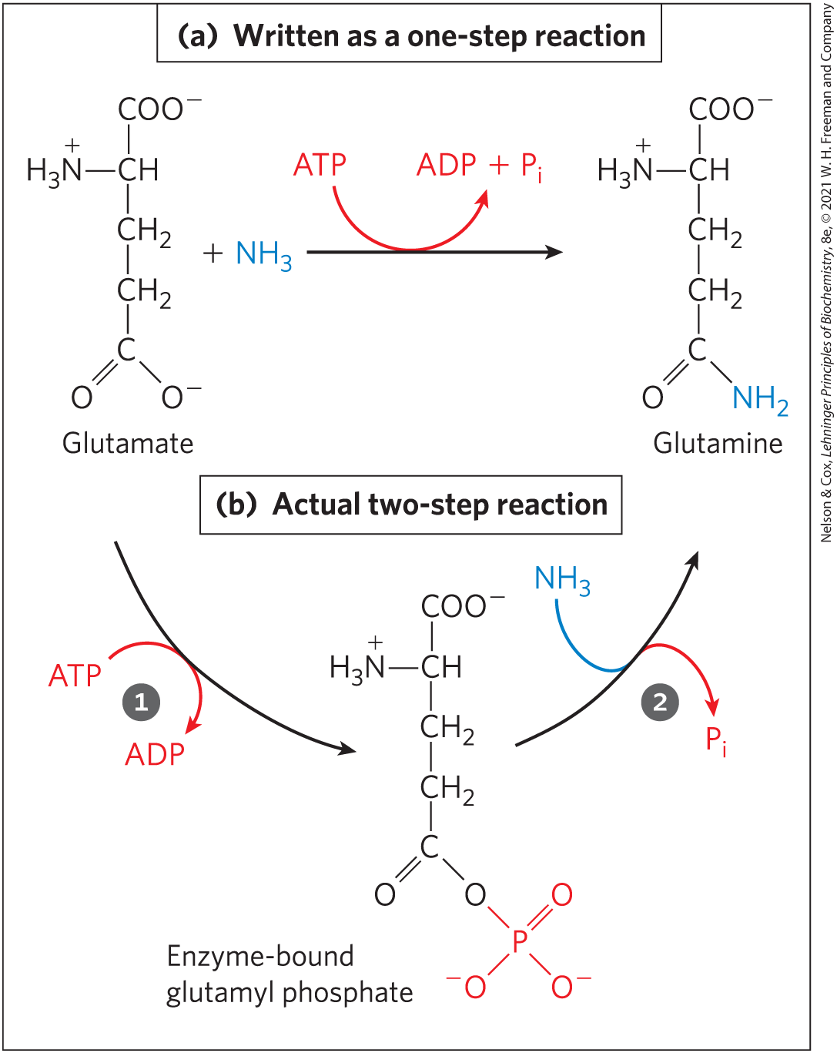
ATP Provides Energy by Group Transfers, Not by Simple Hydrolysis
first step = transfer of part of the ATP molecule to a substrate molecule or to an amino acid residue, activating it
second step = displacement of the phosphate-containing moiety, generating P_{i}, PP_{i}, or AMP as the leaving group

Slide 124
Clicker Question 18
While you have learned in many classes that ATP hydrolysis powers reactions in cells, this is not the case! What is the MOST common biochemical role of ATP?
to induce a conformational change in a protein
to release energy that can be captured for an associated reaction
to be a source for the transfer of part of the ATP to another molecule, a group transfer
to donate a phosphate group to a chemical reaction
Notes:
Answer: C
Principle: 13.4
Learning Objective(s): Differentiate between the different mechanisms ATP provides energy into a biological system.
Bloom’s: 2:2

Slide 125
Clicker Question 18, Response
While you have learned in many classes that ATP hydrolysis powers reactions in cells, this is not the case! What is the MOST common biochemical role of ATP?
to be a source for the transfer of part of the ATP to another molecule, a group transfer
In general, it is not ATP hydrolysis but the transfer of a phosphoryl group from ATP to a substrate or an enzyme that couples the energy of ATP breakdown to endergonic transformations of substrates.

Slide 126
Principle 4 (3 of 5)
ATP is the universal energy currency in living organisms. Transfer of its phosphoryl group to a water molecule or metabolic intermediates provides the energetic push for muscle contraction, the pumping of solutes against concentration gradients, and the synthesis of complex molecules.

Slide 127
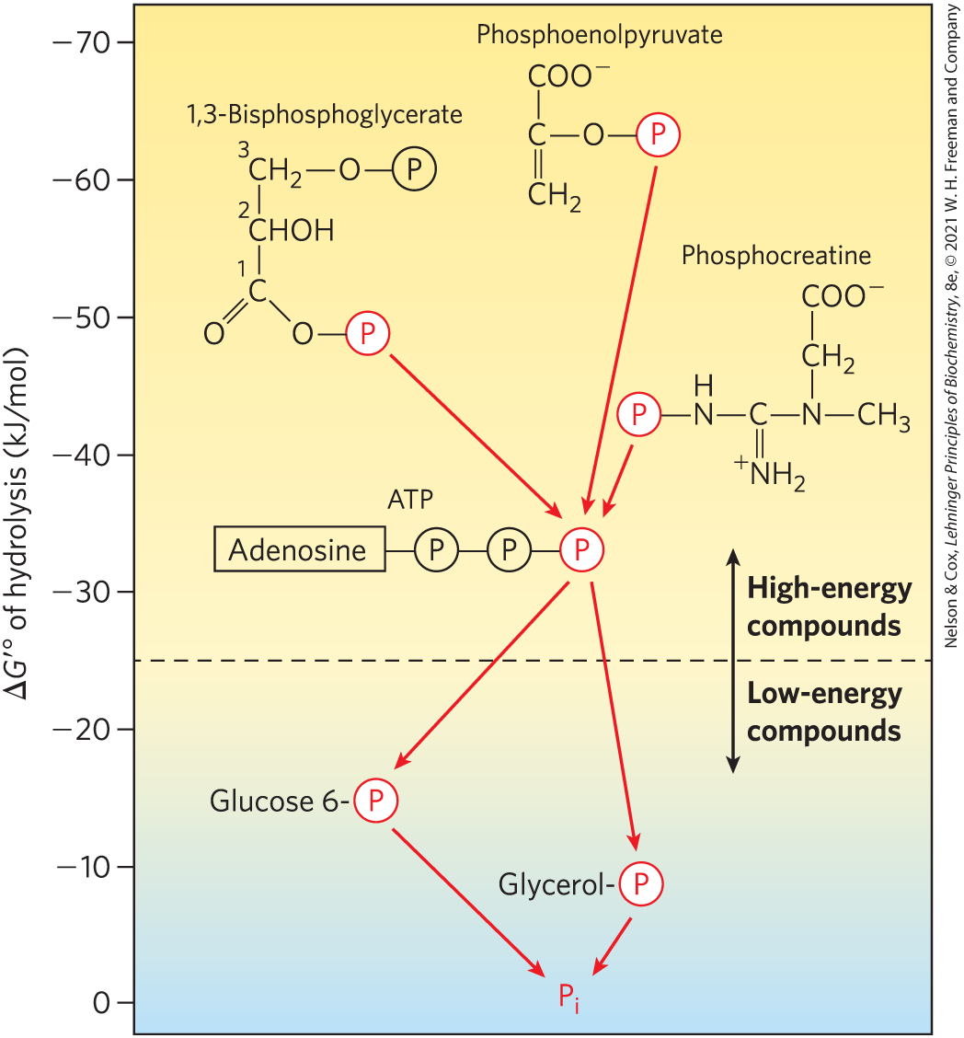
Ranking of Biological Phosphate Compounds by ∆G′°
“high-energy” compounds have a ∆G′° more negative than -25 kJ/mol
“low-energy” compounds have a less negative ∆G′°

Slide 128
Principle 2 (3 of 3)
The free-energy change is the maximum energy made available to do work when a chemical reaction occurs. If two reactions can be combined to yield a third reaction, the overall free energy change is the sum of the two. Cells accomplish energy-requiring chemical work by coupling an energy-releasing (exergonic) reaction, such as the cleavage of ATP, to an endergonic reaction (which requires energy input).

Slide 129

Phosphate Compounds with High ∆G′° of Hydrolysis Donate their Phosphoryl Group
any phosphorylated compound can be synthesized by coupling the synthesis to the breakdown of another phosphorylated compound with a more negative free energy of hydrolysis

Slide 130

ATP Donates Phosphoryl, Pyrophosphoryl, and Adenylyl Groups
each of the three phosphates of ATP is susceptible to nucleophilic attack

Slide 131
Clicker Question 19
Group transfer reactions from ATP are common in biochemistry. What is the soluble product from pyrophosphorylation from ATP?
inorganic phosphate
pyrophosphate
AMP
ADP
Notes:
Answer: C
Principle: 13.4
Learning Objective(s): Describe an experiment that can be used to identify the different ways in which an ATP molecule can break after nucleophilic attack.
Bloom’s: 2:2

Slide 132
Clicker Question 19, Response
Group transfer reactions from ATP are common in biochemistry. What is the soluble product from pyrophosphorylation from ATP?
C. AMP
Pyrophosphorylation transfers a pyrophosphoryl group to the nucleophile and displaces AMP.

Slide 133
Principle 4 (4 of 5)
ATP is the universal energy currency in living organisms. Transfer of its phosphoryl group to a water molecule or metabolic intermediates provides the energetic push for muscle contraction, the pumping of solutes against concentration gradients, and the synthesis of complex molecules.

Slide 134
Adenylylation Reactions
adenylylation = reaction that transfers adenylate (5′-AMP) as an adenyl group
  often the method of energy coupling
thermodynamically very favorable
  hydrolysis of the α–β phosphoanhydride bond releases more energy than hydrolysis of the β–γ bond
  PP_{i} formed as a byproduct is hydrolyzed to two P_{i} by inorganic pyro­phosphatase, releasing additional energy

Slide 135
Clicker Question 20
Which group transfer is overall the MOST favorable thermodynamically but involves two different enzymes?
phosphorolysis
pyrophosphorylation
phosphorylation
adenylylation
Notes:
Answer: D
Principle: 13.4
Learning Objective(s): Differentiate between the different mechanisms ATP provides energy into a biological system.
Bloom’s: 2:2

Slide 136
Clicker Question 20, Response
Which group transfer is overall the MOST favorable thermodynamically but involves two different enzymes?
D. adenylylation
Hydrolysis of the α–β phosphoanhydride bond releases considerably more energy (~46 kJ/mol) than hydrolysis of the β–γ bond (~31 kJ/mol). Furthermore, the PP_{i} formed as a byproduct of the adenylylation is hydrolyzed to two P_{i} by the inorganic pyro­phosphatase, releasing another 19 kJ/mol.

Slide 137
Assembly of Informational Macromolecules Requires Energy
through group transfer reactions, ATP provides the energy for:
  the synthesis of informational macromolecules (DNA, RNA, protein)
  the transport of molecules and ions across membranes against gradients
through hydrolysis, ATP provides the energy for muscle contraction

Slide 138
Clicker Question 21
Which statement regarding ATP is false?
Most enzymes that use ATP bind it in a form complexed with Mg²⁺.
Compared with other phosphate-containing compounds in biochemistry, ATP has a higher free energy than nearly all of the others.
ATP concentrations in a cell are usually much higher than the equilibrium constants.
ATP can act as a group donor in adenylylation reactions.
Notes:
Answer: B
Principle: 13.4
Learning Objective(s): List other phosphorylated compounds, besides ATP, that can be used for energy in a metabolic reaction.
Bloom’s: 2:2

Slide 139
Clicker Question 21, Response
Which statement regarding ATP is false?
Compared with other phosphate-containing compounds in biochemistry, ATP has a higher free energy than nearly all of the others.
ADP (-32.8 kJ/mol), phosphocreatine (-43.0 kJ/mol), 1,3-bisphosphoglycerate (-49.3 kJ/mol), and phosphoenolpyruvate (-61.9 kJ/mol) have higher free-energy values than ATP (-30.5 kJ/mol).

Slide 140
Principle 4 (5 of 5)
ATP is the universal energy currency in living organisms. Transfer of its phosphoryl group to a water molecule or metabolic intermediates provides the energetic push for muscle contraction, the pumping of solutes against concentration gradients, and the synthesis of complex molecules.

Slide 141
Transphosphorylations between Nucleotides Occur in All Cell Types
the other nucleoside triphosphates (GTP, UTP, and CTP) and all deoxynucleoside triphosphates (dATP, dGTP, dTTP, and dCTP) are energetically equivalent to ATP
nucleoside diphosphate kinase = carries phosphoryl groups from ATP to other nucleotides
  high [ATP]/[ADP] ratio normally drives the reaction forward

Slide 142

Ping-Pong Mechanism of Nucleoside Diphosphate Kinase
first step = phosphoryl group transfer from ATP to an active-site His residue produces a phosphoenzyme intermediate
second step = transfer of the phosphoryl group is from the His residue to an NDP acceptor

Slide 143
Adenylate Kinase and Creatine Kinase
adenylate kinase = lowers the ADP concentration and replenishes ATP during periods of intense demand for ATP
  guanylate kinase is a similar enzyme
creatine kinase = uses the phosphocreatine reservoir to replenish ATP at a rapid rate
  lower phyla organisms employ phosphagens (phosphocreatine-like molecules) as phosphoyl reservoirs

Slide 144
Clicker Question 22
Which transphosphorylation enzyme is MOST important at the end of an intense workout in a gym to begin restoring the ATP/ADP mass action ratio?
adenylate kinase
creatine kinase
nucleoside diphosphate kinase
inorganic pyrophosphatase
Notes:
Answer: A
Principle: 13.4
Learning Objective(s): Identify how adenylate kinase and creatine kinase can maintain ATP concentrations during periods of intense ATP consumption, such as exercise.
Bloom’s: 2:2

Slide 145
Clicker Question 22, Response
Which transphosphorylation enzyme is MOST important at the end of an intense workout in a gym to begin restoring the ATP/ADP mass action ratio?
adenylate kinase
During periods of intense demand for ATP, the cell lowers the ADP concentration, and at the same time replenishes ATP, by the action of adenylate kinase. This reaction is fully reversible, so, after the intense demand for ATP ends, the enzyme can recycle AMP by converting it to ADP, which can then be phosphorylated to ATP in mitochondria.

Slide 146
13.4 Biological Oxidation-Reduction Reactions

Slide 147
Principle 5 (3 of 5)
Oxidation-reduction reactions indirectly provide much of the energy needed to make ATP. Reduced substrates such as glucose are oxidized in several steps, with the energy of oxidation steps conserved in the form of a reduced cofactor, NADH. Energy stored in NADH is used to drive the synthesis of ATP.

Slide 148
The Flow of Electrons in Oxidation-Reduction Reactions
electron flow in oxidation-reduction reactions is responsible for all work done by living organisms
electrons move from metabolic intermediates to electron carriers to acceptors with higher electron affinities
  release energy

Slide 149
Principle 5 (4 of 5)
Oxidation-reduction reactions indirectly provide much of the energy needed to make ATP. Reduced substrates such as glucose are oxidized in several steps, with the energy of oxidation steps conserved in the form of a reduced cofactor, NADH. Energy stored in NADH is used to drive the synthesis of ATP.

Slide 150
The Flow of Electrons Can Do Biological Work
electromotive force (emf) = force proportional to the difference in electron affinity between chemical species
  drives electron flow spontaneously through a circuit
biological “circuit” = electrons from glucose flow through a series of electron-carrier intermediates to another chemical species, such as O₂

Slide 151

Oxidation-Reductions Can Be Described as Half-Reactions
the oxidation of ferrous ion by cupric ion,
Fe²⁺ + Cu²⁺ $⇄$ Fe³⁺ + Cu³⁺
can be describe in terms of two half-reactions:
(1) Fe²⁺ $⇄$ Fe³⁺ + e⁻
(2) Cu²⁺+ e⁻ $⇄$ Cu⁺

Slide 152
Conjugate Redox Pairs
reducing agent or reductant = electron-donating molecule
oxidizing agent or oxidant = electron-accepting molecule
conjugate redox pair = consists of an electron donor and an electron acceptor

Slide 153


Biological Oxidations Often Involve Dehydrogenation
the more electro-negative atom “owns” the bonding electrons it shares with another atom

Slide 154
Oxidation Is Often Synonymous
With Dehydrogenation
dehydrogenation = reaction where a compound loses two electrons and two hydrogen ions
  catalyzed by dehydrogenases
electrons are transferred from the electron donor to the electron acceptor:
  directly as electrons
  as hydrogen atoms
  as a hydride ion (:H⁻)
  through direct combination with oxygen

Slide 155

Clicker Question 23
By which method are electrons NOT transferred from one molecule to another?
directly as electrons
as hydrogen atoms
through direct combination with nitrogen
as a hydride ion
Notes:
Answer: C
Principle: 13.5
Learning Objective(s): Summarize the different mechanisms used by biological systems to transfer electrons from one molecule to another.
Bloom’s: 2:2

Slide 156
Clicker Question 23, Response
By which method are electrons NOT transferred from one molecule to another?
C. through direct combination with nitrogen
Electrons are transferred from one molecule (electron donor) to another (electron acceptor) in one of four ways: directly as electrons, as hydrogen atoms, as a hydride ion, or through direct combination with oxygen.

Slide 157
Reducing Equivalent
reducing equivalent = designates a single electron equivalent participating in an oxidation-reduction reaction regardless of the transfer method

Slide 158

Reduction Potentials Measure Affinity for Electrons
standard reduction potential, E° = a measure (in volts) of the relative affinity of the electron acceptor of each redox pair for electrons
  positive value = takes electrons
  negative value = donates electrons

Slide 159

Electrons Tend to Flow From Low to High Reduction Potential
standard of reference is the half-reaction H⁺ + e⁻ $⟶$ ½ H₂
when any two half-cells are connected, the half-cell with the more positive E° is reduced
  this half-cell has the greater reduction potential

Slide 160

The Nernst Equation
the Nernst equation relates standard reduction potential to actual reduction potential:
E = E° + $\frac{\text{RT}}{\text{nF} } \text{+} \frac{\text{[}\text{electron} \text{acceptor}\text{] }}{\text{[}\text{electron} \text{donor}\text{] } }$
where R and T have their usual meanings, n is the
number of electrons transferred per molecule, and F is the
Faraday constant
(13-5)

Slide 161

The Simplified Nernst Equation
at 298 K (25 °C), the Nernst equation reduces to:
E = E° + $\frac{\text{0.026 }\text{V} }{\text{n} } \text{+} \frac{\text{[}\text{electron} \text{acceptor}\text{] }}{\text{[}\text{electron} \text{donor}\text{] }}$
(13-6)

Slide 162
Standard Reduction Potentials
Half-reaction | E′˚ (V)
½O₂ + 2H⁺ + 2e⁻→H₂O | 0.816
Fe³⁺ + e⁻→Fe²⁺ | 0.771
NO⁻₃ + 2H⁺ + 2e⁻→NO⁻₂ + H₂O | 0.421
Cytochrome f (Fe³⁺) + e⁻→cytochrome f (Fe²⁺) | 0.365
Fe(CN)³⁻₆ (ferricyanide) + e⁻→Fe(CN)⁴⁻₆ | 0.36
Cytochrome a₃ (Fe³⁺) + e⁻→cytochrome a₃ (Fe²⁺) | 0.35
O₂ + 2H⁺ + 2e⁻→H₂O₂ | 0.295
Cytochrome a (Fe³⁺) + e⁻→cytochrome a (Fe²⁺) | 0.29
Cytochrome c (Fe³⁺) + e⁻→cytochrome c (Fe²⁺) | 0.254
Cytochrome c₁ (Fe³⁺) + e⁻→cytochrome c₁ (Fe²⁺) | 0.22
Cytochrome b (Fe³⁺) + e⁻→cytochrome b (Fe²⁺) | 0.077
Ubiquinone + 2H⁺ + 2e⁻→ubiquinol | 0.045
Fumarate²⁻ + 2H⁺ + 2e⁻→succinate²⁻ | 0.031
2H⁺ + 2e⁻→H₂ (at standard conditions, pH 0) | 0.000
Crotonyl-CoA + 2H⁺ + 2e⁻→butyryl-CoA | −0.015
Oxaloacetate²⁻ + 2H⁺ + 2e⁻→lactate⁻ | −0.166
Pyruvate⁻ + 2H⁺ + 2e⁻→lactate⁻ | −0.185
Acetaldehyde + 2H⁺ + 2e⁻→ethanol | −0.197
FAD + 2H⁺ + 2e⁻→FADH₂ | −0.219
Glutathione + 2H⁺ + 2e⁻→2 reduced glutathione | −0.23
S + 2H⁺ + 2e⁻→H₂S | −0.243
Lipoic acid + 2H⁺ + 2e⁻→dihydrolipoic acid | −0.29
NAD⁺ + H⁺ + 2e⁻→NADH | −0.320
NADP⁺ + H⁺ + 2e⁻→NADPH | −0.324
Acetoacetate + 2H⁺ + 2e⁻→β-hydroxybutyrate | −0.346
α-Ketoglutarate + CO₂ + 2H⁺ + 2e⁻→isocitrate | −0.38
2H⁺ + 2e⁻→H₂ (at pH 7) | −0.414
Ferredoxin (Fe³⁺) + e⁻→ferredoxin (Fe²⁺) | −0.432
standard reduction potentials are valid only for systems at neutral pH
by convention, ∆E′° for any redox reaction is given as E′° of the electron acceptor minus E′° of the electron donor
Table 13-7 Standard Reduction Potentials of Some Biologically Important Half-Reactions

Slide 163

Clicker Question 24
Which statement regarding reduction potentials is false?
They are usually tabulated as half-reactions.
They can be used to calculate free-energy changes.
Reactions with positive standard reduction potentials are oxidation reactions.
The reference standard for them is H⁺ + e⁻ $⟶$ ½ H₂.
Notes:
Answer: C
Principle: 13.5
Learning Objective(s): Explain how a standard reduction potential is calculated using the standard half-cell reaction H+ +e -> ½ H2.; Analyze how flow of electrons through a biochemical reaction can provide energy independent of ATP.
Bloom’s: 2:2

Slide 164
Clicker Question 24, Response
Which statement regarding reduction potentials is false?
Reactions with positive standard reduction potentials are oxidation reactions.
By convention, a half-cell that takes electrons from the standard hydrogen cell is assigned a positive standard reduction potential value, and one that donates electrons to the hydrogen cell, a negative value. The mnemonic OIL RIG — oxidation is losing, reduction is gaining — may be helpful in remembering what happens to electrons in redox reactions.

Slide 165
Principle 5 (5 of 5)
Oxidation-reduction reactions indirectly provide much of the energy needed to make ATP. Reduced substrates such as glucose are oxidized in several steps, with the energy of oxidation steps conserved in the form of a reduced cofactor, NADH. Energy stored in NADH is used to drive the synthesis of ATP.

Slide 166
Standard Reduction Potentials
Can Be Used to Calculate
Free-Energy Change
electrons tend to flow to the half-cell with the more positive E (higher reduction potential)
the strength of this tendency is:
  proportional to ∆E
  a function of the concentrations of oxidized and reduced species
∆G = −nF∆E or ∆G′° = −nF∆E′°
  where n is the number of electrons transferred
(13-7)

Slide 167

Clicker Question 25
For the reaction pyruvate + NADH $⟶$ lactate + NAD⁺ + H⁺:
∆G′° = -26 kJ/mol.
∆G′° = -13 kJ/mol.
Electrons flow from pyruvate to NADH.
∆G′° = +13 kJ/mol.
Notes:
Answer: A
Principle: 13.5
Learning Objective(s): Calculate the free energy change in an oxidation reduction reaction using the change in reduction potential.
Bloom’s: 3:2

Slide 168

Clicker Question 25, Response
For the reaction pyruvate + NADH $⟶$ lactate + NAD⁺ + H⁺:
∆G′° = -26 kJ/mol.
∆G′° = −nF∆E′°
= −2(96.5 kJ/V·mol)(-0.320 V − (-0.185 V))
= −2(96.5 kJ/V·mol)(-0.135 V)
= -26 kJ/mol
Remember that, by convention, ∆E′° is E′° of the electron acceptor minus E′° of the electron donor.

Slide 169
Clicker Question 26
A study of the free-energy change for a hydride transfer from an aldehyde to a flavin nucleotide does NOT require which value?
Faraday’s constant
the number of electrons transferred
the half-cell standard reduction potential for the flavin accepting the electrons
the temperature of the reaction in degrees Kelvin
Notes:
Answer: D
Principle: 13.5
Learning Objective(s): Calculate the free energy change in an oxidation reduction reaction using the change in reduction potential.
Bloom’s: 2:2

Slide 170
Clicker Question 26, Response
A study of the free-energy change for a hydride transfer from an aldehyde to a flavin nucleotide does NOT require which value?
D. the temperature of the reaction in degrees Kelvin
The equation ∆G′° = −nF∆E′° is used to calculate the free-energy change from the number of electrons transferred, Faraday’s constant, and the standard reduction potentials for both half-cells. It does not depend on the temperature of the reaction.

Slide 171
A Few Types of Coenzymes and Proteins Serve as Universal Electron Carriers
NAD, NADP, FMN, and FAD are water-soluble coenzymes that undergo reversible oxidation and reduction in many of the electron-transfer reactions
  NAD and NADP are freely diffusible
  FMN and FAD are usually enzyme-bound

Slide 172
The Pyridine Nucleotides
pyridine nucleotides = compounds with a nicotinamide ring that resembles pyridine
  nicotinamide adenine dinucleotide (NAD; NAD⁺ when oxidized)
  nicotinamide adenine dinucleotide phosphate (NADP; NADP⁺ when oxidized)

Slide 173

NAD and NADP Undergo Reversible Reduction of the Nicotinamide Ring

Slide 174

Half-Reactions for
Nucleotide Cofactors
both NAD+ and NADP+ accept two electrons and one proton
NAD⁺ + 2e⁻ + 2H⁺ $⟶$ NADH + H⁺
NADP⁺ + 2e⁻ + 2H⁺ $⟶$ NADPH + H⁺

Slide 175

General Reactions for
Nucleotide Cofactors
accepting a hydride ion from a reduced substrate:
AH₂ + NAD⁺ $⟶$ A + NADH + H⁺
AH₂ + NADP⁺ $⟶$ A + NADPH + H⁺
donating a hydride ion to an oxidized substrate:
A + NADH + H⁺ $⟶$ AH₂ + NAD⁺
A + NADPH + H⁺ $⟶$ AH₂ + NADP⁺
where AH₂ is the reduced substrate and A is the oxidized substrate

Slide 176
Clicker Question 27
NADP⁺ is:
the oxidized form of NADH.
the reduced form of NADPH.
NAD⁺ with a phosphorus added.
a hydride ion acceptor.
Notes:
Answer: D
Principle: 13.5
Learning Objective(s): Explain the mechanism by which NAD+ and NADP+ transfer electrons from a hydride anion.
Bloom’s: 2:2

Slide 177

Clicker Question 27, Response
NADP⁺ is:
D. a hydride ion acceptor.
In many reactions, NADP⁺ (or NAD⁺) accepts a hydride ion from a reduced substrate. The general equation for this reaction is AH₂ + NADP⁺ $⟶$ A + NADPH + H⁺.

Slide 178
Oxidoreductase (Dehydrogenases)
oxidoreductases = also called dehydrogenases = catalyze oxidation-reductase reactions using NAD⁺ (or NADP⁺) as coenzymes

Slide 179
NAD Has Important Functions in Addition to Electron Transfer
NAD⁺ is:
  the source of the activating AMP group in the bacterial DNA ligase reaction
  the source of ADP-ribose in the cholera toxin reaction
  hydrolyzed in the deacetylation of the ε-amino group of an acetylated Lys residue by sirtuin proteins
    regulates inflammation, apoptosis, aging, and DNA transcription (through histones)

Slide 180

Insufficient Niacin in the Diet
Causes Pellagra
dietary deficiency of niacin (the vitamin form of NAD and NADP) prevents NAD synthesis and causes pellagra
  characterized by the “three Ds”: dermatitis, diarrhea, and dementia
black tongue = related disease in dogs

Slide 181

Niacin (Nicotinic Acid) and Its Derivative Nicotin-Amide
tryptophan = the biosynthetic precursor
nicotinic acid and nicotinamide cure pellagra
nicotine (from cigarettes) has no curative activity

Slide 182
Flavin Nucleotides Are Tightly Bound in Flavoproteins
flavoproteins = enzymes that catalyze oxidation- reduction reactions using either flavin mononucle- otide (FMN) or flavin adenine dinucleotide (FAD) as coenzyme
flavin nucleotides = enzymes derived from the vitamin riboflavin
  reduction potentials depend on the flavoprotein with which they are associated

Slide 183

Oxidized and Reduced FAD and FMN
can accept either one or two electrons in the form of one or two hydrogen atoms from a reduced substrate

Slide 184
Clicker Question 28
Which electron carrier is MOST appropriate for accepting two electrons as a hydride ion and then later participating in an anabolic pathway?
FAD⁺
NADP⁺
FMN
NAD⁺
Notes:
Answer: B
Principle: 13.5
Learning Objective(s): Indicate other roles NAD+ and NADP+ play in the cell besides participating in oxidation reactions.
Bloom’s: 2:2

Slide 185
Clicker Question 28, Response
Which electron carrier is MOST appropriate for accepting two electrons as a hydride ion and then later participating in an anabolic pathway?
B. NADP⁺
NADPH is a common reactant in amino acid and lipid synthesis, as well as formation of deoxyribonucleotides.

Slide 186
Clicker Question 29
Of these options, which is NOT a method that transfers electrons?
as hydrogen ions (H⁺)
as hydrogen atoms
directly as electrons
as hydride ions (H⁻)
Notes:
Answer: A
Principle: 13.5
Learning Objective(s): Summarize the different mechanisms used by biological systems to transfer electrons from one molecule to another.
Bloom’s: 2:2

Slide 187
Clicker Question 29, Response
Of these options, which is NOT a method that transfers electrons?
as hydrogen ions (H⁺)
Electrons are transferred from one molecule (electron donor) to another (electron acceptor) in one of four ways: directly as electrons, as hydrogen atoms, as a hydride ion, or through direct combination with oxygen.

Slide 188

Activity: Energy for
Biological Work
Watch the Animated Mechanism video titled “Glyceraldehyde 3-Phosphate Dehydrogenase Oxidizes Glyceraldehyde 3-Phosphate to 1,3-Bisphosphoglycerate” about one of the energy-conserving reactions of glycolysis.
Notes:
Instructor: This Animated Mechanism is found within Chapter 14 of Achieve. It is in the folder titled “Ch14 In-Class Activities, Videos, and Resources.”
Ch 13 Principle 5. Oxidation-reduction reactions indirectly provide much of the energy needed to make ATP. Reduced substrates such as glucose are oxidized in several steps, with the energy of oxidation steps conserved in the form of a reduced cofactor, NADH.

Slide 189
Activity Instructions (4 of 4)
On your own, think of answers to the question:
  How does the breakdown of glucose provide energy to do biological work in the cell?
  (2 minutes)
Pair up to discuss your ideas. (2 minutes)
Share your ideas with the class in group discussion. (3 minutes)
Notes:
Instructor: This Animated Mechanism is found within Chapter 14 of Achieve. It is in the folder titled “Ch14 In-Class Activities, Videos, and Resources.”

Slide 190
Activity Solution (4 of 4)
  How does the breakdown of glucose provide energy to do biological work in the cell? As glucose is enzymatically oxidized, the released electrons flow spontaneously through a series of electron-carrier intermediates (e.g. NADH) to another chemical species, such as O₂. This electron flow is exergonic, because O₂ has a higher affinity for electrons than do the electron-carrier intermediates. The resulting electromotive force provides energy to a variety of molecular energy transducers (enzymes and other proteins) that do biological work.
Notes:
Instructor: This Animated Mechanism is found within Chapter 14 of Achieve. It is in the folder titled “Ch14 In-Class Activities, Videos, and Resources.”

Slide 191
13.5 Regulation of Metabolic Pathways

Slide 192

Metabolism as a Three-Dimensional Meshwork
pathways are inextricably intertwined with all the other cellular pathways in a multidimensional network of reactions

Slide 193
Principle 6 (2 of 5)
To respond to changes in external circumstances, cells must regulate enzyme activities by changing either the number of enzyme molecules or the catalytic activity of preexisting enzyme molecules.

Slide 194

Cells and Organisms Maintain a Dynamic Steady State
in a metabolically active cell in a steady state, intermediates are formed and consumed at equal rates:
A $⟶$ S $⟶$ P
when v₁ = v₂, [S] is constant (homeostasis)
flux = rate (v) of metabolite flow
v₁
v₂

Slide 195
Both the Amount and the Catalytic Activity of an Enzyme Can
Be Regulated
to return a system to the steady state, flux can be modulated by changes in the:
  number of enzyme molecules
  catalytic activity of each present enzyme molecule
time scale = less than a millisecond to days

Slide 196

Factors Affecting Enzyme Activity

Slide 197

Clicker Question 30
Which of these forms of regulation changes the total activity of an enzyme by changing the amount of enzyme in the cell?
phosphorylation/dephosphorylation
combining with a regulatory protein
binding to an allosteric regulator
mRNA degradation
Notes:
Answer: D
Principle: 13.6
Learning Objective(s): Identify mechanisms that can be used to alter the effective activity of an enzyme.
Bloom’s: 2:2

Slide 198
Clicker Question 30, Response
Which of these forms of regulation changes the total activity of an enzyme by changing the amount of enzyme in the cell?
mRNA degradation
The total activity of an enzyme can be changed by altering the number of its molecules in the cell, which depends in part on the amount of the mRNA encoding that enzyme. The amount of a given mRNA in the cell is a function of its rates of synthesis and degradation.

Slide 199
Extracellular Signals
extracellular signals may be:
  hormonal (insulin, epinephrine)
  neuronal (acetylcholine)
  growth factors
  cytokines

Slide 200
Transcription Factors
transcription factors = nuclear proteins that, when activated, bind specific DNA regions (response elements) near a gene’s promoter
  can activate or repress gene transcription

Slide 201
mRNA Degradation and Translation
stability of mRNA varies
  depends on their resistance to ribonuclease degradation
rate of mRNA translation is regulated

Slide 202
Clicker Question 31
Which of these factors can produce very rapid allosteric changes in enzyme activity?
cytokine signals
hormonal signals
changes in local product concentration
changes in gene transcription
Notes:
Answer: C
Principle: 13.6
Learning Objective(s): Identify mechanisms that can be used to alter the effective activity of an enzyme.
Bloom’s: 2:2

Slide 203
Clicker Question 31, Response
Which of these factors can produce very rapid allosteric changes in enzyme activity?
changes in local product concentration
Very rapid allosteric changes in enzyme activity are generally triggered locally, by changes in the local concentration of a small molecule — a substrate of the pathway in which that reaction is a step (say, glucose for glycolysis), a product of the pathway (ATP from glycolysis), or a key metabolite or cofactor (such as NADH) that indicates the cell’s metabolic state.

Slide 204
Principle 6 (3 of 5)
To respond to changes in external circumstances, cells must regulate enzyme activities by changing either the number of enzyme molecules or the catalytic activity of preexisting enzyme molecules.

Slide 205
Protein Degradation
turnover = synthesis followed by degradation
rapid turnover is energetically expensive, but proteins with a short half-life reach new steady-state levels faster than those with a long half-life
Table 13-8 Average Half-Life of Proteins in Mammalian Tissues
Tissue | Average half-life (days)
Liver | 0.9
Kidney | 1.7
Heart | 4.1
Brain | 4.6
Muscle | 10.7

Slide 206
Enzyme Sequestration
sequestering enzyme and its substrate in different compartments alters the effective activity of an enzyme

Slide 207
Changes in the Transcriptome Affect the Proteome and the Metabolome
changes in the transcriptome lead to changes in the proteome and, ultimately, in the metabolome of a cell or tissue
transcriptome = entire complement of mRNAs
proteome = entire complement of protein
metabolome = entire complement of low molecular weight metabolites

Slide 208

The Metabolome of E. coli Growing on Glucose

Slide 209
Clicker Question 32
Which characteristic of a cell or organ includes the molar abundance of redox factors?
genome
metabolome
proteome
transcriptome
Notes:
Answer: B
Principle: 13.6
Learning Objective(s): Determine the control mechanisms of metabolic flux in a biological system using transcriptomic, proteomic, and metabolomic data.
Bloom’s: 2:2

Slide 210
Clicker Question 32, Response
Which characteristic of a cell or organ includes the molar abundance of redox factors?
metabolome
The metabolome is the total ensemble of low molecular weight metabolites. The metabolome of E. coli growing on glucose is dominated by a few classes of metabolites: glutamate (49%); nucleotides (15%); intermediates of central pathways of carbohydrate metabolism (15%); and redox factors and glutathione (9%).

Slide 211
Regulating the Catalytic Activity of Individual Enzyme Molecules
can be regulated by:
  the concentration of substrate
  the presence of allosteric effectors
  covalent modifications
  binding of regulatory proteins

Slide 212

Enzymes Are Sensitive to
Substrate Concentration
for enzymes that follow Michaelis-Menten kinetics:
  the initial rate of the reaction is half-max when [S] = K_{m}
  activity drops off at lower [S]
  when [S] << K_{m}, the reaction rate is linearly dependent on [S]

Slide 213
Allosteric Effectors Can Increase or Decrease Enzyme Activity
typically convert hyperbolic kinetics to sigmoid kinetics
cooperativity of an allosteric protein can be expressed as a Hill coefficient, with higher coefficients meaning greater cooperativity
Hill coefficient (n_{H}) | Required change in [S] to increase V₀ from 10% to 90% V_{max}
0.5 | × 6,600
1.0 | × 81
2.0 | × 9
3.0 | × 4.3
4.0 | × 3
Table 13-9 Relationship between Hill Coefficient and the Effect of Substrate Concentration on Reaction Rate for Allosteric Enzymes

Slide 214
Clicker Question 33
An increase in V₀ from 10% to 90% V_{max} by an enzyme with no cooperative effects requires:
a 3-fold increase in [S].
a 9-fold increase in [S].
an 81-fold increase in [S].
a 6,600-fold increase in [S].
Notes:
Answer: C
Principle: 13.6
Learning Objective(s): Recall how allosteric regulators, post-translational modifications, and interactions with other proteins can control metabolism.
Bloom’s: 2:1

Slide 215
Clicker Question 33, Response
An increase in V₀ from 10% to 90% V_{max} by an enzyme with no cooperative effects requires:
an 81-fold increase in [S].
For an allosteric enzyme with a Hill coefficient of 4, activity increases from 10% V_{max} to 90% V_{max} with only a 3-fold increase in [S], compared with the 81-fold rise in [S] needed by an enzyme with no cooperative effects (Hill coefficient of 1; Table 13-9).

Slide 216

Covalent Modifications and Binding of Regulatory Proteins
covalent modifications:
  occur within seconds or minutes of a regulatory signal
  phosphorylation and dephosphorylation are most common
association with and dissociation from regulatory proteins regulates enzymes

Slide 217
Principle 6 (4 of 5)
To respond to changes in external circumstances, cells must regulate enzyme activities by changing either the number of enzyme molecules or the catalytic activity of preexisting enzyme molecules.

Slide 218
The Mechanisms for Altering Flux Are Not Mutually Exclusive
enzymes are commonly regulated at the level of transcription and by both allosteric and covalent mechanisms
allow for fast, smooth, effective regulation

Slide 219


Activity: Regulation of
Enzyme Activities
Muddiest Point (1 of 2)
Complete the Ch13 Student Activity, Day 1: Regulation of Enzyme Activies (Muddiest Point) Achieve assessment.
Notes:
Instructor: This muddiest point activity can be found in Achieve in the Chapter 13 folder titled “Ch13 In-Class Activities and Resources.” See the Instructor Activity Guide in the same folder for more information.

Slide 220

Activity: Regulation of
Enzyme Activities
Muddiest Point (2 of 2)
Complete the Ch13 Student Activity, Day 2: Regulation of Enzyme Activities (Muddiest Point) Achieve assessment.
Notes:
Instructor: This muddiest point activity can be found in Achieve in the Chapter 13 folder titled “Ch13 In-Class Activities and Resources.” See the Instructor Activity Guide in the same folder for more information.

Slide 221
Metabolic Regulation and
Metabolic Control
metabolic regulation = processes that serve to maintain homeostasis at the molecular level
metabolic control = processes that lead to a change in the output of a metabolic pathway over time

Slide 222
Clicker Question 34
Metabolic regulation:
maintains all reactions in a pathway near the equilibrium of each.
is the same thing as metabolic control.
is the maintenance of homeostasis at the molecular level.
always involves changing the amount of enzyme in the cell.
Notes:
Answer: C
Principle: 13.6
Learning Objective(s): Contrast how flux can be regulated within a system during a fast and long-term response.
Bloom’s: 2:2

Slide 223
Clicker Question 34, Response
Metabolic regulation:
is the maintenance of homeostasis at the molecular level.
The term metabolic regulation refers to processes that serve to maintain homeostasis at the molecular level — to hold some cellular parameter (concentration of a metabolite, for example) at a steady level over time.

Slide 224
Clicker Question 35
Metabolic regulation is:
the act of both changing the flux of metabolites through a pathway and the rebalancing of the levels of those metabolites.
the rebalancing of the levels of metabolites in a pathway in response to a change in flux in that pathway.
changing the flux of metabolites through a pathway.
a mechanism of metabolic control.
Notes:
Answer: B
Principle: 13.6
Learning Objective(s): Contrast how flux can be regulated within a system during a fast and long-term response.
Bloom’s: 2:2

Slide 225
Clicker Question 35, Response
Metabolic regulation is:
the rebalancing of the levels of metabolites in a pathway in response to a change in flux in that pathway.
Metabolic regulation holds some cellular parameter (concentration of a metabolite, for example) at a steady level over time, even as the flow of metabolites through the pathway changes.

Slide 226

Reactions Far from Equilibrium in Cells Are Common Points of Regulation
far from equilibrium
near equilibrium

Slide 227

Mass-Action Ratio, Q
mass-action ratio, Q = [C][D]/[A][B] for the reaction A + B $⟶$ C + D
when Q and K′_{eq} are within 1 to 2 orders of magnitude of each other, the reaction is near equilibrium

Slide 228
Enzymes of Carbohydrate Metabolism
Table 13-10 Equilibrium Constants, Mass-Action Ratios, and Free-Energy Changes for Enzymes of Carbohydrate Metabolism
Enzyme | K′_{eq} | Mass-action ratio, Q: Liver | Mass-action ratio, Q: Heart | Reaction near equilibrium in vivo? | ΔG′˚ (kJ/mol) | ΔG′˚ (kJ/mol) in heart
Hexokinase | 1 ×10³ | 2 ×10⁻² | 8 ×10⁻² | No | −17 | −27
PFK-1 | 1.0 ×10³ | 9 ×10⁻² | 3 ×10⁻² | No | −14 | −23
Aldolase | 1.0 ×10⁻⁴ | 1.2 ×10⁻⁶ | 9 ×10⁻⁶ | Yes | +24 | −6.0
Triose phosphate isomerase | 4 ×10⁻² | ⸻ | 2.4 ×10⁻¹ | Yes | +7.5 | +3.8
Glyceraldehyde 3-phosphate dehydrogenase + phosphoglycerate kinase | 2 ×10³ | 6 ×10² | 9.0 | Yes | −13 | +3.5
Phosphoglycerate mutase | 1 ×10⁻¹ | 1 ×10⁻¹ | 1.2 ×10⁻¹ | Yes | +4.4 | +0.6
Enolase | 3 | 2.9 | 1.4 | Yes | −3.2 | −0.5
Pyruvate kinase | 2 ×10⁴ | 7 ×10⁻¹ | 40 | No | −31 | −17
Phosphohexose isomerase | 4 ×10⁻¹ | 3.1 ×10⁻¹ | 2.4 ×10⁻¹ | Yes | +2.2 | −1.4
Pyruvate carboxylase + PEP carboxykinase | 7 | 1 ×10⁻³ | ⸻ | No | −5.0 | −23
Glucose 6-phosphatase | 8.5 ×10² | 1.2 ×10² | ⸻ | Yes | −17 | −5.0

Slide 229
Clicker Question 36
The reaction catalyzed by phosphoglucoisomerase has a K′_{eq} of 4 × 10⁻¹ and a mass-action ratio (Q) in the liver of 3.1 × 10⁻¹. Which statement is TRUE about this reaction?
It is close to equilibrium.
It is far from equilibrium.
It is highly endergonic.
It is highly exergonic.
Notes:
Answer: A
Principle: 13.6
Learning Objective(s): Explain how cells use reactant and product concentrations far from equilibrium to regulate metabolism.
Bloom’s: 3:2

Slide 230
Clicker Question 36, Response
The reaction catalyzed by phosphoglucoisomerase has a K′_{eq} of 4 × 10⁻¹ and a mass-action ratio (Q) in the liver of 3.1 × 10⁻¹. Which statement is TRUE about this reaction?
It is close to equilibrium.
When Q and K′_{eq} are within 1 to 2 orders of magnitude of each other, the reaction is near equilibrium. This is the case for more than half of the enzymes in the glycolytic pathway.

Slide 231

Adenine Nucleotides Play Special Roles in Metabolic Regulation
if [ATP] were to drop, enzymes would be less than fully saturated by their substrate (ATP), and the reaction rates would decrease

Slide 232
Principle 6 (5 of 5)
To respond to changes in external circumstances, cells must regulate enzyme activities by changing either the number of enzyme molecules or the catalytic activity of preexisting enzyme molecules.

Slide 233

Adenylate Kinase and AMP-Activated Protein Kinase (AMPK)
adenylate kinase = catalyzes the production of AMP in the reaction 2ADP $⟶$ AMP + ATP
AMP-activated protein kinase (AMPK) = responds to a decrease in the [ATP]/[AMP] ratio by phosphorylating key proteins and regulating their activities

Slide 234
Clicker Question 37
All of the changes effected by AMP-activated protein kinase (AMPK) serve to:
raise [ATP] and [AMP].
lower [ATP] and [AMP].
raise [ATP] and lower [AMP].
lower [ATP] and raise [AMP].
Notes:
Answer: C
Principle: 13.6
Learning Objective(s): Summarize why organisms have developed systems to maintain specific ATP/ADP ratios.
Bloom’s: 2:1

Slide 235
Clicker Question 37, Response
All of the changes effected by AMP-activated protein kinase (AMPK) serve to:
raise [ATP] and lower [AMP].
AMP activates AMPK allosterically, which increases glucose transport and activates glycolysis and fatty acid oxidation, while suppressing energy-requiring processes such as the synthesis of glycogen, fatty acids, cholesterol, and protein. The net effect is that [ATP] increases and [AMP] decreases.

Slide 236
[AMP] Is a More Sensitive Indicator Than [ATP]
Table 13-11 Relative Changes in [ATP] and [AMP] When ATP Is Consumed
Adenine nucleotide | Concentration before ATP depletion (mM) | Concentration after ATP depletion (mM) | Relative change
ATP | 5.0 | 4.5 | 10%
ADP | 1.0 | 1.0 | 0
AMP | 0.1 | 0.6 | 600%

Slide 237
Clicker Question 38
What is MOST likely to serve as a regulatory signal that a cell is energy depleted?
high [ADP]
high [AMP]
high [ATP]
high [NADH]
Notes:
Answer: B
Principle: 13.6
Learning Objective(s): Summarize why organisms have developed systems to maintain specific ATP/ADP ratios.
Bloom’s: 2:2

Slide 238
Clicker Question 38, Response
What is MOST likely to serve as a regulatory signal that a cell is energy depleted?
high [AMP]
If ATP is consumed such that its concentration drops 10%, the relative increase in [AMP] is much greater than that of [ADP]. It is not surprising, therefore, that many regulatory processes are keyed to changes in [AMP].

