Slide 1

11 Biological Membranes and Transport
© 2021 Macmillan Learning

Slide 2

Principle 1 (1 of 3)
The biological membrane is a lipid bilayer with proteins of various functions (enzymes, transporters) embedded in or associated with the bilayer. The hydrophobic effect stabilizes structures (lipid bilayers and vesicles) in which lipids with some polar and some nonpolar regions can protect their nonpolar regions from interaction with the very polar solvent, water. Membrane proteins are associated with the lipid bilayer more or less tightly, and proteins and lipids are both allowed limited lateral motion in the plane of the bilayer.

Slide 3

Principle 2 (1 of 8)
All of the internal membranes of cells are part of an interconnected, functionally specialized, and dynamic endomembrane system. Proteins and lipids synthesized in the endoplasmic reticulum move through the Golgi apparatus, and they are targeted to the membranes of organelles or to the plasma membrane, where they provide the essential properties of these structures. During this membrane trafficking, some proteins are covalently altered, and some lipids are segregated into different organelles or are concentrated in one of the bilayer leaflets. Rafts are functionally specialized regions with unique lipid and protein compositions.

Slide 4

Principle 3 (1 of 11)
Although the lipid bilayer is impermeable to charged or polar solutes, cells of all kinds have many membrane transporters and
ion channels that catalyze transmembrane movement of specific solutes. Some transporters merely speed the movement of solutes in the direction that simple diffusion takes them, whereas others use an energy source to move solutes against a concentration gradient.

Slide 5
11.1 The Composition and Architecture of Membranes

Slide 6
The Lipid Bilayer Is Stable in Water
glycerophospholipids, sphingolipids, and sterols:
  virtually insoluble in water
  spontaneously form microscopic lipid aggregates when mixed with water
hydrophobic interactions = the clustering of hydrophobic molecule surfaces in an aqueous environment to find the lowest-energy environment by reducing the hydrophobic surface area exposed to water

Slide 7
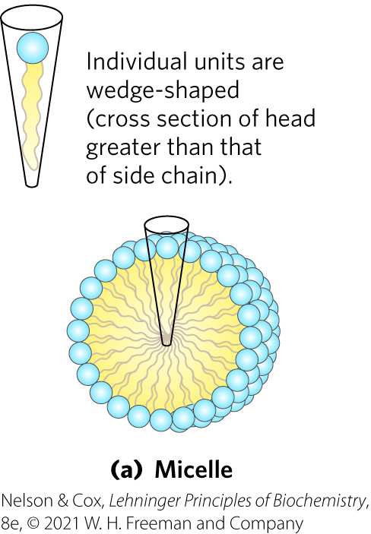
Micelle Formation
micelles = spherical structures containing amphipathic molecules arranged with hydrophobic regions in the interior and hydrophilic head groups on the exterior
  favored when the cross-sectional area of the head group is greater than that of the acyl side chain(s)

Slide 8

Clicker Question 1
Micelles were constructed for delivery of a hydrophobic chemotherapeutic drug. What change would INCREASE the diameter of the micelles?
increasing the concentration of cholesterol
increasing the length of the acyl chains used to make them
increasing the concentration of polyunsaturated fatty acids
using lipids with head groups having greater polarity
Notes:
Answer: B
Principle: 11.1
Learning Objective(s): Classify lipid micelles, bilayers, vesicles, and liposomes based on structure.
Bloom’s: 2:2

Slide 9
Clicker Question 1, Response
Micelles were constructed for delivery of a hydrophobic chemotherapeutic drug. What change would INCREASE the diameter of the micelles?
increasing the length of the acyl chains used to make them
In micelles, the hydrophobic chains of the fatty acids are sequestered at the core of the sphere. There is virtually no water in the hydrophobic interior. Increasing the length of the acyl chains in the fatty acids will increase the diameter of the micelles.

Slide 10
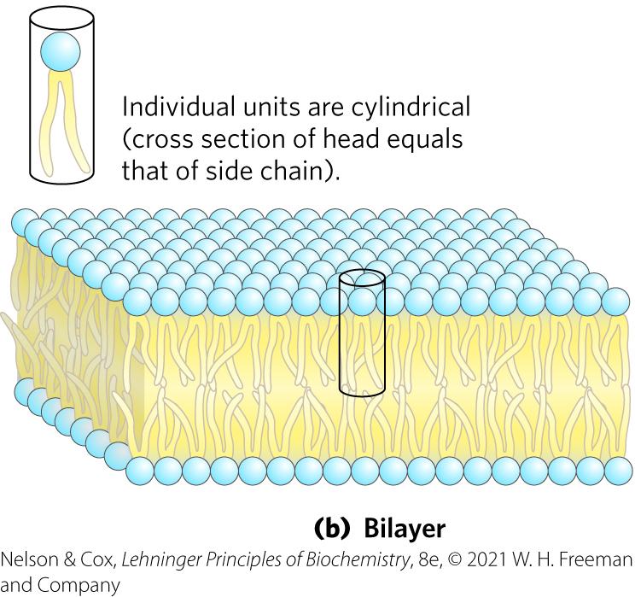
Bilayer Formation
bilayer = lipid aggregate in which two lipid monolayers (leaflets) form a two-dimensional sheet
  favored when the cross-sectional areas of the head group and acyl side chain(s) are similar

Slide 11
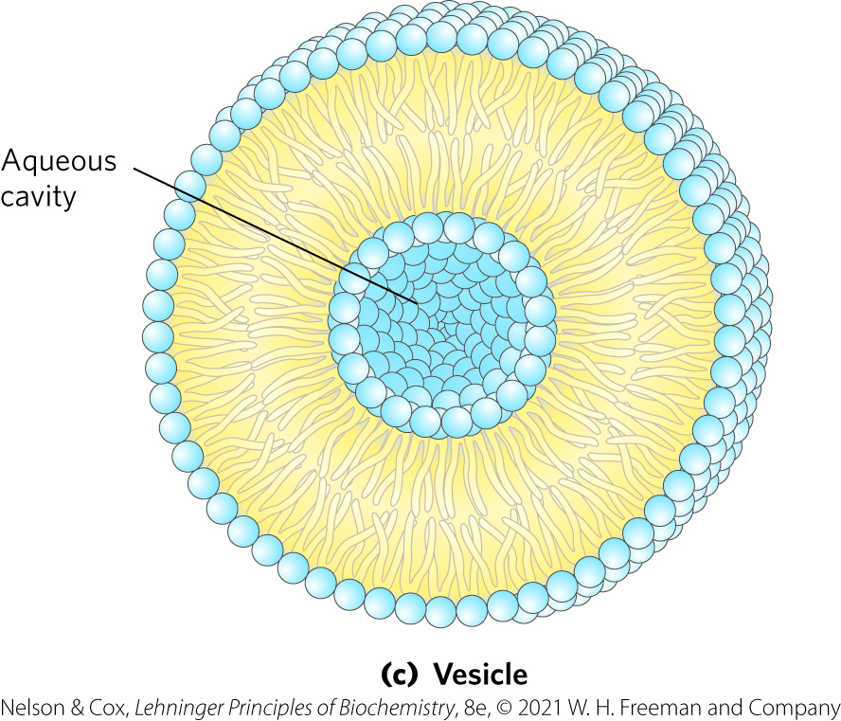
Vesicle Formation
vesicle (liposome) = forms spontaneously when a bilayer sheet folds back on itself to form a hollow sphere

Slide 12
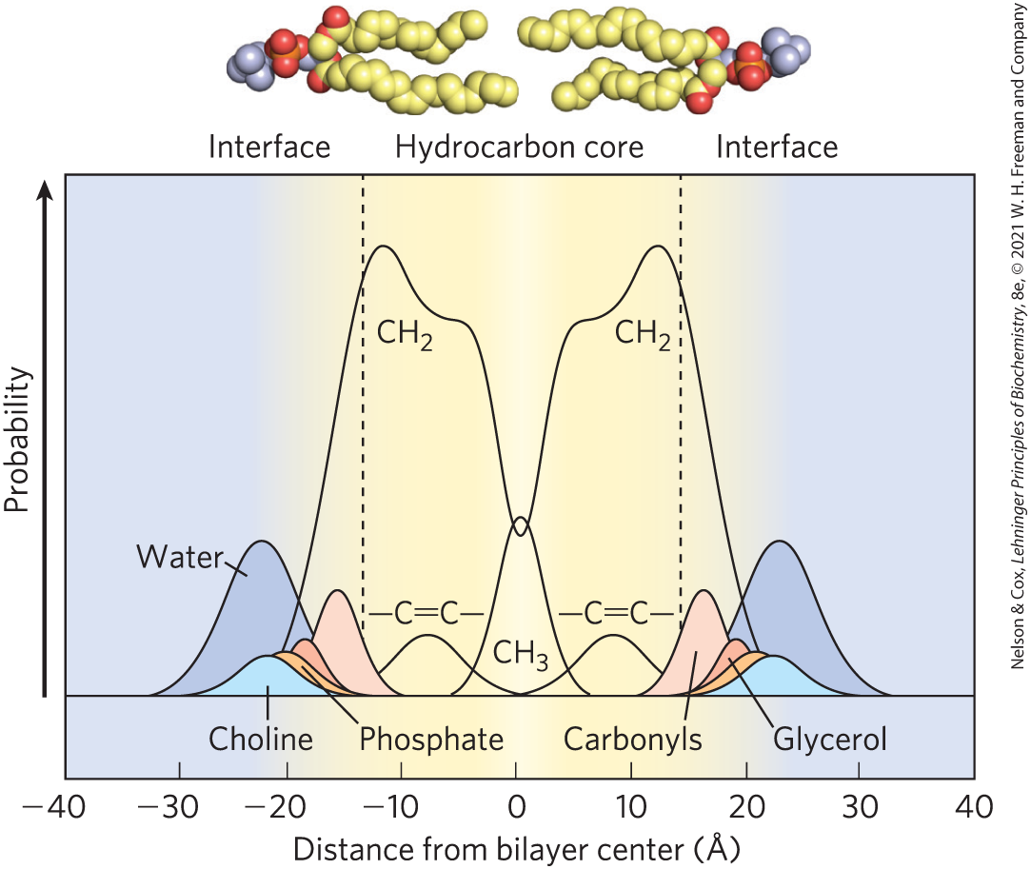
Distribution of Membrane Lipids in an Artificial Membrane
hydrocarbon core of the bilayer = ~30 Å
biological membranes (including protruding proteins) = ~50 – 80 Å

Slide 13
Clicker Question 2
Which amphipathic lipid aggregate is favored to form when glycerophospholipids are mixed with water?
No aggregate will form.
micelle
bilayer
vesicle (liposome)
Notes:
Answer: C
Principle: 11.1
Learning Objective(s): Classify lipid micelles, bilayers, vesicles, and liposomes based on structure.
Bloom’s: 2:2

Slide 14
Clicker Question 2, Response
Which amphipathic lipid aggregate is favored to form when glycerophospholipids are mixed with water?
C. bilayer
Bilayer formation is favored if the cross-sectional areas of the head group and acyl side chain(s) are similar, as in glycerophospholipids and sphingolipids.

Slide 15
Principle 1 (2 of 3)
The biological membrane is a lipid bilayer with proteins of various functions (enzymes, transporters) embedded in or associated with the bilayer. The hydrophobic effect stabilizes structures (lipid bilayers and vesicles) in which lipids with some polar and some nonpolar regions can protect their nonpolar regions from interaction with the very polar solvent, water. Membrane proteins are associated with the lipid bilayer more or less tightly, and proteins and lipids are both allowed limited lateral motion in the plane of the bilayer.

Slide 16
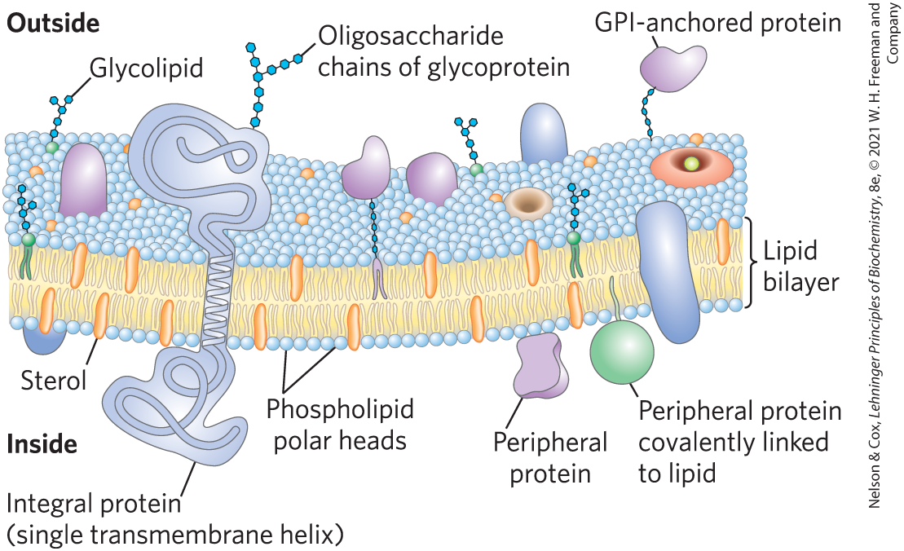
Bilayer Architecture Underlies the Structure and Function of Biological Membranes
fluid mosaic = pattern formed by individual lipid and protein units in a membrane
  pattern can change while maintaining the permeability membrane

Slide 17
Functions of Biological Membranes
permit shape changes that accompany cell growth and movement
permit exocytosis, endocytosis, and cell division
serve as molecular gatekeepers

Slide 18
Proteins and Enzymes In and On Membranes
transporters = move specific organic solutes and inorganic ions across the membrane
receptors = sense extracellular signals and trigger molecular changes in the cell
ion channels = mediate electrical signaling between cells
adhesion molecules = hold neighboring cells together

Slide 19
Clicker Question 3
Which statement is false?
All biological membranes have the same composition.
All biological membranes contain lipids.
Amphipathic molecules may form micelles rather than bilayers, depending on their structures.
Biological membranes typically contain proteins.
Notes:
Answer: A
Principle: 11.1
Learning Objective(s):
Bloom’s: 2:1

Slide 20
Clicker Question 3, Response
Which statement is false?
All biological membranes have the same composition.
The relative proportions of protein and lipid vary with the type of membrane, reflecting the diversity of biological roles. For example, certain neurons have a myelin sheath, consisting primarily of lipids. In contrast, the plasma membranes of bacteria, the sites of many enzyme-catalyzed processes, contain more protein than lipid.

Slide 21
Principle 2 (2 of 8)
All of the internal membranes of cells are part of an interconnected, functionally specialized, and dynamic endomembrane system. Proteins and lipids synthesized in the endoplasmic reticulum move through the Golgi apparatus, and they are targeted to the membranes of organelles or to the plasma membrane, where they provide the essential properties of these structures. During this membrane trafficking, some proteins are covalently altered, and some lipids are segregated into different organelles or are concentrated in one of the bilayer leaflets. Rafts are functionally specialized regions with unique lipid and protein compositions.

Slide 22
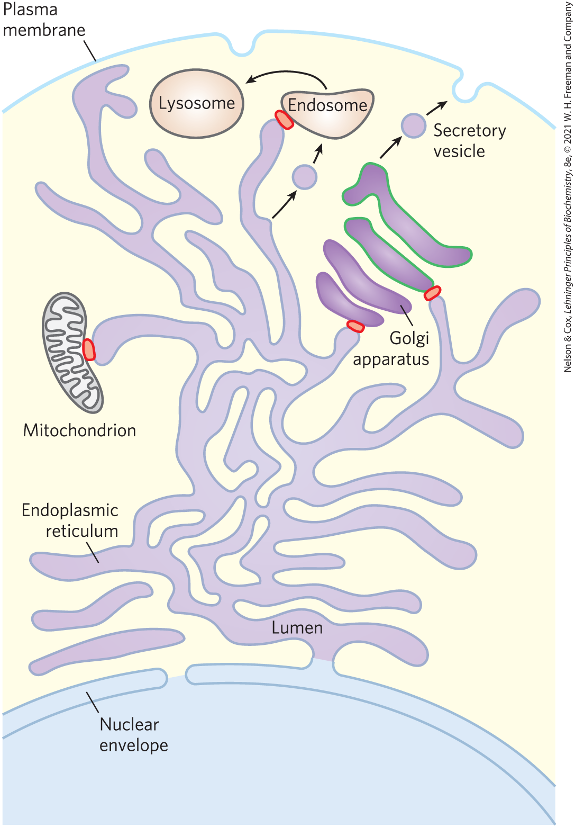
The Endomembrane System Is Dynamic and Functionally Differentiated
single membrane surrounds:
  endoplasmic reticulum (ER)
  Golgi apparatus
  lysosomes
  various small vesicles
double membrane surrounds:
  nucleus
  mitochondrion
  chloroplasts (in plants)

Slide 23
Clicker Question 4
What is the general sequence of membrane trafficking for an extracellular protein?
endoplasmic reticulum, Golgi apparatus, endosome, secretory vesicle, secretion from cell
endoplasmic reticulum, trans Golgi, secretory vesicle, cis Golgi, secretion from cell
Golgi apparatus, endoplasmic reticulum, secretory vesicle, secretion from cell
endoplasmic reticulum, cis Golgi, trans Golgi, secretory vesicle, secretion from cell
Notes:
Answer: D
Principle: 11.2
Learning Objective(s): List the components that make up the endomembrane system.
Bloom’s: 2:2

Slide 24
Clicker Question 4, Response
What is the general sequence of membrane trafficking for an extracellular protein?
endoplasmic reticulum, cis Golgi, trans Golgi, secretory vesicle, secretion from cell
Small vesicles bud off the endoplasmic reticulum, move to and fuse with the cis Golgi apparatus, exit the trans Golgi apparatus as secretory or transport vesicles, and fuse with the plasma membrane for secretion from the cell.

Slide 25
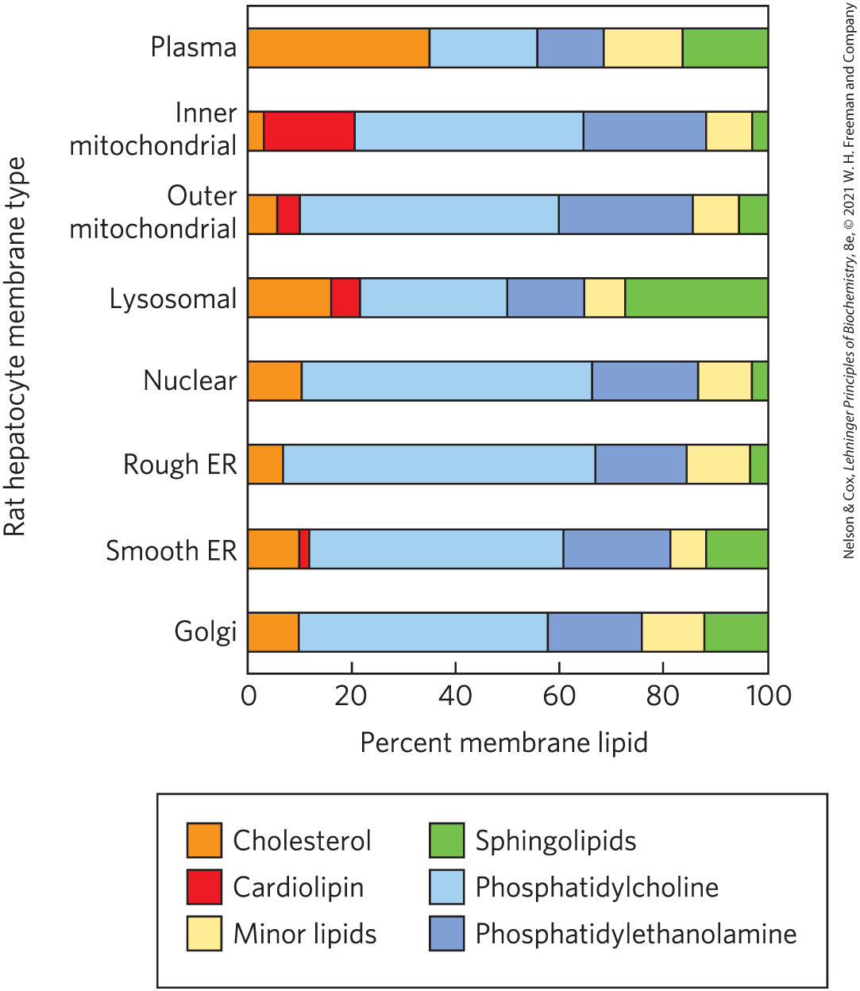
Lipid Composition of the Plasma and Organelle Membranes
the functional specialization of each membrane type is reflected in its unique lipid composition

Slide 26
Membrane Trafficking
membrane trafficking = process by which membrane lipids and proteins that are synthesized in the ER move to their destination organelles or to the plasma membrane
lipids and proteins undergo covalent modifications in the Golgi apparatus
  dictates the eventual location of the mature protein

Slide 27
Principle 2 (3 of 8)
All of the internal membranes of cells are part of an interconnected, functionally specialized, and dynamic endomembrane system. Proteins and lipids synthesized in the endoplasmic reticulum move through the Golgi apparatus, and they are targeted to the membranes of organelles or to the plasma membrane, where they provide the essential properties of these structures. During this membrane trafficking, some proteins are covalently altered, and some lipids are segregated into different organelles or are concentrated in one of the bilayer leaflets. Rafts are functionally specialized regions with unique lipid and protein compositions.

Slide 28
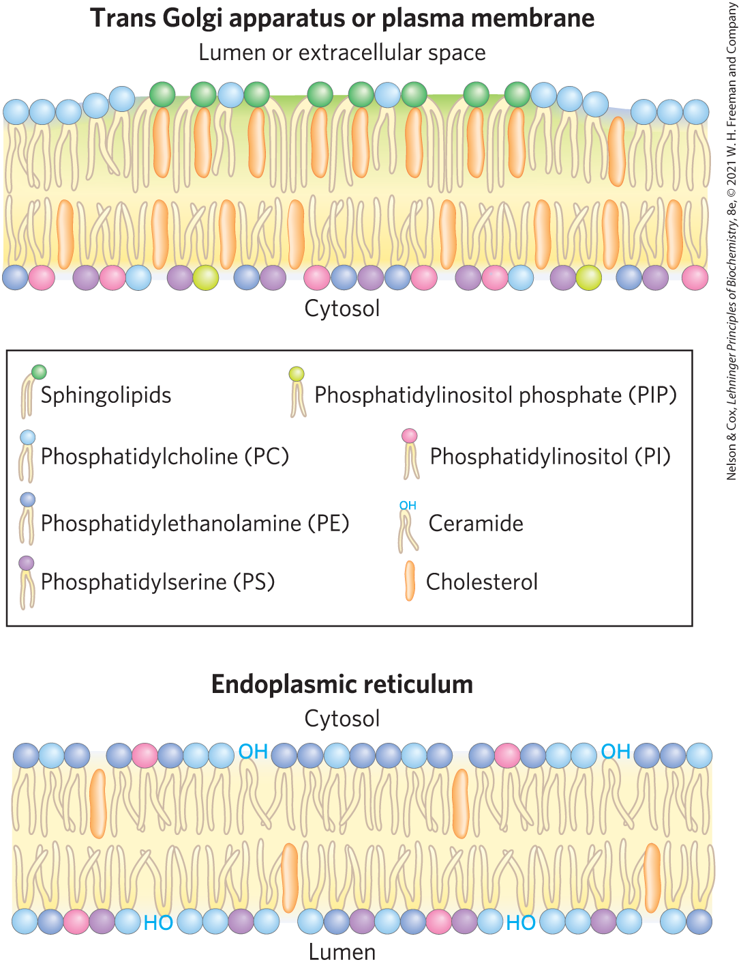
Changes in Lipid Composition During Membrane Trafficking
sphingolipids and cholesterol largely replace phosphatidylcholine
plasma membrane lipids are asymmetrically distributed between the two leaflets of the bilayer

Slide 29
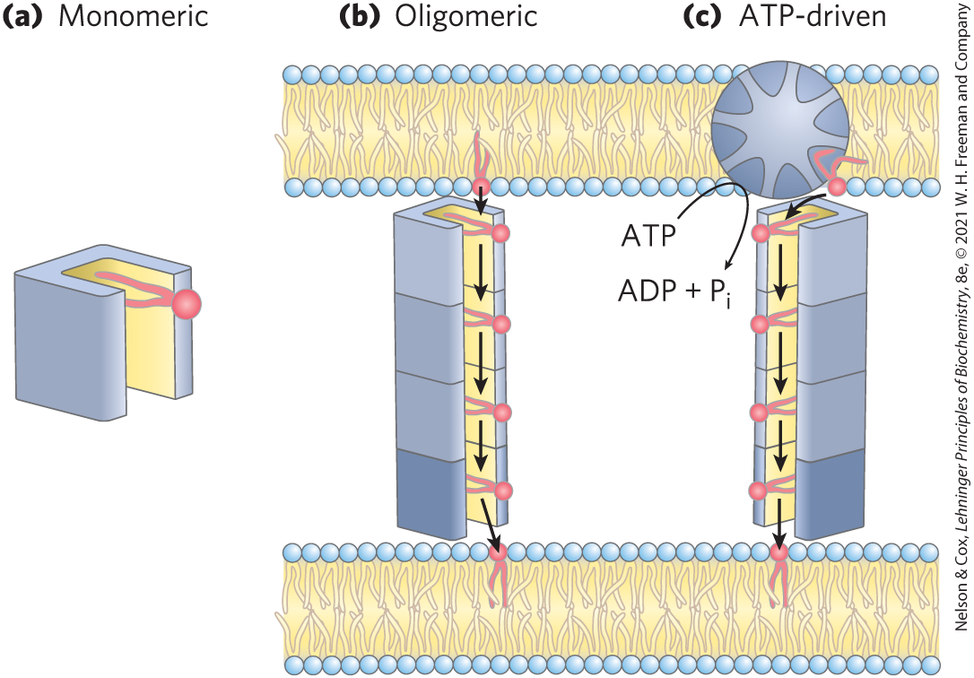
Lipid Transfer Proteins (LTPs)
lipid transfer proteins (LTPs) = soluble proteins that contain a hydrophobic lipid-binding pocket to carry a lipid from one membrane to another
  can be bispecific

Slide 30

Clicker Question 5
Which statement is false regarding lipid transfer proteins (LTPs)?
They are soluble in water.
They have a hydrophilic pocket for binding lipids.
In some cases, ATP is needed to drive the process.
The rate of lipid movement from one membrane to another in vivo is significantly greater than the rate of vesicle budding and fusion.
Notes:
Answer: B
Principle: 11.2
Learning Objective(s): Describe the mechanisms that are used to membrane lipids to their specific destinations.
Bloom’s: 2:2

Slide 31
Clicker Question 5, Response
Which statement is false regarding lipid transfer proteins (LTPs)?
They have a hydrophilic pocket for binding lipids.
Lipid transfer proteins move lipids and other nonpolar solutes through the very polar cytosol by providing a hydrophobic groove or pocket into which the hydrophobic solute can fit, with its nonpolar regions masked from the surrounding water.

Slide 32
Principle 2 (4 of 8)
All of the internal membranes of cells are part of an interconnected, functionally specialized, and dynamic endomembrane system. Proteins and lipids synthesized in the endoplasmic reticulum move through the Golgi apparatus, and they are targeted to the membranes of organelles or to the plasma membrane, where they provide the essential properties of these structures. During this membrane trafficking, some proteins are covalently altered, and some lipids are segregated into different organelles or are concentrated in one of the bilayer leaflets. Rafts are functionally specialized regions with unique lipid and protein compositions.

Slide 33
Membrane Proteins Are Receptors, Transporters, and Enzymes
groups of membrane proteins:
  receptors for extracellular signals
  transporters to carry specific polar or charged compounds across the plasma membrane or between organelles
  enzymes

Slide 34
Clicker Question 6
Which statement is true?
The fluid mosaic model considers biological membranes to be a sea of lipids floating in the aqueous fluid of the cytoplasm.
Membrane phospholipids always comprise the majority (by weight %) of a cell membrane.
All membranes in a given cell have the same lipid composition.
Lipid bilayers are essentially impermeable to polar solutes.
Notes:
Answer: D
Principle: 11.1
Learning Objective(s): Describe why flexibility and being selectively permeable are important features of a lipid membrane.
Bloom’s: 2:2

Slide 35
Clicker Question 6, Response
Which statement is true?
Lipid bilayers are essentially impermeable to polar solutes.
Cells have hundreds of membrane transporters that carry specific polar or charged compounds — sugars, amino acids, vitamins, a wide variety of metabolic inter- mediates, minerals (Mg²⁺, Ca²⁺, Na⁺, K⁺), and trace metal ions (Mn²⁺, Ni²⁺, Co²⁺) — in and out of cells and throughout the endomembrane system. All transporters must span the membrane at least once to play their roles.

Slide 36
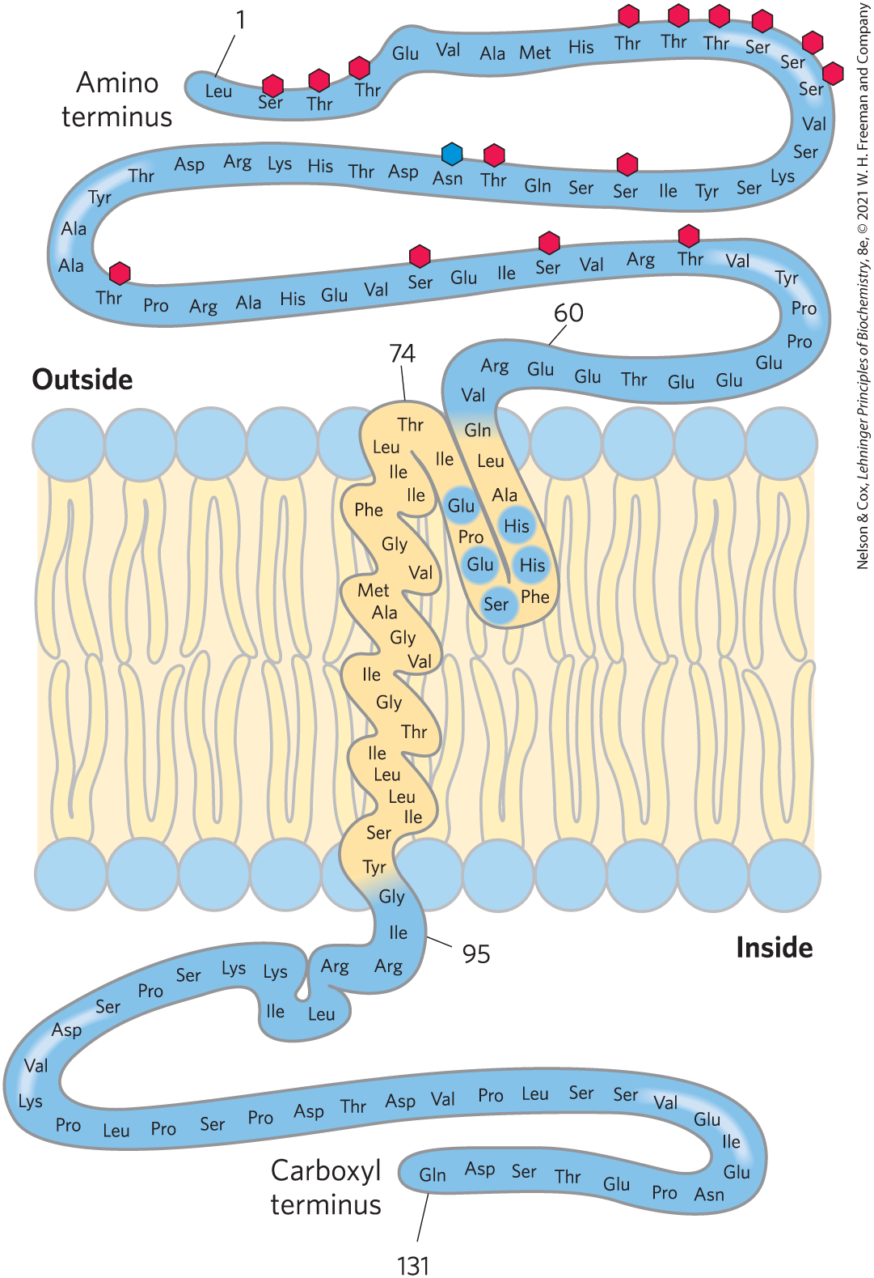
Posttranslational Modification of Membrane Proteins
glycosylation = attachment of oligosaccharides to proteins
  typically on the outer face of the plasma membrane
attachment of 1+ lipids = serve as hydrophobic anchors or targeting tags

Slide 37
Membrane Proteins Differ in the Nature of Their Association with the Membrane Bilayer
integral membrane proteins = firmly embedded within the lipid bilayer
peripheral membrane proteins = associate with the membrane through electrostatic interactions and hydrogen bonding
amphitropic proteins = associate reversibly with membranes
  found in both membranes and the cytosol

Slide 38
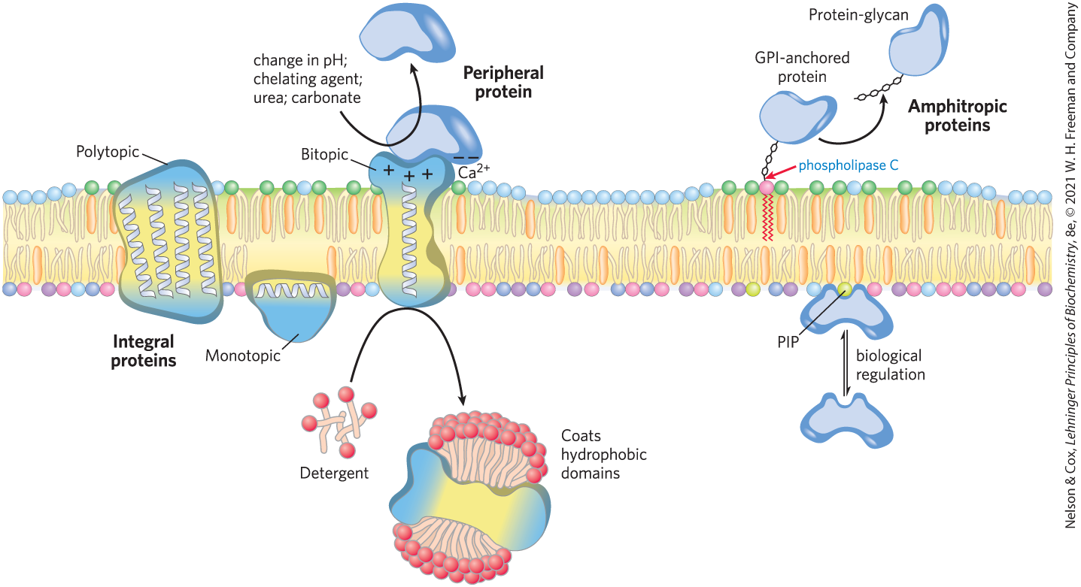
Integral, Peripheral, and Amphitropic Proteins

Slide 39
Clicker Question 7
An amphitropic protein:
has both basic and acidic surfaces.
switches from one face of a membrane to the other.
is sometimes associated with a membrane and sometimes not.
is never a peripheral membrane protein.
Notes:
Answer: C
Principle: 11.2
Learning Objective(s): Contrast transmembrane, integral, amphitropic, and peripheral proteins.
Bloom’s: 2:1

Slide 40
Clicker Question 7, Response
An amphitropic protein:
is sometimes associated with a membrane and sometimes not.
Amphitropic proteins associate reversibly with membranes and are therefore found both in the membrane and in the cytosol. Their affinity for membranes results in some cases from the protein’s noncovalent interaction with another membrane protein or lipid, and in other cases from the presence of one or more covalently attached lipids.

Slide 41
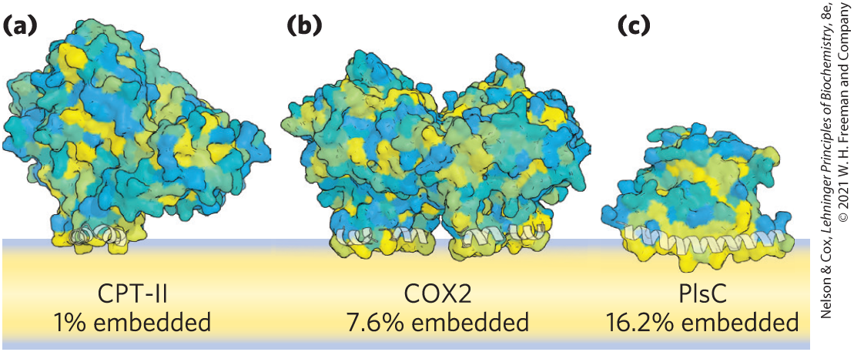
Monotopic Proteins
monotopic = have small hydrophobic domains that interact with only a single leaflet of the membrane

Slide 42
Bitopic Proteins
bitopic = span the bilayer once, extending on either surface
  have a single hydrophobic sequence somewhere in the molecule

Slide 43
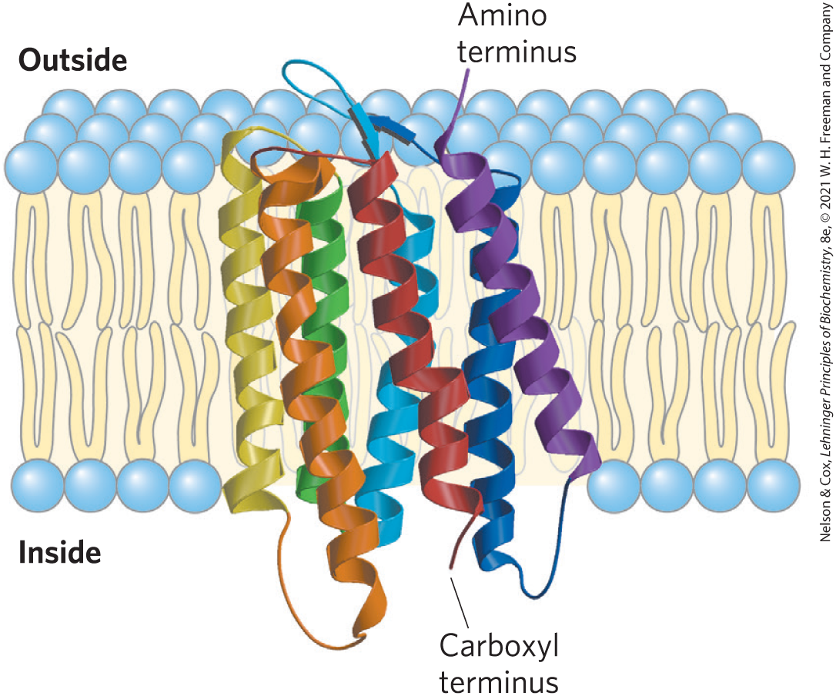
Polytopic Proteins
polytopic = cross the membrane several times
  have multiple hydrophobic sequences of ~20 residues that each cross the membrane when in the α-helical conformation
bacteriorhodopsin

Slide 44
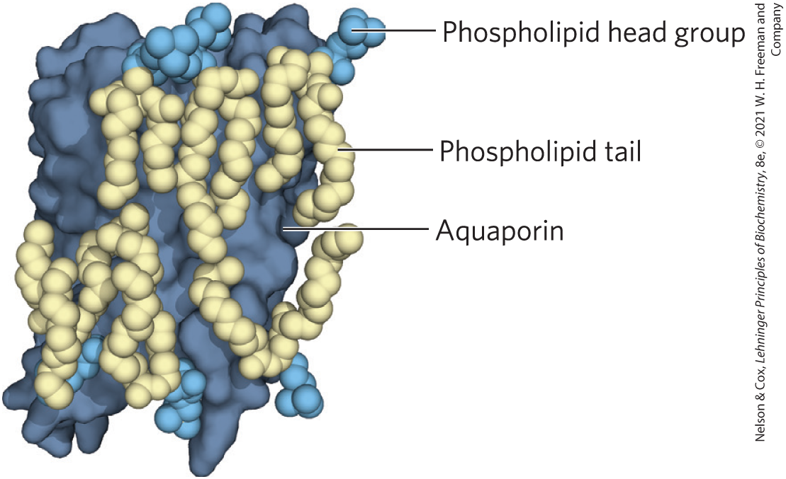
Many Membrane Proteins Co-Crystallize with Phospholipid Molecules
phospholipids lie:
  on the protein surface
  at interfaces between monomers of multisubunit proteins, forming a “grease seal”

Slide 45
Clicker Question 8
Which statement is true?
Monotopic integral proteins have small hydrophilic domains that hold the proteins to the membrane.
Bitopic proteins span the bilayer twice.
A hydrophobic sequence of 20 amino acid residues will span the lipid bilayer when in the α-helical conformation.
Membrane proteins do not co-crystallize with phospholipids.
Notes:
Answer: C
Principle: 11.2
Learning Objective(s): Identify a monotropic, bitropic, and polytropic protein.
Bloom’s: 2:2

Slide 46
Clicker Question 8, Response
Which statement is true?
A hydrophobic sequence of 20 amino acid residues will span the lipid bilayer when in the α-helical conformation.
Polytopic proteins cross the membrane several times. They have multiple hydrophobic sequences, each of which, when in the α-helical conformation, is long enough (about 20 residues) to span the lipid bilayer.

Slide 47
The Topology of an Integral Membrane Protein Can Often Be Predicted from Its Sequence
an α-helical sequence of 20-25 residues (each 1.5 Å) is just long enough to span the thickness (30 Å) of the lipid bilayer
  stabilized by intrachain hydrogen bonding and the hydrophobic effect
in many organisms, 20-30% of proteins are integral proteins

Slide 48
Hydropathy Index
hydropathy index = expresses the free-energy change associated with the movement of an amino acid side chain from a hydrophobic environment to water
  ranges from highly exergonic to highly endergonic
overall hydropathy index = estimated by summing the free energies of transfer for the residues in the sequence

Slide 49
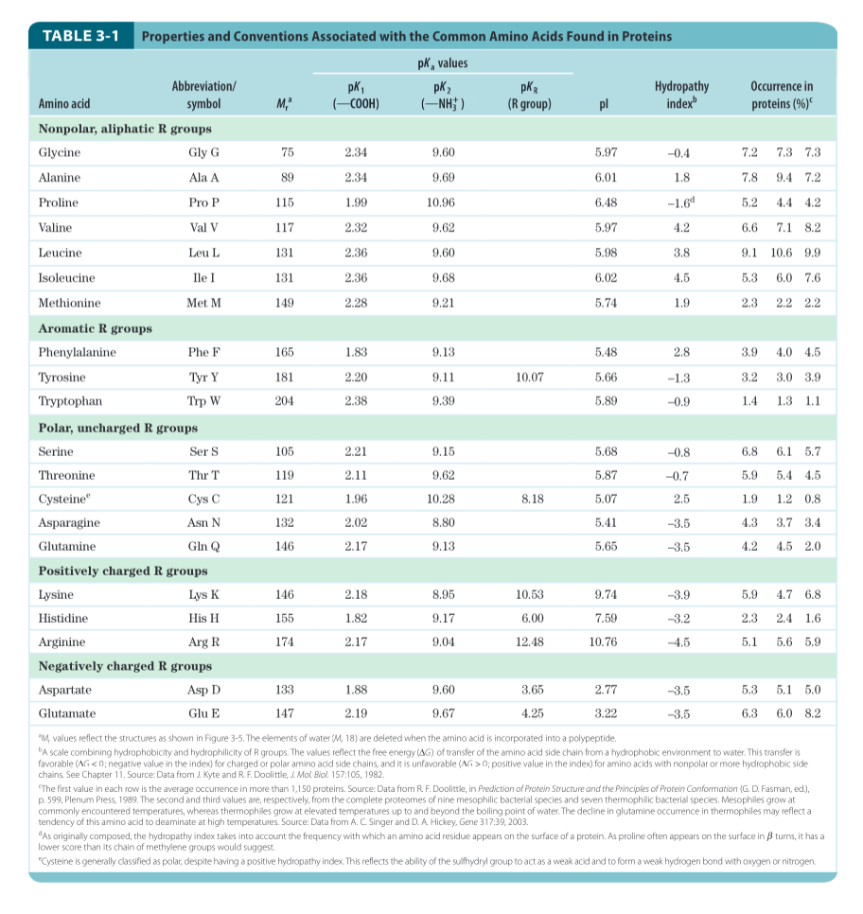
Hydropathy Index for the 20 Common Amino Acids

Slide 50
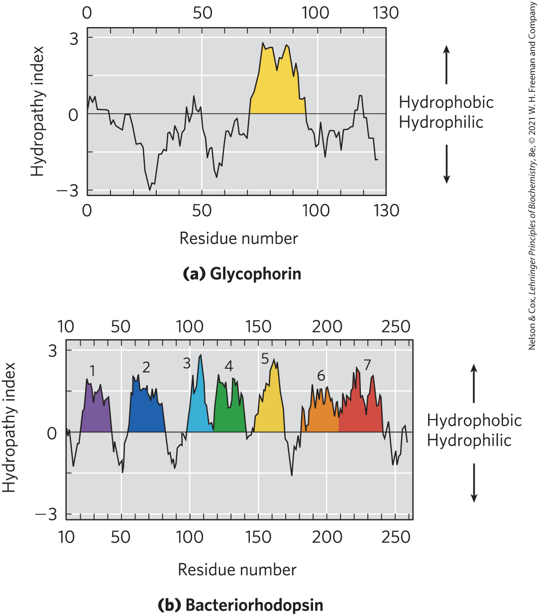
Hydropathy Plots
hydropathy plot = average hydropathy index plotted against residue number
  window = segment of given length
  hydropathy index (y-axis) = average hydropathy for a window
  residue number (x-axis) = the residue in the middle of the window

Slide 51
Clicker Question 9
Which statement is true regarding hydropathy plots?
A negative hydropathy index indicates the residue number is hydrophobic.
A region with more than 20 residues of high hydropathy index is presumed to be a transmembrane segment.
An integral protein must have at least one sequence of 20 hydrophilic residues.
Hydropathy plots plot residue number (y-axis) against average hydropathy index (x-axis).
Notes:
Answer: B
Principle: 11.2
Learning Objective(s): Predict a membrane-spanning region within a protein based on its hydropathy plot; Distinguish a membrane spanning beta sheet from a membrane spanning alpha helix using a hydropathy plot.
Bloom’s: 2:2

Slide 52
Clicker Question 9, Response
Which statement is true regarding hydropathy plots?
A region with more than 20 residues of high hydropathy index is presumed to be a transmembrane segment.
The presence of unbroken sequences of more than 20 hydrophobic residues in a membrane protein is commonly taken as evidence that these sequences traverse the lipid bilayer.

Slide 53
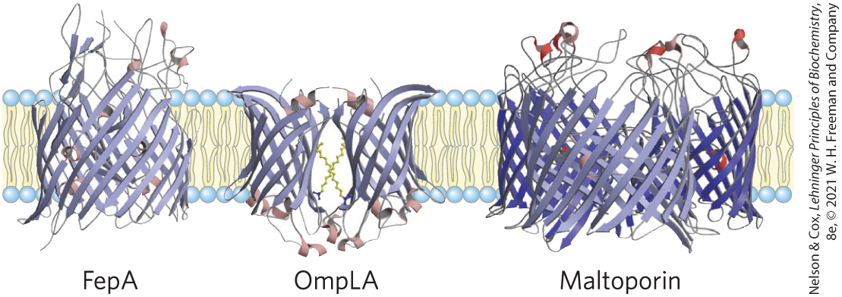
β Barrel
β barrel = structural motif in which 20+ transmembrane segments form β sheets that line a cylinder
  stabilized by intrachain hydrogen bonds
porins = proteins that allow certain polar solutes to cross the outer membrane of gram-negative bacteria
  have β barrels lining the transmembrane passage

Slide 54
β Strands of Membrane Proteins
in β conformation:
  seven to nine residues are needed to span a membrane
  alternating side chains project above and below the sheet
in β strands of membrane proteins:
  every second residue in the membrane-spanning segment is hydrophobic and interacts with the lipid bilayer
  aromatic side chains are commonly found at the lipid-protein interface

Slide 55
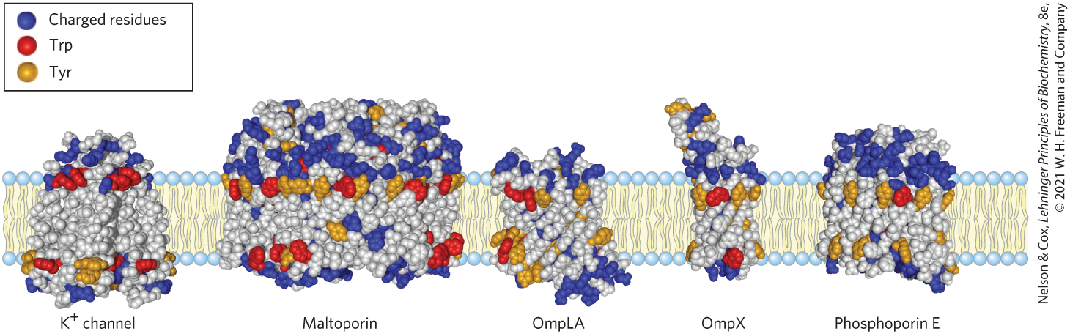
Amino Acid Locations Relative to the Bilayer
Tyr and Trp side chains serve as membrane interface anchors
positive-inside rule = positively charged Lys and Arg residues in the extramembrane loop of membrane proteins occur more commonly on the cytoplasmic face

Slide 56
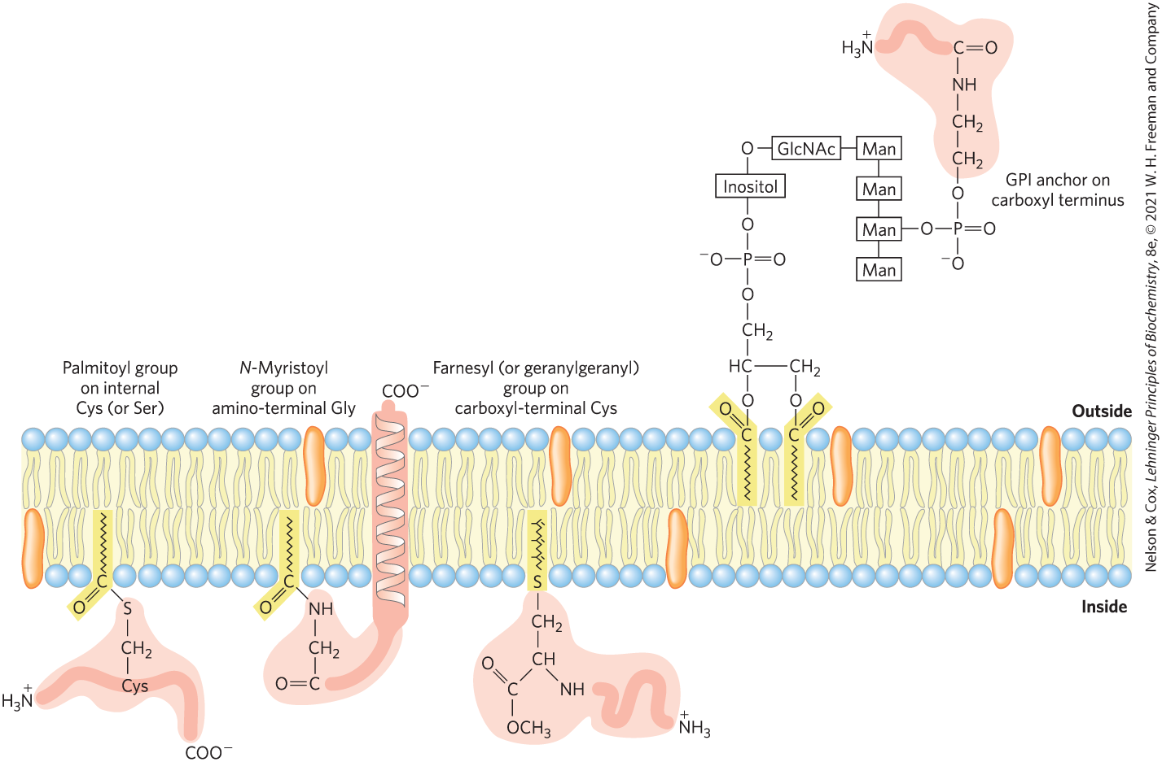
Covalently Attached Lipids Anchor or Direct Some Membrane Proteins
GPI-anchored protein = exclusively on the outer face and are clustered in certain regions

Slide 57
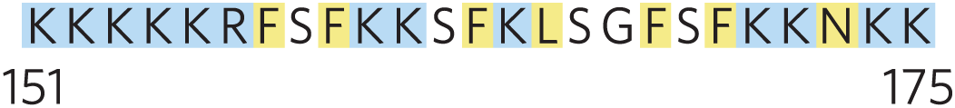
Ionic Attractions Can Add to the Anchoring Effect of a Covalently Bound Lipid
ionic attractions between positively charged residues in the protein and negatively charged lipid head groups add to the protein’s affinity for the membrane
  example: the plasma membrane protein MARCKS (myristoylated alanine-rich C-kinase substrate)

Slide 58
Clicker Question 10
Which statement is true?
Hydropathy analysis provides a measure of H-bonding within the transmembrane portion of a membrane-spanning protein.
For all glycoproteins of a plasma membrane, the glycosylated domains are always found on the extracellular face of the bilayer.
Proteins may be embedded in, but never span, a biological membrane.
Once a membrane is synthesized, the lipid composition of each monolayer does not change.
Notes:
Answer: B
Principle: 11.2
Learning Objective(s): Contrast transmembrane, integral, amphitropic, and peripheral proteins.
Bloom’s: 2:2

Slide 59
Clicker Question 10, Response
Which statement is true?
For all glycoproteins of a plasma membrane, the glycosylated domains are always found on the extracellular face of the bilayer.
One covalent modification is the glycosylation (attachment of oligosaccharides) of proteins bound for the plasma membrane. For these glycoproteins, Ser, Thr, and Asn residues are the most common points of carbohydrate attachment, and the carbohydrates are invariably on the outer face of the plasma membrane.

Slide 60
11.2 Membrane Dynamics

Slide 61
Principle 1 (3 of 3)
The biological membrane is a lipid bilayer with proteins of various functions (enzymes, transporters) embedded in or associated with the bilayer. The hydrophobic effect stabilizes structures (lipid bilayers and vesicles) in which lipids with some polar and some nonpolar regions can protect their nonpolar regions from interaction with the very polar solvent, water. Membrane proteins are associated with the lipid bilayer more or less tightly, and proteins and lipids are both allowed limited lateral motion in the plane of the bilayer.

Slide 62
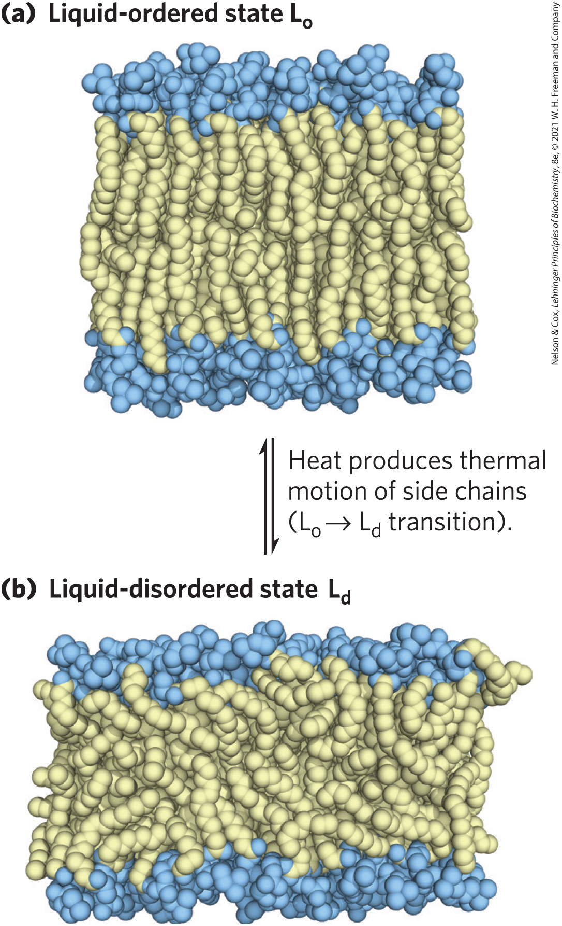
Acyl Groups in the Bilayer Interior Are Ordered to Varying Degrees
liquid-ordered (L_{o}) state = gel-like state in which all types of motion of individual molecules are strongly constrained
liquid-disordered (L_{d}) state = state in which individual hydrocarbon chains are in constant motion (lateral and rotational)

Slide 63
Fatty Acid Composition Affects Membrane Fluidity
at physiological temperatures:
  long-chain saturated fatty acids tend to pack into an L_{o} phase
  kinks in unsaturated fatty acids interfere with packing, favoring the L_{d} state
  shorter-chain fatty acyl groups favor the L_{d} state

Slide 64
Sterol Content Affects Membrane Fluidity
sterols have paradoxical effects on bilayer fluidity:
  they interact with phospholipids containing unsaturated fatty acyl chains, compacting them and constraining their motion
  they associate with sphingolipids and phospholipids having long, saturated fatty acyl chains, making the bilayer fluid

Slide 65
Clicker Question 11
Membrane fluidity:
is maximal when the membrane lipids are in the L_{o} state.
is a function of temperature if composition is held constant.
increases with saturated fatty acid content.
is not affected by sterol content.
Notes:
Answer: B
Principle: 11.1
Learning Objective(s): Contrast the liquid-ordered state and the liquid-disordered state
Bloom’s: 2:2

Slide 66
Clicker Question 11, Response
Membrane fluidity:
is a function of temperature if composition is held constant.
Heat produces thermal motion of side chains, causing the transition from the liquid-ordered (L_{o}) state to the liquid-disordered (L_{d}) state.

Slide 67
Clicker Question 12
Liposomes were constructed for an experiment with liver cells in culture. The experiment will be at 25 °C and not 37 °C. Which change could NOT increase liposome fluidity at the lower temperature?
increasing the concentration of sterols
increasing the concentration of polyunsaturated fatty acids in phospholipids
decreasing the concentration of saturated fatty acids in sphingolipids
increasing the concentration of triacylglycerol in liposomes
Notes:
Answer: D
Principle: 11.1
Learning Objective(s): Contrast the liquid-ordered state and the liquid-disordered state
Bloom’s: 2:2

Slide 68
Clicker Question 12, Response
Liposomes were constructed for an experiment with liver cells in culture. The experiment will be at 25 °C and not 37 °C. Which change could NOT increase liposome fluidity at the lower temperature?
increasing the concentration of triacylglycerol in liposomes
Triacylglycerols are storage lipids and not used for making liposomes.

Slide 69
Clicker Question 13
A cell was growing happily at 37 °C, but the temperature was then changed to 40 °C. What modifications to the plasma membrane could a cell make to counteract the increase in temperature?
Add more cholesterol into the plasma membrane.
Introduce more saturated fatty acids into the phospholipids.
Decrease the number of double bonds in fatty acids in the phospholipids.
All of the answers are correct.
Notes:
Answer: D
Principle: 11.1
Learning Objective(s): Contrast the liquid-ordered state and the liquid-disordered state
Bloom’s: 2:2

Slide 70
Clicker Question 13, Response
A cell was growing happily at 37 °C, but the temperature was then changed to 40 °C. What modifications to the plasma membrane could a cell make to counteract the increase in temperature?
D. All of the answers are correct.
To counteract the temperature, the cell needs to make the plasma membrane more ordered. This can be achieved by adding cholesterol, introducing more saturated fatty acids, or decreasing the number of double bonds in fatty acids.

Slide 71

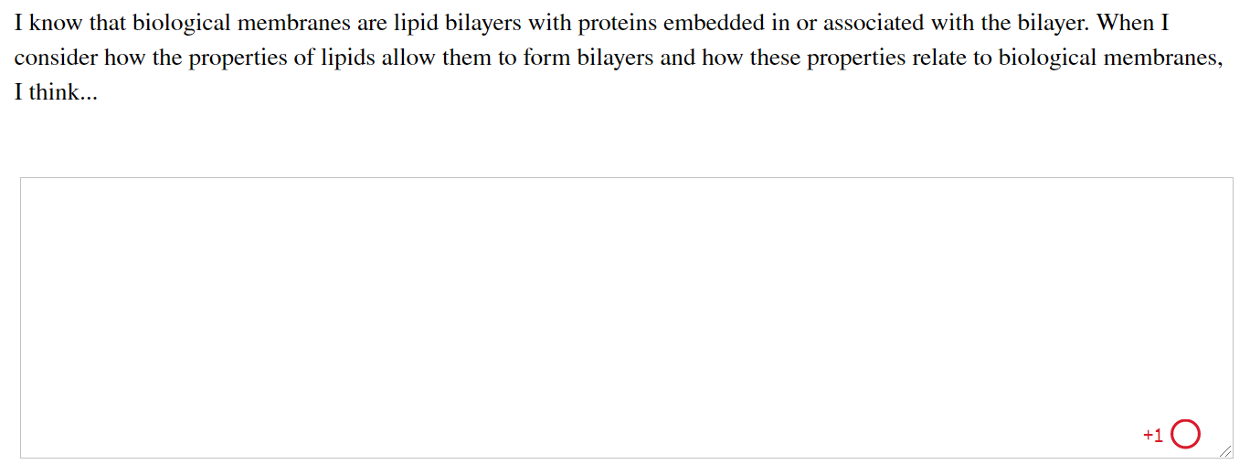
Activity: Biological Membrane
Structure Muddiest Point (1 of 2)
Complete the Ch11 Student Activity, Day 1: Biological Membrane Structure (Muddiest Point) Achieve assessment.
Notes:
Instructor: This muddiest point activity can be found in Achieve in the Chapter 11 folder titled “Ch11 In-Class Activities, Videos, and Resources.” See the Instructor Activity Guide in the same folder for more information.

Slide 72
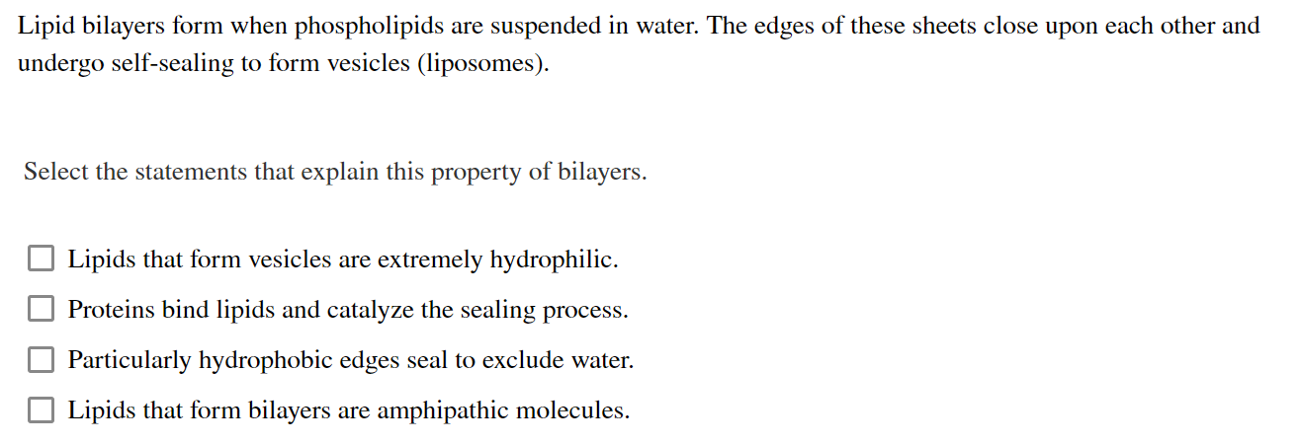
Activity: Biological Membrane
Structure Muddiest Point (2 of 2)
Complete the Ch11 Student Activity, Day 2: Biological Membrane Structure (Muddiest Point) Achieve assessment.
Notes:
Instructor: This muddiest point activity can be found in Achieve in the Chapter 11 folder titled “Ch11 In-Class Activities, Videos, and Resources.” See the Instructor Activity Guide in the same folder for more information.

Slide 73
Principle 2 (5 of 8)
All of the internal membranes of cells are part of an interconnected, functionally specialized, and dynamic endomembrane system. Proteins and lipids synthesized in the endoplasmic reticulum move through the Golgi apparatus, and they are targeted to the membranes of organelles or to the plasma membrane, where they provide the essential properties of these structures. During this membrane trafficking, some proteins are covalently altered, and some lipids are segregated into different organelles or are concentrated in one of the bilayer leaflets. Rafts are functionally specialized regions with unique lipid and protein compositions.

Slide 74
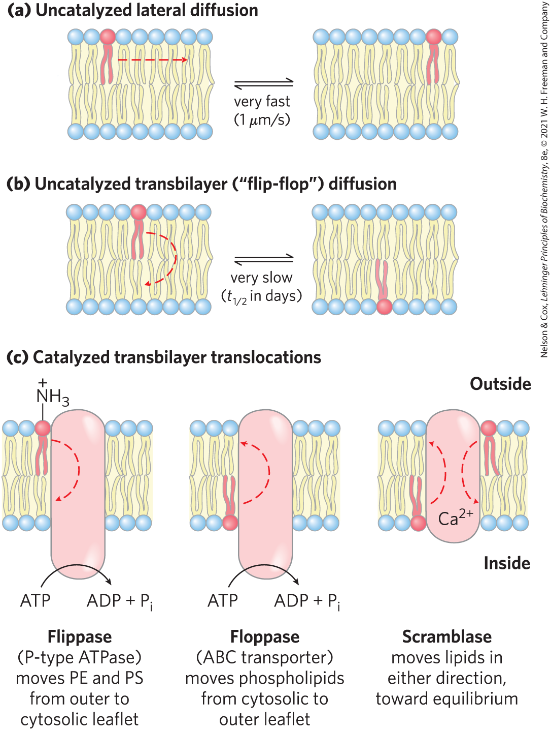
Transbilayer Movement of Lipids Requires Catalysis
transbilayer (“flip-flop”) movement has a large, positive free-energy change
membrane proteins facilitate the translocation of individual lipid molecules

Slide 75
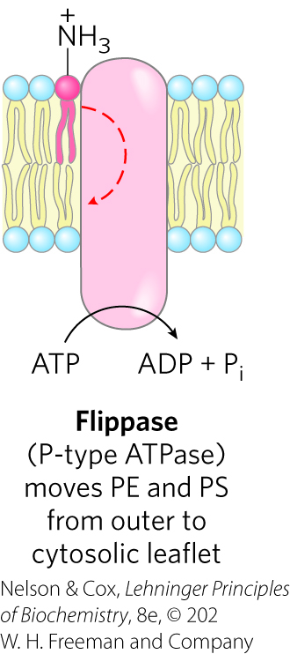
Flippases
flippases = catalyze translocation of the amino- phospholipids phosphatidylethanolamine (PE) and phosphatidylserine (PS) from the extracellular to the cytoplasmic leaflet of the plasma membrane
  consume ~1 ATP per molecule of phospholipid translocated
  related to the P-type ATPases (active transporters)

Slide 76
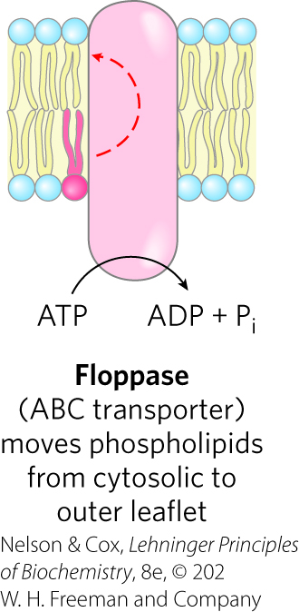
Floppases
floppases = move plasma membrane phospholipids and sterols from the cytoplasmic leaflet to the extracellular leaflet
  are ATP-dependent
  members of the ABC transporter family
  each specializes in movement of specific lipids

Slide 77
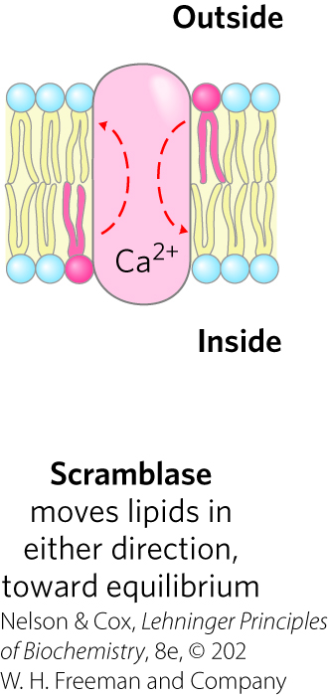
Scramblases
scramblases = move any membrane phospholipid across the bilayer down its concentration gradient
  not dependent on ATP; some require Ca²⁺
  lead to controlled randomization of the head-group composition on the two faces of the bilayer

Slide 78
Clicker Question 14
Which movement type of membrane phospholipids is slowest?
transbilayer diffusion
lateral diffusion
scramblase-mediated movement
flippase-mediated movement
Notes:
Answer: A
Principle: 11.2
Learning Objective(s): Identify a flipase, flopase, scramblase, and phosphatidylinositol transfer proteins based on the mechanisms of phospholipid transport.
Bloom’s: 2:2

Slide 79
Clicker Question 14, Response
Which movement type of membrane phospholipids is slowest?
transbilayer diffusion
Transbilayer movement requires that a polar or charged head group leave its aqueous environment and move into the hydrophobic interior of the bilayer, a process with a large, positive free-energy change. Transbilayer diffusion is slow; however, membrane proteins called flippases, floppases, and scramblases provide a path that is energetically more favorable and much faster than the uncatalyzed movement.

Slide 80
Phosphatidylinositol Transfer Proteins
phosphatidylinositol transfer proteins = move phosphatidylinositol lipids across lipid bilayers
  believed to have roles in lipid signaling and membrane trafficking

Slide 81
Clicker Question 15
To move phospholipids from the inner leaflet to the outer leaflet of the plasma membrane, which enzyme is used?
No enzyme is necessary.
flippase
floppase
scramblase
Notes:
Answer: C
Principle: 11.2
Learning Objective(s): Identify a flipase, flopase, scramblase, and phosphatidylinositol transfer proteins based on the mechanisms of phospholipid transport.
Bloom’s: 2:2

Slide 82
Clicker Question 15, Response
To move phospholipids from the inner leaflet to the outer leaflet of the plasma membrane, which enzyme is used?
C. floppase
Floppases move plasma membrane phospholipids and sterols from the cytoplasmic leaflet to the extracellular leaflet.

Slide 83
Principle 2 (6 of 8)
All of the internal membranes of cells are part of an interconnected, functionally specialized, and dynamic endomembrane system. Proteins and lipids synthesized in the endoplasmic reticulum move through the Golgi apparatus, and they are targeted to the membranes of organelles or to the plasma membrane, where they provide the essential properties of these structures. During this membrane trafficking, some proteins are covalently altered, and some lipids are segregated into different organelles or are concentrated in one of the bilayer leaflets. Rafts are functionally specialized regions with unique lipid and protein compositions.

Slide 84
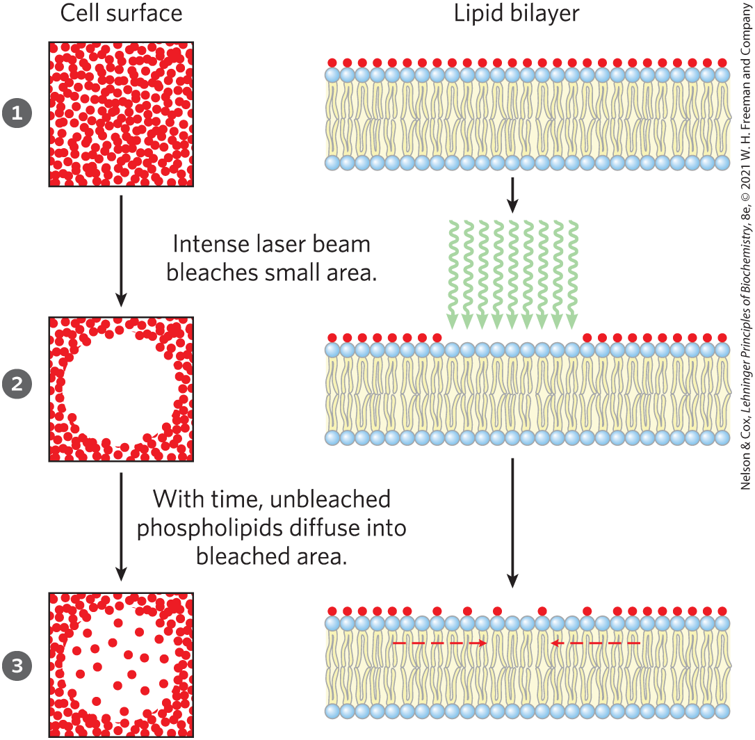
Lipids and Proteins Diffuse Laterally in the Bilayer
individual lipid molecules undergo Brownian movement
FRAP = fluorescence recovery after photobleaching
  rate is a measure of the rate of lateral diffusion of the lipids

Slide 85
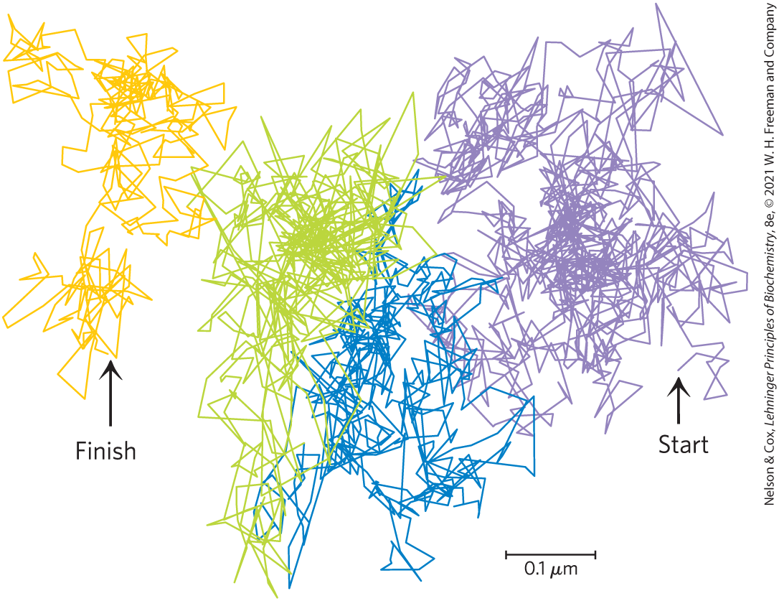
Hop Diffusion of Individual Lipid Molecules
single particle tracking confirms lipid molecules diffuse laterally within small regions
movement from one region to another (“hop diffusion”) is rarer

Slide 86
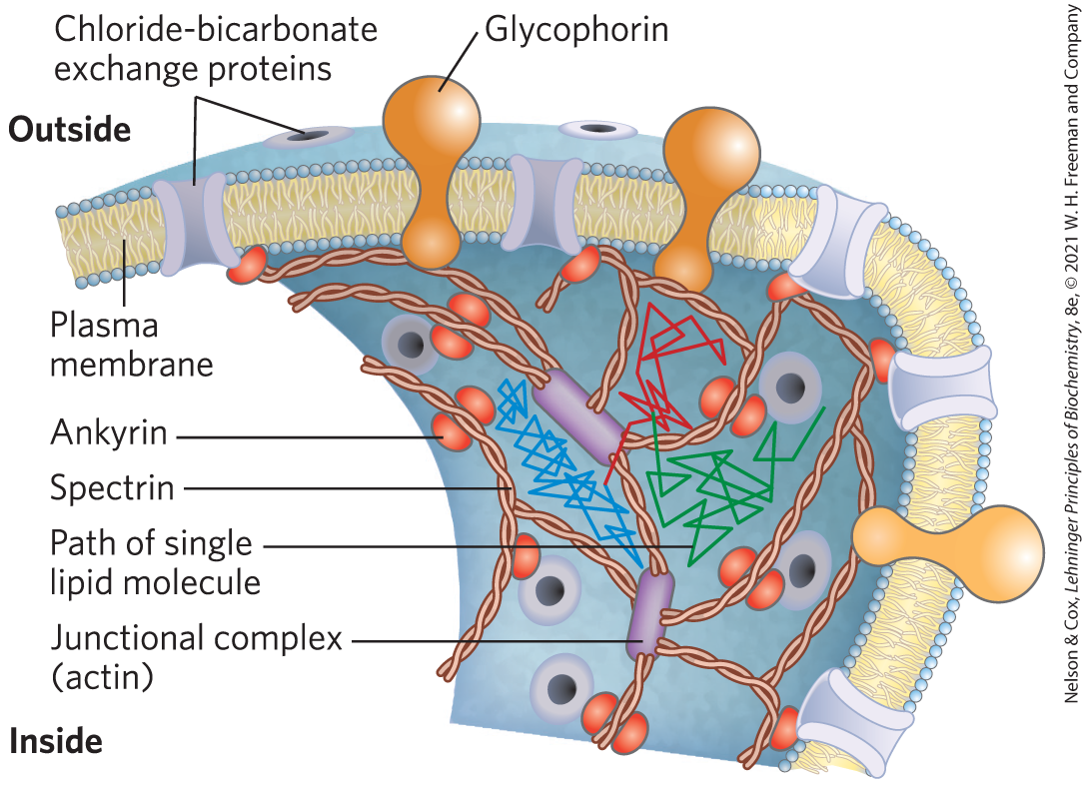
Some Membrane Proteins Are Free to Diffuse, Whereas Others Are Not
membrane proteins are limited in movement by:
  associating to form large aggregates (“patches”)
  anchoring to internal structures

Slide 87
Principle 2 (7 of 8)
All of the internal membranes of cells are part of an interconnected, functionally specialized, and dynamic endomembrane system. Proteins and lipids synthesized in the endoplasmic reticulum move through the Golgi apparatus, and they are targeted to the membranes of organelles or to the plasma membrane, where they provide the essential properties of these structures. During this membrane trafficking, some proteins are covalently altered, and some lipids are segregated into different organelles or are concentrated in one of the bilayer leaflets. Rafts are functionally specialized regions with unique lipid and protein compositions.

Slide 88
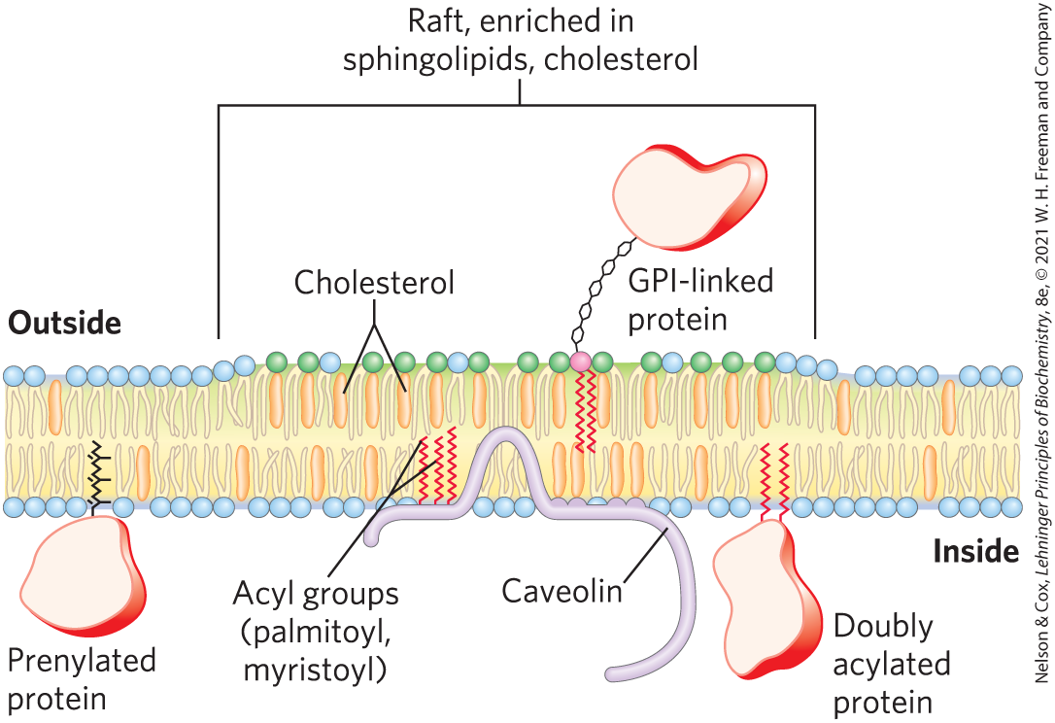
Sphingolipids and Cholesterol Cluster Together in Membrane Rafts
microdomains (rafts) = clusters of cholesterol and sphingolipids that make the bilayer slightly thicker and more ordered than neighboring, phospholipid-rich regions
  can be up to 50% of the cell surface

Slide 89
Proteins and Lipid Rafts
proteins must have hydrophobic helical sections long enough to segregate into the thicker bilayer regions of rafts
lipid rafts are enriched in:
  proteins that have two long-chain saturated fatty acids covalently attached through Cys residues
  GPI-anchored proteins

Slide 90
Clicker Question 16
Lipid rafts:
tend to exclude receptors and signaling proteins.
are enriched in two kinds of integral membrane proteins.
are areas of lipids in a membrane completely surrounded by proteins.
largely consist of phospholipids in a liquid-disordered state.
Notes:
Answer: B
Principle: 11.2
Learning Objective(s): Describe how a sphingolipid raft differs from other areas of the phospholipid membrane; Correlate membrane protein structure to location in a lipid raft or other parts of the phospholipid membrane.
Bloom’s: 2:2

Slide 91
Clicker Question 16, Response
Lipid rafts:
are enriched in two kinds of integral membrane proteins.
Lipid rafts are remarkably enriched in two classes of integral proteins, with two specific types of covalently attached lipids. Members of the first class have two long-chain saturated fatty acids covalently attached through Cys residues. Members of the second class are GPI-anchored proteins.

Slide 92
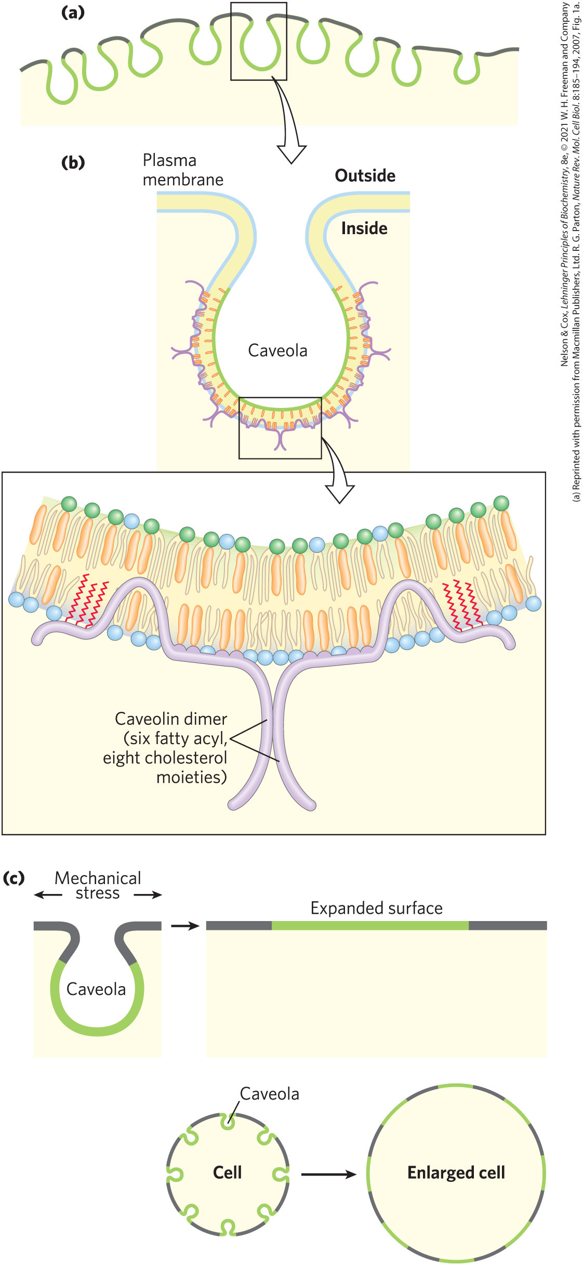
Caveolae and Caveolin
caveolae (“little caves”) = specialized rafts
caveolin = integral protein that binds to the cytoplasmic leaflet of the plasma membrane
  forms dimers
  associates with cholesterol-rich membrane regions
  forces the bilayer to curve inward to form caveolae

Slide 93
Clicker Question 17
Which statement regarding caveolae is false?
They are a means of expanding the cell surface.
Their extracellular leaflets are lipid rafts.
They tend to be cholesterol poor.
They result from the formation of caveolin dimers.
Notes:
Answer: C
Principle: 11.2
Learning Objective(s): List the functions caveolae play in cellular function
Bloom’s: 2:2

Slide 94
Clicker Question 17, Response
Which statement regarding caveolae is false?
They tend to be cholesterol poor.
Plasma membranes of many cells have specialized rafts called caveolae (“little caves”). Like all rafts, they are enriched in cholesterol and sphingolipids.

Slide 95
Clicker Question 18
What can be learned from a hydropathy plot of caveolin?
The protein may have several α helices and at least one β strand.
There is a calcium-binding domain.
There are three polypeptides in the functional protein.
It provides a prediction of two membrane-spanning regions.
Notes:
Answer: D
Principle: 11.2
Learning Objective(s): Predict a membrane-spanning region within a protein based on its hydropathy plot
Bloom’s: 2:2

Slide 96
Clicker Question 18, Response
What can be learned from a hydropathy plot of caveolin?
It provides a prediction of two membrane-spanning regions.
A hydropathy plot of the amino acid sequence identifies segments that are likely to cross the lipid bilayer as helices or barrels.

Slide 97
Principle 2 (8 of 8)
All of the internal membranes of cells are part of an interconnected, functionally specialized, and dynamic endomembrane system. Proteins and lipids synthesized in the endoplasmic reticulum move through the Golgi apparatus, and they are targeted to the membranes of organelles or to the plasma membrane, where they provide the essential properties of these structures. During this membrane trafficking, some proteins are covalently altered, and some lipids are segregated into different organelles or are concentrated in one of the bilayer leaflets. Rafts are functionally specialized regions with unique lipid and protein compositions.

Slide 98
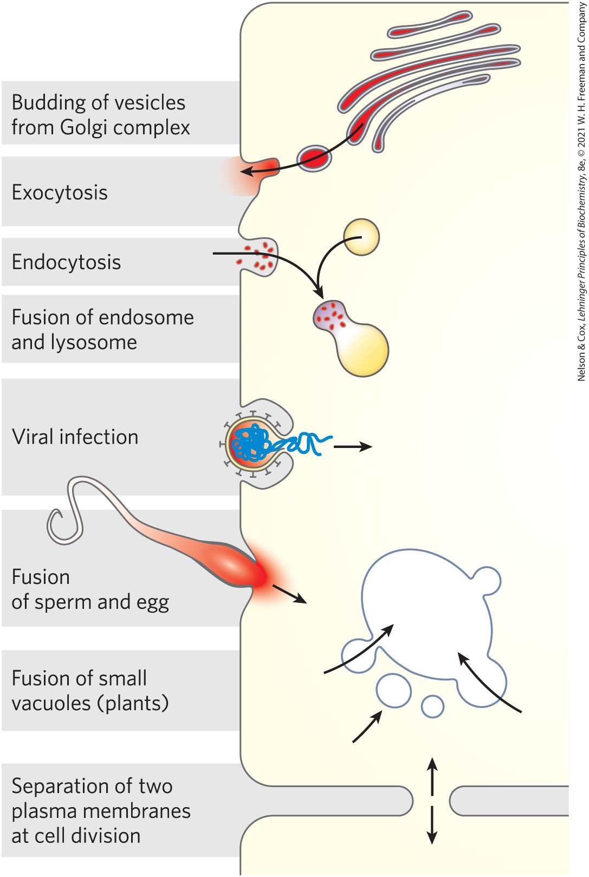
Membrane Curvature and Fusion
Are Central to Many Biological Processes
curvature changes are central to the ability of biological membranes to undergo fusion with other membranes without losing continuity

Slide 99
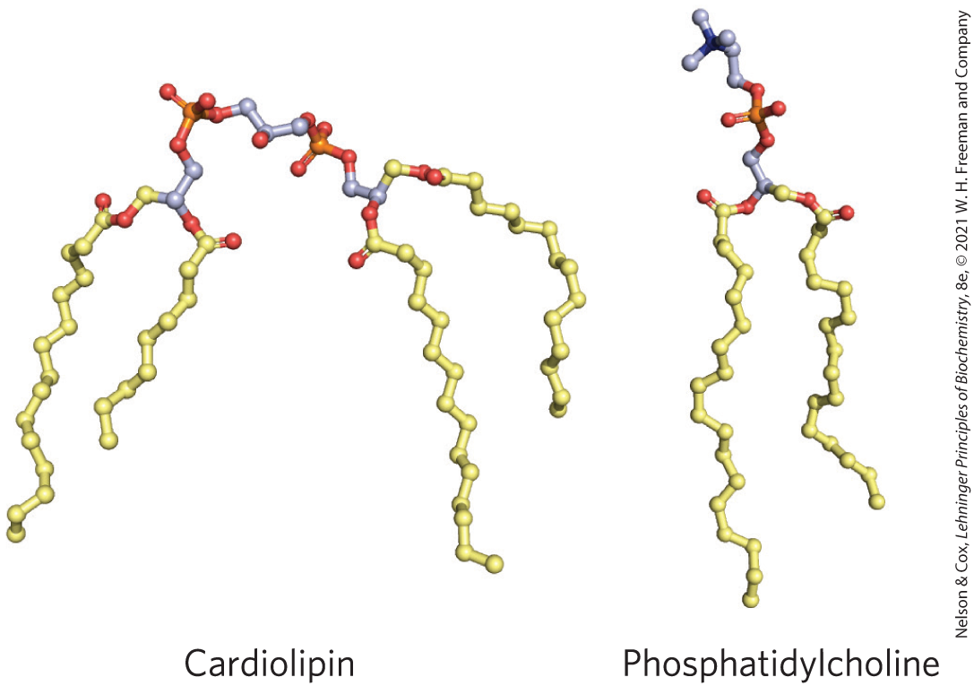
Cardiolipid
cardiolipin = can create or recognize membrane curvature
  located in mitochondrial and bacterial membranes

Slide 100
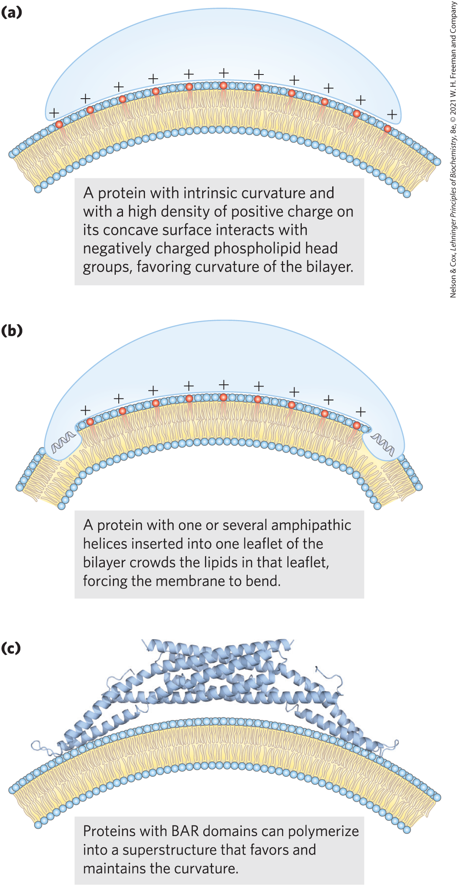
Protein-Induced Curvature of Membranes
BAR domains = domains consisting of coiled coils that form long, thin, curved dimers with a positively charged concave surface
BAR domain proteins assemble into crescent-shaped scaffolds and favor membrane curvature

Slide 101
Septins
septins = family of GTP-binding proteins that polymerize at curved regions of the plasma membrane
  participate in cell division, exocytosis, phagocytosis, and apoptosis
  have an amphipathic helix that is important in vesicle trafficking and neurotransmitter release

Slide 102
Fusion Proteins
fusion proteins = mediate specific fusion of two membranes by bringing about specific recognition and a transient local distortion of the bilayer structure

Slide 103
Clicker Question 19
Proteins containing BAR domains cause local membrane curvature and mediate the fusion of two membranes. Which process is not accompanied by fusion of two membranes?
endocytosis
viral invasion
transport of Na⁺
exocytosis
Notes:
Answer: C
Principle: 11.2
Learning Objective(s): Recall why fusion proteins are important in combining two membranes.
Bloom’s: 2:1

Slide 104
Clicker Question 19, Response
Proteins containing BAR domains cause local membrane curvature and mediate the fusion of two membranes. Which process is not accompanied by fusion of two membranes?
C. transport of Na⁺
Solute transport is not accompanied by the fusion of two membranes.

Slide 105
SNARE Proteins
SNAREs (snap receptors) = family of proteins
v-SNAREs = SNAREs in the cytoplasmic face of the intracellular vesicle
t-SNAREs = SNAREs in the target membrane with which the vesicle fuses

Slide 106
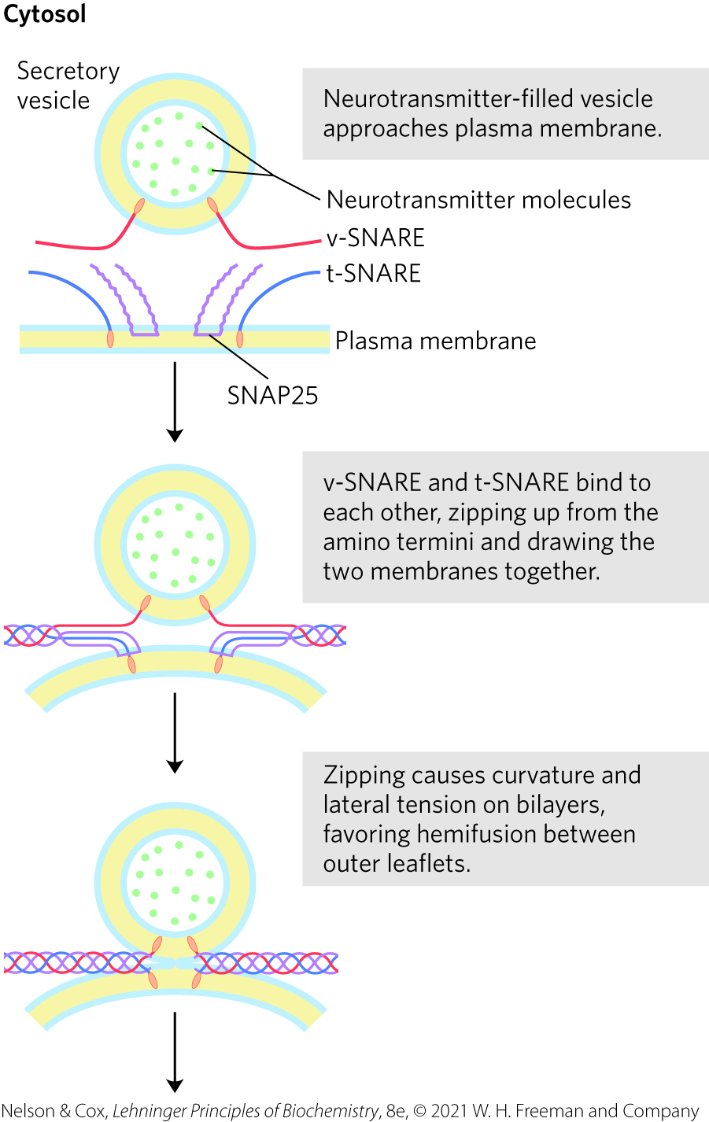
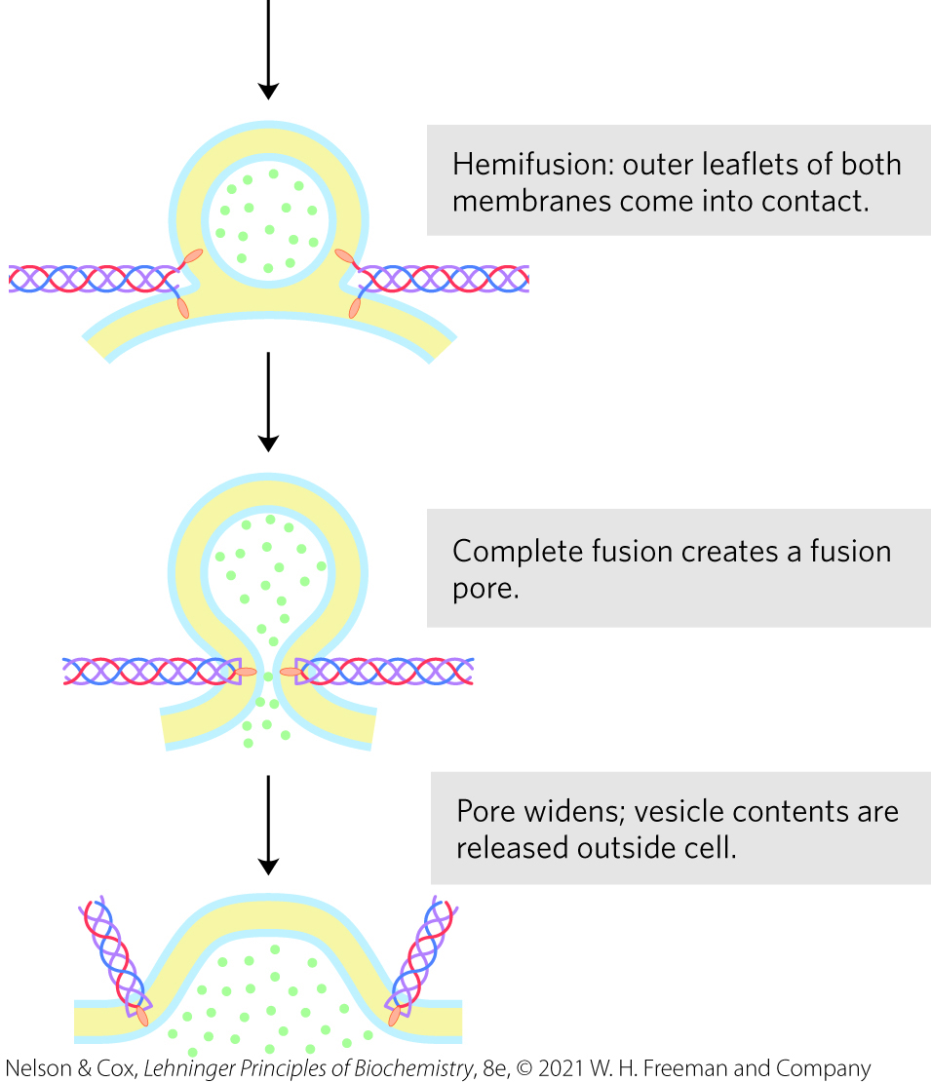
Membrane Fusion During Neurotransmitter Release

Slide 107
Integral Proteins of the Plasma Membrane Are Involved in Surface Adhesion, Signaling, and Other Cellular Processes
integrins = surface adhesion proteins that mediate a cell’s interaction with the extracellular matrix and with other cells
  carry signals in both directions across the plasma membrane
  heterodimeric proteins composed of two unlike subunits, α and β

Slide 108
Cadherins and Selectins
cadherins = involved in surface adhesion
  undergo homophilic interactions with identical cadherins in an adjacent cell
selectins = have extracellular domains that bind specific polysaccharides on the surface of an adjacent cell
  require Ca²⁺
  essential part of the blood-clotting process

Slide 109
Clicker Question 20
Integrins, cadherins, and selectins:
are never all found in the same cell.
are only found in caveolae.
are sometimes integral and sometimes peripheral membrane proteins.
allow for attachments between cells or between a cell and the extracellular matrix.
Notes:
Answer: D
Principle: 11.2
Learning Objective(s): Identify the role of integrins, cadherins and selectins play on the extracellular surface of a cell.
Bloom’s: 2:2

Slide 110
Clicker Question 20, Response
Integrins, cadherins, and selectins:
allow for attachments between cells or between a cell and the extracellular matrix.
Several families of integral proteins in the plasma membrane provide specific points of attachment between cells or between a cell and proteins of the extracellular matrix. Integrins, cadherins, and selectins are transmembrane proteins of the plasma membrane that act both to attach cells to each other and to carry messages between the extracellular matrix and the cytoplasm.

Slide 111

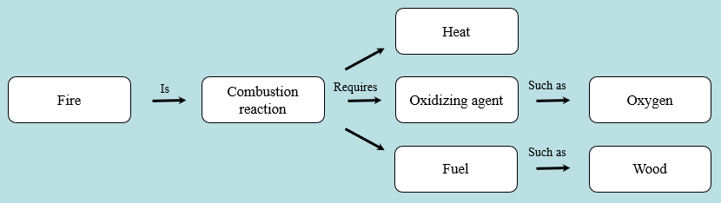
Activity: Relating
Terms within the Chapter
A concept map displays the relationships between different concepts. Observe the following example of a concept map.
Notes:
Instructor: For additional information, see the Instructor Activity Guide located in Achieve. It can be found within Chapter 11, in the folder titled “Ch11 In-Class Activities, Videos, and Resources.”

Slide 112
Activity Instructions (1 of 2)
Think about how the following terms and phrases relate to each other and then use scratch paper to draw a concept map using these terms and phrases. (3 minutes)
proteins and lipids
endoplasmic reticulum
golgi apparatus
organelle and plasma membranes
endomembrane system
rafts
membrane trafficking
lipids concentrated in bilayer leaflet
proteins covalently altered
lipids segregated into different organelles
internal membranes of cells
Notes:
Instructor: For additional information, see the Instructor Activity Guide located in Achieve. It can be found within Chapter 11, in the folder titled “Ch11 In-Class Activities, Videos, and Resources.”

Slide 113
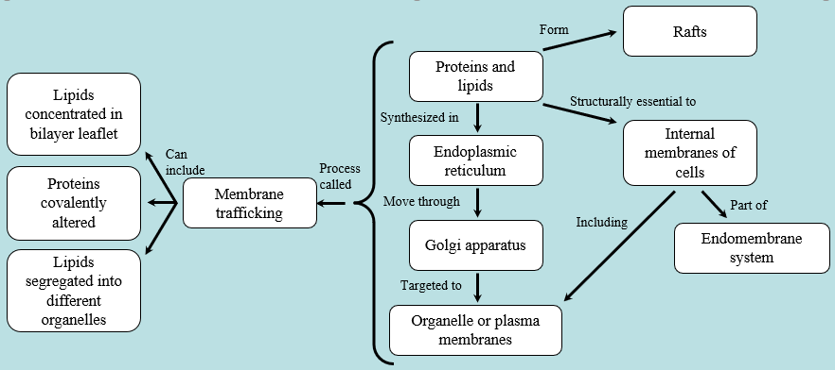
Activity Solution (1 of 2)
Pair up and share how this possible concept map might differ from yours. (2 minutes)
Notes:
Instructor: For additional information, see the Instructor Activity Guide located in Achieve. It can be found within Chapter 11, in the folder titled “Ch11 In-Class Activities, Videos, and Resources.”

Slide 114
11.3 Solute Transport across Membranes

Slide 115
Principle 3 (2 of 11)
Although the lipid bilayer is impermeable to charged or polar solutes, cells of all kinds have many membrane transporters and
ion channels that catalyze transmembrane movement of specific solutes. Some transporters merely speed the movement of solutes in the direction that simple diffusion takes them, whereas others use an energy source to move solutes against a concentration gradient.

Slide 116
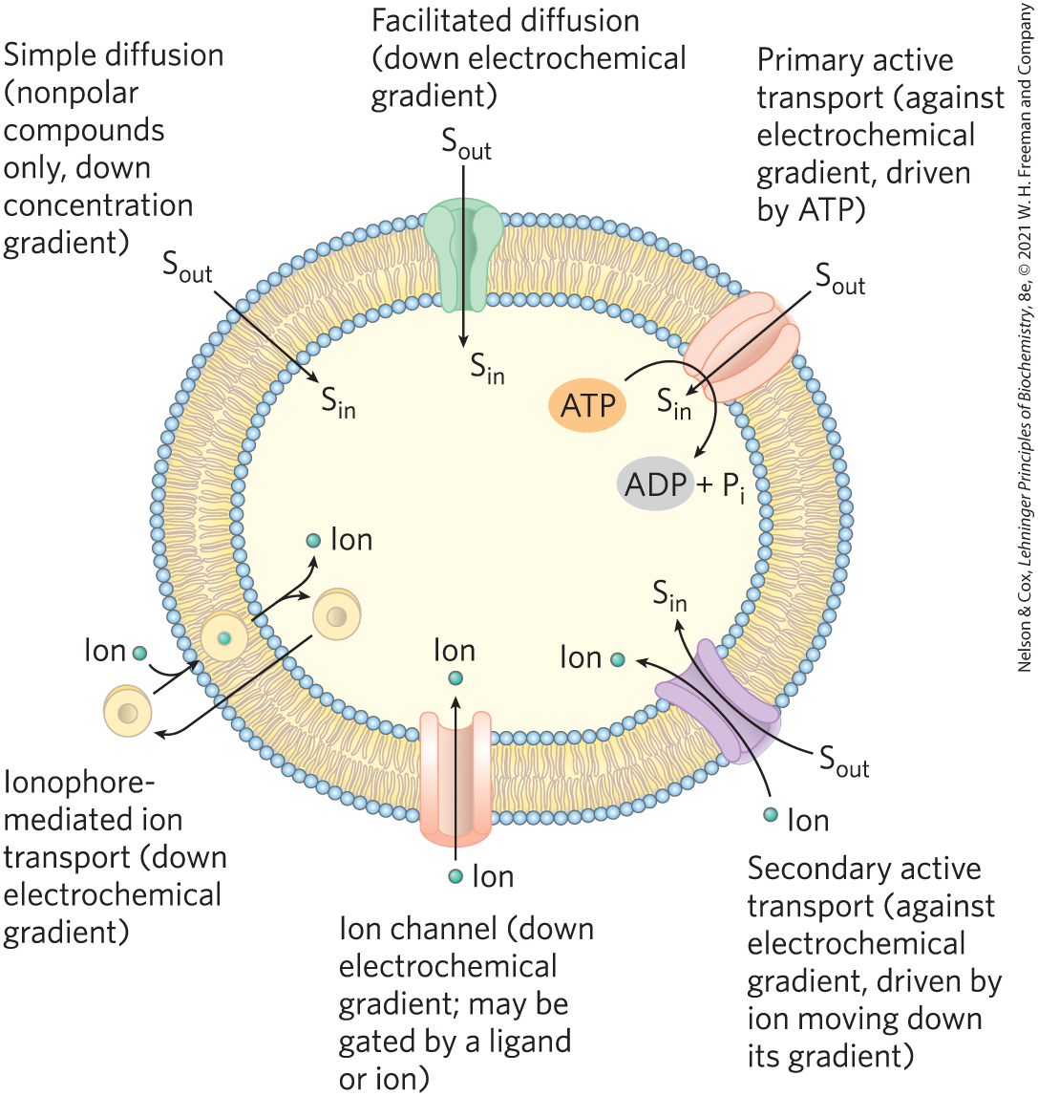
Summary of Transport Types
nonpolar compounds can dissolve in the lipid bilayer and cross a membrane unassisted
polar compounds and ions require a specific membrane protein carrier

Slide 117
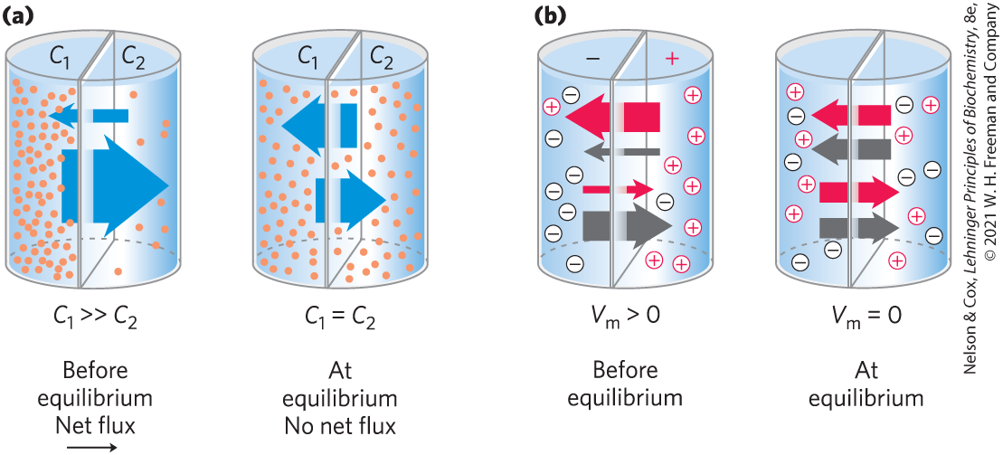
Transport May Be Passive or Active
simple diffusion = movement of a solute from the region of higher concentration to the region of lower concentration

Slide 118
Membrane Potential, V_{m}
membrane potential, V_{m} = a transmembrane electrical gradient that occurs when ions of opposite charge are separated by a permeable membrane
  produces a force that:
    opposes ion movements that increase V_{m}
    drives movements that reduce V_{m}

Slide 119
Principle 3 (3 of 11)
Although the lipid bilayer is impermeable to charged or polar solutes, cells of all kinds have many membrane transporters and
ion channels that catalyze transmembrane movement of specific solutes. Some transporters merely speed the movement of solutes in the direction that simple diffusion takes them, whereas others use an energy source to move solutes against a concentration gradient.

Slide 120
Electrochemical Gradient
electrochemical gradient (electrochemical potential) = determines the direction in which a charged solute moves across a membrane
  composed of:
    the chemical gradient
    the electrical gradient (V_{m})

Slide 121
Principle 3 (4 of 11)
Although the lipid bilayer is impermeable to charged or polar solutes, cells of all kinds have many membrane transporters and
ion channels that catalyze transmembrane movement of specific solutes. Some transporters merely speed the movement of solutes in the direction that simple diffusion takes them, whereas others use an energy source to move solutes against a concentration gradient.

Slide 122
Passive and Active Transporters
passive transporters = facilitate movement down a concentration gradient, increasing the transport rate
  process is called passive transport or facilitated diffusion
active transporters = move substrates across a membranes against a concentration gradient or an electrical potential
  process is called active transport

Slide 123

Clicker Question 21
Which statement is NOT consistent with facilitated diffusion?
There is rapid movement of polar molecules across a membrane.
Solute movement can only proceed down a concentration gradient.
Two different solutes can move through the same transporter, in the same or opposite directions.
Solute movement proceeds against a concentration gradient as long as there is a specific transporter.
Notes:
Answer: D
Principle: 11.3
Learning Objective(s): Contrast primary active transport, secondary active transport, and passive transport.
Bloom’s: 2:2

Slide 124
Clicker Question 21, Response
Which statement is NOT consistent with facilitated diffusion?
Solute movement proceeds against a concentration gradient as long as there is a specific transporter.
In a process called passive transport or facilitated diffusion, passive transporters facilitate movement down a concentration gradient, increasing the transport rate.

Slide 125
Types of Active Transporters
primary active transporters = use energy provided directly by a chemical reaction
secondary active transporters = couple uphill transport of one substrate with downhill transport of another

Slide 126
Clicker Question 22
What type of membrane transporter would most likely move a hydrophobic molecule from a high concentration to a low concentration?
passive
active
no transporter needed
secondary active
Notes:
Answer: C
Principle: 11.3
Learning Objective(s): Contrast primary active transport, secondary active transport, and passive transport.
Bloom’s: 2:2

Slide 127
Clicker Question 22, Response
What type of membrane transporter would most likely move a hydrophobic molecule from a high concentration to a low concentration?
C. no transporter needed
Through simple diffusion, nonpolar compounds move down their concentration gradient.

Slide 128
Principle 3 (5 of 11)
Although the lipid bilayer is impermeable to charged or polar solutes, cells of all kinds have many membrane transporters and
ion channels that catalyze transmembrane movement of specific solutes. Some transporters merely speed the movement of solutes in the direction that simple diffusion takes them, whereas others use an energy source to move solutes against a concentration gradient.

Slide 129
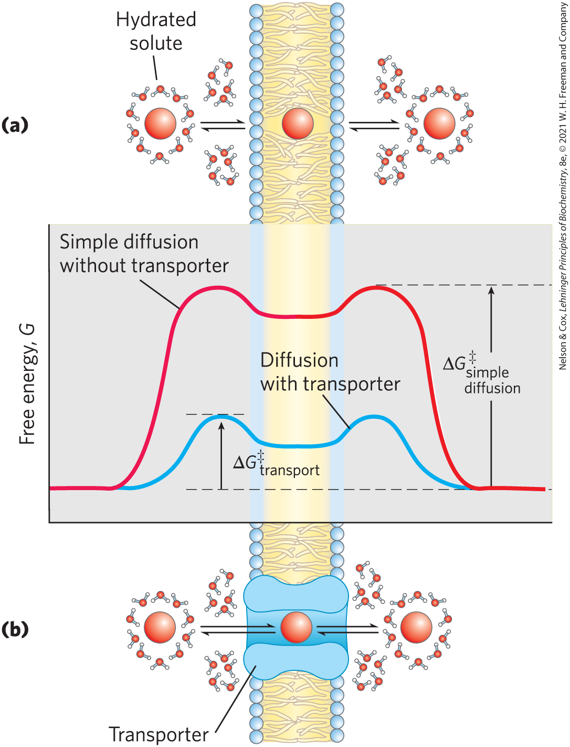
Transporters and Ion Channels Share Some Structural Properties but Have Different Mechanisms
transporter proteins reduce the energy of activation (∆G‡) for diffusion by:
  forming noncovalent interactions with the dehydrated solute
  providing a hydrophilic transmembrane pathway

Slide 130
Principle 3 (6 of 11)
Although the lipid bilayer is impermeable to charged or polar solutes, cells of all kinds have many membrane transporters and
ion channels that catalyze transmembrane movement of specific solutes. Some transporters merely speed the movement of solutes in the direction that simple diffusion takes them, whereas others use an energy source to move solutes against a concentration gradient.

Slide 131
Ion Channels
ion channels = provide an aqueous path across the membrane through which inorganic ions can diffuse at very high rates
  most have a “gate” regulated by a biological signal
  typically show some specificity for an ion
  are not saturable with their ion substrate
  flow stops either when the gate is closed or when there is no longer an electrochemical gradient

Slide 132
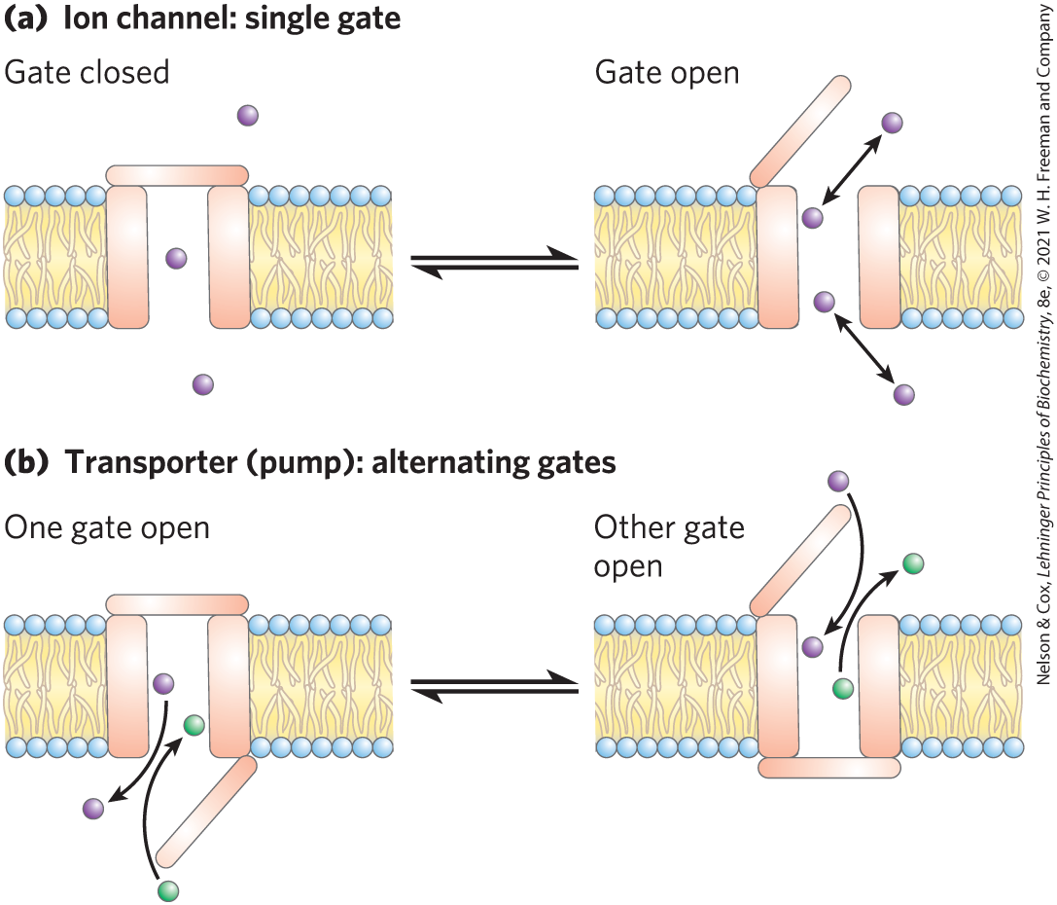
Differences Between Ion Channels and Transporters

Slide 133
Clicker Question 23
Which statement is true about ion channels and transporters?
Transporters have a transmembrane pore that is either open or closed.
When the gate is open, ions move through the ion channel at a rate limited only by the maximum rate of diffusion.
Ion channels have two gates, and both are never open at the same time.
Channels can move a substrate against its concentration gradient.
Notes:
Answer: B
Principle: 11.3
Learning Objective(s): Indicate how membrane transporters are different than ion channels; Recall how ion channels are regulated.
Bloom’s: 2:2

Slide 134
Clicker Question 23, Response
Which statement is true about ion channels and transporters?
When the gate is open, ions move through the ion channel at a rate limited only by the maximum rate of diffusion.
Ion channels have a transmembrane pore that is either open or closed. When the gate is open, ions move through at a rate limited only by the maximum rate of diffusion. Transporters have two gates, and both are never open at the same time. Active transporters (pumps) can move a substrate against its concentration gradient.

Slide 135
Principle 3 (7 of 11)
Although the lipid bilayer is impermeable to charged or polar solutes, cells of all kinds have many membrane transporters and
ion channels that catalyze transmembrane movement of specific solutes. Some transporters merely speed the movement of solutes in the direction that simple diffusion takes them, whereas others use an energy source to move solutes against a concentration gradient.

Slide 136
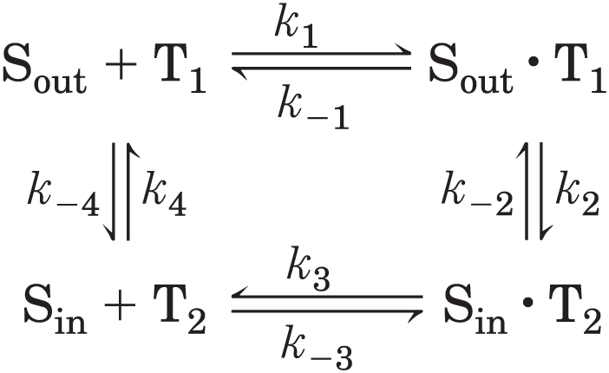
The Glucose Transporter of Erythrocytes Mediates Passive Transport
glucose enters the erythrocyte by passive transport via GLUT1
analogous with an enzymatic reaction where:
  glucose (“substrate”) outside is S_{out}
  glucose (“product”) inside is S_{in}
  transporter (“enzyme”) is T

Slide 137
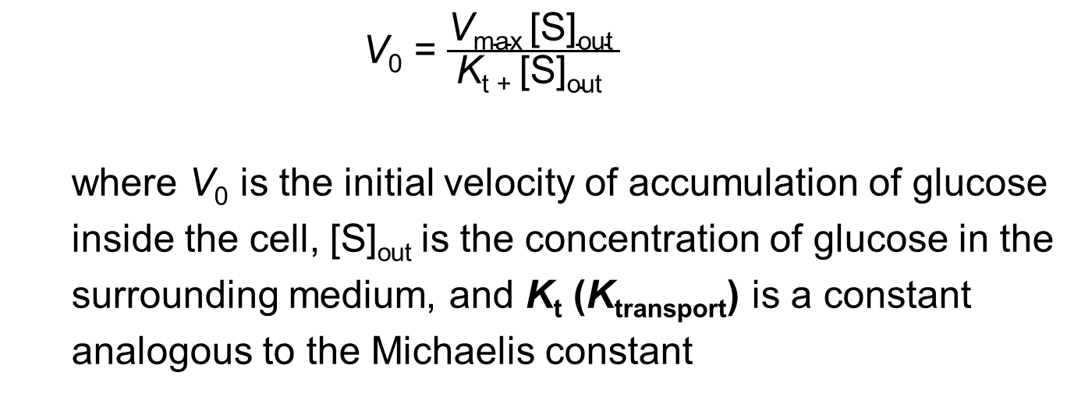
Rate Equations for Glucose Transport
analogous to the Michaelis-Menten equation:
V₀ = $\frac{\text{V}\text{max}\text{ [}\text{S}\text{]}\text{out} }{\text{K}\text{t}\text{ + [}\text{S}\text{]}\text{out} }$
where V₀ is the initial velocity of accumulation of glucose
inside the cell, [S]_{out} is the concentration of glucose in the
surrounding medium, and K_{t} (K_{transport}) is a constant
analogous to the Michaelis constant
(11-1)

Slide 138
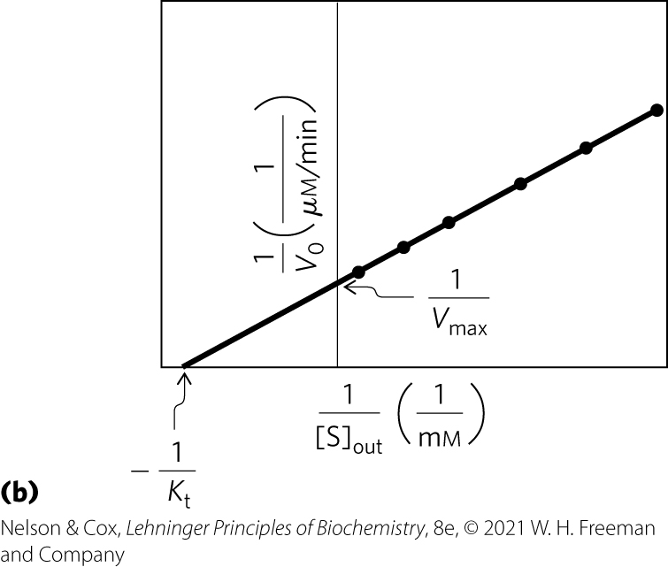
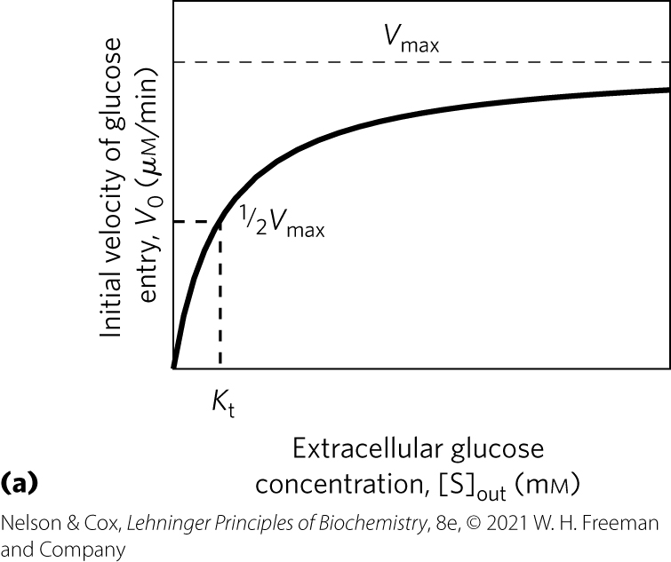
Kinetics of Glucose Transport into Erythrocytes

Slide 139
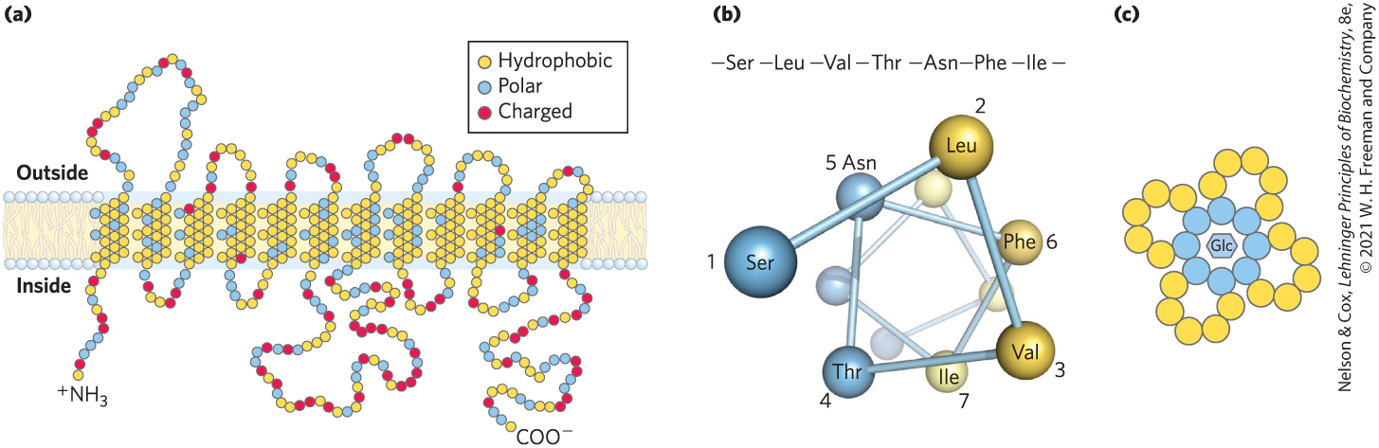
Membrane Topology of GLUT1
GLUT1 = integral membrane protein with 12 hydrophobic segments that form 12 membrane-spanning helices
  helices are amphipathic (resides are nonpolar on one side and polar on the other side)

Slide 140
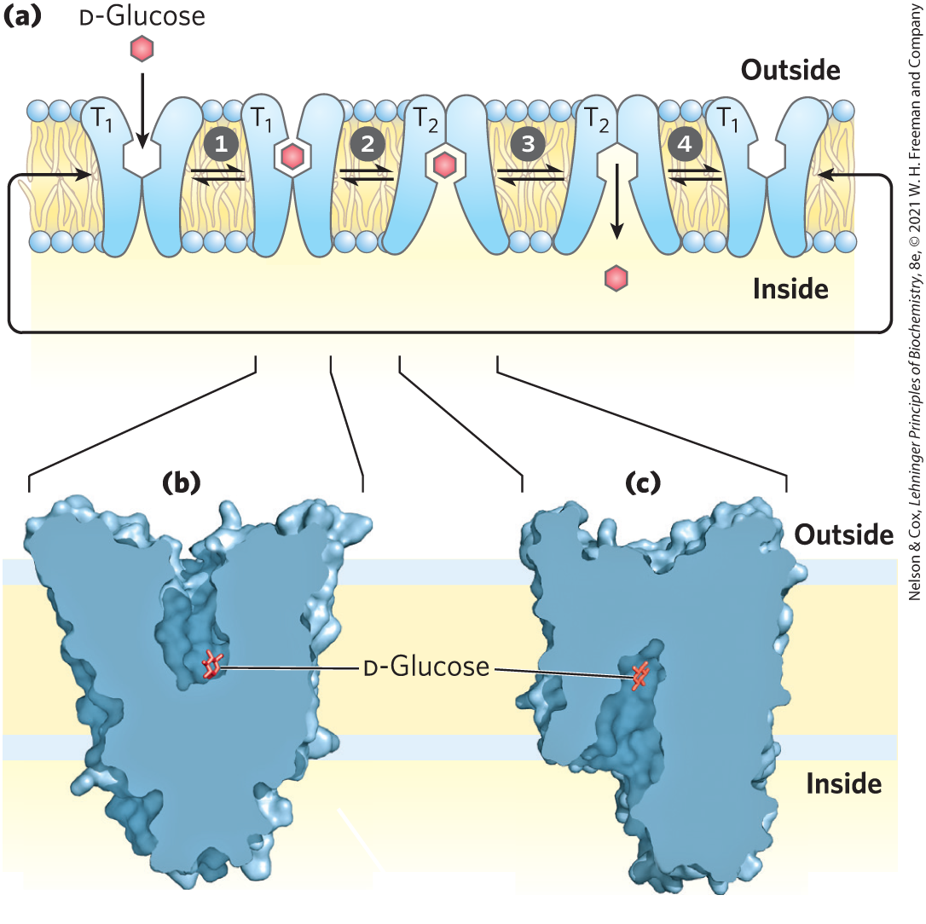
Model of Glucose Transport into Erythrocytes
cycles between two extreme conformations:
  T₁ form: glucose-binding site exposed on the outer membrane surface
  T₂ form: glucose-binding site exposed on the inner surface

Slide 141
Clicker Question 24
Another GLUT transporter was discovered in vertebrates. Which observation would NOT be expected if this protein is similar to other GLUT transporters?
Transport kinetics yield a hyperbolic curve.
The hydropathy plot suggests many transmembrane domains.
Transporters decrease in concentration on the plasma membrane as glucose levels drop outside the cell.
The ATP/ADP ratio decreases when the transporter is maximally active.
Notes:
Answer: D
Principle: 11.3
Learning Objective(s): Summarize how glucose is transported across a membrane using GLUT1.
Bloom’s: 2:2

Slide 142
Clicker Question 24, Response
Another GLUT transporter was discovered in vertebrates. Which observation would NOT be expected if this protein is similar to other GLUT transporters?
The ATP/ADP ratio decreases when the transporter is maximally active.
GLUT transporters mediate passive transport. A decreasing ATP/ADP ratio would indicate active transport.

Slide 143
Glucose Transporters in Humans
Table 11-1 Glucose Transporters in Humans
Transporter | Tissue(s) where expressed | K_{t} (mᴍ) | Role/characteristics
GLUT1 | Erythrocytes, blood-brain barrier, placenta, most tissues at a low level | 3 | Basal glucose uptake; defective in De Vivo disease
GLUT2 | Liver, pancreatic islets, intestine, kidney | 17 | In liver and kidney, removal of excess glucose from blood; in pancreas, regulation of insulin release
GLUT3 | Brain (neuron), tests (sperm) | 1.4 | Badal glucose uptake; high turnover number
GLUT4 | Muscle, fat, heart | 5 | Activity increased by insulin
GLUT5 | Intestine (primarily), testis, kidney | 6 | Primarily fructose transport
GLUT6 | Spleen, leukocytes, brain | >5 | Possibly no transporter function
GLUT7 | Small intestine, colon, testis, kidney | 0.3 | ⸻
GLUT8 | Testis, sperm acrosome | −2 | ⸻
GLUT9 | Liver, kidney, intestine, lung, placenta | 0.6 | Urate and glucose transporter in liver, kidney
GLUT10 | Heart, lung, brain, liver, muscle, pancreas, placenta, kidney | 0.3 | Glucose and galactose transporter
GLUT11 | Heart, skeletal muscle | 0.16 | Glucose and fructose transporter
GLUT12 | Skeletal muscle, heart, prostate, placenta | ⸻ | ⸻

Slide 144
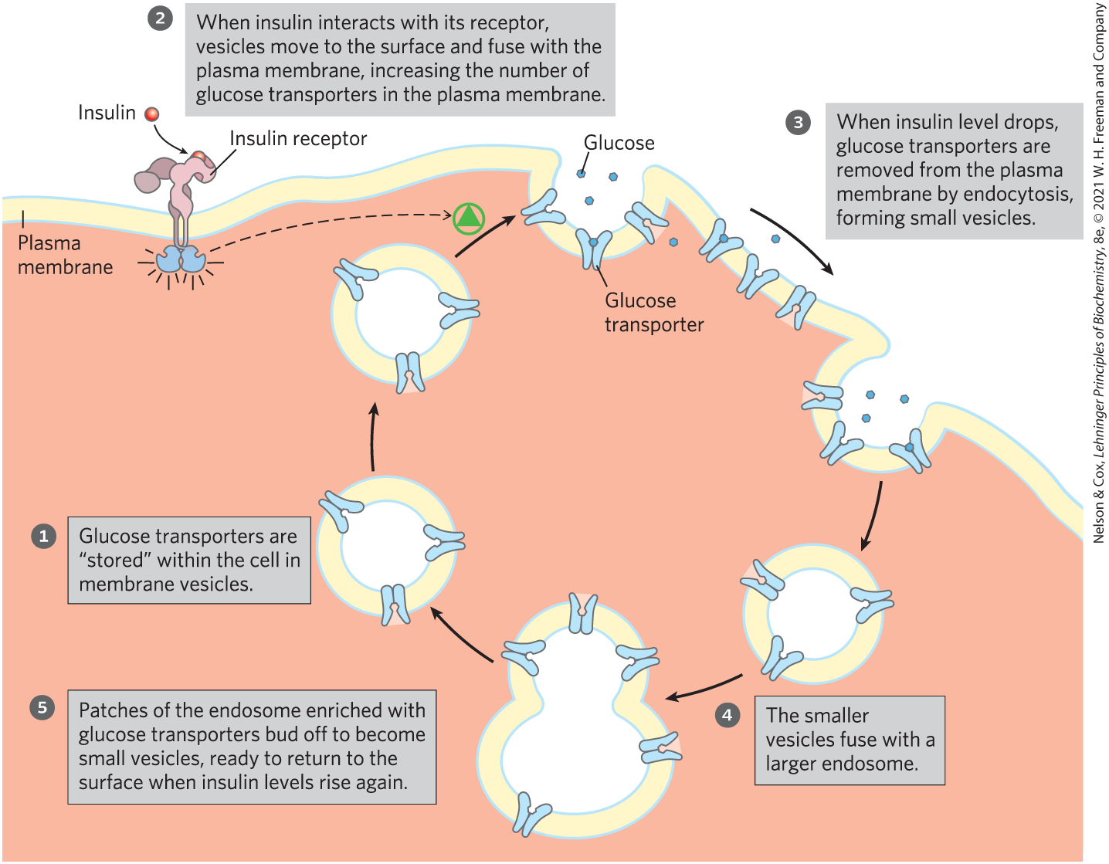
Transport of Glucose Into a Myocyte by GLUT4 Is Regulated by Insulin

Slide 145

The Chloride-Bicarbonate Exchanger Catalyzes Electroneutral Cotransport of Anions across the Plasma Membrane
chloride-bicarbonate exchanger = anion exchanger essential in CO₂ transport to the lungs from tissues
  passive transport system
  electroneutral exchange = no net transfer of charge

Slide 146
Clicker Question 25
The chloride-bicarbonate exchanger:
is an active transport system.
is essential in CO₂ transport to tissues from the lungs.
allows the entry and exit of HCO₃⁻ without changing the membrane potential.
causes movement of Cl⁻ and HCO₃⁻ that results in a net transfer of charge.
Notes:
Answer: C
Principle: 11.3
Learning Objective(s): Define the role the chloride-bicarbonate transporter plays in transporting CO2.
Bloom’s: 2:2

Slide 147
Clicker Question 25, Response
The chloride-bicarbonate exchanger:
allows the entry and exit of HCO₃⁻ without changing the membrane potential.
The chloride-bicarbonate exchanger is a passive transport system that is essential in CO₂ transport to the lungs from tissues such as skeletal muscle and liver. For every HCO₃⁻ ion that moves in one direction, one Cl⁻ ion moves in the opposite direction, with no net transfer of charge. Thus, the exchange is electroneutral.

Slide 148

Three General Classes of Transport Systems
cotransport systems = simultaneously transport two solutes across a membrane
  antiport = moves in opposite directions
  symport = moves in the same direction
uniport systems = carry only one substrate

Slide 149
Principle 3 (8 of 11)
Although the lipid bilayer is impermeable to charged or polar solutes, cells of all kinds have many membrane transporters and
ion channels that catalyze transmembrane movement of specific solutes. Some transporters merely speed the movement of solutes in the direction that simple diffusion takes them, whereas others use an energy source to move solutes against a concentration gradient.

Slide 150
Active Transport Results in Solute Movement against a Concentration or Electrochemical Gradient
results in the accumulation of a solute above the equilibrium point
thermodynamically unfavorable (endergonic)
  must be directly or indirectly coupled to an exergonic process

Slide 151

Two Types of Active Transport
primary active transport = solute accumulation is coupled directly to an exergonic chemical reaction
secondary active transport = endergonic transport of one solute is coupled to the exergonic flow of a different solute that was originally pumped uphill by primary active transport

Slide 152
Free-Energy Change for the Conversion of a Substrate to a Product
general equation for the free-energy change:
∆G = ∆G′° + RT ln ([P]/[S])
where ∆G′° is the standard free-energy change, R is the
gas constant, and T is the absolute temperature
(11-2)

Slide 153
Free-Energy Change for Transport of an Uncharged Solute
no bonds are broken and ∆G′° is zero
free-energy change for transport, ∆G_{t}, of a solute from a region where its concentration is C₁ to a region where its concentration is C₂ is:
∆G_{t} = RT ln(C₂/C₁)
(11-3)

Slide 154
Clicker Question 26
Calculate the energy cost (free-energy change) of pumping an uncharged solute against a 10⁶-fold concentration gradient at 25 °C. Recall that R is the gas constant (8.315 J/mol• K).
34,233 kJ/mol
2.87 kJ/mol
−34 kJ/mol
34 kJ/mol
Notes:
Answer: D
Principle: 11.3
Learning Objective(s): Calculate the free-energy change of a molecule moving across a membrane.
Bloom’s: 3:2

Slide 155
Clicker Question 26, Response
Calculate the energy cost (free-energy change) of pumping an uncharged solute against a 10⁶-fold concentration gradient at 25 °C. Recall that R is the gas constant (8.315 J/mol• K).
D. 34 kJ/mol
∆G_{t} = RT ln(C₂/C₁)
= (8.315 J/mol•K) (298 K) ln(1.0 x 10⁶)
= 34 kJ/mol

Slide 156
Free-Energy Change for Transport of an Ion
without movement of an accompanying counterion, the process is electrogenic (produces an electrical potential)
free-energy change for transport, ∆G_{t}, of an ion is the sum of the chemical and electrical gradients:
∆G_{t} = RT ln(C₂/C₁) + ZF ∆ψ
where Z is the charge on the ion, F is the Faraday
constant, and ∆ψ is the transmembrane electrical potential
(in volts)
(11-4)

Slide 157

P-Type ATPases Undergo Phosphorylation during Their Catalytic Cycles
P-type ATPases = family of cation transporters that are reversibly phosphorylated by ATP as part of the transport cycle
  integral proteins with 8 or 10 predicted membrane-spanning regions
  sensitive to inhibition by the transition-state analog vanadate

Slide 158
Examples of P-Type ATPases
Na⁺ K⁺ ATPase = animal cell antiporter for Na⁺ and K⁺
H⁺ ATPase = plant and fungi transporter
sarcoplasmic/endoplasmic reticulum Ca²⁺ ATPase (SERCA) pump and the plasma membrane Ca²⁺ ATPase pump = uniporters for Ca²⁺ ions

Slide 159

General Structure of the P-Type ATPases
critical Asp residue in the P domain undergoes phosphorylation and dephosphorylation

Slide 160
Clicker Question 27
P-type ATPases:
undergo reversible phosphorylation on an Asp residue.
transport anions.
transport phosphate up (against) its concentration gradient.
transport phosphate down its concentration gradient.
Notes:
Answer: A
Principle: 11.3
Learning Objective(s): Classify P-type, V-type, and F-type ATPases based on cellular localization and mechanism used to pump protons.
Bloom’s: 2:2

Slide 161
Clicker Question 27, Response
P-type ATPases:
undergo reversible phosphorylation on an Asp residue.
P-type ATPases couple phosphorylation and dephosphorylation of the critical Asp residue in the P (phosphorylation) domain of the transporter to alternate exposure of solute-binding sites on the inside and the outside of the membrane. All P-type pumps have similar and similar mechanisms.

Slide 162

Postulated Mechanism of the
SERCA Pump
each catalytic cycle moves two Ca²⁺ ions across the membrane and converts an ATP to ADP and P_{i}
two conformations of the transporter, E1 and E2, interconvert

Slide 163

Role of the Na⁺ K⁺ ATPase in Animal Cells
Na⁺ K⁺ ATPase = couples phosphorylation-dephosphorylation of the critical Asp residue to the movement of Na⁺ and K⁺ against their electrochemical gradients
  maintains low [Na⁺] and high [K⁺] in the cell
  essential to the conduction of action potentials in neurons

Slide 164
Clicker Question 28
Which consequence of the action of a Na⁺K⁺ ATPase in the plasma membrane is useful?
depleting the cells of Na⁺, which can be harmful
drawing K⁺ into cells, contributing to buffering capacity
maintaining charge equilibrium across the membrane
membrane repolarization
Notes:
Answer: D
Principle: 11.3
Learning Objective(s): Classify P-type, V-type, and F-type ATPases based on cellular localization and mechanism used to pump protons.
Bloom’s: 2:2

Slide 165
Clicker Question 28, Response
Which consequence of the action of a Na⁺/K⁺ ATPase in the plasma membrane is useful?
D. membrane repolarization
For each molecule of ATP converted to ADP and P_{i}, the transporter moves two K⁺ ions inward and three Na⁺ ions outward across the plasma membrane. Cotransport is therefore electrogenic, creating a net separation of charge across the membrane. In animals, this produces a negative membrane potential, which is essential to the conduction of action potentials in neurons.

Slide 166


Activity: Properties of
Ion Channels
Observe the structure of the SERCA P-type ATPase, a calcium transporter, in Mol3D viewer in your Achieve course.
Notes:
Instructor: This Mol3D structure is located in the Achieve course. It can be found in the Chapter 11 content, in the folder titled “Ch11 In-Class Activities, Videos, and Resources.”

Slide 167
Activity Instructions (2 of 2)
On your own, think of answers to the questions:
  Is calcium actively or passively transported through the SERCA P-type ATPase?
  Is ATP present in this crystal structure?
  What does the presence or absence of ATP tell you about the activity of the transporter?
  (2 minutes)
Pair up to discuss your ideas. (2 minutes)
Share your ideas with the class in group discussion.
(3 minutes)
Notes:
Instructor: This Mol3D structure is located in the Achieve course. It can be found in the Chapter 11 content, in the folder titled “Ch11 In-Class Activities, Videos, and Resources.”

Slide 168
Activity Solution (2 of 2)
  Is calcium actively or passively transported through the SERCA P-type ATPase? Calcium is actively transported through the SERCA P-type ATPase.
  Is ATP present in this crystal structure? No.
  What does the presence or absence of ATP tell you about the activity of the transporter? The absence of ATP means that the transporter is in its closed conformation.
Notes:
Instructor: This Mol3D structure is located in the Achieve course. It can be found in the Chapter 11 content, in the folder titled “Ch11 In-Class Activities, Videos, and Resources.”

Slide 169

V-Type and F-Type ATPases Are ATP-Driven Proton Pumps
V-type ATPases = class of proton-transporting ATPases responsible for acidifying intracellular compartments
  V_{o} domain serves as a proton channel
  V₁ domain contains the ATP-binding site and the ATPase activity

Slide 170

F-Type ATPases
F-type ATPases = catalyze the uphill transmembrane passage of protons, driven by ATP hydrolysis
  F_{o} integral membrane protein complex provides a pathway for protons
  F₁ protein uses energy of ATP to drive proteins uphill

Slide 171
Principle 3 (9 of 11)
Although the lipid bilayer is impermeable to charged or polar solutes, cells of all kinds have many membrane transporters and
ion channels that catalyze transmembrane movement of specific solutes. Some transporters merely speed the movement of solutes in the direction that simple diffusion takes them, whereas others use an energy source to move solutes against a concentration gradient.

Slide 172
F-Type ATPases Catalyze Reactions in Both Directions
a large proton gradient can supply the energy to drive ATP synthesis
when functioning in this direction, F-type ATPases are named ATP synthases

Slide 173
Clicker Question 29
A bacterial F-Type ATPase was found to be synthesizing ATP. How is that possible?
by moving a counterion, such as K⁺, in the opposite direction
by moving H⁺ in the opposite direction, down a gradient to power the synthase activity
by the action of a chemical “uncoupling” agent
by the action of a positive allosteric modulator
Notes:
Answer: B
Principle: 11.3
Learning Objective(s): Classify P-type, V-type, and F-type ATPases based on cellular localization and mechanism used to pump protons.
Bloom’s: 2:2

Slide 174
Clicker Question 29, Response
A bacterial F-Type ATPase was found to be synthesizing ATP. How is that possible?
by moving H⁺ in the opposite direction, down a gradient to power the synthase activity
Like all enzymes, F-type ATPases catalyze their reactions in both directions. A sufficiently large proton gradient can supply the energy to drive the reverse reaction: ATP synthesis. When functioning in this direction, the F-type ATPases are more appropriately named ATP synthases.

Slide 175
ABC Transporters Use ATP to Drive the Active Transport of a Wide Variety of Substrates
ABC transporters = family of ATP-driven transporters that pump substrates across a membrane against a concentration gradient
  have two ATP-binding domains (“cassettes”) and two transmembrane domains
  example substrates: amino acids, peptides, proteins, metal ions, various lipids, bile salts, and hydrophobic compounds, including drugs

Slide 176

Mechanism of ABC Transporters
substrates move across the membrane when two forms of the transporter interconvert
  driven by ATP hydrolysis

Slide 177
Some ABC Transporters in Humans
Table 11-2 Some ABC Transporters in Humans
Gene(s) | Role/characteristics | Text reference
ABCA1 | Reverse cholesterol transport; defect causes Tangier disease | Fig. 21-47
ABCA4 | Only in visual receptors, recycling of all-trans-retinal | Fig. 12-19
ABCB1 | Multidrug resistance P-glycoprotein 1; transport across blood-brain barrier | ⸻
ABCB4 | Multidrug resistance; transport of phosphatidylcholine | ⸻
ABCB11 | Transports bile salts out of hepatocytes | Fig. 17-1
ABCC6 | Sulfonylurea receptor; targeted by the drug glipizide in type 2 diabetes | Fig. 23-27
ABCG2 | Breast cancer resistance protein (BCRP); major exporter of anticancer drugs | p. 396
ABCC7 | CFTR (Cl₋ channel); defect causes cystic fibrosis | Box 11-2
multidrug transporter (MDR1) = human ABC transporter with very broad substrate specificity
  encoded by the ABCB1 gene
  removes toxic compounds
  responsible for resistance of tumors to drugs

Slide 178

A Defective Ion Channel in Cystic Fibrosis

Slide 179

Cystic Fibrosis Therapies

Slide 180
Clicker Question 30
Which statement is false?
The mechanism of ATP transporters is believed to involve two forms of the transporter.
The stoichiometry of ATP transporters is about one ATP hydrolyzed per molecule of substrate transported.
Inhibition of MDR1 is often associated with treatment failure in cancers of the liver, kidney, and colon.
ABC transporters are also present in simpler animals and in plants and microorganisms.
Notes:
Answer: C
Principle: 11.3
Learning Objective(s): Recognize ABC transporters based on structure and roles they play in the cell
Bloom’s: 2:2

Slide 181
Clicker Question 30, Response
Which statement is false?
Inhibition of MDR1 is often associated with treatment failure in cancers of the liver, kidney, and colon.
MDR1 pumps chemotherapeutic drugs out of cells, thus preventing their accumulation within a tumor and blocking their therapeutic effects. Overexpression of MDR1 is often associated with treatment failure in cancers of the liver, kidney, and colon. Highly selective inhibitors of these multidrug transporters are expected to enhance the effectiveness of antitumor drugs.

Slide 182
Principle 3 (10 of 11)
Although the lipid bilayer is impermeable to charged or polar solutes, cells of all kinds have many membrane transporters and
ion channels that catalyze transmembrane movement of specific solutes. Some transporters merely speed the movement of solutes in the direction that simple diffusion takes them, whereas others use an energy source to move solutes against a concentration gradient.

Slide 183

Ion Gradients Provide the Energy for Secondary Active Transport
Na⁺-glucose symporter = takes up glucose from the intestine in a process driven by the downhill flow of Na⁺
strong thermodynamic tendency for Na⁺ to move into the cell provides the energy needed for the transport of glucose into the cell

Slide 184

The Peptide Ionophore Valinomycin Is An Antibiotic
acts as a shuttle, carrying K⁺ across the membrane down its concentration gradient and deflating that gradient
ionophores (“ion bearers”) = compounds that shuttle ions across membranes in this way

Slide 185
Principle 3 (11 of 11)
Although the lipid bilayer is impermeable to charged or polar solutes, cells of all kinds have many membrane transporters and
ion channels that catalyze transmembrane movement of specific solutes. Some transporters merely speed the movement of solutes in the direction that simple diffusion takes them, whereas others use an energy source to move solutes against a concentration gradient.

Slide 186
Aquaporins Form Hydrophilic Transmembrane Channels for the Passage of Water
aquaporins (AQPs) = provide channels for movement of water molecules across plasma membranes
  each protein has a specific location and role
  low activation energy suggests that water moves in a continuous stream
  do not allow passage of protons (hydronium ions, H₃O⁺)

Slide 187
The 11 Known Aquaporins in Mammals
Table 11-3 Permeability Characteristics and Predominant Distribution of Known Mammalian Aquaporins
Aquaporin | Permeant (permeability) | Tissue distribution | Primary subcellular distribution
AQP0 | Water (low) | Lens | Plasma membrane
AQP1 | Water (high) | Erythrocyte, kidney, lung, vascular endothelium, brain, eye | Plasma membrane
AQP2 | Water (high) | Kidney, vas deferens | Apical plasma membrane, intracellular vesicles
AQP3 | Water (high), glycerol (high), urea (moderate) | Kidney, skin, lung, eye, colon | Basolateral plasma membrane
AQP4 | Water (high) | Brain, muscle, kidney, lung, stomach, small intestine | Basolateral plasma membrane
AQP5 | Water (high) | Salivary gland, lacrimal gland, sweat gland, lung, cornea | Apical plasma membrane
AQP6 | Water (low), anions (NO⁻₃>Cl⁻) | Kidney | Intracellular vesicles
AQP7 | Water (high), glycerol (high), urea (high) | Adipose tissue, kidney, testis | Plasma membrane
AQP8 | Water (high) | Testis, kidney, liver, pancreas, small intestine, colon | Plasma membrane, intracellular vesicles
AQP9 | Water (low), glycerol (high), urea (high) | Liver, leukocyte, brain, testis | Plasma membrane
AQP10 | Water (low), glycerol (high), urea (high) | Small intestine | Intracellular vesicles

Slide 188
Clicker Question 31
Aquaporins:
exclusively transport water.
allow passage of H₃O⁺.
are unregulated.
have a higher turnover number than enzymes.
Notes:
Answer: D
Principle: 11.3
Learning Objective(s): Recall the role aquaporins play in regulating water transport throughout an organism.
Bloom’s: 2:2

Slide 189
Clicker Question 31, Response
Aquaporins:
D. have a higher turnover number than enzymes.
Water moves across membranes through aquaporins. Some aquaporins are regulated. For example, AQP2 in the epithelial cells of the renal collecting duct is regulated by vasopressin. Some aquaporins also transport glycerol, anions, or urea. Water molecules flow through an AQP1 channel at a rate of about 10⁹ s⁻¹, whereas the highest known turnover number for an enzyme is 4 x 10⁷ s⁻¹, and many enzymes have turnover numbers between 1 s⁻¹ and 10⁴ s⁻¹.

Slide 190
Ion-Selective Channels Allow Rapid Movement of Ions across Membranes
ion-selective channels = move inorganic ions across membranes
  the rate of flux can be orders of magnitude greater than the turnover number for a transporter
  not saturable
  gated in response to cellular event

Slide 191
Ligand-Gated Channels and Voltage-Gated Ion Channels
ligand-gated channels = binding of an extracellular or intracellular small molecule forces an allosteric transition in the protein, which opens or closes the channel
  generally oligomeric
voltage-gated ion channels = a change in transmembrane electrical potential (V_{m}) causes a charged protein domain to move relative to the membrane, opening or closing the channel

Slide 192

Electrical Measurements of Ion-Channel Function
patch-clamping = currents are measured through a region of the membrane surface containing only one or a few ion-channel molecules

Slide 193

The Structure of a K⁺ Channel Reveals the Basis for Its Specificity
channel is just wide enough to accommodate an unhydrated metal ion such as potassium
K⁺ (radius 1.33 Å) passes 10⁴ times more readily than Na⁺ (radius 0.95 Å)

Slide 194

The Mechanism of the K⁺ Channel
the polar transmembrane passage precisely fits the K⁺ ion

Slide 195
Clicker Question 32
Which statement does not describe how ion channels are distinct from ion transporters?
The rate of flux through channels can be orders of magnitude greater than the turnover number for a transporter.
Only ion channels determine the membrane potential.
Ion channels are not saturable.
Ion channels are gated in response to a cellular event.
Notes:
Answer: B
Principle: 11.3
Learning Objective(s): Indicate how membrane transporters are different than ion channels; Recall how ion channels are regulated.
Bloom’s: 2:2

Slide 196
Clicker Question 32, Response
Which statement does not describe how ion channels are distinct from ion transporters?
B. Only ion channels determine the membrane potential.
Ion channels, together with ion pumps such as the Na⁺K⁺ ATPase, determine a plasma membrane’s permeability to specific ions and regulate the cytosolic concentration of ions and the membrane potential.

