Slide 1

10 Lipids
© 2021 Macmillan Learning

Slide 2

Principle 1 (1 of 4)
Fatty acids are water-insoluble hydrocarbons used for cellular energy storage. Fatty acids are highly reduced and thus provide a rich source of stored chemical energy for cells. Storage of hydrophobic fats as triacylglycerols is also highly efficient because water is not needed to hydrate the stored fats.

Slide 3

Principle 2 (1 of 6)
Membrane lipids are composed of hydrophobic tails attached to polar head groups. Cellular membranes are composed of a variety of lipids, including glycerophospholipids and sterols. These lipids are used for structuring membranes as well as for displaying molecules on the membrane surfaces for signaling and molecular recognition.

Slide 4

Principle 3 (1 of 7)
Lipids have uses in the cell beyond energy storage and membranes construction. Many lipids are present in the cell at smaller amounts than those making up membranes or being stored as fat. These lipids can function as cellular messengers, hormones, electron carriers, or pigments.

Slide 5

Principle 4 (1 of 6)
The chemical properties of lipids are
related to their structure and composition. As in studies of other biomolecules, methods such as enzymatic, chromatographic, and mass spectrometry can all be used to identify lipids and determine their atomic structure.

Slide 6
10.1 Storage Lipids

Slide 7
Principle 1 (2 of 4)
Fatty acids are water-insoluble hydrocarbons used for cellular energy storage. Fatty acids are highly reduced and thus provide a rich source of stored chemical energy for cells. Storage of hydrophobic fats as triacylglycerols is also highly efficient because water is not needed to hydrate the stored fats.

Slide 8
Fats and Oils Used as Stored Energy Are Derivatives of Fatty Acids
fatty acids = hydrocarbon derivatives
oxidation of fatty acids (to CO₂ and H₂O) is highly exergonic

Slide 9
Fatty Acids Are Hydrocarbon Derivatives
fatty acids = carboxylic acids with hydrocarbon tails ranging from 4 to 36 carbons long (C₄ to C₃₆)
  can be saturated or unsaturated
  can be branched or unbranched

Slide 10
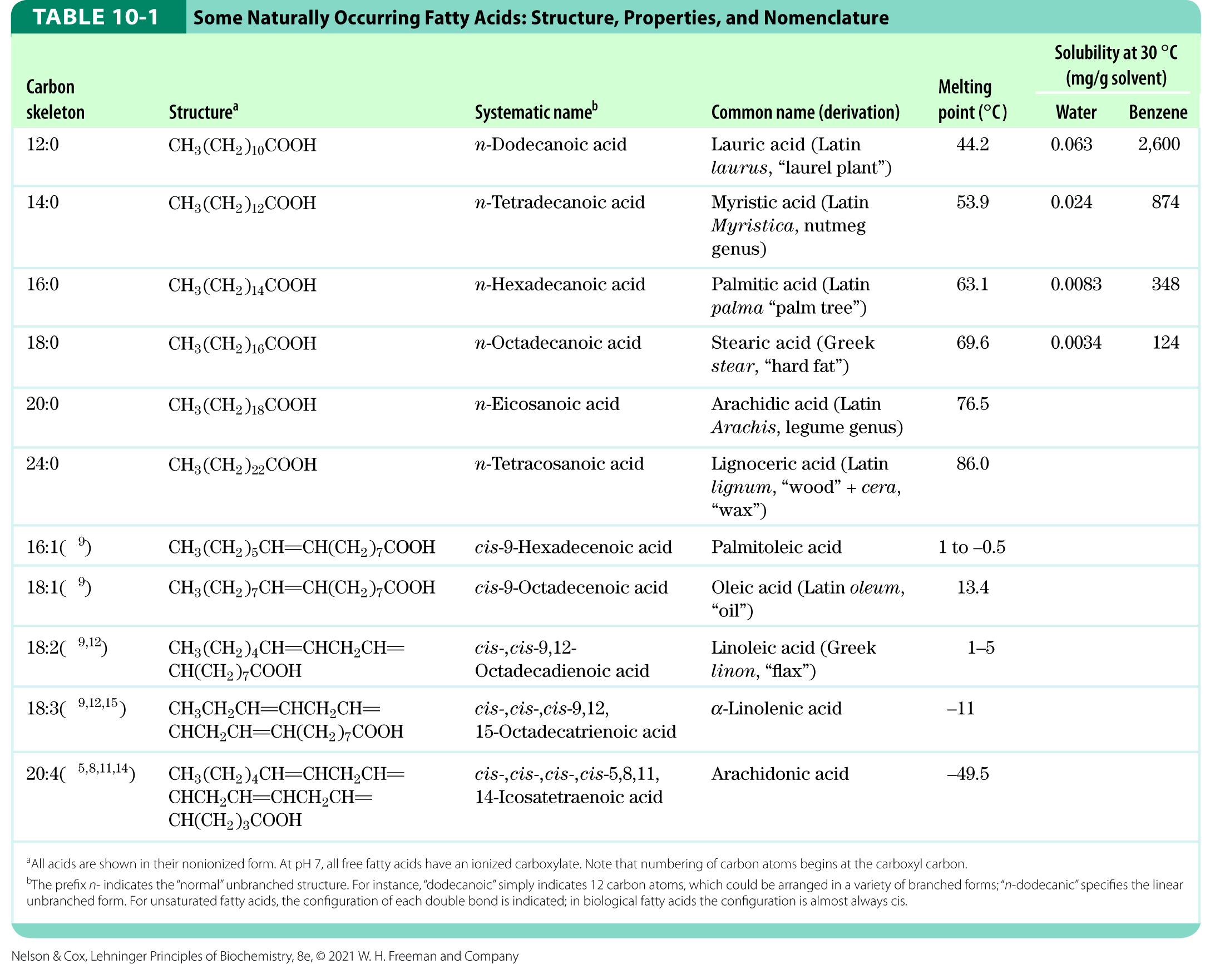
Naturally Occurring Fatty Acids

Slide 11

Clicker Question 1
Fatty acids:
can be branched or unbranched.
are highly oxidized storage forms of hydrocarbons.
are referred to as “saturated” if they have one or more C–C double bonds.
never exceed 20 carbons in length, by definition.
Notes:
Answer: A
Principle: 10:1
Learning Objective(s):
Bloom’s: 1:1

Slide 12
Clicker Question 1, Response
Fatty acids:
can be branched or unbranched.
Fatty acids are carboxylic acids with hydrocarbon chains ranging from 4 to 36 carbons long (C₄ to C₃₆). In some fatty acids, this chain is unbranched and fully saturated (contains no double bonds); in others, the chain contains one or more double bonds. A few contain three-carbon rings, hydroxyl groups, or methyl-group branches.

Slide 13
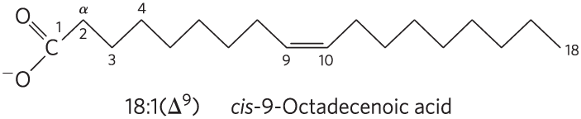
Nomenclature for Unbranched Fatty Acids
the chain length and number of bonds, separated by a colon
numbering begins at the carboxyl carbon
positions of double bonds are indicated by ∆ and a superscript number

Slide 14
Common Patterns in Fatty Acids
most common fatty acids have even numbers of carbon atoms in an unbranched chain of 12 to 24 carbons
in monounsaturated fatty acids, the double bond is usually between C-9 and C-10 (∆⁹)
in polyunsaturated fatty acids:
  the double bonds are usually ∆¹² and ∆¹⁵
  double bonds are usually separated by a methylene group
double bonds are usually in the cis configuration

Slide 15
Clicker Question 2
Which statement regarding linoleic acid [18:2(∆^{9,12})] is false?
It has one carboxylic acid functional group.
It has two double bonds.
It has 20 carbons.
It has a C–C double bond between carbons 9 and 10.
Notes:
Answer: C
Principle: 10:1
Learning Objective(s): Relate the name, structure, and composition of a triglyceride.
Bloom’s: 2:2

Slide 16
Clicker Question 2, Response
Which statement regarding linoleic acid [18:2(∆^{9,12})] is false?
C. It has 20 carbons.
A simplified nomenclature for unbranched fatty acids specifies the chain length and number of double bonds, separated by a colon. Thus, linoleic acid has 18 carbons with two double bonds: one between C-9 and C-10 and another between C-12 and C-13.

Slide 17
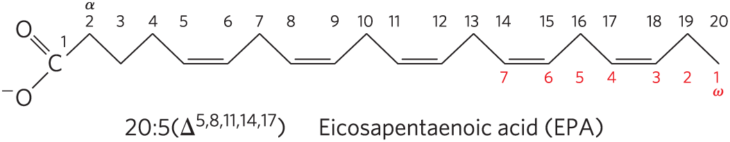
Polyunsaturated Fatty Acids (PUFAs)
polyunsaturated fatty acids (PUFAs) = contain more than one double bond in their backbone
  omega-3 (ω-3) fatty acids = double bond between C-3 and C-4 relative to the most distant carbon (ω)
  omega-6 (ω-6) fatty acids = double bond between C-6 and C-7 relative to ω
omega-3 (ω-3) fatty acid

Slide 18
PUFAs and Human Nutrition
humans must obtain the omega-3 PUFA α-linolenic acid (ALA; 18:3(∆^{9,12,15})) from their diet
humans use ALA to synthesize:
  eicosapentaenoic acid (EPA; 20:5(∆^{5,8,11,14,17}))
  docosahexaenoic acid (DHA; 22:6(∆^{4,7,10,13,16,19}))
the optimal dietary ratio of omega-6 to omega-3 PUFAs is between 1:1 and 4:1

Slide 19
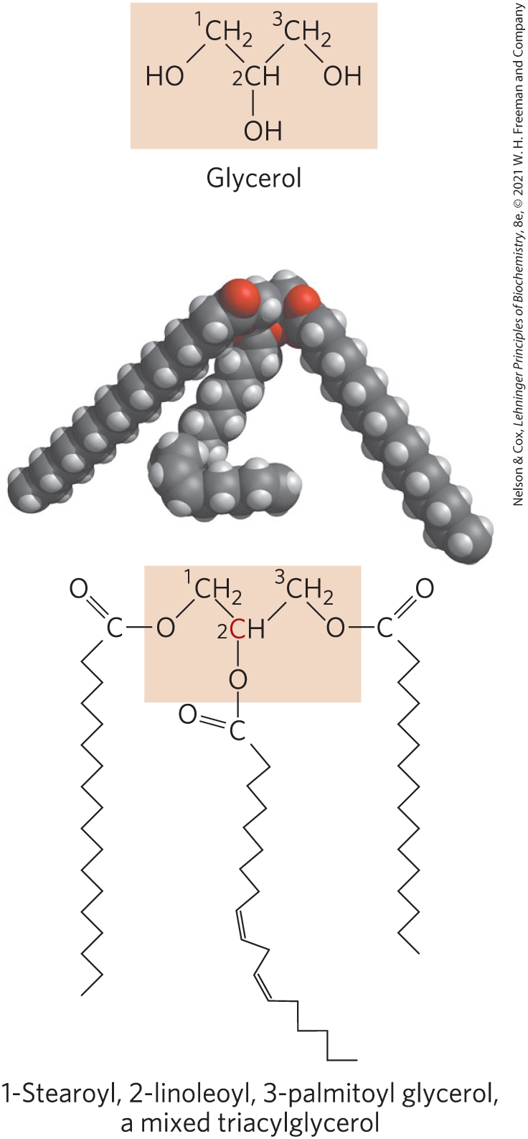
Triacylglycerols Are Fatty Acid Esters of Glycerol
triacylglycerols = simplest lipids constructed from fatty acids
  composed of three fatty acids, each in ester linkage with a single glycerol
  can be simple (one kind of fatty acid) or mixed (two or three different fatty acids)
  non-polar, hydrophobic

Slide 20
Clicker Question 3
Triacylglycerols:
always have at least one fatty acid with a trans double bond.
consist of glycerol and three different fatty acids.
consist of glycerol and three identical fatty acids.
are a major energy storage form.
Notes:
Answer: D
Principle: 10:1
Learning Objective(s): Relate the function of lipids to their structure and physical properties.
Bloom’s: 2:1

Slide 21
Clicker Question 3, Response
Triacylglycerols:
D. are a major energy storage form.
Triacylglycerols are primarily used for storing energy and providing insulation in animals.

Slide 22
Principle 1 (3 of 4)
Fatty acids are water-insoluble hydrocarbons used for cellular energy storage. Fatty acids are highly reduced and thus provide a rich source of stored chemical energy for cells. Storage of hydrophobic fats as triacylglycerols is also highly efficient because water is not needed to hydrate the stored fats.

Slide 23
Solubility of Fatty Acids
poor solubility in water due to the nonpolar hydrocarbon chain
  increased chain length decreases solubility
  decreased double bond number decreases solubility
carboxylic acid group is polar and ionized at neutral pH

Slide 24
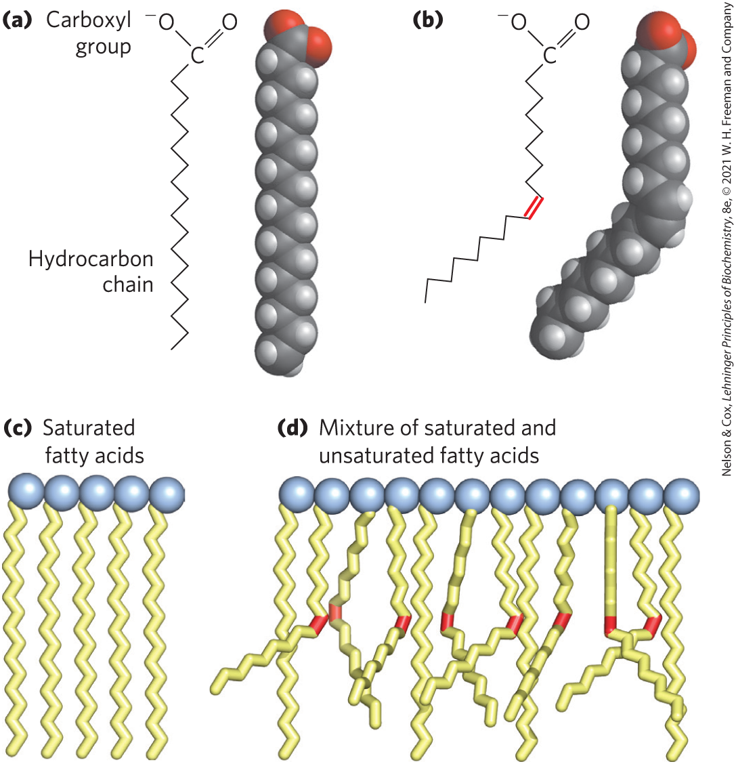
Melting Points of Fatty Acids
at room temperature:
  saturated fatty acids have a waxy consistency
  unsaturated fatty acids are oily liquids
extent of packing depends on degree of saturation

Slide 25
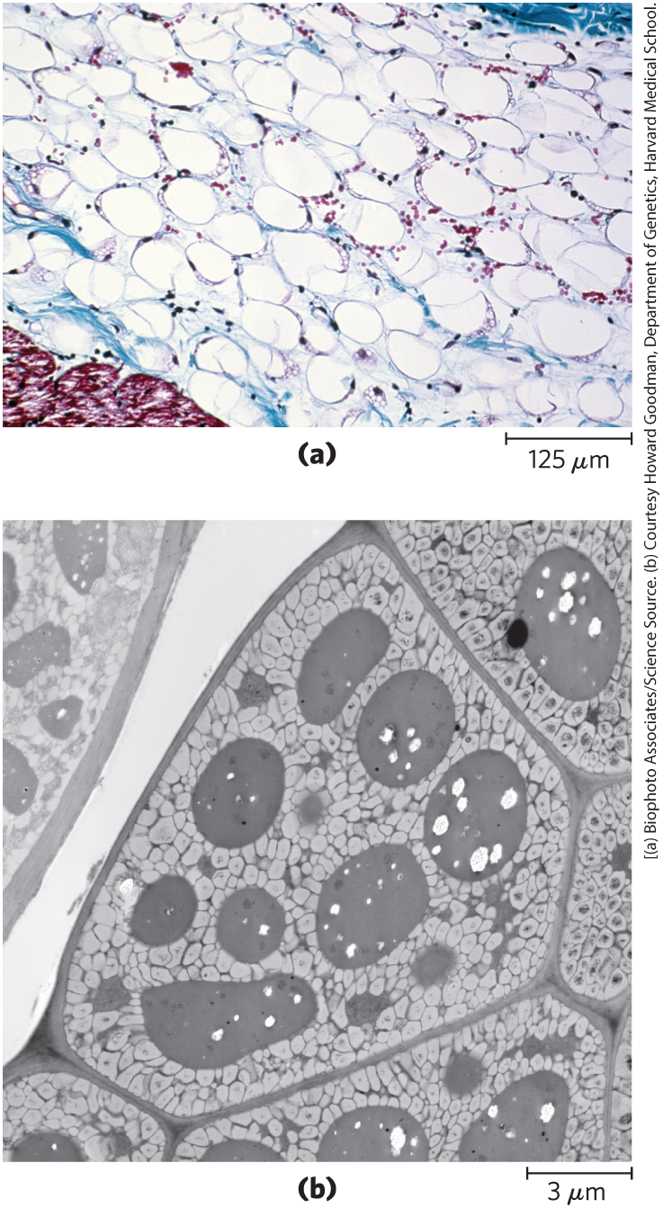
Triacylglycerols Provide Stored Energy and Insulation
vertebrates store triacylglycerols as lipid droplets in adipocytes (fat cells)
plants store triacylglycerols in the seeds

Slide 26
Lipases
lipases = enzymes that catalyze the hydrolysis of stored triacylglycerols, releasing fatty acids for export to sites where they are required as fuel
  adipocytes and germinating seeds contain lipases

Slide 27
Clicker Question 4
Where do we store triacylglycerol (triglyceride)?
in the lumen of the ER
in the mitochondria
in the lipid droplet
in the nucleus
Notes:
Answer: C
Principle: 10:1
Learning Objective(s): Explain how triacylglycerols are stored and broken down in an organism.
Bloom’s: 2:1

Slide 28
Clicker Question 4, Response
Where do we store triacylglycerol (triglyceride)?
C. in the lipid droplet
In vertebrates, specialized cells called adipocytes, or fat cells, store large amounts of triacylglycerols as fat droplets (lipid droplets) that nearly fill the cell.

Slide 29
Principle 1 (4 of 4)
Fatty acids are water-insoluble hydrocarbons used for cellular energy storage. Fatty acids are highly reduced and thus provide a rich source of stored chemical energy for cells. Storage of hydrophobic fats as triacylglycerols is also highly efficient because water is not needed to hydrate the stored fats.

Slide 30
Advantages to Using Triacylglycerols as Stored Fuels
two significant advantages:
  because carbon atoms of fatty acids are more reduced than those of sugars, oxidation of fatty acids yields more energy
  because triacylglycerols are hydrophobic and unhydrated, the organism does not have to carry the extra weight of water hydration that is associated with stored polysaccharides

Slide 31
Triacylglycerols Provide Insulation
seals, walruses, penguins, and other warm-blooded polar animals are amply padded with triacylglycerols
  provides insulation against low temperatures
hibernating animals (e.g. bears) accumulate huge fat reserves before hibernation
  provides insulation and energy storage

Slide 32
Clicker Question 5
What is the advantage of storing energy in the form of triacylglycerol over glycogen?
Triacylglycerol has a lower melting temperature.
Glycogen hydrolysis is poorly regulated.
Because triacylglycerol is bigger, it takes up more space inside the cell.
Because triacylglycerol is hydrophobic and excludes water, it takes up less space.
Notes:
Answer: D
Principle: 10:1
Learning Objective(s): Explain the advantages and disadvantages of using triacylglycerol as an energy source.
Bloom’s: 2:2

Slide 33
Clicker Question 5, Response
What is the advantage of storing energy in the form of triacylglycerol over glycogen?
Because triacylglycerol is hydrophobic and excludes water, it takes up less space.
One significant advantage to using triacylglycerols as stored fuels rather than glycogen is triacylglycerols are hydrophobic and therefore unhydrated. Because of this, the organism that carries stored fuel in the form of fat does not have to carry the extra weight of water of hydration that is associated with stored polysaccharides (2 g per gram of polysaccharide).

Slide 34
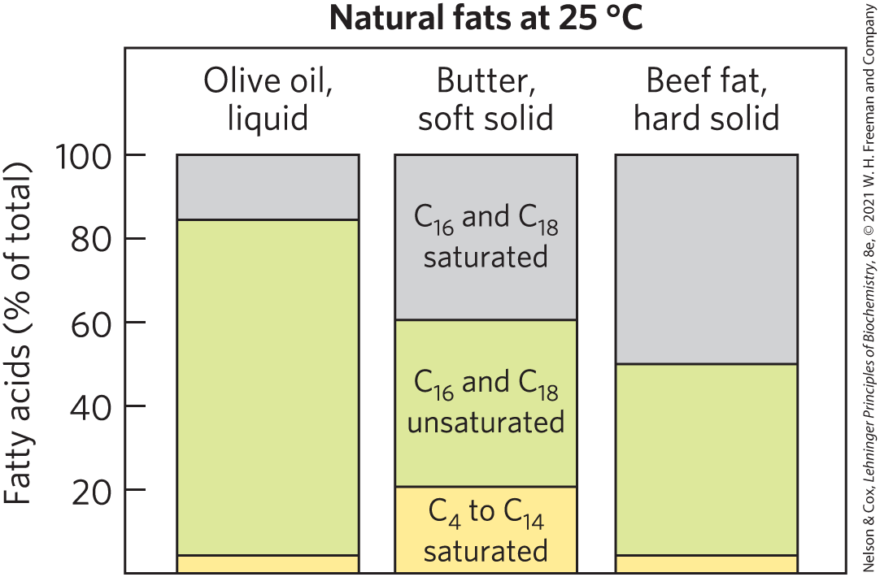
Partial Hydrogenation of Cooking Oils Improves Their Stability but Creates Fatty Acids with Harmful Health Effects
natural fats are complex mixtures of simple and mixed triacylglycerols

Slide 35
Partial Hydrogenation
oxidative cleavage of double bonds in unsaturated fatty acids to aldehydes and carboxylic acids causes lipid-rich food to become rancid
partial hydrogenation = process that converts many of the cis double bonds in the fatty acids to single bonds
  improves shelf life and increases stability
  increases the melting temperature
  converts some cis double bonds to trans double bonds

Slide 36
Trans Fatty Acids (“Trans Fats”)
dietary intake of trans fatty acids is linked to a higher incidence of cardiovascular disease
trans fatty acids:
  raise the level of triacylglycerols in the blood
  raise the level of LDL (“bad”) cholesterol in the blood
  lower the level of HDL (“good”) cholesterol
  increase the body’s inflammatory response

Slide 37
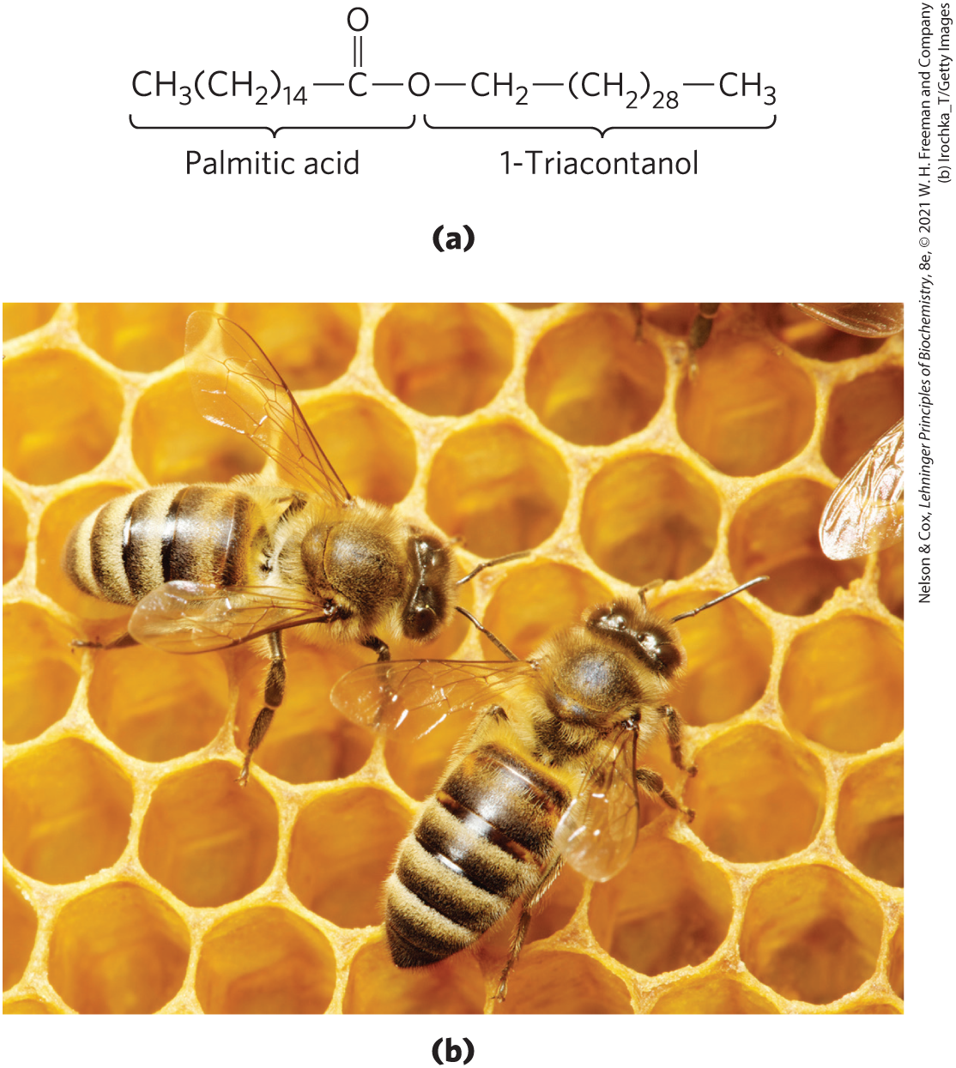
Waxes Serve as Energy Stores and Water Repellents
biological waxes = esters of long-chain (C₁₄ to C₃₆) saturated and unsaturated fatty acids with long-chain (C₁₆ to C₃₀) alcohols
  higher melting point than triacylglycerols
  water-repellant properties
  firm consistency

Slide 38
Clicker Question 6
Which statement is false?
Naturally occurring fatty acids usually have an even number of carbons.
Wax esters contain long chain fatty acids and long chain alcohols.
Triacylglycerols are polar due to their ester functional groups.
The number of C–C double bonds in a fatty acid affects its melting point.
Notes:
Answer: C
Principle: 10:1
Learning Objective(s): Describe the structure of a triglyceride.
Bloom’s: 2:2

Slide 39
Clicker Question 6, Response
Which statement is false?
Triacylglycerols are polar due to their ester functional groups.
Because the polar hydroxyls of glycerol and the polar carboxylates of the fatty acids are bound in ester linkages, triacylglycerols are nonpolar, hydrophobic molecules, essentially insoluble in water.

Slide 40

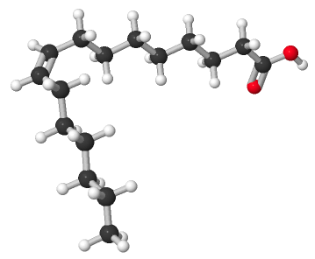
Activity: Properties of
Fatty Acids
Observe the structure of palmitoleic acid (16:1)
in Mol3D viewer in your Achieve course.
Notes:
Instructor: This Mol3D structure is located in the Achieve course. It can be found in the Chapter 10 content, in the folder titled “Ch10 In-Class Activities and Resources.”

Slide 41
Activity Instructions (1 of 3)
On your own, think of answers to the questions:
  Is palmitoleic acid more or less reduced than palmitic acid (16:0)?
  Which atom in palmitoleic acid binds to the glycerol backbone in a triacylglycerol? Select the atom and upload a screenshot to your course.
  (2 minutes)
Pair up to discuss your ideas. (2 minutes)
Share your ideas with the class in group discussion.
(3 minutes)
Notes:
Instructor: This Mol3D structure is located in the Achieve course. It can be found in the Chapter 10 content, in the folder titled “Ch10 In-Class Activities and Resources.”

Slide 42
Activity Solution (1 of 3)
  Is palmitoleic acid more or less reduced than palmitic acid (16:0)? The double bond in palmitoleic acid makes it less reduced than palmitic acid.
  Which atom in palmitoleic acid binds to the glycerol backbone in a triacylglycerol? During triacylglycerol synthesis, the carbonyl carbon of the carboxylic acid group of palmitoleic acid binds to one of glycerol’s oxygen (displacing palmitoleic acid’s -OH group).
Notes:
Instructor: This Mol3D structure is located in the Achieve course. It can be found in the Chapter 10 content, in the folder titled “Ch10 In-Class Activities and Resources.”

Slide 43
10.2 Structural Lipids in Membranes

Slide 44
Principle 2 (2 of 6)
Membrane lipids are composed of hydrophobic tails attached to polar head groups. Cellular membranes are composed of a variety of lipids, including glycerophospholipids and sterols. These lipids are used for structuring membranes as well as for displaying molecules on the membrane surfaces for signaling and molecular recognition.

Slide 45
Biological Membranes
biological membranes = double layer of lipids that acts as a barrier to polar molecules and ions
membrane lipids:
  amphipathic = one end of the molecule is hydrophobic, the other hydrophilic
  hydrophobic regions associate with each other
  hydrophilic regions associate with water

Slide 46
Four General Types of Membrane Lipids
phospholipids = have hydrophobic regions composed of two fatty acids joined to glycerol or sphingosine
glycolipids = contain a simple sugar or a complex oligosaccharide at the polar ends
archaeal tetraether lipids = have two very long alkyl chains ether-linked to glycerol at both ends
sterols = compounds characterized by a rigid system of four fused hydrocarbon rings

Slide 47
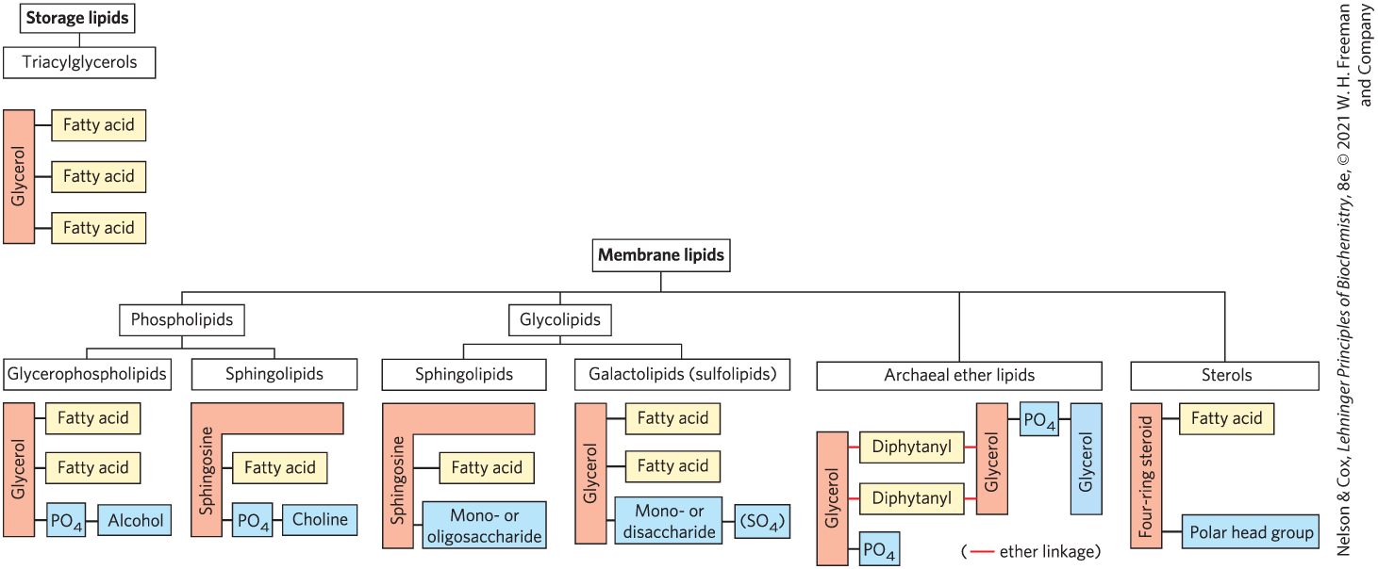
Some Common Types of Storage and Membrane Lipids

Slide 48
Principle 2 (3 of 6)
Membrane lipids are composed of hydrophobic tails attached to polar head groups. Cellular membranes are composed of a variety of lipids, including glycerophospholipids and sterols. These lipids are used for structuring membranes as well as for displaying molecules on the membrane surfaces for signaling and molecular recognition.

Slide 49
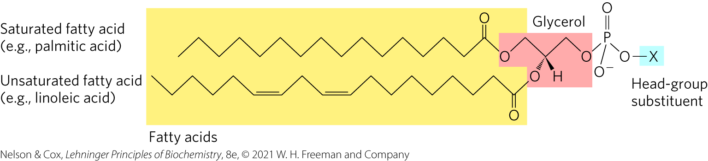
Glycerophospholipids Are Derivatives of Phosphatidic Acid
glycerophospholipids (phosphoglycerides) = membrane lipids in which two fatty acids are attached in ester linkage to the first and second carbons of glycerol, and a highly polar or charged group is attached through a phosphodiester linkage to the third carbon

Slide 50
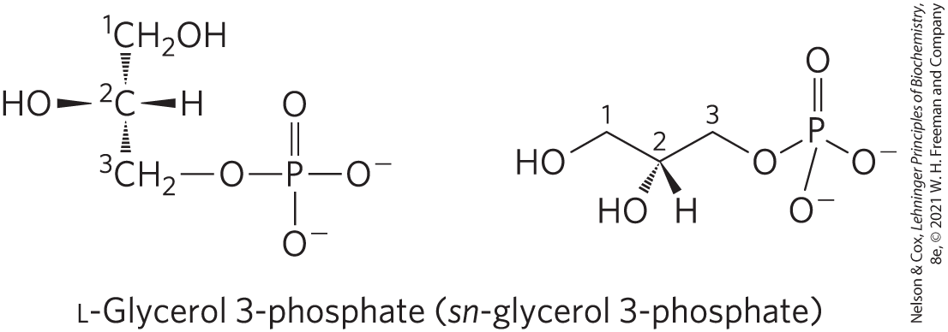
Glycerol is Prochiral
attachment of phosphate at one end of glycerol converts it to a chiral compound
  named using the D, L system

Slide 51

Clicker Question 7
Glycerophospholipids do NOT contain:
fatty acids
ester linkages
glycerol
a mono- or disaccharide
Notes:
Answer: D
Principle: 10:2
Learning Objective(s): Describe the structure of a phospholipid.
Bloom’s: 2:1

Slide 52
Clicker Question 7, Response
Glycerophospholipids do NOT contain:
D. a mono- or disaccharide
Glycerophospholipids are membrane lipids in which two fatty acids are attached in ester linkage to the first and second carbons of glycerol, and a highly polar or charged group is attached through a phosphodiester linkage to the third carbon. They do not contain monosaccharides or disaccharides.

Slide 53
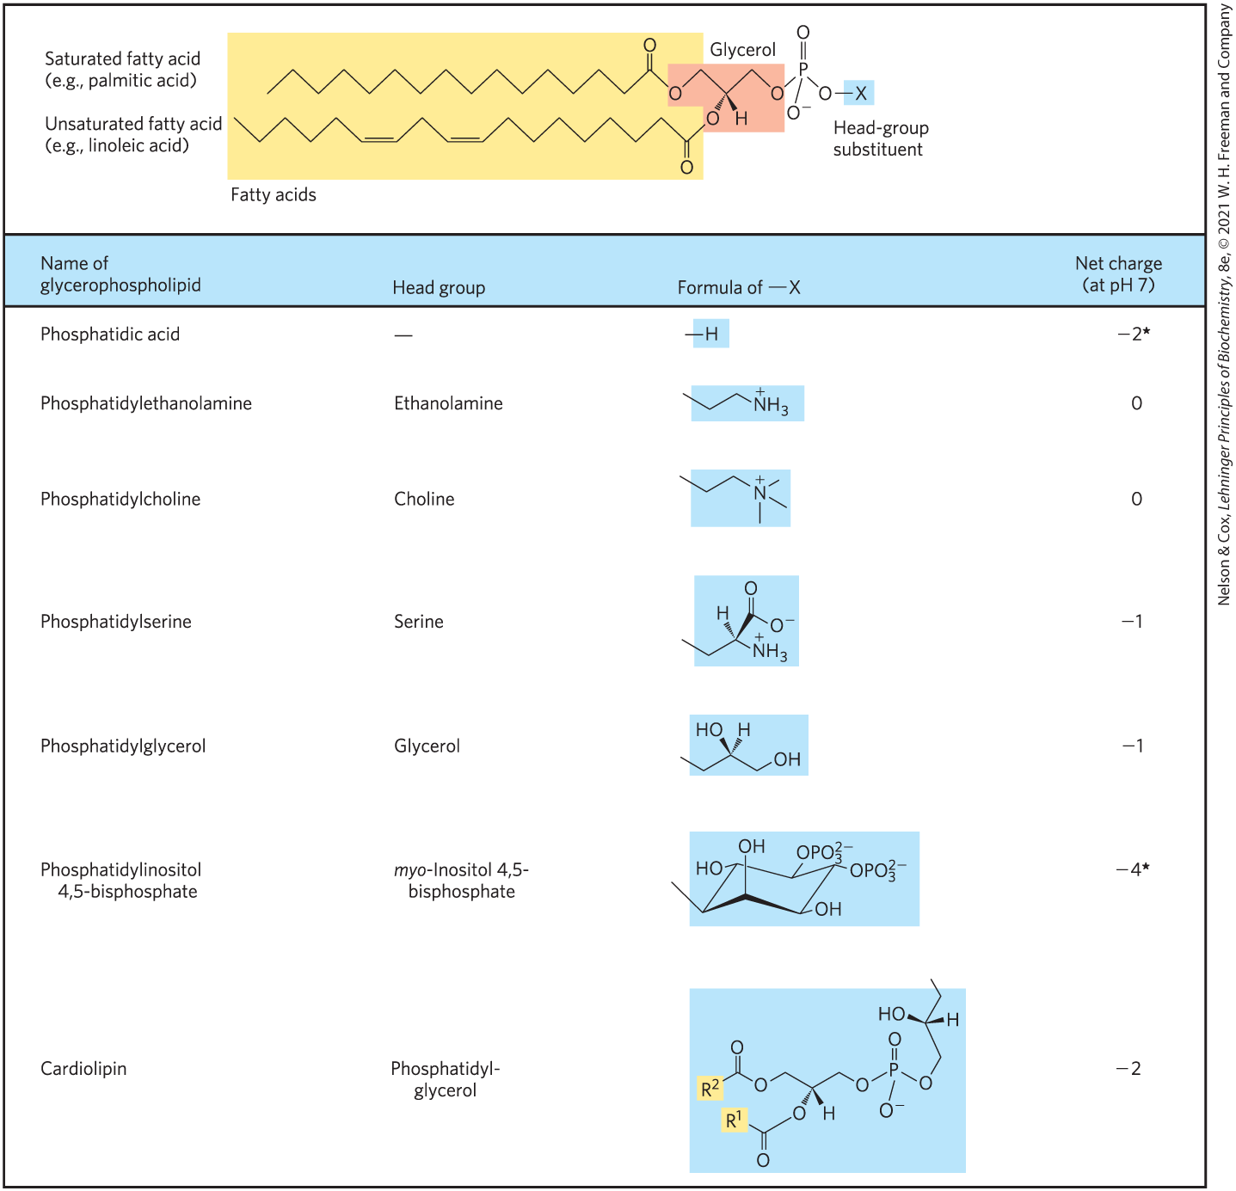
Glycerophospholipids Are Named as Derivatives of Phosphatidic Acid
a phosphodiester bond joins the head group to glycerol
the phosphate group can bear a negative, neutral, or positive charge

Slide 54
The Fatty Acids in Glycerophospholipids
can be any of a wide variety
in general, glycerophospholipids contain:
  a C₁₆ or C₁₈ saturated fatty acid at C-1
  a C₁₈ or C₂₀ unsaturated fatty acid at C-2

Slide 55
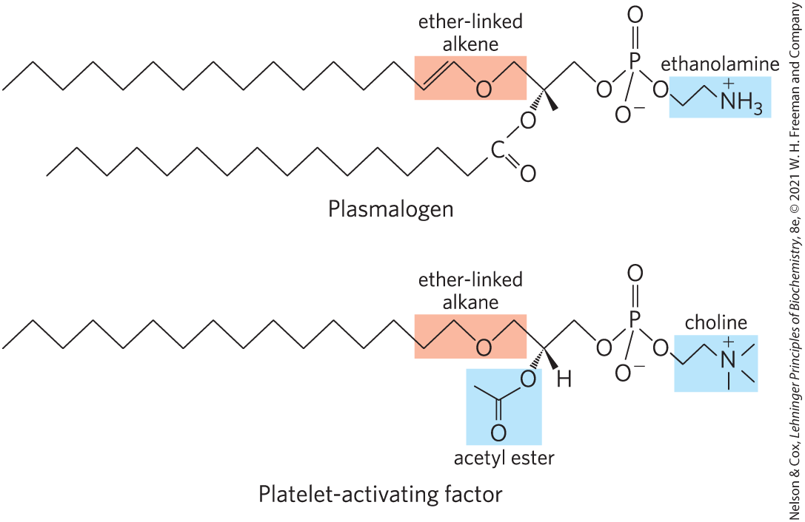
Some Glycerophospholipids Have Ether-Linked Fatty Acids
ether lipids = one of the two acyl chains is attached to glycerol in ether, rather than ester, linkage
  chain may be saturated
  chain may contain a double bond between C-1 and C-2 as in plasmalogens

Slide 56
Platelet-Activating Factor
platelet-activating factor = an ether lipid that serves as a potent molecular signal
  releases from leukocytes called basophils
  stimulates platelet aggregation and serotonin release
  plays a role in inflammation and the allergic response

Slide 57
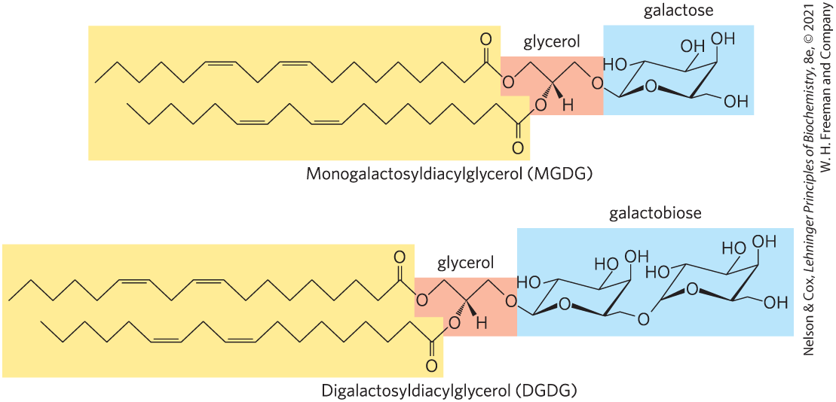
Galactolipids of Plants and Ether-Linked Lipids of Archaea Are Environmental Adaptations
galactolipids = member of the glycolipids group that predominate in plant cells
  one or two galactose residues are connected by a glycosidic linkage to C-3 of a 1,2-diacylglycerol

Slide 58
Clicker Question 8
Which statement is false?
Glycerophospholipids are named as derivatives of the parent compound, phosphatidic acid.
Ether lipids may be saturated or contain a double bond.
Platelet-activating factor is a glycerophospholipid.
The stroma of the chloroplast is rich in galactolipids, composed of a diacylglycerol with one or two linked galactose residues.
Notes:
Answer: D
Principle: 10:2
Learning Objective(s): Identify a glycolipid.
Bloom’s: 2:2

Slide 59
Clicker Question 8, Response
Which statement is false?
The stroma of the chloroplast is rich in galactolipids, composed of a diacylglycerol with one or two linked galactose residues.
Galactolipids are localized in the thylakoid membranes (internal membranes) of chloroplasts.

Slide 60
Principle 2 (4 of 6)
Membrane lipids are composed of hydrophobic tails attached to polar head groups. Cellular membranes are composed of a variety of lipids, including glycerophospholipids and sterols. These lipids are used for structuring membranes as well as for displaying molecules on the membrane surfaces for signaling and molecular recognition.

Slide 61
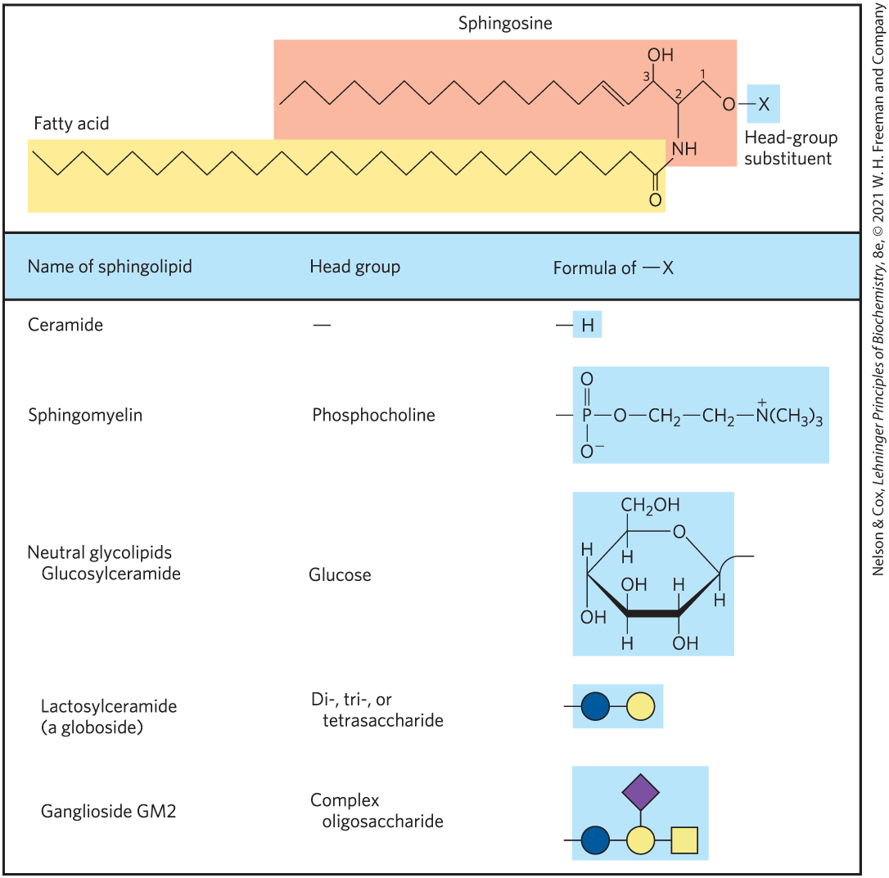
Sphingolipids Are Derivatives of Sphingosine
sphingolipids = large class of membrane phospholipids and glycolipids
  have a polar head group and two nonpolar tails
  contain no glycerol
  contain one molecule of the long-chain amino alcohol sphingosine or one of its derivatives

Slide 62
Ceramides Are The Structural Parent of All Sphingolipids
C-1, C-2, and C-3 of sphingosine are structurally analogous of the three carbons of glycerol in glycerophospholipids
ceramide = compound resulting when a fatty acid is attached in amide linkage to the –NH₂ on C-2
  structurally similar to a diacylglycerol

Slide 63
Clicker Question 9
__________________ a parent compound or compounds of sphingolipids.
Phospholipases are
Glycerol-3-phosphate is
Sphingomyelins are
Ceramides are
Notes:
Answer: D
Principle: 10:2
Learning Objective(s): Identify sphingosine backbone in a sphingolipid.
Bloom’s: 2:1

Slide 64
Clicker Question 9, Response
__________________ a parent compound or compounds of sphingolipids.
D. Ceramides are
When a fatty acid is attached in amide linkage to the –NH2 on C-2, the resulting compound is a ceramide, which is structurally similar to a diacylglycerol. Ceramides are the structural parents of all sphingolipids.

Slide 65
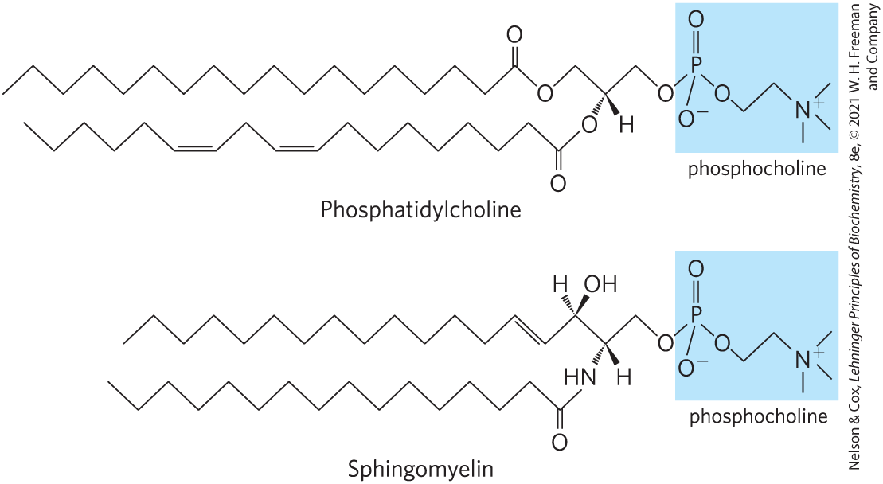
Sphingomyelins
sphingomyelins = subclass of sphingolipids that contains phosphocholine or phosphoethanolamine as their polar head group

Slide 66
Glycosphingolipids
glycosphingolipids = have head groups with 1+ sugars connected directly to the –OH at C-1 of the ceramide moiety
  do not contain phosphate
  occur largely in the outer face of plasma membranes

Slide 67
Cerebrosides and Globosides
cerebrosides = have a single sugar linked to ceramide
  those with galactose are found in the plasma membranes of cells in neural tissue
  those with glucose are found in the plasma membranes of cells in nonneural tissues
globosides = glycosphingolipids with 2+ sugars, usually D-glucose, D-galactose, or N-acetyl-D-galactosamine
sometimes called neutral glycolipids, as they have no charge at pH 7

Slide 68
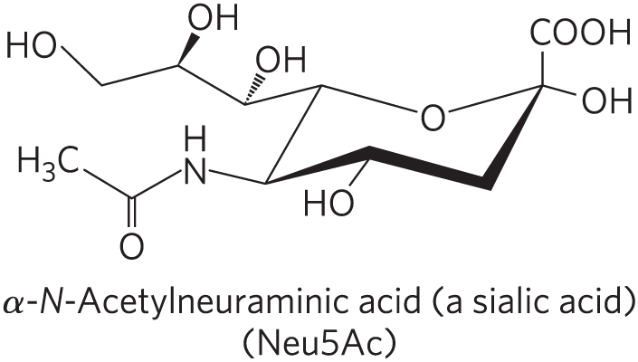
Gangliosides
gangliosides = have oligosaccharides as their polar head groups and 1+ residues of N-acetylneuraminic acid (Neu5Ac), a sialic acid, at the termini
  1 sialic acid residue = GM (M for mono-) series
  2 sialic acid residues = GD (D for di-) series
  3 sialic acid residues = GT (T for tri-) series (and so on)

Slide 69
Clicker Question 10
Which sphingolipids have a single monosaccharide as a component?
cerebrosides
gangliosides
globosides
plasmalogens
Notes:
Answer: A
Principle: 10:2
Learning Objective(s): Locate structural differences between ceremide and ceremide derivatives (sphingomyelin and glycosphingolipids).
Bloom’s: 2:2

Slide 70
Clicker Question 10, Response
Which sphingolipids have a single monosaccharide as a component?
cerebrosides
Cerebrosides have a single sugar linked to ceramide.

Slide 71
Principle 2 (5 of 6)
Membrane lipids are composed of hydrophobic tails attached to polar head groups. Cellular membranes are composed of a variety of lipids, including glycerophospholipids and sterols. These lipids are used for structuring membranes as well as for displaying molecules on the membrane surfaces for signaling and molecular recognition.

Slide 72
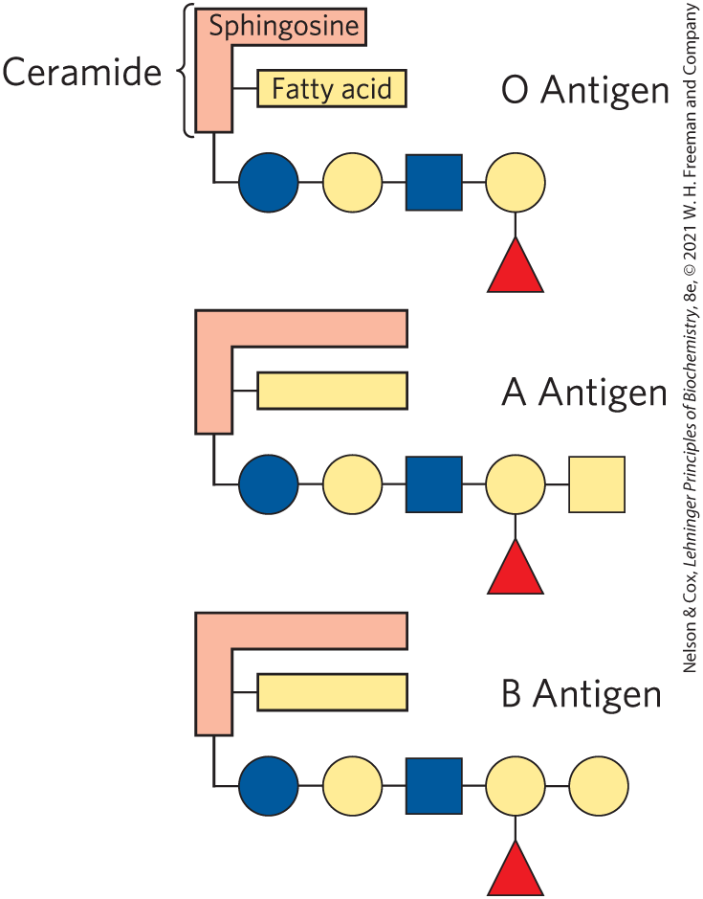
Sphingolipids at Cell Surfaces Are Sites of Biological Recognition
prominent in the plasma membranes of neurons
human blood groups (O, A, B) are determined in part by the oligosaccharide head groups of these glycosphingolipids

Slide 73
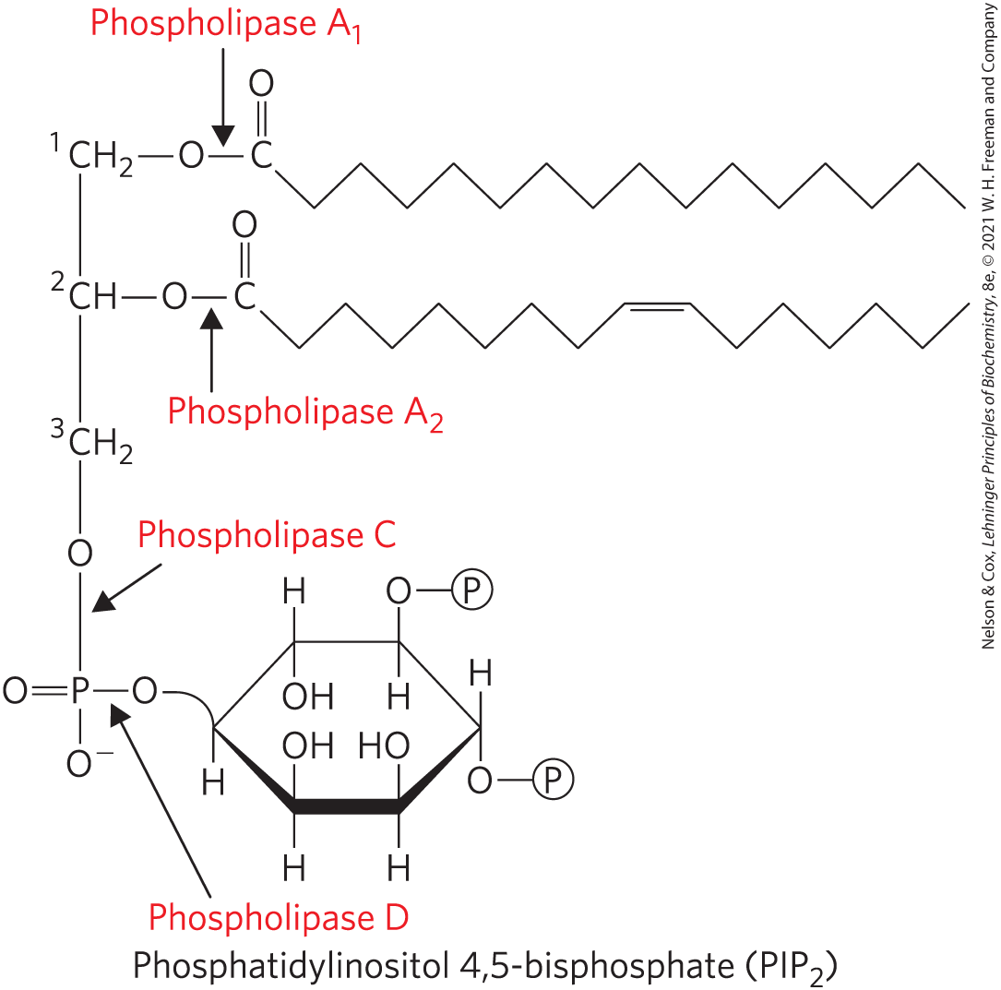
Phospholipids and Sphingolipids Are Degraded in Lysosomes
phospholipases of the A type remove one of the two fatty acids
lysophospholipases remove the remaining fatty acid
lysosomal enzymes catalyze the stepwise removal of sugar units of gangliosides

Slide 74
Clicker Question 11
What are the products of phospholipase D degradation of phosphatidylethanolamine?
diacylglycerol and phosphocholine
diacylglycerol and phosphoethanolamine
phosphatidate and ethanolamine
phosphatidate and choline
Notes:
Answer: C
Principle: 10:2
Learning Objective(s):
Bloom’s: 3:2

Slide 75
Clicker Question 11, Response
What are the products of phospholipase D degradation of phosphatidylethanolamine?
C. phosphatidate and ethanolamine
Phospholipase D splits one of the phosphodiester bonds in the head group. Thus, phospholipase D degradation of phosphatidylethanolamine would form phosphatidate and ethanolamine.

Slide 76
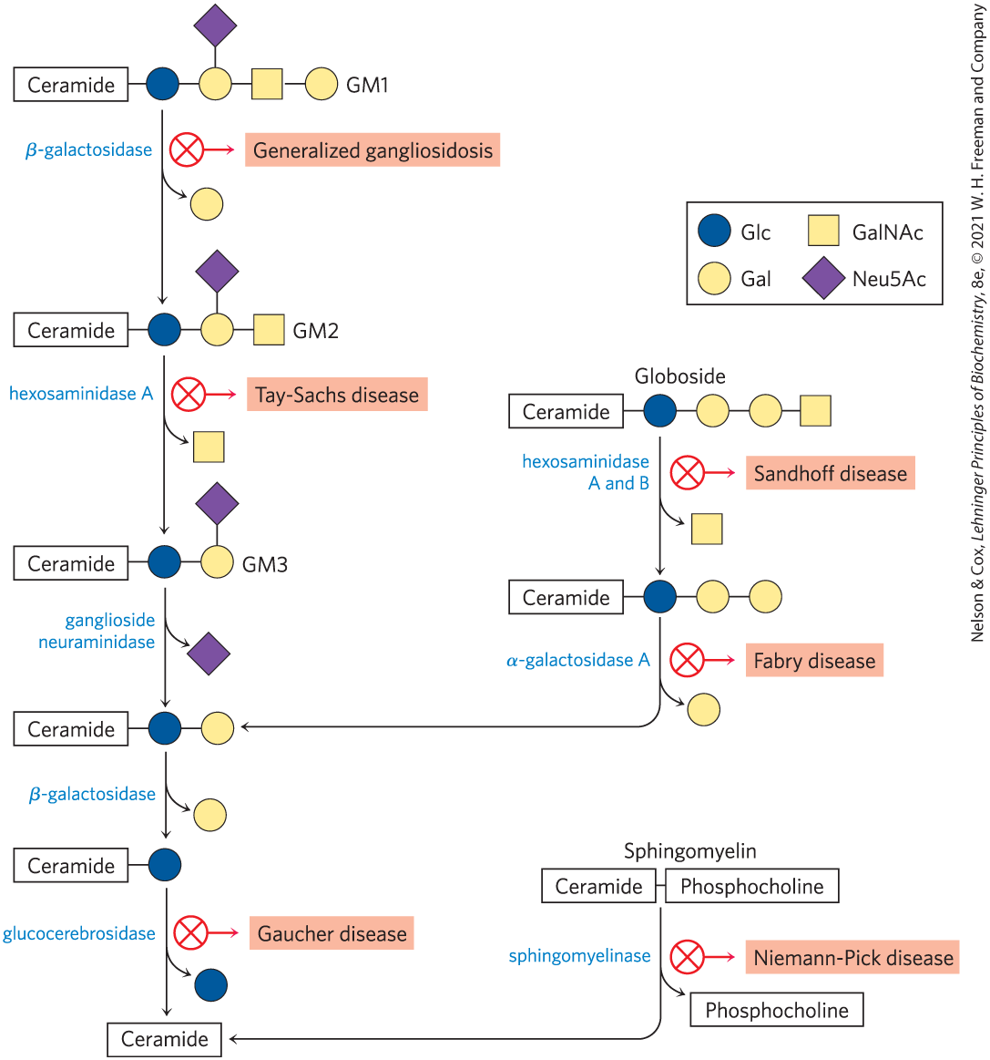
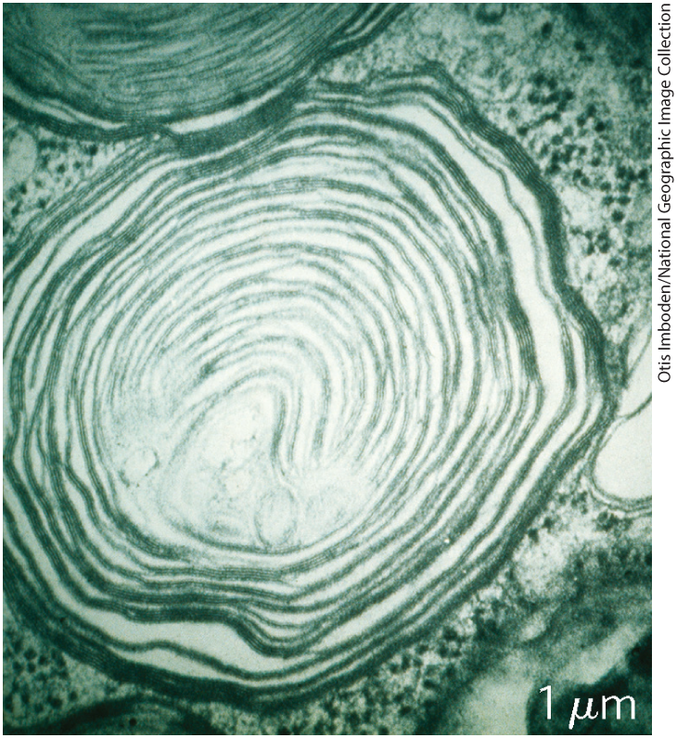
Abnormal Accumulations of Membrane Lipids
genetic defects in any of these hydrolytic enzymes leads to the accumulation of gangliosides in the cell

Slide 77
Principle 2 (6 of 6)
Membrane lipids are composed of hydrophobic tails attached to polar head groups. Cellular membranes are composed of a variety of lipids, including glycerophospholipids and sterols. These lipids are used for structuring membranes as well as for displaying molecules on the membrane surfaces for signaling and molecular recognition.

Slide 78
Sterols Have Four Fused Carbon Rings
sterols = structural lipids present in the membranes of most eukaryotic cells
steroid nucleus:
  consists of four fused rings
  almost planar
  relatively rigid

Slide 79
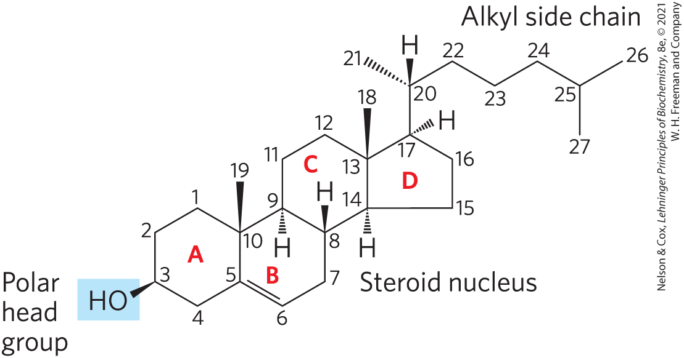
Cholesterol
cholesterol = major sterol in animal tissues
  amphipathic
  polar head group
  nonpolar hydrocarbon body
  membrane constituents
  similar to stigmasterol in plants and ergosterol in fungi

Slide 80
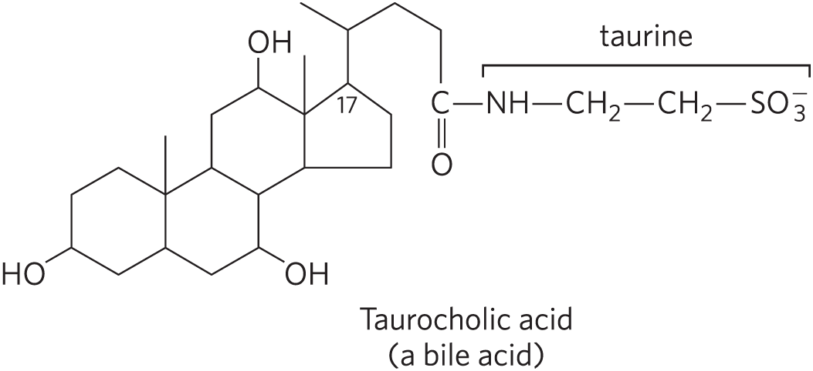
Sterols Serve as Precursors for Products with Specific Biological Activities
steroid hormones regulate gene expression
bile acids = polar derivatives of cholesterol that emulsify dietary fats in the intestine to make them more readily accessible to digestive lipases

Slide 81
Clicker Question 12
Which statement regarding cholesterol is false?
It is the precursor for steroid hormones.
It is the precursor for bile acids.
It is not usually a component of eukaryotic membranes.
It has a hydrophilic functional group.
Notes:
Answer: C
Principle: 10:2
Learning Objective(s): Describe the biological roles of sterols in and out of cellular membranes
Bloom’s: 2:2

Slide 82
Clicker Question 12, Response
Which statement regarding cholesterol is false?
It is not usually a component of eukaryotic membranes.
Cholesterol, the major sterol in animal tissues, is amphipathic, with a polar head group and a nonpolar hydrocarbon body. In addition to their roles as membrane constituents, the sterols serve as precursors for a variety of products with specific biological activities.

Slide 83
Clicker Question 13
Membrane lipids do NOT include:
glycerophospholipids.
triacylglycerols.
sphingolipids.
glycolipids.
Notes:
Answer: B
Principle: 10:2
Learning Objective(s): Identify the roles different lipids play in maintaining membrane function.
Bloom’s: 2:1

Slide 84
Clicker Question 13, Response
Membrane lipids do NOT include:
B. triacylglycerols.
Triacylglycerols are primarily used for storing energy and providing insulation in animals. They are not structural lipids in membranes.

Slide 85
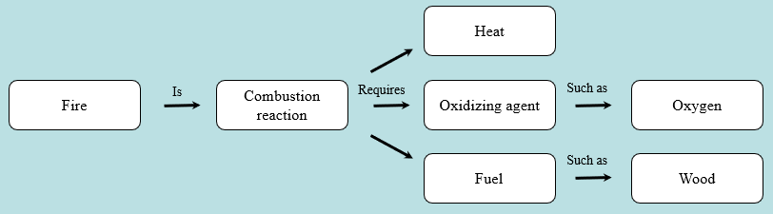
Activity: Relating
Terms within the Chapter
A concept map displays the relationships between different concepts. Observe the following example of a concept map.
Notes:
Instructor: For additional information, see the Instructor Activity Guide located in Achieve. It can be found within Chapter 10, in the folder titled “Ch10 In-Class Activities and Resources.”

Slide 86
Activity Instructions (2 of 3)
Think about how the following terms and phrases relate to each other and then use scratch paper to draw a concept map using these terms and phrases. (3 minutes)
cellular membrane
variety of membrane lipids
hydrophobic tails attached to polar heads
sterols
glycerophospholipids
structure membranes
display molecules on cell surface
signaling and molecular recognition
Notes:
Instructor: For additional information, see the Instructor Activity Guide located in Achieve. It can be found within Chapter 10, in the folder titled “Ch10 In-Class Activities and Resources.”

Slide 87
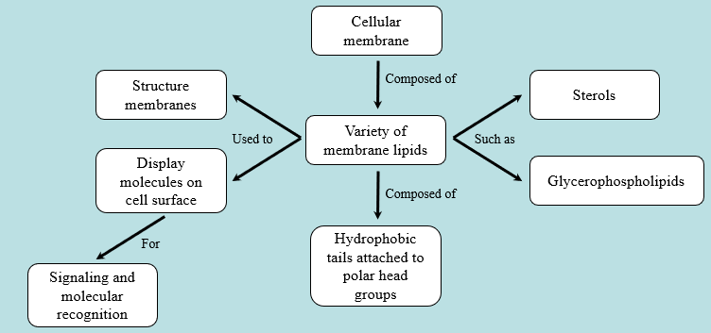
Activity Solution (2 of 3)
Pair up and share how this possible concept map might differ from yours. (2 minutes)
Notes:
Instructor: For additional information, see the Instructor Activity Guide located in Achieve. It can be found within Chapter 10, in the folder titled “Ch10 In-Class Activities and Resources.”

Slide 88
10.3 Lipids as Signals, Cofactors, and Pigments

Slide 89
Principle 3 (2 of 7)
Lipids have uses in the cell beyond energy storage and membranes construction. Many lipids are present in the cell at smaller amounts than those making up membranes or being stored as fat. These lipids can function as cellular messengers, hormones, electron carriers, or pigments.

Slide 90
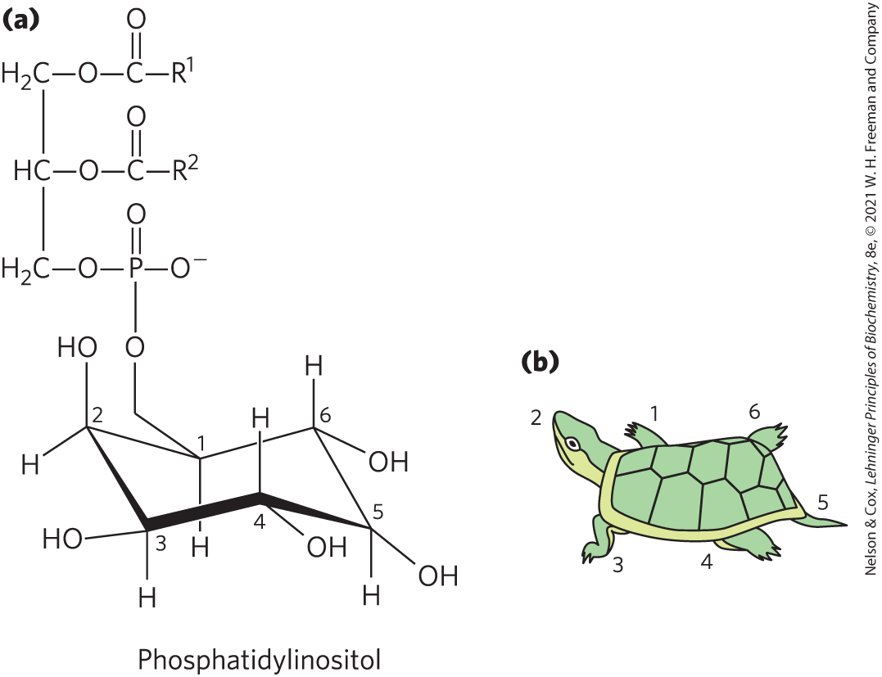
Phosphatidylinositols and Sphingosine Derivatives Act as Intracellular Signals
phosphatidylinositol (PI) and its phosphorylated derivatives regulate cell structure and metabolism

Slide 91
Phosphatidylinositol 4,5-Bisphosphate (PIP₂)
in the cytoplasmic face of plasma membranes
serves as a reservoir of messenger molecules that are released in response to extracellular signals
  phospholipase C hydrolyzes PIP₂ to IP₃ and diacylglycerol (intracellular messengers)

Slide 92
Principle 3 (3 of 7)
Lipids have uses in the cell beyond energy storage and membranes construction. Many lipids are present in the cell at smaller amounts than those making up membranes or being stored as fat. These lipids can function as cellular messengers, hormones, electron carriers, or pigments.

Slide 93
Inositol Phospholipids Serve As Points of Nucleation
signaling proteins bind specifically to phosphatidylinositol 3,4,5-trisphosphate (PIP₃) in the plasma membrane
  initiates formation of multienzyme complexes at the membrane’s cytosolic surface

Slide 94
Membrane Sphingolipids Serve As Sources of Intracellular Messengers
ceramide and sphingomyelin are potent regulators of protein kinases
ceramide or its derivatives are involved in the regulation of:
  cell division
  differentiation
  migration
  programmed cell death

Slide 95

Clicker Question 14
Which statement is false?
Phosphorylated derivatives of phosphatidylinositol regulate cell structure and metabolism.
Extracellular signals activate a specific phospholipase C in the membrane, which hydrolyzes PIP₂ to release two products that act as intracellular messengers.
Formation of PIP₃ in response to extracellular signals brings the proteins together in signaling complexes at the surface of the plasma membrane.
PIP₃ is a potent regulator of protein kinases.
Notes:
Answer: D
Principle: 10:3
Learning Objective(s): Explain how phosphatidylinositol can regulate cellular structure and extracellular responses.
Bloom’s: 2:2

Slide 96
Clicker Question 14, Response
Which statement is false?
D. PIP₃ is a potent regulator of protein kinases.
Membrane sphingolipids also can serve as sources of intracellular messengers. Both ceramide and sphingomyelin are potent regulators of protein kinases.

Slide 97
Principle 3 (4 of 7)
Lipids have uses in the cell beyond energy storage and membranes construction. Many lipids are present in the cell at smaller amounts than those making up membranes or being stored as fat. These lipids can function as cellular messengers, hormones, electron carriers, or pigments.

Slide 98
Eicosanoids Carry Messages to Nearby Cells
eicosanoids = paracrine hormones, substances that act only on cells near the point of hormone synthesis instead of being transported in the blood
involved in:
  reproductive function
  inflammation, fever, and pain associated with injury or disease
  formation of blood clots
  regulation of blood pressure
  gastric acid secretion

Slide 99
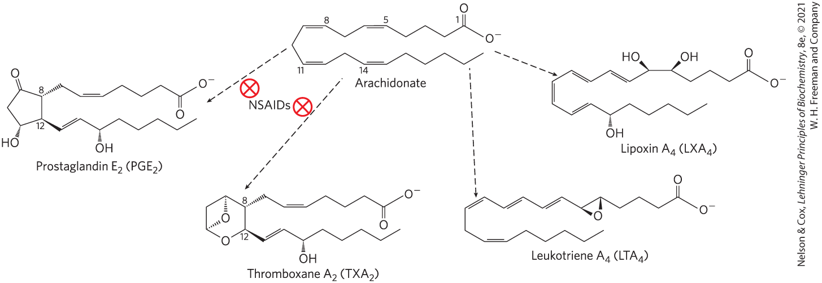
Eicosanoids Are Derived From Arachidonic Acid
four major classes of eicosanoids = prostaglandins, thromboxanes, leukotrienes, and lipoxins

Slide 100
Clicker Question 15
Which statement regarding eicosanoids is false?
They are produced from arachidonate.
They are classified as neither prostaglandins nor thromboxanes.
They act as paracrine hormones.
They have many different effects.
Notes:
Answer: B
Principle: 10:3
Learning Objective(s): Describe how the four main types of eicosanoids (prostaglandins, thromboxanes, leukotrienes, and lipoxins) function differently within a cell.
Bloom’s: 2:1

Slide 101
Clicker Question 15, Response
Which statement regarding eicosanoids is false?
They are classified as neither prostaglandins nor thromboxanes.
There are four major classes of eicosanoids: prostaglandins, thromboxanes, leukotrienes, and lipoxins.

Slide 102
Prostaglandins (PG)
prostaglandins (PG) = class of eicosanoids that contain a five-carbon ring
array of functions:
  stimulate contraction of the smooth muscle of the uterus
  affect blood flow to specific organs, the wake-sleep cycle, and the responsiveness of certain tissues to hormones
  elevate body temperature and cause inflammation and pain

Slide 103
Thromboxanes (TX)
thromboxanes (TX) = class of eicosanoids that have a six-membered ring containing an ether
produced by platelets (also called thrombocytes)
act in the formation of blood clots and reduction of blood flow to the site of a clot

Slide 104
Leukotrienes (LT)
leukotrienes (LT) = class of eicosanoids that contain three conjugated double bonds
powerful biological signals
  leukotriene D₄ induces contraction of the smooth muscle lining the airways to the lung

Slide 105
Lipoxins (LX)
lipoxins (LX) = class of eicosanoids that are linear and contain several hydroxyl groups along the chain
potent anti-inflammatory agents

Slide 106
Clicker Question 16
A novel subclass of thromboxane was discovered in lipids isolated from a newly discovered poison dart from the Amazon valley. What unique structural feature is likely present in these lipids?
four conjugated double bonds
a six-membered ring
a long-chain alcohol bound to a double ring
a five-membered ring
Notes:
Answer: B
Principle: 10:3
Learning Objective(s): Describe how the four main types of eicosanoids (prostaglandins, thromboxanes, leukotrienes, and lipoxins) function differently within a cell.
Bloom’s: 2:2

Slide 107
Clicker Question 16, Response
A novel subclass of thromboxane was discovered in lipids isolated from a newly discovered poison dart from the Amazon valley. What unique structural feature is likely present in these lipids?
B. a six-membered ring
The thromboxanes (TX) have a six-membered ring containing an ether.

Slide 108
Principle 3 (5 of 7)
Lipids have uses in the cell beyond energy storage and membranes construction. Many lipids are present in the cell at smaller amounts than those making up membranes or being stored as fat. These lipids can function as cellular messengers, hormones, electron carriers, or pigments.

Slide 109
Steroid Hormones Carry Messages between Tissues
steroids = oxidized derivates of sterols
  lack the alkyl chain attached to ring D of cholesterol
  more polar than cholesterol
steroid hormones move through the bloodstream (on protein carriers) to target tissues
binding to highly specific receptor proteins in the nucleus triggers changes in gene expression

Slide 110
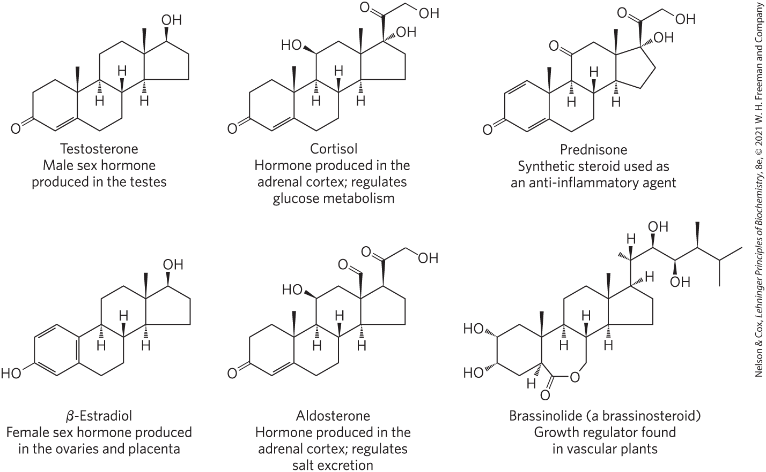
Steroids Derived From Cholesterol

Slide 111
Clicker Question 17
Steroid hormones:
act locally.
travel through the bloodstream on lipid carriers.
bind to receptor proteins in the nucleus to change metabolism.
have low affinity for their receptors.
Notes:
Answer: C
Principle: 10:3
Learning Objective(s): Classify a hormone as a cholesterol derivative.
Bloom’s: 2:2

Slide 112
Clicker Question 17, Response
Steroid hormones:
bind to receptor proteins in the nucleus to change metabolism.
Steroid hormones move through the bloodstream (on protein carriers) from their production site to target tissues, where they enter cells, bind to highly specific receptor proteins in the nucleus, and trigger changes in gene expression and thus metabolism. Hormones have very high affinity for their receptors, so very low concentrations of hormones are sufficient to produce responses in target tissues.

Slide 113
Principle 3 (6 of 7)
Lipids have uses in the cell beyond energy storage and membranes construction. Many lipids are present in the cell at smaller amounts than those making up membranes or being stored as fat. These lipids can function as cellular messengers, hormones, electron carriers, or pigments.

Slide 114
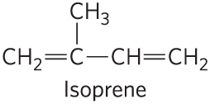
Vascular Plants Produce Thousands of Volatile Signals
functions of volatile, lipophilic compounds:
  attract pollinators
  repel herbivores
  attract organisms that defend the plant against herbivores
  communicate with other plants
many are derived from fatty acids or from compounds made by the condensation of isoprene units

Slide 115
Principle 3 (7 of 7)
Lipids have uses in the cell beyond energy storage and membranes construction. Many lipids are present in the cell at smaller amounts than those making up membranes or being stored as fat. These lipids can function as cellular messengers, hormones, electron carriers, or pigments.

Slide 116
Vitamins A and D Are Hormone Precursors
vitamins = compounds that are essential to the health of humans and other vertebrates but cannot be synthesized
fat-soluble vitamins include the groups A, D, E, and K

Slide 117
Vitamin D₃ and Calcitrol
vitamin D₃ (cholecalciferol) = formed in the skin from 7-dehydrocholesterol in a photochemical reaction driven by the UV component of sunlight
  not biologically active
  converted by enzymes in the liver and kidney to calcitriol

Slide 118
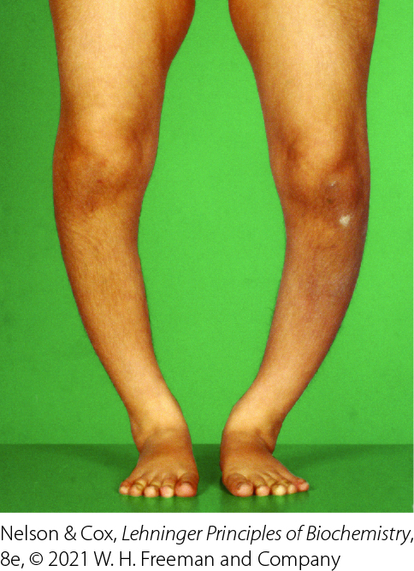
Vitamin D Deficiencies
deficiency leads to defective bone formation and the disease rickets

Slide 119
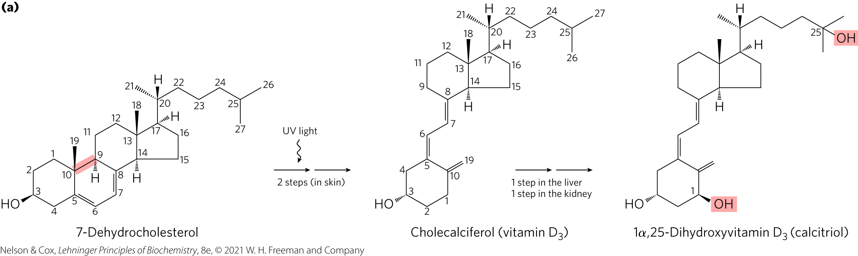
Vitamin D₃ Production and Metabolism
calcitrol = hormone that regulates calcium uptake in the intestine and calcium levels in the kidney and bone

Slide 120
Clicker Question 18
Which statement is false regarding vitamin D₃?
Vitamin D₃ serves as a hormone precursor.
Vitamin D₃ forms from a photochemical reaction driven by UV light.
Vitamin D₃ is biologically active in the intestine, kidney, and bone.
Vitamin D₃ is a cure for the disease rickets.
Notes:
Answer: C
Principle: 10:3
Learning Objective(s): Summarize how vitamin D is activated and regulates calcium levels within the body.
Bloom’s: 2:2

Slide 121
Clicker Question 18, Response
Which statement is false regarding vitamin D₃?
Vitamin D₃ is biologically active in the intestine, kidney, and bone.
Vitamin D₃ is not itself biologically active, but it is converted by enzymes in the liver and kidney to 1α,25-dihydroxyvitamin D3 (calcitriol), a hormone that regulates calcium uptake in the intestine and calcium levels in the kidney and bone.

Slide 122
Vitamin A₁
vitamin A₁ (all-trans-retinol) = acts in processes of development, cell growth and differentiation, and vision
  can be stored for some time in the body

Slide 123
All-Trans-Retinoic Acid
vitamin A₁ (all-trans-retinol) = acts in processes of development, cell growth and differentiation, and vision
vitamin A₁ or β-carotene can be converted enzymatically to all-trans-retinoic acid
all-trans-retinoic acid = retinoid hormone that acts through a family of nuclear receptor proteins to regulate gene expression

Slide 124
Carotenoids
carotenoids = natural products with a characteristic extensive system of conjugated double bonds, which makes possible their strong absorption of visible light (450–470 nm)
  β-carotene pigment is a source of vitamin A

Slide 125
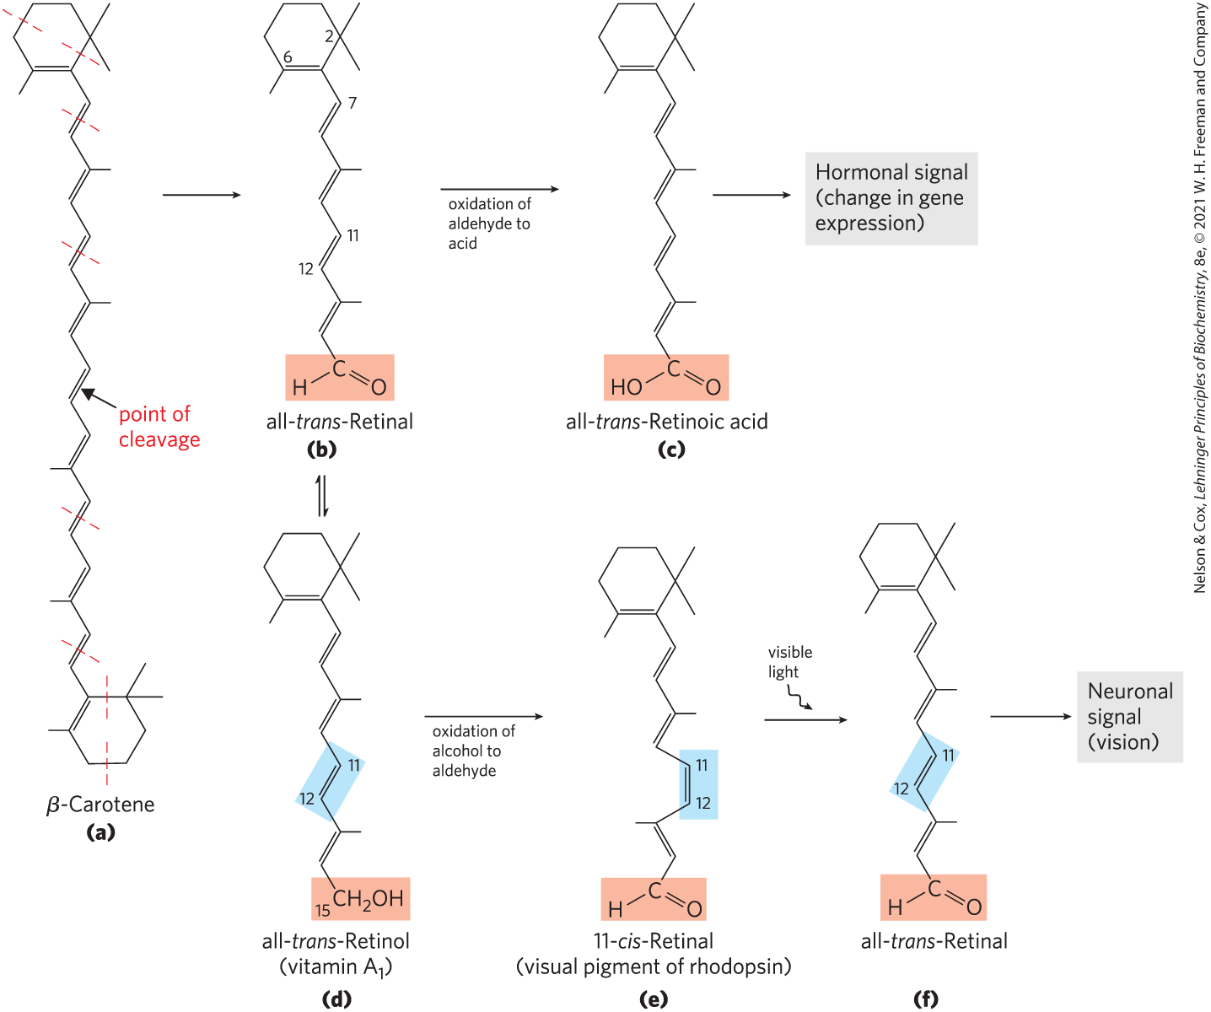
Dietary β-Carotene and Vitamin A₁ as Precursors of the Retinoids

Slide 126
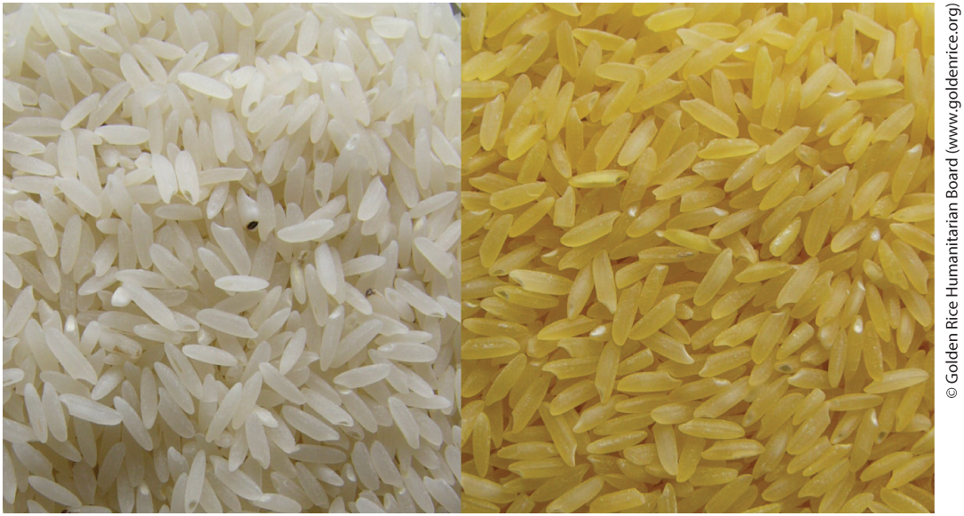
Vitamin A Deficiencies
in pregnant women, leads to congenital malformations and growth retardation in the infant
in adults, leads to dryness of skin, eyes, and mucous membranes, and night blindness
“golden rice” = genetically engineered rice enriched in β-carotene

Slide 127
Clicker Question 19
Vitamin A₁ and its derivatives:
are involved in regulating cell growth and differentiation.
contain only trans C–C double bonds.
are not stored in the body in significant amounts.
act as antioxidants.
Notes:
Answer: A
Principle: 10:3
Learning Objective(s): Hypothesize why a vitamin A deficiency can lead to congenital abnormalities.
Bloom’s: 2:2

Slide 128
Clicker Question 19, Response
Vitamin A₁ and its derivatives:
are involved in regulating cell growth and differentiation.
Vitamin A₁ (all-trans-retinol) and its oxidized metabolites retinoic acid and retinal act in the processes of development, cell growth and differentiation, and vision.

Slide 129
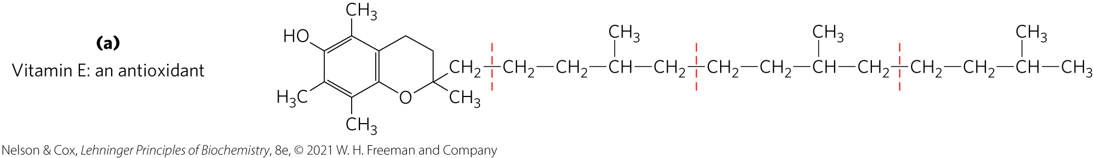
Vitamins E and K and the Lipid Quinones Are Oxidation-Reduction Cofactors
vitamin E = collective name for a group of lipids called tocopherols
tocopherols = hydrophobic compounds that contain a substituted aromatic ring and a long isoprenoid side chain
  associate with cell membranes, lipid deposits, and lipoproteins
  biological antioxidants

Slide 130
Vitamin E Deficiencies
cause scaly skin, muscular weakness and wasting, and sterility
very rare in humans
principal symptom is fragile erythrocytes

Slide 131
Clicker Question 20
Which statement is true?
Vitamin E is a hormone precursor.
Vitamin D regulates milk production in mammary glands.
Prostaglandins are found only in the prostate gland.
Membrane sphingolipids can be used to produce intracellular messengers.
Notes:
Answer: D
Principle: 10:3
Learning Objective(s): Distinguish lipid signaling molecules based on structure and mechanism of action.
Bloom’s: 2:2

Slide 132
Clicker Question 20, Response
Which statement is true?
Membrane sphingolipids can be used to produce intracellular messengers.
Membrane sphingolipids can serve as sources of intracellular messengers. Both ceramide and sphingomyelin are potent regulators of protein kinases, and ceramide or its derivatives are involved in the regulation of cell division, differentiation, migration, and programmed cell death.

Slide 133
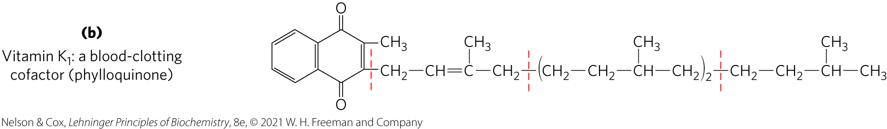
Vitamin K
vitamin K = contains an aromatic ring that undergoes a cycle of oxidation and reduction during the formation of active prothrombin, a blood plasma protein essential in blood clotting

Slide 134
Vitamin K Deficiencies
slow blood clotting
extremely uncommon in humans

Slide 135
Clicker Question 21
How do the features of vitamins E and K cause them to be in a different cellular location than vitamins B and C?
They are synthesized in the endoplasmic reticulum, unlike vitamins B and C, which are made in the cytosol.
They have receptors on the plasma membrane, whereas vitamins B and C have nuclear receptors.
They are hydrophobic, so they are located in membranes, rather than in the cytosol, like vitamins B and C.
Their mass is too large to move through membrane transporters, unlike vitamins B and C.
Notes:
Answer: C
Principle: 10:3
Learning Objective(s): Distinguish lipid signaling molecules based on structure and mechanism of action.
Bloom’s: 2:2

Slide 136
Clicker Question 21, Response
How do the features of vitamins E and K cause them to be in a different cellular location than vitamins B and C?
They are hydrophobic, so they are located in membranes, rather than in the cytosol, like vitamins B and C.
Vitamins A, D, E, and K are fat-soluble and hydrophobic. In contrast, vitamins B and C are water-soluble and hydrophilic. Fat-soluble vitamins are located in membranes, whereas water-soluble vitamins are located in the cytosol.

Slide 137
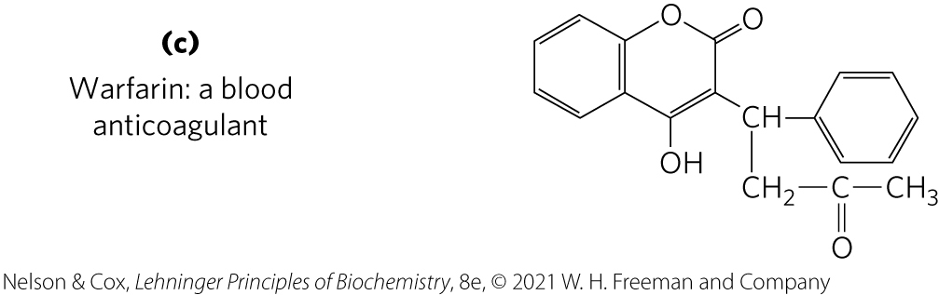
Warfarin
warfarin = a synthetic compound that inhibits the formation of active prothrombin
  potent rodenticide
  invaluable anticoagulant drug for treating humans at risk for excessive blood clotting

Slide 138
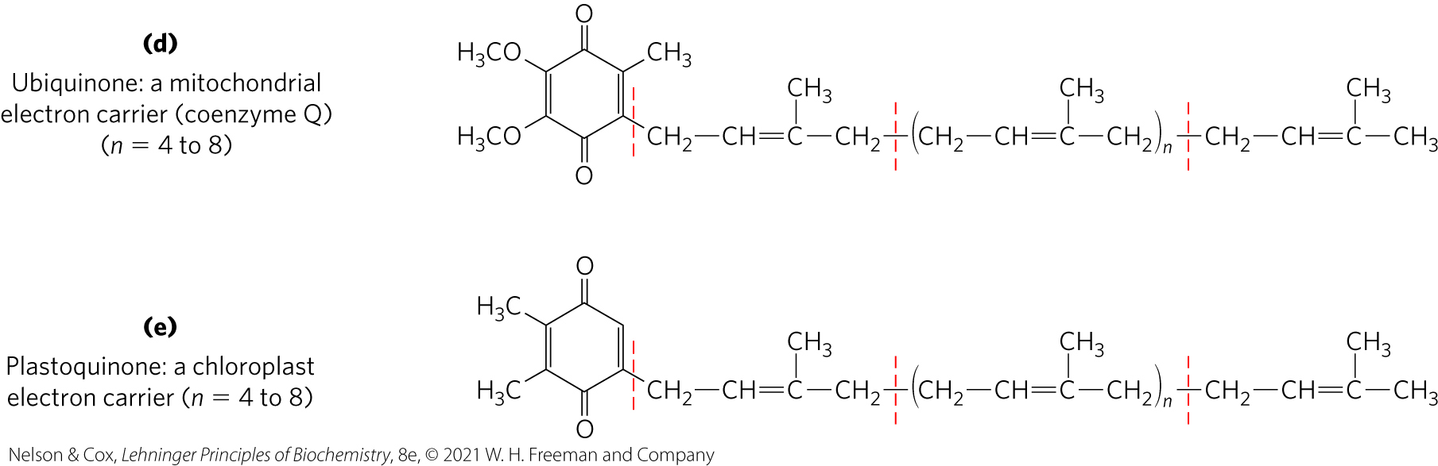
Ubiquinone and Plastoquinone
ubiquinone (coenzyme Q) and plastoquinone = isoprenoids that function as lipophilic electron carriers in the oxidation-reduction reactions that drive ATP synthesis in mitochondria and chloroplasts, respectively

Slide 139
Dolichols Activate Sugar Precursors for Biosynthesis
dolichols = isopenoid alcohols that activate and anchor sugars to cellular membranes
  sugar groups are then used in the synthesis of complex carbohydrates, glycolipids, and glycoproteins
  allow attached sugars to participate in sugar-transfer reactions

Slide 140
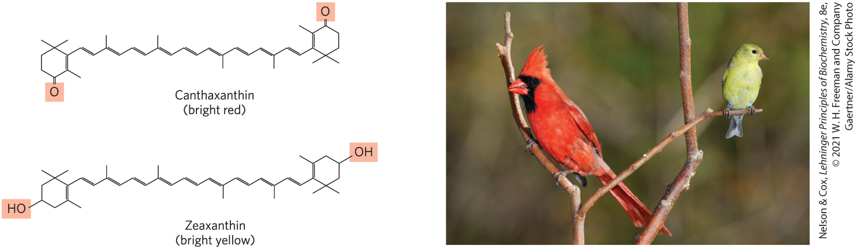
Many Natural Pigments Are Lipidic Conjugated Dienes
conjugated dienes = have carbon chains with alternating single and double bonds
  allow the delocalization of electrons
  compounds can be excited by visible light

Slide 141
Clicker Question 22
Which statement is false?
Ubiquinone is involved in electron transport.
Natural pigments are often lipids with conjugated double bonds.
Many lipids have structures based on repeating isoprene units.
Vitamin K is essential for the dissolution of blood clots.
Notes:
Answer: D
Principle: 10:3
Learning Objective(s): Describe how a deficiency in vitamin K can lead to bleeding disorders; Distinguish lipid signaling molecules based on structure and mechanism of action.
Bloom’s: 2:2

Slide 142
Clicker Question 22, Response
Which statement is false?
D. Vitamin K is essential for the dissolution of blood clots.
The aromatic ring of vitamin K undergoes a cycle of oxidation and reduction during the formation of active prothrombin, a blood plasma protein essential in blood clotting. Prothrombin is a proteolytic enzyme that splits peptide bonds in the blood protein fibrinogen to convert it to fibrin, the insoluble fibrous protein that holds blood clots together.

Slide 143
Polyketides Are Natural Products with Potent Biological Activities
polyketides = diverse group of lipids with biosynthetic pathways (Claisen condensations) similar to those for fatty acids
  secondary metabolites = compounds that are not central to an organism’s metabolism but serve some subsidiary function that gives the organism an advantage
  used as antibiotics, antifungals, or inhibitors of cholesterol synthesis

Slide 144
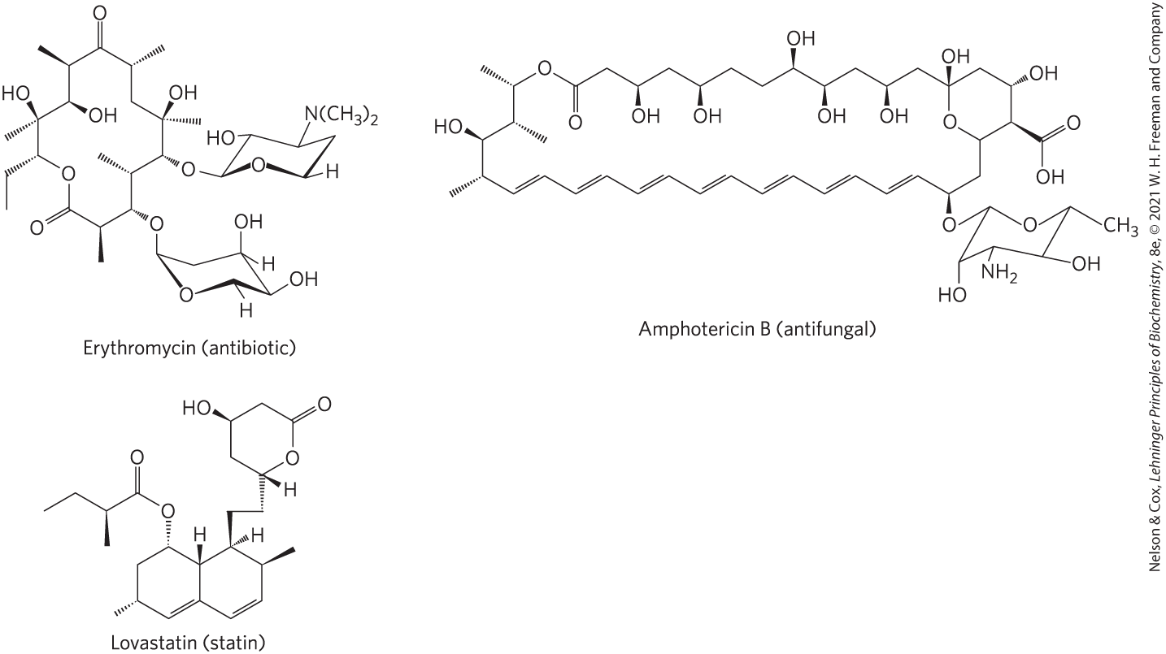
Polyketide Natural Products Used in Human Medicine

Slide 145
Clicker Question 23
Polyketides:
are synthesized from five-carbon isoprene derivatives.
anchor attached sugars to the membrane, where they participate in sugar-transfer reactions.
include antibiotics, antifungals, and statins.
are compounds that are central to an organism’s metabolism.
Notes:
Answer: C
Principle: 10:3
Learning Objective(s): Distinguish lipid signaling molecules based on structure and mechanism of action.
Bloom’s: 2:1

Slide 146
Clicker Question 23, Response
Polyketides:
C. include antibiotics, antifungals, and statins.
Polyketides are a diverse group of lipids with biosynthetic pathways (Claisen condensations) similar to those for fatty acids. They are secondary metabolites, compounds that are not central to an organism’s metabolism but serve some subsidiary function that gives the organism an advantage. Many polyketides find use in medicine as antibiotics, antifungals, or inhibitors of cholesterol synthesis.

Slide 147

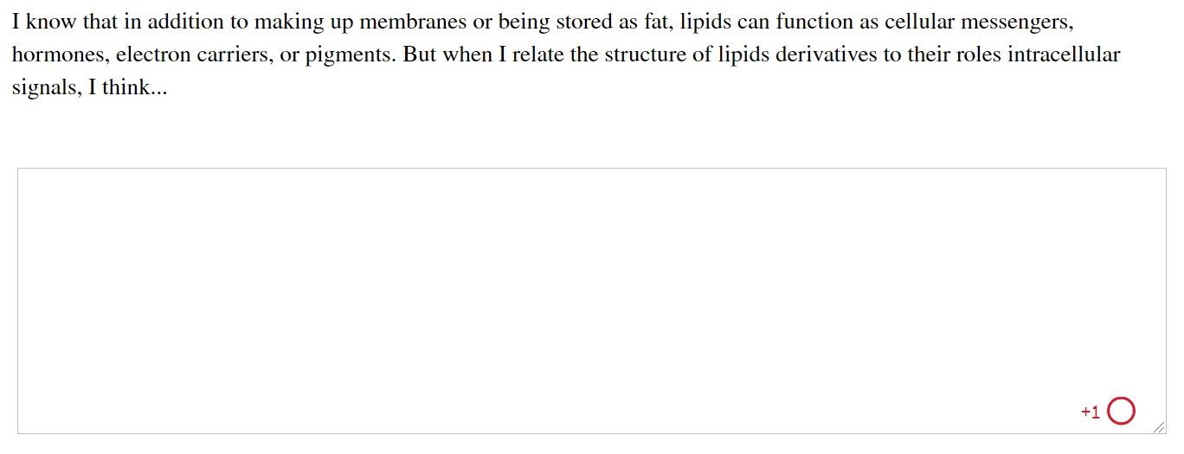
Activity: Lipids as Signal
Molecules Muddiest Point (1 of 2)
Complete the Ch10 Student Activity, Day 1: Lipids as Signal Molecules (Muddiest Point) Achieve assessment.
Notes:
Instructor: This muddiest point activity can be found in Achieve in the Chapter 10 folder titled “Ch10 In-Class Activities and Resources.” See the Instructor Activity Guide in the same folder for more information.

Slide 148
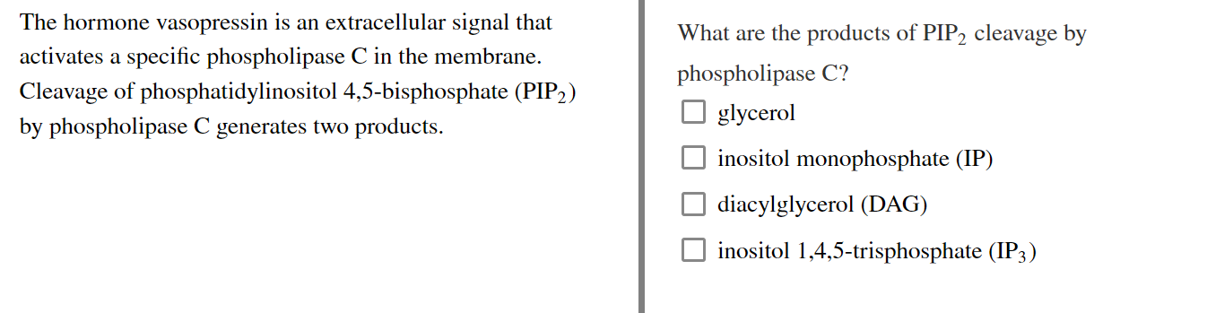
Activity: Lipids as Signal
Molecules Muddiest Point (2 of 2)
Complete the Ch10 Student Activity, Day 2: Lipids as Signal Molecules (Muddiest Point) Achieve assessment.
Notes:
Instructor: This muddiest point activity can be found in Achieve in the Chapter 10 folder titled “Ch10 In-Class Activities and Resources.” See the Instructor Activity Guide in the same folder for more information.

Slide 149
10.4 Working with Lipids

Slide 150
Principle 4 (2 of 6)
The chemical properties of lipids are
related to their structure and composition. As in studies of other biomolecules, methods such as enzymatic, chromatographic, and mass spectrometry can all be used to identify lipids and determine their atomic structure.

Slide 151
Separation of Lipids
lipids are insoluble in water
in general, complex mixtures of lipids are separated by differences in polarity or solubility in nonpolar solvents

Slide 152
Lipid Extraction Requires Organic Solvents
neutral lipids are extracted with ethyl ether, chloroform, or benzene
  does not permit lipid clustering driven by the hydrophobic effect
membrane lipids are extracted by ethanol or methanol
  reduces the hydrophobic interactions among lipid molecules
  weakens the hydrogen bonds and electrostatic interactions that bind membrane lipids to membrane proteins

Slide 153
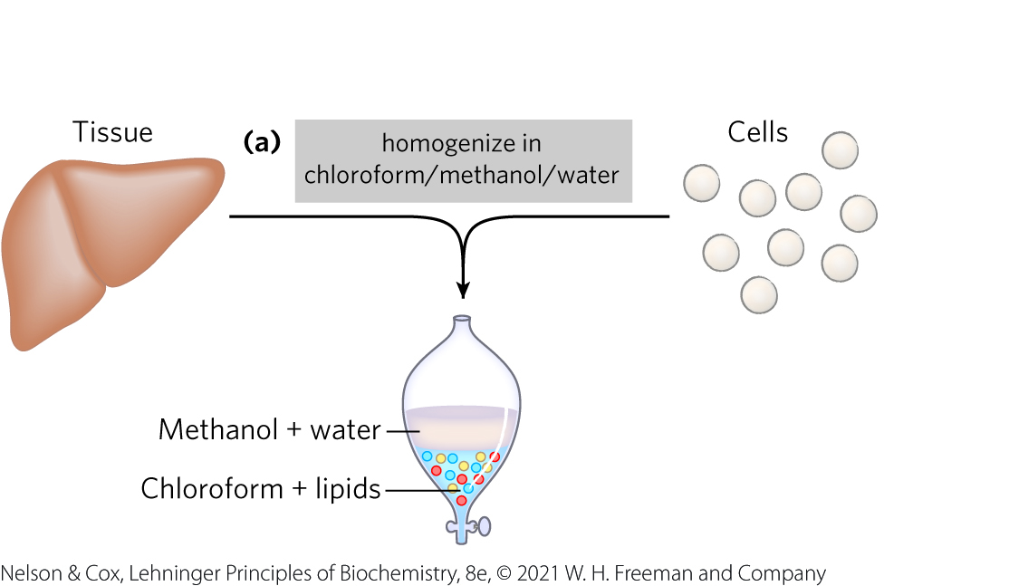
A Commonly Used Extractant is a Mixture of Chloroform, Methanol, and Water
mixture separates into two phases: methanol/water (top phase) and chloroform (bottom phase)
  lipids remain in the chloroform layer
  more polar molecules (proteins and sugars) partition into the methanol/water layer

Slide 154

Clicker Question 24
A biochemist is performing a lipid extraction using a protocol that uses a mixture of chloroform, methanol, and water, initially in volume proportions that are miscible, producing a single phase. Which statement is true after the biochemist homogenizes the tissue with the solvent and adds more water?
The mixture will separate into three phases: methanol, chloroform, and water.
Lipids will remain in the chloroform layer.
Proteins, sugars, and lipids will be found in the same layer.
The mixture will separate into two phases: methanol/water (bottom phase) and chloroform (top phase).
Notes:
Answer: B
Principle: 10:4
Learning Objective(s): Contrast lipid extraction methods for neutral and membrane lipids.
Bloom’s: 2:2

Slide 155
Clicker Question 24, Response
A biochemist is performing a lipid extraction using a protocol that uses a mixture of chloroform, methanol, and water, initially in volume proportions that are miscible, producing a single phase. Which statement is true after the biochemist homogenizes the tissue with the solvent and adds more water?
B. Lipids will remain in the chloroform layer.
The mixture will separate into two phases: methanol/water (top phase) and chloroform (bottom phase). The lipids remain in the chloroform layer, and the more polar molecules, such as proteins and sugars, partition into the methanol/water layer.

Slide 156
Principle 4 (3 of 6)
The chemical properties of lipids are
related to their structure and composition. As in studies of other biomolecules, methods such as enzymatic, chromatographic, and mass spectrometry can all be used to identify lipids and determine their atomic structure.

Slide 157
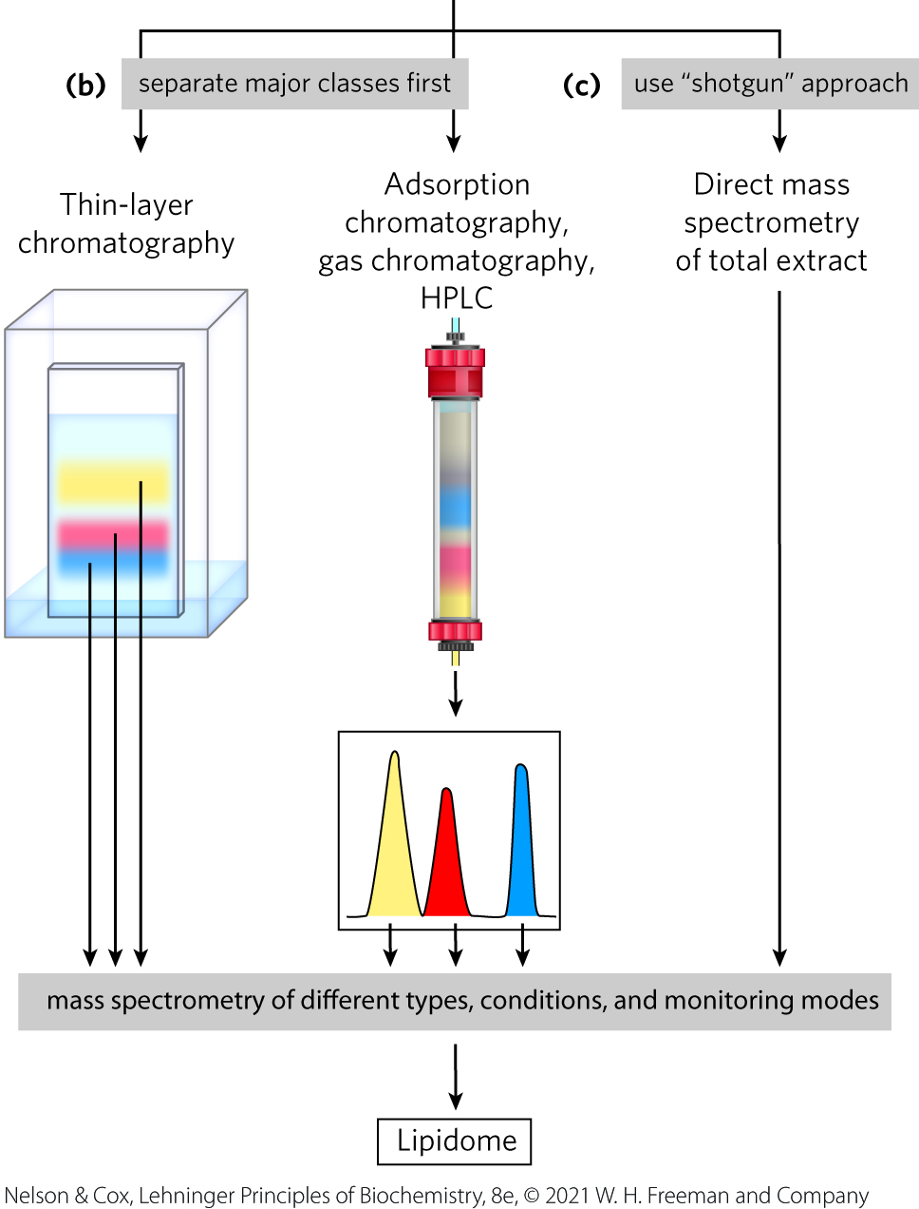
Adsorption Chromatography Separates Lipids of Different Polarity
lipids in mixtures can be separated based on their polarity and interactions with polar materials such as silica, using adsorption chromatography methods such as HPLC or TLC

Slide 158
Principle 4 (4 of 6)
The chemical properties of lipids are
related to their structure and composition. As in studies of other biomolecules, methods such as enzymatic, chromatographic, and mass spectrometry can all be used to identify lipids and determine their atomic structure.

Slide 159
Gas Chromatography Resolves Mixtures of Volatile Lipid Derivatives
GC volatilizes lipids so that they can be carried by a stream of inert gas and resolved based on their ability to partition into a soluble column material

Slide 160

Clicker Question 25
Which method is NOT typically used in the purification of lipids?
ammonium sulfate precipitation
extraction with organic solvents
thin-layer chromatography
gas chromatography
Notes:
Answer: A
Principle: 10:4
Learning Objective(s): Describe techniques that can separate lipids based on polarity; Develop experiments to isolate and identify lipids from a biological sample.
Bloom’s: 2:2

Slide 161
Clicker Question 25, Response
Which method is NOT typically used in the purification of lipids?
ammonium sulfate precipitation
Ammonium sulfate precipitation is commonly used in the purification of proteins, not lipids.

Slide 162
Clicker Question 26
Lipids were extracted from plasma membranes. What method could be used to separate them by exploiting differences in volatility?
gas chromatography
adsorption-column chromatography
thin-layer chromatography
mass spectroscopy
Notes:
Answer: A
Principle: 10:4
Learning Objective(s): Describe how gas chromatography can be used to separate volatile lipid molecules.
Bloom’s: 2:1

Slide 163
Clicker Question 26, Response
Lipids were extracted from plasma membranes. What method could be used to separate them by exploiting differences in volatility?
gas chromatography
Gas chromatography (GC) separates volatile components of a mixture according to their relative tendencies to dissolve in the inert material packed in the chromatography column or to volatilize and move through the column, carried by a current of an inert gas such as helium.

Slide 164
Principle 4 (5 of 6)
The chemical properties of lipids are
related to their structure and composition. As in studies of other biomolecules, methods such as enzymatic, chromatographic, and mass spectrometry can all be used to identify lipids and determine their atomic structure.

Slide 165
Specific Hydrolysis Aids in Determination of Lipid Structure
all ester-linked fatty acids are released by mild acid or alkaline treatment
harsher hydrolysis conditions release amide-bound fatty acids from sphingolipids
phospholipases specific for one of the bonds in a phospholipid generate simpler compounds

Slide 166
Clicker Question 27
Which method is NOT typically used to break down lipids into their components?
alkaline hydrolysis
acid hydrolysis
phospholipases
strong oxidation
Notes:
Answer: D
Principle: 10:4
Learning Objective(s): Develop experiments to isolate and identify lipids from a biological sample.
Bloom’s: 2:2

Slide 167
Clicker Question 27, Response
Which method is NOT typically used to break down lipids into their components?
D. strong oxidation
Lipids that contain ester- or amide- linked fatty acids can be hydrolyzed by treatment with acid or alkali or with specific hydrolytic enzymes (phospholipases, glycosidases) to yield their components for analysis. However, strong oxidation is not typically used to break down lipids.

Slide 168
Principle 4 (6 of 6)
The chemical properties of lipids are
related to their structure and composition. As in studies of other biomolecules, methods such as enzymatic, chromatographic, and mass spectrometry can all be used to identify lipids and determine their atomic structure.

Slide 169
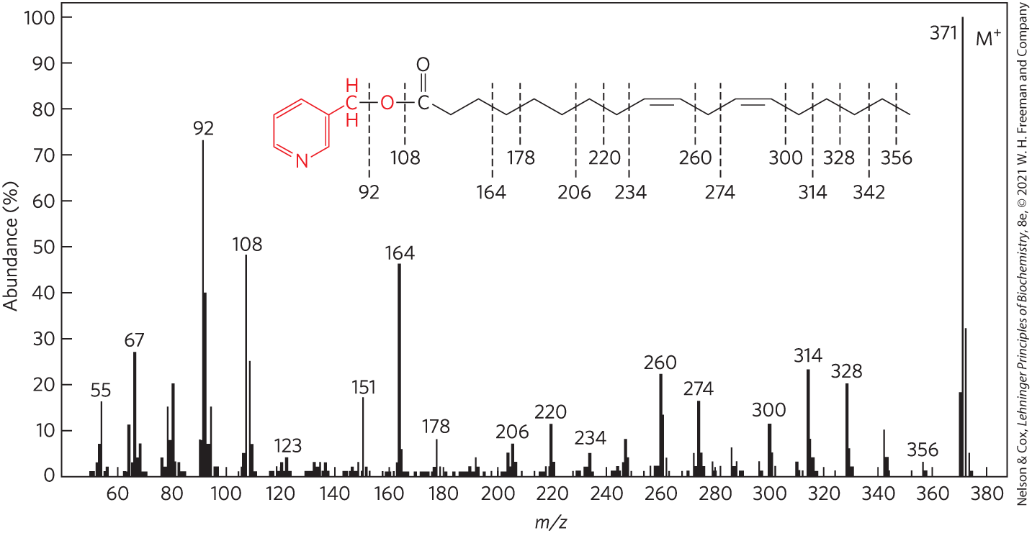
Mass Spectrometry Reveals Complete Lipid Structure
allows the analysis of crude mixtures of lipids without prefractionation
can determine the length of a hydrocarbon chain or positions of double bonds

Slide 170
Clicker Question 28
Mass spectrometry:
cannot be used with lipids other than fatty acids.
can determine the mass but not the identify of a lipid.
can be used to identify individual lipids in complex mixtures.
cannot determine the locations of double bonds in a fatty acid.
Notes:
Answer: C
Principle: 10:4
Learning Objective(s): Identify methods that can be used to determine lipid structure.
Bloom’s: 2:2

Slide 171
Clicker Question 28, Response
Mass spectrometry:
can be used to identify individual lipids in complex mixtures.
With the increased resolution of mass spectrometry, it is possible to identify individual lipids in very complex mixtures without first fractionating the lipids in a crude extract — the “shotgun” approach.

Slide 172
Lipidomics Seeks to Catalog All Lipids and Their Functions
LIPID MAPS Lipidomics Gateway = database analogous to the Protein Data Bank
  has its own classification system of eight chemical categories
Table 10-2 Eight Major Categories of Biological Lipids
Category | Category code | Examples
Fatty acids | FA | Oleate, stearoyl-CoA, palmitoylcarnitine
Glycerolipids | GL | Di- and triaclyglycerols
Glycerophospholipids | GP | Phosphatidylcholine, phosphatidylserine, phosphatidyethanoloamine
Sphingolipids | SP | Sphingomyelin, ganglioside, GM2
Sterol lipids | ST | Cholesterol, progesterone, bile acids
Prenol lipids | PR | Farnesol, geraniol, retinol, ubiquinone
Saccharolipids | SL | Lipopolysaccharide
Polyketides | PK | Tetracycline, erythromycin, aflatoxin B₁

Slide 173
The Lipidome
lipidome = the full complement of lipids present in a specific cell type under particular conditions

Slide 174
Clicker Question 29
Which statement is false?
The LIPID MAPS Lipidomics Gateway is analogous to the Protein Data Bank.
The eight major categories of biological lipids perfectly coincide with the less formal characterization by biological function.
Mass spectrometric techniques with high throughput and high resolution can be used to determine the lipidome.
Lipid biochemists can study the ways in which the lipidome changes with differentiation, a disease such as cancer, or drug treatment.
Notes:
Answer: B
Principle: 10:
Learning Objective(s): Describe how the lipidome is analyzed using mass spectrometry.
Bloom’s: 2:2

Slide 175
Clicker Question 29, Response
Which statement is false?
The eight major categories of biological lipids perfectly coincide with the less formal characterization by biological function.
The eight major categories of biological lipids (as listed in Table 10-2) do not coincide perfectly with the less formal categorization according to biological function. For example, the structural lipids of membranes include both glycerophospholipids and sphingolipids, which are separate categories.

Slide 176
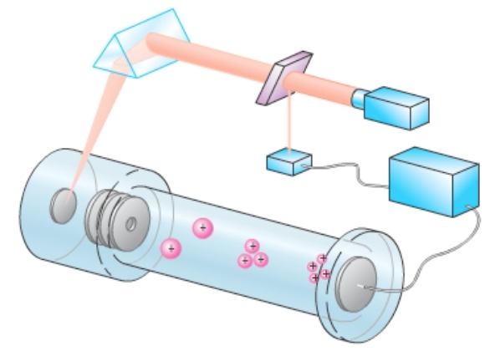
Activity: Mass
Spectrometry
Watch the Animated Technique video titled “MALDI-tof and Tandem Mass Spectrometry.”
Notes:
Instructor: This Animated Technique video is found within Chapter 3 of Achieve. It is in the folder titled “Ch3 In-Class Activities, Videos, and Resources.”

Slide 177
Activity Instructions (3 of 3)
On your own, think of answers to the questions:
  Consider MALDI-TOF mass spectrometry can be used to detect analytes of interest. What information could you acquire from MALDI-TOF about the lipid composition of a fat cell?
  Would the flight time of cholesterol, a lipid, be shorter or longer than that of alanine, an amino acid? (2 minutes)
Pair up to discuss your ideas. (2 minutes)
Share your ideas with the class in group discussion. (3 minutes)
Notes:
Instructor: This Animated Technique video is found within Chapter 3 of Achieve. It is in the folder titled “Ch3 In-Class Activities, Videos, and Resources.”

Slide 178
Activity Solution (3 of 3)
  What information could you acquire from MALDI-TOF about the lipid composition of a fat cell? MALDI-TOF mass spectrometry can tell you the mass-to-charge ratio of each lipid species in the fat cell. However, it cannot tell you the absolute differences in the levels of the lipid species present.
  Would the flight time of cholesterol, a lipid, be shorter or longer than that of alanine, an amino acid? The flight time of cholesterol would be longer than that of alanine because cholesterol has a higher mass which causes it to travel more slowly through the flight tube.
Notes:
Instructor: This Animated Technique video is found within Chapter 3 of Achieve. It is in the folder titled “Ch3 In-Class Activities, Videos, and Resources.”

