Slide 1

8 Nucleotides and Nucleic Acids
© 2021 Macmillan Learning

Slide 2
Nucleotides
have a variety of roles in cellular metabolism:
  energy currency in metabolic transactions
  essential chemical links in the response of cells to hormones and other extracellular stimuli
  structural components of an array of enzyme cofactors and metabolic intermediates
  constituents of nucleic acids: deoxyribonucleic acid (DNA) and ribonucleic acid (RNA)

Slide 3

Principle 1 (1 of 6)
Nucleic acids are both repositories and functional expressions of biological information. Biological information is one of the required conditions for life, a blueprint for each species transmitted from one generation to the next. RNA can be a functional expression of that information, directing the synthesis of proteins or, in some cases, acting directly as a signal or a reaction catalyst.

Slide 4

Principle 2 (1 of 4)
The transmission of biological information relies on molecular complementarity. Chromosomes are the largest molecules in any cell. They are polymers composed of a small set of common nucleotides, with information embedded in the nucleotide sequence. The common nucleotides in RNA and DNA are organized so that two strands of nucleic acid can maintain a complementary and uniform structure over vast molecular distances. This extended potential for both variable sequence and complementarity, and thus information storage and transmission, is a property shared by no other class of biological molecule.

Slide 5

Principle 3 (1 of 3)
Biological information is subject to natural damage and change. DNA damage is a constant, and it results in occasional mutation — the raw material for evolution.

Slide 6

Principle 4 (1 of 4)
Biological information can be accessed, interpreted, and altered in the laboratory. The information embedded in nucleic acids
is of singular importance to biochemistry and molecular biology. The techniques for sequencing, synthesizing, and altering nucleic acids are continually advancing.

Slide 7

Principle 5 (1 of 3)
Nucleoside triphosphates occupy a central role in cellular metabolism, serving as an energy currency and as important regulatory signals. ATP is the ultimate product of catabolic pathways, providing fuel for anabolic pathways.

Slide 8
8.1 Some Basic Definitions and Conventions

Slide 9
Principle 1 (2 of 6)
Nucleic acids are both repositories and functional expressions of biological information. Biological information is one of the required conditions for life, a blueprint for each species transmitted from one generation to the next. RNA can be a functional expression of that information, directing the synthesis of proteins or, in some cases, acting directly as a signal or a reaction catalyst.

Slide 10
The Functions of DNA
gene = a segment of a DNA molecule that contains the information required for the synthesis of a functional biological product, whether protein or RNA
only known functions of DNA:
  storage of biological information
  transmission of that information to the next generation

Slide 11
The Functions of RNA
several classes of RNA:
  ribosomal RNAs (rRNAs) = components of ribosomes
  messenger RNAs (mRNAs) = intermediates in protein synthesis
  transfer RNAs (tRNAs) = adapter molecules that translate the information in mRNA into a specific amino acid sequence
  noncoding RNAs (ncRNAs) = wide variety of functions

Slide 12
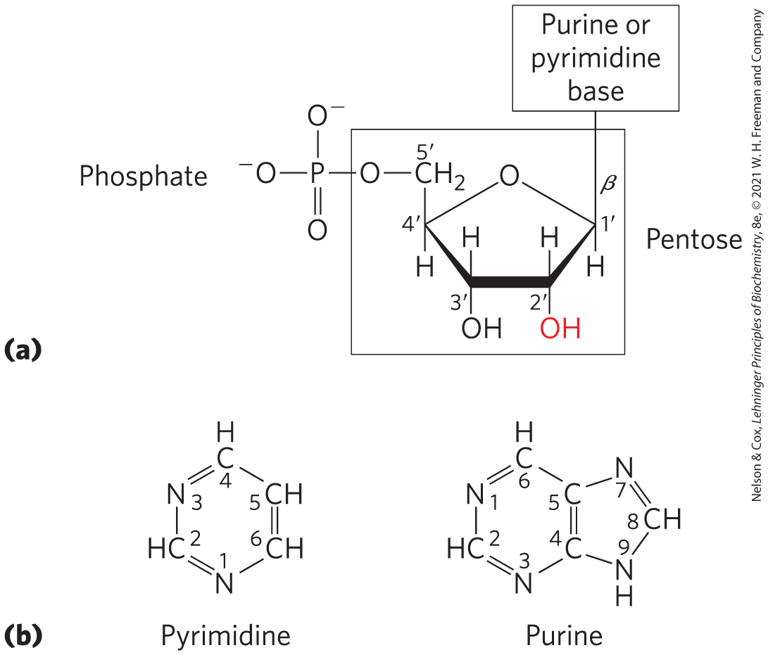
Nucleotides and Nucleic Acids Have Characteristic Bases and Pentoses
nucleotides have three components:
  a nitrogenous base (pyrimidine or purine)
  a pentose
  1+ phosphates
nucleoside = the molecule without a phosphate group

Slide 13

Clicker Question 1
What other name can be given to a nucleotide?
glycosylated nucleoside
purinated pentose
deoxyribonucleotide
D. nucleoside phosphate
Notes:
Answer: D
Principle: 8.1
Learning Objective(s): Differentiate between bases, nucleosides, nucleotides, and nucleic acids.
Bloom’s: 2:2

Slide 14
Clicker Question 1, Response
What other name can be given to a nucleotide?
D. nucleoside phosphate
A nucleotide has three characteristic components: (1) a nitrogenous (nitrogen-containing) base, (2) a pentose, and (3) one or more phosphates. The molecule without a phosphate group is called a nucleoside. Thus, a nucleoside phosphate is another name for a nucleotide.

Slide 15
Nucleotide Bonds
N-β-glycosyl bond = covalently joins the 1′ carbon of the pentose to the base (at N-1 of pyrimidines and N-9 of purines)
  formed by removal of the elements of water
the phosphate is esterified to the 5′ carbon

Slide 16
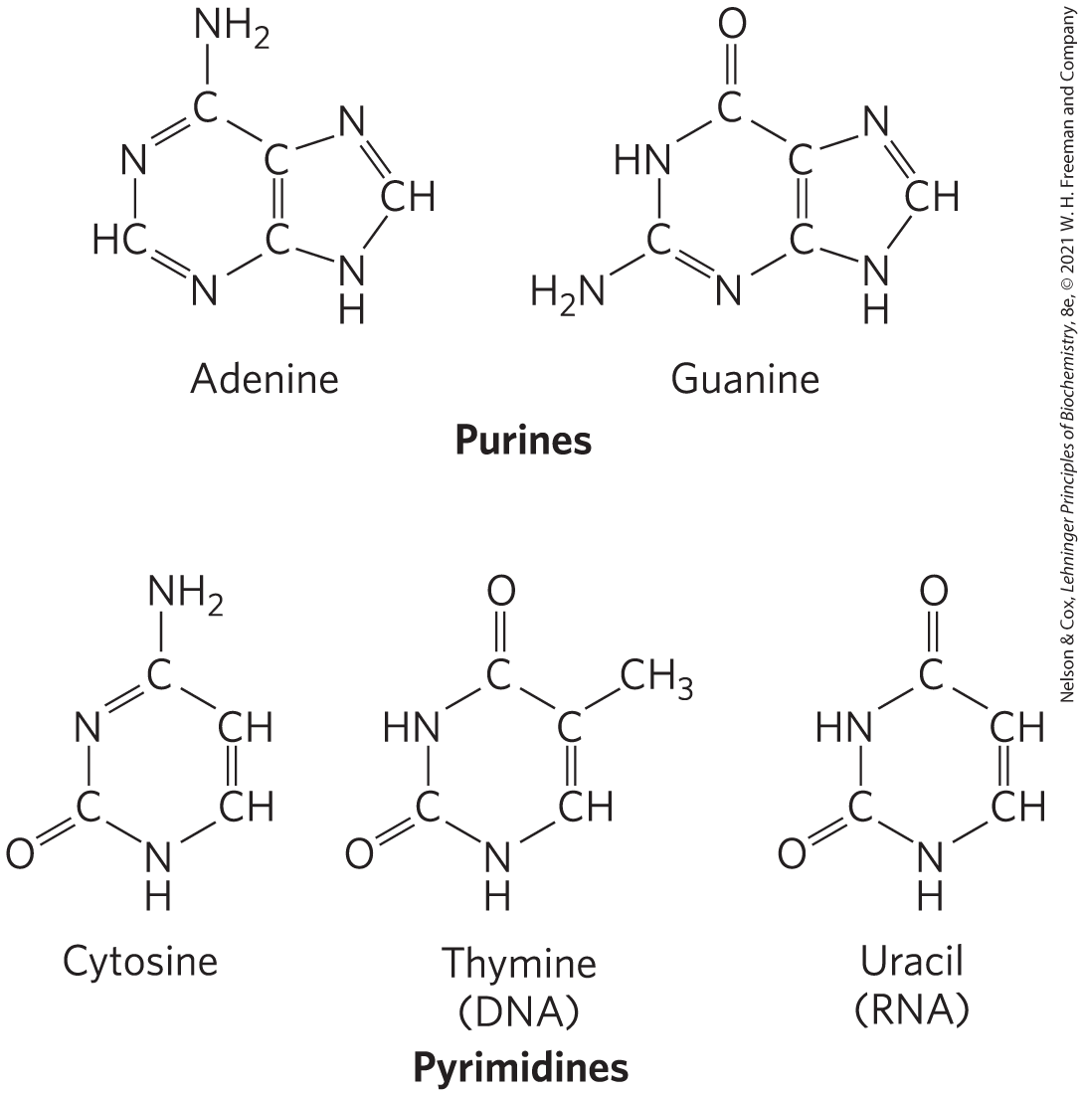
Nucleotide Nitrogenous Bases
major purine bases:
  adenine (A) = in DNA and RNA
  guanine (G) = in DNA and RNA
major pyrimidine bases:
  cytosine (C) = in DNA and RNA
  thymine (T) = only in DNA
  uracil (U) = only in RNA

Slide 17
Clicker Question 2
Which of the following is NOT a pyrimidine base?
cytosine
uracil
adenosine
D. thymine
Notes:
Answer: C
Principle: 8.1
Learning Objective(s): Identify major and minor nucleobases.
Bloom’s: 1:1

Slide 18
Clicker Question 2, Response
Which of the following is NOT a pyrimidine base?
C. adenosine
Cytosine, thymine, and uracil are pyrimidine bases. Adenine and guanine are purines. Adenosine is a purine nucleoside.

Slide 19
Nucleotide and Nucleic Acid Nomenclature
Table 8-1 Nucleotide and Nucleic Acid Nomenclature
Base | Nucleoside | Nucleotide | Nucleic Acid
Purines: Adenine | Adenosine Deoxyadenosine | Adenylate Deoxyadenylate | RNA DNA
Purines: Guanine | Guanosine Deoxyguanosine | Guanylate Deoxyguanylate | RNA DNA
Pyrimidines: Cytosine | Cytidine Deoxycytidine | Cytidylate Deoxycytidylate | RNA DNA
Pyrimidines: Thymine | Thymidine or deoxythymidine | Thymidylate or deoxythymidylate | DNA
Pyrimidines: Uracil | Uridine | Uridylate | RNA

Slide 20
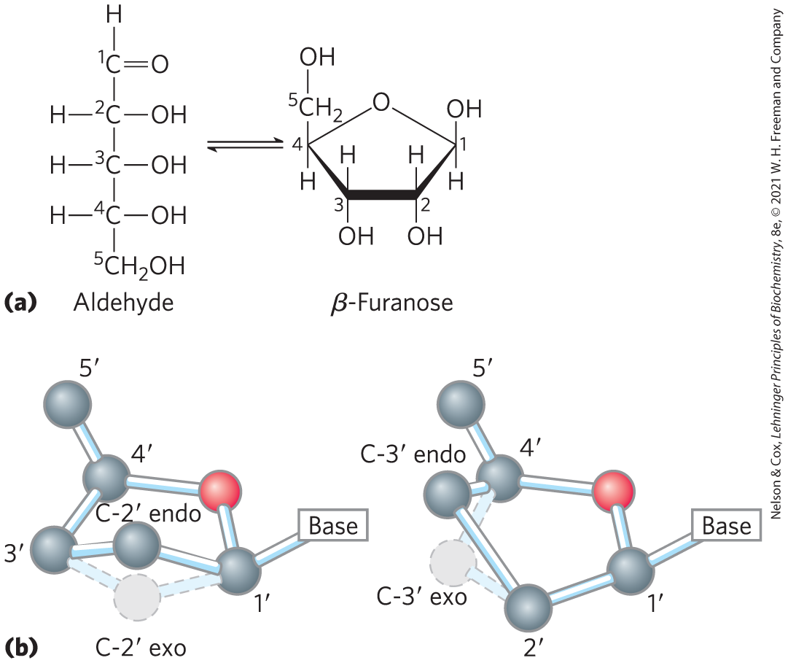
Nucleotide Pentoses
two kinds of pentoses:
  2′-deoxy-d-ribose = in DNA
  D-ribose = in RNA
both are in their β-furanose (closed five-membered ring) form

Slide 21
Clicker Question 3
Which of the following is NOT part of a deoxyribonucleotide?
a deoxyribonucleoside
phosphate
a nitrogenous base
ribose
Notes:
Answer: D
Principle: 8.1
Learning Objective(s): Differentiate between bases, nucleosides, nucleotides, and nucleic acids; Compare DNA and RNA.
Bloom’s: 2:2

Slide 22
Clicker Question 3, Response
Which of the following is NOT part of a deoxyribonucleotide?
ribose
A deoxyribonucleotide contains a nitrogenous (nitrogen-containing) base, a 2′-deoxy-D-ribose pentose, and one or more phosphates. A deoxyribonucleotide contains a deoxyribonucleoside, the molecule without a phosphate group. A ribonucleotide contains ribose in place of 2′-deoxy-D-ribose.

Slide 23
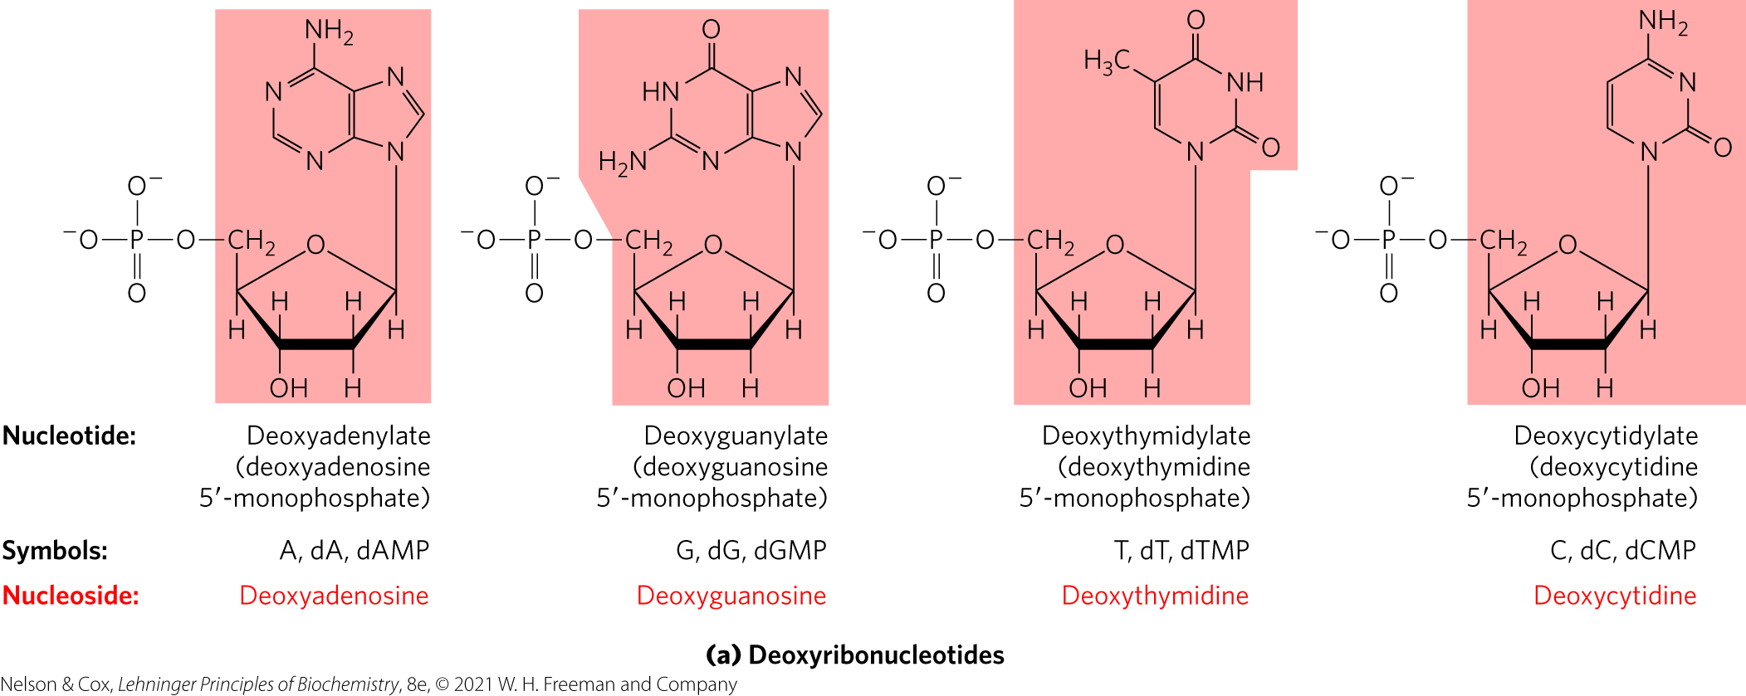
Structure and Names of The Four Major Deoxyribonucleotides
deoxyribonucleotides = structural units of DNA
  also called deoxyribonucleoside 5′-monophosphates, deoxynucleotides, and deoxynucleoside triphosphates

Slide 24
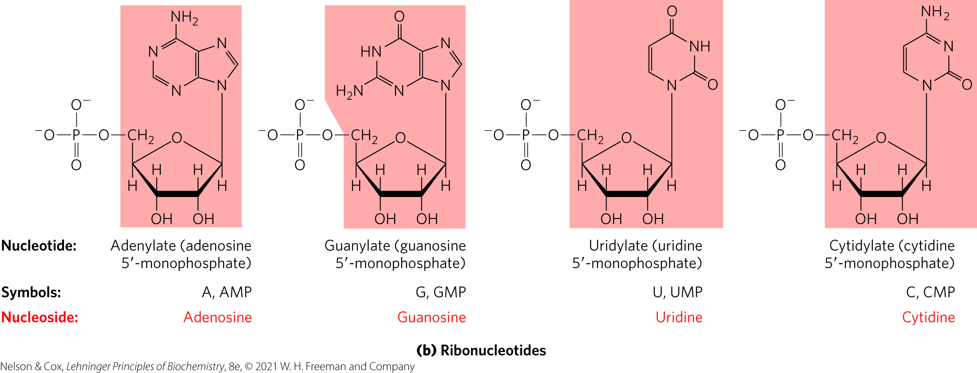
Structure and Names of The Four Major Ribonucleotides
ribonucleotides = structural units of RNA
  also called ribonucleoside 5′-monophosphates

Slide 25
Clicker Question 4
What name is given to the nucleotide found in DNA and NOT in RNA?
uridylate
thymidine
uracil
D. deoxythymidylate
Notes:
Answer: D
Principle: 8.1
Learning Objective(s): Differentiate between bases, nucleosides, nucleotides, and nucleic acids; Compare DNA and RNA.
Bloom’s: 2:2

Slide 26
Clicker Question 4, Response
What name is given to the nucleotide found in DNA and NOT in RNA?
D. deoxythymidylate
Table 8-1 Nucleotide and Nucleic Acid Nomenclature
Base | Nucleoside | Nucleotide | Nucleic Acid
Purines: Adenine | Adenosine Deoxyadenosine | Adenylate Deoxyadenylate | RNA DNA
Purines: Guanine | Guanosine Deoxyguanosine | Guanylate Deoxyguanylate | RNA DNA
Pyrimidines: Cytosine | Cytidine Deoxycytidine | Cytidylate Deoxycytidylate | RNA DNA
Pyrimidines: Thymine | Thymidine or deoxythymidine | Thymidylate or deoxythymidylate | DNA
Pyrimidines: Uracil | Uridine | Uridylate | RNA

Slide 27
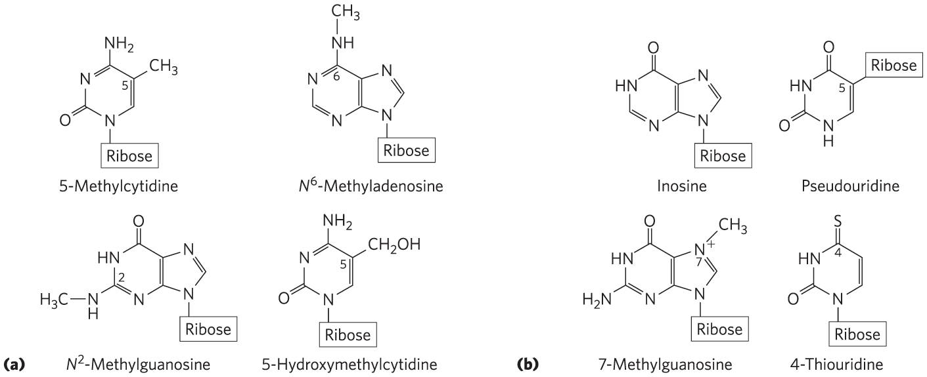
Minor Purine and Pyrimidine Bases
methylated forms – most common in DNA

Slide 28
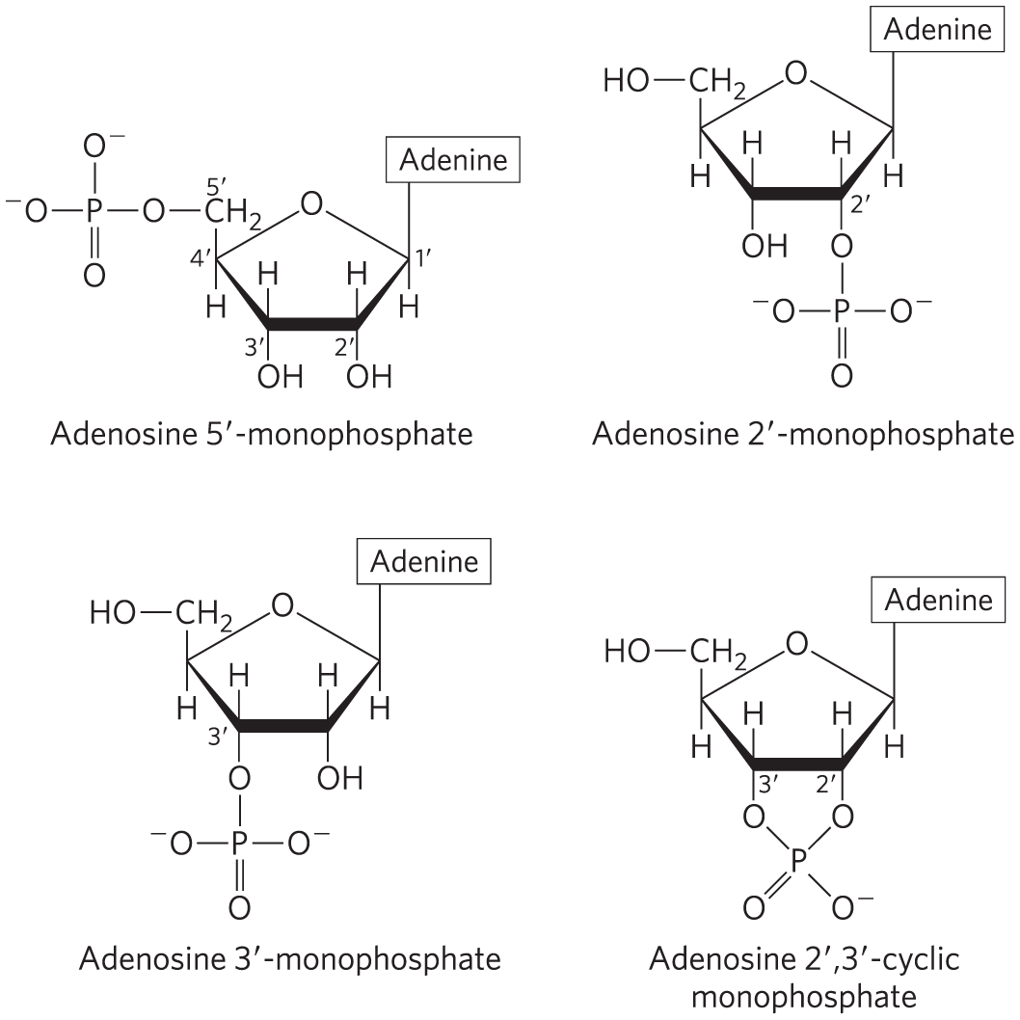
Nucleotides with Phosphate Groups in Different Positions
ribonucleoside 2′,3′-cyclic monophosphates = isolatable intermediates
ribonucleoside 3′-monophosphates = end products of RNA hydrolysis
adenosine 3′,5′-cyclic monophosphate (cAMP)
guanosine 3′,5′-cyclic monophosphate (cGMP)

Slide 29
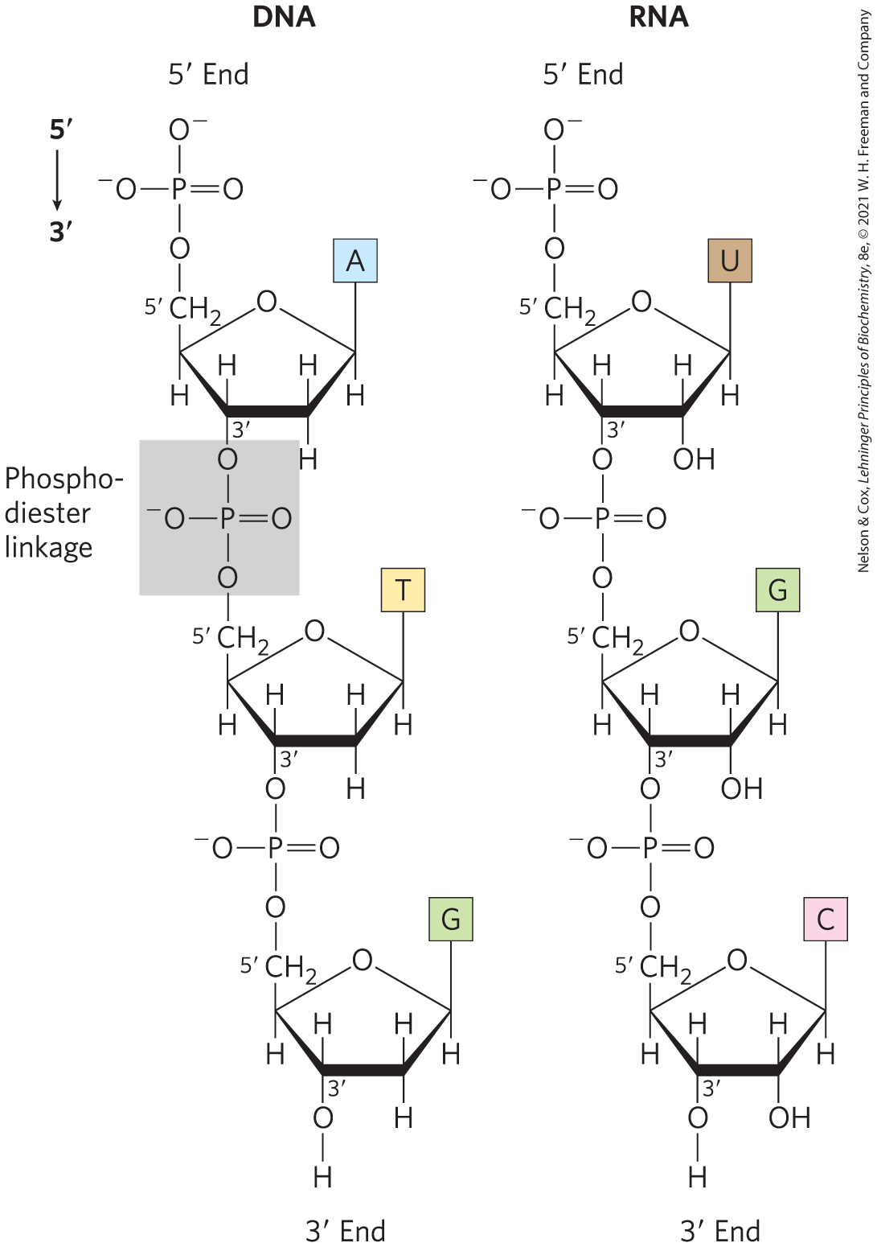
Phosphodiester Bonds Link Successive Nucleotides in Nucleic Acids
phosphodiester linkage = covalent bond that joins successive nucleotides of both DNA and RNA
  between the 5′-phosphate group of one nucleotide unit and the 3′-hydroxyl group of the next nucleotide

Slide 30
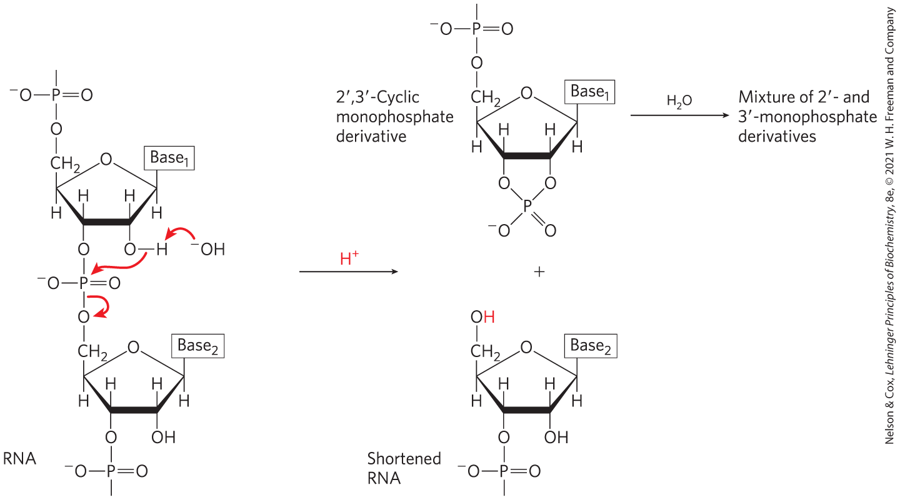
Hydrolysis of DNA and RNA
under alkaline conditions:
  RNA is rapidly hydrolyzed due to the presence of 2′-hydroxyl groups
  DNA is not rapidly hydrolyzed

Slide 31
Clicker Question 5
Why is DNA more stable than RNA?
RNA can never be double-stranded; therefore, DNA is more stable.
The 2′-hydroxyl groups in RNA (absent in DNA) are directly involved in the hydrolysis of oligonucleotides.
Thymine forms more stable hydrogen bonds than uracil.
RNA does not have secondary structure.
Notes:
Answer: B
Principle: 8.1
Learning Objective(s): Compare DNA and RNA.
Bloom’s: 2:2

Slide 32
Clicker Question 5, Response
Why is DNA more stable than RNA?
The 2′-hydroxyl groups in RNA (absent in DNA) are directly involved in the hydrolysis of oligonucleotides.
The covalent backbone of DNA and RNA is subject to slow, nonenzymatic hydrolysis of the phosphodiester bonds. In the test tube, RNA is hydrolyzed rapidly under alkaline conditions, but DNA is not; the 2′-hydroxyl groups in RNA (absent in DNA) are directly involved in the process.

Slide 33
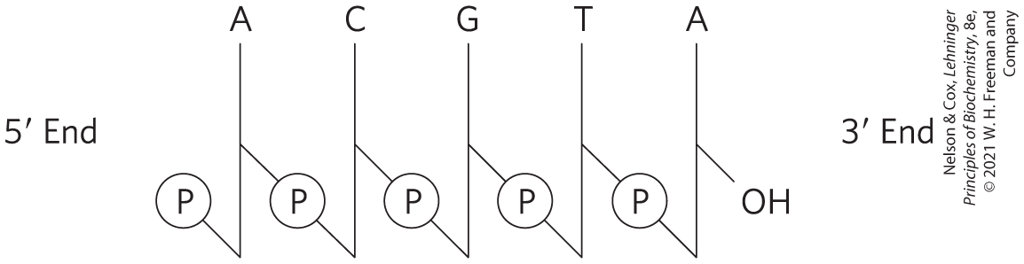
Schematic Representation of Nucleotide Sequences
phosphate groups symbolized by ℗
deoxyribose symbolized by a vertical line, from C-1′ at the top to C-5′ at the bottom
lines connecting nucleotides drawn diagonally from C-3′ to C-5′

Slide 34
Simpler Representations of Nucleotide Sequences
can also be written as:
  pA-C-G-T-A_{OH}
  pApCpGpTpA
  pACGTA

Slide 35
Oligonucleotides and Polynucleotides
oligonucleotide = short (typically < 50 nucleotides) nucleic acid
polynucleotide = longer nucleic acid

Slide 36
Clicker Question 6
A strand of DNA or RNA:
contains 5′ - 2′ phosphodiester bonds.
might be an oligonucleotide.
has a C-terminus and an N-terminus.
has no charge.
Notes:
Answer: B
Principle: 8.1
Learning Objective(s): Compare DNA and RNA.
Bloom’s: 2:2

Slide 37
Clicker Question 6, Response
A strand of DNA or RNA:
B. might be an oligonucleotide.
A short nucleic acid is referred to as an oligonucleotide. The definition of “short” is somewhat arbitrary, but polymers containing 50 or fewer nucleotides are generally called oligonucleotides.

Slide 38
The Properties of Nucleotide Bases Affect the Three-Dimensional Structure of Nucleic Acids
weakly basic compounds
aromatic molecules
because most bonds in the ring have partial double-bond character:
  pyrimidines are planar
  purines have a slight pucker

Slide 39
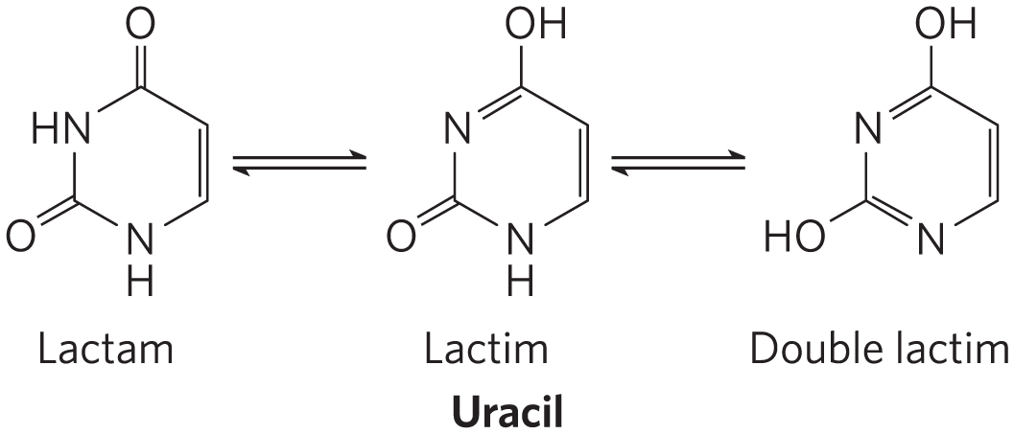
Free Pyrimidine and Purine Bases May Exist as Tautomers
may exist in readily interconverted forms called tautomers
  lactam
  lactim
  double lactim
predominates at pH 7.0

Slide 40
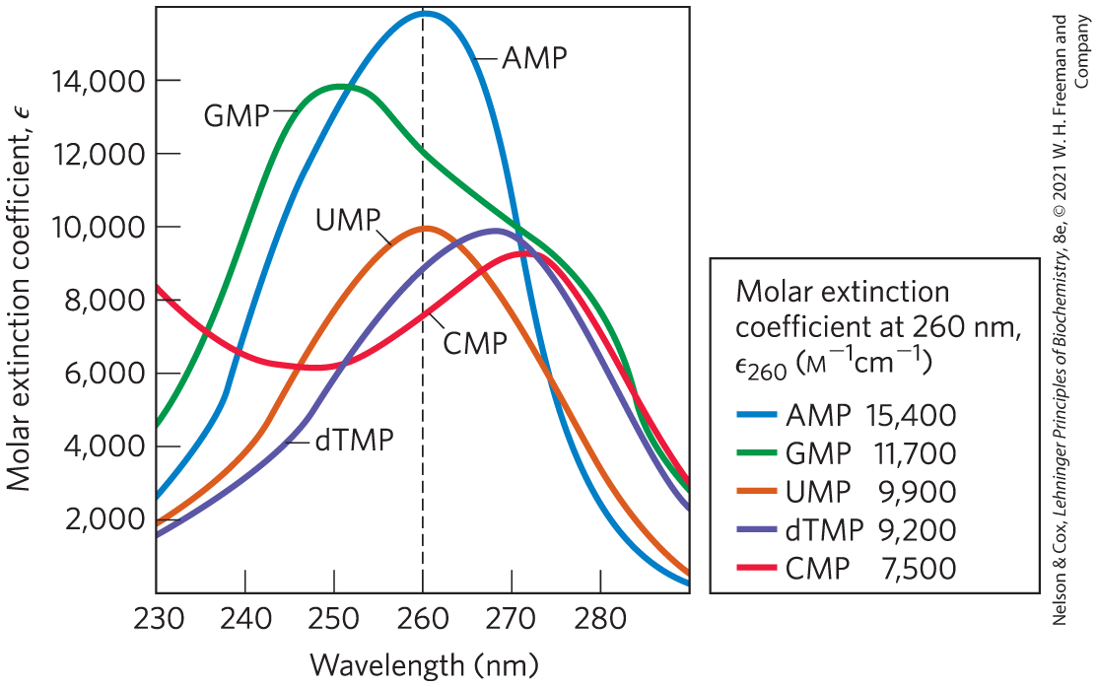
Absorption Spectra of Common Nucleotides
all nucleotide bases absorb UV light
strong absorption near 260 nm

Slide 41
Solubility of Nucleotides
hydrophobic and relatively insoluble in pH 7.0 water
  leads to stacking interactions (van der Waals and dipole-dipole)
charged and more soluble at acidic or alkaline pH values

Slide 42
Clicker Question 7
A property of nucleotide bases that affects the three-dimensional structure of nucleic acids is:
their weakly acidic nature.
their absorption of UV light at wavelengths above 280 nm.
their hydrophilic nature.
their existence in tautomeric forms depending on pH.
Notes:
Answer: D
Principle: 8.1
Learning Objective(s): Relate the structure of a nucleic acid to its properties.
Bloom’s: 2:2

Slide 43
Clicker Question 7, Response
A property of nucleotide bases that affects the three-dimensional structure of nucleic acids is:
their existence in tautomeric forms depending on pH.
Free pyrimidine and purine bases may exist in two or more tautomeric forms depending on the pH. Uracil, for example, occurs in several readily interconverted forms called tautomers — lactam, lactim, and double lactim forms.

Slide 44
Principle 1 (3 of 6)
Nucleic acids are both repositories and functional expressions of biological information. Biological information is one of the required conditions for life, a blueprint for each species transmitted from one generation to the next. RNA can be a functional expression of that information, directing the synthesis of proteins or, in some cases, acting directly as a signal or a reaction catalyst.

Slide 45
Principle 2 (2 of 4)
The transmission of biological information relies on molecular complementarity. Chromosomes are the largest molecules in any cell. They are polymers composed of a small set of common nucleotides, with information embedded in the nucleotide sequence. The common nucleotides in RNA and DNA are organized so that two strands of nucleic acid can maintain a complementary and uniform structure over vast molecular distances. This extended potential for both variable sequence and complementarity, and thus information storage and transmission, is a property shared by no other class of biological molecule.

Slide 46
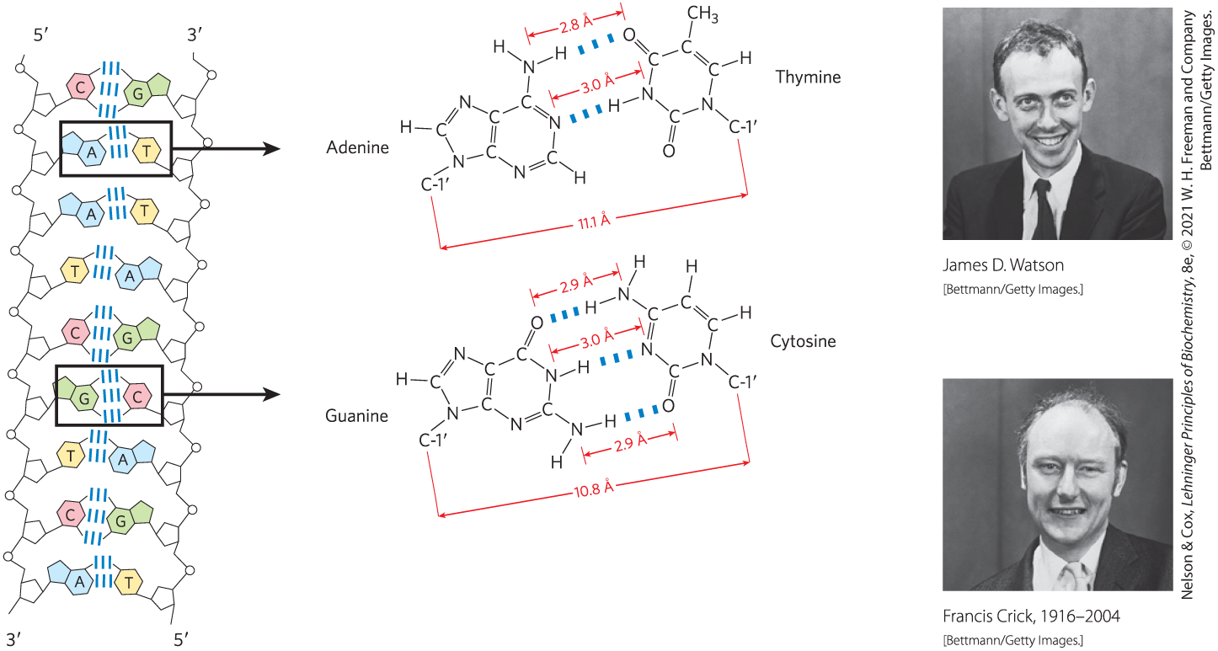
Base Pairing Permits the Duplication of Genetic Information
base pairs = hydrogen-bonding patterns between complementary strands of nucleic acids
  A bonds specifically to T (or U)
  G bonds specifically to C

Slide 47

Clicker Question 8
In a sample of DNA isolated from an unidentified species of bacteria, adenine makes up 28% of the total bases. Which statement is false about the relative proportions of the bases in the DNA sample?
The DNA must contain 28% C.
A and T bases account for 56% of the bases.
G and C base pairs account for 44% of the bases.
C, T, and G bases account for 72% of the bases.
Notes:
Answer: A
Principle: 8.2
Learning Objective(s): Determine the sequence of a nucleic acid strand from its compliment.
Bloom’s: 3:2

Slide 48
Clicker Question 8, Response
In a sample of DNA isolated from an unidentified species of bacteria, adenine makes up 28% of the total bases. Which statement is false about the relative proportions of the bases in the DNA sample?
The DNA must contain 28% C.
For any double-helical DNA, A = T and G = C. The DNA from the unidentified bacteria has 28% A and therefore must contain 28% T. A and T bases account for 56% of the bases and leaves 44% as G and C pairs: 22% G and 22% C. Together, C, T, and G bases account for 72% of the bases.

Slide 49
8.2 Nucleic Acid Structure

Slide 50
Hierarchical Levels of Nucleic Acid Structure
primary structure = covalent structure and nucleotide sequence
secondary structure = regular, stable structure taken up by some or all the nucleotides
tertiary structure = complex folding of large chromosomes or the elaborate folding of tRNA or rRNA structures

Slide 51
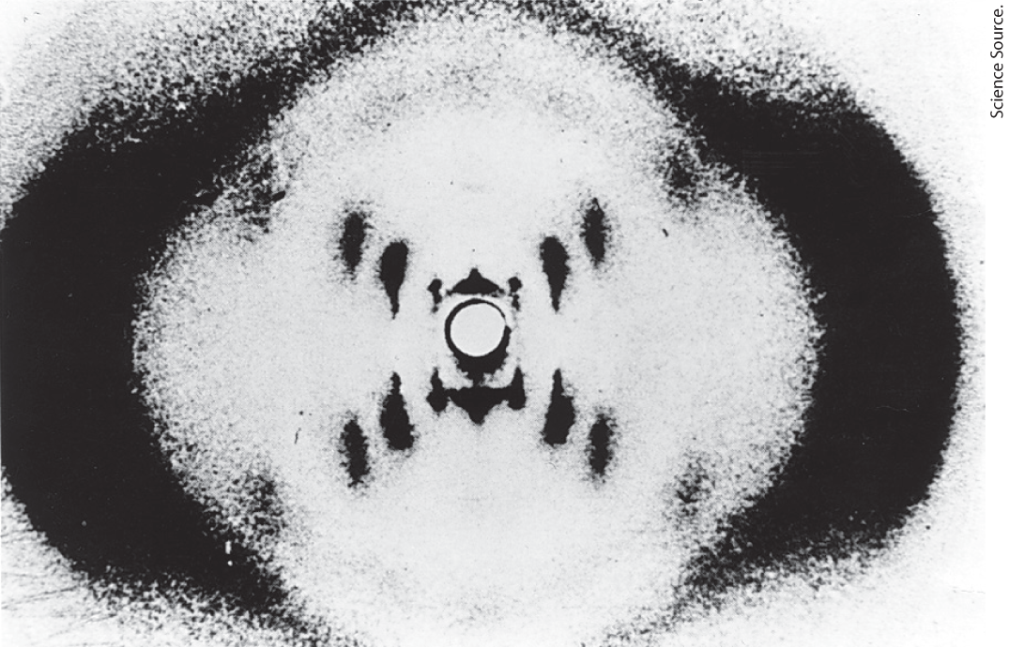
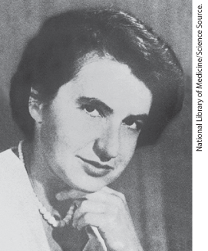
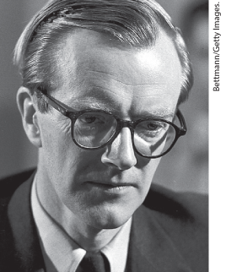
DNA Is a Double Helix that Stores Genetic Information
x-ray diffraction pattern revealed DNA molecules are helical

Slide 52
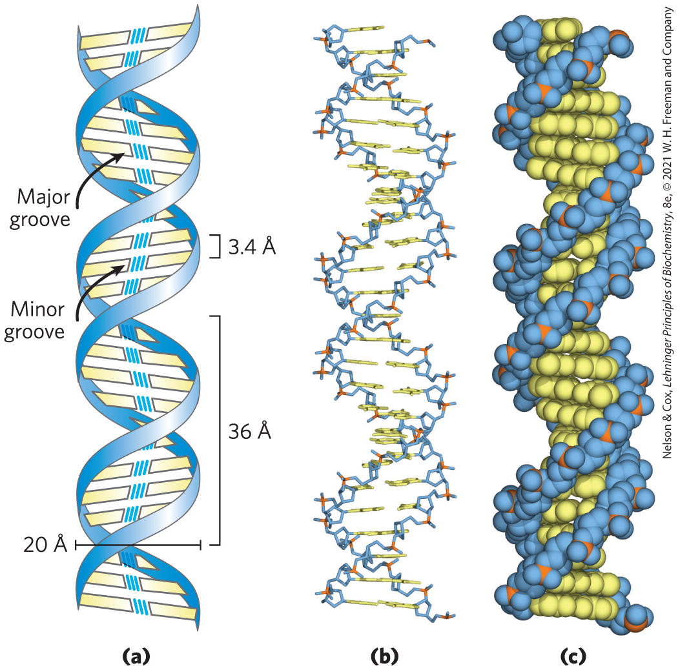
Watson-Crick Model for the Structure of DNA
offset pairing of the two strands creates a major groove and a minor groove
3 hydrogen bonds form between G and C
2 hydrogen bonds form between A and T

Slide 53
DNA Strands Are Antiparallel
parallel = 3′ ,5′ -phosphodiester bonds run in the same direction
antiparallel = 3′ ,5′ -phosphodiester bonds run in opposite directions
  ultimately confirmed by x-ray analysis

Slide 54
Clicker Question 9
Which statement is true about the three-dimensional structure of DNA?
Native DNA consists of two parallel chains in a right-handed double-helical arrangement.
Complementary base pairs, A≡C and G=T, are formed by hydrogen bonding between chains in the helix.
The base pairs are stacked parallel to the long axis of the double helix.
The offset pairing of the two strands creates a major groove and a minor groove on the surface of the duplex.
Notes:
Answer: D
Principle: 8.2
Learning Objective(s): Relate self-complimentarity of a DNA strand to its three dimensional structure; Identify the manor and minor grooves.
Bloom’s: 2:2

Slide 55
Clicker Question 9, Response
Which statement is true about the three-dimensional structure of DNA?
The offset pairing of the two strands creates a major groove and a minor groove on the surface of the duplex.
Native DNA consists of two antiparallel chains in a right-handed double-helical arrangement. Complementary base pairs, G≡C and A=T, are formed by hydrogen bonding between chains in the helix. The base pairs are stacked perpendicular to the long axis of the double helix.

Slide 56
The Double Helix Has 10.5 Base Pairs Per Helical Turn
per helical turn:
  10.5 bp
  36 Å (3.6 nm)

Slide 57
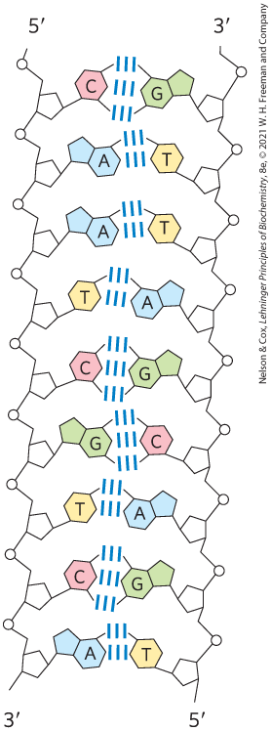
Antiparallel Polynucleotides Chains Are Complementary
double-helical DNA strands are complementary:
  when A occurs in one chain, T is found in the other
  when G occurs in one chain, C is found in the other
hydrogen bonding does not contribute significantly to stability of the structure

Slide 58
Stabilization of the DNA
Double Helix
the double helix is stabilized by:
  metal cations that shield the negative charges of backbone phosphates
  base stacking interactions between successive base pairs
    successive G≡C or C≡G are stronger than successive A=T or T=A
    duplexes with higher G≡C context are more stable

Slide 59
Clicker Question 10
Which statement regarding bases in DNA is false?
They absorb UV light.
Pyrimidines are aromatic; purines are not.
They have vertical stacking interactions.
They hydrogen bond between two or more complementary DNA strands.
Notes:
Answer: B
Principle: 8.2
Learning Objective(s): Relate the structure of a nucleic acid to its properties.
Bloom’s: 2:2

Slide 60
Clicker Question 10, Response
Which statement regarding bases in DNA is false?
B. Pyrimidines are aromatic; purines are not.
The purines and pyrimidines common in DNA and RNA are aromatic molecules, a property with important consequences for the structure, electron distribution, and light absorption of nucleic acids.

Slide 61
Principle 1 (4 of 6)
Nucleic acids are both repositories and functional expressions of biological information. Biological information is one of the required conditions for life, a blueprint for each species transmitted from one generation to the next. RNA can be a functional expression of that information, directing the synthesis of proteins or, in some cases, acting directly as a signal or a reaction catalyst.

Slide 62
Principle 2 (3 of 4)
The transmission of biological information relies on molecular complementarity. Chromosomes are the largest molecules in any cell. They are polymers composed of a small set of common nucleotides, with information embedded in the nucleotide sequence. The common nucleotides in RNA and DNA are organized so that two strands of nucleic acid can maintain a complementary and uniform structure over vast molecular distances. This extended potential for both variable sequence and complementarity, and thus information storage and transmission, is a property shared by no other class of biological molecule.

Slide 63
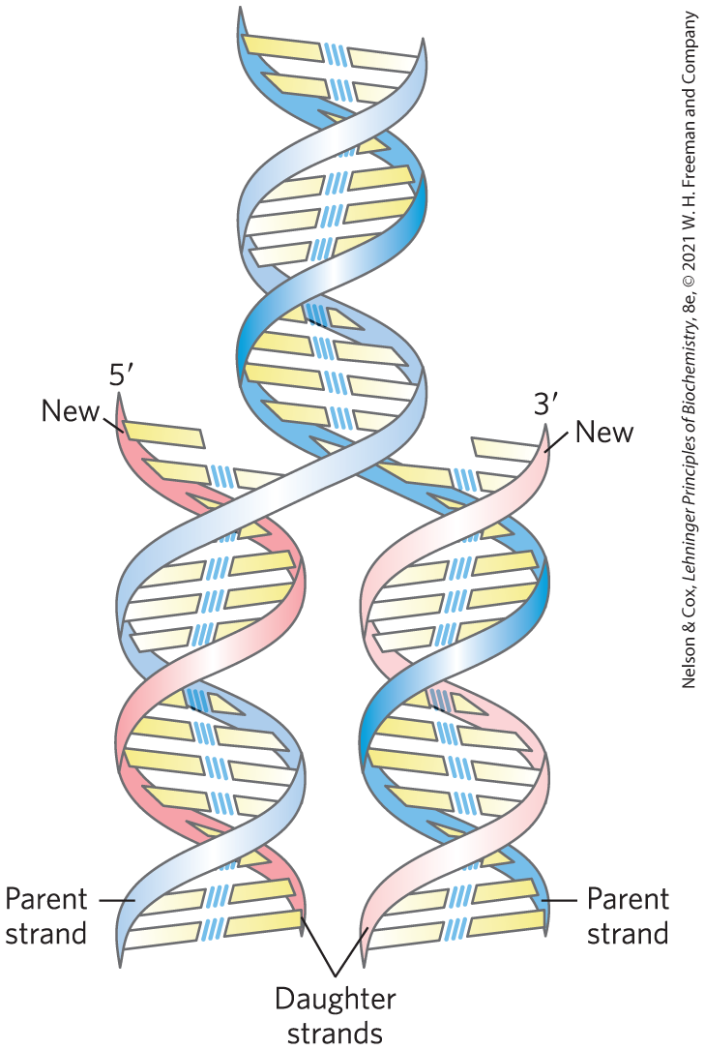
Replication of DNA
Step 1: preexisting or “parent” strands become separated
Step 2: each “parent” strand serves as a template for the biosynthesis of a complementary “daughter strand”

Slide 64
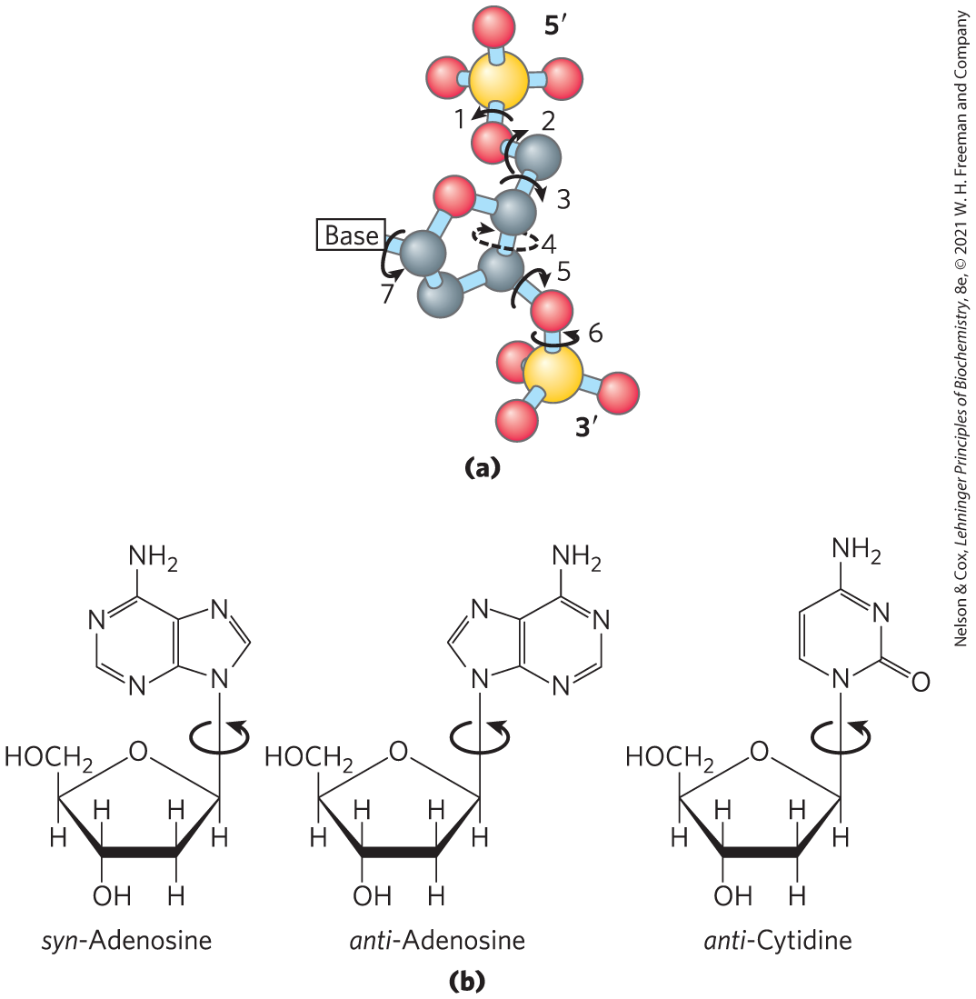
DNA Can Occur in Different Three-Dimensional Forms
structural variation in DNA reflects:
  different possible conformations of the deoxyribose
  rotation about the contiguous bonds making up the phosphodeoxyribose backbone
  free rotation about the C-1′–N-glycosyl bond

Slide 65
The Three Forms of DNA
B-form DNA = the Watson-Crick structure
  most stable for a random-sequence DNA molecule under physiological conditions
A-form DNA = right-handed double helix with a wider helix, 11 bp/turn, and a tilted plane
  favored in solutions devoid of water
Z-form DNA = left-handed helix with 12 bp/turn and a backbone with a zig-zag appearance
  appears more slender and elongated

Slide 66
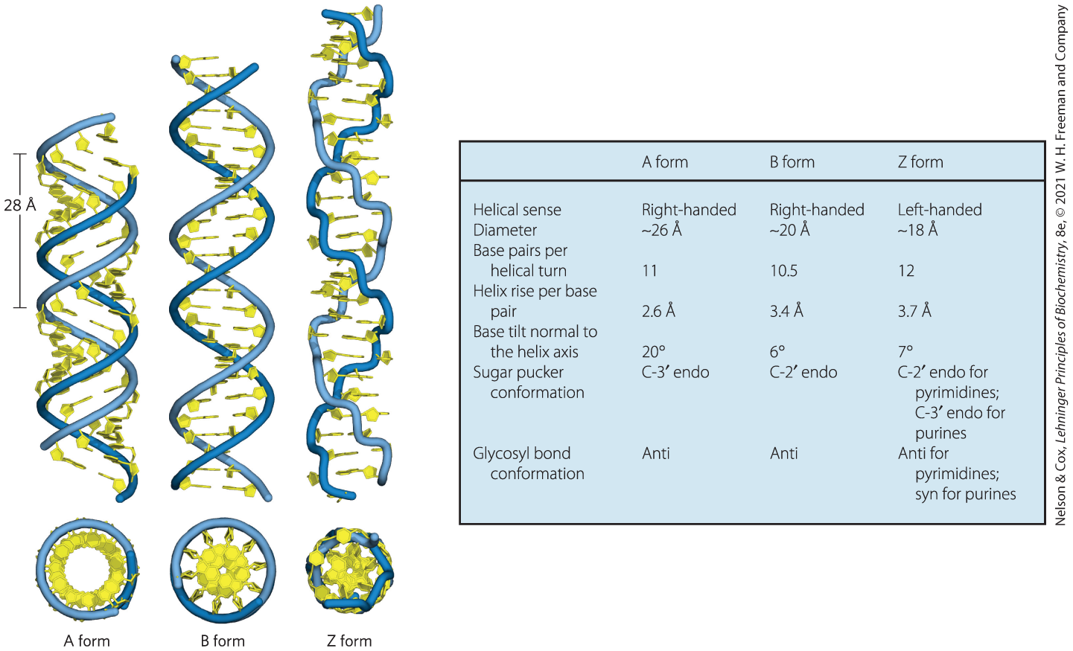
A, B, and Z Forms of DNA

Slide 67
Clicker Question 11
Some effort has been made to extract DNA from fossilized dinosaur bones that have been buried for many million of years in arid climates. In what form is this DNA MOST likely to be found?
A
B
Z
D. completely denatured
Notes:
Answer: A
Principle: 8.2
Learning Objective(s): Describe the structures of A, B, and Z DNA.
Bloom’s: 2:2

Slide 68
Clicker Question 11, Response
Some effort has been made to extract DNA from fossilized dinosaur bones that have been buried for many million of years in arid climates. In what form is this DNA MOST likely to be found?
A
The A form is favored in many solutions that are relatively devoid of water, such as the arid climate where the fossilized dinosaur bones were extracted from.

Slide 69
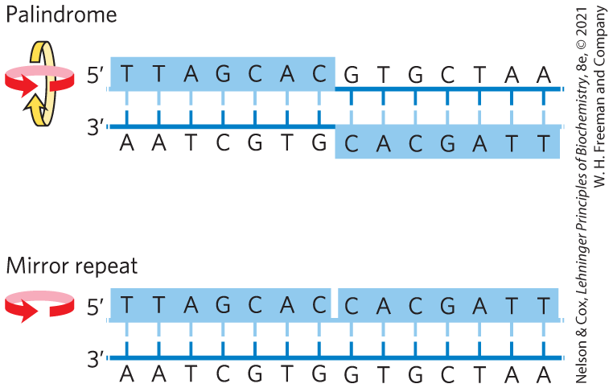
Certain DNA Sequences Adopt Unusual Structures
palindrome = region of DNA that is identical when read either forward or backward
  applied to regions of DNA with inverted repeats
mirror repeat = sequence when the inverted repeat occurs within each individual strand

Slide 70
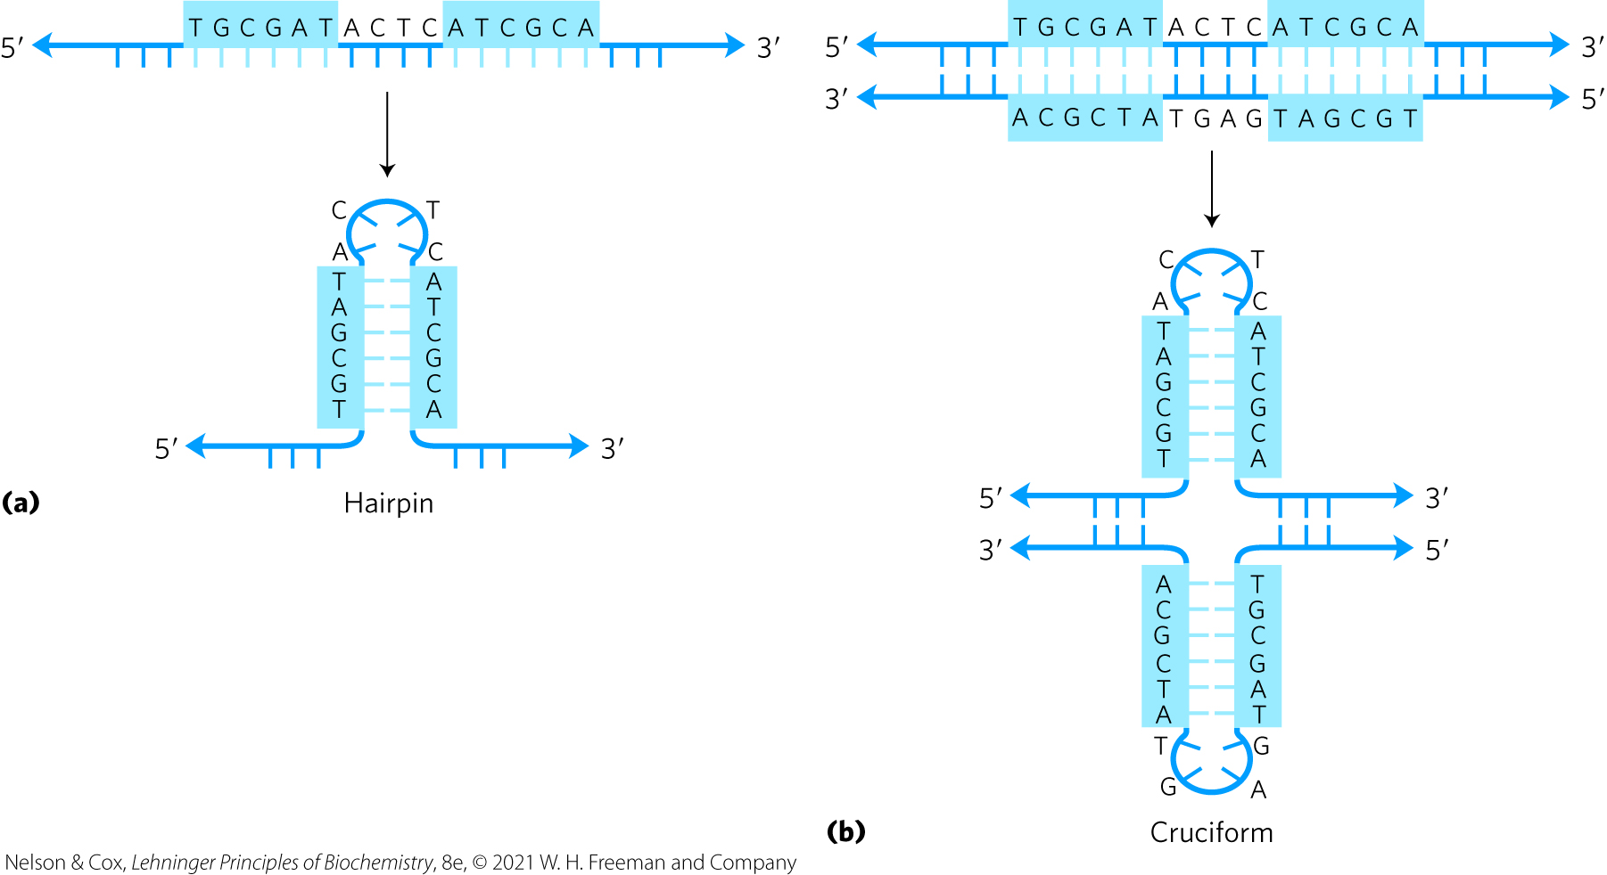
Hairpin and Cruciform Structures
hairpin and cruciform structures = form from the self-complementarity within each strand

Slide 71
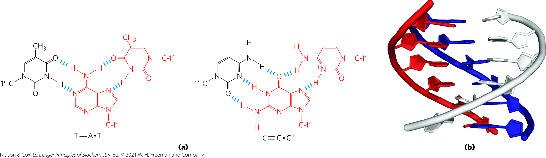
DNA Structures Containing Three DNA Strands
Hoogsteen positions = N-7, O⁶, and N⁶ of purines
  participate in the hydrogen bonding with a third DNA strand
Hoogsteen pairing = the non-Watson-Crick pairing
triplex DNAs = form from Hoogsteen pairing

Slide 72
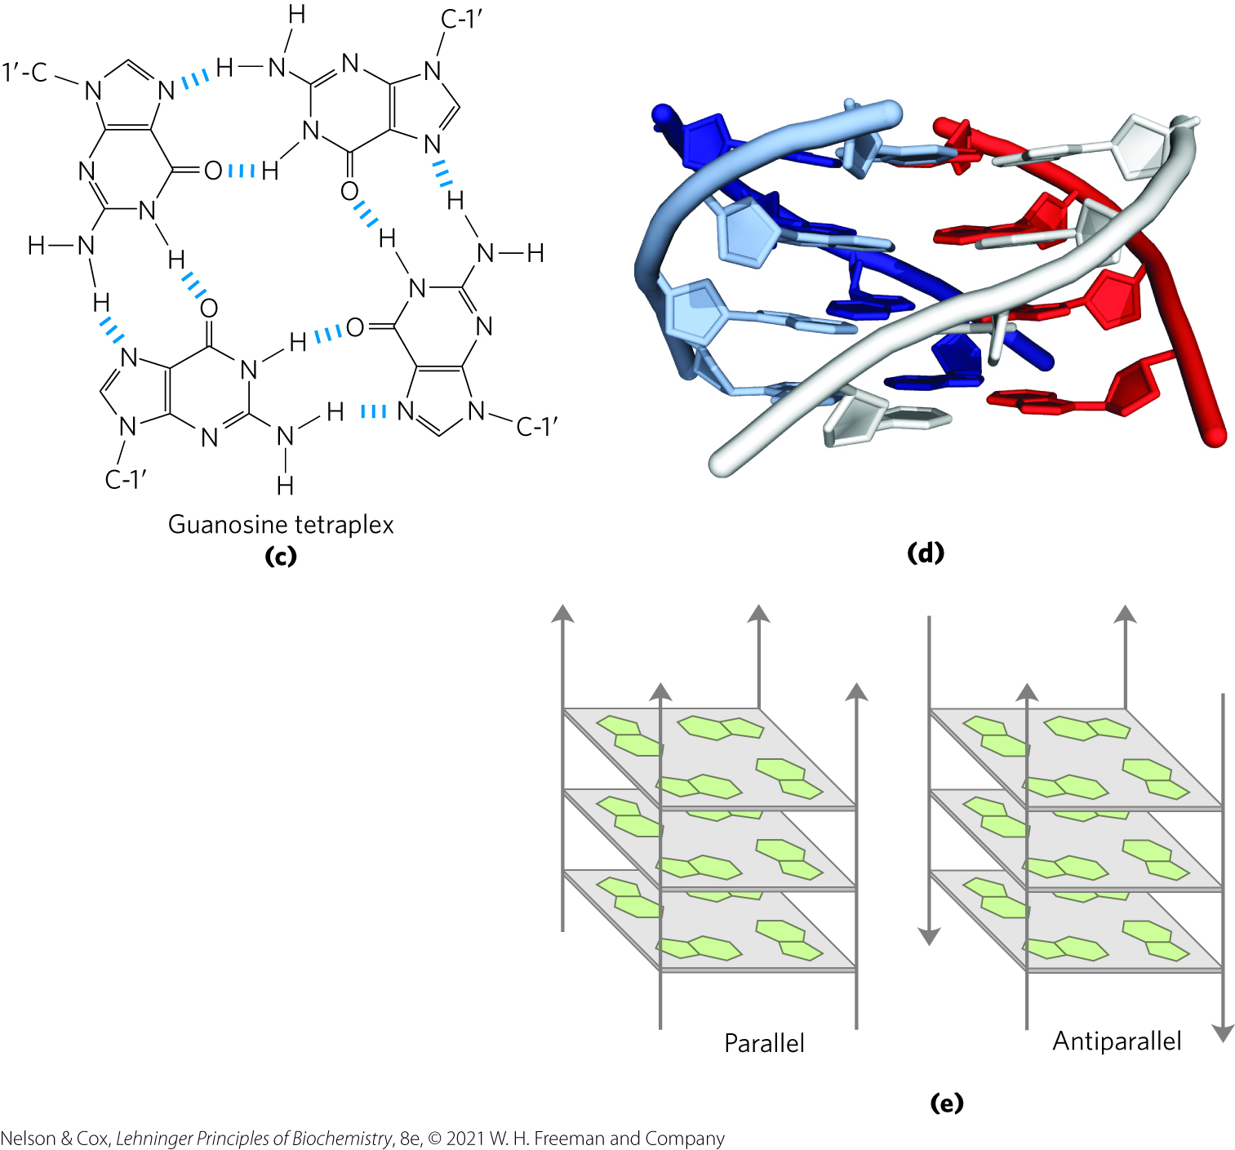
DNA Structures Containing Four DNA Strands
tetraplex DNAs = occur when four DNA strands pair
  occur readily only for DNA sequences with a very high proportion of G residues
  G tetraplex = very stable

Slide 73
Clicker Question 12
Telomeres are noncoding sequences on the ends of chromosomes. They contain a high concentration of guanosine. Given this information, what other structure may be in telomeres?
cyclobutane dimers
a high concentration of triplexes
tetraplexes
A-form DNA
Notes:
Answer: C
Principle: 8.2
Learning Objective(s): Relate the structure of a nucleic acid to its properties.
Bloom’s: 2:2

Slide 74
Clicker Question 12, Response
Telomeres are noncoding sequences on the ends of chromosomes. They contain a high concentration of guanosine. Given this information, what other structure may be in telomeres?
C. tetraplexes
Four DNA strands can pair to form a tetraplex, but this occurs readily only for DNA sequences with a very high proportion of guanosine residues. The guanosine tetraplex, or G tetraplex, is quite stable over a broad range of conditions. Indeed, telomeres have been shown to contain guanosine tetraplexes.

Slide 75
Clicker Question 13
Which of the following is NOT associated with DNA structure?
Z-DNA
G tetraplexes
three hydrogen bonds between A and T
pyrimidines in the anti conformation
Notes:
Answer: C
Principle: 8.2
Learning Objective(s): Relate the structure of a nucleic acid to its properties.
Bloom’s: 2:2

Slide 76
Clicker Question 13, Response
Which of the following is NOT associated with DNA structure?
C. three hydrogen bonds between A and T
Three hydrogen bonds can form between G and C, but only two can form between A and T.

Slide 77
Principle 1 (5 of 6)
Nucleic acids are both repositories and functional expressions of biological information. Biological information is one of the required conditions for life, a blueprint for each species transmitted from one generation to the next. RNA can be a functional expression of that information, directing the synthesis of proteins or, in some cases, acting directly as a signal or a reaction catalyst.

Slide 78
Principle 2 (4 of 4)
The transmission of biological information relies on molecular complementarity. Chromosomes are the largest molecules in any cell. They are polymers composed of a small set of common nucleotides, with information embedded in the nucleotide sequence. The common nucleotides in RNA and DNA are organized so that two strands of nucleic acid can maintain a complementary and uniform structure over vast molecular distances. This extended potential for both variable sequence and complementarity, and thus information storage and transmission, is a property shared by no other class of biological molecule.

Slide 79
Messenger RNAs Code for Polypeptide Chains
“messenger RNA” (mRNA) = portion of cellular RNA carrying the genetic information from DNA to the ribosome
transcription = process by which mRNAs are formed on a DNA template

Slide 80
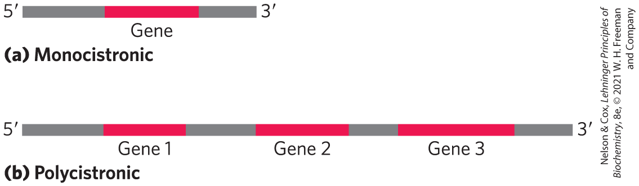
mRNA Can Be Monocistronic or Polycistronic
monocistronic = codes for only one polypeptide
  most mRNAs in eukaryotes
polycistronic = codes for 2+ different polypeptides
  occurs in bacteria and archaea
noncoding RNA

Slide 81
Clicker Question 14
Which statement regarding mRNA is false?
It is always monocistronic.
It carries genetic information to the ribosomes.
It is formed by transcription.
It can be of varying lengths.
Notes:
Answer: A
Principle: 8.2
Learning Objective(s): Classify an mRNA as monocistronic or polycistronic.
Bloom’s: 2:2

Slide 82
Clicker Question 14, Response
Which statement regarding mRNA is false?
It is always monocistronic.
In bacteria and archaea, a single mRNA molecule may code for one or several polypeptide chains. If it carries the code for only one polypeptide, the mRNA is monocistronic; if it codes for two or more different polypeptides, the mRNA is polycistronic. In eukaryotes, most mRNAs are monocistronic.

Slide 83
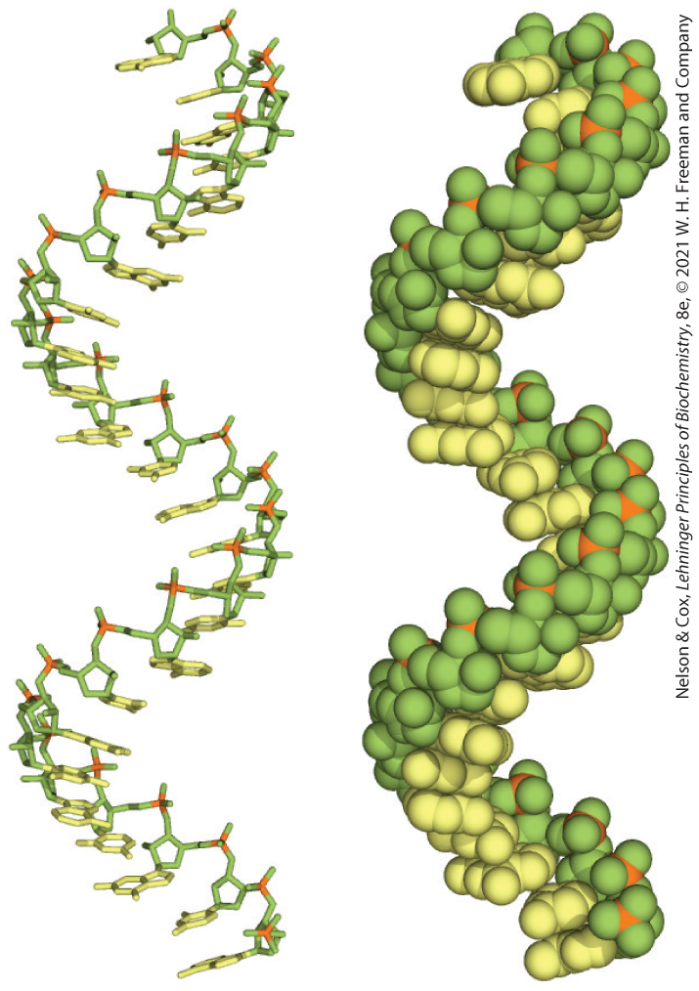
Many RNAs Have More Complex Three-Dimensional Structures
mRNA is always single-stranded
  right-handed helical conformation
  dominated by base-stacking interactions
    strongest between two purines
  can base pair with complementary regions of DNA or RNA
    paired strands are antiparallel

Slide 84
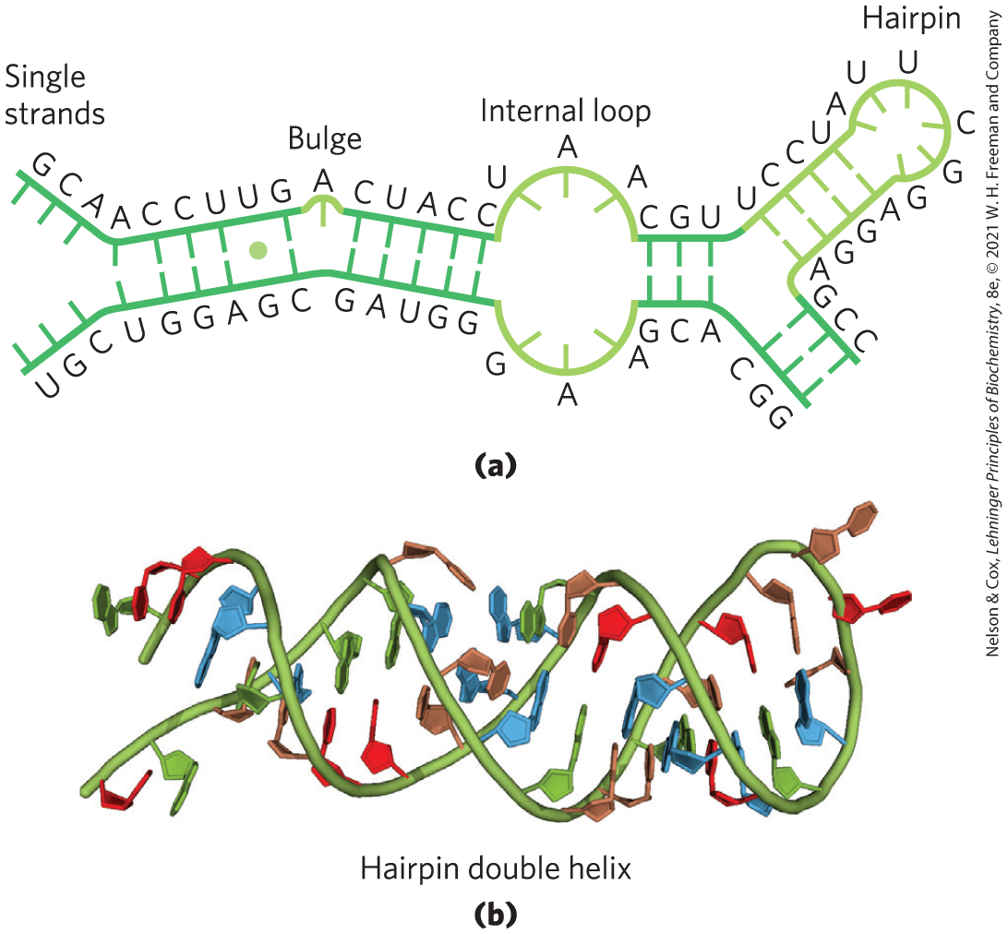
Secondary Structure of RNAs
structure of complementary RNA strands is an A-form right-handed double helix
breaks caused by mismatched or unmatched bases result in bulges or internal loops
internal loops form between palindromic sequences

Slide 85
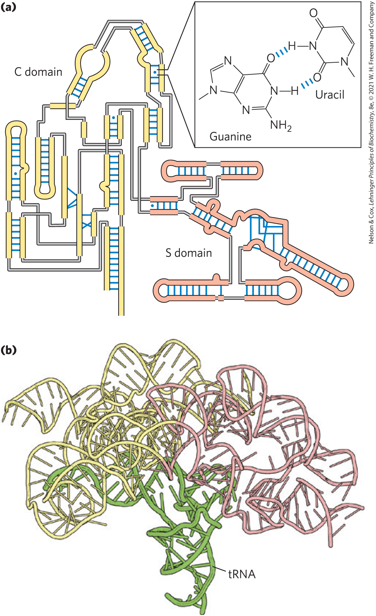
Base-Paired Helical Structures
In RNA
extensive base-paired helical segments form in RNAs
hairpins are the most common type of secondary structure

Slide 86
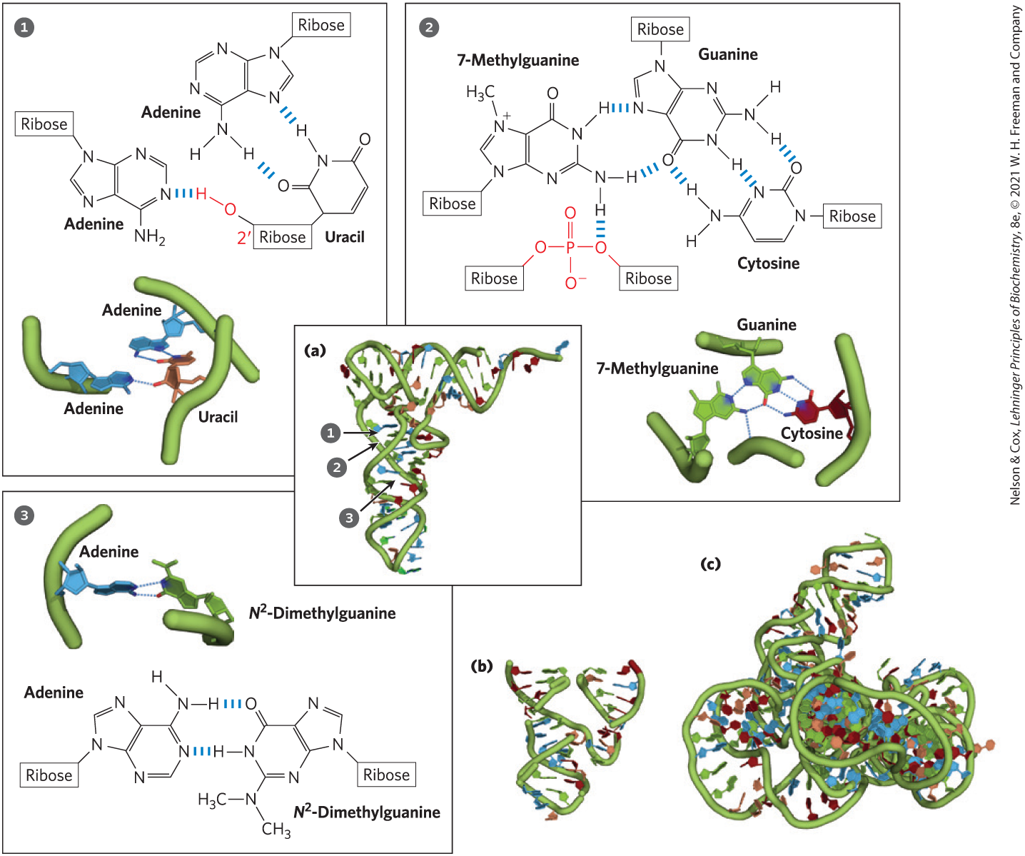
Three-Dimensional Structure in RNA

Slide 87
Clicker Question 15
Which structure is found in RNA but would be the result of a mutation of faulty annealing in DNA?
hairpin
double-stranded helix
cruciform
bulge
Notes:
Answer: D
Principle: 8.2
Learning Objective(s): Relate the structure of a nucleic acid to its properties.
Bloom’s: 2:2

Slide 88
Clicker Question 15, Response
Which structure is found in RNA but would be the result of a mutation of faulty annealing in DNA?
bulge
Breaks in the regular A-form RNA helix caused by mismatched or unmatched bases in one or both strands are common and can result in bulges. Unpaired bases are not found in DNA, and it indicates loss or addition of one base.

Slide 89

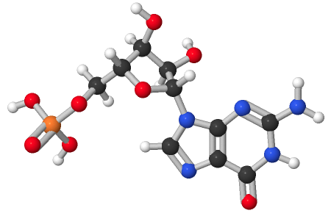
Activity: Properties of Nucleotides
Observe the structure of a nucleotide in Mol3D viewer in your Achieve course.
Notes:
Instructor: This Mol3D structure is located in the Achieve course. It can be found in the Chapter 8 content, in the folder titled “Ch8 In-Class Activities and Resources.”

Slide 90
Activity Instructions (1 of 4)
On your own, think of answers to the questions:
  What structural characteristics make this molecule a nucleotide?
  Which nucleotide is this and with which nucleotide does it base pair?
  Which atoms within this nucleotide facilitate hydrogen bonding to its complementary nucleotide base? Select the atoms and take a screenshot to upload to your course.
  (2 minutes)
Notes:
Instructor: This Mol3D structure is located in the Achieve course. It can be found in the Chapter 8 content, in the folder titled “Ch8 In-Class Activities and Resources.”

Slide 91
Activity Instructions (2 of 4)
Pair up to discuss your ideas. (2 minutes)
Share your ideas with the class in group discussion.
(3 minutes)
Notes:
Instructor: This Mol3D structure is located in the Achieve course. It can be found in the Chapter 8 content, in the folder titled “Ch8 In-Class Activities and Resources.”

Slide 92
Activity Solution (1 of 4)
  What structural characteristics make this molecule a nucleotide? a ribose unit, a nitrogenous base, and a phosphate group
  Which nucleotide is this and with which nucleotide does it base pair? This is guanosine monophosphate, which base pairs with cytosine monophosphate in nucleic acids.
Notes:
Instructor: This Mol3D structure is located in the Achieve course. It can be found in the Chapter 8 content, in the folder titled “Ch8 In-Class Activities and Resources.”

Slide 93
Activity Solution (2 of 4)
  Which atoms within this nucleotide facilitate hydrogen bonding to its complementary nucleotide base? Select the atoms and take a screenshot to upload to your course.
hydrogen bond donor
hydrogen bond donor
hydrogen bond acceptor
Notes:
Instructor: This Mol3D structure is located in the Achieve course. It can be found in the Chapter 8 content, in the folder titled “Ch8 In-Class Activities and Resources.”

Slide 94
8.3 Nucleic Acid Chemistry

Slide 95
Principle 1 (6 of 6)
Nucleic acids are both repositories and functional expressions of biological information. Biological information is one of the required conditions for life, a blueprint for each species transmitted from one generation to the next. RNA can be a functional expression of that information, directing the synthesis of proteins or, in some cases, acting directly as a signal or a reaction catalyst.

Slide 96
Principle 3 (2 of 3)
Biological information is subject to natural damage and change. DNA damage is a constant, and it results in occasional mutation — the raw material for evolution.

Slide 97
The Role of DNA as a Repository of Genetic Information
depends in part on its inherent stability
chemical transformations are generally very slow in the absence of enzyme catalysts
carcinogenesis and aging may be linked to slowly accumulating, irreversible DNA alternations

Slide 98

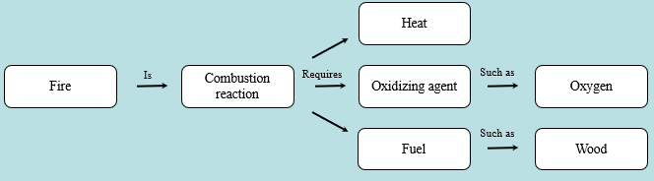
Activity: Relating
Terms within the Chapter
A concept map displays the relationships between different concepts. Observe the following example of a concept map.
Notes:
Instructor: For additional information, see the Instructor Activity Guide located in Achieve. It can be found within Chapter 8, in the folder titled “Ch8 In-Class Activities, Videos, and Resources.”

Slide 99
Activity Instructions (3 of 4)
Think about how the following terms and phrases relate to each other and then use scratch paper to draw a concept map using these terms and phrases. (3 minutes)
nucleic acids
biological information
repositories of biological information
functional expressions of biological information
required condition for life
blueprint for each species
transmitted from one generation to the next
RNA
can act as reaction catalyst
can act directly as a signal
directs protein synthesis
Notes:
Instructor: For additional information, see the Instructor Activity Guide located in Achieve. It can be found within Chapter 8, in the folder titled “Ch8 In-Class Activities, Videos, and Resources.”

Slide 100
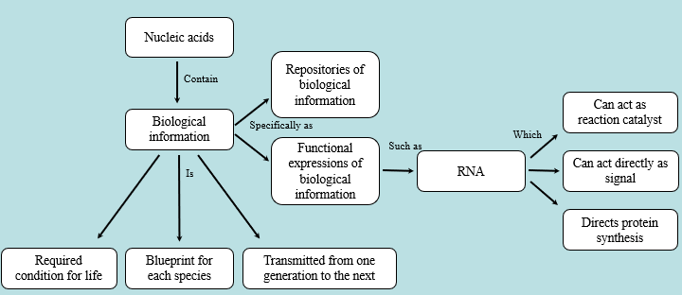
Activity Solution (3 of 4)
Pair up and share how this possible concept map might differ from yours. (2 minutes)
Notes:
Instructor: For additional information, see the Instructor Activity Guide located in Achieve. It can be found within Chapter 8, in the folder titled “Ch8 In-Class Activities, Videos, and Resources.”

Slide 101
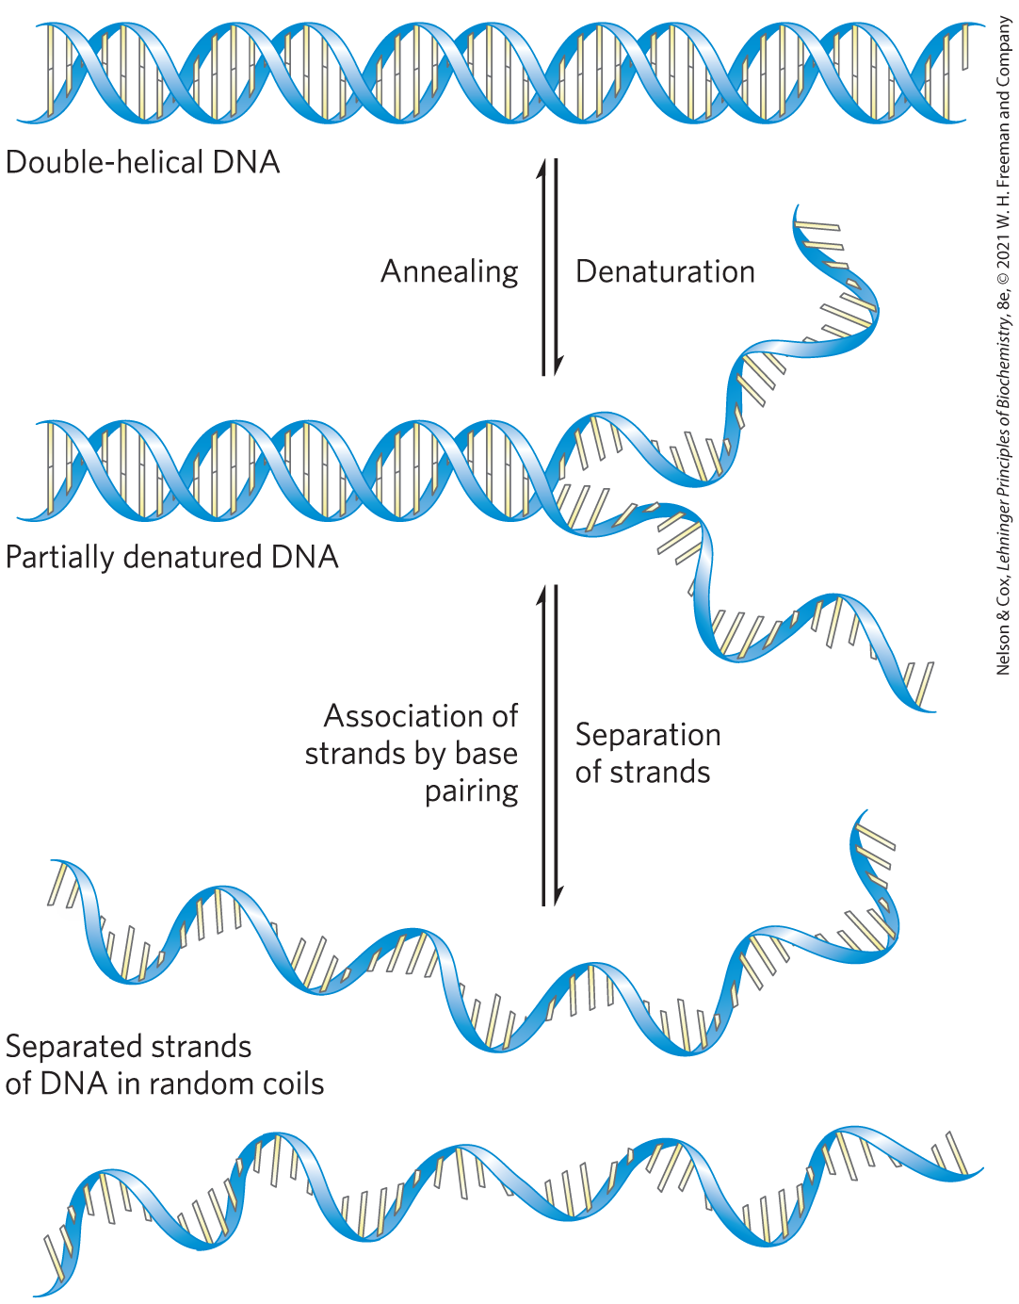
Double-Helical DNA and RNA Can Be Denatured
denaturation, or melting, of the double helix:
  due to pH extremes or high temperatures
  disrupts hydrogen bonds and base-stacking interactions

Slide 102
Clicker Question 16
Which statement is false regarding a solution of DNA subjected to extremes of pH?
The viscosity of the solution will decrease sharply.
Hydrogen bonds between paired bases will be disrupted.
Covalent bonds in the DNA will be broken.
D. Base-stacking interactions will be disrupted.
Notes:
Answer: C
Principle: 8.1
Learning Objective(s): Relate the structure of a nucleic acid to its properties.
Bloom’s: 2:2

Slide 103
Clicker Question 16, Response
Which statement is false regarding a solution of DNA subjected to extremes of pH?
C. Covalent bonds in the DNA will be broken.
Extremes in pH denature, or melt, double helical DNA. The double helix unwinds to form two single strands, completely separate from each other along the entire length or part of the length (partial denaturation) of the molecule. No covalent bonds in the DNA are broken.

Slide 104
Clicker Question 17
The process of separating strands of a DNA double helix is known as:
separation.
denaturation.
annealing.
D. replication.
Notes:
Answer: B
Principle: 8.1
Learning Objective(s):
Bloom’s: 1:1

Slide 105
Clicker Question 17, Response
The process of separating strands of a DNA double helix is known as:
B. denaturation.
Just as heat and extremes of pH denature globular proteins, they also cause denaturation, or melting, of double-helical DNA.

Slide 106
Double-Helical DNA and RNA Can Anneal
anneal = process by which two strands spontaneously rewind when temperature or pH is returned to its normal range
  two-step process

Slide 107
The Hypochromic and Hyperchromic Effects
hypochromic effect = the observed decrease in the absorption of UV light when complementary strands are paired
hyperchromic effect = the observed increase in the absorption of UV light when a double-stranded nucleic acid is denatured
monitoring UV absorption at 260 nm can detect the transition from double-stranded to single-stranded DNA

Slide 108
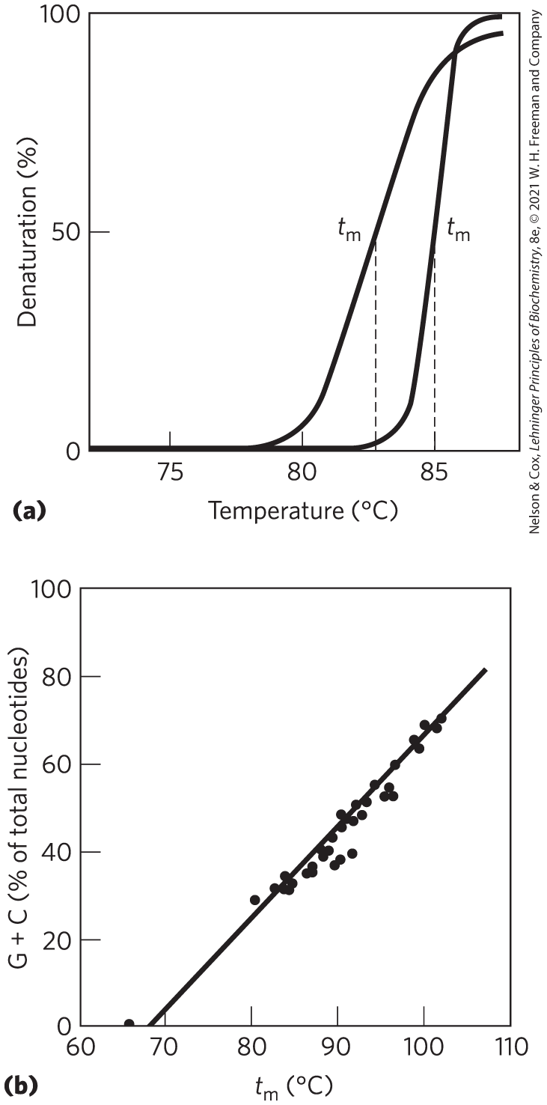
Heat Denaturation of DNA
denaturation temperature, t_{m} = temperature at which ½ of DNA is present as separated single strands
  increases with content of G≡C base pairs

Slide 109
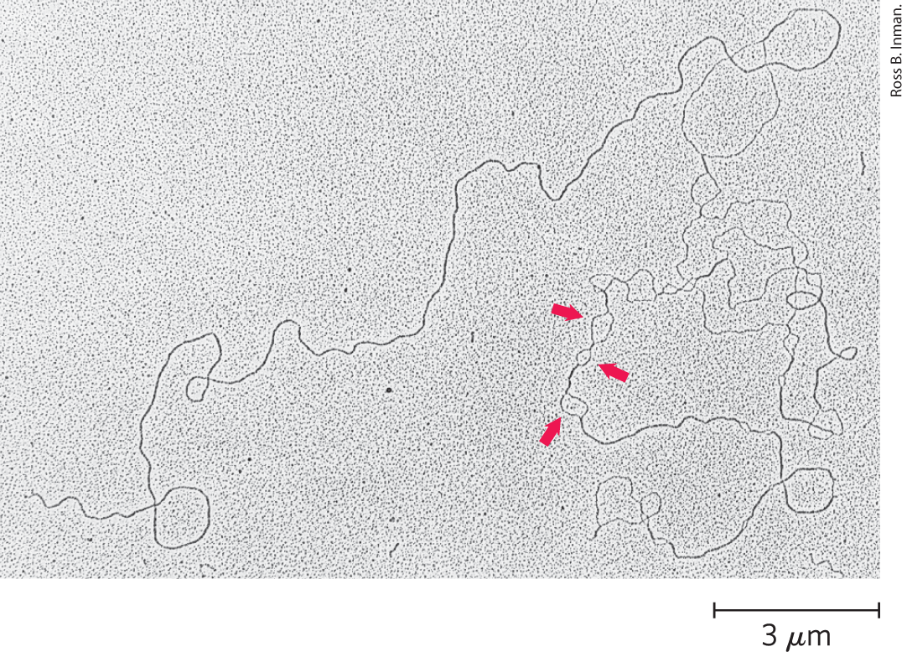
Partially Denatured DNA
denatured regions form bubbles
often rich in A=T base pairs

Slide 110
Clicker Question 18
A graduate student carefully heated DNA to about 80 °C and then prepared it for electron microscopy. She observed several small open loops of DNA. What conclusion did she CORRECTLY make from her observation?
The open loops contain DNA mutations, such as cyclobutane dimers and deaminations.
The denatured DNA is the site of genes, and the annealed DNA is the site of noncoding DNA.
The open loops contain DNA with a high A-T content.
The open loops contain denatured DNA that is being transcribed.
Notes:
Answer: C
Principle: 8.1
Learning Objective(s): Relate GC content to thermal stability.
Bloom’s: 2:2

Slide 111
Clicker Question 18, Response
A graduate student carefully heated DNA to about 80 °C and then prepared it for electron microscopy. She observed several small open loops of DNA. What conclusion did she CORRECTLY make from her observation?
C. The open loops contain DNA with a high A-T content.
During heat denaturation, regions that are rich in A=T base pairs will denature while most of the DNA remains double-stranded, resulting in the formation of single-stranded bubbles. This is because G≡C base pairs make greater contributions to base stacking than do A=T base pairs.

Slide 112
Denaturation of Double-Stranded RNA and RNA-DNA Hybrids
RNA duplexes are more stable to heat denaturation than DNA duplexes
RNA-DNA hybrid stability is generally intermediate

Slide 113
Nucleotides and Nucleic Acids Undergo Nonenzymatic Transformations
mutations = alterations in DNA structure that produce permanent changes in the genetic information encoded
  linked to aging and carcinogenesis

Slide 114
Principle 3 (3 of 3)
Biological information is subject to natural damage and change. DNA damage is a constant, and it results in occasional mutation — the raw material for evolution.

Slide 115
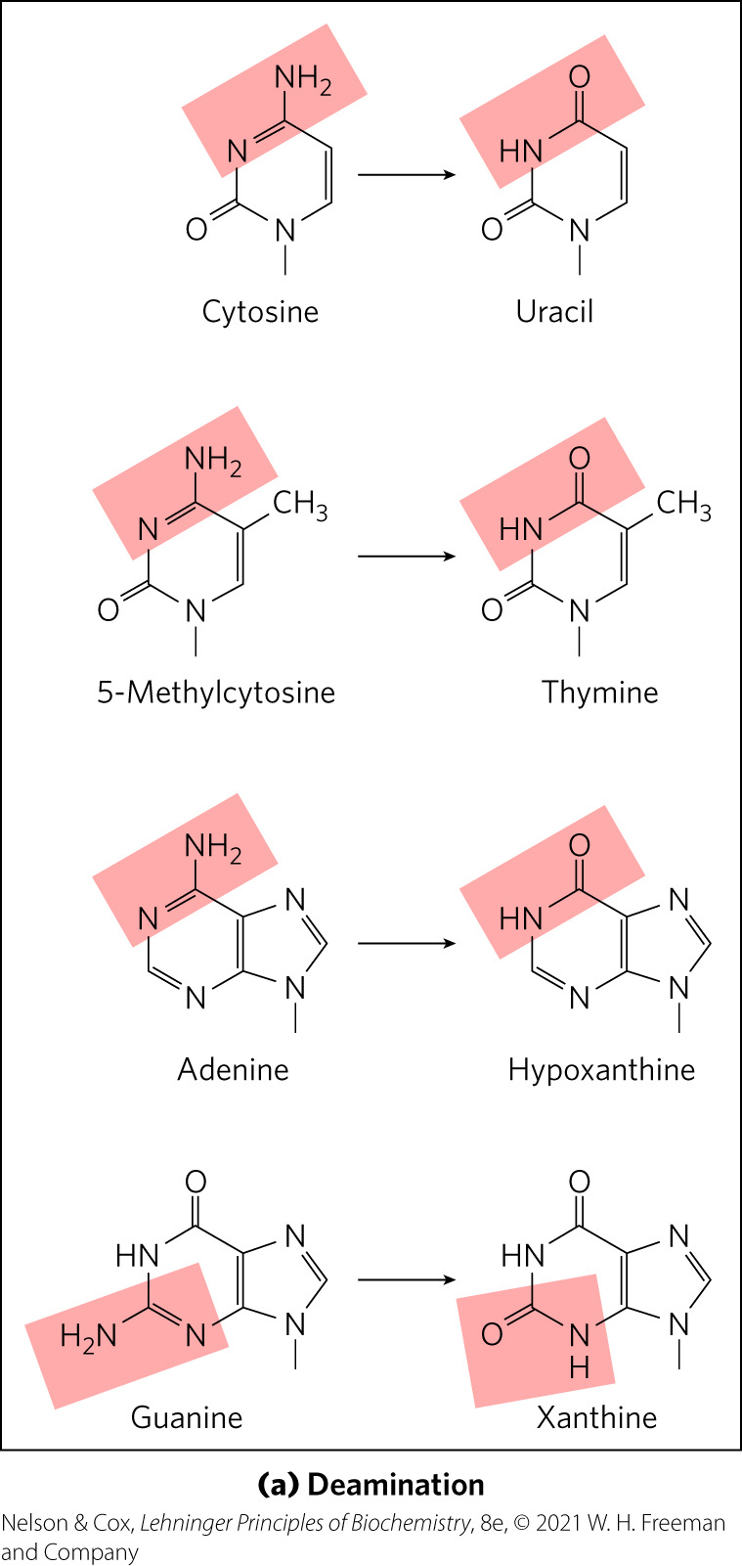
Deamination Reactions
deamination = spontaneous loss of exocyclic amino groups
deamination of cytosine to uracil = ~100 events/day
  recognized as foreign in DNA and removed
  almost certainly why DNA contains thymine rather than uracil

Slide 116
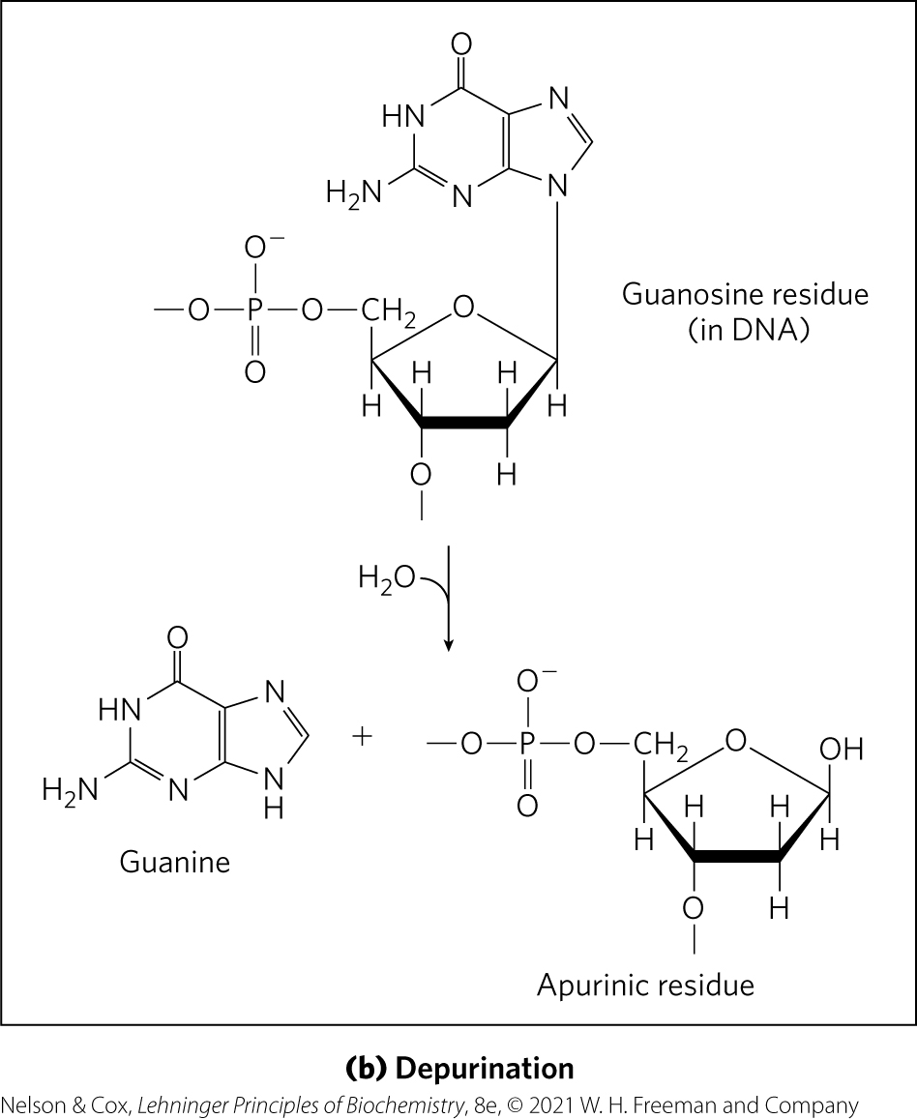
Depurination Reactions
depurination = hydrolysis of the N-β-glycosyl bond between the base and the pentose
  creates an AP (apurinic, apyrimidinic) site or abasic site
  more common with purines

Slide 117
Reactions Promoted by Radiation
UV light causes:
  cyclobutane pyrimidine dimers
  6-4 photoproduct
ionizing radiation (x-rays and gamma rays) causes:
  ring opening
  base fragmentation
  breaks in the covalent backbone of nucleic acids

Slide 118

Clicker Question 19
Which statement is false about nucleotides and nucleic acids undergoing nonenzymatic transformations?
Several nucleotide bases undergo spontaneous loss of their exocyclic amino groups.
Hydrolysis of the N-β-glycosyl bond between the base and the pentose creates a DNA lesion called an AP site.
Ionizing radiation induces the condensation of two ethylene groups to form a cyclobutene ring.
UV irradiation can result in a 6-4 photoproduct, a type of pyrimidine dimer.
Notes:
Answer: C
Principle: 8.3
Learning Objective(s): Describe deamination of nucleotides.; Describe depurination of nucleotides; Describe UV-induced dimerization of pyrimidines.
Bloom’s: 2:2

Slide 119
Clicker Question 19, Response
Which statement is false about nucleotides and nucleic acids undergoing nonenzymatic transformations?
Ionizing radiation induces the condensation of two ethylene groups to form a cyclobutene ring.
UV light induces the condensation of two ethylene groups to form a cyclobutane ring. Ionizing radiation (x-rays and gamma rays) can cause ring opening and fragmentation of bases as well as breaks in the covalent backbone of nucleic acids.

Slide 120
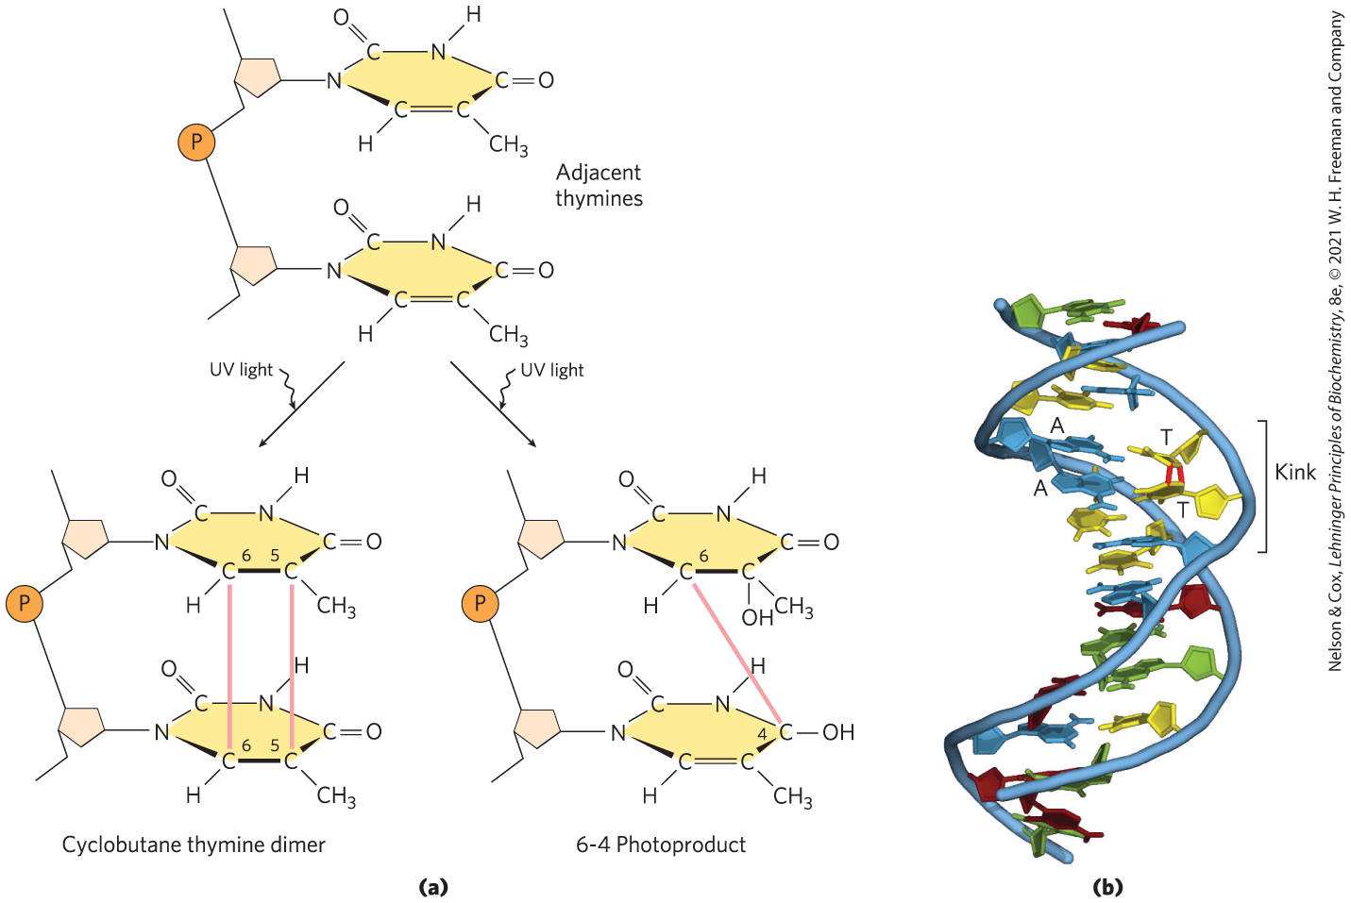
Formation of Pyrimidine Dimers by UV Light

Slide 121
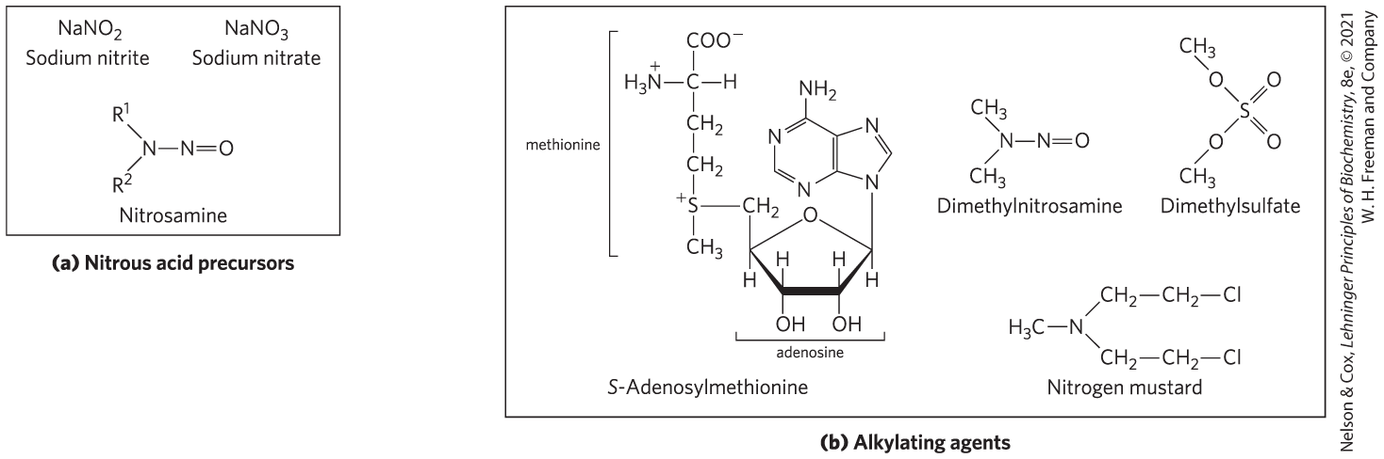
DNA Damage by Reactive Chemicals
nitrous acid precursors = deaminating agents
alkylating agents = generate modified nucleotides nonenzymatically

Slide 122
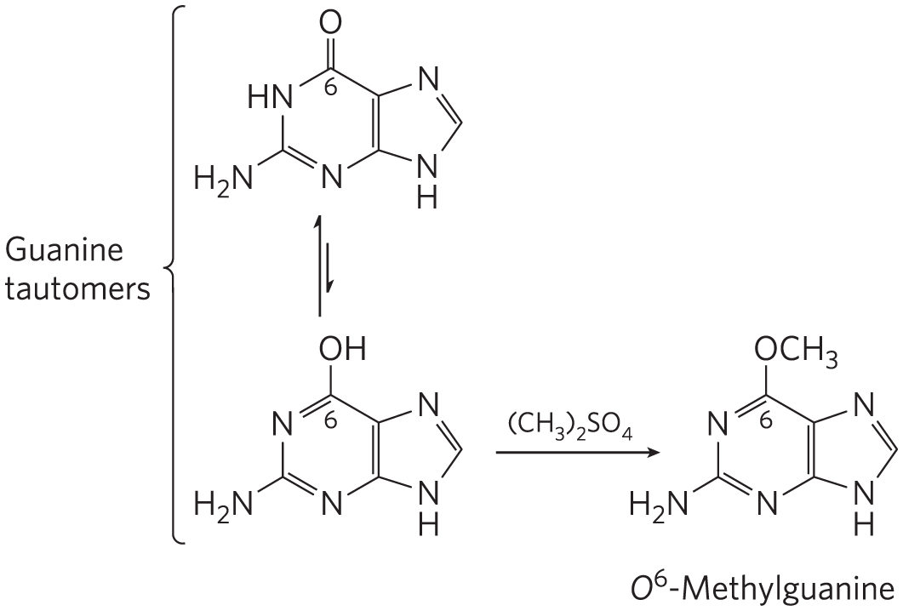
Alkylating Agents Can Alter Certain Bases of DNA
can methylate guanine to O⁶-methyl-guanine, which cannot base-pair with cytosine

Slide 123
DNA Damage by Oxidative Damage
reactive oxygen species (hydrogen peroxide, hydroxyl radicals, superoxide radical) damage DNA
hydroxyl radicals are responsible for most oxidative DNA damage
cells have an elaborate defense system to destroy reactive oxygen species

Slide 124

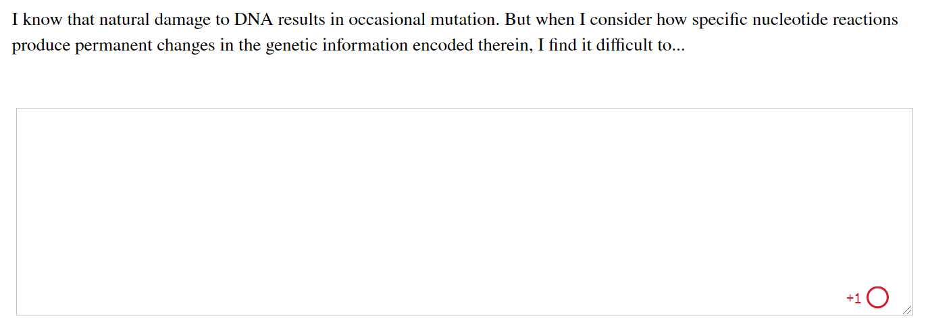
Activity: Natural DNA
Damage Muddiest Point (1 of 2)
Complete the Ch8 Student Activity, Day 1: Natural DNA Damage (Muddiest Point) Achieve assessment.
Notes:
Instructor: This muddiest point activity can be found in Achieve in the Chapter 8 folder titled “Ch8 In-Class Activities, Videos, and Resources.” See the Instructor Activity Guide in the same folder for more information.

Slide 125
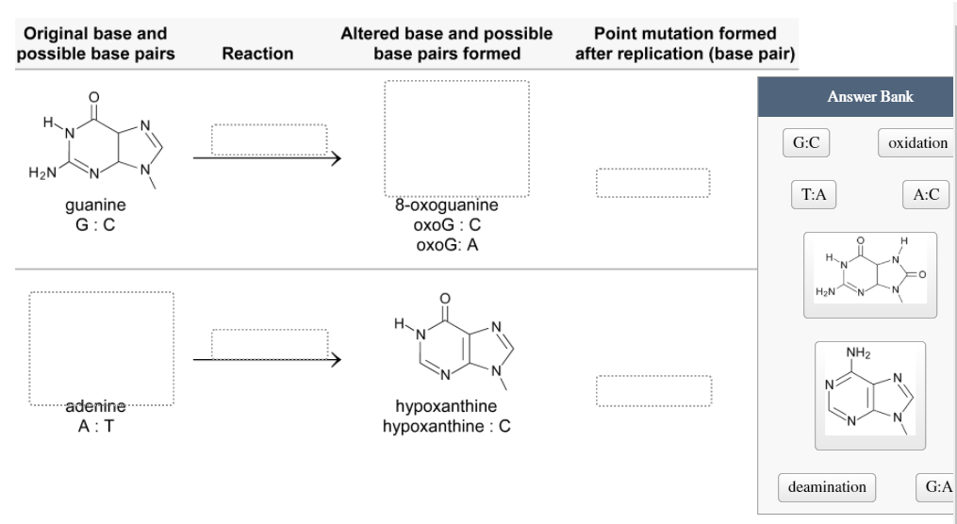
Activity: Natural DNA
Damage Muddiest Point (2 of 2)
Complete the Ch8 Student Activity, Day 2: Natural DNA Damage (Muddiest Point) Achieve assessment.
Notes:
Instructor: This muddiest point activity can be found in Achieve in the Chapter 8 folder titled “Ch8 In-Class Activities, Videos, and Resources.” See the Instructor Activity Guide in the same folder for more information.

Slide 126
Some Bases of DNA Are Methylated
A and C are methylated more frequently than G and T
all known DNA methylases use S-adenosylmethionine as a methyl group donor
In eukaryotes, 5% of cytidine residues are methylated
  affects DNA metabolism and gene expression

Slide 127
Clicker Question 20
Mutations in DNA can result from:
deamination of ribose.
UV-induced purine dimers.
alkylation of the phosphodiester bond.
oxidation of deoxyribose.
Notes:
Answer: D
Principle: 8.3
Learning Objective(s):
Bloom’s: 2:2

Slide 128
Clicker Question 20, Response
Mutations in DNA can result from:
oxidation of deoxyribose.
The most important source of mutagenic alterations in DNA is oxidative damage. Reactive oxygen species such as hydrogen peroxide, hydroxyl radicals, and superoxide radicals arise during irradiation or (more commonly) as a byproduct of aerobic metabolism. These species damage DNA through any of a large, complex group of reactions, ranging from oxidation of deoxyribose and base moieties to strand breaks.

Slide 129
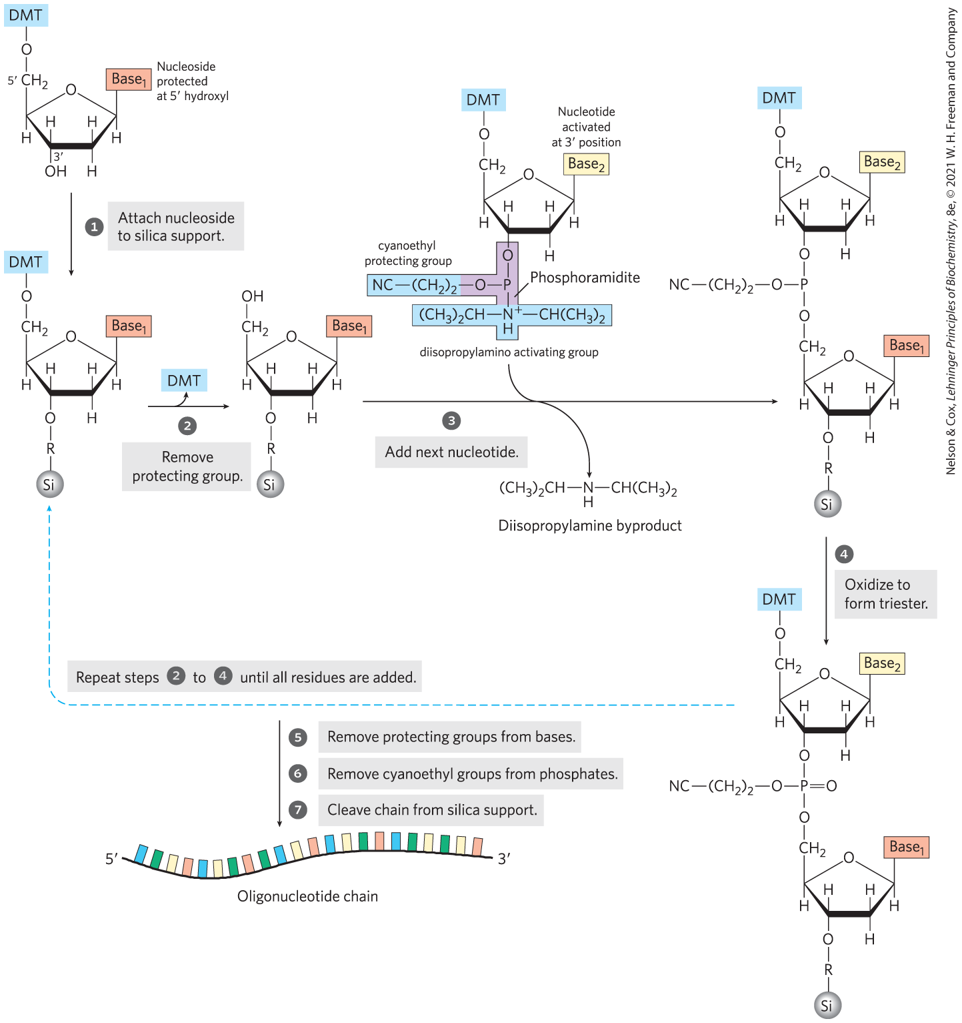
The Chemical Synthesis of DNA Has Been Automated
chemical synthesis of DNA by the phosphoramidite method is highly efficient

Slide 130
Gene Sequences Can Be Amplified with the Polymerase Chain Reaction
polymerase chain reaction (PCR) = method of amplifying DNA segments of interest
  relies on DNA polymerases (enzymes that synthesize DNA from deoxyribonucleotides (dNTPs) using a DNA template)
  DNA polymerases add nucleotides to the 3′ ends of preexisting strands called primers

Slide 131
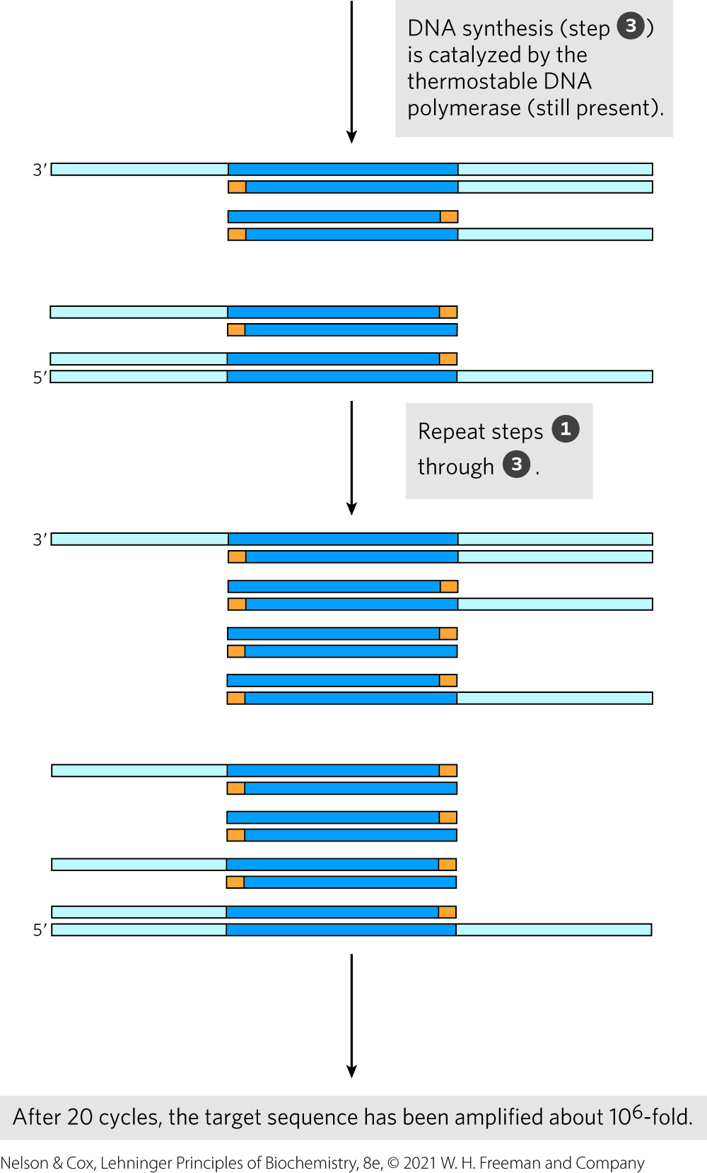
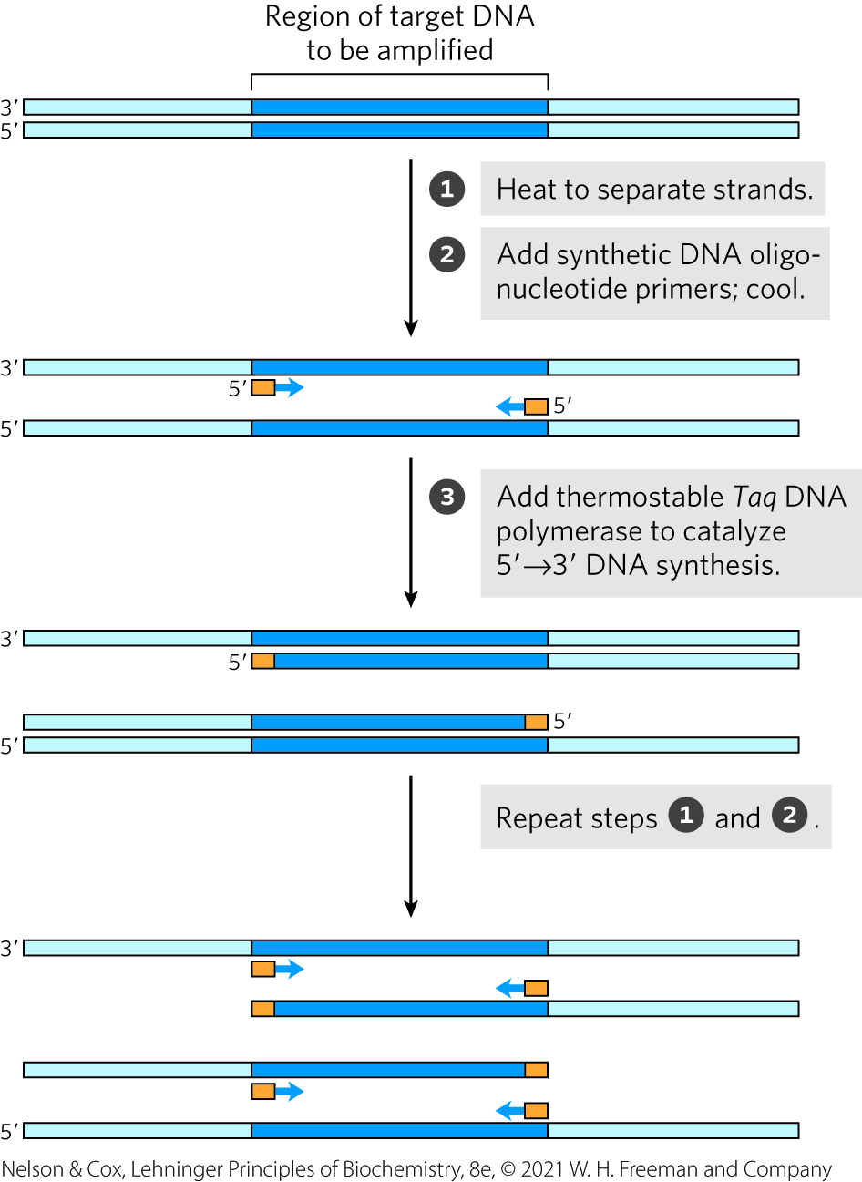
The Polymerase Chain Reaction

Slide 132
Principle 4 (2 of 4)
Biological information can be accessed, interpreted, and altered in the laboratory. The information embedded in nucleic acids
is of singular importance to biochemistry and molecular biology. The techniques for sequencing, synthesizing, and altering nucleic acids are continually advancing.

Slide 133
PCR Technology Is Highly Sensitive
PCR can detect and amplify just one DNA molecule in almost any sample type
Uses of PCR:
  cloning of rare, undegraded DNA segments from 40,000+ years ago
  tracing evolution
  potent tool in forensic medicine
  detecting viral infections and cancers before they cause symptoms
  prenatal diagnosis of genetic diseases

Slide 134

Clicker Question 21
In its simplest form, polymerase chain reaction:
is remarkably insensitive to contamination.
requires reverse transcriptase.
requires two oligonucleotide primers.
requires a minimum of 10,000 copies of DNA to be amplified.
Notes:
Answer: C
Principle: 8.4
Learning Objective(s): Identify the necessary components of a PCR reaction.
Bloom’s: 2:2

Slide 135
Clicker Question 21, Response
In its simplest form, polymerase chain reaction:
C. requires two oligonucleotide primers.
In PCR, two synthetic oligonucleotides are prepared for use as replication primers that can be extended by a DNA polymerase.

Slide 136
Principle 4 (3 of 4)
Biological information can be accessed, interpreted, and altered in the laboratory. The information embedded in nucleic acids
is of singular importance to biochemistry and molecular biology. The techniques for sequencing, synthesizing, and altering nucleic acids are continually advancing.

Slide 137
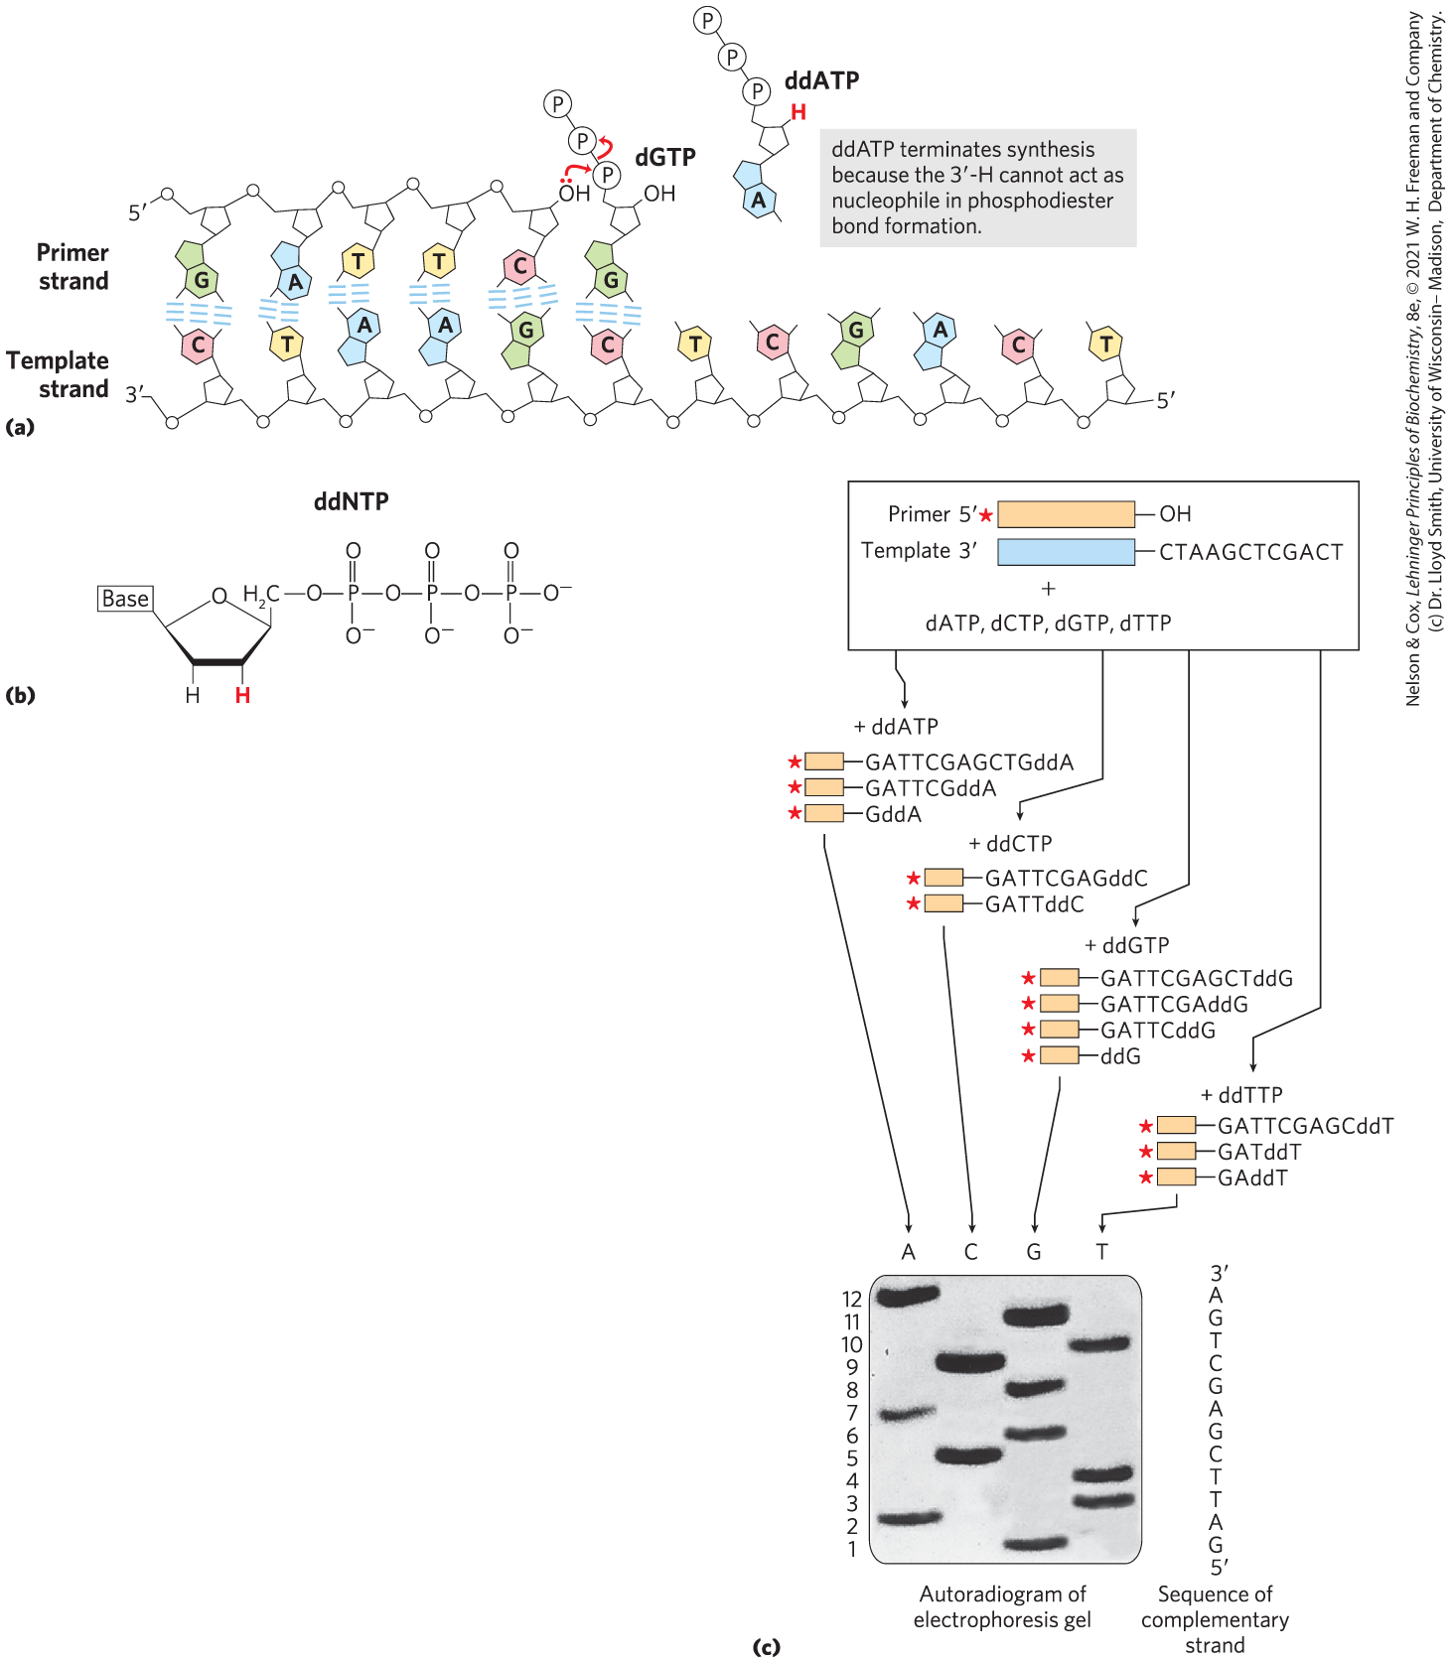
The Sequences of Long DNA Strands Can Be Determined
Sanger sequencing = dideoxy chain-termination sequencing
nucleotide analogs called dideoxynucleoside triphosphates (ddNTPs) interrupt synthesis

Slide 138
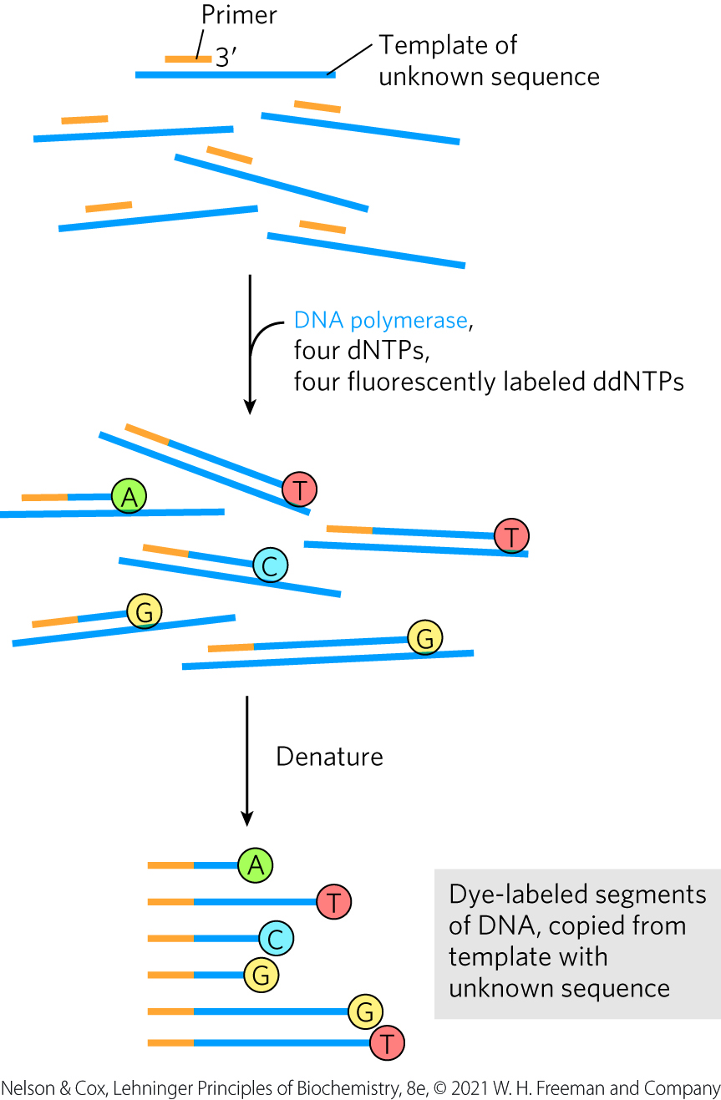
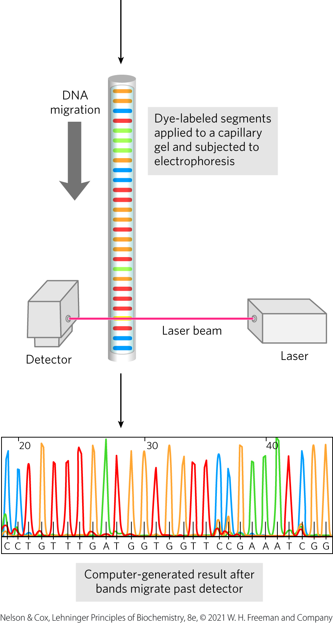
Automation of DNA Sequencing Reactions
each of the four ddNTPs is labeled with a different-colored fluorescent tag

Slide 139
Clicker Question 22
Sanger sequencing was performed on DNA from chloroplasts of a new plant species discovered in the rain forest of Puerto Rico. The x-ray film showed bands in the A, C, and T lanes, but the G lane was blank. What is the MOST likely explanation for this unexpected result?
ddG was not added to the reaction tube.
Different template DNA was added to the reaction tube.
The template DNA contained no G.
The template DNA contained no C.
Notes:
Answer: A
Principle: 8.4
Learning Objective(s): Describe the Sanger sequencing method.
Bloom’s: 3:2

Slide 140
Clicker Question 22, Response
Sanger sequencing was performed on DNA from chloroplasts of a new plant species discovered in the rain forest of Puerto Rico. The x-ray film showed bands in the A, C, and T lanes, but the G lane was blank. What is the MOST likely explanation for this unexpected result?
ddG was not added to the reaction tube.
ddNTPs interrupt DNA synthesis because they bind to the template strand but lack the 3′-hydroxyl group needed to add the next nucleotide. Omitting ddG from the reaction tube is the most likely explanation for a blank G lane.

Slide 141
Principle 4 (4 of 4)
Biological information can be accessed, interpreted, and altered in the laboratory. The information embedded in nucleic acids
is of singular importance to biochemistry and molecular biology. The techniques for sequencing, synthesizing, and altering nucleic acids are continually advancing.

Slide 142
DNA Sequencing Technologies Are Advancing Rapidly
“next-gen” sequencing:
  reversible terminator sequencing
  single-molecule real time (SMRT) sequencing

Slide 143
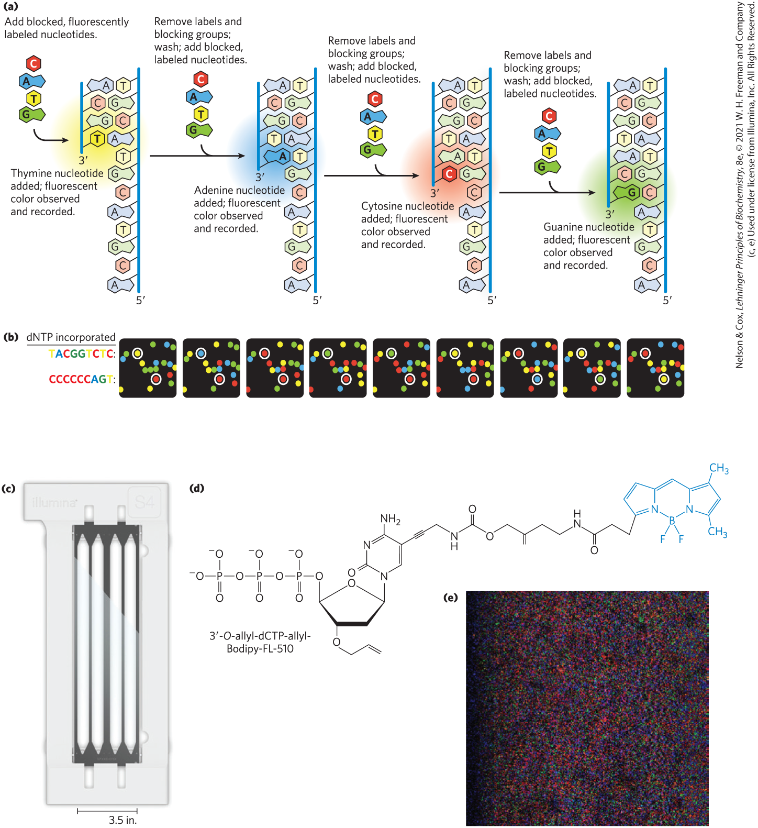
Reversible Terminator Sequencing
developed by Illumina
uses four different modified deoxynucleotides (A, T, G, and C), each with a particular fluorescent label and a 3′ blocking group

Slide 144

SMRT Sequencing
SMRT sequencing = technology allowing read lengths averages up to 30,000-40,000 bp
lower throughput, higher cost, and higher error rate than the Illumina approach

Slide 145

Sequence Assembly Requires the Computerized Alignment of Overlapping Fragments
sequencing depth = the number of times that a particular nucleotide in a genome is sequenced, on average
contigs = long, contiguous sequences that are assembled from overlaps

Slide 146
Clicker Question 23
Which method is NOT associated with DNA sequencing?
Sanger sequencing
electrophoresis
alignment
Maxam and Watson sequencing
Notes:
Answer: D
Principle: 8.4
Learning Objective(s): Describe the Sanger sequencing method.; Describe reversible terminator sequencing; Describe single molecule real time (SMRT) sequencing.
Bloom’s: 2:2

Slide 147
Clicker Question 23, Response
Which method is NOT associated with DNA sequencing?
Maxam and Watson sequencing
Sanger sequencing enables the sequencing of large DNA molecules. The different-sized fragments formed during the Sanger method of DNA sequencing are separated by electrophoresis. With more advanced DNA sequencing technologies, translating the sequences of millions of short DNA fragments into a complex and contiguous genomic sequence requires the computerized alignment of overlapping fragments.

Slide 148


Activity: Nucleic Acid
Sequencing
Watch the Animated Technique video titled “RNA Sequencing.”
Notes:
Instructor: This Animated Technique video is found within Chapter 9 of Achieve. It is in the folder titled “Ch9 In-Class Activities, Videos, and Resources.”

Slide 149
Activity Instructions (4 of 4)
On your own, think of answers to the question:
  Consider what type of information can be acquired using RNAseq technology. How can RNAseq data help researchers understand the similarities and differences between two different cell types? (2 minutes)
Pair up to discuss your ideas. (2 minutes)
Share your ideas with the class in group discussion. (3 minutes)
Notes:
Instructor: This Animated Technique video is found within Chapter 9 of Achieve. It is in the folder titled “Ch9 In-Class Activities, Videos, and Resources.”

Slide 150
Activity Solution (4 of 4)
  How can RNAseq data help researchers understand the similarities and differences between two different cell types? RNAseq technology facilitates the identification and quantification of mRNA transcript levels within cells. Performing RNAseq on two different cell types would allow researchers to understand 1) which genes are expressed in each cell type and 2) the relative expression levels of each gene across the two cell types.
Notes:
Instructor: This Animated Technique video is found within Chapter 9 of Achieve. It is in the folder titled “Ch9 In-Class Activities, Videos, and Resources.”

Slide 151
8.4 Other Functions of Nucleotides

Slide 152
Principle 5 (2 of 3)
Nucleoside triphosphates occupy a central role in cellular metabolism, serving as an energy currency and as important regulatory signals. ATP is the ultimate product of catabolic pathways, providing fuel for anabolic pathways.

Slide 153

Nucleotides Carry Chemical Energy in Cells
hydrolysis of nucleoside triphosphates provides chemical energy
  ATP is the most widely used

Slide 154
Principle 5 (3 of 3)
Nucleoside triphosphates occupy a central role in cellular metabolism, serving as an energy currency and as important regulatory signals. ATP is the ultimate product of catabolic pathways, providing fuel for anabolic pathways.

Slide 155

Hydrolysis of Nucleoside Phosphates
when coupled to a reaction with a positive free-energy change, ATP hydrolysis shifts the equilibrium to favor product formation
  hydrolysis of the ester linkage yields ~14 kJ/mol (under standard conditions)
  hydrolysis of each anhydride bond yields ~30 kJ/mol

Slide 156

Clicker Question 24
Which statement is true?
Hydrolysis of the α, β, and β, γ phosphoester bonds of a nucleotide is used as a source of chemical energy.
dATP is the most common source of chemical energy in cells.
CTP hydrolysis can be a source of chemical energy.
Hydrolysis of ATP to ADP and phosphate releases about 14 kJ/mol of free energy.
Notes:
Answer: C
Principle: 8.5
Learning Objective(s): Identify mono-, di-, and tri nucleotide phosphates.; Identify alpha, beta, and gamma phophoanhydride linkages.
Bloom’s: 2:2

Slide 157
Clicker Question 24, Response
Which statement is true?
C. CTP hydrolysis can be a source of chemical energy.
Hydrolysis of nucleoside triphosphates provides the chemical energy to drive many cellular reactions. Adenosine 5′-triphosphate (ATP) is by far the most widely used nucleoside triphosphate for this purpose, but UTP, GTP, and CTP are also used in some reactions.

Slide 158

Adenine Nucleotides Are Components of Many Enzyme Cofactors
adenosine does not participate directly in the primary function, but its removal reduces cofactor activities
nucleotide-binding fold = single protein domain that binds adenosine

Slide 159
Clicker Question 25
Which nucleoside is the one MOST commonly found as part of coenzymes?
adenosine
guanosine
cytosine
inosine
Notes:
Answer: A
Principle: 8.5
Learning Objective(s): Recognize adenosine in common cofactors.
Bloom’s: 2:2

Slide 160
Clicker Question 25, Response
Which nucleoside is the one MOST commonly found as part of coenzymes?
adenosine
Enzyme cofactors serving a wide range of chemical functions include adenosine as part of their structure.

Slide 161

Some Nucleotides Are Regulatory Molecules
second messengers = compounds produced inside the cell following the interaction of extracellular chemical signals with receptors
  often a nucleotide, like adenosine 3′,5′-cyclic monophosphate (cyclic AMP, or cAMP)
ppGpp = produced in bacteria during amino acid starvation to inhibit the synthesis of the rRNA and tRNA molecules

Slide 162
Adenine Nucleotides Also Serve as Signals
ATP and ADP serve as:
  neurotransmitters in a variety of signaling pathways
  signals for receptors that mediate pain sensation
  blood clotting signals

Slide 163
Clicker Question 26
In which way can nucleotides NOT be involved in signaling?
cyclic dGMP as a second messenger
as precursors for synthesizing second messengers
extracellular ADP binding to its receptor
extracellular ATP binding to its receptor
Notes:
Answer: A
Principle: 8.5
Learning Objective(s): Recognize the role of nucleotides in metabolism and regulation.
Bloom’s: 2:2

Slide 164
Clicker Question 26, Response
In which way can nucleotides NOT be involved in signaling?
cyclic dGMP as a second messenger
Often, a second messenger is a nucleotide. One of the most common is adenosine 3′,5′-cyclic monophosphate (cyclic AMP, or cAMP), formed from ATP in a reaction catalyzed by adenylyl cyclase. Guanosine 3′,5′-cyclic monophosphate (cGMP) also has regulatory functions in many cells; however, cyclic dGMP does not. Extracellular ADP and ATP can serve as signals by binding to receptors.

Slide 165


Activity: Nucleotides as
Chemical Energy
Carriers Muddiest Point (1 of 2)
Complete the Ch8 Student Activity, Day 1: Nucleotides as Chemical Energy Carriers (Muddiest Point) Achieve assessment.
Notes:
Instructor: This muddiest point activity can be found in Achieve in the Chapter 8 folder titled “Ch8 In-Class Activities, Videos, and Resources.” See the Instructor Activity Guide in the same folder for more information.

Slide 166

Activity: Nucleotides as
Chemical Energy
Carriers Muddiest Point (2 of 2)
Complete the Ch8 Student Activity, Day 2: Nucleotides as Chemical Energy Carriers (Muddiest Point) Achieve assessment.
Notes:
Instructor: This muddiest point activity can be found in Achieve in the Chapter 8 folder titled “Ch8 In-Class Activities, Videos, and Resources.” See the Instructor Activity Guide in the same folder for more information.

