Slide 1

7 Carbohydrates and Glycobiology
© 2021 Macmillan Learning

Slide 2
Carbohydrates
carbohydrates = aldehydes or ketones with at least two hydroxyl groups, or substances that yield such compounds on hydrolysis
many carbohydrates have the empirical formula (CH₂O)_{n}

Slide 3
Classes of Carbohydrates
monosaccharides = simple sugars, consist of a single polyhydroxy aldehyde or ketone unit
  example: D-glucose
oligosaccharides = short chains of monosaccharide units, or residues, joined by glycosidic bonds

Slide 4
Classes of Carbohydrates, Continued
disaccharides = oligosaccharides with two monosaccharide units
  example: sucrose (D-glucose and D-fructose)
polysaccharides = sugar polymers with 10+ monosaccharide units
  examples: cellulose (linear), glycogen (branched)

Slide 5

Clicker Question 1
A(n) ________ is a(n) ________ with two monosaccharide units.
oligosaccharide; polysaccharide
polysaccharide; oligosaccharide
disaccharide; oligosaccharide
disaccharide; polysaccharide
Notes:
Answer: C
Principle: 7.2
Learning Objective(s): Describe polysaccharides based on their length.
Bloom’s: 2:1

Slide 6
Clicker Question 1, Response
A(n) ________ is a(n) ________ with two monosaccharide units.
C. disaccharide; oligosaccharide
Oligosaccharides consist of short chains of monosaccharide units, or residues, joined by characteristic linkages called glycosidic bonds. The most abundant are the disaccharides, with two monosaccharide units.

Slide 7

Principle 1 (1 of 4)
Carbohydrates can have multiple chiral carbons; the configuration of groups around each carbon atom determines how the compound interacts with other biomolecules. As we saw for L-amino acids in proteins, with rare exceptions, biological evolution selected one stereochemical series (D-series) for sugars.

Slide 8

Principle 2 (1 of 3)
Monomeric subunits, monosaccharides, serve as the building blocks of large carbohydrate polymers. The specific sugar, the way the units are linked, and whether the polymer is branched determine its properties and thus its function.

Slide 9

Principle 3 (1 of 2)
Storage of low molecular weight metabolites in polymeric form avoids the very high osmolarity that would result from storing them as individual monomers. If the glucose in liver glycogen were monomeric, the glucose concentration in liver would be so high that cells would swell and lyse from the entry of water by osmosis.

Slide 10

Principle 4 (1 of 2)
The sequences of complex polysaccharides
are determined by the intrinsic properties
of the biosynthetic enzymes that add each monomeric unit to the growing polymer. This is in contrast with DNA, RNA, and proteins, which are synthesized on templates that direct their sequence.

Slide 11

Principle 5 (1 of 6)
Polysaccharides assume three-dimensional structures with the lowest-energy conformations, determined by covalent bonds, hydrogen bonds, charge interactions, and steric factors. Starch folds into a helical structure stabilized by internal hydrogen bonds; cellulose assumes an extended structure in which intermolecular hydrogen bonds are more important.

Slide 12
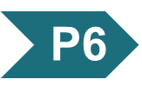
Principle 6 (1 of 4)
Molecular complementarity is central to function. The recognition of oligosaccharides by sugar-binding proteins (lectins) results from a perfect fit between lectin and ligand.

Slide 13

Principle 7 (1 of 3)
An almost infinite variety of discrete structures can be built from a small number of monomeric subunits. Even short polymers, when arranged in different sequences, joined through different linkages, and branched to specific degrees, present unique faces recognized by their molecular partners.

Slide 14
7.1 Monosaccharides and Disaccharides

Slide 15
Stereoisomerism in Sugars
sugar stereoisomers arise because many of the carbon atoms to which the hydroxyl groups are attached are chiral centers
enzymes that act on sugars are stereospecific

Slide 16
Principle 1 (2 of 4)
Carbohydrates can have multiple chiral carbons; the configuration of groups around each carbon atom determines how the compound interacts with other biomolecules. As we saw for L-amino acids in proteins, with rare exceptions, biological evolution selected one stereochemical series (D-series) for sugars.

Slide 17
The Two Families of Monosaccharides Are Aldoses and Ketoses
backbones of monosaccharides:
  unbranched carbon chains with single bonds linking all carbon atoms
  one of the carbon atoms is double-bonded to an oxygen atom to form a carbonyl group
  other carbon atoms are bonded to a hydroxyl group

Slide 18
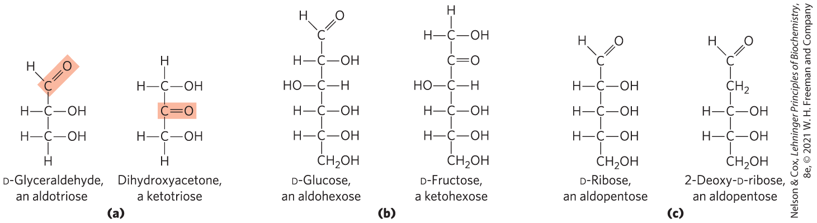
Aldoses and Ketoses
aldose = carbonyl group is at an end of the carbon chain (in an aldehyde group)
ketose = carbonyl group is at any other position (in a ketone group)

Slide 19

Clicker Question 2
What chemical feature determines if a sugar is an aldose or a ketose?
the direction of rotation of polarized light
the position of the carbonyl carbon
if the enantiomers resemble either glyceraldehyde or dihydroxyacetone
if the epimers differ in configuration around one carbon or more than one carbon
Notes:
Answer: B
Principle: 7.1
Learning Objective(s): Differentiate between aldose and ketose sugars.
Bloom’s: 1:1

Slide 20
Clicker Question 2, Response
What chemical feature determines if a sugar is an aldose or a ketose?
B. the position of the carbonyl carbon
The backbones of common monosaccharides are unbranched carbon chains in which all the carbon atoms are linked by single bonds. In this open-chain form, one of the carbon atoms is double-bonded to an oxygen atom to form a carbonyl group. If the carbonyl group is at an end of the carbon chain, the monosaccharide is an aldose. If the carbonyl group is at any other position, it is a ketose.

Slide 21
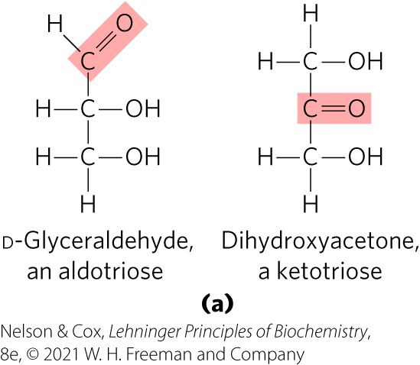
Trioses
trioses = simplest monosaccharides, three carbon backbone

Slide 22
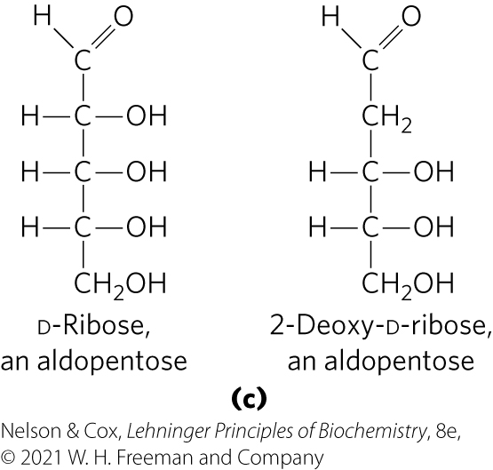
Tetroses and Pentoses
tetroses = four carbon backbone
pentoses = five carbon backbone
  component of RNA
  component of DNA

Slide 23
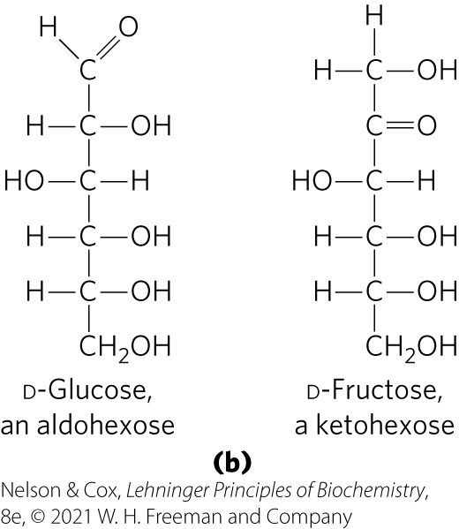
Hexoses and Heptoses
hexoses = six carbon backbone
heptoses = seven carbon backbone

Slide 24
Clicker Question 3
Glucose is a monosaccharide with a(n):
aldehyde functional group and six carbons.
ketone functional group and six carbons.
aldehyde functional group and seven carbons.
ketone functional group and seven carbons.
Notes:
Answer: A
Principle: 7.1
Learning Objective(s): Describe the general structure of a monosaccharide.
Bloom’s: 2:2

Slide 25
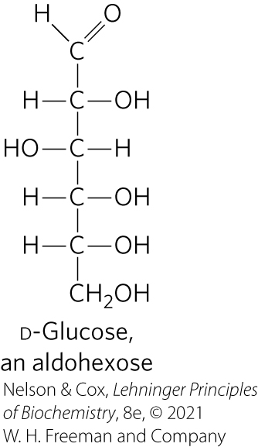
Clicker Question 3, Response
Glucose is a monosaccharide with a(n):
aldehyde functional group and six carbons.
Glucose is an aldohexose, a monosaccharide with an aldehyde functional group and six carbons.

Slide 26
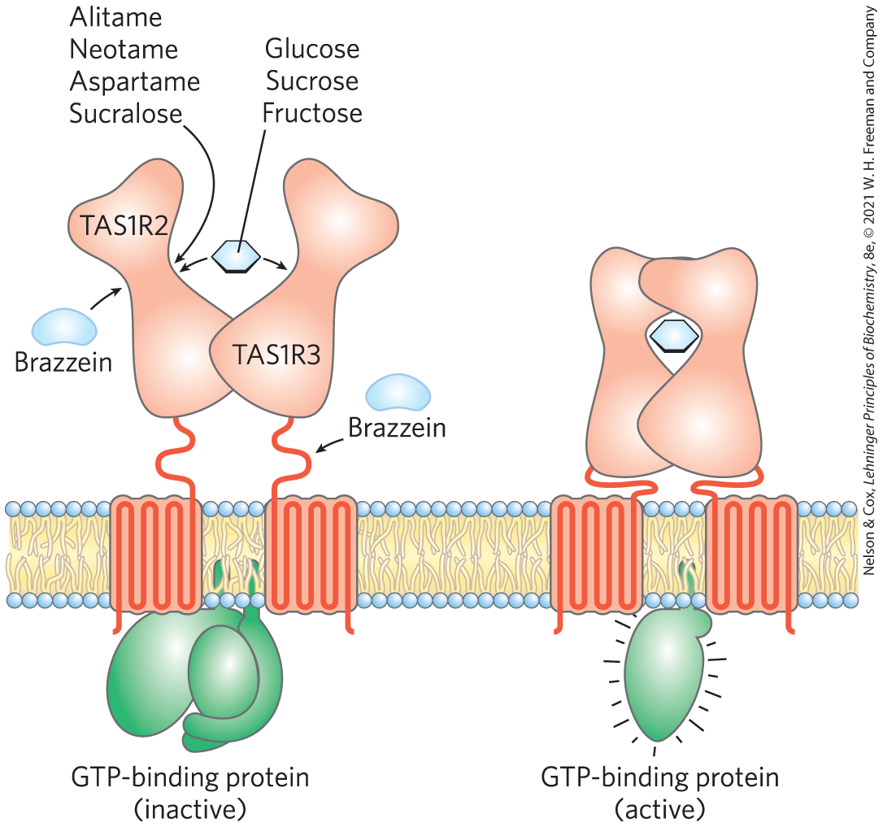
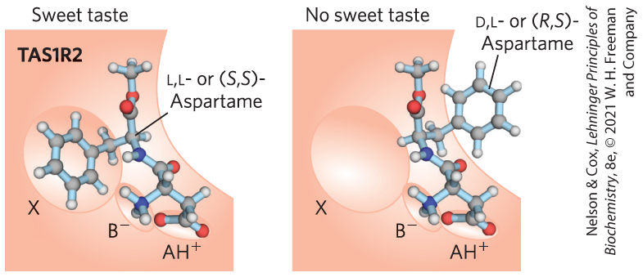
What Makes Sugar Sweet?
TAS1R2 and TAS1R3 encode sweet-taste receptors
binding of a compatible molecule generates a “sweet” electrical signal in the brain
  requires a steric match

Slide 27
Clicker Question 4
Why does (R,S)-aspartame NOT stimulate the sweet receptor?
Site AH⁺ cannot bind the partially negative oxygen of the carboxylic acid.
Site B– cannot hydrogen bond with the amine nitrogen.
Site X cannot accommodate the hydrophobic benzene ring.
None of the sites can interact with (R,S)-aspartame.
Notes:
Answer: C
Principle: 7.1
Learning Objective(s):
Bloom’s: 2:2

Slide 28
Clicker Question 4, Response
Why does (R,S)-aspartame NOT stimulate the sweet receptor?
Site X cannot accommodate the hydrophobic benzene
ring.
The steric match must be correct to stimulate the sweet receptor. Site X is oriented perpendicular to AH⁺ and B– and can accommodate the hydrophobic benzene ring of (S,S)-aspartame. However, Site X cannot accommodate the hydrophobic benzene ring of (R,S)-aspartame.

Slide 29
Principle 1 (3 of 4)
Carbohydrates can have multiple chiral carbons; the configuration of groups around each carbon atom determines how the compound interacts with other biomolecules. As we saw for L-amino acids in proteins, with rare exceptions, biological evolution selected one stereochemical series (D-series) for sugars.

Slide 30
Monosaccharides Have Asymmetric Centers
all monosaccharides (except dihydroxyacetone) contain 1+ chiral carbon atom
  occur in optically active isomeric forms
enantiomers = two different optical isomers that are mirror images
in general, a molecule with n chiral centers can have 2^{n} stereoisomers

Slide 31
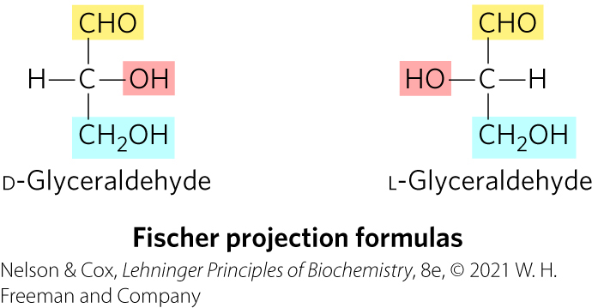
Fischer Projection Formulas
used to represent three-dimensional sugar structures on paper
bonds drawn horizontally indicate bonds that project out of the plane of the paper
bonds drawn vertically project behind the plane of the paper

Slide 32
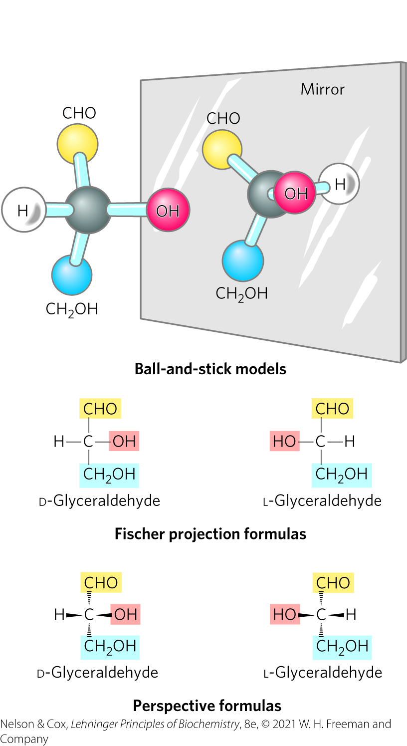
Enantiomers of Glyceraldehyde

Slide 33
Principle 1 (4 of 4)
Carbohydrates can have multiple chiral carbons; the configuration of groups around each carbon atom determines how the compound interacts with other biomolecules. As we saw for L-amino acids in proteins, with rare exceptions, biological evolution selected one stereochemical series (D-series) for sugars.

Slide 34
D Isomers and L Isomers
reference carbon = chiral center most distant from the carbonyl carbon
two groups of stereoisomers:
  D isomers = configuration at reference carbon is the same as D-glyceraldehyde
    on the right (dextro) in a projection formula
    most hexoses of living organisms
  L isomers = configuration at reference carbon is the same as L-glyceraldehyde
    on the left (levo) in a projection formula

Slide 35
Clicker Question 5
Which statement is false regarding the enantiomers of glyceraldehyde?
The enantiomers of glyceraldehyde are mirror images of each other.
Because glyceraldehyde contains one chiral center, it has two enantiomers.
In the Fischer projection formula for D-glyceraldehyde, the hydroxyl group is on the right.
Glyceraldehyde does not occur in optically active isomeric forms.
Notes:
Answer: D
Principle: 7.1
Learning Objective(s): Describe the general structure of a monosaccharide; Describe how one isomer of a monosaccharide could be converted to another monosaccharide or isomer.
Bloom’s: 2:2

Slide 36
Clicker Question 5, Response
Which statement is false regarding the enantiomers of glyceraldehyde?
Glyceraldehyde does not occur in optically active isomeric forms.
All the monosaccharides except dihydroxyacetone contain one or more asymmetric (chiral) carbon atoms and thus occur in optically active isomeric forms. The simplest aldose, glyceraldehyde, contains one chiral center (the middle carbon atom) and therefore has two different optical isomers, or enantiomers.

Slide 37
Numbering Carbons of a Sugar
carbons are numbered beginning at the end of the chain near the carbonyl group

Slide 38
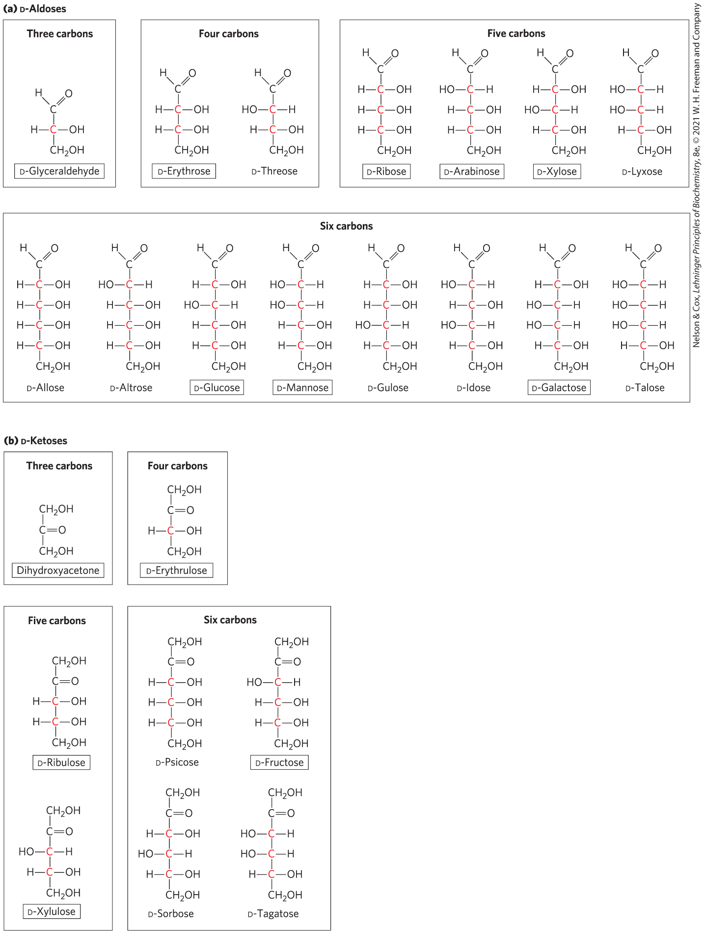
D-Aldoses

Slide 39
D-Ketoses

Slide 40

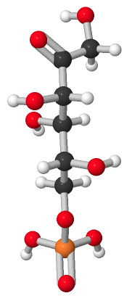
Activity: Properties of Carbohydrates
Observe the structure of the carbohydrate fructose 6-phosphate (F6P) in Mol3D viewer in your Achieve course.
Notes:
Instructor: This Mol3D structure is located in the Achieve course. It can be found in the Chapter 7 content, in the folder titled “Ch7 In-Class Activities and Resources.”

Slide 41
Activity Instructions (1 of 5)
On your own, think of answers to the questions:
  How many chiral carbons does F6P possess? Select one chiral carbon, take a screenshot, and upload it to your course.
  As shown, is F6P in its D or L form and why?
(2 minutes)
Pair up to discuss your ideas. (2 minutes)
Share your ideas with the class in group discussion.
Notes:
Instructor: This Mol3D structure is located in the Achieve course. It can be found in the Chapter 7 content, in the folder titled “Ch7 In-Class Activities and Resources.”

Slide 42
Activity Solution (1 of 5)
  How many chiral carbons does F6P possess? three chiral carbons (in its linear form, as depicted, carbons 3, 4, and 5; in its cyclic form, it has 4 chiral carbons)
  As shown, is F6P in its D or L form and why? F6P is in its D form because, when drawn in its linear form, the —OH group attached to carbon 5 is on the right side of the molecule.
Notes:
Instructor: This Mol3D structure is located in the Achieve course. It can be found in the Chapter 7 content, in the folder titled “Ch7 In-Class Activities and Resources.”

Slide 43
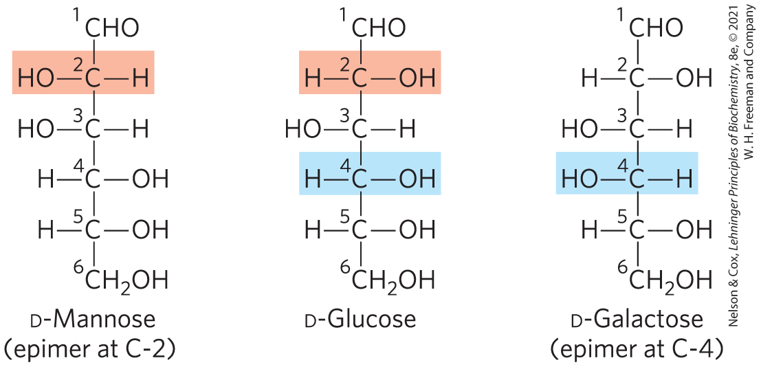
Epimers
epimers = two sugars that differ only in the configuration around one carbon atom

Slide 44
The Common Monosaccharides Have Cyclic Structures
in aqueous solution, aldotetroses and all monosaccharides with 5+ backbone carbon atoms occur as cyclic structures
  covalent bond between the carbonyl group and the oxygen of a hydroxyl group

Slide 45
Clicker Question 6
A monosaccharide with a ketone functional group and seven carbons:
can never exist in cyclic form.
is a ketoheptose.
is the monosaccharide found in RNA but not DNA.
has a single chiral center.
Notes:
Answer: B
Principle: 7.1
Learning Objective(s): Describe the general structure of a monosaccharide; Differentiate between aldose and ketose sugars.
Bloom’s: 3:2

Slide 46
Clicker Question 6, Response
A monosaccharide with a ketone functional group and seven carbons:
B. is a ketoheptose.
Monosaccharides with seven carbon atoms in their backbones are called heptoses. A ketose of this chain length is a ketoheptose.

Slide 47
Hemiacetals and Hemiketals
hemiacetals or hemiketals = derivatives formed by a general reaction between alcohols and aldehydes or ketones
  product of the first alcohol molecule addition
  a five- or six-membered ring forms if the —OH and carbonyl groups are on the same molecule
acetal or ketal = product of the second alcohol molecule addition
  forms a glycosidic bond

Slide 48
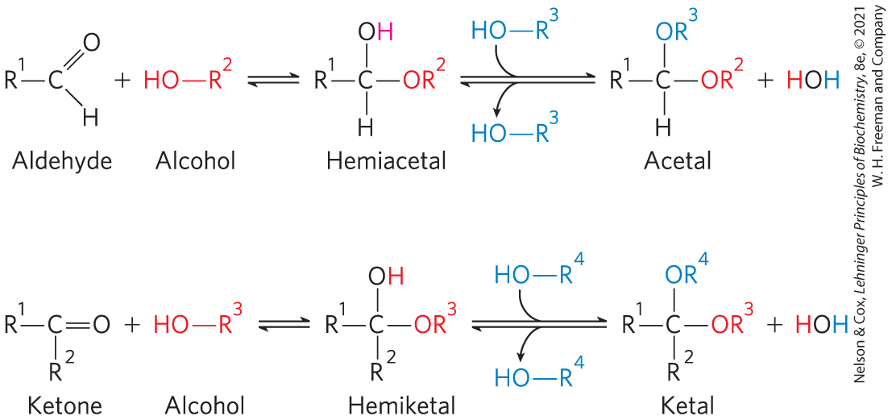
Formation of Hemiacetals and Hemiketals

Slide 49
α and β Stereoisomeric Configurations
reaction with the first alcohol molecule creates an additional chiral center (the carbonyl carbon)
produces either of two stereoisomeric configurations: α and β
anomers = isomeric forms of monosaccharides that differ only in their configuration about the hemiacetal or hemiketal carbon atom
anomeric carbon = the carbonyl carbon atom

Slide 50
Clicker Question 7
What name is given to monosaccharides that differ in configuration about the hemiacetal carbon atom?
enantiomers
isomers
epimers
anomers
Notes:
Answer: D
Principle: 7.1
Learning Objective(s): Identify the anomeric carbon.
Bloom’s: 1:1

Slide 51
Clicker Question 7, Response
What name is given to monosaccharides that differ in configuration about the hemiacetal carbon atom?
D. anomers
Isomeric forms of monosaccharides that differ only in their configuration about the hemiacetal or hemiketal carbon atom are called anomers.

Slide 52
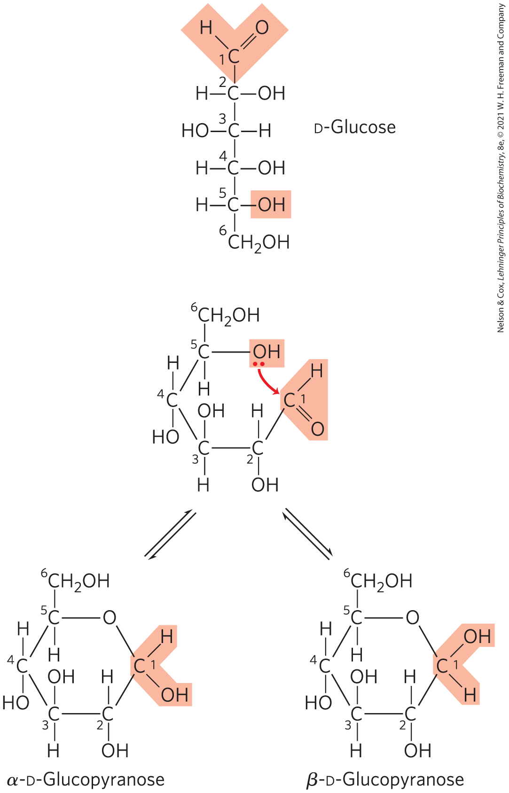
Formation of the Two Cyclic Forms of D-Glucose
reaction between the aldehyde group at C-1 and the hydroxyl group at C-5 forms a hemiacetal linkage
mutarotation = the interconversion of α and β anomers

Slide 53
Clicker Question 8
Cyclization of monosaccharides:
is the reaction of hemiketal or hemiacetal formation.
is irreversible.
creates α and β epimers.
only occurs in hexoses.
Notes:
Answer: A
Principle: 7.1
Learning Objective(s): Describe the cyclization and mutarotation of a monosaccharide.
Bloom’s: 2:2

Slide 54
Clicker Question 8, Response
Cyclization of monosaccharides:
is the reaction of hemiketal or hemiacetal formation.
In aqueous solution, all monosaccharides with five or more carbon atoms in the backbone occur predominantly as cyclic (ring) structures in which the carbonyl group has formed a covalent bond with the oxygen of a hydroxyl group in the same sugar molecule. The formation of these ring structures is the result of a general reaction between alcohols and aldehydes or ketones to form derivatives called hemiacetals or hemiketals.

Slide 55
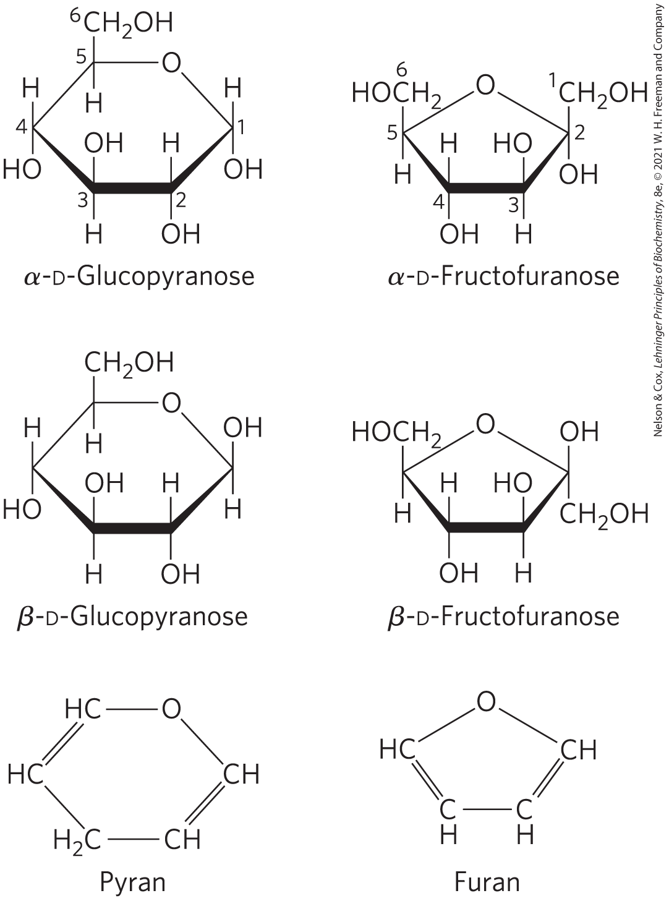
Pyranoses and Furanoses
pyranoses = six-membered ring compounds
  form when the hydroxyl group at C-6 reacts with the keto group at C-2
furanoses = five-membered ring compounds
  form when the hydroxyl group at C-5 reacts with the keto group at C-2

Slide 56
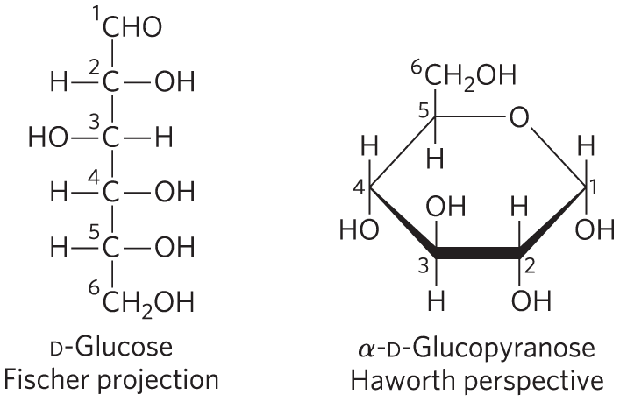
Haworth Perspective Formulas
Haworth perspective formulas = more accurate representation of cyclic sugar structure than Fischer projections
  six-membered ring is tilted to make its plane almost perpendicular to that of the paper
  bonds closest to the reader are drawn thicker than those farther away

Slide 57
Converting D-Hexose Fischer Projections to Haworth Perspective Formulas
step 1: draw the six­-membered ring (five carbons, and one oxygen at the upper right)
step 2: number the carbons in a clockwise direction beginning with the anomeric carbon
step 3: place the hydroxyl groups
  hydroxyl groups on the right in a Fischer projection are placed pointing down and those on the left are placed pointing up

Slide 58
Converting D-Hexose Fischer Projections to Haworth Perspective Formulas, Continued
step 4: place the terminal —CH₂OH group
  projects upward for the D enantiomer, downward for the L enantiomer
step 5: place the anomeric hydroxyl group
  for a β structure, the hydroxyl group is placed on the same side of the ring as C-­6
  for an α structure, it is placed on the opposite side

Slide 59
Clicker Question 9
Using the Fischer projection of D-glucose, identify which statement is true of the Haworth perspective formula of α-D-glucopyranose.
The terminal —CH₂OH group projects downward.
The anomeric hydroxyl is on the opposite side from C-6.
The hydroxyl group on C-2 is placed pointing up.
The cyclic structure is a five-membered ring.
Notes:
Answer: B
Principle: 7.1
Learning Objective(s): Draw a Haworth perspective formula for a sugar.
Bloom’s: 3:2

Slide 60
Clicker Question 9, Response
Using the Fischer projection of D-glucose, identify which statement is true of the Haworth perspective formula of α-D-glucopyranose.
B. The anomeric hydroxyl is on the opposite side from C-6.
For an α structure, the
anomeric carbon (C-1)
has its hydroxyl group
placed on the opposite
side from C-6.

Slide 61

Principle 5 (2 of 6)
Polysaccharides assume three-dimensional structures with the lowest-energy conformations, determined by covalent bonds, hydrogen bonds, charge interactions, and steric factors. Starch folds into a helical structure stabilized by internal hydrogen bonds; cellulose assumes an extended structure in which intermolecular hydrogen bonds are more important.

Slide 62
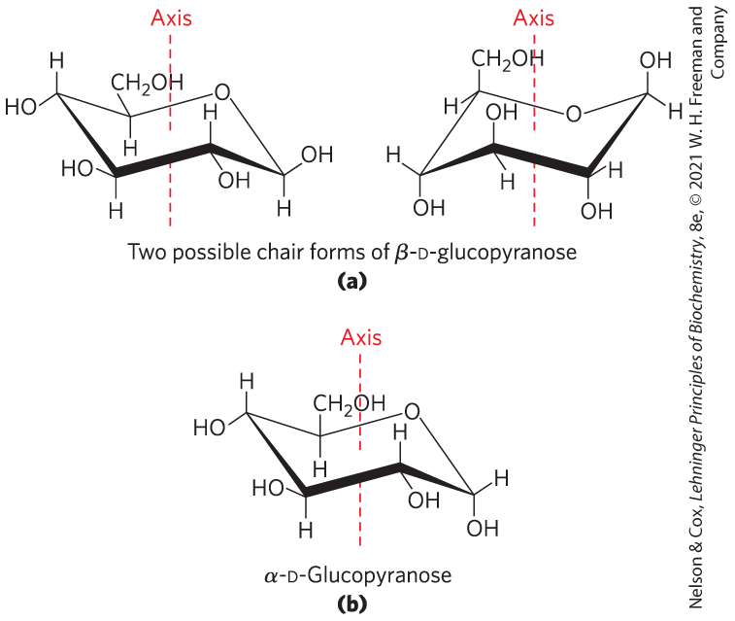
Conformational Formulas of Pyranoses
pyranose rings tend to assume either of two “chair” conformations
  interconvertible without breaking covalent bonds
  requires energy input

Slide 63
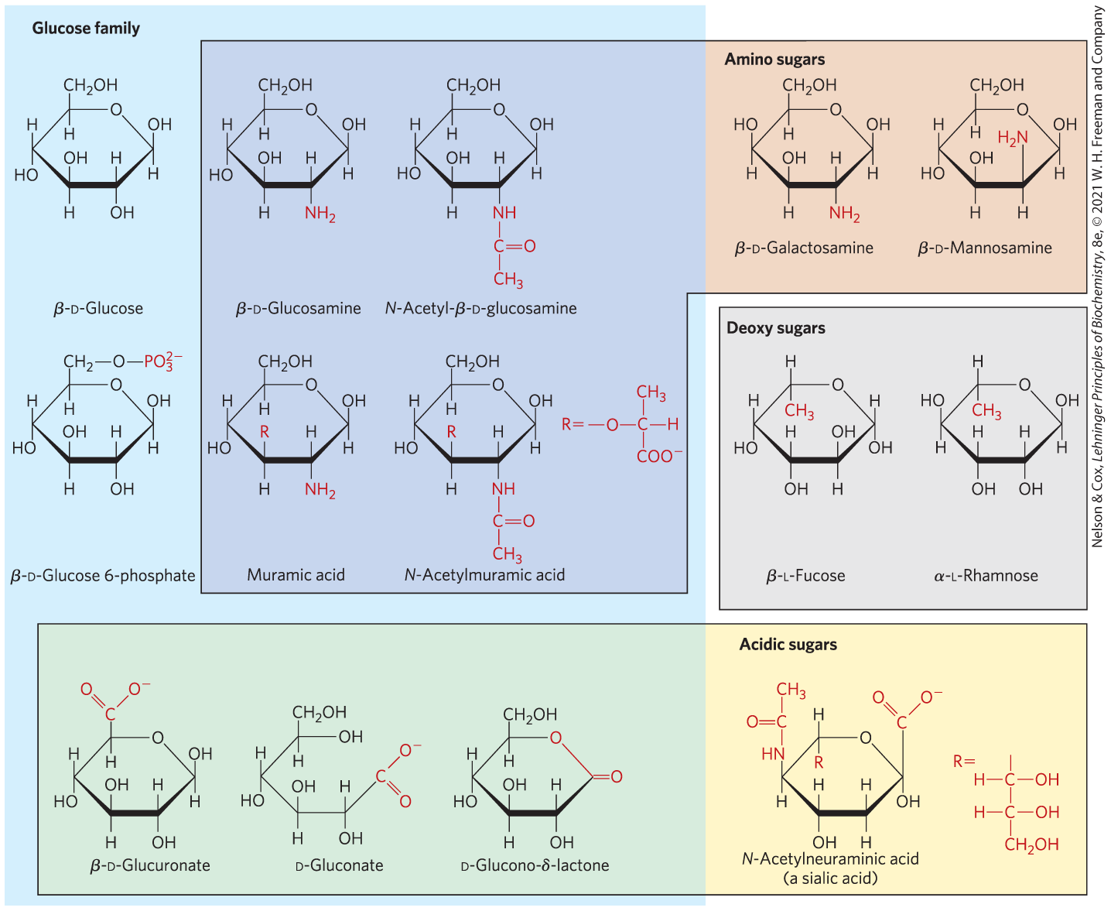
Organisms Contain a Variety of Hexose Derivatives

Slide 64
Aldonic and Uronic Acids
aldonic acids = form following oxidation of the carbonyl carbon of aldoses
uronic acids = form following oxidation at C-6
both form stable intramolecular esters called lactones

Slide 65
Phosphorylated Derivatives
some sugar intermediates are phosphate esters
  example: glucose 6-phosphate
stable at neutral pH and bear a negative charge
functions to trap sugar inside the cell because most cells do not have membrane transporters for phosphorylated sugars

Slide 66
Sugars That Are, or Can Form, Aldehydes Are Reducing Sugars
reducing sugars = undergo a characteristic redox reaction where free aldehyde groups react with Cu²⁺ under alkaline condition
  reduction of Cu²⁺ to Cu⁺ forms a brick-red precipitate
ketoses that can tautomerize to form aldehydes are also reducing sugars

Slide 67
Clicker Question 10
Which reaction is one that is NOT common of glucose?
mutarotation
oxidation to an aldonic acid
oxidation to an uronic acid
oxidation by reducing sugars
Notes:
Answer: D
Principle: 7.1
Learning Objective(s): Identify common hexose derivatives; Classify a sugar as reducing or nonreducing.
Bloom’s: 2:2

Slide 68
Clicker Question 10, Response
Which reaction is one that is NOT common of glucose?
D. oxidation by reducing sugars
Glucose does not undergo oxidation by reducing sugars. Glucose itself is a reducing sugar. Free aldehyde groups in glucose undergo a characteristic redox reaction with Cu²⁺ under alkaline conditions. As glucose is oxidized from aldehyde to carboxylic acid, Cu²⁺ is reduced to Cu⁺, which forms a brick-red precipitate.

Slide 69
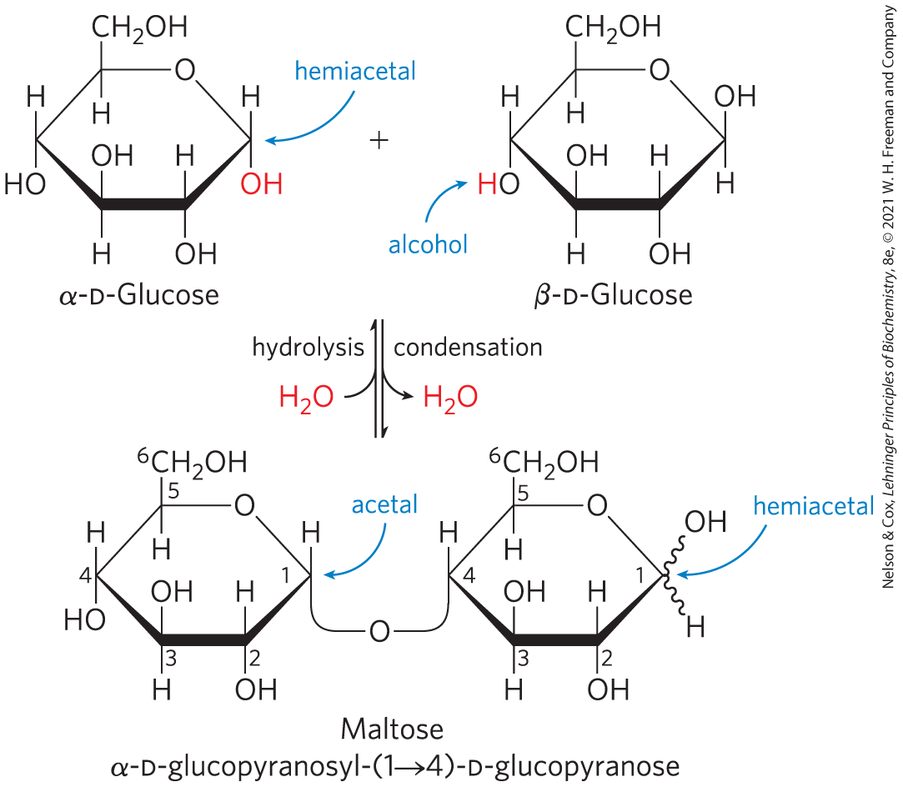
O-Glycosidic Bonds
O-glycosidic bond = covalent linkage joining two monosaccharides
  formed when a hydroxyl group of one sugar molecule reacts with the anomeric carbon of the other
  readily hydrolyzed by acid

Slide 70
The Reducing End
formation of a glycosidic bond renders a sugar nonreducing
reducing end = the end of a disaccharide or polysaccharide chain with a free anomeric carbon
Free anomeric carbon

Slide 71

Clicker Question 11
What term is given to carbohydrates linked by their anomeric carbons?
nonreducing sugars
glycosides
anomers
hemiketals
Notes:
Answer: A
Principle: 7.1
Learning Objective(s): Classify a sugar as reducing or nonreducing.
Bloom’s: 1:1

Slide 72
Clicker Question 11, Response
What term is given to carbohydrates linked by their anomeric carbons?
nonreducing sugars
When the anomeric carbon is involved in a glycosidic bond, the easy interconversion of linear and cyclic forms is prevented. Formation of a glycosidic bond therefore renders a sugar nonreducing.

Slide 73
Naming Reducing Oligosaccharides
step 1: with the nonreducing end on the left, give the configuration (α or β) at the anomeric carbon joining the first unit to the second
step 2: name the nonreducing residue using “furano” or “pyrano”
step 3: indicate in parentheses the two carbon atoms joined by the glycosidic bond, with an arrow connecting the two numbers
step 4: name the second residue and repeat for additional residues

Slide 74
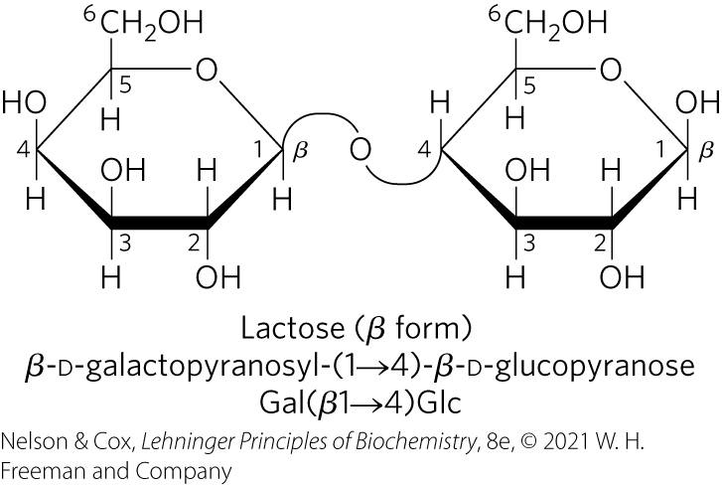
Clicker Question 12
Following the convention for
naming reducing
oligosaccharides, what is the
name of lactose, as shown.
A. α-L-glucopyranose-(1→6)-α-L-galactopyranosyl
B. β-D-glucopyranose-(1→4)-β-D-galactopyranosyl
C. β-D-galactopyranosyl-(1→4)-β-D-glucopyranose
D. α-L-galactopyranosyl-(1→6)-α-L-glucopyranose
Notes:
Answer: C
Principle: 7.1
Learning Objective(s): Name or interpret the name for a disaccharide using abbreviations and symbols.
Bloom’s: 3:2

Slide 75
Clicker Question 12, Response
Following the convention for
naming reducing
oligosaccharides, what is the
name of lactose, as shown.
C. β-D-galactopyranosyl-(1→4)-β-D-glucopyranose
The image is drawn with the nonreducing end on the left. The anomeric carbon joining the first unit to the second is β and the nonreducing unit is the six-membered ring D-galactose. A (1→4)-glycosidic bond links the two monosaccharides together. The second residue is the six-membered ring D-glucose.

Slide 76
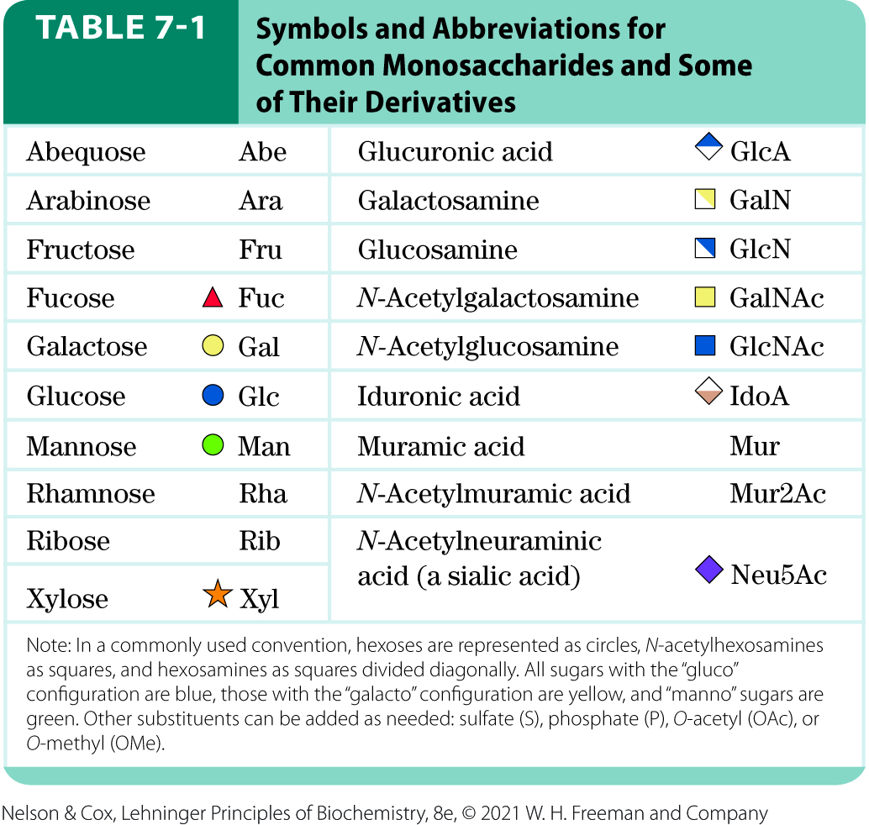
Symbols and Abbreviations for Monosaccharides and Derivatives

Slide 77
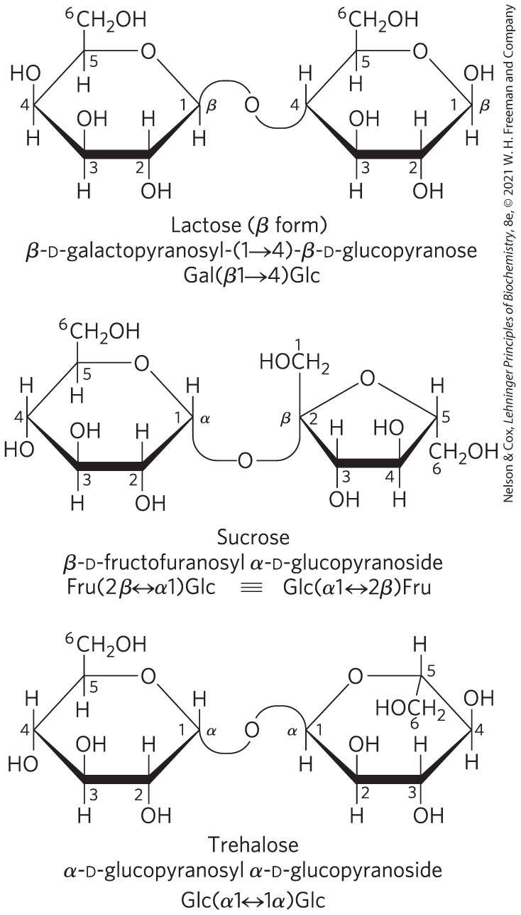
Three Common Disaccharides
lactose is a reducing disaccharide
sucrose and trehalose are nonreducing sugars

Slide 78
Clicker Question 13
Which of these sugars is nonreducing?
trehalose
glucose
maltose
lactose
Notes:
Answer: A
Principle: 7.1
Learning Objective(s): Classify a sugar as reducing or nonreducing.
Bloom’s: 2:1

Slide 79
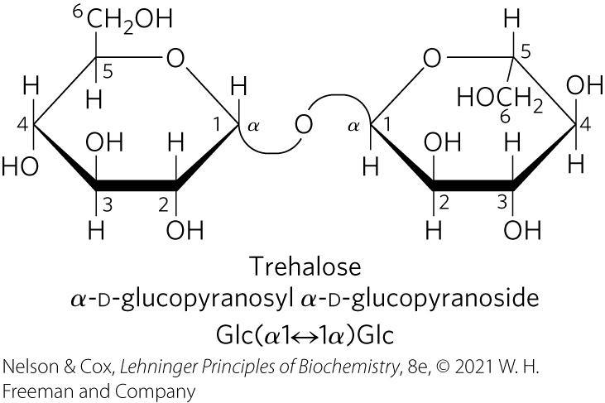
Clicker Question 13, Response
Which of these sugars is nonreducing?
trehalose
When the anomeric carbon is involved in a glycosidic bond, the easy interconversion of linear and cyclic forms is prevented. Formation of a glycosidic bond therefore renders a sugar nonreducing. Trehalose is a disaccharide of D-glucose that is a nonreducing sugar.

Slide 80
Clicker Question 14
Which item is NOT associated with disaccharides?
A. O-glycosidic linkages
formation of a ketal or acetal
never having free anomeric carbons
sucrose
Notes:
Answer: C
Principle: 7.1
Learning Objective(s): Relate the structure and properties of a disaccharide.
Bloom’s: 3:2

Slide 81
Clicker Question 14, Response
Which item is NOT associated with disaccharides?
C. never having free anomeric carbons
In describing disaccharides and polysaccharides, the end of a chain with a free anomeric carbon (one not involved in a glycosidic bond) is called the reducing end. There are a number of disaccharides with free anomeric carbons, including glucose and lactose.

Slide 82
7.2 Polysaccharides

Slide 83
Principle 2 (2 of 3)
Monomeric subunits, monosaccharides, serve as the building blocks of large carbohydrate polymers. The specific sugar, the way the units are linked, and whether the polymer is branched determine its properties and thus its function.

Slide 84
Polysaccharides
most carbohydrates in nature occur as polysaccharides (M_{r} > 20,000)
also called glycans

Slide 85
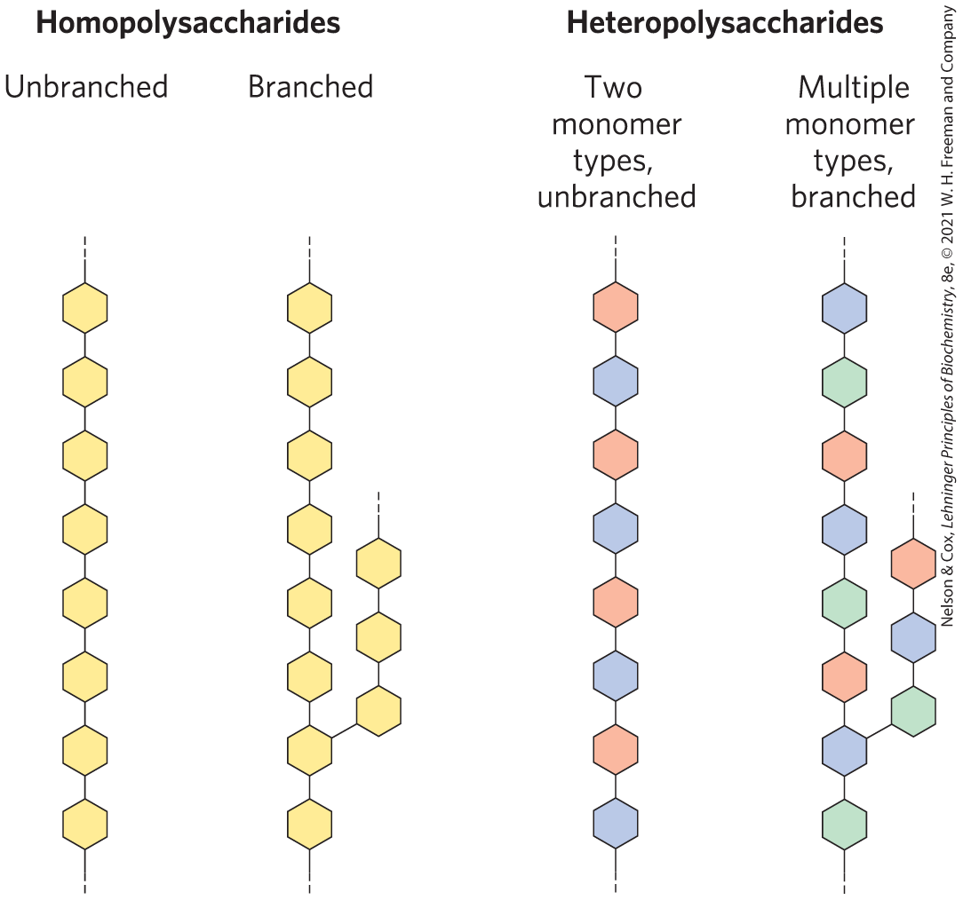
Homopolysaccharides and Heteropolysaccharides
homopolysaccharides = contain only a single monomeric sugar species
  serve as storage forms and structural elements
heteropolysaccharides = contain 2+ kinds of monomers
  provide extracellular support

Slide 86
Clicker Question 15
Which statement is false regarding homopolysaccharides and heteropolysaccharides?
Homopolysaccharides contain a single monomeric sugar species.
Some homopolysaccharides serve as structural elements in animal exoskeletons.
Heteropolysaccharides serve as storage forms of monosaccharides that are used as fuel.
In animal tissues, the extracellular space is occupied by several types of heteropolysaccharides.
Notes:
Answer: C
Principle: 7.2
Learning Objective(s): Classify a sugar as a homopolysaccharide or a heteropolysaccharide.
Bloom’s: 2:2

Slide 87
Clicker Question 15, Response
Which statement is false regarding homopolysaccharides and heteropolysaccharides?
Heteropolysaccharides serve as storage forms of
monosaccharides that are used as fuel.
Some homopolysaccharides serve as storage forms of monosaccharides that are used as fuels; starch and glycogen are homopolysaccharides of this type.

Slide 88

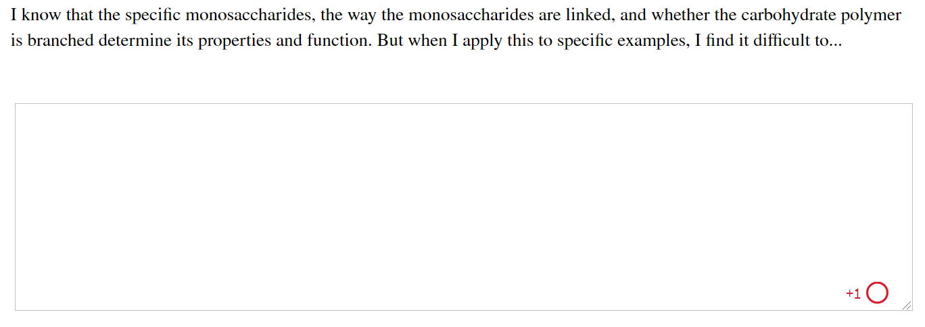
Activity: Carbohydrate
Polymer Structure and Function Muddiest Point (1 of 2)
Complete the Ch7 Student Activity, Day 1: Carbohydrate Polymer Structure and Function (Muddiest Point) Achieve assessment.
Notes:
Instructor: This muddiest point activity can be found in Achieve in the Chapter 7 folder titled “Ch7 In-Class Activities and Resources.” See the Instructor Activity Guide in the same folder for more information.

Slide 89

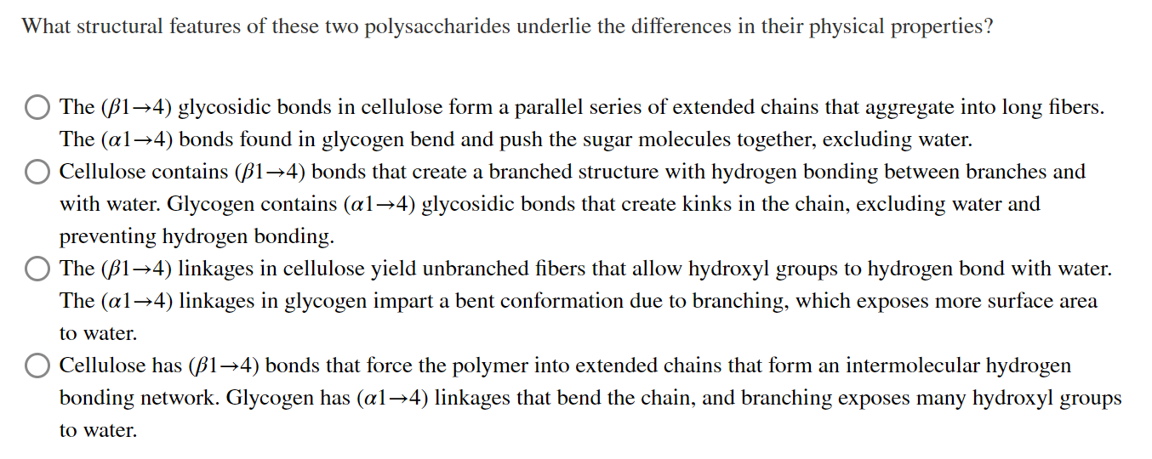
Activity: Carbohydrate
Polymer Structure and Function Muddiest Point (2 of 2)
Complete the Ch7 Student Activity, Day 2: Carbohydrate Polymer Structure and Function (Muddiest Point) Achieve assessment.
Notes:
Instructor: This muddiest point activity can be found in Achieve in the Chapter 7 folder titled “Ch7 In-Class Activities and Resources.” See the Instructor Activity Guide in the same folder for more information.

Slide 90
Principle 4 (2 of 2)
The sequences of complex polysaccharides
are determined by the intrinsic properties
of the biosynthetic enzymes that add each monomeric unit to the growing polymer. This is in contrast with DNA, RNA, and proteins, which are synthesized on templates that direct their sequence.

Slide 91
Polysaccharides Generally Do Not Have Defined Lengths or Molecular Weights
this distinction between proteins and polysaccharides is a consequence of the mechanisms of assembly
there is no template for polysaccharide synthesis
the program for polysaccharide synthesis is intrinsic to the enzymes that catalyze the polymerization of monomer units

Slide 92

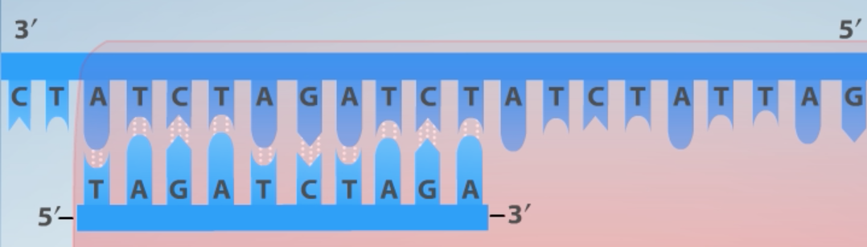
Activity:
Understanding
Complex Polymer Synthesis
Watch the Animated Technique Video titled “Polymerase Chain Reaction (PCR).”
Notes:
Instructor: This Animated Technique video is found within Chapter 8 of Achieve. It is in the folder titled “Ch8 In-Class Activities, Videos, and Resources.”

Slide 93
Activity Instructions (2 of 5)
On your own, think of answers to the question:
  How does the process by which DNA is synthesized contract with the synthesis of starch, a complex polysaccharide?
  (2 minutes)
Pair up to discuss your ideas. (2 minutes)
Share your ideas with the class in group discussion. (3 minutes)
Notes:
Instructor: This Animated Technique video is found within Chapter 8 of Achieve. It is in the folder titled “Ch8 In-Class Activities, Videos, and Resources.”

Slide 94
Activity Solution (2 of 5)
  How does the process by which DNA is synthesized contract with the synthesis of starch, a complex polysaccharide? During DNA synthesis, a DNA template, known as the template strand, facilitates the addition of a specific complementary nucleotide to each position of the growing DNA strand. Accordingly, the length of the newly formed DNA strand matches the length of the template strand. In polysaccharide synthesis, there is no template. Instead, the program for polysaccharide synthesis is intrinsic to the enzymes that catalyze the polymerization of the monomeric units, with no specific stopping point in the synthetic process. Thus, the products vary in length.
Notes:
Instructor: This Animated Technique video is found within Chapter 8 of Achieve. It is in the folder titled “Ch8 In-Class Activities, Videos, and Resources.”

Slide 95
Some Homopolysaccharides Are Storage Forms of Fuel
storage polysaccharides = starch in plant cells and glycogen in animal cells
starch and glycogen molecules are heavily hydrated because they have many exposed hydroxyl groups available to hydrogen bond

Slide 96
Starch and Glycogen
starch = contains two types of glucose polymer, amylose and amylopectin
  amylose = long, unbranched chains of D-glucose residues connected by (α1→4) linkages
  amylopectin = larger than amylose with (α1→4) linkages between glucose residues and highly branched due to (α1→6) linkages
glycogen = polymer of (α1→4)-linked glucose subunits, with (α1→6)-linked branches
  more extensively branched
  more compact than starch

Slide 97
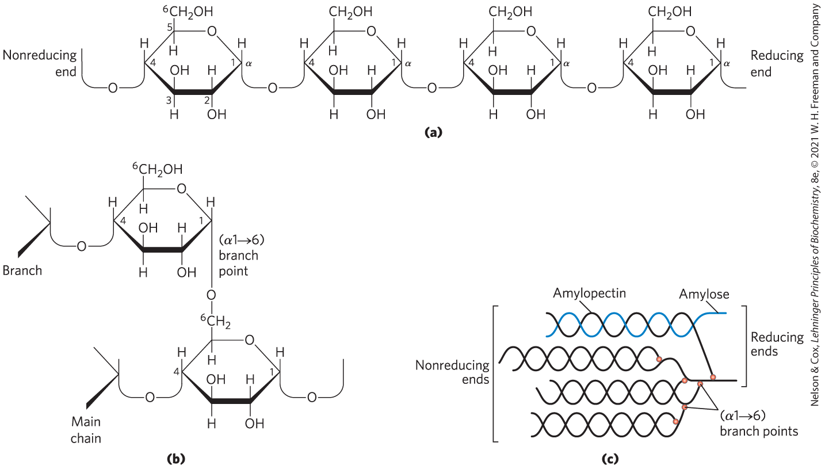
Structure of Starch and Glycogen

Slide 98
Clicker Question 16
What O-glycosidic bond is commonly found in amylose, amylopectin, and glycogen?
(β14)
(α16)
(β16)
(α14)
Notes:
Answer: D
Principle: 7.2
Learning Objective(s): Describe the structure and function of common polysaccharides.
Bloom’s: 2:2

Slide 99
Clicker Question 16, Response
What O-glycosidic bond is commonly found in amylose, amylopectin, and glycogen?
D. (α14)
Amylose, amylopectin, and glycogen all contain (α1→4) linkages joining successive glucose residues.

Slide 100
Clicker Question 17
A glycogen molecule with 28 branches has how many nonreducing and reducing ends?
28 nonreducing ends and 28 reducing ends
29 nonreducing ends and 1 reducing end
1 nonreducing end and 29 reducing ends
1 nonreducing end and 1 reducing end
Notes:
Answer: B
Principle: 7.2
Learning Objective(s): Describe the structure and function of common polysaccharides.
Bloom’s: 3:2

Slide 101
Clicker Question 17, Response
A glycogen molecule with 28 branches has how many nonreducing and reducing ends?
29 nonreducing ends and 1 reducing end
Because each branch of glycogen ends with a nonreducing sugar unit, a glycogen molecule with n branches has n + 1 nonreducing ends, but only one reducing end. Thus, a glycogen molecule with 28 branches has 29 nonreducing ends and 1 reducing end.

Slide 102
Principle 3 (2 of 2)
Storage of low molecular weight metabolites in polymeric form avoids the very high osmolarity that would result from storing them as individual monomers. If the glucose in liver glycogen were monomeric, the glucose concentration in liver would be so high that cells would swell and lyse from the entry of water by osmosis.

Slide 103
Storage of Glucose as Polymers Avoids High Osmolarity
hepatocytes in the fed state store glycogen equivalent to a glucose concentration of 0.4 M
0.4 M glucose in the cytosol would elevate the osmolarity
  the resulting osmotic entry of water might rupture the cell

Slide 104

Clicker Question 18
Why is it logical for sugars to be added to only one end of glycogen, making them excellent molecules for glucose storage?
Because the other end of the molecule is anchored to a membrane with a lipid.
Because it is the reducing end, and a reduction reaction is the mechanism for adding the sugar.
Because it has the hemiacetal carbon, the one carbon to which more sugars can be attached.
Because there are many nonreducing ends on one molecule, allowing rapid glucose storage and release.
Notes:
Answer: D
Principle: 7.3
Learning Objective(s): Relate the structure and biological function of an oligosaccharide.
Bloom’s: 2:2

Slide 105
Clicker Question 18, Response
Why is it logical for sugars to be added to only one end of glycogen, making them excellent molecules for glucose storage?
Because there are many nonreducing ends on one
molecule, allowing rapid glucose storage and release.
A glycogen molecule with n branches has n + 1 nonreducing ends. When glycogen is used as an energy source, glucose units are removed one at a time from the nonreducing ends. Degradative enzymes that act only at nonreducing ends can work simultaneously on the many branches, speeding the conversion of the polymer to monosaccharides.

Slide 106

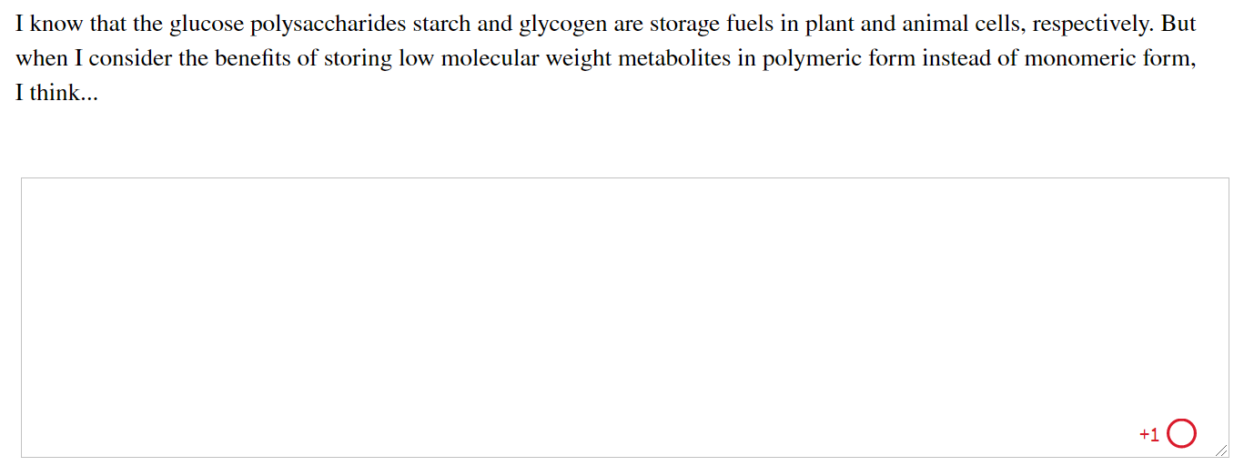
Activity: Storing
Low Molecular Weight Metabolites in Polymeric Form Muddiest Point (1 of 2)
Complete the Ch7: Student Activity, Day 1: Storing Low Molecular Weight Metabolites in Polymeric Form
(Muddiest Point) Achieve assessment.
Notes:
Instructor: This muddiest point activity can be found in Achieve in the Chapter 7 folder titled “Ch7 In-Class Activities and Resources.” See the Instructor Activity Guide in the same folder for more information.

Slide 107
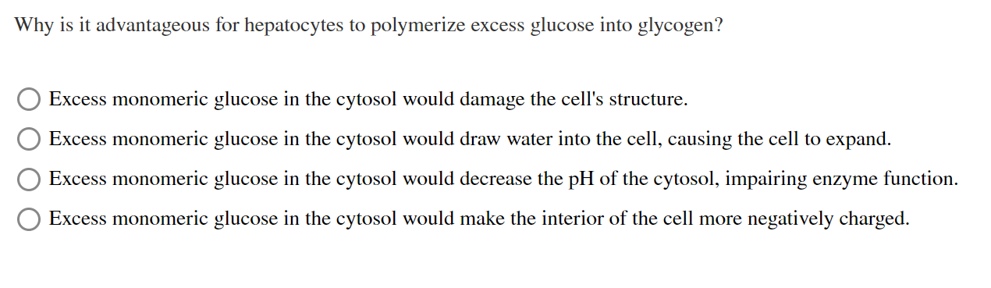
Activity: Storing
Low Molecular Weight Metabolites in Polymeric Form Muddiest Point (2 of 2)
Complete the Ch7: Student Activity, Day 2: Storing Low Molecular Weight Metabolites in Polymeric Form
(Muddiest Point) Achieve assessment.
Notes:
Instructor: This muddiest point activity can be found in Achieve in the Chapter 7 folder titled “Ch7 In-Class Activities and Resources.” See the Instructor Activity Guide in the same folder for more information.

Slide 108
Principle 5 (3 of 6)
Polysaccharides assume three-dimensional structures with the lowest-energy conformations, determined by covalent bonds, hydrogen bonds, charge interactions, and steric factors. Starch folds into a helical structure stabilized by internal hydrogen bonds; cellulose assumes an extended structure in which intermolecular hydrogen bonds are more important.

Slide 109
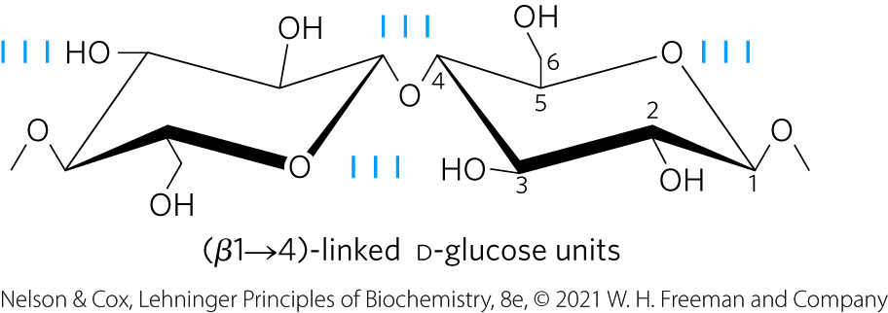
Some Homopolysaccharides Serve Structural Roles
cellulose = tough, fibrous, water-insoluble substance
  linear, unbranched homopolysaccharide, consisting of 10,000 to 15,000 D-glucose units
  glucose residues have the β configuration
  linked by (β1→4) glycosidic bonds
  animals do not have the enzyme to hydrolyze (β1→4) glycosidic bonds

Slide 110

Clicker Question 19
Even though amylose and cellulose are made of similar homopolysaccharide chains, they have very different properties. Why?
The β-glycosidic linkage of glucose molecules in cellulose form interchain and intrachain hydrogen bonds that produce straight, stable fibers that exclude water.
Cellulose is composed of galactose, while amylose is composed of glucose.
The α-glycosidic linkage of glucose molecules in amylose causes it to form helices that exclude water.
Amylose makes a linear polymer which cannot make hydrogen bonds.
Notes:
Answer: A
Principle: 7.5
Learning Objective(s): Describe factors that contribute to the conformation of a polysaccharide.
Bloom’s: 2:2

Slide 111
Clicker Question 19, Response
Even though amylose and cellulose are made of similar homopolysaccharide chains, they have very different properties. Why?
The β-glycosidic linkage of glucose molecules in cellulose form interchain and intrachain hydrogen bonds that produce straight, stable fibers that exclude water.
The glucose residues in cellulose are linked by (β1→4) glycosidic bonds, allowing for the formation of interchain and intrachain hydrogen bonds.

Slide 112
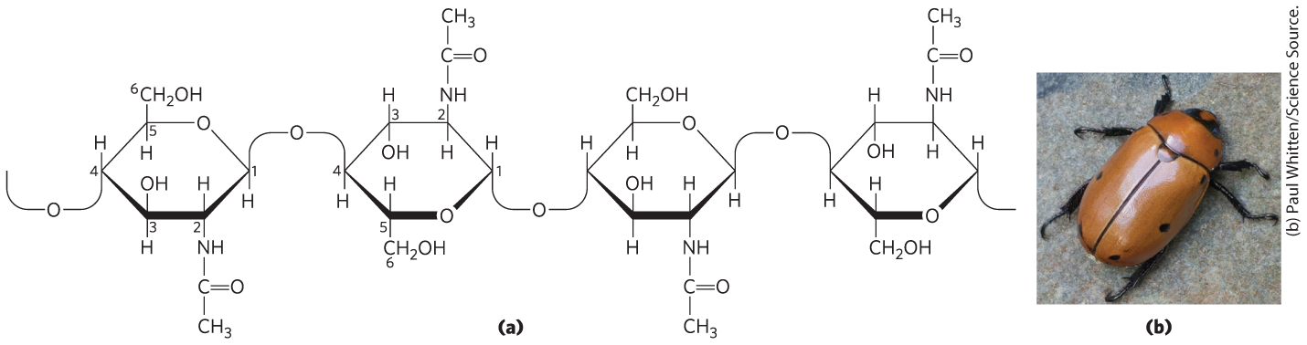
Chitin
chitin = linear homopolysaccharide composed of N-acetylglucosamine residues in (β1→4) linkage
  acetylated amino group makes chitin more hydrophobic and water-resistant than cellulose

Slide 113
Clicker Question 20
Why are chitin and cellulose hydrophobic and essentially insoluble in an aqueous media?
Because polymers of these molecules pack so tightly together, there is no geometric space left for water.
Because they form many internal hydrogen bonds, they leave no sites for binding to water.
Because there are no enzymes that can break the beta linkages.
Because the linear polymer cannot make hydrogen bonds.
Notes:
Answer: B
Principle: 7.5
Learning Objective(s): Describe factors that contribute to the conformation of a polysaccharide.
Bloom’s: 2:2

Slide 114
Clicker Question 20, Response
Why are chitin and cellulose hydrophobic and essentially insoluble in an aqueous media?
Because they form many internal hydrogen bonds, they
leave no sites for binding to water.
The residues in chitin and cellulose are both linked by (β1→4) linkages, allowing for the formation of internal hydrogen bonds.

Slide 115

Principle 5 (4 of 6)
Polysaccharides assume three-dimensional structures with the lowest-energy conformations, determined by covalent bonds, hydrogen bonds, charge interactions, and steric factors. Starch folds into a helical structure stabilized by internal hydrogen bonds; cellulose assumes an extended structure in which intermolecular hydrogen bonds are more important.

Slide 116
Steric Factors and Hydrogen Bonding Influence Homopolysaccharide Folding
three-dimensional structures stabilized by weak interactions within or between molecules
  hydrogen bonding is especially important due to the high number of hydroxyl groups in polysaccharides
free rotation about both C—O bonds linking the residues is limited by steric hindrance by substituents

Slide 117
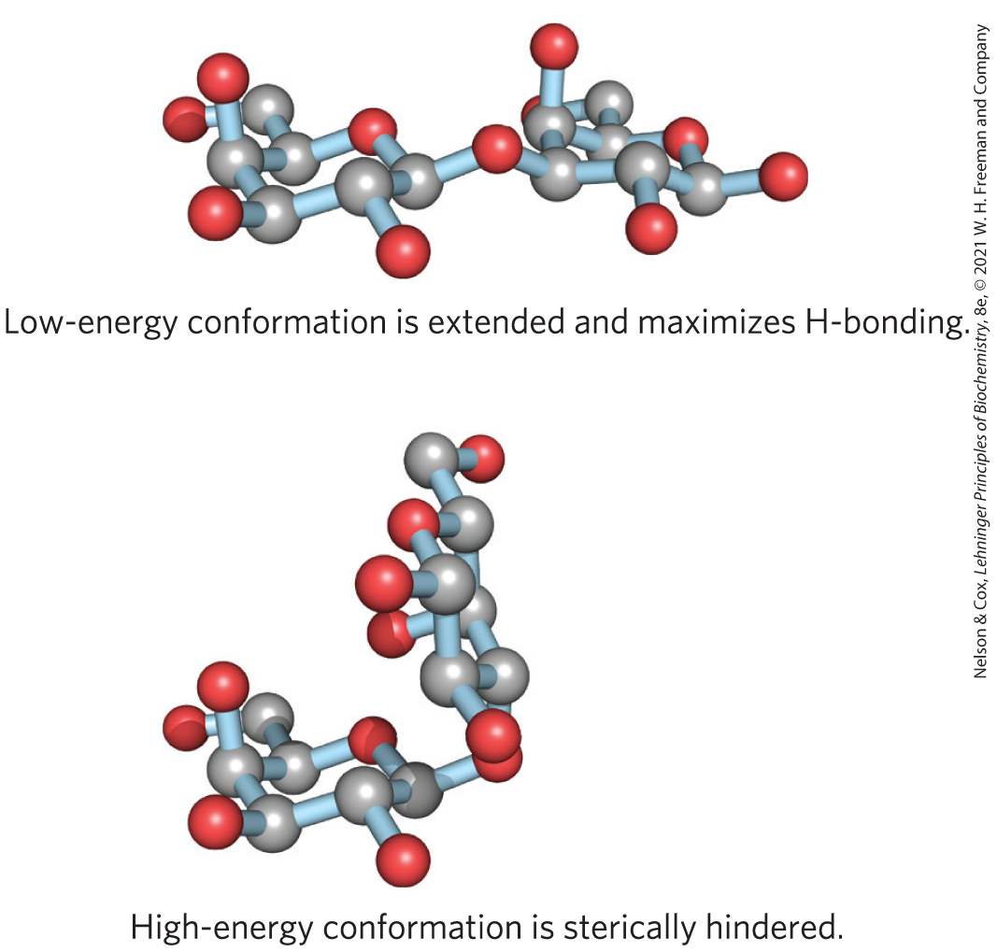
Different Energetic Conformation of a Disaccharide
bulkiness and electronic effects at the anomeric carbon place constraints on φ and ψ

Slide 118
Principle 5 (5 of 6)
Polysaccharides assume three-dimensional structures with the lowest-energy conformations, determined by covalent bonds, hydrogen bonds, charge interactions, and steric factors. Starch folds into a helical structure stabilized by internal hydrogen bonds; cellulose assumes an extended structure in which intermolecular hydrogen bonds are more important.

Slide 119
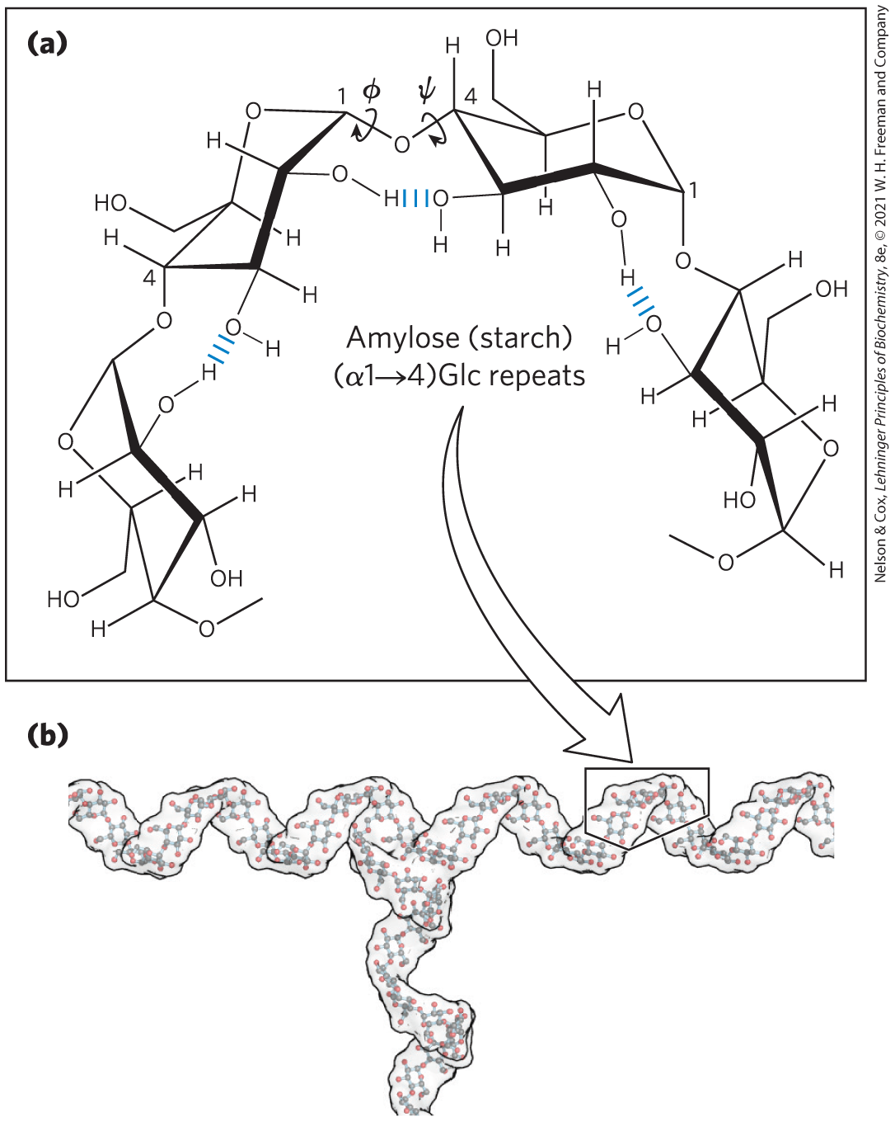
Helical Structure of Starch and Glycogen
most stable three-dimensional structure for the (α1→4)-linked chains of starch and glycogen
  six residues/turn

Slide 120

Principle 5 (6 of 6)
Polysaccharides assume three-dimensional structures with the lowest-energy conformations, determined by covalent bonds, hydrogen bonds, charge interactions, and steric factors. Starch folds into a helical structure stabilized by internal hydrogen bonds; cellulose assumes an extended structure in which intermolecular hydrogen bonds are more important.

Slide 121
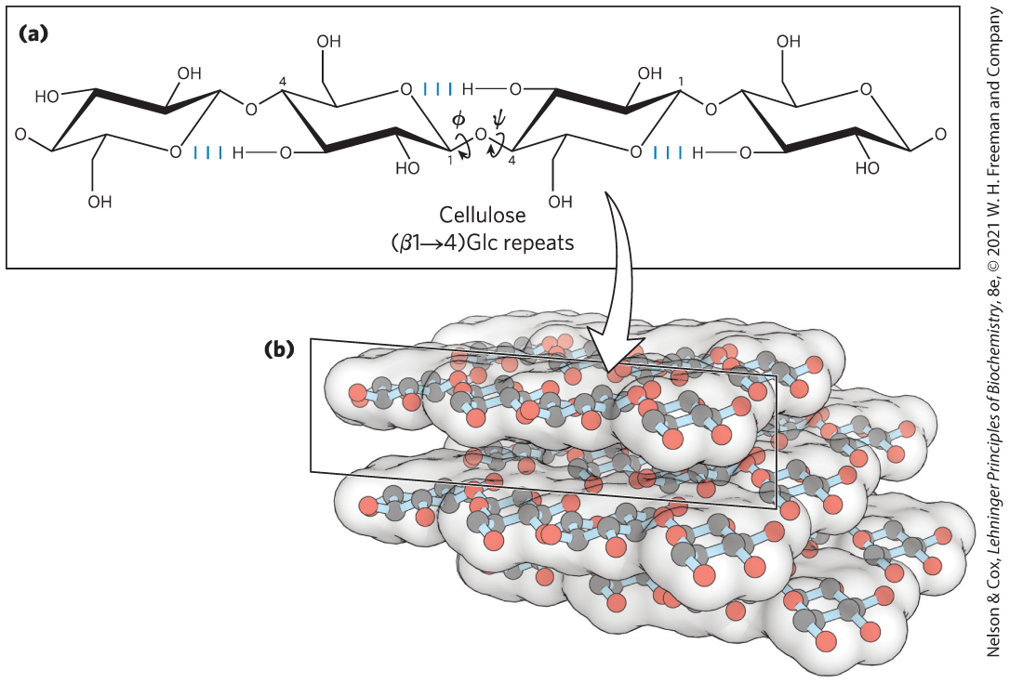
Linear Structure of Cellulose
most stable conformation is a straight, extended chain
  each chair is turned 180° relative to its neighbors

Slide 122
Clicker Question 21
Polysaccharides:
do not fold into three-dimensional structures.
are glycans.
must be homopolysaccharides.
are never branched.
Notes:
Answer: B
Principle: 7.2
Learning Objective(s): Describe the structure and function of common polysaccharides.
Bloom’s: 2:1

Slide 123
Clicker Question 21, Response
Polysaccharides:
B. are glycans.
Polysaccharides are also called glycans.

Slide 124

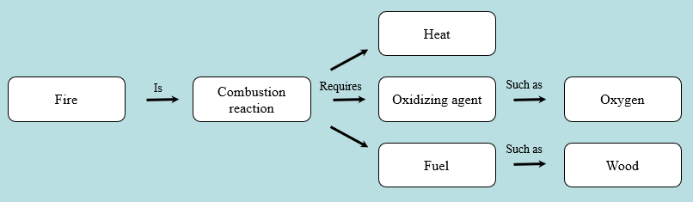
Activity: Relating
Terms within the Chapter
A concept map displays the relationships between different concepts. Observe the following example of a concept map.
Notes:
Instructor: For additional information, see the Instructor Activity Guide located in Achieve. It can be found within Chapter 7, in the folder titled “Ch7 In-Class Activities and Resources.”

Slide 125
Activity Instructions (3 of 5)
Think about how the following terms and phrases relate to each other and then use scratch paper to draw a concept map using these terms and phrases. (3 minutes)
polysaccharides
three-dimensional structures
lowest energy conformations
steric factors
covalent bonds
weak interactions
internal hydrogen bonds
intermolecular hydrogen bonds
interactions between charged residues
starch
cellulose
helical structure
extended structure
Notes:
Instructor: For additional information, see the Instructor Activity Guide located in Achieve. It can be found within Chapter 7, in the folder titled “Ch7 In-Class Activities and Resources.”

Slide 126
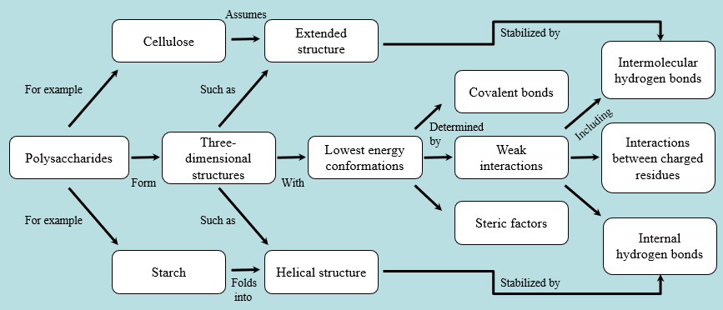
Activity Solution (3 of 5)
Pair up and share how this possible concept map might differ from yours. (2 minutes)
Notes:
Instructor: For additional information, see the Instructor Activity Guide located in Achieve. It can be found within Chapter 7, in the folder titled “Ch7 In-Class Activities and Resources.”

Slide 127
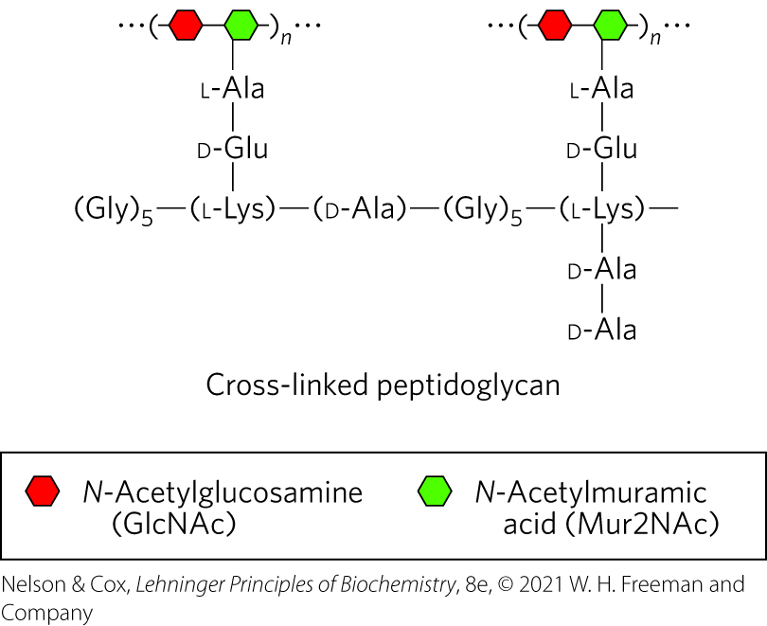
Peptidoglycan Reinforces the Bacterial Cell Wall
peptidoglycan = rigid component of bacterial cell walls
  heteropolymer of alternating (β1→4)-linked N-acetylglucosamine and N-acetylmuramic acid residues
  cross-linked by short peptides

Slide 128
Glycosaminoglycans Are Heteropolysaccharides of the Extracellular Matrix
extracellular matrix (ECM) = gel-like material in the extracellular space of tissues that holds cells together and provides a porous pathway for nutrient and O₂ diffusion
  composed of an interlocking meshwork of heteropolysaccharides (ground substance) and fibrous proteins
basement membrane (specialized ECM) also contains heteropolysaccharides

Slide 129
Principle 2 (3 of 3)
Monomeric subunits, monosaccharides, serve as the building blocks of large carbohydrate polymers. The specific sugar, the way the units are linked, and whether the polymer is branched determine its properties and thus its function.

Slide 130
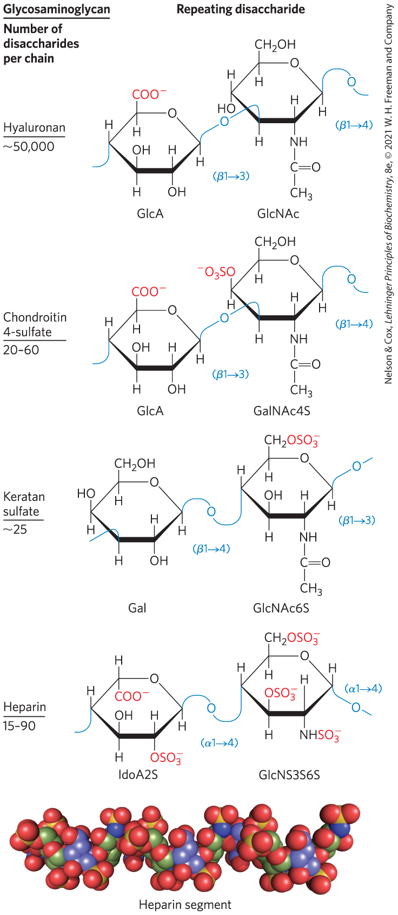
Repeating Units of Glycosaminoglycans of ECM
glycosaminoglycans = heteropolysaccharides in ECM
  linear polymers composed of repeating disaccharide units
  one monosaccharide is always either N-acetylglucosamine or N-acetylgalactosamine and the other is usually a uronic acid
  unique to animals and bacteria
  some contain esterified sulfate groups

Slide 131
Types of Glycosaminoglycans
hyaluronan (hyaluronic acid) = alternating residues of D-glucuronic acid and N-acetylglucosamine
chondroitin sulfate, dermatan sulfate, keratan sulfate, and heparan sulfate differ from hyaluronan in three respects:
  generally much shorter polymers
  covalently linked to specific proteins (proteoglycans)
  one or both monomer units differ from hyaluronan
provide viscosity, adhesiveness, and tensile strength to the extracellular matrix

Slide 132
Clicker Question 22
Which characteristic is NOT one that is true of glycosaminoglycans?
found in extracellular matrix
always contain sulfates
are heteropolysaccharides
are disaccharide repeat units
Notes:
Answer: B
Principle: 7.2
Learning Objective(s): Identify the types of glycoconjugates and their components.
Bloom’s: 2:2

Slide 133
Clicker Question 22, Response
Which characteristic is NOT one that is true of glycosaminoglycans?
B. always contain sulfates
The glycosaminoglycans, are a family of linear polymers composed of repeating disaccharide units. Some, but not all, glycosaminoglycans contain esterified sulfate groups.

Slide 134
Heparan Sulfate
contains variable, nonrandom arrangements of sulfated and nonsulfated sugars
sulfated residues gives the molecule the ability to interact specifically with proteins

Slide 135
Heparan
highly sulfated, intracellular form of heparan sulfate produced primarily by mast cells
used as a therapeutic agent to inhibit coagulation of blood through its capacity to bind the protease inhibitor antithrombin

Slide 136
Structure and Roles of Some Polysaccharides
Table 7-2 Structures and Roles of Some Polysaccharides
Polymer | Type | Repeating unit | Size (number of monosaccharide units) | Roles/significance
Starch: Amylose | Homo- | (𝛼1→4)Glc, linear | 50-5,000 | Energy storage: in plants
Starch: Amylopectin | Homo- | (𝛼1→4)Glc, with (𝛼1→6)Glc branches every 24-30 residues | Up to 10⁶ | Energy storage: in plants
Glycogen | Homo- | (𝛼1→4)Glc, with (𝛼1→6)Glc branches every 8-12 residues | Up to 50,000 | Energy storage: in bacteria and animal cells
Cellulose | Homo- | (𝛽1→4)Glc | Up to 15,000 | Structural: in plants, gives rigidity and strength to cell walls
Chitin | Homo- | (𝛽1→4)GlcNAc | Very large | Structural: in insects, spiders, crustaceans, gives rigidity and strength to exoskeletons
Dextran | Homo- | (𝛼1→6)Glc, with (𝛼1→3) branches | Wide range | Structural: in bacteria, extracellular adhesive
Peptidoglycan | Hetero-; peptides attached | 4)Mur2Ac(𝛽1→4) GlcNAc (𝛽1 | Very large | Structural: in bacteria, gives rigidity and strength to cell envelope
Hyaluronan (a glycosaminoglycan) | Hetero-; acidic | 4)GlcA(𝛽1→3) GlcNAc (𝛽1 | Up to 100,000 | Structural: in vertebrates, extracellular matrix of skin and connective tissue; viscosity and lubrication in joints

Slide 137
Clicker Question 23
The glycosaminoglycan hyaluronan:
is a homopolysaccharide.
consists of alternating residues of D-glucuronic acid and N-acetylglucosamine.
is covalently linked to specific proteins.
is a much shorter polymer than heparin.
Notes:
Answer: B
Principle: 7.2
Learning Objective(s): Identify the types of glycoconjugates and their components.
Bloom’s: 2:2

Slide 138
Clicker Question 23, Response
The glycosaminoglycan hyaluronan:
consists of alternating residues of D-glucuronic acid and N-acetylglucosamine.
The glycosaminoglycan hyaluronan (hyaluronic acid) contains alternating residues of D-glucuronic acid and N-acetylglucosamine.

Slide 139
7.3 Glycoconjugates: Proteoglycans, Glycoproteins, and Glycolipids

Slide 140
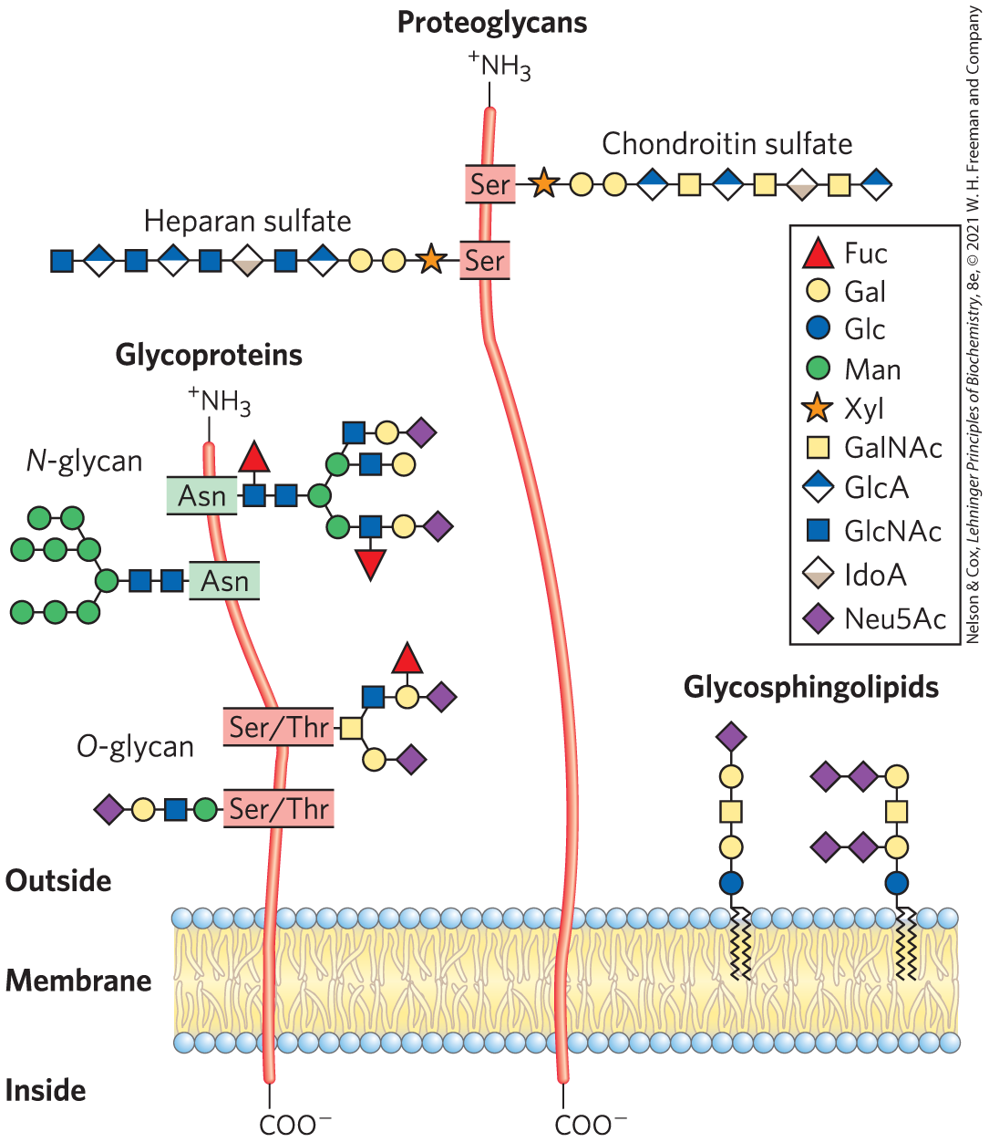
Glycoconjugate
glycoconjugate = biologically active molecule consisting of an informational carbohydrate joined to a protein or lipid

Slide 141
Proteoglycans
proteoglycans = macromolecules of the cell surface or ECM consisting of 1+ sulfated glycosaminoglycan chain(s) joined covalently to a membrane protein or secreted protein
  major component of all extracellular matrices

Slide 142
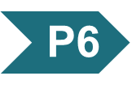
Principle 6 (2 of 4)
Molecular complementarity is central to function. The recognition of oligosaccharides by sugar-binding proteins (lectins) results from a perfect fit between lectin and ligand.

Slide 143
Glycoproteins
glycoproteins = have one or several oligosaccharides joined covalently to a protein
  found on the outer face of the plasma membrane, in ECM, in blood, and in organelles (Golgi complexes, secretory granules, and lysosomes)
  oligosaccharide portions are heterogenous and rich in information

Slide 144
Glycolipids and Glycosphingolipids
glycolipids = plasma membrane components in which the hydrophilic head groups are oligosaccharides
glycosphingolipids = class of glycolipids with specific backbone structure
  neurons are rich in glycosphingolipids
  play a role in signal transduction

Slide 145
Clicker Question 24
Which statement about glycoconjugates is false?
A. The glycosaminoglycan chain of the proteoglycan can bind
to extracellular proteins through electrostatic interactions.
Glycolipids are found in specific organelles, such as Golgi
complexes.
C. Glycosphingolipids play a role in signal transduction.
The oligosaccharide portions of glycoproteins are very
heterogeneous.
Notes:
Answer: B
Principle: 7.2
Learning Objective(s): Compare and contrast the structure and function of glycoconjugates.
Bloom’s: 2:2

Slide 146
Clicker Question 24, Response
Which statement about glycoconjugates is false?
Glycolipids are found in specific organelles, such as Golgi complexes.
Inside cells, glycoproteins are found in specific organelles such as Golgi complexes (where the oligosaccharide moieties are added to the proteins), secretory granules, and lysosomes. Glycolipids are plasma membrane components in which the hydrophilic head groups are oligosaccharides.

Slide 147
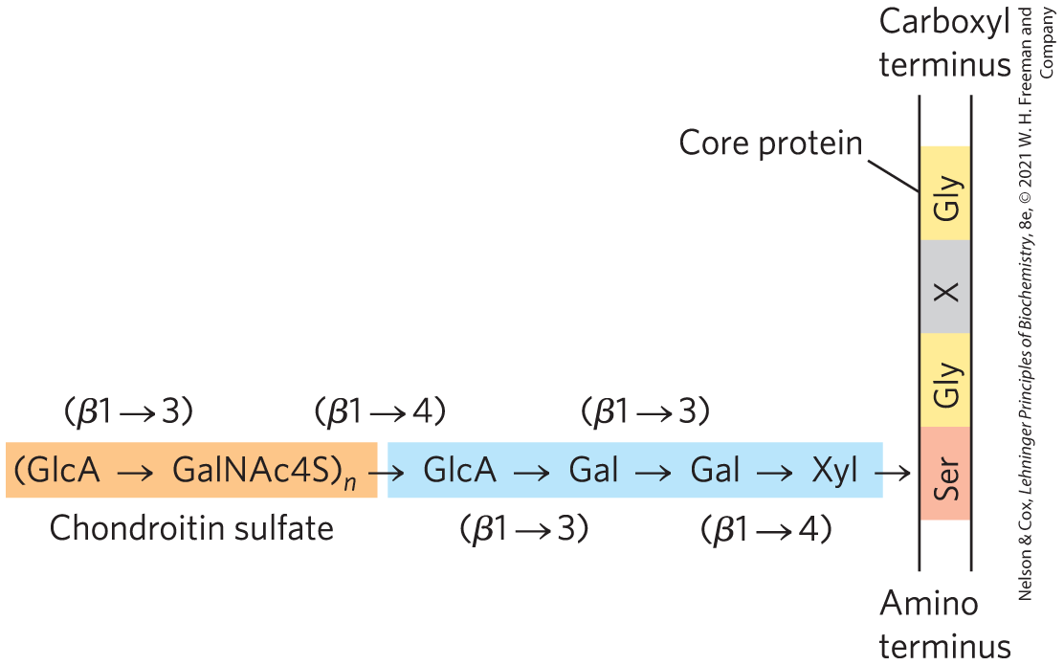
Proteoglycans Are Glycosaminoglycan-Containing Macromolecules of the Cell Surface and Extracellular Matrix
proteoglycan unit = “core protein” with covalently attached glycosaminoglycan(s)
tetrasaccharide linker connects to glycosaminoglycan to a Ser residue of the protein

Slide 148
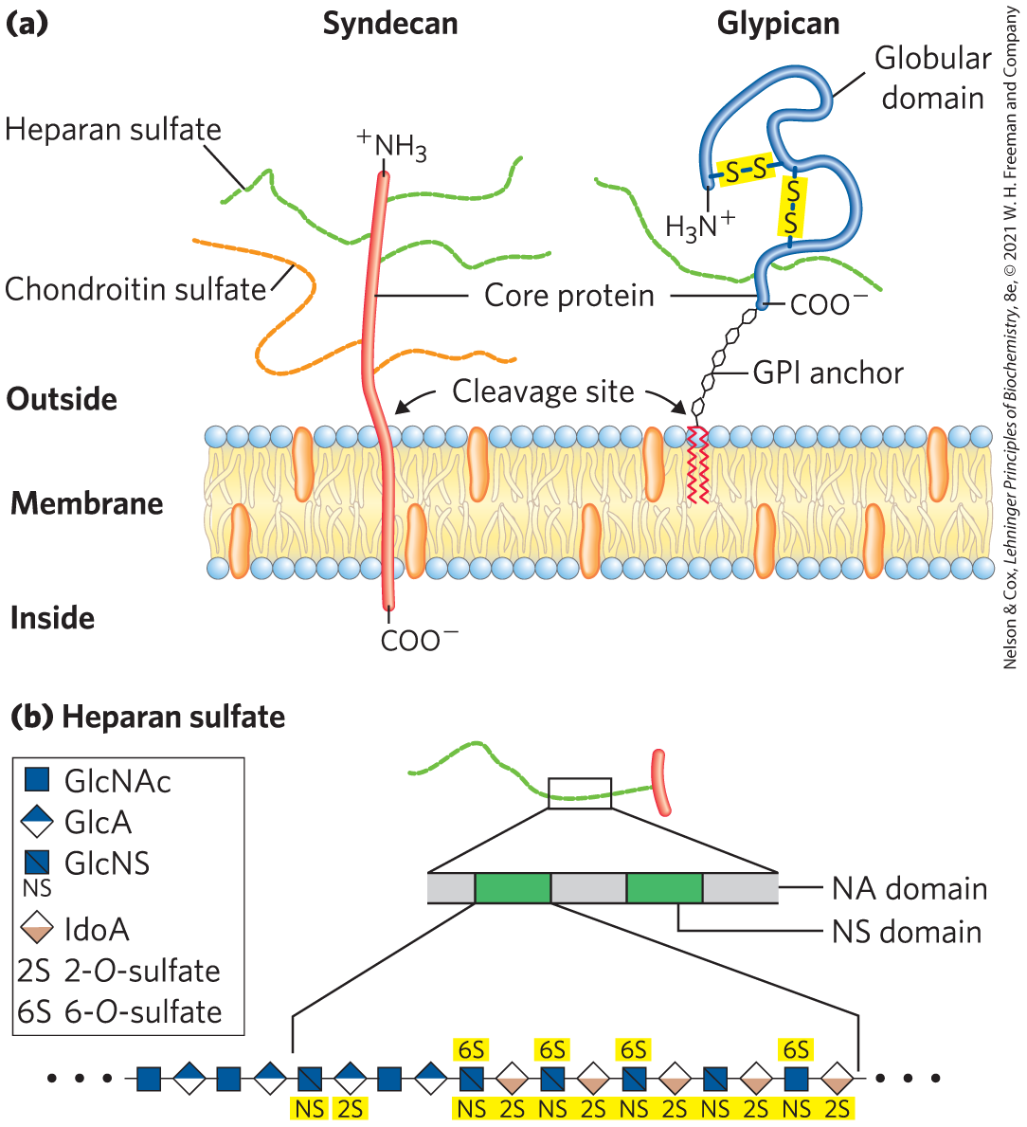
Two Families of Membrane Heparan Sulfate Proteoglycans
syndecans = single transmembrane domain and an extracellular domain bearing 3–5 chains of heparan sulfate and chondroitin sulfate
glypicans = attached to the membrane by a GPI anchor (a glycosylated derivative of the membrane lipid phosphatidylinositol)

Slide 149
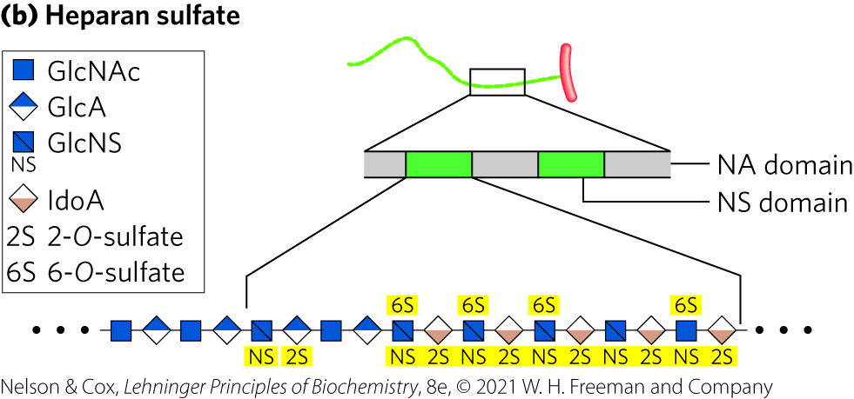
NS Domains
NS domains = highly sulfated domains that alternate with domains having unmodified GlcNAc and GlcA residues

Slide 150
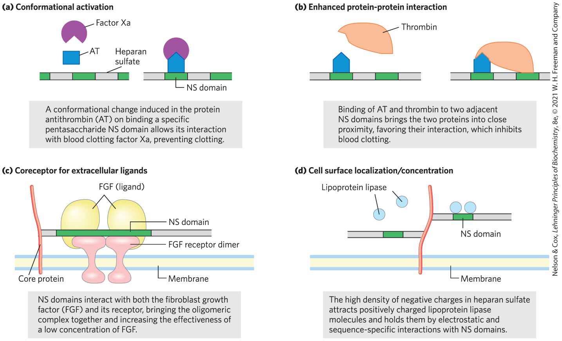
Four Types of Protein Interactions with NS Domains of Heparan Sulfate

Slide 151
Clicker Question 25
Which statement about proteoglycans is false?
They contain protein.
They can affect ligand-receptor interactions.
They are always extracellular.
They contain glycosaminoglycans.
Notes:
Answer: C
Principle: 7.2
Learning Objective(s): Describe the general structure and function of proteoglycans.
Bloom’s: 2:2

Slide 152
Clicker Question 25, Response
Which statement about proteoglycans is false?
C. They are always extracellular.
Proteoglycans are macromolecules of the cell surface or ECM in which one or more sulfated glycosaminoglycan chains are joined covalently to a membrane protein or a secreted protein.

Slide 153
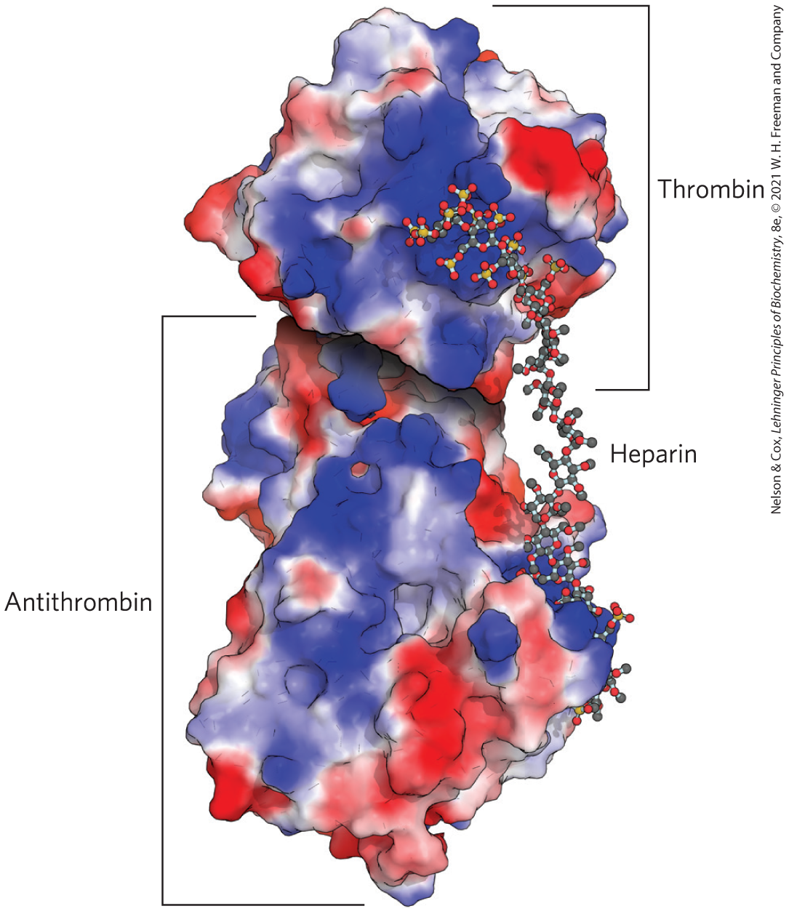
Heparan Sulfate Enhancement of the Binding of Thrombin to Antithrombin
antithrombin binds to and inhibits the protease thrombin only in the presence of heparan sulfate
both proteins are rich in Arg and Lys residues
  interact electrostatically with the sulfates of the glycosaminoglycans
Positively charged regions

Slide 154
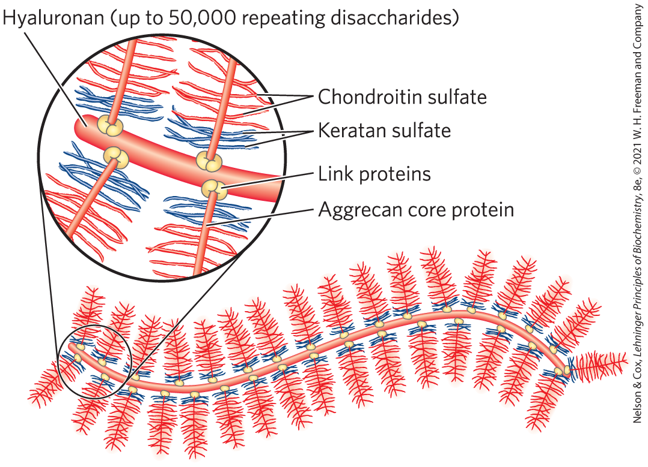
Proteoglycan Aggregates
proteoglycan aggregates = supramolecular assemblies of many core proteins all bound to a single molecule of hyaluronan
aggrecan interacts strongly with collagen in the ECM of cartilage

Slide 155
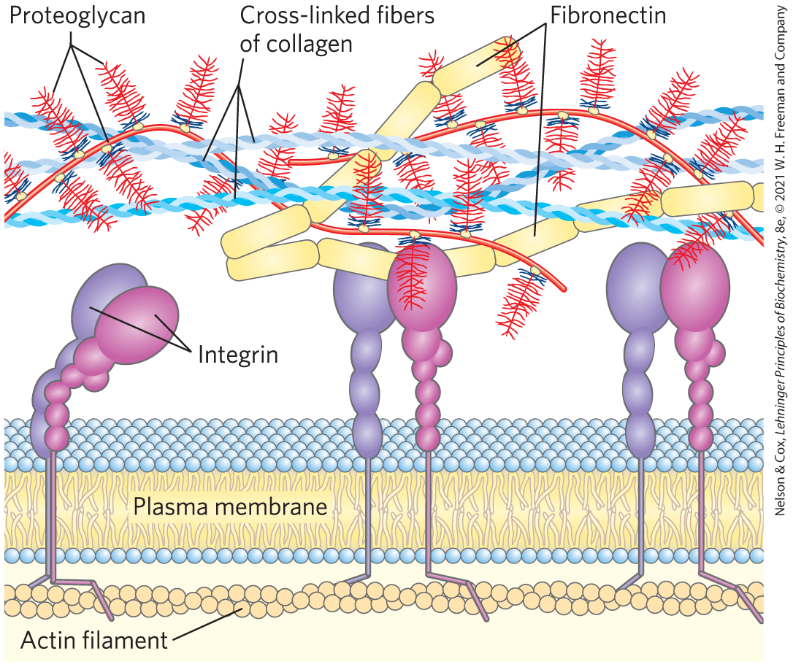
Fibronectin and Integrins
fibronectin = has separate domains to bind fibrin, heparan sulfate, and collagen
  contain the conserved RGD sequence (Arg–Gly–Asp) to bind integrins
integrins = mediate signaling between cell interior and ECM molecules

Slide 156
Principle 7 (2 of 3)
An almost infinite variety of discrete structures can be built from a small number of monomeric subunits. Even short polymers, when arranged in different sequences, joined through different linkages, and branched to specific degrees, present unique faces recognized by their molecular partners.

Slide 157
Purpose of Interactions between Cells and the ECM
interactions between cells and the ECM:
  anchor cells to the ECM, providing the strength and elasticity of skin and joints
  provide paths that direct the migration of cells in developing tissue
  convey information in both directions across the plasma membrane

Slide 158
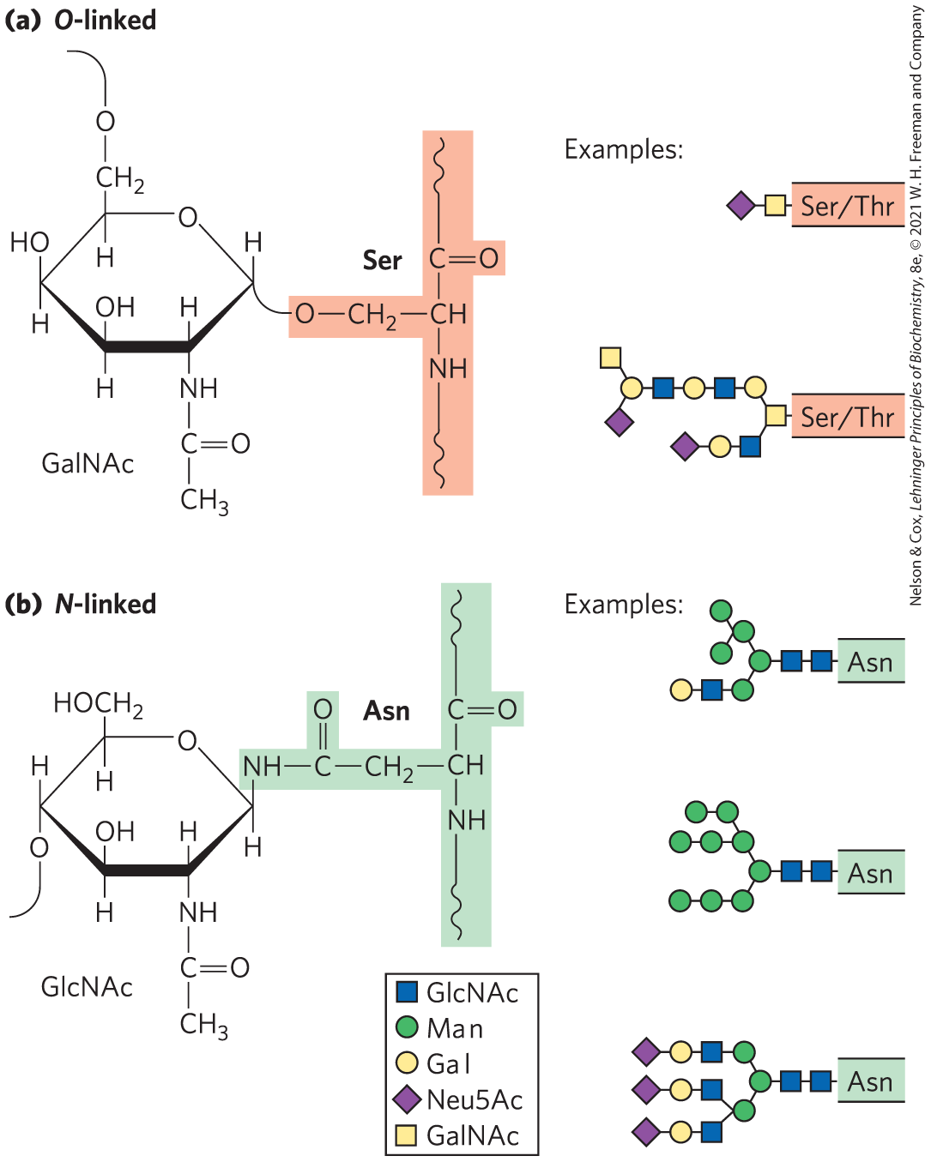
Glycoproteins Have Covalently Attached Oligosaccharides
two types of attachments:
  O-linked = a glycoside bond joins the anomeric carbon of a carbohydrate to the —OH of a Ser or Thr residue
  N-linked = an N-glycosyl bond joins the anomeric carbon of a sugar to the amide nitrogen of an Asn residue

Slide 159
Clicker Question 26
A laboratory is studying the binding properties of a glycoprotein on the plasma membrane. What amino acids should they analyze for the presence of branched heteropolysaccharides?
Ser, Thr, and Tyr
Ser, Thr, and Asn
Trp, Tyr, and Phe
Lys, His, and Arg
Notes:
Answer: B
Principle: 7.2
Learning Objective(s): Identify amino acid residues that can participate in O-linked and N-linked glycosidic bonds.
Bloom’s: 2:2

Slide 160
Clicker Question 26, Response
A laboratory is studying the binding properties of a glycoprotein on the plasma membrane. What amino acids should they analyze for the presence of branched heteropolysaccharides?
B. Ser, Thr, and Asn
Glycoproteins are carbohydrate-protein conjugates. The carbohydrate is attached at its anomeric carbon through a glycosidic link to the —OH of a Ser or Thr residue (O-linked), or through an N-glycosyl link to the amide nitrogen of an Asn residue (N-linked).

Slide 161
Examples of Glycoproteins
mucins = secreted or membrane glycoproteins
  can contain large numbers of O-linked oligosaccharide chains
  present in most secretions
proteins of the blood
  examples: immunoglobulins (antibodies), follicle-stimulating hormone, luteinizing hormone, and thyroid-stimulating hormone
milk proteins
  example: major whey protein α-lactalbumin

Slide 162
Glycomics
glycomics = the systematic characterization of all carbohydrate components of a given cell or tissue, including those attached to proteins and to lipids

Slide 163
Principle 7 (3 of 3)
An almost infinite variety of discrete structures can be built from a small number of monomeric subunits. Even short polymers, when arranged in different sequences, joined through different linkages, and branched to specific degrees, present unique faces recognized by their molecular partners.

Slide 164
The Biological Advantages of Adding Oligosaccharides to Proteins
covalently attached oligosaccharides:
  influence the folding and stability of the proteins
  provide critical information about the targeting of newly synthesized proteins
  allow specific recognition by other proteins

Slide 165
Clicker Question 27
Glycoproteins:
contain unbranched oligosaccharides.
are sometimes intracellular.
have oligosaccharides covalently attached to aspartate residues.
are a small fraction of the total number of proteins in a human cell.
Notes:
Answer: B
Principle: 7.2
Learning Objective(s): Describe the structure and function of glycoproteins.
Bloom’s: 2:2

Slide 166
Clicker Question 27, Response
Glycoproteins:
B. are sometimes intracellular.
Many of the proteins secreted by eukaryotic cells are glycoproteins, including most of the proteins of blood. Some of the proteins secreted by the pancreas are glycosylated, as are most of the proteins contained in lysosomes.

Slide 167

Glycolipids and Lipopolysaccharides Are Membrane Components
gangliosides = membrane lipids of eukaryotic cells in which the polar head group is a complex oligosaccharide containing a sialic acid and other monosaccharide residues
lipopolysaccharides = dominant surface feature of the outer membrane of gram-negative bacteria

Slide 168
Clicker Question 28
Which of these is NOT a glycoconjugate?
trehalose
syndecan
glypican
glycosphingolipid
Notes:
Answer: A
Principle: 7.2
Learning Objective(s): Identify the types of glycoconjugates and their components.
Bloom’s: 2:2

Slide 169
Clicker Question 28, Response
Which of these is NOT a glycoconjugate?
trehalose
A glycoconjugate is a biologically active molecule in which an informational carbohydrate is covalently joined to a protein or a lipid. Trehalose is a disaccharide of glucose.

Slide 170
Clicker Question 29
Oligosaccharides are:
never found in mucins.
classified as a N- or O-linked when found in gangliosides.
found in bacterial lipopolysaccharides.
never attached to hormones.
Notes:
Answer: C
Principle: 7.2
Learning Objective(s): Relate the structure, composition, and functions of a glycoconjugate.
Bloom’s: 2:2

Slide 171
Clicker Question 29, Response
Oligosaccharides are:
C. found in bacterial lipopolysaccharides.
The lipopolysaccharides of S. typhimurium contain six fatty acids bound to two glucosamine residues, one of which is the point of attachment for a complex oligosaccharide. E. coli has similar but unique lipopolysaccharides.

Slide 172
7.4 Carbohydrates as Informational Molecules: The Sugar Code

Slide 173
Principle 6 (3 of 4)
Molecular complementarity is central to function. The recognition of oligosaccharides by sugar-binding proteins (lectins) results from a perfect fit between lectin and ligand.

Slide 174
The Challenge of Glycobiology
glycobiology = the study of the structure and function of glycoconjugates
the challenge is to understand how cells use specific oligosaccharides to encode information about:
  intracellular targeting of proteins
  cell-cell interactions
  cell differentiation and tissue development
  extracellular signals

Slide 175
Oligosaccharide Structures Are Information-Dense
branched structures, not found in nucleic acids or proteins, are common in oligosaccharides
almost limitless variety of oligosaccharides due to differences in:
  stereochemistry and position of glycosidic bonds
  type and orientation of substituent groups
  the number and type of branches

Slide 176
Principle 6 (4 of 4)
Molecular complementarity is central to function. The recognition of oligosaccharides by sugar-binding proteins (lectins) results from a perfect fit between lectin and ligand.

Slide 177
Lectins Are Proteins That Read the Sugar Code and Mediate Many Biological Processes
lectins = bind carbohydrates with high specificity and with moderate to high affinity
functions:
  cell-cell recognition
  signaling
  adhesion
  intracellular targeting of newly synthesized proteins

Slide 178
Selectins
selectins = family of plasma membrane lectins that mediate cell-cell recognition and adhesion in a wide range of cellular processes
  move immune cells through the capillary wall
  mediate inflammatory responses
  mediate the rejection of transplanted organs

Slide 179
Clicker Question 30
Which statement about selectins is false?
They mediate cell-cell recognition.
They are involved in the movement of immune system cells.
They can be involved in the process rejection of transplanted organs.
They are intracellular.
Notes:
Answer: D
Principle: 7.5
Learning Objective(s): Describe the general structure and function of a lectin.
Bloom’s: 2:2

Slide 180
Clicker Question 30, Response
Which statement about selectins is false?
D. They are intracellular.
Selectins are a family of plasma membrane lectins that mediate cell-cell recognition and adhesion in a wide range of cellular processes.

Slide 181

Role of Lectin-Ligand Interactions in Leukocyte Movement

Slide 182

Binding Site on Influenza Neuraminidase

Slide 183

Lectin-Carbohydrate Interactions Are Highly Specific and Often Multivalent
subtle molecular complementarity allows interaction only with the lectin’s correct carbohydrate binding partners

Slide 184
Lectin Multivalency
lectin multivalency = single lectin molecule has multiple carbohydrate binding domains
  increases effective affinity

Slide 185

Interactions of Sugar Residues Due to the Hydrophobic Effect
many sugars have a more polar side and a less polar side

Slide 186
Clicker Question 31
Lectins:
often bind their ligands via multiple weak interactions.
bind their ligands with relatively low specificity.
prevent viruses from binding to their target cells.
are carbohydrates that bind to receptor proteins.
Notes:
Answer: A
Principle: 7.5
Learning Objective(s): Identify noncovalent interactions between a protein and an oligosaccharide.
Bloom’s: 2:2

Slide 187
Clicker Question 31, Response
Lectins:
often bind their ligands via multiple weak interactions.
Many sugars have a more polar side and a less polar side; the more polar side hydrogen-bonds with the lectin, while the less polar side undergoes interactions with nonpolar amino acid residues through the hydrophobic effect. The sum of all these interactions produces high-affinity binding and high specificity of lectins for their carbohydrate ligands.

Slide 188

Biological Interactions Mediated by the Sugar Code

Slide 189


Activity: Lectins and the Sugar Code
Observe the structure of a C-type lectin protein in Mol3D viewer in your Achieve course.
Notes:
Instructor: This Mol3D structure is located in the Achieve course. It can be found in the Chapter 7 content, in the folder titled “Ch7 In-Class Activities and Resources.”

Slide 190
Activity Instructions (4 of 5)
On your own, think of answers to the questions:
  What type of molecule is bound to the lectin? Take a screenshot of the molecule and upload it to your course.
  What ion is present in the binding site of this lectin to promote ligand binding?
(2 minutes)
Pair up to discuss your ideas. (2 minutes)
Share your ideas with the class in group discussion.
Notes:
Instructor: This Mol3D structure is located in the Achieve course. It can be found in the Chapter 7 content, in the folder titled “Ch7 In-Class Activities and Resources.”

Slide 191
Activity Solution (4 of 5)
  What type of molecule is bound to the lectin? Take a screenshot of the molecule and upload it to your course. An oligosaccharide is bound to the lectin-binding site, specifically an oligomannose asparaginyl-oligosaccharide. The structure of the oligosaccharide is shown in ball-and-stick format.
  What ion is present in the binding site of this lectin to promote ligand binding? A calcium (Ca²⁺) ion is present in the binding site. All “C-type” lectins possess this calcium ion.
Notes:
Instructor: This Mol3D structure is located in the Achieve course. It can be found in the Chapter 7 content, in the folder titled “Ch7 In-Class Activities and Resources.”

Slide 192
7.5 Working with Carbohydrates

Slide 193

Methods of Carbohydrate Analysis

Slide 194
Determining Oligosaccharide and Polysaccharide Structures
more complex than protein and nucleic acid analysis
can employ a variety of methods to determine sequence, configuration at anomeric and other carbons, and positions of glycosidic bonds:
  traditional chemical and enzymatic approaches
  mass spectrometry
  high-resolution NMR spectroscopy

Slide 195
Solid-Phase Synthetic Methods
carbohydrate chemists can synthesize short segments of almost any glycosaminoglycan
solid-phase oligosaccharide synthesis:
  based on the same principles as peptide synthesis
  yields defined oligosaccharides
  useful in exploring lectin-oligosaccharide interactions

Slide 196

Activity: Relating Terms within the Chapter
A concept map displays the relationships between different concepts. Observe the following example of a concept map.
Notes:
Instructor: For additional information, see the Instructor Activity Guide located in Achieve. It can be found within Chapter 7, in the folder titled “Ch7 In-Class Activities and Resources.”

Slide 197
Activity Instructions (5 of 5)
Think about how the following terms and phrases relate to each other and then use scratch paper to draw a concept map using these terms and phrases: (3 minutes)
small number of monomeric subunits
infinite variety of discrete structures
sequences
linkages
degrees of branching
unique faces
molecular partners
Notes:
Instructor: For additional information, see the Instructor Activity Guide located in Achieve. It can be found within Chapter 7, in the folder titled “Ch7 In-Class Activities and Resources.”

Slide 198

Activity Solution (5 of 5)
Pair up and share how this possible concept map might differ from yours. (2 minutes)
Notes:
Instructor: For additional information, see the Instructor Activity Guide located in Achieve. It can be found within Chapter 7, in the folder titled “Ch7 In-Class Activities and Resources.”

Slide 199
Clicker Question 32
The ________ does NOT need to be determined in fully characterizing oligosaccharides and polysaccharides.
sequence of monosaccharides
amino acid sequence of the protein
location of branch points
D. α-versus-β configurations of linkages
Notes:
Answer: B
Principle: 7.2
Learning Objective(s): Identify the type of information gained from various characterization methods.
Bloom’s: 2:2

Slide 200
Clicker Question 32, Response
The ________ does NOT need to be determined in fully characterizing oligosaccharides and polysaccharides.
B. amino acid sequence of the protein
Oligosaccharides and polysaccharides are sugar polymers containing multiple monosaccharide units. Determination of the amino acid sequence is only needed if the oligosaccharide of polysaccharide is conjugated to a protein.

