Slide 1

6 Enzymes
© 2021 Macmillan Learning

Slide 2

Principle 1 (1 of 4)
Enzymes are powerful biological catalysts. Rate accelerations by enzymes are often far greater than those by synthetic or inorganic catalysts. Like all catalysts, enzymes increase reaction rates, lowering reaction activation barriers. Enzymes do not affect the equilibria of reactions.

Slide 3

Principle 2 (1 of 3)
Enzymes exhibit a very high degree of specificity. Each enzyme catalyzes only one chemical reaction, or sometimes a few closely related reactions. Reaction activation barriers are thus lowered selectively.

Slide 4

Principle 3 (1 of 3)
Enzymatic reactions occur in specialized pockets called active sites. These pockets are similar to ligand binding sites, except that a reaction occurs there—the conversion of a substrate, a molecule that is acted on by an enzyme, to a product.

Slide 5

Principle 4 (1 of 8)
Two concepts explain the catalytic power of enzymes. First, enzymes bind most tightly to the transition state of the catalyzed reaction, using binding energy to lower the activation barrier. Second, enzyme active sites are organized by evolution to facilitate multiple mechanisms of chemical catalysis simultaneously.

Slide 6
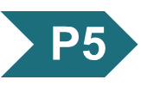
Principle 5 (1 of 3)
Many enzymes are regulated. Regulatory mechanisms include reversible covalent modification, binding of allosteric modulators, proteolytic activation, noncovalent binding to regulatory proteins, and elaborate regulatory cascades. Enzymes are often subject to multiple methods of regulation, which allows for exquisite control of every chemical process that occurs in a cell.

Slide 7
6.1 An Introduction to Enzymes

Slide 8
Enzymes
in 1897, Eduard Buchner:
  demonstrated cell-free yeast extracts could ferment sugar to alcohol
  showed fermentation was promoted by molecules that continued to function when removed from cells
the name enzymes were given to the molecules detected by Buchner

Slide 9
Principle 1 (2 of 4)
Enzymes are powerful biological catalysts. Rate accelerations by enzymes are often far greater than those by synthetic or inorganic catalysts. Like all catalysts, enzymes increase reaction rates, lowering reaction activation barriers. Enzymes do not affect the equilibria of reactions.

Slide 10
Most Enzymes Are Proteins
catalytic activity depends on the integrity of the native protein conformation
molecular weight = ranges from 12,000 to >1 million
some enzyme require additional chemical components:
  cofactor = 1+ inorganic ions, such as Fe²⁺, Mg²⁺, Mn²⁺, or Zn²⁺
  coenzyme = complex organic or metalloorganic molecule that act as transient carriers of specific functional groups

Slide 11
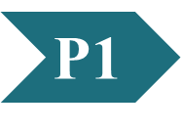
Clicker Question 1
Enzymes:
A. are proteins (with few exceptions).
B. can be denatured and still retain full activity.
C. have names always ending in “-ase.”
D. are also referred to as “coenzymes.”
Notes:
Answer: A
Principle: 6.1
Learning Objective(s): Describe the key characteristics of an enzyme.
Bloom’s: 2:1

Slide 12
Clicker Question 1, Response
Enzymes:
A. are proteins (with few exceptions).
With the exception of a few classes of catalytic RNA molecules, enzymes are proteins.

Slide 13
Inorganic Ions as Cofactors
Table 6-1 Some Inorganic Ions That Serve as Cofactors for Enzymes
Ions | Enzymes
Cu²⁺ | Cytochrome oxidase
Fe²⁺ or Fe³⁺ | Cytochrome oxidase, catalase, peroxidase
K⁺ | Pyruvate kinase
Mg²⁺ | Hexokinase, glucose 6-phosphatase, pyruvate kinase
Mn²⁺ | Arginase, ribonucleotide reductase
Mo | Dinitrogenase
Ni²⁺ | Urease
Zn²⁺ | Carbonic anhydrase, alcohol dehydrogenase, carboxypeptidases A and B

Slide 14
Clicker Question 2
In enzymes, which inorganic ion does NOT serve as a cofactor?
A. Zn²⁺
B. Cu²⁺
C. Ca²⁺
D. Mg²⁺
Notes:
Answer: C
Principle: 6.1
Learning Objective(s): Identify common cofactors.
Bloom’s: 1:1

Slide 15
Clicker Question 2, Response
In enzymes, which inorganic ion does NOT serve as a cofactor?
C. Ca²⁺
Zn²⁺, Cu²⁺, and Mg²⁺ all serve
as cofactors. Ca²⁺ does not.
Notes:
Refer to Table 6-1 on slide 13.

Slide 16
Coenzymes as Transient Carriers of Atoms or Functional Groups
Table 6-2 Some Coenzymes That Serve as Transient Carriers of Specific Atoms or Functional Groups
Coenzyme | Examples of chemical groups transferred | Dietary precursor in mammals
Biocytin | CO₂ | Biotin (vitamin B₇)
Coenzyme A | Acyl groups | Pantothenic acid (vitamin B5) and other compounds
5′-Deoxyadenosylcobalamin (coenzyme B₁₂) | H atoms and alkyl groups | Vitamin B₁₂
Flavin adenine dinucleotide | Electrons | Riboflavin (vitamin B₂)
Lipoate | Electrons and acyl groups | Not required in diet
Nicotinamide adenine dinucleotide | Hydride ion (:H–) | Nicotinic acid (niacin, vitamin B₃)
Pyridoxal phosphate | Amino groups | Pyridoxine (vitamin B₆)
Tetrahydrofolate | One-carbon groups | Folate (vitamin B₉)
Thiamine pyrophosphate | Aldehydes | Thiamine (vitamin B₁)
Notes:
Note on Table 6-2: The structures and modes of action of these coenzymes are described in Part II.

Slide 17
Describing Enzymes and Their Additional Chemical Components
prosthetic group = coenzyme or metal ion that is very tightly or covalently bound to the enzyme protein
holoenzyme = complete catalytically active enzyme together with its bound coenzyme and/or metal ions
apoenzyme or apoprotein = the protein part of a holoenzyme

Slide 18
Clicker Question 3
An apoenzyme:
A. is the nonprotein component of a holoenzyme.
B. always requires an inorganic ion for its activity.
C. requires a cofactor for its activity.
D. is an enzyme consisting of RNA rather than protein.
Notes:
Answer: C
Principle: 6.1
Learning Objective(s): Differentiate between a holoenzyme and an apoenzyme.
Bloom’s: 2:1

Slide 19
Clicker Question 3, Response
An apoenzyme:
C. requires a cofactor for its activity.
A coenzyme or metal ion that is very tightly or even covalently bound to the enzyme protein is called a prosthetic group. A complete, catalytically active enzyme together with its bound coenzyme and/or metal ions is called a holoenzyme. The protein part of such an enzyme is called the apoenzyme or apoprotein. An apoenzyme requires a cofactor for its activity.

Slide 20
Clicker Question 4
Some enzymes require an inorganic ion for catalytic function. When this inorganic ion is very tightly or covalently bound by the enzyme it is called a(n):
A. apoenzyme.
B. prosthetic group.
C. holoenzyme.
D. catalyst.
Notes:
Answer: B
Principle: 6.1
Learning Objective(s): Determine whether a cofactor or coenzyme is also a prosthetic group.
Bloom’s: 1:1

Slide 21
Clicker Question 4, Response
Some enzymes require an inorganic ion for catalytic function. When this inorganic ion is very tightly or covalently bound by the enzyme it is called a(n):
B. prosthetic group.
A coenzyme or metal ion that is very tightly or even covalently bound to the enzyme protein is called a prosthetic group.

Slide 22
Enzymes Are Classified by the Reactions They Catalyze
enzymes are divided into seven classes, each with subclasses, based on the type of reaction catalyzed
each enzyme has a four-part Enzyme Commission number (E.C. number) and a systematic name
most enzymes have trivial names
Table 6-3 International Classification of Enzymes
Class number | Class name | Type of reaction catalyzed
1 | Oxidoreductases | Transfer of electrons (hydride ions or H atoms)
2 | Transferases | Group transfer
3 | Hydrolases | Hydrolysis (transfer of functional groups to water)
4 | Lyases | Cleavage of C—C, C—O, C—N, or other bonds by elimination, leaving double bonds or rings, or addition of groups to double bonds
5 | Isomerases | Transfer of groups within molecules to yield isomeric forms
6 | Ligases | Formation of C—C, C—S, C—O, and C—N bonds by condensation reactions coupled to cleavage of ATP or similar cofactor
7 | Translocases | Movement of molecules or ions across membranes or their separation within membranes

Slide 23
Clicker Question 5
________ is NOT an E.C. class name for enzymes.
A. Transferases
B. Polymerases
C. Lyases
D. Isomerases
Notes:
Answer: B
Principle: 6.1
Learning Objective(s): Relate the E.C. number or name of an enzyme to the reaction it catalyzes; Describe an Enzyme Commission (E.C.) number.
Bloom’s: 1:1

Slide 24
Clicker Question 5, Response
________ is NOT an E.C. class name for enzymes.
B. Polymerases
Polymerases is not one of the 7 E.C. classes of enzymes.
Notes:
Refer to Table 6-3 in slide 22.

Slide 25
6.2 How Enzymes Work

Slide 26
Principle 3 (2 of 3)
Enzymatic reactions occur in specialized pockets called active sites. These pockets are similar to ligand binding sites, except that a reaction occurs there—the conversion of a substrate, a molecule that is acted on by an enzyme, to a product.

Slide 27
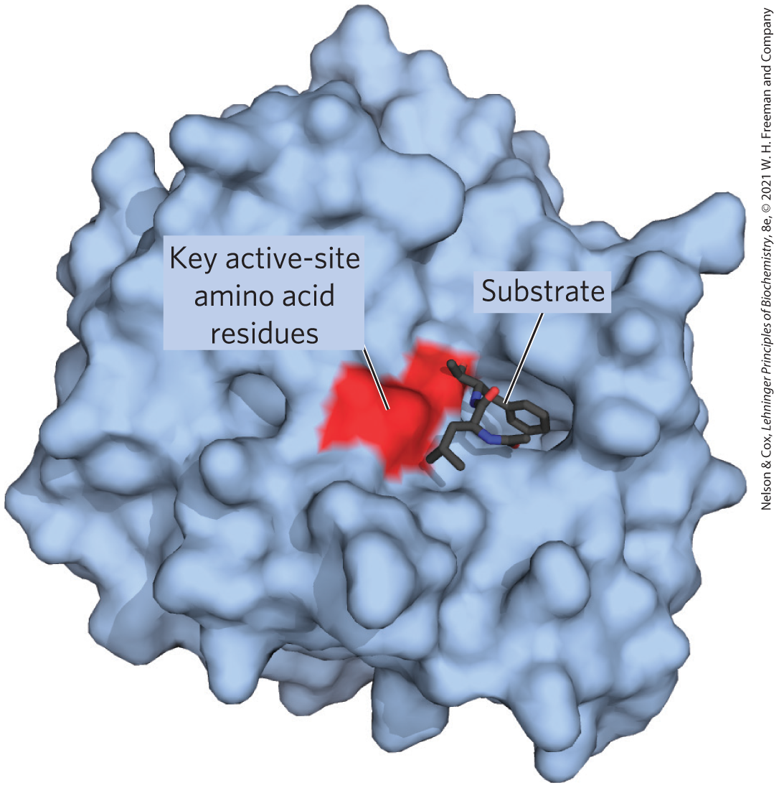
Enzyme-Catalyzed Reactions Take Place within the Active Site
active site = provides a specific environment in which a given reaction can occur more rapidly
substrate = the molecule that is bound to the active site and acted upon by the enzyme

Slide 28
Enzymes Affect Reaction Rates,
Not Equilibria
simple enzymatic reactions can be written as
E + S ⇌ ES ⇌ EP ⇌ E + P
(6-1)
where E, S, and P represent the enzyme, substrate, and product and ES and EP are transient complexes of the enzyme

Slide 29
Principle 1 (3 of 4)
Enzymes are powerful biological catalysts. Rate accelerations by enzymes are often far greater than those by synthetic or inorganic catalysts. Like all catalysts, enzymes increase reaction rates, lowering reaction activation barriers. Enzymes do not affect the equilibria of reactions.

Slide 30
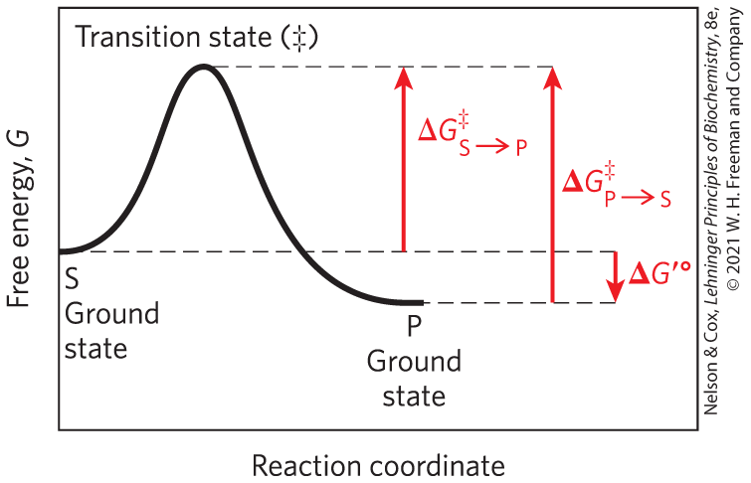
Ground State and Transition State
ground state = starting point for either the forward or reverse reaction
transition state (‡) = the point at which decay to substrate or product are equally likely

Slide 31
Energy Changes in a Reaction Coordinate Diagram
biochemical standard free-energy change = ∆G′° = the standard free-energy change at pH 7.0
activation energy (∆G‡) = difference between the ground state energy level and the transition state energy level

Slide 32
Clicker Question 6
What is the free-energy starting point for a reverse reaction designated as?
A. transition state (‡)
B. ground state
C. biochemical standard free energy
D. activation energy (∆G‡)
Notes:
Answer: B
Principle: 6.1
Learning Objective(s): Represent an enzyme-catalyzed reaction using a reaction coordinate diagram.
Bloom’s: 2:1

Slide 33
Clicker Question 6, Response
What is the free-energy starting point for a reverse reaction designated as?
B. ground state
The starting point for either the forward reaction or the reverse reaction is called the ground state, the contribution to the free energy of the system by an average molecule (S or P) under a given set of conditions.

Slide 34
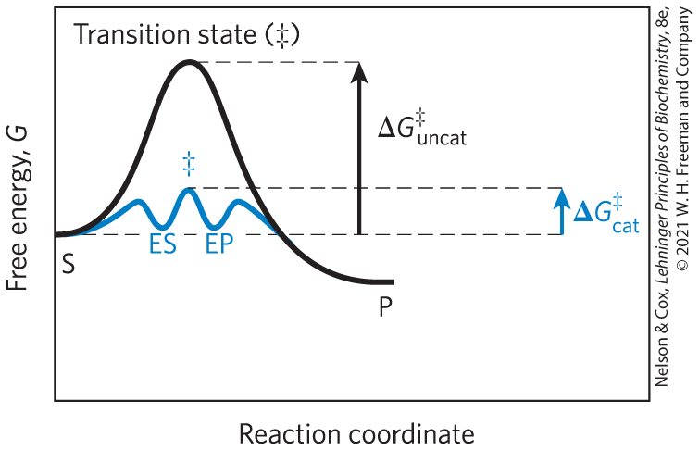
Catalysts Lower the Activation Energy and Increase the Reaction Rate

Slide 35
Catalysts Do Not Affect Reaction Equilibria
any enzyme that catalyzes the reaction S → P also catalyzes the reaction P → S
enzymes accelerate the interconversion of S and P
enzymes are not used up in the process
the equilibrium point is unaffected

Slide 36
Reaction Intermediates
reaction intermediate = any species on the reaction pathway that has a finite chemical lifetime
  example: ES and EP complexes

Slide 37
Rate-Limiting Steps
rate-limiting step = the step in a reaction with the highest activation energy that determines the overall rate of the reaction
activation energies are barriers to chemical reactions

Slide 38
Clicker Question 7
The conversion of sucrose to CO₂ and water has a very large and negative ∆G′°. Why is the conversion NOT spontaneous?
A. Only some reactions have a negative ∆G′°.
B. Conversion requires heat and O₂.
C. Conversion requires the presence of cofactors.
D. There is a very large activation energy barrier.
Notes:
Answer: D
Principle: 6.1
Learning Objective(s): Identify the factors that affect the rate of a reaction.
Bloom’s: 2:2

Slide 39
Clicker Question 7, Response
The conversion of sucrose to CO₂ and water has a very large and negative ∆G′°. Why is the conversion NOT spontaneous?
D. There is a very large activation energy barrier.
The difference between the ground state energy level and the transition state energy level is the activation energy (∆G‡). The rate of a reaction reflects this activation energy: a higher activation energy corresponds to a slower reaction. Activation energies are energy barriers to chemical reactions. Without such energy barriers, sucrose would spontaneously form CO₂ and water.

Slide 40
Principle 2 (2 of 3)
Enzymes exhibit a very high degree of specificity. Each enzyme catalyzes only one chemical reaction, or sometimes a few closely related reactions. Reaction activation barriers are thus lowered selectively.

Slide 41
Enzymes Lower Activation Energies Selectively
enzymes have developed to lower activation energies selectively to increase rates for reactions needed for cell survival

Slide 42

Clicker Question 8
What does an enzyme change relative to an uncatalyzed reaction?
A. the equilibrium constant
B. the rate of the reaction
C. the pH
D. the free energy change of the reaction
Notes:
Answer: B
Principle: 6.2
Learning Objective(s): Explain how an enzyme affects the rate of a reaction.
Bloom’s: 2:2

Slide 43
Clicker Question 8, Response
What does an enzyme change relative to an uncatalyzed reaction?
B. the rate of the reaction
The role of enzymes is to accelerate the interconversion of S and P. The enzyme is not used up in the process, and the equilibrium point is unaffected. However, the reaction reaches equilibrium much faster when the appropriate enzyme is present because the rate of the reaction is increased.

Slide 44
Principle 1 (4 of 4)
Enzymes are powerful biological catalysts. Rate accelerations by enzymes are often far greater than those by synthetic or inorganic catalysts. Like all catalysts, enzymes increase reaction rates, lowering reaction activation barriers. Enzymes do not affect the equilibria of reactions.

Slide 45
Reaction Rates and Equilibria Have Precise Thermodynamic Definitions
reaction equilibria are linked to the standard free-energy change for the reaction, ∆G′°
reaction rates are linked to the activation energy, ∆G‡

Slide 46
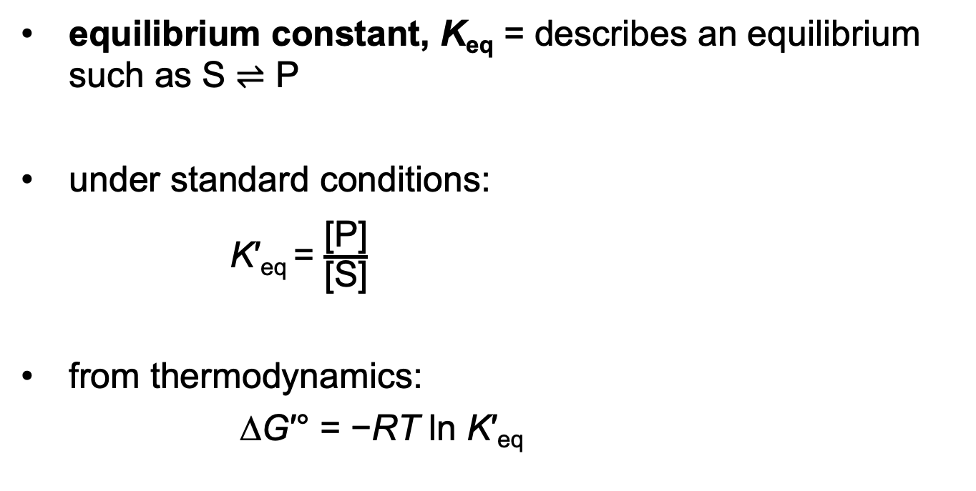
Thermodynamics Relates
K′_{eq} and ∆G′ °
equilibrium constant, K_{eq} = describes an equilibrium such as S ⇌ P
under standard conditions:
K′_{eq} = $\frac{\text{[}\text{P}\text{]}}{\text{[}\text{S}\text{]}}$
from thermodynamics:
∆G′° = −RT ln K′_{eq}
(6-2)
(6-3)

Slide 47
The Relationship between
K′ _{eq} and ∆G′ °
Table 6-4 Relationship between K′_{eq} and ∆G′°
K′_{eq} | ∆G′° (kJ/mol)
10^{–6} | 34.2
10^{–5} | 28.5
10^{–4} | 22.8
10^{–3} | 17.1
10^{–2} | 11.4
10^{–1} | 5.7
1 | 0.0
10¹ | –5.7
10² | –11.4
10³ | –17.1
Notes:
Note on Table 6-4: The relationship is calculated from ∆G′° = –RT in K′_{eq} (6-3)

Slide 48
Clicker Question 9
Which statement is true regarding the relationship between biochemical standard free-energy change and the equilibrium constant K_{eq}?
∆G′° = –RT ln K′_{eq}
The relationship between free-energy change and equilibrium is exponential.
A decrease in K_{eq} translates into a more negative free energy.
The higher the temperature, the less the reaction favors product formation.
Small changes in free energy can lead to large changes in equilibria.
Notes:
Answer: D
Principle: 6.1
Learning Objective(s):
Bloom’s: 2:2

Slide 49
Clicker Question 9, Response
Which statement is true regarding the relationship between biochemical standard free-energy change and the equilibrium constant K_{eq}?
∆G′° = –RT ln K′_{eq}
Small changes in free energy can lead to large changes in equilibria.
According to the equation relating K′_{eq} to ∆G′° for the overall reaction, small changes in ∆G′° can lead to large changes in K′_{eq}.
Notes:
Refer to Table 6-4 in Slide 47.

Slide 50
Rate Constants and Rate Equations
the rate of any reaction is determined by the concentration of reactant(s) and the rate constant, k
for the unimolar reaction S → P, a rate equation expresses the rate of the reaction
V = k[S]
(6-4)
where V is the velocity or rate of the reaction and [S] is
the concentration of the substrate

Slide 51
First-Order Reactions
first-order reaction = rate depends only on the concentration of S
k has units of reciprocal time, such as s^{–1}

Slide 52
Clicker Question 10
If a first-order reaction for the unimolar reaction S → P has a rate constant k of 0.05 s^{–1}, how is this interpreted qualitatively?
A. 0.05% of the available S will be converted to P in 1 second.
B. 5% of the available S will be converted to P in 1 second.
C. 0.05% of the available P will be converted to S in 1 second.
D. 5% of the available P will be converted to S in 1 second.
Notes:
Answer: B
Principle: 6.1
Learning Objective(s): Relate the rate of reaction V, the rate constant k, and concentration of reactants for a reaction.
Bloom’s: 2:2

Slide 53
Clicker Question 10, Response
If a first-order reaction has a rate constant k of 0.05 s^{–1}, how is this interpreted qualitatively?
B. 5% of the available S will be converted to P in 1 second.
The factor k is a proportionality constant that reflects the probability of reaction under a given set of conditions. For a first-order reaction, the rate constant k has units of reciprocal time. If a first-order reaction has a rate constant k of 0.05 s^{–1}, this may be interpreted qualitatively to mean that 5% of the available S will be converted to P in 1 second.

Slide 54
Second-Order Reactions
second-order reaction = rate depends on the concentration of two different compounds or the reaction is between two molecules of the same compound
k has units of M^{–1}s^{–1}
the rate equation becomes
V = k[S₁][S₂]
(6-5)

Slide 55
Clicker Question 11
A reaction where the rate depends on the concentration of two molecules is called a:
A. first-order reaction.
B. second-order reaction.
C. third-order reaction.
D. fourth-order reaction.
Notes:
Answer: B
Principle: 6.1
Learning Objective(s): Classify an enzyme-catalyzed reaction as first or second order.
Bloom’s: 1:1

Slide 56
Clicker Question 11, Response
A reaction where the rate depends on the concentration of two molecules is called a:
B. second-order reaction.
If a reaction rate depends on the concentration of two different compounds, or if the reaction is between two molecules of the same compound, the reaction is second order.

Slide 57
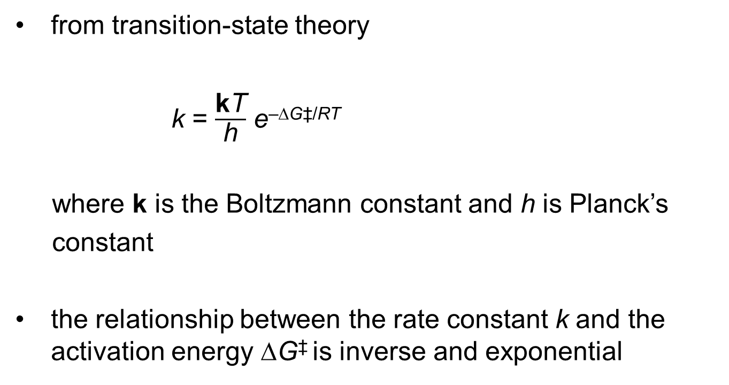
The Relationship between Rate Constants and Activation Energy
from transition-state theory
k = $\frac{\text{k}\text{T}}{\text{h}}$ e^{–∆G‡/RT}
where k is the Boltzmann constant and h is Planck’s
constant
the relationship between the rate constant k and the activation energy ∆G‡ is inverse and exponential
(6-6)

Slide 58
A Few Principles Explain the Catalytic Power and Specificity of Enzymes
enzymes enhance rates in the range of 5 to 17 orders of magnitude
Table 6-5 Some Rate Enhancements Produced by Enzymes
Cyclophilin | 10⁵
Carbonic anhydrase | 10⁷
Triose phosphate isomerase | 10⁹
Carboxypeptidase A | 10¹¹
Phosphoglucomutase | 10¹²
Succinyl-CoA transferase | 10¹³
Urease | 10¹⁴
Orotidine monophosphate decarboxylase | 10¹⁷

Slide 59
Principle 4 (2 of 8)
Two concepts explain the catalytic power of enzymes. First, enzymes bind most tightly to the transition state of the catalyzed reaction, using binding energy to lower the activation barrier. Second, enzyme active sites are organized by evolution to facilitate multiple mechanisms of chemical catalysis simultaneously.

Slide 60
Interactions between Enzymes and Substrates
binding energy, ∆G_{B} = energy derived from noncovalent enzyme-substrate interaction
  mediated by hydrogen bonds, ionic interactions, and the hydrophobic effect
  major source of free energy used by enzymes to lower the activation energy
covalent interactions between enzyme and substrate lower the activation energy

Slide 61
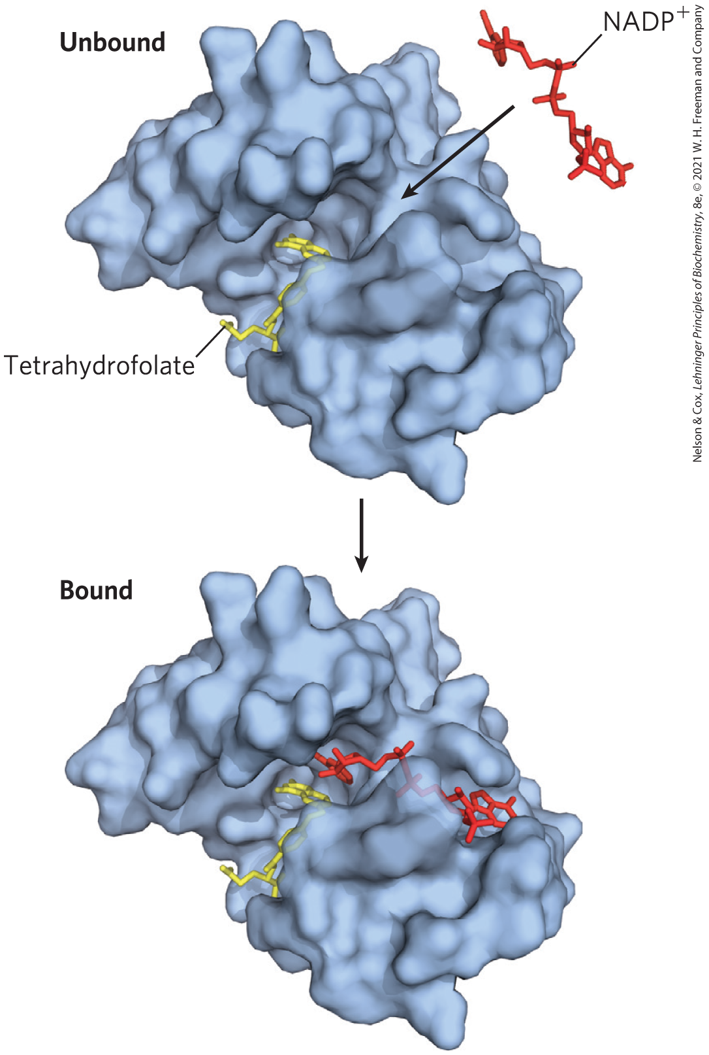
Noncovalent Interactions between Enzyme and Substrate Are Optimized in the Transition State
“lock and key” hypothesis = enzymes are structurally complementary to their substrates
  would make for a poor enzyme

Slide 62
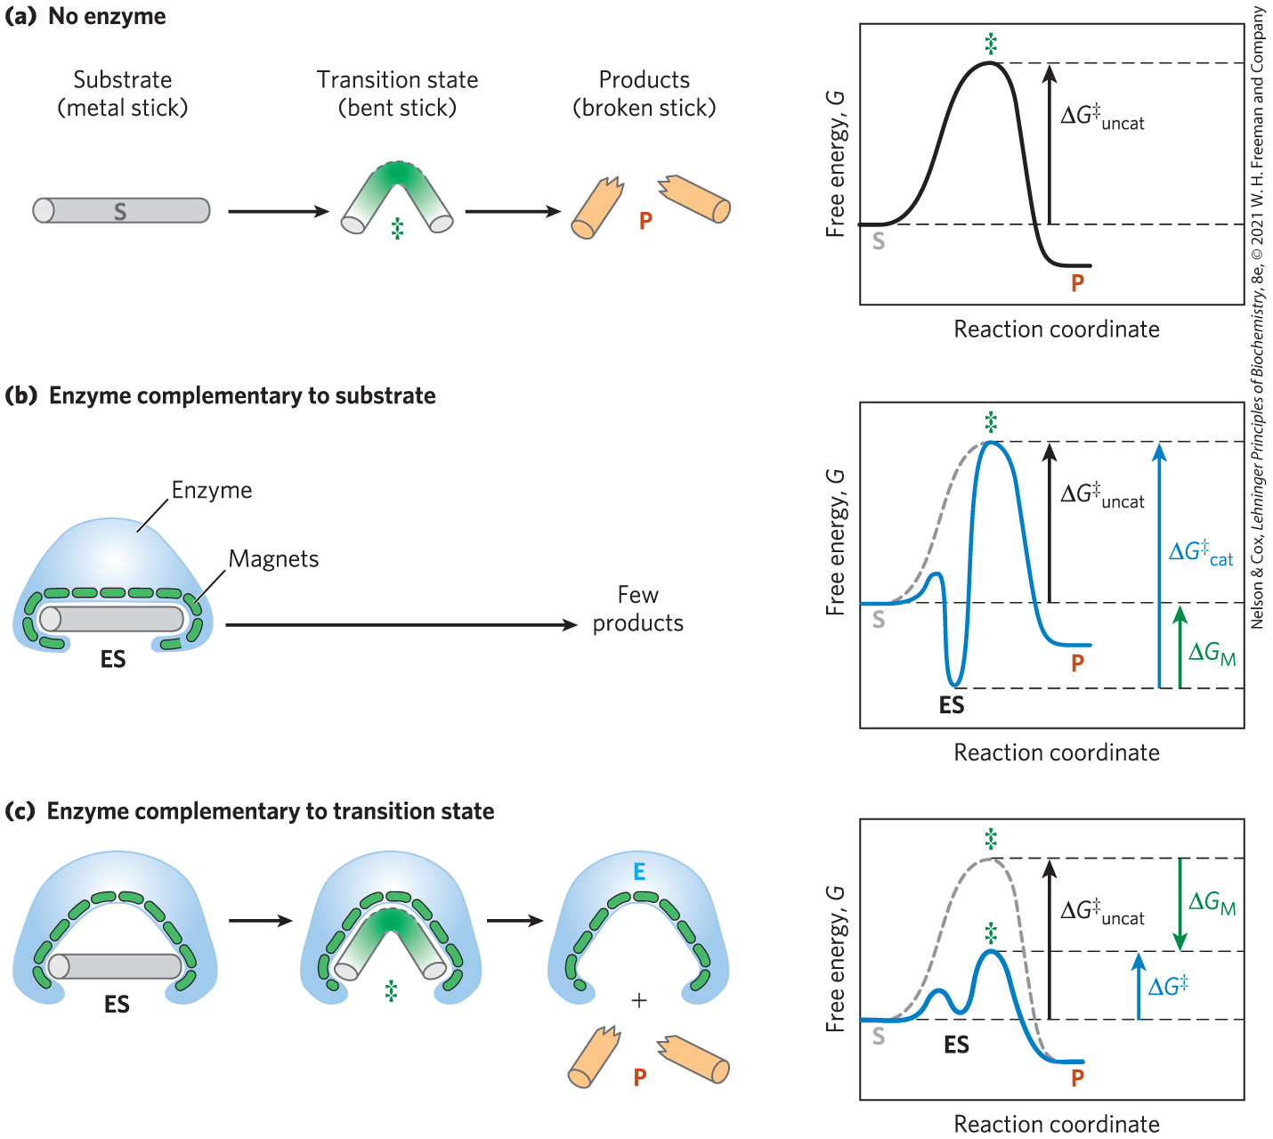
Enzymes Must Be Complementary to the Reaction Transition State
the full complement of interactions between substrate and enzyme is formed only when the substrate reaches the transition state

Slide 63
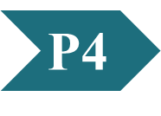
Clicker Question 12
How does the concept of “induced fit” support the current theory of substrate-enzyme interaction?
A. Enzyme structure is rigid, allowing for competition for the
active site and easy ejection of the final product.
B. Enzyme conformational changes demonstrate feedback
regulation of the enzyme and the ability to “turn off” activity.
C. Having a rigid structure allows the enzyme to bind the
substrate and stabilize the ES complex.
D. Enzyme conformation changes allow additional stabilizing
interactions with the transition state and enhance the
activity.
Notes:
Answer: D
Principle: 6.4
Learning Objective(s): Differentiate between the “lock and key” and “induced fit” models of enzyme-substrate interaction.
Bloom’s: 3:2

Slide 64
Clicker Question 12, Response
How does the concept of “induced fit” support the current theory of substrate-enzyme interaction?
D. Enzyme conformation changes allow additional
stabilizing interactions with the transition state and
enhance the activity.
Some weak interactions are formed in the ES complex, but the full complement of such interactions between substrate and enzyme is formed only when the substrate reaches the transition state. Enzyme conformational changes allow for additional stabilizing interactions between the enzyme and the transition state.

Slide 65
Principle 4 (3 of 8)
Two concepts explain the catalytic power of enzymes. First, enzymes bind most tightly to the transition state of the catalyzed reaction, using binding energy to lower the activation barrier. Second, enzyme active sites are organized by evolution to facilitate multiple mechanisms of chemical catalysis simultaneously.

Slide 66
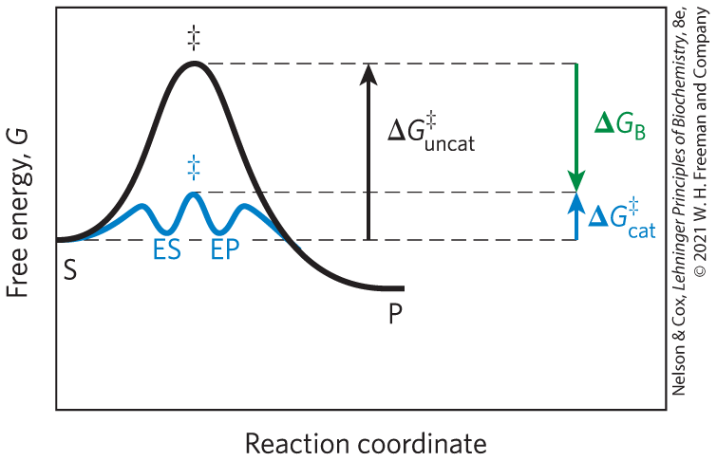
The Role of Binding Energy in Catalysis
the sum of the unfavorable activation energy ∆G‡ and the favorable binding energy ∆G_{B} results in a lower net activation energy
weak binding interactions between the enzyme and the substrate drive enzymatic catalysis

Slide 67
Clicker Question 13
Binding energy is defined as the:
A. energy derived from noncovalent enzyme-substrate
interaction.
B. energy derived from release of the product and release from
the EP interaction.
C. energy released from the conversion of ES to EP.
D. difference in the uncatalyzed activation energy and
catalyzed activation energy.
Notes:
Answer: A
Principle: 6.4
Learning Objective(s): Differentiate between the “lock and key” and “induced fit” models of enzyme-substrate interaction.
Bloom’s: 1:1

Slide 68
Clicker Question 13, Response
Binding energy is defined as:
A. the energy derived from noncovalent enzyme-substrate
interaction.
The energy derived from noncovalent enzyme-substrate interaction is called binding energy, ∆G_{B}. Binding energy is a major source of free energy used by enzymes to lower the activation energies of reactions.

Slide 69
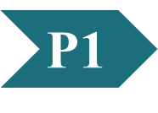
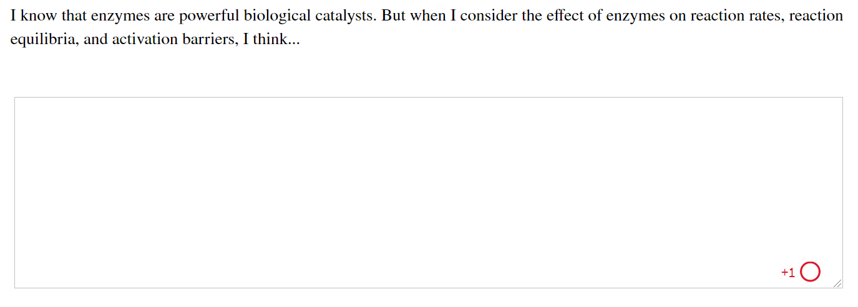
Activity: Enzyme
Catalysis Muddiest Point (1 of 2)
Complete the Ch6 Student Activity, Day 1: Enzyme Catalysis (Muddiest Point) Achieve assessment.
Notes:
Instructor: This muddiest point activity can be found in Achieve in the Chapter 6 folder titled “Ch6 In-Class Activities, Videos, and Resources.” See the Instructor Activity Guide in the same folder for more information.

Slide 70
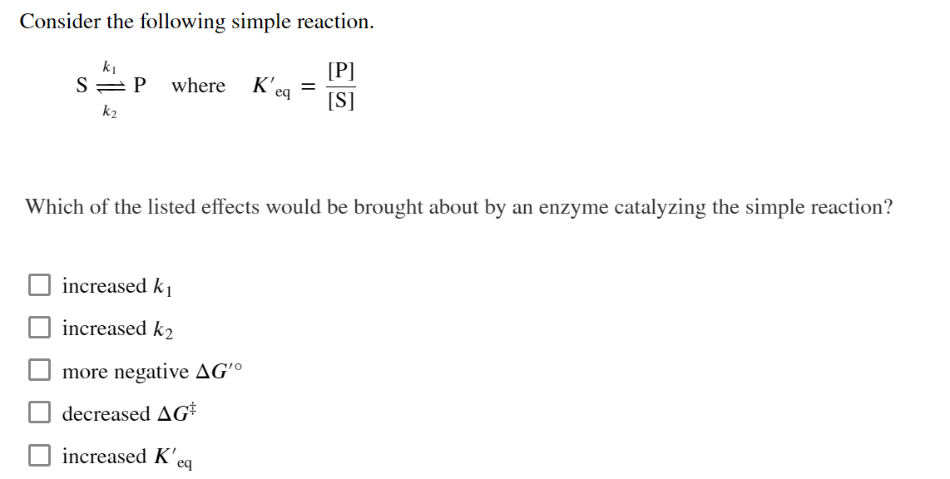
Activity: Enzyme
Catalysis Muddiest Point (2 of 2)
Complete the Ch6 Student Activity, Day 2: Enzyme Catalysis (Muddiest Point) Achieve assessment.
Notes:
Instructor: This muddiest point activity can be found in Achieve in the Chapter 6 folder titled “Ch6 In-Class Activities, Videos, and Resources.” See the Instructor Activity Guide in the same folder for more information.

Slide 71
Principle 3 (3 of 3)
Enzymatic reactions occur in specialized pockets called active sites. These pockets are similar to ligand binding sites, except that a reaction occurs there—the conversion of a substrate, a molecule that is acted on by an enzyme, to a product.

Slide 72
The Active Site of an Enzyme
optimized binding energy in the transition state is accomplished by positioning a substrate in a cavity (the active site), removed from H₂O

Slide 73
Principle 2 (3 of 3)
Enzymes exhibit a very high degree of specificity. Each enzyme catalyzes only one chemical reaction, or sometimes a few closely related reactions. Reaction activation barriers are thus lowered selectively.

Slide 74
Enzyme Specificity
specificity = ability to discriminate between a substrate and a competing molecule
  given by binding energy

Slide 75

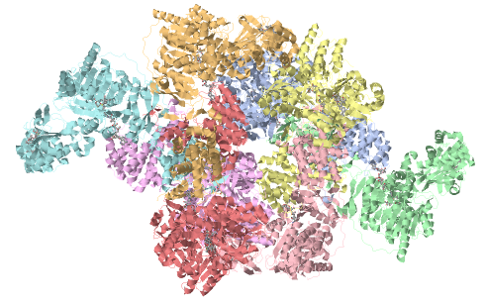
Activity: Visualizing
Ligand-Protein Interactions (1 of 2)
Observe the structure of ATP citrate lyase (ACLY) in Mol3D viewer in your Achieve course. ACLY is a lipogenic enzyme that converts citrate and coenzyme A into acetyl-CoA.
Notes:
Instructor: This Mol3D structure is located in the Achieve course. It can be found in the Chapter 6 content, in the folder titled “Ch6 In-Class Activities, Videos, and Resources.”

Slide 76
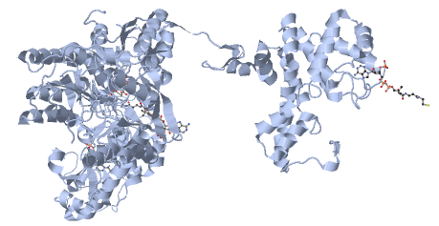
Activity: Visualizing
Ligand-Protein Interactions (2 of 2)
Then, zoom in on a single chain of the structure in Mol3D viewer in your Achieve course to observe the ligands in complex with ACLY.
Notes:
Instructor: This Mol3D structure is located in the Achieve course. It can be found in the Chapter 6 content, in the folder titled “Ch6 In-Class Activities, Videos, and Resources.”

Slide 77
Activity Instructions (1 of 3)
On your own, think of answers to the question:
  What ligands are bound to ACLY in this crystal structure?
(2 minutes)
Pair up to discuss your ideas. (2 minutes)
Share your ideas with the class in group discussion.
Notes:
Instructor: The Mol3D structures are located in the Achieve course. They can be found in the Chapter 6 content, in the folder titled “Ch6 In-Class Activities, Videos, and Resources.”

Slide 78
Activity Solution (1 of 3)
  What ligands are bound to ACLY in this crystal structure? coenzyme A, citrate, ADP, magnesium, phosphate
Notes:
Instructor: The Mol3D structures are located in the Achieve course. They can be found in the Chapter 6 content, in the folder titled “Ch6 In-Class Activities, Videos, and Resources.”

Slide 79
Binding Energy Overcomes the Barrier to Reaction
barrier to reaction, ∆G‡ includes:
  the entropy of molecules in solution
  the solvation shell of hydrogen-bonded water that surrounds and stabilizes most biomolecules in aqueous solution
  the distortion of substrates that must occur in many reactions
  the need for proper alignment of catalytic functional groups on the enzyme

Slide 80
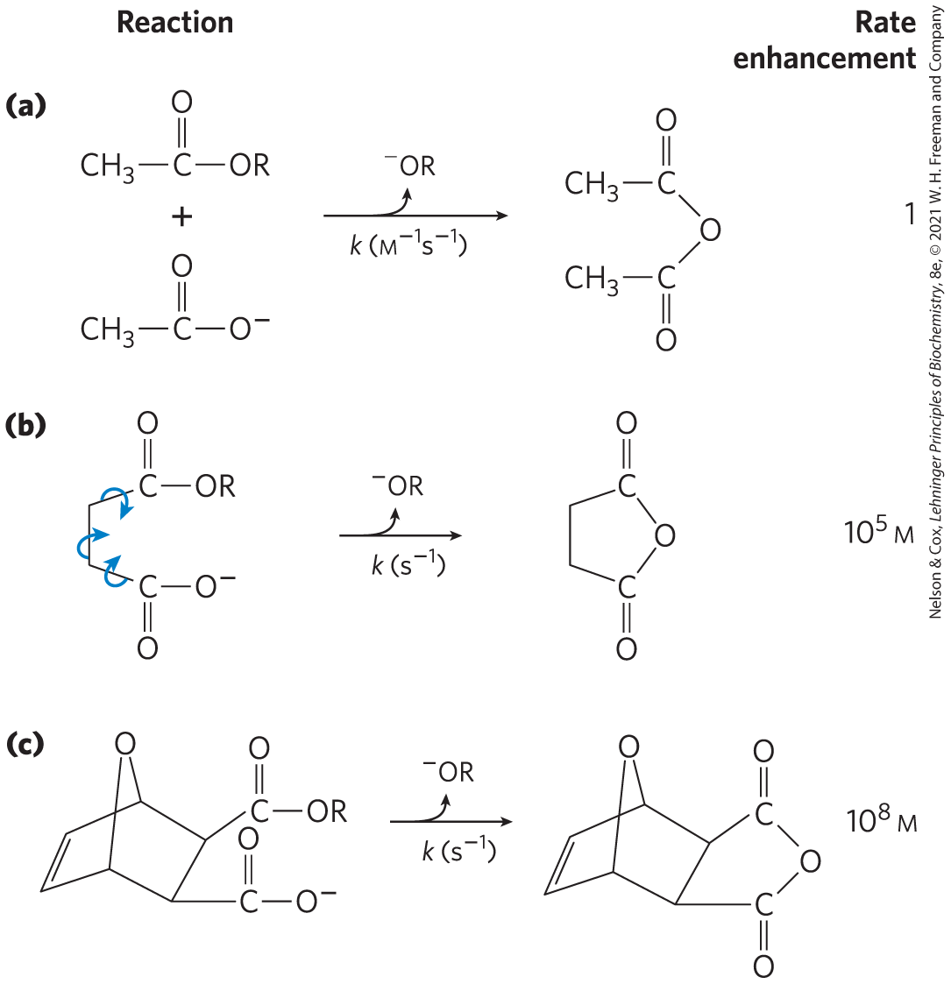
Rate Enhancement by Entropy Reduction
entropy reduction = large restriction in the relative motions of two substrates that are to react
binding energy constrains substrates in the proper orientation to reaction

Slide 81
Desolvation of the Substrate
desolvation = replacement of the solvation shell of structured water around the substrate with weak bonds between substrate and enzyme
  replaces most or all hydrogen bonds between the substrate and H₂O

Slide 82
Clicker Question 14
What is the primary source of the energy enzymes used to reduce activation energies?
A. desolvation of the substrate
B. kinetic energy from the transition state
C. noncovalent enzyme-substrate interaction
D. covalent enzyme-product interaction
Notes:
Answer: C
Principle: 6.2
Learning Objective(s): Explain how binding energy contributes to enzyme-mediated catalysis.
Bloom’s: 2:2

Slide 83
Clicker Question 14, Response
What is the primary source of the energy enzymes used to reduce activation energies?
C. noncovalent enzyme-substrate interaction
Weak binding interactions between the enzyme and the substrate provide a substantial driving force for enzymatic catalysis.

Slide 84
Distortion of the Substrate
substrate must undergo distortion (electron redistribution) to react
  causes an unfavorable free-energy change
binding energy compensates thermodynamically for this

Slide 85
The Induced Fix Mechanism
induced fit = mechanism by which the enzyme itself undergoes a conformational change when the substrate binds, induced by multiple weak interactions with the substrate
  enhances catalytic properties

Slide 86
Clicker Question 15
How does the induced fit mechanism of enzyme catalysis work?
A. The enzyme assumes a conformation identical to the
substrate.
B. The enzyme undergoes a conformational change to
maximize weak interactions to the substrate.
C. The substrate binds the active site of the enzyme.
D. The enzyme undergoes entropy reduction to accommodate
substrate.
Notes:
Answer: B
Principle: 6.2
Learning Objective(s): Differentiate between the “lock and key” and “induced fit” models of enzyme-substrate interaction.
Bloom’s: 2:2

Slide 87
Clicker Question 15, Response
How does the induced fit mechanism of enzyme catalysis work?
B. The enzyme undergoes a conformational change to
maximize weak interactions to the substrate.
The enzyme usually undergoes a change in conformation when the substrate binds, induced by multiple weak interactions with the substrate, a mechanism referred to as induced fit. Induced fit brings specific functional groups on the enzyme into the proper position to catalyze the reaction and permits formation of additional weak bonding interactions in the transition state.

Slide 88
Clicker Question 16
Which statement about enzymes is false?
A. They lower the activation energy of a reaction.
B. They alter the overall thermodynamics of a reaction.
C. A substantial amount of their catalytic power results from
binding of the substrate(s) through weak interactions.
D. They increase the rates of reactions by 10⁵-fold to 10¹⁷-fold.
Notes:
Answer: B
Principle: 6.1
Learning Objective(s): Explain how an enzyme affects the rate of a reaction.
Bloom’s: 2:2

Slide 89
Clicker Question 16, Response
Which statement about enzymes is false?
B. They alter the overall thermodynamics of a reaction.
Catalysts do not affect the overall thermodynamics of a reaction. Instead, catalysts increase the rate of the reaction.

Slide 90
Principle 4 (4 of 8)
Two concepts explain the catalytic power of enzymes. First, enzymes bind most tightly to the transition state of the catalyzed reaction, using binding energy to lower the activation barrier. Second, enzyme active sites are organized by evolution to facilitate multiple mechanisms of chemical catalysis simultaneously.

Slide 91
Covalent Interactions and Metal Ions Contribute to Catalysis
catalytic functional groups aid in the cleavage and formation of bonds by a variety of mechanisms:
  general acid-base catalysis
  covalent catalysis
  metal ion catalysis

Slide 92
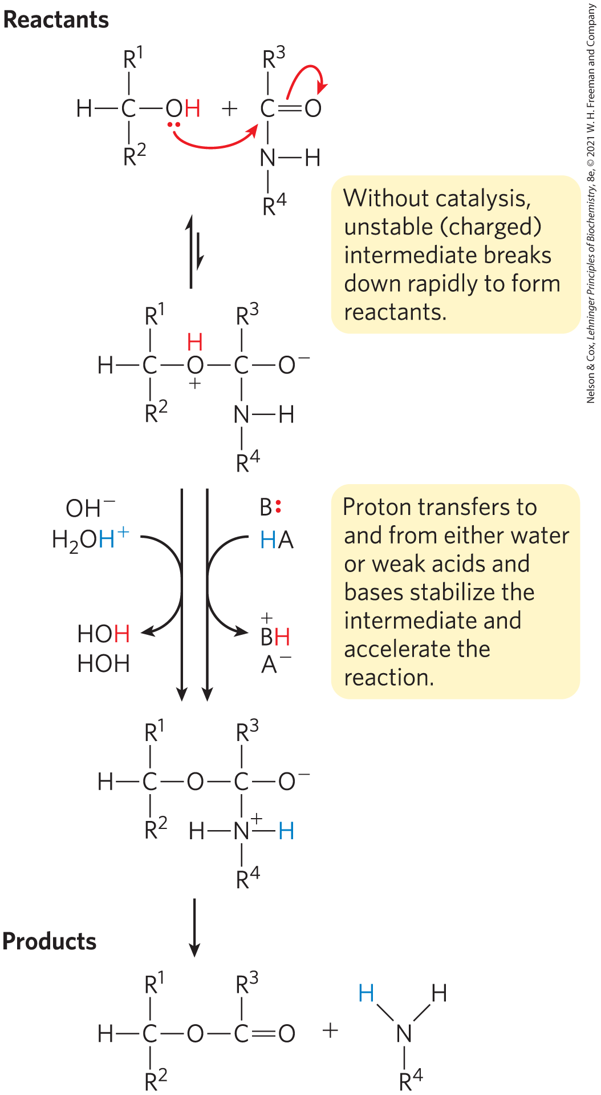
General Acid-Base Catalysis
protons are transferred between an enzyme and a substrate or intermediate
specific acid-base catalysis = uses only the H⁺ (H₃O⁺) or OH– ions present in water
general acid-base catalysis = mediated by weak acids or bases other than water

Slide 93
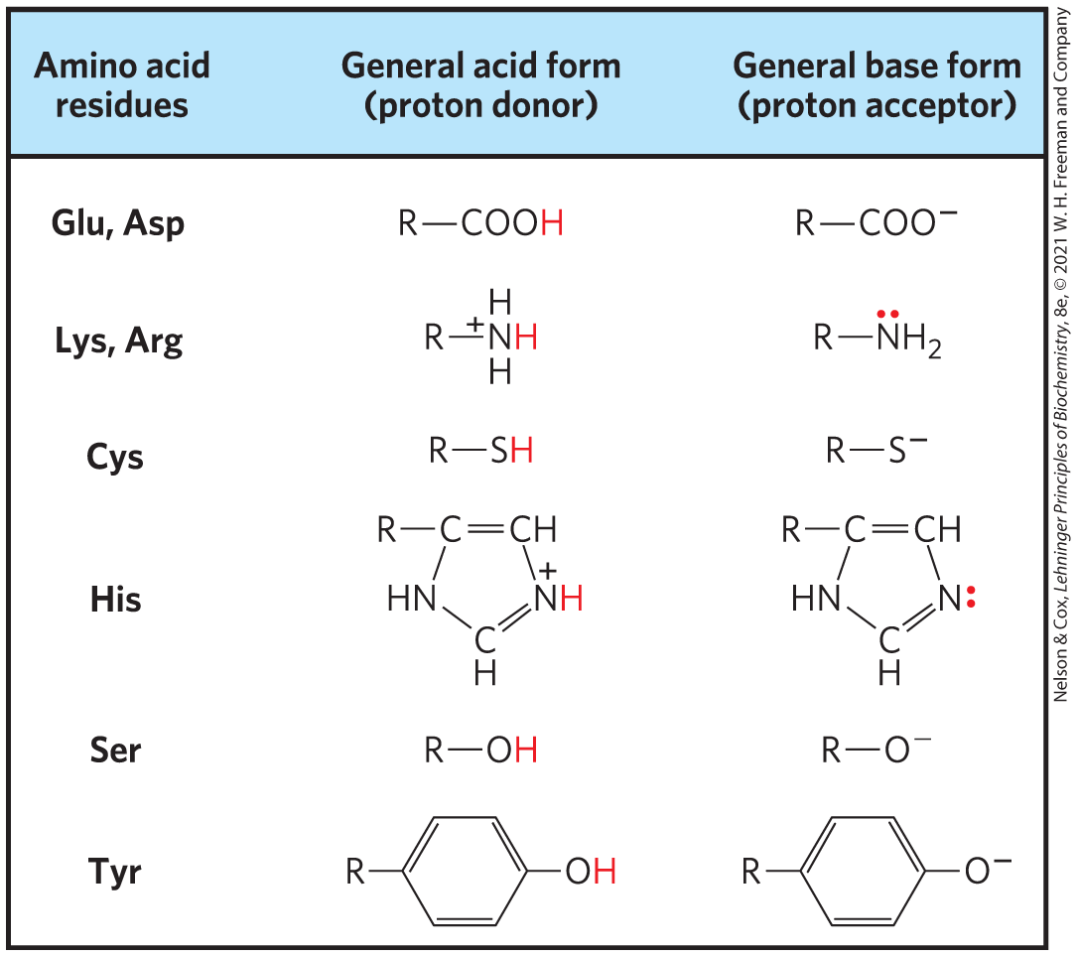
Amino Acids in General Acid-Base Catalysis
occurs in the vast majority of enzymes

Slide 94
Clicker Question 17
Which amino acid might be expected to have the LEAST effect on the function of an enzyme if it replaces a Glu residue in the enzyme?
A. Gly
B. Lys
C. His
D. Asp
Notes:
Answer: D
Principle: 6.4
Learning Objective(s): Determine which amino acids in an active site may participate in acid-base or covalent catalysis.
Bloom’s: 3:2

Slide 95
Clicker Question 17, Response
Which amino acid might be expected to have the LEAST effect on the function of an enzyme if it replaces a Glu residue in the enzyme?
D. Asp
Asp and Glu have similar general acid forms (R—COOH) and general base forms (R—COO–). Thus, replacing a Glu residue with an Asp residue would have a lesser effect on the function of the enzyme than a Gly, Lys, or His residue.

Slide 96
Covalent Catalysis
covalent catalysis = transient covalent bond forms between the enzyme and the substrate
  catalysis only results when the new pathway has a lower activation energy than the uncatalyzed pathway
  all new steps must be faster than the uncatalyzed reaction
hydrolysis of a bond:
hydrolysis of a bond between A and B in the presence of a covalent catalyst:

Slide 97
Clicker Question 18
Which statement is NOT associated with covalent catalysis by enzymes?
A. When the reaction is complete, the enzyme returns to its
original state.
B. It never involves coenzymes.
C. A transient covalent bond is formed between the enzyme
and the substrate.
D. A new pathway from substrate(s) to product(s) is formed
that is faster than the uncatalyzed reaction.
Notes:
Answer: B
Principle: 6.4
Learning Objective(s): Differentiate between acid-base, covalent, and metal ion catalysis.
Bloom’s: 2:2

Slide 98
Clicker Question 18, Response
Which statement is NOT associated with covalent catalysis by enzymes?
B. It never involves coenzymes.
Coenzymes can be involved in covalent catalysis. In covalent catalysis, a transient covalent bond is formed between the enzyme and the substrate. The covalent bond formed between the enzyme and the substrate can activate a substrate for further reaction in a manner that is usually specific to the particular group or coenzyme.

Slide 99
Metal Ion Catalysis
metals:
  help orient the substrate for reaction
  stabilize charged reaction transition states
  mediate oxidation-reduction reactions by reversible changes in the metal ion’s oxidation state
nearly 1/3 of all known enzymes require 1+ metal ions for catalytic activity

Slide 100
Clicker Question 19
An enzyme accepts H⁺ from hydronium and transfers it to an amine group of the substrate. The result is an increase in the rate of release of the product. This is an example of:
A. metal ion catalysis.
B. general acid catalysis.
C. covalent catalysis.
D. specific acid catalysis.
Notes:
Answer: B
Principle: 6.4
Learning Objective(s): Differentiate between acid-base, covalent, and metal ion catalysis.
Bloom’s: 3:1

Slide 101
Clicker Question 19, Response
An enzyme accepts H⁺ from hydronium and transfers it to an amine group of the substrate. The result is an increase in the rate of release of the product. This is an example of:
B. general acid catalysis.
General acid-base catalysis refers to proton transfers mediated by weak acids and bases other than water. Thus, an enzyme-mediated transfer of a H⁺ from hydronium to an amine group of a substrate is an example of general acid catalysis.

Slide 102
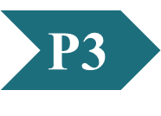
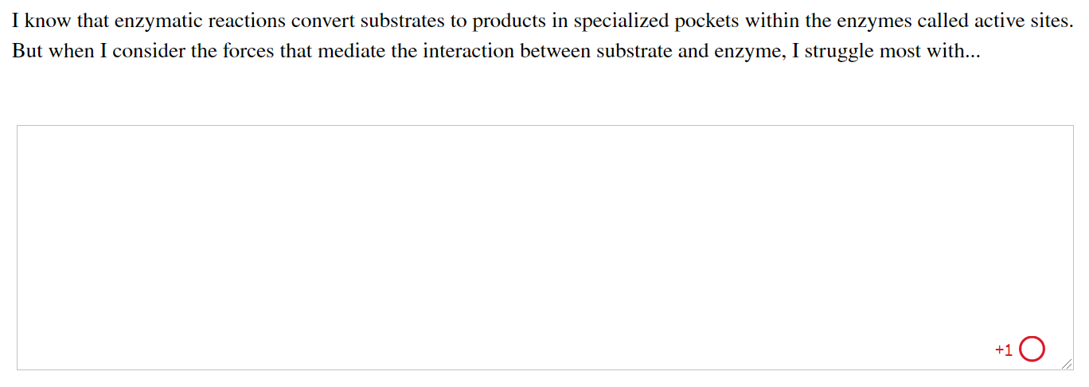
Activity: Active
Sites Muddiest Point (1 of 2)
Complete the Ch6: Student Activity, Day 1: Active Sites (Muddiest Point) Achieve assessment.
Notes:
Instructor: This muddiest point activity can be found in Achieve in the Chapter 6 folder titled “Ch6 In-Class Activities, Videos, and Resources.” See the Instructor Activity Guide in the same folder for more information.

Slide 103
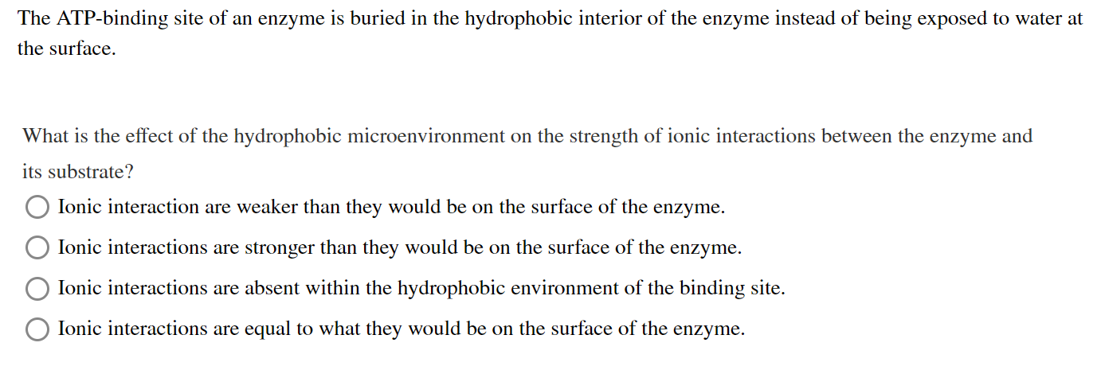
Activity: Active
Sites Muddiest Point (2 of 2)
Complete the Ch6: Student Activity, Day 2: Active Sites (Muddiest Point) Achieve assessment.
Notes:
Instructor: This muddiest point activity can be found in Achieve in the Chapter 6 folder titled “Ch6 In-Class Activities, Videos, and Resources.” See the Instructor Activity Guide in the same folder for more information.

Slide 104
6.3 Enzyme Kinetics as an Approach to Understanding Mechanism

Slide 105
Enzyme Kinetics
enzyme kinetics = the discipline focused on determining the rate of a reaction and how it changes in response to changes in experimental parameters

Slide 106
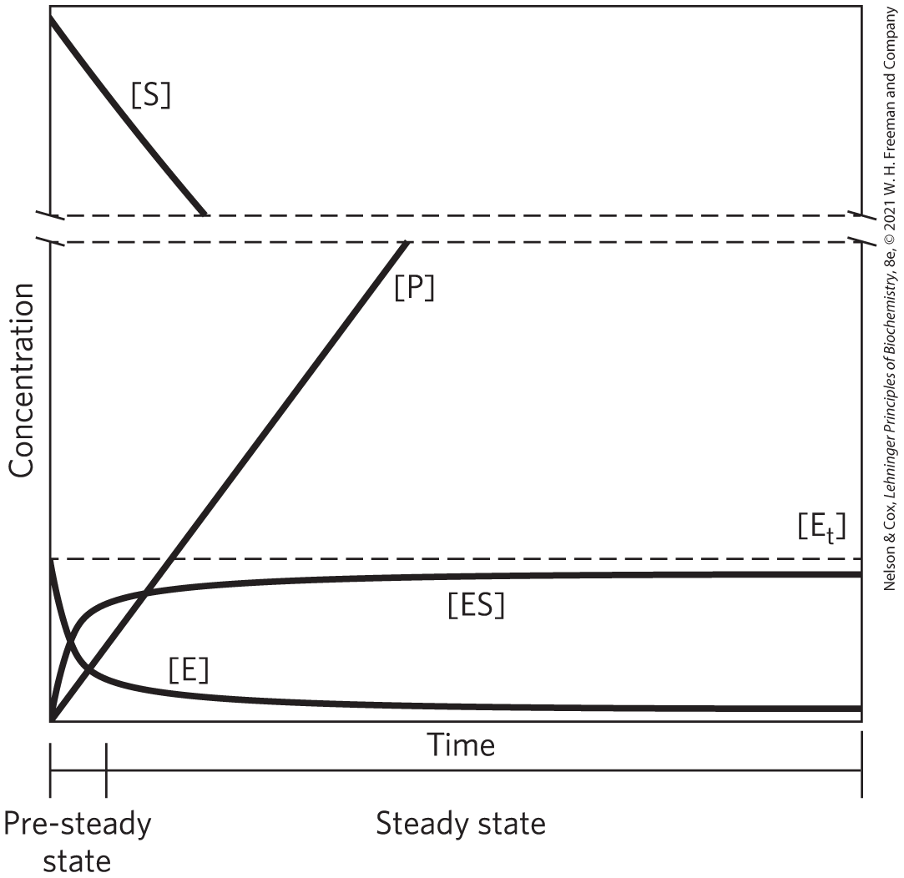
Substrate Concentration Affects the Rate of Enzyme-Catalyzed Reactions
pre–steady state = initial transient period during which ES builds up
steady state = period during which [ES] and other intermediates remain constant
steady-state kinetics = the traditional analysis of reaction rates

Slide 107
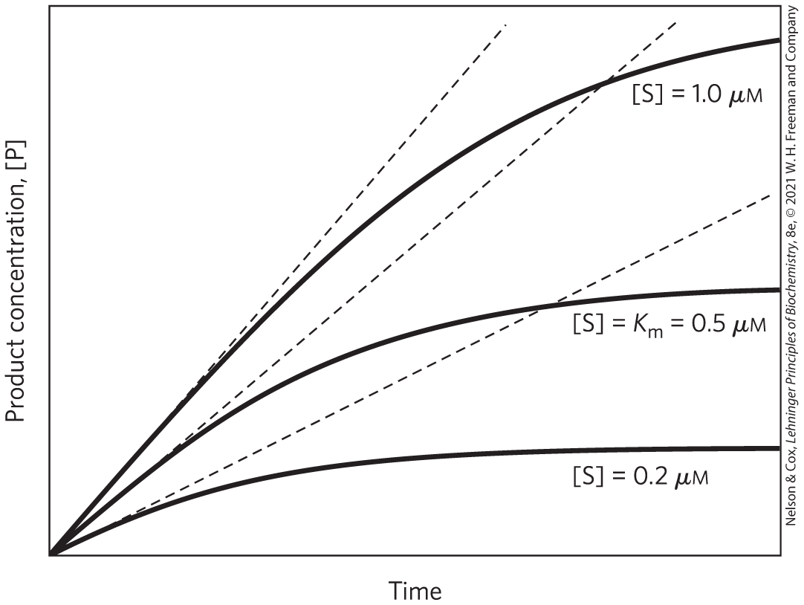
Initial Velocities of Enzyme-Catalyzed Reactions
initial rate (initial velocity), V₀ = tangent to each curve taken at time = 0
  reflects a steady state
at the beginning of the reaction, [S] is regarded as constant

Slide 108
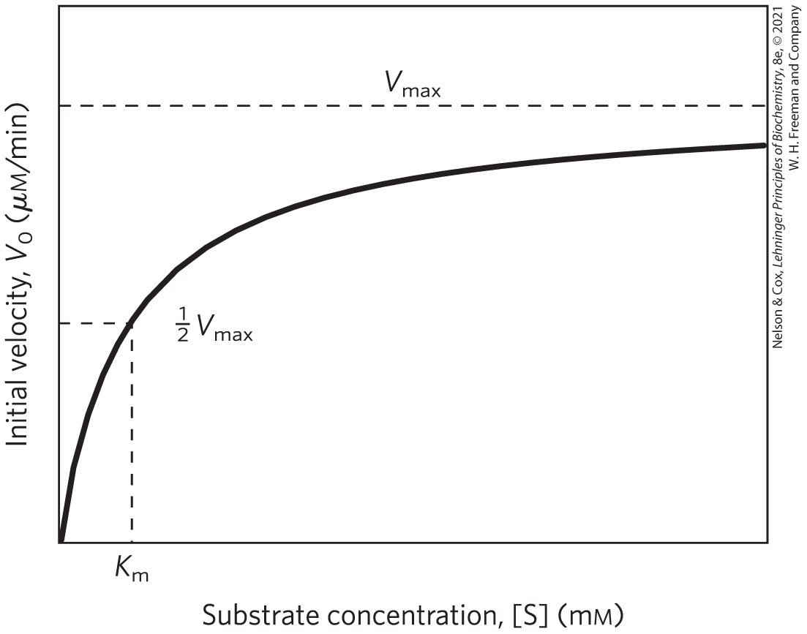
Effect of [S] on the V₀ of an
Enzyme-Catalyzed Reaction
the plateau-like V₀ region is close to the maximum velocity, V_{max}

Slide 109
Clicker Question 20
After you mix a substrate and enzyme together, there is an
initial transient period, the pre–steady state. What happens during the pre–steady state?
A. [E_{t}] decreases until it reaches a constant level.
B. [S] decreases until it reaches a constant level.
C. [P] increases until it reaches a constant level.
D. [ES] increases until it reaches a constant level.
Notes:
Answer: D
Principle: 6.4
Learning Objective(s): Differentiate between pre–steady state and steady state reaction conditions.
Bloom’s: 2:2

Slide 110
Clicker Question 20, Response
After you mix a substrate and enzyme together, there is an
initial transient period, the pre–steady state. What happens during the pre–steady state?
D. [ES] increases until it reaches a constant level.
When the enzyme is first mixed with a large excess of substrate, there is an initial transient period, the pre–steady state, during which the concentration of ES builds up until it reaches a constant level.

Slide 111
General Theory of Enzyme Action Proposed by Michaelis and Menten
step 1 – enzyme and substrate combine to form a complex in a reversible, relatively fast step:
(6-7)
step 2 – the complex breaks down to yield the free enzyme and the reaction product in a slower step:
(6-8)
because the second step limits the overall reaction rate, the overall rate is proportional to [ES]

Slide 112
The Saturation Effect
V_{max} is observed when virtually all the enzyme is present as the ES complex
  further increases in [S] have no effect on rate
  responsible for the plateau observed

Slide 113
Clicker Question 21
Which statement is false about the saturation effect?
The maximum initial rate of the catalyzed reaction is
observed.
B. Virtually all of the enzyme is present as the ES complex.
C. It is responsible for the linear increase of V₀ with an
increase in [S].
D. Further increases in [S] have no effect on rate.
Notes:
Answer: C
Principle: 6.4
Learning Objective(s): Differentiate between the initial velocity V₀ and maximum velocity V_{max}.
Bloom’s: 2:2

Slide 114
Clicker Question 21, Response
Which statement is false about the saturation effect?
C. It is responsible for the linear increase of V₀ with an
increase in [S].
The saturation effect is a
distinguishing characteristic
of enzymatic catalysts and is
responsible for the plateau
observed in the figure.

Slide 115
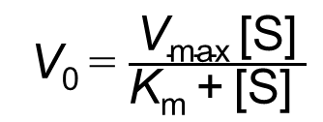
The Relationship between Substrate Concentration and Reaction Rate Can Be Expressed with the Michaelis-Menten Equation
the curve expressing the relationship between [S] and V₀ can be expressed by the Michaelis-Menten equation:
V₀ = $\frac{\text{V}\text{max} \text{[}\text{S}\text{]}}{\text{K}\text{m} \text{+} \text{[}\text{S}\text{] }}$
(6-9)
where V₀ is the initial velocity, V_{max} is the maximum velocity, [S] is the initial substrate concentration, and K_{m} is a constant called the Michaelis constant

Slide 116
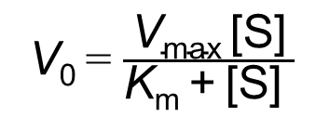
The Michaelis-Menten Equation
the Michaelis-Menten equation is the rate equation for a one-substrate enzyme-catalyzed reaction:
V₀ = $\frac{\text{V}\text{max}\text{ [}\text{S}\text{]}}{\text{K}\text{m}\text{ + [}\text{S}\text{] }}$
(6-9)
V₀, V_{max}, [S], and K_{m} are readily measured experimentally

Slide 117
Deriving the Michaelis-Menten Equation
the overall reaction for the formation and breakdown of ES simplifies to
(6-10)
V₀ is determined by the breakdown of ES to form product, which is determined by [ES]:
V₀ = k₂[ES]
(6-11)

Slide 118
Deriving the Michaelis-Menten Equation, [E_{t}]
[ES] is not easily measured experimentally
[E_{t}] = the total enzyme concentration (the sum of free and substrate-bound enzyme)
free or unbound enzyme [E] = [E_{t}] – [ES]
because [S] >> [E_{t}], the amount of substrate bound by the enzyme at any given time is negligible compared with the total [S]

Slide 119
Clicker Question 22
For a specific enzyme/substrate system, which condition will ALWAYS result in an increase in V₀ (assuming nothing else changes)?
A. a decrease in K_{m} and an increase in V_{max}
B. an increase in pH
C. an increase in [S]
D. a decrease in [E_{t}]
Notes:
Answer: A
Principle: 6.4
Learning Objective(s): Relate V₀, V_{max}, [S], and K_{m} using the Michaelis-Menten equation.
Bloom’s: 3:2

Slide 120
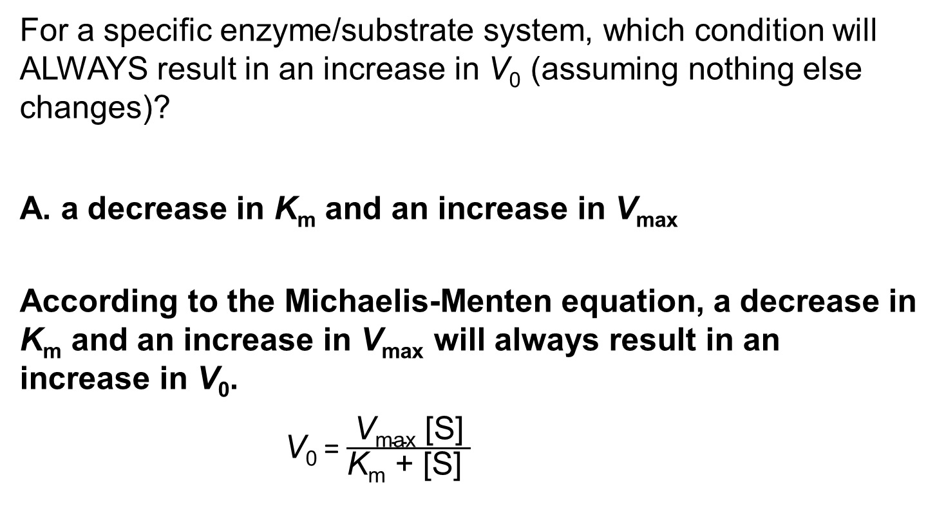
Clicker Question 22, Response
For a specific enzyme/substrate system, which condition will ALWAYS result in an increase in V₀ (assuming nothing else changes)?
A. a decrease in K_{m} and an increase in V_{max}
According to the Michaelis-Menten equation, a decrease in K_{m} and an increase in V_{max} will always result in an increase in V₀.
V₀ = $\frac{\text{V}\text{max}\text{ [}\text{S}\text{]}}{\text{K}\text{m}\text{ + [}\text{S}\text{] }}$

Slide 121
Deriving the Michaelis-Menten Equation, Step 1
rate of ES formation = k₁([E_{t}] – [ES])[S]
rate of ES breakdown = k_{–1}[ES] + k₂[ES]
(6-12)
(6-13)

Slide 122
Deriving the Michaelis-Menten Equation, Step 2
steady-state assumption = the rate of formation of ES is equal to the rate of its breakdown
when equated for the steady state:
k₁([E_{t}] – [ES])[S] = k_{–1} [ES] + k₂[ES]
(6-14)

Slide 123
Clicker Question 23
In deriving the Michaelis-Menten equation, what is the steady-state assumption?
A. [P] is negligible and k_{–2} can be ignored.
B. The rate of formation of ES is equal to the rate of its
breakdown.
C. The amount of substrate bound by the enzyme at any given
time is negligible compared with the total [S].
D. The reaction is a one-substrate enzyme-catalyzed reaction.
Notes:
Answer: B
Principle: 6.4
Learning Objective(s): Describe the steady-state assumption.
Bloom’s: 2:1

Slide 124
Clicker Question 23, Response
In deriving the Michaelis-Menten equation, what is the steady-state assumption?
B. The rate of formation of ES is equal to the rate of its
breakdown.
The steady-state assumption is the assumption that the initial rate of reaction reflects a steady state in which [ES] is constant—that is, the rate of formation of ES is equal to the rate of its breakdown.

Slide 125
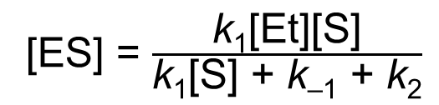
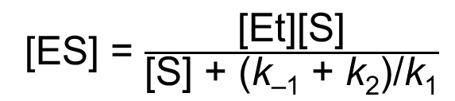
Deriving the Michaelis-Menten Equation, Step 3
solving for [ES]:
k₁[E_{t}][S] – k₁[ES][S] = (k_{–1} + k₂)[ES]
(6-15)
k₁[E_{t}][S] = (k₁[S] + k_{–1} + k₂)[ES]
(6-16)
[ES] = $\frac{\text{k}\text{1}\text{[}\text{Et}\text{][}\text{S}\text{]}}{\text{k}\text{1}\text{[}\text{S}\text{] + }\text{k}\text{–1} \text{+} \text{k}\text{2}}$
(6-17)
[ES] = $\frac{\text{[}\text{Et}\text{][}\text{S}\text{]}}{\text{[}\text{S}\text{] + (}\text{k}\text{–1} \text{+} \text{k}\text{2}\text{)/}\text{k}\text{1}}$
(6-18)

Slide 126
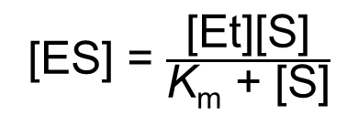
Deriving the Michaelis-Menten Equation, K_{m}
the Michaelis constant, K_{m} = (k_{–1} + k₂)/ k₁
substituting K_{m} into the equation:
[ES] = $\frac{\text{[}\text{Et}\text{][}\text{S}\text{]}}{\text{K}\text{m}\text{ + [}\text{S}\text{]}}$
(6-19)

Slide 127
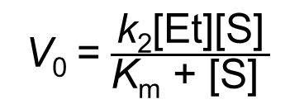
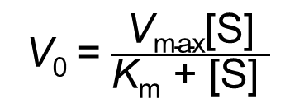
Deriving the Michaelis-Menten Equation, Step 4
expressing V₀ in terms of [ES]:
V₀ = k₂[ES]
(6-11)
V₀ = $\frac{\text{k}\text{2}\text{[}\text{Et}\text{][}\text{S}\text{]}}{\text{K}\text{m}\text{ + [}\text{S}\text{]} }$
(6-20)
given V_{max} occurs when the enzyme is saturated (when [ES] = [E_{t}]), V_{max} = k₂[E_{t}]:
V₀ = $\frac{\text{V}\text{max}\text{[}\text{S}\text{]}}{\text{K}\text{m}\text{ + [}\text{S}\text{]} }$
(6-9)

Slide 128
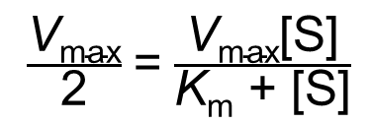
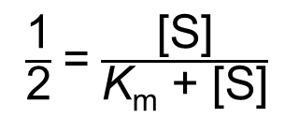
K_{m} = [S], When V₀ = ½V_{max}
when V₀ = ½V_{max}:
$\frac{\text{V}\text{max}}{\text{2}}$ = $\frac{\text{V}\text{max}\text{[}\text{S}\text{]}}{\text{K}\text{m}\text{ + [}\text{S}\text{]}}$
(6-21)
$\frac{\text{1}}{\text{2}}$ = $\frac{\text{[}\text{S}\text{]}}{\text{K}\text{m}\text{ + [}\text{S}\text{]}}$
(6-22)
solving for K_{m}:
K_{m} = [S] when V₀ = ½V_{max}
(6-23)

Slide 129
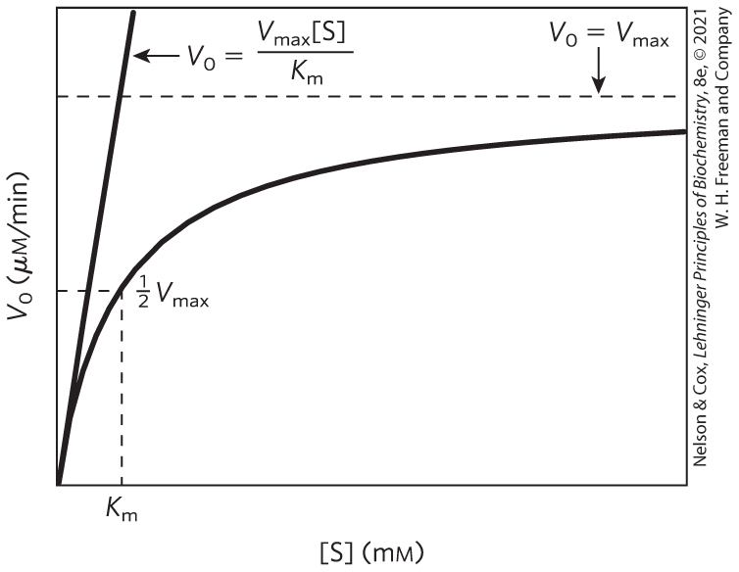
Dependence of V₀ on [S]

Slide 130
Clicker Question 24
What is the definition of K_{m}, the Michaelis constant?
A. the rate at which enzyme is turning substrate into product at
½V_{max}
B. the V₀ at ½ maximal [S]
C. the number of molecules of substrate converted to product
per second
D. the concentration of substrate at which the enzyme is
operating at half its maximal velocity
Notes:
Answer: D
Principle: 6.4
Learning Objective(s): Relate V₀, V_{max}, [S], and K_{m} using the Michaelis-Menten equation.
Bloom’s: 2:2

Slide 131
Clicker Question 24, Response
What is the definition of K_{m}, the Michaelis constant?
D. the concentration of substrate at which the enzyme is
operating at half its maximal velocity
A very useful, practical definition of K_{m} is that K_{m} is equivalent to the substrate concentration at which V₀ is one-half V_{max}.

Slide 132
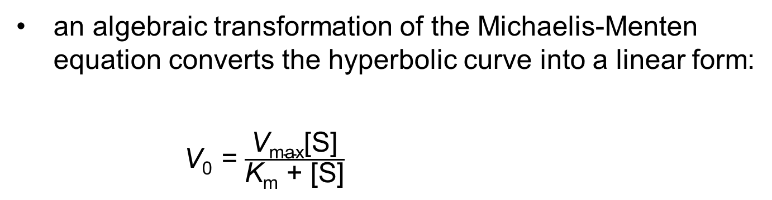
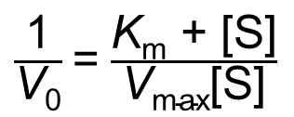
Michaelis-Menten Kinetics Can Be Analyzed Quantitatively
an algebraic transformation of the Michaelis-Menten equation converts the hyperbolic curve into a linear form:
V₀ = $\frac{\text{V}\text{max}\text{[}\text{S}\text{]}}{\text{K}\text{m}\text{ + [}\text{S}\text{]}}$
$\frac{\text{1}}{\text{V}\text{0}}$ = $\frac{\text{K}\text{m}\text{ + [}\text{S}\text{]}}{\text{V}\text{max}\text{[}\text{S}\text{]}}$
(6-24)

Slide 133
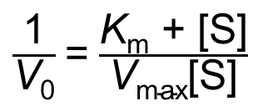
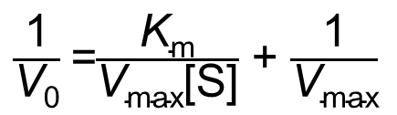
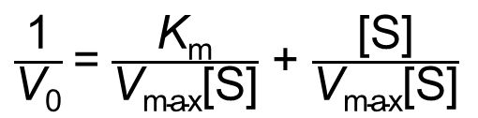
Deriving the Lineweaver-Burk Equation
simplifying this equation gives the Lineweaver-Burk equation:
$\frac{\text{1}}{\text{V}\text{0}}$ = $\frac{\text{K}\text{m}\text{ + [}\text{S}\text{]}}{\text{V}\text{max}\text{[}\text{S}\text{]}}$
(6-24)
$\frac{\text{1}}{\text{V}\text{0}}$ = $\frac{\text{K}\text{m}}{\text{V}\text{max}\text{[}\text{S}\text{]}}$ + $\frac{\text{[}\text{S}\text{]}}{\text{V}\text{max}\text{[}\text{S}\text{]}}$
(6-25)
$\frac{\text{1}}{\text{V}\text{0}}$ =$\frac{\text{K}\text{m}}{\text{V}\text{max}\text{[}\text{S}\text{]}}$ + $\frac{\text{1}}{\text{V}\text{max}}$
(6-26)

Slide 134
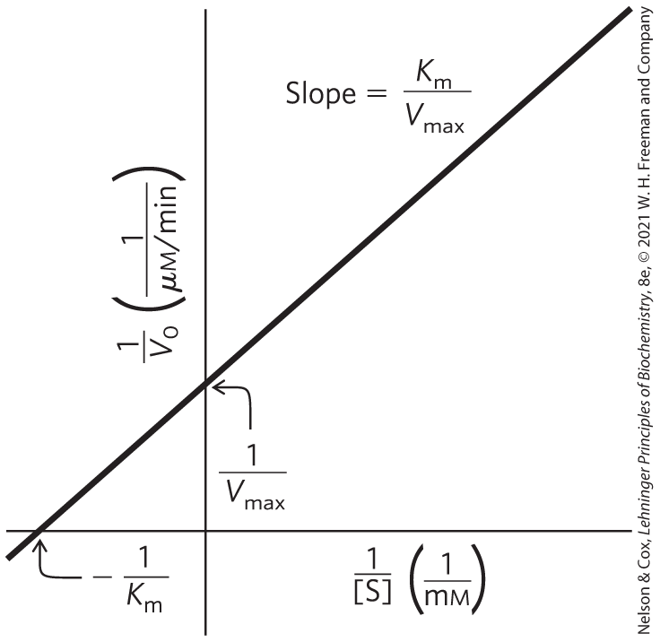
A Double-Reciprocal, or Lineweaver-Burk, Plot
for enzymes obeying the Michaelis-Menten relationship, a plot of 1/V₀ versus 1/[S] yields a straight line

Slide 135
Clicker Question 25
The K_{m} on a Lineweaver-Burk plot is:
A. equal to the y intercept.
B. equal to the slope of the line.
C. the reciprocal of the y intercept.
D. the negative reciprocal of the x intercept.
Notes:
Answer: D
Principle: 6.4
Learning Objective(s): Relate V_{max} and K_{m} using Lineweaver-Burk plot.
Bloom’s: 2:2

Slide 136
Clicker Question 25, Response
The K_{m} on a Lineweaver-Burk plot is:
D. the negative reciprocal of the x intercept.
The K_{m} on a Lineweaver-Burk
plot is the negative reciprocal
of the x intercept.

Slide 137
Kinetic Parameters Are Used to Compare Enzyme Activities
all enzymes that exhibit a hyperbolic dependence of V₀ on [S] follow Michaelis-Menten kinetics where:
K_{m} = [S] when V₀ = ½V_{max}
(6-23)

Slide 138
Interpreting K_{m} and V_{max}
K_{m} can vary for different substrates of the same enzyme
Table 6-6 K_{m} for Some Enzymes and Substrates
Enzyme | Substrate | K_{m} (mM)
Hexokinase (brain) | ATP D-Glucose D-Fructose | 0.4 0.05 1.5
Carbonic anhydrase | HCO₃– | 26
Chymotrypsin | Glycyltyrosinylglycine N-Benzoyltyrosinamide | 108 2.5
β-Galactosidase | D-Lactose | 4.0
Threonine dehydratase | L-Threonine | 5.0

Slide 139
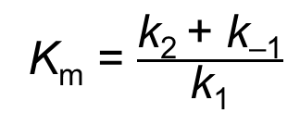
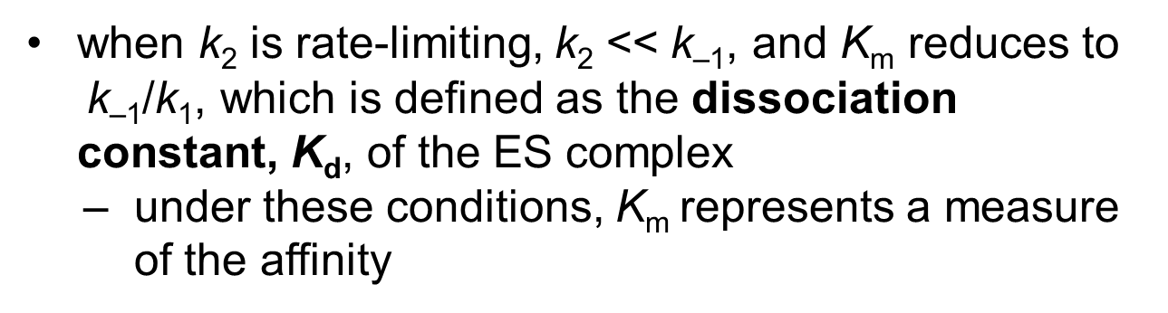
The Dissociation Constant, K_{d}
for reactions with two steps:
K_{m} = $\frac{\text{k}\text{2 }\text{+} \text{k}\text{–1}}{\text{k}\text{1}}$
(6-27)
when $\text{k}\text{2}$is rate-limiting, k₂ << $\text{k}\text{–1}\text{, }\text{and}$K_{m} reduces to $\text{k}\text{–1}\text{/}\text{k}\text{1}\text{,}$ which is defined as the dissociation constant, K_{d}, of the ES complex
under these conditions, K_{m} represents a measure of the affinity

Slide 140
Clicker Question 26
In drug design, a drug’s affinity for a selected target, such as an enzyme, is an important factor in assessing a drug’s potential. The higher the affinity, the better the candidate. Under conditions where K_{d} measures affinity, which drug would be the BEST candidate?
Drug A: 10^{–4} Drug C: 10^{–8}
Drug B: 10^{–6} Drug D: 10^{–10}
A. drug A
B. drug B
C. drug C
D. drug D
Notes:
Answer: D
Principle: 6.4
Learning Objective(s): Differentiate between the Michaelis constant and dissociation constant for an enzyme and substrate pair.
Bloom’s: 3:2

Slide 141
Clicker Question 26, Response
In drug design, a drug’s affinity for a selected target, such as an enzyme, is an important factor in assessing a drug’s potential. The higher the affinity, the better the candidate. Under conditions where K_{d} measures affinity, which drug would be the BEST candidate?
Drug A: 10^{–4} Drug C: 10^{–8}
Drug B: 10^{–6} Drug D: 10^{–10}
D. drug D
Lower dissociation constants (K_{d}) mean higher affinities. Thus, drug D would be the best drug candidate.

Slide 142
Interpreting V_{max}
the number of reactions steps and the identity of the rate-limiting step(s) varies from enzyme to enzyme
for a two-step Michaelis-Menten mechanism,
V_{max} = k₂[E_{t}]
when product release, EP → E + P, is rate-limiting:
(6-28)

Slide 143
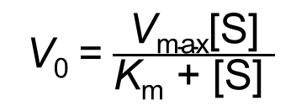
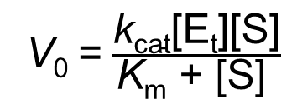
The General Rate Constant, k_{cat}
general rate constant, k_{cat} = describes the limiting rate of any enzyme-catalyzed reaction at saturation
  if one step in a multistep reaction is clearly limiting, k_{cat} equals the rate constant for the step
  more complex when several steps are rate-limiting
in the Michaelis-Menten equation, k_{cat} = V_{max}/[E_{t}]:
V₀ = $\frac{\text{V}\text{max}\text{[}\text{S}\text{]}}{\text{K}\text{m}\text{ + [}\text{S}\text{]} }$
(6-9)
V₀ = $\frac{\text{k}\text{cat}\text{[}\text{Et}\text{][}\text{S}\text{]}}{\text{K}\text{m}\text{ + [}\text{S}\text{]} }$
(6-29)

Slide 144
The Constant k_{cat} Is a First-Order Rate Constant
k_{cat} = turnover number = the number of substrate molecules converted to product in a given unit of time on a single enzyme molecule when the enzyme is saturated
Table 6-7 Turnover Number, k_{cat}, of Some Enzymes
Enzyme | Substrate | k_{cat} (s^{–1})
Catalase | H₂O₂ | 40,000,000
Carbonic anhydrase | HCO₃– | 400,000
Acetylcholinesterase | Acetylcholine | 14,000
β-Lactamase | Benzylpenicillin | 2,000
Fumarase | Fumarate | 800
RecA protein (an ATPase) | ATP | 0.5

Slide 145
Clicker Question 27
The rate-limiting step of an enzyme-catalyzed reaction:
A. is always the last step.
B. has a rate constant equal to k_{cat}.
C. is always the fastest step.
D. is always slower than the rate of diffusion of the substrate to
the active site.
Notes:
Answer: B
Principle: 6.4
Learning Objective(s): Describe the rate-limiting step of an enzyme-catalyzed reaction.
Bloom’s: 2:2

Slide 146
Clicker Question 27, Response
The rate-limiting step of an enzyme-catalyzed reaction:
B. has a rate constant equal to k_{cat}.
The general rate constant, k_{cat}, describes the limiting rate of any enzyme-catalyzed reaction at saturation.

Slide 147
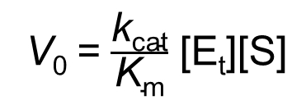
Comparing Catalytic Mechanisms and Efficiencies
comparing the ratio k_{cat}/k_{m} for two reactions is the best way to compare catalytic efficiencies or turnover
specificity constant = the rate constant for the conversion of E + S to E + P
when [S] << k_{m}:
V₀ = $\frac{\text{k}\text{cat}}{\text{K}\text{m}}$ $\text{[}\text{Et}\text{][}\text{S}\text{]}$
(6-30)

Slide 148
The Constant k_{cat}/K_{m} Is a Second-Order Rate Constant
k_{cat}/K_{m} has units of M^{–1}s^{–1} with an upper limit of 10⁸ to 10⁹ M^{–1}s^{–1}
Table 6-8 Enzymes for Which k_{cat}/K_{m} Is Close to the Diffusion-Controlled Limit (10⁸ to 10⁹ M^{–1}s^{–1})
Enzyme | Substrate | k_{cat} (s^{–1}) | K_{m} (M) | k_{cat}/K_{m} (M^{–1}s^{–1})
Acetylcholinesterase | Acetylcholine | 1.4×10⁴ | 9×10^{–5} | 1.6×10⁸
Carbonic anhydrase | CO₂ HCO₃– | 1×10⁶ 4×10⁵ | 1.2×10^{–2} 2.6×10^{–2} | 8.3×10⁷ 1.5×10⁷
Catalase | H₂O₂ | 4×10⁷ | 1.1×10⁰ | 4×10⁷
Crotonase | Crotonyl-CoA | 5.7×10³ | 2×10^{–5} | 2.8×10⁸
Fumarase | Fumarate Malate | 8×10² 9×10² | 5×10^{–6} 2.5×10^{–5} | 1.6×10⁸ 3.6×10⁷
β-Lactamase | Benzylpenicillin | 2.0×10³ | 2×10^{–5} | 1×10⁸
Notes:
Note on Table 6-8: Information from A. Fersht, Structure and Mechanism in Protein Science, p. 166, W. H. Freeman and Company, 1999.

Slide 149
Many Enzymes Catalyze Reactions with Two or More Substrates
nearly 2/3 of all enzymatic reactions have 2 substrates and 2 products
example types of reactions:
  a group is transferred from one substrate to the other
  one substrate is oxidized while the other is reduced

Slide 150
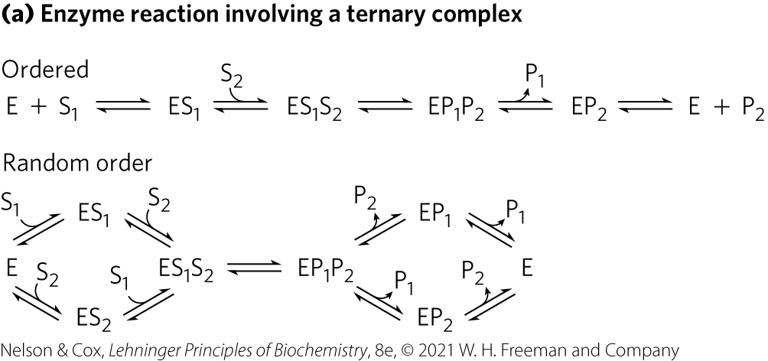
Some Enzyme Reactions Involve a Ternary Complex
substrates can bind in a random sequence or in a specific order

Slide 151
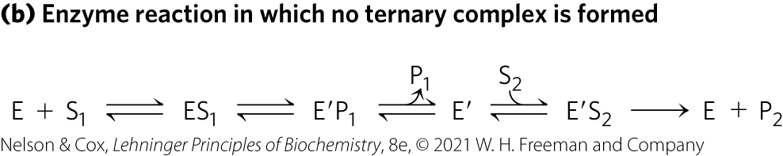
Some Enzyme Reactions Do Not Form a Ternary Complex
the first substrate is converted to product and dissociates before the second substrate binds
  example: Ping-Pong, or double-displacement, mechanism

Slide 152
Clicker Question 28
In enzyme kinetics, what characterizes a Ping-Pong pathway?
A. The pathway involves two substrates and two products.
B. The enzyme and both substrates form a ternary complex.
C. The enzyme reacts with one substrate, then the other
substrate, but does not form a ternary complex.
D. The two substrates bind to the enzyme in a random order.
Notes:
Answer: C
Principle: 6.4
Learning Objective(s): Identify common mechanisms for bisubstrate reactions.
Bloom’s: 2:2

Slide 153
Clicker Question 28, Response
In enzyme kinetics, what characterizes a Ping-Pong pathway?
C. The enzyme reacts with one substrate, then the other
substrate, but does not form a ternary complex.
In the Ping-Pong, or double-displacement, mechanism, the first substrate is converted to product and dissociates before the second substrate binds, so no ternary complex is formed.

Slide 154
Cleland Nomenclature
Cleland nomenclature = shorthand notation for describing reactions with multiple substrates and products
  substrates = A, B, C, and D, in the order in which they bind to the enzyme
  products = P, Q, S, and T, in the order in which they dissociate
  one, two, three, or four substrates = uni, bi, ter, and quad, respectively
  the enzyme = E, but if modified during the reaction, successive forms = F, G, and so on

Slide 155
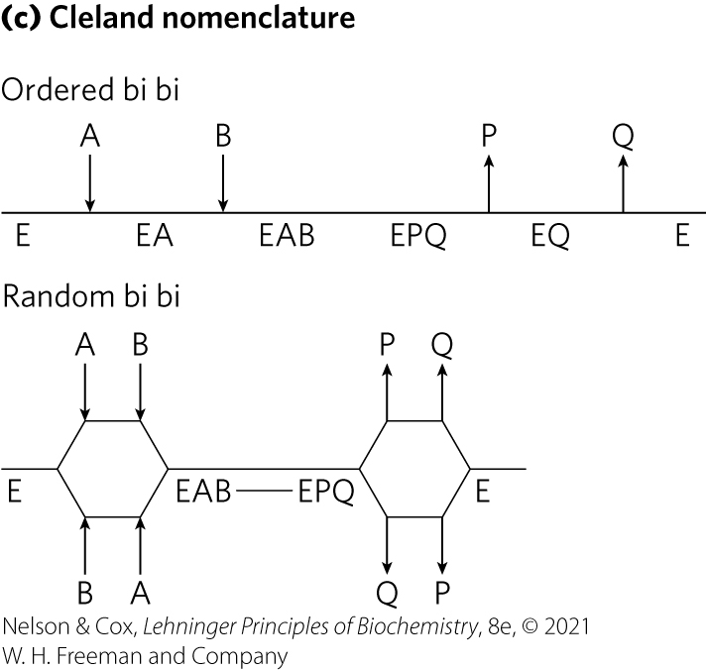
Cleland Nomenclature for a Bi Bi Reaction

Slide 156

Cleland Nomenclature for a Ping-Pong Reaction

Slide 157
Clicker Question 29
Which statement is false regarding Cleland nomenclature?
The progress of the reaction is indicated with a vertical line.
Substrates are denoted A, B, C, and D, in the order in which they bind to the enzyme.
The products are denoted P, Q, S, and T, in the order in which they dissociate.
Successive modified forms of the enzyme E are denoted F, G, and so on.
Notes:
Answer: A
Principle: 6.4
Learning Objective(s): Describe the mechanism of an enzymatic reaction using Cleland nomenclature.
Bloom’s: 2:1

Slide 158
Clicker Question 29, Response
Which statement is false regarding Cleland nomenclature?
A. The progress of the reaction is indicated with a vertical
line.
In the Cleland nomenclature system, the progress of the reaction is indicated with a horizontal line, with successive chemical species indicated below it.

Slide 159
Steady-State Kinetic Analysis of Bisubstrate Reactions
Michaelis-Menten steady-state kinetics can distinguish between pathways that have a ternary intermediate and pathways that do not

Slide 160

Intersecting Lines Indicate the Formation of a Ternary Complex

Slide 161

Parallel Lines Indicate a Ping-Pong (Double-Displacement) Pathway

Slide 162

Enzyme Activity Depends on pH
the pH range over which an enzyme undergoes changes in activity can provide a clue to the type of amino acid residue involved

Slide 163
Clicker Question 30
Pepsin, a peptidase found in the stomach, has an optimal pH optimum of about 1.6. Normally the gastric juice is between 1 and 2. An individual experiencing heartburn dissolves baking soda in water and drinks the mixture to neutralize the stomach acid. What happens to pepsin activity in this case?
A. Activity will decrease due to a decrease in pH.
B. Activity will decrease due to an increase in pH.
C. Activity will increase due to a decrease in pH.
D. Activity will increase due to an increase in pH.
Notes:
Answer: B
Principle: 6.4
Learning Objective(s): Relate the environment of an amino acid in an enzyme active site to its reactivity.
Bloom’s: 2:2

Slide 164
Clicker Question 30, Response
Pepsin, a peptidase found in the stomach, has an optimal pH optimum of about 1.6. Normally the gastric juice is between 1 and 2. An individual experiencing heartburn dissolves baking soda in water and drinks the mixture to neutralize the stomach acid. What happens to pepsin activity in this case?
B. Activity will decrease due to an increase in pH.
Drinking baking soda will increase the pH of the gastric juice to levels higher than pepsin’s optimal pH. Therefore, pepsin activity will decrease due to an increase in pH.

Slide 165

Pre–Steady State Kinetics Can Provide Evidence for Specific Reaction Steps
used to measure rate constants of individual steps
stopped-flow device allows mixing and sampling on a second or millisecond time scale

Slide 166


Dissociation of the Product is Rate-Limiting for Many Enzymes
for an enzyme where product release, EP → E + P, is rate-limiting (k₃ is rate-limiting):
E + S ⇌ ES ⇌ EP ⇌ E + P
k₁
k₂
k₃
(6-28)
k$\text{–}$₁
k$\text{–}$₂

Slide 167

Using Pre–Steady State Kinetics to Determine the Rate-Limiting Step
the observation of a burst indicates that a rate-limiting step (product release, enzyme conformational change, etc.) occurs after formation of the product being monitored

Slide 168
Clicker Question 31
Which statement is false for enzymes where dissociation of the product (k₃) is rate-limiting?
A. k₃ is slower than k₂.
B. A slow k₃ gives rise to a burst of product formation in the
pre–steady state phase.
C. Following the pre–steady state phase, the observed rate of
product formation increases to the steady-state rate.
D. k₂ can be derived from the observed rate of the burst phase.
Notes:
Answer: C
Principle: 6.4
Learning Objective(s): Describe the rate-limiting step of an enzyme-catalyzed reaction.
Bloom’s: 2:2

Slide 169
Clicker Question 31, Response
Which statement is false for enzymes where dissociation of the product (k₃) is rate-limiting?
C. Following the pre–steady state phase, the observed rate
of product formation increases to the steady-state rate.
Following the burst of product formation in the pre–steady state phase, the observed rate of product formation soon slows to the steady-state rate as the bound product is slowly released.

Slide 170
Enzymes Are Subject to Reversible or Irreversible Inhibition
enzyme inhibitors = molecules that interfere with catalysis, slowing or halting enzymatic reactions
2 classes of enzyme inhibitors:
  reversible
  irreversible

Slide 171
Reversible Inhibition
types of reversible inhibition:
  competitive inhibition
  uncompetitive inhibition
  mixed inhibition
  noncompetitive inhibition

Slide 172

Competitive Inhibition
competitive inhibitor:
  competes with the substrate for the active site of an enzyme
  type of reversible inhibition
  by definition, the value of α′ for a competitive inhibitor is 1

Slide 173
Clicker Question 32
Competitive inhibitors:
A. compete with other inhibitors for the active site of an
enzyme.
B. occupy the active site to exclude the substrate.
C. are rarely similar in structure to the substrate.
D. often combine with the enzyme to form a reactive EI
complex.
Notes:
Answer: B
Principle: 6.4
Learning Objective(s): Compare the mechanisms of action for competitive, noncompetitive, and mixed reversible inhibitors.
Bloom’s: 2:1

Slide 174
Clicker Question 32, Response
Competitive inhibitors:
B. occupy the active site to exclude the substrate.
A competitive inhibitor competes with the substrate for the active site of an enzyme. While the inhibitor (I) occupies the active site, the substrate is excluded, and vice versa.

Slide 175


Competitive Inhibitors Alter the Michaelis-Menten Equation
competitive inhibition can be measured by steady-state kinetics
the Michaelis-Menten equation becomes
V₀ = $\frac{\text{V}\text{max}\text{[}\text{S}\text{]}}{\text{α}\text{K}\text{m}\text{ + [}\text{S}\text{]}}$
(6-31)
where $\text{α}$ = 1 + $\frac{\text{[}\text{I}\text{]}}{\text{K}\text{I}}$ and K_{I} = $\frac{\text{[}\text{E}\text{][}\text{I}\text{]}}{\text{[}\text{EI}\text{]}}$

Slide 176

Competitive Inhibitors Affect the Apparent K_{m}, but Not the V_{max}
“apparent” K_{m} = the experimentally determined variable αK_{m}
when [S] >> [I], the reaction exhibits normal V_{max}
in the presence of inhibitor, the [S] at which V₀ = ½V_{max}, the apparent K_{m}, increases by the factor α

Slide 177

A Lineweaver-Burk Plot Reveals Competitive Inhibition
lines intersect at the y axis

Slide 178
Clicker Question 33
Which statement is false for a competitive inhibitor?
A. α′ = 1.0
B. It is often structurally similar to substrate.
C. It does not change V_{max}.
D. It is irreversible.
Notes:
Answer: D
Principle: 6.4
Learning Objective(s): Relate V₀, V_{max}, [S], K_{m}, and alpha or alpha prime for an enzyme in the presence of a reversible inhibitor using the Michaelis-Menten equation; Compare the mechanisms of action for competitive, noncompetitive, and mixed reversible inhibitors.
Bloom’s: 2:2

Slide 179
Clicker Question 33, Response
Which statement is false for a competitive inhibitor?
D. It is irreversible.
Competitive inhibition is a common type of reversible inhibition.

Slide 180

Uncompetitive Inhibition
uncompetitive inhibitor:
  binds at a site distinct from the substrate active site
  unlike a competitive inhibitor, binds only to the ES complex
  type of reversible inhibition

Slide 181


Uncompetitive Inhibitors Alter the Michaelis-Menten Equation
the Michaelis-Menten equation becomes
V₀ = $\frac{\text{V}\text{max}\text{[}\text{S}\text{]}}{\text{K}\text{m}\text{ + }\text{α}\text{′[}\text{S}\text{]} }$
(6-32)
where $\text{α}$′ = 1 + $\frac{\text{[}\text{I}\text{]}}{\text{K}\text{′}\text{I}}$ and K′_{I} = $\frac{\text{[}\text{ES}\text{][}\text{I}\text{]}}{\text{[}\text{ESI}\text{]}}$

Slide 182

Uncompetitive Inhibitors Affect Both the Apparent K_{m} and the V_{max}
the measured V_{max} decreases because at high [S], V₀ approaches V_{max}/α′
apparent K_{m} decreases because the [S] required to reach ½V_{max} decreases by the factor α′

Slide 183

A Lineweaver-Burk Plot Reveals Uncompetitive Inhibition
lines are parallel

Slide 184
Clicker Question 34
Which statement is false for an uncompetitive inhibitor?
A. Uncompetitive inhibitors bind at a site distinct from the
substrate active site.
B. Uncompetitive inhibitors bind only to the ES complex.
C. Uncompetitive inhibitors are reversible.
D. Uncompetitive inhibitors affect the apparent K_{m}, but not the
V_{max}.
Notes:
Answer: D
Principle: 6.4
Learning Objective(s): Differentiate between heterotropic modulators and uncompetitive or mixed inhibitors for an allosteric enzyme.
Bloom’s: 2:2

Slide 185

Clicker Question 34, Response
Which statement is false for an uncompetitive inhibitor?
D. Uncompetitive inhibitors affect the apparent K_{m}, but not
the V_{max}.
Uncompetitive inhibitors
affect both the apparent
K_{m} and the V_{max}.

Slide 186

Mixed Inhibition
mixed inhibitor:
  binds at a site distinct from the substrate active site
  binds to either E or the ES complex
  type of reversible inhibition

Slide 187

Mixed Inhibitors Alter the Michaelis-Menten Equation
the Michaelis-Menten equation becomes
V₀ = $\frac{\text{V}\text{max}\text{[}\text{S}\text{]}}{\text{α}\text{K}\text{m}\text{ + }\text{α}\text{′[}\text{S}\text{]}}$
(6-33)

Slide 188

Mixed Inhibitors Usually Affect Both the Apparent K_{m} and the V_{max}
V_{max} is affected because the effective [E] on which V_{max} depends decreases
apparent K_{m} may increase or decrease depending on which enzyme form the inhibitor binds most strongly

Slide 189

A Lineweaver-Burk Plot Reveals Mixed Inhibition
lines intersect to the left of the y axis

Slide 190
Clicker Question 35
Which statement is true about both mixed inhibitors and uncompetitive inhibitors?
A. Both inhibitors bind to the active site of an enzyme.
B. Both inhibitors affect the K_{m}, but not the V_{max}.
C. Both inhibitors can bind to the enzyme-substrate complex.
D. Both inhibitors can bind to either the free enzyme or the
enzyme-substrate complex.
Notes:
Answer: C
Principle: 6.4
Learning Objective(s): Differentiate between heterotropic modulators and uncompetitive or mixed inhibitors for an allosteric enzyme.
Bloom’s: 3:2

Slide 191
Clicker Question 35, Response
Which statement is true about both mixed inhibitors and uncompetitive inhibitors?
C. Both inhibitors can bind to the enzyme-substrate
complex.
Uncompetitive inhibitors bind at a site distinct from the substrate active site and, unlike a competitive inhibitor, binds only to the ES complex. Mixed inhibitors also binds at a site distinct from the substrate active site, but it binds to either E or ES. Thus, both inhibitors can bind to the ES complex.

Slide 192
Noncompetitive Inhibition
noncompetitive inhibitor:
  special case of α = α′
  affects the V_{max} but not the K_{m}

Slide 193
Effects of Reversible Inhibitors on Apparent V_{max} and Apparent K_{m}
Table 6-9 Effects of Reversible Inhibitors on Apparent V_{max} and Apparent K_{m}
Inhibitor type | Apparent V_{max} | Apparent K_{m}
None | V_{max} | K_{m}
Competitive | V_{max} | K_{m}
Uncompetitive | V_{max}/α′ | K_{m}/α′
Mixed | V_{max}/α′ | αK_{m}/α′

Slide 194
Clicker Question 36
Michaelis-Menten kinetics:
can be applied to reactions with multiple substrates.
determine the V₀ at ½ maximal [S].
can be used to analyze inhibitor action.
apply to all regulatory enzymes.
Notes:
Answer: C
Principle: 6.4
Learning Objective(s): Relate V₀, V_{max}, [S], K_{m}, and alpha or alpha prime for an enzyme in the presence of a reversible inhibitor using the Michaelis-Menten equation.
Bloom’s: 2:2

Slide 195
Clicker Question 36, Response
Michaelis-Menten kinetics:
C. can be used to analyze inhibitor action.
The Michaelis-Menten equation can be adapted and applied to competitive inhibitors, uncompetitive inhibitors, mixed inhibitors, and noncompetitive inhibitors.

Slide 196

Irreversible Inhibition
irreversible inhibitor = bind covalently with or destroy a functional group on an enzyme that is essential for the enzyme’s activity, or form a highly stable noncovalent association

Slide 197
Suicide Inactivators
suicide inactivator = mechanism-based inactivators = undergo the first few steps until it is converted into a compound that combines irreversibly with the enzyme
  class of irreversible inhibitors

Slide 198
Principle 4 (5 of 8)
Two concepts explain the catalytic power of enzymes. First, enzymes bind most tightly to the transition state of the catalyzed reaction, using binding energy to lower the activation barrier. Second, enzyme active sites are organized by evolution to facilitate multiple mechanisms of chemical catalysis simultaneously.

Slide 199

Transition-State Analogs
transition-state analogs = stable molecules designed to resemble transition states
  type of irreversible inhibitors
  bind to an enzyme more tightly than does the substrate in the ES complex

Slide 200
Clicker Question 37
Which type of inhibitor binds to the active site of an enzyme and undergoes the initial steps of the reaction before combining irreversibly with the enzyme?
mixed inhibitors
suicide inactivators
transition-state analogs
competitive inhibitors
Notes:
Answer: B
Principle: 6.4
Learning Objective(s): Compare the mechanisms of action for the different classes of irreversible inhibitors.
Bloom’s: 1:1

Slide 201
Clicker Question 37, Response
Which type of inhibitor binds to the active site of an enzyme and undergoes the initial steps of the reaction before combining irreversibly with the enzyme?
B. suicide inactivators
Suicide inactivators are relatively unreactive until they bind to the active site of a specific enzyme. They undergo the first few chemical steps of the normal enzymatic reaction, but instead of being transformed into the normal product, the inactivator is converted to a very reactive compound that combines irreversibly with the enzyme.

Slide 202
6.4 Examples of Enzymatic Reactions

Slide 203

The Chymotrypsin Mechanism Involves Acylation and Deacylation of a Ser Residue
protease = an enzyme that catalyzes the hydrolytic cleavage of peptide bonds
  example = bovine pancreatic chymotrypsin

Slide 204
The Chymotrypsin Mechanism Involves Two Phases
acylation phase = the peptide bond is cleaved and an ester linkage is formed between the peptide carbonyl carbon and the enzyme
deacylation phase = the ester linkage is hydrolyzed and the nonacylated enzyme is regenerated

Slide 205

Pre–Steady State Kinetic Evidence for an Acyl-Enzyme Intermediate
presence of a burst suggested that turnover of the enzyme was limited by a subsequent, slower deacylation step

Slide 206

The pH Dependence of Chymotrypsin-Catalyzed Reactions
optimal activity at pH 8
  His⁵⁷ is unprotonated and Ile¹⁶ is protonated
the transition just above pH 7 is due to changes in k_{cat}
  results from protonation of His⁵⁷
the transition above pH 8.5 is due to changes in 1/K_{m}
  results from the ionization of the α-amino group of Ile¹⁶

Slide 207
The Chymotrypsin Reaction
serine proteases = proteases with a Ser residue that acts as the nucleophile
  acylation phase nucleophile is the oxygen of Ser¹⁹⁵
catalytic triad = hydrogen bonding network
  in chymotrypsin, Ser¹⁹⁵ is linked to His⁵⁷ and Asp¹⁰²

Slide 208
Clicker Question 38
Which three amino acids form the catalytic triad in chymotrypsin?
Ser, Asp, Lys
Glu, Ser, Asp
Ser, Asp, His
Phe, Tyr, Ala
Notes:
Answer: C
Principle: 6.4
Learning Objective(s): Describe the arrangement of the chymotrypsin active site.
Bloom’s: 1:1

Slide 209
Clicker Question 38, Response
Which three amino acids form the catalytic triad in chymotrypsin?
C. Ser, Asp, His
In chymotrypsin, Ser¹⁹⁵ is linked to His⁵⁷ and Asp¹⁰² in a hydrogen-bonding network referred to as the catalytic triad.

Slide 210
Principle 4 (6 of 8)
Two concepts explain the catalytic power of enzymes. First, enzymes bind most tightly to the transition state of the catalyzed reaction, using binding energy to lower the activation barrier. Second, enzyme active sites are organized by evolution to facilitate multiple mechanisms of chemical catalysis simultaneously.

Slide 211

Chymotrypsin Mechanism, Step 1

Slide 212

Chymotrypsin Mechanism, Step 2

Slide 213

Chymotrypsin Mechanism, Step 3

Slide 214

Chymotrypsin Mechanism, Step 4

Slide 215
Clicker Question 39
During which of the first four steps in chymotrypsin-catalyzed peptide bond cleavage (the acetylation phase) does the short-lived tetrahedral intermediate form?
step 1
step 2
step 3
step 4
Notes:
Answer: B
Principle: 6.4
Learning Objective(s): Order the steps of chymotrypsin-mediated hydrolysis.
Bloom’s: 2:2

Slide 216
Clicker Question 39, Response
During which of the first four steps in chymotrypsin-catalyzed peptide bond cleavage (the acetylation phase) does the short-lived tetrahedral intermediate form?
B. step 2
In step 2 of chymotrypsin-catalyzed peptide bond cleavage, the interaction of Ser¹⁹⁵ and His⁵⁷ generates a strongly nucleophilic alkoxide ion on Ser¹⁹⁵. The ion attacks the peptide carbonyl group, forming a tetrahedral acyl-enzyme. This is accompanied by formation of a short-lived negative charge on the carbonyl oxygen of the substrate.

Slide 217

Chymotrypsin Mechanism, Step 5

Slide 218

Chymotrypsin Mechanism, Step 6

Slide 219

Chymotrypsin Mechanism, Step 7

Slide 220
Clicker Question 40
Chymotrypsin:
is a rare example of an enzyme that does not use the
transition-state stabilization.
B. uses the oxygen of an aspartate side chain as a
nucleophile.
C. uses the oxygen of a serine side chain as a nucleophile.
D. does not exhibit burst phase kinetics.
Notes:
Answer: C
Principle: 6.4
Learning Objective(s): Describe the roles of the amino acids found in the catalytic triad.
Bloom’s: 2:2

Slide 221
Clicker Question 40, Response
Chymotrypsin:
C. uses the oxygen of a serine side chain as a nucleophile.
The nucleophile in the acylation phase is the oxygen of Ser¹⁹⁵.

Slide 222
An Understanding of Protease Mechanisms Leads to New Treatments for HIV Infection
retrovirus = possess an RNA genome and an enzyme, reverse transcriptase, that uses RNA to direct the synthesis of a complementary DNA
  example = HIV
most HIV viral genes are translated into large polyproteins, which are cut by an HIV protease into the individual proteins
  HIV protease is an aspartyl protease (does not form covalent enzyme-substrate complexes)

Slide 223

Mechanism of Action of an HIV Protease

Slide 224
Principle 4 (7 of 8)
Two concepts explain the catalytic power of enzymes. First, enzymes bind most tightly to the transition state of the catalyzed reaction, using binding energy to lower the activation barrier. Second, enzyme active sites are organized by evolution to facilitate multiple mechanisms of chemical catalysis simultaneously.

Slide 225

HIV Protease Inhibitors
HIV protease inhibitors form noncovalent complexes with the enzyme
  designed as transition-state analogs
  can be considered irreversible inhibitors

Slide 226
Clicker Question 41
The HIV protease contains two active-site ________ residues that facilitate the direct attack of a water molecule on the carbonyl group of the peptide bond to be cleaved.
Cys
B. Ser
C. Pro
D. Asp
Notes:
Answer: D
Principle: 6.1
Learning Objective(s): Describe an example of an irreversible inhibitor used in medicine.
Bloom’s: 2:1

Slide 227
Clicker Question 41, Response
The HIV protease contains two active-site ________ residues that facilitate the direct attack of a water molecule on the carbonyl group of the peptide bond to be cleaved.
D. Asp
Two active-site Asp residues (from different subunits) act as general acid-base catalysts, facilitating the attack of water on the peptide bond.

Slide 228

Hexokinase Undergoes Induced Fit on Substrate Binding
yeast hexokinase = bisubstrate enzyme that catalyzes the reversible reaction:

Slide 229

Induced Fit in Hexokinase
when glucose (but not water) and Mg⋅ATP bind, the binding energy derived induces a conformational change in hexokinase to the catalytically active form

Slide 230

Addition of Xylose Increases the Rate of ATP Hydrolysis
xylose cannot be phosphorylated
binding of xylose induces a change in hexokinase to its active conformation

Slide 231
Principle 4 (8 of 8)
Two concepts explain the catalytic power of enzymes. First, enzymes bind most tightly to the transition state of the catalyzed reaction, using binding energy to lower the activation barrier. Second, enzyme active sites are organized by evolution to facilitate multiple mechanisms of chemical catalysis simultaneously.

Slide 232
The Catalytic Mechanism of Hexokinase
active-site amino acid residues participate in general acid-base catalysis and transition-state stabilization

Slide 233
Clicker Question 42
The induced fit model of the mechanism of hexokinase is supported by:
the fact that using xylose as a “substrate” results in phosphorylation of water.
the enzyme catalyzing phosphorylation of water instead when glucose is not present.
the involvement of general acid-base catalysis in phosphorylation of glucose.
hexokinase having a relatively high molecular mass (M_{r} = 107,862).
Notes:
Answer: A
Principle: 6.4
Learning Objective(s): Differentiate between the “lock and key” and “induced fit” models of enzyme-substrate interaction.
Bloom’s: 3:2

Slide 234
Clicker Question 42, Response
The induced fit model of the mechanism of hexokinase is supported by:
the fact that using xylose as a “substrate” results in phosphorylation of water.
The binding of xylose is sufficient to induce a change in hexokinase to its active conformation, and the enzyme is thereby “tricked” into phosphorylating water. This supports the induced fit model of the mechanism of hexokinase.

Slide 235

The Enolase Reaction Mechanism Requires Metal Ions
enolase = catalyzes the reversible dehydration of 2-phosphoglycerate to phosphoenolpyruvate:

Slide 236

The Enolase Reaction Illustrates Metal Ion Catalysis

Slide 237
Clicker Question 43
Which statement is false regarding the enolase reaction?
Two Mg²⁺ ions act as coenzymes in this reaction.
The reaction uses a metal catalyst mechanism.
The reaction uses a general acid-base catalysis mechanism.
The reaction uses a transition-state stabilization mechanism.
Notes:
Answer: A
Principle: 6.4
Learning Objective(s): Describe the catalytic mechanisms used by enolase; Describe the role of the magnesium ion cofactors in the enolase catalytic mechanism.
Bloom’s: 2:2

Slide 238
Clicker Question 43, Response
Which statement is false regarding the enolase reaction?
Two Mg²⁺ ions act as coenzymes in this reaction.
The enolase reaction provides an example of the use of an enzymatic cofactor, Mg²⁺.

Slide 239

An Understanding of Enzyme Mechanism Produces Useful Antibiotics
peptidoglycan = major component of the bacterial cell wall
  consists of polysaccharides and peptides cross-linked in several steps that include a transpeptidase reaction

Slide 240

Transpeptidase Inhibition by β-Lactam Antibiotics
β-lactam antibiotics bind to the active site of transpeptidase
the covalent complex irreversibly inactivates the enzyme, blocking synthesis of the cell wall

Slide 241

β-Lactamases
β-lactamases = enzymes that cleave β-lactam antibiotics
bacteria that express β-lactamases become resistant to β-lactam antibiotics
compounds that mimic the structure of a β-lactam antibiotic can inactivate β-lactamases

Slide 242
Clicker Question 44
Which statement is false about β-lactam antibiotics?
They inhibit a bacterial transpeptidase reaction.
They are inactivated by bacterial β-lactamases.
They can maintain their activity by coadministering β-lactamase inhibitors.
They are reversible inhibitors.
Notes:
Answer: D
Principle: 6.4
Learning Objective(s): Compare the mechanisms of action for the different classes of irreversible inhibitors; Describe an example of an irreversible inhibitor used in medicine.
Bloom’s: 2:2

Slide 243
Clicker Question 44, Response
Which statement is false about β-lactam antibiotics?
D. They are reversible inhibitors.
Peptidoglycan consists of polysaccharides and peptides cross-linked in several steps that include a transpeptidase reaction. β-lactam antibiotics are irreversible inhibitors of transpeptidase.

Slide 244


Activity: Enzyme–
Substrate Complementarity
Watch the Animated Mechanism video titled “Enolase Catalyzes the Two-Step Conversion of 2-Phosphoglycerate to Phosphoenolpyruvate” in your Achieve course.
Notes:
Instructor: This Animated Mechanism is found within Chapter 6 of Achieve. It is in the folder titled “Ch6 In-Class Activities, Videos, and Resources.”
Ch 6 4. Two concepts explain the catalytic power of enzymes. First, enzymes bind most tightly to the transition state of the catalyzed reaction, using binding energy to lower the activation barrier. Second, enzyme active sites are organized by evolution to facilitate multiple mechanisms of chemical catalysis simultaneously.
Video link: https://players.brightcove.net/1500315202001/default_default/index.html?videoId=6197617601001
https://docs.google.com/presentation/d/11IQjaxBm-2KL0VcC8GdAsT-jCdi1cKXX2WabxKY3pQg/edit#slide=id.g86facb609b_0_4
https://docs.google.com/presentation/d/1PLuYNomU-8WqM0ZLn9EzmH9mR3Wafrv7Gx_wofJIvC8/edit#slide=id.g86facb6088_0_25

Slide 245
Activity Instructions (2 of 3)
On your own, think of answers to the question:
  Is it better for an enzyme to be complementary to the substrate or to the reaction transition state? Why?
  (2 minutes)
Pair up to discuss your ideas. (2 minutes)
Share your ideas with the class in group discussion. (3 minutes)
Notes:
Instructor: This Animated Mechanism is found within Chapter 6 of Achieve. It is in the folder titled “Ch6 In-Class Activities, Videos, and Resources.”

Slide 246
Activity Solution (2 of 3)
  Is it better for an enzyme to be complementary to the substrate or to the reaction transition state? Why? If the enzyme were complementary to the substrate, it would stabilize the substrate, making it difficult for the substrate to escape, and thus, impeding the reaction. It is better for the enzyme to be complementary to the reaction transition state. Some weak interactions are formed in the enzyme–substrate complex, but the full complement of such interactions between substrate and enzyme is formed only when the substrate reaches the transition state. The free energy (binding energy) released by the formation of these interactions partially offsets the energy required to reach the top of the energy hill of the reaction.
Notes:
Instructor: This Animated Mechanism is found within Chapter 6 of Achieve. It is in the folder titled “Ch6 In-Class Activities, Videos, and Resources.”

Slide 247
6.5 Regulatory Enzymes

Slide 248
Principle 5 (2 of 3)
Many enzymes are regulated. Regulatory mechanisms include reversible covalent modification, binding of allosteric modulators, proteolytic activation, noncovalent binding to regulatory proteins, and elaborate regulatory cascades. Enzymes are often subject to multiple methods of regulation, which allows for exquisite control of every chemical process that occurs in a cell.

Slide 249
Regulatory Enzymes
regulatory enzymes = catalytic activity increases or decreases in response to certain signals
  allows the cell to meet changing needs for energy and biomolecules

Slide 250
Modulation of Regulatory Enzymes
activities of regulatory enzymes are modulated in a variety of ways:
  allosteric enzymes = function through reversible, noncovalent binding of regulatory compounds called allosteric modulators or allosteric effectors (small metabolites or cofactors)
  reversible covalent modification
  binding of separate regulatory proteins
  removal of peptide segments by proteolytic cleavage

Slide 251

Allosteric Enzymes Undergo Conformational Changes in Response to Modulator Binding
homotrophic = regulation in which the substrate and modulator are identical
heterotropic = regulation in which the modulator is a molecule other than the substrate

Slide 252

Clicker Question 45
A substrate that causes a conformational change in an enzyme to enhance its own binding is a(n):
heterotropic modulator.
homotrophic modulator.
competitive inhibitor.
uncompetitive inhibitor.
Notes:
Answer: B
Principle: 6.5
Learning Objective(s): Describe a modulator; Classify a modulator based on its type and effect.
Bloom’s: 2:1

Slide 253
Clicker Question 45, Response
A substrate that causes a conformational change in an enzyme to enhance its own binding is a(n):
B. homotrophic modulator.
A modulator can be the substrate itself; regulation in which substrate and modulator are identical is referred to as homotropic.

Slide 254

The Regulatory Enzyme Aspartate Transcarbamoylase
aspartate transcarbamoylase (ATCase) = catalyzes the formation of carbamoyl aspartate, an early step in pyrimidine biosynthesis:

Slide 255

The Quaternary Structure of Aspartate Transcarbamoylase
ATP = Positive regulator
CTP = Negative regulator

Slide 256
Clicker Question 46
Aspartate transcarbamoylase (ATCase) catalyzes the formation of carbamoyl aspartate from carbamoyl phosphate and aspartate, an early step in pyrimidine biosynthesis. In this reaction, ATP and CTP are:
heterotropic modulators.
homotrophic modulators.
mixed inhibitors.
uncompetitive inhibitors.
Notes:
Answer: A
Principle: 6.5
Learning Objective(s): Classify a modulator based on its type and effect; Differentiate between heterotropic modulators and uncompetitive or mixed inhibitors for an allosteric enzyme.
Bloom’s: 2:1

Slide 257
Clicker Question 46, Response
Aspartate transcarbamoylase (ATCase) catalyzes the formation of carbamoyl aspartate from carbamoyl phosphate and aspartate, an early step in pyrimidine biosynthesis. In this reaction, ATP and CTP are:
heterotropic modulators.
The regulatory subunits of ATCase have binding sites for ATP and CTP, which function as positive and negative regulators, respectively. Because the modulators are molecules other than the substrate, ATP and CTP are heterotropic modulators.

Slide 258
The Kinetic Properties of Allosteric Enzymes Diverge from Michaelis-Menten Behavior
plots of V₀ versus [S] usually produce a sigmoid saturation curve, rather than a hyperbolic curve
[S]_{0.5} or K_{0.5} represents the [S] giving half-maximal velocity of the reaction

Slide 259

The Sigmoid Curve of a Homotropic Enzyme
a relatively small increase in [S] in the steep part of the curve causes a comparatively large increase in V₀

Slide 260

Modulation in Which K_{0.5}, but Not V_{max}, Is Altered
for heterotropic allosteric enzymes:
  activators may cause the curve to become more hyperbolic
  inhibitor may cause the curve to become more sigmoidal

Slide 261

Modulation in Which V_{max}, but Not K_{0.5}, Is Altered
less common type of modulation for heterotropic allosteric enzymes

Slide 262
Clicker Question 47
Allosteric enzymes:
are never regulated by substrate binding.
have their activity changed by changes in intersubunit interactions.
exhibit Michaelis-Menten kinetics.
always have both inhibitory and activating modulators.
Notes:
Answer: B
Principle: 6.5
Learning Objective(s): Describe key features of an allosteric enzyme.
Bloom’s: 2:2

Slide 263
Clicker Question 47, Response
Allosteric enzymes:
B. have their activity changed by changes in intersubunit
interactions.
Allosteric proteins are those having “other shapes” or conformations induced by the binding of modulators. Conformational changes induced by one or more modulators interconvert more-active and less-active forms of the enzyme.

Slide 264


Some Enzymes Are Regulated by Reversible Covalent Modification

Slide 265
Phosphoryl Groups Affect the Structure and Catalytic Activity of Enzymes
protein kinases = catalyze the attachment of phosphoryl groups to specific amino acid residues (Ser, Thr, Tyr, His)
phosphoprotein phosphatases = protein phosphatases = remove phosphoryl groups from the same target proteins

Slide 266
Clicker Question 48
A protein ________ catalyzes the attachment of phosphoryl groups to specific amino acid residues including ________.
phosphatase; His and Ser
phosphatase; Arg and Gln
kinase; His and Ser
kinase; Arg and Gln
Notes:
Answer: C
Principle: 6.5
Learning Objective(s): Relate the type of covalent modification with the amino acid residues that are targeted.
Bloom’s: 1:1

Slide 267
Clicker Question 48, Response
A protein ________ catalyzes the attachment of phosphoryl groups to specific amino acid residues including ________.
C. kinase; His and Ser
The attachment of phosphoryl groups to specific amino acid residues of a protein is catalyzed by protein kinases. In the reactions they catalyze, the γ-phosphoryl group derived from a nucleoside triphosphate (usually ATP) is transferred to a particular Ser, Thr, or Tyr residue (occasionally His as well) on the target protein.

Slide 268


Regulation of Muscle Glycogen Phosphorylase Activity by Phosphorylation

Slide 269

Phosphorylation in Glycogen Phosphorylase Causes a Conformational Change

Slide 270
Multiple Phosphorylations Allow Exquisite Regulatory Control
residues that are typically phosphorylated in regulated proteins occur within common structural motifs (consensus sequences)

Slide 271
Common Recognition Sequences for Protein Kinases
Table 6-10 Consensus Recognition Sequences for a Few Protein Kinases
Protein kinase | Consensus sequence and phosphorylated residue
Protein kinase A | -x-R-[RK]-x-[ST]-B-
Protein kinase G | -x-R-[RK]-x-[ST]-X-
Protein kinase C | -[RK](2)-x-[ST]-B-[RK](2)-
Protein kinase B | R-x-x-R-x-[ST]-x-ψ-
Ca²⁺/calmodulin kinase I | -B-x-R-x(2)-[ST]-x(3)-B-
Ca²⁺/calmodulin kinase II | -B-x-[RK]-x(2)-[ST]-x(2)-
Myosin light chain kinase (smooth muscle) | -K(2)-R-x(2)-S-x-B(2)-
Phosphorylase b kinase | -K-R-K-Q-I-S-V-R-
Extracellular signal-regulated kinase (ERK) | -P-x-[ST]-P(2)
Cyclin-dependent protein kinase (cdc2) | -x-[ST]-P-x-[KR]-
Casein kinase I | -[SpTp]-x(2)-[ST]-B
Casein kinase II | -x-[ST]-x(2)-[ED]-x-
β-Adrenergic receptor kinase | -[DE](n)-[ST]-x(3)
Rhodopsin kinase | -x(2)-[ST]-E(n)-vABL-[YLV]-Y-X₁₋₃-[PF]-
Epidermal growth factor (EGF) receptor kinase | -E(4)-Y-F-E-L-V-
Notes:
See Table 6-10 in text for footnotes.

Slide 272

Multiple Regulatory Phosphorylations
provide the potential for extremely subtle modulation of enzyme activity
sequential phosphorylation processes can be hierarchical

Slide 273
Clicker Question 49
Phosphorylation of enzymes:
always increases their activity.
is irreversible.
is one of only five known covalent forms of regulation.
generally occurs on Ser, Thr, and/or Tyr side chains (with phosphorylation of His side chains also known to occur with less frequency).
Notes:
Answer: D
Principle: 6.5
Learning Objective(s): Relate the type of covalent modification with the amino acid residues that are targeted; Identify common covalent modifications used to regulate enzyme activity.
Bloom’s: 2:2

Slide 274
Clicker Question 49, Response
Phosphorylation of enzymes:
generally occurs on Ser, Thr, and/or Tyr side chains (with phosphorylation of His side chains also known to occur with less frequency).
Phosphorylation occurs on a particular Ser, Thr, or Tyr residue (occasionally His as well) on the target protein.

Slide 275

Some Enzymes and Other Proteins Are Regulated by Proteolytic Cleavage of an Enzyme Precursor
zymogen = inactive precursor that is cleaved to form an active protease enzyme
proprotein or proenzyme = precursors that are cleaved to form other proteins

Slide 276
Clicker Question 50
________ is an irreversible enzyme regulatory mechanism.
Phosphorylation
Acetylation
Ubiquitination
Activation of a zymogen
Notes:
Answer: D
Principle: 6.1
Learning Objective(s): Describe how proteolytic cleavage can be used as a regulatory modification.
Bloom’s: 2:1

Slide 277
Clicker Question 50, Response
________ is an irreversible enzyme regulatory mechanism.
D. Activation of a zymogen
For some enzymes, an inactive precursor called a zymogen is cleaved to form the active enzyme. This is an irreversible enzyme regulatory mechanism.

Slide 278
A Cascade of Proteolytically Activated Zymogens Leads to Blood Coagulation
regulatory cascade = a mechanism that allows a very sensitive response to—and amplification of—a molecular signal
  example = formation of a blood clot

Slide 279

Blood Clots
blood clot = aggregate of specialized cell fragments that lack nuclei (platelets) cross-linked and stabilized by proteinaceous fibers consisting mainly of the protein fibrin (derived from the soluble zymogen fibrinogen)

Slide 280
Platelet Activation
caused by collagen exposure to blood
causes the release of signaling molecules such as thromboxanes to stimulate the activation of additional platelets

Slide 281
The Cleavage of Fibrinogen to Fibrin
fibrinogen is converted to fibrin by the proteolytic removal of amino acid residues
thrombin = serine protease that catalyzes peptide removal
factor XIIIa = transglutaminase enzyme that catalyzes the formation of covalent cross-links between fibrins

Slide 282

Two Regulatory Cascades Lead to Fibrinogen Activation
intrinsic pathway = involves all components found in the blood plasma
extrinsic pathway = tissue factor pathway = involves the protein tissue factor (TF) which is not present in blood

Slide 283
Clicker Question 51
Which statement is false?
Zymogens are involved in the process of blood clotting.
Regulation of glycogen phosphorylase is solely through its phosphorylation by phosphorylase kinase.
Some enzymes are regulated by a sequential hierarchy of phosphorylations.
Allosteric enzymes cannot be said to have a K_{m}.
Notes:
Answer: B
Principle: 6.5
Learning Objective(s): Identify common covalent modifications used to regulate enzyme activity; Describe how covalent modifications are added or removed from enzymes.
Bloom’s: 2:2

Slide 284
Clicker Question 51, Response
Which statement is false?
B. Regulation of glycogen phosphorylase is solely
through its phosphorylation by phosphorylase kinase.
In the more-active form of the enzyme, phosphorylase a, specific Ser residues, one on each subunit, are phosphorylated. Phosphorylase a is converted to the less active phosphorylase b by enzymatic loss of these phosphoryl groups, promoted by phosphoprotein phosphatase 1 (PP1). Phosphorylase b can be reconverted (reactivated) to phosphorylase a by phosphorylase kinase.

Slide 285

The Inheritance of Hemophilia B

Slide 286
Principle 5 (3 of 3)
Many enzymes are regulated. Regulatory mechanisms include reversible covalent modification, binding of allosteric modulators, proteolytic activation, noncovalent binding to regulatory proteins, and elaborate regulatory cascades. Enzymes are often subject to multiple methods of regulation, which allows for exquisite control of every chemical process that occurs in a cell.

Slide 287
Some Regulatory Enzymes Use Several Regulatory Mechanisms
when chemical resources are plentiful, cells synthesize and store glucose and other metabolites
when chemical resources are scarce, cells use these stores to fuel cellular metabolism
the availability of specific catalysts allows for the regulation of these reactions

Slide 288
Clicker Question 52
What is the advantage of regulatory enzymes using several regulatory mechanisms?
All possible reactions in a cell can be catalyzed simultaneously.
Cells can catalyze only the reactions that are needed at a given moment.
This limits the availability of specific, powerful enzyme catalysts.
It allows macromolecules and metabolites to be broken down quickly to simpler chemical forms.
Notes:
Answer: B
Principle: 6.5
Learning Objective(s): Describe the action of a regulatory protein.
Bloom’s: 2:2

Slide 289
Clicker Question 52, Response
What is the advantage of regulatory enzymes using several regulatory mechanisms?
Cells can catalyze only the reactions that are needed at a given moment.
The control of catalysis is also critical to life. If all possible reactions in a cell were catalyzed simultaneously, macromolecules and metabolites would quickly be broken down to much simpler chemical forms. Instead, cells catalyze only the reactions they need at a given moment.

Slide 290


Activity: Relating
Terms within the Chapter
A concept map displays the relationships between different concepts. Observe the following example of a concept map.
Notes:
Instructor: For additional information, see the Instructor Activity Guide located in Achieve. It can be found within Chapter 6, in the folder titled “Ch6 In-Class Activities, Videos, and Resources.”

Slide 291
Activity Instructions (3 of 3)
Think about how the following terms and phrases relate to each other and then use scratch paper to draw a concept map using these terms and phrases. (3 minutes)
enzymes
regulatory mechanisms
exquisite control of cellular chemical processes
reversible covalent modification
proteolytic activation
binding of allosteric modulators
noncovalent binding to regulatory proteins
elaborate regulatory cascades
Notes:
Instructor: For additional information, see the Instructor Activity Guide located in Achieve. It can be found within Chapter 6, in the folder titled “Ch6 In-Class Activities, Videos, and Resources.”

Slide 292

Activity Solution (3 of 3)
Pair up and share how this possible concept map might differ from yours. (2 minutes)
Notes:
Instructor: For additional information, see the Instructor Activity Guide located in Achieve. It can be found within Chapter 6, in the folder titled “Ch6 In-Class Activities, Videos, and Resources.”

