Slide 1

5 Protein Function
© 2021 Macmillan Learning

Slide 2
Proteins Function by Interacting Dynamically with Other Molecules
two types of interactions:
  protein acting as a reaction catalyst, or enzyme, alters the chemical configuration or composition of a bound molecule
  neither the chemical configuration nor the composition of the bound molecule is changed

Slide 3

Principle 1 (1 of 4)
The functions of many proteins involve the reversible binding of other molecules. A molecule bound reversibly by a protein is called a ligand. A ligand may be any kind of molecule, including another protein. The transient nature of protein-ligand interactions is critical to life, allowing an organism to respond rapidly and reversibly to changing environmental and metabolic circumstances.

Slide 4

Principle 2 (1 of 4)
A ligand binds a protein at a binding site that is complementary to the ligand in size, shape, charge, and hydrophobic or hydrophilic character. The interaction is specific: the protein can discriminate among the thousands of different molecules in its environment and selectively bind only one or a few types. A given protein may have separate binding sites for several different ligands. These specific molecular interactions are crucial in maintaining the high degree of order in a living system.

Slide 5

Principle 3 (1 of 2)
Proteins are flexible. Changes in conformation may be subtle, reflecting molecular vibrations and small movements of amino acid residues throughout the protein. Changes in conformation may also be more dramatic, with major segments of the protein structure moving as much as several nanometers. Specific conformational changes are frequently essential to a protein’s function.

Slide 6

Principle 4 (1 of 2)
The binding of a protein and a ligand is often coupled to a conformational change in the protein that makes the binding site more complementary to the ligand, permitting tighter binding. The structural adaptation that occurs between protein and ligand is called induced fit.

Slide 7

Principle 5 (1 of 4)
In a multisubunit protein, a conformational change in one subunit often affects the conformation of other subunits.

Slide 8

Principle 6 (1 of 3)
Interactions between ligands and proteins may be regulated.

Slide 9
5.1 Reversible Binding of a Protein to a Ligand: Oxygen-Binding Proteins

Slide 10
Principle 1 (2 of 4)
The functions of many proteins involve the reversible binding of other molecules. A molecule bound reversibly by a protein is called a ligand. A ligand may be any kind of molecule, including another protein. The transient nature of protein-ligand interactions is critical to life, allowing an organism to respond rapidly and reversibly to changing environmental and metabolic circumstances.

Slide 11
Oxygen Can Bind to a Heme Prosthetic Group
oxygen:
  poorly soluble in aqueous solutions
  diffusion through tissues is ineffective over large distances
  transition metals have strong tendency to bind (iron, copper)

Slide 12
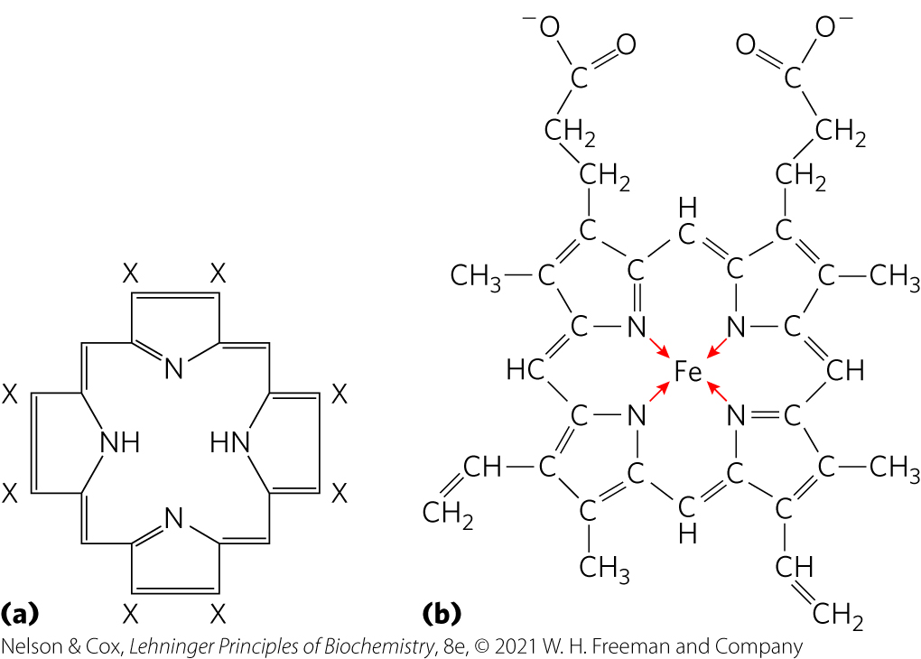
Heme Prosthetic Group
heme = protein-bound prosthetic group
  present in myoglobin and hemoglobin
  consists of a complex organic ring structure, protoporphyrin, with a bound Fe²⁺ atom

Slide 13
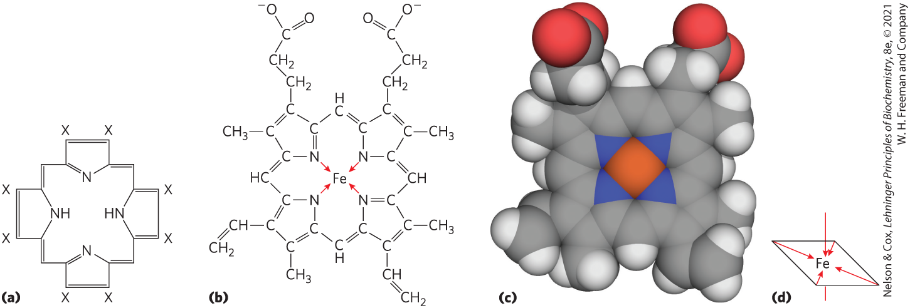
Coordination Bonds of Iron
six coordination bonds:
  four to nitrogen atoms in the flat porphyrin ring
  two perpendicular to the porphyrin

Slide 14

Clicker Question 1
The heme prosthetic group:
A. consists of protoporphyrin and an iron (II) ion.
B. is found only in myoglobin and hemoglobin.
C. contains a single iron atom in its ferrous (Fe²⁺) state that
has a total of 4 coordination bonds.
D. is only found bound to protein.
Notes:
Answer: A
Principle: 5.1
Learning Objective(s): Describe the function of heme.
Bloom’s: 2:2

Slide 15
Clicker Question 1, Response
The heme prosthetic group:
A. consists of protoporphyrin and an iron (II) ion.
Heme consists of a complex organic ring structure, protoporphyrin, to which is bound a single iron atom in its ferrous (Fe²⁺) state.

Slide 16
Principle 2 (2 of 4)
A ligand binds a protein at a binding site that is complementary to the ligand in size, shape, charge, and hydrophobic or hydrophilic character. The interaction is specific: the protein can discriminate among the thousands of different molecules in its environment and selectively bind only one or a few types. A given protein may have separate binding sites for several different ligands. These specific molecular interactions are crucial in maintaining the high degree of order in a living system.

Slide 17
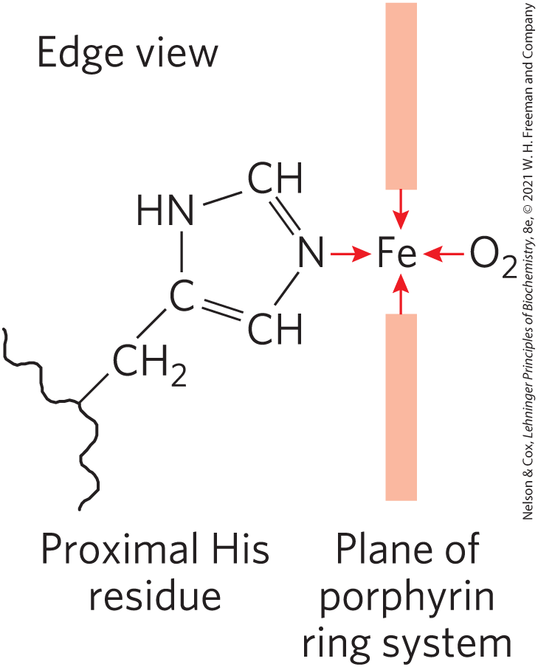
Perpendicular Coordination Bonds
two perpendicular coordination bonds:
  one is occupied by a side-chain nitrogen of a highly conserved proximal His residue
  one is the binding site for molecular oxygen (O₂)
    Fe²⁺ binds O₂ reversibly
    Fe³⁺ does not bind O₂

Slide 18
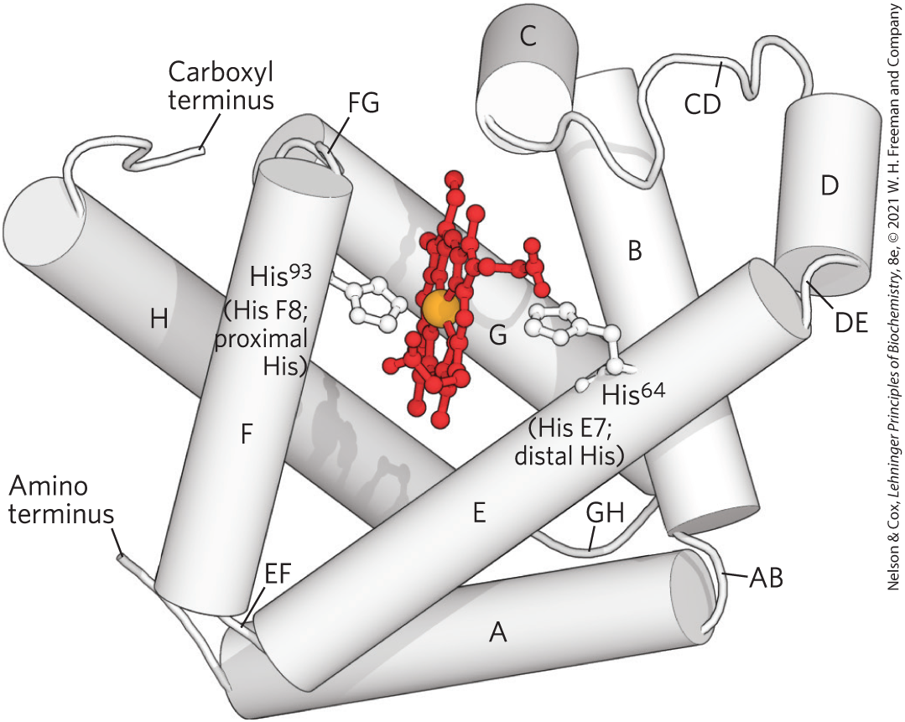
Globins Are a Family of Oxygen-Binding Proteins
globins = widespread protein family
  highly conserved tertiary structure: eight α-helical segments connected by bends (globin fold)
  most function in O₂ transport or storage

Slide 19
Types of Globins
four types in humans and other mammals:
  myoglobin = monomeric, facilitates O₂ diffusion in muscle tissue
  hemoglobin = tetrameric, responsible for O₂ transport in the bloodstream
  neuroglobin = monomeric, expressed largely in neurons to protect the brain from low O₂ or restricted blood supply
  cytoglobin = monomeric, regulates levels of nitric oxide, a localized signal for muscle relaxation

Slide 20
Myoglobin Has a Single Binding Site for Oxygen
myoglobin:
  153 residues + one molecule of heme
  bends named after the α-helical segments they connect
His⁹³ = ninety-third reside from the amino terminal end
His F8 = eighth residue in α helix F

Slide 21

Clicker Question 2
Myoglobin:
A. has quaternary structure.
B. contains a pocket for binding heme that is made up of
largely the C and D helices.
C. contains multiple binding sites for O₂.
D. consists mostly of α helices.
Notes:
Answer: D
Principle: 5:2
Learning Objective(s): Describe the relationship between globin structure and function.
Bloom’s: 2:2

Slide 22
Clicker Question 2, Response
Myoglobin:
D. consists mostly of α helices.
Myoglobin is a single polypeptide of 153 amino acid residues with one molecule of heme. About 78% of the amino acid residues in the protein are found in the eight α helices typical of the globin fold, named A through H.

Slide 23
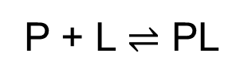
Protein-Ligand Interactions Can Be Described Quantitively
a simple equilibrium expression describes the reversible binding of a protein (P) to a ligand (L):
(5-1)

Slide 24
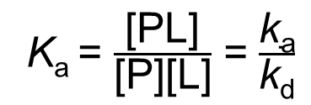
Association Constant
association constant (K_{a}) = provides a measure of the affinity of the ligand L for the protein
  higher K_{a} = higher affinity
  equivalent to the ratio of the rates of the forward (association) and the reverse (dissociation) reactions that form the PL complex
K_{a} = $\frac{\text{[}\text{PL}\text{]}}{\text{[}\text{P}\text{][}\text{L}\text{]}}$ = $\frac{\text{k}\text{a}}{\text{k}\text{d}}$
(5-2)

Slide 25
Clicker Question 3
Protein A has a binding site for ligand L with a K_{a} of 10⁵ M^{–1}. Protein B has a binding site for ligand L with a K_{a} of 10⁸ M^{–1}. Which protein has the higher affinity for ligand L?
A. protein A
B. protein B
C. It is not possible to determine based only on K_{a} values.
Notes:
Answer: B
Principle: 5.2
Learning Objective(s): Compare the relative affinities of protein and ligand pairs based on the equilibrium constant.
Bloom’s: 2:2

Slide 26
Clicker Question 3, Response
Protein A has a binding site for ligand L with a K_{a} of 10⁵ M^{–1}. Protein B has a binding site for ligand L with a K_{a} of 10⁸ M^{–1}. Which protein has the higher affinity for ligand L?
B. protein B
The association constant provides a measure of the affinity of the ligand L for the protein. A higher value of K_{a} corresponds to a higher affinity of the ligand for the protein.

Slide 27
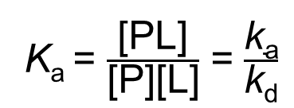
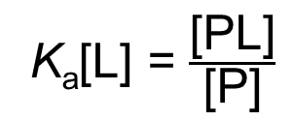
[L] Remains Constant
K_{a} = $\frac{\text{[}\text{PL}\text{]}}{\text{[}\text{P}\text{][}\text{L}\text{]}}$ = $\frac{\text{k}\text{a}}{\text{k}\text{d}}$
(5-2)
when [L] >>> [ligand-binding sites], the binding of the ligand by the protein does not appreciably change [L]
K_{a}[L] = $\frac{\text{[}\text{PL}\text{]}}{\text{[}\text{P}\text{]}}$
(5-3)

Slide 28
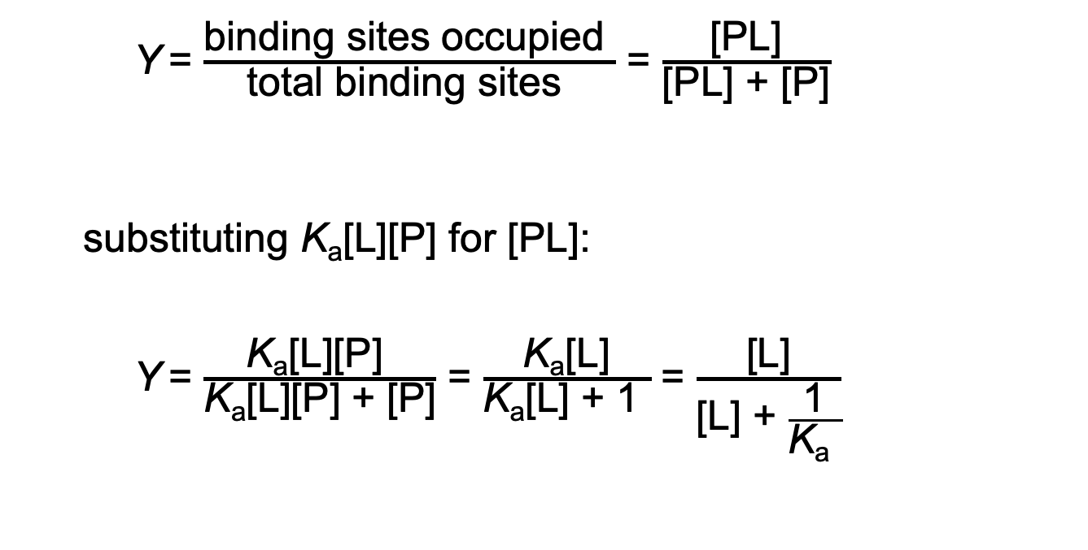
Binding Equilibrium
Y = $\frac{\text{binding} \text{sites} \text{occupied} }{\text{total} \text{binding} \text{sites} }$ = $\frac{\text{[}\text{PL}\text{]}}{\text{[}\text{PL}\text{] + [}\text{P}\text{]}}$
  substituting K_{a}[L][P] for [PL]:
  Y = $\frac{\text{K}\text{a}\text{[}\text{L}\text{][}\text{P}\text{]} }{\text{K}\text{a}\text{[}\text{L}\text{][}\text{P}\text{]} \text{+ [}\text{P}\text{]}}$ = $\frac{\text{K}\text{a}\text{[}\text{L}\text{]}}{\text{K}\text{a}\text{[}\text{L}\text{]} \text{+} \text{1} }$ = $\frac{\text{[}\text{L}\text{]}}{\text{[}\text{L}\text{] + }\frac{\text{1}}{\text{K}\text{a} }}$
(5-4)
(5-5)
x = y/(y + z) describes a hyperbola

Slide 29
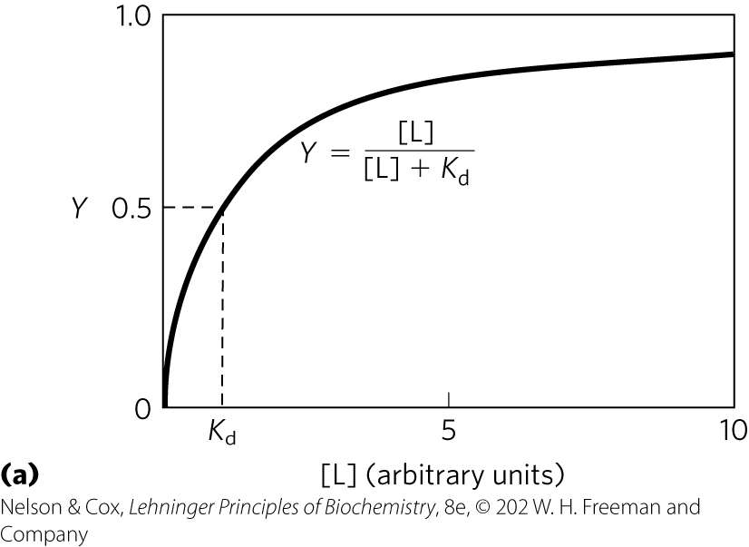
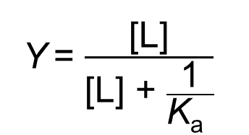
Graphical Representations of
Ligand Binding
Y = $\frac{\text{[}\text{L}\text{]}}{\text{[}\text{L}\text{] + }\frac{\text{1}}{\text{K}\text{a} }}$
(5-5)
[L] at which ½ of the available ligand-binding sites are occupied (Y = 0.5) corresponds to 1/K_{a}

Slide 30
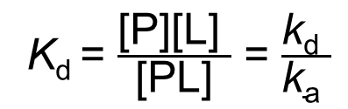
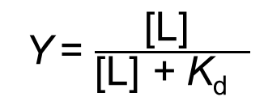
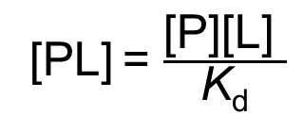
Dissociation Constant
dissociation constant (K_{d}) = reciprocal of K_{a}
  equilibrium constant for the release of ligand
  lower K_{d} = higher affinity
K_{d} = $\frac{\text{[}\text{P}\text{][}\text{L}\text{] }}{\text{[}\text{PL}\text{]}}$ = $\frac{\text{k}\text{d} }{\text{k}\text{a} }$
when [L] = K_{d}, ½ of the ligand-binding sites are occupied
(5-6)
[PL] = $\frac{\text{[}\text{P}\text{][}\text{L}\text{] }}{\text{K}\text{d}}$
(5-7)
Y = $\frac{\text{[}\text{L}\text{] }}{\text{[}\text{L}\text{]}\text{ + }\text{K}\text{d} }$
(5-8)

Slide 31
Clicker Question 4
Protein A has a K_{a} = 6.0 μM^{–1} for binding ligand L, and the protein B has a K_{d} = 4.0 μM for binding ligand L. Based on this information, which statement is true?
A. Protein B binds L with higher affinity.
B. Protein A is half-saturated with L when [L] is 6.0 μM^{–1}.
C. The K_{a} of protein B for L is 0.25 μM^{–1}.
D. When [L] = 1 μM, Y = 0.17 for protein A.
Notes:
Answer: C
Principle: 5.2
Learning Objective(s): Relate the concentrations of protein, ligand, and protein-ligand complex to an association or dissociation equilibrium constant; Compare the relative affinities of protein and ligand pairs based on the equilibrium constant; Relate the fraction of bound sites, concentration of ligand, and equilibrium constant for a protein and ligand pair.
Bloom’s: 2:2

Slide 32
Clicker Question 4, Response
Protein A has a K_{a} = 6.0 μM^{–1} for binding ligand L, and the protein B has a K_{d} = 4.0 μM for binding ligand L. Based on this information, which statement is true?
C. The K_{a} of protein B for L is 0.25 μM^{–1}.
K_{a} = 1/K_{d}
For protein B, K_{a} = 1/(4.0 μM) = 0.25 μM^{–1}.

Slide 33
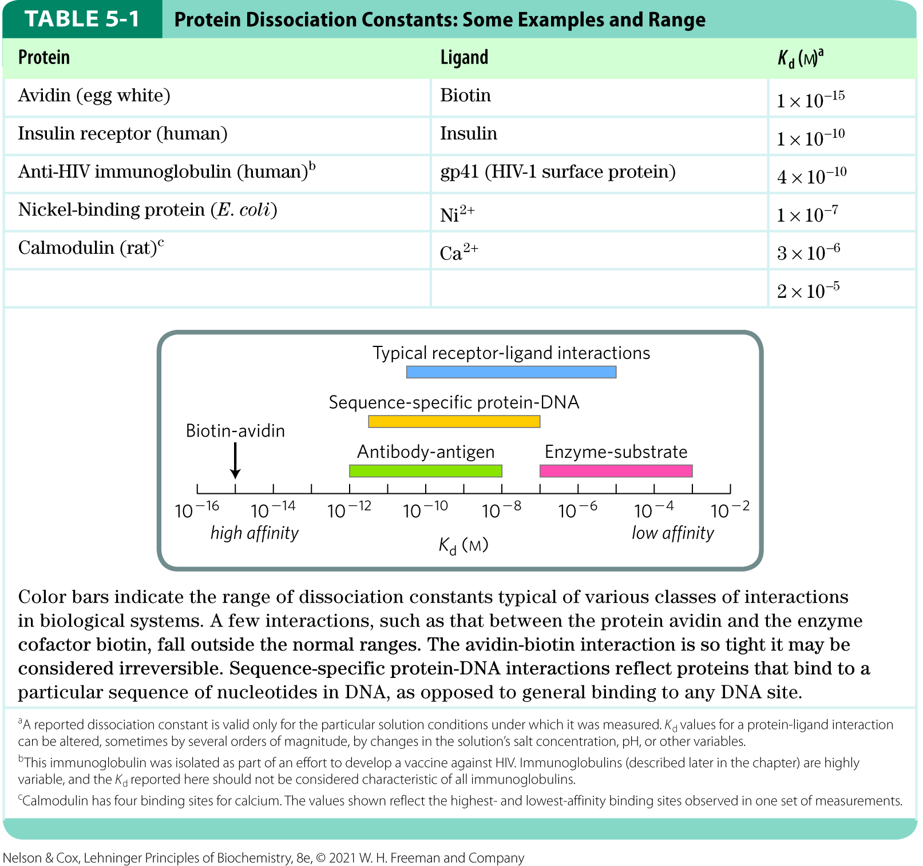
Representative K_{d} Values

Slide 34
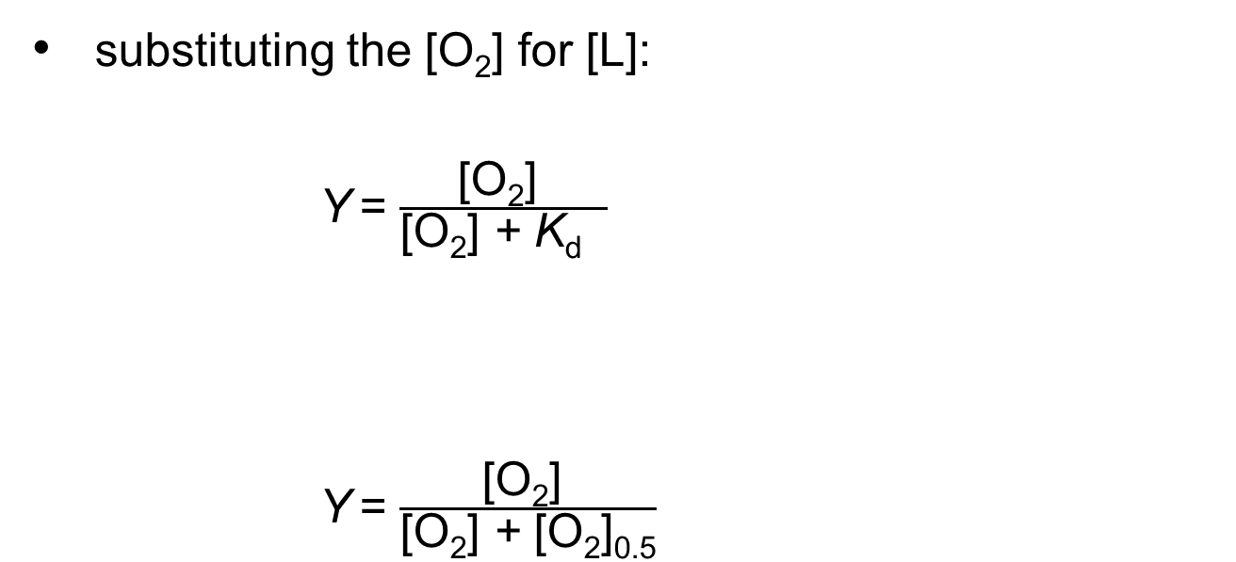
Binding of O₂ to Myoglobin
substituting the [O₂] for [L]:
Y = $\frac{\text{[}\text{O}\text{2}\text{] }}{\text{[}\text{O}\text{2}\text{] }\text{+ }\text{K}\text{d} }$
Y = $\frac{\text{[}\text{O}\text{2}\text{] }}{\text{[}\text{O}\text{2}\text{] }\text{+} \text{[}\text{O}\text{2}\text{]}\text{0.5}}$
(5-9)
K_{d} equals the [O₂] at which ½ of the available ligand-binding sites are occupied, or [O₂]_{0.5}:
(5-10)

Slide 35
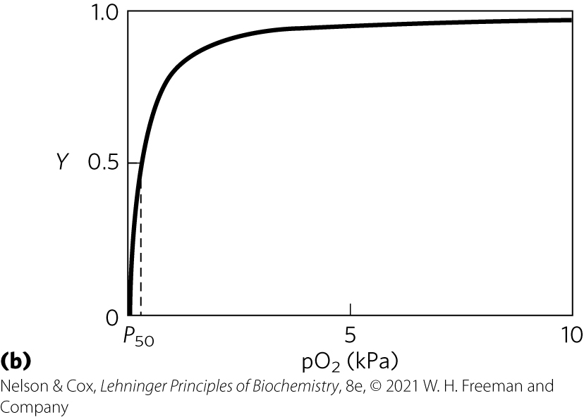
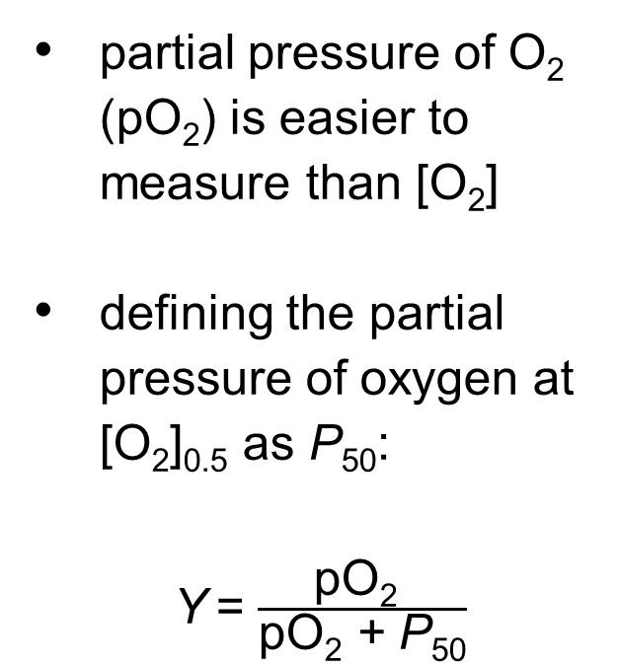
Partial Pressure of O₂
partial pressure of O₂ (pO₂) is easier to measure than [O₂]
defining the partial pressure of oxygen at [O₂]_{0.5} as P₅₀:
Y = $\frac{\text{p}\text{O}\text{2} }{\text{p}\text{O}\text{2} \text{+} \text{P}\text{50}}$
(5-11)

Slide 36
Clicker Question 5
When the partial pressure of oxygen is equal to the P₅₀ of myoglobin, what is the value of Y?
A. 0.0
B. 0.25
C. 0.50
D. 0.75
E. 1.0
Notes:
Answer: C
Principle: 5.2
Learning Objective(s): Relate the fraction of bound sites, concentration of ligand, and equilibrium constant for a protein and ligand pair.
Bloom’s: 3:2

Slide 37
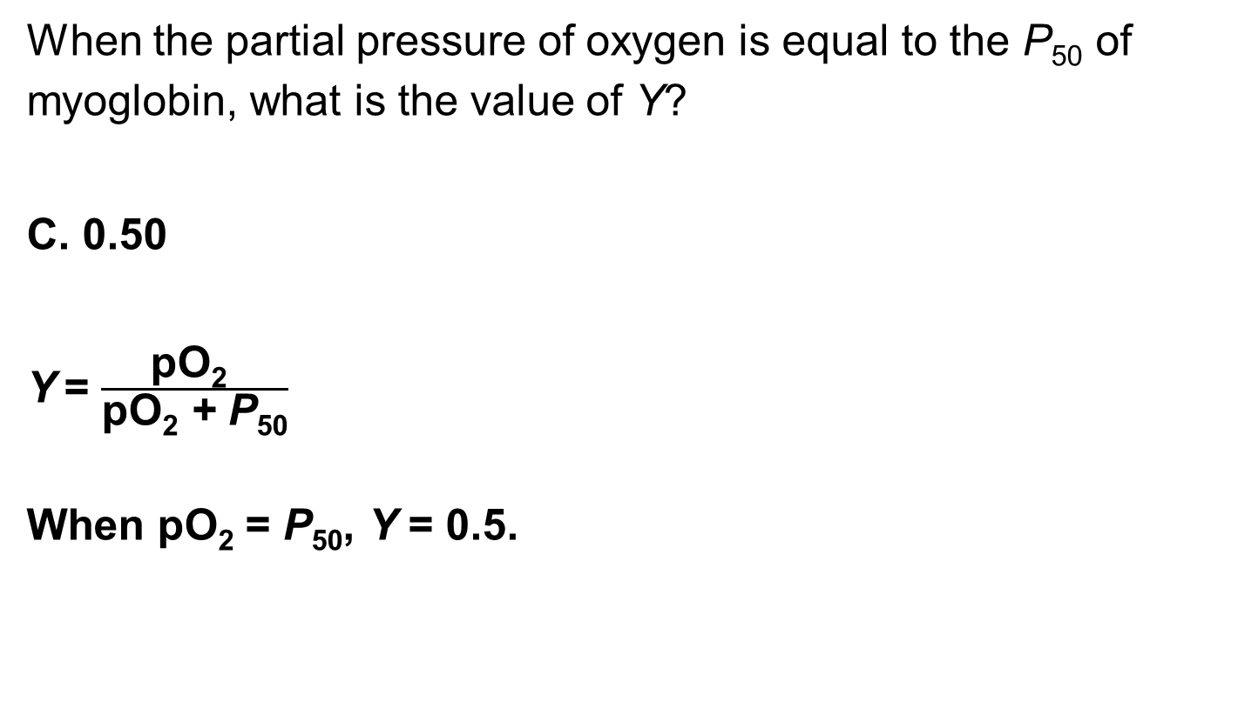
Clicker Question 5, Response
When the partial pressure of oxygen is equal to the P₅₀ of myoglobin, what is the value of Y?
C. 0.50
Y = $\frac{\text{pO}\text{2} }{\text{pO}\text{2} \text{+ }\text{P}\text{50}}$
When pO₂ = P₅₀, Y = 0.5.

Slide 38
Principle 3 (2 of 2)
Proteins are flexible. Changes in conformation may be subtle, reflecting molecular vibrations and small movements of amino acid residues throughout the protein. Changes in conformation may also be more dramatic, with major segments of the protein structure moving as much as several nanometers. Specific conformational changes are frequently essential to a protein’s function.

Slide 39
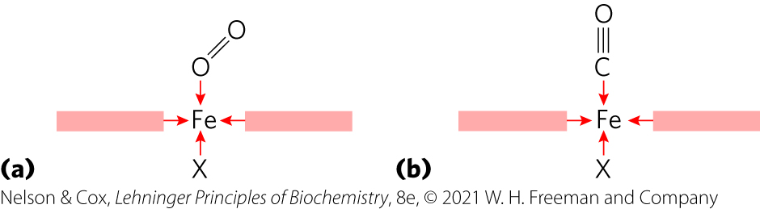
Protein Structure Affects How Ligands Bind
carbon monoxide (CO) binds free heme more than 20,000 times better than does O₂
  differences in the orbital structures affect binding geometries

Slide 40

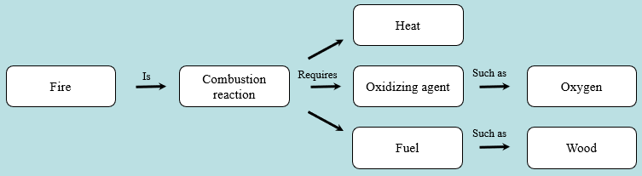
Activity: Relating
Terms within the Chapter
A concept map displays the relationships between different concepts. Observe the following example of a concept map.
Notes:
Instructor: For additional information, see the Instructor Activity Guide located in Achieve. It can be found within Chapter 5, in the folder titled “Ch5 In-Class Activities, Videos, and Resources.”

Slide 41
Activity Instructions (1 of 3)
Think about how the following terms and phrases relate to each other and then use scratch paper to draw a concept map using these terms and phrases. (3 minutes)
ligand
binding site
complementary to ligand
size
shape
charge
hydrophobic/hydrophilic character
protein
specific
separate binding sites for different ligands
discriminate among many molecules
selectively bind ligands
high degree of order
Notes:
Instructor: For additional information, see the Instructor Activity Guide located in Achieve. It can be found within Chapter 5, in the folder titled “Ch5 In-Class Activities, Videos, and Resources.”

Slide 42
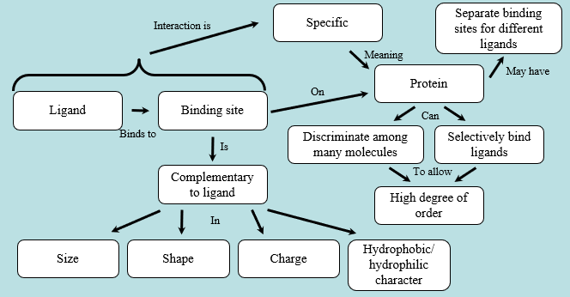
Activity Solution (1 of 4)
Pair up and share how this possible concept map might differ from yours. (2 minutes)
Notes:
Instructor: For additional information, see the Instructor Activity Guide located in Achieve. It can be found within Chapter 5, in the folder titled “Ch5 In-Class Activities, Videos, and Resources.”

Slide 43
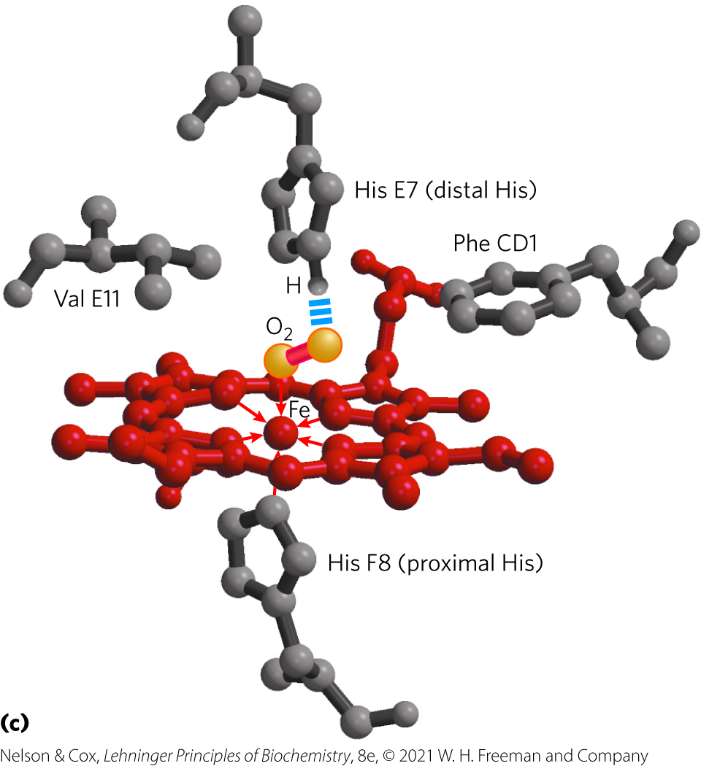
Myoglobin’s Distal His Increases Heme’s Affinity for O₂
hydrogen bond between the imidazole side chain of His E7 and bound O₂ electrostatically stabilizes the Fe-O₂ polar complex
20,000-fold stronger binding affinity of free heme for CO compared with O₂ declines to ~40-fold
Rotates to open and close the pocket

Slide 44
Hemoglobin Transports Oxygen in Blood
erythrocytes (red blood cells) transport O₂
  formed from hemocytoblasts (precursor stem cells)
  main function is to carry hemoglobin
arterial blood = ~96% saturated with O₂
peripheral blood = ~64% saturated with O₂

Slide 45

Clicker Question 6
Oxygen carried by whole blood in animals is bound and transported by hemoglobin in what type of cell?
A. hemocytoblasts
B. erythrocytes
C. white blood cells
D. stem cells
E. neurons
Notes:
Answer: B
Principle: 5.3
Learning Objective(s): Describe how molecular oxygen, carbon dioxide, and protons bind hemoglobin.
Bloom’s: 1:1

Slide 46
Clicker Question 6, Response
Oxygen carried by whole blood in animals is bound and transported by hemoglobin in what type of cell?
B. erythrocytes
Nearly all the oxygen carried by whole blood in animals is bound and transported by hemoglobin in erythrocytes (red blood cells). They are formed from precursor stem cells called hemocytoblasts.

Slide 47
Principle 5 (2 of 4)
In a multisubunit protein, a conformational change in one subunit often affects the conformation of other subunits.

Slide 48
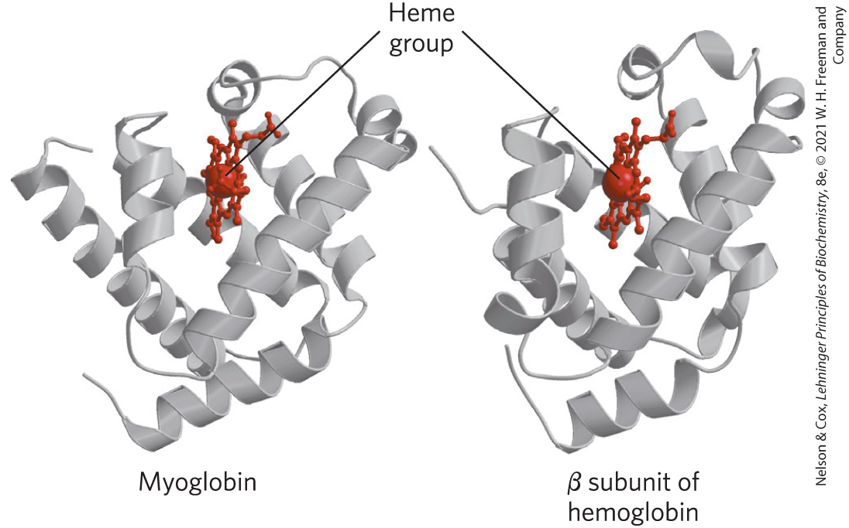
Hemoglobin Subunits Are Structurally Similar to Myoglobin
hemoglobin:
  tetrameric protein with 4 heme groups
  adult hemoglobin has two globin types: two α chains (141 residues each) and two β chains (146 residues each)

Slide 49
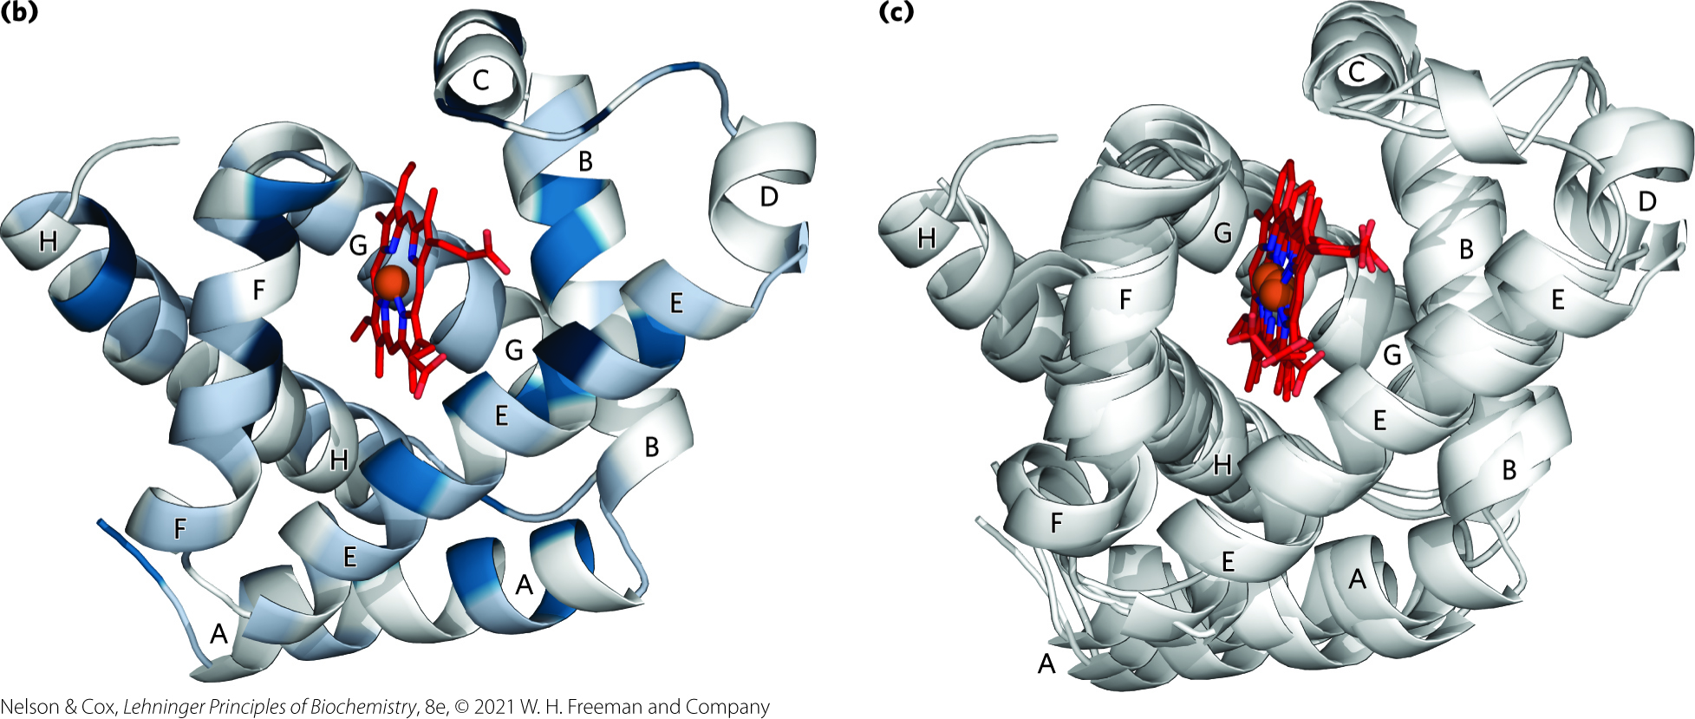
Structural Conservation of Globins
Low sequence similarity
High structural similarity

Slide 50
The Quaternary Structure of Hemoglobin
strong interactions between unlike subunits
  hydrophobic effect
  hydrogen bonds
  ion pairs (salt bridges)
α₁β₁ (and α₂β₂) interface involves >30 residues
α₁β₂ (and α₂β₁) interface involves 19 residues

Slide 51

Clicker Question 7
The α and β subunits of hemoglobin:
A. each contain 4 heme prosthetic groups.
B. contain several stretches of identical amino acids.
C. are both tetramers.
D. have high structural similarity to each other.
E. differ in structure and sequence.
Notes:
Answer: D
Principle: 5.5
Learning Objective(s): Describe the relationship between globin structure and function.
Bloom’s: 2:2

Slide 52
Clicker Question 7, Response
The α and β subunits of hemoglobin:
D. have high structural similarity to each other.
The three-dimensional structures of the two types of subunits are very similar to each other and to myoglobin, reflecting their evolution within the larger globin superfamily.

Slide 53
Principle 4 (2 of 2)
The binding of a protein and a ligand is often coupled to a conformational change in the protein that makes the binding site more complementary to the ligand, permitting tighter binding. The structural adaptation that occurs between protein and ligand is called induced fit.

Slide 54
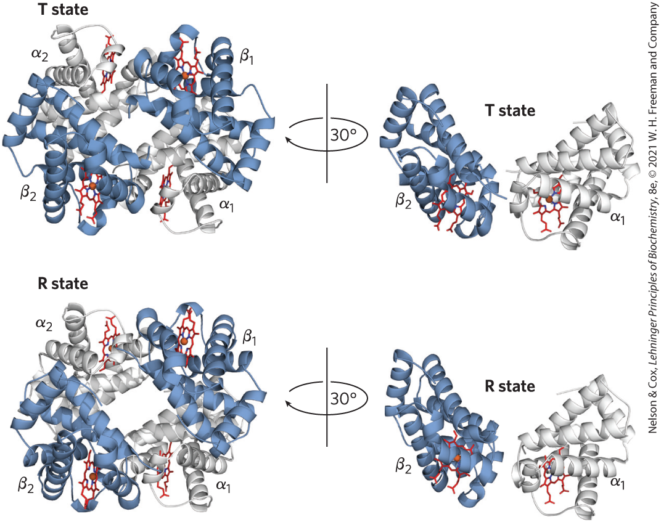
Hemoglobin Undergoes a Structural Change on Binding Oxygen
two conformations of hemoglobin:
  R state = O₂ has a higher affinity for hemoglobin
  T state = more stable when O₂ is absent, predominant conformation of deoxyhemoglobin
Greater number of ion pairs

Slide 55
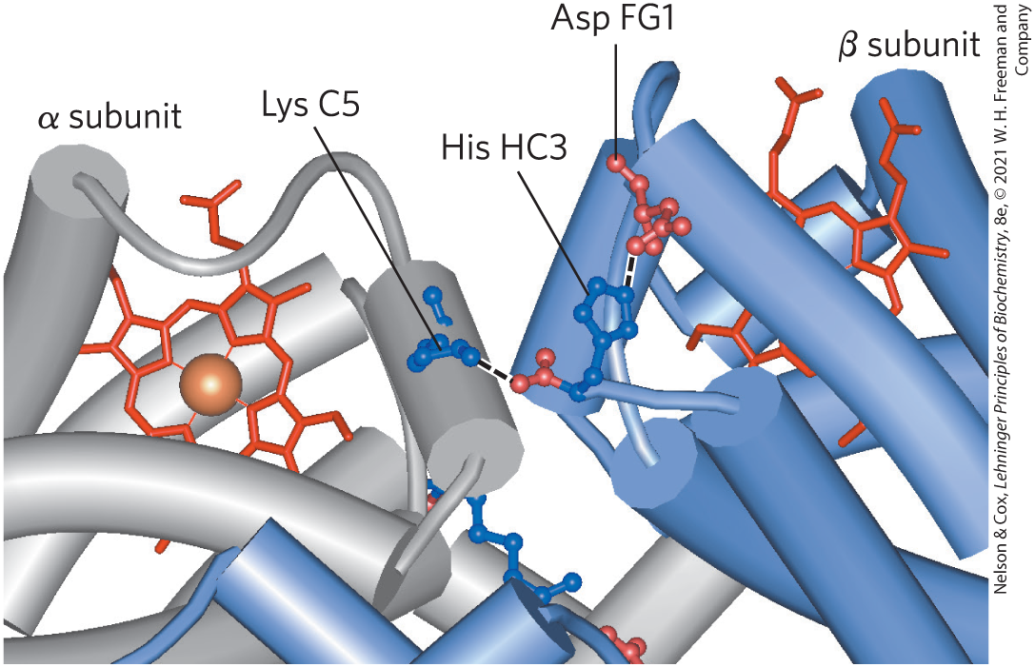
Ion Pairs Stabilize the T State
T state is stabilized by a greater number of ion pairs, many of which lie at the α₁β₂ (and α₂β₁) interface

Slide 56
Conformational Change in Hemoglobin
O₂ binding to hemoglobin in the T state triggers a conformational change to the R state
  αβ subunit pairs slide past each other and rotate
  the pocket between the β subunits narrow
  some ion pairs that stabilize the T state break and some new ones form

Slide 57
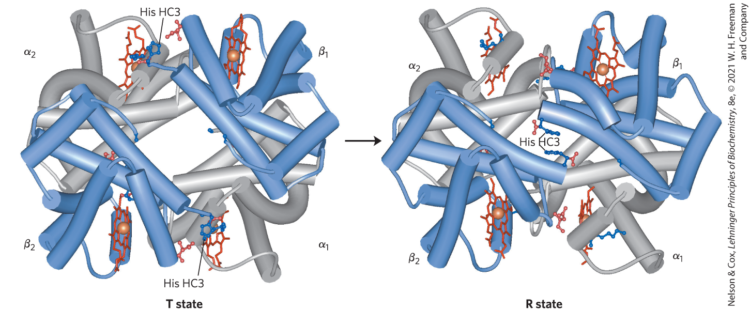
The T → R Transition

Slide 58
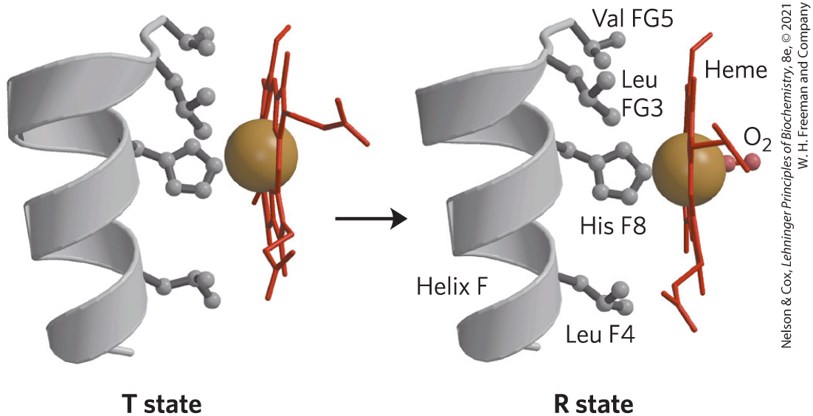
Changes in Conformation Near Heme

Slide 59

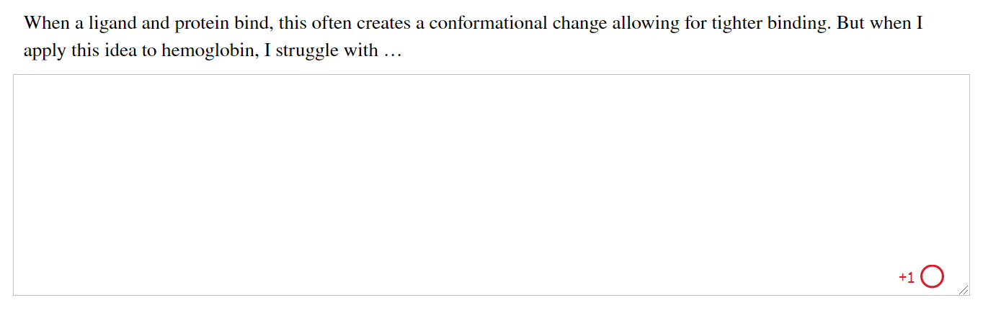
Activity: Conformational
Changes for Ligand Binding Muddiest Point (1 of 2)
Complete the Ch5 Student Activity, Day 1: Conformational Changes for Ligand Binding (Muddiest Point) Achieve assessment.
Notes:
Instructor: This muddiest point activity can be found in Achieve in the Chapter 5 folder titled “Ch5 In-Class Activities, Videos, and Resources.” See the Instructor Activity Guide in the same folder for more information.

Slide 60
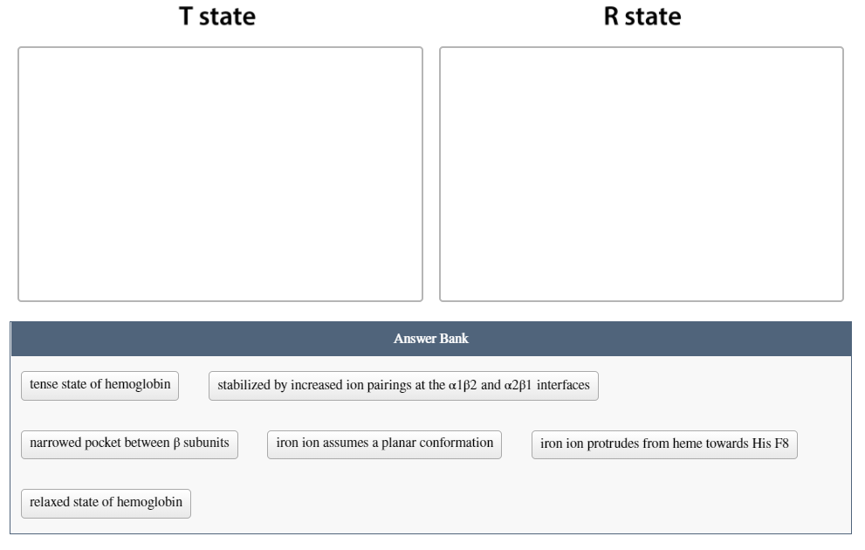
Activity: Conformational
Changes for Ligand Binding Muddiest Point (2 of 2)
Complete the Ch5 Student Activity, Day 2: Conformational Changes for Ligand Binding (Muddiest Point) Achieve assessment.
Notes:
Instructor: This muddiest point activity can be found in Achieve in the Chapter 5 folder titled “Ch5 In-Class Activities, Videos, and Resources.” See the Instructor Activity Guide in the same folder for more information.

Slide 61

Clicker Question 8
The T → R transition is triggered by:
A. ion pairs forming between residues and O₂ at the α₁β₂ (and
α₂β₁) interface.
B. the structures of the individual subunits changing.
C. O₂ causing the heme to assume a more planar
conformation, shifting the position of His F8 and the F helix.
D. αβ subunit pairs sliding past each other and rotating,
narrowing the pocket between the α subunits.
Notes:
Answer: C
Principle: 5.4
Learning Objective(s): Compare the T and R states of hemoglobin; Describe the conformational changes governing oxygen access to the heme prosthetic group
Bloom’s: 2:2

Slide 62
Clicker Question 8, Response
The T → R transition is triggered by:
C. O₂ causing the heme to assume a more planar
conformation, shifting the position of His F8 and the F
helix.
In the T state, the porphyrin is slightly puckered, causing the heme iron to protrude on the His F8 side. O₂ binding causes the heme to assume a more planar conformation, shifting the position of His F8 and the F helix. This leads to adjustments in the ion pairs at the α₁β₂ interface.

Slide 63

Principle 5 (3 of 4)
In a multisubunit protein, a conformational change in one subunit often affects the conformation of other subunits.

Slide 64
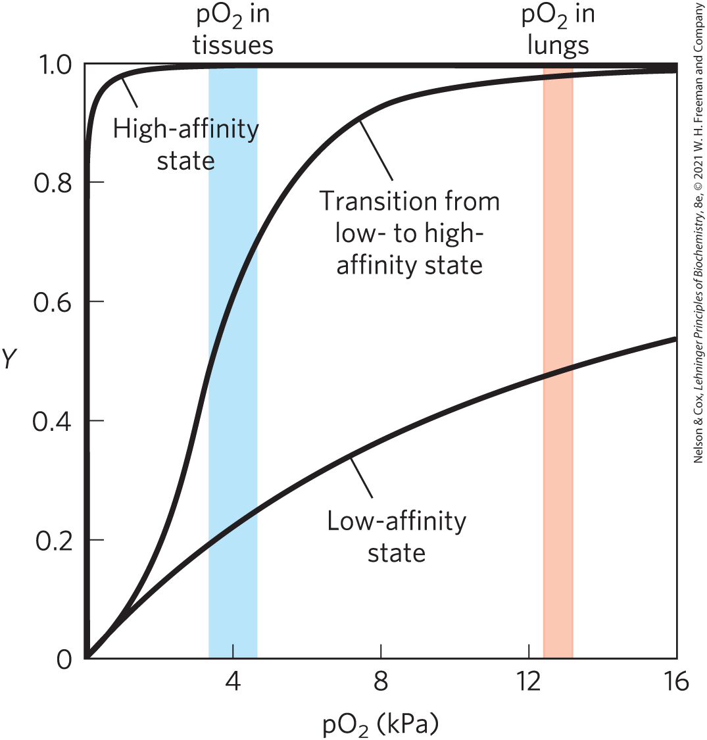
Hemoglobin Binds Oxygen Cooperatively
hemoglobin has a hybrid sigmoid binding curve for oxygen

Slide 65
Clicker Question 9
Leghemoglobin is an oxygen-binding protein in root nodules that contain bacteria and fix atmospheric nitrogen. Which statement is true if leghemoglobin is like myoglobin and not hemoglobin?
A. There are four oxygen-binding sites.
B. The oxygen-binding curve is hyperbolic.
C. There is cooperative oxygen binding.
D. The oxygen-binding curve is sigmoidal.
E. Oxygen binding changes the heme configuration from
T to R.
Notes:
Answer: B
Principle: 5.5
Learning Objective(s): Describe the relationship between globin structure and function; Relate the shape of a binding curve with the extent of allosteric interactions.
Bloom’s: 3:2

Slide 66
Clicker Question 9, Response
Leghemoglobin is an oxygen-binding protein in root nodules that contain bacteria and fix atmospheric nitrogen. Which statement is true if leghemoglobin is like myoglobin and not hemoglobin?
B. The oxygen-binding curve is hyperbolic.
For a monomeric protein such as myoglobin, the fraction of binding sites occupied by a ligand is a hyperbolic function of ligand concentration. Thus, if leghemoglobin is like myoglobin, the oxygen-binding curve is hyperbolic.

Slide 67

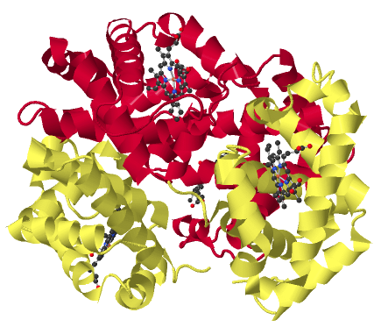
Activity: Protein
Conformation
Observe the structure of hemoglobin in
Mol3D viewer in your Achieve course.
Notes:
Instructor: This Mol3D structure is located in the Achieve course. It can be found in the Chapter 5 content, in the folder titled “Ch5 In-Class Activities, Videos, and Resources.”

Slide 68
Activity Instructions (2 of 3)
On your own, think of answers to the questions:
  Is this oxy- or deoxyhemoglobin?
  Is hemoglobin in the T state or the R state?
  What is the difference between the T state and the R state?
(2 minutes)
Pair up to discuss your ideas. (2 minutes)
Share your ideas with the class in group discussion.
Notes:
Instructor: This Mol3D structure is located in the Achieve course. It can be found in the Chapter 5 content, in the folder titled “Ch5 In-Class Activities, Videos, and Resources.”

Slide 69
Activity Solution (2 of 4)
  Is this oxy- or deoxyhemoglobin? The structure depicts deoxyhemoglobin because no oxygen is bound to any of the four heme groups present.
  Is hemoglobin in the T state or the R state? It is the T state because deoxyhemoglobin primarily exists in the T state. The T state is more stable than the R state.
Notes:
Instructor: This Mol3D structure is located in the Achieve course. It can be found in the Chapter 5 content, in the folder titled “Ch5 In-Class Activities, Videos, and Resources.”

Slide 70
Activity Solution (3 of 4)
  What causes the transition from T state to R state in hemoglobin? Deoxyhemoglobin exists primarily in the T state. Although T state hemoglobin can bind oxygen, it does so at a low affinity. When a molecule of oxygen binds to one of the heme groups, a conformational change occurs that shifts the protein into its R state. The binding of subsequent molecules of oxygen further stabilizes the R state.
Notes:
Instructor: This Mol3D structure is located in the Achieve course. It can be found in the Chapter 5 content, in the folder titled “Ch5 In-Class Activities, Videos, and Resources.”

Slide 71
Principle 6 (2 of 3)
Interactions between ligands and proteins may be regulated.

Slide 72
Allosteric Proteins
allosteric protein (e.g., hemoglobin) = binding of a ligand to one site affects the binding properties of another site on the same protein
  modulators = ligands that bind to an allosteric protein to induce a conformational change
  homotropic = normal ligand and modulator are identical
  heterotropic = modulator is a molecule other than the normal ligand

Slide 73

Clicker Question 10
Which molecule is a homotropic modulator of oxygen binding to hemoglobin?
A. oxygen
B. H⁺
C. carbon dioxide
D. hemoglobin
E. carbon monoxide
Notes:
Answer: A
Principle: 5.6
Learning Objective(s): Classify a modulator based on its type and effect.
Bloom’s: 2:2

Slide 74
Clicker Question 10, Response
Which molecule is a homotropic modulator of oxygen binding to hemoglobin?
A. oxygen
Cooperative binding of oxygen to hemoglobin, a multimeric protein, is a form of allosteric binding. The binding of one ligand affects the affinities of any remaining unfilled binding sites. Oxygen can be considered as both a ligand and an activating homotropic modulator.

Slide 75
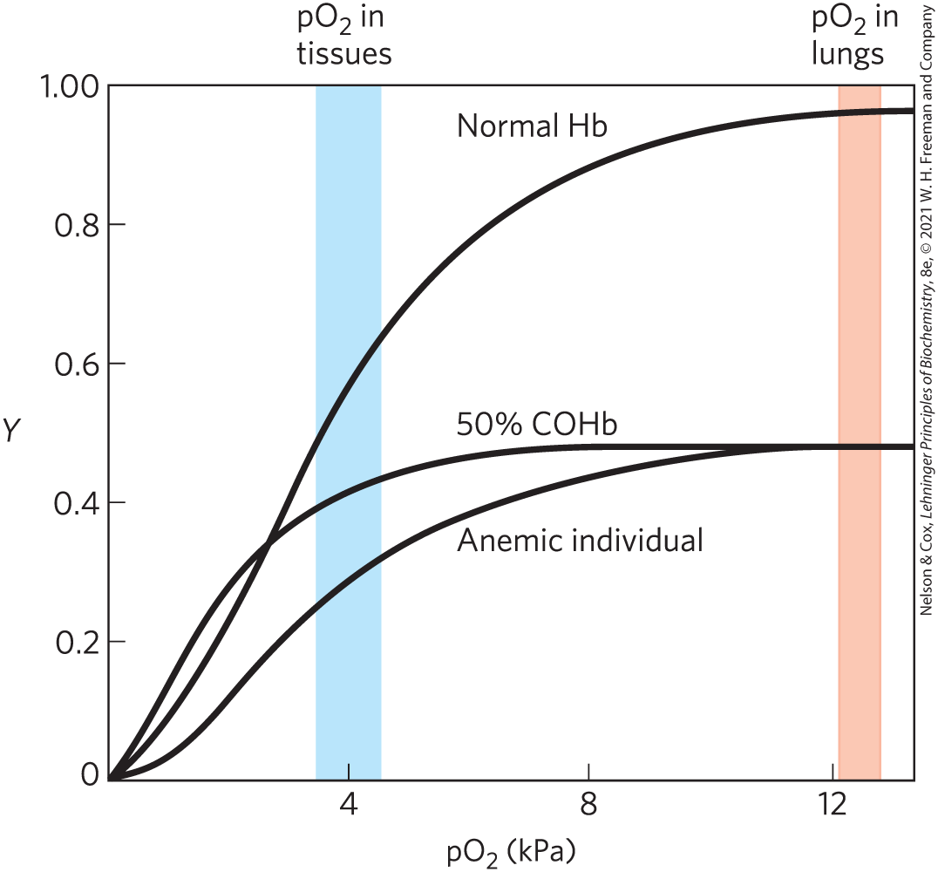
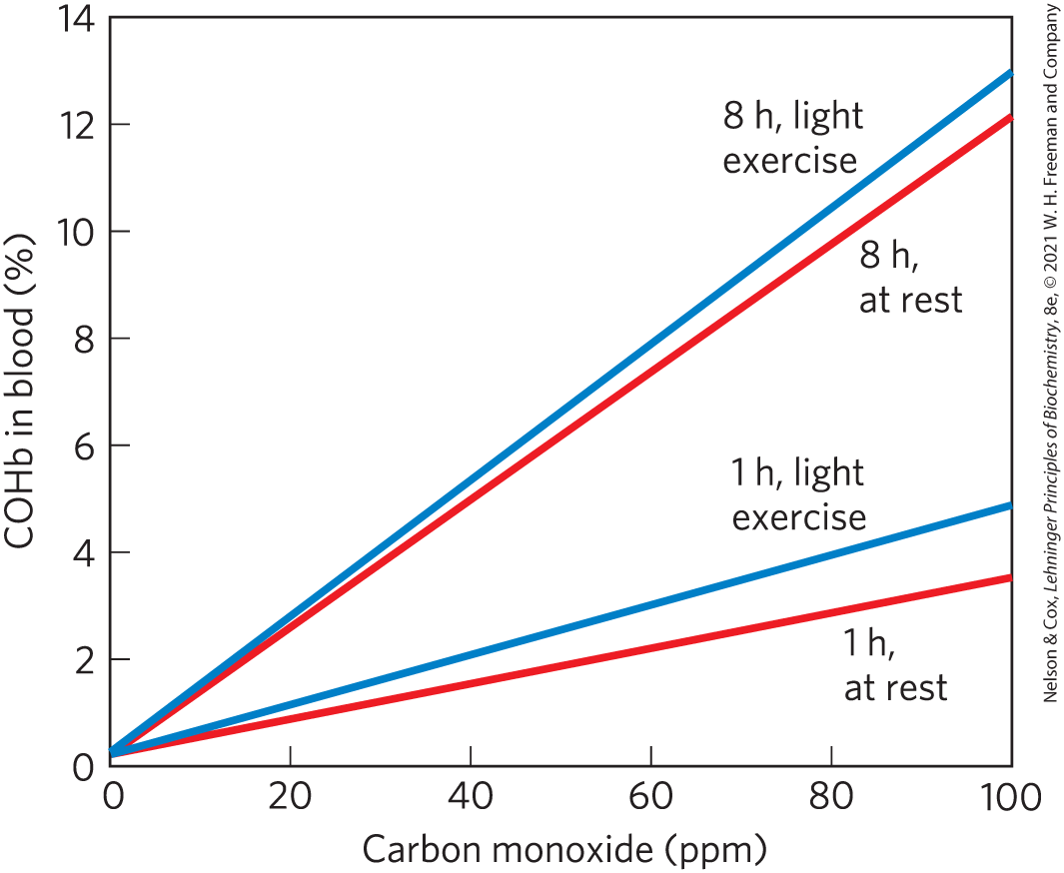
Carbon Monoxide Can Bind to Hemoglobin
CO has ~250-fold greater affinity for hemoglobin than does O₂

Slide 76
Cooperative Ligand Binding Can Be Described Quantitatively
for a protein with n binding sites, the equilibrium becomes:
P + nL ⇌ PL_{n}
(5-12)

Slide 77
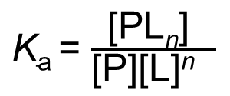
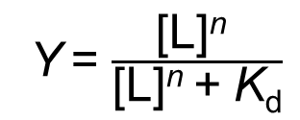
The K_{a} and Y for Cooperative
Ligand Binding
the expression for the association constant becomes:
$\text{K}\text{a}$ = $\frac{\text{[}\text{PL}\text{n}\text{] }}{\text{[}\text{P}\text{][}\text{L}\text{]}\text{n} }$
(5-13)
the expression for Y is:
Y = $\frac{\text{[}\text{L}\text{]}\text{n} }{\text{[}\text{L}\text{]}\text{n}\text{ + }\text{K}\text{d}}$
(5-14)

Slide 78
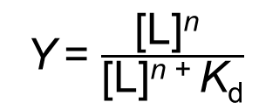
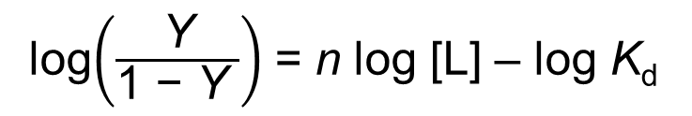
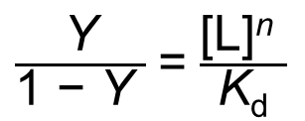
The Hill Equation
Y = $\frac{\text{[}\text{L}\text{]}\text{n} }{\text{[}\text{L}\text{]}\text{n}\text{ + }\text{K}\text{d}}$
(5-14)
rearranging, then taking the log of both sides, yields:
$\frac{\text{Y}}{\text{1 − }\text{Y} }$ = $\frac{\text{[}\text{L}\text{]}\text{n} }{\text{K}\text{d}}$
(5-15)
the Hill equation:
log$\left(\frac{\text{Y}}{\text{1 − }\text{Y} }\right)$ = n log [L] – log $\text{K}\text{d}$
(5-16)

Slide 79
Hill Plots and Hill Coefficients
Hill plot = plot of log [Y/(1 − Y)] versus log [L]
Hill coefficient = n_{H} = slope of a Hill plot
  If n_{H} = 1, ligand binding is not cooperative
  n_{H} > 1 indicates positive cooperativity
  n_{H} < 1 indicates negative cooperativity

Slide 80
Clicker Question 11
A newly discovered protein has multiple subunits, each with a single ligand-binding site. Binding of ligand to one site increases the binding affinity of other sites for the ligand. The Hill coefficient (n_{H}) is:
A. equal to 1.
B. greater than 1.
C. less than 1.
D. not able to be calculated.
Notes:
Answer: B
Principle: 5.6
Learning Objective(s): Relate the Hill coefficient to observed cooperativity.
Bloom’s: 2:2

Slide 81
Clicker Question 11, Response
A newly discovered protein has multiple subunits, each with a single ligand-binding site. Binding of ligand to one site increases the binding affinity of other sites for the ligand. The Hill coefficient (n_{H}) is:
B. greater than 1.
The Hill coefficient (n_{H}) is the slope of a Hill plot. An n_{H} of greater than 1 indicates positive cooperativity in ligand binding. This is the situation observed in the newly discovered protein, in which the binding of one molecule of ligand facilitates the binding of others.

Slide 82
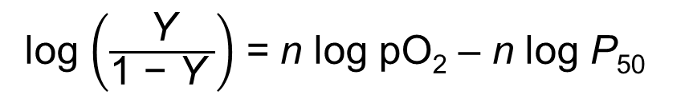
Adapting the Hill Equation to the Binding of O₂ to Hemoglobin
substituting pO₂ for [L] and ${\text{P}}_{\text{50} }^{ \text{n}}$for K_{d}:
log $\left(\frac{\text{Y}}{\text{1 − }\text{Y} }\right)$ = n log pO₂ – n log P₅₀
(5-17)
Hill coefficient = n_{H} = slope of a Hill plot
  If n_{H} = 1, ligand binding is not cooperative
  n_{H} > 1 indicates positive cooperativity
  n_{H} < 1 indicates negative cooperativity

Slide 83
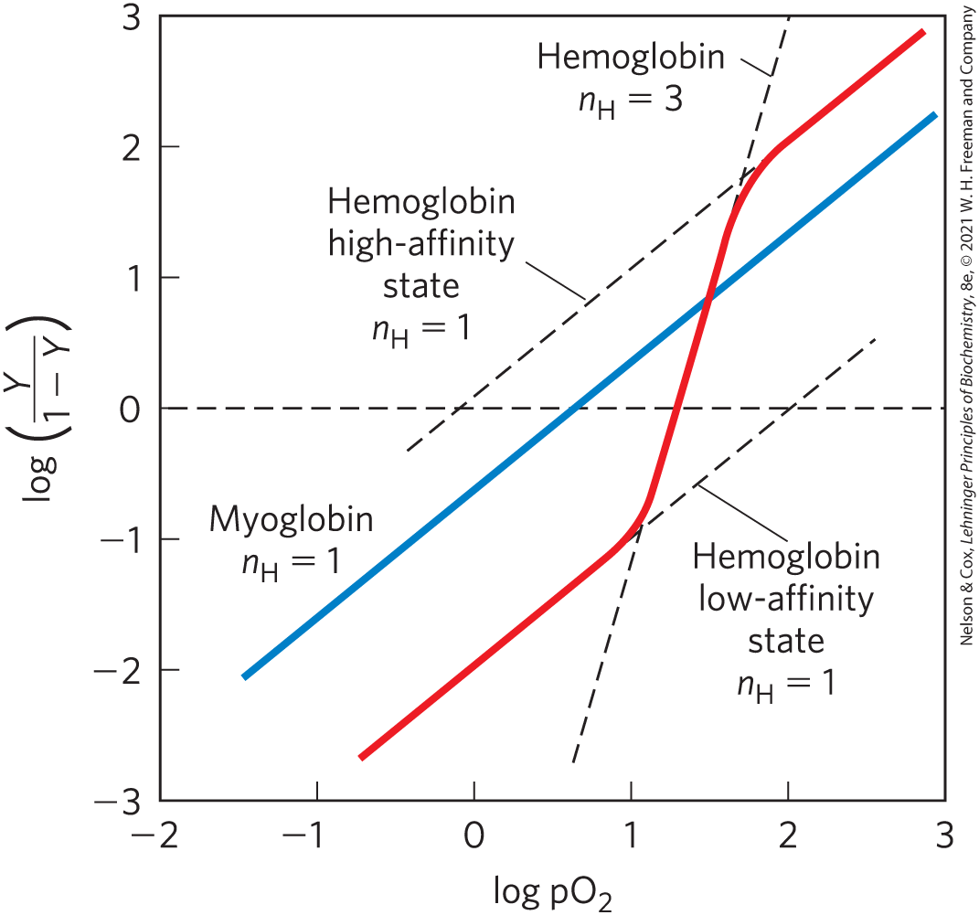
Hill Plots for Myoglobin and Hemoglobin

Slide 84
Clicker Question 12
There are two binding sites for acetylcholine on its receptor. What would be the shape of a Hill plot if there were cooperativity of binding?
A. hyperbolic
B. linear
C. sigmoidal, with a sharp change in slope
D. two sigmoidal areas linked together, one for each
binding event
E. two sigmoidal lines, one higher than the other on the
graph
Notes:
Answer: C
Principle: 5.6
Learning Objective(s): Relate the shape of a binding curve with the extent of allosteric interactions.
Bloom’s: 2:2

Slide 85
Clicker Question 12, Response
There are two binding sites for acetylcholine on its receptor. What would be the shape of a Hill plot if there were cooperativity of binding?
C. sigmoidal, with a sharp change in slope
The shape of the Hill plot would resemble that of oxygen binding to hemoglobin.

Slide 86

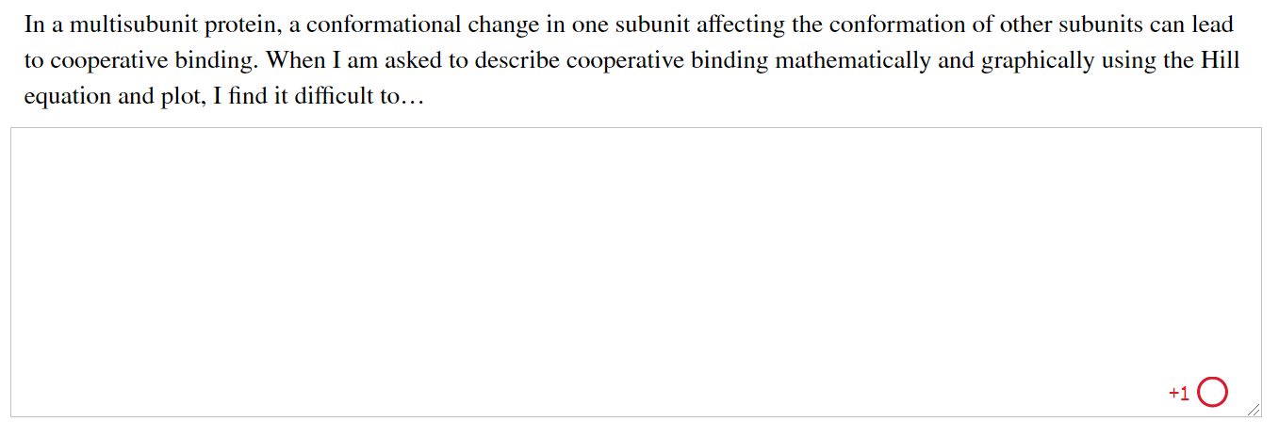
Activity: Cooperative
Binding Muddiest Point (1 of 2)
Complete the Ch5 Student Activity, Day 1: Cooperative Binding (Muddiest Point) Achieve assessment.
Notes:
Instructor: This muddiest point activity can be found in Achieve in the Chapter 5 folder titled “Ch5 In-Class Activities, Videos, and Resources.” See the Instructor Activity Guide in the same folder for more information.

Slide 87
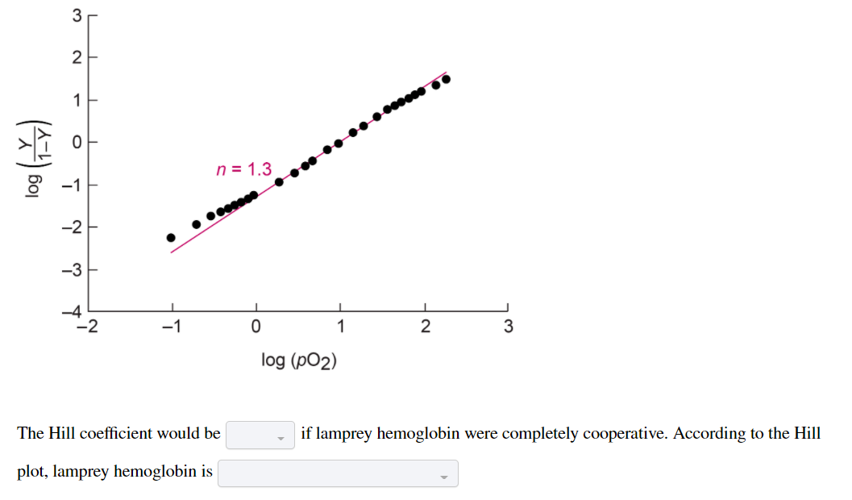
Activity: Cooperative
Binding Muddiest Point (2 of 2)
Complete the Ch5 Student Activity, Day 2: Cooperative Binding (Muddiest Point) Achieve assessment.
Notes:
Instructor: This muddiest point activity can be found in Achieve in the Chapter 5 folder titled “Ch5 In-Class Activities, Videos, and Resources.” See the Instructor Activity Guide in the same folder for more information.

Slide 88

Principle 5 (4 of 4)
In a multisubunit protein, a conformational change in one subunit often affects the conformation of other subunits.

Slide 89
Two Models Suggest Mechanisms for Cooperative Binding
MWC model = concerted model
  all subunits in the same conformation
  ligand binds more tightly to the R state
sequential model
  each subunit can be in either conformation
  equilibrium is altered as additional ligands are bound, progressively favoring the R state

Slide 90
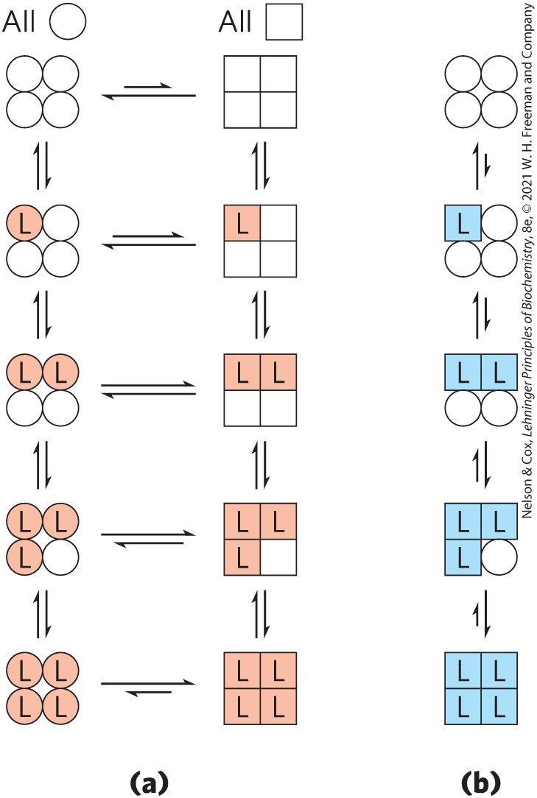
Concerted and Sequential Models
Low affinity or inactive
High affinity or active
MWC model (concerted model)
Sequential model

Slide 91
Clicker Question 13
Regarding the models of cooperativity:
A. the concerted model and sequential model only apply to
tetramers.
B. the concerted model and the sequential model are mutually
exclusive.
C. the concerted model is based on the T state and the
sequential on the R state.
D. T state is low affinity and R state is high affinity.
Notes:
Answer: D
Principle: 5.5
Learning Objective(s): Compare the MWC (concerted) and sequential models of allostery.
Bloom’s: 2:2

Slide 92
Clicker Question 13, Response
Regarding the models of cooperativity:
D. T state is low affinity and R state is high affinity.
In both the concerted model and sequential models of cooperativity, the T state is the low affinity state and the R state is the high affinity state.

Slide 93
Hemoglobin Also Transports H⁺ and CO₂
hemoglobin carries two end products of cellular respiration: H⁺ and CO₂
carbonic anhydrase catalyzes the hydration of CO₂ to bicarbonate:
  CO₂ + H₂O ⇌ H⁺ + HCO₃–

Slide 94

Principle 6 (3 of 3)
Interactions between ligands and proteins may be regulated.

Slide 95
The Bohr Effect
the structural effects of H⁺ and CO₂ binding to hemoglobin favor the T state
  the binding of H⁺ and CO₂ is inversely related to the binding of O₂
Bohr effect = describes the effect of pH and [CO₂] on the binding and release of O₂ by hemoglobin
  HHB⁺ + O₂ ⇌ HbO₂ + H⁺

Slide 96
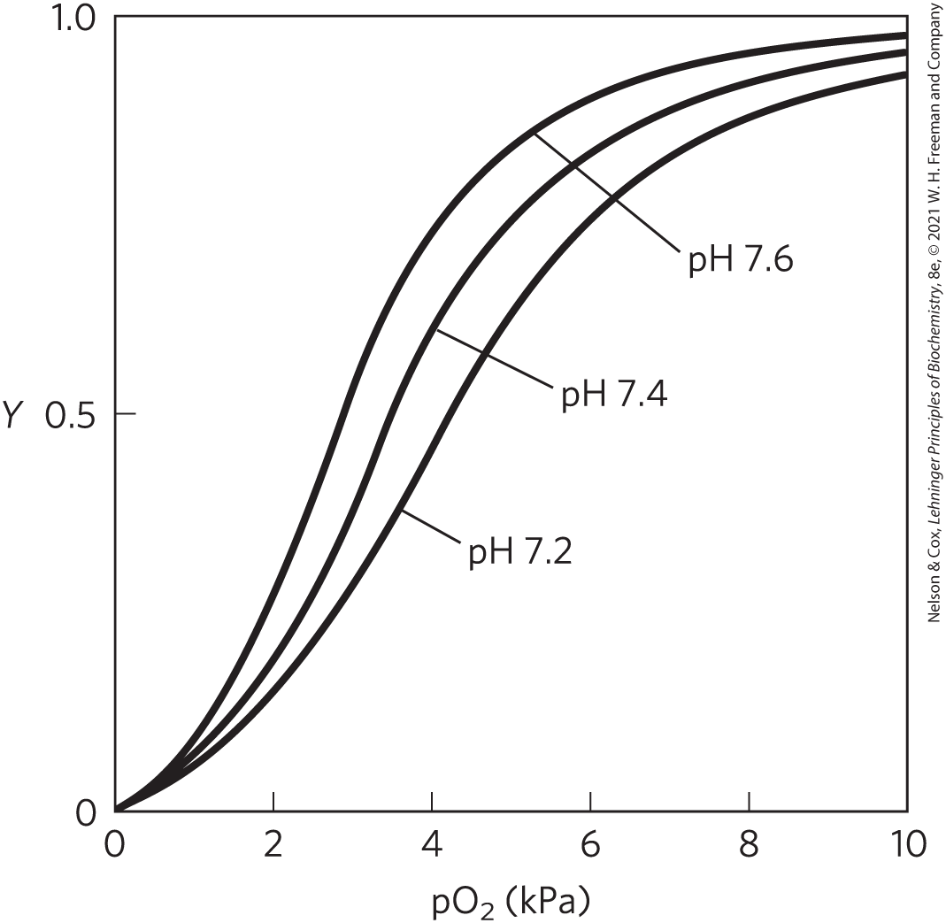
The Effect of pH on O₂ Binding to Hemoglobin
when [O₂] is high, hemoglobin binds O₂ and releases H⁺
when [O₂] is low, hemoglobin releases O₂ and binds H⁺

Slide 97
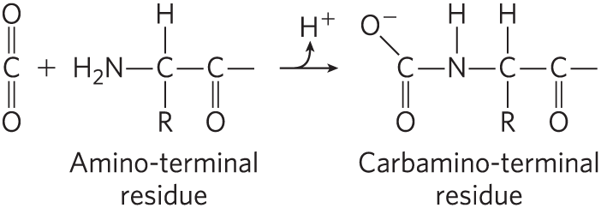
Hemoglobin Binds CO₂
CO₂ binding to hemoglobin is inversely related to binding of O₂
  contributes to the Bohr effect by producing H⁺

Slide 98
Clicker Question 14
In peripheral tissues:
A. the affinity of hemoglobin for oxygen increases and the
protein binds more O₂.
B. CO₂ is excreted.
C. the structural effects of H⁺ and CO₂ binding to hemoglobin
favor the R state.
D. O₂ is released.
Notes:
Answer: D
Principle: 5.6
Learning Objective(s): Explain how the Bohr effect facilitates the exchange of oxygen, carbon dioxide, and protons in the body; Describe how molecular oxygen, carbon dioxide, and protons bind hemoglobin.
Bloom’s: 2:2

Slide 99
Clicker Question 14, Response
In peripheral tissues:
D. O₂ is released.
At the relatively low pH and high CO₂ concentration of peripheral tissues, the affinity of hemoglobin for oxygen decreases as H⁺ and CO₂ are bound, and O₂ is released to the tissues.

Slide 100
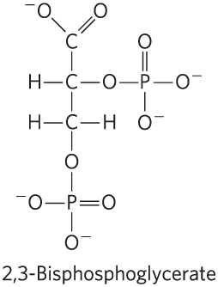
Oxygen Binding to Hemoglobin Is Regulated by 2,3-Bisphosphoglycerate (1 of 2)
2,3-bisphosphoglycerate (BPG):
  example of heterotropic allosteric modulation
  binds to a site distant from O₂-binding site
  greatly reduces the affinity of hemoglobin for oxygen

Slide 101
Oxygen Binding to Hemoglobin Is Regulated by 2,3-Bisphosphoglycerate (2 of 2)
2,3-bisphosphoglycerate (BPG):
  example of heterotropic allosteric modulation
  binds to a site distant from O₂-binding site
  greatly reduces the affinity of hemoglobin for oxygen
  HbBPG + O₂ ⇌ HbO₂ + BPG

Slide 102
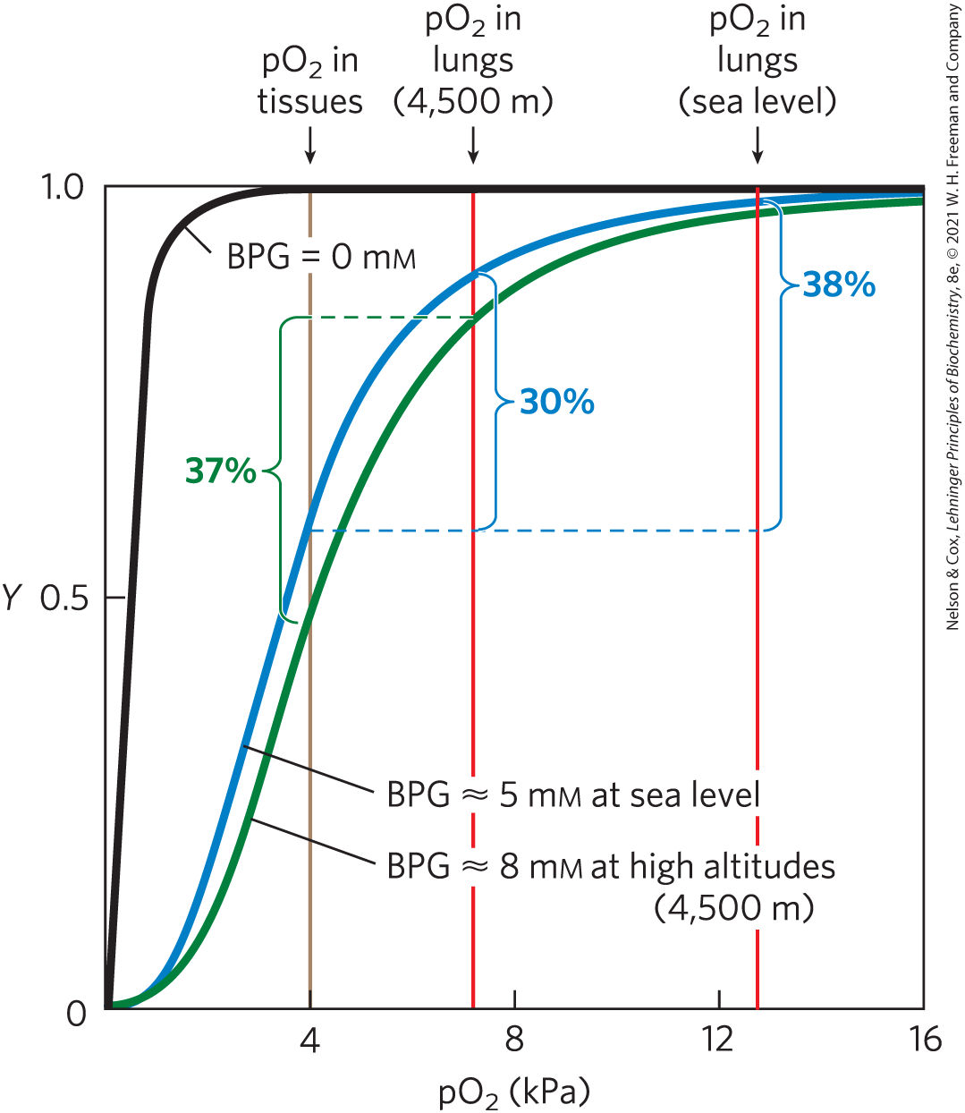
Effect of BPG on O₂ Binding to Hemoglobin
BPG increases at high altitudes
hypoxia = lowered oxygenation of peripheral tissues
  causes BPG increases

Slide 103
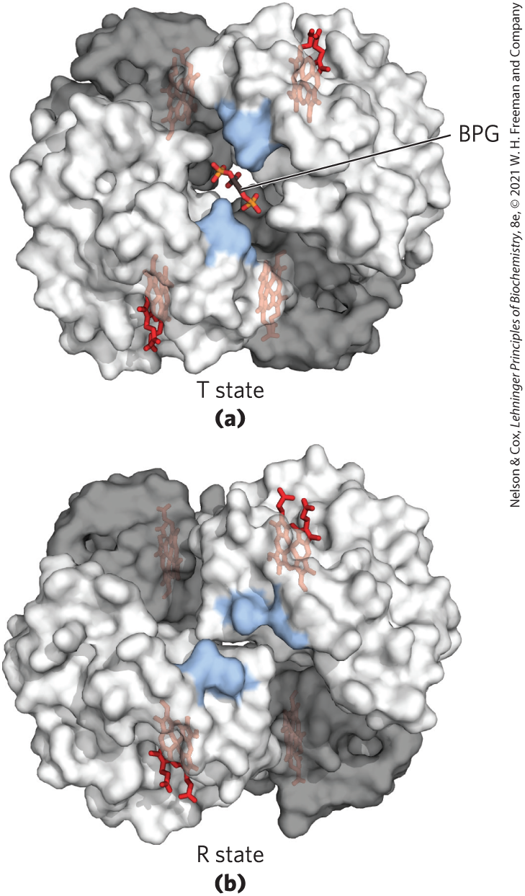
Binding of BPG to Deoxyhemoglobin
BPG binds to the cavity between the β subunits in the T state
  cavity is lined with positively charged residues
  BPG stabilizes the T state

Slide 104
Clicker Question 15
What is the actual, significant effect of 2,3-bisphosphoglycerate on oxygen binding by hemoglobin?
A. There is an increase in K_{d} for oxygen in peripheral tissues.
B. A higher concentration of oxygen can bind at high
altitudes compared to low altitudes.
C. The affinity of hemoglobin for oxygen in peripheral
tissues increases at high altitudes.
D. Heme further decreases affinity for both CO₂ and H⁺ in
lungs, allowing more O₂ to bind.
E. It has no effect on O₂ affinity, but it forces heme into the
R state.
Notes:
Answer: A
Principle: 5.6
Learning Objective(s): Describe the role of bisphosphoglycerate in hemoglobin delivery of oxygen in the body.
Bloom’s: 2:2

Slide 105
Clicker Question 15, Response
What is the actual, significant effect of 2,3-bisphosphoglycerate on oxygen binding by hemoglobin?
A. There is an increase in K_{d} for oxygen in peripheral
tissues.
2,3-Bisphosphoglycerate greatly reduces the affinity of hemoglobin for oxygen. A higher value of K_{d} corresponds to a lower affinity of ligand for the protein. Thus, 2,3-bisphosphoglycerate increases the K_{d} for oxygen binding by hemoglobin.

Slide 106
Fetal Hemoglobin
fetus synthesizes α₂γ₂ hemoglobin
  lower affinity for BPG than normal adult hemoglobin
  higher affinity for O₂ than normal adult hemoglobin

Slide 107

Sickle Cell Anemia Is a Molecular Disease of Hemoglobin
sickle cell anemia:
  homozygous condition
  single amino acid substitution (Glu⁶ to Val⁶) β chains produces a hydrophobic patch

Slide 108

Normal and Sickle Cell Hemoglobin
deoxygenated hemoglobin becomes insoluble and forms polymers that aggregate
normal hemoglobin remains soluble upon deoxygenation

Slide 109
Clicker Question 16
Which statement is false?
A. Hemoglobin can be considered a dimer of αβ dimers.
B. O₂ binding to myoglobin is allosteric but not cooperative.
C. 2,3-bisphosphoglycerate decreases the affinity of
hemoglobin for O₂.
D. Fetal hemoglobin has a lower affinity for BPG than normal
adult hemoglobin.
E. The Glu⁶ to Val⁶ that causes sickle cell anemia produces a
hydrophobic patch on hemoglobin’s surface.
Notes:
Answer: B
Principle: 5.6
Learning Objective(s): Classify a protein as allosteric; Relate the shape of a binding curve with the extent of allosteric interactions.
Bloom’s: 2:2

Slide 110
Clicker Question 16, Response
Which statement is false?
B. O₂ binding to myoglobin is allosteric but not
cooperative.
Cooperative binding of a ligand to a multimeric protein, such as the binding of O₂ to hemoglobin, is a form of allosteric binding. As such, O₂ binding to myoglobin is both allosteric and cooperative.

Slide 111
5.2 Complementary Interactions between Proteins and Ligands: The Immune System and Immunoglobulins

Slide 112
Principle 2 (3 of 4)
A ligand binds a protein at a binding site that is complementary to the ligand in size, shape, charge, and hydrophobic or hydrophilic character. The interaction is specific: the protein can discriminate among the thousands of different molecules in its environment and selectively bind only one or a few types. A given protein may have separate binding sites for several different ligands. These specific molecular interactions are crucial in maintaining the high degree of order in a living system.

Slide 113
Immune Responses
immune response = coordinated set of interactions among many classes of proteins, molecules, and cell types
  distinguishes molecular “self” from “nonself” and destroys “nonself”
  eliminates viruses, bacteria, and other pathogens and molecules

Slide 114
The Immune Response Includes a Specialized Array of Cells and Proteins
leukocytes = white blood cells, including macrophages and lymphocytes
The immune response consists of two complementary systems:
  humoral immune system = directed at bacterial infections and extracellular viruses
  cellular immune system = destroys infected host cells, parasites, and foreign tissues

Slide 115
The Humoral Immune Response
antibodies = immunoglobulins (Ig) = bind bacteria, viruses, or large molecules identified as foreign and target them for destruction
  produced by B lymphocytes or B cells

Slide 116
The Cellular Immune Response
T lymphocytes = cytotoxic T cells (T_{C} cells)
  recognition of infected cells or parasites involves T-cell receptors on the surface of T_{C} cells
helper T cells (T_{H} cells) = produce soluble signaling proteins called cytokines
  interact with macrophages
  stimulate the selective proliferation of T_{C} and B cells that can bind to a particular antigen (clonal selection)
memory cells = permit a rapid response to pathogens previously encountered

Slide 117
Vaccines
often consists of weakened or killed virus or isolated proteins from a viral or bacterial protein coat
“teaches” the immune system what the viral particles look like, stimulating the production of memory cells

Slide 118
Clicker Question 17
Which statement is false?
A. T lymphocytes produce immunoglobulins.
B. Immunoglobulins target foreign bacteria and viruses for
destruction.
C. Memory cells allow the body to quickly respond to viruses
it has encountered before.
D. Clonal selection increases the number of immune system
cells that can respond to a particular pathogen.
E. Vaccines stimulate the production of memory cells.
Notes:
Answer: A
Principle: 5.2
Learning Objective(s): Compare the humoral and cellular immune systems.
Bloom’s: 2:2

Slide 119
Clicker Question 17, Response
Which statement is false?
A. T lymphocytes produce immunoglobulins.
T lymphocytes produce T-cell receptors on the surface of T cells. Recognition of infected cells or parasites involves these T-cell receptor proteins.

Slide 120
Principle 1 (3 of 4)
The functions of many proteins involve the reversible binding of other molecules. A molecule bound reversibly by a protein is called a ligand. A ligand may be any kind of molecule, including another protein. The transient nature of protein-ligand interactions is critical to life, allowing an organism to respond rapidly and reversibly to changing environmental and metabolic circumstances.

Slide 121
Antigens and Haptens
antigen = molecule or pathogen capable of eliciting an immune response
  can be a virus, a bacterial cell wall, or an individual protein or other macromolecule
  antibodies or T-cell receptors bind to an antigenic determinant or epitope within the antigen
haptens = small molecules that can elicit an immune response when covalently attached to large proteins

Slide 122
Antibodies Have Two Identical Antigen-Binding Sites
immunoglobulin G (IgG) = major class of antibodies
  one of the most abundant blood serum proteins
  4 polypeptide chains: 2 heavy chains and 2 light chains
  cleavage with protease papain releases the basal fragment Fc and two Fab branches (each with a single antigen-binding site)
  constant domains contain the immunoglobulin fold structural motif

Slide 123
Clicker Question 18
The molecular structure for which an individual antibody or T-cell receptor is specific is known as:
A. an epitope.
B. its target.
C. an immune response.
D. an immunoglobulin fold.
Notes:
Answer: A
Principle: 5.1
Learning Objective(s): Describe the interactions underlying antigen recognition.
Bloom’s: 1:1

Slide 124
Clicker Question 18, Response
The molecular structure for which an individual antibody or T-cell receptor is specific is known as:
A. an epitope.
An individual antibody or T-cell receptor binds only a particular molecular structure within the antigen, called its epitope.

Slide 125

The Structure of Immunoglobulin G

Slide 126

The Variable Domain of Immunoglobulin G
heavy and light chains each have a variable domain
  variable domains associate to create the antigen-binding site
  allows formation of an antigen-antibody complex

Slide 127
Classes of Immunoglobulins
5 classes in vertebrates:
  characterized by heavy chain:
    α for IgA
    δ for IgD
    ε for IgE
    γ for IgG
    μ for IgM

Slide 128

Structure of Immunoglobulins
IgD and IgE = similar in structure to IgG
IgM = monomeric, membrane-bound form or in a secreted form that is a cross-linked pentamer of this basic structure
IgA = monomer, dimer, or trimer
IgM pentamer

Slide 129
Clicker Question 19
Which description is associated with immunoglobulin G?
A. consists of two Fc fragments and two Fab fragments
B. consists of one heavy and one light chain
C. most abundant immunoglobulin
D. important in the allergic response
Notes:
Answer: C
Principle: 5.1
Learning Objective(s): Identify the key features of immunoglobulin G (IgG).
Bloom’s: 2:1

Slide 130
Clicker Question 19, Response
Which description is associated with immunoglobulin G?
C. most abundant immunoglobulin
The IgG described above is the major antibody in secondary immune responses, which are initiated by a class of B cells called memory B cells. IgG is the most abundant immunoglobulin in the blood.

Slide 131

Phagocytosis of Antibody-Bound Viruses by Macrophages
When Fc receptors bind an antibody pathogen complex, macrophages engulf the complex

Slide 132
Principle 2 (4 of 4)
A ligand binds a protein at a binding site that is complementary to the ligand in size, shape, charge, and hydrophobic or hydrophilic character. The interaction is specific: the protein can discriminate among the thousands of different molecules in its environment and selectively bind only one or a few types. A given protein may have separate binding sites for several different ligands. These specific molecular interactions are crucial in maintaining the high degree of order in a living system.

Slide 133

Antibodies Bind Tightly and Specifically to Antigen
induced fit = conformational changes in the antibody and/or antigen allow the complementary groups to interact fully
K_{d} values as low as 10^{–10} M

Slide 134
Clicker Question 20
Which biochemical principle is NOT true of immunoglobulins as examples of protein structure and function?
A. Disulfide linkages strengthen the quaternary structure.
B. Because the antigen-binding domain has high affinity,
there is no observed induced fit.
C. Amino acid chain flexibility and bond rotation permit
optimal epitope binding.
D. There are two specific and identical binding sites with
high affinity on the same molecule.
E. There is 100% sequence homology between the two
antigen-binding sites.
Notes:
Answer: B
Principle: 5.2
Learning Objective(s): Identify the key features of immunoglobulin G (IgG); Describe the interactions underlying antigen recognition.
Bloom’s: 2:2

Slide 135
Clicker Question 20, Response
Which biochemical principle is NOT true of immunoglobulins as examples of protein structure and function?
B. Because the antigen-binding domain has high affinity,
there is no observed induced fit.
Complementarity between the antigen and its specific binding site is often achieved interactively as the structures of antigen and binding site influence each other. Conformational changes in the antibody and/or the antigen then allow the complementary groups to interact fully. This is an example of induced fit.

Slide 136
The Antibody-Antigen Interaction Is the Basis for a Variety of Important Analytical Procedures
two types of antibody preparations are used:
  polyclonal antibodies
    produced by injecting a protein into an animal
    contain a mixture of antibodies that recognize different parts of the protein
  monoclonal antibodies
    Synthesized by a population of identical B cells (a clone)
    homogeneous, all recognizing the same epitope.

Slide 137

Western Blots
immunoblot = Western blot assay = uses antibodies to detect a protein

Slide 138
Clicker Question 21
Polyclonal antibodies:
A. are synthesized by a population of identical B cells.
B. all recognize the same epitope.
C. are identical to monoclonal antibodies.
D. are used as analytic reagents in Western blot assays.
Notes:
Answer: D
Principle: 5.2
Learning Objective(s): Compare monoclonal and polyclonal antibody preparations; Compare primary and secondary antibodies.
Bloom’s: 2:2

Slide 139
Clicker Question 21, Response
Polyclonal antibodies:
D. are used as analytic reagents in Western blot assays.
Polyclonal antibodies are used in Western blot assays. The specific reaction of the antibody with its antigen makes it possible to identify and quantify a specific protein in a complex sample.

Slide 140

Activity: Case Study
Watch the Animated Technique video titled “Western Blotting.”
Notes:
Instructor: This Animated Technique video is found within Chapter 5 of Achieve. It is in the folder titled “Ch5 In-Class Activities, Videos, and Resources.”

Slide 141
Activity Instructions, Part 1
On your own, think of answers to the question:
  In a Western blot, what is the ligand for the antibody?
  (2 minutes)
Pair up to discuss your ideas. (2 minutes)
Share your ideas with the class in group discussion. (3 minutes)
Notes:
Instructor: This Animated Technique video is found within Chapter 5 of Achieve. It is in the folder titled “Ch5 In-Class Activities, Videos, and Resources.”

Slide 142
Activity Solution, Part 1
  In a Western blot, what is the ligand for the antibody? A ligand is a small molecule that binds specifically to a larger one. In Western blotting, the primary antibody binds to the target protein in a sample and the secondary antibody binds to the primary antibody.
Notes:
Instructor: This Animated Technique video is found within Chapter 5 of Achieve. It is in the folder titled “Ch5 In-Class Activities, Videos, and Resources.”

Slide 143
Activity Instructions, Part 2
On your own, think of answers to the question:
  You are running a Western blot to detect the presence of protein A in a mixture of three proteins. Protein A has a binding site for antibody X with a K_{d} of 10⁻⁶ M, protein B has a binding site for ligand X with a K_{d} of 10⁻⁹ M, and protein C has a binding site for antibody X with a K_{d} of 10⁻¹² M. Should you use antibody X to detect protein A in the Western blot? Why or why not?
Pair up to discuss your ideas. (2 minutes)
Share your ideas with the class in group discussion.
(3 minutes)
Notes:
Instructor: This Animated Technique video is found within Chapter 5 of Achieve. It is in the folder titled “Ch5 In-Class Activities, Videos, and Resources.”

Slide 144
Activity Solution, Part 2
  Should you use antibody X to detect protein A in the Western blot? Why or why not? No, antibody X is not an appropriate antibody to detect protein A. Both protein B and protein C have lower K_{d} values, indicating that these proteins have a higher affinity for antibody X. Thus, protein B and protein C will be half-saturated with bound antibody X at a lower concentration of antibody than will protein A. An ideal antibody to detect protein A would have a much lower K_{d} value than the K_{d} value of protein B and protein C.
Notes:
Instructor: This Animated Technique video is found within Chapter 5 of Achieve. It is in the folder titled “Ch5 In-Class Activities, Videos, and Resources.”

Slide 145
5.3 Protein Interactions Modulated by Chemical Energy: Actin, Myosin, and Molecular Motors

Slide 146
The Major Proteins of Muscle Are Myosin and Actin
arranged in filaments that undergo transient interactions and slide past each other to bring about contraction

Slide 147

Myosin
myosin (M_{r} 520,000)
  2 heavy chains and 4 light chains
  forms a fibrous, left-handed coiled coil domain (tail) and a large globular domain (head)

Slide 148
Clicker Question 22
Which biochemical structure is NOT present in myosin?
A. a motif
B. a fibrous region
C. a globular region
D. a prosthetic group
E. an enzyme
Notes:
Answer: D
Principle: 5.2
Learning Objective(s): Describe thick filaments.
Bloom’s: 2.2

Slide 149
Clicker Question 22, Response
Which biochemical structure is NOT present in myosin?
D. a prosthetic group
A prosthetic group is a compound permanently associated with a protein that contributes to the protein’s function. Prosthetic groups are not present in myosin.

Slide 150

Actin
actin:
  monomeric G-actin (M_{r} 42,000) associates to form a long polymer called F-actin

Slide 151

Thick Filaments
thick filaments = rodlike structures of aggregated myosin

Slide 152
Thin Filaments
thin filaments = F-actin along with the proteins troponin and tropomyosin
  assemble as successive monomeric actin molecules add to one end
  each monomer binds and hydrolyzes ATP

Slide 153

Components of Muscle
each actin monomer in the thin filament binds to one myosin head group

Slide 154

Additional Proteins Organize the Thin and Thick Filaments into Ordered Structures
muscle fiber = large, single, elongated, multinuclear cell
each muscle fiber contains ~1,000 myofibrils, each consisting of thick and thin filaments and surrounded by sarcoplasmic reticulum

Slide 155
Clicker Question 23
Thin filaments:
A. consist of only F-actin.
B. are the only type of filament in the A band.
C. assemble as successive monomeric actin molecules add
to one end.
D. are rodlike structures.
Notes:
Answer: C
Principle: 5.2
Learning Objective(s): Describe thin filaments.
Bloom’s: 2:2

Slide 156
Clicker Question 23, Response
Thin filaments:
C. assemble as successive monomeric actin molecules
add to one end.
The filamentous parts of thin filaments assemble as successive monomeric G-actin monomers add to one end.

Slide 157

The Structure of a Sarcomere
sarcomere = entire contractile unit
  A band = stretches the length of the thick filament
  I band = contains only thin filaments
  Z disk = attachment site for thin filaments
  M line = bisects the A band

Slide 158
Principle 1 (4 of 4)
The functions of many proteins involve the reversible binding of other molecules. A molecule bound reversibly by a protein is called a ligand. A ligand may be any kind of molecule, including another protein. The transient nature of protein-ligand interactions is critical to life, allowing an organism to respond rapidly and reversibly to changing environmental and metabolic circumstances.

Slide 159

Myosin Thick Filaments Slide along Actin Thin Filaments
myosin binds actin tightly when ATP is not bound to myosin
series of conformational changes due to binding, hydrolysis, and release of ATP and ADP causes muscle contraction

Slide 160
Clicker Question 24
Which of the major proteins involved in muscle contraction hydrolyzes ATP?
A. actin
B. troponin
C. myosin
D. tropomyosin
Notes:
Answer: C
Principle: 5.1
Learning Objective(s): Relate the myosin ATP hydrolysis cycle to actin filament movement.
Bloom’s:

Slide 161
Clicker Question 24, Response
Which of the major proteins involved in muscle contraction hydrolyzes ATP?
C. Myosin
During muscle contraction, ATP hydrolysis in myosin is coupled to a series of conformational changes in the myosin head, leading to dissociation of myosin from one F-actin subunit and its eventual reassociation with another, farther along the thin filament.

Slide 162

Tropomyosin
tropomyosin = binds to the thin filament and blocks the myosin-binding sites

Slide 163
Troponin
troponin = binds Ca²⁺ released from the sarcoplasmic reticulum, causes a conformational change, and exposes myosin-binding sites
  subunit C binds Ca²⁺
  subunit I prevents binding of the myosin head to actin
  subunit T links the troponin complex to tropomyosin

Slide 164
Clicker Question 25
What prevents binding of myosin to actin?
A. troponin I
B. troponin C
C. troponin A
D. troponin M
Notes:
Answer: A
Principle: 5.1
Learning Objective(s): Describe how the tropomyosin/troponin complex regulates muscle contraction in response to signals from the nervous system.
Bloom’s: 2:2

Slide 165
Clicker Question 25, Response
What prevents binding of myosin to actin?
A. troponin I
Troponin I prevents binding of the myosin head to actin. When the muscle receives a neural signal to initiate contraction, Ca²⁺ is released from the sarcoplasmic reticulum and binds to troponin C. This causes a conformational change in troponin C, which alters the positions of troponin I and tropomyosin so as to relieve the inhibition by troponin I and allow muscle contraction.

Slide 166


Activity: Ligand-
Protein Interactions
Observe the structure of human fructose 1,6-bisphosphatase (FBPase-1) in Mol3D viewer in your Achieve course. FBPase-1 is a gluconeogenic enzyme that catalyzes the conversion of fructose 1,6-bisphosphate to fructose 6-phosphate.
Notes:
Instructor: This Mol3D structure is located in the Achieve course. It can be found in the Chapter 5 content, in the folder titled “Ch5 In-Class Activities, Videos, and Resources.”

Slide 167
Activity Instructions (3 of 3)
On your own, think of answers to the questions:
  What ligands are bound to FBPase-1 in this crystal structure?
  Would you expect these ligands to influence the activity of FBPase-1 in a cellular environment?
Hint: Gluconeogenesis is an energy-consuming process, with a net cost of 4 ATP.
(2 minutes)
Pair up to discuss your ideas. (2 minutes)
Share your ideas with the class in group discussion.
Notes:
Instructor: This Mol3D structure is located in the Achieve course. It can be found in the Chapter 5 content, in the folder titled “Ch5 In-Class Activities, Videos, and Resources.”

Slide 168
Activity Solution (4 of 4)
  What ligands are bound to FBPase-1 in this crystal structure? fructose 1,6-bisphosphate and AMP
  Would you expect AMP to influence the activity of FBPase-1 in a cellular environment? High levels of AMP indicate that the energy charge of a cell is low, which is not conducive to the activity of energy-consuming pathways like gluconeogenesis. AMP is an allosteric inhibitor of FBPase-1, meaning that its binding causes a structural change that leads to a decrease in the enzyme’s catalytic activity.
Notes:
Instructor: This Mol3D structure is located in the Achieve course. It can be found in the Chapter 5 content, in the folder titled “Ch5 In-Class Activities, Videos, and Resources.”

