Slide 1

4 The Three-Dimensional Structure of Proteins
© 2021 Macmillan Learning

Slide 2

Principle 1 (1 of 2)
Protein structures are stabilized by noncovalent interactions and forces. Formation of a thermodynamically favorable structure depends on the influences of the hydrophobic effect, hydrogen bonds, ionic interactions, and van der Waals forces. Natural protein structures are constrained by peptide bonds, whose configurations can be described by the dihedral angles φ and ψ.

Slide 3

Principle 2 (1 of 2)
Protein segments can adopt regular secondary structures such as the α helix and the β conformation. These structures are defined by particular values of φ and ψ and their formation is impacted by the amino acid composition of the segment. All of the φ and ψ values for a given protein structure can be visualized using a Ramachandran plot.

Slide 4

Principle 3 (1 of 2)
Tertiary structure describes the well-defined, three-dimensional fold adopted by a protein. Protein structures are often built by combinatorial use of common protein folds or motifs. Quaternary structure describes the interactions between components of a multisubunit assembly.

Slide 5

Principle 4 (1 of 2)
Tertiary structure is determined by amino acid sequence. Even though protein folding is complex, some denatured proteins can spontaneously refold into their active conformation based only on the chemical properties of their constituent amino acids. Cellular proteostasis involves numerous pathways that regulate the folding, unfolding, and degradation of proteins. Many human diseases arise from protein misfolding and defects in proteostasis.

Slide 6

Principle 5 (1 of 2)
The three-dimensional structures of proteins can be defined. Structural biologists use a variety of instruments and computational methods to solve biomolecular structures. The choice of method may depend on factors such as the size of the protein being studied, its properties, or the desired resolution of the final structure.

Slide 7
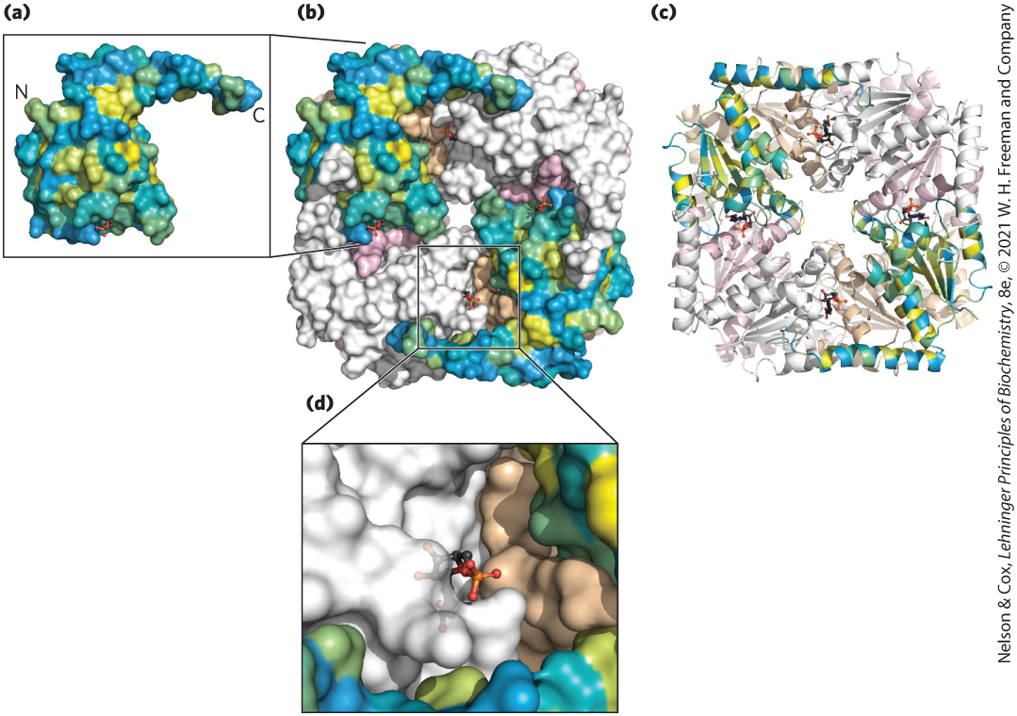
The Relationship between Protein Structure and Function
in principle, proteins can assume an uncountable number of special arrangements, or conformations
chemical or structural functions relate to unique three-dimensional structures

Slide 8
4.1 Overview of Protein Structure

Slide 9
Principle 1 (2 of 2)
Protein structures are stabilized by noncovalent interactions and forces. Formation of a thermodynamically favorable structure depends on the influences of the hydrophobic effect, hydrogen bonds, ionic interactions, and van der Waals forces. Natural protein structures are constrained by peptide bonds, whose configurations can be described by the dihedral angles φ and ψ.

Slide 10
Protein Conformations
limited number of conformations predominate under biological conditions
conformations = thermodynamically the most stable, that is, lowest free energy (G)
native = proteins in any functional, folded conformations

Slide 11
A Protein’s Conformation Is Stabilized Largely by Weak Interactions
stability = tendency of a protein to maintain a native conformation
unfolded proteins have high conformational entropy
chemical interactions stabilize native conformations:
  strong disulfide (covalent) bonds are uncommon
  weak (noncovalent) interactions and forces are numerous
    hydrogen bonds
    hydrophobic effect
    ionic interactions

Slide 12
Packing of Hydrophobic Amino Acids Away from Water Favors Protein Folding
hydrophobic effect = predominating weak interaction
solvation layer = highly structured shell of H₂O around a hydrophobic molecule
  decreases when nonpolar groups cluster together
  decrease causes a favorable increase in net entropy
hydrophobic R chains form a hydrophobic protein core

Slide 13
Polar Groups Contribute Hydrogen Bonds and Ion Pairs to Protein Folding
repeating secondary structures (α helices and β sheets) optimize hydrogen bonding
interaction of oppositely charged groups = ion pair = salt bridge
  strength increases in an environment of lower dielectric constant, ε
    polar aqueous solvent: ε ~ 80
    nonpolar protein interior: ε ~ 4

Slide 14

Clicker Question 1
Which item is the predominant factor in protein stability?
A. disulfide bonds
B. the hydrophobic effect
C. salt bridges
D. nonpeptide covalent bonds
Notes:
Answer: B
Principle: 4.1
Learning Objective(s): Explain how chemical and physical interactions govern protein structure and stability.
Bloom’s: 2:2

Slide 15
Clicker Question 1, Response
Which item is the predominant factor in protein stability?
B. the hydrophobic effect
The hydrophobic effect, derived from the increase in entropy of the surrounding water when nonpolar molecules or groups are clustered together, makes the major contribution to stabilizing the globular form of most soluble proteins.

Slide 16
Individual van der Waals Interactions Are Weak but Combine to Promote Folding
van der Waals interactions = dipole-dipole interactions over short distances
individual interactions contribute little to overall protein stability
high number of interactions can be substantial

Slide 17
Clicker Question 2
Which statement regarding protein structure is true?
A. Entropy is generally not a consideration when
determining stability.
B. Van der Waals interactions are insignificant.
C. Hydrophilic side chains are never found in the interior.
D. Hydrophobic side chains are usually in the interior of
the native structure.
Notes:
Answer: D
Principle: 4.1
Learning Objective(s): Describe the role of water in determining the overall free energy of a protein conformation.
Bloom’s: 2:2

Slide 18
Clicker Question 2, Response
Which statement regarding protein structure is true?
D. Hydrophobic side chains are usually in the interior
of the native structure.
When nonpolar groups cluster together, the extent of the solvation layer decreases, because each group no longer presents its entire surface to the solution. The result is a favorable increase in entropy. Hydrophobic amino acid side chains therefore tend to cluster in a protein’s interior, away from water.

Slide 19
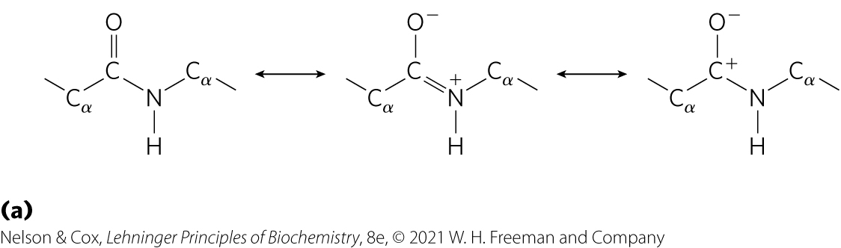
The Peptide Bond Is Rigid and Planar
3 covalent bonds separate the α carbons of adjacent amino acid residues: C_{α} —C—N—C_{α}
resonance between the carbonyl oxygen and the amide nitrogen
partial negative charge and partial positive charge sets up a small electric dipole

Slide 20
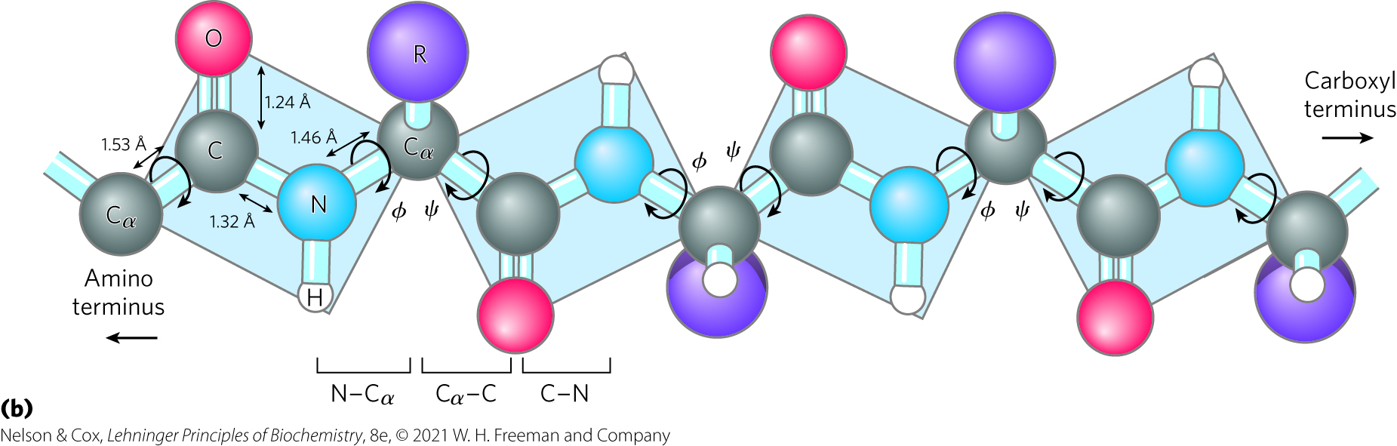
Peptide C—N Bonds Cannot
Rotate Freely
6 atoms of the peptide group lie in a single plane
partial double-bond character of C—N peptide bond prevents rotation, limiting range of conformations

Slide 21
Dihedral Angles Define Peptide Conformations
3 dihedral angles:
  φ (phi) = between −180 and +180 degrees
  ψ (psi) = between −180 and +180 degrees
  ω (omega) = ±180 degrees for trans

Slide 22
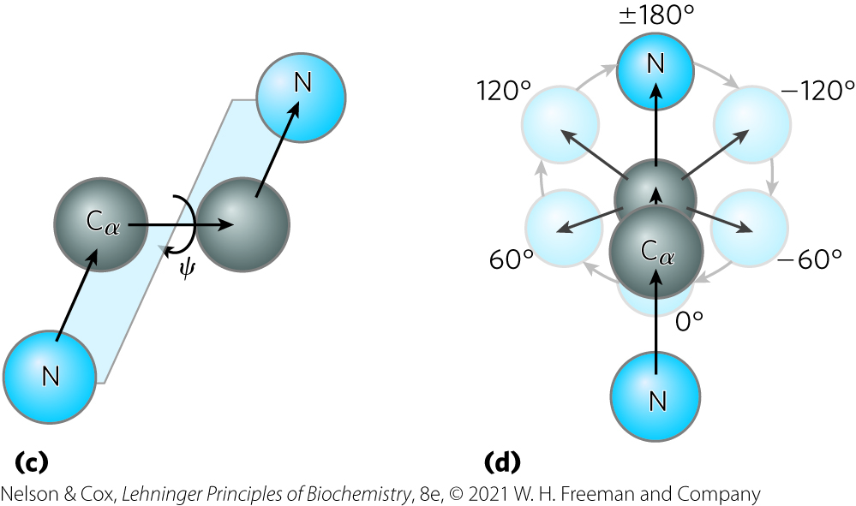
Prohibited Conformations
many φ (phi) and ψ (psi) values are prohibited by steric interference
  φ and ψ cannot both = 0 degrees
Notes:
Peptide conformation is defined by three dihedral angles (also known as torsion angles) called φ (phi), ψ (psi), and ω (omega),

Slide 23
Clicker Question 3
Why is there very little allowable rotation around the peptide bond?
A. Peptide bonds are amide bonds.
B. The R group prevents rotation about the peptide bond,
except in glycine.
C. The C—N bond is shorter.
D. Peptide bonds are only formed in the cis configuration.
E. The partial double-bond character makes the peptide
bond planar.
Notes:
Answer: E
Principle: 4.1
Learning Objective(s): Explain how peptide bonds influence protein structure.
Bloom’s: 2:2

Slide 24
Clicker Question 3, Response
Why is there very little allowable rotation around the peptide bond?
E. The partial double-bond character makes the
peptide bond planar.
Because of their partial double-bond character, peptide C—N bonds cannot rotate freely. This keeps the entire six-atom peptide group in a rigid planar configuration.

Slide 25

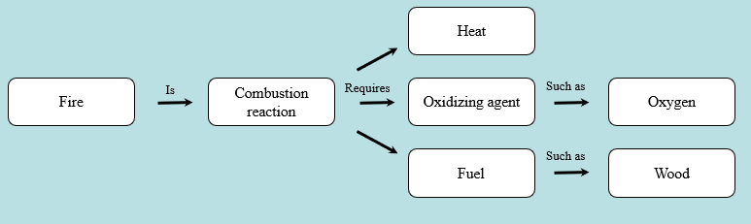
Activity: Relating
Terms within the Chapter
A concept map displays the relationships between different concepts. Observe the following example of a concept map.
Notes:
Instructor: For additional information, see the Instructor Activity Guide located in Achieve. It can be found within Chapter 4, in the folder titled “Ch4 In-Class Activities, Videos, and Resources.”

Slide 26
Activity Instructions (1 of 3)
Think about how the following terms and phrases relate to each other and then use scratch paper to draw a concept map using these terms and phrases. (3 minutes)
protein structure
peptide bonds
dihedral angles ϕ and ψ
nonpeptide covalent bonds
weak and noncovalent interactions and forces
disulfide bonds
van der Waals forces
hydrogen bonds
hydrophobic effect
ionic interactions
Notes:
Instructor: For additional information, see the Instructor Activity Guide located in Achieve. It can be found within Chapter 4, in the folder titled “Ch4 In-Class Activities, Videos, and Resources.”

Slide 27
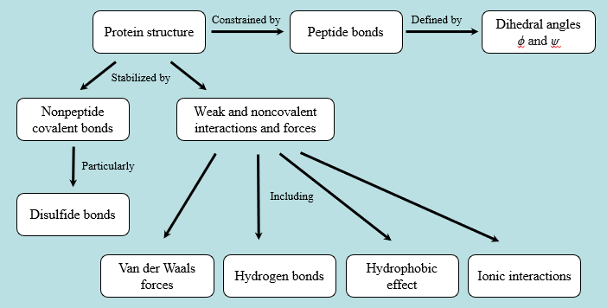
Activity Solution (1 of 3)
Pair up and share how this possible concept map might differ from yours. (2 minutes)
Notes:
Instructor: For additional information, see the Instructor Activity Guide located in Achieve. It can be found within Chapter 4, in the folder titled “Ch4 In-Class Activities, Videos, and Resources.”

Slide 28
4.2 Protein Secondary Structure

Slide 29
Principle 2 (2 of 2)
Protein segments can adopt regular secondary structures such as the α helix and the β conformation. These structures are defined by particular values of φ and ψ and their formation is impacted by the amino acid composition of the segment. All of the φ and ψ values for a given protein structure can be visualized using a Ramachandran plot.

Slide 30
Protein Secondary Structure
secondary structure = describes the spatial arrangement of the main-chain atoms in a segment of a polypeptide chain
  regular secondary structure = φ and ψ remain the same throughout the segment
  common types = α helix, β conformation, β turn, random coils

Slide 31
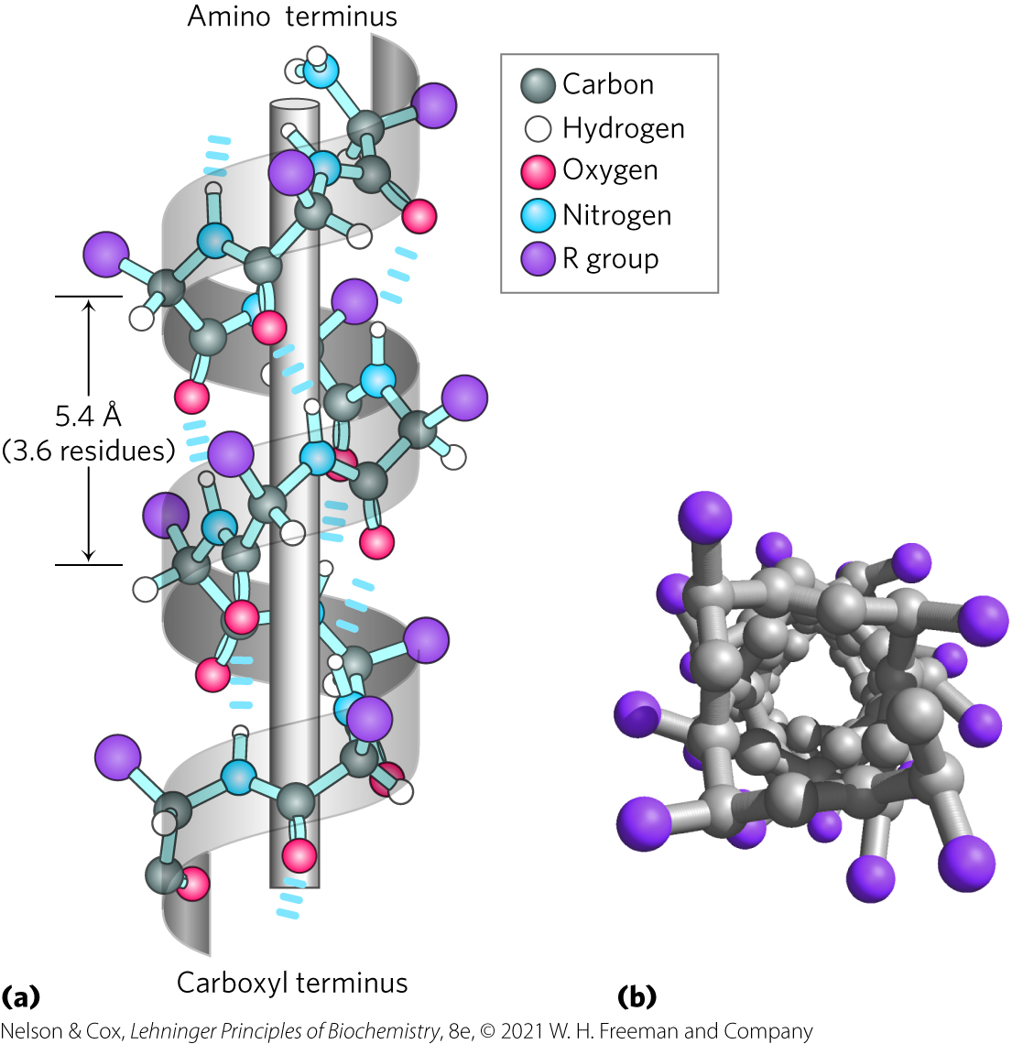
The α Helix Is a Common Protein Secondary Structure
α helix = simplest arrangement, maximum number of hydrogen bonds
  backbone wound around an imaginary longitudinal axis
  R groups protrude out from the backbone
  each helical turn = 3.6 residues, ∼5.4 Å

Slide 32

Clicker Question 4
Given that an α helix has 3.6 amino acids per turn and and a rise of 5.4 Å per turn, what is the length per amino acid of the α helix?
A. 3.6 Å
B. 5.4 Å
C. 1.5 Å
D. 19.4 Å
Notes:
Answer: C
Principle: 4.2
Learning Objective(s): Identify key features of an alpha helix; Relate the structure and composition of a protein to its physical properties.
Bloom’s: 3:2

Slide 33
Clicker Question 4, Response
Given that an α helix has 3.6 amino acids per turn and and a rise of 5.4 Å per turn, what is the length per amino acid of the α helix?
C. 1.5 Å
length per amino acid = (5.4 Å per turn)/(3.6 amino acids per turn)
= 1.5 Å

Slide 34
Dihedral Angles Define Protein Conformations
Structure | ϕ | ψ
α Helix | –57˚ | –47˚
β Conformation: Antiparallel | –139˚ | +135˚
β Conformation: Parallel | –119˚ | +113˚
Collagen triple helix | –51˚ | +153˚
β Turn type I: i+1 | –60˚ | –30˚
β Turn type I: i+2 | –90˚ | 0˚
β Turn type II: i+1 | –60˚ | +120˚
β Turn type II: i+2 | +80˚ | 0˚
Table 4-1 Idealized ϕ and ψ Angles for Common Secondary Structures in Proteins
Notes:
See Table 4-1 in text for footnotes.

Slide 35
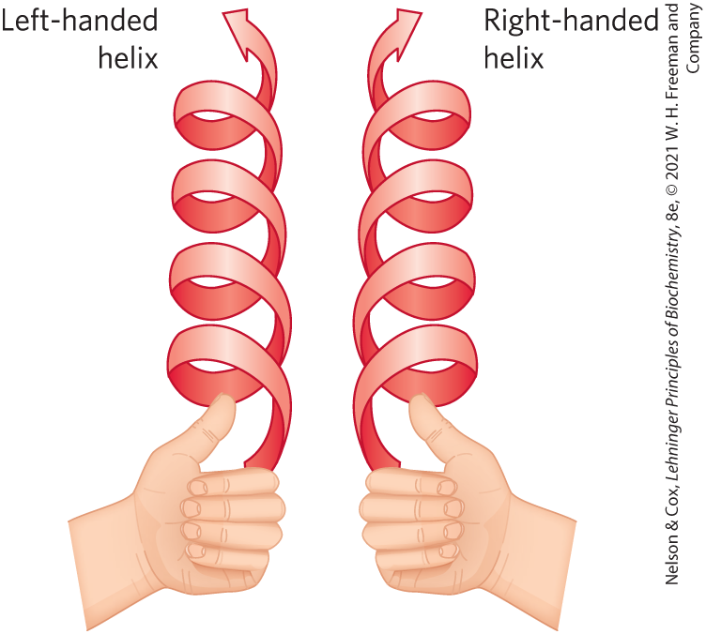
Handedness of the α Helix
right-handed:
  R groups protruding away from the helical backbone
  most common
extended left-handed: theoretically less stable, not observed in proteins

Slide 36
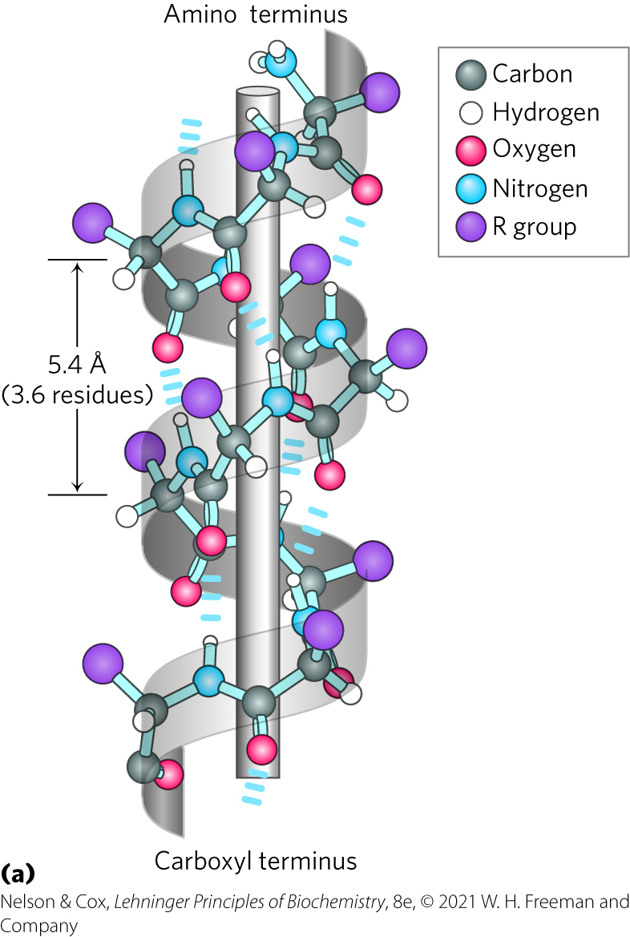
Intrahelical Hydrogen Bonds
between hydrogen atom attached to the electronegative nitrogen atom of residue n and the electronegative carbonyl oxygen atom of residue n + 4
confers significant stability
n + 4
n
Notes:
Helical backbone is held together by hydrogen bonds between the backbone amides of an n and n + 4 amino acids.

Slide 37
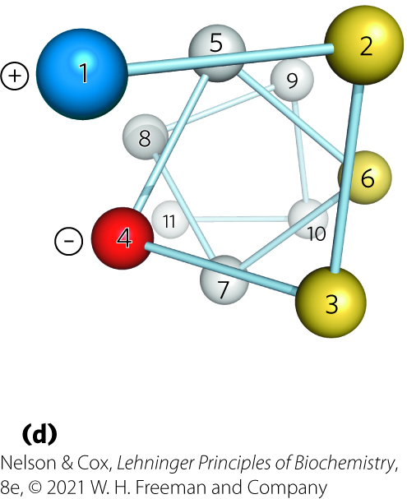
Amino Acid Sequence Affects Stability of the α Helix
amino acid residues have an intrinsic propensity to form an α helix
interactions between R chains spaced 3–4 residues apart can stabilize or destabilize α helix
  charge, size, and shape of R chains can destabilize
  formation of ion pairs and hydrophobic effect can stabilize
Helical wheel

Slide 38
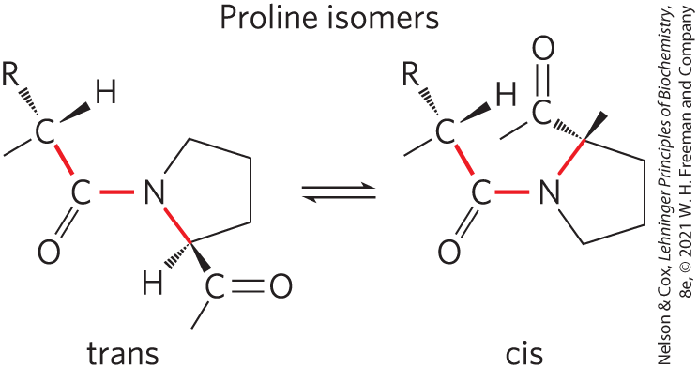
Proline and Glycine Occur Infrequently in an α Helix
proline = introduces destabilizing kink in helix
  nitrogen atom is part of rigid ring
  rotation about N—C_{α} bond not possible
glycine = high conformational flexibility, take up coiled structures

Slide 39
Clicker Question 5
Which amino acid would destabilize an amphipathic α helix if placed in the middle of one?
A. glycine
B. proline
C. glutamate
D. valine
E. All of these amino acids would potentially destabilize an
amphipathic α helix.
Notes:
Answer: E
Principle: 4.2
Learning Objective(s): Identify key features of an alpha helix.
Bloom’s: 1:1

Slide 40
Clicker Question 5, Response
Which amino acid would destabilize an amphipathic α helix if placed in the middle of one?
E. All of these amino acids would potentially
destabilize an amphipathic α helix.
Glycine has high conformational flexibility and tends to take up coiled structures. Proline introduces a destabilizing kink and the nitrogen atom of proline has no substituent hydrogen to participate in hydrogen bonds. The charge of glutamate and the branching of valine could destabilize the helix.

Slide 41
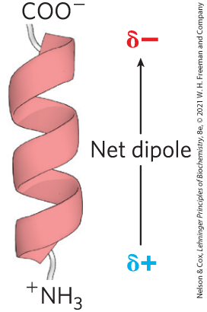
Amino Acid Residues Near the End of the α Helix Segment Affect Stability
small electric dipoles in each peptide bond align through hydrogen bonds
negatively charged amino acids often found near the NH₃⁺ terminus
positively charged amino acids often found near the COO– terminus

Slide 42
Clicker Question 6
The α helix is:
A. affected by the identities of the residues near each end.
B. stabilized by amino acid R-group interactions.
C. a left-handed helix with 3.6 amino acids per turn.
D. stabilized primarily by the hydrophobic effect.
Notes:
Answer: A
Principle: 4.2
Learning Objective(s): Identify key features of an alpha helix.
Bloom’s: 1:1

Slide 43
Clicker Question 6, Response
The α helix is:
A. affected by the identities of the residues near each
end.
There is a net dipole along the helical axis of an α helix. The partial positive and negative charges of the helix dipole reside on the peptide NH₃⁺ and COO⁻ groups. For this reason, negatively charged amino acids are often found near the NH₃⁺ terminus and positively charged amino acids are often found near the COO⁻ terminus.

Slide 44
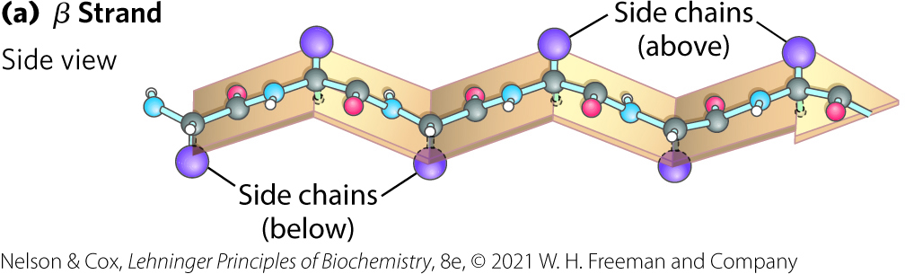
The β Conformation Organizes Polypeptide Chains into Sheets
β conformation = backbone extends into a zigzag
  β strand = single protein segment
  β sheet = several strands in β conformation side by side

Slide 45
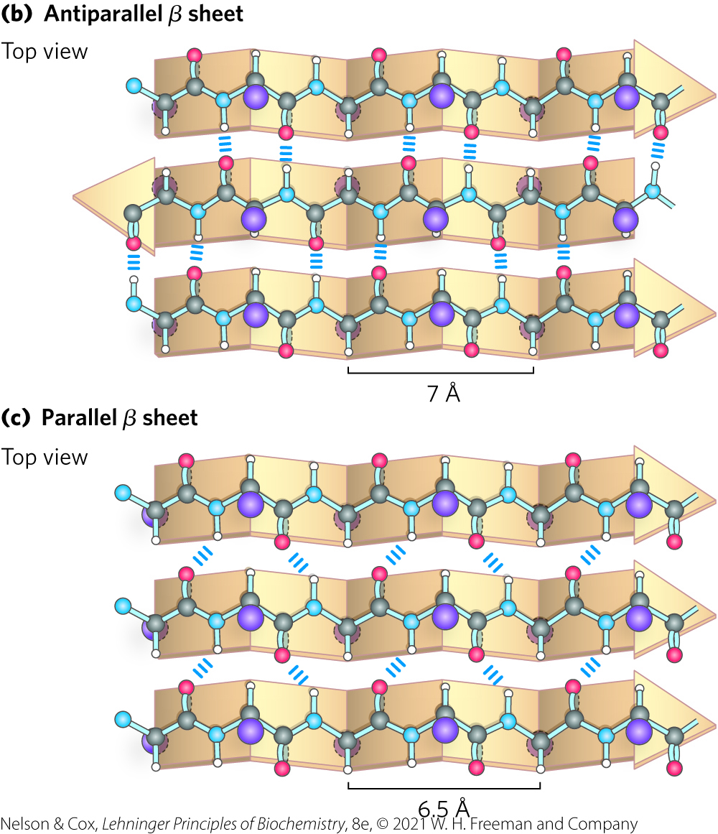
Adjacent Polypeptide Chains in a β Sheet Can Be Antiparallel or Parallel
antiparallel = opposite orientation
  occur more frequently
parallel = same orientation
H bonds form between backbone atoms of adjacent segments

Slide 46
Clicker Question 7
The β sheet:
A. can be either parallel or perpendicular.
B. has strands in which the R groups of the amino acids are
all on the same side of the sheet.
C. is composed of amino acid residues all very near each
other in the primary structure.
D. is primarily stabilized by hydrogen bonds.
Notes:
Answer: D
Principle: 4.2
Learning Objective(s): Identify key features of the beta conformation.
Bloom’s: 1:1

Slide 47
Clicker Question 7, Response
The β sheet:
D. is primarily stabilized by hydrogen bonds.
Hydrogen bonds form between backbone atoms of adjacent segments of polypeptide chains within the sheet.

Slide 48
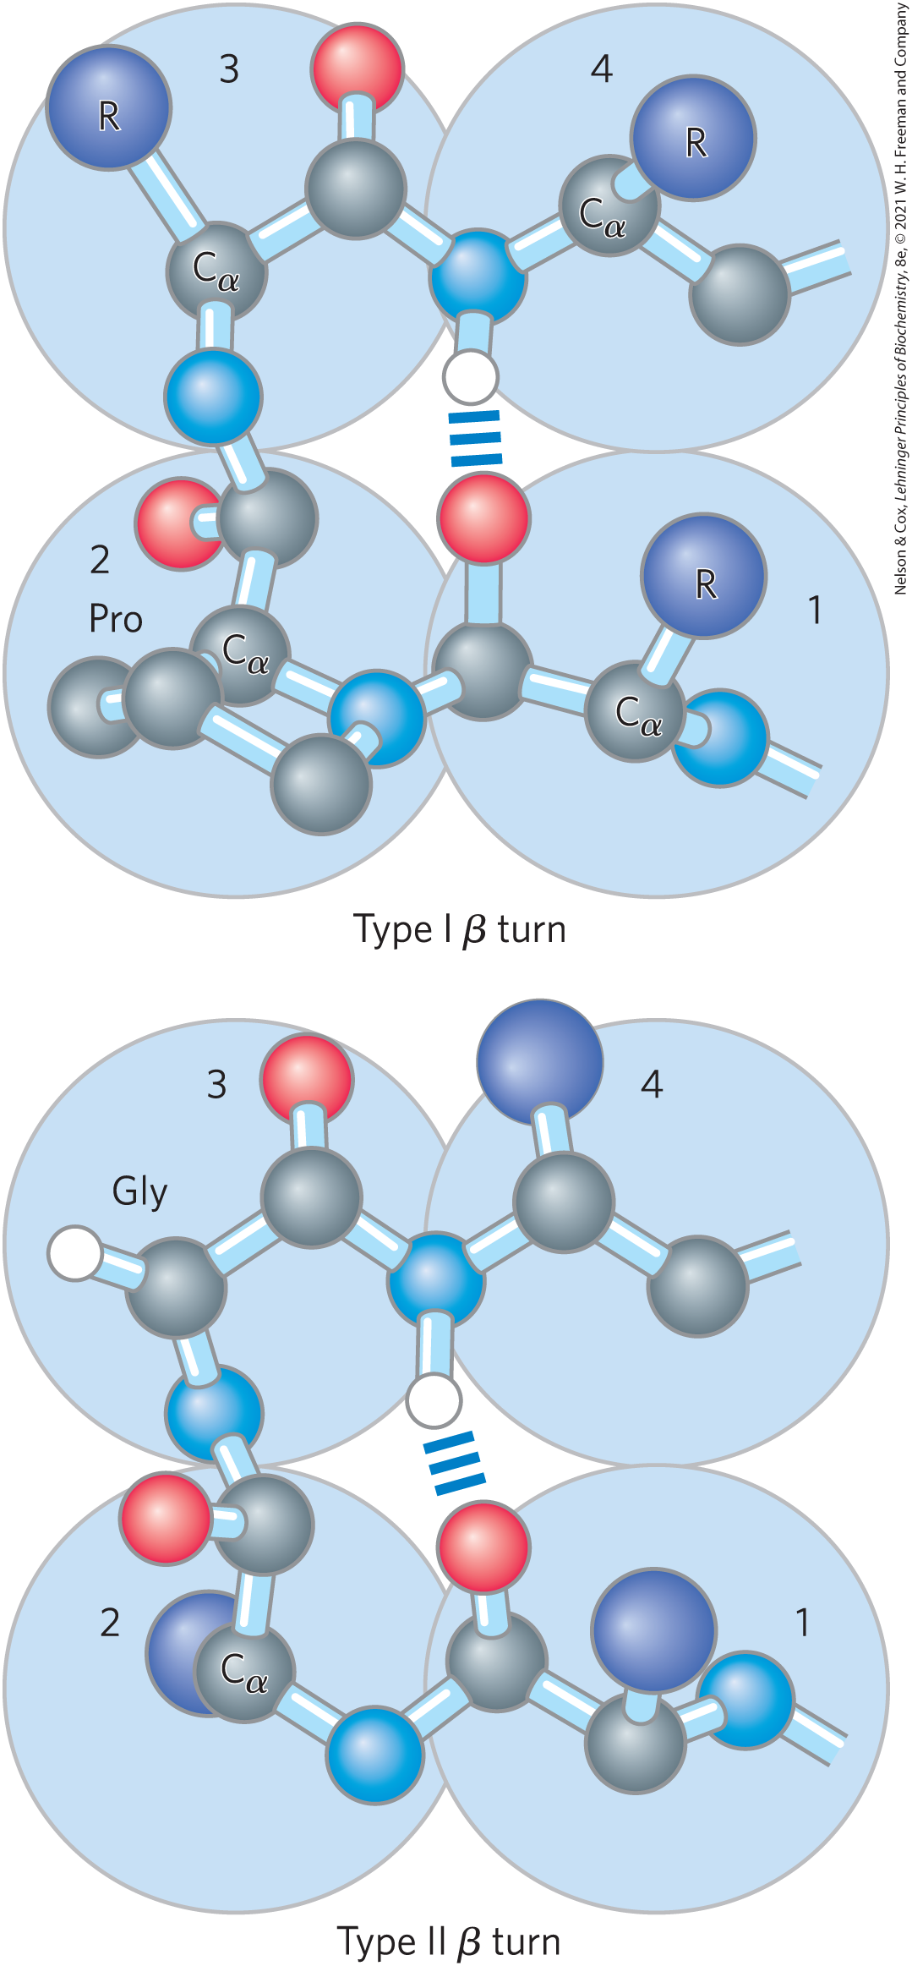
β Turns Are Common in Proteins
β turns = connect ends of two adjacent segments of an antiparallel β sheet
  180° turn
  involves 4 residues
  hydrogen bond forms between first and fourth residue
  Gly (residue 2) and Pro (residue 3) often occur in β turns

Slide 49
Clicker Question 8
Which is the more stable β sheet: parallel or antiparallel?
antiparallel due to more linear hydrogen bonds
parallel due to the alignment of all terminal amino groups on one side and all carboxyl groups on the other side
parallel due to a high concentration of proline residues, promoting more linear hydrogen bonds
antiparallel due to a more elongated structure than parallel sheets
antiparallel because β turns can join the strands, an arrangement that is not possible with parallel sheets
Notes:
Answer: A
Principle: 4.2
Learning Objective(s): Identify key features of the beta conformation.
Bloom’s: 1:1

Slide 50
Clicker Question 8, Response
Which is the more stable β sheet: parallel or antiparallel?
antiparallel due to more linear hydrogen bonds
The interstrand hydrogen bonds are essentially in-line in the antiparallel β sheet, whereas they are distorted or not in-line for the parallel variant.

Slide 51
Common Secondary Structures Have Characteristic Dihedral Angles
dihedral angles φ (phi) and ψ (psi) associated with each residue completely described secondary structure
Ramachandran plots:
  visualize all φ and ψ angles
  test quality of three-dimensional protein structures

Slide 52
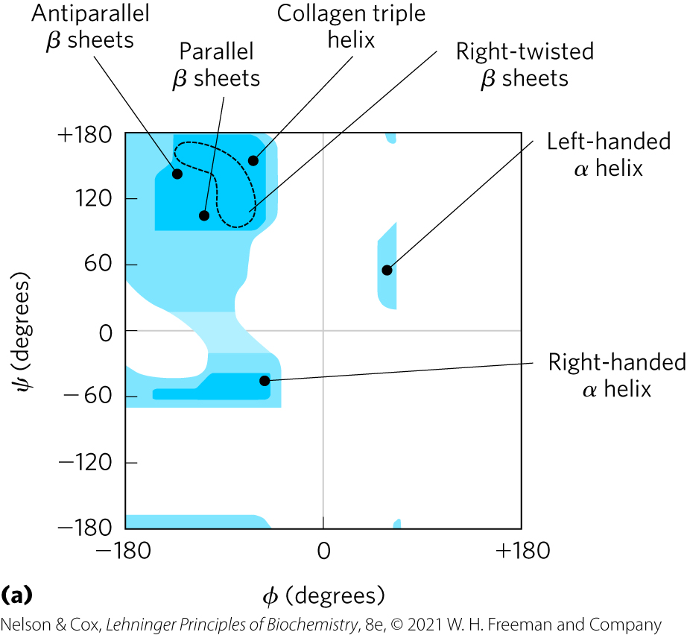
Secondary Structure Conformations are Defined by φ and ψ Values

Slide 53
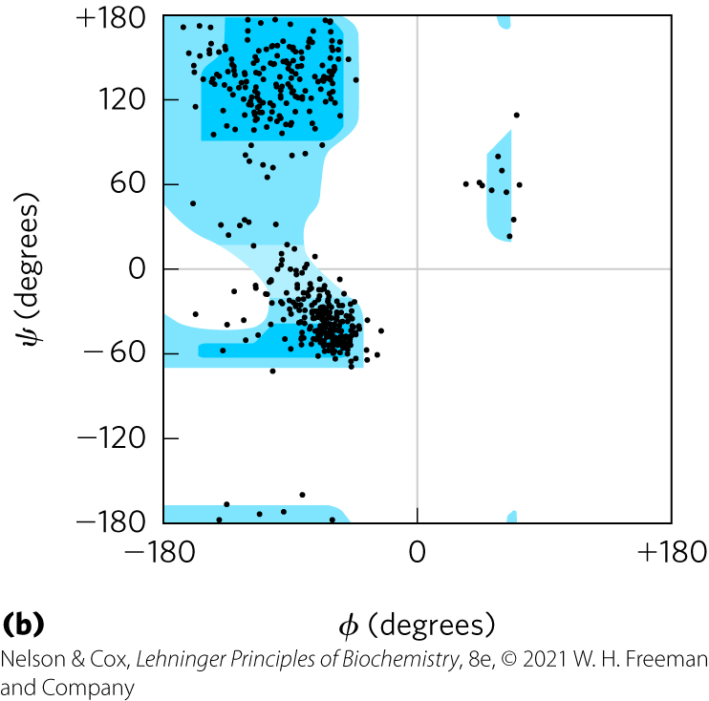
φ and ψ Values from Known Proteins Fall into Expected Regions
glycine frequently falls outside the expected ranges

Slide 54
Clicker Question 9
Ramachandran plots measure which dihedral angles?
A. φ (phi) and ψ (psi) angles
B. ψ (psi) and ω (omega) angles
C. φ (phi) and ω (omega) angles
D. φ (phi), ψ (psi), and ω (omega) angles
Notes:
Answer: A
Principle: 4.2
Learning Objective(s): Identify key features of a Ramachandran plot.
Bloom’s: 1:1

Slide 55
Clicker Question 9, Response
Ramachandran plots measure which dihedral angles?
A. φ (phi) and ψ (psi) angles
Ramachandran plots are useful tools for visualizing all of the φ and ψ angles observed in a particular protein structure and are often used to test the quality of three-dimensional protein structures.

Slide 56
Common Secondary Structures Can Be Assessed by Circular Dichroism
circular dichroism (CD) spectroscopy = measures differences in the molar absorption of left-handed vs. right-handed circularly polarized light:
Δε = ε_{L} – ε_{R}
chromophore = peptide bond

Slide 57
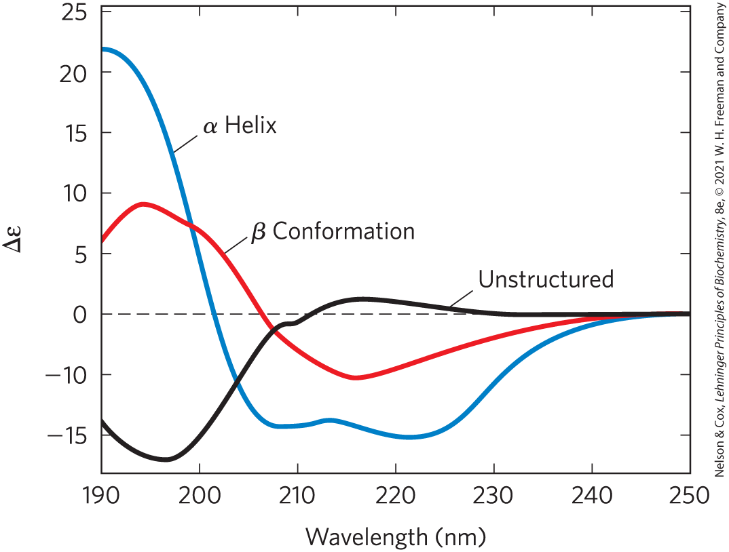
Different Secondary Structures Have Different Circular Dichroism Spectra

Slide 58
Clicker Question 10
Circular dichroism can NOT:
A. provide a rough estimate for the fraction of the protein
made up of the two common secondary structures.
B. monitor the denaturation of a protein.
C. monitor conformational changes in a protein.
D. obtain a high-resolution three-dimensional structure.
Notes:
Answer: D
Principle: 4.2
Learning Objective(s): Describe how circular dichroism is used to study protein structure.
Bloom’s: 2:2

Slide 59
Clicker Question 10, Response
Circular dichroism can NOT:
D. obtain a high-resolution three-dimensional
structure.
Circular dichroism spectroscopy is a method for assessing common secondary structure and monitoring folding in proteins based on absorption of circularly polarized UV light. However, circular dichroism can not be used to obtain a high-resolution three-dimensional structure.

Slide 60

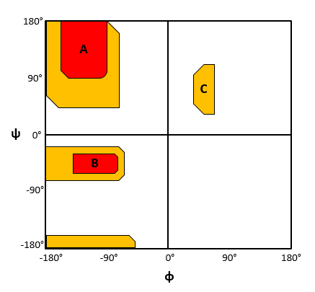
Activity: Properties of Protein Structures
Study the Ramachandran plot model.

Slide 61
Activity Instructions (2 of 3)
On your own, think of answers to the question:
  Which secondary structures possess φ and ψ angles that fall within regions A, B, and C, respectively?
  (2 minutes)
Pair up to discuss your ideas. (2 minutes)
Share your ideas with the class in group discussion.

Slide 62
Activity Solution (2 of 3)
  Which secondary structures possess φ and ψ angles that fall within regions A, B, and C, respectively? Region A corresponds to beta sheets, region B corresponds to right-handed alpha helices, region C corresponds to left-handed alpha helices.

Slide 63
4.3 Protein Tertiary and Quaternary Structures

Slide 64
Principle 3 (2 of 2)
Tertiary structure describes the well-defined, three-dimensional fold adopted by a protein. Protein structures are often built by combinatorial use of common protein folds or motifs. Quaternary structure describes the interactions between components of a multisubunit assembly.

Slide 65
Protein Tertiary and Quaternary Structure
tertiary structure = overall three-dimensional arrangement of all the atoms in a protein
  weak interactions and covalent bonds hold interacting segments in position
quaternary structure = arrangement of 2+ separate polypeptide chains in three-dimensional complexes

Slide 66
Classifying Proteins
four major types of protein groups based on polypeptide chains:
  fibrous proteins = arranged in long strands or sheets
  globular proteins = folded into a spherical or globular shape
  membrane proteins = embedded in hydrophobic lipid membranes
  intrinsically disordered proteins = lacking stable tertiary structures

Slide 67

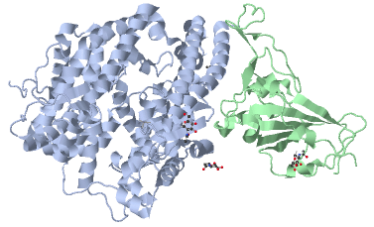
Activity: Visualizing
Protein Structure
Observe the structure of the SARS-CoV-2 spike protein in complex with its receptor ACE2 in Mol3D viewer in your Achieve course.
Notes:
Instructor: This Mol3D structure is located in the Achieve course. It can be found in the Chapter 4 content, in the folder titled “Ch4 In-Class Activities, Videos, and Resources.”

Slide 68
Activity Instructions (3 of 3)
On your own, think of answers to the questions:
  How do the secondary structures within ACE2 differ from those of the spike protein?
  What type of bonding likely occurs between each of the following pairs of amino acids: Y453 of the spike protein with H34 of ACE2, N487 of the spike protein with Q24 of ACE2, and K417 of the spike protein with D30 of ACE2?
  (2 minutes)
Pair up to discuss your ideas. (2 minutes)
Share your ideas with the class in group discussion.
Notes:
Instructor: This Mol3D structure is located in the Achieve course. It can be found in the Chapter 4 content, in the folder titled “Ch4 In-Class Activities, Videos, and Resources.”

Slide 69
Activity Solution (3 of 3)
  How do the secondary structures within ACE2 differ from those of the spike protein? ACE2 comprises primarily alpha helices whereas the spike protein comprises primarily beta sheets.
  What type of bonding likely occurs between each of the following pairs of amino acids: Y453 of the spike protein with H34 of ACE2, N487 of the spike protein with Q24 of ACE2, and K417 of the spike protein with D30 of ACE2?
Y453 and H34: hydrogen bonding
N487 and Q24: hydrogen bonding
K417 and D30: ionic bonding
Notes:
Instructor: This Mol3D structure is located in the Achieve course. It can be found in the Chapter 4 content, in the folder titled “Ch4 In-Class Activities, Videos, and Resources.”

Slide 70
Clicker Question 11
Which statement regarding the tertiary structure of proteins is false?
A. Amino acid residues far apart in primary structure may
interact with each other in the tertiary structure.
B. The tertiary structure of a protein is destabilized by the
hydrophobic effect.
C. Many proteins can be classified as either globular or
fibrous (but not both).
D. Quaternary structure is the description of how the
tertiary structures in a multisubunit protein are
arranged with respect to each other.
Notes:
Answer: B
Principle: 4.3
Learning Objective(s): Describe the primary, secondary, tertiary, and quaternary structures of a protein.
Bloom’s: 2:2

Slide 71
Clicker Question 11, Response
Which statement regarding the tertiary structure of proteins is false?
B. The tertiary structure of a protein is destabilized by
the hydrophobic effect.
The tertiary structure of a protein is largely stabilized by the hydrophobic effect. In typical globular proteins, most of the hydrophobic R groups are in the interior of the molecule, hidden from exposure to water.

Slide 72
Fibrous Proteins Are Adapted for a Structural Function
give strength and/or flexibility to structures
simple repeating element of secondary structure
H₂O insoluble due to high concentrations of hydrophobic residues
Table 4-2 Secondary Structures and Properties of Some Fibrous Proteins
Structure | Characteristics | Examples of occurrence
α Helix, cross-linked by disulfide bonds | Tough, insoluble protective structures of varying hardness and flexibility | α-Keratin of hair, feathers, nails
β Conformation | Soft, flexible filaments | Silk fibron
Collagen triple helix | High tensile strength, without stretch | Collagen of tendons, bone matrix

Slide 73
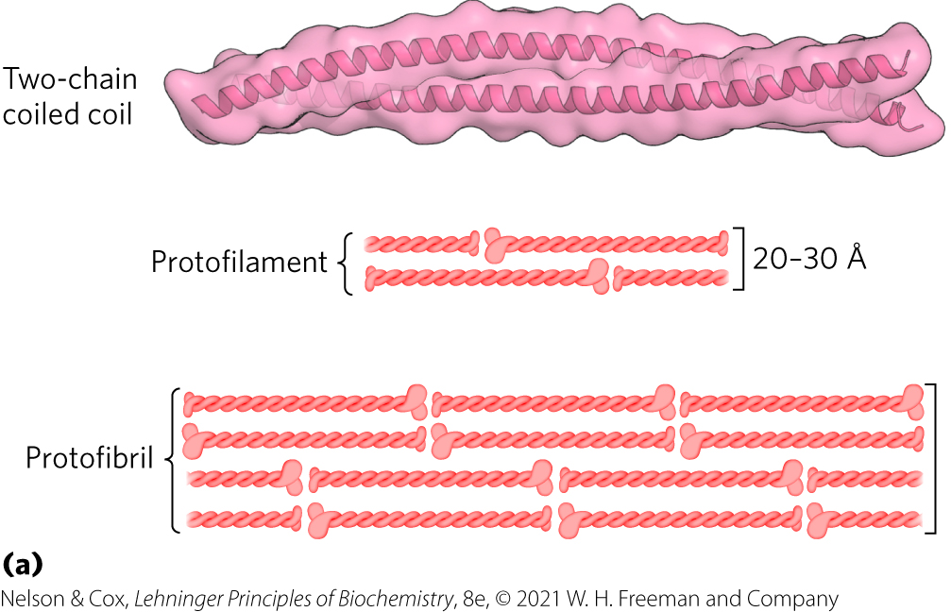
The Structure of α-Keratin in Hair
α-keratin helix is a right-handed α helix
two strands of α-keratin, oriented in parallel, wrap about each other to form a supertwisted coiled coil
  supertwisted helical path is left-handed

Slide 74
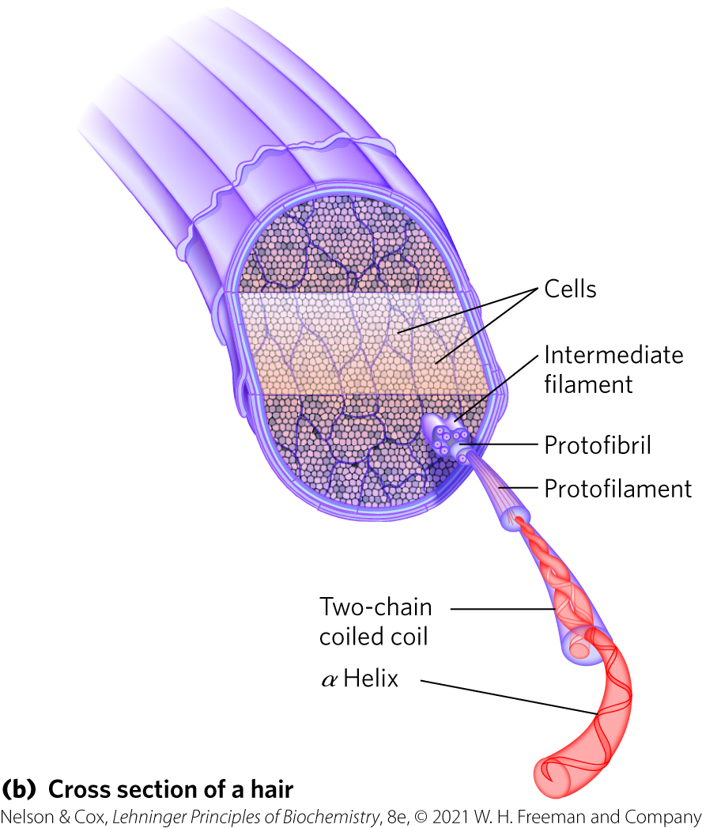
Hair Contains Many α-Keratin Filaments
rich in hydrophobic residues: Ala, Val, Leu, Ile, Met, Phe
cross-links stabilized by disulfide bonds

Slide 75
Clicker Question 12
α-Keratin proteins constitute almost the entire dry weight
of horns and hooves in mammals. The strength of α-
keratin proteins comes from:
A. cross-linking of α helices by disulfide bonds.
B. a close packing of β sheets.
C. a triple helix.
D. high concentrations of charged amino acids.
Notes:
Answer: A
Principle: 4.3
Learning Objective(s): Compare the structures of alpha-keratin, fibroin, and collagen.
Bloom’s: 2:2

Slide 76
Clicker Question 12, Response
α-Keratin proteins constitute almost the entire dry weight
of horns and hooves in mammals. The strength of α-
keratin proteins comes from:
A. cross-linking of α helices by disulfide bonds.
The α-keratin helix is a right-handed α helix, enhanced by covalent (disulfide) cross-links.

Slide 77
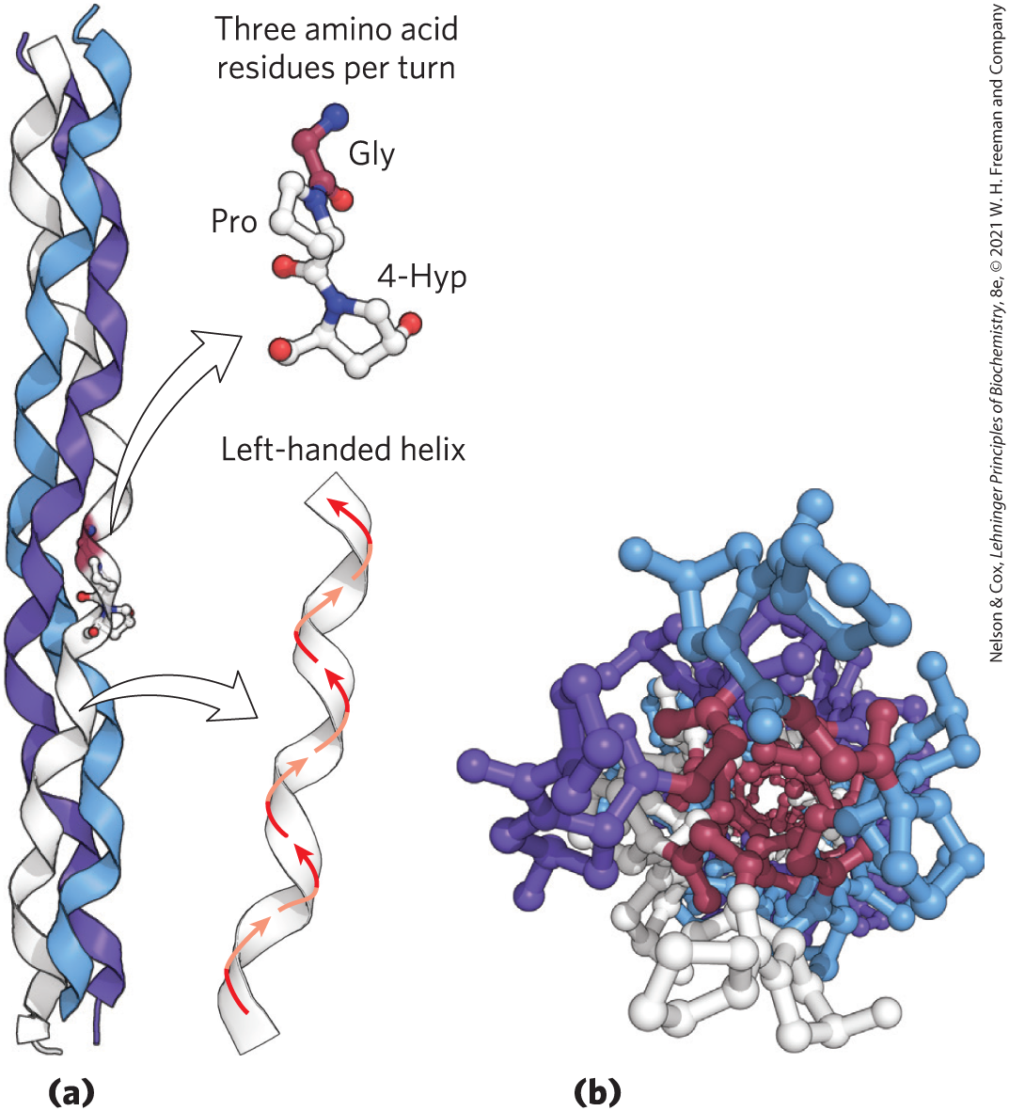
The Structure of Collagen
collagen = found in connective tissue
  secondary structure = left-handed, repeating tripeptide unit Gly–X–Y, where X is often Pro and Y is often 4-Hyp
  tertiary and quaternary structure = right-handed twisting of 3 separate polypeptides

Slide 78
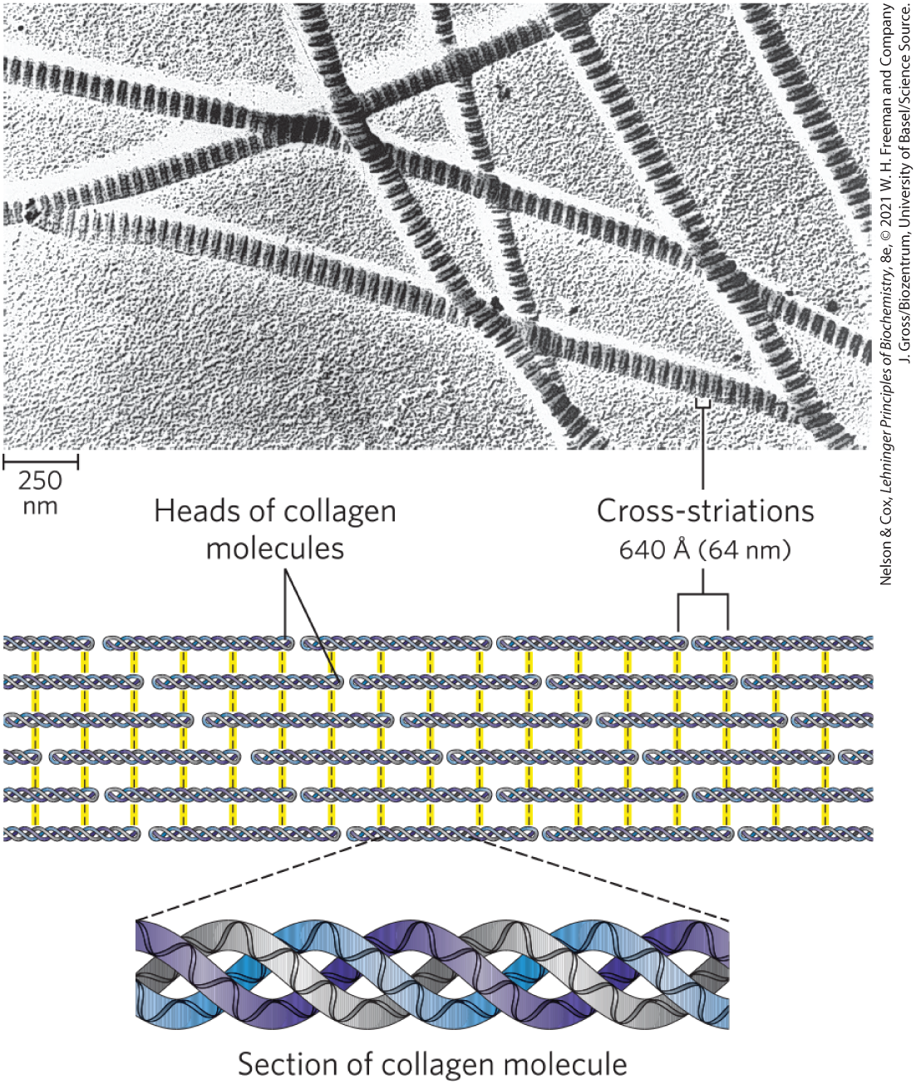
The Structure of Collagen Fibrils

Slide 79
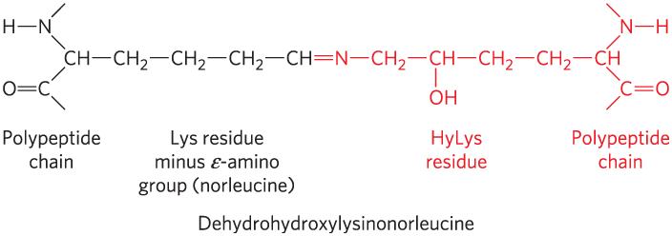
Covalent Cross-Links in
Collagen Fibrils
cross-linked by covalent bonds involving Lys, HyLys (5-hydroxylysine), or His
  links create uncommon amino acid residues

Slide 80
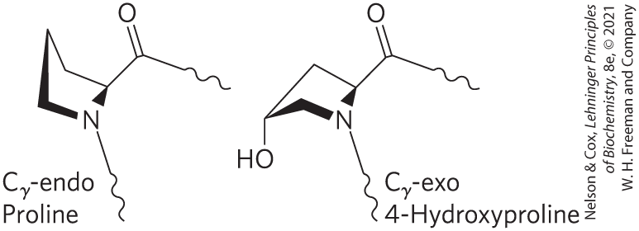
Scurvy, Vitamin C, and Collagen Formation
scurvy is caused by a lack of vitamin C
  characterized by general degeneration of connective tissue
vitamin C is required for the hydroxylation of proline and lysine in collagen

Slide 81
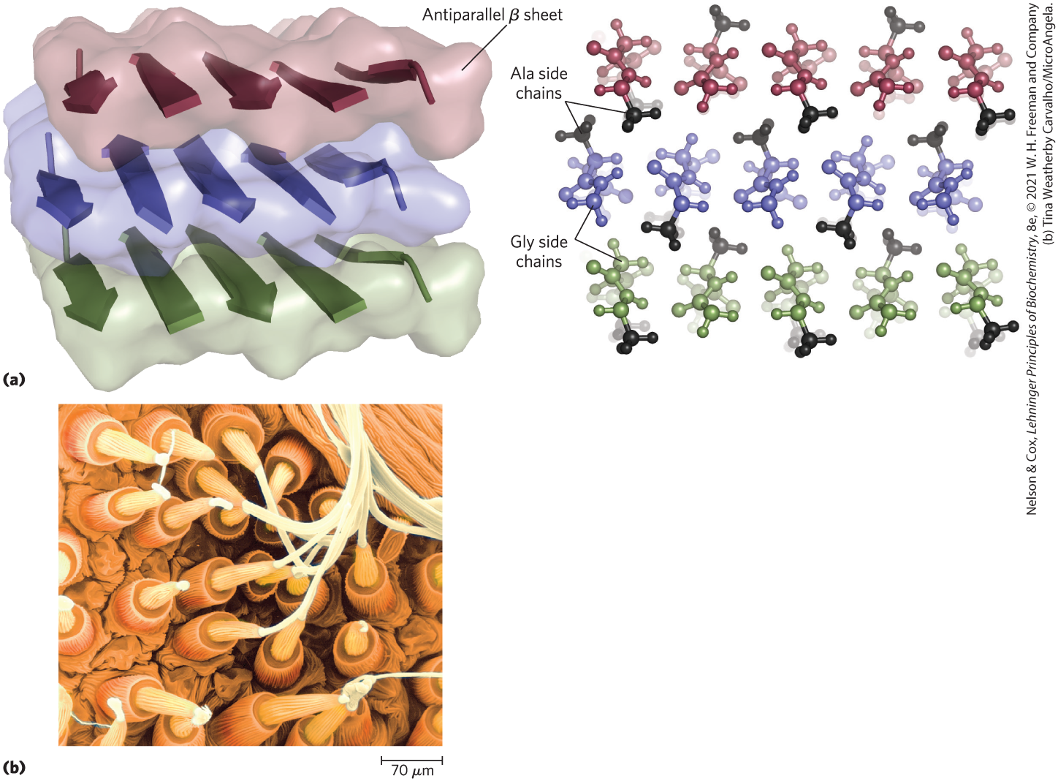
The Structure of Fibroin
main protein in silk
predominantly β conformation
rich in Ala and Gly
stabilized by hydrogen bonding and van der Waals interactions

Slide 82
Clicker Question 13
Collagen:
A. has fibrils consisting of cross-linked triple helices
of polypeptide chains.
B. dose not have quaternary structure.
C. consists of α-helical subunits.
D. has a primary structure of repeating –Glu-X-Y-.
Notes:
Answer: A
Principle: 4.3
Learning Objective(s): Compare the structures of alpha-keratin, fibroin, and collagen.
Bloom’s: 2:2

Slide 83
Clicker Question 13, Response
Collagen:
A. has fibrils consisting of cross-linked triple helices
of polypeptide chains.
Collagen is composed of three separate polypeptides twisted about each other. Collagen fibrils are made up of collagen molecules aligned in a staggered fashion and cross-linked for strength.

Slide 84
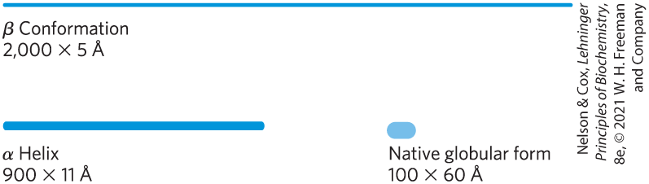
Structural Diversity Reflects Functional Diversity in Globular Proteins
globular proteins:
  fold back on each other
  more compact than fibrous proteins
  enzymes, transport proteins, motor proteins, regulatory proteins, immunoglobulins

Slide 85
The Protein Data Bank
The Protein Data Bank (PDB): www.rcsb.org
  archive of experimentally determined three-dimensional structures
  structures assigned an identifier called the PDB ID
  PDB data files describe:
    the spatial coordinates of each atom
    information on how the structure was determined
    information on its accuracy
  structure visualization software can convert atomic coordinates to an image of the molecule

Slide 86
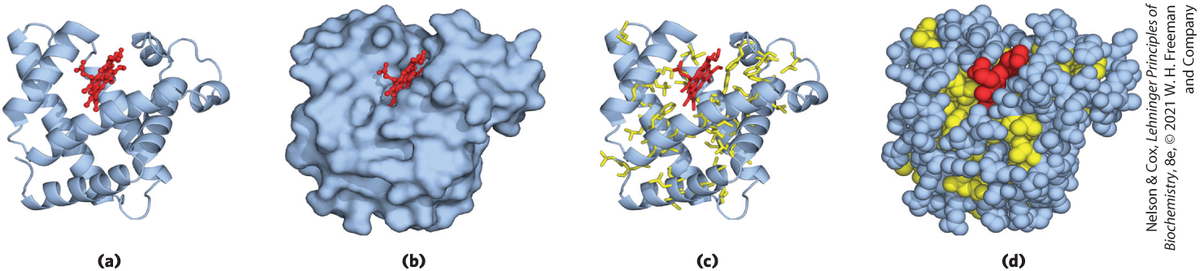
Myoglobin Provided Early Clues about the Complexity of Globular Protein Structure
several structural representations of myoglobin’s tertiary structure:
Binding pocket
α-Helical regions
Hydrophobic R chains

Slide 87
Globular Proteins Have a Variety of Tertiary Structures
Table 4-3 Approximate Proportion of α Helix and β Conformation in Some Single-Chain Proteins
each globular protein has a distinct structure, adapted for its biological function
Protein (total residues) | Residues (%): α Helix | Residues (%): β Conformation
Chymotrypsin (247) | 14 | 45
Ribonuclease (124) | 26 | 35
Carboxypeptidase (307) | 38 | 17
Cytochrome c (104) | 39 | 0
Lysozyme (129) | 40 | 12
Myoglobin (153) | 78 | 0
Notes:
See Table 4-3 in text for footnotes.

Slide 88
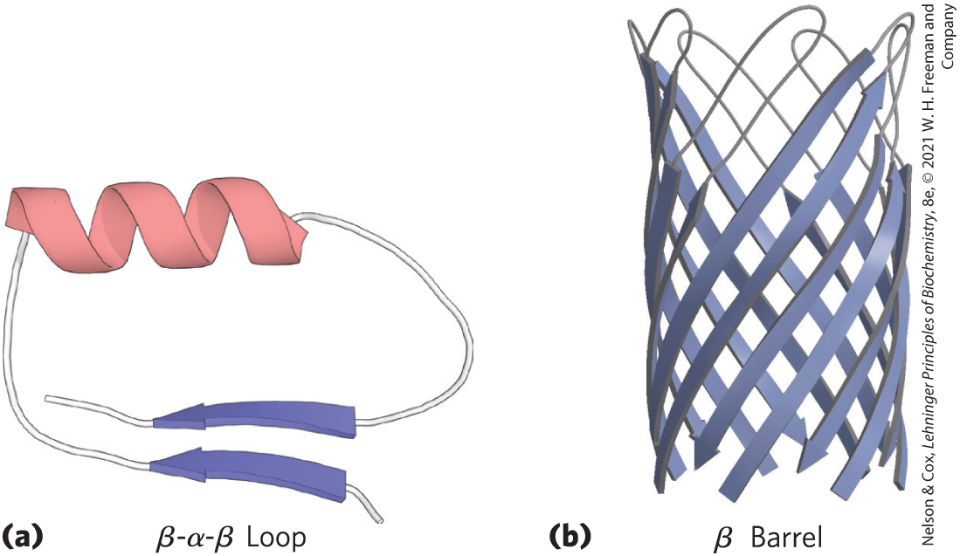
Folding Patterns of Proteins
motif = fold = recognizable folding pattern involving 2+ elements of secondary structures and the connection(s)
  can be simple, such as in a β-α-β loop
  can be elaborate, such as in a β barrel

Slide 89
Clicker Question 14
A motif in the glycolysis enzyme hexokinase could NOT contain:
A. a β turn.
B. a β sheet.
C. an α helix.
D. disulfide bonds
E. All of these could be found in a motif.
Notes:
Answer: E
Principle: 4.3
Learning Objective(s): Differentiate between structural motifs or folds and domains.
Bloom’s: 2:2

Slide 90
Clicker Question 14, Response
A motif in the glycolysis enzyme hexokinase could NOT contain:
E. All of these could be found in a motif.
A motif or fold is a recognizable folding pattern involving two or more elements of secondary structure and the connection(s) between them. A motif could include a β turn, a β sheet, an α helix, and disulfide bonds.

Slide 91
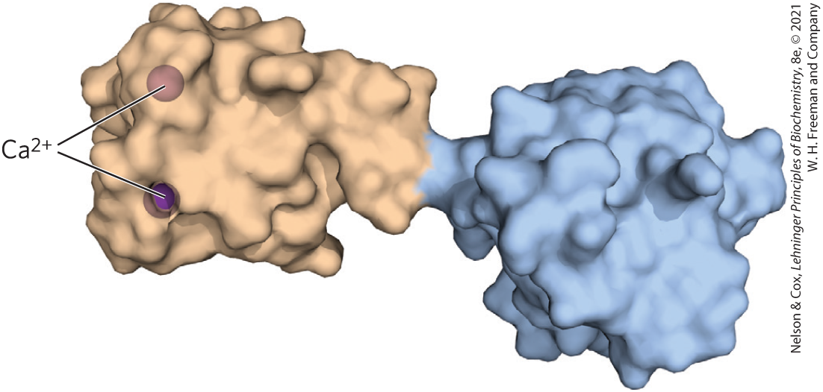
Protein Domains
domain = part of a polypeptide chain that is independently stable or could undergo movements as a single entity
  domains may appear as distinct or be difficult to discern
  small proteins usually have only one domain

Slide 92
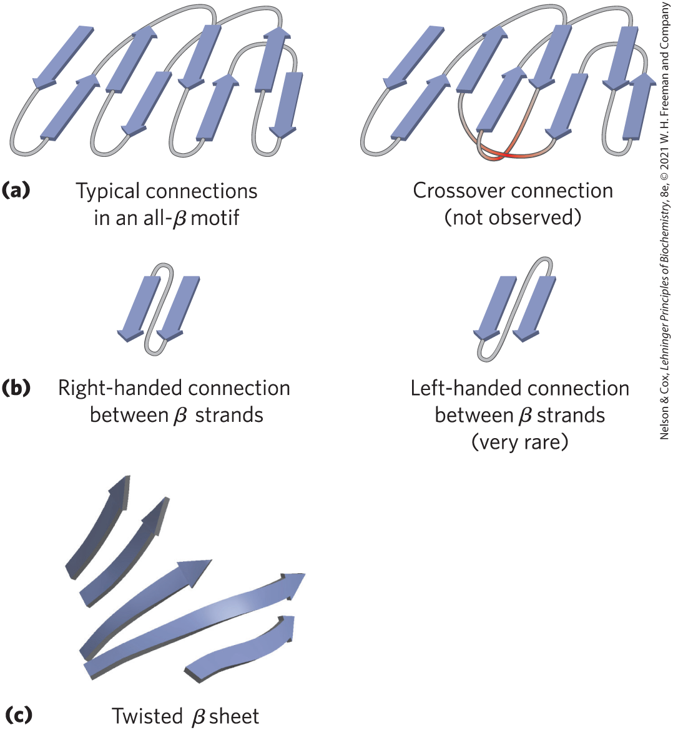
Protein-Folding Rules
burial of hydrophobic R groups requires 2+ layers of secondary structure
α helices and β sheets are found in different layers
adjacent amino acid segments are usually stacked adjacent
the β conformation is most stable with right-handed connections

Slide 93
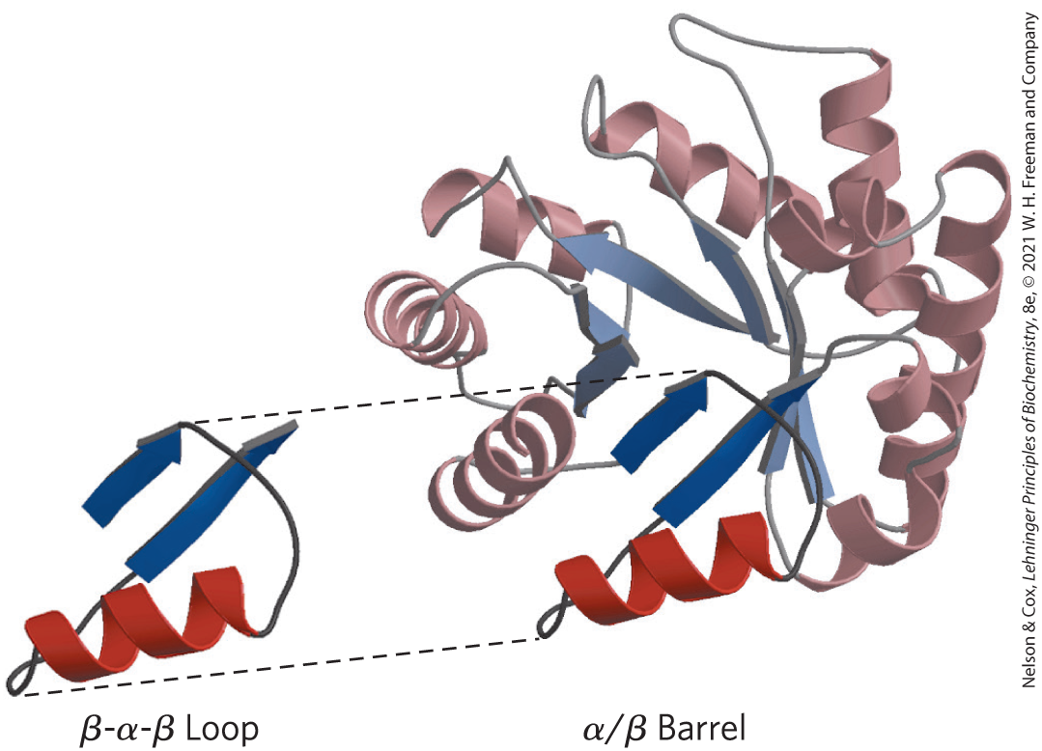
Complex Motifs Are Built from Simple Motifs
α/β barrel = series of β-α-β loops arranged such that the β strands form a barrel

Slide 94
Some Proteins or Protein Segments Are Intrinsically Disordered
intrinsically disordered proteins:
  lack definable structure
  often lack a hydrophobic core
  high densities of charged residues (Lys, Arg, Glu) and Pro
  facilitates a protein to interact with multiple binding partners

Slide 95
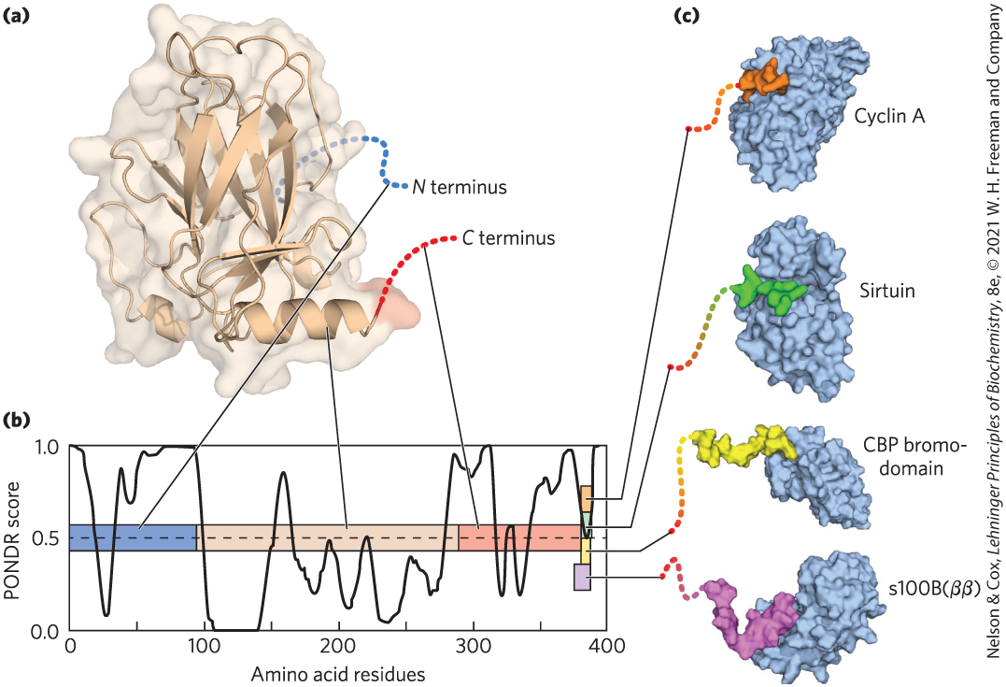
Intrinsically Disordered Segments Can Assume Different Structures

Slide 96
Clicker Question 15
Which feature is NOT associated with globular proteins?
domains
motifs
classified as either all α or all β
intrinsically disordered regions of structure
Notes:
Answer: C
Principle: 4.3
Learning Objective(s): Classify a protein as a fibrous, globular, membrane, or intrinsically disordered protein.
Bloom’s: 2:2

Slide 97
Clicker Question 15, Response
Which feature is NOT associated with globular proteins?
classified as either all α or all β
Globular proteins are folded into a spherical or globular shape. Globular proteins often contain several types of secondary structure and have a variety of tertiary structures. These proteins are not classified as either all α or all β.

Slide 98

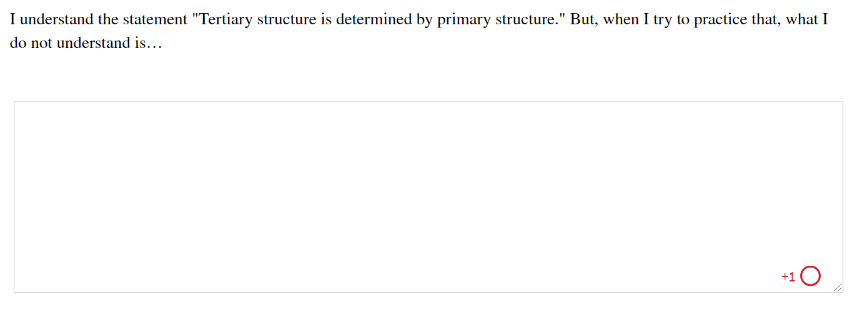
Activity: Tertiary
Structure Muddiest Point (1 of 2)
Complete the Ch4 Student Activity, Day 1: Tertiary Structure (Muddiest Point) Achieve assessment.
Notes:
Instructor: This muddiest point activity can be found in Achieve in the Chapter 4 folder titled “Ch4 In-Class Activities, Videos, and Resources.” See the Instructor Activity Guide in the same folder for more information.

Slide 99
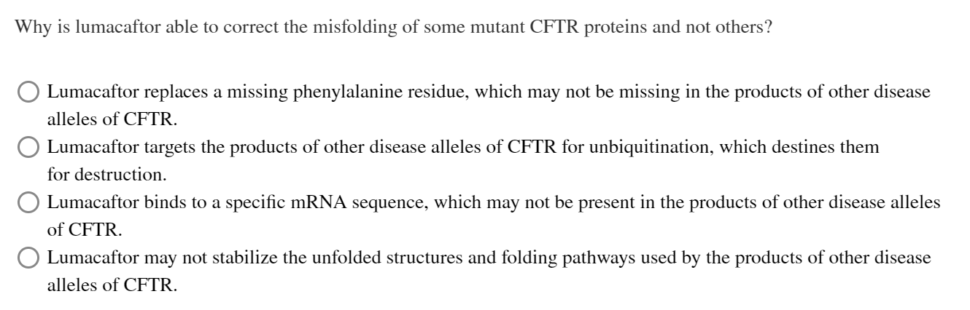
Activity: Tertiary
Structure Muddiest Point (2 of 2)
Complete the Ch4 Student Activity, Day 2: Tertiary Structure (Muddiest Point) Achieve assessment.
Notes:
Instructor: This muddiest point activity can be found in Achieve in the Chapter 4 folder titled “Ch4 In-Class Activities, Videos, and Resources.” See the Instructor Activity Guide in the same folder for more information.

Slide 100
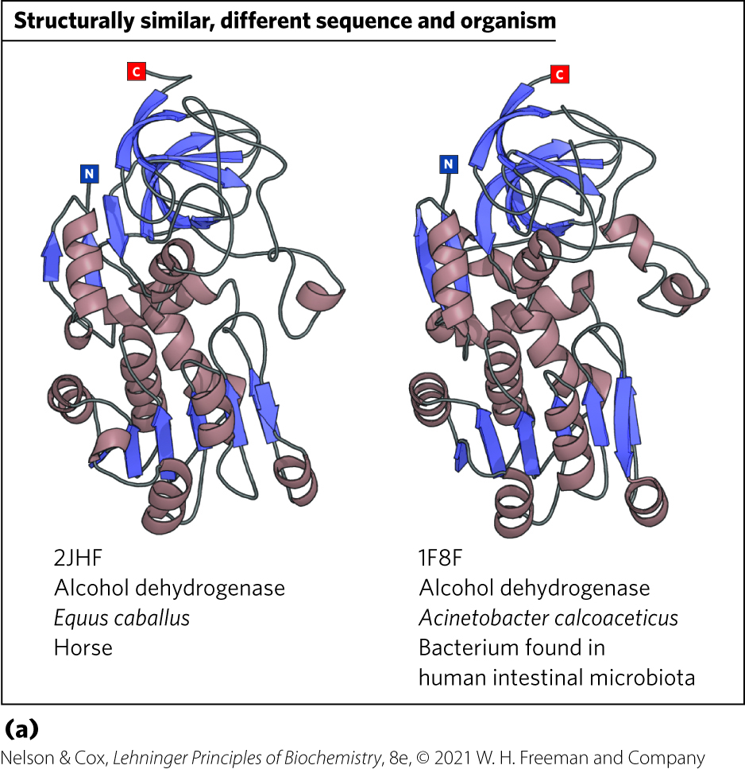
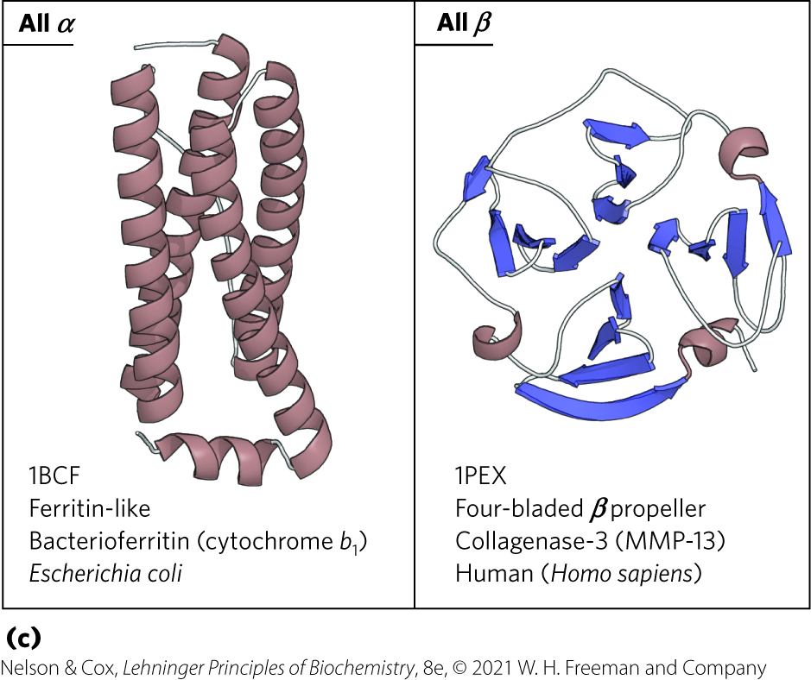
Protein Motifs Are the Basis for Protein Structural Classification
Protein Data Bank (PDB) = 150,000+ structures archived
Structural Classification of Proteins database (SCOP2) = searches protein information in the PDB

Slide 101
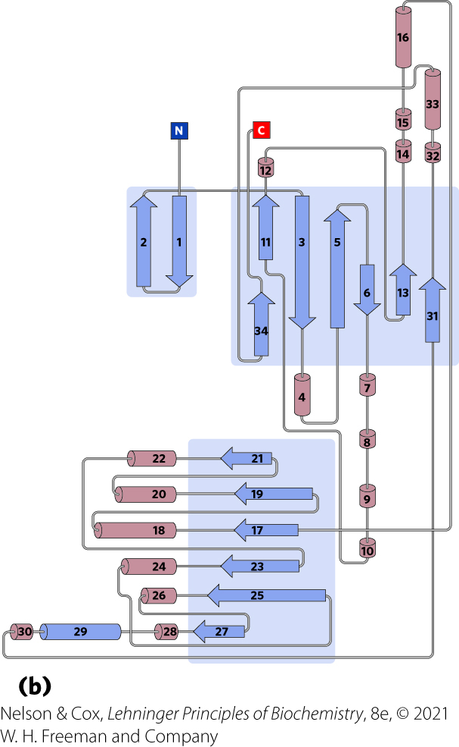
Topology Diagrams
topology diagram = represent elements of secondary structure and the relationships among segments of secondary structure in a protein

Slide 102
Protein Families and Superfamilies
proteins with significant similarity in primary structure and/or tertiary structure and function are in the same protein family
  ~4,000 different protein families in the PDB
  strong evolutionary relationship within a family
superfamilies = 2+ families that have little sequence similarity, but the same major structural motif and have functional similarities
  evolutionary relationship is probable

Slide 103
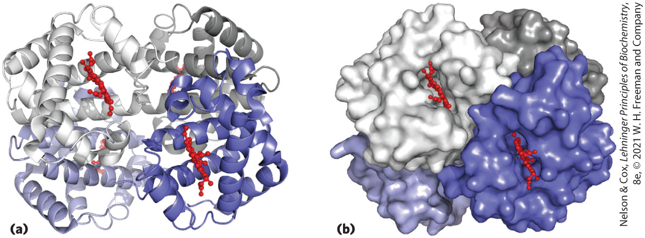
Protein Quaternary Structures Range from Simple Dimers to Large Complexes
quaternary structure = assembly of multiple peptide subunits
oligomer = multimer = multisubunit protein
  repeating structural unit = protomer

Slide 104
Clicker Question 16
Quaternary structure:
A. describes how oligomers are assembled into protomers.
B. refers to proteins with identical subunits.
C. refers to proteins with four subunits.
D. refers to an arrangement of tertiary protein subunits in
a three-dimensional complex.
Notes:
Answer: D
Principle: 4.3
Learning Objective(s): Describe the primary, secondary, tertiary, and quaternary structures of a protein.
Bloom’s: 2:2

Slide 105
Clicker Question 16, Response
Quaternary structure:
D. refers to an arrangement of tertiary protein subunits
in a three-dimensional complex.
Some proteins contain two or more separate polypeptide chains, or subunits, which may be identical or different. The arrangement of these protein subunits in three-dimensional complexes constitutes a quaternary structure.

Slide 106
4.4 Protein Denaturation and Folding

Slide 107
Principle 4 (2 of 2)
Tertiary structure is determined by amino acid sequence. Even though protein folding is complex, some denatured proteins can spontaneously refold into their active conformation based only on the chemical properties of their constituent amino acids. Cellular proteostasis involves numerous pathways that regulate the folding, unfolding, and degradation of proteins. Many human diseases arise from protein misfolding and defects in proteostasis.

Slide 108
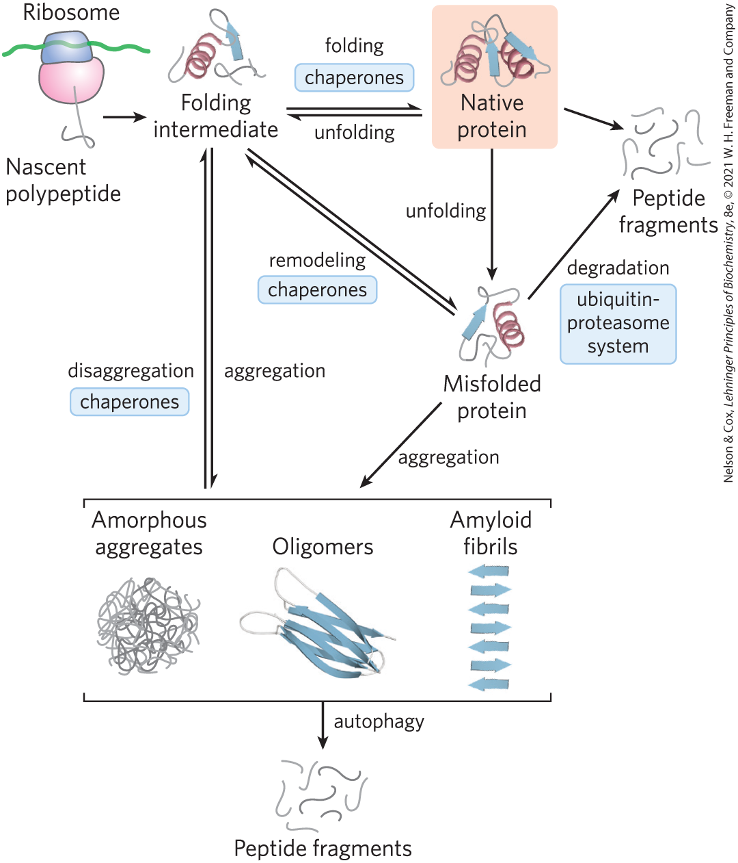
Pathways Involved in Proteostasis
proteostasis = continual maintenance of the active set of cellular proteins required under a given set of conditions

Slide 109

Clicker Question 17
Which characteristic of protein is NOT associated with proteostasis?
A. structure
B. synthesis
C. refolding
D. degradation
Notes:
Answer: A
Principle: 4.4
Learning Objective(s): Define proteostasis.
Bloom’s: 1:1

Slide 110
Clicker Question 17, Response
Which characteristic of protein is NOT associated with proteostasis?
A. structure
Proteostasis is the continual maintenance of the active set of cellular proteins required under a given set of conditions. This requires the coordinated function of pathways for protein synthesis and folding, the refolding of partially unfolded proteins, and the sequestration and degradation of proteins that are irreversibly unfolded or are no longer needed.

Slide 111
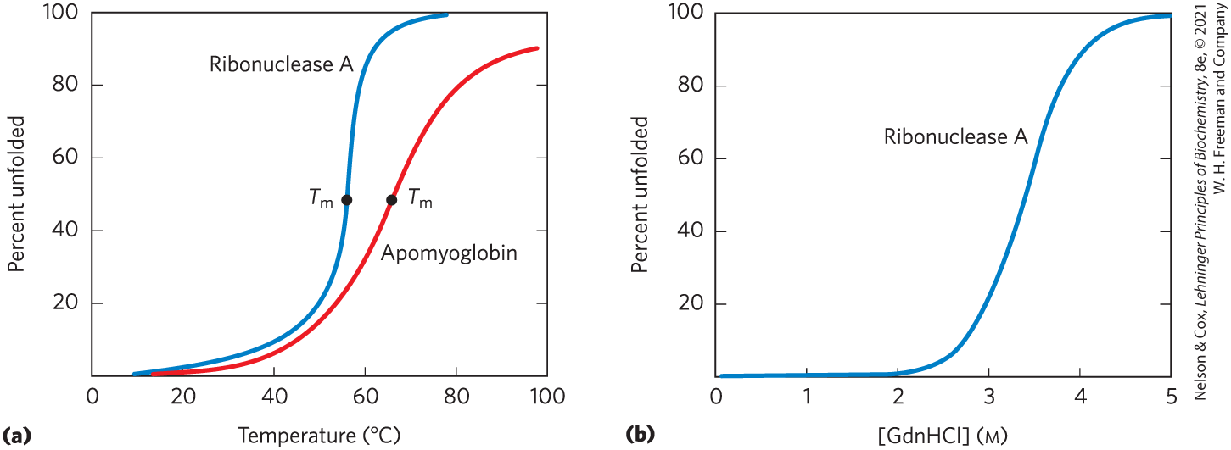
Loss of Protein Structure Results in Loss of Function
denaturation = loss of three-dimensional structure sufficient to cause loss of function
  can occur by heat, pH extremes, miscible organic solvents, certain solutes, detergents
  often leads to protein precipitation

Slide 112
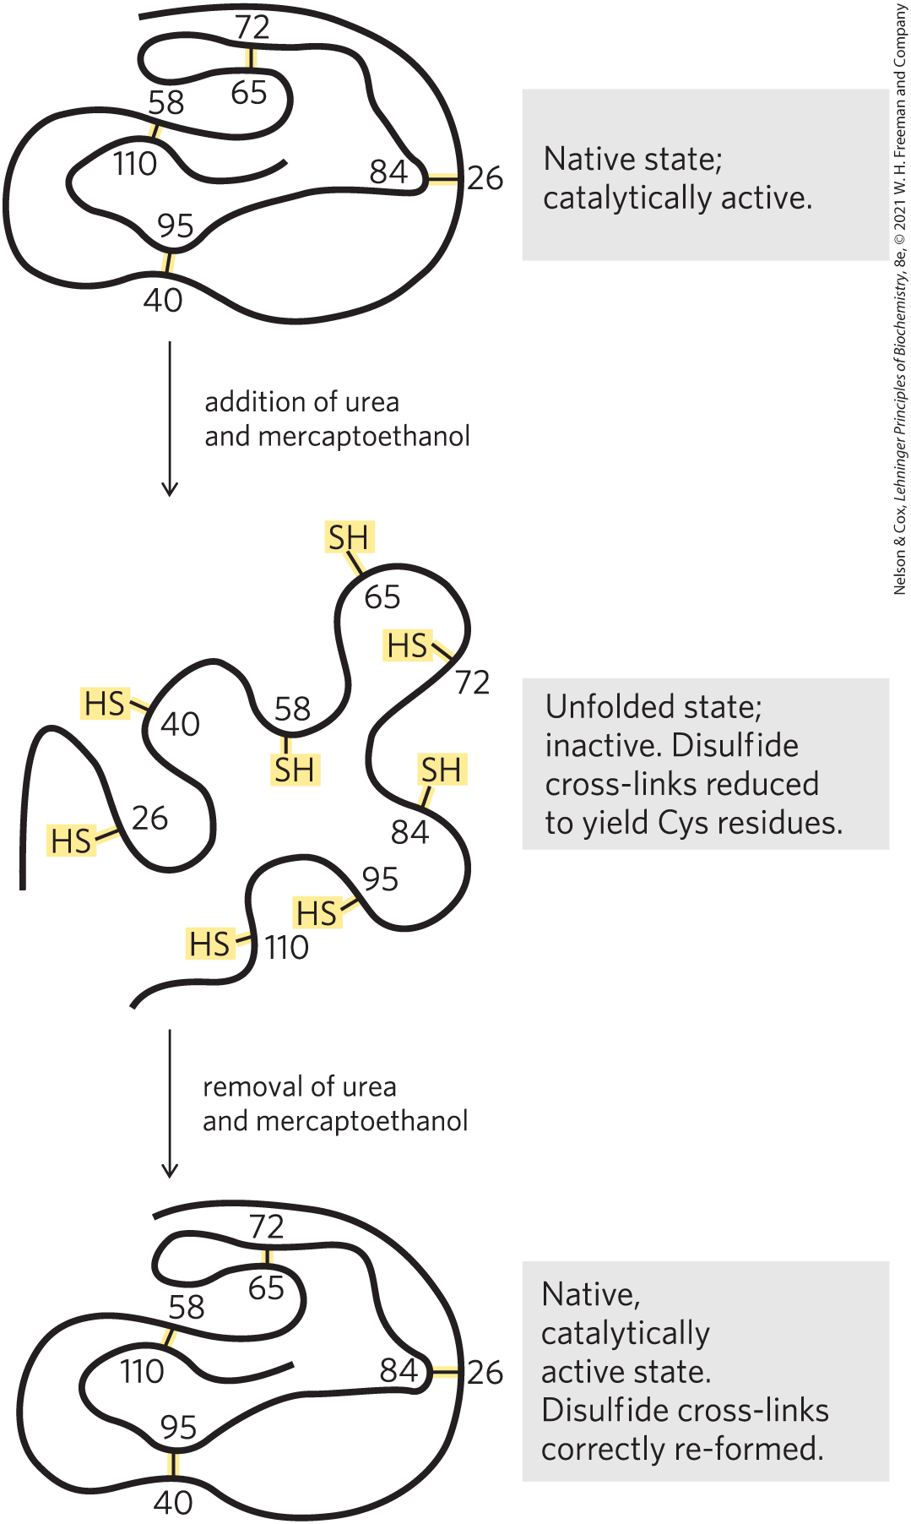
Amino Acid Sequence Determines Tertiary Structure
renaturation = process by which certain denatured globular proteins regain their native structure and biological activity
Anfinsen experiment showed the amino acid sequence contains all the information required to fold the chain

Slide 113
Clicker Question 18
Denaturing followed by renaturing of a protein:
A. always results in the protein regaining its function.
B. demonstrates that primary structure dictates tertiary
structure.
C. requires heat.
D. requires breaking and reforming disulfide bonds.
Notes:
Answer: B
Principle: 4.4
Learning Objective(s): Define denaturation; Define renaturation; Describe Christian Anfinsen’s ribonuclease A experiment.
Bloom’s: 2:2

Slide 114
Clicker Question 18, Response
Denaturing followed by renaturing of a protein:
B. demonstrates that primary structure dictates
tertiary structure.
The Anfinsen experiment provided the first evidence that the amino acid sequence of a polypeptide chain contains all the information required to fold the chain into its native, three-dimensional structure.

Slide 115
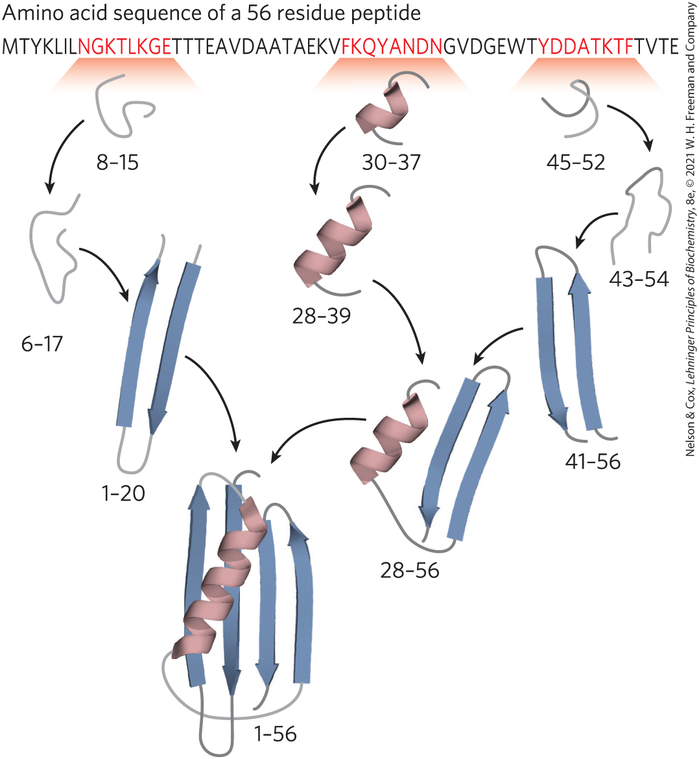
Polypeptides Fold Rapidly by a Stepwise Process
local secondary structures fold first
  ionic interactions play an important role
longer range interactions follow
  hydrophobic effect plays a significant role
process continues until the entire polypeptide folds

Slide 116
Levinthal’s Paradox
it is mathematically impossible for protein folding to occur by randomly trying every conformation until the lowest energy one is found

Slide 117
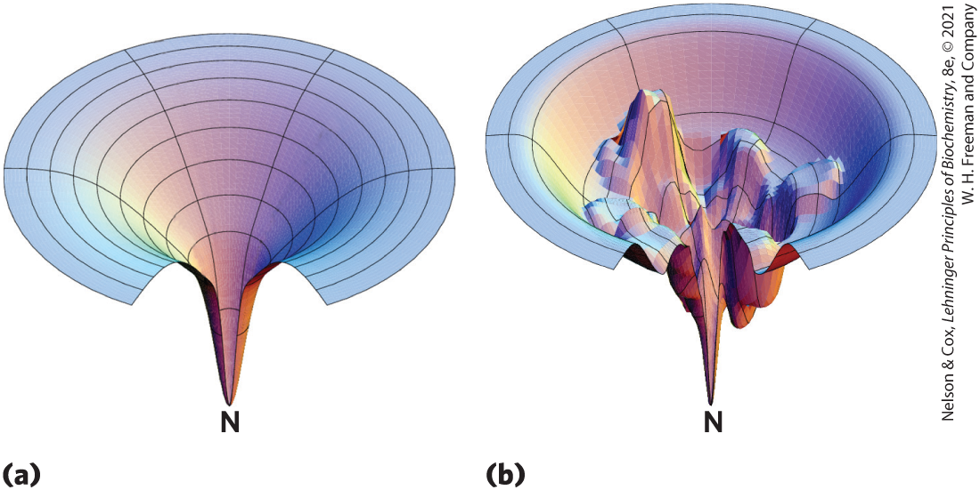
The Thermodynamics of
Protein Folding
free-energy funnel:
  unfolded states = high degree of conformational entropy, high free energy
Multiple pathways leading to one stable outcome
Multiple stable intermediates leading to final fold

Slide 118
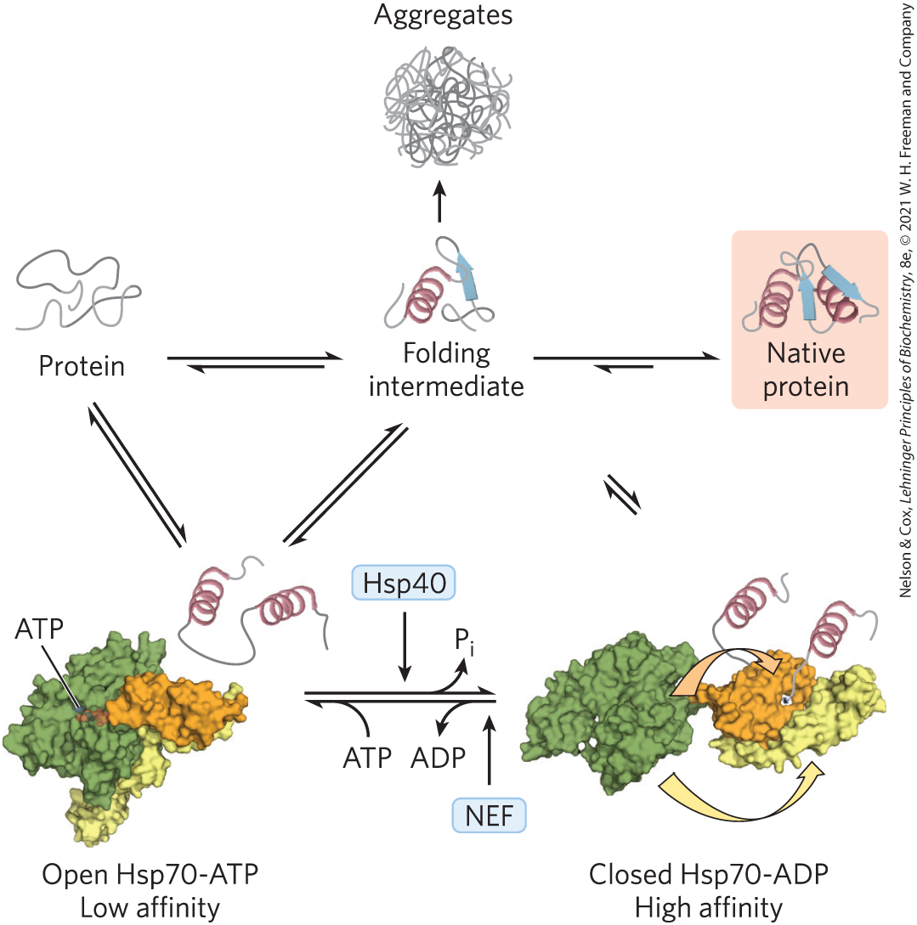
Some Proteins Undergo
Assisted Folding
chaperone proteins = facilitate correct folding pathways or ideal microenvironments
  Hsp70 = bind to hydrophobic regions
  chaperonins = required for the folding of proteins that do not fold spontaneously

Slide 119
Clicker Question 19
What important function do molecular chaperones perform?
A. assemble protein subunits into a quaternary structure
B. fold proteins into a native conformation
C. transport proteins to either the plasma membrane or
release them from cells to the extracellular space
D. add cofactors, coenzymes, or prosthetic groups to
proteins as they are synthesized
E. move proteins from endoplasmic reticulum to the Golgi
apparatus
Notes:
Answer: B
Principle: 4.4
Learning Objective(s): Define a chaperone.
Bloom’s: 1:1

Slide 120
Clicker Question 19, Response
What important function do molecular chaperones perform?
B. fold proteins into a native conformation
Chaperone proteins interact with partially folded or improperly folded polypeptides, facilitating correct folding pathways or providing microenvironments in which folding can occur.

Slide 121
Some Folding Pathways Require Isomerization Reactions
protein disulfide isomerase (PDI) = catalyzes interchange, or shuffling, of disulfide bonds
peptide prolyl cis-trans isomerase (PPI) = catalyzes the interconversion of the cis and trans isomers of peptide bonds formed by Pro residues

Slide 122
Clicker Question 20
Which statement about protein folding is false?
A. It requires protein disulfide and peptide prolyl cis-trans
isomerases.
B. It is a stepwise process.
C. It is sometimes assisted by proteins known as
chaperones.
D. It is driven by changes in free energy.
Notes:
Answer: A
Principle: 4.4
Learning Objective(s): Describe how a protein adopts its native conformation.
Bloom’s: 2:2

Slide 123
Clicker Question 20, Response
Which statement about protein folding is false?
A. It requires protein disulfide and peptide prolyl
cis-trans isomerases.
Only some folding pathways require protein disulfide and peptide prolyl cis-trans isomerases to catalyze isomerization reactions.

Slide 124
Defects in Protein Folding Are the Molecular Basis for Many Human Genetic Disorders
amyloid fiber = protein secreted in a misfolded state and converted to an insoluble extracellular fiber
amyloidose diseases: type 2 diabetes, Alzheimer disease, Huntington disease, and Parkinson disease

Slide 125
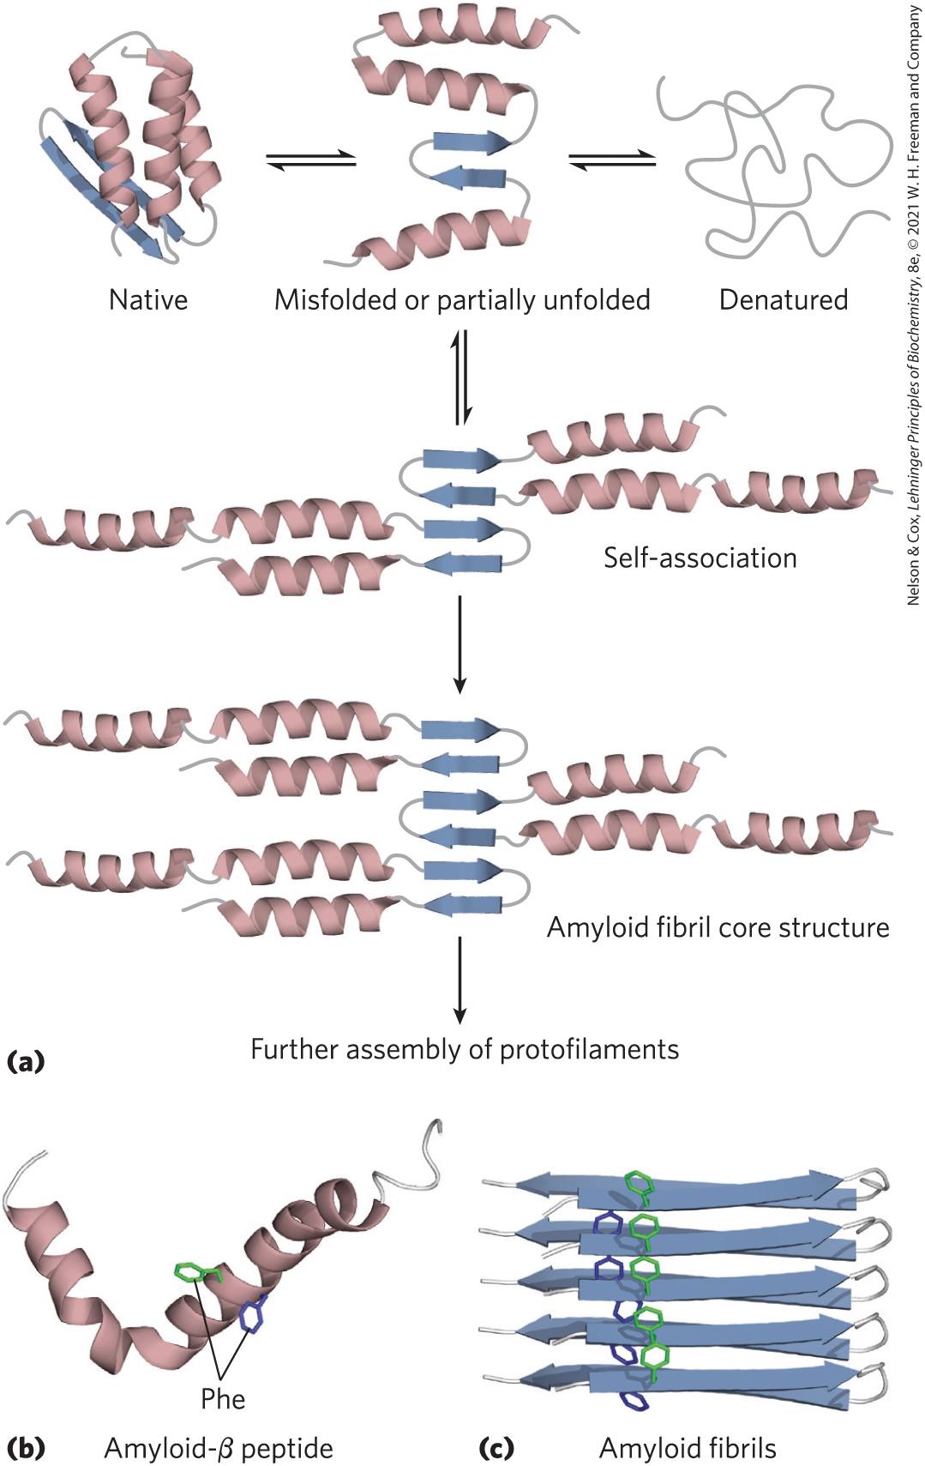
Formation of Disease-Causing Amyloid Fibrils
native = high degree of β-sheet structure
misfolded β amyloid promotes aggregation, forming an amyloid fibril

Slide 126
Neurodegenerative Conditions
Alzheimer disease = associated with extracellular amyloid deposition by neurons, involving the amyloid-β peptide
Parkinson disease = misfolded form α-synuclein aggregates into spherical filamentous masses called Lewy bodies
Huntington disease = involves the intracellular aggregation of huntingtin, a protein with long polyglutamine repeat

Slide 127
Cystic Fibrosis
cystic fibrosis = caused by defects in the membrane-bound protein cystic fibrosis transmembrane conductance regulator (CFTR)
  deletion of a Phe residue causes improper protein folding

Slide 128
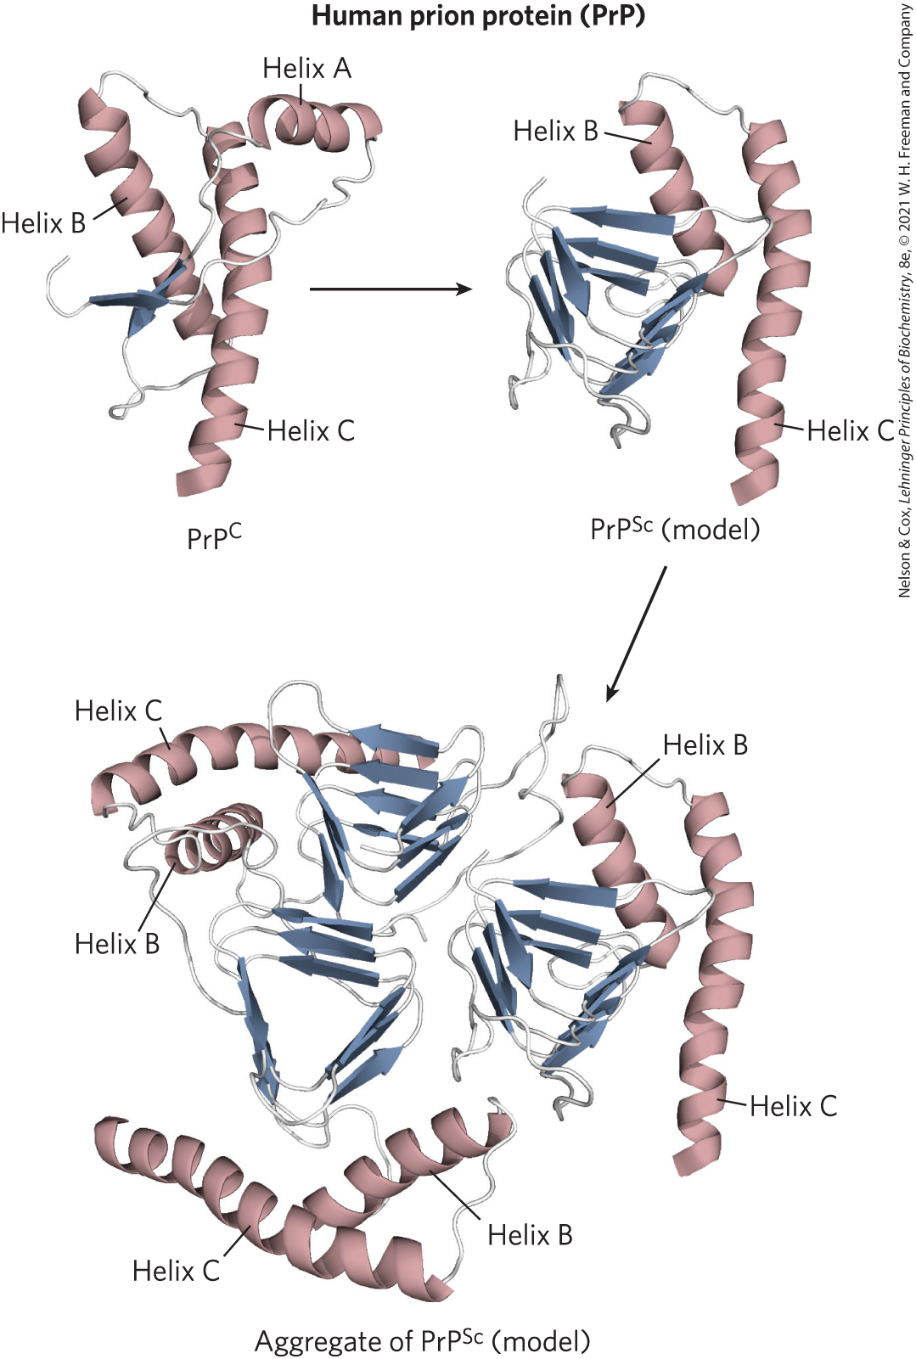
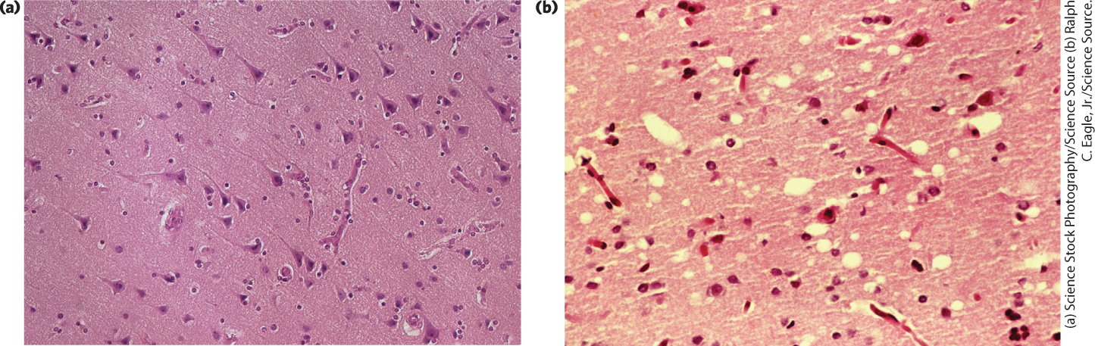
Death by Misfolding: The Prion Diseases
prion protein (PrP) = misfolded brain protein
Pyramidal cells in the human cerebral cortex
Comparable section from a patient with Creutzfeldt-Jakob disease

Slide 129
Clicker Question 21
Which disease is NOT associated with protein misfolding?
A. cystic fibrosis
B. amyloidosis
C. Parkinson disease
D. type 1 diabetes mellitus
Notes:
Answer: D
Principle: 4.4
Learning Objective(s): Describe examples of diseases caused by misfolded proteins.
Bloom’s: 2:2

Slide 130
Clicker Question 21, Response
Which disease is NOT associated with protein misfolding?
D. type 1 diabetes mellitus
Many conditions, including amyloidosis, Parkinson disease, and cystic fibrosis are associated with protein misfolding. Unlike type 2 diabetes, type 1 diabetes mellitus is not associated with protein misfolding.

Slide 131
4.5 Determination of Protein and Biomolecular Structures

Slide 132

Principle 5 (2 of 2)
The three-dimensional structures of proteins can be defined. Structural biologists use a variety of instruments and computational methods to solve biomolecular structures. The choice of method may depend on factors such as the size of the protein being studied, its properties, or the desired resolution of the final structure.

Slide 133
Determining Protein Structures
structural biology = study of three-dimensional structures of biomolecules, including proteins, nucleic acids, lipid membranes, and oligosaccharides
  employs biochemical approaches, physical tools, and computational methods

Slide 134
X-ray Diffraction Produces Electron Density Maps from Protein Crystals
x-ray crystallography = pattern of diffracted x-rays is collected directly and an image is reconstructed by mathematical techniques
limited to molecules that can be crystallized
information obtained depends on the degree of structural order in the sample

Slide 135
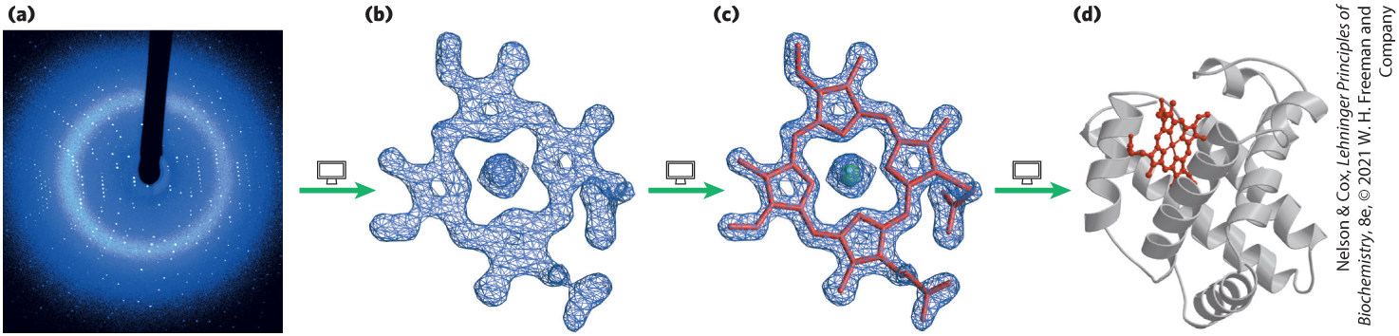
Protein Crystallography Steps
X-ray diffraction patterns from protein crystals
three-dimensional electron-density map using a Fourier transform
localized atomic nuclei
completed protein structure

Slide 136
The Physical Environment in a Crystal
not identical to the physical environment in solution or in a living cell
  imposes a space and time average on the structure
  provides little information about molecular movement of protein
crystal-derived structure usually represents a functional conformation

Slide 137

Clicker Question 22
In protein crystallography, a Fourier transform:
A. generates an x-ray diffraction pattern from a protein
crystal.
B. reveals the location of atomic nuclei.
C. constructs an electron-density map from the overall
diffraction pattern of spots.
D. causes a beam of x-rays to diffract into many
directions.
Notes:
Answer: C
Principle: 4.5
Learning Objective: Describe how x-ray crystallography is used to study protein structure.
Bloom’s: 2:2

Slide 138
Clicker Question 22, Response
In protein crystallography, a Fourier transform:
C. constructs an electron-density map from the
overall diffraction pattern of spots.
An electron-density map of the protein is reconstructed from the overall diffraction pattern of spots by a mathematical technique called a Fourier transform.

Slide 139
Distances between Protein Atoms Can Be Measured by Nuclear Magnetic Resonance
nuclear magnetic resonance (NMR) = carried out on molecules in solution
captures dynamics of protein structure:
  conformational changes
  protein folding
  interactions with other molecules

Slide 140
Nuclear Spin
NMR measures nuclear spin angular momentum, a quantum mechanical property of atomic nuclei
  nuclear spin of ¹H, ¹³C, ¹⁵N, ¹⁹F, and ³¹P gives rise to an NMR signal
  nuclear spin generates a magnetic dipole

Slide 141

NMR Spectrum
magnetic field causes magnetic dipoles to align in the field in one of two orientations: parallel (low energy) or antiparallel (high energy)
pulse of electromagnetic energy generates an NMR spectrum

Slide 142
Clicker Question 23
The primary structure of a protein is known and the location of internal disulfide bonds has been determined. What method (assuming limitations are overcome) could one use to determine secondary and tertiary structure in the protein once it folds into a native conformation?
A. perform x-ray diffraction on crystalized protein
B. perform a Ramachandran plot/analysis on the protein
C. perform circular dichroism experiments
D. perform NMR experiments on soluble protein
E. All of these methods could be used.
Notes:
Answer: E
Principle: 4.2, 4.5
Learning Objective: Describe how circular dichroism is used to study protein structure; Identify key features of a Ramachandran plot; Identify methods that can be used to study three-dimensional protein structure.
Bloom’s: 1:1

Slide 143
Clicker Question 23, Response
What method (assuming limitations are overcome) could one use to determine secondary and tertiary structure in the protein once it folds into a native conformation?
E. All of these methods could be used.
Ramachandran plots and circular dichroism would provide information on secondary structure. X-ray diffraction on crystalized protein and NMR experiments on soluble protein would provide information on the tertiary structure.

Slide 144
Two-Dimensional NMR Techniques
NOESY = nuclear Overhauser effect (NOE) spectroscopy = measures distance-dependent coupling of nuclear spins in nearby atoms through space
TOCSY = total correlation spectroscopy = measures the coupling of nuclear spins in atoms connected by covalent bonds

Slide 145

Translating 2D NMR Spectra to 3D Structures

Slide 146

Activity: NMR and X-ray Crystallography
Video Case Study
Watch the Animated Technique videos titled “NMR Spectroscopy” and “X-ray Crystallography” in your Achieve course.
Notes:
Instructor: These Animated Technique videos are found within Chapter 4 of Achieve. They are in the folder titled “Ch4 In-Class Activities, Videos, and Resources.”

Slide 147
Activity Instructions, Part 1
On your own, think of answers to the questions:
  Is NMR or x-ray crystallography better suited for identifying the three-dimensional structure of:
    proteins that are very large in size?
    proteins that are in solution?
    proteins that undergo conformational changes upon ligand binding?
(2 minutes)
Pair up to discuss your ideas. (2 minutes)
Share your ideas with the class in group discussion.
Notes:
Instructor: These Animated Technique videos are found within Chapter 4 of Achieve. They are in the folder titled “Ch4 In-Class Activities, Videos, and Resources.”

Slide 148
Activity Solution, Part 1
  Is NMR or x-ray crystallography better suited for identifying the three-dimensional structure of:
    proteins that are very large in size? x-ray crystallography
    proteins that are in solution? NMR
    proteins that undergo conformational changes upon ligand binding? NMR
Notes:
Instructor: These Animated Technique videos are found within Chapter 4 of Achieve. They are in the folder titled “Ch4 In-Class Activities, Videos, and Resources.”

Slide 149
Activity Instructions, Part 2
On your own, think of an answer to the question:
  Researchers translate NMR spectra, generated from NMR signals, into a complete three-dimensional structure. Why do only certain atoms, including ¹H, ¹³C, ¹⁵N, ¹⁹F, and ³¹P give rise to an NMR signal?
  (2 minutes)
Pair up to discuss your ideas. (2 minutes)
Share your ideas with the class in group discussion.
Notes:
Instructor: These Animated Technique videos are found within Chapter 4 of Achieve. They are in the folder titled “Ch4 In-Class Activities, Videos, and Resources.”

Slide 150
Activity Solution, Part 2
  Why do only certain atoms, including ¹H, ¹³C, ¹⁵N, ¹⁹F, and ³¹P give rise to an NMR signal?
  Because these atoms contain an odd number of protons and/or neutrons, they have the kind of nuclear spin that gives rise to an NMR signal.
Notes:
Instructor: These Animated Technique videos are found within Chapter 4 of Achieve. They are in the folder titled “Ch4 In-Class Activities, Videos, and Resources.”

Slide 151
Thousands of Individual Molecules Are Used to Determine Structures by Cryo-Electron Microscopy
cryo-electron microscopy (cryo-EM) = sample of the structure of interest is quick-frozen in vitreous (or noncrystalline) ice and kept frozen while being observed in two dimensions with the EM
  greatly reduces damage to the specimen
  useful for determining the molecular structure of large, dynamic, macromolecular complexes and integral membrane proteins

Slide 152


Structures Derived from Cryo-EM
Chaperone protein GroEL
Human telomerase

Slide 153
Clicker Question 24
Why are samples prepared for cryo-EM quick-frozen in vitreous (or noncrystalline) ice prior to analysis?
A. to promote crystallization of the protein
B. to ensure all particles are in the same conformation
C. to align magnetic dipoles in parallel or antiparallel
orientations
D. to minimize damage to the specimen by the electron
beam
Notes:
Answer: D
Principle: 4.5
Learning Objective: Describe how cryo-electron microscopy is used to study protein structure.
Bloom’s: 2:2

Slide 154
Clicker Question 24, Response
Why are samples prepared for cryo-EM quick-frozen in vitreous (or noncrystalline) ice prior to analysis?
D. to minimize damage to the specimen by the
electron beam
In cryo-electron microscopy (cryo-EM), a sample is quick-frozen in vitreous (or noncrystalline) ice and kept frozen while being observed in two dimensions with the electron microscope, greatly reducing damage to the specimen by the electron beam.

