Slide 1

3 Amino Acids, Peptides, and Proteins
© 2021 Macmillan Learning

Slide 2

Principle 1 (1 of 2)
In every living organism, proteins are constructed from a common set of 20 amino acids. Each amino acid has a side chain with distinctive chemical properties. Amino acids may be regarded as the alphabet in which the language of protein structure is written.

Slide 3

Principle 2 (1 of 3)
In proteins, amino acids are joined in characteristic linear sequences through a common amide linkage, the peptide bond. The amino acid sequence of a protein constitutes its primary structure, a first level we will introduce within the broader complexities of protein structure.

Slide 4

Principle 3 (1 of 2)
For study, individual proteins can be separated from the thousands of other proteins present in a cell, based on differences in their chemical and functional properties arising from their distinct amino acid sequences. As proteins are central to biochemistry, the purification of individual proteins for study is a quintessential biochemical endeavor.

Slide 5

Principle 4 (1 of 2)
Shaped by evolution, amino acid sequences are a key resource for understanding the function of individual proteins and for tracing broader functional and evolutionary relationships.

Slide 6
3.1 Amino Acids

Slide 7
Principle 1 (2 of 2)
In every living organism, proteins are constructed from a common set of 20 amino acids. Each amino acid has a side chain with distinctive chemical properties. Amino acids may be regarded as the alphabet in which the language of protein structure is written.

Slide 8
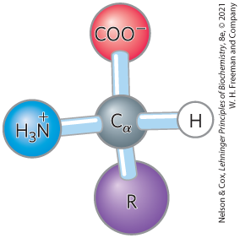
Amino Acids Share
Common Structural Features
α carbon and four substituents
α carbon is the chiral center
tetrahedral

Slide 9
Amino Acid Substituents
four substituents:
  a carboxyl group
  an amino group
  a hydrogen atom
  an R group (a side chain unique to each amino acid)
    glycine has a second hydrogen atom instead of an R group

Slide 10
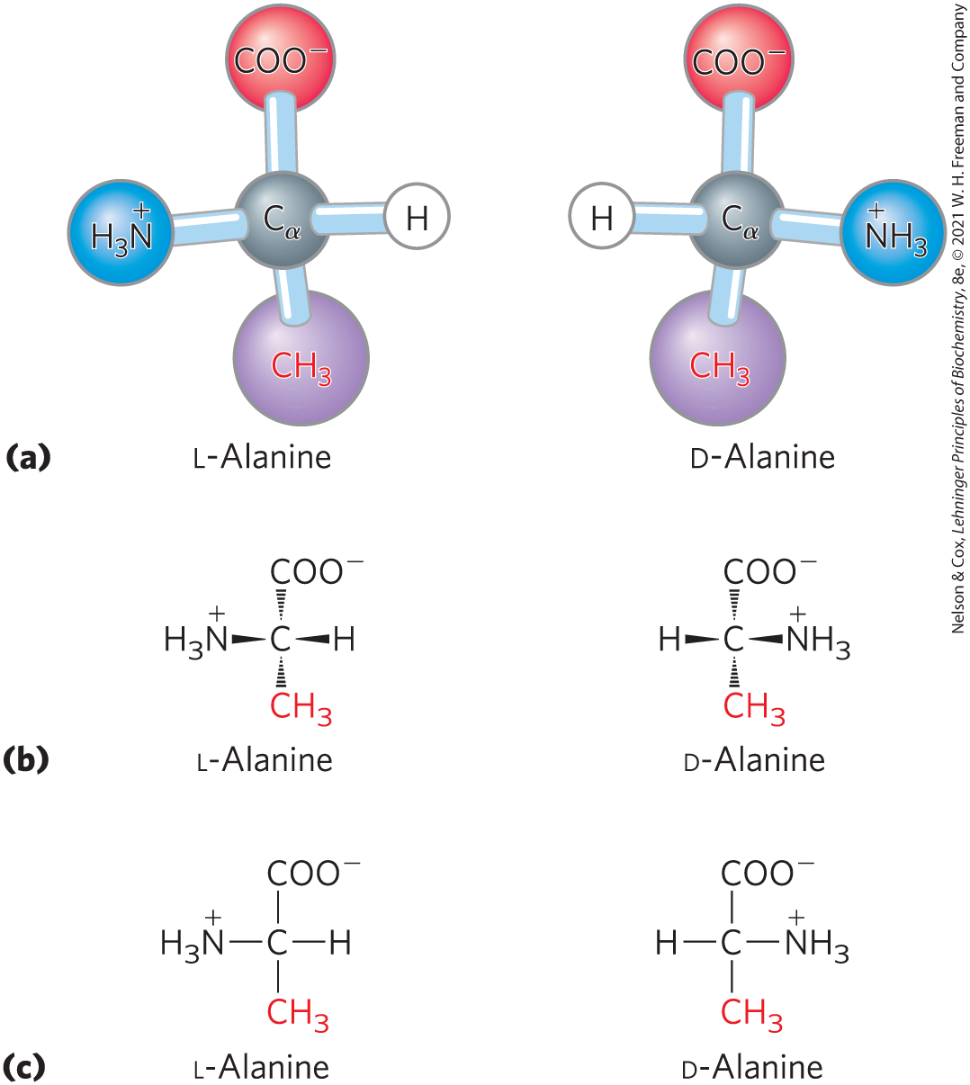
The Amino Acid Residues in
Proteins are L Stereoisomers
two possible stereoisomers = enantiomers
optically active
D, L system specifies absolute configuration

Slide 11
Amino Acids Can Be Classified by
R Group
five main classes:
  nonpolar, aliphatic (7)
  aromatic (3)
  polar, uncharged (5)
  positively charged (3)
  negatively charged (2)

Slide 12
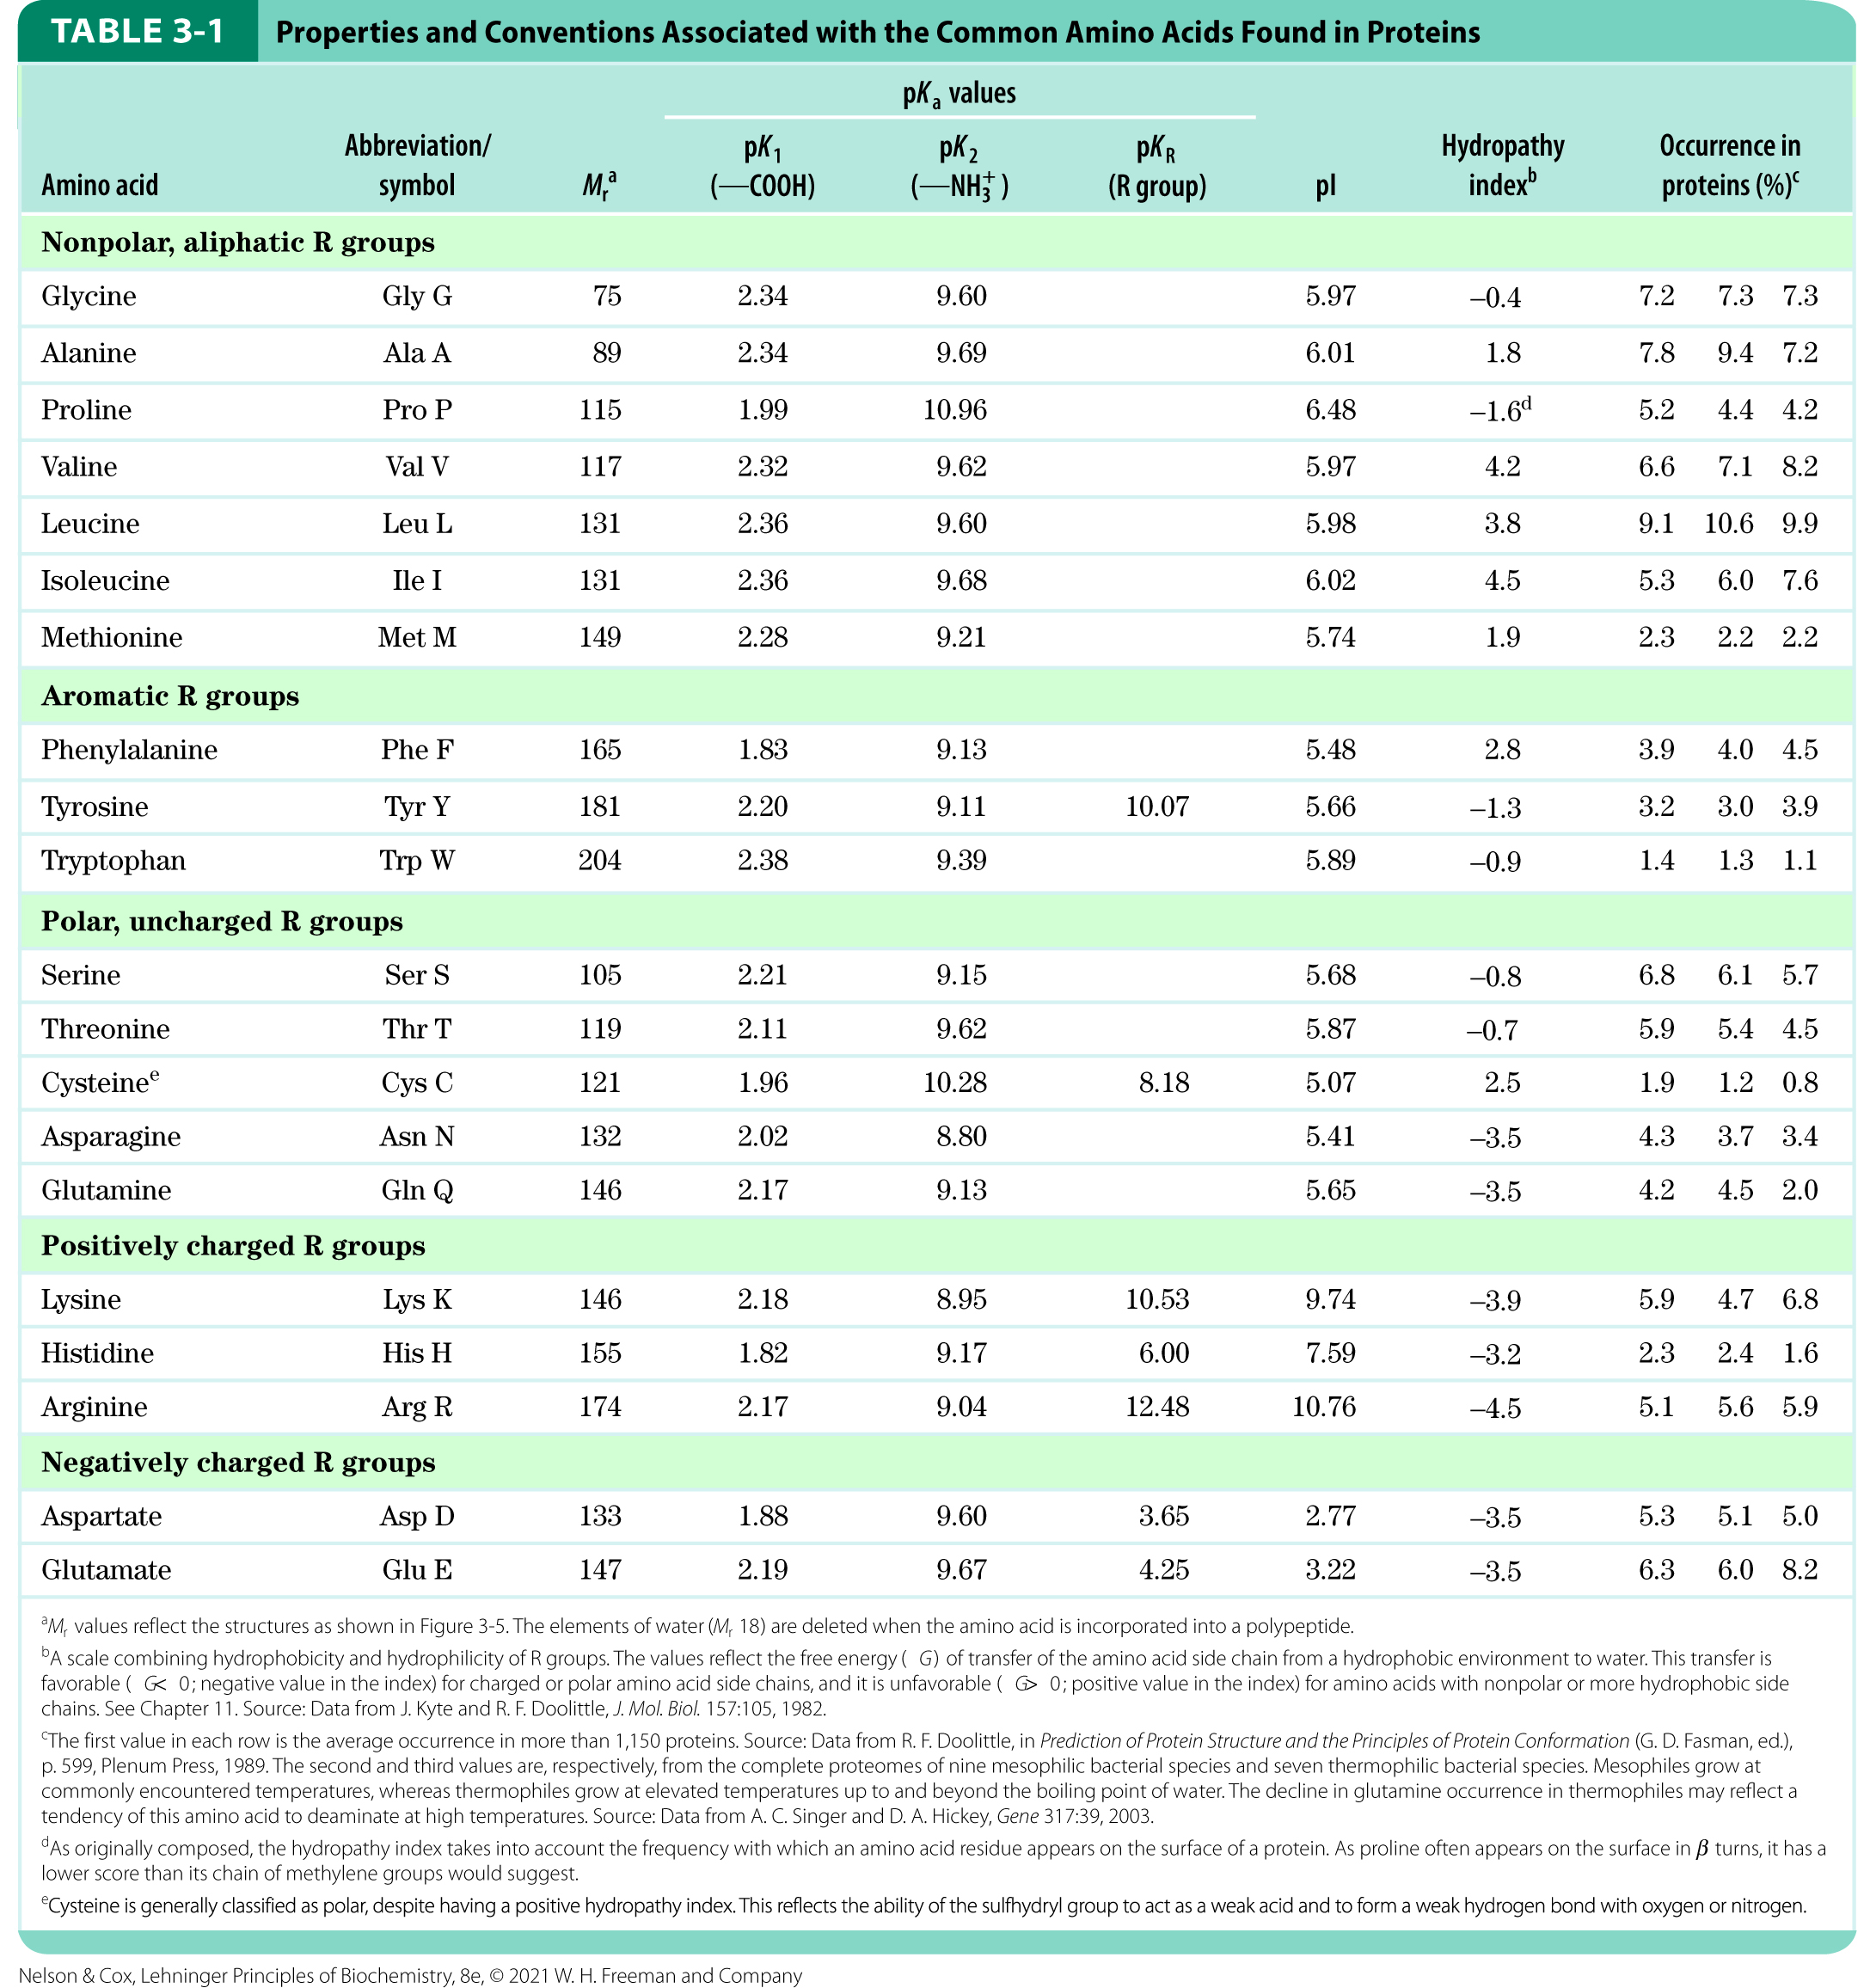
Table 3-1

Slide 13

Clicker Question 1
Which amino acid has three pK_{a} values?
A. leucine
B. proline
C. glycine
D. threonine
E. cysteine
Notes:
Answer: E
Principle: 3.1
Learning Objective: Classify amino acids based on their R group.
Bloom’s: 2:2

Slide 14
Clicker Question 1, Response
Which amino acid has three pK_{a} values?
E. cysteine
Cysteine has three pK_{a} values:
pK₁ (—COOH): 1.96
pK₂ (—NH₃⁺): 10.28
pK₃ (R group): 8.18

Slide 15
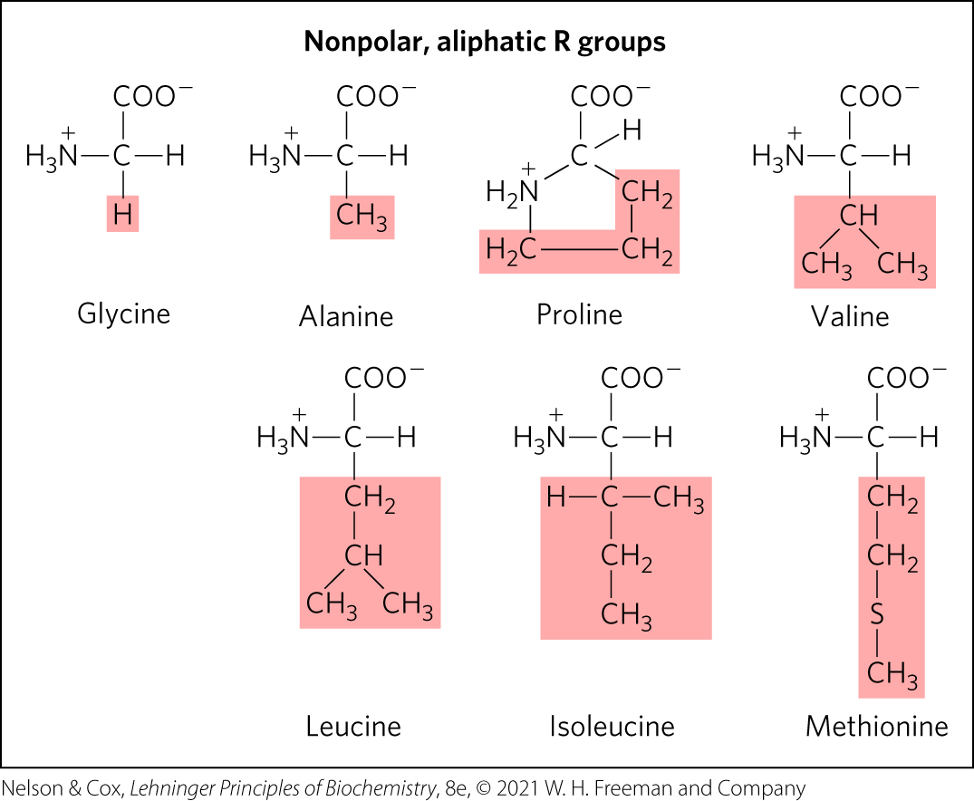
Nonpolar, aliphatic R groups
the hydrophobic effect stabilizes protein structure

Slide 16
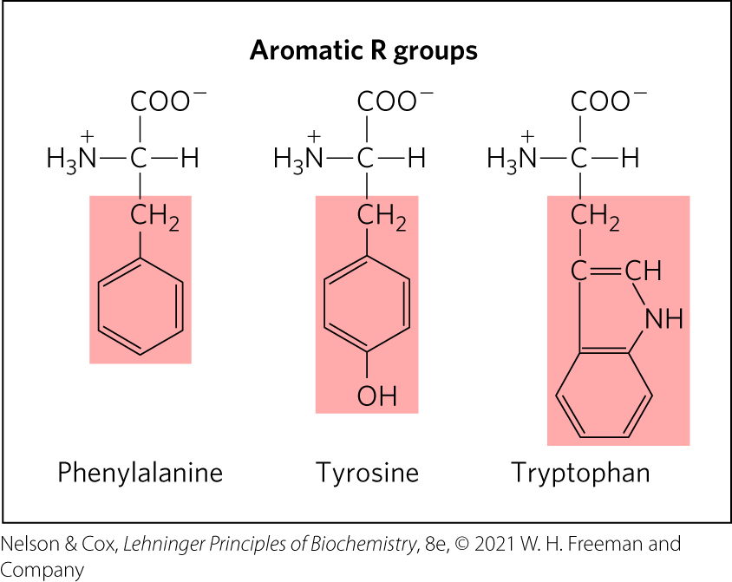
Aromatic R Groups
R groups absorb UV light at 270–280 nm
can contribute to the hydrophobic effect

Slide 17
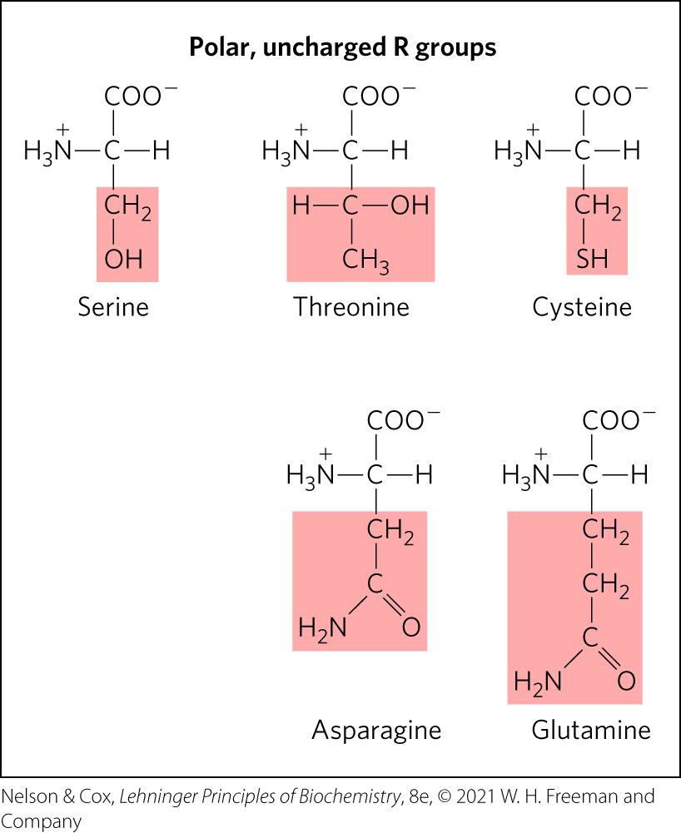
Polar, Uncharged R Groups
R groups can form hydrogen bonds
cysteine can form disulfide bonds

Slide 18
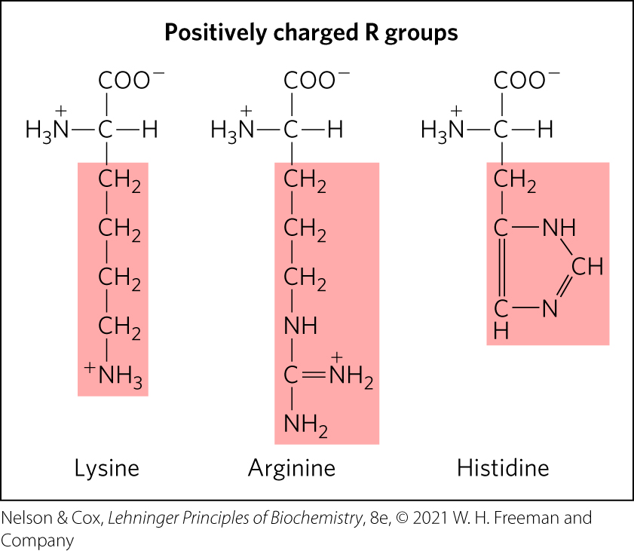
Positively Charged R Groups
have significant positive charge at pH 7.0

Slide 19
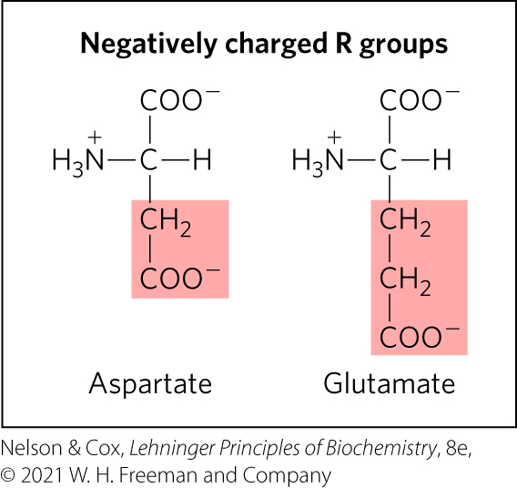
Negatively Charged R Groups
have a net negative charge at pH 7.0

Slide 20

Clicker Question 2
Which amino acid would MOST likely be found in the interior of a globular protein?
A. Ala
B. D
C. glutamate
D. cysteine
E. Lys
Notes:
Answer: A
Principle: 3.1
Learning Objective(s): Compare the chemical properties of amino acids; Relate the name, structure, symbol, and 3-letter abbreviation of an amino acid.
Bloom’s: 2:2

Slide 21
Clicker Question 2, Response
Which amino acid would MOST likely be found in the interior of a globular protein?
A. Alanine (Ala)
Alanine has a nonpolar, aliphatic R group, —CH₃. Nonpolar, hydrophobic side chains tend to cluster together within proteins, stabilizing protein structure through the hydrophobic effect.

Slide 22
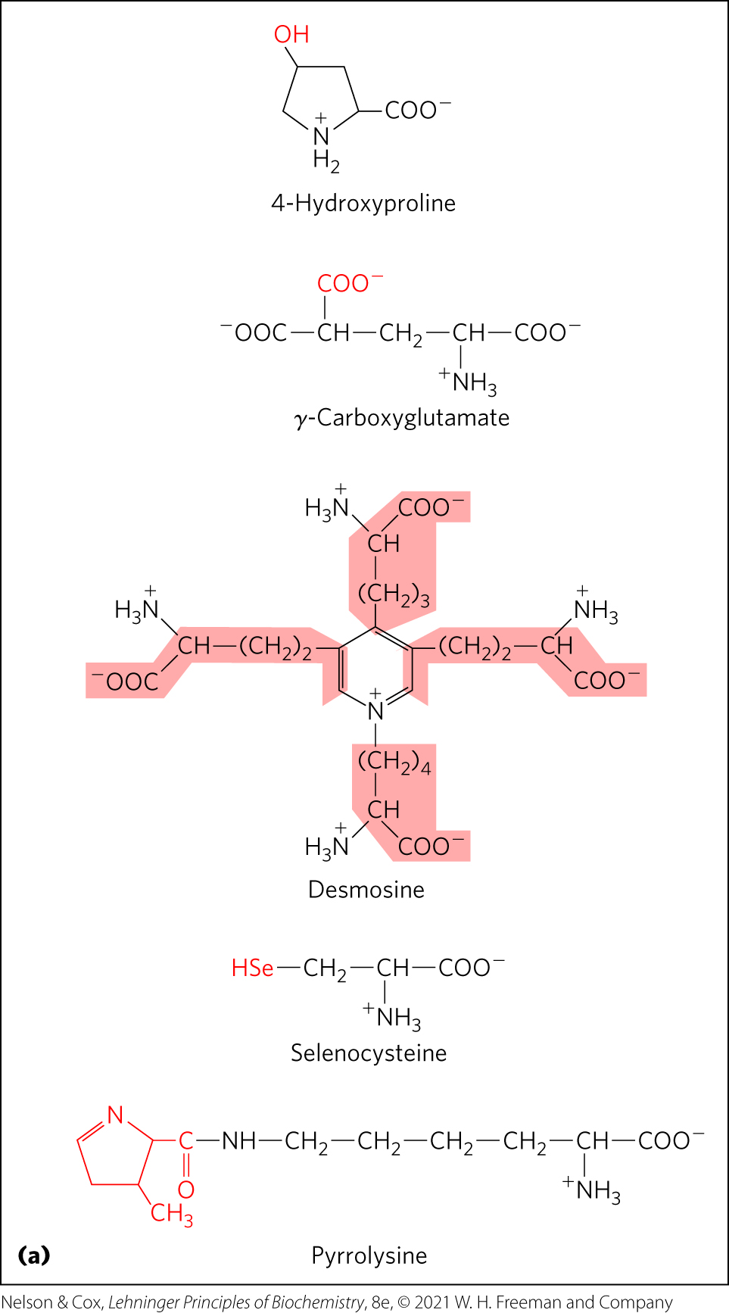
Uncommon Amino Acids Also Have Important Functions
modifications of common amino acids:
  modified after protein synthesis (e.g., 4-hydroxyproline, found in collagen)
  modified during protein synthesis (e.g., pyrrolysine, contributes to methane biosynthesis)
  modified transiently to change protein’s function (e.g., phosphorylation)
free metabolites (e.g., ornithine, intermediate in arginine biosynthesis)

Slide 23
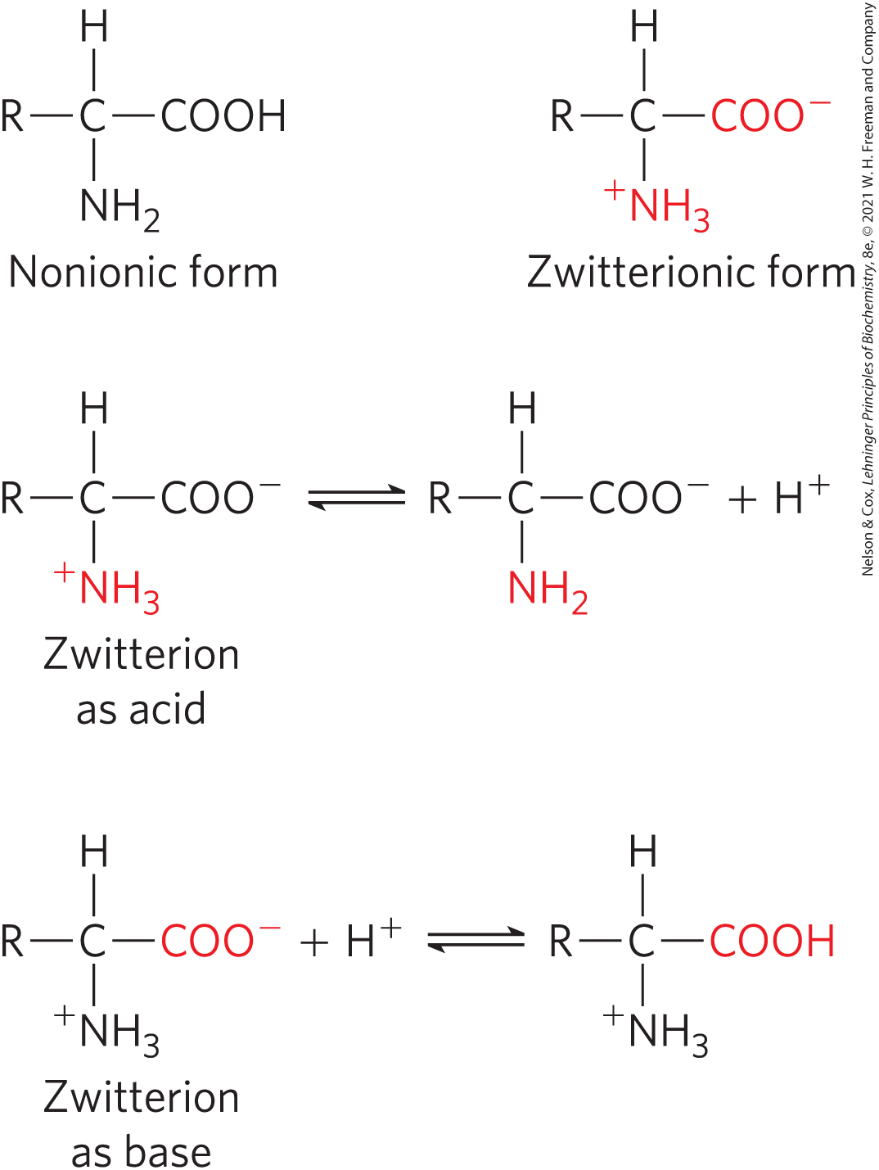
Amino Acids Can Act as Acids or Bases
amino groups, carboxyl groups, and ionizable R groups = weak acids and bases
zwitterion occurs at neutral pH

Slide 24
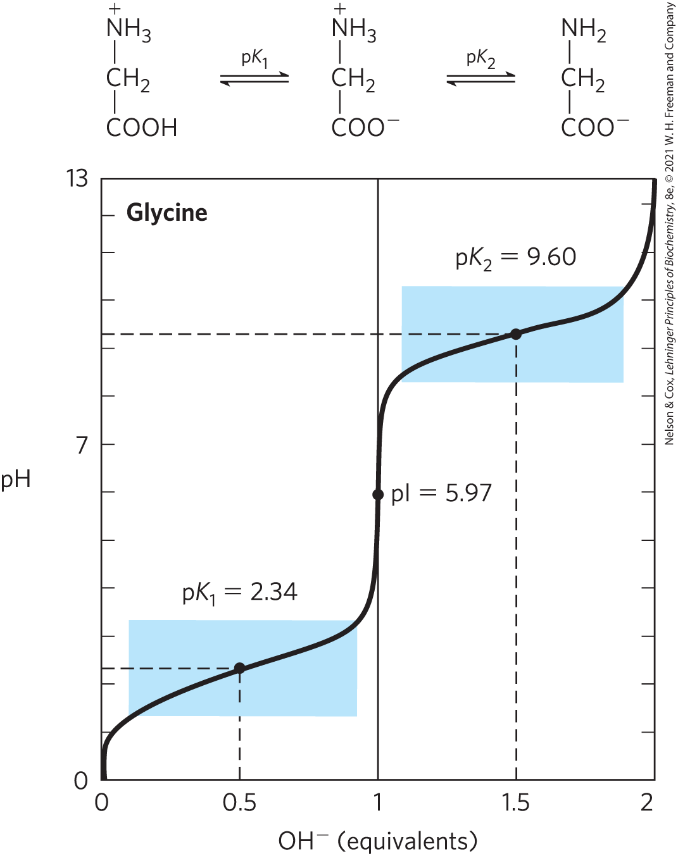
Titration of Amino Acids
cation ⇌ zwitterion ⇌ anion
—COOH has an acidic pK_{a} (pK₁)
—NH₃⁺ has a basic pK_{a} (pK₂)
the pH at which the net electric charge is zero is the isoelectric point (pI)

Slide 25
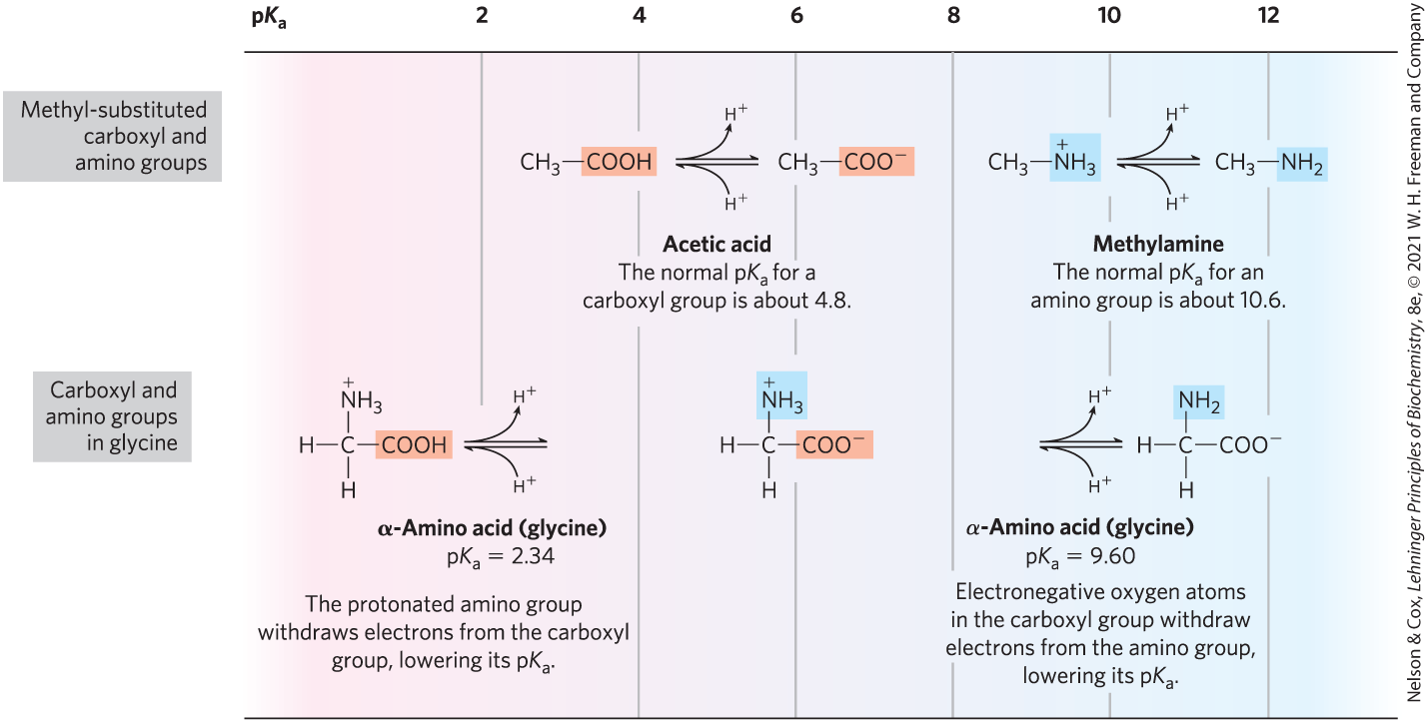
Effect of the Chemical Environment on pK_{a}
α-carboxyl group is more acidic than in carboxylic acids
α-amino group is less basic than in amines

Slide 26

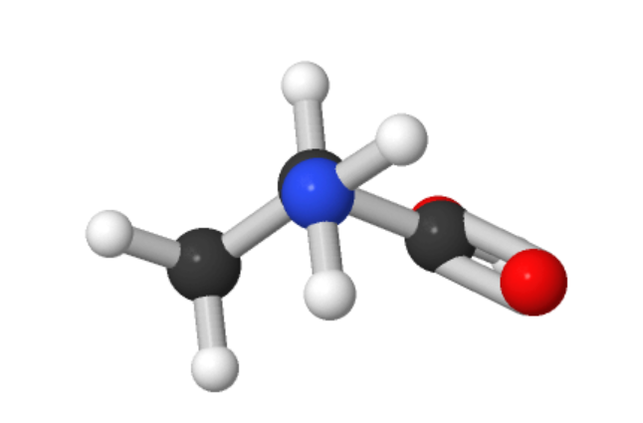
Activity: Visualizing Common Properties of an Amino Acid
Observe the structure of an amino acid in Mol3D viewer in your Achieve course.
Notes:
Instructor: This Mol3D structure is located in the Achieve course. It can be found in the Chapter 3 content, in the folder titled “Ch3 In-Class Activities, Videos, and Resources.”

Slide 27
Activity Instructions, Part 1
On your own, think of answers to the questions:
  What amino acid is this?
  Which structures of the amino acid are common to all amino acids? Which are unique?
  What is an example pH at which you could observe this structure?
(2 minutes)
Pair up to discuss your ideas. (2 minutes)
Share your ideas with the class in group discussion.
Notes:
Instructor: This Mol3D structure is located in the Achieve course. It can be found in the Chapter 3 content, in the folder titled “Ch3 In-Class Activities, Videos, and Resources.”

Slide 28
Activity Solution, Part 1
  What amino acid is this? Alanine
  Which structures of the amino acid are common to all amino acids? Which are unique?
  All amino acids contain a carboxyl group, an amino group, and a hydrogen atom. The R group of alanine, a methyl group, is unique.
  What is an example pH at which you could observe this structure? pH values greater than 9.69
Notes:
Instructor: This Mol3D structure is located in the Achieve course. It can be found in the Chapter 3 content, in the folder titled “Ch3 In-Class Activities, Videos, and Resources.”

Slide 29
Activity Instructions, Part 2
On your own:
  Draw a titration curve.
  Identify the location of this structure on a titration curve.
(2 minutes)
Pair up to discuss your ideas. (2 minutes)
Share your ideas with the class in group discussion.
Notes:
Instructor: This Mol3D structure is located in the Achieve course. It can be found in the Chapter 3 content, in the folder titled “Ch3 In-Class Activities, Videos, and Resources.”

Slide 30
Activity Solution, Part 2 (1 of 2)
  Draw a titration curve.
  This is an example titration curve from glycine. The titration curve for alanine is similar because both glycine and alanine do not have an ionizable R group. Glycine and alanine have identical pK₁ values (pK₁ = 2.34). The pK₂ value for alanine is 9.69 and the pI value is 6.01.
Notes:
Instructor: This Mol3D structure is located in the Achieve course. It can be found in the Chapter 3 content, in the folder titled “Ch3 In-Class Activities, Videos, and Resources.”

Slide 31
Activity Solution, Part 2 (2 of 2)
  Identify the location of this structure on a titration curve. After the second pK_{a} point.
Notes:
Instructor: This Mol3D structure is located in the Achieve course. It can be found in the Chapter 3 content, in the folder titled “Ch3 In-Class Activities, Videos, and Resources.”

Slide 32
Information from a Titration Curve
quantitative measure of the pK_{a} of each ionizing group
regions of buffering power
relationship between its net charge and the pH of the solution
  isoelectric point, pI

Slide 33
Amino Acids as Buffers
buffers prevent changes in pH close to the pK_{a}
glycine has two buffer regions:
  centered around the pK_{a} of the α-carboxyl group (pK₁ = 2.34)
  centered around the pK_{a} of the α-amino group (pK₂ = 9.6)
buffer
regions

Slide 34
Isoelectric Point, pI
for amino acids without ionizable side chains, the isoelectric point (pI) is:
pH = pI = net charge is zero (amino acid least soluble in water, does not migrate in electric field)
pH > pI = net negative change
pH < pI = net positive charge

Slide 35

Clicker Question 3
Given that all 20 common amino acids have at least two oppositely charged groups, which statement is NOT correct?
A. Solutions of amino acids can act as buffers.
B. All amino acids are zwitterions.
C. All amino acids carry at least one charge across the
full range of their titration curves.
D. Amino acid isoelectric points should be near
neutrality.
E. It is not possible to fully deprotonate amino acids.
Notes:
Answer: E
Principle: 3.1
Learning Objective: Determine the structure of an amino acid from the pH of its solvent.
Bloom’s: 3:2

Slide 36
Clicker Question 3, Response
Given that all 20 common amino acids have at least two oppositely charged groups, which statement is NOT correct?
E. It is not possible to fully deprotonate amino
acids.
At sufficiently high pH values, the carboxyl group, amine group, and any ionizable R groups are fully deprotonated and the amino acid carries a negative charge.

Slide 37
Amino Acids Differ in Their Acid-Base Properties
ionizable side chains:
  have a pK_{a} value
  act as buffers
  influence the pI of the amino acid
  can be titrated (titration curve has 3 ionization steps)

Slide 38
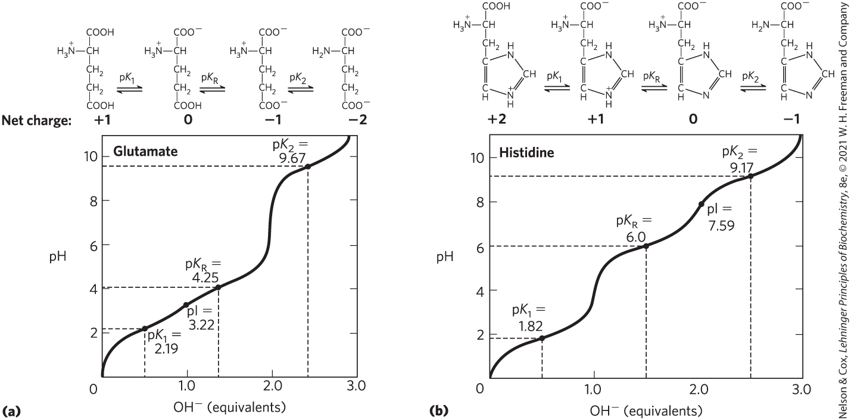
Titration of Amino Acids with an Ionizable R Group

Slide 39
Clicker Question 4
At what pH values will histidine have a net neutral charge?
A. below 1.82
B. between 1.82 and 6.0
C. between 6.0 and 9.17
D. above 9.17
E. There are no pH values where histidine will have a net neutral charge.
Notes:
Answer: C
Principle: 3.1
Learning Objective: Determine the protonation state of a functional group in an amino acid based on the pH of the solvent and the pK_{a} of the group.
Bloom’s: 2:2

Slide 40
Clicker Question 4, Response
At what pH values will histidine have a net neutral charge?
C. between 6.0 and 9.17
Histidine has three pK_{a} values: pK₁ (—COOH): 1.82; pK₂ (—NH₃⁺): 9.17; pK₃ (R group): 6.0. Below pH 1.82, histidine has a net +2 charge. Between pH 1.82 and 6.0, the —COOH group loses its proton and histidine has a net +1 charge. Between 6.0 and 9.17, the R group loses its proton and histidine has a net neutral charge.

Slide 41

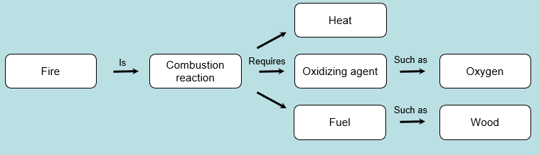
Activity: Relating
Terms within the Chapter
A concept map displays the relationships between different concepts. Observe the following example of a concept map.
Notes:
Instructor: For additional information, see the Instructor Activity Guide located in Achieve. It can be found within Chapter 3, in the folder titled “Ch3 In-Class Activities, Videos, and Resources.”

Slide 42
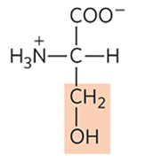
Activity Instructions (1 of 2)
Think about how the following terms and phrases relate to each other and then use scratch paper to draw a concept map using these terms and phrases. (3 minutes)
pH
hydrogen atoms
zwitterion
titration
pK_{a}
isoelectric point
Henderson-Hasselbalch equation
serine
Notes:
Instructor: For additional information, see the Instructor Activity Guide located in Achieve. It can be found within Chapter 3, in the folder titled “Ch3 In-Class Activities, Videos, and Resources.”

Slide 43
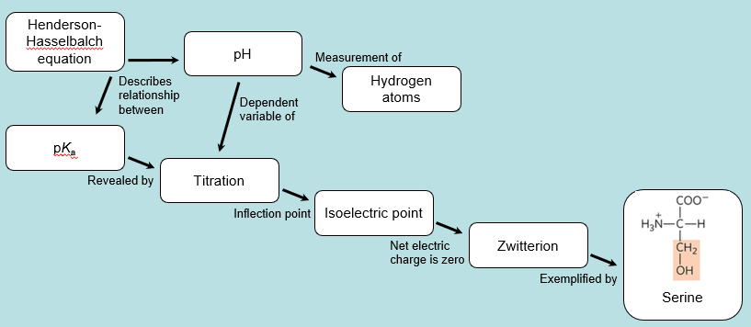
Activity Solution (1 of 2)
Pair up and share how this possible concept map might differ from yours. (2 minutes)
Notes:
Instructor: For additional information, see the Instructor Activity Guide located in Achieve. It can be found within Chapter 3, in the folder titled “Ch3 In-Class Activities, Videos, and Resources.”

Slide 44
3.2 Peptides and Proteins

Slide 45
Principle 2 (2 of 3)
In proteins, amino acids are joined in characteristic linear sequences through a common amide linkage, the peptide bond. The amino acid sequence of a protein constitutes its primary structure, a first level we will introduce within the broader complexities of protein structure.

Slide 46
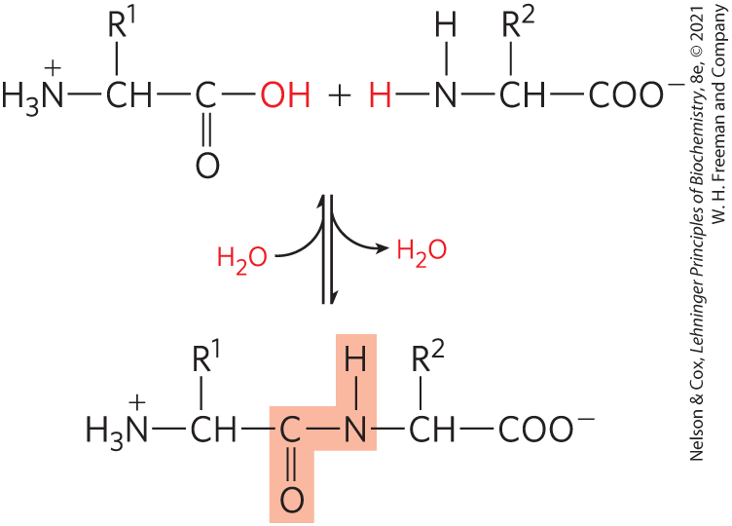
Peptides Are Chains of
Amino Acids
peptide bond:
  covalent
  formed through condensation
  broken through hydrolysis

Slide 47

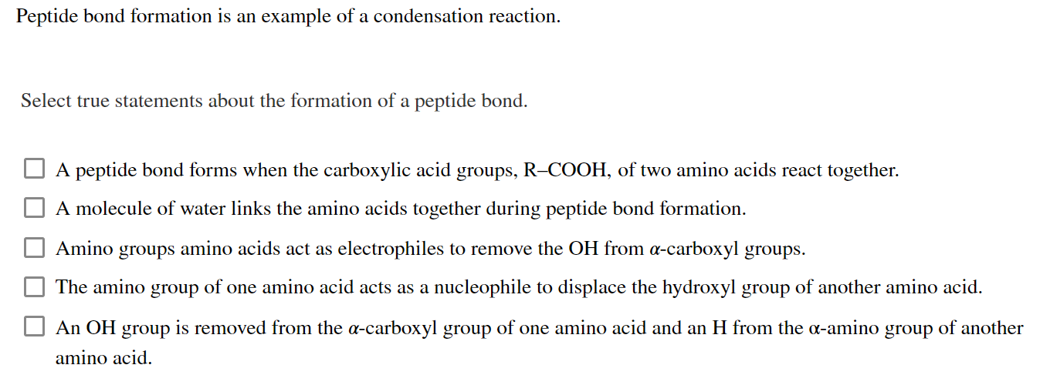
Activity: Peptide Bond
Formation Muddiest Point (1 of 2)
Complete the Ch3 Student Activity, Day 1: Peptide Bond Formation (Muddiest Point) Achieve assessment.
Notes:
Instructor: This muddiest point activity can be found in Achieve in the Chapter 3 folder titled “Ch3 In-Class Activities, Videos, and Resources.” See the Instructor Activity Guide in the same folder for more information.

Slide 48
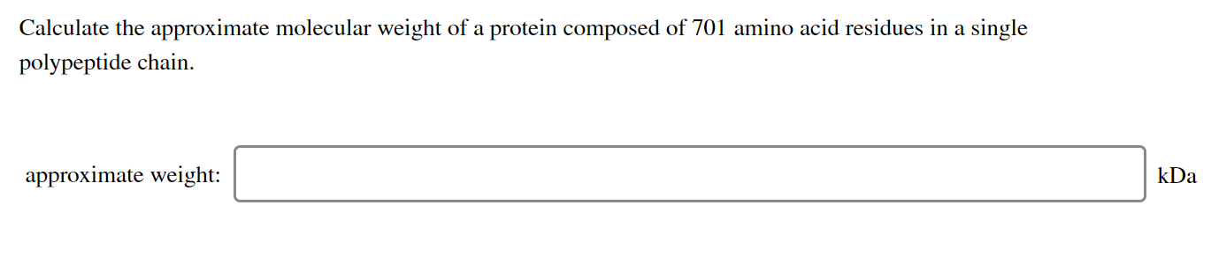
Activity: Peptide Bond
Formation Muddiest Point (2 of 2)
Complete the Ch3: Student Activity, Day 2: Peptide Bond Formation (Muddiest Point) Achieve assessment.
Notes:
Instructor: This muddiest point activity can be found in Achieve in the Chapter 3 folder titled “Ch3 In-Class Activities, Videos, and Resources.” See the Instructor Activity Guide in the same folder for more information.

Slide 49
Peptide Types by the Number
dipeptide = 2 amino acids, 1 peptide bond
tripeptide = 3 amino acids, 2 peptide bonds
oligopeptide = a few amino acids
polypeptide = many amino acids, molecular weight < 10 kDa
protein = thousands of amino acids, molecular weight > 10 kDa

Slide 50
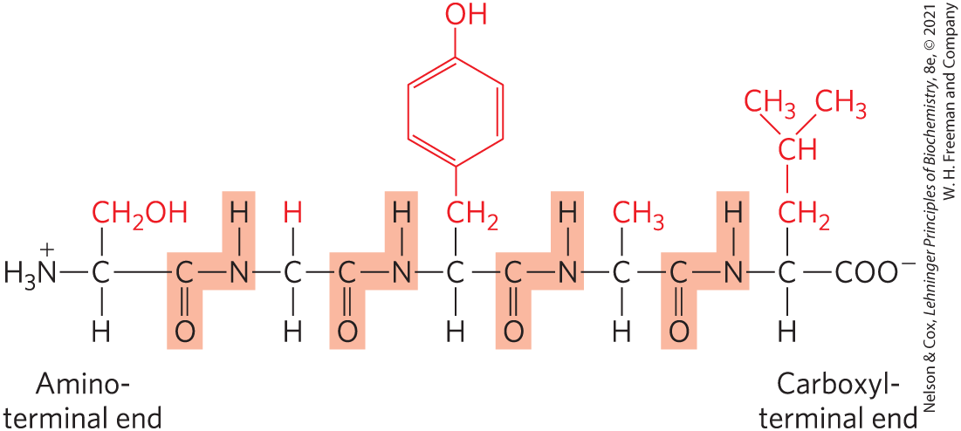
Peptide Terminals
numbering (and naming) starts from the
amino-terminal residue (N-terminal)
N-terminal
C-terminal

Slide 51
Naming Peptides
full amino acid names:
serylglycyltyrosylalanylleucine
three-letter code abbreviations:
Ser–Gly–Tyr–Ala–Leu
one-letter code abbreviation:
SGYAL

Slide 52

Clicker Question 5
Which statement is correct about peptides?
A. Peptides have no α-carboxyl groups.
B. Peptides have their amino acid sequences
written from the N-terminus.
C. Peptides do not have isoelectric points.
D. Peptides are not biologically active.
E. Peptide bonds are broken through
condensation reactions.
Notes:
Answer: B
Principle: 3.2
Learning Objective: Identify the key features of a polypeptide.
Bloom’s: 2:2

Slide 53
Clicker Question 5, Response
Which statement is correct about peptides?
B. Peptides have their amino acid
sequences written from the N-terminus.
Peptides are named beginning with the amino-terminal (N-terminal) residue.

Slide 54
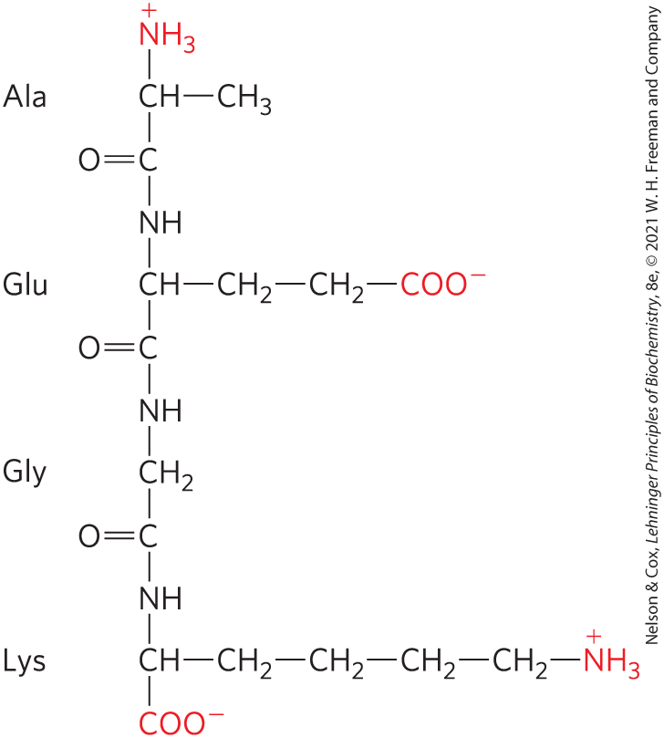
Peptides Can Be Distinguished by Their Ionization Behavior
ionizable groups in peptides:
  one free α-amino group
  one free α-carboxyl group
  some R groups

Slide 55
Biologically Active Peptides and Polypeptides Occur in a Vast Range of Sizes and Compositions
length of naturally occurring peptides = 2 to many thousands of amino acid residues
Table 3-2 Molecular Data on Some Proteins
Protein | Molecular weight | Number of residues | Number of polypeptide chains
Cytochrome c (human) | 12,400 | 104 | 1
Myoglobin (equine heart) | 16,700 | 153 | 1
Chymotrypsin (bovine pancreas) | 25,200 | 241 | 3
Hemoglobin (human) | 64,500 | 574 | 4
Hexokinase (yeast) | 107,900 | 972 | 2
RNS polymerase (E. coli) | 450,00 | 4,158 | 5
Glutamine synthetase (E. coli) | 619,000 | 5,628 | 12
Titin (human) | 2,993,000 | 26,926 | 1

Slide 56
Peptide Subunits
multisubunit protein = 2+ polypeptides associated noncovalently
oligomeric protein = at least 2 identical subunits
  identical units = protomers

Slide 57

Clicker Question 6
The cytoskeletal component filamentous actin is made of many subunits, all of which are globular actin. Which term refers to globular actin in this context?
A. prosthetic group
B. protomer
C. ligand
D. cofactor
E. polymorphism
Notes:
Answer: B
Principle: 3.2
Learning Objective: Identify a protein containing multiple polypeptides as an oligomer or protomer.
Bloom’s: 1:1

Slide 58
Clicker Question 6, Response
The cytoskeletal component filamentous actin is made of many subunits, all of which are globular actin. Which term refers to globular actin in this context?
B. protomer
Identical units in a multisubunit protein are referred to as protomers.

Slide 59
Amino Acid Composition of Proteins
Table 3-3 Amino Acid Composition of Two Proteins
amino acid composition is highly variable
Amino Acid | Bovine cytochrome c: Number of residues per molecule | Bovine cytochrome c: percentage of total | Bovine chymotrypsinogen: Number of residues per molecule | Bovine chymotrypsinogen: Percentage of total
Ala | 6 | 6 | 22 | 9
Arg | 2 | 2 | 4 | 1.6
Asn | 5 | 5 | 14 | 5.7
Asp | 3 | 3 | 9 | 3.7
Cys | 2 | 2 | 10 | 4
Gln | 3 | 3 | 10 | 4
Glu | 9 | 9 | 5 | 2
Gly | 14 | 13 | 23 | 9.4
His | 3 | 3 | 2 | 0.8
Ile | 6 | 6 | 10 | 4
Leu | 6 | 6 | 19 | 7.8
Lys | 18 | 17 | 14 | 5.7
Met | 2 | 2 | 2 | 0.8
Phe | 4 | 4 | 6 | 2.4
Pro | 4 | 4 | 9 | 3.7
Ser | 1 | 1 | 28 | 11.4
Thr | 8 | 8 | 23 | 9.4
Trp | 1 | 1 | 8 | 3.3
Tyr | 4 | 4 | 4 | 1.6
Val | 3 | 3 | 23 | 9.4
Total | 104 | 102 | 245 | 99.7
Notes:
See Table 3-3 in the text for footnotes

Slide 60
Estimating the Number of
Amino Acid Residues
number of residues = molecular weight/110
average molecular weight of amino acid = ~128
molecule of water removed to form peptide bond = 18
128 – 18 = 110

Slide 61
Some Proteins Contain Chemical Groups Other Than Amino Acids
conjugated proteins = contain permanently associated chemical components
  non–amino acid part = prosthetic group
lipoproteins contain lipids
glycoproteins contain sugars
metalloproteins contain specific metals
Table 3-4 Conjugated Proteins
Class | Prosthetic group | Example
Lipoproteins | Lipids | β₁-Lipoprotein of blood (Fig. 17-2)
Glycoproteins | Carbohydrates | Immunoglobulin G (Fig. 5-20)
Phosphoproteins | Phosphate groups | Glycogen phosphorylase (Fig. 6-39)
Hemoproteins | Heme (iron porphyrin) | Hemoglobin (Figs 5-8 to 5-11)
Flavoproteins | Flavin nucleotides | Succinate dehydrogenase (Fig. 19-9)
Metallproteins | Iron Zinc Calcium Molybdenum Copper | Ferritin (Box 16-1) Alcohol dehrogenase (Fig. 14-12) Calmodulin (Fig. 12-17) Dinitrogenase (Fig. 22-3) Complex IV (Fig. 19-12)

Slide 62

Clicker Question 7
Which statement is correct about proteins?
A. Proteins can consist of more than one polypeptide
chain.
B. Proteins consist solely of polymerized amino acids.
C. Proteins all have similar amino acid compositions.
D. Proteins can, by definition, consist of no more than
2,000 amino acid residues.
E. Proteins do not have ionizable groups.
Notes:
Answer: A
Principle: 3.2
Learning Objective: Describe polypeptides based on their length.
Bloom’s: 2:2

Slide 63
Clicker Question 7, Response
Which statement is correct about proteins?
A. Proteins can consist of more than one
polypeptide chain.
Multisubunit proteins have two or more polypeptide chains that are noncovalently associated.

Slide 64
3.3 Working with Proteins

Slide 65
Principle 3 (2 of 2)
For study, individual proteins can be separated from the thousands of other proteins present in a cell, based on differences in their chemical and functional properties arising from their distinct amino acid sequences. As proteins are central to biochemistry, the purification of individual proteins for study is a quintessential biochemical endeavor.

Slide 66
Proteins Can Be Separated and Purified
separated based on:
  size
  charge
  binding properties
  protein solubility

Slide 67
Methods for Purifying Proteins
first step = break open tissue or microbial cells
  crude extract = releases proteins in solution
second step = fractionation = separate proteins into fractions based on size or charge
  “salting out” = lower solubility of proteins in salt to selectively precipitate proteins
third step = dialysis = use semipermeable membrane to separate proteins from small solutes

Slide 68
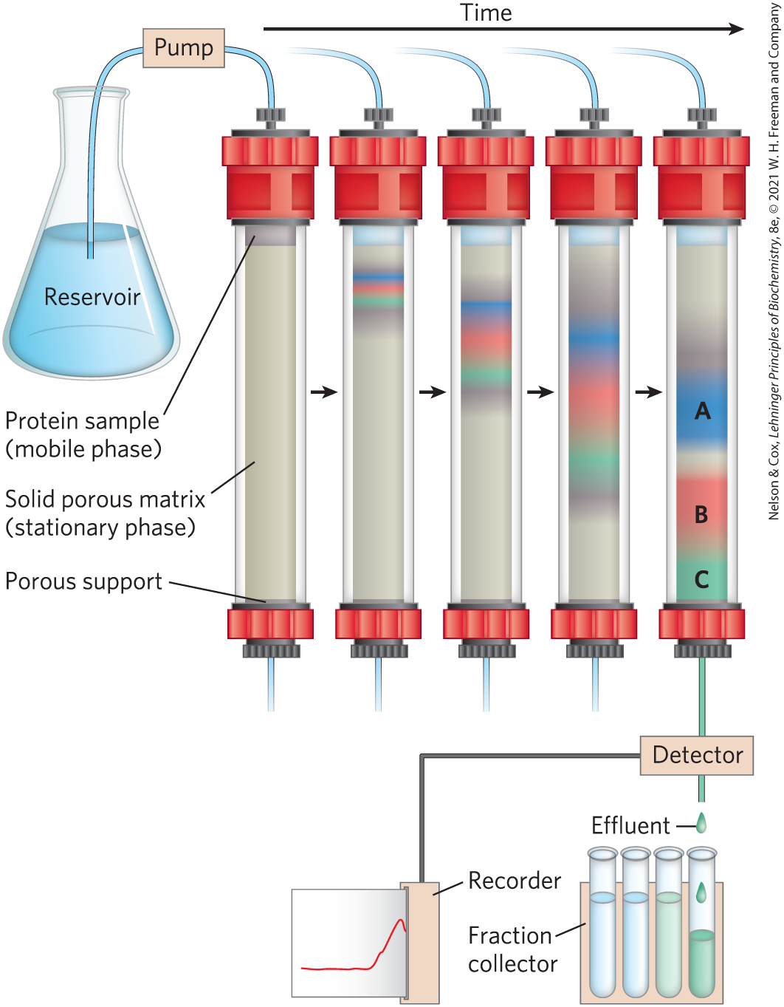
Column Chromatography
first step = buffered solution (mobile phase) migrates through porous solid material (solid phase)
second step = buffered solution containing protein migrates through solid phase
protein properties affect migration rates

Slide 69

Clicker Question 8
Which component is absolutely necessary for the purification of a protein?
A. column chromatography
B. the gene sequence of the protein
C. a means of detecting the protein
D. a centrifuge
Notes:
Answer: C
Principle: 3.3
Learning Objective: Describe the basic steps of protein purification.
Bloom’s: 2:2

Slide 70
Clicker Question 8, Response
Which component is absolutely necessary for the purification of a protein?
C. a means of detecting the protein
To study a protein in detail, researchers must be able to separate it from other proteins in pure form and must have the techniques to determine its properties.

Slide 71
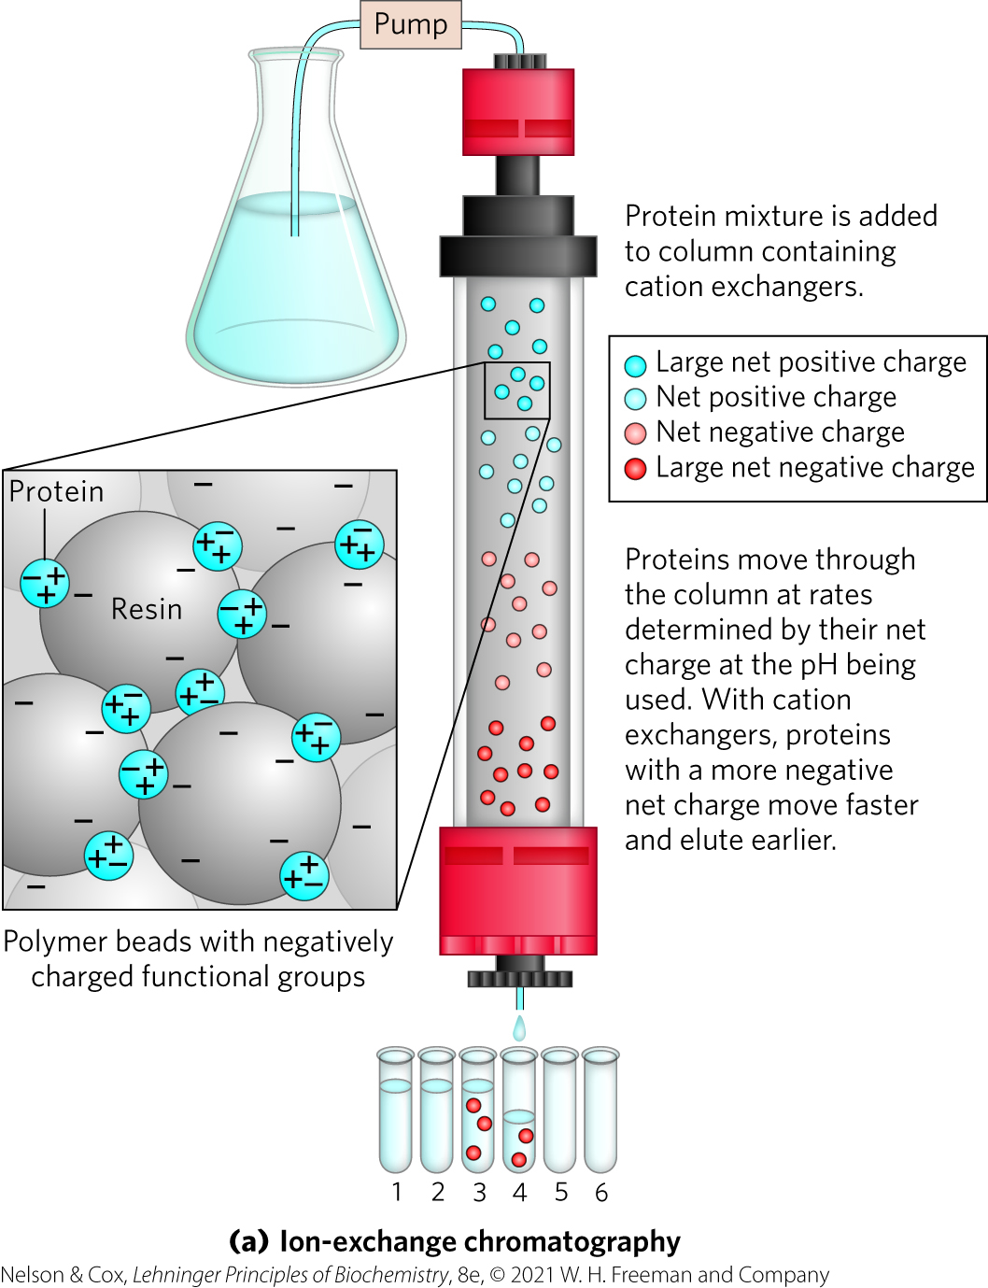
Ion-Exchange Chromatography
separates based on sign and magnitude of the net electric charge
pH and concentration of free salt ions affect protein affinity
uses bound charged groups:
  cation exchangers
  anion exchangers

Slide 72
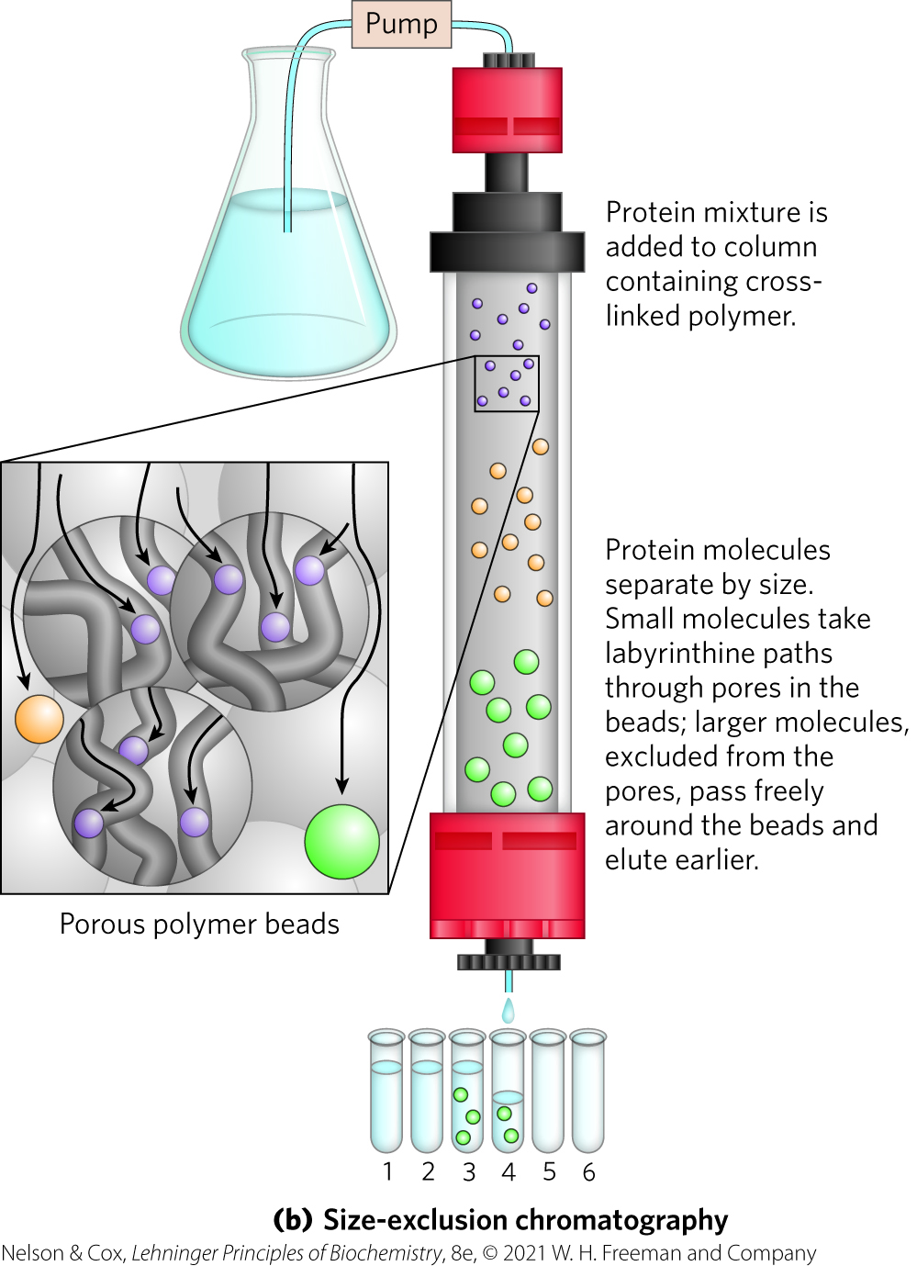
Size-Exclusion Chromatography
also called gel filtration chromatography
separates based on size
large proteins emerge from the column before small proteins do

Slide 73
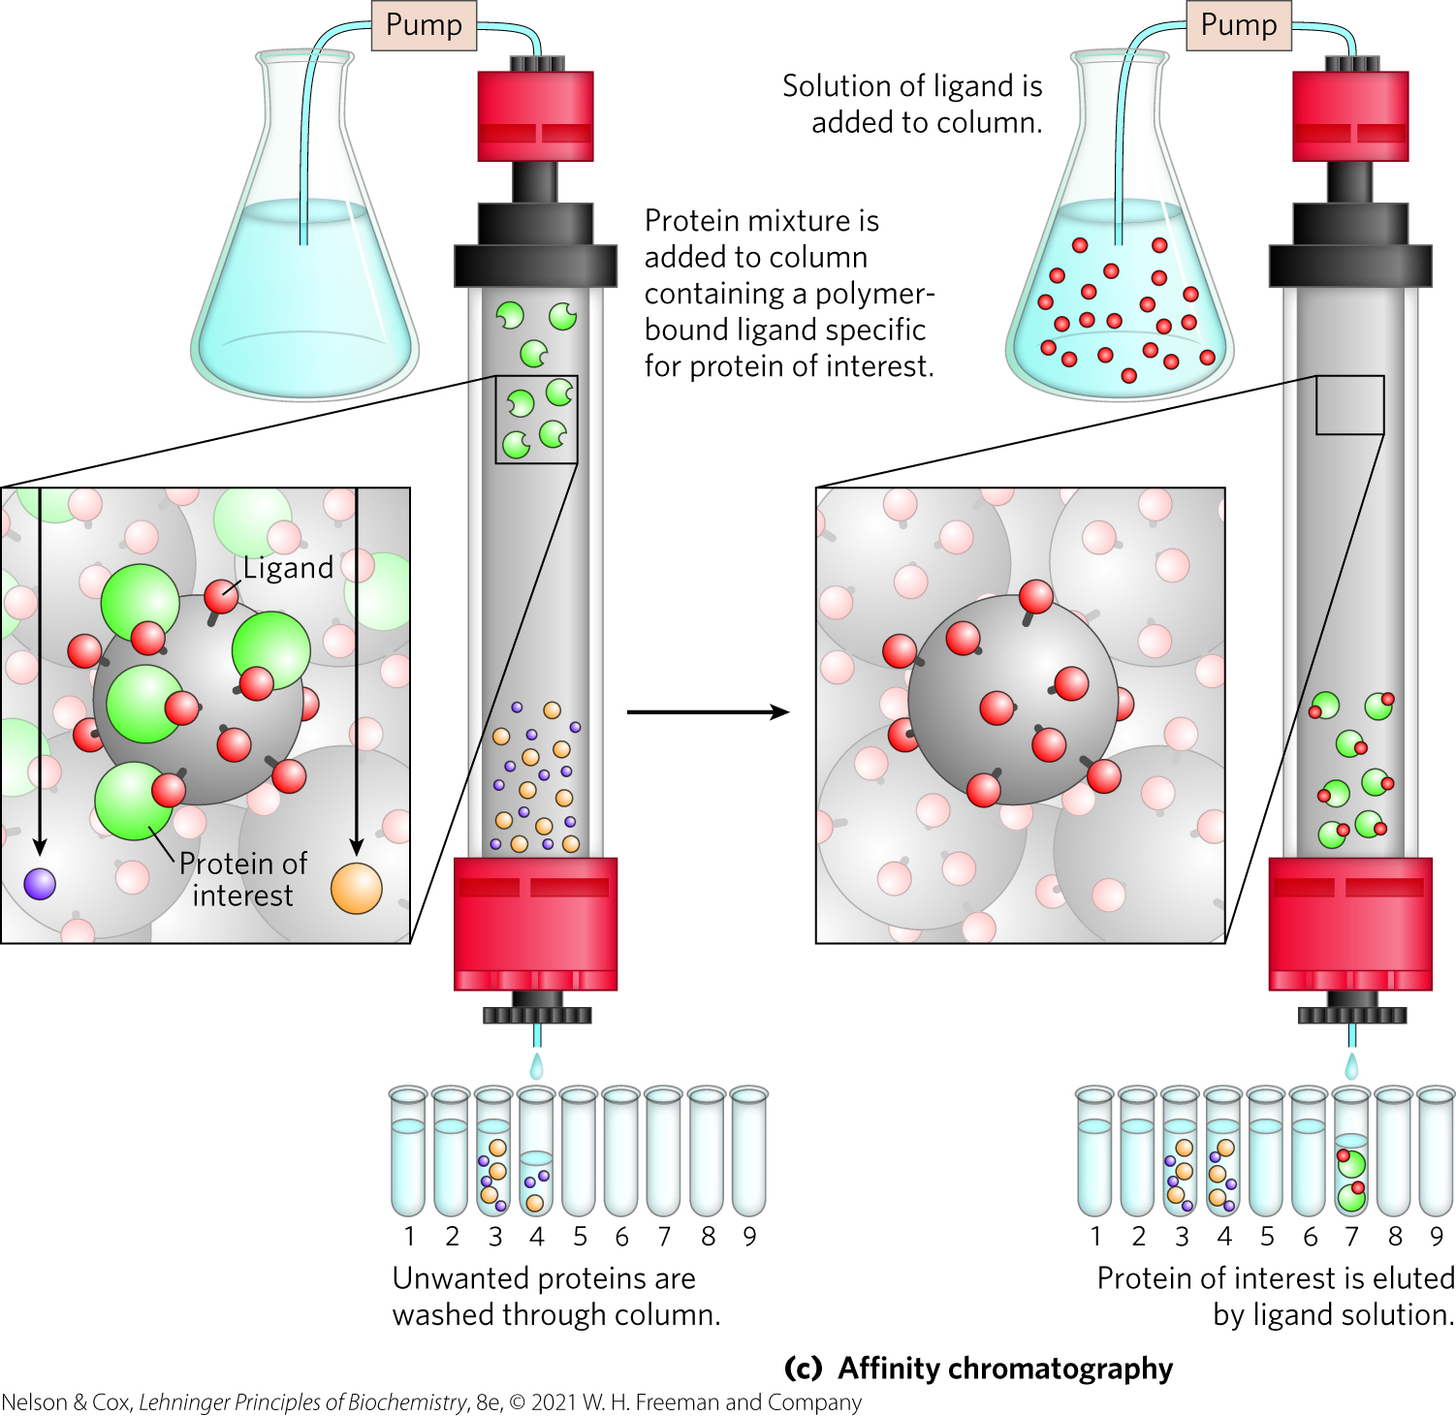
Affinity Chromatography
separates based on binding affinity
eluted by high concentration of salt or ligand

Slide 74
Clicker Question 9
Which protein would elute first from a gel filtration column?
A. protein A, with M_{r} = 27,000
B. protein B, with M_{r} = 58,400
C. protein C, a homodimer with protomer M_{r} = 11,300
D. protein D, with M_{r} = 15,600
Notes:
Answer: B
Principle: 3.3
Learning Objective: Predict the order of peptide elution from a chromatography column.
Bloom’s: 3:2

Slide 75
Clicker Question 9, Response
Which protein would elute first from a gel filtration column?
B. protein B, with M_{r} = 58,400
Size-exclusion chromatography, also called gel filtration, separates proteins according to size. In this method, large proteins emerge from the column sooner than small ones do.

Slide 76
High-Performance Liquid Chromatography
uses high-pressure pumps to move proteins down the column
greatly improves resolution

Slide 77

Clicker Question 10
A new protein resembling myosin was reported. Unlike myosin, it binds calcium. Its isoelectric point and molecular weight are very similar to those of myosin. Which method would BEST separate the new protein from myosin if those two proteins were in the same buffer solution?
A. ion-exchange chromatography
B. size-exclusion chromatography
C. affinity chromatography
D. dialysis
E. fractionation
Notes:
Answer: B
Principle: 3.3
Learning Objective(s): Compare different chromatography techniques; Compare crude purification methods such as precipitation, centrifugation, and dialysis.
Bloom’s: 2:2

Slide 78
Clicker Question 10, Response
Which method would BEST separate the new protein from myosin if those two proteins were in the same buffer solution?
C. affinity chromatography
Attaching calcium to the beads in the column would create an affinity matrix that could help purify the protein. Proteins that do not bind to calcium would flow more rapidly through the column than the new protein, which does bind calcium.

Slide 79
Sequential Purification Steps Decrease Sample Size
Table 3-5 A Hypothetical Purification Table for an Enzyme
Procedure or step | Fraction volume (mL) | Total protein (mg) | Activity (units) | Specific activity (units/mg)
1. Crude cellular extract | 1,400 | 10,000 | 100,000 | 10
2. Precipitation with ammonium sulfate | 280 | 3,000 | 96,000 | 32
3. Ion-exchange chromatography | 90 | 400 | 80,000 | 200
4. Size-exclusion chromatography80 | 80 | 100 | 60,000 | 600
5. Affinity chromatography | 6 | 3 | 45,000 | 15,000
Note: All data represent the status of the sample after the designated procedure has been carried out. “Activity” and “specific activity” are defined on page 90.
final specific activity: starting specific activity ratio = purification factor
percentage of the final activity/percentage starting activity = percent yield

Slide 80
Clicker Question 11
The specific activity of a protein in crude cellular extract is 15 units/mg. Following a purification process, involving precipitation with ammonium sulfate and multiple chromatography steps, the specific activity of the protein is 12,000 units/mg. What is the purification factor?
A. 180,000
B. 800
C. 0.00125
D. 15
E. 12,000
Notes:
Answer: B
Principle: 3.3
Learning Objective: Analyze the effectiveness of a purification strategy used to separate a mixture of proteins.
Bloom’s: 3:2

Slide 81
Clicker Question 11, Response
The specific activity of a protein in crude cellular extract is 15 units/mg. Following a purification process, involving precipitation with ammonium sulfate and multiple chromatography steps, the specific activity of the protein is 12,000 units/mg. What is the purification factor?
B. 800
The ratio of the final specific activity (12,000 units/mg) to the starting specific activity (15 units/mg) gives the purification factor (800).

Slide 82
Proteins Can Be Separated and Characterized by Electrophoresis
electrophoresis = visualize and characterize purified proteins
can be used to estimate:
  number of different proteins in a mixture
  degree of purity
  isoelectric point
  approximate molecular weight

Slide 83
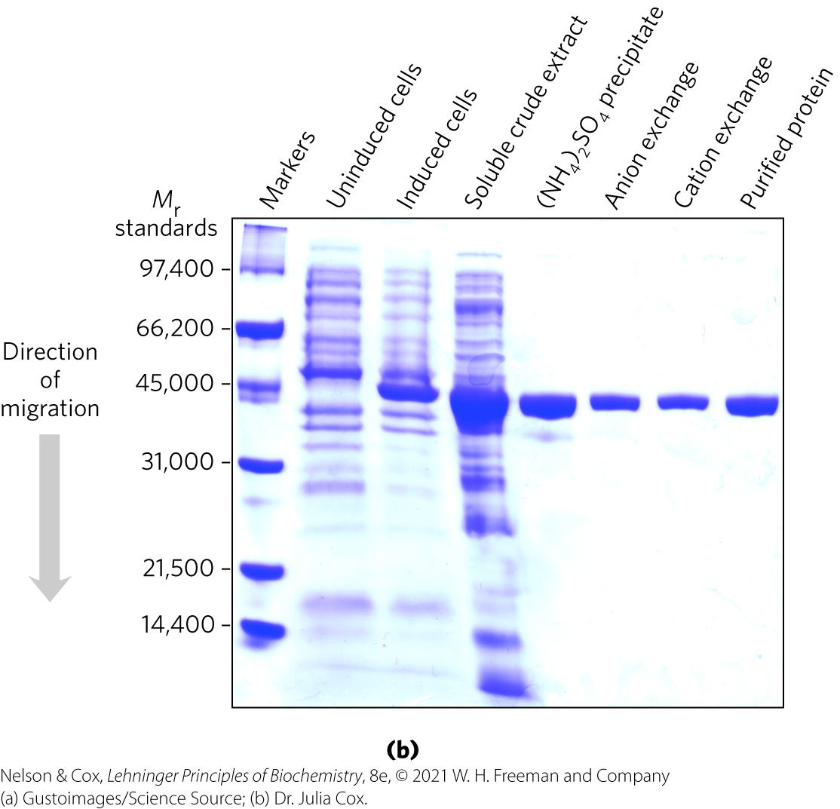
Electrophoresis for Protein Analysis
uses cross-linked polymer polyacrylamide gels
proteins migrate based on charge-to-mass ratio
visualization = Coomassie blue dye binds to proteins

Slide 84
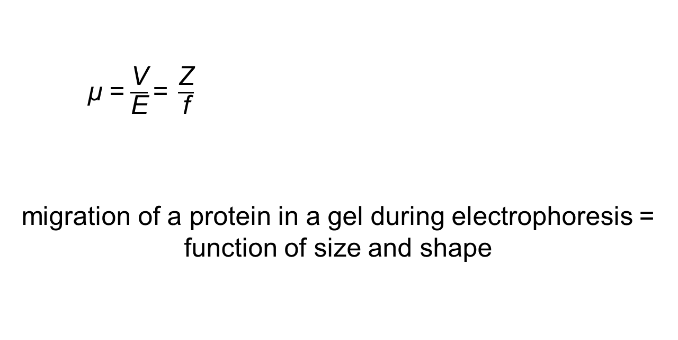
Migration of Proteins during Electrophoresis
  μ =$\frac{\text{V}}{\text{E}}\text{=} \frac{\text{Z}}{\text{f}}$
  migration of a protein in a gel during electrophoresis = function of size and shape
  μ = electrophoretic mobility
  V = velocity
  E = electrical potential
  Z = net charge
  f = frictional coefficient

Slide 85
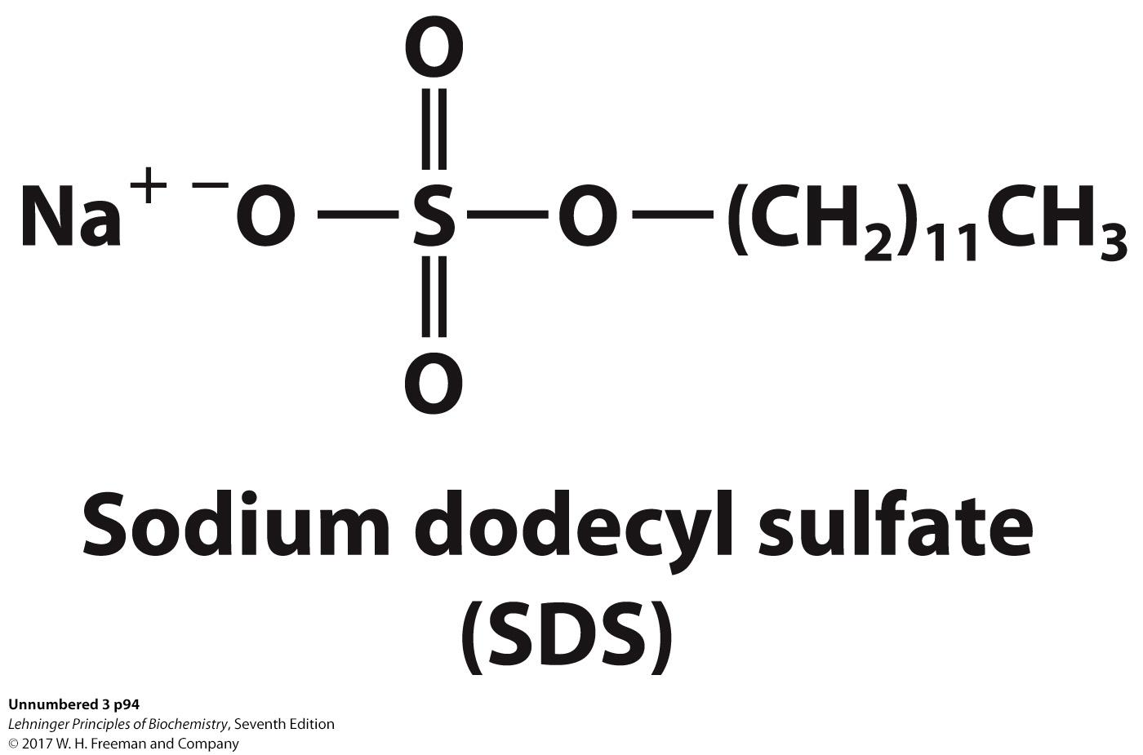
Sodium Dodecyl Sulfate (SDS)
sodium dodecyl sulfate (SDS) = a detergent
  binds and partially unfolds proteins
  gives all proteins a similar charge-to-mass ratio
  electrophoresis in the presence of SDS separates proteins by molecular weight
    smaller proteins migrate more rapidly

Slide 86
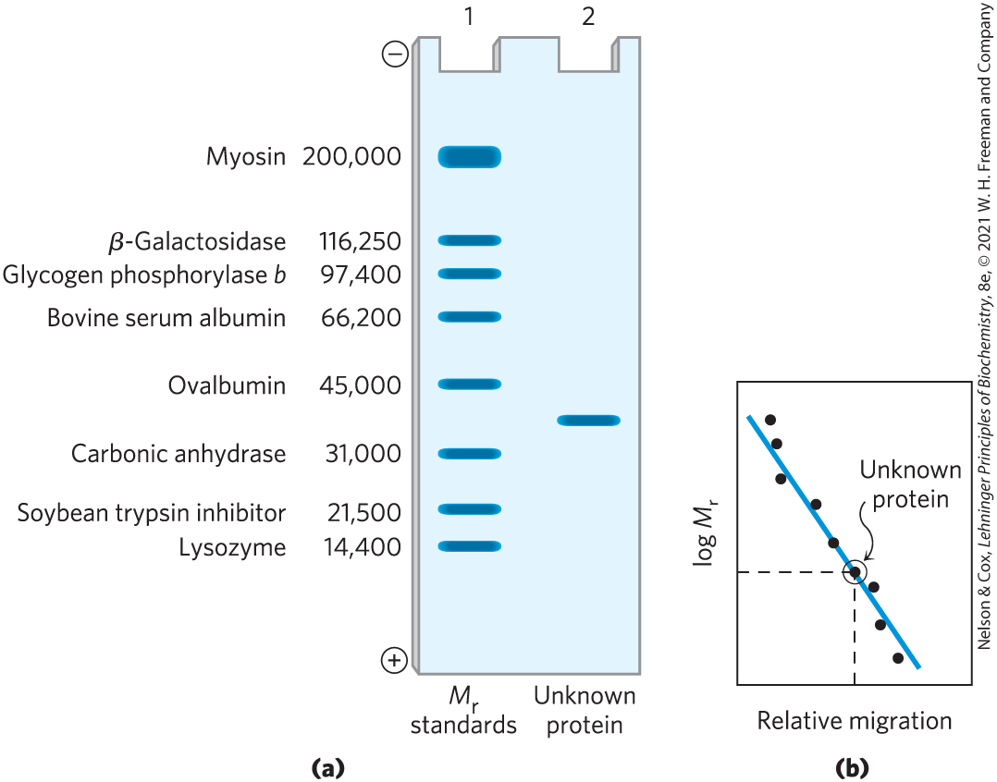
Estimating the Molecular Weight of a Protein
plot of log M_{r} of marker proteins vs. relative migration during electrophoresis = linear

Slide 87
Clicker Question 12
Denaturing gel electrophoresis separates proteins based on differences in:
A. size and shape.
B. molecular mass.
C. charge.
D. amino acid content.
Notes:
Answer: A
Principle: 3.3
Learning Objective: Explain the relationship between molecule size, charge, and electrophoretic mobility.
Bloom’s: 2:2

Slide 88

Clicker Question 12, Response
Denaturing gel electrophoresis separates proteins based on differences in:
A. size and shape.
  μ =$\frac{\text{V}}{\text{E}}\text{=} \frac{\text{Z}}{\text{f}}$
  Thus, the migration of a protein in a gel during electrophoresis is a function of its size and its shape.
  μ = electrophoretic mobility
  V = velocity
  E = electrical potential
  Z = net charge
  f = frictional coefficient

Slide 89
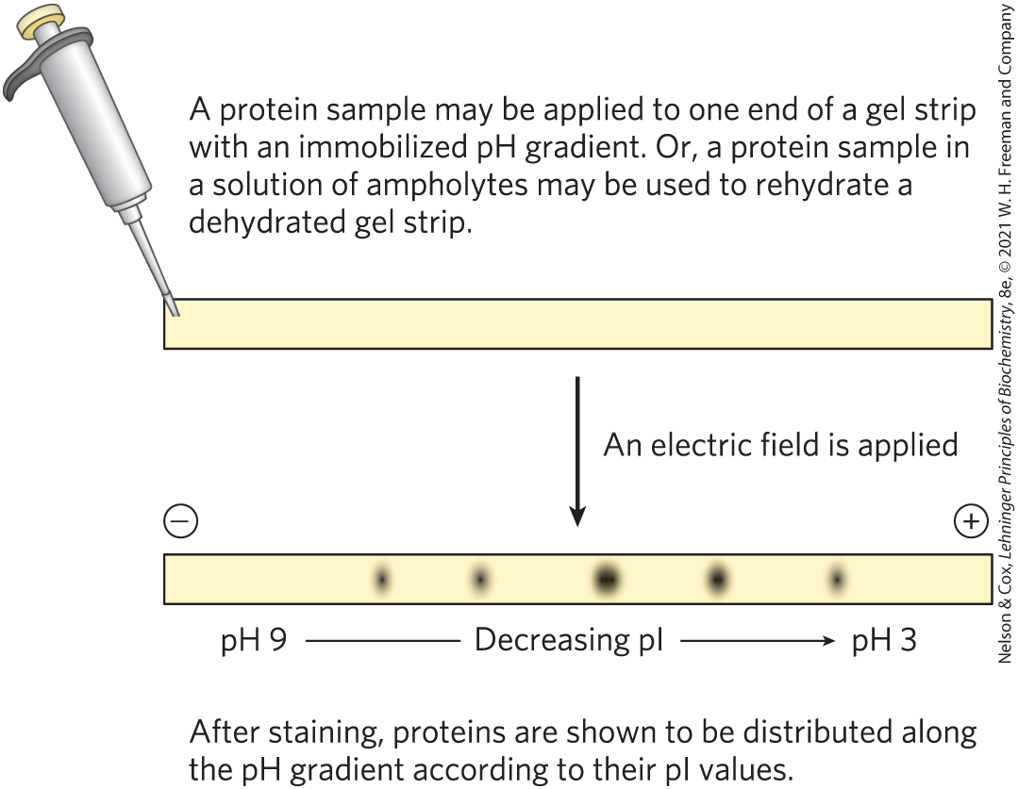
Using Isoelectric Focusing to Determine the pI of a Protein

Slide 90
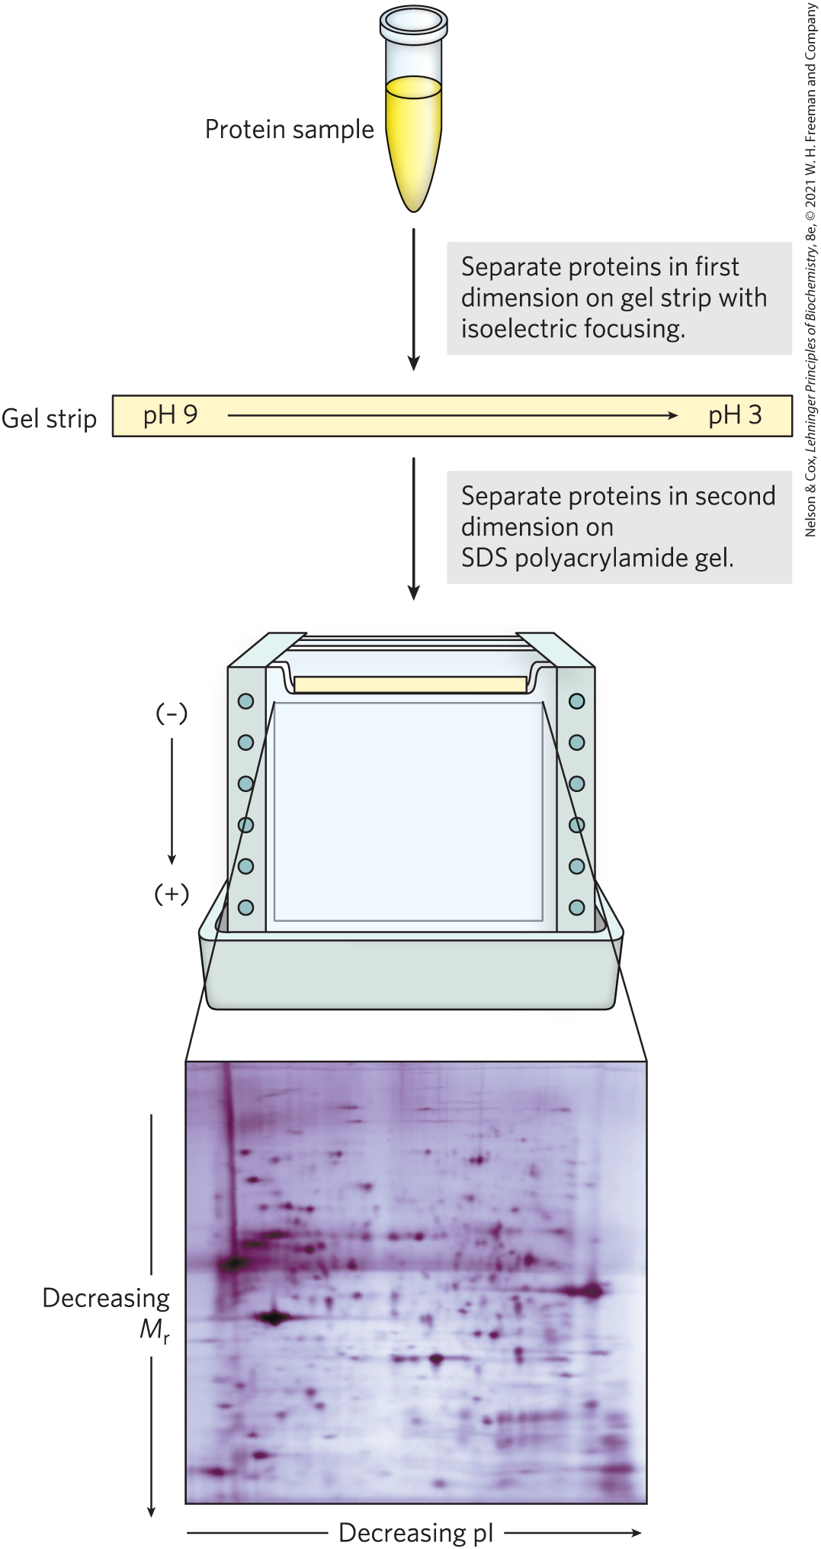
Two-Dimensional Electrophoresis
permits resolution of complex protein mixtures of proteins
more sensitive than individual methods

Slide 91
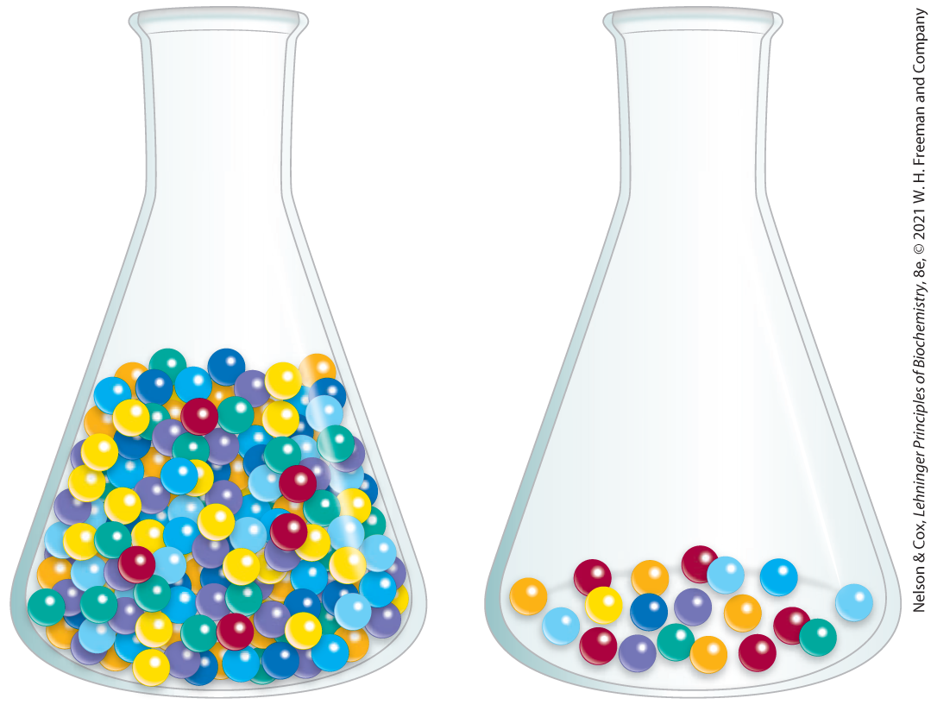
Unseparated Proteins Are Detected and Quantified Based on Their Functions
can monitor enzyme purification by assaying specific activity:
  activity = total enzyme units in a solution
  specific activity = number of enzyme units per mg of total protein

Slide 92
Clicker Question 13
What measurement increases during purification of an enzyme?
A. activity
B. total protein
C. specific activity
D. fraction volume
Notes:
Answer: C
Principle: 3.3
Learning Objective: Analyze the effectiveness of a purification strategy used to separate a mixture of proteins.
Bloom’s: 2:2

Slide 93
Clicker Question 13, Response
What measurement increases during purification of an enzyme?
C. specific activity
The specific activity is the number of enzyme units per milligram of total protein. The specific activity is a measure of enzyme purity: it increases during purification of an enzyme and becomes maximal and constant when the enzyme is pure.

Slide 94

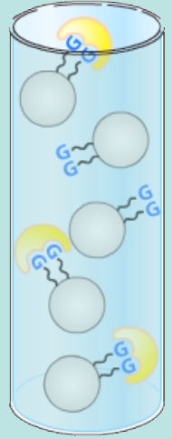
Activity: Methods of Protein Purification
Watch the Animated Technique video titled “Gel Filtration and Affinity Chromatography” in your Achieve course.
Notes:
Instructor: This Animated Technique video is found within Chapter 3 of Achieve. It is in the folder titled “Ch3 In-Class Activities, Videos, and Resources.”

Slide 95
Activity Instructions (2 of 2)
On your own, think about the ways in which proteins can undergo purification. What property of a protein can be exploited to facilitate its isolation?
Pair up to discuss your ideas. (2 minutes)
Share your ideas with the class in group discussion. (3 minutes)
Notes:
Instructor: This Animated Technique video is found within Chapter 3 of Achieve. It’s in the folder titled “Ch3 In-Class Activities, Videos, and Resources.”

Slide 96
Activity Solution (2 of 2)
What property of a protein can be exploited to facilitate its isolation?
A protein’s binding specificity to specific chemical groups can be exploited. This include proteins that bind to other proteins, proteins that bind to DNA (e.g. transcription factors), and proteins that bind to small molecules (e.g. enzymes).
A specific protein can be isolated from a mixture of proteins by running the mixture over a column with a resin that is covalently bound to the protein’s binding partner. The more specificity the protein has for the binding partner, the better the purification.
Notes:
Instructor: This Animated Technique video is found within Chapter 3 of Achieve. It’s in the folder titled “Ch3 In-Class Activities, Videos, and Resources.”

Slide 97
3.4 The Structure of Proteins: Primary Structure

Slide 98
Principle 2 (3 of 3)
In proteins, amino acids are joined in characteristic linear sequences through a common amide linkage, the peptide bond. The amino acid sequence of a protein constitutes its primary structure, a first level we will introduce within the broader complexities of protein structure.

Slide 99
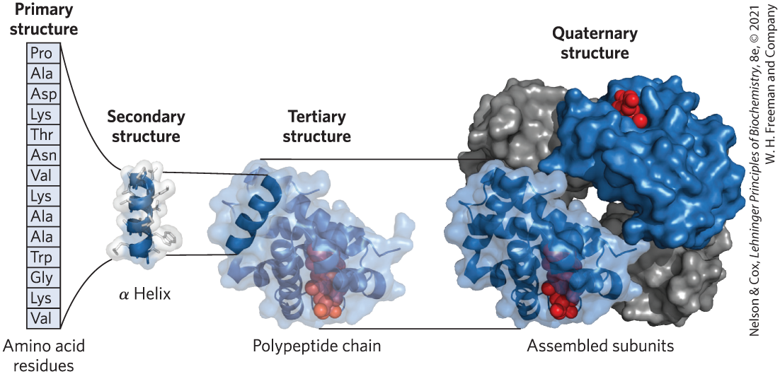
Levels of Structure in Proteins
four levels:
  primary structure = covalent bonds linking amino acid residues in a polypeptide chain
  secondary structure = recurring structural patterns
  tertiary structure = 3D folding of polypeptide
  quaternary structure = 2+ polypeptide subunits

Slide 100

Clicker Question 14
What is the highest level of protein structure in human insulin, which has two polypeptides of different mass linked by several disulfide bonds?
A. primary
B. secondary
C. tertiary
D. quaternary
Notes:
Answer: D
Principle: 3.2
Learning Objective: Identify the key features of a polypeptide.
Bloom’s: 2:2

Slide 101
Clicker Question 14, Response
What is the highest level of protein structure in human insulin, which has two polypeptides of different mass linked by several disulfide bonds?
D. quaternary
Insulin has two polypeptide subunits. When a protein has two or more polypeptide subunits, their arrangement in space is referred to as quaternary structure.

Slide 102
Principle 4 (2 of 2)
Shaped by evolution, amino acid sequences are a key resource for understanding the function of individual proteins and for tracing broader functional and evolutionary relationships.

Slide 103
The Function of a Protein Depends on Its Amino Acid Sequence
amino acid sequence confers 3D structure
3D structure confers function
most human proteins = polymorphic = have amino acid sequence variants
Edman degradation = classic method of sequencing amino acids

Slide 104
Protein Structure Is Studied Using Methods That Exploit Protein Chemistry
traditional protein sequencing techniques:
  labeling proteins
  breaking proteins into parts

Slide 105
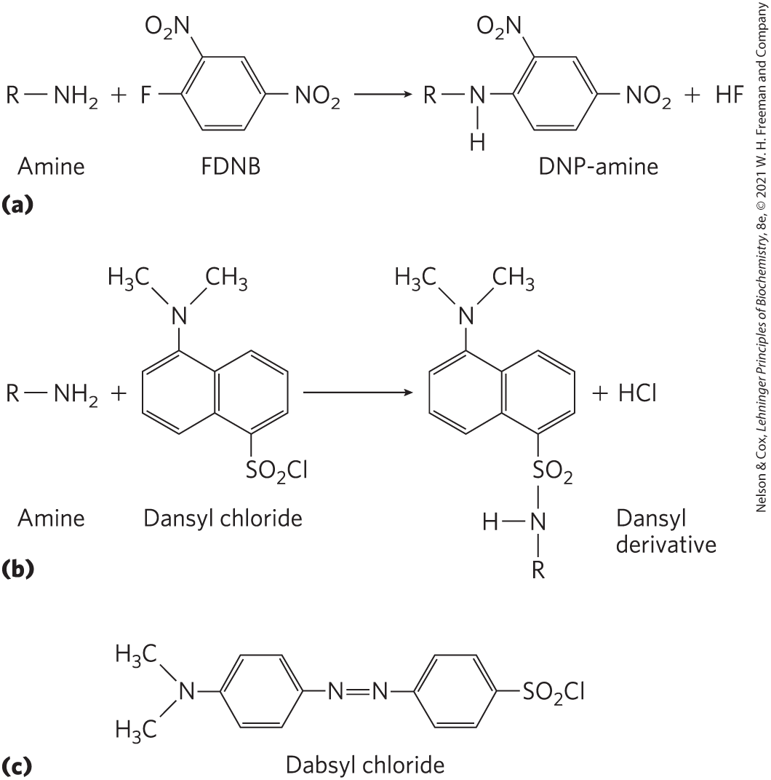
Studying Protein Structure through Labeling
FDNB, dansyl chloride, dabsyl chloride = label amino-terminal α-amino group and ε-amino group of lysine residues

Slide 106
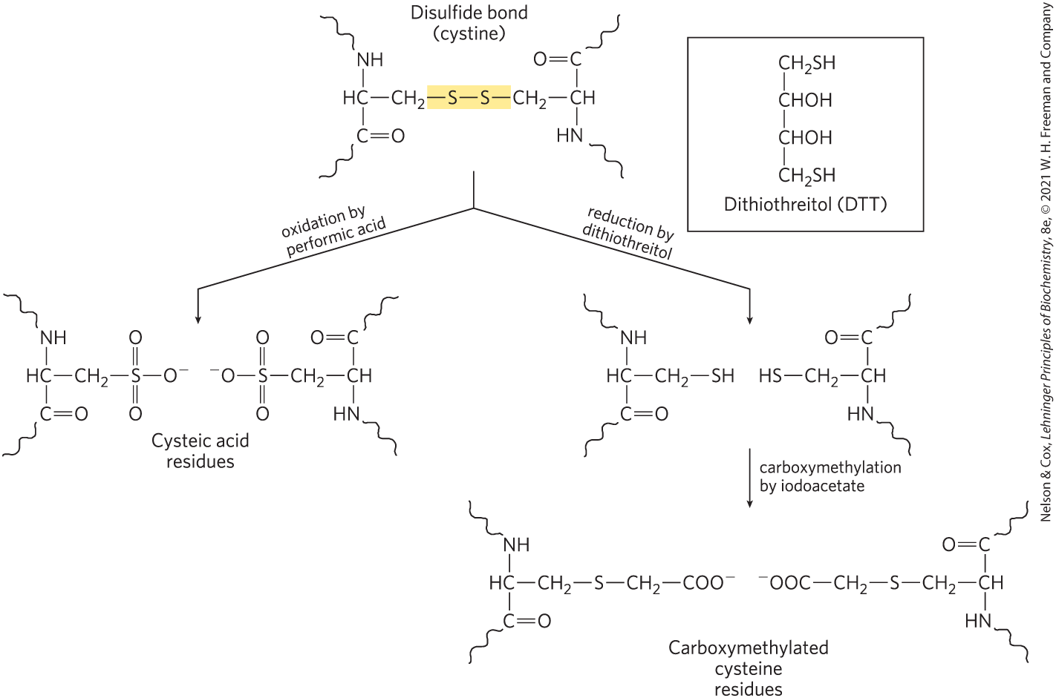
Studying Protein Structure through Breaking Bonds
oxidation with performic acid or reduction by dithiothreitol = breaks disulfide bonds, denatures proteins

Slide 107
Studying Protein Structure Using Proteases
proteases = catalyze hydrolytic cleavage of peptide bonds
Table 3-6 The Specificity of Some Common Methods for Fragmenting Polypeptide Chains
Reagent (biological source) | Cleavage points
Trypsin (bovine pancreas) | Lys, Arg (C)
Chymotrypsin (bovine pancreas) | Phe, Trp, Tyr (C)
Staphylococcus aureus V8 protease (bacterium S. aureus) | Asp, Glu (C)
Asp-N-protease (bacterium Pseudomonas fragi) | Asp, Glu (N)
Pepsin (porcine stomach) | Leu, Phe, Trp, Tyr (N)
Endoproteinase Lys C (bacterium lysobacter enzymogenes) | Lys (C)
Cyanogen bromide | Met (C)
Notes:
See Table 3-6 in text for footnotes.

Slide 108

Clicker Question 15
Trypsin catalyzes the hydrolysis of peptide bonds in which a Lys or Arg residue contributes a carbonyl group LL-37, an antimicrobial peptide with 37 residues has 6 Lys residues and 5 Arg residues. How many smaller peptides will LL-37 yield upon trypsin cleavage?
A. 6
B. 5
C. 12
D. 37
E. 11
Notes:
Answer: C
Principle: 3.4
Learning Objective: Construct a polypeptide amino acid sequence from proteolytic cleavage or acid hydrolysis products.
Bloom’s: 3:2

Slide 109
Clicker Question 15, Response
LL-37, an antimicrobial peptide with 37 residues has 6 Lys residues and 5 Arg residues. How many smaller peptides will LL-37 yield upon trypsin cleavage?
C. 12
A polypeptide with 11 Lys and Arg residues will usually yield 12 smaller peptides upon cleavage with trypsin. Moreover, all except one of these will have a carboxyl-terminal Lys or Arg.

Slide 110
Mass Spectrometry Provides Information on Molecular Mass, Amino Acid Sequence, and Entire Proteomes
mass spectrometry = measure molecular mass with high accuracy
  can sequence short amino acid sequences (20 to 30 amino acid residues)
  can document the entire cellular proteome

Slide 111
General Steps Involved in Mass Spectrometry
first step: ionize analytes in a vacuum
second step: introduce charged molecules to electric and/or magnetic field
third step: charged molecules move through field as a function of the mass-to-charge ratio, m/z
fourth step: deduce mass (m) of analyte

Slide 112
Matrix-Assisted Laser Desorption/Ionization Mass Spectrometry (MALDI MS)
proteins placed in light-absorbing matrix
pulse of laser light ionizes and desorbs proteins from matrix

Slide 113
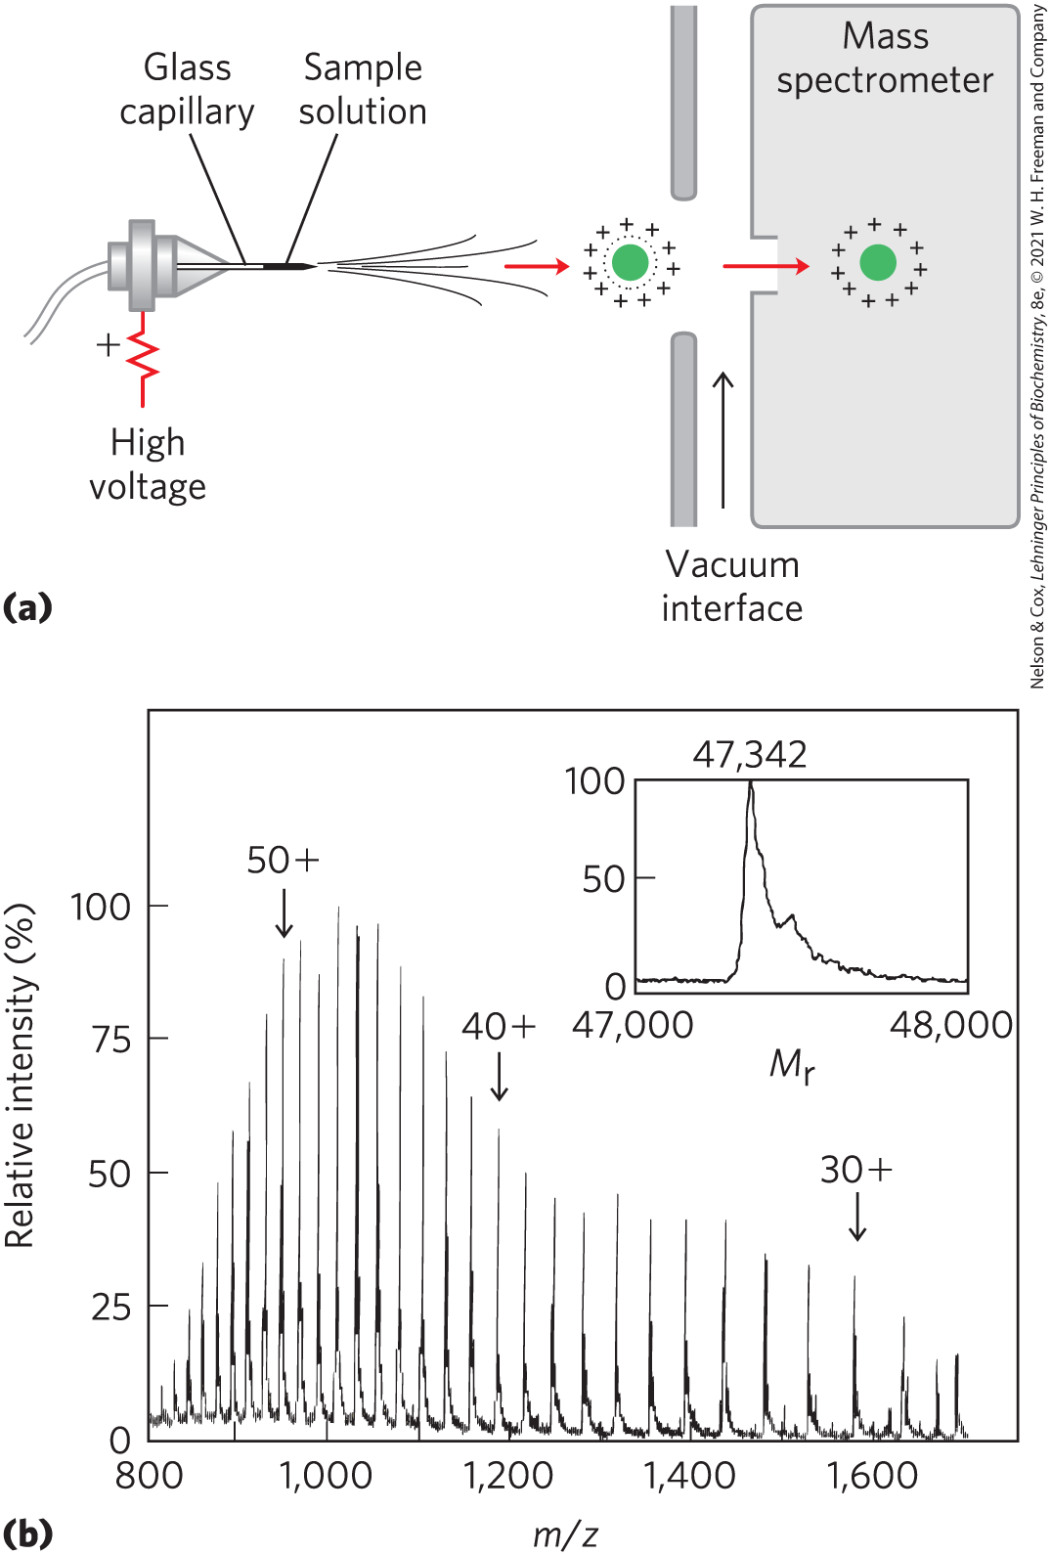
Electrospray Ionization Mass Spectrometry (ESI MS)
macromolecules forced directly from the liquid to gas phase

Slide 114
Methods for Analyzing the Mass-to-Charge Ratio, m/z
time of flight (TOF) = ion acceleration in an electric field depends on m/z
Orbitrap = traps ions in orbit, electron trajectory converted to m/z

Slide 115
Clicker Question 16
Which statement is true about mass spectrometry?
A. Mass spectrometry can be performed on analytes in
the liquid phase.
B. Mass spectrometry can obtain the sequences of
multiple polypeptide segments of 100 residues each.
C. The mass (m) of an analyte is used to deduce the
mass-to-charge ratio, m/z, with high precision.
D. MALDI MS requires treatment of proteins with a
protease before injection into a mass spectrometer.
E. Mass spectrometry can monitor changes in the
cellular proteome as a function of metabolic state.
Notes:
Answer: E
Principle: 3.4
Learning Objective(s): Identify mass spectrometry techniques; Describe the basic steps of mass spectrometry.
Bloom’s: 2:2

Slide 116
Clicker Question 16, Response
Which statement is true about mass spectrometry?
E. Mass spectrometry can monitor changes in the
cellular proteome as a function of metabolic
state.
When coupled to peptide separation protocols, mass spectrometry can document a complete cellular proteome. Changes in the cellular proteome can be monitored as a function of metabolic state or environmental conditions.

Slide 117
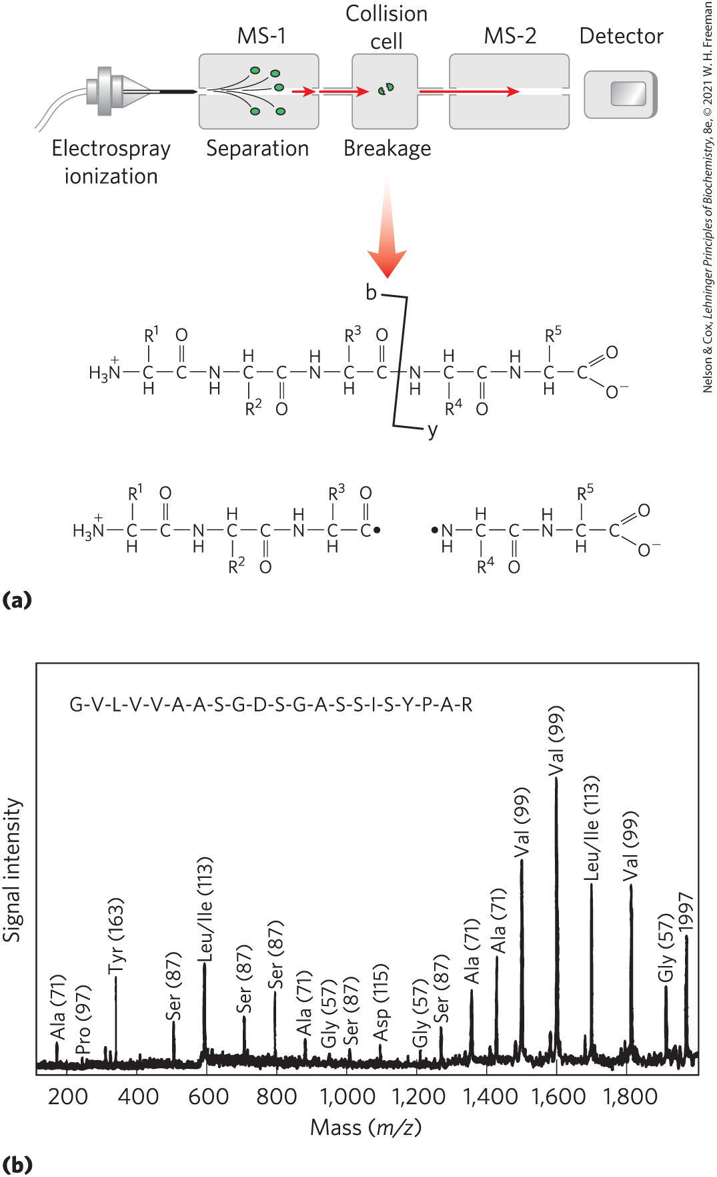
Extracting Amino Acid Sequence Information Using Tandem MS
tandem MS (MS/MS) = two mass filters in tandem
  first = sorts peptides produced by cleavage
  second = measures m/z ratios of charged fragments

Slide 118
Analyzing Complex Protein Mixtures Using Liquid Chromatography (LC)
LC-MS/MS = liquid chromatography-tandem MS
  chromatography on complex mixture of peptides
  resolved peptides introduced to MS successively
  identifies proteins and protein abundance

Slide 119
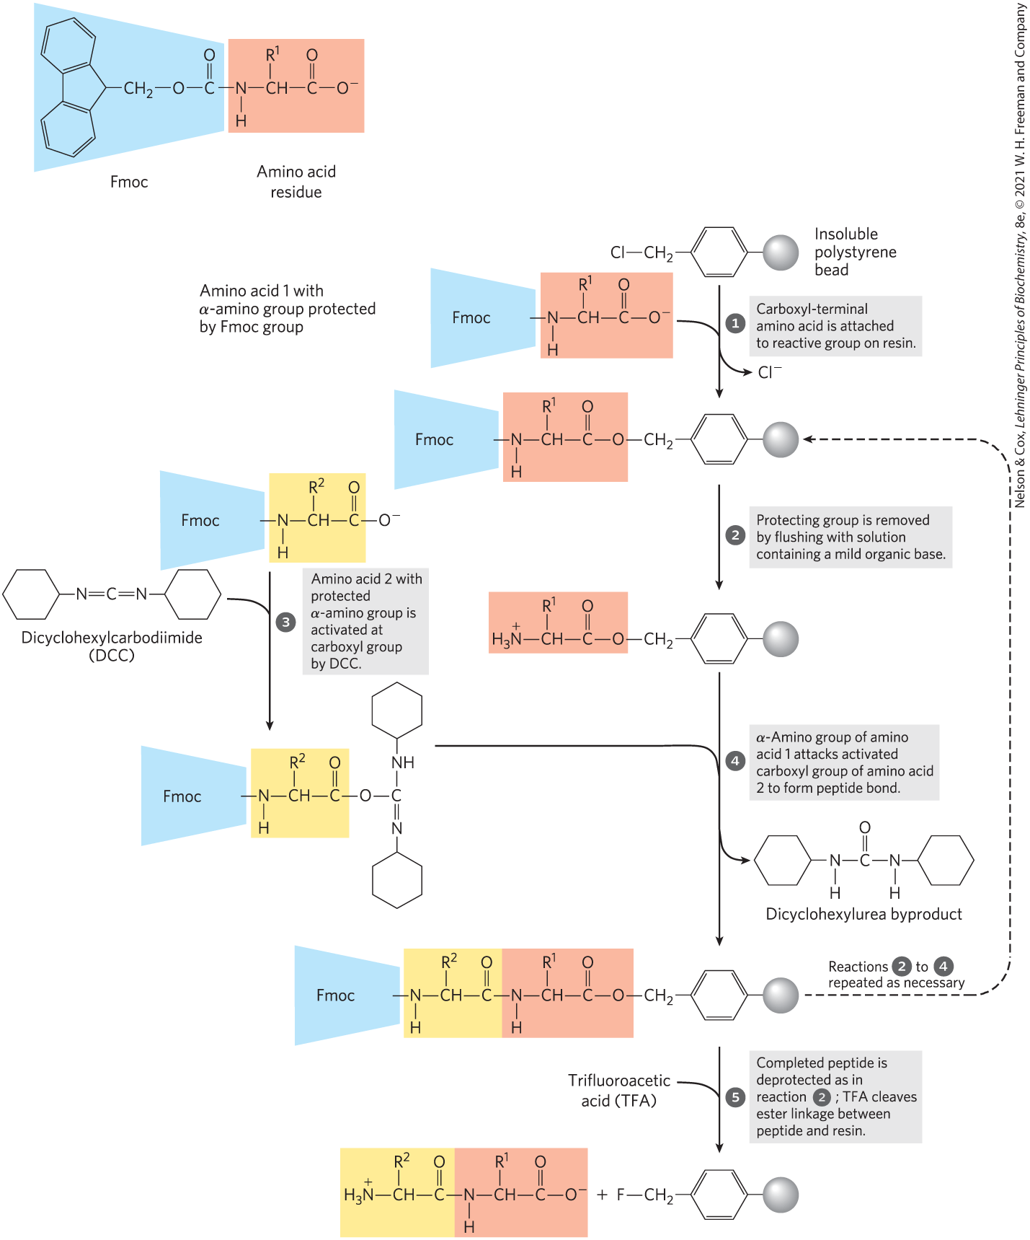
Small Peptides and Proteins Can Be Chemically Synthesized
the Merrifield method
one end of peptide = attached to resin in column
protective chemical groups block unwanted reactions

Slide 120

Clicker Question 17
Chemical synthesis of peptides by the Merrifield method:
A. involves synthesizing the peptide and then attaching
it to a solid support.
B. is nearly as efficient as peptide bond synthesis in
biochemical systems.
C. has a practical upper limit of a polymer of ~500
amino acid residues.
D. proceeds from the carboxyl terminus to the amino
terminus.
Notes:
Answer: D
Principle: 3.4
Learning Objective: Describe in vitro peptide synthesis.
Bloom’s: 2:2

Slide 121
Clicker Question 17, Response
Chemical synthesis of peptides by the Merrifield method:
D. proceeds from the carboxyl terminus to the
amino terminus.
Chemical synthesis proceeds from the carboxyl terminus to the amino terminus, the reverse of the direction of protein synthesis in vivo.

Slide 122
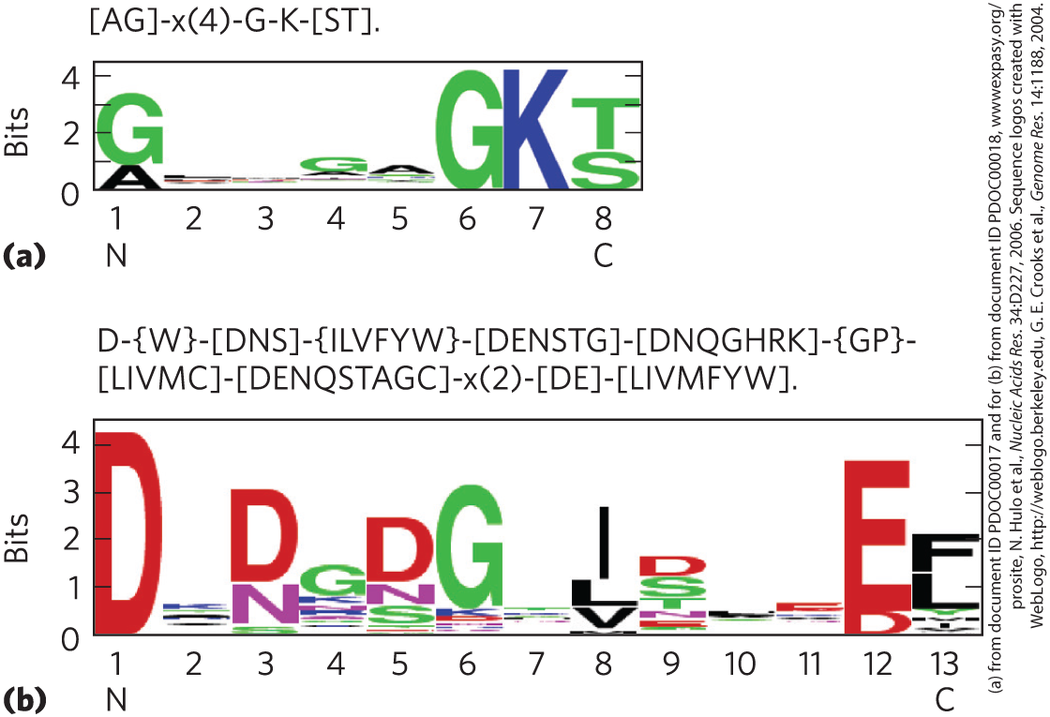
Amino Acid Sequences Provide Important Biochemical Information
amino acid sequence can inform:
  3D structure
  function
  cellular location
  evolution
consensus sequence = reflects most common amino acid at each position

Slide 123
Protein Sequences Help Elucidate the History of Life on Earth
bioinformatics:
  identifies functional segments in new proteins
  establishes sequence and structural relationships to known proteins
essential amino acid residues = conserved over evolutionary time
less important amino acid residues = vary over evolutionary time

Slide 124
Transfer of Genes from Organism to Organism
horizontal gene transfer = transfer of a gene or group of genes from one organism to another
  proteins derived from transferred genes are not good candidates for bacterial evolution studies
  for example, rapid spread of antibiotic-resistance genes in bacterial populations

Slide 125
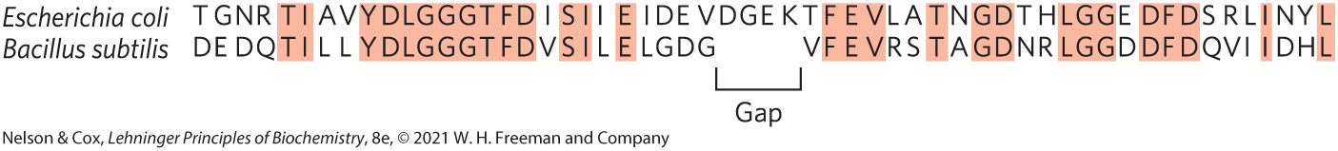
Defining Members of Protein Families
homologs = homologous proteins = members of protein families
  paralogs = homologs in same species
  orthologs = homologs in different species
  identified by comparing protein sequences to a database of protein sequences

Slide 126
Clicker Question 18
Which statement is false?
A. protein structure is commonly defined at four levels.
between organisms.
B. The function of a protein is a result of its amino acid
sequence.
C. Orthologs are homologs found in the same species.
D. It is possible to change the amino acid sequence of a
protein and have no effect on its function.
Notes:
Answer: C
Principle: 3.4
Learning Objective: Classify homologous proteins as paralogs or orthologs.
Bloom’s: 2:2

Slide 127
Clicker Question 18, Response
Which statement is false?
C. Orthologs are homologs found in the same
species.
Homologs from different species are called orthologs.

Slide 128
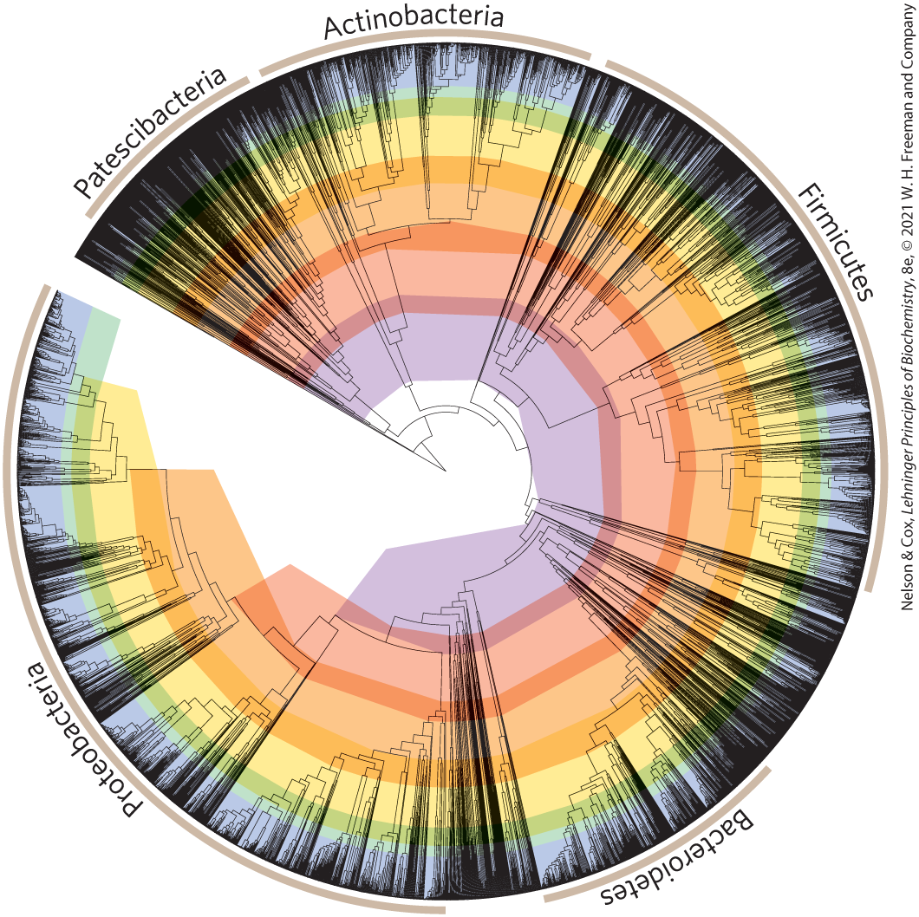
Constructing Evolutionary Trees
segregate organisms into classes based on sequence divergence in protein families
signature sequences = certain protein segments specific to a taxonomic group

Slide 129
Clicker Question 19
The amino acid sequences of proteins:
A. can be used to establish evolutionary relationships
between organisms.
B. are an example of tertiary structure.
C. are similar within a given organism.
D. are also referred to as “consensus sequences.”
Notes:
Answer: A
Principle: 3.4
Learning Objective: Infer an evolutionary relationship from the sequence of amino acids in a protein or polypeptide.
Bloom’s: 2:2

Slide 130
Clicker Question 19, Response
The amino acid sequences of proteins:
A. can be used to establish evolutionary
relationships between organisms.
Protein sequences are a rich source of information about protein structure and function. Bioinformatics can analyze changes in the amino acid sequences of homologous proteins over time to trace the evolution of life on Earth and establish evolutionary relationships between organisms.

