Slide 1

2 Water, the Solvent of Life
© 2021 Macmillan Learning

Slide 2

Principle 1 (5 of 5)
The solvent properties of water shaped the evolution of living things. Most small intermediates of metabolism, as well as nucleic acids and proteins, are soluble in water. Lipid bilayers, the likely forerunners of biological membranes, form spontaneously in water and are stabilized by their interaction with it. Although hydrogen bonds, ionic interactions, and the hydrophobic effect are individually weak, their combined effects powerfully influence the three-dimensional shape and stability of biological molecules and structures.

Slide 3

Principle 2 (1 of 3)
The ionization behavior of water and of weak acids and bases dissolved in water can be represented by one or more equilibrium constants. Most biomolecules are ionizable; their structure and function depend on their ionization state, which is characterized by equilibrium constants.

Slide 4

Principle 3 (1 of 5)
An aqueous solution of a weak acid and its salt makes a buffer that resists changes in pH in response to added acid or base. Biological systems are buffered to maintain a narrow pH range, in which their macromolecules retain their functional structure, which depends on their ionization state. Conditions that produce blood pH outside the range of 7.3 to 7.5 are life-threatening in humans.

Slide 5

Principle 4
Enzymes, which catalyze all of the processes inside a cell, have evolved to function optimally at near-neutral (physiological) pH. However, enzymes that function in intracellular compartments of low or high pH show their greatest activity and stability at those pH values.

Slide 6
2.1 Weak Interactions in Aqueous Systems

Slide 7
Principle 1 (1 of 5)
The solvent properties of water shaped the evolution of living things. Most small intermediates of metabolism, as well as nucleic acids and proteins, are soluble in water. Lipid bilayers, the likely forerunners of biological membranes, form spontaneously in water and are stabilized by their interaction with it. Although hydrogen bonds, ionic interactions, and the hydrophobic effect are individually weak, their combined effects powerfully influence the three-dimensional shape and stability of biological molecules and structures.

Slide 8
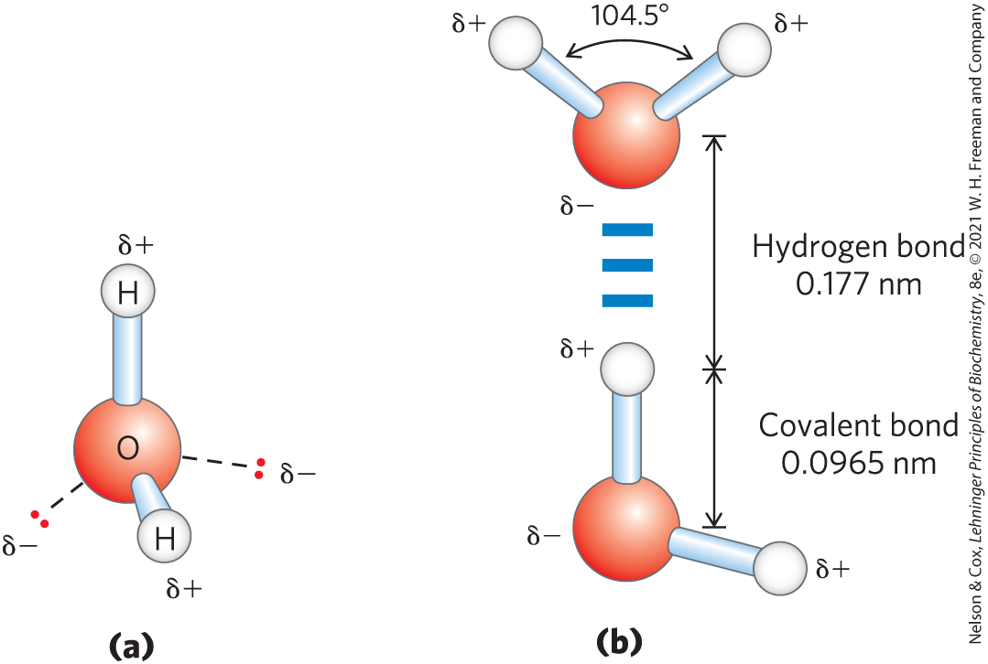
Hydrogen Bonding Gives Water Its Unusual Properties
water has a higher melting point, boiling point, and heat of vaporization than most other common solvents
hydrogen bond = electrostatic attraction between the oxygen atom of one water molecule and the hydrogen of another

Slide 9
Strength of Hydrogen Bonds
hydrogen bonds are relatively weak
  bond dissociation energy = ~23 kJ/mol in liquid H₂O
  10% covalent, 90% electrostatic
hydrogen bonds are fleeting
  lifetime of each hydrogen bond is just 1 to 20 picoseconds in liquid
  when one hydrogen bond breaks, another forms

Slide 10
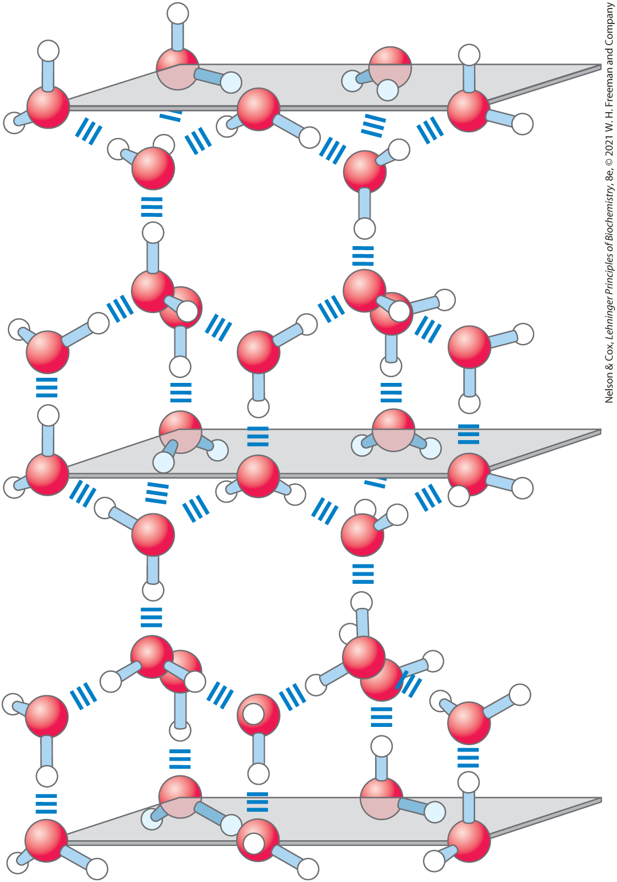
Number of Hydrogen Bonds Formed
in liquid, each H₂O molecule forms hydrogen bonds with an average of 3.4 other molecules
in ice, each H₂O molecule forms 4 hydrogen bonds

Slide 11
Hydrogen Bonds Account for the Relatively High Melting Point of Water
during melting or evaporation, heat is taken up by the system and the entropy of the aqueous system increases:
H₂O(solid) → H₂O(liquid) ∆H = +5.9 kJ/mol
H₂O(liquid) → H₂O(gas) ∆H = +44.0 kJ/mol
at room temperature, melting and evaporation occur spontaneously
  free-energy change (∆G) must be negative
  because ∆H is positive, the increase in ∆S drives these changes

Slide 12
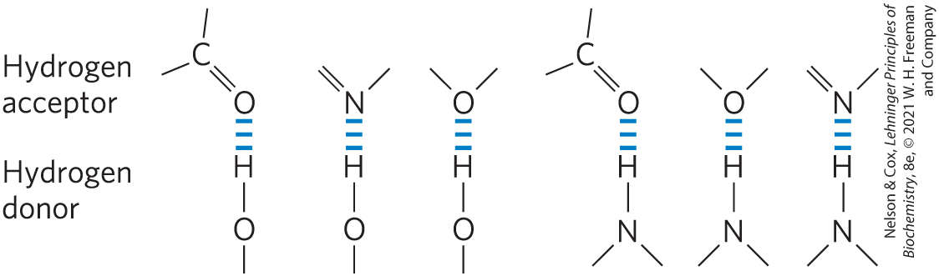
Water Forms Hydrogen Bonds with Polar Solutes
hydrogen bonds readily form between an electronegative atom (the hydrogen acceptor) and a hydrogen atom covalently bonded to another electronegative atom (the hydrogen donor)

Slide 13

Clicker Question 1
An unusual characteristic of H₂O is:
A. greater density in solid form (ice) than in liquid form
(water).
B. high heat of vaporization.
C. low specific heat.
D. not readily forming intermolecular interactions.
Notes:
Answer: B
Principle: 2.1
Learning Objective(s): Describe the key features of water molecules.
Bloom’s: 2:2

Slide 14
Clicker Question 1, Response
An unusual characteristic of H₂O is:
B. high heat of vaporization.
Water has a higher heat of vaporization than most other common solvents. This unusual property is a consequence of attractions between adjacent water molecules that give liquid water great internal cohesion.

Slide 15
Principle 1 (2 of 5)
The solvent properties of water shaped the evolution of living things. Most small intermediates of metabolism, as well as nucleic acids and proteins, are soluble in water. Lipid bilayers, the likely forerunners of biological membranes, form spontaneously in water and are stabilized by their interaction with it. Although hydrogen bonds, ionic interactions, and the hydrophobic effect are individually weak, their combined effects powerfully influence the three-dimensional shape and stability of biological molecules and structures.

Slide 16
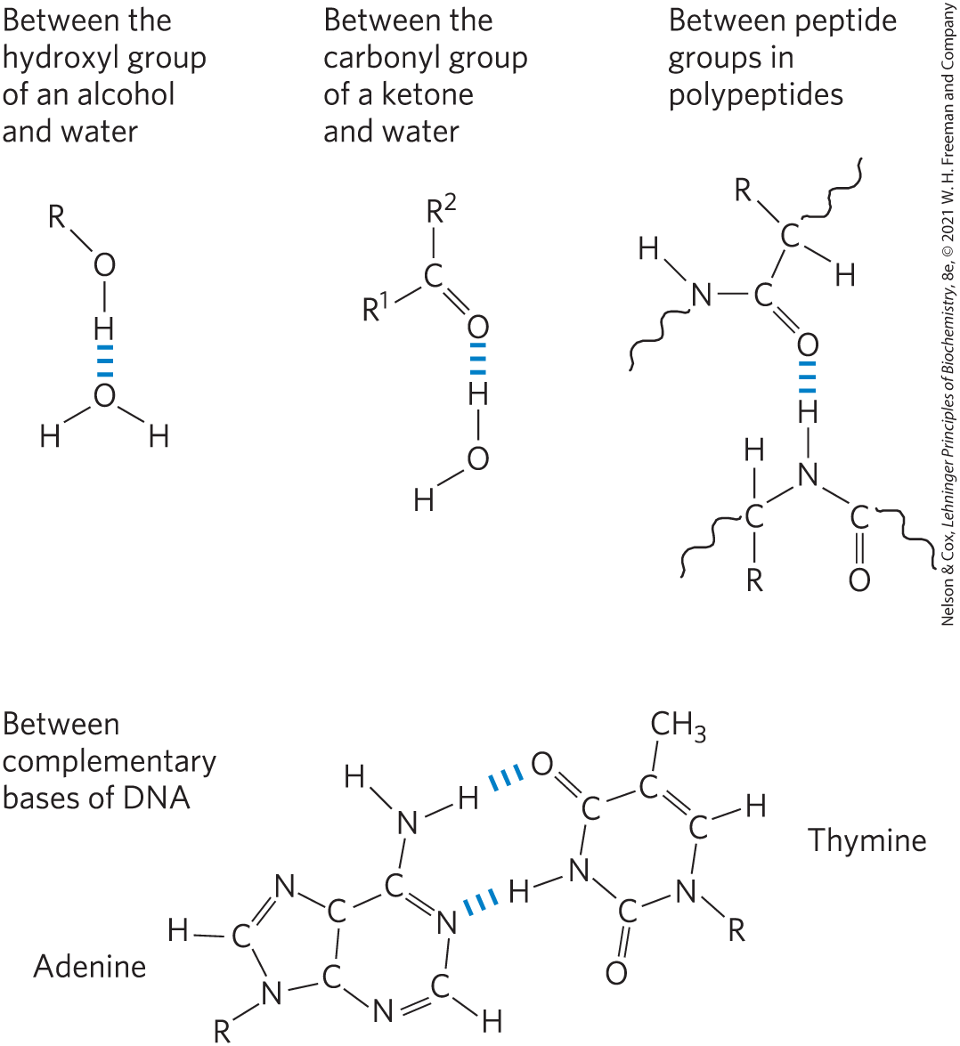
Biologically Important Hydrogen Bonds
hydrogen atoms covalently bonded to carbon atoms do not hydrogen bond
alcohols, aldehydes, ketones, and compounds containing N—H bonds all form hydrogen bonds with water

Slide 17
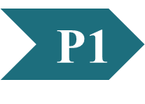
Clicker Question 2
Which atom does NOT commonly form hydrogen bonds between or within biological molecules?
A. oxygen
B. hydrogen
C. carbon
D. nitrogen
Notes:
Answer: C
Principle: 2.1
Learning Objective(s): Determine the donor and acceptor in a hydrogen bond.
Bloom’s: 2:2

Slide 18
Clicker Question 2, Response
Which atom does NOT commonly form hydrogen bonds between or within biological molecules?
C. carbon
Hydrogen atoms covalently bonded to carbon atoms do not participate in hydrogen bonding, because carbon is only slightly more electronegative than hydrogen and thus the C—H bond is only very weakly polar.

Slide 19
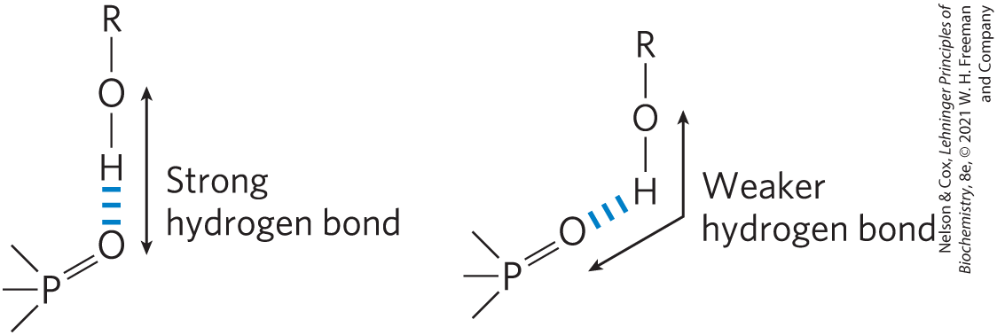
Directionality of the Hydrogen Bond
strongest when the acceptor atom is in line with the covalent bond between the donor atom and H
  maximizes electrostatic interaction

Slide 20
Clicker Question 3
Which statement about hydrogen bonds is false?
A. They only occur between water molecules.
B. They are weak compared with covalent bonds.
C. They cause acid-base reactions in aqueous solutions to be
very rapid.
D. They have an optimal geometry.
Notes:
Answer: A
Principle: 2.1
Learning Objective(s): Differentiate between the types of intermolecular forces.
Bloom’s: 2:2

Slide 21
Clicker Question 3, Response
Which statement about hydrogen bonds is false?
A. They only occur between water molecules.
Alcohols, aldehydes, ketones, and compounds containing N—H bonds all form hydrogen bonds with water molecules.

Slide 22
Water Interacts Electrostatically with Charged Solutes
hydrophilic = describes compounds that dissolve easily in H₂O; generally charged or polar compounds
hydrophobic = nonpolar molecules such as lipids and waxes
amphipathic = contain regions that are polar (or charged) and regions that are nonpolar

Slide 23
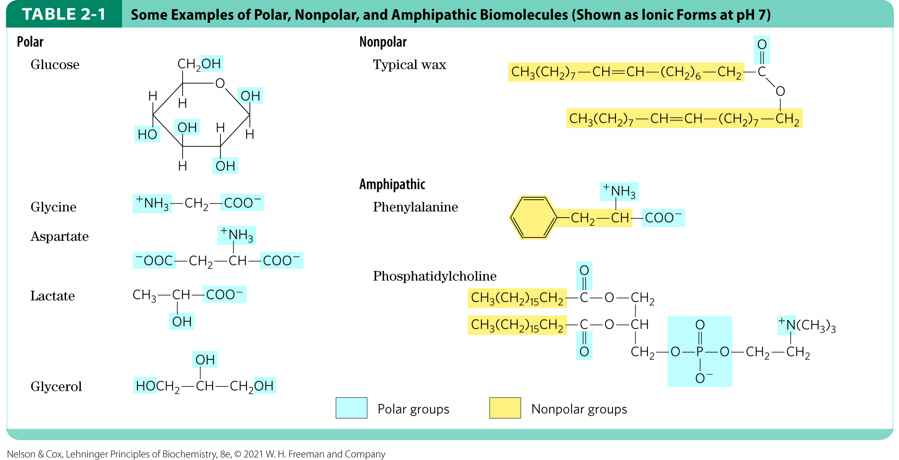
Polar, Nonpolar, and Amphipathic Biomolecules

Slide 24
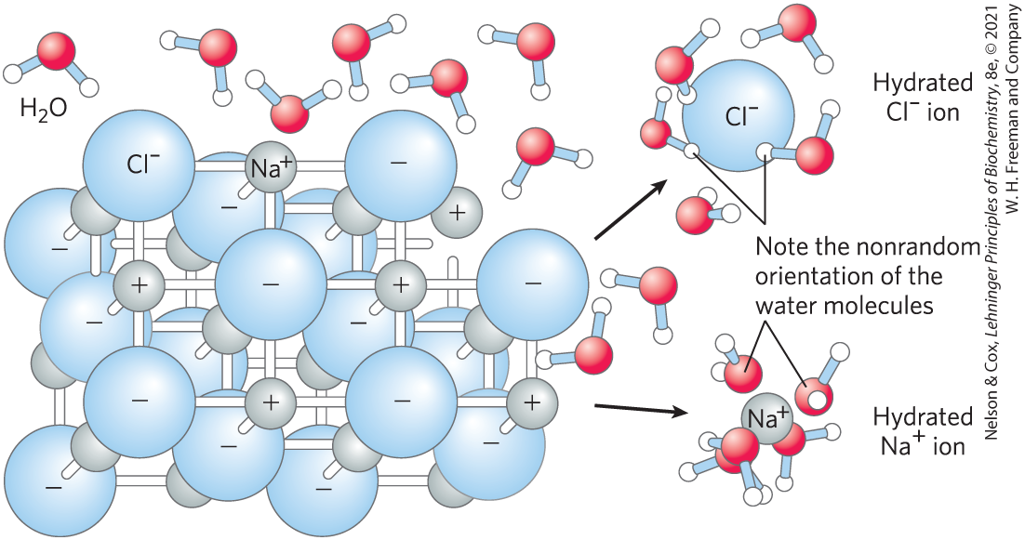
Water as Solvent
H₂O dissolves salts and charged biomolecules by screening electrostatic interactions
the increase in entropy of the system is largely responsible for the ease of dissolving salts in water

Slide 25
Clicker Question 4
Dissolving table sugar into iced tea is an energetically favorable reaction due to a(n):
A. increase in enthalpy as heat moves into the sugar.
B. decrease in free energy due to broken weak interactions
between sugar molecules.
C. increase in entropy as the sugar dissolves.
D. increase in free energy because there is no longer a
solvation layer around the sugar crystal.
Notes:
Answer: C
Principle: 2.1
Learning Objective(s): Explain the process of solution formation.
Bloom’s: 2:2

Slide 26
Clicker Question 4, Response
Dissolving table sugar into iced tea is an energetically favorable reaction due to a(n):
C. increase in entropy as the sugar dissolves.
As table sugar dissolves, individual sugar molecules acquire greater freedom of motion. This increase in entropy is why dissolving table sugar into iced tea is an energetically favorable reaction. In thermodynamic terms, formation of the solution occurs with a favorable free-energy change: ∆G = ∆H − T∆S, where ∆H has a small positive value and T∆S a large positive value.

Slide 27
Water Has a High Dielectric
Constant
dielectric constant (ε) = a dimensionless physical property that reflects the number of dipoles in a solvent
  for water at 25 °C, ε = 78.5
  for nonpolar benzene at 25 °C, ε = 4.6

Slide 28
Calculating the Force of Ionic Interactions
the force (F) of ionic interactions in solution depends on:
  the magnitude of the charges (Q)
  the distance between the charged groups (r)
  the dielectric constant of the solvent (ε)
ionic attractions or repulsions operate over 10 to 40 nm.

Slide 29
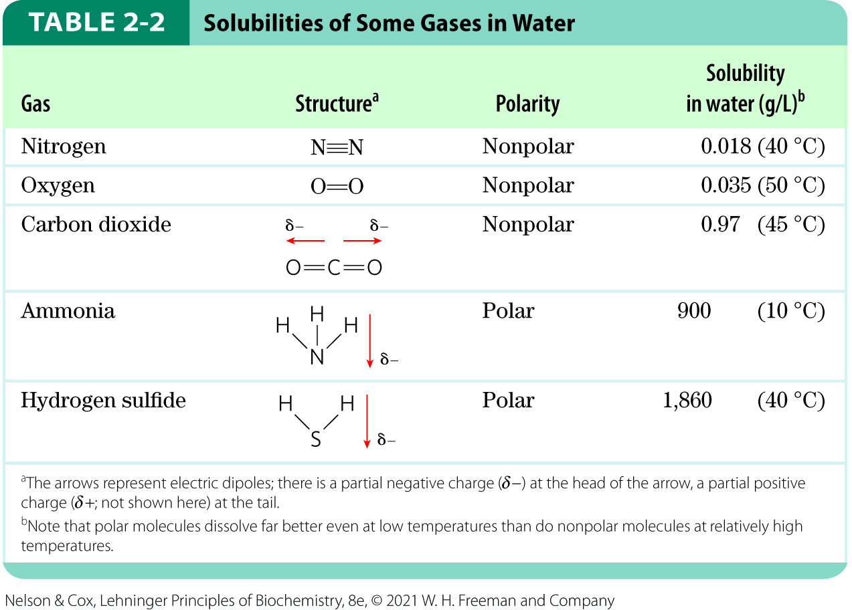
Nonpolar Gases Are Poorly Soluble in Water
biologically important gases CO₂, O₂, N₂ are nonpolar
their movement into aqueous solution decreases entropy by constraining their motion

Slide 30
Nonpolar Compounds Force Energetically Unfavorable Changes in the Structure of Water
nonpolar compounds interfere with the hydrogen bonding among H₂O molecules
  increases enthalpy (∆H) and decreases entropy (∆S)
the free-energy change (∆G = ∆H − T∆S) for dissolving a nonpolar solute in water is unfavorable:
  ∆H has a positive value
  ∆S has a negative value
  ∆G has a positive value

Slide 31
The Ordering of Water Molecules around Nonpolar Solutes
H₂O molecules form a highly ordered, cagelike shell around each solute molecule
  maximizes solvent-solvent hydrogen bonding
  H₂O molecules are not as highly oriented as those in clathrates (crystalline compounds of nonpolar solutes and water)

Slide 32
Clicker Question 5
Nonpolar compounds:
A. force surrounding H₂O molecules to become disordered.
B. increase entropy (∆S) when dissolved in water.
C. decrease enthalpy (∆H) when dissolved in water.
D. interfere with the hydrogen bonding among H₂O
molecules.
Notes:
Answer: D
Principle: 2.1
Learning Objective(s): Determine the intermolecular forces that can exist between two chemical groups; Describe the hydrophobic effect.
Bloom’s: 2:2

Slide 33
Clicker Question 5, Response
Nonpolar compounds:
D. interfere with the hydrogen bonding among H₂O
molecules.
Nonpolar compounds such as benzene and hexane are hydrophobic—they are unable to undergo energetically favorable interactions with water molecules, and they interfere with the hydrogen bonding among water molecules.

Slide 34
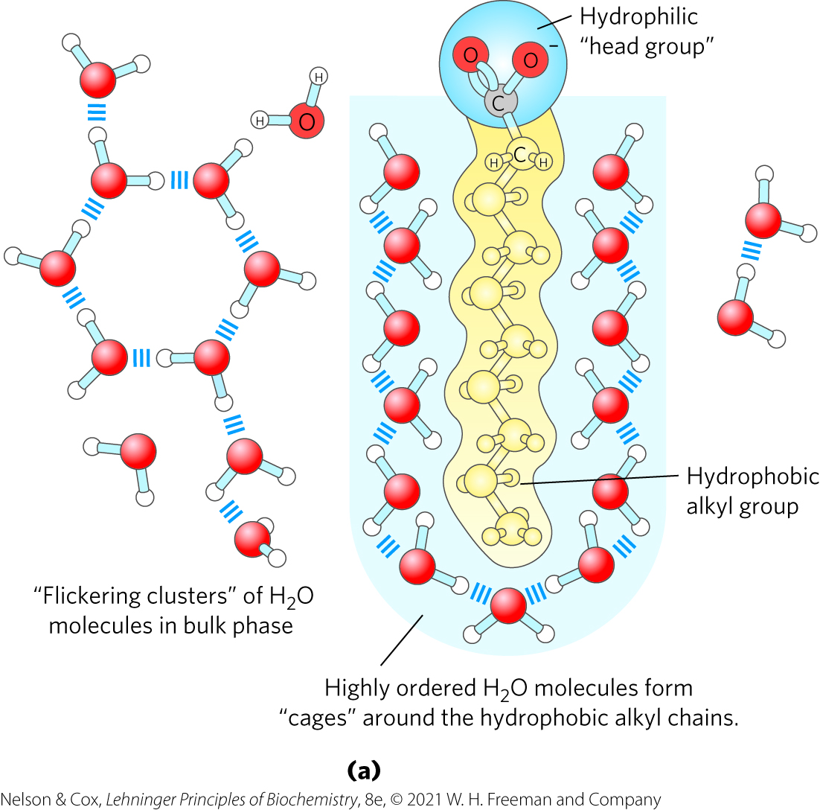
Amphipathic Compounds in Aqueous Solutions
polar, hydrophilic region interacts favorably with H₂O and tends to dissolve
nonpolar, hydrophobic region tends to avoid contact with H₂O and cluster together

Slide 35
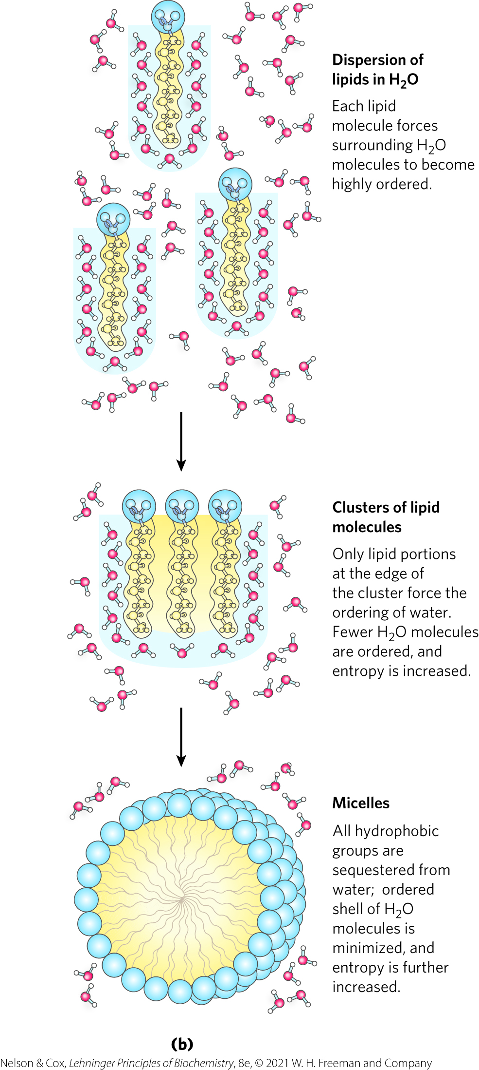
The Hydrophobic Effect
hydrophobic effect =
  nonpolar regions cluster together
  polar regions arrange to maximize interactions with each other and with the solvent
micelles = thermodynamically stable structures of amphipathic compounds in water

Slide 36
Clicker Question 6
The hydrophobic effect:
A. only occurs with amphipathic molecules.
B. does not occur in biological membranes.
C. is driven by an increase in entropy of water molecules.
D. results from attractive forces between hydrophobic
molecules.
Notes:
Answer: C
Principle: 2.1
Learning Objective(s): Describe the hydrophobic effect.
Bloom’s: 2:2

Slide 37
Clicker Question 6, Response
The hydrophobic effect:
C. is driven by an increase in entropy of water molecules.
When amphipathic compounds are mixed with water, the nonpolar regions of the molecules cluster together to present the smallest hydrophobic area to the aqueous solvent. The smaller the hydrophobic surface area, the fewer water molecules are required in the shell of ordered water. The entropy gained by freeing immobilized water molecules drives the hydrophobic effect.

Slide 38
Principle 1 (3 of 5)
The solvent properties of water shaped the evolution of living things. Most small intermediates of metabolism, as well as nucleic acids and proteins, are soluble in water. Lipid bilayers, the likely forerunners of biological membranes, form spontaneously in water and are stabilized by their interaction with it. Although hydrogen bonds, ionic interactions, and the hydrophobic effect are individually weak, their combined effects powerfully influence the three-dimensional shape and stability of biological molecules and structures.

Slide 39
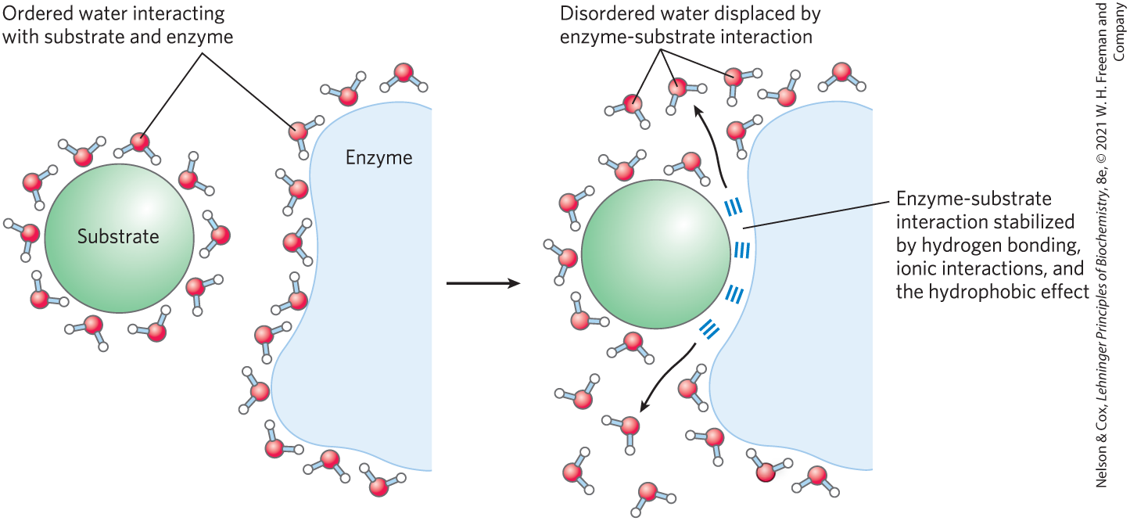
Release of Ordered Water Favors Formation of an Enzyme-Substrate Complex

Slide 40
van der Waals Interactions Are Weak Interatomic Attractions
Table 2-3: van der Waals Radii and Covalent (Single-Bond) Radii of Some Elements
van der Waals interactions (London dispersion forces) = distance-dependent weak attractions and repulsions between transient dipoles
van der Waals radius = measure of how close an atom will allow another to approach
Element | van der Waals radius (nm) | Covalent radius for single bond (nm)
H | 0.11 | 0.030
O | 0.15 | 0.066
N | 0.15 | 0.070
C | 0.17 | 0.077
S | 0.18 | 0.104
P | 0.19 | 0.110
I | 0.21 | 0.133
Sources: For van der Waals radii, R. Chauvin, J. Phys. Chem. 96:9194, 1992. For covalent radii, L. Pauling, Nature of the Chemical Bond, 3rd edn, Cornell University Press, 1960.
Note: van der Waals radii describe the space-filling dimensions of atoms. When two atoms are joined covalently, the atomic radii at the point of the bonding are shorter than the van der Waals radii, because the joined atoms are pulled together by the shared electron pair. The distance between nuclei in a van der Waals interaction or a covalent bond is about equal to the sum of the van der Waals or covalent radii, respectively, for the two atoms. Thus, the length of a carbon-carbon single bond is about 0.077 nm + 0.077 nm = 0.154 nm.

Slide 41
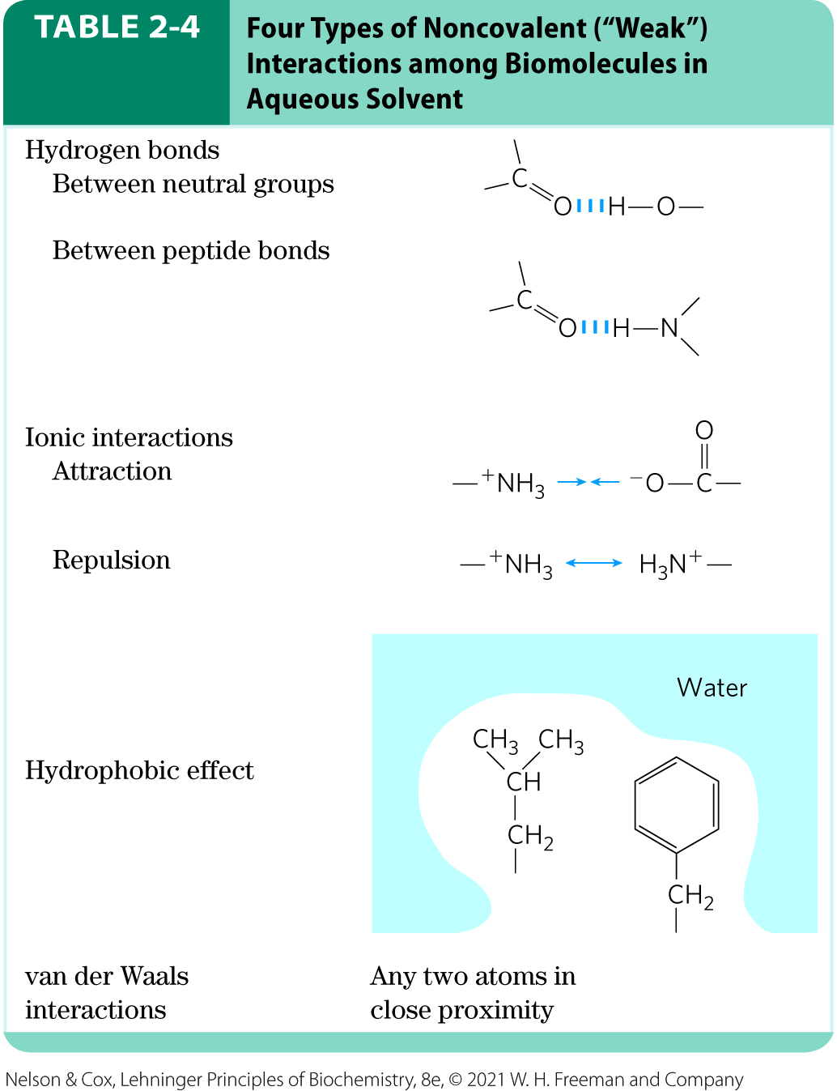
Weak Interactions Are Crucial to Macromolecular Structure and Function
noncovalent interactions are much weaker than covalent bonds
continually forming and breaking

Slide 42
Principle 1 (4 of 5)
The solvent properties of water shaped the evolution of living things. Most small intermediates of metabolism, as well as nucleic acids and proteins, are soluble in water. Lipid bilayers, the likely forerunners of biological membranes, form spontaneously in water and are stabilized by their interaction with it. Although hydrogen bonds, ionic interactions, and the hydrophobic effect are individually weak, their combined effects powerfully influence the three-dimensional shape and stability of biological molecules and structures.

Slide 43
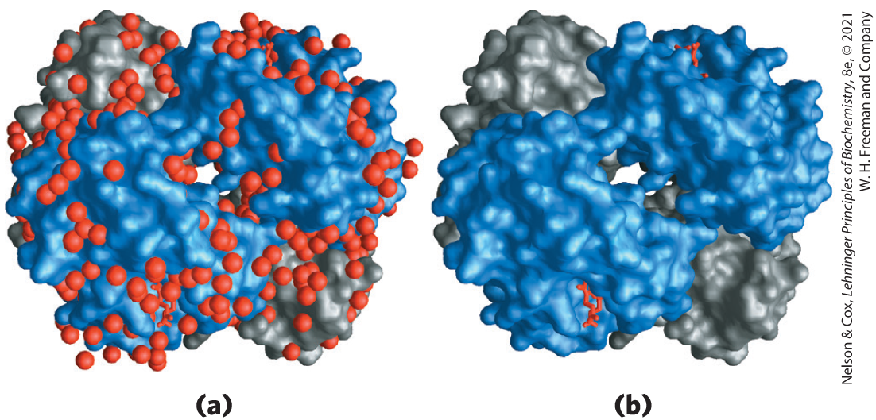
The Cumulative Effect of Weak Interactions
for macromolecules, the most stable structure usually maximizes weak interactions
H₂O molecules are often found to be bound so tightly to biomolecules that they are part of the crystal structure

Slide 44

Clicker Question 7
Weak noncovalent interactions:
A. always involve water.
B. can have a large cumulative effect.
C. do not include ionic interactions.
D. combine to form covalent interactions.
Notes:
Answer: B
Principle: 2.1
Learning Objective(s): Explain how the interactions of biomolecules are stabilized.
Bloom’s: 2:2

Slide 45
Clicker Question 7, Response
Weak noncovalent interactions:
B. can have a large cumulative effect.
Macromolecules such as proteins, DNA, and RNA contain so many sites of potential hydrogen bonding or ionic, van der Waals, or hydrophobic clustering that the cumulative effect can be enormous. For macromolecules, the most stable (that is, the native) structure is usually that in which these weak interactions are maximized.

Slide 46
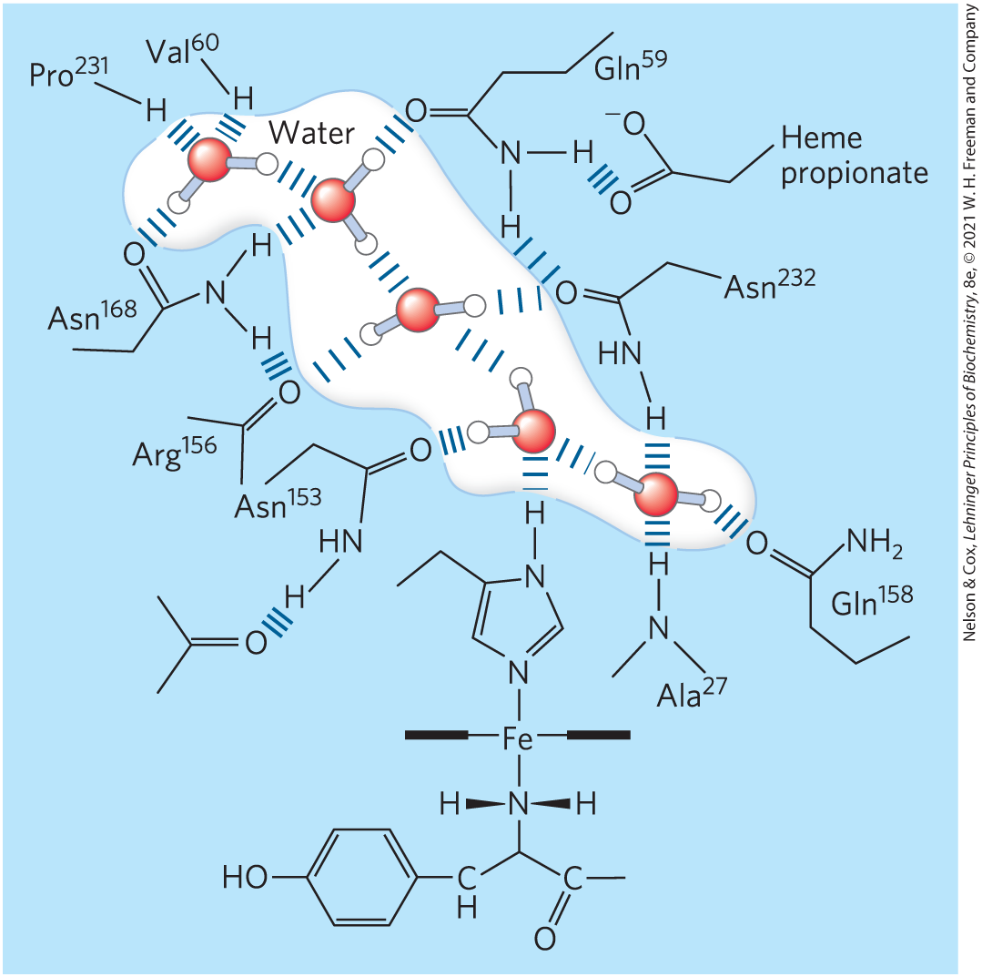
Water Can Be Essential to Protein Function
cytochrome f:
  has a chain of five bound H₂O molecules
  may provide a path for protons to move through the membrane

Slide 47
Concentrated Solutes Produce Osmotic Pressure
solutes alter the colligative properties of the solvent
  vapor pressure
  boiling point
  melting point (freezing point)
  osmotic pressure
effect depends on the number of solute particles (molecules or ions) in a given amount of water

Slide 48
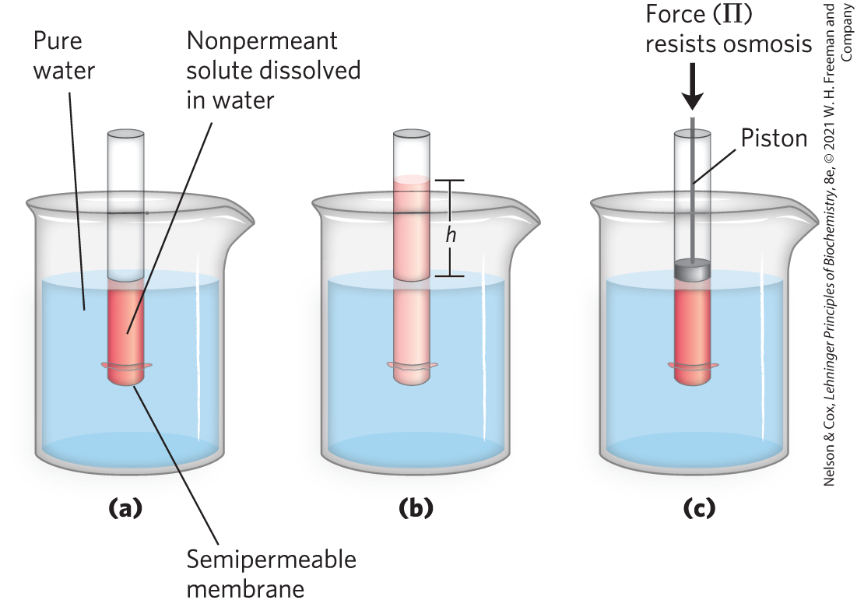
The Movement of Water from Higher to Lower Concentrations Produces Osmotic Pressure

Slide 49
Osmotic Pressure
osmotic pressure, Π:
  is the force necessary to resist water movement
  is approximated by the van’t Hoff equation
Π = icRT

Slide 50
Calculating Osmotic Pressure
the osmotic pressure, Π, depends on:
  the van’t Hoff factor, a measure of the extent to which the solution dissociates into 2+ ionic species (i)
    for nonunionizing solutes, i=1
    for solutes that dissociate into two ions, i=2
  the solute’s molar concentration (c)
Π = icRT
  where R is the gas constant and T is the absolute temperature

Slide 51
Clicker Question 8
I need to calculate the osmotic pressure of a solvent. I know the concentration of the solute and the temperature of the solution. What else do I need?
A. whether the solute dissociates into 2+ ion species
B. the vapor pressure of the solvent
C. the boiling point of the solvent
D. whether the solute is hydrophilic or hydrophobic
Notes:
Answer: A
Principle: 2.1
Learning Objective(s): Relate the osmotic pressure of a solution, van't Hoff factor, concentration of solute, gas constant, and temperature.
Bloom’s: 3:2

Slide 52
Clicker Question 8, Response
I need to calculate the osmotic pressure of a solvent. I know the concentration of the solute and the temperature of the solution. What else do I need?
A. whether the solute dissociates into 2+ ion species
The osmotic pressure, Π, depends on:
  the van’t Hoff factor, the extent to which the solute dissociates into 2+ ionic species (i)
  the solute’s molar concentration (c)
  the absolute temperature (T)

Slide 53
Calculating Osmotic Pressure for Solutions of Several Solution
for solutions of several (n) solutes, Π is the sum of the contributions of each species:
where R is the gas constant and T is the absolute temperature.

Slide 54
Osmolarity and Osmosis
osmolarity = the product of the van’t Hoff factor i and the solute’s molar concentration, c
osmosis = water movement across a semipermeable membrane driven by differences in osmotic pressure

Slide 55
Clicker Question 9
Osmosis occurs:
A. when a cell is in an isotonic solution relative to its cytosol.
B. because osmotic pressure is applied.
C. because cells need H₂O.
D. because diffusion of H₂O from high concentration to low is
thermodynamically spontaneous.
Notes:
Answer: D
Principle: 2.1
Learning Objective(s): Describe the movement of water molecules across a semipermeable membrane.
Bloom’s: 2:2

Slide 56
Clicker Question 9, Response
Osmosis occurs:
D. because diffusion of H₂O from high concentration to
low is thermodynamically spontaneous.
Osmosis is defined as water movement across a semipermeable membrane driven by differences in osmotic pressure. Water molecules tend to move from a region of higher water concentration to one of lower water concentration, in accordance with the tendency in nature for a system to become disordered.

Slide 57
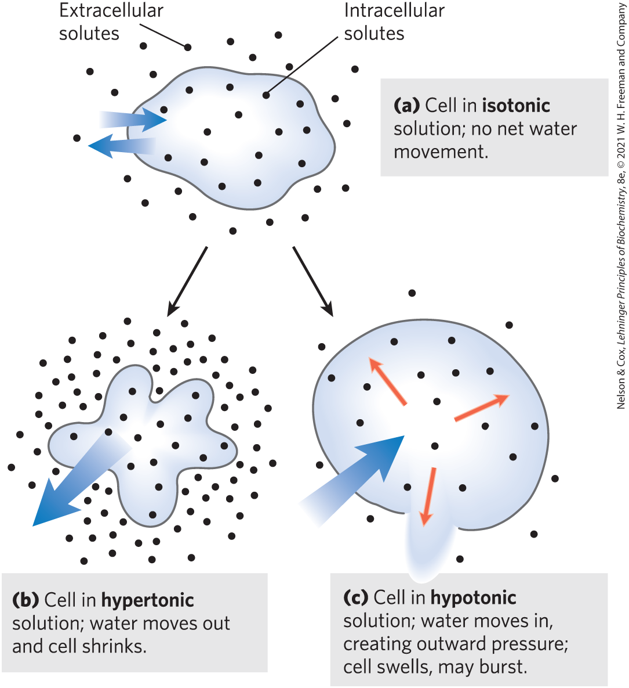
Effects of Extracellular Osmolarity on Water Movement
isotonic solution = osmolarity equal to that of a cell’s cytosol
hypertonic solution = higher osmolarity than that of the cytosol
hypotonic solution = lower osmolarity than that of the cytosol

Slide 58
Clicker Question 10
Which condition would cause red blood cells to burst due to excess water passing through the plasma membrane?
A. Placing the cells in a solution of higher osmolarity than is
present within the cells.
B. Placing the cells in a solution of amphipathic molecules.
C. Adding a charged solute, such as NaCl, to the cell
suspension.
D. Placing the cells in a hypotonic solution.
Notes:
Answer: D
Principle: 2.1
Learning Objective(s): Classify a solution as hypotonic, isotonic, or hypertonic.
Bloom’s: 2:2

Slide 59
Clicker Question 10, Response
Which condition would cause red blood cells to burst due to excess water passing through the plasma membrane?
D. Placing the cells in a hypotonic solution.
In a hypotonic solution, one with a lower osmolarity than the cytosol, the cell swells as water enters. This inward movement of water distends the plasma membrane and eventually causes bursting of the cell (osmotic lysis).

Slide 60

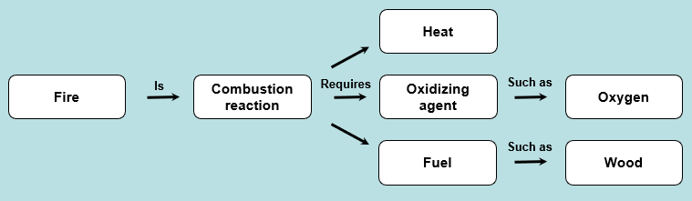
Activity: Relating
Terms within the Chapter
A concept map displays the relationships between different concepts. Observe the following example of a concept map.
Notes:
Instructor: For additional information, see the Instructor Activity Guide located in Achieve. It can be found within Chapter 2, in the folder titled “Ch2 In-Class Activities and Resources.”

Slide 61
Activity Instructions (2 of 2)
Think about how the following terms and phrases relate to each other and then use scratch paper to draw a concept map using these terms and phrases. (3 minutes)
water
solvent properties that shaped the evolution of living things
nucleic acids, proteins, and most small metabolic intermediates
hydrogen bonds, ionic interactions, hydrophobic effect
influences shape, stability, and structure of biomolecules
lipid bilayers
Notes:
Instructor: For additional information, see the Instructor Activity Guide located in Achieve. It can be found within Chapter 2, in the folder titled “Ch2 In-Class Activities and Resources.”

Slide 62
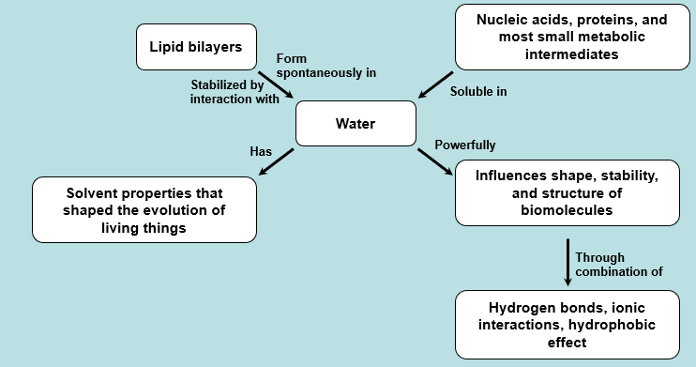
Activity Solution (1 of 2)
Pair up and share how this possible concept map might differ from yours. (2 minutes)
Notes:
Instructor: For additional information, see the Instructor Activity Guide located in Achieve. It can be found within Chapter 2, in the folder titled “Ch2 In-Class Activities and Resources.”

Slide 63
2.2 Ionization of Water, Weak Acids, and Weak Bases

Slide 64
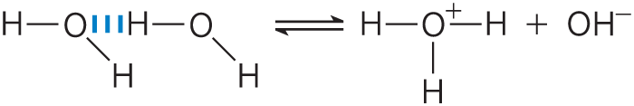
Pure Water Is Slightly Ionized
H₂O molecules have a slight tendency to undergo reversible ionization to yield a hydrogen ion (a proton) and a hydroxide ion:
(Eqn 2-1)
hydrogen ions are immediately hydrated to form hrydonium ions (H₃O⁺):

Slide 65
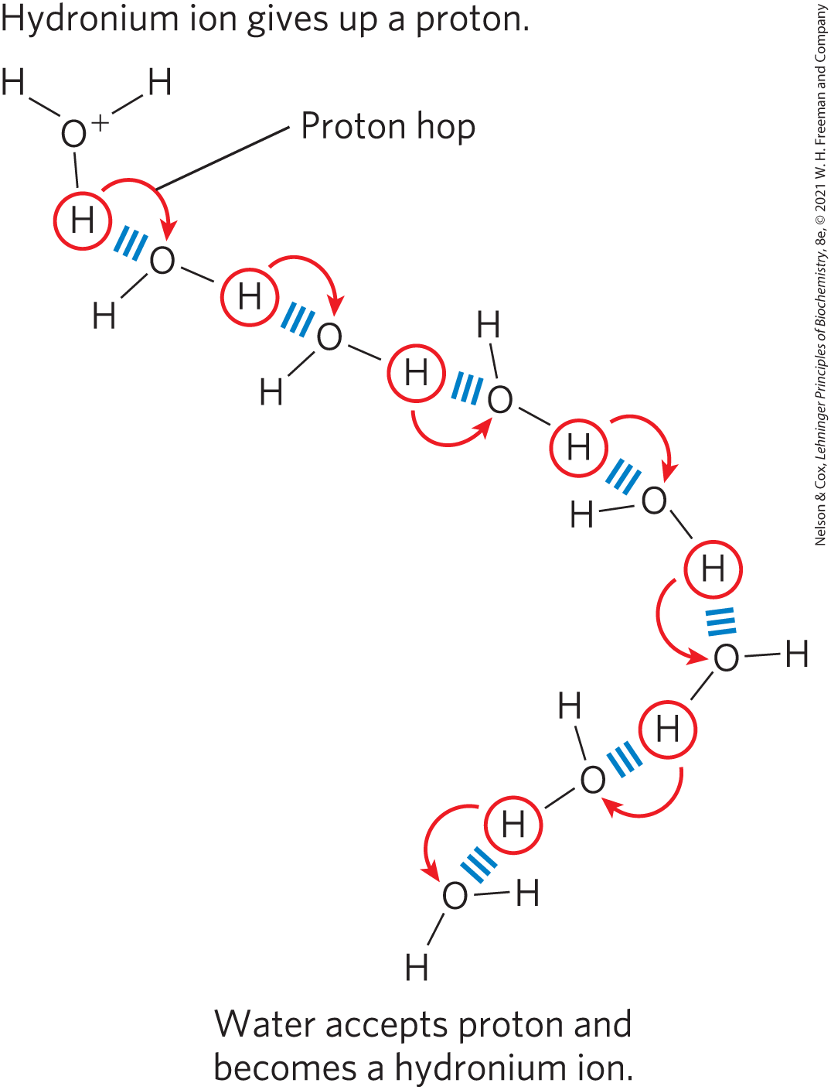
Proton Hopping
“proton hopping” results in high ionic mobility

Slide 66
Equilibrium Constant
equilibrium constant, K_{eq} = gives the position of equilibrium
for the generalized reaction
K_{eq} is defined in terms of the concentrations of reactants (A and B) and products (C and D) at equilibrium:

Slide 67
Clicker Question 11
Carbonic acid (H₂CO₃), is formed from dissolved (aq) carbon dioxide and water, in a reversible reaction:
The equilibrium constant for this reaction is:
Notes:
Answer: C
Principle: 2.1
Learning Objective(s): Determine the equilibrium constant expression for the ionization of a weak acid or base.
Bloom’s: 3:2

Slide 68
Clicker Question 11, Response
Carbonic acid (H₂CO₃), is formed from dissolved (aq) carbon dioxide and water, in a reversible reaction:
The equilibrium constant for this reaction is:

Slide 69
The Ionization of Water Is Expressed by an Equilibrium Constant
the equilibrium constant for the reversible ionization of H₂O is
(Eqn 2-3)
in pure H₂O at 25˚C, the concentration of H₂O is:

Slide 70
The Ion Product of Water
substituting 55.5 m in the equilibrium constant expression yields:
(Eqn 2-4)
where K_{w} is the ion product of water at 25˚C.

Slide 71
Calculating the Ion Product of Water
in pure water at 25˚C,
substituting this value in:

Slide 72
Clicker Question 12
What is the concentration of H⁺ in a solution of 0.01 M NaOH? Because NaOH is a strong base, it dissociates completely into Na⁺ and OH–.
A. 0.01 M
B. 10^{–13} M
C. 10^{–14} M
D. 10^{–12} M
Notes:
Answer: D
Principle: 2.1
Learning Objective(s): Determine the equilibrium constant expression for the ionization of a weak acid or base.
Bloom’s: 3:2

Slide 73
Clicker Question 12, Response
What is the concentration of H⁺ in a solution of 0.01 M NaOH? Because NaOH is a strong base, it dissociates completely into Na⁺ and OH–.
D. 10^{–12} M

Slide 74
Neutral pH
neutral pH = exactly equal concentrations of H⁺ and OH⁻, as in pure water
at neutral pH:

Slide 75
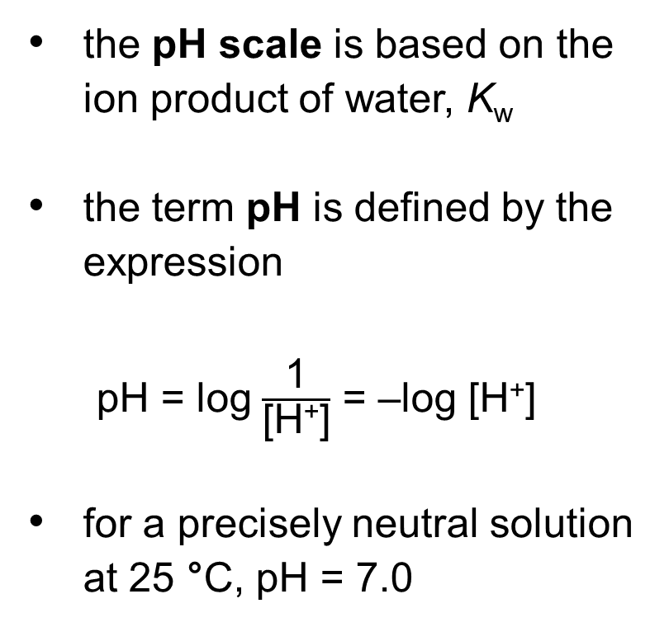
The pH Scale Designates the H⁺ and OH– Concentrations
Table 2-5 The pH Scale
the pH scale is based on the ion product of water, K_{w}
the term pH is defined by the expression
pH = log $\frac{\text{1}}{\text{[}\text{H}\text{+}\text{]}}$ = –log [H⁺]
for a precisely neutral solution at 25 °C, pH = 7.0
[H⁺] (M) | pH | [OH–] (M) | pOHª
10⁰(1) | 0 | 10^{–14} | 14
10^{–1} | 1 | 10^{–13} | 13
10^{–2} | 2 | 10^{–12} | 12
10^{–3} | 3 | 10^{–11} | 11
10^{–4} | 4 | 10^{–10} | 10
10^{–5} | 5 | 10^{–9} | 9
10^{–6} | 6 | 10^{–8} | 8
10^{–7} | 7 | 10^{–7} | 7
10^{–8} | 8 | 10^{–6} | 6
10^{–9} | 9 | 10^{–5} | 5
10^{–10} | 10 | 10^{–4} | 4
10^{–11} | 11 | 10^{–3} | 3
10^{–12} | 12 | 10^{–2} | 2
10^{–13} | 13 | 10^{–1} | 1
10^{–14} | 14 | 10⁰(1) | 0
ªThe expression pOH is sometimes used to describe the basicity OH– concentration of a solution; pOH is defined by the expression pOH = –log [OH–], which is analogous to the expression for pH. Note that in all cases, pH + pOH = 14

Slide 76
Clicker Question 13
What is the pH of a 0.1 mM solution of hydrochloric acid at 37 °C?
A. 0.1
B. 1
C. 3
D. 4
Notes:
Answer: D
Principle: 2.1
Learning Objective(s): Relate the pH or pOH of a solution to the hydronium ion or hydroxide ion concentration.
Bloom’s: 3:2

Slide 77
Clicker Question 13, Response
What is the pH of a 0.1 mM solution of hydrochloric acid at 37 °C?
D. 4
pH = –log [H⁺]
= –log [0.0001 M]
= 4

Slide 78
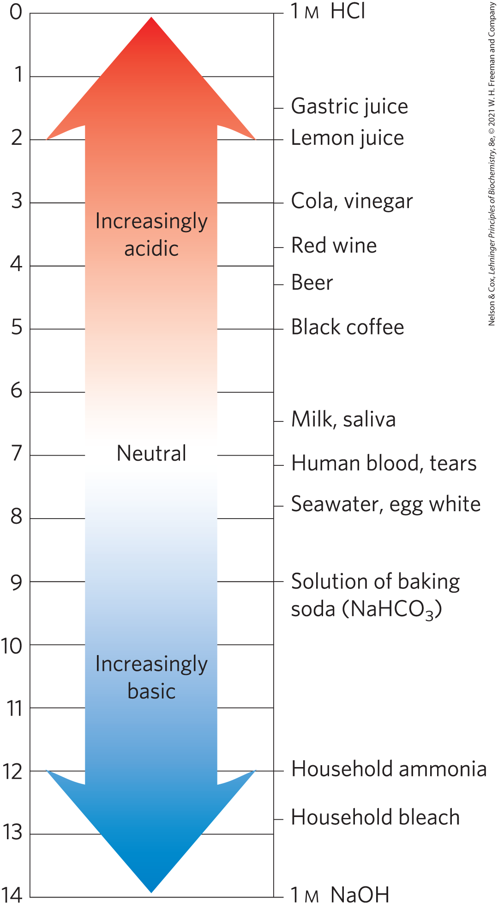
The pH of Some Aqueous Fluids
pH values > 7:
  alkaline or basic
  concentration of OH– is greater than that of H⁺
pH values < 7:
  acidic
  concentration of H⁺ is greater than that of OH–

Slide 79
pH and Medical Diagnoses
acidosis = pH of blood plasma below the normal value of 7.4
  common in people with severe, uncontrolled diabetes
alkalosis = pH of blood plasma above the normal value of 7.4
extreme acidosis or alkalosis can be life-threatening

Slide 80
Clicker Question 14
The pH of an aqueous solution:
A. must remain at 7.
B. is not affected by added OH–.
C. depends solely on the ionization of water.
D. is a function of hydrogen ion concentration (to a
reasonable approximation).
Notes:
Answer: D
Principle: 2.1
Learning Objective(s): Relate the pH or pOH of a solution to the hydronium ion or hydroxide ion concentration.
Bloom’s: 2:2

Slide 81
Clicker Question 14, Response
The pH of an aqueous solution:
D. is a function of hydrogen ion concentration (to a
reasonable approximation).
The term pH is defined by the expression:
Thus, the pH of an aqueous solution is a function of the hydrogen ion concentration.

Slide 82
Weak Acids and Bases Have Characteristic Acid Dissociation Constants
conjugate acid-base pair = a proton donor and its corresponding proton acceptor
the stronger the acid, the greater its tendency to lose its proton

Slide 83
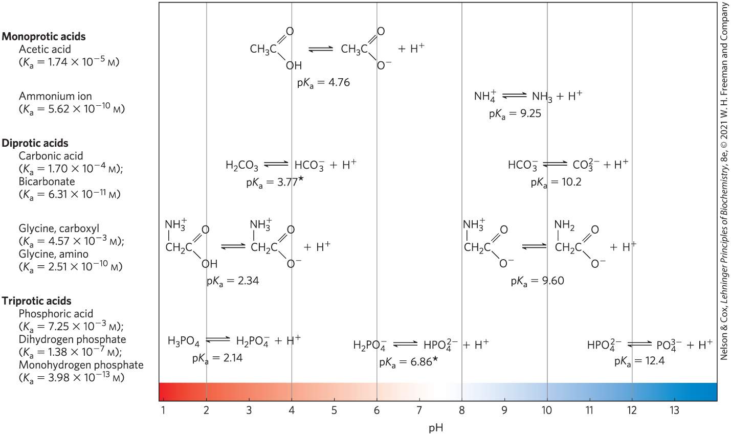
Conjugate Acid-Base Pairs

Slide 84

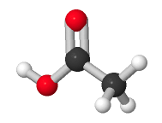
Activity: Acid-Base
Chemistry
Observe the structure of acetic acid in
Mol3D viewer in your Achieve course.
Notes:
Instructor: This Mol3D structure is located in the Achieve course. It can be found in the Chapter 2 content, in the folder titled “Ch2 In-Class Activities and Resources.”

Slide 85
Activity Instructions (1 of 2)
On your own, think of answers to the questions:
  Is acetic acid a weak acid or a strong acid?
  As depicted, is acetic acid in its acid form or its conjugate base form?
  Which atom in this structure ionizes in aqueous solutions? Select the atom and upload a screenshot to your course.
(2 minutes)
Pair up to discuss your ideas. (2 minutes)
Share your ideas with the class in group discussion. (3 minutes)
Notes:
Instructor: This Mol3D structure is located in the Achieve course. It can be found in the Chapter 2 content, in the folder titled “Ch2 In-Class Activities and Resources.”

Slide 86
Activity Solution (2 of 2)
  Is acetic acid a weak acid or a strong acid? A weak acid.
  Is acetic acid in its acid form or its conjugate base form? The hydrogen atom bonded to the oxygen atom at position one indicates that this acetic acid molecule is in its acid form.
  Which atom in this structure ionizes in aqueous solutions? Select the atom and upload a screenshot to your course. The oxygen atom at position one ionizes in aqueous solutions due to loss of the hydrogen atom. This results in a negative charge on the oxygen atom.
Notes:
Instructor: This Mol3D structure is located in the Achieve course. It can be found in the Chapter 2 content, in the folder titled “Ch2 In-Class Activities and Resources.”

Slide 87
Principle 2 (2 of 3)
The ionization behavior of water and of weak acids and bases dissolved in water can be represented by one or more equilibrium constants. Most biomolecules are ionizable; their structure and function depend on their ionization state, which is characterized by equilibrium constants.

Slide 88
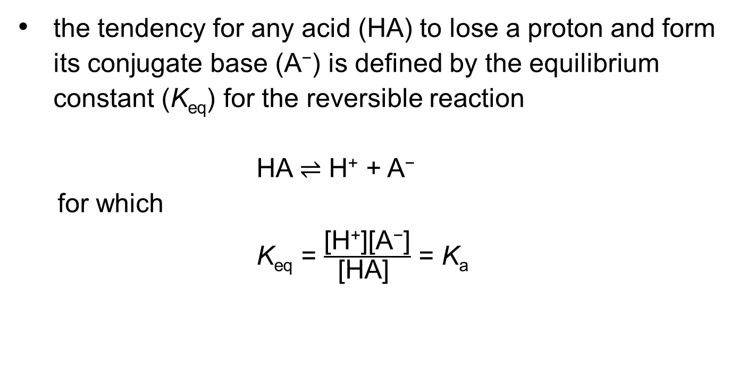
Ionization Constants
the tendency for any acid (HA) to lose a proton and form its conjugate base (A⁻) is defined by the equilibrium constant (K_{eq}) for the reversible reaction
HA ⇌ H⁺ + A⁻
  for which
  K_{eq} = $\frac{\text{[}\text{H}\text{+}\text{][}\text{A}\text{−}\text{]}}{\text{[}\text{HA}\text{] }}$ = K_{a}

Slide 89
Clicker Question 15
When H₂O ionizes:
A. the ∆G° = 0 kJ/mol.
B. it has a measurable K_{eq}.
C. its concentration (7 M) does not appreciably change.
D. free H⁺ ions are present in solution.
Notes:
Answer: B
Principle: 2.2
Learning Objective(s): Determine the equilibrium constant expression for the ionization of a weak acid or base.
Bloom’s: 2:2

Slide 90
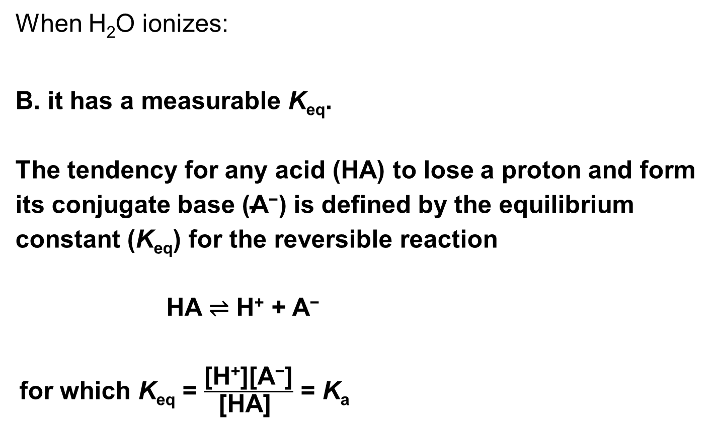
Clicker Question 15, Response
When H₂O ionizes:
B. it has a measurable K_{eq}.
The tendency for any acid (HA) to lose a proton and form its conjugate base ($\text{A}\text{−}$) is defined by the equilibrium constant (K_{eq}) for the reversible reaction
HA ⇌ H⁺ + A⁻
for which K_{eq} = $\frac{\text{[}\text{H}\text{+}\text{][}\text{A}\text{−}\text{]}}{\text{[}\text{HA}\text{] }}$ = K_{a}

Slide 91
Stronger Acids Have Larger Ionization Constants

Slide 92
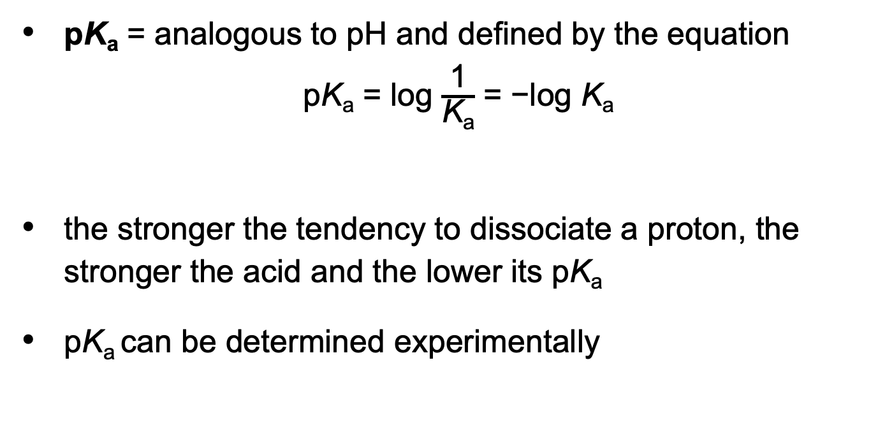
pK_{a}
pK_{a} = analogous to pH and defined by the equation
pK_{a} = log $\frac{\text{1}}{\text{K}\text{a}}$ = −log K_{a}
the stronger the tendency to dissociate a proton, the stronger the acid and the lower its pK_{a}
pK_{a} can be determined experimentally

Slide 93
Clicker Question 16
Weak acids:
A. only partially ionize in water.
B. have a pK_{a} < 7.
C. react very slowly with bases.
D. are formed by dilution of strong acids.
Notes:
Answer: A
Principle: 2.2
Learning Objective(s): Compare strong acids, weak acids, strong bases, and weak bases.
Bloom’s: 2:2

Slide 94
Clicker Question 16, Response
Weak acids:
A. only partially ionize in water.
Weak acids partially ionize to release a hydrogen ion, thus lowering the pH of the aqueous solution.

Slide 95
Titration Curves Reveal the pK_{a} of Weak Acids
titration curve = a plot of pH against the amount of NaOH added

Slide 96
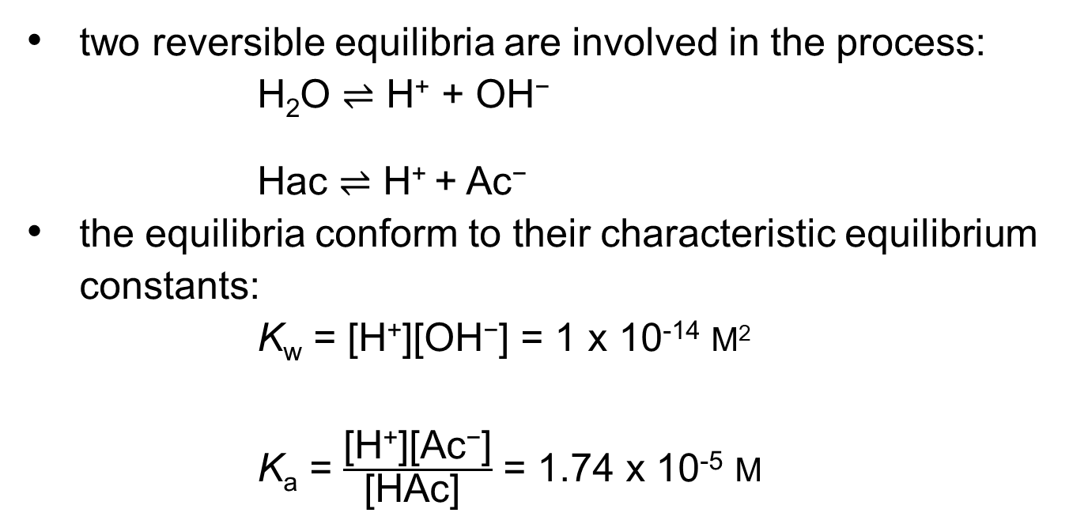
Acetic Acid Equilibrium Constants
two reversible equilibria are involved in the process:
H₂O ⇌ H⁺ + OH⁻
Hac ⇌ H⁺ + Ac⁻
the equilibria conform to their characteristic equilibrium constants:
K_{w} = [H⁺][OH⁻] = 1 x 10⁻¹⁴ M²
K_{a} = $\frac{\text{[}\text{H}\text{+}\text{][}\text{Ac}\text{−}\text{]}}{\text{[}\text{HAc}\text{] }}$ = 1.74 x 10⁻⁵ M
(Eqn 2-5)
(Eqn 2-6)
(Eqn 2-7)
(Eqn 2-8)

Slide 97
Principle 2 (3 of 3)
The ionization behavior of water and of weak acids and bases dissolved in water can be represented by one or more equilibrium constants. Most biomolecules are ionizable; their structure and function depend on their ionization state, which is characterized by equilibrium constants.

Slide 98
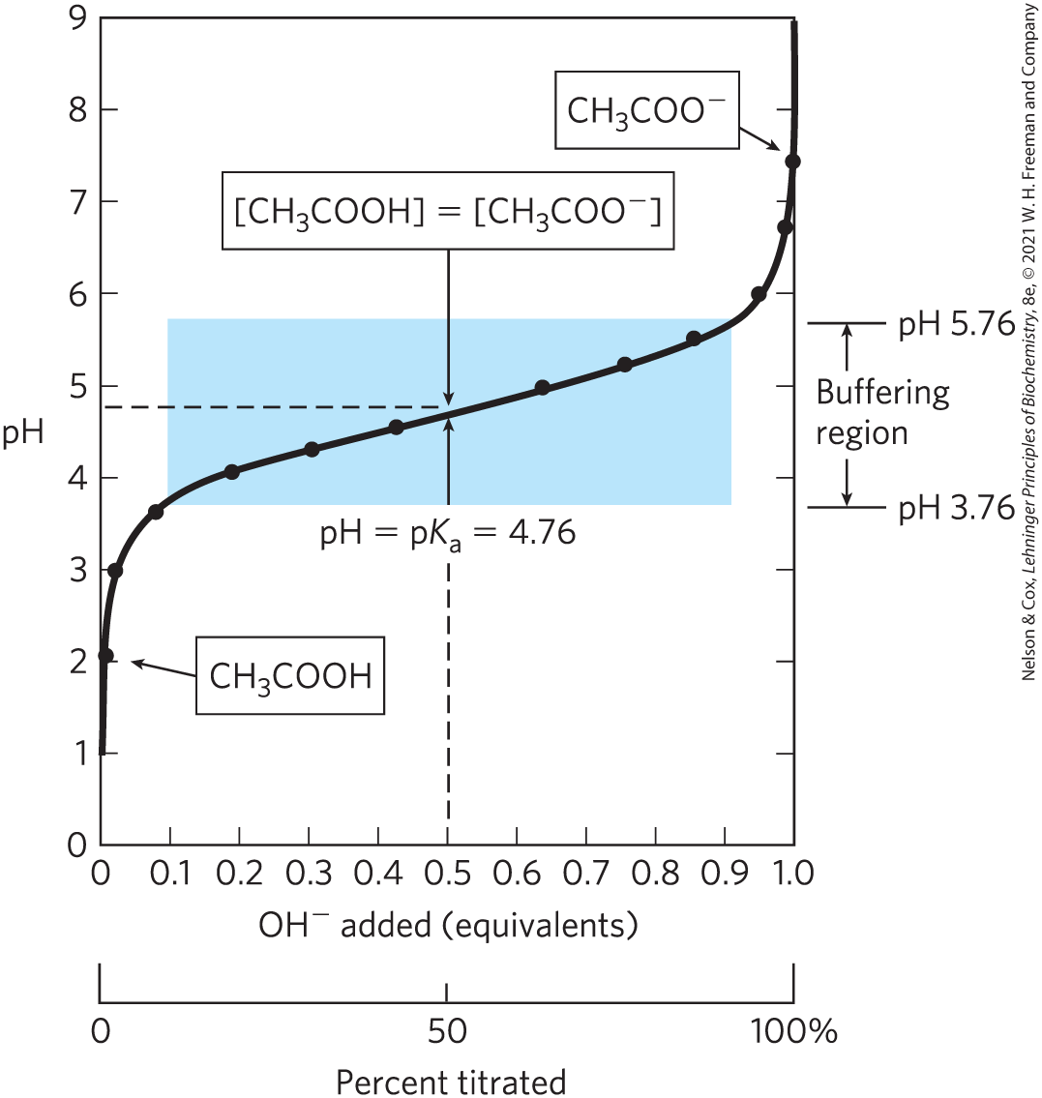
The Titration Curve of Acetic Acid
at the midpoint, the pH of the equimolar solution = the pK_{a} of acetic acid

Slide 99
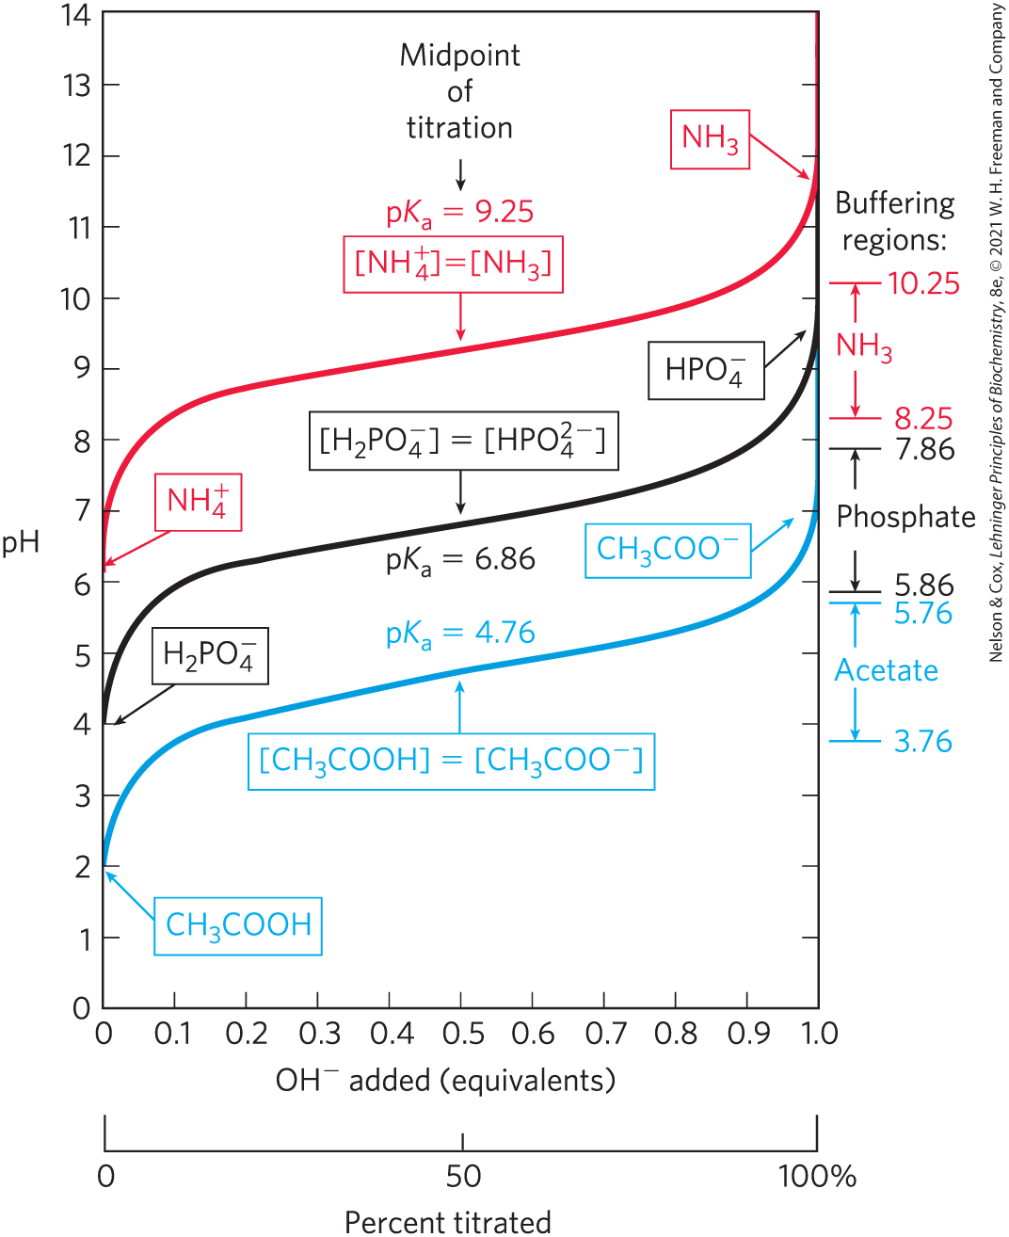
Comparison of the Titration Curves of Three Weak Acids
a weak acid and its anion—a conjugate acid-base pair—can act as a buffer

Slide 100
Clicker Question 17
The pK_{a} of a weak acid:
A. is a function of its concentration.
B. is the pH at which it has no net charge.
C. is <0 at pH > 7.
D. can be determined from its titration curve.
Notes:
Answer: D
Principle: 2.2
Learning Objective(s): Determine the pK_{a} of a substance from experimental data.
Bloom’s: 2:2

Slide 101
Clicker Question 17, Response
The pK_{a} of a weak acid:
D. can be determined from its titration curve.
A plot of pH against the amount of NaOH added (a titration curve) reveals the pK_{a} of the weak acid. At the midpoint of the titration curve, the pH of the equimolar solution is exactly equal to the pK_{a} of the weak acid.

Slide 102
2.3 Buffering against pH Changes in Biological Systems

Slide 103
Principle 4 (1 of 2)
Enzymes, which catalyze all of the processes inside a cell, have evolved to function optimally at near-neutral (physiological) pH. However, enzymes that function in intracellular compartments of low or high pH show their greatest activity and stability at those pH values.

Slide 104
Buffers Are Mixtures of Weak Acids and Their Conjugate Bases
buffers = aqueous systems that tend to resist changes in pH when small amounts of acid (H⁺) or base (OH–) are added
a buffer system consists of a weak acid (the proton donor) and its conjugate acid (the proton acceptor)

Slide 105
The Buffering Region
buffering region = the flat zone of a titration curve

Slide 106
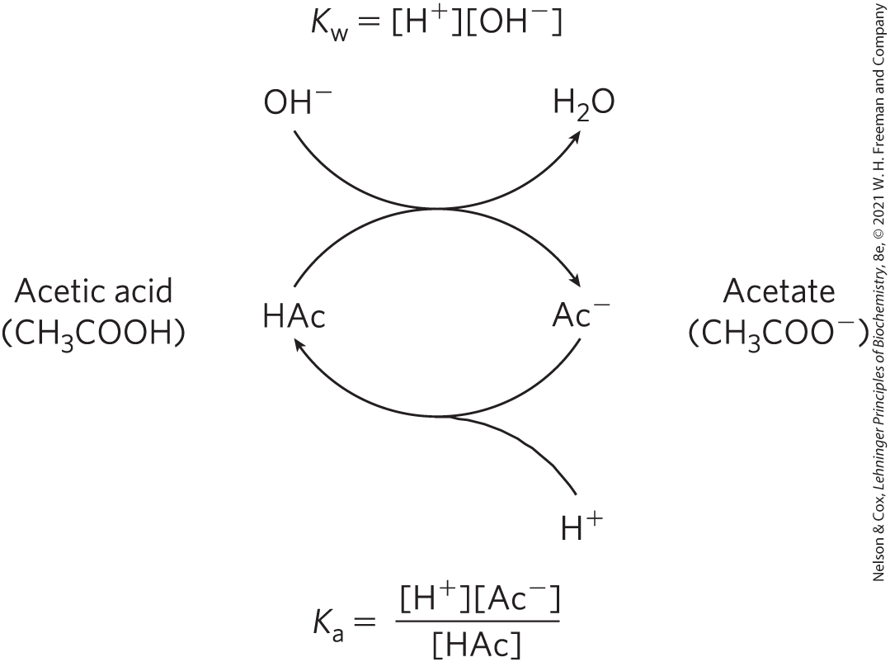
The Acetic Acid–Acetate Pair as a Buffer System

Slide 107

Clicker Question 18
What is the actual function of a buffer system such as acetate/acetic acid?
A. to maintain a constant pH in the event that the
concentration of an acid or base increases
B. to maintain the solution at the pK_{a}
C. to ensure that the solution has no free H⁺ or OH– within a
specific range
D. to keep the solution within one pH unit of the pK_{a}
Notes:
Answer: A
Principle: 2.4
Learning Objective(s): Describe how a buffer resists changes in pH.
Bloom’s: 2:2

Slide 108
Clicker Question 18, Response
What is the actual function of a buffer system such as acetate/acetic acid?
A. to maintain a constant pH in the event that the
concentration of an acid or base increases
Buffer systems are aqueous systems that tend to resist changes in pH when small amounts of acid (H⁺) or base (OH⁻) are added.

Slide 109
Principle 3 (2 of 5)
An aqueous solution of a weak acid and its salt makes a buffer that resists changes in pH in response to added acid or base. Biological systems are buffered to maintain a narrow pH range, in which their macromolecules retain their functional structure, which depends on their ionization state. Conditions that produce blood pH outside the range of 7.3 to 7.5 are life-threatening in humans.

Slide 110
The Henderson-Hasselbalch Equation Relates pH, pK_{a}, and Buffer Concentration
Henderson-Hasselbalch equation = describes the shape of the titration curve of any weak acid
(Eqn 2-9)

Slide 111
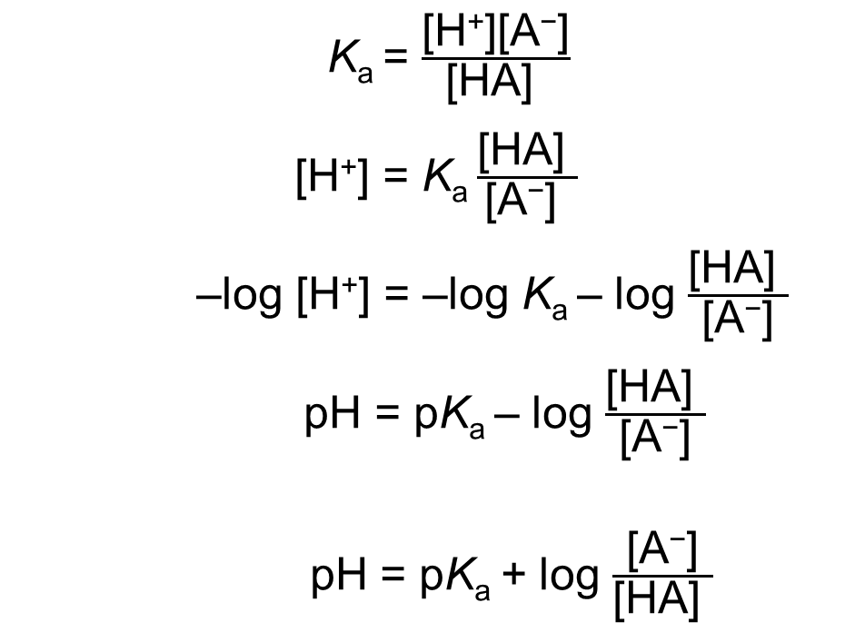
Deriving the Henderson-Hasselbalch Equation
K_{a} = $\frac{\text{[}\text{H}\text{+}\text{][}\text{A}\text{−}\text{]}}{\text{[}\text{HA}\text{] }}$
[H⁺] = K_{a} $\frac{\text{[}\text{H}\text{A}\text{] }}{\text{[}\text{A}\text{−}\text{] }}$
–log [H⁺] = –log K_{a} – log $\frac{\text{[}\text{HA}\text{] }}{\text{[}\text{A}\text{−}\text{]}}$
pH = pK_{a} – log $\frac{\text{[}\text{HA}\text{] }}{\text{[}\text{A}\text{−}\text{]}}$
pH = pK_{a} + log $\frac{\text{[}\text{A}\text{−}\text{]}}{\text{[}\text{H}\text{A}\text{] }}$
(Eqn 2-9)

Slide 112

Clicker Question 19
I need to calculate the pH of a weak acid. I know the concentration of the acid and its conjugate base, and my solution is at 30 °C. Using the Henderson-Hasselbalch equation, what else do I need?
A. the K_{d} for H⁺ of the acid
B. the total H⁺ concentration (that is, free and bound to the acid)
C. the free-energy change for the release of the H⁺
D. the pK_{a} of the acid
Notes:
Answer: D
Principle: 2.3
Learning Objective(s): Relate the pH of a buffer, pK_{a} of a weak acid, and the concentrations of weak acid and its conjugate base.
Bloom’s: 2:2

Slide 113
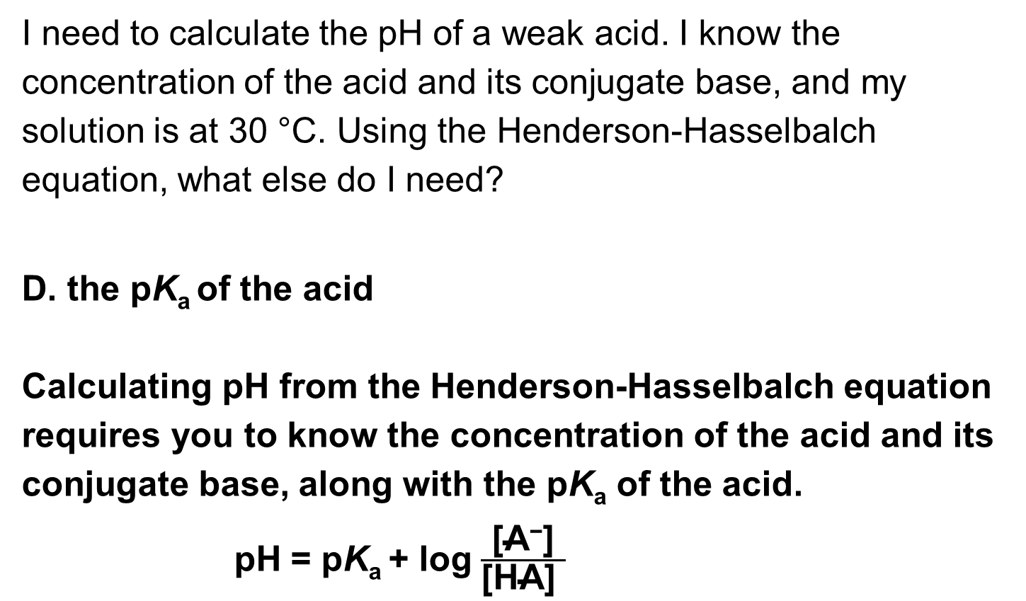
Clicker Question 19, Response
I need to calculate the pH of a weak acid. I know the concentration of the acid and its conjugate base, and my solution is at 30 °C. Using the Henderson-Hasselbalch equation, what else do I need?
D. the pK_{a} of the acid
Calculating pH from the Henderson-Hasselbalch equation requires you to know the concentration of the acid and its conjugate base, along with the pK_{a} of the acid.
pH = pK_{a} + log $\frac{\text{[}\text{A}\text{−}\text{]}}{\text{[}\text{HA}\text{] }}$

Slide 114
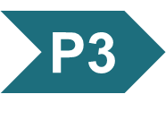
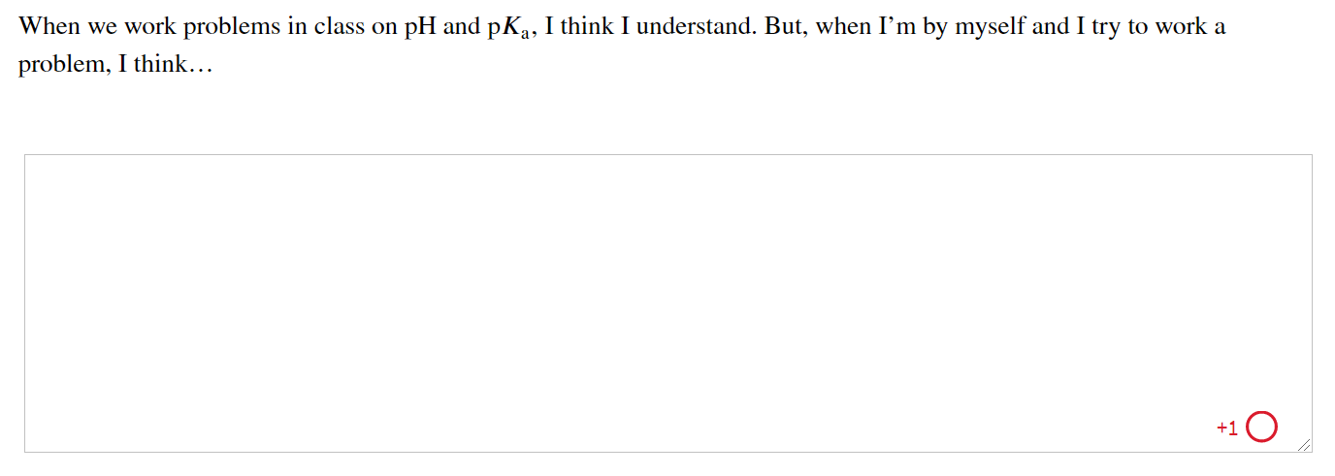
Activity: Amino Acid and pK_{a} Muddiest Point (1 of 2)
Complete the Ch2: Student Activity, Day 1: Amino Acid and pK_{a} (Muddiest Point) Achieve assessment.
Notes:
Instructor: This muddiest point activity can be found in Achieve in the Chapter 2 folder titled “Ch2 In-Class Activities and Resources.” See the Instructor Activity Guide in the same folder for more information.

Slide 115
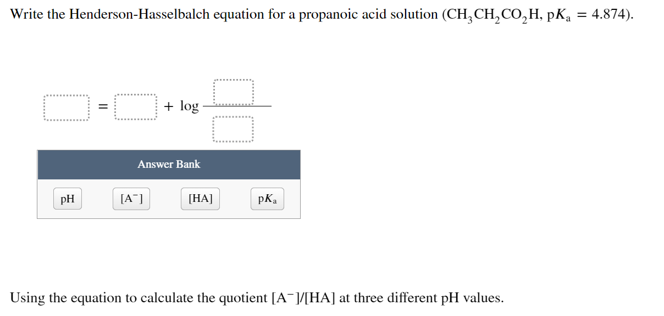
Activity: Amino Acid and pK_{a} Muddiest Point (2 of 2)
Complete the Ch2: Student Activity, Day 2: Amino Acid and pK_{a} (Muddiest Point) Achieve assessment.
Notes:
Instructor: This muddiest point activity can be found in Achieve in the Chapter 2 folder titled “Ch2 In-Class Activities and Resources.” See the Instructor Activity Guide in the same folder for more information.

Slide 116
Principle 3 (3 of 5)
An aqueous solution of a weak acid and its salt makes a buffer that resists changes in pH in response to added acid or base. Biological systems are buffered to maintain a narrow pH range, in which their macromolecules retain their functional structure, which depends on their ionization state. Conditions that produce blood pH outside the range of 7.3 to 7.5 are life-threatening in humans.

Slide 117
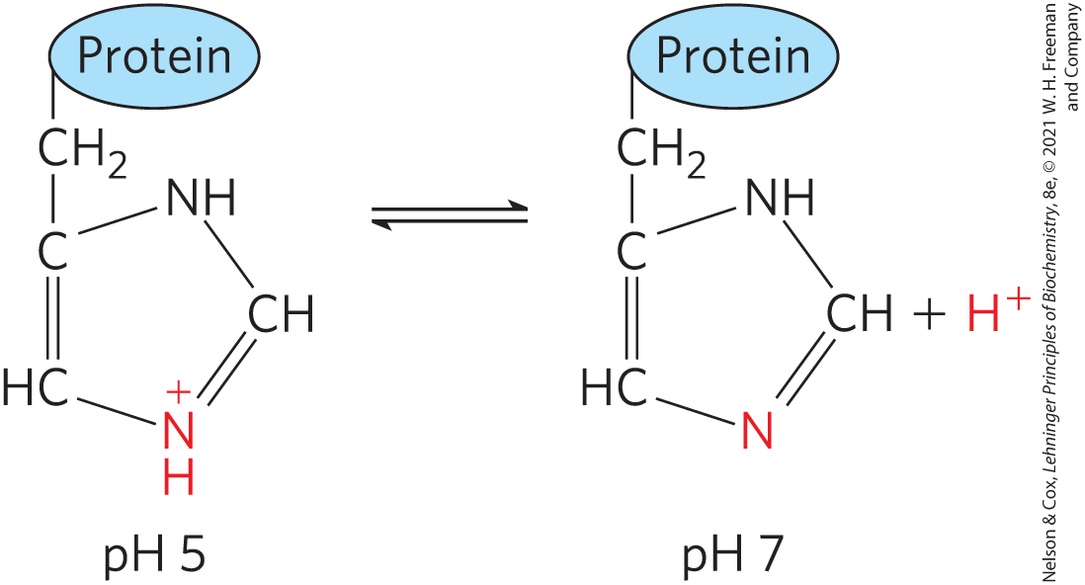
Weak Acids or Bases Buffer Cells and Tissues against pH Changes
proteins containing histidine (side chain pK_{a} of 6.0) residues buffer effectively near neutral pH

Slide 118
The Phosphate Buffer System
the phosphate buffer system acts in the cytoplasm of all cells:
H₂PO₄⁻ ⇌ H⁺ + HPO₄²⁻
HPO₄²⁻ acts as a proton donor and HPO₄²⁻ acts as a proton acceptor
buffer system is maximally effective at a pH close to its pK_{a} of 6.86
  works over a range between 5.9 and 7.9

Slide 119
Clicker Question 20
Which statement about buffers is false?
A. They have maximum buffering capacity.
B. They are weak acids and bases.
C. [A–] = [HA] when pH = pK_{a}
D. They can sometimes be biological macromolecules.
Notes:
Answer: A
Principle: 2.3
Learning Objective(s): Describe how a buffer resists changes in pH; Relate the pH of a buffer, pK_{a} of a weak acid, and the concentrations of weak acid and its conjugate base.
Bloom’s: 2:2

Slide 120
Clicker Question 20, Response
Which statement about buffers is false?
A. They have maximum buffering capacity.
The buffering capacity of buffers can be exhausted. The buffering region, shown as the flat zone of a titration curve, typically extends about 1 pH unit on either side of its midpoint pH.

Slide 121
Principle 3 (4 of 5)
An aqueous solution of a weak acid and its salt makes a buffer that resists changes in pH in response to added acid or base. Biological systems are buffered to maintain a narrow pH range, in which their macromolecules retain their functional structure, which depends on their ionization state. Conditions that produce blood pH outside the range of 7.3 to 7.5 are life-threatening in humans.

Slide 122
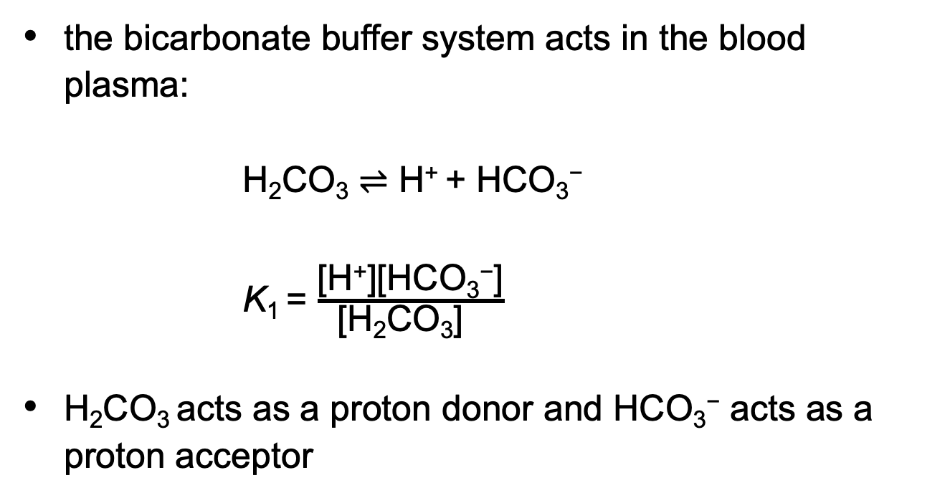
The Bicarbonate Buffer System
the bicarbonate buffer system acts in the blood plasma:
H₂CO₃ ⇌ H⁺ + HCO₃⁻
K₁ = $\frac{\text{[}\text{H}\text{+}\text{][}\text{HCO}\text{3}\text{−}\text{]}}{\text{[}\text{H}\text{2}\text{CO}\text{3}\text{] }}$
H₂CO₃ acts as a proton donor and HCO₃⁻ acts as a proton acceptor

Slide 123
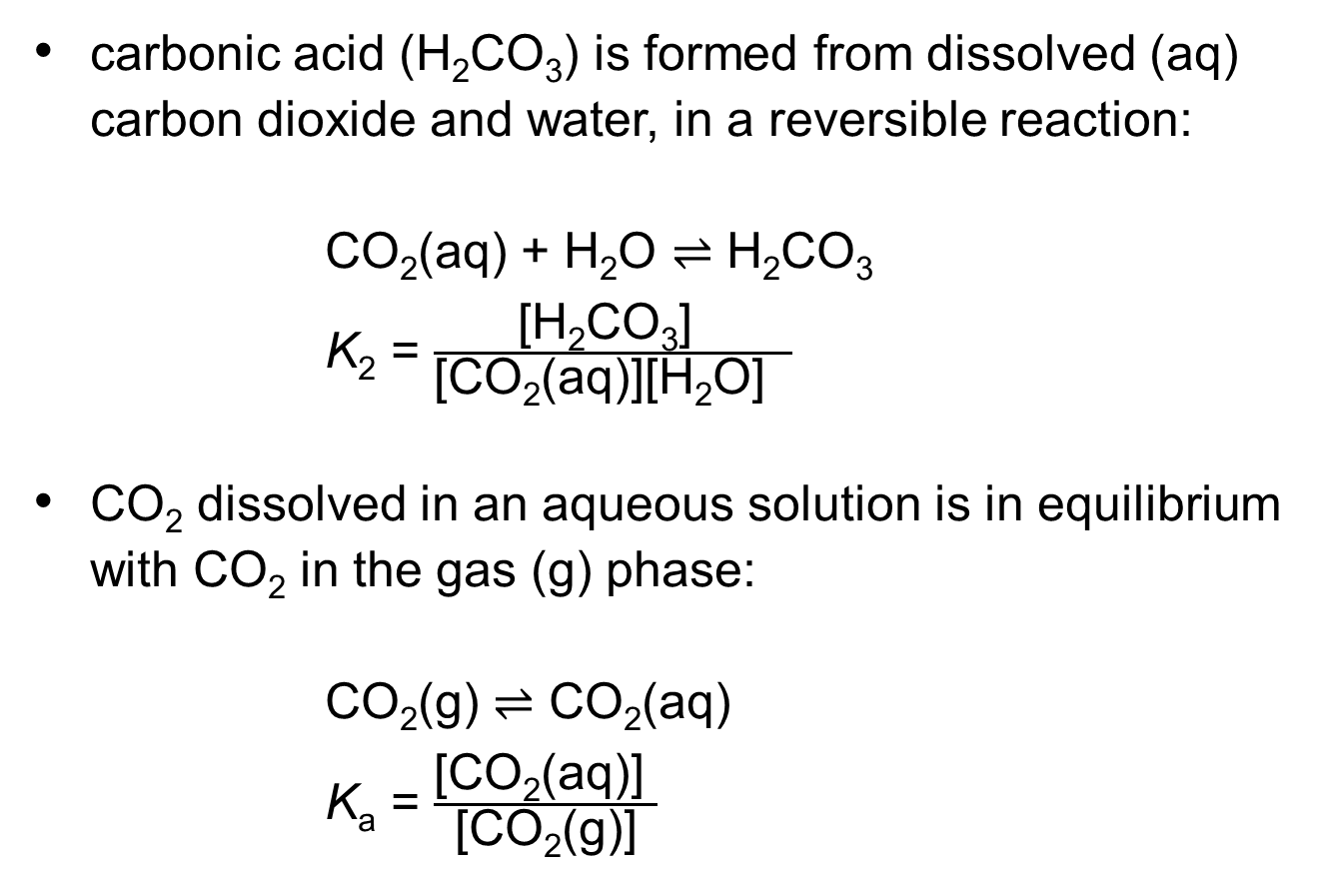
Additional Equilibrium Constants
carbonic acid (H₂CO₃) is formed from dissolved (aq) carbon dioxide and water, in a reversible reaction:
CO₂(aq) + H₂O ⇌ H₂CO₃
K₂ = $\frac{\text{[}\text{H}\text{2}\text{CO}\text{3}\text{] }}{\text{[}\text{CO}\text{2}\text{(}\text{aq}\text{)][}\text{H}\text{2}\text{O}\text{] }}$
CO₂ dissolved in an aqueous solution is in equilibrium with CO₂ in the gas (g) phase:
CO₂(g) ⇌ CO₂(aq)
K_{a} = $\frac{\text{[}\text{CO}\text{2}\text{(}\text{aq}\text{)] }}{\text{[}\text{CO}\text{2}\text{(}\text{g}\text{)]}}$

Slide 124
The pH of a Bicarbonate Buffer System
the pH of a bicarbonate buffer system exposed to a gas phase depends on:
  the concentration of HCO₃–
  the partial pressure of CO₂ (pCO₂) = the concentration of CO₂ in the gas phase
buffer system is effective near pH 7.4

Slide 125
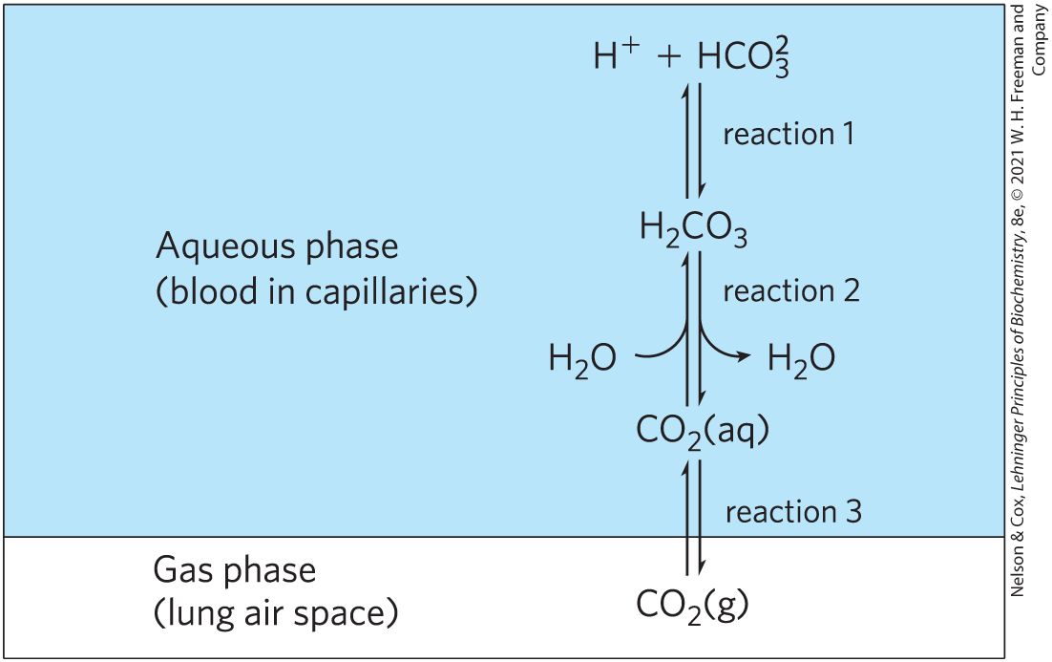
The Bicarbonate Buffer System Involves Three Reversible Equilibria
the rate of respiration (controlled by the brain stem) can quickly adjust these equilibria to keep the blood pH nearly constant
hyperventilation raises blood pH

Slide 126
Clicker Question 21
In what area of the titration curve for carbonic acid (H₂CO₃) is the molecule fully deprotonated?
A. the far left
B. the far right
C. at the center, at the pK_{a}
D. in the area about 1 pH unit higher than the pK_{a}
Notes:
Answer: B
Principle: 2.3
Learning Objective(s): Determine the concentration or amount of a substance present by titration.
Bloom’s: 2:2

Slide 127
Clicker Question 21, Response
In what area of the titration curve for carbonic acid (H₂CO₃) is the molecule fully deprotonated?
B. the far right
The far right of a titration curve, which equates to higher equivalents of OH– and higher percent titrated, is the area of the titration curve where the molecule would be fully deprotonated.

Slide 128
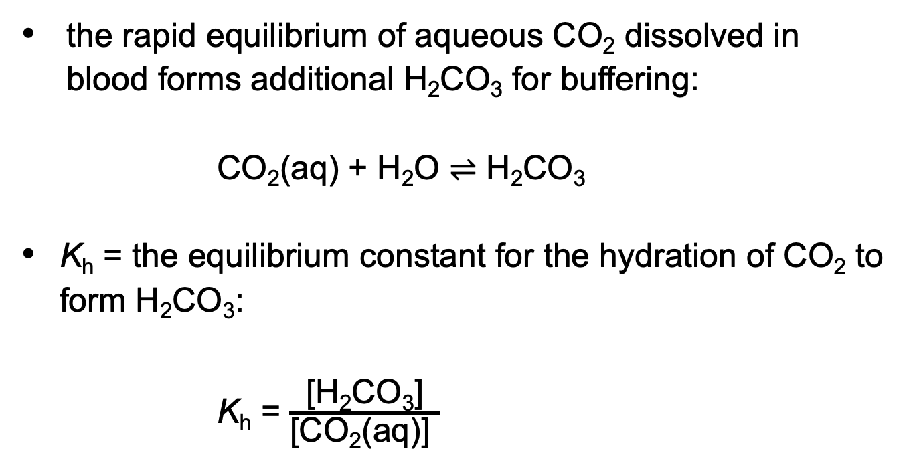
The Equilibrium Constant for the Hydration of CO₂
the rapid equilibrium of aqueous CO₂ dissolved in blood forms additional H₂CO₃ for buffering:
CO₂(aq) + H₂O ⇌ H₂CO₃
K_{h} = the equilibrium constant for the hydration of CO₂ to form H₂CO₃:
K_{h} = $\frac{\text{[}\text{H}\text{2}\text{CO}\text{3}\text{]}}{\text{[}\text{CO}\text{2}\text{(}\text{aq}\text{)] }}$

Slide 129
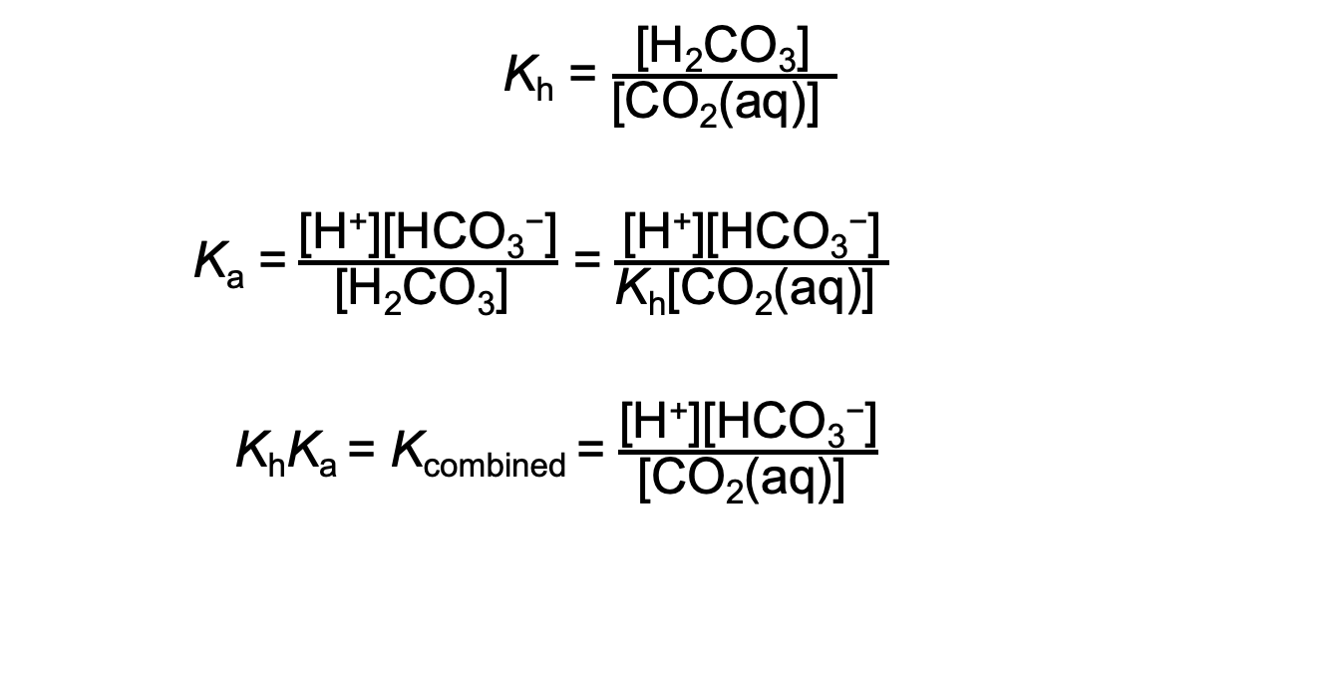
The Overall Equilibrium for Dissociation of H₂CO₃
K_{h} = $\frac{\text{[}\text{H}\text{2}\text{CO}\text{3}\text{]}}{\text{[}\text{CO}\text{2}\text{(}\text{aq}\text{)] }}$
K_{a} = $\frac{\text{[}\text{H}\text{+}\text{][}\text{H}\text{CO}\text{3}\text{−}\text{]}}{\text{[}\text{H}\text{2}\text{CO}\text{3}\text{] }}$ = $\frac{\text{[}\text{H}\text{+}\text{][}\text{HCO}\text{3}\text{−}\text{]}}{\text{K}\text{h}\text{[}\text{CO}\text{2}\text{(}\text{aq}\text{)}\text{] }}$
K_{h}K_{a} = K_{combined} = $\frac{\text{[}\text{H}\text{+}\text{][}\text{HCO}\text{3}\text{−}\text{]}}{\text{[}\text{CO}\text{2}\text{(}\text{aq}\text{)] }}$

Slide 130
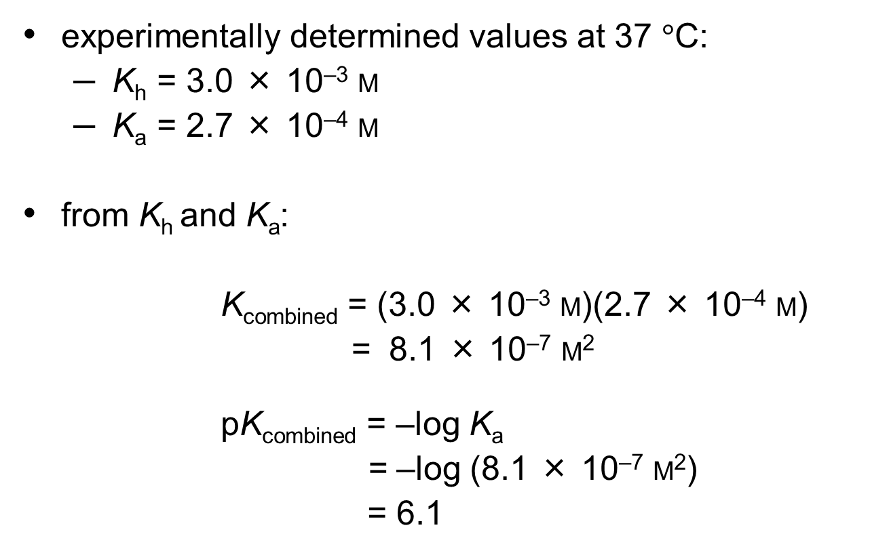
Calculating K_{combined} and pK_{combined}
experimentally determined values at 37 $°\text{C}$:
  K_{h} = 3.0 × 10^{–3} M
  K_{a} = 2.7 × 10^{–4} M
from K_{h} and K_{a}:
K_{combined} = (3.0 × 10^{–3} M)(2.7 × 10^{–4} M)
= 8.1 × 10^{–7} M²
pK_{combined} = –log K_{a}
= –log (8.1 × 10^{–7} M²)
= 6.1

Slide 131
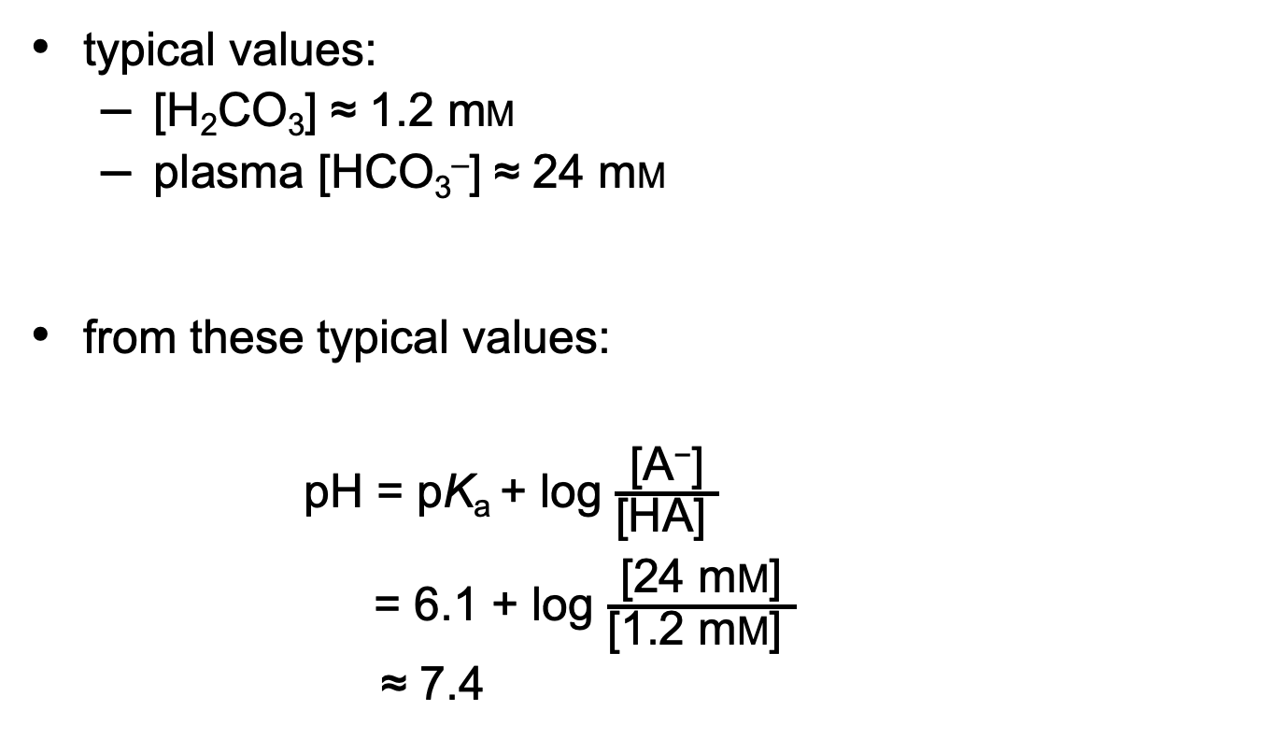
Calculating Blood pH
typical values:
  [H₂CO₃] ≈ 1.2 mM
  plasma [HCO₃–] ≈ 24 mM
from these typical values:
pH = pK_{a} + log $\frac{\text{[}\text{A}\text{−}\text{]}}{\text{[}\text{HA}\text{] }}$
= 6.1 + log $\frac{\text{[}\text{24 }\text{m}\text{M}\text{]}}{\text{[}\text{1.2 }\text{m}\text{M}\text{] }}$
≈ 7.4

Slide 132
Clicker Question 22
The pH of blood is not affected by:
A. fasting and starvation, which force the use of fatty acids as
fuel.
B. the pK_{a} of acetic acid or acetate.
C. consuming large amounts of sodium bicarbonate.
D. hyperventilation.
Notes:
Answer: B
Principle: 3:2
Learning Objective(s): Relate the pH of a buffer, pK_{a} of a weak acid, and the concentrations of weak acid and its conjugate base; Predict how changes in respiration will affect blood pH.
Bloom’s: 2:2

Slide 133
Clicker Question 22, Response
The pH of blood is not affected by:
B. the pK_{a} of acetic acid or acetate.
The pH of blood depends on the pK_{combined}, the concentration of H₂CO₃, and the concentration of plasma HCO₃⁻.

Slide 134
Principle 4 (2 of 2)
Enzymes, which catalyze all of the processes inside a cell, have evolved to function optimally at near-neutral (physiological) pH. However, enzymes that function in intracellular compartments of low or high pH show their greatest activity and stability at those pH values.

Slide 135
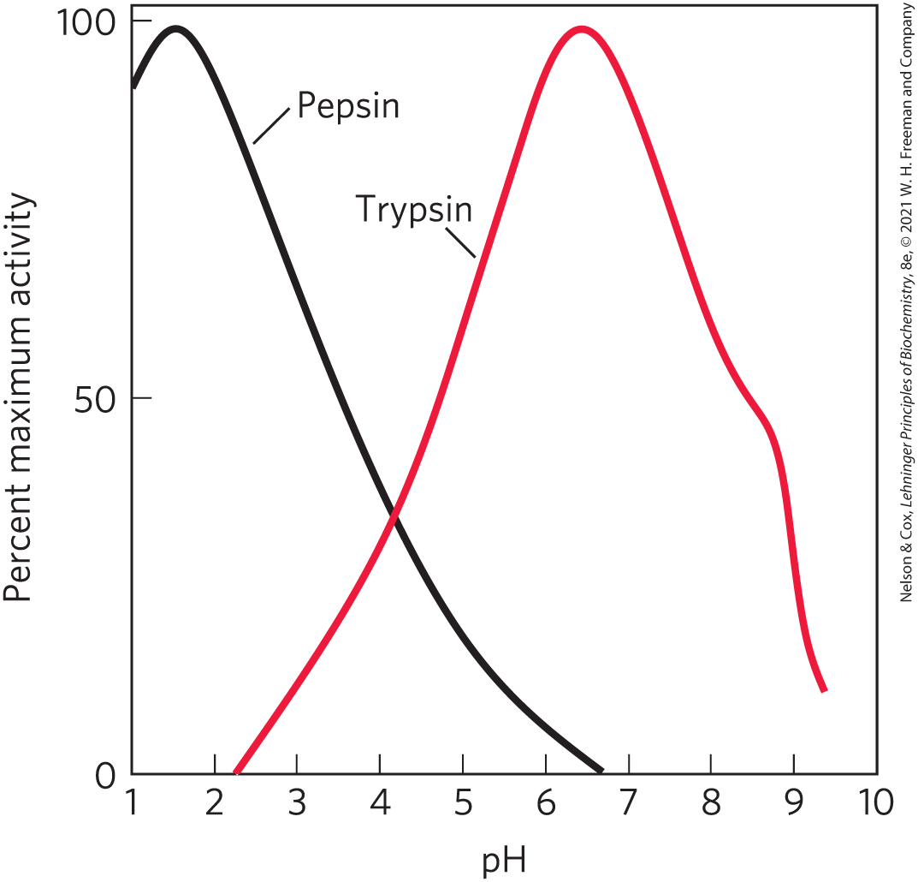
Untreated Diabetes Produces Life-Threatening Acidosis
optimum pH = the characteristic pH at which enzymes typically show maximum catalytic activity

Slide 136
Principle 3 (5 of 5)
An aqueous solution of a weak acid and its salt makes a buffer that resists changes in pH in response to added acid or base. Biological systems are buffered to maintain a narrow pH range, in which their macromolecules retain their functional structure, which depends on their ionization state. Conditions that produce blood pH outside the range of 7.3 to 7.5 are life-threatening in humans.

Slide 137
Untreated Diabetes Mellitus
results in acidosis, the accumulation of high concentrations of two carboxylic acids, β-hydroxybutyric acid and acetoacetic acid
dissociation of these acids lowers the pH of blood plasma to less than 7.35
severe acidosis causes enzymes to not function properly

Slide 138
Clicker Question 23
Generally, physiological pH:
A. must be within one pH unit of its pK_{a}.
B. is determined from its titration curve.
C. is near 7.
D. is between 9.35 and 9.45.
Notes:
Answer: C
Principle: 2.3
Learning Objective(s): Compare the pH of intracellular and extracellular fluids.
Bloom’s: 2:2

Slide 139
Clicker Question 23, Response
Generally, physiological pH:
C. is near 7.
In cells and tissues, phosphate and bicarbonate buffer systems maintain intracellular and extracellular fluids near pH 7.4. Enzymes generally work optimally near this physiological pH.

Slide 140

Activity: pH and the
Chymotrypsin Mechanism
Case Study
Watch the Chapter 6 Animated Mechanism titled “Chymotrypsin.”
Notes:
Instructor: This Animated Mechanism is found within Chapter 6 of Achieve. It’s in the folder titled “Ch6 In-Class Activities, Videos, and Resources.”

Slide 141
Activity Instructions, Part 1
On your own, think of answers to the questions:
  If the pH of a cell is 7.2, do the structures of the amino acids in the active site make sense with their known pK_{a} values?
  What does this tell you about the pH of the active site?
  (2 minutes)
Pair up to discuss your ideas. (2 minutes)
Share your ideas with the class in group discussion. (3 minutes)
Notes:
Instructor: This Animated Mechanism is found within Chapter 6 of Achieve. It’s in the folder titled “Ch6 In-Class Activities, Videos, and Resources.”

Slide 142
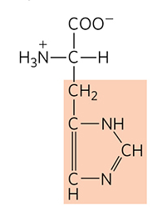
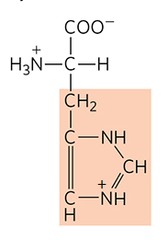
Activity Solution, Part 1
  If the pH of a cell is 7.2, do the structures of the amino acids in the active site make sense with their known pK_{a} values? The pK_{a} of histidine’s side chain is near 6, so one would expect it to be deprotonated.
  What does this tell you about the pH of the active site? The local pH of the enzyme’s active site must be more acidic than that of the cell.
Deprotonated Histidine
Protonated Histidine
Notes:
Instructor: This Animated Mechanism is found within Chapter 6 of Achieve. It’s in the folder titled “Ch6 In-Class Activities, Videos, and Resources.”

Slide 143
Activity Instructions, Part 2
On your own, think of answers to the question:
  If a fellow student states “Aspartate both takes a hydrogen and loses one. If aspartate is near its pK_{a} value, shouldn’t this be impossible?” What would you say?
  (2 minutes)
Pair up to discuss your ideas. (2 minutes)
Share your ideas with the class in group discussion. (3 minutes)
Notes:
Instructor: This Animated Mechanism is found within Chapter 6 of Achieve. It’s in the folder titled “Ch6 In-Class Activities, Videos, and Resources.”

Slide 144
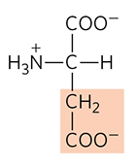
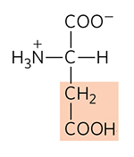
Activity Solution, Part 2
  If a fellow student states “Aspartate both takes a hydrogen and loses one. If aspartate is near its pK_{a} value, shouldn’t this be impossible?” What would you say?
If an amino acid is near its pK_{a} it can both gain and lose hydrogens. This is because at pK_{a}, the functional group is half protonated and half deprotonated.
Deprotonated Aspartate
Protonated Aspartate
Notes:
Instructor: This Animated Mechanism is found within Chapter 6 of Achieve. It’s in the folder titled “Ch6 In-Class Activities, Videos, and Resources.”

