Slide 1

1 The Foundations of Biochemistry
© 2021 Macmillan Learning

Slide 2
Life Arose on Earth around 4 Billion Years Ago
simple microorganisms:
  extracted energy from chemical compounds and sunlight
  used energy to make biomolecules from the simple elements and compounds on the Earth’s surface

Slide 3

Principle 1 (1 of 2)
Cells are the fundamental unit of life. Although they vary in complexity and can be highly specialized for their environment or function within a multicellular organism, they share remarkable similarities.

Slide 4

Principle 2 (1 of 6)
Cells use a relatively small set of carbon- based metabolites to create polymeric machines, supramolecular structures, and information repositories. The chemical structure of these components defines their cellular function. The collection of molecules carries out a program, the end result of which is reproduction of the program and self-perpetuation of that collection of molecules—in short, life.

Slide 5

Principle 3 (1 of 5)
Living organisms exist in a dynamic
steady state, never at equilibrium with
their surroundings. Following the laws of thermodynamics, living organisms extract energy from their surroundings and employ it to maintain homeostasis and do useful work. Essentially all of the energy obtained by a cell comes from the flow of electrons, driven by sunlight or by metabolic redox reactions.

Slide 6

Principle 4 (1 of 5)
Cells have the capacity for precise self-replication and self-assembly using chemical information stored in the genome. A single bacterial cell placed in a sterile nutrient medium can give rise to a billion identical “daughter” cells in 24 hours. Each cell is a faithful copy of the original, its construction directed entirely by information contained in the genetic material of the original cell. On a larger scale, the progeny of vertebrate animals share a striking resemblance to their parents, also the result of their inheritance of parental genes.

Slide 7

Principle 5 (1 of 3)
Living organisms change over time by gradual evolution. The result of eons of evolution is an enormous diversity of life forms, fundamentally related through their shared ancestry, which can be seen at the molecular level in the similarity of gene sequences and protein structures.

Slide 8
What Is Biochemistry?
biochemistry = describes the structures, mechanisms, and chemical processes shared by all organisms

Slide 9
1.1 Cellular Foundations

Slide 10
Principle 1 (2 of 2)
Cells are the fundamental unit of life. Although they vary in complexity and can be highly specialized for their environment or function within a multicellular organism, they share remarkable similarities.

Slide 11
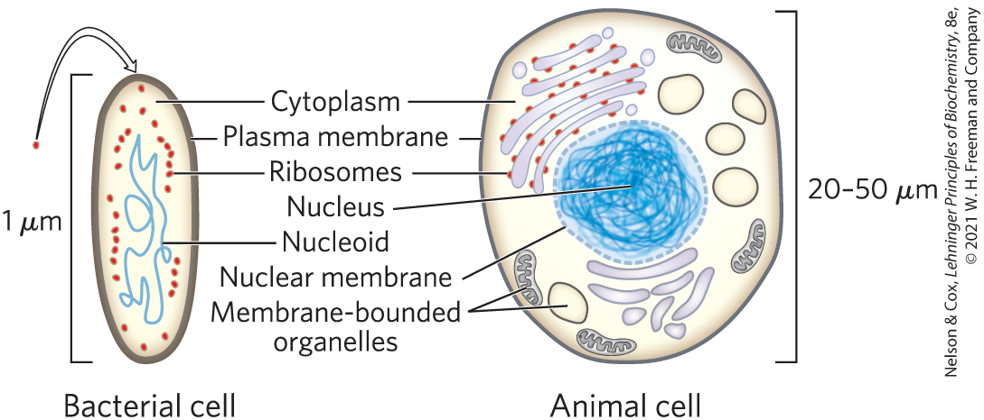
Cells Are the Structural and Functional Units of All Living Organisms

Slide 12
The Plasma Membrane
plasma membrane = defines the periphery of the cell
  composed of lipid and protein molecules
  thin, flexible, hydrophobic barrier around the cell
  contains embedded transport proteins, receptor proteins, and membrane enzymes

Slide 13
Cytoplasm Contains Cytosol and Suspended Particles
cytoplasm = internal volume enclosed by the plasma membrane
  composed of the cytosol (an aqueous solution) and a variety of suspended particles (such as mitochondria, chloroplasts, ribosomes, and proteasomes)
cytosol = highly concentrated solution
  contains enzymes, RNA, amino acids, nucleotides, metabolites, coenzymes, and inorganic ions

Slide 14

Clicker Question 1
Cytosol does not contain:
A. enzymes and the RNA (ribonucleic acid) molecules that
encode them.
B. membranous organelles, such as mitochondria.
C. inorganic ions, such as K⁺, Na⁺, and Mg²⁺.
D. the intermediates in biosynthetic and degradative
pathways.
Notes:
Answer: B
Principle: 1.1
Learning Objective(s): Describe the components found in all cells.
Bloom’s: 2:1

Slide 15
Clicker Question 1, Response
Cytosol does not contain:
B. membranous organelles, such as mitochondria.
Membranous organelles, such as mitochondria, sediment when cytoplasm is centrifuged at 150,000 g. What remains as the supernatant fluid is defined as the cytosol, a highly concentrated solution containing enzymes and the RNA molecules that encode them, intermediates in biosynthetic and degradative pathways, and inorganic ions, in addition to amino acids, nucleotides, and coenzymes.

Slide 16
The Nucleoid or Nucleus of a Cell Stores the Genome
genome = complete set of genes, composed of DNA
  bacteria and archaea (formally grouped as prokaryotes) store their genome in a nucleoid
  eukaryotes store their genome in a membrane-enclosed nucleus

Slide 17
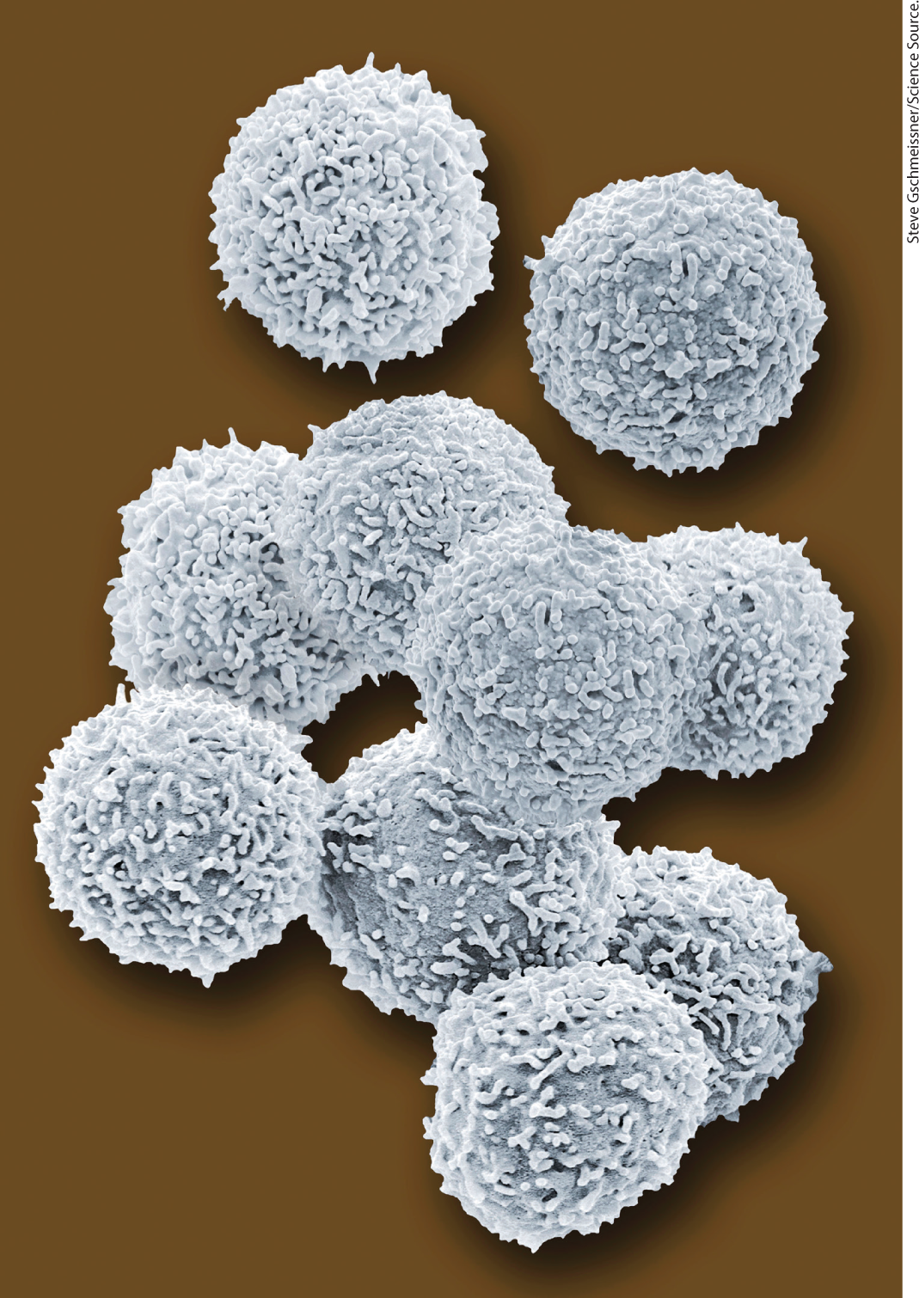
Cellular Dimensions Are Limited by Diffusion
cells are microscopic:
  animal and plant cells:
  5 to 100 μm in diameter
  unicellular microorganisms: 1 to 2 μm long
upper limit of cell size is likely set by the rate of transport and the need to deliver O₂ to all parts of the cell
  as size increases, surface-to-volume ratio decreases
human lymphocytes

Slide 18
Clicker Question 2
All cells:
A. have a plasma membrane.
B. have mitochondria.
C. are approximately the same size.
D. are at least partially aerobic.
Notes:
Answer: A
Principle: 1.1
Learning Objective(s): Describe the components found in all cells.
Bloom’s: 1:1

Slide 19
Clicker Question 2, Response
All cells:
A. have a plasma membrane.
Cells of all kinds have a plasma membrane that defines the periphery of the cell, separating its contents from the surroundings. It is composed of lipid and protein molecules that form a thin, tough, pliable, hydrophobic barrier around the cell.

Slide 20
Organisms Belong to Three Distinct Domains of Life
Bacteria = inhabit soils, surface waters, and the tissues of other living or decaying organisms
Archaea = inhabit extreme environments
Eukarya = all eukaryotic organisms
  more closely related to archaea than bacteria

Slide 21
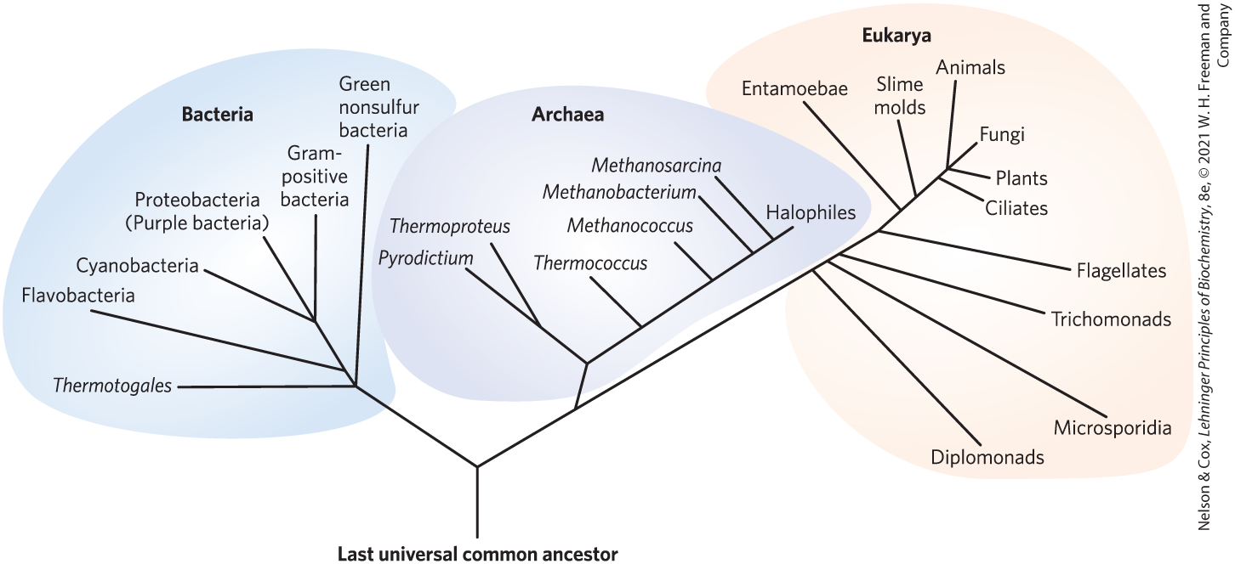
Phylogeny of the Three Domains of Life

Slide 22
Archaea and Bacteria Subgroups Are Distinguished by Their Habitats
aerobic = plentiful supply of O₂; organisms transfer electrons from fuel to O₂ for energy
anaerobic = devoid of O₂; organisms transfer electrons to nitrate, sulfate or CO₂ for energy
  obligate anaerobes = die when exposed to O₂
  facultative anaerobes = can live with or without O₂

Slide 23
Clicker Question 3
You discover a new single-celled organism in a salt lake. Subsequent laboratory experiments reveal that the organism is able to live in the presence or absence of oxygen. This organism would most likely be classified as:
A. an obligate anaerobe in the Bacterial domain.
B. an obligate anaerobe in the Archaeal domain.
C. a facultative anaerobe in the Archaeal domain.
D. a facultative anaerobe in the Bacterial domain.
Notes:
Answer: C
Principle: 1.1
Learning Objective(s): Classify an organism as Archea, Bacteria, or Eukarya.
Bloom’s: 3:2

Slide 24
Clicker Question 3, Response
You discover a new single-celled organism in a salt lake. Subsequent laboratory experiments reveal that the organism is able to live in the presence or absence of oxygen. This organism would most likely be classified as:
C. a facultative anaerobe in the Archaeal domain.
Archaea inhibit extreme environments, such as salt lakes. Within the Archaeal domain are subgroups distinguished by their habitats. Facultative anaerobes are able to live with or without oxygen. Thus, the newly discovered organism would most likely be classified as a facultative anaerobe in the Archaeal domain.

Slide 25
Principle 3 (2 of 5)
Living organisms exist in a dynamic
steady state, never at equilibrium with
their surroundings. Following the laws of thermodynamics, living organisms extract energy from their surroundings and employ it to maintain homeostasis and do useful work. Essentially all of the energy obtained by a cell comes from the flow of electrons, driven by sunlight or by metabolic redox reactions.

Slide 26
Organisms Differ Widely in Their Sources of Energy and Biosynthetic Precursors
phototrophs = trap and use sunlight
chemotrophs = derive energy from oxidation of a chemical fuel
autotrophs = can synthesize all their biomolecules directly from CO₂
heterotrophs = require some preformed organic nutrients made by other organisms

Slide 27
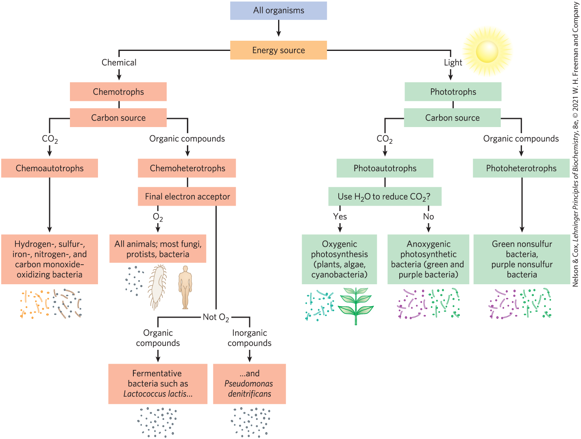
Classifying Organisms According to Their Source of Energy

Slide 28

Clicker Question 4
Humans are:
A. photoautotrophs.
B. chemoautotrophs.
C. photoheterotrophs.
D. chemoheterotrophs.
Notes:
Answer: D
Principle: 1.3
Learning Objective(s): Classify an organism based on how it obtains energy.
Bloom’s: 2:2

Slide 29
Clicker Question 4, Response
Humans are:
D. chemoheterotrophs.
Humans derive energy from oxidation of a chemical fuel, making them chemotrophs. Additionally, humans require some preformed organic nutrients made by other organisms, making them heterotrophs. By combining these terms, humans can be described as chemoheterotrophs.

Slide 30
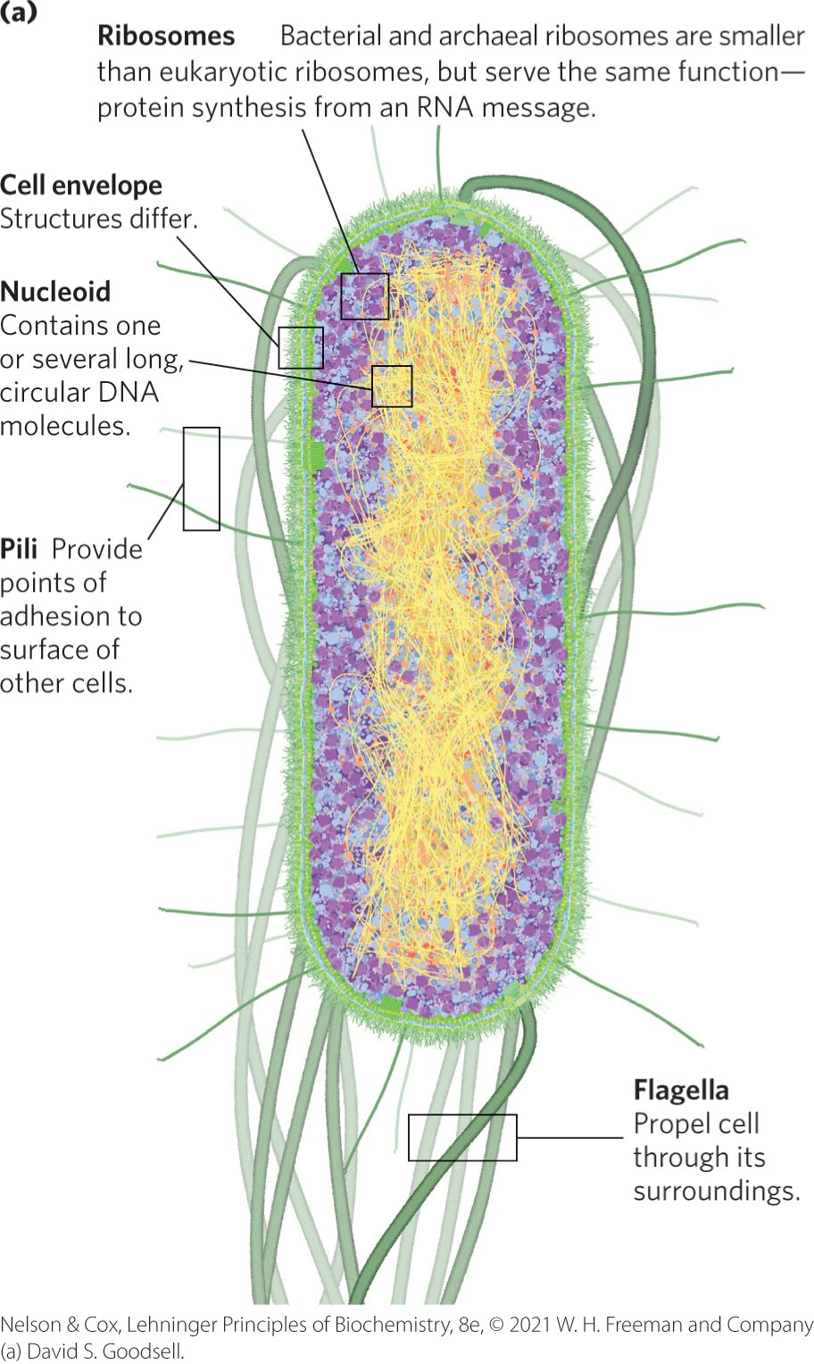
Bacteria and Archaeal Cells Share Common Features but Differ in Important Ways
cell envelope = composed of plasma membrane, outer membrane, and peptidoglycan (high molecular weight polymer)

Slide 31
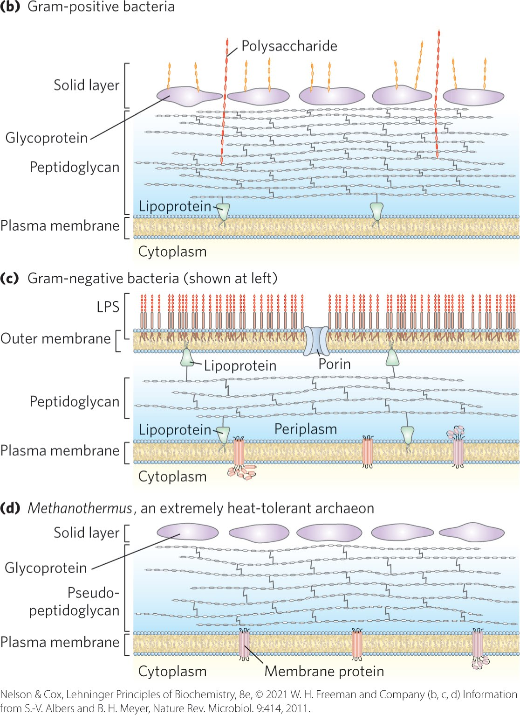
Bacterial and Archaeal Cell Envelopes
gram-positive bacteria:
  colored by Gram’s stain
  thick peptidoglycan layer outside plasma membrane
  lack an outer membrane
gram-negative bacteria:
  outer membrane composed of a lipid bilayer
archaea:
  layer of peptidoglycan or protein confers rigidity on their cell envelopes

Slide 32
Principle 2 (2 of 6)
Cells use a relatively small set of carbon- based metabolites to create polymeric machines, supramolecular structures, and information repositories. The chemical structure of these components defines their cellular function. The collection of molecules carries out a program, the end result of which is reproduction of the program and self-perpetuation of that collection of molecules—in short, life.

Slide 33
The E. coli Cytoplasm
contains ribosomes, enzymes, metabolites, cofactors, and inorganic ions.
the nucleoid contains a single, circular molecule of DNA
plasmids = smaller, circular segments of DNA that confer resistance to toxins and antibiotics in the environment

Slide 34
Eukaryotic Cells Have a Variety of Membranous Organelles, Which Can Be Isolated for Study
mitochondria = the site of most of the energy-extracting reactions of the cell
endoplasmic reticulum and Golgi complexes = play central roles in the synthesis and processing of lipids and membrane proteins
peroxisomes = site of the oxidation of very-long-chain fatty acids and detoxification of reactive oxygen species
lysosomes = filled with digestive enzymes
granules or droplets containing stored nutrients, such as starch and fat

Slide 35

Clicker Question 5
Which organelle is not membrane-bound?
A. a lysosome
B. a peroxisome
C. a ribosome
D. the Golgi complex
Notes:
Answer: C
Principle: 1.2
Learning Objective(s): Relate the name, structure, and function of an organelle.
Bloom’s: 1:1

Slide 36
Clicker Question 5, Response
Which organelle is not membrane-bound?
C. a ribosome
Ribosomes, the site of protein synthesis, are not membrane-bound. The Golgi complex, which plays a central role in the synthesis and processing of lipids and membrane proteins, is membrane-bound. Additionally, peroxisomes, the site of the oxidation of very-long-chain fatty acids and detoxification of reactive oxygen species, and lysosomes, which are filled with digestive enzymes, are membrane-bound.

Slide 37
Plant Cell Organelles
vacuoles = store large quantities of organic acids
chloroplasts = where sunlight drives the synthesis of ATP (adenosine triphosphate) in the process of photosynthesis

Slide 38
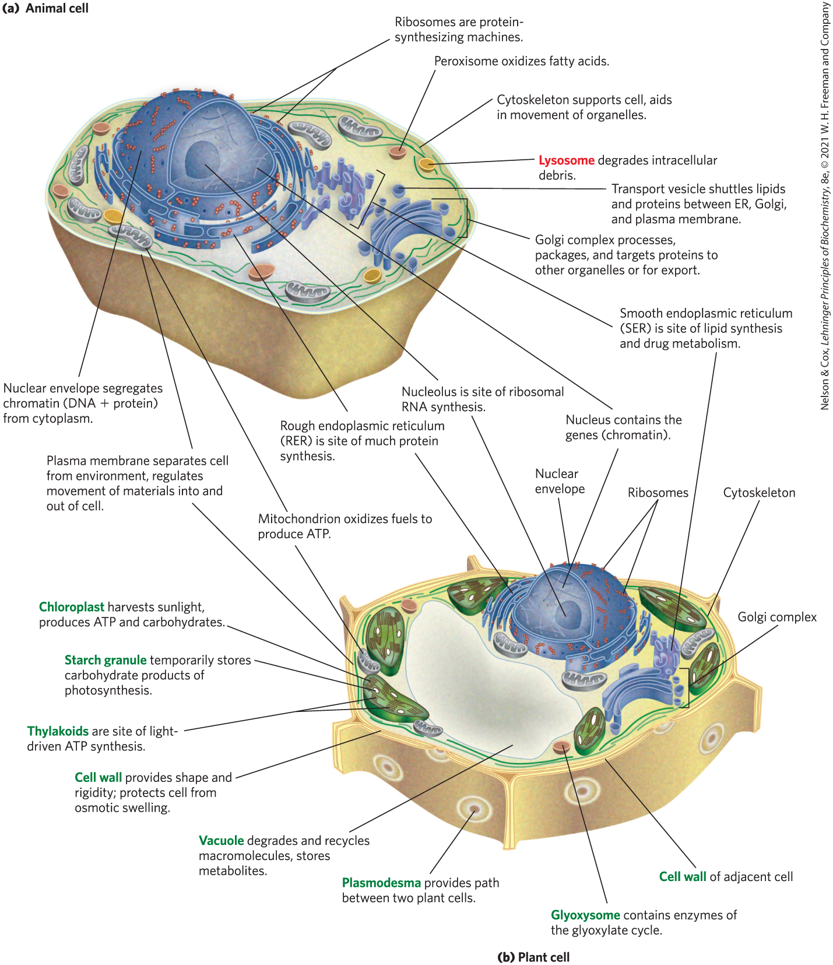
Eukaryotic Cell Structure

Slide 39
Clicker Question 6
Which organelle is found in both plant and animal cells?
A. starch granule
B. chloroplast
C. mitochondria
D. glyoxysome
Notes:
Answer: C
Principle: 1.2
Learning Objective(s): Differentiate between plant and animal cells.
Bloom’s: 2:1

Slide 40
Clicker Question 6, Response
Which organelle is found in both plant and animal cells?
C. mitochondria
Plant and animal cells are eukaryotic cells. Typical eukaryotic cells contain mitochondria, the site of most of the energy-extracting reactions of the cell.

Slide 41

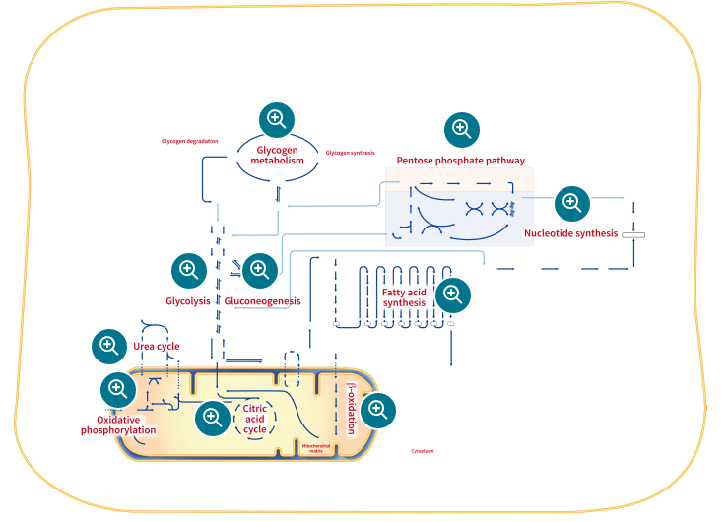
Activity: Metabolic Map
Observe and explore the Metabolic Map in your Achieve course. Use the Tours to guide you through unfamiliar pathways.
Notes:
Instructor: The Metabolic Map is located in the Achieve course. It can be found immediately before the Chapter 13 folder in the list of content. For more information on this activity, please see the In-Class Activity Guide in your Achieve course in Chapter 1.

Slide 42
Activity Instructions (1 of 4)
On your own, think of answers to the question:
  There are many metabolic pathways that are shared among eukaryotes and prokaryotes. Select three pathways and determine if they are utilized by eukaryotes, prokaryotes, or both.
(2 minutes)
Pair up to discuss your ideas. (2 minutes)
Share your ideas with the class in group discussion. (3 minutes)
Notes:
Instructor: The Metabolic Map is located in the Achieve course. It can be found immediately before the Chapter 13 folder in the list of content.

Slide 43
Activity Solution (1 of 4)
Prokaryotes
Both
Glycolysis
Gluconeogenesis
Citric Acid Cycle*
Glycogen Metabolism
Urea cycle
Oxidative Phosphorylation
...
Eukaryotes
Notes:
Instructor: The Metabolic Map is located in the Achieve course. It can be found immediately before the Chapter 13 folder in the list of content.
*If prokaryotic cells lack mitochondria, how can they perform the citric acid cycle? The reactions are performed in the cytosol, utilizing the proton gradient for ATP production across the cell’s surface (plasma membrane) instead of the inner membrane of the mitochondrion.
All of the pathways within the Metabolic Map can be found in both eukaryotes and prokaryotes, however they may not be common to all organisms within those classifications. The bold pathways, glycolysis, gluconeogenesis, the citric acid cycle, and oxidative phosphorylation are shared in some way by all living organisms.

Slide 44
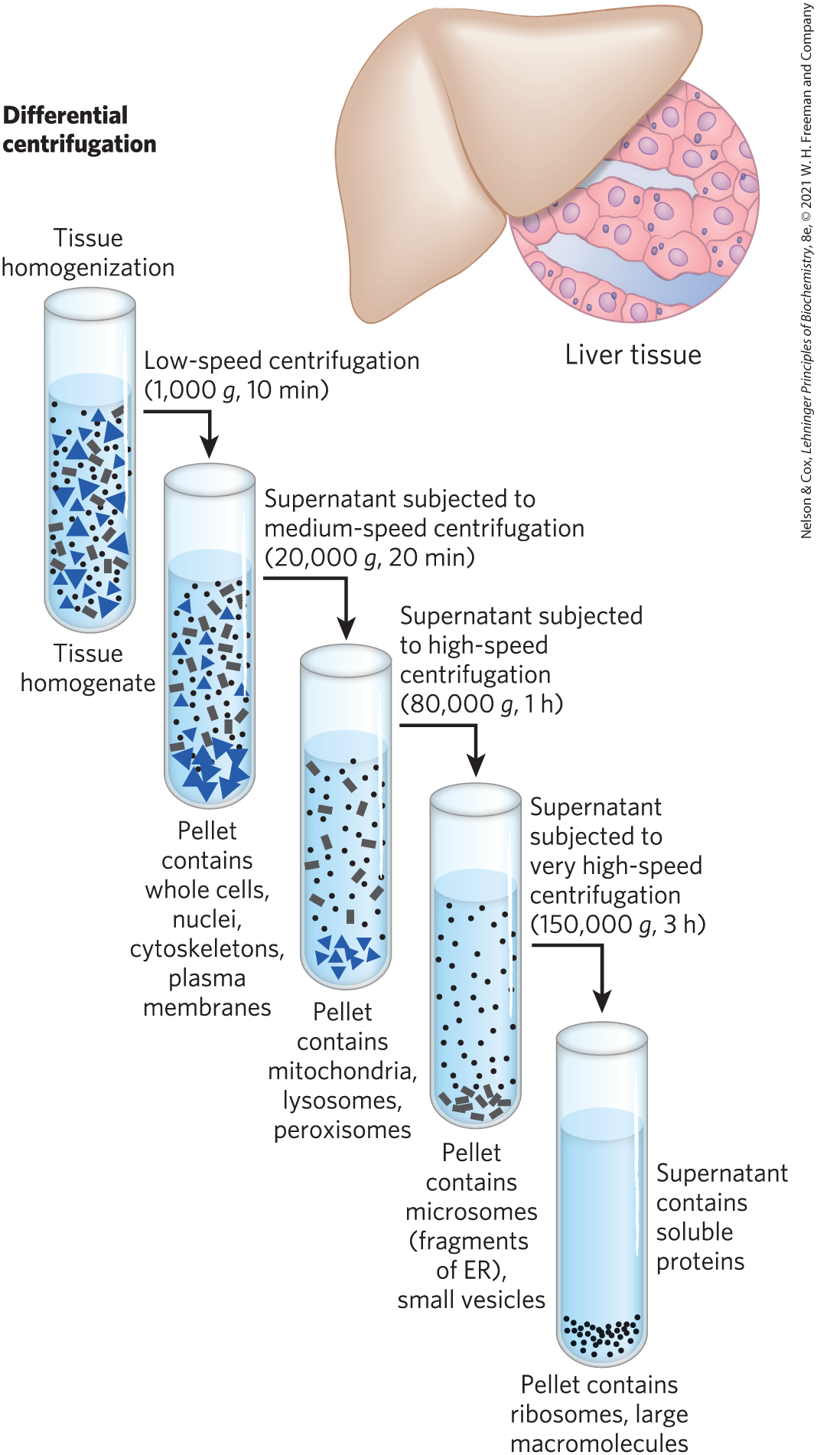
Subcellular Fractionation of Tissue
first step = gently disrupt cells or tissues by physical shear to rupture the plasma membrane
second step = centrifuge the homogenate
organelles differ in size and sediment at different rates

Slide 45
The Cytoplasm Is Organized by the Cytoskeleton and Is Highly Dynamic
cytoskeleton = three-dimensional network of protein filaments in eukaryotic cells
  actin filaments
  microtubules
  intermediate filaments
filaments undergo constant disassembly into their protein subunits and reassembly into filaments

Slide 46
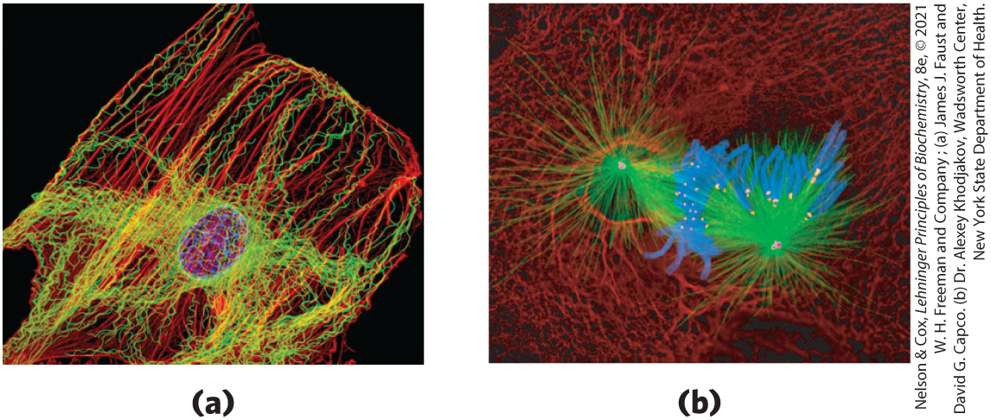
Cytoskeletal Filaments
actin filaments microtubules
chromosomes
microtubules
kinetochores
chromosomes centrosomes
intermediate filaments

Slide 47
The Structural Organization of the Cytoplasm
endomembrane system = segregates specific metabolic processes and provides surfaces on which certain enzyme-catalyzed reactions occur
exocytosis and endocytosis = mechanisms of transport (out of and into cells, respectively)
  involve membrane fusion and fission
  provide paths between the cytoplasm and the surrounding medium

Slide 48
Clicker Question 7
The cytoskeleton is composed of:
A. membraneous organelles.
B. kinetochores and centrosomes.
C. actin filaments, microtubules, and intermediate filaments.
D. chromosomes and plasmids.
Notes:
Answer: C
Principle: 1.2
Learning Objective(s): Describe the eukaryotic cytoskeleton.
Bloom’s: 2:1

Slide 49
Clicker Question 7, Response
The cytoskeleton is composed of:
C. actin filaments, microtubules, and intermediate
filaments.
The cytoskeleton is a three-dimensional network of cytoplasmic protein filaments. Eukaryotes have three general types of cytoplasmic filaments—actin filaments, microtubules, and intermediate filaments.

Slide 50
Principle 2 (3 of 6)
Cells use a relatively small set of carbon- based metabolites to create polymeric machines, supramolecular structures, and information repositories. The chemical structure of these components defines their cellular function. The collection of molecules carries out a program, the end result of which is reproduction of the program and self-perpetuation of that collection of molecules—in short, life.

Slide 51
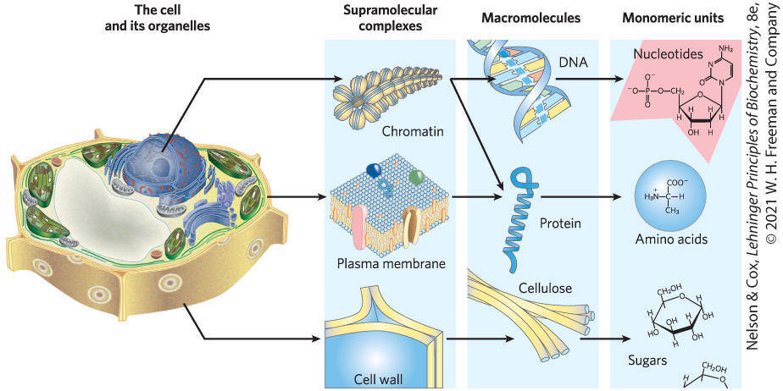
Cells Build Supramolecular Structures
held together by noncovalent interactions (hydrogen bonds, ionic interactions, van der Waals interactions, and the hydrophobic effect)

Slide 52
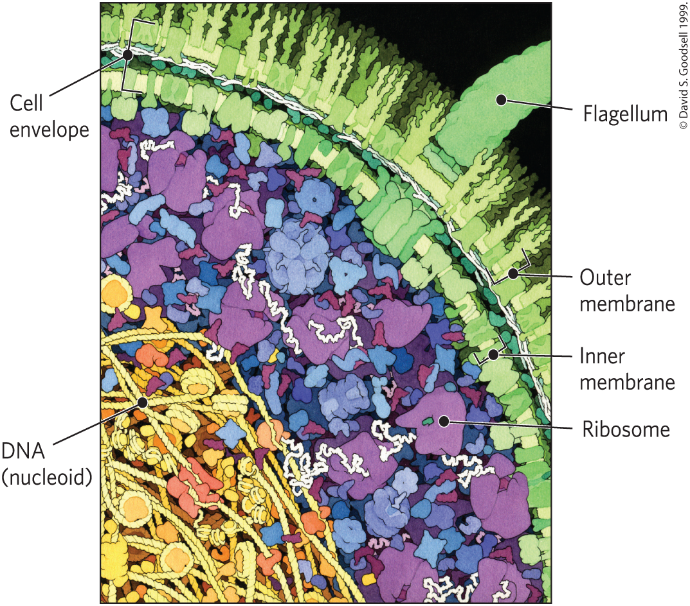
In Vitro Studies May Overlook Important Interactions among Molecules
in vitro = “in glass”
in vivo = “in the living”
molecules may behave differently in vivo and in vitro

Slide 53
Clicker Question 8
Supramolecular complexes, such as chromatin, are held together by:
A. covalent bonds between monomeric units.
B. noncovalent interactions, such as hydrogen bonds.
C. covalent bonds between macromolecules.
D. interactions between the cytoskeleton and organelles.
Notes:
Answer: B
Principle: 1.2
Learning Objective(s): Describe the structural hierarchy of the cell.
Bloom’s: 2:2

Slide 54
Clicker Question 8, Response
Supramolecular complexes, such as chromatin, are held together by:
B. noncovalent interactions, such as hydrogen bonds.
The monomeric subunits of proteins, nucleic acids, and polysaccharides are joined by covalent bonds. In supramolecular complexes, however, macromolecules are held together largely by noncovalent interactions, such as hydrogen bonds, ionic interactions, and aggregations of nonpolar groups.

Slide 55
1.2 Chemical Foundations

Slide 56
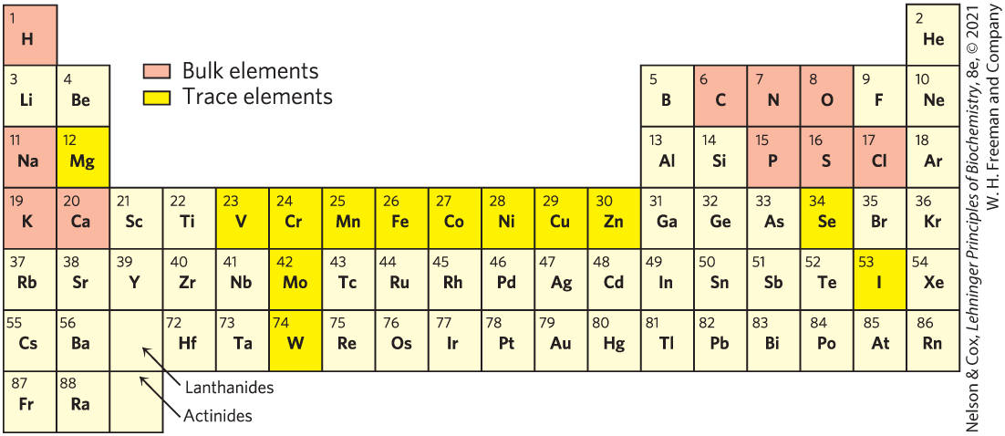
Elements Essential to Animal Life and Health

Slide 57
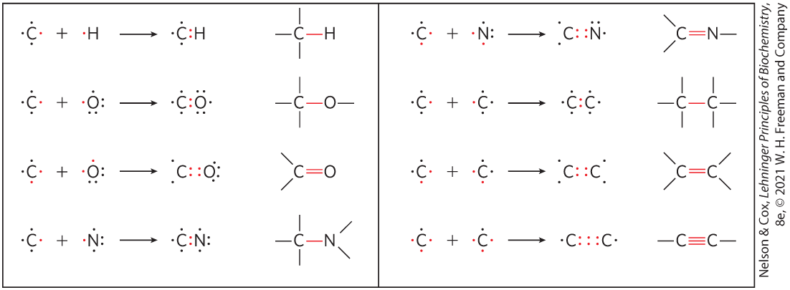
Biomolecules Are Compounds of Carbon with a Variety of Functional Groups
carbon can form covalent single, double, and triple bonds

Slide 58
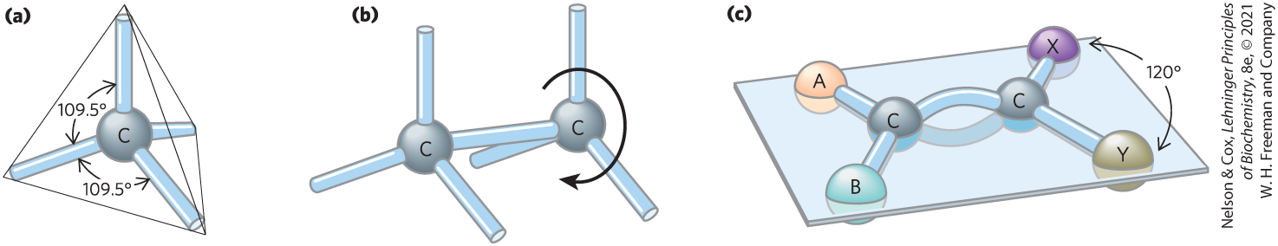
Geometry of Carbon Bonding
carbon atoms have a characteristic tetrahedral arrangement of their four single bonds
free rotation around each single bond
limited rotation about the axis of a double bond

Slide 59
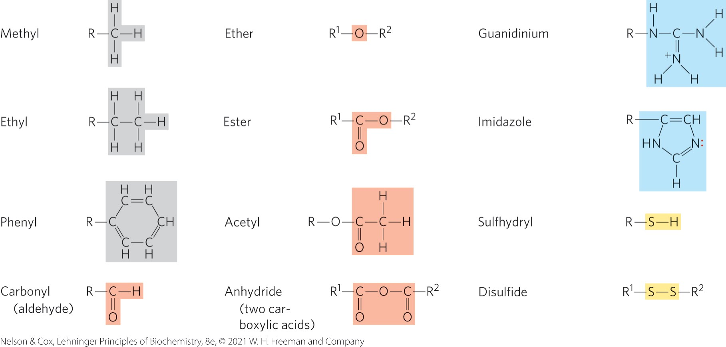
Common Functional Groups of Biomolecules

Slide 60
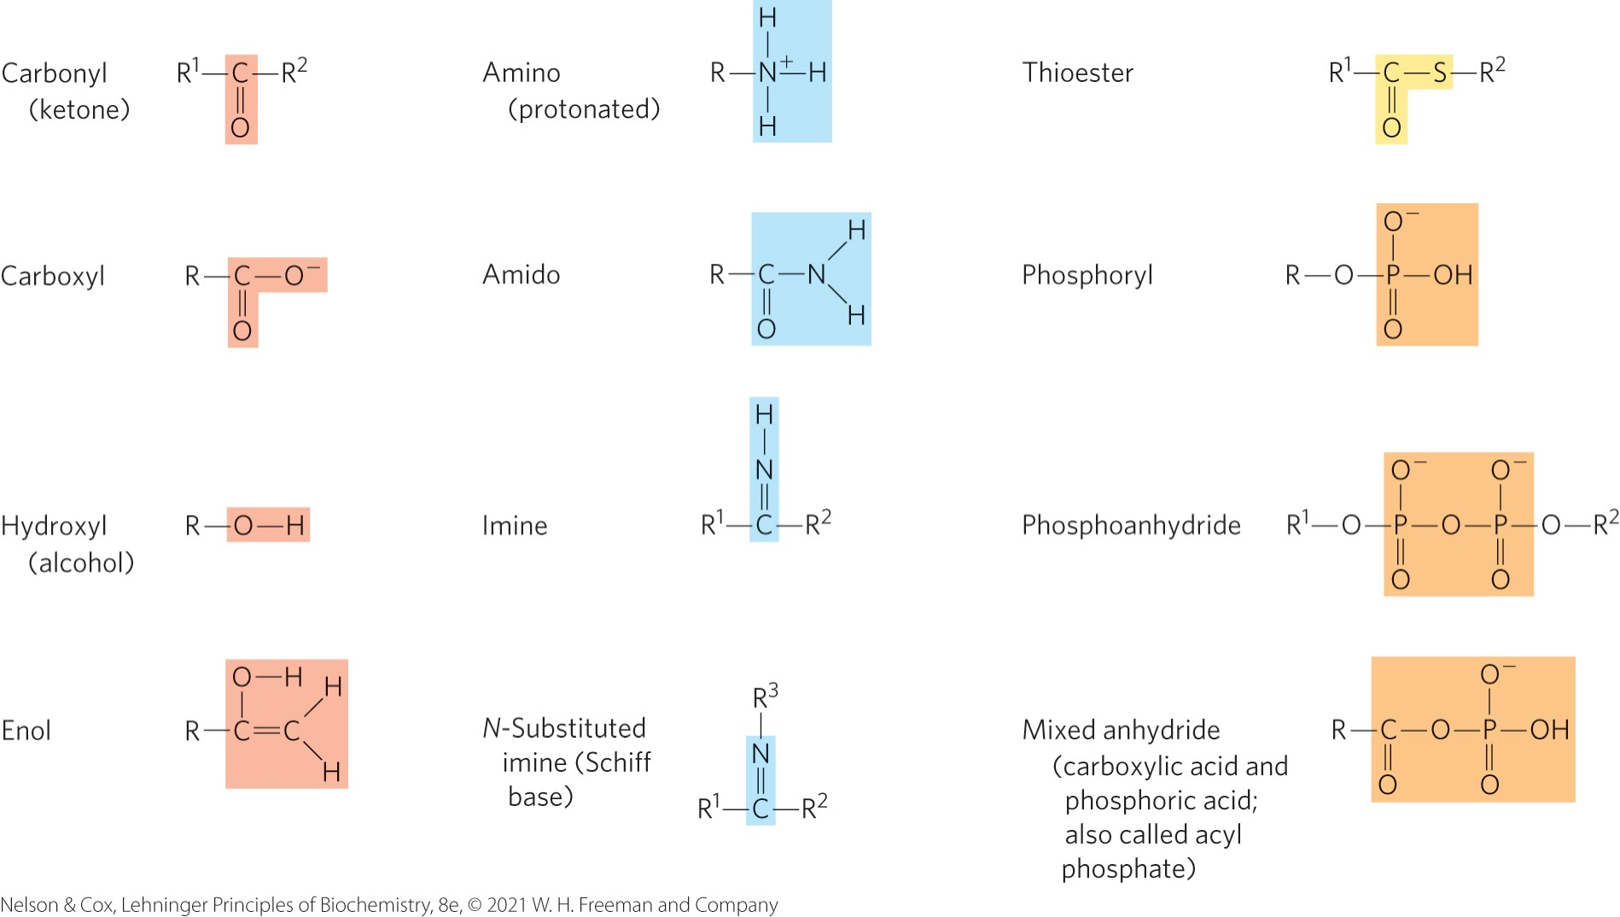
Additional Functional Groups of Biomolecules

Slide 61

Clicker Question 9
Important functional groups in biomolecules include:
A. lipids.
B. thioesters.
C. nucleic acids.
D. carbons.
Notes:
Answer: B
Principle: 1.2
Learning Objective(s): Determine the functional groups in an organic molecule.
Bloom’s: 1:1

Slide 62
Clicker Question 9, Response
Important functional groups in biomolecules include:
B. thioesters.
Functional groups confer specific chemical properties on the molecule, forming various families of organic compounds. Thioesters (R¹—S—CO—R²) are one such functional group in biomolecules.

Slide 63
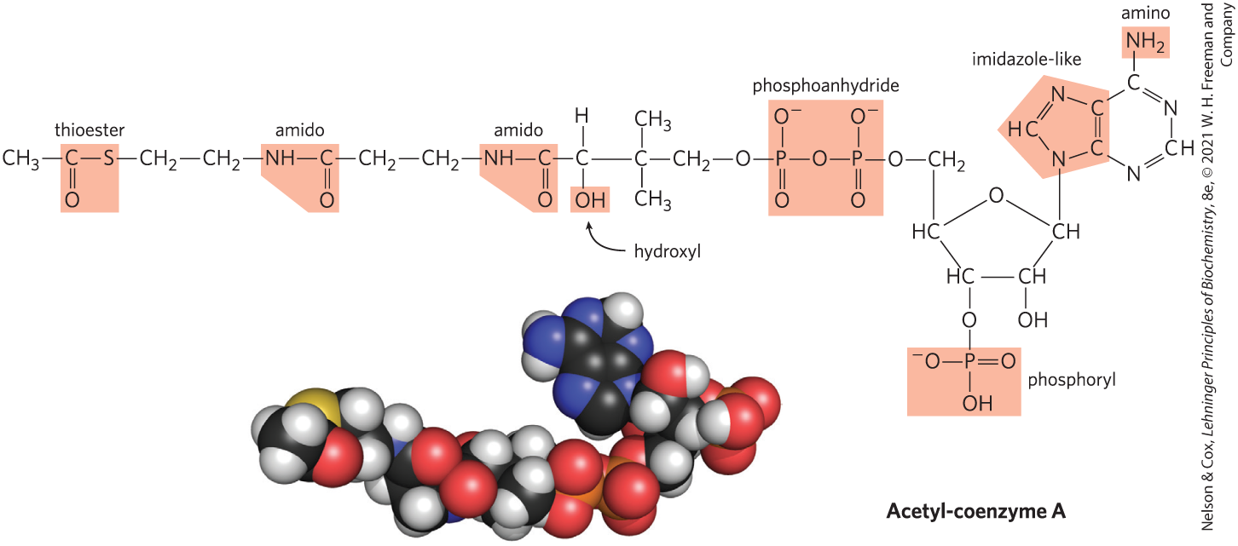
Many Biomolecules Are Polyfunctional

Slide 64
Cells Contain a Universal Set of Small Molecules
central metabolites:
  common amino acids
  nucleotides
  sugars and their phosphorylated derivatives
  mono-, di-, and tricarboxylic acids
secondary metabolites = specific to the organism
metabolome = entire collection of small molecules in a given cell under a specific set of conditions
  metabolomics = the systematic characterization of the metabolome under very specific conditions

Slide 65
Macromolecules Are the Major Constituents of Cells
macromolecules = polymers with molecular weights above ~5,000 that are assembled from relatively simple precursors
  proteins
  nucleic acids
  polysaccharides
oligomers = shorter polymers
informational macromolecules = name for proteins, nucleic acids, and some oligosaccharides, given their information-rich subunit sequences

Slide 66
Protein Macromolecules
proteins = long polymers of amino acids
  can function as enzymes, structural elements, signal receptors, transporters
proteome = sum of all the proteins functioning in a cell
proteomics = the systematic characterization of this protein complement under a specific set of conditions

Slide 67
Clicker Question 10
Proteins are classified as macromolecules because they:
A. can associate noncovalently into very large
structures.
B. are polymers with molecular weights above ~5,000.
C. can function as enzymes, structural elements, signal
receptors, or transporters.
D. are composed of multiple oligomers.
Notes:
Answer: B
Principle: 1.2
Learning Objective(s): Classify a biomolecule based on its composition and structure.
Bloom’s: 2:2

Slide 68
Clicker Question 10, Response
Proteins are classified as macromolecules because they:
B. are polymers with molecular weights above
~5,000.
Macromolecules, including proteins, are polymers with molecular weights above ~5,000 that are assembled from relatively simple precursors.

Slide 69
Nucleic Acid Macromolecules
nucleic acids = DNA and RNA = polymers of nucleotides
  store and transmit genetic information
  some RNA molecules have structural and catalytic roles in supramolecular complexes
genome = entire sequence of a cell’s DNA or RNA
genomics = the characterization of the structure, function, evolution, and mapping of genomes

Slide 70
Polysaccharide Macromolecules
polysaccharides = polymers of simple sugars
  energy-rich fuel stores
  rigid structural components of cell walls (in plants and bacteria)
  extracellular recognition elements that bind to proteins on other cells
glycome = entire complement of carbohydrate-containing molecules

Slide 71
Lipid Molecules
lipids = water-insoluble hydrocarbon derivatives
  structural components of membranes
  energy-rich fuel stores
  pigments
  intracellular signals
lipidome = the lipid containing molecules in a cell

Slide 72


Activity: Classifying
Metabolites
Observe the structure of palmitic acid in Mol3D viewer.
Notes:
Instructor: This Mol3D structure is located in the Achieve course. It can be found in the Chapter 1 content, in the folder titled “Ch1 In-Class Activities and Resources.”

Slide 73
Activity Instructions (2 of 4)
On your own, think of answers to the questions:
  Is palmitic acid a carbon-based metabolite?
  What type of biomolecule is palmitic acid?
(2 minutes)
Pair up to discuss your ideas. (2 minutes)
Share your ideas with the class in group discussion. (3 minutes)
Notes:
Instructor: This Mol3D structure is located in the Achieve course. It can be found in the Chapter 1 content, in the folder titled “Ch1 In-Class Activities and Resources.”

Slide 74
Activity Solution (2 of 4)
  Is palmitic acid a carbon-based metabolite?
  Yes, palmitic acid has a backbone consisting
  of 16 carbons.
  What type of biomolecule is palmitic acid?
  Palmitic acid is a fatty acid, which is a type of
  lipid.
Notes:
Instructor: This Mol3D structure is located in the Achieve course. It can be found in the Chapter 1 content, in the folder titled “Ch1 In-Class Activities and Resources.”

Slide 75
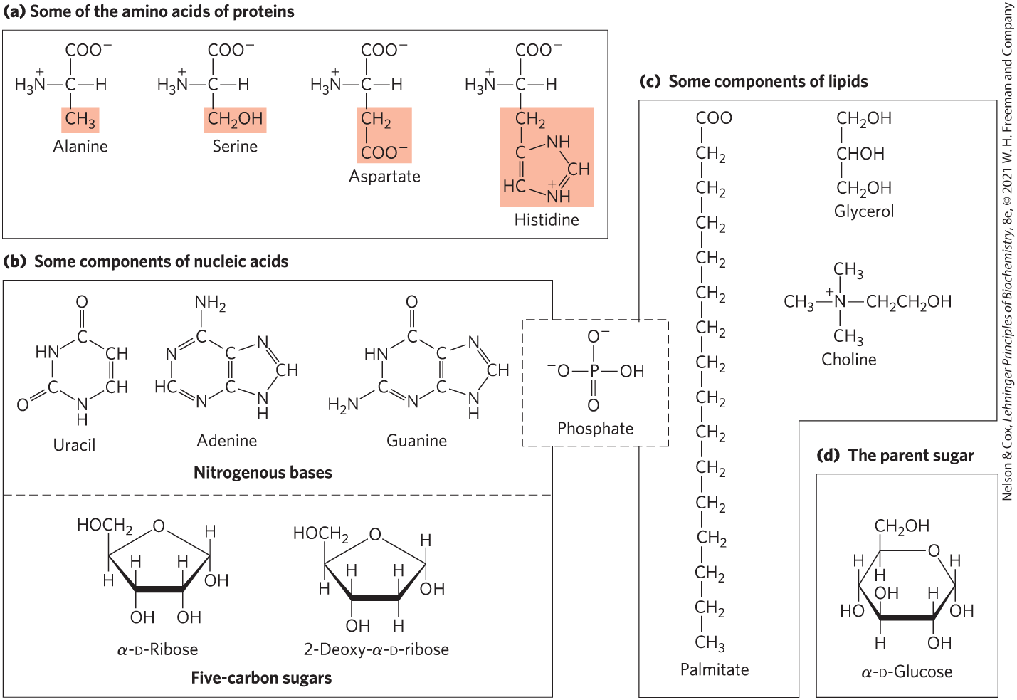
Building Blocks of Biochemistry

Slide 76
Major Classes of Biomolecules in E. coli Cells
Table 1-1 Molecular Components of an E. coli Cell
 | Percentage of total weight of cell | Approximate number of different molecular species
Water | 70 | 1
Proteins | 15 | 3,000
Nucleic acids: DNA | 1 | 1–4
Nucleic acids: RNA | 6 | >3,000
Polysaccharides | 3 | 20
Lipids | 2 | 50ª
Monomeric subunits and intermediates | 2 | 2,600
Inorganic ions | 1 | 20
Source: A. C. Guo et al., Nucleic Acids Res. 41:D625, 2013.
ªIf all permutations and combinations of fatty acid substitutions are considered, this number is much larger.

Slide 77

Clicker Question 11
The systematic characterization of the entire collection of small molecules in a given cell under a specific set of conditions is called:
A. genomics.
B. proteomics.
C. lipidomics.
D. metabolomics.
Notes:
Answer: D
Principle: 1.2
Learning Objective(s): Describe how organisms organize and carry out functions that are necessary for life.
Bloom’s: 1:1

Slide 78
Clicker Question 11, Response
The systematic characterization of the entire collection of small molecules in a given cell under a specific set of conditions is called:
D. metabolomics.
The entire collection of small molecules in a given cell under a specific set of conditions has been called the metabolome. Metabolomics is the systematic characterization of the metabolome under very specific conditions (such as following administration of a drug, or a biological signal such as insulin).

Slide 79
Three-Dimensional Structure Is Described by Configuration and Conformation
configuration = the fixed spatial arrangement of atoms
stereoisomers = molecules with the same chemical bonds and same chemical formula
stereospecific = requiring specific conformations in the interacting molecules
  describes typical interactions between biomolecules

Slide 80
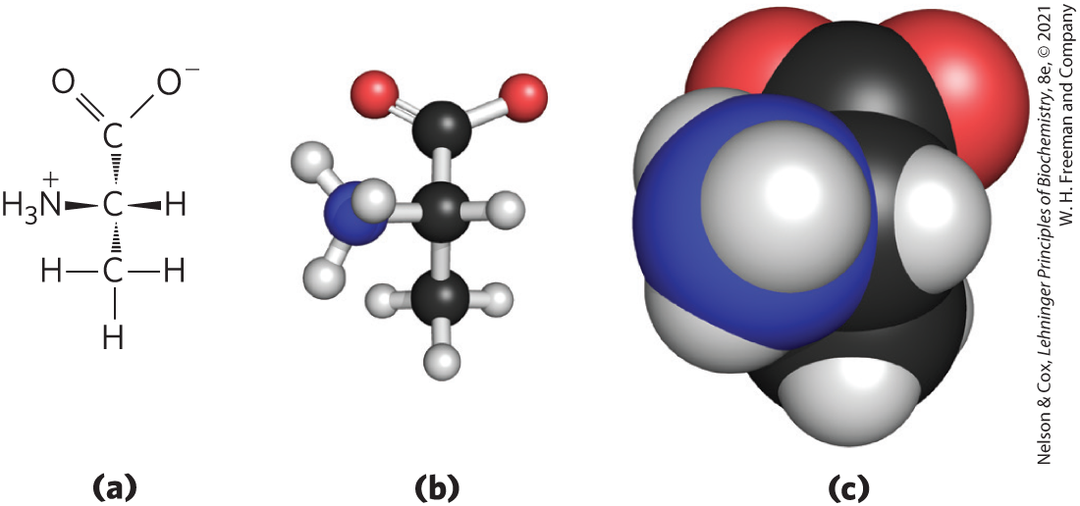
Illustrating Stereochemistry

Slide 81
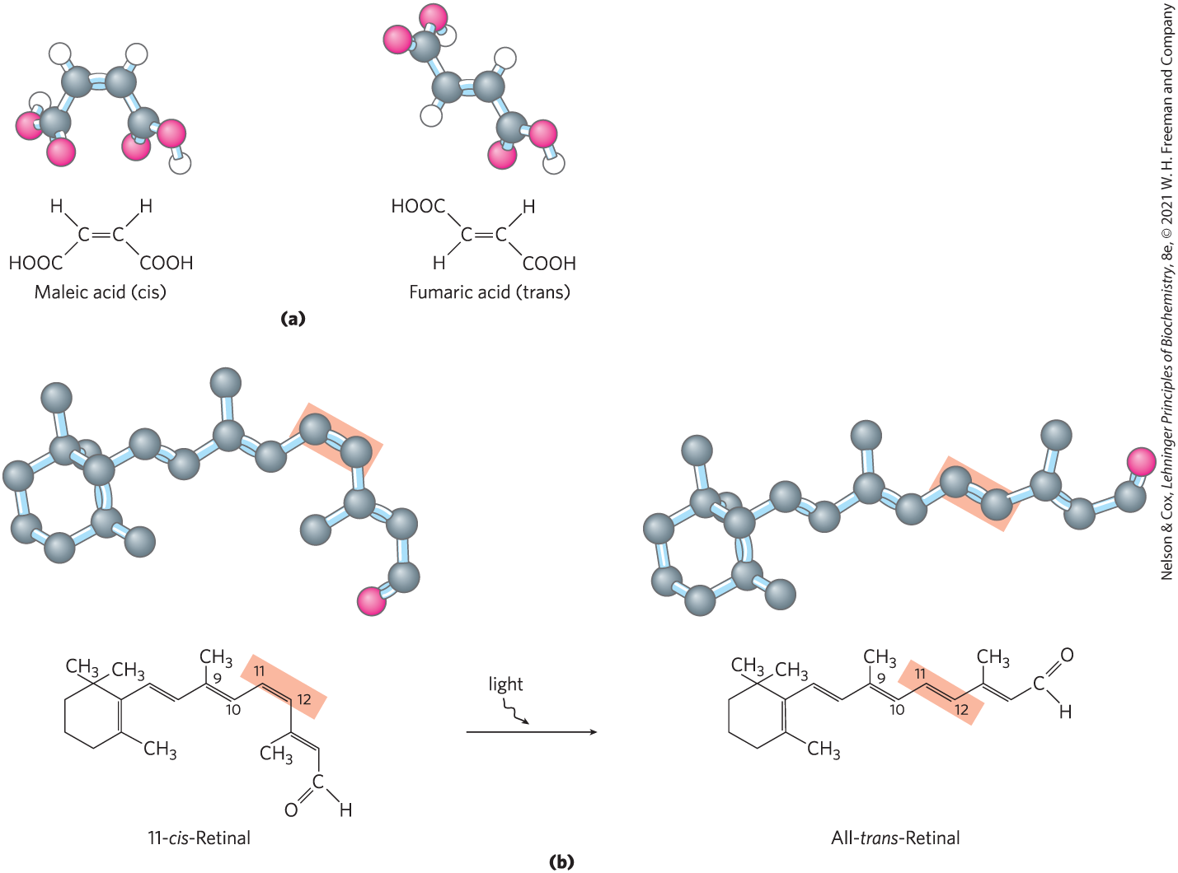
Configurations of Geometric Isomers
geometric isomers, or cis-trans isomers = differ in the arrangement of substituent groups with respect to the double bond

Slide 82
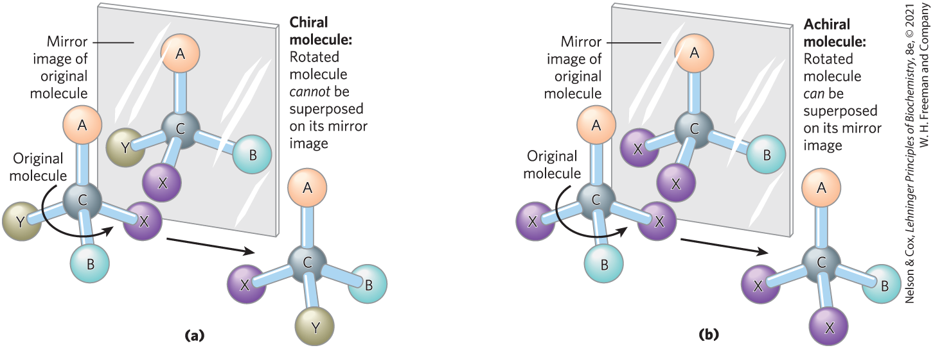
Chiral and Achiral Molecules
chiral centers = asymmetric carbons
a molecule can have 2^{n} stereoisomers, where n is the number of chiral carbons

Slide 83
Clicker Question 12
Molecules that differ in configuration cannot be:
A. stereoisomers.
B. cis-trans isomers.
C. chiral centers that are mirror images of each other.
D. chiral centers that can be interchanged by rotation of a
single bond.
Notes:
Answer: D
Principle: 1.2
Learning Objective(s): Identify a pair of molecules as isomers, the same compound, or different compounds.
Bloom’s: 3:2

Slide 84
Clicker Question 12, Response
Molecules that differ in configuration cannot be:
D. chiral centers that can be interchanged by rotation of a
single bond.
Configuration describes the fixed spatial arrangement of atoms, conferred by the presence of either (1) double bonds, around which there is little or no freedom of rotation, or (2) chiral centers, around which substituent groups are arranged in a specific orientation. Molecules that differ in configuration cannot be chiral centers that can be interchanged by rotation of a single bond.

Slide 85
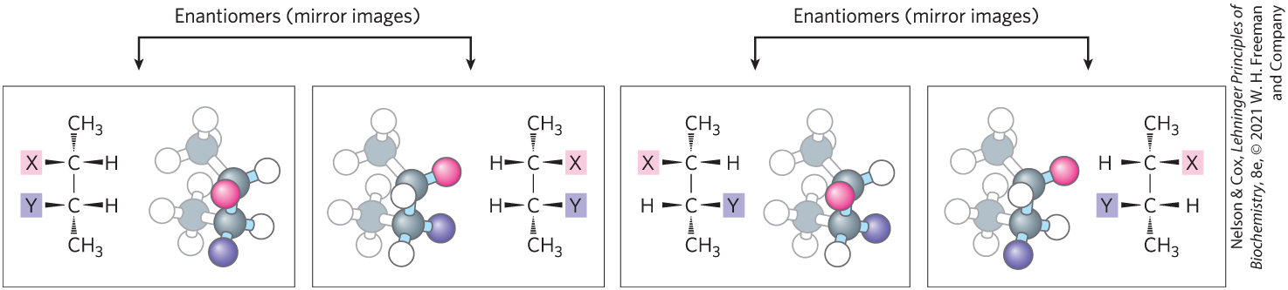
Enantiomers and Diastereomers
enantiomers = stereoisomers that are mirror images of each other
diastereomers = stereoisomers that are not mirror images of each other

Slide 86
Optical Activity of Enantiomers
enantiomers have nearly identical chemical reactivities, but differ in optical activity
a racemic mixture (equimolar solution of two enantiomers) shows no optical rotation

Slide 87
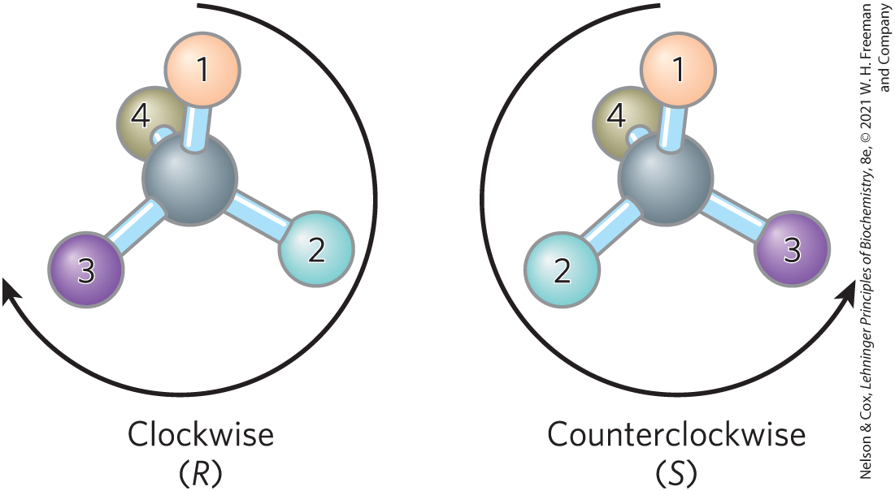
Naming Stereoisomers Using the RS System
each group attached to a chiral carbon is assigned a priority, where:
—OCH₃ > —OH > —NH₂ > —COOH > —CHO >
—CH₂OH > —CH₃ > —H

Slide 88
Clicker Question 13
Enantiomers:
A. are only associated with amino acids.
B. can be specific types of diastereomers.
C. are always designated either D or L.
D. can exist for molecules with more than one chiral carbon.
Notes:
Answer: D
Principle: 1.2
Learning Objective(s): Contrast enantiomers and diastereomers.
Bloom’s: 2:2

Slide 89
Clicker Question 13, Response
Enantiomers:
D. can exist for molecules with more than one chiral
carbon.
A carbon atom with four different substituents is said to be asymmetric, and asymmetric carbons are called chiral centers. A molecule can have 2^{n} stereoisomers, where n is the number of chiral carbons. Stereoisomers that are mirror images of each other are called enantiomers. Enantiomers can exist for molecules that have more than one chiral carbon.

Slide 90
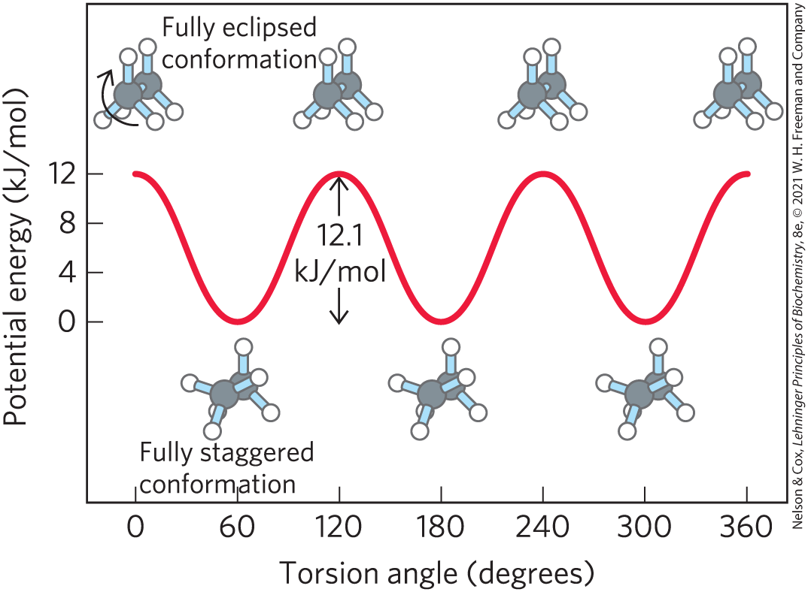
Molecular Conformation
conformation = the spatial arrangement of substituent groups that are free to assume different positions in space

Slide 91
Principle 2 (4 of 6)
Cells use a relatively small set of carbon- based metabolites to create polymeric machines, supramolecular structures, and information repositories. The chemical structure of these components defines their cellular function. The collection of molecules carries out a program, the end result of which is reproduction of the program and self-perpetuation of that collection of molecules—in short, life.

Slide 92
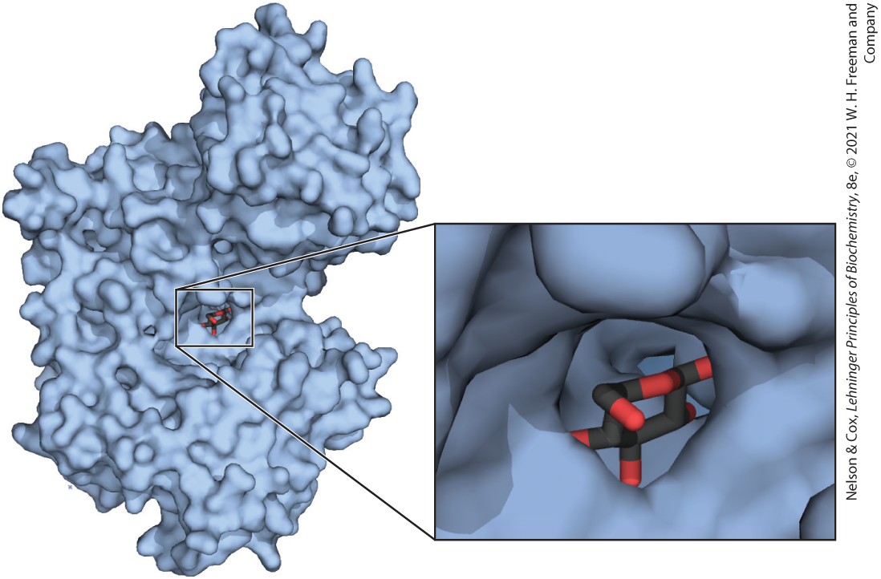
Interactions between Biomolecules Are Stereospecific

Slide 93
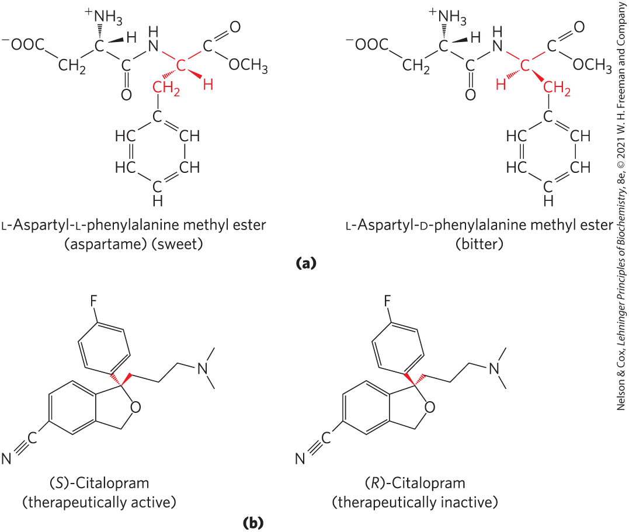
Biological Systems Can Distinguish Stereoisomers
stereospecificity = the ability to distinguish between stereoisomers

Slide 94
Clicker Question 14
The antidepressant medication Celexa is a racemic mixture of two stereoisomers, but only (S)-citalopram has the therapeutic effect. A stereochemically pure preparation of (S)-citalopram is sold under the trade name Lexapro. Which is true about the medications?
A. A solution of Lexapro will show no optical activity.
B. Biological systems are not able to distinguish between the
two stereoisomers.
C. The effective dose of Lexapro is one-half the effective dose
of Celexa.
D. Both stereoisomers are biologically active.
Notes:
Answer: C
Principle: 1.2
Learning Objective(s): Relate the configuration of a chiral carbon atom and its designation in the RS system; Identify a pair of molecules as isomers, the same compound, or different compounds.
Bloom’s: 2:2

Slide 95
Clicker Question 14, Response
The antidepressant medication Celexa is a racemic mixture of two stereoisomers, but only (S)-citalopram has the therapeutic effect. A stereochemically pure preparation of (S)-citalopram is sold under the trade name Lexapro. Which is true about the medications?
C. The effective dose of Lexapro is one-half the effective
dose of Celexa.
Celexa is an equimolar solution of two enantiomers, whereas Lexapro contains only (S)-citalopram. Since only (S)-citalopram is therapeutically active, the effective dose of Lexapro is one-half the effective dose of Celexa.

Slide 96
1.3 Physical Foundations

Slide 97
Living Organisms Exist in a Dynamic Steady State, Never at Equilibrium with Their Surroundings
small molecules, macromolecules, and supramolecular complexes are continuously synthesized and broken down
living cells maintain themselves in a dynamic steady state distant from equilibrium
maintaining steady state requires the constant investment of energy

Slide 98
Organisms Transform Energy and Matter from Their Surroundings
system = all the constituent reactants and products, the solvent that contains them, and the immediate atmosphere
universe = system and its surroundings
types of systems:
  isolated = system exchanges neither matter nor energy with its surroundings
  closed system = system exchanges energy but not matter with its surroundings
  open system = system exchanges both energy and matter with its surroundings

Slide 99
Clicker Question 15
A living organism is a(n):
A. isolated system.
B. closed system.
C. open system.
D. universe.
Notes:
Answer: C
Principle: 1.2
Learning Objective(s): Describe the energy transformations carried out by living organisms; Classify an organism based on how it obtains energy.
Bloom’s: 1:1

Slide 100
Clicker Question 15, Response
A living organism is a(n):
C. open system.
A living organism is an open system; it exchanges both matter and energy with its surroundings.

Slide 101
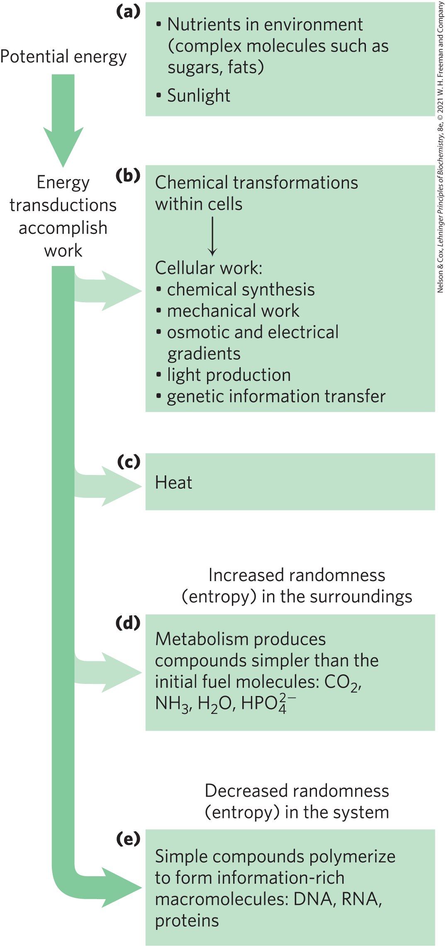
Energy Transformation in Living Organisms
first law of thermodynamics: in any physical or chemical change, the total amount of energy in the universe remains constant, although the form of the energy may change

Slide 102
Principle 3 (3 of 5)
Living organisms exist in a dynamic
steady state, never at equilibrium with
their surroundings. Following the laws of thermodynamics, living organisms extract energy from their surroundings and employ it to maintain homeostasis and do useful work. Essentially all of the energy obtained by a cell comes from the flow of electrons, driven by sunlight or by metabolic redox reactions.

Slide 103
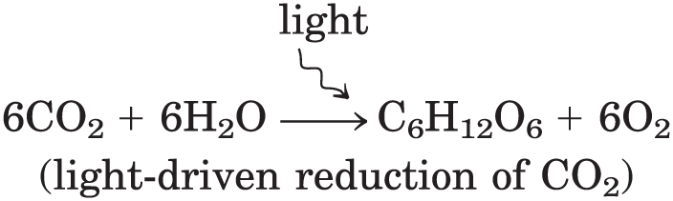
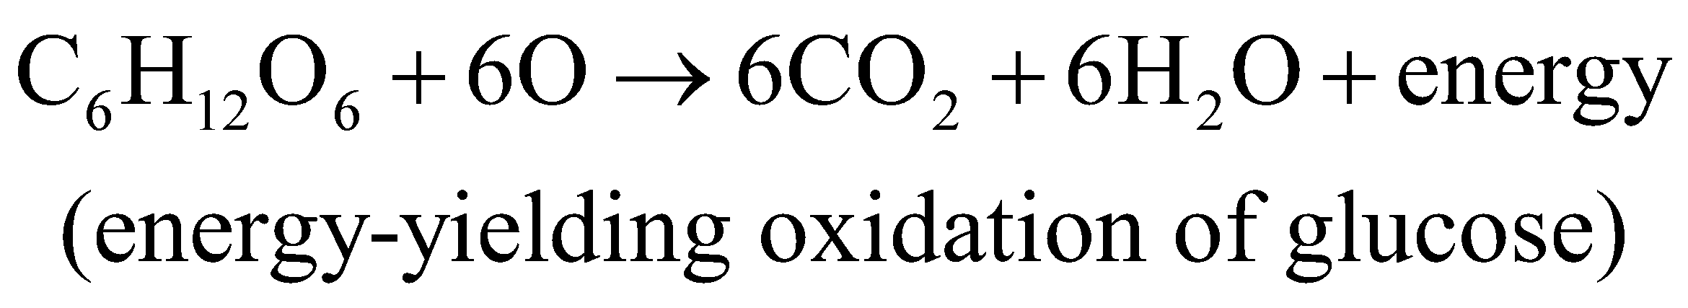
Extracting Energy from the Surroundings
photoautotrophs:
chemotrophs:

Slide 104
Oxidation-Reduction Reactions
autotrophs and heterotrophs participate in global cycles of O₂ and CO₂, driven by sunlight, making these two groups interdependent
oxidation-reduction reactions = one reactant is oxidized (loses electrons) as another is reduced (gains electrons)
  describes reactions involved in electron flow

Slide 105
Creating and Maintaining Order Requires Work and Energy
second law of thermodynamics: randomness in the universe is constantly increasing
entropy, S = represents the randomness or disorder of the components of a chemical system

Slide 106
Free Energy, G
enthalpy, H = heat content, roughly reflecting the number and kinds of bonds
free energy, G, of a closed system = H – TS,
where H represents enthalpy, T represents absolute temperature, and S represents entropy

Slide 107

Clicker Question 16
Which of these is a reflection of the total energy change in a chemical reaction, a measure of the number and kinds of bonds that are made and broken?
A. ∆G
B. ∆H
C. ∆S
D. ∆T
Notes:
Answer: B
Principle: 1.3
Learning Objective(s): Contrast free energy, enthalpy, and entropy.
Bloom’s: 2:1

Slide 108
Clicker Question 16, Response
Which of these is a reflection of the total energy change in a chemical reaction, a measure of the number and kinds of bonds that are made and broken?
B. ∆H
The enthalpy change, ∆H, reflects the kinds and numbers of chemical bonds and noncovalent interactions broken and formed.

Slide 109
Free-Energy Change, ∆G
free-energy change, ∆G = ∆H − T∆S
  where ∆H is negative for a reaction that releases heat, and ∆S is positive for a reaction that increases the system’s randomness
spontaneous reactions occur when ∆G is negative

Slide 110
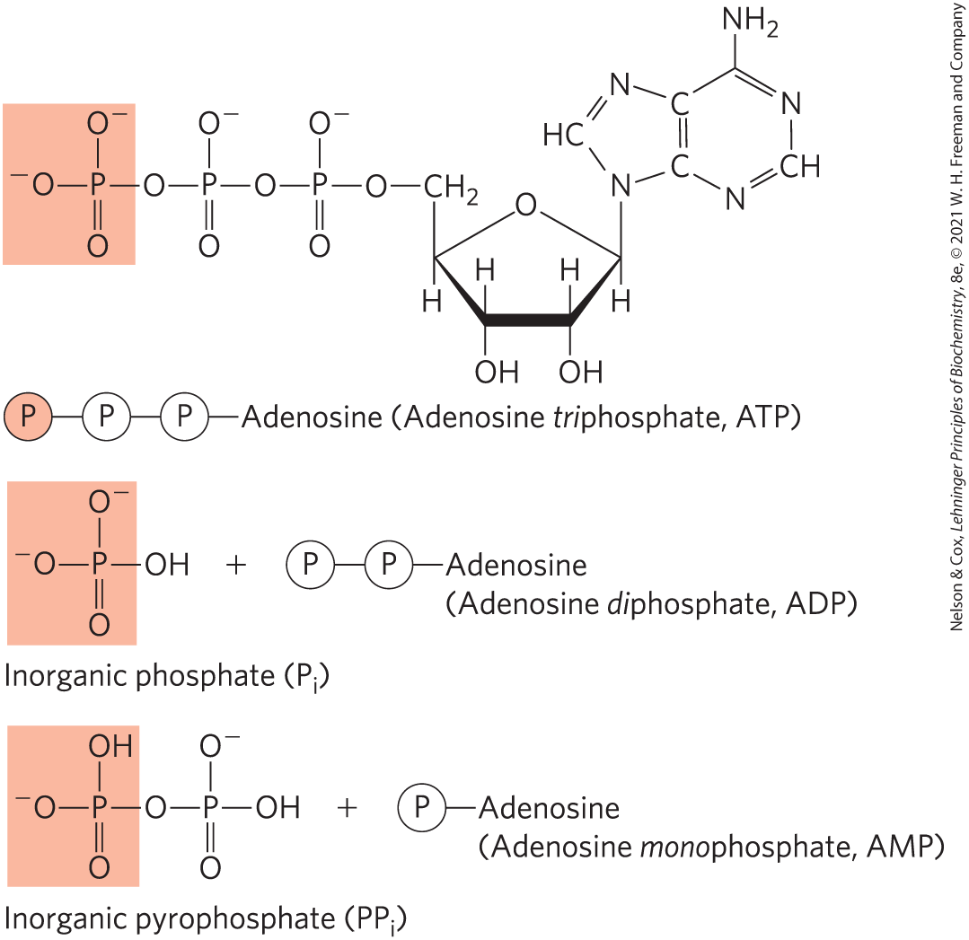
Coupling Reactions
energy-requiring (endergonic) reactions are often coupled to reactions that release free energy (exergonic)
the breakage of phosphoanhydride bonds in ATP is highly exergonic

Slide 111
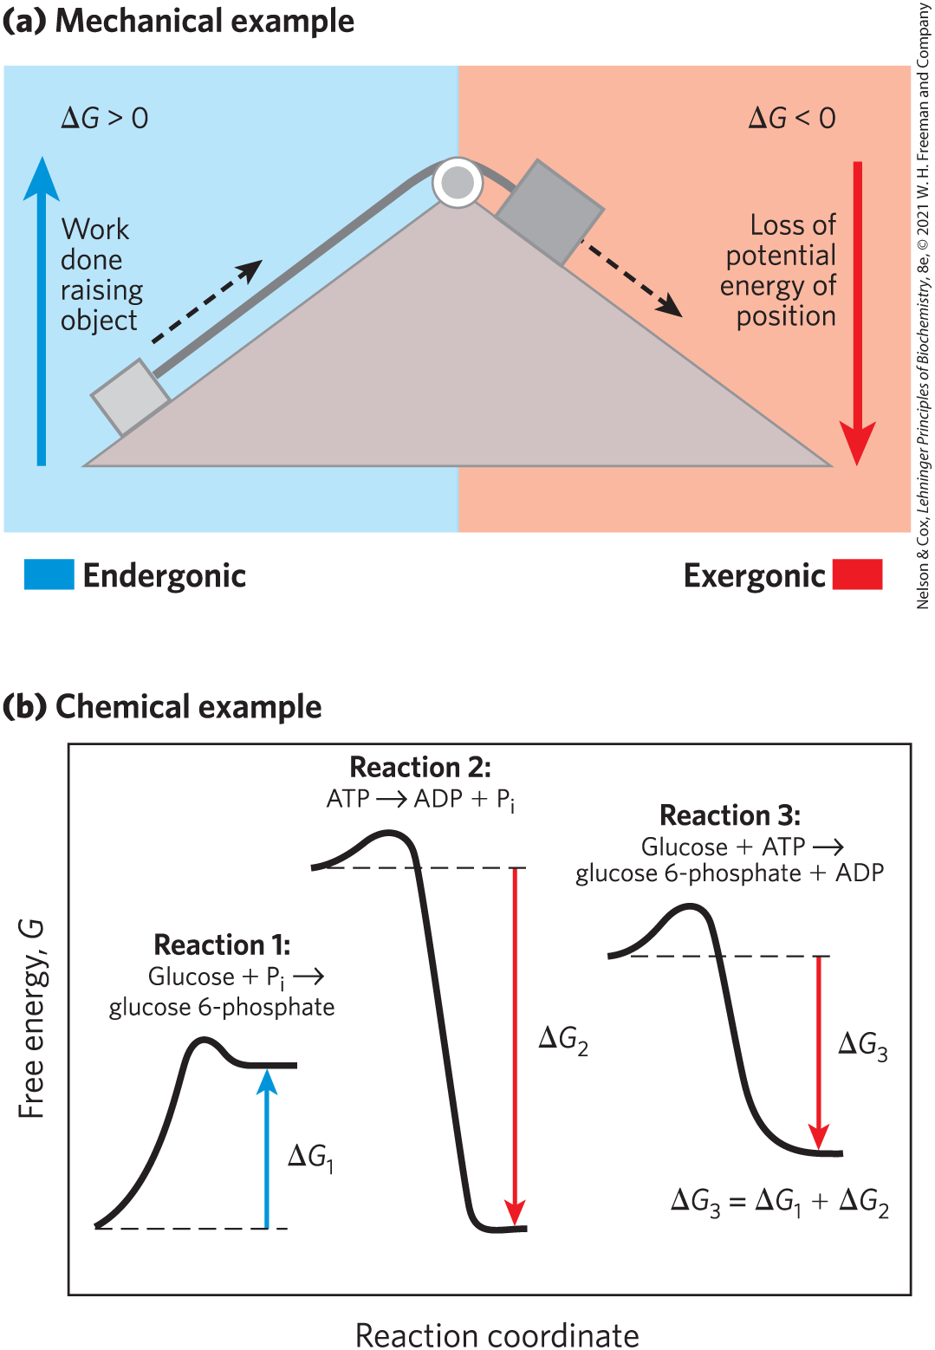
Energy Coupling Links Reactions in Biology
free-energy change, ∆G = amount of energy available to do work
  always less than the theoretical amount of energy released
in closed systems, chemical reactions proceed spontaneously until equilibrium is reached

Slide 112
Clicker Question 17
If under a given set of conditions, the reaction A → B occurs with ∆G = –14 kJ/mol and the reaction C → B occurs when ∆G = +16 kJ/mol, then:
A. the conversion of C to A is freely reversible.
B. the conversion of A to C is exergonic.
C. A and C can never be at equilibrium, even under different
reaction conditions.
D. the conversion of A to C is entropically driven.
Notes:
Answer: B
Principle: 1.3
Learning Objective(s): Relate free energy, enthalpy, temperature, and entropy; Contrast endergonic and exergonic reactions.
Bloom’s: 3:2

Slide 113
Clicker Question 17, Response
If under a given set of conditions, the reaction A → B occurs with ∆G = –14 kJ/mol and the reaction C → B occurs when ∆G = +16 kJ/mol, then:
B. the conversion of A to C is exergonic.
A → B ∆G = –14 kJ/mol
B → C ∆G = –16 kJ/mol
A → C ∆G = –30 kJ/mol
The conversion of A to C is exergonic because ∆G is negative (meaning free energy is released).

Slide 114
K_{eq} and ∆G° Are Measures of a Reaction’s Tendency to Proceed Spontaneously
For the reaction,
The equilibrium constant, K_{eq}, is given by
Where [A]_{eq} is the concentration of A, [B]_{eq} the concentration of B, and so on, when the system has reached equilibrium.

Slide 115
Mass-Action Ratio, Q
mass-action ratio, Q = ratio of product concentrations to reactant concentrations at a given time
  can be calculated to determine how far the reaction is from equilibrium

Slide 116
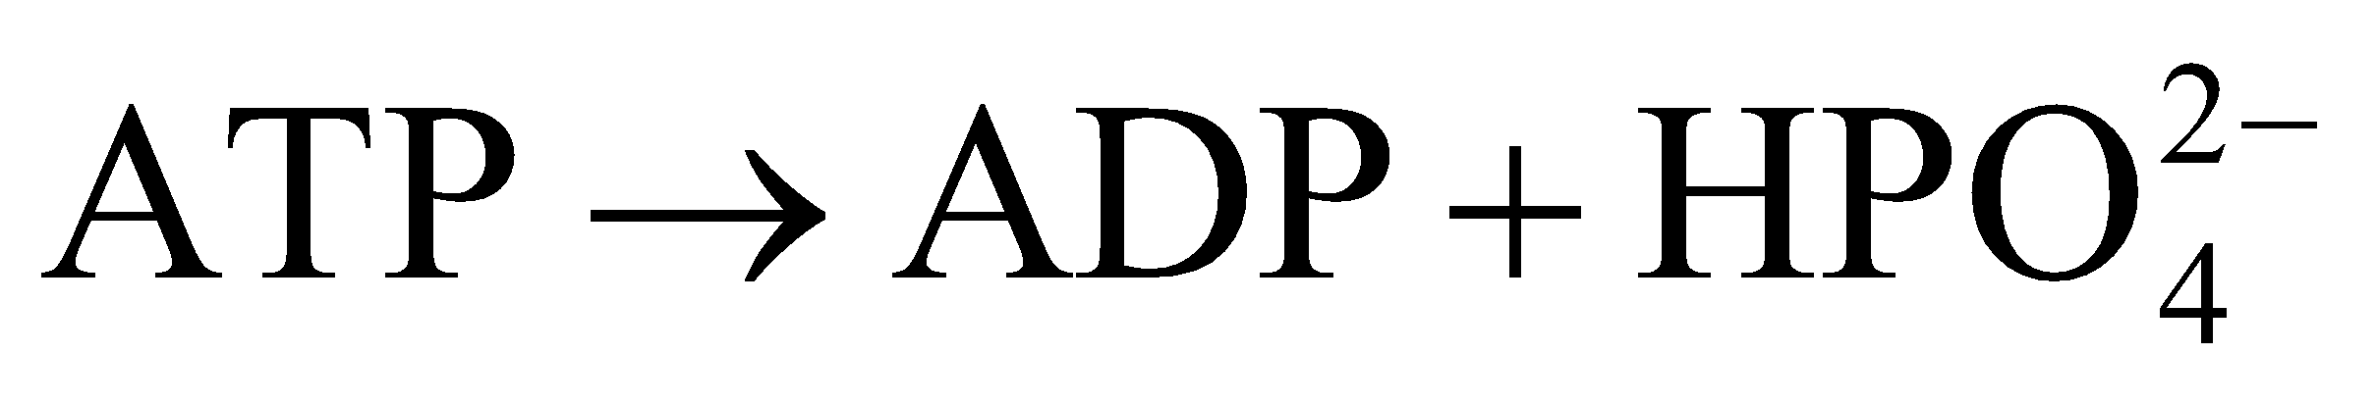
Clicker Question 18
ATP breakdown yields ADP and inorganic phosphate (P_{i}). The K_{eq} for the reaction is 2 × 10⁵ M:
If measured cellular concentrations are [ATP] = 15 mM, [ADP] = 1.5 mM, and [P_{i}] = 15 mM, is this reaction at equilibrium in living cells?
A. Yes, because Q = K_{eq}.
B. No, because Q = K_{eq}.
C. Yes, because Q << K_{eq}.
D. No, because Q << K_{eq}.
Notes:
Answer: D
Principle: 1.3
Learning Objective(s): Determine the equilibrium constant K_{eq} for a reaction; Relate the free energy, standard free-energy change, gas constant, temperature, and the concentrations of reactants and products for a reaction.
Bloom’s: 3:2

Slide 117
Clicker Question 18, Response
ATP breakdown yields ADP and inorganic phosphate (P_{i}). The K_{eq} for the reaction is 2 × 10⁵ M:
If measured cellular concentrations are [ATP] = 15 mM, [ADP] = 1.5 mM, and [P_{i}] = 15 mM, is this reaction at equilibrium in living cells?
D. No, because Q << K_{eq}.
Q = [ADP][P_{i}]/[ATP] = (1.5 mM)(15 mM)/15 mM = 1.5 mM
This value is far from the K_{eq} for the reaction, so the reaction is very far from equilibrium in cells.

Slide 118
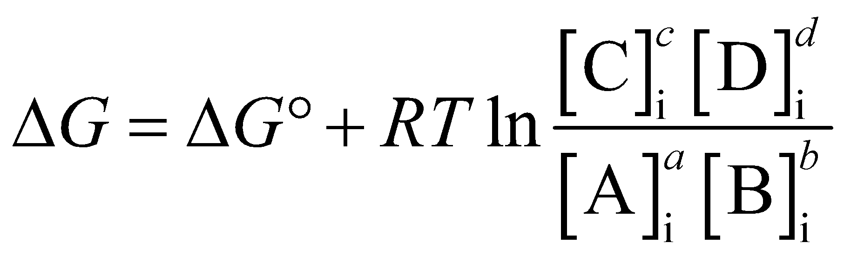
Standard Free-Energy Change, ∆G°
∆G (the actual free-energy change) for any chemical reaction is a function of the standard free-energy change, ∆G°
(Eqn 1-1)
where [A]_{i} is the initial concentration of A, and so forth; R is the gas constant; and T is the absolute temperature

Slide 119
Clicker Question 19
A reaction will always be thermodynamically spontaneous if:
A. ∆H < 0 and ∆S > 0.
B. ∆G = 0.
C. it is coupled to another reaction.
D. ∆G° > 0.
Notes:
Answer: A
Principle: 1.3
Learning Objective(s): Relate free energy, enthalpy, temperature, and entropy.
Bloom’s: 2:2

Slide 120
Clicker Question 19, Response
A reaction will always be thermodynamically spontaneous if:
A. ∆H < 0 and ∆S > 0.
Spontaneous reactions occur when ∆G is negative. From the equation ∆G = ∆H − T∆S, we can deduce that ∆G will always be negative if ∆H < 0 and ∆S > 0.

Slide 121
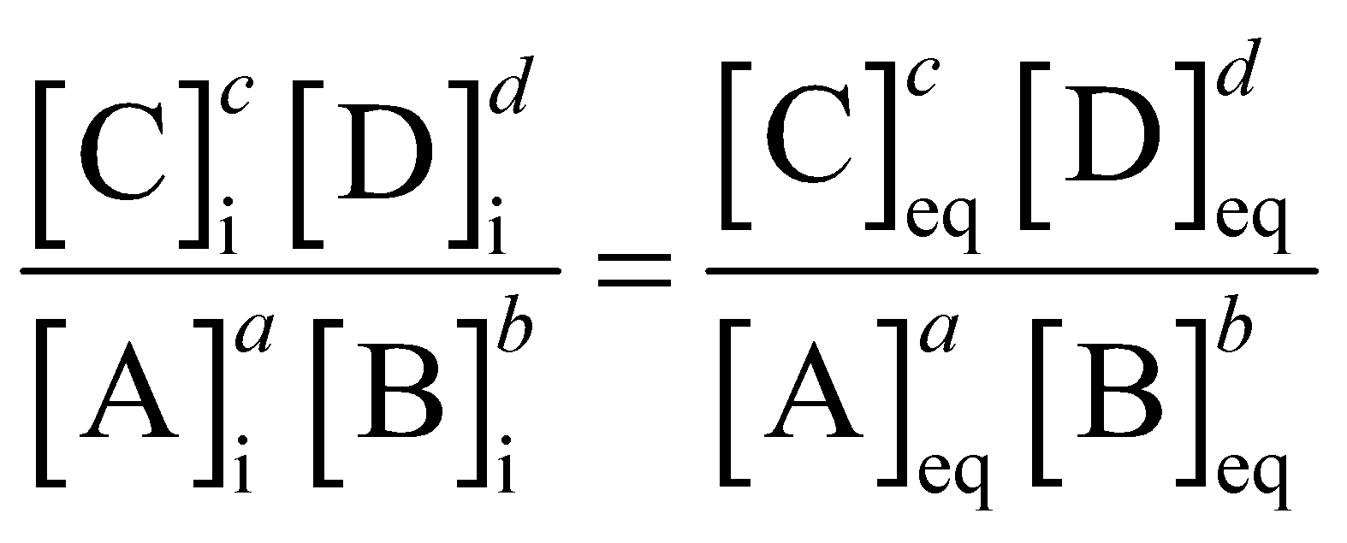
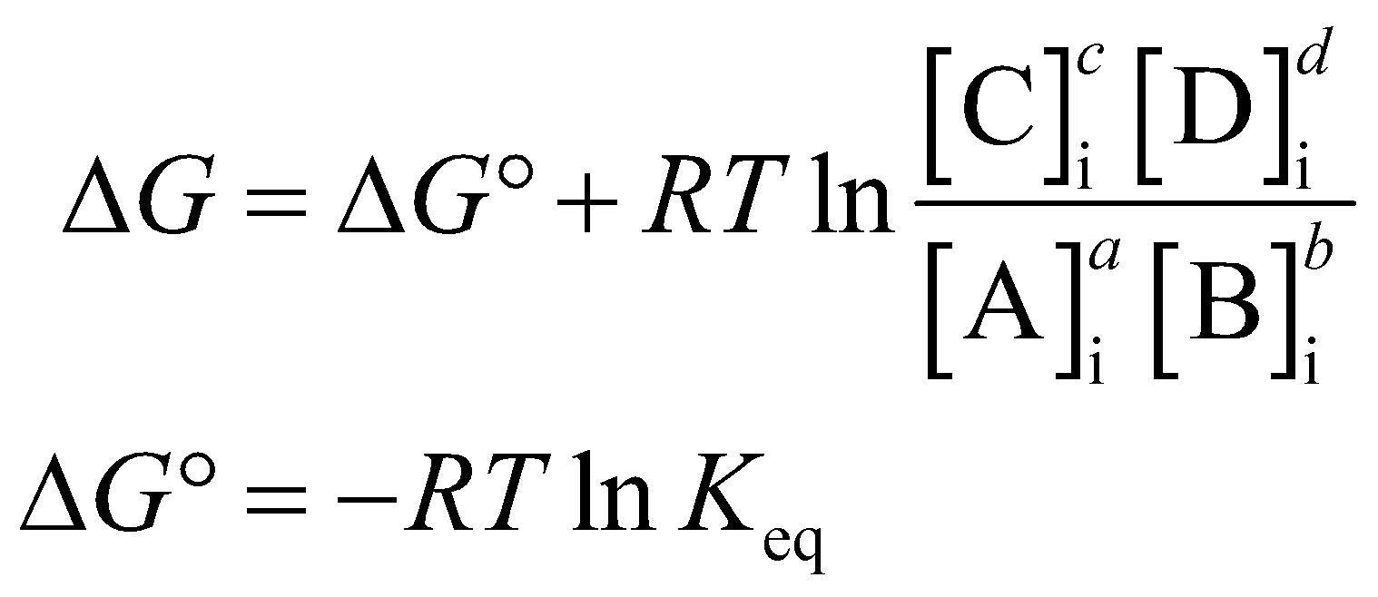
Reactions Can Do No Work at Equilibrium
at equilibrium, ∆G = 0 and
thus,

Slide 122
Principle 3 (4 of 5)
Living organisms exist in a dynamic
steady state, never at equilibrium with
their surroundings. Following the laws of thermodynamics, living organisms extract energy from their surroundings and employ it to maintain homeostasis and do useful work. Essentially all of the energy obtained by a cell comes from the flow of electrons, driven by sunlight or by metabolic redox reactions.

Slide 123
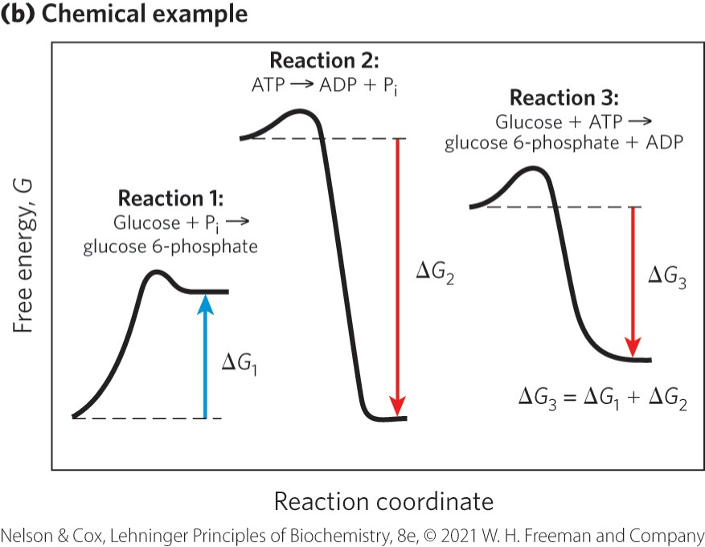
Reaction Coordinate Diagrams
reaction coordinate diagrams = illustrates how exergonic reactions can be coupled to endergonic reactions
reaction 1: endergonic; ∆G₁ is positive
reaction 2: exergonic; ∆G₂ is negative
reaction 3: ∆G₃ is negative

Slide 124
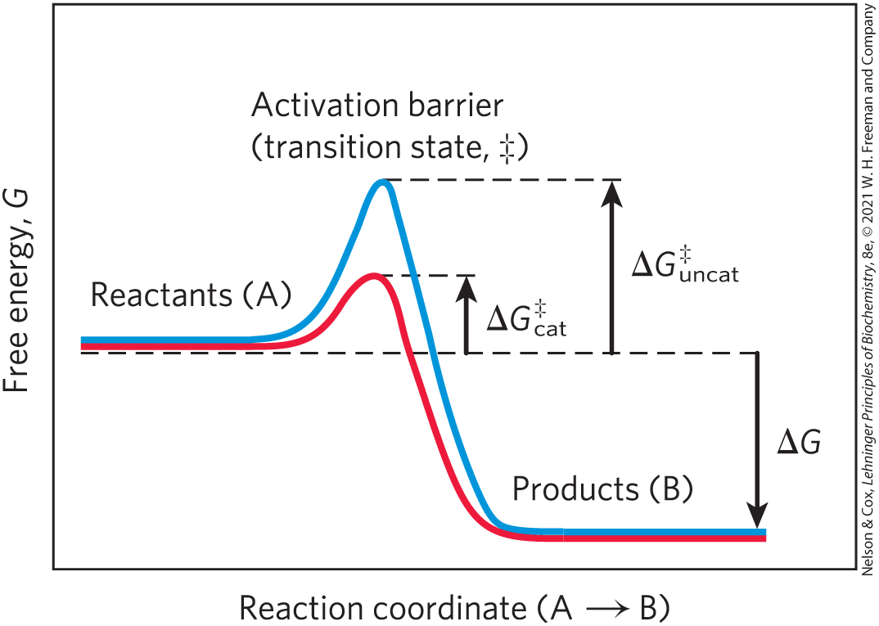
Enzymes Promote Sequences of Chemical Reactions
enzymes = greatly enhance reaction rates of specific chemical reactions without being consumed in the process
transition state = higher free energy than reactant or product
activation energy, ∆G‡ = difference in energy between the reactant in its ground state and its transition state

Slide 125
Clicker Question 20
What function do enzymes actually perform in biochemical reactions?
A. They increase the equilibrium of reactions.
B. They increase the rate of the reactions, but not the
equilibrium.
C. They increase the activation energy of reactions, causing
them to be favorable thermodynamically.
D. They cause products to have higher free energy than
reactants.
Notes:
Answer: B
Principle: 1.3
Learning Objective(s): Describe activation energy.
Bloom’s: 2:2

Slide 126
Clicker Question 20, Response
What function do enzymes actually perform in biochemical reactions?
B. They increase the rate of the reactions, but not the
equilibrium.
Enzymes are biocatalysts that greatly enhance the rate of specific chemical reactions by binding the transition-state intermediates tightly and effectively reducing the activation energy. Enzymes do not increase the equilibrium of the reaction.

Slide 127
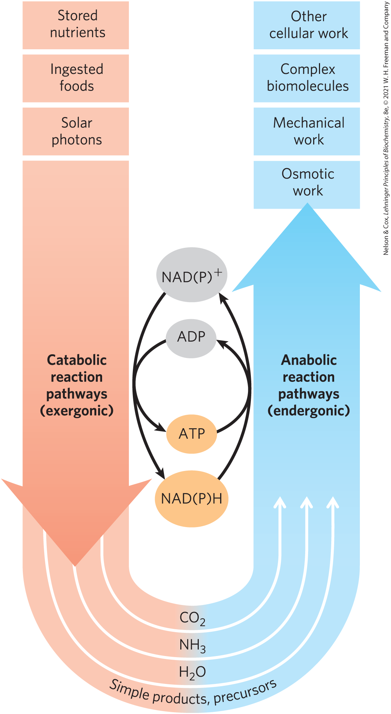
Catabolism and Anabolism
pathways = sequences of consecutive reactions in which the product of one reaction becomes the reactant in the next
catabolism = degradative, free-energy-yielding reactions
  drives ATP synthesis
  produces the reduced electron carriers NAD(P)H
anabolism = synthetic pathways that require the input of energy

Slide 128
Principle 2 (5 of 6)
Cells use a relatively small set of carbon- based metabolites to create polymeric machines, supramolecular structures, and information repositories. The chemical structure of these components defines their cellular function. The collection of molecules carries out a program, the end result of which is reproduction of the program and self-perpetuation of that collection of molecules—in short, life.

Slide 129
Metabolism
metabolism = overall network of enzyme-catalyzed pathways, both catabolic and anabolic
unity of life = pathways of enzyme-catalyzed reactions that act on the main constituents of cells—proteins, fats, sugars, and nucleic acids—are nearly identical in all living organisms

Slide 130
Principle 3 (5 of 5)
Living organisms exist in a dynamic
steady state, never at equilibrium with
their surroundings. Following the laws of thermodynamics, living organisms extract energy from their surroundings and employ it to maintain homeostasis and do useful work. Essentially all of the energy obtained by a cell comes from the flow of electrons, driven by sunlight or by metabolic redox reactions.

Slide 131
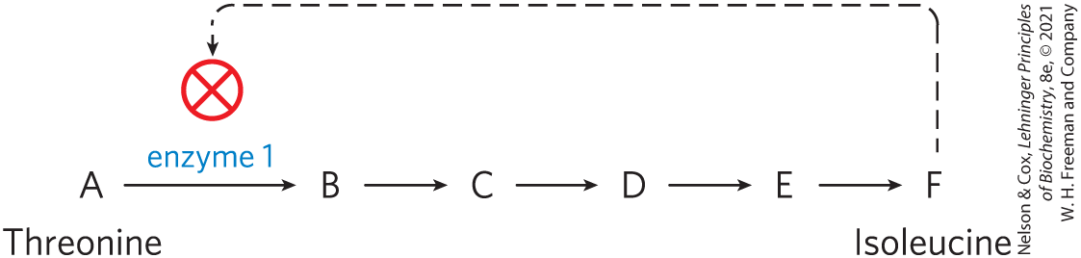
Metabolism Is Regulated to Achieve Balance and Economy
feedback inhibition = keeps the production and utilization of each metabolic intermediate in balance
systems biology = tasked with understanding complex interactions among intermediates and pathways in quantitative terms

Slide 132
Clicker Question 21
Feedback inhibition:
A. contains the overall network of catabolic and anabolic
enzyme-catalyzed pathways.
B. inhibits the catalytic activity of an enzyme to slow
production of a metabolic product.
C. is defined as a sequence of consecutive reactions in which
the product of one reaction becomes the reactant in the
next.
D. increases production of metabolic intermediates.
Notes:
Answer: B
Principle: 1.3
Learning Objective(s): Explain how living organisms maintain a dynamic steady state.
Bloom’s: 2:1

Slide 133
Clicker Question 21, Response
Feedback inhibition:
B. inhibits the catalytic activity of an enzyme to slow
production of a metabolic product.
If a cell begins to produce more metabolic product than it needs, the product accumulates, and the increased concentration inhibits the catalytic activity of an enzyme in the pathway, immediately slowing the production of the metabolic product. Such feedback inhibition keeps the production and utilization of each metabolic intermediate in balance.

Slide 134
Activity: Metabolic Map
Observe the pathways, and note the chemical reactions in the Metabolic Map in your Achieve course.
Notes:
Instructor: The Metabolic Map is located in the Achieve course. It can be found immediately before the Chapter 13 folder in the list of content. For more information on this activity, please see the In-Class Activity Guide in your Achieve course in Chapter 1.

Slide 135
Activity Instructions (3 of 4)
On your own, think of answers to the questions:
  The Metabolic Map focuses on the metabolic pathways of chemotrophs. Based on this information, what drives the flow of electrons to obtain energy?
  Looking at glycolysis as an example, the breakdown of what molecule releases energy and drives forward endergonic processes? (2 minutes)
Pair up to discuss your ideas. (2 minutes)
Share your ideas with the class in group discussion. (3 minutes)
Notes:
Instructor: The Metabolic Map is located in the Achieve course. It can be found immediately before the Chapter 13 folder in the list of content.

Slide 136
Activity Solution (3 of 4)
  The Metabolic Map focuses on the metabolic pathways of chemotrophs. Based on this information, what drives the flow of electrons to obtain energy?
  redox reactions
  Looking at glycolysis as an example, the breakdown of what molecule releases energy and drives forward endergonic processes?
  ATP
Notes:
Instructor: The Metabolic Map is located in the Achieve course. It can be found immediately before the Chapter 13 folder in the list of content.
Students may recognize this from looking at detailed reactions within the Metabolic Map, however that may be a high level for Chapter 1. This is primarily expected to be understood from the text.
The breakdown of ATP releases energy, which drives forward endergonic processes in cells. It is not just the breakdown of ATP that provides energy to drive endergonic reactions; it is the the transfer of a phosphoryl group from ATP to another small molecule that conserves some of the chemical potential originally in ATP.

Slide 137
Bonus Discussion
Looking at the Metabolic Map, note how different pathways lead from one into the other.
With your partner, identify three metabolic intermediates that are shared between at least two pathways.
How might a change within one pathway affect another?
Notes:
Instructor: The Metabolic Map is located in the Achieve course. It can be found immediately before the Chapter 13 folder in the list of content.
This is intended to be a general introduction and high-level discussion to assist in the understanding that metabolic pathways do not exist as discrete pathways, but rather as a complex interconnected system where changes in one pathway might have direct consequences within another.

Slide 138
1.4 Genetic Foundations

Slide 139
Principle 4 (2 of 5)
Cells have the capacity for precise self-replication and self-assembly using chemical information stored in the genome. A single bacterial cell placed in a sterile nutrient medium can give rise to a billion identical “daughter” cells in 24 hours. Each cell is a faithful copy of the original, its construction directed entirely by information contained in the genetic material of the original cell. On a larger scale, the progeny of vertebrate animals share a striking resemblance to their parents, also the result of their inheritance of parental genes.

Slide 140
Principle 2 (6 of 6)
Cells use a relatively small set of carbon- based metabolites to create polymeric machines, supramolecular structures, and information repositories. The chemical structure of these components defines their cellular function. The collection of molecules carries out a program, the end result of which is reproduction of the program and self-perpetuation of that collection of molecules—in short, life.

Slide 141
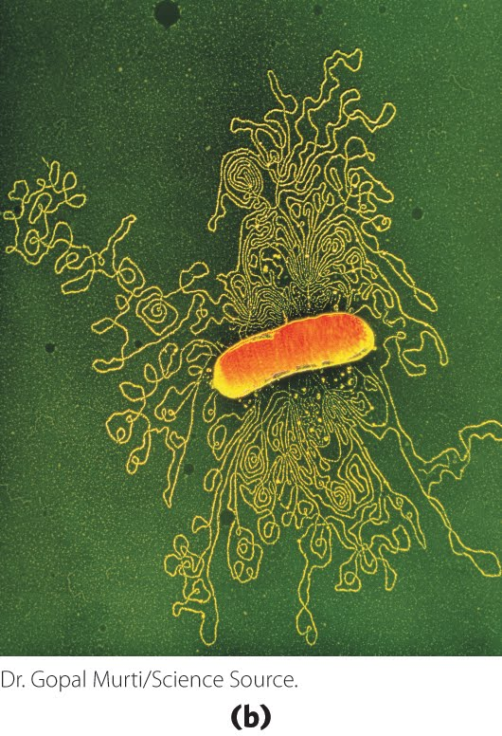
Genetic Information Is Encoded in DNA
deoxyribonucleic acid, DNA = sequence of the monomeric subunits (deoxyribonucleotides)
  encode the instructions for forming all other cellular components
  provide a template to produce identical DNA molecules

Slide 142
Principle 4 (3 of 5)
Cells have the capacity for precise self-replication and self-assembly using chemical information stored in the genome. A single bacterial cell placed in a sterile nutrient medium can give rise to a billion identical “daughter” cells in 24 hours. Each cell is a faithful copy of the original, its construction directed entirely by information contained in the genetic material of the original cell. On a larger scale, the progeny of vertebrate animals share a striking resemblance to their parents, also the result of their inheritance of parental genes.

Slide 143
Genetic Continuity Is Vested in Single DNA Molecules
DNA of an E. coli cell is a single molecule containing 4.64 million nucleotide pairs
  must be replicated perfectly to give rise to identical progeny by cell division

Slide 144
Principle 4 (4 of 5)
Cells have the capacity for precise self-replication and self-assembly using chemical information stored in the genome. A single bacterial cell placed in a sterile nutrient medium can give rise to a billion identical “daughter” cells in 24 hours. Each cell is a faithful copy of the original, its construction directed entirely by information contained in the genetic material of the original cell. On a larger scale, the progeny of vertebrate animals share a striking resemblance to their parents, also the result of their inheritance of parental genes.

Slide 145
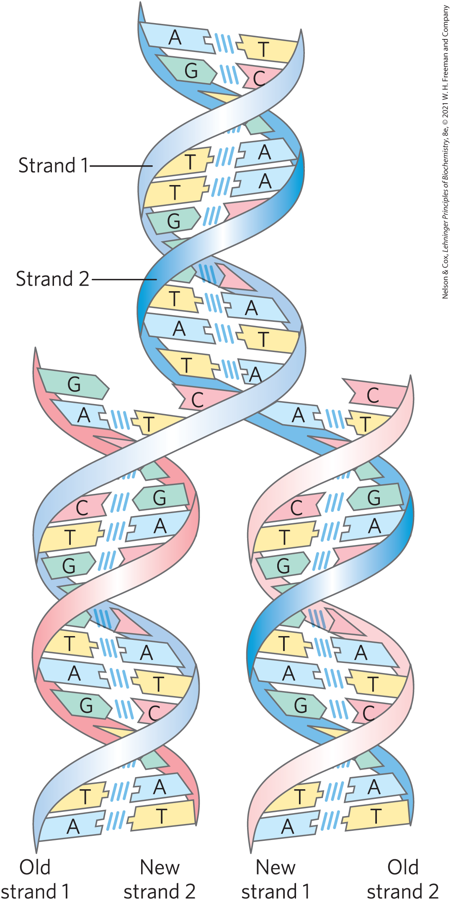
The Structure of DNA Allows Its Replication and Repair with Near-Perfect Fidelity
deoxyribonucleotides = monomeric subunit that make up the DNA polymer
  each deoxyribonucleotide in one strand pairs specifically with a complementary deoxyribonucleotide in the opposite strand
  strands are held together by hydrogen bonds

Slide 146

Clicker Question 22
Which statement about DNA is false?
A. It is a double helix of two polymeric strands twisted about
each other.
B. Each strand serves as a template for copying the DNA
sequence.
C. Covalent interactions between complementary bases occur
between the strands.
D. Deoxyguanylate is complementary to deoxycytidylate.
Notes:
Answer: C
Principle: 1.4
Learning Objective(s): Explain the importance of complementarity to DNA replication.
Bloom’s: 1.1

Slide 147
Clicker Question 22, Response
Which statement about DNA is false?
C. Covalent interactions between complementary bases
occur between the strands.
The two strands of DNA are held together by hydrogen bonds between each pair of complementary nucleotides. Hydrogen bonds are a type of noncovalent interaction.

Slide 148
Principle 4 (5 of 5)
Cells have the capacity for precise self-replication and self-assembly using chemical information stored in the genome. A single bacterial cell placed in a sterile nutrient medium can give rise to a billion identical “daughter” cells in 24 hours. Each cell is a faithful copy of the original, its construction directed entirely by information contained in the genetic material of the original cell. On a larger scale, the progeny of vertebrate animals share a striking resemblance to their parents, also the result of their inheritance of parental genes.

Slide 149
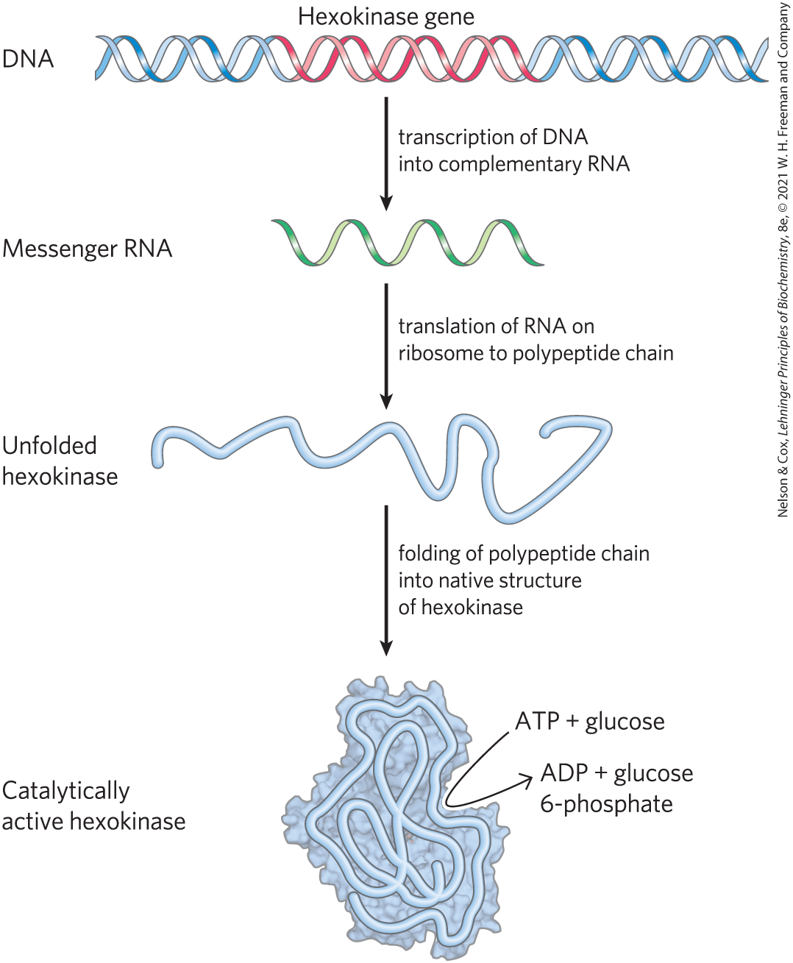
The Linear Sequence in DNA Encodes Proteins with Three-Dimensional Structures
native conformation = precise three-dimensional structure of a protein
  crucial to protein function

Slide 150
Clicker Question 23
The DNA sequence of a gene for a protein:
A. is a nonlinear code.
B. mutates at a high rate.
C. ultimately determines the amino acid sequence of a
protein.
D. is a polymer of four ribonucleotides.
Notes:
Answer: C
Principle: 1.4
Learning Objective(s): Describe the flow of information from linear DNA to three-dimensional proteins.
Bloom’s: 2:1

Slide 151
Clicker Question 23, Response
The DNA sequence of a gene for a protein:
C. ultimately determines the amino acid sequence of a
protein.
A linear sequence of deoxyribonucleotides in DNA codes (through an intermediary, RNA) for the production of a protein with a corresponding linear sequence of amino acids. The protein folds into a particular three-dimensional shape, determined by its amino acid sequence and stabilized primarily by noncovalent interactions.

Slide 152
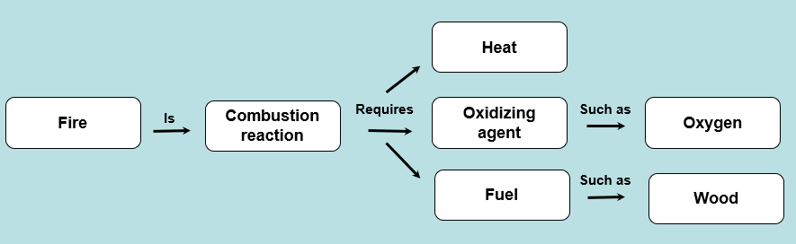
Activity: Relating
Terms within the Chapter
A concept map displays the relationships between different concepts. Observe the following example of a concept map.
Notes:
Instructor: For additional information, see the Instructor Activity Guide located in Achieve. It can be found within Chapter 1, in the folder titled “Ch1 In-Class Activities and Resources.”

Slide 153
Activity Instructions (4 of 4)
Think about how the following terms and phrases relate to each other and then use scratch paper to draw a concept map using these terms and phrases. (3 minutes)
each cell
genomic information
precise self-replication
precise self-assembly
faithful copy of the original cell
progeny of vertebrate animal
bacterial cell
a billion identical “daughter” cells in 24 hours
striking resemblance to parents
inheritance of parental genes
Notes:
Instructor: For additional information, see the Instructor Activity Guide located in Achieve. It can be found within Chapter 1, in the folder titled “Ch1 In-Class Activities and Resources.”

Slide 154
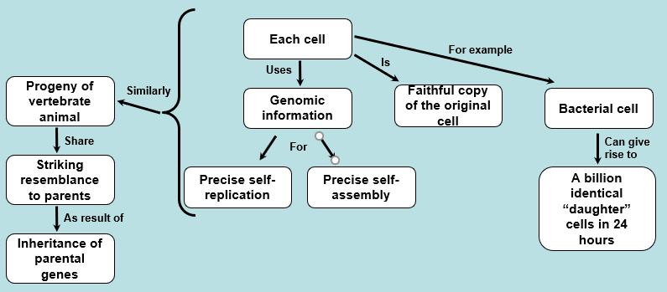
Activity Solution (4 of 4)
Pair up and share how this possible concept map might differ from yours. (2 minutes)
Notes:
Instructor: For additional information, see the Instructor Activity Guide located in Achieve. It can be found within Chapter 1, in the folder titled “Ch1 In-Class Activities and Resources.”

Slide 155
1.5 Evolutionary Foundations

Slide 156

Principle 5 (2 of 3)
Living organisms change over time by gradual evolution. The result of eons of evolution is an enormous diversity of life forms, fundamentally related through their shared ancestry, which can be seen at the molecular level in the similarity of gene sequences and protein structures.

Slide 157
Changes in the Hereditary Instructions Allow Evolution
mutation = changes in the nucleotide sequence of DNA
  changes the instructions for a cellular component
  can be beneficial
wild type = unmutated cells

Slide 158
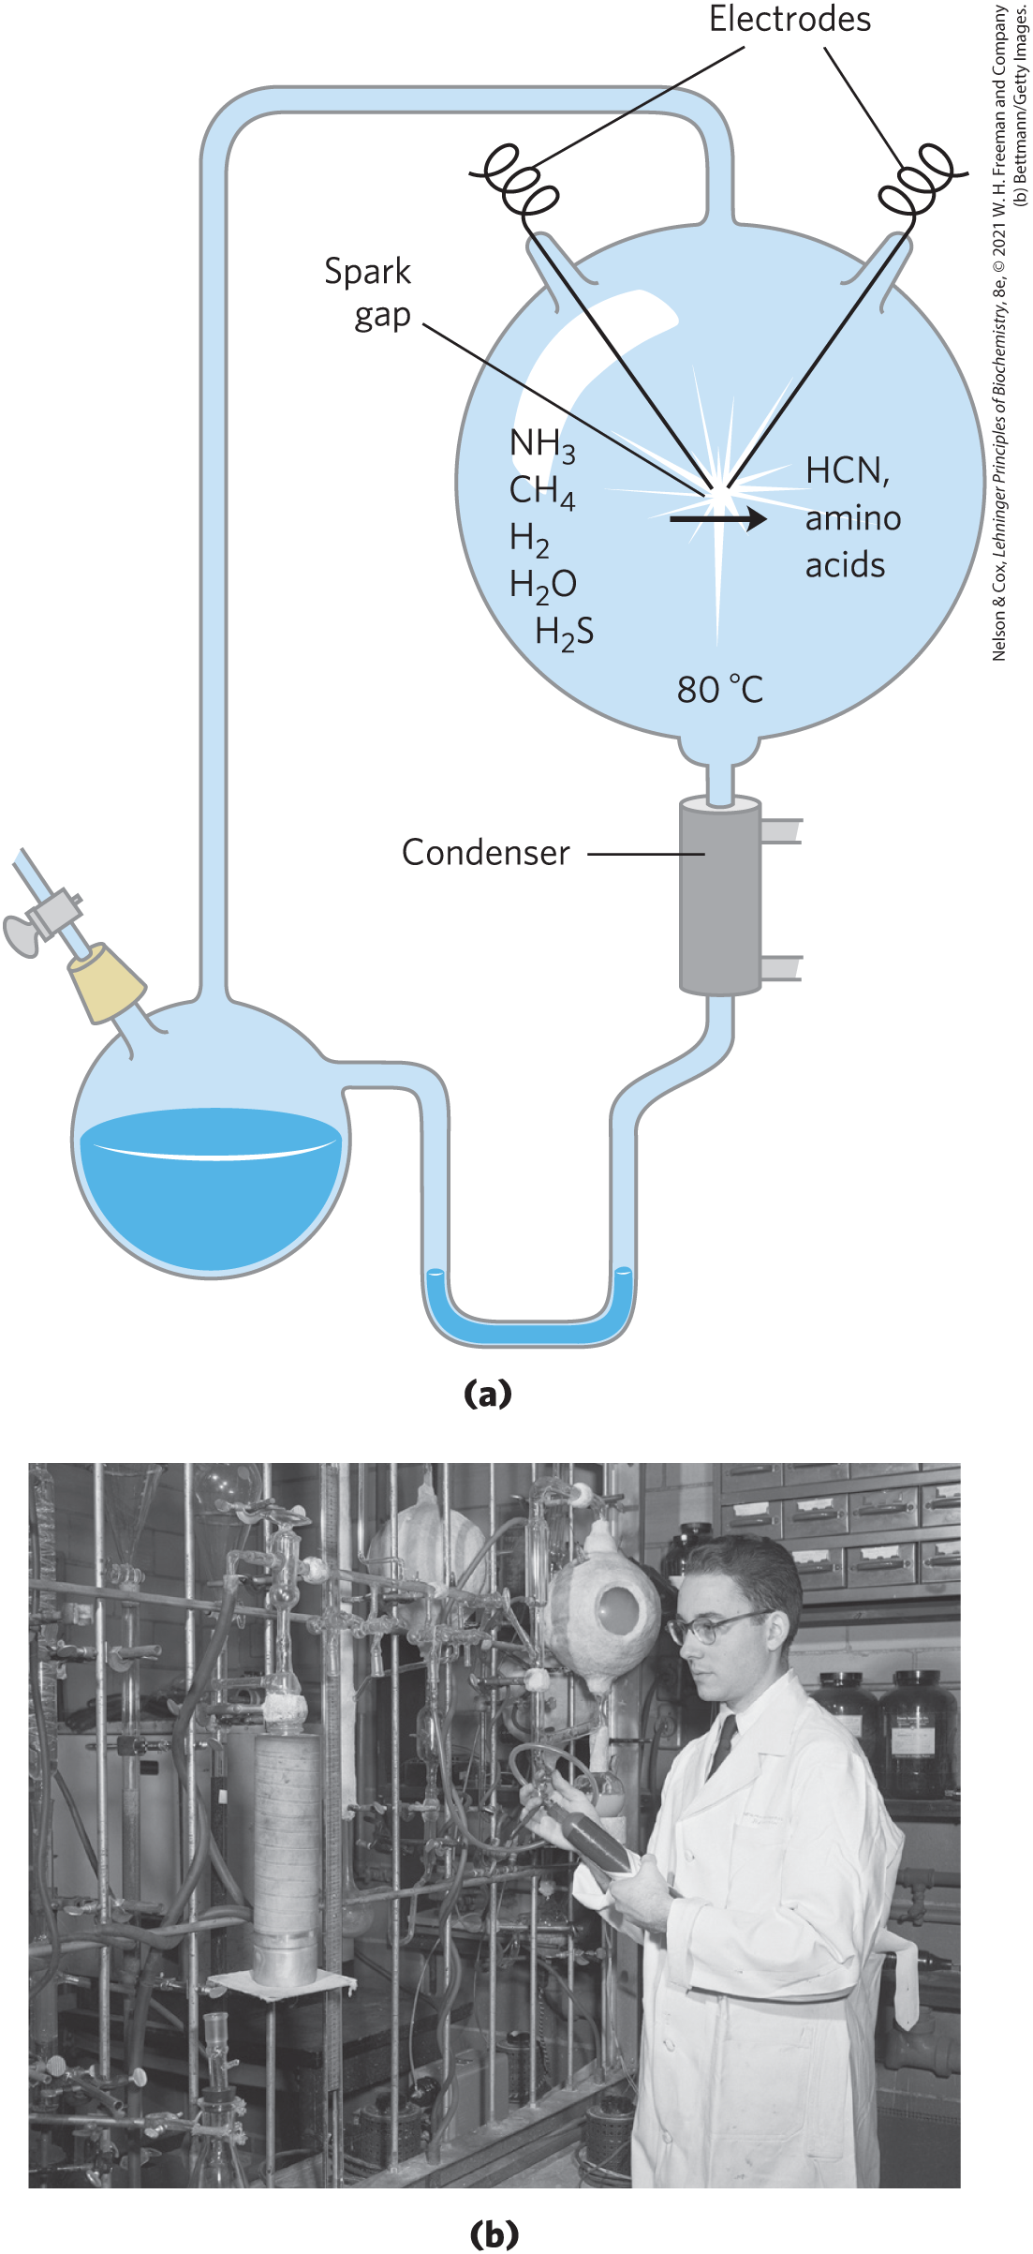
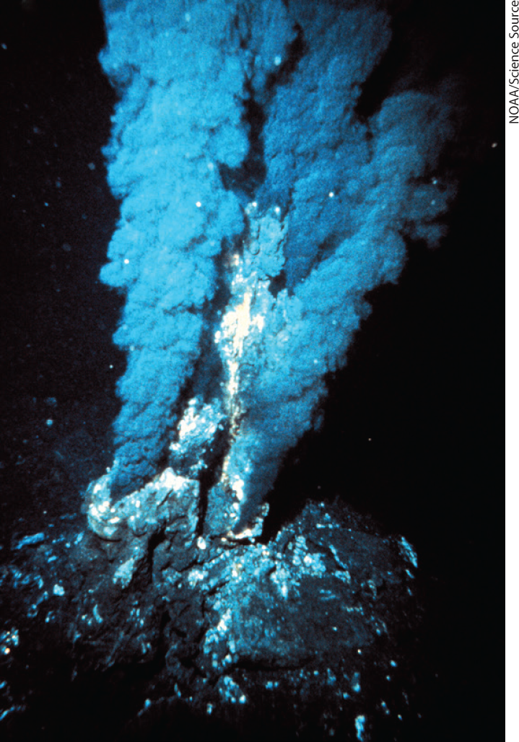
Biomolecules First Arose by Chemical Evolution
Miller and Urey experiments found that biomolecules may have been produced near hydrothermal vents at the bottom of the sea or by the action of lightning and high temperature on gaseous mixtures

Slide 159
The Role of RNA in Prebiotic Evolution
RNA (ribonucleic acid) = can act as catalysts in biologically significant reactions
likely played a crucial role in prebiotic evolution, both as catalyst and as information repository

Slide 160
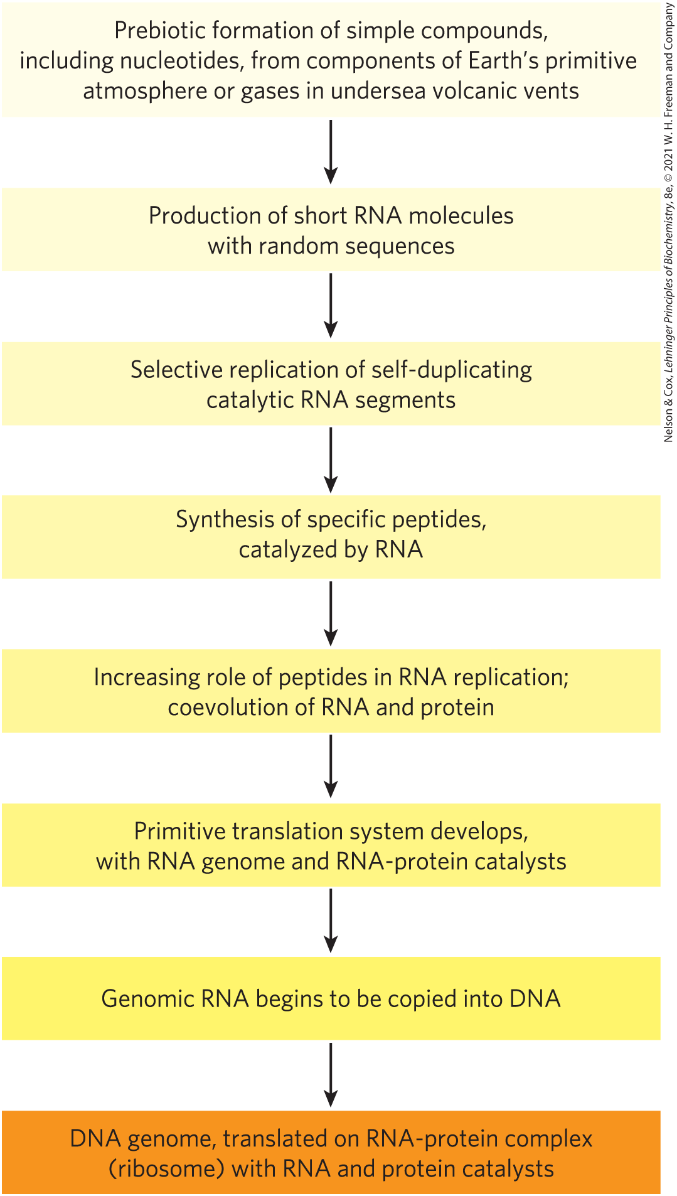
RNA or Related Precursors May Have Been the First Genes and Catalysts
RNA or similar molecule may have been the first gene and the first catalyst
alternatively, simple metabolic pathways may have evolved first, perhaps at the hot vents in the ocean floor

Slide 161
Clicker Question 24
Which statement regarding the Miller and Urey experiments is false?
A. The energy used to drive the reaction was provided by
boiling the liquid phase.
B. The starting gaseous mixture included NH₃, CH₄, H₂O,
H₂S, and H₂.
C. Amino acids, hydroxy acids, and aldehydes were formed in
the experiments.
D. CO and CO₂ were produced.
Notes:
Answer: A
Principle:
Learning Objective(s): Describe Miller and Urey’s experiment demonstrating abiotic formation of organic biomolecules.
Bloom’s: 2:2

Slide 162
Clicker Question 24, Response
Which statement regarding the Miller and Urey experiments is false?
A. The energy used to drive the reaction was provided by
boiling the liquid phase.
Miller and Urey’s experiments involved subjecting gaseous mixtures, such as those presumed to exist on the prebiotic Earth, to electrical sparks produced across a pair of electrodes (to simulate lightning) for periods of a week or more.

Slide 163
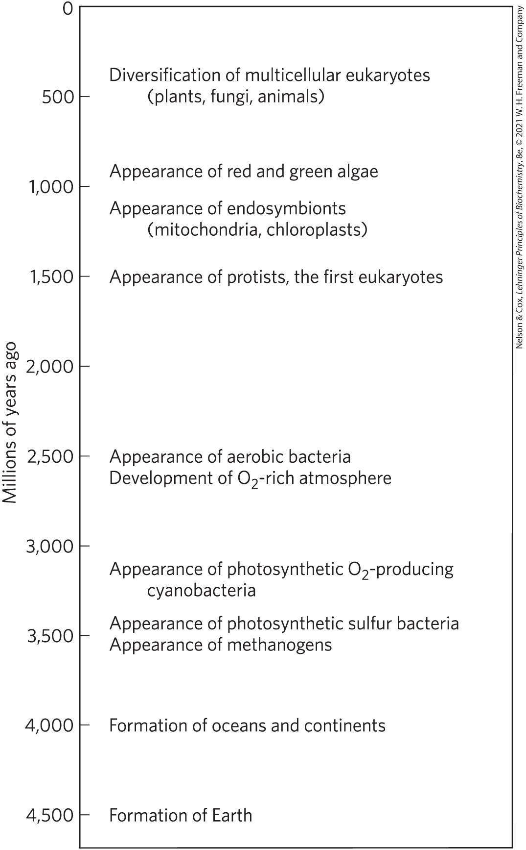
Biological Evolution Began More Than Three and a Half Billion Years Ago
lipid vesicles containing organic compounds and self-replicating RNA gave rise to protocells
protocells with the greatest capacity for self-replication became more numerous

Slide 164
The First Cell Probably Used Inorganic Fuels
earliest cells probably obtained energy from inorganic fuels, such as ferrous sulfide and ferrous carbonate
photosynthetic processes:
  arose from evolution
  pigments capture energy of light from the sun and reduce CO₂ to organic compounds
atmosphere became richer in O₂ with the rise of O₂-producing photosynthetic bacteria

Slide 165
Eukaryotic Cells Evolved from Simpler Precursors in Several Stages
three major changes led to the evolution of eukaryotes:
  evolution of the chromosome
  evolution of the nucleus
  formation of endosymbiotic associations between early eukaryotic cells and aerobic or photosynthetic bacteria
in multicellular organisms, differentiated cell types specialize in functions essential to the organism’s survival

Slide 166
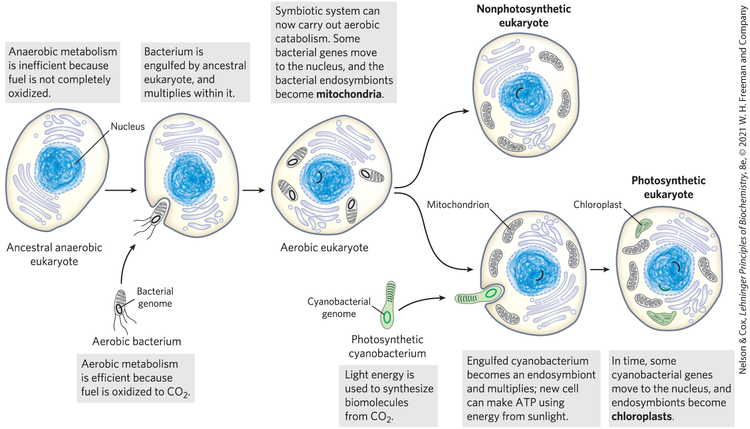
Evolution of Eukaryotes through Endosymbiosis

Slide 167
Clicker Question 25
Eukaryotic cells:
A. first appeared about 3.5 billion years ago.
B. apparently obtained their mitochondria via a symbiotic
relationship with an ancient bacterium.
C. are similar in most respects to Archaeal cells.
D. preceded the development of a double membrane
surrounding the DNA.
Notes:
Answer: B
Principle: 1.5
Learning Objective(s): Describe the key events required for the evolution of eukaryotic cells.
Bloom’s: 2:2

Slide 168
Clicker Question 25, Response
Eukaryotic cells:
B. apparently obtained their mitochondria via a symbiotic
relationship with an ancient bacterium.
Early eukaryotic cells, which were incapable of photosynthesis or aerobic metabolism, enveloped aerobic bacteria or photosynthetic bacteria to form endosymbiotic associations that eventually became permanent. Some aerobic bacteria evolved into the mitochondria of modern eukaryotes.

Slide 169
Principle 5 (3 of 3)
Living organisms change over time by gradual evolution. The result of eons of evolution is an enormous diversity of life forms, fundamentally related through their shared ancestry, which can be seen at the molecular level in the similarity of gene sequences and protein structures.

Slide 170
Molecular Anatomy Reveals Evolutionary Relationships
homologs = proteins encoded by genes that share ready detectable sequence similarities
gene or protein sequence similarities between organisms can determine phylogenetic relationships

Slide 171
Functional Genomics Shows the Allocations of Genes to Specific Cellular Processes
genes can be grouped according to the specific process in which they function
  can approximate the proportion of the genome dedicated to a specific process
  genes involved in regulation of cellular processes tend to increase with organism complexity
housekeeping genes = expressed under all conditions, not subject to much regulation

Slide 172
Genomic Comparisons Have Increasing Importance in Medicine
large-scale sequencing studies have identified many genes in which mutations correlate with a medical condition
the proteins these genes encode might become the target for drugs to treat a given condition

Slide 173
Clicker Question 26
Sequencing of entire genomes:
A. has demonstrated that very few genes in humans are of
unknown function.
B. is unlikely to reveal the underlying causes of very complex
genetic diseases.
C. has demonstrated that the more complicated an organism,
the fewer regulatory genes it has and the more
housekeeping genes it has.
D. has revealed that differences in genes between individual
humans are few.
Notes:
Answer: D
Principle: 1.5
Learning Objective(s): Define unity of life; Define biochemical unity.
Bloom’s: 2:2

Slide 174
Clicker Question 26, Response
Sequencing of entire genomes:
D. has revealed that differences in genes between
individual humans are few.
Although organisms have continuously diverged at the level of gross anatomy, at the molecular level the basic unity of life is readily apparent; molecular structures and mechanisms are remarkably similar from the simplest to the most complex organisms. Thus, sequencing of entire genomes has revealed few differences in genes between individual humans.

Slide 175

Activity: Evolution
Muddiest Point (1 of 2)
Complete the Ch1 Student Activity, Day 1: Evolution (Muddiest Point) Achieve assessment.
Notes:
Instructor: This muddiest point activity can be found in Achieve in the Chapter 1 folder titled “Ch1 In-Class Activities and Resources.” See the Instructor Activity Guide in the same folder for more information.

Slide 176

Activity: Evolution
Muddiest Point (2 of 2)
Complete the Ch1: Student Activity, Day 2: Evolution (Muddiest Point) Achieve assessment.
Notes:
Instructor: This muddiest point activity can be found in Achieve in the Chapter 1 folder titled “Ch1 In-Class Activities and Resources.” See the Instructor Activity Guide in the same folder for more information.

