Slide 1

16 The Citric Acid Cycle
© 2021 Macmillan Learning

Slide 2
Cellular Respiration
cellular respiration = process by which the pyruvate produced by glycolysis is further oxidized to H₂O and CO₂

Slide 3
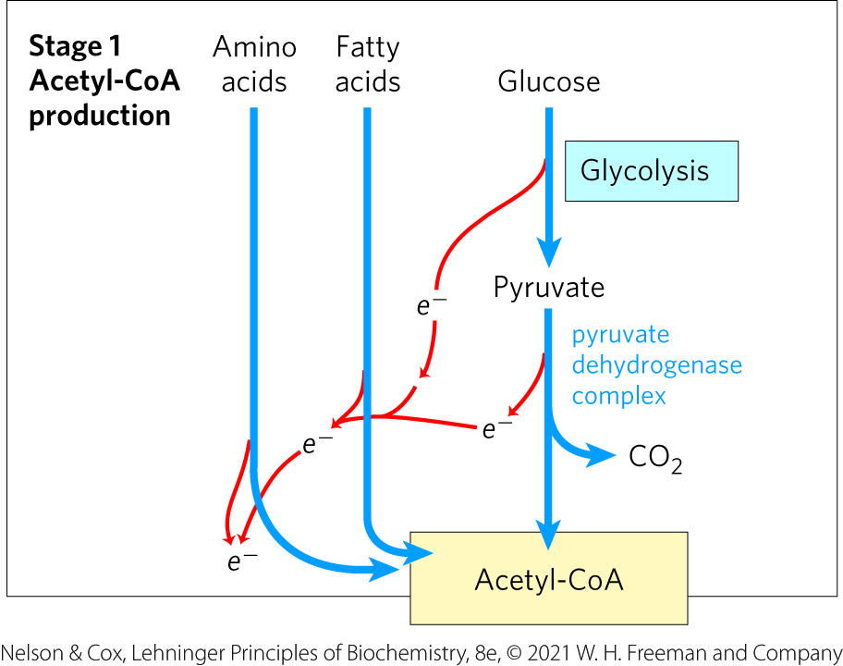
Stage 1 of Cellular Respiration
Stage 1: oxidation of fuels to acetyl-CoA
  generates ATP, NADH, FADH₂

Slide 4
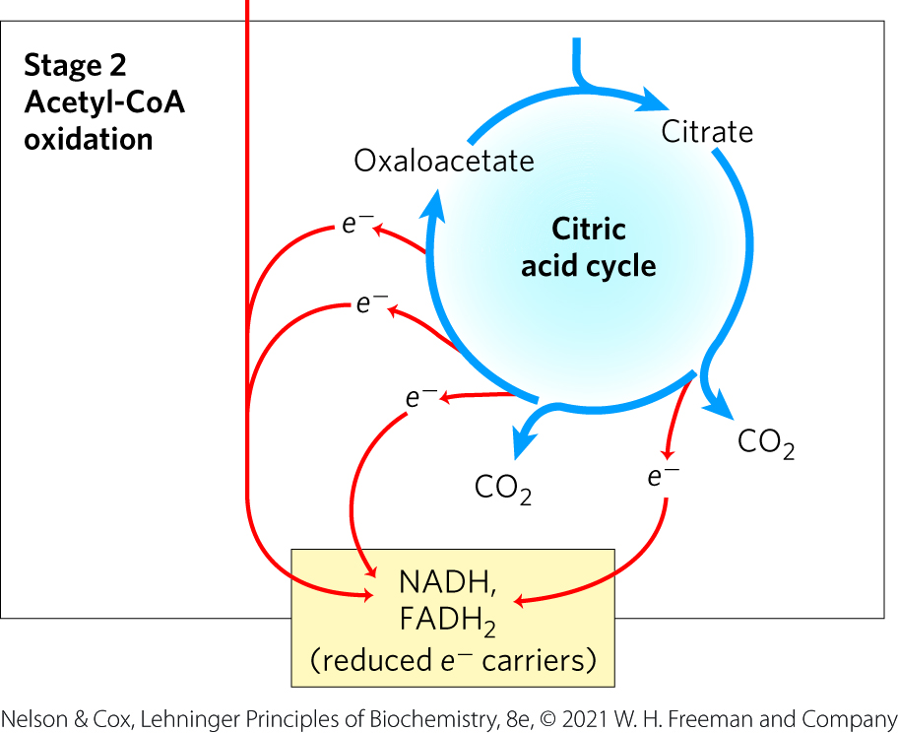
Stage 2 of Cellular Respiration
Stage 2: oxidation of acetyl groups to CO₂ in the citric acid cycle (tricarboxylic acid (TCA) cycle, Krebs cycle)
  nearly universal pathway
  generates NADH, FADH₂, and one GTP

Slide 5
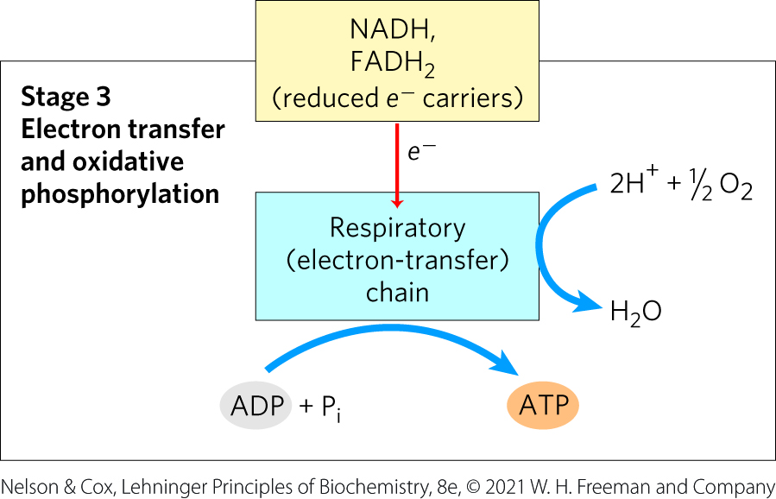
Stage 3 of Cellular Respiration
Stage 3: electron transfer chain and oxidative phosphorylation
  generates the vast majority of ATP from catabolism

Slide 6
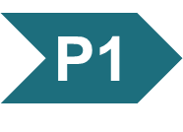
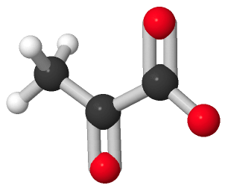
Activity: Source and
Fate of Pyruvate
Observe the structure of pyruvate in Mol3D viewer in your Achieve course.
Notes:
Instructor: This Mol3D structure is located in the Achieve course. It can be found in the Chapter 16 content, in the folder titled “Ch16 In-Class Activities, Videos, and Resources.”

Slide 7
Activity Instructions (1 of 4)
On your own, think of answers to the questions:
  What pathway produces pyruvate?
  What pathway consumes pyruvate to support cellular energy production?
  How must the structure of pyruvate transform to allow it to contribute to energy production? Select the atoms involved in this transformation and upload a screenshot to your course. (2 minutes)
Pair up to discuss your ideas. (2 minutes)
Share your ideas with the class in group discussion.
(3 minutes)
Notes:
Instructor: This Mol3D structure is located in the Achieve course. It can be found in the Chapter 16 content, in the folder titled “Ch16 In-Class Activities, Videos, and Resources.”

Slide 8
Activity Solution (1 of 4)
  What pathway produces pyruvate?
  glycolysis
  What pathway consumes pyruvate to support cellular energy production?
  The citric acid cycle (TCA cycle) consumes pyruvate following its transformation into acetyl-CoA by the pyruvate dehydrogenase (PDH) reaction.
Notes:
Instructor: This Mol3D structure is located in the Achieve course. It can be found in the Chapter 16 content, in the folder titled “Ch16 In-Class Activities, Videos, and Resources.”

Slide 9
Activity Solution (2 of 4)
  How must the structure of pyruvate transform to allow it to contribute to energy production?
  Pyruvate must undergo decarboxylation (i.e. loss of CO₂) before entering the citric acid cycle. Specifically, carbon one and the two oxygen atoms bonded to carbon one are lost. This forms an acetyl group that esterifies to a molecule of coenzyme A to form acetyl-CoA. Acetyl-CoA then enters the citric acid cycle.
Notes:
Instructor: This Mol3D structure is located in the Achieve course. It can be found in the Chapter 16 content, in the folder titled “Ch16 In-Class Activities, Videos, and Resources.”

Slide 10

Principle 1 (1 of 4)
Pyruvate is the metabolite that links two central catabolic pathways, glycolysis and the citric acid cycle. It is therefore a logical point for regulation that determines the rate of catabolic activity and the partitioning of pyruvate among its possible uses.

Slide 11

Principle 2 (1 of 7)
The reactions of the citric acid cycle follow
a chemical logic. In its catabolic role, the
citric acid cycle oxidizes acetyl-CoA to CO₂ and H₂O. Energy from the oxidations in the cycle drives the synthesis of ATP. The chemical strategies for activating groups for oxidation and for conserving energy in the form of reducing power and high-energy compounds are used in many other biochemical pathways.

Slide 12

Principle 3 (1 of 4)
The citric acid cycle is a hub of metabolism, with catabolic pathways leading in and anabolic pathways leading out. Acetate groups (acetyl-CoA) from the catabolism of various fuels are used in the synthesis of such metabolites as amino acids, fatty acids, and sterols. The breakdown products of many amino acids and nucleotides are intermediates of the cycle, and they can be fed in or siphoned off as needed by the cell.

Slide 13
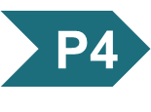
Principle 4 (1 of 5)
The central role of the citric acid cycle in metabolism requires that it be regulated
in coordination with many other pathways. Regulation occurs by both allosteric and covalent mechanisms that overlap and interact to achieve homeostasis. Some mutations that affect the reactions of the citric acid cycle lead to tumor formation.

Slide 14

Principle 5 (1 of 6)
Enzymes have evolved to form complexes to efficiently achieve a series of chemical transformations without releasing the intermediates into the bulk solvent. This strategy, seen in the pyruvate dehydrogenase complex and the metabolons of the citric acid cycle, is ubiquitous in other pathways of metabolism, in respiration, and in the many “ — somes” that assemble and disassemble informational macromolecules.

Slide 15
16.1 Production of Acetyl-CoA (Activated Acetate)

Slide 16
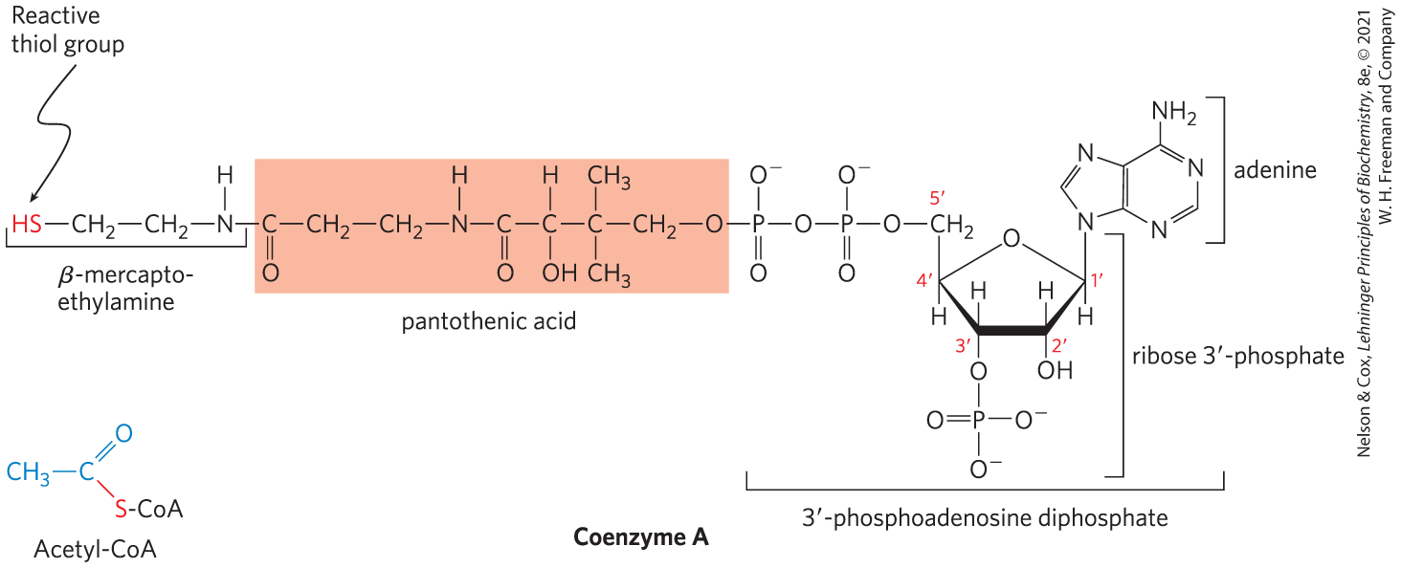
Coenzyme A (CoA-SH)
coenzyme A has a reactive thiol (–SH) group that is critical to its role as an acyl carrier
  the –SH group forms a thioester with acetate in acetyl-CoA

Slide 17
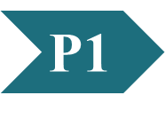
Clicker Question 1
Coenzyme A:
forms thioester acyl groups.
has lipoic acid as one of its components.
forms esters with relatively small standard free energies of hydrolysis.
can have pyruvate linked to it through an ester linkage.
Notes:
Answer: A
Principle: 16.1
Learning Objective(s): Describe the role of each cofactor involved in the reaction catalyzed by the pyruvate dehydrogenase complex.
Bloom’s: 2:1

Slide 18
Clicker Question 1, Response
Coenzyme A:
forms thioester acyl groups.
The —SH group of the mercaptoethylamine moiety forms a thioester with acetate in acetyl-coenzyme A (acetyl-CoA).

Slide 19
Principle 1 (2 of 4)
Pyruvate is the metabolite that links two central catabolic pathways, glycolysis and the citric acid cycle. It is therefore a logical point for regulation that determines the rate of catabolic activity and the partitioning of pyruvate among its possible uses.

Slide 20
Principle 5 (2 of 6)
Enzymes have evolved to form complexes to efficiently achieve a series of chemical transformations without releasing the intermediates into the bulk solvent. This strategy, seen in the pyruvate dehydrogenase complex and the metabolons of the citric acid cycle, is ubiquitous in other pathways of metabolism, in respiration, and in the many “ — somes” that assemble and disassemble informational macromolecules.

Slide 21
Principle 4 (2 of 5)
The central role of the citric acid cycle in metabolism requires that it be regulated
in coordination with many other pathways. Regulation occurs by both allosteric and covalent mechanisms that overlap and interact to achieve homeostasis. Some mutations that affect the reactions of the citric acid cycle lead to tumor formation.

Slide 22
Pyruvate Is Oxidized to Acetyl-CoA and CO₂
mitochondrial pyruvate carrier (MPC) = an H⁺-coupled pyruvate-specific symporter in the inner mitochondrial membrane
pyruvate dehydrogenase (PDH) complex = highly ordered cluster of enzymes and cofactors that oxidizes pyruvate in the mitochondrial matrix to acetyl-CoA and CO₂
  the series of chemical intermediates remain bound to the enzyme subunits
  regulation results in precisely regulated flux

Slide 23
Clicker Question 2
Pyruvate is produced in glycolysis and used by the citric acid cycle in the mitochondrial matrix. How does pyruvate get into the matrix?
It moves through the membrane by simple diffusion.
Diffusion is facilitated through a specific uniport.
It transforms into acetate, which moves through a facilitated transporter.
A transporter is not needed because pyruvate from glycolysis is already in the matrix.
It moves through the malate shuttle system.
Notes:
Answer: B
Principle: 16.1
Learning Objective(s): Describe the process by which pyruvate enters the mitochondrial matrix.
Bloom’s: 2:1

Slide 24
Clicker Question 2, Response
Pyruvate is produced in glycolysis and used by the citric acid cycle in the mitochondrial matrix. How does pyruvate get into the matrix?
Diffusion is facilitated through a specific uniport.
In eukaryotes, pyruvate may diffuse into mitochondria, first through large openings in the outer mitochondrial membrane and then into the matrix via an H⁺-coupled pyruvate-specific symporter in the inner mitochondrial membrane, the mitochondrial pyruvate carrier (MPC).

Slide 25
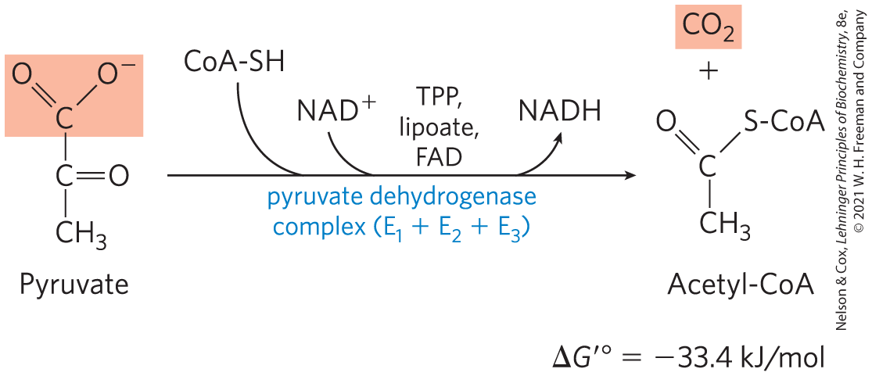
The PDH Complex Catalyzes an Oxidative Decarboxylation
oxidative decarboxylation = an irreversible oxidation process in which the carboxyl group is removed, forming CO₂

Slide 26
The PDH Complex Employs Three Enzymes and Five Coenzymes to Oxidize Pyruvate
three enzymes:
  pyruvate dehydrogenase, E₁
  dihydrolipoyl transacetylase, E₂
  dihydrolipoyl dehydrogenase, E₃
five coenzymes:
  thiamine pyrophosphate (TPP)
  lipoate
  coenzyme A (CoA, CoA-SH)
  flavin adenine dinucleotide (FAD)
  nicotinamide adenine dinucleotide (NAD)

Slide 27
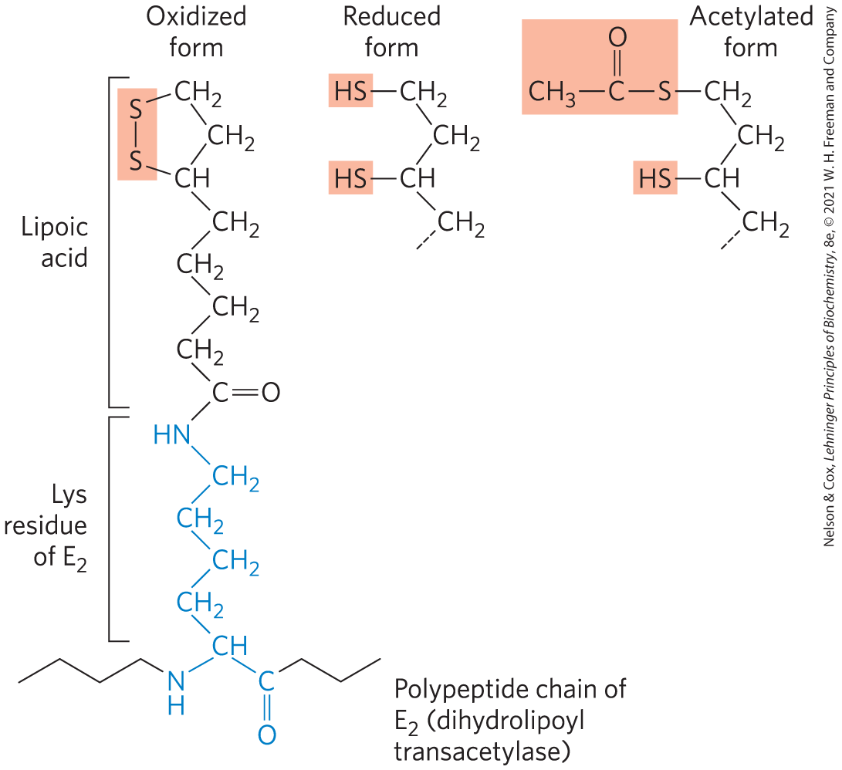
Lipoate
lipoate = coenzyme with two thiol groups that can undergo reversible oxidation to a disulfide bond (–S–S–)
  serves as an electron (hydrogen) carrier and an acyl carrier
  covalently linked to E₂ via a lysine residue

Slide 28
Clicker Question 3
Which vitamin is a coenzyme to the pyruvate dehydrogenase (PDH) complex?
pantothenate
thiamine pyrophosphate
niacin
riboflavin
All of the answers are correct.
Notes:
Answer: E
Principle: 16.1
Learning Objective(s): Identify the cofactors required by the pyruvate dehydrogenase complex.
Bloom’s: 1:1

Slide 29
Clicker Question 3, Response
Which vitamin is a coenzyme to the pyruvate dehydrogenase (PDH) complex?
All of the answers are correct.
Four different vitamins required in human nutrition are vital components of the PDH complex: thiamine (TPP), pantothenate (CoA), riboflavin (FAD), and niacin (NAD).

Slide 30
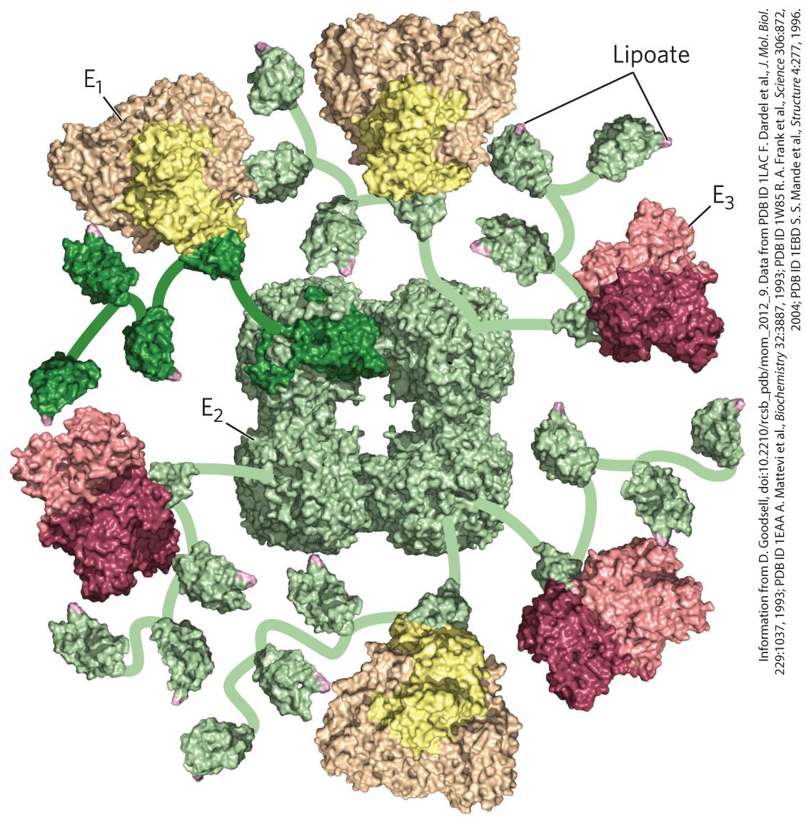
The PDH Complex Enzymes
the PDH complex contains multiple copies of:
  pyruvate dehydrogenase (E₁)
  dihydrolipoyl transacetylase (E₂)
  dihydrolipoyl dehydrogenase (E₃)
an E₂ core (of 24-60 copies) is surrounded by multiple and variable numbers of E₁ and E₃ copies

Slide 31
Principle 5 (3 of 6)
Enzymes have evolved to form complexes to efficiently achieve a series of chemical transformations without releasing the intermediates into the bulk solvent. This strategy, seen in the pyruvate dehydrogenase complex and the metabolons of the citric acid cycle, is ubiquitous in other pathways of metabolism, in respiration, and in the many “ — somes” that assemble and disassemble informational macromolecules.

Slide 32
The E₁-E₂-E₃ Structure of the PDH Complex
the structure of the PDH complex is similar to other enzymes that catalyze oxidations:
  α-ketoglutarate dehydrogenase
  branched-chain α-keto acid dehydrogenase
in a given species, E₃ is identical in all three complexes
similarities reflect a common evolutionary origin
  they are paralogs

Slide 33
Principle 5 (4 of 6)
Enzymes have evolved to form complexes to efficiently achieve a series of chemical transformations without releasing the intermediates into the bulk solvent. This strategy, seen in the pyruvate dehydrogenase complex and the metabolons of the citric acid cycle, is ubiquitous in other pathways of metabolism, in respiration, and in the many “ — somes” that assemble and disassemble informational macromolecules.

Slide 34
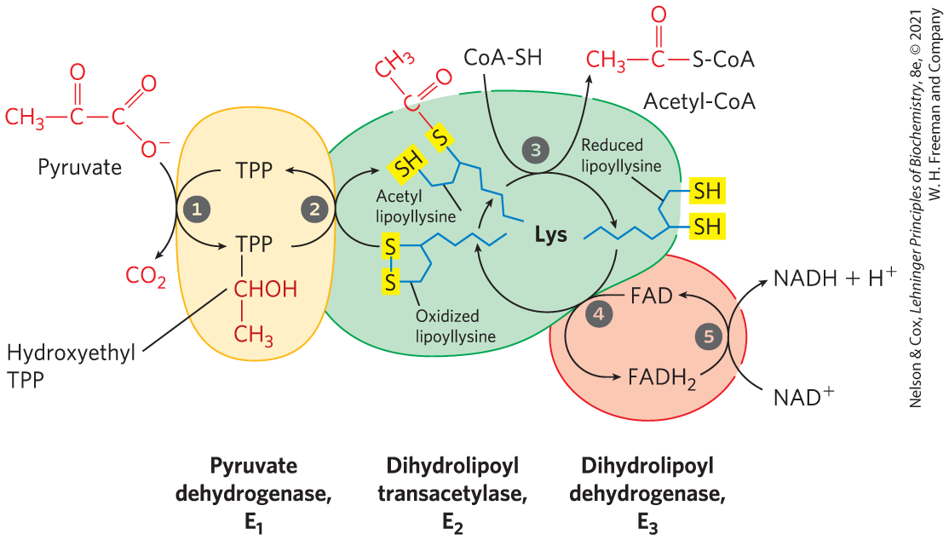
The PDH Complex Channels Its Intermediates through Five Reactions

Slide 35
Oxidative Decarboxylation of Pyruvate - Steps 1 and 2
pyruvate dehydrogenase, E₁, with bound TPP catalyzes:
  step 1: decarboxylation of pyruvate to the hydroethyl derivate
    rate-limiting step
  step 2: oxidation of the hydroethyl derivate to an acetyl group
    electrons and the acetyl group are transferred from TPP to the lipoyllysyl group of E₂

Slide 36
Oxidative Decarboxylation of Pyruvate - Steps 3-5
dihydrolipoyl transacetylase, E₂, catalyzes:
  step 3: esterification of the acetyl moiety to one of the lipoyl –SH groups, followed by transesterification to CoA to form acetyl-CoA
dihydrolipoyl dehydrogenase, E₃, catalyzes:
  step 4: electron transfer to regenerate the oxidized form of the lipoyllysyl group
  step 5: electron transfer to regenerate the oxidized FAD cofactor, forming NADH

Slide 37
Clicker Question 4
Which two chemical mechanisms change pyruvate to acetyl-CoA in the pyruvate dehydrogenase complex?
dehydrogenation and oxidation
decarboxylation and condensation
condensation and dehydrogenation
dehydrogenation and decarboxylation
condensation and oxidation
Notes:
Answer: D
Principle: 16.1
Learning Objective(s): Explain the result of the pyruvate dehydrogenase complex acting upon pyruvate.
Bloom’s: 2:2

Slide 38
Clicker Question 4, Response
Which two chemical mechanisms change pyruvate to acetyl-CoA in the pyruvate dehydrogenase complex?
dehydrogenation and decarboxylation
The overall reaction catalyzed by the pyruvate dehydrogenase complex is an oxidative decarboxylation, an irreversible oxidation process in which the carboxyl group is removed from pyruvate as a molecule of CO₂ and the two remaining carbons become the acetyl group of acetyl-CoA.

Slide 39
Principle 5 (5 of 6)
Enzymes have evolved to form complexes to efficiently achieve a series of chemical transformations without releasing the intermediates into the bulk solvent. This strategy, seen in the pyruvate dehydrogenase complex and the metabolons of the citric acid cycle, is ubiquitous in other pathways of metabolism, in respiration, and in the many “ — somes” that assemble and disassemble informational macromolecules.

Slide 40
The Five-Reaction Sequence of the PDH Complex Is An Example of Substrate Channeling
substrate channeling = the passage of intermediates from one enzyme directly to another enzyme without release
the long lipoyllysyl arm of E₂ channels the substrate from the active site of E₁ to E₂ to E₃
  tethers intermediates to the enzyme complex
  increases the efficiency of the overall reaction
  minimizes side reactions

Slide 41

Clicker Question 5
What is the advantage to having an enzyme complex, as in pyruvate dehydrogenase (PDH) complex?
Multiple steps can be regulated at one point.
Products do not need to diffuse to become substrates for the next enzymatic reaction.
Products cannot be scavenged by other enzymes or pathways.
Conservation of energy drives the reactions.
All of the answers are correct.
Notes:
Answer: E
Principle: 16.5
Learning Objective(s): Explain why substrate channeling is beneficial.
Bloom’s: 2:2

Slide 42
Clicker Question 5, Response
What is the advantage to having an enzyme complex, as in pyruvate dehydrogenase (PDH) complex?
All of the answers are correct.
Substrate channeling in this five-reaction sequence keeps the local concentration of the substrate of E₂ very high and prevents theft of the activated acetyl group by other enzymes. It also allows the energy of oxidation to drive the formation of a high-energy thioester of acetate and provides a single point for the regulation of multiple steps.

Slide 43
16.2 Reactions of the Citric Acid Cycle

Slide 44
Principle 2 (2 of 7)
The reactions of the citric acid cycle follow
a chemical logic. In its catabolic role, the
citric acid cycle oxidizes acetyl-CoA to CO₂ and H₂O. Energy from the oxidations in the cycle drives the synthesis of ATP. The chemical strategies for activating groups for oxidation and for conserving energy in the form of reducing power and high-energy compounds are used in many other biochemical pathways.

Slide 45
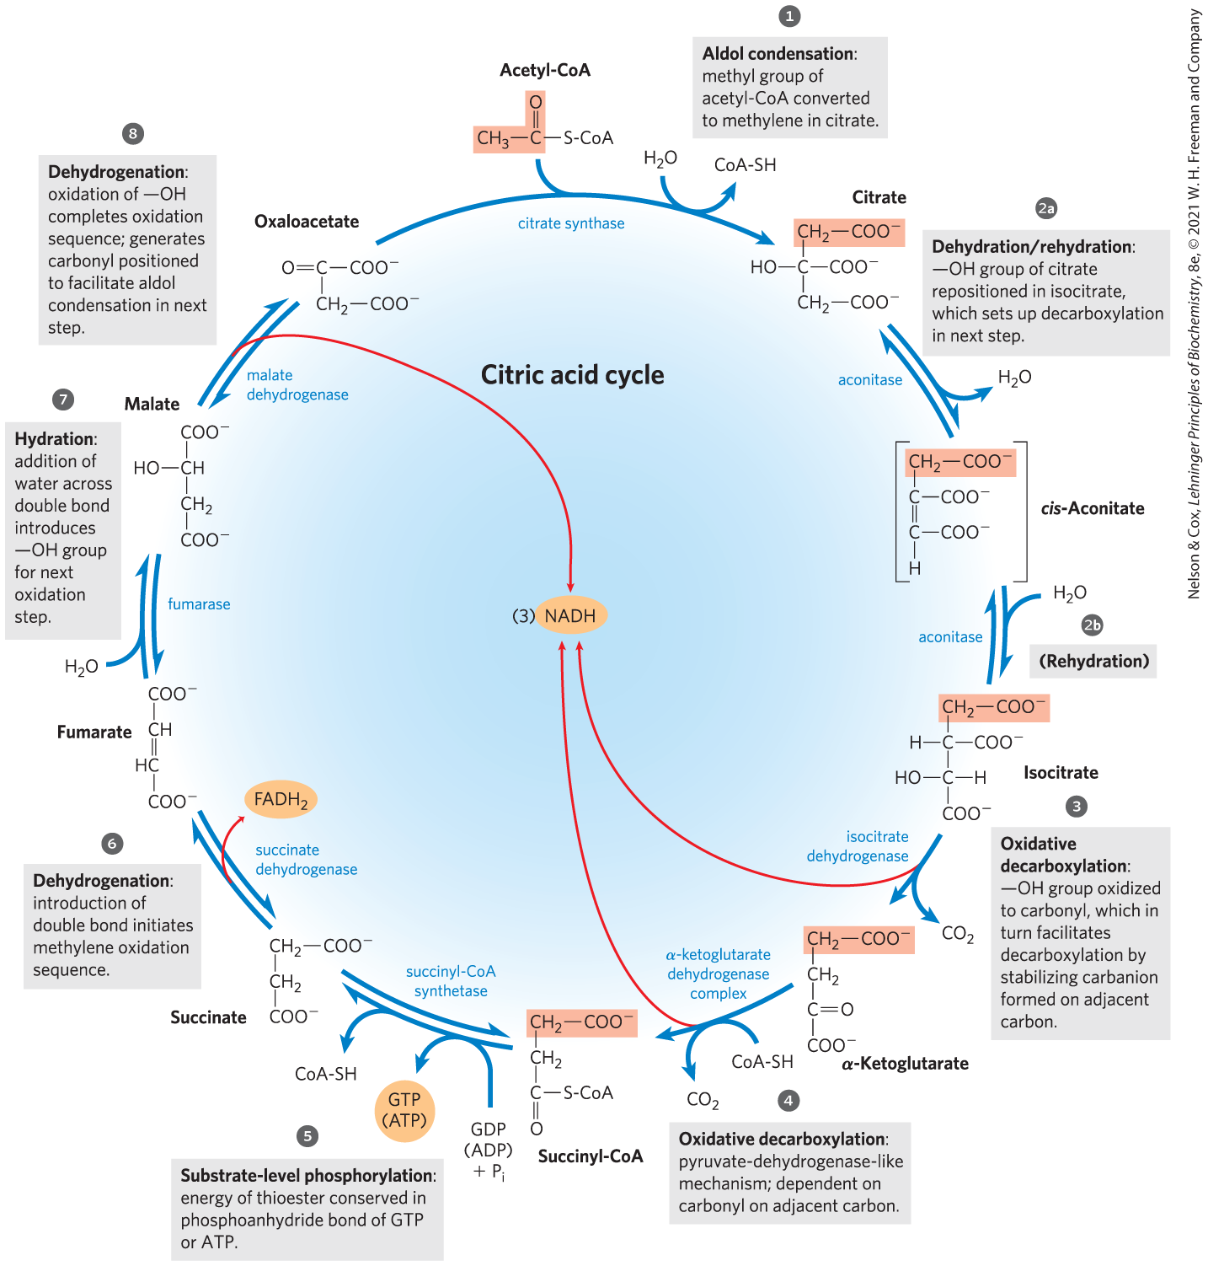
Reactions of the Citric Acid Cycle
one oxaloacetate molecule can theoretically oxidize an infinite number of acetyl groups
energy from the four oxidations is conserved as NADH and FADH₂

Slide 46
In Eukaryotes, the Mitochondrion Is the Site of Energy-Yielding Oxidative Reactions and ATP Synthesis
isolated mitochondria contain all enzyme, coenzymes, and proteins needed for:
  the citric acid cycle
  electron transfer and ATP synthesis by oxidative phosphorylation
  oxidation of fatty acids and amino acids to acetyl-CoA
  oxidative degradation of amino acids to citric acid cycle intermediates

Slide 47
Principle 2 (3 of 7)
The reactions of the citric acid cycle follow
a chemical logic. In its catabolic role, the
citric acid cycle oxidizes acetyl-CoA to CO₂ and H₂O. Energy from the oxidations in the cycle drives the synthesis of ATP. The chemical strategies for activating groups for oxidation and for conserving energy in the form of reducing power and high-energy compounds are used in many other biochemical pathways.

Slide 48
The Sequence of Reactions in the Citric Acid Cycle Makes Chemical Sense
complete oxidation of acetyl-CoA to CO₂ extracts the maximum potential energy
direct oxidation to yield CO₂ and CH₄ is not biochemically feasible because organisms cannot oxidize CH₄

Slide 49
Principle 2 (4 of 7)
The reactions of the citric acid cycle follow
a chemical logic. In its catabolic role, the
citric acid cycle oxidizes acetyl-CoA to CO₂ and H₂O. Energy from the oxidations in the cycle drives the synthesis of ATP. The chemical strategies for activating groups for oxidation and for conserving energy in the form of reducing power and high-energy compounds are used in many other biochemical pathways.

Slide 50
The Chemical Logic of the Citric Acid Cycle
carbonyl groups are more chemically reactive than a methylene group or methane
each step of the cycle involves either:
  an energy-conserving oxidation
  placing functional groups in position to facilitate oxidation or oxidative decarboxylation

Slide 51
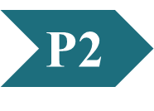
Clicker Question 6
Which statement regarding the citric acid cycle is false?
Part of the chemical logic behind it involves the conversion of the relatively unreactive methyl group of acetyl-CoA to a more reactive methylene group.
The carbon atoms that feed into the cycle as acetyl-CoA do not leave as CO₂ during their first turn in the cycle.
It is found in the mitochondria of eukaryotes.
Its role is strictly limited to energy conservation during the catabolism of the acetyl group.
Notes:
Answer: D
Principle: 16.2
Learning Objective(s):
Bloom’s: 2:1

Slide 52
Clicker Question 6, Response
Which statement regarding the citric acid cycle is false?
Its role is strictly limited to energy conservation during the catabolism of the acetyl group.
Although the citric acid cycle is central to energy-yielding metabolism, its role is not limited to energy conservation.

Slide 53
The Citric Acid Cycle Has
Eight Steps
citrate formed from acetyl-CoA and oxaloacetate is oxidized to yield:
  CO₂
  NADH
  FADH₂
  GTP or ATP

Slide 54
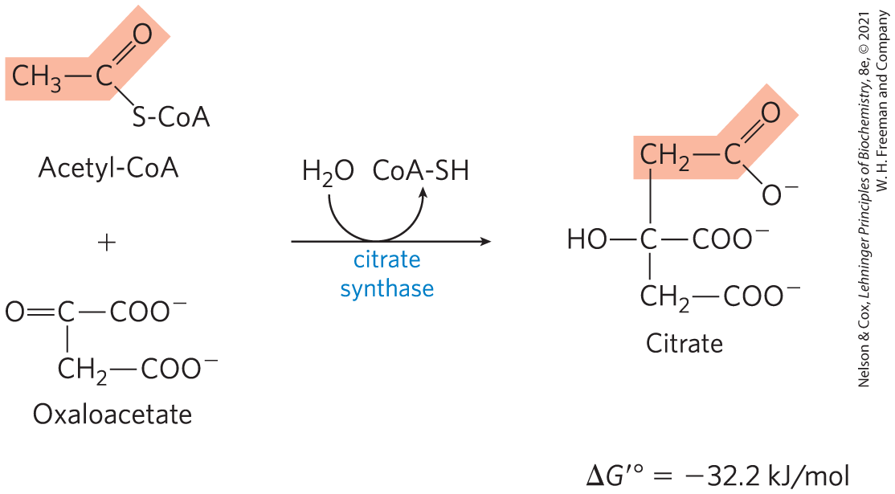
Formation of Citrate
citrate synthase = catalyzes the condensation of acetyl-CoA with oxaloacetate to form citrate
  involves the formation of a transient intermediate, citroyl-CoA
  large, negative ∆G′° is needed because [oxaloacetate] is normally very low

Slide 55
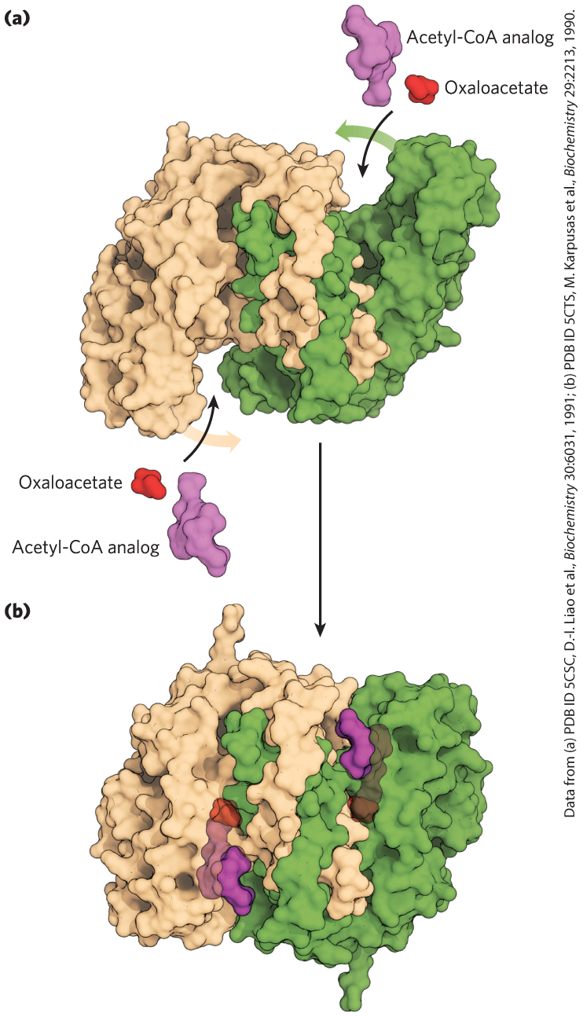
Structure of Citrate Synthase
binding of oxaloacetate creates a binding site for acetyl-CoA
induced fit decreases the likelihood of premature cleavage of the thioester bond of acetyl-CoA

Slide 56
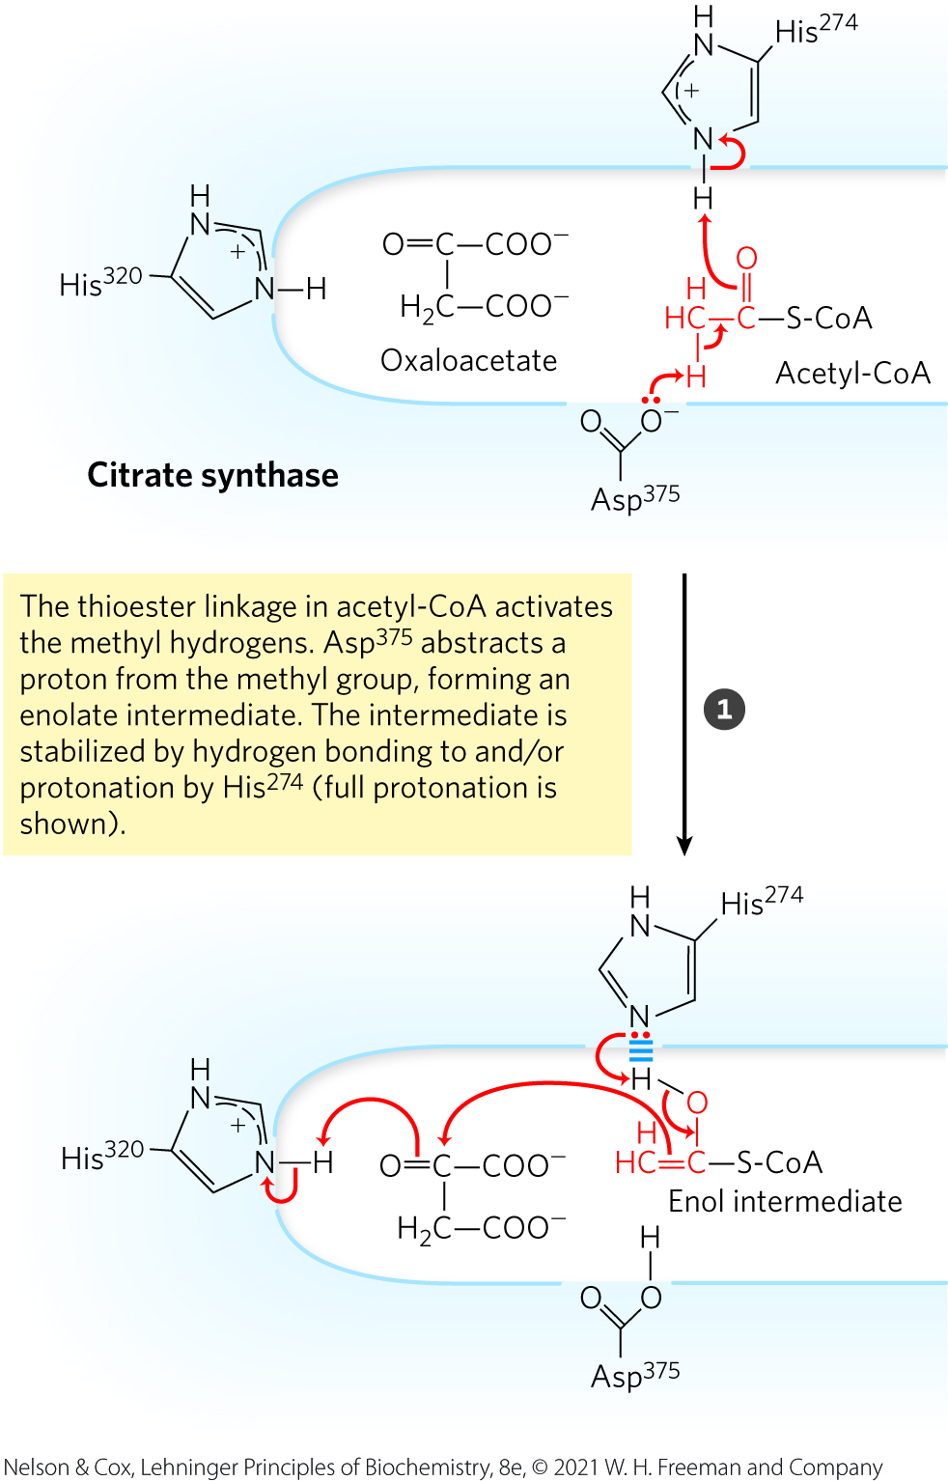
Mechanism of Citrate Synthase: Acid/Base Catalysis

Slide 57
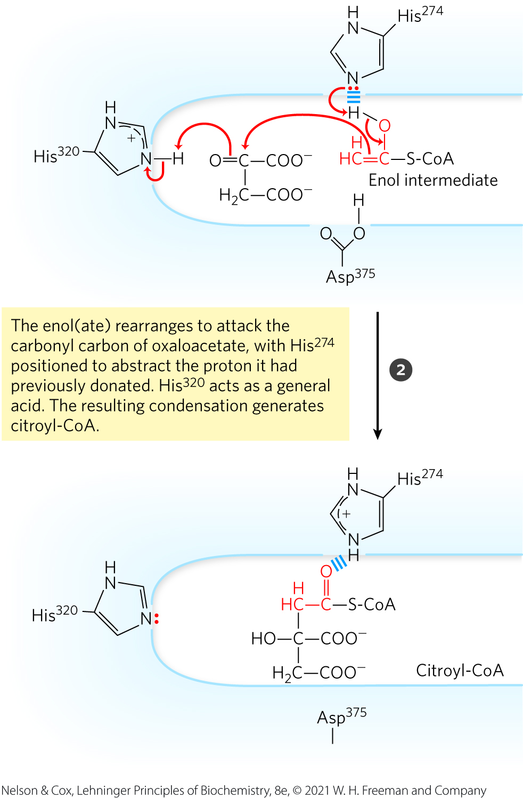
Mechanism of Citrate Synthase: Acid/Base Catalysis, Continued

Slide 58
Clicker Question 7
The citrate synthase step of the citric acid cycle:
is freely reversible under physiological conditions.
is an example of a Ping-Pong enzyme mechanism.
does not involve ATP hydrolysis.
is considered to be both the first and last step of the cycle.
Notes:
Answer: C
Principle: 16.2
Learning Objective(s): List the cofactor(s) required by each enzyme reaction of the citric acid cycle.
Bloom’s: 2:1

Slide 59
Clicker Question 7, Response
The citrate synthase step of the citric acid cycle:
does not involve ATP hydrolysis.
Unlike synthetase enzymes, synthases do not require nucleotide triphosphates such as ATP. The hydrolysis of a high-energy thioester in a citroyl-CoA intermediate makes the forward reaction catalyzed by citrate synthase highly exergonic.

Slide 60
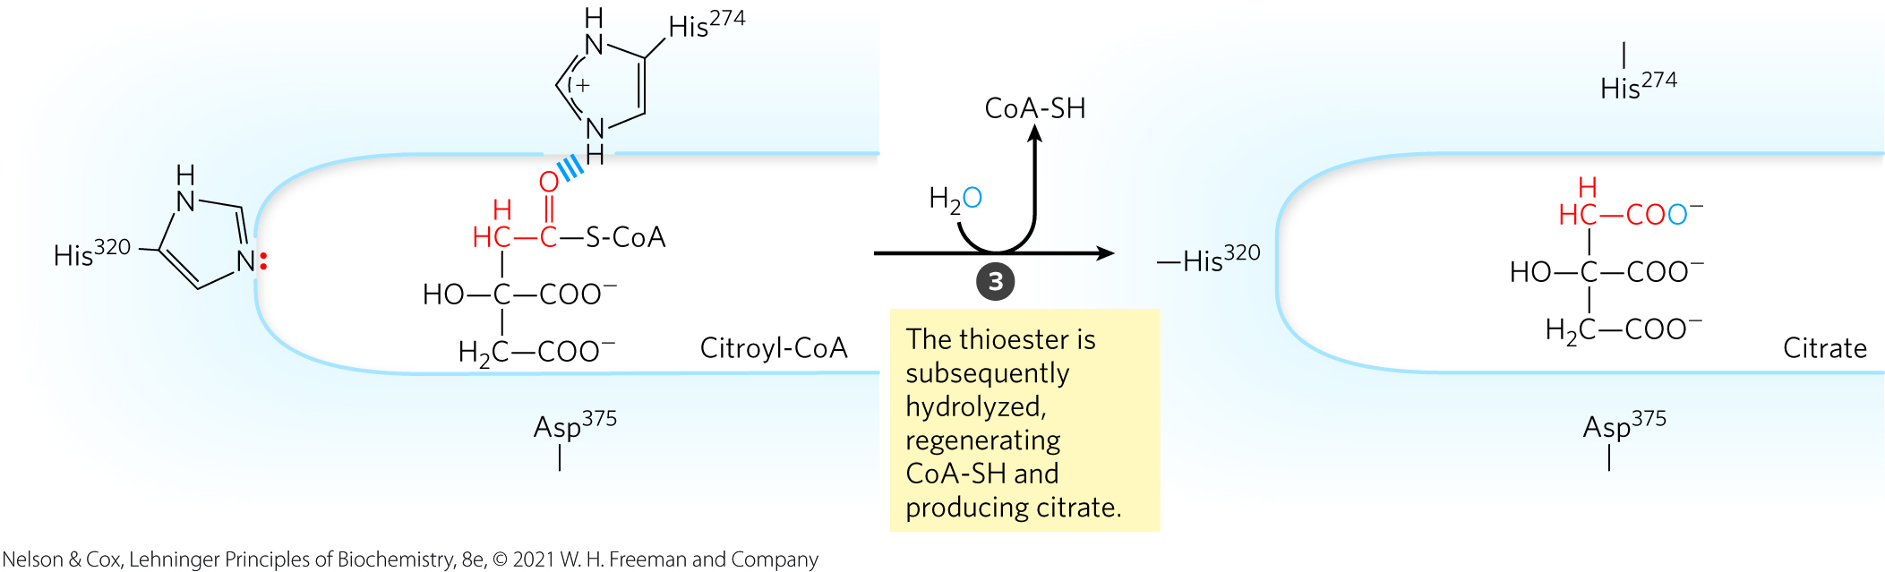
Mechanism of Citrate Synthase: Thioester Hydrolysis

Slide 61
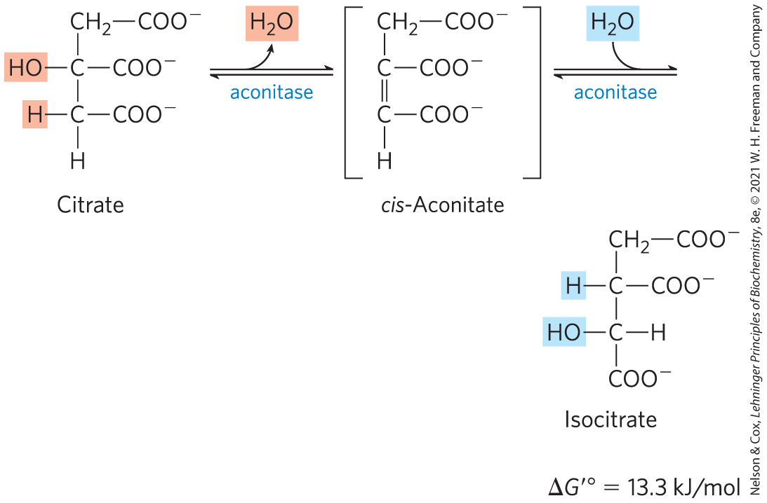
Formation of Isocitrate via
Cis-Aconitate
aconitase (aconitate hydratase) = catalyzes the reversible transformation of citrate to isocitrate through the intermediate cis-aconitate
  addition of H₂O to cis-aconitate is stereospecific
  low [isocitrate] pulls the reaction forward

Slide 62
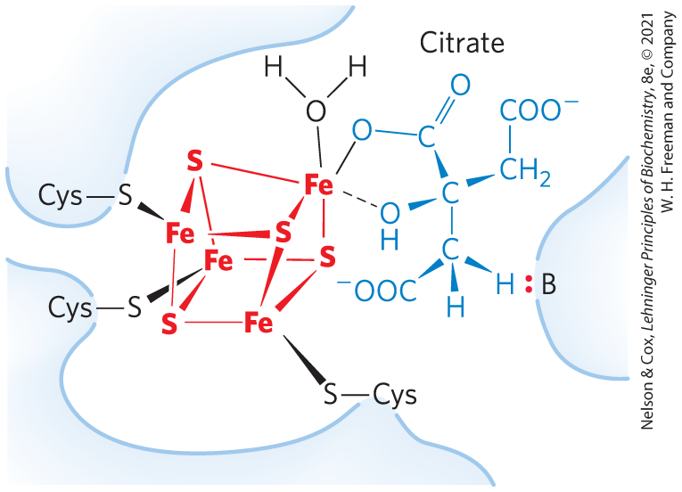
Iron-Sulfur Center in Aconitase
iron-sulfur center = acts both in the binding of the substrate to the active site and in the catalytic addition or removal of H₂O

Slide 63
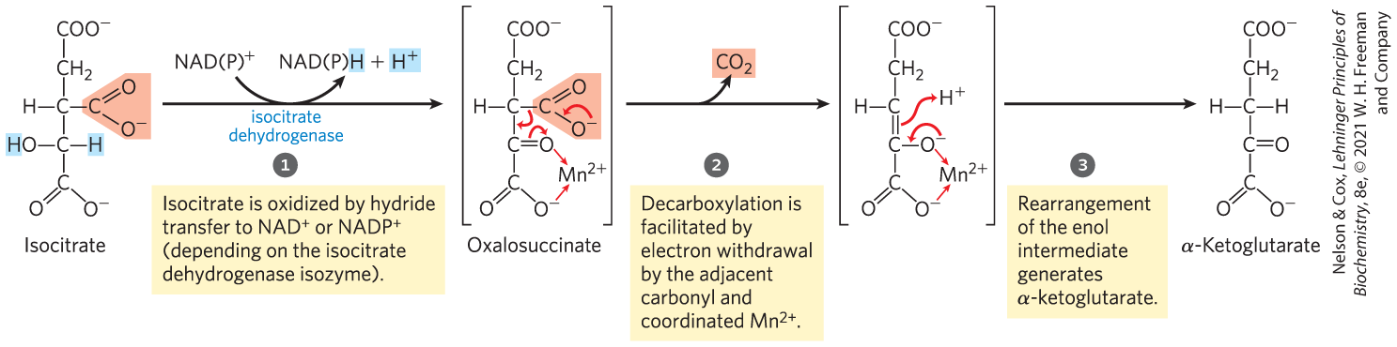
Oxidation of Isocitrate to α-Ketoglutarate and CO₂
isocitrate dehydrogenase = catalyzes the oxidative decarboxylation of isocitrate to α-ketoglutarate
  Mn²⁺ interacts with the carbonyl group of the oxalosuccinate and stabilizes the transiently-formed enol
  specific isozymes for NADP⁺ (cytosolic and mitochondrial) or NAD⁺ (mitochondrial)

Slide 64
Clicker Question 8
Which statement regarding isocitrate dehydrogenase is false?
It has a Mn²⁺ cofactor.
In eukaryotes, there is an NAD⁺-dependent form in mitochondria and an NAD⁺-independent form found in both mitochondria and the cytosol.
It catalyzes a reversible reaction under physiological conditions.
It catalyzes an oxidative decarboxylation.
Notes:
Answer: C
Principle: 16.2
Learning Objective(s): For each enzyme of the citric acid cycle, determine the type of reaction.
Bloom’s: 2:1

Slide 65
Clicker Question 8, Response
Which statement regarding isocitrate dehydrogenase is false?
It catalyzes a reversible reaction under physiological conditions.
Isocitrate dehydrogenase catalyzes an irreversible oxidation process in which a carboxyl group is removed from isocitrate as a molecule of CO₂.

Slide 66
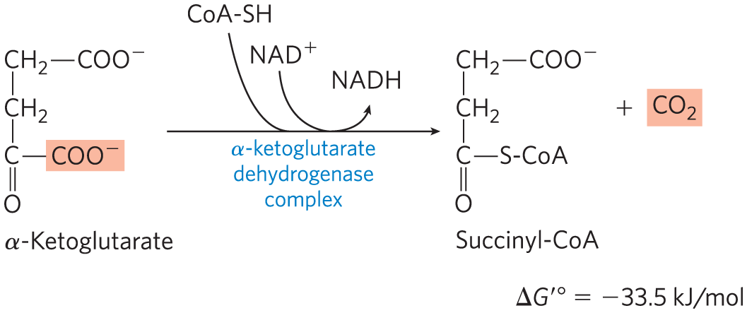
Oxidation of α-Ketoglutarate to Succinyl-CoA and CO₂
α-ketoglutarate dehydrogenase complex = catalyzes the oxidative decarboxylation of α-ketoglutarate to succinyl-CoA and CO₂
  energy of oxidation is conserved in the thioester bond of succinyl-CoA

Slide 67
Principle 2 (5 of 7)
The reactions of the citric acid cycle follow
a chemical logic. In its catabolic role, the
citric acid cycle oxidizes acetyl-CoA to CO₂ and H₂O. Energy from the oxidations in the cycle drives the synthesis of ATP. The chemical strategies for activating groups for oxidation and for conserving energy in the form of reducing power and high-energy compounds are used in many other biochemical pathways.

Slide 68
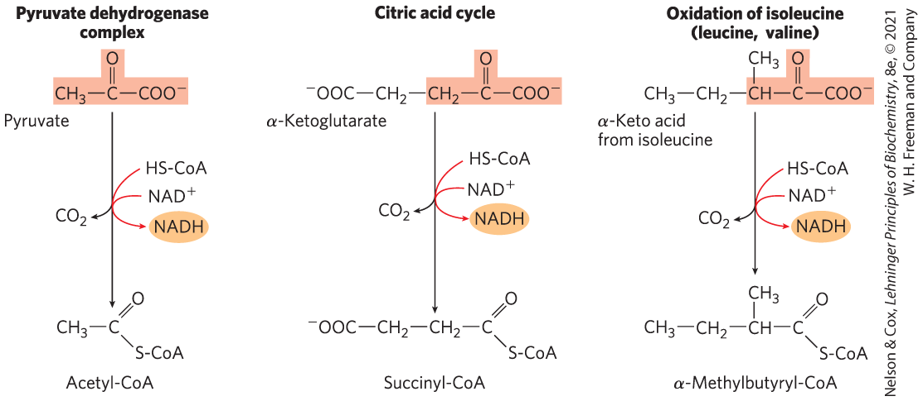
A Conserved Mechanism for Oxidative Decarboxylation
pathways use the same five cofactors, similar multienzyme complexes, and the same enzymatic mechanism
  have homologous E₁ and E₂ and identical E₃
  example of gene duplication and divergent evolution

Slide 69
Clicker Question 9
Which two other enzyme complexes have an E₁—E₂—E₃ structure similar to that of the pyruvate dehydrogenase (PDH) complex?
α-ketoglutarate dehydrogenase and branched-chain α-keto
acid dehydrogenase
α-ketoglutarate dehydrogenase and lactate
dehydrogenase
branched-chain α-keto acid dehydrogenase and lactate
dehydrogenase
pyruvate carboxylase and pyruvate decarboxylase
Notes:
Answer: A
Principle: 16.1
Learning Objective(s): Describe the evolutionary relationship between the pyruvate dehydrogenase complex, alpha-ketoglutarate dehydrogenase, and alpha-keto acid dehydrogenase.
Bloom’s: 2:1

Slide 70
Clicker Question 9, Response
Which two other enzyme complexes have an E₁—E₂—E₃ structure similar to that of the pyruvate dehydrogenase (PDH) complex?
α-ketoglutarate dehydrogenase and branched-chain
α-keto acid dehydrogenase
The remarkable similarity in protein structure, cofactor requirements, and reaction mechanisms of these three complexes doubtless reflects a common evolutionary origin; they are paralogs.

Slide 71
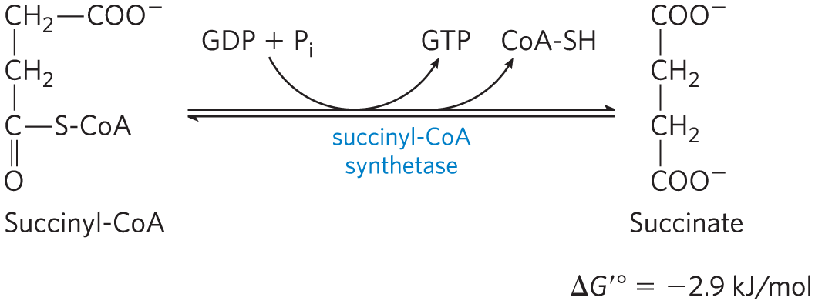
Conversion of Succinyl-CoA to Succinate
succinyl-CoA synthetase (succinic thiokinase) = catalyzes the breakage of the thioester bond of succinyl-CoA to form succinate
  energy released drives the synthesis of a phosphoanhydride bond in either GTP or ATP (substrate level phosphorylation)

Slide 72
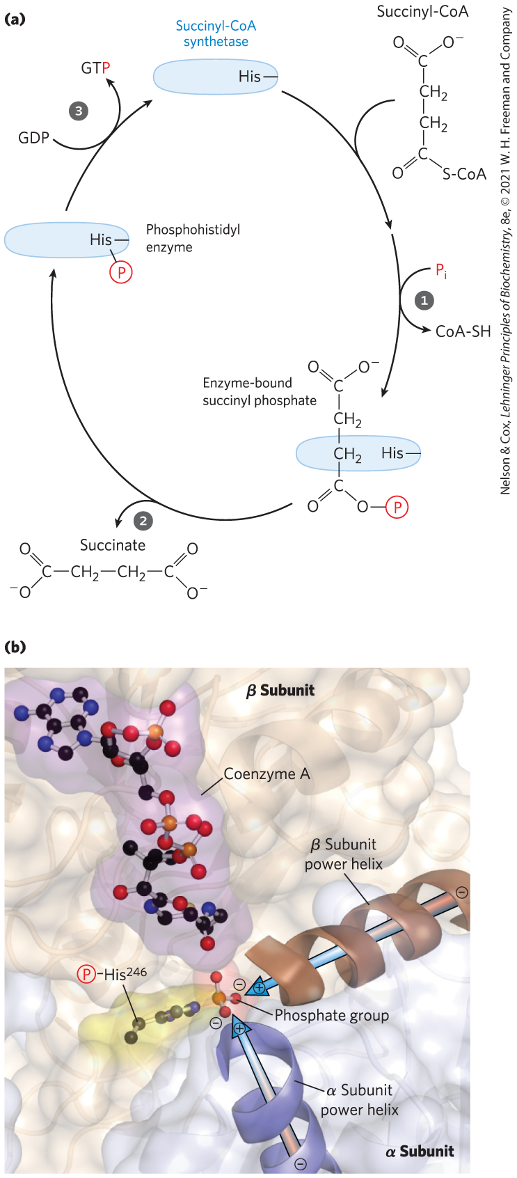
The Succinyl-CoA
Synthetase Reaction (1 of 2)
enzyme molecule becomes phosphorylated at a His residue in the active site
phosphoryl group is then transferred to ADP or GDP to form ATP or GTP
  animal cells have specific isozymes for ADP and GDP

Slide 73
The Succinyl-CoA
Synthetase Reaction (2 of 2)
power helices place the partial positive charges of the helix dipole near the phosphate group of the α chain phosphorylated His²⁴⁶ to stabilize the phosphoenzyme intermediate

Slide 74
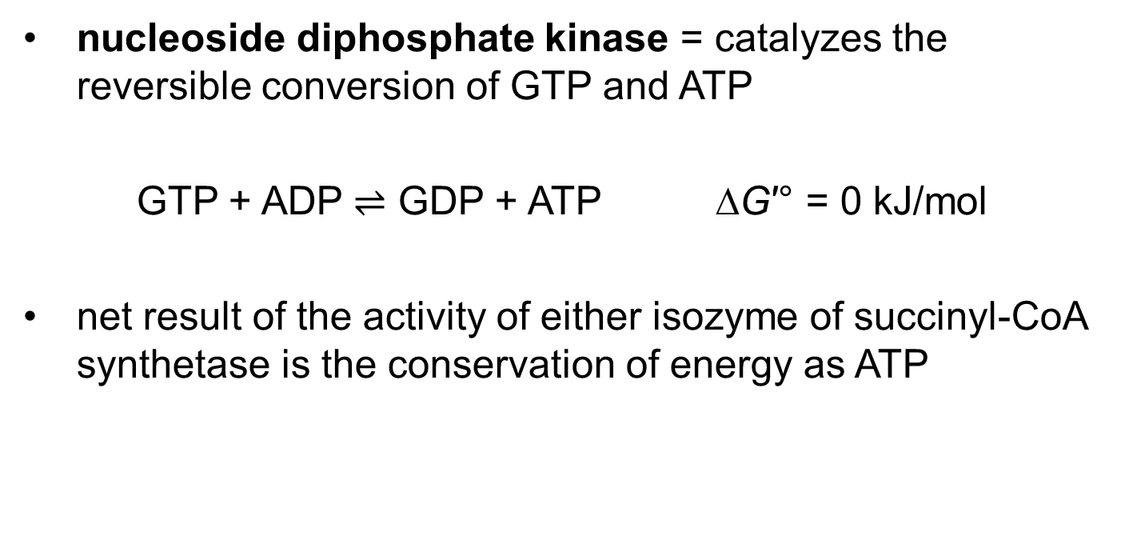
Nucleoside Diphosphate Kinase
nucleoside diphosphate kinase = catalyzes the reversible conversion of GTP and ATP
GTP + ADP $⇌$ GDP + ATP ∆G′° = 0 kJ/mol
net result of the activity of either isozyme of succinyl-CoA synthetase is the conservation of energy as ATP

Slide 75
Clicker Question 10
Which enzyme of the citric acid cycle is capable of a substrate-level phosphorylation?
citrate synthase
aconitase
succinate dehydrogenase
isocitrate dehydrogenase
succinyl-CoA synthetase
Notes:
Answer: E
Principle: 16.2
Learning Objective(s): Identify the amount of ATP or reduced coenzyme directly formed or consumed by each reaction of the citric acid cycle.
Bloom’s: 1:1

Slide 76
Clicker Question 10, Response
Which enzyme of the citric acid cycle is capable of a substrate-level phosphorylation?
succinyl-CoA synthetase
The formation of ATP (or GTP) at the expense of the energy released by the oxidative decarboxylation of α‐ketoglutarate is a substrate-level phosphorylation, like the synthesis of ATP in the glycolytic reactions catalyzed by phosphoglycerate kinase and pyruvate kinase.

Slide 77
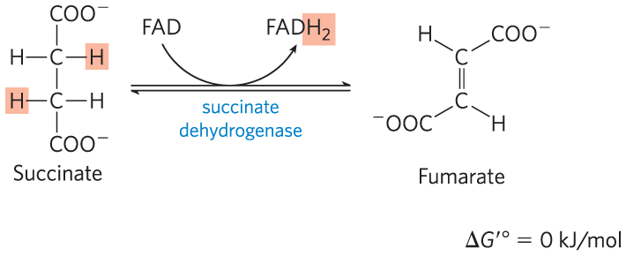
Oxidation of Succinate to Fumarate
succinate dehydrogenase = flavoprotein that catalyzes the reversible oxidation of succinate to fumarate
  integral protein of the mitochondrial inner membrane in eukaryotes
  contains three iron-sulfur clusters and covalently bound FAD

Slide 78
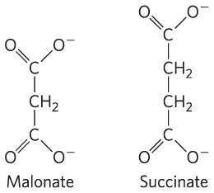
Malonate Is a Strong Competitive Inhibitor of Succinate Dehydrogenase
malonate = an analog of succinate
  not normally present in cells
  addition to mitochondria in vitro blocks citric acid cycle activity

Slide 79
Clicker Question 11
Which citric acid cycle reaction produces FADH₂?
succinyl-CoA synthetase
aconitase
α-ketoglutarate dehydrogenase complex
isocitrate dehydrogenase
succinate dehydrogenase
Notes:
Answer: E
Principle: 16.2
Learning Objective(s): List the cofactor(s) required by each enzyme reaction of the citric acid cycle.
Bloom’s: 1:1

Slide 80
Clicker Question 11, Response
Which citric acid cycle reaction produces FADH₂?
succinate dehydrogenase
The flavoprotein succinate dehydrogenase oxidizes succinate while reducing FAD to FADH₂.

Slide 81
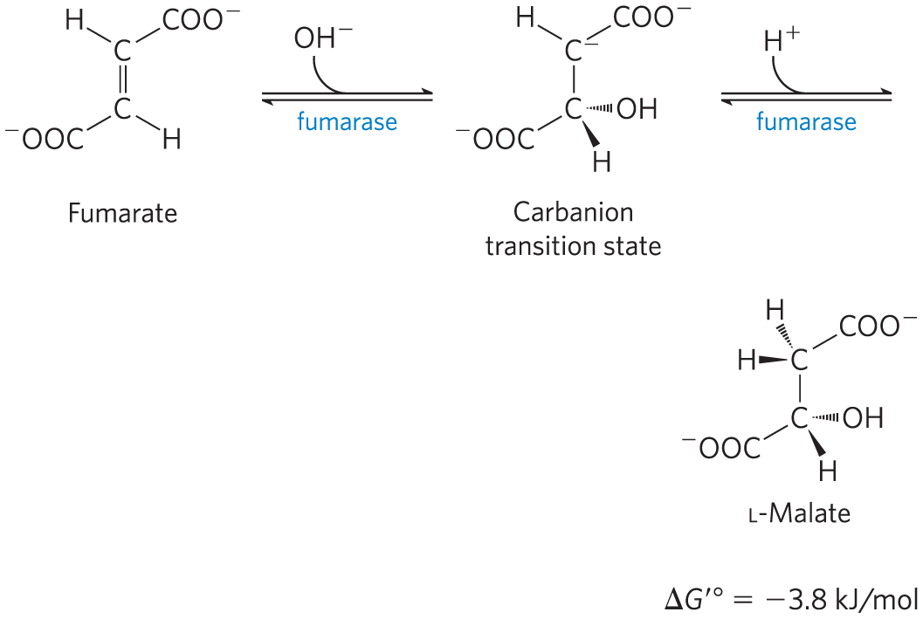
Hydration of Fumarate to Malate
fumarase = catalyzes the reversible hydration of fumarate to L-malate
  transition state is a carbanion

Slide 82
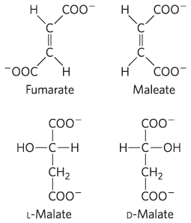
Fumarase Is Highly Stereospecific
in the forward direction, fumarase catalyzes hydration of the trans double bond of fumarate but not the cis double bond of maleate
in the reverse direction, fumarase is equally stereospecific

Slide 83
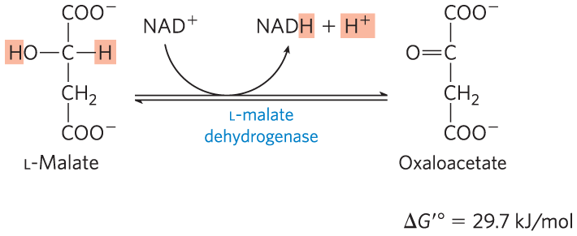
Oxidation of Malate to Oxaloacetate
L-malate dehydrogenase = catalyzes the oxidation of L-malate to oxaloacetate, coupled to the reduction of NAD⁺
  low [oxaloacetate] pulls the reaction forward
  regenerates oxaloacetate for citrate synthesis

Slide 84
Clicker Question 12
Which statement regarding the citric acid cycle is false?
The PDH complex is considered to be an enzyme of the citric acid cycle.
Succinate dehydrogenase is an integral membrane protein.
For the complete conversion of glucose to CO₂, approximately 32 ATP can be synthesized.
Succinyl-CoA synthetase and succinic thiokinase are two names for the same enzyme.
Notes:
Answer: A
Principle: 16.2
Learning Objective(s): List the enzymes of the citric acid cycle.
Bloom’s: 1:1

Slide 85
Clicker Question 12, Response
Which statement regarding the citric acid cycle is false?
The PDH complex is considered to be an enzyme of the citric acid cycle.
Although the PDH complex links glycolysis and the citric acid cycle, it is not considered to be part of either pathway.

Slide 86
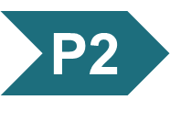
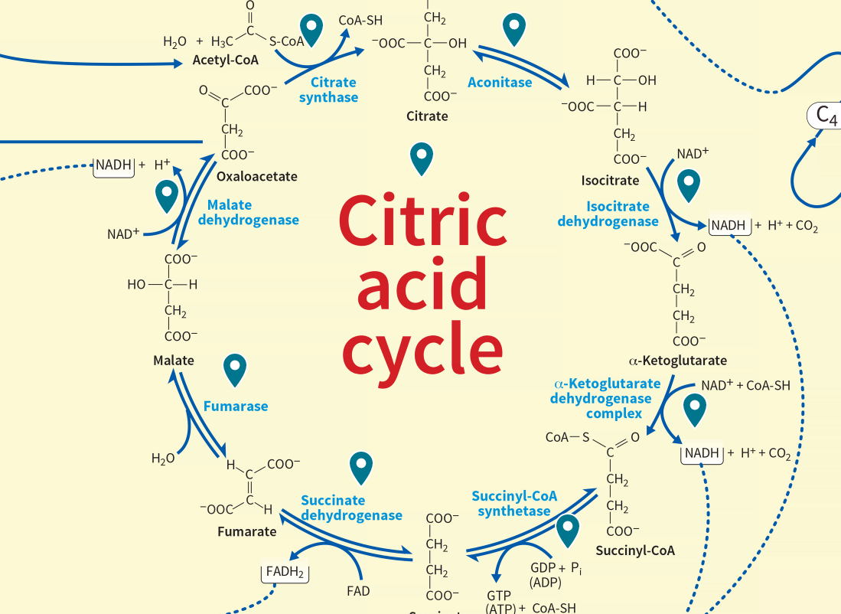
Activity: The Citric
Acid Cycle
Review the citric acid cycle pathway in the Metabolic Map in your Achieve course.
Notes:
Instructor: The Metabolic Map is located in the Achieve course. It can be found immediately before the Chapter 13 folder in the list of content. For more information on this activity, please see the In-Class Activity Guide in your Achieve course in Chapter 16.

Slide 87
Activity Instructions (2 of 4)
On your own, think of answers to the questions:
  Why is it not biochemically feasible to oxidize acetate (or acetyl-CoA) directly to CO₂?
  Which steps of the citric acid cycle involve an energy-conserving oxidation?
  Which steps of the citric acid cycle are necessary preparation steps to an oxidation? (2 minutes)
Pair up to discuss your ideas. (2 minutes)
Share your ideas with the class in group discussion.
(3 minutes)
Notes:
Instructor: The Metabolic Map is located in the Achieve course. It can be found immediately before the Chapter 13 folder in the list of content. For more information on this activity, please see the In-Class Activity Guide in your Achieve course in Chapter 16.

Slide 88
Activity Solution, Part 1
  Why is it not biochemically feasible to oxidize acetate (or acetyl-CoA) directly to CO₂? Decarboxylation of this two-carbon acid would result in CO₂ and methane, and methane is chemically stable, unable to be broken down further.
  How does the citric acid cycle get around this?
Notes:
Instructor: The Metabolic Map is located in the Achieve course. It can be found immediately before the Chapter 13 folder in the list of content. For more information on this activity, please see the In-Class Activity Guide in your Achieve course in Chapter 16.
This answer is available to students within the Tour for the Citric Acid Cycle within the Metabolic Map.
Answer to bonus/discussion question: For optimal oxidation, acetyl-CoA must be attached to a molecule with appropriate reactive groups to facilitate oxidation. This is done by attaching acetyl-CoA to oxaloacetate forming citrate, the first step of the citric acid cycle. The remainder of the cycle is dedicated to extraction of chemical energy and regeneration of oxaloacetate.

Slide 89
Activity Solution, Part 2
  Which steps of the citric acid cycle involve an energy-conserving oxidation?
    Step 3: Oxidation of isocitrate to α-ketoglutarate
    Step 4: Oxidation of α-ketoglutarate to succinyl-CoA
    Step 6: Oxidation of succinate to fumarate
    Step 8: Oxidation of malate to oxaloacetate
  What makes them energy conserving?
Notes:
Instructor: The Metabolic Map is located in the Achieve course. It can be found immediately before the Chapter 13 folder in the list of content. For more information on this activity, please see the In-Class Activity Guide in your Achieve course in Chapter 16.
Additional explanation: Step 3 - This is the first oxidation-reduction reaction of the cycle, the oxidative decarboxylation of isocitrate is coupled with the reduction of NAD⁺ to NADH and the release of CO₂. Step 4 - Like the previous reaction, this oxidation reaction results in the release of NADH and CO₂. While at this point two carbons have entered the cycle as acetyl and two carbons have exited as CO₂, the carbons that entered the cycle are not the two carbons that are immediately released as CO₂. Step 6: The goal of this reaction (as well as the next two) is to regenerate oxaloacetate. At the same time, more electrons are captured. Succinate dehydrogenase catalyzes the oxidation of succinate to fumarate, while reducing FAD to FADH₂. Step 8: l-malate dehydrogenase catalyzes the oxidation of l-malate to oxaloacetate, coupled with the reduction of NAD⁺ to NADH.
Answer to bonus question: The energy released by these oxidations is conserved in the reduction of three NAD⁺ and one FAD, and the production of one ATP or GTP.

Slide 90
Activity Solution, Part 3
  Which steps of the citric acid cycle are necessary preparation steps to an oxidation?
    Step 1: Formation of citrate
    Step 2: Formation of isocitrate
    Step 5: Conversion of succinyl-CoA to succinate
    Step 7: Hydration of fumarate to malate
  Why are all of these steps worth the effort if they only generate one ATP?
Notes:
Instructor: The Metabolic Map is located in the Achieve course. It can be found immediately before the Chapter 13 folder in the list of content. For more information on this activity, please see the In-Class Activity Guide in your Achieve course in Chapter 16.
Additional explanation. Step 1 and 2: The formation of citrate from oxaloacetate and acetyl-CoA is required for the full oxidation of the compound. Citrate however is not positioned to allow oxidation. Step 5: Succinyl-CoA synthetase hydrolyzes succinyl-CoA to form succinate, and uses the energy of the thioester to synthesize GTP. Step 7: To regenerate oxaloacetate, an oxygen atom must be introduced to fumarate. Fumarase hydrates fumarate to produce malate, which is more reduced than oxaloacetate.
Answer to bonus question: Although the citric acid cycle only directly generates one ATP per turn, the NADH and FADH₂ are utilized in oxidative phosphorylation, generating almost 10 times more ATP.

Slide 91
Bonus Discussion
  Which enzymes, intermediates, and byproducts of the citric acid cycle are utilized by other pathways?
Notes:
Instructor: The Metabolic Map is located in the Achieve course. It can be found immediately before the Chapter 13 folder in the list of content. For more information on this activity, please see the In-Class Activity Guide in your Achieve course in Chapter 16.
Additional explanation. Step 1 and 2: The formation of citrate from oxaloacetate and acetyl-CoA is required for the full oxidation of the compound. Citrate however is not positioned to allow oxidation. Step 5: Succinyl-CoA synthetase hydrolyzes succinyl-CoA to form succinate, and uses the energy of the thioester to synthesize GTP.

Slide 92
Bonus Discussion, Solution
  Which enzymes, intermediates, and byproducts of the citric acid cycle are utilized by other pathways?
Enzymes
Succinate Dehydrogenase
Aconitase*
Intermediates
Acetyl-CoA
α-Ketoglutarate
Oxaloacetate
Citrate
Byproducts
NADH
FADH₂
CoA
Notes:
Instructor: The Metabolic Map is located in the Achieve course. It can be found immediately before the Chapter 13 folder in the list of content. For more information on this activity, please see the In-Class Activity Guide in your Achieve course in Chapter 16.
Enzymes: Succinate Dehydrogenase - part of the electron transport chain. *Aconitase, in iron-depleted cells, loses its iron-sulfur center and acquires a new role in the regulation of iron homeostasis (this information can be gained from the text rather than the Metabolic Map), not officially another metabolic pathway.
Intermediates: Acetyl-CoA is a product of the pyruvate dehydrogenase complex, following glycolysis, or could be sourced from β-Oxidation, it can also feed into fatty acid synthesis. α-Ketoglutarate and oxaloacetate are part of the Urea cycle. Oxaloacetate and citrate can also be used as precursors to gluconeogenesis or fatty acid synthesis, in reactions to export intermediates from the mitochondria.
Byproducts: NADH and FADH₂ are utilized in oxidative phosphorylation. The CoA from acetyl-CoA is recycled to participate in the oxidative carboxylation of another molecule of pyruvate by the PDH complex.
Possible sticking point: some students may bring up isocitrate dehydrogenase and its role in fatty acid and sterol synthesis, however this is a different form of isocitrate dehydrogenase that requires NADP⁺ rather than NAD⁺.

Slide 93
Principle 2 (6 of 7)
The reactions of the citric acid cycle follow
a chemical logic. In its catabolic role, the
citric acid cycle oxidizes acetyl-CoA to CO₂ and H₂O. Energy from the oxidations in the cycle drives the synthesis of ATP. The chemical strategies for activating groups for oxidation and for conserving energy in the form of reducing power and high-energy compounds are used in many other biochemical pathways.

Slide 94
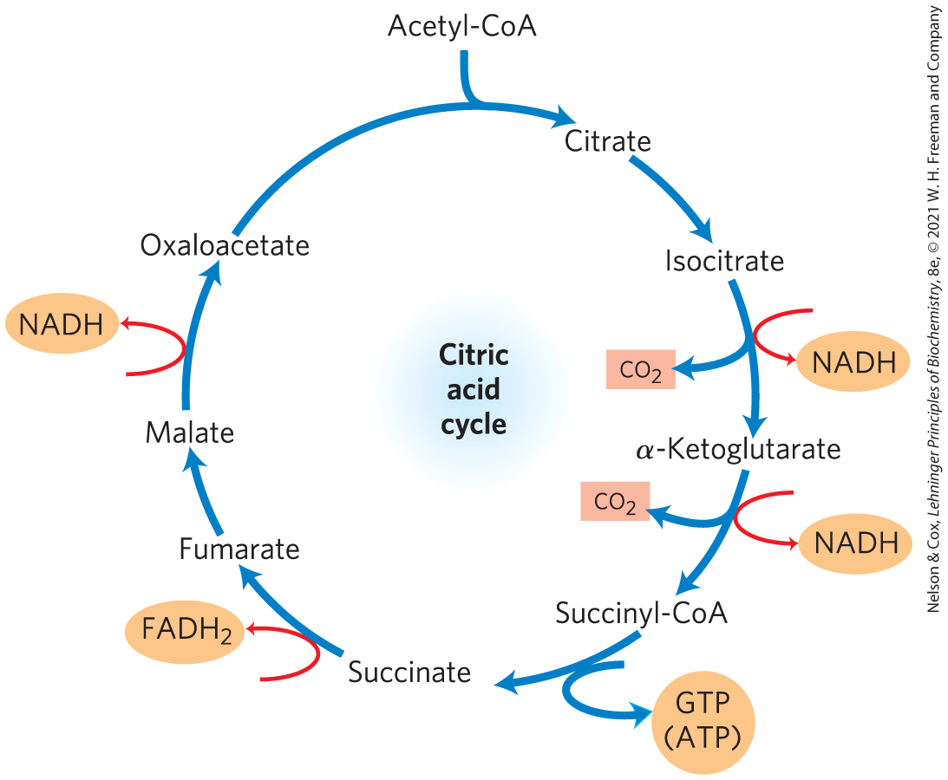
The Energy of Oxidations in the Cycle Is Efficiently Conserved
energy released by oxidation is conserved in the production of:
  3 NADH
  1 FADH₂
  1 GTP (or ATP)

Slide 95
Clicker Question 13
How many reducing equivalents are transferred to electron carriers after one turn of the citric acid cycle?
4
6
8
10
16
Notes:
Answer: C
Principle: 16.2
Learning Objective(s): Identify the amount of ATP or reduced coenzyme directly formed or consumed by each reaction of the citric acid cycle.
Bloom’s: 2:2

Slide 96
Clicker Question 13, Response
How many reducing equivalents are transferred to electron carriers after one turn of the citric acid cycle?
8
One turn of the citric acid cycle generates three NADH and one FADH₂ with two electrons each.

Slide 97
Principle 2 (7 of 7)
The reactions of the citric acid cycle follow
a chemical logic. In its catabolic role, the
citric acid cycle oxidizes acetyl-CoA to CO₂ and H₂O. Energy from the oxidations in the cycle drives the synthesis of ATP. The chemical strategies for activating groups for oxidation and for conserving energy in the form of reducing power and high-energy compounds are used in many other biochemical pathways.

Slide 98
Electrons from NADH and FADH₂ Enter the Respiratory Chain
the citric acid cycle directly generates only one ATP per turn
the large flow of electrons into the respiratory chain via NADH and FADH₂ leads to formation of almost 10 times more ATP during oxidative phosphorylation
  each NADH drives formation of ~2.5 ATP
  each FADH₂ drives formation of ~1.5 ATP

Slide 99
Clicker Question 14
Which statement regarding the energetics of the citric acid cycle is true?
The cycle in animal cells directly produces one ATP instead of one GTP.
All of the energy-producing capacity of the cycle occurs in the first four reactions; the remaining reactions serve to regenerate oxaloacetate.
Production of FADH₂ by the citric acid cycle represents the energic capacity to synthesize about 1.5 ATP.
Production of 3 NADH by the citric acid cycle represents the energic capacity to synthesize about 2.5 ATP.
Notes:
Answer: C
Principle: 16.2
Learning Objective(s): Identify the energetic products of the citric acid cycle.
Bloom’s: 2:2

Slide 100
Clicker Question 14, Response
Which statement regarding the energetics of the citric acid cycle is true?
Production of FADH₂ by the citric acid cycle represents the energic capacity to synthesize about 1.5 ATP.
In oxidative phosphorylation, passage of two electrons from FADH₂ to O₂ yields about 1.5 ATP.

Slide 101
Clicker Question 15
Using currently accepted P/O ratios, what is the total ATP potential yield from one acetyl-CoA in the citric acid cycle?
8
10
24
32
106
Notes:
Answer: B
Principle: 16.2
Learning Objective(s): Calculate the number of ATP ultimately formed during the citric acid cycle.
Bloom’s: 2:2

Slide 102
Clicker Question 15, Response
Using currently accepted P/O ratios, what is the total ATP potential yield from one acetyl-CoA in the citric acid cycle?
10
The oxidation of one acetyl-CoA in the citric acid cycle yields three NADH (3×2.5 = 7.5) , one FADH₂ (1×1.5), and one GTP/ATP.

Slide 103
Stoichiometry of Coenzyme Reduction and ATP Formation in Aerobic Oxidation of Glucose
Table 16-1 Stoichiometry of Coenzyme Reduction and ATP Formation in the Aerobic Oxidation of Glucose via Glycolysis, the Pyruvate Dehydrogenase Complex Reaction, the Citric Acid Cycle, and Oxidative Phosphorylation
Reaction | Number of ATP or reduced coenzyme directly formed | Number of ATP ultimately formed
Glucose → glucose 6-phosphate | −1 ATP | −1
Fructose 6-phosphate → fructose 1,6-bisphosphate | −1 ATP | −1
2 Glyceraldehyde 3-phosphate → 2 1,3-biphosphoglycerate | 2 NADH | 3 or 5
2 1,3-Bisphosphoglycerate → 2 3-phosphoglycerate | 2 ATP | 2
2 Phosphoenolpyruvate → 2 pyruvate | 2 ATP | 2
2 Pyruvate → 2 acetyl-CoA | 2 NADH | 5
2 Isocitrate → 2 α-ketoglutarate | 2 NADH | 5
2 α-Ketoglutarate → 2 succinyl-CoA | 2 NADH | 5
2 Succinyl-CoA → 2 succinate | 2 ATP (or 2 GTP) | 2
2 Succinate → 2 fumarate | 2 FADH₂ | 3
2 Malate → 2 oxaloacetate | 2 NADH | 5
Total |  | 30-32

Slide 104
Clicker Question 16
How many NADH molecules are generated from the complete oxidation of one glucose?
5
7
10
16
32
Notes:
Answer: C
Principle: 16.2
Learning Objective(s): Write the net biochemical equation for the metabolism of a molecule of glucose by glycolysis and the citric acid cycle, including all cofactors.
Bloom’s: 2:2

Slide 105
Clicker Question 16, Response
How many NADH molecules are generated from the complete oxidation of one glucose?
10
Glycolysis produces two NADH and two pyruvates. The two pyruvates yield two NADH via pyruvate dehydrogenase and two acetyl-CoA. Each acetyl-CoA generates three NADH in the citric acid cycle.

Slide 106
16.3 The Hub of Intermediary Metabolism

Slide 107
Principle 3 (2 of 4)
The citric acid cycle is a hub of metabolism, with catabolic pathways leading in and anabolic pathways leading out. Acetate groups (acetyl-CoA) from the catabolism of various fuels are used in the synthesis of such metabolites as amino acids, fatty acids, and sterols. The breakdown products of many amino acids and nucleotides are intermediates of the cycle, and they can be fed in or siphoned off as needed by the cell.

Slide 108
The Citric Acid Cycle Accepts Carbon Skeletons
the cycle accepts 3-, 4-, and 5-carbon skeletons
the breakdown of amino acids yields carbon skeletons:
  deaminated aspartate yields oxaloacetate
  deaminated glutamate yields α-ketoglutarate

Slide 109
Principle 3 (3 of 4)
The citric acid cycle is a hub of metabolism, with catabolic pathways leading in and anabolic pathways leading out. Acetate groups (acetyl-CoA) from the catabolism of various fuels are used in the synthesis of such metabolites as amino acids, fatty acids, and sterols. The breakdown products of many amino acids and nucleotides are intermediates of the cycle, and they can be fed in or siphoned off as needed by the cell.

Slide 110
The Citric Acid Cycle Serves in Both Catabolic and Anabolic Processes
amphibolic pathway = one that serves in both catabolic and anabolic processes
animals cannot convert acetate or acetyl-CoA to glucose
  in the citric acid cycle, there is no net conversion of acetate to oxaloacetate
glyoxylate cycle = reaction sequence that converts acetate to carbohydrate
  present in bacteria, plants, fungi, and protists

Slide 111
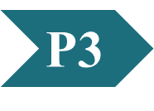
Clicker Question 17
The term amphibolic means:
something that is both catabolic and anabolic.
nothing; it is a made-up word.
thermodynamic coupling of catabolic pathways to drive anabolic pathways.
containing both polar and nonpolar functional groups.
Notes:
Answer: D
Principle: 16.3
Learning Objective(s): Describe the anabolic processes of the citric acid cycle..
Bloom’s: 1:1

Slide 112
Clicker Question 17, Response
The term amphibolic means:
something that is both catabolic and anabolic.
The prefix amph- comes from the Greek word meaning “both kinds.” In aerobic organisms, the citric acid cycle is an amphibolic pathway, one that serves in both catabolic and anabolic processes.

Slide 113
Clicker Question 18
The glyoxylate cycle is remarkably similar to the citric acid cycle but differs in several important ways. Which important molecule is conserved by the glyoxylate cycle but NOT the citric acid cycle?
acetyl-CoA
malate
citrate
carbon dioxide
NADH
Notes:
Answer: D
Principle: 16.3
Learning Objective(s): Describe the purpose of the glyoxylate cycle in non-animal organisms.
Bloom’s: 2:1

Slide 114
Clicker Question 18, Response
The glyoxylate cycle is remarkably similar to the citric acid cycle but differs in several important ways. Which important molecule is conserved by the glyoxylate cycle but NOT the citric acid cycle?
carbon dioxide
The citric acid cycle has a net carbon loss (2 CO₂), whereas the glyoxylate cycle does not contain the two oxidative decarboxylations from the citric acid cycle. Conserving the carbon allows the cell to make cellulose and sucrose in high concentrations rapidly.

Slide 115
Principle 3 (4 of 4)
The citric acid cycle is a hub of metabolism, with catabolic pathways leading in and anabolic pathways leading out. Acetate groups (acetyl-CoA) from the catabolism of various fuels are used in the synthesis of such metabolites as amino acids, fatty acids, and sterols. The breakdown products of many amino acids and nucleotides are intermediates of the cycle, and they can be fed in or siphoned off as needed by the cell.

Slide 116
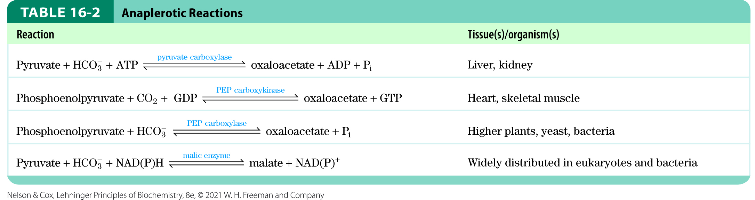
Anaplerotic Reactions Replenish Citric Acid Cycle Intermediates
when intermediates are shunted from the citric acid cycle to other pathways, they are replenished
anaplerotic reactions = chemical reactions that replenish intermediates

Slide 117
Clicker Question 19
Anaplerotic reactions:
are also known as cataplerotic reactions.
are defined as those that have oxaloacetate as a product.
never involve ATP hydrolysis.
replenish all citric acid cycle intermediates.
Notes:
Answer: D
Principle: 16.3
Learning Objective(s): Explain the purpose of anaplerotic reactions.
Bloom’s: 2:1

Slide 118
Clicker Question 19, Response
Anaplerotic reactions:
replenish all citric acid cycle intermediates.
The term anapleortic derives from the Greek wording meaning “to refill.” When the withdrawal of cycle intermediates for use in biosynthesis lowers the concentrations of citric acid cycle intermediates enough to slow the cycle, the intermediates are replenished by anaplerotic reactions.

Slide 119
Clicker Question 20
Which enzyme does NOT catalyze an anaplerotic reaction?
pyruvate carboxylase
PEP carboxykinase
succinate carboxykinase
PEP carboxylase
malic enzyme
Notes:
Answer: C
Principle: 16.3
Learning Objective(s): Explain the purpose of anaplerotic reactions.
Bloom’s: 2:2

Slide 120
Clicker Question 20, Response
Which enzyme does NOT catalyze an anaplerotic reaction?
succinate carboxykinase
Pyruvate carboxylase, PEP carboxykinase, and PEP carboxylase all replenish the oxaloacetate that is lost from the citric acid cycle to biosynthetic reactions. Malic enzyme replenishes malate. Succinate carboykinase is not an actual enzyme.

Slide 121
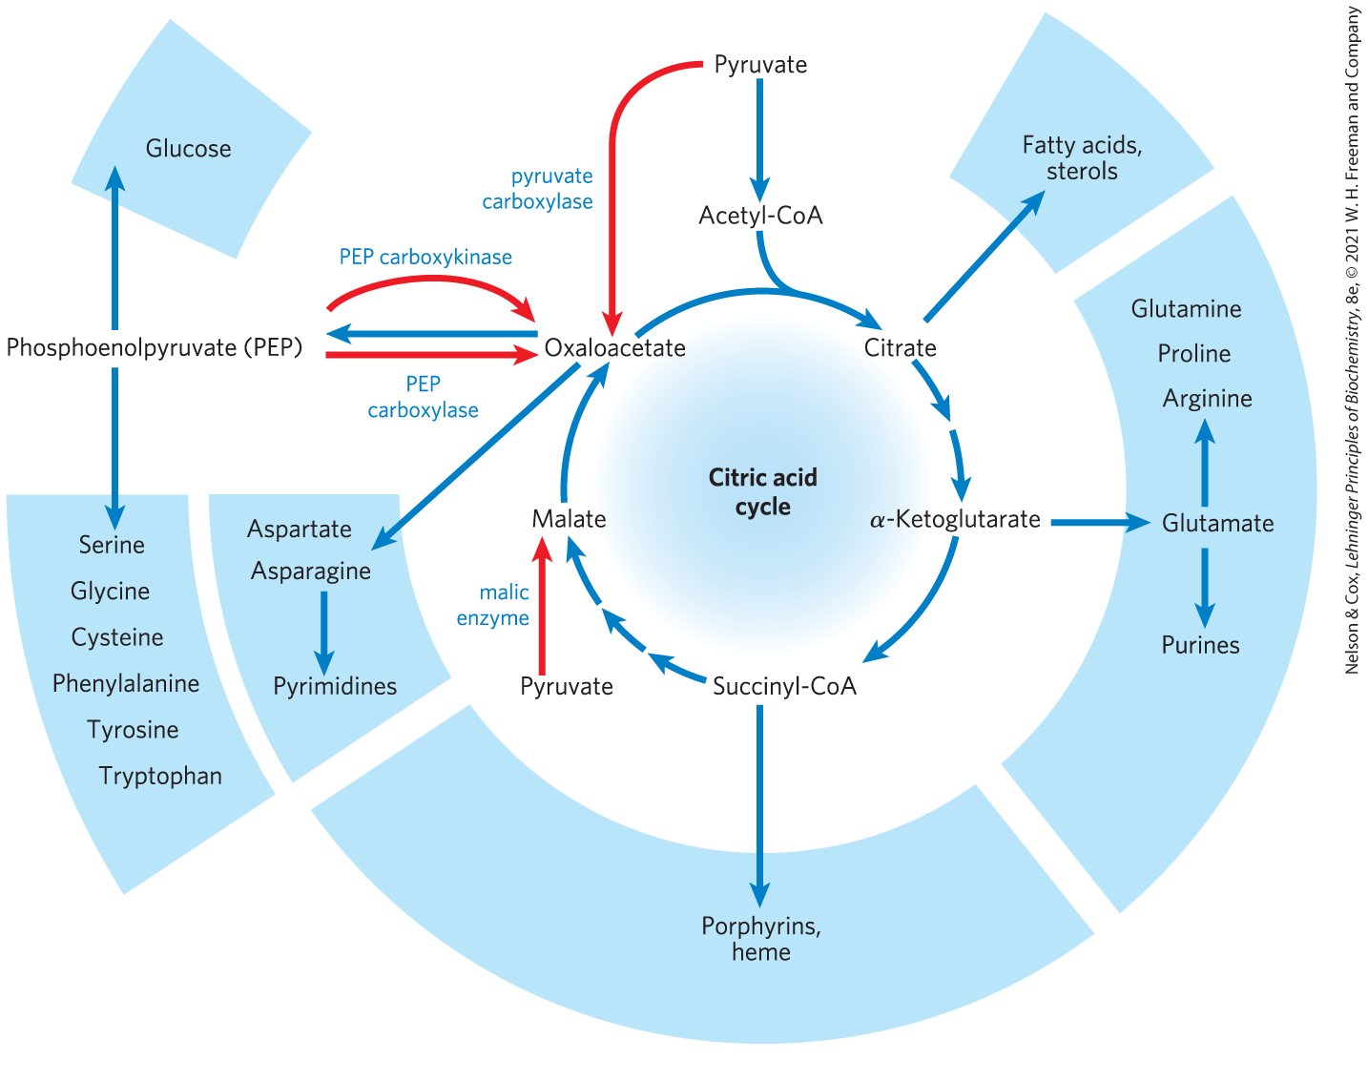
Role of the Citric Acid Cycle in Anabolism

Slide 122
Clicker Question 21
The power of the citric acid cycle is partly in the ability to shuttle intermediates out for the synthesis of important groups of molecules. What group of molecules is produced from citrate?
lipids and sterols
nucleic acids (purines)
a number of amino acids
glucose and a few amino acids
porphyrin rings for various molecules such as heme
Notes:
Answer: A
Principle: 16.3
Learning Objective(s): Explain the purpose of anaplerotic reactions.
Bloom’s: 2:1

Slide 123
Clicker Question 21, Response
The power of the citric acid cycle is partly in the ability to shuttle intermediates out for the synthesis of important groups of molecules. What group of molecules is produced from citrate?
lipids and sterols
Citrate may be exported from the mitochondria and used as the starting material for synthesis of fatty acids and sterols in the cytosol.

Slide 124
Pyruvate Carboxylase
pyruvate carboxylase = catalyzes the reversible carboxylation of pyruvate by HCO₃⁻ to form oxaloacetate
  most important anaplerotic reaction in mammalian liver, kidney, and brown adipose tissue
  requires energy from ATP
  allosterically activated by acetyl-CoA

Slide 125
Biotin in Pyruvate Carboxylase Carries One-Carbon (CO₂) Groups
biotin = vitamin that acts as a specialized carrier of one-carbon groups as CO₂ in many carboxylation reactions
  serves as the prosthetic group of pyruvate carboxylase

Slide 126
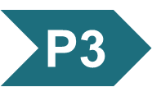
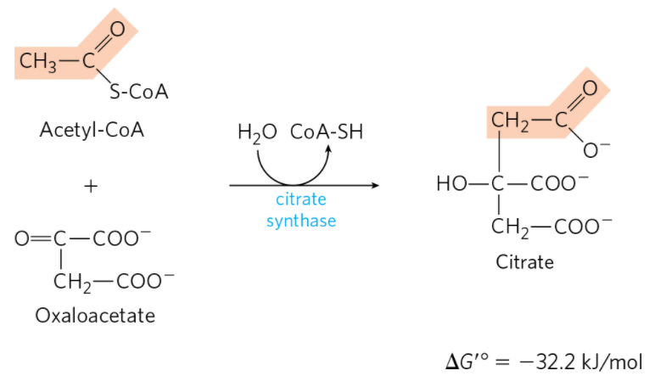
Activity: Activation by CoA
Watch the Animated Mechanism titled “Citrate Synthase Combines Acetyl-CoA and Oxaloacetate to Form Citrate.”
Notes:
Instructor: This Animated Mechanism is found within Chapter 16 of Achieve. It is in the folder titled “Ch16 In-Class Activities, Videos, and Resources.”
Ch 16 3. The citric acid cycle is a hub of metabolism, with catabolic pathways leading in and anabolic pathways leading out. Acetate groups (acetyl-CoA) from the catabolism of various fuels are used in the synthesis of such metabolites as amino acids, fatty acids, and sterols. The breakdown products of many amino acids and nucleotides are intermediates of the cycle, and they can be fed in or siphoned off as needed by the cell.

Slide 127
Activity Instructions (3 of 4)
On your own, think of answers to the question:
  Why must carbons enter the citric acid cycle in the form of acetyl-CoA instead of as acetate?
  (2 minutes)
Pair up to discuss your ideas. (2 minutes)
Share your ideas with the class in group discussion. (3 minutes)
Notes:
Instructor: This Animated Mechanism is found within Chapter 16 of Achieve. It is in the folder titled “Ch16 In-Class Activities, Videos, and Resources.”

Slide 128
Activity Solution (3 of 4)
  Why must carbons enter the citric acid cycle in the form of acetyl-CoA instead of as acetate? Activation of acetate with CoA, forming acetyl-CoA, allows hydrolysis of the high-energy thioester during the citrate synthase reaction. This makes the forward reaction highly exergonic. The large, negative standard free-energy change of the forward citrate synthase reaction is essential to the operation of the cycle because the concentration of oxaloacetate is normally very low.
Notes:
Instructor: This Animated Mechanism is found within Chapter 16 of Achieve. It is in the folder titled “Ch16 In-Class Activities, Videos, and Resources.”

Slide 129
Principle 5 (6 of 6)
Enzymes have evolved to form complexes to efficiently achieve a series of chemical transformations without releasing the intermediates into the bulk solvent. This strategy, seen in the pyruvate dehydrogenase complex and the metabolons of the citric acid cycle, is ubiquitous in other pathways of metabolism, in respiration, and in the many “ — somes” that assemble and disassemble informational macromolecules.

Slide 130
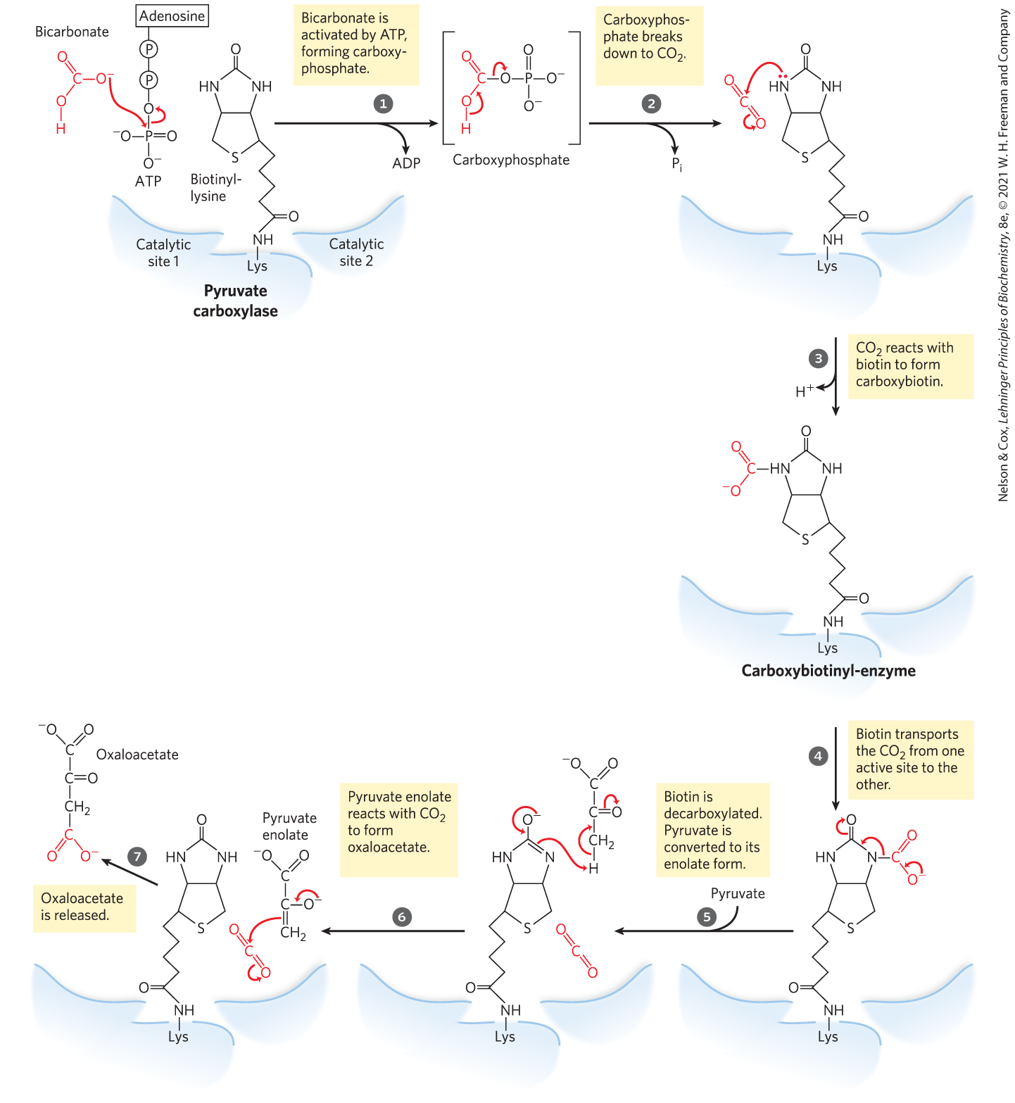
The Role of Biotin in the Pyruvate Carboxylase Reaction
the two steps in carboxylation of pyruvate occur at separate active sites
  the arm of biotin transfers activated carboxyl groups from the first active site to the second

Slide 131
Clicker Question 22
The release of carbon dioxide from the complete oxidation of pyruvate can pose problems for cells. Which molecule can easily be formed from carbon dioxide that can serve as a one-carbon donor and double as a biological buffer?
biotin
acetate
glyceraldehyde 3-phosphate
glycine
bicarbonate
Notes:
Answer: E
Principle: 16.3
Learning Objective(s): Explain the purpose of anaplerotic reactions.
Bloom’s: 2:2

Slide 132
Clicker Question 22, Response
The release of carbon dioxide from the complete oxidation of pyruvate can pose problems for cells. Which molecule can easily be formed from carbon dioxide that can serve as a one-carbon donor and double as a biological buffer?
bicarbonate
Only bicarbonate (HCO₃⁻) serves both of these roles. Biotin can accept a CO₂, but it is not a biological buffer nor the molecule into which CO₂ is transformed. Acetate is a biological buffer, but it has two carbons and does not serve as a one-carbon donor.

Slide 133
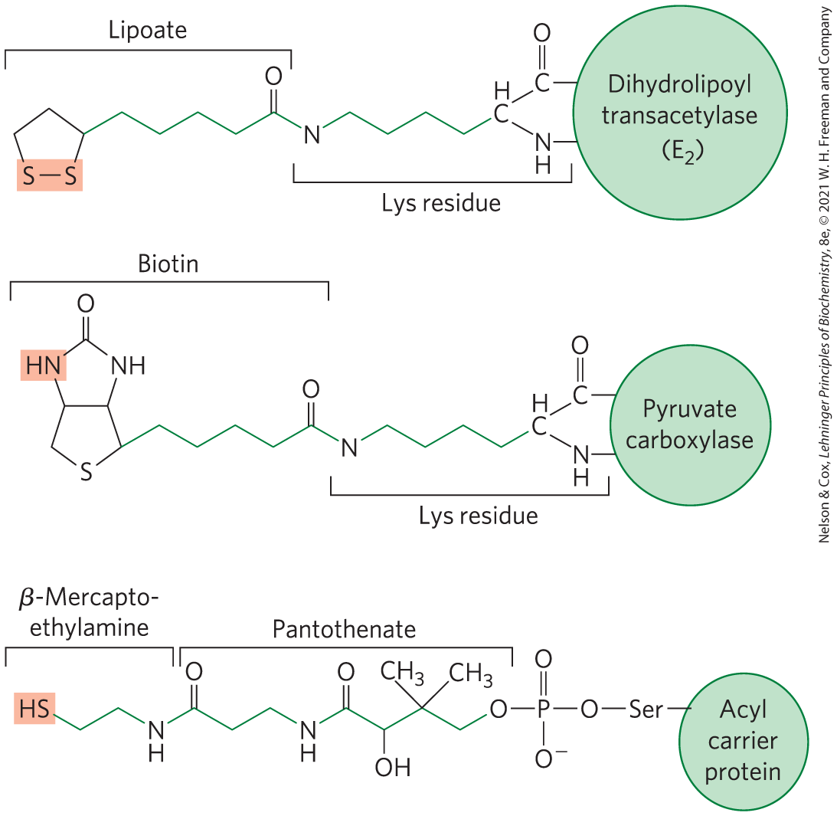
Biological Tethers Allow Flexibility
all participate in substrate channeling through the flexible tethers that move intermediates from one active site to the next

Slide 134
16.4 Regulation of the Citric Acid Cycle

Slide 135
Principle 4 (3 of 5)
The central role of the citric acid cycle in metabolism requires that it be regulated
in coordination with many other pathways. Regulation occurs by both allosteric and covalent mechanisms that overlap and interact to achieve homeostasis. Some mutations that affect the reactions of the citric acid cycle lead to tumor formation.

Slide 136
Citric Acid Cycle Regulation
regulation balances the supply of key intermediates with the demands of energy production and biosynthetic processes
regulation occurs at several points:
  PDH complex
  citrate synthase
  isocitrate dehydrogenase complex
  α-ketoglutarate dehydrogenase complex

Slide 137
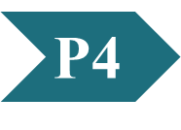
Clicker Question 23
The citric acid cycle is regulated at the reactions catalyzed by citrate synthase, isocitrate dehydrogenase, and α-ketoglutarate dehydrogenase. What do these three reactions have in common?
They are all close to equilibrium.
They are all strongly exergonic.
They all reduce NAD⁺ to NADH.
They all carry out substrate-level phosphorylation.
Notes:
Answer: B
Principle: 16.4
Learning Objective(s): Describe how the exergonic steps of the citric acid cycle are regulated.
Bloom’s: 2:2

Slide 138
Clicker Question 23, Response
The citric acid cycle is regulated at the reactions catalyzed by citrate synthase, isocitrate dehydrogenase, and α-ketoglutarate dehydrogenase. What do these three reactions have in common?
They are all strongly exergonic.
Recall from Chapter 13 that reactions far from equilibrium are common points of regulation. Each of these three strongly exergonic steps in the citric acid cycle can become the rate-limiting step under some circumstances.

Slide 139
Principle 1 (3 of 4)
Pyruvate is the metabolite that links two central catabolic pathways, glycolysis and the citric acid cycle. It is therefore a logical point for regulation that determines the rate of catabolic activity and the partitioning of pyruvate among its possible uses.

Slide 140
Production of Acetyl-CoA by the PDH Complex Is Regulated by Allosteric and Covalent Mechanisms
PDH complex activity is turned off when:
  ample fatty acids and acetyl-CoA are available as fuel
  [ATP]/[ADP] and [NADH]/[NAD⁺] ratios are high
PDH complex activity is turned on when:
  energy demands are high
  the cell requires greater flux of acetyl-CoA into the citric acid cycle

Slide 141
Clicker Question 24
The pyruvate dehydrogenase (PDH) complex is NOT regulated by:
ADP.
fatty acids.
covalent modification.
acetyl-CoA.
Notes:
Answer: A
Principle: 16.4
Learning Objective(s): Describe the covalent modifications that regulate the pyruvate dehydrogenase complex.
Bloom’s: 2:1

Slide 142
Clicker Question 24, Response
The pyruvate dehydrogenase (PDH) complex is NOT regulated by:
ADP.
The PDH complex is regulated by allosteric mechanisms and covalent modification (phosphorylation). ATP, acetyl-CoA, NADH, and fatty acids inhibit the activity of the PDH complex, whereas AMP, CoA, NAD⁺, and Ca²⁺ stimulate PDH complex activity.

Slide 143
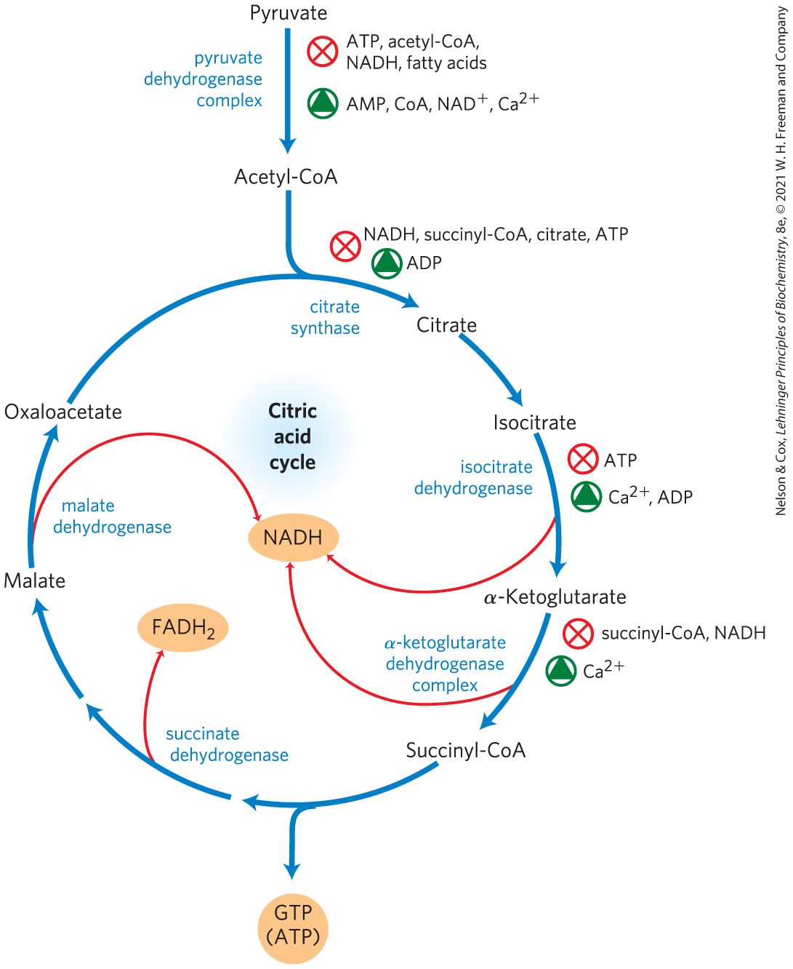
Regulation of Metabolite Flow Through the Citric Acid Cycle

Slide 144
Principle 1 (4 of 4)
Pyruvate is the metabolite that links two central catabolic pathways, glycolysis and the citric acid cycle. It is therefore a logical point for regulation that determines the rate of catabolic activity and the partitioning of pyruvate among its possible uses.

Slide 145
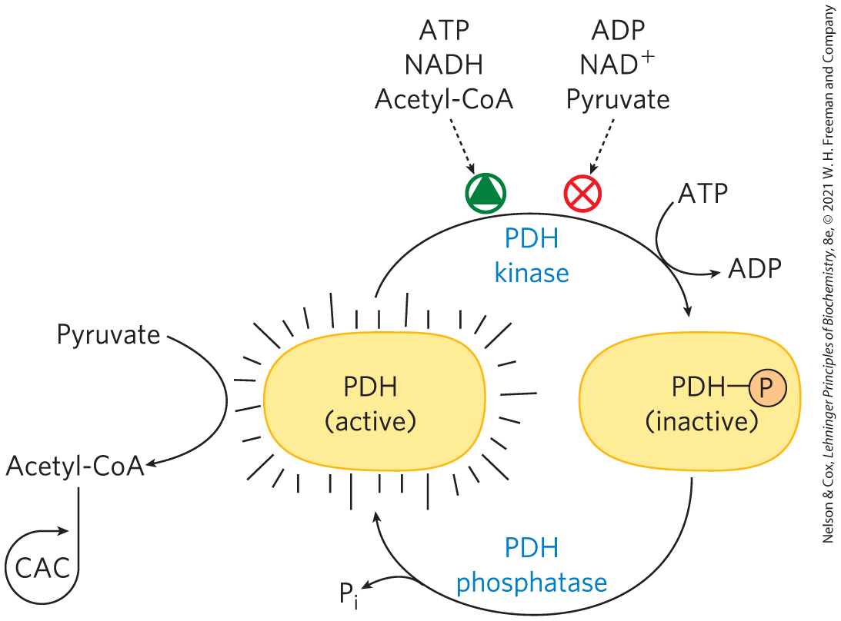
Covalent Modification of the
PDH Complex
PDH kinase = inhibits the PDH complex by phosphorylation
  allosterically activated by products of the complex
  inhibited by substrates of the complex
PDH phosphatase = reverses the inhibition by PDH kinase

Slide 146
Principle 4 (4 of 5)
The central role of the citric acid cycle in metabolism requires that it be regulated
in coordination with many other pathways. Regulation occurs by both allosteric and covalent mechanisms that overlap and interact to achieve homeostasis. Some mutations that affect the reactions of the citric acid cycle lead to tumor formation.

Slide 147
The Citric Acid Cycle Is Also Regulated at Three Exergonic Steps
regulation occurs at strongly exergonic steps catalyzed by:
  citrate synthase
  isocitrate dehydrogenase complex
  α-ketoglutarate dehydrogenase complex
fluxes are affected by the concentrations of substrates and products:
  end products ATP and NADH are inhibitory
  NAD⁺ and ADP are stimulatory
  long-chain fatty acids are inhibitory

Slide 148
Clicker Question 25
The citric acid cycle is regulated in a manner similar to glycolysis. Which molecule is an allosteric activator of BOTH of those pathways?
ATP
NAD+
ADP
citrate
NADH
Notes:
Answer: C
Principle: 16.4
Learning Objective(s): Describe how the exergonic steps of the citric acid cycle are regulated.
Bloom’s: 2:2

Slide 149
Clicker Question 25, Response
The citric acid cycle is regulated in a manner similar to glycolysis. Which molecule is an allosteric activator of BOTH of those pathways?
ADP
ADP allosterically activates the glycolytic enzyme phosphofructokinase-1 (PFK-1) as well as the citric acid cycle enzymes citrate synthase and isocitrate dehydrogenase.

Slide 150
Clicker Question 26
How is the regulation of glucose metabolism through glycolysis and the citric acid cycle coordinated?
High ADP levels stimulate glycolysis and the citric acid cycle.
High NADH levels inhibit glycolysis and the citric acid cycle.
High citrate levels inhibit glycolysis.
In muscle, Ca²⁺ release (a signal of muscle contraction) stimulates both glycogen phosphorylase and enzymes of the citric acid cycle.
All of the answers are correct.
Notes:
Answer: E
Principle: 16.4
Learning Objective(s): Describe how the exergonic steps of the citric acid cycle are regulated.
Bloom’s: 2:2

Slide 151
Clicker Question 26, Response
How is the regulation of glucose metabolism through glycolysis and the citric acid cycle coordinated?
All of the answers are correct.
High levels of ADP and Ca²⁺ stimulate both glycolysis and citric acid cycle. Conversely, high levels of NADH inhibit both glycolysis and the citric acid cycle. High levels of citrate also inhibit glycolysis.

Slide 152
Citric Acid Cycle Activity Changes in Tumors
some mutations that affect the PDH complex or citric acid cycle enzymes are oncogenic:
  downregulation of mitochondrial pyruvate carrier (MPC)
  inactivation of PDH complex
  inactivation of succinate dehydrogenase
oncometabolites = stimulate tumor growth by acting though specific GPCRs in the plasma membrane

Slide 153
Clicker Question 27
Which statement regarding regulation of the citric acid cycle is false?
Ca²⁺ is involved in citric acid cycle regulation in vertebrate muscle.
Dysfunction of the citric acid cycle (e.g., due to mutations in enzymes of the cycle) is often associated with different types of cancer
In addition to regulation of the PDH complex, regulation of the citric acid cycle occurs by regulation of the enzymes that catalyze the strongly exergonic steps.
As [NADH]/[NAD⁺] increases, flux through the cycle increases.
Notes:
Answer: D
Principle: 16.4
Learning Objective(s): Describe how the exergonic steps of the citric acid cycle are regulated.
Bloom’s: 2:2

Slide 154
Clicker Question 27, Response
Which statement regarding regulation of the citric acid cycle is false?
As [NADH]/[NAD⁺] increases, flux through the cycle increases.
PDH complex activity is turned off when the cell’s [NADH]/[NAD⁺] ratio is high. Similarly, a high [NADH]/[NAD⁺] ratio inhibits the citric acid cycle reactions catalyzed by isocitrate and α-ketoglutarate dehydrogenase by mass action.

Slide 155
Lactate and Succinate
Are Oncometabolites
tumor cells accumulate lactate and succinate
oncometabolites = stimulate tumor growth by acting though specific GPCRs in the plasma membrane

Slide 156
Principle 4 (5 of 5)
The central role of the citric acid cycle in metabolism requires that it be regulated
in coordination with many other pathways. Regulation occurs by both allosteric and covalent mechanisms that overlap and interact to achieve homeostasis. Some mutations that affect the reactions of the citric acid cycle lead to tumor formation.

Slide 157
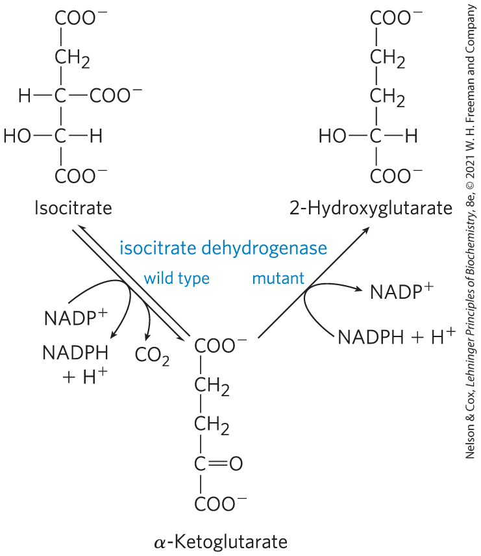
Mutations in Citric Acid
Cycle Enzymes
mutations in succinate dehydrogenase and fumarase cause tumors, defining them as tumor suppressors
many glial cell tumors have mutant NADPH-dependent isocitrate dehydrogenase
  lose ability to convert isocitrate to α-ketoglutarate
  gain ability to convert α-ketoglutarate to 2-hydroxyglutarate

Slide 158

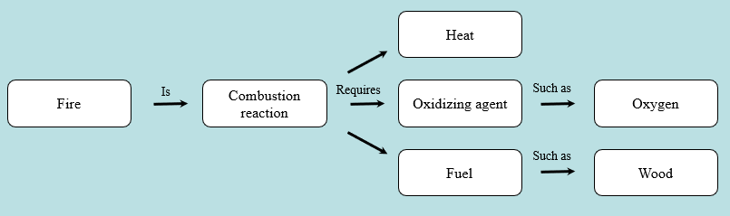
Activity: Relating
Terms within the Chapter
A concept map displays the relationships between different concepts. Observe the following example of a concept map.
Notes:
Instructor: For additional information, see the Instructor Activity Guide located in Achieve. It can be found within Chapter 16, in the folder titled “Ch16 In-Class Activities, Videos, and Resources.”

Slide 159
Activity Instructions (4 of 4)
Think about how the following terms and phrases relate to each other and then use scratch paper to draw a concept map using these terms and phrases. (3 minutes)
citric acid cycle
mutations that lead to tumor formation
regulated in coordination with many other pathways
allosteric mechanisms
covalent mechanisms
overlap and interact to achieve homeostasis
Notes:
Instructor: For additional information, see the Instructor Activity Guide located in Achieve. It can be found within Chapter 16, in the folder titled “Ch16 In-Class Activities, Videos, and Resources.”

Slide 160
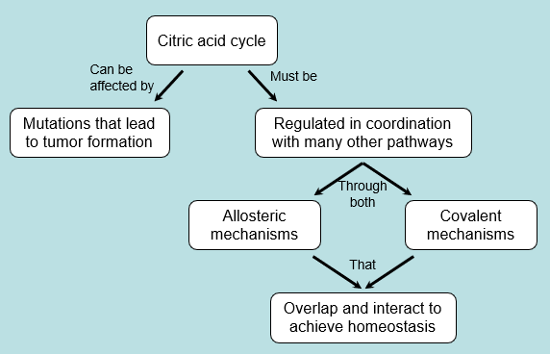
Activity Solution (4 of 4)
Pair up and share how this possible concept map might differ from yours. (2 minutes)
Notes:
Instructor: For additional information, see the Instructor Activity Guide located in Achieve. It can be found within Chapter 16, in the folder titled “Ch16 In-Class Activities, Videos, and Resources.”

Slide 161
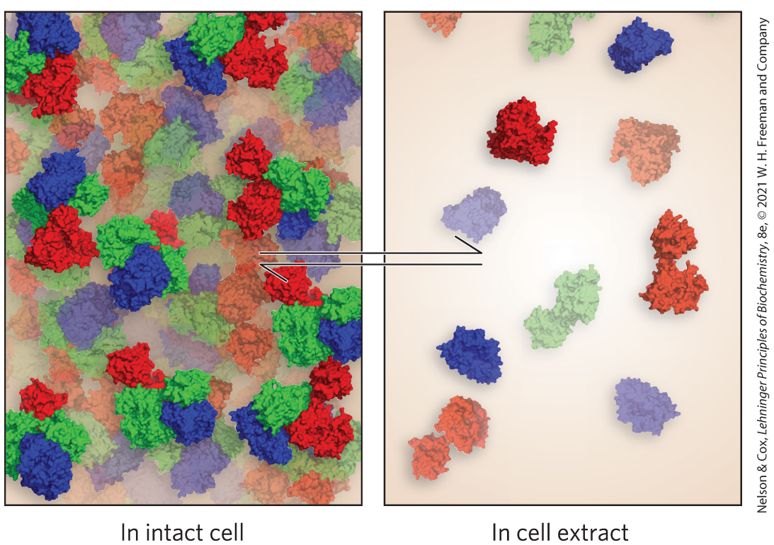
Certain Intermediates Are Channeled through Metabolons
metabolons = integrated multienzyme complexes that are held together by noncovalent interactions
malate dehydrogenase, citrate synthase, and aconitase likely constitute a metabolon

Slide 162
Clicker Question 28
Metabolons are:
multienzyme complexes that ensure efficient passage of the product of one enzyme to the next enzyme in the pathway.
products of one metabolic pathway that act as allosteric regulators of another pathway.
metabolic intermediates in a pathway that act as allosteric regulators of that pathway.
individual functional units of regulation for a metabolic pathway or cycle.
Notes:
Answer: A
Principle: 16.5
Learning Objective(s): Define metabolon.
Bloom’s: 1:1

Slide 163
Clicker Question 28, Response
Metabolons are:
multienzyme complexes that ensure efficient passage of the product of one enzyme to the next enzyme in the pathway.
Many reactions occur in metabolons, integrated multienzyme complexes held together by noncovalent interactions. Metabolons ensure efficient passage of the product of one enzyme reaction to the next enzyme in the pathway.

Slide 164

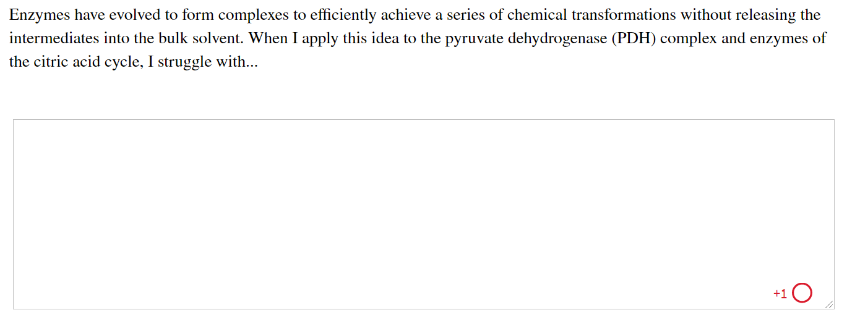
Activity: Substrate
Channeling Muddiest Point (1 of 2)
Complete the Ch16 Student Activity, Day 1: Substrate Channeling (Muddiest Point) Achieve assessment.
Notes:
Instructor: This muddiest point activity can be found in Achieve in the Chapter 16 folder titled “Ch16 In-Class Activities, Videos, and Resources.” See the Instructor Activity Guide in the same folder for more information.

Slide 165

Activity: Substrate
Channeling Muddiest Point (2 of 2)
Complete the Ch16 Student Activity, Day 2: Substrate Channeling (Muddiest Point) Achieve assessment.
Notes:
Instructor: This muddiest point activity can be found in Achieve in the Chapter 16 folder titled “Ch16 In-Class Activities, Videos, and Resources.” See the Instructor Activity Guide in the same folder for more information.

