Slide 1

23 Hormonal Regulation and Integration of Mammalian Metabolism
© 2021 Macmillan Learning

Slide 2

Principle 1 (1 of 4)
The tissues in a mammal are connected by
a neurosecretory system that coordinates their activities. Mammals use chemically diverse hormones in a highly specific and multidirectional signaling system, connecting the tissues with each other and with the central nervous system.

Slide 3

Principle 2 (1 of 3)
Among the tissues and organs of an animal, there is a striking division of labor. The specialized role of each organ is reflected in its metabolic activities and capabilities. The circulatory system connects all of the tissues by carrying hormonal signals and metabolites between and among them.

Slide 4

Principle 3 (1 of 7)
Because the brain requires a continuous supply of glucose, maintaining an adequate concentration of glucose in the blood is a high priority in the activities of the other tissues. The liver integrates the use of fuels (glucose, fatty acids, and amino acids) by each tissue to keep the blood glucose level within the optimal range. Hormones carried in the blood (insulin, glucagon, epinephrine, cortisol) mediate this regulation.

Slide 5

Principle 4 (1 of 4)
Maintaining an optimal body mass is an important priority in the adult mammal. Body mass is a function of dietary intake, physical activity, and the choice of metabolic fuel, all of which are subject to hormonal regulation. Hormonal signals between the brain, the adipose tissue, and the gastrointestinal tract help to set activity and feeding behavior.

Slide 6

Principle 5 (1 of 3)
The metabolic activities of cells and organisms are complex and intertwined; perturbation at one point in the system has far-reaching consequences for health. When the normal energy-yielding metabolism of glucose and fatty acids is impeded by defective insulin signaling, the result is the disease diabetes.

Slide 7
23.1 Hormone Structure and Action

Slide 8
Hormones and the
Neuroendocrine System
hormones = small molecules or proteins that are produced in one tissue, released into the bloodstream, and carried to other tissues
  act through specific receptors to bring about changes in cellular activities
  serve to coordinate the metabolic activities of several tissues or organs
neuroendocrine system = the system that coordinates metabolism in mammals

Slide 9
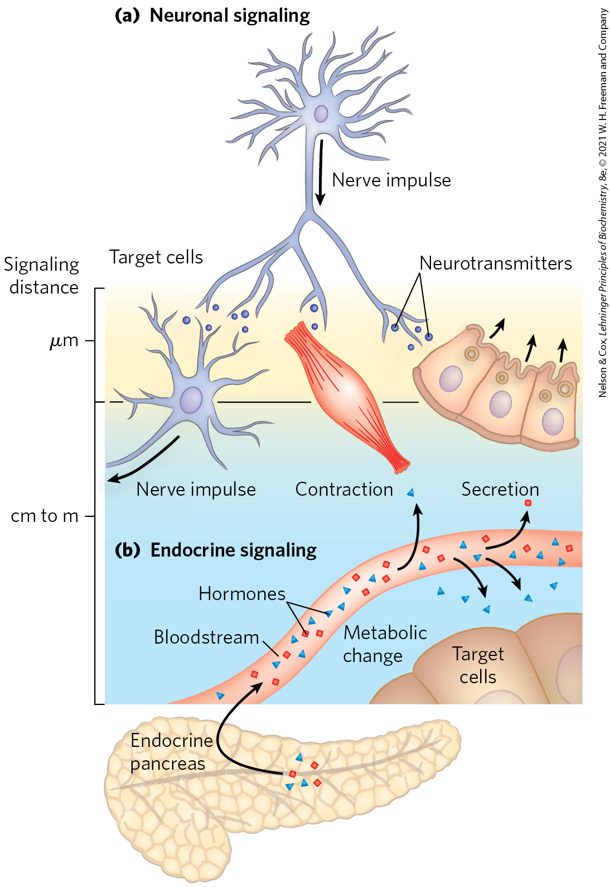
Neuronal and Endocrine Signaling
neuronal signaling = nerve cells release neurotransmitters that act on nearby cells
  distance may be small (<1 μm)
endocrine signaling = hormones are carried by the bloodstream to nearby cells or other organs
  distance may be great (>1 m)

Slide 10
Hormones Act through Specific High-Affinity Cellular Receptors
four general types of intracellular consequences of ligand-receptor interaction:
  generation of a second messenger that acts as an allosteric regulator of one or more enzymes
  activation of a a receptor tyrosine kinase
  opening or closing of an ion channel causes a change in membrane potential
  a nuclear hormone receptor protein mediates a change in gene expression

Slide 11
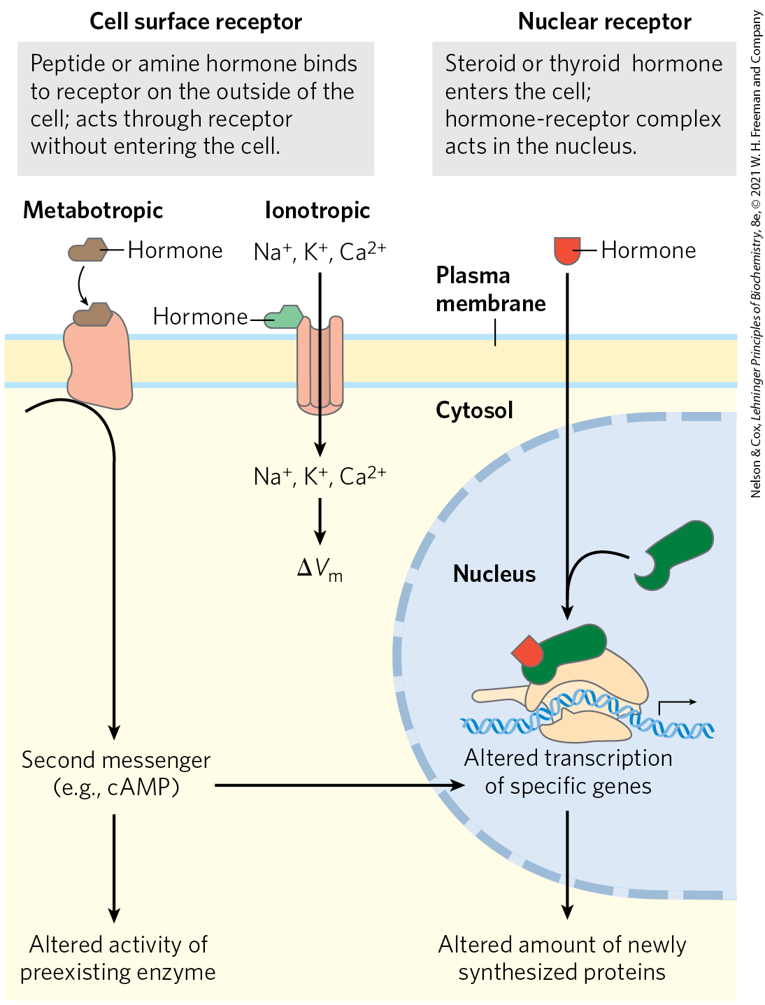
Metabotropic and
Ionotropic Surface Receptors
metabotropic = cell surface hormone receptors that activate or inhibit a downstream enzyme
ionotropic = those that open or close an ion channel in the plasma membrane, resulting in a change ∆V_{m} or ion concentration
both trigger rapid physiological or biological responses

Slide 12
Water-Insoluble Hormones Pass Through the Plasma Membrane
water-insoluble hormones = readily enter the cell and bind receptor proteins in the nucleus to alter the expression of specific genes
promote maximal responses after hours or days

Slide 13
Principle 1 (2 of 4)
The tissues in a mammal are connected by
a neurosecretory system that coordinates their activities. Mammals use chemically diverse hormones in a highly specific and multidirectional signaling system, connecting the tissues with each other and with the central nervous system.

Slide 14
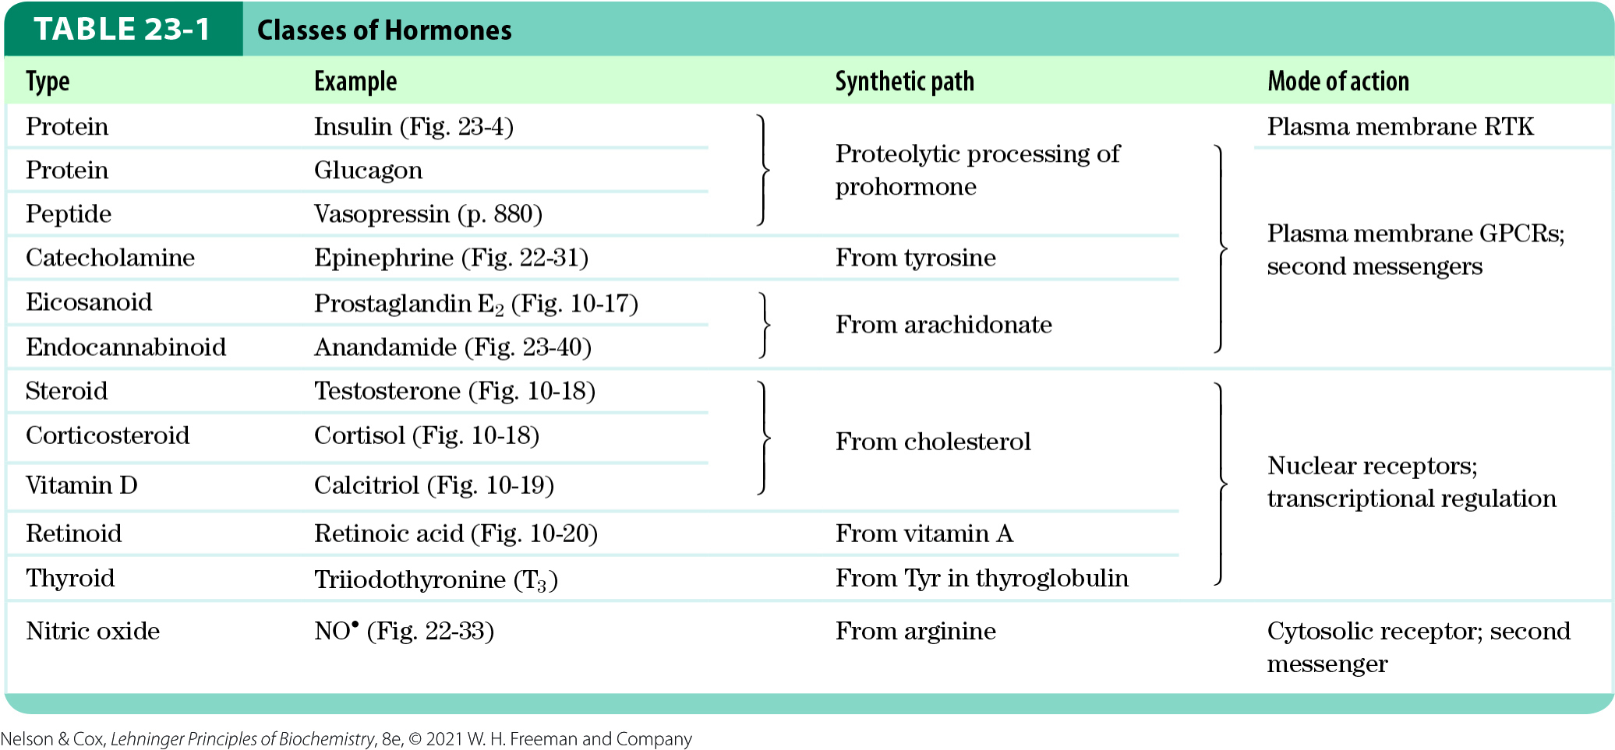
Hormones Are Chemically Diverse

Slide 15
Endocrine, Paracrine, and Autocrine Hormones
endocrine hormones = released into the blood and carried to target cells throughout the body
  examples: insulin and glucagon
paracrine hormones = released into the extracellular space and diffuse to neighboring target cells
  example: eicosanoid hormones
autocrine hormones = affect the same cell that releases them

Slide 16
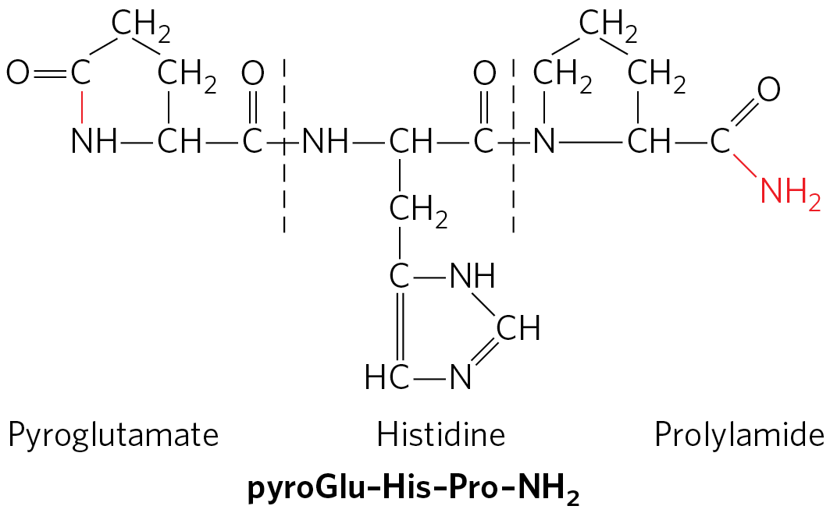
Peptide Hormones
peptide hormones = hormones that are synthesized as proproteins (prohormones) that are activated upon release by proteolytic cleavage
  vary in size from 3 to >200 amino acid residues
  examples: insulin, glucagon, somatostatin, calcitonin, and all the hormones of the hypothalamus and pituitary

Slide 17
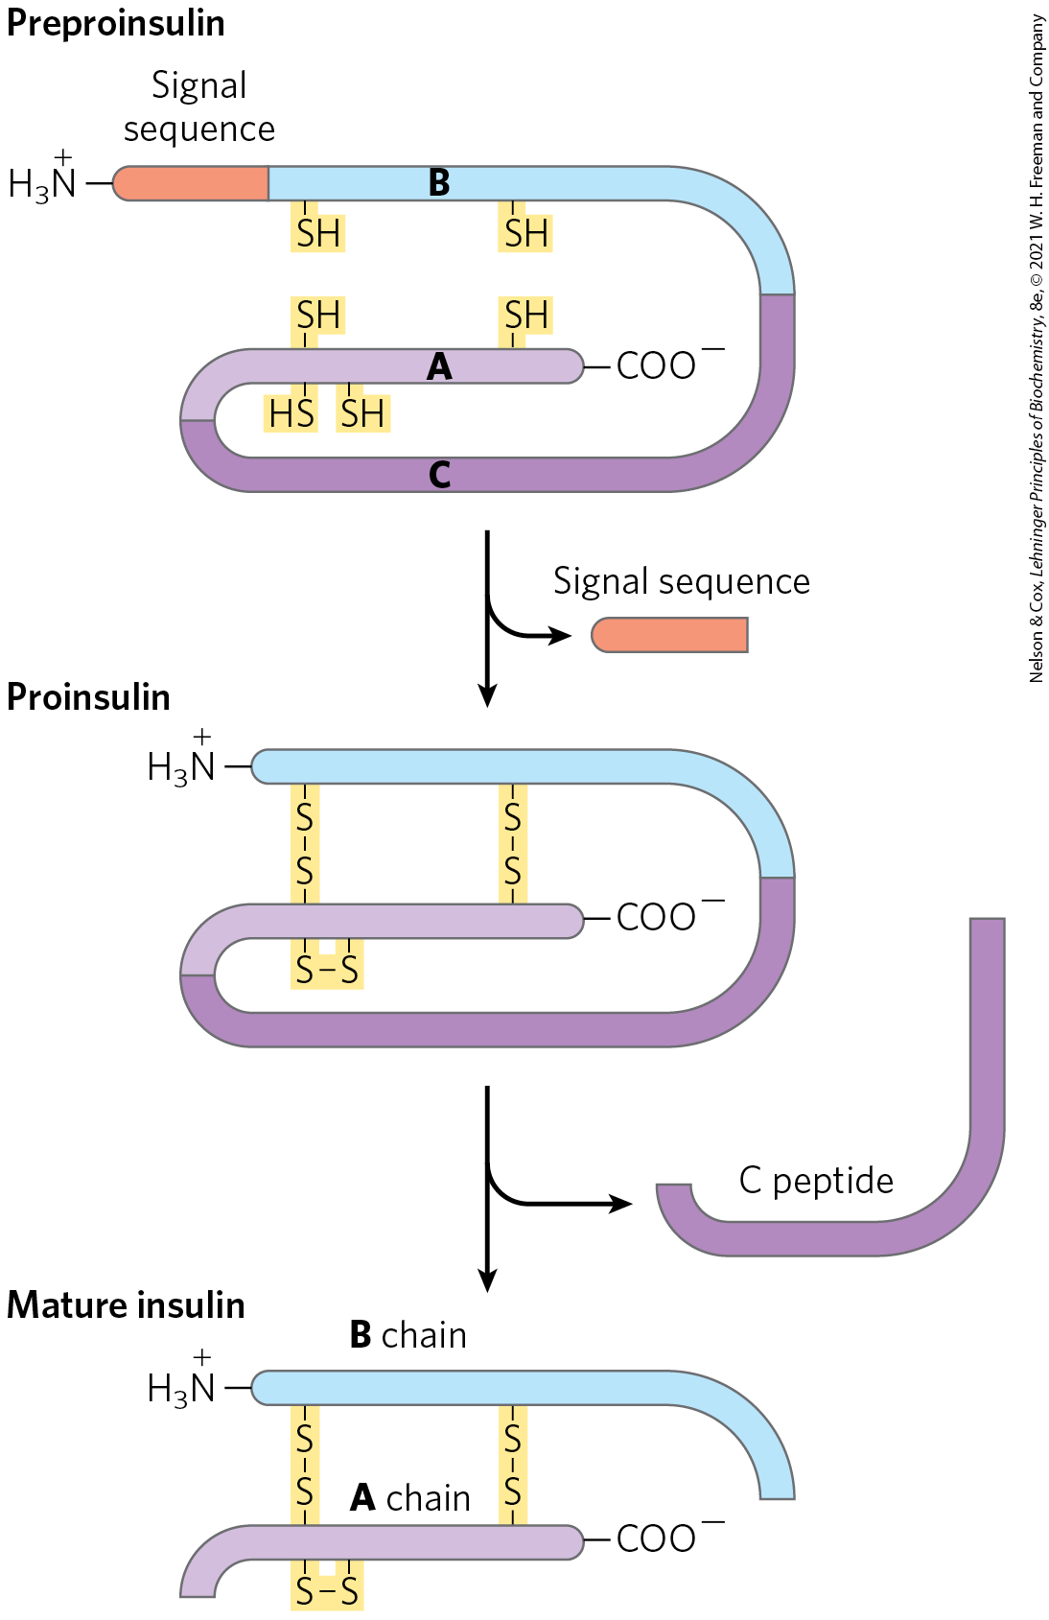
Insulin is a Peptide Hormone
insulin = a small protein with two polypeptide chains, A and B, joined by two disulfide bonds
  synthesized on ribosomes in the pancreas as preproinsulin
  stored as proinsulin in secretory vesicles
  converted to active insulin by proteases when blood glucose is sufficiently elevated

Slide 18
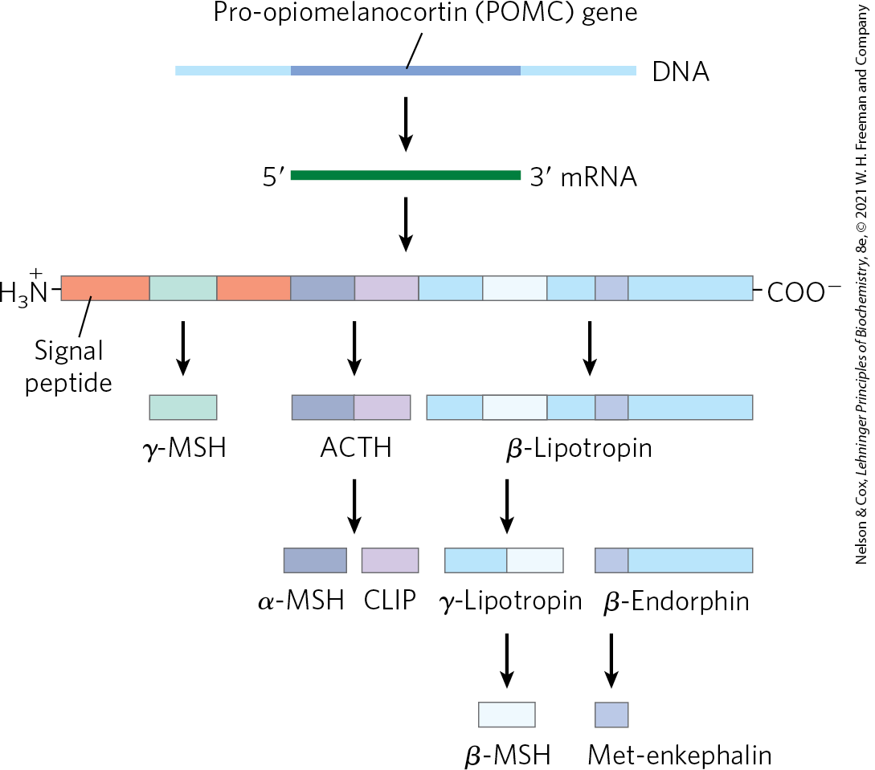
Some Peptide Prohormones Can Yield Multiple Products
pro-opiomelanocortin (POMC) = a proprotein that undergoes specific cleavage to produce several active hormones
the proprotein is processed differently in different tissues
  depends on which proteases are expressed

Slide 19
Principle 1 (3 of 4)
The tissues in a mammal are connected by
a neurosecretory system that coordinates their activities. Mammals use chemically diverse hormones in a highly specific and multidirectional signaling system, connecting the tissues with each other and with the central nervous system.

Slide 20
Some Hormones Are Released by a “Top-Down” Hierarchy of Neuronal and Hormonal Signals
the central nervous system (CNS) receives input from many internal and external sensors and orchestrates the production of appropriate hormonal signals by the endocrine tissues
hypothalamus = the coordination center of the endocrine system
  receives and integrates messages from the CNS
  produces releasing factors

Slide 21
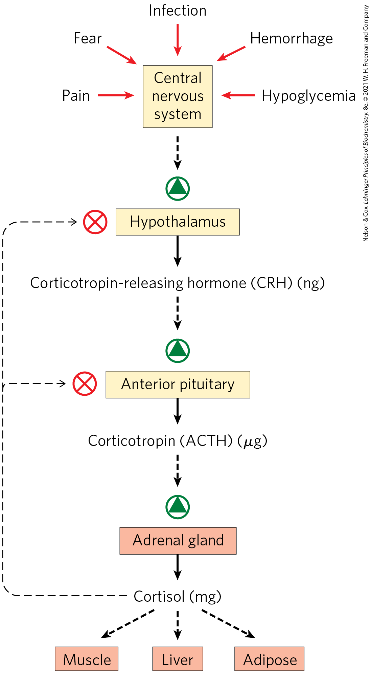
Top-Down Hormone Release
at each level of a hormonal cascade, feedback inhibition of earlier steps is possible

Slide 22
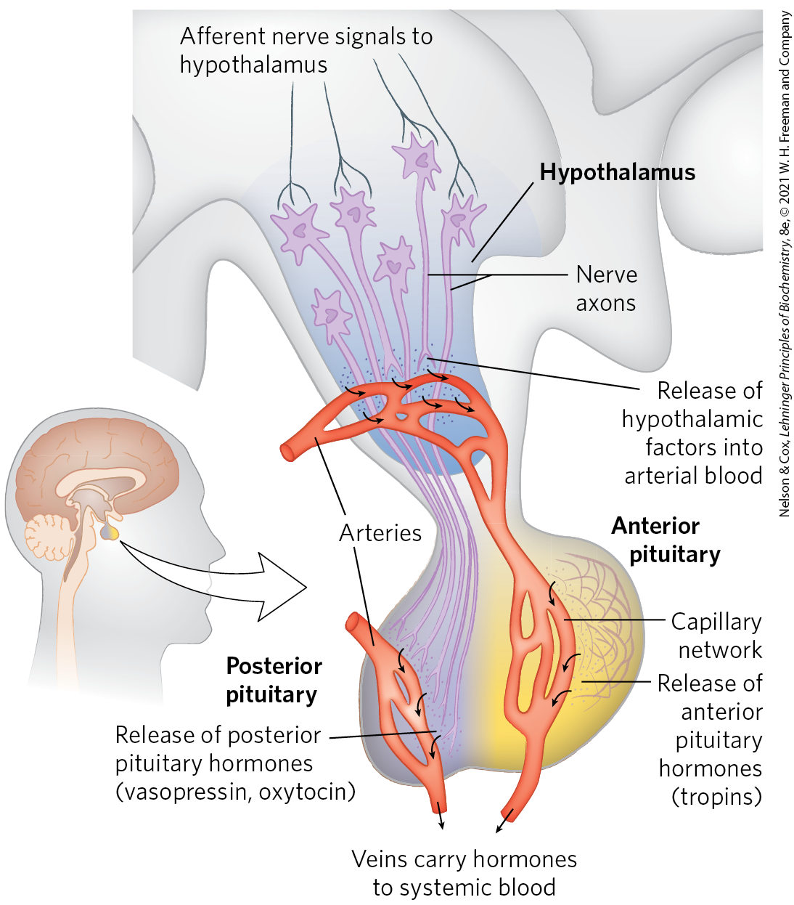
Neuroendocrine Origins of
Hormone Signals
posterior pituitary = contains the end of axons from the hypothalmus
anterior pituitary = the endocrine organ that receives releasing factors from the hypothalamus via blood vessels

Slide 23
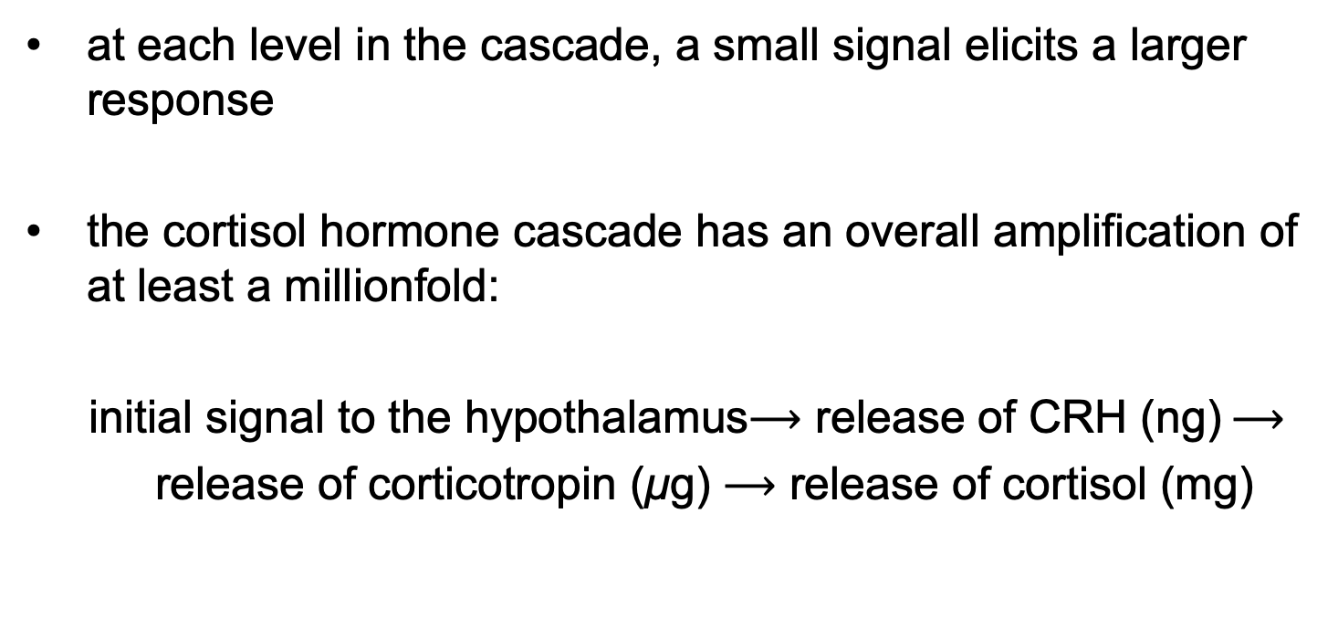
Hormonal Cascades Result in Large Signal Amplifications
at each level in the cascade, a small signal elicits a larger response
the cortisol hormone cascade has an overall amplification of at least a millionfold:
initial signal to the hypothalamus$⟶$ release of CRH (ng)$⟶$
release of corticotropin (μg) $⟶$ release of cortisol (mg)

Slide 24
Principle 1 (4 of 4)
The tissues in a mammal are connected by
a neurosecretory system that coordinates their activities. Mammals use chemically diverse hormones in a highly specific and multidirectional signaling system, connecting the tissues with each other and with the central nervous system.

Slide 25
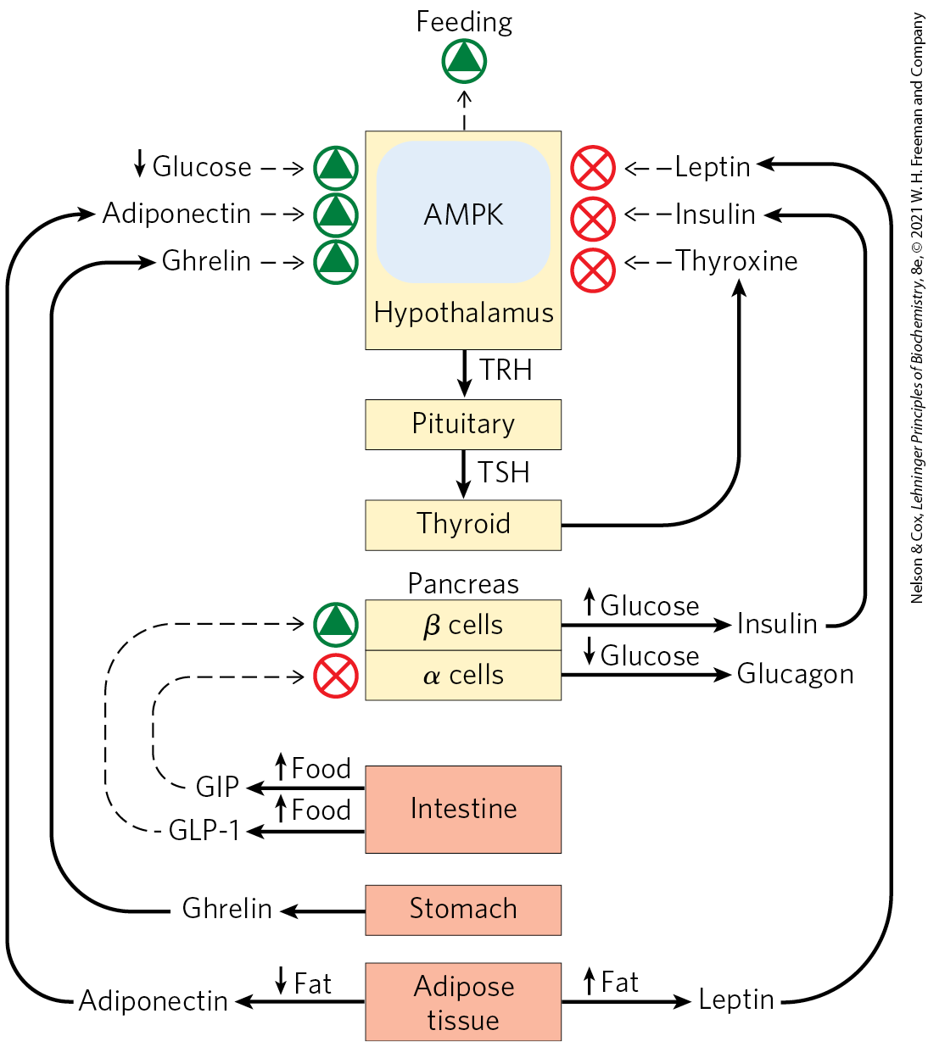
“Bottom-Up” Hormonal Systems Send Signals Back to the Brain and to Other Tissues
some hormones are produced in the digestive tract, muscle, and adipose tissue and communicate the current metabolic state to the hypothalamus

Slide 26
Adipokines
adipokines = peptide hormones produced in adipose tissue that signal the adequacy of fat reserves
leptin = an adipokine released when adipose tissue is well-filled with triacylglycerols
  acts in the brain to inhibit feeding
adiponectin = an adipokine released when adipose tissue is depleted of fat reserves
  acts in the brain to stimulate feeding

Slide 27
Ghrelin and Incretins
ghrelin = produced in the gastrointestinal tract when the stomach is empty
  acts in the hypothalamus to stimulate feeding
incretins = peptide hormones produced in the gut after ingestion of a meal
  acts in the pancreas to increase insulin secretion and decreases glucagon secretion

Slide 28
Neuropeptide Y, Peptide YY, and Irisin
neuropeptide Y (NPY) = a hormone produced in the hypothalamus and in the adrenal glands
  promotes feeding and reduces nonessential energy expenditure
peptide YY (PYY3–36) = a hormone produced in the intestine
  signals satiety in the brain
irisin = a peptide hormone produced in muscle from exercise
  acts to convert white adipose tissue into beige adipose tissue

Slide 29
Peptide Hormones That Act on Feeding Behavior and Fuel Selection in Mammals
Table 23-2 Some Peptide Hormones That Act on Feeding Behavior and Fuel Selection in Mammals
Hormone | Production site(s) | Target tissue(s) | Action(s)
Insulin | Pancreatic β cells | Muscle, adipose, liver | Stimulates glucose uptake and synthesis of glycogen and fat
Glucagon | Pancreatic α cells | Liver, adipose | Stimulates gluconeogenesis and glucose release to blood
Leptin | Adipose tissue | Hypothalamus | Reduces hunger
Adiponectin | Adipose tissue | Muscle, liver, others | Stimulates catabolism and feeding behavior
Ghrelin | Stomach, intestine | Brain | Signals hunger
Incretins: GLP-1, GIP | Intestine | Pancreas | Stimulate insulin release
NPY | Hypothalamus, adrenals | Brain, autonomic nervous system | Stimulates feeding behavior
PYY_{3–36} | Intestine | Brain | Signals satiety
Irisin | Muscle (after exercise) | Adipose | Turns white adipose tissue to beige

Slide 30
23.2 Tissue-Specific Metabolism

Slide 31
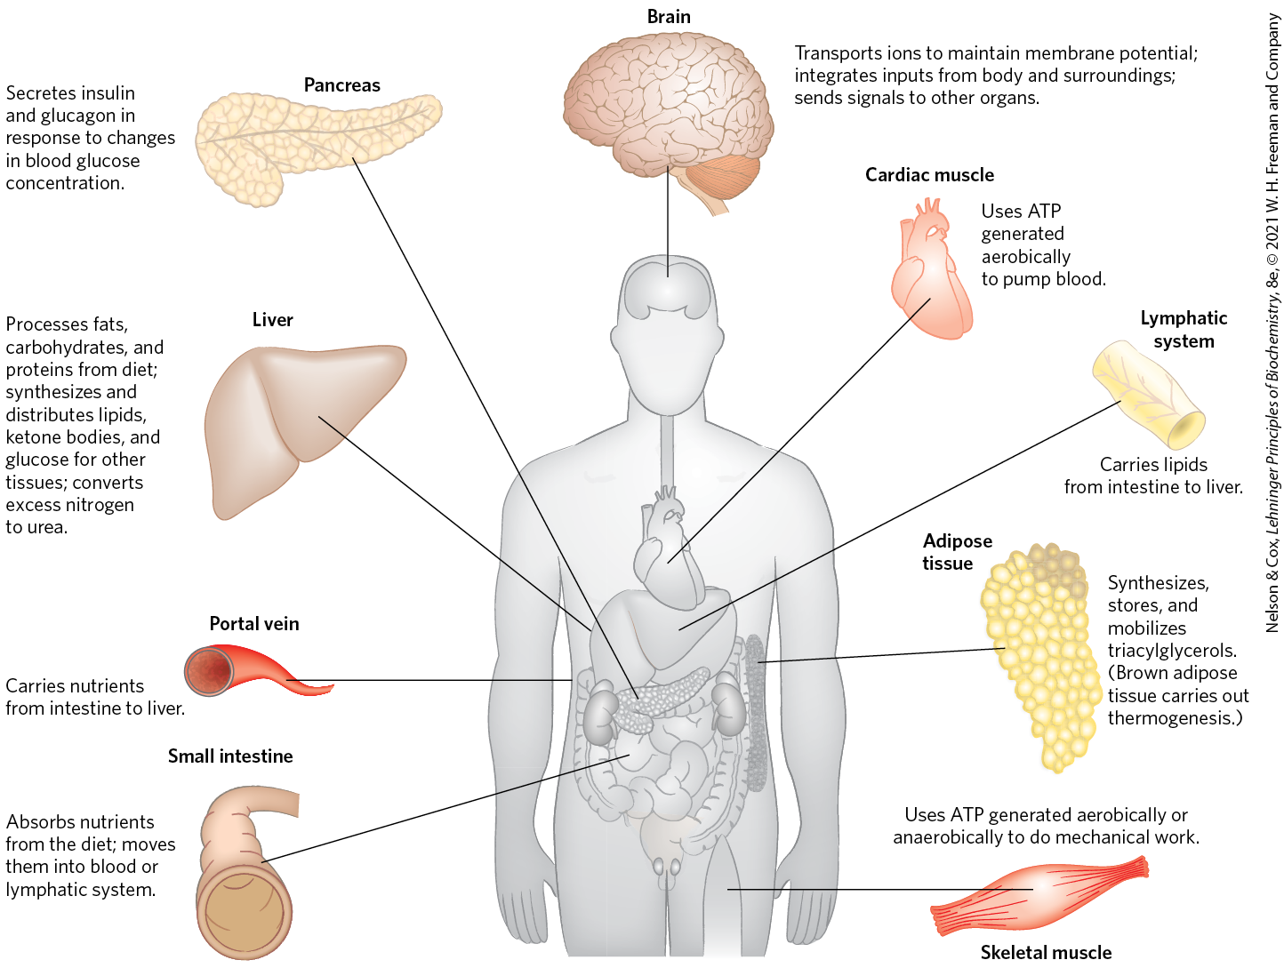
Specialized Metabolic Functions of Mammalian Tissues

Slide 32
The Liver Processes and
Distributes Nutrients
the liver is the central processing and distribution organ for nutrients
  can adjust metabolism to meet changing circumstances
sugars, amino acids, and some reconstituted TAGs pass from intestinal epithelial cells to the liver via the portal vein

Slide 33
The Liver Has Two Main Cell Types
Kupffer cells = phagocytes that are important in immune function
hepatocytes = transform dietary nutrients into the fuels and precursors required by other tissues and export them via the blood

Slide 34
Carbohydrates
glucose 6-phosphate may:
  be exported as glucose to replenish blood glucose
  be used to synthesize glycogen or fatty acids
  enter the citric acid cycle (following glycolysis and the pyruvate dehydrogenase reaction) to produce ATP
  enter the pentose phosphate pathway to yield NADPH and pentoses

Slide 35
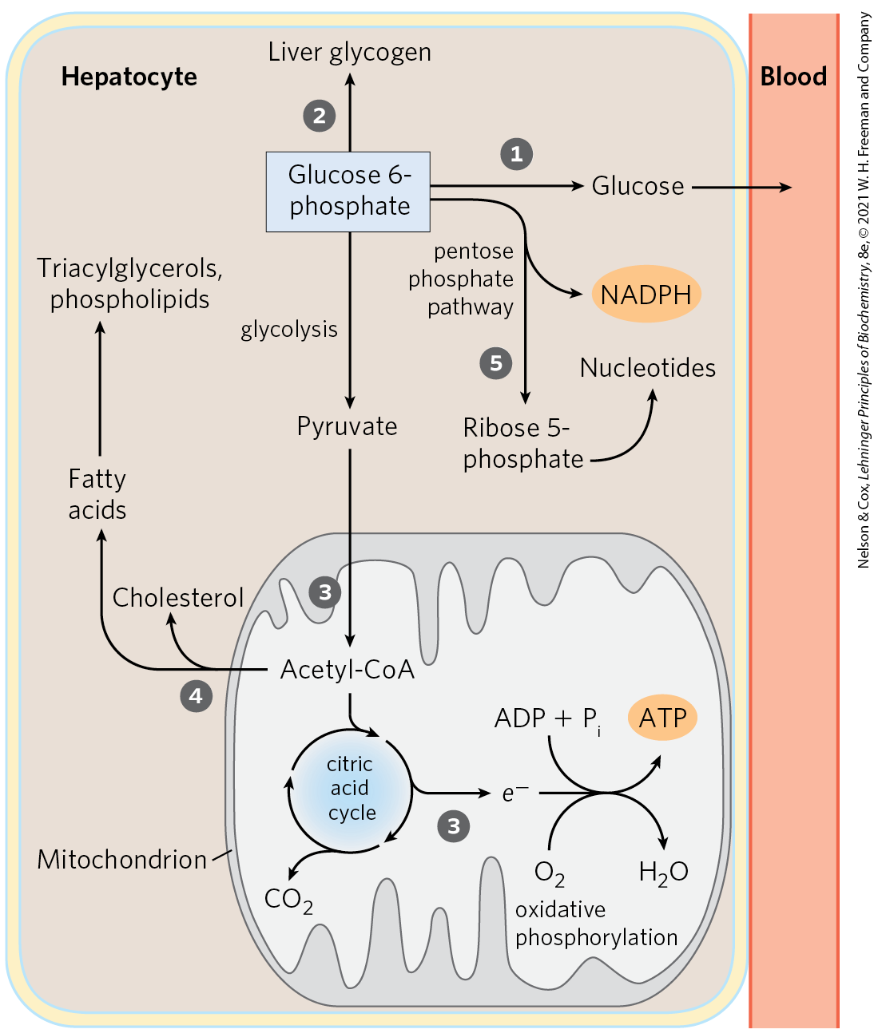
Metabolic Pathways for Glucose 6-Phosphate in the Liver

Slide 36
Xenobiotics
xenobiotics = compounds that do not occur naturally but are the products of human activity
  examples: drugs, food additives, and preservatives
xenobiotics are metabolized in the liver
  NADPH is an essential cofactor

Slide 37
Amino Acids
amino acids may:
  be used to synthesize liver and plasma proteins
  enter the bloodstream to pass to other organs
  be used as biosynthetic precursors for proteins, nucleotides, hormones, etc. in the liver
  be converted to pyruvate and ammonia
    ammonia is converted to urea

Slide 38
Possible Fates of Pyruvate and Acetyl CoA from Amino Acids
pyruvate formed from amino acids may be converted to:
  glucose and glycogen via gluconeogenesis
  acetyl-CoA
fates of acetyl-CoA include:
  oxidation via the citric acid cycle and oxidative phosphorylation to produce ATP
  conversion to lipids for storage

Slide 39
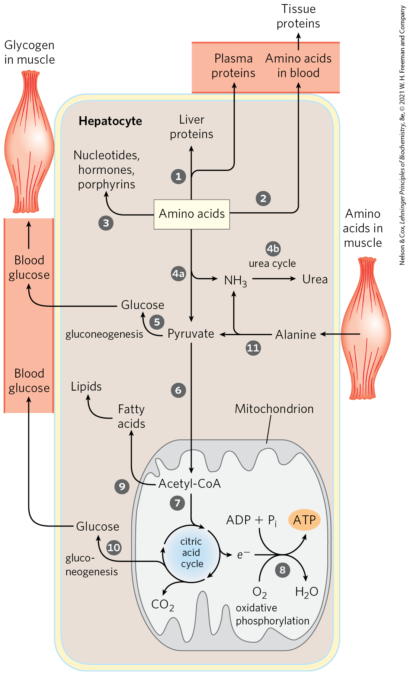
Metabolic Pathways for Amino Acids in the Liver

Slide 40
Principle 2 (2 of 3)
Among the tissues and organs of an animal, there is a striking division of labor. The specialized role of each organ is reflected in its metabolic activities and capabilities. The circulatory system connects all of the tissues by carrying hormonal signals and metabolites between and among them.

Slide 41
Metabolism of Amino Acids from Muscle
during prolonged intervals between meals, some muscle protein is degraded to amino acids
the amino acids undergo transamination to pyruvate to yield alanine
in hepatocytes:
  alanine in deaminated to yield pyruvate, which enters gluconeogenesis
  ammonia is converted to urea for excretion

Slide 42
Lipids
lipids may:
  be converted to liver lipids
  undergo β oxidation to form acetyl-CoA and NADH
  be converted to the phospholipids and TAGs of plasma lipoproteins
  bind to albumin in the blood for transport to the heart and skeletal muscles

Slide 43
Possible Fates of Acetyl CoA from Lipids
fates of acetyl-CoA from lipids include:
  oxidation via the citric acid cycle and oxidative phosphorylation to produce ATP
  conversion to acetoacetate and β-hydroxybutyrate (ketone bodies)
  biosynthesis of cholesterol, steroid hormones, and bile salts

Slide 44
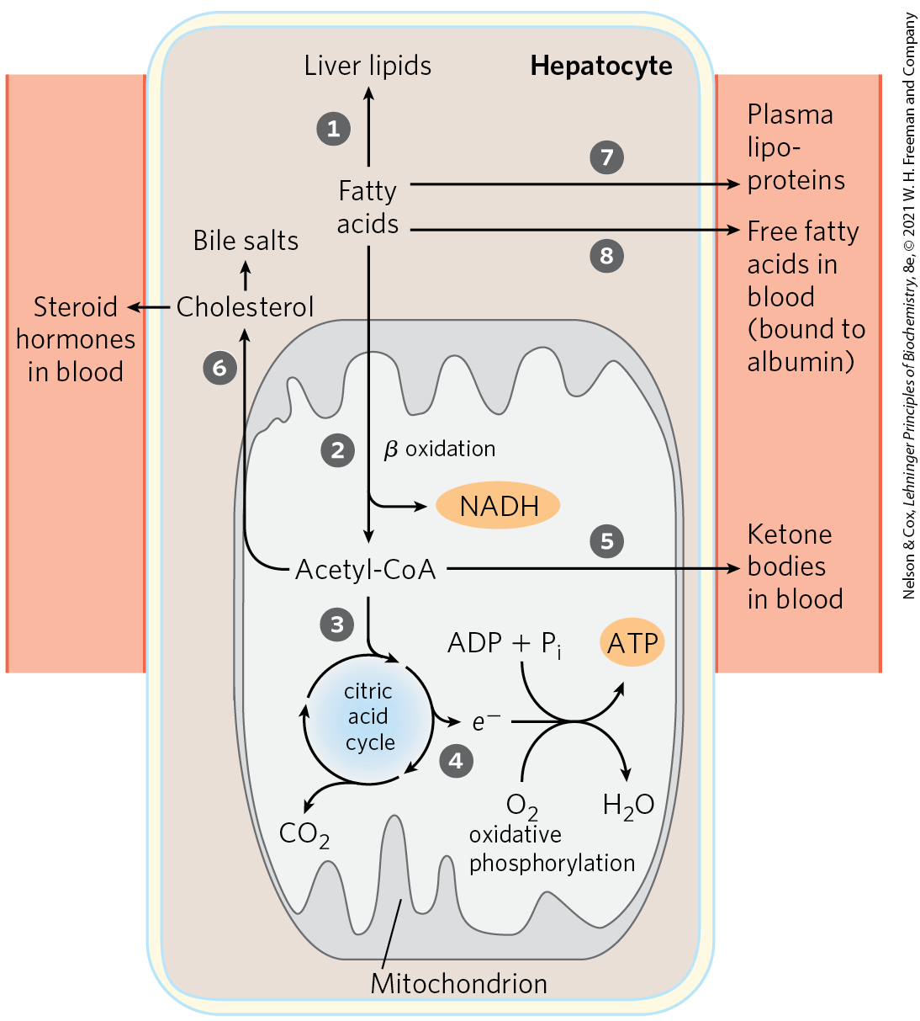
Metabolic Pathways for Lipids in the Liver

Slide 45
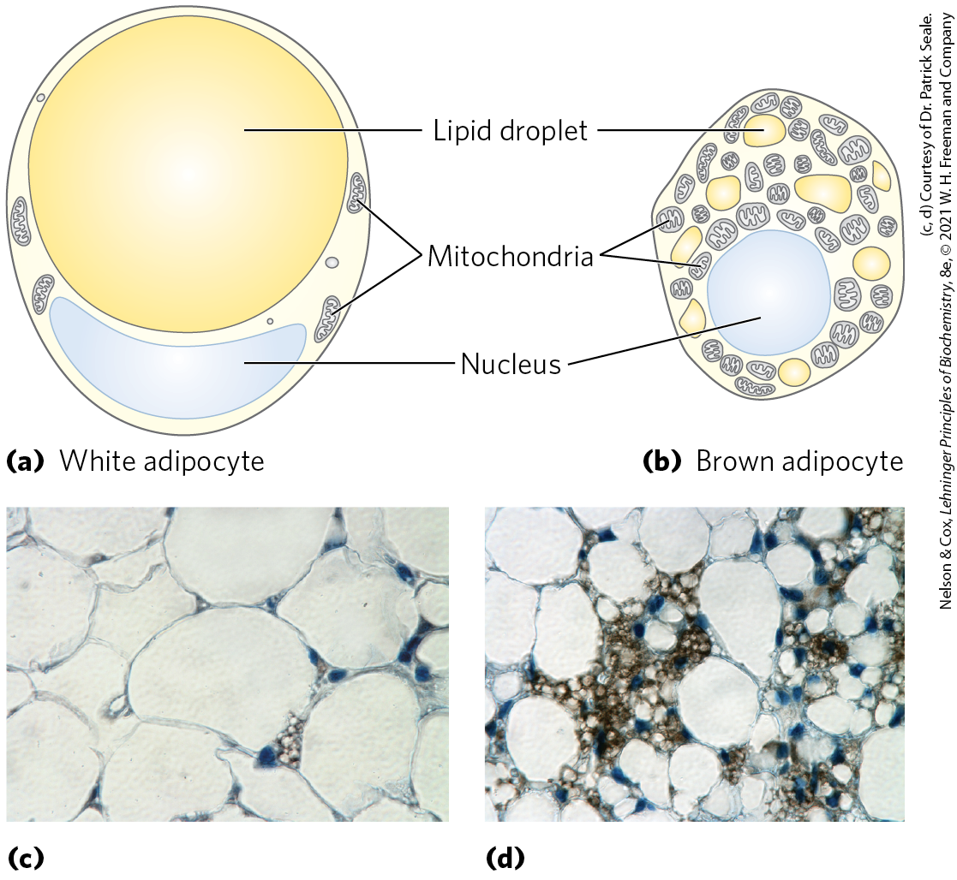
Adipose Tissues Store and Supply Fatty Acids
white adipose tissue (WAT) = adipose tissue located under the skin, around deep blood vessels, and in the abdominal cavity
  its adipocytes are large, spherical cells filled with a single lipid droplet containing TAGs and sterol esters

Slide 46
WAT Releases TAGs in Response to Epinephrine
lipases hydrolyze stored TAGs to release FFAs
  activity is stimulated by epinephrine and phosphorylation
  activity is decreased by insulin

Slide 47
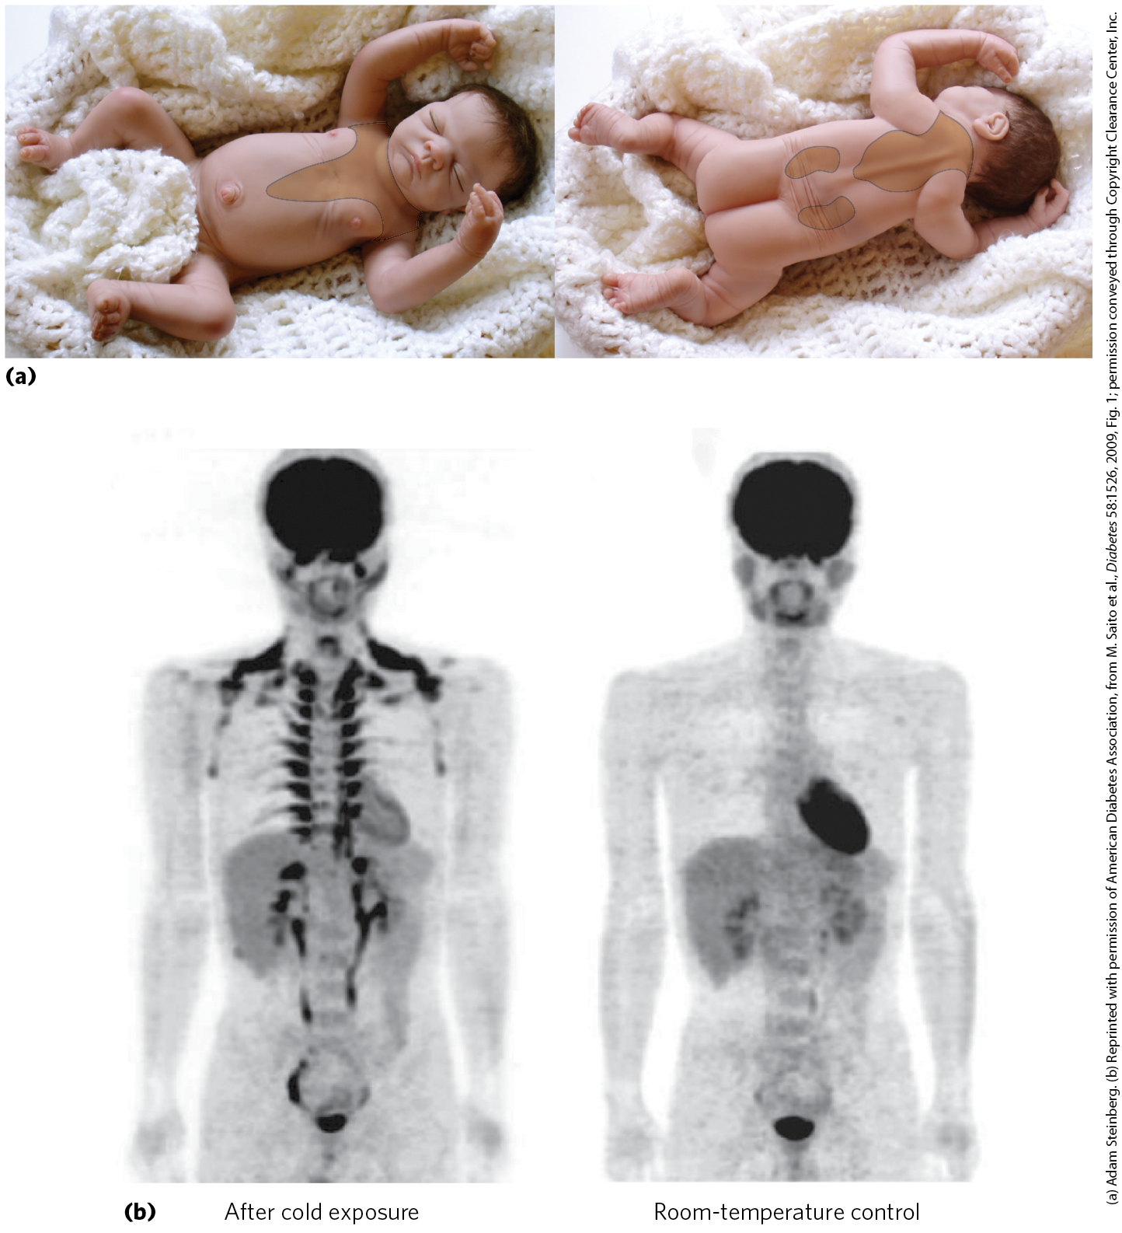
Brown and Beige Adipose Tissues Are Thermogenic
brown adipose tissue (BAT) = adipose tissue specialized for thermogenesis
  its adipocytes are smaller, polygonal cells filled with multiple smaller lipid droplets
  contain more mitochondria
  contain a richer supply of capillaries and innervation

Slide 48
Uncoupling Protein 1 is Responsible for Thermogenesis
uncoupling protein 1 (UCP1) = protein produced by BAT that allows the H⁺ gradient in mitochondria to be dissipated as heat in a process is known as thermogenesis
  keeps organs warm in low temperature environments

Slide 49
Beige Adipocytes
beige adipocytes = adipocytes that can be converted by cold exposure or by β-adrenergic stimulation into cells very similar to brown adipocytes
  have multiple lipid droplets
  are richer in mitochondria than white adipocytes
  produce UCP1

Slide 50
Muscles Use ATP for
Mechanical Work
myocytes = skeletal muscle cells
metabolism in myocytes is specialized to generate and use ATP for contraction

Slide 51
Slow-Twitch Muscle
slow-twitch muscle (red muscle) = provides relatively low tension but is highly resistant to fatigue
  produces ATP by oxidative phosphorylation
  very rich in mitochondria
  served by dense networks of blood vessels which bring oxygen

Slide 52
Fast-Twitch Muscle
fast-twitch muscle (white muscle) = can develop greater tension and do so faster, but is quicker to fatigue
  has fewer mitochondria than red muscle
  is less well-supplied with blood vessels
  uses ATP faster than it can replace it

Slide 53
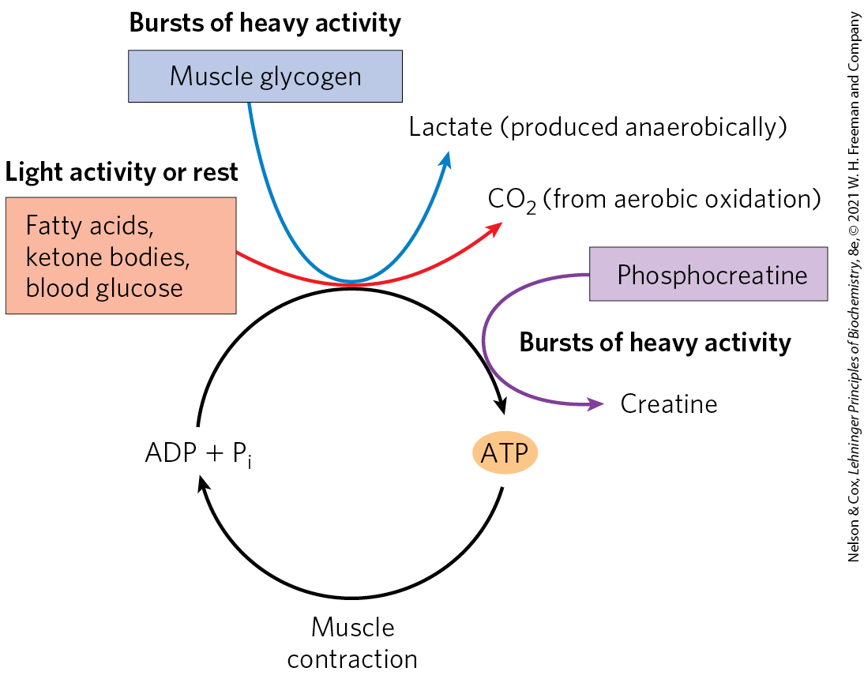
Energy Sources for
Muscle Contraction

Slide 54
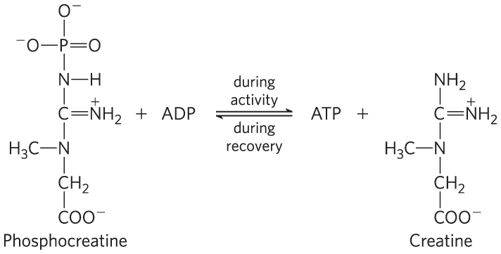
The Creatine Kinase Reaction
creatine kinase = uses phosphocreatine to rapidly regenerate ATP from ADP
creatine shuttles ATP equivalents from the mitochondrion to sites of ATP consumption

Slide 55
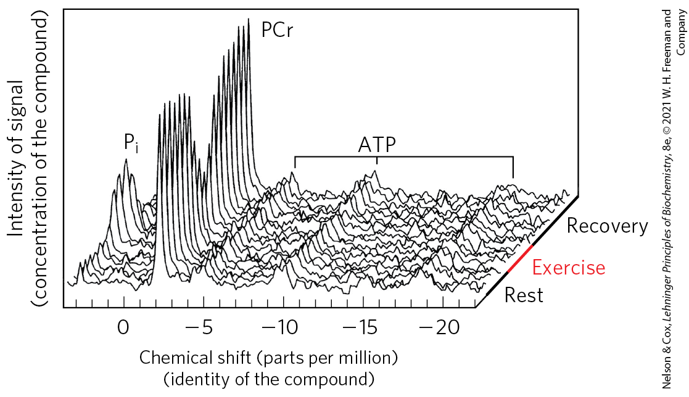
Phosphocreatine Buffers ATP Concentration During Exercise
the ATP signal barely changes during exercise due to continued respiration and the reservoir of phosphocreatine

Slide 56
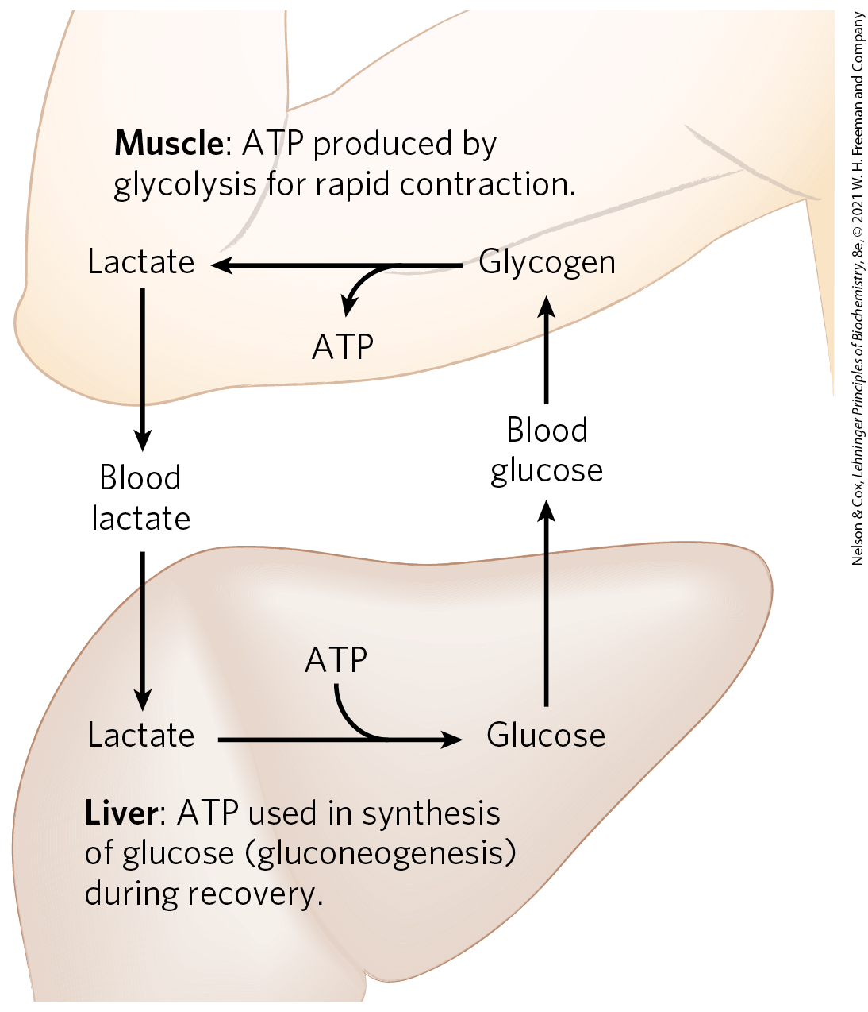
The Cori Cycle
during recovery, lactate is transported to the liver and converted to glucose by gluconeogenesis
glucose is released to the blood and returned to the muscles to replenish their glycogen stores

Slide 57
Shivering Thermogenesis
shivering thermogenesis = rapidly repeated muscle contraction that produces heat but little motion
  helps maintain the body at its preferred temperature of 37°C

Slide 58
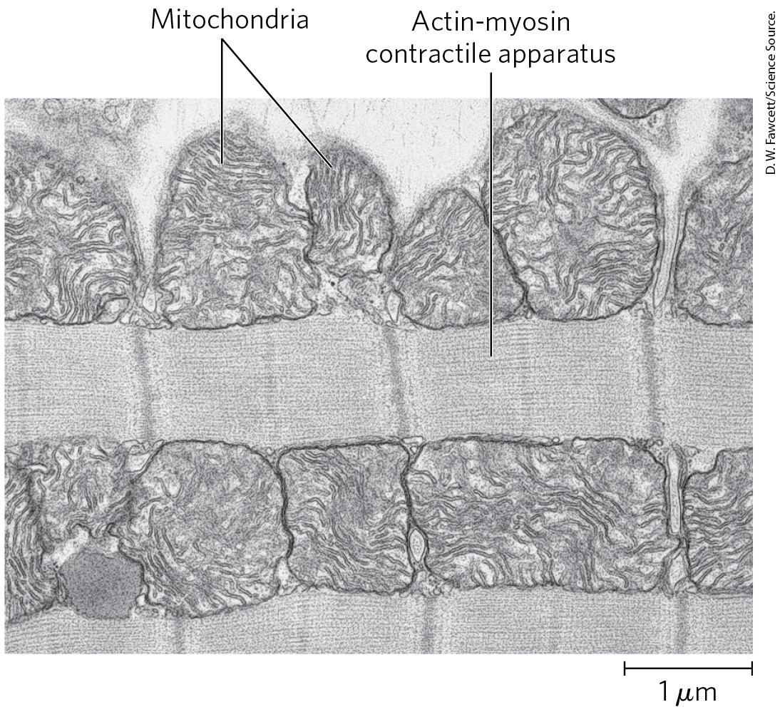
The Heart Mainly Uses FFAs as an Energy Source
heart muscle obtains nearly all its ATP from oxidative phosphorylation
fatty acids are the primary fuel
  glucose and ketone bodies are also oxidized aerobically

Slide 59
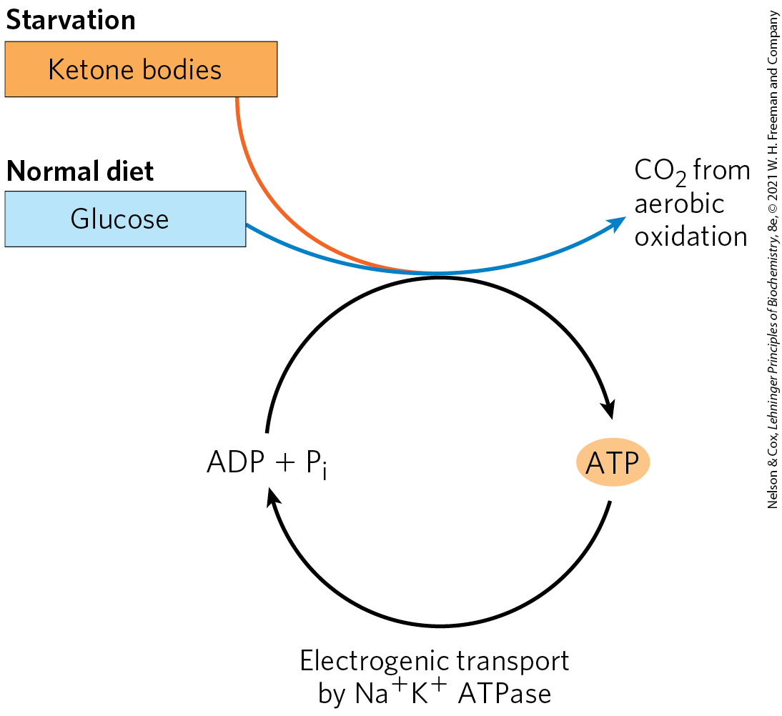
The Brain Uses Energy for Transmission of Electrical Impulses
neurons of the brain normally use only glucose
most ATP comes from oxidative phosphorylation

Slide 60
Principle 3 (2 of 7)
Because the brain requires a continuous supply of glucose, maintaining an adequate concentration of glucose in the blood is a high priority in the activities of the other tissues. The liver integrates the use of fuels (glucose, fatty acids, and amino acids) by each tissue to keep the blood glucose level within the optimal range. Hormones carried in the blood (insulin, glucagon, epinephrine, cortisol) mediate this regulation.

Slide 61
Neurons Can Oxidize β-Hydroxybutyrate
neurons of the brain cannot directly use free fatty acids or lipids from the blood as fuels
neurons can oxidize β-hydroxybutyrate (a ketone body)
  important during prolonged fasting or starvation
  allows the brain to use body fat as an energy source and spare muscle proteins

Slide 62
The Brain Uses ATP to Create and Maintain the Electrical Potential
the membrane contains an electrogenic ATP-driven antiporter, the Na⁺K⁺ ATPase
action potential = an electrical signal resulting from transmembrane potential changes
  serve as the main mechanism of information transfer in the nervous system
  requires ATP

Slide 63
Principle 2 (3 of 3)
Among the tissues and organs of an animal, there is a striking division of labor. The specialized role of each organ is reflected in its metabolic activities and capabilities. The circulatory system connects all of the tissues by carrying hormonal signals and metabolites between and among them.

Slide 64
Blood Carries Oxygen, Metabolites, and Hormones
blood mediates the metabolic interactions among all tissues
  transports nutrients
  transports waste products
  moves O₂ and CO₂ generated
  carries hormonal signals

Slide 65
The Three Types of Blood Cells
erythrocytes (red cells) = filled with hemoglobin and specialized for carrying O₂ and CO₂
leukocytes (white cells) = central to the immune system to defend against infections
  include lymphocytes
platelets (cell fragments) = help to mediate blood clotting.

Slide 66
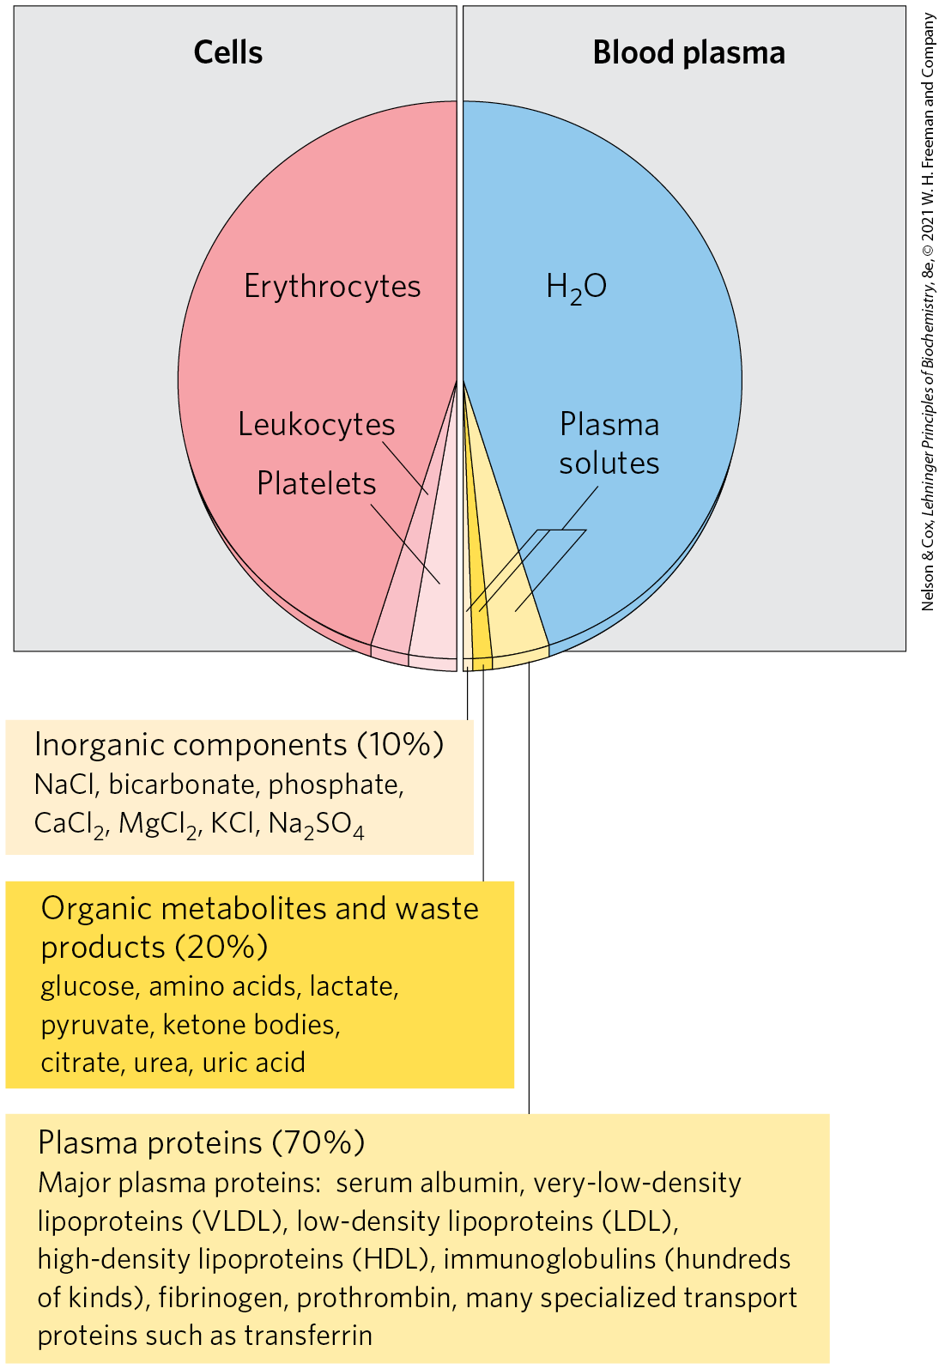
The Composition of Blood
(By Weight)
blood plasma = the liquid portion of blood
  90% water and 10% solutes
plasma proteins = immunoglobulins, serum albumin, apolipoproteins, transferrin, and blood-clotting proteins
  make up more than 70% of the plasma solids

Slide 67
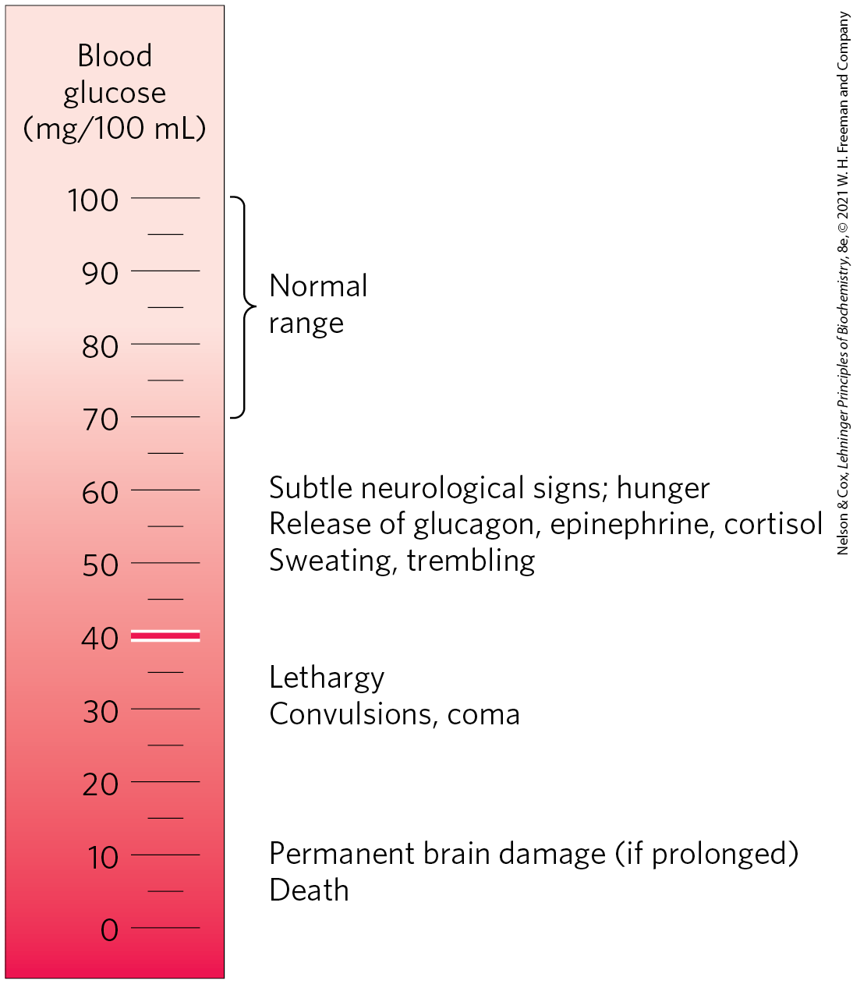
Physiological Effects of Low
Blood Glucose
blood glucose is ideally kept at ~4.5 mM (60−90 mg/dL)
some fluctuations occur after a meal

Slide 68
23.3 Hormonal Regulation of Fuel Metabolism

Slide 69
Principle 3 (3 of 7)
Because the brain requires a continuous supply of glucose, maintaining an adequate concentration of glucose in the blood is a high priority in the activities of the other tissues. The liver integrates the use of fuels (glucose, fatty acids, and amino acids) by each tissue to keep the blood glucose level within the optimal range. Hormones carried in the blood (insulin, glucagon, epinephrine, cortisol) mediate this regulation.

Slide 70
Maintaining Blood Glucose Levels Requires the Combined Actions of Multiple Hormones
minute-by-minute adjustments that keep the blood glucose level near 4.5 mM involve the combined actions of:
  insulin
  glucagon
  epinephrine
  cortisol

Slide 71
Insulin Counters High Blood Glucose in the Well-Fed State
Table 23-3 Effects of Insulin on Blood Glucose: Uptake of Glucose by Cells and Storage as Triacylglycerols and Glycogen
Metabolic effect | Target enzyme
↑ Glucose uptake (muscle, adipose tissue) | ↑ Glucose transporter (GLUT4)
↑ Glucose uptake (liver) | ↑ Glucokinase (increased expression)
↑ Glycogen synthesis (liver, muscle) | ↑ Glycogen synthase
↓ Glycogen breakdown (liver, muscle) | ↓ Glycogen phosphorylase
↑ Glycolysis, acetyl-CoA production (liver, muscle) | ↑ PFK-1 (by PFK-2) ↑ Pyruvate dehydrogenase complex
↑ Fatty acid synthesis (liver) | ↑ Acetyl-CoA carboxylase
↑ Triacylglycerol synthesis (adipose tissue) | ↑ Lipoprotein lipase

Slide 72
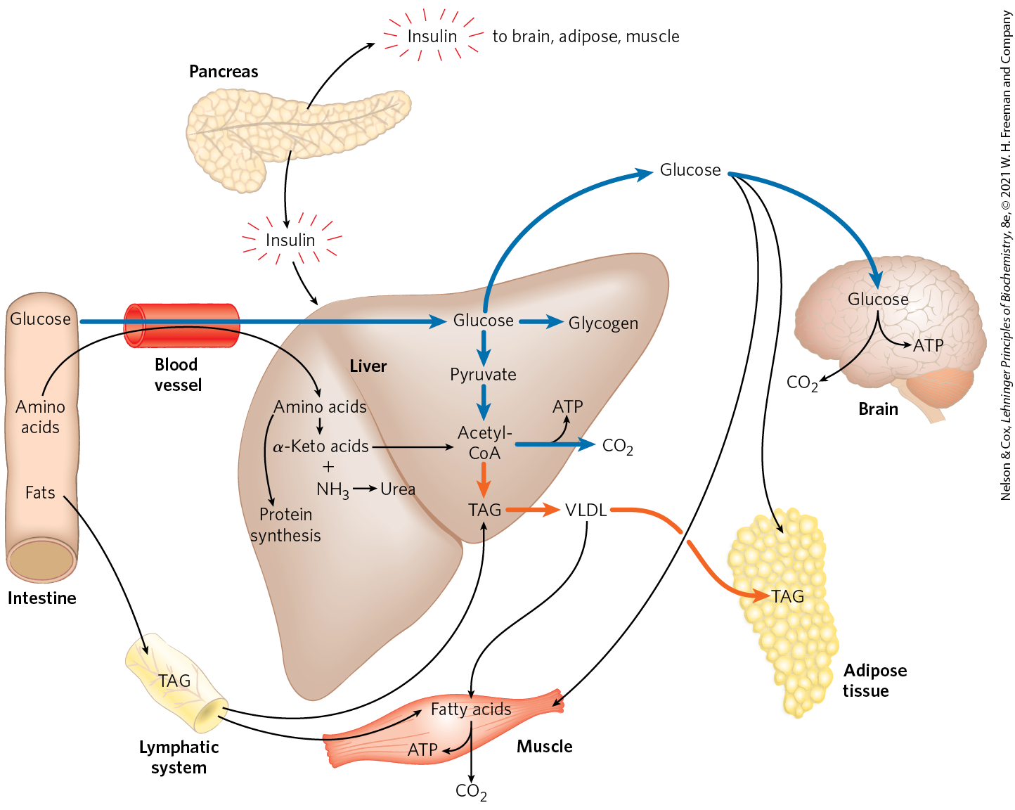
The Well-Fed State: The
Lipogenic Liver
insulin brings about the conversion of excess blood glucose after a meal to:
  glycogen in the liver and muscle
  TAGs in adipose tissue

Slide 73
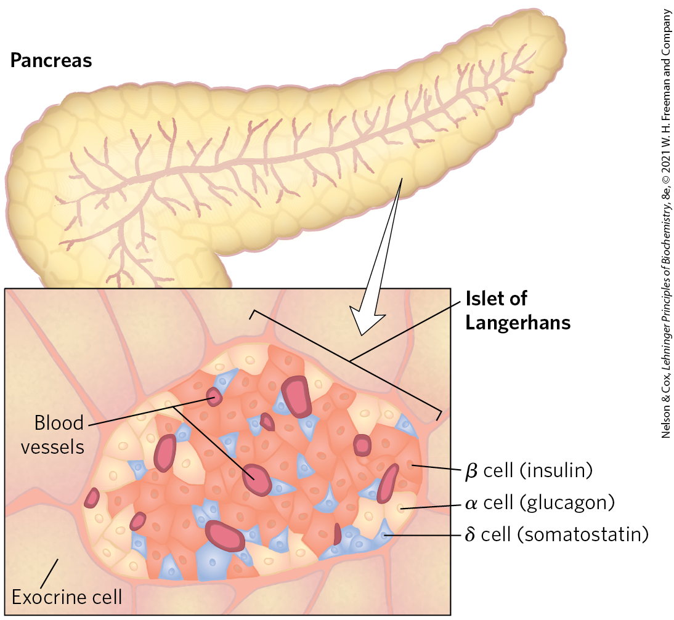
Pancreatic β Cells Secrete Insulin in
Response to Changes in Blood Glucose
islets of Langerhans = clusters of specialized pancreatic cells
  each cell type produces a single hormone
increase in blood glucose causes the pancreas to secrete insulin and decrease secretion of glucagon

Slide 74
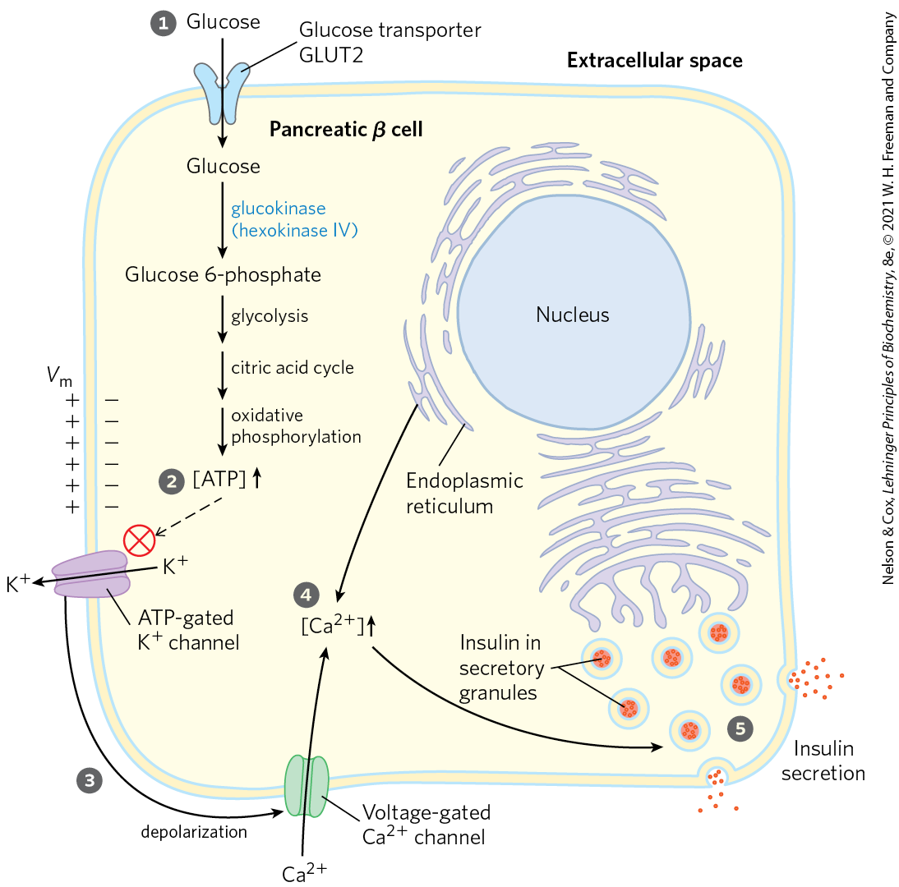
Glucose Regulation of Insulin Secretion by Pancreatic β Cells
increased [ATP] closes ATP-gated K⁺ channels
  depolarizes the membrane, leading to the opening of voltage-gated Ca²⁺ channels
the increase in cytosolic [Ca²⁺] triggers the release of insulin by exocytosis

Slide 75
A Simple Feedback Loop Limits Insulin Release
insulin lowers blood glucose by stimulating glucose uptake
reduced blood glucose is detected by the β cell as a diminished flux through the glucokinase reaction
  this slows or stops the release of insulin

Slide 76
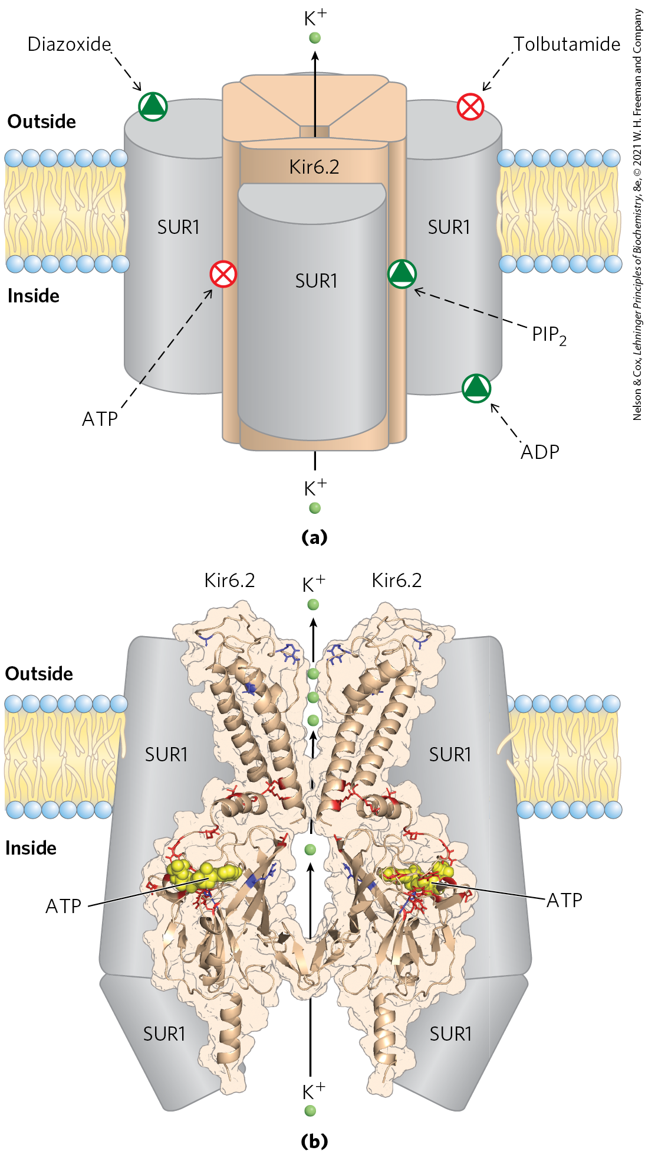
ATP-Gated K⁺ Channels in β Cells
channels are octamers:
  four identical Kir6.2 subunits
  four identical SUR1 subunits
sulfonylurea drugs = oral medications used in the treatment of type 2 diabetes mellitus
  bind to the SUR1 subunits, closing the channels and stimulating insulin release

Slide 77
Principle 3 (4 of 7)
Because the brain requires a continuous supply of glucose, maintaining an adequate concentration of glucose in the blood is a high priority in the activities of the other tissues. The liver integrates the use of fuels (glucose, fatty acids, and amino acids) by each tissue to keep the blood glucose level within the optimal range. Hormones carried in the blood (insulin, glucagon, epinephrine, cortisol) mediate this regulation.

Slide 78
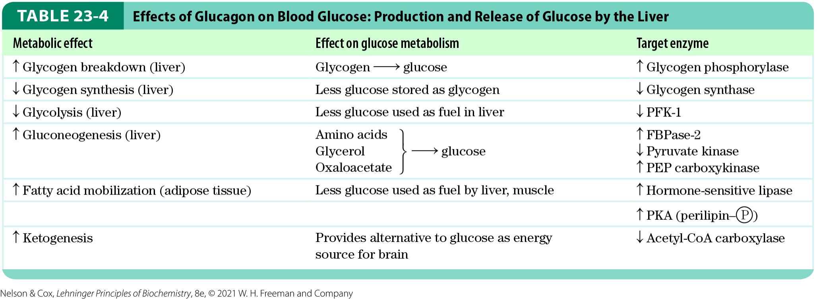
Glucagon Counters Low
Blood Glucose
glucagon enables the liver to restore blood glucose to its normal level by:
  stimulating glycogen breakdown
  preventing glycolysis
  promoting gluconeogenesis

Slide 79
Principle 3 (5 of 7)
Because the brain requires a continuous supply of glucose, maintaining an adequate concentration of glucose in the blood is a high priority in the activities of the other tissues. The liver integrates the use of fuels (glucose, fatty acids, and amino acids) by each tissue to keep the blood glucose level within the optimal range. Hormones carried in the blood (insulin, glucagon, epinephrine, cortisol) mediate this regulation.

Slide 80
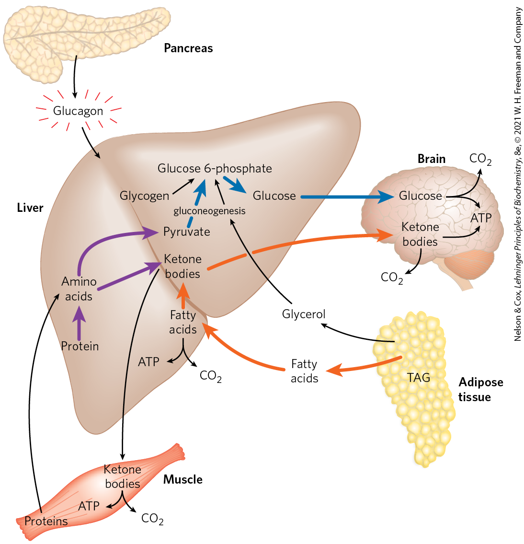
The Fasted State: The
Glucogenic Liver
lowered blood glucose triggers the pancreas to secrete glucagon and decrease the release of insulin
glucagon stimulates glucose synthesis and release by the liver and mobilizes fatty acids from adipose tissue

Slide 81
During Fasting and Starvation, Metabolism Shifts to Provide Fuel for the Brain
Table 23-5 Available Metabolic Fuels in a Normal-Weight, 70 kg Man and in an Obese, 140 kg Man at the Beginning of a Fast
Type of fuel | Weight (kg) | Caloric equivalent (thousands of kcal (kJ)) | Estimated survival (months)
Normal-weight, 70 kg man
Triacylglycerols (adipose tissue) | 15 | 140 (590)
Proteins (mainly muscle) | 6 | 24 (100)
Glycogen (muscle, liver) | 0.23 | 0.90 (3.8)
Circulating fuels (glucose, fatty acids, triacylglycerols, etc.) | 0.023 | 0.10 (0.42)
Total |  | 165 (690) | 3
Obese, 140 kg man
Triacylglycerols (adipose tissue) | 80 | 750 (3,100)
Proteins (mainly muscle) | 8 | 32 (130)
Glycogen (muscle, liver) | 0.23 | 0.92 (3.8)
Circulating fuels | 0.025 | 0.11 (0.46)
Total |  | 783 (3,200) | 14

Slide 82
Principle 3 (6 of 7)
Because the brain requires a continuous supply of glucose, maintaining an adequate concentration of glucose in the blood is a high priority in the activities of the other tissues. The liver integrates the use of fuels (glucose, fatty acids, and amino acids) by each tissue to keep the blood glucose level within the optimal range. Hormones carried in the blood (insulin, glucagon, epinephrine, cortisol) mediate this regulation.

Slide 83
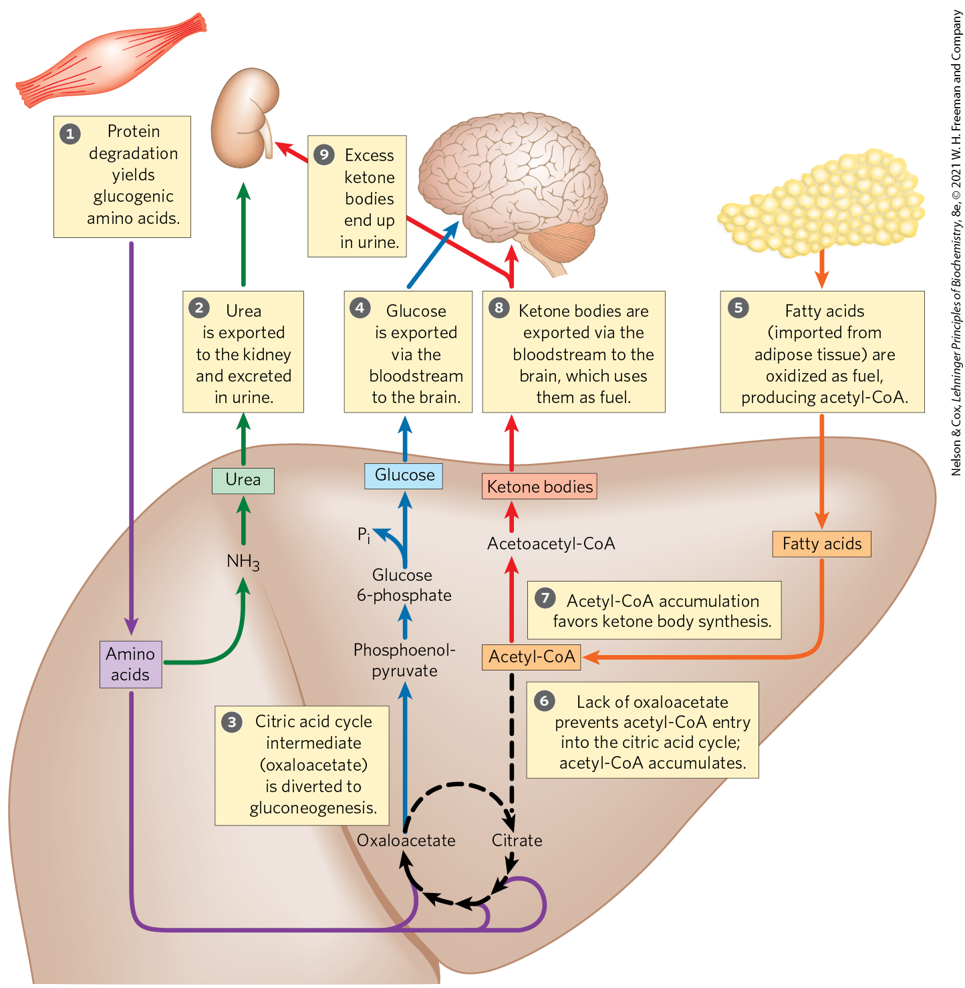
Fuel Metabolism in the Liver
During Fasting
slowing of insulin secretion and increased glucagon secretion mobilize TAGs
the liver converts fatty acids to ketone bodies for export to other tissues, including the brain

Slide 84
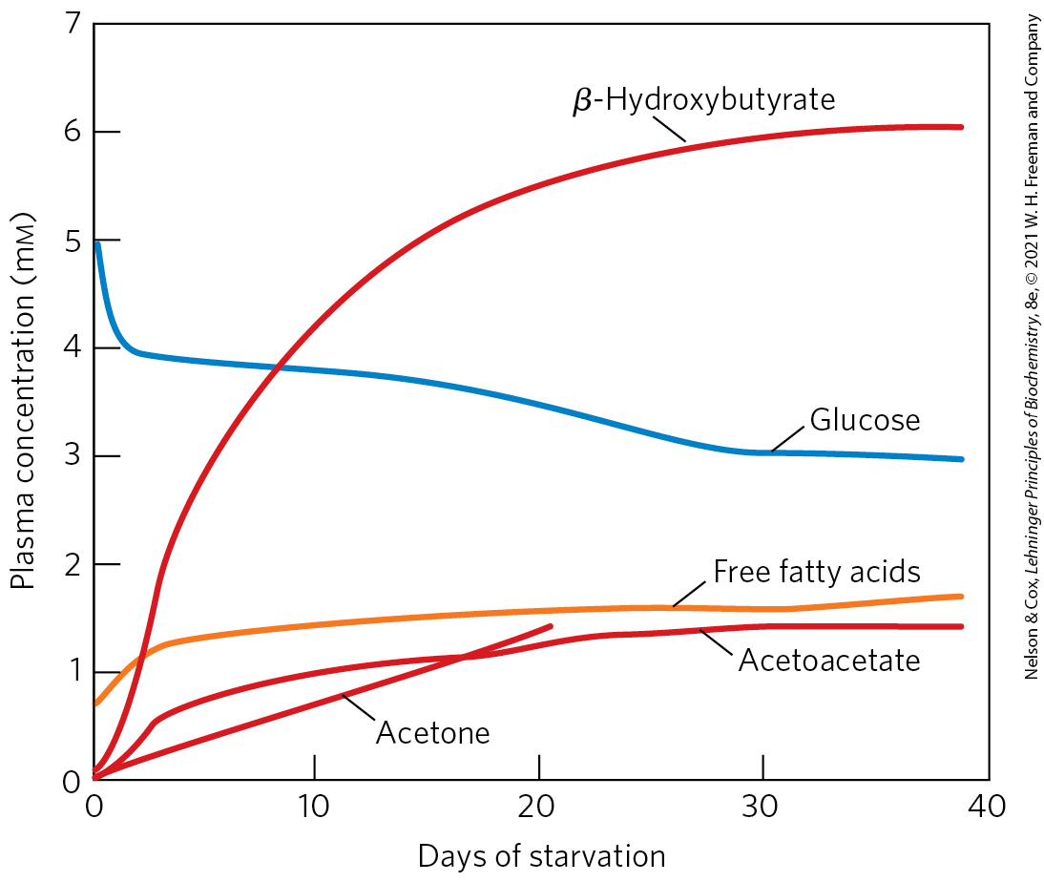
Plasma Concentrations
During Starvation
glucose begins to diminish within 2 days
levels of ketone bodies rise dramatically after 2 to 4 days
  exported from the liver to the the heart, skeletal muscle, and brain

Slide 85
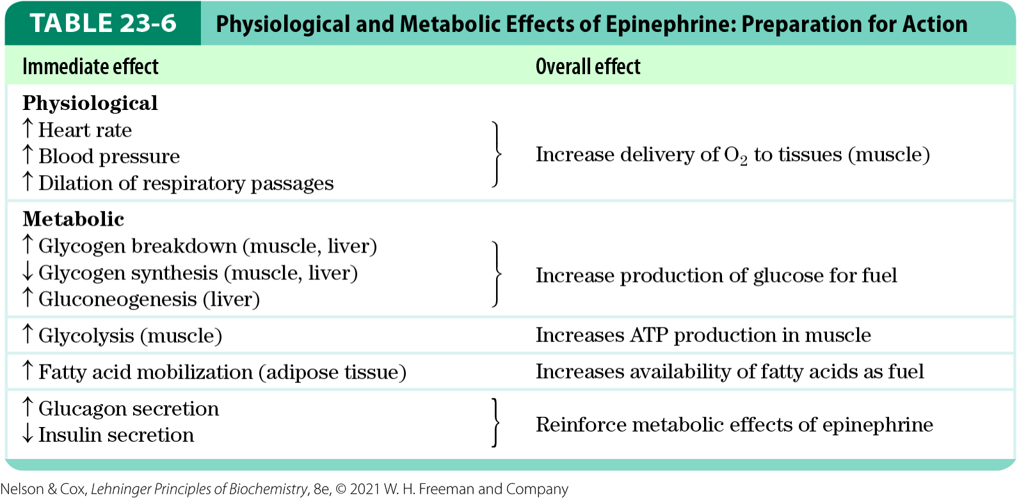
Epinephrine Signals
Impending Activity
epinephrine prepares the body for increased activity by mobilizing glucose

Slide 86
Principle 3 (7 of 7)
Because the brain requires a continuous supply of glucose, maintaining an adequate concentration of glucose in the blood is a high priority in the activities of the other tissues. The liver integrates the use of fuels (glucose, fatty acids, and amino acids) by each tissue to keep the blood glucose level within the optimal range. Hormones carried in the blood (insulin, glucagon, epinephrine, cortisol) mediate this regulation.

Slide 87
Cortisol Signals Stress, Including Low Blood Glucose
cortisol = a glucocorticoid released from the adrenal cortex in response to a variety of stressors (anxiety, fear, pain, low blood glucose, etc.)
  relatively slow-acting hormone that alters metabolism

Slide 88
Cortisol Acts on Muscle, Liver, and Adipose Tissue
leads to an increased release of fatty acids from stored TAGs in adipose tissue
stimulates the breakdown of nonessential muscle proteins and export of amino acids to the liver
stimulates gluconeogenesis from amino acids and glycerol in the liver
  raises blood glucose
  counterbalances the effects of insulin

Slide 89
23.4 Obesity and the Regulation of Body Mass

Slide 90
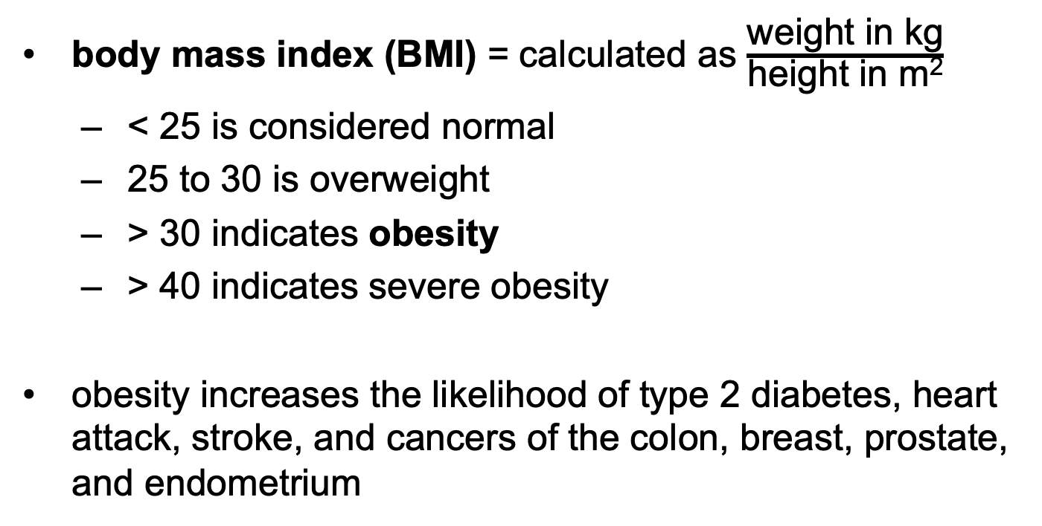
Body Mass Index (BMI)
body mass index (BMI) = calculated as $\frac{\text{weight} \text{in} \text{kg}}{\text{height} \text{in} \text{m}\text{2}}$
  < 25 is considered normal
  25 to 30 is overweight
  > 30 indicates obesity
  > 40 indicates severe obesity
obesity increases the likelihood of type 2 diabetes, heart attack, stroke, and cancers of the colon, breast, prostate, and endometrium

Slide 91
Principle 4 (2 of 4)
Maintaining an optimal body mass is an important priority in the adult mammal. Body mass is a function of dietary intake, physical activity, and the choice of metabolic fuel, all of which are subject to hormonal regulation. Hormonal signals between the brain, the adipose tissue, and the gastrointestinal tract help to set activity and feeding behavior.

Slide 92
Fates of Excess Dietary Calories
the body deals with an excess of dietary calories by:
  converting excess fuel to fat and storing it in adipose tissue
  burning excess fuel by extra exercise
  “wasting” fuel by diverting it to heat production (thermogenesis) by uncoupled mitochondria
in mammals, hormonal and neuronal signals act to keep fuel intake and energy expenditure in balance

Slide 93
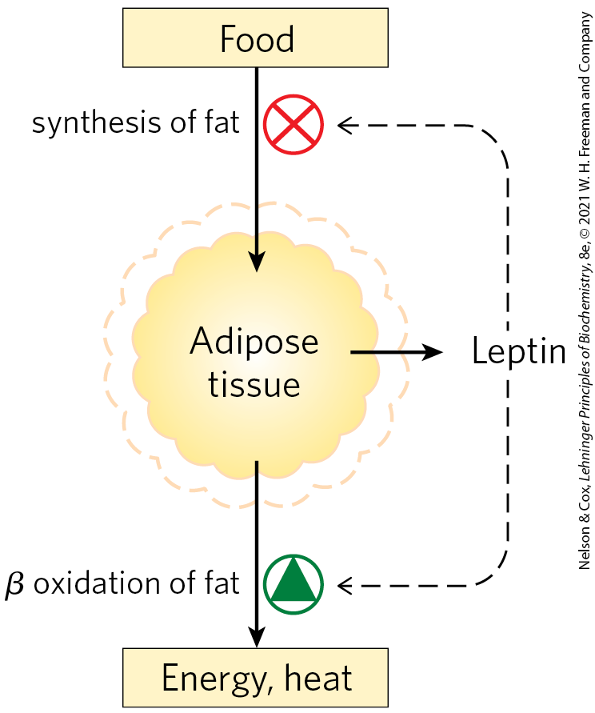
Adipose Tissue Has Important Endocrine Functions
“adiposity negative-feedback” model = suggests that eating behavior is inhibited and energy expenditure is increased whenever body weight exceeds a certain “set point” value

Slide 94
Principle 4 (3 of 4)
Maintaining an optimal body mass is an important priority in the adult mammal. Body mass is a function of dietary intake, physical activity, and the choice of metabolic fuel, all of which are subject to hormonal regulation. Hormonal signals between the brain, the adipose tissue, and the gastrointestinal tract help to set activity and feeding behavior.

Slide 95
Adipose Tissue
Produces Adipokines
adipose tissue is an important endocrine organ that produces adipokines (peptide hormones)
adipokines may act locally or systemically (endocrine action)
adipokines carry information about the adequacy of the energy reserves (TAGs) stored in adipose tissue to other tissues and to the brain

Slide 96
Leptin is an Adipokine
leptin = an adipokine produced by adipose tissue that regulates feeding behavior and energy expenditure to maintain adequate reserves of fat
  production and release increases with number and size of adipocytes

Slide 97
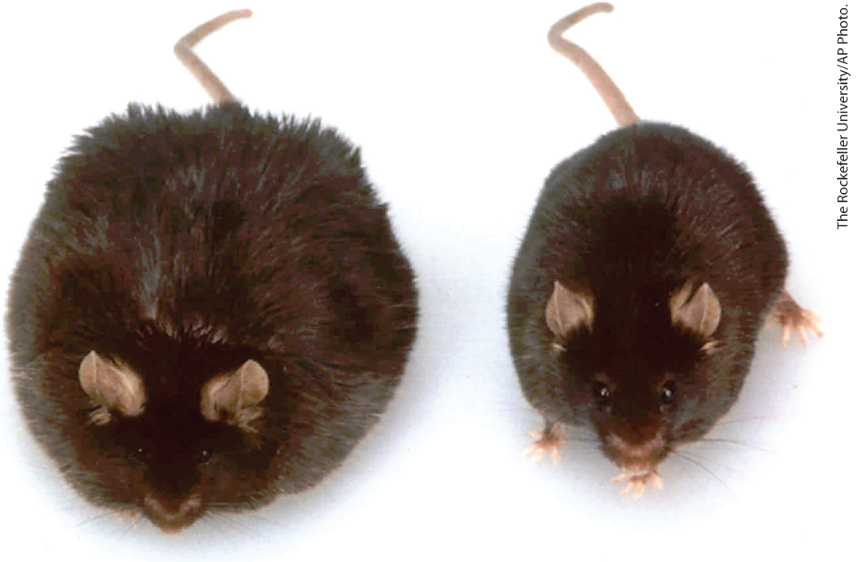
Obesity Caused by Defective
Leptin Production
mice with two defective copies of the OB (obese) gene (ob/ob) show the behavior and physiology of animals in a constant state of starvation
leptin injections into ob/ob mice cause the mice to:
  eat less
  lose weight
  increase locomotor activity and thermogenesis

Slide 98
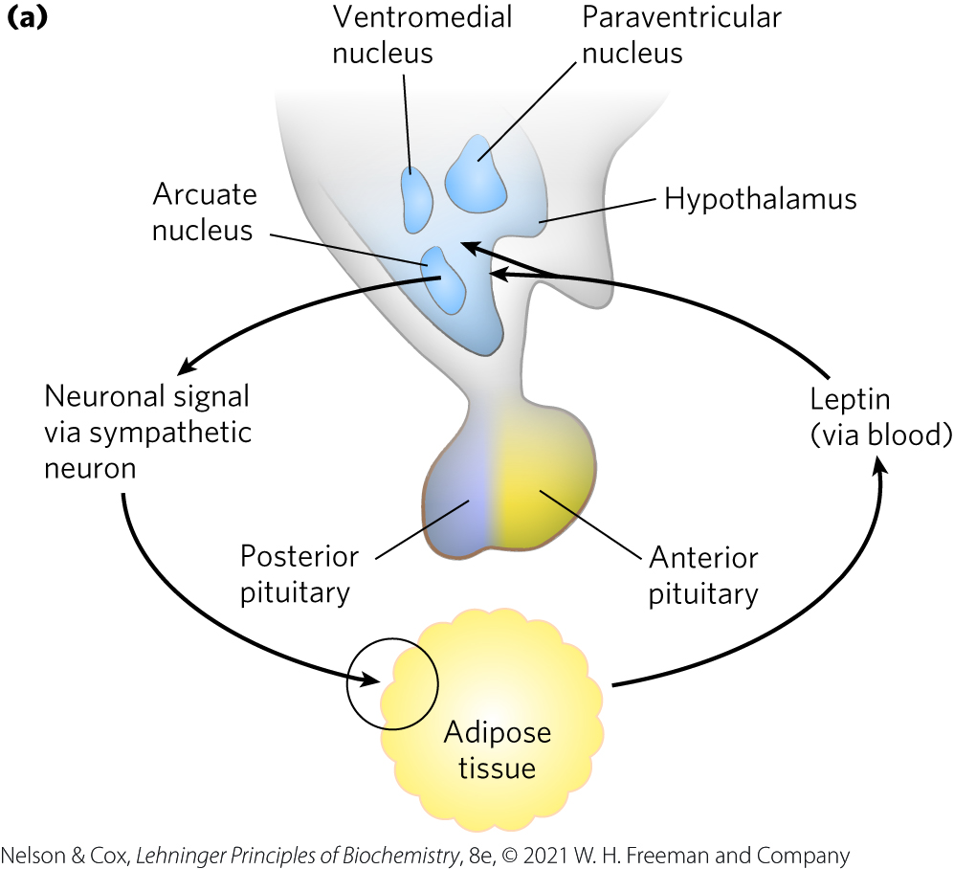
The Leptin Receptor
leptin receptor = receptor encoded by the DB (diabetic) gene that permits signaling by leptin
  expressed primarily in neurons of the arcuate nucleus of the hypothalamus
  db/db mice are obese and diabetic

Slide 99
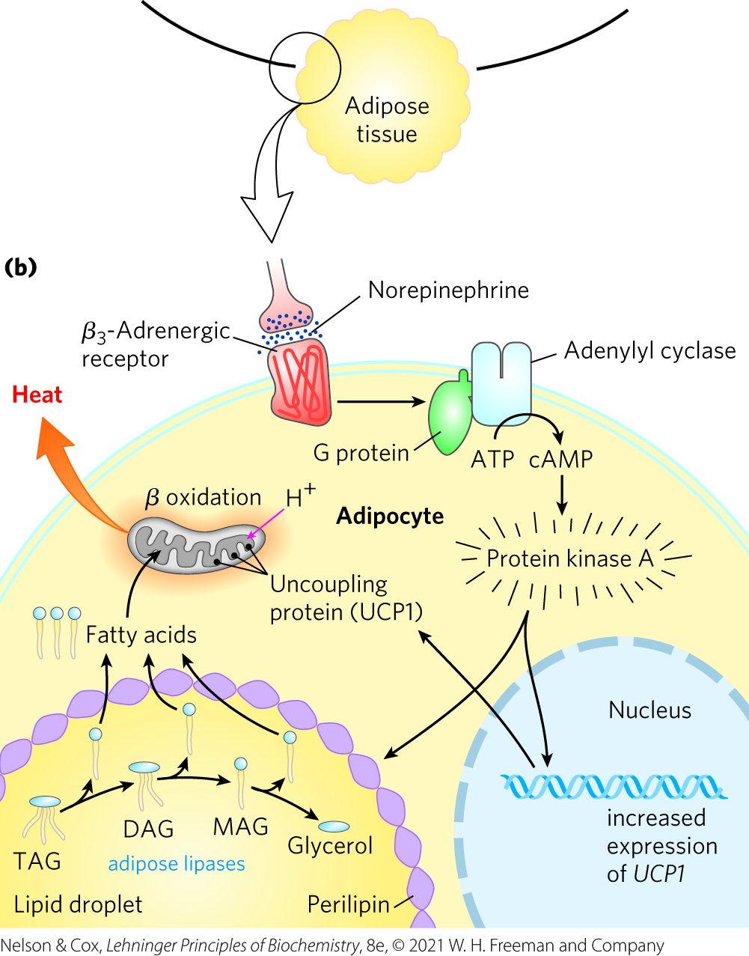
Hypothalamic Regulation of Food Intake and Energy Expenditure
the hypothalamus responds to leptin with norepinephrine signals to adipocytes
the signal activates protein kinase A, which triggers fatty acid mobilization and their uncoupled oxidation in mitochondria, generating heat

Slide 100
Leptin Stimulates Production of Anorexigenic Peptide Hormones
two types of neurons in the arcuate nucleus control fuel intake and metabolism:
  orexigenic (appetite-stimulating) neurons stimulate eating by producing and releasing neuropeptide Y (NPY)
  anorexigenic (appetite-suppressing) neurons produce α-melanocyte-stimulating hormone (α-MSH) from its polypeptide precursor POMC

Slide 101
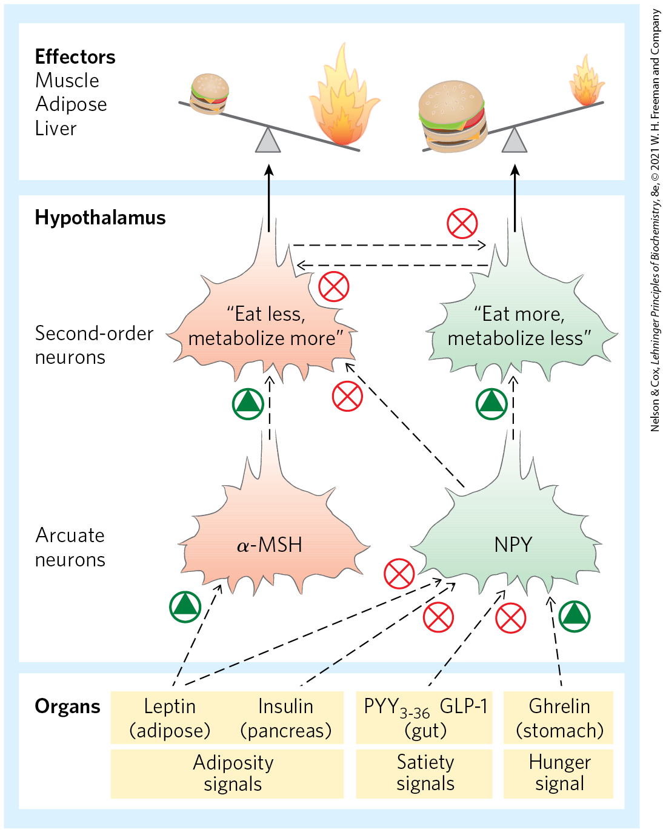
Hormones That Control Eating
leptin causes the release of anorexigenic peptides, including α-MSH, to inhibit eating

Slide 102
Leptin Triggers a Signaling Cascade That Regulates Gene Expression
leptin receptor monomers dimerize and undergo phosphorylation on several Tyr residues
  initiates a chain of events that ends with the increased synthesis of the POMC gene
leptin also:
  increases synthesis of the mitochondria in brown and beige adipocytes
  stimulates UCP1 synthesis

Slide 103
Leptin and Human Obesity
blood levels of leptin are usually much higher in obese animals than in animals of normal body mass
leptin injections are not effective at reducing weight in individuals that do not have a defective leptin gene (OB)
  indicates some downstream element in the leptin response system is defective in obese individuals

Slide 104
Adiponectin Acts through AMPK to Increase Insulin Sensitivity
adiponectin = an adipokine produced in adipose tissue
  stimulates fatty acid uptake and oxidation
  inhibits fatty acid synthesis
  sensitizes muscle and liver to insulin
AMP-activated protein kinase (AMPK) = mediates many effects of adiponectin

Slide 105
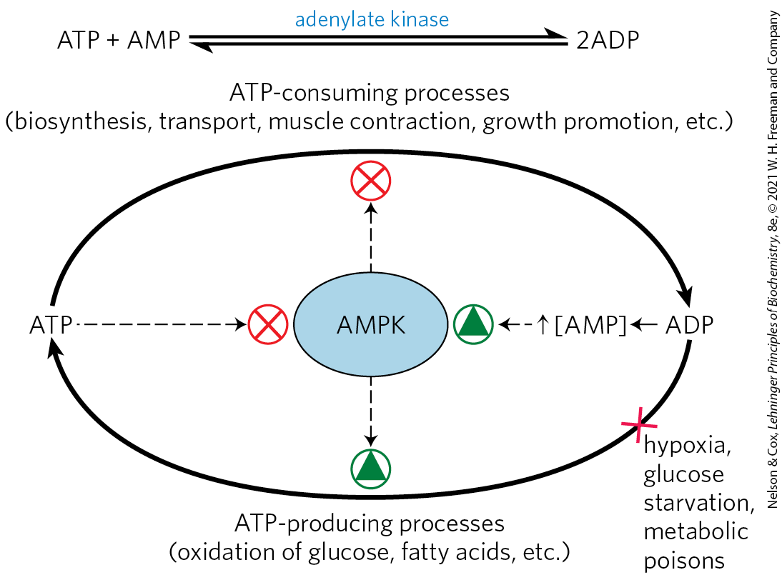
The Role of AMPK in Maintaining Energy Homeostasis
adiponectin triggers phosphorylation and activation of AMPK
AMPK is allosterically activated by AMP

Slide 106
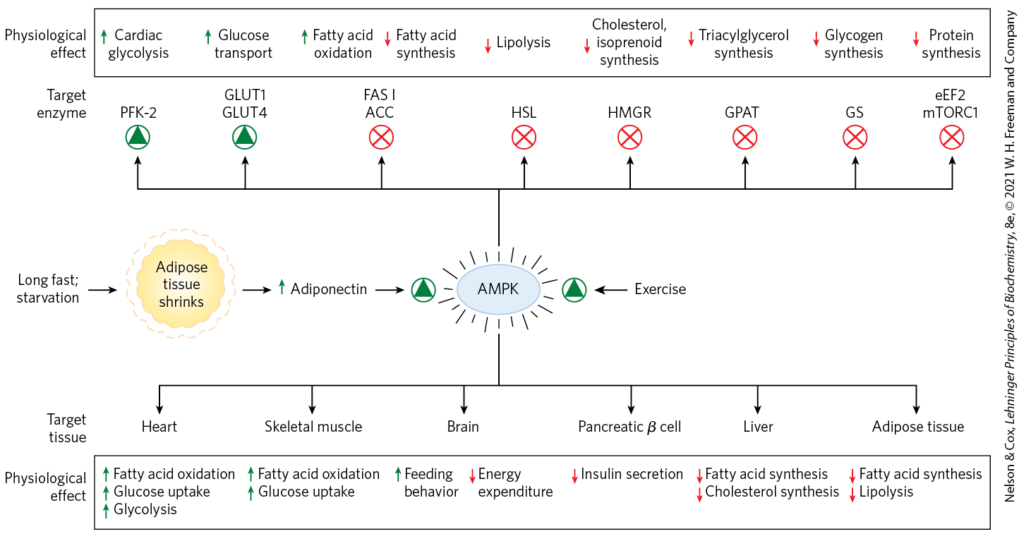
AMPK Coordinates Catabolism and Anabolism in Response to Metabolic Stress

Slide 107
The mTORC1 Pathway Coordinates Cell Growth with the Supply of Nutrients and Energy
mTOR = a highly conserved Ser/Thr kinase
  forms a complex, mTORC1, with a scaffold protein, raptor, and other regulatory proteins
mTORC is recruited to the cytosolic surface of the lysosome through raptor by the Ragulator-Rag complex
Rheb = G protein that activates the protein kinase activity of mTOR

Slide 108
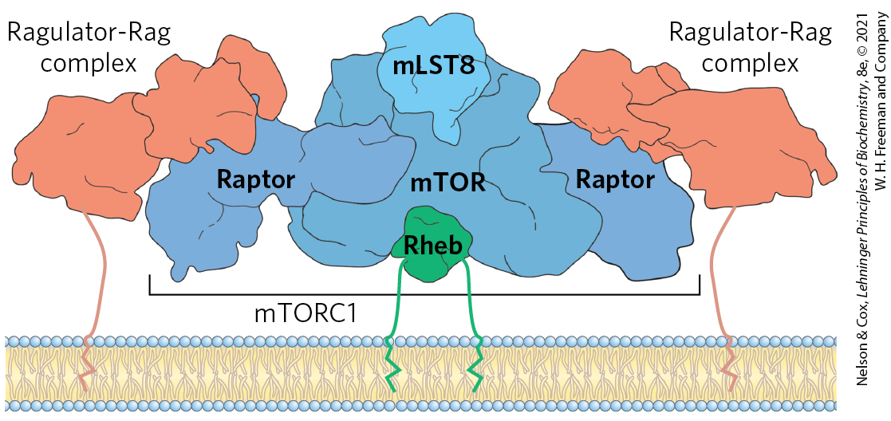
The mTORC-Ragulator-Rag Complex on the Lysosomal Surface
the complex integrates signals from inside and outside of the lysosome about:
  the energy status of the cell
  the availability of critical amino acids needed for protein synthesis
  the presence of growth factors

Slide 109
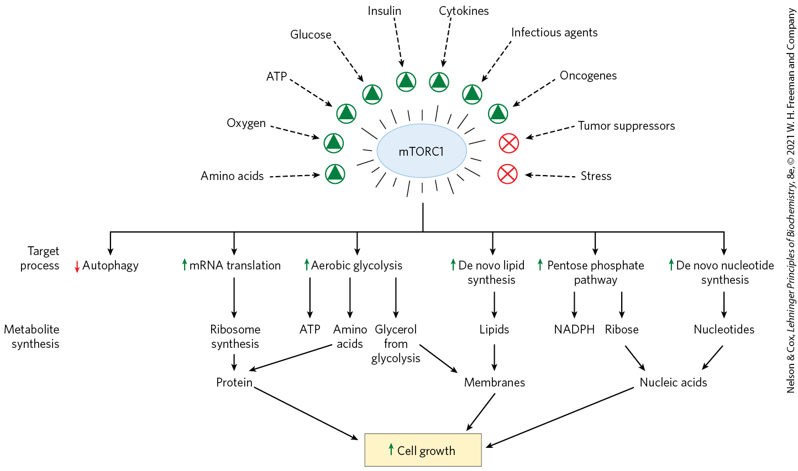
mTORC1 Activation Signals and the Cellular Process it Activates

Slide 110
Diet Regulates the Expression of Genes Central to Maintaining Body Mass
peroxisome proliferator-activated receptors (PPARs) = family of ligand-activated transcription factors
  respond to changes in dietary lipid by altering the expression of genes involved in fat and carbohydrate metabolism

Slide 111
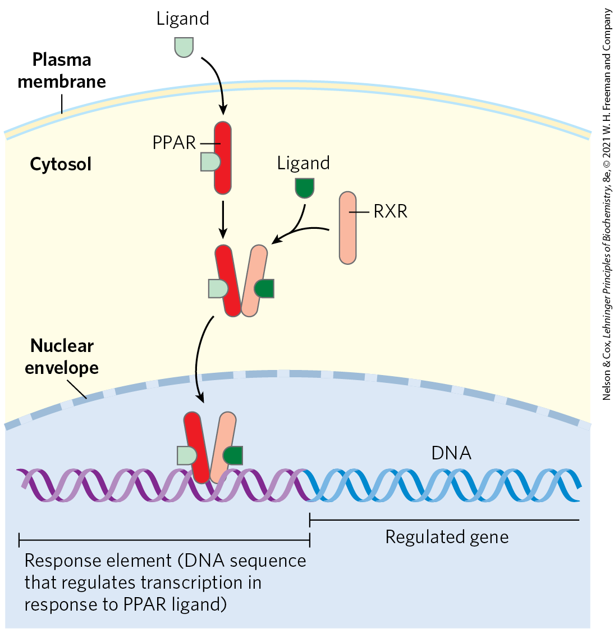
Mode of Action of PPARs
ligands are fatty acids or fatty acid derivatives
PPARs form heterodimers in the nucleus with RXR
the heterodimers bind to regulatory regions of DNA

Slide 112
The Three PPAR Isoforms Regulate Lipid and Glucose Homeostasis
PPARγ = regulates the differentiation of fibroblasts into adipocytes and lipid synthesis and storage in adipocytes
PPARα = regulates the uptake and β oxidation of fatty acids and the formation of ketone bodies during fasting
  expressed in liver, kidney, heart, skeletal muscle, and brown adipose tissue
PPARδ = regulates β oxidation and energy dissipation through uncoupling of mitochondria
  acts in the liver and muscle

Slide 113
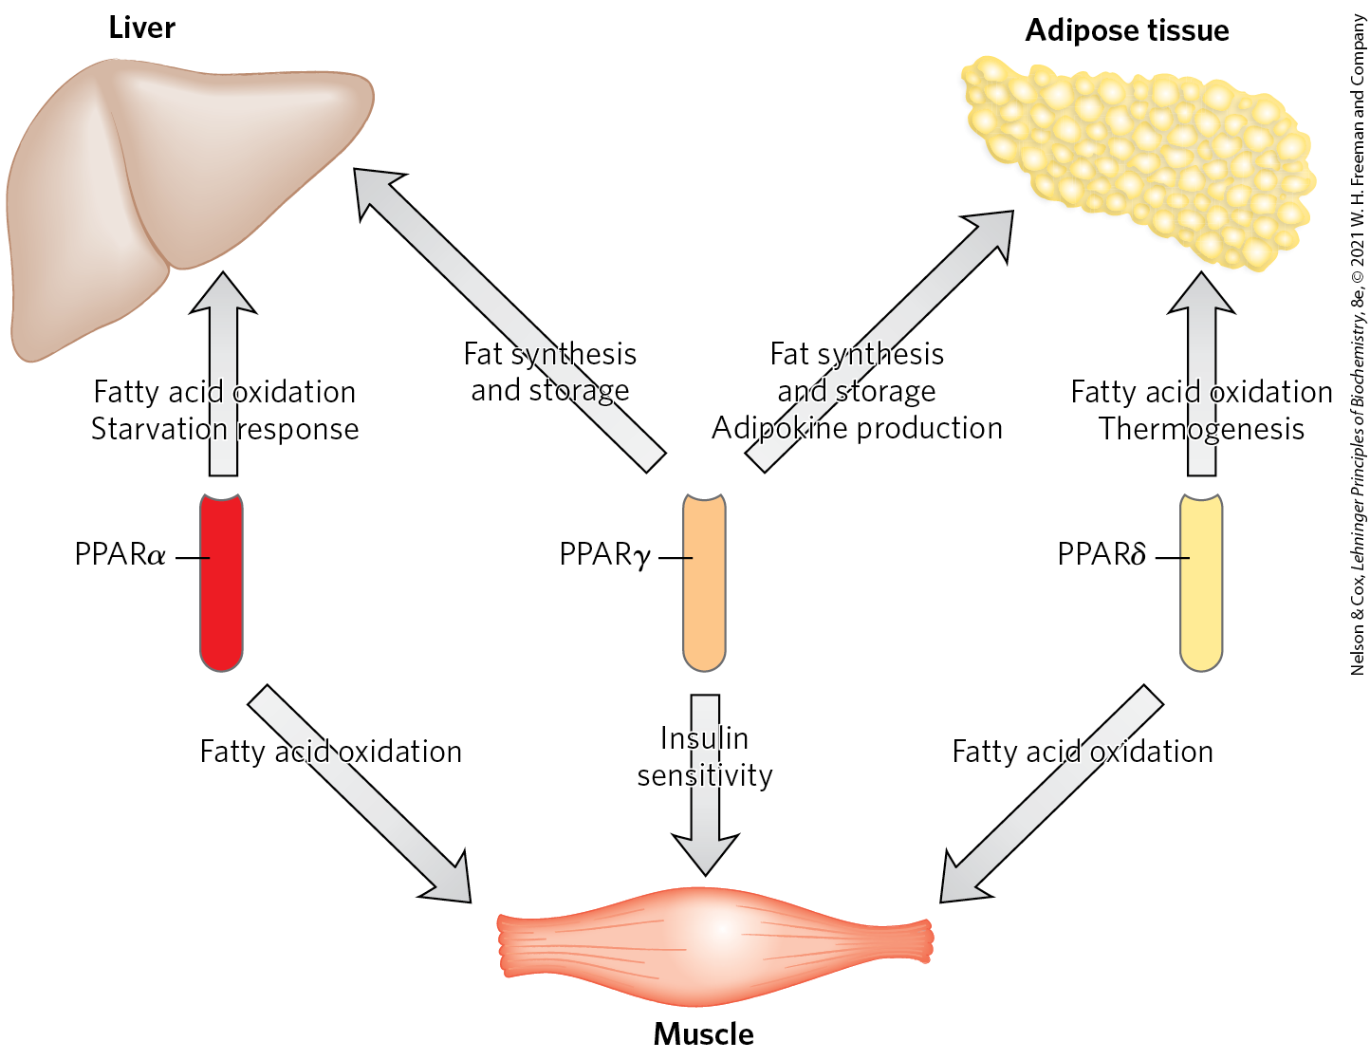
Metabolic Integration by PPARs

Slide 114
Short-Term Eating Behavior Is Influenced by Ghrelin, PYY₃₋₃₆, and Cannabinoids
ghrelin = a peptide hormone produced in cells lining the stomach
  acts on orexigenic (appetite-stimulating) neurons in the arcuate nucleus to produce hunger
  works on a shorter time scale than leptin and insulin
  acts through a GPCR to generate IP₃

Slide 115
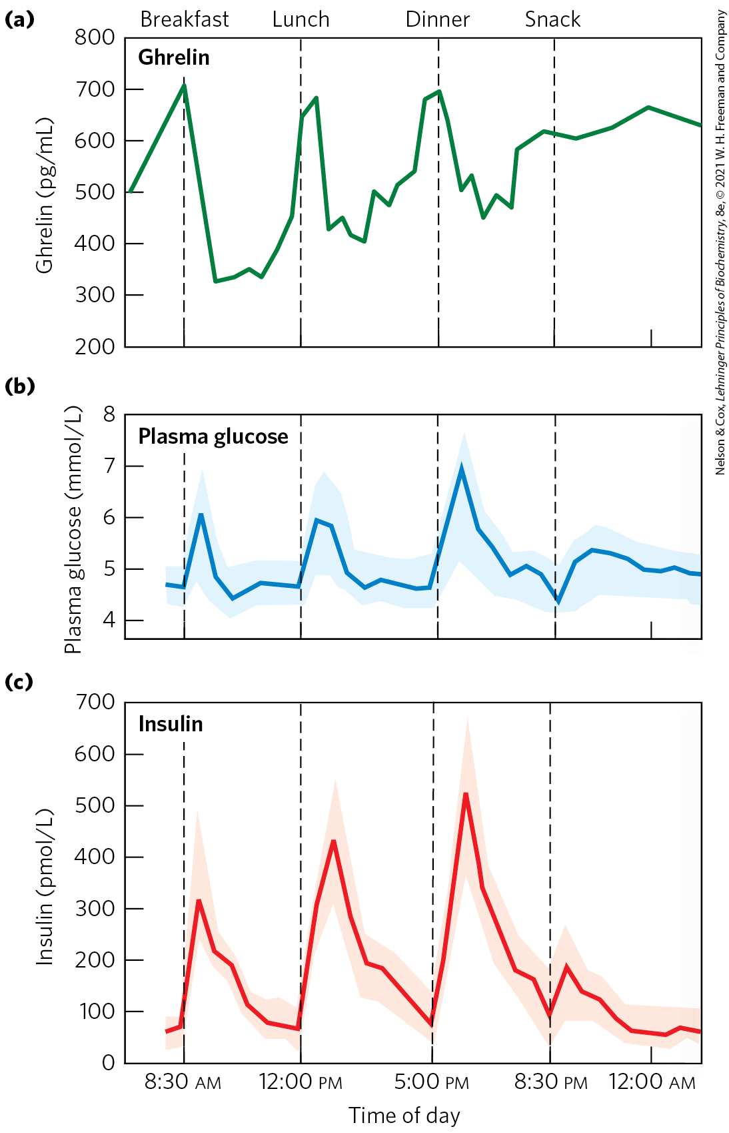
Variations in Blood Concentrations of Glucose, Ghrelin, and Insulin
ghrelin concentration in the blood peaks just before a meal
injection of ghrelin into humans produces immediate sensations of intense hunger

Slide 116
PYY₃₋₃₆ Acts to Lessen Hunger After a Meal
PYY₃₋₃₆ = a peptide hormone secreted by endocrine cells in the small intestine and colon in response to food entering from the stomach
  acts on orexigenic neurons in the arcuate nucleus to inhibit NPY release and reduce hunger

Slide 117
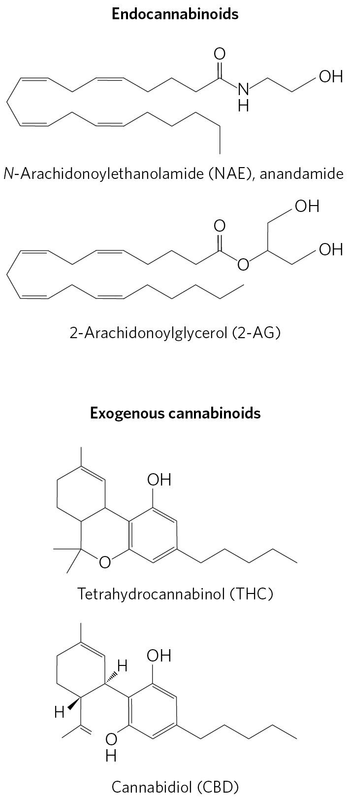
Cannabinoids
endocannabinoids = eicosanoid lipid messengers that signal the availability of sweet or fatty food and stimulate its consumption
  act through specific GPCRs in the brain and PNS that control ion channels
cannabinoid receptors also mediate the psychoactive effects of ∆⁹-tetrahydrocannabinol (the main active ingredient in marijuana)

Slide 118
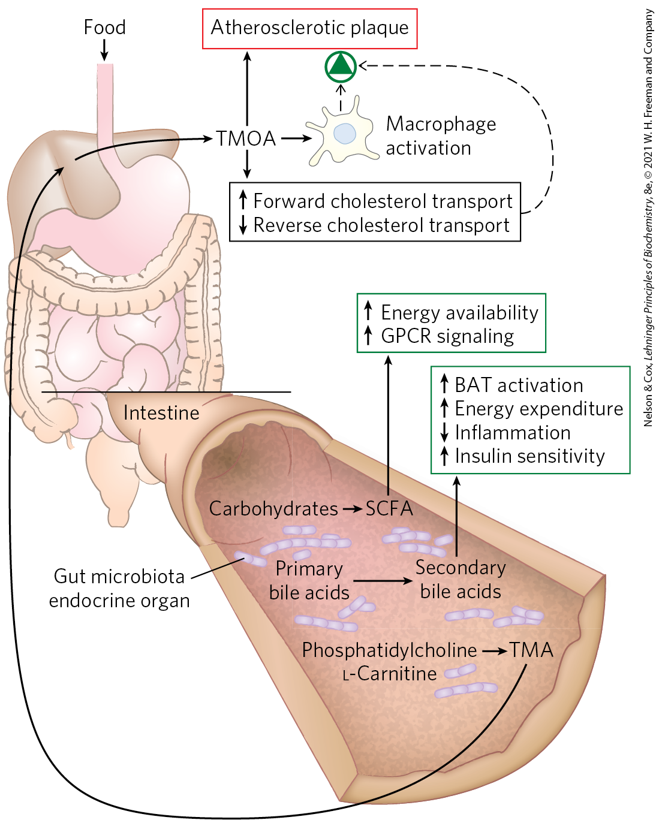
Microbial Symbionts in the Gut Influence Energy Metabolism and Adipogenesis
Adult humans are hosts to ~10¹⁴ gut microbes.
Microbial symbionts in the gut release fermentation products and secondary bile acids.
  influence release of gut hormones that regulate body mass

Slide 119
Probiotics and Prebiotics
weight reduction might be accomplished by adding to the gut either:
  probiotics (microbial species that disfavor adipogenesis)
  prebiotics (nutrients that favor the dominance of probiotic microbes)

Slide 120
Principle 4 (4 of 4)
Maintaining an optimal body mass is an important priority in the adult mammal. Body mass is a function of dietary intake, physical activity, and the choice of metabolic fuel, all of which are subject to hormonal regulation. Hormonal signals between the brain, the adipose tissue, and the gastrointestinal tract help to set activity and feeding behavior.

Slide 121
Endocrine Cell Interactions with Gut Microbes May Affect Peptide Release
endocrine cells in the intestinal tract secrete peptides that modulate food intake and energy expenditure:
  the anorexigenic PYY_{3–36} and GLP-1
  the orexigenic ghrelin
peptide release may be affected by the interaction of endocrine cells with specific microbes in the gut or with their fermentation products

Slide 122
23.5 Diabetes Mellitus

Slide 123
Diabetes Mellitus
diabetes mellitus = a relatively common disease affecting ~9% of the U.S. population
two major clinical classes of diabetes mellitus:
  type 1 diabetes (insulin-dependent diabetes mellitus (IDDM))
  type 2 diabetes (non-insulin-dependent diabetes mellitus (NIDDM))

Slide 124
Diabetes Mellitus Arises from Defects in Insulin Production or Action
type 1 diabetes = stems from an autoimmune destruction of pancreatic β cells, resulting in the inability to produce sufficient insulin
  begins early in life
  responds to insulin injection

Slide 125
Type 2 Diabetes
type 2 diabetes = group of diseases in which the regulatory activity of insulin is disordered
  slower to develop and typically in obese adults
  responds to insulin injection

Slide 126
Symptoms and Pathology of Diabetes
both type 1 and type 2 diabetes are characterized by excessive thirst and frequent urination
  due to excretion of large amounts of glucose in urine
pathology includes cardiovascular disease, renal failure, blindness, and neuropathy

Slide 127
Principle 5 (2 of 3)
The metabolic activities of cells and organisms are complex and intertwined; perturbation at one point in the system has far-reaching consequences for health. When the normal energy-yielding metabolism of glucose and fatty acids is impeded by defective insulin signaling, the result is the disease diabetes.

Slide 128
Diagnosis of Diabetes
individuals with type 1 and type 2 diabetes are unable to take up glucose efficiently from the blood
HbA1c = a glucose derivative of hemoglobin, which forms in the blood and reflects the average blood glucose level
glucose-tolerance test = measures the blood glucose after an overnight fast and after drinking glucose water
  diabetic individuals assimilate the test dose of glucose poorly and glucose also appears in the urine

Slide 129
Carboxylic Acids (Ketone Bodies) Accumulate in the Blood of Those with Untreated Diabetes
because glucose is unavailable to cells, fatty acids become the principal fuel
this leads to excessive but incomplete oxidation of fatty acids in the liver
  high [NADH]/[NAD⁺] ratio produced by β oxidation inhibits the cycle
  acetyl-CoA accumulates

Slide 130
Untreated Diabetes Can
Cause Ketoacidosis
accumulated acetyl-CoA leads to ketosis (the overproduction of ketone bodies)
  results in greatly increased concentrations of ketone bodies in the blood (ketonemia) and urine (ketonuria)
ionization of ketone bodies can lead to acidosis (a lowering of blood pH)
ketoacidosis = the potentially life-threatening condition of ketosis and acidosis

Slide 131
Principle 5 (3 of 3)
The metabolic activities of cells and organisms are complex and intertwined; perturbation at one point in the system has far-reaching consequences for health. When the normal energy-yielding metabolism of glucose and fatty acids is impeded by defective insulin signaling, the result is the disease diabetes.

Slide 132
In Type 2 Diabetes the Tissues Become Insensitive to Insulin
a hallmark of type 2 diabetes is the development of insulin resistance
  more insulin is required to bring about the same biological effects
metabolic syndrome = the stage preceding type 2 diabetes
  includes obesity, hypertension, abnormal blood lipids, high fasting blood glucose, and reduced ability to clear glucose
  affects ~30% of the adult U.S. population

Slide 133
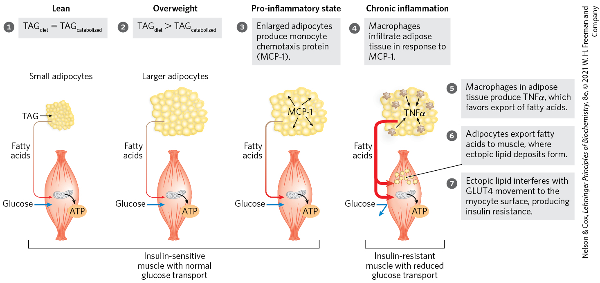
The “Lipid Toxicity” Hypothesis
insulin resistance in type 2 diabetes may be due to abnormal lipid storage in muscle and liver when adipocytes cannot store additional TAGs

Slide 134
Type 2 Diabetes Is Managed with Diet, Exercise, Medication, and Surgery
Table 23-7 Treatments for Type 2 Diabetes Mellitus
Intervention/treatment | Direct target | Effect of treatment
Weight loss | Adipose tissue; reduction in TAG content | Reduces lipid burden; increases capacity for lipid storage in adipose tissue; restores insulin sensitivity
Exercise | AMPK, activated by increasing [AMP]/[ATP] | Aids weight loss (see Fig. 23-34)
Bariatric surgery | Unknown | Leads to weight loss, better control of blood glucose
Sulfonylureas: glipizide (Glucotrol), glyburide (Micronase), glimepiride (Amaryl) | Pancreatic β cells; K⁺ channels blocked | Stimulates insulin secretion by pancreas (see Fig. 23-24)
Biguanides: metformin (Glucophage) | AMPK, activated | Increases glucose uptake by muscle; decreases glucose production in liver
Thiazolidinediones: rosiglitazone (Avandia), pioglitazone (Actos) | PPARγ | Stimulates expression of genes potentiating the action of insulin in liver, muscle, adipose tissue; increases glucose uptake; decreases glucose synthesis in liver
GLP-1 modulators: exenatide (Byetta), sitagliptin (Januvia), dulaglutide (Trulicity) | Glucagon-like peptide-1, dipeptide protease IV | Enhances insulin secretion by pancreas

Slide 135
Irisin
irisin = increases the expression of UCP1 genes in white adipose tissue and stimulates the development of beige adipocytes
  exercise increases release from muscle into the blood

