Slide 1

21 Lipid Biosynthesis
© 2021 Macmillan Learning

Slide 2

Principle 1 (1 of 3)
Lipids are the principal form of stored energy in most higher organisms, as well as the major constituents of membranes.

Slide 3

Principle 2 (1 of 4)
Anabolism is not simply the reverse of catabolism. Biosynthetic pathways typically diverge from breakdown pathways to overcome irreversible steps in catabolism.

Slide 4

Principle 3 (1 of 5)
Like other anabolic pathways, the reaction sequences in lipid biosynthesis are endergonic and reductive. They use ATP as a source of metabolic energy and a reduced electron carrier (usually NADPH) as a reductant.

Slide 5
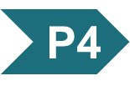
Principle 4 (1 of 5)
Lipid biosynthesis, like other anabolic pathways, is subject to regulation to respond to cellular and organismal requirements. The places where catabolic and anabolic pathways diverge (Principle 2) provide opportunities to impose metabolic regulation to conserve resources and avoid futile cycles.

Slide 6
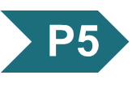
Principle 5 (1 of 7)
Like other major classes of biological molecules, lipids have a plethora of cellular functions. Specialized lipids serve as pigments (retinal, carotene), cofactors (vitamin K), detergents (bile salts), transporters (dolichols), hormones (vitamin D derivatives, sex hormones), extracellular and intracellular messengers (eicosanoids, phosphatidylinositol derivatives), and anchors for membrane proteins (covalently attached fatty acids, prenyl groups, phosphatidylinositol). The ability to synthesize a variety of lipids is essential to all organisms.

Slide 7
21.1 Biosynthesis of Fatty Acids and Eicosanoids

Slide 8
Principle 2 (2 of 4)
Anabolism is not simply the reverse of catabolism. Biosynthetic pathways typically diverge from breakdown pathways to overcome irreversible steps in catabolism.

Slide 9
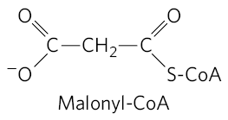
Differences between Fatty Acid Breakdown and Biosynthesis
occur by different pathways
  biosynthesis requires malonyl-CoA
catalyzed by different sets of enzymes
occur in different cellular compartments (in eukaryotes)
  breakdown occurs in the mitochondria
  biosynthesis occurs in the cytosol

Slide 10
Malonyl-CoA Is Formed from Acetyl-CoA and Bicarbonate
acetyl-CoA carboxylase = catalyzes the irreversible formation of malonyl-CoA from acetyl-CoA
  reaction occurs in the cytoplasm
  contains a biotin prosthetic group covalently bound in amide linkage to the ε-amino group of a Lys residue

Slide 11
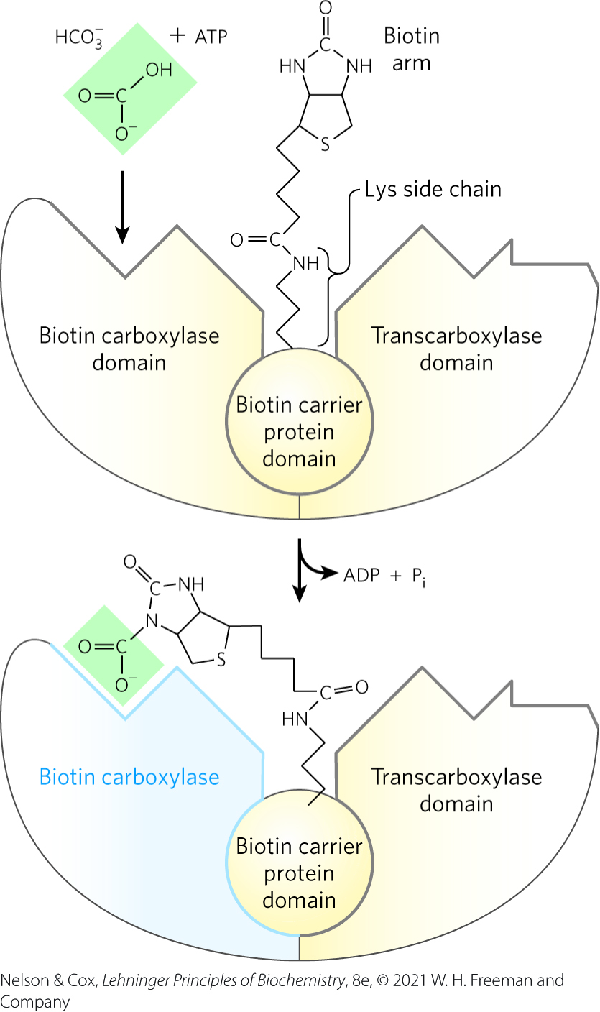
The Acetyl-CoA
Carboxylase Reaction
this reaction is similar to other biotin-dependent carboxylation reactions
the carboxyl group from HCO₃⁻ is transferred to biotin in an ATP-dependent reaction

Slide 12
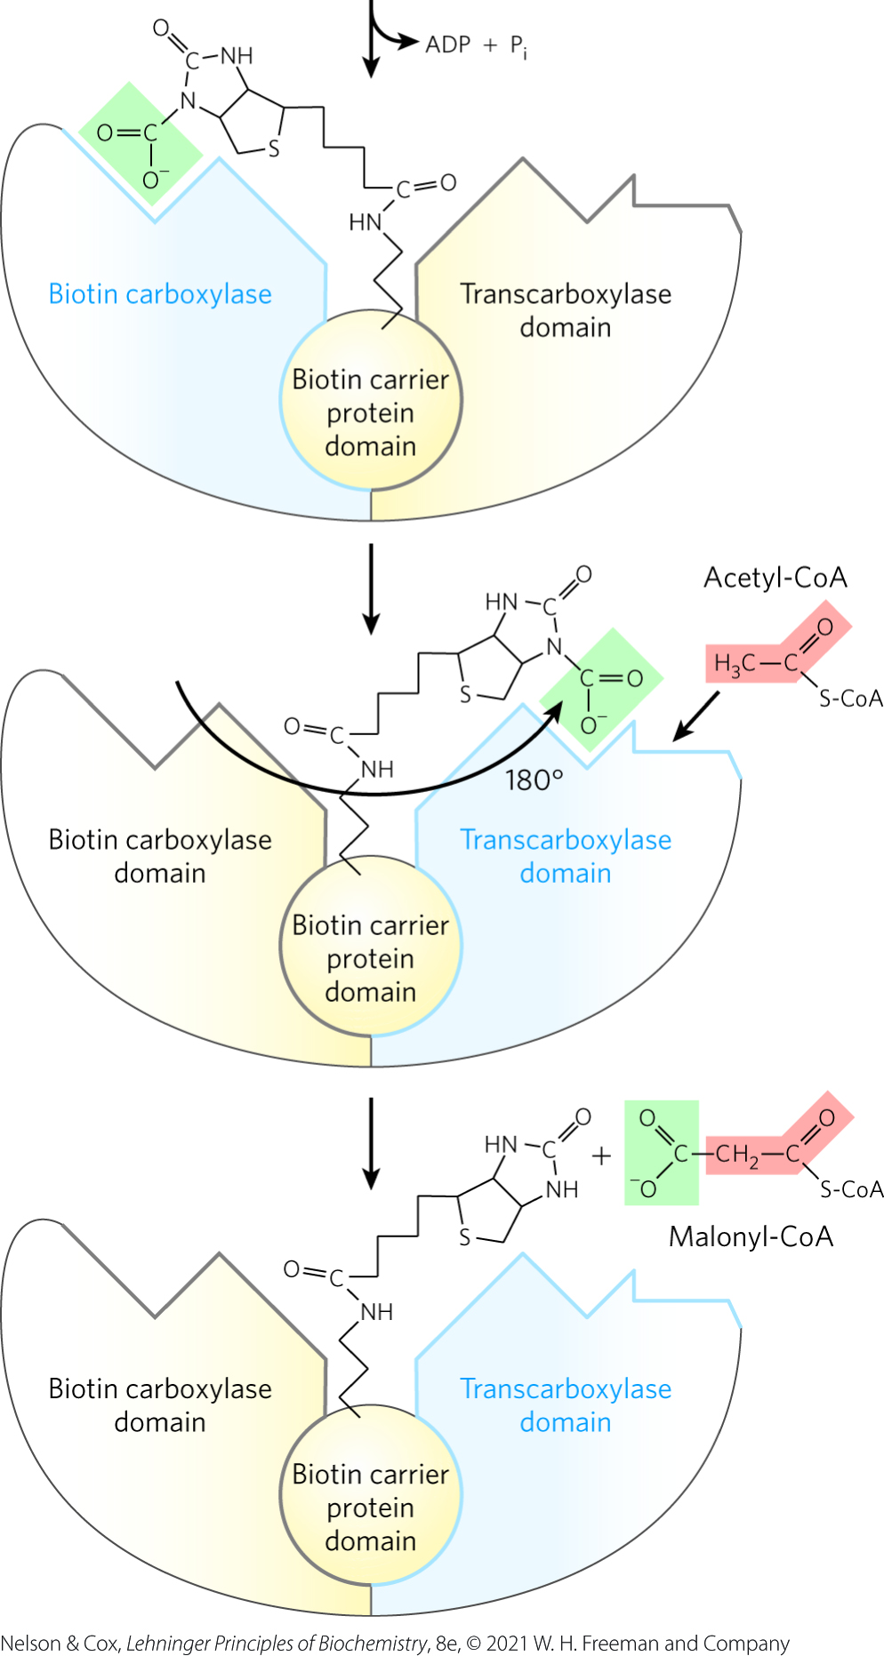
The Acetyl-CoA Carboxylase Reaction, Continued
the carboxyl group is carried by the biotin to a different active site, where the CO₂ is transferred to acetyl-CoA to yield malonyl-CoA
  functions to make subsequent steps more thermodynamically favorable

Slide 13
Bacterial and Plant
Acetyl-CoA Carboxylase
bacterial acetyl-CoA carboxylase has three separate polypeptide subunits
plant cells contain both types of acetyl-CoA carboxylase

Slide 14
Fatty Acid Synthesis Proceeds in a Repeating Reaction Sequence
fatty acid synthase = catalyzes assembly of long carbon chains of fatty acids in the cytosol through a repeating four-step sequence
  begins with malonyl-CoA and acetyl-CoA
  each sequence elongates chain by two carbons

Slide 15
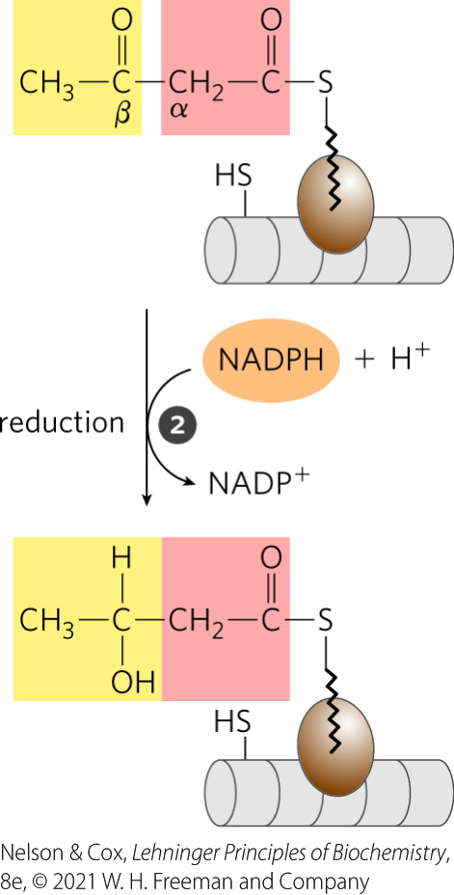
Step 1 of Fatty Acid
Synthesis: Condensation
an activated acyl group and two carbons from malonyl-CoA undergo condensation to form a β-keto product
  CO₂ from the malonyl group is eliminated
  the acyl chain is extended by two carbons

Slide 16
Step 2 of Fatty Acid Synthesis: Reduction of the β-Keto Product
the β-keto product is reduced to an alcohol
  requires NADPH

Slide 17
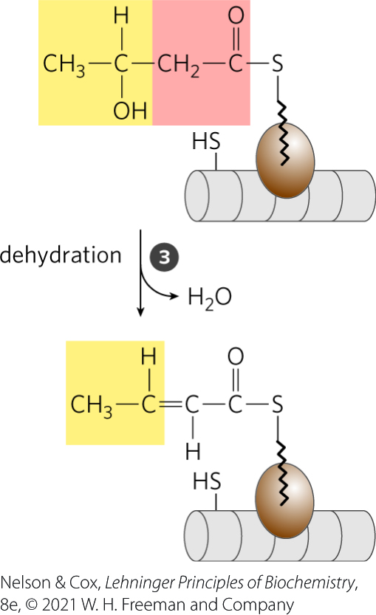
Step 3 of Fatty Acid
Synthesis: Dehydration
H₂O is eliminated to form a double bond

Slide 18
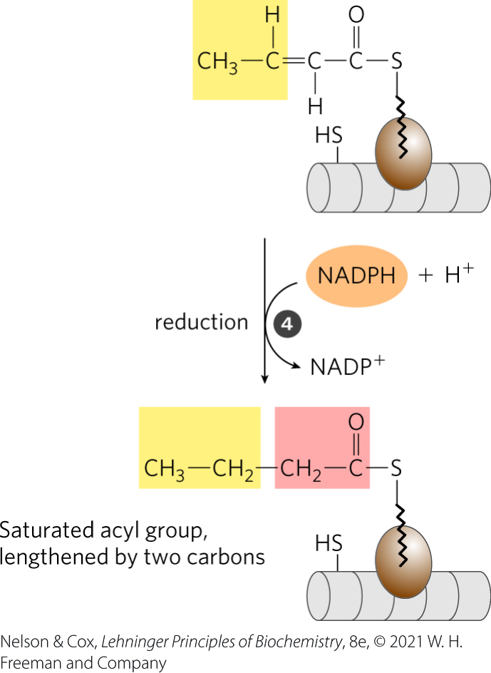
Step 4 of Fatty Acid Synthesis: Reduction of the Double Bond
the double bond is reduced to form the corresponding saturated fatty acyl group
  requires NADPH

Slide 19
Principle 2 (3 of 4)
Anabolism is not simply the reverse of catabolism. Biosynthetic pathways typically diverge from breakdown pathways to overcome irreversible steps in catabolism.

Slide 20
The Cofactor and Activating Groups in Fatty Acid Breakdown and Biosynthesis
in β oxidation:
  NAD and FAD serve as electron acceptors
  the activating group is the thiol (–SH) group of coenzyme A
in fatty acid synthesis:
  the reducing agent is NADPH
  the activating groups are two different enzyme-bound –SH groups

Slide 21
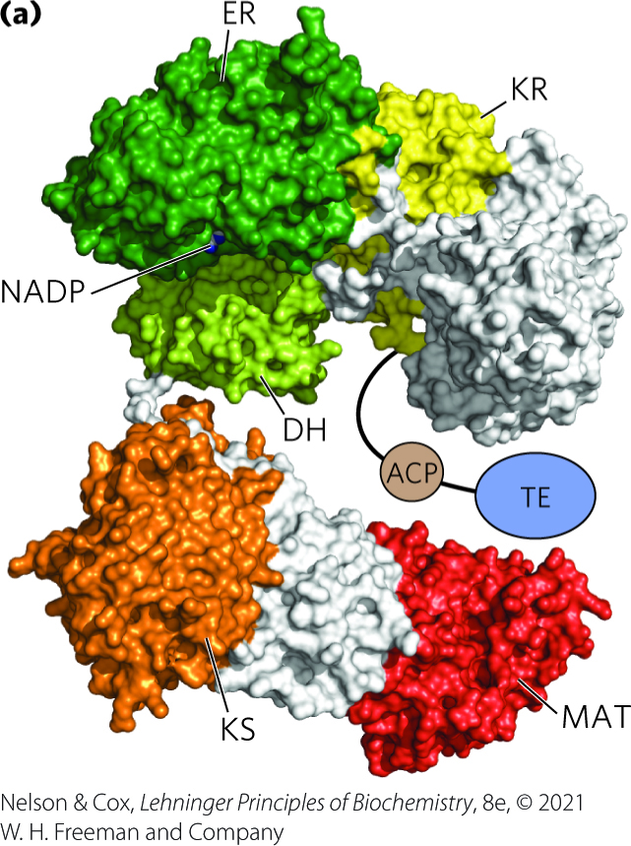
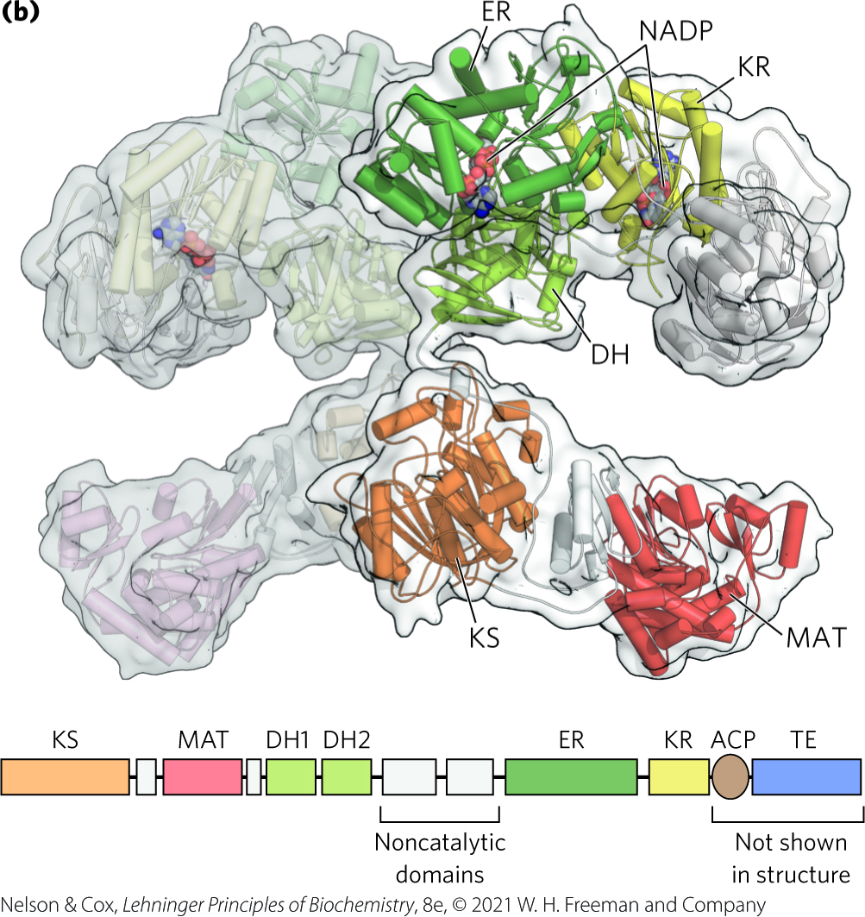
Fatty Acid Synthase I (FAS I)
FAS I = found in mammals
  seven active sites are in separate domains within a single multifunctional polypeptide chain
  two polypeptide chains function independently, but as a homodimer
  forms a single product

Slide 22
Acyl Carrier Protein (ACP)
acyl carrier protein (ACP) = shuttles the acyl group from one active site to another in sequence
  is covalently linked to the acyl group
  is part of the single FAS I polypeptide

Slide 23
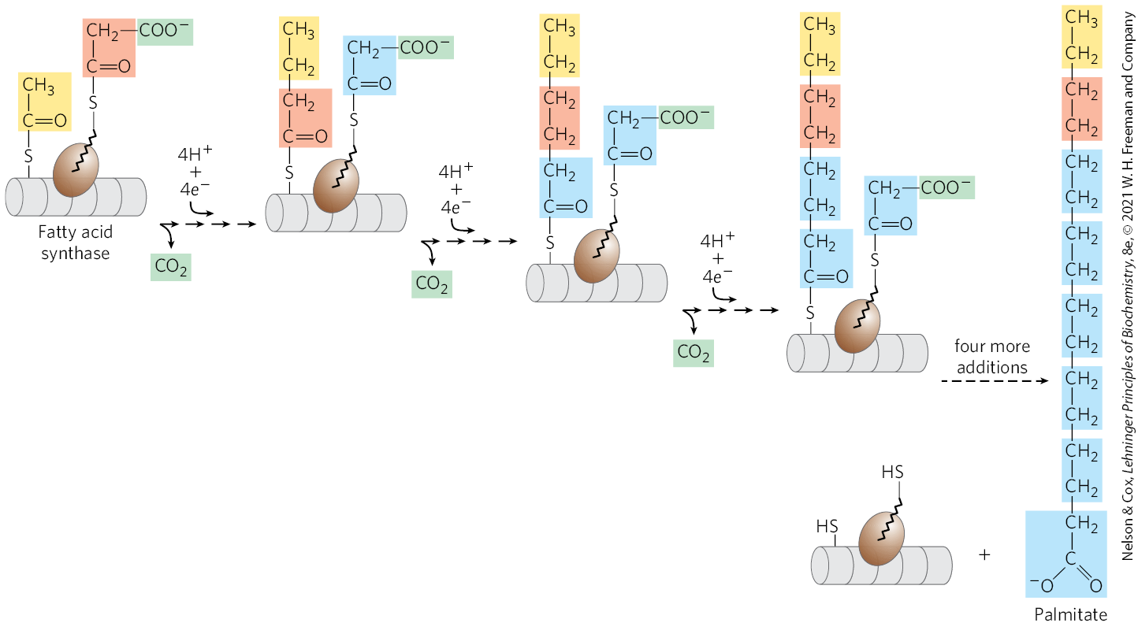
The Overall Process of
Palmitate Synthesis
carbons C-16 and C-15 of the palmitate are derived from the methyl and carboxyl carbon atoms, respectively, of an acetyl-CoA used to prime the system at the outset

Slide 24
Fatty Acid Synthase II (FAS II)
FAS II = found in plants, most bacteria, and vertebrate mitochondria
  is a dissociated system
  each step in the synthesis catalyzed by a separate enzyme
  generates a variety of products

Slide 25
The Mammalian Fatty Acid Synthase Has Multiple Active Sites
the intermediates remain covalently attached as thioesters to one of two thiol groups:
  the —SH group of a Cys residue in β-ketoacyl-ACP synthase
  the —SH group of acyl carrier protein

Slide 26
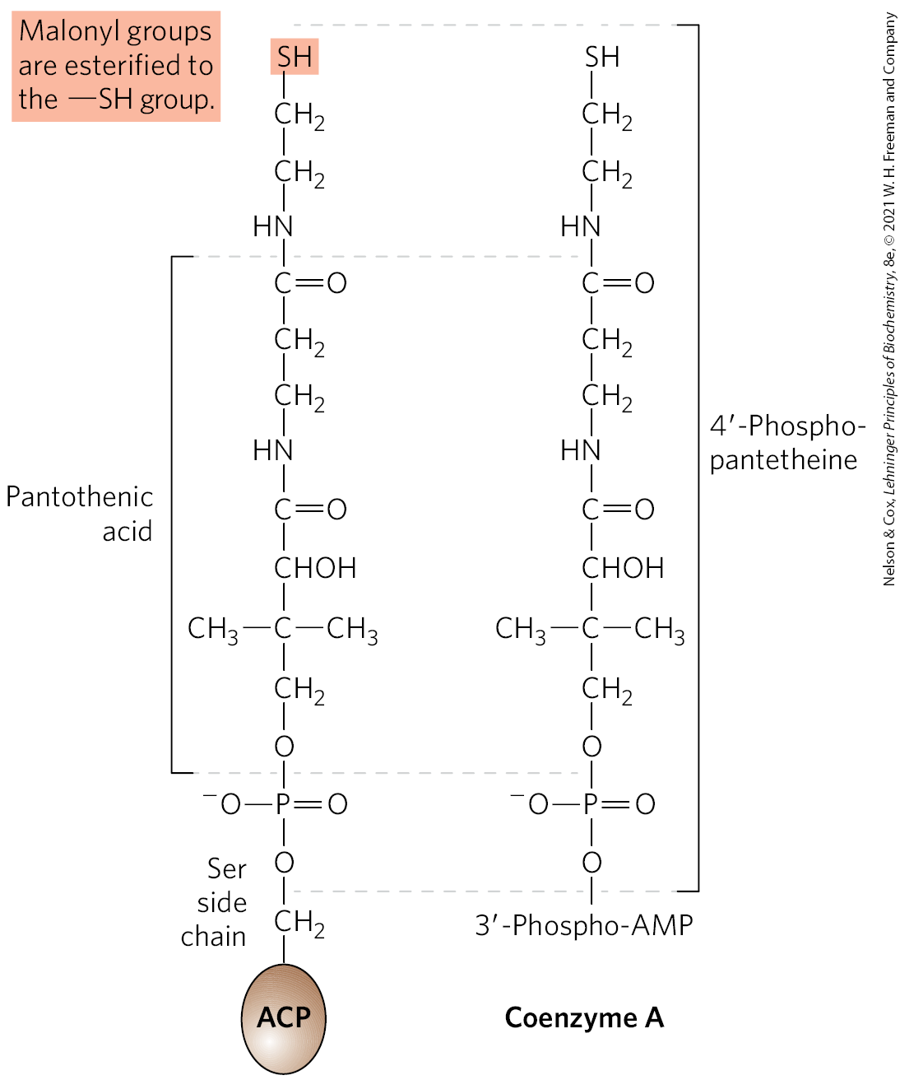
Acyl Carrier Protein (ACP) Contains 4′-Phosphopantetheine
4′-phosphopantetheine = a prosthetic group of ACP that serves as a flexible arm
  also in coenzyme A
  tethers the fatty acyl chain to the surface of the FAS complex
  carries reaction intermediates from one active site to the next

Slide 27
Fatty Acid Synthase Receives the Acetyl and Malonyl Groups
the two thiol groups on the enzyme complex must first be charged with the correct acyl groups
malonyl/acetyl-CoA–ACP transferase (MAT) domain = catalyzes two reactions:
  the transfer of the acetyl group of acetyl-CoA to ACP (which is then transferred to β-ketoacyl-ACP synthase (KS))
  the transfer of the malonyl group from malonyl-CoA to the —SH group of ACP

Slide 28
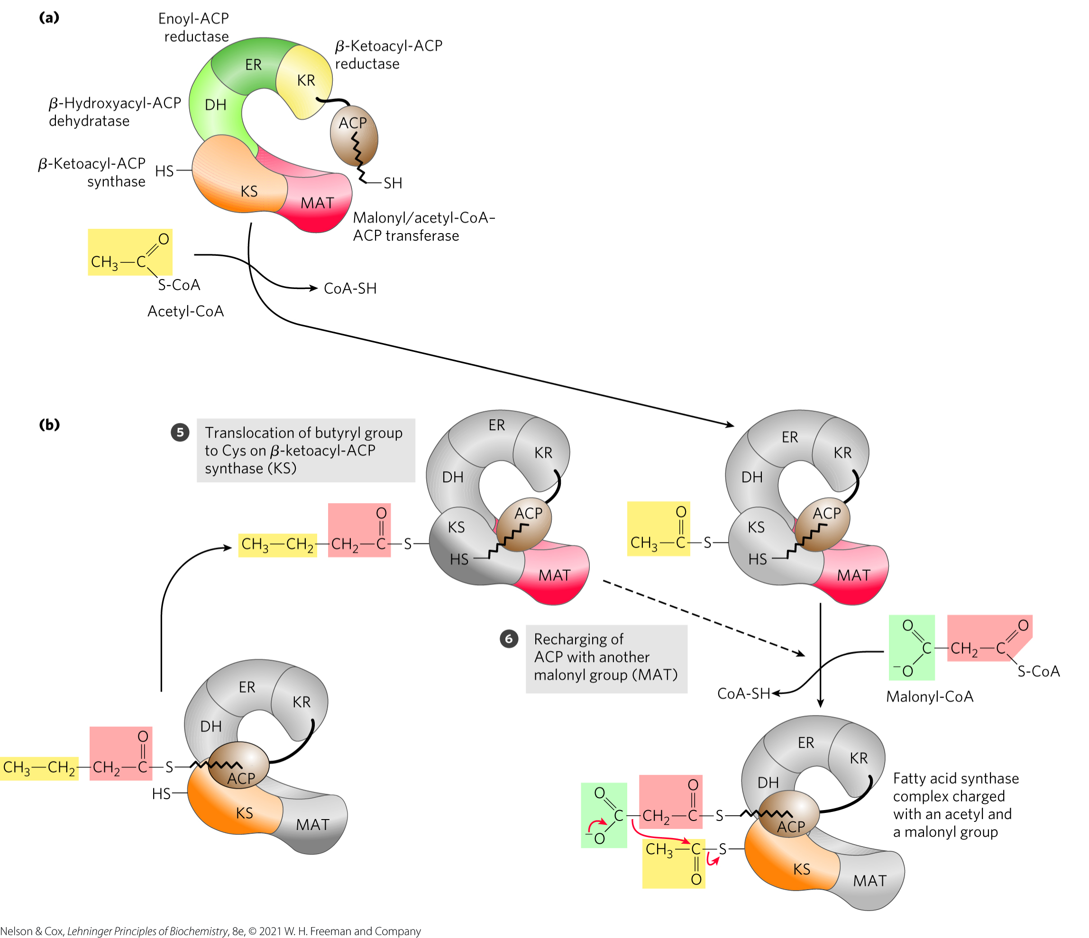
Activation of the Acetyl and
Malonyl Groups

Slide 29
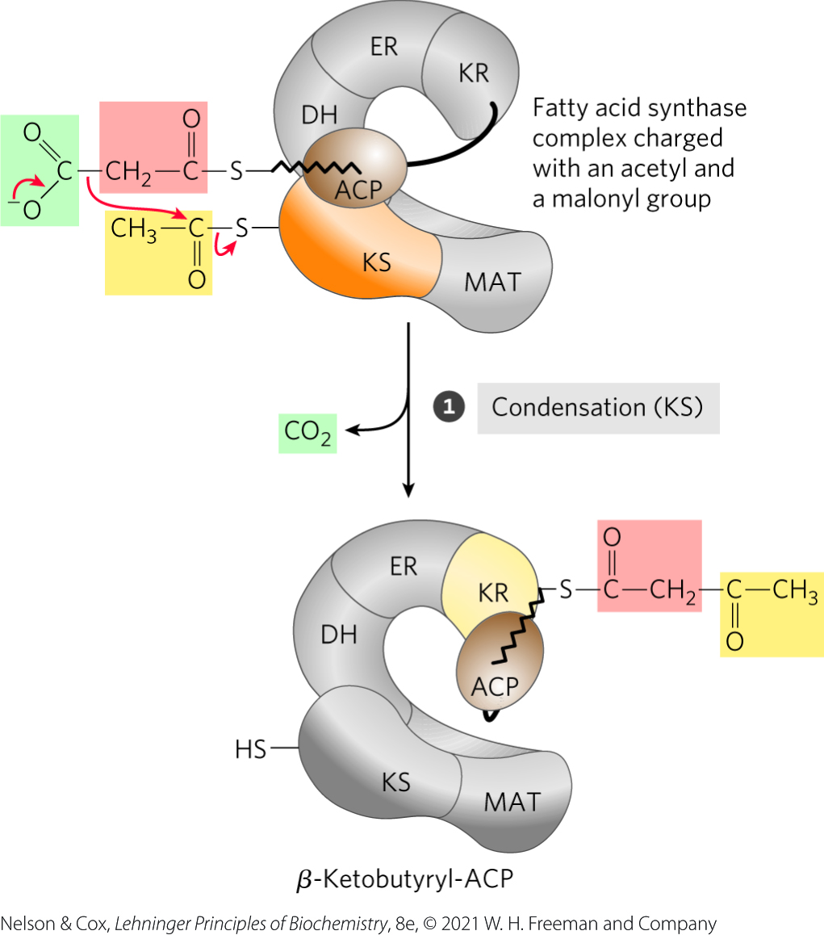
Step 1: Condensation
a formal Claisen condensation of the activated acetyl and malonyl groups yields acetoacetyl-ACP and CO₂

Slide 30
Principle 2 (4 of 4)
Anabolism is not simply the reverse of catabolism. Biosynthetic pathways typically diverge from breakdown pathways to overcome irreversible steps in catabolism.

Slide 31
Principle 3 (2 of 5)
Like other anabolic pathways, the reaction sequences in lipid biosynthesis are endergonic and reductive. They use ATP as a source of metabolic energy and a reduced electron carrier (usually NADPH) as a reductant.

Slide 32
The Use of Activated Malonyl Groups Makes Condensation Thermodynamically Favorable
coupling the condensation to the decarboxylation of the malonyl group renders the overall process highly exergonic
by using activated malonyl groups in the synthesis of fatty acids and activated acetate in their degradation, the cell makes both processes energetically favorable

Slide 33
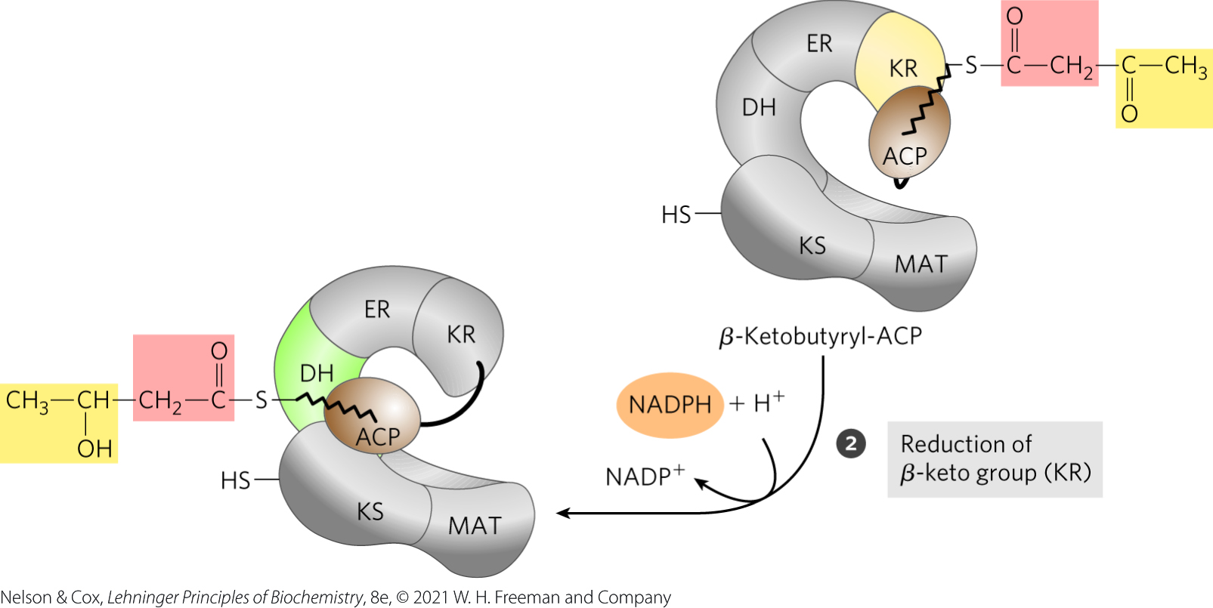
Step 2: Reduction of the
Carbonyl Group
β-ketoacyl-ACP reductase (KR) = catalyzes the reduction of the carbonyl group at C-3 of acetoacetyl-CoA to form D-β-hydroxybutyryl-ACP
  uses NADPH as the electron donor

Slide 34
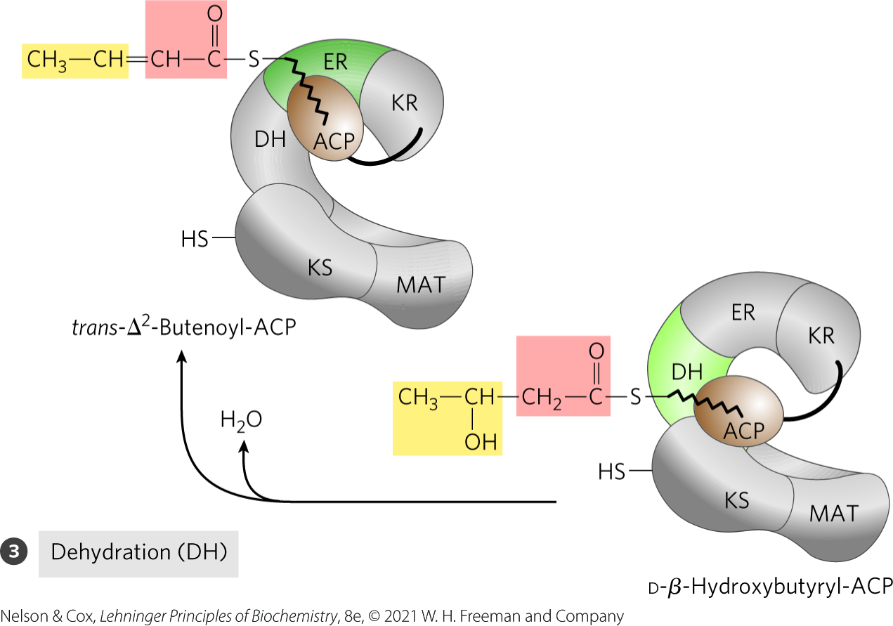
Step 3: Dehydration
β-hydroxyacyl-ACP dehydratase (DH) = catalyzes the formation of trans-∆²-butenoyl-ACP
  elements of H₂O are removed from C-2 and C-3 of D-β-hydroxybutyryl-ACP

Slide 35
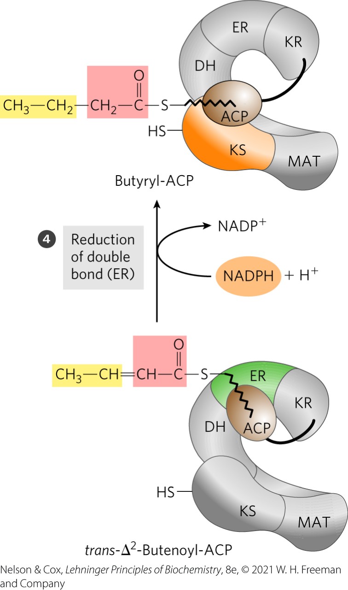
Step 4: Reduction of the Double Bond
enoyl-ACP reductase (ER) = catalyzes the reduction of the double bond of trans-∆²-butenoyl-ACP to form butyryl-ACP
  uses NADPH as the electron donor

Slide 36
The Fatty Acid Synthase Reactions Are Repeated to Form Palmitate
production of butyryl-ACP marks completion of one pass through the fatty acid synthase complex

Slide 37
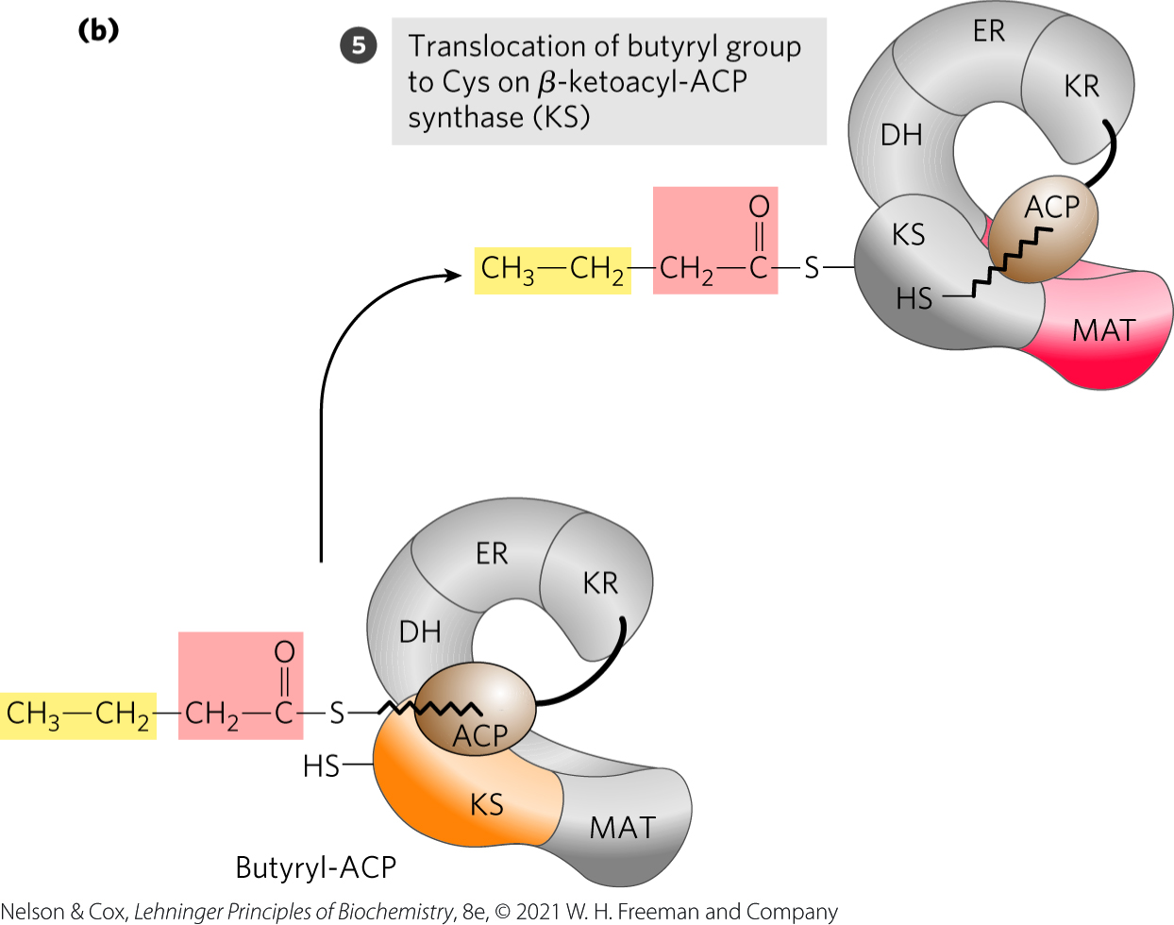
Step 5: Transfer of the
Butyryl Group
the butyryl group is transferred from the phosphopantetheine —SH group of ACP to the Cys —SH group of β-ketoacyl-ACP synthase

Slide 38
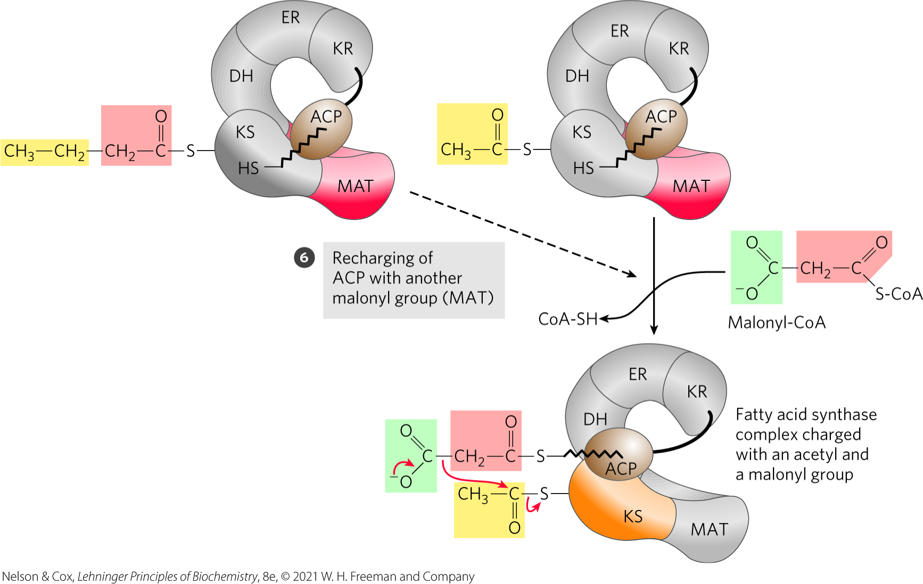
Step 6: Recharging ACP
ACP is recharged by the linkage of another malonyl group to the unoccupied phosphopantetheine —SH group

Slide 39
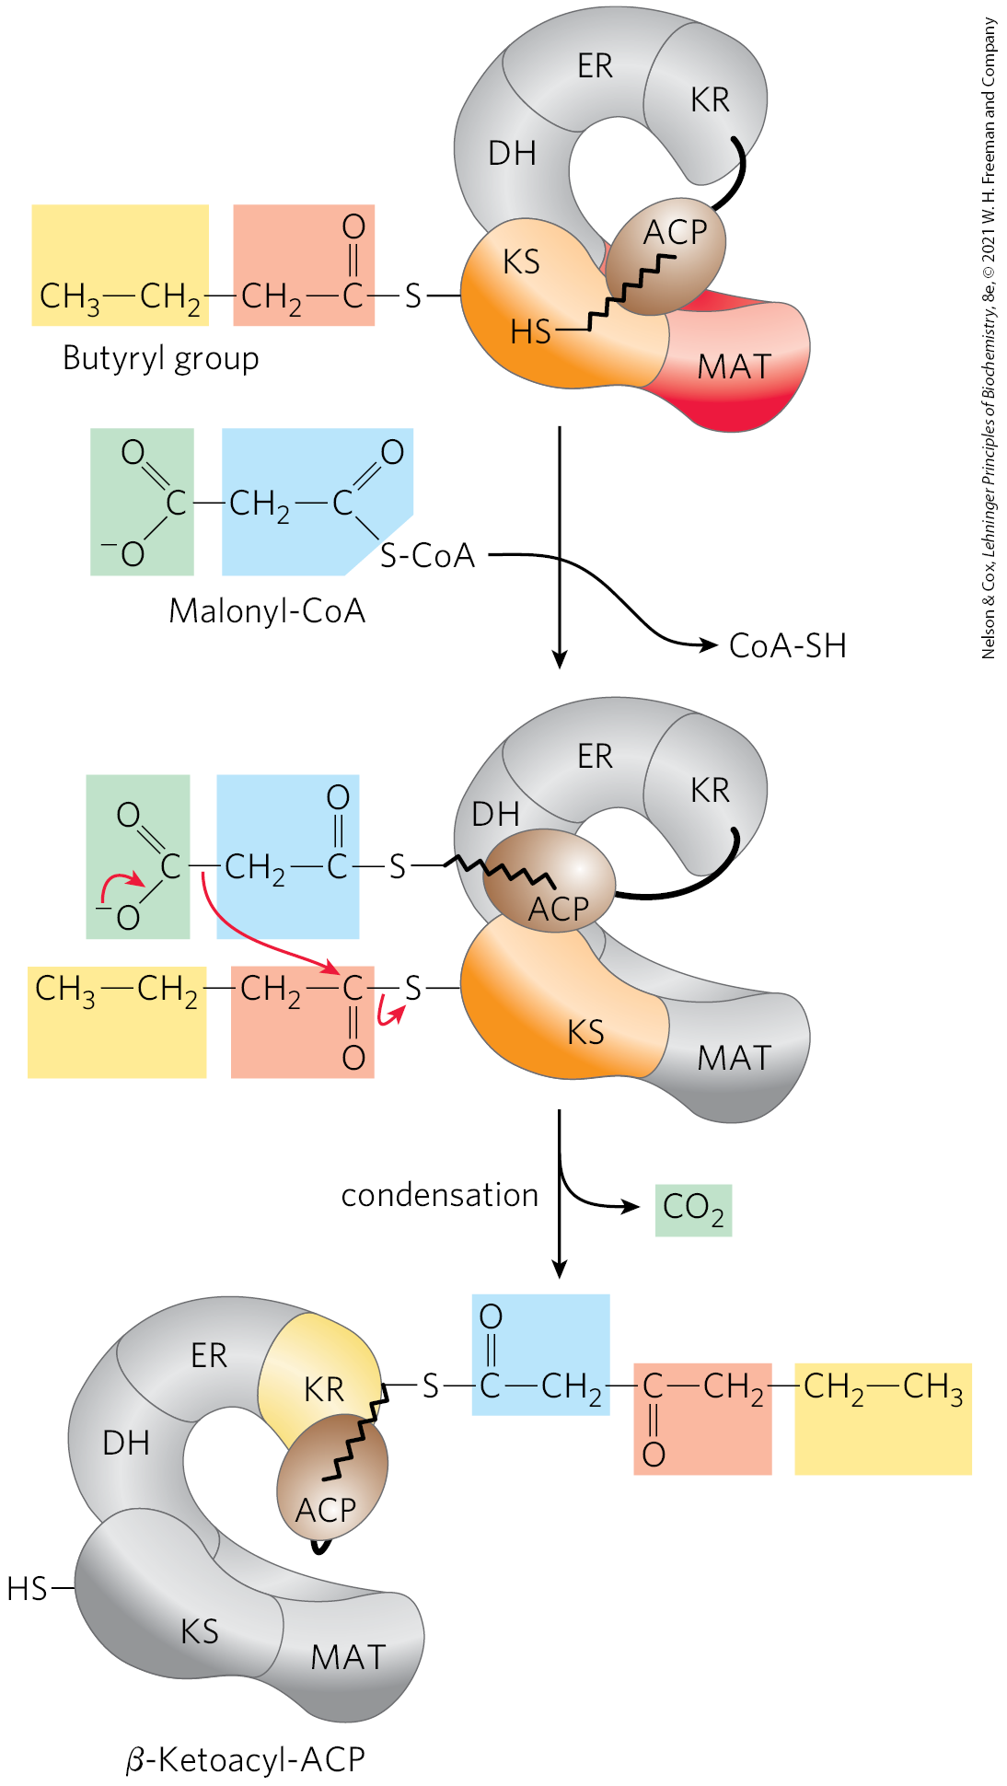
Beginning of the Second Round of the Fatty Acid Synthesis Cycle

Slide 40
Thioesterase Releases Palmitate from ACP
thioesterase (TE) = hydrolyzes the thioester linkage between palmitate and ACP to release free palmitate

Slide 41

The Reaction for the Formation of Seven Malonyl-CoA Molecules
the overall reaction is:
7 acetyl-CoA + 7CO₂ + 7ATP $→$
7 malonyl-CoA + 7ADP + 7P_{i}
(21-1)

Slide 42
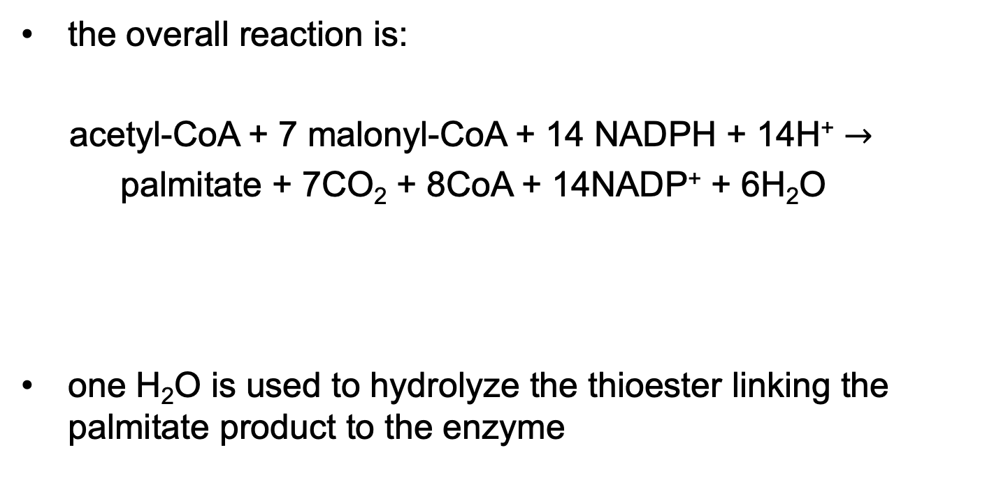
The Reaction for the Seven Cycles of Condensation and Reduction
the overall reaction is:
acetyl-CoA + 7 malonyl-CoA + 14 NADPH + 14H⁺ $→$
palmitate + 7CO₂ + 8CoA + 14NADP⁺ + 6H₂O
one H₂O is used to hydrolyze the thioester linking the palmitate product to the enzyme
(21-2)

Slide 43

The Overall Reaction for the Synthesis of Palmitate
the overall reaction is:
8 acetyl-CoA + 7ATP + 14NADPH + 14H⁺ $→$
palmitate + 8CoA + 7ADP + 7P_{i} + 14NADP⁺ + 6H₂O
(21-3)

Slide 44
Principle 3 (3 of 5)
Like other anabolic pathways, the reaction sequences in lipid biosynthesis are endergonic and reductive. They use ATP as a source of metabolic energy and a reduced electron carrier (usually NADPH) as a reductant.

Slide 45
Biosynthesis of Fatty Acids Requires Acetyl-CoA and Two Forms of Chemical Energy
biosynthesis of fatty acids requires:
  acetyl-CoA
  the group transfer potential of ATP to make malonyl-CoA
  the reducing power of NADPH to reduce the β-keto group and the double bond

Slide 46
Principle 3 (4 of 5)
Like other anabolic pathways, the reaction sequences in lipid biosynthesis are endergonic and reductive. They use ATP as a source of metabolic energy and a reduced electron carrier (usually NADPH) as a reductant.

Slide 47
Fatty Acid Synthesis Is a Cytosolic Process in Most Eukaryotes but Takes Place in the Chloroplasts in Plants
electron-carrying cofactors for anabolism and catabolism are segregated
fatty acid synthesis occurs where NADPH levels are high:
  cytosol for animals and yeast
  chloroplasts for plants

Slide 48
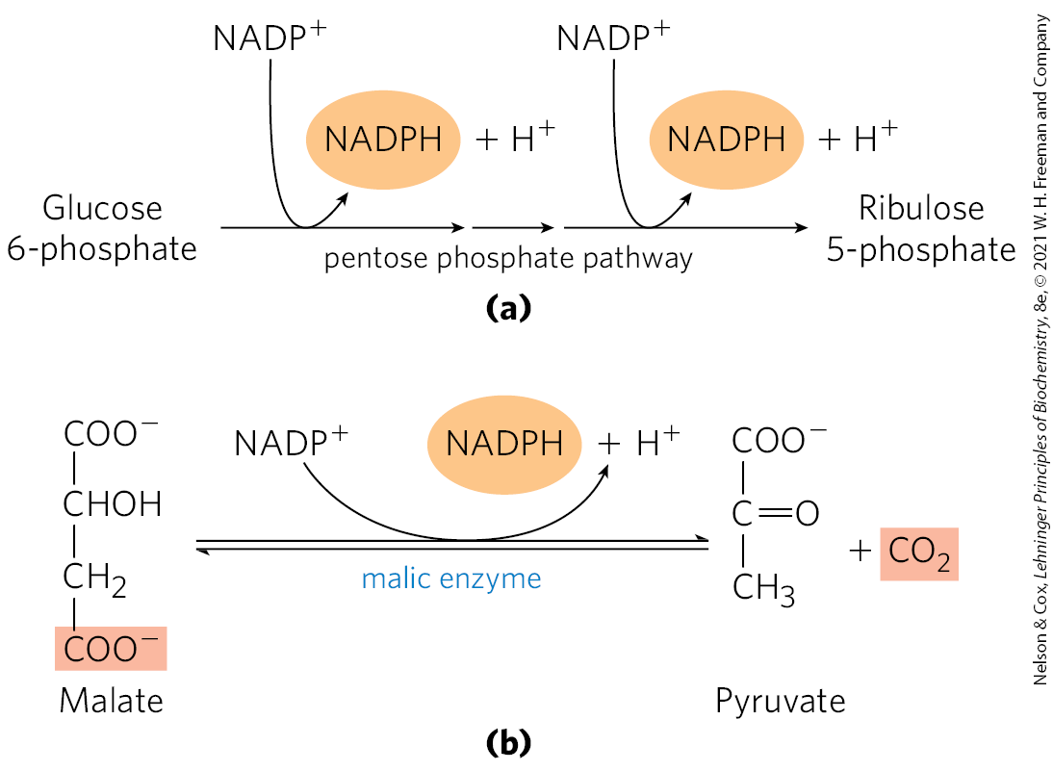
Production of NADPH in Hepatocytes and Adipocytes
fatty acid synthesis occurs in the cytosol
malic enzyme = catalyzes the reversible formation of pyruvate and CO₂ from malate

Slide 49
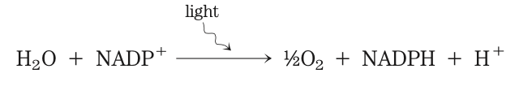
Production of NADPH in Photosynthetic Cells
fatty acid synthesis occurs in the chloroplast stroma
NADPH is produced in chloroplasts by the light-dependent reactions of photosynthesis:

Slide 50
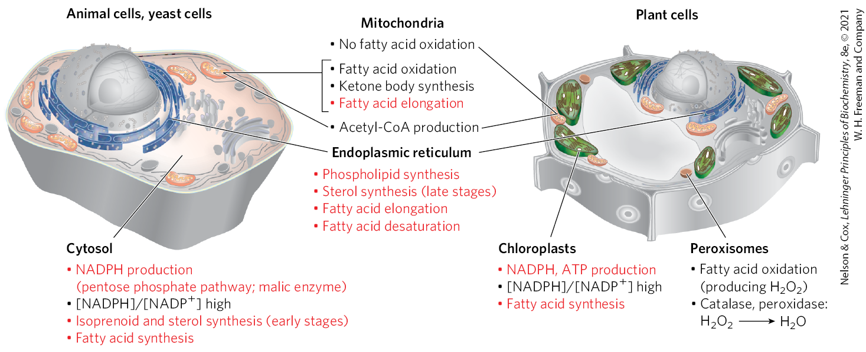
Subcellular Localization of
Lipid Metabolism

Slide 51
Acetate is Shuttled Out of Mitochondria as Citrate
in nonphotosynthetic eukaryotes, acetyl CoA is formed in mitochondria from:
  pyruvate oxidation
  catabolism of the carbon skeletons of amino acids

Slide 52
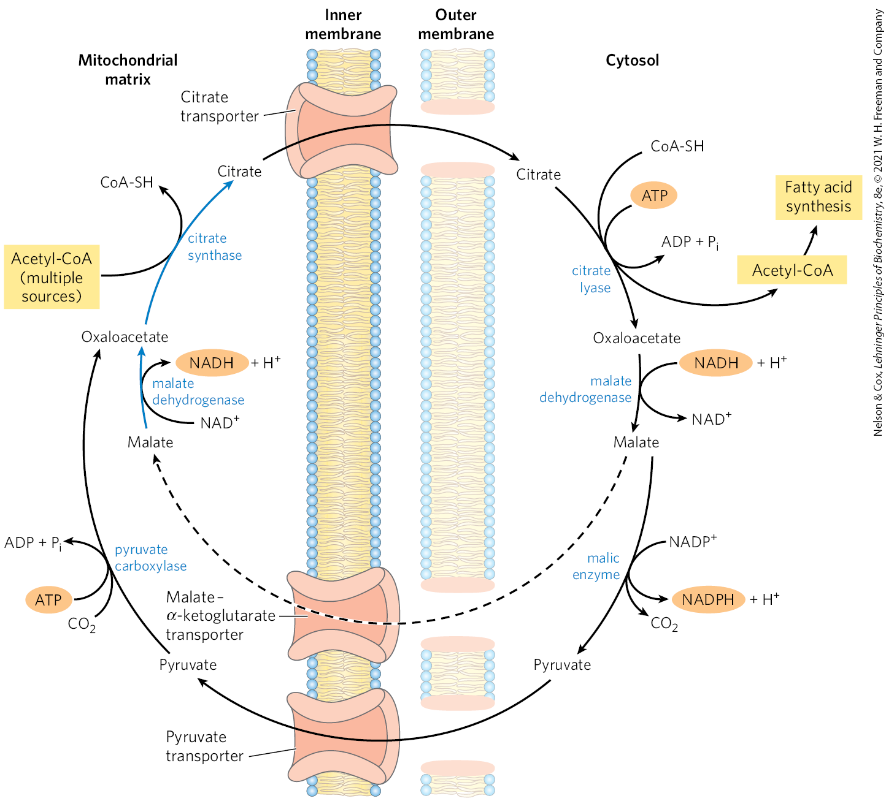
Shuttle for Transfer of Acetyl Groups from Mitochondria to the Cytosol
the energy cost is two ATP per acetyl-CoA transported into the cytosol

Slide 53
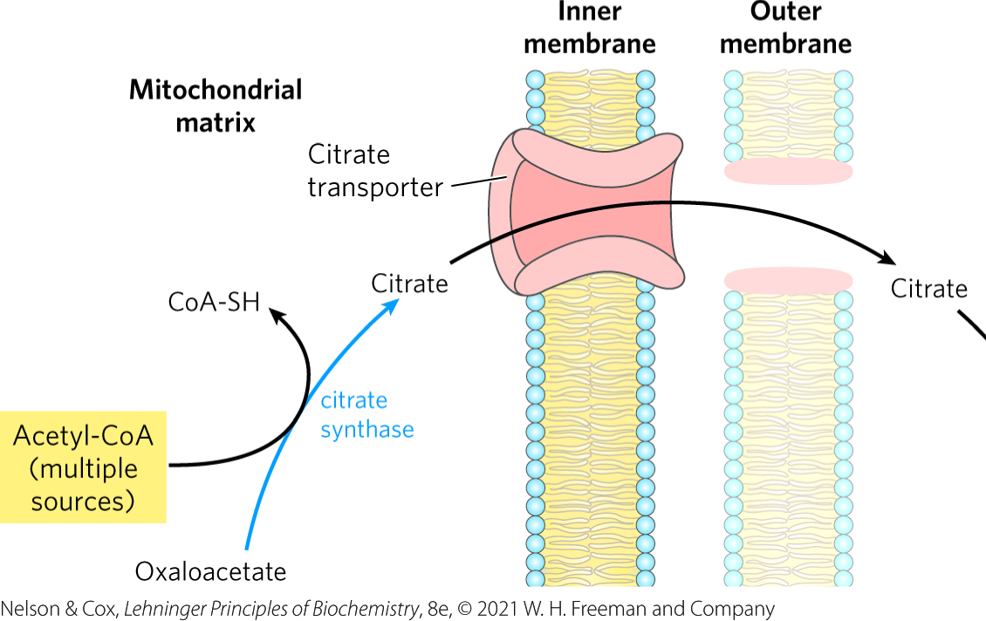
Citrate Passes Through the Inner Membrane on the Citrate Transporter
citrate synthase = catalyzes the formation of citrate from acetyl-CoA and oxaloacetate
  occurs in the mitochondrial matrix
citrate transporter = transports citrate through the inner mitochondrial membrane

Slide 54
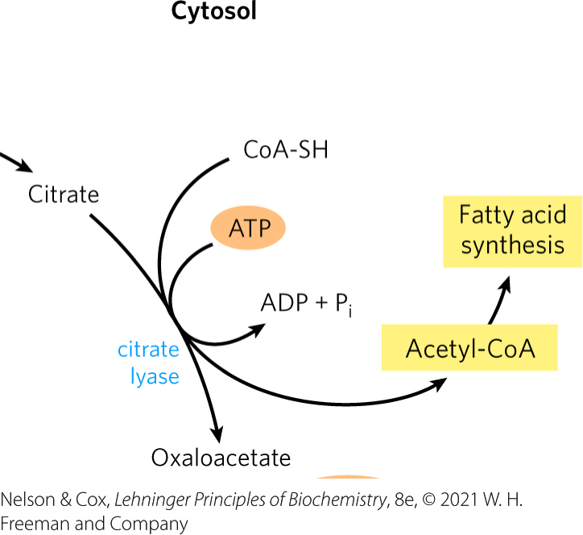
Citrate Is Cleaved in the Cytosol
citrate lyase = catalyzes cleavage of citrate to regenerate acetyl-CoA and oxaloacetate
  requires ATP

Slide 55
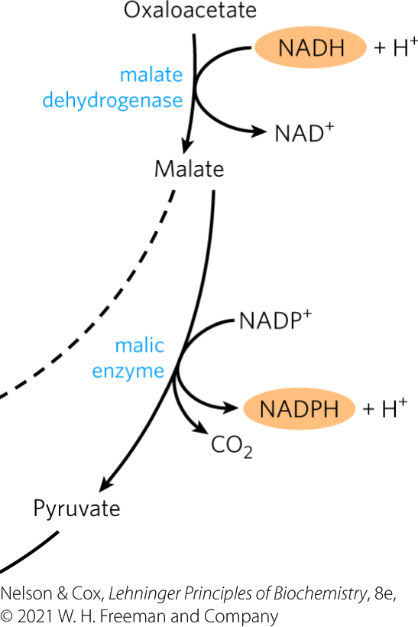
The Fate of Malate in the Cytosol
there is no oxaloacetate transporter in the mitochondrial membrane
malate dehydrogenase = reduces oxaloacetate to malate
malic enzyme = oxidizes malate to pyruvate

Slide 56
The Malate-α-Ketoglutarate Transporter and the Pyruvate Transporter
malate-α-ketoglutarate transporter = transports malate into the matrix where it is reoxidized to oxaloacetate by malate dehydrogenase
pyruvate transporter = transports pyruvate into the matrix where it is converted to oxaloacetate by pyruvate carboxylase

Slide 57
Principle 1 (2 of 3)
Lipids are the principal form of stored energy in most higher organisms, as well as the major constituents of membranes.

Slide 58
Principle 4 (2 of 5)
Lipid biosynthesis, like other anabolic pathways, is subject to regulation to respond to cellular and organismal requirements. The places where catabolic and anabolic pathways diverge (Principle 2) provide opportunities to impose metabolic regulation to conserve resources and avoid futile cycles.

Slide 59
Fatty Acid Biosynthesis Is
Tightly Regulated
excess metabolic fuel is generally converted to fatty acids and stored as lipids, such as triacylglycerols
the reaction catalyzed by acetyl-CoA carboxylase is the rate-limiting step in the biosynthesis of fatty acids

Slide 60
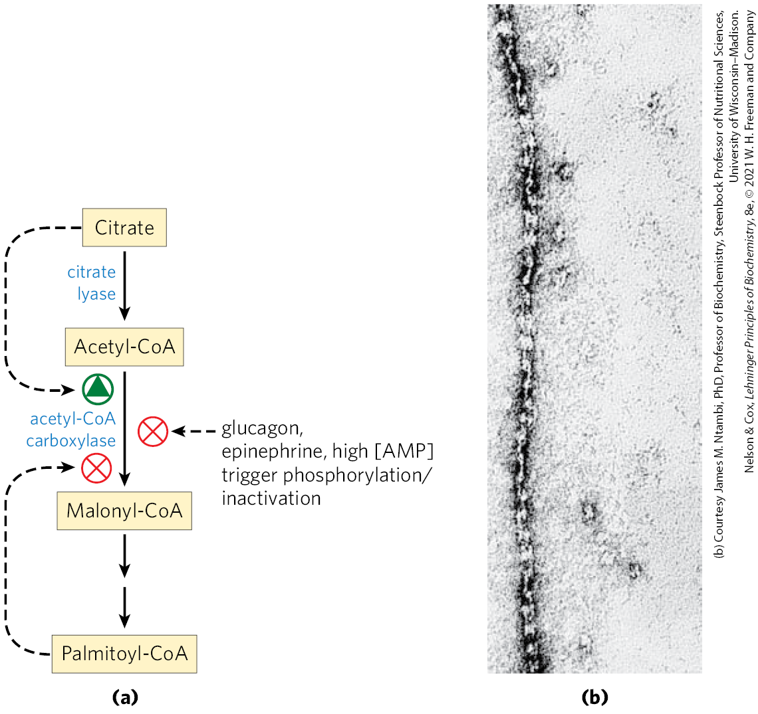
Regulation of Fatty Acid Synthesis

Slide 61
Principle 4 (3 of 5)
Lipid biosynthesis, like other anabolic pathways, is subject to regulation to respond to cellular and organismal requirements. The places where catabolic and anabolic pathways diverge (Principle 2) provide opportunities to impose metabolic regulation to conserve resources and avoid futile cycles.

Slide 62
Regulation of Acetyl-CoA Carboxylase By Covalent Modification
phosphorylation inactivates the enzyme
  triggered by the hormones glucagon and epinephrine or by high [AMP]
  reduces sensitivity of citrate activation and slows fatty acid synthesis
  causes polymerization of ACC into long, inactive filaments

Slide 63
Principle 4 (4 of 5)
Lipid biosynthesis, like other anabolic pathways, is subject to regulation to respond to cellular and organismal requirements. The places where catabolic and anabolic pathways diverge (Principle 2) provide opportunities to impose metabolic regulation to conserve resources and avoid futile cycles.

Slide 64
Regulation of Acetyl-CoA in Plants and Bacteria
the plant enzyme is activated by an increase in stromal pH and [Mg²⁺]
  occurs during illumination
bacterial regulation employs guanine nucleotides to coordinate cell growth with membrane formation

Slide 65
Principle 4 (5 of 5)
Lipid biosynthesis, like other anabolic pathways, is subject to regulation to respond to cellular and organismal requirements. The places where catabolic and anabolic pathways diverge (Principle 2) provide opportunities to impose metabolic regulation to conserve resources and avoid futile cycles.

Slide 66
Additional Regulation of Fatty
Acid Pathways
pathways are also regulated at the level of gene expression
  example: fatty acids bind PPARs (nuclear receptor proteins).
fatty acid synthesis and β oxidation do not occur simultaneously
  during fatty acid synthesis, malonyl-CoA inhibits fatty acid import into the mitochondria
    shuts down β oxidation

Slide 67
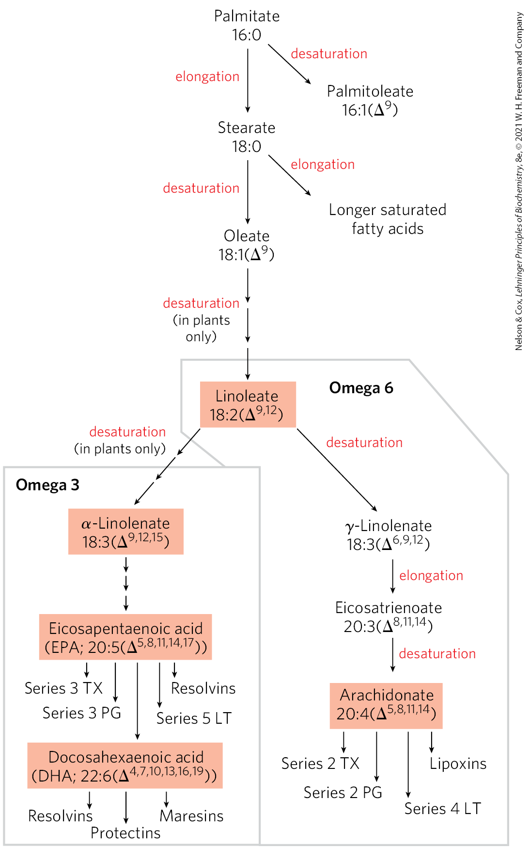
Long-Chain Saturated Fatty Acids Are Synthesized from Palmitate
palmitate is the precursor of other long-chain fatty acids.
fatty acid elongation systems = lengthen palmitate to form long saturated fatty acids
  present in smooth ER and mitochondria
  stearate (18:0) is the most common product

Slide 68
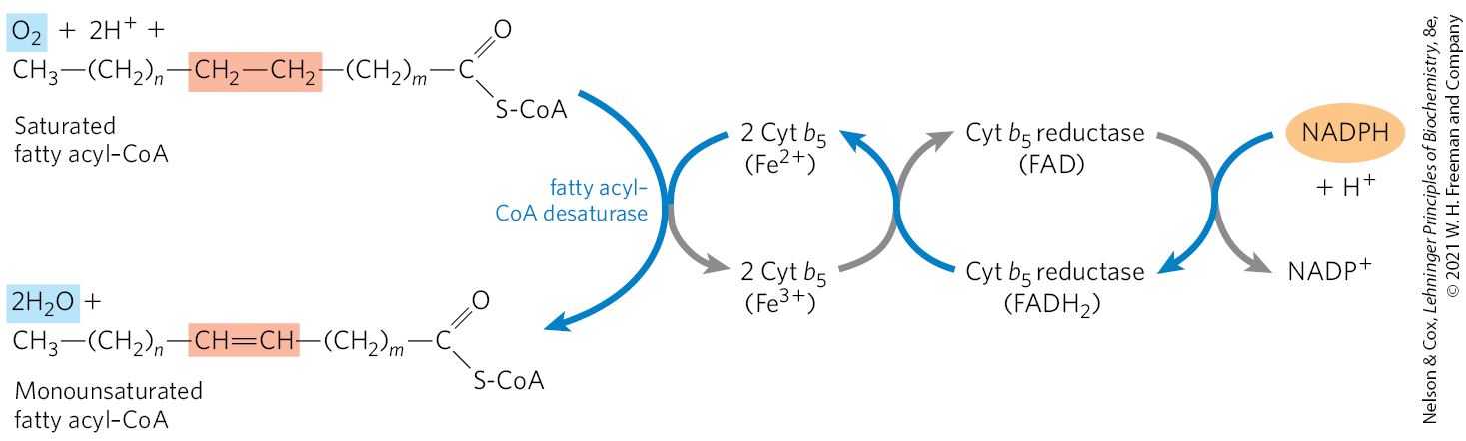
Desaturation of Fatty Acids Requires a Mixed-Function Oxidase
fatty acyl-CoA desaturase = catalyzes an oxidative reaction that introduces a double bond into a fatty acid chain
  is a mixed-function oxidase
  requires NADPH, cytochrome b₅, and cytochrome b₅ reductase

Slide 69
Desaturation of a Fatty Acid by Fatty Acyl-CoA Desaturase
O₂ accepts four electrons from two substrates:
  two electrons come from the saturated fatty acid.
  two electrons come from ferrous state of cytochrome b₅

Slide 70
Palmitate and Stearate Can
Be Desaturated
a Δ⁹-desaturase reduces the bond between C-9 and C-10 to form:
  palmitoleate (16:1; Δ⁹) from palmitate (16:0)
  oleate (18:1; Δ⁹) from stearate (18:0)

Slide 71
Plants Can Desaturate Positions Beyond C-9
humans cannot desaturate beyond Δ⁹
plants can, to produce:
  linoleate 18:2(Δ^{9,12})
  α-linolenate 18:3 (Δ^{9,12,15})

Slide 72
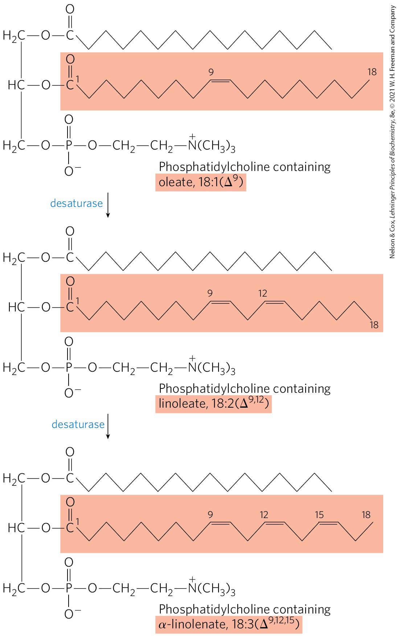
Action of Plant Desaturases
stearoyl-ACP desaturase (SCD) = uses reduced ferredoxin as the electron donor in the chloroplast stroma to produce oleate
plant desaturases = oxidize phosphatidylcholine-bound fatty acids to polyunsaturated fatty acids

Slide 73
Linoleate and α-Linolenate Are Necessary Precursors
essential fatty acids = must be obtained from dietary plant material
  linoleate and α-linolenate for mammals
linoleate may be converted to:
  γ-linolenate
  eicosatrienoate
  arachidonate (eicosatetraenoate)
α-linolenate may be converted to:
  eicosapentaenoic acid (EPA)
  docosahexaenoic acid (DHA)

Slide 74
Eicosanoids Are Formed from 20- and 22-Carbon Polyunsaturated Fatty Acids
eicosanoid hormones include prostaglandins, leukotrienes, and thromboxanes
enzymes of the smooth ER convert arachidonate to prostaglandins
  cyclooxygenase (COX) = prostaglandin H₂ synthase = catalyzes the formation of prostaglandin H₂ (PGH₂)

Slide 75
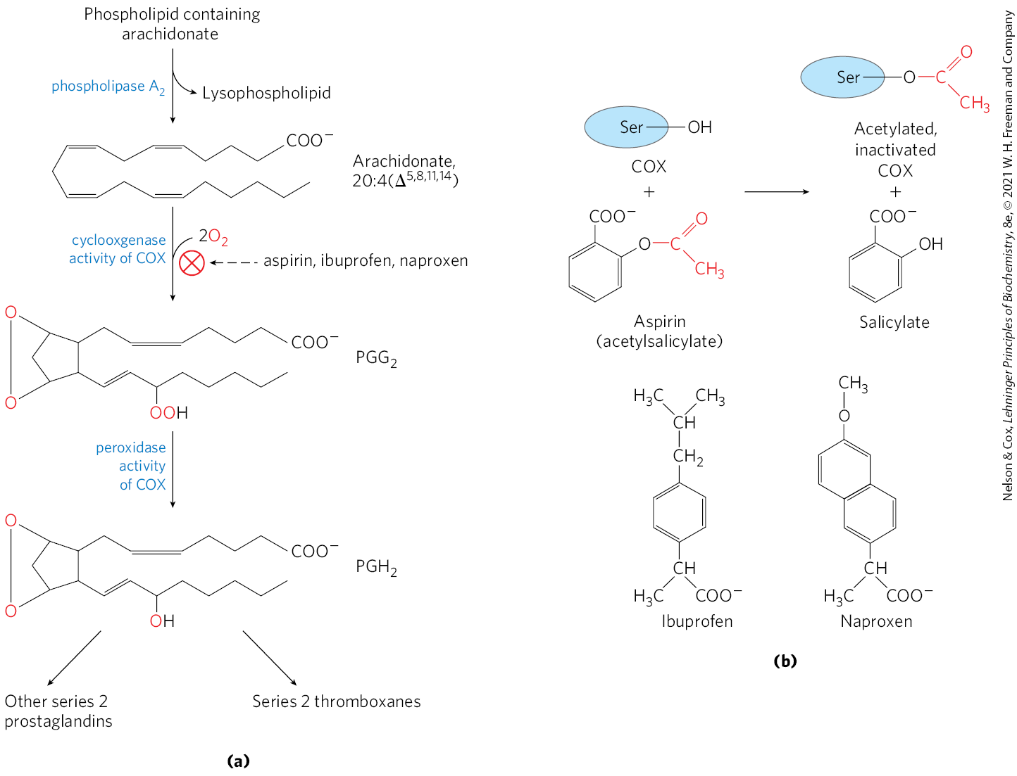
The Mechanism of Prostaglandin
H₂ Synthase
PGH₂ synthase has cyclooxygenase and peroxidase activity enzyme
  cyclooxygenase activity adds 2 O₂ to form PGG₂
  peroxidase activity converts peroxide to alcohol to form PGH₂

Slide 76
Prostaglandin H₂ Synthase Has
Two Isoforms
COX-1 = catalyzes synthesis of prostaglandins that regulate gastric mucin secretion
COX-2 = catalyzes synthesis of prostaglandins that mediate pain, inflammation, and fever

Slide 77
The Action of Aspirin and NSAIDs
aspirin irreversibly inactivates the cyclooxygenase activity of both COX isozymes
  acetylates a Ser residue and blocks the enzyme’s active site
  inhibits the synthesis of prostaglandins and thromboxanes
NSAIDs also inhibit both COX isozymes

Slide 78
Thromboxane Synthase
thromboxane synthase = converts PGH₂ to thromboxane A₂, from which other series 2 thromboxanes are derived
  present in blood platelets (thrombocytes)

Slide 79
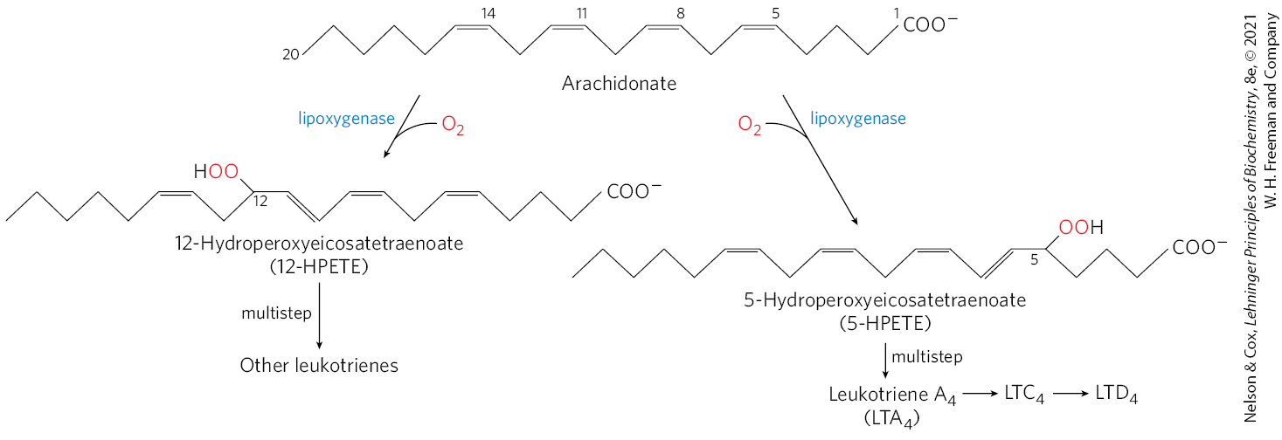
The Pathway from Arachidonate to Leukotrienes
leukotrienes = linear eicosanoids

Slide 80
Catabasis
catabasis = resolution of inflammation
  promoted by leukotrienes and prostaglandins
specialized pro-resolving mediators (SPMs) = set of eicosanoids that promote catabasis
  includes lipoxins

Slide 81
21.2 Biosynthesis of Triacylglycerols

Slide 82
Principle 1 (3 of 3)
Lipids are the principal form of stored energy in most higher organisms, as well as the major constituents of membranes.

Slide 83
Fatty Acids Have Two Fates
fatty acids synthesized or ingested have one of two fates:
  incorporation into triacylglycerols for the storage of metabolic energy
  incorporation into the phospholipid components of membranes
both pathways begin with the formation of fatty acyl esters of glycerol

Slide 84
Triacylglycerols and Glycerophospholipids Are Synthesized from the Same Precursors
triacylglycerols and glycerophospholipids share two precursors:
  fatty acyl–CoA
  L-glycerol 3-phosphate

Slide 85
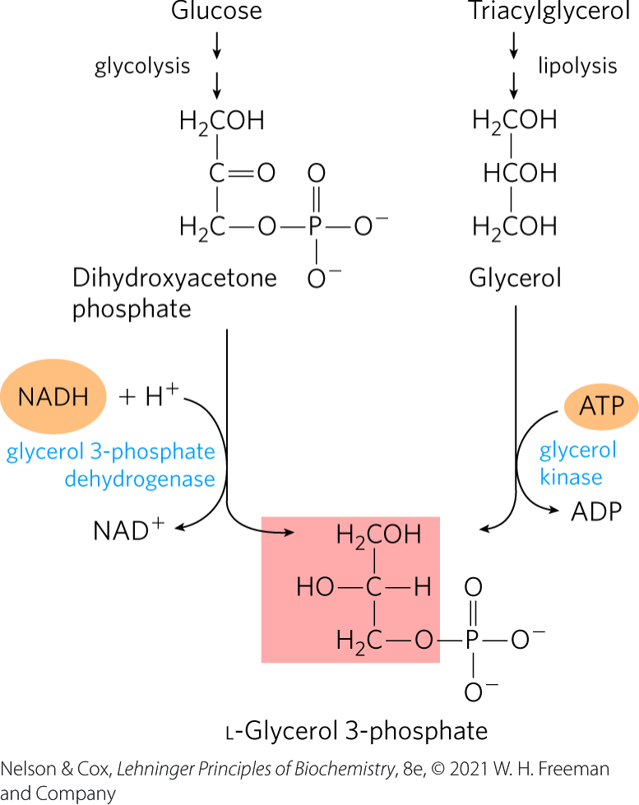
Glycerol 3-Phosphate Is Formed from DHAP and Glycerol
glycerol 3-phosphate dehydrogenase = catalyzes the formation of glycerol 3-phosphate from the glycolytic intermediate dihydroxyacetone phosphate (DHAP)
  cytosolic NAD-linked enzyme
glycerol kinase = catalyzes the formation of small amounts of glycerol 3-phosphate from glycerol
  in liver and kidney

Slide 86
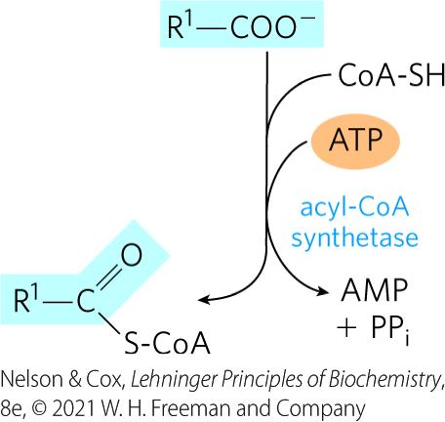
Fatty Acyl-CoAs Are Formed from Fatty Acids
acyl-CoA synthetases = catalyzes the formation of fatty acyl-CoAs from fatty acids
  the same enzymes responsible for the activation of fatty acids for β oxidation

Slide 87
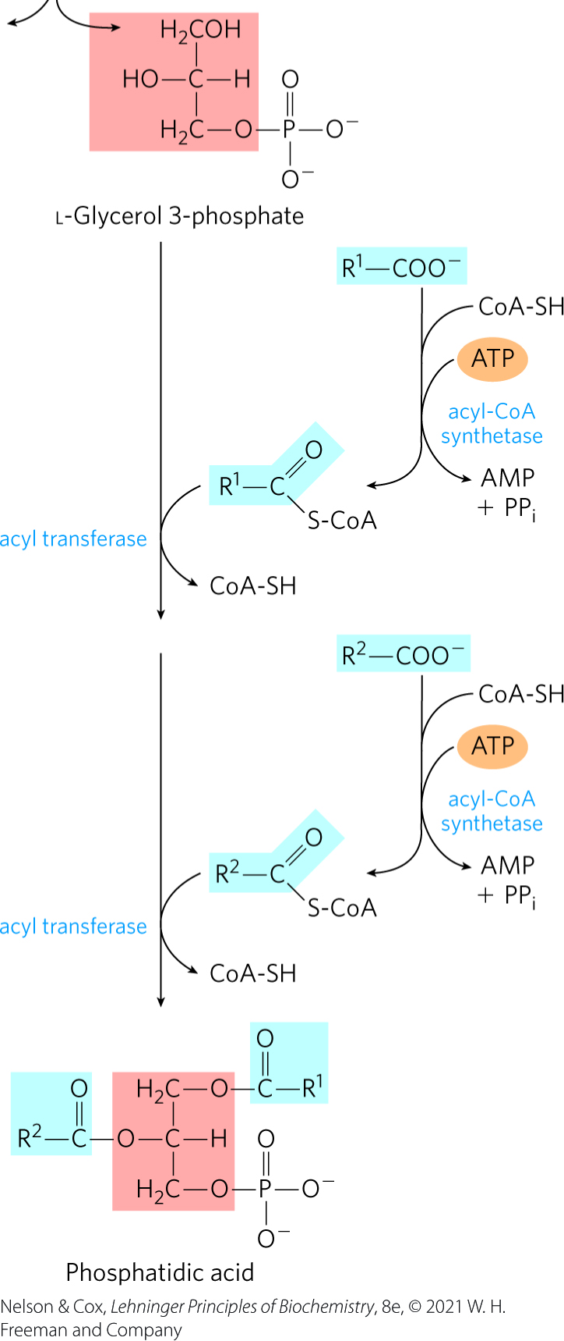
The First Stage in the Biosynthesis of Triacylglycerols
acyl transferase = catalyzes the acylation of the two free hydroxyl groups of L-glycerol 3-phosphate by two molecules of fatty acyl–CoA to yield diacylglycerol 3-phosphate (phosphatidic acid)

Slide 88

Formation of Triacylglycerols from Phosphatidic Acid
phosphatidic acid phosphatase = hydrolyzes phosphatidic acid to form a 1,2-diacylglycerol
diacylglycerols are converted to triacylglycerols by transesterification with a third fatty acyl–CoA

Slide 89
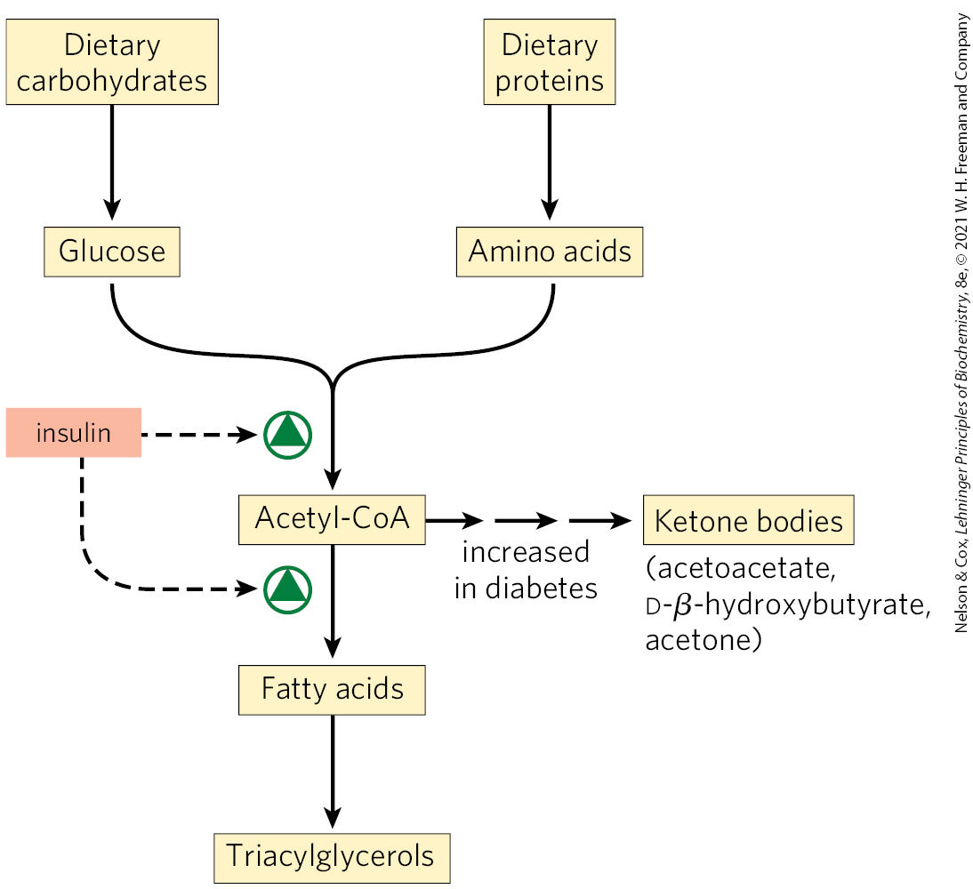
Triacylglycerol Biosynthesis in Animals Is Regulated by Hormones
the synthesis and degradation of triacylglycerols are hormonally regulated
people with severe diabetes mellitus fail to synthesize fatty acids

Slide 90
Triacylglycerol Breakdown and Resynthesis Create a Futile Cycle
~75% of all fatty acids released by TAG breakdown are reesterified to form TAGs, rather than used for fuel.
  occurs even during starvation
some fatty acid recycling takes place in adipose tissue before release into the bloodstream
triacylglycerol cycle = a systemic cycle in which FFAs are transported to the liver, recycled to TAGs, exported into the blood, and taken up again by adipose tissue after release from TAG by lipoprotein lipase

Slide 91
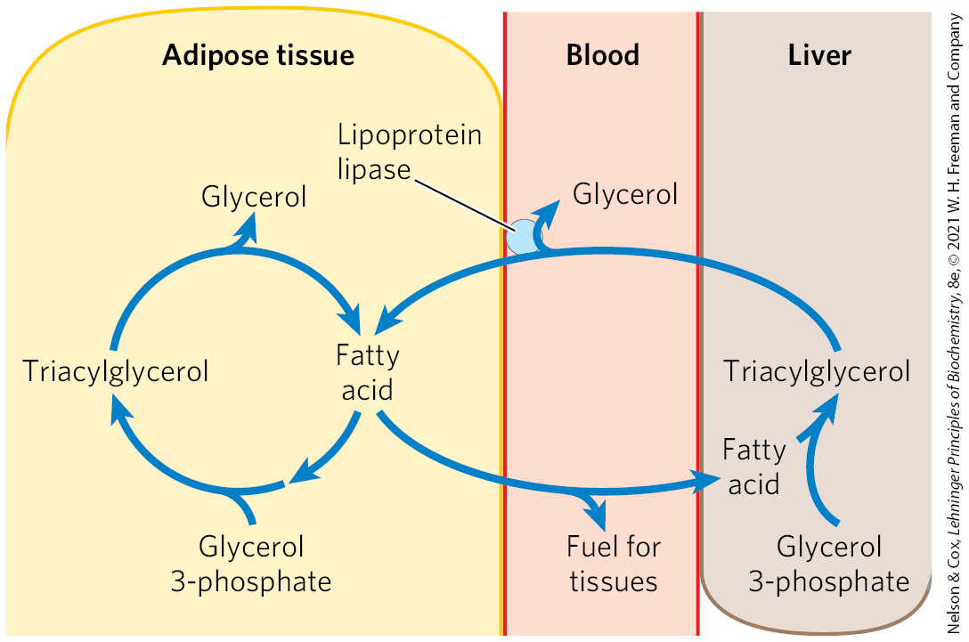
The Triacylglycerol Cycle

Slide 92
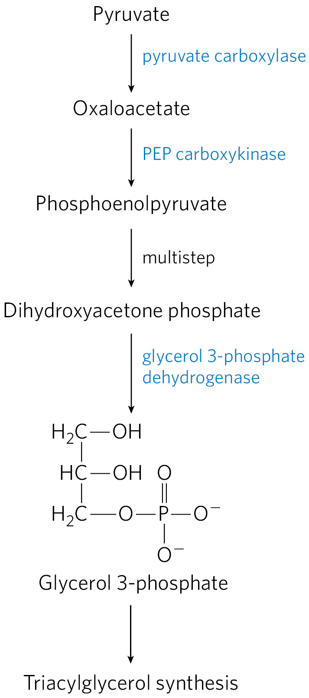
Adipose Tissue Generates Glycerol 3-Phosphate by Glyceroneogenesis
glyceroneogenesis = a shortened version of gluconeogenesis, from pyruvate to DHAP, followed by conversion of the DHAP to glycerol 3-phosphate
glycerol 3-phosphate is used in triacylglycerol synthesis

Slide 93
Roles of Glyceroneogenesis
glyceroneogenesis functions to:
  help control the rate of fatty acid release to the blood
  control the rate at which free fatty acids are delivered to mitochondria for use in thermogenesis
  support the synthesis of glycerol 3-phosphate in fasting humans

Slide 94
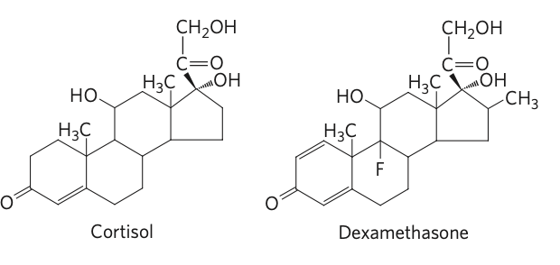
PEP Carboxykinase Controls Flux Through the Triacylglycerol Cycle
PEP carboxykinase = limits the rate of both gluconeogenesis and glyceroneogenesis
glucocorticoid hormones (cortisol, dexamethasone) = regulate the levels of PEP carboxykinase reciprocally in the liver and adipose tissue

Slide 95
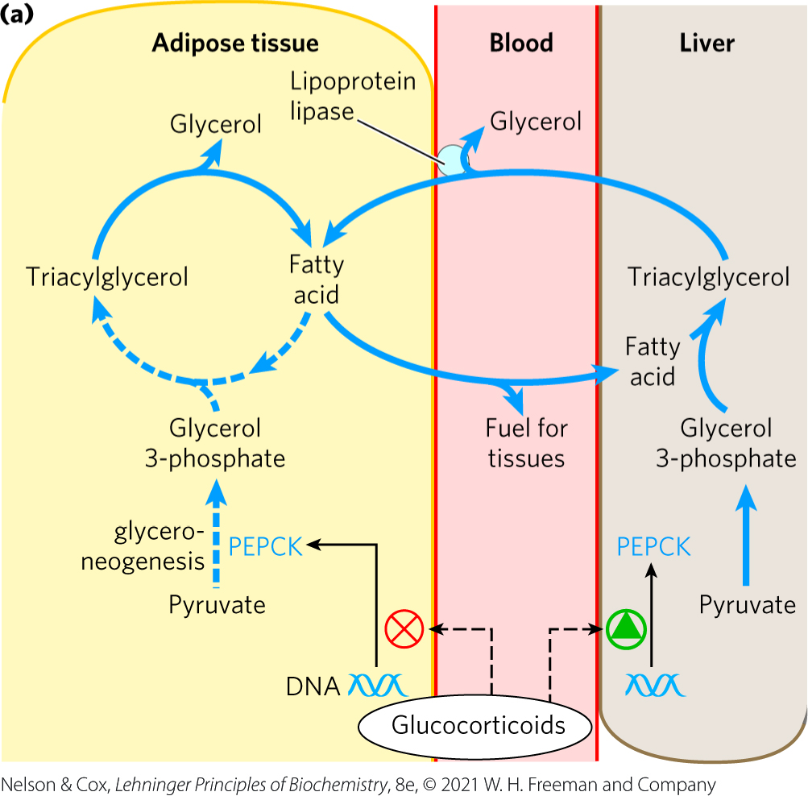
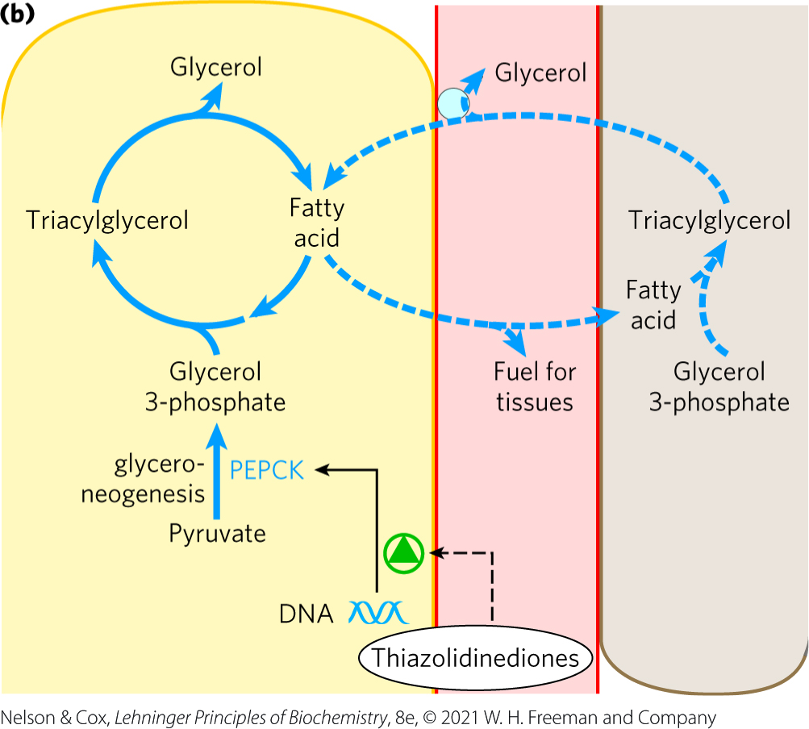
Regulation of Glyceroneogenesis
glucocorticoids increase the expression of the gene encoding PEP carboxykinase in the liver to increase gluconeogenesis and glyceroneogenesis

Slide 96
Thiazolidinediones Treat Type 2 Diabetes by Increasing Glyceroneogenesis
thiazolidinediones = class of drugs that reduces the levels of fatty acids circulating in the blood and increases sensitivity to insulin
  promotes the increased expression of PEP carboxykinase in adipose tissue

Slide 97
21.3 Biosynthesis of Membrane Phospholipids

Slide 98
Assembly of Phospholipids
occurs primarily on the surfaces of the smooth ER and the inner mitochondrial membrane in eukaryotic cells

Slide 99
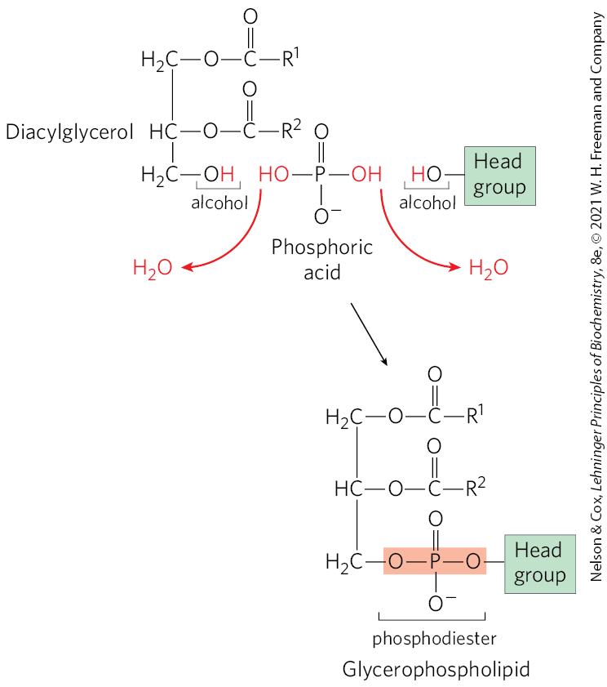
Cells Have Two Strategies for Attaching Phospholipid Head Groups
begins with phosphatidic acid or diacylglcerols
polar head group is attached through a phosphodiester bond
  each of two alcohol hydroxyls forms an ester with phosphoric acid

Slide 100
Attaching the Phospholipid Head Group Requires Activation by CDP
one of the hydroxyls is first activated by attachment of a cytidine diphosphate (CDP) nucleotide
CMP is then displaced in a nucleophilic attack by the other hydroxyl

Slide 101
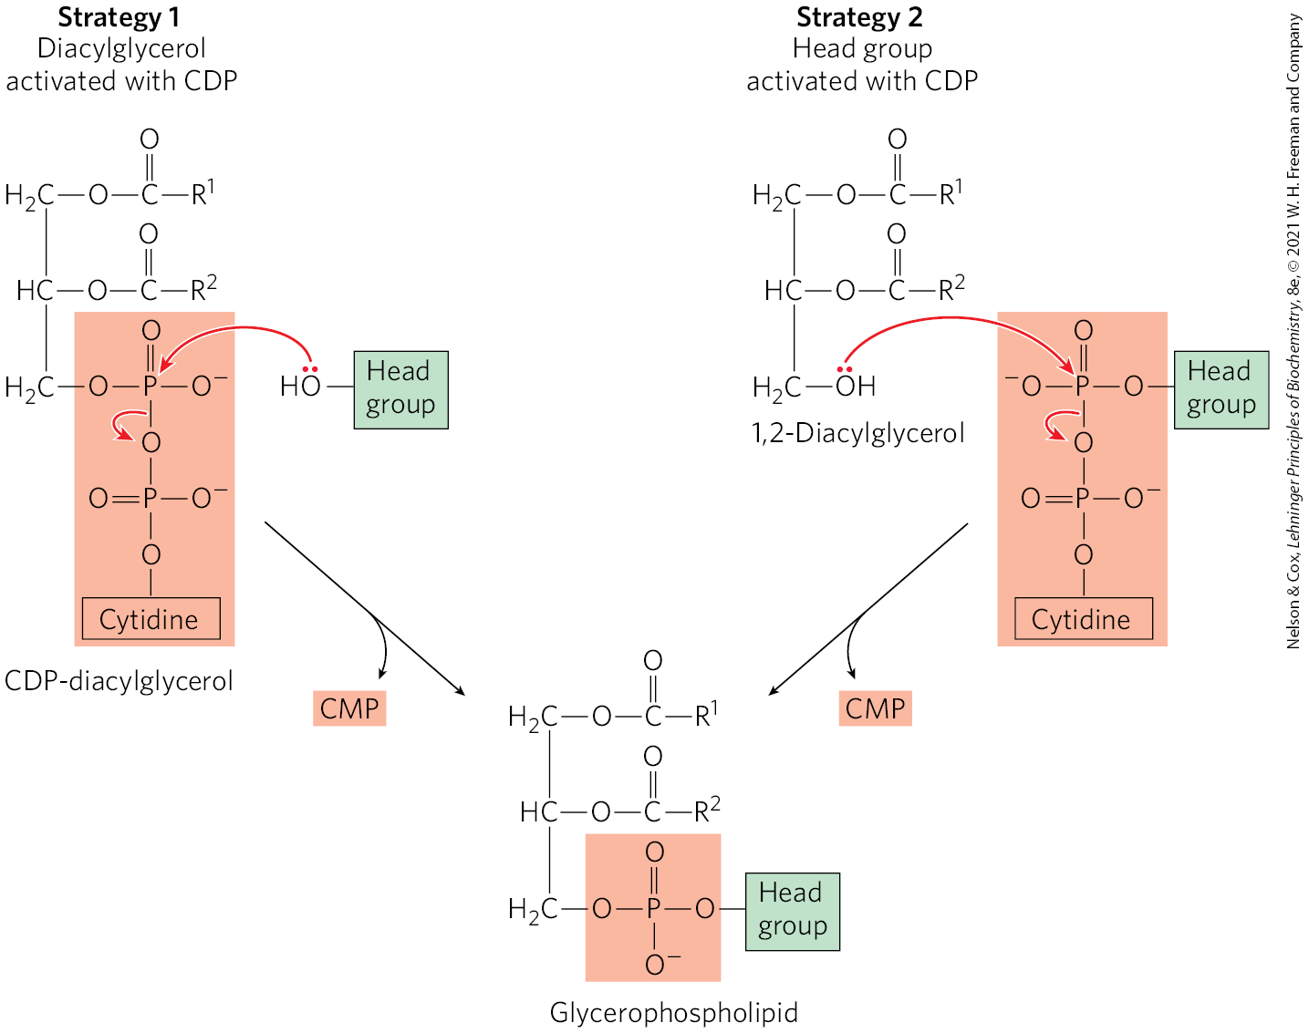
Strategies for Forming the Phosphodiester Bond
strategy 1 = CDP is attached to diacylglycerol, forming the activated phosphatidic acid CDP-diacylglycerol
strategy 2 = CDP is attached to the hydroxyl of the head group

Slide 102
Pathways for Phospholipid Biosynthesis Are Interrelated
many pathways begin with CDP-diacylglycerol, including synthesis of:
  phosphatidylglycerol
  cardiolipin
  phosphatidylinositol
    conversion to its phosphorylated derivatives requires specific phosphatidylinositol kinases
  phosphatidylserine → phosphatidylethanolamine → phosphatidylcholine

Slide 103
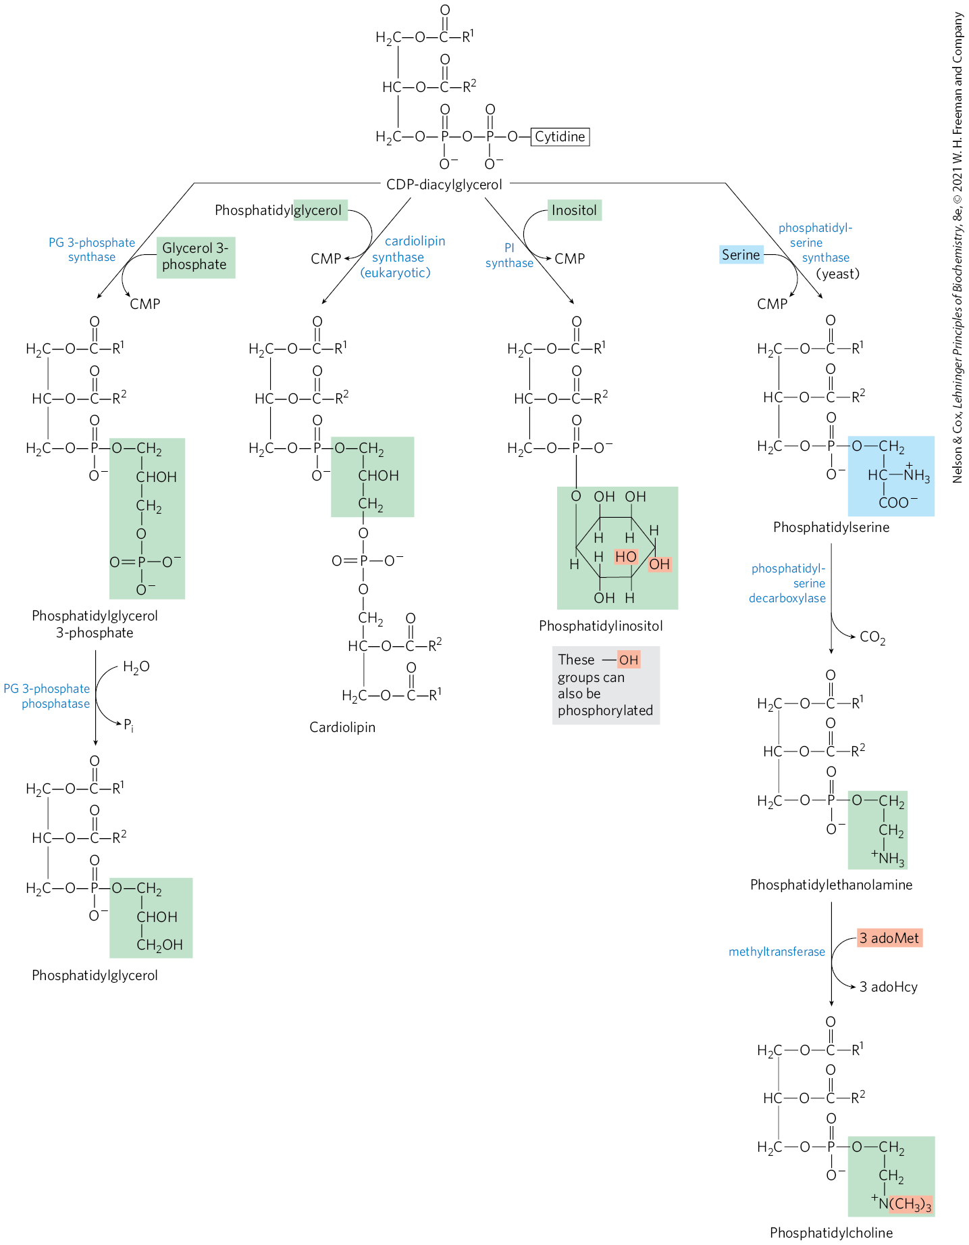
Synthesis of Glycerophospholipids from CDP-Diacylglycerol
phosphatidyl-ethanolamine and phosphatidylcholine are synthesized using strategy 1 in the mitochondria

Slide 104
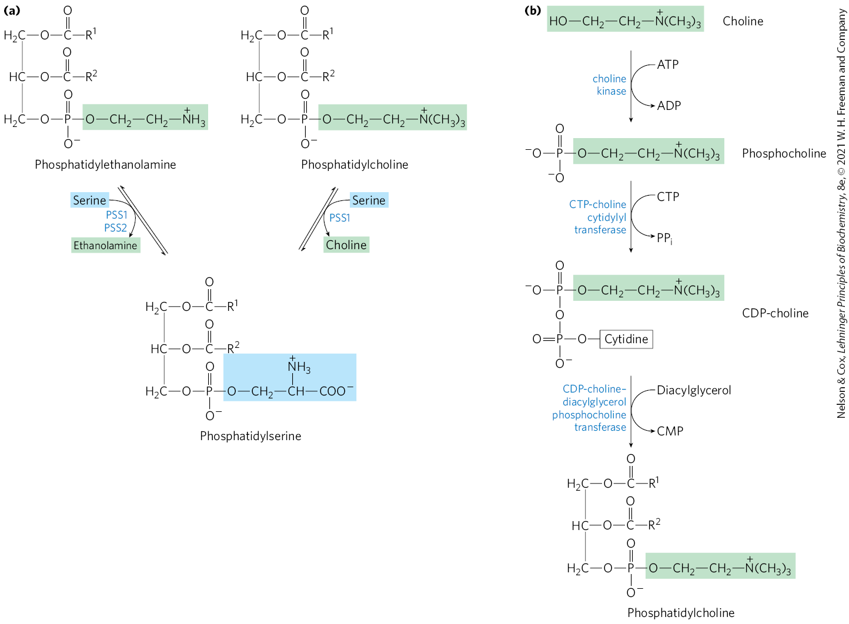
Pathways For Phosphatidylserine and Phosphatidylcholine Synthesis in Mammals
phosphatidyl-ethanolamine and phosphatidyl-choline are synthesized using strategy 2 in the ER and nucleus
phosphatidyl-serine is derived from head-group exchange

Slide 105
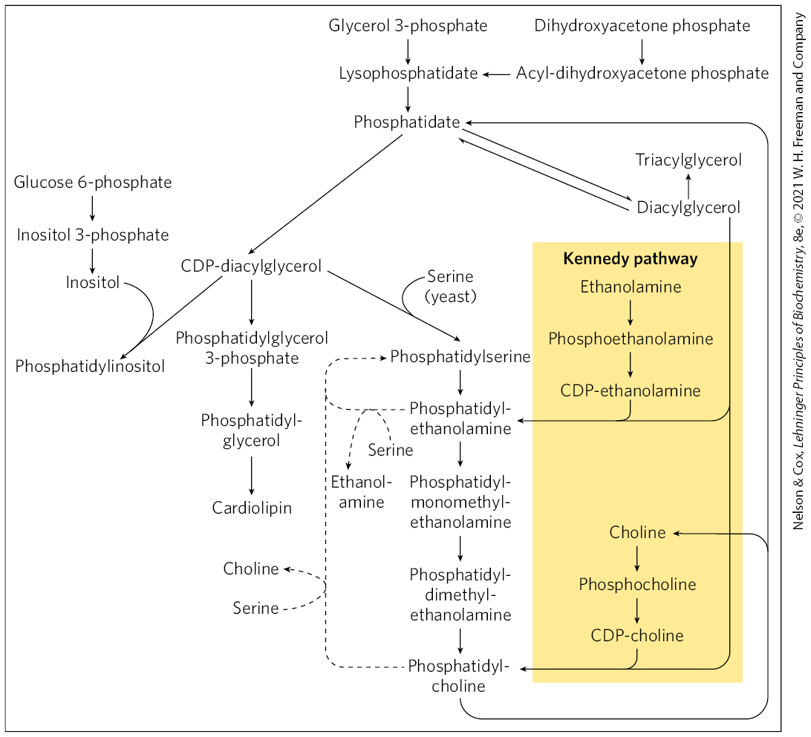
Phospholipid and Triacylglycerol Biosynthetic Pathways

Slide 106

Origin of Polar Head Groups of Phospholipids in E. coli

Slide 107

Eukaryotic Membrane Phospholipids Are Subject to Remodeling
in mammals, phospholipids are remodeled in membranes via the Lands cycle
  facilitated by lysophosphatidyl-choline acyltransferases (LPCATs)

Slide 108
Principle 5 (2 of 7)
Like other major classes of biological molecules, lipids have a plethora of cellular functions. Specialized lipids serve as pigments (retinal, carotene), cofactors (vitamin K), detergents (bile salts), transporters (dolichols), hormones (vitamin D derivatives, sex hormones), extracellular and intracellular messengers (eicosanoids, phosphatidylinositol derivatives), and anchors for membrane proteins (covalently attached fatty acids, prenyl groups, phosphatidylinositol). The ability to synthesize a variety of lipids is essential to all organisms.

Slide 109

Plasmalogen Synthesis Requires Formation of an Ether-Linked
Fatty Alcohol
biosynthesis of ether lipids (including plasmalogens and the platelet-activating factor) uses similar pathways
the characteristic double bond in plasmalogens is introduced by a mixed-function oxidase

Slide 110
Principle 5 (3 of 7)
Like other major classes of biological molecules, lipids have a plethora of cellular functions. Specialized lipids serve as pigments (retinal, carotene), cofactors (vitamin K), detergents (bile salts), transporters (dolichols), hormones (vitamin D derivatives, sex hormones), extracellular and intracellular messengers (eicosanoids, phosphatidylinositol derivatives), and anchors for membrane proteins (covalently attached fatty acids, prenyl groups, phosphatidylinositol). The ability to synthesize a variety of lipids is essential to all organisms.

Slide 111
Sphingolipid and Glycerophospholipid Synthesis Share Precursors and
Some Mechanisms
four stages of sphingolipid biosynthesis:
  synthesis of the 18-carbon amine sphinganine from palmitoyl-CoA and serine
  attachment of a fatty acid in amide linkage to yield N-acylsphinganine
  desaturation of the sphinganine moiety to form N-acylsphingosine (ceramide)
  attachment of a head group to produce a sphingolipid such as a cerebroside or sphingomyelin

Slide 112
Principle 5 (4 of 7)
Like other major classes of biological molecules, lipids have a plethora of cellular functions. Specialized lipids serve as pigments (retinal, carotene), cofactors (vitamin K), detergents (bile salts), transporters (dolichols), hormones (vitamin D derivatives, sex hormones), extracellular and intracellular messengers (eicosanoids, phosphatidylinositol derivatives), and anchors for membrane proteins (covalently attached fatty acids, prenyl groups, phosphatidylinositol). The ability to synthesize a variety of lipids is essential to all organisms.

Slide 113
Glycolipids
glycolipids = cerebrosides and gangliosides
  the head-group sugar is attached directly to the C-1 hydroxyl of sphingosine in glycosidic linkage
  the sugar donor is a UDP-sugar

Slide 114

Biosynthesis of Sphingolipids

Slide 115
Polar Lipids Are Targeted to Specific Cellular Membranes
membrane lipids are insoluble in water and cannot diffuse to their point of insertion
membrane lipids travel to their intracellular destinations via:
  transport vesicles
  specific proteins

Slide 116
21.4 Cholesterol, Steroids, and Isoprenoids: Biosynthesis, Regulation, and Transport

Slide 117

Synthesis of Cholesterol
all of its carbon atoms are provided by acetate
isoprene units are essential intermediates in the pathway

Slide 118

Origin of the Carbon Atoms of Cholesterol

Slide 119
Principle 5 (5 of 7)
Like other major classes of biological molecules, lipids have a plethora of cellular functions. Specialized lipids serve as pigments (retinal, carotene), cofactors (vitamin K), detergents (bile salts), transporters (dolichols), hormones (vitamin D derivatives, sex hormones), extracellular and intracellular messengers (eicosanoids, phosphatidylinositol derivatives), and anchors for membrane proteins (covalently attached fatty acids, prenyl groups, phosphatidylinositol). The ability to synthesize a variety of lipids is essential to all organisms.

Slide 120

Cholesterol Is Made from Acetyl-CoA in Four Stages
four stages:
  condensation of three acetate units to form mevalonate
  conversion of mevalonate to activated isoprene units
  polymerization of six isoprene units to form the 30-carbon linear squalene
  cyclization of squalene to form the four rings of the steroid nucleus

Slide 121

Stage 1: Synthesis of Mevalonate from Acetate
acetyl-CoA acetyl transferase = catalyzes the condensation of two acetyl-CoA molecules
HMG-CoA synthase = catalyzes the condensation of acetyl-CoA with acetoacetyl-CoA to form β-hydroxy-β-methylglutaryl-CoA (HMG-CoA)

Slide 122
Principle 3 (5 of 5)
Like other anabolic pathways, the reaction sequences in lipid biosynthesis are endergonic and reductive. They use ATP as a source of metabolic energy and a reduced electron carrier (usually NADPH) as a reductant.

Slide 123

Stage 1: Synthesis of Mevalonate from Acetate, Continued
HMG-CoA reductase = an integral membrane protein of the smooth ER that catalyzes the reduction of HMG-CoA to mevalonate
  the major point of regulation on the pathway to cholesterol
  catalyzes the committed step
  requires 2 molecules of NADPH

Slide 124

Stage 2: Conversion of Mevalonate to Two Activated Isoprenes
three phosphate groups are transferred from three ATP molecules to mevalonate to form 3-phospho-5- pyrophosphomevalonate

Slide 125

Stage 2: Conversion of Mevalonate to Two Activated Isoprenes, Continued
CO₂ and P_{i} leave to produce a double bond in ∆³-isopentenyl pyrophosphate
  the first activated isoprene
isomerization of ∆³-isopentenyl pyrophosphate yields dimethylallyl pyrophosphate
  the second activated isoprene

Slide 126
Stage 3: Condensation of Six Activated Isoprene Units to Form Squalene
the two activated isoprenes undergo head-to-tail condensation to form geranyl pyrophosphate
geranyl pyrophosphate undergoes head-to-tail condensation with isopentenyl pyrophosphate to form farnesyl pyrophosphate
two molecules of farnesyl pyrophosphate join head-to-head to form squalene

Slide 127

Formation of Squalene

Slide 128

Stage 4: Conversion of Squalene to the Four-Ring Steroid Nucleus (1 of 2)
squalene monooxygenase = adds one oxygen atom from O₂ to the end of the squalene chain to form squalene 2,3-epoxide
  mixed-function oxidase
  requires NADPH

Slide 129

Stage 4: Conversion of Squalene to the Four-Ring Steroid Nucleus (2 of 2)
cyclization of squalene 2,3-epoxide forms lanosterol
a series of ~20 reactions converts lanosterol to cholesterol
in plants, the epoxide cyclizes to other sterols, such as ergosterol

Slide 130
Cholesterol Has Several Fates
cholesterol is synthesized primarily in the liver
most of it is exported as:
  bile acids
  biliary cholesterol
  cholesteryl esters
    formed in the liver by acyl-CoA–cholesterol acyltransferase (ACAT)

Slide 131

Metabolic Fates of Cholesterol

Slide 132
Export of Cholesterol as Bile Acids
bile acids = the principal components of bile, a fluid stored in the gallbladder
  excreted into the small intestine to aid in the digestion
  relatively hydrophilic cholesterol derivatives that serve as emulsifiers

Slide 133
Export of Cholesterol as
Biliary Cholesterol
biliary cholesterol = cholesterol contained in bile
  bile removes excess cholesterol from the intestine and facilitates excretion
  dietary fiber binds to bile and interferes with bile reabsorption in the intestines

Slide 134
Export of Cholesterol as
Cholesteryl Esters
cholesteryl esters = cholesterol molecule with a fatty acid from coenzyme A attached to its hydroxyl group
  formed in the liver by acyl-CoA–cholesterol acyltransferase (ACAT)
  cannot function appropriately in membranes due to high hydrophobicity
  transported to other tissues or stored in the liver in lipid droplets

Slide 135
Cholesterol and Other Lipids Are Carried on Plasma Lipoproteins
apolipoproteins = specific carrier proteins
plasma lipoproteins = macromolecular complexes of apolipoproteins and various combinations of phospholipids, cholesterol, cholesteryl esters, and triacylglycerols
  carry cholesterol and cholesteryl ester in the blood

Slide 136

Lipoproteins

Slide 137
Four Major Classes of Human Plasma Lipoproteins
different combinations of lipids and proteins produce particles of different densities
  can be separated by ultracentrifugation
Table 21-1 Major Classes of Human Plasma Lipoproteins: Some Properties
Lipoprotein | Density (g/mL) | Protein | Phospholipids | Composition (wt %): Free cholesterol | Composition (wt %): Cholesteryl esters | Triacylglycerols
Chylomicrons | <1.006 | 2 | 9 | 1 | 3 | 85
VLDL | 0.95–1.006 | 10 | 18 | 7 | 12 | 50
LDL | 1.006–1.063 | 23 | 20 | 8 | 37 | 10
HDL | 1.063–1.210 | 55 | 24 | 2 | 15 | 4

Slide 138
Apolipoproteins of the Human Plasma Lipoproteins
“apo” designates the protein in its lipid-free form
Table 21-2 Apolipoproteins of the Human Plasma Lipoproteins
Apolipoprotein | Polypeptide molecular weight | Lipoprotein association | Function (if known)
ApoA-I | 28,100 | HDL | Activates LCAT; interacts with ABC transporter
ApoA-II | 17,400 | HDL | Inhibits LCAT
ApoA-IV | 44,500 | Chylomicrons, HDL | Activates LCAT; cholesterol transport/clearance
ApoB-48 | 242,000 | Chylomicrons | Cholesterol transport/clearance
ApoB-100 | 512,000 | VLDL, LDL | Binds to LDL receptor
ApoC-I | 7,000 | VLDL, HDL
ApoC-II | 9,000 | Chylomicrons, VLDL, HDL | Activates lipoprotein lipase
ApoC-III | 9,000 | Chylomicrons, VLDL, HDL | Inhibits lipoprotein lipase
ApoD | 32,500 | HDL
ApoE | 34,200 | Chylomicrons, VLDL, HDL | Triggers clearance of VLDL and chylomicron remnants
ApoH | 50,000 | Possibly VLDL, binds phospholipids such as cardiolipin | Roles in coagulation, lipid metabolism, apoptosis, inflammation

Slide 139

Lipoproteins and Lipid Transport

Slide 140
Chylomicrons
chylomicrons = the largest and least dense of the lipoproteins
  contain a high proportion of triacylglycerols

Slide 141
The Exogenous Pathway
exogenous pathway = the pathway from dietary cholesterol to the liver
  chylomicrons are synthesized from dietary fats in the ER of enterocytes and enter the bloodstream
  apoC-II activates lipoprotein lipase in tissues to release FFAs
  chylomicron remnants move through the bloodstream to the liver
  receptors in the liver bind to the apoE in the remnants and mediate uptake of these remnants by endocytosis

Slide 142
Very-Low-Density Lipoprotein (VLDL)
very-low-density lipoprotein (VLDL) = lipoproteins that carry cholesteryl esters or triacylglycerols from the liver to muscle and adipose tissue
  apoC-II activates lipoprotein lipase to release FFAs from triacylglycerols

Slide 143
Low-Density Lipoprotein (LDL) and LDL Receptors
low-density lipoprotein (LDL) = formed by triacylglycerol loss in VLDL
  rich in cholesterol and cholesteryl esters
  carries cholesterol to extrahepatic tissues and macrophages
LDL receptors = receptors in the hepatocyte plasma membrane that take up LDL not taken up by peripheral tissues and cells

Slide 144
The Endogenous Pathway (1 of 2)
endogenous pathway = the pathway from VLDL formation in the liver to LDL return to the liver

Slide 145

HDL Carries Out Reverse Cholesterol Transport
high-density lipoprotein (HDL) = lipoproteins that originate in the liver and small intestine as small, protein-rich particles
  contain lecithin-cholesterol acyltransferase (LCAT) to catalyze the formation of cholesteryl esters
  mediates cholesterol scavenging and transport back to the liver

Slide 146
The Endogenous Pathway (2 of 2)
reverse cholesterol transport = the HDL circuit where HDL picks up cholesterol from cholesterol-rich extrahepatic cells and returns it to the liver for unloading
  much of this cholesterol is converted to bile salts and stored in the gallbladder

Slide 147
Enterohepatic Circulation
enterohepatic circulation = cycle where bile salts are reabsorbed by the liver and recirculate through the gallbladder

Slide 148

Cholesterol Esters Enter Cells by Receptor-Mediated Endocytosis
receptor-mediated endocytosis = apoB-100 of LDL is recognized by receptors in the plasma membrane

Slide 149
Familial Hypercholesterolemia (FH) and Niemann-Pick Type-C (NPC)
familial hypercholesterolemia (FH) = genetic disease resulting when individuals have mutations in the LDL receptor that prevent the normal uptake of LDL by liver and peripheral tissues
Niemann-Pick type-C (NPC) = inherited defect in lipid storage
  cholesterol is not transported out of the lysosomes and accumulates in the lysosomes

Slide 150
Cholesterol Synthesis and Transport Are Regulated at Several Levels
five modes of regulation:
  covalent modification of HMG-CoA reductase
  transcriptional regulation of HMG-CoA gene
  proteolytic degradation of HMG-CoA reductase
  activation of ACAT, which increases esterification for storage
  transcriptional regulation of the LDL receptor

Slide 151

Regulation of Cholesterol Metabolism

Slide 152
HMG-CoA Reductase is Most Active When Dephosphorylated
covalent modification provides short-term regulation of HMG-CoA reductase
  AMPK phosphorylates HMG-CoA to decrease its activity in response to rising AMP levels
insulin promotes dephosphorylation (activation)
glucagon and epinephrine promote phosphorylation (inactivation)

Slide 153
SREBP, SCAP, and Insig
sterol regulatory element-binding proteins (SREBPs) = transcriptionally regulate the HMG-CoA gene and other genes encoding enzymes that mediate the uptake and synthesis of cholesterol and unsaturated fatty acids
SREBP cleavage-activating protein (SCAP) and Insig (insulin-induced gene protein) = membrane proteins that act as sterol sensors

Slide 154

Regulation of Cholesterol Synthesis by SREBP
the complex of Insig, SCAP, and SREBP senses cholesterol levels and triggers increased synthesis or degradation of HMG-CoA reductase

Slide 155

Regulation by LXR-Mediated Transcription
liver X receptor (LXR) = nuclear transcription factor that forms a heterodimer with retinoid X receptors (RXR) when cholesterol levels are high
the LXR- RXR dimer activates transcription from a set of genes

Slide 156
The Genes Activated by LXR-RXR Are Largely for Cholesterol Transport
acetyl-CoA carboxylase
  first enzyme in fatty acid synthesis
apoproteins (C-I, C-II, D, and E)
  for cholesterol transport
GLUT4
ABC transporters
  for reverse cholesterol transport

Slide 157
Regulation of LXRs By The Activity of Farnesoid X Receptor (FXR)
farnesoid X receptor (FXR) = forms a heterodimer with RXR
  represses many of the genes activated by LXR

Slide 158

Dysregulation of Cholesterol Metabolism Can Lead to Cardiovascular Disease
atherosclerosis = the obstruction of blood vessels from the pathological accumulation of cholesterol (plaques)
foam cells = form from macrophages

Slide 159
Cardiovascular Disease (CVD) is Multifactorial
very high LDL-cholesterol levels tend to correlate with atherosclerosis
low HDL-cholesterol levels are negatively associated with heart disease

Slide 160
Familial Hypercholesterolemia
familial hypercholesterolemia = characterized by extremely high blood levels of cholesterol
  due to a defective LDL receptor
  cholesterol accumulates in foam cells and contributes to the formation of atherosclerotic plaques

Slide 161

Statins
statins = drug class used to treat patients with elevated serum cholesterol
  resemble mevalonate
  are competitive inhibitors of HMG-CoA reductase

Slide 162

Reverse Cholesterol Transport by HDL Counters Plaque Formation and Atherosclerosis
reverse cholesterol transport = process by which HDL removes cholesterol from peripheral tissues and carries it to the liver
  protects against atherosclerosis

Slide 163
Familial HDL Deficiency and
Tangier Disease
familial HDL deficiency = HDL levels are very low
Tangier disease = HDL levels are almost undetectable
both are the result of mutations in the ABCA1 protein
  apoA-I in cholesterol-depleted HDL cannot take up cholesterol from cells that lack ABCA1 protein

Slide 164
Principle 5 (6 of 7)
Like other major classes of biological molecules, lipids have a plethora of cellular functions. Specialized lipids serve as pigments (retinal, carotene), cofactors (vitamin K), detergents (bile salts), transporters (dolichols), hormones (vitamin D derivatives, sex hormones), extracellular and intracellular messengers (eicosanoids, phosphatidylinositol derivatives), and anchors for membrane proteins (covalently attached fatty acids, prenyl groups, phosphatidylinositol). The ability to synthesize a variety of lipids is essential to all organisms.

Slide 165

Steroid Hormones Are Formed by Side-Chain Cleavage and Oxidation of Cholesterol
steroid hormones are derived from cholesterol
  mineralocorticoids
  glucocorticoids
  sex hormones (progesterone, androgens, estrogens)

Slide 166

Side-Chain Cleavage in the Synthesis of Steroid Hormones
takes place in the mitochondria of steroidogenic tissues
catalyzed by mixed-function oxygenases that use NADPH, O₂, and mitochondrial cytochrome P-450

Slide 167
Principle 5 (7 of 7)
Like other major classes of biological molecules, lipids have a plethora of cellular functions. Specialized lipids serve as pigments (retinal, carotene), cofactors (vitamin K), detergents (bile salts), transporters (dolichols), hormones (vitamin D derivatives, sex hormones), extracellular and intracellular messengers (eicosanoids, phosphatidylinositol derivatives), and anchors for membrane proteins (covalently attached fatty acids, prenyl groups, phosphatidylinositol). The ability to synthesize a variety of lipids is essential to all organisms.

Slide 168

Intermediates in Cholesterol Biosynthesis Have Many Alternative Fates
isopentenyl pyrophosphate is the activated precursor of numerous biomolecules

Slide 169
Protein Prenylation
prenylation = the covalent attachment of an isoprenoid
  targets certain proteins for association with cellular membranes

