Slide 1

20 Photosynthesis and Carbohydrate Synthesis in Plants
© 2021 Macmillan Learning

Slide 2

Principle 1 (1 of 3)
The capture of solar energy by photosynthetic organisms and its conversion to the chemical energy of reduced organic compounds is
the ultimate source of nearly all biological energy and organic nutrients for all of the nonphotosynthetic organisms, including humans. It is arguably the most important biochemical process in the biosphere.

Slide 3

Principle 2 (1 of 5)
Photosynthetic organisms use tightly organized light-harvesting complexes to absorb sunlight and capture its energy in chemical form: a separation of positive and negative charge leading to electron flow. The energy from an absorbed photon moves from one antenna chlorophyll to another and another until it arrives at the reaction center, where it promotes the photochemical reaction that sends electrons through a series of electron carriers.

Slide 4

Principle 3 (1 of 7)
The light-driven flow of electrons through specialized protein carriers is coupled to ATP synthesis. A strong reducing agent (NADPH) is also produced, and simultaneously, water is oxidized to O₂, which is released into the atmosphere.

Slide 5

Principle 4 (1 of 4)
Evolution yielded a universal mechanism for coupling ATP synthesis to the flow of electrons. A proton gradient created by electron flow is used to energize the ATP-synthesizing enzyme in microorganisms, animals, and plants.

Slide 6

Principle 5 (1 of 15)
The ATP and NADPH produced in the light- dependent reactions of photosynthesis provide the energy and the reducing power to convert atmospheric CO₂ into simple organic compounds. High concentrations of ATP and NADPH allow the chloroplast to carry out redox reactions that are thermodynamically unfavorable.

Slide 7
Photosynthesis
photosynthesis encompasses two processes:
  light-dependent reactions = sunlight provides the energy for the synthesis of ATP and NADPH
  CO₂-assimilation reactions = ATP and NADPH are used to reduce CO₂ to form triose phosphate through the Calvin cycle

Slide 8
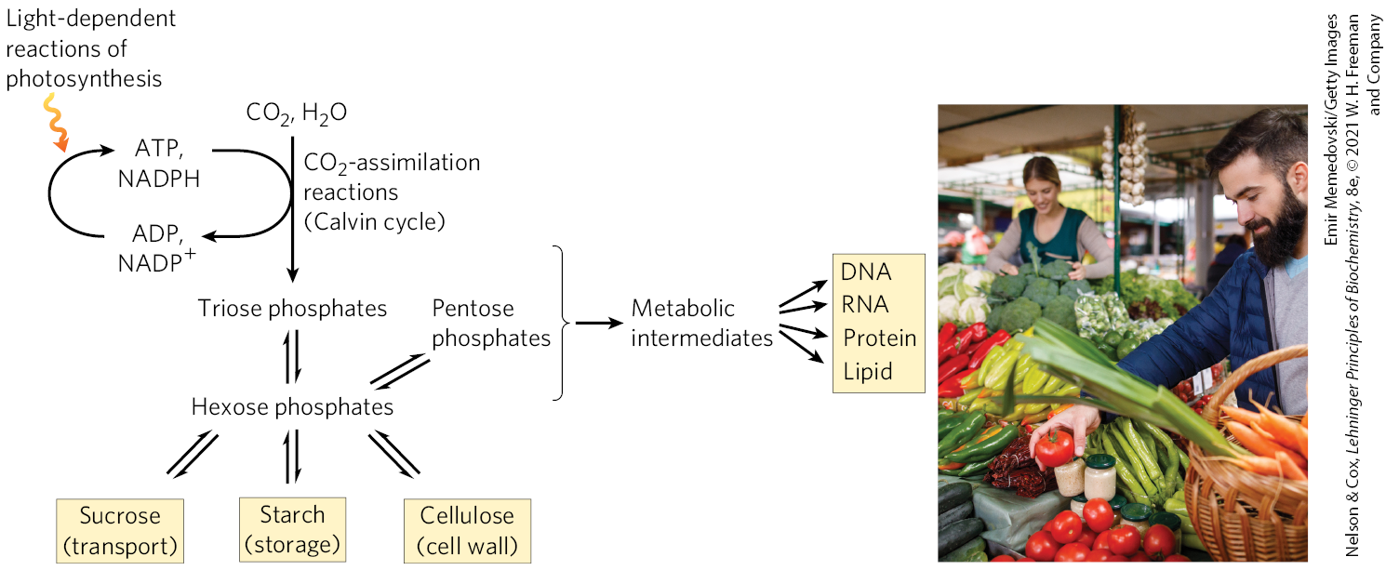
The Calvin Cycle

Slide 9
20.1 Light Absorption

Slide 10
Photophosphorylation
photophosphorylation = ATP synthesis driven by light
  electron flow through a series of membrane carriers is coupled to proton pumping
  H₂O is the electron donor
  NADPH is formed

Slide 11
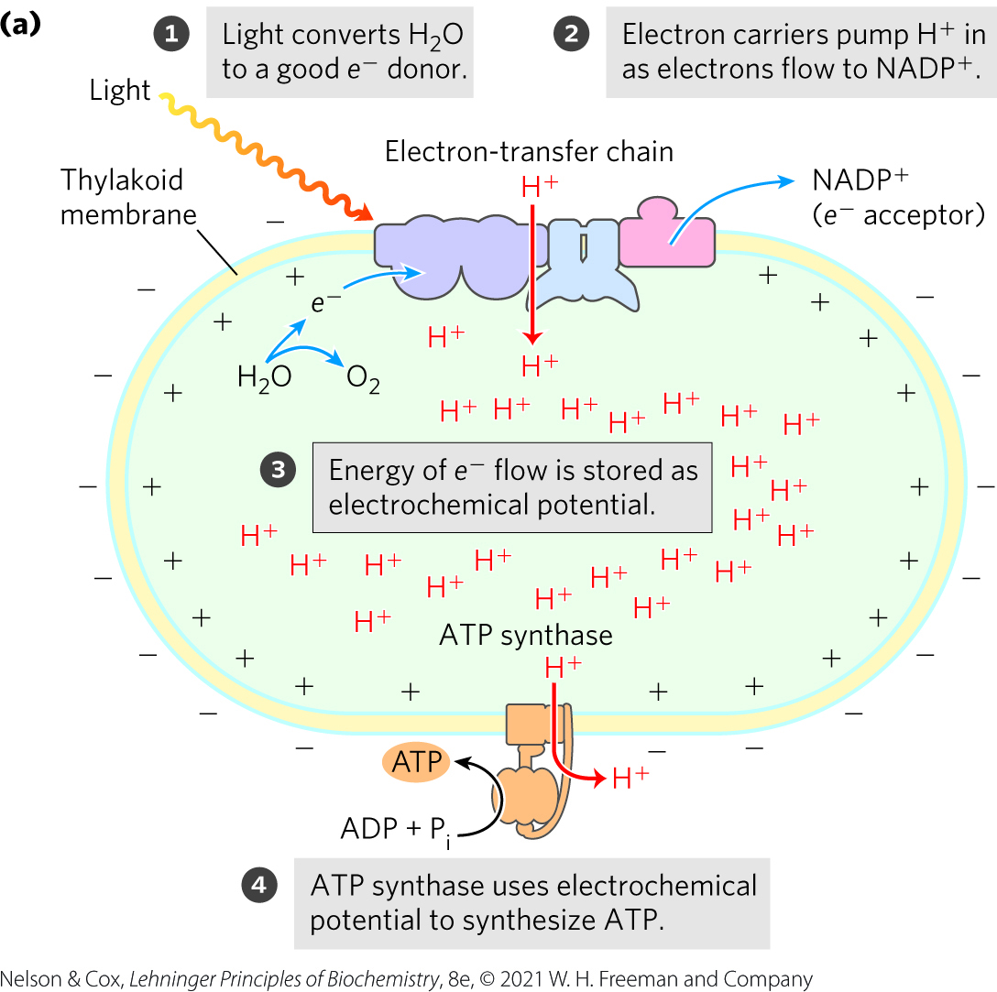
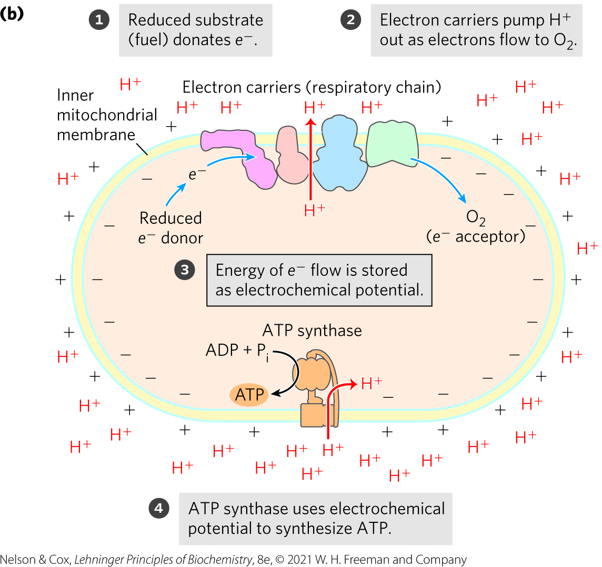
The Chemiosmotic Mechanism for ATP Synthesis in Chloroplasts and Mitochondria

Slide 12
Principle 1 (2 of 3)
The capture of solar energy by photosynthetic organisms and its conversion to the chemical energy of reduced organic compounds is
the ultimate source of nearly all biological energy and organic nutrients for all of the nonphotosynthetic organisms, including humans. It is arguably the most important biochemical process in the biosphere.

Slide 13
Light Energy Creates Good Electron Donors and Electron Acceptors
water is a poor electron donor (E′° = 0.816 V)
NADH is a good electron donor (E′° = -0.320 V)
photosynthesis requires light energy to create a good electron donor and electron acceptor

Slide 14
Principle 3 (2 of 7)
The light-driven flow of electrons through specialized protein carriers is coupled to ATP synthesis. A strong reducing agent (NADPH) is also produced, and simultaneously, water is oxidized to O₂, which is released into the atmosphere.

Slide 15
The Flow of Electrons
electrons flow from the electron donor through a series of membrane-bound carriers:
  cytochromes
  quinones
  iron-sulfur proteins
electron flow is coupled to the pumping of protons across a membrane to create an electrochemical potential
  serves as the driving force for ATP synthesis from ADP and P_{i}

Slide 16
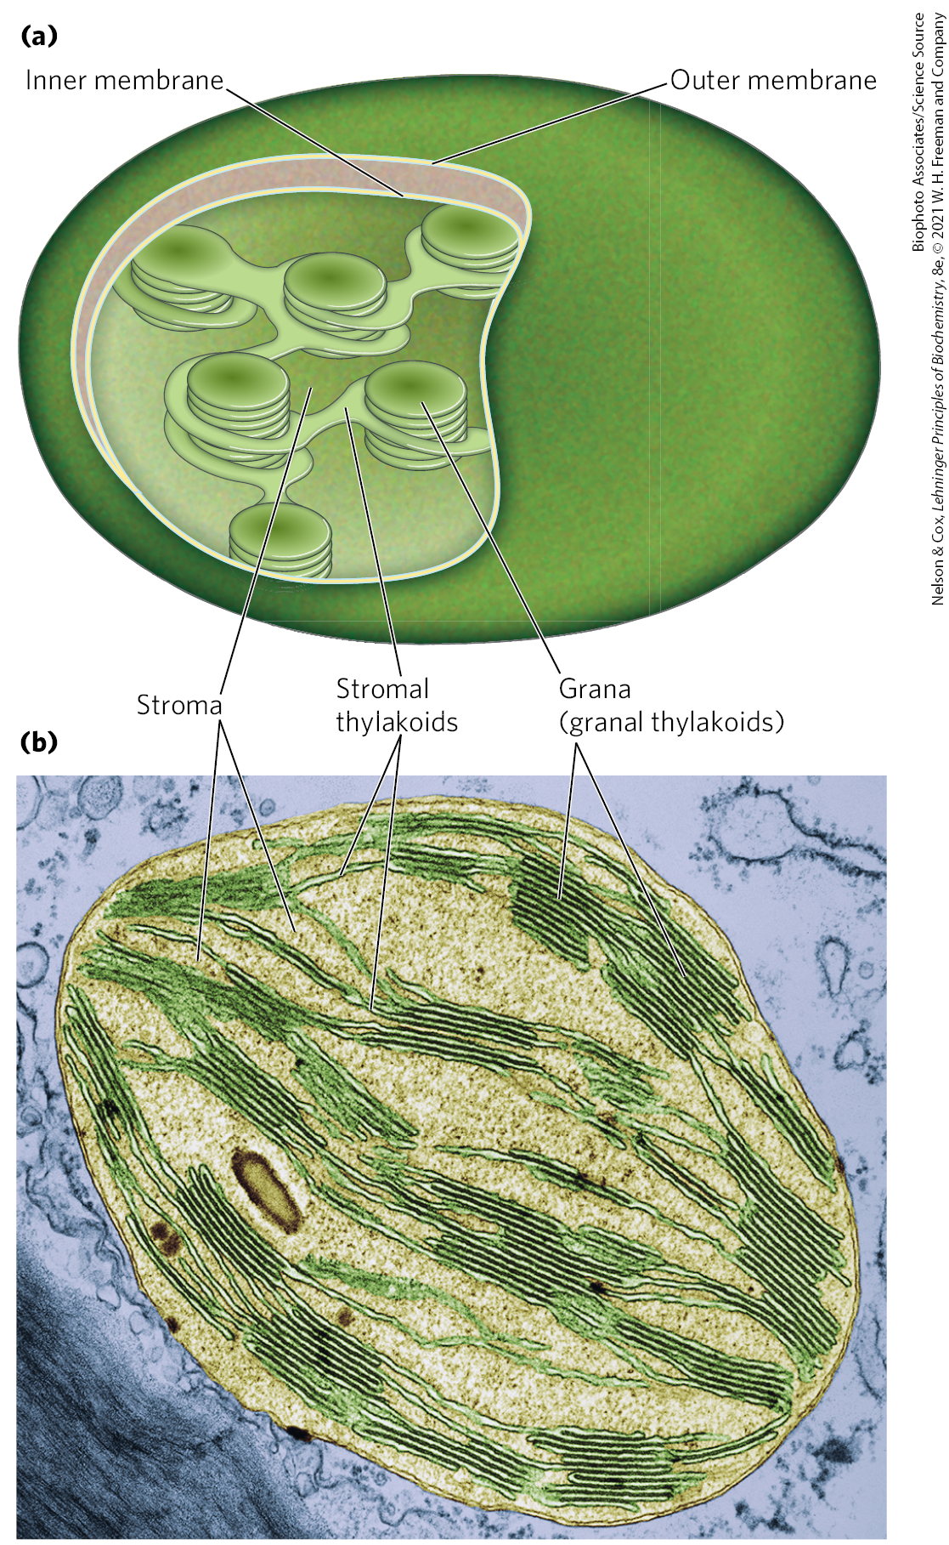
Chloroplasts Are the Site of Light-Driven Electron Flow and Photosynthesis in Plants
chloroplasts = organelles when both the light-dependent and CO₂-assimilation reactions take place
  contain a permeable outer membrane and an impermeable inner membrane with specific transporters

Slide 17
Stroma and Thylakoids
stroma = aqueous phase enclosed by the inner membrane
  analogous to mitochondrial matrix
  contains most of the soluble enzymes required for CO₂-assimilation reactions
thylakoids = flattened sacks formed from an internal membrane system in the stroma
  membranes contain the photosynthetic machinery
granal thylakoids = disk-like pouches arranged in stacks connected by stromal thylakoids

Slide 18
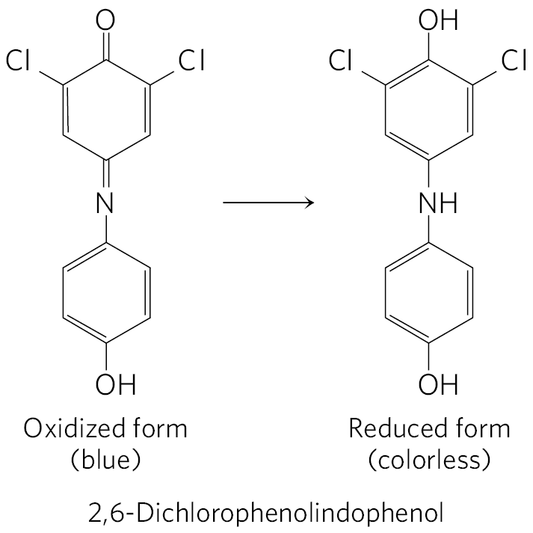
The Hill Reaction
leaf extracts containing chloroplasts perform the Hill reaction:
where A is an artificial electron acceptor, or Hill reagent

Slide 19
Principle 2 (2 of 5)
Photosynthetic organisms use tightly organized light-harvesting complexes to absorb sunlight and capture its energy in chemical form: a separation of positive and negative charge leading to electron flow. The energy from an absorbed photon moves from one antenna chlorophyll to another and another until it arrives at the reaction center, where it promotes the photochemical reaction that sends electrons through a series of electron carriers.

Slide 20
The Hill Reaction Requires Light
in the dark, no O₂ evolution or dye reduction took place
  provided evidence that absorbed light energy causes electrons to flow from donor to acceptor

Slide 21
NADP⁺ Is the Electron Acceptor
in chloroplasts, NADP⁺ accepts electrons from water:

Slide 22
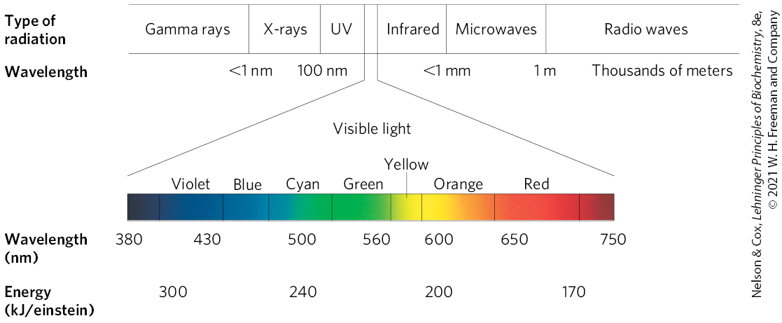
Electromagnetic Radiation
photon = a quantum of light
  greater at the violet end of the spectrum than the red end

Slide 23
The Planck Equation
shorter wavelength (and higher frequency) corresponds to higher energy
energy, E, in a single photon of visible light is:
E = hν = hc/λ
where h is Planck’s constant (6.626×10⁻³⁴ J•s), ν is the
frequency of the light in cycles/s, c is the speed of light
(3.00×10⁸ m/s), and λ is the wavelength of the light in
meters

Slide 24
Excited and Ground States
quantum = a quantity of energy in a photon equal to the energy of the electronic transition to a higher energy level
  to be absorbed, a photon must contain a quantum
excited state = a molecule’s state of energy following the absorption of a photon
  generally unstable
ground state = stable state of energy

Slide 25
Fluorescence
fluorescence = light emission accompanying decay of excited molecules
  always at a longer wavelength (lower energy) than that of the absorbed light

Slide 26
Exciton and Exciton Transfer
excitation energy can be directly transferred
exciton = quantum of energy passed from an excited molecule to another molecule through exciton transfer

Slide 27
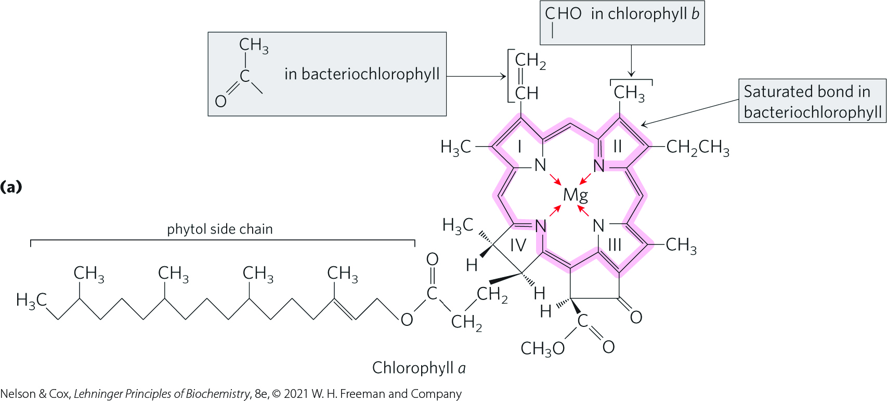
Chlorophylls Absorb Light Energy for Photosynthesis
chlorophylls = green light-absorbing pigments in the thylakoid membranes
  have polycyclic, planar structures with Mg²⁺ occupying the central position
  chloroplasts contain both chlorophyll a and chlorophyll b

Slide 28
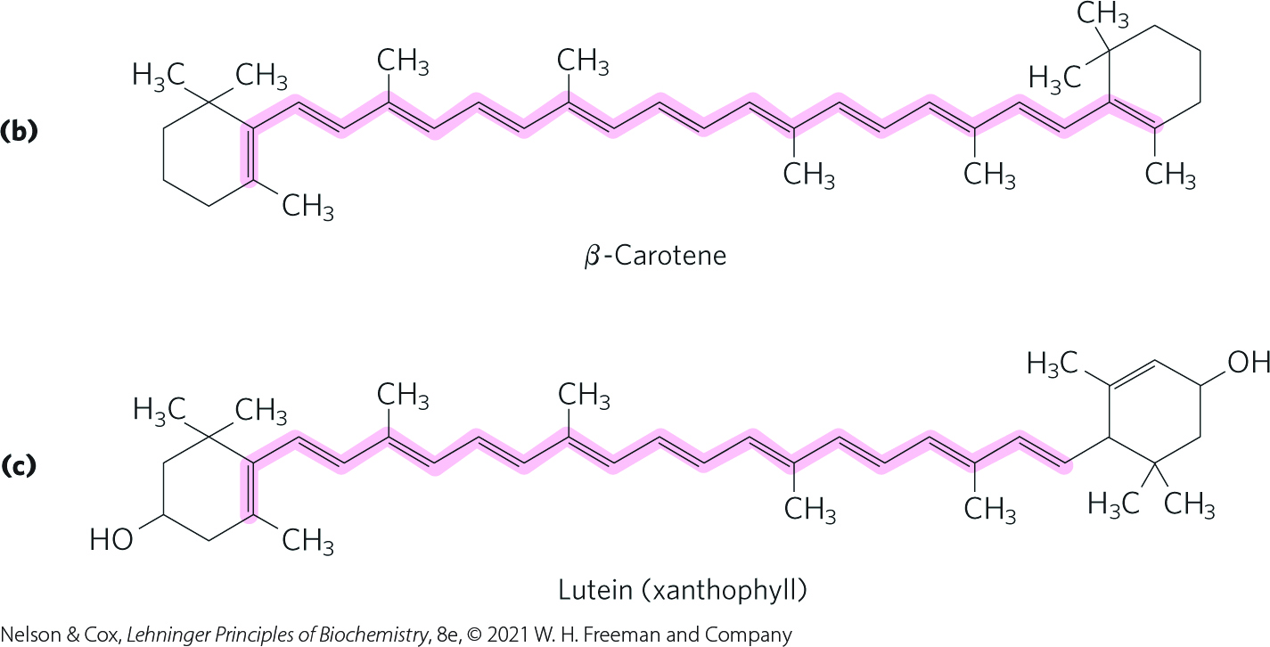
Accessory Pigments in Plants
accessory pigments = secondary light-absorbing pigments called carotenoids
carotenoids = may be yellow, red, or purple
  β-carotene = a red-orange isoprenoid
  lutein = a yellow carotenoid

Slide 29
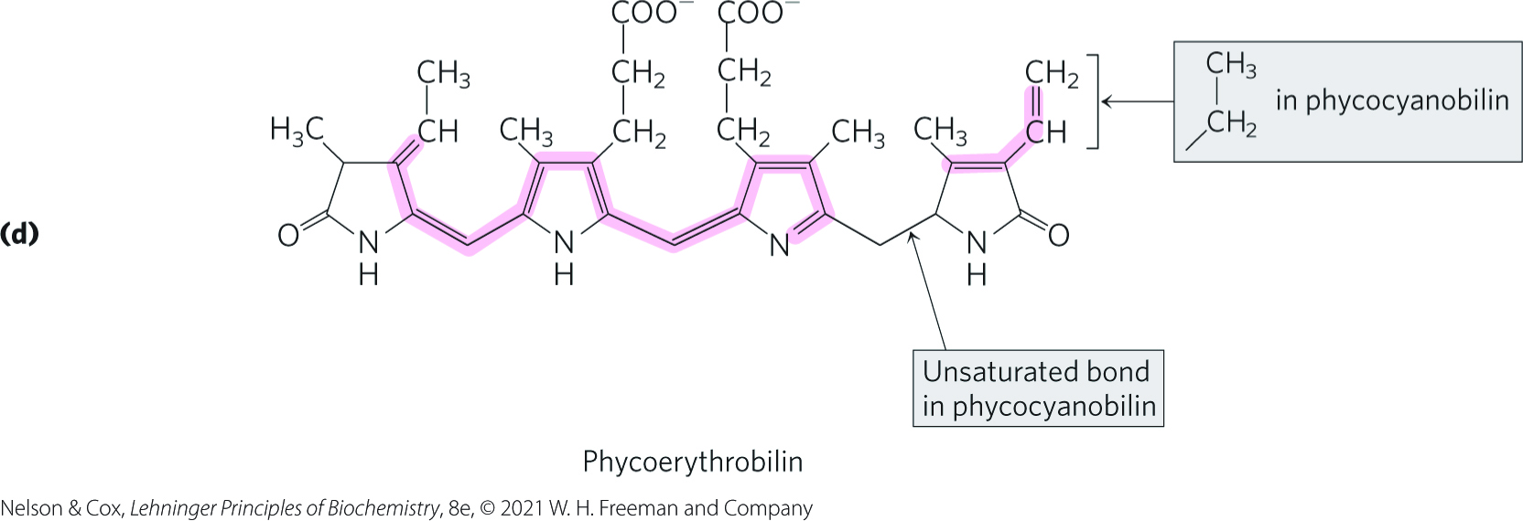
Accessory Pigments in Cyanobacteria and Red Algae
cyanobacteria and red algae use the accessory pigments phycocyanobilin and phycoerythrobilin

Slide 30
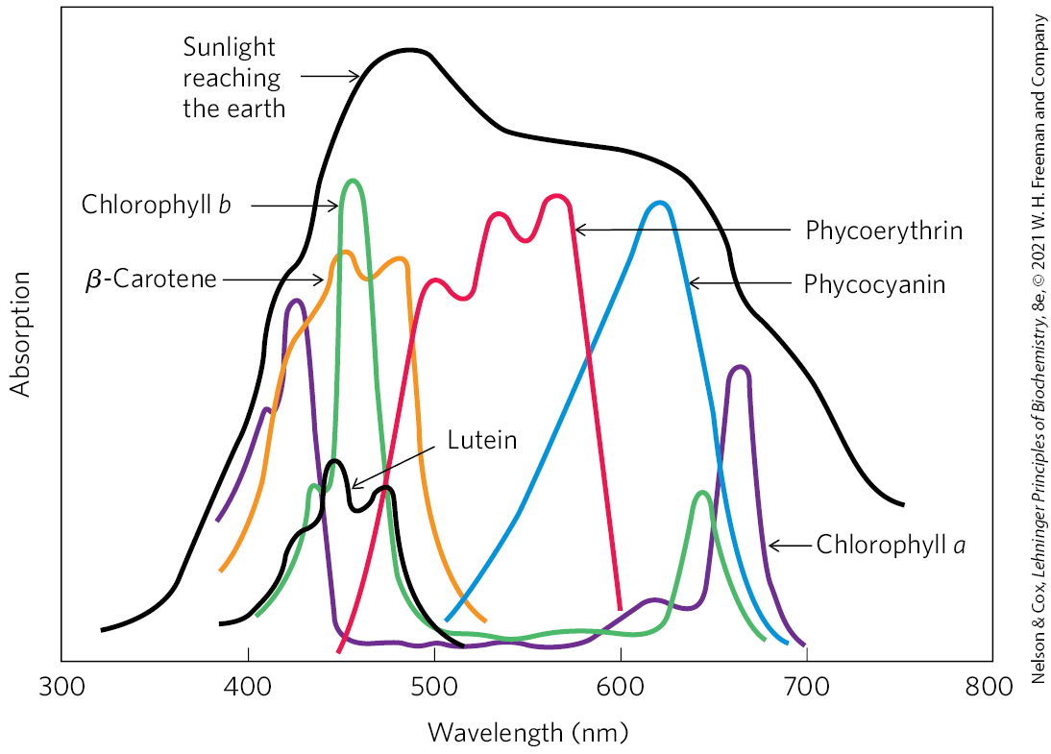
Absorption of Visible Light by Photopigments

Slide 31
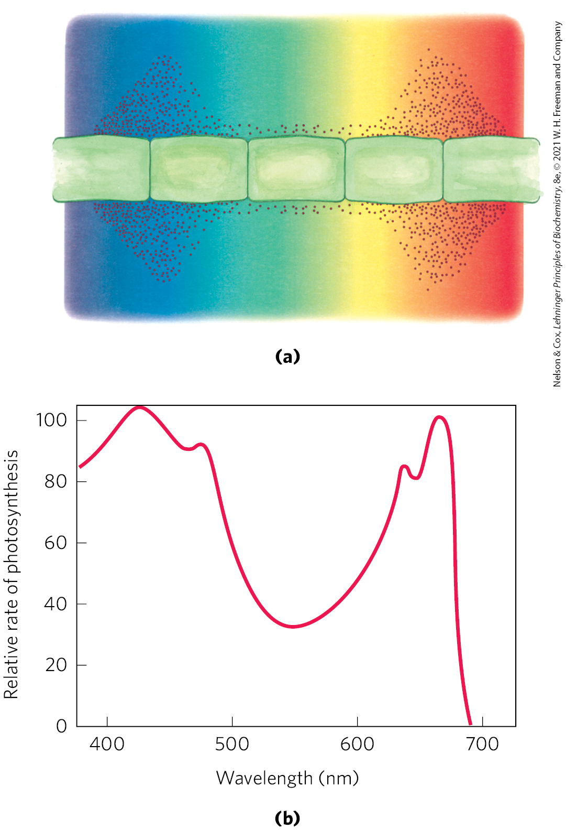
Action Spectrum
action spectrum = describes the relative rate of photosynthesis for illumination with a constant number of photons of different wavelengths

Slide 32
Principle 2 (3 of 5)
Photosynthetic organisms use tightly organized light-harvesting complexes to absorb sunlight and capture its energy in chemical form: a separation of positive and negative charge leading to electron flow. The energy from an absorbed photon moves from one antenna chlorophyll to another and another until it arrives at the reaction center, where it promotes the photochemical reaction that sends electrons through a series of electron carriers.

Slide 33
Chlorophylls Funnel Absorbed Energy to Reaction Centers by Exciton Transfer
photosystems = functional arrays of light-absorbing pigments located in the thylakoid or bacterial membrane
photochemical reaction center = location where a photochemical reaction converts the energy of a photon into a separation of charge
  associated with one pair of chlorophyll molecules that transduces light into chemical energy

Slide 34
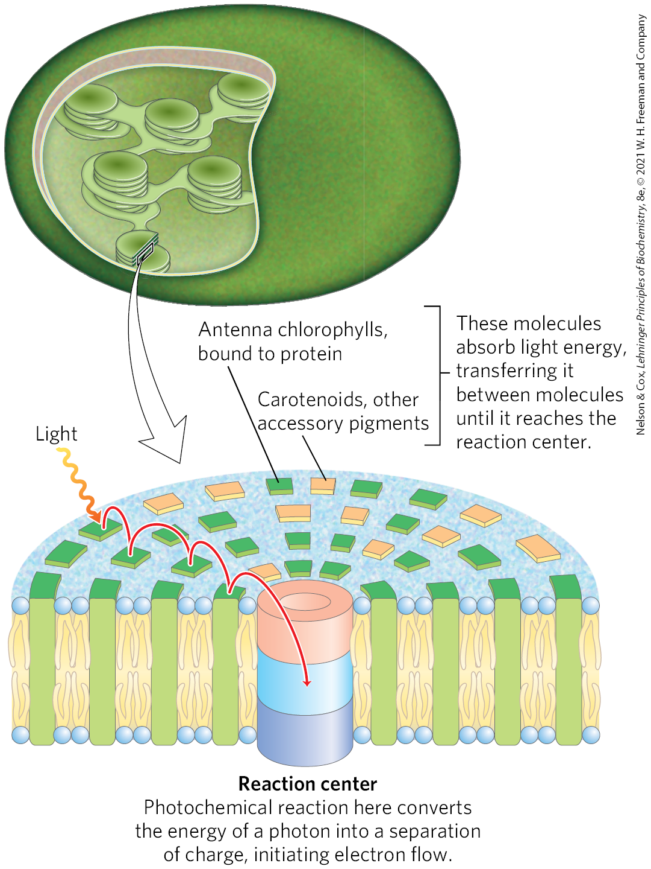
Organization of Photosystems in the Thylakoid Membrane
antenna molecules = absorb light energy and transmit it rapidly and efficiently to the reaction center

Slide 35
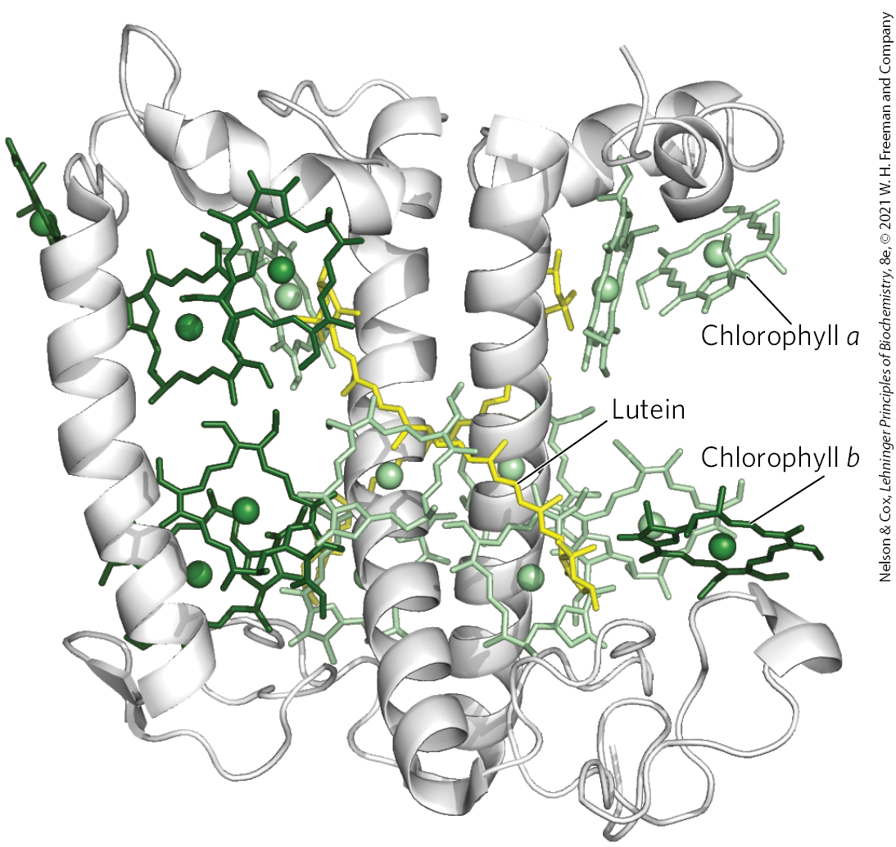
Light-Harvesting Complexes (LHCs)
light-harvesting complexes (LHCs) = complexes of chlorophyll, other pigments, and binding proteins that are located around the periphery of the core complex

Slide 36
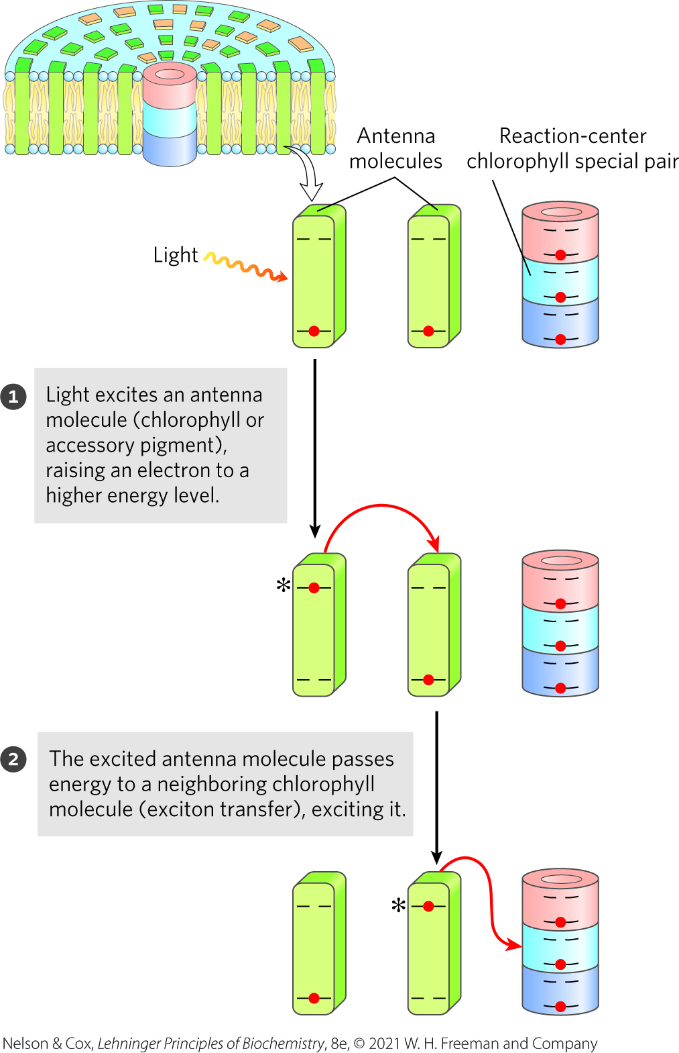
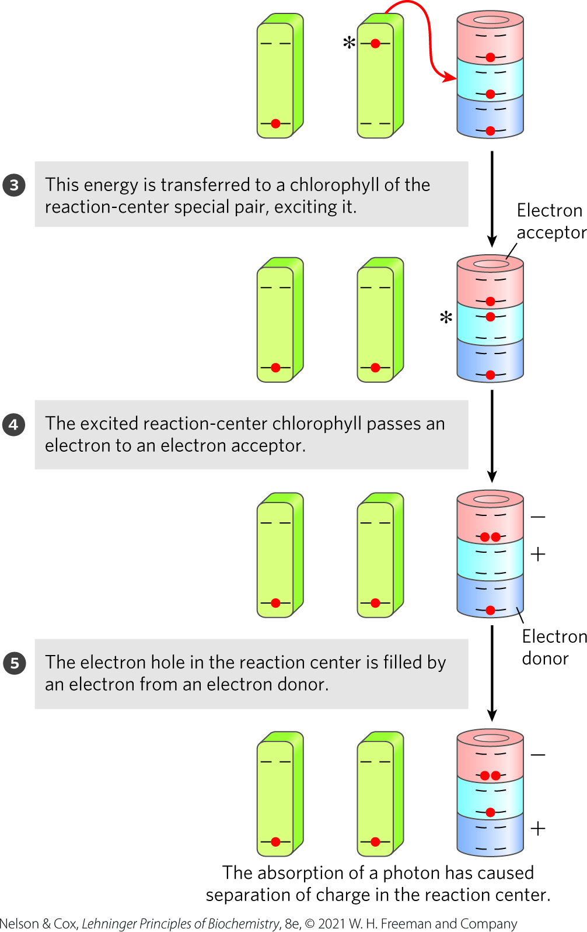
Harvested Light Energy Excites Electrons in the Reaction Center

Slide 37
Principle 1 (3 of 3)
The capture of solar energy by photosynthetic organisms and its conversion to the chemical energy of reduced organic compounds is
the ultimate source of nearly all biological energy and organic nutrients for all of the nonphotosynthetic organisms, including humans. It is arguably the most important biochemical process in the biosphere.

Slide 38
Principle 2 (4 of 5)
Photosynthetic organisms use tightly organized light-harvesting complexes to absorb sunlight and capture its energy in chemical form: a separation of positive and negative charge leading to electron flow. The energy from an absorbed photon moves from one antenna chlorophyll to another and another until it arrives at the reaction center, where it promotes the photochemical reaction that sends electrons through a series of electron carriers.

Slide 39
Charge Separation Initiates Electron Flow
in the reaction center, energy (exciton) is used to create a charge separation
the electric charge separation initiates electron flow through an oxidation-reduction chain

Slide 40
20.2 Photochemical Reaction Centers

Slide 41
Photosynthetic Bacteria Have Two Types of Reaction Center
Type II photosystem = contains a single P870 reaction center, a cytochrome bc₁ electron-transfer complex, and an ATP synthase
  in purple bacteria
  electrons pass through pheophytin (chlorophyll a lacking its central Mg²⁺), quinone, and the cytochrome bc₁ complex
cyclic electron transfer = light-driven cycle that provides the energy for proton pumping by the cytochrome bc₁ complex

Slide 42
Type I Photosystem
Type I photosystem = can send electrons through a cyclic electron transfer path or through a linear path that reduces NAD⁺ to NADH
  in green sulfur bacteria
linear electron transfer = pathway from the reaction center to the soluble iron-sulfur protein ferredoxin to ferredoxin: NAD+ reductase to NAD⁺

Slide 43
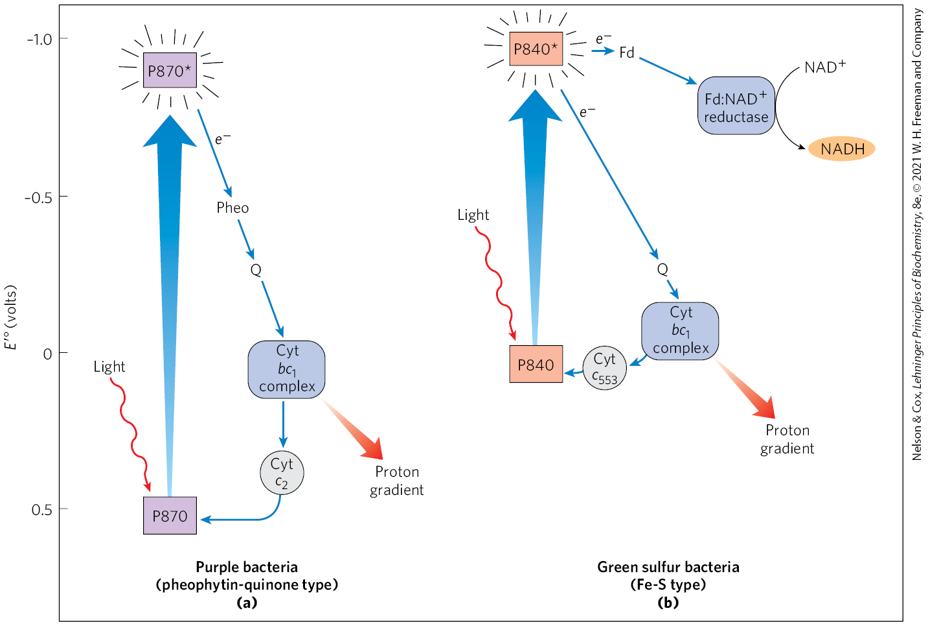
Functional Modules of Photosynthetic Machinery

Slide 44
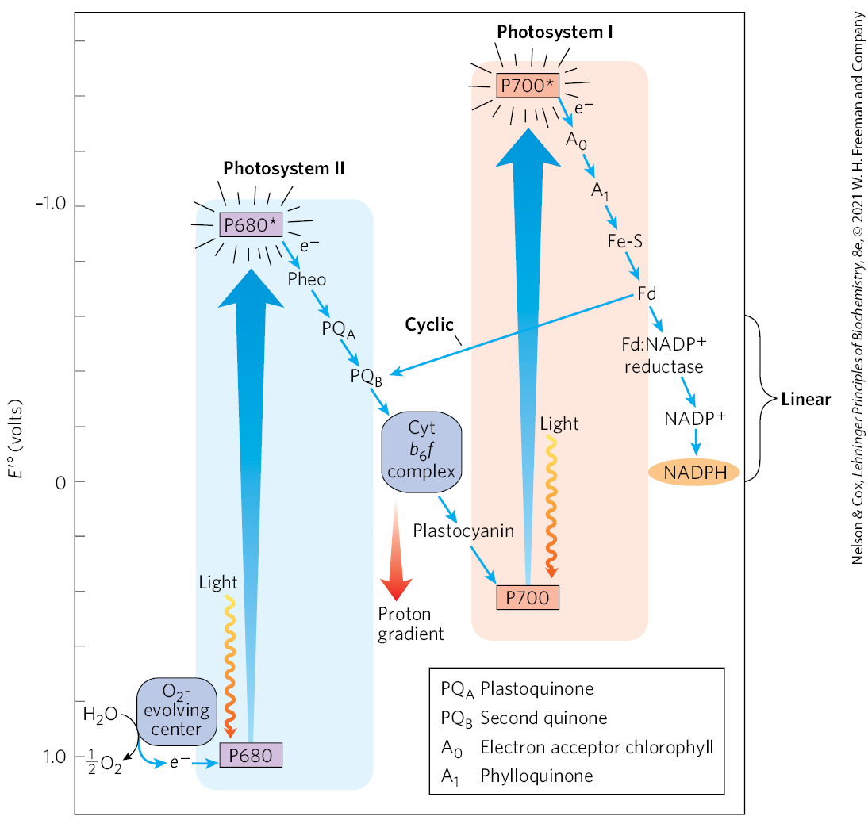
In Vascular Plants, Two Reaction Centers Act in Tandem
Z scheme = diagram that outlines the path of electron flow between the two photosystems and the energy relationships

Slide 45
The First Photosystem: Photosystem II (PSII)
Photosystem II (PSII) = pheophytin-quinone type of system like the purple bacteria photosystem
  contains roughly equal amounts of chlorophylls a and b
  electrons pass from the excited P680 special pair to the cytochrome b6f complex
    electrons lost from P680 are replaced by electrons from H₂O

Slide 46
The Second Photosystem: Photosystem I (PSI)
Photosystem I (PSI) = structurally and functionally related to the photosystem of the green sulfur bacteria
  contains a high ratio of chlorophyll a to b.
  has two paths of electron transfer:
    linear = electrons pass from the excited P700 special pair through a linear chain to NADP⁺
    cyclic = electrons pass from Fd to plastoquinone (PQ) through cytochrome b6f

Slide 47
Principle 3 (3 of 7)
The light-driven flow of electrons through specialized protein carriers is coupled to ATP synthesis. A strong reducing agent (NADPH) is also produced, and simultaneously, water is oxidized to O₂, which is released into the atmosphere.

Slide 48
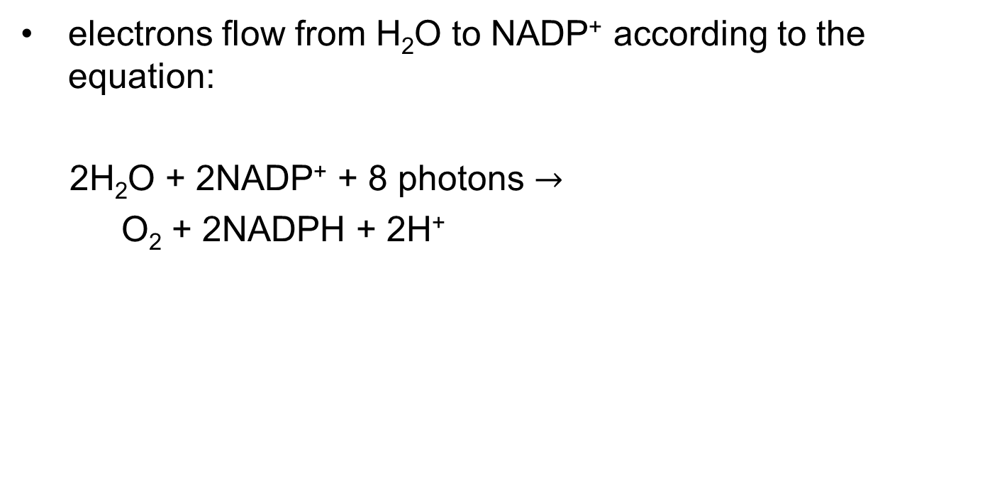
Net Equation for Electron Flow from H₂O to NADP⁺
electrons flow from H₂O to NADP⁺ according to the equation:
2H₂O + 2NADP⁺ + 8 photons $→$
O₂ + 2NADPH + 2H⁺

Slide 49
Principle 3 (4 of 7)
The light-driven flow of electrons through specialized protein carriers is coupled to ATP synthesis. A strong reducing agent (NADPH) is also produced, and simultaneously, water is oxidized to O₂, which is released into the atmosphere.

Slide 50
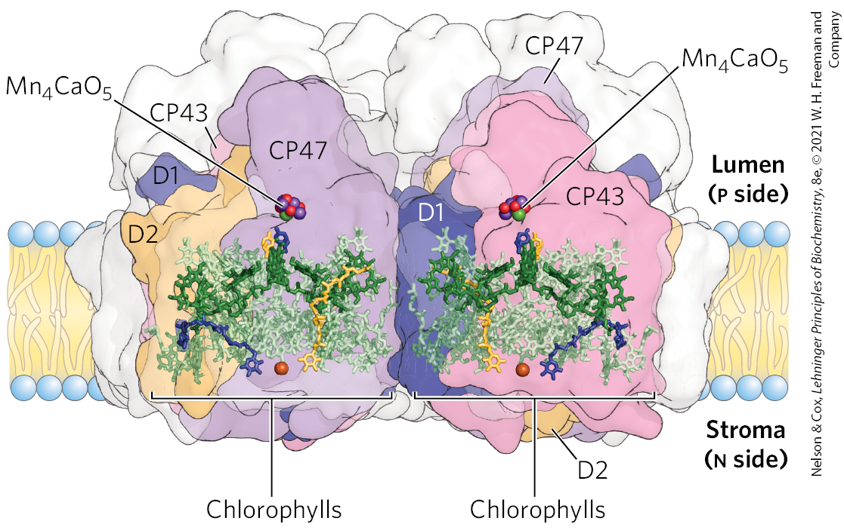
Photosystem II
exciton moves between antenna molecules to P680 (the special pair of chlorophyll a molecules (Chl a)₂) in the reaction center

Slide 51
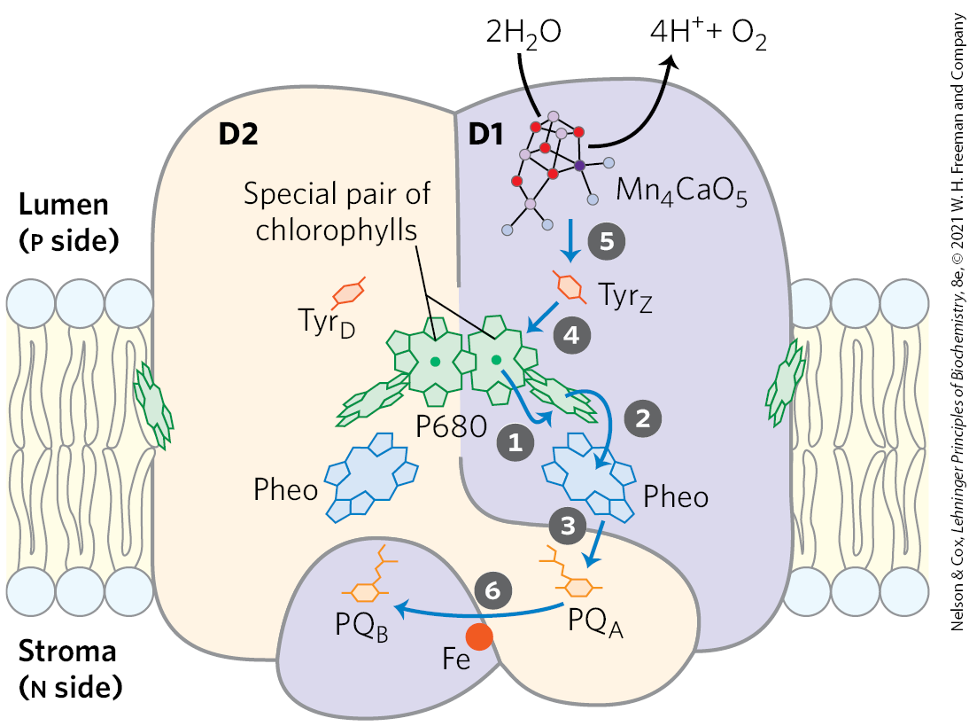
Excitation of P680 in PSII
an electron passes from P680* to pheophytin to a protein-bound plastoquinone, PQ_{A}, to PQ_{B}
the electron removed from P680 is replaced with an electron from the oxidation of water
plastoquinones = structurally and functionally similar to ubiquinones

Slide 52

The Overall Reaction Initiated by Light in PSII
the overall reaction is:
4 P680 + 4H⁺ + 2PQ_{B} + 4 photons $→$
4 P680⁺ + 2 PQ_{B}H₂
(20-1)

Slide 53
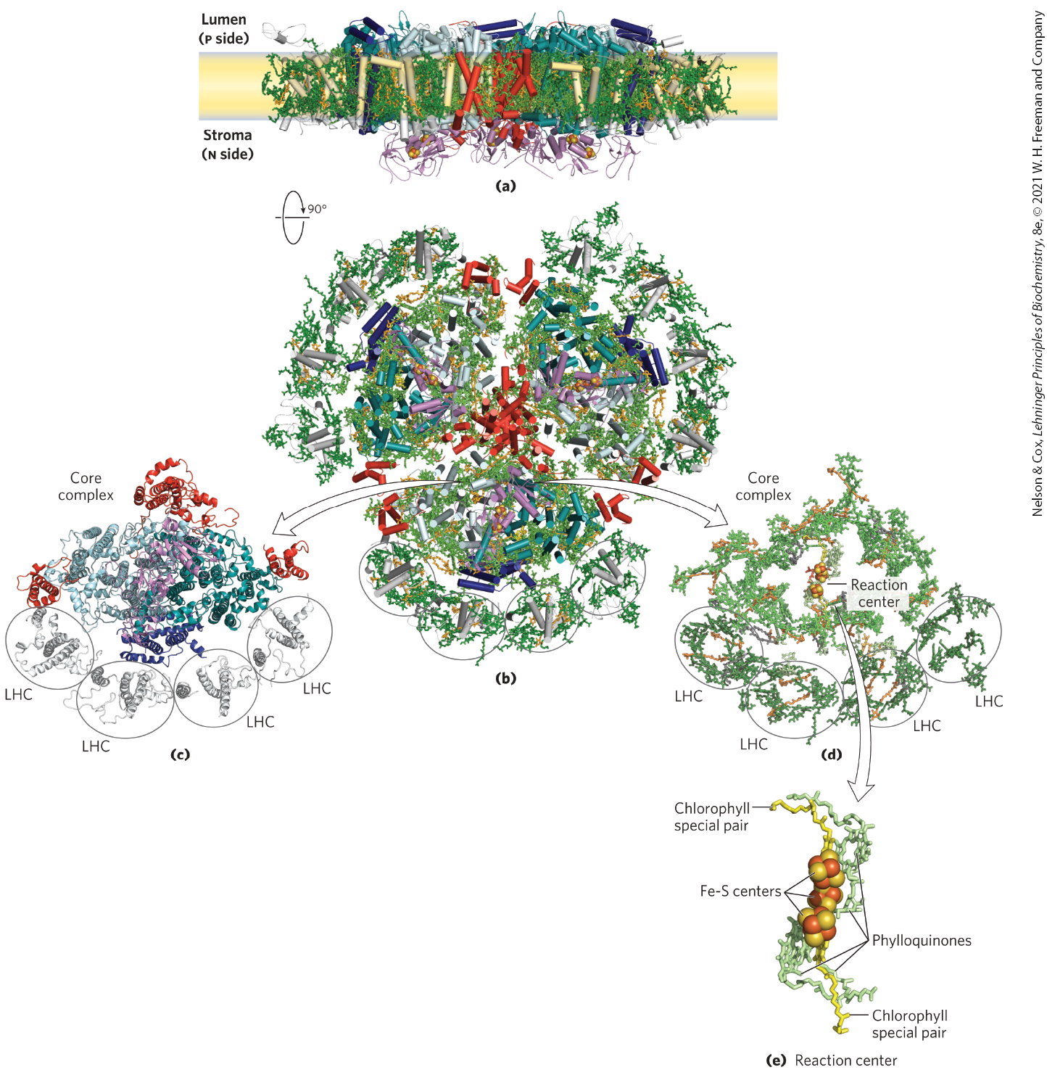
Photosystem I
PSI is excited at the reaction-center P700

Slide 54
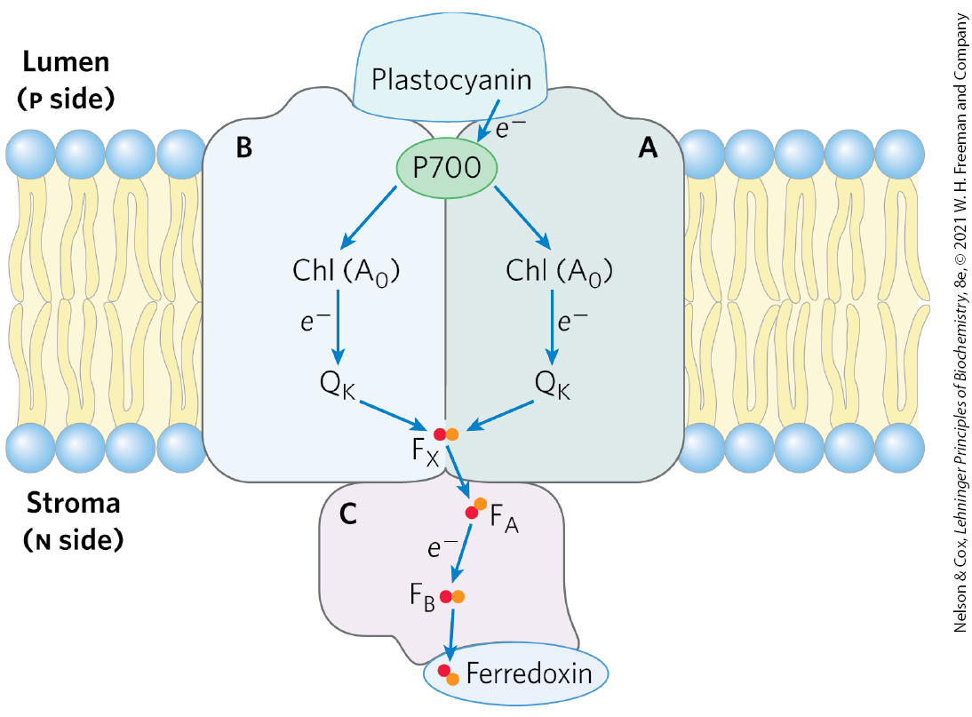
Excitation of P700 in PSI
an electron passes from P700* to an acceptor A₀ (a chlorophyll a molecule) to phylloquinone (Q_{K}) through three Fe-S centers to ferredoxin
P700⁺ acquires an electron from plastocyanin, a soluble Cu-containing electron-transfer protein

Slide 55
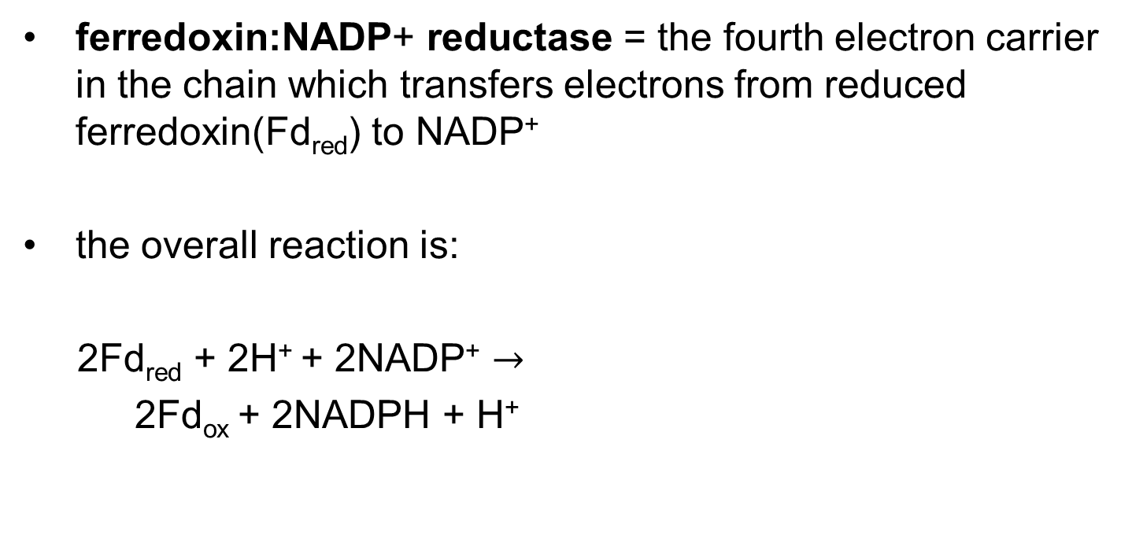
The Overall Reaction in PSI
ferredoxin:NADP+ reductase = the fourth electron carrier in the chain which transfers electrons from reduced ferredoxin(Fd_{red}) to NADP⁺
the overall reaction is:
2Fd_{red} + 2H⁺ + 2NADP⁺ $→$
2Fd_{ox} + 2NADPH + H⁺

Slide 56
Principle 3 (5 of 7)
The light-driven flow of electrons through specialized protein carriers is coupled to ATP synthesis. A strong reducing agent (NADPH) is also produced, and simultaneously, water is oxidized to O₂, which is released into the atmosphere.

Slide 57
The Cytochrome b₆f Complex Links Photosystems II and I, Conserving the Energy of Electron Transfer
cytochrome b₆f complex = contains a b-type cytochrome with two heme groups, a Rieske iron-sulfur protein, and cytochrome f
  analogous to Complex III in mitochondria
  electron flow through the complex produces a proton gradient across the thylakoid membrane

Slide 58
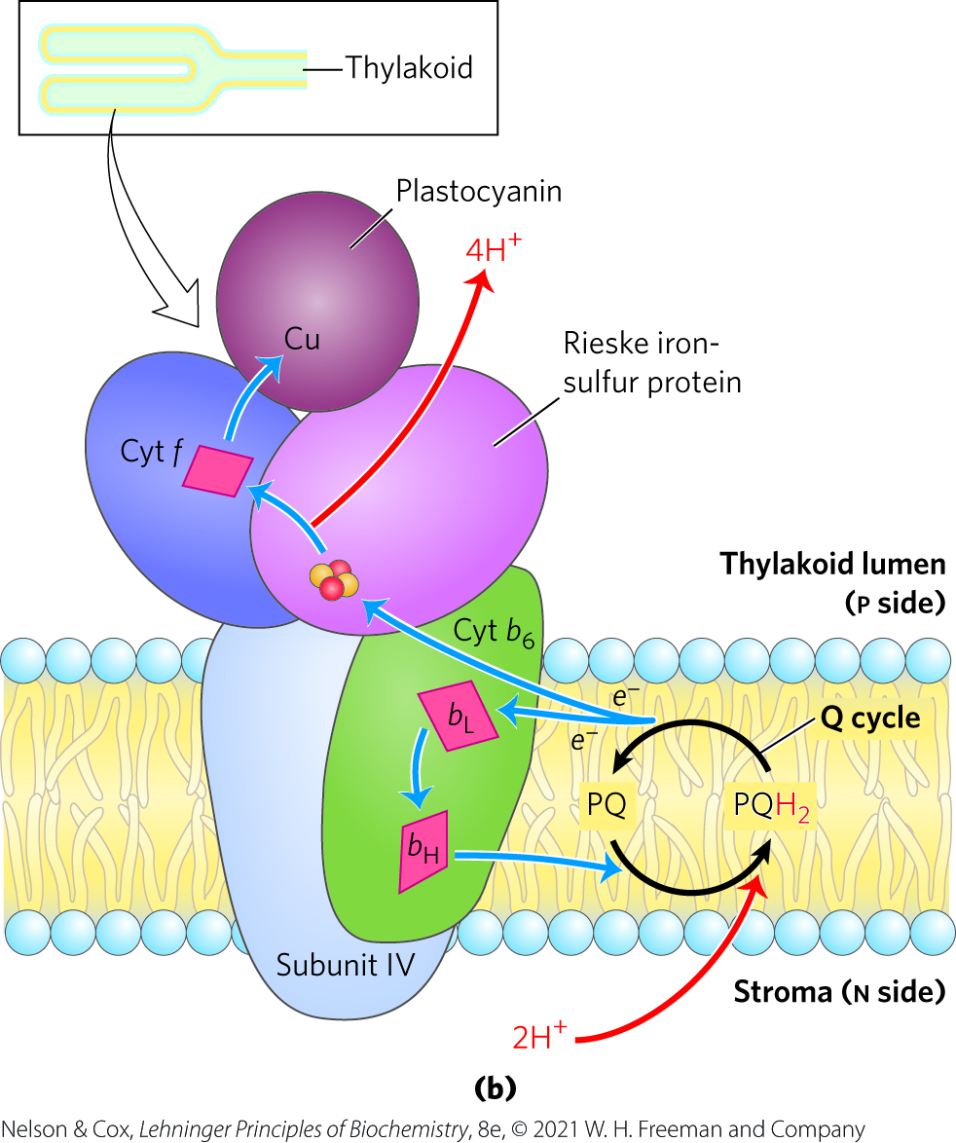
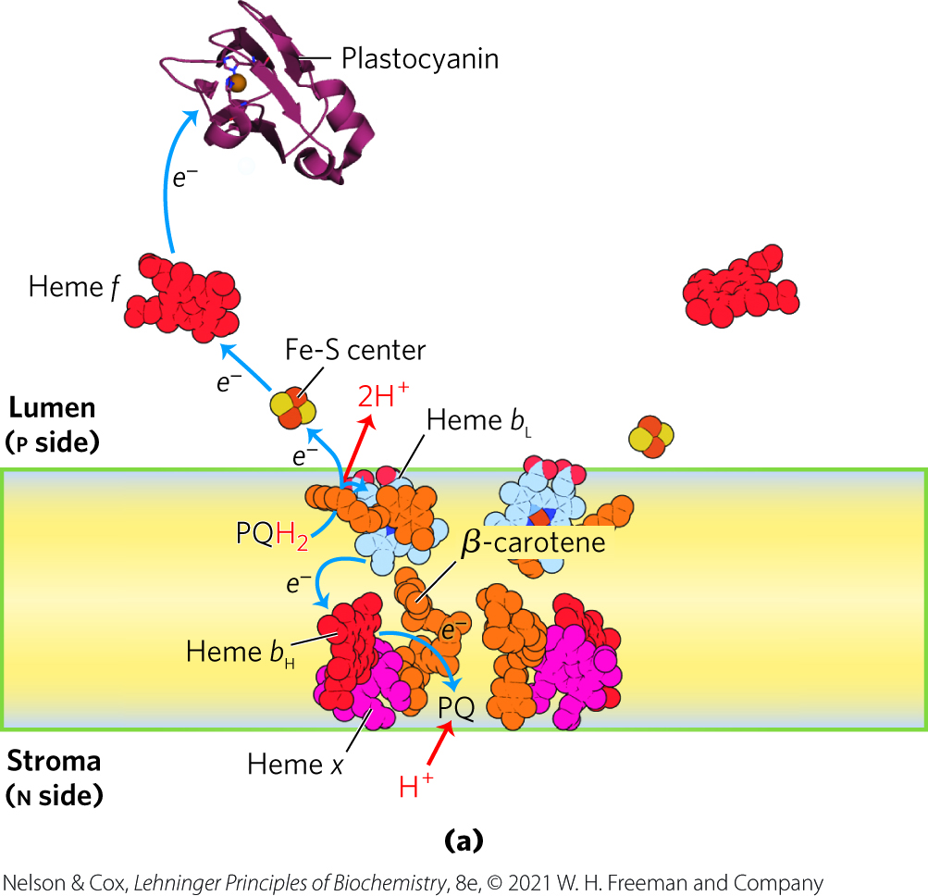
Electron and Proton Flow through the Cytochrome b₆f Complex

Slide 59
Principle 5 (2 of 15)
The ATP and NADPH produced in the light- dependent reactions of photosynthesis provide the energy and the reducing power to convert atmospheric CO₂ into simple organic compounds. High concentrations of ATP and NADPH allow the chloroplast to carry out redox reactions that are thermodynamically unfavorable.

Slide 60
Cyclic Electron Transfer Allows Variation in the Ratio of ATP/NADPH Synthesized
linear electron transfer produces NADPH and ATP
cyclic electron transfer produces only ATP
  allows plants to adjust the ratio of ATP to NADPH to match its needs

Slide 61
The Overall Equation for Cyclic Electron Flow
cyclic photophosphorylation = the phosphorylation of ADP to ATP that accompanies cyclic electron flow
the overall reaction for cyclic electron flow is:

Slide 62
State Transitions Change the Distribution of LHCII between the Two Photosystems
energy needed to excite PSI is less than the energy needed to excite PSII
PSII would be chronically underexcited if the two photosystems were physically contiguous
  prevented by physically separating the two photosystems

Slide 63
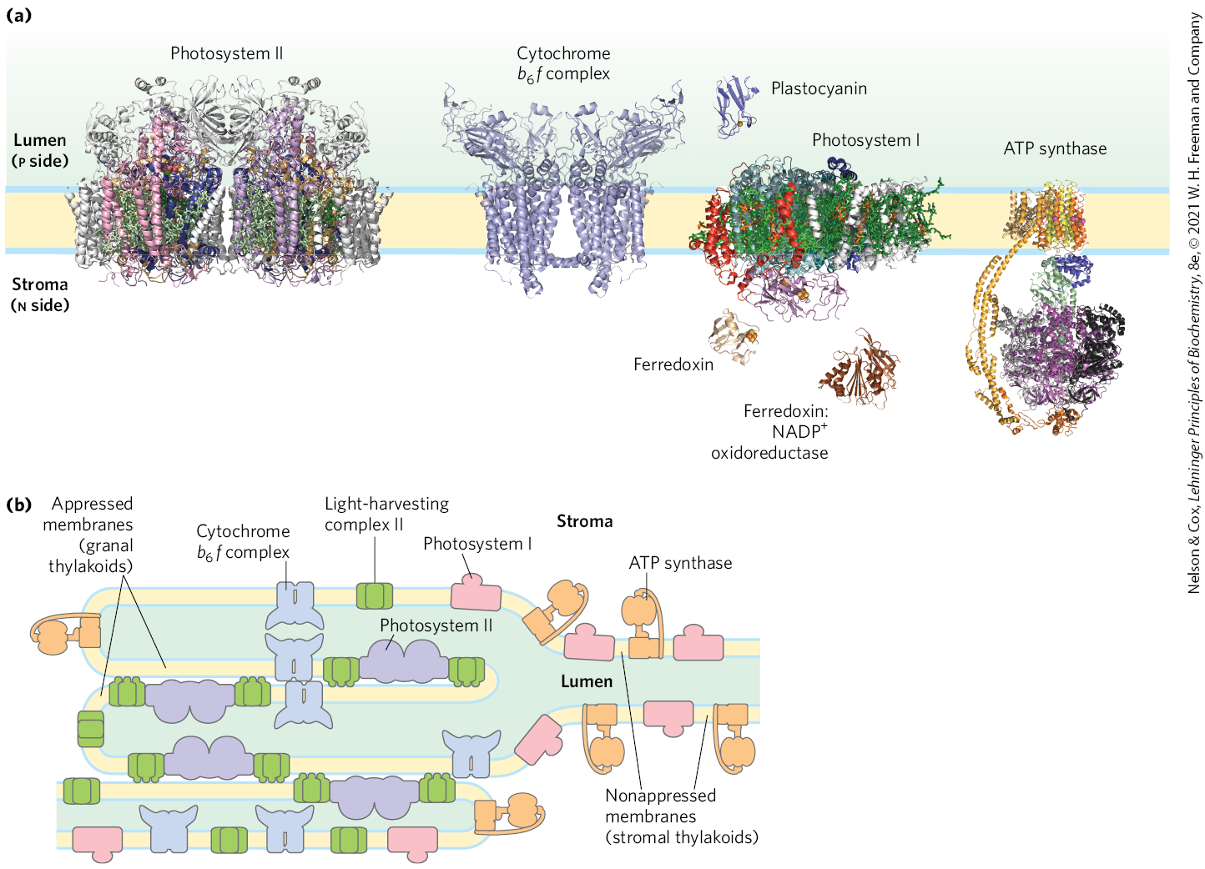
Localization of PSI and PSII in Thylakoid Membranes

Slide 64
Principle 2 (5 of 5)
Photosynthetic organisms use tightly organized light-harvesting complexes to absorb sunlight and capture its energy in chemical form: a separation of positive and negative charge leading to electron flow. The energy from an absorbed photon moves from one antenna chlorophyll to another and another until it arrives at the reaction center, where it promotes the photochemical reaction that sends electrons through a series of electron carriers.

Slide 65
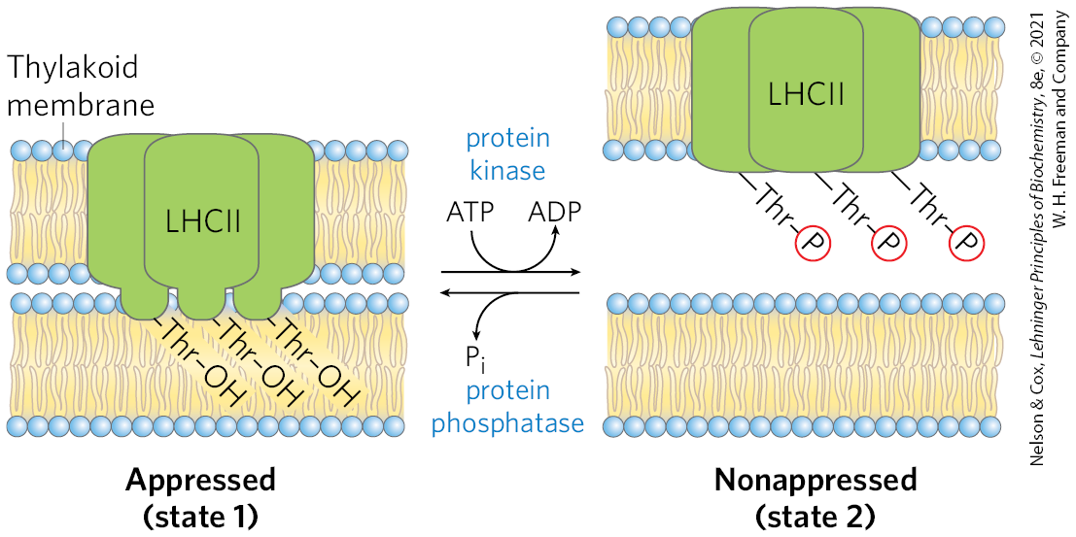
State Transitions
state transitions = mechanism that adjusts the distribution of LHCII between PSI and PSII
  accumulation of PQH₂ activates a protein kinase
  phosphorylated LHCII captures excitons for PSI to reverse the imbalance between electron flow in PSI and PSII

Slide 66
Principle 3 (6 of 7)
The light-driven flow of electrons through specialized protein carriers is coupled to ATP synthesis. A strong reducing agent (NADPH) is also produced, and simultaneously, water is oxidized to O₂, which is released into the atmosphere.

Slide 67
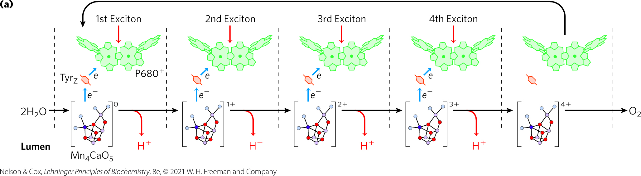
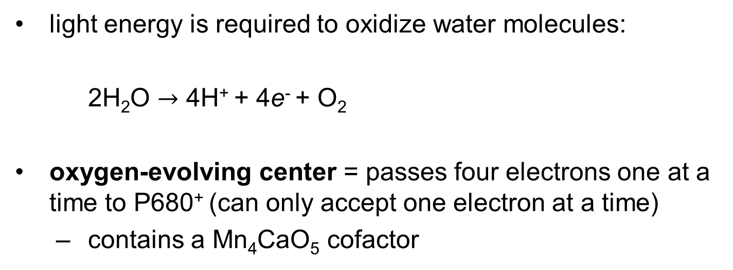
Water Is Split at the Oxygen-Evolving Center
light energy is required to oxidize water molecules:
2H₂O $→$ 4H⁺ + 4e⁻ + O₂
oxygen-evolving center = passes four electrons one at a time to P680⁺ (can only accept one electron at a time)
  contains a Mn₄CaO₅ cofactor

Slide 68
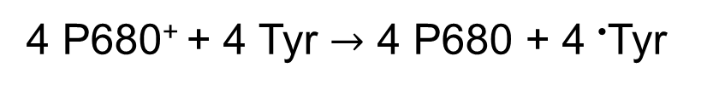
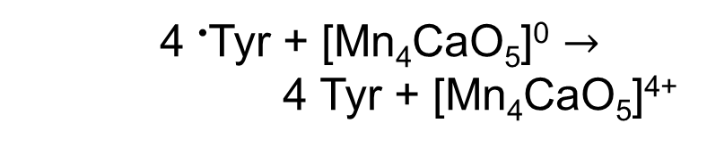
A Tyr Residue is the Immediate Electron Donor to P680⁺
Tyr loses an electron and a proton to generate a free radical:
4 P680⁺ + 4 Tyr $→$ 4 P680 + 4 •Tyr
(20-2)
the Tyr radical oxidizes the Mn₄CaO₅ cofactor in the oxygen-evolving center:
    4 •Tyr + [Mn₄CaO₅]⁰ $→$
    4 Tyr + [Mn₄CaO₅]⁴⁺
(20-3)

Slide 69

The Mn₄CaO₅ Cofactor Can Take Four Electrons from Two Water Molecules
the charged cofactor takes four electrons from a pair of water molecules:
    [Mn₄CaO₅]⁴⁺ + 2H₂O $→$
    [Mn₄CaO₅]⁰ + 4H⁺ + O₂
(20-4)

Slide 70
Principle 4 (2 of 4)
Evolution yielded a universal mechanism for coupling ATP synthesis to the flow of electrons. A proton gradient created by electron flow is used to energize the ATP-synthesizing enzyme in microorganisms, animals, and plants.

Slide 71
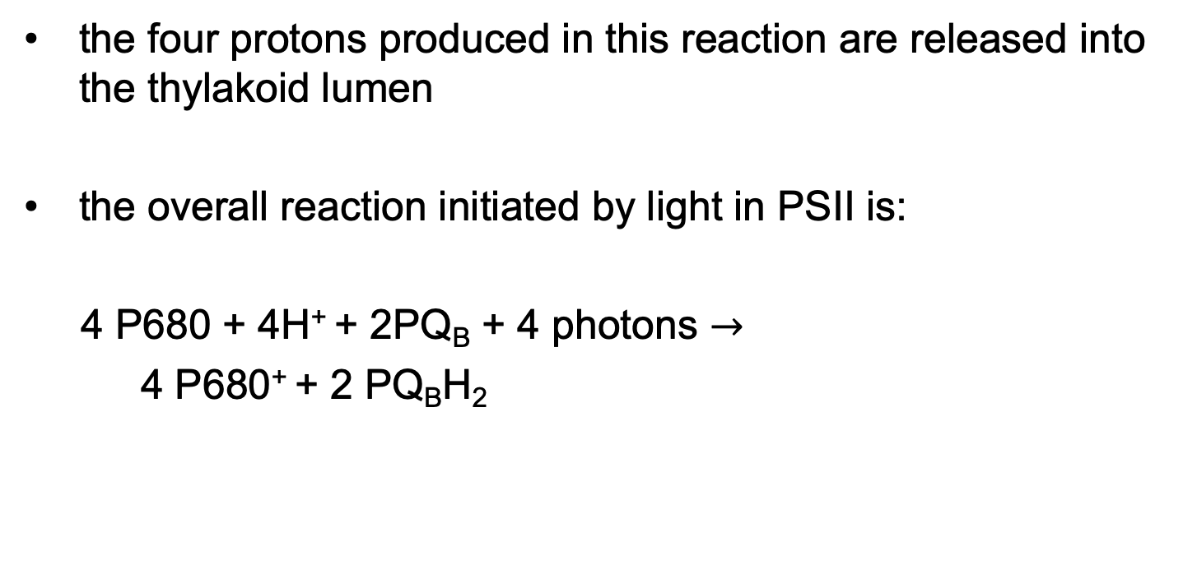
The Oxygen-Evolving Center Acts As a Proton Pump Driven By Electron Transfer
the four protons produced in this reaction are released into the thylakoid lumen
the overall reaction initiated by light in PSII is:
4 P680 + 4H⁺ + 2PQ_{B} + 4 photons $→$
4 P680⁺ + 2 PQ_{B}H₂
(20-1)

Slide 72

The Overall Reaction of Water Splitting and Electron Transfer in PSII
the overall reaction is:
2H₂O + 2PQ_{B} + 4 photons $→$
O₂ + 2PQ_{B}H₂
(20-5)

Slide 73
Principle 3 (7 of 7)
The light-driven flow of electrons through specialized protein carriers is coupled to ATP synthesis. A strong reducing agent (NADPH) is also produced, and simultaneously, water is oxidized to O₂, which is released into the atmosphere.

Slide 74
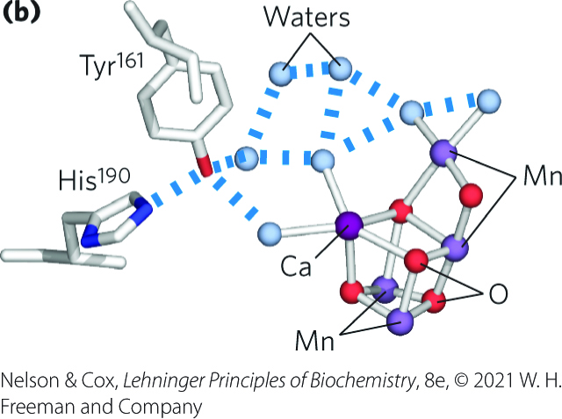
The Structure of the Oxygen-Evolving Cofactor
takes the shape of a chair
stabilized by several peripheral membrane proteins on the lumenal side of the thylakoid membrane
mechanism of water oxidation by the cofactor is unknown

Slide 75
20.3 Evolution of a Universal Mechanism of ATP Synthesis

Slide 76
Principle 4 (3 of 4)
Evolution yielded a universal mechanism for coupling ATP synthesis to the flow of electrons. A proton gradient created by electron flow is used to energize the ATP-synthesizing enzyme in microorganisms, animals, and plants.

Slide 77
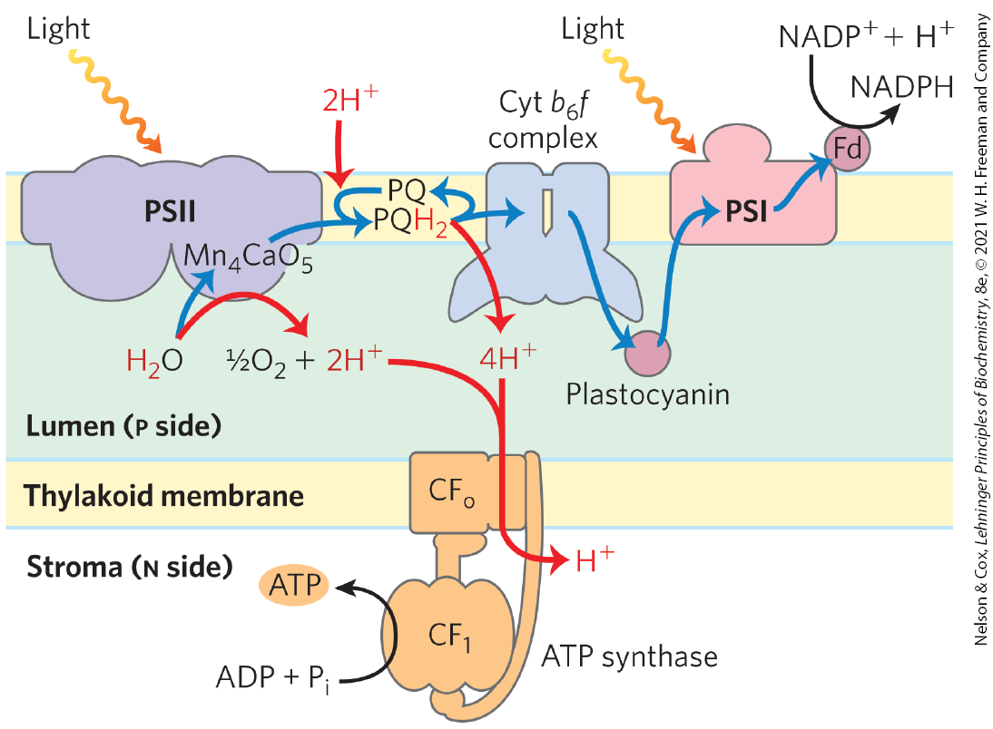
A Proton Gradient Couples Electron Flow and Phosphorylation
photoinduced electron flow results in the net movement of protons across the membrane, from the stromal side to the thylakoid lumen

Slide 78
The Approximate Stoichiometry of Photophosphorylation Has
Been Established
~12 protons move from the stroma into the thylakoid lumen per 4 electrons passed
in illuminated chloroplasts, the energy stored in the proton gradient per mole of protons is:
∆G = 2.3RT ∆pH + ZF ∆ψ = −17 kJ/mol
experimental measurements show eight photons drive the production of one O₂, yielding ~3 ATP molecules

Slide 79

The Overall Reaction for Linear Photophosphorylation
the overall reaction is:
2H₂O + 8 photons + 2NADP⁺ + ~3ADP⁺ + ~3P_{i} $→$
O₂ + ~3ATP + 2NADPH
(20-6)

Slide 80
The ATP Synthase Structure and Mechanism Are Nearly Universal
CF_{o}CF₁ complex = enzyme responsible for ATP synthesis in chloroplasts
  CF_{o} = transmembrane proton pore that is homologous to mitochondria F_{o}
  CF₁ = peripheral membrane protein complex similar to mitochondrial F₁

Slide 81
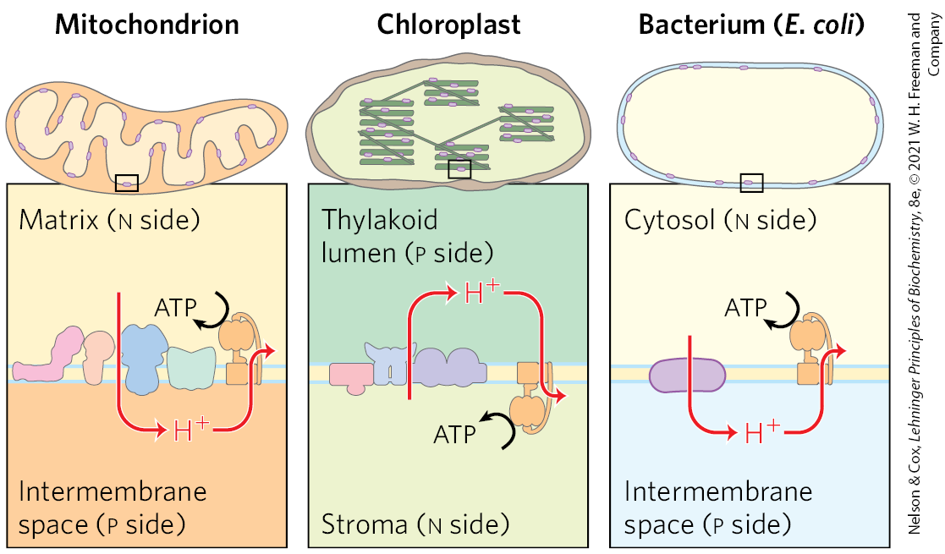
Orientation of ATP Synthase is Fixed Relative to the Proton Gradient

Slide 82
Principle 4 (4 of 4)
Evolution yielded a universal mechanism for coupling ATP synthesis to the flow of electrons. A proton gradient created by electron flow is used to energize the ATP-synthesizing enzyme in microorganisms, animals, and plants.

Slide 83
The Mechanism of Chloroplast ATP Synthase
essentially identical to its mitochondrial analog:
  ADP and P_{i} condense to form ATP on the enzyme surface
  release of enzyme-bound ATP requires a proton-motive force
  rotational catalysis sequentially engages each of the three β subunits of the ATP synthase in ATP synthesis, ATP release, and ADP + P_{i} binding

Slide 84
The Appearance of Oxygenic Photosynthesis
cyanobacteria appeared on Earth ~2.5 billion years ago.
  acquired two photosystems that operated in tandem: one of Type II and one of Type I
  had water-splitting activity that released oxygen into the atmosphere

Slide 85
Photosynthetic Microorganisms Can Acquire Electrons From Other Donors
many photosynthetic microorganisms obtain electrons for photosynthesis from donors such as H₂S or lactate
  forms an oxidized product, such as elemental sulfur or pyruvate

Slide 86
The Equation of Photosynthesis in its General Form
the general form of photosynthesis is:

Slide 87
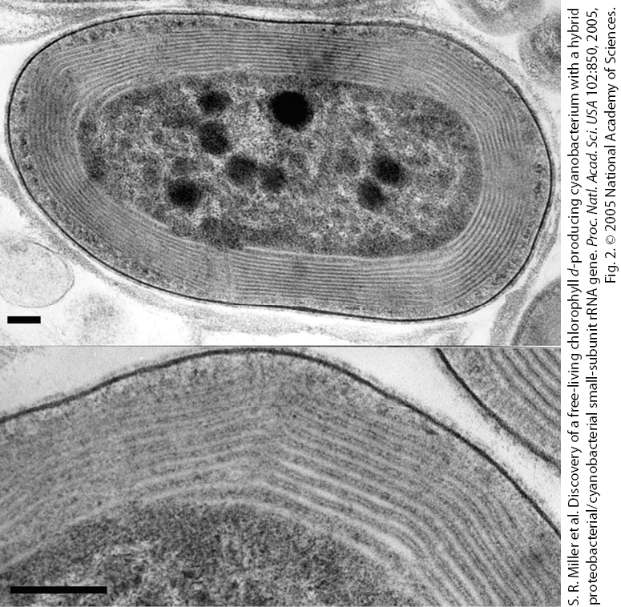
Modern Cyanobacteria
can synthesize ATP by oxidative phosphorylation or by photophosphorylation
do not have mitochondria or chloroplasts

Slide 88
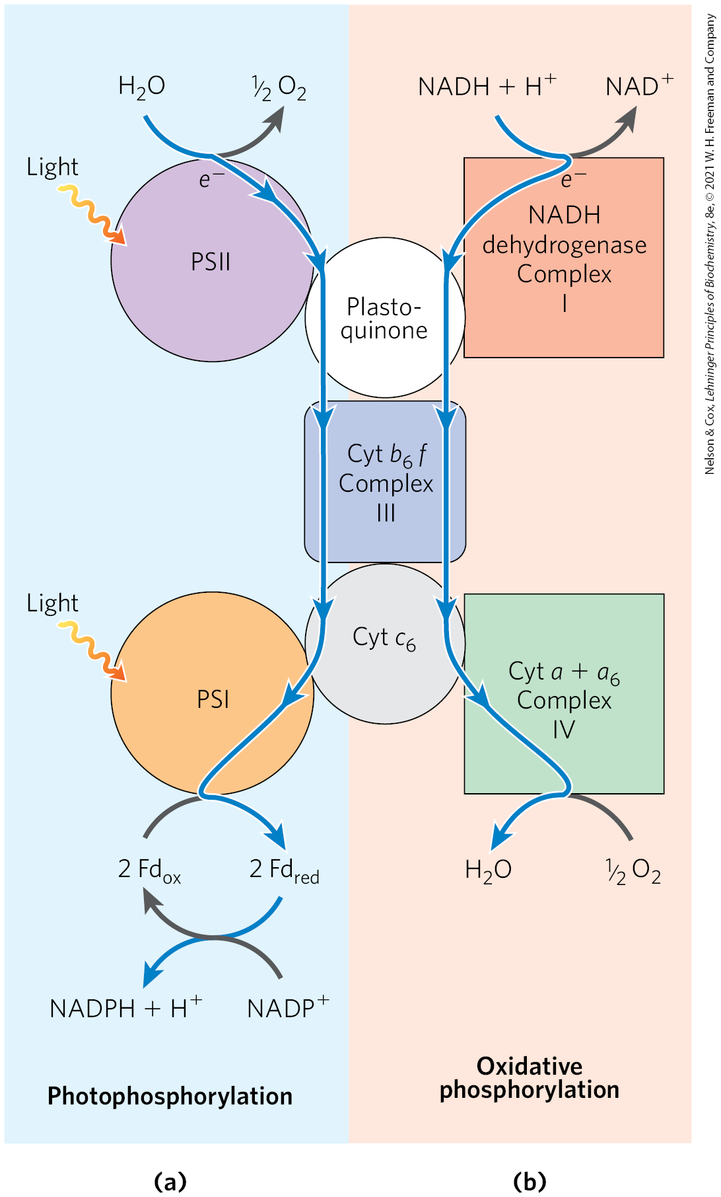
Dual Roles of Cytochrome b₆f and Cytochrome c₆
functional homology between:
  cyanobacterial cytochrome b₆f complex and the mitochondrial cytochrome bc1 complex
  cyanobacterial cytochrome c₆ and plant plastocyanin
gives evidence that the processes have a common evolutionary origin

Slide 89
20.4 CO₂-Assimilation Reactions

Slide 90
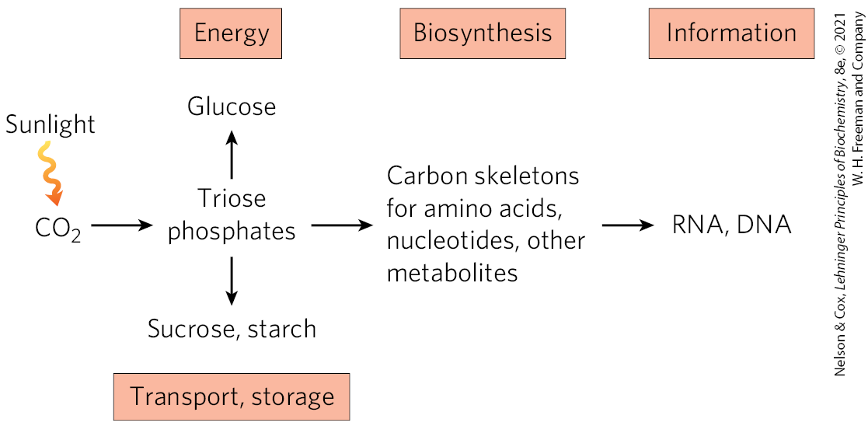
Products of Photosynthesis
photosynthetic organisms use ATP and NADPH to reduce atmospheric CO₂ to trioses

Slide 91
CO₂ Assimilation and CO₂ Fixation
CO₂ assimilation = the process of converting CO₂ to simple (reduced) organic compounds
  via a cyclic pathway called the Calvin cycle (reductive pentose phosphate pathway)
CO₂ fixation = the process of incorporating (fixing) CO₂ into the triose phosphate 3-phosphoglycerate

Slide 92
Principle 5 (3 of 15)
The ATP and NADPH produced in the light- dependent reactions of photosynthesis provide the energy and the reducing power to convert atmospheric CO₂ into simple organic compounds. High concentrations of ATP and NADPH allow the chloroplast to carry out redox reactions that are thermodynamically unfavorable.

Slide 93
Carbohydrate Metabolism is More Complex in Plant Cells
plants have the following:
  glycolysis pathway
  gluconeogenesis pathway
  the pentose phosphate pathway
  pathways for the reduction of CO₂ to triose phosphates and the associated reductive pentose phosphate pathway

Slide 94
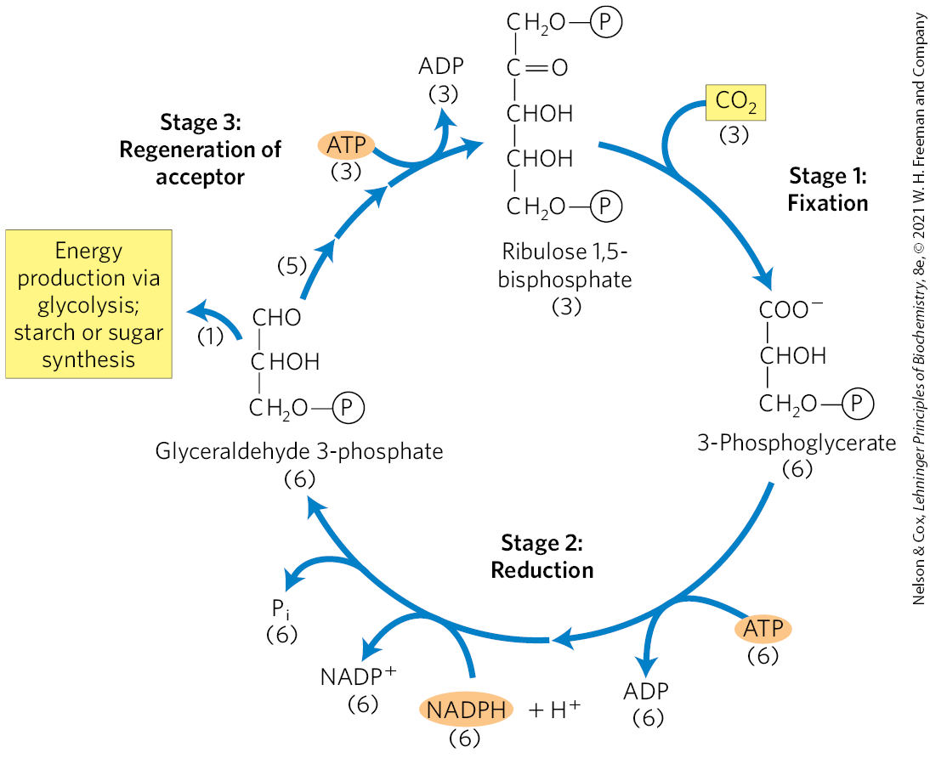
Carbon Dioxide Assimilation Occurs in Three Stages
occurs in the stroma of chloroplasts

Slide 95
Principle 5 (4 of 15)
The ATP and NADPH produced in the light- dependent reactions of photosynthesis provide the energy and the reducing power to convert atmospheric CO₂ into simple organic compounds. High concentrations of ATP and NADPH allow the chloroplast to carry out redox reactions that are thermodynamically unfavorable.

Slide 96
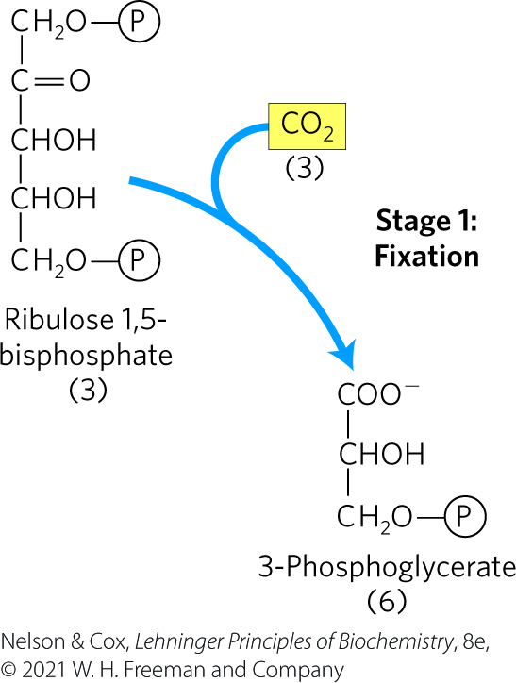
Stage 1 of Carbon Dioxide Assimilation
CO₂ condenses with a five-carbon acceptor, ribulose 1,5-bisphosphate, to form two molecules of 3-phosphoglycerate
  a total of six molecules of 3-phosphoglycerate are formed

Slide 97
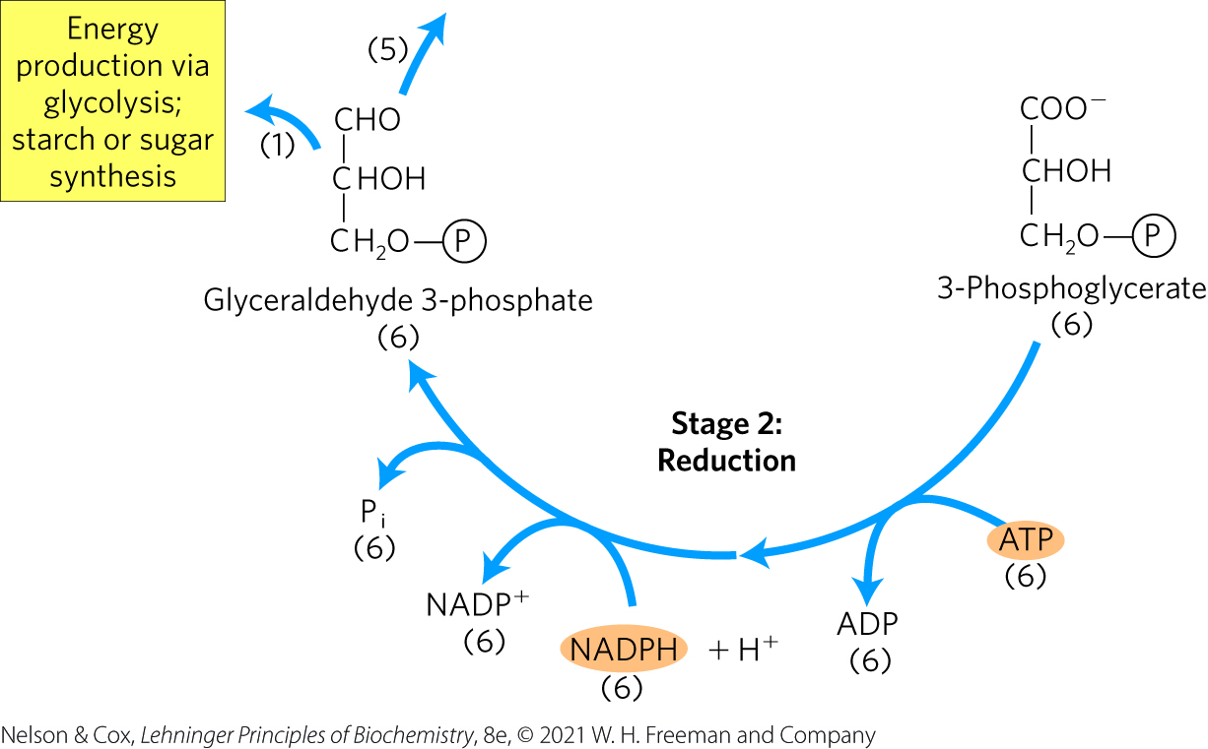
Stage 2 of Carbon Dioxide Assimilation
3-phosphoglycerate is reduced to triose phosphates
  a total of six molecules of triose phosphates are formed

Slide 98
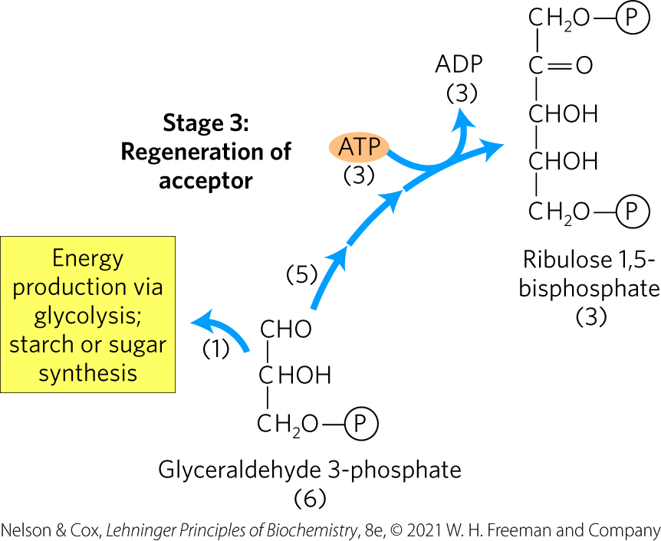
Stage 3 of Carbon Dioxide Assimilation
five of the six molecules of triose phosphate are used to regenerate three molecules of ribulose 1,5-bisphosphate
the sixth triose phosphate is the net product of photosynthesis

Slide 99
Stage 1: Fixation of CO₂ into 3-Phosphoglycerate
C₃ plants = plants in which the three-carbon compound 3-phosphoglycerate is the first intermediate in photosynthesis
  trees, wheat, oats, rice, beans, peas, and spinach
ribulose 1,5-bisphosphate carboxylase/oxygenase (rubisco) = catalyzes the incorporation of tCO₂ into an organic form

Slide 100
Principle 5 (5 of 15)
The ATP and NADPH produced in the light- dependent reactions of photosynthesis provide the energy and the reducing power to convert atmospheric CO₂ into simple organic compounds. High concentrations of ATP and NADPH allow the chloroplast to carry out redox reactions that are thermodynamically unfavorable.

Slide 101
Rubisco
rubisco catalyzes:
  the covalent attachment of CO₂ to ribulose 1,5-bisphosphate
  the cleavage of the unstable six-carbon intermediate to form two molecules of 3-phosphoglycerate

Slide 102
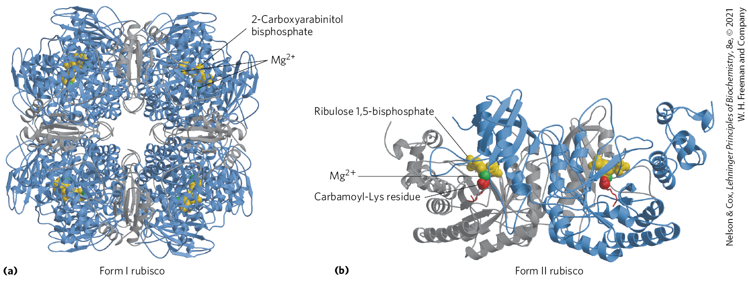
Form I and Form II Rubisco
Form I = enzyme of vascular plants, algae, and cyanobacteria
  present in high concentrations due to its low turnover number
Form II = enzyme of photosynthetic bacteria

Slide 103
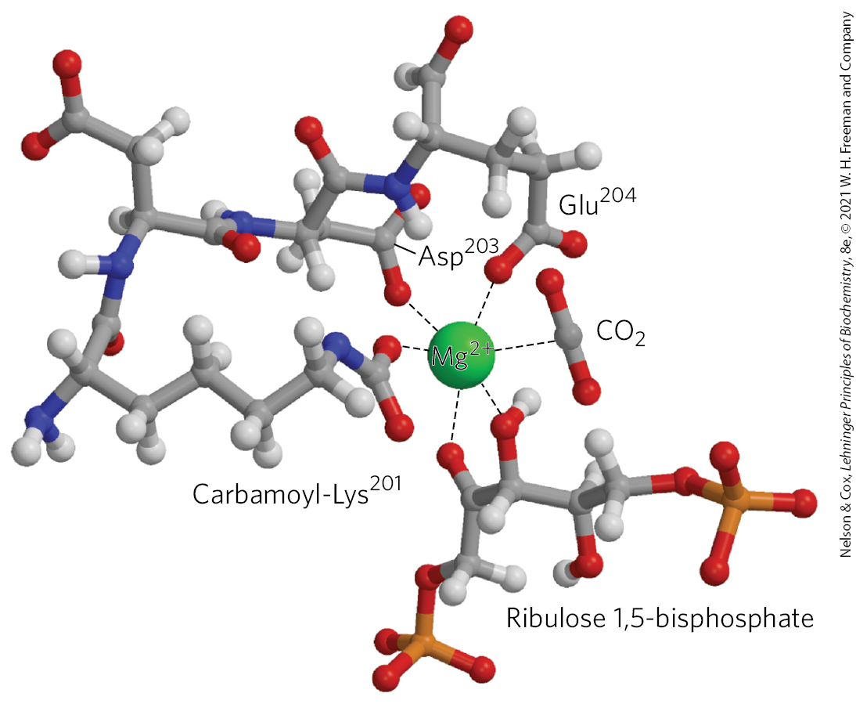
Central Role of Mg²⁺ in the Active Site of Rubisco
a carbamoylated Lys side chain has a bound Mg²⁺ ion
  the Mg²⁺ ion brings together and orients the reactants at the active site

Slide 104
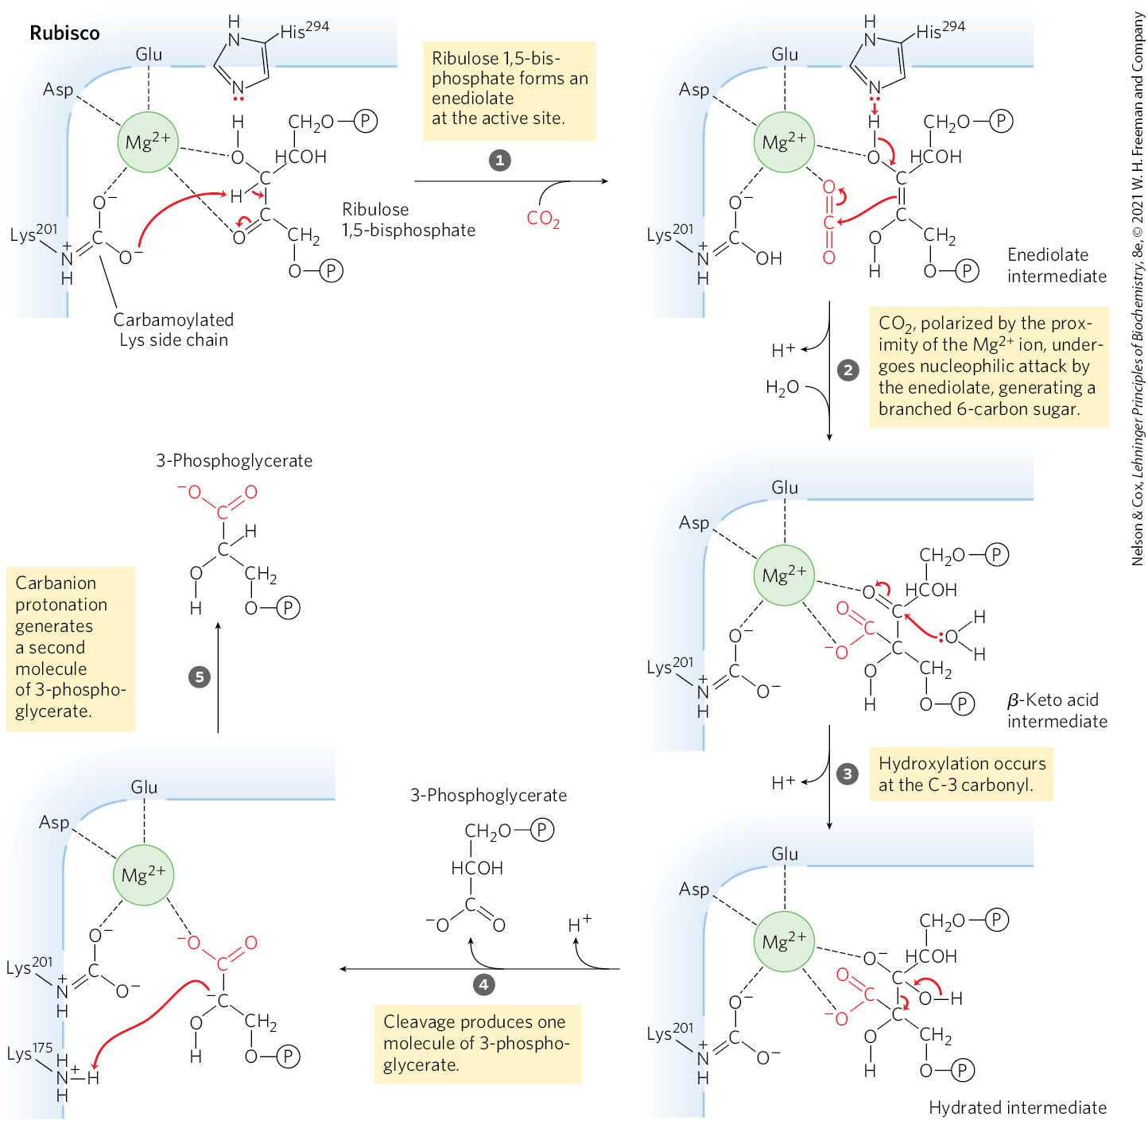
First Stage of CO₂ Assimilation

Slide 105
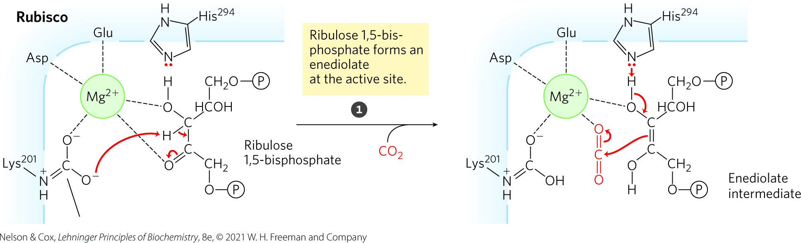
Step 1: Creation of an Enediolate Intermediate
Mg²⁺ facilitates the interaction of carbamoylated Lys to ribulose 1,5-bisphosphate

Slide 106

Step 2: Nucleophilic Attack to Create a β-Keto Acid Intermediate
Mg²⁺ polarizes CO₂ to accept nucleophilic attack by the enediolate

Slide 107

Step 3: Hydroxylation at C-3
hydroxylation occurs at C-3 of the β-keto acid intermediate

Slide 108

Step 4: Cleavage to Yield the First 3-Phosphoglycerate
cleavage of the hydrated intermediate produces one molecule of 3-phosphoglycerate

Slide 109

Step 5: Protonation and Release of a Second 3-Phosphoglycerate
deprotonation of Lys¹⁷⁵ resets the active site

Slide 110

Role of Rubisco Activase
rubisco is inactive until carbamoylated on the ε-amino group of Lys²⁰¹
rubisco activase = promotes ATP-dependent release of ribulose 1,5-bisphosphate
  exposes Lys²⁰¹ to nonenzymatic carbamoylation

Slide 111
Stage 2: Conversion of 3-Phosphoglycerate to Glyceraldehyde 3-Phosphate
stromal 3-phosphoglycerate kinase = catalyzes the transfer of a phosphoryl group from ATP to 3-phosphoglycerate, yielding 1,3-bisphosphoglycerate
glyceraldehyde 3-phosphate dehydrogenase = catalyzes a reduction between NADPH and 1,3-bisphosphoglycerate, producing glyceraldehyde 3-phosphate and P_{i}

Slide 112
Triose Phosphate Isomerase and Aldolase
triose phosphate isomerase = interconverts glyceraldehyde 3-phosphate and dihydroxyacetone phosphate
aldolase = condenses glyceraldehyde 3-phosphate and dihydroxyacetone phosphate into fructose 1,6-bisphosphate

Slide 113
Stage 3: Regeneration of Ribulose 1,5-Bisphosphate from Triose Phosphates
stromal enzymes rearrange the carbon skeletons of triose phosphates to generate intermediates
the pentose phosphates are converted to ribulose 5-phosphate, which is phosphorylated to ribulose 1,5-bisphosphate to complete the Calvin cycle

Slide 114

Third Stage of CO₂ Assimilation
three exergonic reactions make the whole process irreversible
  fructose 1,6-bisphosphatase
  sedoheptulose 1,7-bisphosphatase
  ribulose 5-phosphate kinase

Slide 115
Principle 5 (6 of 15)
The ATP and NADPH produced in the light- dependent reactions of photosynthesis provide the energy and the reducing power to convert atmospheric CO₂ into simple organic compounds. High concentrations of ATP and NADPH allow the chloroplast to carry out redox reactions that are thermodynamically unfavorable.

Slide 116

Synthesis of Each Triose Phosphate from CO₂ Requires Six NADPH and Nine ATP
fixation of three CO₂ yields one glyceraldehyde 3-phosphate for anabolic processes
ATP and NADPH are provided by the light-dependent reactions of photosynthesis

Slide 117

A Transport System Exports Triose Phosphates from the Chloroplast and Imports Phosphate
unlike starch, sucrose is made in the cytosol
the inner chloroplast membrane is impermeable to phosphorylated compounds

Slide 118

Role of the Antiporter in the Transport of ATP and Reducing Equivalents
oxidation of dihydroxyacetone phosphate in the cytosol generates ATP and NADH
  moves ATP and reducing equivalents from the chloroplast to the cytosol

Slide 119

Four Enzymes of the Calvin Cycle Are Indirectly Activated by Light
when chloroplasts are illuminated:
  concentrations of ATP and NADPH increase
  stromal pH increases
  stromal [Mg²⁺] increase

Slide 120
Principle 5 (7 of 15)
The ATP and NADPH produced in the light- dependent reactions of photosynthesis provide the energy and the reducing power to convert atmospheric CO₂ into simple organic compounds. High concentrations of ATP and NADPH allow the chloroplast to carry out redox reactions that are thermodynamically unfavorable.

Slide 121

Some Stromal Enzymes Are More Active in an Alkaline Environment and at High [Mg²⁺]
fructose 1,6-bisphosphatase activity increases more than 100-fold when pH and [Mg²⁺] rise

Slide 122
Principle 5 (8 of 15)
The ATP and NADPH produced in the light- dependent reactions of photosynthesis provide the energy and the reducing power to convert atmospheric CO₂ into simple organic compounds. High concentrations of ATP and NADPH allow the chloroplast to carry out redox reactions that are thermodynamically unfavorable.

Slide 123
Light-Driven Reduction of Disulfide Bonds Activates Enzymes
enzymes are activated by light-driven reduction of disulfide bonds between critical Cys residues:
  ribulose 5-phosphate kinase
  fructose 1,6-bisphosphatase
  sedoheptulose 1,7-bisphosphatase
  glyceraldehyde 3-phosphate dehydrogenase
enzymes are inactive in the dark so that hexose synthesis does not compete with glycolysis

Slide 124

Light Activation of Several Enzymes of the Calvin Cycle
ferredoxin:thioredoxin reductase = catalyzes the reaction that passes electrons from ferredoxin to thioredoxin
  reduced thioredoxin donates electrons for the reduction of the disulfide bonds of the light-activated enzymes

Slide 125
20.5 Photorespiration and the C₄ and CAM Pathways

Slide 126
Processes that Produce CO₂
mitochondrial respiration = the oxidation of substrates to CO₂ and the conversion of O₂ to H₂O
  occurs in the dark
photorespiration = a costly side reaction of photosynthesis that consumes O₂ and produces CO₂
  driven by light
  results from the lack of specificity of rubisco

Slide 127
Principle 5 (9 of 15)
The ATP and NADPH produced in the light- dependent reactions of photosynthesis provide the energy and the reducing power to convert atmospheric CO₂ into simple organic compounds. High concentrations of ATP and NADPH allow the chloroplast to carry out redox reactions that are thermodynamically unfavorable.

Slide 128

Photorespiration Results from Rubisco’s Oxygenase Activity
rubisco is not specific for CO₂ as its substrate
  ~1 in every 3 or 4 turns, O₂ binds
2-phosphoglycolate = a metabolically unneeded product resulting from rubisco using O₂ as its substrate
  carbons must be salvaged

Slide 129

Phosphoglycolate Is Salvaged in a Costly Set of Reactions in C₃ Plants
glycolate pathway = converts two molecules of 2-phosphoglycolate to a molecule of serine and a molecule of CO₂
  ATP- and O₂-consuming process
  results in loss of carbon as CO₂ by mitochondrial decarboxylation of glycine

Slide 130

Glycine Decarboxylase Complex
glycine decarboxylase complex = catalyzes oxidative decarboxylation of glycine in the mitochondrial matrix
  makes up 50% of all proteins in the mitochondrial matrix in photosynthetic parts of some plants

Slide 131
Serine Hydroxymethyltransferase
serine hydroxymethyltransferase = transfers the one-carbon unit from the glycine decarboxylase complex reaction from tetrahydrofolate to glycine, yielding serine

Slide 132

The Net Reaction Catalyzed by the Glycine Decarboxylase Complex and Serine Hydroxymethyltransferase
the net reaction is:
2 glycine + NAD⁺ + H₂O $⟶$
serine + CO₂ + NH₃ + NADH + H⁺

Slide 133
Principle 5 (10 of 15)
The ATP and NADPH produced in the light- dependent reactions of photosynthesis provide the energy and the reducing power to convert atmospheric CO₂ into simple organic compounds. High concentrations of ATP and NADPH allow the chloroplast to carry out redox reactions that are thermodynamically unfavorable.

Slide 134
The Process of Photorespiration
photorespiration = the combined activity of the rubisco oxygenase and the glycolate salvage pathway
  consumes O₂
  produces CO₂
  does not conserve energy
  inhibits net biomass formation

Slide 135
In C₄ Plants, CO₂ Fixation and Rubisco Activity Are Spatially Separated
C₄ plants = plants that utilize a CO₂-assimilation process to minimize photorespiration
  tropical plants and crops that grow at high light intensity and high temperatures
C₄ pathway = the CO₂-assimilation process

Slide 136


CO₂ Assimilation in C₄ Plants

Slide 137

Phosphoenolpyruvate (PEP) Carboxylase Fixes CO₂
phosphoenolpyruvate (PEP) carboxylase = catalyzes the fixation of CO₂ (as HCO₃⁻) into oxaloacetate in the cytosol of leaf mesophyll cells

Slide 138

Reduction or Transamination of Oxaloacetate
oxaloacetate undergoes either:
  reduction to malate by malate dehydrogenase in a reaction that requires NADPH
  transamination to aspartate

Slide 139

Oxidation and Decarboxylation of Malate
malate passes through plasmodesmata into neighboring bundle-sheath cells
malic enzyme = catalyzes the oxidation and decarboxylation of malate to yield pyruvate and CO₂
  reduces NADP⁺ to NADPH

Slide 140
Transamination of Aspartate
aspartate passes through plasmodesmata into neighboring bundle-sheath cells
aspartate is transaminated to form oxaloacetate and reduced to malate
CO₂ is released by malic enzyme or PEP carboxykinase

Slide 141

Rubisco Fixes CO₂ as in C₃ Plants
rubisco incorporates CO₂ into C-1 of 3-phosphoglycerate

Slide 142

Pyruvate Phosphate Dikinase
pyruvate is transferred back to the mesophyll cells
pyruvate phosphate dikinase = catalyzes the conversion of pyruvate to PEP

Slide 143
Principle 5 (11 of 15)
The ATP and NADPH produced in the light- dependent reactions of photosynthesis provide the energy and the reducing power to convert atmospheric CO₂ into simple organic compounds. High concentrations of ATP and NADPH allow the chloroplast to carry out redox reactions that are thermodynamically unfavorable.

Slide 144
High Concentrations of CO₂ Are Released From Malate
release of CO₂ from malate in the bundle-sheath cells yields a sufficiently high local concentration of CO₂
  allows rubisco to function near its maximal rate
  suppresses rubisco’s oxygenase activity

Slide 145
Principle 5 (12 of 15)
The ATP and NADPH produced in the light- dependent reactions of photosynthesis provide the energy and the reducing power to convert atmospheric CO₂ into simple organic compounds. High concentrations of ATP and NADPH allow the chloroplast to carry out redox reactions that are thermodynamically unfavorable.

Slide 146
Energy Cost of CO₂ Assimilation
C₄ plants need five ATP molecules to assimilate one molecule of CO₂
C₃ plants need three ATP molecules

Slide 147
In CAM Plants, CO₂ Capture and Rubisco Action Are Temporally Separated
CAM plants = plants that fix CO₂ into malate in the dark and store it in vacuoles until daylight, when the stored malate serves as a source of CO₂ for rubisco
  succulents such as cactus and pineapple
  reduces loss of water vapor through stomata

Slide 148
Comparison of C₃, C₄, and
CAM Plants
Table 20-1 Comparison of C₃, C₄, and CAM Plants
 | C₃ Plants | C₄ Plants | CAM Plants
Examples | Spinach, pea, rice, wheat, beans, most trees | Maize (corn), sugarcane, crabgrass | Cactus, prickly pear, orchid, pineapple
Most efficient environment | 15 to 25 °C | Hot and dry; 30 to 47 °C | Extremely dry; 35 °C
Path of CO₂ fixation | C₃ photosynthesis only | Sequential C₄ and C₃ cycles spatially separated: C₄ in mesophyll cells followed by C₃ in bundle-sheath cells | C₃ and C₄ cycles, separated spatially and temporally
Cell type involved | Mesophyll cells | C₄ in mesophyll cells, C₃ in bundle-sheath cells | C₃ and C₄ in the same mesophyll cells
Light conditions | Light | Light | C₃ in light; C₄ in in dark
Initial CO₂ acceptor | Ribulose 1,5-bisphosphate | Phosphoenolpyruvate | Ribulose 1,5-bisphosphate in light; phosphoenolpyruvate in dark
CO₂-fixing enzyme | Rubisco | PEP carboxylase, then rubisco | Rubisco in light; PEP carboxylase at night
First stable product of CO₂ fixation | 3-Phosphoglycerate | Oxaloacetate in C₄ cycle | 3-Phosphoglycerate in light; oxaloacetate in dark
Energy needed for complete reduction of one molecule of CO₂ | 3 ATP, 2 NADPH | 5 ATP, 2 NADPH | 6.5 ATP, 2 NADPH
Photorespiration | Present | Absent or suppressed | Absent or suppressed

Slide 149
20.6 Biosynthesis of Starch, Sucrose, and Cellulose

Slide 150
Principle 5 (13 of 15)
The ATP and NADPH produced in the light- dependent reactions of photosynthesis provide the energy and the reducing power to convert atmospheric CO₂ into simple organic compounds. High concentrations of ATP and NADPH allow the chloroplast to carry out redox reactions that are thermodynamically unfavorable.

Slide 151
The Fate of Excess Carbohydrate
during active photosynthesis, plant leaves produce more carbohydrate than needed
excess carbohydrate is converted to sucrose and transported to other parts of the plant
  used as fuel or stored (as starch or sucrose)

Slide 152
ADP-Glucose Is the Substrate for Starch Synthesis in Plant Plastids and for Glycogen Synthesis in Bacteria
starch = a high molecular weight polymer of D-glucose
condensation of glucose 1-phosphate with ATP yields an activated sugar nucleotide (ADP-glucose)
starch synthase = transfers glucose residues from ADP-glucose to preexisting starch molecules

Slide 153

The Overall Reaction for Starch Formation from Glucose 1-Phosphate
the overall reaction is:
starch_{n} + glucose 1-phosphate + ATP $⟶$
starch_{n+1} + ADP + 2P_{i}
∆G′° = −50 kJ/mol

Slide 154
UDP-Glucose Is the Substrate for Sucrose Synthesis in the Cytosol of Leaf Cells
sucrose is synthesized from UDP-glucose and fructose 6-phosphate, which are synthesized from triose phosphates in the plant cell cytosol

Slide 155

Sucrose Synthesis
sucrose 6-phosphate synthase = catalyzes the reaction of fructose 6-phosphate with UDP-glucose to form sucrose 6-phosphate

Slide 156
Principle 5 (14 of 15)
The ATP and NADPH produced in the light- dependent reactions of photosynthesis provide the energy and the reducing power to convert atmospheric CO₂ into simple organic compounds. High concentrations of ATP and NADPH allow the chloroplast to carry out redox reactions that are thermodynamically unfavorable.

Slide 157
Conversion of Triose Phosphates to Sucrose and Starch is Tightly Regulated
fructose 2,6-bisphosphate (F26BP) = regulates the partitioning of triose phosphates between sucrose synthesis and starch synthesis
  inhibits fructose 1,6-bisphosphatase (FBPase-1)
  stimulates PPi-dependent phosphofructokinase (PP-PFK-1)

Slide 158

Fructose 2,6-Bisphosphate As Regulator of Sucrose Synthesis
[F26BP] varies inversely with the rate of photosynthesis
F26BP inhibits the synthesis of fructose 6-phosphate (the precursor of sucrose)

Slide 159

Regulation of Sucrose
6-Phosphate Synthase

Slide 160

Regulation of
ADP-Glucose Pyrophosphorylase
ADP-glucose pyrophosphorylase = produces the precursor for starch synthesis

Slide 161

The Glyoxylate Cycle and Gluconeogenesis Produce Glucose in Germinating Seeds
glyoxysomes = specialized peroxisomes where acetyl-CoA is formed from triacylglycerols and the glyoxylate cycle occurs
glyoxylate cycle = converts acetate to succinate or another four-carbon intermediate of the citric acid cycle
2 acetyl-CoA + NAD⁺ + 2H₂O $⟶$
succinate + 2CoA + NADH + H⁺

Slide 162

The Glyoxylate Cycle
isocitrate lyase = catalyzes the cleavage of isocitrate to succinate and glyoxylate
malate synthase = catalyzes the condensation of glyoxylate with acetyl-CoA to yield malate
other enzymes are isozymes of the citric acid enzymes

Slide 163
The Glyoxylate Cycle Bypasses the Decarboxylation Reactions of the Citric Acid Cycle
the two decarboxylation steps of the citric acid cycle are bypassed
  allows for the net formation of succinate, oxaloacetate, and other cycle intermediates from acetyl-CoA

Slide 164

Succinate Enters the Citric
Acid Cycle
succinate passes into the mitochondrial matrix, where it is converted to oxaloacetate
oxaloacetate enters the cytosol, where it serves as starting material for gluconeogenesis and sucrose synthesis

Slide 165
Principle 5 (15 of 15)
The ATP and NADPH produced in the light- dependent reactions of photosynthesis provide the energy and the reducing power to convert atmospheric CO₂ into simple organic compounds. High concentrations of ATP and NADPH allow the chloroplast to carry out redox reactions that are thermodynamically unfavorable.

Slide 166


Cellulose Is Synthesized by Supramolecular Structures in the Plasma Membrane
cellulose = linear polymer of (β1$⟶$4)-linked D-glucose units
  must be synthesized from intracellular precursors but deposited and assembled outside the plasma membrane

Slide 167
Cellulose Synthase
cellulose synthase = catalyzes the assembly of cellulose chains
  has a glycosyl transferase activity in its cytoplasmic domain
  forms a transmembrane channel through which the growing cellulose chain is extruded

Slide 168

A Model for the Synthesis of Cellulose
Glucose units are transferred from UDP-glucose to the nonreducing end of the growing chain.

Slide 169

Pools of Common Intermediates Link Pathways in Different Organelles
metabolic pools = metabolic intermediates that are connected by readily reversible reactions

Slide 170

Movement of Sucrose Between Source and Sink Tissues

