Slide 1

12 Biochemical Signaling
© 2021 Macmillan Learning

Slide 2
Signal Transduction Is a Universal Property of Living Cells
signal transduction = the conversion of information into a chemical change
  signal represents information that is detected by specific receptors
  conversion of the signal to a cellular response always involves a chemical process

Slide 3

Principle 1 (1 of 5)
Cells respond to external signals through receptor-mediated processes that amplify the signal, integrate it with input from other receptors, transmit the signal to the appropriate effectors, and eventually end the response.

Slide 4

Principle 2 (1 of 4)
There is a high degree of evolutionary conservation of signaling proteins and transduction mechanisms across the animal phyla. At least a billion years of evolution have passed since the plant and animal branches of the eukaryotes diverged, which is reflected in the differences in signaling mechanisms used in the two kingdoms. We focus here on the animal kingdom.

Slide 5

Principle 3 (1 of 3)
In multicellular animals, GPCRs with seven transmembrane helices are the largest group of plasma membrane receptors. These G Protein–Coupled Receptors act through G proteins, which
are turned on when they bind guanosine triphosphate (GTP). Animals have hundreds of different GPCRs, each able to respond to a specific signal.

Slide 6

Principle 4 (1 of 5)
Plasma membrane receptors with an intracellular tyrosine kinase activity act through cascades of protein kinases to transduce signals about the metabolic state, including growth factors.

Slide 7

Principle 5 (1 of 6)
Phosphorylation of intrinsically disordered regions of signaling proteins acts as a switch, toggling enzyme activity or creating binding sites for other molecules. Signal responses are integrated by multiprotein signaling complexes with modular domains that bind phosphorylated Tyr, Ser, or Thr residues.

Slide 8

Principle 6 (1 of 5)
Ion channels gated by membrane potential or ligands are central to signaling in all cells, including bacteria, plants, and animals.

Slide 9

Principle 7 (1 of 2)
Some hormone signals act inside the cell, not at the plasma membrane, forming complexes with specific receptor proteins that regulate gene expression.

Slide 10

Principle 8 (1 of 2)
Cells receive extracellular signals that determine progress through the cell division cycle, or trigger cell death—processes regulated by phosphorylation and dephosphorylation of key regulatory proteins.

Slide 11

Principle 9 (1 of 6)
Defective signaling proteins or defective regulation of their synthesis and breakdown can disrupt cell cycle regulation and lead to tumor formation (cancer).

Slide 12
12.1 General Features of Signal Transduction

Slide 13
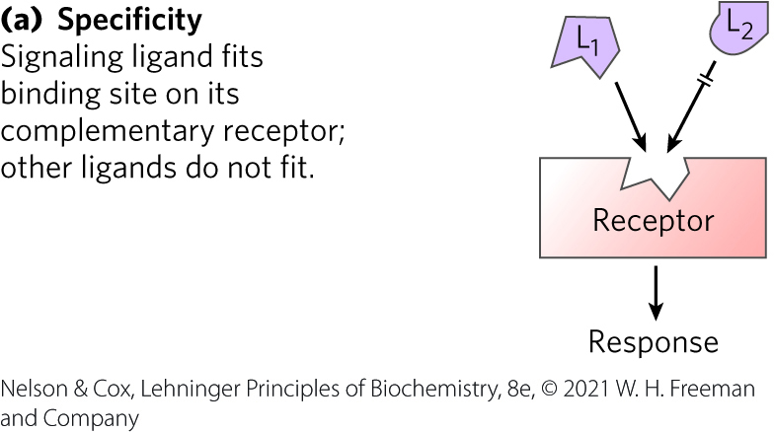
Signal Transductions Are Remarkably Specific
specificity = achieved by precise molecular complementarity between the signal and receptor molecules
  mediated by weak (noncovalent) forces

Slide 14
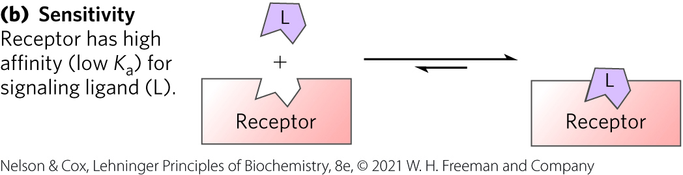
Signal-Transducing Systems Share Common Features
sensitivity = results from the high affinity of signal receptors for their ligands
  dissociation constant, K_{d}, is commonly < 10⁻⁷ M

Slide 15
Principle 1 (2 of 5)
Cells respond to external signals through receptor-mediated processes that amplify the signal, integrate it with input from other receptors, transmit the signal to the appropriate effectors, and eventually end the response.

Slide 16
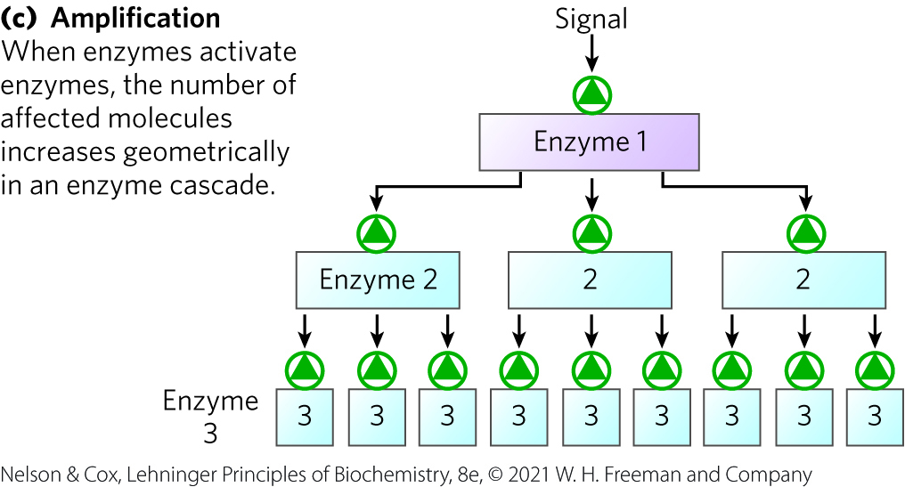
Amplification and Enzyme Cascades
amplification = results when an enzyme is activated by a signal receptor and, in turn, catalyzes the activation of many molecules of a second enzyme, and so on, in an enzyme cascade

Slide 17
Principle 5 (2 of 6)
Phosphorylation of intrinsically disordered regions of signaling proteins acts as a switch, toggling enzyme activity or creating binding sites for other molecules. Signal responses are integrated by multiprotein signaling complexes with modular domains that bind phosphorylated Tyr, Ser, or Thr residues.

Slide 18
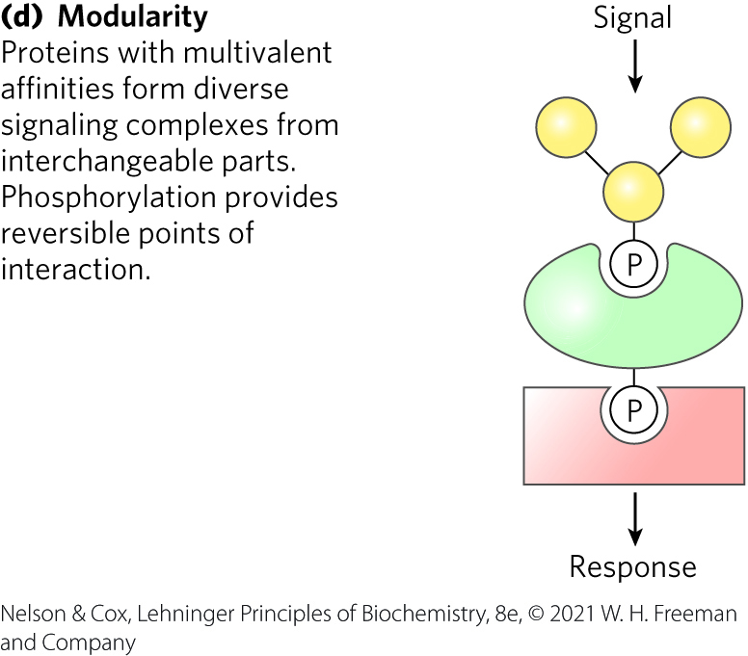
Interacting Signaling Proteins Are Modular
modular = has multiple domains that recognize specific features
  allows cells to mix and match a set of signaling molecules
scaffold proteins = nonenzymatic proteins that bring together enzymes that interact in cascades

Slide 19
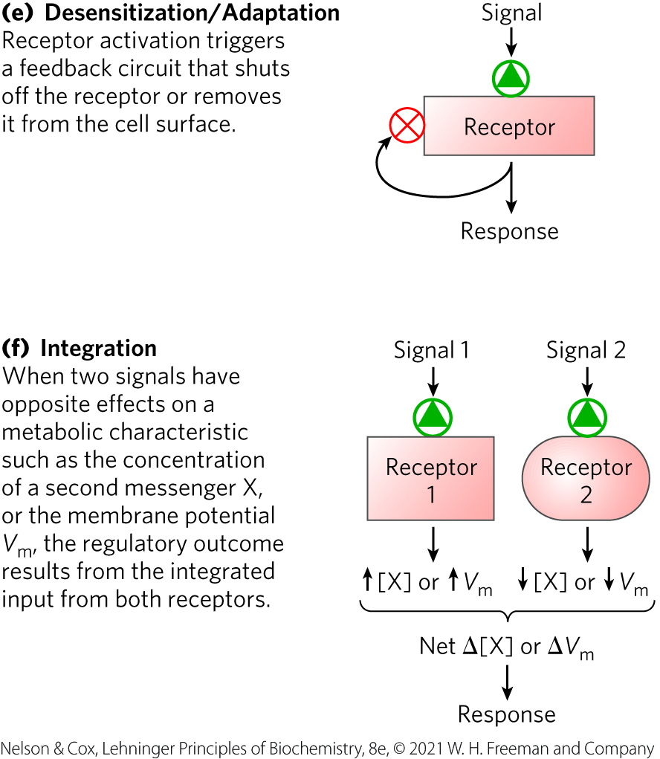
Desensitization and Integration of Receptor Systems
desensitized = no longer responsive to a signal
  occurs when a signal is present continuously
integration = the ability of the system to receive multiple signals and produce a unified response

Slide 20
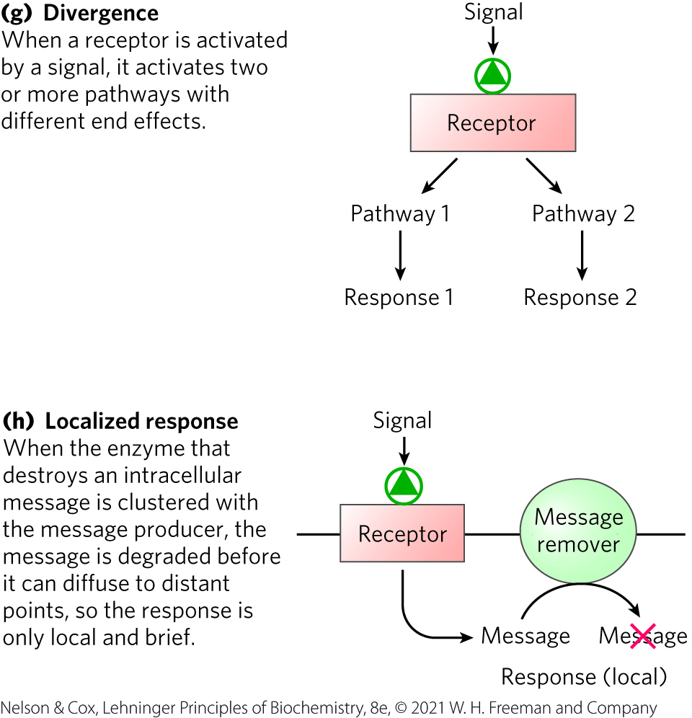
Signaling Pathways Are Often Divergent and Provide A Localized Response
divergent = branched rather than linear
  occurs when a signal is present continuously
response localization = cells confine signaling system components to a structure to regulate processes locally

Slide 21
Principle 5 (3 of 6)
Phosphorylation of intrinsically disordered regions of signaling proteins acts as a switch, toggling enzyme activity or creating binding sites for other molecules. Signal responses are integrated by multiprotein signaling complexes with modular domains that bind phosphorylated Tyr, Ser, or Thr residues.

Slide 22
Cells Respond to Thousands of Different Biological Signals
Table 12-1 Some Signals to Which Cells Respond
Antigens | Mechanical touch
Cell surface glycoproteins, oligosaccharides | Microbial, insect pathogens
Developmental signals | Neurotransmitters
Extracellular matrix components | Nutrients
Growth factors | Odorants
Hormones | Pheromones
Hypoxia | Tastants
Light

Slide 23
The Basic Protein Components of Signal Transduction Machinery
Table 12-2 Some Conserved Elements of Animal Signaling Systems
Plasma membrane receptors with 7 transmembrane (7tm) helices
G proteins that bind GTP or GDP and interface with membrane receptors
Membrane enzymes with cyclic nucleotides as substrates or products
Protein kinases that phosphorylate GPCR receptors
Membrane protein tyrosine kinases
Cyclic nucleotide-dependent protein kinases
Ca²⁺-binding proteins
Ca²⁺-dependent protein kinases
Protein kinases that are activated during cell division
Nonenzymic protein scaffolds that bring modules together

Slide 24
Principle 1 (3 of 5)
Cells respond to external signals through receptor-mediated processes that amplify the signal, integrate it with input from other receptors, transmit the signal to the appropriate effectors, and eventually end the response.

Slide 25
The General Process of Signal Transduction in Animals Is Universal
general features of signal transduction:
  a signal (ligand) interacts with a receptor
  the activated receptor interacts with cellular machinery to produce a second signal or a change in protein activity
  cellular metabolic activity changes
  the transduction event ends

Slide 26
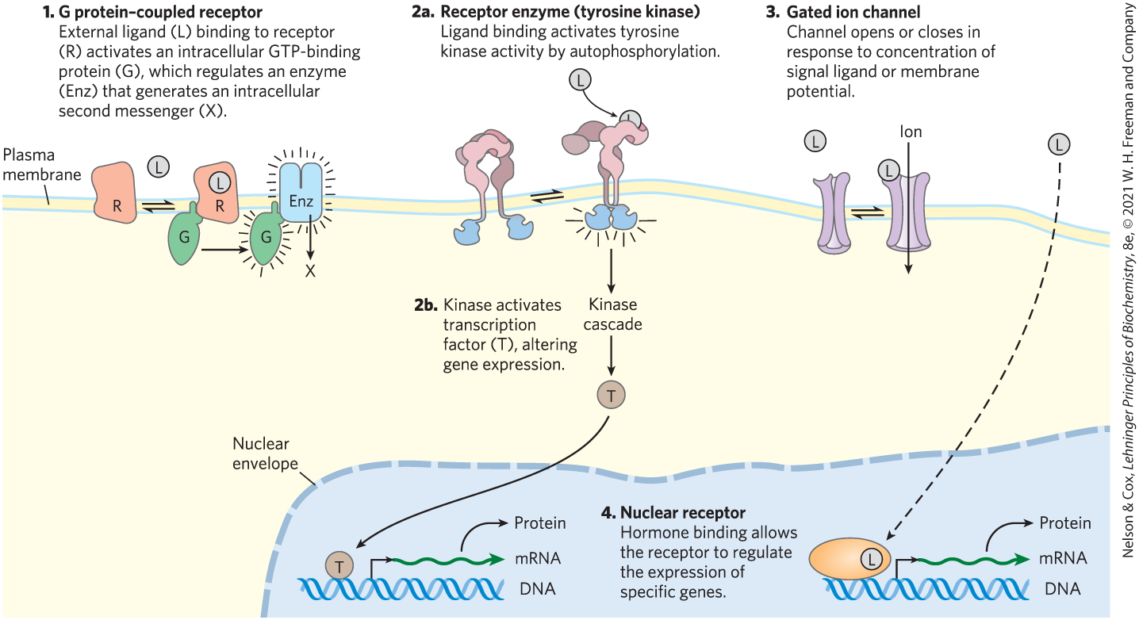
Four General Types of Signal Transducers

Slide 27
12.2 G Protein-Coupled Receptors and Second Messengers

Slide 28
G Protein-Coupled Receptors (GPCRs)
G protein-coupled receptors (GPCRs) = receptors that act through a member of the guanosine nucleotide-binding protein (G protein) family

Slide 29
Principle 3 (2 of 3)
In multicellular animals, GPCRs with seven transmembrane helices are the largest group of plasma membrane receptors. These G Protein–Coupled Receptors act through G proteins, which
are turned on when they bind guanosine triphosphate (GTP). Animals have hundreds of different GPCRs, each able to respond to a specific signal.

Slide 30
Components of Signal Transduction Through GPCRs
three essential components:
  a plasma membrane receptor with seven transmembrane helical segments
  a G protein that cycles between active (GTP-bound) and inactive (GDP-bound) forms
  an effector enzyme (or ion channel) in the plasma membrane that is regulated by the activated G protein

Slide 31
First and Second Messengers
“first messenger” = extracellular signal that activates a receptor from the outside of the cell
second messenger = low MW metabolite or inorganic ion that changes in concentration due to the effector enzyme
  functions to activate or inhibit downstream targets

Slide 32
The β-Adrenergic Receptor System Acts through the Second Messenger cAMP
adrenergic receptors = protein receptors in the plasma membrane that bind epinephrine
  four general types: α₁, α₂, β₁, β₂
β-adrenergic receptors = applies to both β₁ and β₂ subtypes

Slide 33
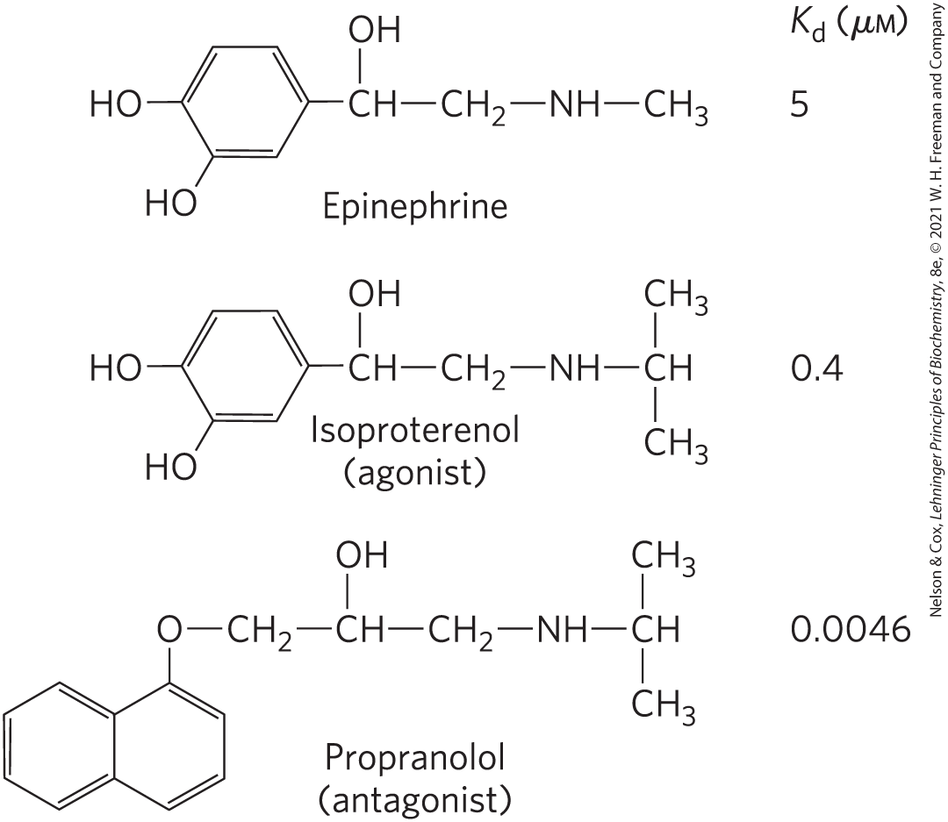
Agonists and Antagonists
agonist = molecule that binds a receptor and produces the effects of the natural ligand
antagonist = analog that binds the receptor and blocks the effects of the agonist, including the natural ligand

Slide 34
Principle 3 (3 of 3)
In multicellular animals, GPCRs with seven transmembrane helices are the largest group of plasma membrane receptors. These G Protein–Coupled Receptors act through G proteins, which
are turned on when they bind guanosine triphosphate (GTP). Animals have hundreds of different GPCRs, each able to respond to a specific signal.

Slide 35
The β-Adrenergic Receptor Is a GPCR
GPCRs (seven-transmembrane (7tm) or heptahelical receptors) span the membrane seven times
  interact with heterotrimeric G proteins
heterotrimeric G proteins = conserved family of signaling proteins with three subunits: α, β, and γ
  α subunit is the binding site for GDP or GTP

Slide 36
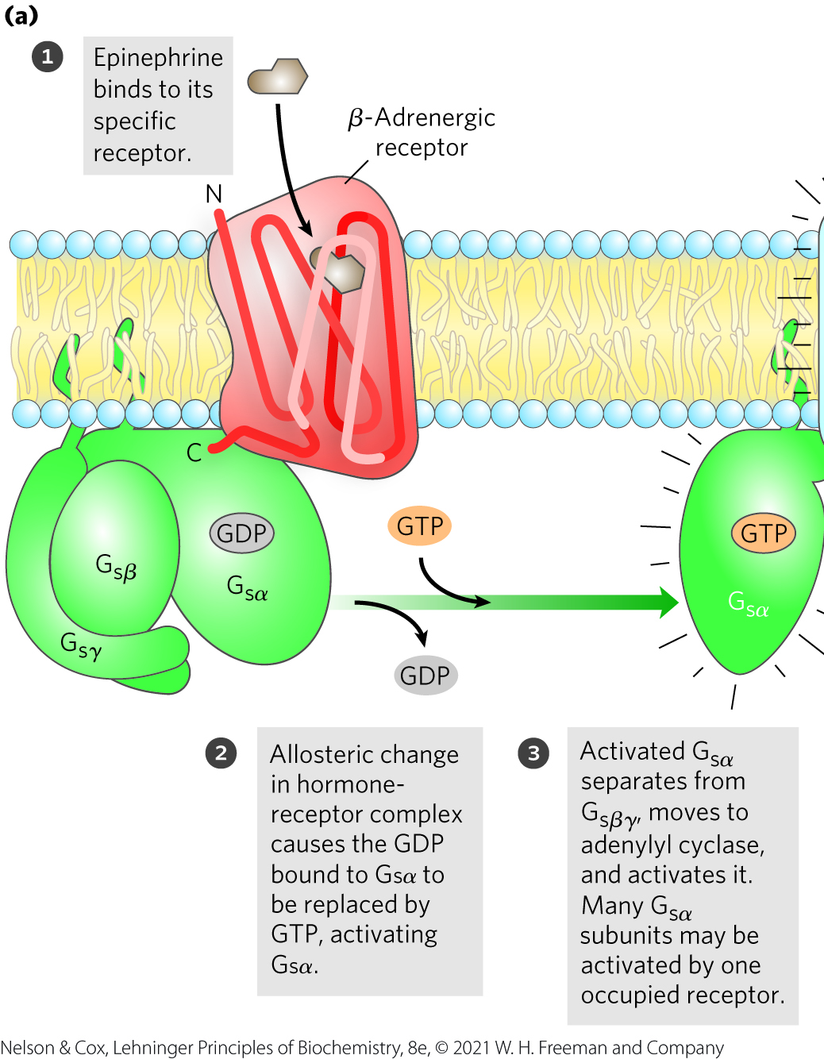
The β-Adrenergic Pathway
hormone-bound GPCR acts as a guanosine nucleotide–exchange factor (GEF)
because the G protein stimulates its effector, it is referred to as a stimulatory G protein (G_{s})

Slide 37
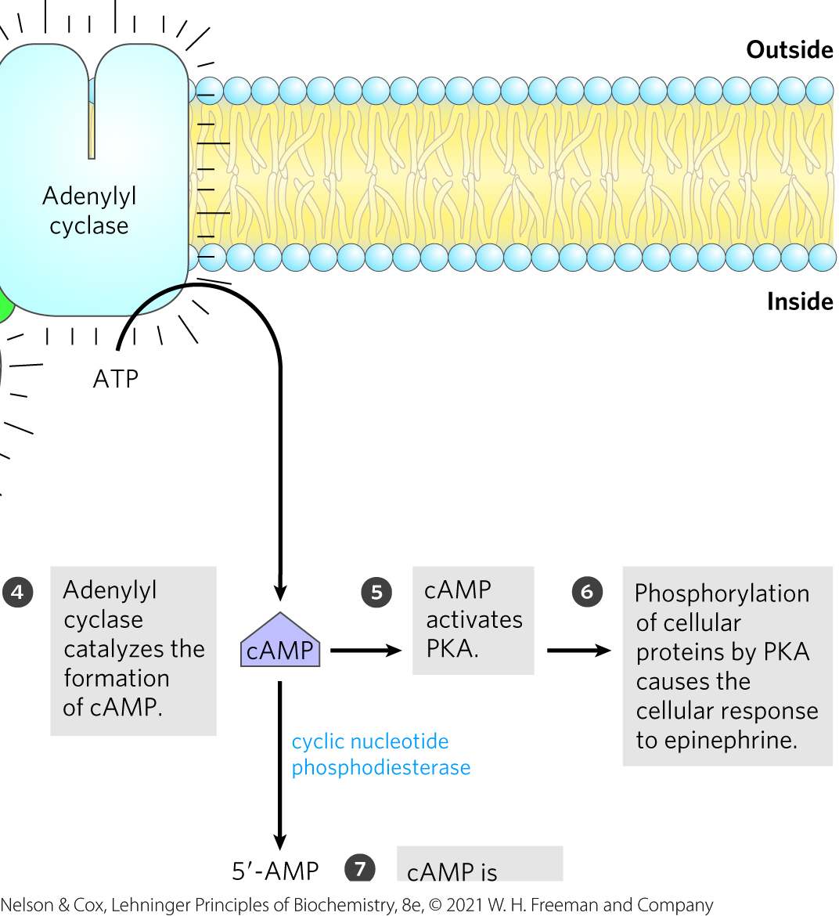
The β-Adrenergic Pathway, Continued
adenylyl cyclase = integral protein in the plasma membrane that catalyzes the synthesis of cAMP from ATP when associated with active G_{sα}

Slide 38
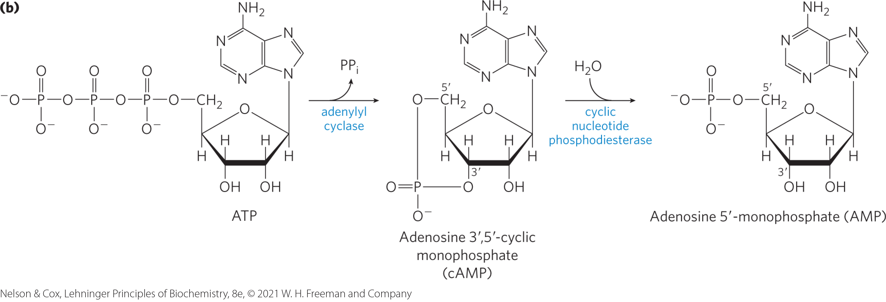
The Synthesis and Hydrolysis of cAMP
cAMP activates PKA
degradation of cAMP reverses the activation of PKA

Slide 39
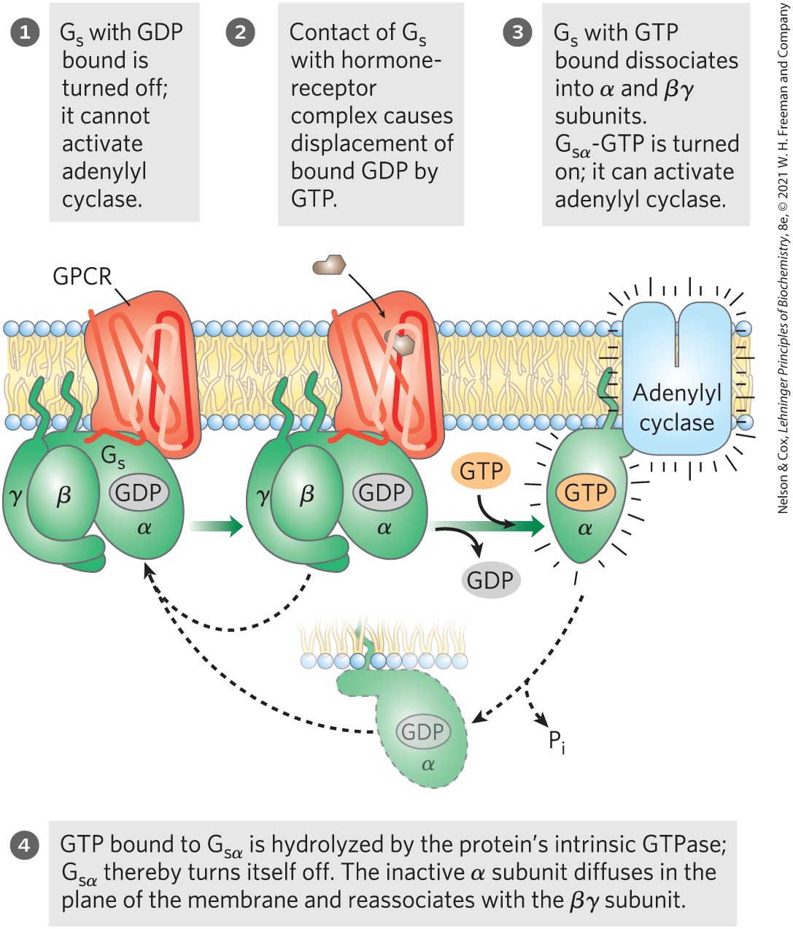
The GTPase Switch
G_{sα} has intrinsic GTPase activity that switches G_{sα} to its inactive form by converting its bound GTP to GDP

Slide 40
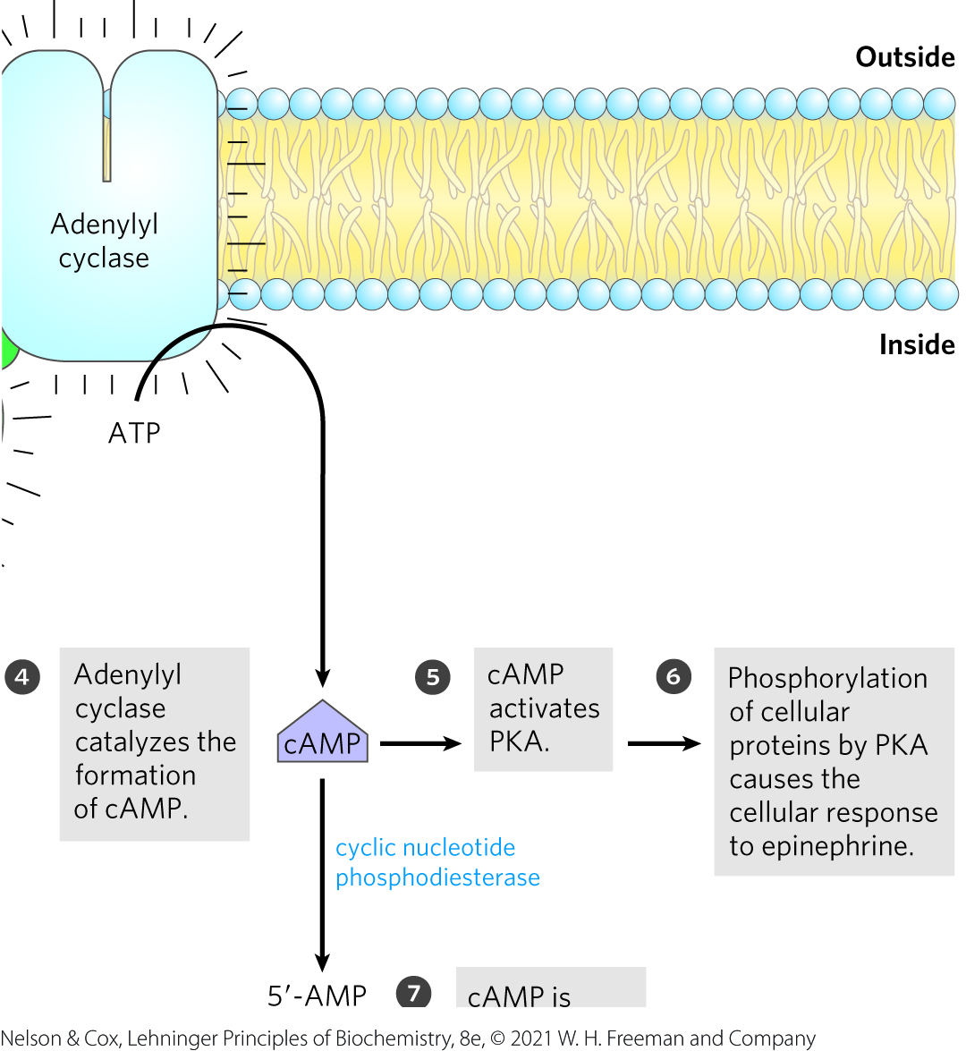
Cyclic AMP Activates Protein
Kinase A
cAMP–dependent protein kinase (protein kinase A or PKA) = activated by cyclic AMP
  catalyzes the phosphorylation of specific Ser or Thr residues of target proteins

Slide 41
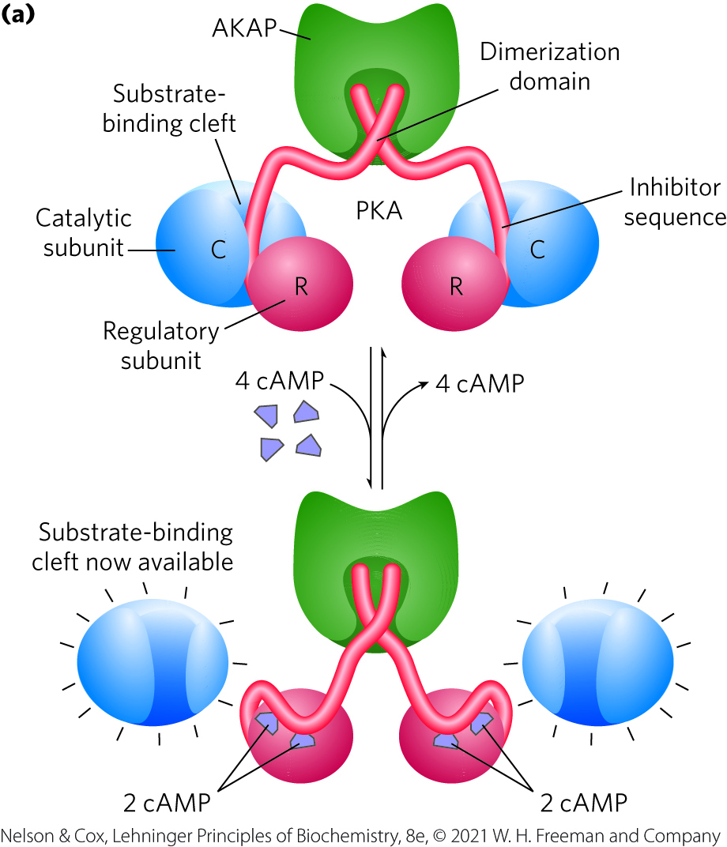
Activation of cAMP-Dependent Protein Kinase (PKA)
R₂C₂ complex is catalytically inactive because the autoinhibitory domain of each R subunit occupies the substrate-binding cleft of each C subunit
cyclic AMP is an allosteric activator of PKA
  binding of cAMP yields two active C subunits

Slide 42
Principle 5 (4 of 6)
Phosphorylation of intrinsically disordered regions of signaling proteins acts as a switch, toggling enzyme activity or creating binding sites for other molecules. Signal responses are integrated by multiprotein signaling complexes with modular domains that bind phosphorylated Tyr, Ser, or Thr residues.

Slide 43
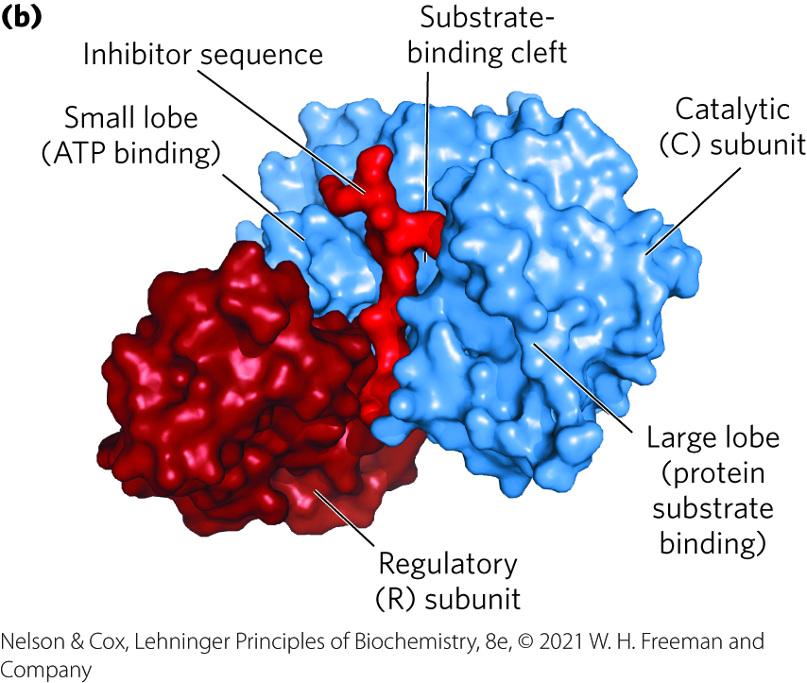
Displacement of an Autoinhibitory Domain Mediates Allosteric Activation of Many Protein Kinases
structure of the substrate-binding cleft in PKA is the prototype of all known protein kinases

Slide 44
Consensus Sequences
consensus sequences = commonly contain the target for phosphorylation (Ser or Thr) by protein kinases
Table 6-10 Consensus Recognition Sequences for a Few Protein Kinases
Protein kinase | Consensus sequence and phosphorylated residue
Protein kinase A | -x-R-[RK]-x-[ST]-B-
Protein kinase G | -x-R-[RK]-x-[ST]-X-
Protein kinase C | -[RK](2)-x-[ST]-B-[RK](2)-
Protein kinase B | R-x-x-R-x-[ST]-x-ψ-
Ca²⁺/calmodulin kinase I | -B-x-R-x(2)-[ST]-x(3)-B-
Ca²⁺/calmodulin kinase II | -B-x-[RK]-x(2)-[ST]-x(2)-
Myosin light chain kinase (smooth muscle) | -K(2)-R-x(2)-S-x-B(2)-
Phosphorylase b kinase | -K-R-K-Q-I-S-V-R-
Extracellular signal-regulated kinase (ERK) | -P-x-[ST]-P(2)
Cyclin-dependent protein kinase (cdc2) | -x-[ST]-P-x-[KR]-
Casein kinase I | -[SpTp]-x(2)-[ST]-B
Casein kinase II | -x-[ST]-x(2)-[ED]-x-
β-Adrenergic receptor kinase | -[DE](n)-[ST]-x(3)
Rhodopsin kinase | -x(2)-[ST]-E(n)-vABL-[YLV]-Y-X₁₋₃-[PF]-
Epidermal growth factor (EGF) receptor kinase | -E(4)-Y-F-E-L-V-

Slide 45
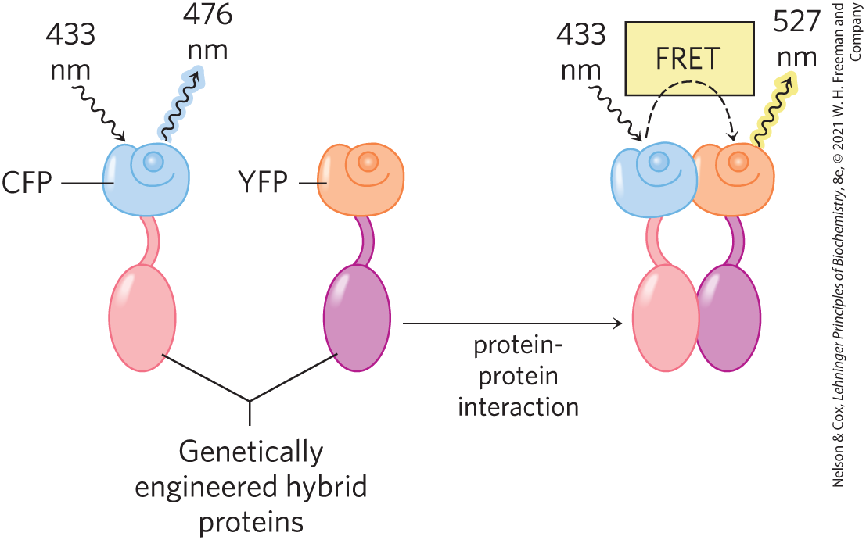
Fluorescence Resonance Energy Transfer (FRET)
fluorescence resonance energy transfer (FRET) = measures the nonradiative transfer of energy between fluorescent probes attached to each protein
  used to determine if two proteins interact and where in the cell they interact

Slide 46
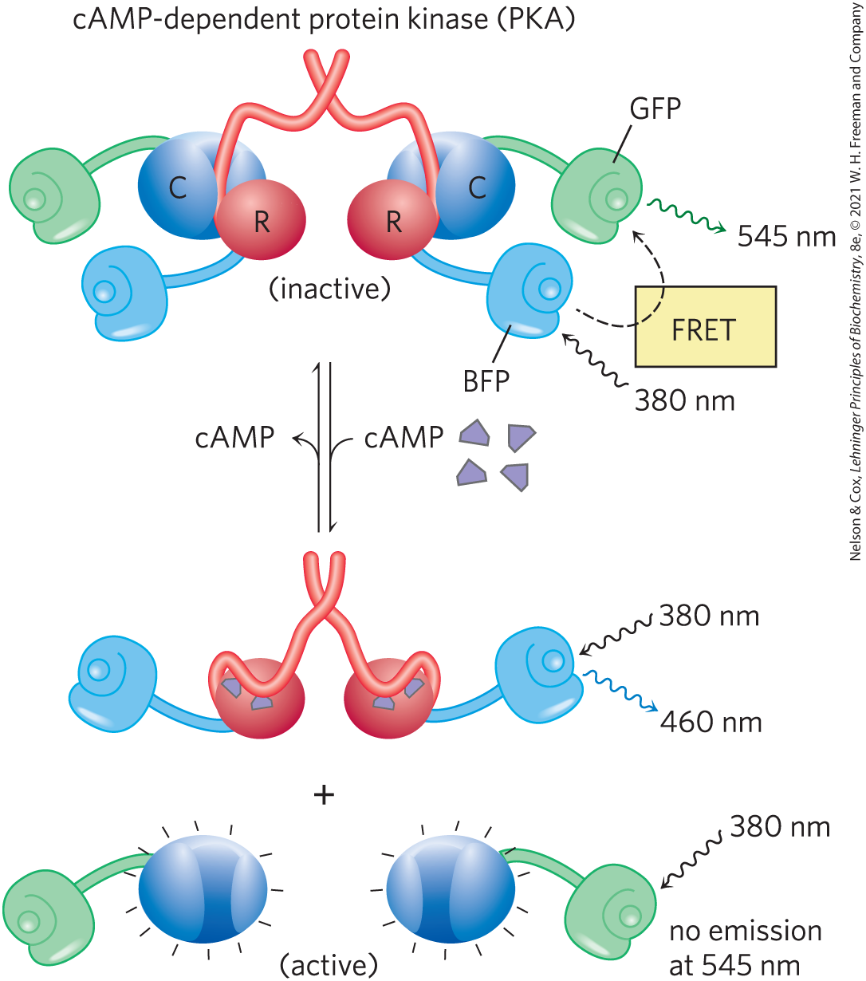
Measuring [cAMP] with FRET
when [cAMP] is low, R and C subunits of PKA are associated and FRET is exhibited
when [cAMP] rises, R and C subunits of PKA dissociate and FRET ceases

Slide 47
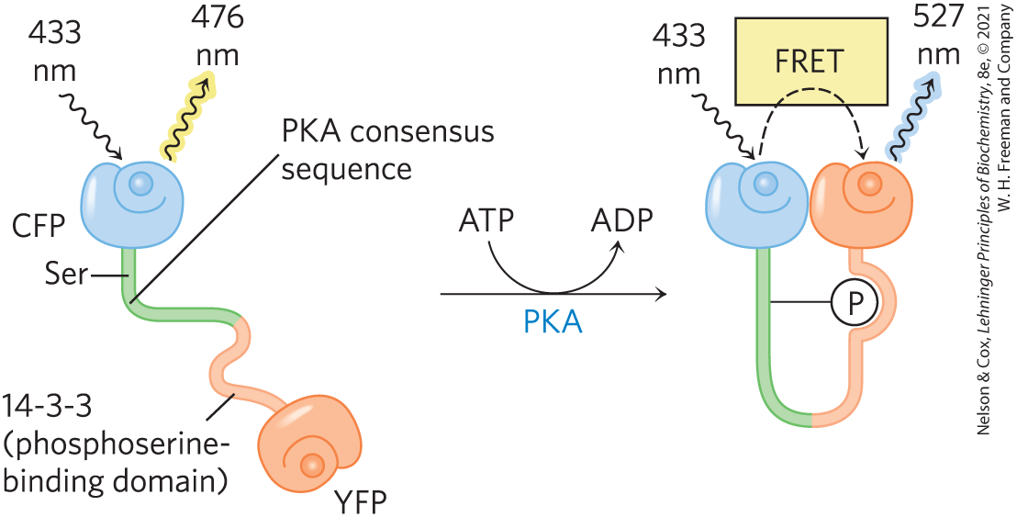
Measuring PKA Activity with FRET
when PKA is inactive, the Ser residue is not phosphorylated, 14-3-3 has no affinity for the Ser residue, and FRET is not observed
when PKA is active in the cell, the Ser residue is phosphorylated, 14-3-3 binds the Ser residue, and FRET is observed

Slide 48
Principle 1 (4 of 5)
Cells respond to external signals through receptor-mediated processes that amplify the signal, integrate it with input from other receptors, transmit the signal to the appropriate effectors, and eventually end the response.

Slide 49
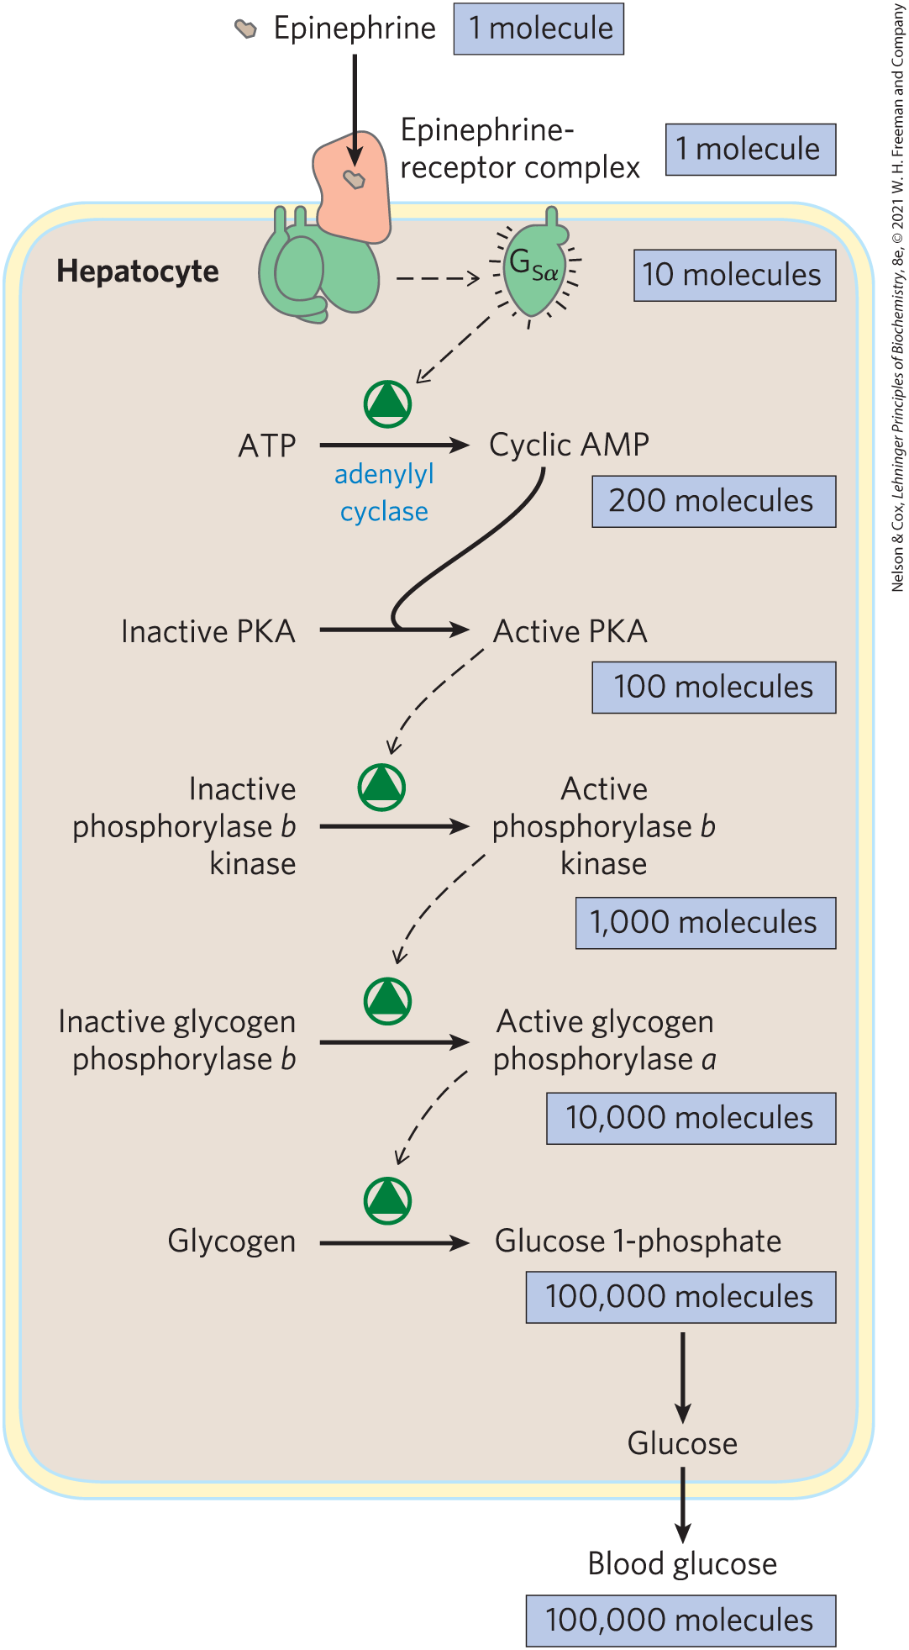
Epinephrine Cascade
the cascade amplifies the hormonal signal by orders of magnitude
  accounts for the low concentration of epinephrine required for activity
the signal leads to intracellular changes within fractions of a second

Slide 50
Principle 1 (5 of 5)
Cells respond to external signals through receptor-mediated processes that amplify the signal, integrate it with input from other receptors, transmit the signal to the appropriate effectors, and eventually end the response.

Slide 51
Several Mechanisms Cause Termination of the β-Adrenergic Response
methods of termination:
  epinephrine concentration drops below the K_{d} for its receptor
  the GTPase activity of the G protein hydrolyzes the GTP bound to the G_{α} subunit
  cAMP is hydrolyzed to 5′ AMP by cyclic nucleotide phosphodiesterase

Slide 52
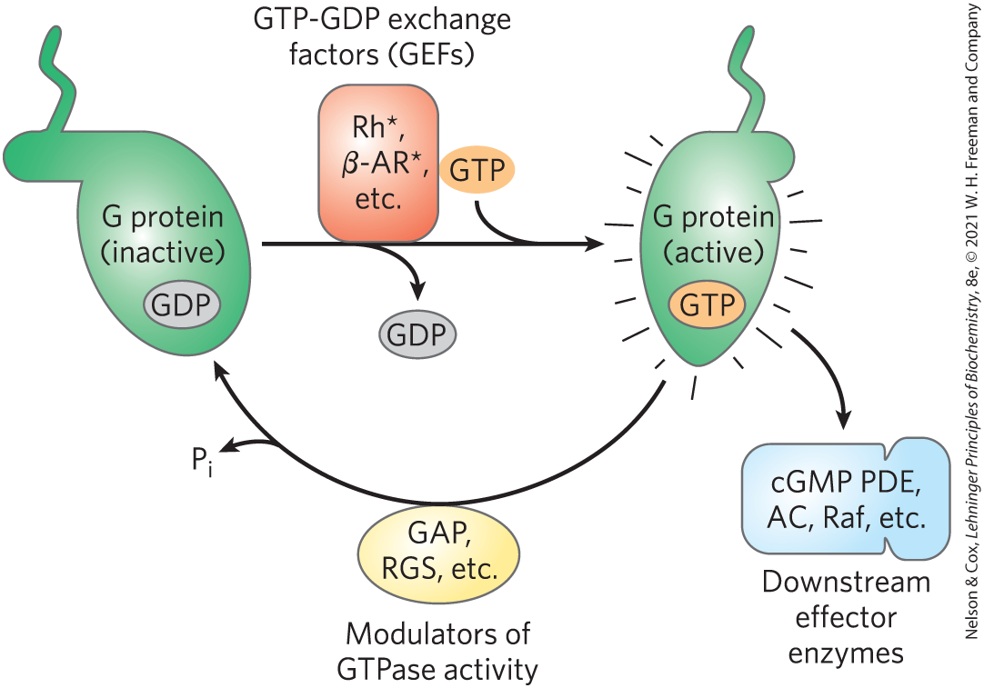
GTPase Activator Proteins (GAPs)
GTPase activator proteins (GAPs) = strongly stimulate GTPase activity

Slide 53
Phosphoprotein Phosphatases
phosphoprotein phosphatase = enzyme that hydrolyzes phosphorylated Tyr, Ser, or Thr residues, releasing inorganic phosphate (P_{i})
  reverses the metabolic effects that result from PKA activity

Slide 54
The β-Adrenergic Receptor is Desensitized by Phosphorylation and by Association with Arrestin
desensitization decreases the response while the signal persists
β-adrenergic receptor kinase (βARK) = phosphorylates several Ser residues near the receptor’s carboxyl terminus when epinephrine is bound to the receptor
β-arrestin (βarr or arrestin 2) = protein that binds to the receptor following receptor phosphorylation and blocks receptor sites that interact with the G protein

Slide 55
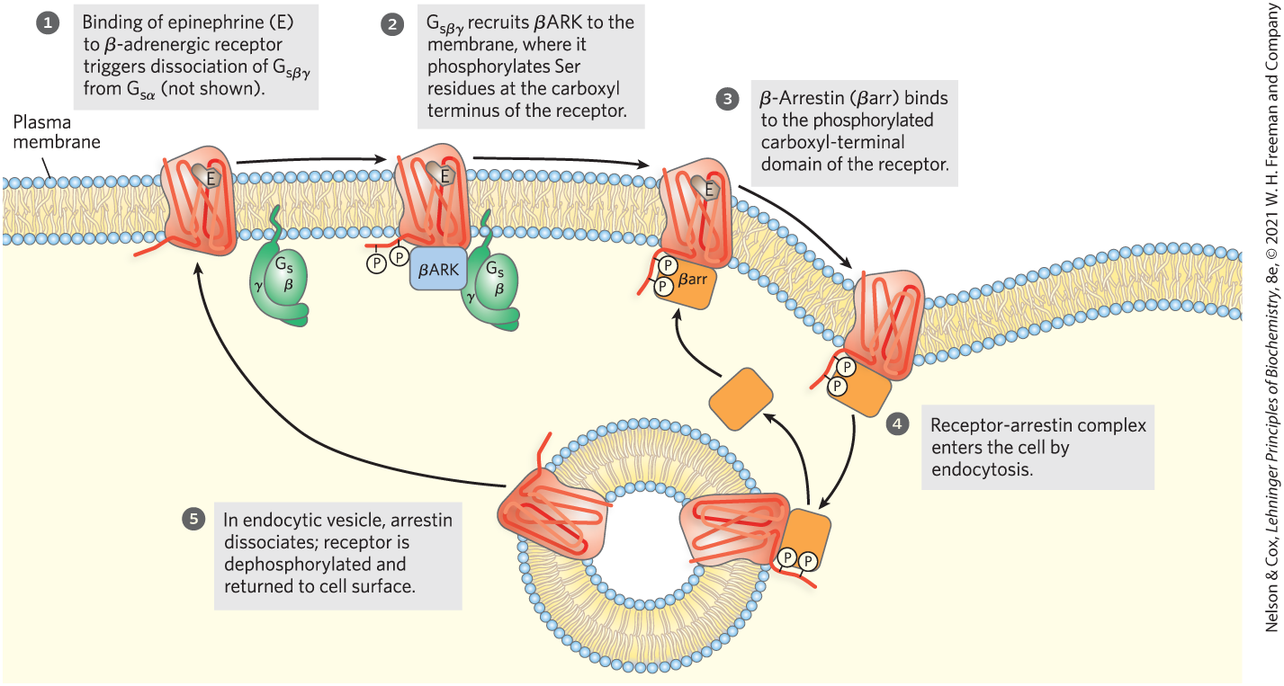
Desensitization of the β-Adrenergic Receptor in the Presence of Epinephrine

Slide 56
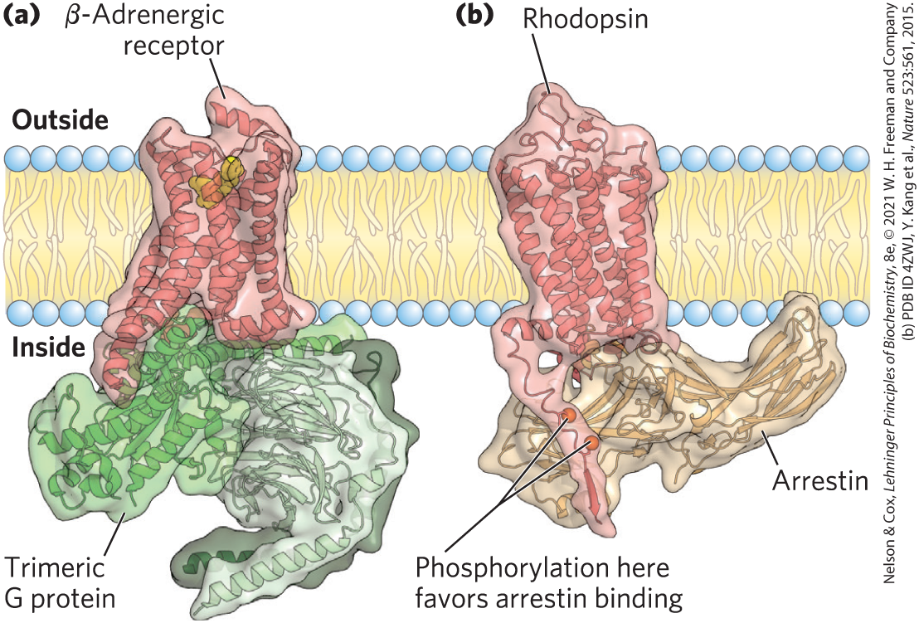
Mutual Exclusion of Trimeric G Protein and Arrestin in Their Interaction with a GPCR
binding of arrestin blocks binding and further activation of the G protein and ends the response to the initial signal

Slide 57
G Protein-Coupled Receptor
Kinases (GRKs)
G protein-coupled receptor kinases (GRKs) = protein family that phosphorylates GPCRs on their carboxyl-terminal cytoplasmic domains and plays a role similar to that of βARK in receptor desensitization and resensitization

Slide 58
Principle 2 (2 of 4)
There is a high degree of evolutionary conservation of signaling proteins and transduction mechanisms across the animal phyla. At least a billion years of evolution have passed since the plant and animal branches of the eukaryotes diverged, which is reflected in the differences in signaling mechanisms used in the two kingdoms. We focus here on the animal kingdom.

Slide 59
Cyclic AMP Acts as a Second Messenger for Many Regulatory Molecules
acts by changing intracellular [cAMP] and thus the activity of PKA
Table 12-3 Some Signals That Use cAMP as Second Messenger
Corticotropin (ACTH)
Corticotropin-releasing hormone (CRH)
Dopamine [D₁, D₂]
Epinephrine (β-adrenergic)
Follicle-stimulating hormone (FSH)
Glucagon
Histamine [H₂]
Luteinizing hormone (LH)
Melanocyte-stimulating hormone (MSH)
Odorants (many)
Parathyroid hormone
Prostaglandins E₁, E₂ (PGE₁, PGE₂)
Serotonin [5-HT₁, 5-HT₄]
Somatostatin
Tastants (sweet, bitter)
Thyroid-stimulating hormone (TSH)

Slide 60
cAMP Response Element Binding Protein (CREB)
in some cells, the catalytic subunit of PKA can also move into the nucleus, where it phosphorylates cAMP response element binding protein (CREB)
cAMP response element binding protein (CREB) = alters the expression of specific genes regulated by cAMP

Slide 61
Some Hormones Inhibit
Adenylyl Cyclase
inhibitory G protein (G_{i}) = inhibits adenylyl cyclase and lowers [cAMP]
  activated by the binding of somatostatin to its receptor
  structurally homologous to G_{s}
extracellular signals have different effects on different tissues or cell types, depending on:
  the type of receptor in the tissue
  the type of G protein (G_{s} or G_{i} ) coupled to the receptor
  the set of PKA target enzymes in the cell

Slide 62
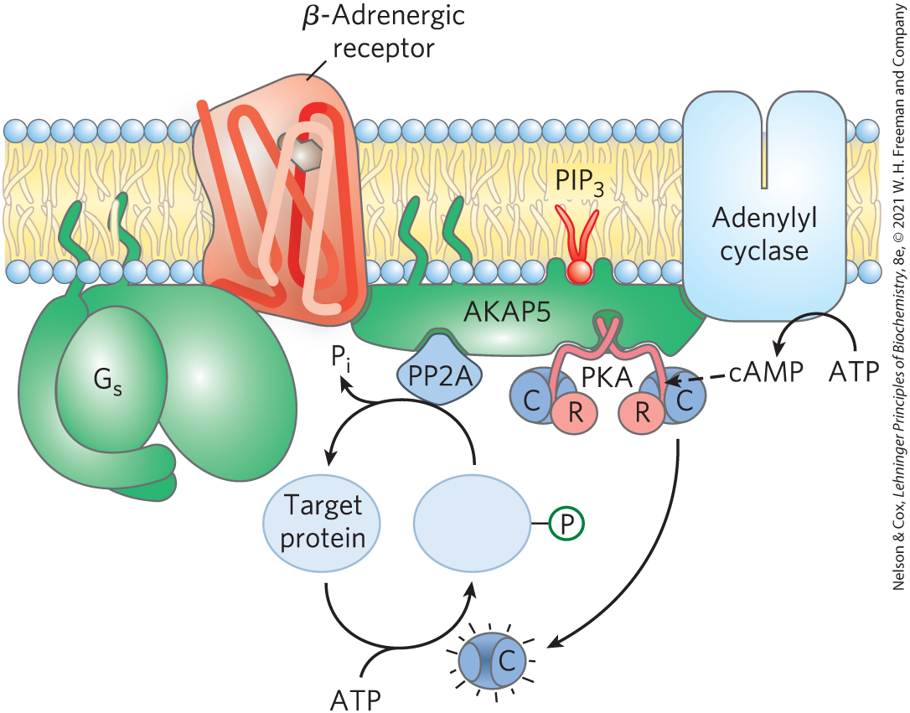
Adaptor Proteins Confine Signaling to a Specific Region of the Cell
adaptor proteins = noncatalytic proteins that hold together other protein molecules that function in concert
AKAPs (A kinase anchoring proteins) = have multiple, distinct protein-binding domains

Slide 63
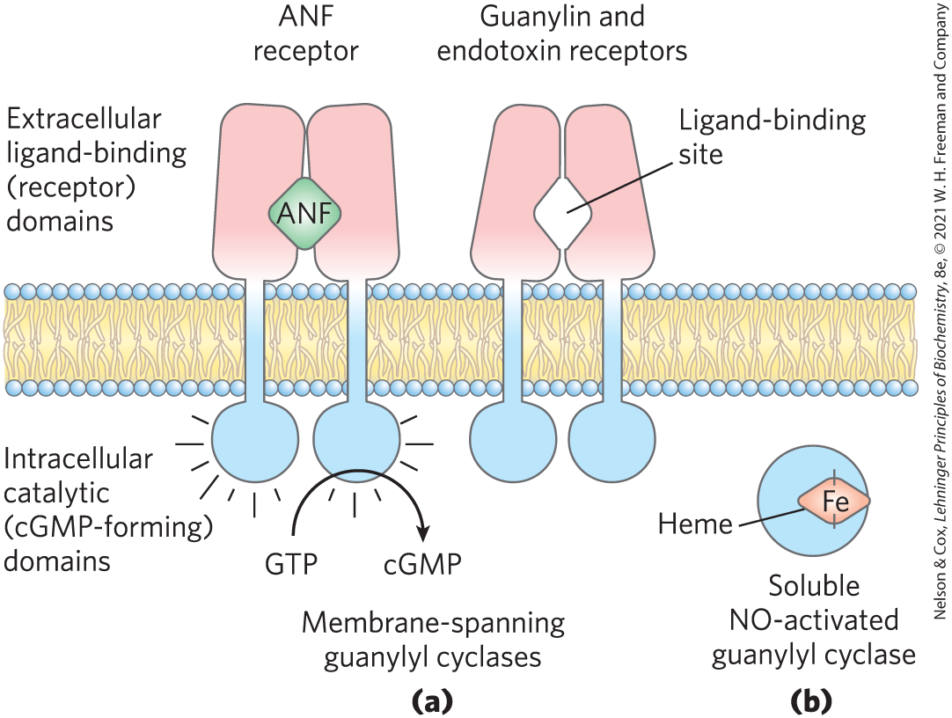
cGMP Activates a cGMP-Dependent Protein Kinase (PKG)
guanylyl cyclase = converts GTP to cGMP when activated
guanosine 3′,5′-cyclic monophosphate (cGMP) = second messenger
cGMP-dependent protein kinase = protein kinase G (PKG) = mediates many of the actions of cGMP

Slide 64
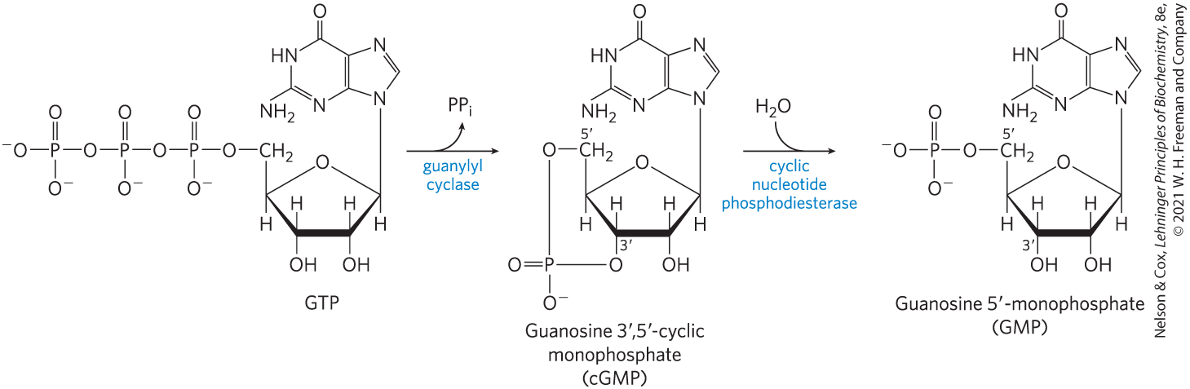
The Synthesis and Hydrolysis of cGMP
cGMP activates PKG
degradation of cGMP reverses the activation of PKG

Slide 65
Atrial Natriuretic Factor (ANF)
atrial natriuretic factor (ANF) = peptide hormone that activates guanylyl cyclase in the kidney
  released by cardiac atrium cells when blood volume increases
rise in [cGMP] triggers increased renal excretion of Na⁺ and consequently of water
  reduces blood volume

Slide 66
Guanylin and Nitric Oxide
guanylin = peptide that activates guanylyl cyclase in the plasma membrane of intestine epithelial cells
  regulates Cl⁻ secretion
NO synthase = produces nitric oxide from arginine
nitric oxide = activates a soluble cytosolic guanylyl cyclase with an associated heme group
  relieves angina pectoris (pain caused by constriction of a heart deprived of O₂)

Slide 67
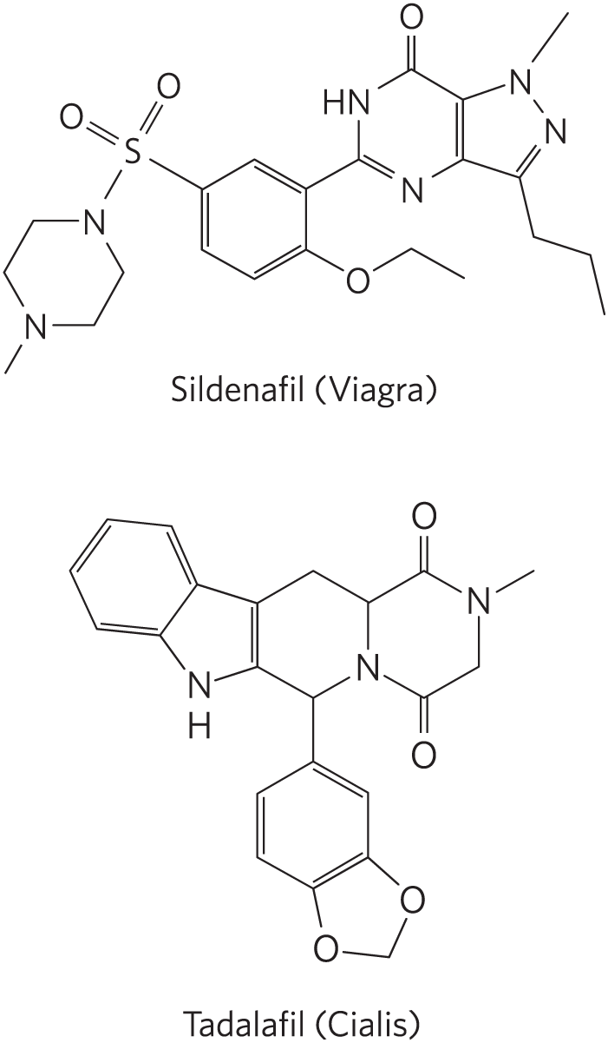
Erectile Dysfunction Drugs Inhibit cGMP PDE
the erectile dysfunction drugs Viagra and Cialis inhibit the cGMP phosphodiesterase (cGMP PDE) in the blood vessels of the penis
  cause [cGMP] to remain elevated

Slide 68
G Proteins Act as Self-Limiting Switches in Many Processes
play roles in cellular processes, including:
  sensory perception
  signaling for cell division
  growth and differentiation
  intracellular movements of proteins and membrane vesicles
  protein synthesis

Slide 69
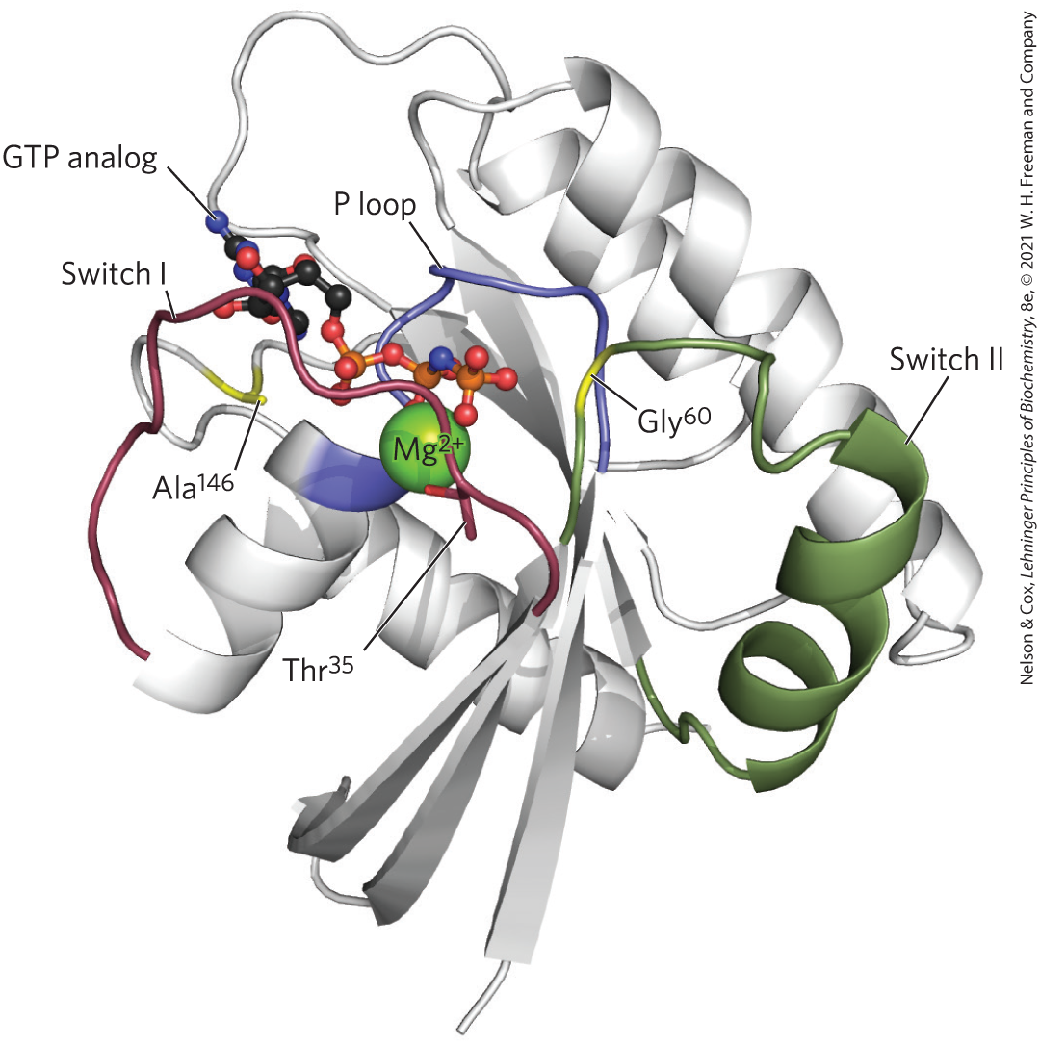
Ras, the G-Protein Prototype
Ras = a ~20 kDa minimal signaling unit
in the nucleotide-binding site, Ala¹⁴⁶ hydrogen bonds to the guanine oxygen, allowing GTP, but not ATP, to bind

Slide 70
Regions of Ras
switch I and switch II = regions that are exposed when GTP is bound
  Thr³⁵ and Gly⁶⁰ hydrogen bond with the oxygens of the γ phosphate of GTP
P loop (phosphate-binding) = contains a Lys residue that binds the γ phosphate of GTP

Slide 71
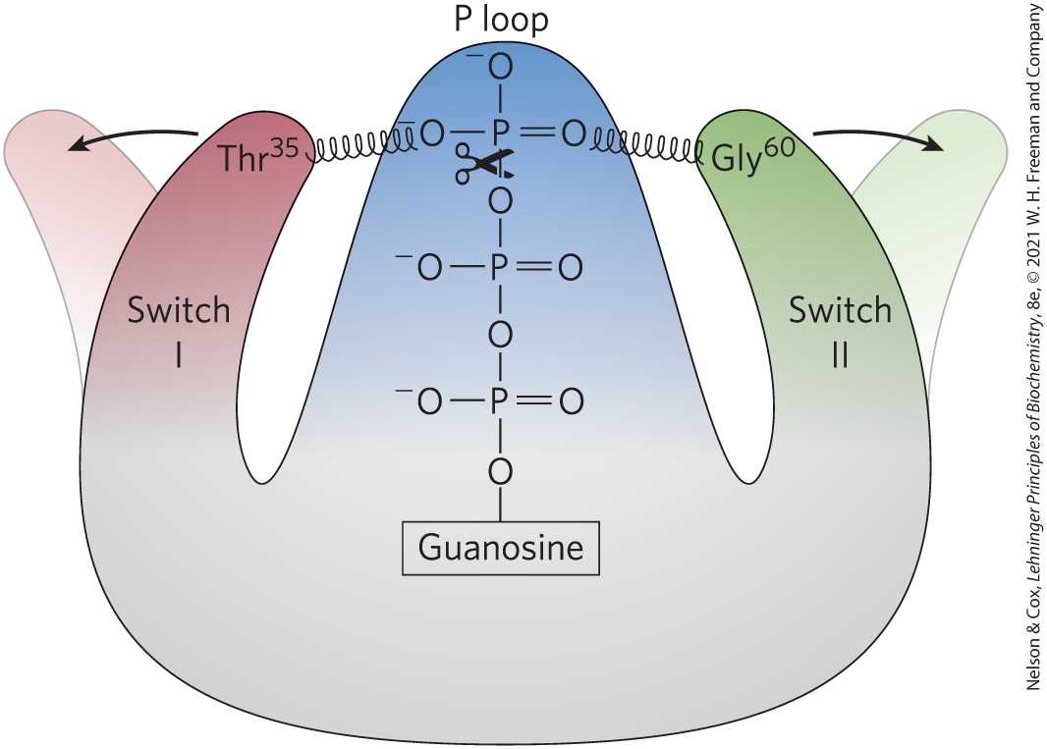
GTP Hydrolysis Flips the Switches in Ras
when GTP is hydrolyzed, the loss of hydrogen bonds allows the switch I and switch II regions to relax into a buried conformation

Slide 72
GTPase Activator Proteins (GAPs) and Regulators of G-Protein Signaling (RGSs)
GTPase activator proteins (GAPs) = increase the GTPase activity of G proteins
  called regulators of G-protein signaling (RGSs) in the case of heterotrimeric G proteins

Slide 73
Guanosine Nucleotide-Exchange Factors (GEFs)
guanosine nucleotide-exchange factors (GEFs) = catalyze the exchange of bound GDP with GTP
  example: the β-adrenergic receptor

Slide 74
Principle 9 (2 of 6)
Defective signaling proteins or defective regulation of their synthesis and breakdown can disrupt cell cycle regulation and lead to tumor formation (cancer).

Slide 75
Defects in G Proteins Are Implicated in Human Cancers
a mutation in Ras eliminates its GTPase activity, causing the protein to remain constantly active
  occurs in ~25% of human cancers
mutations in the tumor suppressor gene NF1 (which encodes a GAP) cause Ras to stay active for an extended period

Slide 76
“Activating” and “Inactivating” Mutations in G_{α}
“activating” mutations = lead to a continuously elevated [cAMP]
  found in ~40% of adenomas
“inactivating” mutations = cause individuals to be unresponsive to hormones that act through cAMP

Slide 77
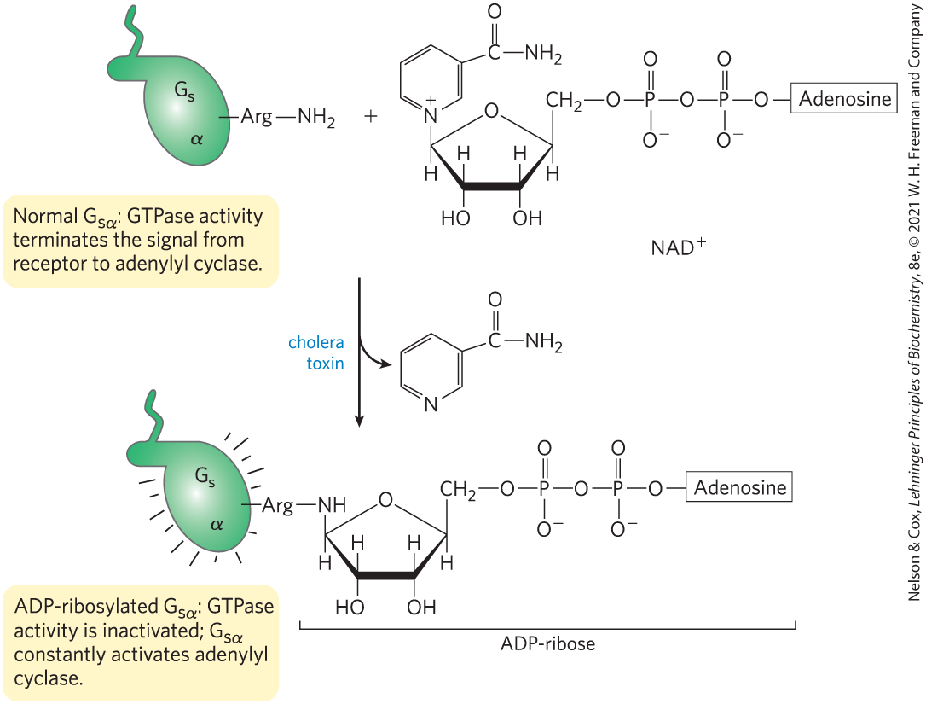
Cholera Toxin Blocks the GTPase Activity of G_{s}
cholera toxin = enzyme that catalyzes transfer of the ADP-ribose moiety of NAD⁺ to an Arg residue of G_{sα}
  secreted by Vibrio cholerae
  causes massive water loss due to chronically active PKA causing an efflux of NaCl

Slide 78
Diacylglycerol, Inositol Triphosphate, and Ca²⁺ Have Related Roles as Second Messengers
phospholipase C (PLC) = catalyzes cleavage of the membrane phospholipid phosphatidylinositol 4,5-bisphosphate, or PIP₂
Table 12-4 Some Signals that Act through Phospholipase C, IP₃, and Ca²⁺
Acetylcholine [muscarinic M¹] | Gastrin-releasing peptide | Platelet-derived growth factor (PDGF)
α₁-Adrenergic agonists | Glutamate | Serotonin [5-HT₂]
Angiogenin | Gonadotropin-releasing hormone (GRH) | Thyrotropin-releasing hormone (TRH)
Angiotensin II | Histamine [H₁] | Vasopressin
ATP [P_{2x}, P_{2y}] | Light (Drosophila)
Auxin | Oxytocin

Slide 79
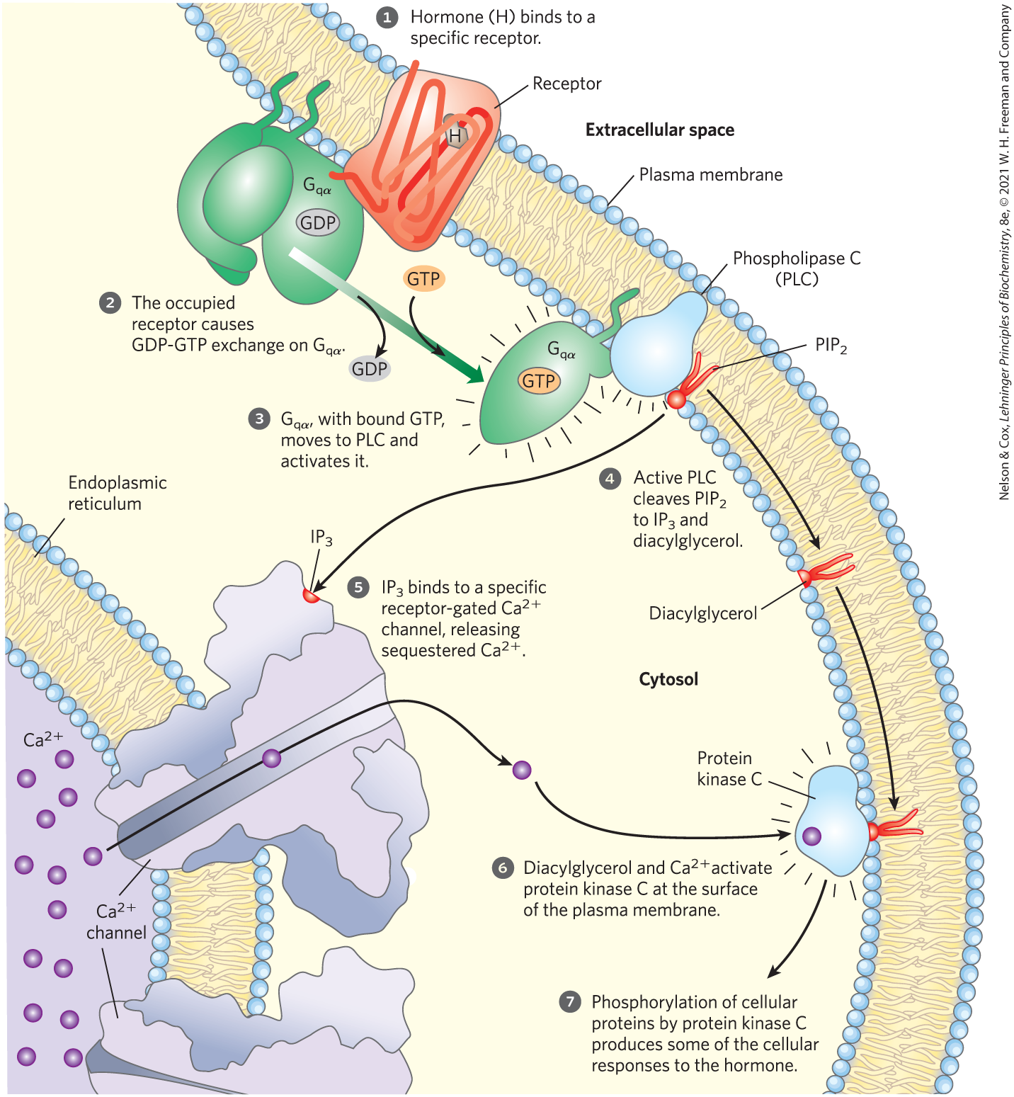
The Production of Diacylglycerol and Inositol 1,4,5-Triphosphate (IP₃)
G_{q} = associated trimeric G protein that activates the PIP₂-specific PLC when an agonist binds its specific receptor
diacylglycerol and inositol 1,4,5-triphosphate (IP₃) = potent second messengers

Slide 80
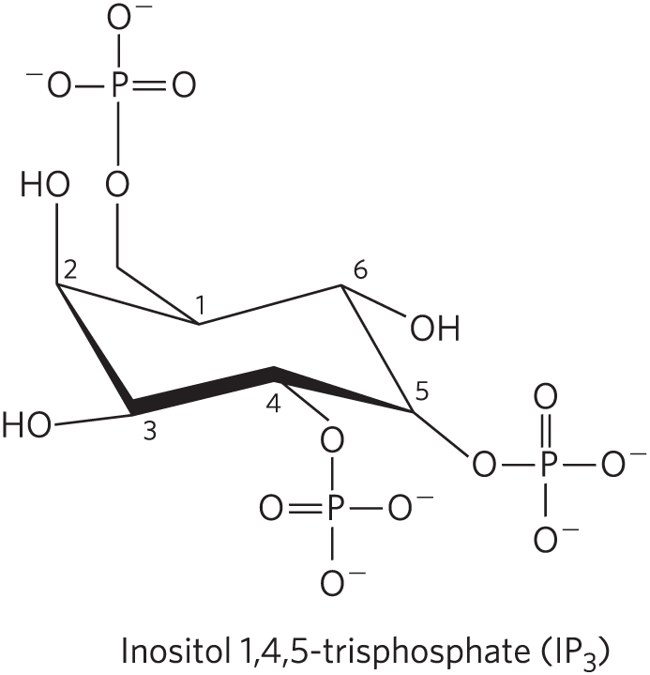
IP₃ Opens the IP₃-Gated
Ca²⁺ Channel
IP₃-gated
Ca²⁺ channel = receptor-gated channel in the endoplasmic reticulum that opens to release sequestered Ca²⁺ into the cytosol

Slide 81
Elevated [Ca²⁺] and Diacylglycerol Activate Protein Kinase C (PKC)
protein kinase C (PKC) = binds and phosphorylates proteins that contain a PKC consensus sequence
  several known isozymes exist

Slide 82
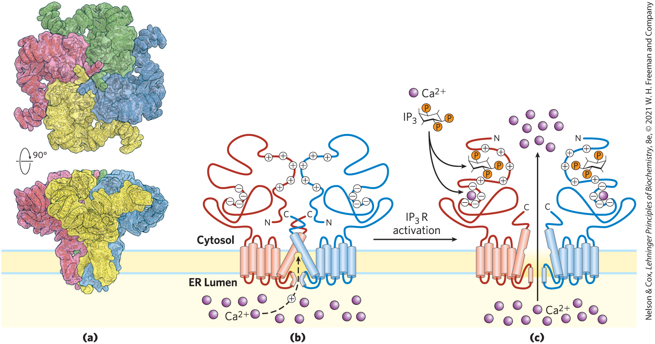
Proposed Mechanism of Action of the IP₃-Gated Ca²⁺ Channel

Slide 83
Principle 6 (2 of 5)
Ion channels gated by membrane potential or ligands are central to signaling in all cells, including bacteria, plants, and animals.

Slide 84
Calcium Is a Second Messenger
That Is Limited in Space and Time
in unstimulated cells, cytosolic [Ca²⁺] is kept very low by Ca²⁺ pumps
hormonal, neural, or other stimuli cause either:
  an influx of Ca²⁺ into the cell through Ca²⁺ channel
  the release of sequestered Ca²⁺ into the cytosol

Slide 85
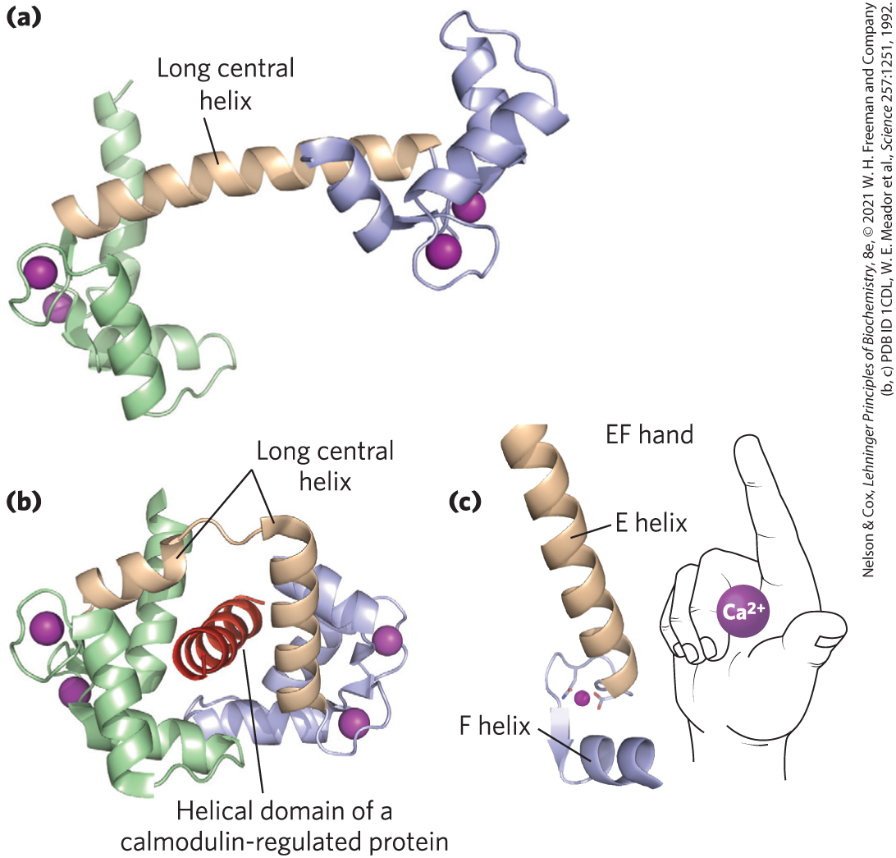
Calmodulin (CaM)
calmodulin (CaM) = acidic protein that undergoes a conformational changes when Ca²⁺ binds
  associates with a variety of proteins and modulates their activities

Slide 86
Many Enzymes Are Modulated by Ca²⁺ Through Calmodulin
Ca²⁺/calmodulin-dependent protein kinases (CaM kinases) = phosphorylates target enzymes following activation by Ca²⁺-bound calmodulin
calmodulin is a regulatory subunit of phosphorylase b kinase of muscle, which is activated by Ca²⁺
Table 12-5 Some Proteins Regulated by Ca²⁺ and Calmodulin
Adenylyl cyclase (brain)
Ca²⁺/calmodulin-dependent protein kinases (CaM kinases I to IV)
Ca²⁺-dependent Na⁺ channel (Paramecium)
Ca²⁺-release channel of sarcoplasmic reticulum
Calcineurin (phosphoprotein phosphatase 2B)
cAMP phosphodiesterase
cAMP-gated olfactory channel
cGMP-gated Na⁺, Ca²⁺ channels (rod and cone cells)
Glutamate decarboxylase
Myosin light-chain kinases
NAD⁺ kinase
Nitric oxide synthase
Phosphatidylinositol 2-kinase
Plasma membrane Ca²⁺ ATPase (Ca²⁺ pump)
RNA helicase (p68)

Slide 87
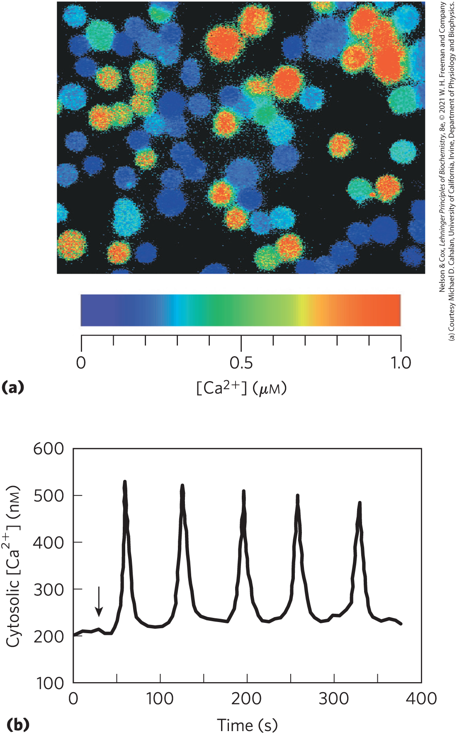
Extracellular Signals Trigger Oscillating Intracellular [Ca²⁺] Levels
mechanism underlying oscillations likely entails feedback regulation by Ca²⁺

Slide 88
12.3 GPCRs in Vision, Olfaction, and Gustation

Slide 89
The Vertebrate Eye Uses Classic GPCR Mechanisms
rhodopsin = a GPCR in the disk membranes of rod cells of the vertebrate eye
opsin = the protein component of rhodopsin
  covalently attached to the light-absorbing pigment (chromosphore) 11-cis-retinal

Slide 90
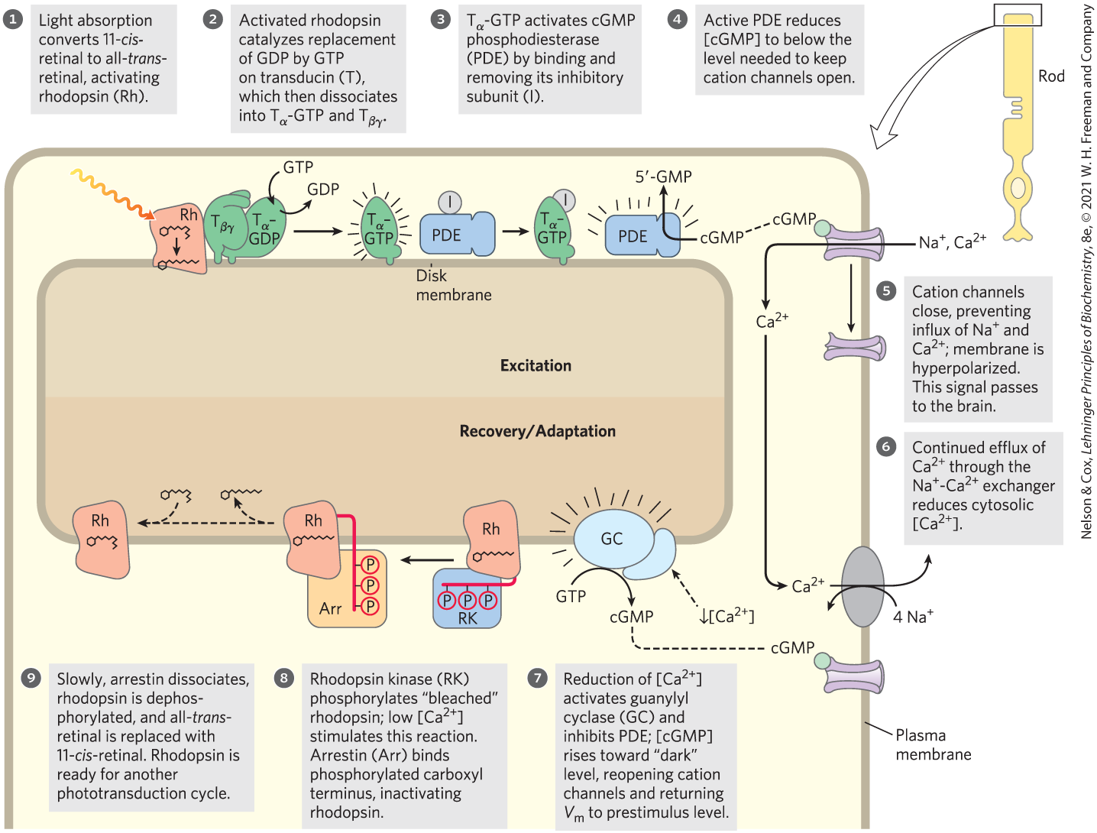
Photon Absorption by Rhodopsin

Slide 91
Rhodopsin Kinase and Arrestin 1
rhodopsin kinase = phosphorylates Thr and Ser residues in the carboxyl-terminal domain of rhodopsin
  functionally and structurally homologous to the βARK that desensitizes the β-adrenergic receptor
arrestin 1 = binds the phosphorylated carboxyl-terminal domain of rhodopsin to prevent further interaction between activated rhodopsin and transducin

Slide 92
Principle 5 (5 of 6)
Phosphorylation of intrinsically disordered regions of signaling proteins acts as a switch, toggling enzyme activity or creating binding sites for other molecules. Signal responses are integrated by multiprotein signaling complexes with modular domains that bind phosphorylated Tyr, Ser, or Thr residues.

Slide 93
Vertebrate Olfaction and Gustation Use Mechanisms Similar to the Visual System
G_{olf} = G protein analogous to transducing and to G_{s}
receptor potential = small depolarization produced by the influx of Na⁺ and Ca²⁺ following the opening of cAMP-gated Na⁺ and Ca²⁺ channels in the plasma membrane
  neuron fires an action potential when the receptor potential is strong enough

Slide 94
Gustducin
gustducin = heterotrimeric G protein coupled to GPCRs in taste sensory neurons
  stimulates cAMP production by adenylyl cyclase
the closing of K⁺ channels in the plasma membrane following phosphorylation by PKA sends an electrical signal to the brain

Slide 95
All GPCR Systems Share
Universal Features (1 of 2)
GPCRs are encoded in vertebrates, Drosophila, Caenorhabditis elegans, Saccharomyces
of the ~20,000 genes in the human genome, as many as 800 are encoded as GPCRs

Slide 96
All GPCR Systems Share
Universal Features (2 of 2)
Amines | Peptides | Protein hormones | Prostanoids | Others
Acetylcholine (muscarinic) | Angiotensin | Follicle-stimulating hormone | Prostacyclin | Cannabinoids
Dopamine | Bombesin | Gonadotropin | Prostaglandin | Lysosphingolipids
Epinephrine | Bradykinin | Lutropin-choriogonadotropic hormone | Thromboxane | Melatonin
Histamine | Chemokine | Thyrotropin |  | Olfactory stimuli
Serotonin | Colecystokinin (CCK) |  |  | Opioids
 | Endothelin |  |  | Rhodopsin
 | Gonadotropin-releasing hormone
 | Interleukin-8
 | Melanocortin
 | Neuropeptide Y
 | Neurotensin
 | Orexin
 | Somatostatin
 | Tachykinin
 | Thyrotropin-releasing hormone
 | Vasopressin
Table 12-6 Some Signals That Act through GPCRs

Slide 97
Principle 2 (3 of 4)
There is a high degree of evolutionary conservation of signaling proteins and transduction mechanisms across the animal phyla. At least a billion years of evolution have passed since the plant and animal branches of the eukaryotes diverged, which is reflected in the differences in signaling mechanisms used in the two kingdoms. We focus here on the animal kingdom.

Slide 98
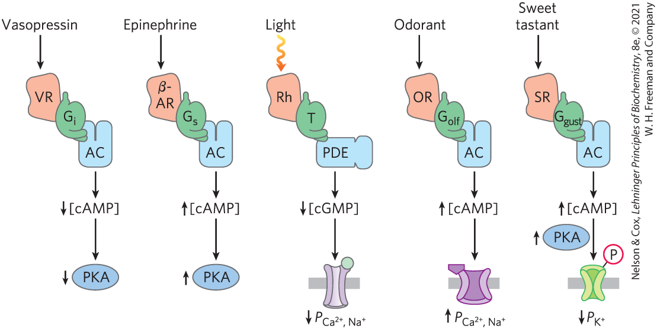
Common Features of Signaling Systems Detecting Hormones, Light, Smells, and Tastes
GPCRs with seven transmembrane helices, G proteins with intrinsic GTPase activities, cyclic nucleotides, and protein kinases are central to signaling

Slide 99
12.4 Receptor Tyrosine Kinases

Slide 100

Principle 4 (2 of 5)
Plasma membrane receptors with an intracellular tyrosine kinase activity act through cascades of protein kinases to transduce signals about the metabolic state, including growth factors.

Slide 101
Receptor Tyrosine Kinases (RTKs)
receptor tyrosine kinases (RTKs) = family of plasma membrane receptors with protein kinase activity
  have an extracellular ligand binding domain and a cytoplasmic Tyr kinase domain

Slide 102
Stimulation of the Insulin Receptor Initiates a Cascade of Protein Phosphorylation Reactions
active insulin receptor protein (INSR) = a dimer of αβ monomers
  α subunits contain the insulin-binding domain
  intracellular domains of the β subunits contain the protein kinase activity

Slide 103
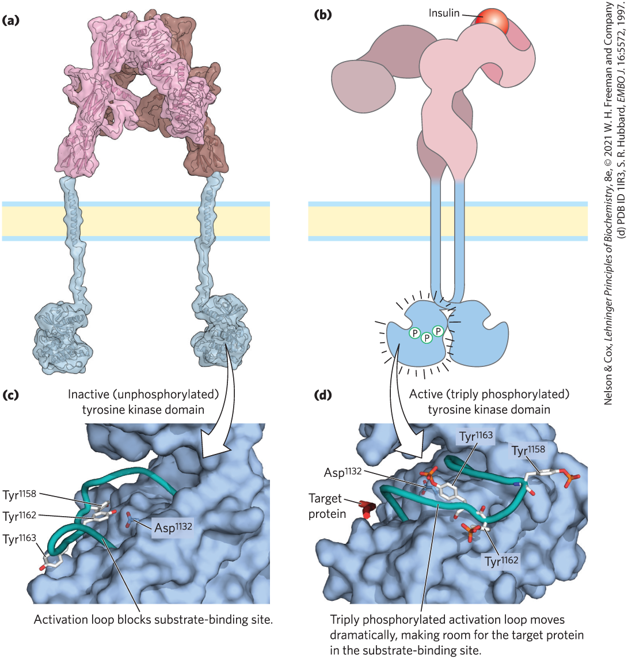
Activation of Tyrosine Kinase by Autophosphorylation
autophosphorylation = each β subunit phosphorylates three essential Tyr residues near the C-terminus of the other β subunit
  opens the active site

Slide 104
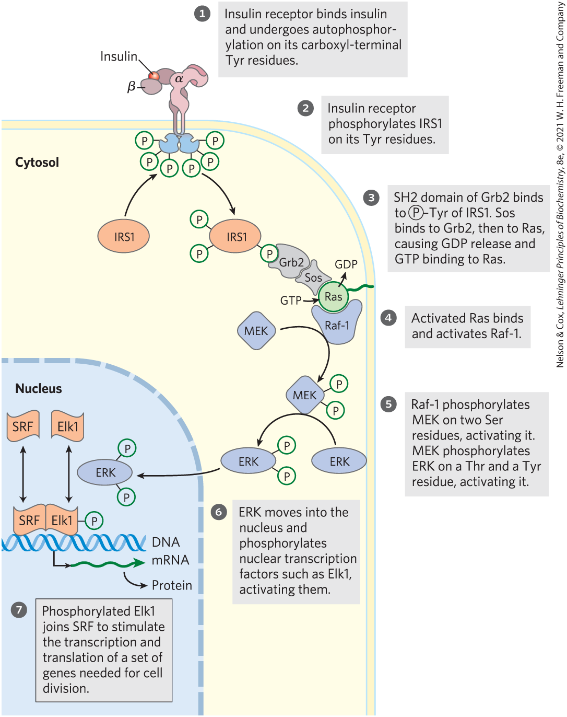
Regulation of Gene Expression by Insulin
insulin receptor substrate 1 (IRS1) = becomes the point of nucleation for a complex of proteins that carry the message from the receptor to end targets
SH2 domain = binds phosphorylated Tyr residues in a protein partner

Slide 105
Raf-1, MEK, and ERK Are Members of Larger Families
ERK is in the MAPK family (mitogen-activated protein kinases)
  specific for Ser or Thr residues
MEK is in the MAP kinase kinase (MAPKK) family
  activates the MAP kinase
  phosphorylates both Ser and Try residues
Raf-1 is in the MAP kinase kinase kinase (MAPKKK) family
  activates the MAP kinase kinase
  specific for Ser or Thr residues

Slide 106
Principle 4 (3 of 5)
Plasma membrane receptors with an intracellular tyrosine kinase activity act through cascades of protein kinases to transduce signals about the metabolic state, including growth factors.

Slide 107
MAPK Cascades
MAPK cascades = mediate signaling initiated by a variety of growth factors
  amplify the initial signal by many orders of magnitude

Slide 108
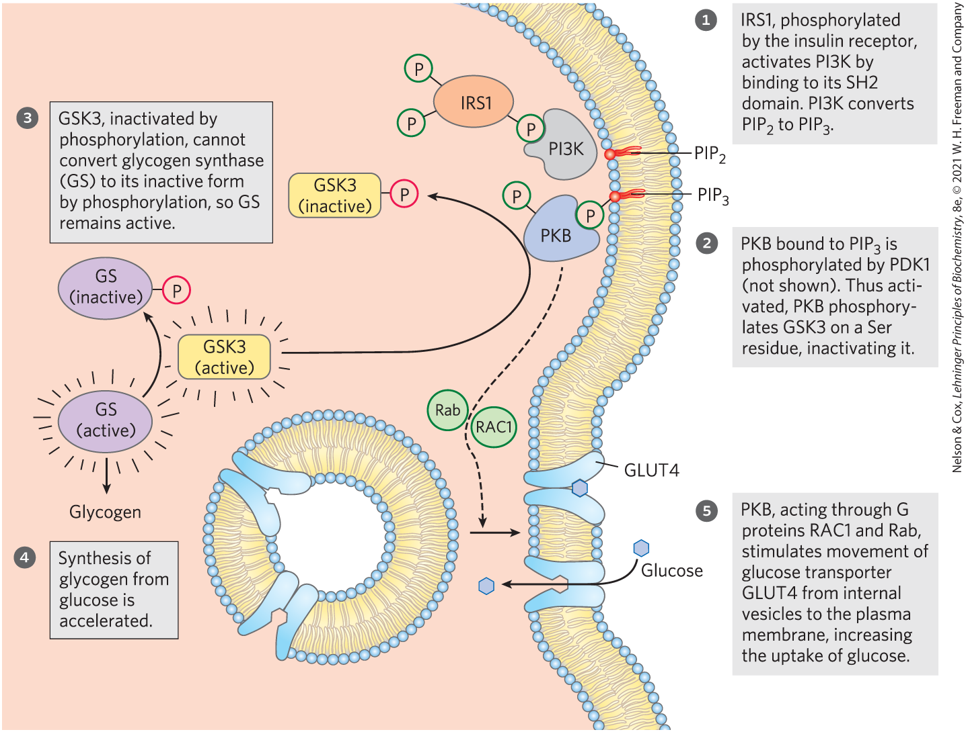
The Membrane Phospholipid PIP₃ Functions at a Branch in Insulin Signaling
activation of PI3K by phosphorylated IRS1 initiates movement of GLUT4 to the plasma membrane and activation of glycogen synthase

Slide 109
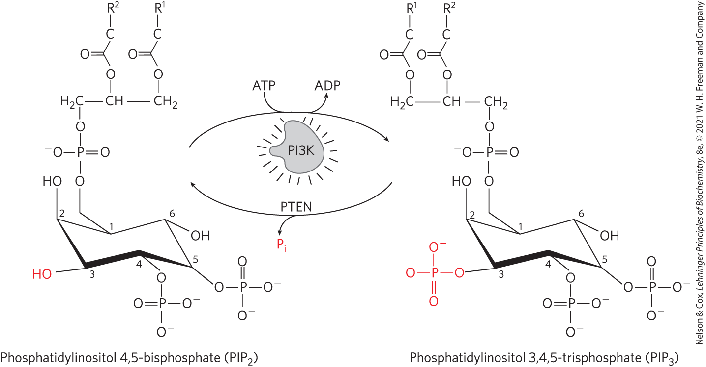
Regulation of PIP₃ Formation and Breakdown
once activated, PI3K converts the membrane lipid PIP₂ to PIP₃ by the transfer of a phosphoryl group from ATP

Slide 110
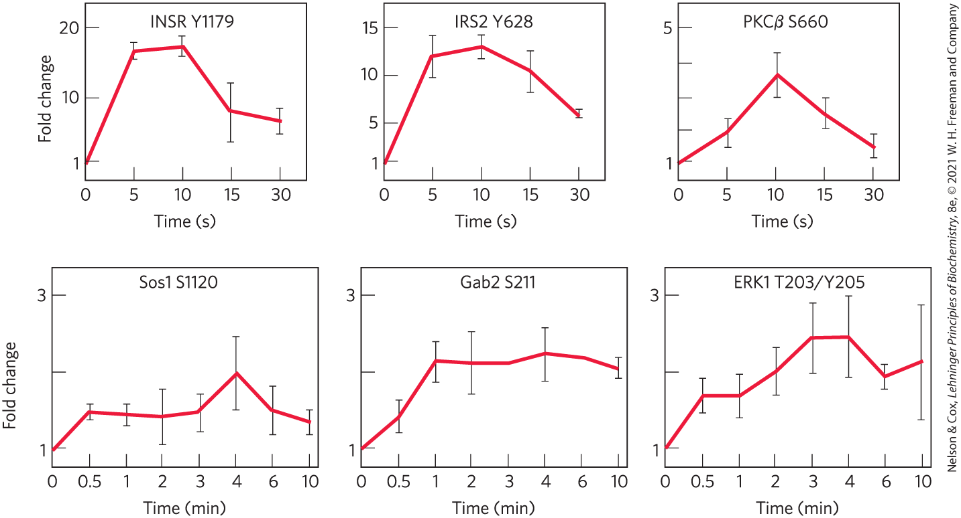
Time Course of Phosphorylations Triggered by Insulin

Slide 111
Principle 4 (4 of 5)
Plasma membrane receptors with an intracellular tyrosine kinase activity act through cascades of protein kinases to transduce signals about the metabolic state, including growth factors.

Slide 112
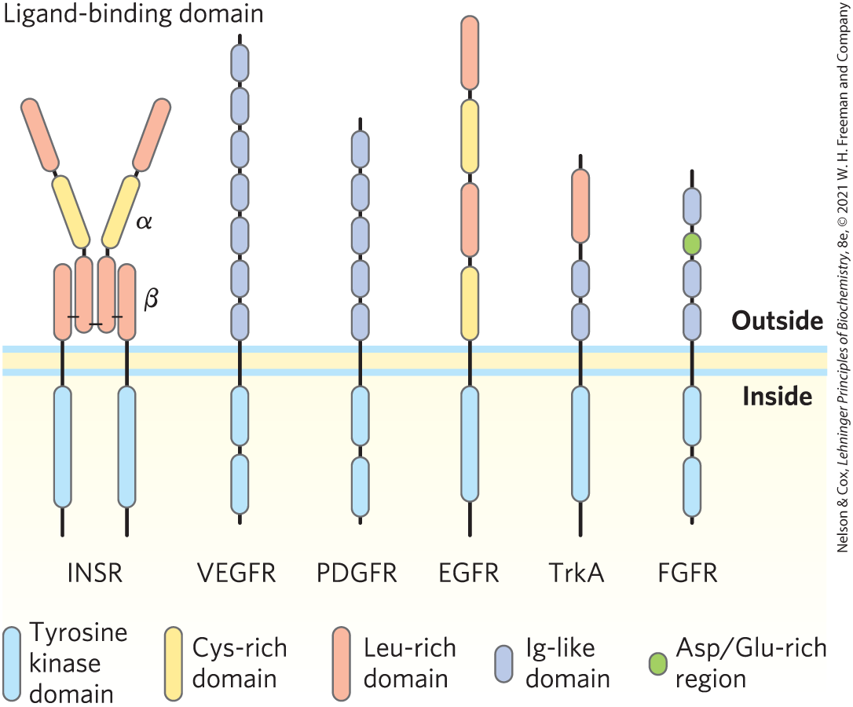
The Insulin Receptor Is A Prototype for Receptor Tyrosine Kinases

Slide 113
Principle 2 (4 of 4)
There is a high degree of evolutionary conservation of signaling proteins and transduction mechanisms across the animal phyla. At least a billion years of evolution have passed since the plant and animal branches of the eukaryotes diverged, which is reflected in the differences in signaling mechanisms used in the two kingdoms. We focus here on the animal kingdom.

Slide 114
Evolution of Insulin Receptor Signaling Machinery
the regulatory machinery:
  allows for amplification of the insulin signal
  provides for the integration of signals from different receptors
  can trigger two or more signaling pathways
  involves closely related IRS proteins, each with its own characteristic tissue distribution and function

Slide 115
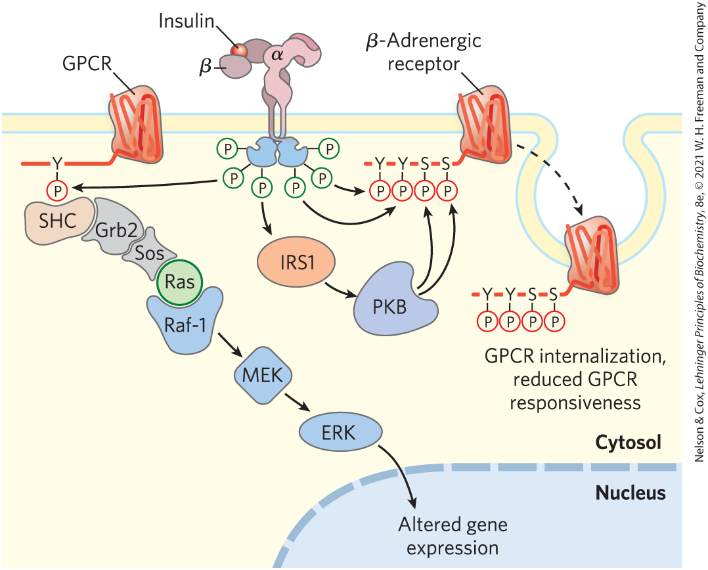
Cross Talk among Signaling Systems Is Common and Complex
extensive interconnections among signaling pathways allow integration and fine-tuning of multiple hormonal effects

Slide 116
12.5 Multivalent Adaptor Proteins and Membrane Rafts

Slide 117
Principle 4 (5 of 5)
Plasma membrane receptors with an intracellular tyrosine kinase activity act through cascades of protein kinases to transduce signals about the metabolic state, including growth factors.

Slide 118
Phosphorylation-Dependent Protein Interactions
protein-protein interactions brought about by reversible phosphorylation create docking sites for other proteins
many signaling proteins are multivalent
  due to flexible intrinsically disordered regions (IDRs)

Slide 119
Protein Modules Bind Phosphorylated Tyr, Ser, or Thr Residues in Partner Proteins
SH2 domains bind to proteins containing phosphorylated Tyr residues
other domains bind phosphorylated Ser and phosphorylated Thr residues in various contexts
SH3 and PH domains bind the membrane phospholipid PIP₃

Slide 120
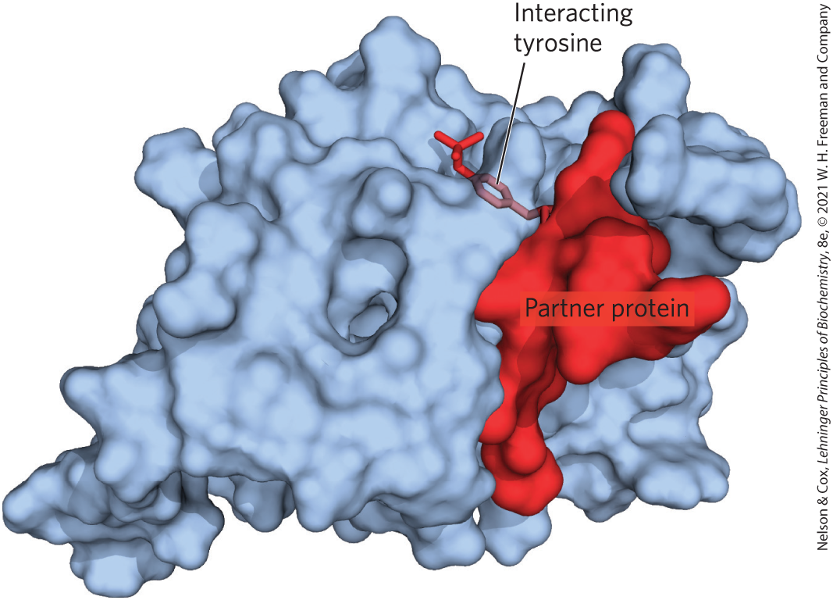
Phosphotyrosine-Binding Domains (PTB Domains)
phosphotyrosine-binding domains (PTB domains) = another binding partner for phosphorylated Tyr

Slide 121
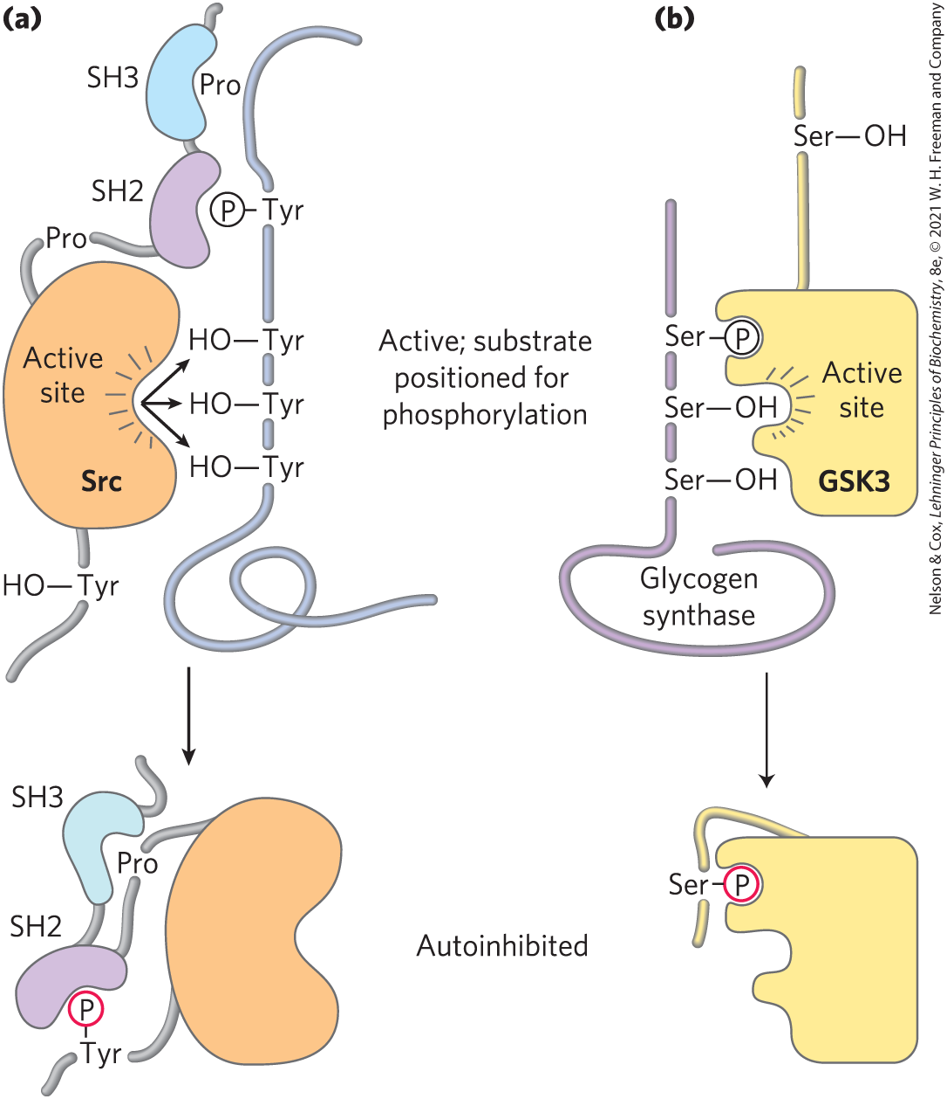
Mechanism of Autoinhibition of Src and GSK3
removal of a phosphorylated Tyr residue turns on the Tyr kinase activity of Src
dephosphorylation of a Ser residue in the autoinhibitory domain of GSK3 frees the enzyme

Slide 122
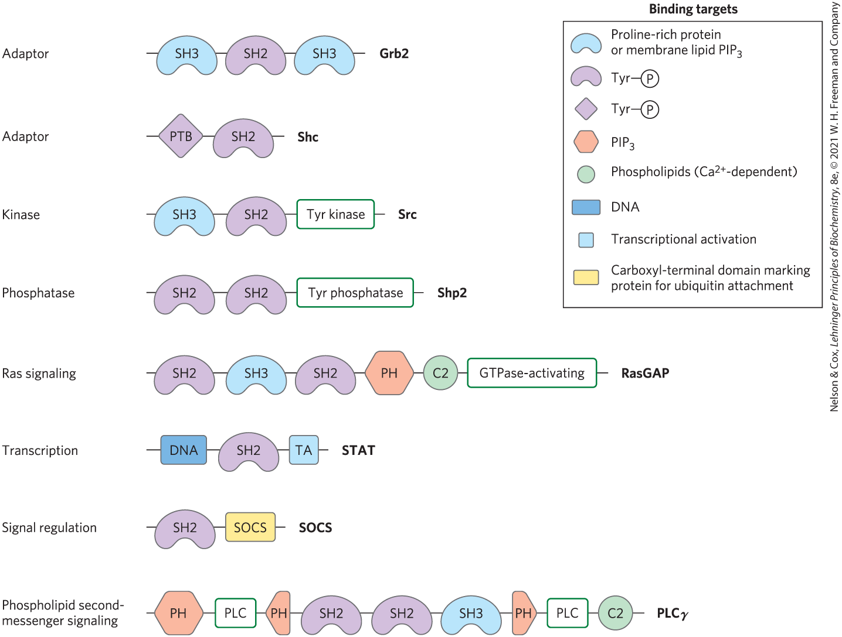
Some Binding Modules of
Signaling Proteins

Slide 123
Principle 5 (6 of 6)
Phosphorylation of intrinsically disordered regions of signaling proteins acts as a switch, toggling enzyme activity or creating binding sites for other molecules. Signal responses are integrated by multiprotein signaling complexes with modular domains that bind phosphorylated Tyr, Ser, or Thr residues.

Slide 124
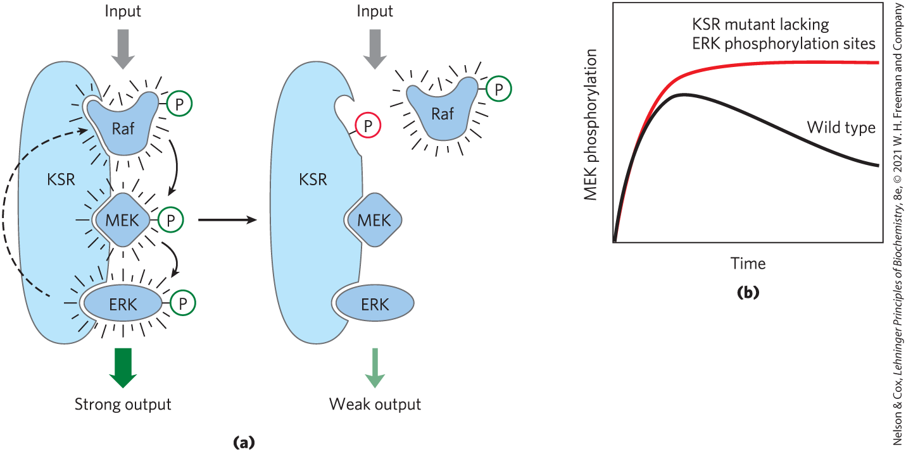
Scaffolds with Multivalent Binding Capacities Assemble Large Multiprotein Complexes

Slide 125
Membrane Rafts and Caveolae Segregate Signaling Proteins
membrane rafts = regions of the membrane bilayer enriched in sphingolipids, sterols, and proteins attached to the bilayer by GPI anchors
caveolae = specialized membrane rafts
segregating signaling proteins in rafts and caveolae:
  raises their local concentrations
  makes signaling more efficient

Slide 126
12.6 Gated Ion Channels

Slide 127
Principle 6 (3 of 5)
Ion channels gated by membrane potential or ligands are central to signaling in all cells, including bacteria, plants, and animals.

Slide 128
Ion Channels Underlie Rapid Electrical Signaling in Excitable Cells
ion channels open when a specific ligand binds to its associated receptor or there is change in the transmembrane electrical potential (voltage-gated ion channels)

Slide 129
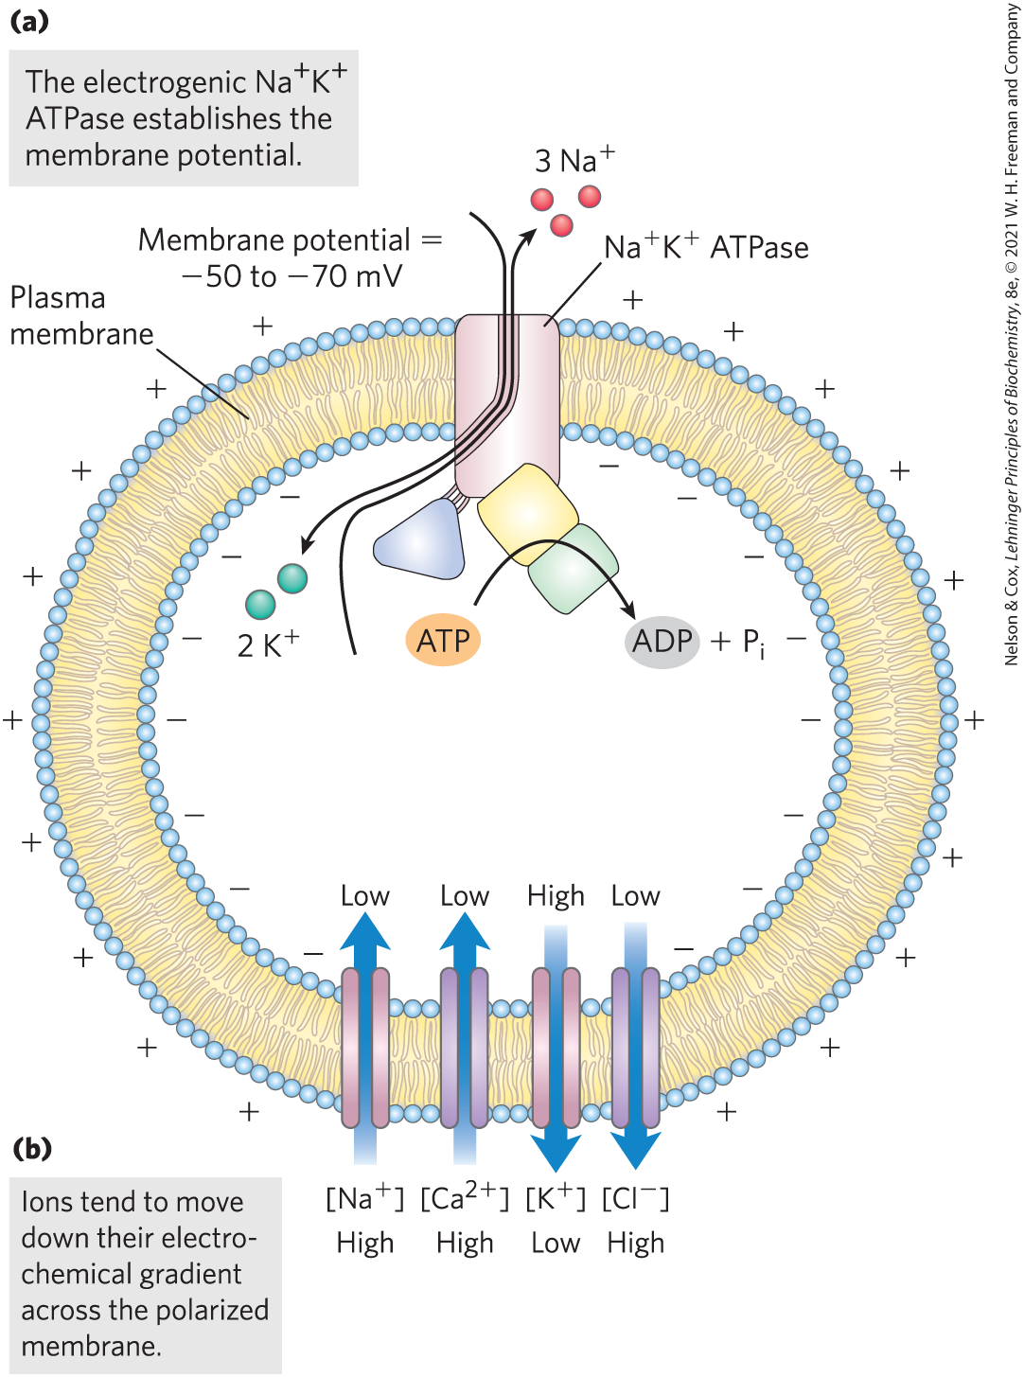
The Na⁺K⁺ ATPase Is Electrogenic
electrochemical potential determines spontaneous ion flow across a polarized membrane
when their respective channel opens,
  Na⁺ and Ca²⁺ flow inward
  K⁺ and Cl⁻ flow outward

Slide 130
Principle 6 (4 of 5)
Ion channels gated by membrane potential or ligands are central to signaling in all cells, including bacteria, plants, and animals.

Slide 131
The Opening and Closing of Ion Channels Underlies Electrical Signaling
Na⁺, K⁺, and Cl⁻ ion fluxes have essentially no effect on the concentrations of these ions
membrane potential at a given time depends on the types and numbers of ion channels open at that instant
  transient changes in membrane potential underlie electric signaling

Slide 132
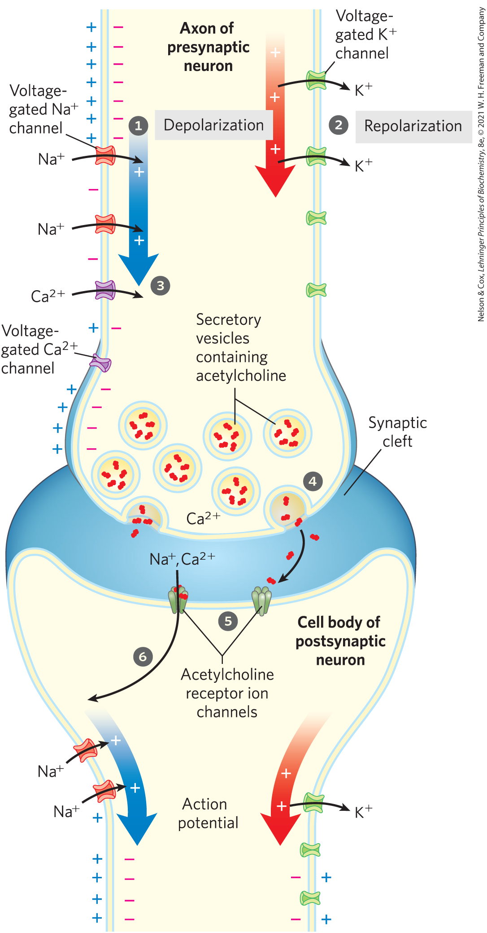
Voltage-Gated Ion Channels Produce Neuronal Action Potentials
action potential = wave of depolarization (Na⁺ influx) followed by repolarization (K⁺ efflux)
  travels the length of a neuron from the cell body to the end of an axon
  carried by the voltage-gated Na⁺ and K⁺ channels of neuronal membranes
  arrival at the distal end of a presynaptic neuron triggers neurotransmitter release

Slide 133
Principle 6 (5 of 5)
Ion channels gated by membrane potential or ligands are central to signaling in all cells, including bacteria, plants, and animals.

Slide 134
Neurons Have Receptor Channels That Respond to Different Neurotransmitters
ionotropic receptors = receptors that are ion channels
metabotropic receptors = receptors that generate a second messenger
ligands (neurotransmitters) each binds to their specific receptors and triggers a change in V_{m}
  the target cell’s V_{m} is the sum of the effects of all ion-channel contributions

Slide 135
Toxin Target Ion Channels
neurotoxins attack neuronal ion channels
  fast-acting and deadly
examples:
  dendrotoxin (from the black mamba snake) affects voltage-gated K⁺ channels
  tetrodotoxin (produced by puffer fish) affects voltage-gated Na⁺ channels
  cobrotoxin (from cobras) affects acetylcholine receptor ion channels

Slide 136
12.7 Regulation of Transcription by Nuclear Hormone Receptors

Slide 137
Principle 7 (2 of 2)
Some hormone signals act inside the cell, not at the plasma membrane, forming complexes with specific receptor proteins that regulate gene expression.

Slide 138
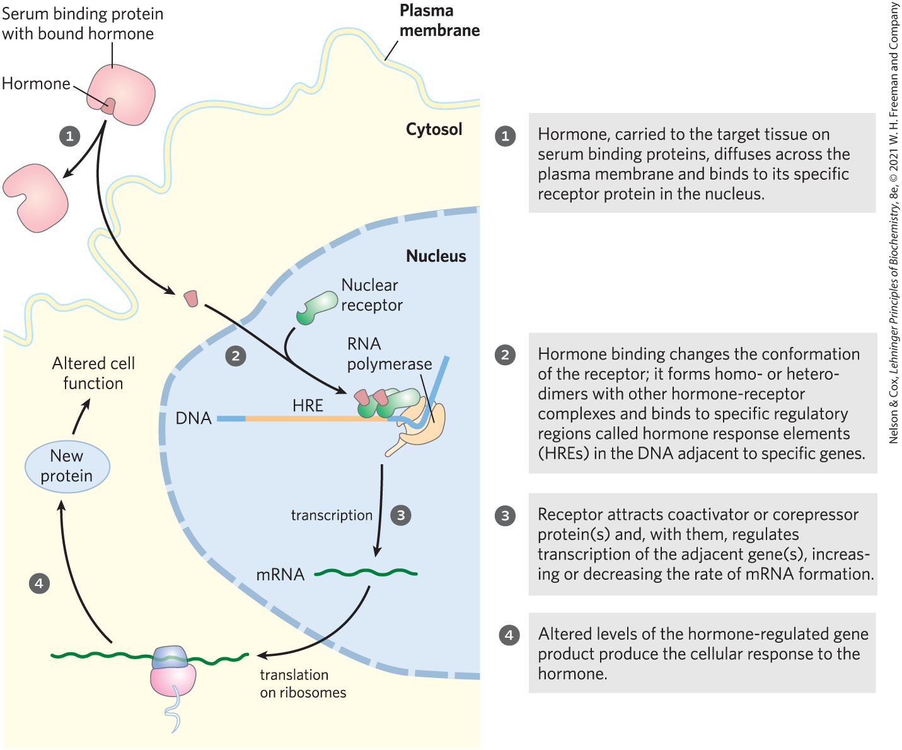
Steroid Hormones Diffuse Into The Cell and Regulate Gene Expression
hormone response elements (HREs) = specific regulatory sequences in DNA that interact with receptor proteins following hormone binding

Slide 139

Tamoxifen and Mifepristone
tamoxifen = estrogen antagonist used in the treatment of breast cancer
  has little or no effect on gene expression
mifepristone (RU486) = contraceptive
  binds to the progesterone receptor and blocks hormone actions essential to implantation of the fertilized ovum

Slide 140
12.8 Regulation of the Cell Cycle by Protein Kinases

Slide 141
Principle 9 (3 of 6)
Defective signaling proteins or defective regulation of their synthesis and breakdown can disrupt cell cycle regulation and lead to tumor formation (cancer).

Slide 142
Cancer
cancer occurs when:
  the regulatory mechanisms that limit cell division are defective
  cells undergo unregulated division

Slide 143

The Cell Cycle Has Four Stages
after passing through the M phase and into G1, a cell either continues through another division or enters G0
differentiated cells remain in the G0 phase

Slide 144
Principle 8 (2 of 2)
Cells receive extracellular signals that determine progress through the cell division cycle, or trigger cell death—processes regulated by phosphorylation and dephosphorylation of key regulatory proteins.

Slide 145

Levels of Cyclin-Dependent Protein Kinases Oscillate
a family of kinases controls the timing of the cell cycle
cyclin-dependent protein kinase (CDK) = catalytic subunit of the kinases
cyclin = regulatory subunit of the kinases

Slide 146
Oscillations Are the Result of Regulating CDK Activity
oscillations are the result of:
  phosphorylation or dephosphorylation of the CDK
  controlled degradation of the cyclin subunit
  periodic synthesis of CDKs and cyclins
  the action of specific CDK-inhibiting proteins

Slide 147
CDKs Are Regulated by Phosphorylation, Cyclin Degradation, Growth Factors, and Specific Inhibitors
phosphorylation of Thr¹⁶⁰ of CDK2 opens the substrate-binding cleft in the kinase
dephosphorylation of phosphorylated Tyr¹⁵ of CDK2 unblocks the ATP-binding site

Slide 148

Activation of Cyclin-Dependent Protein Kinases (CDKs)

Slide 149

Regulation of CDK by Phosphorylation and Proteolysis
ubiquitin = regulatory protein that targets proteins for destruction
proteasomes = proteolytic enzyme complexes

Slide 150

Regulation of Cell Division by Growth Factors and Inhibitors
growth factors = extracellular signals that phosphorylate and activate nuclear transcription factors
specific protein inhibitors bind to and inactivate specific CDKs
  example: p21

Slide 151
CDKs Regulate Cell Division by Phosphorylating Critical Proteins
lamin = protein that makes up the intermediate filaments of the nuclear envelope
  phosphorylation by a CDK causes depolymerization of the filaments
actin and myosin = pinch a dividing cell into two parts during cytokinesis
  phosphorylation of myosin by a CDK causes dissociation of myosin from actin filaments

Slide 152

Phosphorylation of pRb
retinoblastoma protein (pRb) = binds the transcription factor E2F to arrest cell division in G1 when DNA damage is detected
  phosphorylation by a CDK relieves the pRb-E2F blocking mechanism

Slide 153
12.9 Oncogenes, Tumor Suppressor Genes, and Programmed Cell Death

Slide 154
Principle 9 (4 of 6)
Defective signaling proteins or defective regulation of their synthesis and breakdown can disrupt cell cycle regulation and lead to tumor formation (cancer).

Slide 155
Cell Division Is Regulated by Extracellular Growth Factors
cell division is regulated by extracellular growth factors
  causes a balance between the formation and destruction of cells
defects in regulatory proteins disrupt this balance
  can result in the formation of a tumor and cancer

Slide 156
Principle 9 (5 of 6)
Defective signaling proteins or defective regulation of their synthesis and breakdown can disrupt cell cycle regulation and lead to tumor formation (cancer).

Slide 157
Oncogenes Are Mutant Forms of the Genes for Proteins That Regulate the Cell Cycle
oncogenes = mutated versions of genes encoding signaling proteins involved in cell cycle regulation
  lead to tumor formations
  genetically dominant
  may encode defective growth factors, receptors, G proteins, protein kinases, or nuclear regulators of transcription
proto-oncogenes = genes in animal host cells that encode growth-regulating proteins

Slide 158
Defects in Certain Genes Remove Normal Restraints on Cell Division
tumor suppressor genes = encode regulatory proteins that normally inhibit cell division
  mutations in these genes are genetically recessive
mutations in both copies of the genes for pRb, p53, or p21 cause tumor formation

Slide 159
Stability Genes
stability genes (caretaker genes) = encode proteins necessary for the repair of genetic damage
  mutations cause other mutations to go unrepaired
  can cause cancer when the unrepaired mutations are in proto-oncogenes and tumor suppressor genes

Slide 160

Multistep Transition from Normal Epithelial Cell to Colorectal Cancer
in some (and perhaps all) cancers, the progression from a normal cell to a malignant tumor requires an accumulation of mutations

Slide 161
Driver and “Passenger” Mutations
driver mutations = mutations that are the cause of unregulated cell division
“passenger mutations” = mutations that occur randomly and do not confer a selective growth advantage

Slide 162
Apoptosis Is Programmed
Cell Suicide
programmed cell death = apoptosis = mechanism by which cells precisely control the time of their own death
  triggered by irreparable DNA damage and severe stresses
  occurs during normal embryo development

Slide 163
Principle 9 (6 of 6)
Defective signaling proteins or defective regulation of their synthesis and breakdown can disrupt cell cycle regulation and lead to tumor formation (cancer).

Slide 164

Tumor Necrosis Factor (TNF) Can Trigger Apoptosis
tumor necrosis factor (TNF) = produced by cells of the immune system
  interacts with cells through specific TNF receptors
“death domain” = carries the self-destruct signal through the membrane to cytosolic proteins

