Slide 1

9 DNA-Based Information Technologies
© 2021 Macmillan Learning

Slide 2

Principle 1 (1 of 8)
An organism’s DNA — its genome — is the ultimate source of biological information. Genomic information is a resource of unparalleled importance for investigators studying any aspect of biology. Genomes vary in size, but all are large enough to direct all aspects of an organism’s structure and function. To approach them often requires tools to break them into small parts that are experimentally digestible.

Slide 3

Principle 2 (1 of 9)
Genomic information is accessible. Advances in DNA sequencing (Chapter 8) are being matched by new approaches to understanding how chromosomal information is expressed and regulated on a genomic and cellular scale. Important clues to protein function are embedded in the sequences of the genes that encode them.

Slide 4

Principle 3 (1 of 6)
Genomic information is malleable. We can not only elucidate cellular genomic information; we can also change it. That capacity provides a path to altering any aspect of cellular metabolism, structure, or function.

Slide 5
Genome and Genomics
genome = the complete haploid genetic complement of an organism
genomics = the study of DNA on a cellular scale
  contributes to systems biology (the study of biochemistry on the scale of whole cells and organisms)

Slide 6
9.1 Studying Genes and Their Products

Slide 7
Principle 1 (2 of 8)
An organism’s DNA — its genome — is the ultimate source of biological information. Genomic information is a resource of unparalleled importance for investigators studying any aspect of biology. Genomes vary in size, but all are large enough to direct all aspects of an organism’s structure and function. To approach them often requires tools to break them into small parts that are experimentally digestible.

Slide 8
Genes Can Be Isolated by DNA Cloning
clone = an identical copy
DNA cloning = selective amplification of a particular gene or DNA segment so that its genetic information may be studied and utilized
recombinant DNA technology or genetic engineering = the methods used to accomplish DNA cloning and related tasks

Slide 9
The Process of DNA Cloning
five general processes:
  obtain the DNA segment to be cloned
  select a small molecule of DNA capable of autonomous replication
  join the two DNA fragments covalently
  move the recombinant DNA from the test tube to the host organism
  select or identify host cells that contain the recombinant DNA

Slide 10
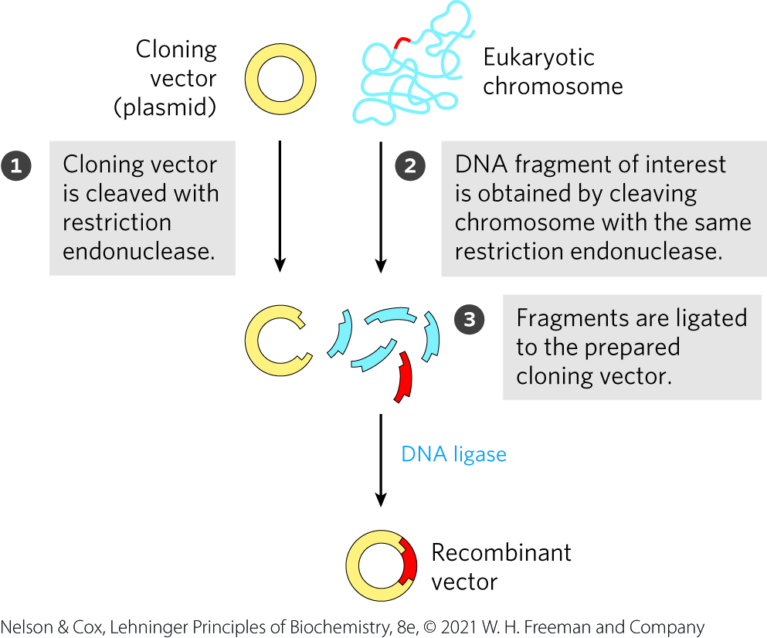
The Process of DNA Cloning – Generating a Recombinant Vector
cloning vectors = small DNAs capable of autonomous replication
recombinant DNAs = composite DNA molecules comprised of covalently linked segments from 2+ sources

Slide 11
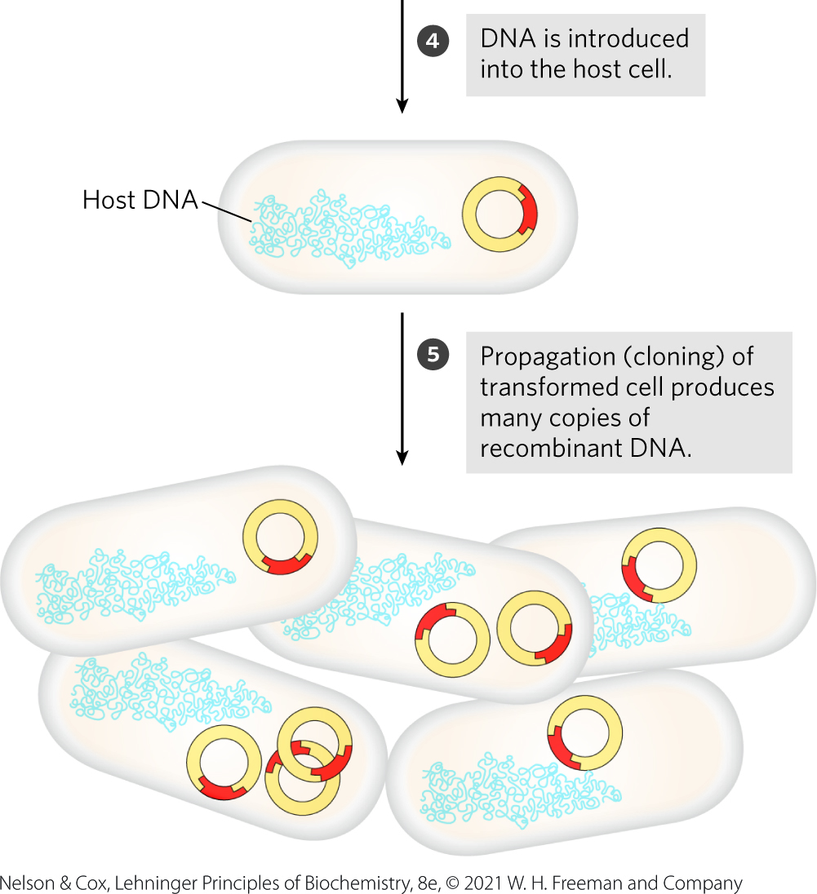
The Process of DNA Cloning – Introducing DNA into the Organism
advantages of cloning in
E. coli:
  DNA metabolism is well understood
  many naturally occurring cloning vectors (plasmids and bacteriophages)
  techniques for moving DNA from one bacterial cell to another

Slide 12
Restriction Endonucleases and DNA Ligases Yield Recombinant DNA
Table 9-1 Some Enzymes Used in Recombinant DNA Technology
Enzyme(s) | Function
Type II restriction endonucleases | Cleave DNA molecules at specific base sequences
DNA ligase | Joins two DNA molecules or fragments
DNA polymerase I (E. Coli) | Fills gaps in duplexes by stepwise addition of nucleotides to 3′ ends
Reverse transcriptase | Makes a DNA copy of an RNA molecule
Polynucleotide Kinase | Adds a phosphate to the 5′-OH end of a polynucleotide to label it or to permit ligation
Terminal transferase | Adds homopolymer tails to the 3′-OH ends of a linear duplex
Exonuclease III | Removes nucleotide residues from the 3′ ends of a DNA strand
Bacteriophage λ exonuclease | Removes nucleotides from the 5′ ends of a duplex to expose single-stranded 3′ ends
Alkaline phosphatase | Removes terminal phosphates from the 5′ and 3′ end (or both)

Slide 13
Principle 1 (3 of 8)
An organism’s DNA — its genome — is the ultimate source of biological information. Genomic information is a resource of unparalleled importance for investigators studying any aspect of biology. Genomes vary in size, but all are large enough to direct all aspects of an organism’s structure and function. To approach them often requires tools to break them into small parts that are experimentally digestible.

Slide 14
Restriction Endonucleases
restriction endonucleases (restriction enzymes) = recognize and cleave DNA at specific sequences (recognition sequences or restriction sites)
methylases = catalyze methylation of host DNA to protect it from digestion by the host cell’s restriction endonucleases
restriction-modification system = the restriction endonuclease and the corresponding methylase

Slide 15
DNA Ligases
DNA ligases = joins the DNA fragment to be cloned to a suitable cloning vector

Slide 16
Types of Restriction Endonucleases
types I and III restriction endonucleases = large, multisubunit complexes containing both endonuclease and methylase activities
type II restriction endonucleases = simpler than types I and III, require no ATP, and catalyze the hydrolytic cleavage of DNA phosphodiester bonds within the recognition sequence

Slide 17
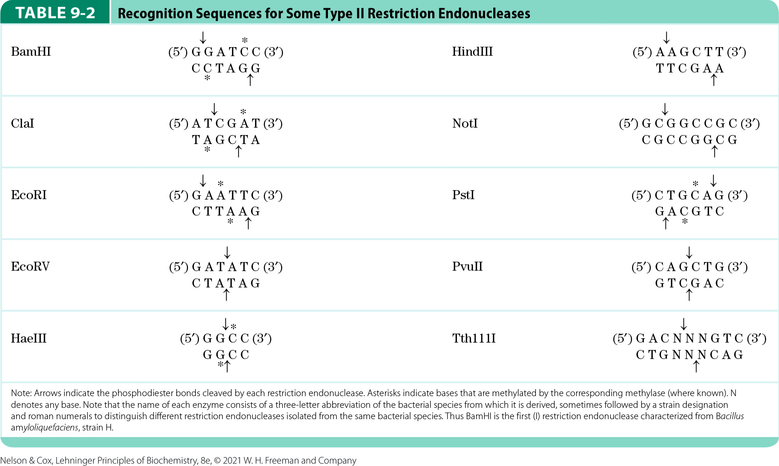
Restriction Sequences for Some Type II Endonucleases
typically 4-6 bp long
palindromic

Slide 18
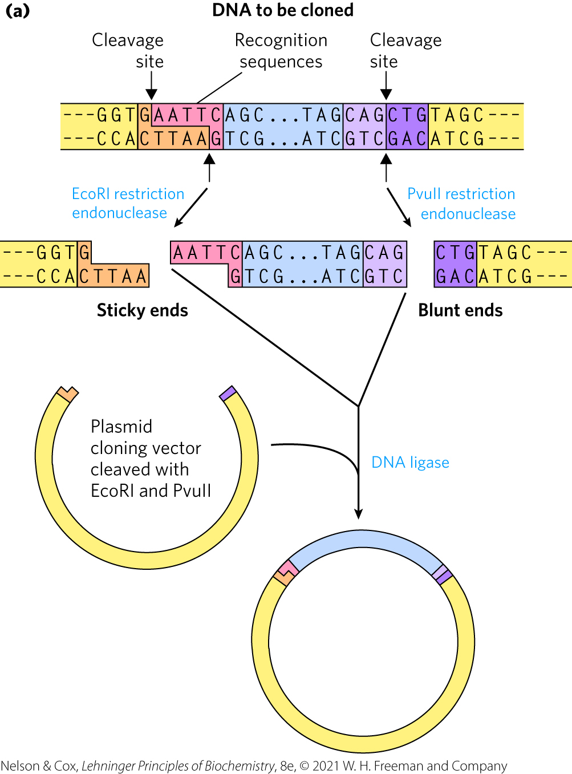
Restriction Endonucleases Leave Either Sticky Ends or Blunt Ends
sticky ends = unpaired bases on the ends
  due to endonucleases making staggered cuts
  can base pair with each other or complementary sticky ends
blunt ends = no unpaired bases on the ends
  due to endonucleases making straight cuts

Slide 19
Principle 2 (2 of 9)
Genomic information is accessible. Advances in DNA sequencing (Chapter 8) are being matched by new approaches to understanding how chromosomal information is expressed and regulated on a genomic and cellular scale. Important clues to protein function are embedded in the sequences of the genes that encode them.

Slide 20
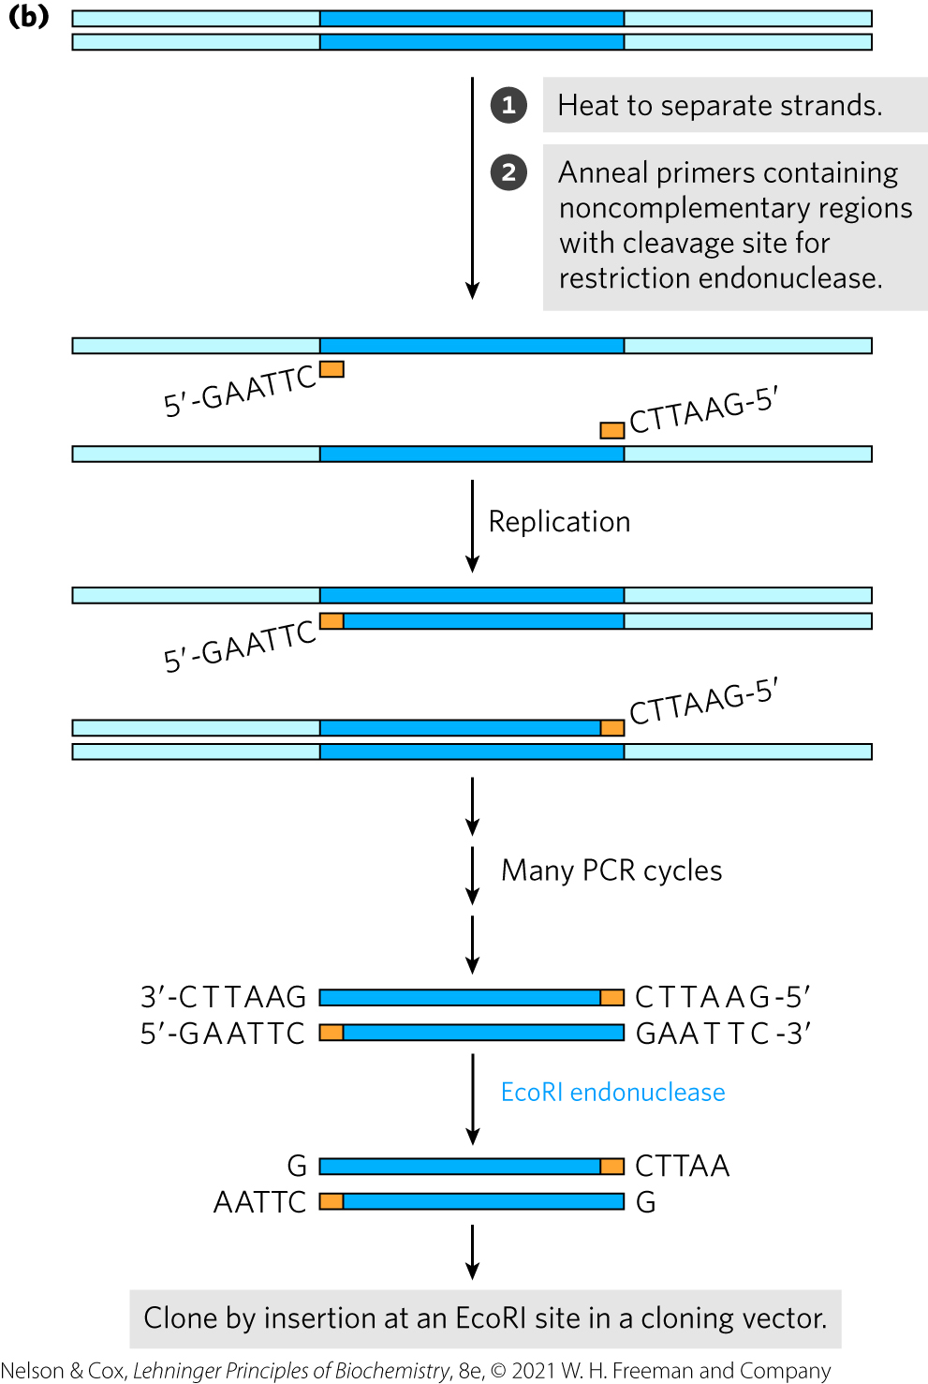
The DNA Segment to Be Cloned Is Generated By PCR
including restriction endonuclease cleavage sites facilitates the subsequent cloning of amplified DNA

Slide 21
Principle 3 (2 of 6)
Genomic information is malleable. We can not only elucidate cellular genomic information; we can also change it. That capacity provides a path to altering any aspect of cellular metabolism, structure, or function.

Slide 22
PCR-Amplified DNA Can Be Cloned
cleavage of PCR-amplified DNA creates sticky ends used to ligate the amplified DNA to a cloning vector

Slide 23
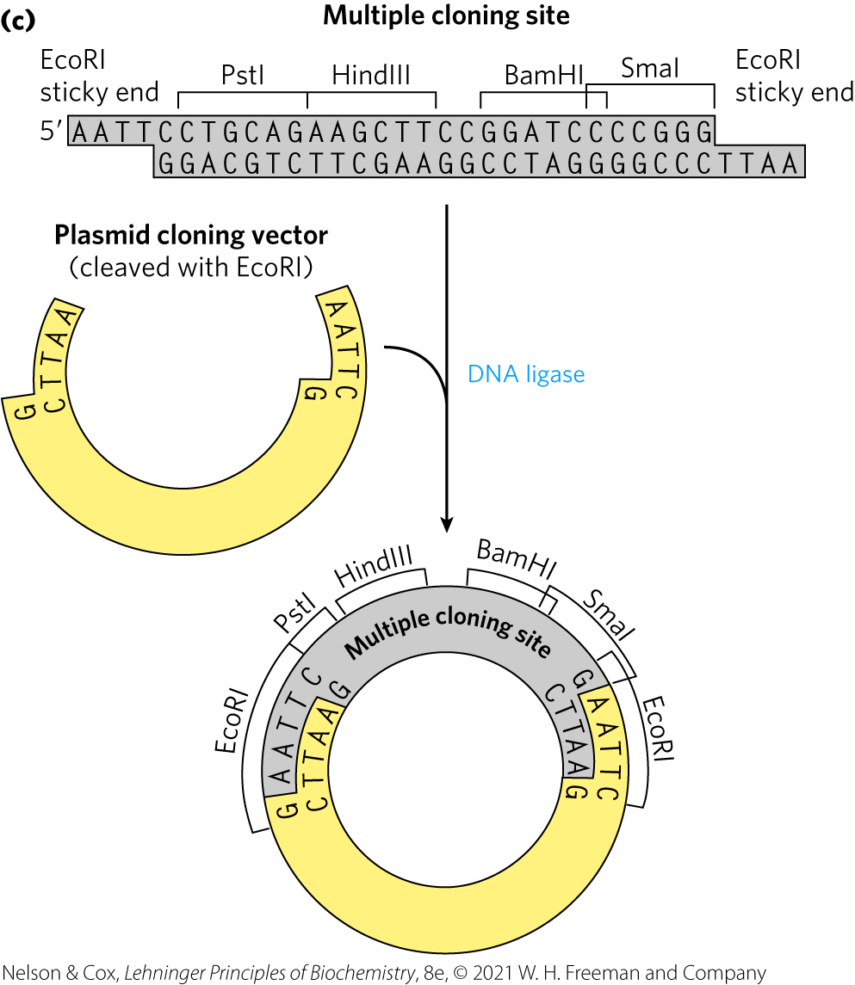
A Synthetic DNA Fragment Can Be Inserted Into a Plasmid
linkers = synthetic DNA fragments created to bridge ligated ends
multiple cloning site (MCS) = inserted DNA fragment with multiple recognition sequences for restriction endonucleases
  useful for inserting additional DNA at a later point

Slide 24
Cloning Vectors Allow Amplification of Inserted DNA Segments
three popular cloning vectors:
  plasmids
  bacterial artificial chromosomes
  yeast artificial chromosomes

Slide 25
Plasmids
plasmid = circular DNA molecule that replicates separately from the host chromosome
  5,000 – 400,000 bp
  usually have a symbiotic role in the cell

Slide 26
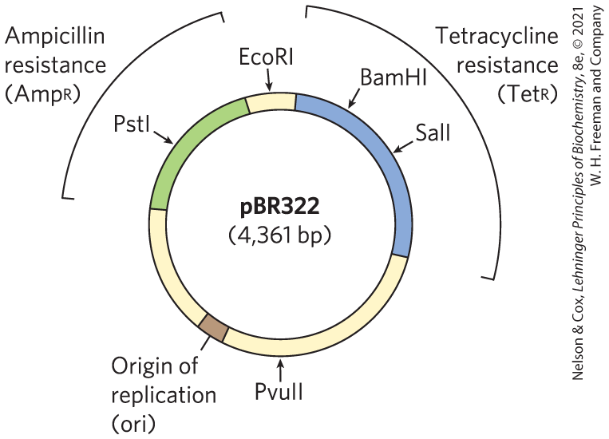
The Constructed E. coli Plasmid pBR322
key features:
  origin of replication (ori) = sequence where replication is initiated
  resistance genes
  recognition sequences for restriction endonucleases

Slide 27
Bacterial Transformation and Electroporation
transformation = laboratory process by which small plasmids are introduced into bacterial cells through heat shock treatment
  reason why is not well understood
  becomes less successful as plasmid size increases
electroporation = laboratory process by which small plasmids are introduced into bacterial cells through high-voltage pulses
  transiently renders the bacterial membrane permeable

Slide 28
Selectable Markers and Screenable Markers
used to identify cells that take up plasmid DNA
selectable marker = either permits the growth of a cell (positive selection) or kills the cell (negative selection) under defined conditions
screenable marker = gene encoding a protein that causes the cell to produce a colored or fluorescent molecule

Slide 29
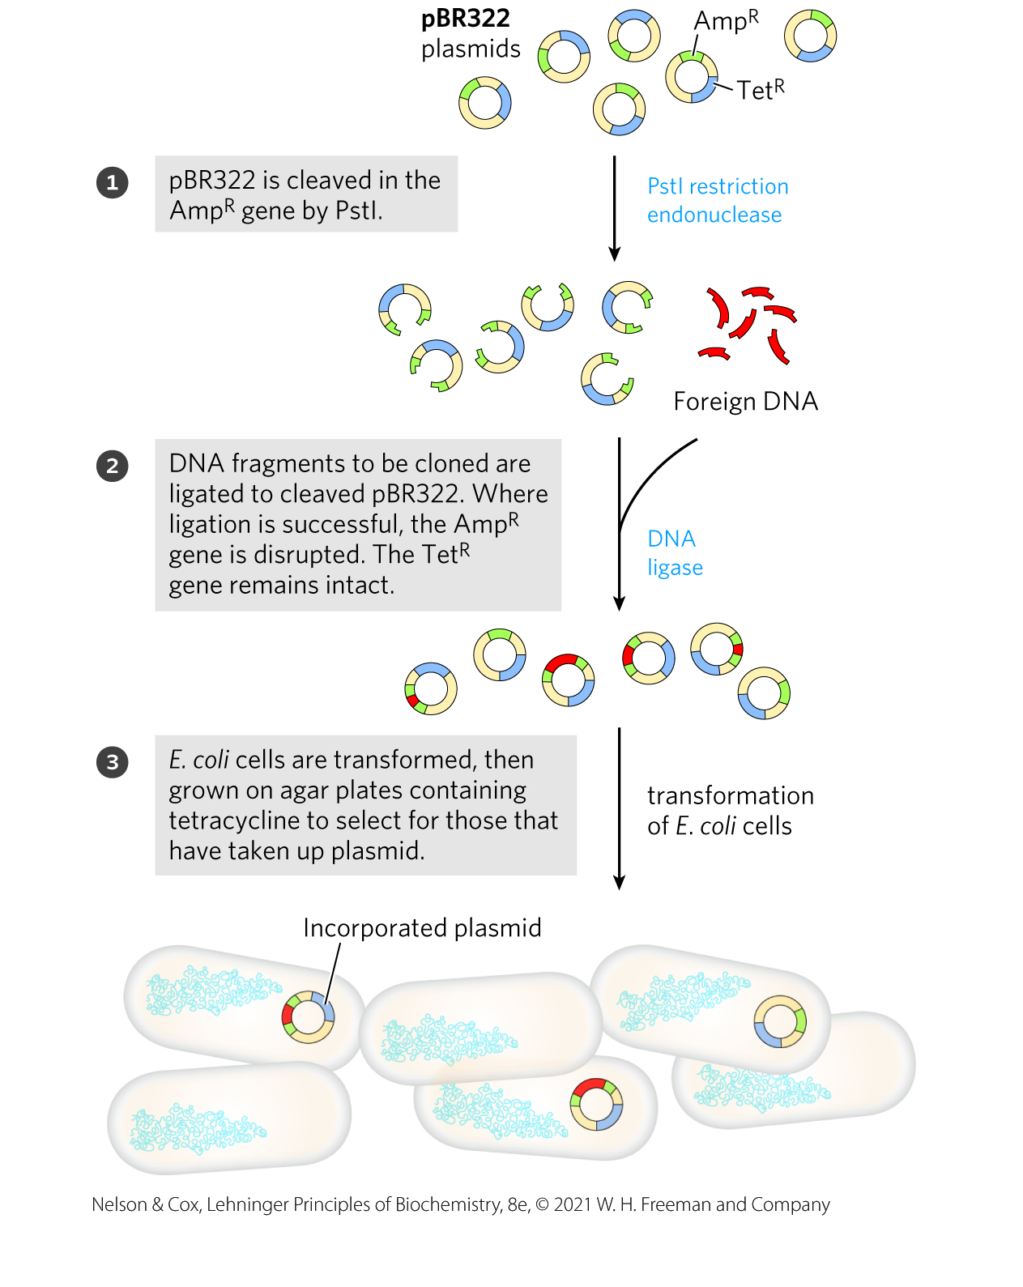
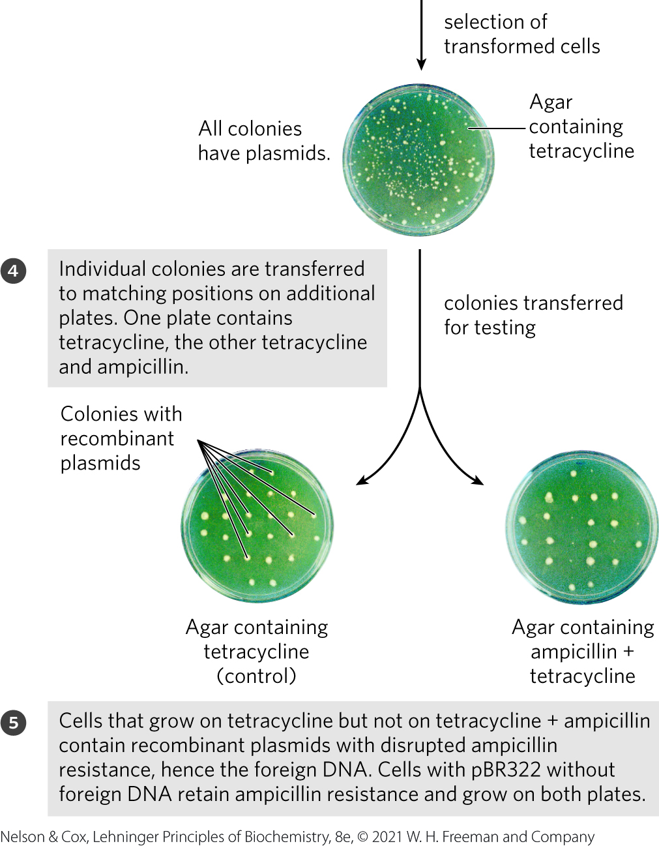
Plasmid pBR322 Provides Positive and Negative Selection Markers

Slide 30
Bacterial Artificial Chromosomes
plasmid vectors developed to allow the cloning of very long segments of DNA (100,000 – 300,000 bp)
bacterial artificial chromosomes (BACs) = composed of the plasmid vector and large segments of cloned DNA

Slide 31
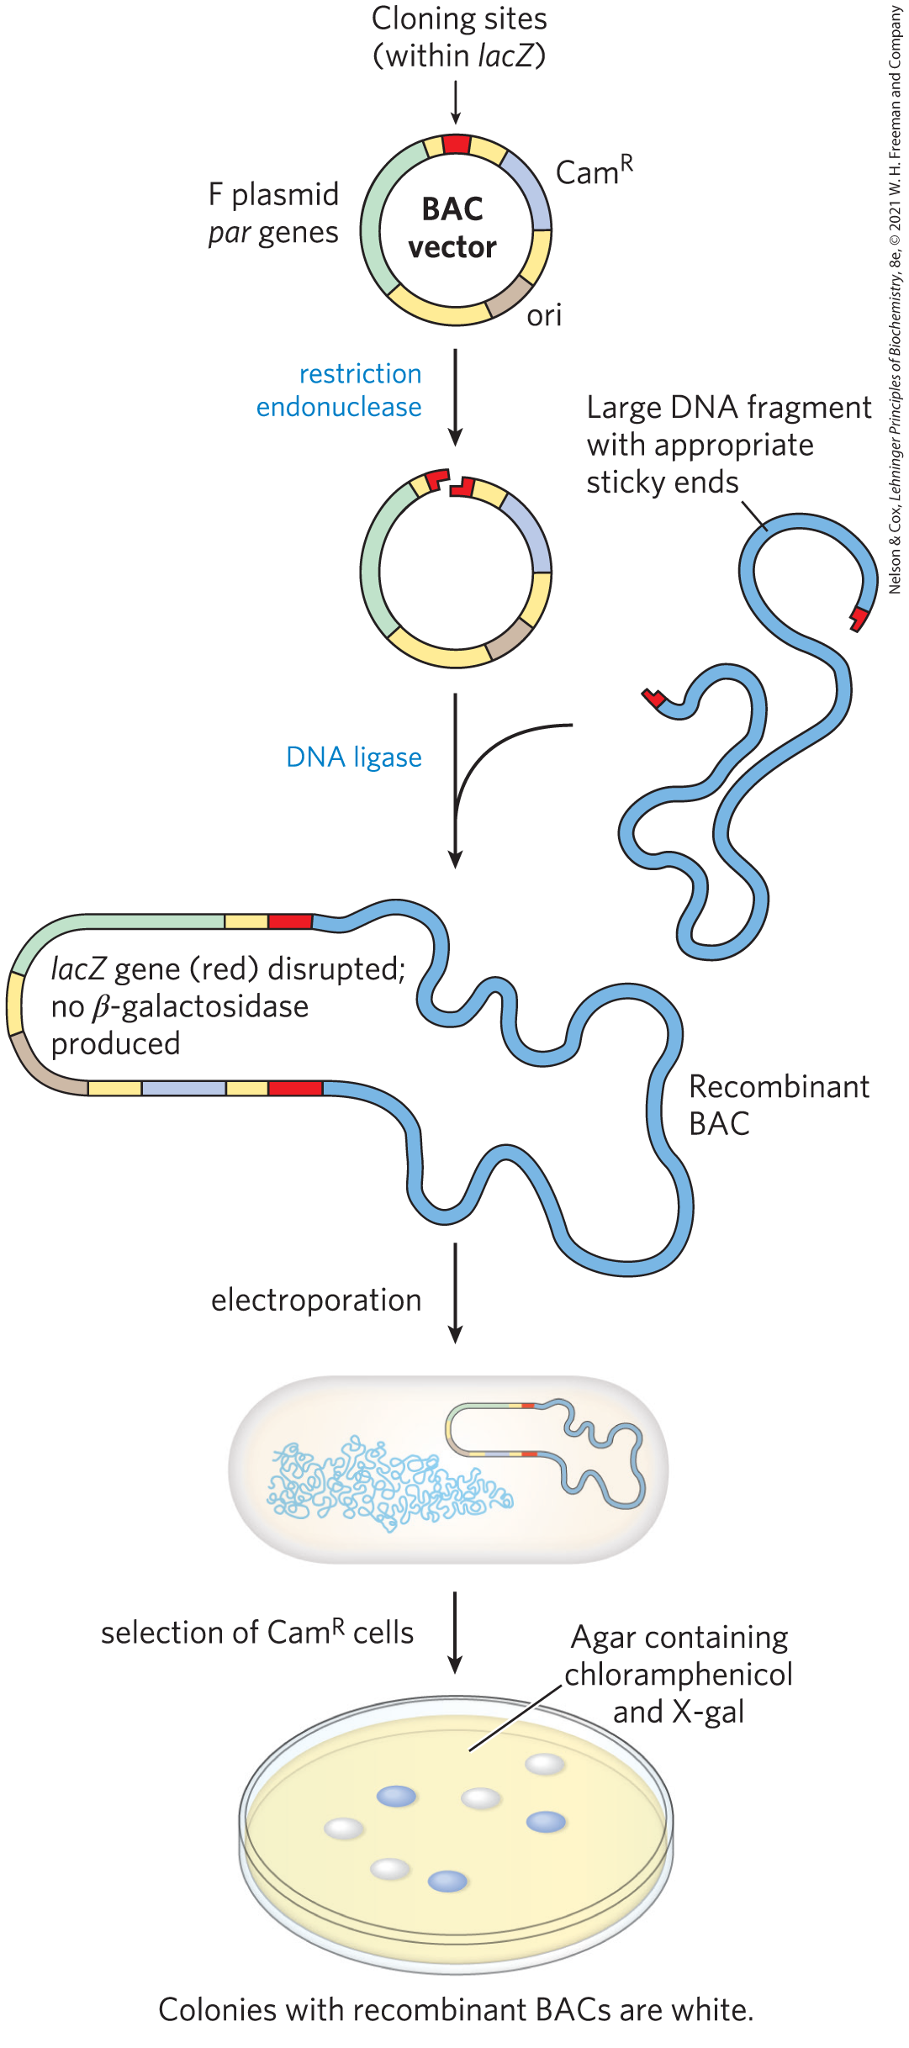
The BAC Vector
have stable origins of replications that maintain low copy numbers
contain par genes from an F plasmid that direct the reliable distribution of the recombinant chromosomes at cell division
Cam^{R} = positive selection marker
lacZ = screenable marker

Slide 32
Principle 3 (3 of 6)
Genomic information is malleable. We can not only elucidate cellular genomic information; we can also change it. That capacity provides a path to altering any aspect of cellular metabolism, structure, or function.

Slide 33
Yeast Artificial Chromosomes
yeast artificial chromosomes (YACs) = composed of the plasmid vector and large segments of cloned DNA
DNA cloned in a YAC can be altered to study:
  the function of specialized sequences in chromosome metabolism
  mechanisms of gene regulation and expression

Slide 34
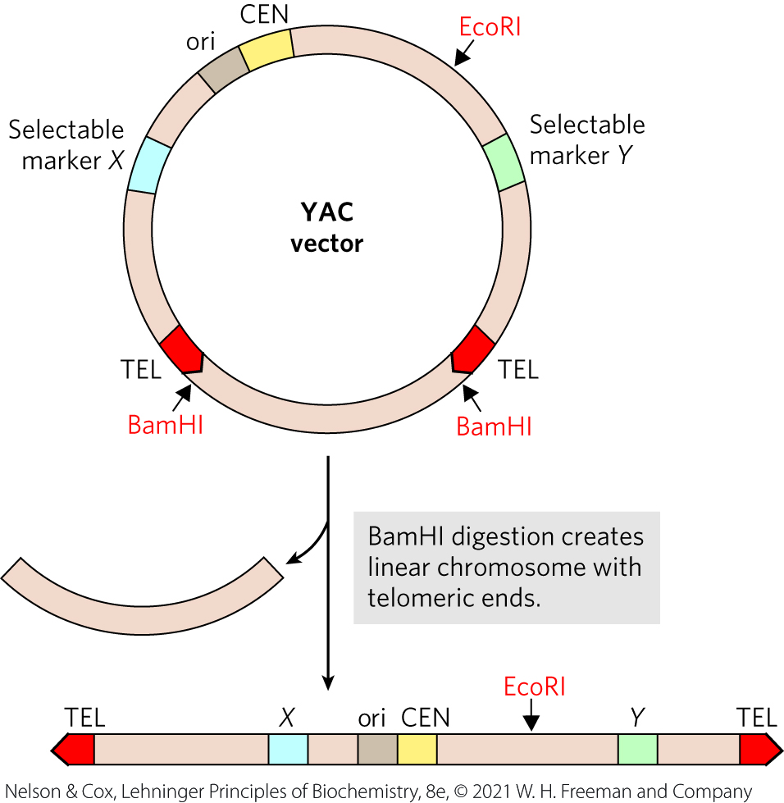
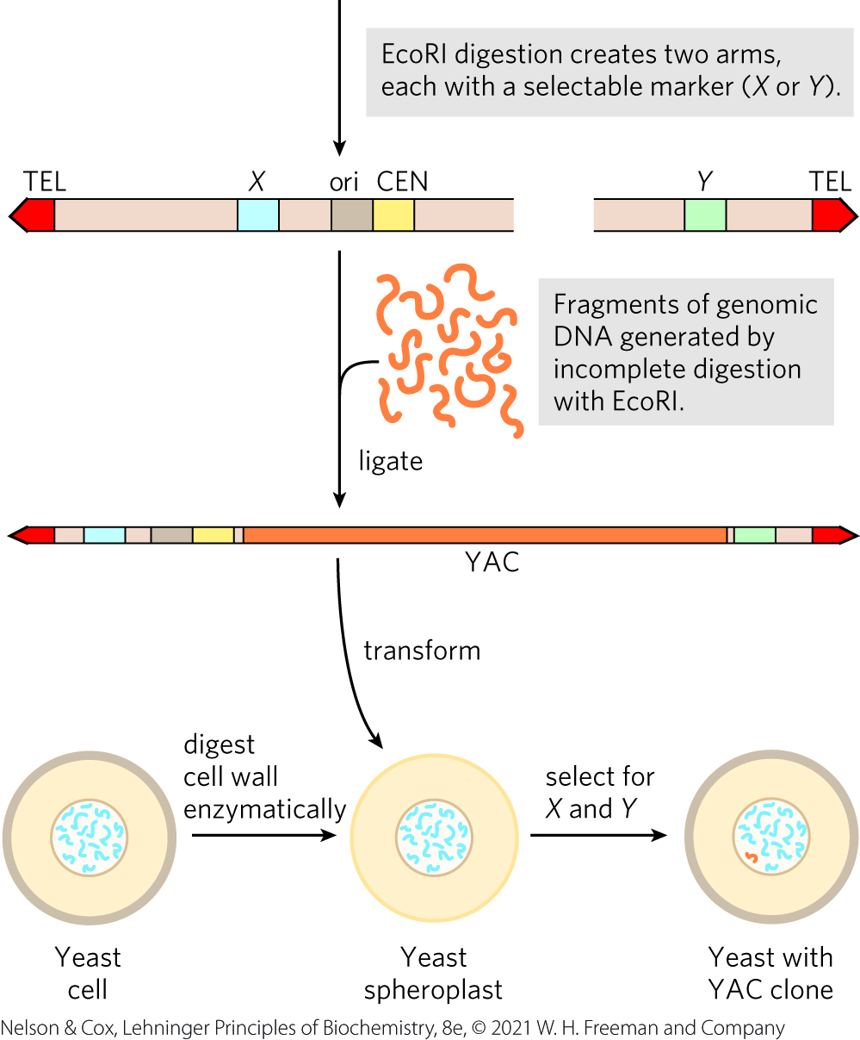
Construction of a Yeast Artificial Chromosome (YAC)

Slide 35
Shuttle Vectors
shuttle vectors = plasmids that can be propagated in cells of 2+ species
  incorporate multiple replication origins or other elements

Slide 36
The YAC Vector
contains elements to maintain a eukaryotic chromosome in the yeast nucleus:
  yeast origin of replication (ori)
  two selectable markers
  specialized sequences for stability and proper chromosome segregation at cell division:
    centromere (CEN)
    two telomeres (TEL)

Slide 37
Pulsed Field Gel Electrophoresis
pulsed field gel electrophoresis = segregates genomic fragments following partial digestion with restriction endonucleases
  used to obtain a suitable fragment size

Slide 38
The Stability of YAC Clones
increases with the length of the cloned DNA segment (up to a point)
  inserts > 150,000 bp are very stable
  inserts < 100,000 bp are gradually lost during mitosis
YACs that lack a telomere at either end are rapidly degraded

Slide 39
Principle 1 (4 of 8)
An organism’s DNA — its genome — is the ultimate source of biological information. Genomic information is a resource of unparalleled importance for investigators studying any aspect of biology. Genomes vary in size, but all are large enough to direct all aspects of an organism’s structure and function. To approach them often requires tools to break them into small parts that are experimentally digestible.

Slide 40
Cloned Genes Can Be Expressed to Amplify Protein Production
purified proteins have many purposes:
  elucidating protein function
  studying reaction mechanisms
  generating antibodies to the proteins
  reconstituting complex cellular activities in the test tube with purified components
  examining protein binding partners

Slide 41
Expressing a Eukaryotic Protein in a Bacterium
eukaryotic genes have surrounding sequences needed for their transcription and regulation
  sequences do not function in bacteria
expression vectors = cloning vectors with transcription and translation signals needed for the regulated expression of a cloned gene

Slide 42
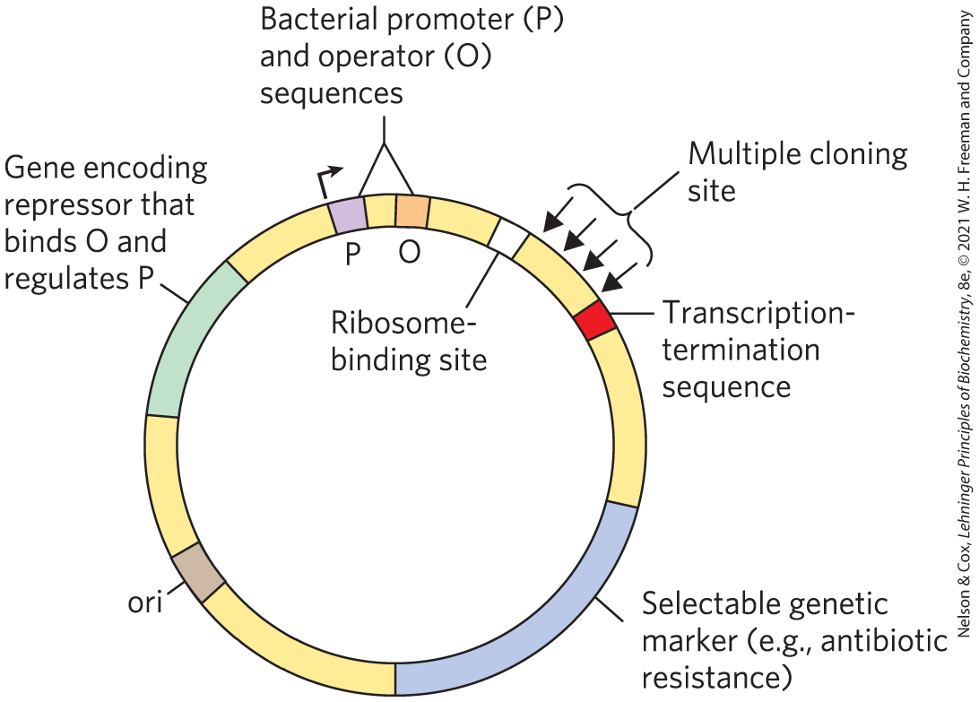
DNA Sequences in a Typical E. coli Expression Vector

Slide 43
Many Different Systems Are Used to Express Recombinant Proteins
in principle, any organism can serve as a host to express proteins from a different species:
  bacteria
  yeast
  insects and insect viruses
  mammalian cells in culture

Slide 44
Bacteria
most common hosts for protein expression

Slide 45
Advantages of Using Bacterial
Hosts
regulatory sequences are well understood
can express high levels of cloned proteins
easy to store and grow
efficient methods for transforming and extracting DNA
can be grown in huge amounts

Slide 46
Disadvantages of Using Bacterial
Hosts
some heterologous proteins do not fold correctly
proteins may not undergo necessary posttranslational modifications or proteolytic cleavage
some gene sequences can be difficult to express
  many eukaryotic proteins aggregate into insoluble cellular precipitates (inclusion bodies)

Slide 47
Transcription from the Lac
Promoter
gene of interest fused to lactose operon promotor and regulatory sequences
transcription occurs when lactose is added to the medium
regulation is “leaky”

Slide 48
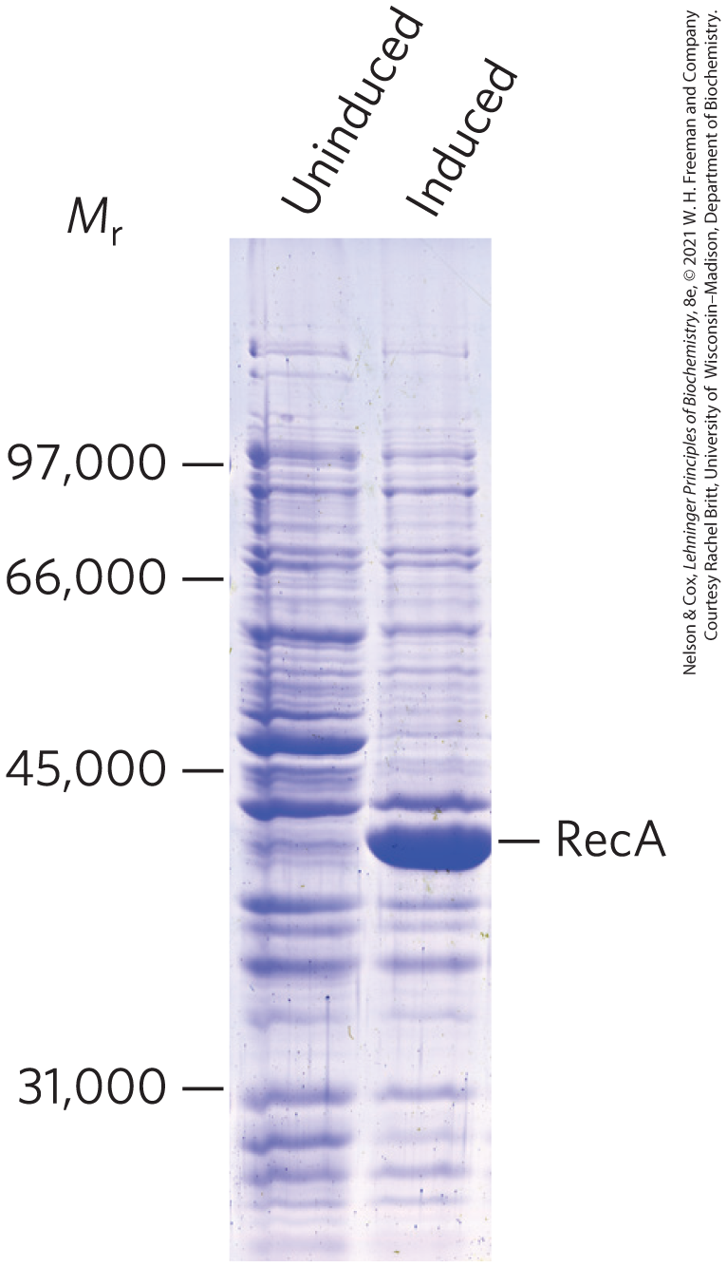
Transcription from the Bacteriophage T7 Promoter and RNA Polymerase
cloned gene is fused to a T7 promoter and transcribed by T7 RNA polymerase
affords tight regulation

Slide 49
Yeast
Saccharomyces cerevisiae is probably the best understood eukaryotic organism
principles underlying protein expression in yeast are the same as those for bacteria:
  cloned genes must be linked to appropriate promoters
  gene expression can be controlled by choosing an appropriate medium

Slide 50
Advantages of Using Yeast
Hosts
well-understood eukaryotic organism
expression of eukaryotic genes can be more efficient
proteins may be folded and modified more accurately

Slide 51
Disadvantages of Using Yeast
Hosts
heterologous proteins may not fold properly
yeast may lack the enzymes needed to modify the proteins to their active forms
certain features of the gene sequence may hinder expression of a protein

Slide 52
Insects and Insect Viruses
baculoviruses = insect viruses with double-stranded DNA genomes
  p10 and polyhedrin genes can be replaced with the gene for a heterologous protein
bacmids = large circular DNAs that include the entire baculovirus gene and sequences that allow replication of the bacmid in E. coli

Slide 53
Recombinant Bacmids Are Transfected into Insect Cells
transfection = term used when the DNA used for transformation includes viral sequences and leads to viral replication

Slide 54
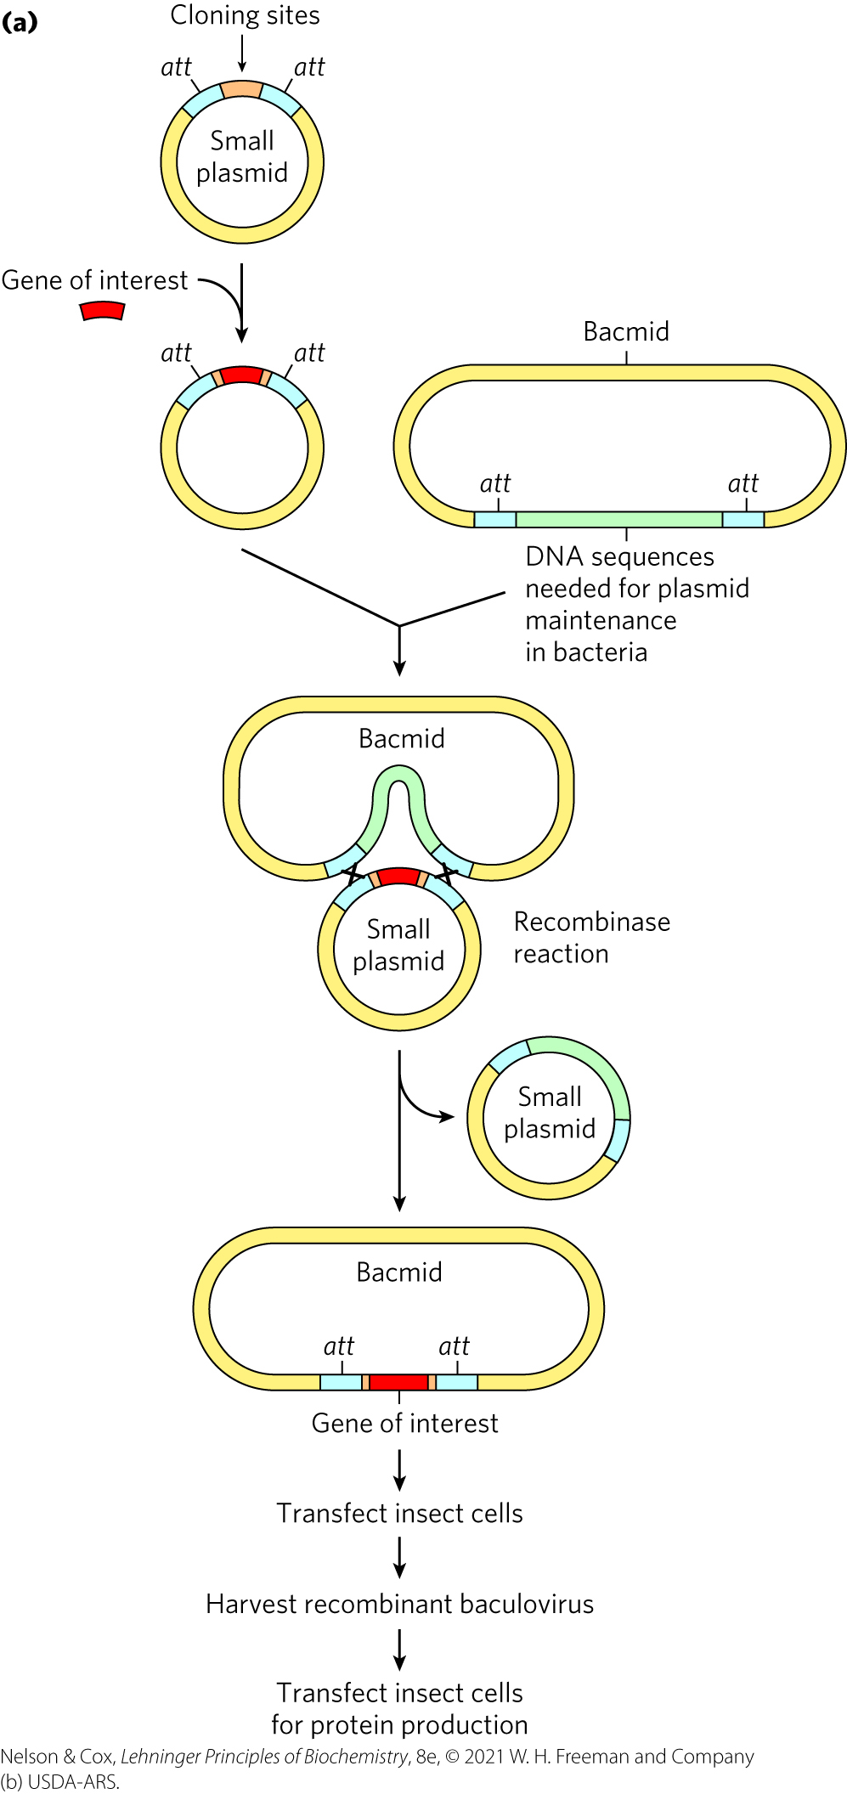
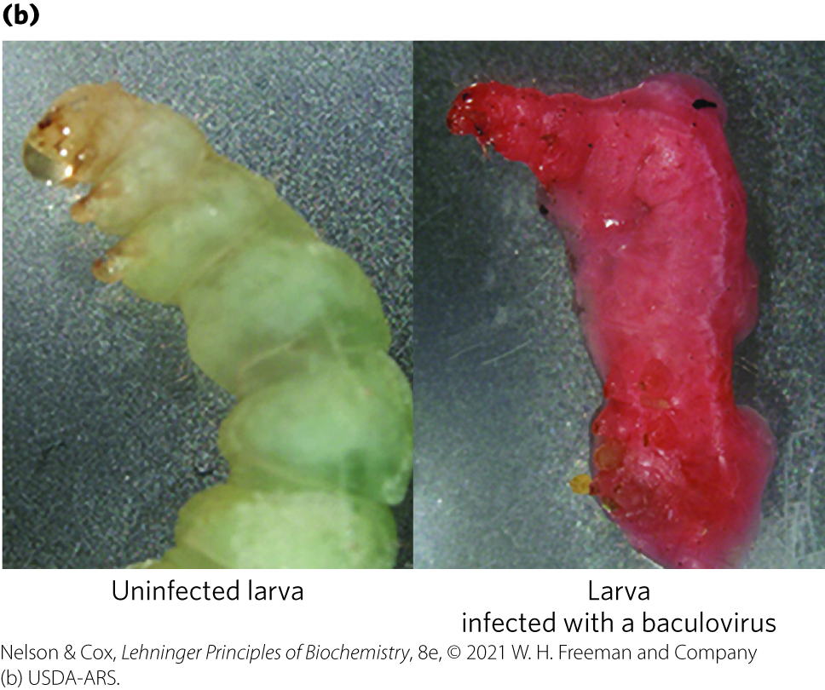
Cloning with Baculoviruses

Slide 55
Advantages and Disadvantages of Using Bacmid Systems
advantages:
  wide range available commercially
  may successfully replicate protein-modification patterns and produce active, correctly modified proteins
disadvantage:
  not successful with all proteins

Slide 56
Mammalian Cells in Culture
DNA introduced into mammalian cells using engineered mammalian viruses as vectors
advantages:
  proteins can be expressed either transiently or permanently
  proper posttranslational modification can be ensured
disadvantage:
  very expensive

Slide 57
Principle 1 (5 of 8)
An organism’s DNA — its genome — is the ultimate source of biological information. Genomic information is a resource of unparalleled importance for investigators studying any aspect of biology. Genomes vary in size, but all are large enough to direct all aspects of an organism’s structure and function. To approach them often requires tools to break them into small parts that are experimentally digestible.

Slide 58
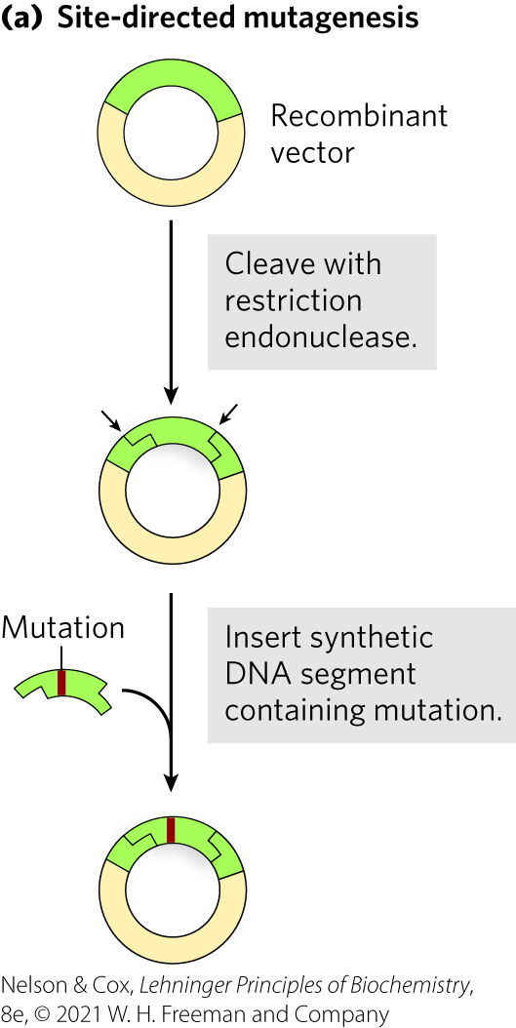
Alteration of Cloned Genes Produces Altered Proteins
site-directed mutagenesis = technique used to individually replace specific amino acids

Slide 59
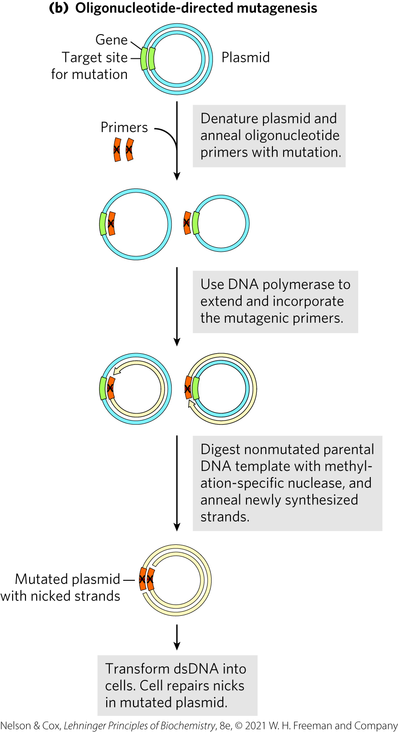
Oligonucleotide-Directed Mutagenesis
oligonucleotide-directed mutagenesis = technique used to create a specific DNA sequence change

Slide 60
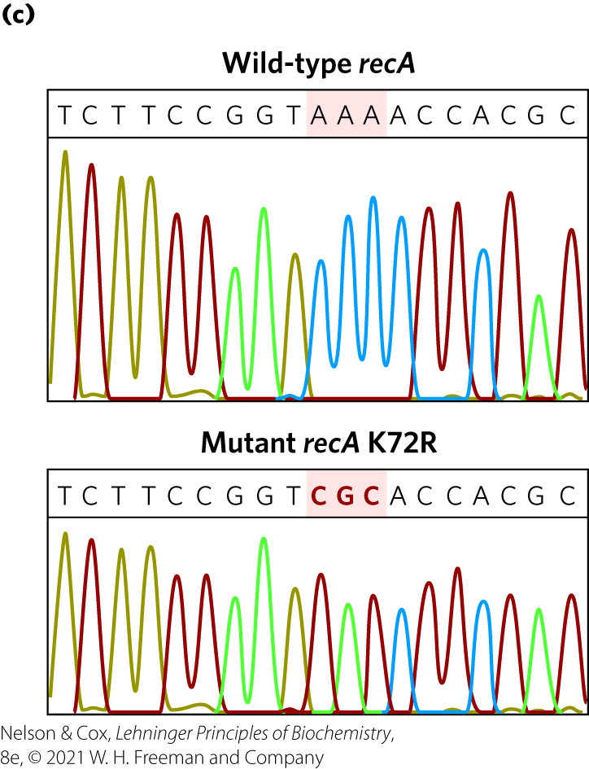
Mutagenesis of the Bacterial recA Gene
Lys⁷² of RecA protein hydrolyzes ATP
  K72R mutant binds but does not hydrolyze ATP

Slide 61
Additional Gene Changes
deletions = performed by cutting out a segment with restriction endonucleases and ligating the remaining portions
fusion protein = product of a ligated gene containing parts of two different genes

Slide 62
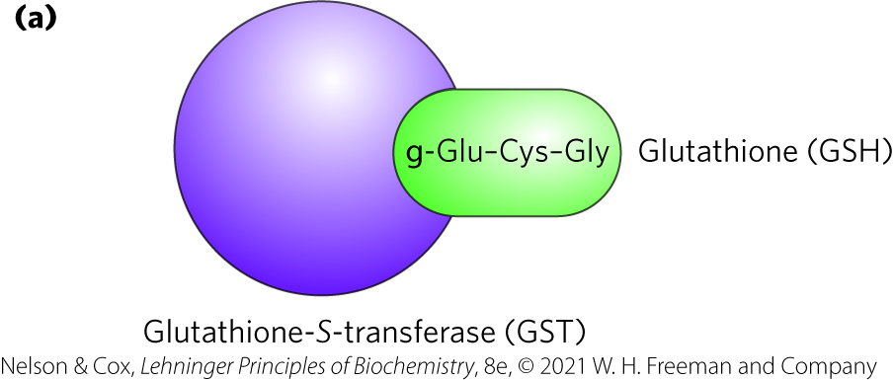
Terminal Tags Provide Handles for Affinity Purification
Table 9-3 Commonly Used Protein Tags
tag = peptide or protein that binds a simple, stable ligand with high affinity and specificity
  fused to gene encoding target protein
  permits purification by affinity chromatography
Tag protein/peptide | Molecular mass (kDa) | Immobilized ligand
Protein A | 59 | Fc portion of IgG
(His)₆ | 0.8 | Ni²⁺
Glutathione-S-transferase (GST) | 26 | Glutathione
Maltose-binding protein | 41 | Maltose
β-Galactosidase | 116 | р-Aminophenyl-β-D-thiogalactoside (TPEG)
Chitin-binding domain | 5.7 | Chitin

Slide 63
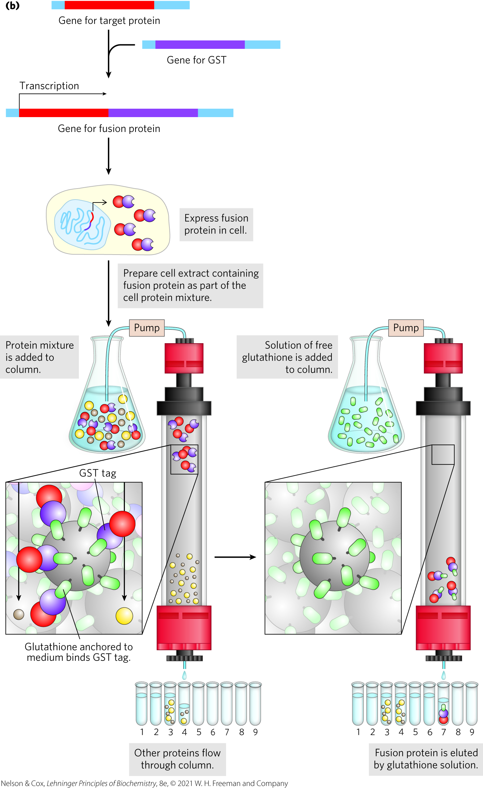
Use of Tagged Proteins in Protein Purification
provides good yield and high purity
may affect the properties of attached proteins

Slide 64
Principle 1 (6 of 8)
An organism’s DNA — its genome — is the ultimate source of biological information. Genomic information is a resource of unparalleled importance for investigators studying any aspect of biology. Genomes vary in size, but all are large enough to direct all aspects of an organism’s structure and function. To approach them often requires tools to break them into small parts that are experimentally digestible.

Slide 65
The Polymerase Chain Reaction Offers Many Options for Cloning Experiments
reverse transcriptase PCR (RT-PCR) = uses reverse transcriptase to generate a DNA strand from an RNA template, followed by standard PCR protocols using DNA polymerases
quantitative PCR (qPCR) or real-time PCR = is used to estimate relative copy numbers of particular sequences in a sample

Slide 66
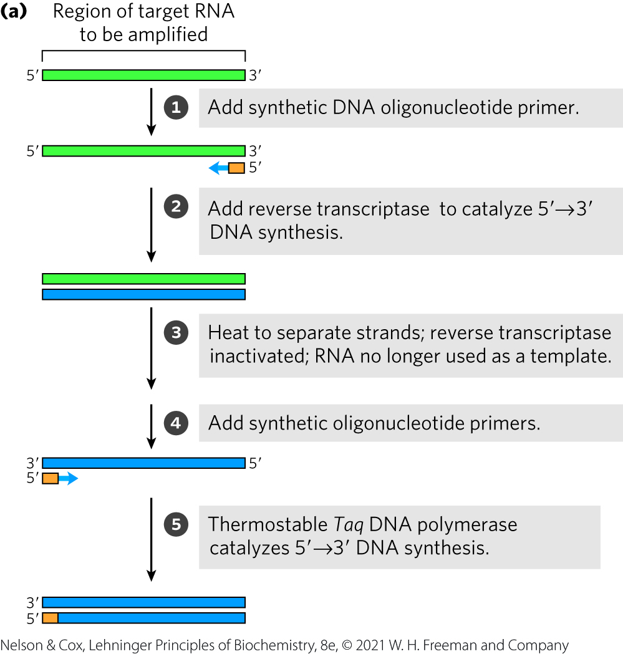
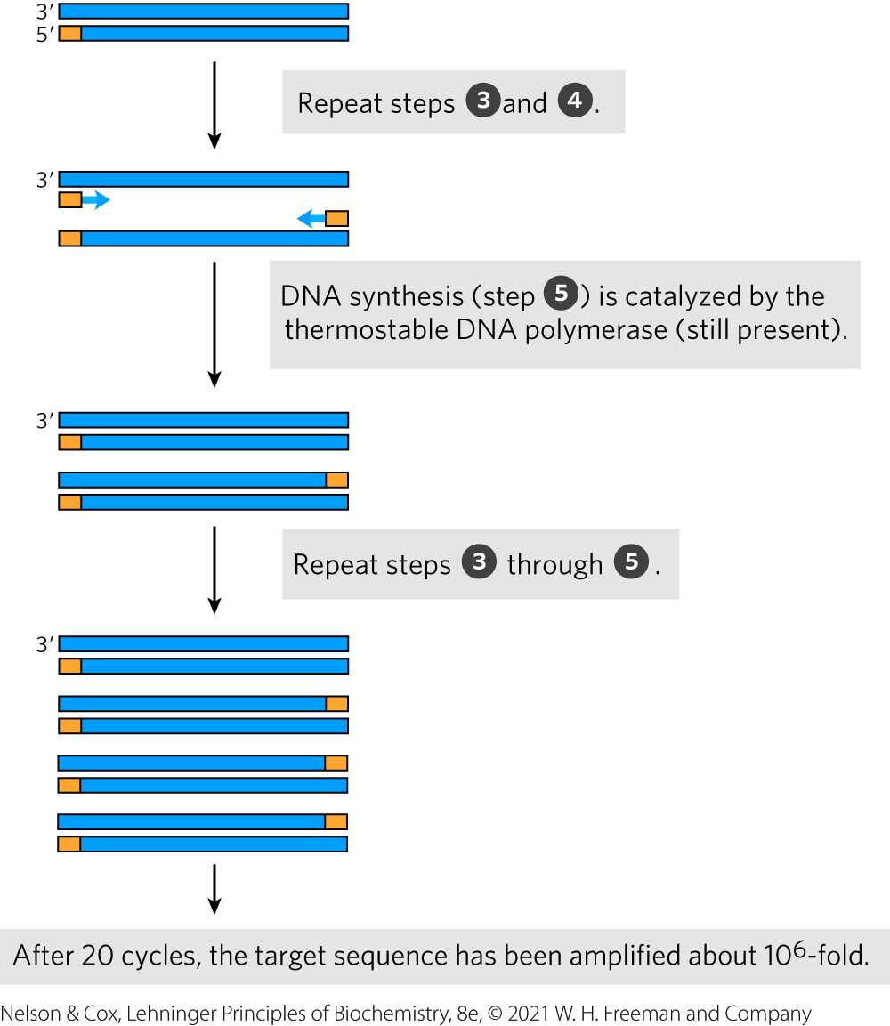
Reverse Transcriptase PCR
(RT-PCR)

Slide 67
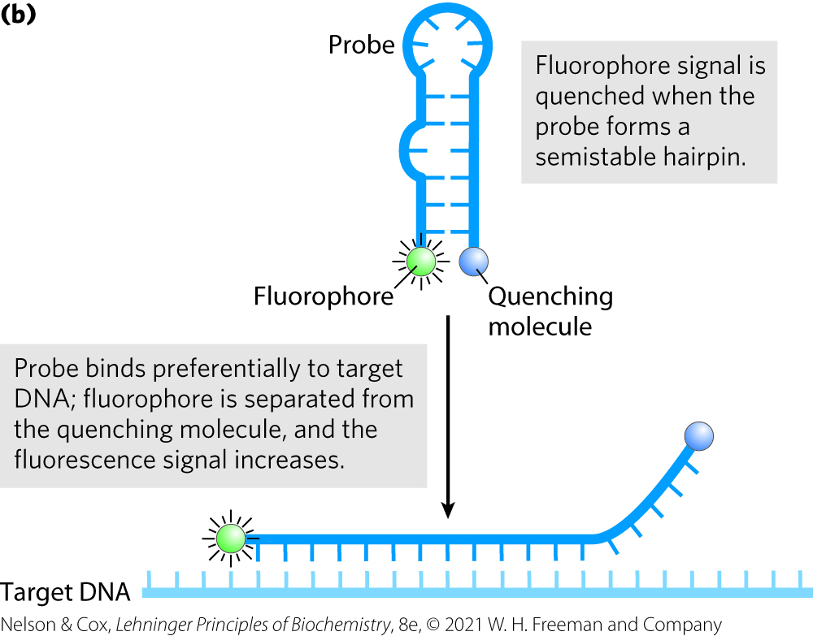
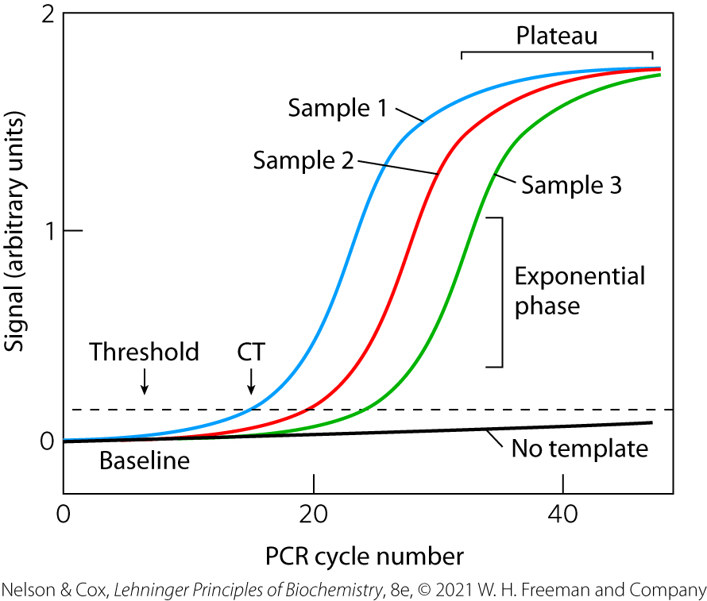
Quantitative PCR (qPCR)

Slide 68
DNA Libraries Are Specialized Catalogs of Genetic Information
DNA library = collection of DNA clones
purposes of DNA libraries:
  gene discovery
  determination of gene or protein function

Slide 69
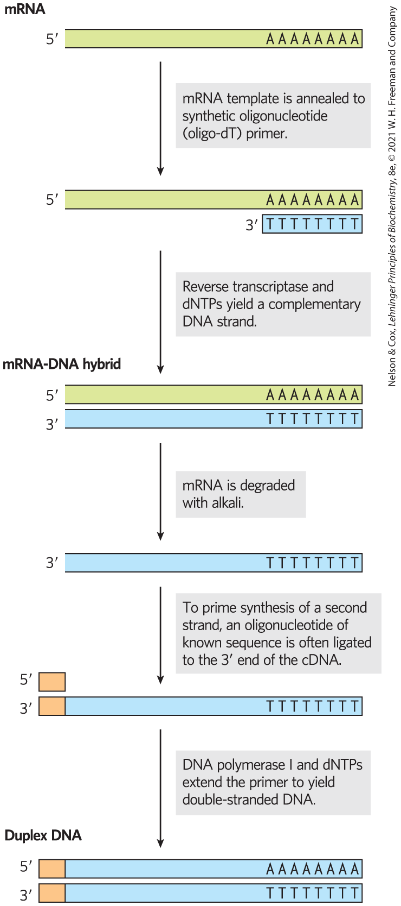
Building a cDNA Library from mRNA
complementary DNAs (cDNAs) = double-stranded DNA fragments formed from mRNA templates
  relies on reverse transcriptase
cDNA library = population of clones created by inserting cDNA fragments into vectors and cloning

Slide 70
Combinatorial Gene Libraries
combinatorial library or gene library = library focusing on sequence variants within one gene

Slide 71
9.2 Exploring Protein Function on the Scale of Cells or Whole Organisms

Slide 72
The Three Levels of Protein
Function
phenotypic function = describes the effects of a protein on the entire organism
cellular function = describes the network of interactions a protein engages in at the cellular level
molecular function = describes the precise biochemical activity of a protein

Slide 73
The Transcriptome and Proteome
transcriptome = the entire complement of transcribed RNAs present at a given moment in the cell
  transcriptomics = the study of transcriptomes
proteome = the entire complement of proteins present at a given moment in a cell
  proteomics = the study of proteomes

Slide 74
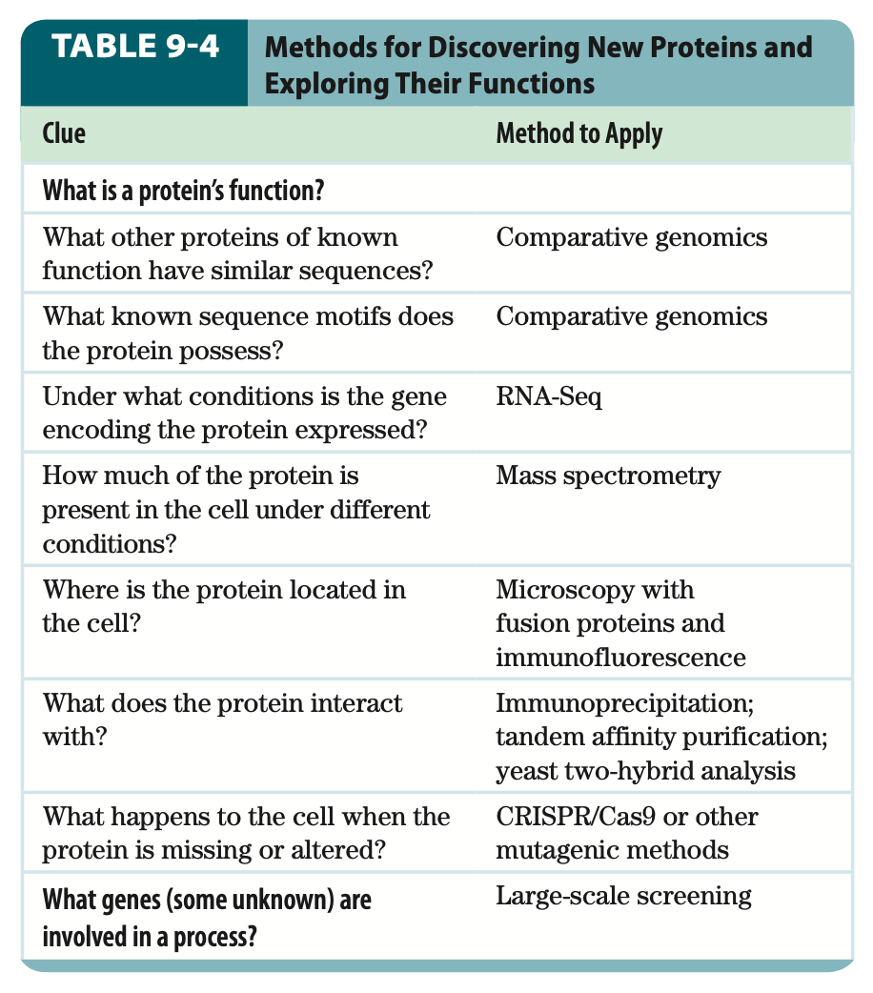
Methods for Exploring Protein Function

Slide 75
Principle 2 (3 of 9)
Genomic information is accessible. Advances in DNA sequencing (Chapter 8) are being matched by new approaches to understanding how chromosomal information is expressed and regulated on a genomic and cellular scale. Important clues to protein function are embedded in the sequences of the genes that encode them.

Slide 76
Sequence or Structural Relationships Can Suggest Protein Function
comparative genomics = process by which gene functions can be assigned by using genome databases to perform genome comparisons
  BLAST (Basic Local Alignment Search Tool) algorithm allows a rapid search of genome databases
genome annotation = converts the sequence of residues into useful information about the location and function of genes and other critical sequences

Slide 77
Genes Can Be Related by Sequence Homologies
orthologs = genes that occur in different species but have a clear sequence and functional relationship to each other
paralogs = genes similarly related to each other within a single species

Slide 78
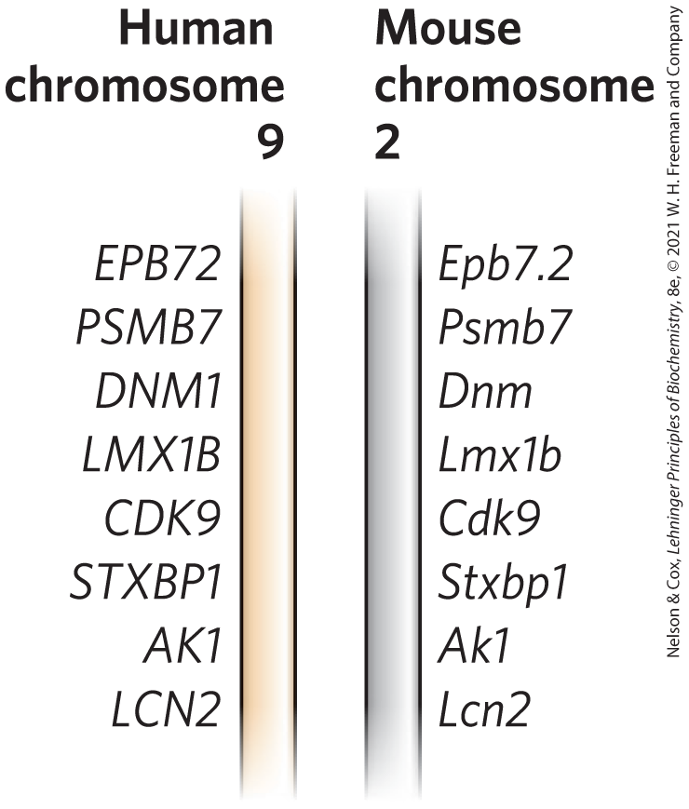
Synteny in the Human and Mouse Genomes
synteny = conserved gene order
  provides additional evidence for an orthologous relationship between genes at identical locations within the related segments

Slide 79
Principle 2 (4 of 9)
Genomic information is accessible. Advances in DNA sequencing (Chapter 8) are being matched by new approaches to understanding how chromosomal information is expressed and regulated on a genomic and cellular scale. Important clues to protein function are embedded in the sequences of the genes that encode them.

Slide 80
Certain Amino Acid Sequences Associate with Structural Motifs
structural motifs may help to define molecular function
  relationships are determined with the aid of computer programs

Slide 81
When and Where a Protein Is Present in a Cell Can Suggest Protein Function
proteins involved in a reaction or process must be present at the specific location and moment
techniques:
  RNA-Seq and transcriptomics
  cell proteomes and mass spectrometry
  fusion proteins and immunofluorescence

Slide 82
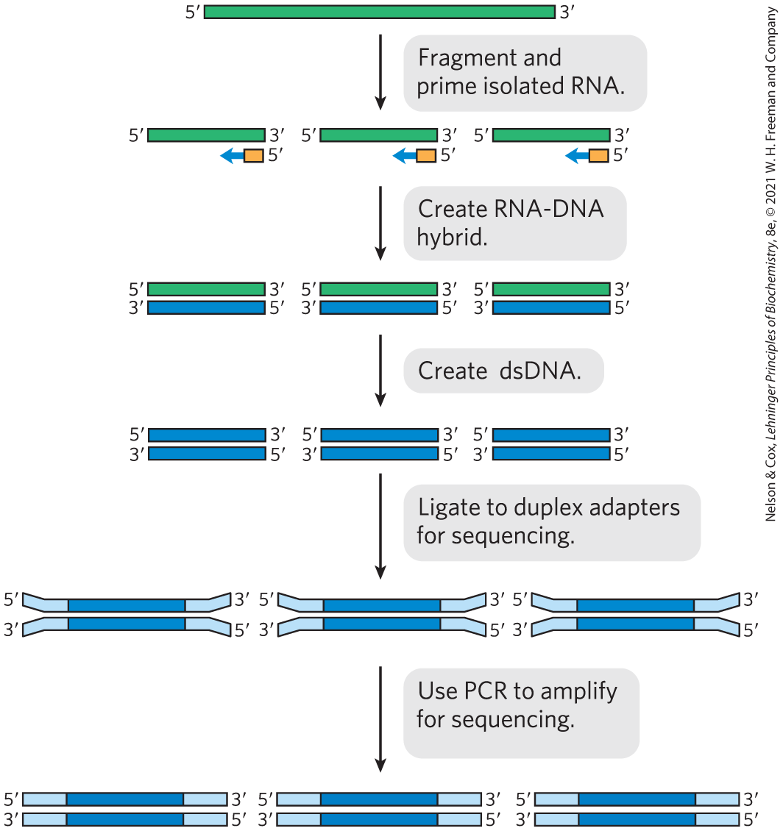
RNA-Seq and Transcriptomics
RNA-Seq = method that determines the RNAs that are transcribed from a genome under a given set of conditions
single cell RNA-seq (scRNA-Seq) = application of RNA-Seq to a single cell
  possible due to the high sensitivity of the method

Slide 83
Cellular Proteomes and Mass Spectrometry
mass spectrometry can accurately catalog and quantify the thousands of proteins present in a typical cell
  complementary approach to RNA-Seq
  provides information about how proteins are modified

Slide 84
Principle 2 (5 of 9)
Genomic information is accessible. Advances in DNA sequencing (Chapter 8) are being matched by new approaches to understanding how chromosomal information is expressed and regulated on a genomic and cellular scale. Important clues to protein function are embedded in the sequences of the genes that encode them.

Slide 85
Fusion Proteins and Immunofluorescence
green fluorescent protein (GFP) = jellyfish protein that serves as a useful location marker
  a target gene fused to the GFP gene generates a highly fluorescent fusion protein
  variants of other colors and characteristics also exist

Slide 86
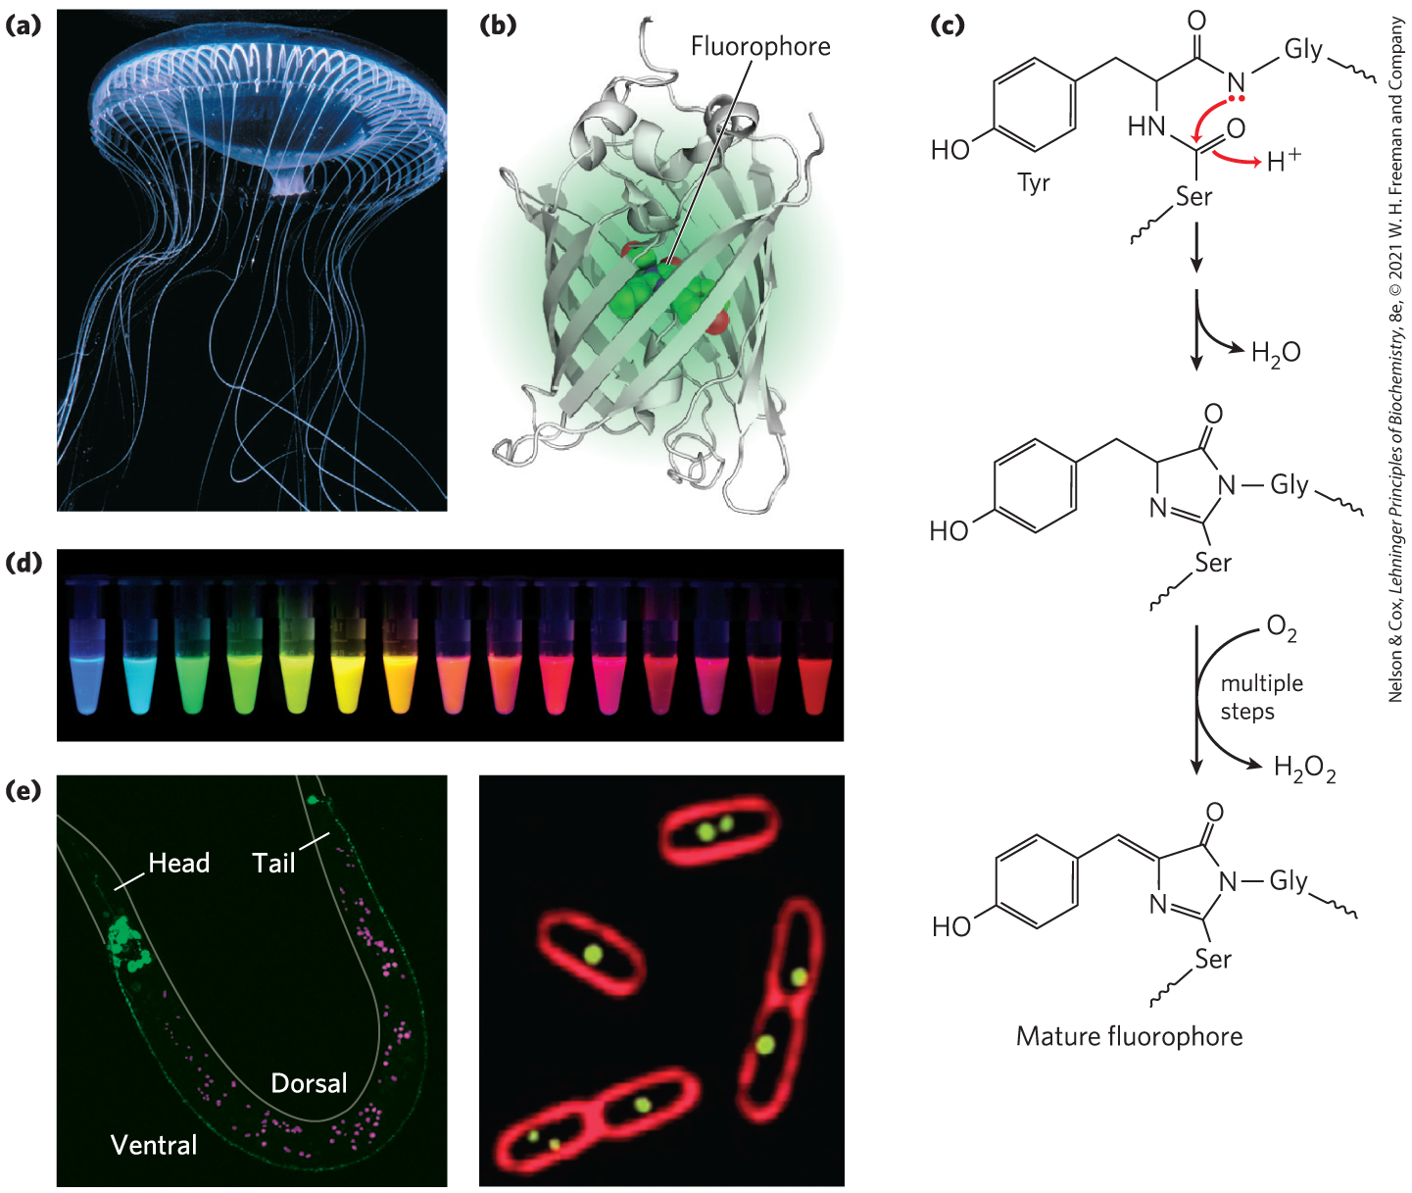
Green Fluorescent Protein (GFP)

Slide 87
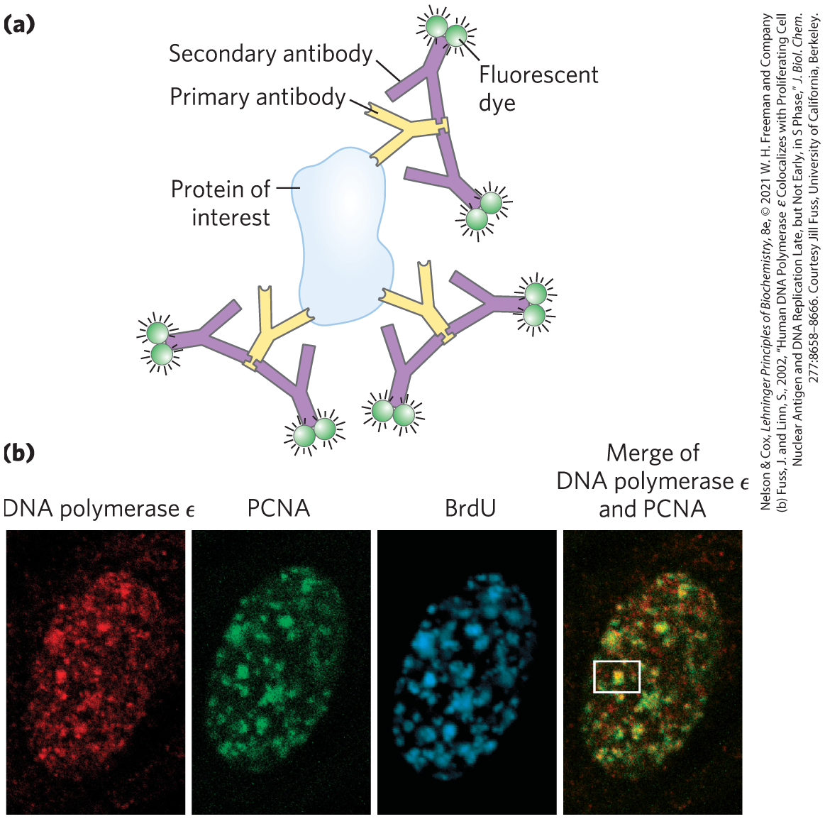
Immunofluorescence
immunofluorescence = alternative approach for visualizing the endogenous protein that involves fixation (and death) of the cell
epitope tag = short protein sequence that is bound tightly by an antibody

Slide 88
Principle 2 (6 of 9)
Genomic information is accessible. Advances in DNA sequencing (Chapter 8) are being matched by new approaches to understanding how chromosomal information is expressed and regulated on a genomic and cellular scale. Important clues to protein function are embedded in the sequences of the genes that encode them.

Slide 89
Knowing What a Protein Interacts with Can Suggest Its Function
the association of a protein of unknown function with one whose function is known can imply a functional relationship
techniques:
  purification of protein complexes
  yeast two-hybrid analysis

Slide 90
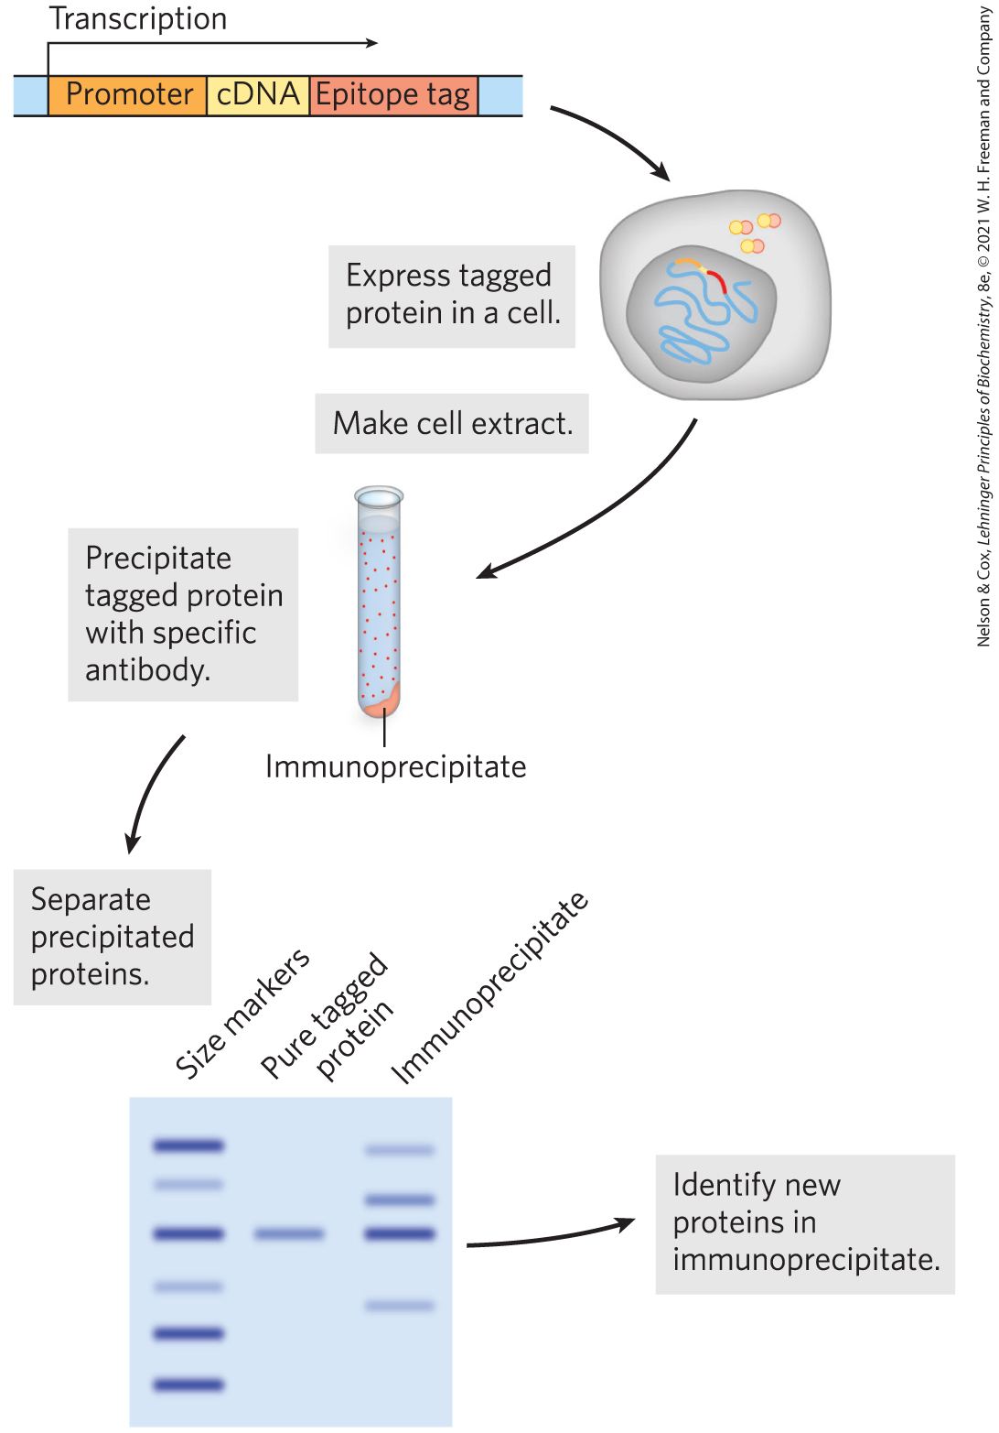
Purification of Protein Complexes
immunoprecipitation = process of precipitating a fusion protein (containing the gene of interest and a gene for an epitope tag) by antibodies to the epitope
  proteins that bind to the tagged protein will also precipitate

Slide 91
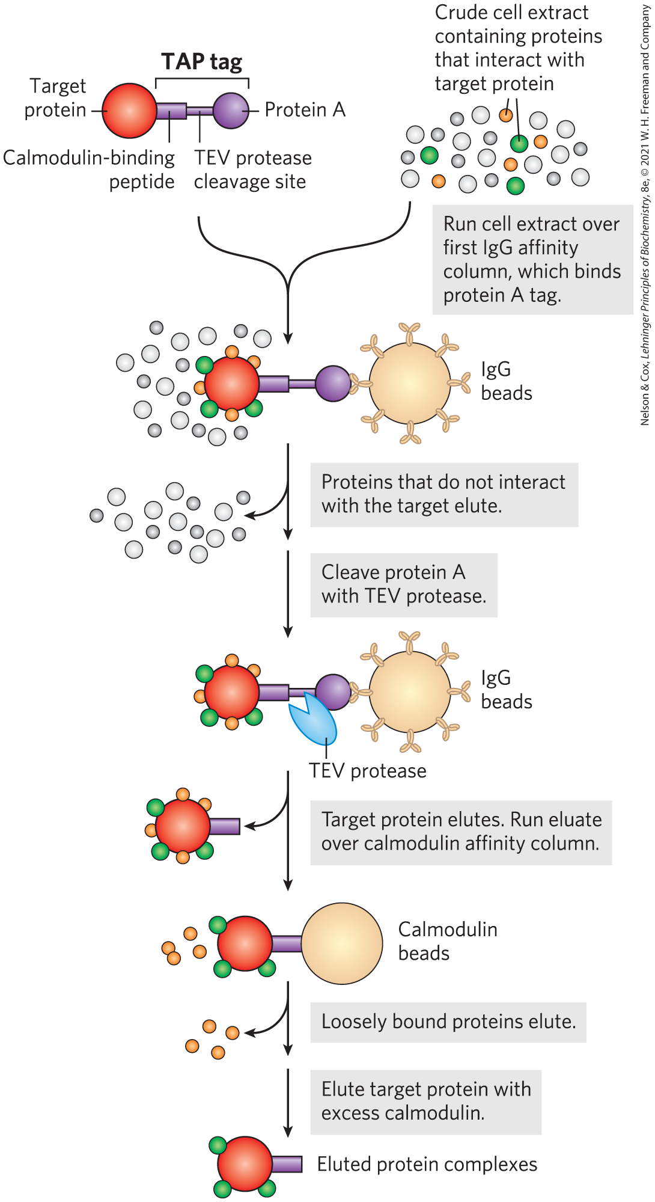
Tandem Affinity Purification
(TAP) Tags
tandem affinity purification (TAP) tags = two consecutive tags that are fused to a target protein to enhance the selectivity of immunoprecipitation
  first tag (protein A) binds mammalian immunoglobulin G (IgG)
  second tag (calmodulin-binding peptide) binds calmodulin

Slide 92
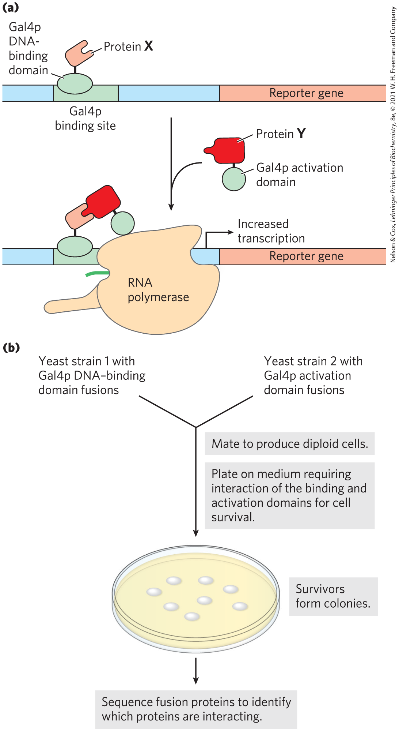
Yeast Two-Hybrid Analysis
yeast two-hybrid analysis = technique that relies on the properties of the Gal4 protein
  the two domains of Gal4p must be brought together to function correctly
  probes molecular interactions in vivo

Slide 93
Principle 2 (7 of 9)
Genomic information is accessible. Advances in DNA sequencing (Chapter 8) are being matched by new approaches to understanding how chromosomal information is expressed and regulated on a genomic and cellular scale. Important clues to protein function are embedded in the sequences of the genes that encode them.

Slide 94
Principle 3 (4 of 6)
Genomic information is malleable. We can not only elucidate cellular genomic information; we can also change it. That capacity provides a path to altering any aspect of cellular metabolism, structure, or function.

Slide 95
The Effect of Deleting or Altering a Protein Can Suggest Its Function
mutating or deleting a gene provides a path to understanding a gene’s function
CRISPR/Cas systems have replaced traditional approaches

Slide 96
CRISPR/Cas Systems
“CRISPR” stands for clustered, regularly interspaced short palindromic repeats
CRISPR sequences = regularly spaced short repeats in the bacterial genome, surrounding sequences derived from phage pathogens that previously infected the bacterium
Cas protein = nuclease

Slide 97
The CRISPR Sequences and Cas Protein Are Components of a Bacterial Immune System
components of the CRISPR/Cas complex:
  guide RNAs = transcribed viral spaced sequences that are cleaved
  trans-activating CRISPR RNA (tracrRNA)
  1+ Cas proteins
the complex binds and destroys invading bacteriophage DNA by the Cas protein nuclease activities

Slide 98
Principle 2 (8 of 9)
Genomic information is accessible. Advances in DNA sequencing (Chapter 8) are being matched by new approaches to understanding how chromosomal information is expressed and regulated on a genomic and cellular scale. Important clues to protein function are embedded in the sequences of the genes that encode them.

Slide 99
Principle 3 (5 of 6)
Genomic information is malleable. We can not only elucidate cellular genomic information; we can also change it. That capacity provides a path to altering any aspect of cellular metabolism, structure, or function.

Slide 100
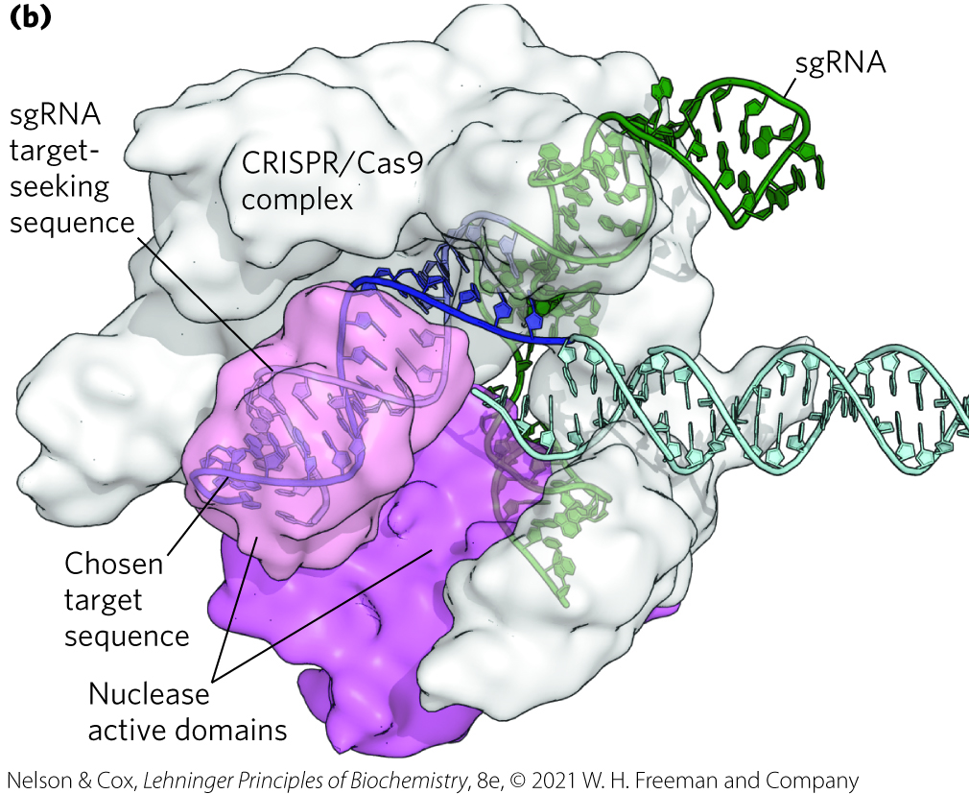
Current CRISPR Technology
requires only two components:
  single Cas protein (Cas9)
  single guide RNA (sgRNA) = consists of gRNA and tracrRNA fused into a single RNA

Slide 101
Cas9 Protein
Cas9 has two separate nuclease domains
  each domain cleaves one strand of DNA

Slide 102
Single Guide RNA (sgRNA)
the sgRNA guide sequence can be altered to target any genomic sequence
required to pair with the target DNA sequence and to activate the nuclease domains

Slide 103
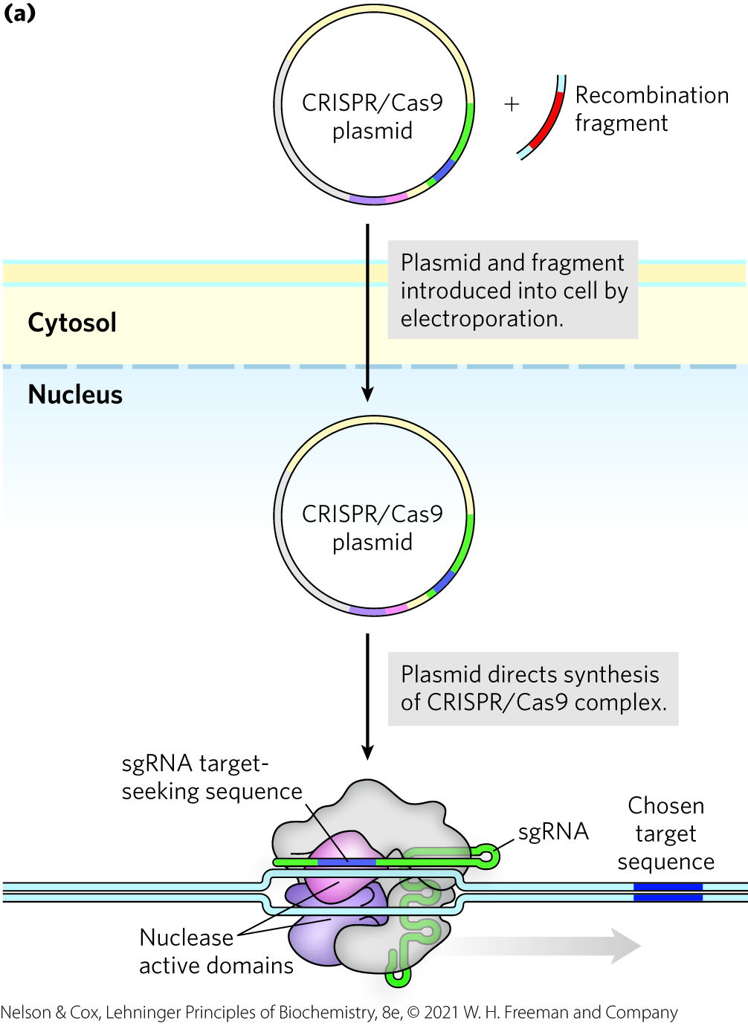
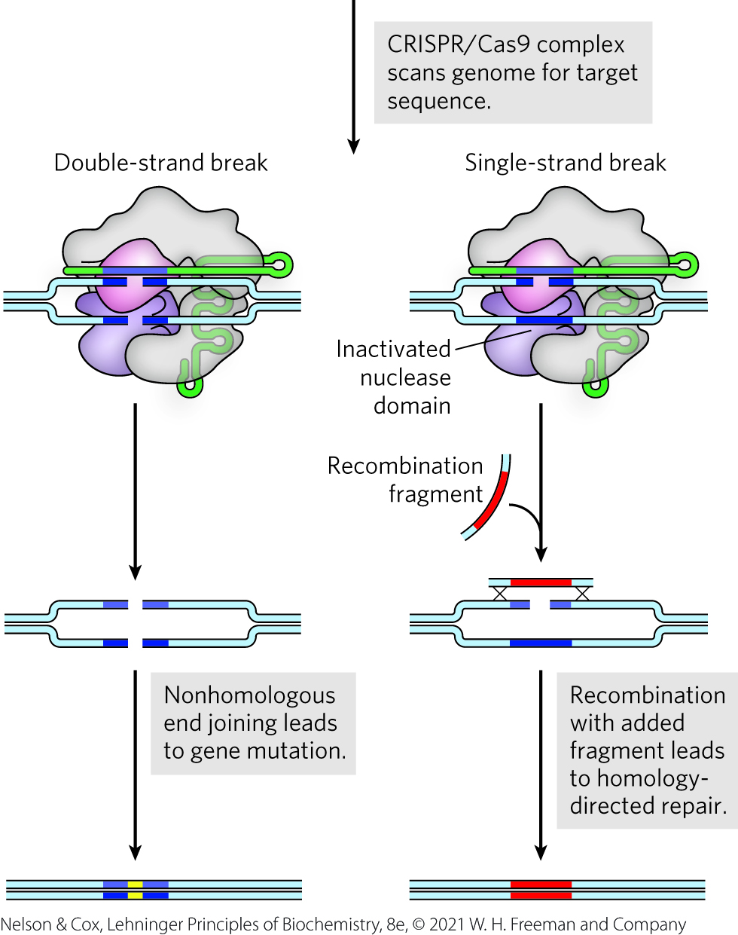
The CRISPR/Cas9 System

Slide 104
Principle 2 (9 of 9)
Genomic information is accessible. Advances in DNA sequencing (Chapter 8) are being matched by new approaches to understanding how chromosomal information is expressed and regulated on a genomic and cellular scale. Important clues to protein function are embedded in the sequences of the genes that encode them.

Slide 105
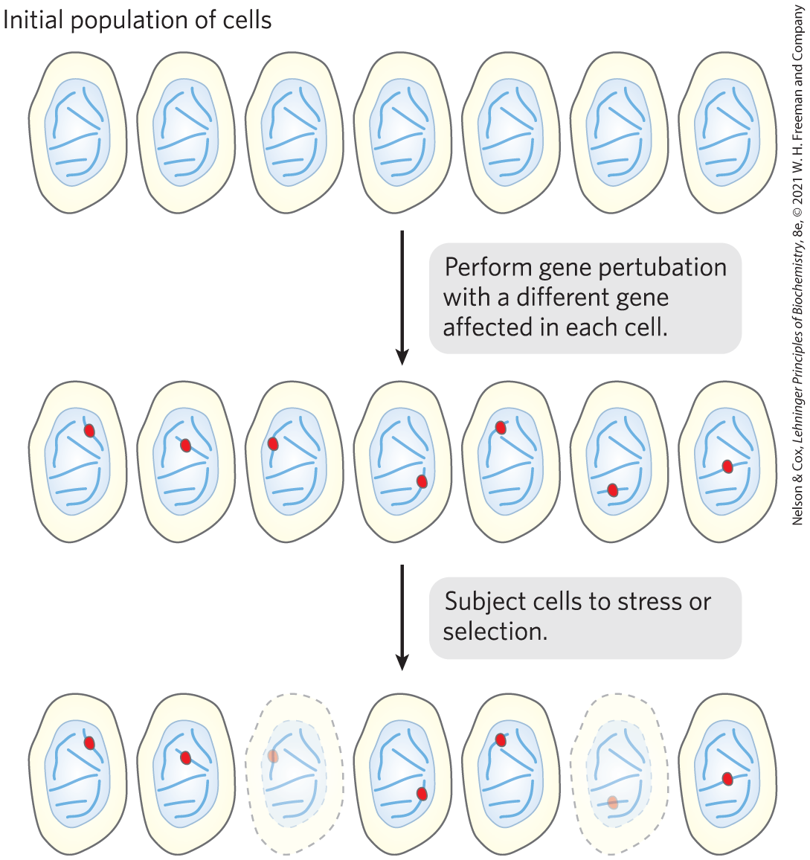
Many Proteins Are Still Undiscovered
high-throughput genetic screening can be used to identify genes required for a specific stress or selection response

Slide 106
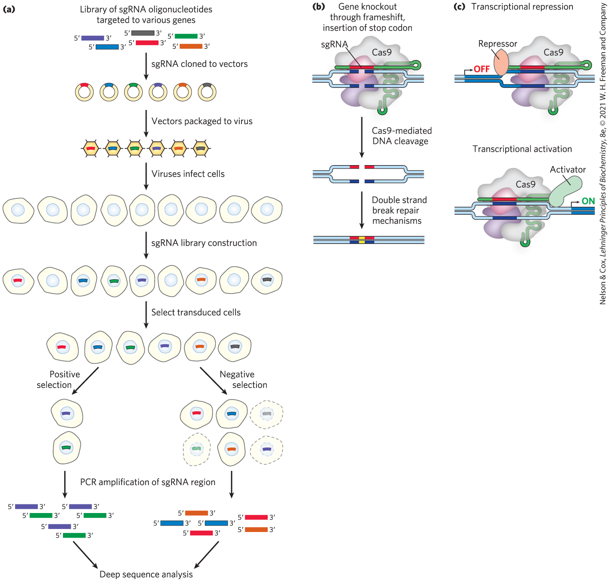
Use of CRISPR/Cas9 in High-Throughput Screening
cells in which genes required to survive the treatment are inactivated or activated by the CRISPR/Cas9 variant will die or thrive

Slide 107
9.3 Genomics and the Human Story

Slide 108
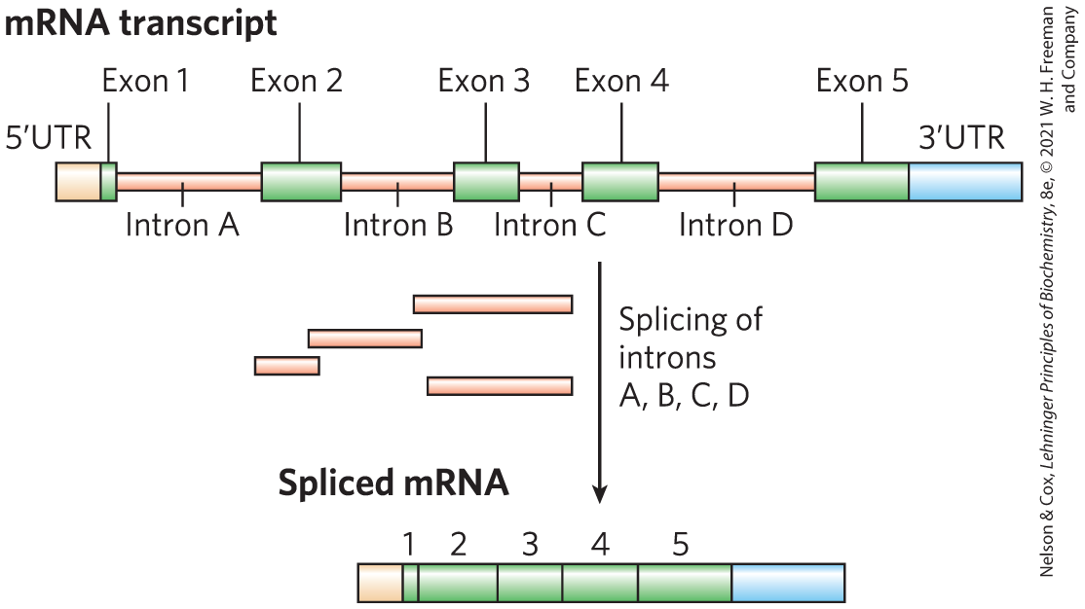
The Human Genome Contains Many Types of Sequences
humans have ~20,000 protein coding genes
introns = non–translated DNA
exons = coding segments of DNA

Slide 109
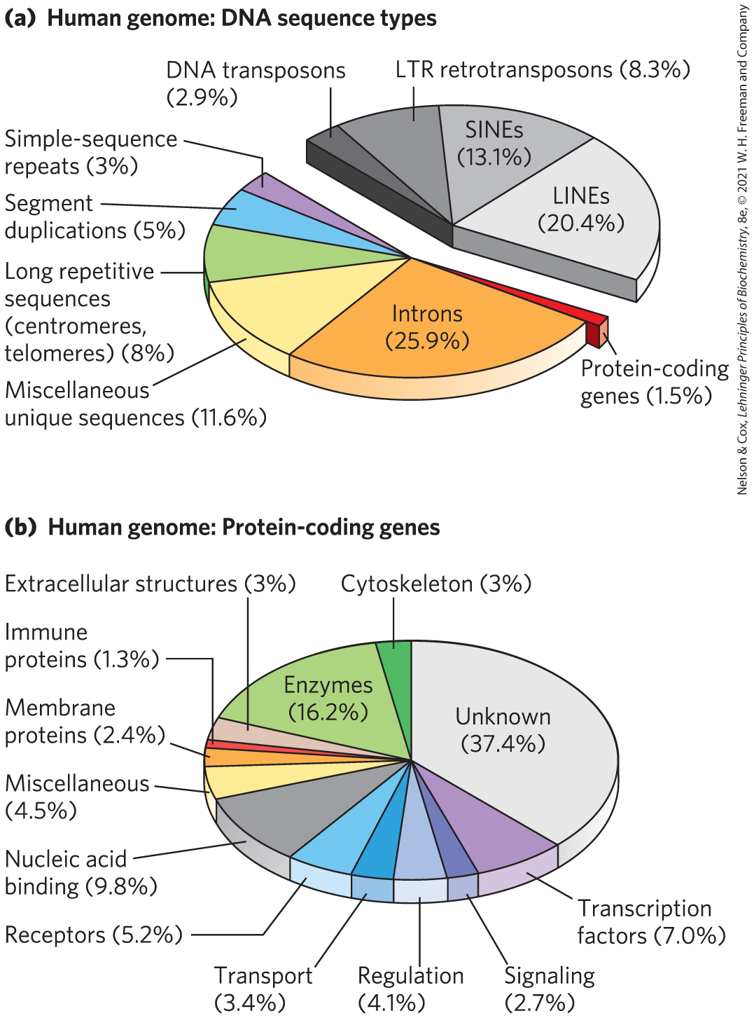
A Snapshot of the Human Genome
<1.5% of human DNA is exon DNA
transposons = segments of DNA that can move from one location to another in the genome
  make up ~½ of human DNA

Slide 110
Principle 1 (7 of 8)
An organism’s DNA — its genome — is the ultimate source of biological information. Genomic information is a resource of unparalleled importance for investigators studying any aspect of biology. Genomes vary in size, but all are large enough to direct all aspects of an organism’s structure and function. To approach them often requires tools to break them into small parts that are experimentally digestible.

Slide 111
The ENCODE Initiative
launched to identify functional elements in the human genome
findings:
  >80% of DNA is transcribed into RNA or is involved in some functional aspect of chromatin structure
  most of the remaining 20% contains regulatory elements affecting the expression of protein-coding genes and genes encoding functional RNAs

Slide 112
Repeats in the Human Genome
simple-sequence repeats (SSRs) = highly repetitive sequences that are generally less than 10 bp long
  make up ~3% of the human genome
  found in centromeres and telomeres
short tandem repeats = isolated segments of repeated sequences, often containing up to a few dozen tandem repeats

Slide 113
Gene Alterations Define Humanity
simple nucleotide polymorphisms (SNPs) = single base variations
deletions, insertions, and rearrangement also produce variations among individuals

Slide 114
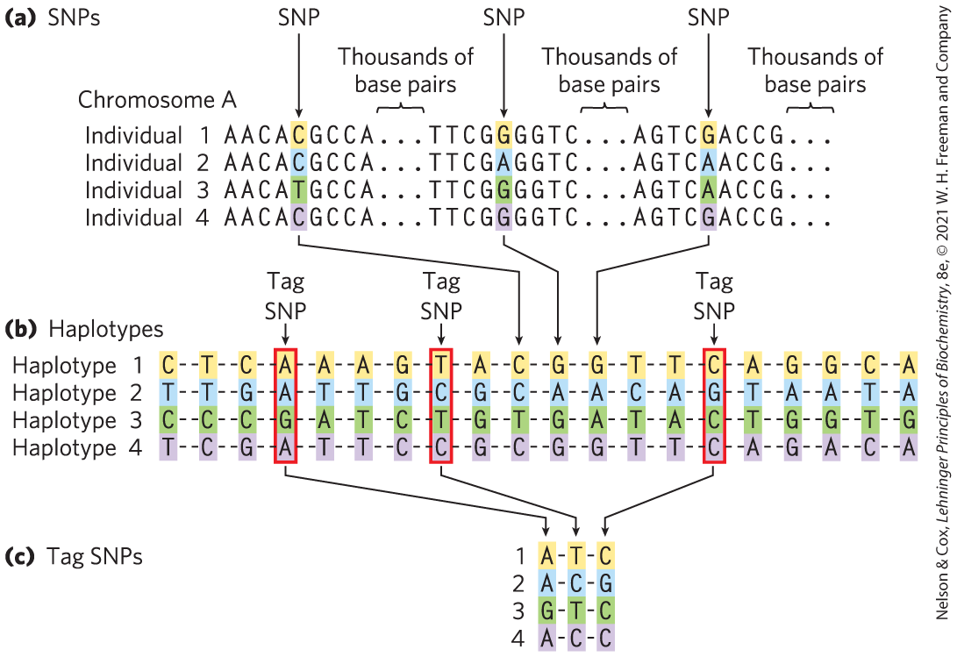
Defining Haplotypes
haplotype = grouping of multiple SNPs that are usually inherited together
tag SNPs = a subset of SNPs that define an entire haplotype

Slide 115
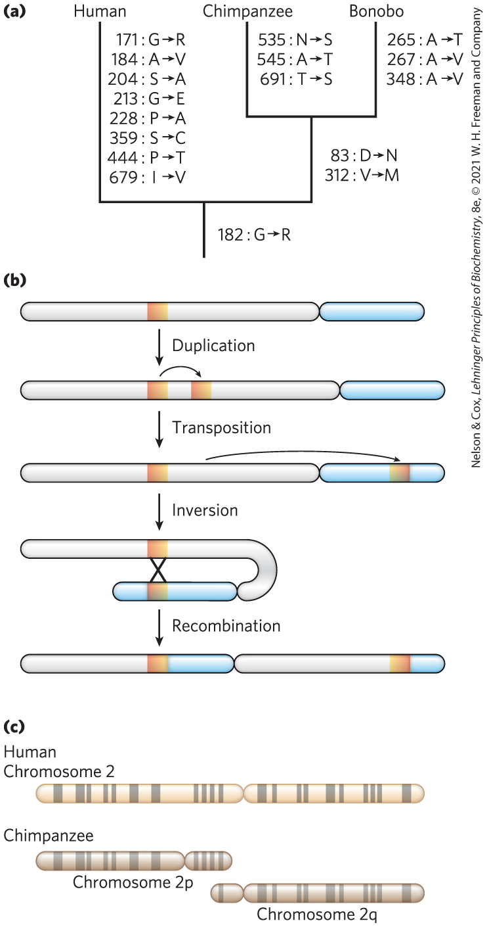
Genome Sequencing Informs Us about Our Humanity
genomic differences between species can be used to construct a phylogenetic tree:
  SNPs
  inversions
  insertions
  deletions
  fusions
  duplications

Slide 116
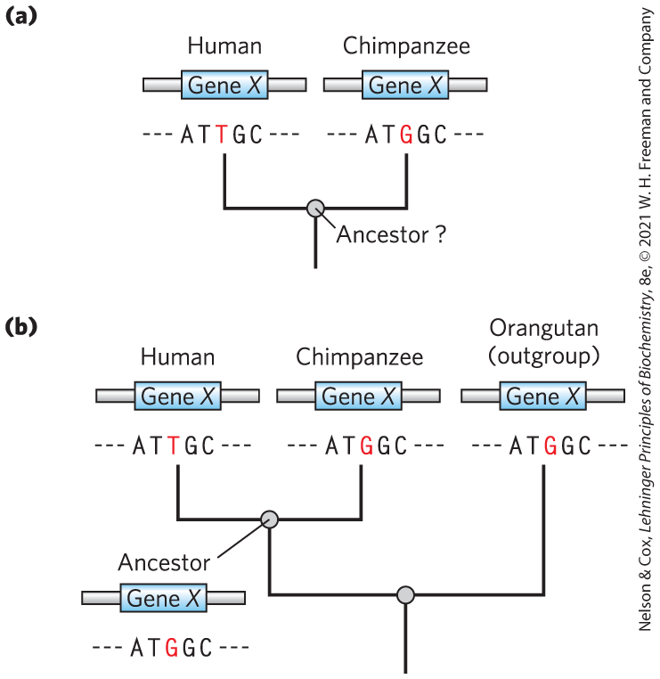
Determining Sequence Alternations Unique to One Ancestral Line
outgroups = more distantly related species

Slide 117
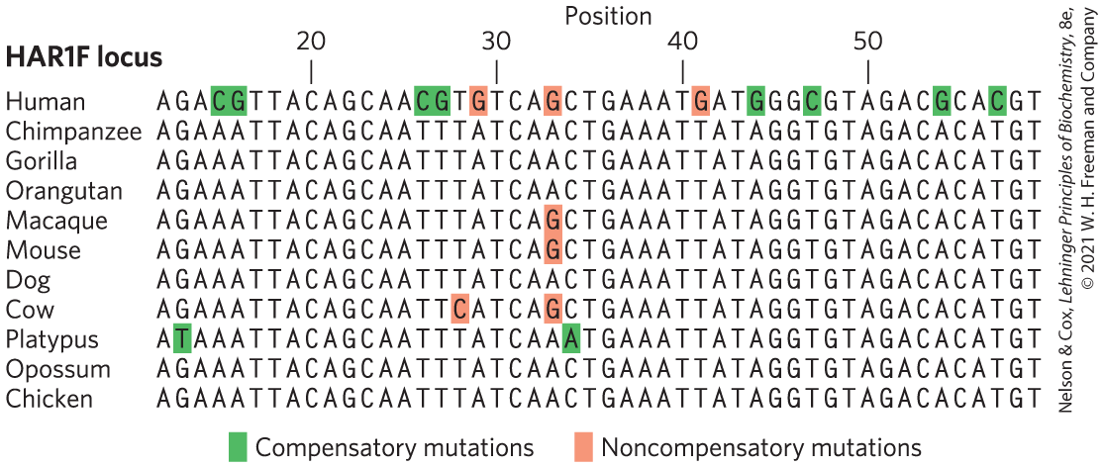
A Variety of RNA-Coding Genes Show Evidence of Accelerated Evolution
HAR1F locus specifies a highly conserved noncoding RNA
retain complementarity where strand segments are paired

Slide 118
Principle 1 (8 of 8)
An organism’s DNA — its genome — is the ultimate source of biological information. Genomic information is a resource of unparalleled importance for investigators studying any aspect of biology. Genomes vary in size, but all are large enough to direct all aspects of an organism’s structure and function. To approach them often requires tools to break them into small parts that are experimentally digestible.

Slide 119
Genome Comparisons Help Locate Genes Involved in Disease
>6,000 human mutation phenotypes have been mapped to particular genes or groups of genes
linkage analysis = evolutionary biology approach that maps the gene involved in a disease condition relative to well-characterized genetic polymorphisms

Slide 120
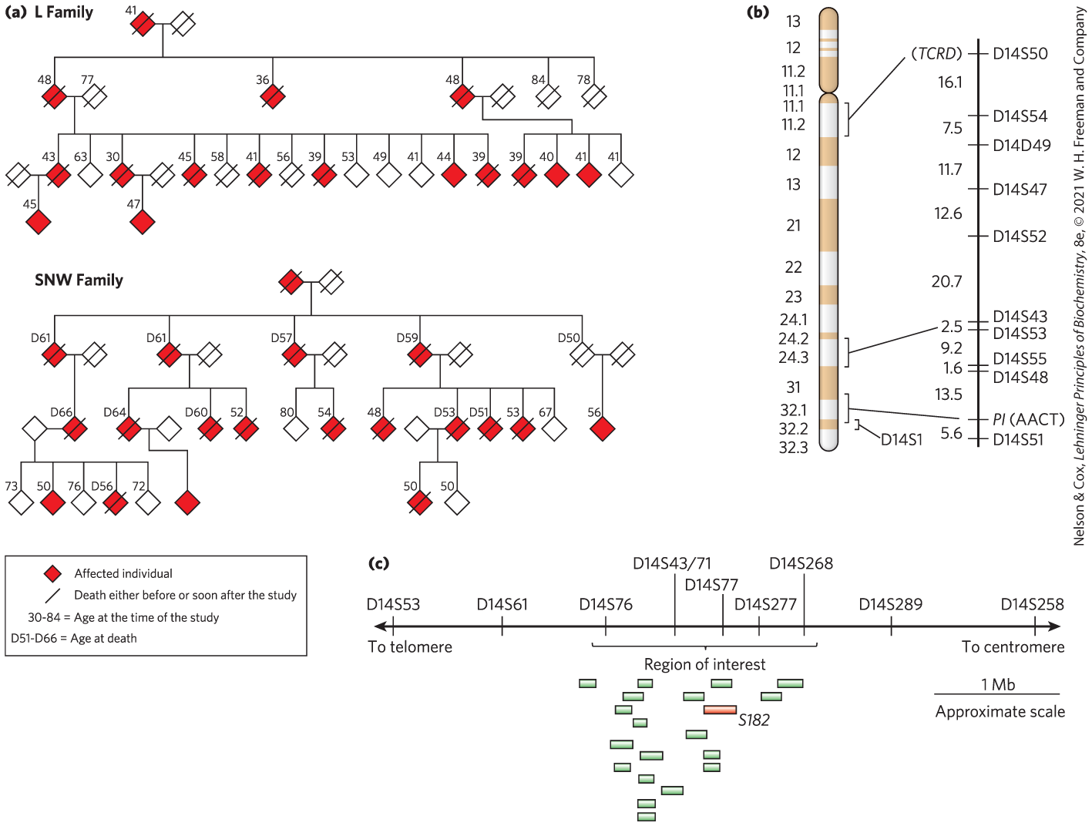
Linkage Analysis in the Discovery of Disease Genes

Slide 121
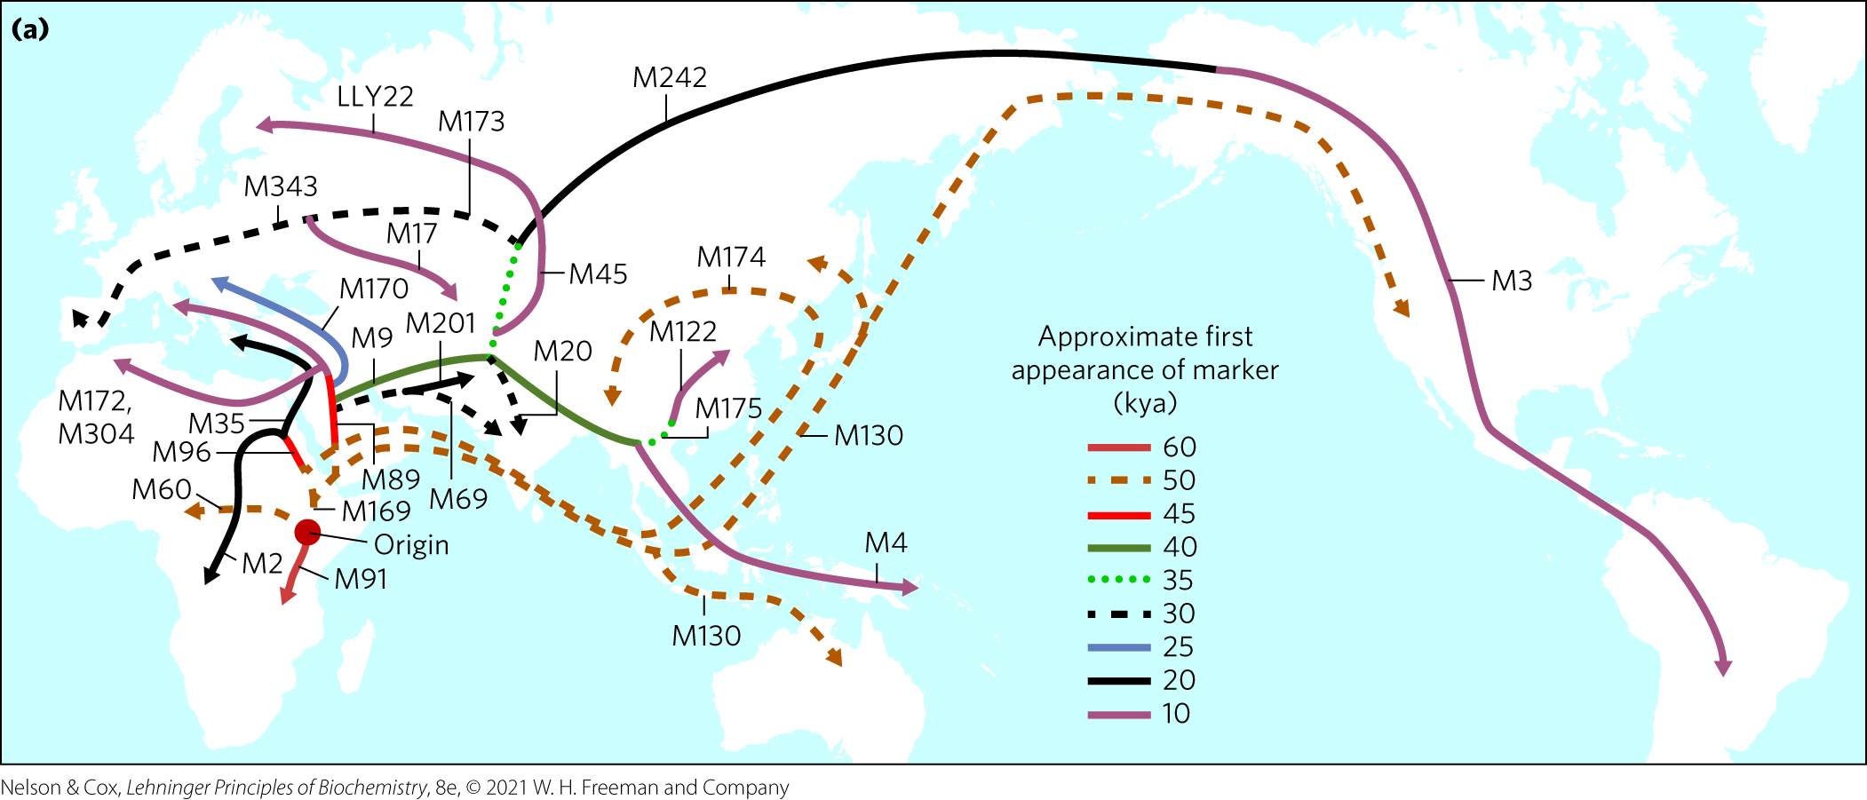
Genome Sequences Inform Us about Our Past and Provide Opportunities for the Future
migrations can be traced using haplotypes present in extant human populations

Slide 122
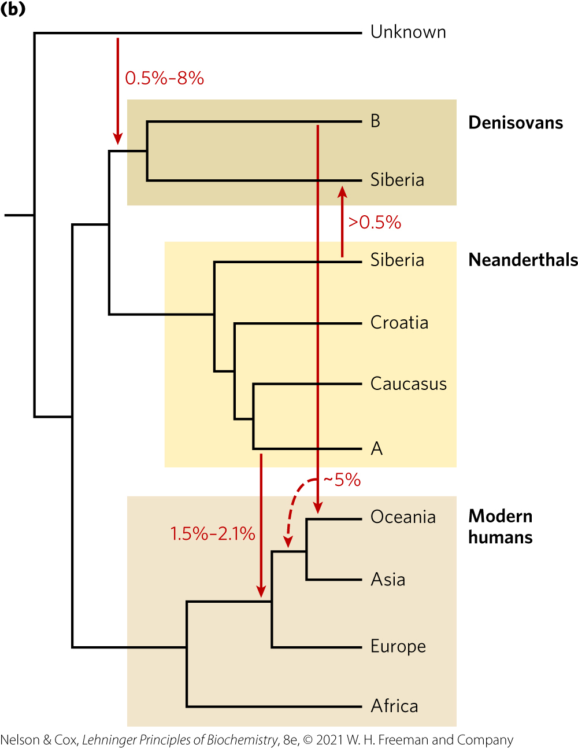
The Paths of Human Migrations

Slide 123
Principle 3 (6 of 6)
Genomic information is malleable. We can not only elucidate cellular genomic information; we can also change it. That capacity provides a path to altering any aspect of cellular metabolism, structure, or function.

Slide 124
The Medical Promise of Personal Genome Sequences
knowledge of genomic sequences provides the prospect of altering them

