Slide 1

28 Regulation of Gene Expression
© 2021 Macmillan Learning

Slide 2

Principle 1 (1 of 6)
The cellular concentration of a protein
is determined by a delicate balance of at least seven processes, each having several potential points of regulation. These processes include synthesis of the primary RNA transcript (transcription); posttranscriptional modification of mRNA; degradation of mRNA; protein synthesis (translation); posttranslational modification of proteins; protein targeting and transport; and protein degradation.

Slide 3

Principle 2 (1 of 7)
Regulation is achieved by specialized proteins and RNAs. The proteins are usually ligand-binding proteins with no other function. They bind to specific sequences in DNA or RNA. They respond to molecular signals that can be any kind of biological molecule. The RNAs either interact with other RNAs or serve as protein cofactors.

Slide 4

Principle 3 (1 of 4)
Regulated gene expression may bring about increases or decreases in the amount of a gene product. Gene products that increase in concentration under particular molecular circumstances are referred to as inducible; the process of increasing their expression is induction. Conversely, gene products that decrease in concentration in response to a molecular signal are referred to as repressible, and the process is called repression.

Slide 5
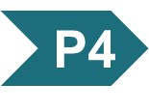
Principle 4 (1 of 6)
The default transcriptional state of a gene, on or off, is dictated in part by the size and complexity of the genome. In bacteria, where genomes are relatively small and DNA is readily accessible, the default state of genes is generally “on.” Transcription of each gene or gene cluster is usually limited by a specific protein repressor. In eukaryotes, where genomes are larger and genes are encapsulated in chromatin, the default state of most genes is “off.” Gene transcription requires chromatin modification followed by the action of transcription activators.

Slide 6
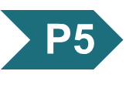
Principle 5 (1 of 2)
Regulation is expensive. For many genes, especially in eukaryotes, the regulatory processes can require a considerable investment of chemical energy. That expenditure is nevertheless small when compared to the cost of RNA and protein synthesis when the gene is expressed.

Slide 7
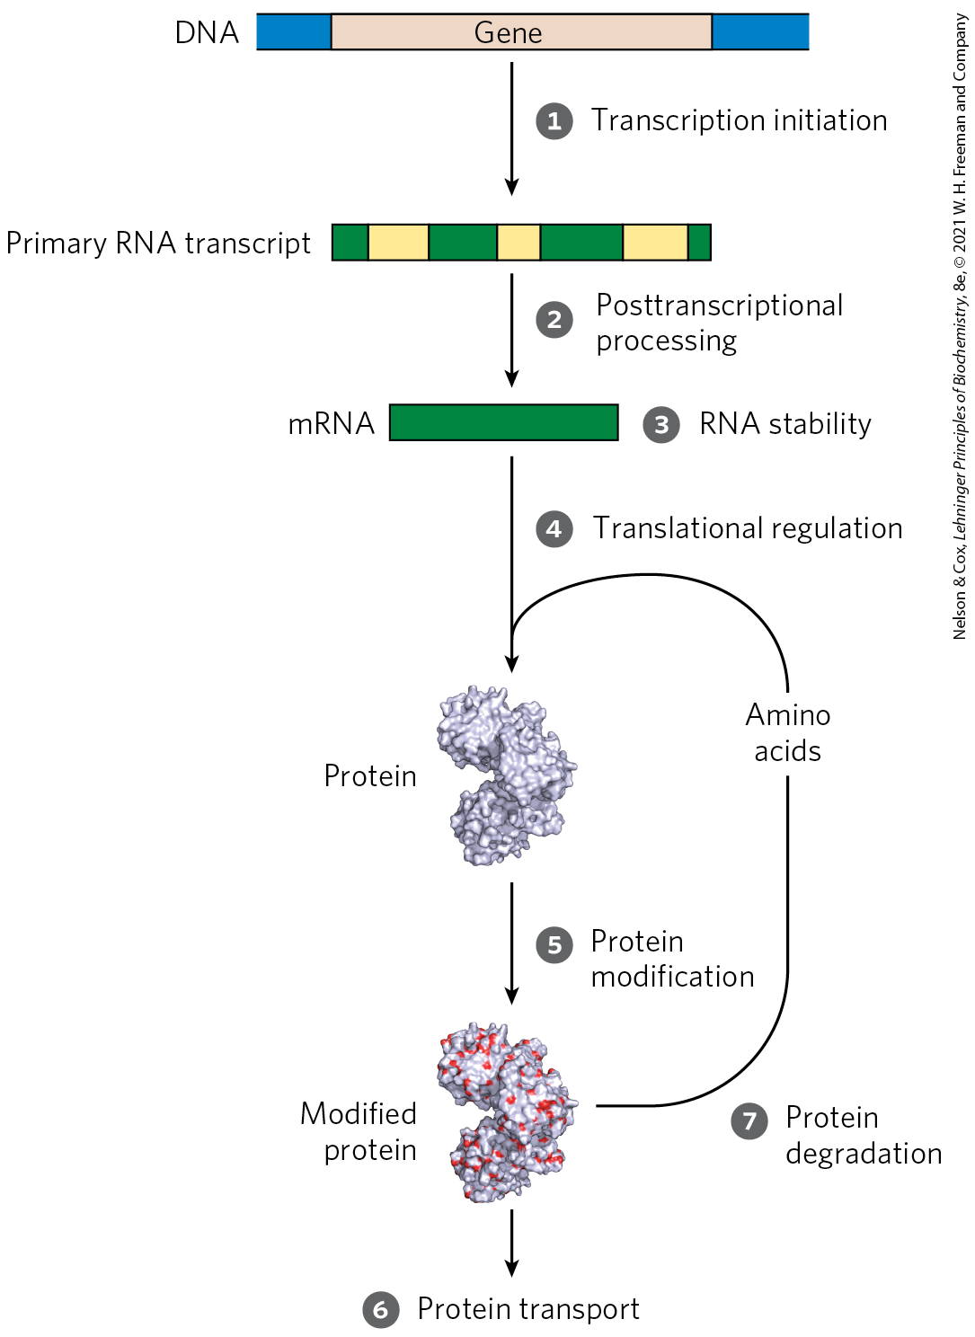
Processes that Affect the Steady-State Concentration of a Protein

Slide 8
28.1 The Proteins and RNAs of Gene Regulation

Slide 9
RNA Polymerase Binds to DNA at Promoters
promoters = sites on the DNA template that are generally found near points at which RNA synthesis begins
regulation of transcription initiation often changes how RNA polymerase interacts with a promoter
differences in promoter sequence affect RNA polymerase binding and the frequency of transcription initiation

Slide 10
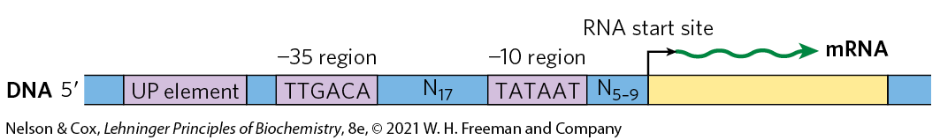
Consensus Sequence for Many E. coli Promoters
most E. coli promoters have a sequence close to a consensus
  mutations away from consensus sequence usually decrease promoter function
  mutations toward consensus usually enhance promoter function

Slide 11
Housekeeping Genes
housekeeping genes = genes for products that are required at all times and are expressed continuously
  examples: enzymes of central metabolic pathways
  cellular concentrations of the proteins encoded vary
constitutive gene expression = expression of a gene at approximately constant levels
the RNA polymerase–promoter interaction strongly influences the rate of transcription initiation

Slide 12
Transcription Initiation Is Regulated by Proteins and RNAs
regulatory proteins regulate transcription initiation by RNA polymerase:
  specificity factors = alter the specificity of RNA polymerase for a given promoter or set of promoters
  repressors = restrict access of RNA polymerase to the promoter
  activators = enhance the RNA polymerase–promoter interaction

Slide 13
Eukaryotic Specificity Factors
some of the general transcription factors may be considered specificity factors
  example: the TATA-binding protein (TBP)

Slide 14
Bacterial Repressors
repressors = proteins that block RNA polymerase binding or its movement along DNA
operators = binding sites on the DNA that bind repressors
  generally located near a promoter
effector = a small molecule or a protein that regulates repressor binding to DNA to alter transcription
  binds to the repressor and causes a conformational change

Slide 15
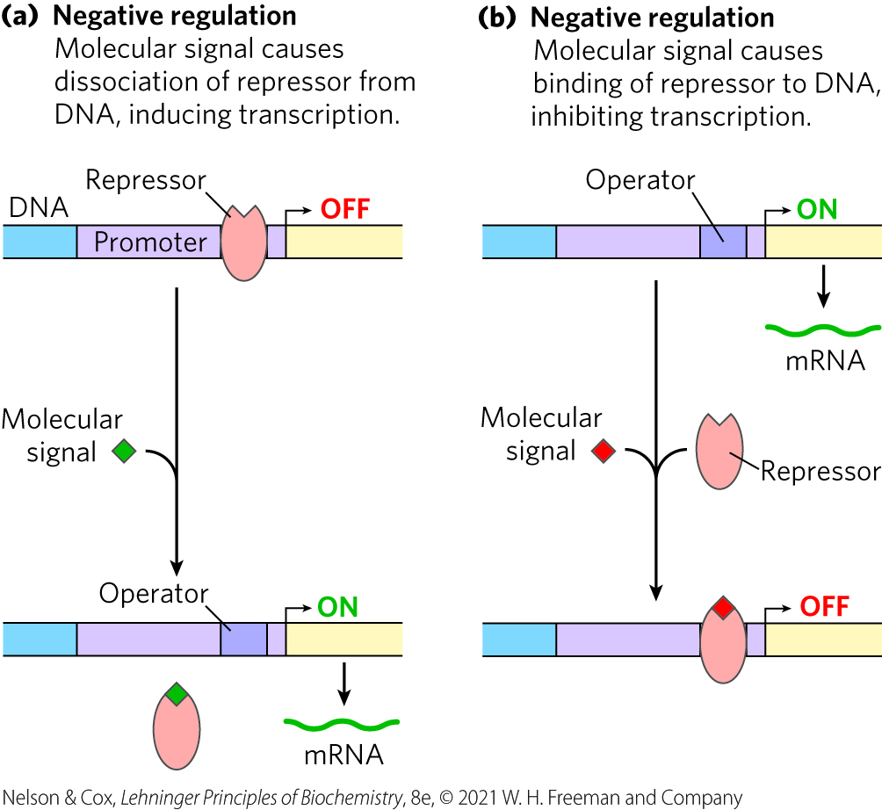
Negative Regulation
negative regulation = regulation by means of a repressor protein that blocks transcription

Slide 16
Eukaryotic Repressors
gene regulation by a repressor is less common in eukaryotic cells
  more common in lower eukaryotes such as yeast
the binding site for a repressor may be some distance from the promoter

Slide 17
Bacterial Activators
activators = proteins that enhance the RNA polymerase–promoter interaction
activator-binding sites are often adjacent to promoters that are bound weakly or not at all by RNA polymerase alone

Slide 18
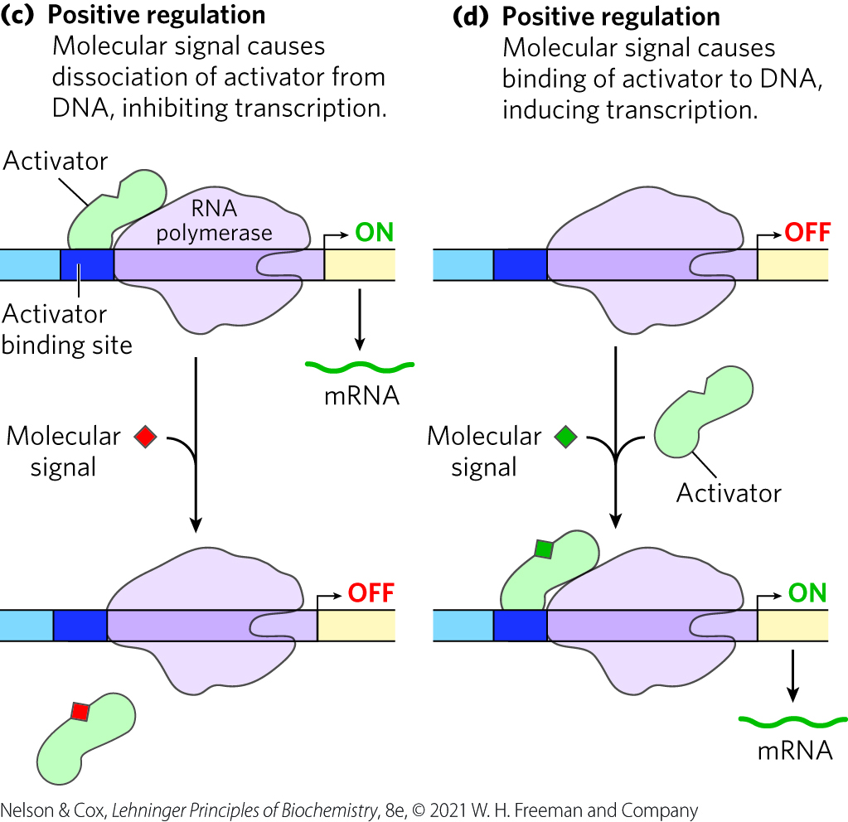
Positive Regulation
positive regulation = regulation by means of an activator protein that induces transcription

Slide 19
Eukaryotic Activators
positive regulation by activators is common in eukaryotes
enhancers = DNA sites that bind activators and are distant from the promoter
  activator binding can affect the rate of transcription at far away promoters

Slide 20
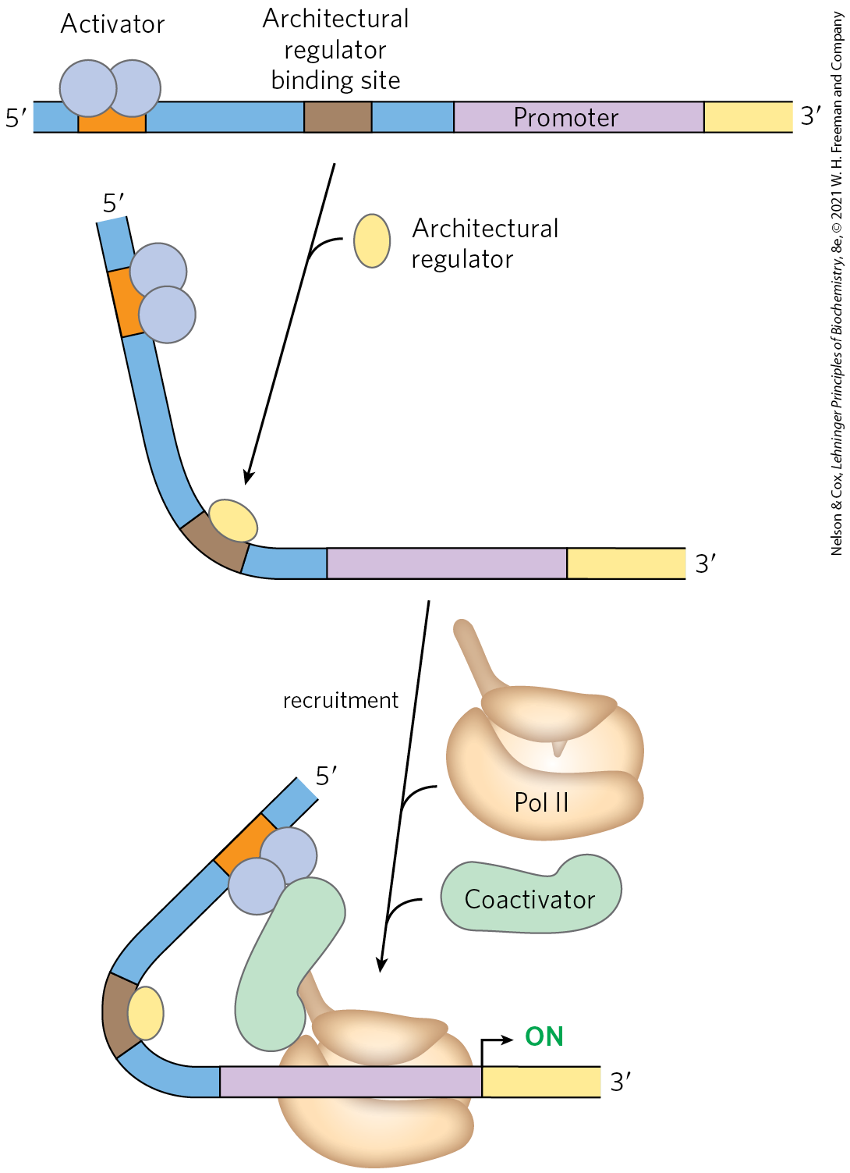
Architectural Regulators and Coactivators
architectural regulators = proteins that bind to sites between a promotor and the activator or repressor binding site and facilitate DNA looping
coactivators = proteins that mediate the interaction between activators and RNA polymerase
  protein repressors may bind in their place instead

Slide 21
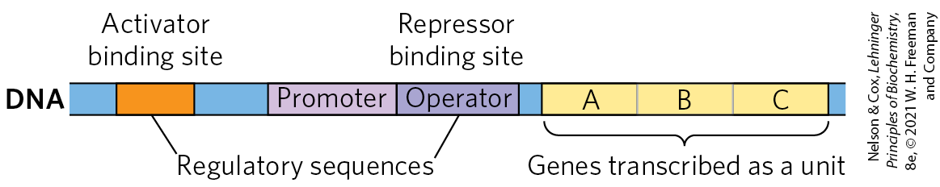
Many Bacterial Genes Are Clustered and Regulated in Operons
operon = a gene cluster and promoter, plus additional sequences that function together in regulation
many genes in the same operon encode subunits of a larger protein complex or are involved in related processes that require coordinated regulation

Slide 22
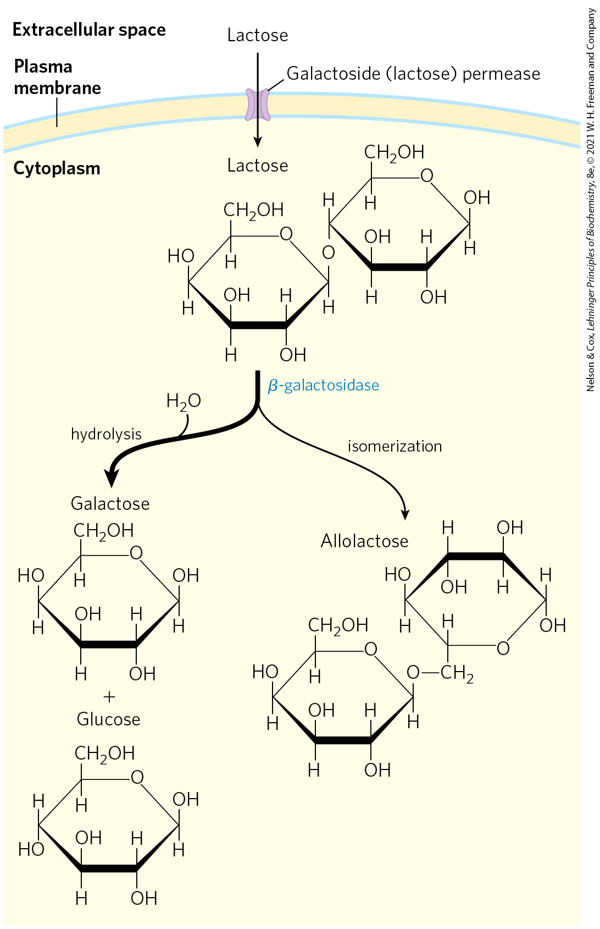
Lactose Metabolism in E. coli
β-galactosidase = cleaves lactose to galactose and glucose
galactoside permease = transports lactose into the cell

Slide 23
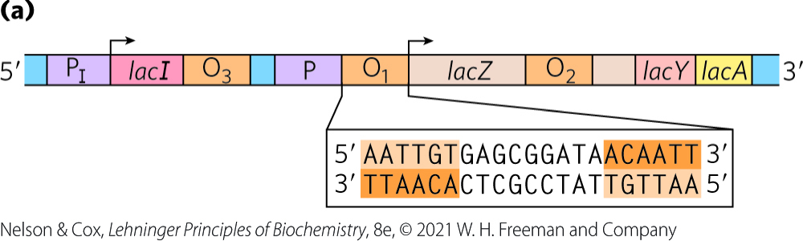
The lac Operon Is Subject to Negative Regulation
lactose (lac) operon includes the genes for:
  β-galactosidase (Z)
  galactoside permease (Y)
  thiogalactoside transacetylase (A) = modifies toxic galactosides to facilitate their removal
the lac operon is repressed in the absence of lactose
  repression is not absolute

Slide 24
lacI Encodes the Lac Repressor
lacI encodes the Lac repressor protein
  lacI has its own promoter (P_{I})
  mutations in lacI result in constitutive synthesis of the operon

Slide 25
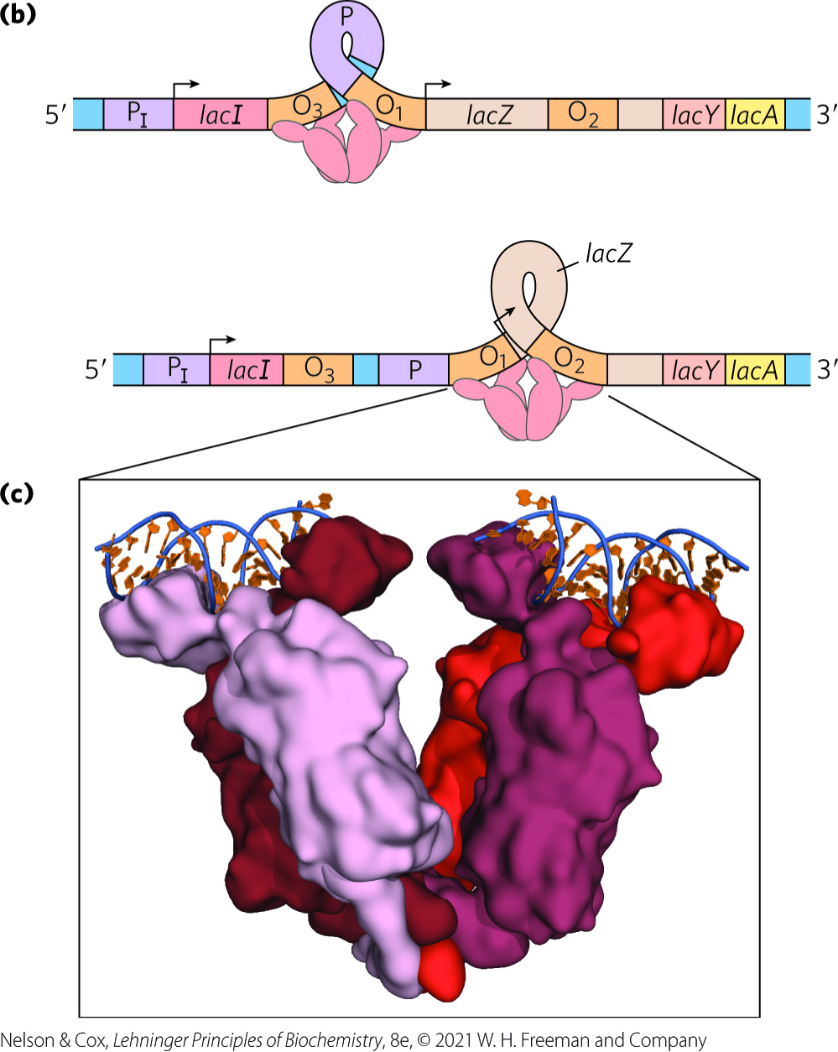
The Lac Repressor Binds to Operators
the Lac repressor binds to O₁ (the main operator for the lac operon) and either O₂ or O₃
Lac repressor binding loops the intervening DNA to block transcription initiation

Slide 26
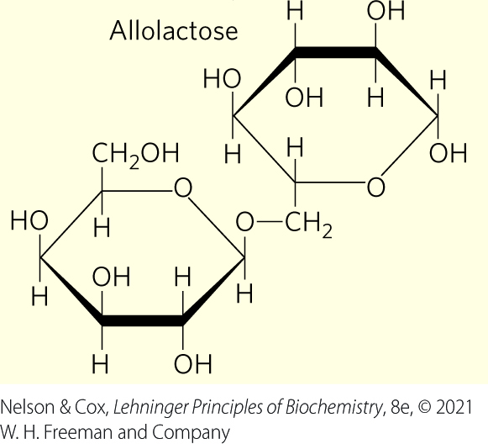
Allolactose Is The Inducer of the lac Operon System
allolactose, an isomer of lactose, is the inducer of the lac operon
binding of allolactose to the Lac repressor causes a conformational change and dissociation
  results in expression of lac operon genes

Slide 27
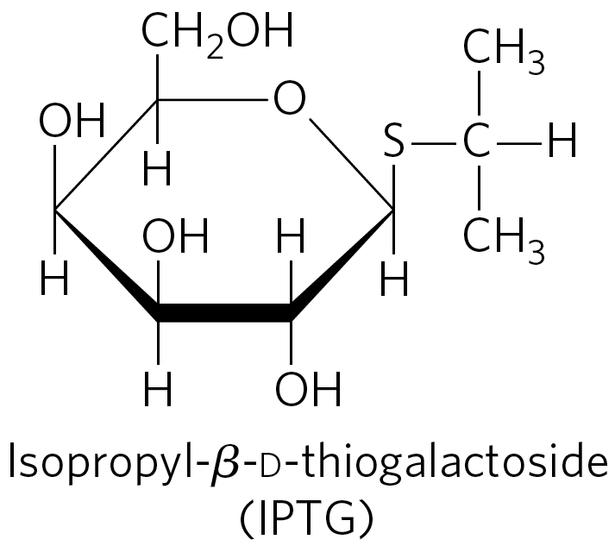
IPTG is an Inducer of the lac Operon
isopropylthiogalactoside (IPTG) is an inducer of the lac operon
  nonmetabolizable
  often used experimentally

Slide 28
Regulatory Proteins Have Discrete DNA-Binding Domains
regulatory proteins generally bind to specific DNA sequences.
  have discrete DNA-binding domains containing characteristic structural motifs that interact with the DNA

Slide 29
Regulatory Proteins Must Recognize DNA Surface Features
most of the chemical groups that differ among the four bases are hydrogen-bond donor and acceptor groups exposed in the major groove of DNA
  permits discrimination between base pairs
most of the protein-DNA contacts that impart specificity are hydrogen bonds

Slide 30
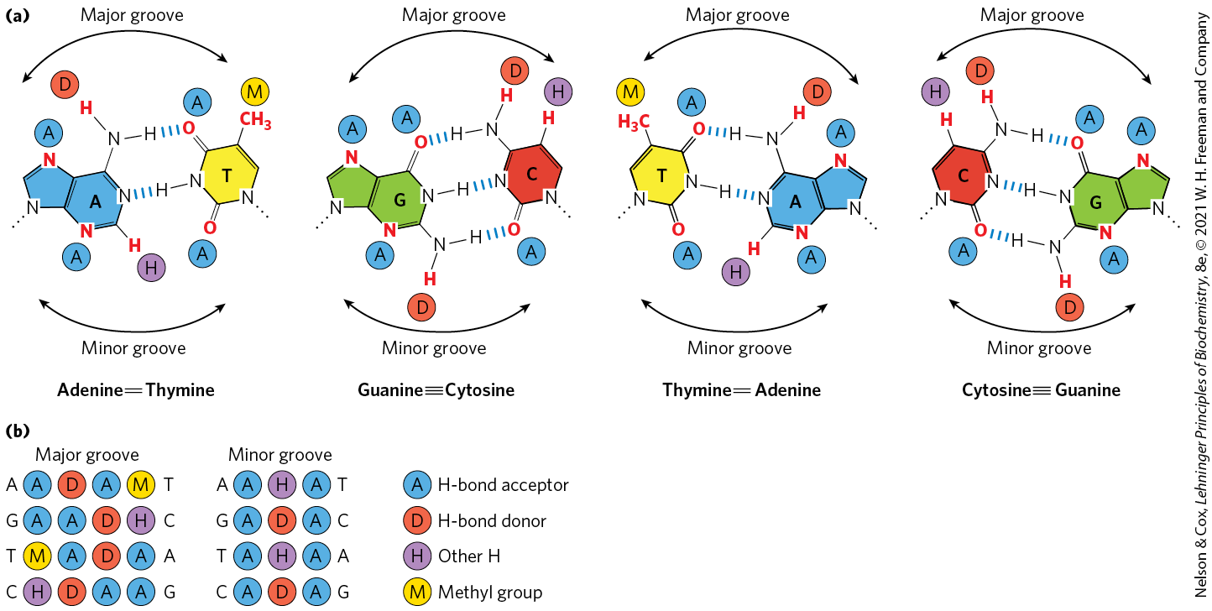
Groups in DNA Available for
Protein Binding

Slide 31
Interactions Between Amino Acid Residues and DNA Base Pairs
Asn, Gln, Glu, Lys, and Arg side chains most often hydrogen bond to the DNA bases
there is no simple amino acid–base code

Slide 32
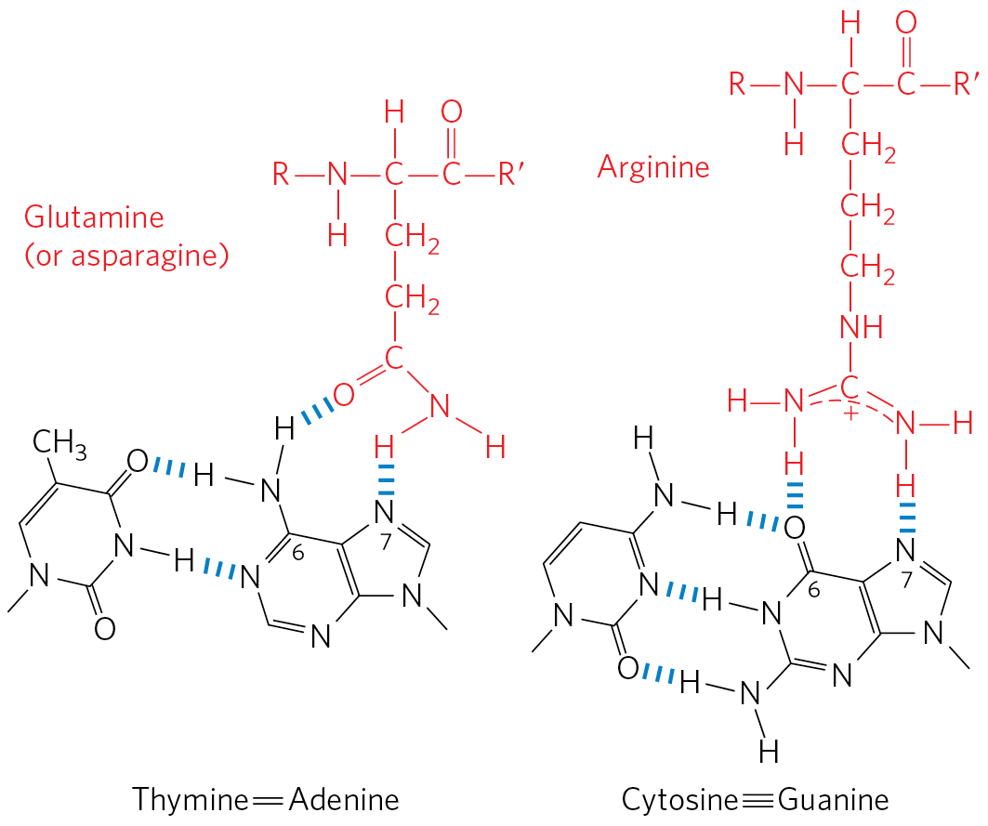
Specific Amino Acid Residue–Base
Pair Interactions
Gln or Asn can hydrogen bond with the N⁶ and N-7 positions of adenine
Arg can form two hydrogen bonds with N-7 and O⁶ of guanine

Slide 33
DNA-Binding Sites for
Regulatory Proteins
often inverted repeats of a short DNA sequence (a palindrome)
multiple (usually two) subunits of a regulatory protein bind cooperatively to the sequence
Lac repressor binding is unique
  each of the two tethered dimers of the Lac repressor separately binds to a palindromic operator sequence

Slide 34
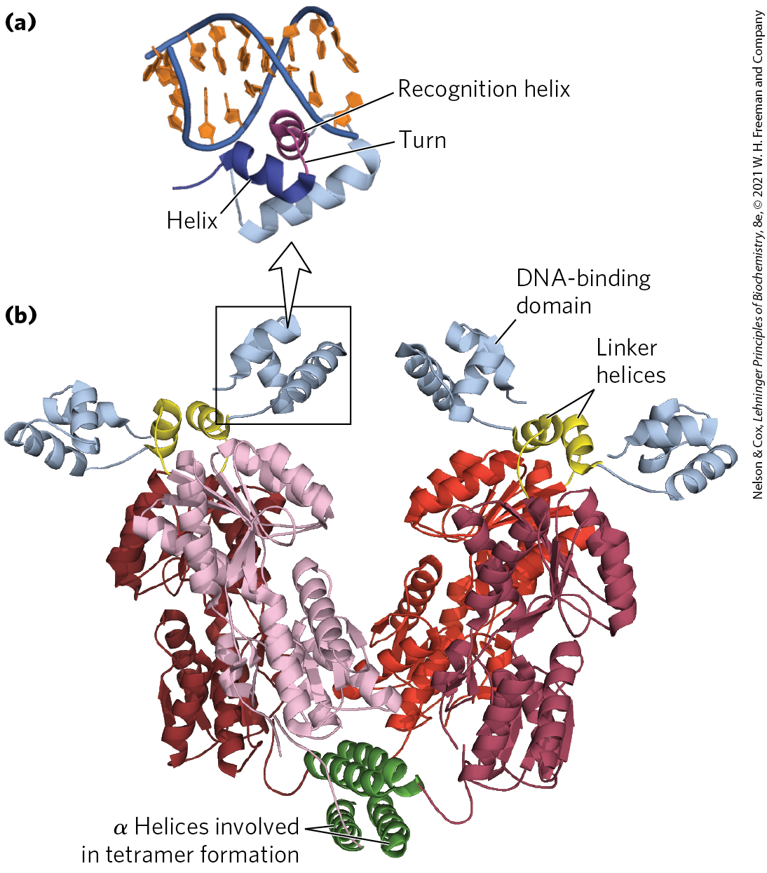
Helix-Turn-Helix
helix-turn-helix motif = ~20 amino acid residues in two short α-helical segments, each 7 to 9 residues long, separated by a β turn
  example: the Lac repressor
  not stable by itself

Slide 35
The Recognition Helix
recognition helix = the α-helical segment that contains many of the amino acids that interact with DNA in a sequence-specific way
  protrudes from the protein surface
  positioned in or nearly in the major groove when bound to DNA

Slide 36
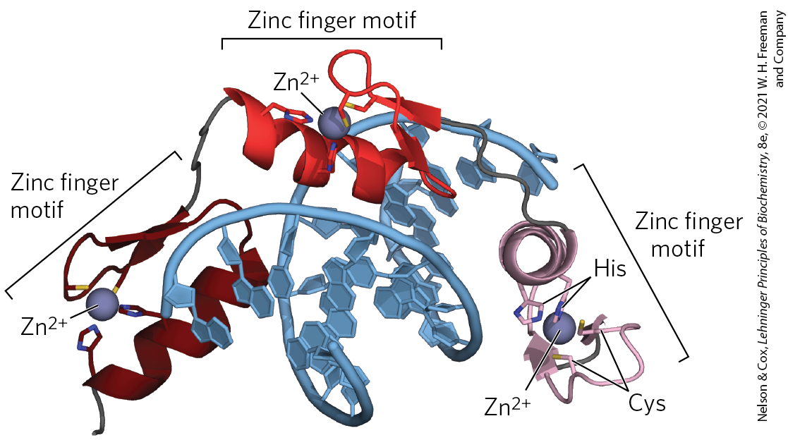
Zinc Finger
zinc finger = ~30 amino acid residues forming an elongated loop held together at the base by a single Zn²⁺ ion
  Zn²⁺ is coordinated to 4 residues (4 Cys or 2 Cys and 2 His)
many eukaryotic DNA-binding proteins contain zinc fingers

Slide 37
Zinc Finger Binding
the interaction of a single zinc finger with DNA is typically weak
  multiple zinc fingers substantially enhances binding
some zinc fingers have the residues for sequence discrimination, whereas others seem to bind DNA nonspecifically
zinc fingers can also function as RNA-binding motifs

Slide 38
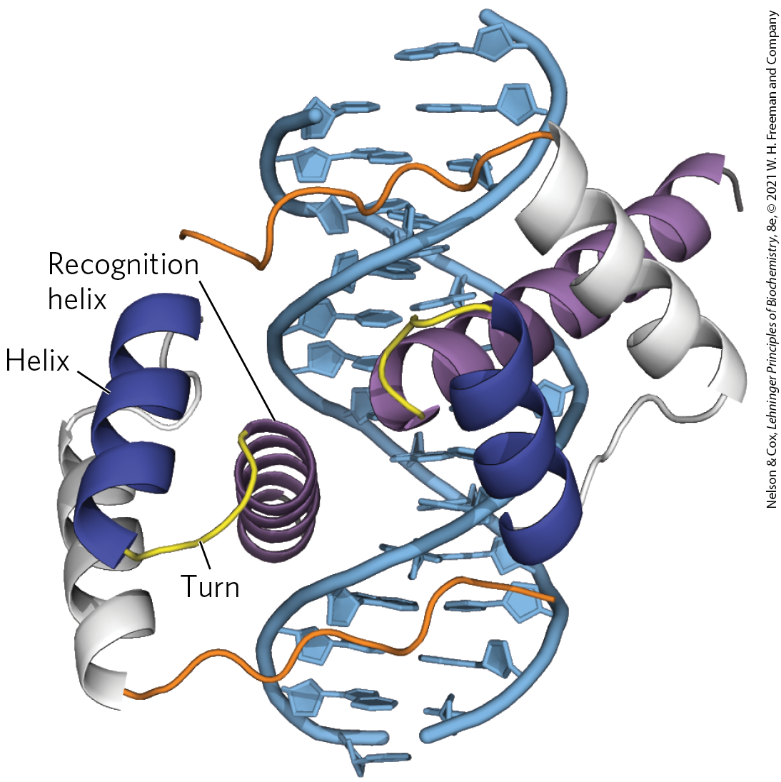
Homeodomain
homeodomain = 60 highly-conserved amino acid residues
  identified in proteins that function as transcriptional regulators, especially during eukaryotic development
homeobox = the DNA sequence that encodes this domain

Slide 39
RNA Recognition Motif
RNA recognition motifs (RRMs) = 90 to 100 amino acid residues arranged in a four-strand antiparallel β sheet sandwiched against two α helices (β₁-α₁-β₂-β₃-α₂-β₄)
  found in some eukaryotic gene activators, where they may bind DNA and RNA to induce transcription
  proteins with RRM motifs may bind to mRNA, rRNA, or other smaller, noncoding RNAs
  lncRNAs compete with DNA binding and decrease gene transcription

Slide 40
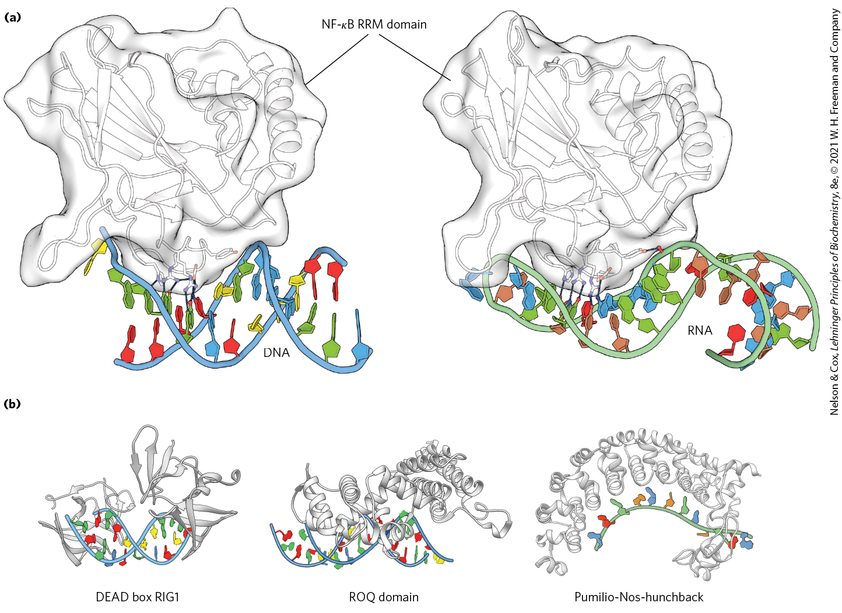
Examples of RNA Recognition
Motifs (RRMs)

Slide 41
Regulatory Proteins Also Have Protein-Protein Interaction Domains
regulatory proteins contain domains for protein-protein interactions
  example: domains for dimer formation of eukaryotic transcription factors

Slide 42
Leucine Zipper
leucine zipper = an amphipathic α helix with a series of hydrophobic amino acid residues on one side and a hydrophobic surface between two polypeptides of a dimer
  Leu occurs at every 7th position along the α helices
  helices form a coiled coil
  found in many eukaryotic proteins
  often found in proteins with a separate DNA-binding domain containing a high concentration of basic (Lys or Arg) residues that can interact with the DNA backbone

Slide 43
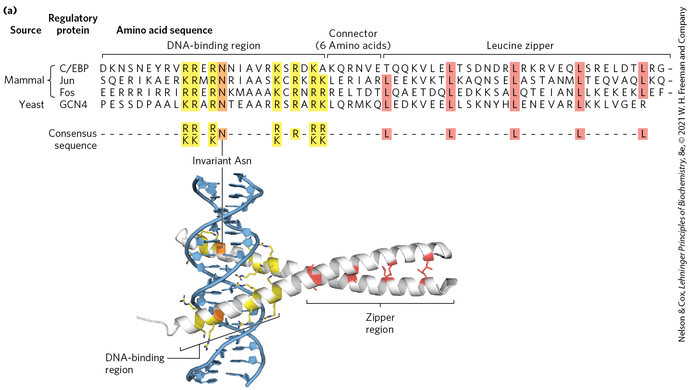
Leucine Zippers

Slide 44
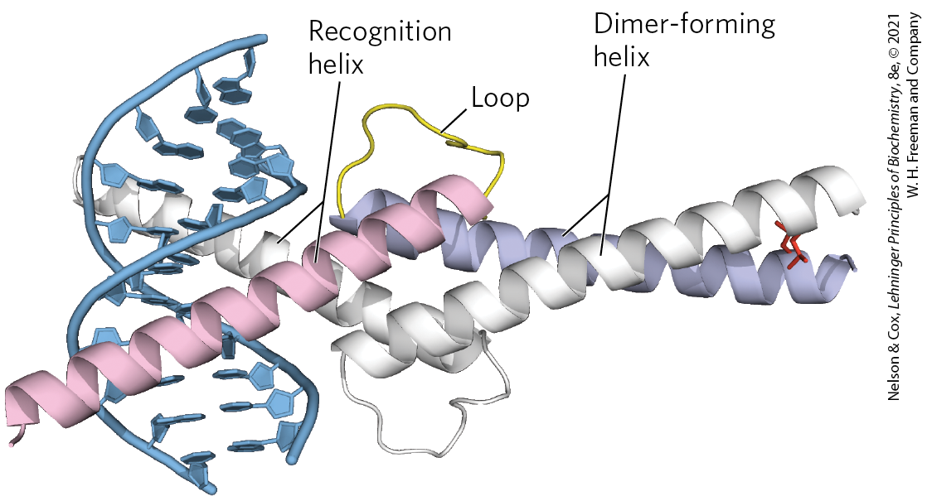
Basic Helix-Loop-Helix
basic helix-loop-helix = conserved 50 amino acid residues that can form two short, amphipathic α helices linked by a loop of variable length
  two helix-loop-helix motifs can interact to form dimers
  occurs in some eukaryotic regulatory proteins involved in gene expression during development

Slide 45
Protein-Protein Interactions in Eukaryotic Regulatory Proteins
eukaryotes have a larger number of genes than activators
  yeast have 300 transcription factors for 1000s of genes
most genes are subject to regulation by multiple transcription factors
combinatorial control = a mechanism involving mixing and matching of protein family variants in dimeric transcription factors
  provides for more efficient and responsive regulation

Slide 46
28.2 Regulation of Gene Expression in Bacteria

Slide 47
The lac Operon Undergoes
Positive Regulation
other factors besides lactose, such as the availability of glucose, affect the expression of the lac gene
glucose is the preferred energy source in E. coli
expressing the genes for proteins that metabolize other sugars is wasteful when glucose is abundant

Slide 48
Catabolite Repression
catabolite repression = a regulatory mechanism that restricts expression of the genes required for catabolism of other sugars in the presence of glucose
  mediated by cAMP as a coactivator and an activator protein, cAMP receptor protein (CRP)

Slide 49
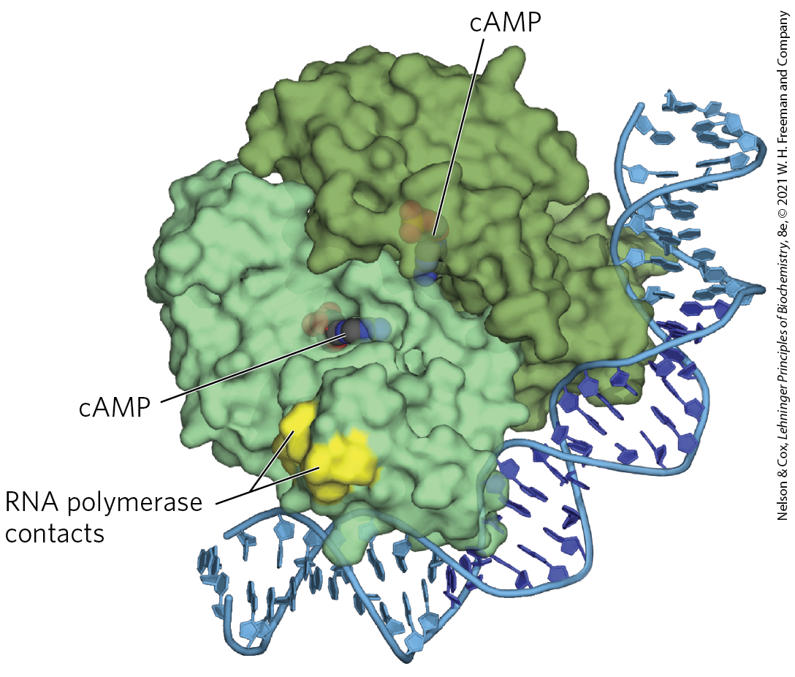
cAMP Receptor Protein (CRP)
cAMP receptor protein (CRP) = an activator protein that contains binding sites for DNA and cAMP
  binding is mediated by a helix-turn-helix motif in the DNA-binding domain

Slide 50
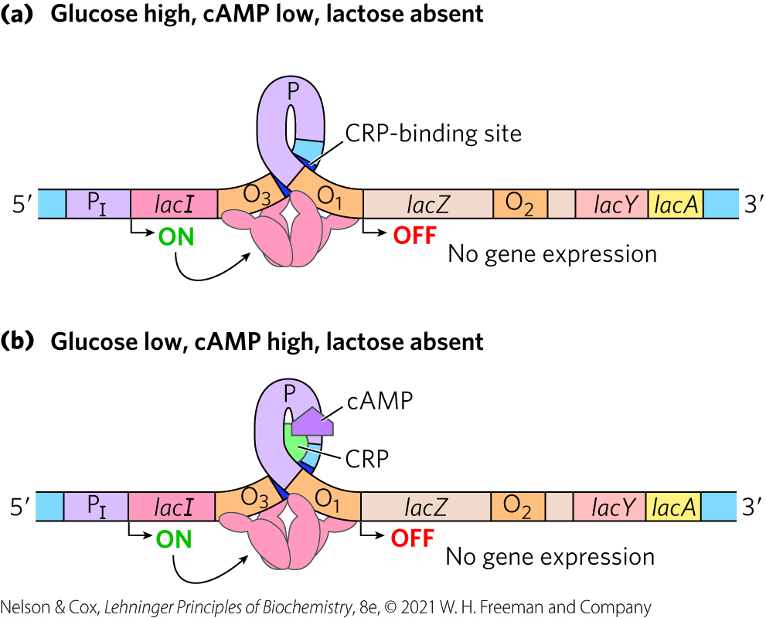
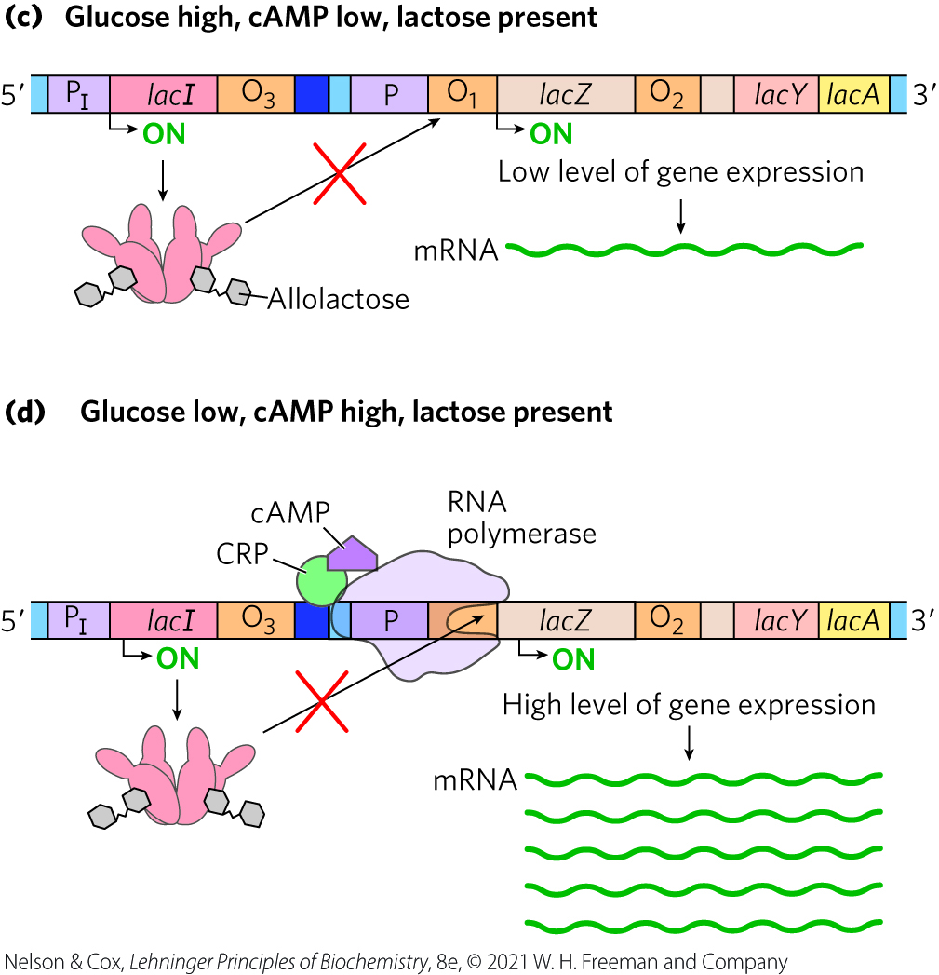
Positive Regulation of the lac Operon by CRP

Slide 51
Regulon
regulon = a network of operons with a common regulator
  allows coordinated shifts in cellular functions
examples include:
  operons encoding enzymes for secondary sugar metabolism (regulated by CRP and cAMP)
  the heat shock gene system that responds to temperature changes
  genes induced as part of the SOS response to DNA damage in E. coli

Slide 52
Many Genes for Amino Acid Biosynthetic Enzymes Are Regulated by Transcription Attenuation
E. coli can synthesize all 20 common amino acids
operons contain the genes encoding enzymes needed to synthesize a given amino acid
  the operon is repressed when the amino acid is abundant

Slide 53
The E. coli Tryptophan (trp) Operon
the E. coli tryptophan (trp) operon contains five genes for the enzymes required to convert chorismate to tryptophan
the Trp repressor binds to the trp operator when tryptophan is abundant
  inhibits expression of the trp operon by blocking RNA polymerase binding

Slide 54
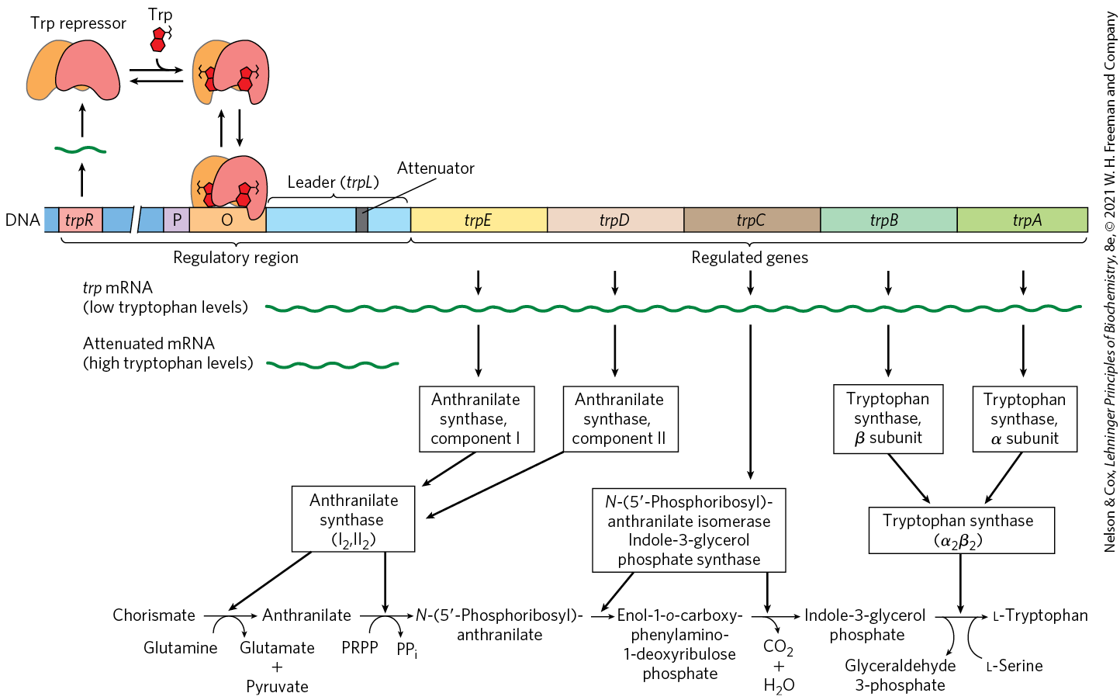
The trp Operon

Slide 55
Transcription Attenuation
once repression is lifted, the rate of transcription is fine-tuned to cellular tryptophan requirements
transcription attenuation = a regulatory process in which transcription is initiated normally but is abruptly halted before the operon genes are transcribed

Slide 56
Other Amino Acid Biosynthetic Operons Use Similar Attenuation Strategies
the phe operon leader peptide contains 7 Phe residues
the leu operon leader peptide contains 4 Leu residues
the his operon leader peptide contains 7 His residues
  attenuation is sufficiently sensitive to be the only regulatory mechanism

Slide 57
The Energetic Cost of Regulation
LexA must be resynthesized to reestablish SOS regulon repression when the DNA damage is no longer present
protein synthesis requires a considerable amount of ATP and GTP

Slide 58
28.3 Regulation of Gene Expression in Eukaryotes

Slide 59
Transcriptional Ground States
transcriptional ground state = the inherent activity of promoters and transcriptional machinery in vivo
  in bacteria, RNA polymerase can initiate transcription at some level of efficiency
  in eukaryotes, strong promoters are generally inactive in the absence of regulatory proteins

Slide 60
Features of Eukaryotic
Gene Regulation
access to eukaryotic promoters is restricted by the structure of chromatin
  transcription requires chromatin remodeling
positive regulation mechanisms are more prominent and are required for transcription
eukaryotic transcriptional regulation commonly involves lncRNAs

Slide 61
Features of Eukaryotic
Gene Regulation, Continued
eukaryotic cells have larger, more complex multimeric regulatory proteins
transcription (in the nucleus) and translation (in the cytoplasm) are separated in space and time

Slide 62
Transcriptionally Active Chromatin Is Structurally Distinct from Inactive Chromatin
heterochromatin = more-condensed form of chromatin that is transcriptionally inactive
  ~10% of chromatin in a typical eukaryotic cell
  generally associated with chromosome structures, such as centromeres
euchromatin = less-condensed form of chromatin

Slide 63
Chromatin Remodeling
chromatin remodeling = transcription-associated structural changes in chromatin
chromatin remodeling to yield transcriptionally active genes involves:
  repositioning nucleosomes
  the presence of histone variants
  covalent modification of nucleosomes

Slide 64
Some Enzyme Complexes That Catalyze Chromatin Remodeling
Table 28-2 Some Enzyme Complexes That Catalyze Chromatin Structural Changes Associated with Transcription
Enzyme complexª | Oligomeric structure (number of polypeptides) | Source | Activities
Histone movement, replacement, or editing, requiring ATP
SWI/SNF family | 8–17, M_{r} > 10⁶ | Eukaryotes | Nucleosome remodeling; transcriptional activation
ISWI family | 2–4 | Eukaryotes | Nucleosome remodeling; transcriptional repression; transcriptional activation in some cases
CHD family | 1–10 | Eukaryotes | Nucleosome remodeling; nucleosome ejection for transcriptional activation; some have repressive roles
INO80 family | >10 | Eukaryotes | Nucleosome remodeling; transcriptional activation; family member SWR1 engages in replacement of H2A-H2B with H2AZ-H2B
Histone modification
GCN5-ADA2-ADA3 | 3 | Yeast | GCN5 has type A HAT activity
SAGA/PCAF | >20 | Eukaryotes | Includes GCN5-ADA2-ADA3; acetylates residues in H3, H2B, H2AZ
NuA4 | ≥12 | Eukaryotes | EsaI component has HAT activity; acetylates H4, H2A, and H2AZ
Histone chaperones not requiring ATP
HIRA | 1 | Eukaryotes | Deposition of H3.3 during transcription

Slide 65
Covalent Modification of Histones
the core histones of nucleosome particles are modified by:
  methylation of Lys or Arg residues
  phosphorylation of Ser or Thr residues
  acetylation
  ubiquitination
  SUMOylation
covalent modifications occur at specific residues concentrated in this amino-terminal domain
  patterns of modification may indicate the existence of a histone code

Slide 66
Most Eukaryotic Promoters Are Positively Regulated
initiation of transcription depends on multiple activator proteins, not RNA polymerase affinity
chromatin renders most promoters inaccessible
  repressors would be redundant
combinatorial control provides precise positive control
negative regulation in eukaryotes typically involves lncRNAs

Slide 67
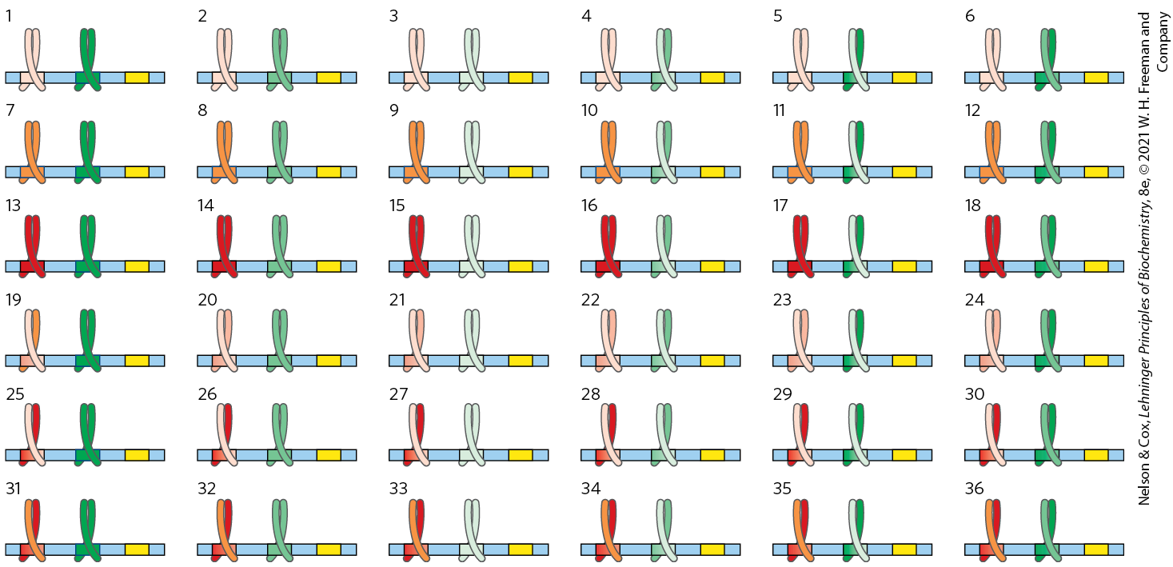
Advantages of
Combinatorial Control
with two regulatory gene families (each with three members that can form dimers), 36 different regulatory combinations are possible

Slide 68
Hormone Receptors
hormone receptors:
  have a consensus HRE sequence
  have a highly conserved DNA-binding domain with two zinc fingers
  have a specific ligand-binding region at the carboxyl terminus
Table 28-4 Hormone Response Elements (HREs) Bound by Steroid-Type Hormone Receptors
Receptor | HRE consensus sequence bound
Androgen | GG(A/T)ACAN₂TGTTCT
Glucocorticoid | GGTACAN₃TGTTCT
Retinoic acid (some) | AGGTCAN₅AGGTCA
Vitamin D | AGGTCAN₃AGGTCA
Thyroid hormone | AGGTCAN₃AGGTCA
RX^{b} | AGGTCANAGGTCANAG GTCANAGGTCA

Slide 69
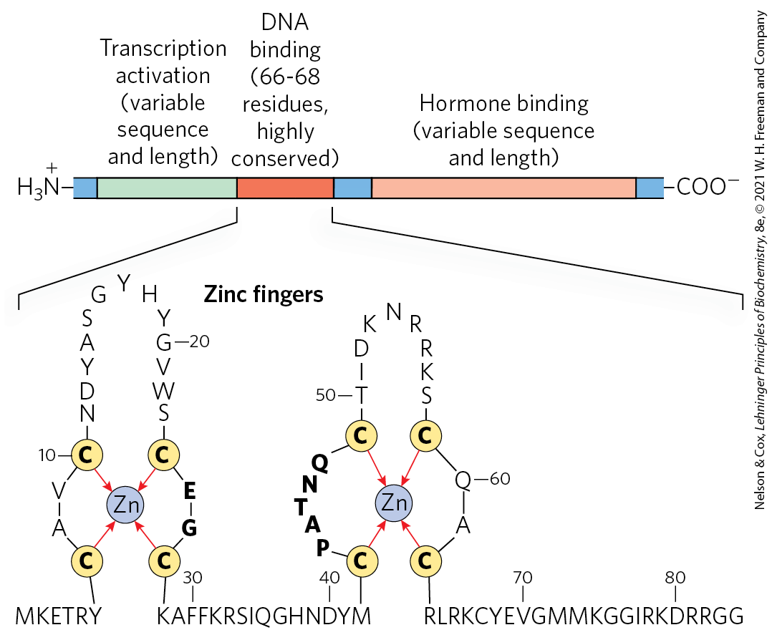
Typical Steroid Hormone Receptors

Slide 70
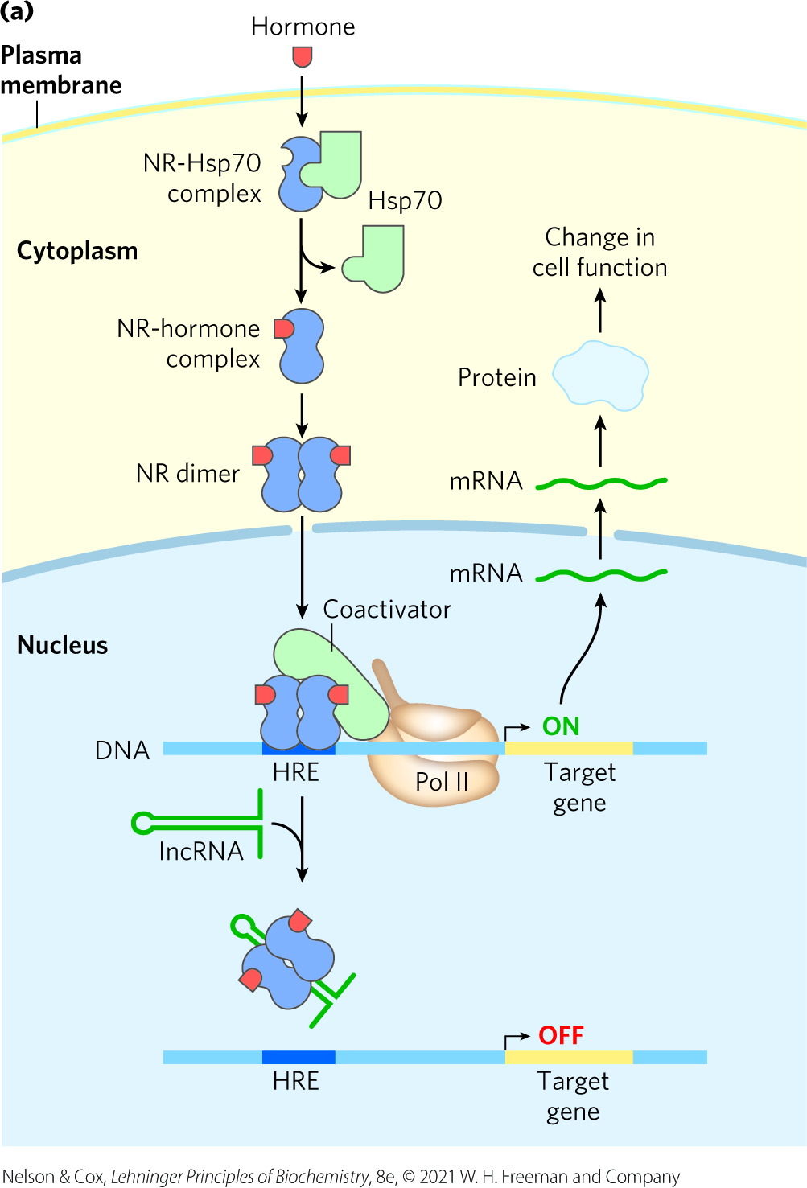
Monomeric Type I Receptors (NR)
examples: receptors for sex hormones and glucocorticoids
found in the cytoplasm, in complex with Hsp70
Hsp70 dissociates when the hormone binds and the receptor dimerizes, exposing a nuclear localization signal
  receptor enters the nucleus and acts as an activator

Slide 71
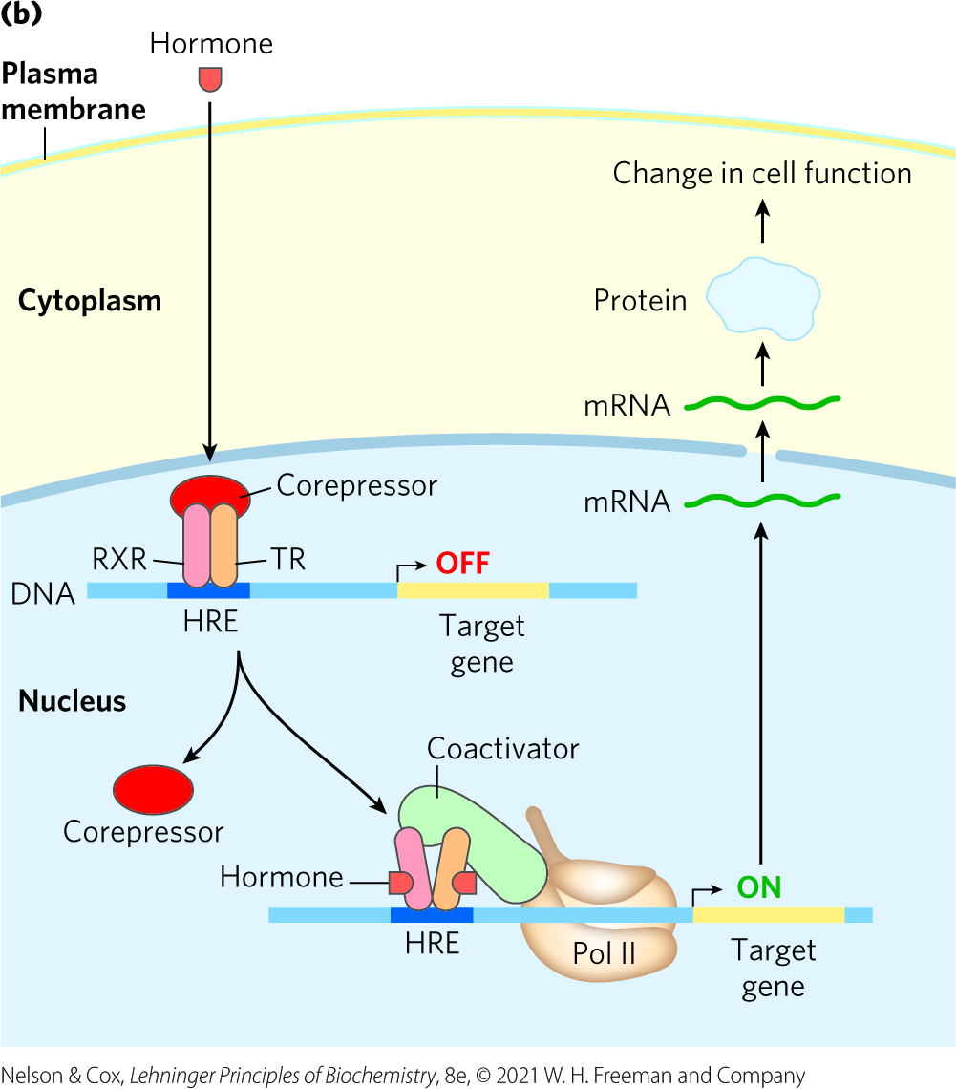
Type II Receptors
example: thyroid hormone receptor
found in the nucleus, bound to an HRE and a corepressor
the corepressor dissociates when the hormone binds
  receptor functions as an activator

Slide 72
RNA-Mediated Regulation of Gene Expression Takes Many Forms in Eukaryotes
ncRNAs = RNAs that do not encode proteins
  called lncRNAs when their length is >200 nucleotides
the lncRNA HSR1 stimulates heat shock factor 1 trimerization and DNA binding to activate transcription
the lncRNA 7SK binds to the Pol II transcription elongation factor pTEFb and represses transcript elongation
ncRNA B2 binds directly to Pol II during heat shock and represses transcription

Slide 73
Development Is Controlled by Cascades of Regulatory Proteins
embryonic development requires tightly coordinated changes in genome expression
more genes are expressed during early development than any other part of the life cycle
  sea urchin oocyte has ~18,500 different mRNAs vs. ~6,000 different mRNAs in a differentiated tissue

Slide 74
Translational Repression Regulates Developmental Pathways
many mRNAs are deposited in the egg long before translation is required
  translational repression helps regulate developmental pathways

Slide 75
Stem Cells Have Developmental Potential That Can Be Controlled
stem cells = cells that can differentiate into various tissues
totipotent cells = cells that can differentiate into any tissue or a complete organism
pluripotent cells = cells that can give rise to cells of all three germ layers and many tissue types
  cannot differentiate into a complete organism
unipotent cells = cells that can develop into only one type of cell and/or tissue

Slide 76
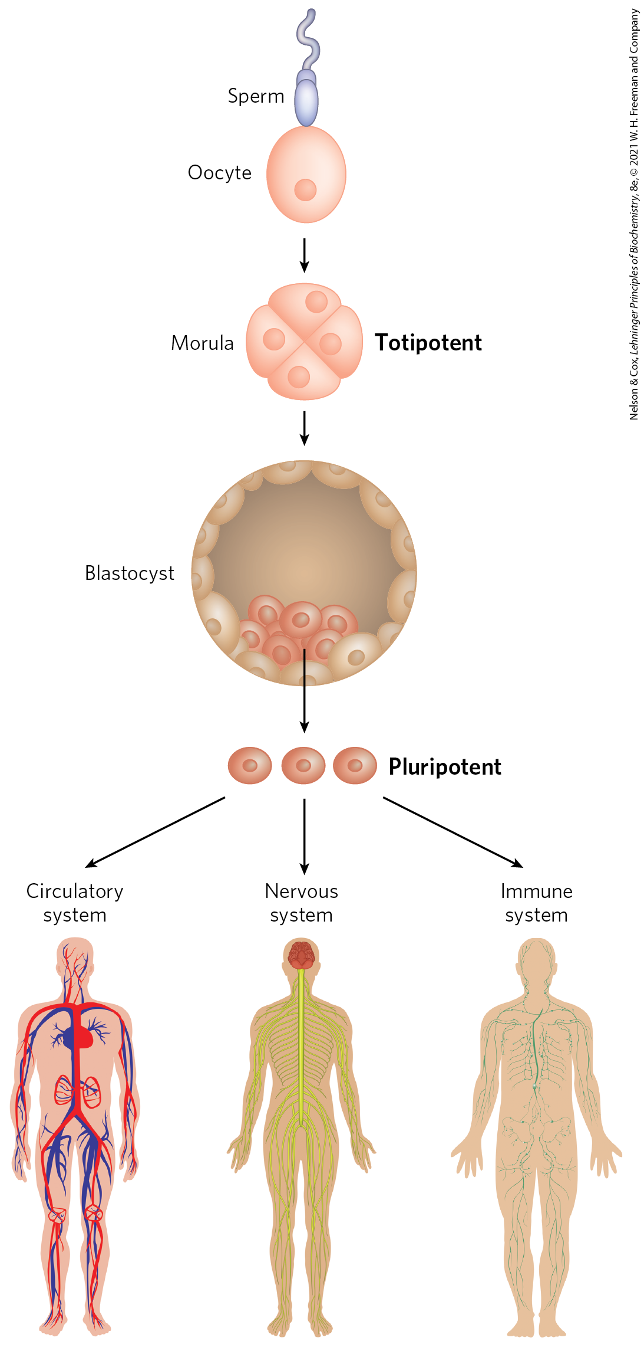
Development Potential of Stem Cells

Slide 77
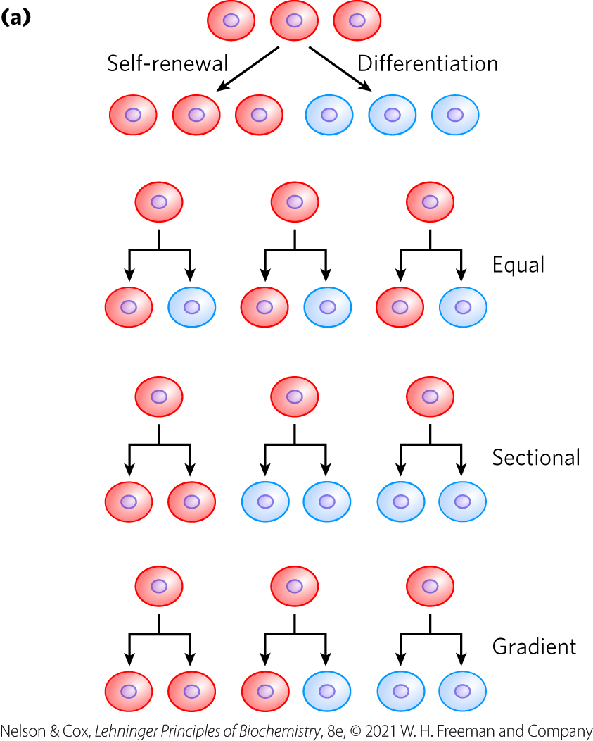
Stem Cell Proliferation Versus Differentiation and Development
stem cells have two functions:
  replenishing themselves
  providing cells that can differentiate

Slide 78
Embryonic and Adult Stem Cells
embryonic stem cells = pluripotent cells of the blastocyst
  used in embryonic stem cell research
adult stem cells = have more limited potential than embryonic stem cells
  considered multipotent
  have a niche, a microenvironment that promotes stem cell maintenance while allowing differentiation of some daughter cells

Slide 79
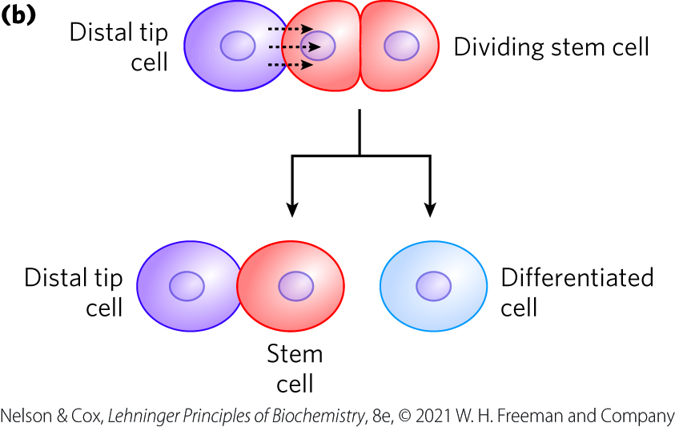
Adult Stem Cells Have a Niche
niche = a microenvironment that promotes stem cell maintenance while allowing differentiation of some daughter cells
signaling from neighboring cells maintains the stem cell lineage

