Slide 1

27 Protein Metabolism
© 2021 Macmillan Learning

Slide 2

Principle 1 (1 of 8)
Information is expensive. This principle, noted in earlier chapters, is particularly well illustrated by protein synthesis. Protein synthesis consumes more cellular resources than any other process in most cells. The 15,000 ribosomes, 100,000 molecules of protein synthesis–related protein factors and enzymes, and 200,000 tRNA molecules in a typical bacterial cell can account for more than 35% of the cell’s dry weight. Overall, almost 300 different macromolecules cooperate to synthesize polypeptides. Protein synthesis can account for up to 90% of the chemical energy used by a cell for all biosynthetic reactions. Why? The enzymatic synthesis of an amide bond should require little energetic input. However, the sequence of amino acids in a protein is a form of biological information. Synthesis of each amide (peptide) bond between two particular amino acids is ensured by the investment of more than four nucleoside triphosphates (NTPs).

Slide 3

Principle 2 (1 of 3)
The genetic code is nearly universal and arose early in evolution. This is one of the many characteristics of living systems that ties all of them to a common ancestor. Even the rare exceptions to code universality reinforce this rule.

Slide 4

Principle 3 (1 of 6)
The genetic code functions via linker molecules. The tRNAs are the crucial adaptor, matching amino acids with DNA codons.

Slide 5
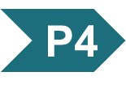
Principle 4 (1 of 3)
Proteins are synthesized by RNAs. The study of protein synthesis offers another important reward: a look at a world of RNA catalysts that may have existed in an RNA world before the dawn of life “as we know it.” Proteins are synthesized by a gigantic RNA enzyme.

Slide 6

Principle 5
Protein metabolism is regulated at many levels. The resource investment in protein synthesis ensures that many layers of regulation work together to determine which proteins are synthesized at any given moment. However, proteins often function only in particular cellular locations and at particular times. Mechanisms for spatial and temporal regulation — protein targeting, activation, and eventual degradation — exhibit complexities that can approach those of the biosynthetic processes.

Slide 7
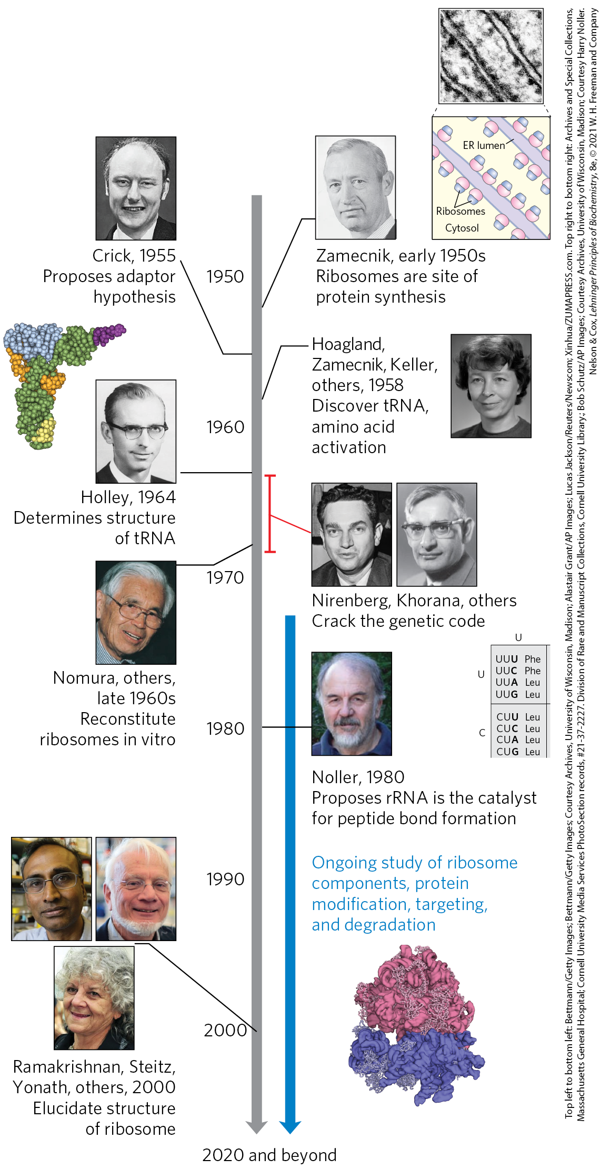
Timeline for Elucidating Protein Biosynthetic Pathways

Slide 8
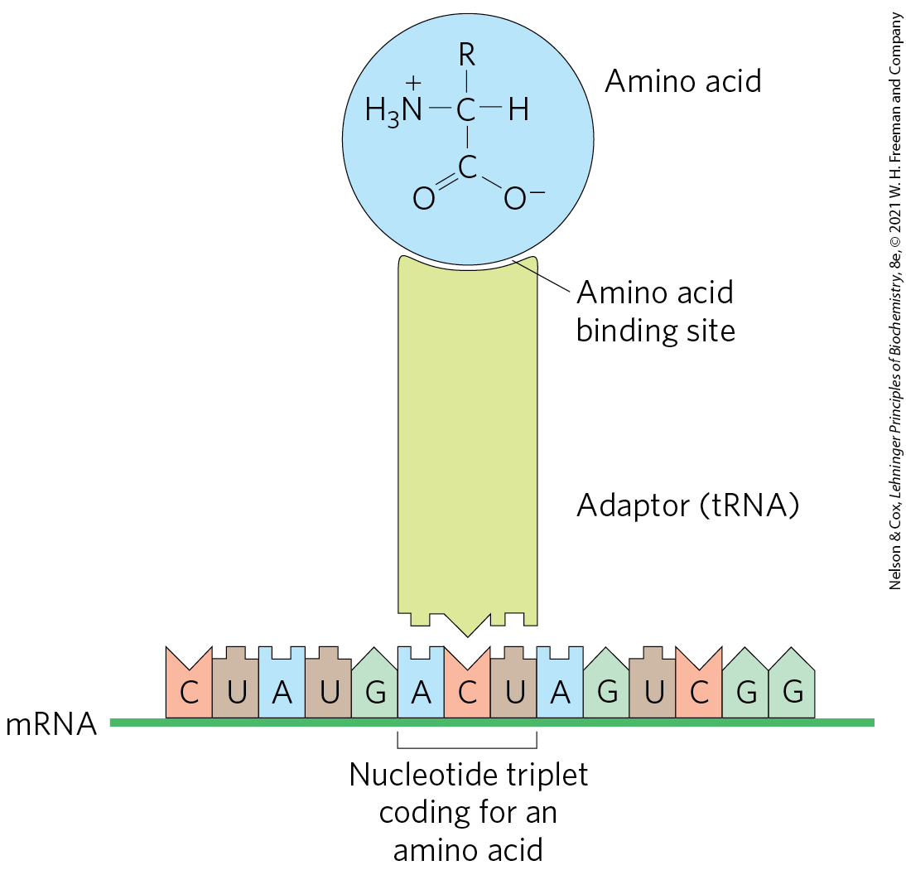
Crick’s Adaptor Hypothesis
adaptor hypothesis = postulation that a small nucleic acid could act as an adaptor, binding to both a specific amino acid and the mRNA sequence encoding that amino acid
  verified with the discovery of tRNA

Slide 9
The Process of Translation
translation = the overall process of mRNA-guided protein synthesis
the tRNA adaptor “translates” the nucleotide sequence of an mRNA into the amino acid sequence of a polypeptide

Slide 10
Aminoacyl-tRNAs
amino acids are “activated” for protein synthesis.
aminoacyl-tRNAs = tRNA attached to an amino acid
aminoacyl-tRNA synthetases = catalyze the formation of aminoacyl-tRNAs

Slide 11
27.1 The Genetic Code

Slide 12
Three Nucleotides are Necessary to Encode Each Amino Acid
the four code letters of DNA (A, T, G, and C) in groups of two yields only 4² = 16 different combinations
  insufficient to encode 20 amino acids.
groups of three yield 4³ = 64 different combinations

Slide 13
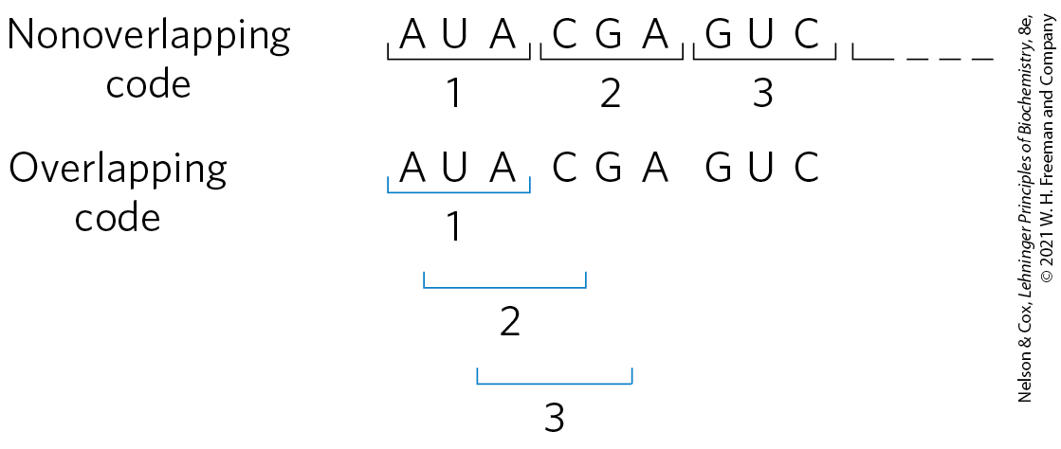
The Genetic Code Was Cracked Using Artificial mRNA Templates
codon = a triplet of nucleotides that codes for a specific amino acid
in all living systems, translation occurs in such a way that codons are read in a successive, nonoverlapping fashion

Slide 14
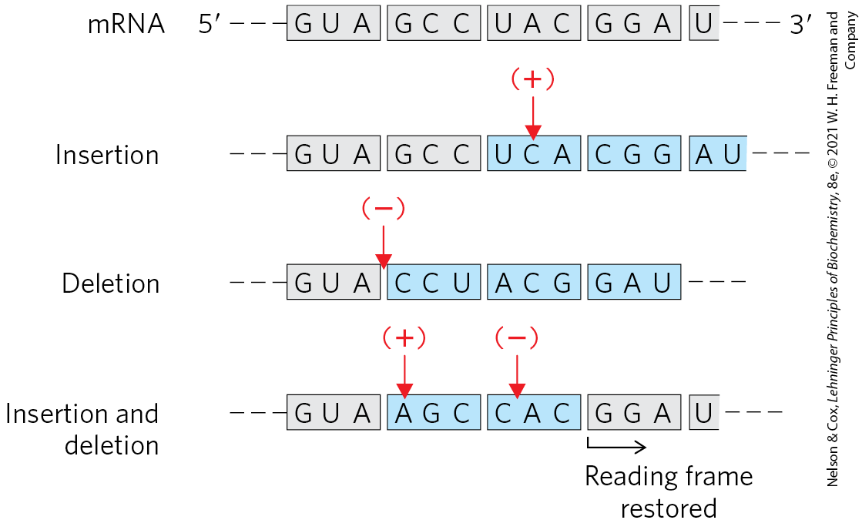
The Triplet, Nonoverlapping Code
inserting or deleting one base pair alters the amino acid sequence coded by the mRNA
inserting or deleting three nucleotides leaves the remaining triplets intact
  provides evidence that a codon has only three nucleotides

Slide 15
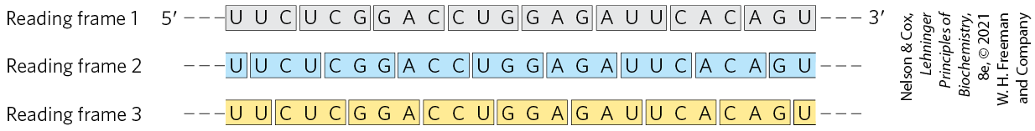
Reading Frames in the Genetic Code
reading frame = method of dividing nucleotides such that a new codon begins every three nucleotide residues
  established by the first codon
  no punctuation between codons
  in principle, any given ssDNA or mRNA sequence has three possible reading frames

Slide 16
The First Breakthrough
Nirenberg and Matthaei fed poly(U) and 20 radiolabeled amino acids to E.coli
  found that radioactive polypeptide only formed in the tube containing *Phe
  thus UUU codes for Phe
the same approach revealed:
  CCC codes for proline
  AAA codes for lysine
  GGG did not generate any polypeptide, because it forms tetraplexes that cannot be bound by ribosomes

Slide 17
Polynucleotide Phosphorylase
polynucleotide phosphorylase = catalyzes the formation of RNA polymers with a base composition that reflects the relative concentrations of precursors in the medium
  discovered by Ochoa
Nirenberg and Ochoa groups used artificial mRNAs made by polynucleotide phosphorylase to identify the base compositions of coding triplets

Slide 18
A Complementary Approach
Khorana used defined mRNAs in planned patterns to produce polypeptides with repeating patterns
  (AC)_{n} (alternating ACA and CAC codons) produced a polypeptide with equal amounts of His and Thr

Slide 19
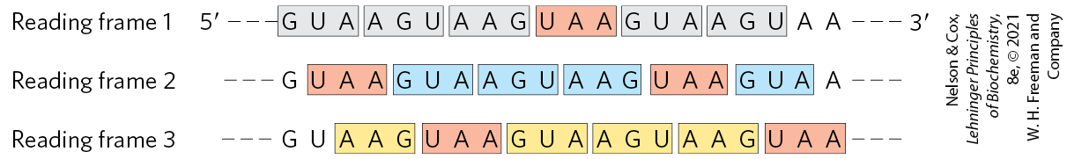
Effect of a Termination Codon
three codons disrupted amino acid coding patterns when they occurred in a synthetic RNA polymer
  synthesized dipeptides or tripeptides
these codons were identified as termination codons
termination codons

Slide 20
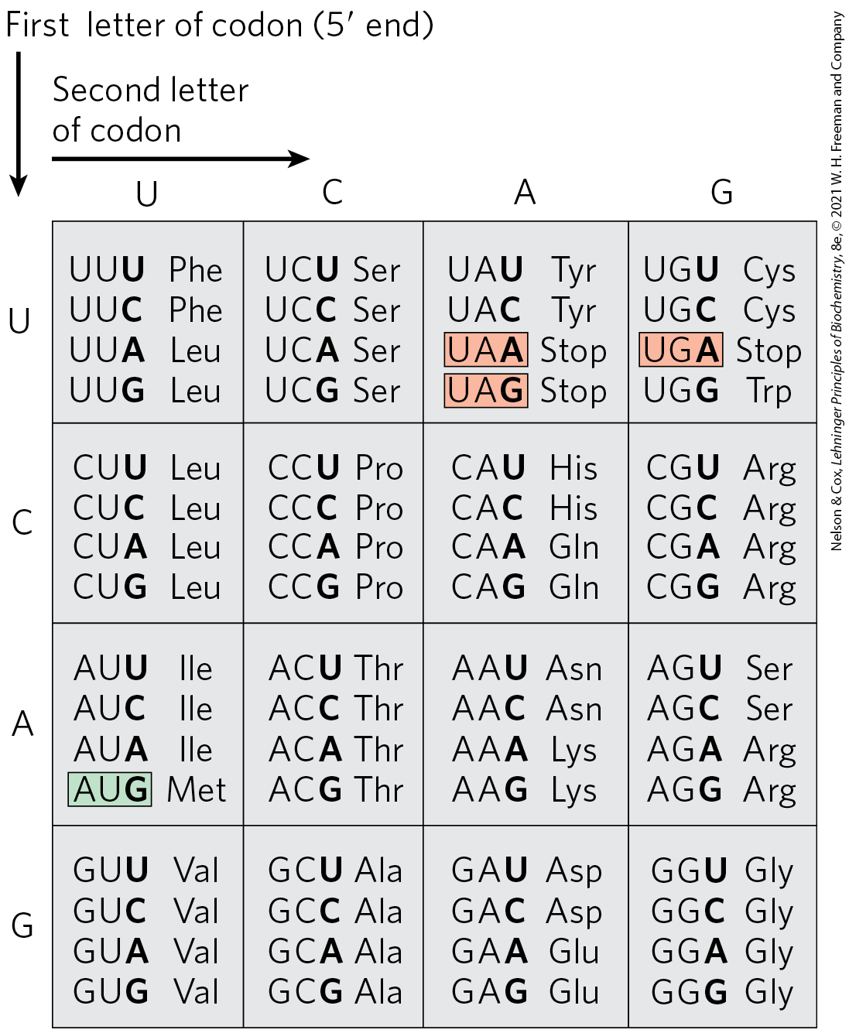
“Dictionary” of Amino Acid Code Words in mRNAs
61 codons code for amino acids
3 codons (UAA, UGA, UAG) are termination codons
1 codon (AUG) is the start codon (as well as the Met codon)

Slide 21
Setting and Maintaining the
Reading Frame
the reading frame is set when translation of an mRNA molecule begins
the reading frame is maintained as triplets are read sequentially
a “missense” protein with a garbled amino acid sequence forms if:
  the initial reading frame is off by one or two bases
  translation skips a nucleotide in the mRNA

Slide 22
Several Codons Serve
Special Functions
initiation codon (AUG) = signal the beginning of a polypeptide in all cells
  also codes for Met in internal positions of polypeptides
termination codons (UAA, UAG, and UGA) = normally signal the end of polypeptide synthesis
  also called stop codons or nonsense codons
  do not code for any known amino acids

Slide 23
Initiation of Protein Synthesis is an Elaborate Process
initiation of protein synthesis in the cell relies on initiation codons and other signals in the mRNA
in retrospect, the experiments to identify codon function should not have worked without initiation codons
  experimental conditions caused the initiation requirements for protein synthesis to be relaxed

Slide 24
Open Reading Frame (ORF)
open reading frame (ORF) = a reading frame without a termination codon among 50+ consecutive codons
long ORFs usually correspond to genes that encode proteins
  a typical protein requires an ORF with 500+ codons

Slide 25
The Genetic Code is Degenerate
degenerate = an amino acid may be specified by more than one codon
  degeneracy of the code is not uniform
each codon specifies only one amino acid
Table 27-3 Degeneracy of the Genetic Code
Amino acid | Number of codons | Amino acid | Number of codons
Met | 1 | Tyr | 2
Trp | 1 | Ile | 3
Asn | 2 | Ala | 4
Asp | 2 | Gly | 4
Cys | 2 | Pro | 4
Gln | 2 | Thr | 4
Glu | 2 | Val | 4
His | 2 | Arg | 6
Lys | 2 | Leu | 6
Phe | 2 | Ser | 6

Slide 26
The Genetic Code is
Nearly Universal
amino acid codons are identical in nearly all species examined so far
  exceptions include minor variations in mitochondria, some bacteria, and some single-celled eukaryotes
suggests that all life-forms have a common evolutionary ancestor

Slide 27
Wobble Allows Some tRNAs to Recognize More than One Codon
when several different codons specify one amino acid, the difference usually lies at the third base position
  for example, alanine is encoded by GCU, GCC, GCA, and GCG
the third position in each codon is much less specific and is said to “wobble”
  this allows certain tRNAs to recognize more than one codon

Slide 28
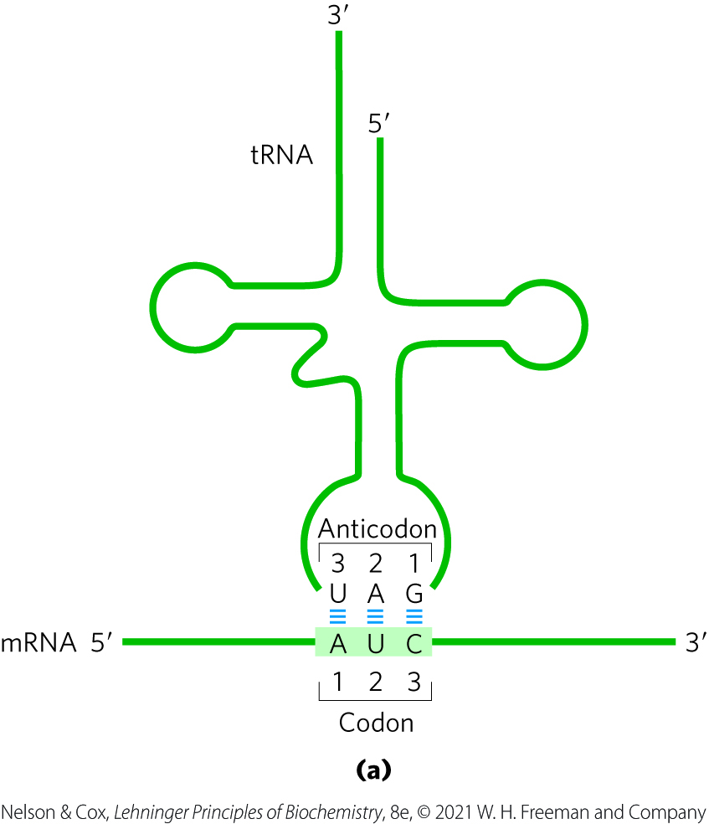
Pairing Relationship of Codon and Anticodon
anticodon = a three-base sequence on the tRNA that base pairs with mRNA codons
base pairing occurs via hydrogen bonding
the alignment of the two RNA segments is antiparallel

Slide 29
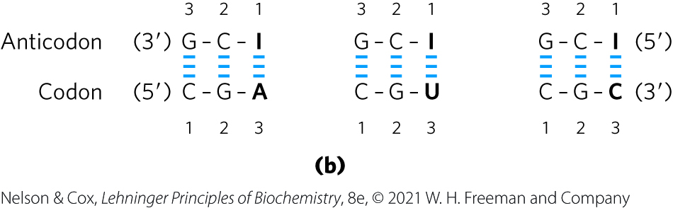
Inosinate in Anticodons
the anticodons in some tRNAs include the nucleotide inosinate (designated I)
inosinate can form weak hydrogen bonds with A, U, and C

Slide 30
The Wobble Hypothesis
the wobble hypothesis = proposes the third base of most codons pairs loosely with the corresponding anticodon base
  permits rapid dissociation of the tRNA from its codon during protein synthesis

Slide 31
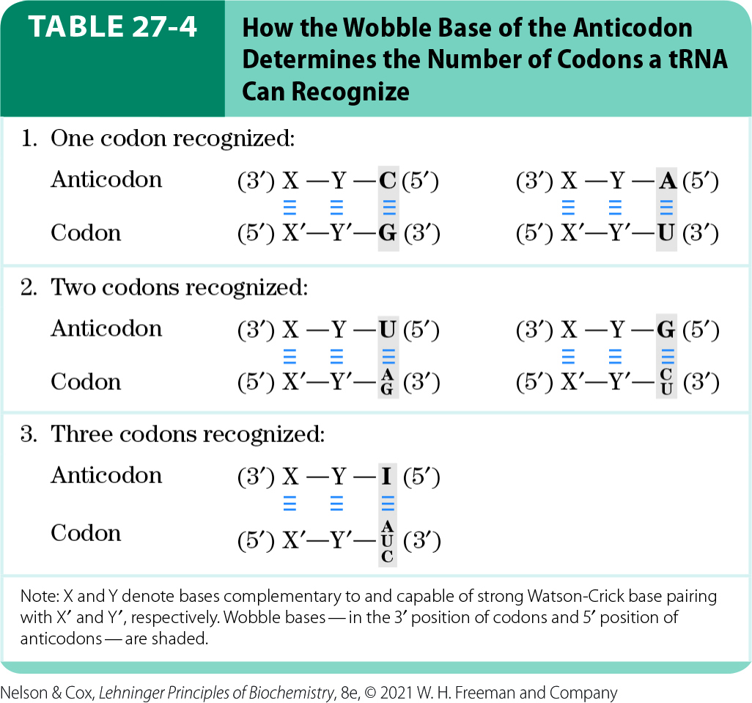
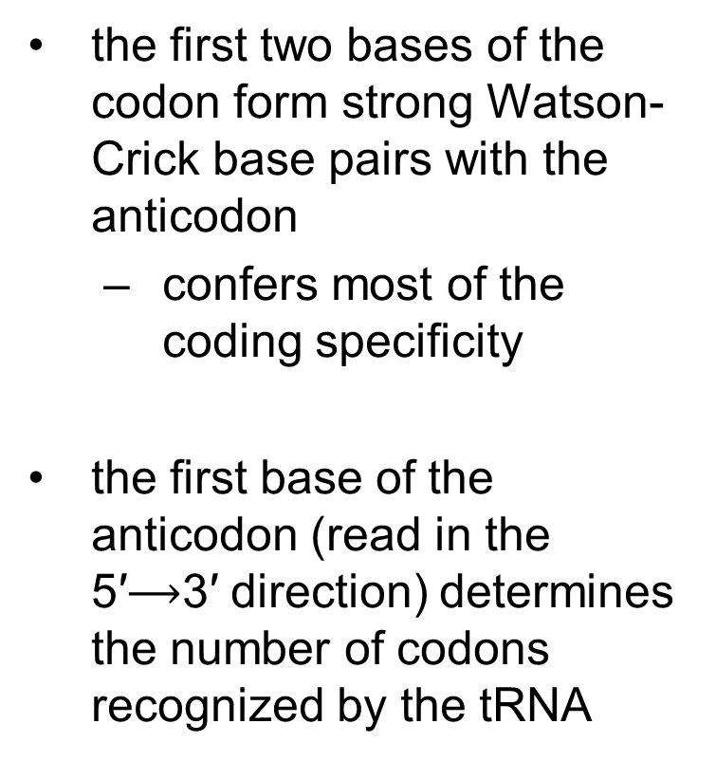
The Relationships of the Wobble Hypothesis (1 of 2)
the first two bases of the codon form strong Watson-Crick base pairs with the anticodon
  confers most of the coding specificity
the first base of the anticodon (read in the 5′$⟶$3′ direction) determines the number of codons recognized by the tRNA

Slide 32
The Relationships of the Wobble Hypothesis (2 of 2)
when an amino acid is specified by several different codons, the codons that differ in either of the first two bases require different tRNAs
at least 32 tRNAs are required to translate all 61 codons (31 to encode the amino acids, 1 for initiation)

Slide 33
The Genetic Code Is
Mutation-Resistant
missense mutations = mutations in which a single new base pair replaces another
  most common type of mutation
  in the third position of the codon, single base substitutions change the amino acid ~25% of the time
silent mutations = mutations in which the nucleotide is different but the encoded amino acid stays the same

Slide 34
Transition Mutations
transition mutation = a missense mutation in which a a purine is replaced by a purine, or a pyrimidine by a pyrimidine
  all three codon positions have some resistance to these mutations
mutation in the first base of a codon usually produces a conservative substitution
  for example, changing GUU (Val) to AUU (Ile) substitutes one hydrophobic amino acid for another

Slide 35
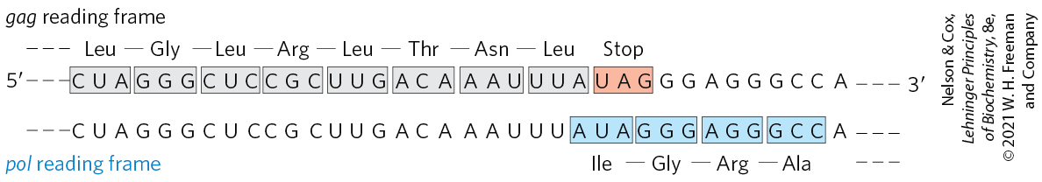
Translational Frameshifting Affects How the Code Is Read
translational frameshifting = “hiccupping” of ribosomes at a certain point in the translation to change the reading frame
  allows 2+ related but distinct proteins to be produced from a single transcript
  occurs during translation for the overlapping gag and pol genes of the retrovirus Rous sarcoma virus

Slide 36
27.2 Protein Synthesis

Slide 37
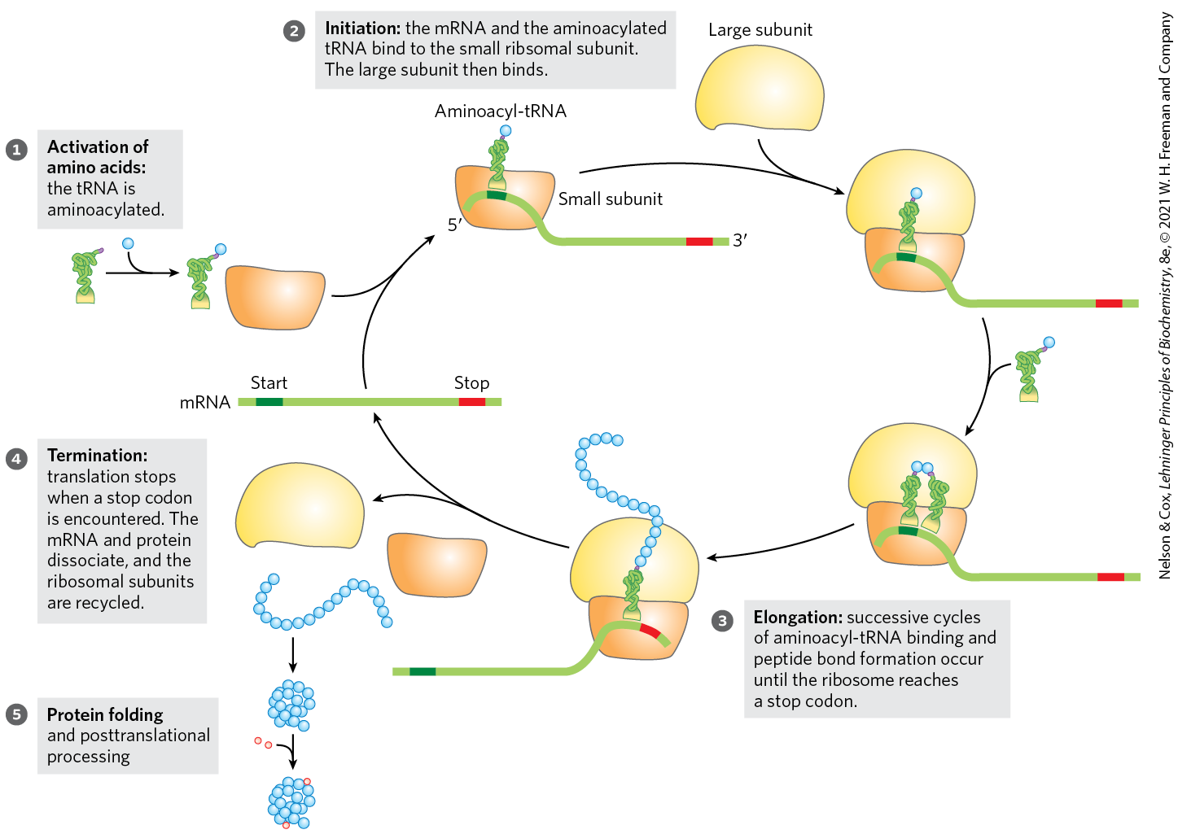
An Overview of the Five Stages of Protein Synthesis

Slide 38
Components Required for Protein Synthesis in E. coli
Table 27-5 Components Required for the Five Major Stages of Protein Synthesis in E.coli
Stage | Essential components | Essential components
1. Activation of amino acids | 20 amino acids 20 aminoacyl-tRNA synthases 32 or more tRNAs | ATP Mg²⁺
2. Initiation | mRNA N-Formylmethionyl-tRNA^{fMet} Initiation codon in mRNA (AUG) 30S ribosomal subunit | 50S ribosomal subunit Initiation factors (IF1, IF2, IF3) GTP Mg²⁺
3. Elongation | Functional 70S ribosomes (initiation complex) Aminoacyl-tRNAs specified by codons | Elongation factors (EF-Tu, EF-Ts, EF-G) GTP Mg²⁺
4. Termination and ribosome recycling | Termination codon in mRNA Release factors (RF1, RF2, RF3, RRF) | EF-G IF3
5. Folding and posttranslational processing | Chaperones and folding enzymes (PPI, PDI); specific enzymes, cofactors, and other components for removal of initiating residues and signal sequences, additional proteolytic processing, modification of terminal residues, and attachment of acetyl, phosphoryl, methyl, carboxyl, carbohydrate, or prosthetic groups

Slide 39
The Ribosome Is a Complex Supramolecular Machine
each E. coli cell contains 15,000+ ribosomes
  ~25% of the dry weight of bacteria
bacterial ribosomes:
  contain ~65% rRNA (forms the core and catalyzes peptide bond formation) and ~35% protein
  have two unequal subunits (30S and 50S)
Table 27-6 RNA and Protein Components of the E.coli Ribosome
Subunit | Number of different proteins | Total number of proteins | Protein designations | Number and type of rRNAs
30S | 21 | 21 | S1–S21 | 1 (16S rRNA)
50S | 33 | 36 | L1–L36ª | 2 (5S and 23S rRNAs)

Slide 40
Ribosomal Subunits are Identified by Their S Values
S (Svedberg unit) values = sedimentation coefficients that refer to their rate of sedimentation in a centrifuge
bacterial ribosomes have 30S and 50S subunits
  the combined sedimentation coefficient is 70S

Slide 41
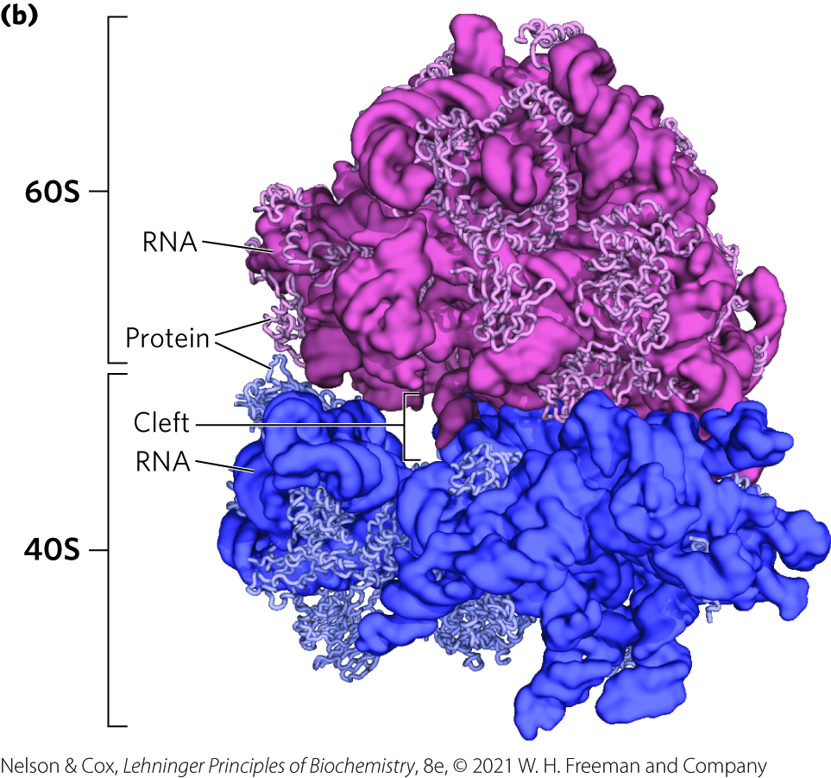
Eukaryotic Ribosomal Structure
eukaryotic ribosomes have a similar structure to bacterial ribosomes with somewhat increased complexity

Slide 42
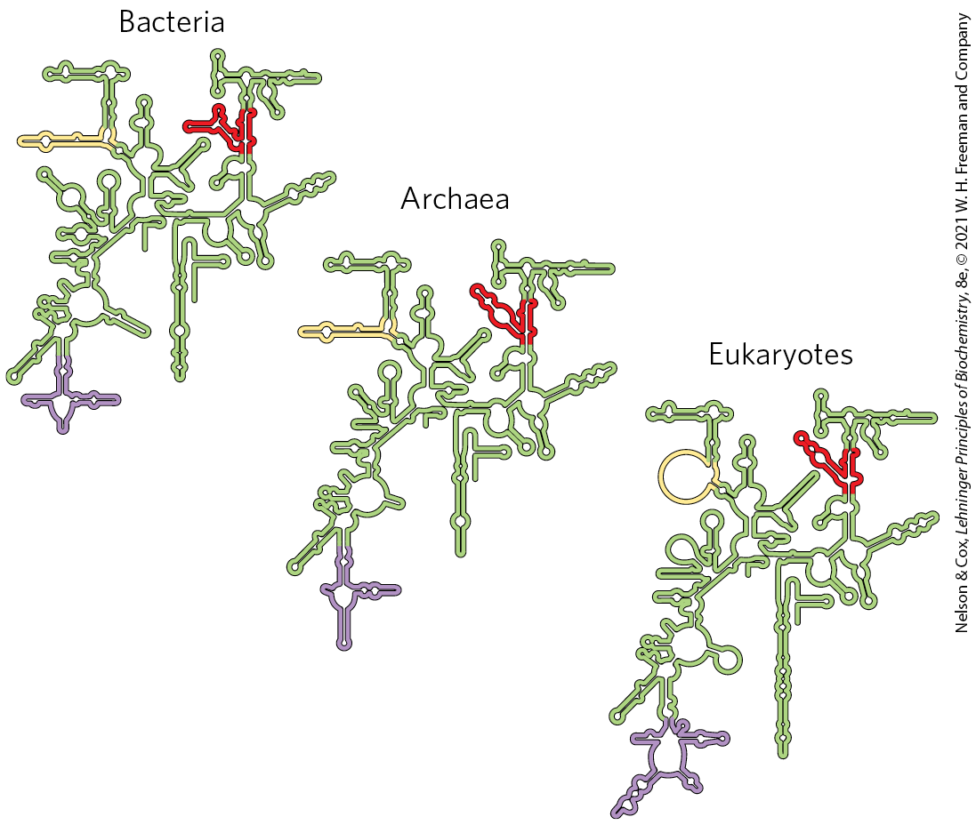
Conservation of Secondary Structure in Small Subunit rRNAs
folding patterns of rRNAs are highly conserved in all organisms

Slide 43
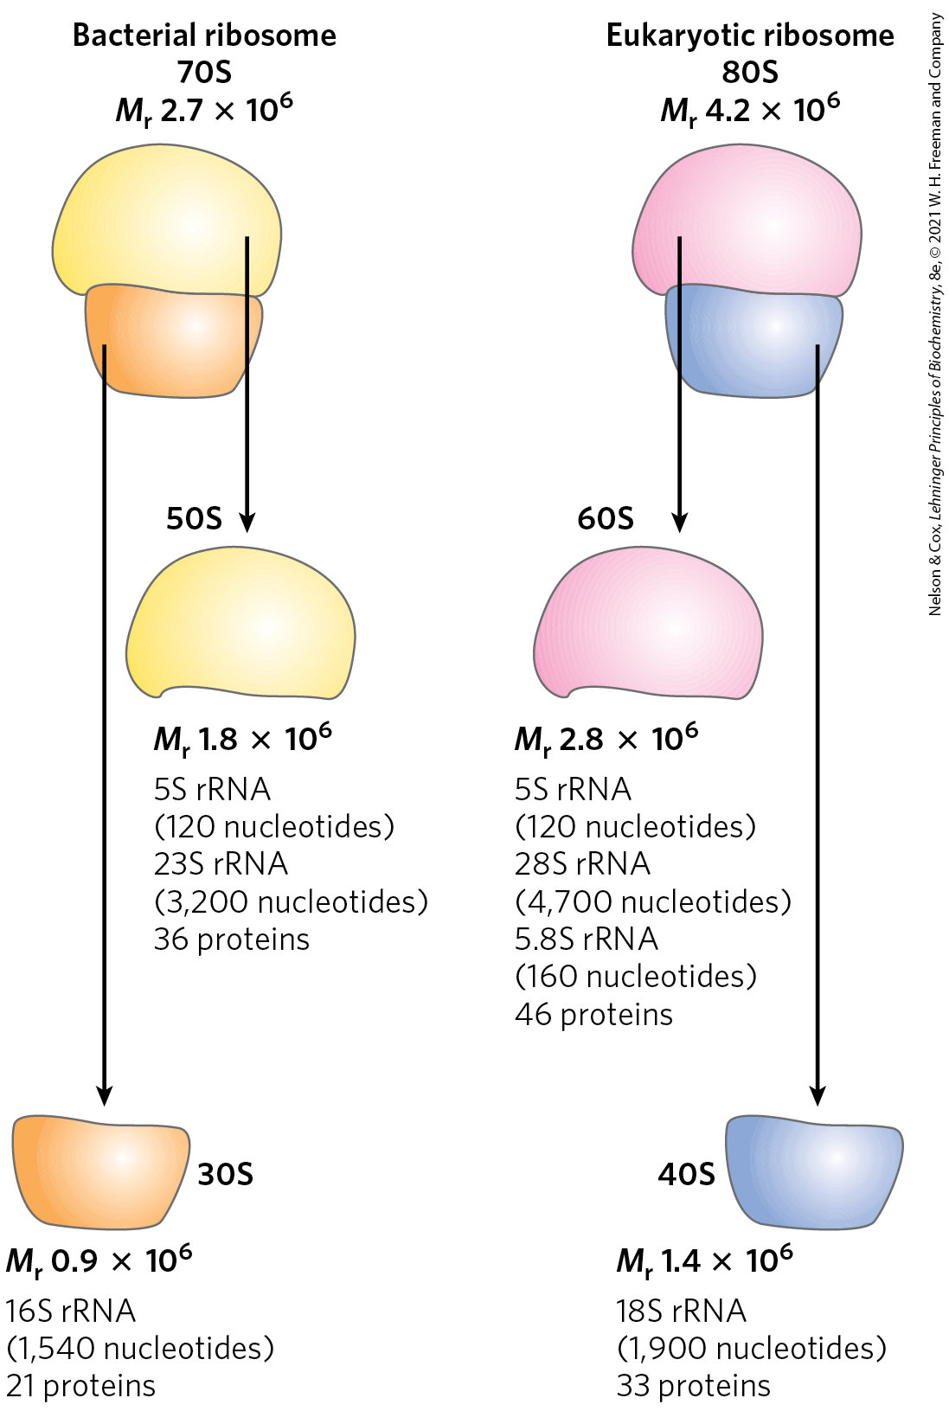
Summary of Eukaryotic Ribosomes
overall very similar to bacterial ribosomes
eukaryotic ribosomes:
  are larger (~80S) and more complex than bacterial ribosomes
  have two subunits (60S and 40S on average)
chloroplasts and mitochondria have simpler ribosomes than bacteria

Slide 44
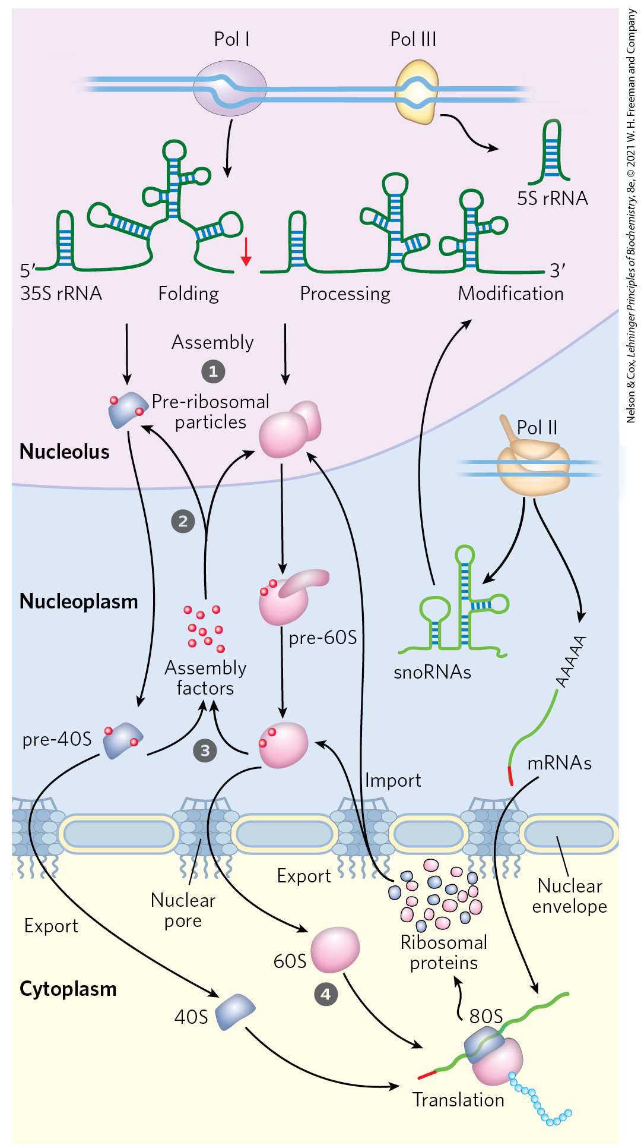
Assembly of Ribosomes in Eukaryotes
ribosomes are assembled through a hierarchical incorporation of r-proteins as the rRNAs are synthesized
processing of pre-rRNAs occurs within large ribonucleoprotein complexes
dozens of proteins and snoRNAs are involved in final maturation of the ribosome

Slide 45
Transfer RNAs Have Characteristic Structural Features
in both bacteria and eukaryotes, tRNAs are small and consist of 73-93 nucleotide ssRNA
  mitochondria and chloroplasts contain smaller tRNAs
common structural elements:
  8+ residues have modified bases and sugars (many are methylated derivatives)
  have a guanylate (pG) residue at the 5′ end
  have the trinucleotide sequence CCA(3′) at the 3′ end
  have a cloverleaf shape in 2-D and a twisted L shape in 3-D

Slide 46
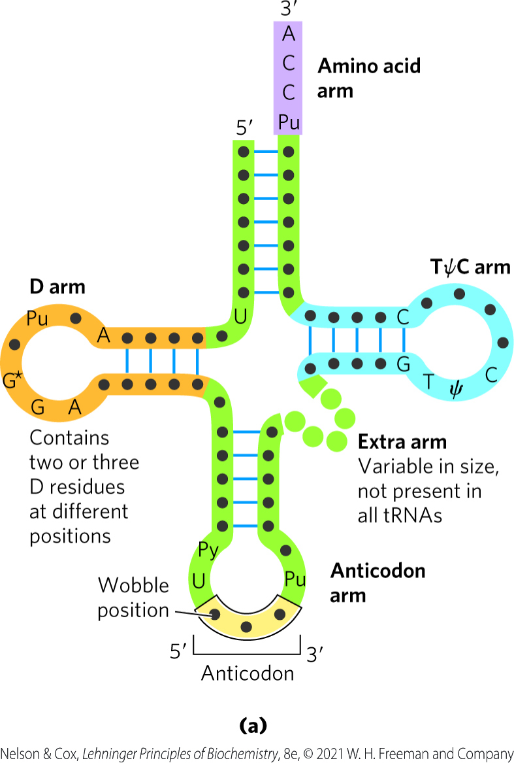
The Amino Acid Arm and Anticodon Arm of tRNA
amino acid arm = carries a specific amino acid esterified by its carboxyl group to the 2′-OH or 3′-OH group of the A residue at the 3′ end of the tRNA
anticodon arm = contains the anticodon

Slide 47
The D Arm and TψC Arm of tRNA
D arm = contains the unusual nucleotide dihydrouridine (D)
  contributes to overall folding of tRNAs
TψC arm = contains ribothymidine and pseudouridine (ψ)
  ψ has an unusual carbon-carbon bond between the base and ribose
  contributes to overall folding of tRNAs
  interacts with the large-subunit rRNA

Slide 48
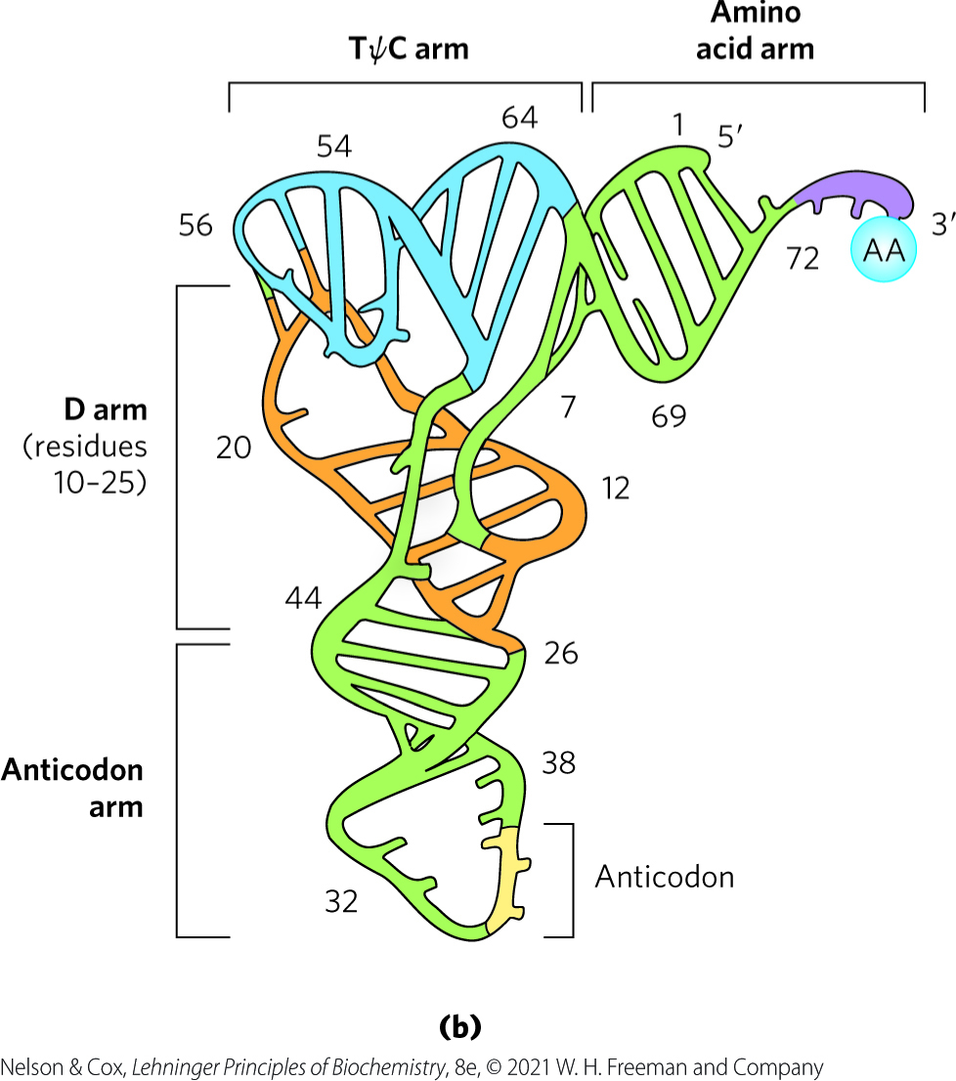
3-D Structure of tRNAs

Slide 49
Stage 1: Aminoacyl-tRNA Synthetases Attach the Correct Amino Acids to Their tRNAs
stage 1:
  occurs in the cytosol
  activates the carboxyl group of each amino acid
  establishes a link between each new amino acid and the information encoding it in the mRNA
tRNAs are “charged” when attached to their amino acid (aminoacylated)

Slide 50
Aminoacyl-tRNA Synthetases
aminoacyl-tRNA synthetases = esterify the 20 amino acids to their corresponding tRNAs
  specific for one amino acid and 1+ corresponding tRNAs
  most organisms have one enzyme for each amino acid

Slide 51
Aminoacyl-tRNA Synthetases Fall into Two Different Classes
aminoacyl-tRNA synthetases fall into Class I or Class II
no evidence of a common ancestor
based on differences in:
  primary and tertiary structure
  reaction mechanism
Table 27-7 The Two Classes of Aminoacyl-tRNA Synthesis
Class I | Class I | Class II | Class II
Arg | Leu | Ala | Lys
Cys | Met | Asn | Phe
Gln | Trp | Asp | Pro
Glu | Tyr | Gly | Ser
Ile | Val | His | Thr

Slide 52
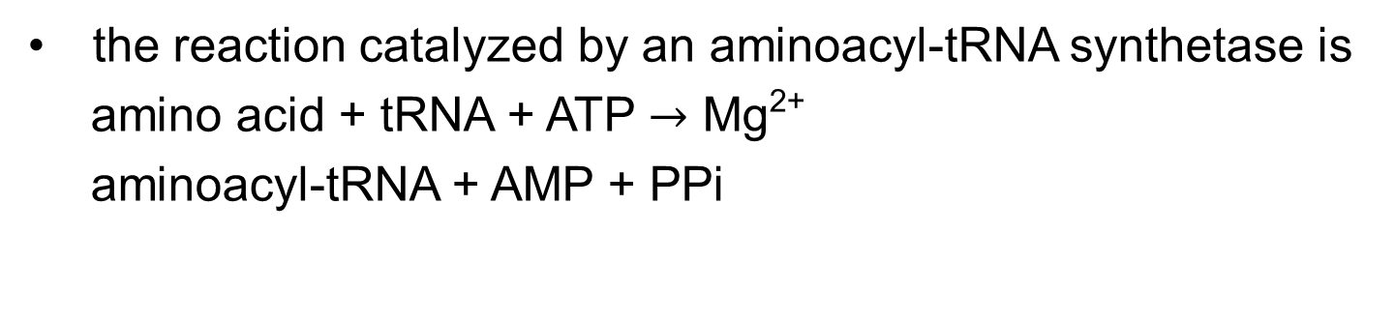
The Reaction Catalyzed by Aminoacyl-tRNA Synthetases
the reaction catalyzed by an aminoacyl-tRNA synthetase is
amino acid + tRNA + ATP $→$ Mg²⁺
aminoacyl-tRNA + AMP + PPi

Slide 53
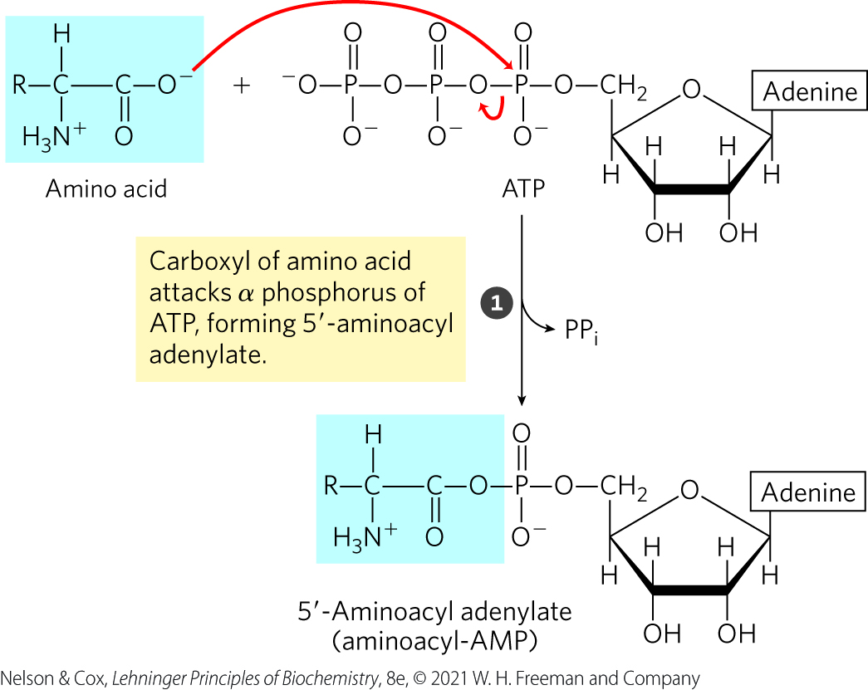
Step 1 of The Aminoacyl-tRNA Synthetase Reaction
step 1 forms the enzyme-bound intermediate, aminoacyl adenylate (aminoacyl-AMP)

Slide 54
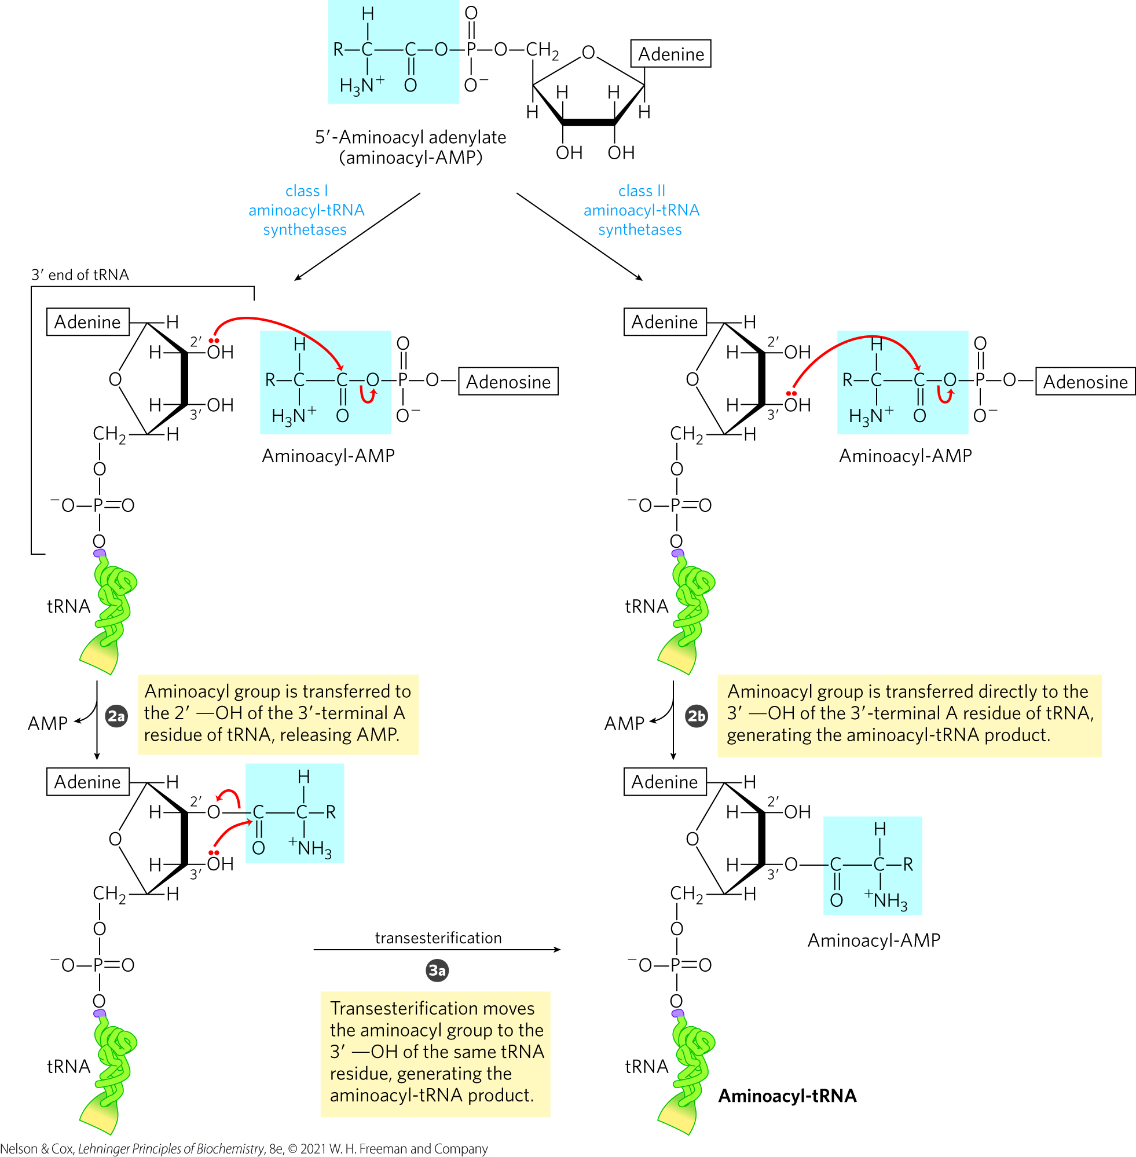
Step 2 of The Aminoacyl-tRNA Synthetase Reaction
step 2 transfers the aminoacyl group from enzyme-bound aminoacyl-AMP to its corresponding specific tRNA
  mechanism depends on the enzyme class

Slide 55
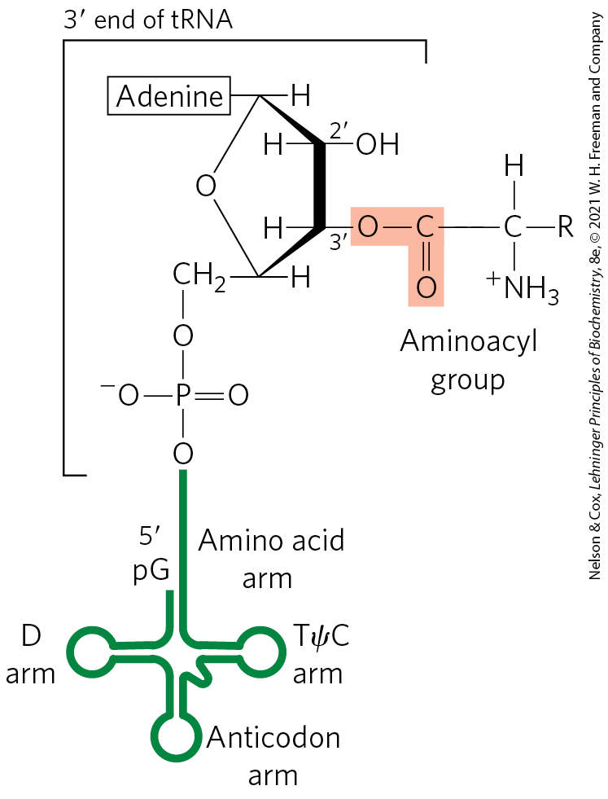
General Structure of
Aminoacyl-tRNAs
the aminoacyl group is esterified to the 3′ position of the terminal A residue
the ester linkage activates the amino acid and joins it to the tRNA

Slide 56
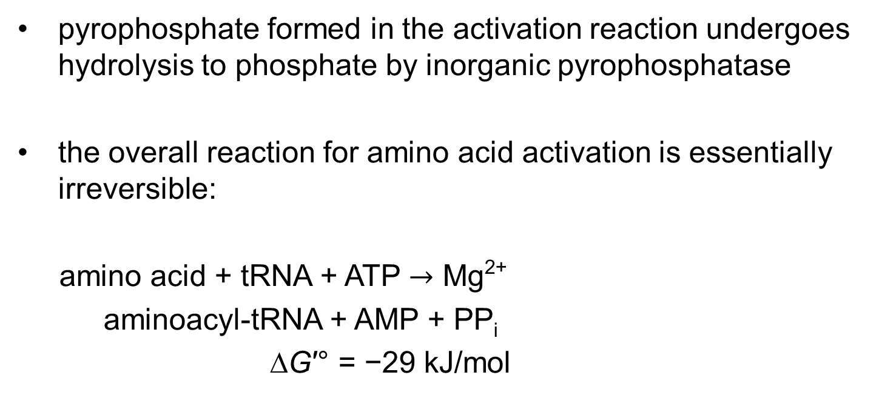
The Ester Linkage Has a Highly Negative ∆G′°
pyrophosphate formed in the activation reaction undergoes hydrolysis to phosphate by inorganic pyrophosphatase
the overall reaction for amino acid activation is essentially irreversible:
amino acid + tRNA + ATP $→$ Mg²⁺
aminoacyl-tRNA + AMP + PP_{i}
∆G′° = −29 kJ/mol

Slide 57
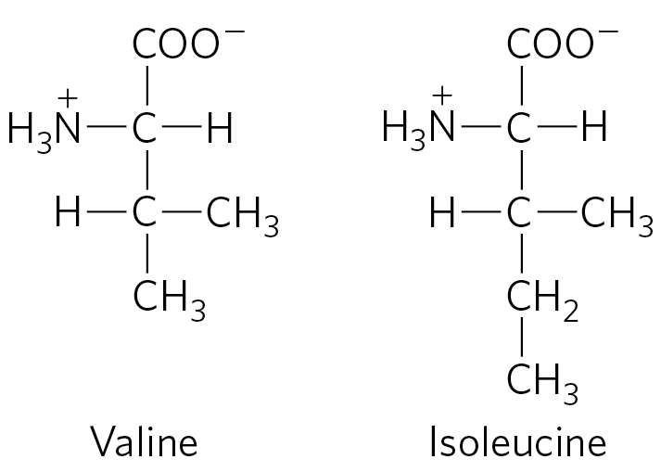
Proofreading by
Aminoacyl-tRNA Synthetases
Ile-tRNA synthetase has a proofreading function to distinguish between Val and Ile
Val-AMP fits into the hydrolytic (proofreading) site of Ile-tRNA synthetase
  Val-AMP is hydrolyzed
  tRNA does not become aminoacylated to the wrong amino acid

Slide 58
Additional Methods for Enhancing Fidelity of Protein Synthesis
most aminoacyl-tRNA synthetases can hydrolyze the ester linkage in the aminoacyl-tRNAs
some aminoacylation active sites can sufficiently discriminate between the proper substrate and incorrect amino acids

Slide 59
The Error Rate of Protein Synthesis
the overall error rate of protein synthesis is ∼1 mistake per 10⁴ amino acids incorporated
  higher than that of DNA replication
flaws in a protein have less biological significance
  eliminated when the protein is degraded
  not passed on to future generations

Slide 60
A “Second Genetic Code”
individual aminoacyl-tRNA synthetases must be specific for a single amino acid and for certain tRNAs
“second genetic code” refers to the interaction between aminoacyl-tRNA synthetases and tRNAs
nucleotides in tRNA that confer binding specificity are concentrated in:
  the amino acid arm
  the anticodon arm
  the nucleotides of the anticodon itself

Slide 61
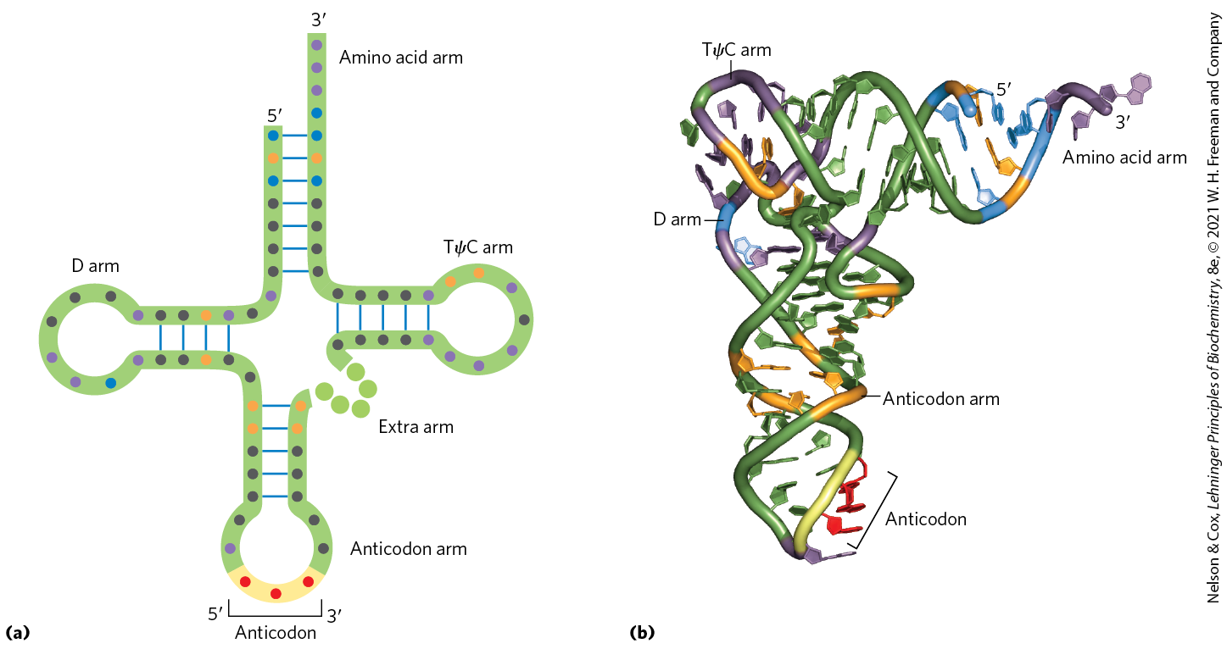
Nucleotide Positions in a tRNA That are Recognized by Aminoacyl-tRNA Synthetases

Slide 62
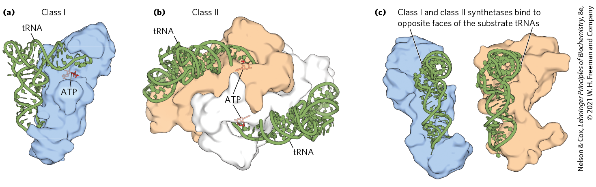
Crystal Structures of Aminoacyl-tRNA Synthetases

Slide 63
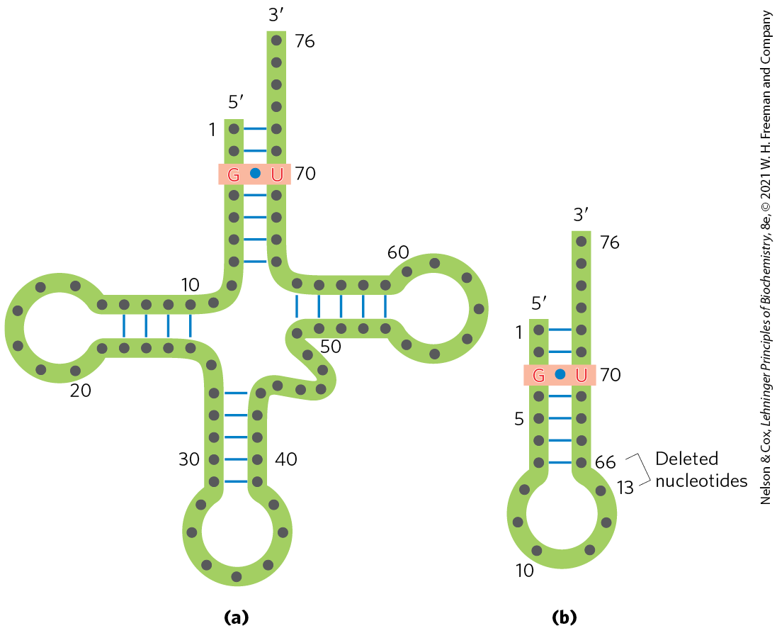
tRNA Recognition by
Ala-tRNA Synthetases
a single G=U base pair in the amino acid arm of tRNA^{Ala} determines tRNA recognition by Ala-tRNA synthetases
  true across a range of organisms, from bacteria to humans

Slide 64
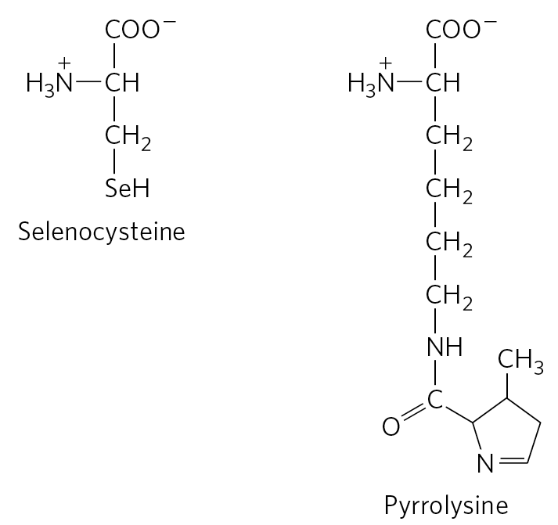
Unusual Amino Acids in Peptides
selenocysteine = formed after charging a UGA-recognizing tRNA with serine in both bacteria and eukaryotes
pyrrolysine = directly attached to its tRNA that recognizes UAG(stop) codon in some archaea

Slide 65
Stage 2: A Specific Amino Acid Initiates Protein Synthesis
the AUG initiation codon specifies an amino-terminal methionine residue.
all organisms have two tRNAs for methionine:
  one for when (5′)AUG is the initiation codon
  one when a Met residue in an internal position in a polypeptide

Slide 66
tRNAs Specific for Methionine in Eukaryotic Cells
in eukaryotic cells:
  a specialized initiating tRNA inserts methionine at the amino-terminal end
  Met-tRNA^{Met} inserts methionine in interior positions
polypeptides synthesized by mitochondrial and chloroplast ribosomes begin with N-formylmethionine

Slide 67
The Three Steps of Initiation
initiation in bacteria requires:
  the 30S ribosomal subunit
  mRNA
  the initiating fMet-tRNA^{fMet}
  three initiation factors (IF1, IF2, and IF3)
  GTP
  the 50S ribosomal subunit
  Mg²⁺

Slide 68
Initiation in Eukaryotic Cells
eukaryotic mRNAs are bound to the ribosome as a complex with specific binding proteins
eukaryotic cells have at least 12 initiation factors
  eIF1A is a functional homolog of IF1
  eIF3 is a functional homolog of IF3

Slide 69
Protein Factors Required for Initiation of Translation
Table 27-8 Protein Factors Required for Initiation of Translation in Bacterial and Eukaryotic Cells
Factor | Function
Bacterial
IF1 | Prevents premature binding of tRNAs to A site
IF2 | Facilitates binding of fMet-tRNA^{fMet} to 30S ribosomal subunit
IF3 | Binds to 30S subunit; prevents premature association of 50S subunit; enhances specificity of P site for fMet-rRNA^{fMet}
Eukaryotic
eIF1 | Binds to the E site of the 40S subunit; facilitates interaction between elF2-tRNA-GTP ternary complex and the 40S subunit
elF1A | Homolog of bacterial IF1; prevents premature binding of tRNAs to A site
eIF2 | GTPase; facilitates binding of initiating Met-tRNA^{Met} to 40S ribosomal subunit
eIF2Bª, eIF3 | First factors to bind 40S subunit; facilitate subsequent steps
eIF4F | Complex consisting of eIF4E, eIF4A, and eIF4G
eIF4A | RNA helicase activity; removes secondary structure in the mRNA to permit binding to 40S subunit; part of the eIF4F complex
eIF4B | Binds to mRNA; facilitates scanning of mRNA to locate the first AUG
eIF4E | Binds to the 5′ cap of mRNA; part of the eIF4F complex
eIF4G | Binds to eIF4E and to poly(A) binding protein (PABP); part of the eIF4F complex
eIF5ª | Promotes dissociation of several other initiation factors from 40S subunit as a prelude to association of 60S subunit to form 80S initiation complex
eIF5b | GTPase homologous to bacterial IF2; promotes dissociation of initiation factors before final ribosome assembly

Slide 70
Stage 3: Peptide Bonds Are Formed in the Elongation Stage
elongation requires:
  the initiation complex
  aminoacyl-tRNAs
  elongation factors (EF-Tu, EF-Ts, and EF-G in bacteria)
  GTP

Slide 71
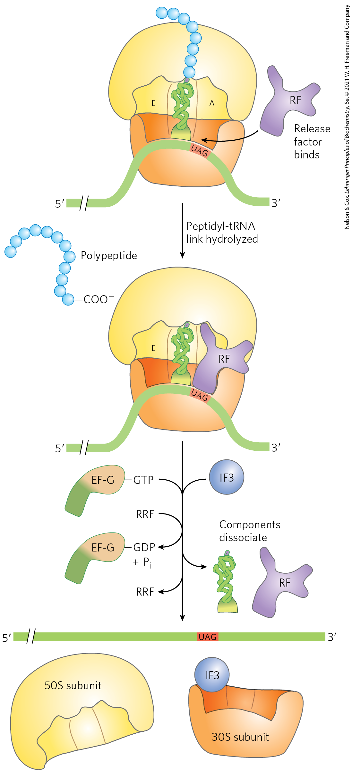
Elongation Step 1: Binding of an Incoming Aminoacyl-tRNA
an incoming aminoacyl-tRNA binds an GTP-bound EF-Tu complex
the aminoacyl-tRNA–EF-Tu–GTP complex binds to the A site of the 70S initiation complex
after GTP hydrolysis, EF-Tu–GDP complex leaves the ribosome

Slide 72
Elongation Step 2: Peptide Bond Formation
the N-formylmethionyl group is transferred to the amino group of the aminoacyl-tRNA in the A site to form a dipeptidyl-tRNA
  α-amino group of the amino acid in the A site acts as the nucleophile
tRNA shift to a hybrid binding state
  the 3′ and 5′ ends of tRNA^{fMet} are in the E site
  the 3′ and 5′ ends of the peptidyl-tRNA are in the P site

Slide 73
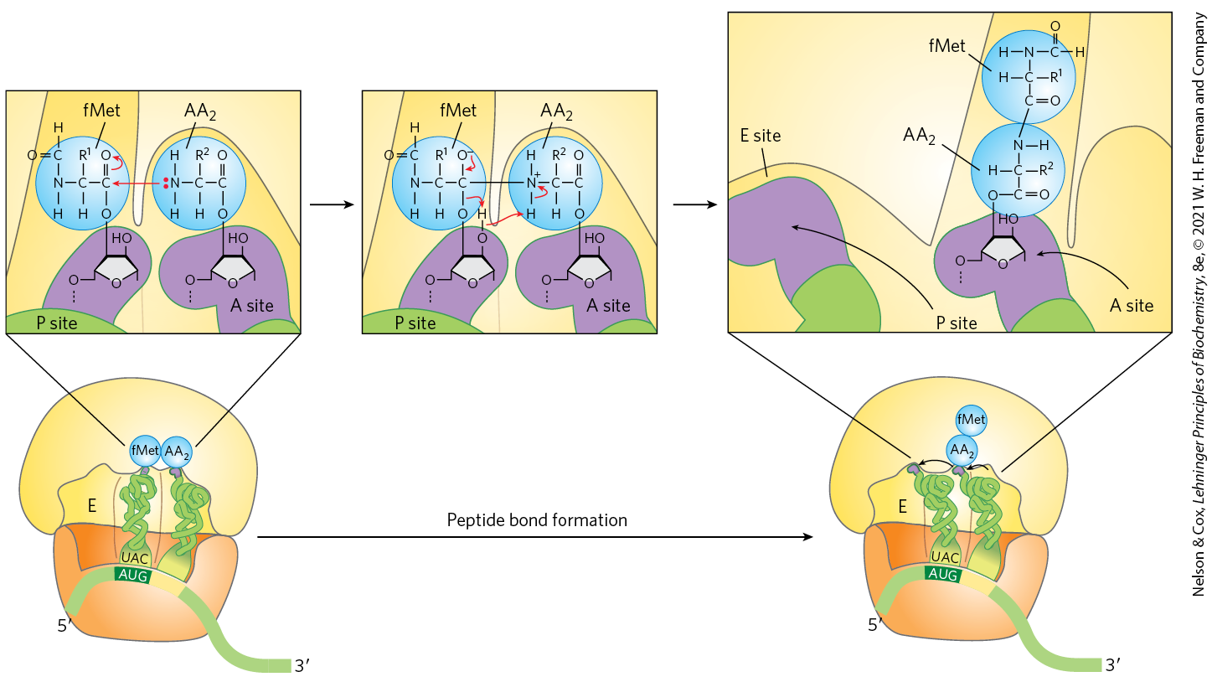
Formation of the First Peptide Bond in Bacteria

Slide 74
Peptidyl Transferase Activity
the 23S rRNA has peptidyl transferase activity that catalyzes peptide bond formation
  catalyzes the reaction by binding and aligning the tRNAs in the A and P sites in the proper orientations
a highly conserved active site A residue in 23S rRNA may facilitate the reaction by general base catalysis and transition state stabilization

Slide 75
Elongation Step 3: Translocation
in translocation, the ribosome moves one codon toward the 3′ end of the mRNA
  shifts the anticodon of the dipeptidyl-tRNA from the A site to the P site
  shifts the deacylated tRNA from the P site to the E site
  leaves the A site open for a new aminocyl-tRNA
ribosome translocation requires EF-G and energy provided GTP hydrolysis

Slide 76
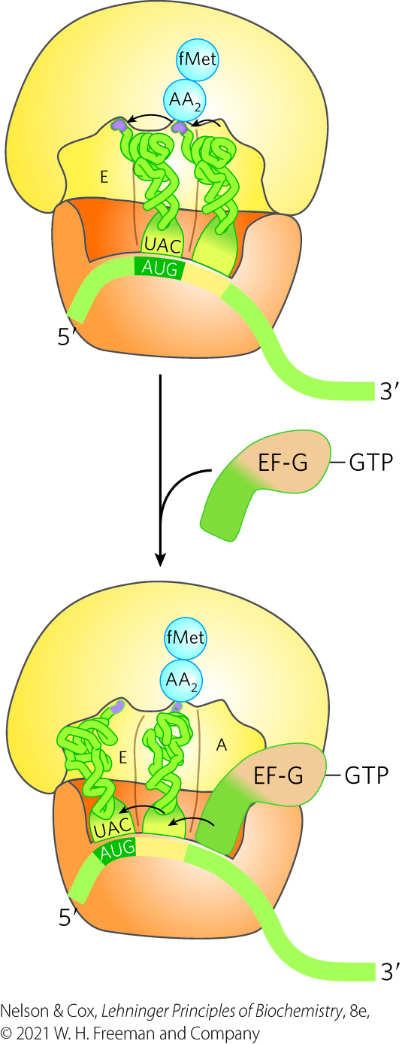
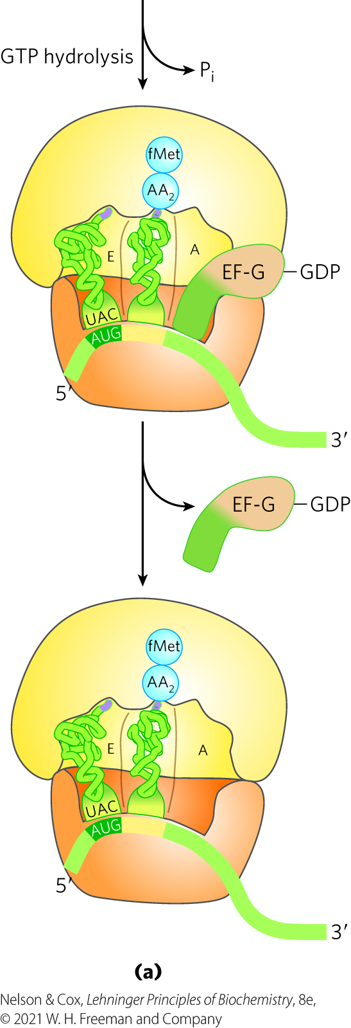
Translocation in Bacteria

Slide 77
The Elongation Cycle Repeats
the attachment of a third amino acid residue occurs in the same way as addition of the second residue
two GTPs are hydrolyzed for each amino acid residue added to the growing polypeptide

Slide 78
The Eukaryotic Elongation Cycle
elongation cycle steps are similar to those in bacteria
eukaryotic elongation factors have analogous functions to the bacterial elongation factors
  eEF1α is analogous to EF-Tu
  eEF1βγ is analogous to EF-Ts
  eEF2 is analogous to EF-G
when a new aminoacyl-tRNA binds to the A site, an allosteric interaction leads to ejection of the uncharged tRNA from the E site

Slide 79
Stage 4: Termination of Polypeptide
Synthesis Requires a Special Signal
termination is signaled by a termination codon in the mRNA (UAA, UAG, UGA) occupying the A site
termination factors (release factors) = the proteins RF1, RF2, and RF3 which function to:
  hydrolyze the terminal peptidyl-tRNA bond
  release the polypeptide and the last uncharged tRNA
  cause dissociation of the 70S ribosome into its subunits
eukaryotes have a single release factor, eRF

Slide 80
Termination of Protein Synthesis in Bacteria
ribosome recycling factor (RRF) and energy from GTP hydrolysis aid in ribosome dissociation
IF3 promotes dissociation of the tRNA
the complex of IF3 and the 30S subunit is then ready to initiate another round

Slide 81
Energy Cost of Fidelity in
Protein Synthesis
at least four high-energy phosphate equivalents are required to generate each peptide bond
  aminoacyl-tRNA formation uses two high-energy phosphate groups
  a GTP is cleaved during the first elongation step
  a GTP is cleaved during translocation
  ATP is consumed each time an incorrectly activated amino acid is hydrolyzed during proofreading
the energy investment is required to guarantee fidelity

Slide 82
Stage 5: Newly Synthesized Polypeptide Chains Undergo Folding and Processing
during or after synthesis, a polypeptide progressively assumes its native conformation
chaperones and chaperonins assist by restricting formation of unproductive aggregates and limiting the conformational space
  examples: GroEL/GroES in bacteria and Hsp60 in eukaryotes
  requires ATP

Slide 83
Posttranslational Modifications
many proteins require further processing by posttranslational modifications to attain their final active conformation

Slide 84
Amino-Terminal and Carboxyl-Terminal Modifications
forming the final functional protein may include enzymatic removal of residues, including:
  the formyl group
  the amino-terminal Met residue
  additional amino-terminal residues
  carboxyl-terminal residues
the amino group of the amino-terminal residue is N-acetylated in up to 50% of eukaryotic proteins
carboxyl-terminal residues may also be modified

Slide 85
Loss of Signal Sequences
signal sequences = the 15 to 30 residues at the amino-terminal end of some proteins
  play a role in directing the protein to its ultimate destination in the cell
  are eventually removed by specific peptidases

Slide 86
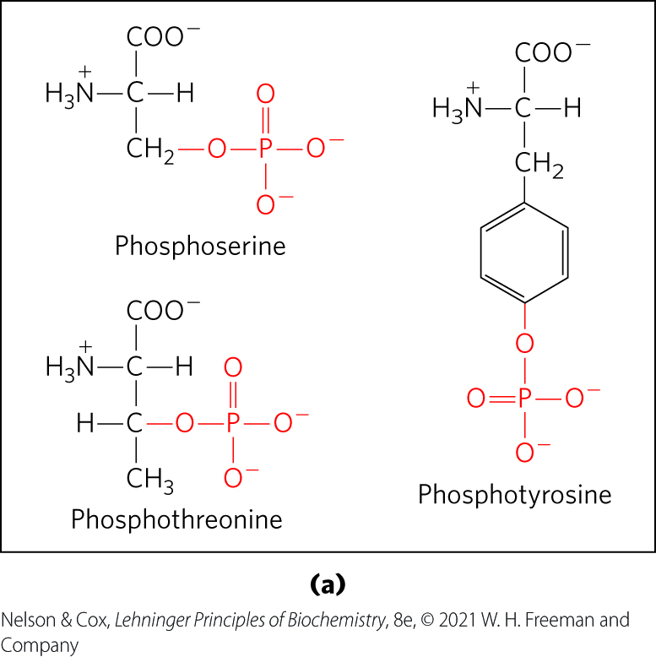
Modification of Individual Amino Acid Residues
the -OH groups of certain Ser, Thr, and Tyr residues may be enzymatically phosphorylated by ATP
  adds negative charges to these polypeptides
  functional significance varies

Slide 87
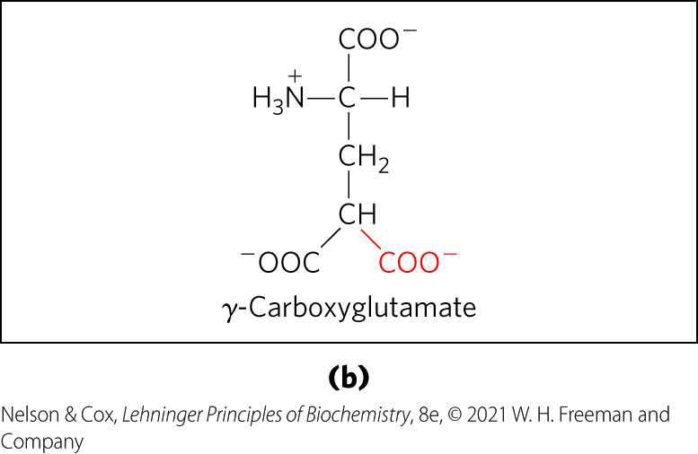
The Addition of Extra Carboxyl Groups to Glu Residues
extra carboxyl groups may be added to Glu residues of some proteins
γ-carboxyglutamate residues in the amino-terminal region of prothrombin bind Ca²⁺ to initiate the clotting mechanism

Slide 88
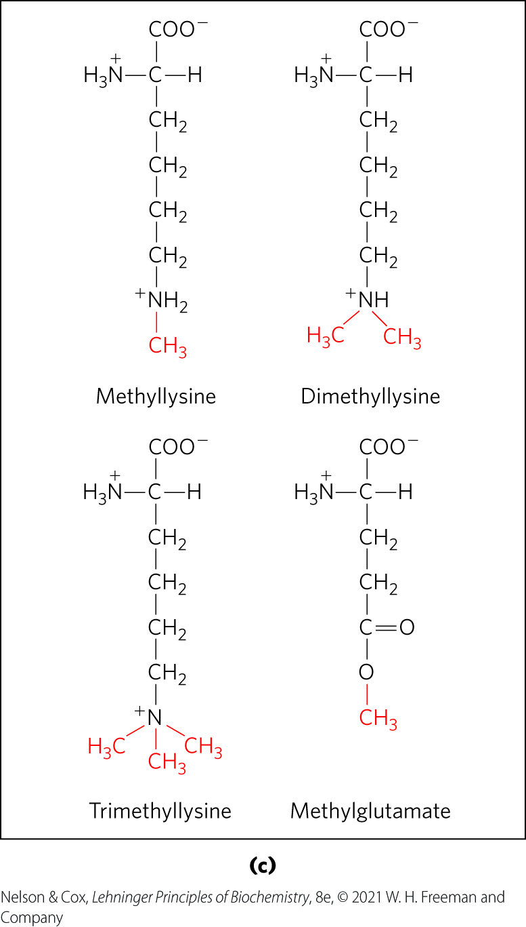
Methylated Amino Acids
monomethyl- and dimethyllysine residues occur in some muscle proteins and in cytochrome c
calmodulin contains trimethyllysine
carboxyl groups of Glu residues may undergo methylation to remove their negative charge

Slide 89
Attachment of Carbohydrate
Side Chains
carbohydrate side chains of glycoproteins are attached covalently during or after polypeptide synthesis
can be attached enzymatically to:
  Asn residues (N-linked oligosaccharides)
  Ser or Thr residues (O-linked oligosaccharides)

Slide 90
Additional of Isoprenyl Groups
isoprenyl groups are added to some eukaryotic proteins
  via a thioester bond between the isoprenyl group and a Cys resiude
  helps anchor proteins in a membrane
proteins modified this way include Ras proteins and lamins

Slide 91
Additional of Prosthetic Groups
many proteins require covalently bound prosthetic groups for their activity
examples:
  the biotin molecule of acetyl-CoA carboxylase
  the heme group of hemoglobin or cytochrome c

Slide 92
Proteolytic Processing
many proteins are synthesized as large, inactive precursor polypeptides
  proteolytic cleavage yields their active forms
examples:
  proinsulin
  some viral proteins
  proteases (chymotrypsinogen, trypsinogen, etc.)

Slide 93
Formation of Disulfide Cross-Links
some proteins form intrachain or interchain disulfide bridges between Cys residues
  common in exported eukaryotic proteins
  helps protect the native conformation of the protein from the extracellular environment

Slide 94
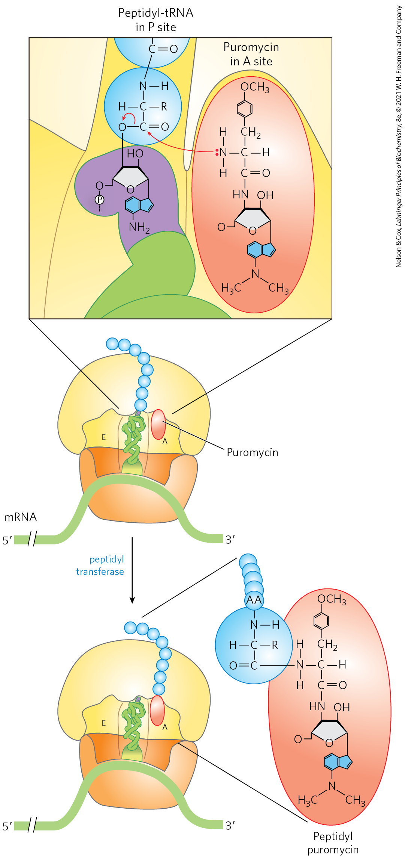
Protein Synthesis Is Inhibited by Many Antibiotics and Toxins
puromycin = an inhibitory antibiotic that binds to the A site and terminates polypeptide synthesis
  made by the mold Streptomyces alboniger
  structure similar to the 3′ end of an aminoacyl-tRNA

Slide 95
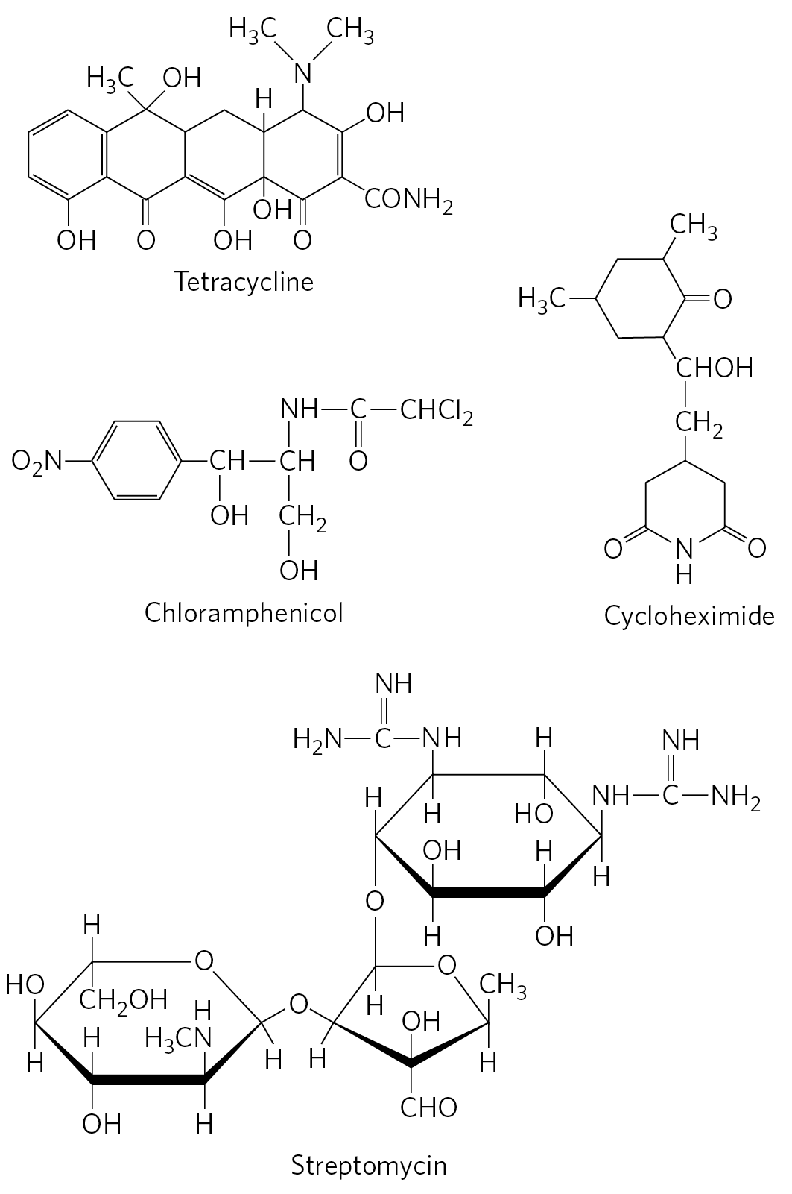
Tetracycline and Chloramphenicol
tetracyclines = inhibit bacterial protein by blocking the A site
  prevent aminoacyl-tRNA binding
chloramphenicol = inhibits bacterial, mitochondrial, and chloroplast protein synthesis blocking peptidyl transfer
  does not affect eukaryotic protein synthesis

Slide 96
Cycloheximide and Streptomycin
cycloheximide = blocks the peptidyl transferase of 80S eukaryotic ribosomes
  does not affect 70S bacterial, mitochondrial, and chloroplast ribosomes
streptomycin = causes misreading of the genetic code in bacteria at low concentrations and inhibits initiation at higher concentrations

Slide 97
The Diphtheria Toxin and Ricin
diphtheria toxin = catalyzes the ADP-ribosylation of a diphthamide (a modified histidine) residue of eEF2 to inactivate it
  released by the bacterium Corynebacterium diphtheriae
ricin = a toxic protein of the castor bean that inactivates the 60S subunit of eukaryotic ribosomes by depurinating a specific A residue in 28S rRNA

