Slide 1

26 RNA Metabolism
© 2021 Macmillan Learning

Slide 2
Ribozymes and
Ribonucleoproteins (RNPs)
ribozymes = catalytic RNAs that act as enzymes
ribonucleoproteins (RNPs) = complexes of RNAs with proteins

Slide 3
Transcription Produces RNA Molecules from DNA
transcription = process by which an enzyme system converts the genetic information in dsDNA into an RNA strand with a complementary base sequence

Slide 4
Major Types of RNA Molecules
messenger RNAs (mRNAs) = encode the amino acid sequences of polypeptides
transfer RNAs (tRNAs) = read the mRNA and transfer the appropriate amino acid to a growing polypeptide chain during protein synthesis
ribosomal RNAs (rRNAs) = constituents of ribosomes, the cellular machines that synthesize proteins
noncoding RNAs (ncRNAs) = have a variety of catalytic, structural, and regulatory functions

Slide 5
The Cellular Transcriptome
the entire chromosome is usually copied during replication
transcription is more selective
transcriptome = the sum of all the RNA molecules produced in a cell under a given set of conditions
  ~76% of the human genome is transcribed into RNA
  most products are ncRNAs

Slide 6

Principle 1 (1 of 5)
RNA is synthesized by RNA polymerases using DNA templates and ribonucleoside 5′-triphosphates. RNA is made in the 5′→3′ direction and complementary to the template DNA strand. Transcription is highly regulated and initiates by recruitment of the transcription machinery to gene promoters. Although bacterial and eukaryotic polymerases share many conserved features, the transcriptional machinery and its regulation are much more complex in eukaryotes.

Slide 7

Principle 2 (1 of 8)
Many RNAs must be modified and processed to become functional. RNAs can be modified by nucleases, by excision of certain RNA segments, and/or by chemical modification of the RNA nucleotides. In humans, nearly all mRNAs are 5′ capped, spliced, and polyadenylated before being exported from the nucleus for translation in the cytoplasm.

Slide 8

Principle 3 (1 of 4)
RNA can be used as a template for synthesis of DNA by reverse transcriptases. RNA carries genetic information that can be reverse transcribed into DNA. Retroviruses, such as HIV or those responsible for some cancers, must convert their RNA genomes into DNA by reverse transcription. Reverse transcription by telomerase is also responsible for producing the telomeres that protect the DNA found at the ends of eukaryotic chromosomes.

Slide 9
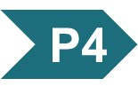
Principle 4 (1 of 5)
RNA can act as both a catalyst and carrier of genetic information. Ribozymes can catalyze chemical transformations using many of the same strategies as protein-based enzymes. The dual capacity of RNA as both a carrier of genetic information and a catalyst is support for the RNA world hypothesis for the evolution of life on Earth.

Slide 10
26.1 DNA-Dependent Synthesis of RNA

Slide 11
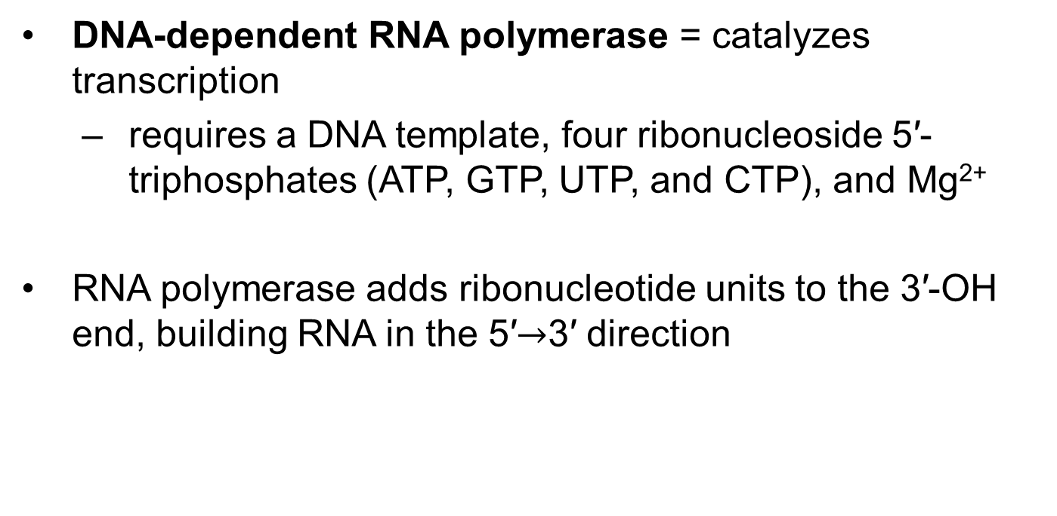
RNA Is Synthesized by RNA Polymerases
DNA-dependent RNA polymerase = catalyzes transcription
  requires a DNA template, four ribonucleoside 5′-triphosphates (ATP, GTP, UTP, and CTP), and Mg²⁺
RNA polymerase adds ribonucleotide units to the 3′-OH end, building RNA in the 5′$→$3′ direction

Slide 12
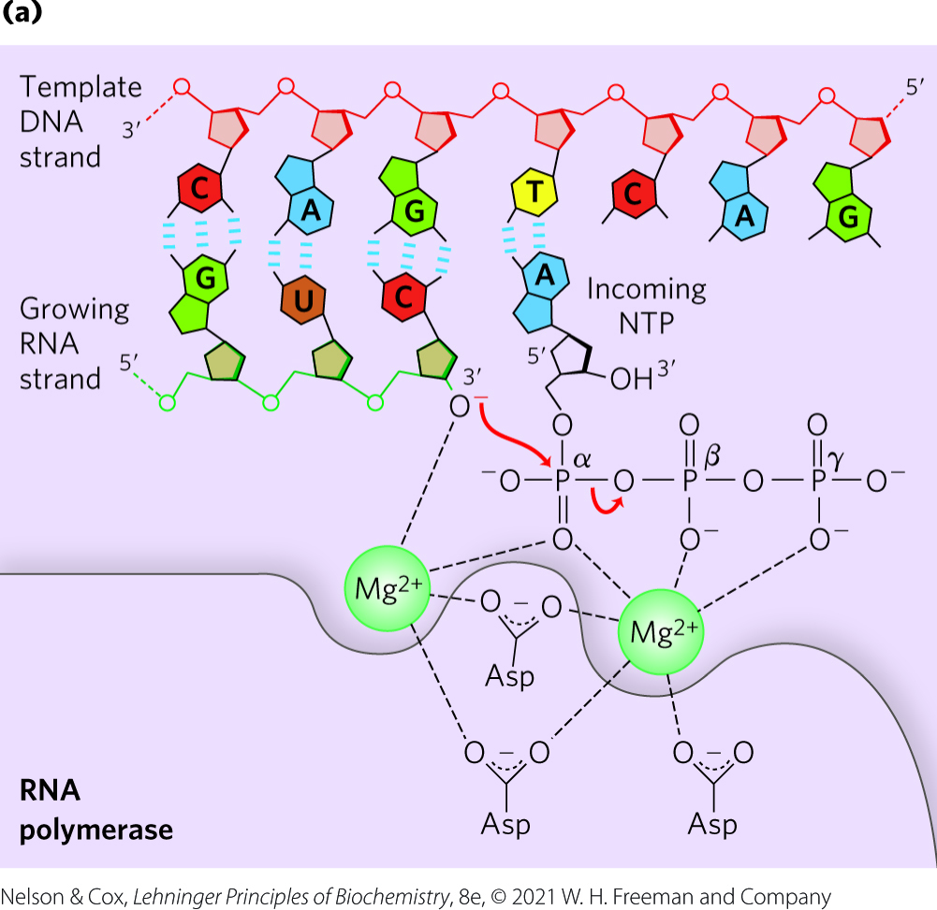
Transcription by RNA Polymerase in E. coli
the 3′-OH acts as a nucleophile, attacking the α phosphate of the incoming ribonucleoside triphosphate
each nucleotide in the RNA is selected by Watson-Crick base-pairing interaction

Slide 13
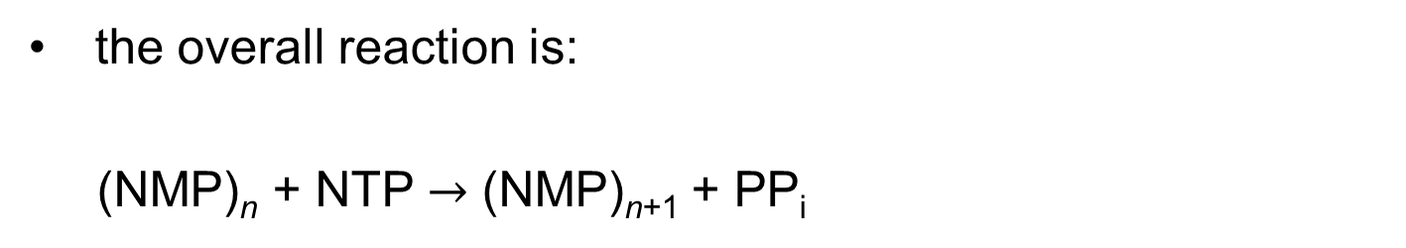
The Overall Reaction of Transcription
the overall reaction is:
(NMP)_{n} + NTP $→$ (NMP)_{n+1} + PP_{i}
RNA
lengthened
RNA

Slide 14
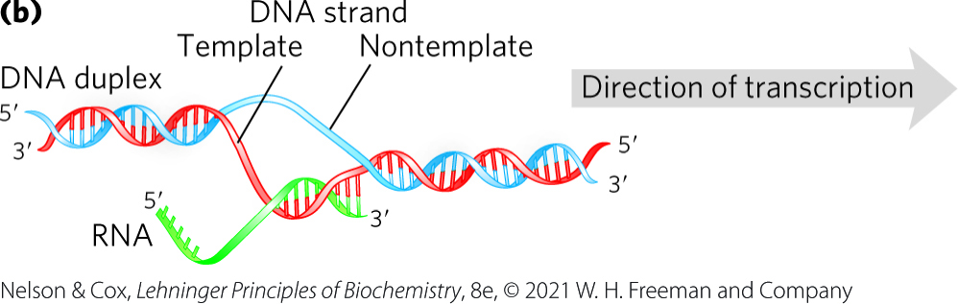
Initiation and Elongation of Transcription
initiation occurs when RNA polymerase binds at promoter sequences
  promoters are not required
during elongation, the growing RNA strand temporarily base-pairs with the DNA template to form a short hybrid RNA-DNA double helix

Slide 15
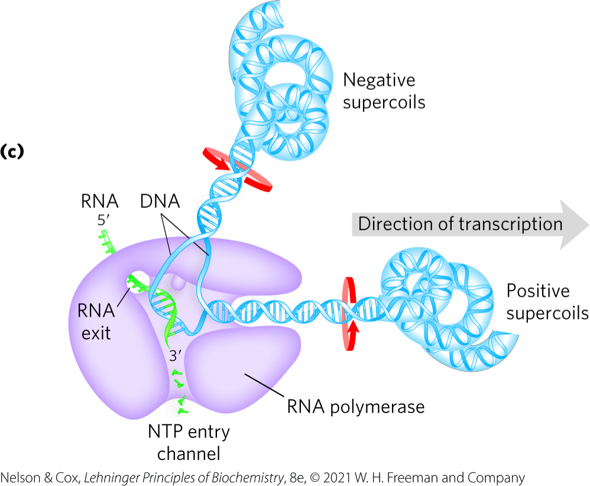
Movement of RNA Polymerase Creates Supercoils
a transcription “bubble” forms when the DNA duplex unwinds
RNA polymerase generates positive supercoils ahead of the “bubble” and negative supercoils behind
  due to restricted DNA strand rotation
  relieved through topoisomerases

Slide 16
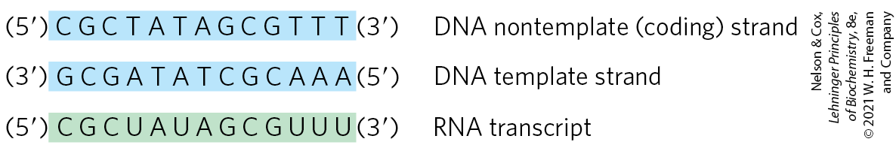
The Template and
Nontemplate Strand
template strand = DNA strand that serves as template for RNA synthesis
nontemplate strand (coding strand) = DNA strand that is identical in base sequence to the transcribed RNA, with U in RNA in place of T in DNA

Slide 17
RNA Synthesis Begins at Promoters
promoters = specific sequences in DNA that RNA polymerase binds to
  direct that transcription of adjacent segments of DNA (genes)
  sequences are variable
promoter regions extend between positions -70 and +30

Slide 18
Consensus Sequences and the UP Element
consensus sequence = formed by certain nucleotides that are particularly common at a given position
  (5′)TATAAT(3′) at the -10 region
  (5′)TTGACA(3′) at the -35 region
UP (upstream promoter) element = a third AT-rich recognition element that occurs between positions -40 and -60 in the promoters of certain highly expressed genes
  bound by the α subunit of RNA polymerase

Slide 19
Initiation by E. coli RNA Polymerase
the polymerase binds to the promoter
  directed by its bound σ factor
a closed complex (bound DNA remains double-stranded) forms, followed by an open complex (bound DNA is partially unwound near the −10 sequence)
initiation causes a conformational change that converts the complex to the elongation form and moves the complex away from the promoter (promoter clearance)

Slide 20
Elongation by E. coli
RNA Polymerase
the σ subunit dissociates at random as the polymerase enters elongation
the NusA protein competes with the σ subunit to bind the polymerase
after transcription:
  NusA dissociates from the enzyme
  RNA polymerase dissociates from the DNA

Slide 21
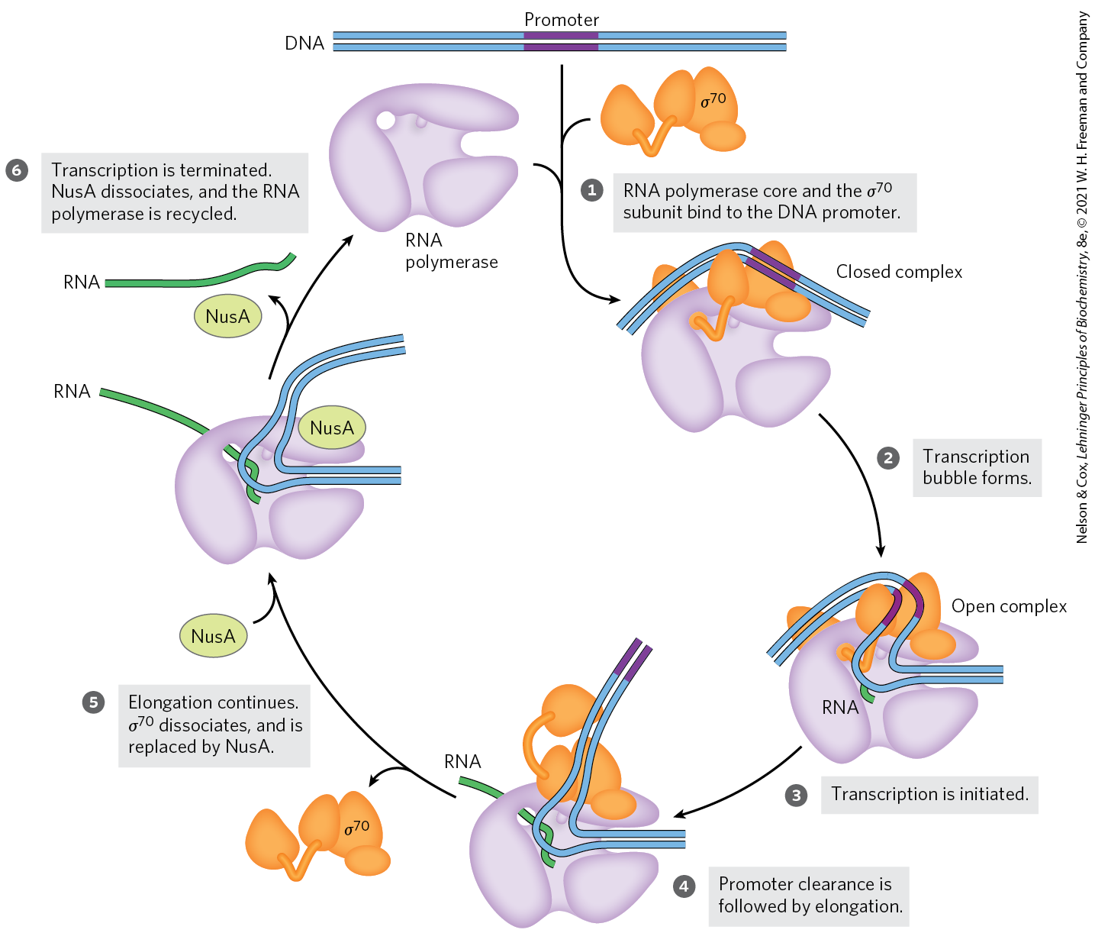
Initiation and Elongation by E. coli RNA Polymerase

Slide 22
Transcription Is Regulated at
Several Levels
regulation can occur at any step of transcription
as the first committed steps in transcription, binding of RNA polymerase to the promoter and initiation of transcription are closely regulated
protein binding can activate or repress transcription
  cAMP receptor protein (CRP) activates transcription
  repressors block RNA synthesis at specific genes

Slide 23
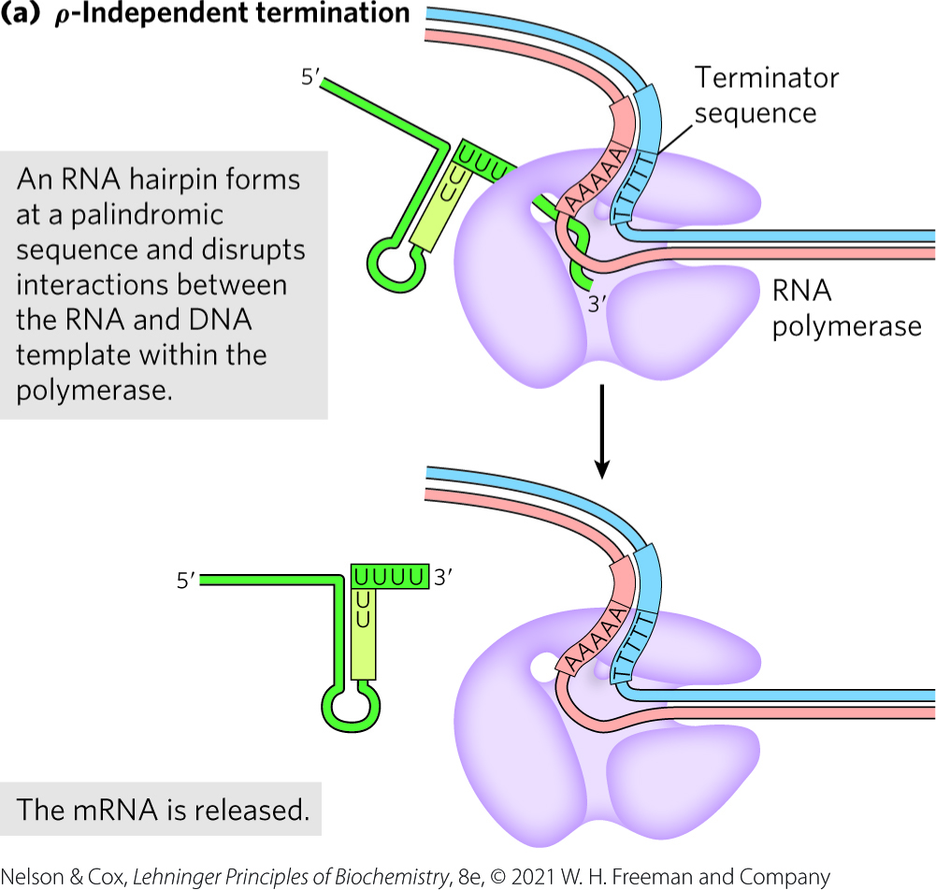
Specific Sequences Signal Termination of RNA Synthesis
ρ-independent terminators:
  have a self-complementary region that forms a hairpin
  have a conserved string of three A residues that are transcribed into U residues near the 3′ end of the hairpin

Slide 24
Eukaryotic Cells Have Three Kinds of Nuclear RNA Polymerases
eukaryotes have three nuclear RNA polymerases: I, II, and III
  each has a specific function and is recruited to a specific promoter sequence
Table 26-1 Eukaryotic Nuclear RNA Polymerases
RNA polymerase | Types of RNA synthesized
I | Pre-ribosomal RNA
II | mRNA ncRNA
III | tRNA 5S rRNA ncRNA

Slide 25
RNA Polymerase I (Pol I)
RNA polymerase I (Pol I) = responsible for the synthesis of a transcript called pre-ribosomal RNA (or pre-rRNA)
pre-rRNA contains the precursor for the 18S, 5.8S, and 28S rRNAs

Slide 26
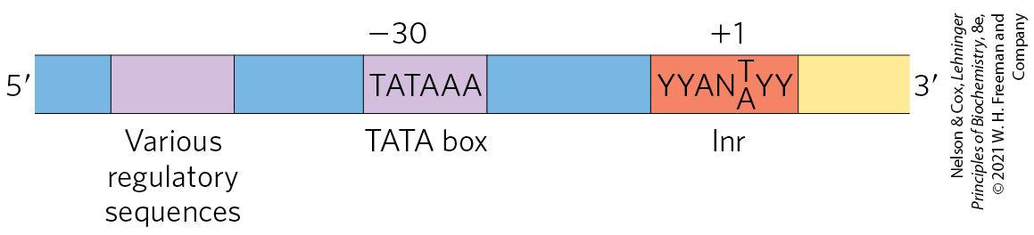
RNA Polymerase II (Pol II)
RNA polymerase II (Pol II) = responsible for the synthesis of mRNAs and many ncRNAs
  can recognize 1000s of promoters
some Pol II promoters have sequences in common:
  a TATA box consensus sequence (TATA(A/T)A(A/T)(A/G)) near -30
  an Inr sequence (initiator) at +1

Slide 27
RNA Polymerase III (Pol III)
RNA polymerase III (Pol III) = responsible for the synthesis of tRNAs, the 5S rRNA, and other ncRNAs
Pol III promoters are well characterized

Slide 28
RNA Polymerase II Requires Many Other Protein Factors for Its Activity
Pol II is more complex than its bacterial counterpart, but structure, function, and mechanism are conserved
  RBP1 subunit exhibits a high degree of homology to the bacterial β′ subunit
  RBP2 subunit is structurally similar to the bacterial β subunit
  RBP3 and RBP11 subunits show some structural homology to the two bacterial α subunits

Slide 29
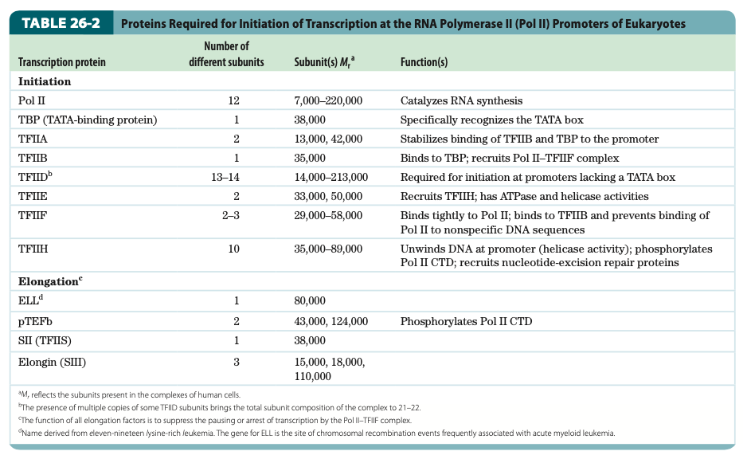
Proteins Required for Initiation of Transcription at Pol II Promoters of Eukaryotes

Slide 30
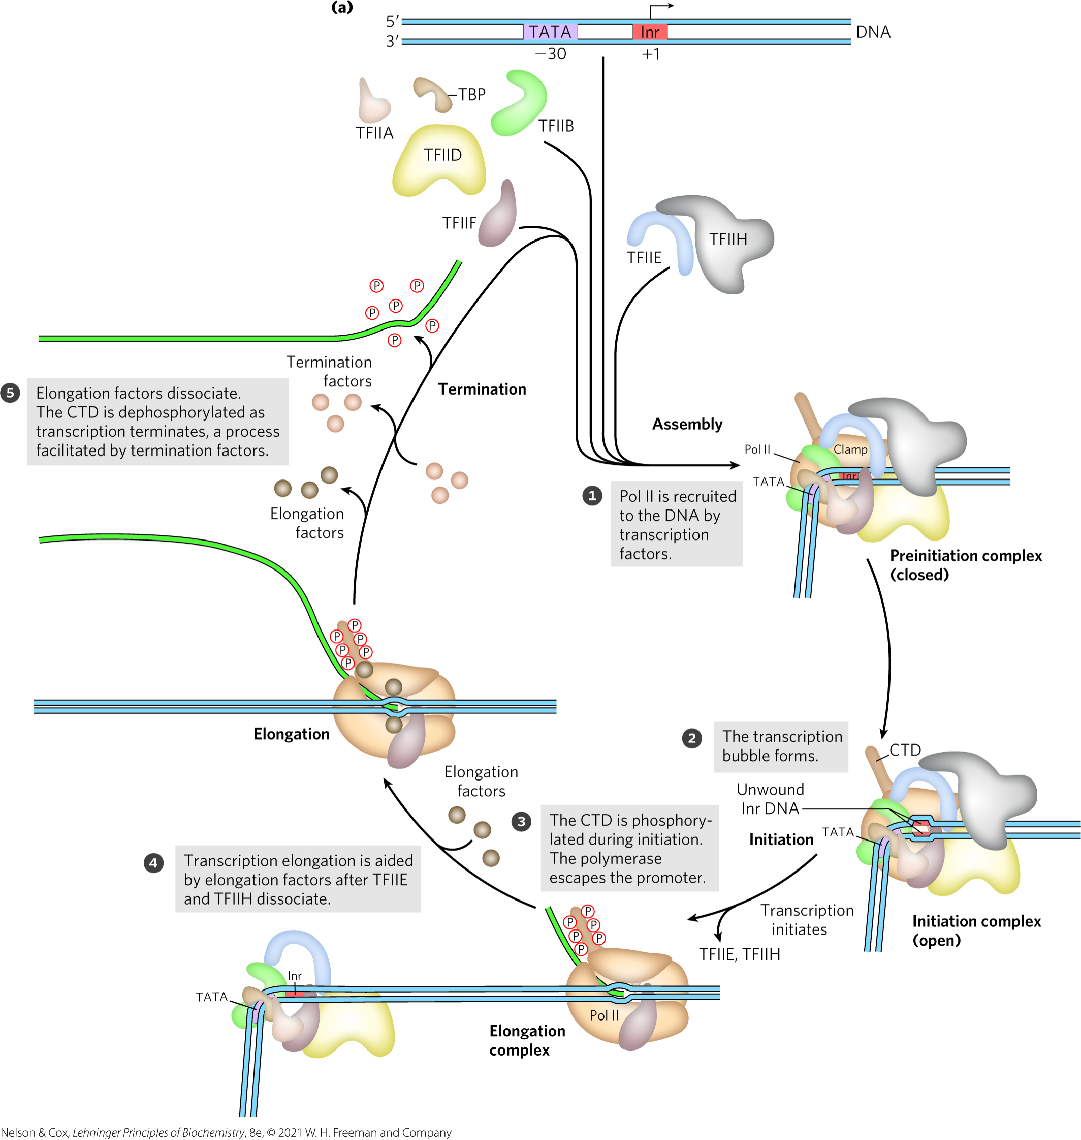
Transcription at RNA
Polymerase II Promoters

Slide 31
Elongation, Termination, and Release
during elongation, elongation factors bound to RNA Pol II enhance processivity and coordinate posttranslational modifications
  some are bound to phosphorylated CTD
during termination, Pol II CTD is dephosphorylated and transcription machinery is recycled

Slide 32
RNA Polymerases Are Drug Targets
actinomycin D = an antibiotic that inhibits RNA elongation in bacteria and eukaryotes
  intercalates into the double-helical DNA to deform the DNA duplex and prevent polymerase movement

Slide 33
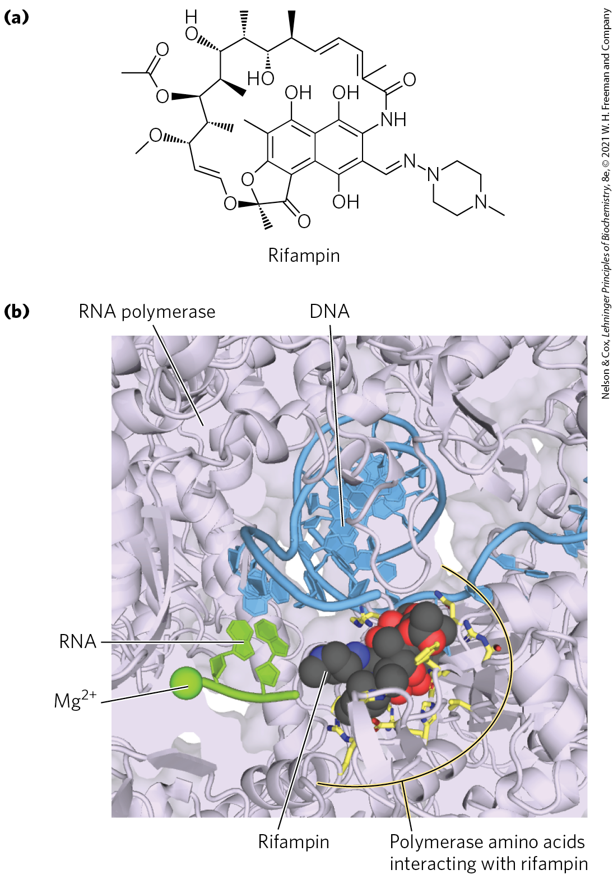
Rifampin
rifampin = antibiotic that inhibits bacterial RNA synthesis by preventing the promoter clearance step of transcription
  important for the treatment of tuberculosis (TB)
  binds near the active site of RNA polymerase and prevents extension of the RNA product

Slide 34
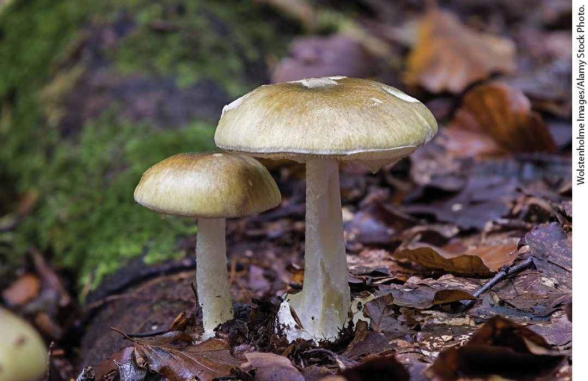
The Death Cap Mushroom Produces α-Amanitin
α-amanitin = compound produced by the death cap mushroom Amanita phalloides
  disrupts transcription in animal cells by blocking Pol II and, at higher concentrations, Pol III

Slide 35
26.2 RNA Processing

Slide 36
RNA Processing
virtually all eukaryotic RNAs and many bacterial RNAs undergo processing
processing includes:
  addition and deletion of nucleotide sequences
  chemical modification of RNA nucleotides
  degradation
ribozymes = catalytic RNAs that catalyze posttranscriptional processing reactions

Slide 37
RNA Splicing
primary or precursor transcript = a newly synthesized RNA molecule
introns = noncoding tracts that break up the coding region of the mRNA transcript
  human genes average eight introns per gene
exons = coding segments of the mRNA transcript
RNA splicing = the process by which introns are removed from pre-mRNA and exons are spliced together to form a continuous sequence that specifies a functional polypeptide

Slide 38
Eukaryotic mRNAs Are Modified At Each End
at the 5′ end, a 5′ cap (a modified nucleotide structure) is added
at the 3′ end, cleavage occurs and 80 to 250 A residues are added to create a poly(A) “tail”

Slide 39
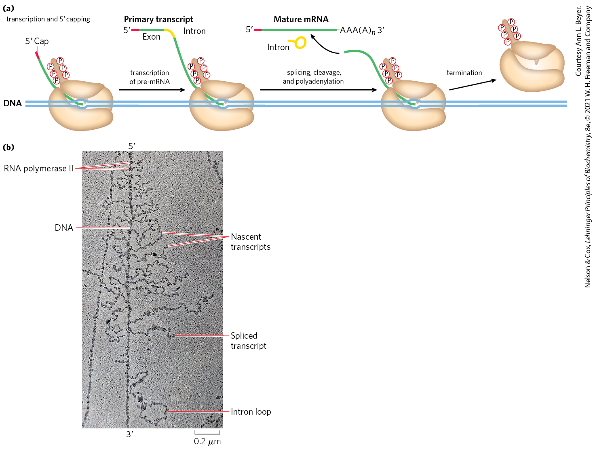
Processing of the Primary
Transcript during mRNA Maturation
the protein complexes that carry out mRNA-processing reactions are organized in association with each other and with the phosphorylated CTD of Pol II

Slide 40
Eukaryotic mRNAs Are Capped at the 5′ End
5′ cap = a residue of 7-methylguanosine linked to the 5′-terminal residue of the mRNA through an unusual 5′,5′-triphosphate linkage
functions:
  helps protect mRNA from ribonucleases
  binds to specific cap-binding complexes of proteins
  participates in binding of the mRNA to the ribosome

Slide 41
Formation of the 5′ Cap
formed by condensation of a molecule of GTP with the triphosphate at the 5′ end of the transcript
methylation occurs at the N-7 guanine and often the 2′-OH groups of the two nucleotides adjacent to the cap
  methyl groups are derived from S-adenosylmethionine

Slide 42
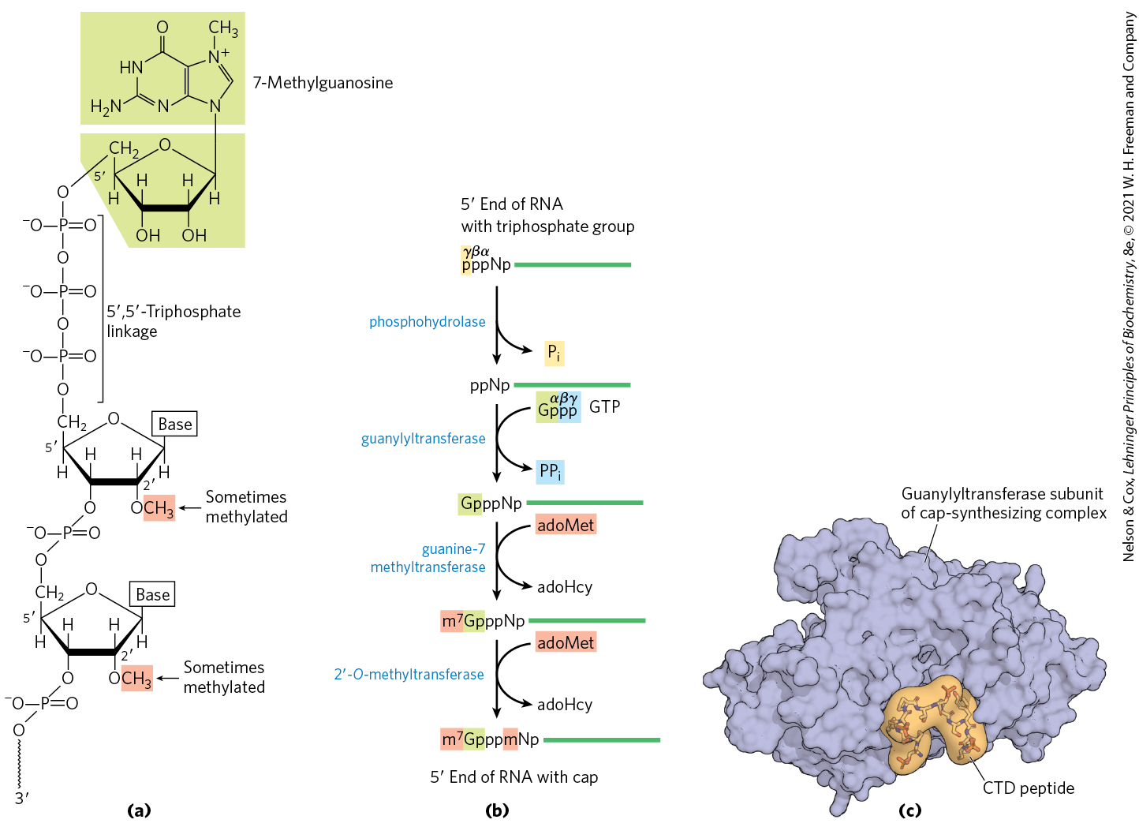
The 5′ Cap of mRNA

Slide 43
Both Introns and Exons Are Transcribed from DNA into RNA
most genes in vertebrates contain introns
  exceptions include genes that encode histones
some yeast and a few bacterial and archaeal genes contain introns
in eukaryotic mRNAs:
  exons are <1,000 bp long
  introns are 50-700,000 bp long (median = 1,800)
the human genome has 200,000+ introns spread across ~20,000 genes

Slide 44
RNA Catalyzes the Splicing of Introns
four classes of introns:
  group I and II are self-splicing
  spliceosome introns are removed by a large RNP called the spliceosome
  protein-catalyzed introns are removed by enzymes
Table 26-3 Mechanisms of RNA Splicing
Mechanism | Components | Features | Cellular locations
Group I Intron | Catalytic RNA | Self-splicing using a guanine-derived cofactor | Found in nuclear, mitochondrial, and chloroplast genes that encode mRNAs, rRNAs, or tRNAs. Can be found in bacteria.
Group II Intron | Catalytic RNA; maturase and reverse transcriptase proteins | Self-splicing using a nucleophile within the intron to form a lariat | Primarily found in mitochondrial and chloroplast genes of fungi, algae, and plants. Can be found in bacteria.
Spliceosome | Catalytic snRNAs; dozens of protein splicing factors | Requires a large RNP for processing using a nucleophile within the intron to form a lariat | Found in nuclear genes of eukaryotes. Capable of alternative splicing to create multiple products from a given transcript.
Protein-catalyzed | Protein enzymes | Uses a splicing endonuclease and ligase | Found in tRNAs and a few mRNAs.

Slide 45
In Eukaryotes, the Spliceosome Carries out Nuclear pre-mRNA Splicing
spliceosome introns are the most common intron in eukaryotes
  GU at the 5′ end and AG at the 3′ end mark the sites of splicing
some splicing apparatus components are tethered to the CTD of RNA polymerase II
  indicates splicing is tightly coordinated with transcription

Slide 46
The Spliceosome and snRNAs
spliceosome = a large complex made up of multiple specialized RNP complexes called small nuclear ribonucleoproteins (snRNPs) and dozens of other proteins
small nuclear RNAs (snRNAs) = 100-200 nucleotide RNAs that make up snRNPs
  U1, U2, U4, U5, and U6 are abundant in the nuclei

Slide 47
Proteins Catalyze Splicing of tRNAs
found in certain tRNAs and a few mRNAs
endonucleases cleave the phosphodiester bonds at both ends of the intron
ligases join the two exons

Slide 48
Eukaryotic mRNAs Have a Distinctive 3′ End Structure
poly(A) tail = a string of A residues added to the 3′ end of most eukaryotic mRNAs that undergo translation
  ~30 residues in yeast and 50-100 in animals
  serves as a binding site for specific proteins
  may help protect mRNA from enzymatic destruction

Slide 49
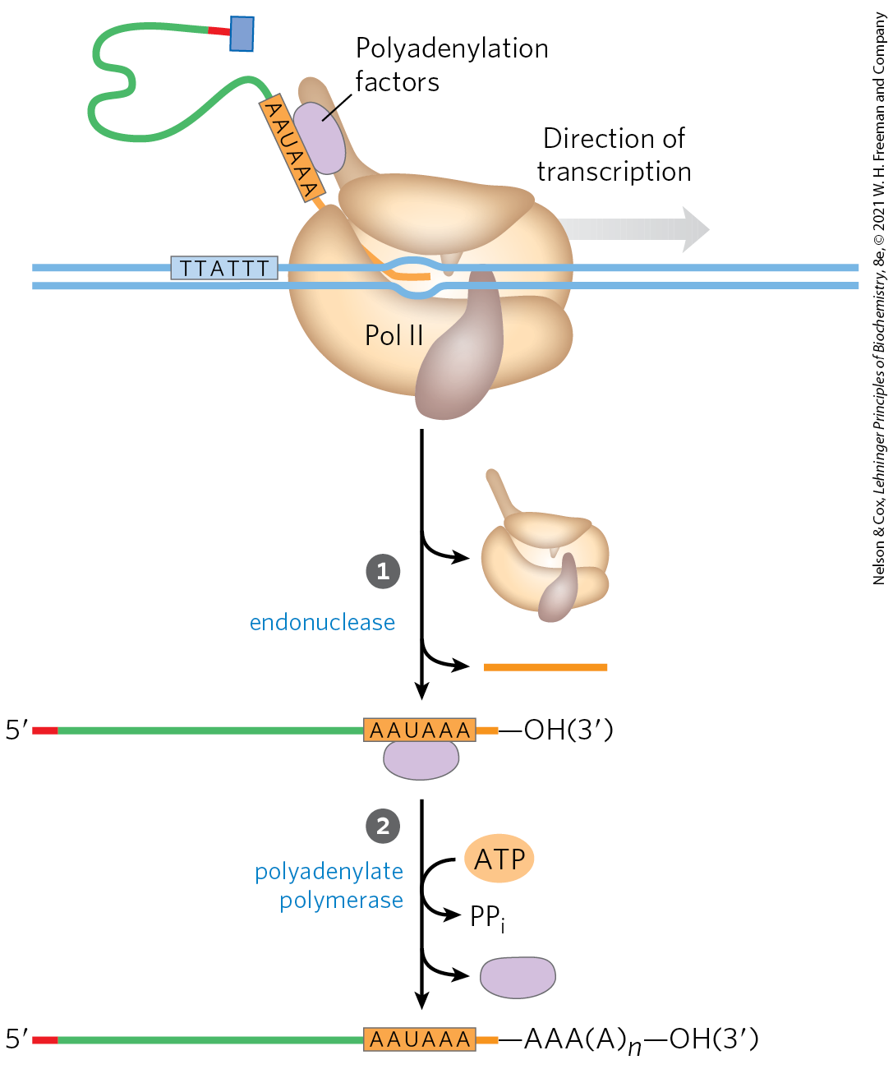
Addition of the Poly(A) Tail
endonuclease cleaves at the poly(A) addition site
the addition site is:
  10-30 nucleotides downstream from the highly conserved sequence (5′)AAUAAA(3′)
  20-40 nucleotides upstream from a sequence rich in G and U residues

Slide 50
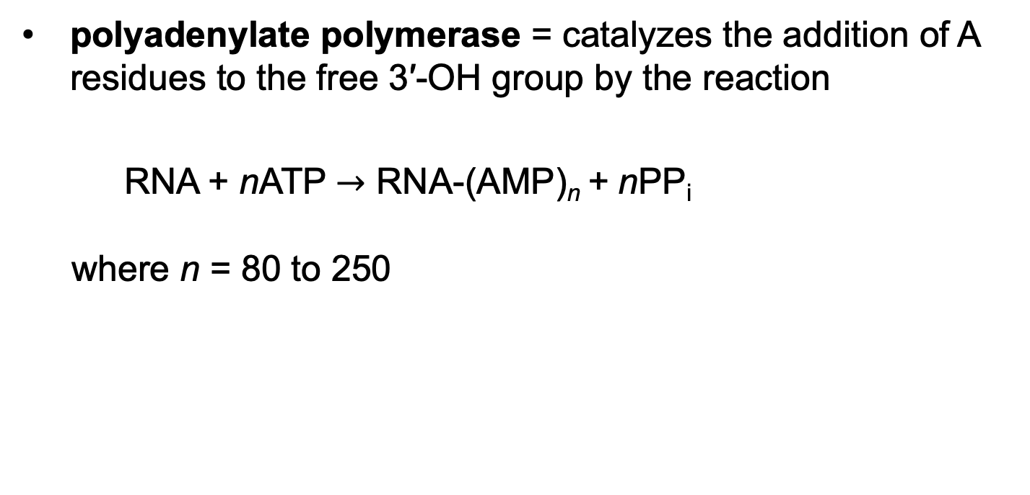
Polyadenylate Polymerase
polyadenylate polymerase = catalyzes the addition of A residues to the free 3′-OH group by the reaction
RNA + nATP $→$ RNA-(AMP)_{n} + nPP_{i}
where n = 80 to 250

Slide 51
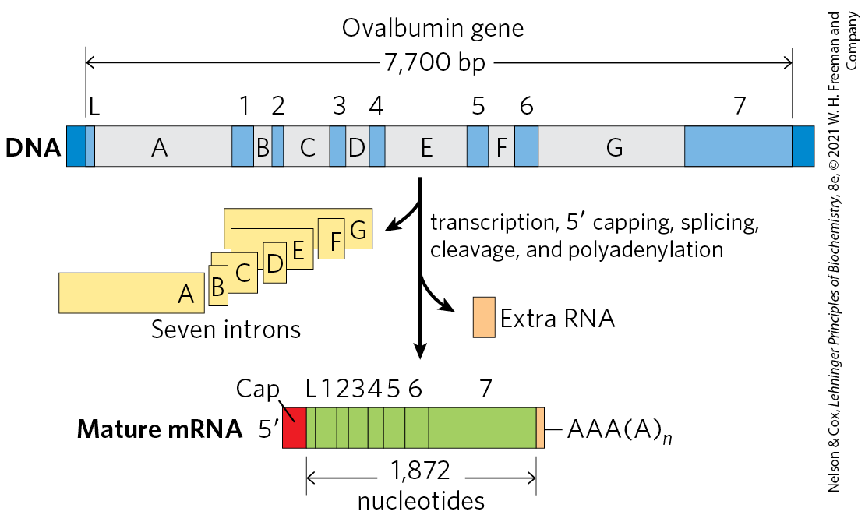
Overview of mRNA Processing

Slide 52
A Gene Can Give Rise to Multiple Products by Differential RNA Processing
some eukaryotic mRNA transcripts can be processed in more than one way to produce different mRNAs and thus different polypeptides
alternative splicing = process in which a particular exon may or may not be incorporated into the mature mRNA transcript
  occurs in >95% of human genes

Slide 53
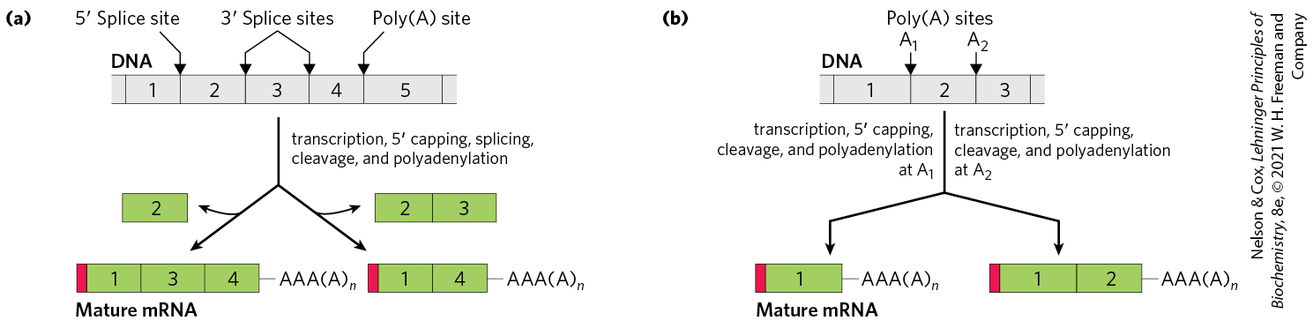
Alternative Transcript Production in Eukaryotes
pre-mRNA contains molecular signals for all the alternative processing pathways
  RNA-binding proteins promote one particular path
complex transcripts can have more than one site where poly(A) tails can form (poly(A) site)

Slide 54
Ribosomal RNAs and tRNAs Also Undergo Processing
pre-ribosomal RNAs (pre-rRNAs) = longer precursors of ribosomal RNAs
transfer RNAs are also derived from longer precursors
these RNAs may contain modified nucleosides

Slide 55
Transfer RNAs
most cells have 40 to 50 distinct tRNAs
eukaryotic cells have multiple copies of many of the tRNA genes
transfer RNAs are derived from longer RNA precursors by enzymatic removal of nucleotides from the 5′ and 3′ ends
  the endonuclease RNase P removes RNA at the 5′ end
  1+ nucleases, including the exonuclease RNase D, remove RNA at the 3′ end

Slide 56
Further Post-Transcriptional Processing of tRNA Precursors
further post-transcriptional processing includes:
  addition of the 3′-terminal trinucleotide CCA(3′) by tRNA nucleotidyltransferase
  modification of some bases by methylation, deamination, or reduction

Slide 57
Cellular mRNAs Are Degraded at Different Rates
the cellular concentration of mRNA helps govern the level of gene expression
degradative pathways ensure that mRNAs do not build up in the cell and direct the synthesis of unnecessary proteins
rates of degradation vary greatly for eukaryotic mRNAs
  average half-life is ~3 hours

Slide 58
26.3 RNA-Dependent Synthesis of RNA and DNA

Slide 59
Reverse Transcriptase Produces DNA from Viral RNA
reverse transcriptase = an RNA-dependent DNA polymerase
  contained within certain RNA viruses called retroviruses
  discovery showed genetic information can flow “backward” from RNA to DNA
reverse transcriptase catalyzes conversion of viral RNA to dsDNA, which is often integrated into the host genome

Slide 60
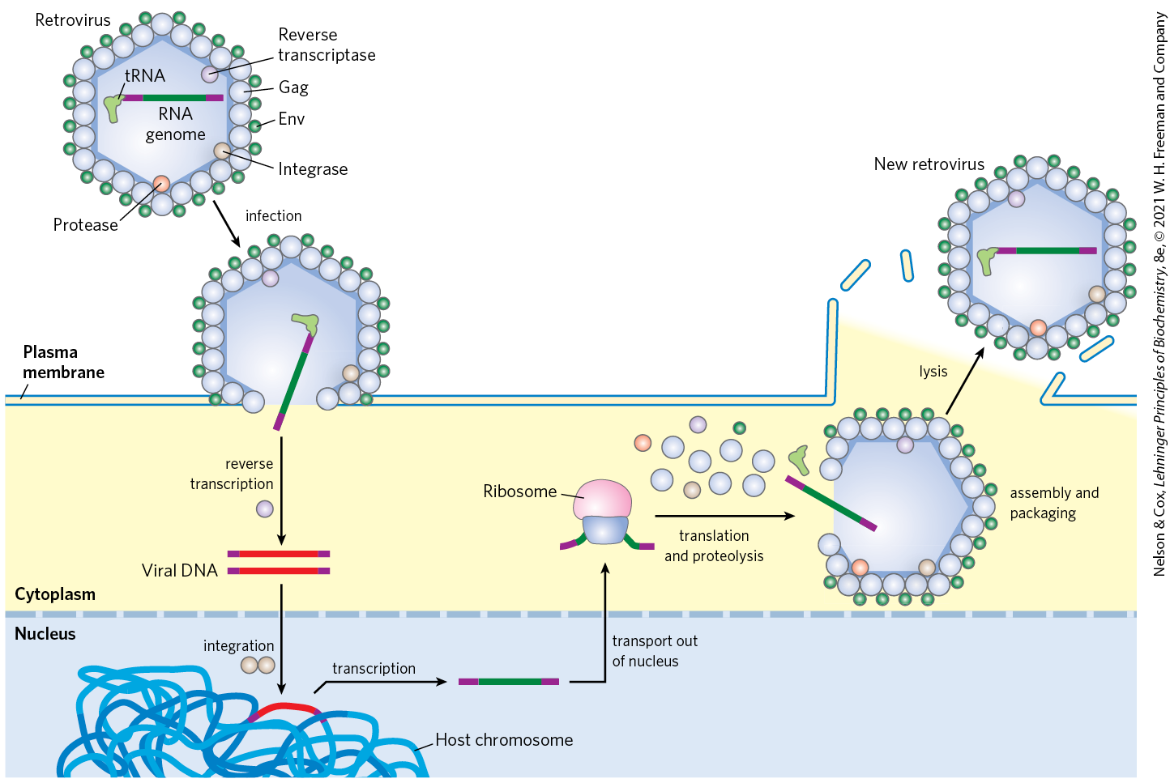
Retroviral Infection of a
Mammalian Cell

Slide 61
Some Retroviruses Cause Cancer and AIDS
some retroviruses contain an oncogene that can cause the cell to grow abnormally
  classified as RNA tumor viruses
  example: Rous sarcoma virus (also called avian sarcoma virus)

Slide 62
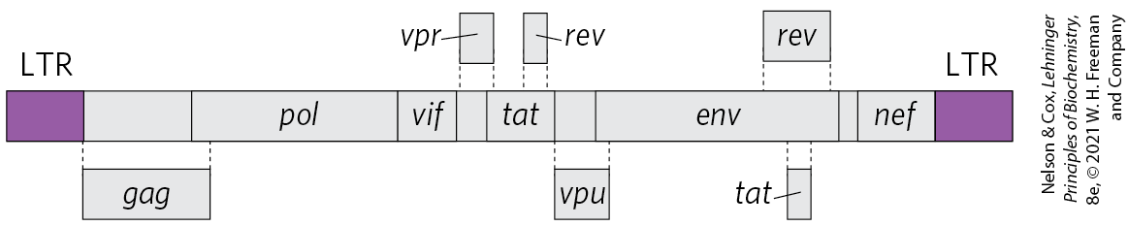
The Human Immunodeficiency
Virus (HIV)
the retrovirus human immunodeficiency virus (HIV) causes acquired immune deficiency syndrome (AIDS)
  kills many of the cells it infects (T lymphocytes)
  leads to suppression of the host immune system
the reverse transcriptase of HIV is very error-prone
  results in 1+ errors every time the genome is replicated

Slide 63
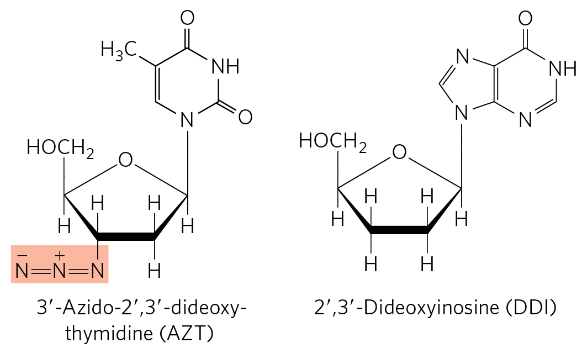
Fighting AIDS With Inhibitors of HIV Reverse Transcriptase
azidothymidine (AZT) is a deoxythymidine analog
  converted to AZT triphosphate inside T lymphocytes
binding of AZT triphosphate to HIV reverse transcriptase competitively inhibits dTTP binding
  terminates viral DNA synthesis
dideoxyinosine (DDI) has a similar mechanism of action

Slide 64
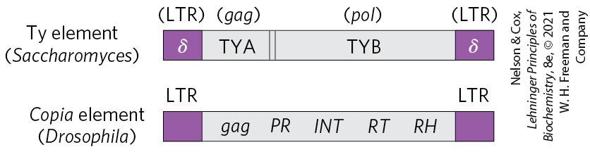
Many Transposons, Retroviruses, and Introns May Have a Common Evolutionary Origin
retrotransposons = eukaryotic DNA transposons with structures similar to retroviruses
  encode an enzyme homologous to the retroviral reverse transcriptase
  transpose by means of an RNA intermediate,
  lack an env gene and so cannot form viral particles

Slide 65
Telomerase is a Specialized
Reverse Transcriptase
telomeres = structures at the ends of linear eukaryotic chromosomes
  not easily replicated by cellular DNA polymerases because there is no template for an RNA primer

Slide 66
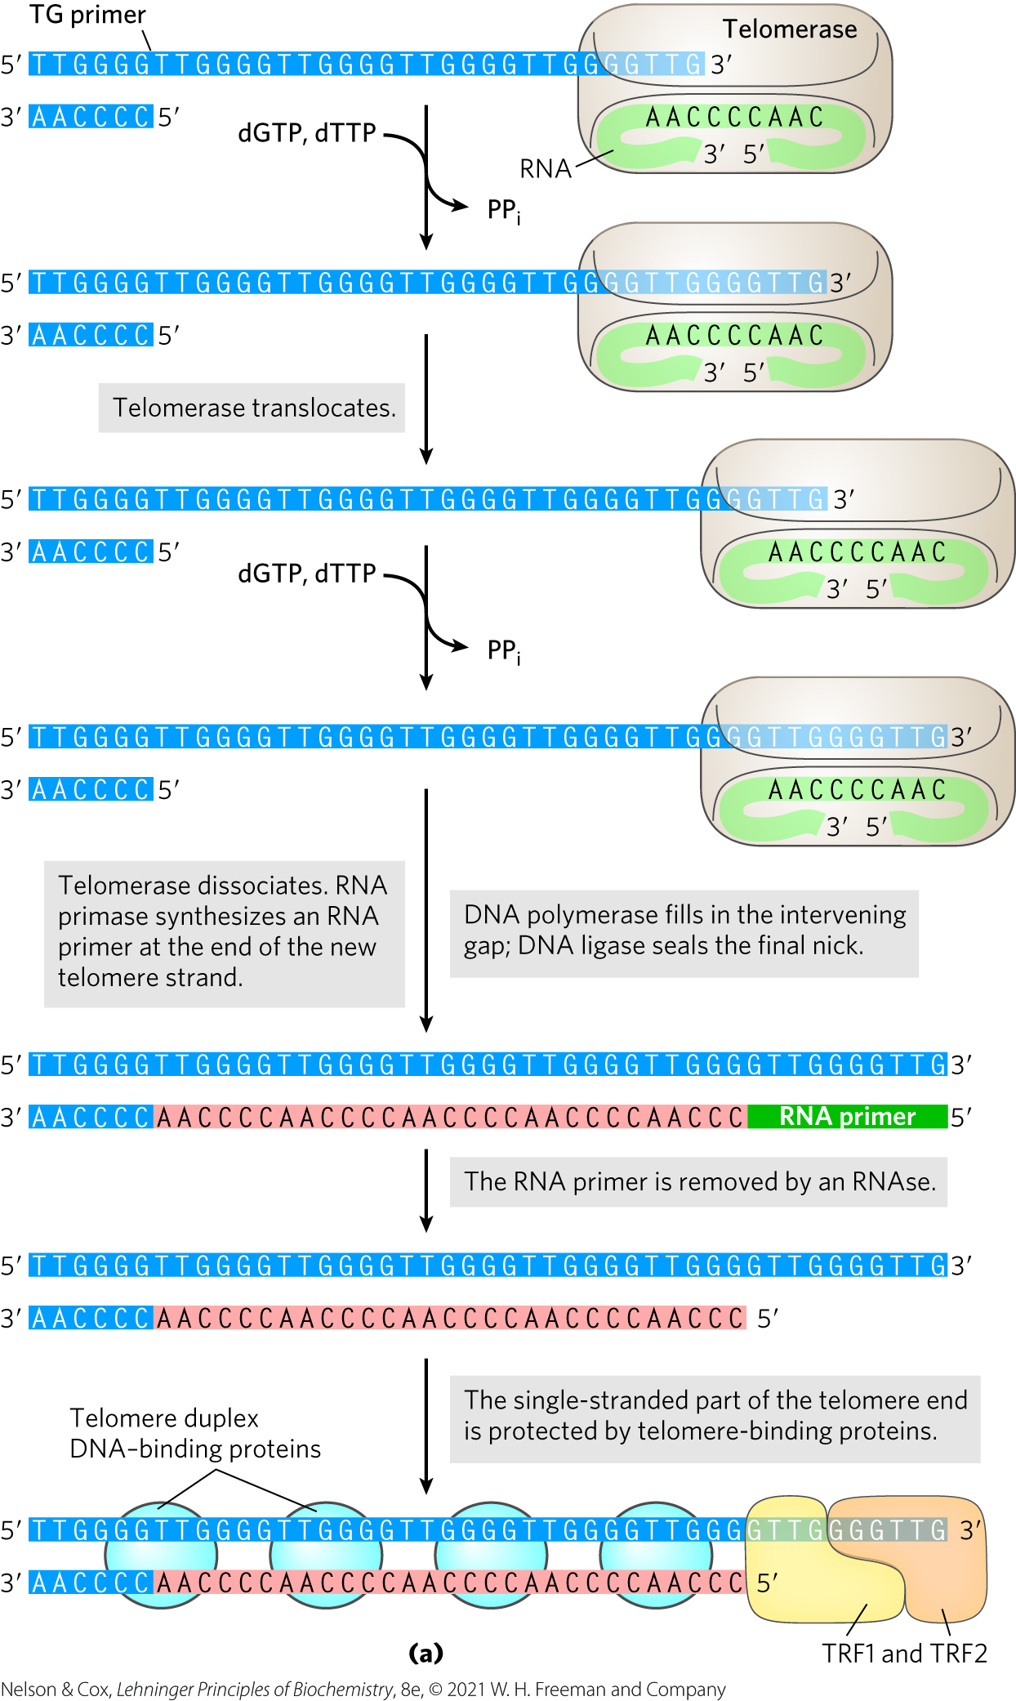
Telomere Synthesis and Structure
telomerase = a ribonucleoprotein that synthesizes the telomere ends of linear chromosomes
  acts as a specialized reverse transcriptase
  contains an internal RNA with C_{y}A_{x} repeat that serves as a template for synthesis of the T_{x}G_{y} strand of the telomere

