Slide 1

25 DNA Metabolism
© 2021 Macmillan Learning

Slide 2

Principle 1 (1 of 6)
Along with catalysis, biological information is one of the two key prerequisites for life. The faithful maintenance and transmission of genetic information from one generation to another ensures continuity within each species.

Slide 3

Principle 2 (1 of 7)
Information is expensive. The chemistry of joining one nucleotide to the next in DNA replication is elegant and simple, almost deceptively so. However, the enzymatic and thermodynamic commitment to linking one nucleotide to another in DNA far exceeds what would normally be required to successfully form a phosphodiester bond. It is not enough to synthesize a phosphodiester bond; that bond must accurately link two particular nucleotides.

Slide 4

Principle 3 (1 of 7)
The fidelity of genome maintenance and transmission is not perfect. DNA damage happens, often by spontaneous processes. DNA replication and repair deal with the vast majority of DNA lesions, providing a high degree of genetic fidelity and stability. The few DNA damage events that slip through uncorrected provide fuel for evolution.

Slide 5
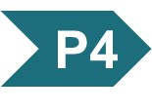
Principle 4 (1 of 5)
Although considered separately, the processes of replication, repair, and recombination of DNA are not distinct. These processes are highly integrated in cells, and they are required for proper genome maintenance.

Slide 6
Eukaryotic Gene Naming
no single convention exists for all eukaryotic systems
in Saccharomyces cerevisiae, gene names are three italicized uppercase letters followed by an italicized number
  example: COX1

Slide 7
Eukaryotic Protein Naming
complex and variable
in yeast, some proteins have long common names
  example: cytochrome oxidase
other yeast proteins have the same name as the gene, with one uppercase and two lowercase letters in roman type, followed by a number and the letter “p”
  example: Rad51p (encoded by RAD51)

Slide 8
25.1 DNA Replication

Slide 9
DNA as a Template
template = a structure that would allow molecules to be lined up in a specific order and joined to create a macromolecule with a unique sequence and function
the structure of DNA revealed one strand is the complement of the other.
  each strand provides the template for a new strand

Slide 10
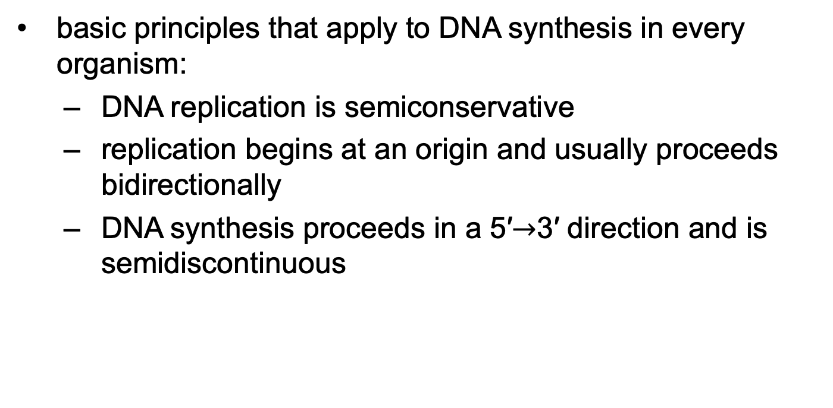
DNA Replication Follows a Set of Fundamental Rules
basic principles that apply to DNA synthesis in every organism:
  DNA replication is semiconservative
  replication begins at an origin and usually proceeds bidirectionally
  DNA synthesis proceeds in a 5′$→$3′ direction and is semidiscontinuous

Slide 11
DNA Replication
Is Semiconservative
semiconservative replication = each DNA strand serves as a template for the synthesis of a new strand
  produces two new DNA molecules, each with one new strand and one old strand
  established by Meselson and Stahl in 1957

Slide 12
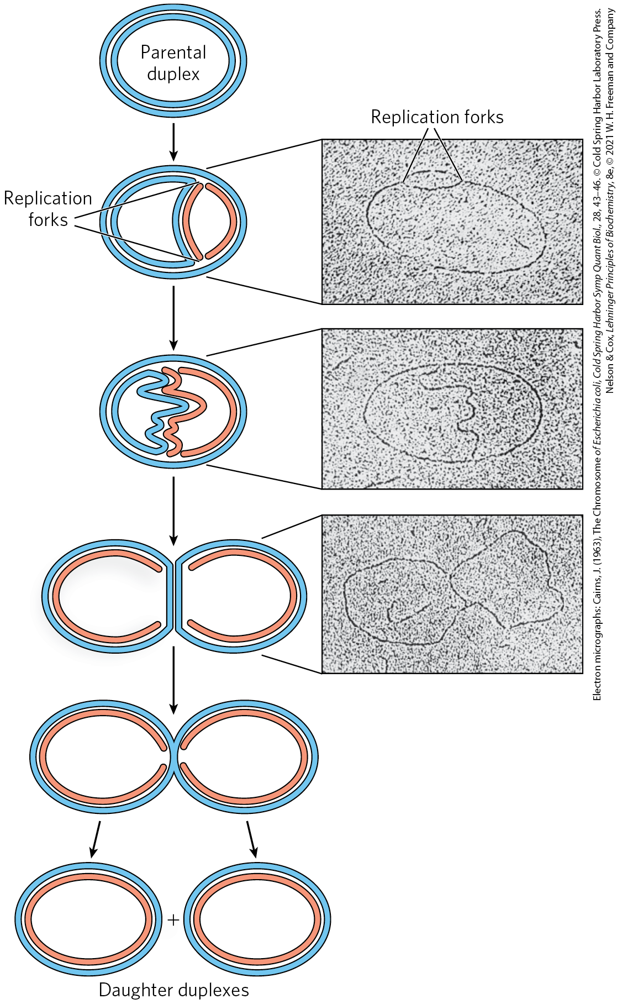
Replication Begins at an Origin and Usually Proceeds Bidirectionally
replication forks = dynamic points where parent DNA is being unwound and separated strands replicated
both DNA strands are replicated simultaneously
both ends of the bacterial chromosome have active replication forks (bidirectional replication)

Slide 13
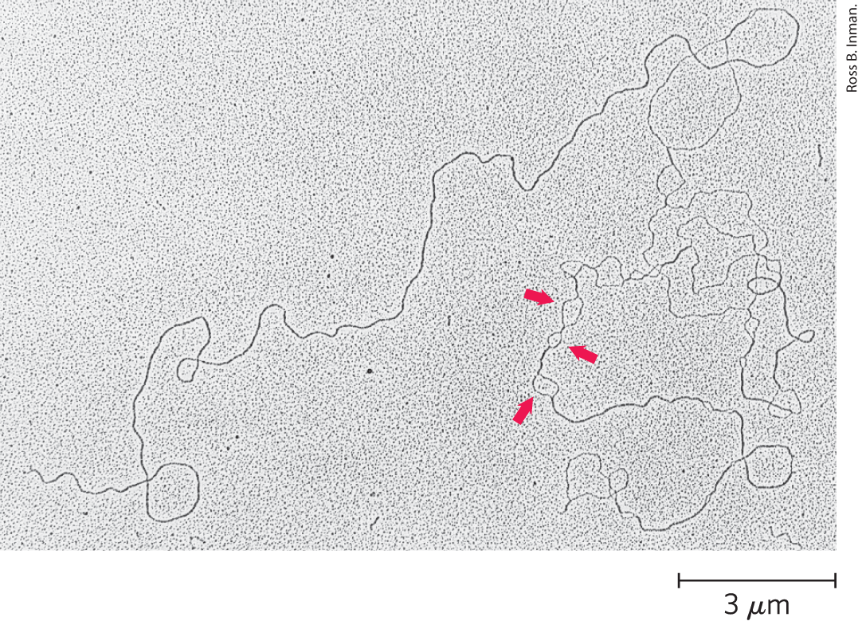
Replication Loops Always Initiate at an Origin
denaturation mapping = selective denaturing of sequences unusually rich in A=T base pairs to provide landmarks along the DNA molecule
  generates a reproducible pattern of single-strand bubbles
origin = location where replication loops are initiated

Slide 14
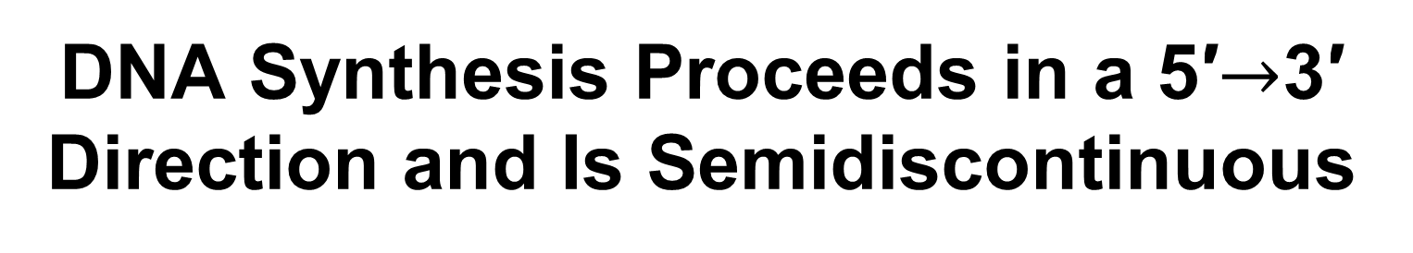
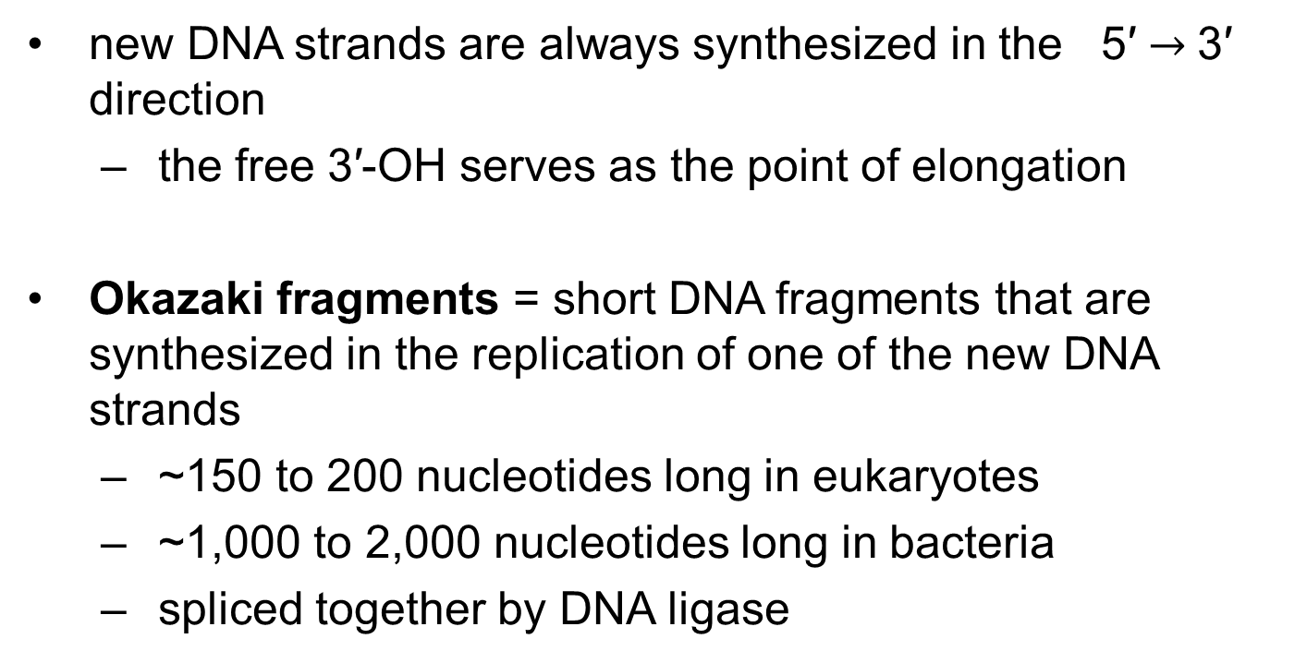
DNA Synthesis Proceeds in a 5′$→$3′ Direction and Is Semidiscontinuous
new DNA strands are always synthesized in the 5′ $→$3′ direction
  the free 3′-OH serves as the point of elongation
Okazaki fragments = short DNA fragments that are synthesized in the replication of one of the new DNA strands
  ~150 to 200 nucleotides long in eukaryotes
  ~1,000 to 2,000 nucleotides long in bacteria
  spliced together by DNA ligase

Slide 15
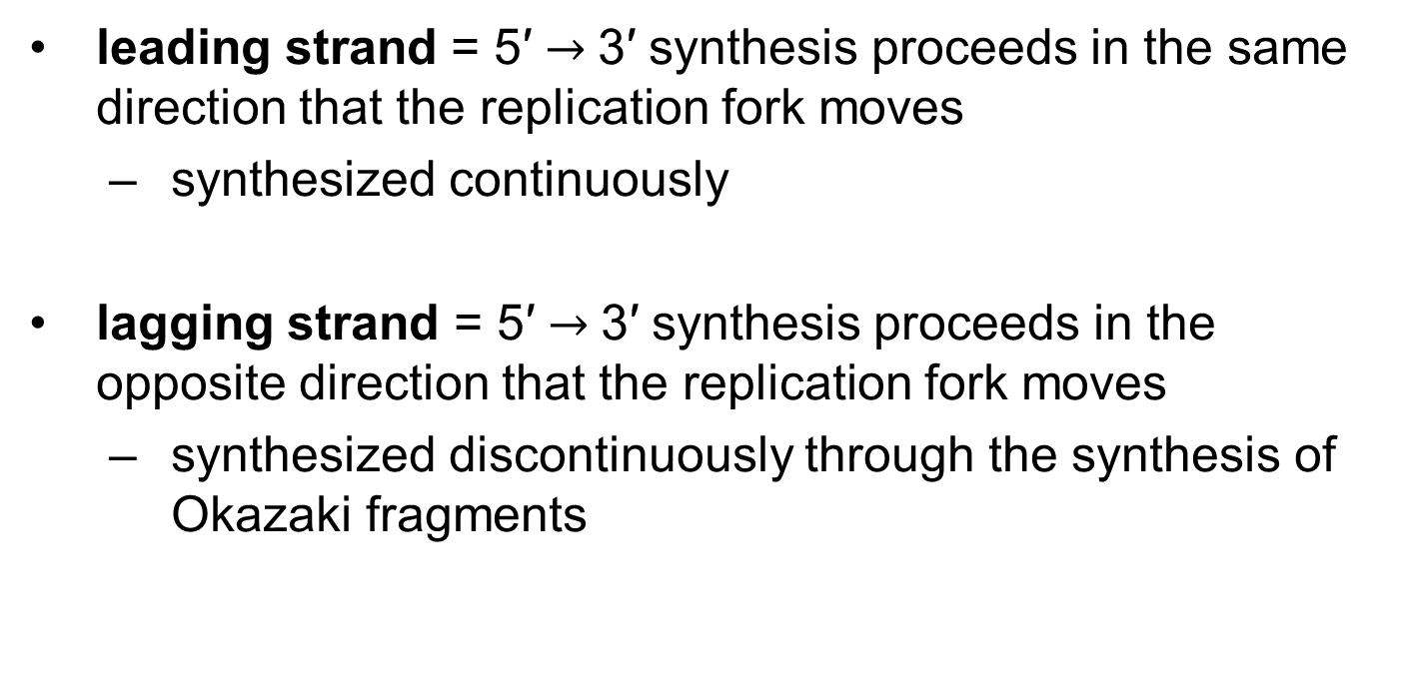
Leading and Lagging Strands
leading strand = 5′ $→$3′ synthesis proceeds in the same direction that the replication fork moves
  synthesized continuously
lagging strand = 5′ $→$3′ synthesis proceeds in the opposite direction that the replication fork moves
  synthesized discontinuously through the synthesis of Okazaki fragments

Slide 16
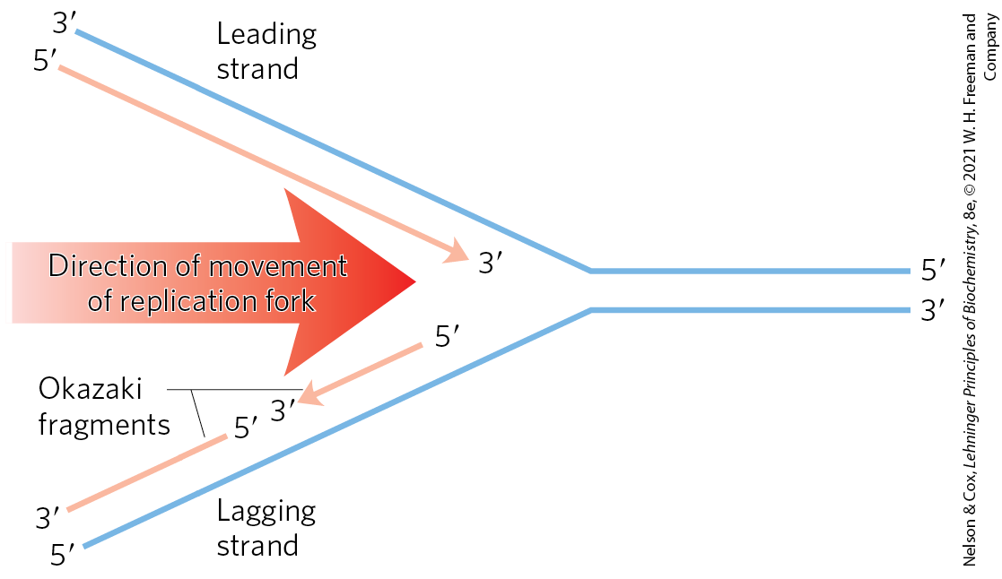
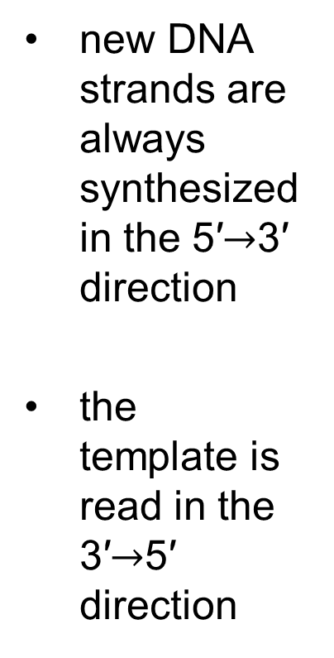
Defining DNA Strands at the Replication Fork
new DNA strands are always synthesized in the 5′$→$3′ direction
the template is read in the 3′$→$5′ direction

Slide 17
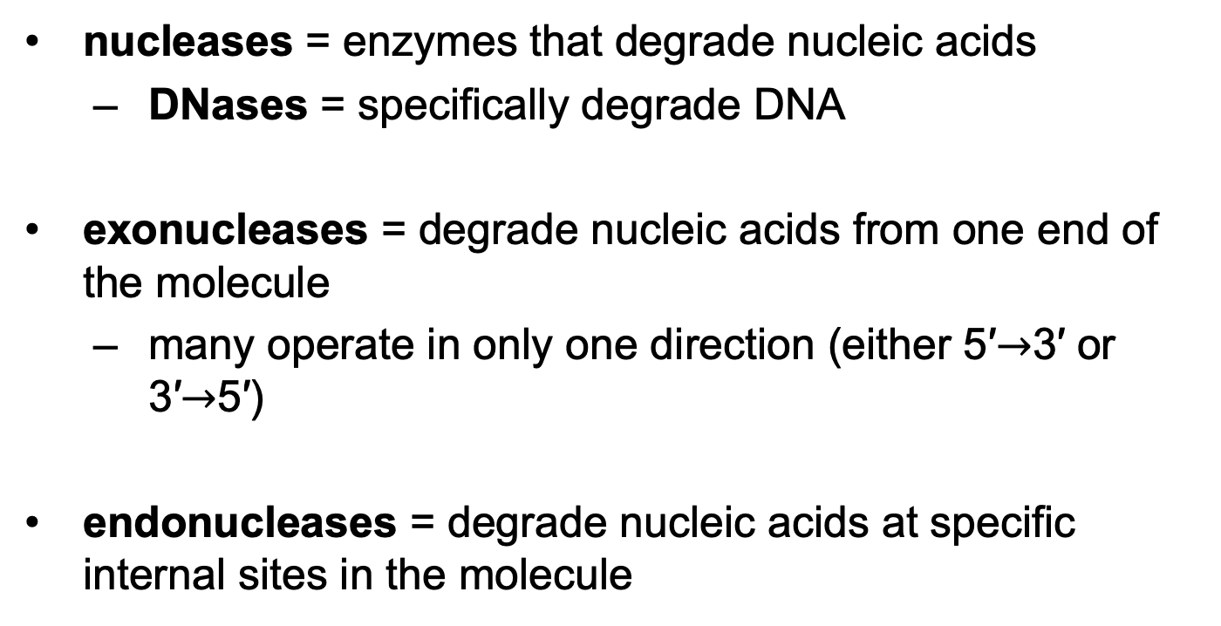
DNA Is Degraded by Nucleases
nucleases = enzymes that degrade nucleic acids
  DNases = specifically degrade DNA
exonucleases = degrade nucleic acids from one end of the molecule
  many operate in only one direction (either 5′$→$3′ or 3′$→$5′)
endonucleases = degrade nucleic acids at specific internal sites in the molecule

Slide 18
DNA Is Synthesized by
DNA Polymerases
DNA polymerase = complex enzymes that can synthesize DNA
  many have additional activities
  E. coli cells have at least 5 DNA polymerases, including DNA polymerase I

Slide 19
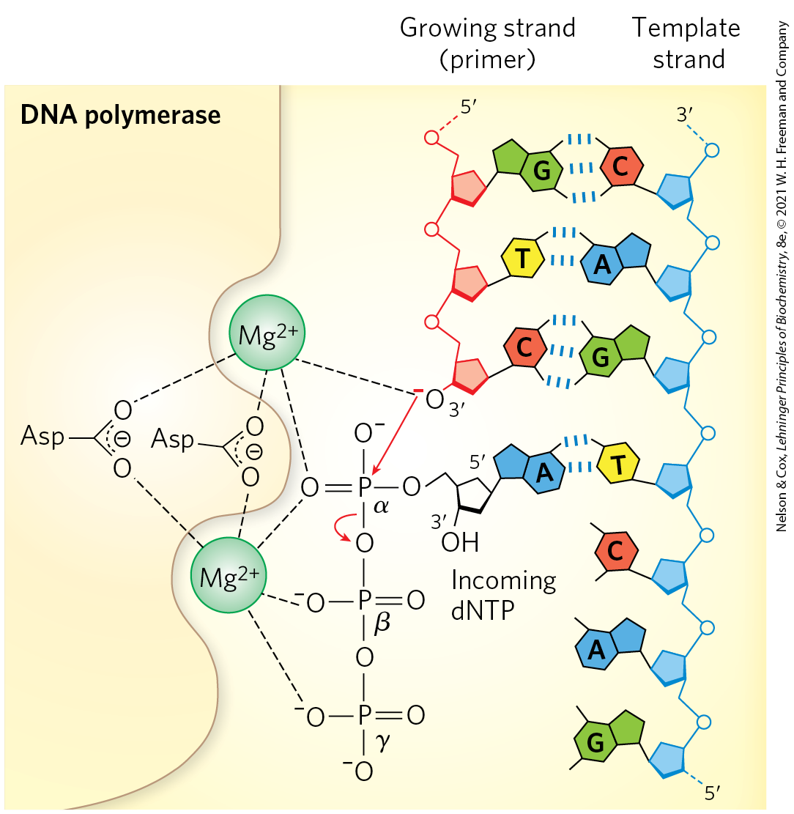
The DNA Polymerase Reaction
the reaction is a phosphoryl group transfer
the 3′-OH of the nucleotide at the 3′ end of the strand (the nucleophile) attacks the α phosphorus of the incoming dNTP

Slide 20
Catalysis by DNA Polymerases Involves Two Mg²⁺ Ions
one Mg²⁺ ion helps deprotonate the 3′-OH group
  makes it a more effective nucleophile
one Mg²⁺ ion binds the incoming dNTP and facilitates departure of PP_{i}

Slide 21
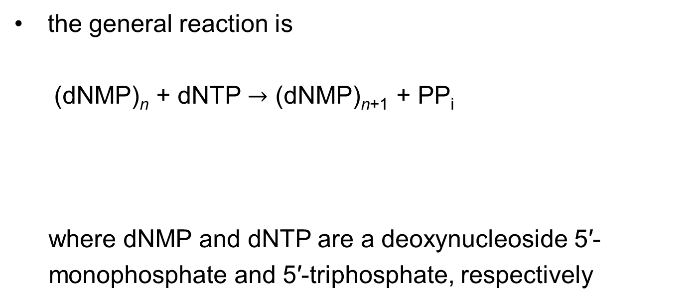
The General DNA Polymerase Reaction
the general reaction is
  (dNMP)_{n} + dNTP $→$ (dNMP)_{n+1} + PP_{i}
where dNMP and dNTP are a deoxynucleoside 5′-
monophosphate and 5′-triphosphate, respectively
(25-1)
lengthened DNA
DNA

Slide 22
The DNA Polymerase Reaction Proceeds with a Minimal Change in Free Energy
one phosphodiester bond is formed at the expense of a somewhat less stable phosphate anhydride
noncovalent base-stacking and base-pairing interactions stabilize the lengthened DNA product
the formation of products is facilitated by the subsequent hydrolysis of the pyrophosphate

Slide 23
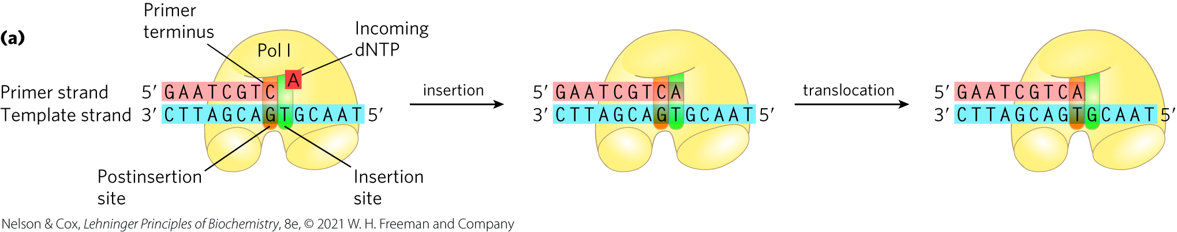
DNA Polymerases Require a Template
polymerization is guided by a template DNA strand according to Watson and Crick base-pairing rules

Slide 24
DNA Polymerases Require a Primer
primer = a strand segment with a free 3′-OH group to which a nucleotide can be added
  must be complementary to the template
  many are RNA oligonucleotides
primer terminus = the free 3′ end of the primer

Slide 25
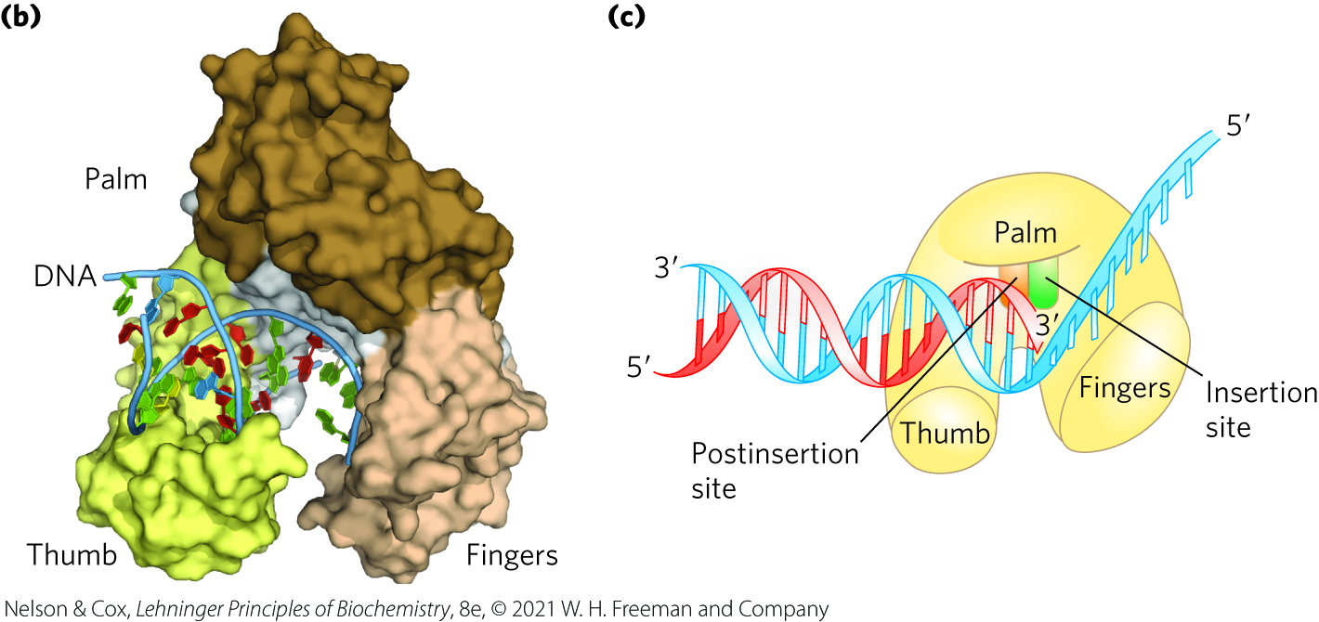
The DNA Polymerase Active Site Has Two Parts
insertion site = the portion of the active site where the incoming nucleotide binds
postinsertion site = the portion of the active site where the new base pair resides when the polymerase slides forward

Slide 26
The Processivity of
DNA Polymerases
processivity = the average number of nucleotides added before a polymerase dissociates
DNA polymerases vary greatly in processivity.
  ranges from a few nucleotides to many thousand

Slide 27
Replication is Very Accurate
errors in E. coli occur every 1 in 10⁹ to 1 in 10¹⁰ nucleotides added
  equates to an error only once per 1,000 to 10,000 replications
the active site of DNA polymerase excludes base pairs with the incorrect geometry
DNA polymerases insert one incorrect nucleotide for every 10⁴ to 10⁵ correct nucleotides
  may occur because a base is in a tautomeric form

Slide 28
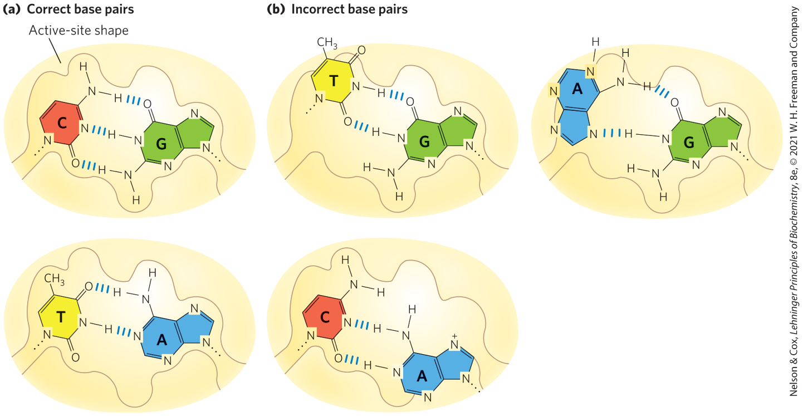
Contribution of Base-Pair Geometry to the Fidelity of DNA Replication

Slide 29
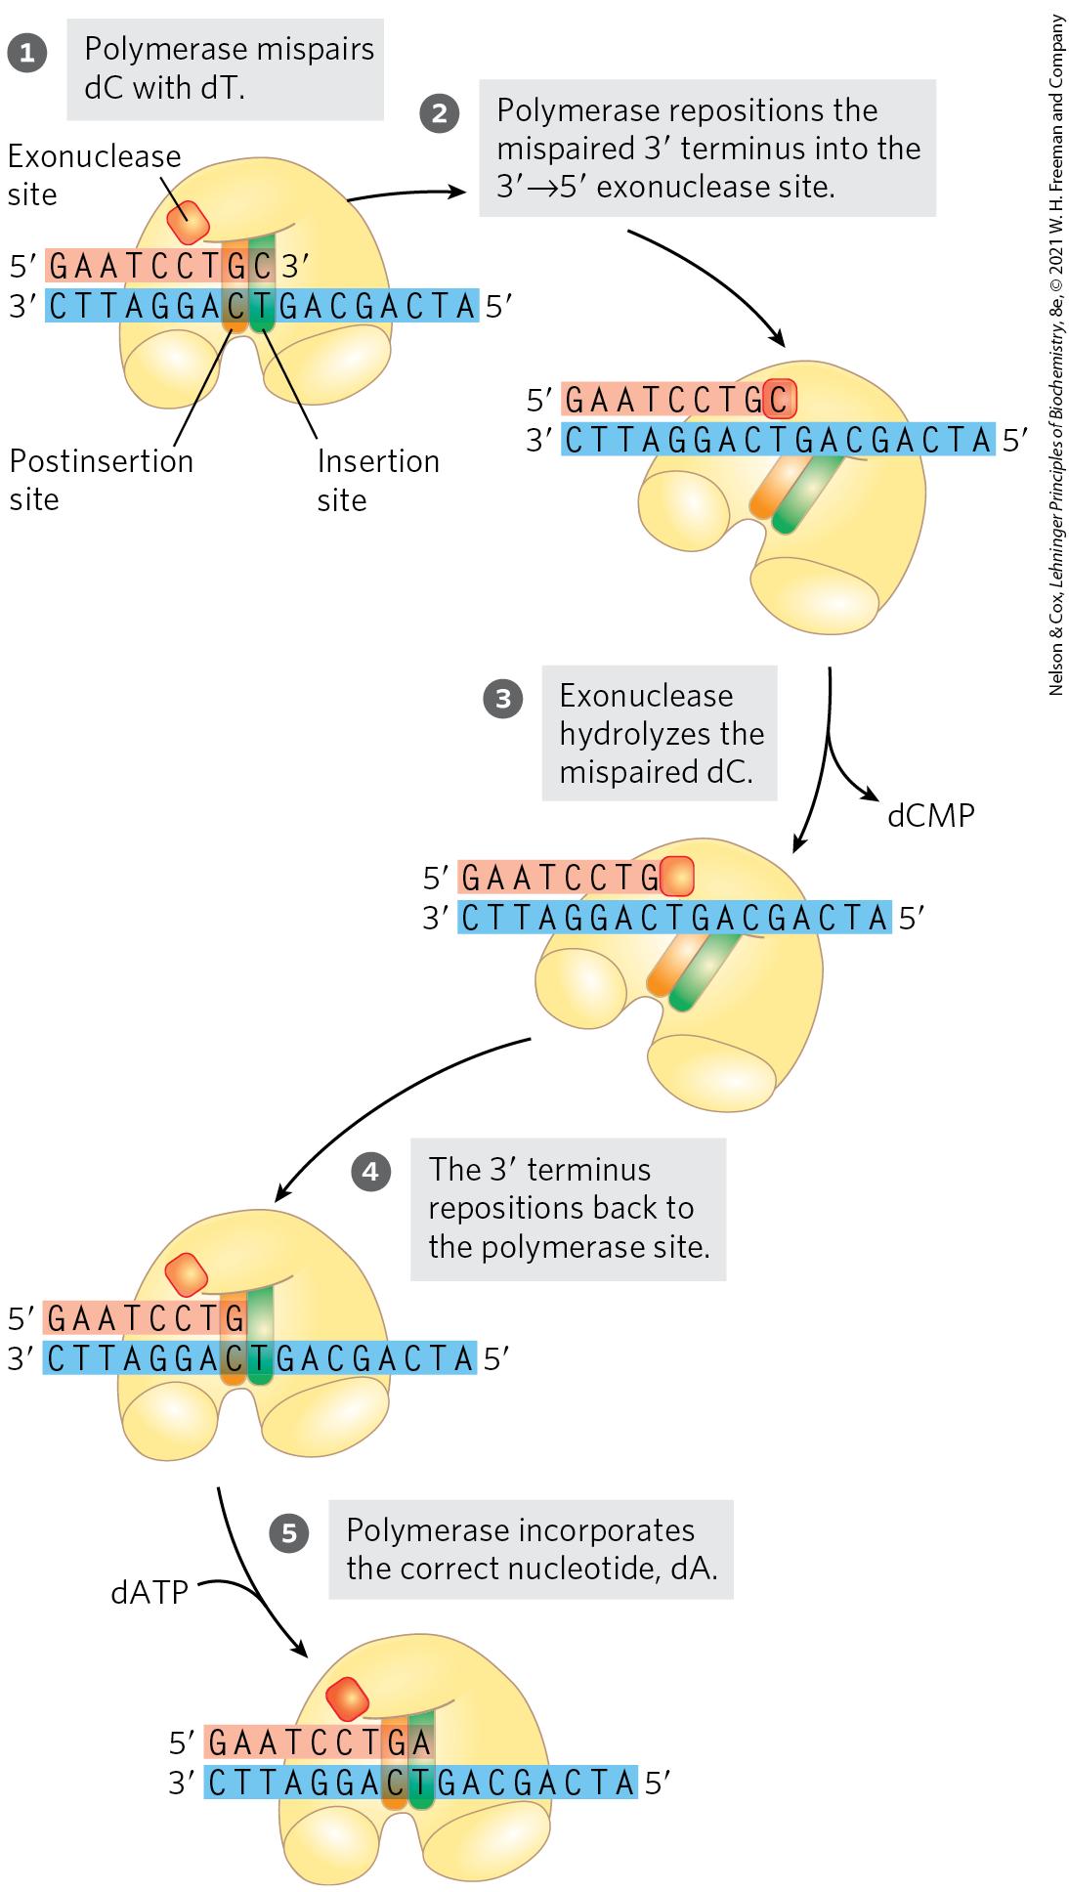
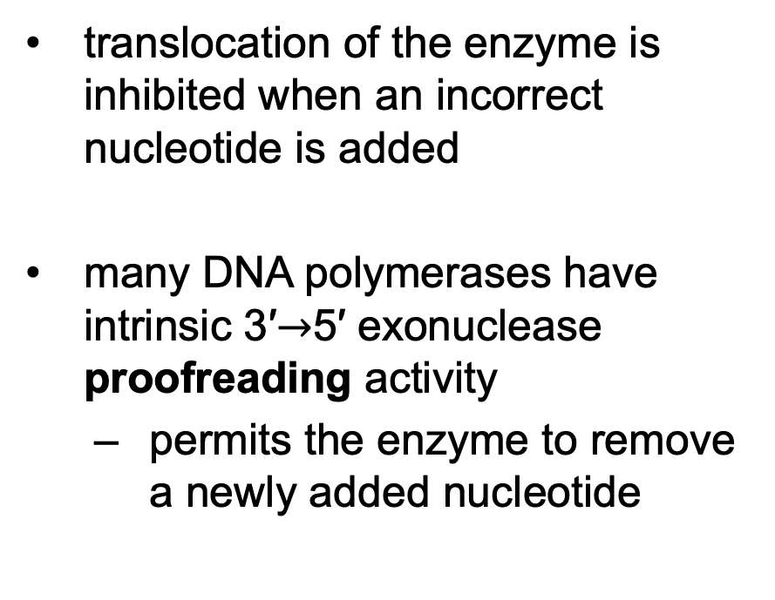
Error Correction by DNA
Polymerase I
translocation of the enzyme is inhibited when an incorrect nucleotide is added
many DNA polymerases have intrinsic 3′$→$5′ exonuclease proofreading activity
  permits the enzyme to remove a newly added nucleotide

Slide 30
Proofreading is Energetically Expensive
proofreading = DNA polymerase activity that involves replacement of the incorrect nucleotide
  requires the expenditure of three high-energy bonds

Slide 31
Accuracy After Base Selection and Proofreading
proofreading improves the accuracy 10² - to 10³-fold
one error in every 10⁶ to 10⁸ bases remains after base selection and proofreading
  the higher measured accuracy of E. coli replication comes from mismatch repair

Slide 32
E. Coli Has at Least Five
DNA Polymerases
DNA polymerase I is abundant, but insufficient for replication of the E. coli chromosome
  rate (600 nucleotides/min) is slower than observed for replication fork movement
  low processivity
the primary function of DNA polymerase I is cleanup during replication, recombination, and repair

Slide 33
DNA Polymerase II, III, IV, and V
DNA polymerase II = involved in DNA repair
DNA polymerase III = the principal replication enzyme in E. coli
DNA polymerases IV and V = involved in an unusual form of DNA repair

Slide 34
Comparison of the Five DNA Polymerases of E. coli
Table 25-1 Comparison of the Five DNA Polymerases of E.coli
 | DNA polymerase I | DNA polymerase II | DNA polymerase III | DNA polymerase IV | DNA polymerase V
Structural gene^{b} | polA | polB | polC (dnaE) | dinB | umuC
Subunits (number of different types) | 1 | 7 | 9 | 1 | 3
M_{r} | 103,000 | 88,000^{c} | 1,065,400 | 39,100 | 110,000
3′→5′ exonuclease (proofreading) | Yes | Yes | Yes | No | No
5′→3′ exonuclease | Yes | No | No | No | No
Polymerization rate (nucleotides/s) | 10–20 | 40 | 250–1,000 | 2–3 | 1
Processivity (nucleotides added before polymerase dissociates) | 3–200 | 1,500 | ≥500,000 | 1 | 6–8

Slide 35
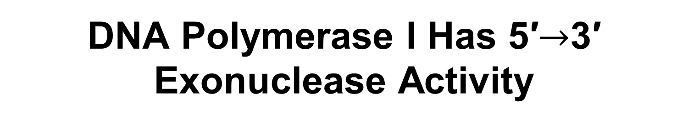
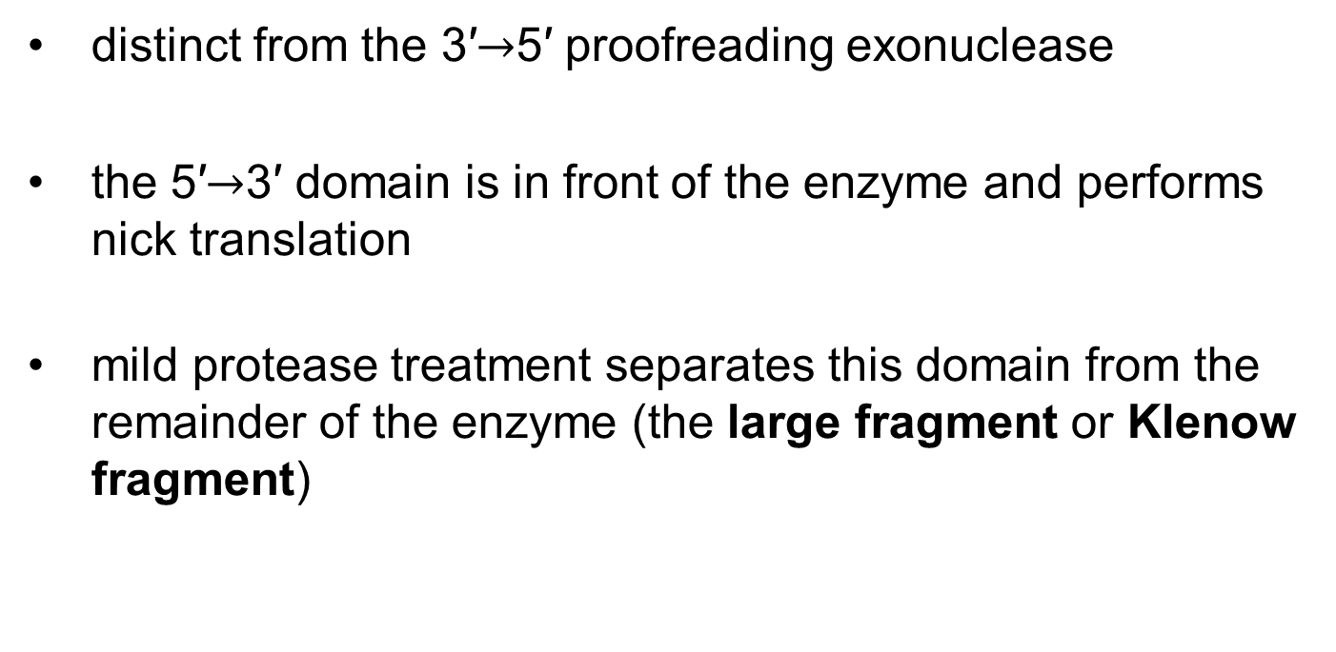
DNA Polymerase I Has 5′$→$3′ Exonuclease Activity
distinct from the 3′$→$5′ proofreading exonuclease
the 5′$→$3′ domain is in front of the enzyme and performs nick translation
mild protease treatment separates this domain from the remainder of the enzyme (the large fragment or Klenow fragment)

Slide 36
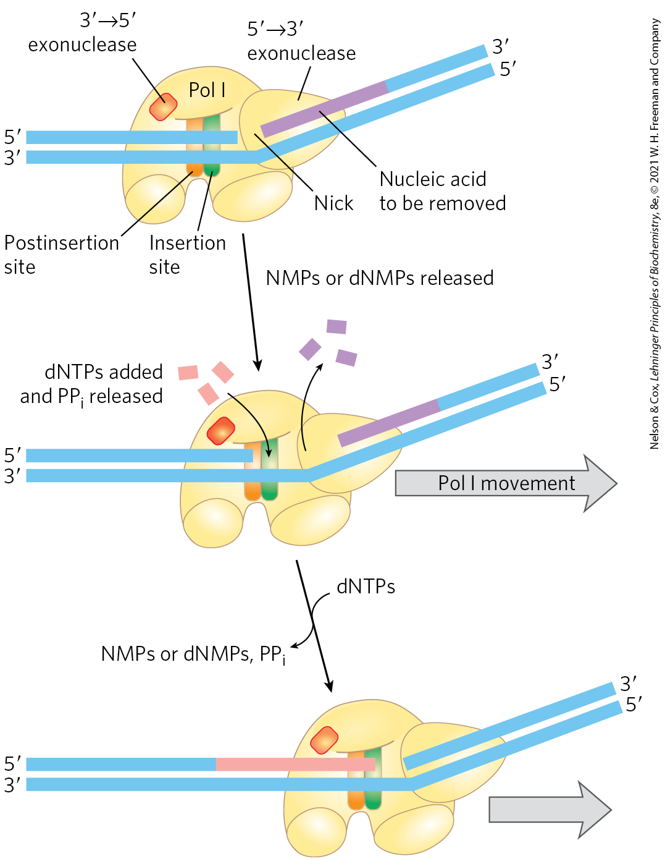
Nick Translation
nick translation = a break or nick in the DNA is moved along with the enzyme
important in:
  DNA repair
  the removal of RNA primers during replication

Slide 37
DNA Replication Requires Many
Enzymes and Protein Factors
DNA replicase system (replisome) = the entire complex of enzymes and proteins required for replication in E. coli
  consists of 20+ different enzymes and proteins

Slide 38
Main Classes of
Replication Enzymes
helicases = enzymes that move along the DNA and separate the strands
  requires chemical energy from ATP
topoisomerases = relieve topological stress created by strand separation
DNA-binding proteins = stabilize separated strands
primases = synthesize short segments of RNA to serve as primers

Slide 39
Main Classes of Replication Enzymes, Continued
DNA polymerase I = removes and replaces RNA primers
RNase H1 = a specialized nuclease that degrades RNA in RNA-DNA hybrids
  can remove RNA primers
DNA ligases = seals nicks in the DNA backbone following removal and replacement of an RNA primer

Slide 40
Replication of the E. coli Chromosome Proceeds in Stages
DNA synthesis can be divided into three stages:
  initiation
  elongation
  termination

Slide 41
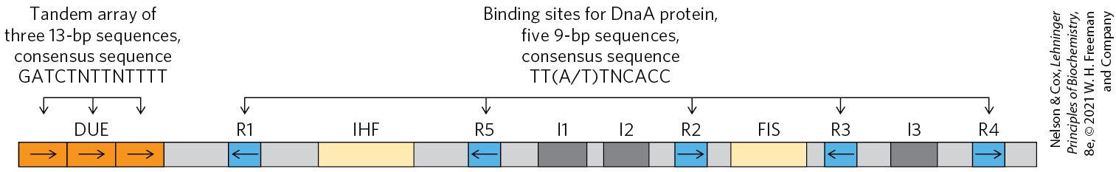
Initiation
the E. coli replication origin (oriC) consists of:
  five repeats of a 9 bp sequence (R sites) that serve as binding sites for the key initiator protein, DnaA
  the DNA unwinding element (DUE) = a region rich in A=T base pairs
  three additional DnaA-binding sites (I sites)
  binding sites for the proteins IHF (integration host factor) and FIS (factor for inversion stimulation)

Slide 42
Proteins Required to Initiation Replication at the E. coli Origin
Table 25-3 Proteins Required to Initiate Replication at the E.coli Origin
Protein | M_{r} | Number of subunits | Function
DnaA protein | 52,000 | 1 | Recognizes oriC sequence; opens duplex at specific sites in origin
DnaB protein (helicase) | 300,000 | 6 | Unwinds DNA
DnaC protein | 174,000 | 6 | Required for DnaB binding at origin
HU | 19,000 | 2 | Histonelike protein; DNA-binding protein; stimulates initiation
FIS | 22,500 | 2 | DNA-binding protein; stimulates initiation
IHF | 22,000 | 2 | DNA-binding protein; stimulates initiation
Primase (DnaG protein) | 60,000 | 1 | Synthesizes RNA primers
Single-stranded DNA–binding protein (SSB) | 75,600 | 4 | Binds single-stranded DNA
DNA gyrase (DNA topoisomerase II) | 400,000 | 4 | Relieves torsional strain generated by DNA unwinding
Dam methylase | 32,000 | 1 | Methylates (5′)GATC sequences at oriC

Slide 43
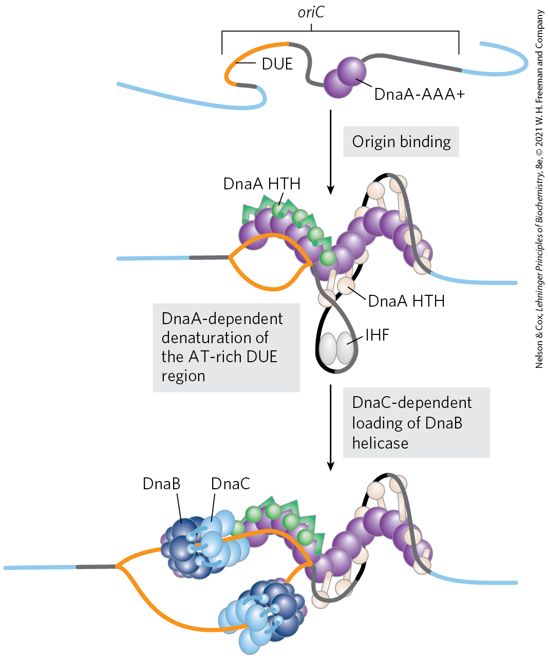
Model for Initiation of Replication

Slide 44
Initiation Occurs Only Once in Each Cell Cycle
Hda protein = an AAA+ ATPase that binds to the β subunits of DNA polymerase III and stimulates hydrolysis of the ATP bound to DnaA
  causes disassembly of the DnaA complex
  homologous to DnaA
release of ADP by DnaA and rebinding of ATP occurs on a time scale of 20 to 40 minutes

Slide 45
Regulation of Replication Initiation via Methylation
Dam (DNA adenine methylation) methylase = methylates the N⁶ position of adenine within the palindromic sequence (5′)GATC of oriC DNA
hemimethylated oriC sequences are sequestered by:
  interaction with the plasma membrane
  binding of the protein SeqA
after SeqA dissociation, oriC sequences are released from the membrane and Dam methylase fully methylates DNA to allow new DnaA to bind

Slide 46
Elongation
elongation includes:
  leading strand synthesis
  lagging strand synthesis

Slide 47
Elongation of the Leading Strand
the more straightforward of the two strands
primase (DnaG) synthesizes a short (10 to 60 nucleotide) RNA primer at the replication origin
  requires interaction with DnaB helicase
  primase and DnaB move in opposite directions
DNA polymerase III adds nucleotides to the 3′ of the primer
  linked to the DnaB tethered to the opposite DNA strand

Slide 48
Elongation of the Lagging Strand
accomplished in short Okazaki fragments
as in leading strand synthesis, primase synthesizes an RNA primer and DNA Pol III adds nucleotides to the 3′ end
DNA of the lagging strand loops around so one asymmetric DNA Pol III dimer complex can synthesize both strands

Slide 49
Leading and Lagging Strand Synthesis by DNA Polymerase III
DNA polymerase III uses one set of its core subunits to synthesize the leading strand continuously
the other two sets of core subunits cycle from one Okazaki fragment to the next on the looped lagging strand

Slide 50
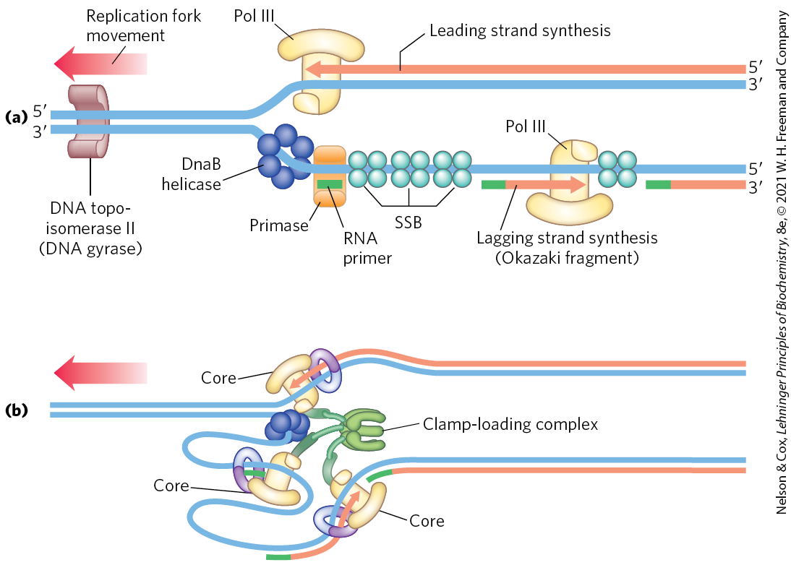
Synthesis of Okazaki Fragments

Slide 51
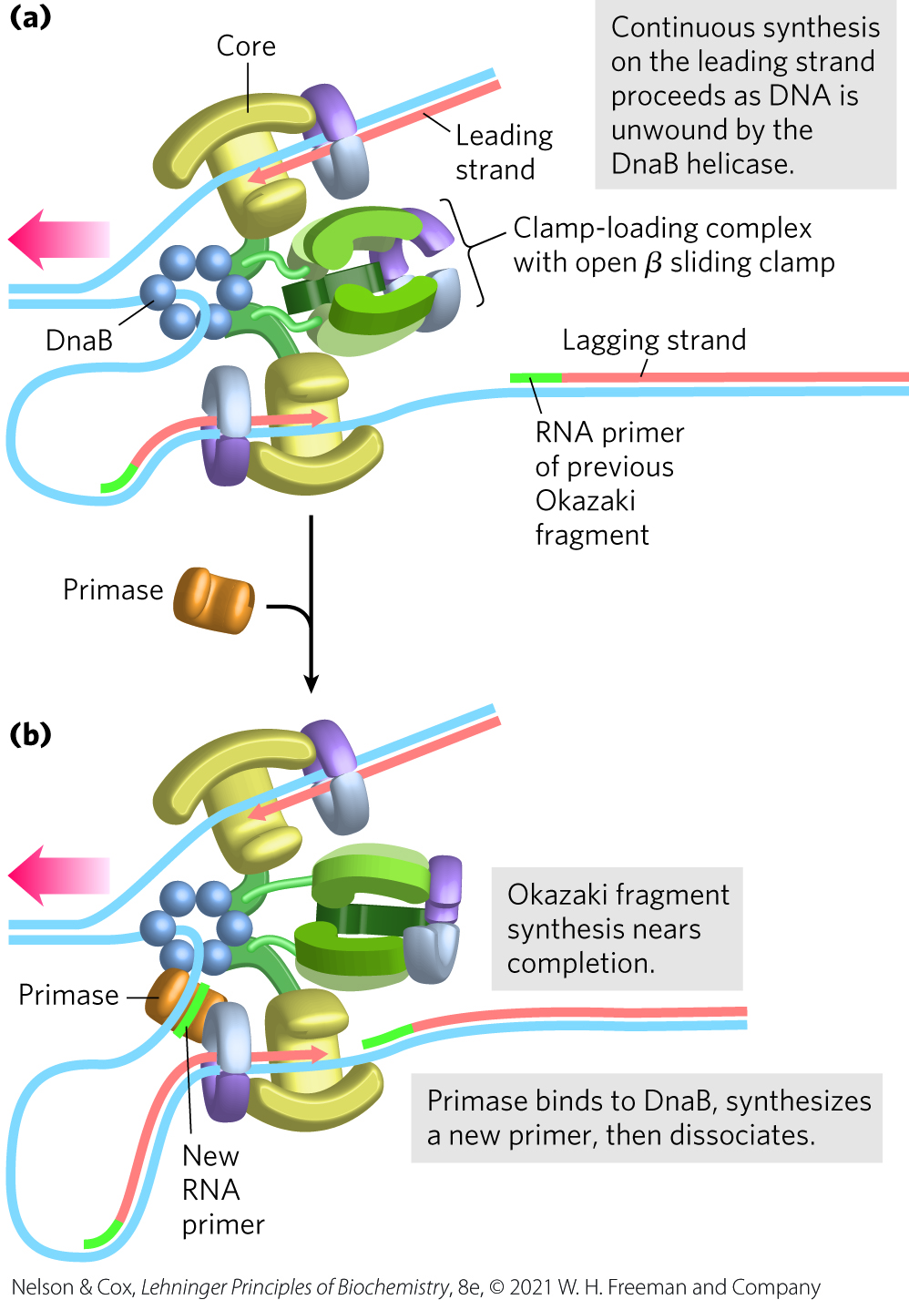
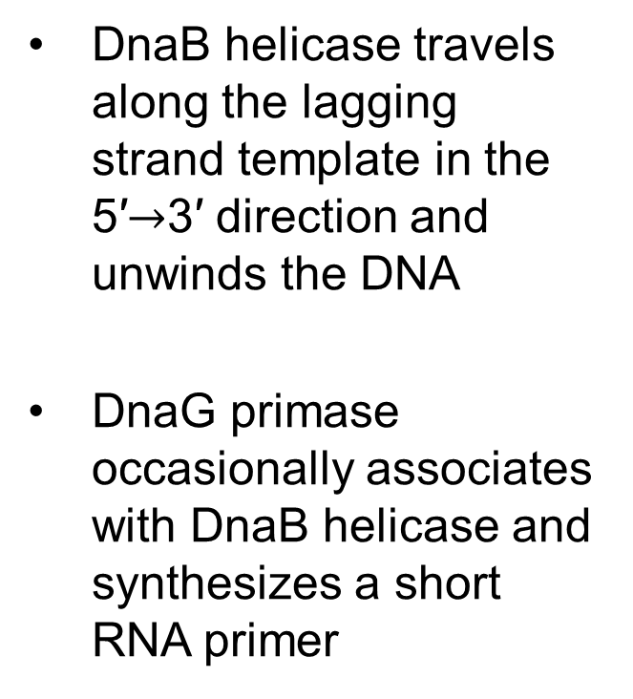
Leading and Lagging Strand Synthesis, Part 1
DnaB helicase travels along the lagging strand template in the 5′$→$3′ direction and unwinds the DNA
DnaG primase occasionally associates with DnaB helicase and synthesizes a short RNA primer

Slide 52
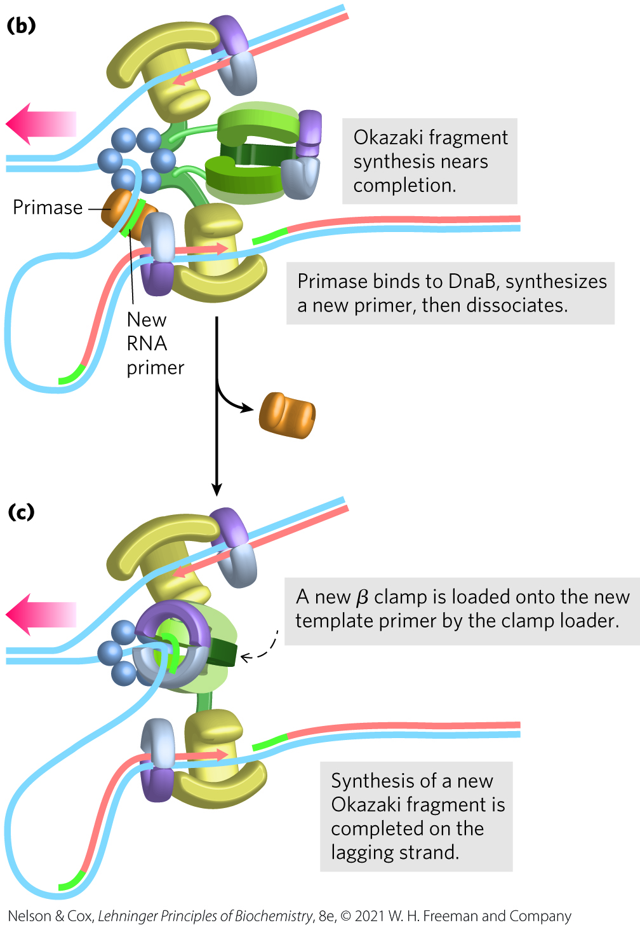
Leading and Lagging Strand Synthesis, Part 2
a new β sliding clamp is positioned at the primer by the clamp-loading complex of DNA polymerase III

Slide 53
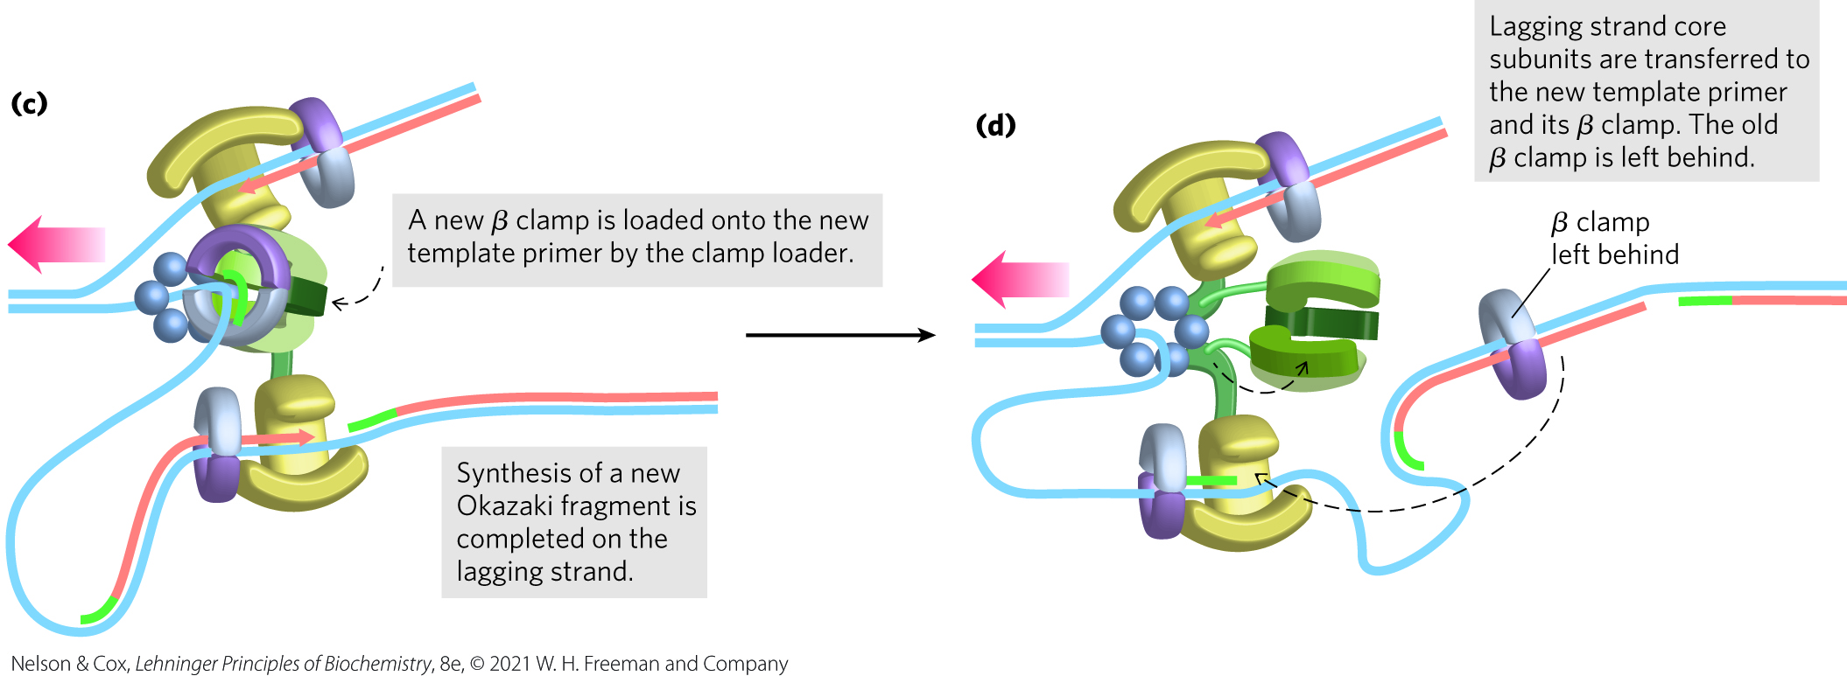
Leading and Lagging Strand Synthesis, Part 3
replication halts after synthesis of an Okazaki fragment is completed and DNA polymerase III core subunits dissociate from the β sliding clamp

Slide 54
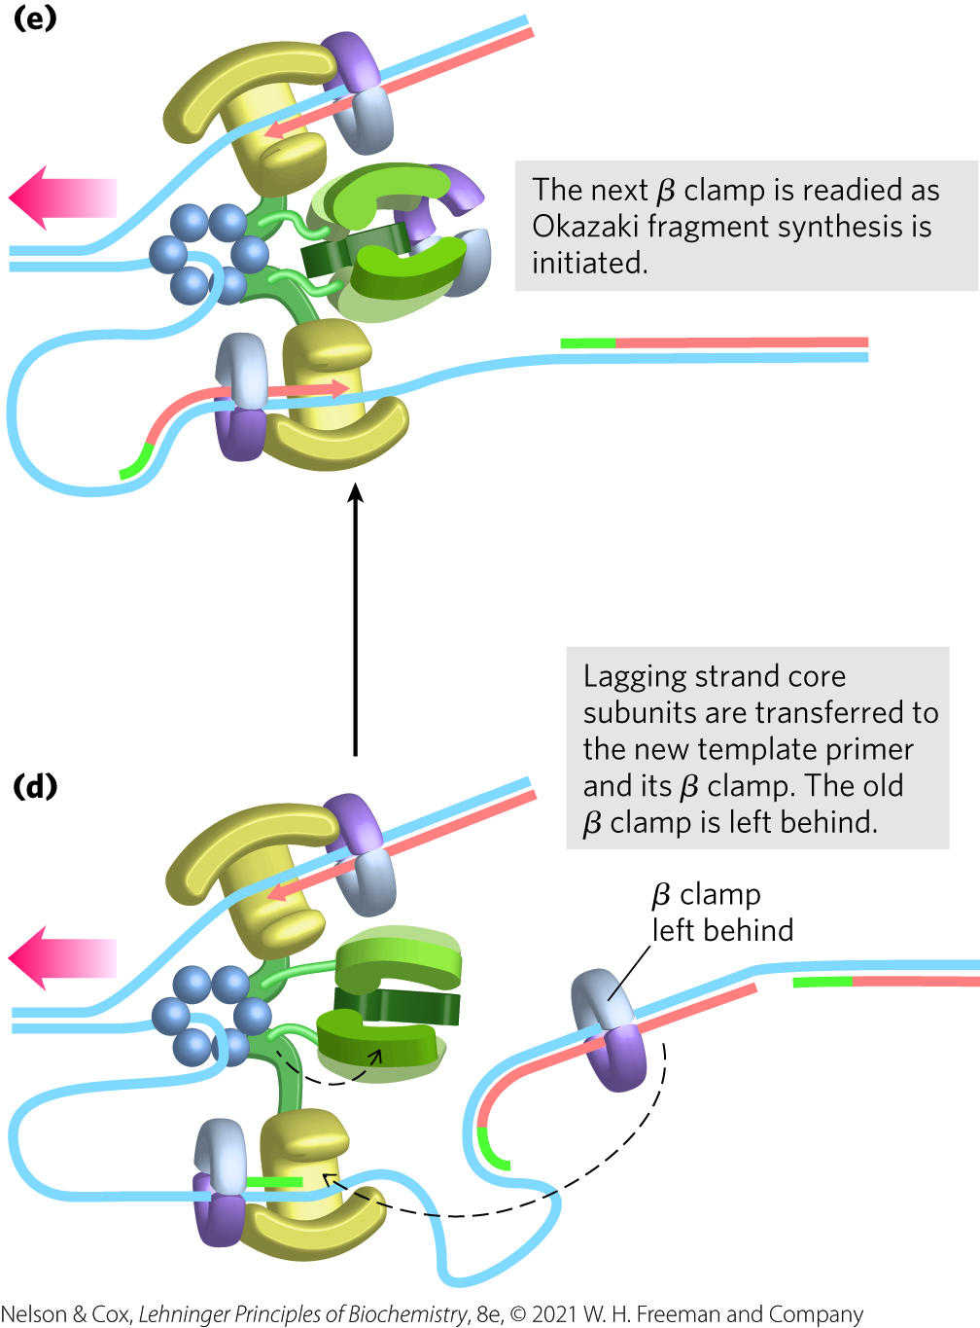
Leading and Lagging Strand Synthesis, Part 4
DNA polymerase III core subunits associate with a new β sliding clamp
  initiates synthesis of a new Okazaki fragment

Slide 55
Proteins Acting at the
Replication Fork
Table 25-4 Proteins of the E.coli Replisome
Protein | M_{r} | Number of subunits | Function
SSB | 75,600 | 4 | Binding to single-stranded DNA
Helicase (DnaB protein) | 300,000 | 6 | DNA unwinding
Primase (DnaG protein) | 60,000 | 1 | RNA primer synthesis
DNA polymerase III | 1,065,400 | 17 | New strand elongation
DNA polymerase I | 103,000 | 1 | Filling of gaps; excision of primers
DNA ligase | 74,000 | 1 | Ligation
DNA gyrase (DNA topoisomerase II) | 400,000 | 4 | Supercoiling

Slide 56
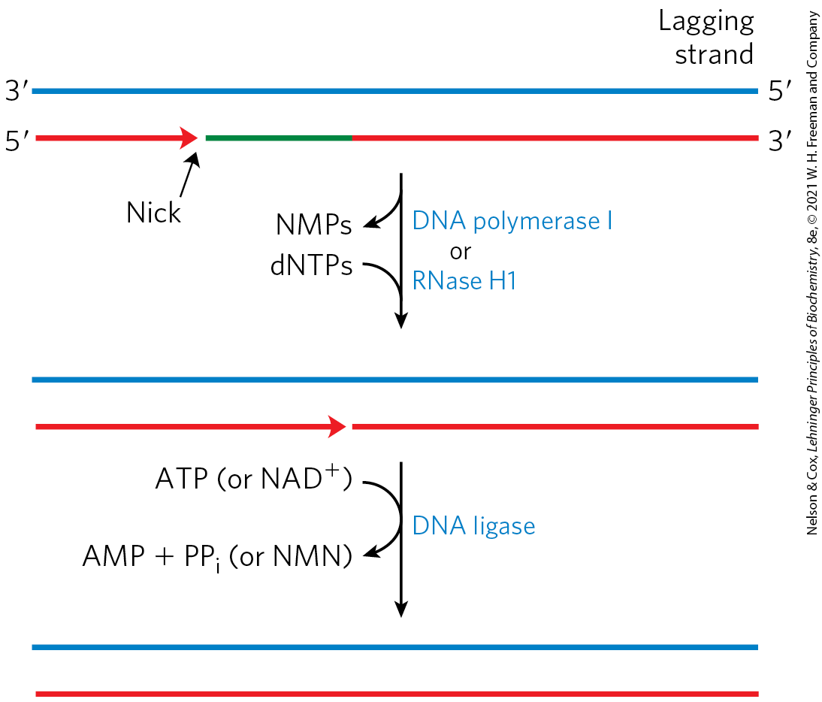
The Final Steps in Lagging Strand Synthesis
DNA polymerase I or RNase H1 = removes the RNA primer and replaces it with DNA
DNA ligase = seals the remaining nick

Slide 57
DNA Ligase
DNA ligase = catalyzes the formation of a phosphodiester bond between a 3′-OH at the end of one DNA strand and a 5′ phosphate at the end of another strand
  the phosphate must be activated by adenylylation using ATP (virus and eukaryotes) or NAD⁺ (bacteria)

Slide 58
Termination
replication forks meet at a region with multiple copies of a 20-bp sequence called Ter
Ter sequences are found near each other, but in opposite directions
  creates a site that replication forks cannot leave
Ter is also a binding site for the protein Tus (terminus utilization sequence)
  causes a replication fork to stop

Slide 59
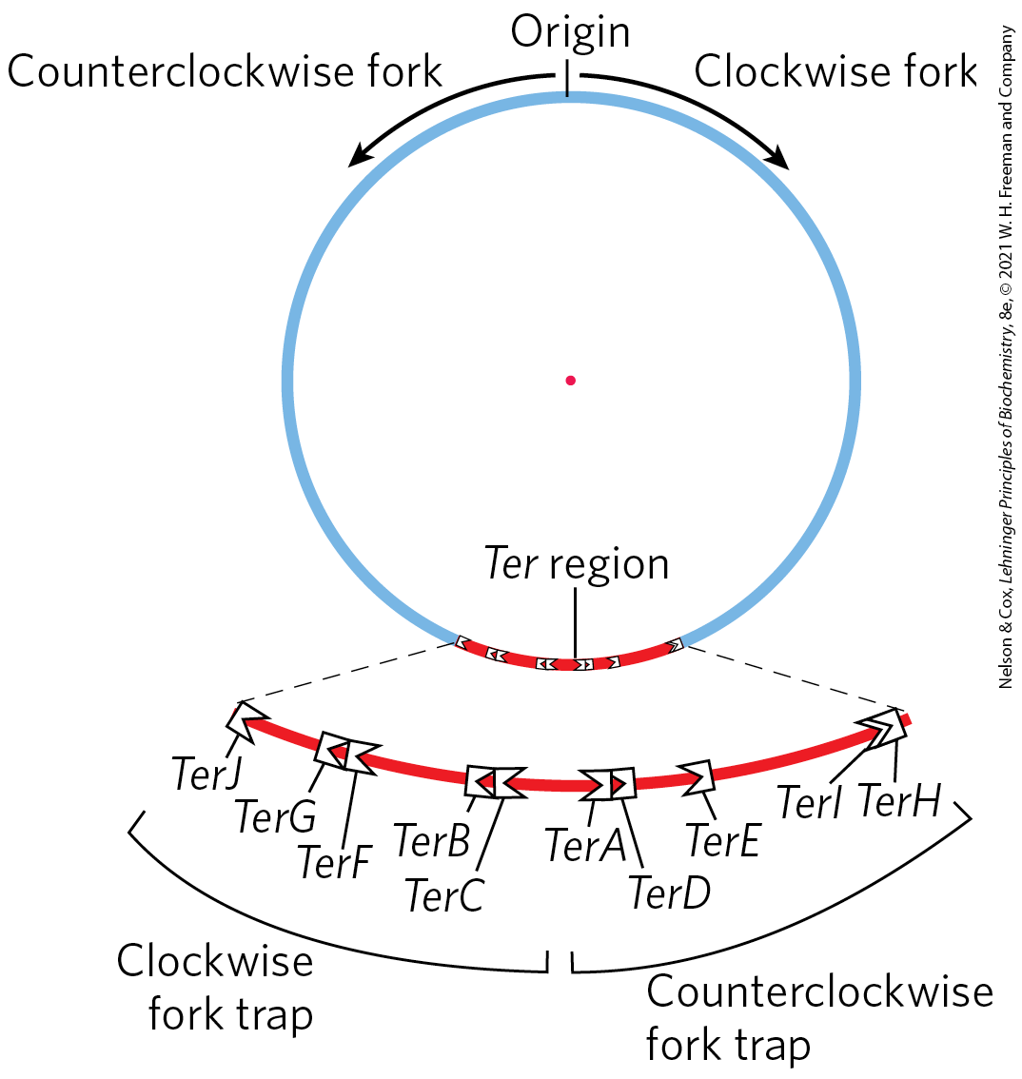
Termination of Chromosome Replication in E. coli
only one Tus-Ter complex functions per replication cycle

Slide 60
Replication in Eukaryotic Cells Is Similar but More Complex
replicators = yeast (S. cerevisiae) replication origins
  also called autonomously replicating sequences (ARSs)
  yeast have ~400 replicators
  each spans ∼150 bp and contains several essential, conserved sequences
human chromosomes have ~30,000 to 50,000 replication origins

Slide 61
Regulation Ensures Cellular DNA Is Replicated Once Per Cell Cycle
regulation involves cyclins and the cyclin-dependent kinases (CDKs)
  cyclins undergo ubiquitin-dependent proteolysis at the end of the M phase (mitosis)
prereplicative complexes (pre-RCs) = established on replication initiation sites in the absence of cyclins
  their formation (sometimes called licensing) renders the cell competent for replication

Slide 62
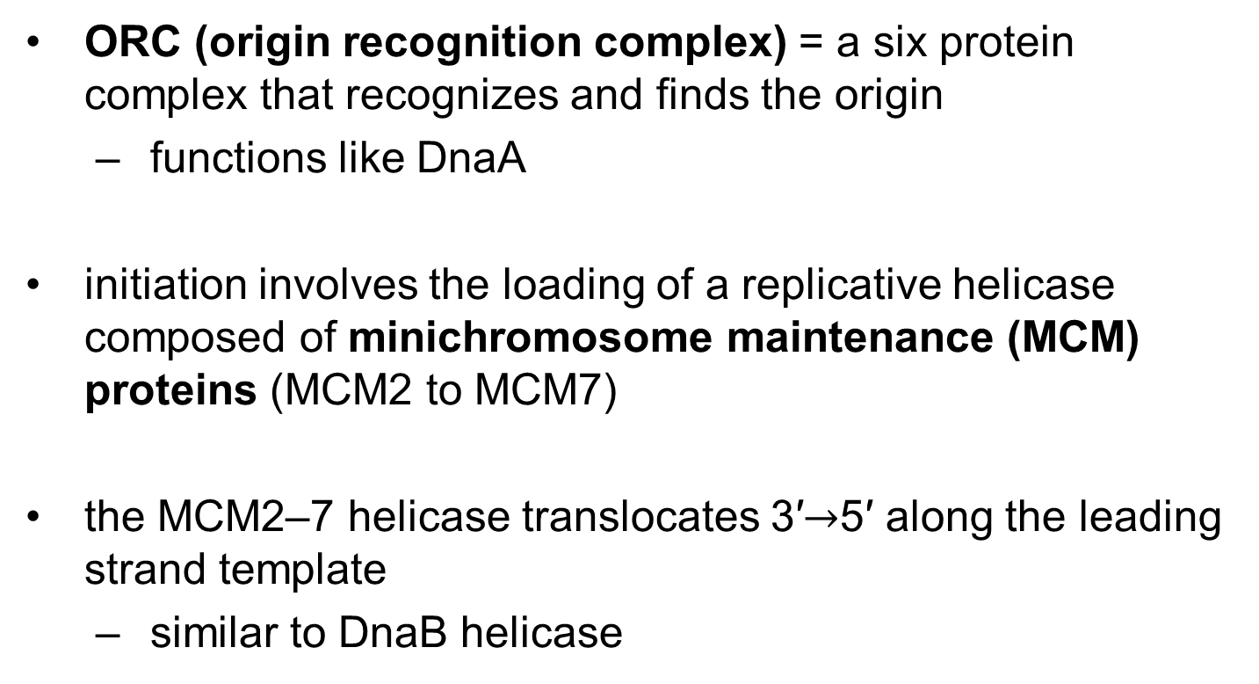
Initiation of Replication in Eukaryotes
ORC (origin recognition complex) = a six protein complex that recognizes and finds the origin
  functions like DnaA
initiation involves the loading of a replicative helicase composed of minichromosome maintenance (MCM) proteins (MCM2 to MCM7)
the MCM2–7 helicase translocates 3′$→$5′ along the leading strand template
  similar to DnaB helicase

Slide 63
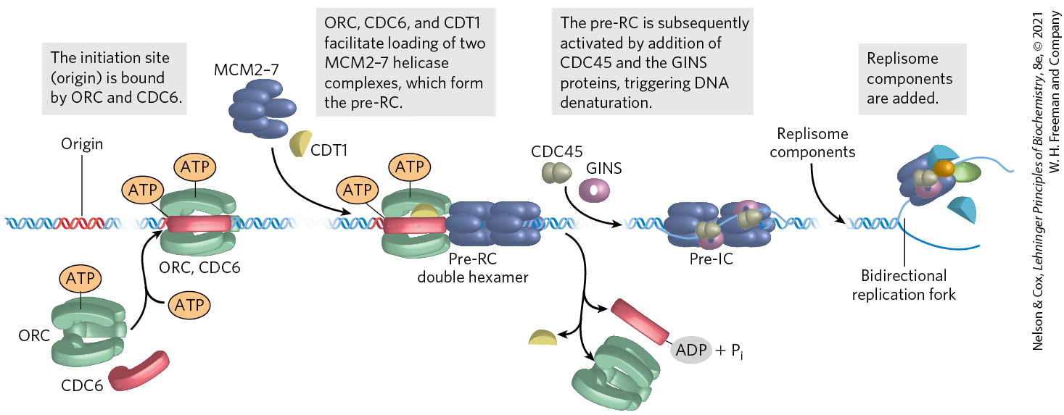
Assembly of a Prereplicative Complex at a Eukaryotic Replication Origin

Slide 64
Eukaryotic Rate of Replication
the replication fork moves ~50 nucleotides/second
  ~1/20th the rate seen in E. coli
eukaryotes compensate for the slower rate by having many origins

Slide 65
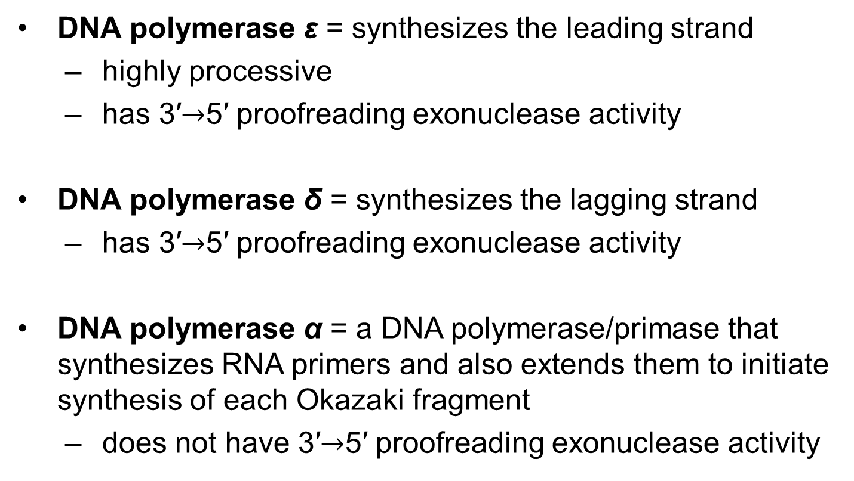
Eukaryotes Have Several Types of DNA Polymerases
DNA polymerase ε = synthesizes the leading strand
  highly processive
  has 3′$→$5′ proofreading exonuclease activity
DNA polymerase δ = synthesizes the lagging strand
  has 3′$→$5′ proofreading exonuclease activity
DNA polymerase α = a DNA polymerase/primase that synthesizes RNA primers and also extends them to initiate synthesis of each Okazaki fragment
  does not have 3′$→$5′ proofreading exonuclease activity

Slide 66
Function of PCNA
proliferating cell nuclear antigen (PCNA) = a protein that forms a circular clamp to enhance the processivity of two polymerases
  analogous function to the β subunit

Slide 67
Functions of RPA and RFC
RPA (replication protein A) = single-stranded DNA-binding protein
  equivalent in function to the E. coli SSB protein
RFC (replication factor C) = a clamp loader for PCNA that facilitates the assembly of active replication complexes
  significant sequence similarity to the subunits of the bacterial clamp-loading (γ) complex

Slide 68
Termination of
Eukaryotic Replication
termination occurs when replication forks operating from nearby origins converge

Slide 69
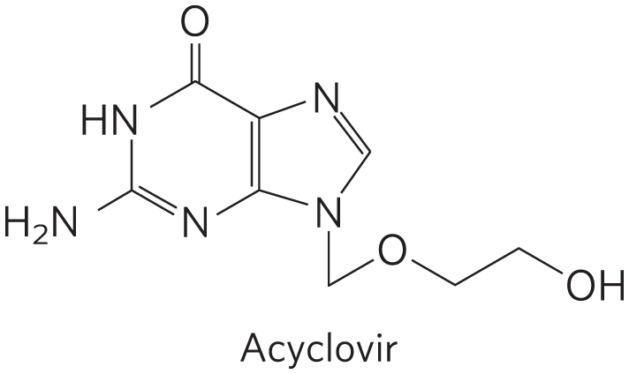
Viral DNA Polymerases Provide Targets for Antiviral Therapy
acyclovir = inhibits the DNA polymerase of the herpes simplex virus
  converted to acyclo-GTP
acyclo-GTP competitively inhibits viral DNA polymerases and terminates replication

Slide 70
25.2 DNA Repair

Slide 71
DNA Molecules Are Irreplaceable
damaged proteins and RNA molecules can be replaced using information encoded in the DNA
DNA molecules themselves are irreplaceable

Slide 72
Mutations Are Linked to Cancer
mutation = a permanent change in the nucleotide sequence
  substitution mutation = replacement of one base pair with another
  insertion mutation = the addition of 1+ base pairs
  deletion mutation = the deletion of 1+ base pairs
silent mutation = a mutation that affects nonessential DNA or has a negligible effect on gene function

Slide 73
Mutations Are
Rarely Advantageous
mutations rarely confer some biological advantage
most nonsilent mutations are neutral or deleterious

Slide 74
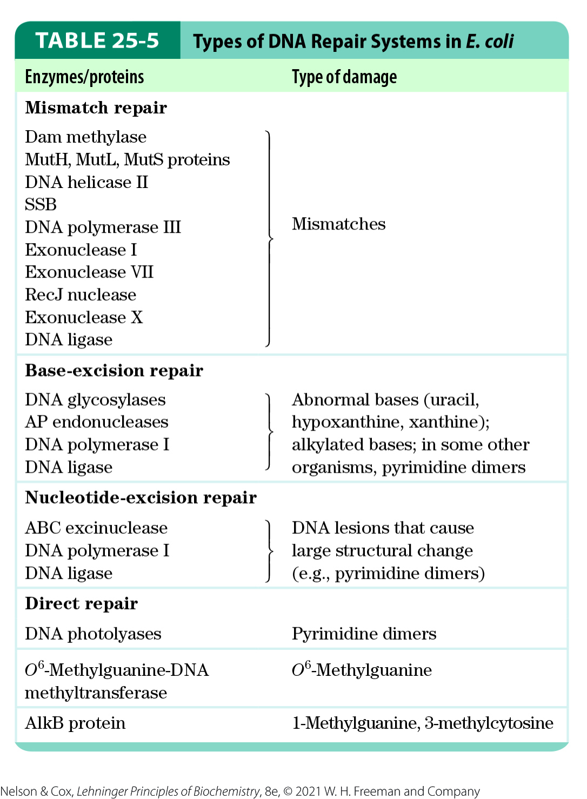
All Cells Have Multiple DNA
Repair Systems
nearly 200 genes in the human genome encode proteins dedicated to DNA repair

Slide 75
DNA Repair Seems
Energetically Inefficient
many DNA repair processes seem to be extraordinarily inefficient energetically
  irrelevant because the integrity of the genetic information is more important

Slide 76
Mismatch Repair
mismatches are corrected to reflect template strand information
  distinguished from the newly synthesized strand by the presence of methyl group tags on the template DNA
in E. coli, Dam methylase methylates DNA at the N⁶ position of adenines within (5′)GATC sequences

Slide 77
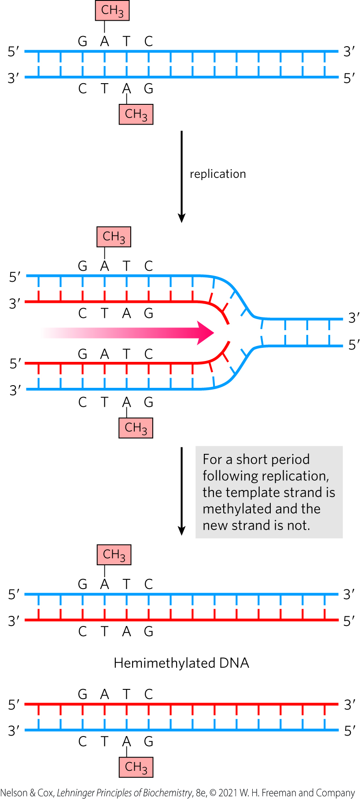
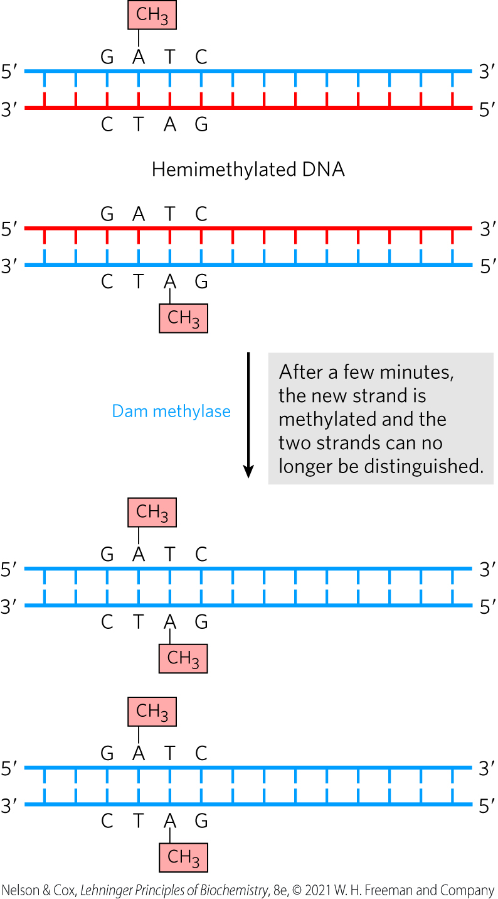
Methylation and Mismatch Repair

Slide 78
Energy Cost of Mismatch Repair
mismatch repair is particularly costly for E. coli
mismatches may occur 1,000+ base pairs from the GATC sequence
  repair requires degradation and replacement of a strand segment of this entire length

Slide 79
Eukaryotic Mismatch Repair Systems
several proteins are structurally and functionally analogous to the bacterial MutS and MutL proteins
many details of eukaryotic mismatch repair are unknown
identification of newly synthesized DNA strands does not involve GATC sequences

Slide 80
Base-Excision Repair
DNA glycosylases = recognize common DNA lesions and remove the affected base by cleaving the N-glycosyl bond in the process of base-excision repair
  generally specific for one lesion type
AP site or abasic site = an apurinic or apyrimidinic site in the DNA resulting from removal of a base by DNA glycosylase

Slide 81
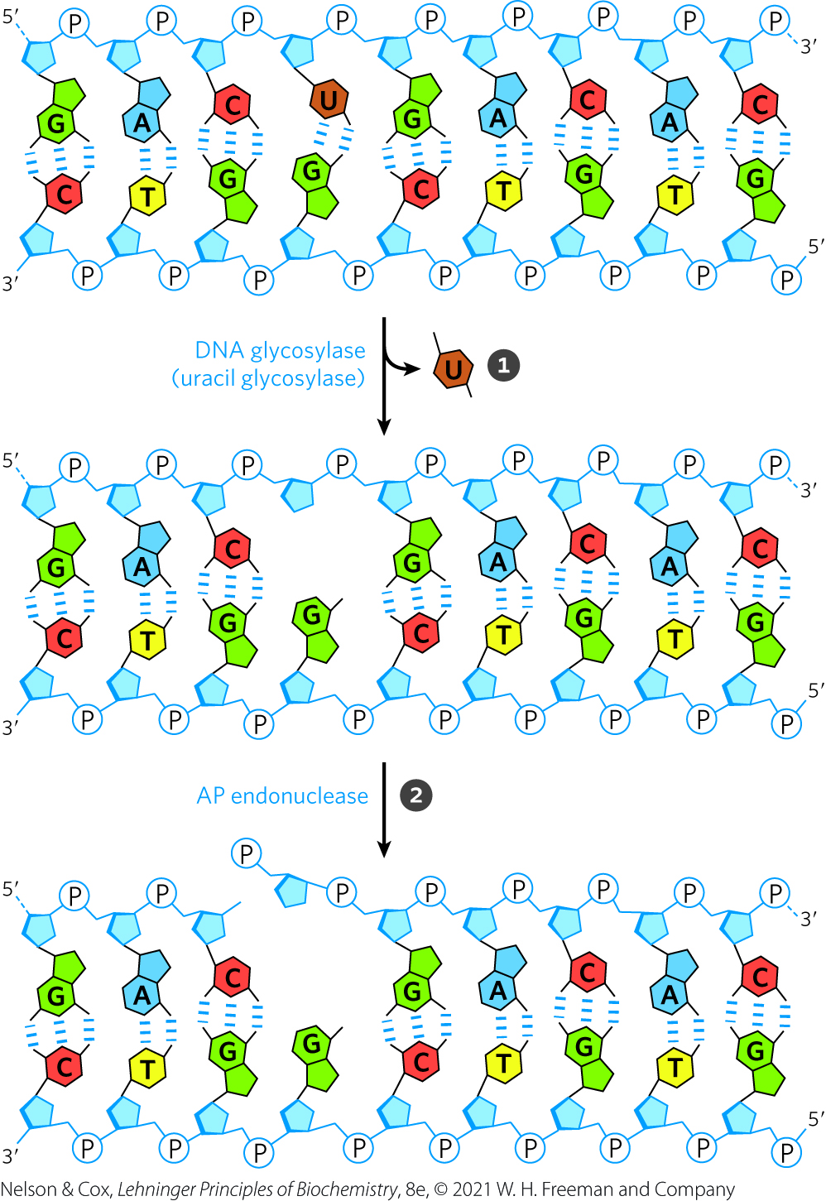
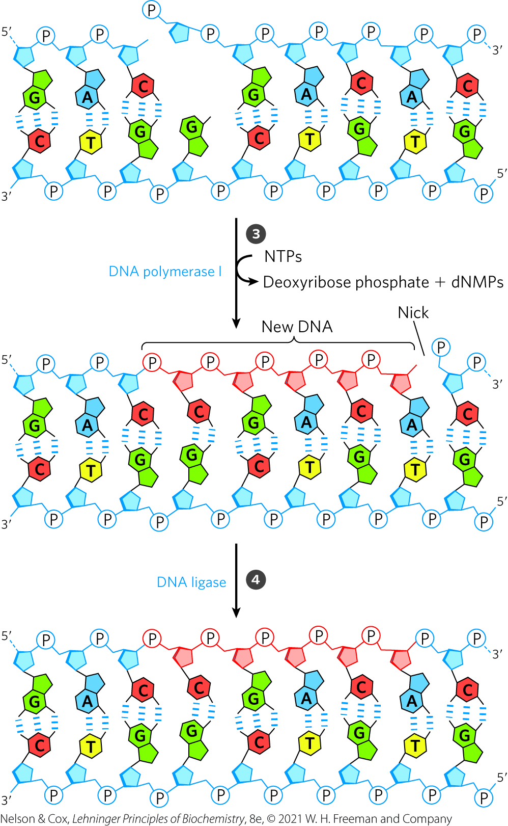
DNA Repair by the Base-Excision Repair Pathway

Slide 82
Nucleotide-Excision Repair
nucleotide-excision system = repairs DNA lesions that cause large distortions in the DNA helical structure
excinuclease = a multisubunit enzyme that hydrolyzes two phosphodiester bonds, one on either side of the distortion
DNA polymerase I (E. coli) or DNA polymerase ε (humans) fills the gap
DNA ligase seals the nick

Slide 83
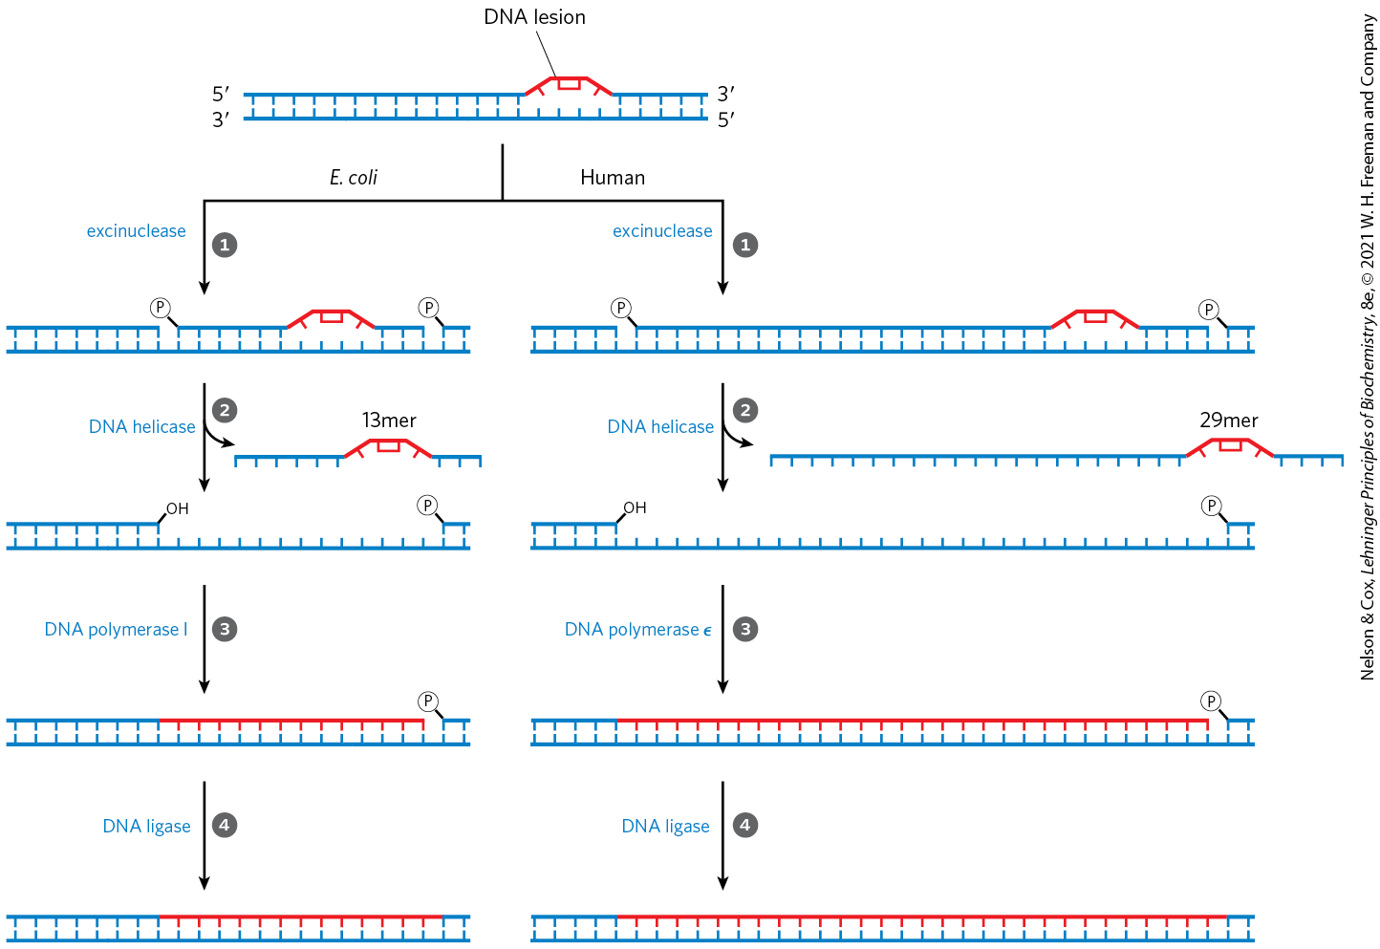
Nucleotide-Excision Repair in E. coli and Humans

Slide 84
Eukaryotic Excinuclease
similar mechanism to that of the bacterial enzyme
requires 16+ polypeptides with no similarity to the E. coli excinuclease subunits
hydrolyzes the sixth phosphodiester bond on the 3′ side and the twenty-second phosphodiester bond on the 5′ side
  produces a fragment of 27 to 29 nucleotides

Slide 85
Direct Repair
pyrimidine dimers result from a UV-induced reaction
DNA photolyases = promote direct photoreactivation of cyclobutane pyrimidine dimers
  use energy from absorbed light
  generally contain two cofactors: FADH₂ and folate

Slide 86
25.3 DNA Recombination

Slide 87
Three Classes of Genetic Recombination Events
homologous genetic recombination = involves genetic exchanges between any two DNAs that share an extended region of nearly identical sequence
site-specific recombination = involves genetic exchanges only at a particular DNA sequence
DNA transposition = involves a short segment of DNA with the capacity to move from one location in a chromosome to another (“jumping genes”)

Slide 88
Bacterial Homologous Recombination Is a DNA Repair Function
recombinational DNA repair = homologous genetic recombination as a DNA repair process
  typically directed at the reconstruction of stalled or collapsed replication forks

Slide 89
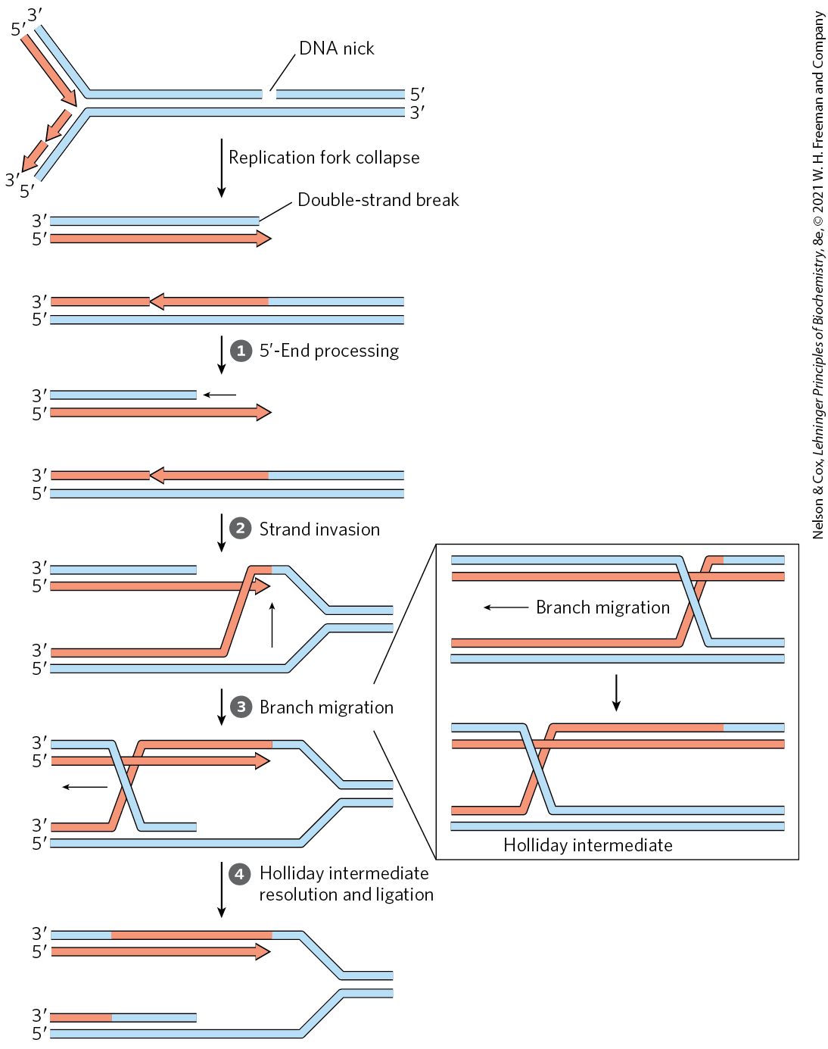
Recombinational DNA Repair

