Slide 1

24 Genes and Chromosomes
© 2021 Macmillan Learning

Slide 2
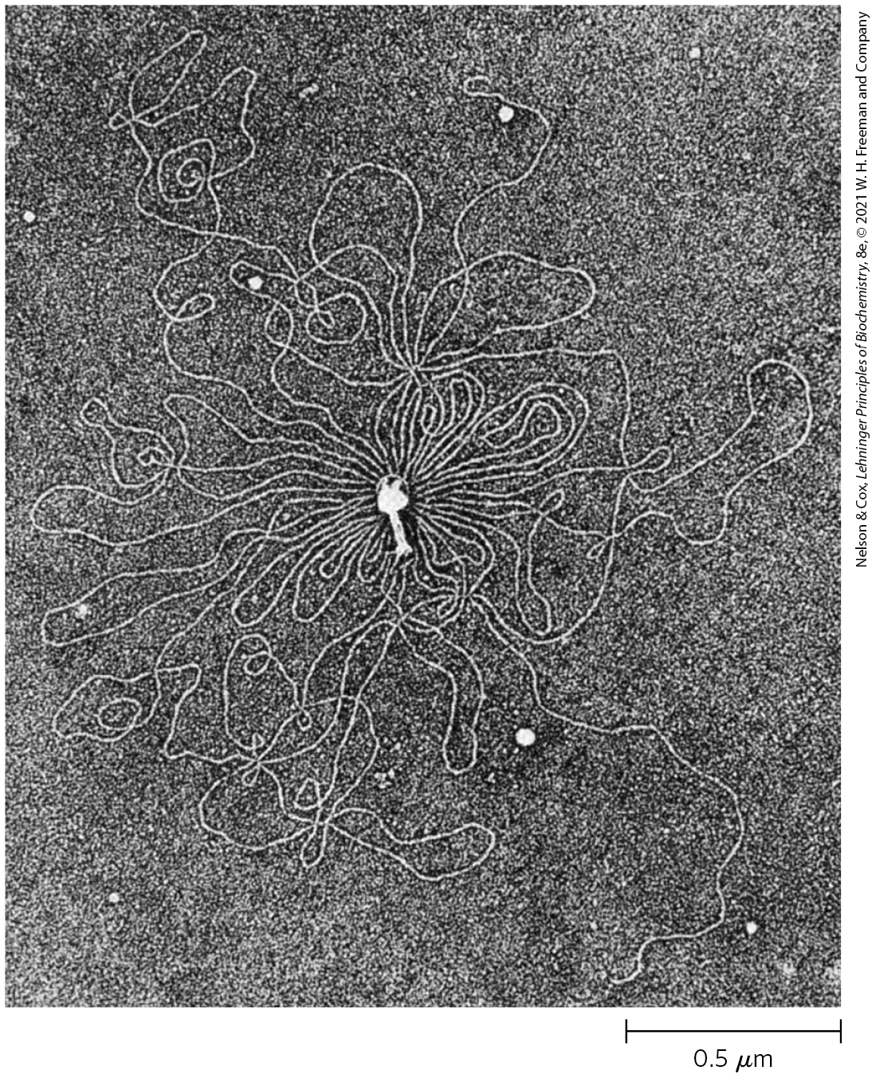
Chromosomes
chromosomes = tertiary packaging of DNA
  serve as repositories of genetic information

Slide 3

Principle 1 (1 of 4)
Chromosomes include dedicated sequences that ensure their replication, transcription, packaging, and transmission from one generation to the next. They are more than a long stretch of protein-encoding genes.

Slide 4

Principle 2 (1 of 6)
Chromosomes are large. To constrain them in a small space can require multiple layers and multiple modes of tertiary structure.

Slide 5

Principle 3 (1 of 7)
Chromosomes in all cells are maintained in a state of torsional stress. DNA is underwound relative to the stable B-form structure, facilitating both the packaging of DNA and access to the genetic information contained within it.

Slide 6

Principle 4 (1 of 7)
Specialized proteins and RNAs maintain chromosome structure. Topoisomerases control DNA underwinding. Histones, condensins, cohesins, and other DNA-binding proteins provide scaffolds to organize chromosome structure. Certain long, noncoding RNAs also play important roles in chromosome structure and function.

Slide 7
24.1 Chromosomal Elements

Slide 8
Genes Are Segments of DNA That Code for Polypeptide Chains and RNAs
phenotype = visible property
classically, a gene was defined as a portion of a chromosome that determines or affects a single phenotype

Slide 9
Molecular Definitions of a Gene
mutations = alterations in DNA sequence
experiments by Beadle and Tatum found that mutant fungal strains lacked one or another specific enzyme
the one gene-one enzyme hypothesis = a gene is a segment of genetic material that determines, or codes for, one enzyme
  later broadened to one gene-one polypeptide hypothesis

Slide 10
The Modern Biochemical Definition of a Gene
gene = all the DNA that encodes the primary sequence of some final gene product (polypeptide or RNA with a structural or catalytic function)

Slide 11
Regulatory Sequences
regulatory sequences = segments of sequences of DNA that have a purely regulatory function
functions of regulatory sequences:
  denote the beginning or the end of genes
  influence the transcription of genes
  initiation points for replication or recombination

Slide 12
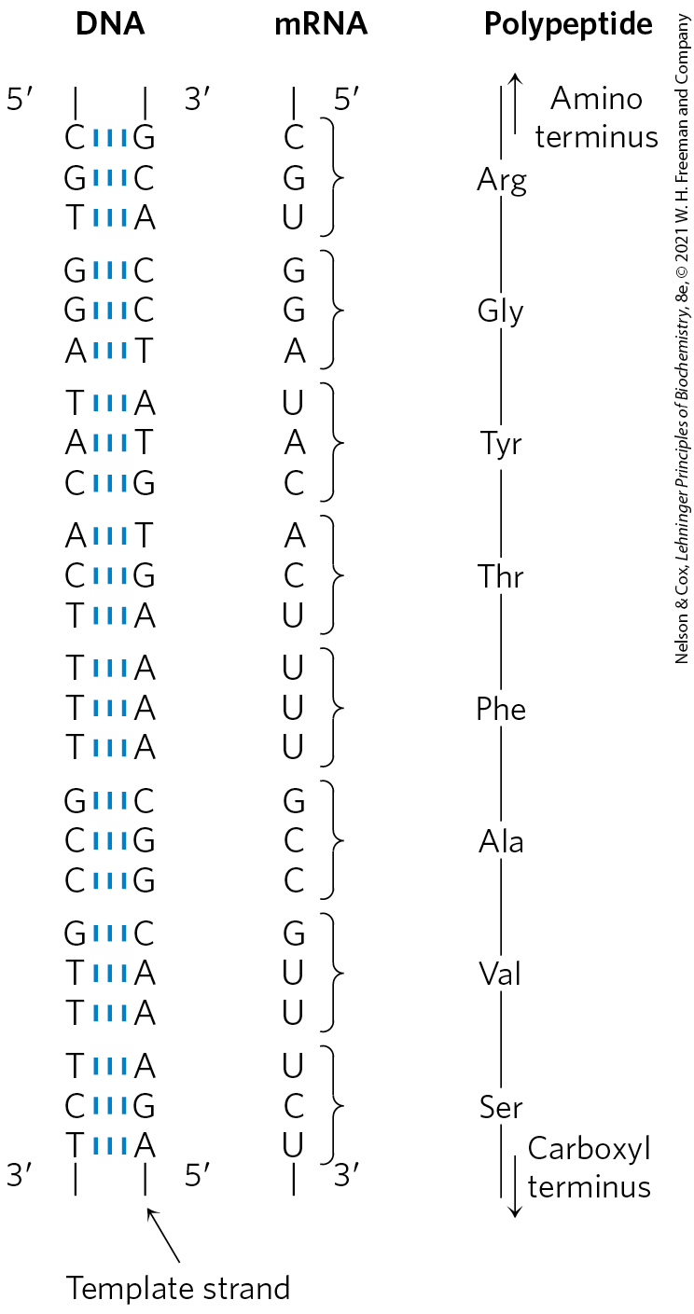
Colinearity of DNA, mRNA, and Protein
each amino acid of a polypeptide chain is coded for by three consecutive nucleotides in a single strand of DNA (“codon”)
a polypeptide chain of 350 amino acid residues (an average-size chain) corresponds to 1,050 base pairs (bp) of coding DNA

Slide 13
Number of Genes in a Single Chromosome
the Escherichia coli chromosome is a circular DNA molecule with 4,641,652 bp
  encodes ~4,300 genes for proteins and >200 genes for structural or catalytic RNAs
the human genome is ~3.1 billion bp
  encodes approximately 20,000 genes across 24 different chromosomes

Slide 14
DNA Molecules Are Much Longer than the Cellular or Viral Packages That Contain Them
chromosomal DNAs are many orders of magnitude longer than the cells or viruses in which they are located
Table 24-1 The Sizes of DNA and Viral Particles for Some Bacteria Viruses (Bacteriophages)
Virus | Size of viral DNA (bp) | Length of viral DNA (nm) | Long dimension of viral particles (nm)
φX174 | 5,386 | 1,939 | 25
T7 | 39,936 | 14,377 | 78
λ (lambda) | 48,502 | 17,460 | 190
T4 | 168,889 | 60,800 | 210

Slide 15
Viruses
viruses = infectious parasites that use resources of a host cell to carry out processes required to propagate
  many consist of just a single RNA or DNA molecule and a protein coat

Slide 16
RNA and DNA Viruses
almost all plant viruses and some bacterial and animal viruses have RNA genomes
  tend to be particularly small
DNA viral genomes vary greatly in size and tend to be circular for at least part of their life
the contour lengths of their DNA are typically hundreds of times longer than the long dimensions of the viral particles that contain them

Slide 17
Replicative Forms Appear During Viral Replication
replicative forms = specific types of viral DNA that appear during viral replication within a host cell
examples of replicative forms:
  many linear DNAs become circular
  all single-stranded DNAs become double-stranded

Slide 18
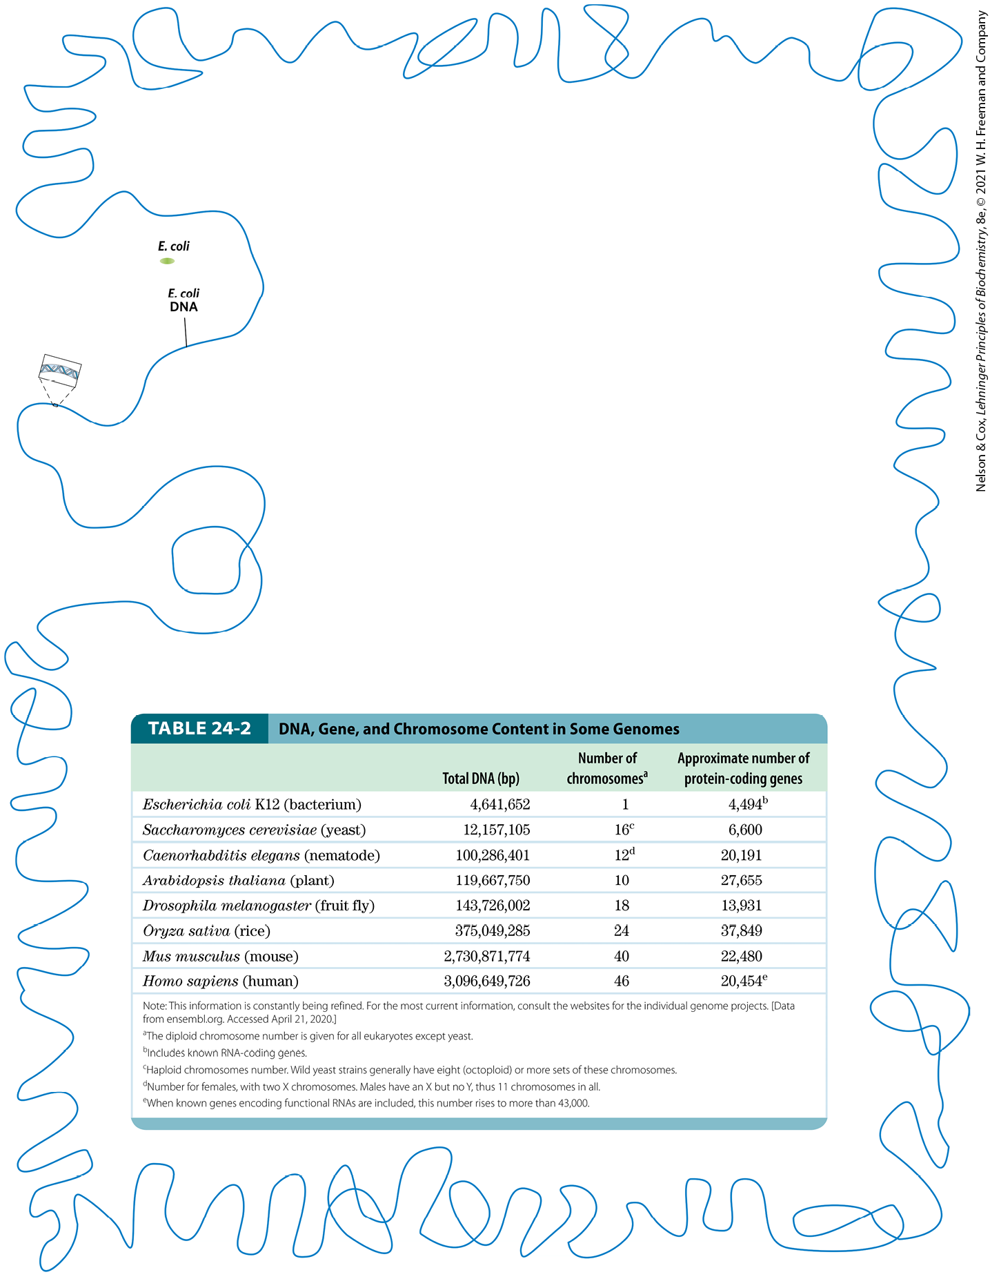
Bacteria
an E. coli cell contains ~100x as much DNA as a bacteriophage λ particle
the E. coli chromosome is a single, double-stranded circular DNA molecule of 4,641,652 bp
  the genome is ~850 times the length of the cell

Slide 19
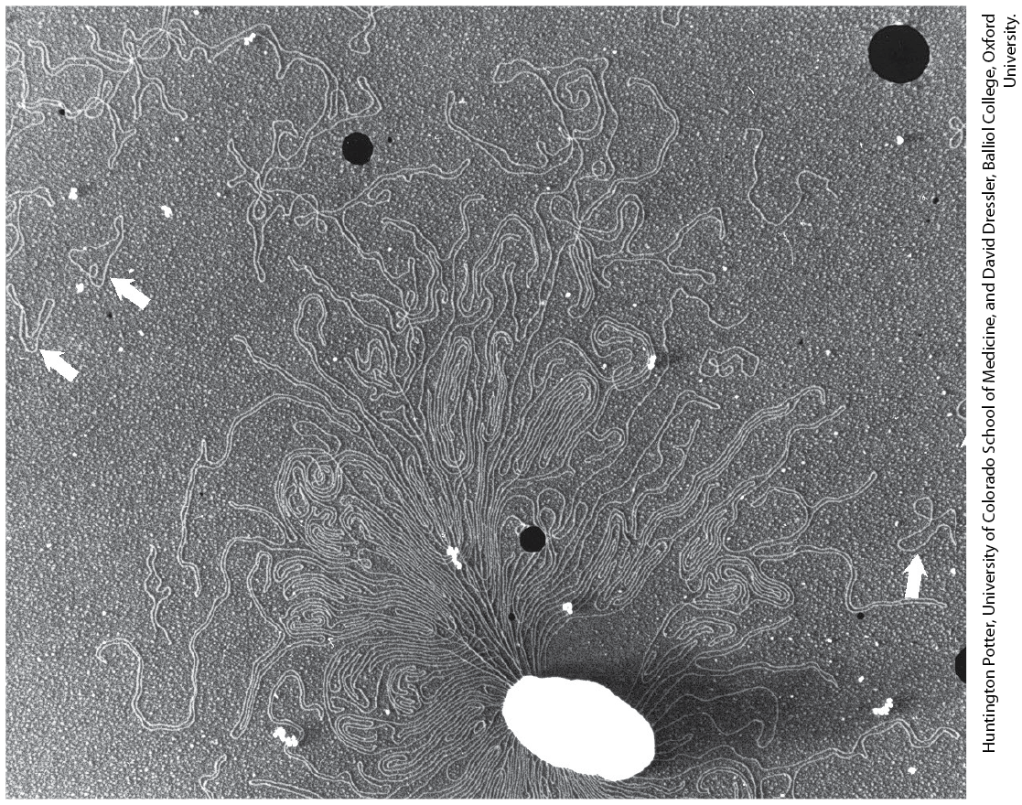
Bacterial Plasmids
plasmids = small, circular DNA molecules that are in the cytosol of many bacteria
  undergo replication
  some carry useful genes, such as antibiotic resistance genes

Slide 20
Eukaryotes
a yeast cell contains 2.6x as much DNA as an E. coli cell.
a Drosophila (fruit fly) cell contains >35x as much DNA as an E. coli cell
a human cell contains ~700x as much DNA as an E. coli cell
  cells of many plants and amphibians contain even more

Slide 21
DNA, Gene, and Chromosome Content in Some Genomes
Table 24-2 DNA, Gene, and Chromosome Content in Some Genomes
 | Total DNA (bp) | Number of chromosomes | Approximate number of protein-coding genes
Escherichia coli K12 (bacterium) | 4,641,652 | 1 | 4,494^{b}
Saccharomyces cerevisiae (yeast) | 12,157,105 | 16^{c} | 6,600
Caenorhabditis elegans (nematode) | 100,286,401 | 12^{d} | 20,191
Arabidopsis thaliana (plant) | 119,667,750 | 10 | 27,655
Drosophila melanogaster (fruit fly) | 143,726,002 | 18 | 13,931
Oryza sativa (rice) | 375,049,285 | 24 | 37,849
Mus musculus (mouse) | 2,730,871,774 | 40 | 22,480
Homo sapiens (human) | 3,096,649,726 | 46 | 20,454e

Slide 22
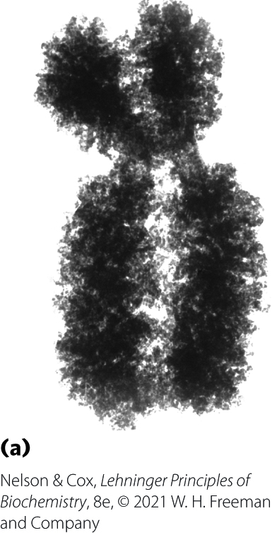
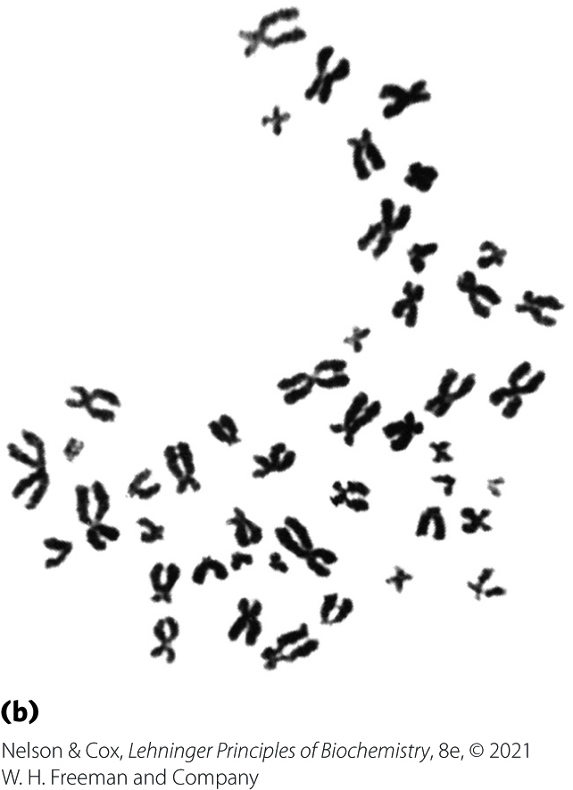
Eukaryotic Chromosomes
genetic material of eukaryotic cells is distributed into chromosomes
  the diploid (2n) number depends on the species
  each chromosome contains a single, very large, duplex DNA molecule that carries a characteristic set of genes
human somatic cells have 46 chromosomes

Slide 23
The Length of Human
DNA Molecules
placed end to end, DNA molecules of one human genome would extend for about a meter
  human cells are diploid, so each cell has 2 m of DNA
the adult human body contains ~10¹⁴ cells and a total DNA length of 2×10¹¹ km
  greater than the the circumference of the earth (4 x 10⁴ km)
  greater than the distance between the earth and the sun (1.5 x 10⁸ km)

Slide 24
Mitochondria Contain DNA
mitochondrial DNA (mtDNA) molecules are much smaller than nuclear chromosomes
  codes for mitochondrial tRNAs and rRNAs and for a few mitochondrial proteins
animal mtDNA contains <20,000 bp in a circular duplex
  each mitochondrion has 2-10 copies
  number of copies rises in some cells in an embryo during cell differentiation
plant mtDNA ranges from 200,000 to 2,500,000 bp

Slide 25
Chloroplasts Contain DNA
chloroplast DNA (cpDNA) exists as circular duplexes from 120,000 to 160,000 bp

Slide 26
Eukaryotic Genes and Chromosomes Are Very Complex
introns = nontranslated, intervening DNA segments that do not code for the amino acid sequence of the polypeptide product
exons = coding DNA segments
  makes up only ~1.5% of human DNA
the colinearity of the eukaryotic DNA and amino acid sequence is broken by introns
  few bacterial genes contain introns

Slide 27
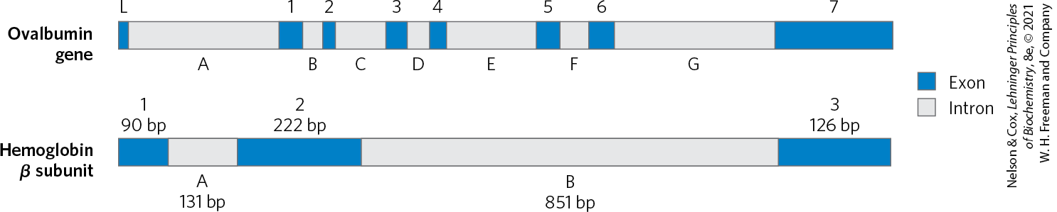
Introns in Eukaryotic Genes
in higher eukaryotes, the typical gene has more intron sequences than exon sequences
together, introns and exons make up as much as 30% of the human genome

Slide 28
Highly Repetitive Sequences
highly repetitive sequences (simple-sequence DNA or simple sequence repeats (SSR)) = short sequences, generally less than 10 bp long, that are sometimes repeated millions of times per cell
  make up ~3% of the human genome
  do not encode proteins or RNAs
  associated with centromeres and telomeres
satellite DNA = another name for simple-sequence DNA
  named as such because it migrates as “satellite” bands in a cesium chloride density gradient

Slide 29
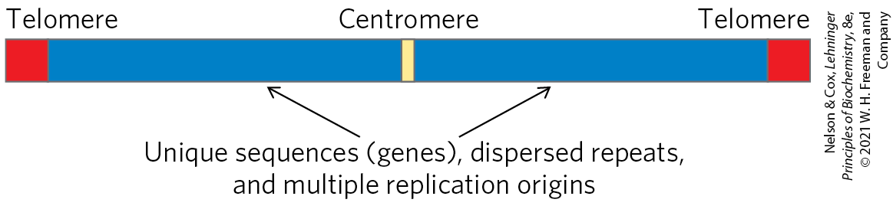
Centromeres
centromere = a DNA sequence that functions during cell division as an attachment point for proteins that link the chromosome to the mitotic spindle
  essential sequences in yeast are ~130 bp long and are very rich in A=T pairs
  sequences of higher eukaryotes are longer and generally consist of thousands of tandem copies of one or several sequences of 5 to 10 bp

Slide 30
Telomeres
telomeres = sequences at the ends of eukaryotic chromosomes that help stabilize the chromosome
  shortened after each round of replication
  end with multiple repeated sequences of the form
(5′)(T_{x}G_{y})_{n}
(3′)(A_{x}C_{y})_{n}
where x and y are generally between 1 and 4 and n is in the range of 20 to 100 for single-celled eukaryotes and >1,500 in mammals

Slide 31
Telomere Sequences
Table 24-3 Telomere Sequences
Organism | Telomere repeat sequence
Homo sapiens (human) | (TTAGGG)_{n}
Tetrahymena thermophile (ciliated protozoan) | (TTGGGG)_{n}
Saccharomyces cerevisiae (yeast) | (T(G)_{1–3}(TG)_{2–3})_{n}
Arabidopsis thaliana (plant) | (TTTAGGG)_{n}

Slide 32
24.2 DNA Supercoiling

Slide 33
The Structural Organization of DNA
keys to DNA compaction:
  neutralizing the negative charges of the phosphoryl groups in the DNA backbone with cations and polyamines
  a DNA structural alteration known as supercoiling

Slide 34
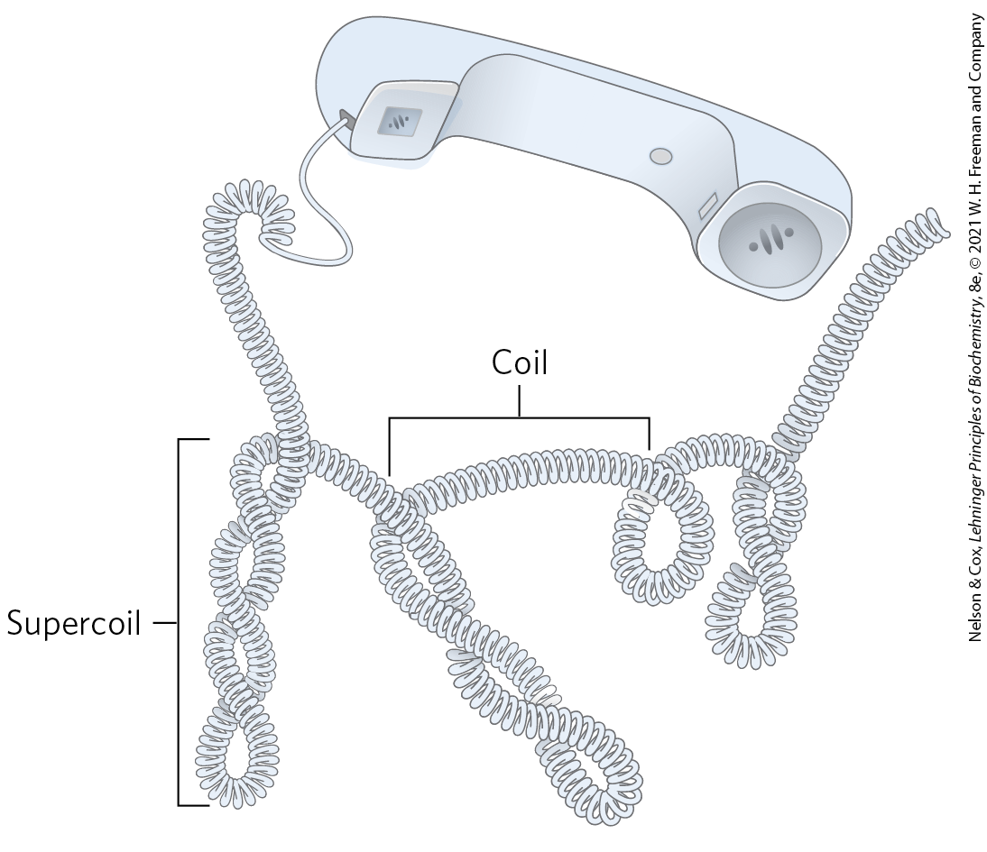
DNA Supercoiling (1 of 2)
“supercoiling” means the coiling of a coil

Slide 35
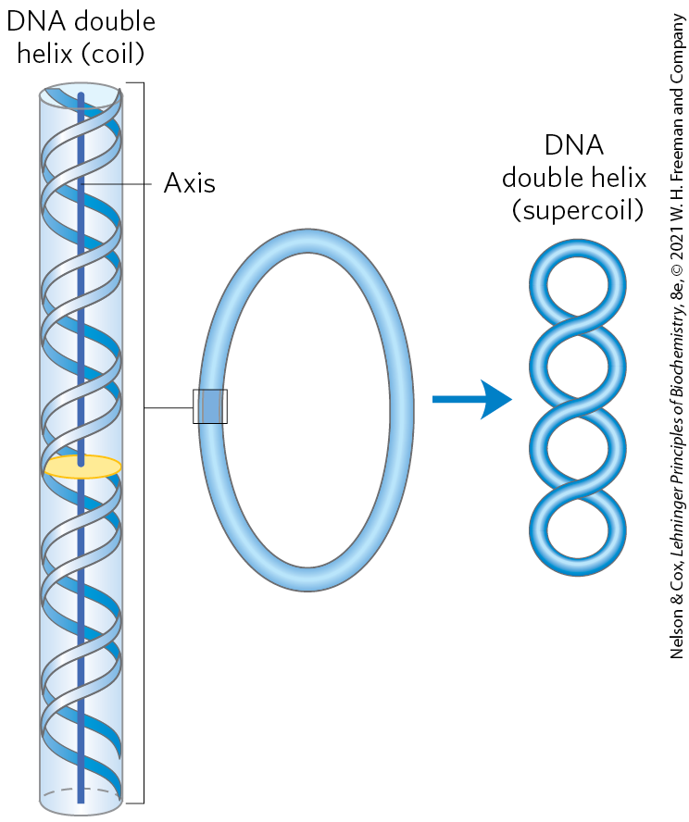
DNA Supercoiling (2 of 2)
underwound DNA = state where DNA has fewer right-handed helical turns per given length of DNA than B-form DNA
  places structural strain on the DNA, causing it to twist upon itself (supercoiling)
most cellular DNAs are supercoiled
  this is an intrinsic property of DNA tertiary structure

Slide 36
The Relaxed State of DNA
relaxed DNA = state where there is no net bending of the DNA axis upon itself

Slide 37
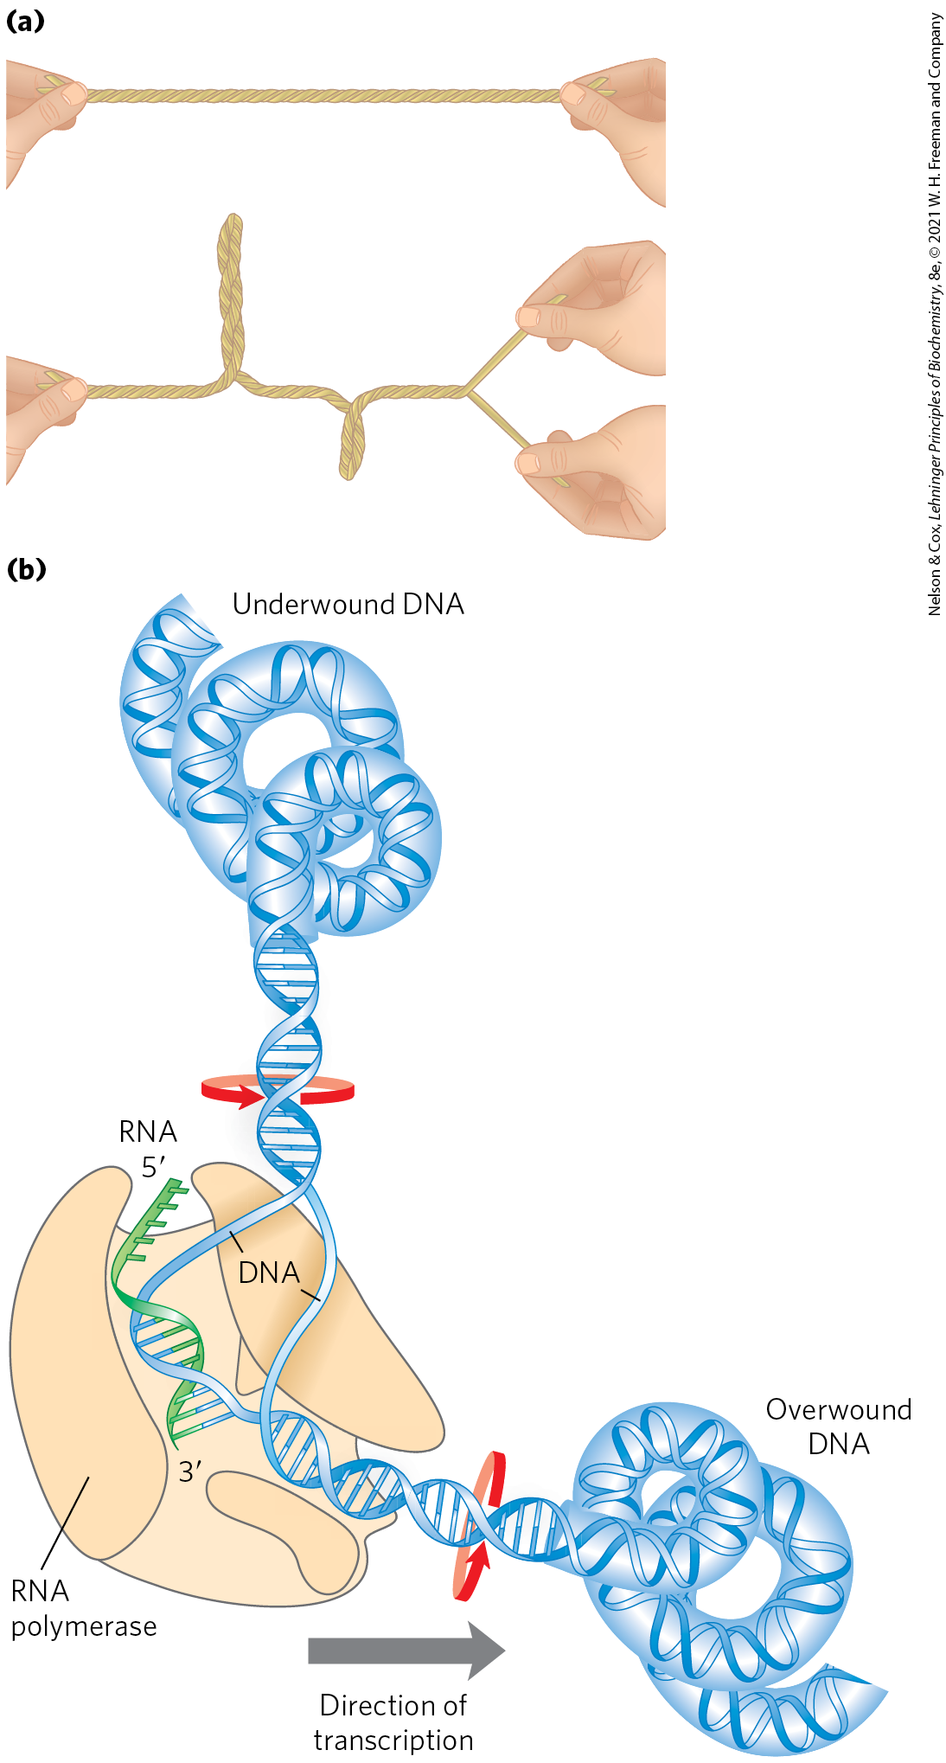
The Effects of Replication and Transcription on DNA Supercoiling
supercoiling reflects underwinding of the DNA
it facilitates the separation of strands required for replication and transcription

Slide 38
The Study of Supercoiling Relies on Topology
topology = the study of the properties of an object that do not change under continuous deformations
  a branch of mathematics
continuous deformations for DNA include conformational changes due to thermal motion or molecular interactions
discontinuous deformations for DNA include strand breakage
  topological properties are changed only by breakage and rejoining of the DNA backbone

Slide 39
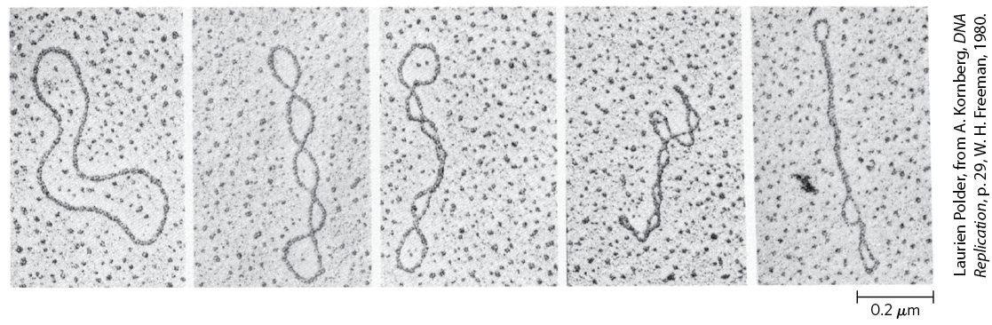
Most Cellular DNA Is Underwound
closed-circular DNAs = small-circular DNAs that have no breaks in either strand
DNA is most stable in the B-form structure (one turn of the double helix per 10.5 bp)
  DNA closely conforming to this is relaxed
increasing supercoiling

Slide 40
Purified Closed-Circular DNA is Rarely Relaxed
DNAs derived from a given cellular source have a characteristic degree of supercoiling
DNA structure is strained in a manner that is regulated by the cell to induce the supercoiling
  typically due to underwinding

Slide 41
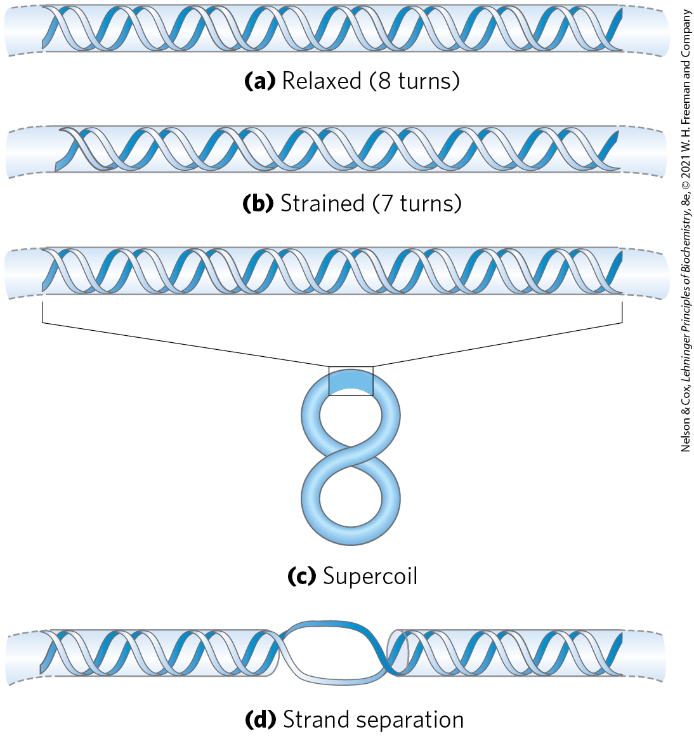
Effects of DNA Underwinding
DNA becomes thermodynamically strained when turns are removed
this strain can be accommodated by forming a supercoil or separating the two DNA strands over a short distance

Slide 42
Maintaining the Underwound State
to maintain an underwound state, DNA must be either:
  a closed circle
  bound and stabilized by protein

Slide 43
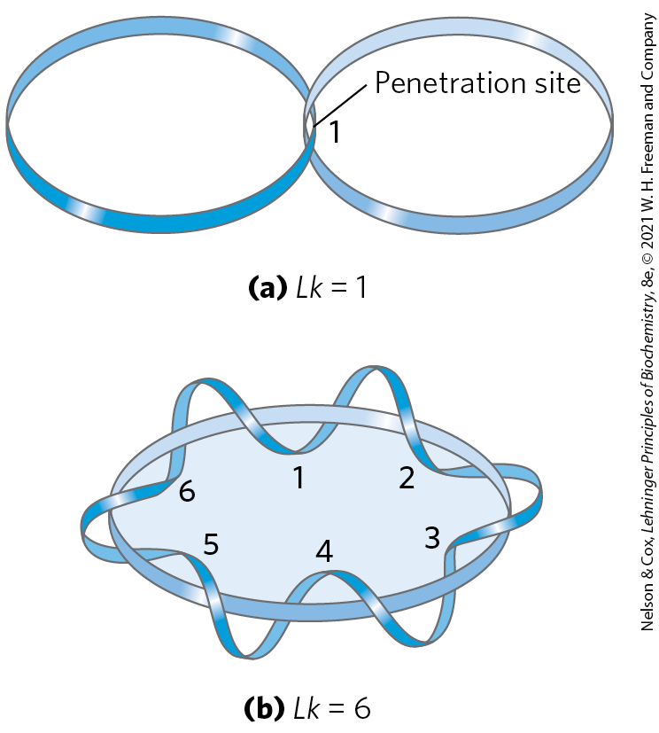
DNA Underwinding Is Defined by Topological Linking Number
linking number (Lk) = the number of times the twisting strand penetrates a surface
  topological property of double-stranded DNA
topoisomerases = catalyze changes in the linking number

Slide 44
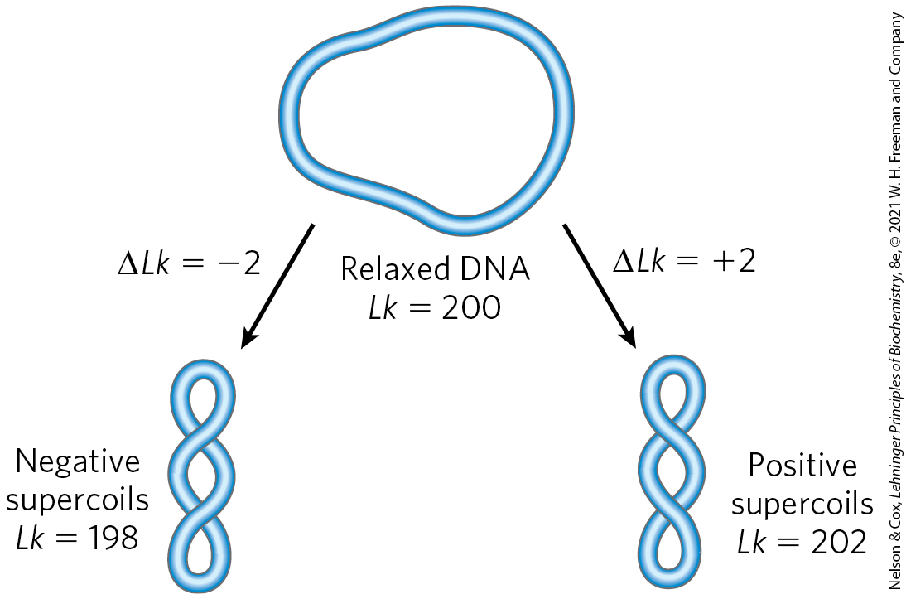
Negative and Positive Supercoils
underwinding results in negative supercoiling
overwinding results in positive supercoiling
an increase in σ brings about an increase in DNA compaction

Slide 45
Topoisomers
topoisomers = two forms of a circular DNA that differ only in a topological property, such as linking number

Slide 46
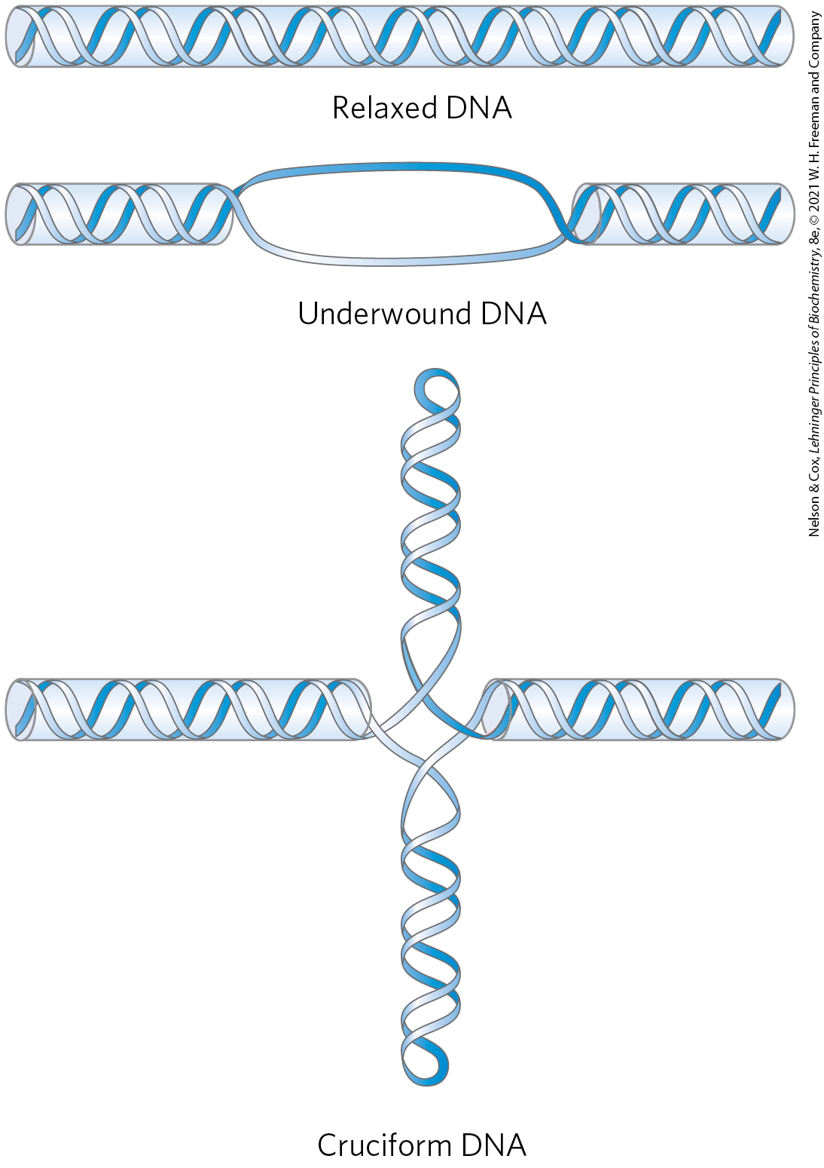
Promotion of Cruciform Structures by DNA Underwinding
a cruciform generally contains a few unpaired bases
DNA underwinding helps to maintain the required strand separation

Slide 47
Topoisomerases
topoisomerases = enzymes that increase or decrease the extent of DNA underwinding
  change the linking number
  play an important role in replication and DNA packaging
type I topoisomerases = act by transiently breaking one of the two DNA strands, passing the unbroken strand through the break, and rejoining the broken ends
type II topoisomerases = break both DNA strands

Slide 48
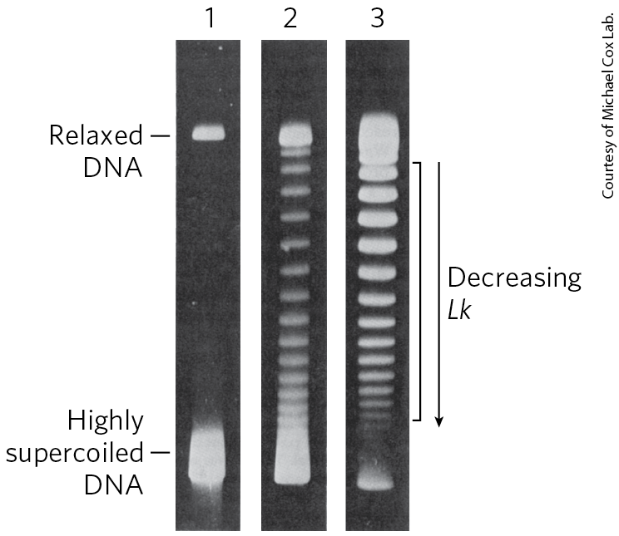
Visualization of Topoisomers
supercoiled circular DNA is more compact than relaxed DNA
  will migrate faster in a gel matrix

Slide 49
Bacterial Topoisomerases
E. coli has at least four individual topoisomerases (I-IV)
  I and II maintain the overall degree of supercoiling of bacterial DNA
  III and IV have more specialized roles in DNA metabolism
type I (topoisomerases I and III) isomerases relax DNA by removing negative supercoils
type II isomerases (called either topoisomerase II or DNA gyrase) introduce negative supercoils

Slide 50
Eukaryotic Topoisomerases
eukaryotes also have type I and type II topoisomerases
the type I enzymes are topoisomerases I and III.
the type II enzyme has two isoforms in vertebrates (IIα and IIβ)
  cannot underwind DNA (introduce negative supercoils)
  can relax both positive and negative supercoils

Slide 51
Type IIα Topoisomerases Can Untangle Catenanes
catenanes = DNA circles that are topologically linked
type II topoisomerases can pass one duplex DNA segment through a double-strand break in another duplex
  allows these enzymes to untangle catenanes

Slide 52
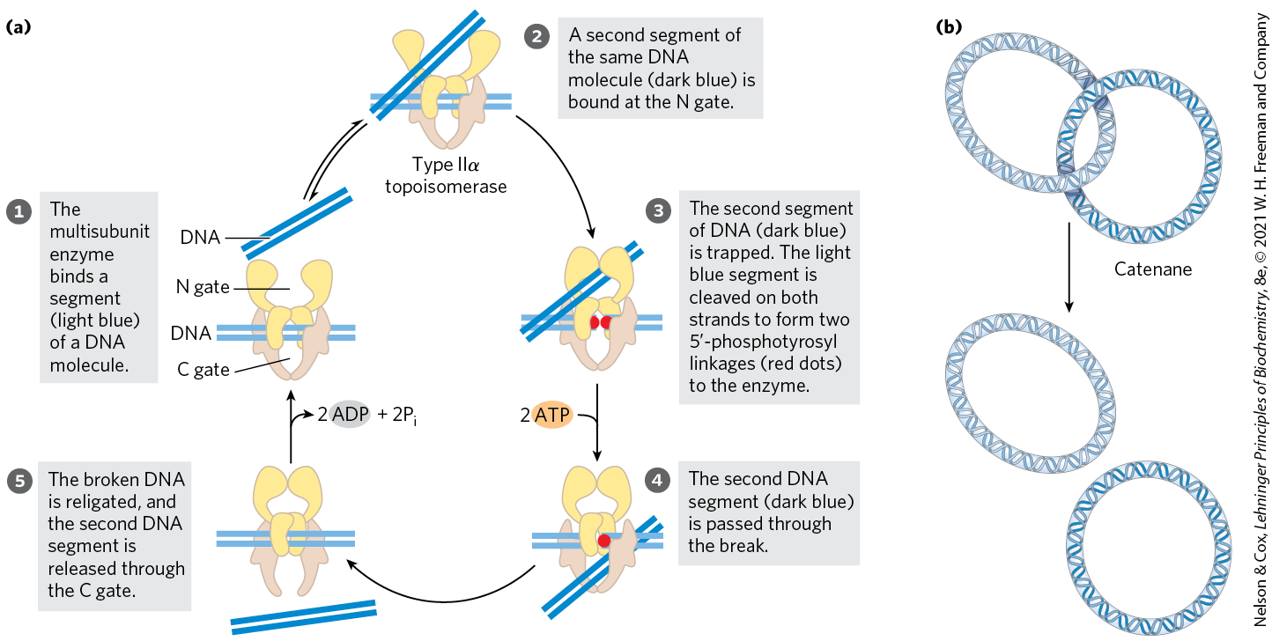
Eukaryotic Type IIα Topoisomerase

Slide 53
Diversity in DNA Topoisomerases
Table 24-4 Diversity in DNA Topoisomerases
Type | Mechanism | Family (defined by structural class) | Domain(s) | Notes
IA | Strand passageª | Topoisomerase I | Bacteria, Eukarya | Relaxes (−)
 |  | Topoisomerase III | Bacteria, Eukarya | Relaxes (−)
 |  | Reverse gyrase | Archaea, Bacteria | Uses ATP to introduce positive supercoils; thermophilic bacteria and archaea only
IB | Swivelase^{b} | Topoisomerase IB | Bacteria, Eukarya | A few bacteria; all eukaryotes
IC | Swivelase | Topoisomerase V | Archaea | Methanopyrus only
IIA | Strand passage^{c} | Topoisomerase II (DNA gyrase) | Archaea, Bacteria | Introduces negative supercoils (ATPase)
 |  | Topoisomerase IIα | Eukarya | Relaxes (+ or −)
 |  | Topoisomerase IIβ | Eukarya | Relaxes (+ or −)
 |  | Topoisomerase IV | Bacteria | Decatenase^{d}
IIB | Strand passage | Topoisomerase VI | Archaea, Bacteria, Eukarya | Among eukaryotes, plants, algae, and protists only

Slide 54
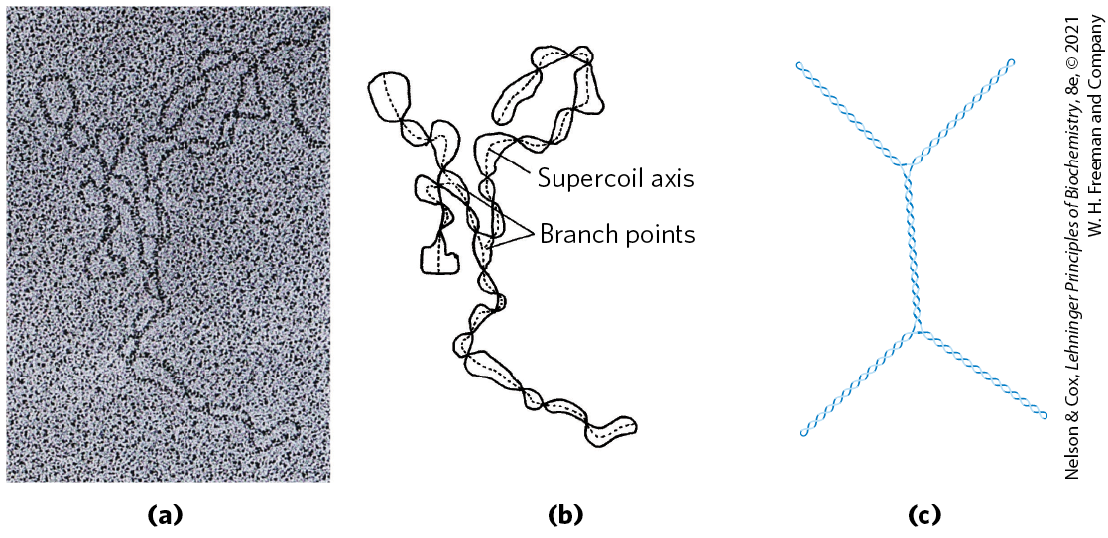
DNA Compaction Requires a Special Form of Supercoiling
plectonemic = extended righthanded supercoils where the length of the supercoil axis (including branches) is ~40% of the DNA length
  the general structure of supercoiled DNA in solution
  does not produce sufficient compaction to package DNA in the cell

Slide 55
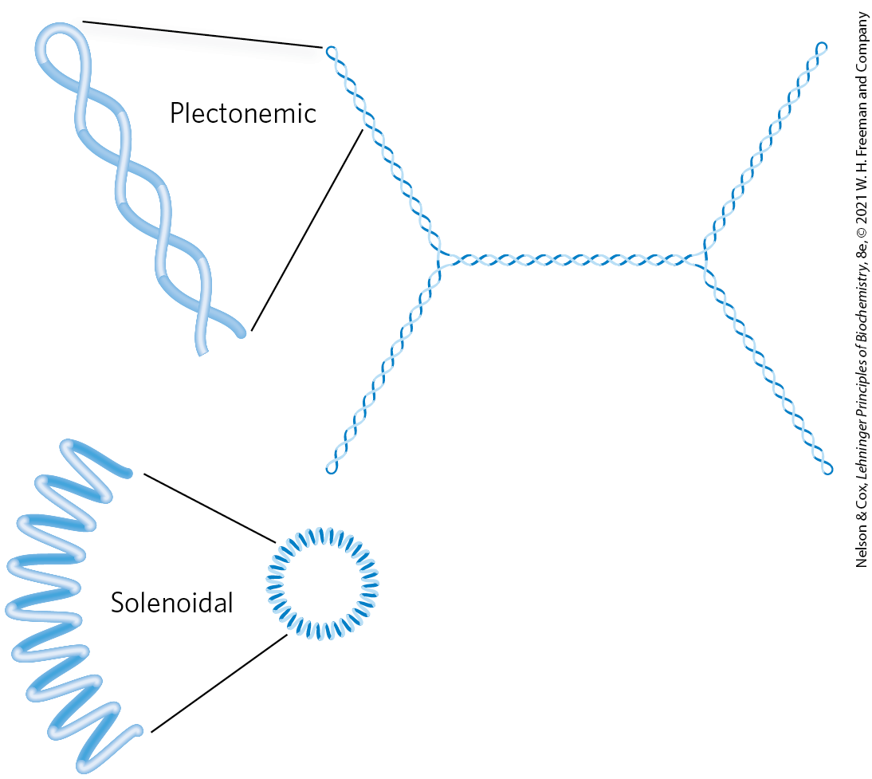
Solenoidal Supercoiling
solenoidal = supercoiling involving tight left-handed turns
  primary mechanism by which underwinding contributes to DNA compaction in cells
  stabilized by protein binding
both plectonemic and solenoidal are negative forms of supercoiling
  readily interconvertible

Slide 56
24.3 The Structure of Chromosomes

Slide 57
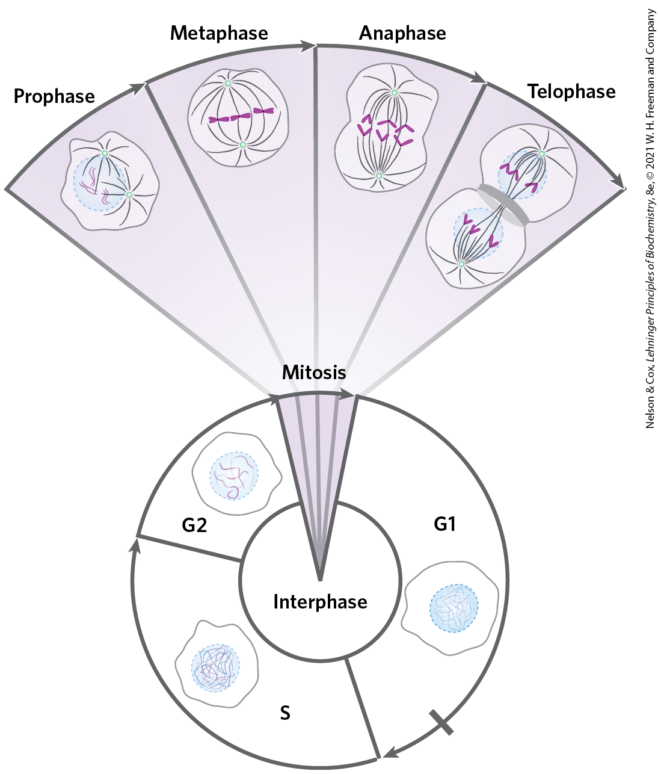
Chromatin Consists of DNA, Proteins, and RNA
chromatin = eukaryotic chromosomal material composed of DNA, RNA, and proteins
  amorphous in G0 and interphase (G1, S, and G2) phases
in the S phase of interphase, the amorphous DNA replicates to produce sister chromatids

Slide 58
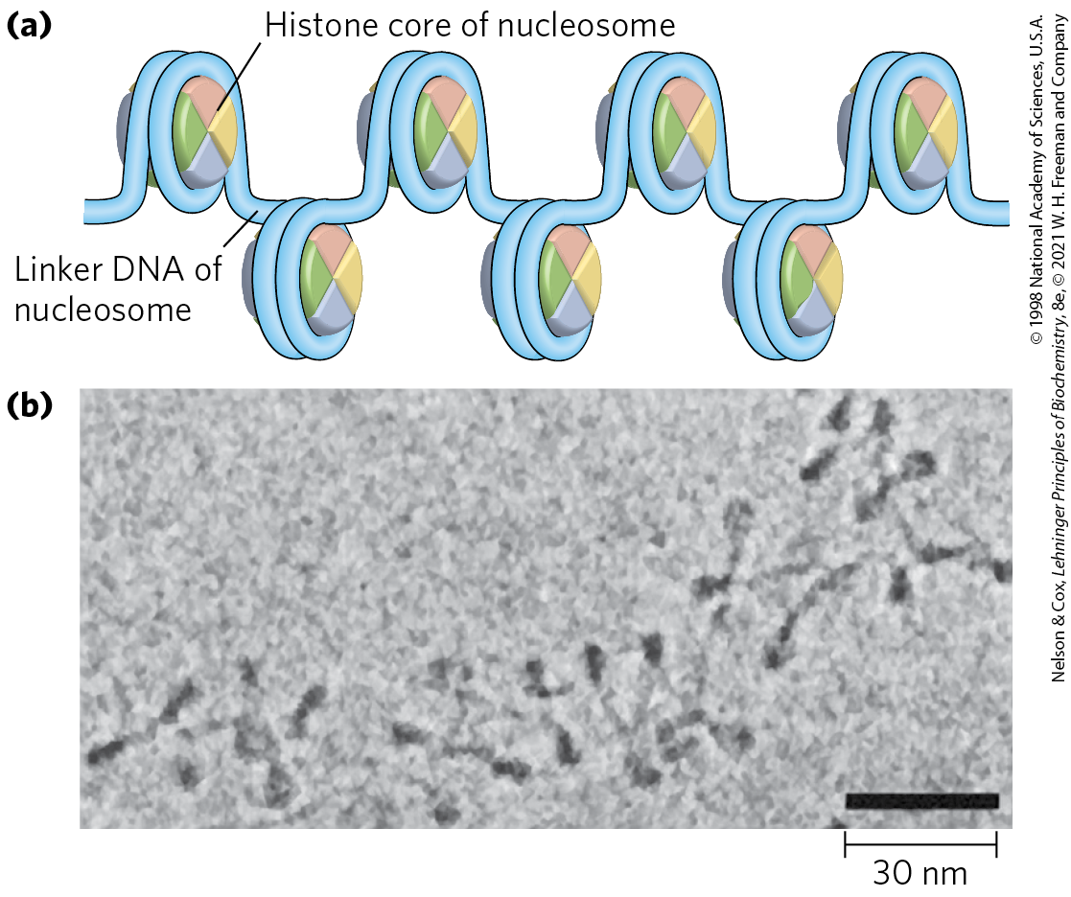
Histones Package and Order DNA into Nucleosomes
histones = proteins that are tightly associated with chromatin and function to package and order the DNA
nucleosomes = the fundamental structural unit of chromatin
  composed of core histone proteins bound to DNA

Slide 59
Histones Are Small, Basic Proteins
all eukaryotic cells have five major classes of histones
  H3 and H4 are nearly identical in all eukaryotes
  H1, H2A, and H2B show less sequence similarity across eukaryotic species
Table 24-5 Types and Properties of the Common Histones
Histones | Molecular weight | Number of amino acid residues | Content of basic amino acids (% of total): Lys | Content of basic amino acids (% of total): Arg
H1ª | 21,130 | 223 | 29.5 | 11.3
H2Aª | 13,960 | 129 | 10.9 | 19.3
H2Bª | 13,774 | 125 | 16.0 | 16.4
H3 | 15,273 | 135 | 19.6 | 13.3
H4 | 11,236 | 102 | 10.8 | 13.7

Slide 60
Nucleosomes Are the Fundamental Organizational Units of Chromatin
chromosomes are arranged as “beads-on-a-string”
the beads are complexes of histones and DNA
  nucleosome contains eight histone molecules: two copies each of H2A, H2B, H3, and H4
  contains ~200 bp of DNA, of which 146 bp are bound tightly around the histone core in a left-handed solenoidal supercoil
the nucleosome is the bead plus the connecting DNA that leads to the next bead

Slide 61
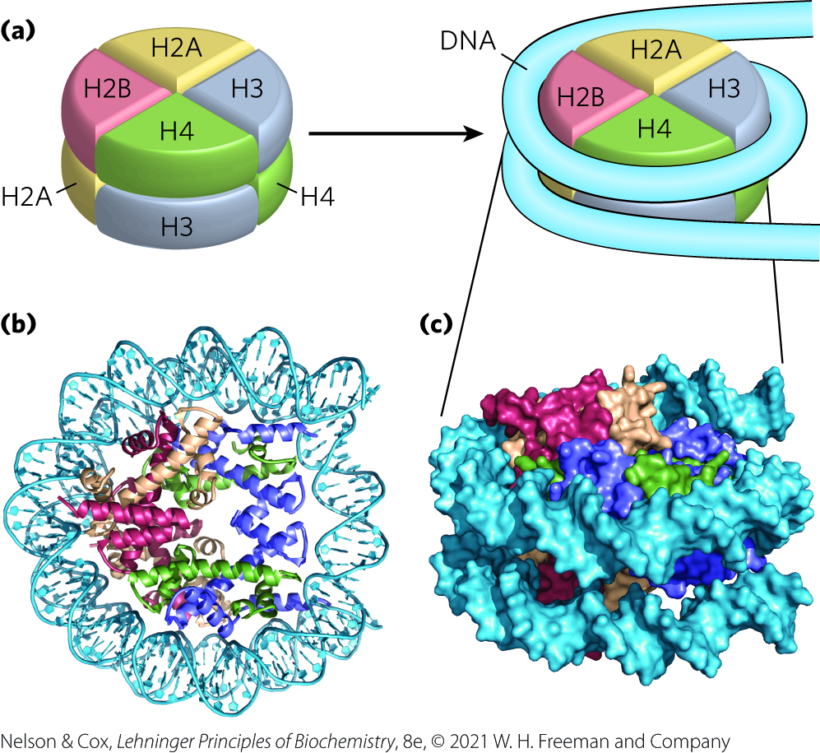
DNA Wrapped Around a
Histone Core

Slide 62
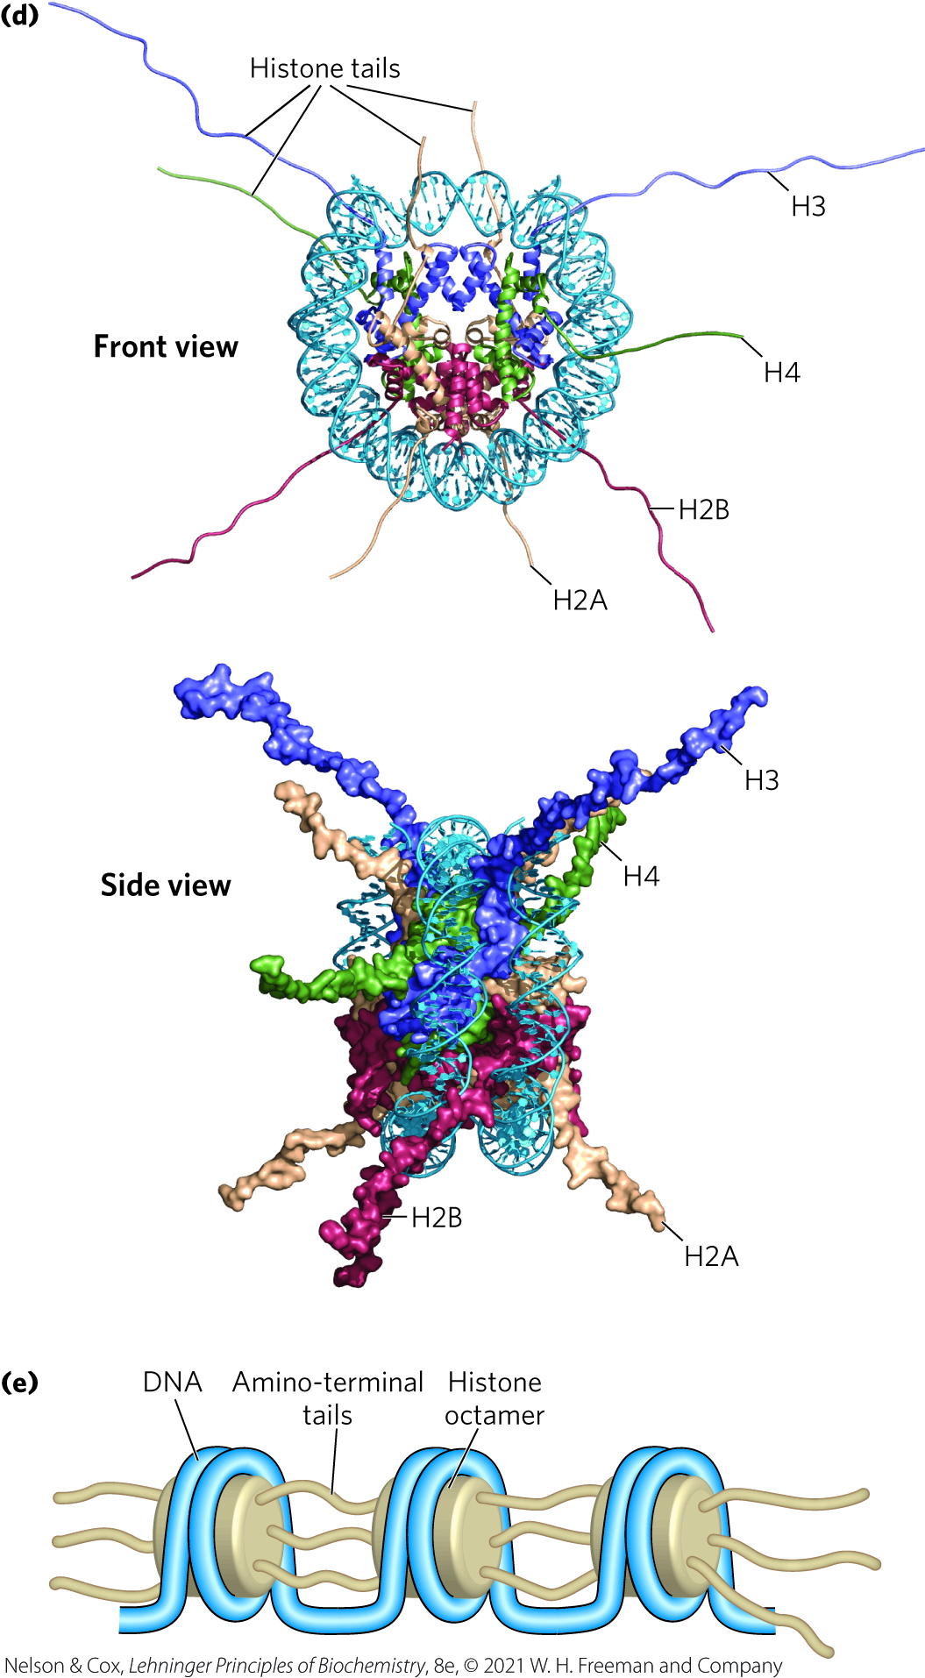
Front and Side Views of Histone Amino-Terminal Tails
the amino-terminal tails of the histones:
  are intrinsically disordered
  are where most of the histone modifications occur
  play a key role in forming contacts between nucleosomes in the chromatin

Slide 63
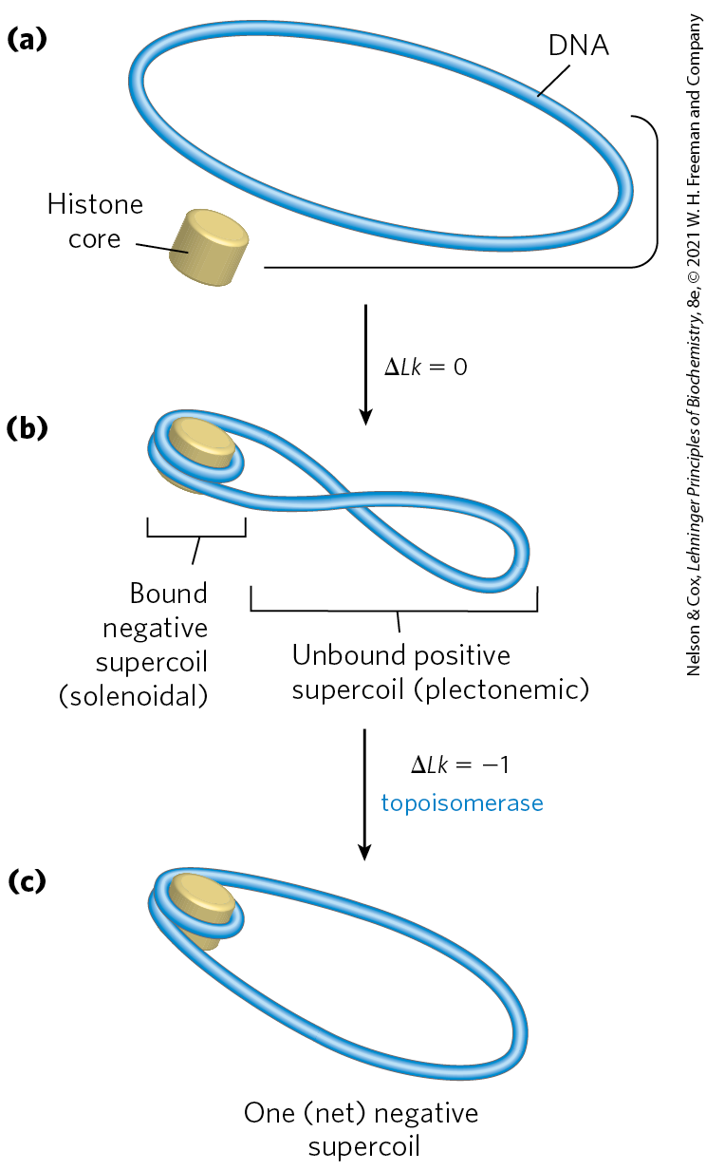
Chromatin Assembly
DNA wrapping around the histone core requires removal of ~1 helical turn in the DNA
binding of the histone core to a relaxed closed-circular DNA introduces a negative supercoil
  accompanied by a positive supercoil in the unbound region
when eukaryotic topoisomerases relax positive supercoils, Lk decreases

Slide 64
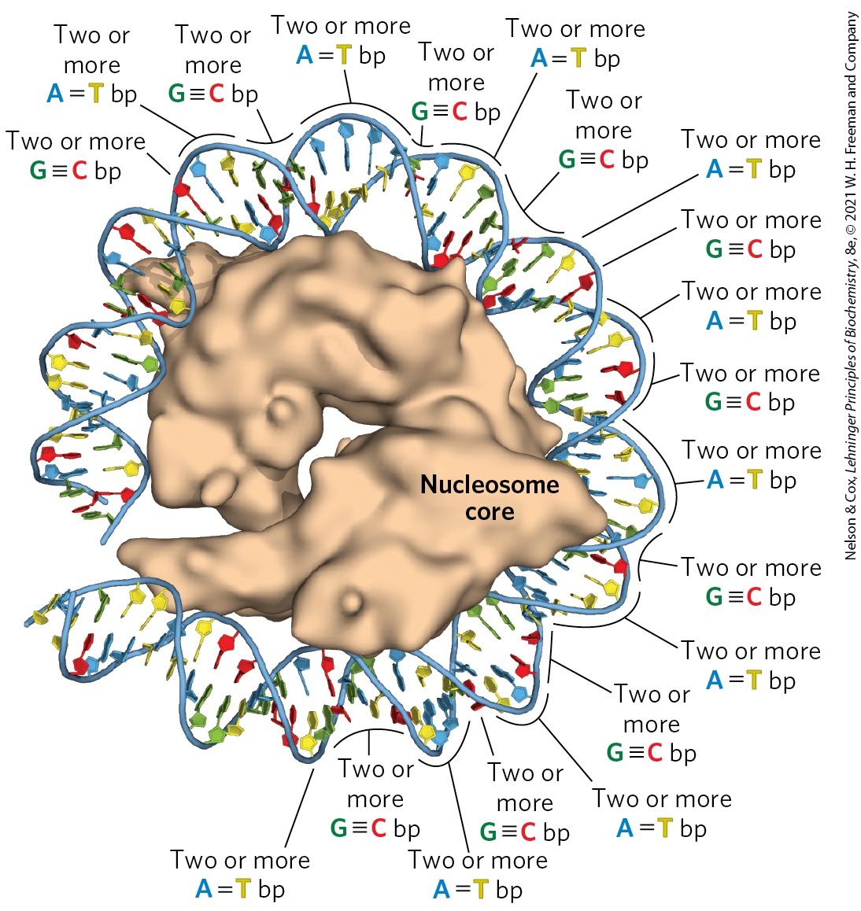
The Effect of DNA Sequence on Nucleosome Binding
histone binding is not random
binding of the histone core seems to depend on a local abundance of A=T base pairs.
staggering AA, AT, or TT dinucleotides at 10 bp intervals facilitates DNA binding around the histone core

Slide 65
Depositing Nucleosome Cores on DNA
deposited stepwise: a tetramer of two H3 and two H4 histones binds first, followed by two H2A–H2B dimers
histone chaperones = mediate the incorporation of nucleosomes into chromosomes after chromosomal replication
  conserved in all eukaryotes
histone exchange factors = permit the substitution of histone variants for core histones in contexts other than postreplication

Slide 66
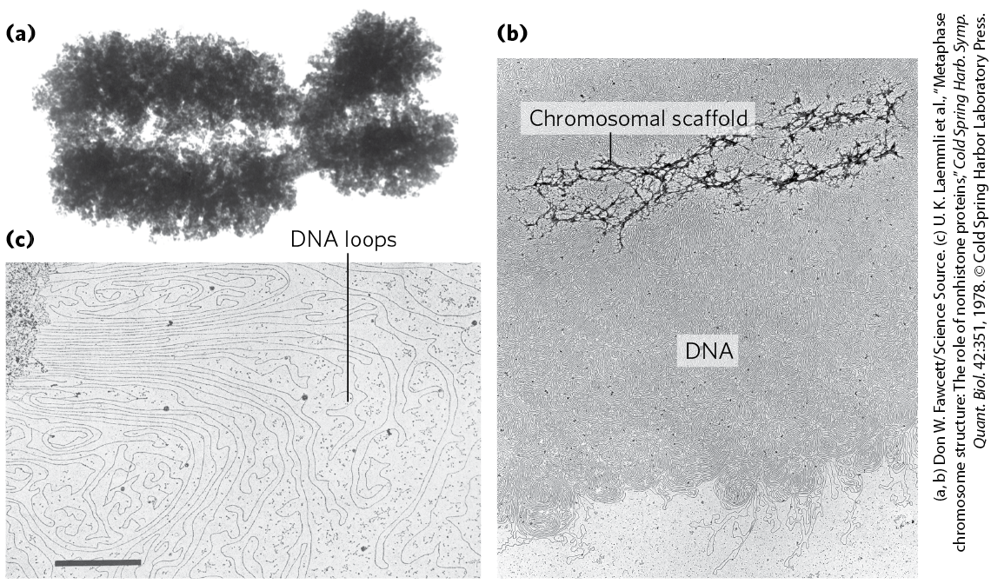
Nucleosomes Are Packed into Highly Condensed Chromosome Structures
certain regions of DNA seem to associate with a chromosomal scaffold

Slide 67
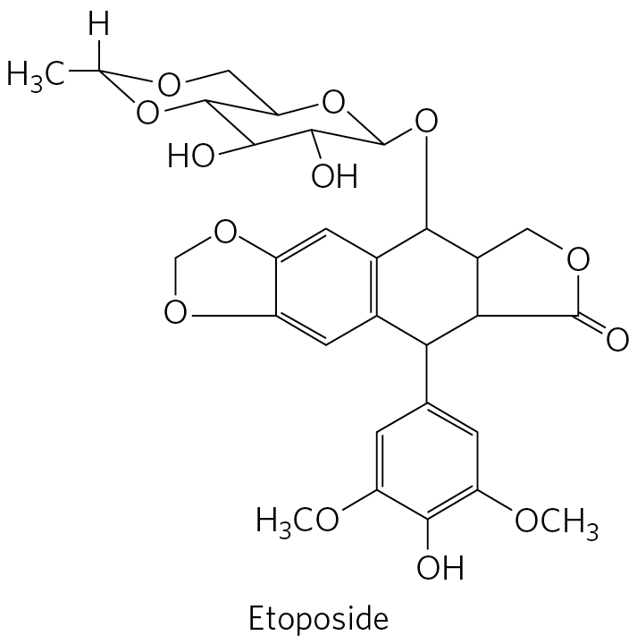
Topoisomerase II Is One of the Most Abundant Proteins in the Chromosome
topoisomerase II is important to the maintenance of chromatin structure
inhibitors of topoisomerase II can kill rapidly dividing cells
  several chemotherapy drugs are topoisomerase II inhibitors

Slide 68
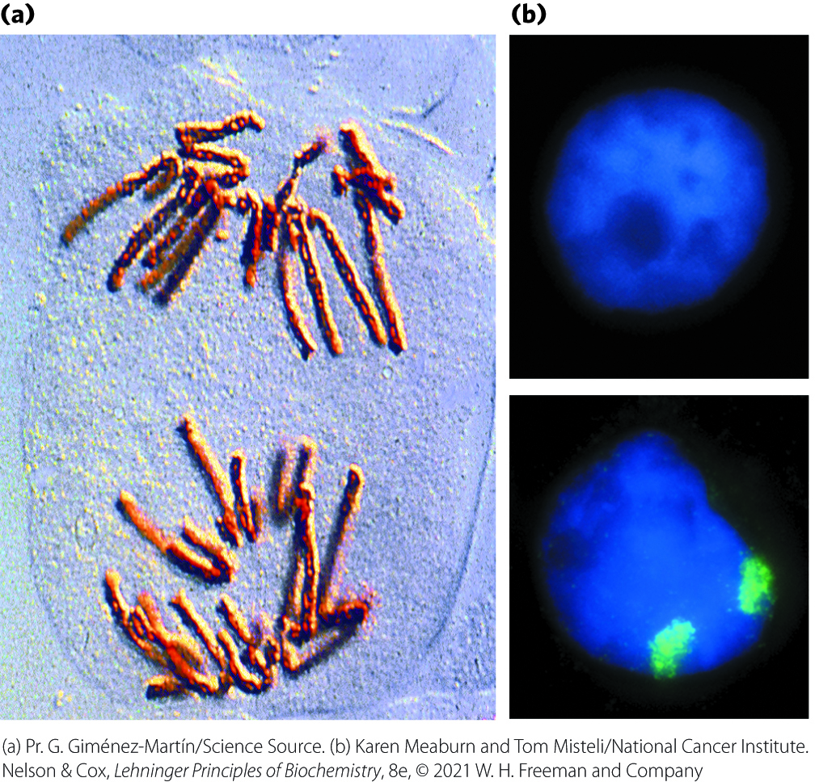
Chromosomal Organization in Eukaryotic Nucleus
chromosomes are highly condensed and organized just before cell division
chromosomes appear dispersed during interphase
  each chromosome is still organized, with two sets of compartments

Slide 69
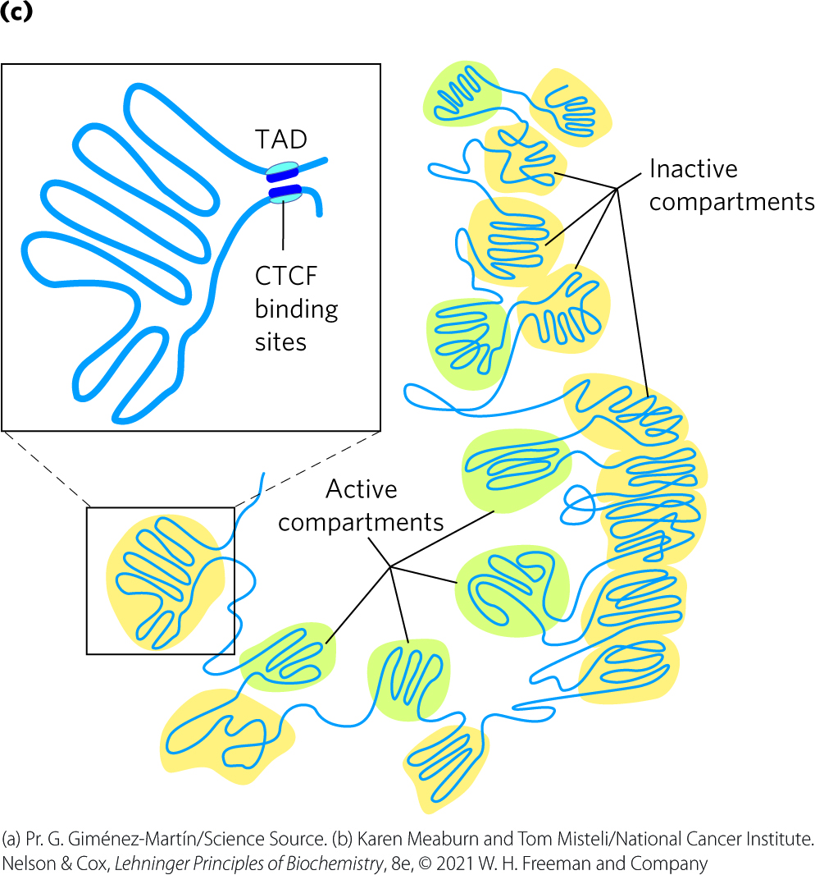
Active and Inactive Compartments
active compartments have reduced chromatin condensation
inactive compartments (heterochromatin) are highly condensed
topologically associating domains (TADs) = large segments of DNA are organized in loops
  binding of CTCF to bordering sites brings DNA together

Slide 70
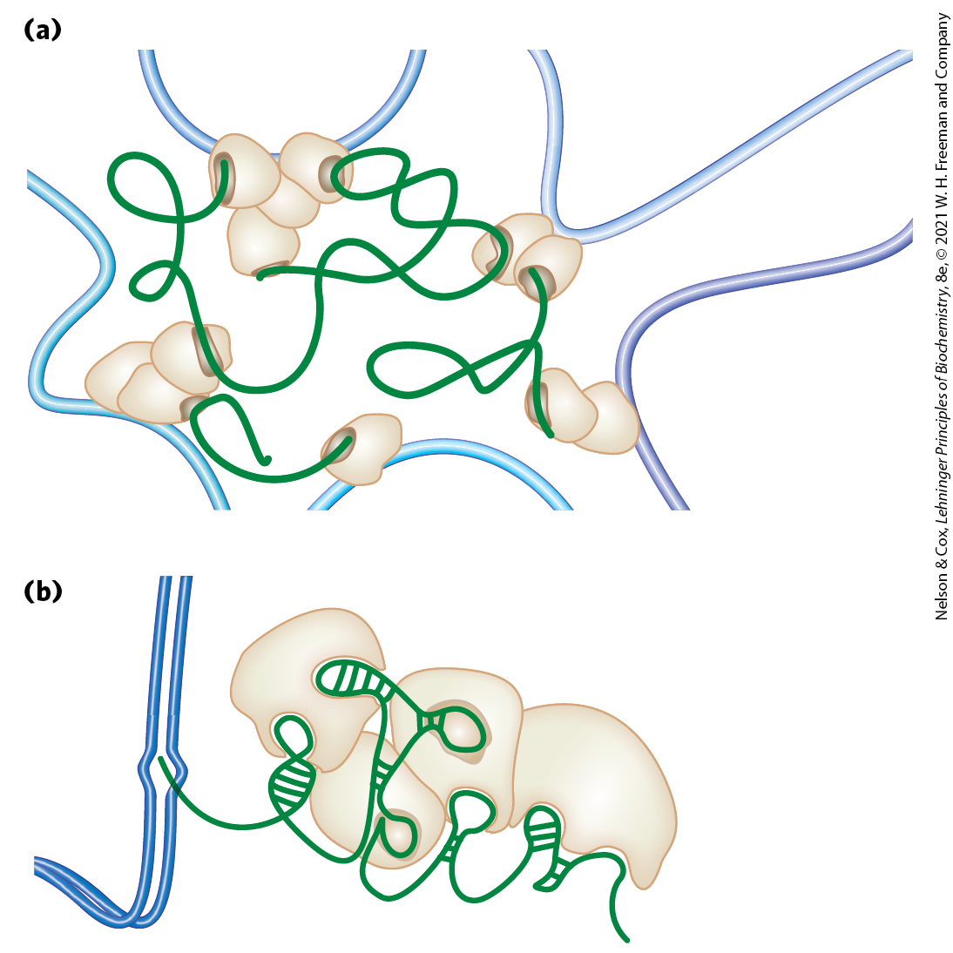
Long Noncoding RNAs (lncRNAs)
long noncoding RNAs (lncRNAs) = play a functional role in defining the chromosome structure
  many provide a scaffold for proteins

Slide 71
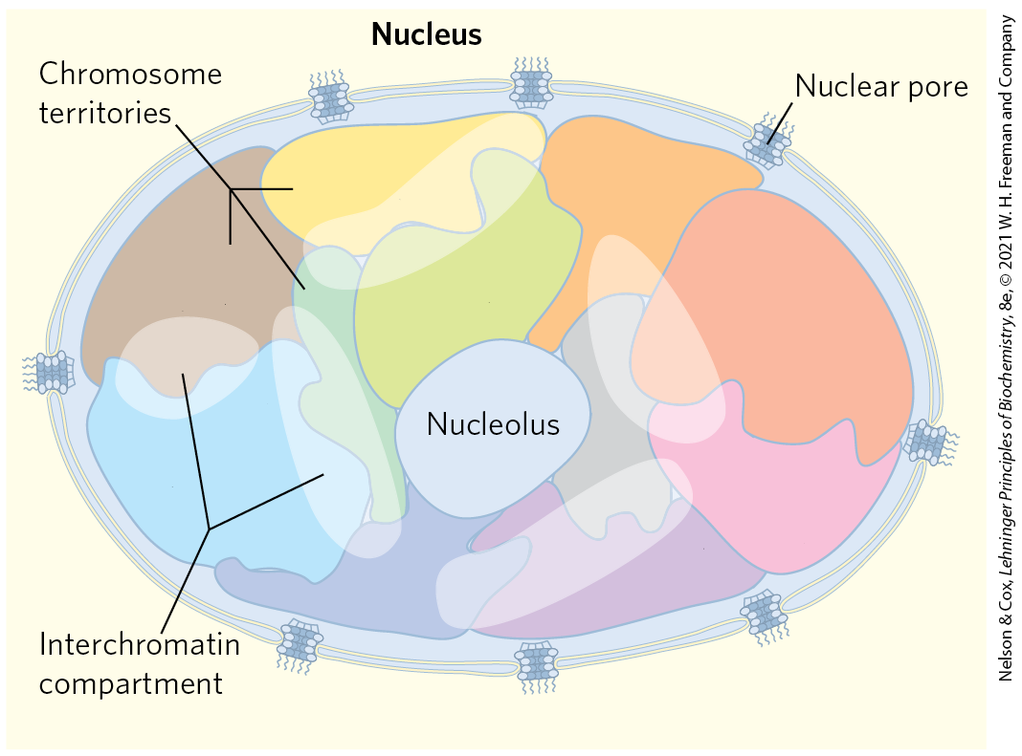
Chromosome Territory
chromosome territory = subnuclear domain that constrains the entire structure of each chromosome
  little or no intermingling of DNA in different territories

Slide 72
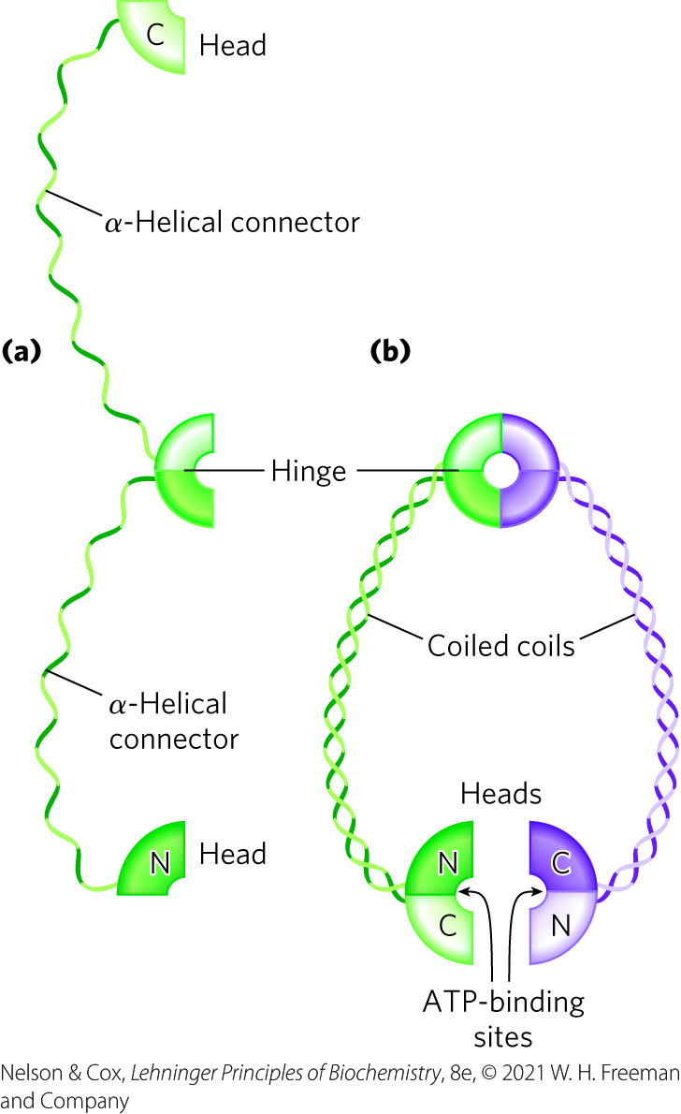
Condensed Chromosome Structures Are Maintained by SMC Proteins
SMC proteins (structural maintenance of chromosomes) = responsible for maintaining the structure and integrity of chromosomes following replication
  consist of 5 distinct domains

Slide 73
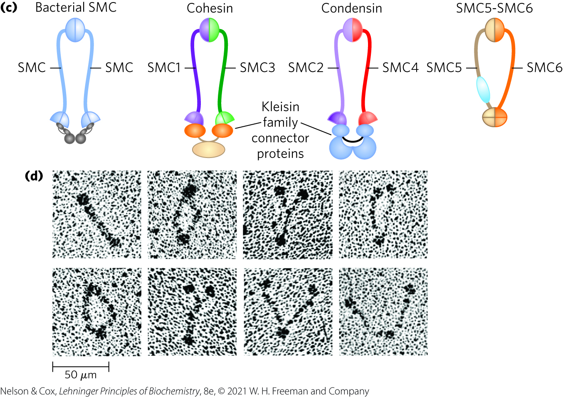
Eukaryotes Have Two Major Types of SMC Proteins
cohesins = link sister chromatids together after replication and keep them together as the chromosomes condense to metaphase
condensins = essential to chromosomal condensation as cells enter mitosis
  create positive supercoils

Slide 74
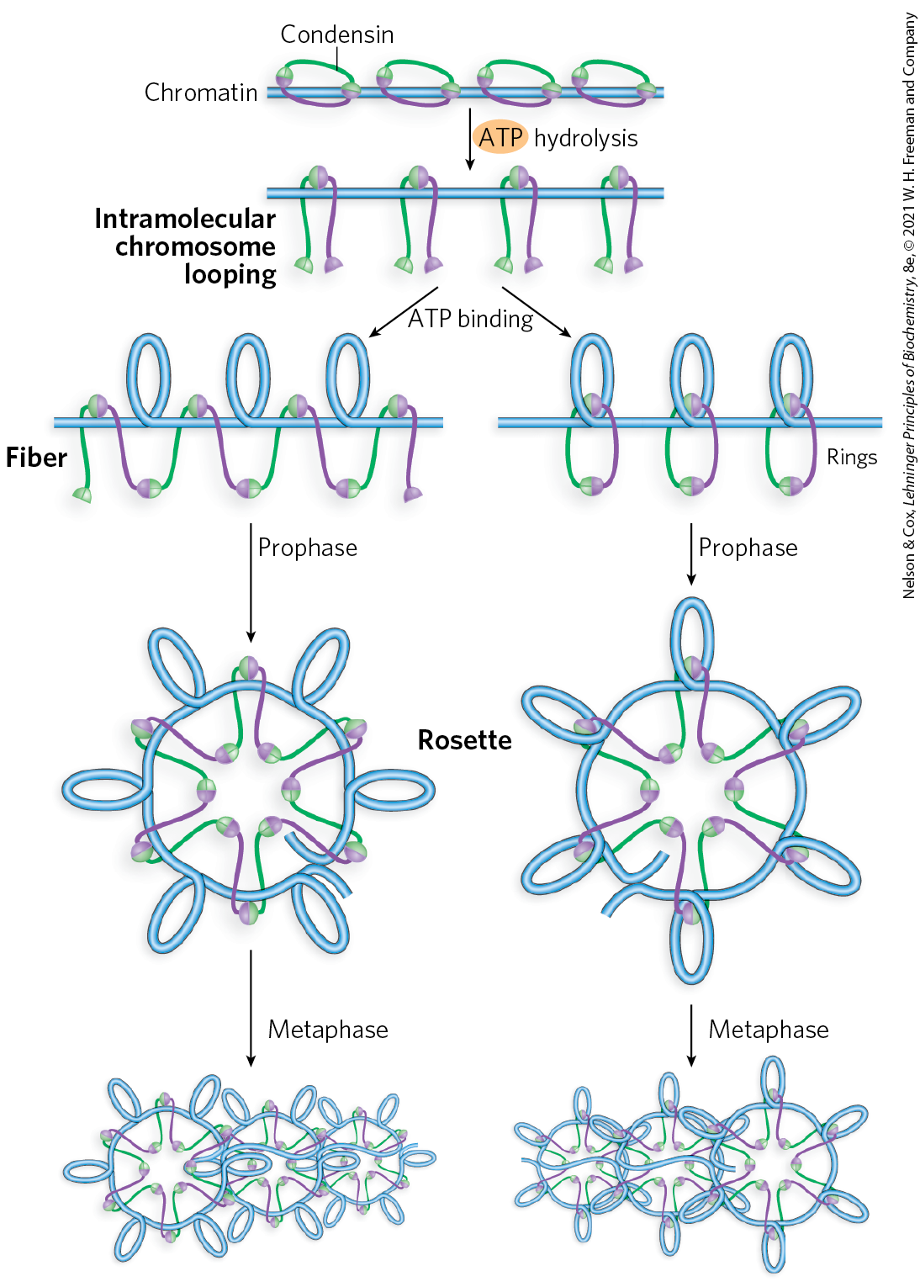
Models of the Role of Condensins in Chromatin Condensation
as DNA is compacted to form tighter and tighter loops, condensins stabilize the loops by binding at the base of each one

Slide 75
Histonelike Proteins Are Abundant in E. coli
bacterial DNA does not seem to have comparable structure to eukaryotic nucleosomes
histonelike proteins = proteins that bind and dissociate within minutes
  no regular, stable DNA-histone structure has been found
the dynamic and irregular structure of the bacterial chromosome reflects:
  the shorter cell cycle
  very active metabolism

