Slide 1

22 Biosynthesis of Amino Acids, Nucleotides, and Related Molecules
© 2021 Macmillan Learning

Slide 2

Principle 1 (1 of 4)
Amino acids and nucleotides are the precursors to proteins and nucleic acids, respectively. They also give rise to numerous neurotransmitters, metabolic cofactors, and other molecules of biological importance.

Slide 3

Principle 2 (1 of 3)
The supply of biologically available nitrogen can be limiting in many environments. Atmospheric N₂ is relatively inert and must be converted to other forms, such as ammonia and nitrate, to accommodate the requirements of life. A complex web of enzymatic processes, based primarily in microorganisms, interconverts the various molecular forms that comprise the global inventory of reactive nitrogen.

Slide 4

Principle 3 (1 of 3)
Oxygen and nitrogen metabolism are interlinked. The oxidation and reduction of the various forms of nitrogen in the biosphere often involve oxygen.

Slide 5
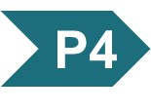
Principle 4 (1 of 8)
Regulation again plays an important role. Many of the processes covered in this chapter are regulated to carefully conserve a critical and limited resource. Tight regulation is needed to maintain balanced supplies of amino acids and nucleotides. The metabolic flux through most of these pathways is far less than for carbohydrate or lipid biosynthetic pathways; most amino acids and nucleotides are not stored, but are synthesized as they are needed.

Slide 6
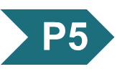
Principle 5 (1 of 2)
The amino acids glutamate and glutamine represent the entry point where reactive forms of nitrogen are incorporated into biological systems. Reflecting their importance, the concentrations of these amino acids are sufficiently elevated in many tissues that they are major contributors to the electrochemical environment of cells. The prominent role of these two amino acids is a universal feature of animate nitrogen metabolism, yet another molecular manifestation of the shared evolutionary history of all organisms on the planet.

Slide 7
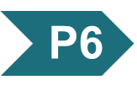
Principle 6 (1 of 9)
Like other anabolic pathways, the reaction sequences in amino acid and nucleotide biosynthesis are endergonic and reductive. They use ATP as a source of metabolic energy and they use a reduced electron carrier (usually NADPH) as a reductant.

Slide 8
22.1 Overview of Nitrogen Metabolism

Slide 9
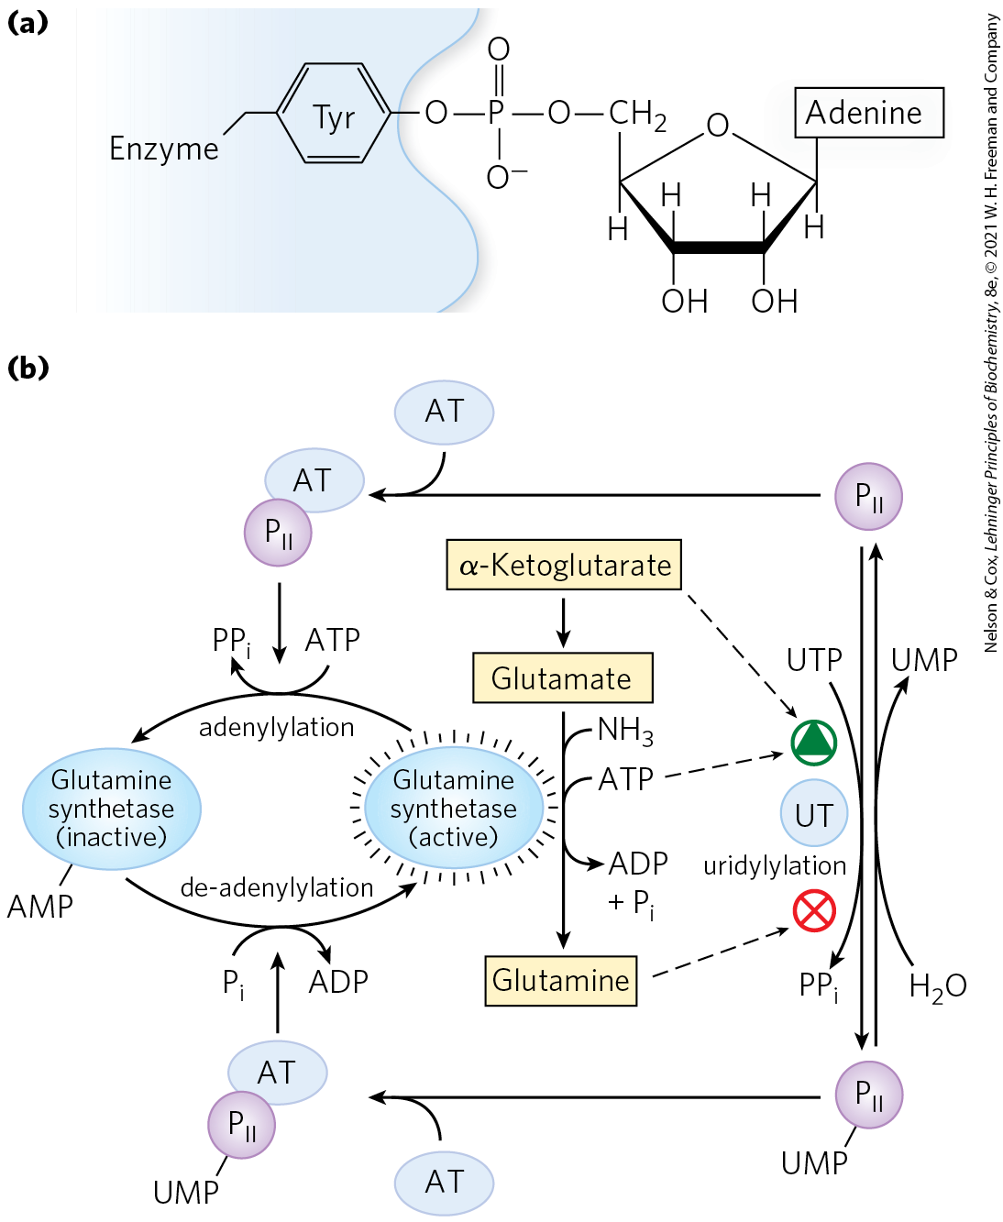
Adenylyltransferases and Uridylyltransferase
adenylyltransferase = promotes adenylylation and deadenylylation
  modulated by the binding of P_{II}, which is regulated by uridylylation at a Tyr residue
uridylyltransferase = promotes uridylylation and deuridylylation of P_{II}

Slide 10
Several Classes of Reactions Play Special Roles in the Biosynthesis of Amino Acids and Nucleotides
amino acid and nucleotide biosynthetic pathways make use of biological cofactors:
  pyridoxal phosphate (required for transamination reactions)
  tetrahydrofolate (used in one-carbon transfers at the -CHO and -CH₂OH oxidation levels)
  S-adenosylmethionine (used in one-carbon transfers at the -CH₃ oxidation level)

Slide 11
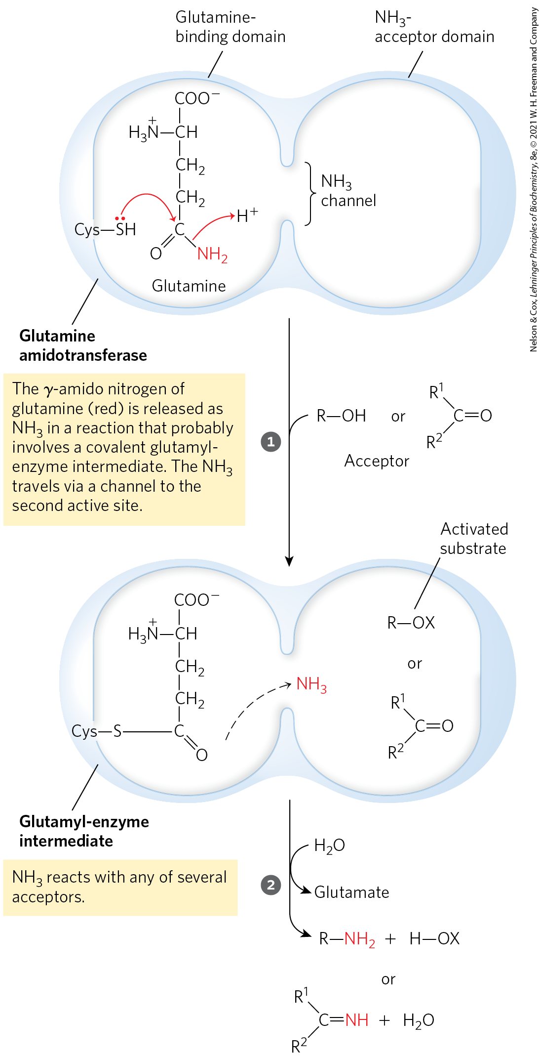
Glutamine Amidotransferases
glutamine amidotransferases = catalyze reactions that incorporate nitrogen derived from the amide group of glutamine

Slide 12
Two Pathways Lead to Nucleotides
de novo pathways = begin with metabolic precursors: amino acids, ribose 5-phosphate, CO₂, and NH₃
  bases are synthesized while attached to ribose
  pyrimidine ring is synthesized as orotate
  Glu provides most amino groups
  Gly is the precursor for purines
  Asp is the precursor for pyrimidines
salvage pathways = recycle the free bases and nucleosides released from nucleic acid breakdown

Slide 13
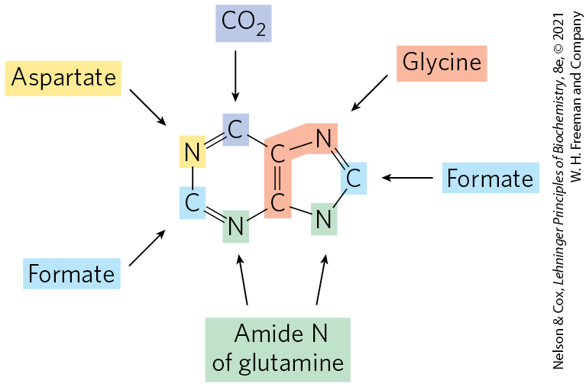
Origin of Ring Atoms in Purines
adenine and guanine are synthesized as AMP and GMP.

Slide 14
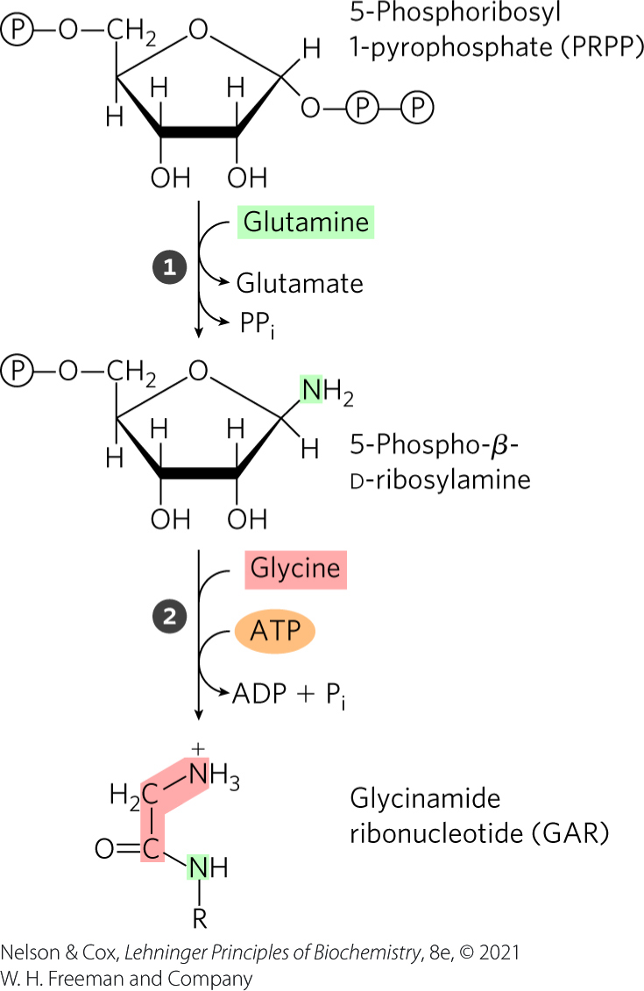
De Novo Purine Nucleotide Synthesis Begins with PRPP
in the first committed step, an amino group donated by glutamine is attached at C-1 of PRPP to form 5-phosphoribosylamine
in the second step, three atoms are added from glycine
  requires ATP

Slide 15
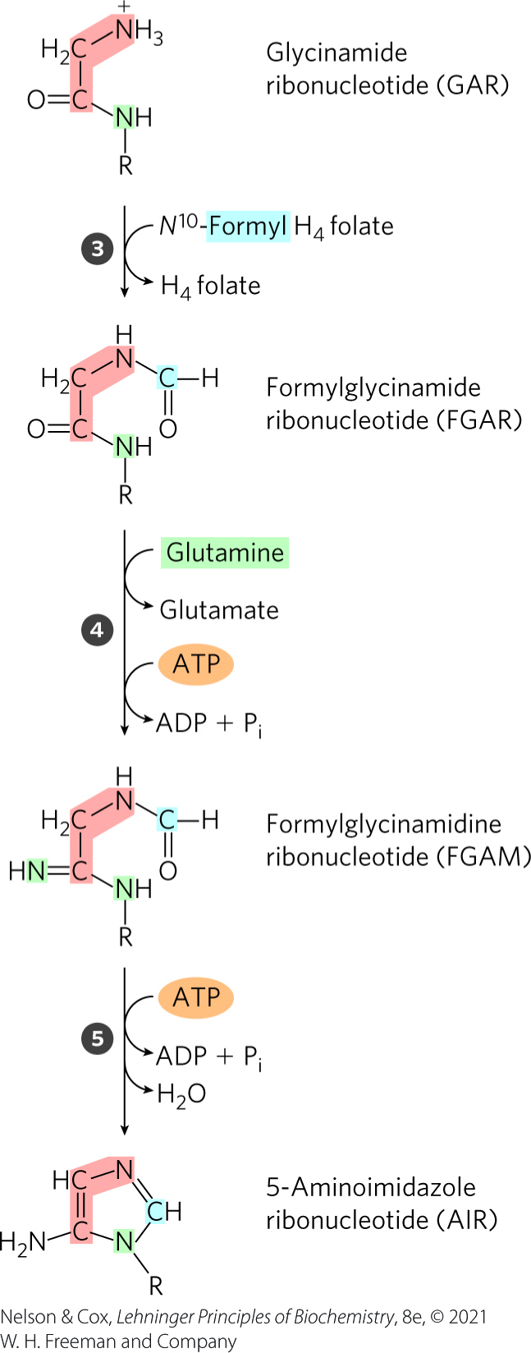
Construction of Inosinate, Steps 3-5
in the third step, the added glycine amino group is formylated by N¹⁰-formyltetrahydrofolate
in the fourth step, glutamine contributes a nitrogen
  requires ATP
in the fifth step, dehydration and ring closure yield the five-membered imidazole ring

Slide 16
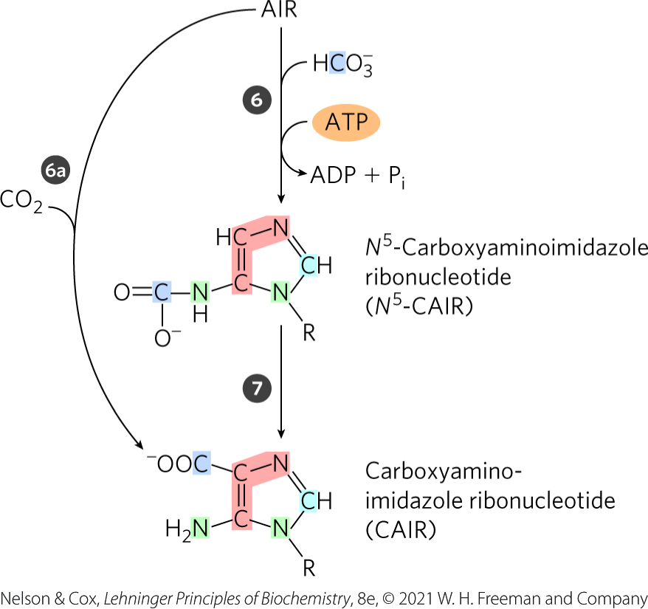
Construction of Inosinate, Steps 6 and 7
in the sixth step, a carboxyl group is added
  uses bicarbonate in aqueous solution
  requires ATP
in the seventh step, a rearrangement transfers the carboxylate to position 4 of the ring
higher eukaryotes combine steps 6 and 7 into one

Slide 17
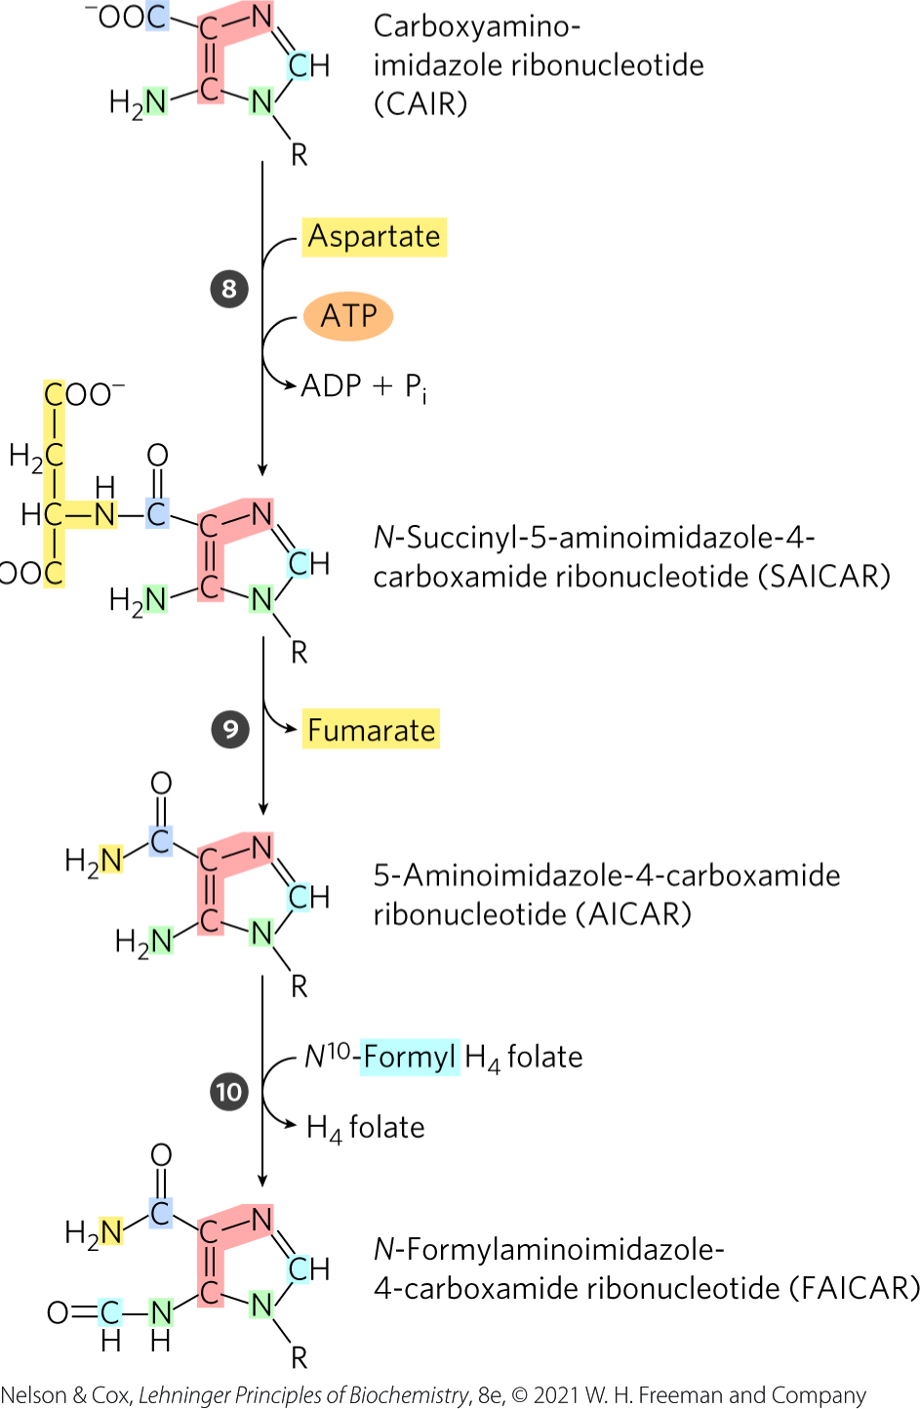
Construction of Inosinate, Steps
8-10
in the eighth step, an amide bond forms
  requires ATP
in the ninth step, the carbon skeleton of aspartate is eliminated as fumarate
in the tenth step, N¹⁰-formyltetrahydrofolate contributes the final carbon

Slide 18
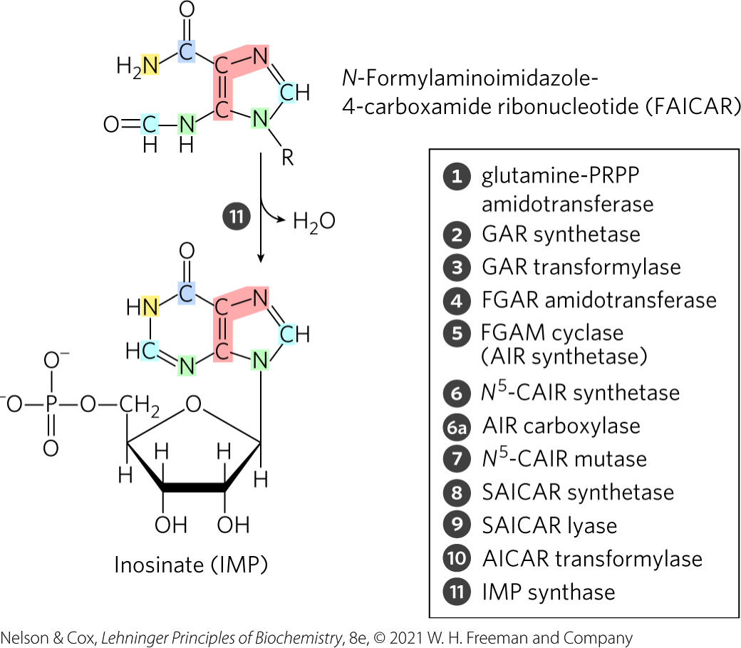
Construction of Inosinate, Step 11
in the eleventh step, a second ring closure occurs to form inosinate (IMP)
IMP is the first intermediate with a complete purine ring

Slide 19
Addition of the Amino Groups of AMP and GMP
conversion of inosinate to adenylate requires an amino group from aspartate
  requires GTP
conversion of inosinate to guanylate requires an amino group from glutamine
  requires ATP

Slide 20
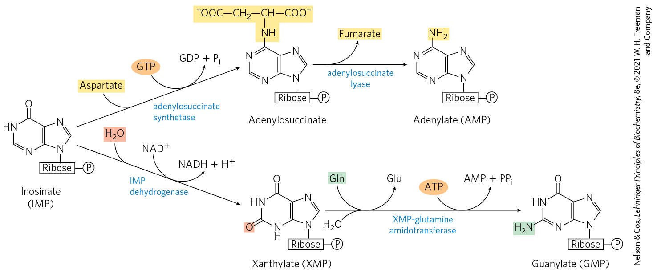
Biosynthesis of AMP and GMP from IMP

Slide 21
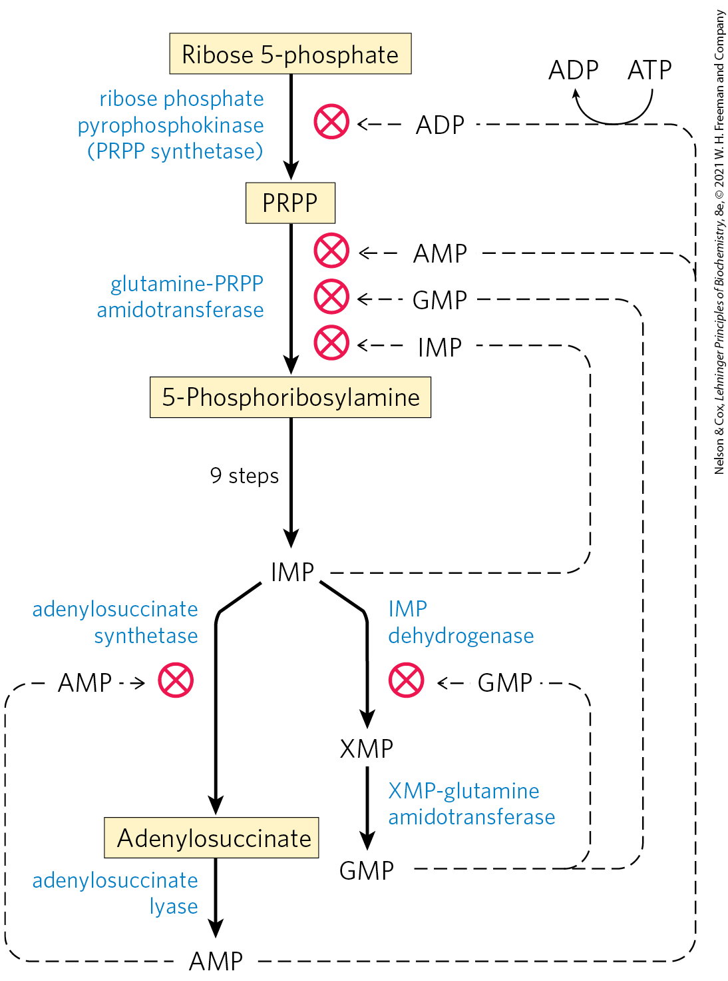
Purine Nucleotide Biosynthesis is Regulated by Feedback Inhibition
four major feedback mechanisms cooperate in regulating:
  the overall rate of de novo purine nucleotide synthesis
  the relative rates of formation of AMP and GMP

Slide 22
Regulation of Purine Biosynthesis in E. coli
glutamine-PRPP amidotransferase is inhibited by end-products IMP, AMP, and GMP
excess GMP inhibits IMP dehydrogenase and excess adenylate inhibits adenylosuccinate synthetase
  when both products are present, IMP builds up and inhibits an earlier step (sequential feedback inhibition)
GMP and AMP concentrations inhibit phosphorylation steps
PRPP synthesis is inhibited by ADP and GDP

Slide 23
Pyrimidine Nucleotides are Made from Aspartate, PRPP, and Carbamoyl Phosphate
pyrimidine synthesis proceeds by first making the pyrimidine ring (in the form of orotate)
ribose 5-phosphate is attached after pyrimidine ring formation
aspartate and carbamoyl phosphate provide the atoms for the ring structure

Slide 24
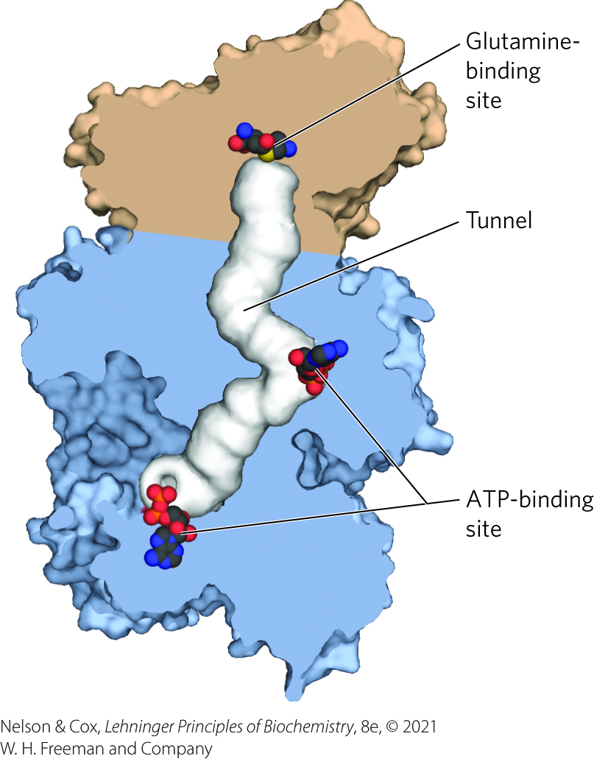
Carbamoyl Phosphate Synthase
carbamoyl phosphate synthetase II = cytosolic enzyme that makes the carbamoyl phosphate required in pyrimidine biosynthesis
  different from carbamoyl phosphate synthetase I in the mitochondria
bacteria have a single enzyme that supplies carbamoyl phosphate

Slide 25
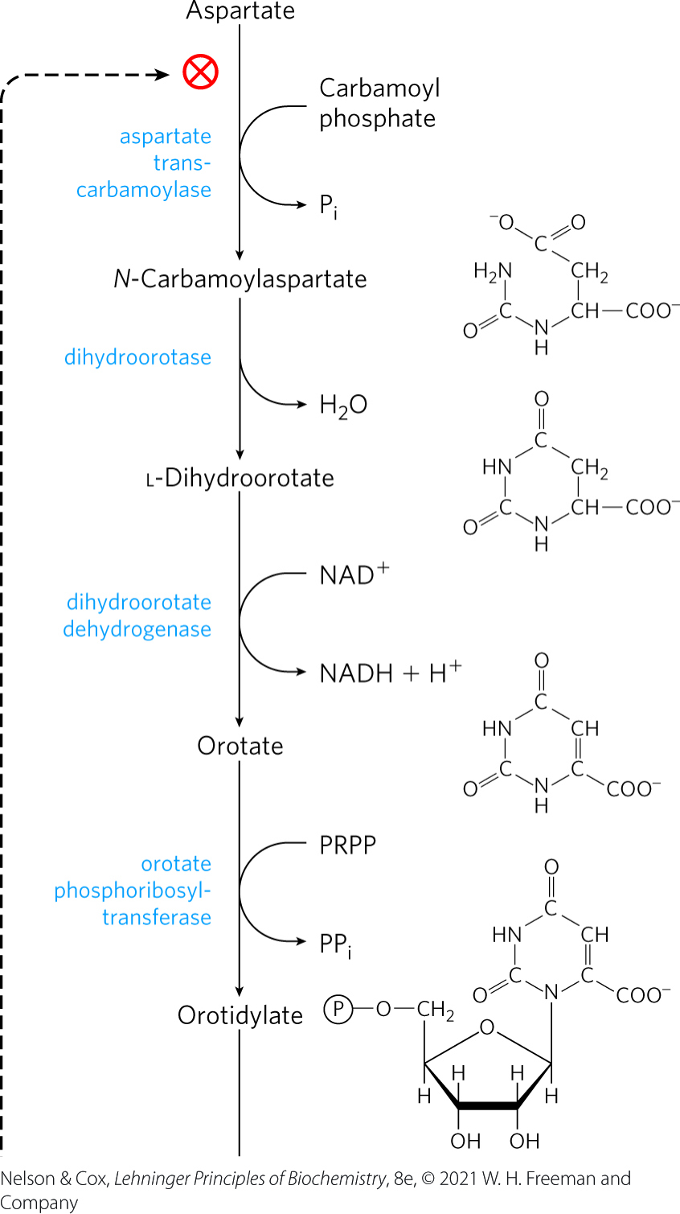
Construction of Pyrimidine Nucleotides (1 of 2)
aspartate transcarbamoylase = catalyzes the first committed step
  highly regulated in bacteria
dihydroorotase = catalyzes the removal of water from N-carbamoylaspartate to close the pyrimidine ring
in eukaryotes, the first three enzymes are part of a single trifunctional protein (CAD)

Slide 26
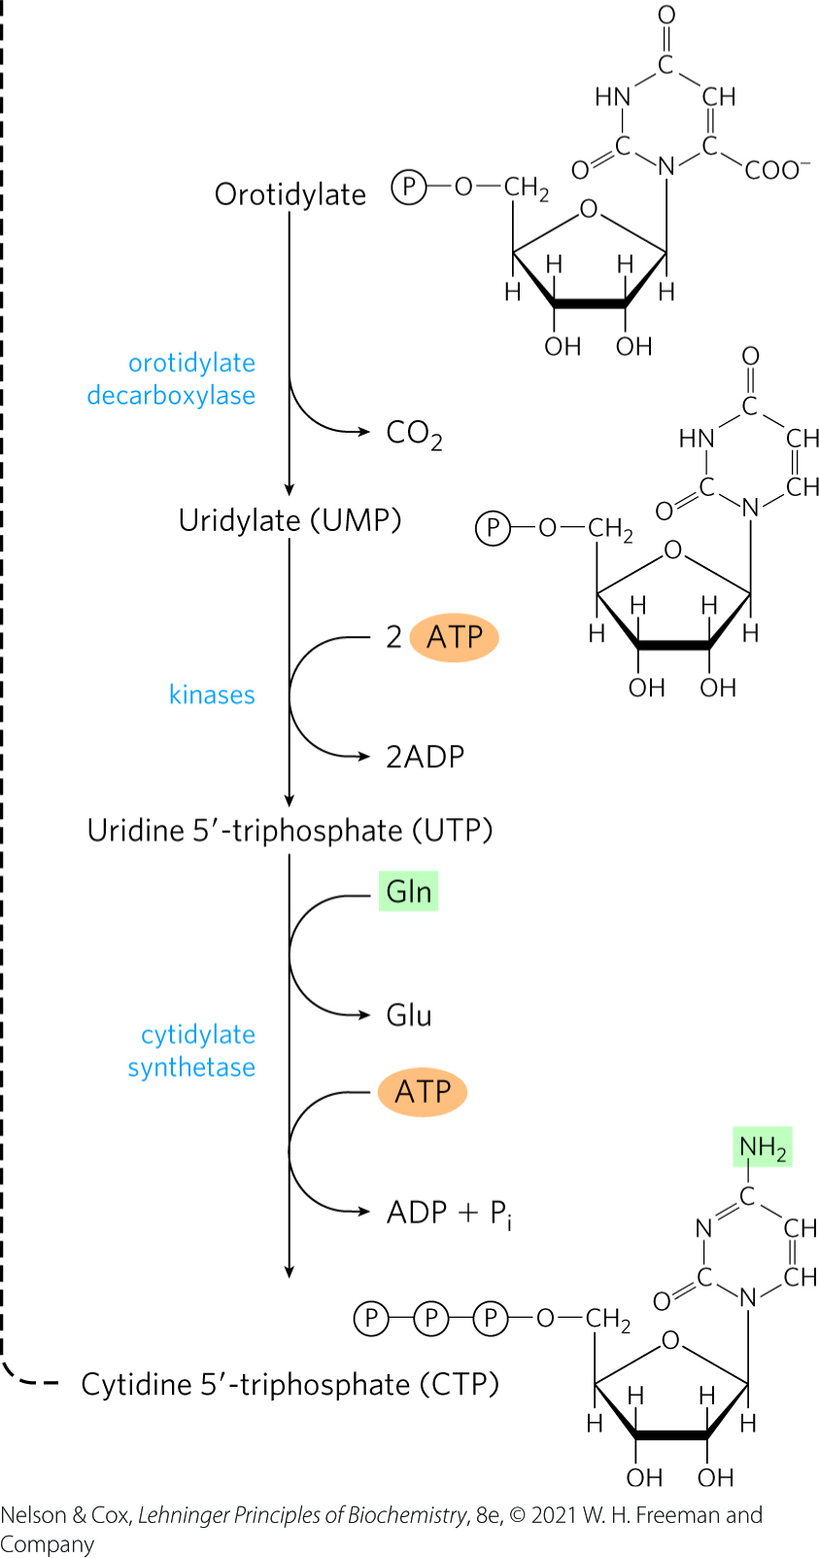
Construction of Pyrimidine Nucleotides (2 of 2)
orotidylate is decarboxylated to uridylate, which is phosphorylated to UTP
cytidylate synthetase = catalyzes the formation of CTP from UTP by way of an acyl phosphate intermediate
  requires ATP

Slide 27
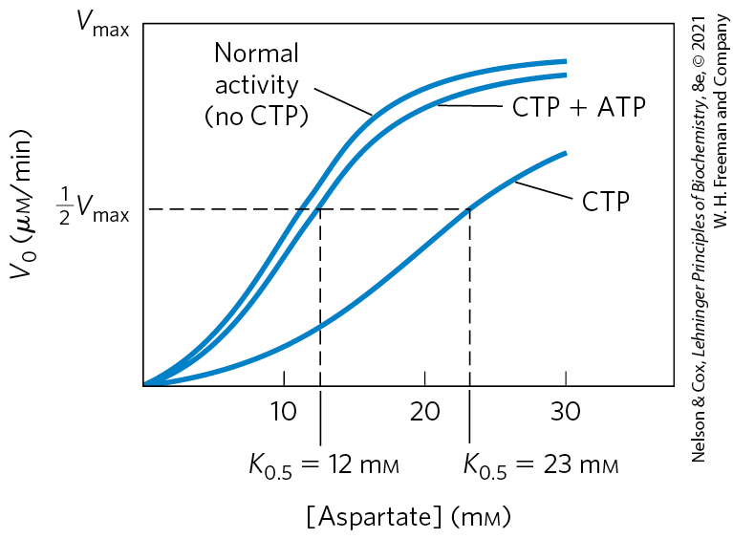
Pyrimidine Nucleotide Biosynthesis Is Regulated by Feedback Inhibition
aspartate transcarbamoylase (ATCase) = catalyzes the first reaction in the sequence
  inhibited by end-product CTP
  accelerated by ATP

Slide 28
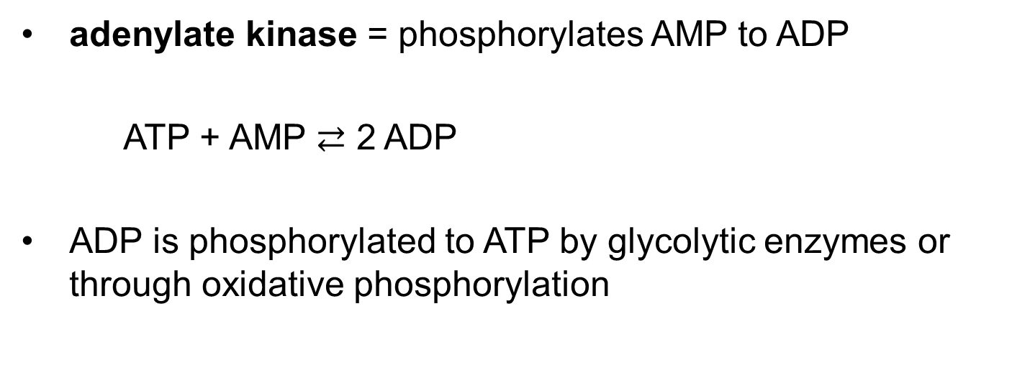
Nucleoside Monophosphates are Converted to Nucleoside Triphosphates
adenylate kinase = phosphorylates AMP to ADP
ATP + AMP $⇄$ 2 ADP
ADP is phosphorylated to ATP by glycolytic enzymes or through oxidative phosphorylation

Slide 29
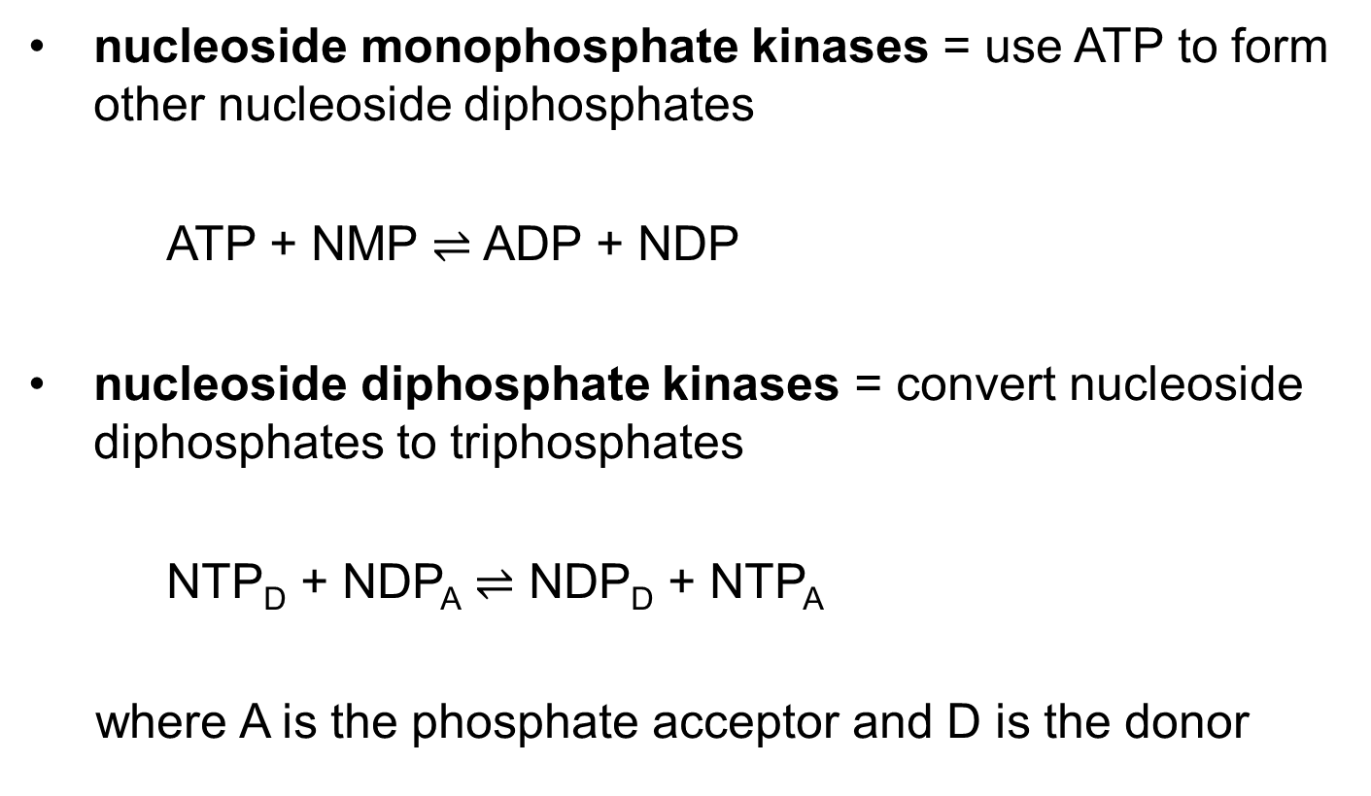
Nucleoside Mono- and Diphosphate Kinases
nucleoside monophosphate kinases = use ATP to form other nucleoside diphosphates
ATP + NMP $⇌$ ADP + NDP
nucleoside diphosphate kinases = convert nucleoside diphosphates to triphosphates
NTP_{D} + NDP_{A} $⇌$ NDP_{D} + NTP_{A}
where A is the phosphate acceptor and D is the donor

Slide 30
Ribonucleotides are the Precursors of Deoxyribonucleotides
ribonucleotide reductase = converts ribonucleotides to deoxyribonucleotides
thioredoxin = intermediate hydrogen-carrying protein that carries a pair of hydrogen atoms from NADPH to the ribonucleoside diphosphate
  has pairs of –SH groups that carry hydrogen atoms
thioredoxin reductase = catalyzes the reduction of the oxidized form of thioredoxin by NADPH

Slide 31
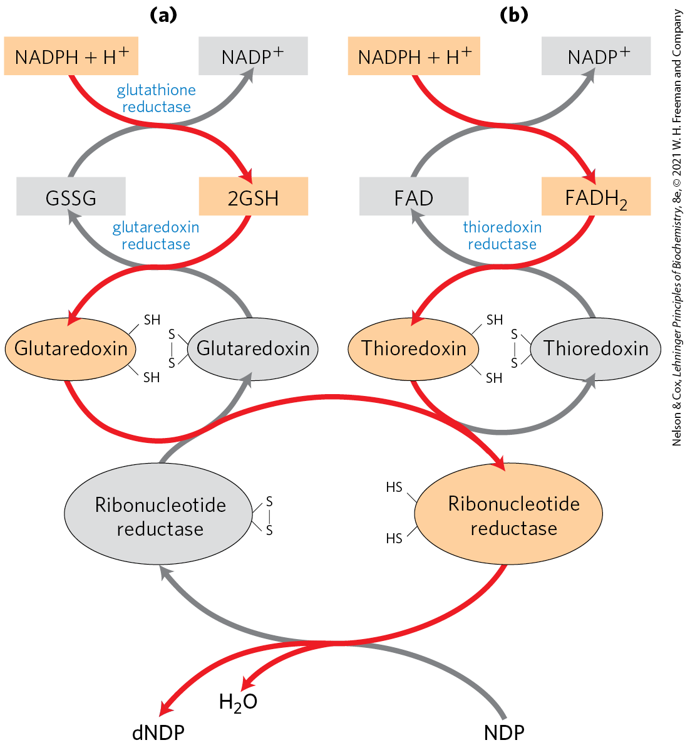
Reduction of Ribonucleotides to Deoxyribonucleotides
glutaredoxin = transfers reducing power from glutathione (GSH) to ribonucleotide reductase
electrons are transmitted to the enzyme from NADPH via glutaredoxin or thioredoxin

Slide 32
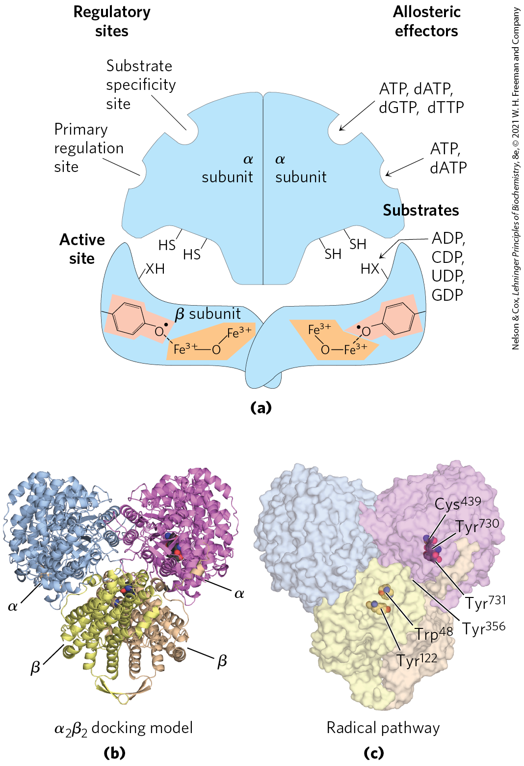
Structure of
Ribonucleotide Reductase
α₂β₂ dimer, with:
  two catalytic subunits, α₂, that contribute sulfhydryl groups
  two radical-generation subunits, β₂, that contribute a tyrosyl radical
β₂ subunits have an Fe³⁺ cofactor that helps generate and stabilize the Tyr¹²² radical

Slide 33
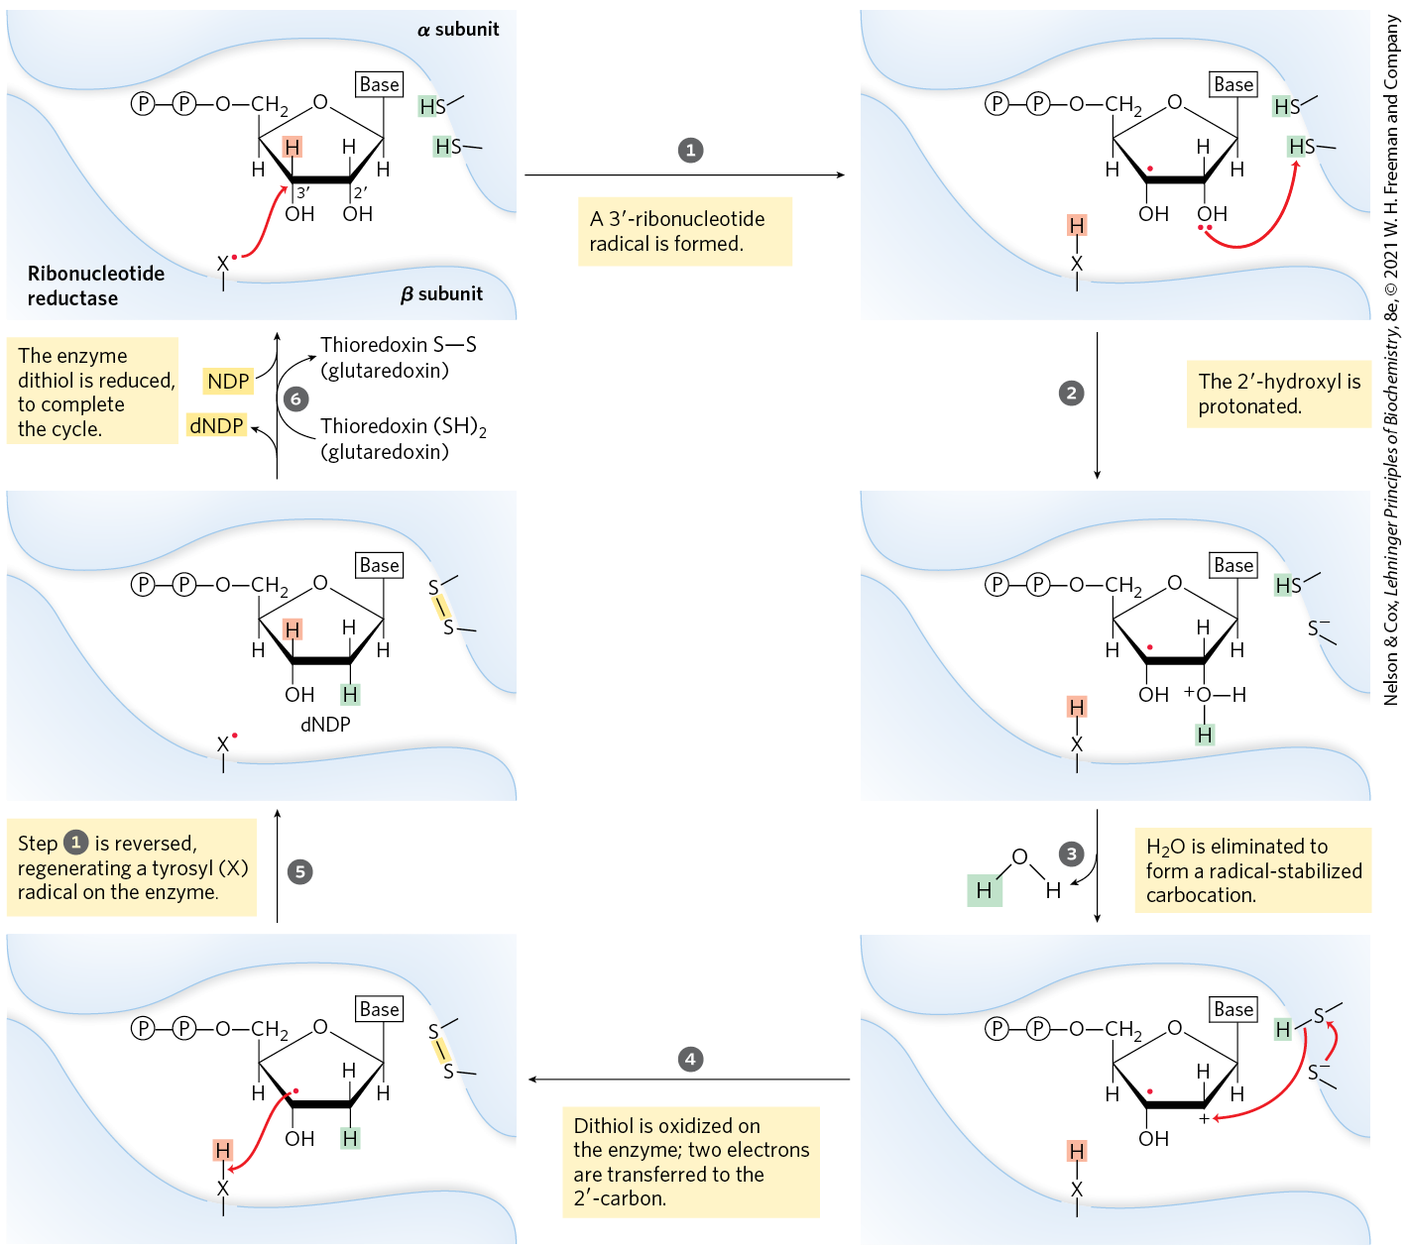
Proposed Mechanism for
Ribonucleotide Reductase

Slide 34
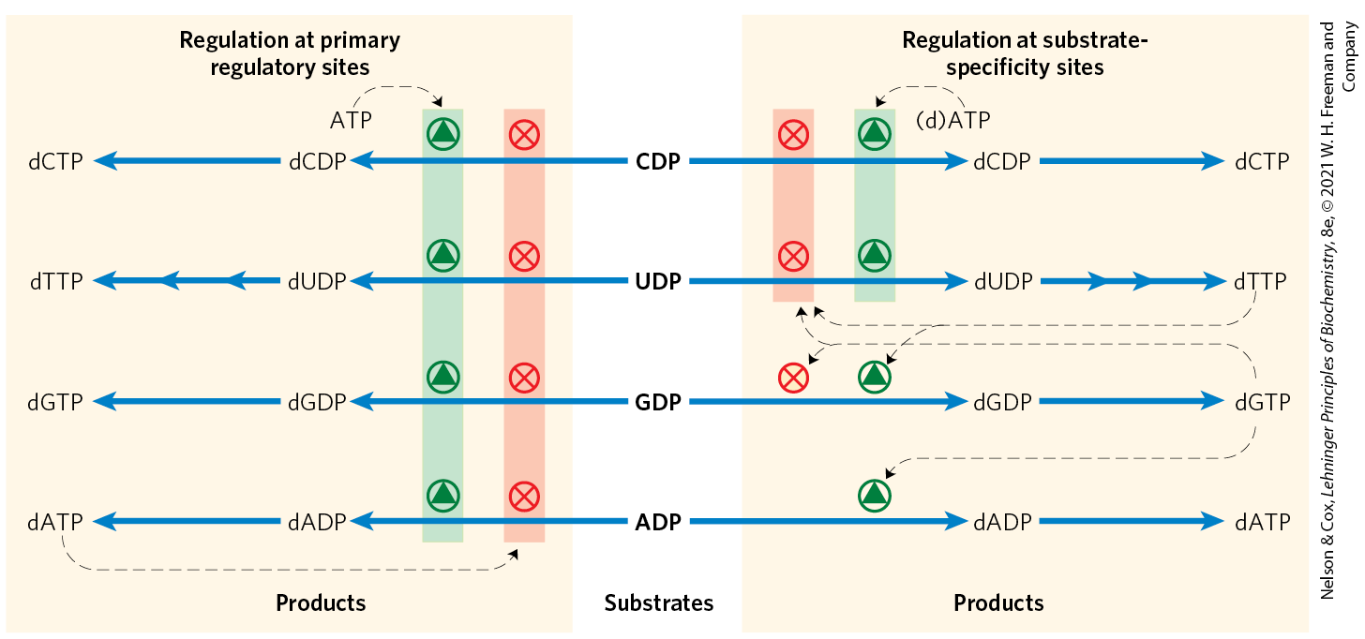
Regulation of Ribonucleotide Reductase by Deoxynucleoside Triphosphates
provides a balanced pool of precursors for DNA synthesis

Slide 35
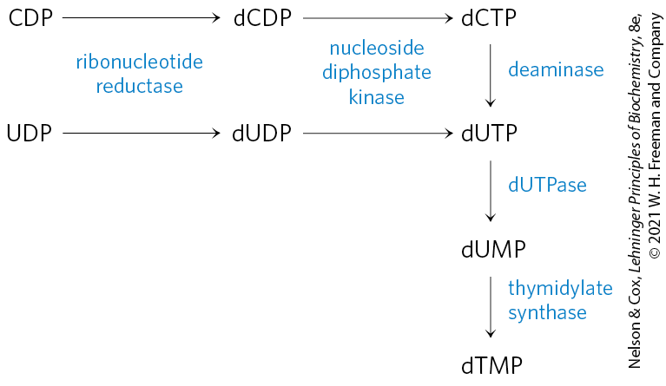
Thymidylate is Derived from dCDP and dUMP
the immediate precursor of thymidylate (dTMP) is dUMP
in bacteria, a dUTPase converts dUTP to dUMP
dUTP forms by deamination of dCTP or by phosphorylation of dUDP

Slide 36
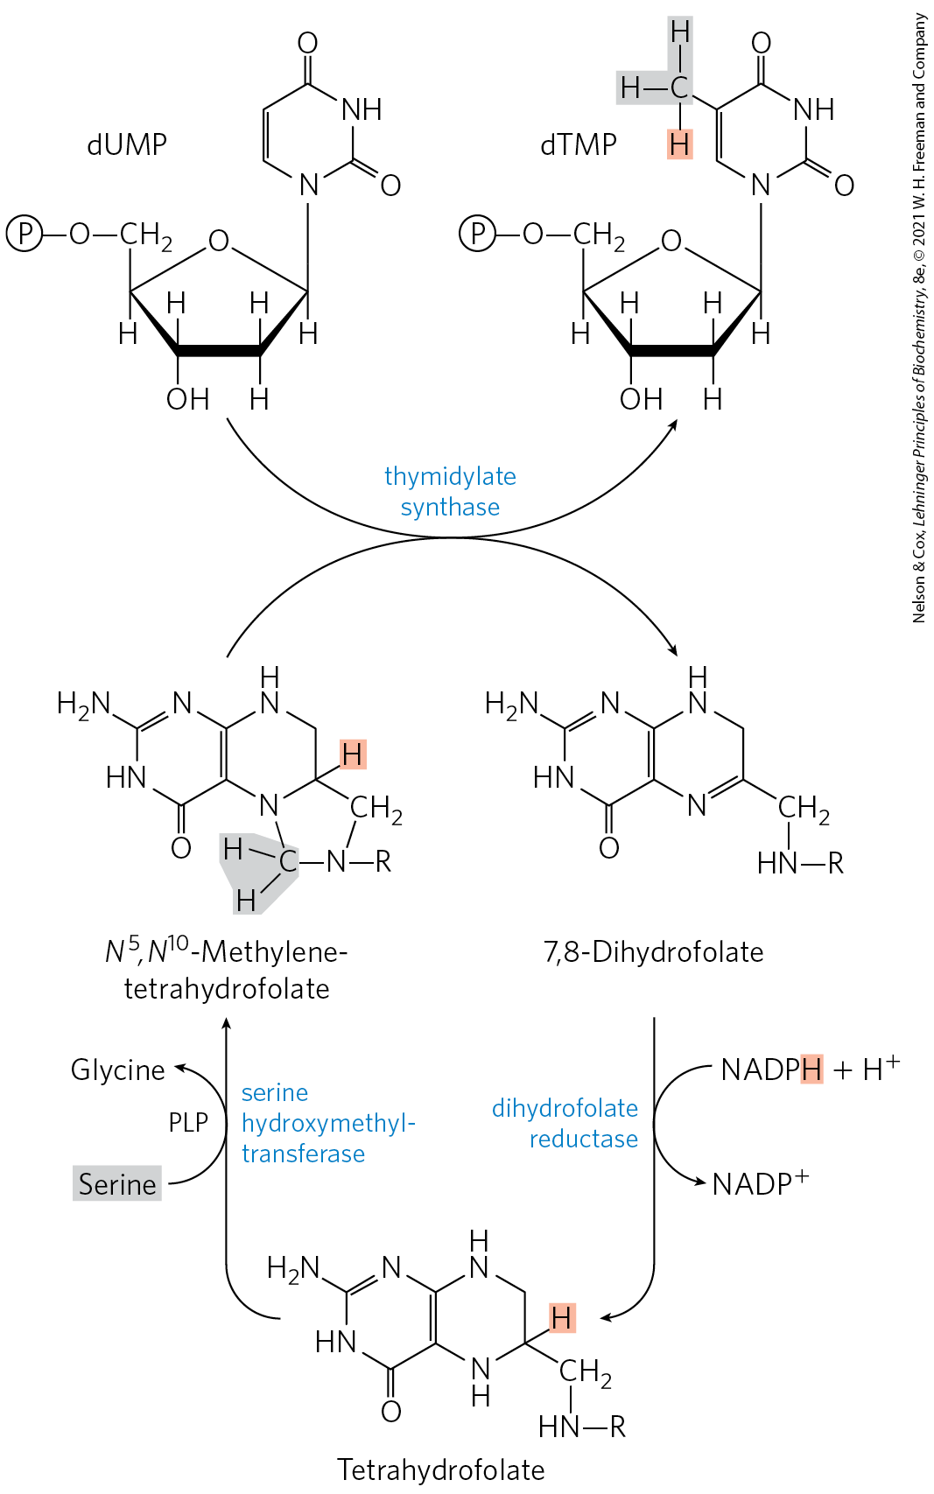
Conversion of dUMP to dTMP is Catalyzed by Thymidylate Synthase
thymidylate synthase = catalyzes the conversion of dUMP to dTMP
  a one-carbon unit is transferred from N⁵,N¹⁰-methylenetetrahydrofolate to dUMP, then reduced to a methyl group
dihydrofolate reductase = reduces dihydrofolate to tetrahydrofolate

Slide 37
Folic Acid Deficiency Leads to Reduced Thymidylate Synthesis
folic acid deficiency occurs in ~10% of the human population (and up to 50% of people in impoverished communities)
reduced thymidylate synthesis causes uracil to be incorporated into DNA
repair mechanisms remove the uracil by creating strand breaks that affect the structure and function of DNA
  associated with cancer, heart disease, and neurological impairment

Slide 38
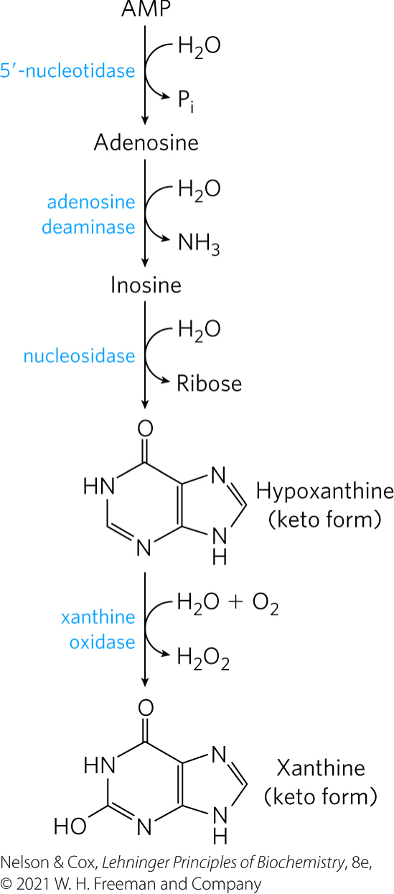
Degradation of Purines and Pyrimidines Produces Uric Acid and Urea, Respectively
5′-nucleotidase = removes the phosphate from purine nucleotides
  adenylate yields adenosine
adenosine deaminase = deaminates adenosine to inosine
inosine is hydrolyzed to hypoxanthine and oxidized to xanthine

Slide 39
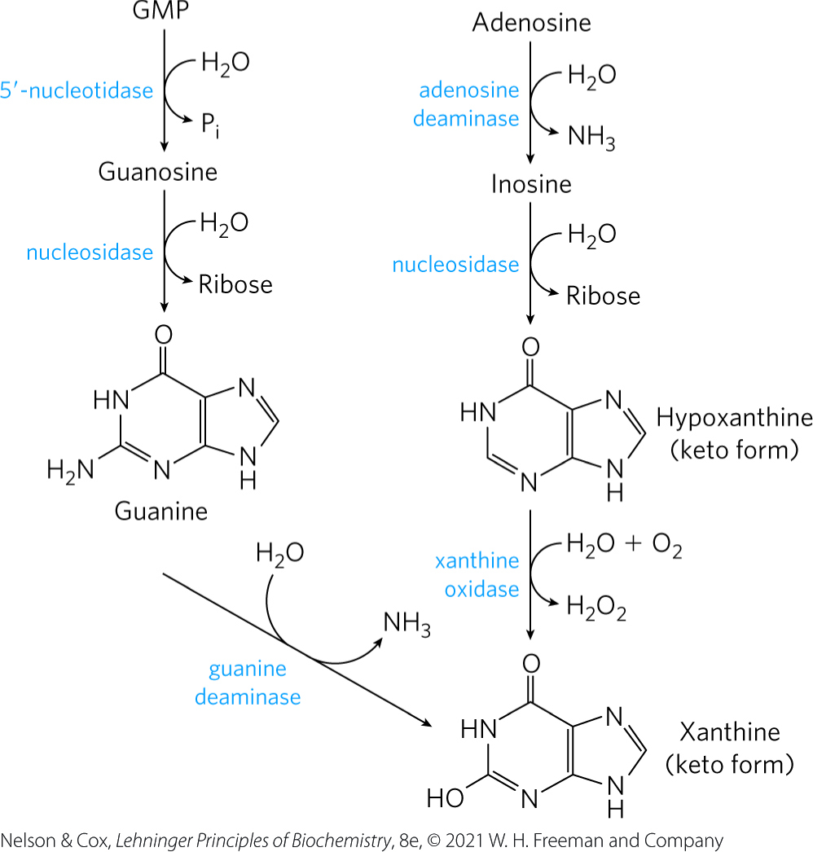
GMP Catabolism
GMP is first hydrolyzed to guanosine, which is then cleaved to free guanine
guanine undergoes hydrolytic removal of its amino group to yield xanthine

Slide 40
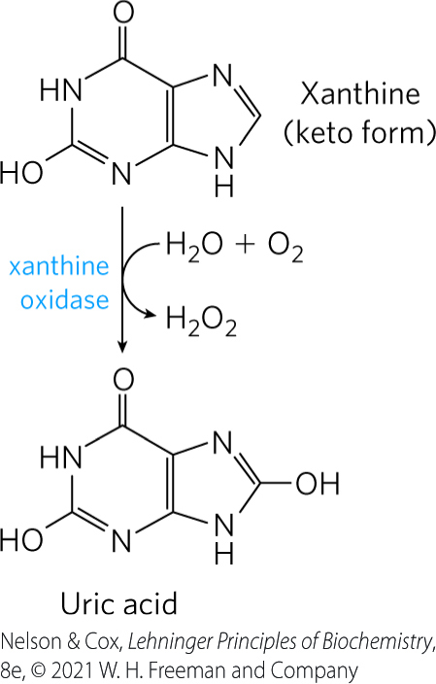
Xanthine Oxidase
xanthine oxidase = flavoenzyme that catalyzes the oxidation of xanthine to uric acid
  contains an atom of molybdenum and four iron-sulfur centers in its prosthetic group
  molecular oxygen is the electron acceptor

Slide 41
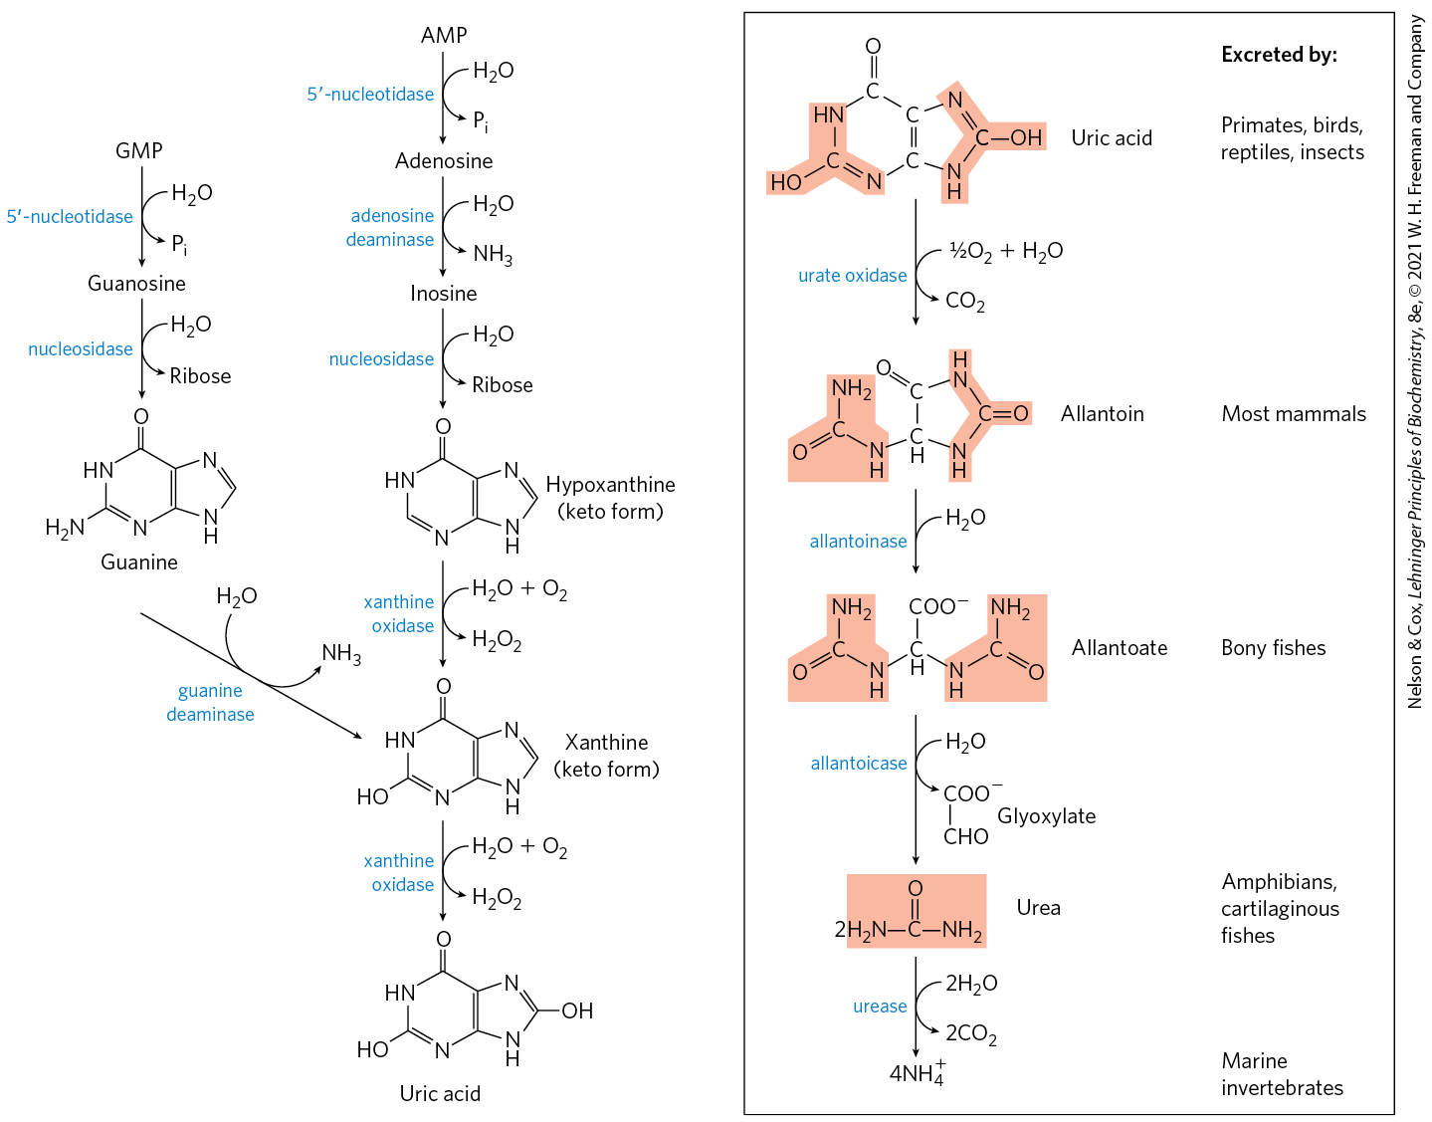
Catabolism of Purine Nucleotides

Slide 42
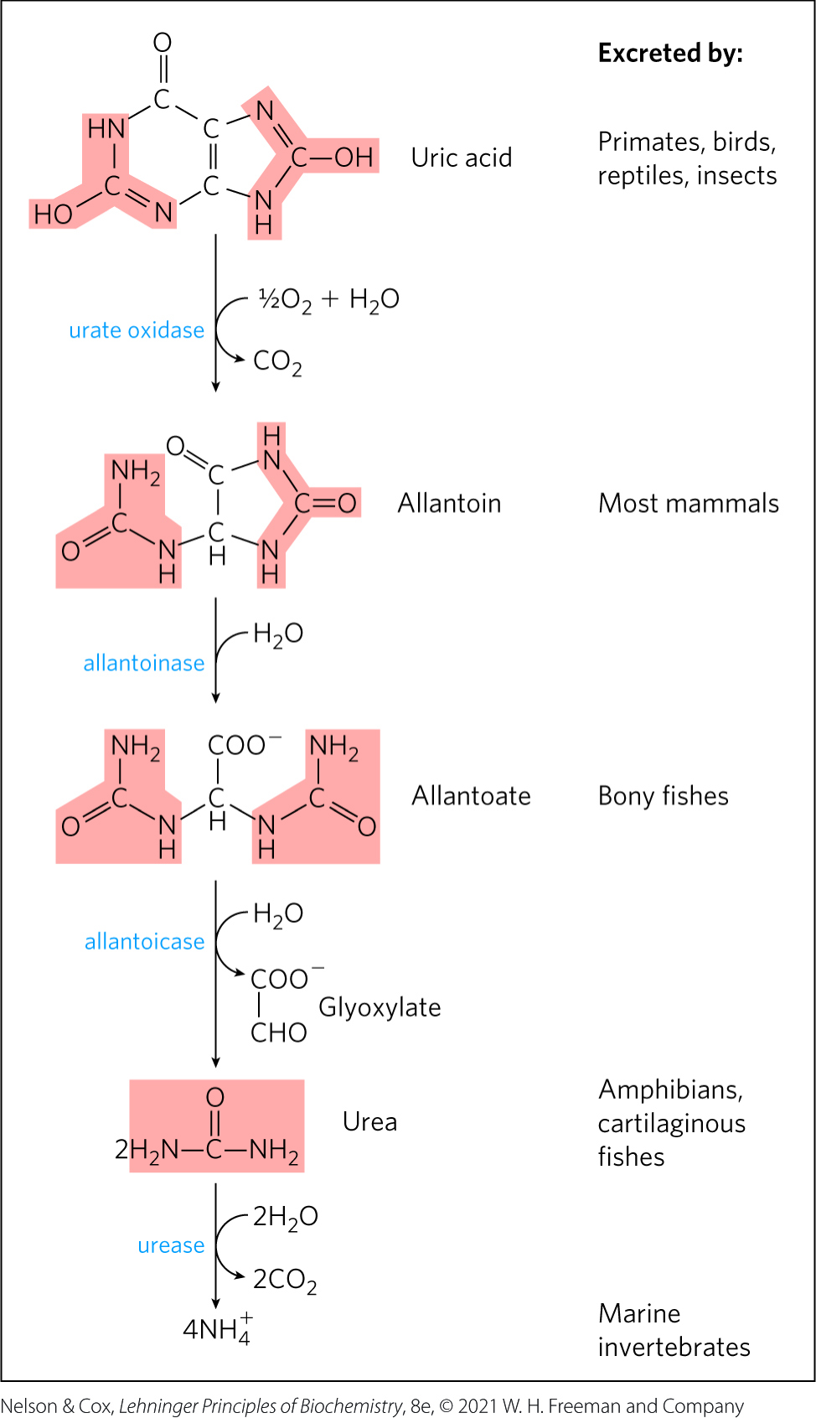
Conversion of Uric Acid to Allantoin, Allantoate, and Urea
the degree of oxidation of uric acid is organism-dependent
  primates, birds, and other animals excrete uric acid.
  most mammals and other vertebrates excrete allantoin
  other organisms excrete allantoate, urea, or NH₄⁺
urate oxidase = catalyzes the degradation of uric acid to allantoin

Slide 43
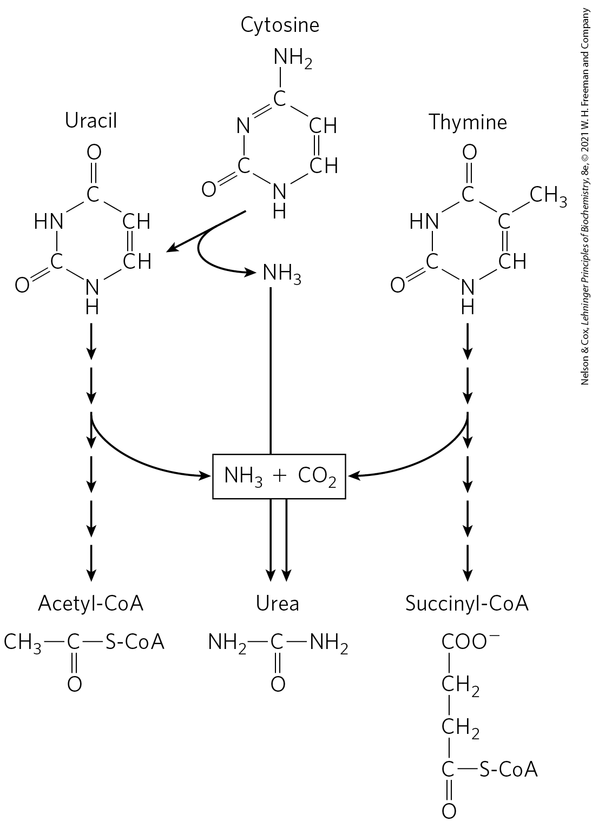
Catabolism of Pyrimidines
pathways for degradation lead to NH₄⁺ production and thus to urea synthesis
carbons of thymine are degraded to succinyl-CoA
carbons of cytosine and uracil are degraded to acetyl-CoA

Slide 44
Adenosine Deaminase (ADA) Deficiency
adenosine deaminase (ADA) deficiency = leads to a 100-fold increase in [dATP], a strong inhibitor of ribonucleotide reductase
  causes severe immunodeficiency disease in which T lymphocytes and B lymphocytes do not develop properly
  produces a general deficiency of other dNTPs in T lymphocytes

Slide 45
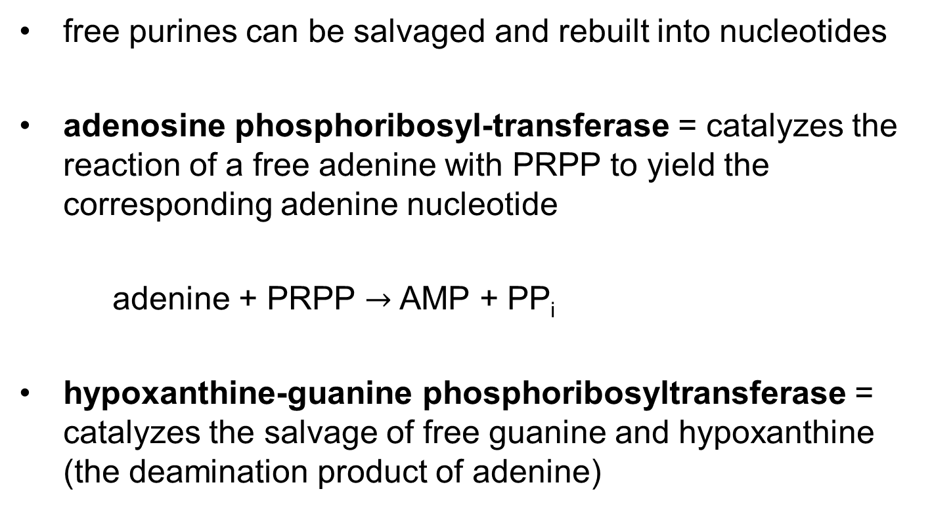
Purine and Pyrimidine Bases are Recycled by Salvage Pathways
free purines can be salvaged and rebuilt into nucleotides
adenosine phosphoribosyl-transferase = catalyzes the reaction of a free adenine with PRPP to yield the corresponding adenine nucleotide
adenine + PRPP $→$ AMP + PP_{i}
hypoxanthine-guanine phosphoribosyltransferase = catalyzes the salvage of free guanine and hypoxanthine (the deamination product of adenine)

Slide 46
Pyrimidine Salvage Pathways
a similar salvage pathway exists for pyrimidine bases in microorganisms, and possibly in mammals

Slide 47
Lesch-Nyhan Syndrome
Lesch-Nyhan syndrome = set of symptoms characterized by poor coordination, intellectual deficits, hostility, and compulsive self-destructive tendencies
  caused by a genetic lack of hypoxanthine-guanine phosphoribosyltransferase activity

Slide 48
Excess Uric Acid Causes Gout
gout = a disease of the joints caused by an elevated concentration of uric acid in the blood and tissues
  often involves an underexcretion of urate
  genetic deficiency of one or another enzyme of purine metabolism may also be a factor

Slide 49
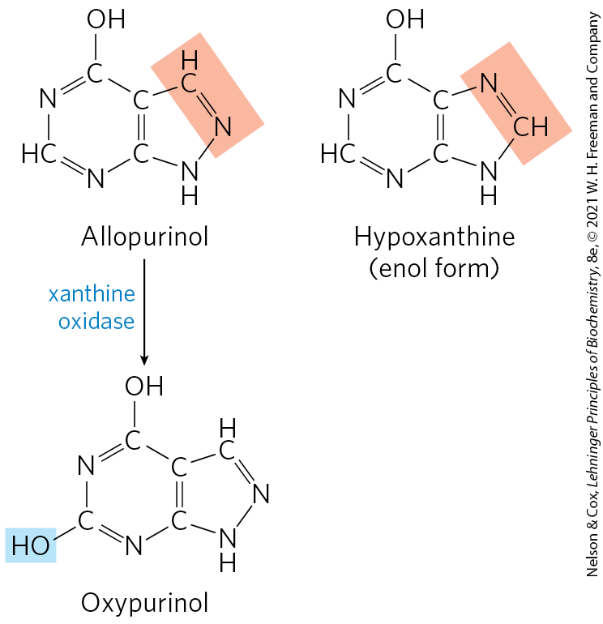
Allopurinol is an Inhibitor of Xanthine Oxidase
allopurinol = inhibitor of xanthine oxidase that is used in the treatment of gout
at the active site, allopurinol is converted to oxypurinol, a strong competitive inhibitor
  remains tightly bound to the enzyme

Slide 50
Many Chemotherapeutic Agents Target Enzymes in Nucleotide Biosynthetic Pathways
targets include thymidylate synthase and dihydrofolate reductase, enzymes that provide the only cellular pathway for thymine synthesis

Slide 51
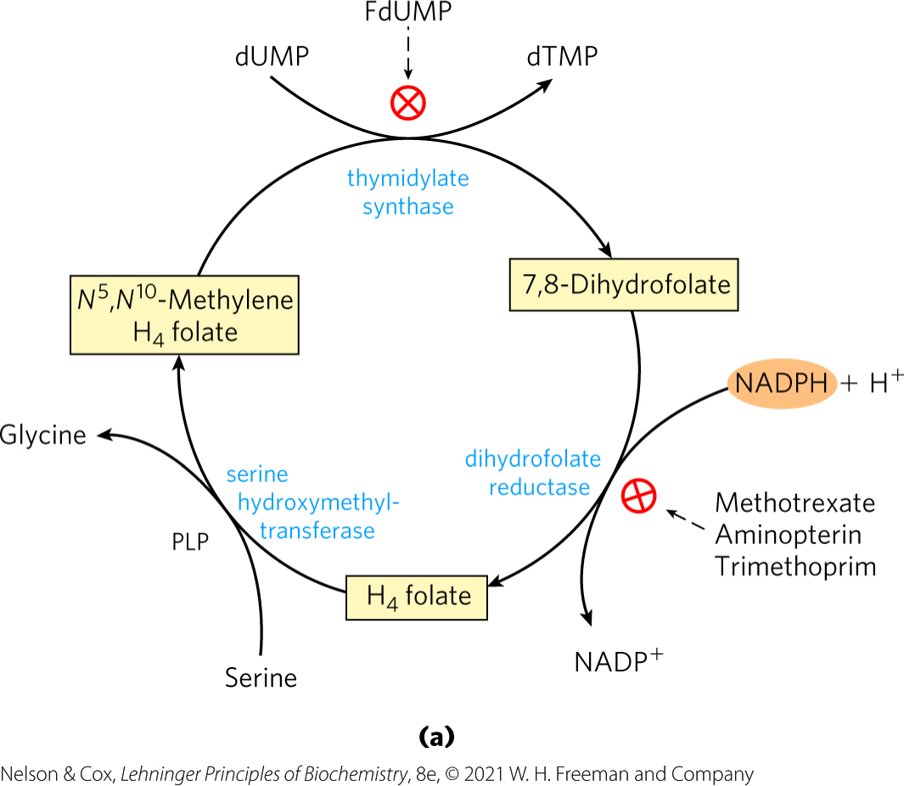
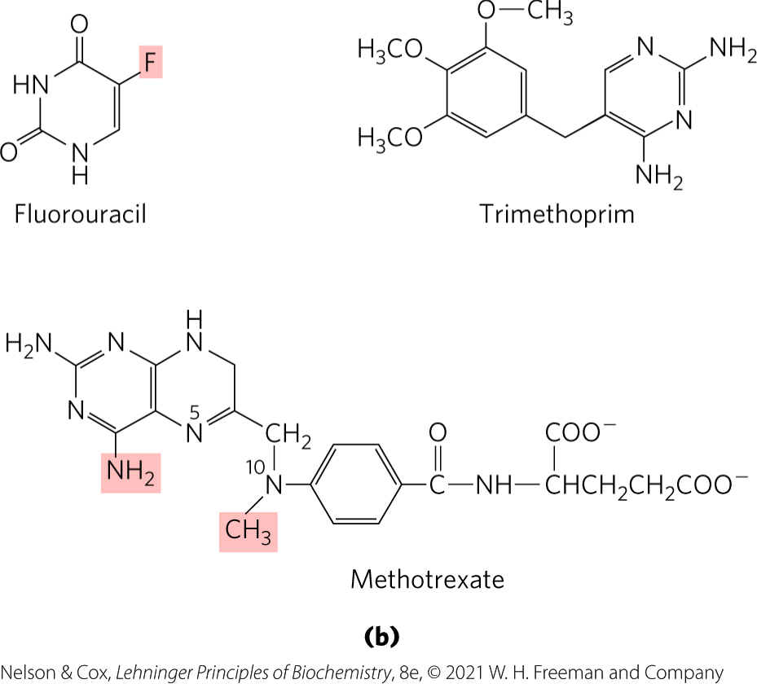
Thymidylate Synthesis and Folate Metabolism as Chemotherapy Targets

Slide 52
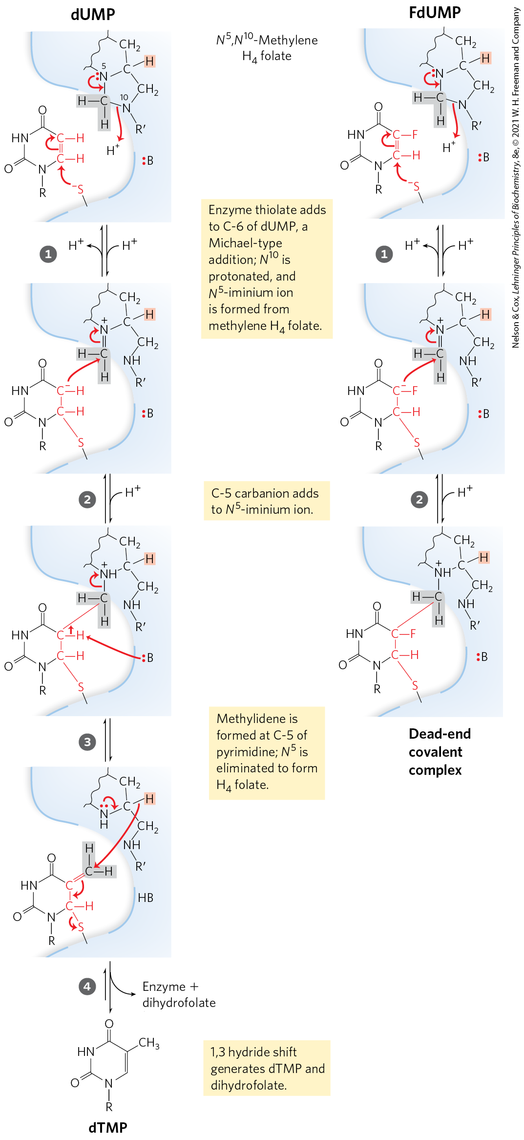
Inhibition of Thymidylate Synthase by FdUMP
fluorouracil = agent that is converted to the deoxynucleoside monophosphate FdUMP in salvage pathways
  FdUMP binds and inactivates thymidylate synthase

Slide 53
Methotrexate, Aminopterin, and Trimethoprim
methotrexate = a folate analog that acts as a competitive inhibitor of dihydrofolate reductase
  used as a chemotherapeutic agent
  aminopterin is a related compound that acts similarly
trimethoprim = an antibiotic that binds to bacterial dihydrofolate reductase nearly 100,000 times better than to the mammalian enzyme
  treats certain urinary and middle-ear bacterial infections

