Slide 1

19 Oxidative Phosphorylation
© 2021 Macmillan Learning

Slide 2

Principle 1 (1 of 5)
Mitochondria play a central role in eukaryotic aerobic metabolism. ATP production is not the only important mitochondrial function. Mitochondria play host to the citric acid cycle, the fatty acid β-oxidation pathway, and the pathways of amino acid oxidation. The mitochondria also act in thermogenesis, steroid synthesis, and apoptosis (programmed cell death). The discovery of these diverse and important roles of mitochondria has stimulated much current research on the biochemistry of this organelle.

Slide 3

Principle 2 (1 of 4)
Mitochondria trace their evolutionary origin to bacteria. Over 1.45 billion years ago, an endosymbiotic relationship arose between bacteria and a primitive eukaryote or eukaryotic progenitor. Mitochondria are ubiquitous in modern eukaryotes, and their bacterial origin is evident in almost every aspect of their structure and function.

Slide 4

Principle 3 (1 of 6)
Electrons flow from electron donors (oxidizable substrates) through a chain of membrane-bound carriers to a final electron acceptor with a large reduction potential. The final acceptor is molecular oxygen, O₂. The appearance of oxygen in the atmosphere some 2.3 billion years ago, and its harnessing in living systems via the evolution of oxidative phosphorylation, made more complex life forms possible.

Slide 5

Principle 4 (1 of 5)
The free energy made available by “downhill” (exergonic) electron flow is coupled to the “uphill” transport of protons across a proton-impermeable membrane. The free energy of fuel oxidation is thus conserved as a transmembrane electrochemical potential.

Slide 6

Principle 5 (1 of 7)
The transmembrane flow of protons back down their electrochemical gradient through specific protein channels provides the free energy for synthesis of ATP. This process is catalyzed by a membrane protein complex (ATP synthase) that couples proton flow to phosphorylation of ADP.

Slide 7
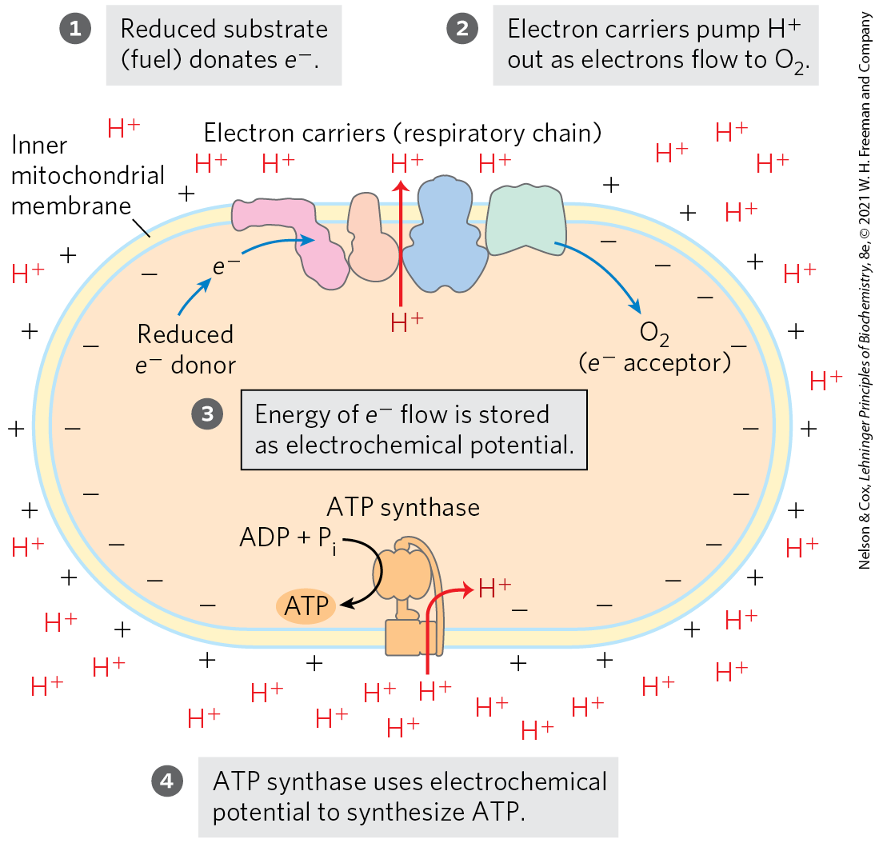
The Chemiosmotic Theory
chemiosmotic theory = transmembrane differences in proton concentration are the reservoir for the energy extracted from biological oxidation reactions

Slide 8
19.1 The Mitochondrial Respiratory Chain

Slide 9
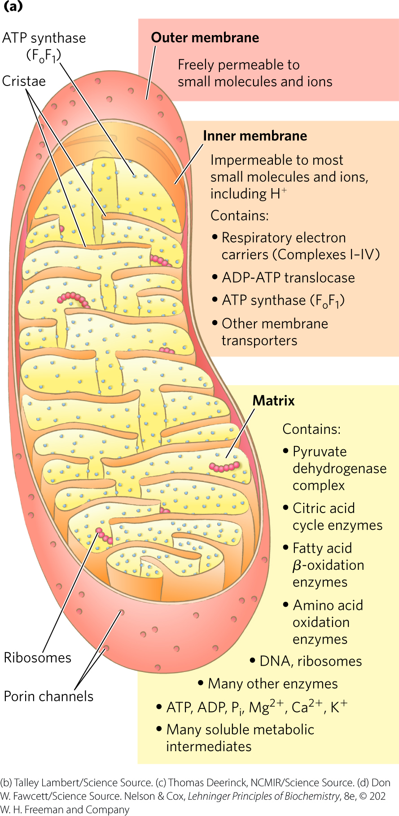
Mitochondria Have Two Membranes
outer membrane is readily permeable to small molecules and ions
  transport occurs through porins
inner membrane is impermeable to most small molecules and ions
  transport requires specific transporters

Slide 10
The Mitochondrial Matrix
the mitochondrial matrix contains:
  the pyruvate dehydrogenase complex
  enzymes of the citric acid cycle
  enzymes of the fatty acid β-oxidation pathway
  enzymes of the pathways of amino acid oxidation
the inner mitochondrial membrane segregates the intermediates and enzymes of cytosolic and matrix metabolic pathways

Slide 11
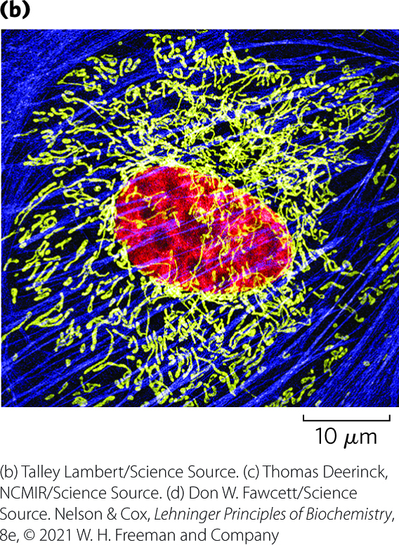
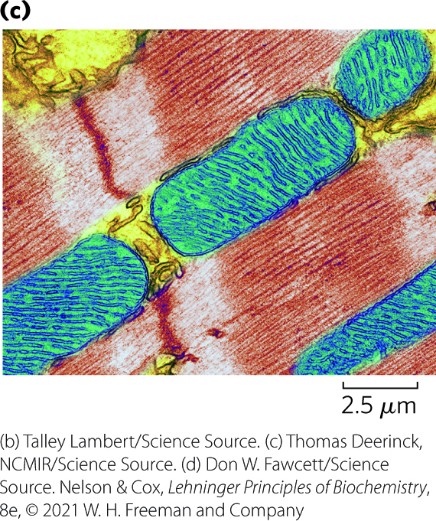
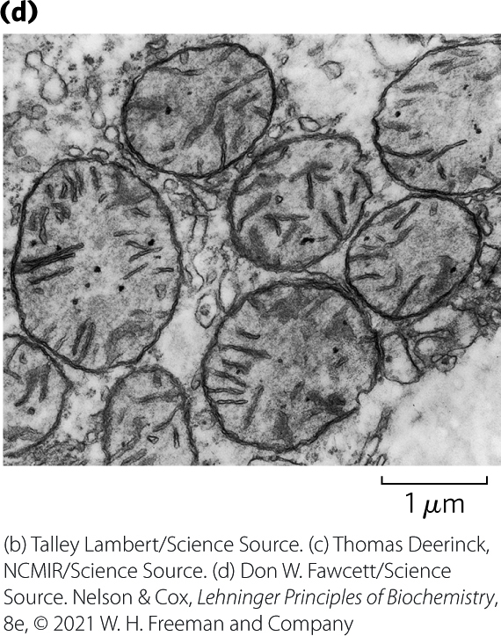
Mitochondrial Cristae
cristae = convolutions in the inner membrane of the mitochondrion
  mitochondria of cells with high metabolic activity have more cristae

Slide 12
The Effect of Stress on Mitochondria
during cell growth and division, mitochondria divide by fission
stressful conditions can trigger:
  mitochondrial fission
  mitophagy = the breakdown of mitochondria and recycling of the amino acids, nucleotides, and lipids
as stress is relieved, small mitochondria fuse to form long, thin, tubular organelles

Slide 13
Electrons Are Funneled to Universal Electron Acceptors
respiratory chain = series of electron carriers
dehydrogenases collect electrons from catabolic pathways and funnel them into universal electron acceptors:
  nicotinamide nucleotides (NAD⁺ or NADP⁺)
  flavin nucleotides (FMN or FAD)

Slide 14
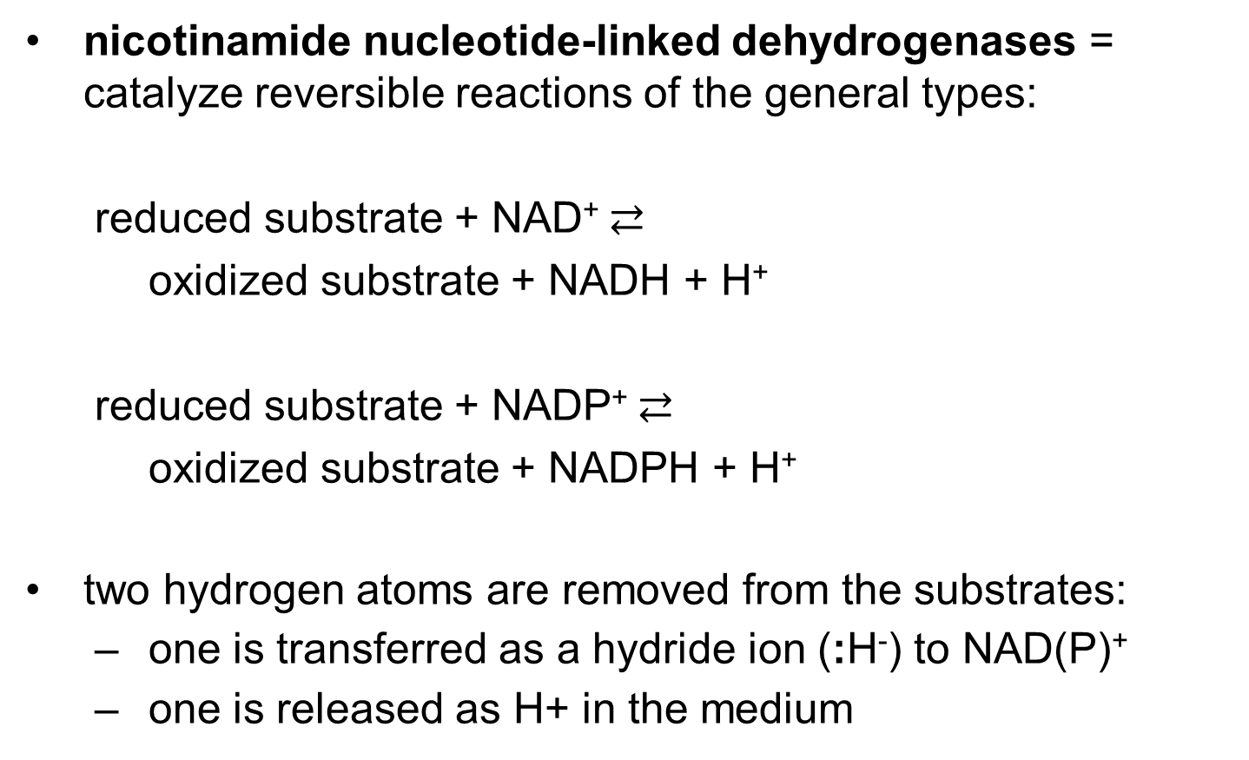
Nicotinamide Nucleotide-
Linked Dehydrogenases
nicotinamide nucleotide-linked dehydrogenases = catalyze reversible reactions of the general types:
  reduced substrate + NAD⁺ $⇄$
  oxidized substrate + NADH + H⁺
  reduced substrate + NADP⁺ $⇄$
  oxidized substrate + NADPH + H⁺
two hydrogen atoms are removed from the substrates:
  one is transferred as a hydride ion (:H⁻) to NAD(P)⁺
  one is released as H+ in the medium

Slide 15
Flavoproteins
flavoproteins = contain a very tightly, sometimes covalently, bound flavin nucleotide (FMN or FAD)
the oxidized flavin nucleotide can accept either:
  one electron (yielding the semiquinone form) or
  two electrons (yielding FADH₂ or FMNH₂)
electron transfer occurs because the flavoprotein has a higher E° than the compound oxidized
  E′° of a flavin nucleotide depends on the protein with which it is associated

Slide 16
Electrons Pass through a Series of Membrane-Bound Carriers
three types of electron transfers occur in oxidative phosphorylation:
  direct transfer of electrons
  transfer as a hydrogen atom (H⁺ + e⁻)
  transfer as a hydride ion (:H⁻)
reducing equivalent = a single electron equivalent transferred in an oxidation-reduction reaction

Slide 17
Electron-Carrying Molecules in the Respiratory Chain
five types of electron-carrying molecules:
  NAD
  flavoproteins
  ubiquinone (coenzyme Q or Q)
  cytochromes
  iron-sulfur proteins

Slide 18
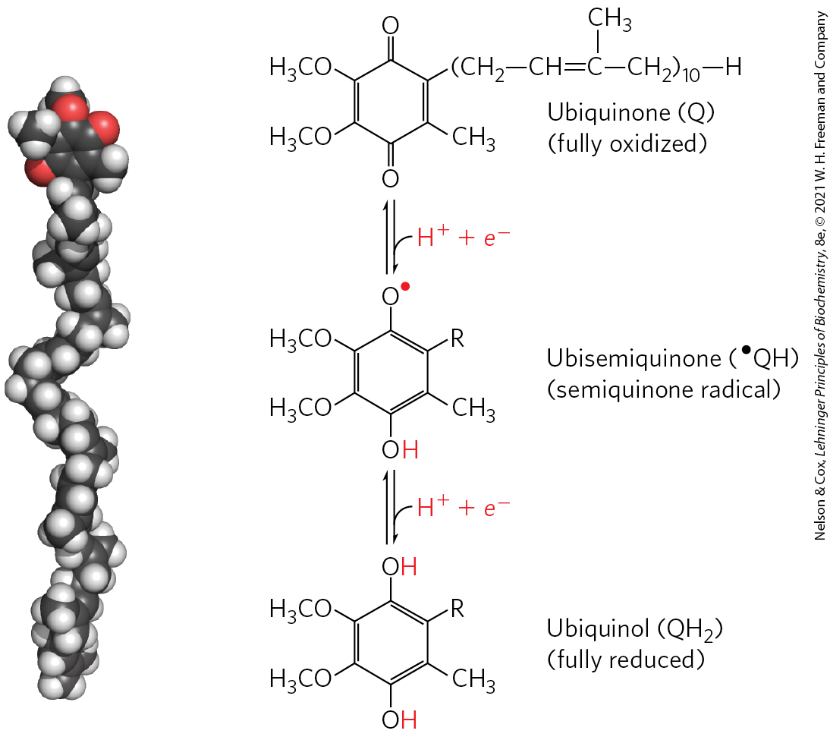
Ubiquinone
ubiquinone (coenzyme Q or Q) = a lipid-soluble benzoquinone with a long isoprenoid side chain
  can accept one or two electrons
  freely diffusible within the inner mitochondrial membrane
  plays a central role in coupling electron flow to proton movement

Slide 19
Cytochromes
cytochromes = proteins with characteristic strong absorption of visible light due to their iron-containing heme prosthetic groups
  one-electron carriers
  3 classes in mitochondria: a, b, and c
    hemes of a and b are not covalently bound to associated proteins
    c is covalently attached through Cys residues

Slide 20
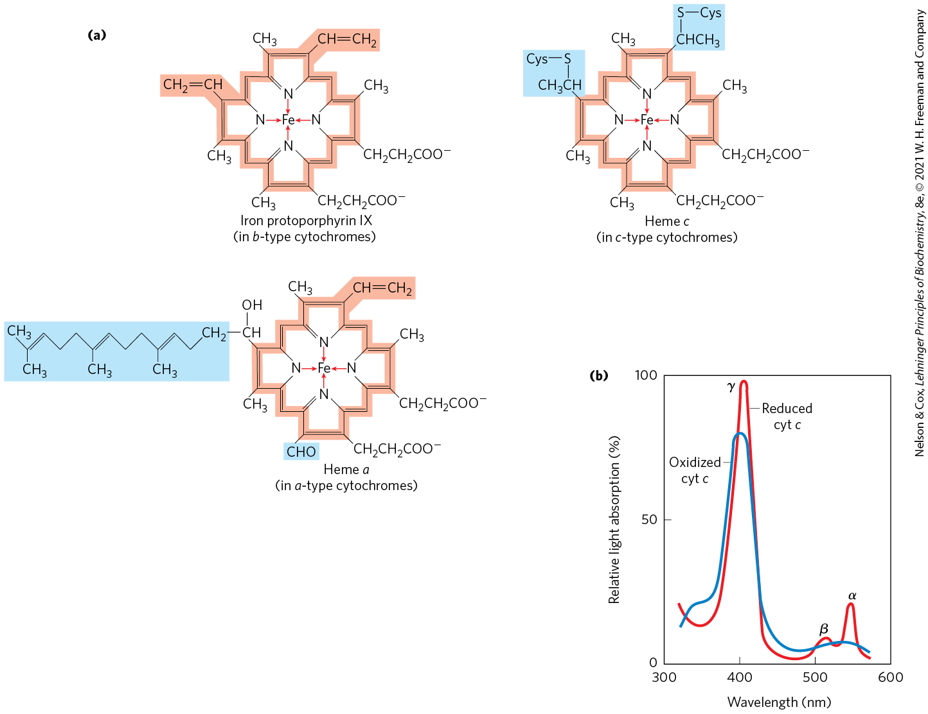
Prosthetic Groups of Cytochromes

Slide 21
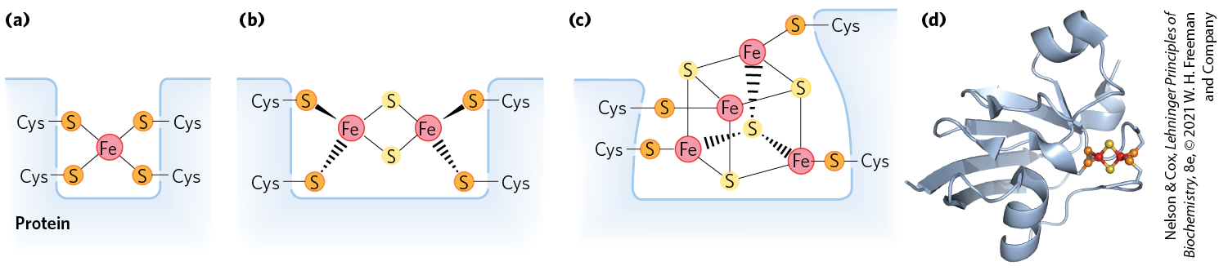
Iron-Sulfur Proteins
iron-sulfur proteins = proteins that contain iron in association with inorganic sulfur atoms and/or with the sulfur atoms of Cys residues in the protein
  participate in one-electron transfers
Rieske iron-sulfur proteins = proteins in which one Fe atom is coordinated to two His residues

Slide 22
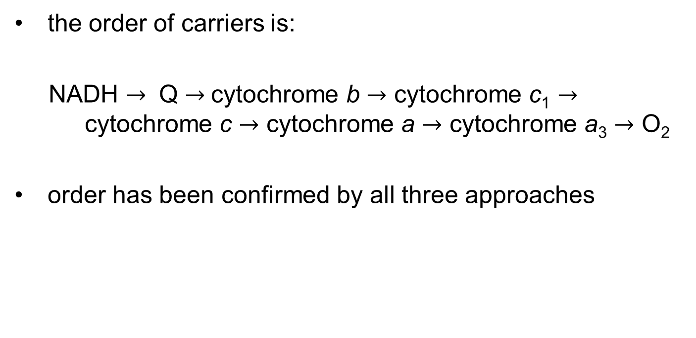
The Sequence of Electron Carriers
the order of carriers is:
NADH $→$ Q $→$cytochrome b $→$ cytochrome c₁ $→$ cytochrome c $→$ cytochrome a $→$ cytochrome a₃ $→$ O₂
order has been confirmed by all three approaches

Slide 23
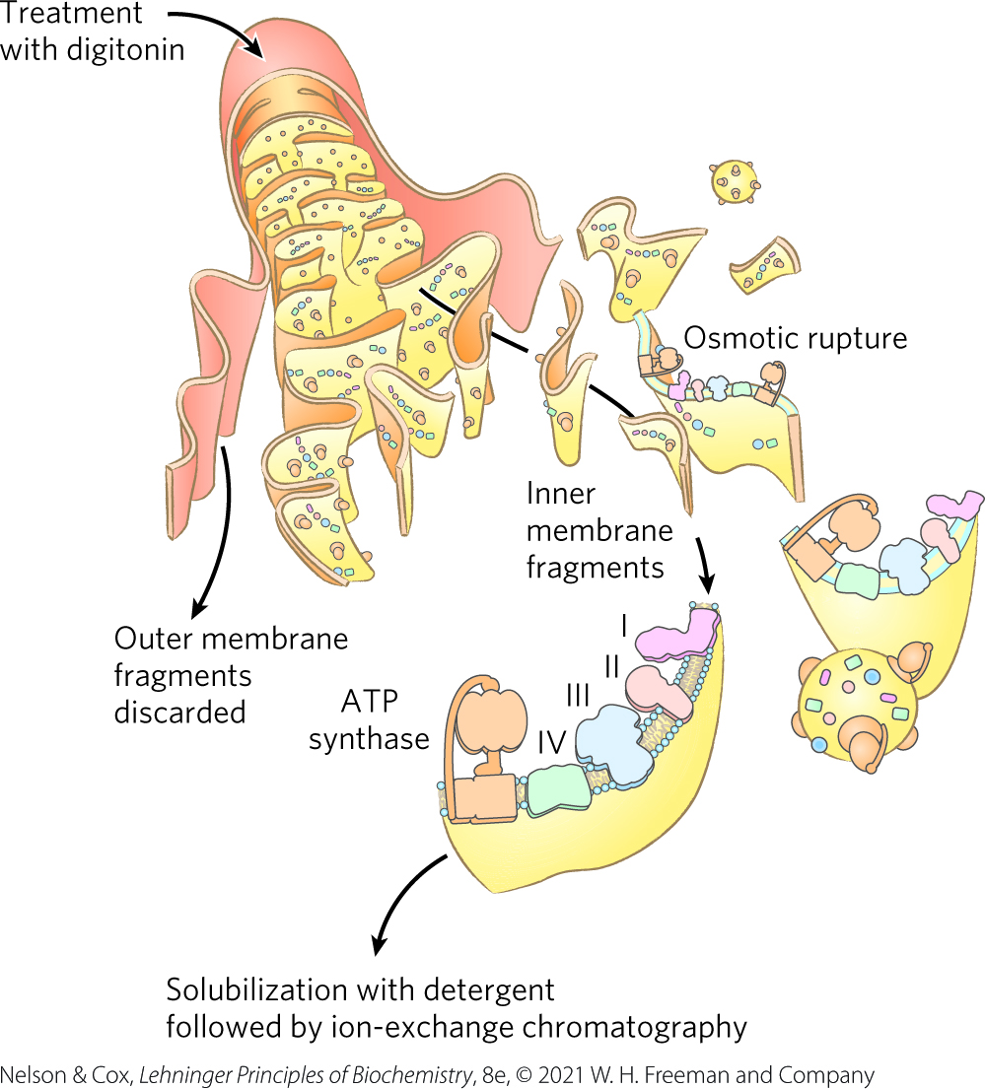
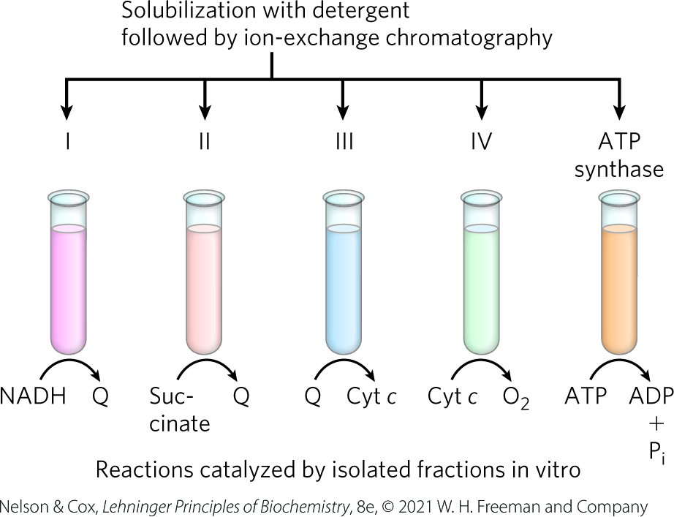
Separation of Functional Complexes of the Respiratory Chain

Slide 24
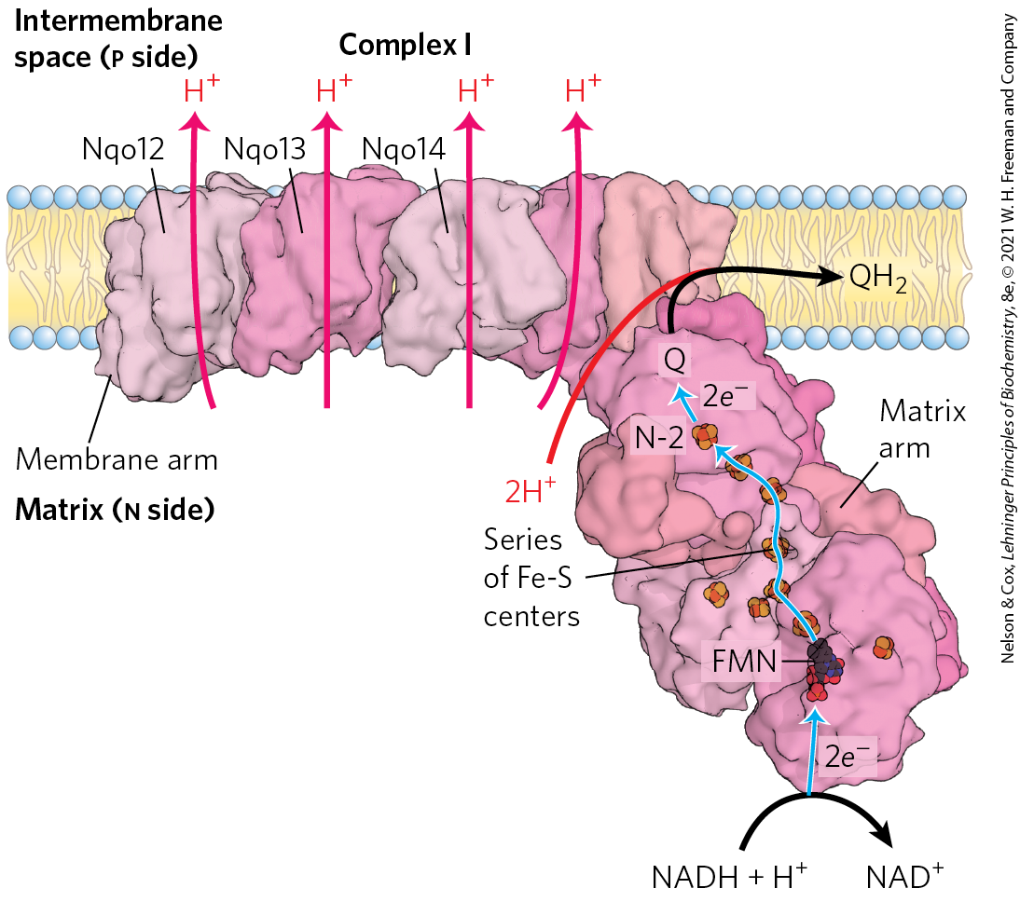
Complex I: NADH to Ubiquinone
Complex I (NADH:ubiquinone oxidoreductase, NADH dehydrogenase) = large L-shaped enzyme with >40 polypeptide chains
  FMN-containing flavoprotein accepts 2 electrons from NADH
  8+ Fe-S centers pass elections to ubiquinone

Slide 25
Complex I Is a Proton Pump
Complex I is a proton pump driven by the energy of electron transfer
Complex I catalyzes a vectorial reaction (moves protons in a specific direction from one location to another)

Slide 26
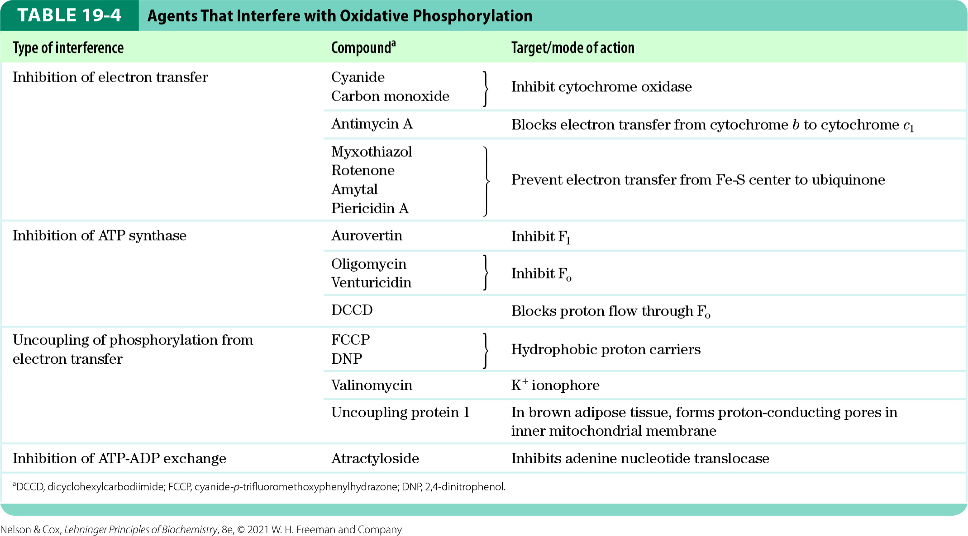
Agents that Inhibit
Oxidative Phosphorylation
inhibitors of Complex I:
  amytal (a barbiturate drug)
  rotenone (an insecticide)
  piericidin A (an antibiotic)

Slide 27
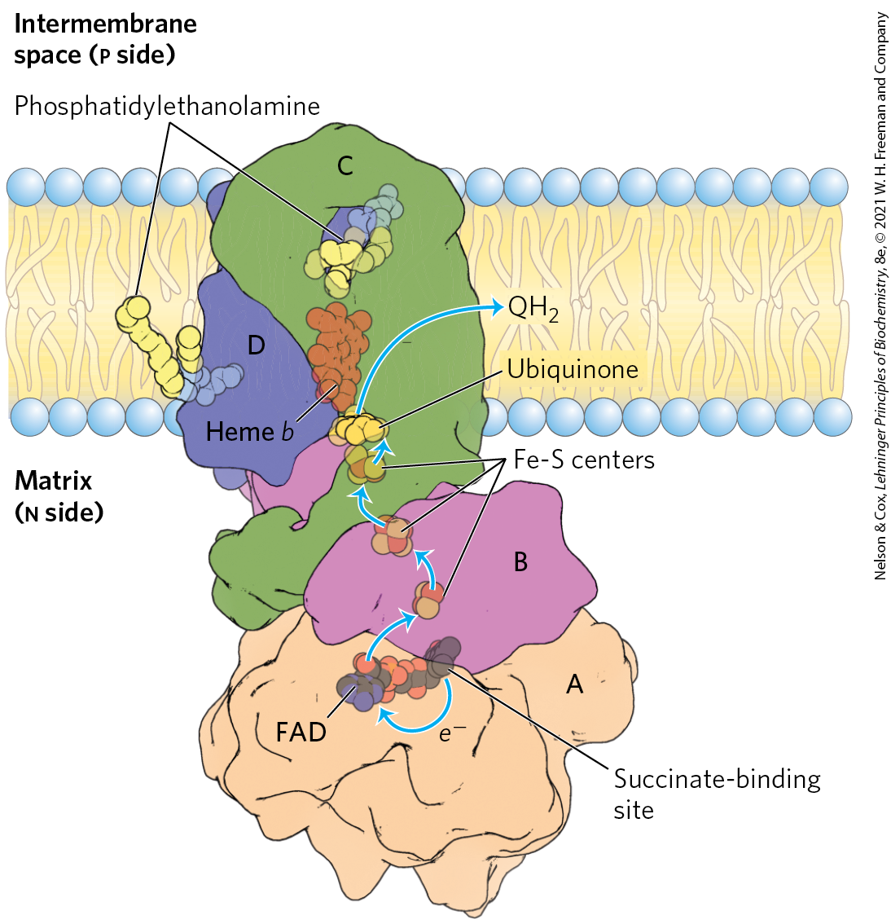
Complex II: Succinate to Ubiquinone
Complex II (succinate dehydrogenase) = couples the oxidation of succinate with the reduction of ubiquinone
  electrons pass from FAD to Fe-S centers to Q
  no proton pumping
  also functions to convert succinate to fumarate in the citric acid cycle

Slide 28
Heme b of Complex II
heme b reduces the frequency with which electrons “leak” out of the system, moving from succinate to molecular oxygen to produce the reactive oxygen species (ROS) H₂O₂ and the superoxide radical

Slide 29
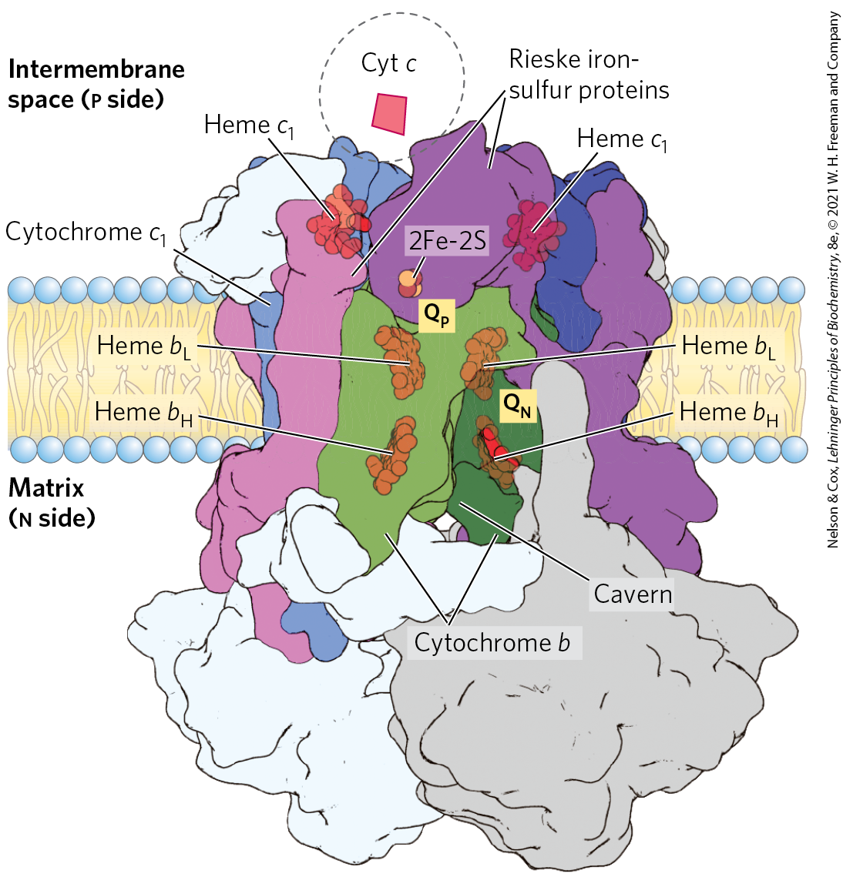
Complex III: Ubiquinone to Cytochrome c
Complex III (cytochrome bc₁ complex, ubiquinone: cytochrome c oxidoreductase) = couples the transfer of 2 electrons from ubiquinol to cytochrome c with the vectorial transport of four protons to the intermembrane space
  contains cytochrome b, cytochrome c1, and the Rieske iron-sulfur protein

Slide 30
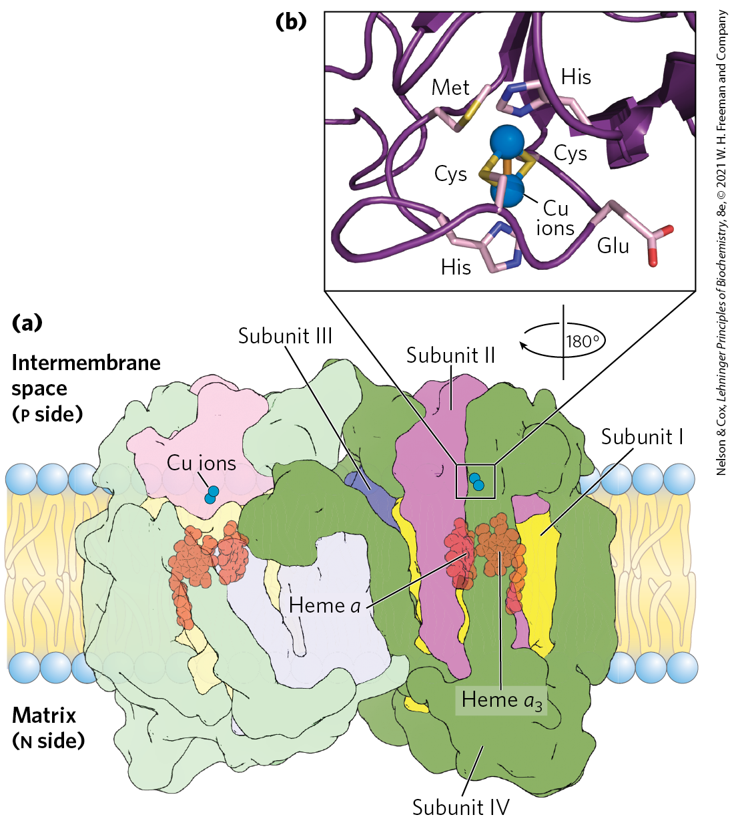
Complex IV: Cytochrome c to O₂
Complex IV (cytochrome oxidase) = carries electrons from cytochrome c to molecular oxygen, reducing it to H₂O
  large dimeric enzyme
  3 subunits have been conserved through evolution
  contains cytochromes a and a₃
  contains 2 Cu ions

Slide 31
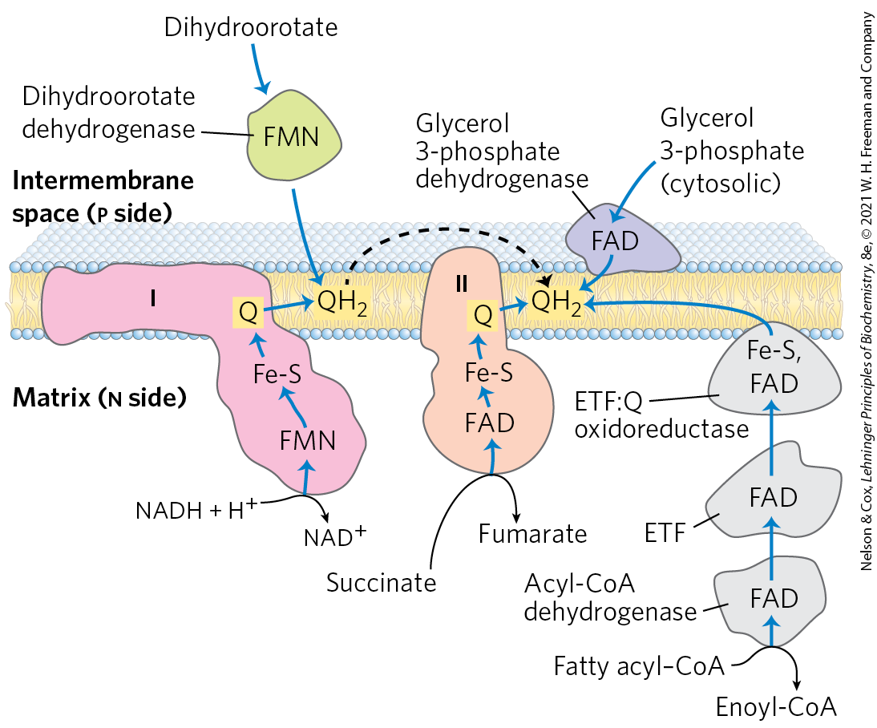
Other Pathways Donate Electrons to the Respiratory Chain via Ubiquinone

Slide 32
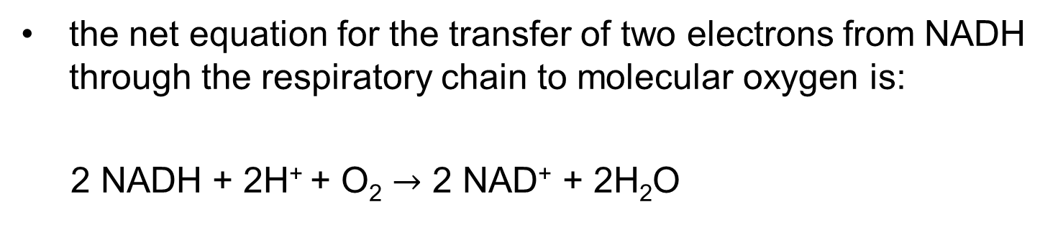
The Energy of Electron Transfer Is Efficiently Conserved in a Proton Gradient
the net equation for the transfer of two electrons from NADH through the respiratory chain to molecular oxygen is:
2 NADH + 2H⁺ + O₂ $→$ 2 NAD⁺ + 2H₂O
(19-5)

Slide 33
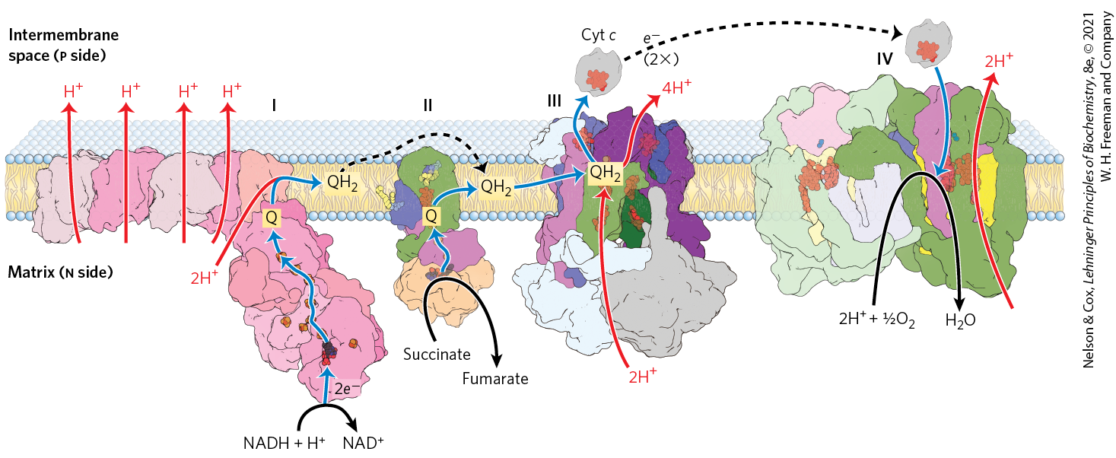
Summary of the Flow of Electrons and Protons through the Respiratory Chain
much of the free energy generated is recovered and stored in the form of an electrochemical proton gradient across the mitochondrial inner membrane

Slide 34
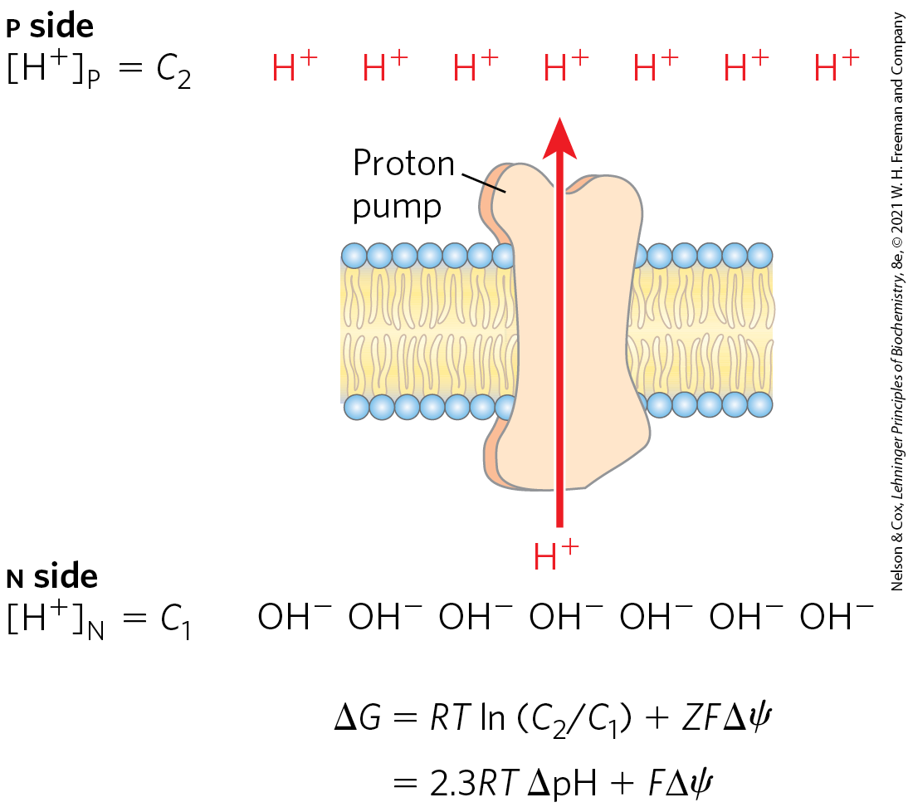
Proton-Motive Force
proton-motive force = the energy stored in an electrochemical proton gradient across the mitochondrial inner membrane
  composed of chemical and electrical potential energy

Slide 35
19.2 ATP Synthesis

Slide 36
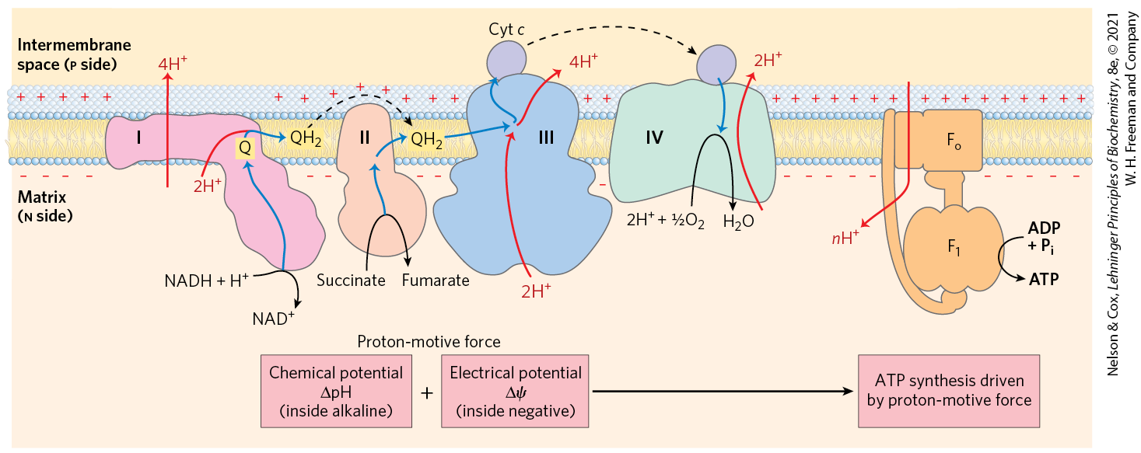
In the Chemiosmotic Model, Oxidation and Phosphorylation Are Obligately Coupled
chemiosmotic model = describes the coupling of ATP synthesis to an electrochemical proton gradient (the proton-motive force)

Slide 37
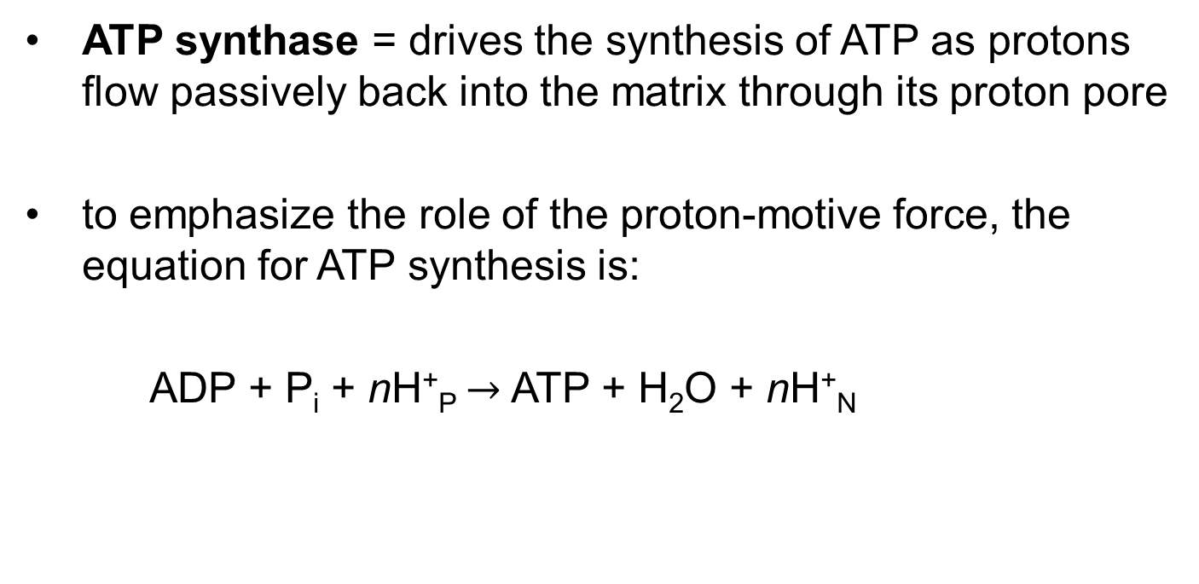
ATP Synthesis
ATP synthase = drives the synthesis of ATP as protons flow passively back into the matrix through its proton pore
to emphasize the role of the proton-motive force, the equation for ATP synthesis is:
  ADP + P_{i} + nH⁺_{P} $→$ ATP + H₂O + nH⁺_{N}
(19-10)

Slide 38
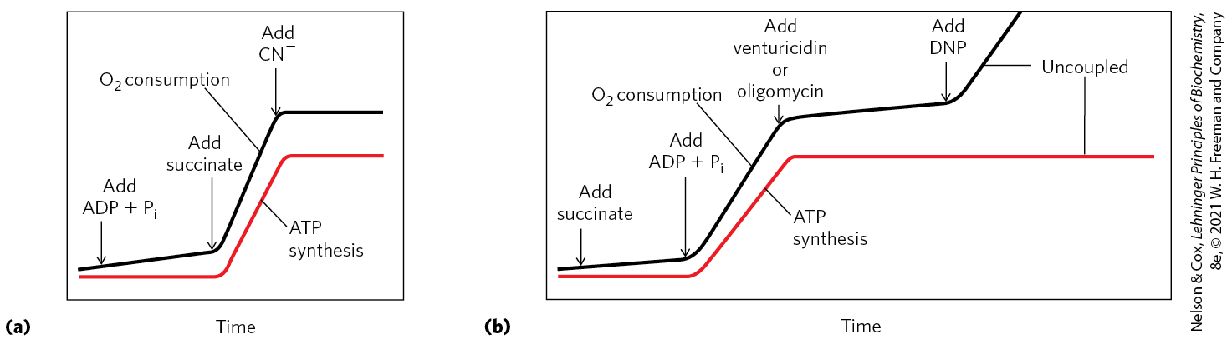
Coupling of Electron Transfer and ATP Synthesis in Mitochondria
inhibitors of electron transfer block ATP synthesis
inhibitors of ATP synthesis block electron transfer (unless oxidation and phosphorylation are uncoupled)

Slide 39
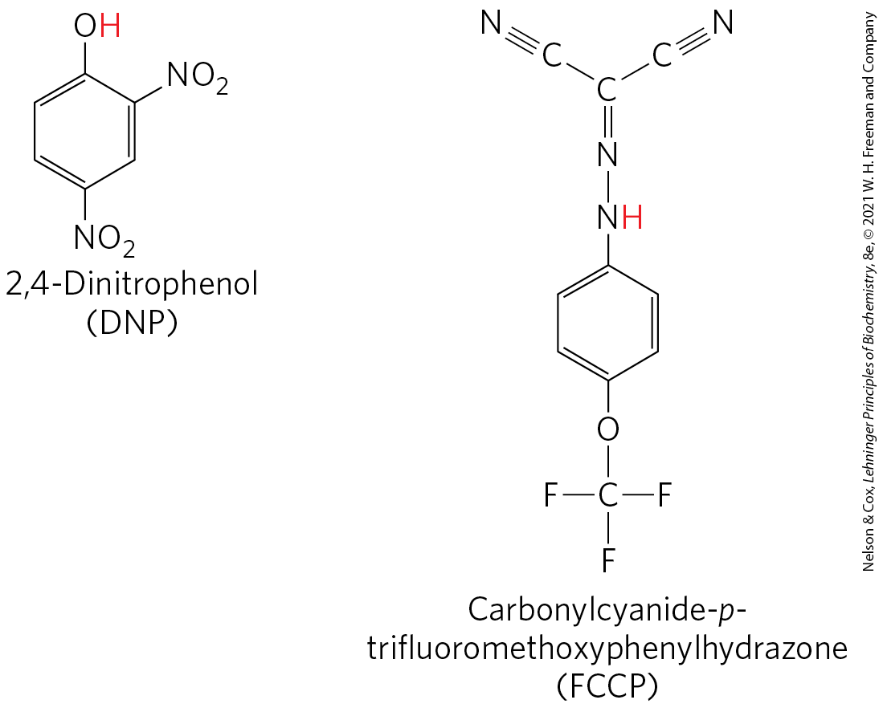
Chemical Uncouplers of
Oxidative Phosphorylation
physical shear or detergent uncouples electron transfer from ATP synthesis
DNP and FCCP = weak acids that carry protons across the inner mitochondrial membrane
  dissipates the proton gradient

Slide 40
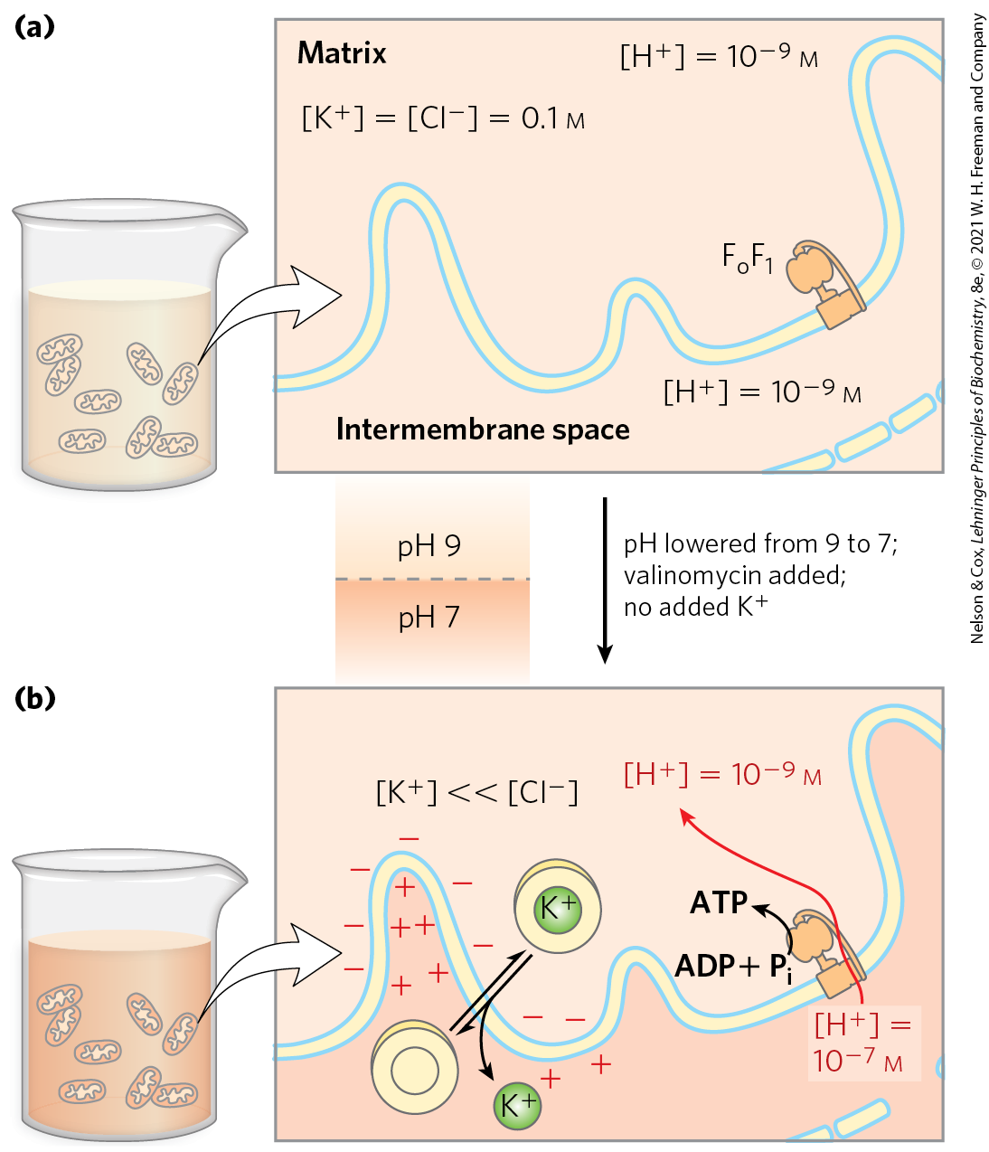
Proton-Motive Force Alone Drives ATP Synthesis
in the absence of an oxidizable substrate, the proton-motive force alone drives ATP synthesis

Slide 41
ATP Synthase Has Two Functional Domains, F_{o} and F₁
mitochondrial ATP synthase is an F-type ATPase
  similar in structure and mechanism to the ATP synthases of bacteria and chloroplasts

Slide 42
Mitochondrial ATP Synthase
contains two distinct components:
  F_{o} = an integral membrane protein with a proton pore
  F₁ (originally F₁ ATPase) = a peripheral membrane protein
    catalyzes hydrolysis of ATP when isolated

Slide 43
The P/O Ratio
the P/O ratio is:
  ~2.5 when electrons enter the respiratory chain at Complex I
  ~1.5 when electrons enter at ubiquinone
the ratio varies among species, depending on the number of c subunits in the F_{o} complex

Slide 44
19.3 Regulation of Oxidative Phosphorylation

Slide 45
ATP Yield from Complete Oxidation of Glucose
Table 19-5 ATP Yield from Complete Oxidation of Glucose
Process | Direct product | Final ATP
Glycolysis | 2 NADH (cytosolic) 2 ATP | 3 or 5 2
Pyruvate oxidation (two per glucose) | 2 NADH (mitochondrial matrix) | 5
Acetyl-CoA oxidation in citric acid cycle (two per glucose) | 6 NADH (mitochondrial matrix) 2 FADH₂ 2 ATP or 2 GTP | 15 3 2
Total yield per glucose |  | 30 or 32
glycolysis under anaerobic conditions (lactate fermentation) yields only 2 ATP per glucose

Slide 46
Hypoxia Leads to ROS Production and Several Adaptive Responses
defenses against ROS:
  glutathione peroxidase system
  regulation of pyruvate dehydrogenase
    phosphorylated (inactive) under hypoxic conditions
  modification of a subunit of Complex IV (COX4-1 to COX4-2)
    acts more efficiently under hypoxic conditions

Slide 47
ATP-Producing Pathways Are Coordinately Regulated
ATP and ADP relative concentrations control the rates of:
  electron transfer
  oxidative phosphorylation
  the citric acid cycle
  pyruvate oxidation
  glycolysis

Slide 48
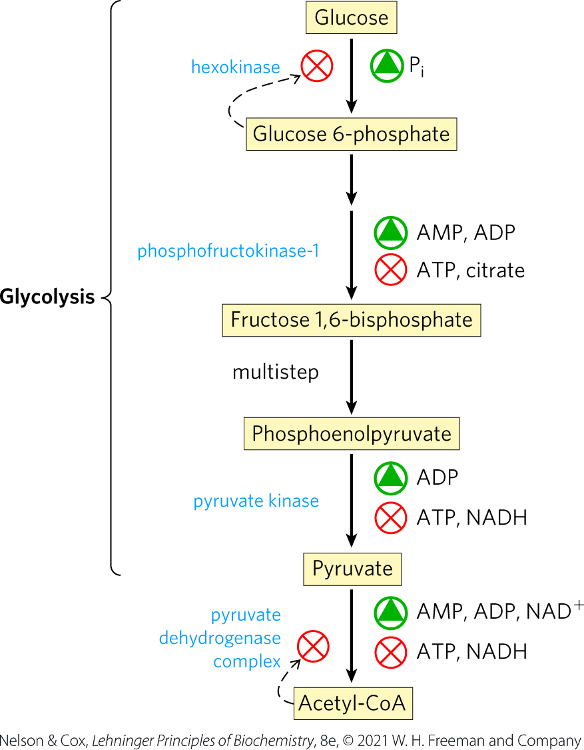
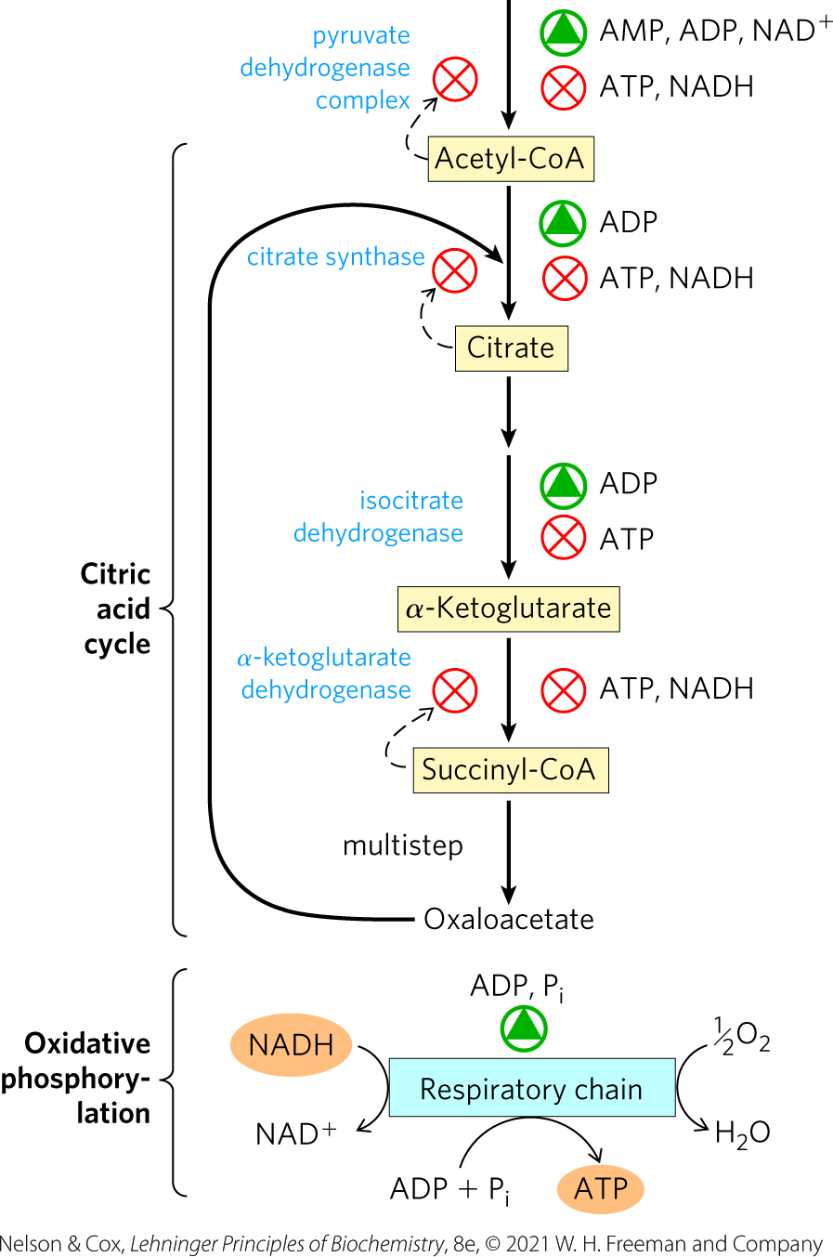
Regulation of ATP-Producing Pathways

