Slide 1

16 The Citric Acid Cycle
© 2021 Macmillan Learning

Slide 2
Cellular Respiration
cellular respiration = process by which the pyruvate produced by glycolysis is further oxidized to H₂O and CO₂

Slide 3
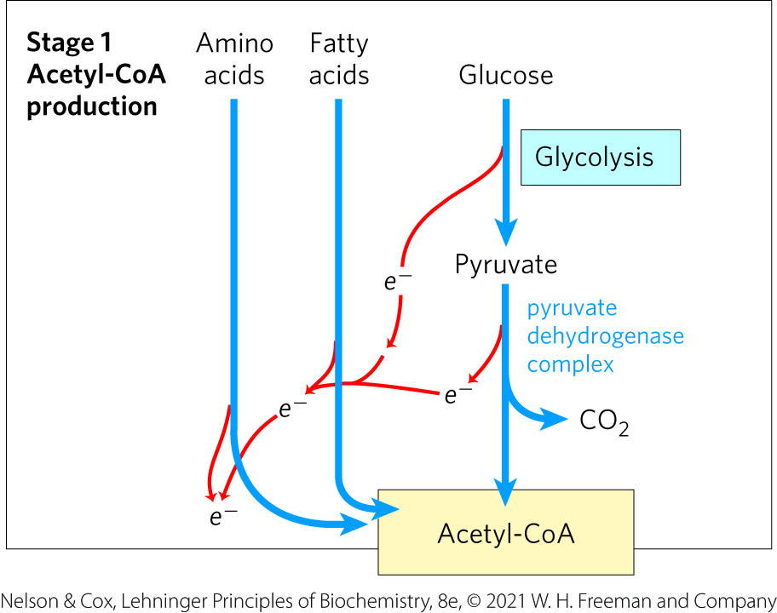
Stage 1 of Cellular Respiration
Stage 1: oxidation of fuels to acetyl-CoA
  generates ATP, NADH, FADH₂

Slide 4
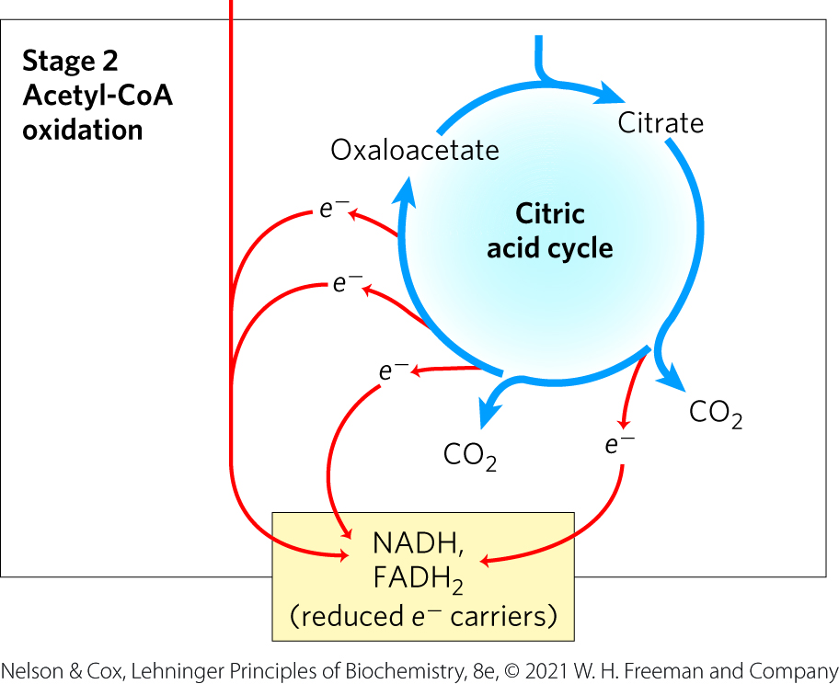
Stage 2 of Cellular Respiration
Stage 2: oxidation of acetyl groups to CO₂ in the citric acid cycle (tricarboxylic acid (TCA) cycle, Krebs cycle)
  nearly universal pathway
  generates NADH, FADH₂, and one GTP

Slide 5
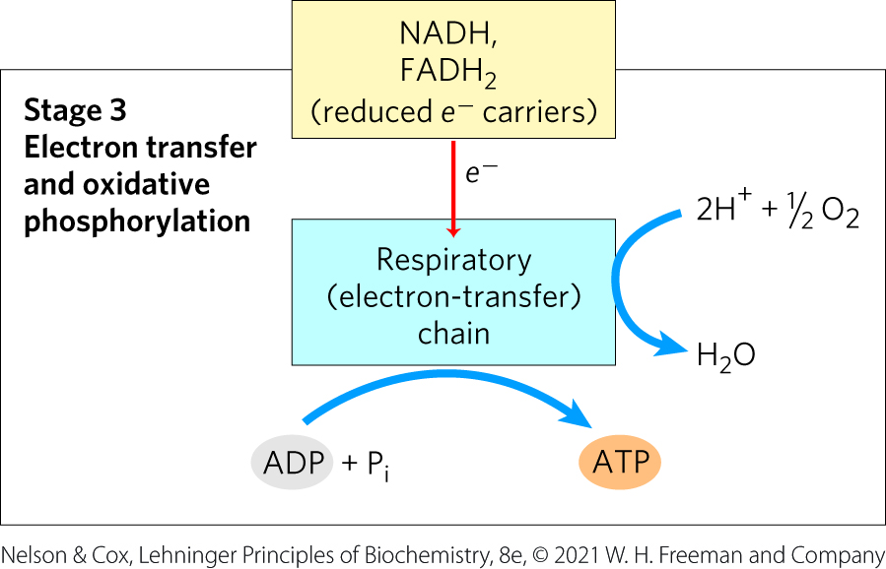
Stage 3 of Cellular Respiration
Stage 3: electron transfer chain and oxidative phosphorylation
  generates the vast majority of ATP from catabolism

Slide 6

Principle 1 (1 of 4)
Pyruvate is the metabolite that links two central catabolic pathways, glycolysis and the citric acid cycle. It is therefore a logical point for regulation that determines the rate of catabolic activity and the partitioning of pyruvate among its possible uses.

Slide 7

Principle 2 (1 of 7)
The reactions of the citric acid cycle follow
a chemical logic. In its catabolic role, the
citric acid cycle oxidizes acetyl-CoA to CO₂ and H₂O. Energy from the oxidations in the cycle drives the synthesis of ATP. The chemical strategies for activating groups for oxidation and for conserving energy in the form of reducing power and high-energy compounds are used in many other biochemical pathways.

Slide 8

Principle 3 (1 of 4)
The citric acid cycle is a hub of metabolism, with catabolic pathways leading in and anabolic pathways leading out. Acetate groups (acetyl-CoA) from the catabolism of various fuels are used in the synthesis of such metabolites as amino acids, fatty acids, and sterols. The breakdown products of many amino acids and nucleotides are intermediates of the cycle, and they can be fed in or siphoned off as needed by the cell.

Slide 9
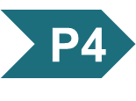
Principle 4 (1 of 5)
The central role of the citric acid cycle in metabolism requires that it be regulated
in coordination with many other pathways. Regulation occurs by both allosteric and covalent mechanisms that overlap and interact to achieve homeostasis. Some mutations that affect the reactions of the citric acid cycle lead to tumor formation.

Slide 10
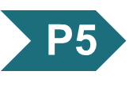
Principle 5 (1 of 6)
Enzymes have evolved to form complexes to efficiently achieve a series of chemical transformations without releasing the intermediates into the bulk solvent. This strategy, seen in the pyruvate dehydrogenase complex and the metabolons of the citric acid cycle, is ubiquitous in other pathways of metabolism, in respiration, and in the many “ — somes” that assemble and disassemble informational macromolecules.

Slide 11
16.1 Production of Acetyl-CoA (Activated Acetate)

Slide 12
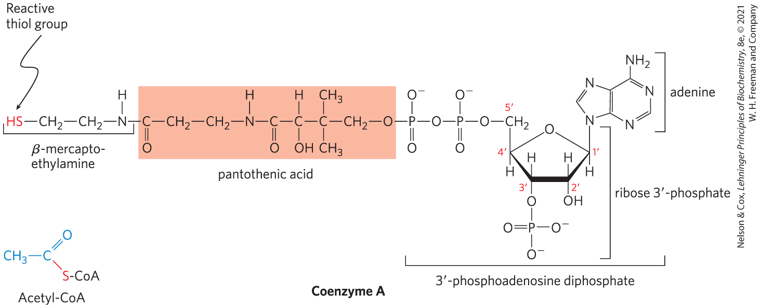
Coenzyme A (CoA-SH)
coenzyme A has a reactive thiol (–SH) group that is critical to its role as an acyl carrier
  the –SH group forms a thioester with acetate in acetyl-CoA

Slide 13
Pyruvate Is Oxidized to Acetyl-CoA and CO₂
mitochondrial pyruvate carrier (MPC) = an H⁺-coupled pyruvate-specific symporter in the inner mitochondrial membrane
pyruvate dehydrogenase (PDH) complex = highly ordered cluster of enzymes and cofactors that oxidizes pyruvate in the mitochondrial matrix to acetyl-CoA and CO₂
  the series of chemical intermediates remain bound to the enzyme subunits
  regulation results in precisely regulated flux

Slide 14
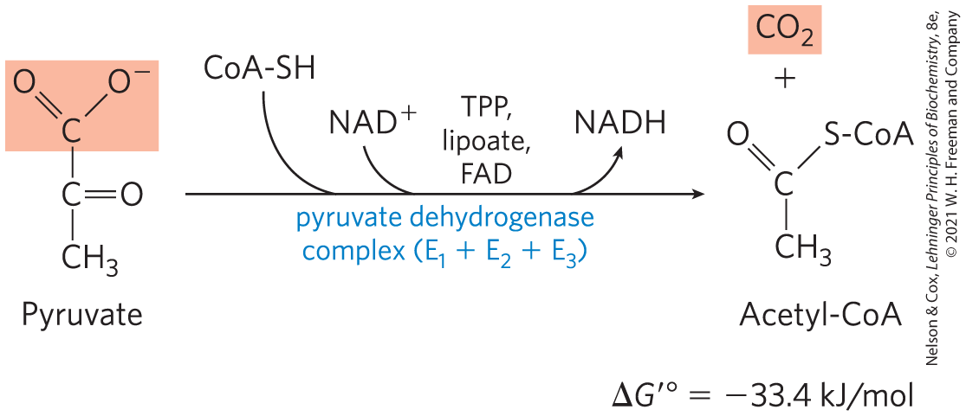
The PDH Complex Catalyzes an Oxidative Decarboxylation
oxidative decarboxylation = an irreversible oxidation process in which the carboxyl group is removed, forming CO₂

Slide 15
The PDH Complex Employs Three Enzymes and Five Coenzymes to Oxidize Pyruvate
three enzymes:
  pyruvate dehydrogenase, E₁
  dihydrolipoyl transacetylase, E₂
  dihydrolipoyl dehydrogenase, E₃
five coenzymes:
  thiamine pyrophosphate (TPP)
  lipoate
  coenzyme A (CoA, CoA-SH)
  flavin adenine dinucleotide (FAD)
  nicotinamide adenine dinucleotide (NAD)

Slide 16
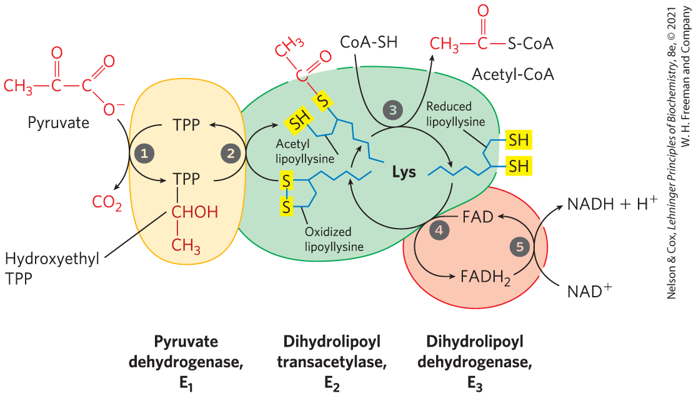
The PDH Complex Channels Its Intermediates through Five Reactions

Slide 17
16.2 Reactions of the Citric Acid Cycle

Slide 18
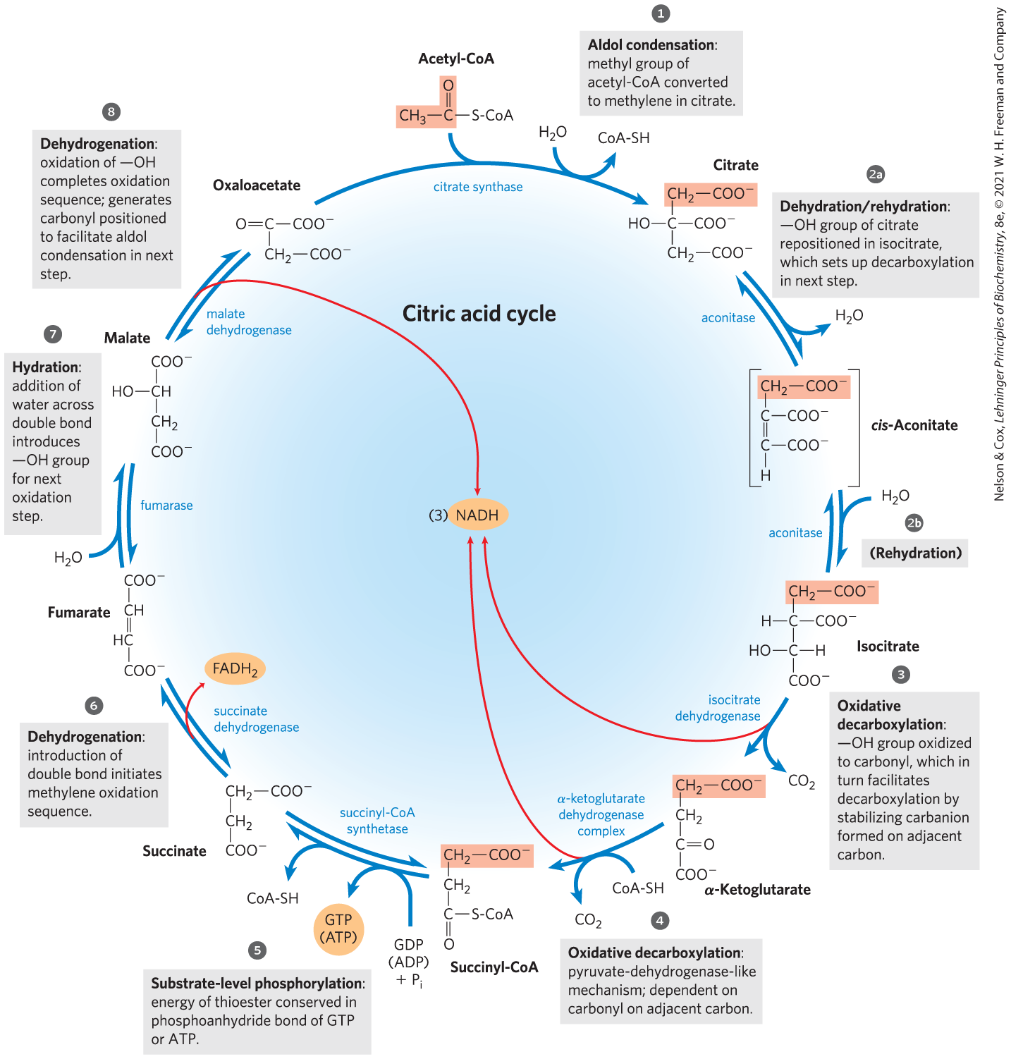
Reactions of the Citric Acid Cycle
one oxaloacetate molecule can theoretically oxidize an infinite number of acetyl groups
energy from the four oxidations is conserved as NADH and FADH₂

Slide 19
In Eukaryotes, the Mitochondrion Is the Site of Energy-Yielding Oxidative Reactions and ATP Synthesis
isolated mitochondria contain all enzyme, coenzymes, and proteins needed for:
  the citric acid cycle
  electron transfer and ATP synthesis by oxidative phosphorylation
  oxidation of fatty acids and amino acids to acetyl-CoA
  oxidative degradation of amino acids to citric acid cycle intermediates

Slide 20
The Sequence of Reactions in the Citric Acid Cycle Makes Chemical Sense
complete oxidation of acetyl-CoA to CO₂ extracts the maximum potential energy
direct oxidation to yield CO₂ and CH₄ is not biochemically feasible because organisms cannot oxidize CH₄

Slide 21
The Chemical Logic of the Citric Acid Cycle
carbonyl groups are more chemically reactive than a methylene group or methane
each step of the cycle involves either:
  an energy-conserving oxidation
  placing functional groups in position to facilitate oxidation or oxidative decarboxylation

Slide 22
The Citric Acid Cycle Has
Eight Steps
citrate formed from acetyl-CoA and oxaloacetate is oxidized to yield:
  CO₂
  NADH
  FADH₂
  GTP or ATP

Slide 23
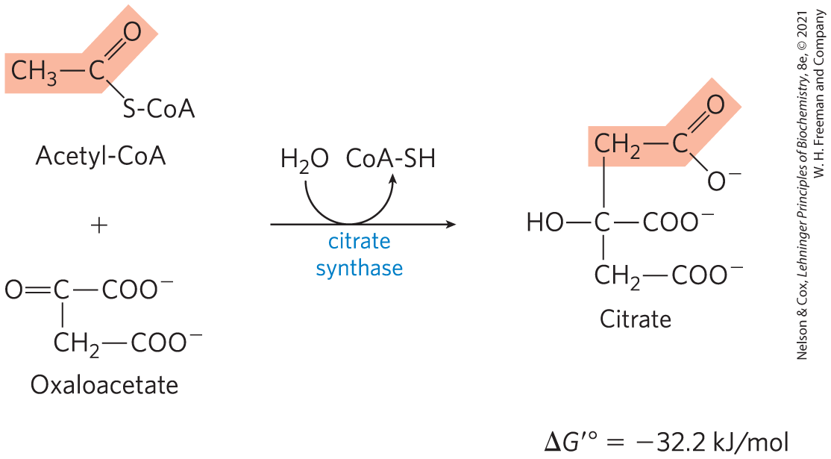
Formation of Citrate
citrate synthase = catalyzes the condensation of acetyl-CoA with oxaloacetate to form citrate
  involves the formation of a transient intermediate, citroyl-CoA
  large, negative ∆G′° is needed because [oxaloacetate] is normally very low

Slide 24
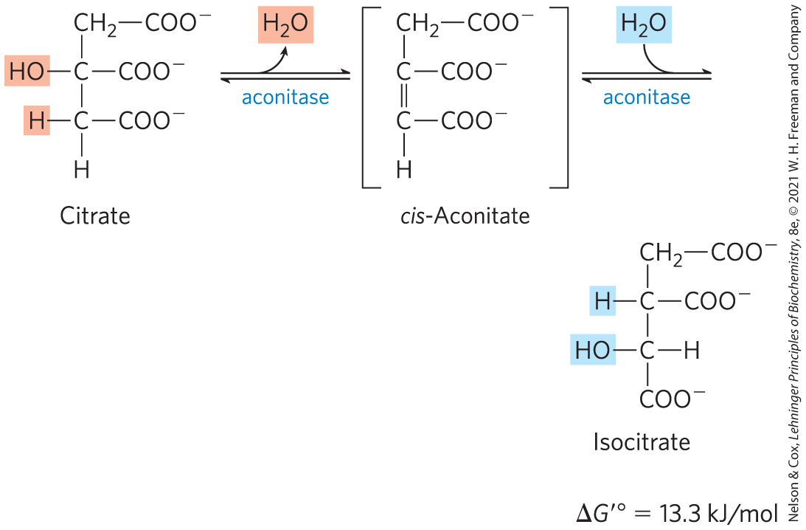
Formation of Isocitrate via
Cis-Aconitate
aconitase (aconitate hydratase) = catalyzes the reversible transformation of citrate to isocitrate through the intermediate cis-aconitate
  addition of H₂O to cis-aconitate is stereospecific
  low [isocitrate] pulls the reaction forward

Slide 25
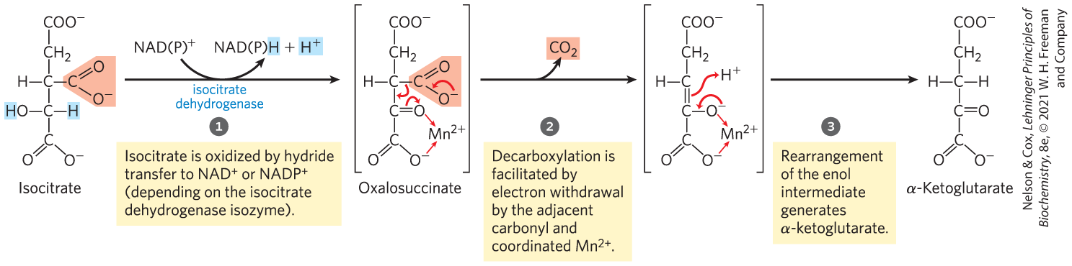
Oxidation of Isocitrate to α-Ketoglutarate and CO₂
isocitrate dehydrogenase = catalyzes the oxidative decarboxylation of isocitrate to α-ketoglutarate
  Mn²⁺ interacts with the carbonyl group of the oxalosuccinate and stabilizes the transiently-formed enol
  specific isozymes for NADP⁺ (cytosolic and mitochondrial) or NAD⁺ (mitochondrial)

Slide 26
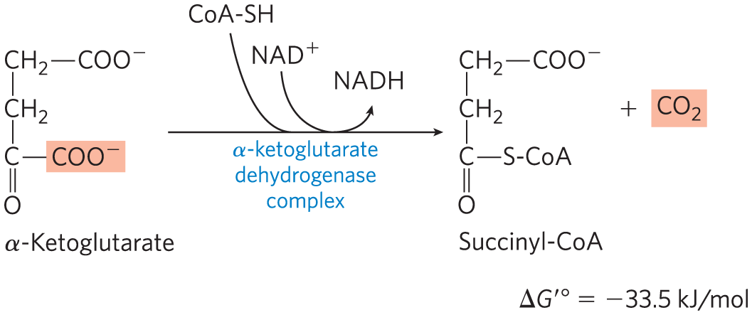
Oxidation of α-Ketoglutarate to Succinyl-CoA and CO₂
α-ketoglutarate dehydrogenase complex = catalyzes the oxidative decarboxylation of α-ketoglutarate to succinyl-CoA and CO₂
  energy of oxidation is conserved in the thioester bond of succinyl-CoA

Slide 27
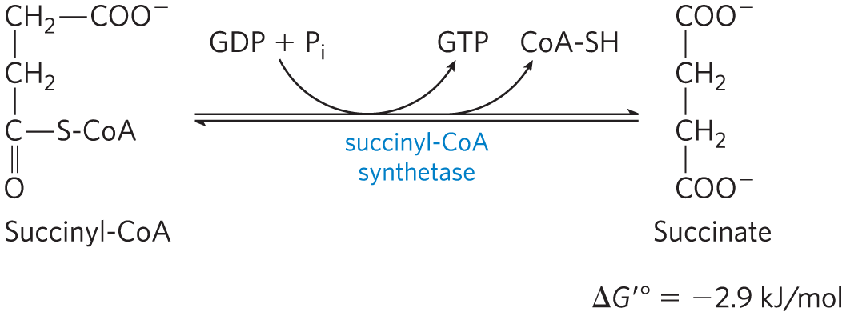
Conversion of Succinyl-CoA to Succinate
succinyl-CoA synthetase (succinic thiokinase) = catalyzes the breakage of the thioester bond of succinyl-CoA to form succinate
  energy released drives the synthesis of a phosphoanhydride bond in either GTP or ATP (substrate level phosphorylation)

Slide 28
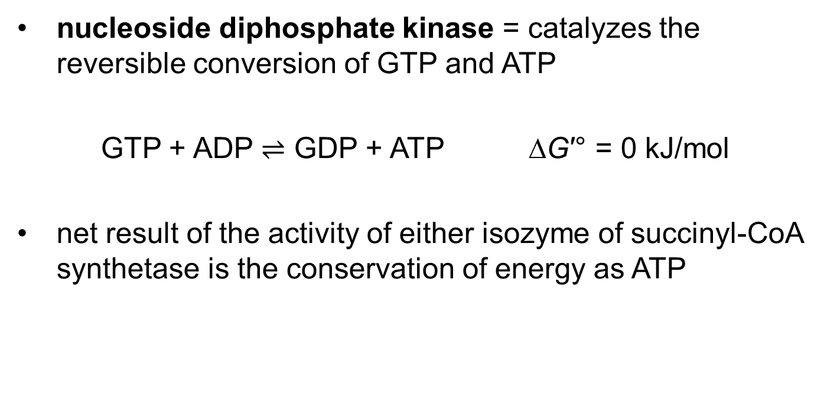
Nucleoside Diphosphate Kinase
nucleoside diphosphate kinase = catalyzes the reversible conversion of GTP and ATP
GTP + ADP $⇌$ GDP + ATP ∆G′° = 0 kJ/mol
net result of the activity of either isozyme of succinyl-CoA synthetase is the conservation of energy as ATP

Slide 29
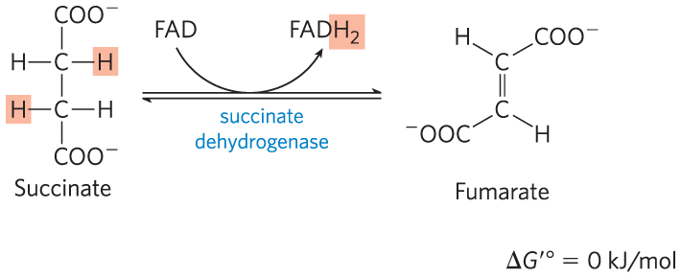
Oxidation of Succinate to Fumarate
succinate dehydrogenase = flavoprotein that catalyzes the reversible oxidation of succinate to fumarate
  integral protein of the mitochondrial inner membrane in eukaryotes
  contains three iron-sulfur clusters and covalently bound FAD

Slide 30
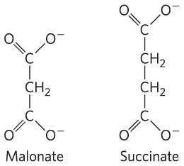
Malonate Is a Strong Competitive Inhibitor of Succinate Dehydrogenase
malonate = an analog of succinate
  not normally present in cells
  addition to mitochondria in vitro blocks citric acid cycle activity

Slide 31
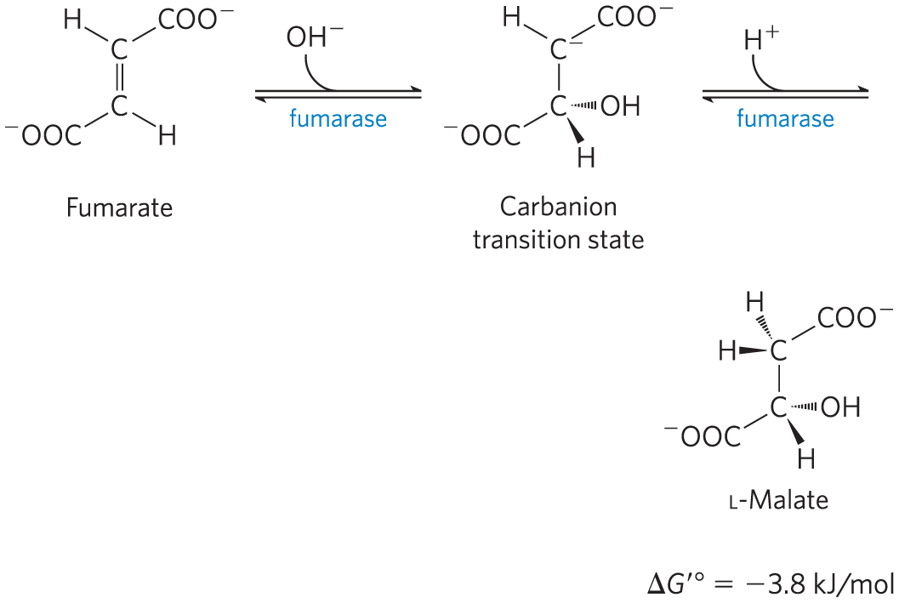
Hydration of Fumarate to Malate
fumarase = catalyzes the reversible hydration of fumarate to L-malate
  transition state is a carbanion

Slide 32
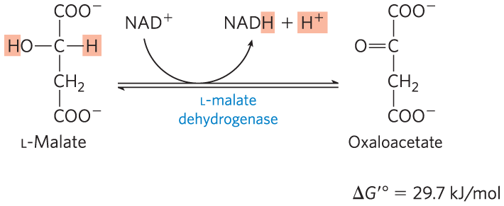
Oxidation of Malate to Oxaloacetate
L-malate dehydrogenase = catalyzes the oxidation of L-malate to oxaloacetate, coupled to the reduction of NAD⁺
  low [oxaloacetate] pulls the reaction forward
  regenerates oxaloacetate for citrate synthesis

Slide 33
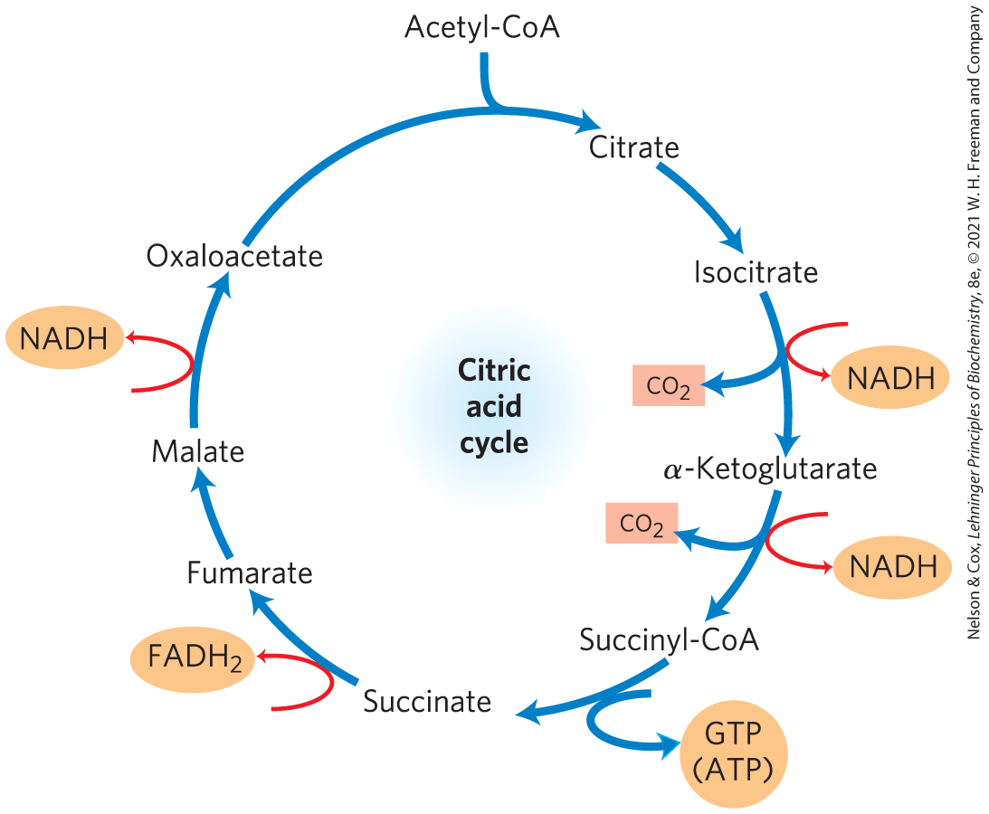
The Energy of Oxidations in the Cycle Is Efficiently Conserved
energy released by oxidation is conserved in the production of:
  3 NADH
  1 FADH₂
  1 GTP (or ATP)

Slide 34
Electrons from NADH and FADH₂ Enter the Respiratory Chain
the citric acid cycle directly generates only one ATP per turn
the large flow of electrons into the respiratory chain via NADH and FADH₂ leads to formation of almost 10 times more ATP during oxidative phosphorylation
  each NADH drives formation of ~2.5 ATP
  each FADH₂ drives formation of ~1.5 ATP

Slide 35
16.4 Regulation of the Citric Acid Cycle

Slide 36
Citric Acid Cycle Regulation
regulation balances the supply of key intermediates with the demands of energy production and biosynthetic processes
regulation occurs at several points:
  PDH complex
  citrate synthase
  isocitrate dehydrogenase complex
  α-ketoglutarate dehydrogenase complex

Slide 37
Production of Acetyl-CoA by the PDH Complex Is Regulated by Allosteric and Covalent Mechanisms
PDH complex activity is turned off when:
  ample fatty acids and acetyl-CoA are available as fuel
  [ATP]/[ADP] and [NADH]/[NAD⁺] ratios are high
PDH complex activity is turned on when:
  energy demands are high
  the cell requires greater flux of acetyl-CoA into the citric acid cycle

Slide 38
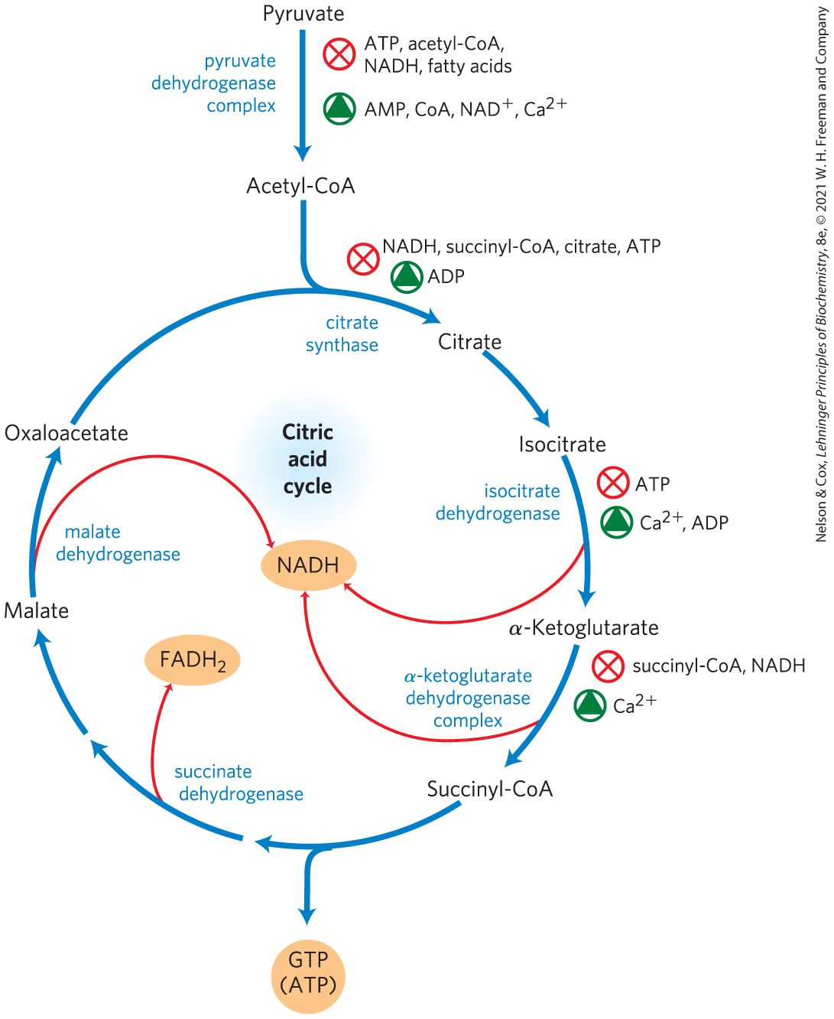
Regulation of Metabolite Flow Through the Citric Acid Cycle

Slide 39
The Citric Acid Cycle Is Also Regulated at Three Exergonic Steps
regulation occurs at strongly exergonic steps catalyzed by:
  citrate synthase
  isocitrate dehydrogenase complex
  α-ketoglutarate dehydrogenase complex
fluxes are affected by the concentrations of substrates and products:
  end products ATP and NADH are inhibitory
  NAD⁺ and ADP are stimulatory
  long-chain fatty acids are inhibitory

Slide 40
Citric Acid Cycle Activity Changes in Tumors
some mutations that affect the PDH complex or citric acid cycle enzymes are oncogenic:
  downregulation of mitochondrial pyruvate carrier (MPC)
  inactivation of PDH complex
  inactivation of succinate dehydrogenase
oncometabolites = stimulate tumor growth by acting though specific GPCRs in the plasma membrane

Slide 41
Lactate and Succinate
Are Oncometabolites
tumor cells accumulate lactate and succinate
oncometabolites = stimulate tumor growth by acting though specific GPCRs in the plasma membrane

