Slide 1

15 The Metabolism of Glycogen in Animals
© 2021 Macmillan Learning

Slide 2

Principle 1 (1 of 2)
Glycogen provides vertebrate animals with a ready source of glucose to supply the brain and skeletal muscles with energy. Although animals store about 100 times more energy as fat than as glycogen, they cannot metabolize fat into glucose. The highly branched polymeric structure of glycogen granules allows cells in the liver and muscle to make large numbers of glucose and glucose phosphate monomers available quickly without raising the osmolarity of the cytosol by storing them in monomeric form.

Slide 3

Principle 2 (1 of 3)
Monomers are released from glycogen granules by a phosphorolysis reaction that creates phosphorylated glucose molecules that can enter glycolysis to supply energy to the cell. Skeletal muscle cells especially require stores of glycogen to supply energy for bursts of activity. In the liver, the phosphate can be removed, allowing free glucose to be transported out of the cell to the blood for use in the brain and other tissues when dietary glucose is not sufficient.

Slide 4

Principle 3 (1 of 4)
Glycogen synthesis requires a protein primer and an activated glucose precursor. Individual glucose molecules activated as sugar nucleotides are added to the nonreducing end of the growing linear chains in the outer tiers of the glycogen β-granules, and a branching enzyme adds branches periodically.

Slide 5
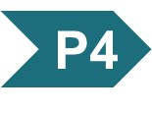
Principle 4 (1 of 7)
Regulation of the balance between
the formation of glycogen from excess glucose and the release of glucose from glycogen polymers when it is needed in metabolism is a critical function of cellular and organismal homeostasis. This balance, ultimately controlled by the hormones epinephrine, glucagon, and insulin, is achieved through allosteric regulation and phosphorylation of the synthetic and degradative enzymes. These enzymes and the regulatory proteins that act on them are integral parts of the glycogen granule.

Slide 6
15.1 The Structure and Function of Glycogen

Slide 7
Vertebrate Animals Require a Ready Fuel Source for Brain and Muscle
glycogen = a polymeric storage form of glucose in animals that is found primarily in muscle and liver
glycogen breakdown in muscle delivers glucose needed for muscle contraction within seconds
glycogen stored in the liver provides a reservoir that maintains homeostasis of blood glucose

Slide 8
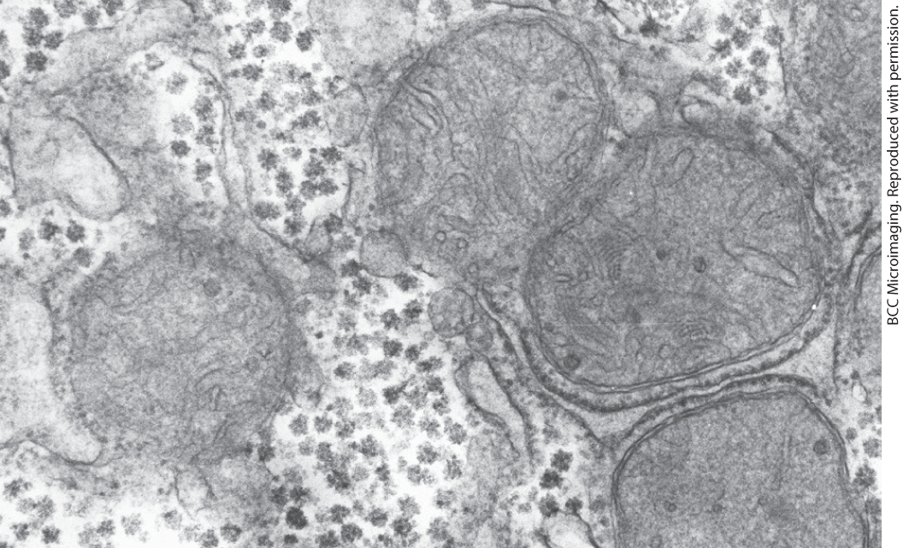
Glycogen Granules Have Many Tiers of Branched Chains of D-Glucose
glycogen β-granules = cytosolic granules that vary in size, structure, and subcellular location
  appear as electron-dense particles

Slide 9
β-Granules Cluster to Form α-Granules in the Liver
α-granules = protein-rich granules composed of 20-40 clustered β-granules
  release glucose slower than β-granules
  visible in well-fed animals, but absent after a 24-hour fast
  often associate with tubules of the smooth ER

Slide 10
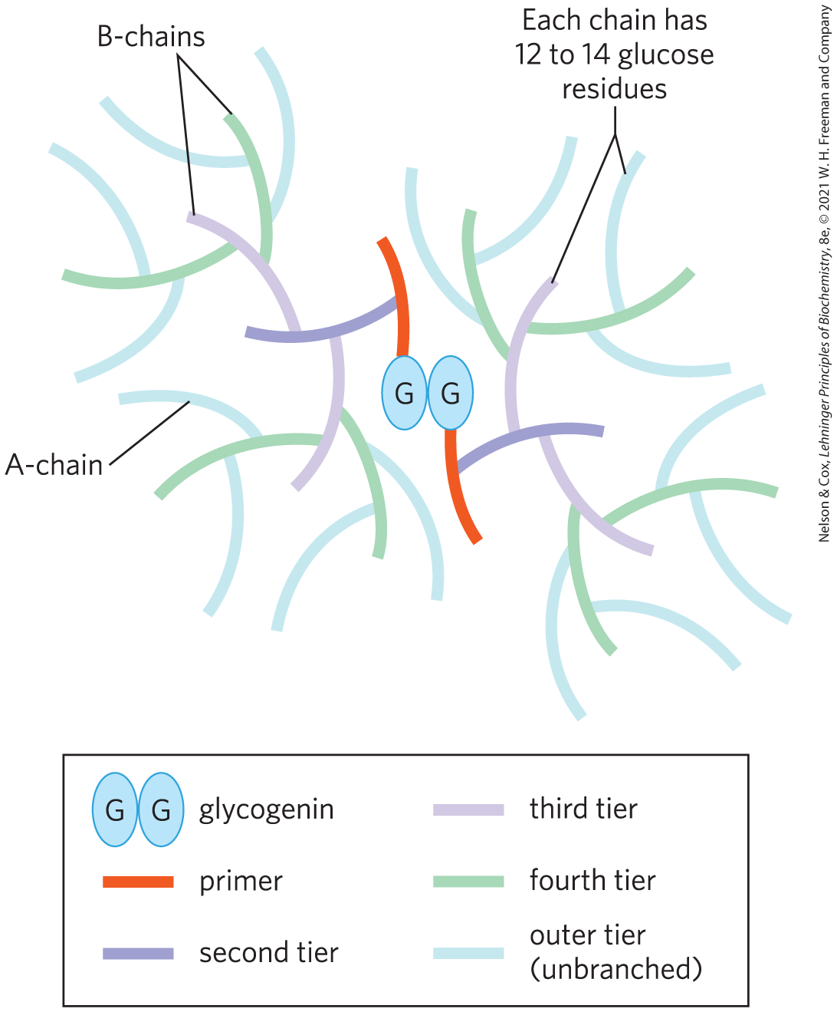
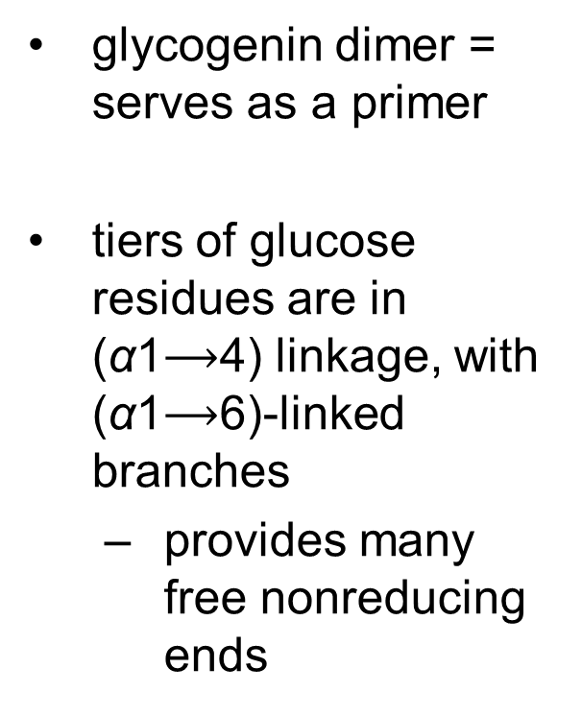
Structure of a Glycogen β-Granule
glycogenin dimer = serves as a primer
tiers of glucose residues are in (α1$⟶$4) linkage, with (α1$⟶$6)-linked branches
  provides many free nonreducing ends

Slide 11
15.2 Breakdown and Synthesis of Glycogen

Slide 12
Glycogenolysis and Glycogenesis
glycogenolysis = the breakdown of cellular glycogen to glucose 1-phosphate
glycogenesis = the synthesis of glycogen

Slide 13
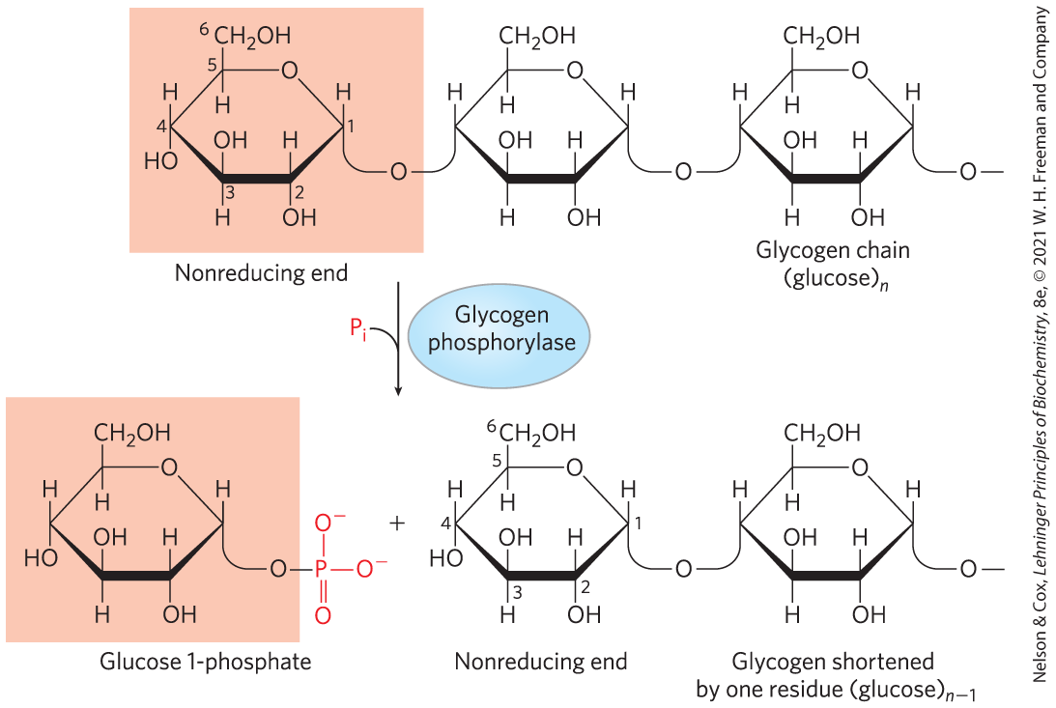
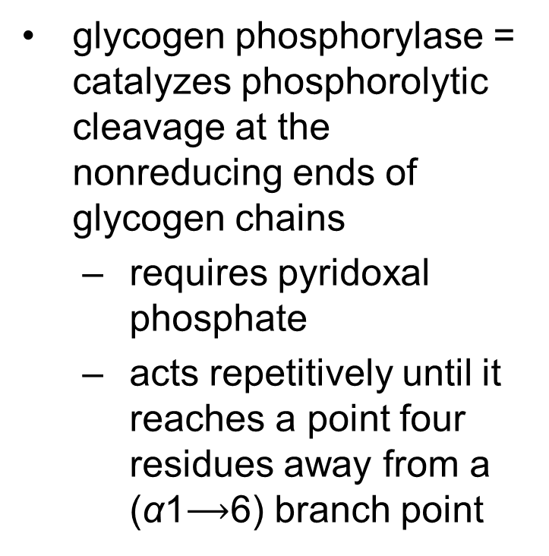
Glycogen Breakdown Is Catalyzed by Glycogen Phosphorylase
glycogen phosphorylase = catalyzes phosphorolytic cleavage at the nonreducing ends of glycogen chains
  requires pyridoxal phosphate
  acts repetitively until it reaches a point four residues away from a (α1$⟶$6) branch point

Slide 14
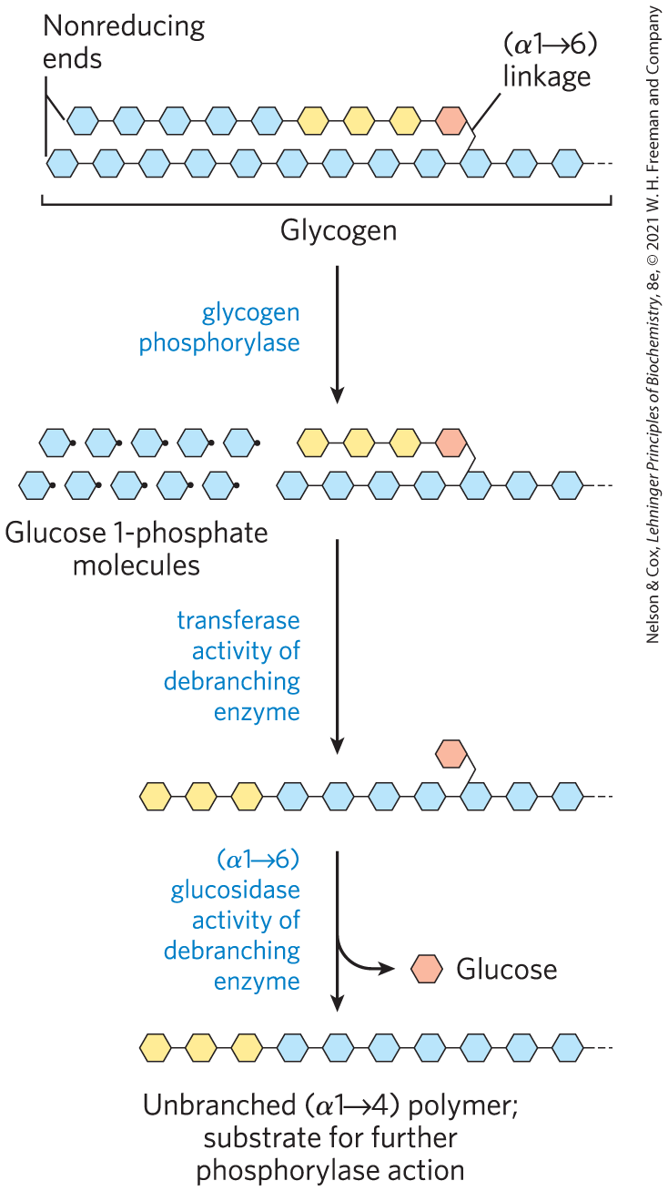

Debranching Enzyme
debranching enzyme = transfers branches onto main chains and releases the residue at the (α1$⟶$6) branch as free glucose

Slide 15
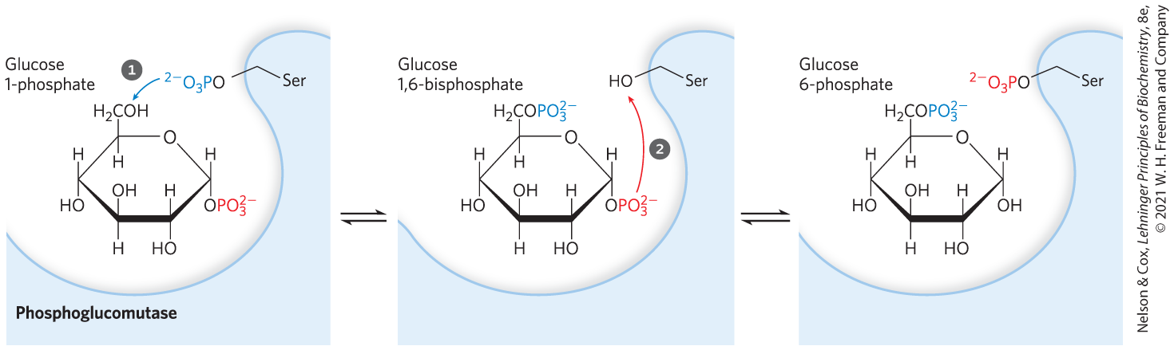
Glucose 1-Phosphate Can Enter Glycolysis or, in Liver, Replenish Blood Glucose
phosphoglucomutase = catalyzes the reversible conversion of glucose 1-phosphate to glucose 6-phosphate

Slide 16
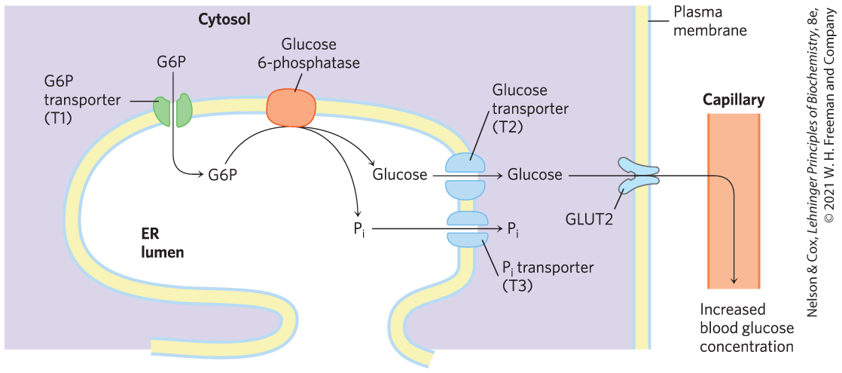
Fates of Glucose 6-Phosphate
in skeletal muscle, glucose 6-phosphate enters glycolysis
in liver, glucose 6-phosphatase converts glucose 6-phosphate to glucose in the ER for export to replenish blood glucose

Slide 17
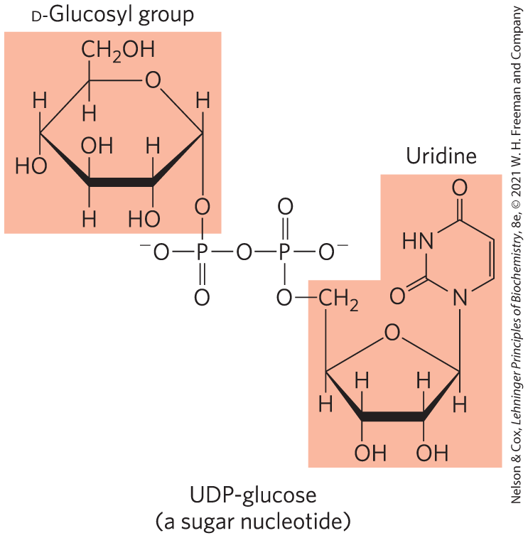
The Sugar Nucleotide UDP-Glucose Donates Glucose for Glycogen Synthesis
sugar nucleotides = compounds in which the anomeric carbon of a sugar is activated by attachment to a nucleotide through a phosphate ester linkage
  involved in reactions where hexoses are transformed or polymerized

Slide 18
Glycogen Synthesis Begins With Glucose 6-Phosphate
sources of glucose 6-phosphate:
  hexokinase isozymes derive glucose 6-phosphate from glucose
  lactate taken up by the liver is converted to glucose 6-phosphate by gluconeogenesis
phosphoglucomutase = converts glucose 6-phosphate to glucose 1-phosphate

Slide 19

UDP-Glucose Pyrophosphorylase Catalyzes A Key Step of Glycogen Biosynthesis
UDP-glucose pyrophosphorylase = converts glucose 1-phosphate to UDP-glucose
  glucose 1-phosphate + UTP $⟶$ UDP-glucose + PP_{i}

Slide 20
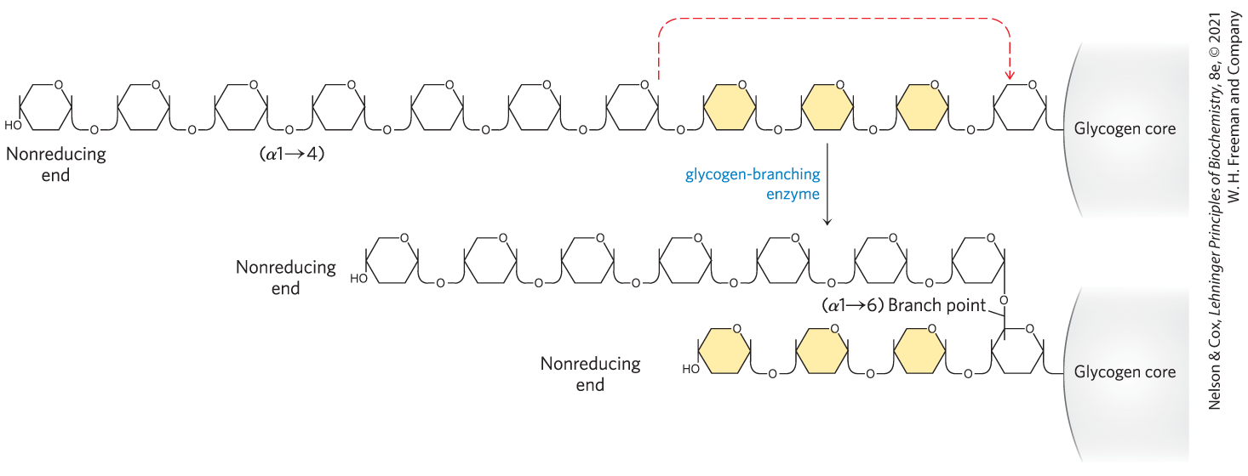
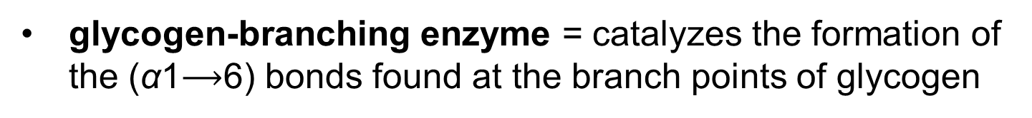
Glycogen-Branching Enzyme
glycogen-branching enzyme = catalyzes the formation of the (α1$⟶$6) bonds found at the branch points of glycogen

Slide 21
15.3 Coordinated Regulation of Glycogen Breakdown and Synthesis

Slide 22
Glycogen Phosphorylase Is Regulated by Hormone-Stimulated Phosphorylation and by Allosteric Effectors
skeletal glycogen phosphorylase has two forms:
  glycogen phosphorylase a = catalytically active
  glycogen phosphorylase b = much less active

Slide 23
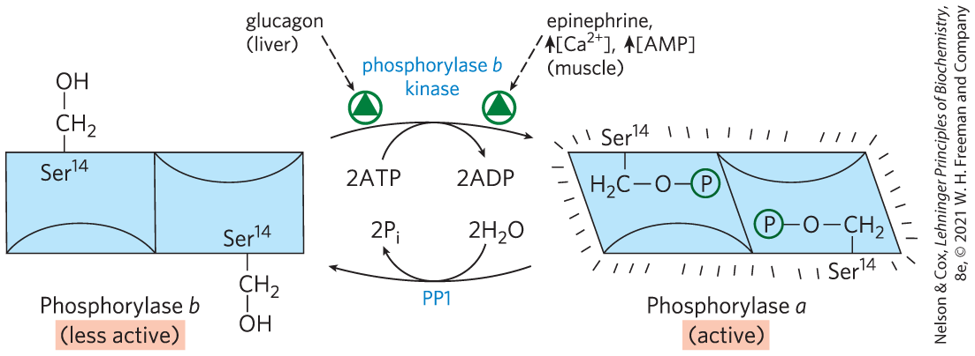
Regulation of Muscle Glycogen Phosphorylase by Covalent Modification
epinephrine (from vigorous muscle activity) and glucagon (in the liver) trigger phosphorylation of phosphorylase b, converting it to phosphorylase a

Slide 24
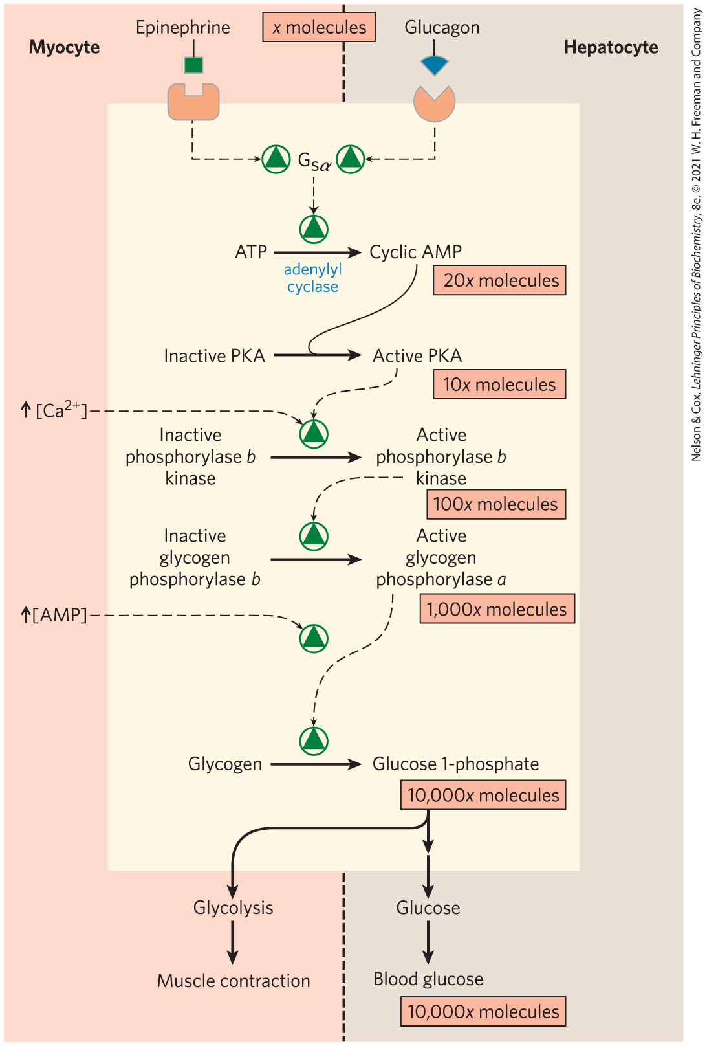
Elevated [cAMP] Initiates an
Enzyme Cascade
enzyme cascade = sequence of enzymatic reactions in which a catalyst activates a catalyst, which activates a catalyst
rise in [cAMP] activates PKA, which phosphorylates phosphorylase b kinase
phosphorylase b kinase = catalyzes the phosphorylation of glycogen phosphorylase b

Slide 25
Allosteric Control Mechanisms
Ca²⁺ is a signal for muscle contraction
  binds to and activates phosphorylase b kinase
AMP accumulates in vigorously contracting muscle
  binds to and activates phosphorylase to speed up glucose 1-phosphate release from glycogen
ATP blocks the allosteric site, inactivating phosphorylase

Slide 26
Phosphoprotein Phosphatase 1 (PP1)
phosphoprotein phosphatase 1 (PP1) = removes phosphoryl groups from phosphorylase a, converting it to the less active form, phosphorylase b

Slide 27
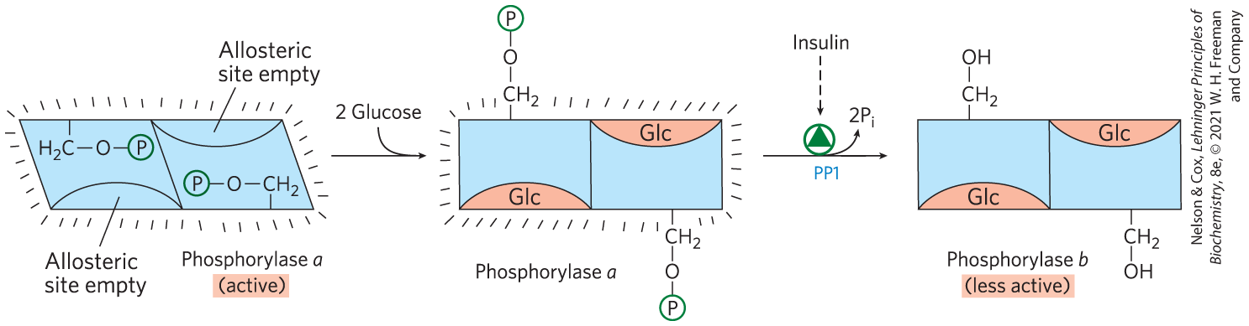
Liver Glycogen Phosphorylase a is a Glucose Sensor
glucose binds to an allosteric site on phosphorylase a, making it more susceptible to dephosphorylation by PP1

Slide 28
Glycogen Synthase Also Is Subject to Multiple Levels of Regulation
glycogen synthase has two forms:
  glycogen synthase a = unphosphorylated and catalytically active
  glycogen synthase b = phosphorylated and inactive unless glucose 6-phosphate is present
glycogen synthase kinase 3 (GSK3) = catalyzes the phosphorylation of glycogen synthase a

Slide 29
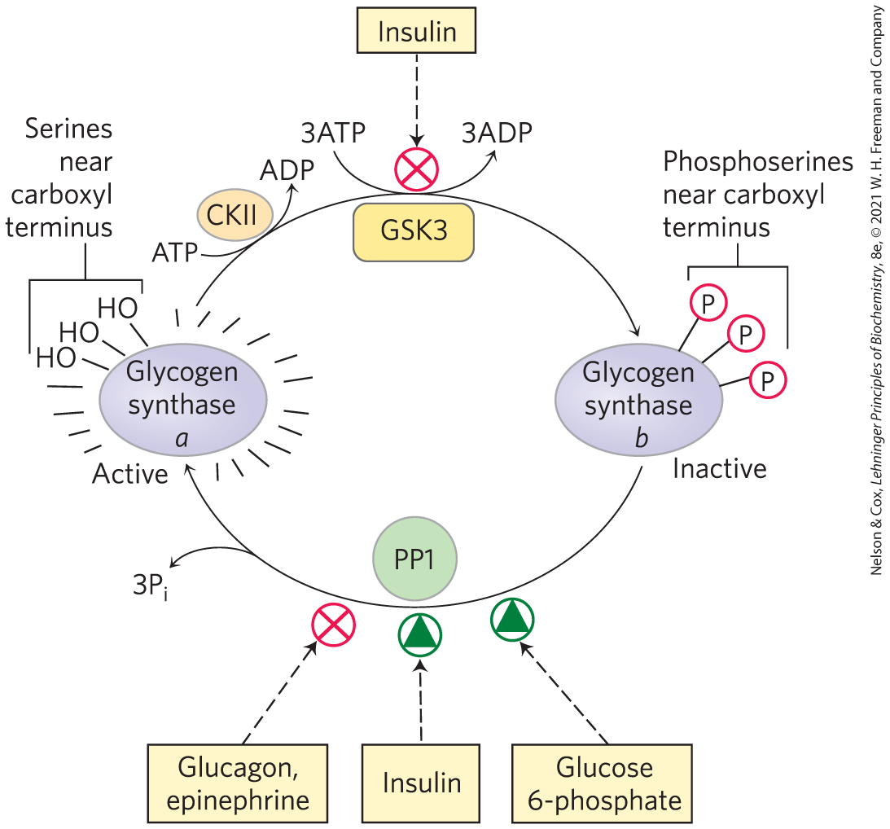
Effects of GSK3 on Glycogen Synthase Activity
insulin inactivates GSK3 and activates PP1
glucose 6-phosphate acts allosterically to make glycogen synthase b a better substrate for PP1

Slide 30
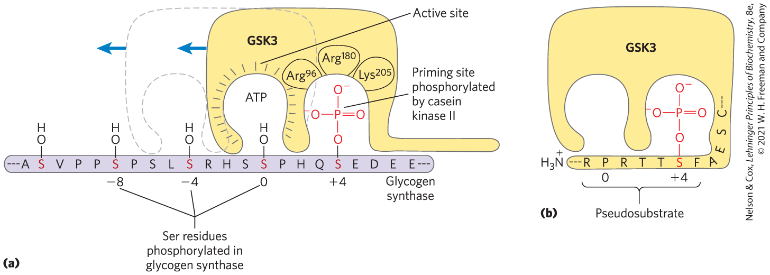
The Action of GSK3 is Hierarchical
GSK3 cannot phosphorylate glycogen synthase until casein kinase II (CKII) has phosphorylated the glycogen synthase on a nearby residue (a priming event)

Slide 31
Allosteric and Hormonal Signals Coordinate Carbohydrate Metabolism Globally
in the liver:
  insulin activates glycogen synthase by inactivating GSK3 and activating PP1
  glucagon stimulates glycogen breakdown and gluconeogenesis while blocking glycolysis
in muscle, epinephrine provides ATP by stimulating glycogen breakdown and glycolysis

